Slide 1
Assimilating realistic GOES-16 infrared radiance observations at storm-scale:
The 17 June 2017 severe weather event in Kansas
Yunji Zhang, Fuqing Zhang
Acknowledgements: Masashi Minamide, David J. Stensrud
August 17, 2017

Slide 2
Background
Previous works:
  Assimilating synthetic GOES-R observations for thunderstorms
  Cloud-adaptive vertical localization of infrared radiance
  Synthetic and realistic Himawari-8 assimilation for TC (Masashi)
  Vertical localization length scale of infrared radiance (Masashi)
  Realistic GOES-16 assimilation for TC (Lei)
Assimilating realistic GOES-16 observations for thunderstorms

Slide 3
Event Overview
WPC Surface Analysis 06/17/17 2100Z

Slide 4
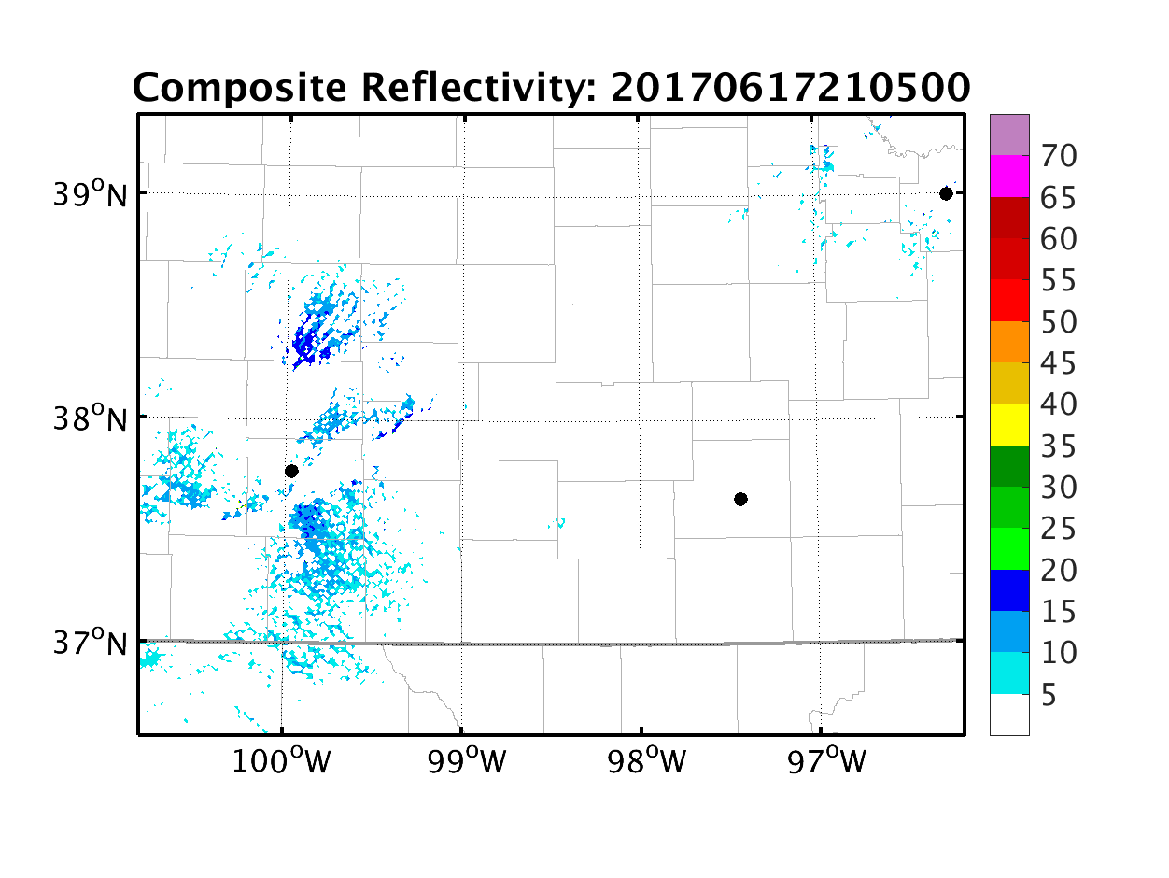
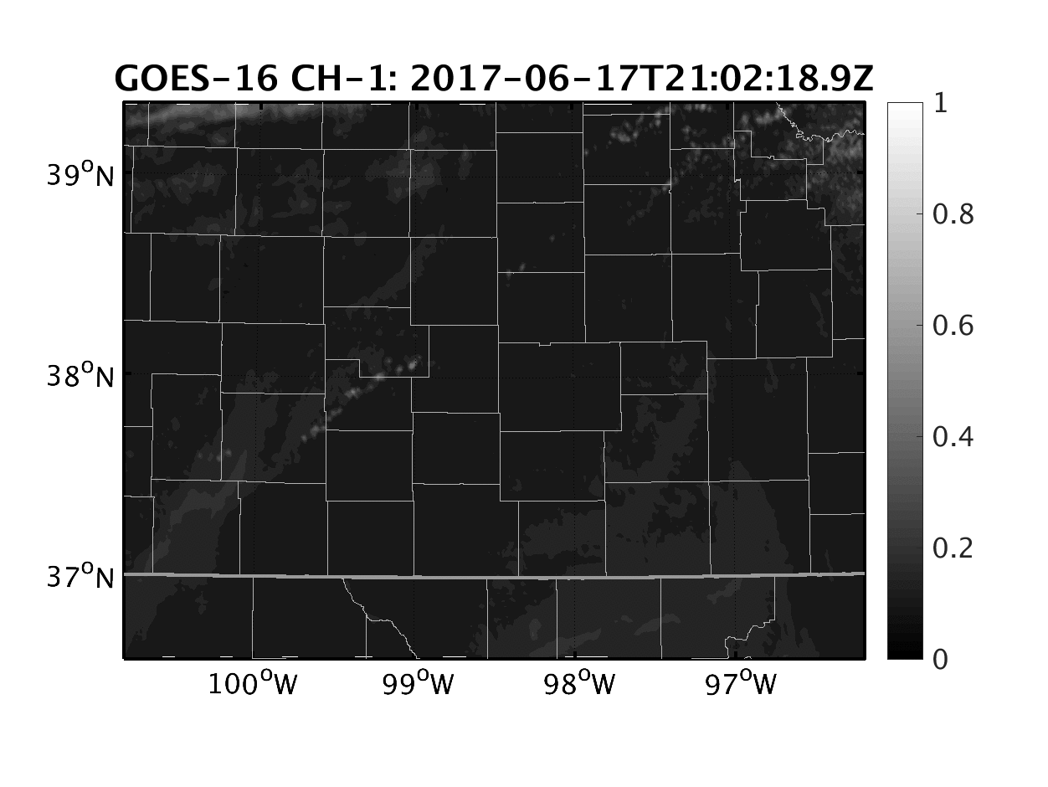
Observations of Convection Initiation
KTWX (Topeka, KS)
KDDC (Dodge City, KS)
KICT (Wichita, KS)

Slide 5
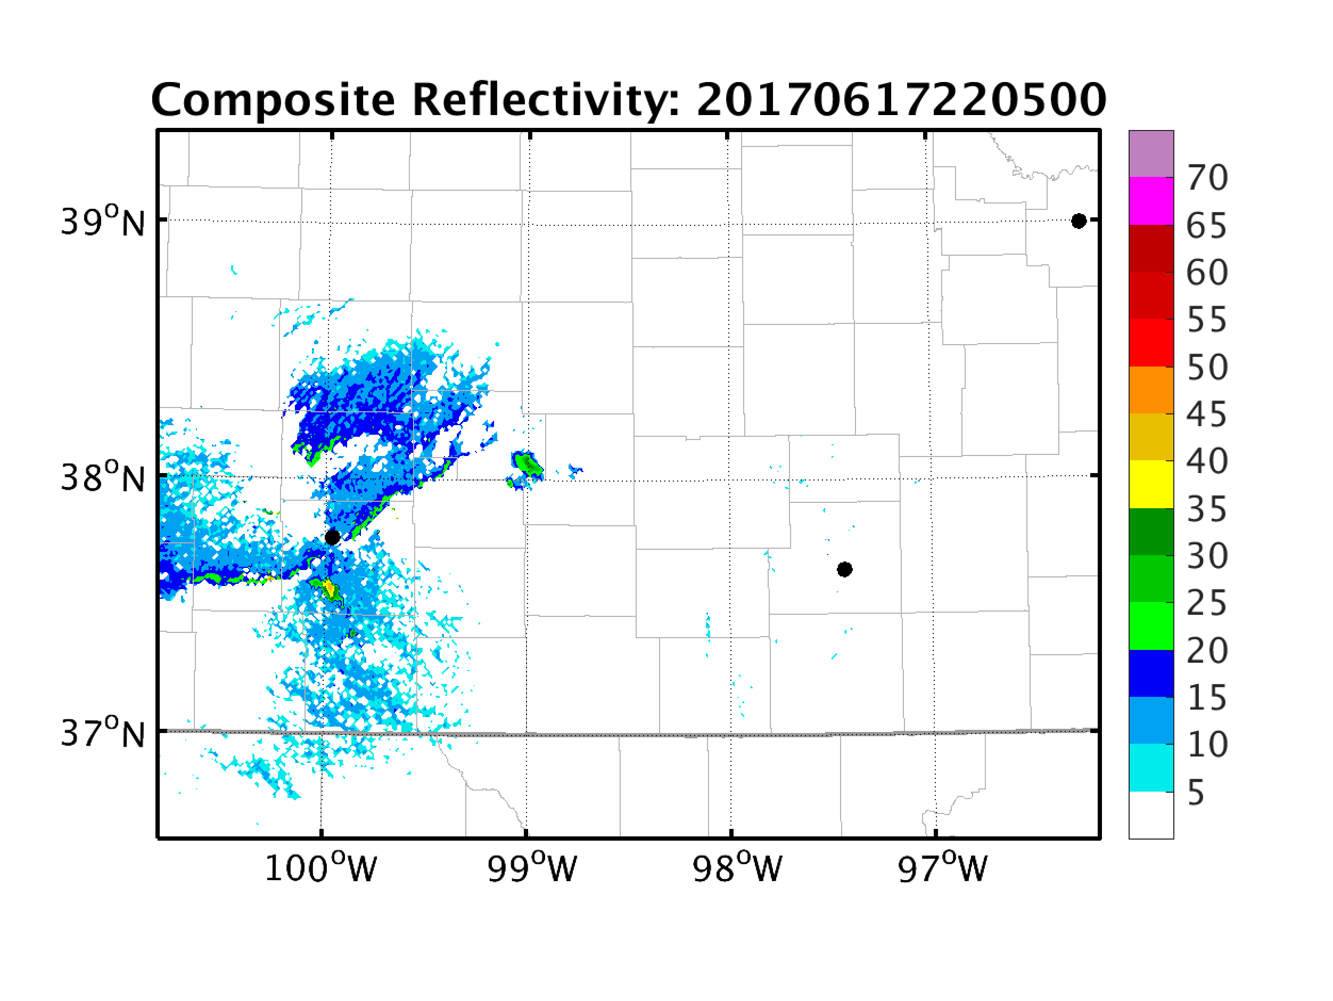
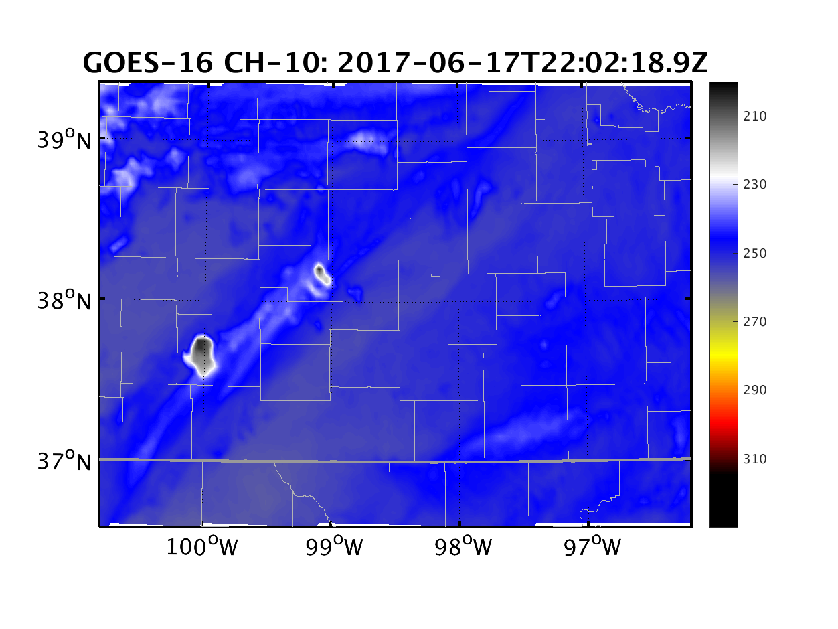
Convection Initiation in Satellite Observations

Slide 6
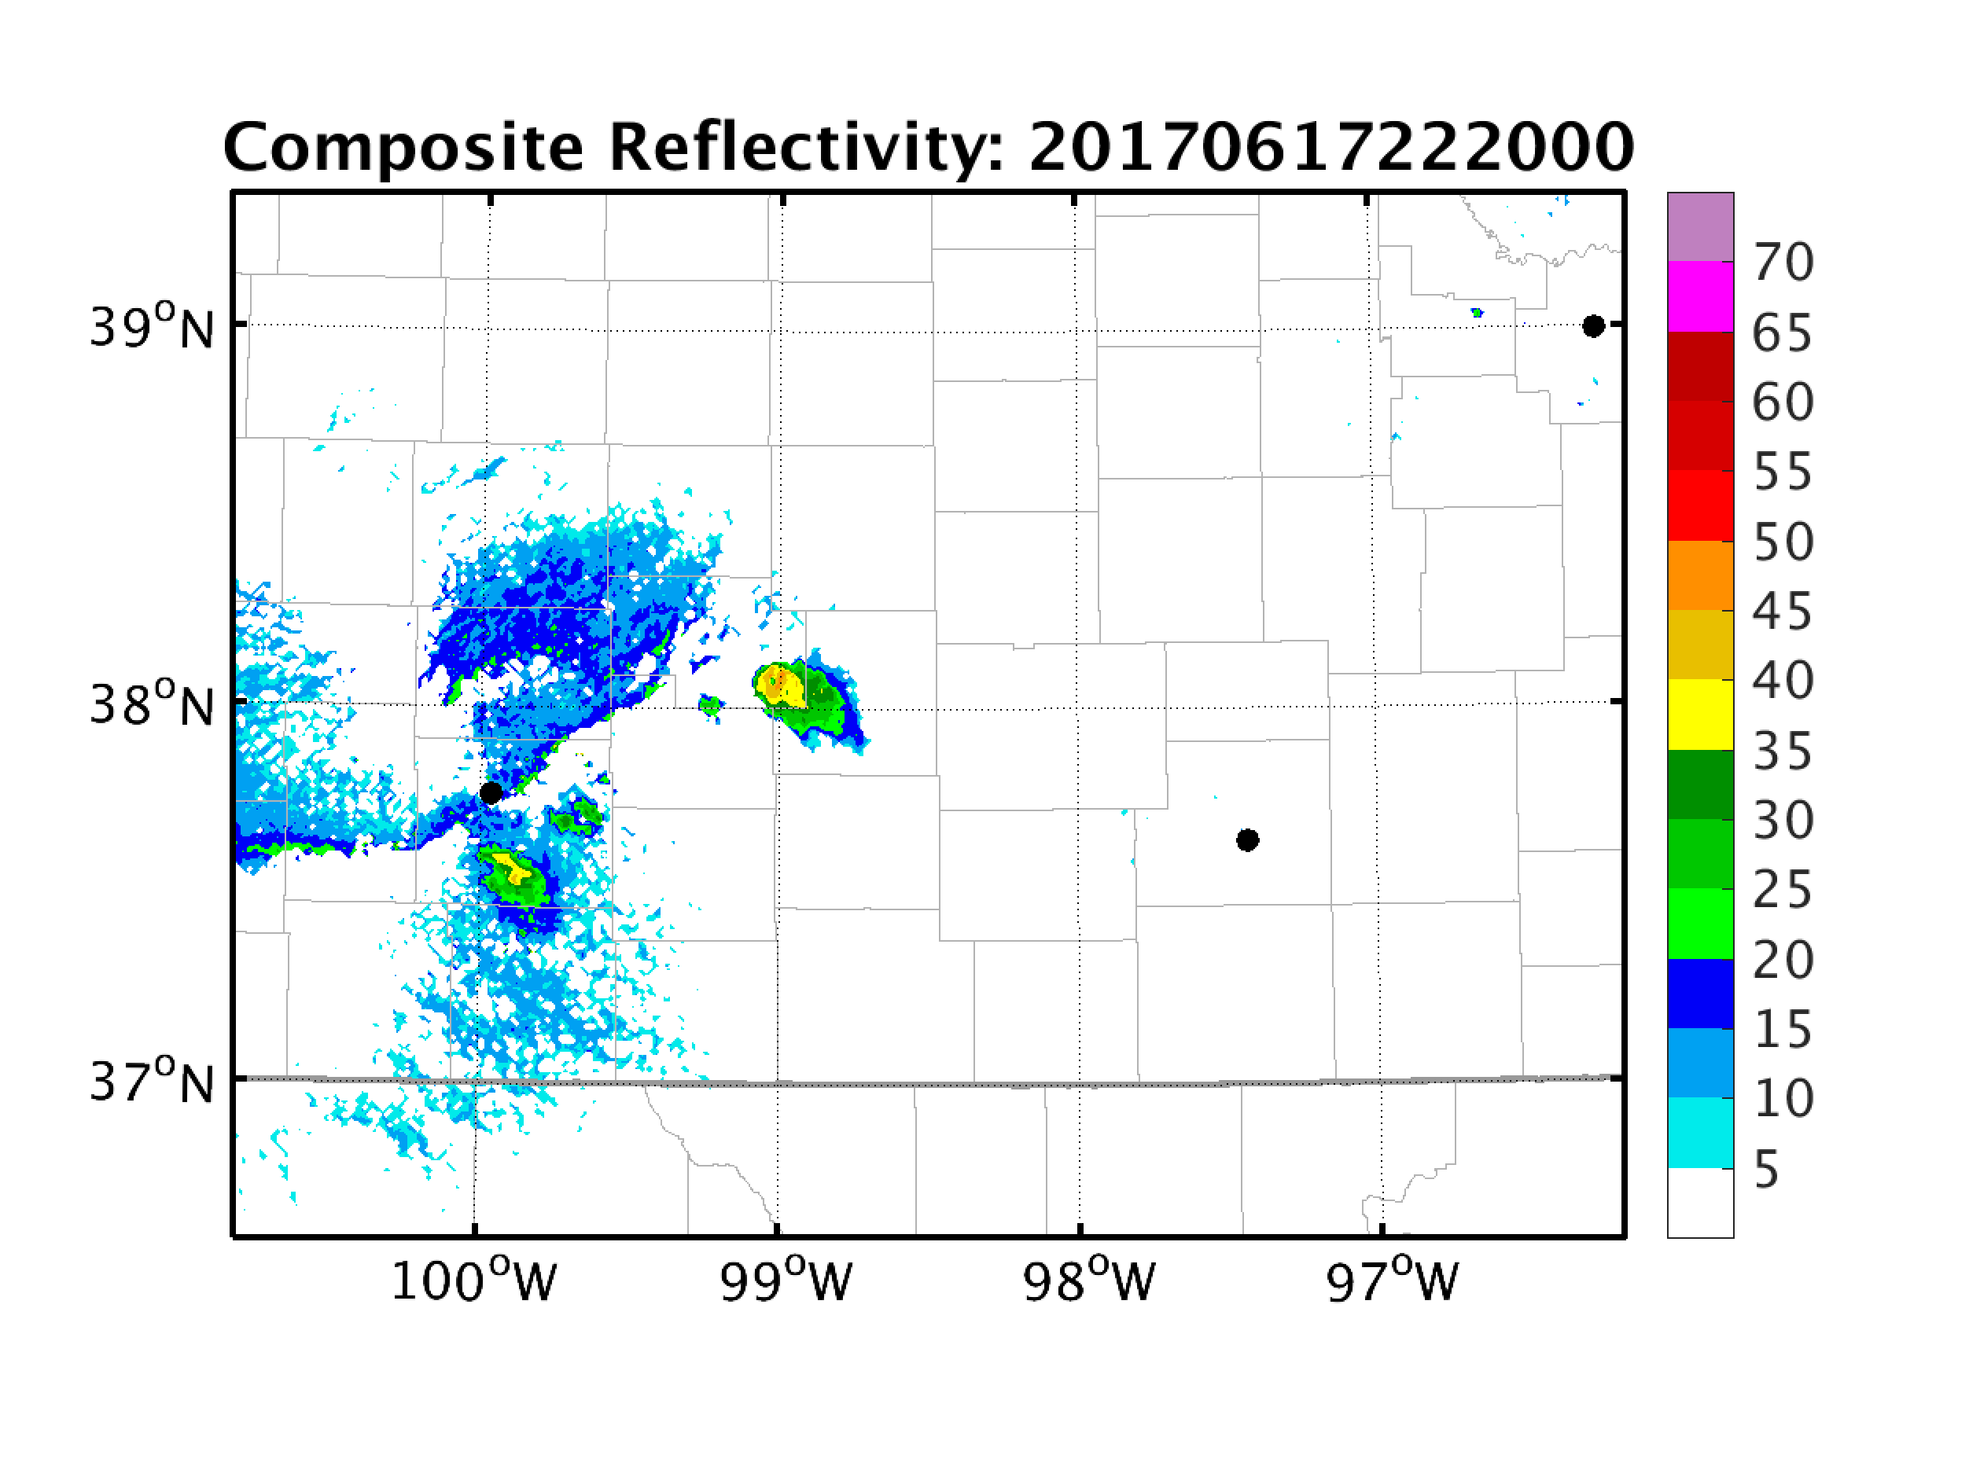
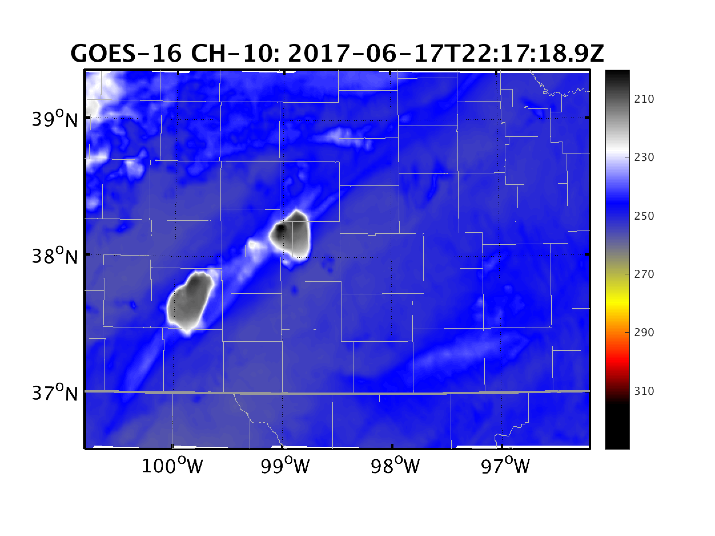
Convection Initiation in Radar Observations

Slide 7
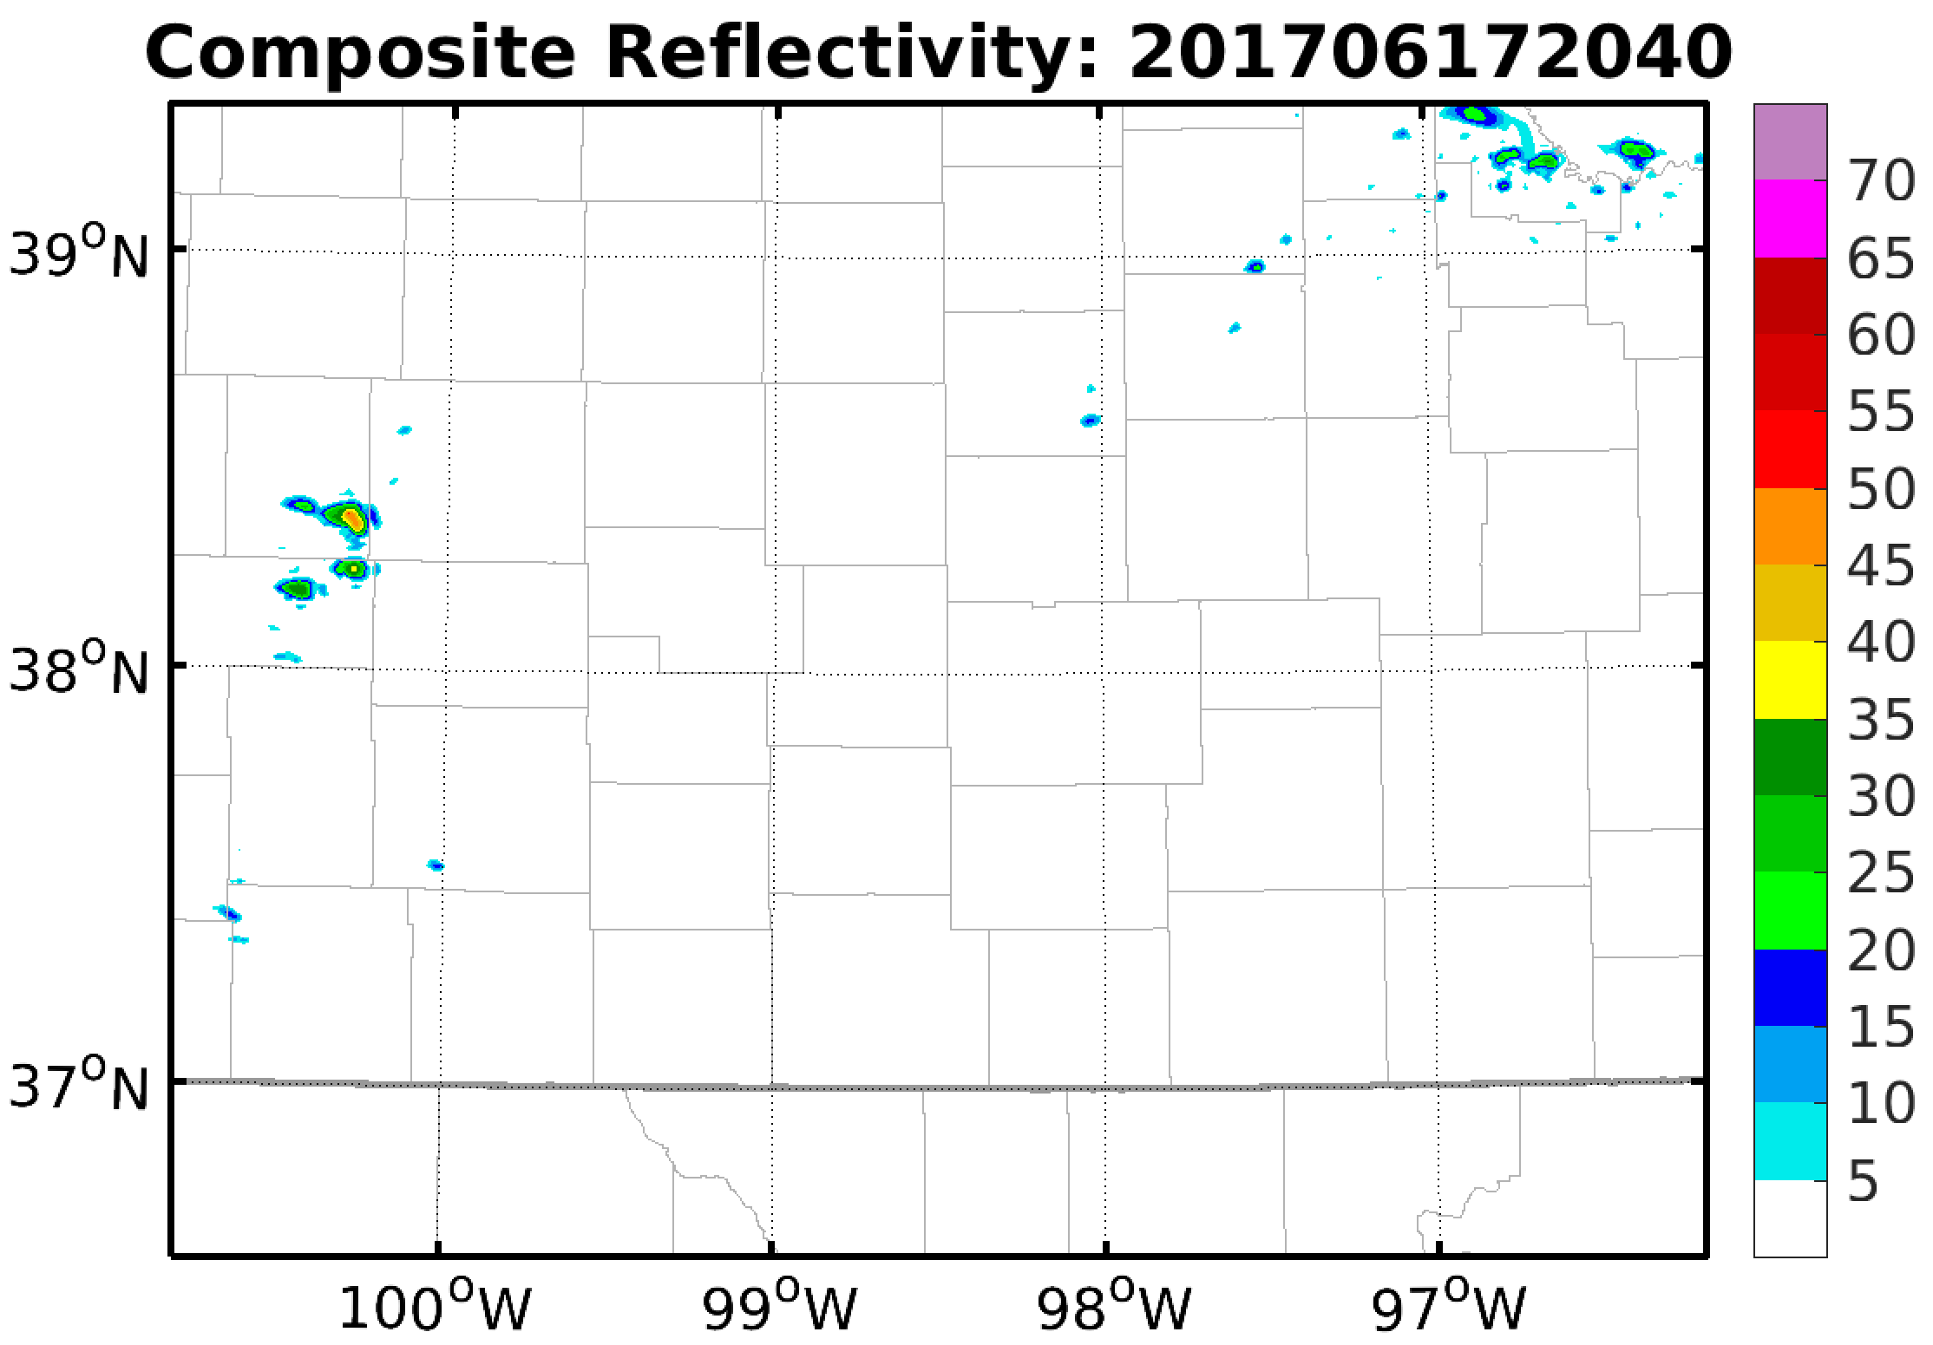
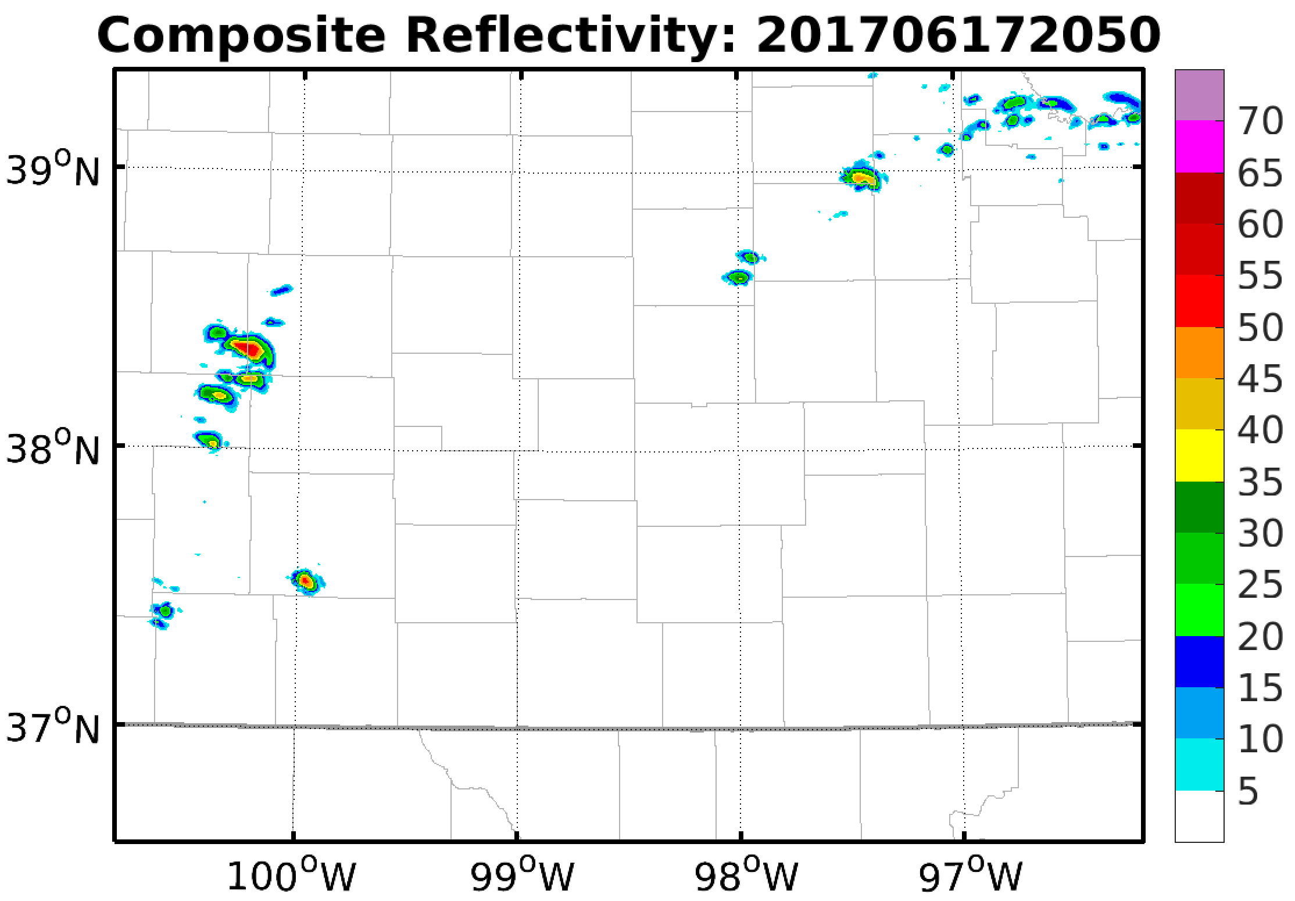
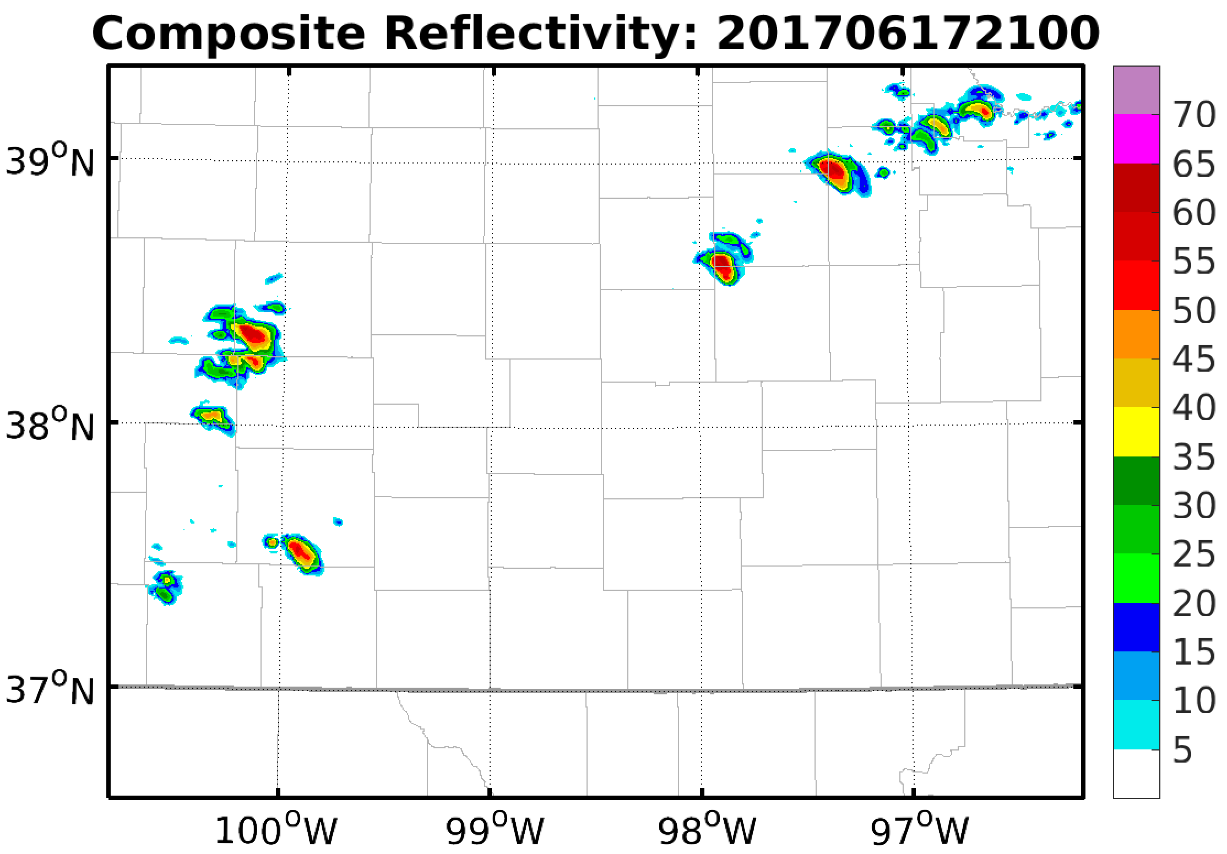
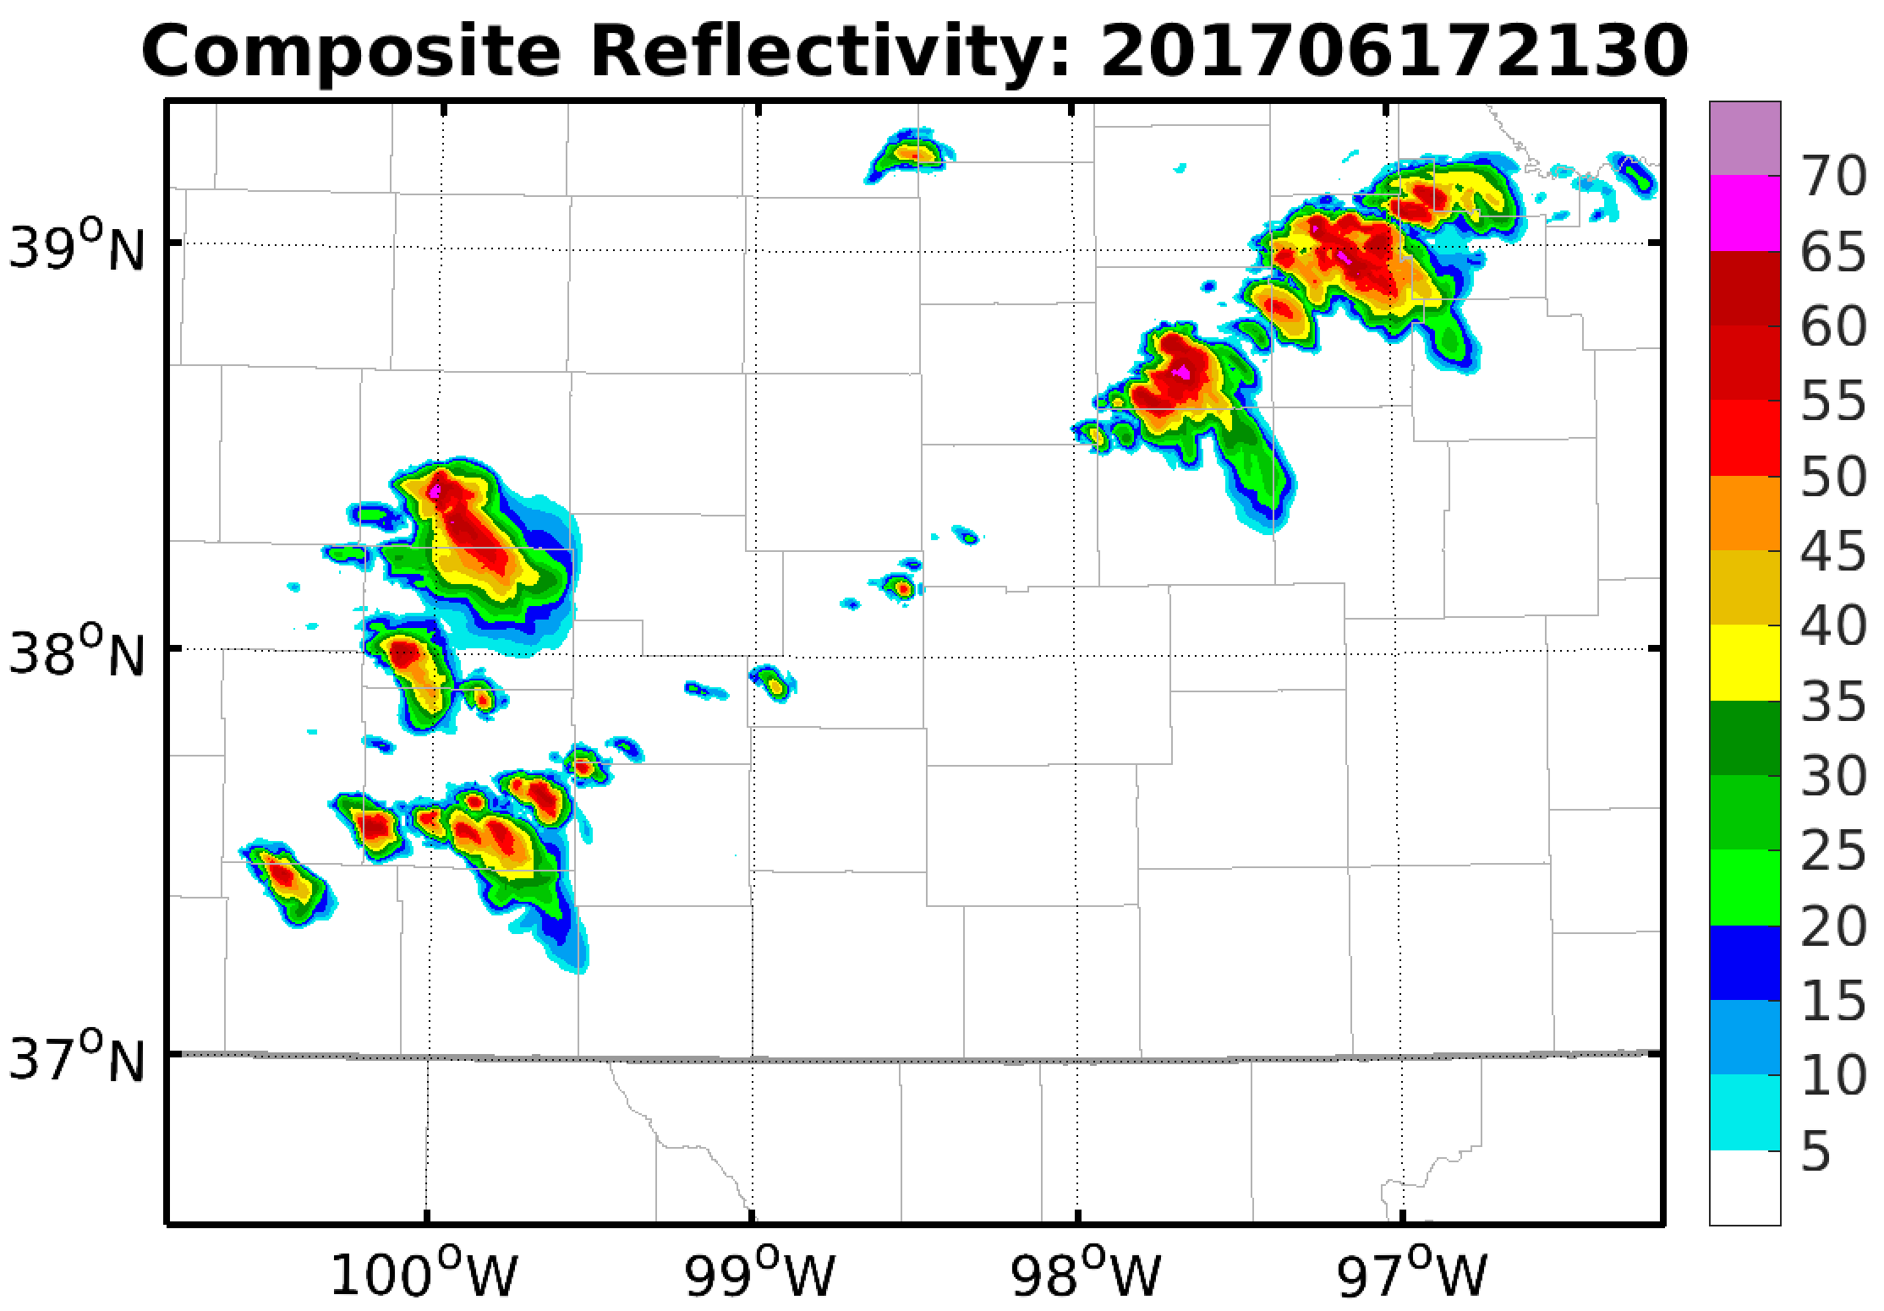
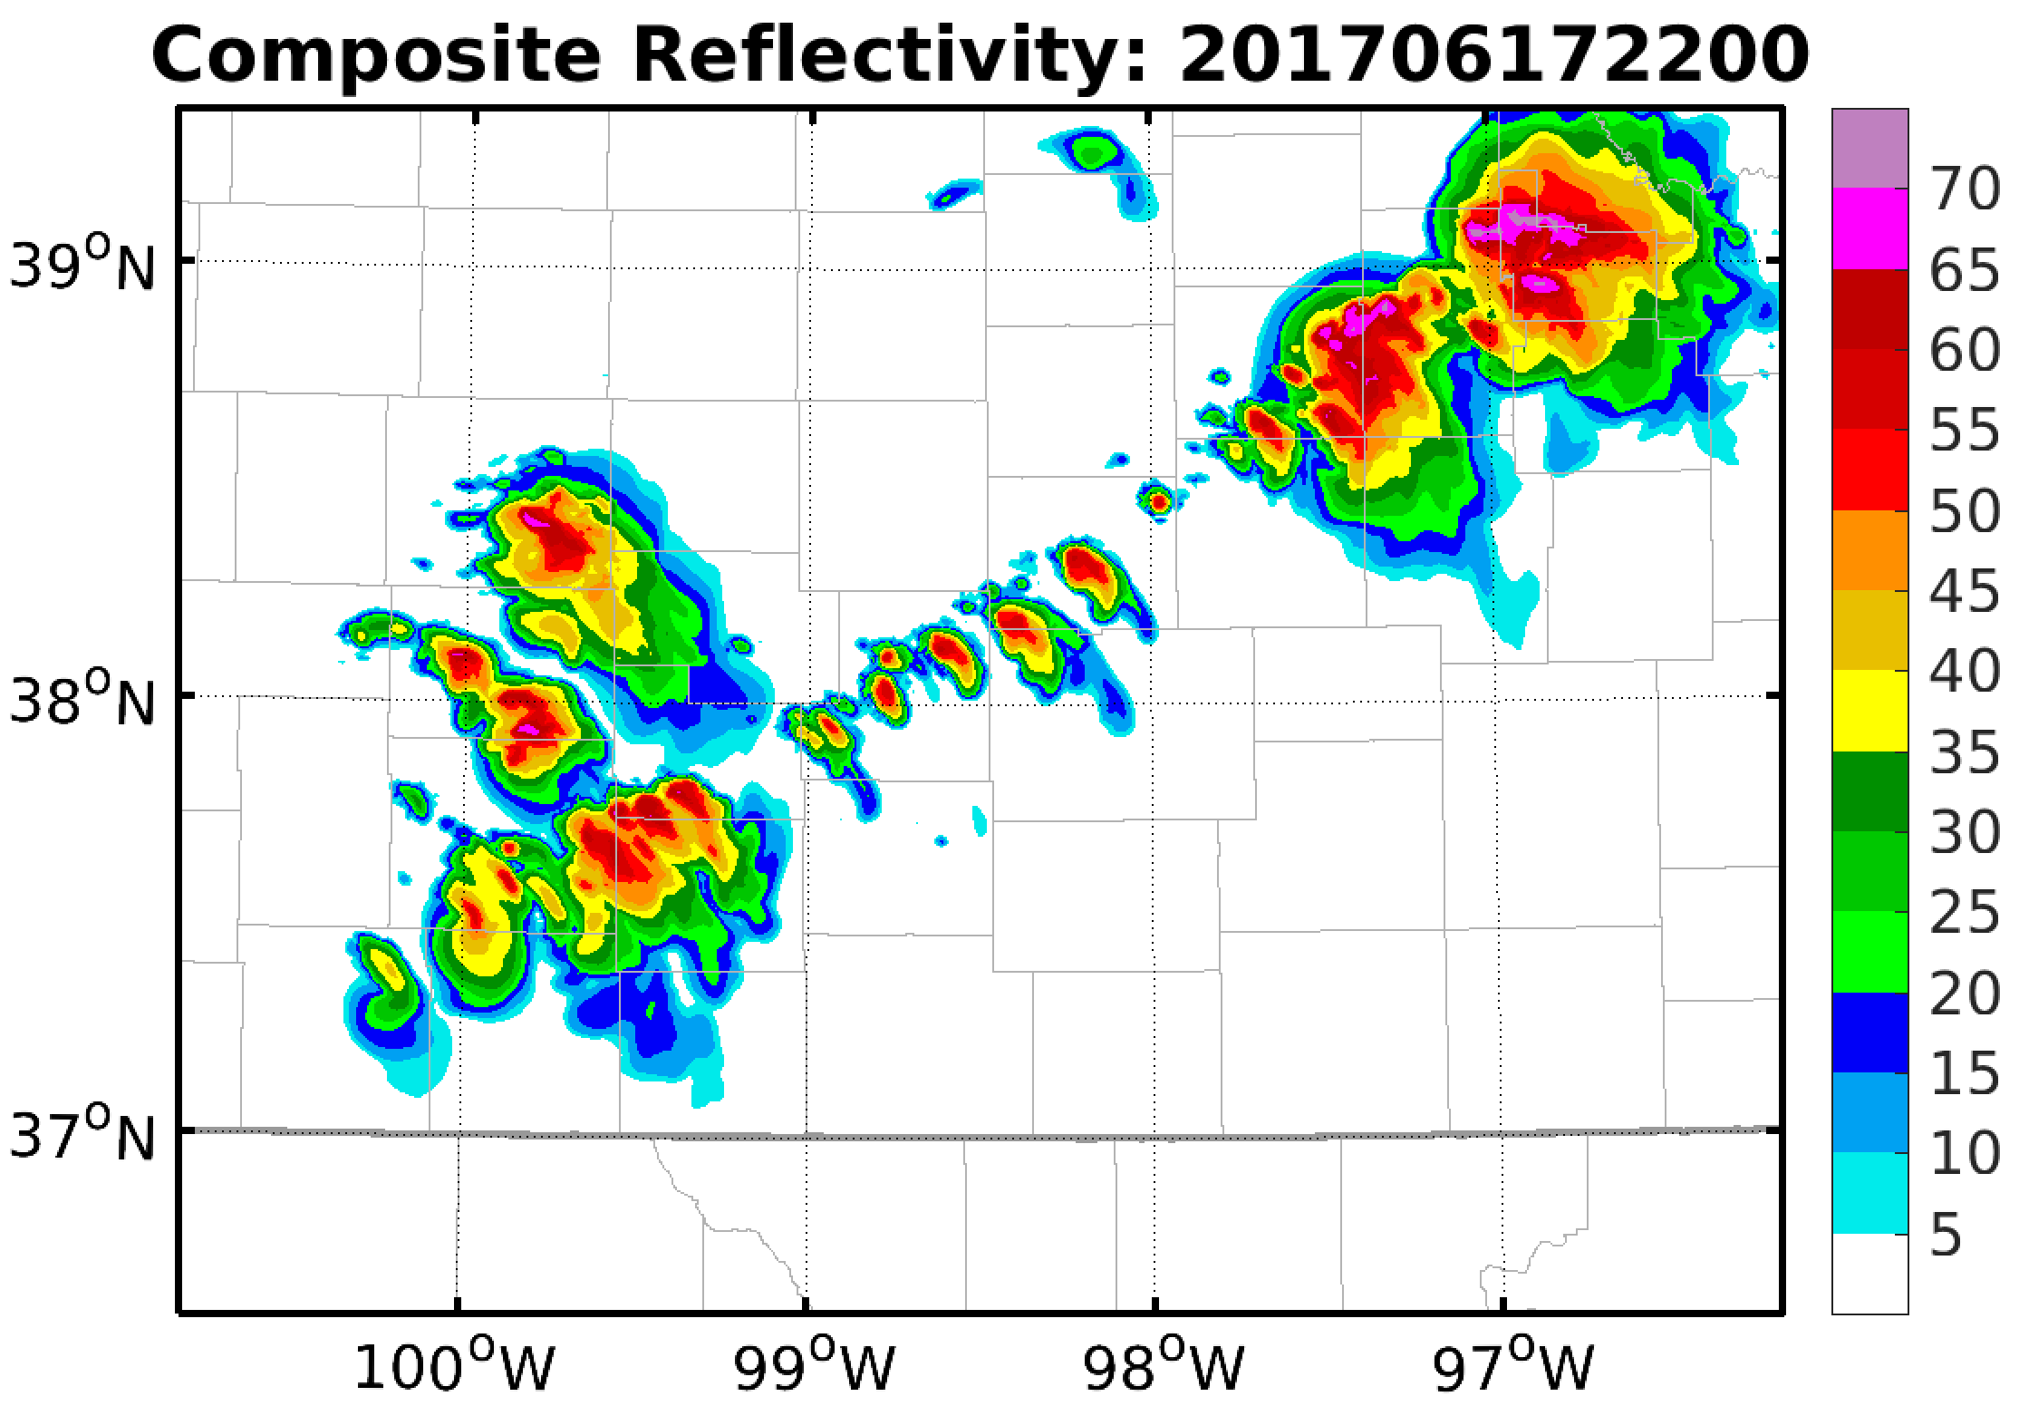
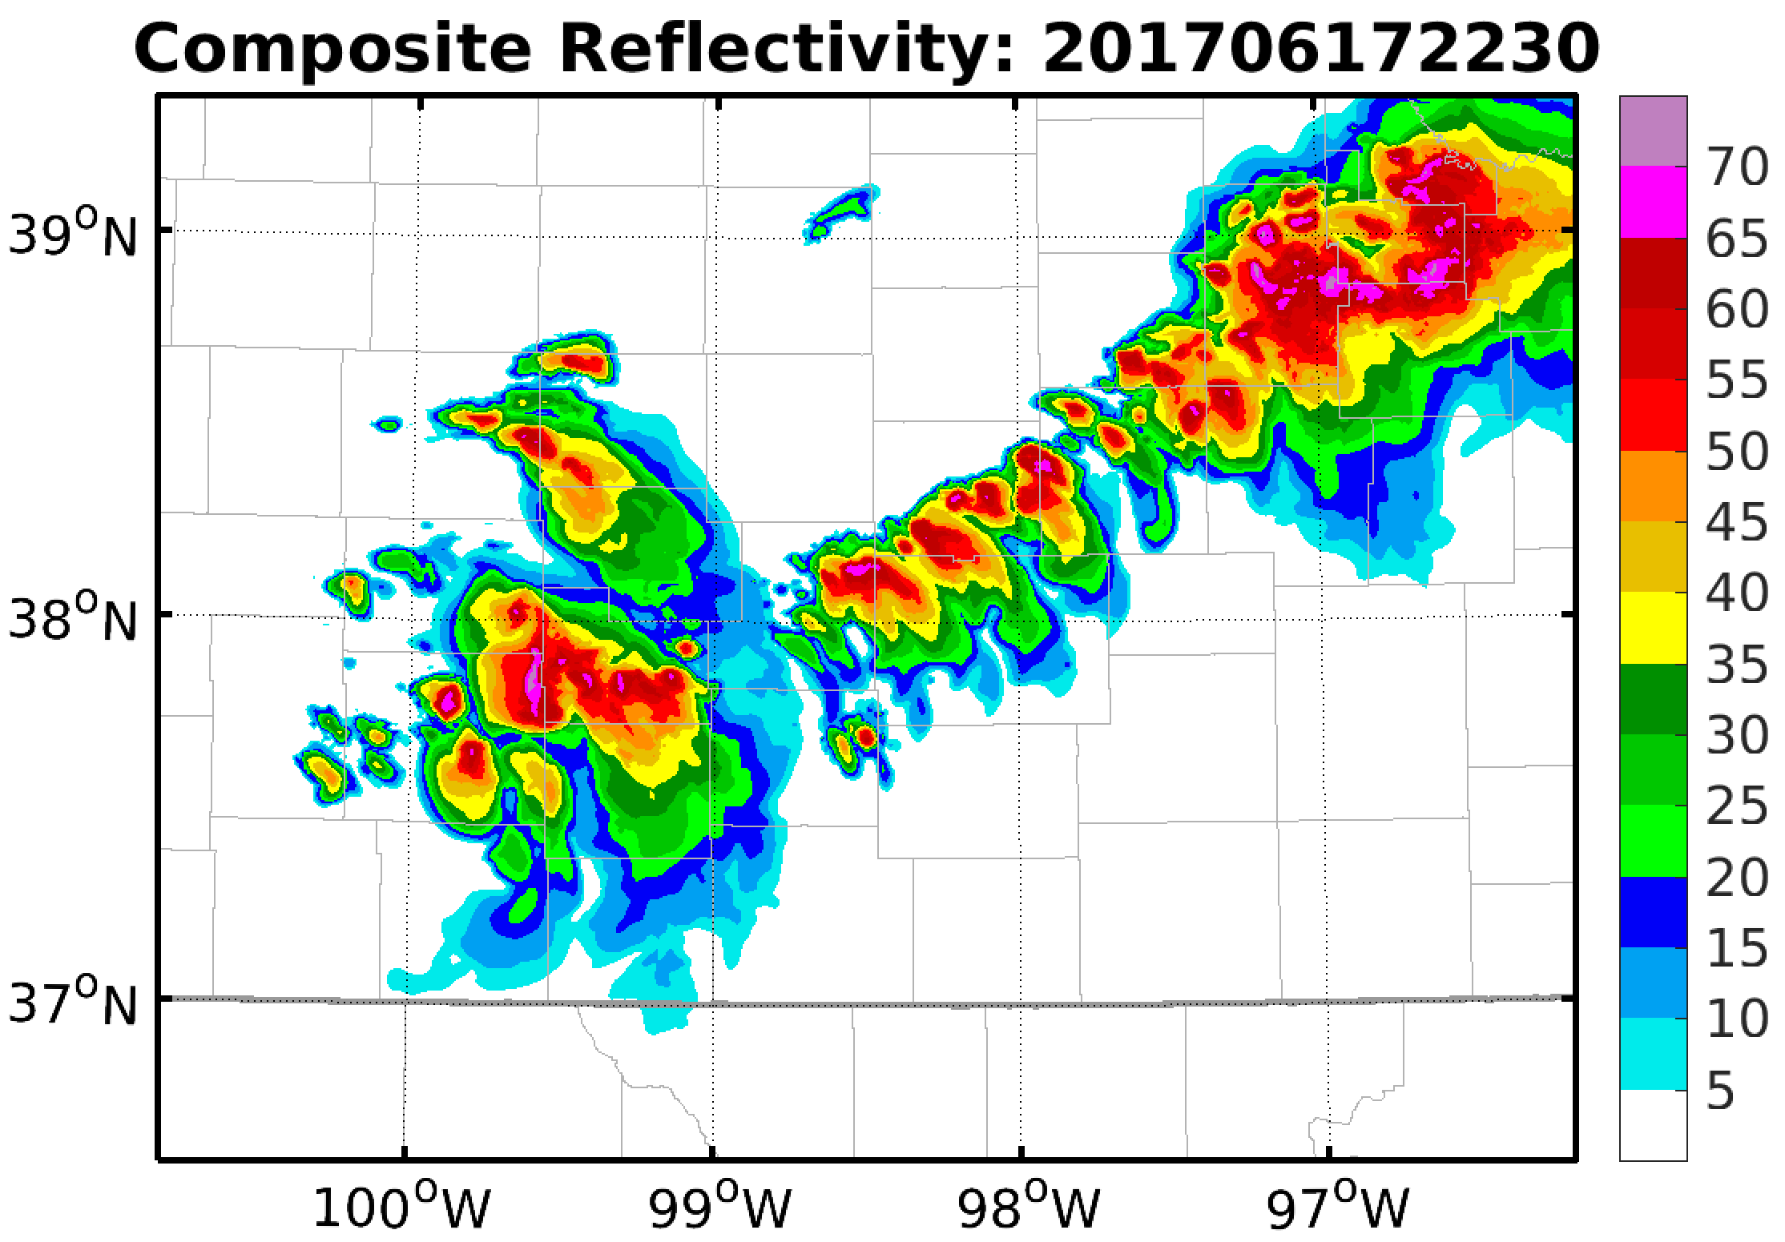
1-km WRF Deterministic Forecast from HRRR

Slide 8
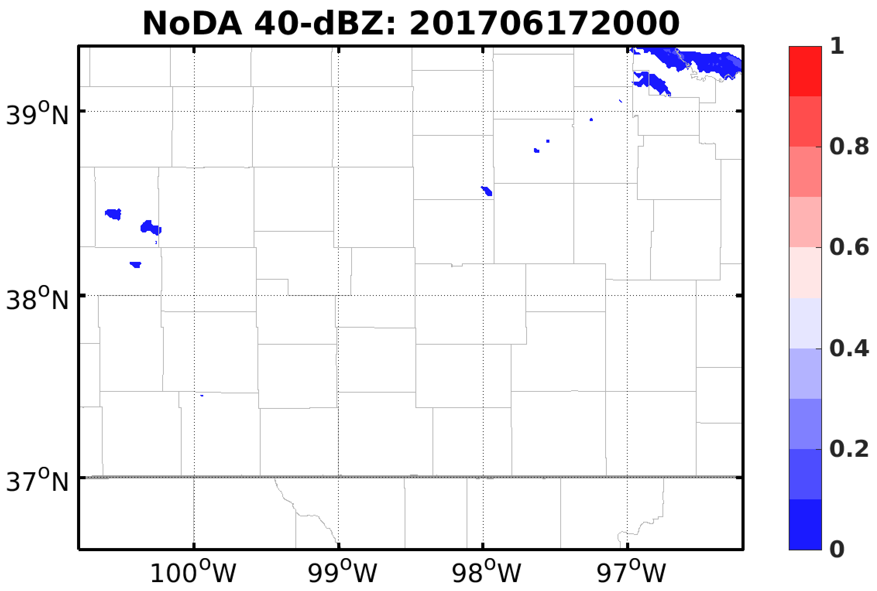
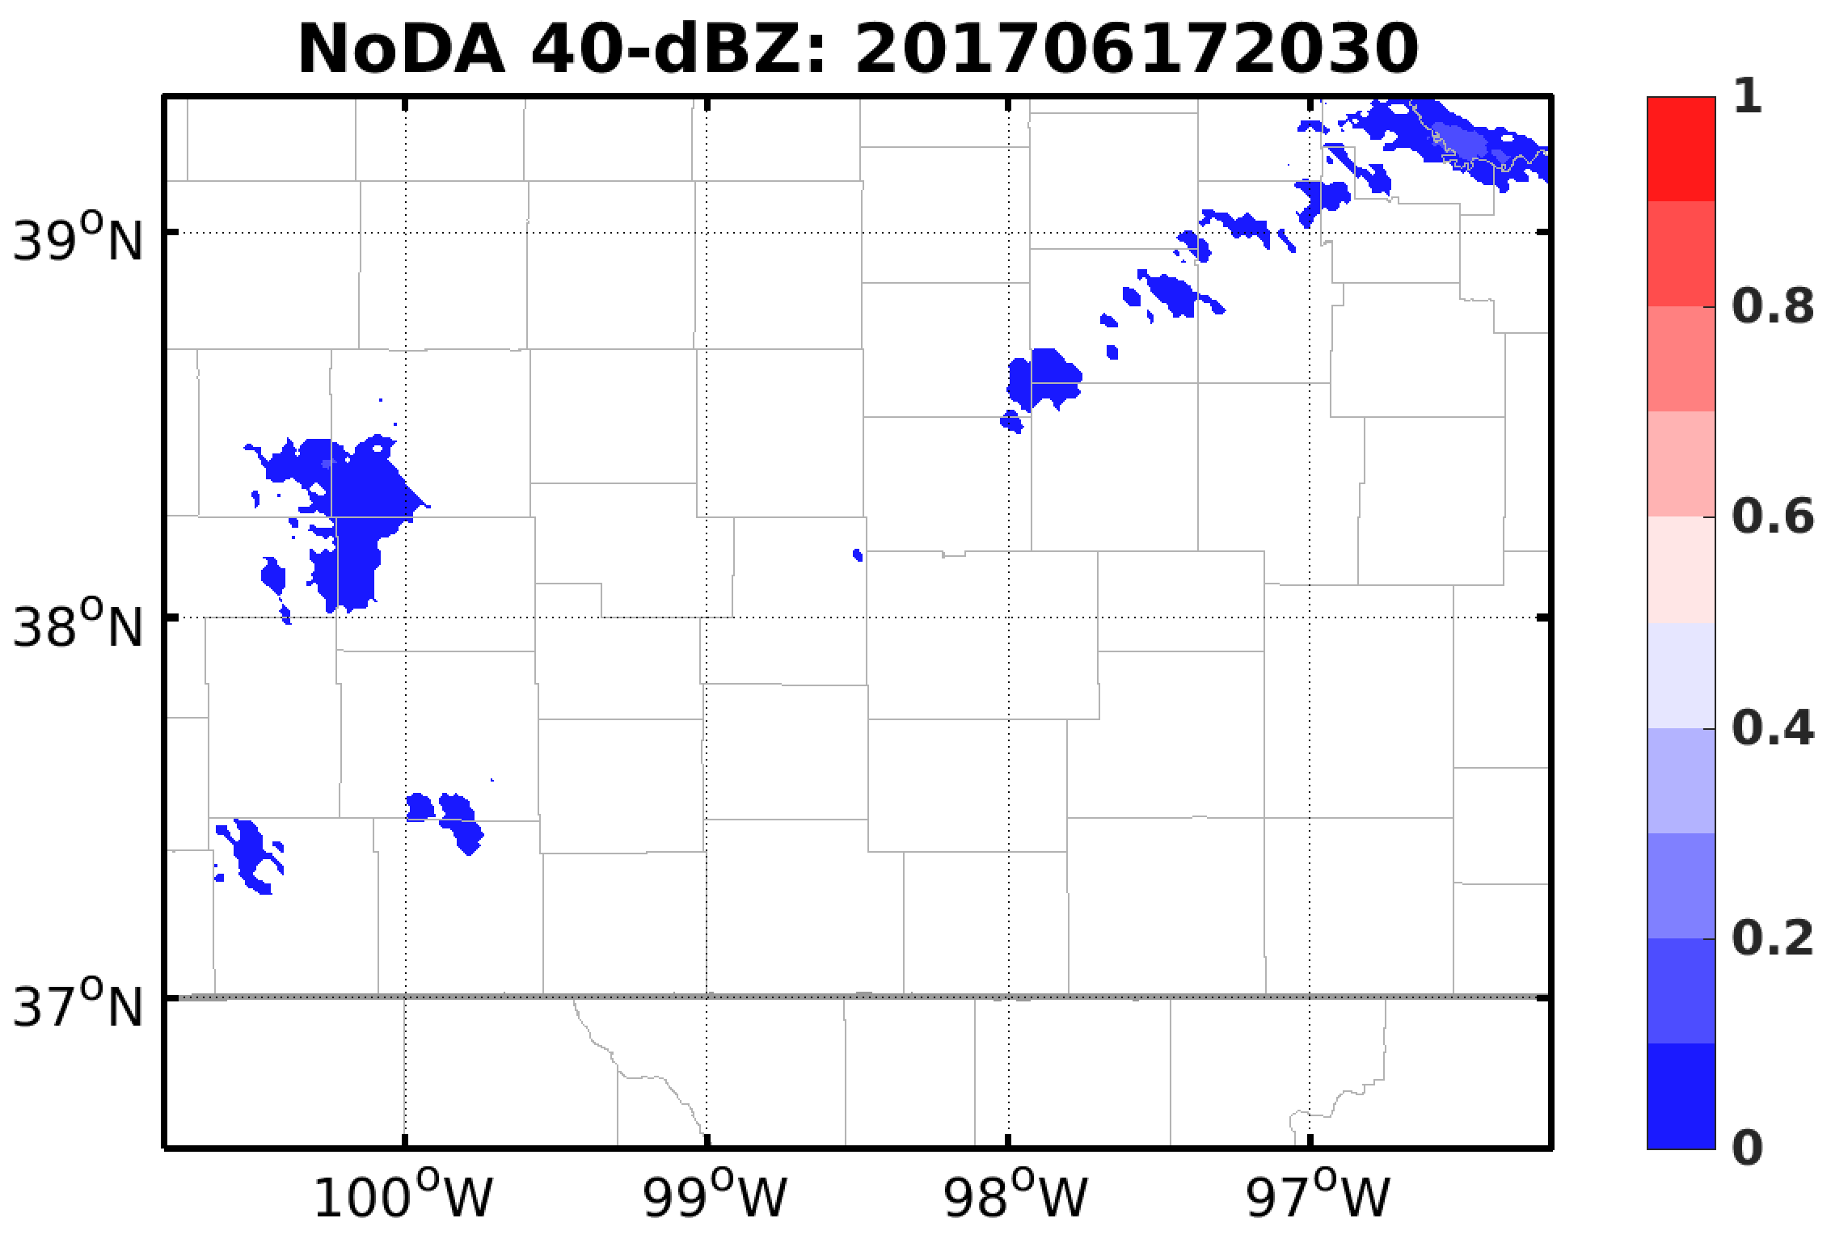
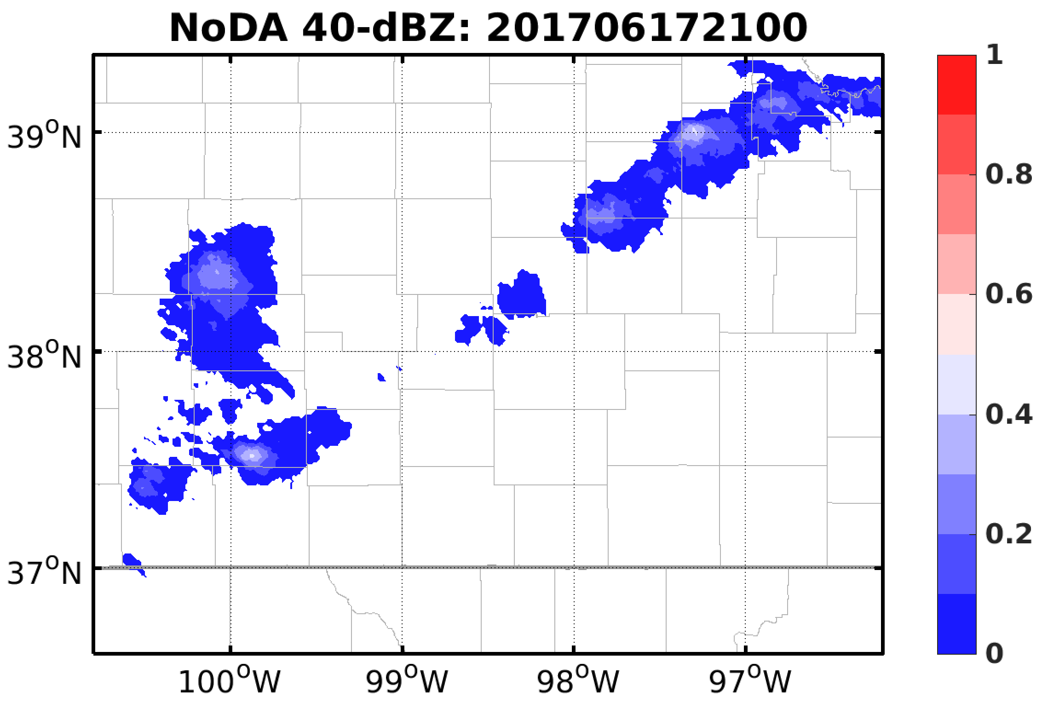
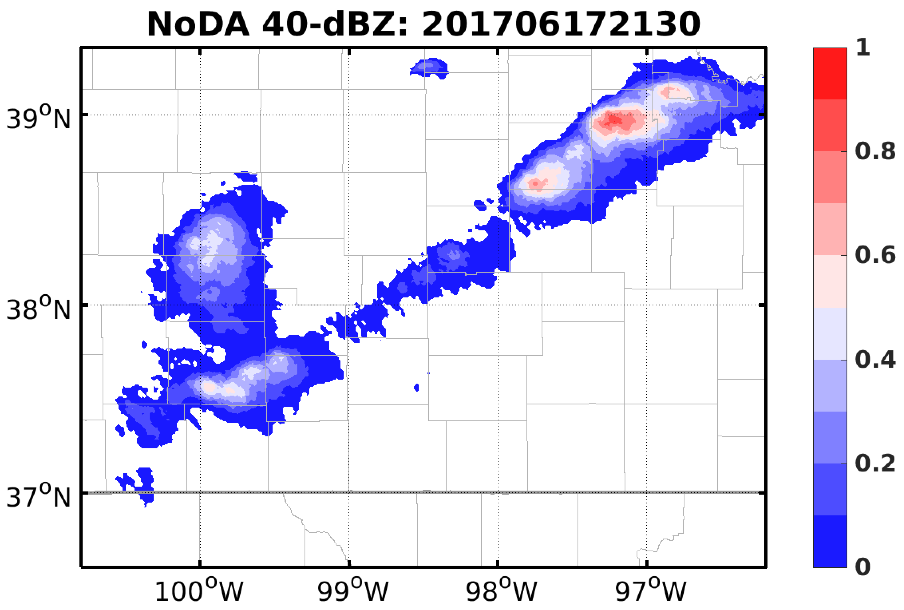
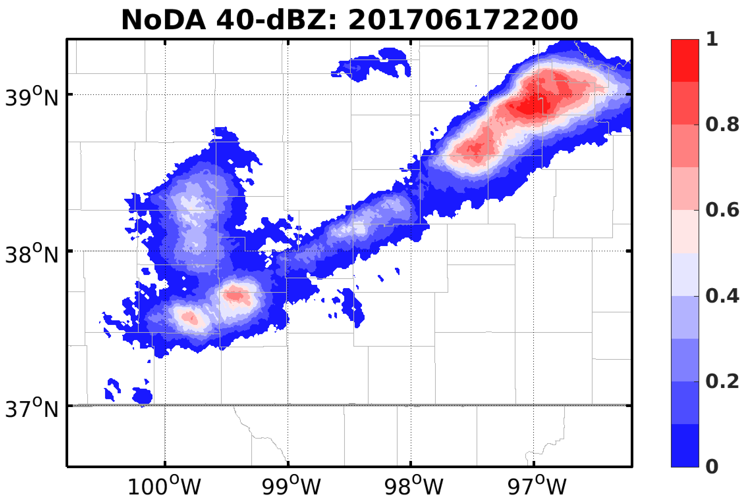
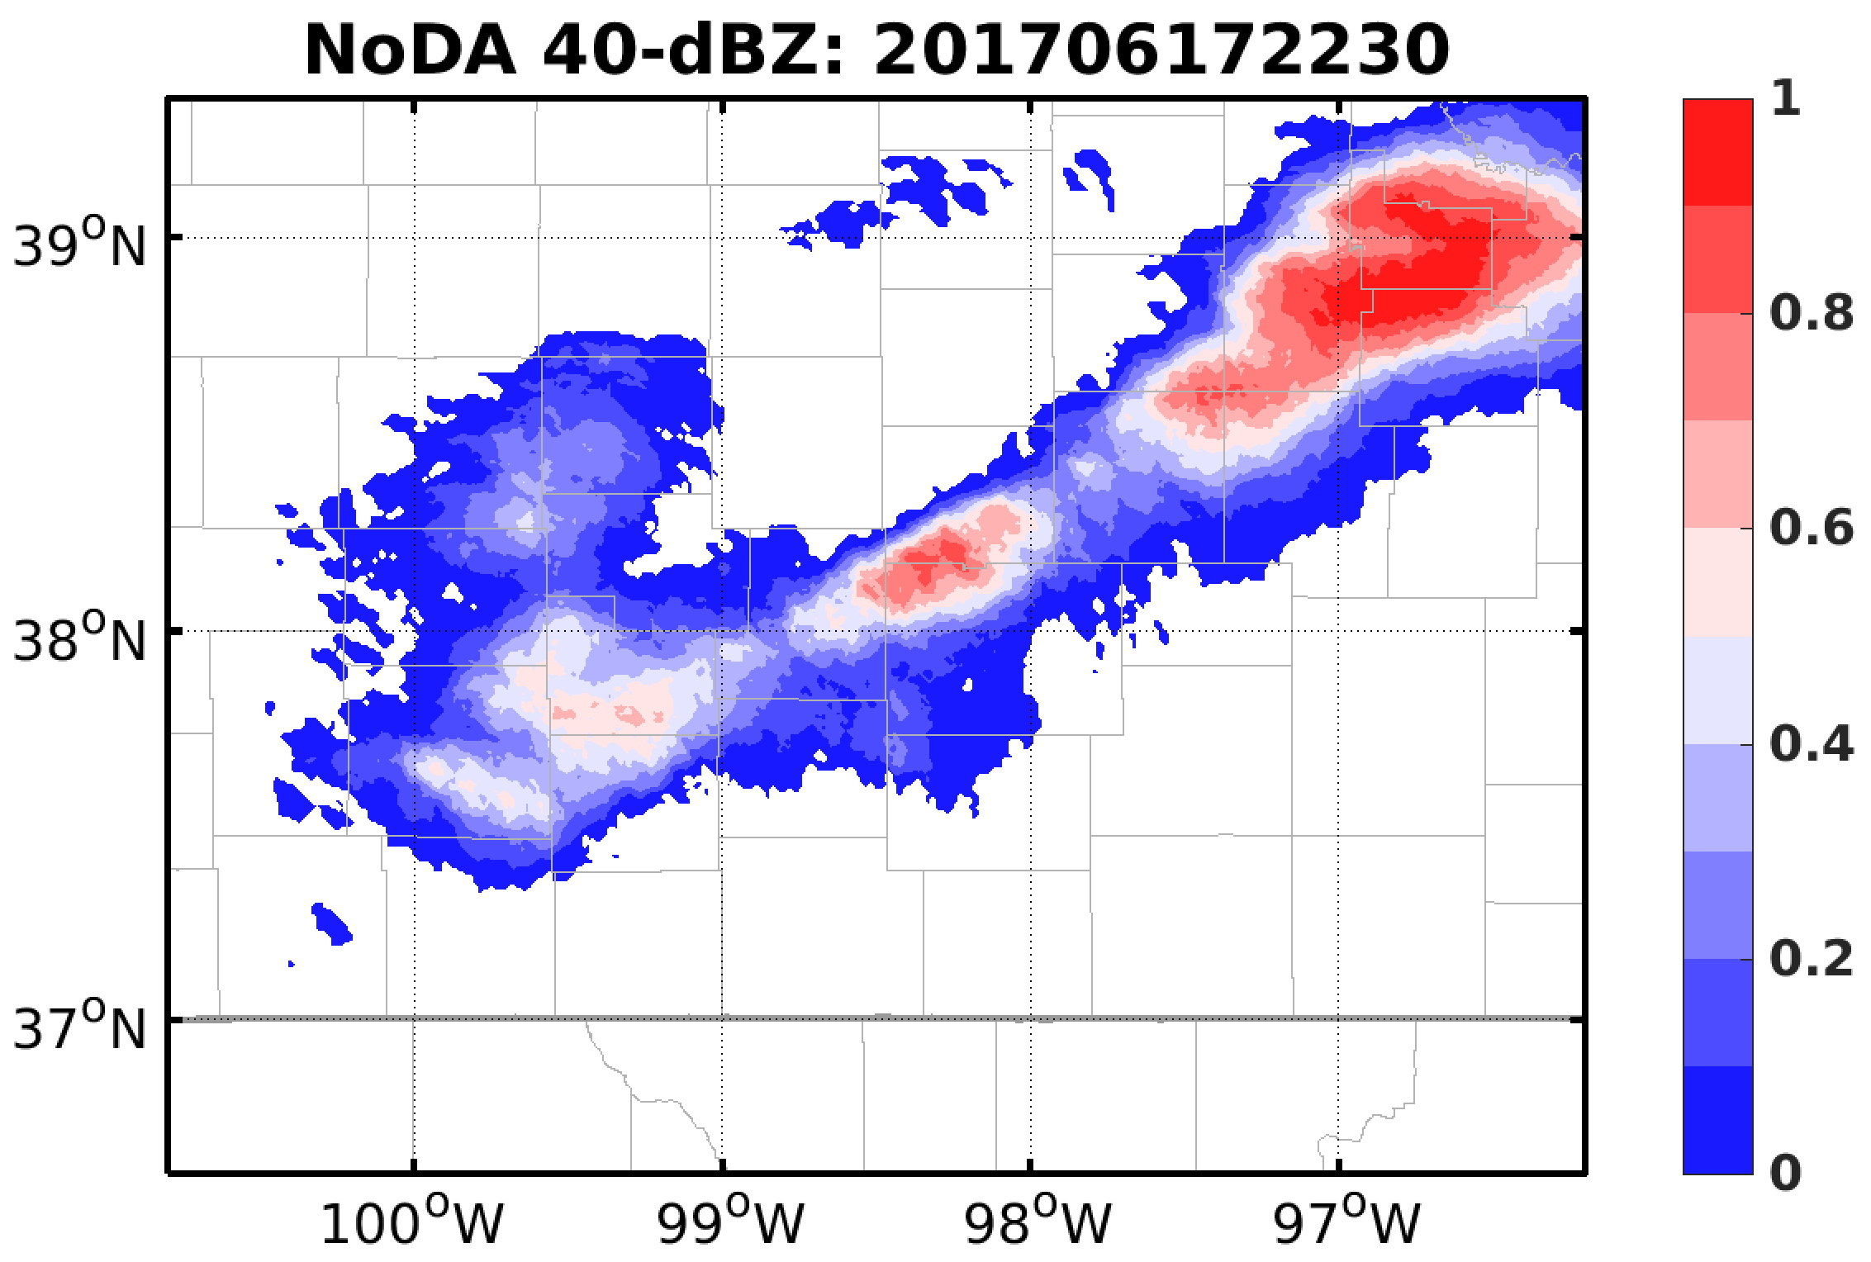
No-DA Ensemble Forecast

Slide 9
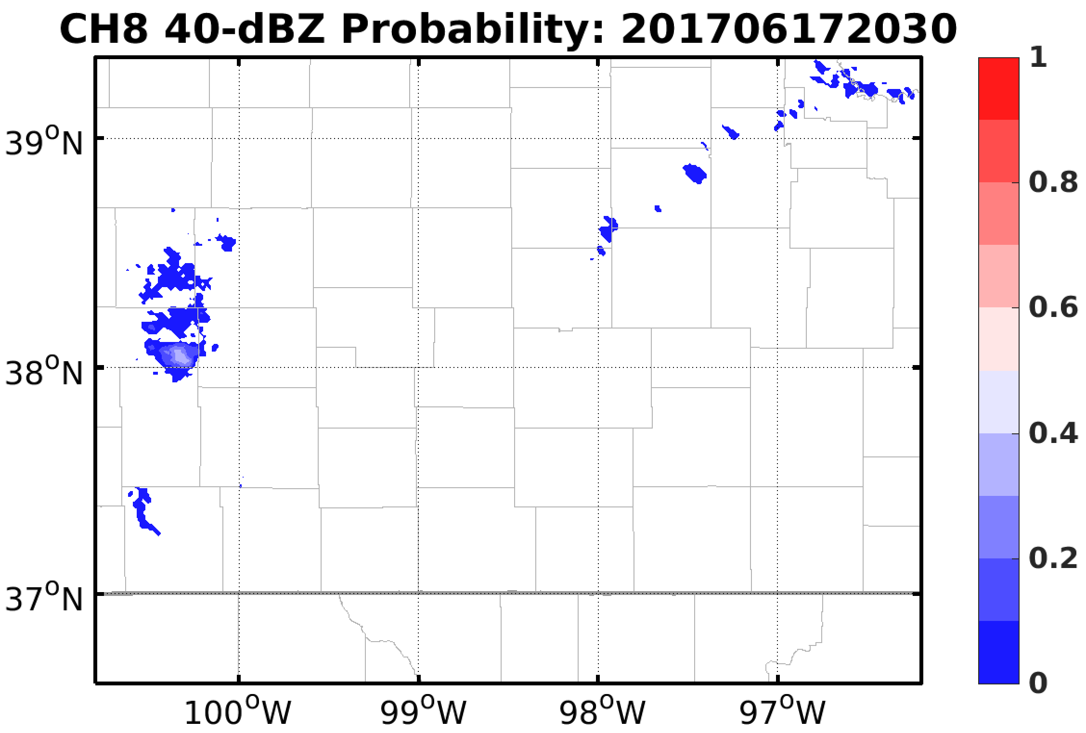
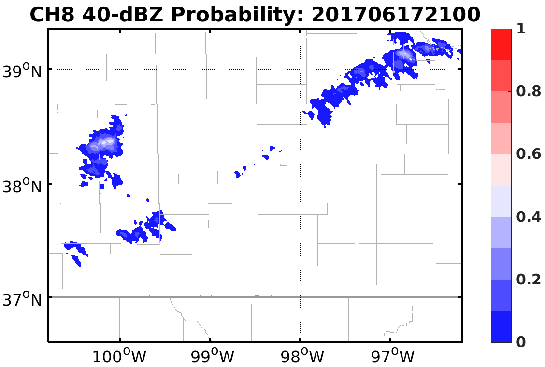
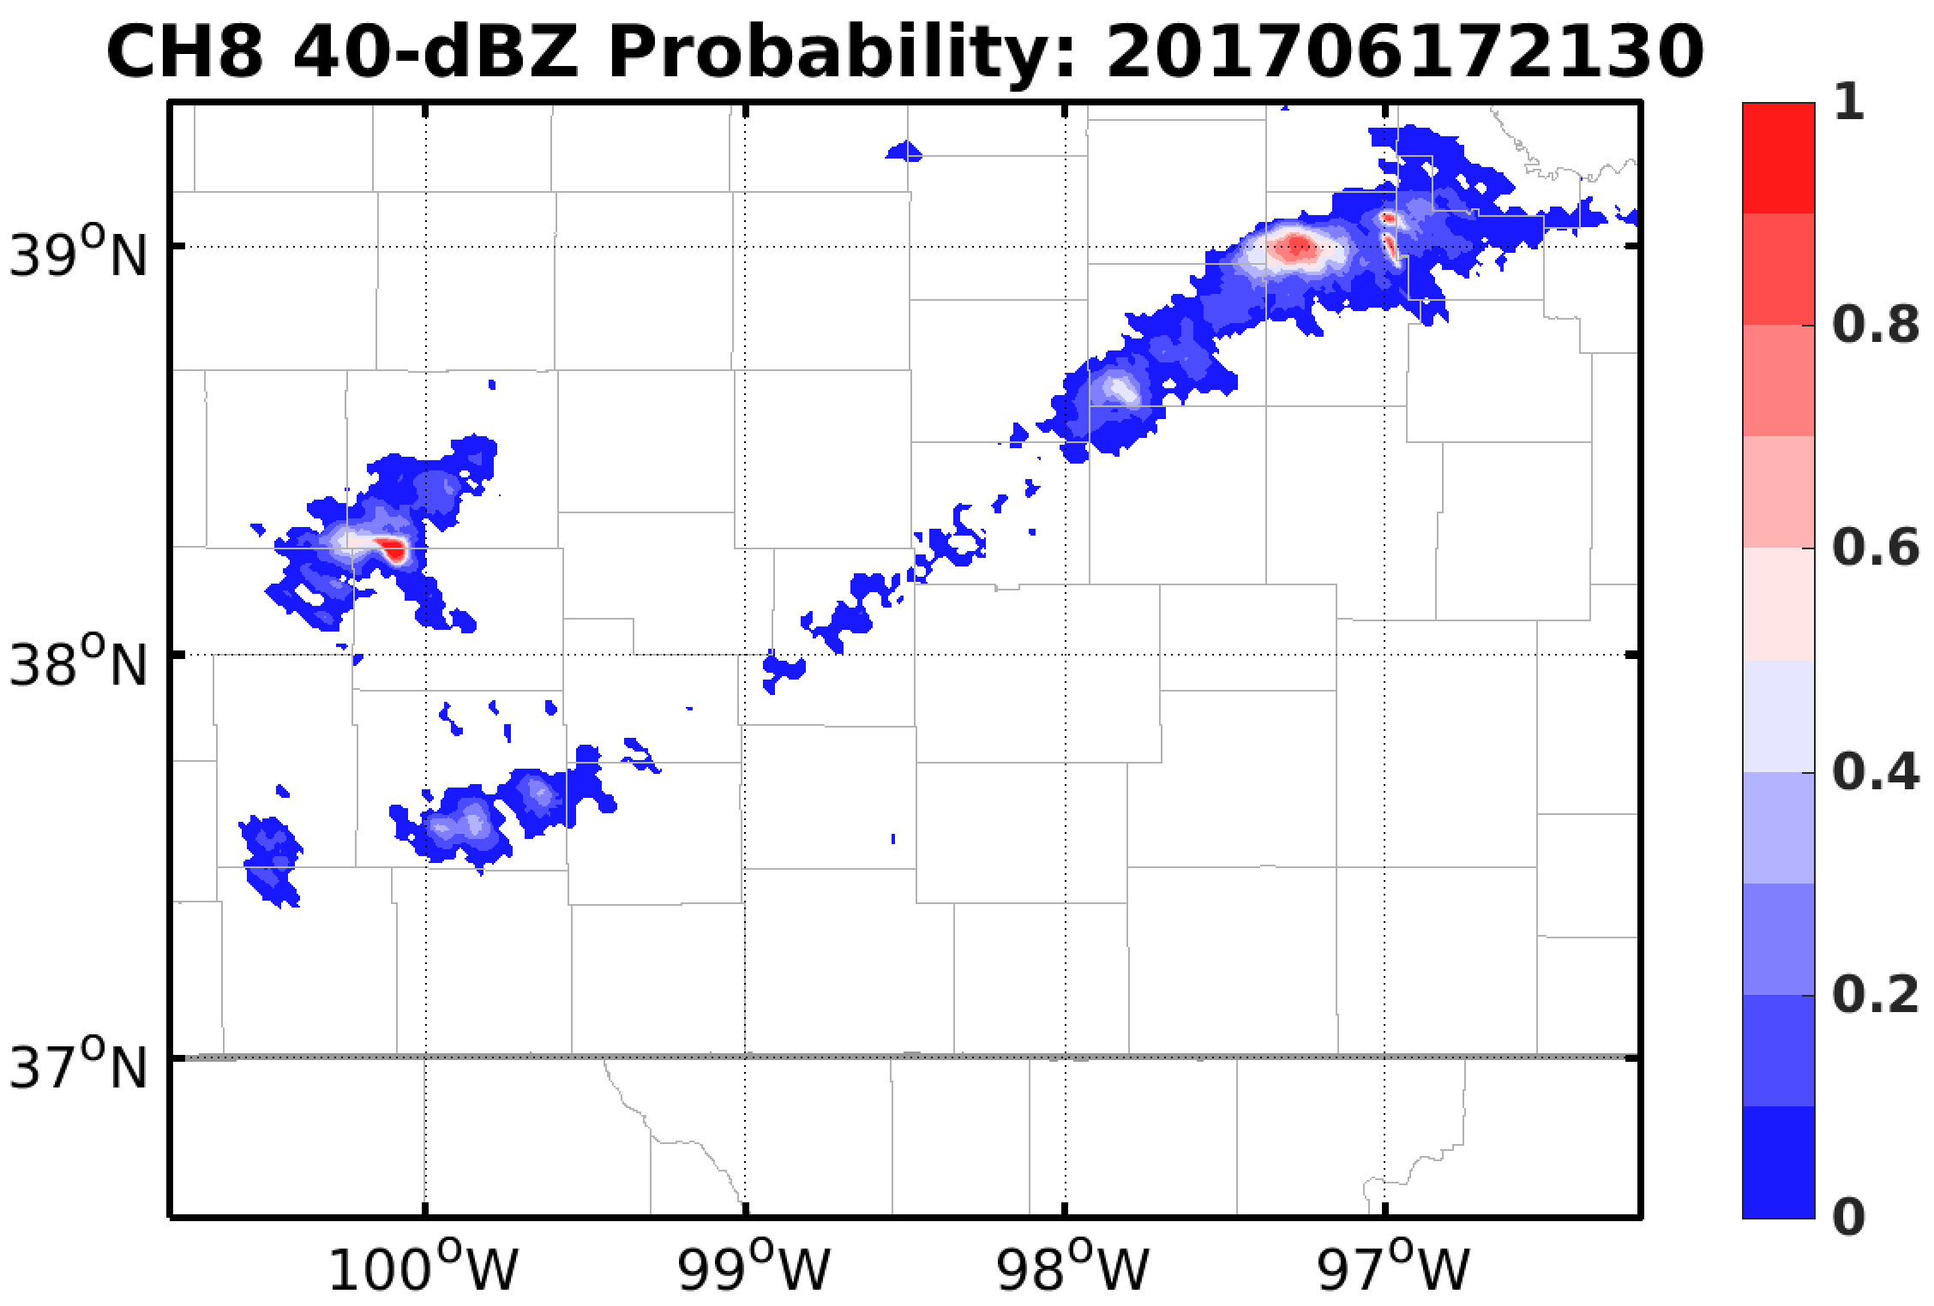
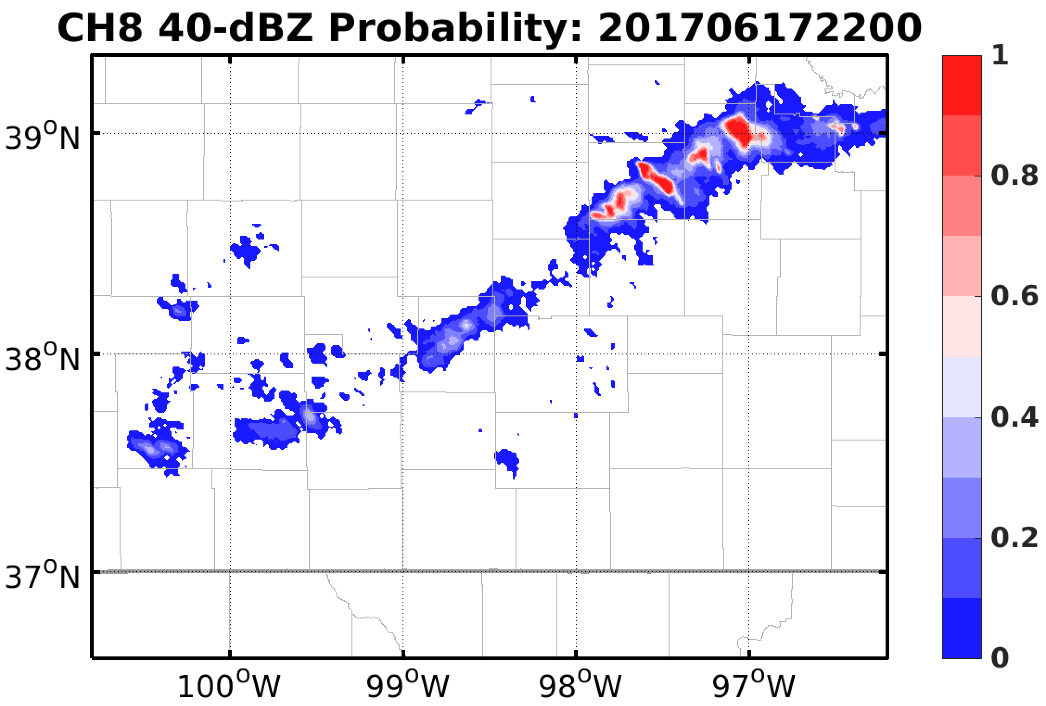
EnKF with GOES-16 Channel 8
20356 Obs per cycle
~2.4 km resolution

Slide 10
EnKF Diagnostics

Slide 11
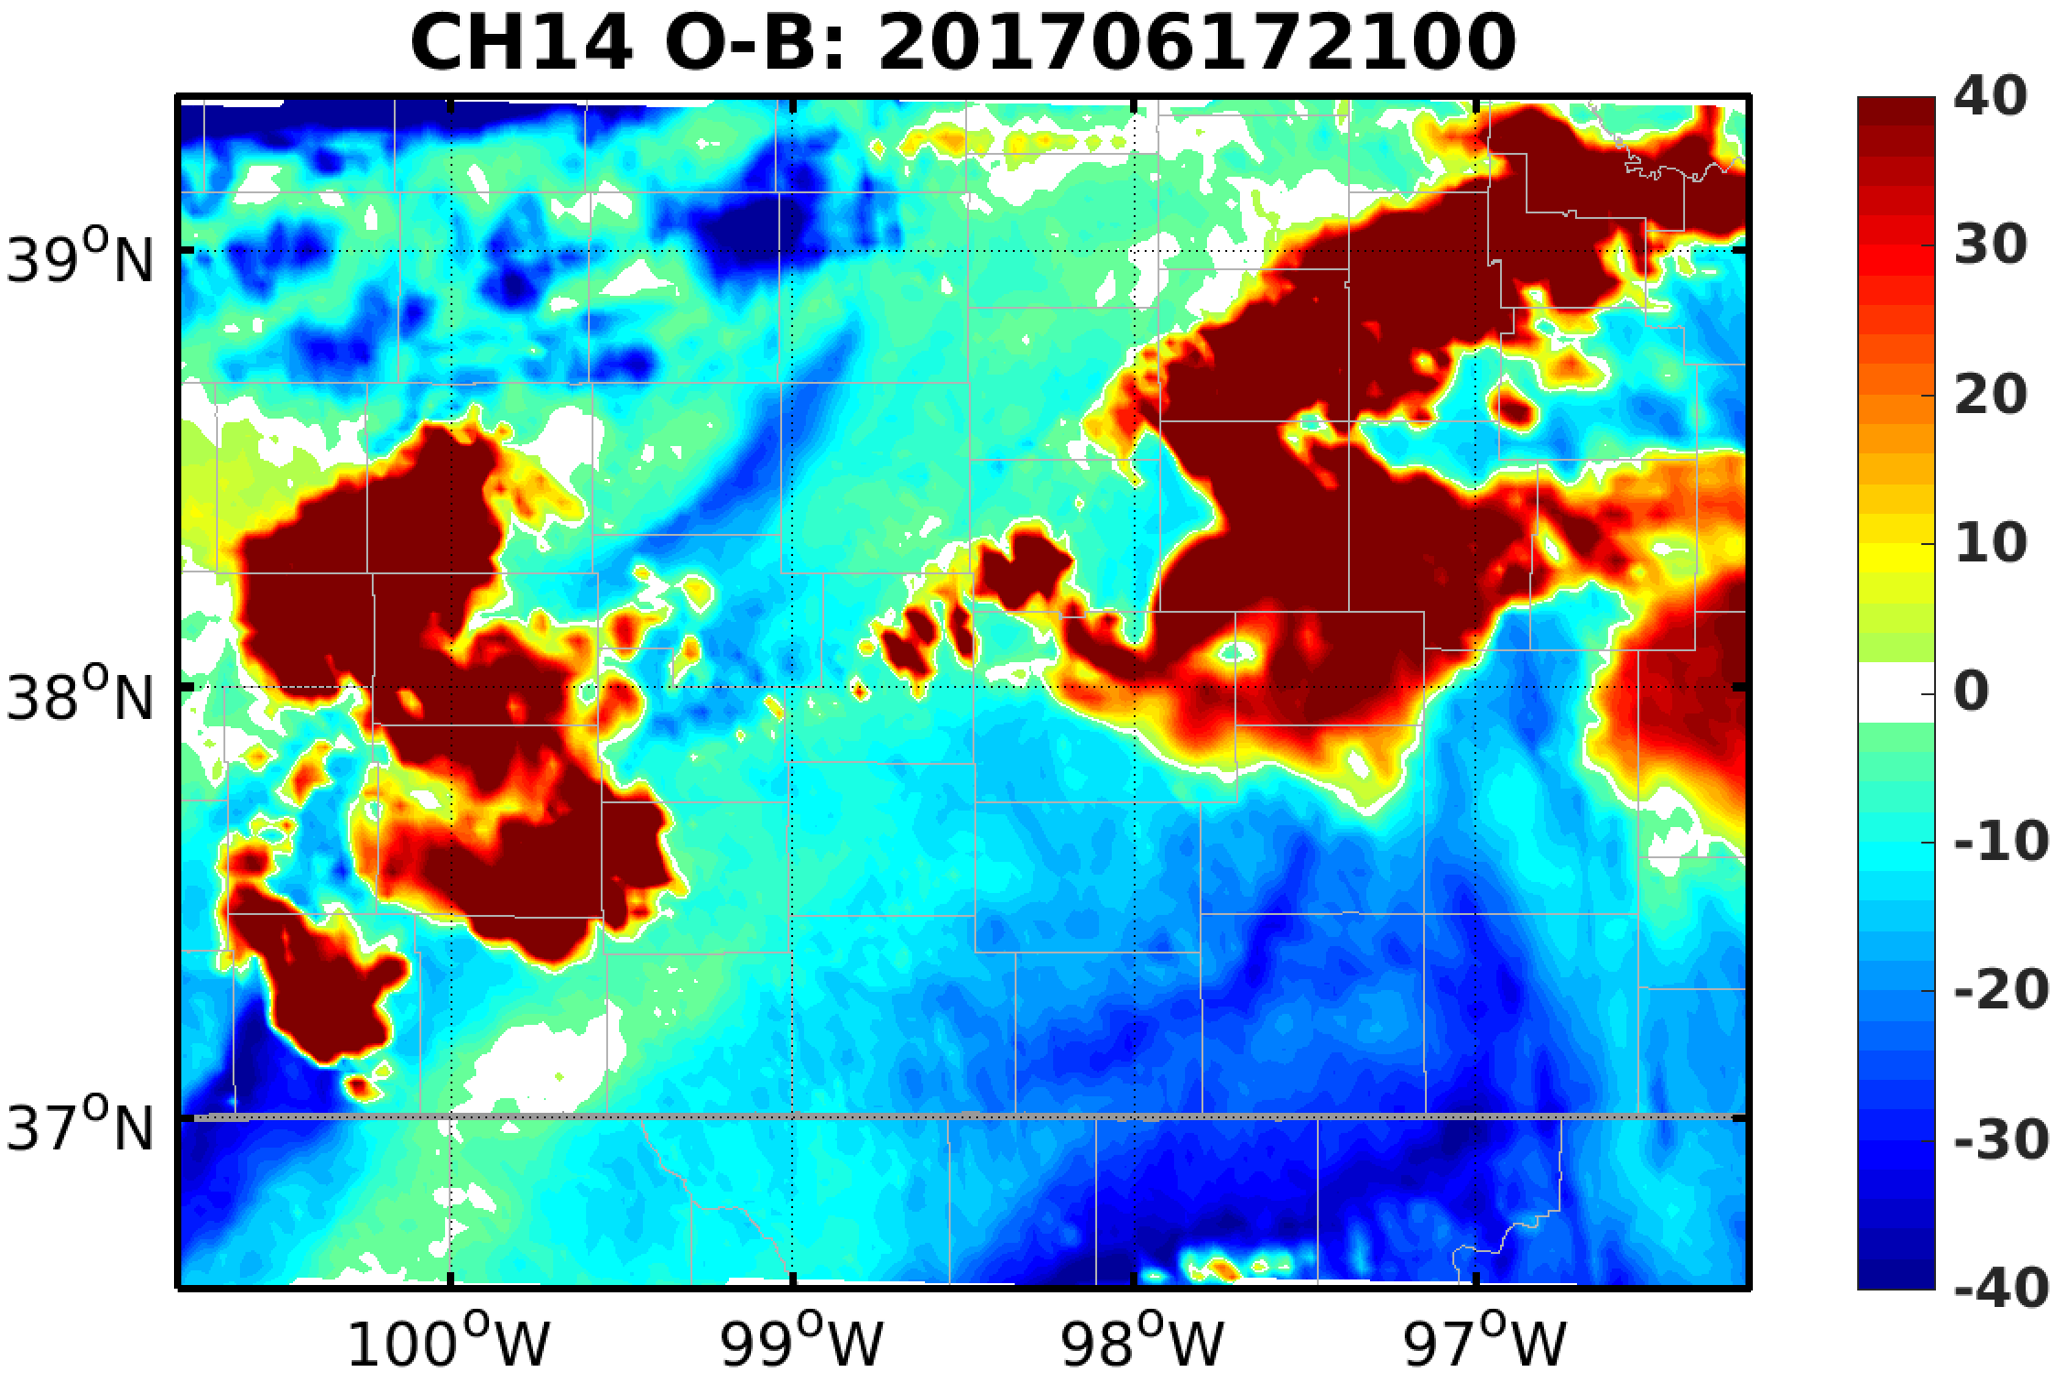
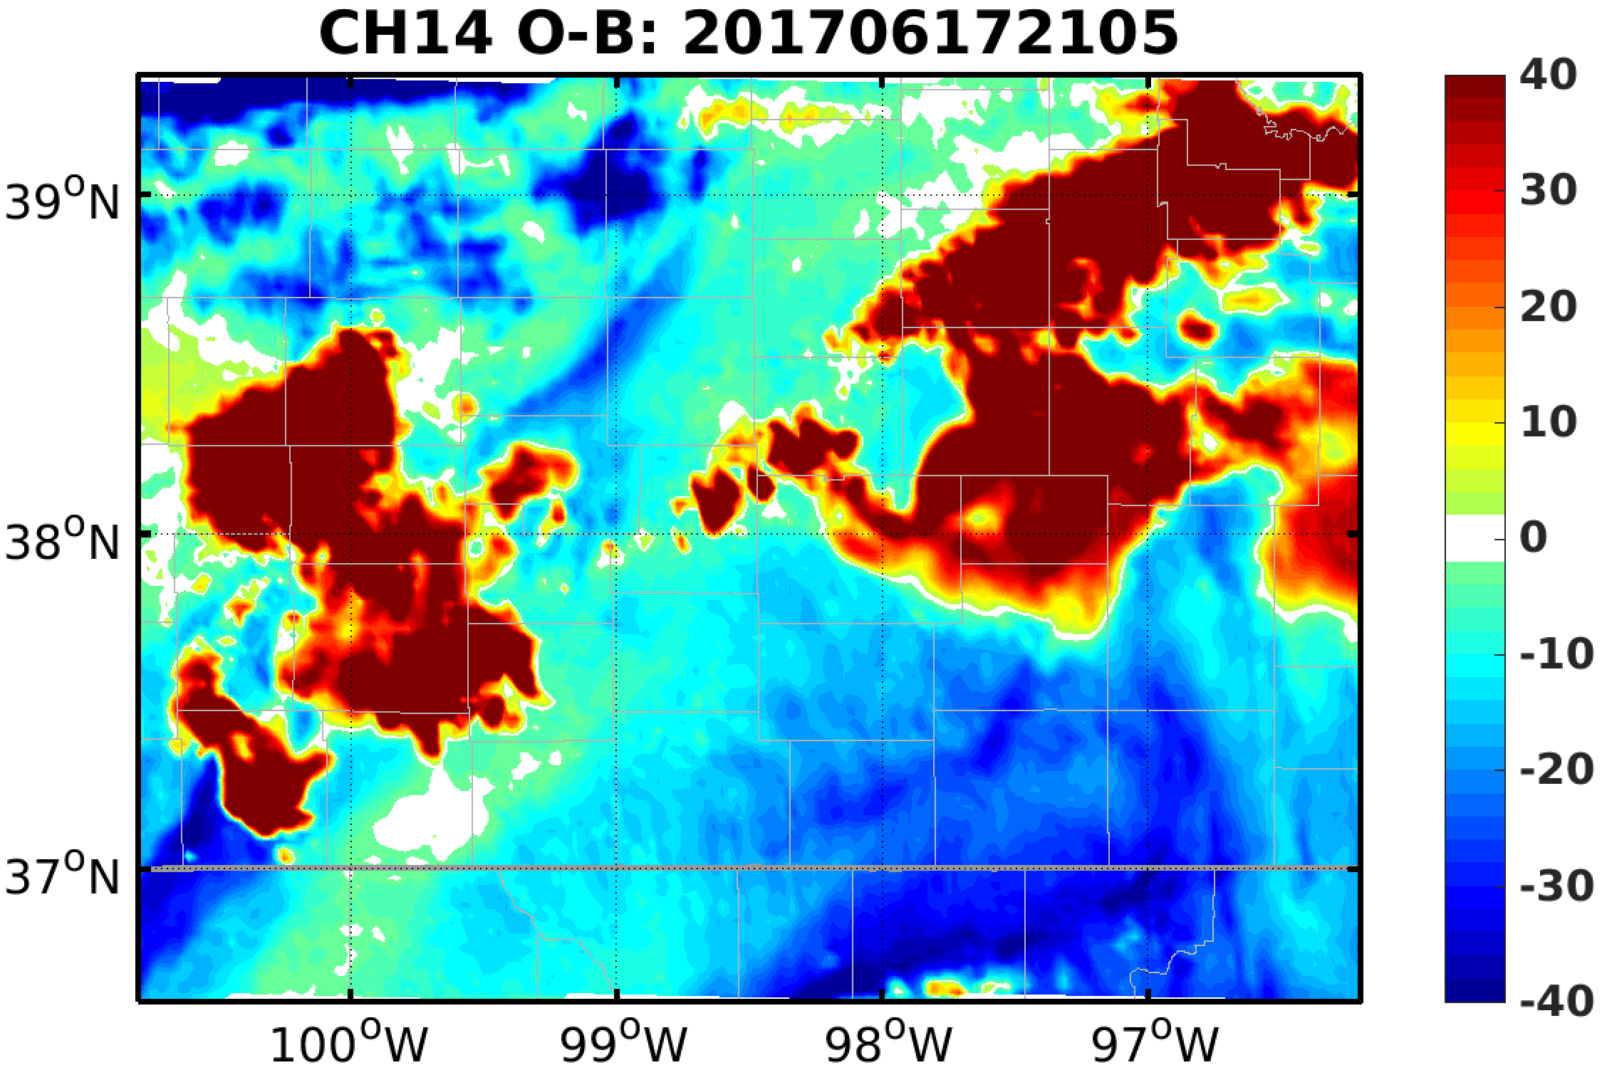
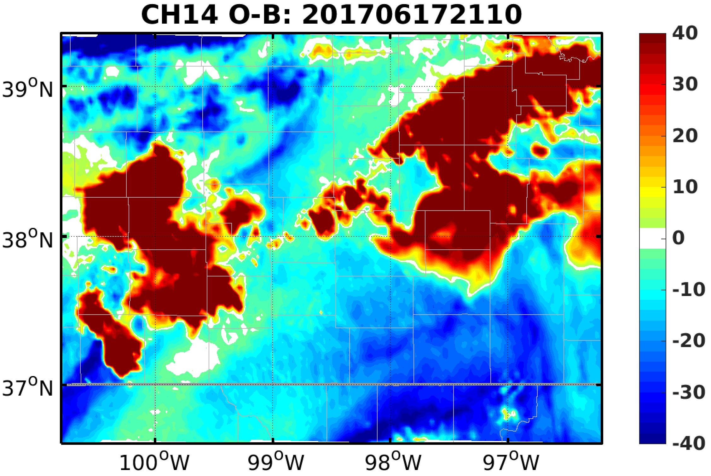

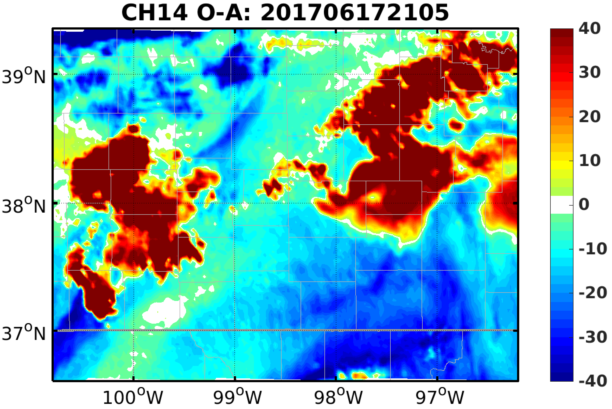
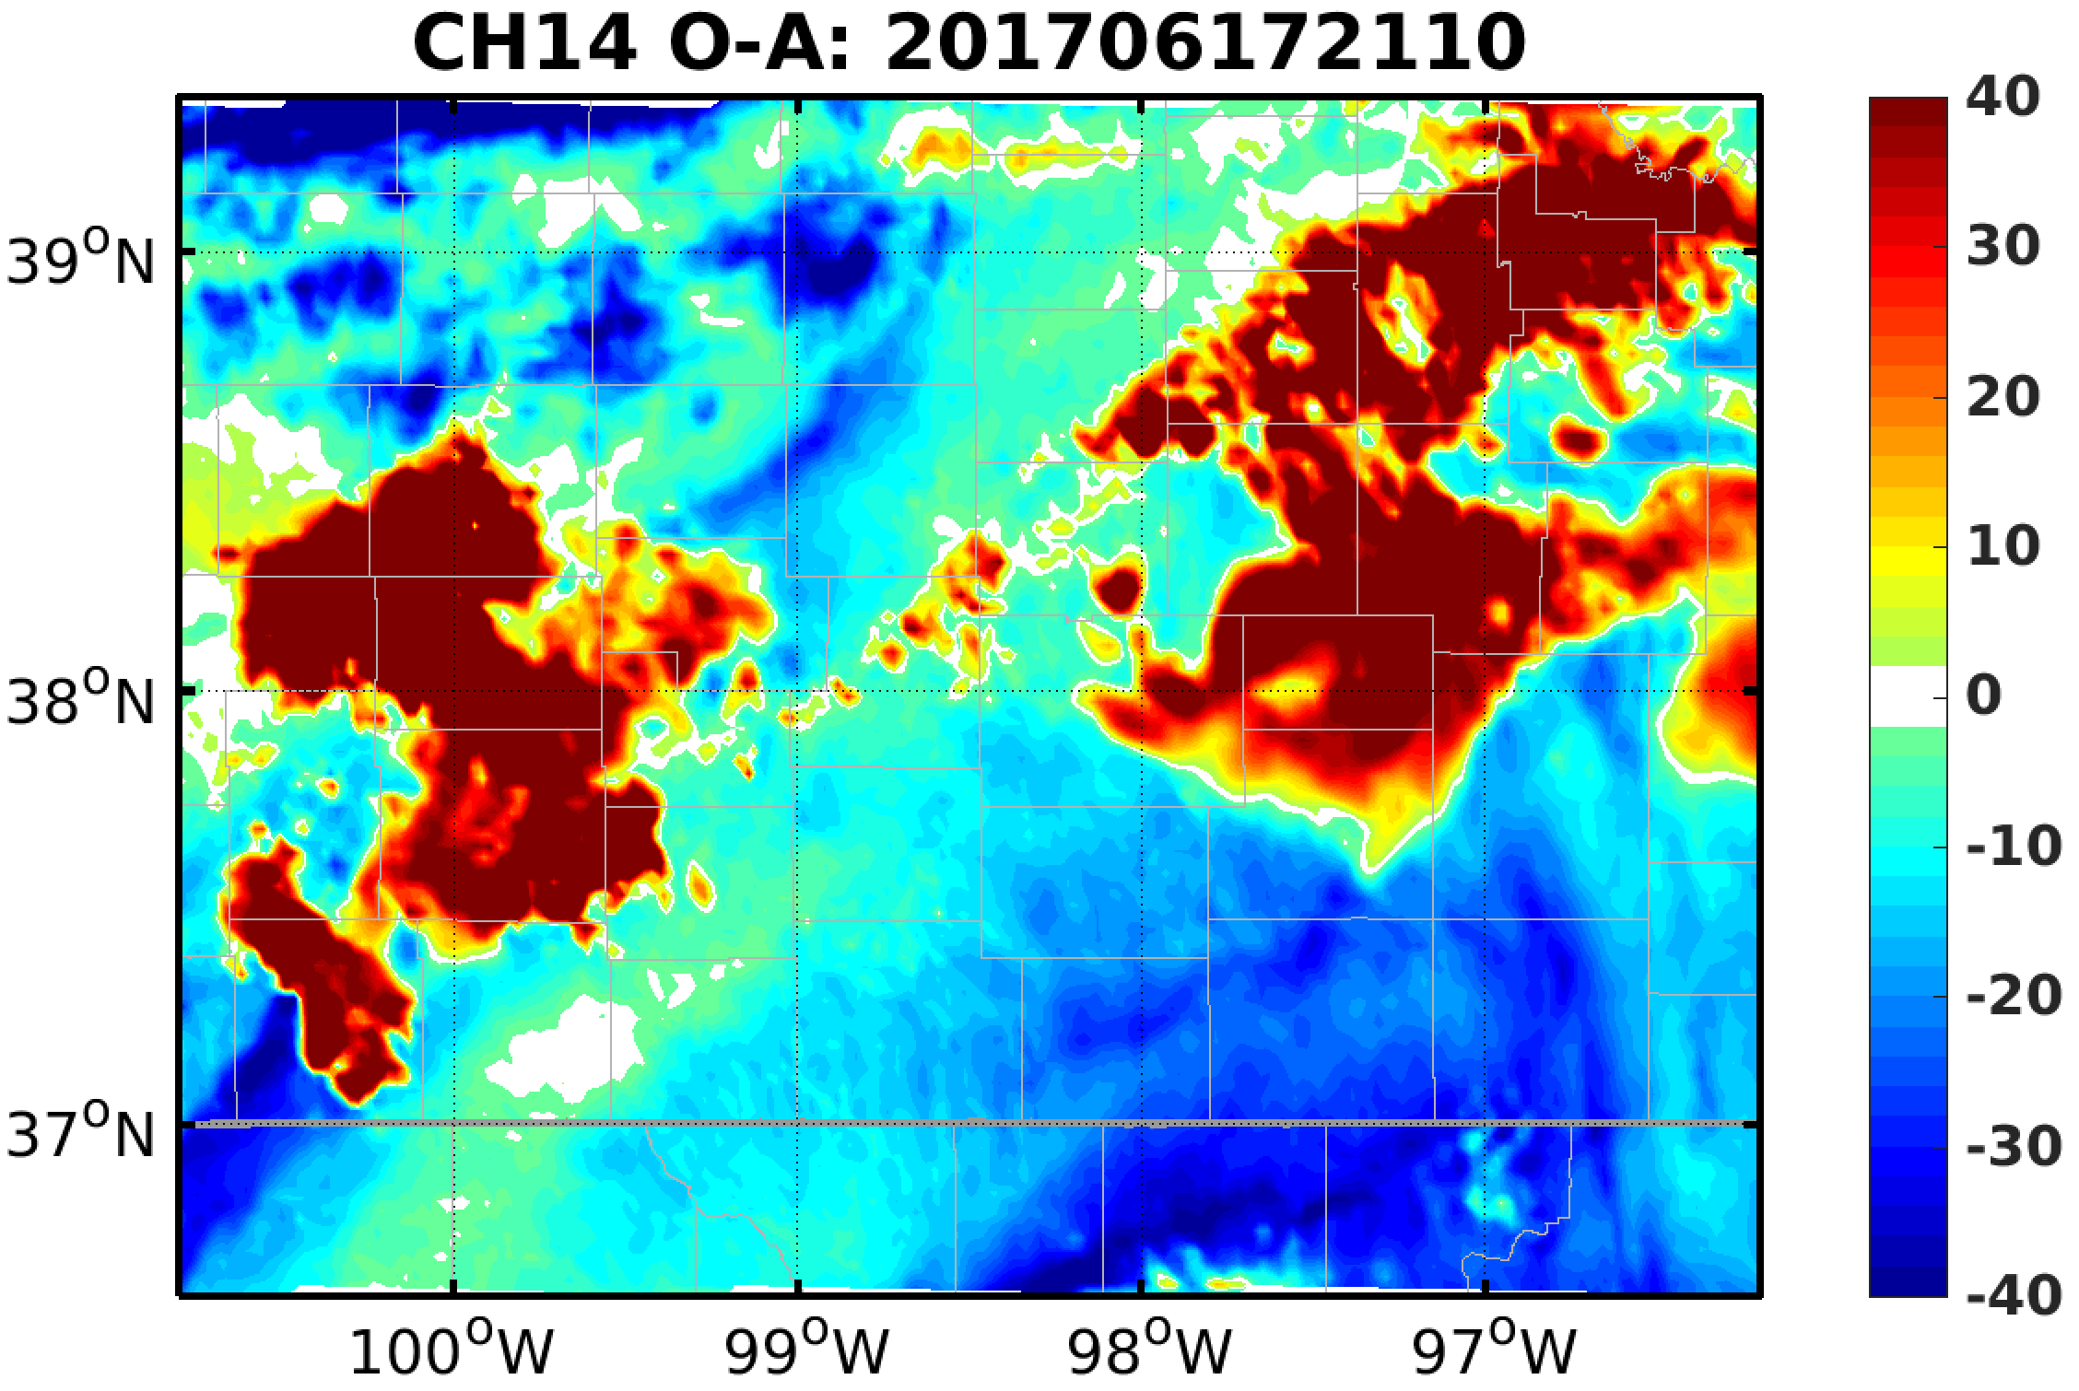
Error Evolution during EnKF

Slide 12

Radiance-based Hydrometeor Removal
Cloud parameter (adapted from Okamoto et al. 2014 QJRMS):
$Ca=\left|B−B_{clear}\right|−\left|O−B_{clear}\right|$
  Large positive Ca: Simulated cloud in observed clear-air region
  Small Ca: Simulation clouds fitted observations good
  Large negative Ca: Observed cloud in simulated clear-air region

Slide 13
Summary
Assimilating channel 8 of GOES-16 can help reduce spurious convection, but not effective and the influence is not persistent
Following works:
  Tests on methods to remove cloud hydrometeors
  Tests on assimilating multiple channels
  Ensemble forecasts after EnKF analysis with GOES-16 observation assimilated

