Slide 1
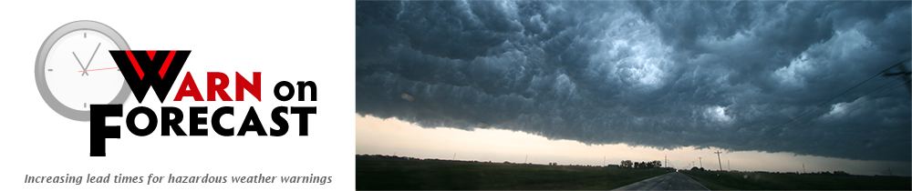

Storm-Scale Data Assimilation and
Ensemble Forecasts for the
27 April 2011 Severe Weather Outbreak in Alabama
Nusrat Yussouf, David Dowell,
Kent Knopfmeier, and Dustan Wheatley

Slide 2
Motivation
NOAA’s Warn-On-Forecast (WoF) research initiative with the goal to develop a short-range (0-1h) storm-scale probabilistic forecasts of severe convective storms.
Is the storm-scale system, which is cycled continuously, effective at assimilating multi-scale (including radar) observations?
How well do probabilistic ensemble forecasts represent the range of observed events?

Slide 3
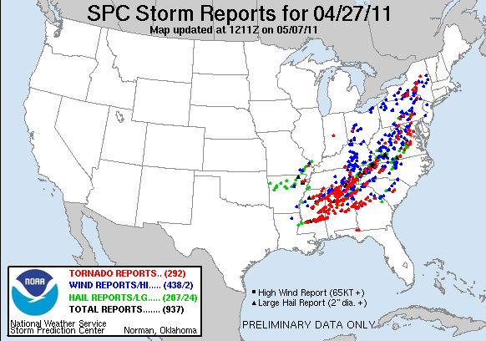
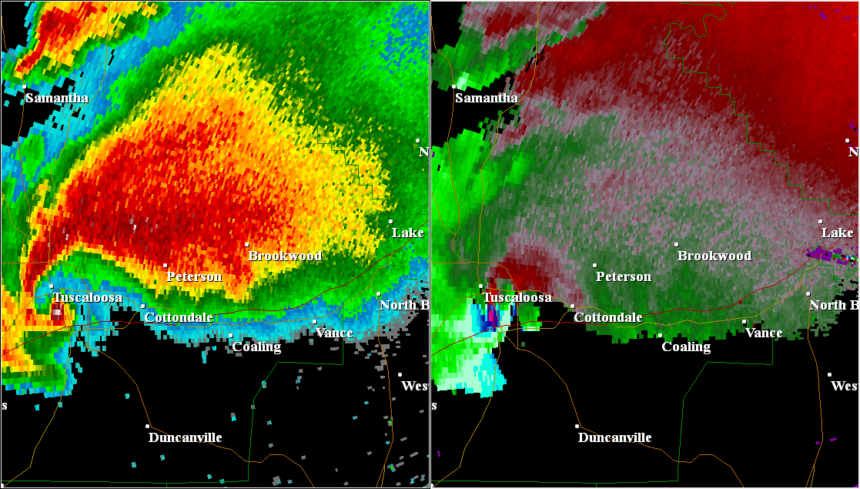
27 April 2011 Supercell Tornado Outbreak
Roughly 300 tornadoes
348 fatalities from tornadoes and other thunderstorm hazards

Slide 4
27 April 2011 Supercell Tornado Outbreak
Roughly 300 tornadoes
348 fatalities from tornadoes and other thunderstorm hazards

Slide 5
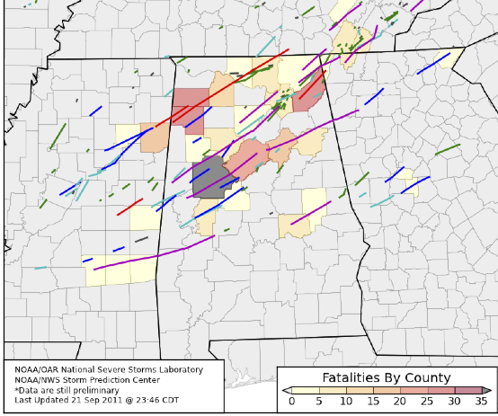
Destructive Tornadoes in Northern Alabama
Tornado | Start Time (UTC) | End Time (UTC) | Duration (min) | EF | Length (km)
Cullman | 19:40 | 20:38 | 60 | 4 | 75
Hackleburg- Phil Campbell-Tanner | 20:05 | 22:20 | 140 | 5 | 212
Cordova | 20:40 | 22:50 | 130 | 4 | 205
Tuscaloosa- Birmingham | 21:43 | 23:14 | 90 | 4 | 130
Sawyerville-Eoline | 22:30 | 23:55 | 85 | 3 | 116
------------------------- | ----------- | ----------- | -------------- | --- | --------
Smithville (MS)-Shottsville | 20:42 | 21:23 | 40 | 5 | 60
Section-Flat Rock | 21:01 | 21:57 | 55 | 4 | 76

Slide 6
Multiscale Ensemble DA and Forecast System
WRF ARW version 3.4.1
A 36-member multi-physics ensemble
51 vertical levels
Mesoscale at 15 km and
Storm-scale at 3 km horizontal grid spacing
Mesoscale
Storm-scale
IC/BC from Global Ensemble Forecast System (GEFS) at 0000 UTC 27 April 2011
Ensemble Adjusted Kalman Filter (EAKF) from DART software
Observation platforms:
METAR, Radiosonde, Maritime, Automated Aircraft, Satellite Derived Winds
No radar data assimilation on 15-km grid

Slide 7
Radar Data Assimilation in Storm-scale
5-min Update System
Storm-scale Domain
Radar DA starts at 1800 UTC in the nested 3-km domain
WSR-88D radar observations from
KDGX, KGWX, KBMX and KHTX
Radar reflectivity, radial velocity, mesonet
other conventional observations
Radar observations objectively analyzed at 6 km
using OPAWS software
Every 5 min from 1800 UTC – 0000 UTC
Launch 1-h storm-scale ensemble forecasts every 15 min
Sources of ensemble spread for storm-scale data assimilation
  GEFS
  Multi-physics
  Adaptive inflation
  Additive noise (Dowell and Wicker, 2009)

Slide 8
Multiscale Ensemble DA and Forecast Timeline

Slide 9
Observation Space Diagnostics

Slide 10
Reflectivity Forecasts from 2130 UTC Analyses
mesocyclone
1.5 km MSL
Notes:
more (too many) small showers in environment

Slide 11
Forecast Probability of Reflectivity
Observed 40-dBZ
Reflectivity Contour
at 1.5 km MSL

Slide 12
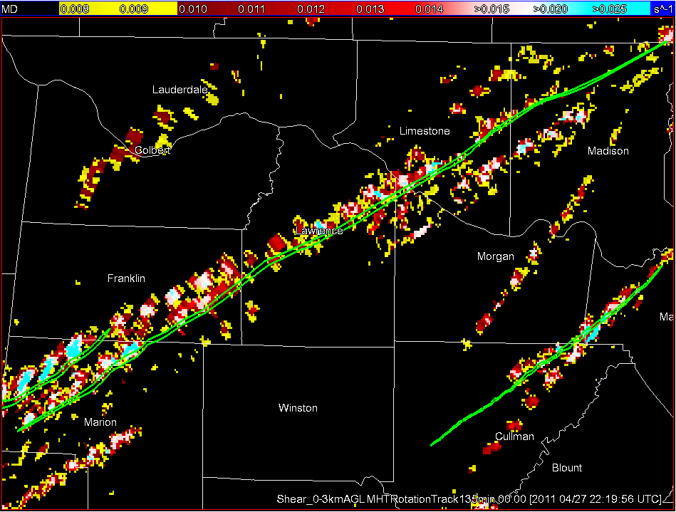
Hackleburg-Phil Campbell-Tanner EF-5 Tornado
2220
NWS Damage Path
Tanner
Huntsville
Phil Campbell
Hackleburg
2005
The strongest and longest track tornado
Duration: 2005 – 2220 UTC
(2 hrs. 15 mins.)
Distance Traveled: 212 km
72 Fatalities
WDSS-II Rotation Track

Slide 13
1 hr Forecast Probability of Vorticity
from every 15-min analyses
Hackleburg tornado on the ground : 2005 - 2220 UTC
Duration: 2 hrs and 15 mins
Cullman tornado on the ground : 1940 - 2038 UTC
Duration: ~1 hr

Slide 14
1 hr Forecast Probability of Vorticity
from every 15-min analyses

Slide 15
Tuscaloosa to Birmingham EF-4 Tornado
65 fatalities, 1500 injuries
Duration : 2143 – 2214 UTC (1 hr. 30 mins.)
Distance Traveled: 130 km
2214
Birmingham
Tuscaloosa
2143

Slide 16
Extended Hour Forecast Probability of Vorticity
out to 2315 UTC
Tornado on the ground: 2143 - 2314 UTC
Duration: 1 hr 30 mins
Notes:
coherent and enhanced probability track forecasts near the surface.

Slide 17
Tornado on the ground from 2143 to 2314 UTC
Duration: 1 hr 30 mins

Slide 18
0-1 hr Forecast Probability of Vorticity every 15-mins

