Slide 1
Development of the Met Office's
4DEnVar System
6th EnKF Data Assimilation Workshop, May 2014.
Andrew Lorenc, Neill Bowler, Adam Clayton and Stephen Pring

Slide 2
Outline of Talk
Terminology
Why are we doing it? What is wrong with 4DVar? Addressed by:
  Hybrid-4DVar. Flow-dependent covariances from localised ensemble perturbations.
  Hybrid-4DEnVar. No need to integrate linear & adjoint models.
Results of initial trials comparing these.
What we need to do to improve hybrid-4DEnVar.

Slide 3
Nomenclature for Ensemble-Variational Data Assimilation
Recommendations by WMO’s DAOS WG (Lorenc 2013):
non-ambiguous terminology based on the most common established usage.
En should be used to abbreviate Ensemble, as in the EnKF.
No need for hyphens (except as established in 4D-Var)
4DVar should only be used, even with a prefix, for methods using a forecast model and its adjoint each iteration.
EnVar means a variational method using ensemble covariances. More specific prefixes (e.g. hybrid-4DEnVar) may be added.
hybrid can be applied to methods using a combination of ensemble and climatological covariances.
The EnKF generate ensembles. EnVar does not, unless it is part of an ensemble of data assimilations (EDA).
© Crown copyright Met Office Andrew Lorenc 3
Notes:
Lorenc, Andrew C 2013: Recommended Nomenclature for EnVar Data Assimilation Methods. WGNE Research Activities in Atmospheric and Oceanic Modelling.
http://www.wcrp-climate.org/WGNE/BlueBook/2013/individual-articles/01_Lorenc_Andrew_EnVar_nomenclature.pdf
9th November 2012
At the THORPEX DAOS WG meeting in 2011, the group felt there was a need for a common terminology for hybrid ensemble variation methods. The issue was discussed again at the 2012 meeting. The recommendations below attempt to represent the views expressed. We have tried to select a non-ambiguous terminology based on the most common existing established usage.
En should be used to abbreviate Ensemble (not Ens), as it is in the EnKF.
Hyphenated abbreviations (4D-Var, 3D-Var) were standardised by Ide et al. (1997) (and some journals), but they are not usually used in names for EnKF methods. The hyphen may be omitted in new names.
4D-Var or 4DVAR are so well established that, even with a prefix or suffix, they should only be used for methods using a forecast model and its adjoint. Methods not using an adjoint method should use a name which does not make them seem variants of 4D-Var. In particular we discourage the terminology En4DVAR used by Liu et al. (2008, 2009) to mean an an algorithm designed not to use an adjoint model. Instead we recommend 4DEnVar as being more distinct from 4DVAR, and more similar to the 4DEnKF of Hunt et al. (2004). A prefix to 4D-Var can qualify it as in 4 or 7 below, but it should not change the basic 4D-Var method.
hybrid should describe the covariances used, not the method. E.g. “hybrid 3DVAR” (Wang et al., 2008a,b) and “hybrid 4D-Var” (Clayton et al., 2012) are Var methods using a combination of climatological and ensemble covariances. Pure 4DEnVar, using only ensemble covariances, should not be described as a hybrid method.
EnVar may be used without qualification (as EnKF is), if there is no need to stress the specific details of the implementation, to mean a variational method using ensemble covariances. For example a hybrid-4DEnVar may be simply described as EnVar.
The EnKF and its specific flavours (e.g. ETKF) generate ensembles as part of their algorithm. EnVar, like 3D-Var or 4D-Var, generates a single best estimate, unless specified, e.g. Bonavita et al. (2012) use EDA as nomenclature for an Ensemble of [4D-Var] Data Assimilations.
Following the style of hybrid-4D-Var, it would be natural to use En4DVar for 4D-Var using ensemble covariances. However En4DVAR was used by Liu et al. (2008, 2009) for something else. So until recommendation 3 is generally adopted, it is safer to use 4D-Var-Ben or 4D-Var-Benkf (Buehner et al., 2010a,b).
References
Bonavita M, Isaksen L, Holm E. 2012. On the use of EDA background error variances in the ECMWF 4D-Var. Q. J. R. Meteorol. Soc. 138: 1540–1559, doi:10.1002/qj.1899.
Buehner M, Houtekamer PL, Charette C, Mitchell HL, He B. 2010a. Intercomparison of variational data assimilation and the ensemble Kalman filter for global deterministic NWP. part i: Description and single-observation experiments. Mon. Weather Rev. 138: 1550–1566, doi:10.1175/2009MWR3157.1.
Buehner M, Houtekamer PL, Charette C, Mitchell HL, He B. 2010b. Intercomparison of variational data assimilation and the ensemble Kalman filter for global deterministic NWP. part ii: One-month experiments with real observations. Mon. Weather Rev. 138: 1567–1586, doi:10.1175/2009MWR3158.1.
Clayton AM, Lorenc AC, Barker DM. 2012. Operational implementation of a hybrid ensemble/4D-Var global data assimilation system at the Met Office. Q. J. R. Meteorol. Soc. accepted: 16pp, doi:10.1002/qj.2054.
Hunt B, Kalnay E, Kostelich E, Ott E, Patil D, Sauer T, Szunyogh I, Yorke J, Zimin A. 2004. Four-dimensional ensemble Kalman filtering. Tellus A 56(4): 273–277.
Ide K, Courtier P, Ghil M, Lorenc A. 1997. Unified notation for data assimilation: Operational, sequential and variational. J. Met. Soc. of Japan 75: 181–189.
Liu C, Xiao Q, Wang B. 2008. An ensemble-based four-dimensional variational data assimilation scheme. part i: Technical formulation and preliminary test. Mon. Weather Rev. 136: 3363–3373, doi:10.1175/2008MWR2312.1.
Liu C, Xiao Q, Wang B. 2009. An ensemble-based four-dimensional variational data assimilation scheme. part ii: Observing System Simulation Experiments with advanced research WRF (ARW). Mon. Weather Rev. 137: 1687–1704, doi:10.1175/2008MWR2699.1.
Wang X, Barker DM, Snyder C, Hamill TM. 2008a. A hybrid ETKF-3DVAR data assimilation scheme for the wrf model. part i: Observing system simulation experiment. Mon. Weather Rev. 136: 5116–5131, doi:10.1175/2008MWR2444.1.
Wang X, Barker DM, Snyder C, Hamill TM. 2008b. A hybrid ETKF-3DVAR data assimilation scheme for the WRF model. part ii: Real observation experiments. Mon. Weather Rev. 136: 5132–5147, doi:10.1175/ 2008MWR2445.1.

Slide 4
Background
4DVar has been the best DA method for operational NWP for the last decade (Rabier 2005).
Since then we have gained a day’s predictive skill – the forecast “background” is usually very good; properly identifying its likely errors is increasingly important.
Most of the gain in skill has been due to increased resolution, which was enabled by faster computers. To continue to improve, we must make effective use of planned massively parallel computers.
© Crown copyright Met Office Andrew Lorenc 4

Slide 5
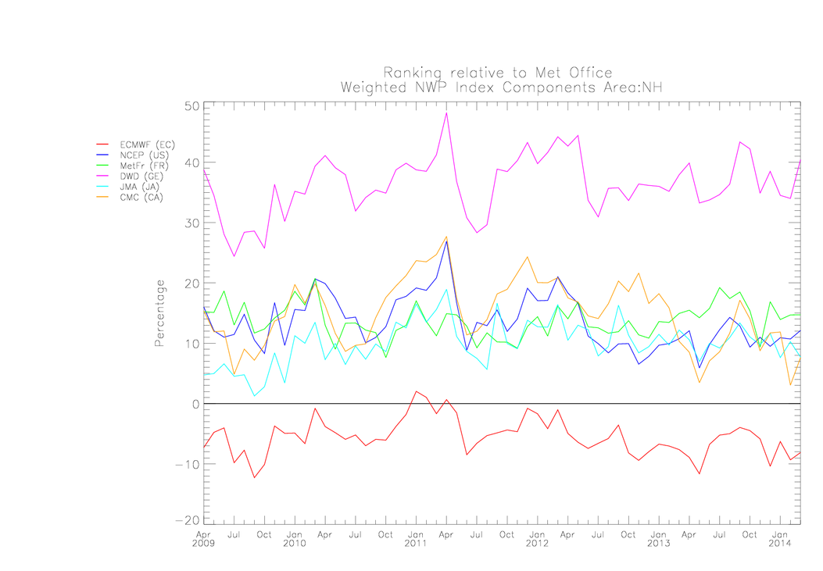

Business Performance Measures: Global Index
What is important for Met Office Global Forecasting System? Competitiveness
© Crown copyright Met Office Andrew Lorenc 5
Notes:
Verification v own analyses.
Met Office hybrid implemented July 2011 improving ~1%
NCEP hybrid implement May 2012
Canada expect 4DEnVar to replaced 4DVar in Fall 2014 (slipped from 2013). NB not comparing to hybrid-4DVar.

Slide 6
Key weaknesses of 4DVar
Scientific: Background errors are modelled using a covariance which is usually assumed to be stationary, isotropic and homogeneous.
  Need to allow for Errors of The Day.
Technical: The minimisation requires repeated sequential runs of a (low resolution) linear model and its adjoint.
  Inefficient on massively parallel computers;
  difficult development when the forecast model is redesigned.
The Met Office has already addressed 1 in its hybrid−4DVar (Clayton et al. 2013).
Our hybrid−4DEnVar developments are attempting to extend this to also address 2.
© Crown copyright Met Office Andrew Lorenc 6

Slide 7
Comparison of hybrid-4DEnVar and hybrid-4DVar data assimilation methods for global NWP
Andrew C Lorenc, Neill Bowler, Adam Clayton, David Fairbairn and Stephen Pring.
Submitted to MWR
Trials:
Name | DA Method | Initialization
4DVar | hybrid-4DVar | J_{c}
4DEnVar | hybrid-4DEnVar | 4DIAU
3DVar | hybrid-3DVar | IAU
3DEnVar | hybrid-3DEnVar | IAU
4DVar4DIAU | hybrid-4DVar | 4DIAU
Trials for July 2013, based on lower res. operational global hybrid-4DVar (Clayton et al. 2013) NWP system:
640×481×70 deterministic model and 432×325×70 ensemble and PF & adjoint models in 4DVar.
44-member ensemble precalculated by MOGREPS-G (Bowler et al. 2008; Flowerdew and Bowler 2011).

Slide 8

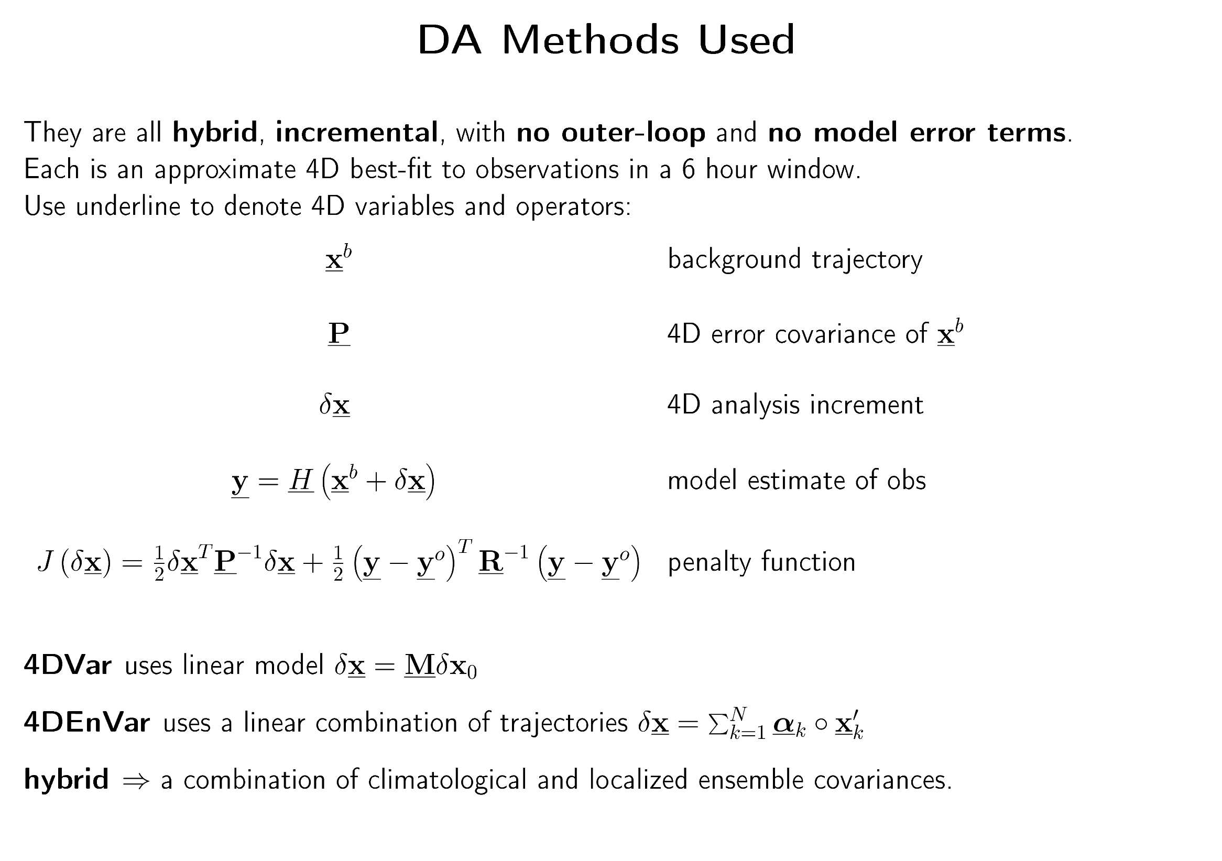

Slide 9
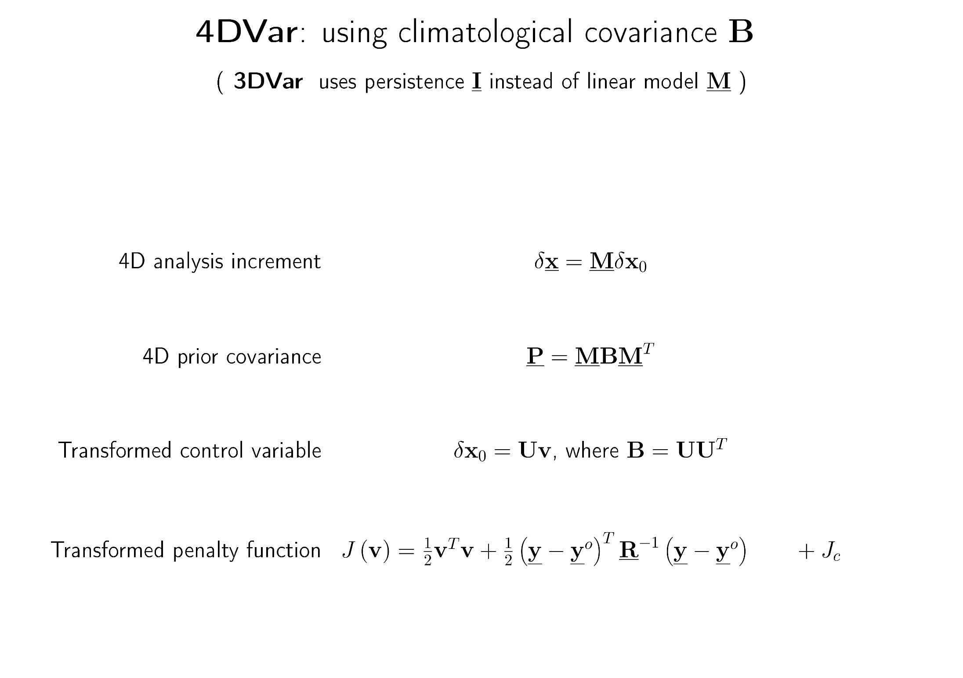

Slide 10
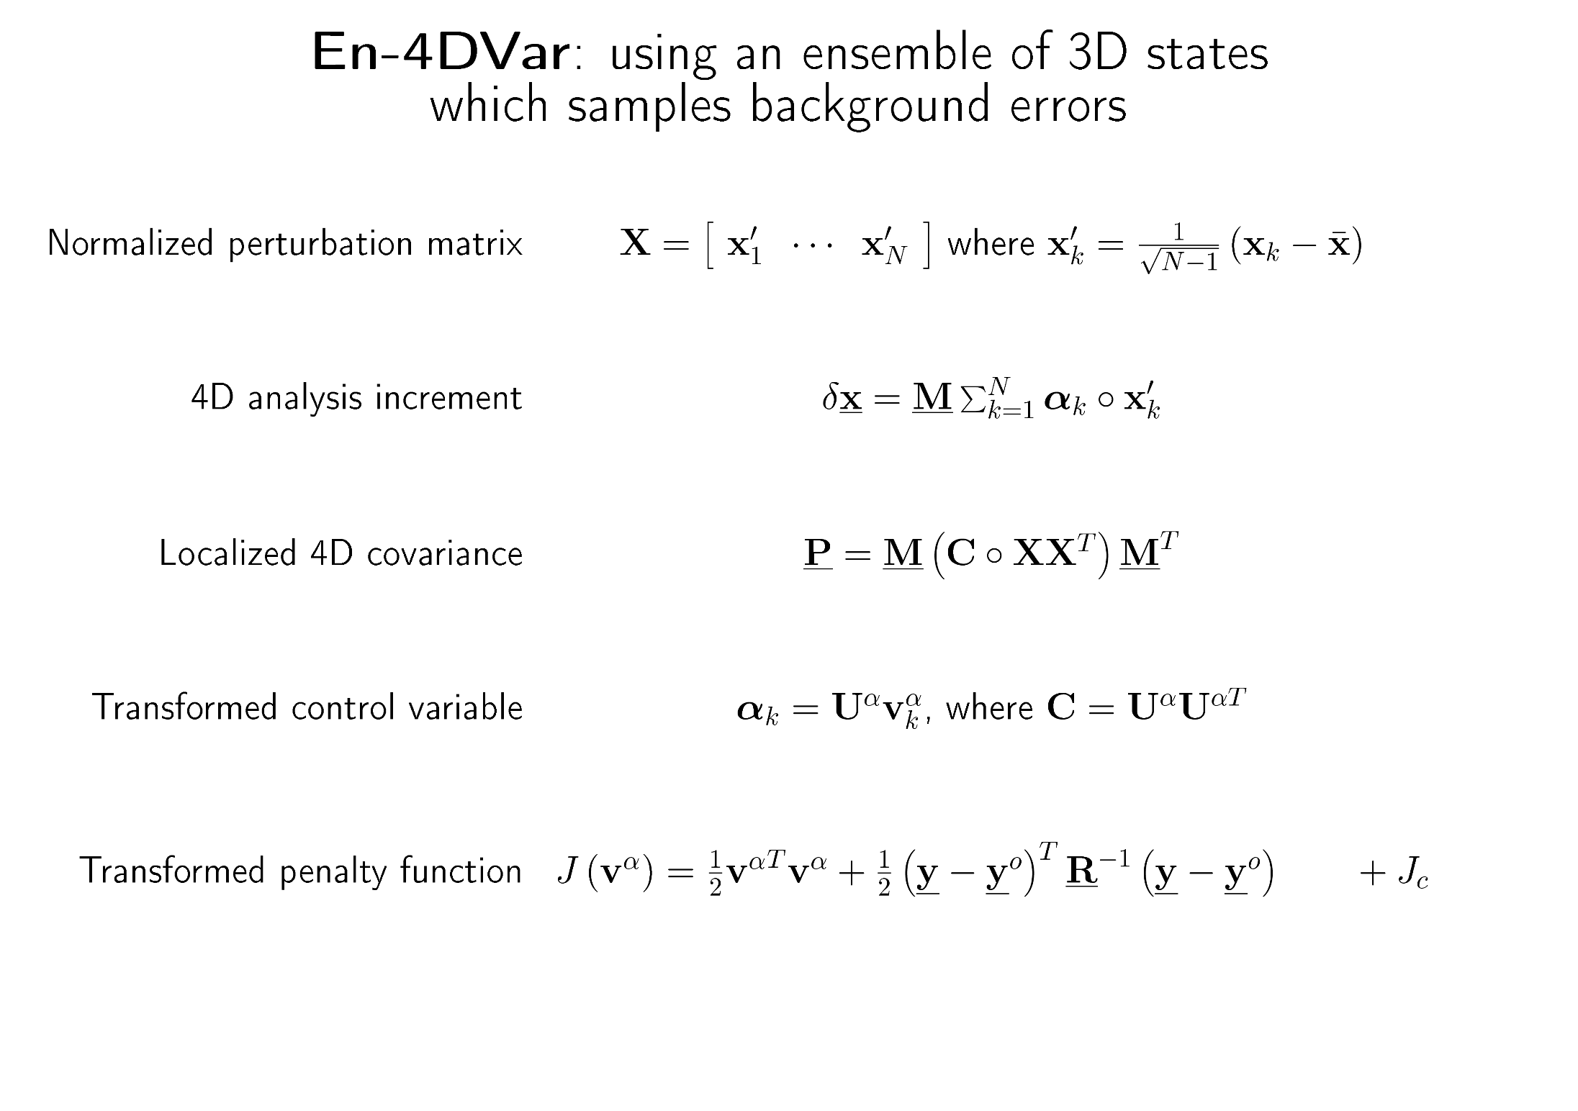

Slide 11
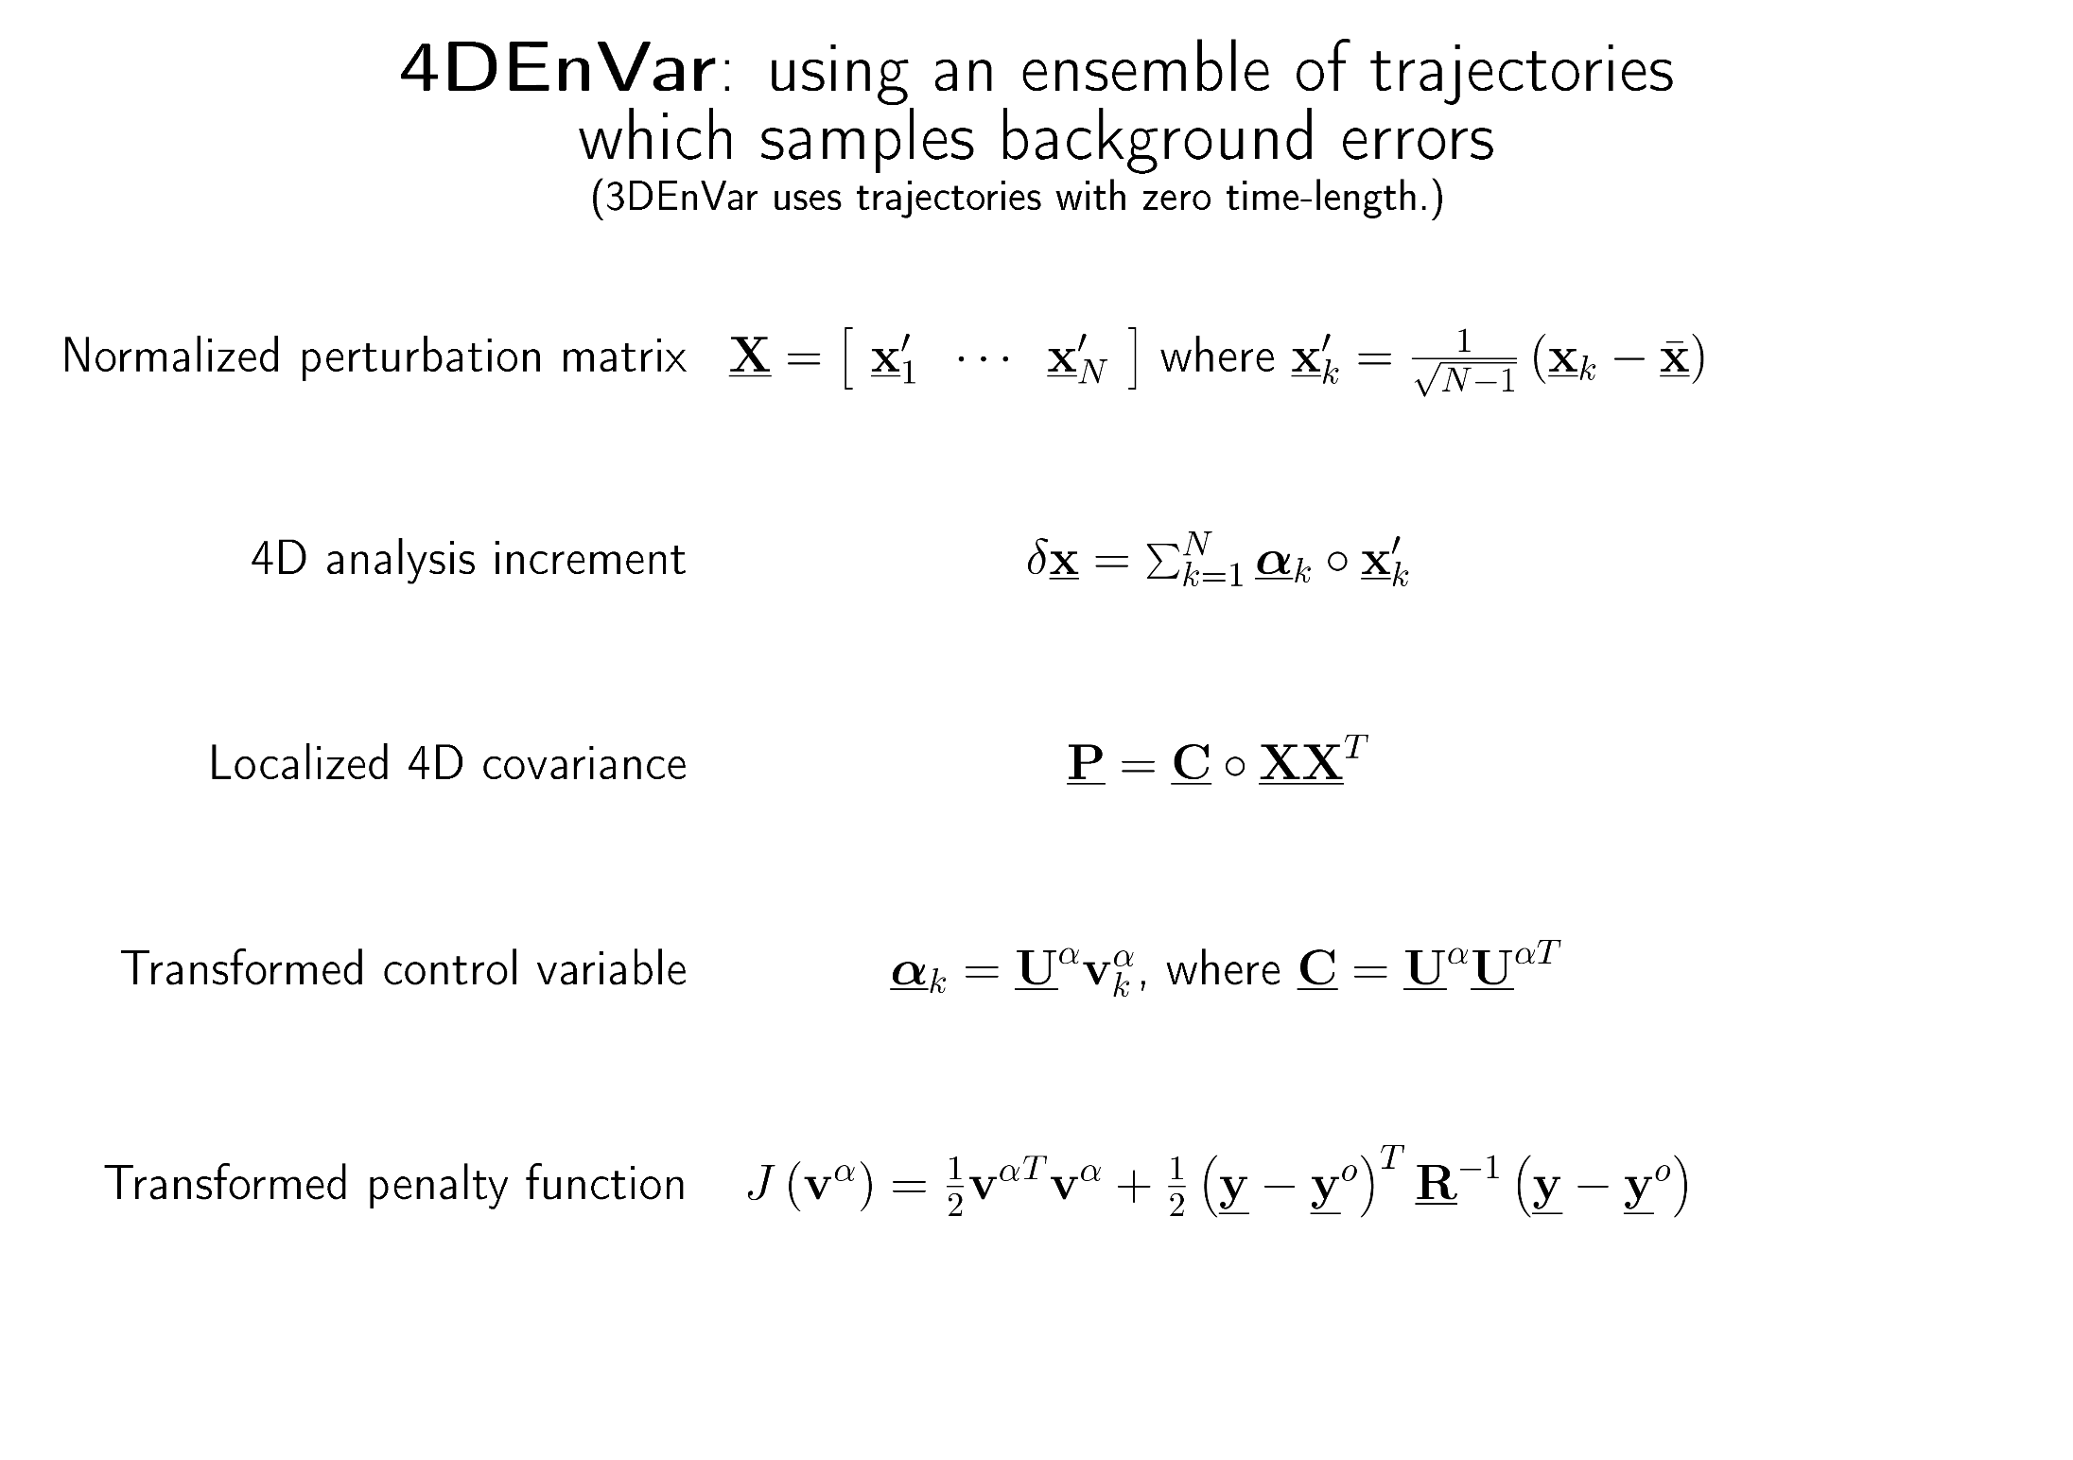

Slide 12
Statistical, incremental 4D-Var
Statistical 4D-Var approximates entire PDF by a 4D Gaussian defined by PF model.
4D analysis increment is a trajectory of the PF model.
Lorenc & Payne 2007
Notes:
12

Slide 13
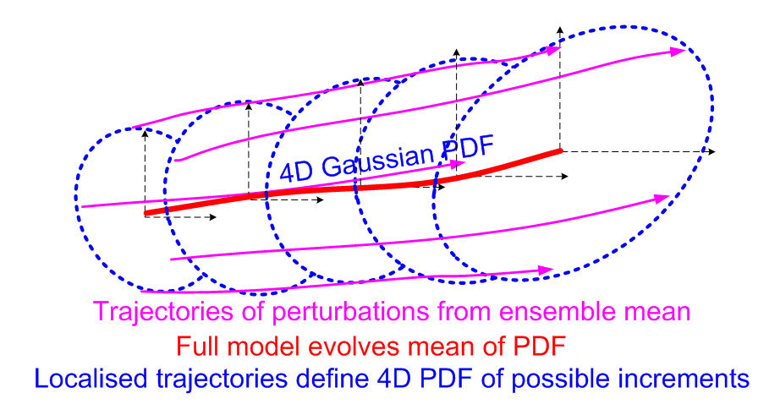
Incremental 4D-Ensemble-Var
Statistical 4D-Var approximates entire PDF by a Gaussian.
4D analysis is a (localised) linear combination of nonlinear trajectories. It is not itself a trajectory.
© Crown copyright Met Office Andrew Lorenc 13
Notes:
13

Slide 14
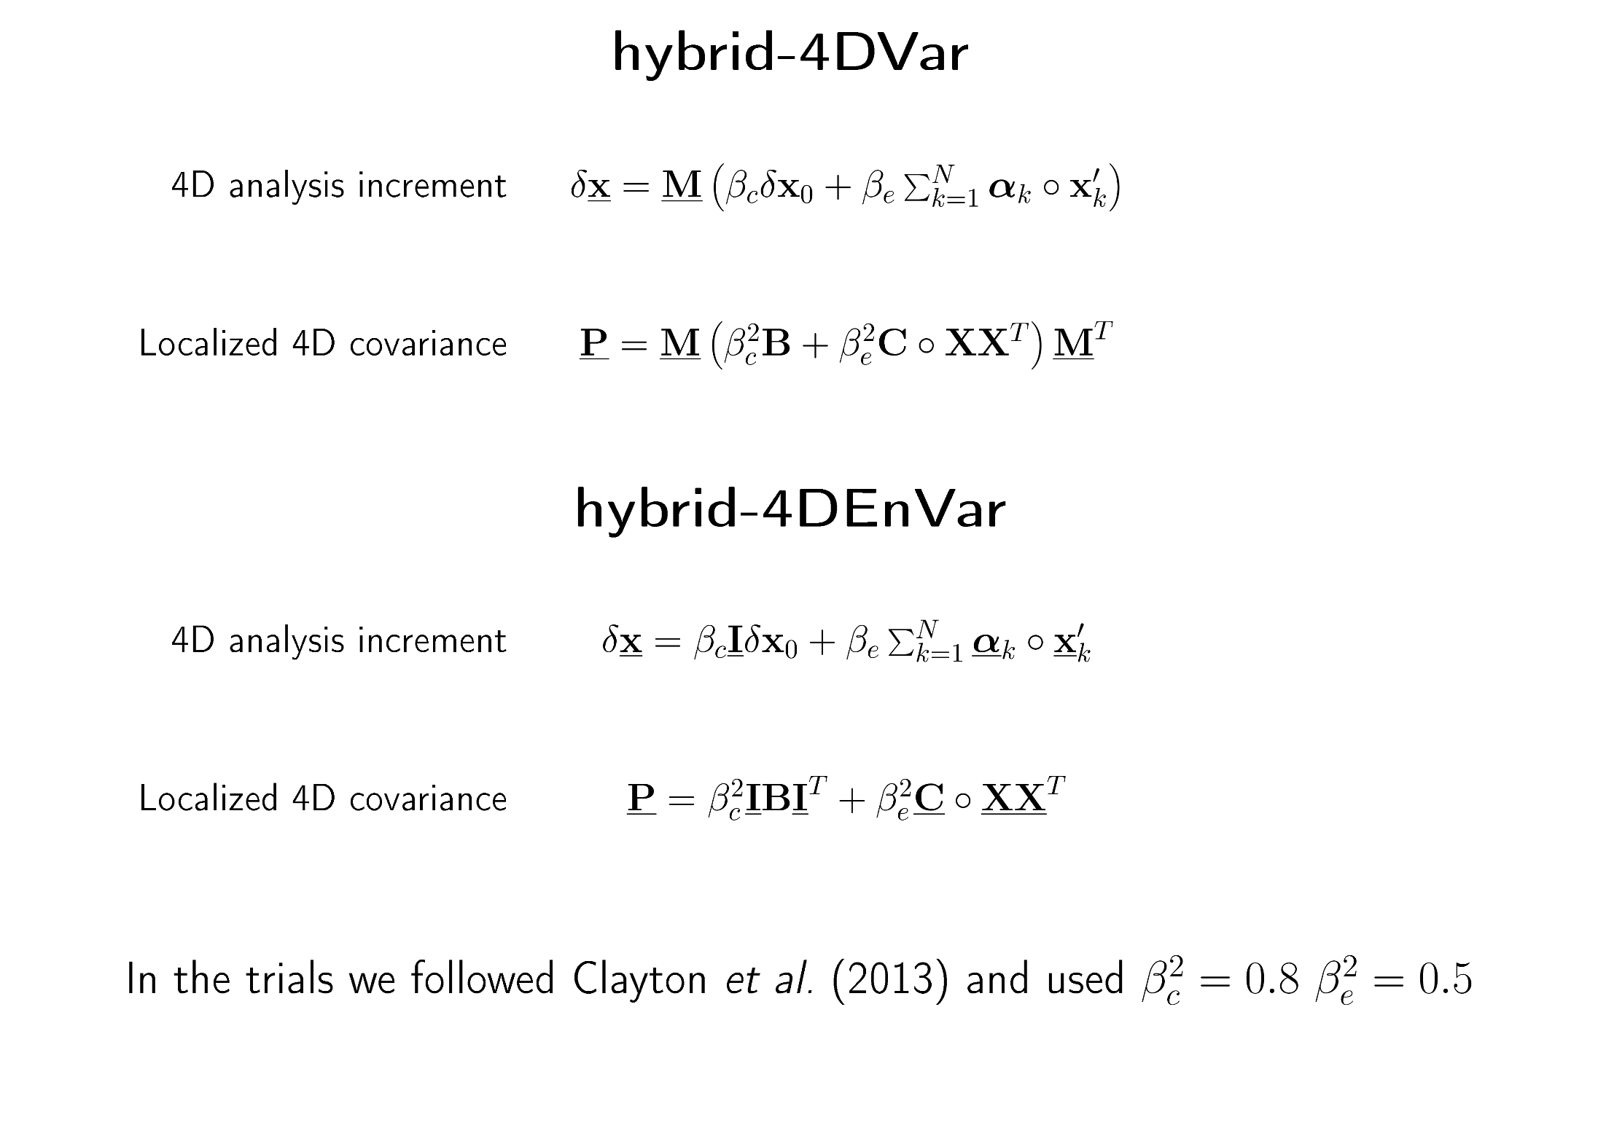

Slide 15
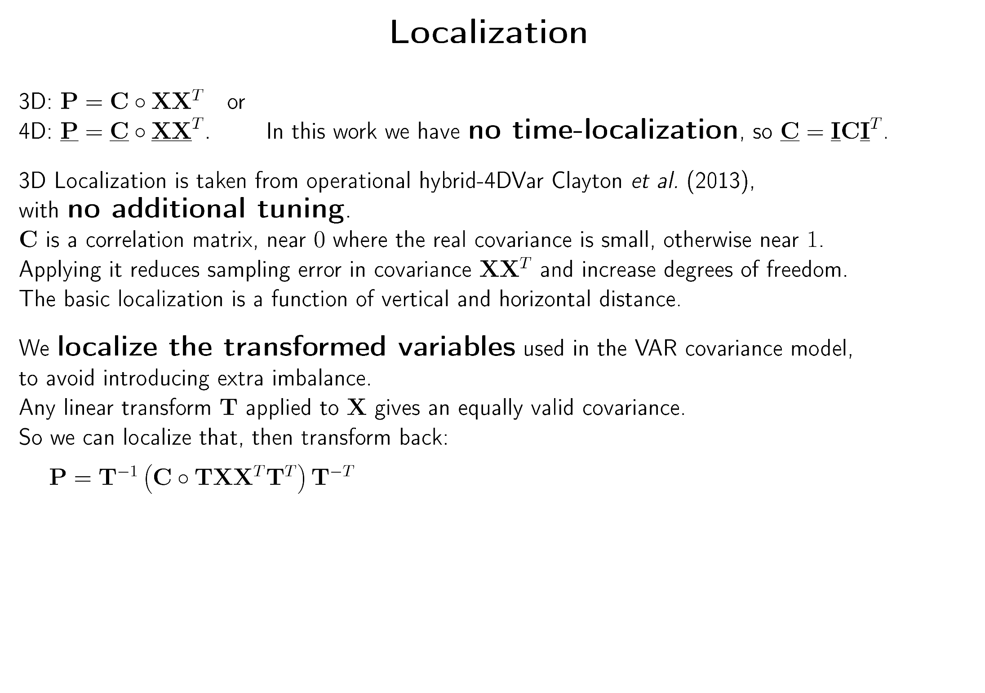

Slide 16
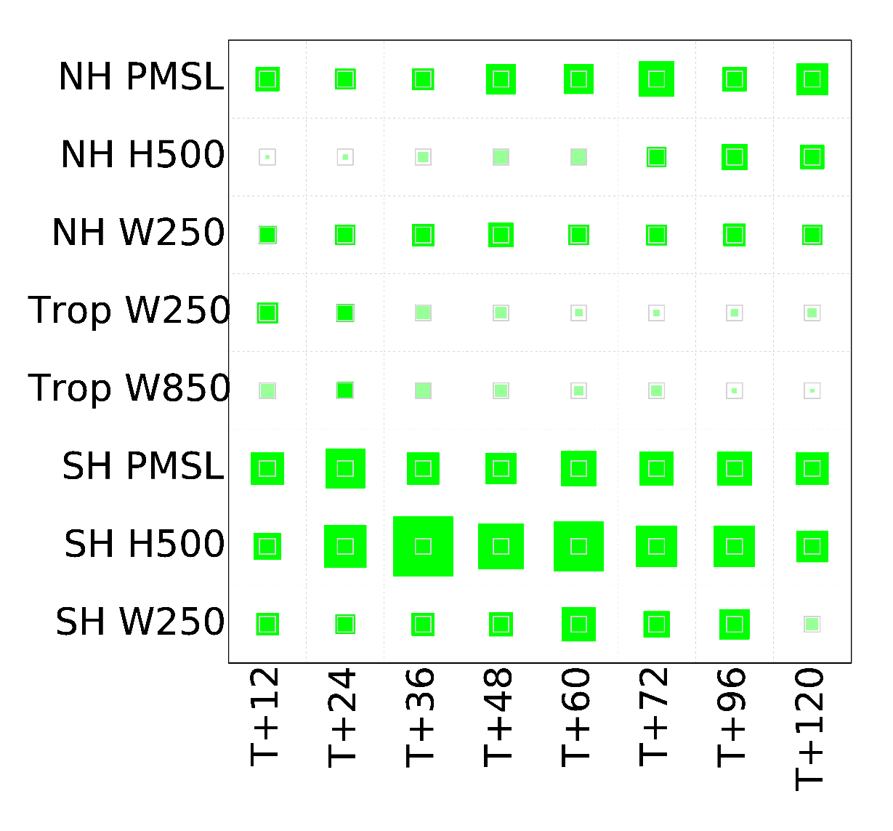
Results of Trial
4DVar
v
4DEnVar
3.138%
Relative RMS error against observations for a sample of fields and forecast ranges.
Hollow grey box is 2%,
max is 10%.
First / Second
trial is better.
#.###% is the average.

Slide 17
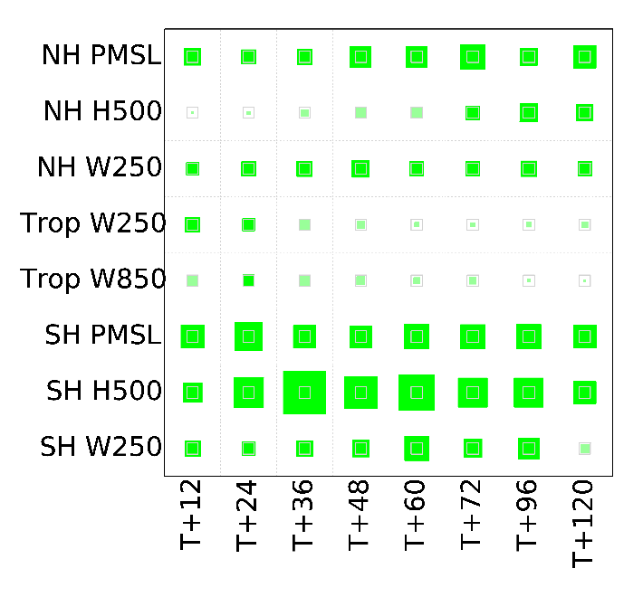
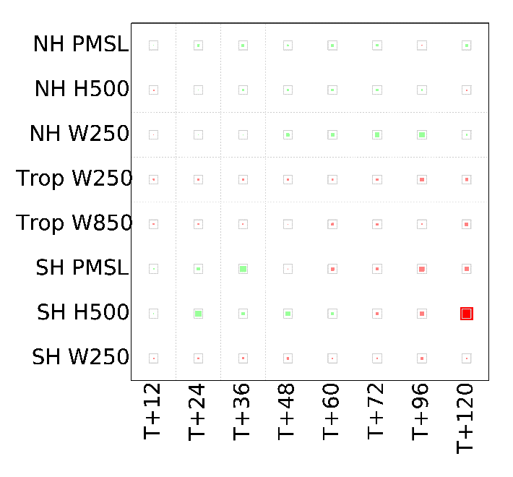
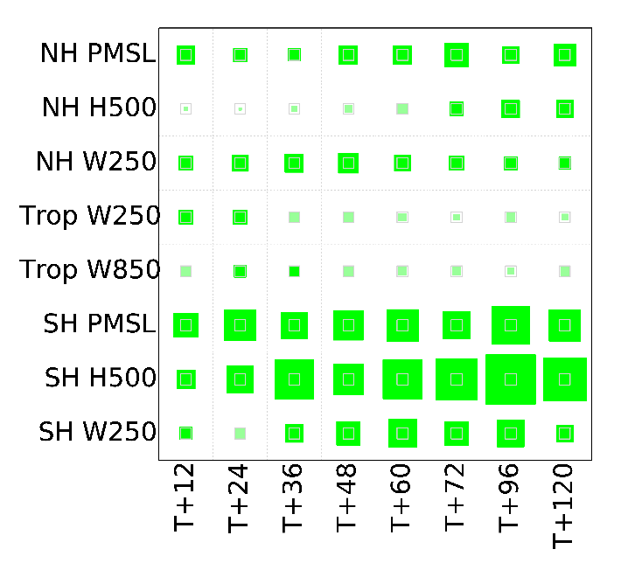
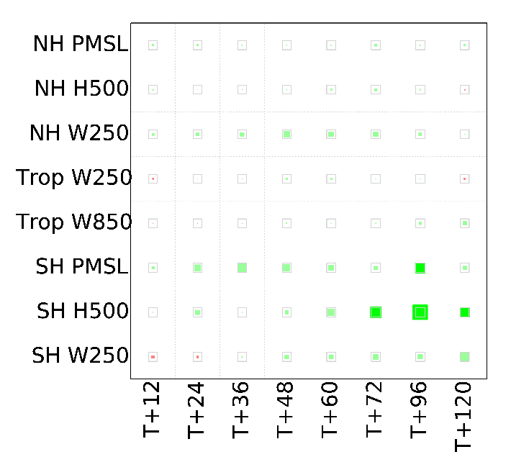
The difference is due to the time-dimension
4DVar
v
4DEnVar
3.138%
3DVar
v
3DEnVar
0.007%
4DVar
v
3DVar
3.506%
4DEnVar
v
3DEnVar
0.474%

Slide 18
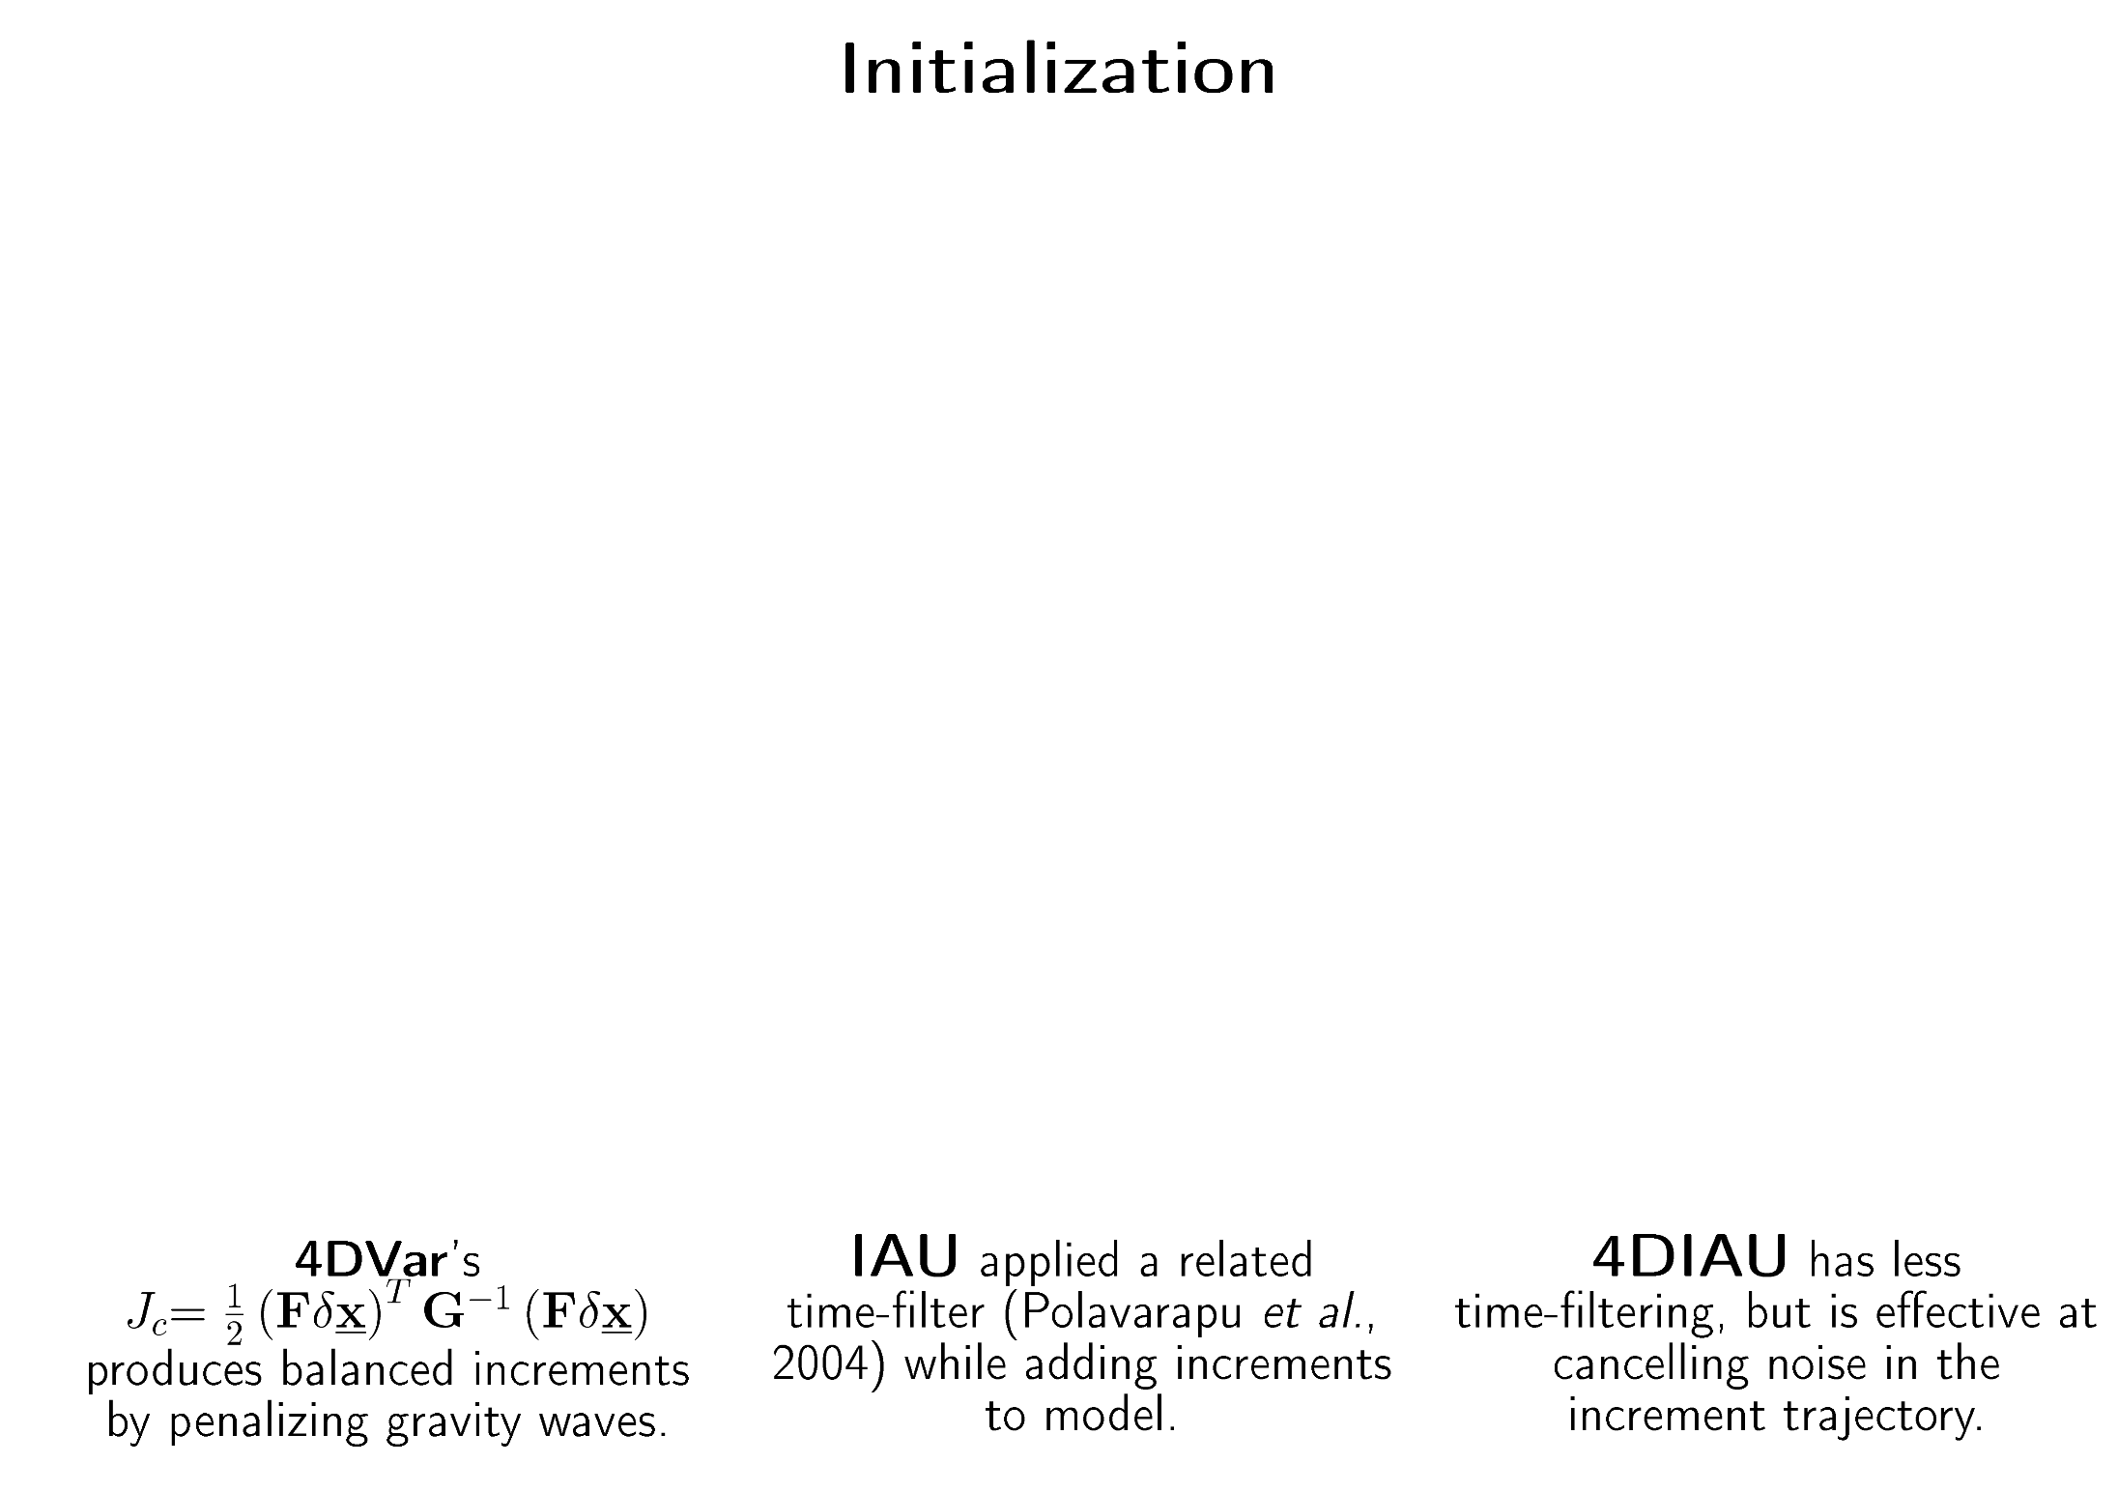
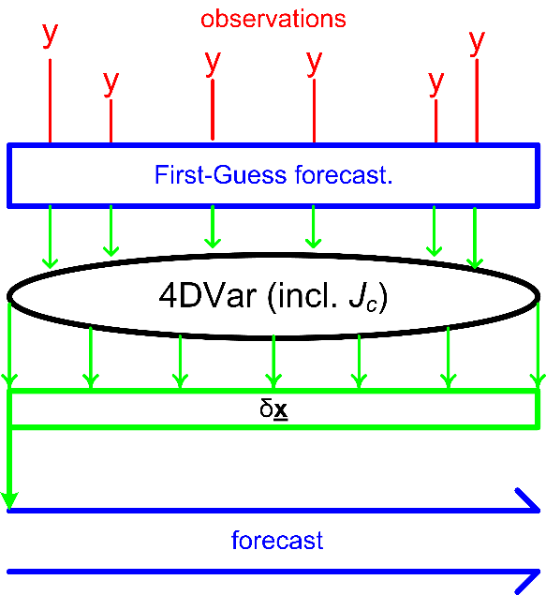
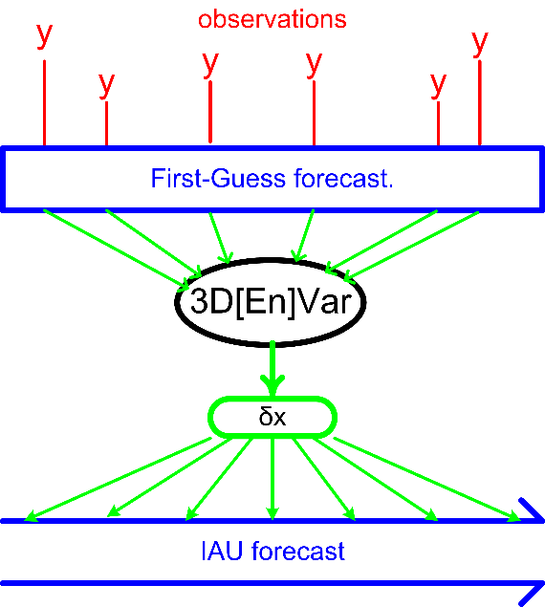
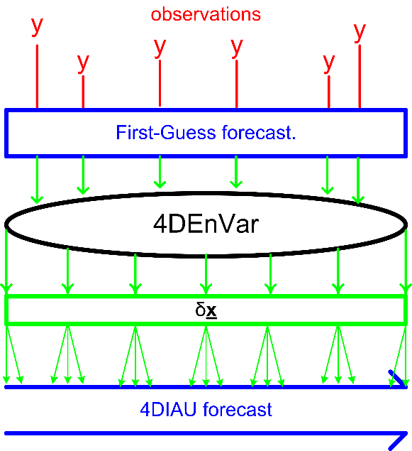

Slide 19
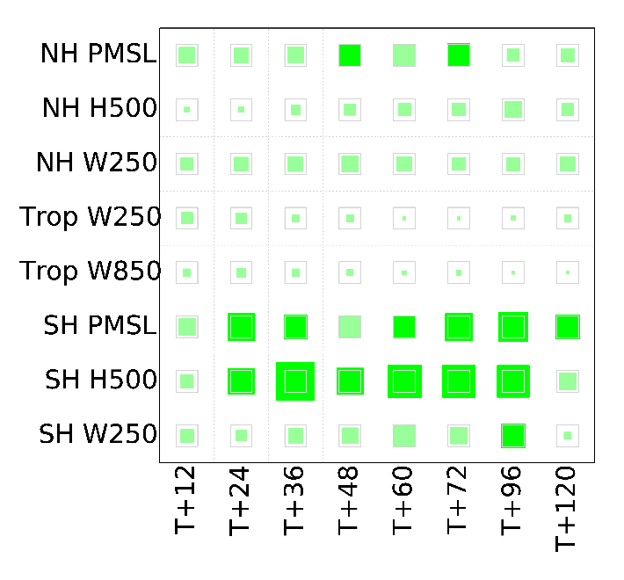
Much smaller differences due to the initialization
4DVar
v
4DEnVar
3.138%
4DVar 4DIAU
v
4DEnVar
2.594%
4DVar
v
4DVar 4DIAU
0.531%

Slide 20
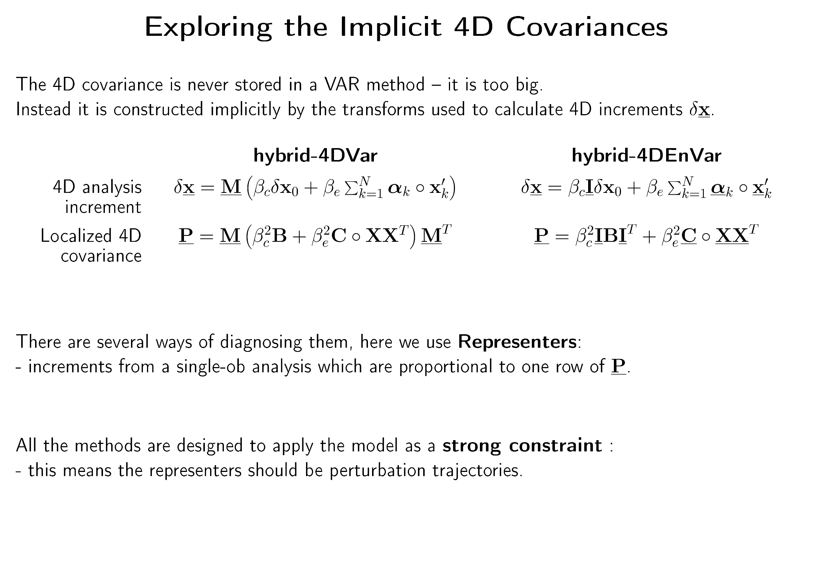

Slide 21
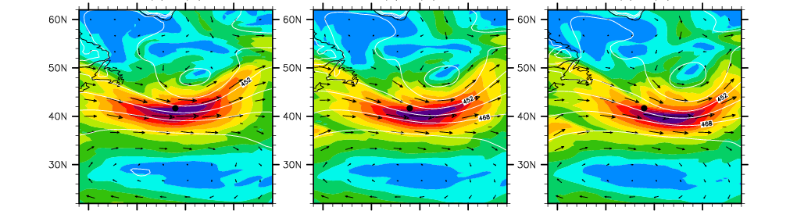
Single wind observation at start of 6 hour window, in jet
Background trajectory
0
3
6
Ob is at  at time 0.

Slide 22
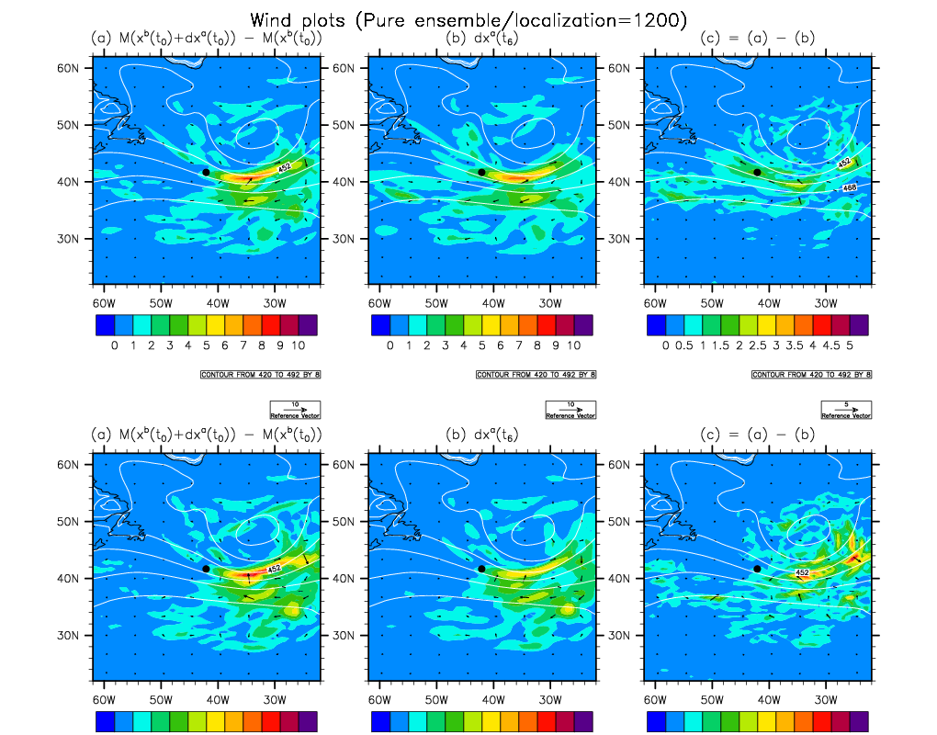
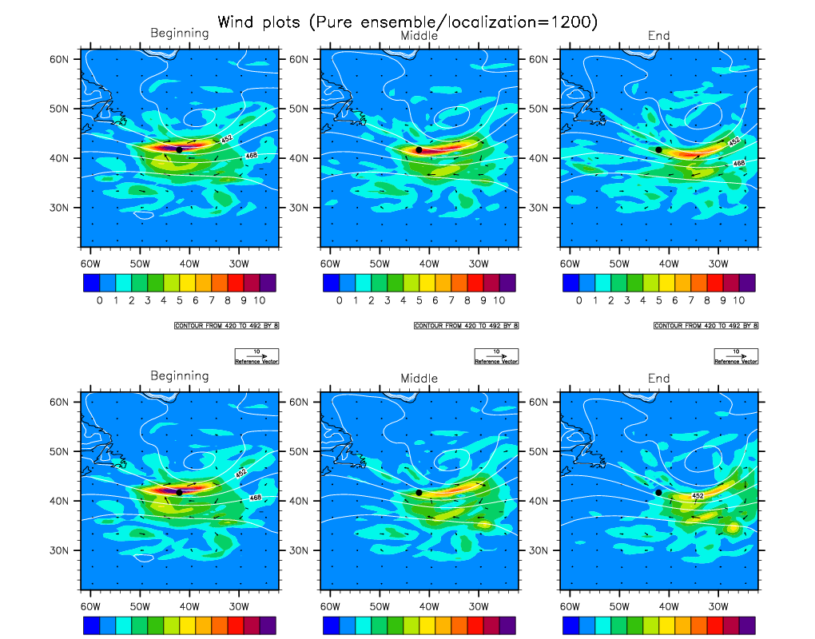
100% ensemble
1200km localization scale
4DEnVar
error
4DVar
Notes:
The overlay shows the “strong constraint” error, i.e. the difference between the analysis increment at the end of the window, and that propagated from the beginning of the window by a pair of full model forecasts.

Slide 23
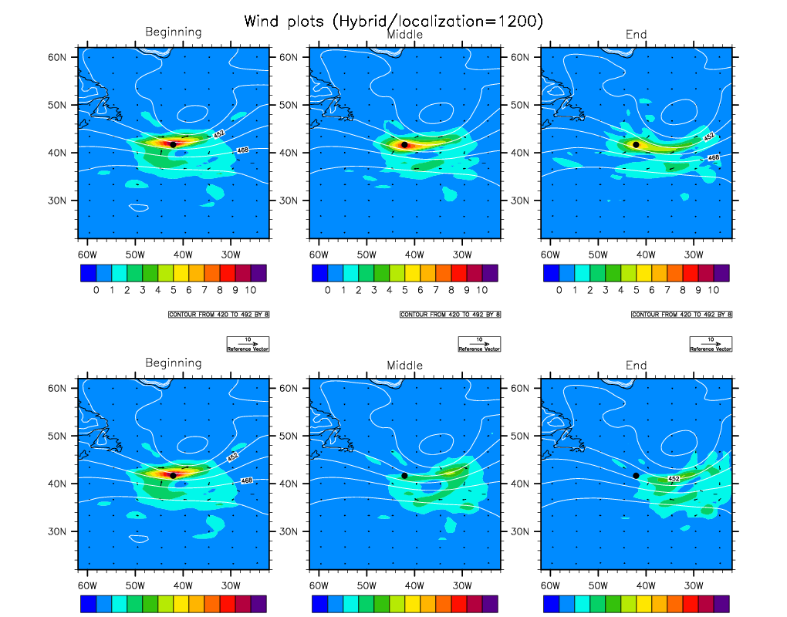
50-50% hybrid
1200km localization scale
4DEnVar
4D-Var

Slide 24
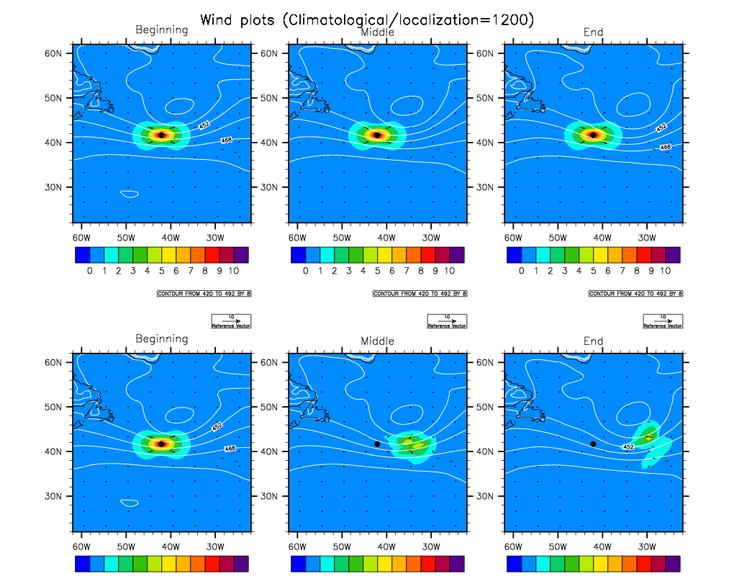
100% climatological B
4DEnVar≡3DVar
4D-Var

Slide 25
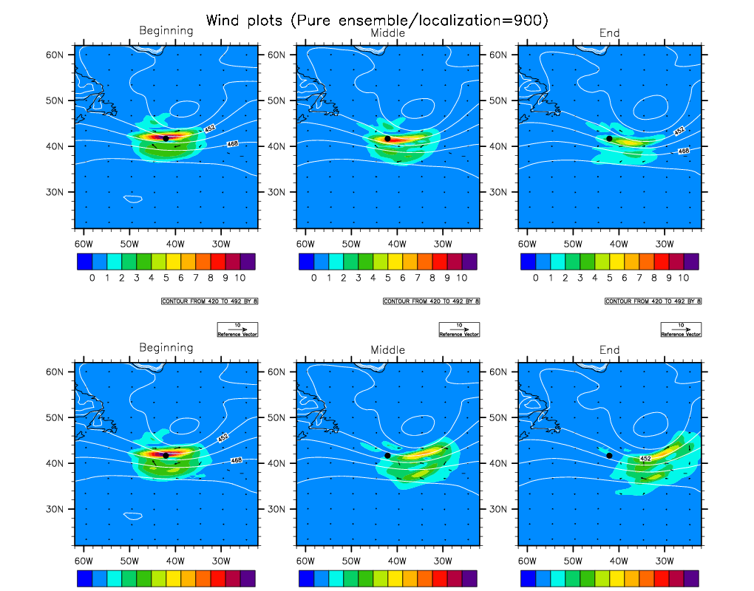
100% ensemble
500km localization scale
4DEnVar
4D-Var

Slide 26
Relative “Strong Constraint Errors”
We ran similar tests on a Hurricane Sandy case.
Here the ensemble covariances dominated, making hybrid-4DEnVar perform better.
1200km localization scale | Jet case | Hurricane Sandy
4DEnVar | 51% | 57%
En-4DVar | 54% | 69%
Hybrid-4DEnVar | 78% | 66%
Hybrid-4DVar | 66% | 75%
When the ensemble covariances dominated the increments,
and the horizontal localization was not too severe,
4DEnVar had better consistency with the strong constraint than 4DVar.

Slide 27
Conclusions from 4D analysis increment study
The main error in our hybrid-4DEnVar (v hybrid-­4DVar) is that the climatological covariance is used as in 3D-Var.
3D localization not following the flow is not an important error for our 1200km localization scale and 6hour window, but does become important for a 500km scale.
Notes:
In retrospect it is not surprising that this effect dominates, since we followed {Clayton13} and gave the climatological covariances a weight of 0.8 in the hybrid.
The 4DEnVar method was able to use the ensemble component of the covariances about as accurately as in En-4DVar.
In the jet stream case evolution errors induced by localization in 4DEnVar were small except when the localization was severe.
In the hurricane case approximations in the perturbation forecast model induced errors in 4DVar evolutions.

Slide 28
Improving 4DEnVar
The maintenance and running costs of hybrid-4DVar are larger, so there is an incentive to improve hybrid-4DEnVar.
Our results show that to do this we need to reduce the weight on climatological B relative to the ensemble covariance. But these weights are usually determined by experiment; both components provide some benefit (Etherton and Bishop 2004; Clayton et al. 2013).
Increasing the ensemble weight requires us to first improve the covariances derived from the ensemble by:
a bigger ensemble;
better ensemble generation;
better localization.

Slide 29
Improving 4DEnVar (2)
a bigger ensemble;
better ensemble generation;
better localization;
These have part of the Met Office research (Stephen Pring’s talk) since we recognised the results presented. But none, alone, has provided early evidence of significant improvement. There are too many combinations to try. So I add to this list:
better covariance diagnostics.
An aim at this workshop is to get leads on the best lines to try!

Slide 30
Met Office R&D:
Bigger Ensemble
Recently doubled from 23 to 44.
Needs computer power (which is coming), + evidence that this is a good way to deploy it! (See Stephen’s talk)
Cost of Ensemble of 4DEnVar option is significant (w.r.t. cost of ensemble forecasts) so need technical improvements to methods.

Slide 31
Met Office R&D:
Better Ensemble
We suspect current MOGREPs (localized ETKF) has deficiencies in its implied covariances. For this & other reasons we have decided to concentrate effort on developing an Ensemble of 4DEnVar. (See Stephen’s talk)
Efficiency work:
  Single executable design to avoid IO costs.
  Perturbed-observation or DENKF options.
  Reformulate ensemble of minimisations as Mean & Perturbations – needs fewer iterations.
  EVIL (Tom Auligne) is only way I know of doing a SQRT filter with 4DEnVar, can be regarded as extreme limit of Mean-Pert approach.

Slide 32
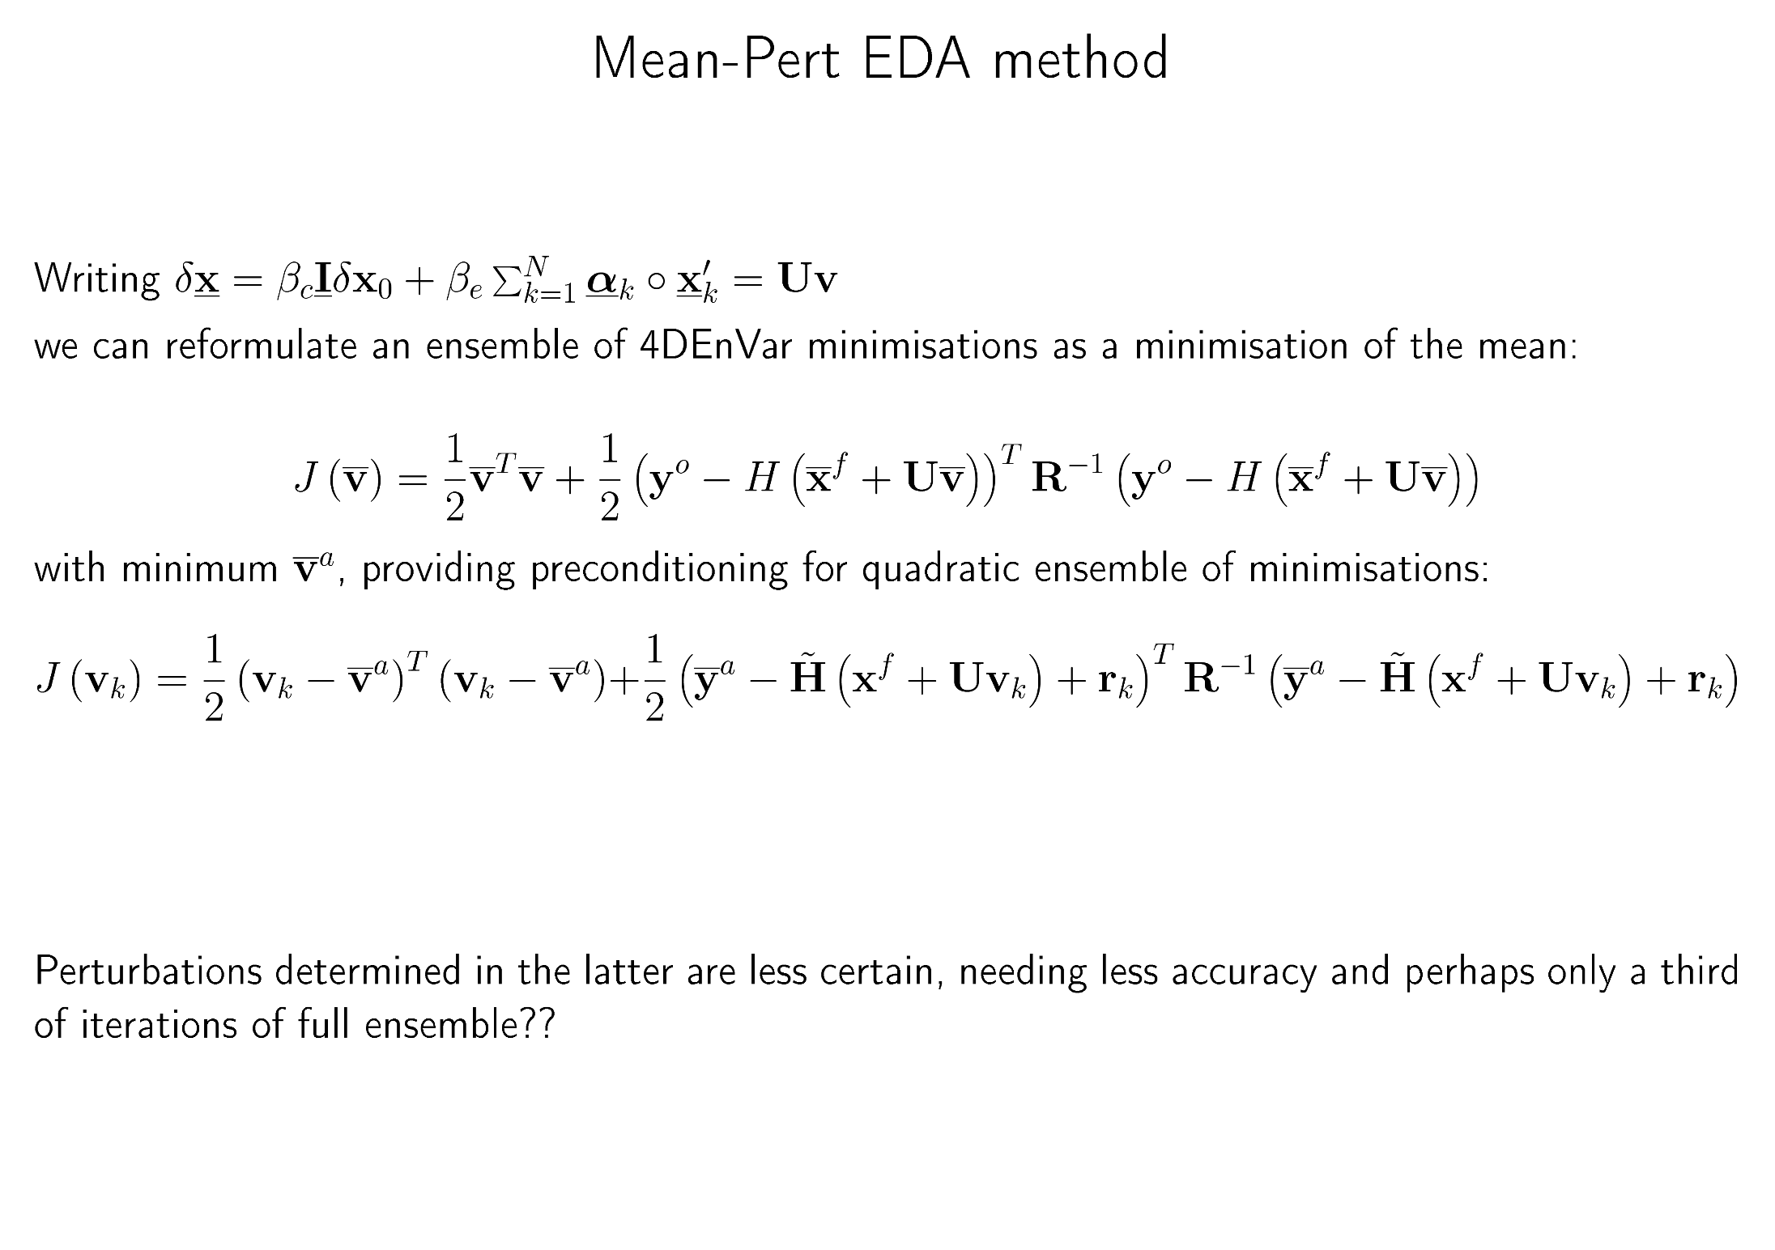

Slide 33
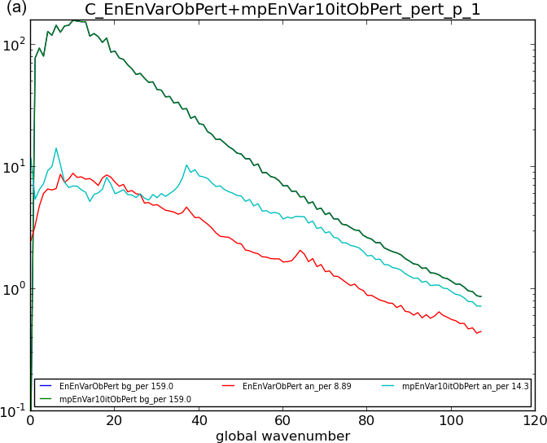
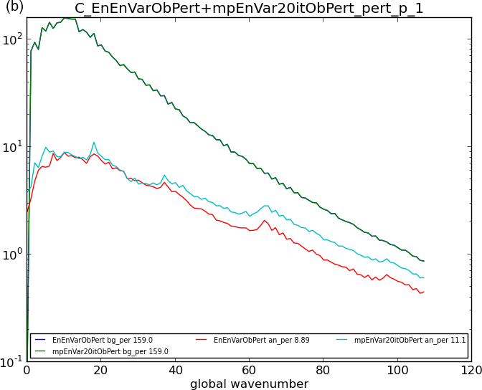

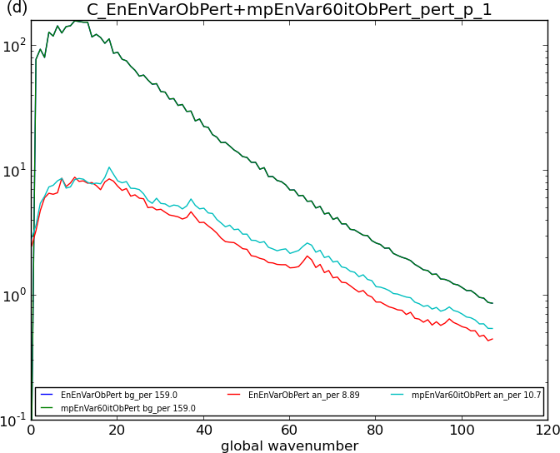
Mean-Pert Testing
Convergence is a function of scale - small perturbations are not fully analysed. Does this matter?
10 iterations
20 iterations
Power spectra of perts from mean, in a perturbed obs ensemble of 4DEnVar:
Background
Control ensemble with 70 iterations
Mean-Pert ensemble
30 iterations
60 iterations

Slide 34
Met Office R&D:
Better Localization
We have coded options for:
Spectral localization using wavebands. This has implicit horizontal smoothing (Buehner and Charron 2007, Buehner 2012)
Multivariate localization: imposing the balance from VAR covariance model (but losing humidity-divergence relationships (Montmerle and Berre 2010)
Multiscale localization – choosing different horizontal and vertical scales for each of the above
Scale-dependent β_{c} and β_{e}.
Vertical localization preserving small vertically integrated divergence.
We are thinking about time localization and allowing for model errors.

Slide 35
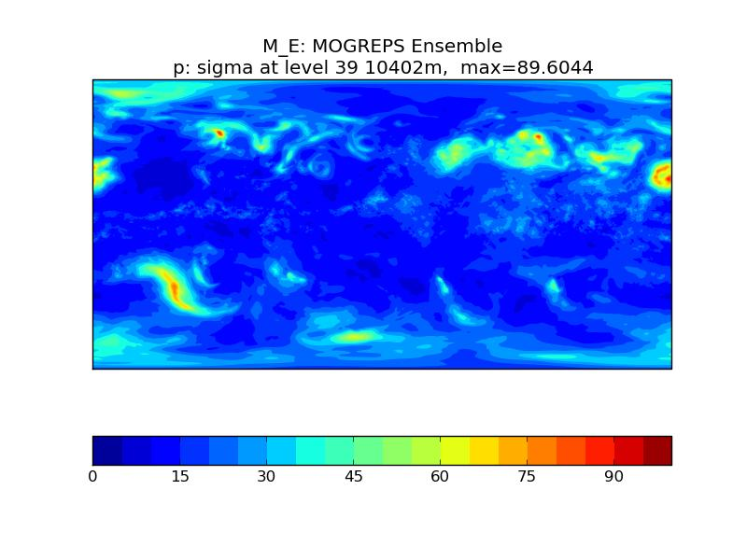
Sampled raw ensemble s.d.

Slide 36

s.d. after spectral localization

Slide 37
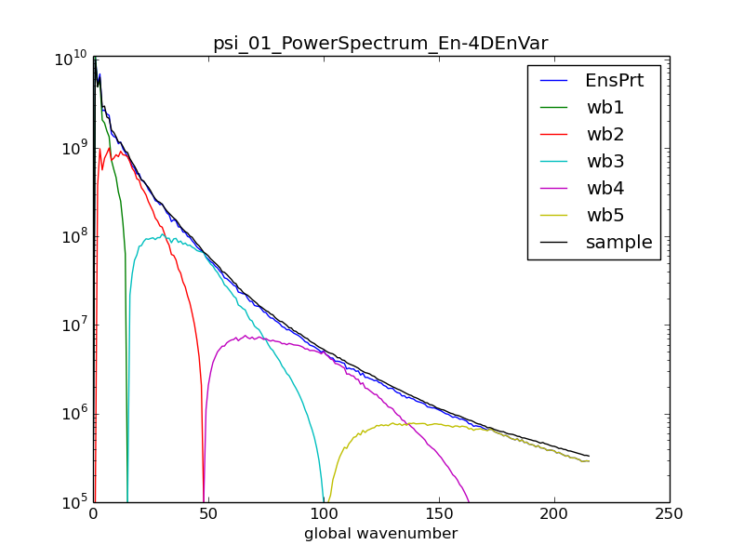
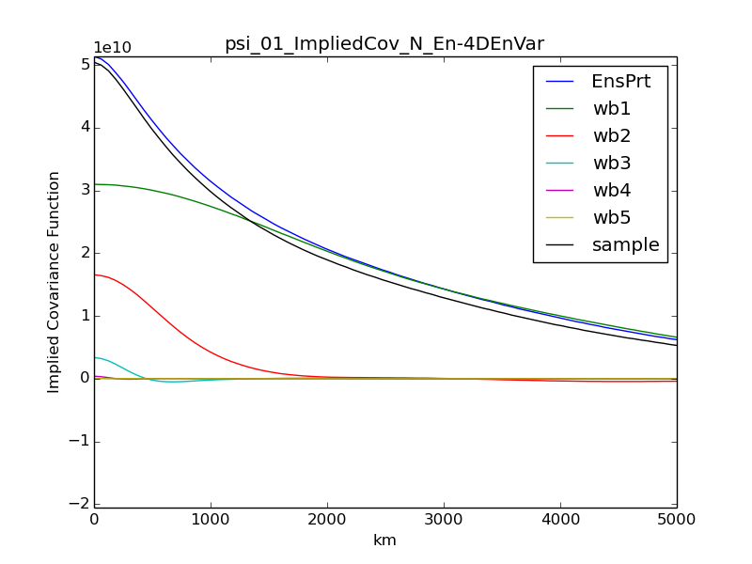
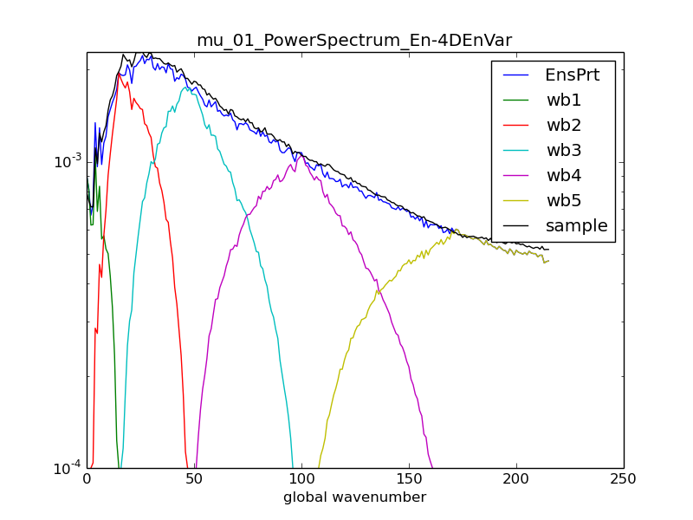
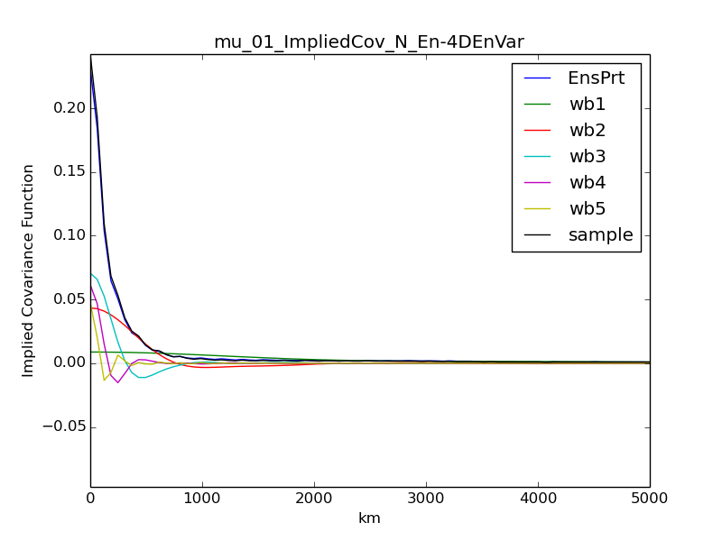
Power Spectra & Implied Cov
Streamfunction
Background perturbations
Wavebands 1 2 3 4 5
Resampled localized perturbations
Unbalanced moisture

Slide 38
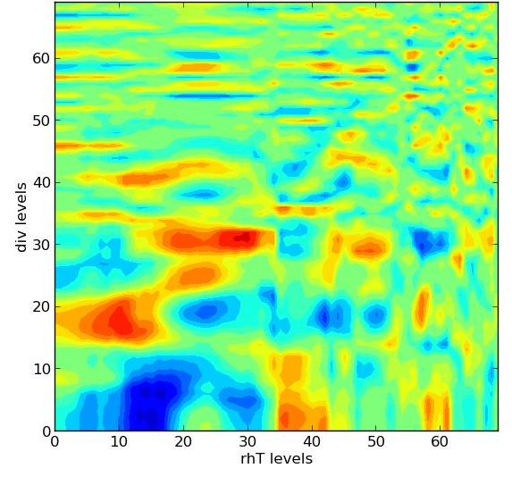
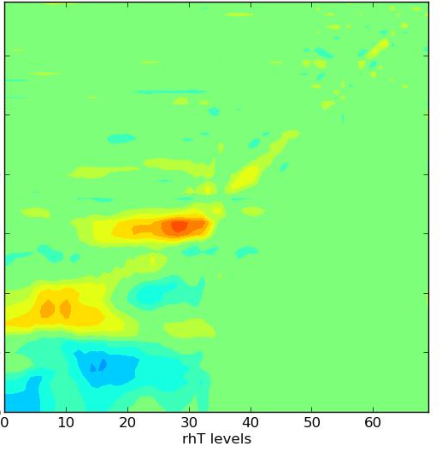
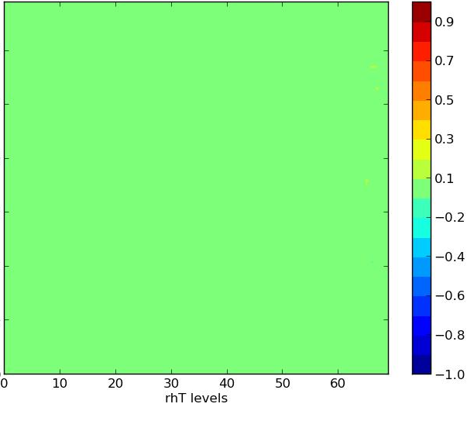
Column cross-correlations between: divergence (up) & relative humidity (across).
Horizontally, vertically & spectrally localized ensemble
multi-variate localized ensemble
Raw ensemble

Slide 39
Summary: Met Office 4DEnVar
Trials show that hybrid-4DEnVar is not as good as the operational hybrid-4DVar in its handling of time-constraints. If it is to improve we need to work on:
  a bigger ensemble;
  better ensemble generation;
  better localization;
  better covariance diagnostics.
I have shown some current Met Office research into all these areas (more from Stephen Pring)

Slide 40
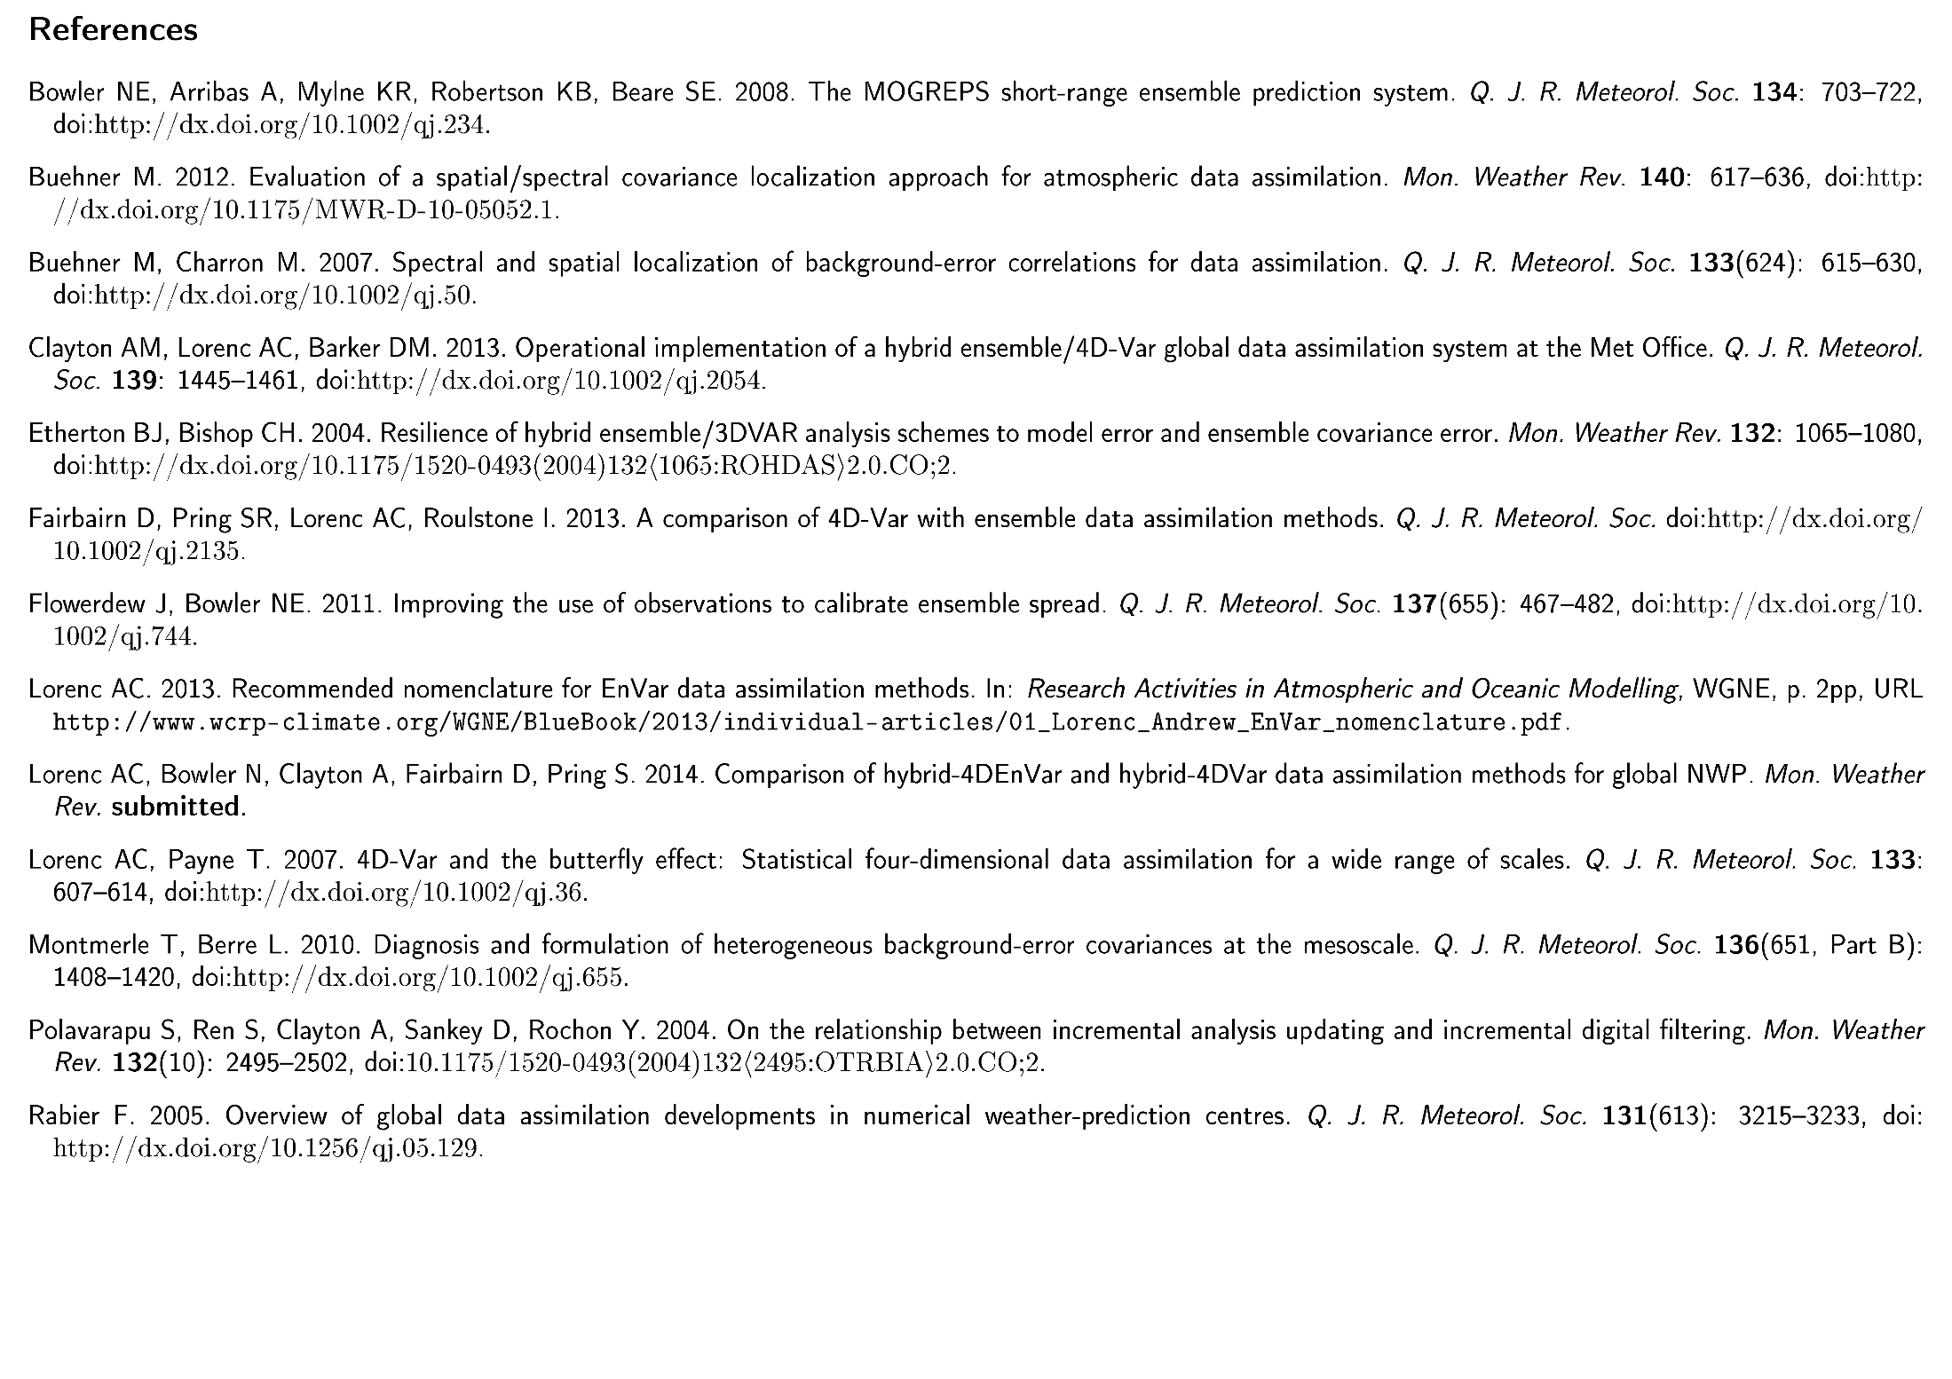
References
© Crown copyright Met Office Andrew Lorenc 40

