Slide 1
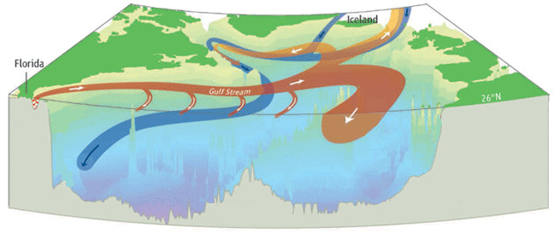
Exploring Coupled Atmosphere-Ocean Data Assimilation Strategies with an EnKF and a Low-Order Analogue of the Climate System
Robert Tardif
Gregory J. Hakim
Chris Snyder
L
University of Washington
NCAR

Slide 2
Motivation
Growing interest in near-term (interannual to interdecadal) climate predictions (Meehl et al. 2009, 2013)
Partly an initial-value problem: uninitialized forecasts: skill limited to large scale externally forced climate variability (Sakaguchi et al. 2012)
Requires coherent initialization of coupled low-frequency atmosphere & ocean
Unclear how to initialize the coupled climate system
Various strategies considered:
Forcing ocean model with atmospheric reanalyses: no ocean DA
Data assimilation (DA) performed independently in atmosphere & ocean (i.e. combine independent atmospheric & oceanic reanalysis products)
Weakly coupled initialization: DA done separately in atmosphere & ocean but use fully coupled model to “carry” information forward
Fully coupled DA: w/ cross-media covariances, still in infancy (Zhang et al. 2007, 2010)
(simple)
(comprehensive)

Slide 3
Challenges
Context: Interacting slow (ocean) & fast (atmosphere) components of the climate system
Challenges:
Slow has the memory but fewer observations than in fast
Q1: Possible to initialize poorly observed or unobserved ocean?
Coherence between initial conditions of slow & fast relies on “cross-media” covariances
What do these look like?
Q2: How to reliably estimate? Fast component is “noisy” …
Practical considerations
Q3: Can fully coupled DA be done at reasonable cost?

Slide 4
DA strategies
Assimilation of time-averaged observations
Averaging over the noise: more robust estimation of cross-media covariances?
“No-cycling” as cost-effective alternative?
Background ensemble from random draws of model states from
long deterministic coupled model simulation
Cross-media covariances:
: obs. of fast -> noisy
: state vector, including slow
variables
Fast noise contaminates K

Slide 5
DA strategies
Time-averaged assimilation
Time averaging & Kalman-filter-update operators linear and commute
Time-mean:
Deviations:
just update time-mean
(Dirren & Hakim, GRL 2005; Huntley & Hakim, Clim. Dyn., 2010)

Slide 6
Approach
Explored using low-order analogue of coupled North Atlantic climate system
Analyses of Atlantic meridional overtuning ciculation (AMOC) as canonical problem
Key component in decadal/centennial climate variability & predictability
Not well observed (i.e. important challenge for coupled DA)
Low-order coupled atmosphere-ocean model
Cheap to run: allows multiple realizations over the attractor
Promising concepts tested using data from a comprehensive Earth System Model (i.e. CCSM4)
To assess robustness

Slide 7
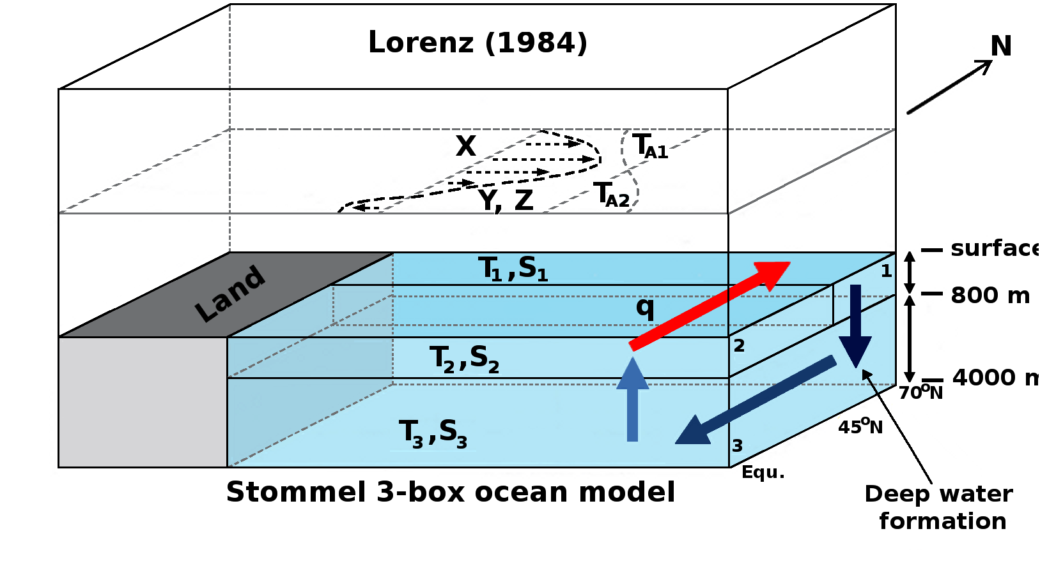
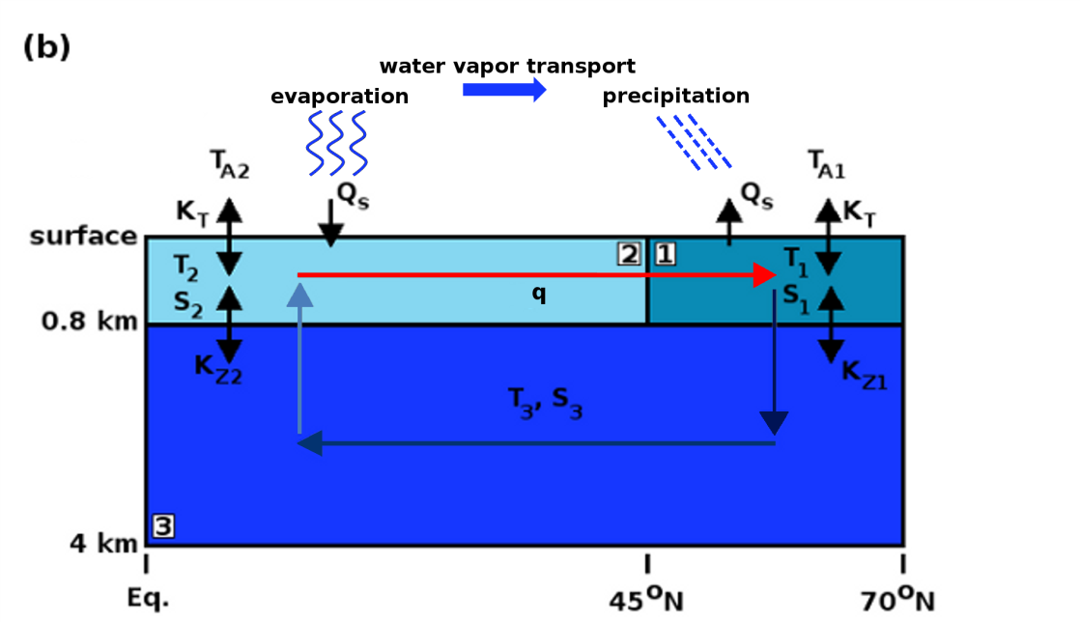
Low-order model
From Roebber (1995)
Features:
Lorenz (1984, 1990) wave—mean-flow model: fast chaotic atmosphere
Stommel (1961) 3-box model of overturning ocean: low-frequency AMOC variability (i.e. no wind-driven gyre)
Coupling:
upper ocean temperature affects mean flow & eddies (ocean -> atmosphere)
hydrological cycle affects upper ocean salinity (atmosphere -> ocean)
State vector: 10 variables!

Slide 8
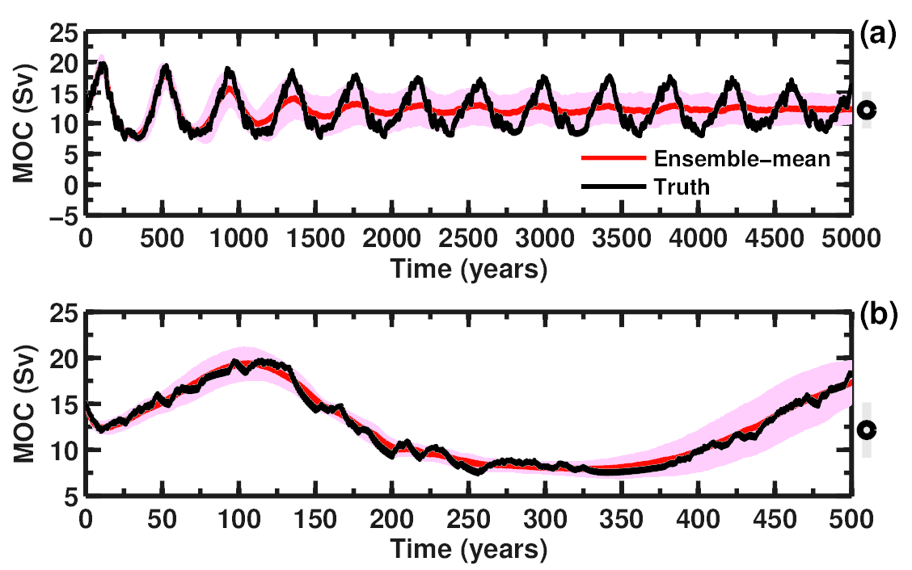
Model variability
Atmosphere: Zonal circulation
Atmosphere: chaotic;
Characteristic time scale (eddy damping) ~ 5 days
Ocean: AMOC
Ocean:
Mainly centennial/millennial variability; weaker decadal variability

Slide 9
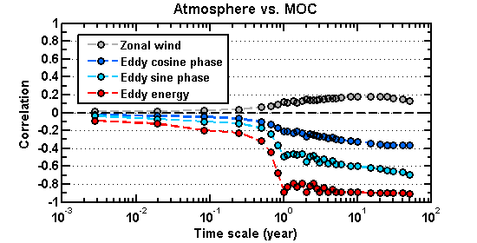
Atmosphere—ocean covariability
Role of atmospheric observations in coupled DA
Increase in covariability w.r.t. AMOC for annual & longer scales
Eddy “energy” (=X²+Y²) has more information that state variables (atmosphere -> ocean coupling through hydrologic cycle)
Correlations with AMOC vs averaging time
X
Y
Z
year
day

Slide 10
DA experiments
EnKF w/ perturbed obs. & inflation for calibrated ensembles
Perfect model framework: (obs. from “truth” w/ Gaussian noise added)
Obs. error stats: large SNR (to mimmick “reliable” modern obs).
100-member ensemble
Compared:
daily DA (availability of instantaneous observations)
time-averaged DA (annual cycling)
Data denial: from well-observed ocean (except AMOC) to not observed at all (atmospheric obs. only)
Cycling vs. “no-cycling”

Slide 11
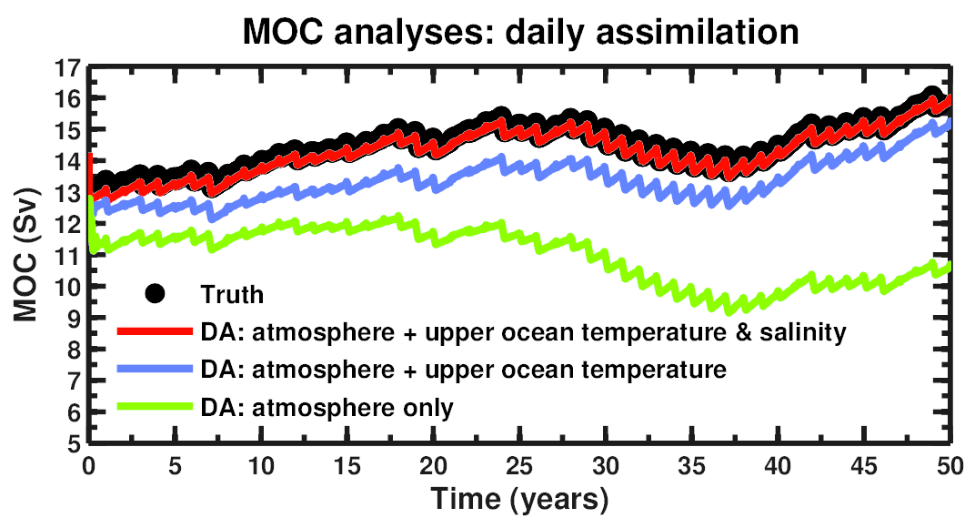
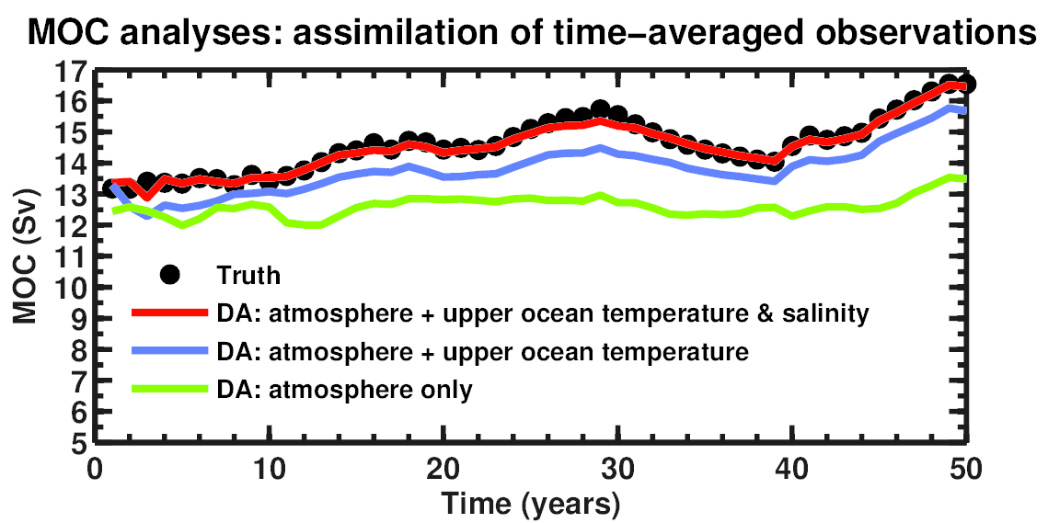
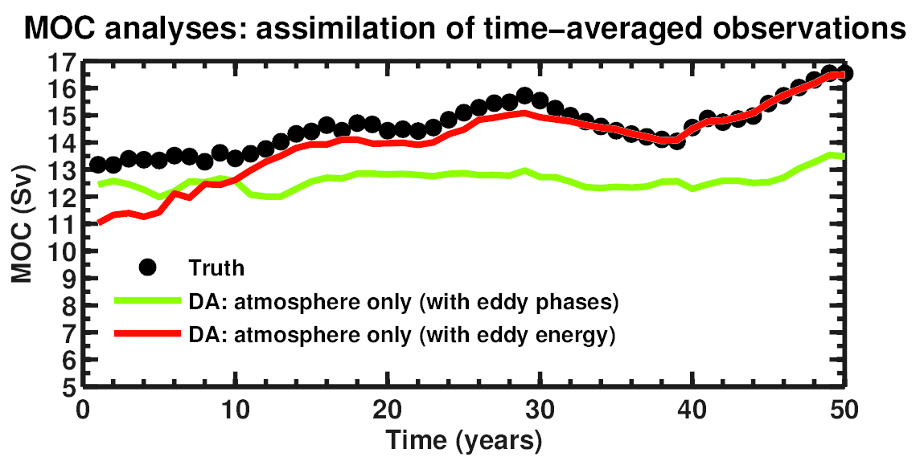
DA experiments
Ensemble-mean AMOC analyses
Initial ensemble populated by
random draws from reference
simulation
Daily DA
Time-average DA
(annual)
Time-average DA
(annual)
**Atmosphere only**
(eddy phases vs eddy energy)

Slide 12
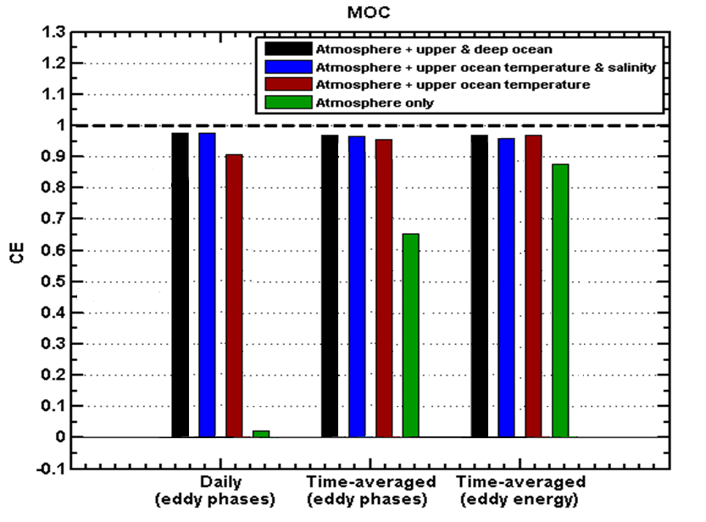
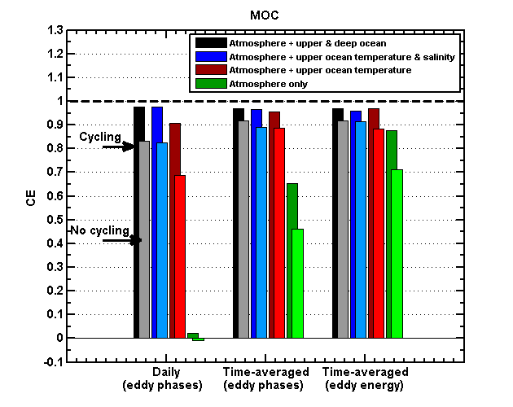
DA experiments
Skill over 100 randomly chosen 50-yr DA periods
Coefficient of efficiency:
CE = 1 : analysis error variance << climo. variance
CE = 0 : no information over climatology

Slide 13
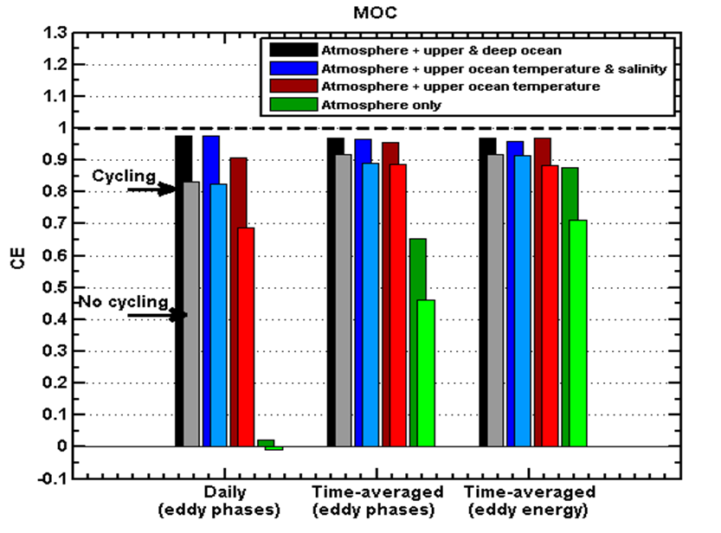
Cycling vs “No-cycling”
Skill over 100 randomly chosen 50-yr DA periods
“No-cycling”: background from random draws of coupled model states from prior long deterministic of the model
Cheaper alternative (no cycling of full coupled model ensemble)
DA based on climatological covariances (no “flow-dependency”)
Coefficient of efficiency:
CE = 1 : analysis error variance << climo. variance
CE = 0 : no information over climatology

Slide 14
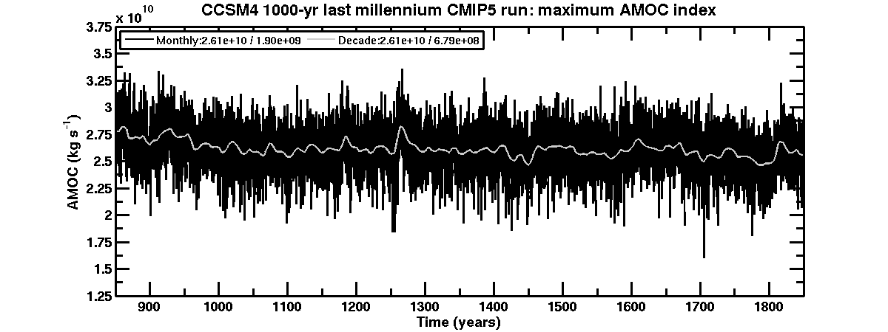
“No-cycling” DA w/ comprehensive with AOGCM
Strategy: derive low-order analogue using CCSM4 gridded output
“Coarse-grained” representation of the N. Atlantic climate system, but underlying complex (i.e. realistic) dynamics
1000-yr “Last Millenium” CMIP5 simulation (pre-industrial natural variability)
Low-order variables:
Ocean: T & S averaged over boxes (upper subpolar & subtropical, deep ocean)
Atmosphere: Strentgh of zonal flow & eddy heat flux across 40ºN
AMOC index: Max. value of overturning streamfunction in N. Atlantic
monthly
10-yr averages

Slide 15
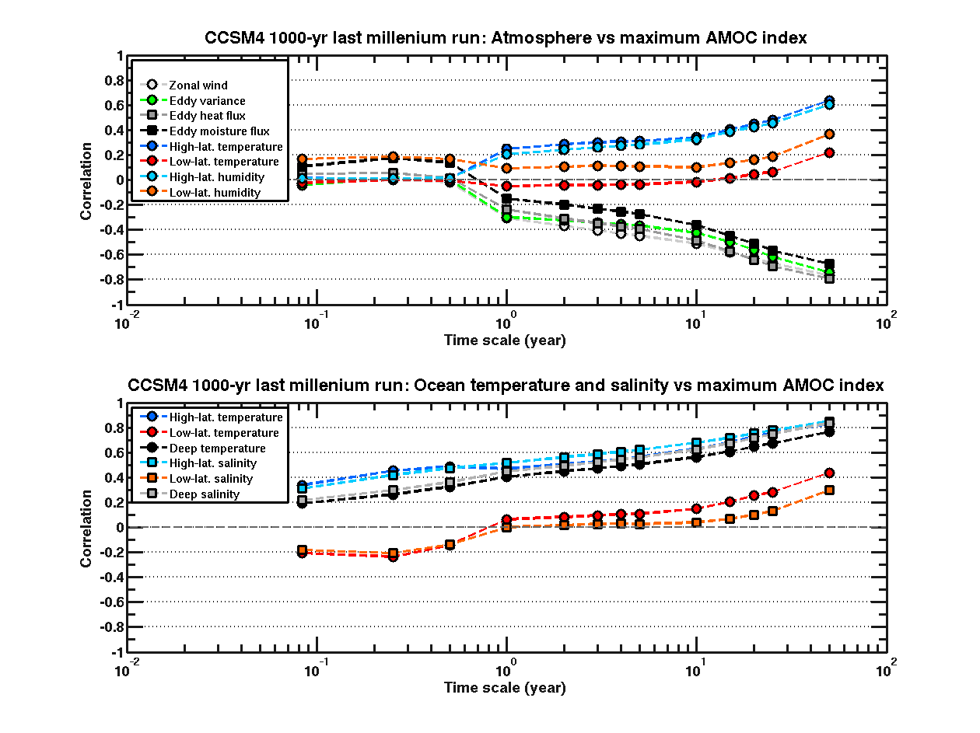
Covariability in CCSM4
Correlations w.r.t. AMOC vs averaging time scale
Atmosphere
eddy heat flux
Ocean
subpolar upper ocean
temperature
month
decade

Slide 16
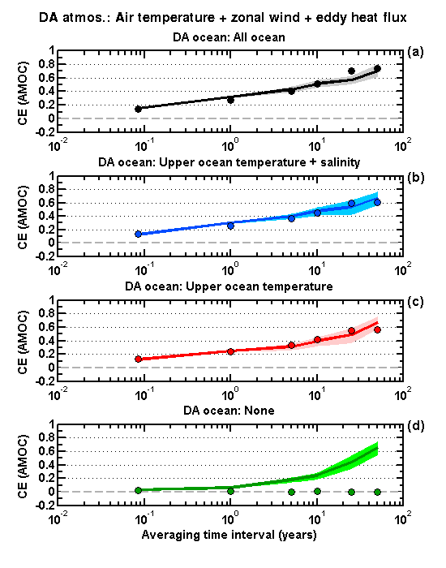
DA results
lines: time-average DA dots: “upscaled” monthly analyses
Analyses over the 1000 years
Well-obs. ocean
Atmosphere only

Slide 17
Summary & conclusions
Q1: Possible to initialize poorly observed or unobserved ocean?
(i.e. ocean DA vs fully coupled DA)
A: Yes, with time-average DA
Frequent ocean DA slightly more effective when ocean is well-observed
Fully coupled DA of time-averaged obs. critical with poorly observed ocean
Q2: How to reliably estimate cross-media covariances?
A: Use time-averaging over appropriate scale
Averaging over “noise” in fast component = > enhanced covariability
Q3: Simplified cost-effective coupled DA available?
A: Yes, “no-cycling” DA (of time-averaged obs.) cheap & viable alternative
Robustness of findings w/ simple low-order model confirmed based on experiments with data from sate-of-the-art coupled climate model (CCSM4)

Slide 18
Extra slides

Slide 19
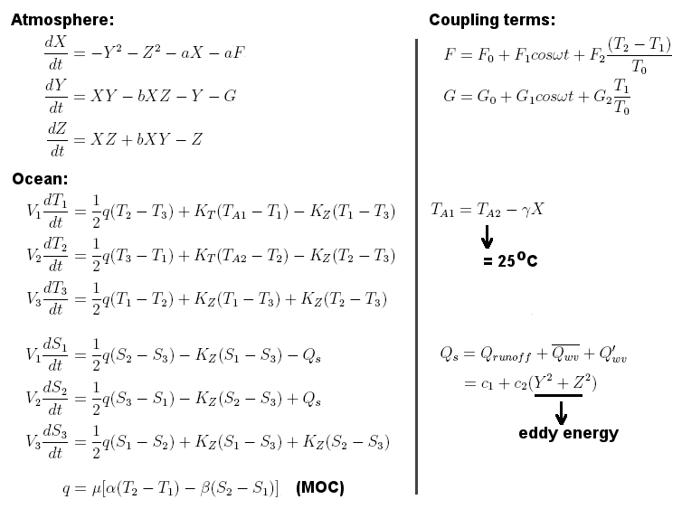
Low-order model equations

Slide 20
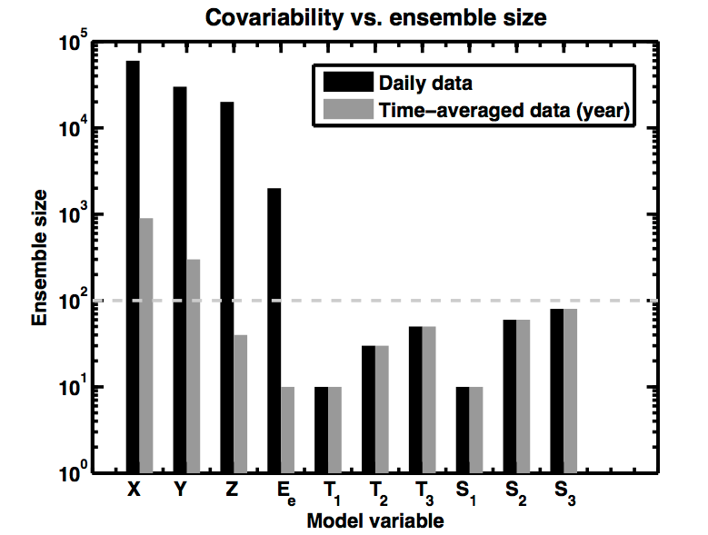
Low-order model equations
Ensemble Size for 95% confidence on correlation
Annual
Daily
Atmosphere
Ocean
10000 realizations for each ensemble size

Slide 21
CCSM4 eddy statistics
24-hr difference filter (Wallace et al, 1988)
Eddy variance
Meridional eddy heat flux

