Slide 1




A Hybrid Ocean Assimilation System at NCEP
Prof. Stephen G. Penny
Dept. of Atmospheric and Oceanic Science
University of Maryland, College Park
Visiting Scientist, National Centers for Environmental Prediction (NCEP/NOAA)
05/21/2014

Slide 2
LETKF applied to 1x1º Ocean
12-month running average RMSD, top 500m
Assimilating: Temperature and Salinity profiles
(RIP => LETKF with “Running-in-Place”)
Penny, Kalnay, Carton, Hunt, Ide, Miyoshi, Chepurin, 2013: LETKF and running-in-place applied to an ocean general circulation model. Non. Proc. Geophys. 20, 1-16. Special issue on ensemble methods.

Slide 3
LETKF applied to 1x1º Ocean
12-month running average RMSD, top 500m
Caveat:
Large inflation via adaptive inflation
Surface forcing derived from random perturbations from historical states
Assimilating: Temperature and Salinity profiles
(RIP => LETKF with “Running-in-Place”)
Penny, Kalnay, Carton, Hunt, Ide, Miyoshi, Chepurin, 2013: LETKF and running-in-place applied to an ocean general circulation model. Non. Proc. Geophys. 20, 1-16. Special issue on ensemble methods.

Slide 4
First port to NCEP op. model (2012)
Motivation
LETKF-GODAS (v2012)
No Inflation
SFC forcing from NCEP GEFS atmospheric ensemble
3DVar-GODAS
1st month of experiment starting 12/02/2010 with real data,
assimilation cycle every 5 days, 20 members

Slide 5
Motivation
GOAL: Generate a functional and effective ensemble-based ocean data assimilation system
CONSTRAINTS:
  Standard ensemble methods (e.g. LETKF, ETKF) have a lower limit ensemble size, below which filter divergence occurs with high probability.
  The dynamics of the climate-scale ocean model are slow to react to small perturbations in initial conditions.
  The ocean dynamics are highly dependent on surface forcing conditions.
  Multiplicative inflation is a poor error model for the ocean
  Assimilation of the global ocean is limited by sparse observations and sparsely sampled ensembles
I examine this problem in a simple scenario and then apply to NCEP’s Operational Global Ocean Data Assimilation System (GODAS)

Slide 6
LETKF
The Local Ensemble Transform Kalman Filter of Hunt et al. (2007)
  Defining terms:
analysis ensemble mean
background (b.g.) ensemble mean
analysis ens.
b.g. perturbations
b.g. error covariance
observation error covariance
b.g. error covariance in ens. subspace
observation operator
k := ensemble dimension
l := observation dimension
m := model dimension
innovation

Slide 7
LETKF
The Local Ensemble Transform Kalman Filter of Hunt et al. (2007)
  To reduce computational burden, the analysis is computed in the k-dimensional subspace formed by the k ensemble members.
  To reduce the required sample size of ensemble members, localization is applied.
“Observation Localization”

Slide 8
Combined Kalman Gain
The general linear gain matrix K is defined as:
The traditional hybrids define a linearly combined error covariance matrix. Suppose instead we form a combination of their respective gain matrices:
Notes:
I do not claim this is optimal (or that it is even possible to find an optimal K with no knowledge of the accuracy of Pb or B).
This provides a minimum rank to K, which is important since Kp will reduce in rank with k and l.

Slide 9
Hybrid-LETKF
Choose the coefficients:
β₁ = 1
β₂ = α
β₃ = -α
where α is a constant scaling parameter so that,
This allows us to form the following algorithm:
Penny, 2013: The Hybrid Local Ensemble Transform Kalman Filter. Mon. Wea. Rev., doi: http://dx.doi.org/10.1175/MWR-D-13-00131.1.
Notes:
I do not claim this is optimal (or that it is even possible to find an optimal K with no knowledge of the accuracy of Pb or B).
This provides a minimum rank to K, which is important since Kp will reduce in rank with k and l.

Slide 10
Hybrid/Mean-LETKF Algorithm
Standard-LETKF
Analysis is performed locally at each grid point, using any specified radius of localization
Use 3D-Var minimization to search larger dimension subspace around the LETKF analysis
3D-Var
Since B is an overestimate of the analysis error, backtrack toward the LETKF analysis solution

Slide 11
Hybrid/Mean-LETKF Algorithm
Standard-LETKF
Analysis is performed locally at each grid point, using any specified radius of localization
This is essentially the only coding required, which can be applied directly to restart files with no modification of existing operational code.
Use 3D-Var minimization to search larger dimension subspace around the LETKF analysis
3D-Var
I.e. Since B is an overestimate of the analysis error, backtrack toward the LETKF analysis solution

Slide 12
Results with Lorenz-96

Slide 13
Lorenz-96 Model
40 points are defined on a cyclic 1-dimensional domain (i.e. a circle of latitude)
The first term represents advection, constructed to conserve kinetic energy,
The second is damping,
The third is forcing
The forcing F determines the degree of chaotic behavior.
For most experiments reported here, F=20, and dt=0.01
Notes:
By ‘chaotic behavior’, I mean the internal doubling time, documented by Orrell (2003).

Slide 14
Standard-LETKF (k=5,l=4)
K=5 Ensemble members are insufficient for a divergence-free filter
Filter Divergence
l=4 Observations are generated randomly at each time step
(circles)
Notes:
figure_L96_LETKF_aerr_l4k5.eps
Bishop and Satterfield (2013) showed that as the variance of the underlying ‘true’ distribution increases, the effective random sample ensemble size decreases.

Slide 15
3D-Var Analysis Error (k=1,l=4)
B matrix formed as a simple exponential decay from the diagonal
There are larger errors present, but filter does not diverge
Again 4 observations per time step, randomly selected from [0,40]
Notes:
figure_L96_3DVar_l4k1.eps

Slide 16
Hybrid-LETKF, Global 3D-Var
k=5,l=4
α = 0.5
3D-Var applied once globally after completion of LETKF
Errors are reduced and filter divergence is prevented.
Notes:
figure_L96_FreeRun.eps

Slide 17
Energy (s²) over longer periods
LETKF (k=5)
LETKF (k=6)
Hybrid/Mean-LETKF (k=5)
Hybrid/Cov-LETKF (k=5)
LETKF (k=20)
Notes:
figure_L96_F20_l4k5_l4k20_energy_2000.eps
Energy metric used by Lorenz (2005), (2006)

Slide 18
Varying α for the
Hybrid-LETKF

Slide 19
Standard-LETKF Error
for t=1 to 600
How well observed (y-axis) vs.
How well sampled (x-axis)
3D-Var Error
(k=1)
1600 experiments shown, 1 per grid box
Model fails in ODE solver
Notes:
figure_mean_aerr_LETKF.eps

Slide 20
Standard-LETKF Error
for t=1 to 600
3D-Var Error
(k=1)
Regime 1:
LETKF < 3DVar
Notes:
figure_mean_aerr_LETKF.eps

Slide 21
Standard-LETKF Error
for t=1 to 600
3D-Var Error
(k=1)
Regime 2:
LETKF diverges
Notes:
figure_mean_aerr_LETKF.eps

Slide 22
Standard-LETKF Error
for t=1 to 600
3D-Var Error
(k=1)
Regime 3:
LETKF > 3DVar
Notes:
figure_mean_aerr_LETKF.eps

Slide 23
Hybrid-LETKF Error (α = 0.0)
3D-Var Error
(k=1)
Notes:
figure_mean_aerr_LETKF.eps

Slide 24
Hybrid-LETKF Error (α = 0.2)
3D-Var Error
(k=1)
As α increases:
Regime 1 expands
Regime 2 contracts
Errors in Regime 1 increase
Notes:
figure_mean_aerr_HybridMean-LETKFap2.eps

Slide 25
Hybrid-LETKF Error (α=0.5)
3D-Var Error
(k=1)
As α increases:
Regime 1 expands
Regime 2 contracts
Errors in Regime 1 increase
Notes:
figure_mean_aerr_Hybrid-LETKFv1ap5.eps

Slide 26
Hybrid-LETKF Error (α = 1.0)
Ideal α for the poorly observed/sampled system
Regime 3 covers all well-observed scenarios
3D-Var Error
(k=1)
As α increases:
Regime 1 expands
Regime 2 contracts
Errors in Regime 1 increase
Notes:
figure_mean_aerr_Hybrid-LETKF.eps

Slide 27
Comparing to the Traditional Hybrid approach

Slide 28
Traditional Hybrid (Hybrid/Cov-LETKF)
The covariance is a linear combination of the Static and Ensemble-derived covariance matrices. These are localized in implementation with LETKF.
α = 0.1
α = 0.2
α = 0.5
As α goes to 1.0, the solution converges to the 3D-Var case (shown here at k=1).
The results are similar to cases for α from 0.5 to 0.1 in the Hybrid/Mean-LETKF.

Slide 29
The hybrid reduces sensitivity to LETKF input parameters

Slide 30
Standard-LETKF Error
3D-Var Error
(k=1)
Model fails in ODE solver
Notes:
figure_mean_aerr_LETKF.eps

Slide 31
Varying Localization Radius (at observation count l=20)
Hybrid-LETKF with 3D-Var localization (r_{B}) equal to LETKF localization (r)
Hybrid-LETKF with 3D-Var localization fixed at r_{B}=5
Standard-LETKF
Hybrid
Radius of all previous results shown so far: r=5
Reduced sensitivity to localization due to Hybrid-LETKF

Slide 32
Hybrid-ETKF
k=35 Members
k=2 Members
l=10 observations
Standard-ETKF
Notes:
figure_L96_ETKF_aerr_l10k35_rho1p1.eps
figure_L96_ETKF_aerr_l10k2_a0p5_rho1p1_HML.eps

Slide 33
Varying Multiplicative Inflation (at observation count l=20)
(Narrow improvement with multiplicative inflation, essentially only in Regime 3)
Standard-LETKF
Hybrid-LETKF
Hybrid
Narrow range of improved stability due to inflation (essentially Regime 3)
Reduced sensitivity to inflation due to Hybrid-LETKF

Slide 34
Results with NCEP’s Global Ocean Data Assimilation System (Hybrid-GODAS)
This work is funded by NOAA’s Modeling, Analysis, Predictions and Projections (MAPP) program as part of the “Research to Advance Climate Reanalysis”.
Intent:
  Upgrade NCEP’s operational global ocean data assimilation system (GODAS) from 3D-Var to an ensemble-based system.
  Advance ocean assimilation component of the next generation Climate Forecasting System (CFS) (i.e. coupled atmos/ocean/ice/land)
Notes:
Integrate with the new Climate Forecast System (CFSv3) being developed at NOAA to benefit the next-generation climate reanalysis

Slide 35
Experiment 1: Real Data
Duration:
14 Months (Dec. 2010 - Feb. 2012)
Model:
GFDL MOM4p1, 1/2º-1/4º, 40-vertical level
Observations:
Temperature and Salinity profiles (Argo)
Surface forcing:
20-member NCEP Global Ensemble Forecast System (GEFS)
Inflation:
none
Horizontal Localization:
Latitude dependent: 720km at Eq. down to 200km at poles
Vertical Localization:
none (=> more accurate, computationally faster, & facilitates the assimilation of satellite data)
Initialization:
Center is the GODAS operational estimate. Scaled perturbations were applied from randomly selected historical fields for ensemble

Slide 36
EnKF and 3DVar for Hybrid:
EnKF is the Local Ensemble Transform Kalman Filter (LETKF) of Hunt et al. (2007), modified for the ocean by Penny (2011)
Operational 3DVar-GODAS (Behringer)
Modifications to operational system:
    Only using obs in the analysis cycle window
    Analysis increment applied at analysis time, i.e. no Incremental Analysis Updates (IAU)
    Not using synthetic salinity observations
    Not relaxing surface to OI SST

Slide 37
Before Implementing the Hybrid
Recall:
LETKF-GODAS (2012)
3DVar-GODAS
1st month of experiment starting 12/02/2010 with real data,
assimilation cycle every 5 days, 20 members

Slide 38
Global Temperature and Salinity Observed minus 5-dy Forecast (O-F) RMSD
Using the Hybrid
α = 1.0
3DVar-GODAS
Temperature
Salinity
Hybrid-GODAS

Slide 39
Pacific T & S (O-F)
3DVar-GODAS
α = 1.0
North (20-60ºN)
Hybrid-GODAS
Temperature
Salinity
Tropical (20ºS-20ºN)
South (20-60ºS)

Slide 40
Atlantic T & S (O-F)
3DVar-GODAS
α = 1
North (20-60ºN)
Hybrid-GODAS
Temperature
Salinity
Tropical (20ºS-20ºN)
South (20-60ºS)

Slide 41
T & S (O-F)
α = 1
3DVar-GODAS
Arctic (60-90ºN)
Note: not assimilated by operational 3DVar-GODAS
Hybrid-GODAS
Temperature
Salinity
Indian (60ºS-20ºN)
Southern Ocean (60-90ºS)

Slide 42
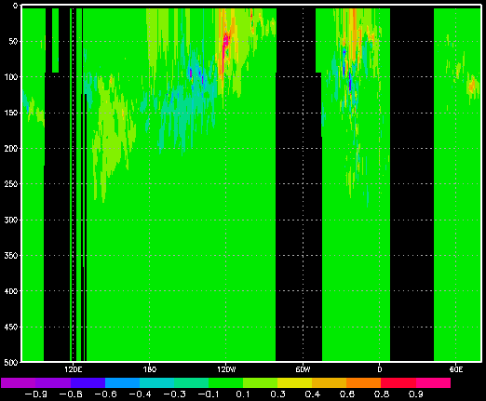
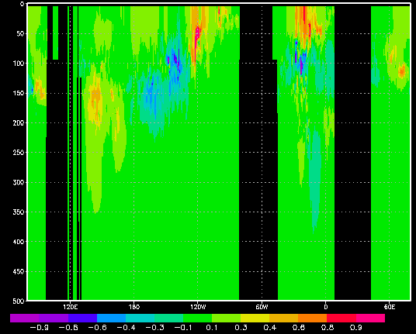
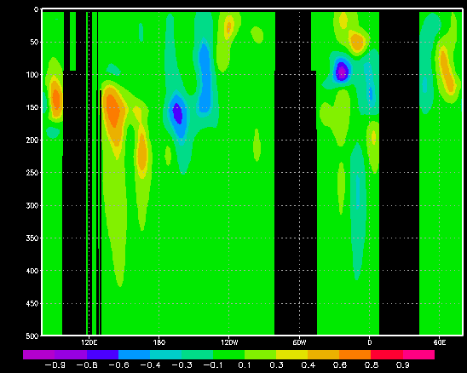
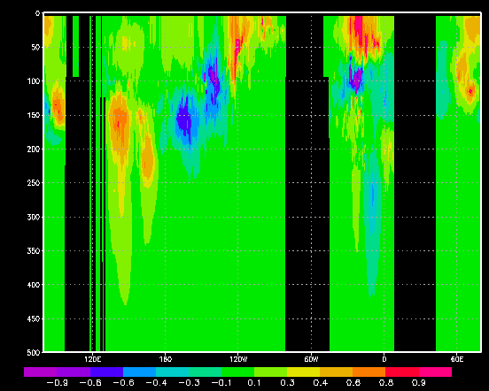
T (ºC) increments at the equator
0-500m
Hybrid-GODAS (α=0.5)
Standard-LETKF
Hybrid-GODAS (α=1.0)
3DVar-GODAS

Slide 43
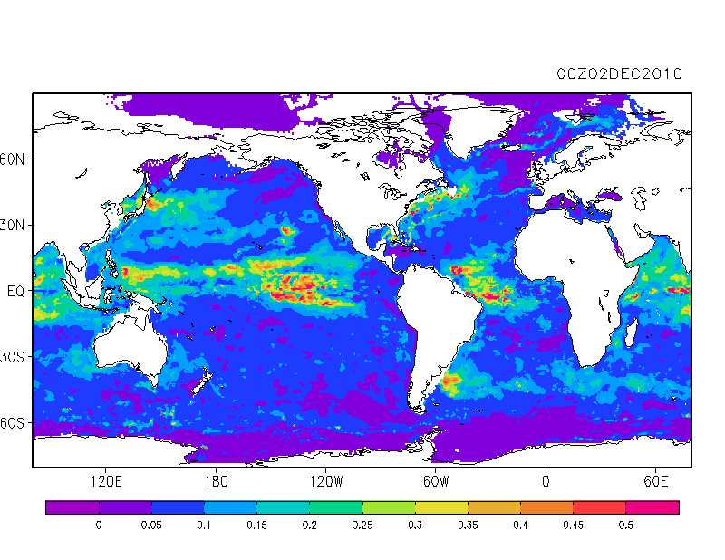

100 m Ensemble Spread (T)
T (ºC)
𝜎^{r}~0.835º

Slide 44
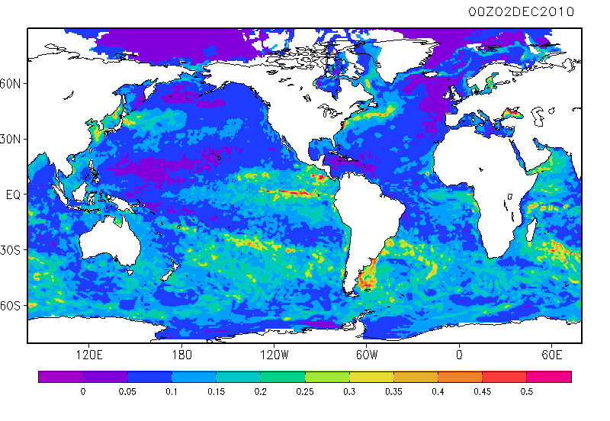

15 m Ensemble Spread (T)
T (ºC)
𝜎^{r}~0.61º

Slide 45
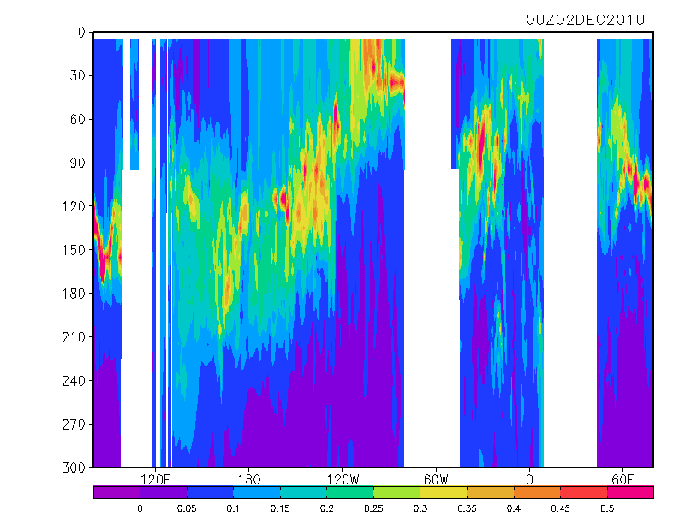

Ens. Spread at the equator (T)
T (ºC)

Slide 46
Possible Weaknesses
Ensemble spread is too small
  Ensemble size too small
  Surface forcing spread too small (esp. horizontal wind stress)
Validation using 5-dy forecast (O-F) RSD may be influenced by temporal correlations on daily to weekly timescales
Initial Ensemble spread not realistic or initial states not well-balanced
Experiment period too short

Slide 47
Experiment 2: OSSE
Duration:
8 Years (Jan. 1991- Dec. 1998)
Model:
GFDL MOM4p1, 1/2º-1/4º, 40-vertical level
Observations:
Synthetic Temperature and Salinity profiles (XBT/CTD historical locations) with realistic magnitude observation errors (representativeness + instrument errors)
Surface forcing:
28-member 20th Century Reanalysis (20CRv2: Compo, Whitaker, et al. 2011),
re-centered at NCEP R2 (members 1-28 selected from 56 after re-centering)
Inflation:
none
Horizontal Localization:
Latitude dependent: 720km at Eq. down to 200km at poles
Vertical Localization:
none (=> more accurate, computationally faster, & facilitates use of satellite data)
Initialization:
6-year spinup from Jan 1st 1985 CFSR ocean state (same for all 56 members), forced by re-centered 56-member 20CRv2

Slide 48
EnKF and 3DVar for Hybrid:
EnKF is the Local Ensemble Transform Kalman Filter (LETKF) of Hunt et al. (2007), modified for the ocean by Penny (2011)
Operational 3DVar-GODAS (Behringer)
Modifications to operational system:
    Only using obs in the analysis cycle window
    Analysis increment applied at analysis time AND Incremental Analysis Updates (IAU) (both cases run)
    Not using synthetic salinity observations
    Relaxing surface to OI SST (as done by operational system and applied in nature run)
Nature run uses 56-member mean surface forcing (R2) for slight model bias vs. 28-member ensemble subset

Slide 49
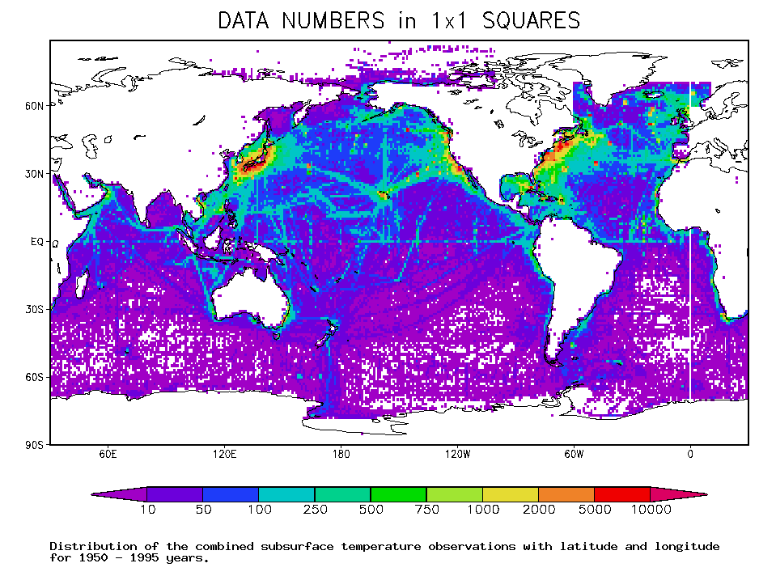
(Carton et al. 2000)

Slide 50
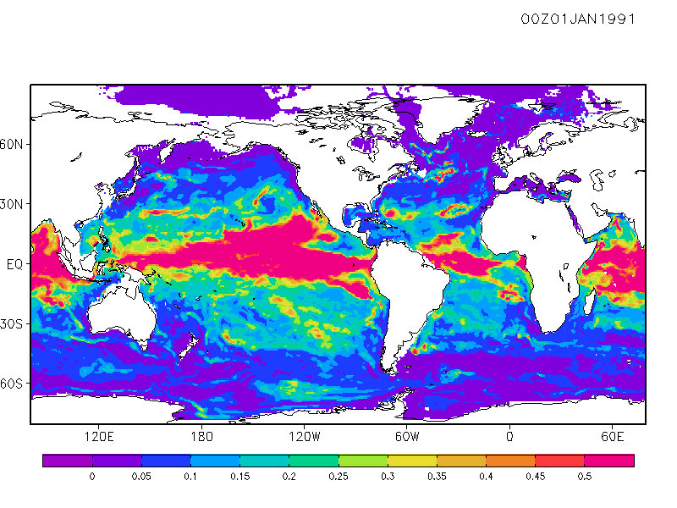

Temperature ens. spread, 100 m

Slide 51
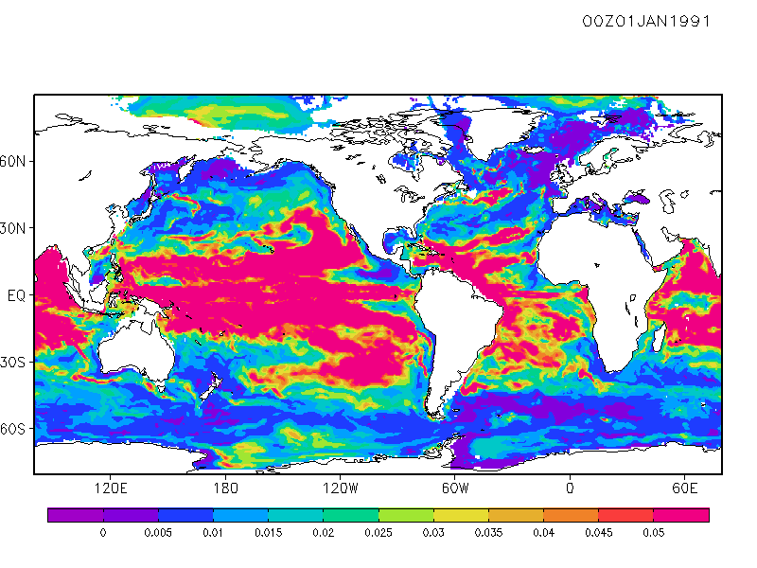

Salinity ens. spread, 100 m

Slide 52
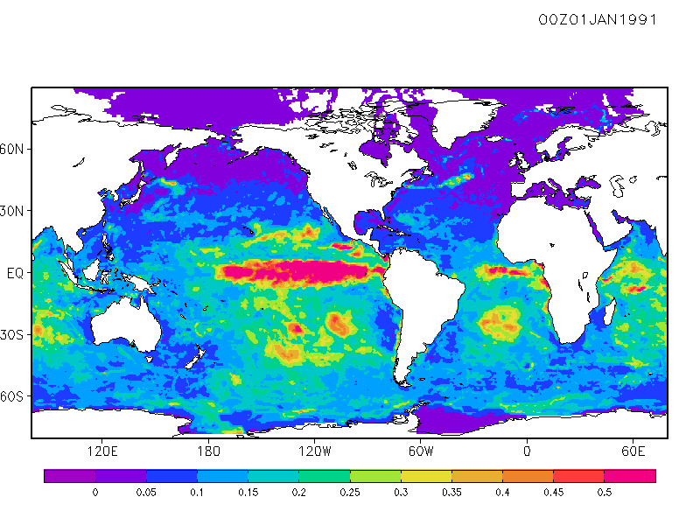

SST ens. spread

Slide 53
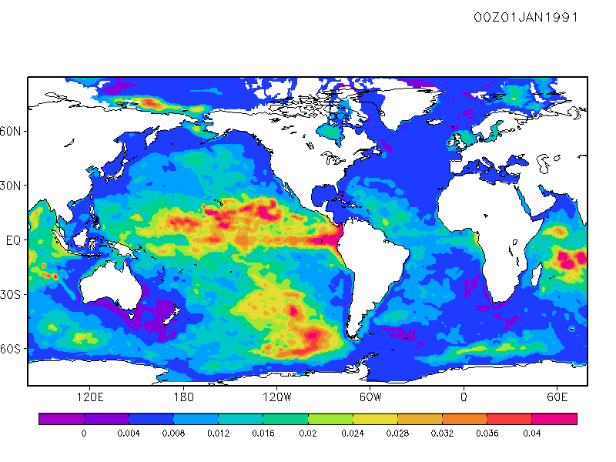

SSH ens. spread

Slide 54
NH Midlatitude Pacific RMSE
3DVar-GODAS
SST
SSH
Hybrid-GODAS
Temp (0-700m)
Salinity(0-700m)

Slide 55
NH Midlatitude Atlantic RMSE
SST
SSH
Temp (0-700m)
Salinity(0-700m)

Slide 56
Tropical Pacific RMS Errors
SST
SSH
Temp (0-700m)
Salinity(0-700m)

Slide 57
Tropical Atlantic RMS Errors
SST
SSH
Temp (0-700m)
Salinity(0-700m)

Slide 58
Indian Ocean RMS Errors
SST
SSH
Temp (0-700m)
Salinity(0-700m)

Slide 59
SH Midlatitude Pacific RMSE
SST
SSH
Temp (0-700m)
Salinity(0-700m)

Slide 60
SH Midlatitude Atlantic RMSE
SST
SSH
Temp (0-700m)
Salinity(0-700m)

Slide 61
Conclusions
The Hybrid-LETKF formulation presented here effectively stabilizes the filter for small ensemble sizes. The results are fairly robust.
There is no generally ‘optimal’ constant alpha, it is dependent on problem parameters such as ensemble size, observation coverage, and localization radius.
Experiments with Hybrid-GODAS using both real and synthetic observation data are encouraging.
Next steps:
  Inclusion of satellite data: altimetry (later: gravity, SST, SSS)
  Seasonal forecast experiments with CFS to validate Hybrid vs. 3DVar initial conditions
  1-month concurrent run with operational system for validation prior to operational implementation

Slide 62
Thank You
Steve.Penny@noaa.gov

Slide 63
Varying Multiplicative Inflation (at observation count l=4)
(Narrow improvement with multiplicative inflation, essentially only in Regime 3)
Standard-LETKF
Hybrid-LETKF with Global 3D-Var
Hybrid
Improved stability due to inflation
Improved stability due to combined inflation and Hybrid-LETKF

