Slide 1

Ensemble-4DVAR for NCEP hybrid GSI-EnKF data assimilation system
Xuguang Wang, Ting Lei
University of Oklahoma, Norman, OK, USA
Daryl Kleist
NOAA/NCEP/EMC, USA
Jeff Whitaker
NOAA/ESRL/PSD, USA
Acknowledgement: Russ Treadon, Dave Parrish, John Derber, Miodrag Rancic (NCEP/EMC)
5th EnKF workshop, New York, May 22, 2012

Slide 2
Hybrid GSI-EnKF DA system
Wang et al. 2012a
member 1 forecast
EnKF analysis 1
Re-center EnKF analysis ensemble
to control analysis
member 1 analysis
member 1 forecast
EnKF
member 2 forecast
EnKF analysis 2
member 2 analysis
member 2 forecast
Ensemble covariance
member k forecast
EnKF analysis k
member k analysis
member k forecast
control forecast
control analysis
control forecast
GSI-ECV
First guess forecast
data assimilation

Slide 3
Why Hybrid? “Best of both worlds”
 | VAR (3D, 4D) | EnKF | hybrid | References (examples)
Benefit from use of flow dependent ensemble covariance instead of static B |  | x | x | Hamill and Snyder 2000; Lorenc 2003, Wang et al. 2007ab,2008ab, 2009; Zhang et al. 2009; Buehner et al. 2010ab; Wang 2011;
Robust for small ensemble |  |  | x | Wang et al. 2007b, 2009b; Buehner et al. 2010b
Better localization for integrated measure, e.g. satellite radiance; radar with attenuation |  |  | x | Campbell et al. 2010
Easiness to add various constraints | x |  | x
Outer loops , nonlinearity treatment | x |  | x
More use of various existing capability in VAR | x |  | x
Summarized in Wang 2010, MWR
Notes:
Highlight balance test

Slide 4
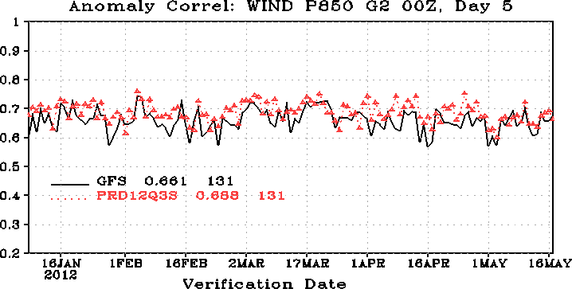
NCEP pre-implementation test of ens3dvar hybrid
http://www.emc.ncep.noaa.gov/gmb/wd20rt/experiments/prd12q3s/vsdb/

Slide 5
ens4dvar for GSI: motivation
In ens3dvar, temporal evolution of error covariance not considered
Observations (e.g., satellite) are spreading through the DA window.
Ensemble-4DVAR (ens4dvar) is further developed. It is a natural extension of ens3dvar.
Conveniently avoid TL/ADJ of the forecast model.
Temporal evolution of the error covariance within the assimilation window is realized through the use of ensemble perturbations (e.g., Buehner et al. 2010).
Cheaper compared to TL/ADJ 4DVAR being developed for GSI (Rancic et al. 2012).
Wang et al. 2012b

Slide 6
ens4dvar for GSI: method
Extended control variable method in 3D GSI hybrid (Wang 2010, MWR):
Add time dimension in ens4dvar
Extra term associated with extended control variable
Extra increment associated with ensemble
Wang et al. 2012b

Slide 7
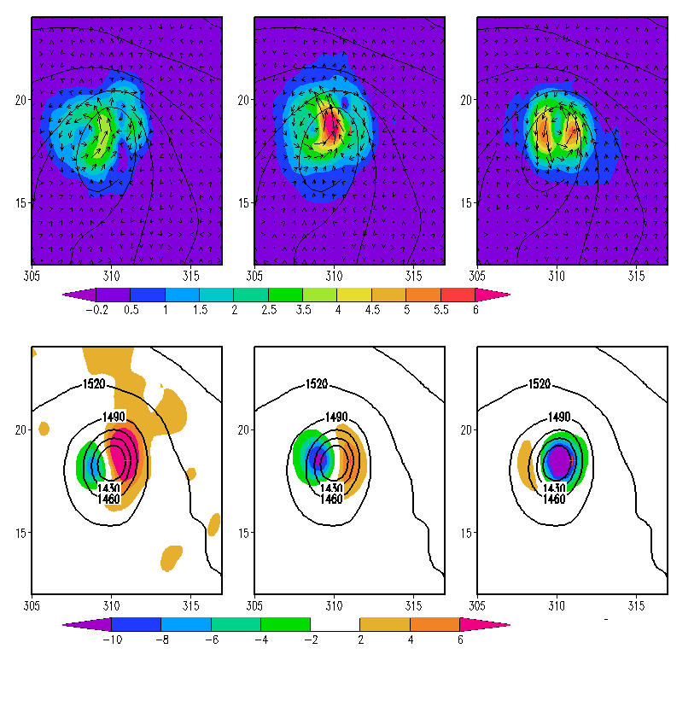
One obs. example for TC
–3h increment propagated by model integration
ens4dvar
ens3dvar
t=0
t=0
t=0
*
time
-3h 0 3h

Slide 8
Another example
Temp.
t-3h
t
t+3h
Height
t-3h
t
t+3h
Downstream impact
Upstream impact

Slide 9
Experiment I
Test period: Aug. 15 2010 – Sep. 20 2010
Model: GFS T190L64
Observations: all operational data
Data assimilation configuration:
GSI (gsi)
ensemble 3DVAR (ens3dvar)
ensemble 4DVAR:
2-hourly frequency (ens4dvar)
1-hourly frequency (ens4dvar-hrly)
excluding the balance constraint:
ens3dvar-nb
ens4dvar-nb

Slide 10
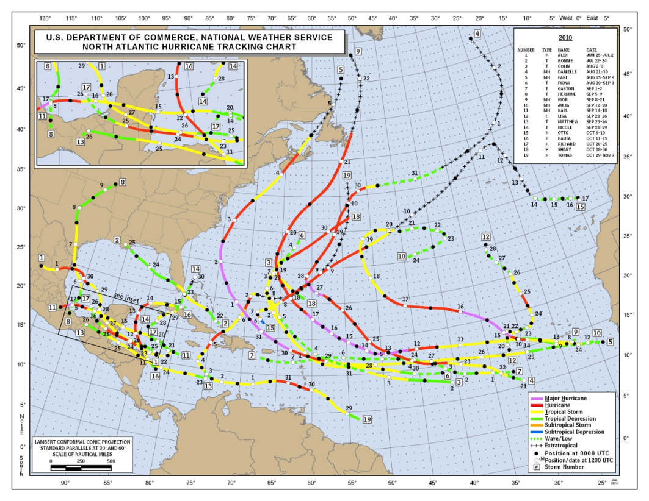
Hurricane track forecasts
2010 hurricanes
ens3dvar better than GSI and further improvement by ens4dvar.
Balance constraint in GSI hurt TC forecast for both ens3dvar and ens4dvar.

Slide 11
Global forecasts verified against EC analyses
Height
Temperature
ens3dvar better than GSI and further improvement by ens4dvar.
Balance constraint in GSI help both ens3dvar and ens4dvar.

Slide 12
Global forecasts verified against conv. obs.
6h wind
6h temp
Improvement of ens3dvar hybrid and ens4dvar hybrid over GSI
ens4dvar showed further improvement over ens3dvar especially for wind
12

Slide 13
Global forecasts verified against conv. obs.
96h wind
96h temp
Significant improvement of ens3dvar hybrid and ens4dvar hybrid over GSI
ens4dvar showed further improvement over ens3dvar especially when “nb”
balance constraint seems helpful at early lead time, but hurt at later lead time for ens4dvar
13

Slide 14
Experiment II
Test period: July 15-Aug. 7, 2011
Model: GFS T126L64 vs. GFS T126/T62L64
Observations: all operational data
Data assimilation configuration:
ensemble 3DVAR no static B dual resol. (ens3dvar-dual)
ensemble 4DVAR no static B dual resol. (ens4dvar-dual)
ensemble 3DVAR w. static B dual resol. (hyb-ens3dvar-dual)
ensemble 4DVAR w. static B dual resol. (hyb-ens4dvar-dual)
ensemble 3DVAR no static B single resol. (ens3dvar-sgl)
ensemble 4DVAR no static B single resol. (ens4dvar-sgl)
Lei et al. 2012
14

Slide 15
Single vs. dual resolution
6h wind
6h temp

Slide 16
Impact of static B at dual resolution
6h wind
6h temp

Slide 17
Summary and ongoing work
ens4dvar capabilities were developed for GSI. Tests show that ens4dvar further improved upon ens3dvar.
Further diagnosing the difference between dual and single resolution, w/o static covariance, impact of balance constraint.
Various capabilities associated with ens4dvar are in development and test: e.g.
temporal localization,
digital filter weak constraint,
sophisticated weighting of static vs. ensemble covariance

Slide 18
References
Campbell, W. F., C. H. Bishop, D. Hodyss, 2010: Vertical Covariance Localization for Satellite Radiances in Ensemble Kalman Filters. Mon. Wea. Rev., 282-290.
Lorenc, A. C. 2003: The potential of the ensemble Kalman filter for NWP – a comparison with 4D-VAR. Quart. J. Roy. Meteor. Soc., 129, 3183-3203.
Buehner, M., 2005: Ensemble-derived stationary and flow-dependent background-error covariances: evaluation in a quasi-operational NWP setting. Quart. J. Roy. Meteor. Soc., 131, 1013-1043.
Hamill, T. and C. Snyder, 2000: A Hybrid Ensemble Kalman Filter–3D Variational Analysis Scheme. Mon. Wea. Rev., 128, 2905-2915.
Wang, X., C. Snyder, and T. M. Hamill, 2007a: On the theoretical equivalence of differently proposed ensemble/3D-Var hybrid analysis schemes. Mon. Wea. Rev., 135, 222-227.
Wang, X., T. M. Hamill, J. S. Whitaker and C. H. Bishop, 2007b: A comparison of hybrid ensemble transform Kalman filter-OI and ensemble square-root filter analysis schemes. Mon. Wea. Rev., 135, 1055-1076.
Wang, X., D. Barker, C. Snyder, T. M. Hamill, 2008a: A hybrid ETKF-3DVar data assimilation scheme for the WRF model. Part I: observing system simulation experiment. Mon. Wea. Rev., 136, 5116-5131.
Wang, X., D. Barker, C. Snyder, T. M. Hamill, 2008b: A hybrid ETKF-3DVar data assimilation scheme for the WRF model. Part II: real observation experiments. Mon. Wea. Rev., 136, 5132-5147.
Wang, X., T. M. Hamill, J. S. Whitaker, C. H. Bishop, 2009: A comparison of the hybrid and EnSRF analysis schemes in the presence of model error due to unresolved scales. Mon. Wea. Rev., 137, 3219-3232.
Wang, X., 2010: Incorporating ensemble covariance in the Gridpoint Statistical Interpolation (GSI) variational minimization: a mathematical framework. Mon. Wea. Rev., 138,2990-2995.
Wang, X. 2011: Application of the WRF hybrid ETKF-3DVAR data assimilation system for hurricane track forecasts. Wea. Forecasting, 26, 868-884.
Li, Y, X. Wang and M. Xue, 2011: Radar data assimilation using a hybrid ensemble-variational analysis method for the prediction of hurricane IKE 2008. Mon. Wea. Rev., in press.
Buehner, M, P. L. Houtekamer, C. Charette, H. L. Mitchell, B. He, 2010: Intercomparison of Variational Data Assimilation and the Ensemble Kalman Filter for Global Deterministic NWP. Part I: Description and Single-Observation Experiments. Mon. Wea. Rev., 138,1550-1566.
Buehner, M, P. L. Houtekamer, C. Charette, H. L. Mitchell, B. He, 2010: Intercomparison of Variational Data Assimilation and the Ensemble Kalman Filter for Global Deterministic NWP. Part II: One-Month Experiments with Real Observations. Mon. Wea. Rev., 138,1550-1566.
Wang, X., D. Parrish, D. Kleist, and J. Whitaker, 2012a: GSI-based hybrid ensemble-variational data assimilation system for NCEP Global Forecast System: reduced resolution experiments. Mon. Wea. Rev. , in review.

Slide 19
Hybrid DA posters
Govindan Kutty (next talk)
Assess the impact of observations in NCEP GSI-EnKF hybrid data assimilation system through OSE and ensemble based observation impact estimate

Slide 20
Hybrid DA posters
Ting Lei (poster)
GSI based Ensemble-4DVar for NCEP GFS at Single and dual resolutions
GSI based Ensemble-4DVar for NCEP GFS at Single and Dual resolutions
GSI based Ensemble-4DVar for NCEP GFS at Single and dual resolutions
based Ensemble-4DVar for NCEP GFS at Single and dual resolutions

Slide 21
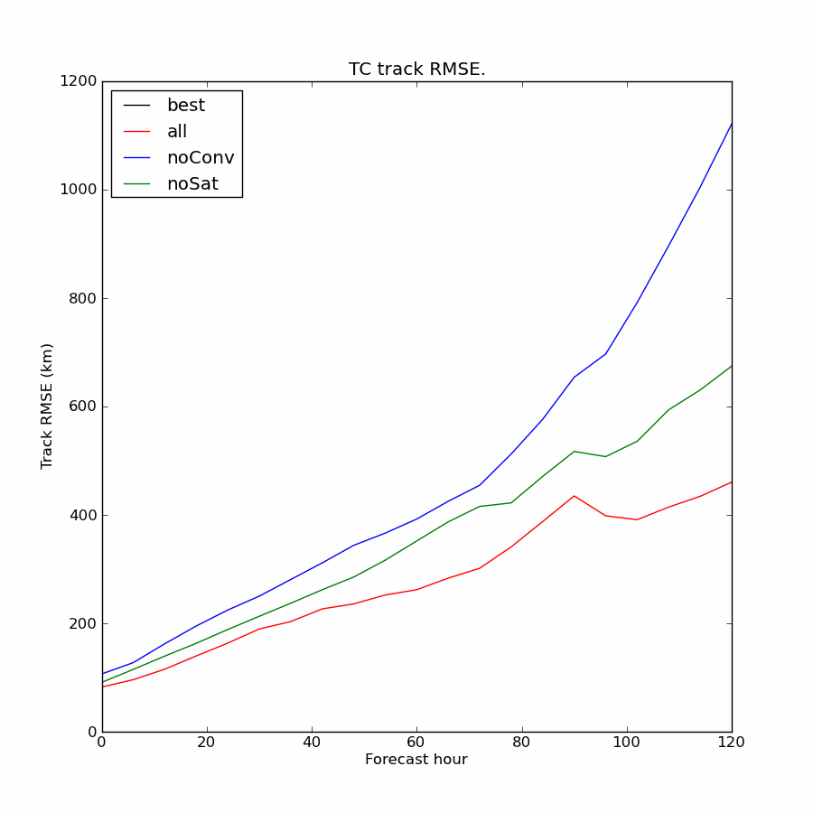
Hybrid DA posters
Andrew Mackenzie (poster)
Impact of observations on tropical cyclone forecasts using the GSI-EnKF hybrid data assimilation system

Slide 22
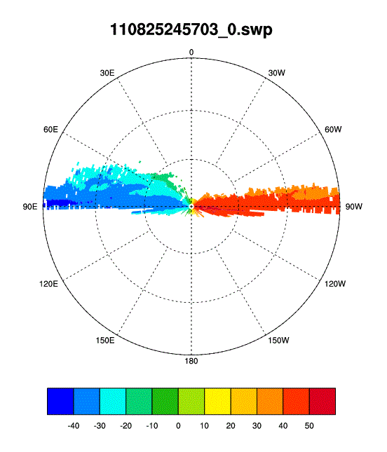
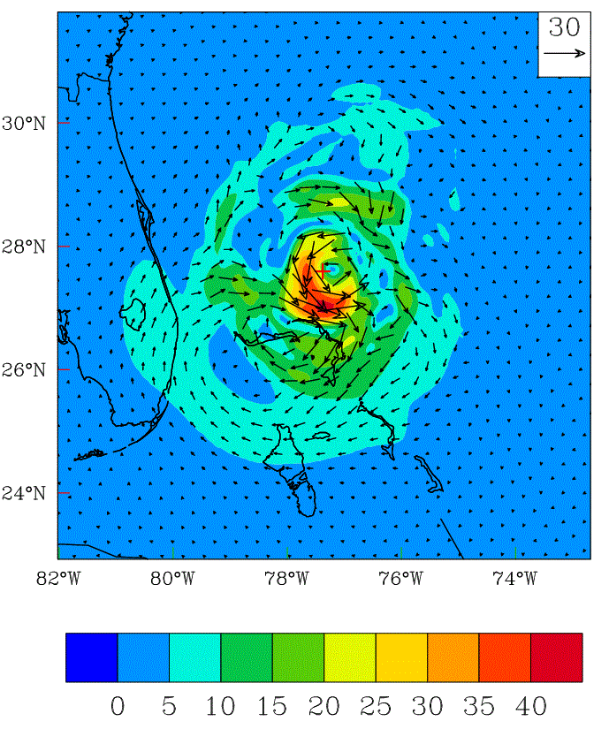
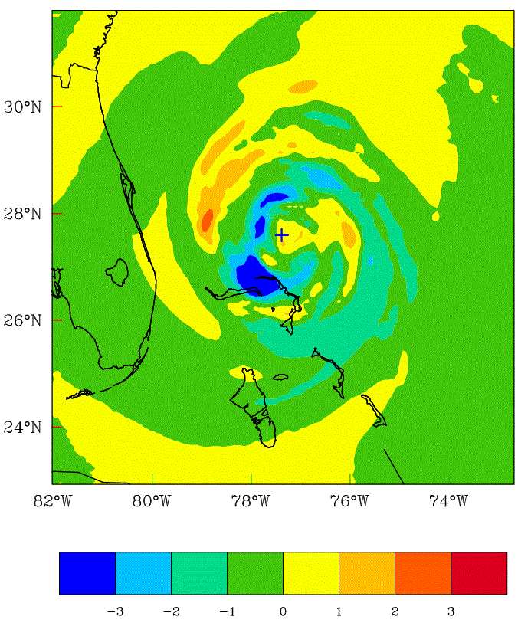
Hybrid DA posters
Yongzuo Li (poster)
GSI based Ensemble-4DVar for NCEP GFS at Single and dual resolutions
Assimilation of Radar Data with the hybrid data assimilation for high resolution hurricane predictions
GSI based Ensemble-4DVar for NCEP GFS at Single and dual resolutions
based Ensemble-4DVar for NCEP GFS at Single and dual resolutions

Slide 23
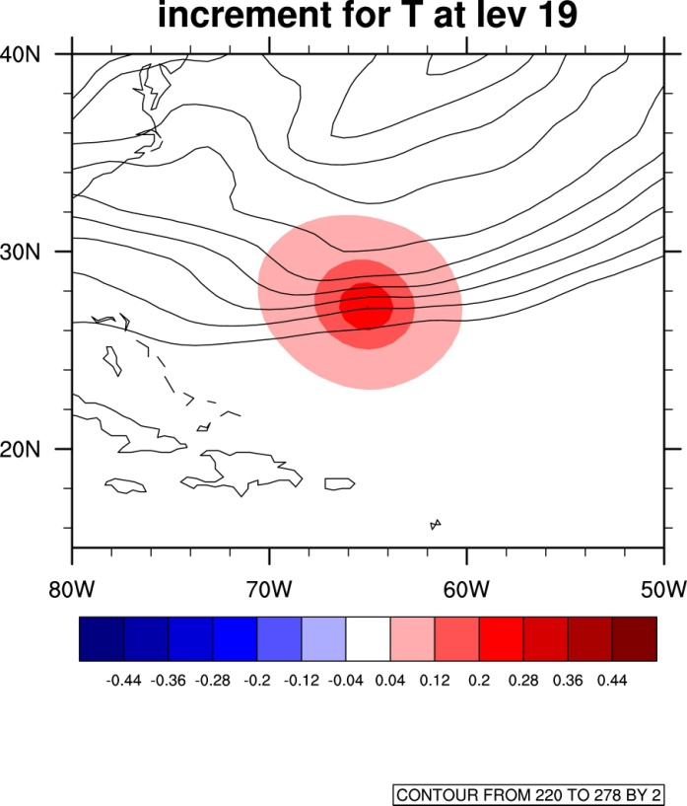
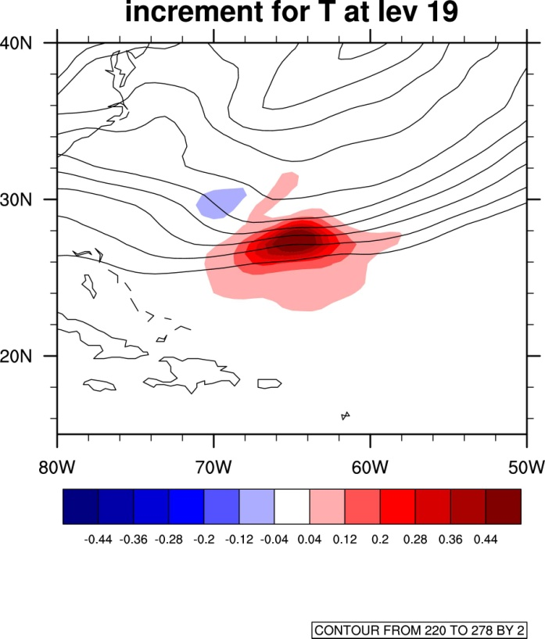
An example from GSI hybrid
GSI (static covariance)
Hybrid (ensemble covariance)
K
k
k
Wang et al. 2012a
23

