Slide 1

Assess Observation Impacts in the Hybrid GSI-EnKF Data Assimilation Systems for NCEP Global Forecast System Model Through OSE and Ensemble Based Observation Impact Metric
Govindan Kutty M and Xuguang Wang
University of Oklahoma, Norman, OK, USA
EnKF workshop, May 22, 2012

Slide 2

Introduction
Numerical weather prediction models, in various operational weather forecast centers assimilate millions of observations each day from satellite as well as in-situ platforms
The impact of observations in a data assimilation platform may be different for
Various satellite platforms
Different data assimilation system
The ways in which impacts are assessed
Hybrid GSI-EnKF DA for NCEP GFS has been developed (Wang et al. 2012). Studies have shown that the hybrid improved forecasts.

Slide 3
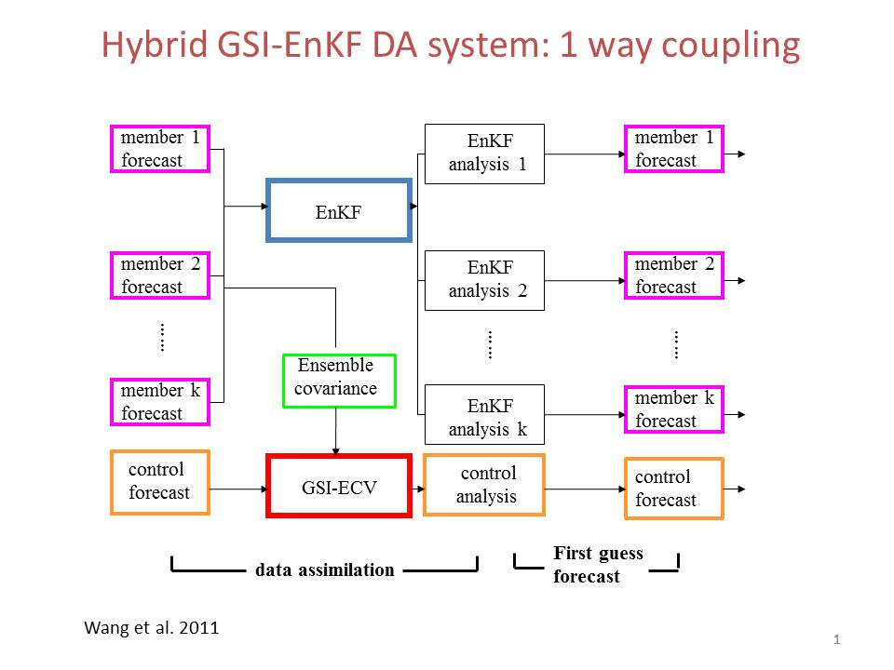
Introduction
Wang et al., 2012

Slide 4
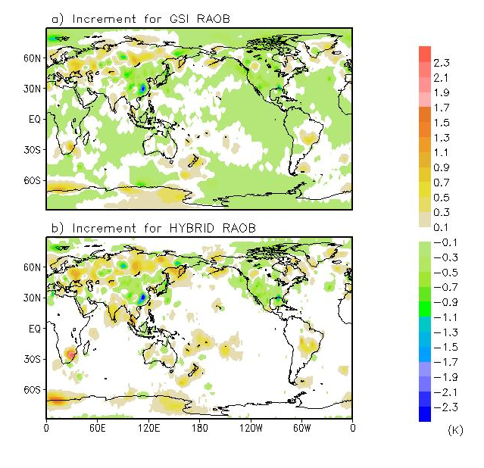
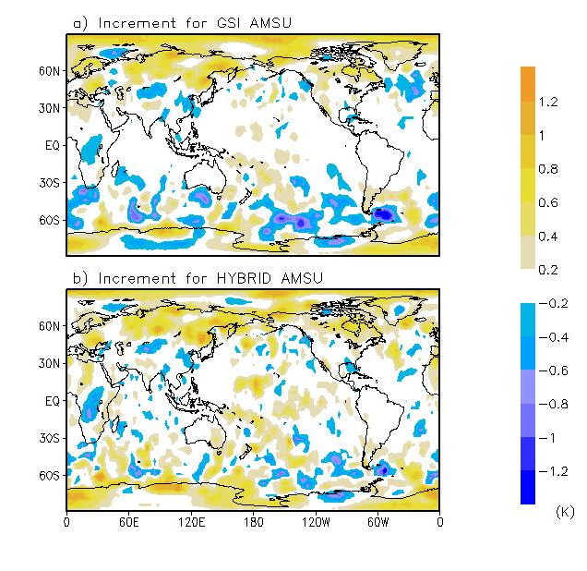
Introduction

Slide 5
Introduction
Various methods have been used to assess the impacts of observations
Observing system experiments (OSE, eg; Zapotocny et al., 2007 )
Adjoint method (eg; Galero et al., 2008)
Ensemble based methods (eg; Liu and Kalnay, 2008 )

Slide 6
Experimental design
Test period : 15 December 2009 – 31 January 2010
Model: Global Forecast System (GFS) with resolution T190L64
Observations denied : AMSU, Rawinsonde
Data Assimilation method:
GSI
Hybrid GSI-EnKF
6 experiments for OSE
GSI assimilating all observations (gsi)
GSI denied Rawinsonde (gsi noraob)
GSI denied AMSU (gsi noamsu)
Hybrid assimilating all observations (hybrid)
Hybrid denied Rawinsonde (hybrid noraob)
Hybrid denied AMSU (hybrid noamsu)
Ensemble based observation impact estimate (Liu and Kalnay, 2008, Kalnay, 2011)
Estimate of rawinsonde temp. impact for temperature and wind forecast

Slide 7
RMSE of global forecasts w.r.t ECMWF analysis
72hr wind
72hr temperature
72hr specific humidity

Slide 8
RMSE of global forecasts w.r.t conventional observations
24hr wind
24hr temperature

Slide 9
Zonally averaged impact (wind RMSE diff.) – 72hr

Slide 10
Zonally averaged impact (temp RMSE diff.) – 72hr

Slide 11
Zonally averaged Impact (Sp.hum. RMSE diff.) -72 hr

Slide 12
Anomaly correlation for geopotential height (GSI)

Slide 13
Anomaly correlation for geopotential height (Hybrid)

Slide 14
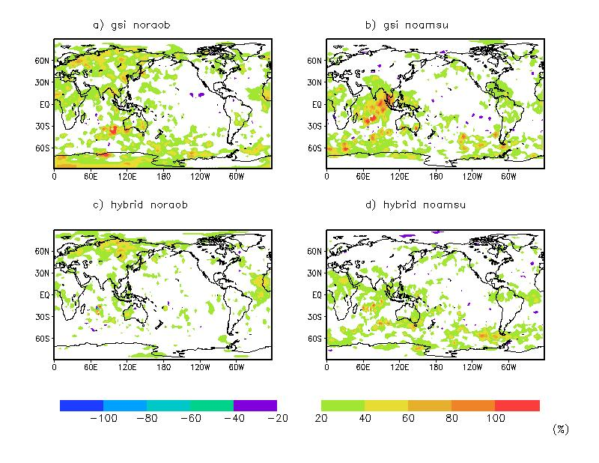
Relative impact for geopotential height (500hPa)

Slide 15
Ensemble based impact estimate for Hybrid system
Rawinsonde temp. impact for 24 hour temp. forecast
Rawinsonde temp. impact for 24 hour wind forecast

Slide 16
Ensemble based impact for Hybrid system
- 5 day forecast (Adaptive localization)

Slide 17
Summary and ongoing work
OSE
Forecast by Hybrid is better than GSI in both control and data denial experiments
Magnitude and distribution of observation impact may depend on observation and data assimilation methods
The relative impact between the AMSU and Rawinsonde may vary for different data assimilation and verification methods
Ensemble based observation impact for hybrid
Initial result and adaptive localization tests are promising.
Ongoing work
Extend OSE using hybrid DA (including ensemble-4DVAR) for other data sets in the NCEP operational system
Tests of other adaptive localization methods for ensemble based observation impact

Slide 18
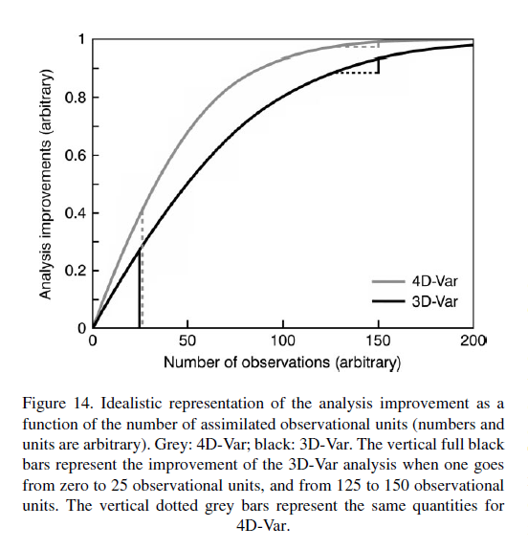
Back up
(Kelly et al., 2007)

