Slide 1
Convectively Forced Diurnal Gravity Waves in the Maritime Continent
James Ruppert, Xingchao Chen, and
Fuqing Zhang
ADAPT Group Meeting
27 September 2019

Slide 2

Challenges of the MC
  1. Land–sea–atmosphere coupling
  2. Rectification by the diurnal cycle
cloud cover
MODIS Terra
NASA Earth Observatory
Image of the Day: 17 Nov 2009

Slide 3
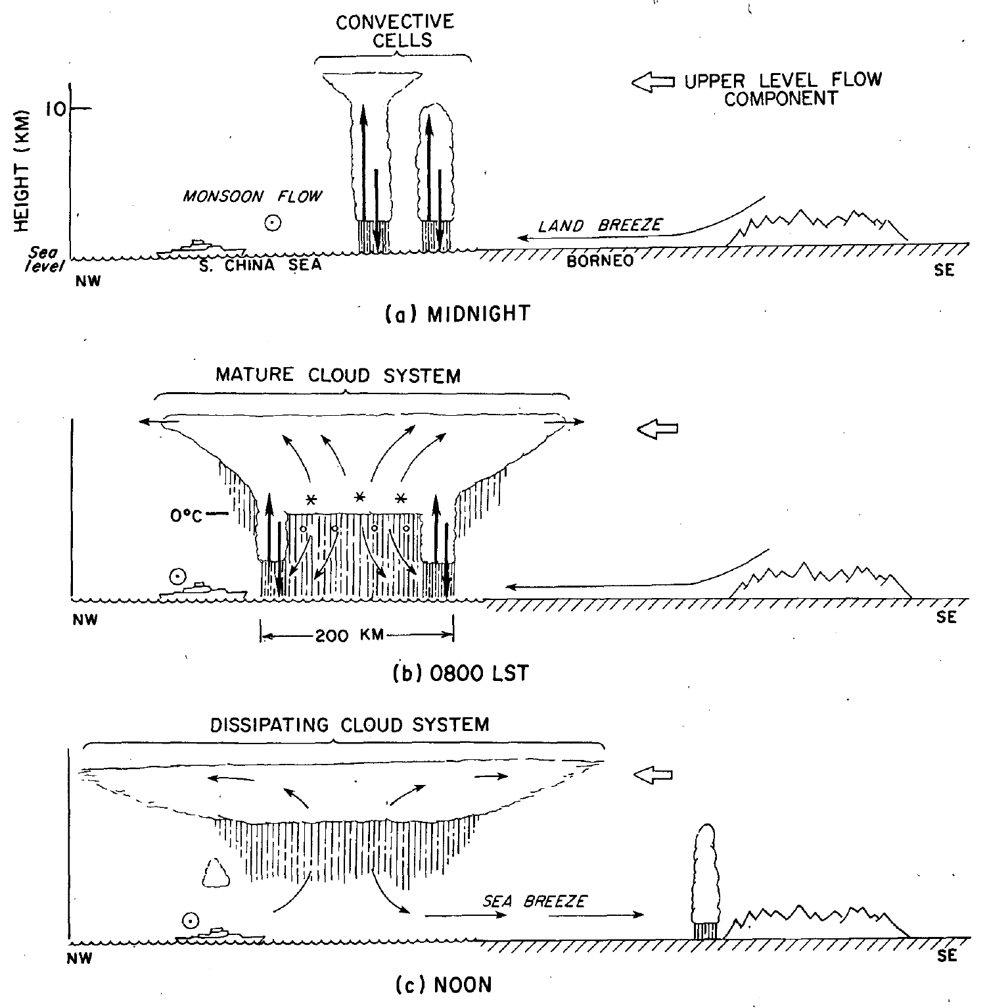
Borneo
Nocturnal mesoscale convective system (MCS) development and offshore propagation are due to land breeze
Houze et al. 1981

Slide 4
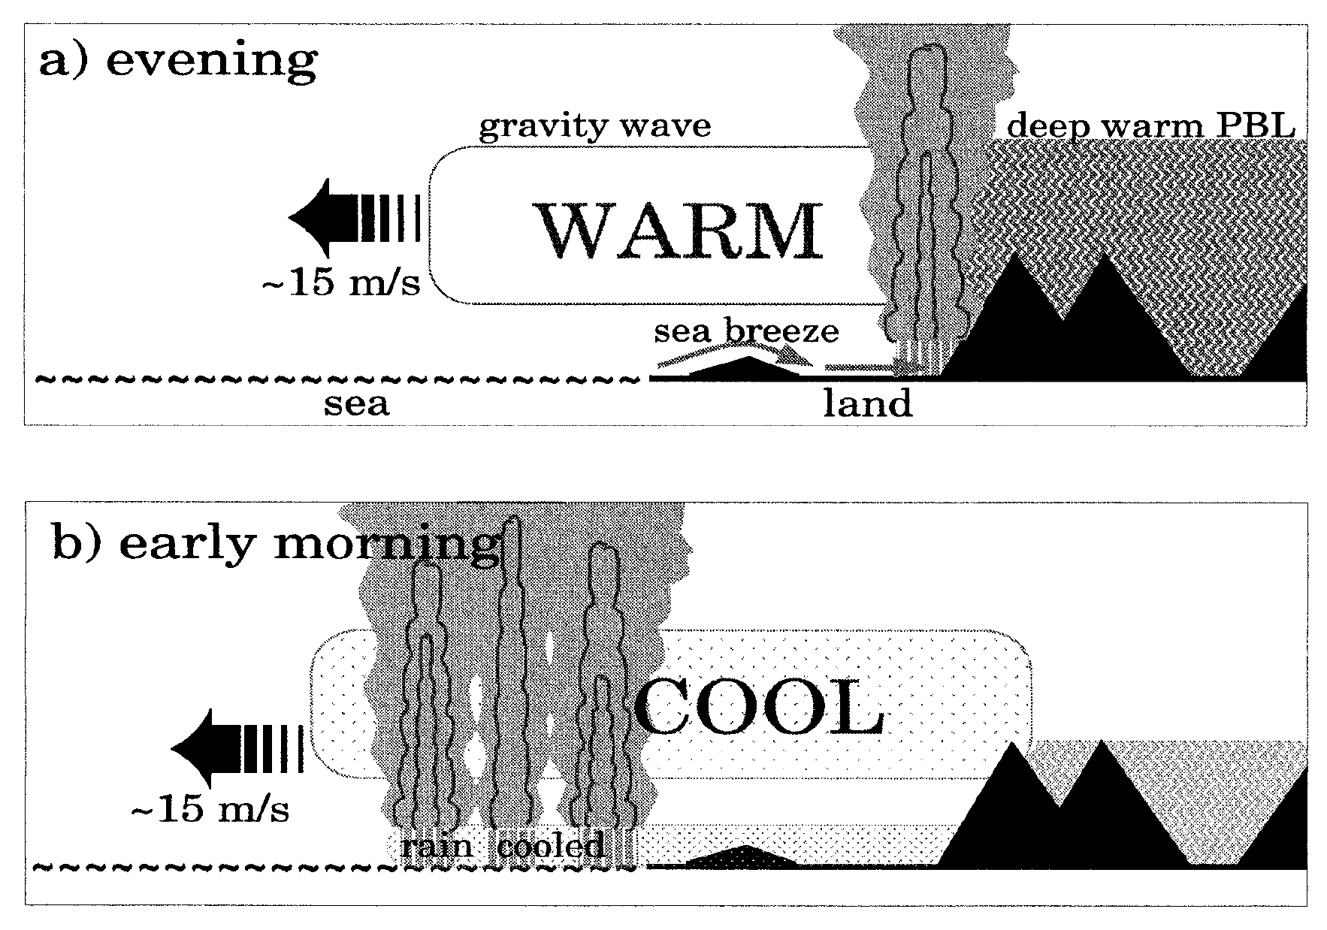
[ fast ] Nocturnal offshore propagation explained by gravity waves; gravity waves excited by topography
Mapes et al. 2003

Slide 5
Rainfall,
U850
Westerly
Diurnal
Easterly
Westerly
Gravity waves AND land breeze are important; gravity waves are key to explaining long-lived propagation
Ruppert and Zhang 2019

Slide 6
Our Objective
To better understand the nature and origin of these gravity waves
RZ19 hypothesized that the gravity waves are excited by MCSs, not topography
Q1: What is the role of topography vs. land–sea contrast for exciting gravity waves?
Q2: Is the gravity wave mode amplified by interaction with the diurnal cycles of both Borneo and Sumatra?

Slide 7
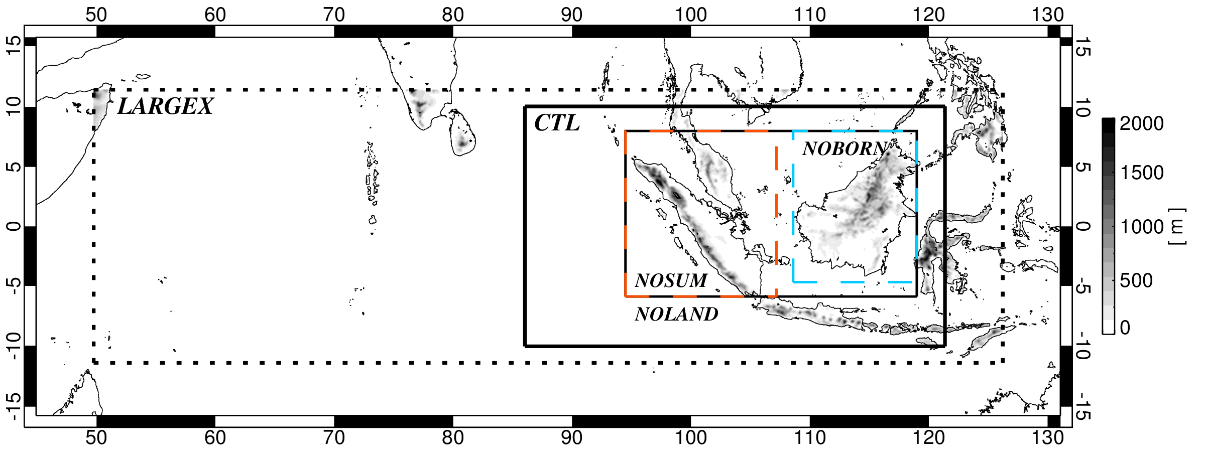
Large-scale model domain of Ruppert and Zhang 2019
(as in Wang et al. 2015)
Model setup
WRF–ARW, dx = 9 km, convection-permitting
Smaller-scale domain to focus on MC

Slide 8
Rainfall,
U850
CTL: cyclic diurnal lateral boundary conditions based on easterly flow regime
Sensitivity tests:
  NOOROG: orography of both islands flattened
  NOLAND: both islands removed
  NODC: solar insolation fixed to daily mean

Slide 9
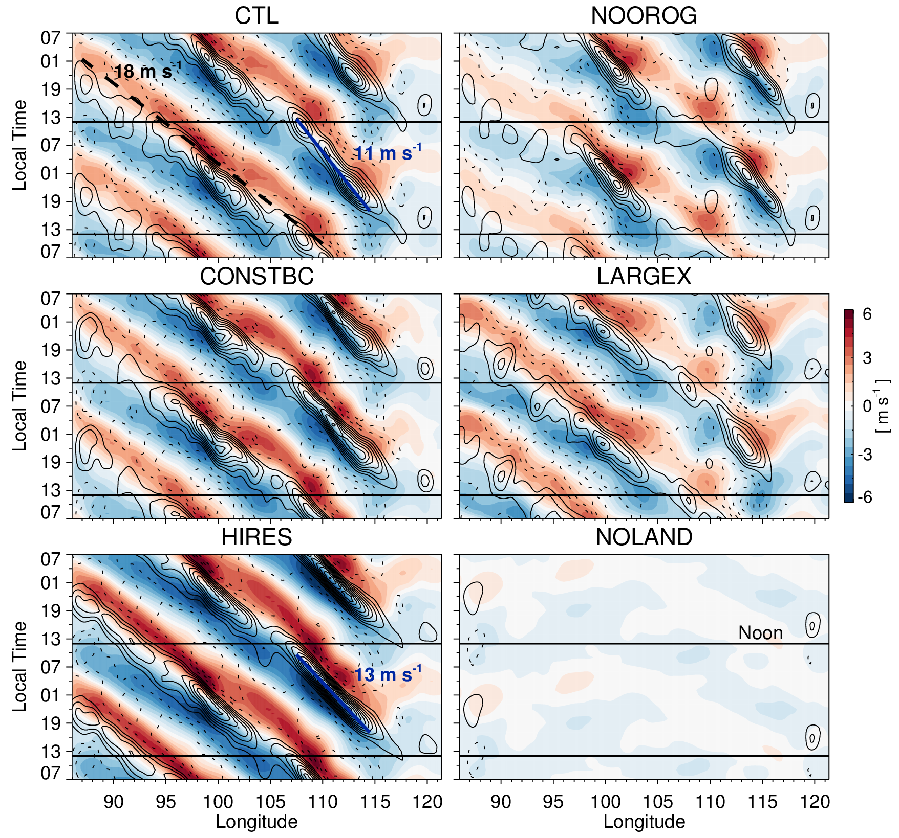
Diurnal Composites
Average as a function of local time (last 5 days)
Small impact of removing orography
Higher resolution → stronger GW
Results confirmed for westerly flow regime
Contours: rainfall r’
Shading: u’ at 150 hPa

Slide 10
Nonlinear Island Interaction
Given
  Gravity wave phase ~ 17 m/s
  Zonal distance between Borneo and Sumatra ~ 1500 km
Gravity waves ~perfectly phase-lock with the diurnal cycle over Borneo and Sumatra over a 2-day period
RZ19 hypothesized that this phase locking amplifies the gravity wave response

Slide 11
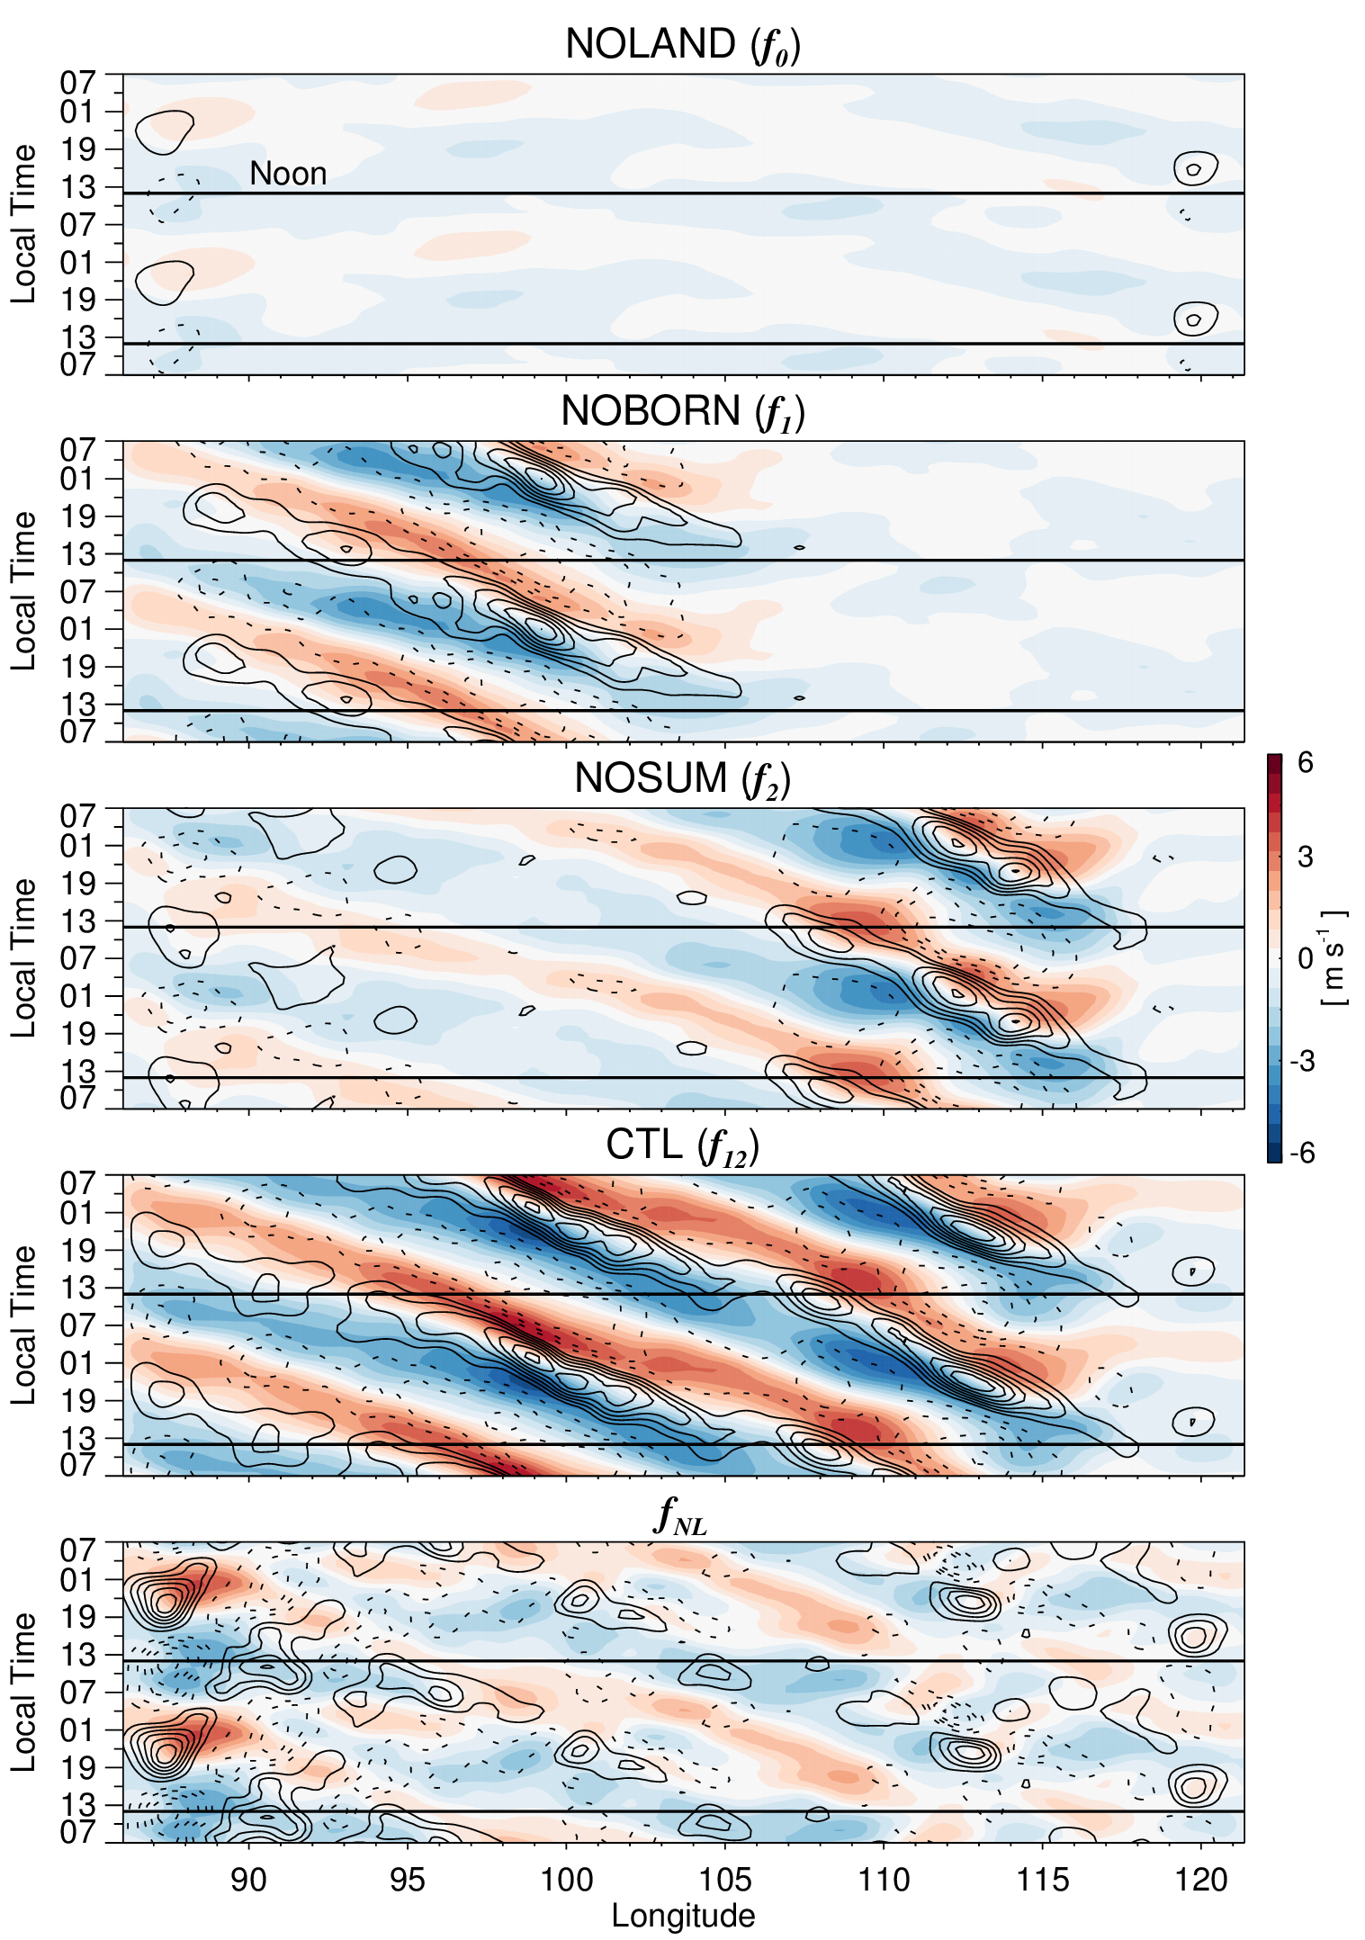
Nonlinear Island Interaction
Land
removed
Nonlinear feedback slightly amplifies the wave
Overall structure preserved when one island is removed
Nonlinear feedback is a secondary (at most) influence
Borneo
removed
Sumatra
removed
Control
Nonlinear feedback

Slide 12
Conclusions
Semi-idealized model experiments indicate that orography has only a small influence
Supports the hypothesis that gravity waves are fundamentally excited by deep convection
A more general hypothesis for diurnally excited gravity waves
  The gravity are fundamentally excited by convection, and hence are only sensitive to terrain to the extent that terrain influences the convection
Nonlinear interaction between Borneo and Sumatra exerts only a small influence on the gravity waves

