Slide 1
A brief self-introduction & work progress on post-landfall typhoon torrential rain of Haikui (2012)
Lingli (Lisa) Zhou
Zhejiang Province Meterological Observatory, Hangzhou, China

Slide 2
Brief self-introduction

Slide 3
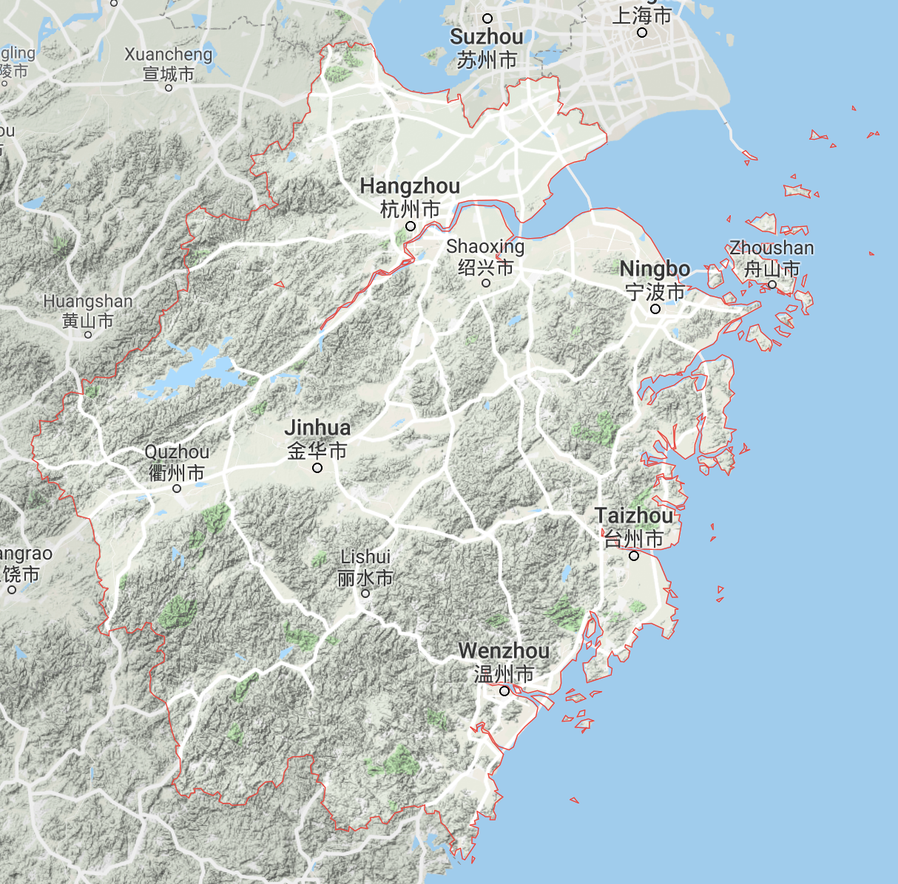
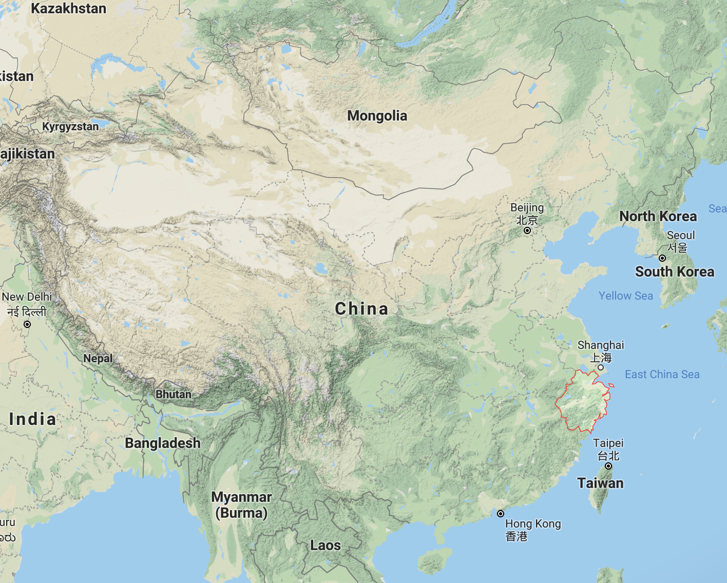
Where am I from?
Hangzhou
Shanghai
Zhejiang Province
West Lake
Grand Canal
Qiantang River
Alibaba
Dragon Well Tea Mountain

Slide 4
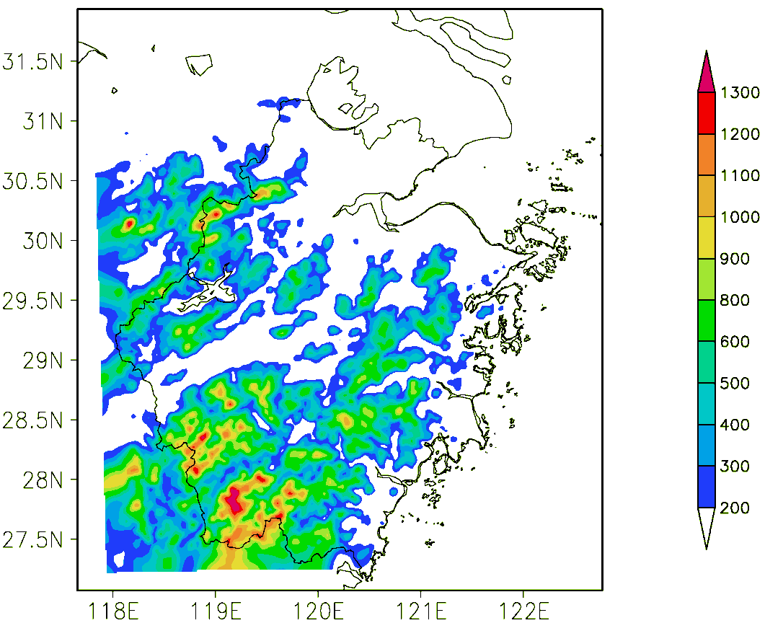
Area average rain during Meiyu period in last 10 years
Meiyu front
plain
basin
Days of Meiyu period in last 10 years
Terrain of Zhejiang Province
Accumulative rain
during 2011 Meiyu period

Slide 5
Observed hourly rain with simulated stream field ($σ=0.97)$
during a Meiyu rainstorm case in 1999
Horizontal wind perpendicular to to C-D cross section
Vorticity (10⁻⁵ m s⁻¹)

Slide 6
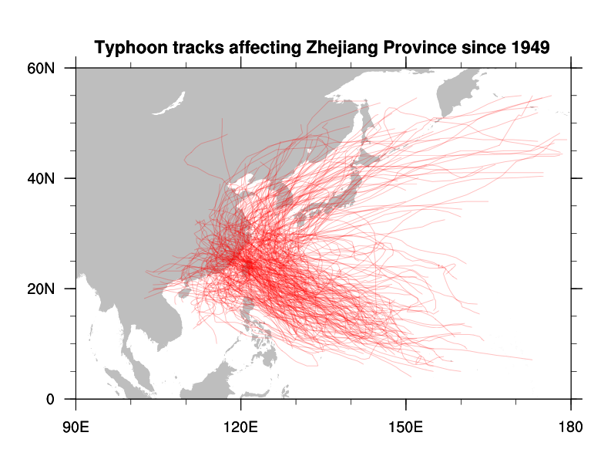
Typhoon
291 typhoons affecting Zhejiang Province, average 4.2 typhoons per year
46 typhoons landing Zhejiang Province, average 0.65 landing typhoon per year

Slide 7
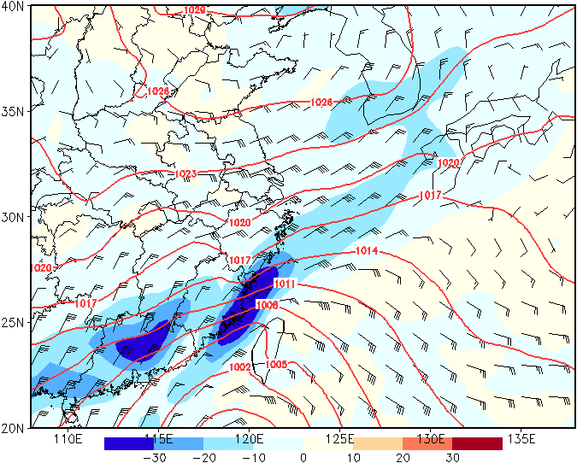
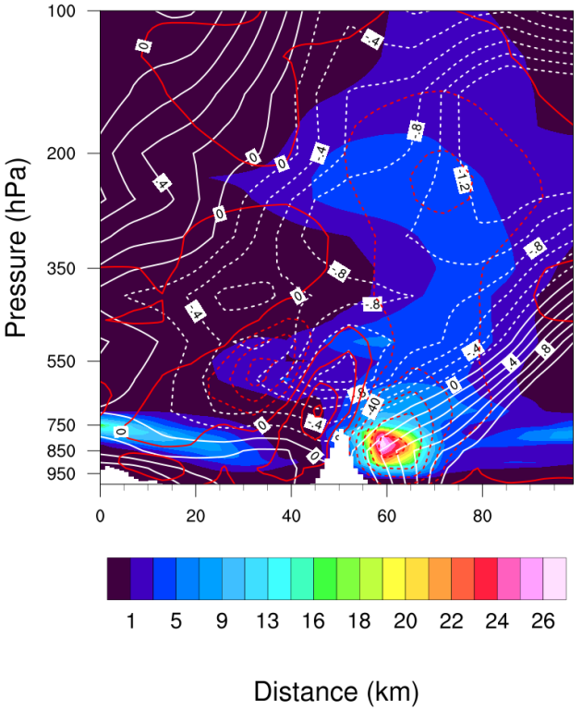
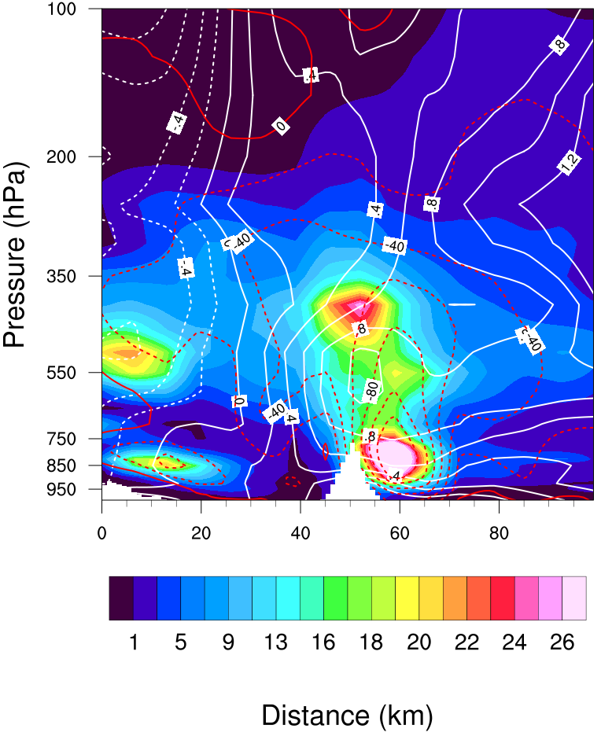
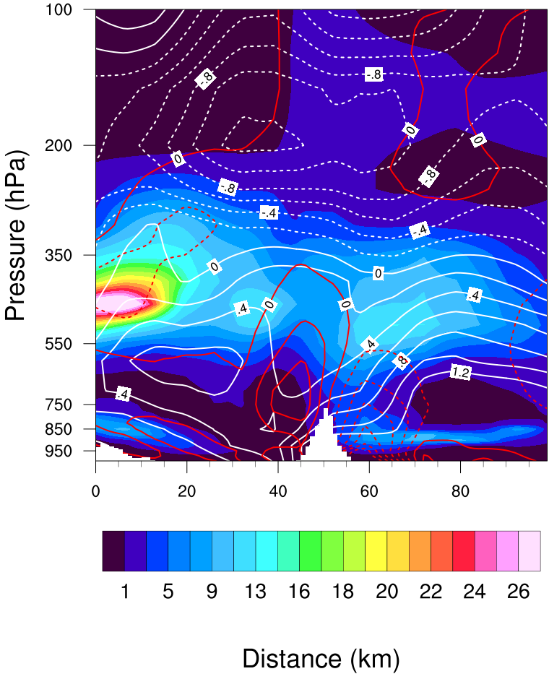
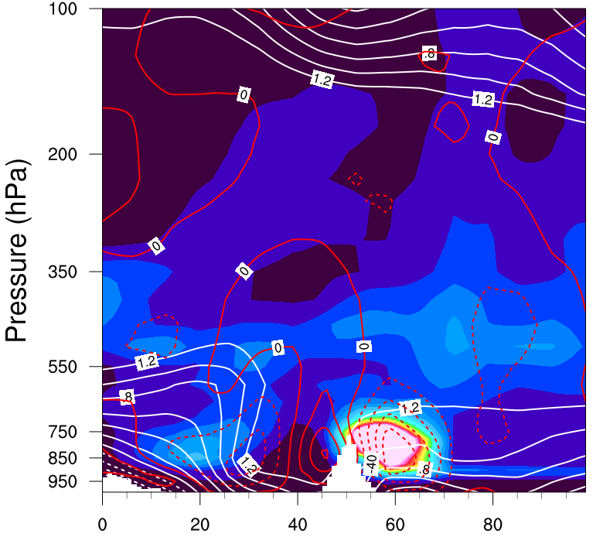
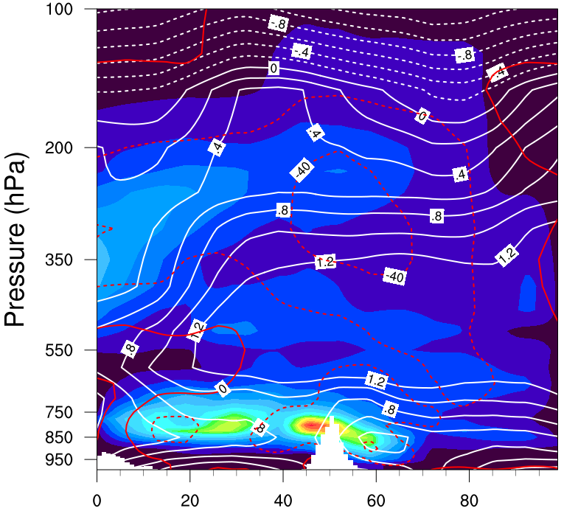
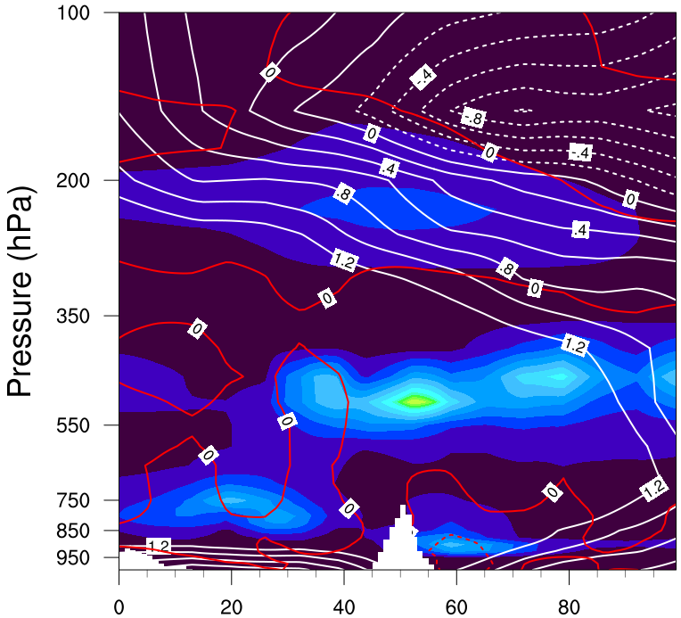
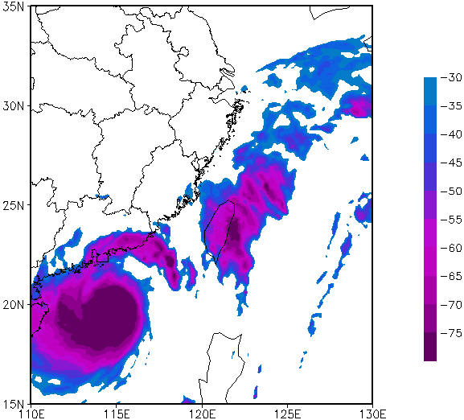

1200 UTC 14 925hPa wind&advT&slp
MCS in inverted trough of typhoon Kanu(1720)
1200 UTC 13
0600 UTC 14
1200 UTC 14
1800 UTC 14
0600 UTC 15
1800 UTC 15
0000 UTC 15 TBB

Slide 8
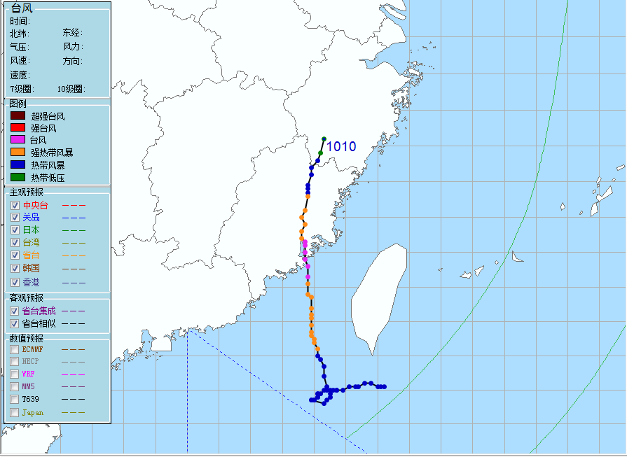
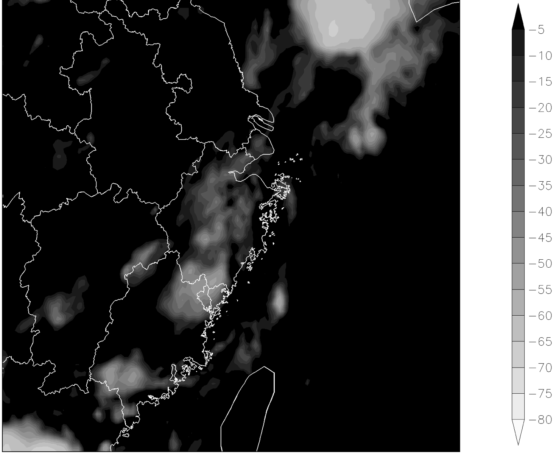
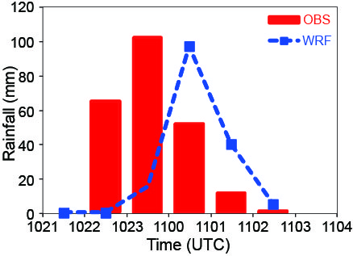
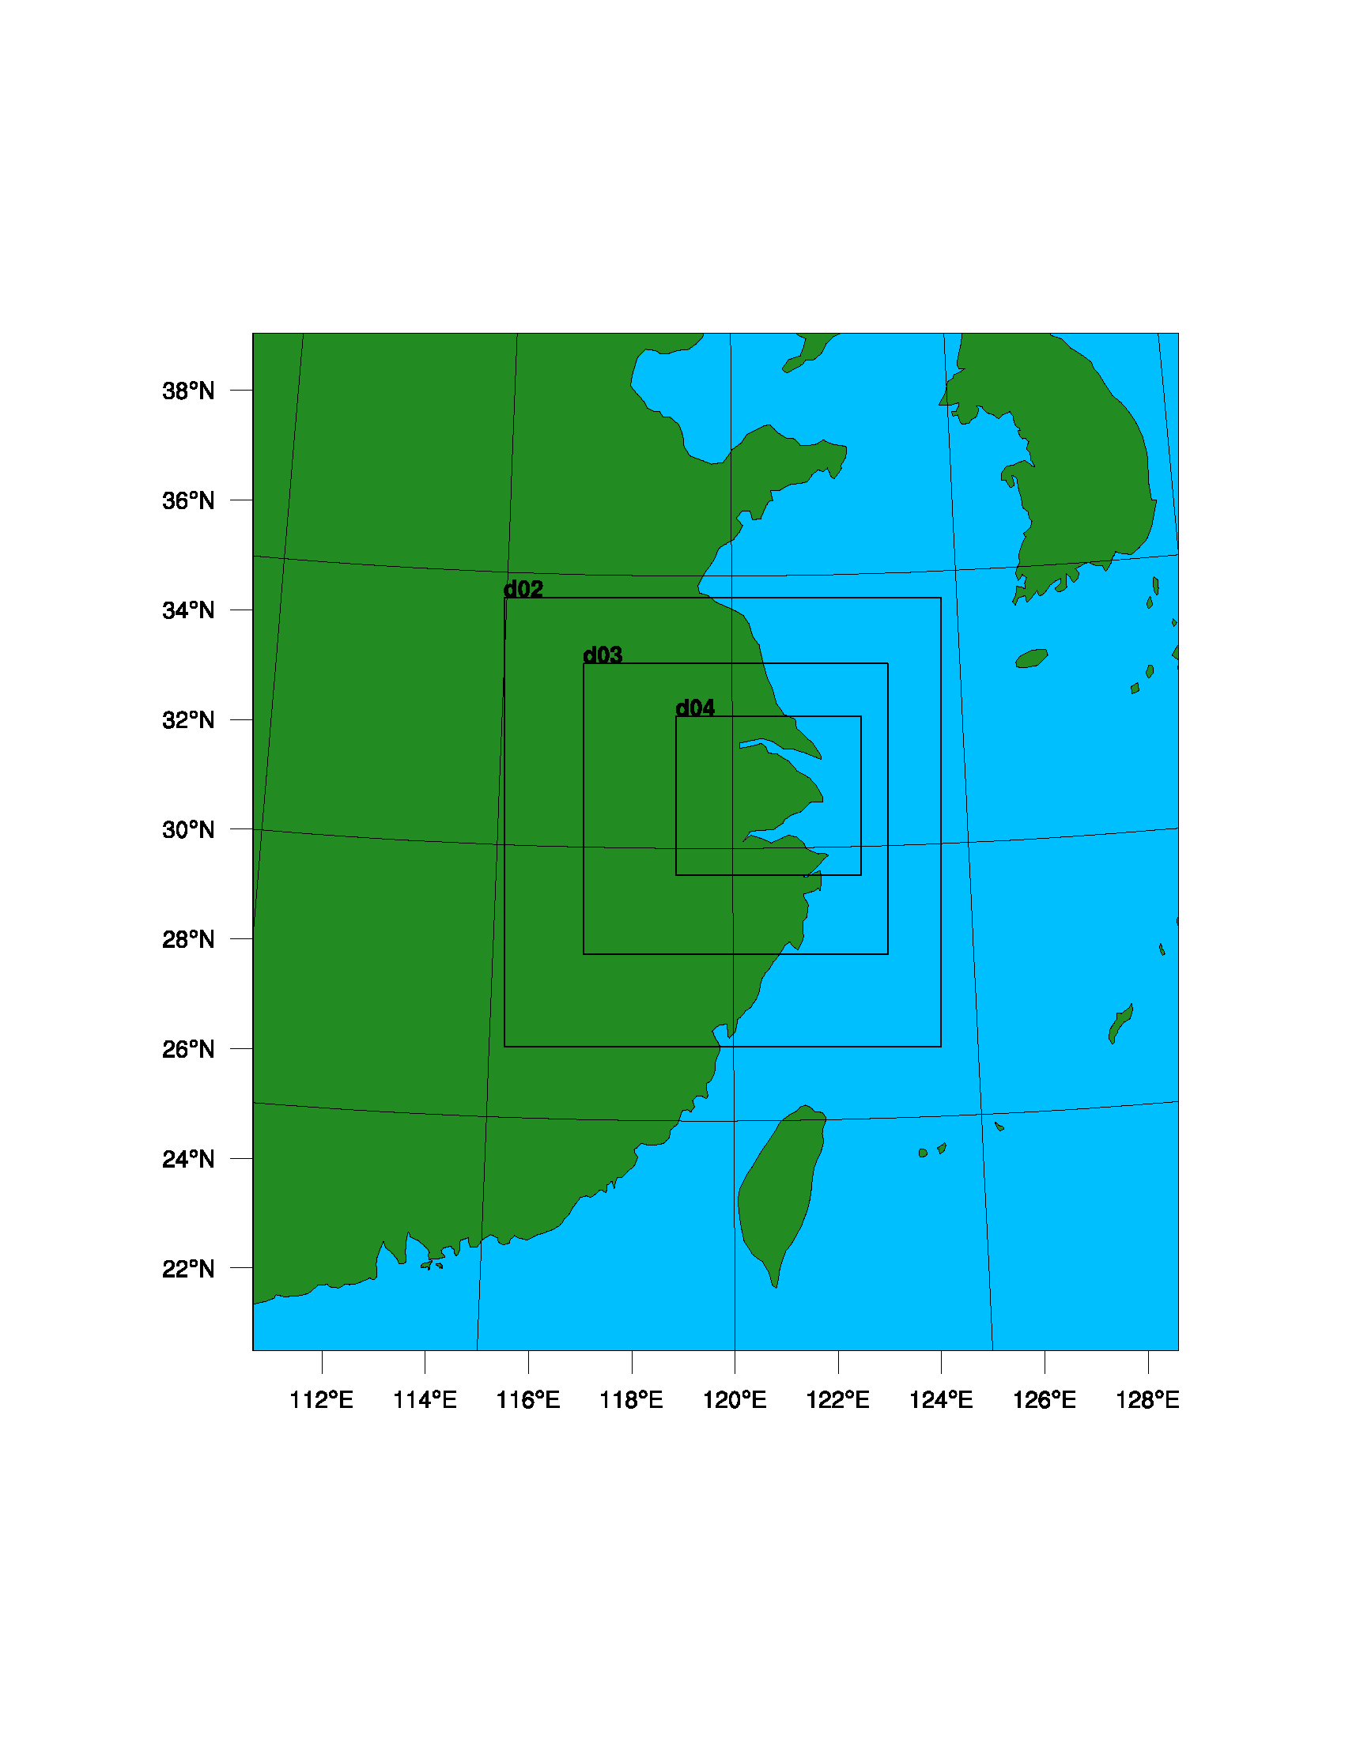

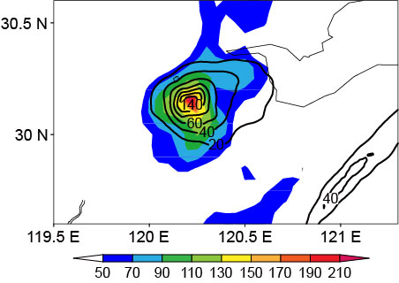
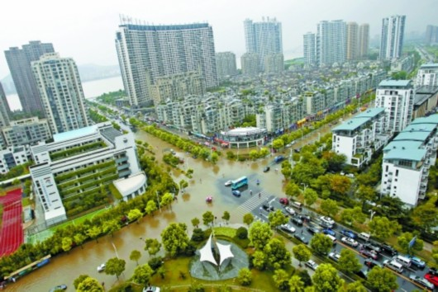
Redevelopment of remnant clouds Meranti (2010)
1500 UTC 10 Sep.
0100 UTC 11 Sep.
declined into TD
1800 UTC 10 Sep. 2010
1km
3km
9km
27km
Hourly rainfall
AccPre 2100 UTC~0400 UTC 11 Sep. 2010

Slide 9
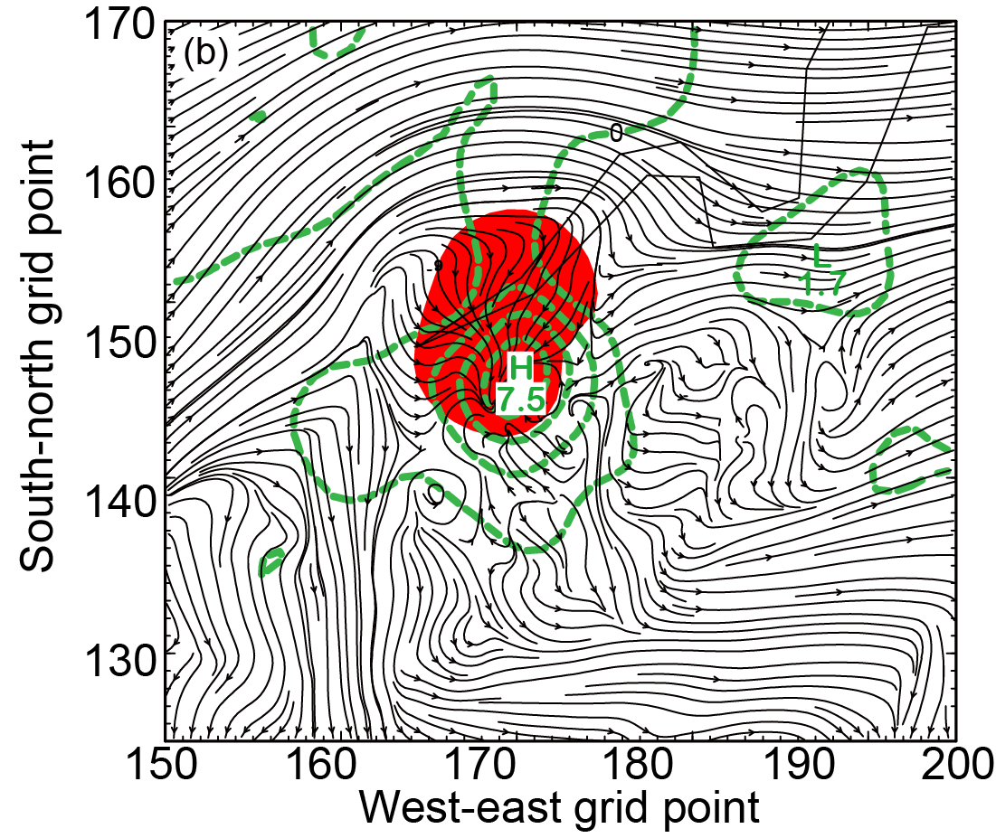
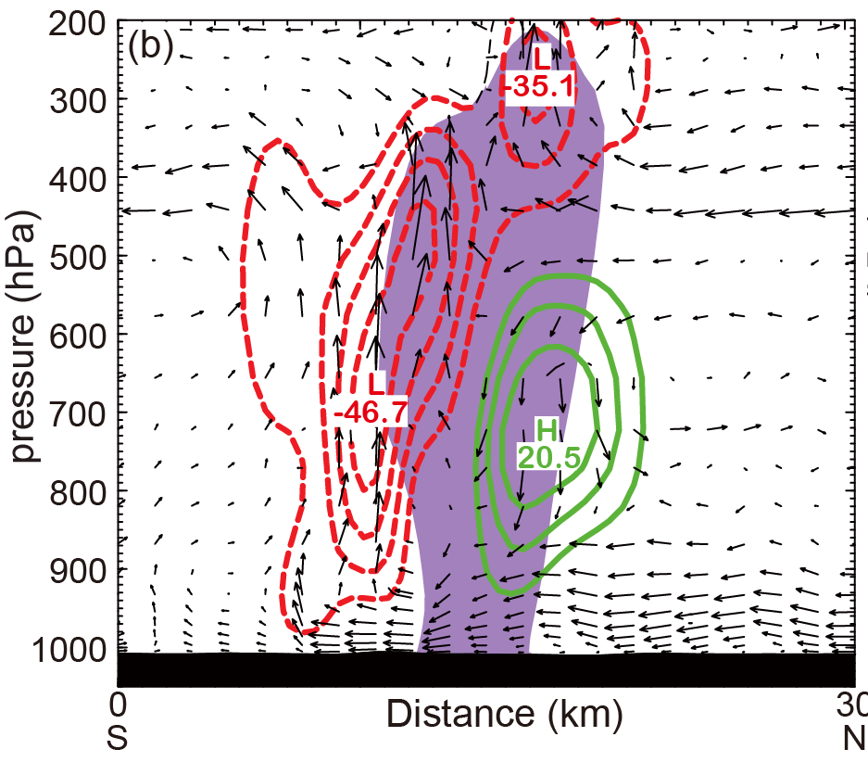
350 K stream field +750 hPa MPV+ 1hr Rain(>=50mm)
MPV
Sudden rainstorm
Remnant clouds re-developed
Vertical vorticity strenghtened
SVD
Slantwise vorticity development
(Wu et al. 1995)
Stability decreased
Horizontal wind shear increased
Vertical vorticity strenghtened
Horizontal moist baroclinicity increased
Vertical velocity & MCS (water+rain mixing ratio > 4g/kg)

Slide 10
Work progress in PSU in past 4 months

Slide 11
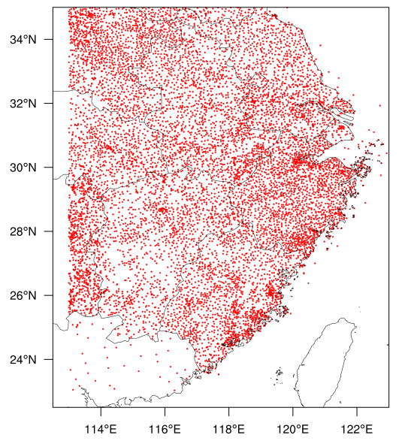
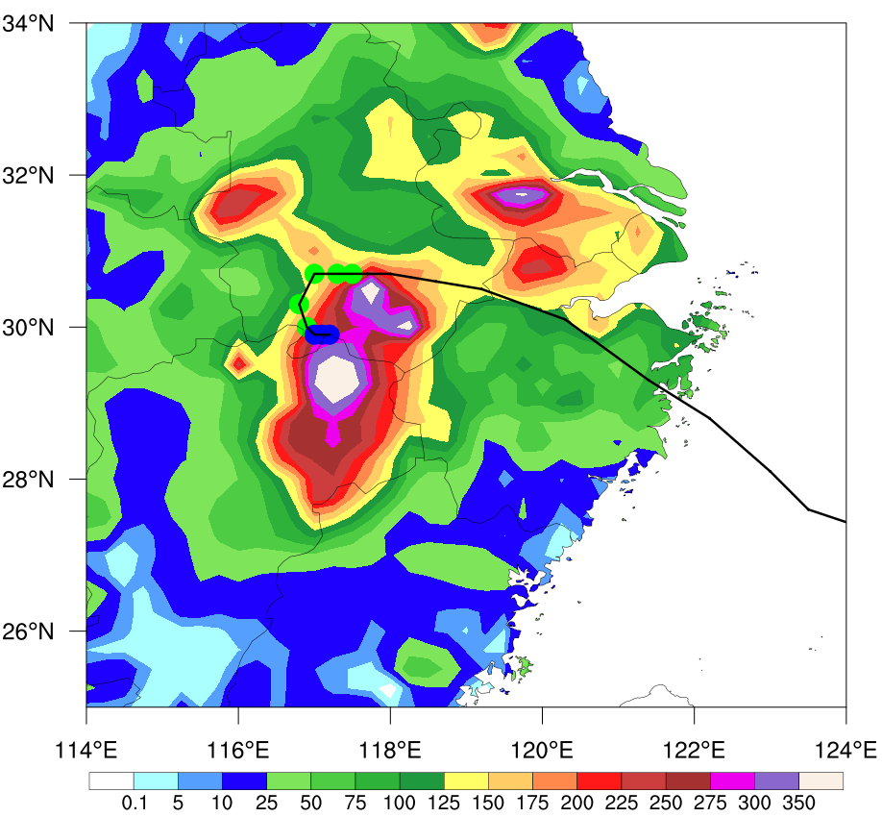
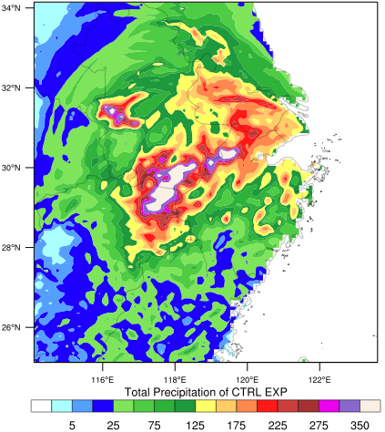
96hr Accumulative rain 1200 UTC 07 – 1200 UTC 11 2012
Typhoon Haikui
Surface observtion station distribution
AWS Observation
Control experiment

Slide 12
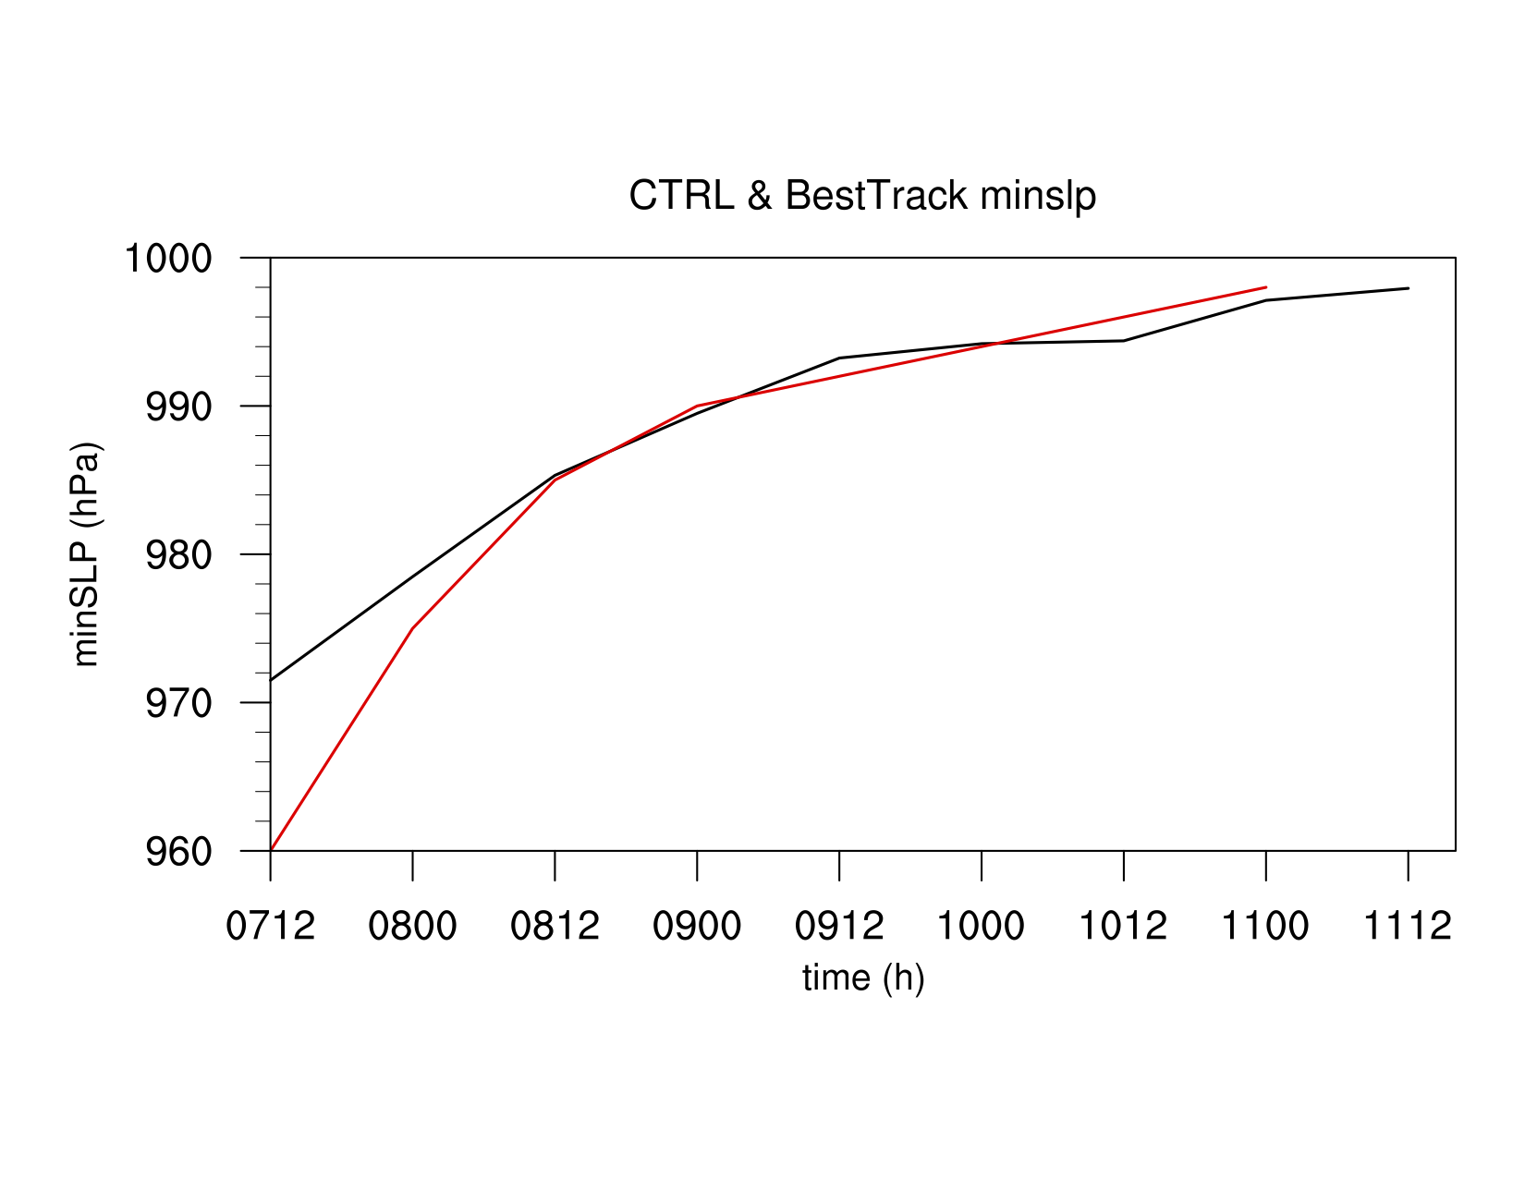
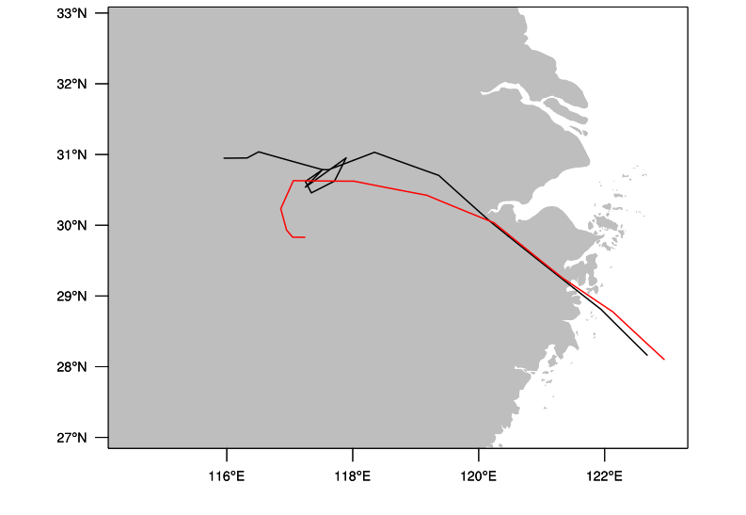
96hr typhoon track & minimum sea level pressure 1200 UTC 07 – 1200 UTC 11 2012
CONTRL
Observation

Slide 13
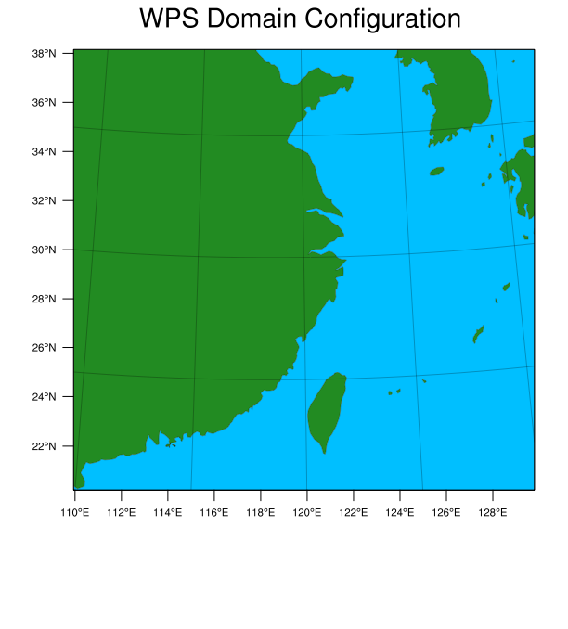
Single domain
231X221 grids
30 vertical levels
9 km grid space
2012-08-07_12:00:00:00 to 2012-08-11_12:00:00:00
physics_suite = “tropical”
mp_physics = 8
Extracting perturbations from Tigge dataset and add them to the initial conditions of control experiement to produce 50 ensemble members.
Perturbations: U, V, T, RH and GH at surface and pressure levels ( 1000, 925,850,700,500,300,250,200 hPa).

Slide 14
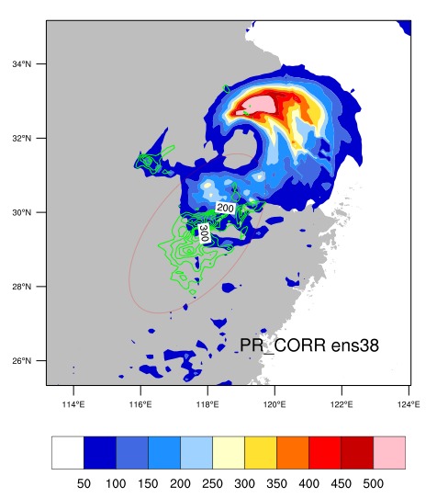
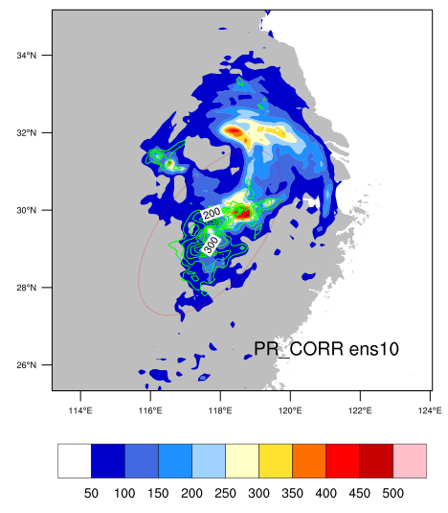
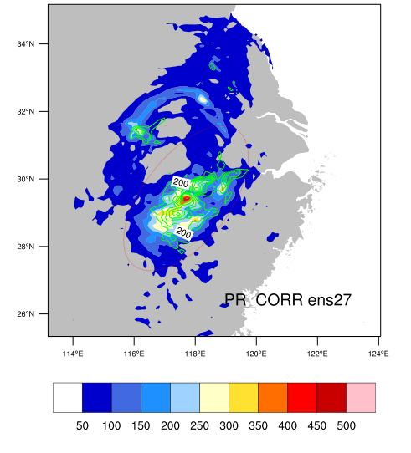
worst
best
Accumulative rain 0900 UTC to 1112 UTC Aug. 2012

Slide 15
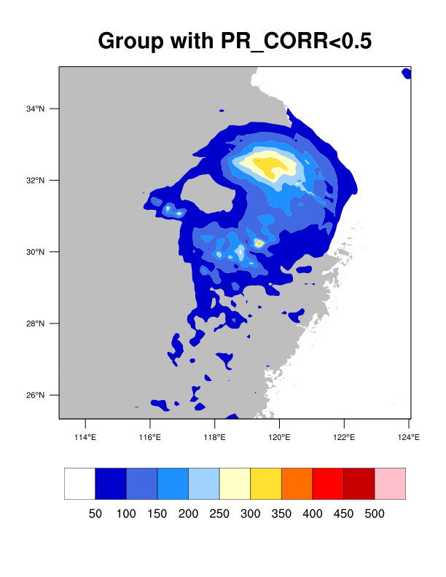
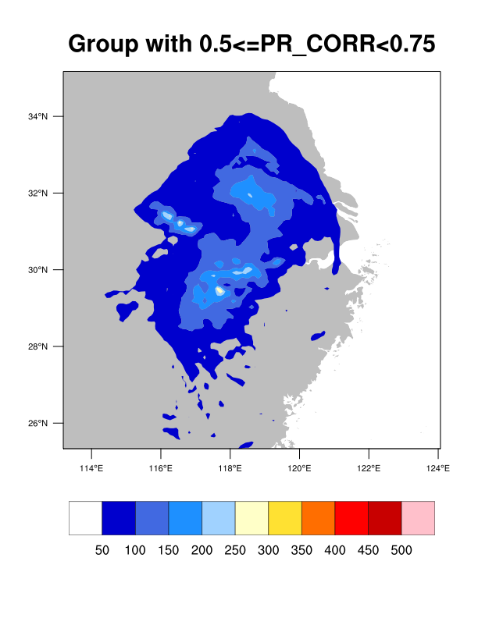
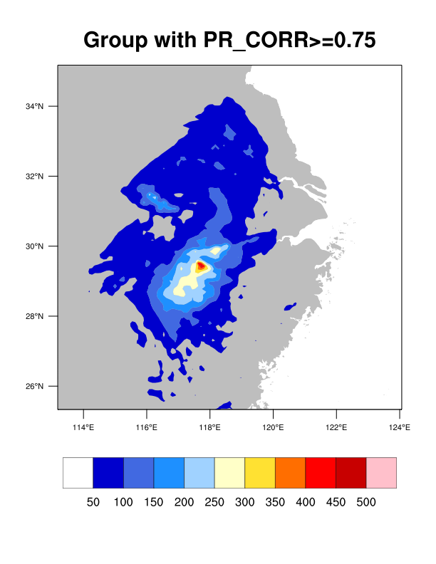
Group mean accumulative rain (0900 ~1112 UTC Aug. 2012)

Slide 16
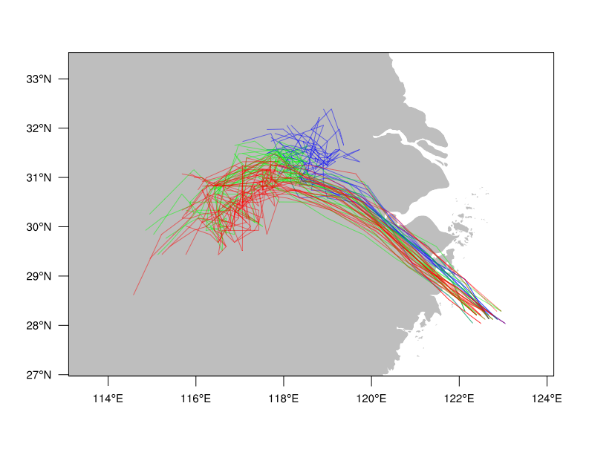
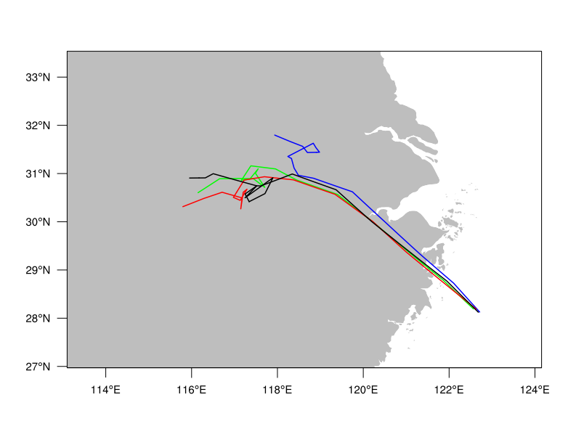
Groups divided by Pearson Correlation between control and ensemble member rains
50 ensemble members tracks
Group mean tracks
PR_CORR <0.5
0.5<=PR_CORR<0.75
PR_CORR>=0.75

Slide 17
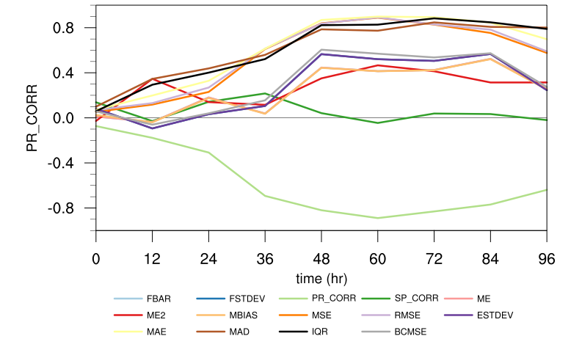
Pearson-correlation b/w rain error statistics &
Ensemble forecast typhoon track deviation from control forecast

Slide 18
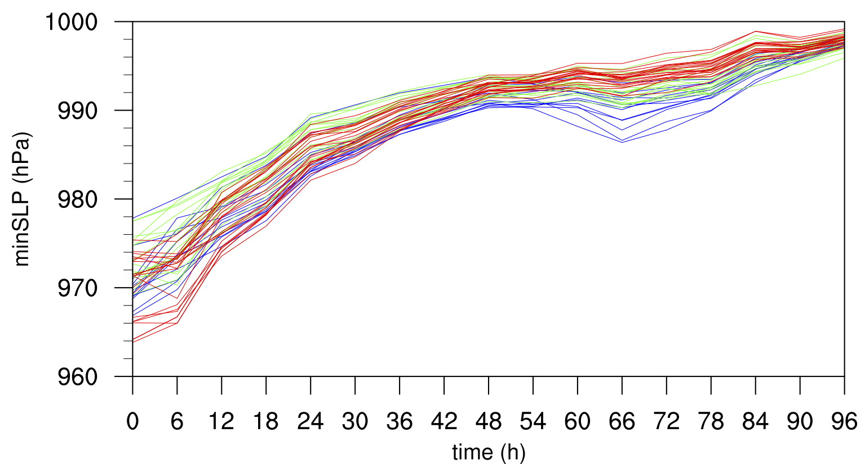
Groups divided by Pearson Correlation between control and ensemble member rains
50 ensemble members minimum sea level pressure
Group mean minimum sea level pressure
50 ensemble members maximum wind
Group mean maximum wind
PR_CORR <0.5
0.5<=PR_CORR<0.75
PR_CORR>=0.75
CONTROL

Slide 19
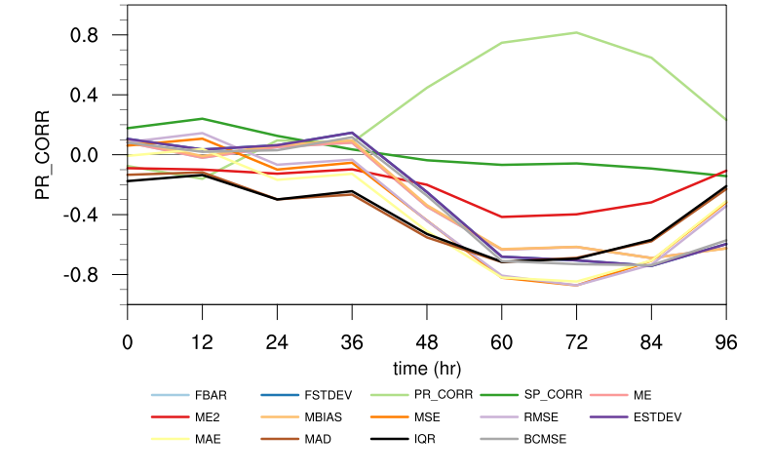
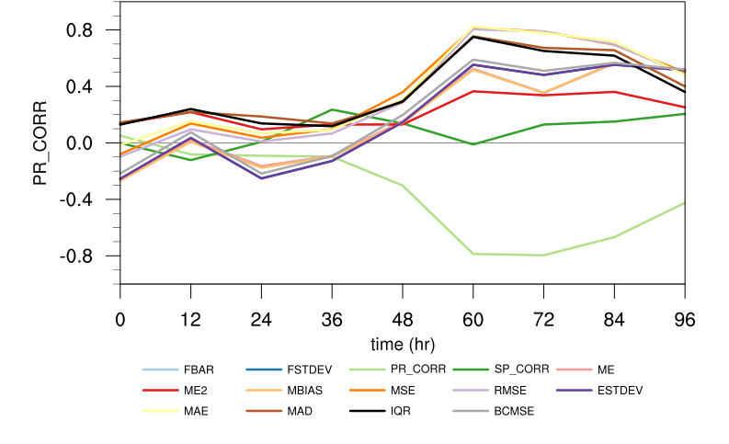
Pearson-correlation b/w rain error statistics &
ensemble forecast typhoon intensity
Minimum central sea level pressure
Maximum wind

Slide 20
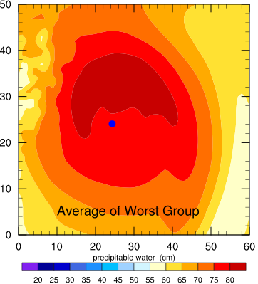
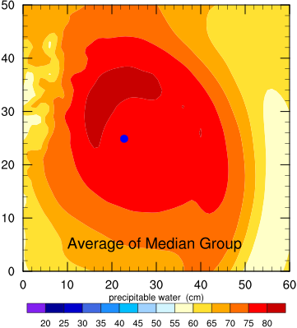
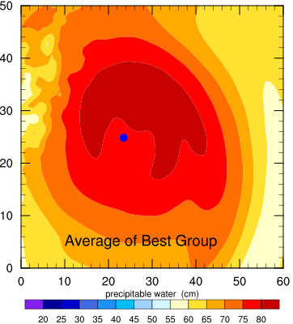
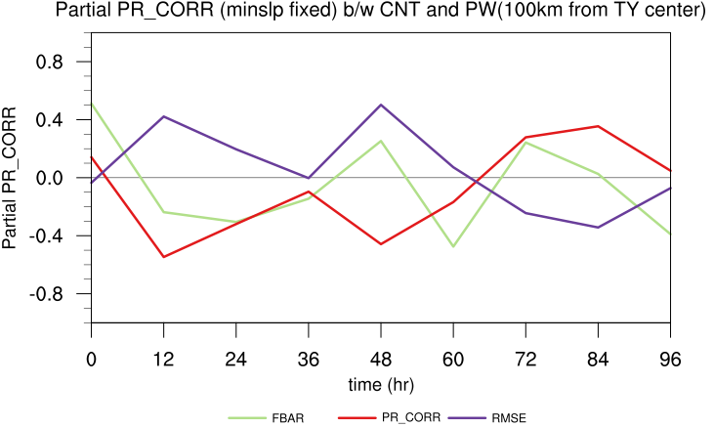
Group mean initial Precipitable Water (cm)

Slide 21
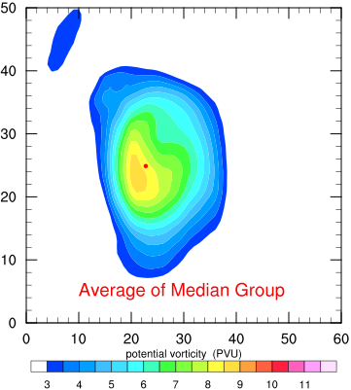
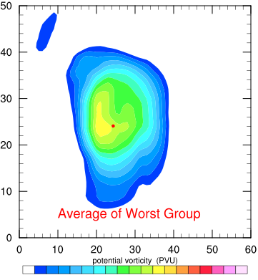
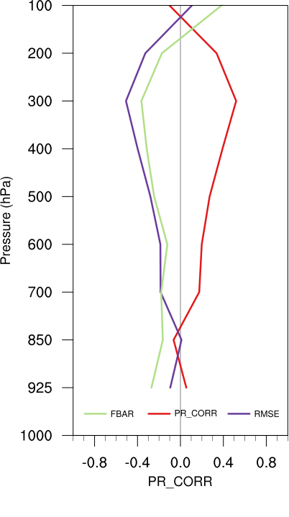
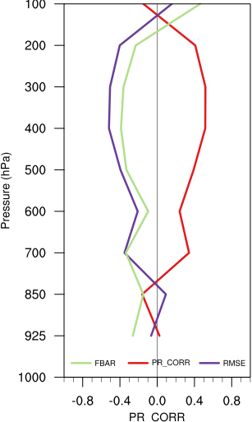
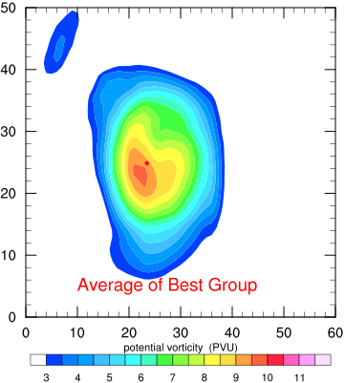
Group mean 400hPa initial Potential Vorticity
Partial PR_CORR
(minslp fixed)
PR_CORR b/w initial PVO & Rain error statistics

Slide 22
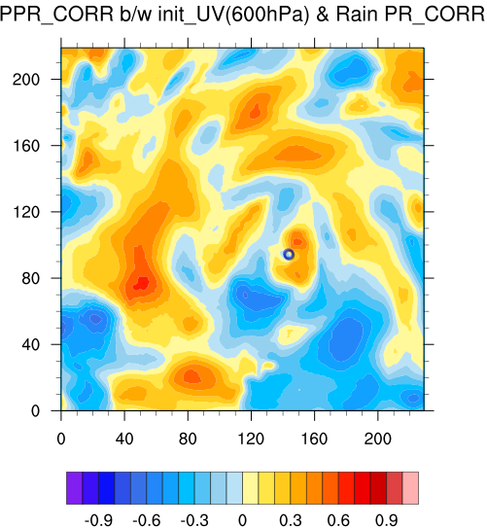
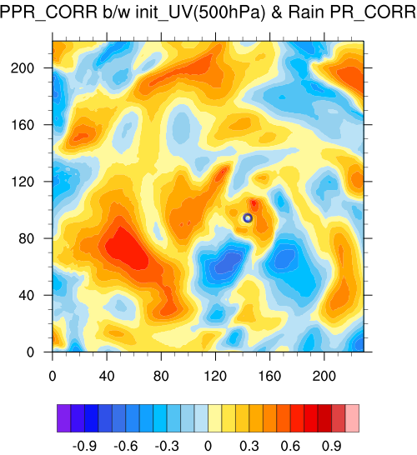
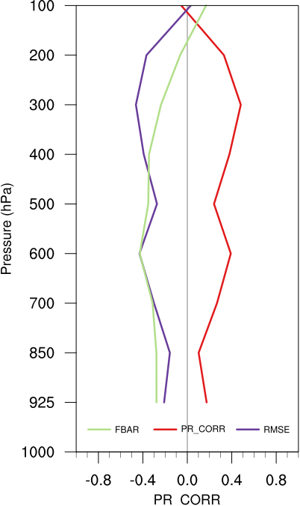



Partial PR_CORR
(with minslp fixed)
Total PR_CORR
PR_CORR b/w initial VOR & Rain error statistics
(100 km distance from initial typhoon center)

Slide 23




Partial PR_CORR
(with minslp fixed)
Total PR_CORR
Partial PR_CORR
(with minslp fixed)
450km
700km
300hPa
700hPa
PR_CORR b/w initial SHUM & Rain error statistics
(100 km distance from initial typhoon center)

Slide 24



Group mean initial 700hPa equivalent potential temperature (K)

Slide 25
Next work:
1、Group mean initial condition experiments
2、Sensitive experiments with
Different initial conditions in environment area?
Different initial conditions in typhoon core area ?

Slide 26
Thanks for your attention!

