Slide 1



Exploring Online Data Assimilation for Paleoclimate Reconstruction
Using an Idealized OSSE Framework
Atsushi Okazaki^{1,2,3},
Takemasa Miyoshi², Kei Yoshimura³,
Steven Greybush¹, Michael Mann¹, Fuqing Zhang¹
¹Pennsylvania State University
²RIKEN Center for Computational Science
³Institute of Industrial Science, The University of Tokyo

Slide 2




Climate Reconstruction and Data Assimilation
H. von Storch proposed the idea of paleo-DA in 2000
Last Millennium Reanalysis Project started in US
Data Assimilation and Proxy System modeling (DAPS)
working group launched
as a part of PAGES
Millennium Reanalysis Project started in Japan
2000
von Storch, Cubasch, Gonzalez-Rouco, Jones, Voss, Widmann, and Zorita,
Combining paleoclimatic evidence and GCMs by means of data assimilation through upscaling and nudging (DATUN), 11th American Symposium on Global Change, 28-31, , 2000.
2015
2018
Notes:
booming

Slide 3

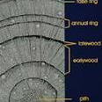
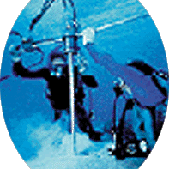



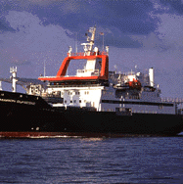


Difficulty in paleo-DA; observation
 | NWP | Paleoclimate
Variable | Direct State (e.g. temperature) | Indirect state (e.g. tree-ring width)
Amount | N>10⁷/day | N~10³/year
Frequency | Finer than daily | Longer than annual
Representativeness | Instantaneous | Time-averaged
Information does not accumulate over time due to the chaotic nature of climate and the temporally sparse observation
Difficult to analyze the initial condition (instantaneous value) with time-averaged data
Tree-ring
Coral
Ice core
photos from
NOAA Paleoclimatology
Datasets
Foraminifera
Speleothem
Notes:
However to apply data assimilation for NWP to paleoclimate is not trivial due to the difference in observation.
This slide compares observation for the present day NWP and for paleoclimate.
First, we cannot know direct state of the climate but what we can get is indirect state like tree-ring width, isotope ratio in ice cores, etc.
Second, the amount of observation is much small for paleoclimate.
Moreover, observation frequency is low in paleoclimate and typically longer than annual. And what we can get is not instantaneous but time-averaged value.
What’s the problem with such data?
First of all, it is difficult to analyze the initial condition for the next DA-cycle with time-averaged data
Second, even if the initial condition are successfully analyzed, the observation information does not propagate over time due to the low temporal resolution
-----
https://www.ncdc.noaa.gov/data-access/paleoclimatology-data/datasets

Slide 4
DA-algorithm in Paleoclimate
Acevedo, W., Fallah, B., Reich, S., Cubasch, U., Assimilation of pseudo-tree-ring-width observations into an atmospheric general circulation model, Clim. Past, 12, 545-557, 2017.
observation
Online-DA
Particle Filter (e.g. Goosse et al., 2006)
analysis is cycled
Offline-DA
Ensemble Kalman Filter / Fitting
(e.g. Bhend et al., 2012)
analysis is NOT cycled
→ background ensemble is same as free-run
time-mean field is analyzed but initial condition for the next DA-cycle is not analyzed
← predictability << proxy temporal resolution
Forecast
Analysis
Online-DA
Offline-DA
Notes:
To assimilate such observations, unique DA methods have been proposed in the field of paleoclimate.
The methods can be classified into two method, online and offline-DA
In the online-DA, the initial condition for the next DA-cycle is somehow analyzed and the analysis is cycled to the simulation.
In the analysis step, a method proposed by Goosse et al. simply selects an ensemble member which fit for observations the best.
In offline-DA, the initial condition for the next DA-cycle is not analyzed, but only time-mean field is analyzed. As such, the simulation is not constrained at all, and therefore, the back ground ensemble does not contain year specific information.
We can use existing simulations.

Slide 5
Offline-DA
Climatological error covariance
Initial Condition Problem
Flow dependent error covariance
Online-DA
Heavier, but better
Notes:
Then, the question is which DA method is better?

Slide 6
Online-DA or Offline-DA?
Acevedo, W., Fallah, B., Reich, S., Cubasch, U., Assimilation of pseudo-tree-ring-width observations into an atmospheric general circulation model,
Clim. Past, 12, 545-557, 2017.
__ online-forecast
__ free-forecast
__ online-analysis
__ offline-analysis
RMSE for SAT [K]
OSSE assimilating annual mean surface air temperature (SAT)
Atmospheric GCM (SPEEDY) coupled with slab ocean
Offline-DA: EnKF based (Bhend et al., 2012)
Online-DA: TAU (Dirren and Hakim, 2005)
Online-DA does not outperform offline-DA when annual-mean data is assimilated
Notes:
Several studies compared their skills.
Let me introduce one study by Acevedo et al., 2017.
In the paper they assimilated 1-year averaged surface air temperature, and investigated which DA-method is better.
The figure compares the RMSE in online-DA and offline-DA for SAT. Blue is offline-DA and green is online-DA analysis. As you can see, offline is below online and they concluded that online-DA does not outperform offline-DA with annual mean data.
Given the performance and the computational cost, offline-DA has been more popular than online-DA these days.

Slide 7
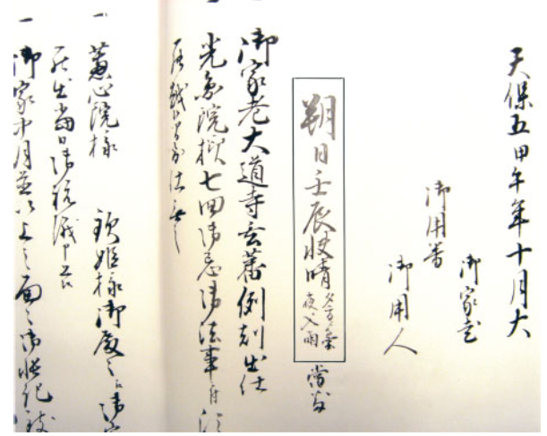
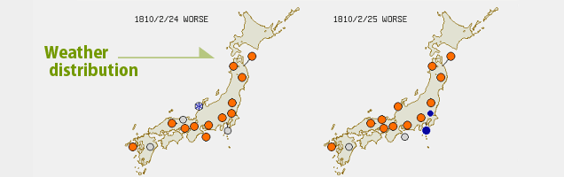
Observation gets finer!
←Zhu, M., Stott, L., Buchley, B., and Yoshimura, K., 20th century seasonal moisture balance in Southeast Asian montane forests from tree cellulose δ¹⁸O, Climatic Change, 115, 3-4, 505-517, 2012.
↓https://tk2-202-10627.vs.sakura.ne.jp/
Isotope ratio in tree-ring cellulose @ Thailand
Weather data on diary @ Japan
Daily ~ Monthly data is nowadays available from climate proxies
Notes:
The previous studies compared the skills with annual mean data.
But, recently temporal resolution of the observations gets finer and finer.
In the case of isotope ratio in tree-ring cellulose, we can get as fine as monthly information.
We can get even daily weather data on for example personal diaries.

Slide 8
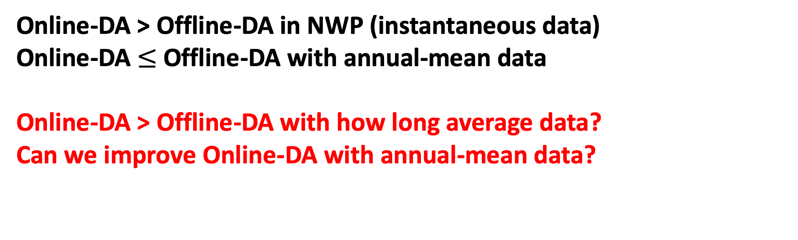
Question
Online-DA > Offline-DA in NWP (instantaneous data)
Online-DA $≤$ Offline-DA with annual-mean data
Online-DA > Offline-DA with how long average data?
Can we improve Online-DA with annual-mean data?
Notes:
We can easily expect that online-DA is better than offline-DA in numerical weather prediction in which instantaneous data is assimilated
Also we know that online-DA is not better than offline-DA with annual-mean data assimilation from the previous studies.
And Now we have observation finer than annual data.
So it’s natural to pose the question, with how long average data online-DA is better than offline-DA.

Slide 9
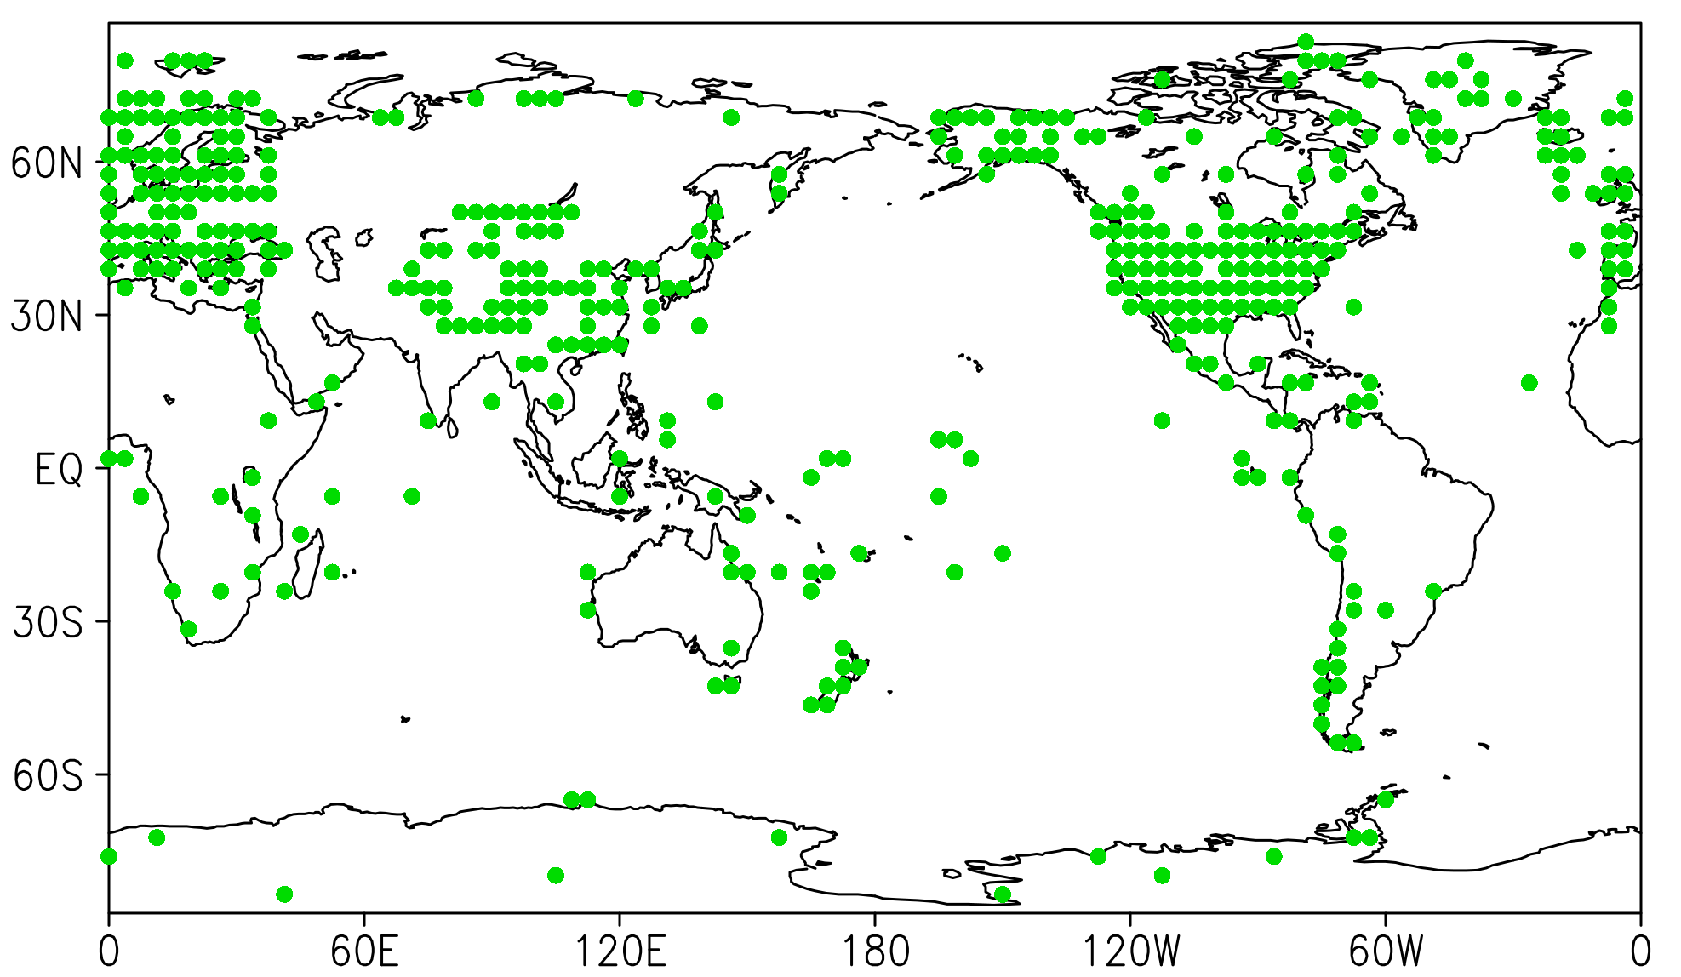
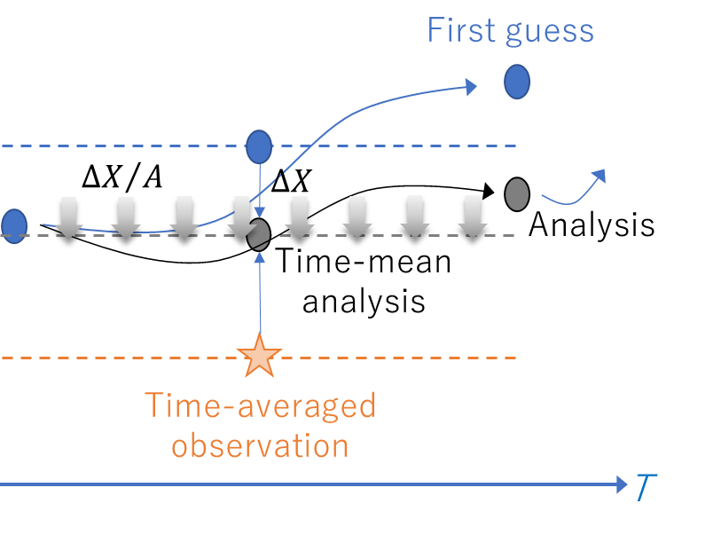
Experimental design
Observation site (based on Mann et al., 2008)
Perfect model OSSE
SPEEDY w/ slab ocean (Molteni, 2003)
the same model as Acevedo et al., 2017!
LETKF (Hunt, 2007) with 30 member
Observations
Time-averaged surface temperature (SAT, SST) (N=435)
1dy, 3dy, 10dy, 1mo, 3mo, 6mo, 1yr mean
Experiments
Offline (Bhend et al., 2012)
Online (IAU; Bloom et al., 1998)
  Analyze time-mean field first
  The time-mean field analysis is incremented every model step
IAU
Notes:
To answer the question, we assimilated various time-averaged data in the framework of the perfect model OSSE.
The observations are daily to 1-year mean surface air temperature and sea surface temperature.
The distribution of the observation mimics that of real proxy.
The model used is SPEEDY coupled with slab ocean.
And, we used LETKF with 30 ensemble member to create analysis.
We did 3 experiments; NoDA, offline, and IAU which is an online-DA. In the IAU simulations are conducted twice. Firstly it analyze time-mean field after the first run. Then the time-mean field is incremented every model time-step in the second run. By doing this, mean field in the second run is expected to be nudged toward the time-mean analysis.

Slide 10
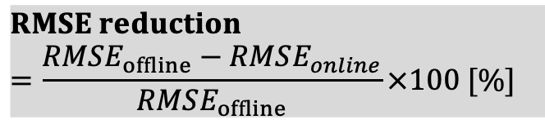
Online-DA vs. Offline-DA
$$RMSE reduction \\ =\frac{RMSE_{offline}−RMSE_{online}}{RMSE_{offline}}×100 [\%]$$
Online-DA is better
RMSE reduction [%]
Suboptimal filter (e.g., localization, covariance inflation)
Atmosphere skill is better
Ocean skill is better
Temporal representation of obs. (=DA cycle)
Notes:
But the question is the skill of IAU relative to offline.
The figure is the same as the previous one but for the RMSE relative to the offline.
With daily mean data, IAU is better than offline for both atmosphere and ocean
The result shows that the IAU is better than offline for atmosphere up to 10-day mean. It is reasonable considering that the atmospheric predictability is on the order of two weeks
While the ocean skill in IAU is better than that in offline up to 3 to 6 months.

Slide 11
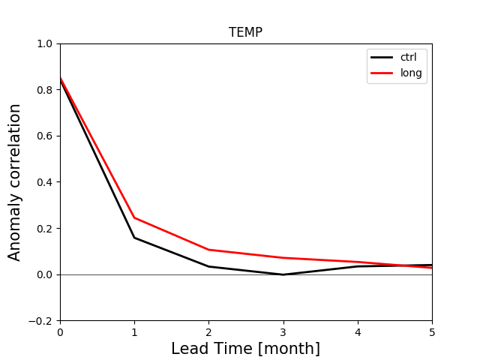
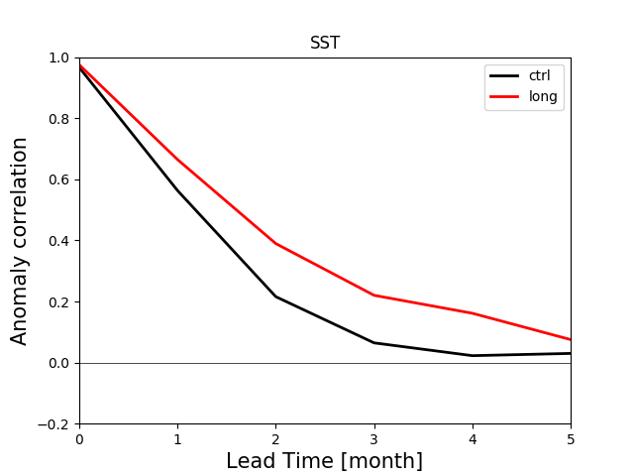
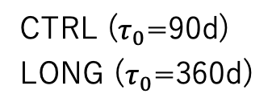
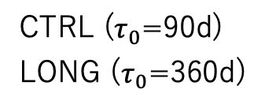
Global mean of anomaly correlation coefficient
CTRL ($τ_{0}$=90d)
LONG ($τ_{0}$=360d)
CTRL ($τ_{0}$=90d)
LONG ($τ_{0}$=360d)
Predictability of monthly mean SAT (SST) is 1~2 (2~4) months
Predictability is a necessary condition for online-DA to beat offline-DA
➔ online-DA does not outperform offline-DA with observations whose temporal resolution is longer than predictable months
Notes:
Why 3 months?
The answer is because the predictability is 3 months.
The figures show the global mean of anomaly correlation between the nature run and the ensemble forecast from the perturbed initial condition of the nature run.
Anomaly correlation is a metric of predictability. If the value is significantly larger than zero, that variable is considered to be predictable.
According to the figures, the predictability of monthly SST is around 2-4 months.
Predictability is a necessary condition for online-DA to beat offline-DA.
Therefore, online-DA does not outperform offline-DA with 6-month data and longer

Slide 12
Then, what the result will be if the predictability is longer?

Slide 13
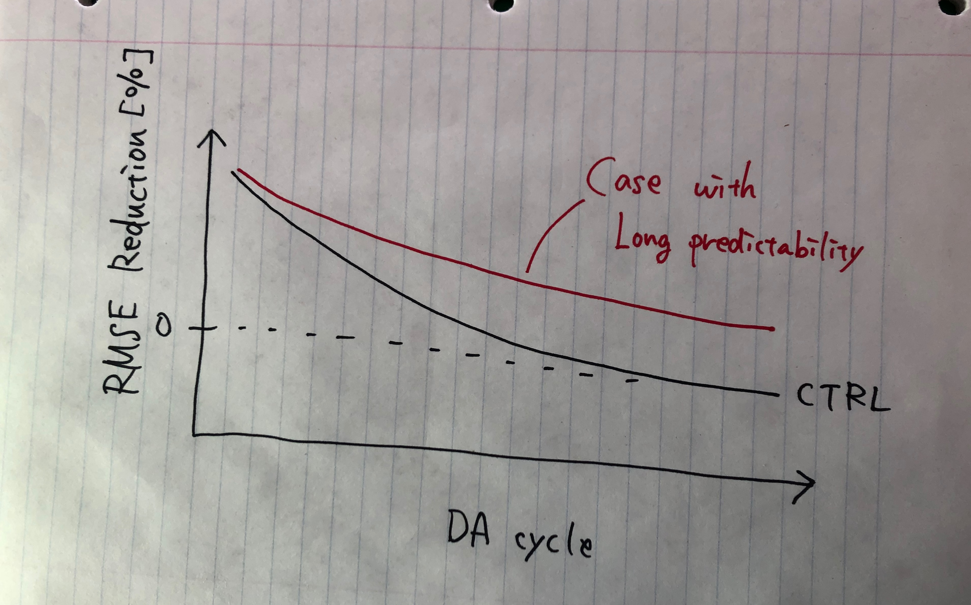
My expectation
The longer the predictability, the longer the upper limit of effectiveness of online-DA

Slide 14
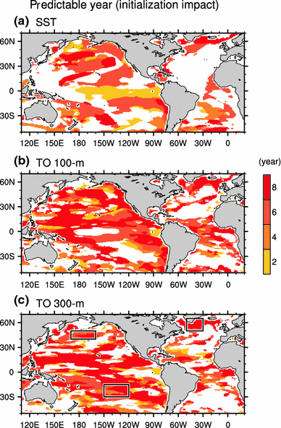
Predictable years of the 3-year-mean ocean temperature anomalies
Shaded region indicates the area with ACC higher than 0.55 (p<0.05) and RMSE of the HCST to NoAS less than 0.9
Predictability is longer than 1-year over most of the ocean
➔ online-DA may outperform offline-DA even with annual mean data
Chikamoto et al., An overview of decadal climate predictability in a multi-model ensemble by climate model MIROC, Clim. Dyn., 40, 1201-1222, 2010.
Notes:
If that is the case, online-DA is promising for paleoclimate reconstruction.
The figure shows the predictable years of ocean temperature for real problem.

Slide 15
Summary and Future plan
Online-DA > Offline-DA with how long average data?
Can we improve Online-DA with annual-mean data?
10-day for atmosphere and 3-month for ocean
Predictability seems to control the upper limit of effectiveness of online-DA
If so, it is highly likely that online-DA > offline-DA for real problem, given that the predictability of the ocean is longer than 1-year
Future plan
Use a model that has realistic predictability (e.g. SPEEDY coupled with full ocean model) to confirm the above idea

Slide 16

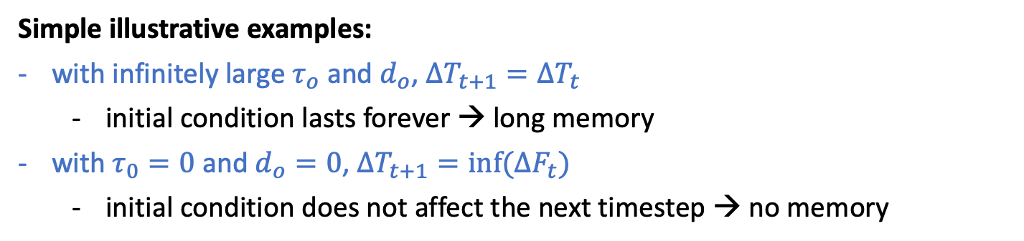
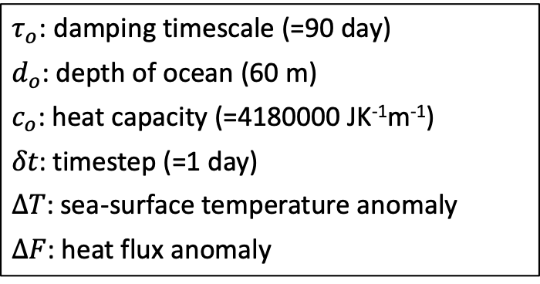
Which parameter should be tuned to control the “memory” in the slab-ocean?
$τ_{o}$: damping timescale (=90 day)
$d_{o}$: depth of ocean (60 m)
$c_{o}$: heat capacity (=4180000 JK⁻¹m⁻¹)
$δt$: timestep (=1 day)
$ΔT$: sea-surface temperature anomaly
$ΔF$: heat flux anomaly
$$ΔT_{t+1}=\frac{τ_{0}}{τ_{0}+δt}ΔT_{t}+\frac{δt}{d_{o}c_{o}}ΔF_{t}$$
Damping-term
Flux-term
Simple illustrative examples:
with infinitely large $τ_{o}$ and $d_{o}$, $ΔT_{t+1}=ΔT_{t}$
  initial condition lasts forever → long memory
with $τ_{0}=0$ and $d_{o}=0$, $ΔT_{t+1}=inf⁡(ΔF_{t})$
  initial condition does not affect the next timestep → no memory
Notes:
The idea can be confirmed by changing the predictability and comparing online-DA and offline-DA.

Slide 17
Which parameter should be tuned to control the “memory” in the slab-ocean?
Global mean of anomaly correlation coefficient
CTRL ($τ_{0}$=90d)
LONG ($τ_{0}$=360d)
CTRL ($τ_{0}$=90d)
LONG ($τ_{0}$=360d)

Slide 18
Online-DA vs. Offline-DA with modified slab ocean parameter
COMING SOON
RMSE reduction [%]
Atmosphere skill is better
Ocean skill is better
Temporal representation of obs. (=DA cycle)
Notes:
But the question is the skill of IAU relative to offline.
The figure is the same as the previous one but for the RMSE relative to the offline.
With daily mean data, IAU is better than offline for both atmosphere and ocean
The result shows that the IAU is better than offline for atmosphere up to 10-day mean. It is reasonable considering that the atmospheric predictability is on the order of two weeks
While the ocean skill in IAU is better than that in offline up to 3 to 6 months.

Slide 19
Anomaly correlation (monthly mean)
$$ACC=\frac{\sum_{i=1}^{T}{\left({\overline{x}}_{i}−x^{clim}\right)\left(x_{i}^{true}−x^{clim}\right)}}{\sum_{i=1}^{T}{{\left({\overline{x}}_{i}−x^{clim}\right)}^{2}}\sum_{i=1}^{T}{{\left(x_{i}^{true}−x^{clim}\right)}^{2}}}, where \overline{x_{i}}=1/N\sum_{n=1}^{N}{x_{n,i}}$$
N: ensemble size (=30)
T: The number of set of forecast (=60)
5-year long ensemble forecast (60 sets of 30-ensemble)
Initial random perturbation
…
1mon
1mon
Unperturbed control run

Slide 20
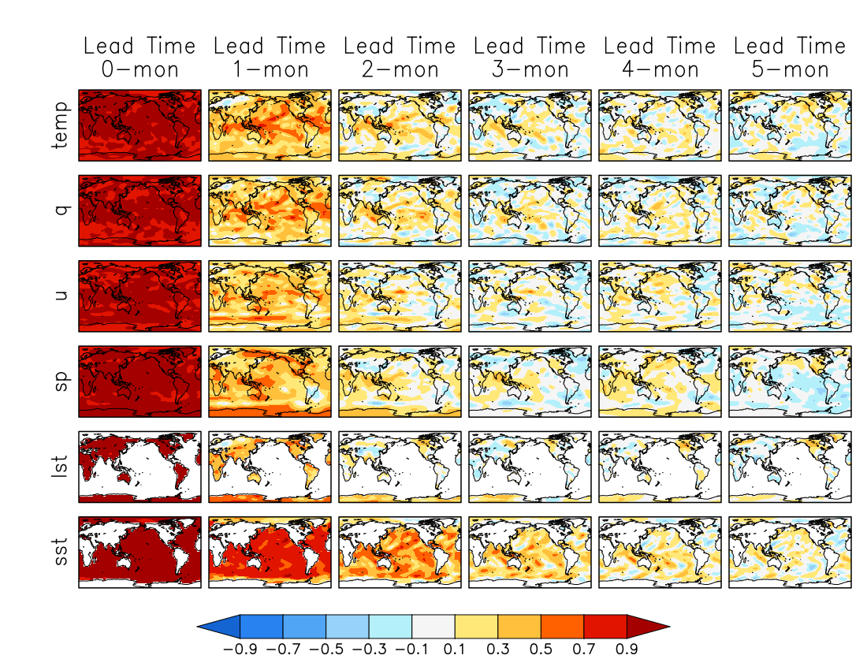
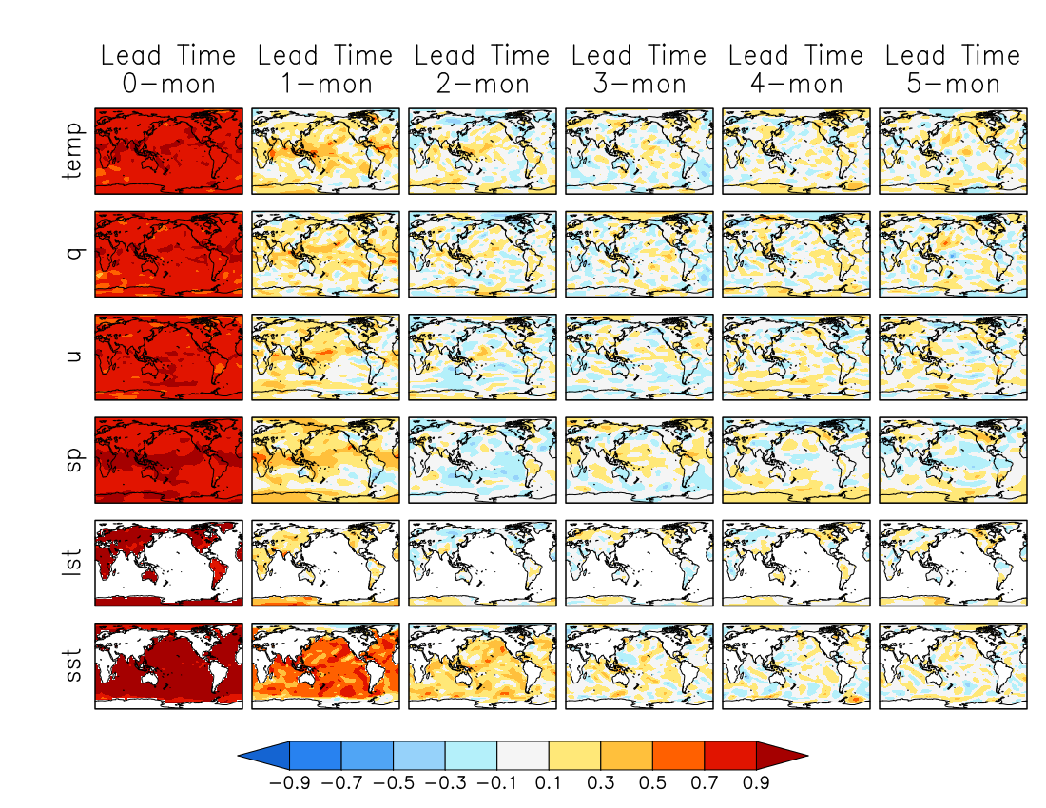
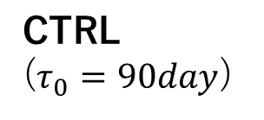
CTRL
($τ_{0}=90day$)

Slide 21
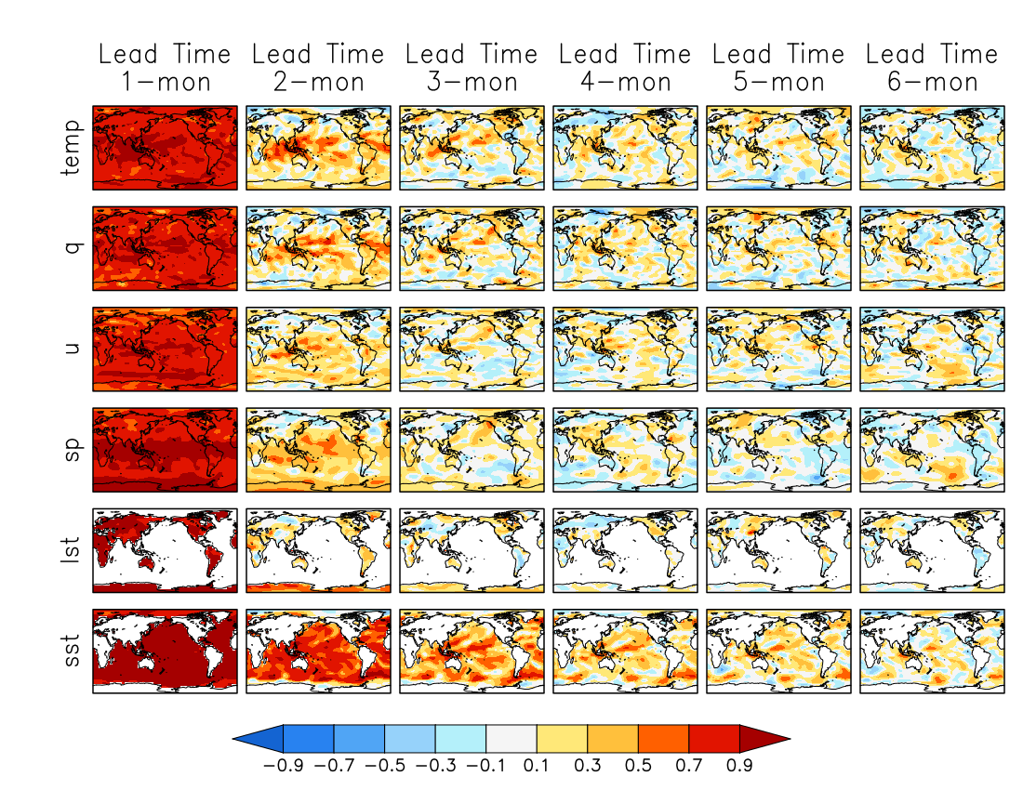
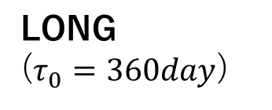
LONG
($τ_{0}=360day$)

