Slide 1
Convectively Coupled Diurnal Gravity Waves in the Maritime Continent
James Ruppert and Fuqing Zhang
End of Academic Year ADAPT Group Meeting
10 May 2019

Slide 2
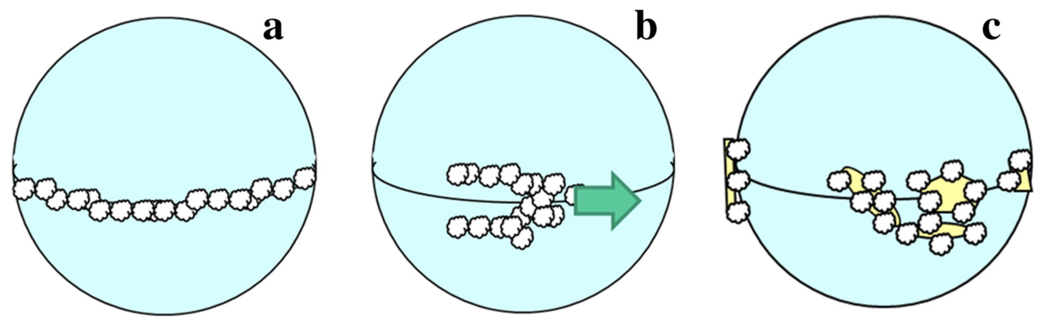
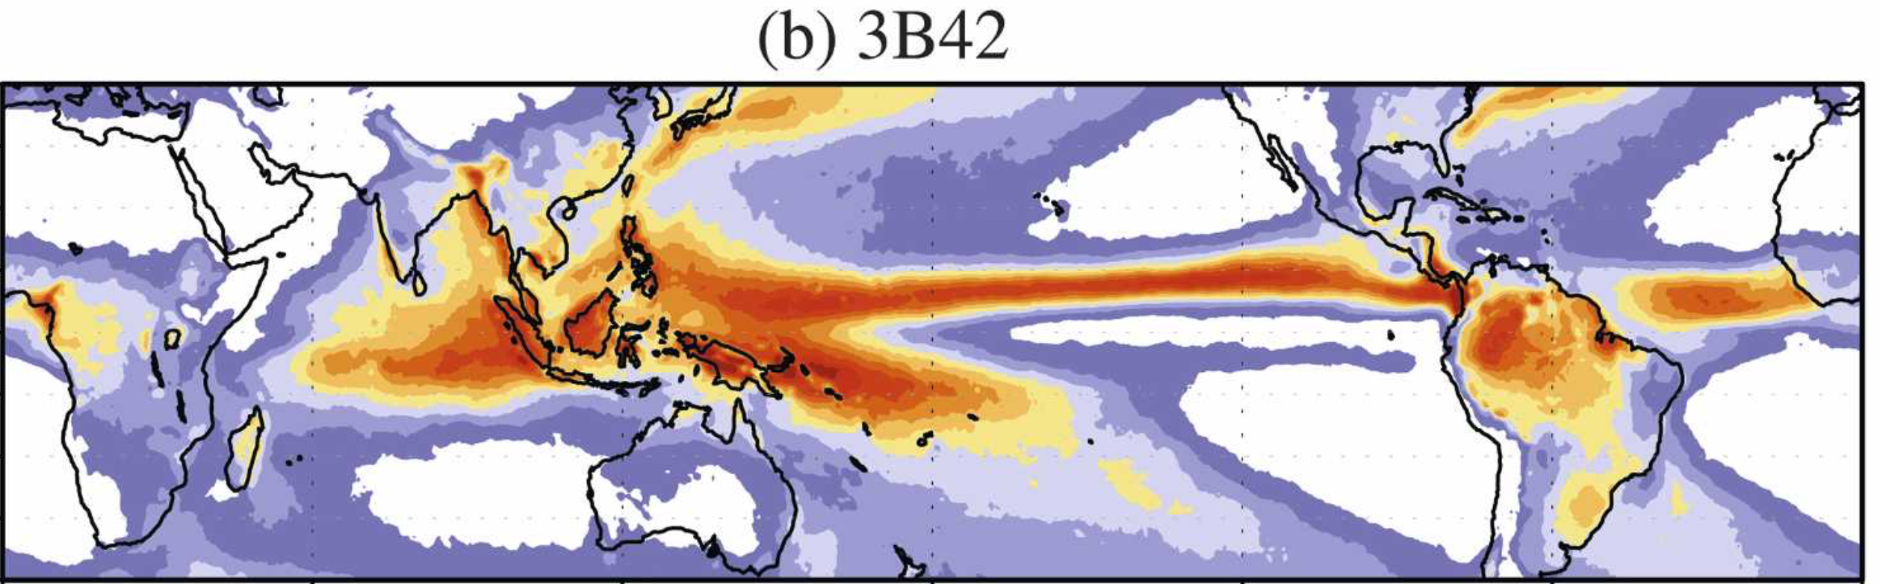
Yamanaka et al. 2018
Annual Mean Precipitation
TRMM 3B42; 1998–2006
mm day⁻¹
Kikuchi and Wang 2008

Slide 3
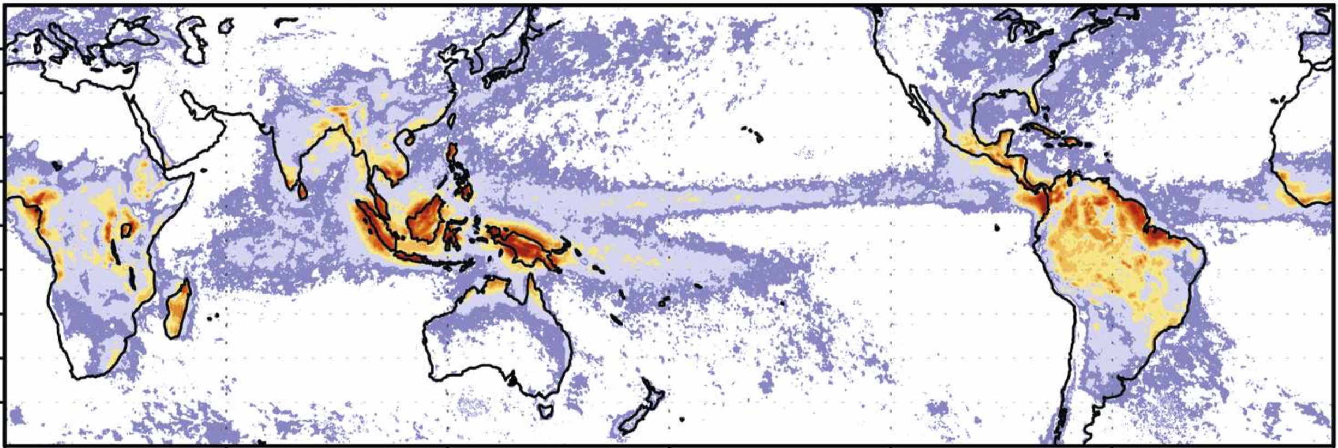
Annual Mean Precipitation
TRMM 3B42; 1998–2006
mm day⁻¹
Diurnal Range
Kikuchi and Wang 2008

Slide 4
The Maritime Continent (MC)
A dominant global source of latent heating
Global climate models greatly suffer here: both their diurnal cycle and mean state
  They do not properly capture feedback between the MC and the MJO
Inherent challenges in modeling the diurnal cycle:
  Depends on small-scale coupling between the atmosphere and a complex surface
  Lifecycle processes: daytime initiation, nocturnal upscale growth, propagation

Slide 5
Our Objective
Understand feedback mechanisms between diurnal convection and larger scale in the MC
Exploit large-scale 9-km WRF simulation (Wang et al. 2015)
Papers using this WRF simulation:
Ying and Zhang 2017
Zhang et al. 2017
Chen et al. 2018
Chen et al. 2019
Analysis / model domain

Slide 6
TRMM rainfall (contours: mm/d)
u₈₅₀ ERA5 (shading; LP filtered)
3ºS-3ºN average
Low-pass filter: 5 days, 2º
MJO
Rainfall, low-level convergence increase over central IO
Shifts eastward toward Maritime Continent at ~5 m/s
Sumatra
Borneo

Slide 7
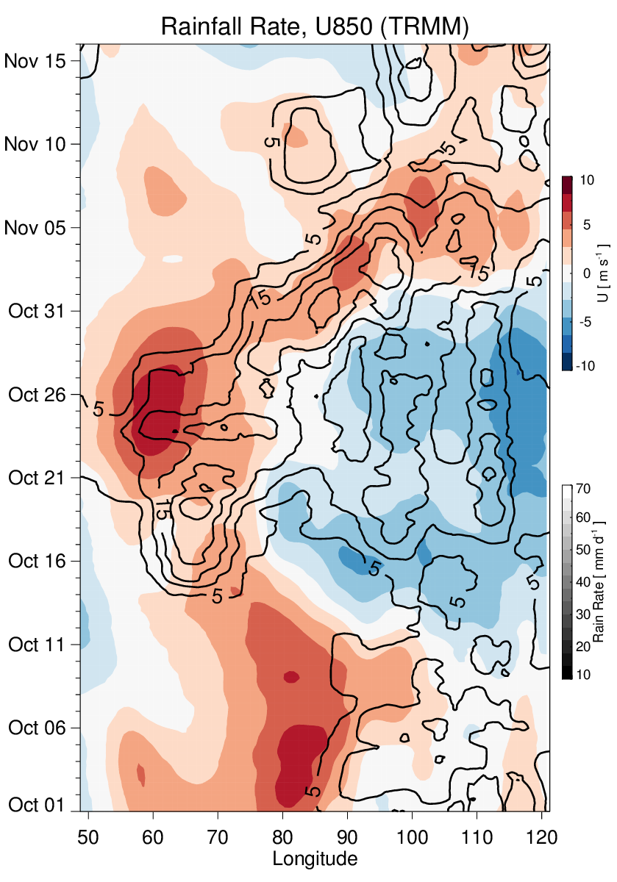
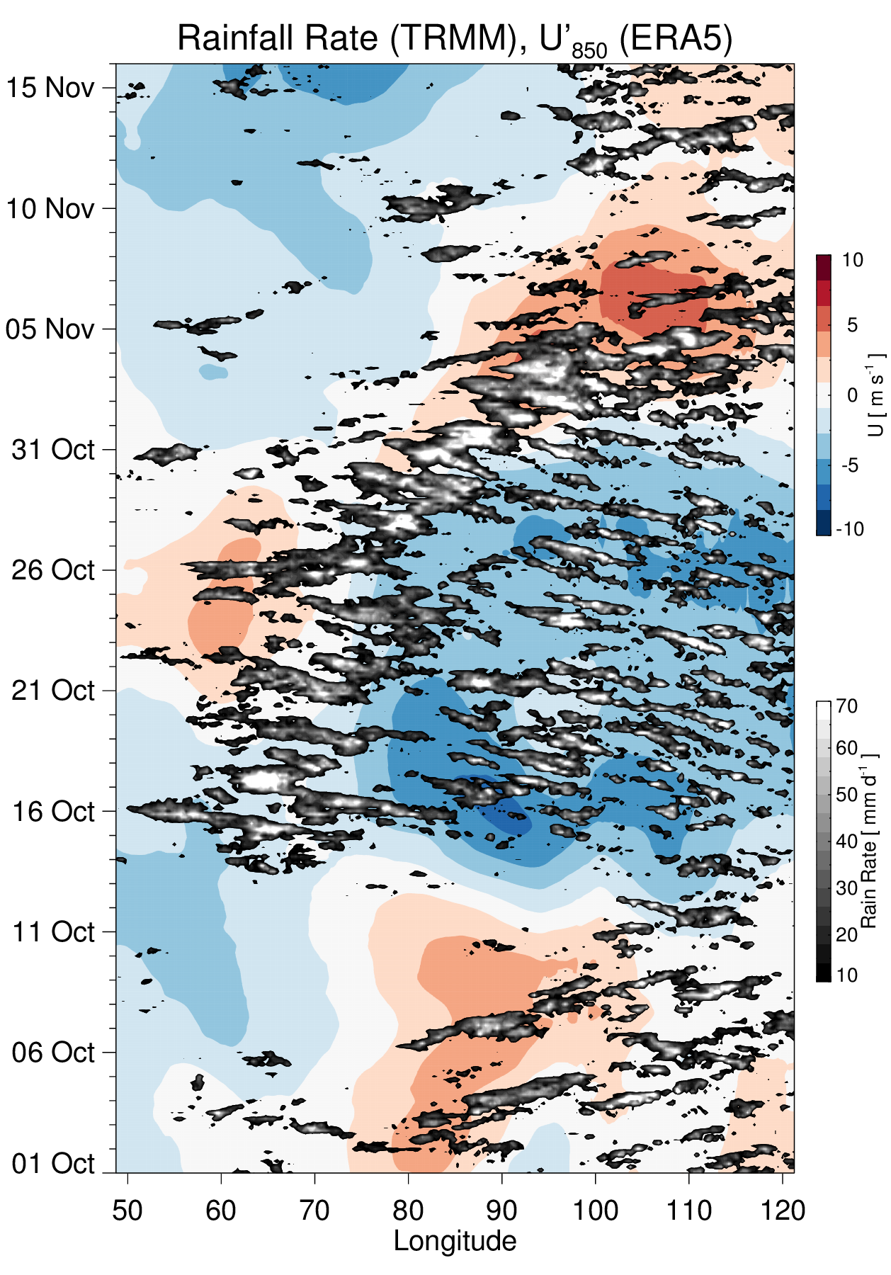
3-hourly rainfall
Diurnal
Ruppert and Zhang 2019 (in review in JAS)

Slide 8
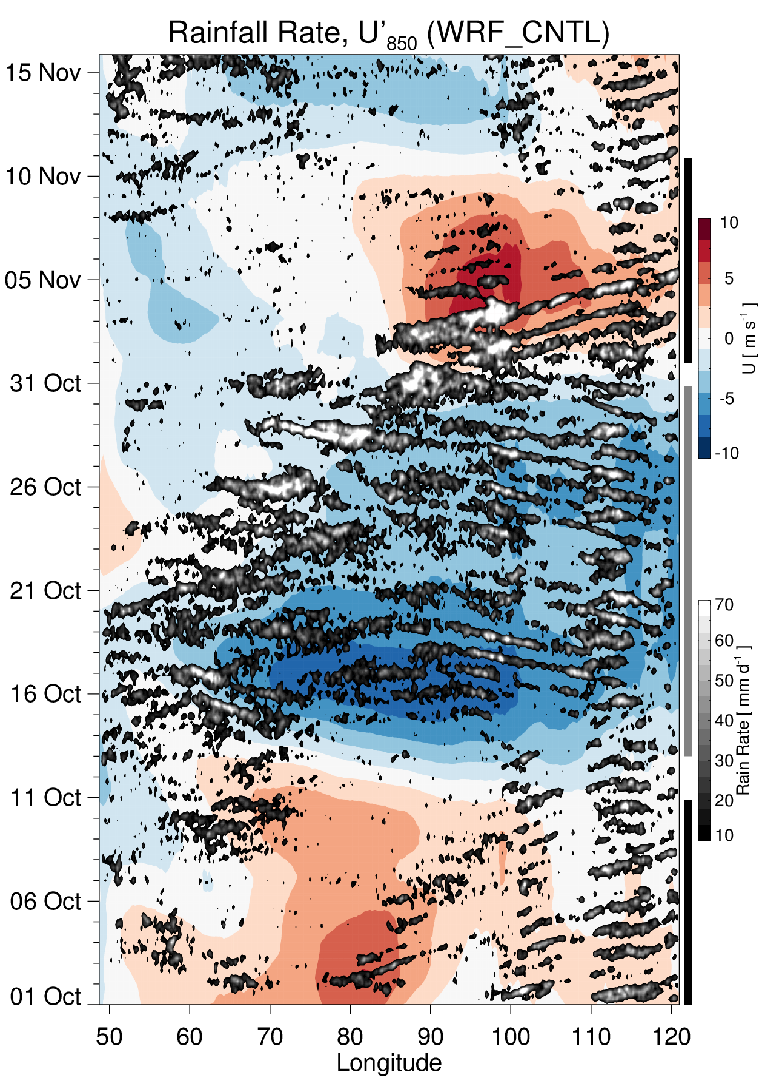
Observation
WRF Simulation
EW
WW
EW

Slide 9
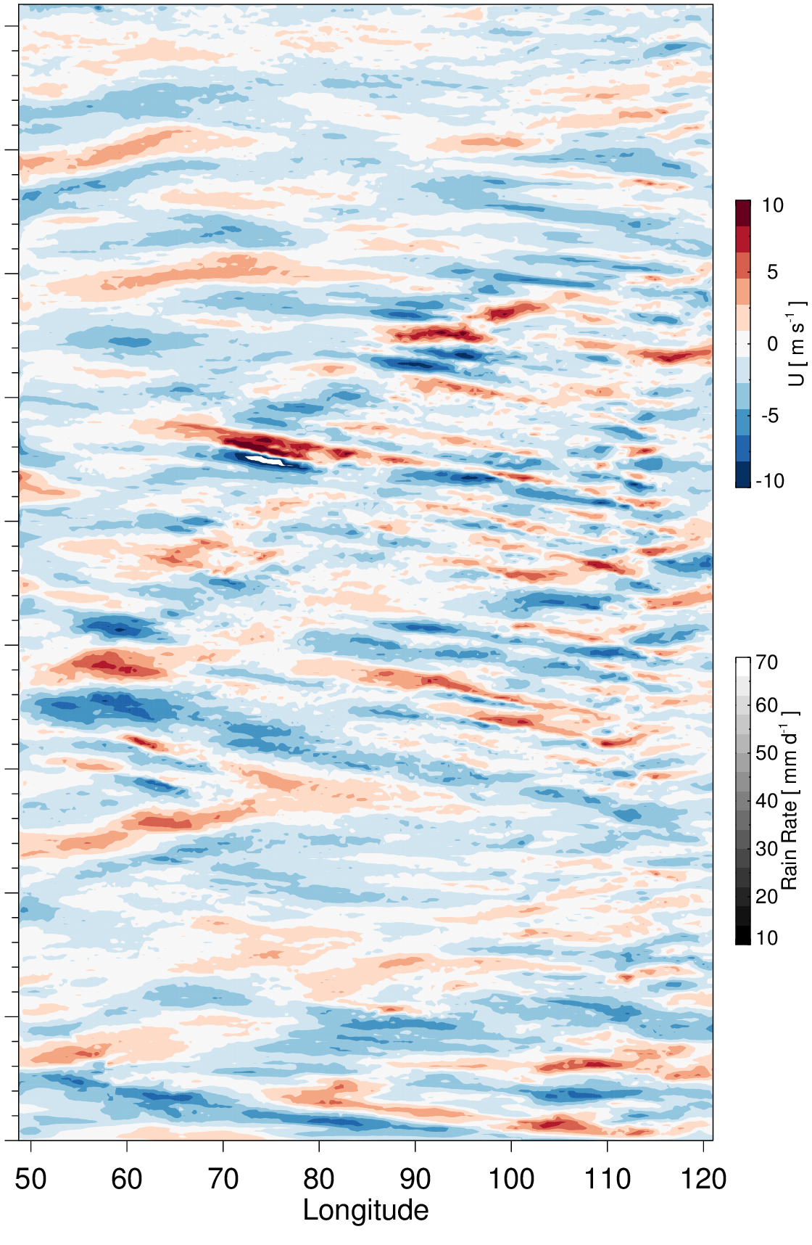
850-hPa u’ (Low-Pass)
150-hPa u’ (High-Pass)
high-pass filter: 3 days

Slide 10
Diurnal Composites
U’₁₅₀
contours: R’ every 3 mm/d

Slide 11
Diurnal Composites
Match between TRMM & WRF
Rainfall signal discontinuous, but upper-level div. is continuous
~1500 km wavelength,
phase speed c_{x} ~ ±17 m/s

Slide 12
Background (Mean) Zonal Wind
U ~ 5 m/s
Phase speed c_{x} ~ ±17 m/s
In both regimes, U ≠ c_{x}
Therefore, intrinsic propagation is implied
Direction of propagation matches background flow
(in lower troposphere)

Slide 13
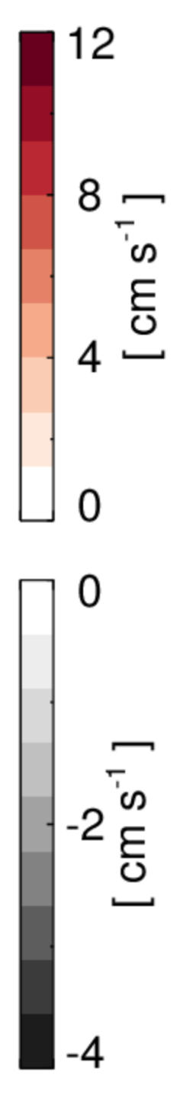
Vertical Motion (WW Composite)
Long dashed: 17 m/s
Short blue: 8 m/s
Rainfall
mm/h
Diurnal cycles of major storms (Borneo, Sumatra/Malay) are synchronized
Storms exhibit clear westward motion, but at ~8 m/s instead of 17
  ~8 m/s consistent with cold pool motion
Rainfall systems propagate “discretely” to keep pace with 17 m/s mode

Slide 14
u’
T’ (𝜃_{v})
Tilted features → vertically propagating gravity waves
~17 m/s westward propagation evident in u’ couplets and tilted modes

Slide 15
Hypothesis for a strong constraint on c_{x}
Vertical Motion (WW Composite)
Rainfall
mm/h
Synchronized diurnal forcing: vigorous mesoscale convective systems of Borneo, Sumatra/Malay region
Wavelength (𝜆) between systems:
13–14º longitude, or ~1500 km
Geography imposes this scale
For a propagating disturbance to phase-lock with this periodic forcing:
  c_{x} = 𝜆 / 𝜏
  = 1500 km / d = 17.4 m/s !

Slide 16
Constraint on Gravity Wave Phase Speed (±17 m/s)
Zonal disturbances of c_{x} ~ ±17 m/s are a common feature of the MC
Our hypothesis: equatorial gravity wave mode constrained by geometry of the MC
Vigorous diurnal MCSs of both Borneo and Sumatra excite this mode
This mode then augments rainfall along its EW/WW trajectory (discrete propagation)

Slide 17
Constraint on Gravity Wave Phase Speed (±17 m/s)
Critical lingering question: Role of the background wind?
MCSs will *tend* to move with the background flow direction
  Does this this select the direction of the faster mode?
Doppler shifting by the background wind (Qian et al. 2009)

Slide 18
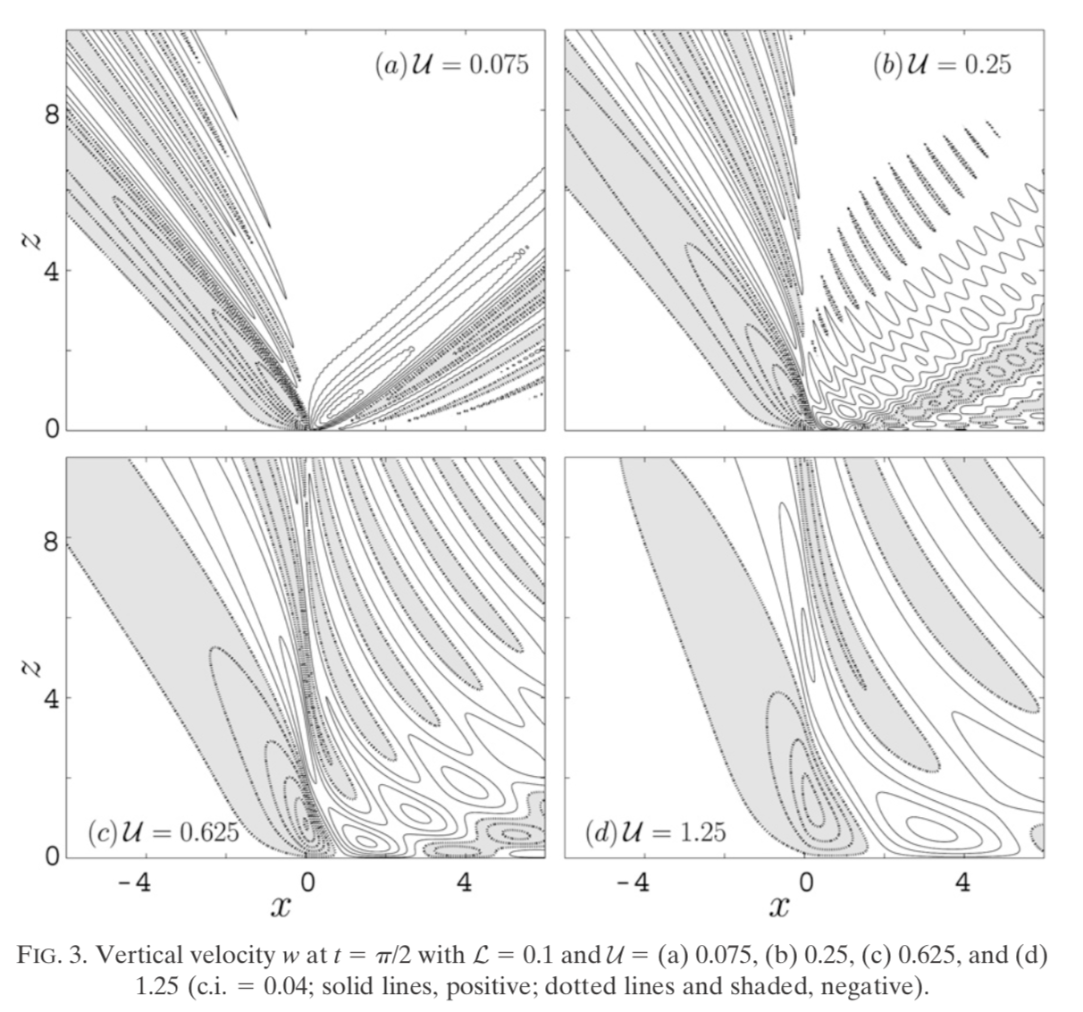
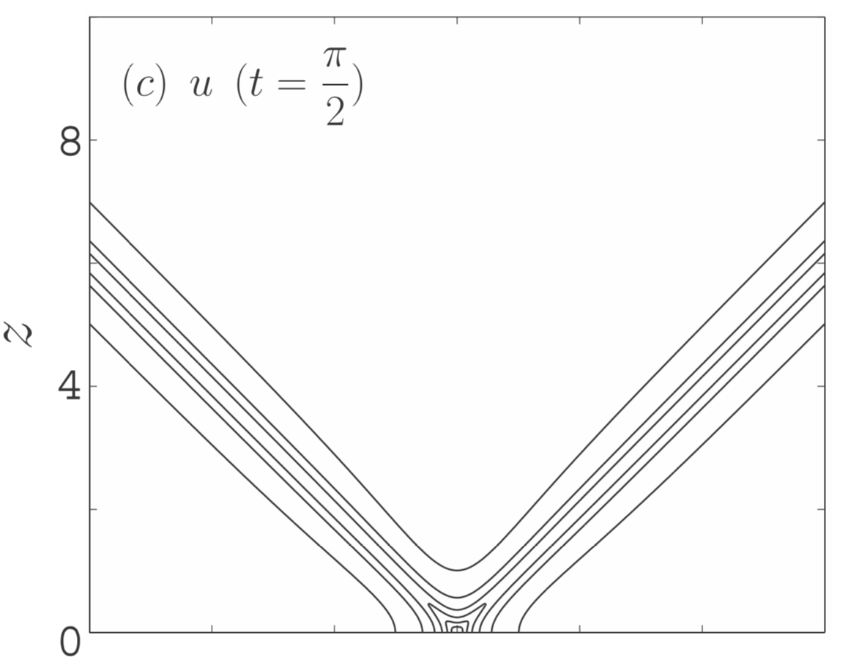
Doppler Shifting of Vertically Propagating Modes by Background Wind
U ≠ 0
U = 0
Qian et al. 2009

Slide 19
Constraint on Gravity Wave Phase Speed (±17 m/s)
Critical lingering question: Role of the background wind?
MCSs will *tend* to move with the background flow direction
  Does this this select the direction of the faster mode?
Doppler shifting by the background wind (Qian et al. 2009):
  Zonally stretches the downstream wave branch, increasing the potential for coupling across distant islands

Slide 20
Idealized Exploration
Understand sensitivity of GW modes to the background flow
Understand impact of GW modes on the basic state (and other phenomena, e.g., the MJO)

Slide 21
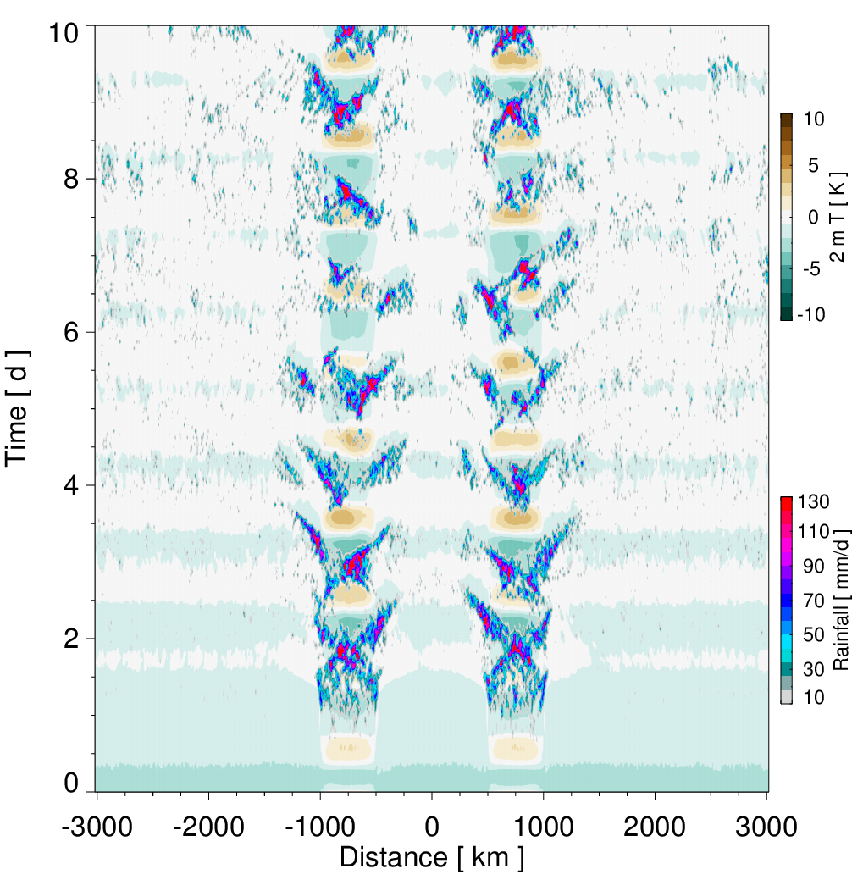
CM1 (G. Bryan)
– Two circular (flat) islands surrounded by ocean
– 6000 x 2000 km,
dx = 9 km
No background wind

Slide 22
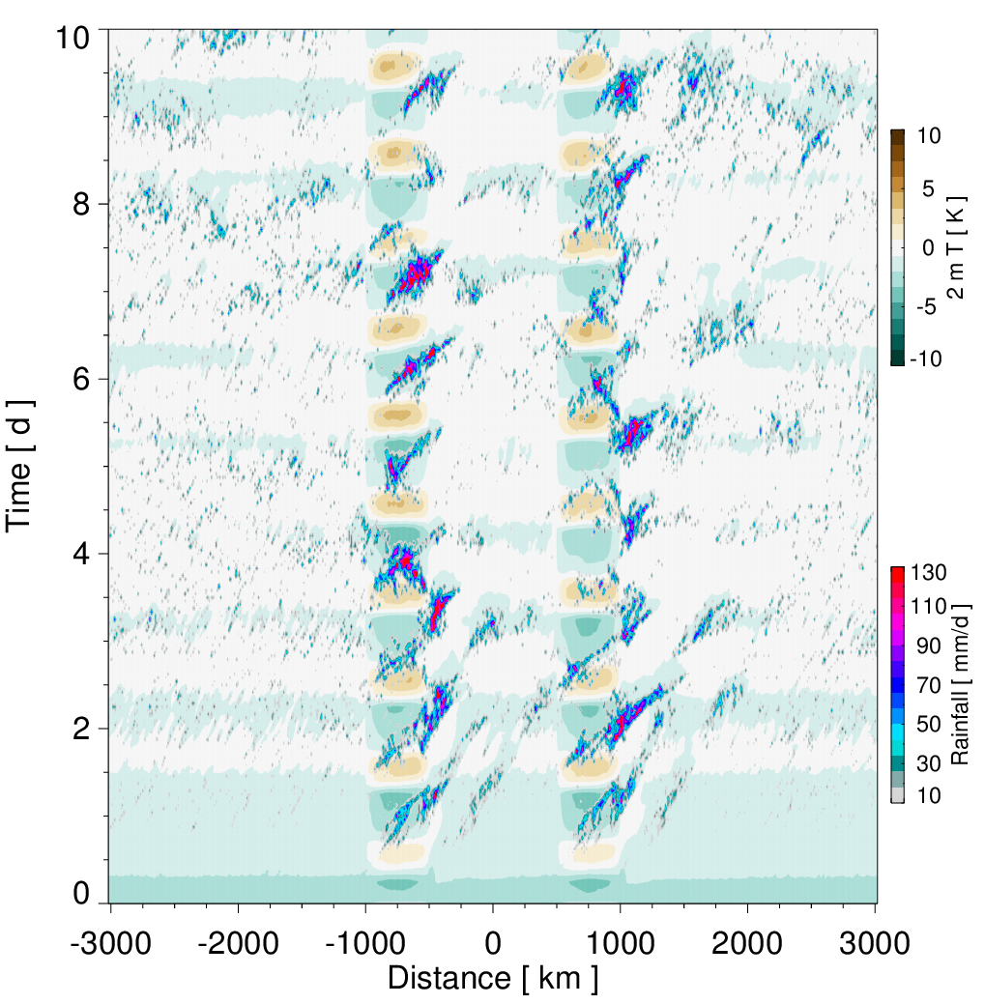
CM1 (G. Bryan)
– Two circular (flat) islands surrounded by ocean
– 6 000 x 2 000 km, dx = 9 km
U = 5 m/s

Slide 23
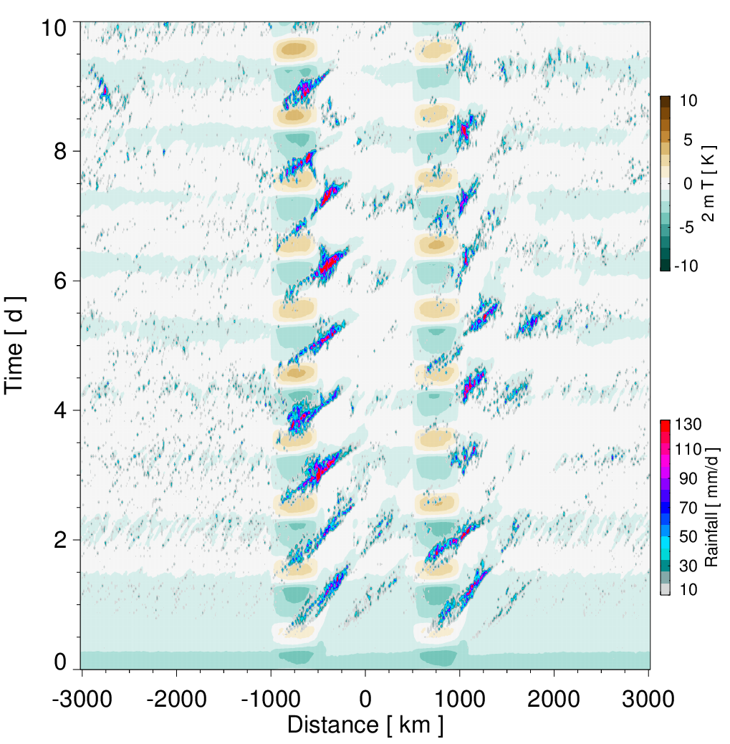
CM1 (G. Bryan)
– Two circular (flat) islands surrounded by ocean
– 6 000 x 2 000 km, dx = 9 km
U = 8 m/s

Slide 24
Westward storm motion
Sea breezes: convergence over land
Convection grows upscale
WW (westward) flow regime
Rainfall: contoured every 15 mm/d
10-m wind: largest vector: 3 m/s

