Slide 1
Application of Deep Convolutional Neural Networks in Detecting Severe Weather Events from Radar Reflectivity Images
Rachel
Under the supervision of Professor Fuqing Zhang and Professor Jia Li
May 10, 2019

Slide 2
High-level Visual Signals in Weather Images
Hook Echo, Velocity Couplet, The V-Notch, or “Flying Eagle”, The Debris Ball, etc.
images credit to: https://www.ustornadoes.com/2013/02/14/understanding-basic-tornadic-radar-signatures/

Slide 3
Motivation
1. Some of the human-designed visual features are hard to interpret.
2. Severe weather detection relies much on experience.
3. Deep learning has the ability to explore the underneath pattern of the images.
Solution: Train a Deep Neural Network to detect severe weather events.

Slide 4
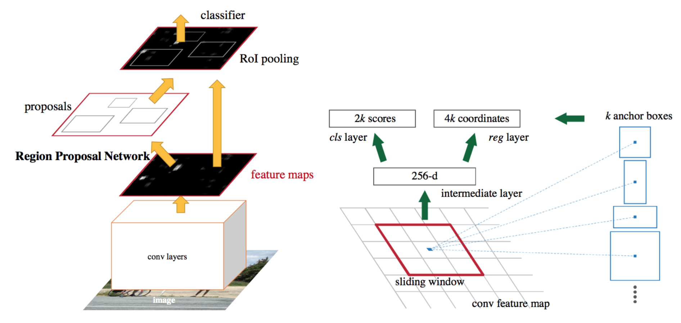
Regional Convolutional Neural Network (RCNN)

Slide 5
Part 1: Convolutional Neural Network (CNN)
Function: output the visual features of the images.
Method: Fix the first 10/24/30 layers of CNN and retrain with radar reflectivity images.
Output: feature map

Slide 6
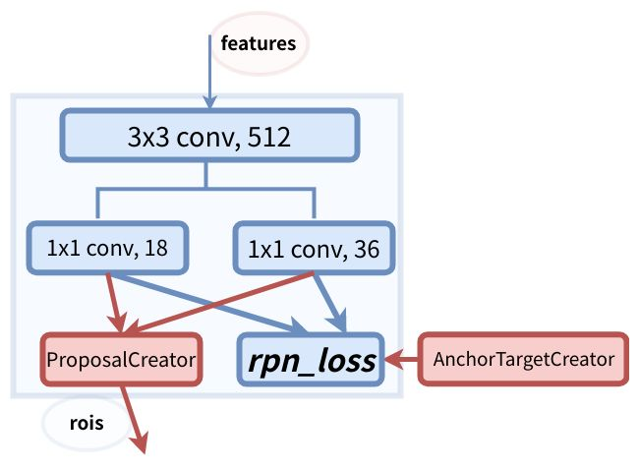
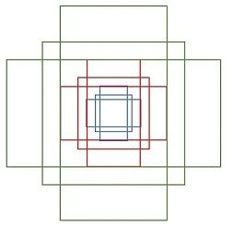
Part 2: Region Proposal Network (RPN)
Function: select regions from the region candidates generate from the anchors and image features. Adjust anchor positions.
Output: about 2000 positive+negative regions.

Slide 7
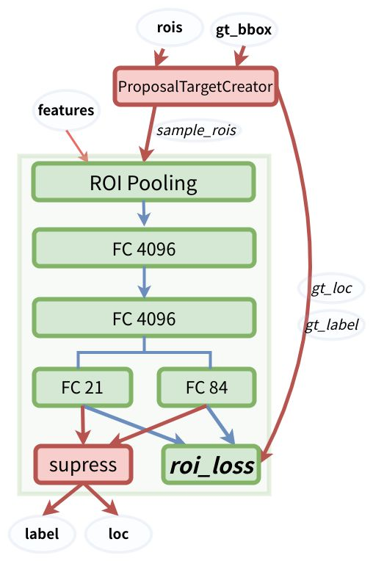
Part 3: Region of Interest (ROI)
Pooling
Function: further select regions of interest on region candidates. Adjust positions of the regions.
Output: 128 positive+negative regions.
Loss: sum of the cross entropy in RPN and ROI pooling stage.

Slide 8
Dataset
1. The historical radar reflection images from 2008 to 2017.
2. The severe weather records.
3. Model simulations of the year 2017.
Targeting regions: 24-50N, 80-106W.

Slide 9
Positive and Negative Region Selection
storm score: #(event in the bbox)
reflectivity score: average radar reflectivity per pixel
Positive regions:
1. Include severe weather events inside. (storm score > 0)
2. For the same event, we label the regions with higher radar reflectivity values. (reflectivity score > thres0)
Negative regions:
1. Far from severe weather events. (storm score = 0)
2. Not having very high radar reflectivity (reflectivity score < thres1)

Slide 10
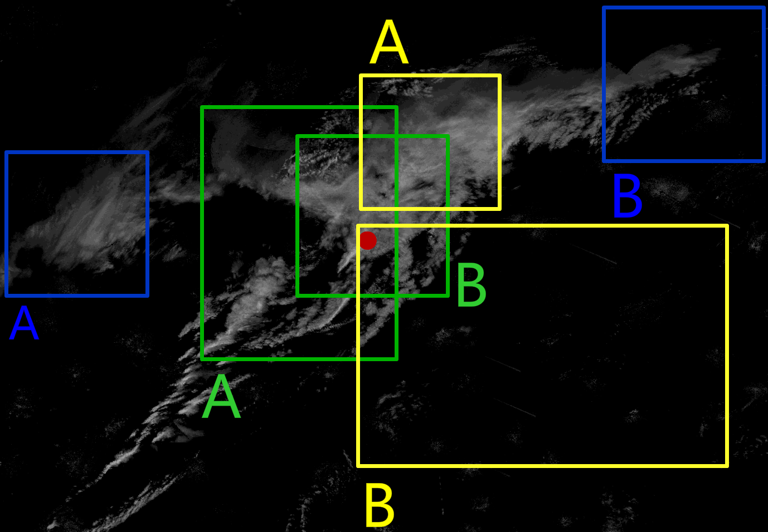
Example
Red dot: event
Green: Positive
Blue: Negative
Yellow: Neither

Slide 11
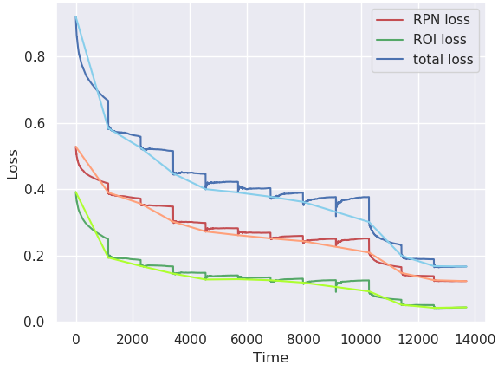
Result: Training

Slide 12
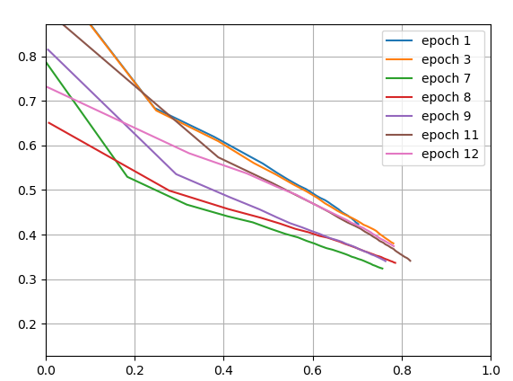
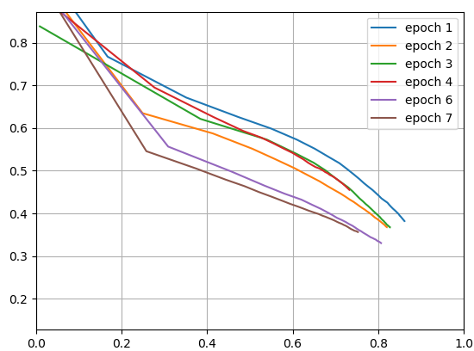
Result: Recall-Precision Curve
Left: Fix 24 layers in VGG16 and retrain the next. Right: Fix first 10 layers
TITAN Baseline: Recall 0.43, Precision 0.21

Slide 13
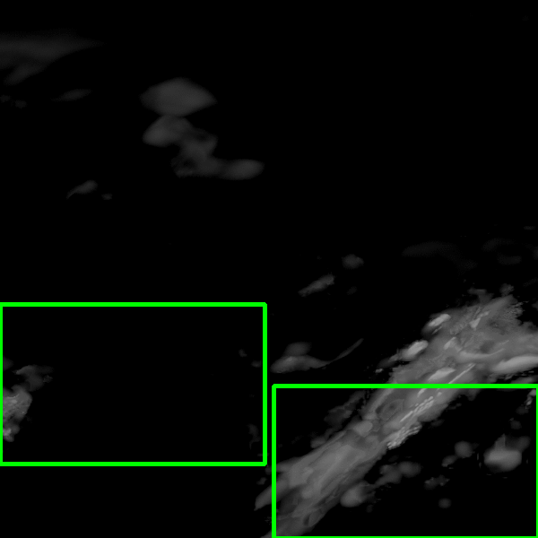
Application: Severe Weather Prediction with Simulations

Slide 14
Conclusion
We Propose a novel deep learning and computer vision framework to detect the severe weather events.
The design of positive and negative regions for training the network automatically uses the large severe weather label dataset.
Future work: validate on the simulation dataset, severe weather classification tasks.

