Slide 1
Case Study: Evaluation of PBL Depth in an Erroneous HRRR forecast for CI
Keenan Eure

Slide 2
Intro
Accurate convective initiation (CI) forecasts remains a challenge
CI requirements:
Low-level moisture
Instability
Lift
Convective-allowing models (CAMs) need sufficient spatial and temporal resolution
Many of these processes ‘live’ in planetary boundary layer (PBL)

Slide 3
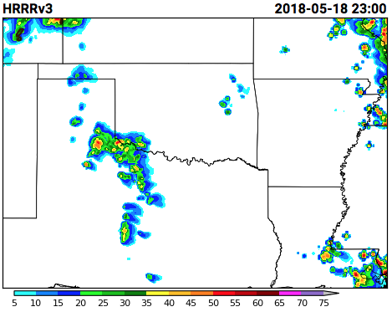
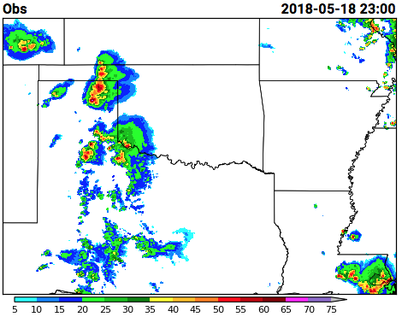
False alarm
Missed CI

Slide 4
Importance of accurate PBL representation
Strong coupling of near-surface and adjacent PBL diurnally
Past studies highlight importance of PBL depth measurements
Vertical wind shear
Convective available potential energy (CAPE)
Erroneous depth can throw off predictive and diagnostic quantities for severe weather
Need sub hourly observations to be assimilated

Slide 5
WSR-88D Observations
Continuously operating radars complete full scan in mins
Top of PBL mixes with free troposphere
Higher reflectivity values
Bragg scattering
Minimum in differential reflectivity (ZDR)
ZDR values can give estimation of PBL depth
Notes:
Perturbations from turbulent mixing leads to higher reflectivity values
Brag scattering occurs at top of PBL, giving low values of ZDR

Slide 6
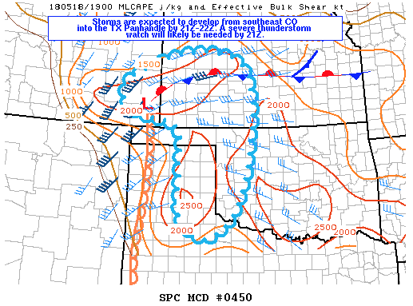
Case Study of 05-18-2018
Strong storms predicted earlier in day
Elevated convection likely
Primary threats - large hail, damaging winds

Slide 7
HRRR and Radar Comparison
Missed CI

Slide 8
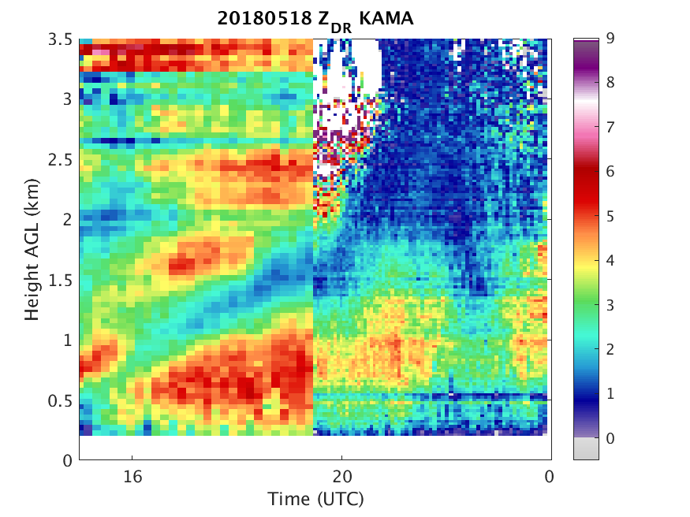
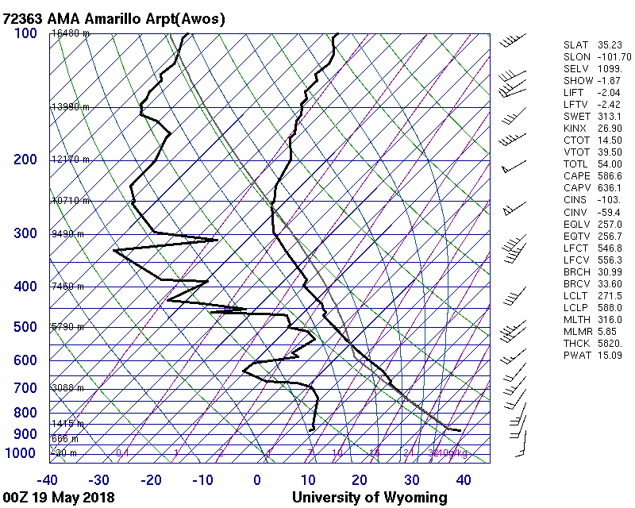
Quasi-Vertical Profile Analysis of 05-18-2018
PBL

Slide 9
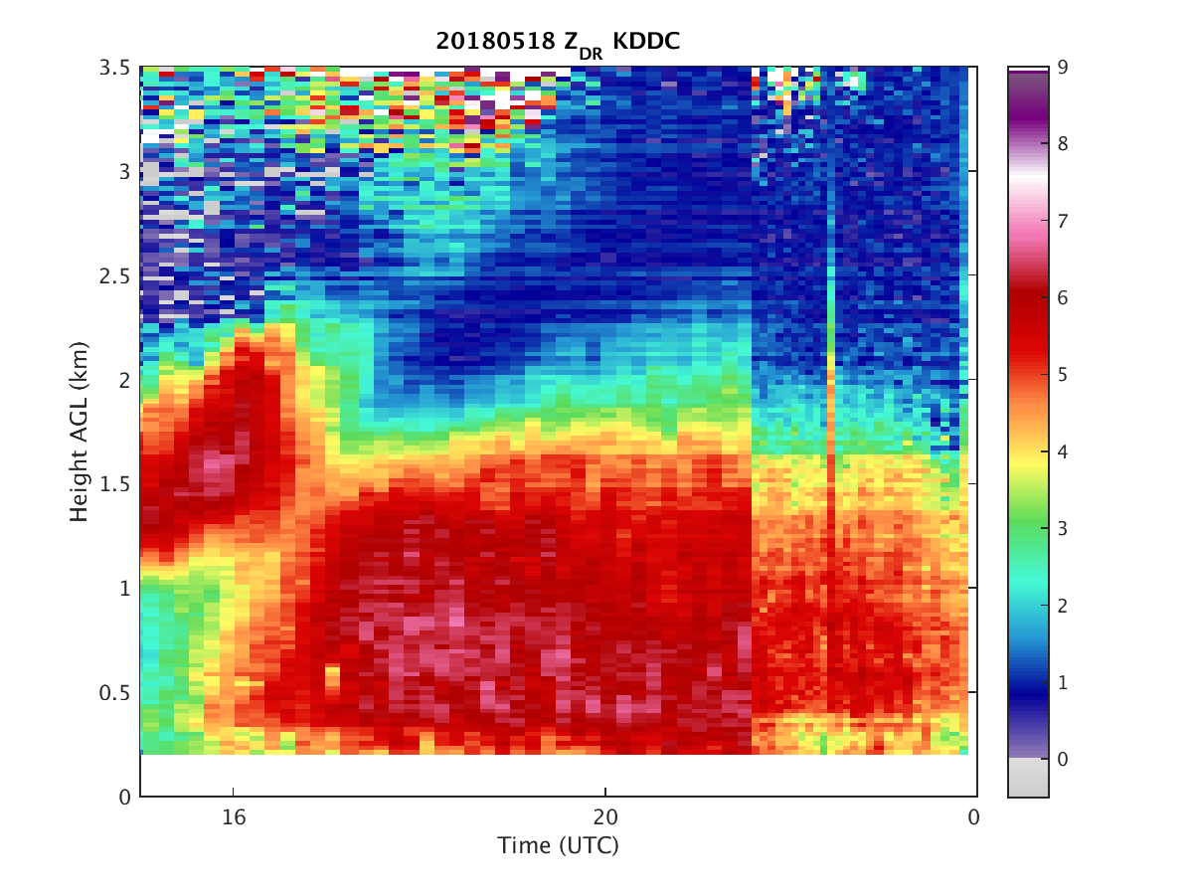
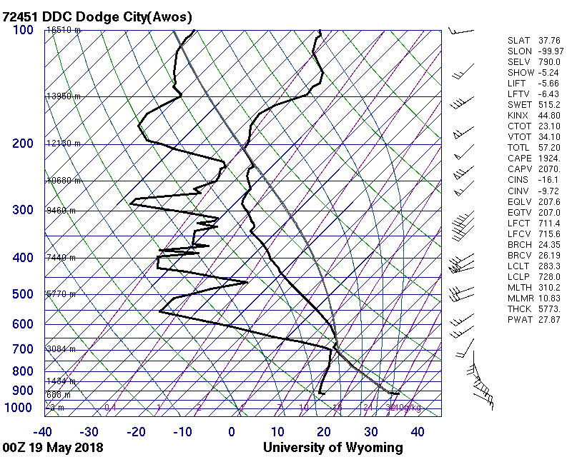
Quasi-Vertical Profile Analysis of 05-18-2018
PBL

Slide 10
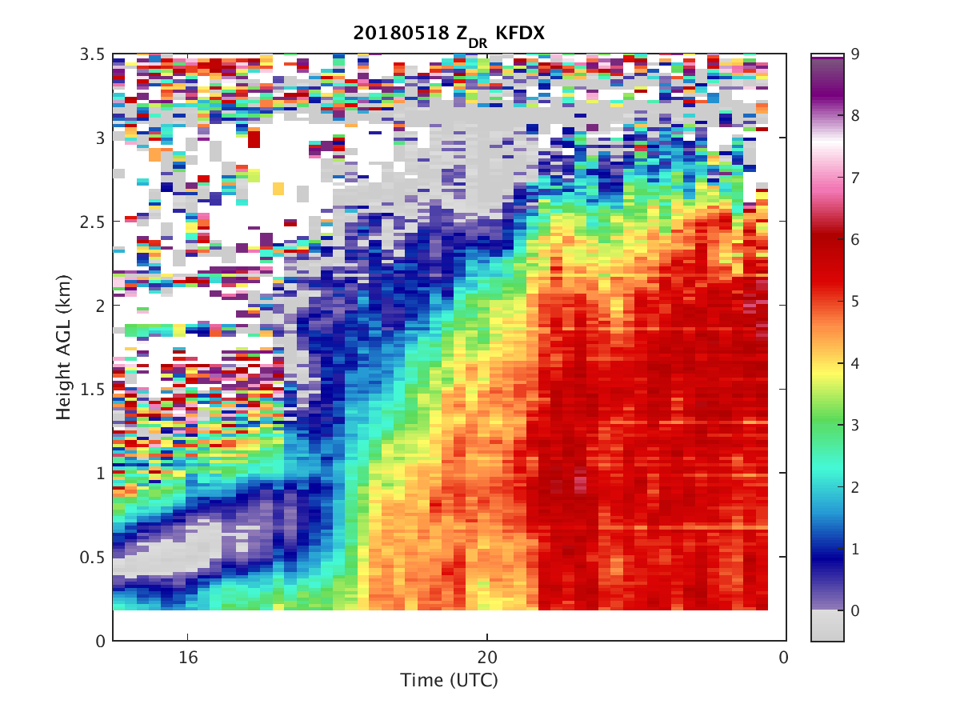
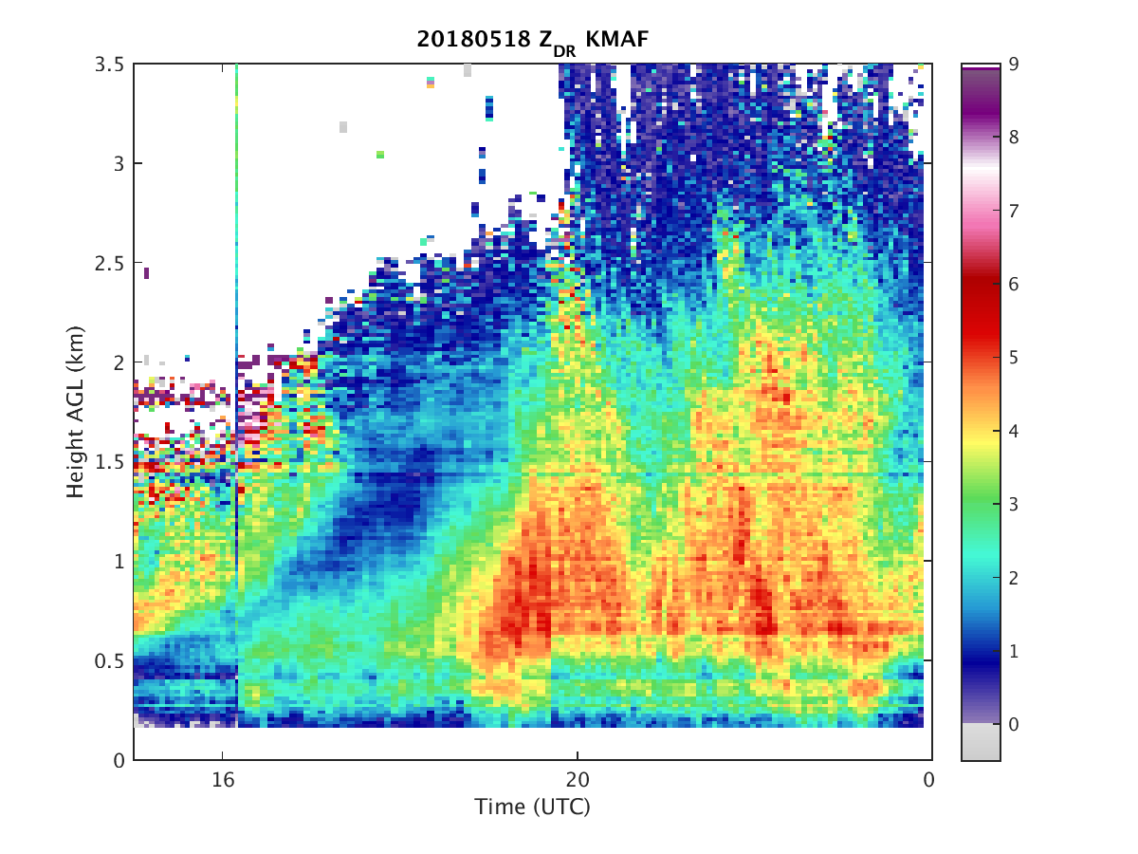
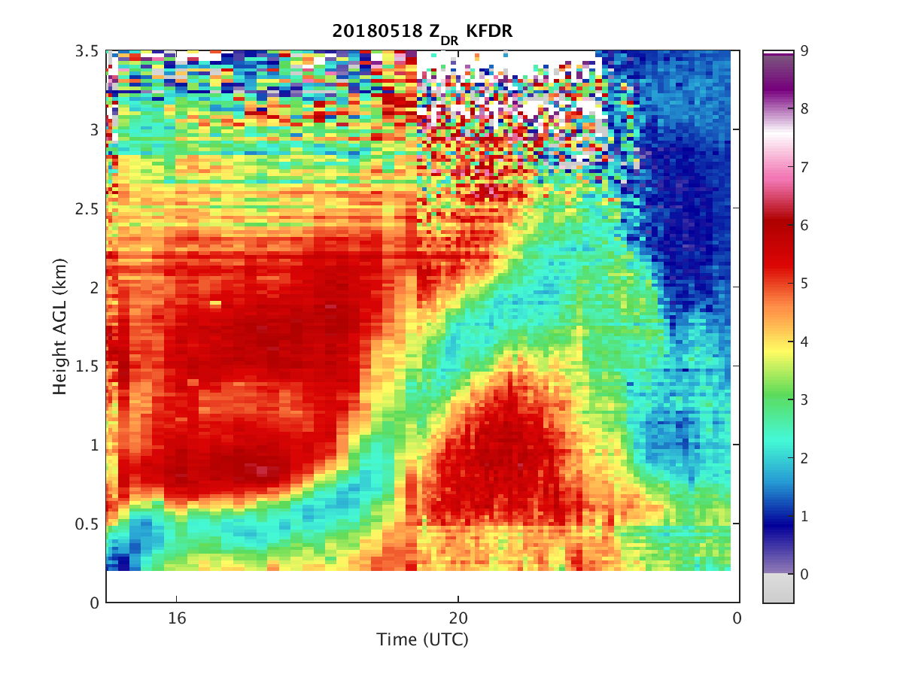

Slide 11
Summary and Future Work
Summary
Radar gives useful PBL depth and evolution data
Encouraging for future DA
Future Work
Analysis of clear-air radial velocity and brightness temps
Preliminary WRF simulations of case(s)
Data assimilation of radar and satellite products
HRRR configuration of WRF-ARW
Inner and outer domain

Slide 12
Future Work
Analysis of clear-air radial velocity, brightness temps
Data assimilation of both radar and satellite products
HRRR configuration of WRF-ARW
Inner domain (12 km) and outer domain (3 km)
Gridpoint Statistical Interpolation (GSI)-based EnKF
Every 30 minutes on outer domain (9 hrs out)
Every 15 minutes on inner domain (2 hrs out)

Slide 13
Acknowledgements
Dave Stensrud
Fuqing Zhang
Jerry Zhang
Paul Mykolajtchuk
Stan Benjamin (NOAA)
Curtis Alexander (NOAA)

