Slide 1
The impact of ocean surface and atmosphere on TOA mircowave radiance
Zhu Yao, Da Fan, Chris Hartman
Notes:
Thank you Jerry! Today my talk is based on our Remote sensing class project, using the WRF model simulation to investigate ..

Slide 2
Basic Idea
Focus on: Microwave
Simulated BT
(CRTM)
Observation BT
(CPM)
TOA Radiance
Compare
Bias/Difference
Atmosphere impact
1. Sky condition: clear or cloudy
Surface wind speed
Ocean surface impact
2. Surface emissivity
……
Notes:
So in this talk, we focus on the microwave radiance.
basically, the TOA radiance is represented by the brightness temperature.
We compared the simulated BT calculated by the radiative transfer model CRTM and the observation BT captured by the satellite CPM and got the bias/difference between them.
By comparing the bias in different sky condition: clear or cloudy, we can get a sense for the atmosphere impact on the TOA radiance.
Also, by altering the surface emissivity, we can see how the ocean surface influences the TOA radiance. Several factors can impact the surface emissivity, but in this talk, we only care about the surface wind speed.

Slide 3
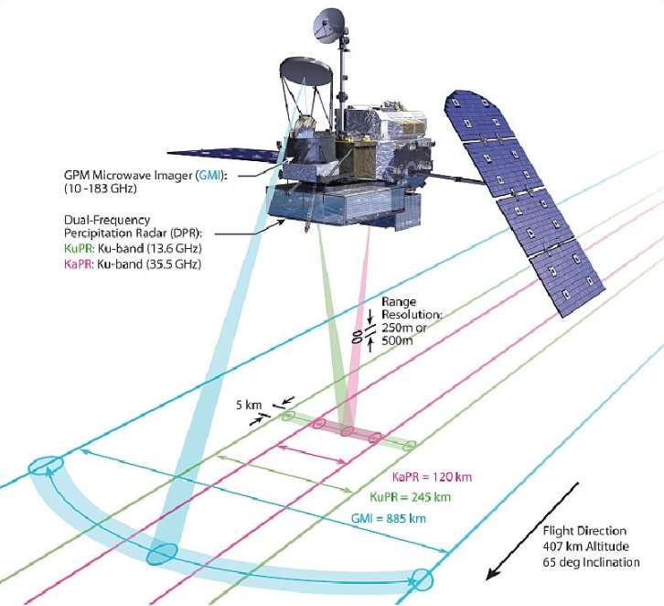
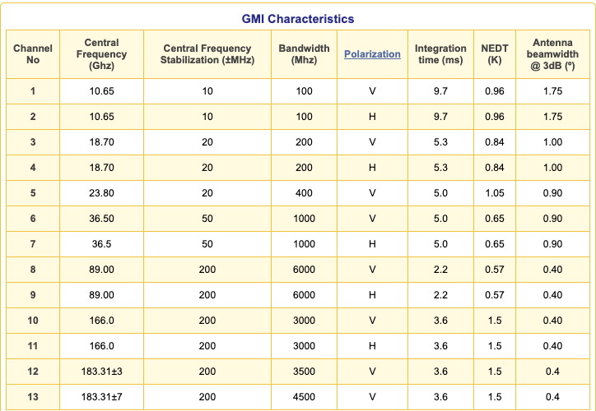
GPM Microwave Imager(GMI)
Notes:
Ok, let’s take a quick look at how the satellite works. The global precipitation measurement Microwave Imager is a passive sensor, measuring the natural energy radiated by different precipitation in the form of brightness temperatures. It has 13 channels and each channel has a frequency range that can detect a different type of precipitation. It should be noticed that the only discrepancy between channel 1 and 2, 3 and 4, etc. is they are polarized differently, either vertically or horizontally.

Slide 4
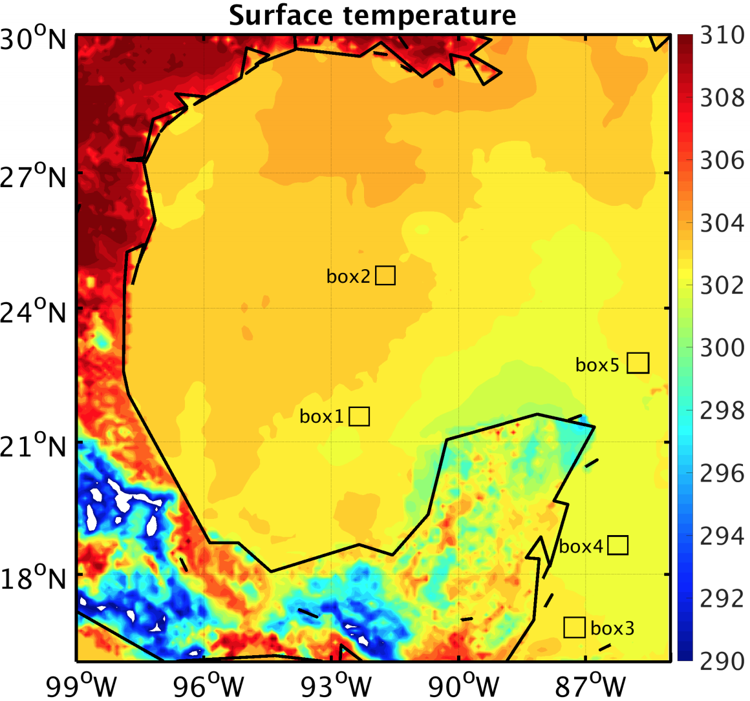
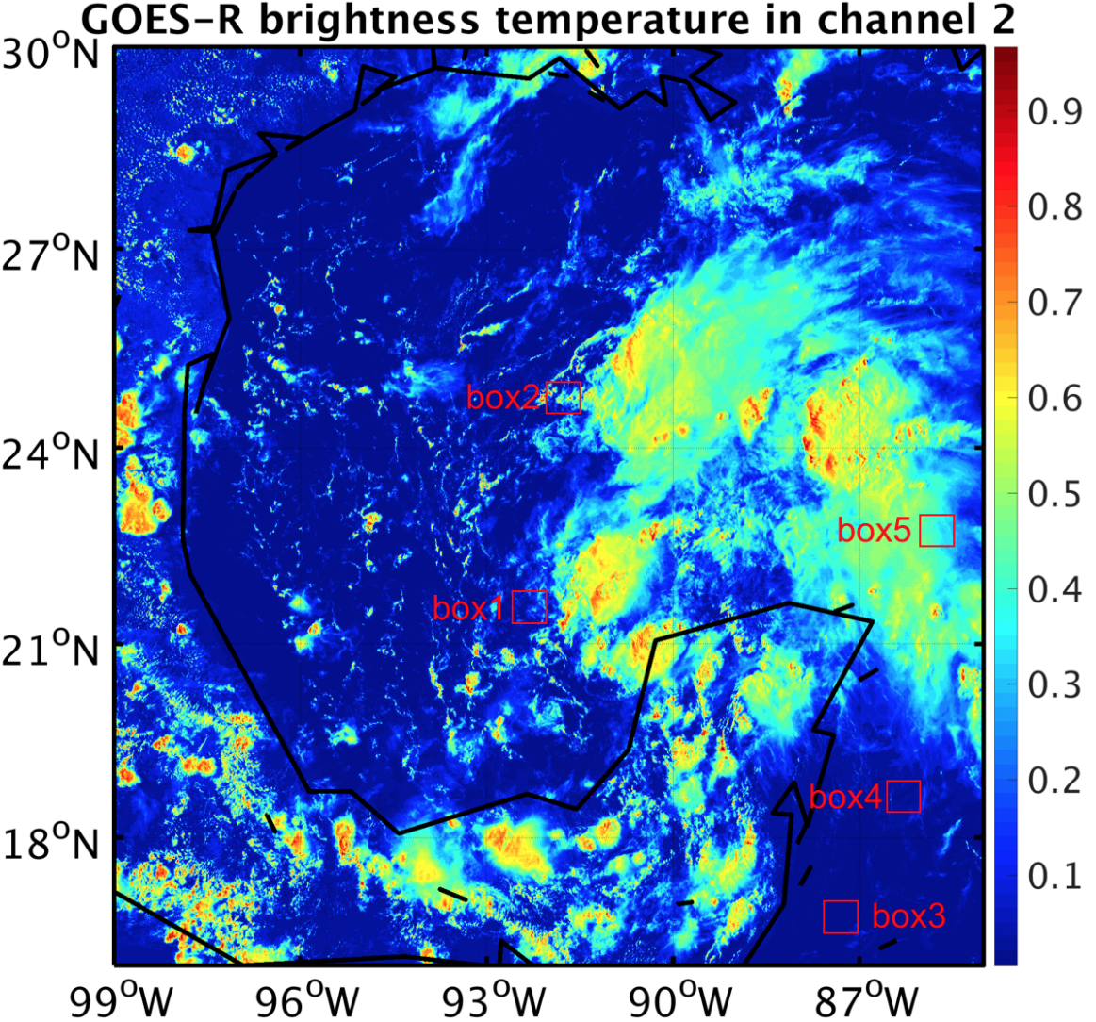
Case Selected
Notes:
The case selected for study is the hurrican Harvey. On August 22nd, we chose 5 boxes in gulf of Mexico to analyze. Notice that the variation of the surface temperature is less than 1 K, and by calculation, the average surface wind speed in these five boxes is all less than 10 meter per second. And the Goes-R BT figure shows the box3 is the clear-sky region and box5 is pretty cloudy.

Slide 5
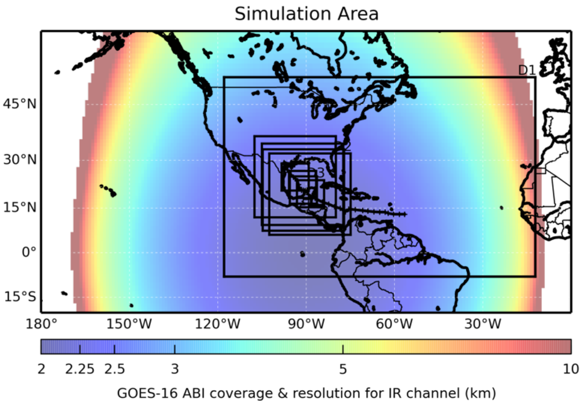
Simulation
PSU WRF-EnKF Configuration for Harvey
60 member ensemble
27/9/3 km grid spacing (following TC center)
IC/BCs provided by NCEP GFS
hourly cycling EnKF for 12 hours to 1200 UTC 22 August
Assimilated all-sky BTs from GOES-16 ABI channel 8 (WV) in domain 3
CRTM —> BT and emissivity
(Masashi, 2018)
Notes:
Ok, let’s get into the simulation part. The model output was generated by PSU WRF-EnKF system provided by Masashi, who was a phd student in Fuqing’s group. In this experiment, we designed a 60-member ensemble simulation. Three nested domains were used with horizontal grid spacing of 27 km, 9 km and 3 km. During the simulation, domain 2 and 3 moved with the TC center. The IC/BCs were provided by NCEP GFS. The hourly cycling EnKF was performed. For each cycle, domain 3 randomly selected a member, assimilated …. and used CRTM to calculate the brightness temperature.
(CRTM: community radiative transfer model)

Slide 6
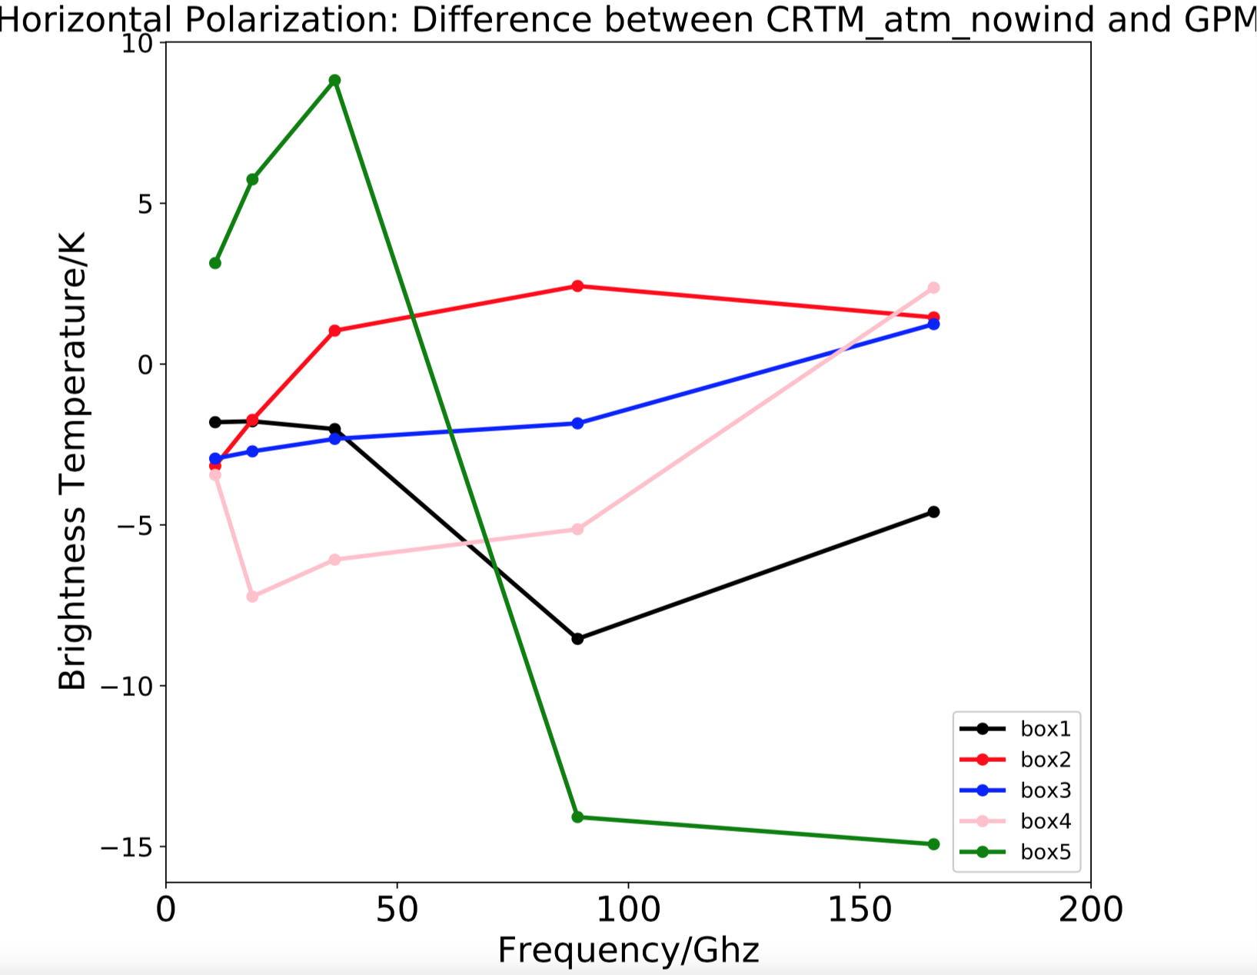
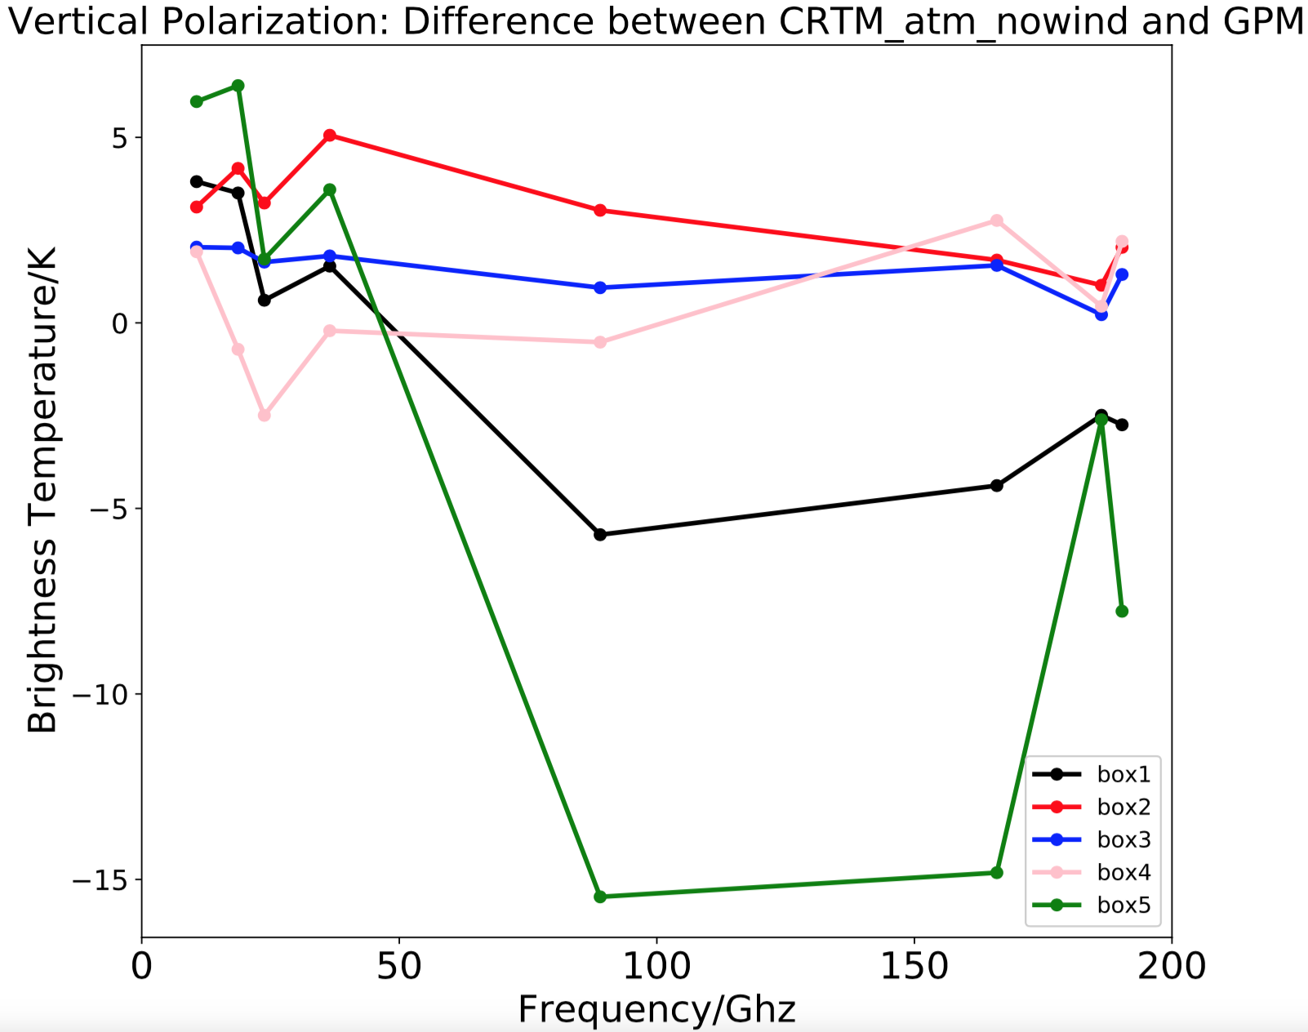
CRTM BT - GPM BT (Bias)
5 boxes
Notes:
From here, analysis begins. This slide shows the difference between CRTM and GPM BT for 5 boxes. No matter what polarization is, Box 5 has the highest bias while the box 3 has lowest bias. There’re two possible reasons. One is the surface wind. Since for now, we assumed no surface wind in the simulation experiment, but it’s not the case for the observation , so probably it’s the surface wind that cause the difference. The other reason is the cloud. We saw it before that the box5 is mostly cloudy, box3 is clear sky. So the scattering and absorption of the cloud liquid water could contribute to the difference. To test the impact of the surface wind, we simply added the simulated surface wind into CRTM and calculated the bias again.

Slide 7
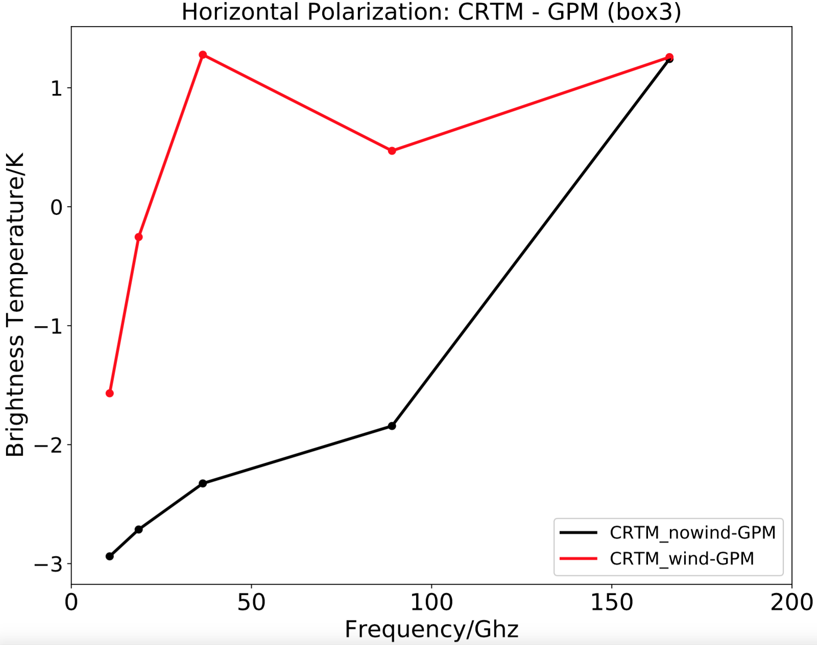
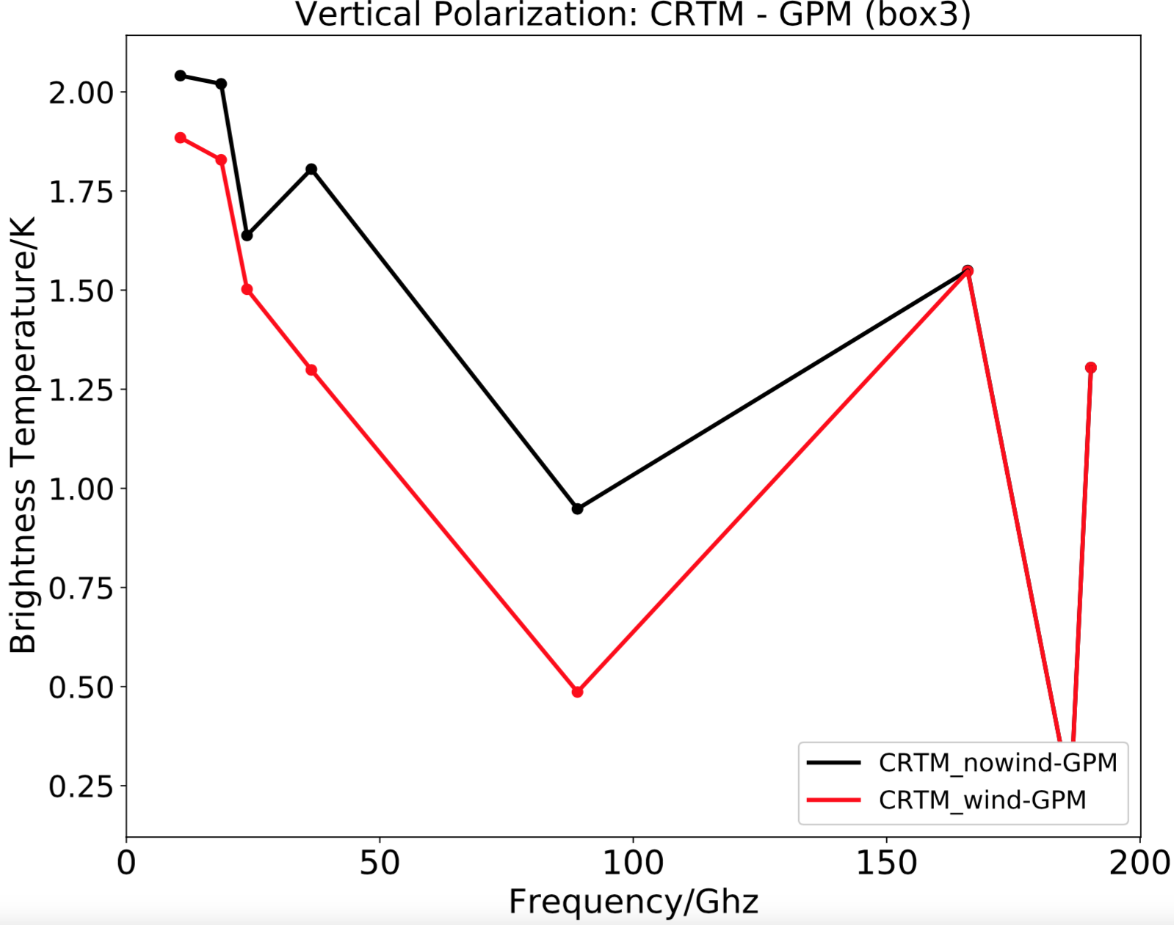
CRTM BT - GPM BT (Bias)
Box 3: clear sky
Notes:
Here’s the results for box3: clear sky region. The red line represents the bias after adding the surface wind and the black line is without wind. With the simulated surface wind, the bias for almost every channel is less than without the surface wind \, both for horizontal and vertical polarization. So surface wind should be part of the reason for the bias in box3.

Slide 8
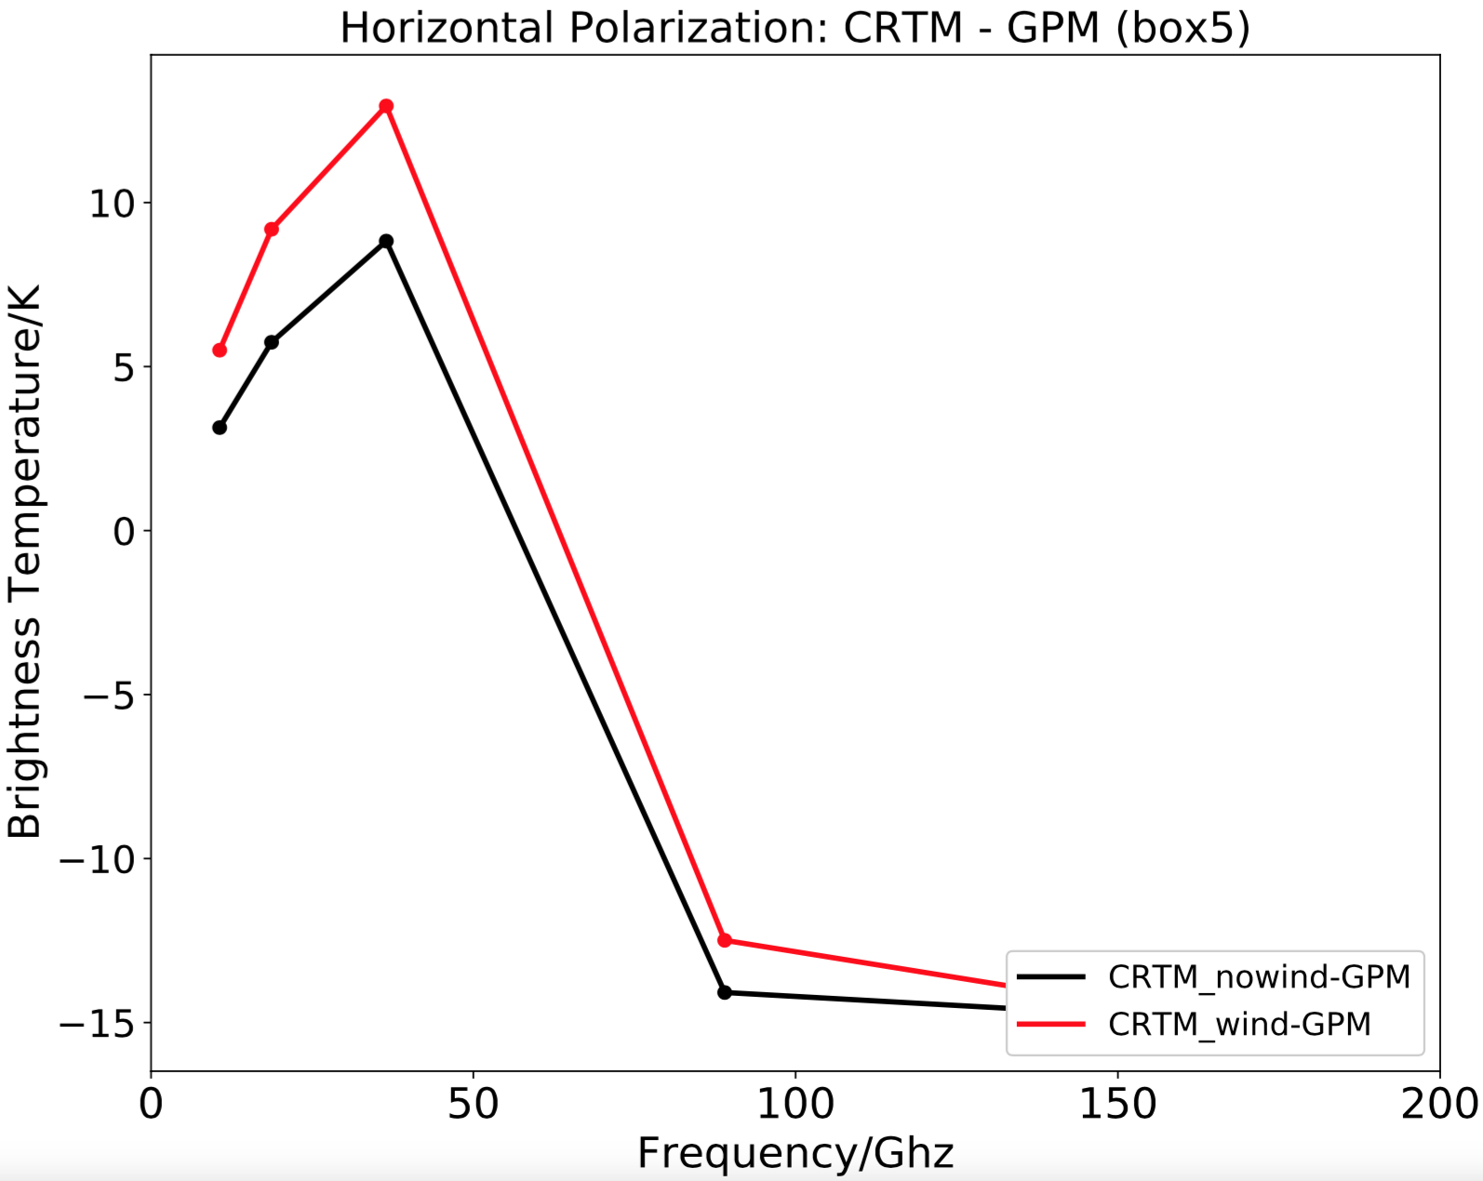
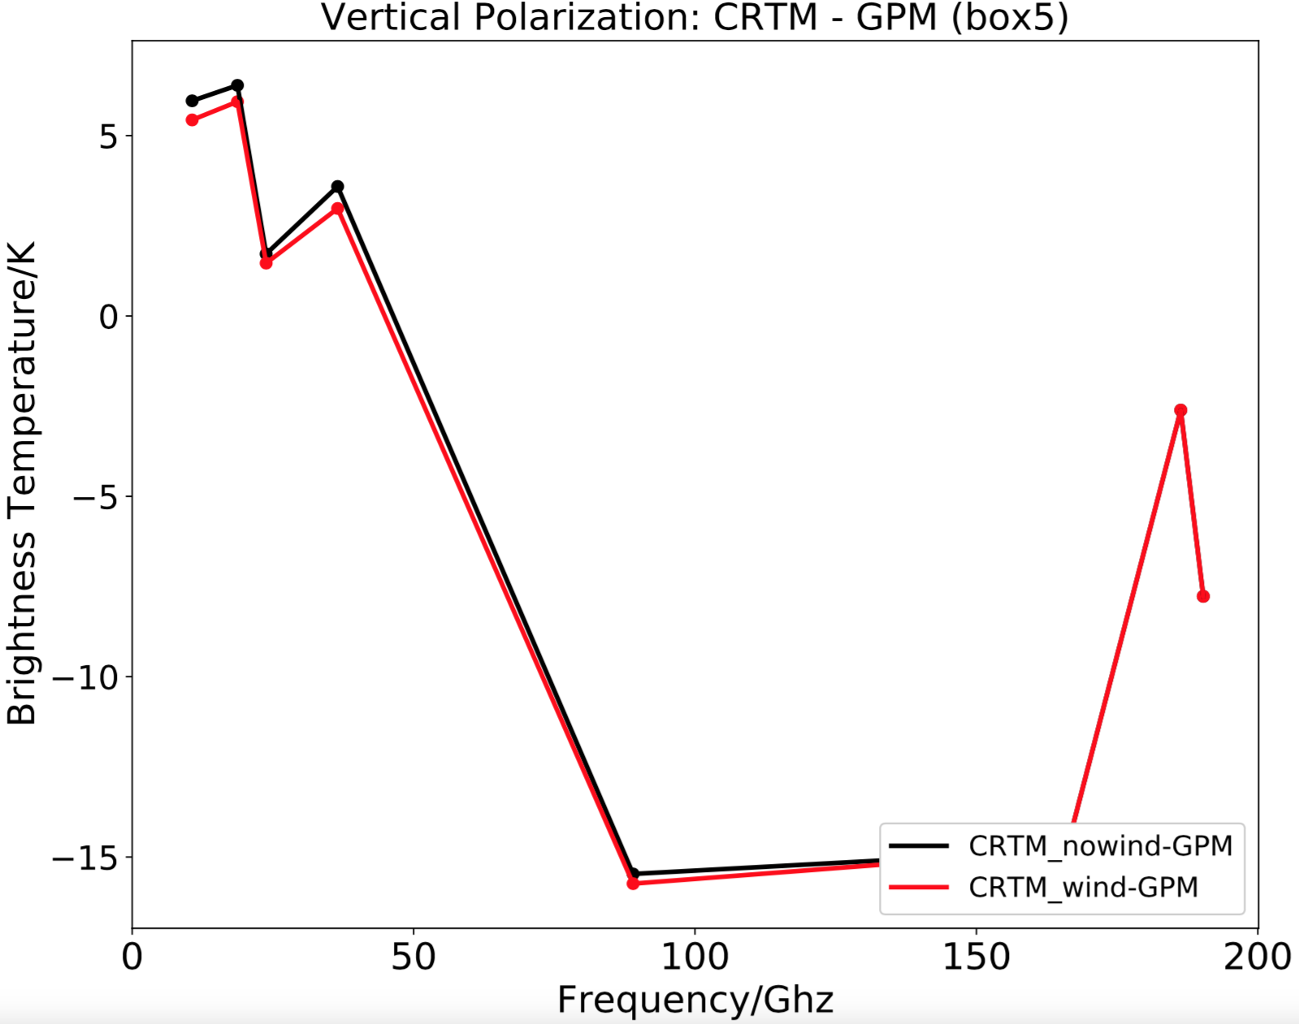
CRTM BT - GPM BT (Bias)
Box 5: cloudy sky
Notes:
Then, let’s look at a more complicated situation, the box5, cloudy sky region. For the horizontal, the bias increases at the low frequencies while decreases at the high frequencies. For the vertical: the bias doesn’t change a lot whether with or without the surface wind. If the surface wind is the main factor contributing to the bias, the bias with the wind should be smaller than the bias without the wind for every channel. But apparently its’s not true for this case. So, surface wind should not be the main reason why box 5 has so large bias. Probably the cloud is the reason.

Slide 9
Basic Idea
Focus on: Microwave
Simulated BT
(CRTM)
Observation BT
(CPM)
TOA Radiance
Compare
Bias/Difference
Atmosphere impact
1. Sky condition: clear or cloudy
Surface wind speed
Ocean surface impact
2. Surface emissivity
……
Notes:
Also, to further investigate how the ocean surface impacts the TOA radiance, we changed the surface wind speed from 0 to 70 meter per second, which alters the surface emissivity, and further influences the surface leaving radiance, that is a huge part of the TOA radiance source.

Slide 10
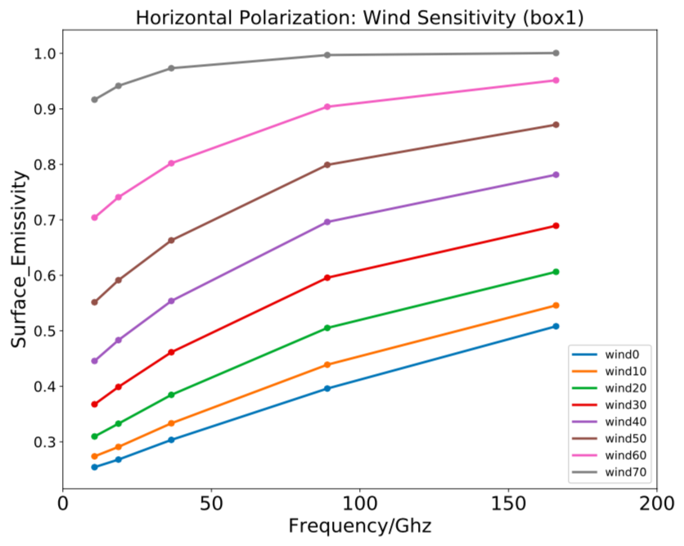
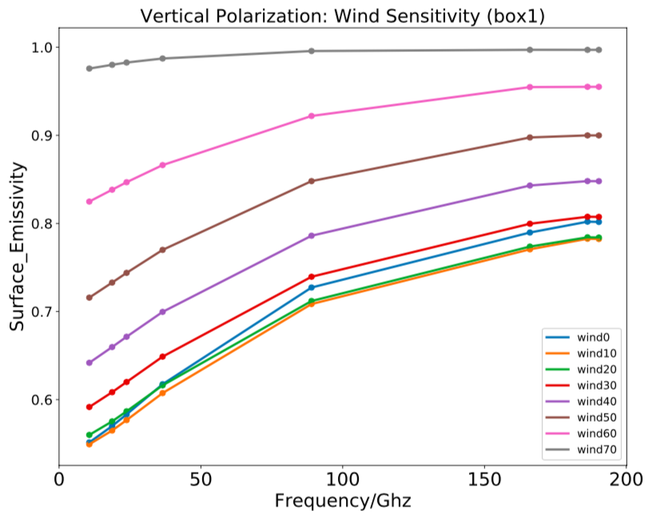
Emissivity is dependent on wind
Notes:
This is the wind sensitivity experiment as for the ocean surface emissivity.
Generally, the emissivity is increasing as the wind speeds up. Explaination: Sea foam, which arises as a mixture of air and water at the wind roughened ocean surface, and leads to a general increase in the surface emissivity. This effect starts to become important at wind speeds above 7 m/s and becomes dominant at high wind speeds.
2. linear increasing: true for horizontal ; vertical : decrease -> increase
(The emissivity signal that is produced by these mechanisms is largely isotropic, which means independent on wind direction)

Slide 11
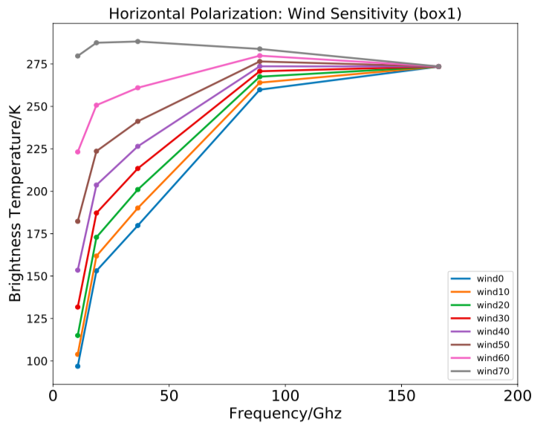
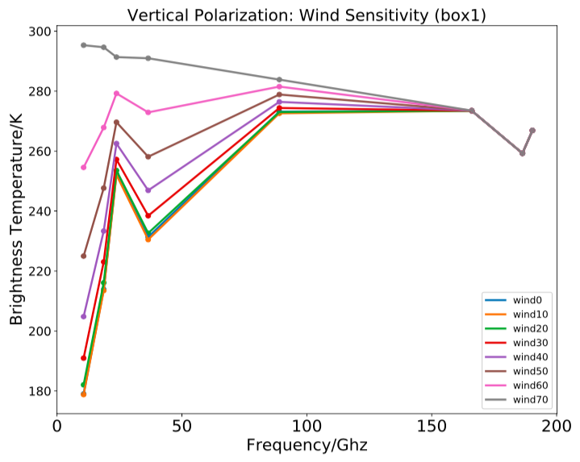
BT is dependent on wind
Notes:
This is for BT.
Generally, because the emissivity goes up as the wind increases, according to the relationship in the microwave : BT = emissivity*physical T, we expected the BT also goes up. It’s true for most of the frequencies. But at the higher frequency, we can notice there’s a brightness temperature convergence. It should be due to the pretty low transmissvity of the atmosphere. That is, most of the surface leaving radiance is absorbed or scattered by the atmosphere, and it cannot contribute much to the TOA radiance. So no matter how the surface emissivity, the surface leaving radiance changes, the TOA radiance doesn’t change too much.
Another interesting point is for the vertical polarization, there’s a BT peak at frequency 23 GHz. That’s
Because the emissivity goes up as the wind increases, according to the relationship in the microwave : BT = emissivity*physical T, the BT also goes up.
2. The convergence at the high frequency is because transmissivity is lower
3. The peak for polarization is the water vapor

Slide 12
Summary
The atmosphere impact on TOA radiance: CRTM BT and GPM BT have a great agreement in clear sky, but don’t agree well in cloudy sky.
For the clear sky, the bias of CRTM BT is related to the accuracy of the surface wind speed.
For the cloudy sky, the bias is probably due to the absorption and scattering of cloud liquid water.
The ocean surface impact on TOA radiance: the surface emissivity as well as surface leaving radiance increases with the surface wind increase.

Slide 13
Thank you.

Slide 14
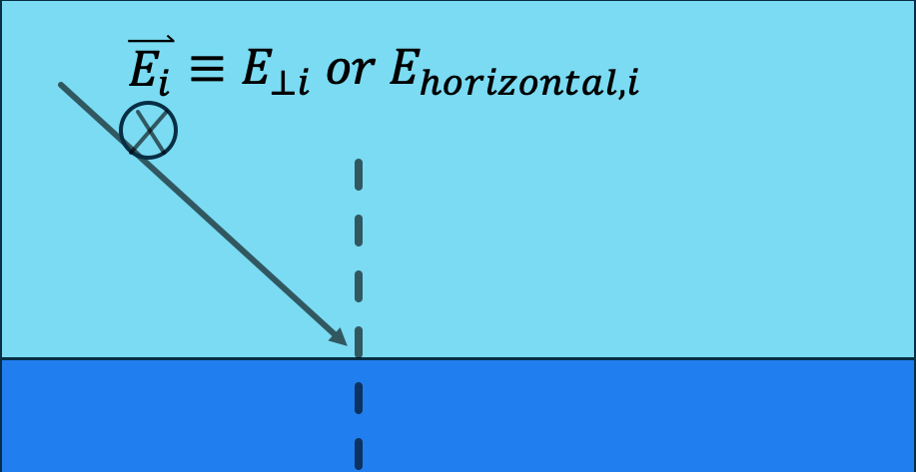
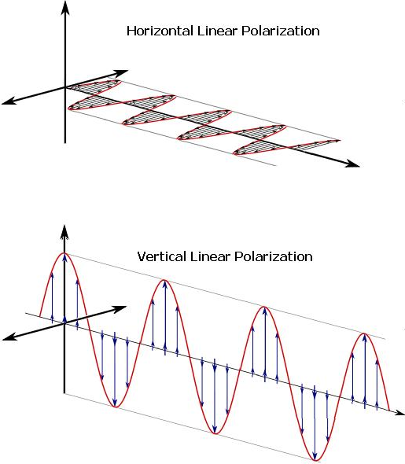
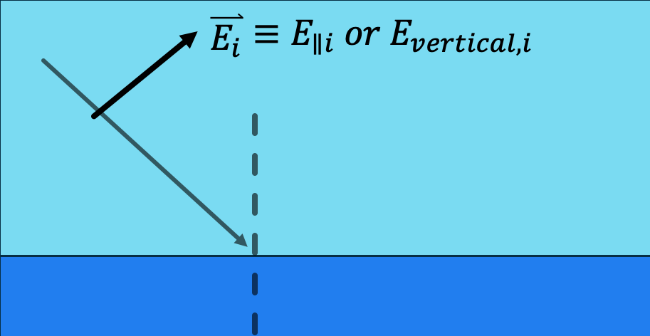
GPM Microwave Imager (GMI)
Polarization

Slide 15
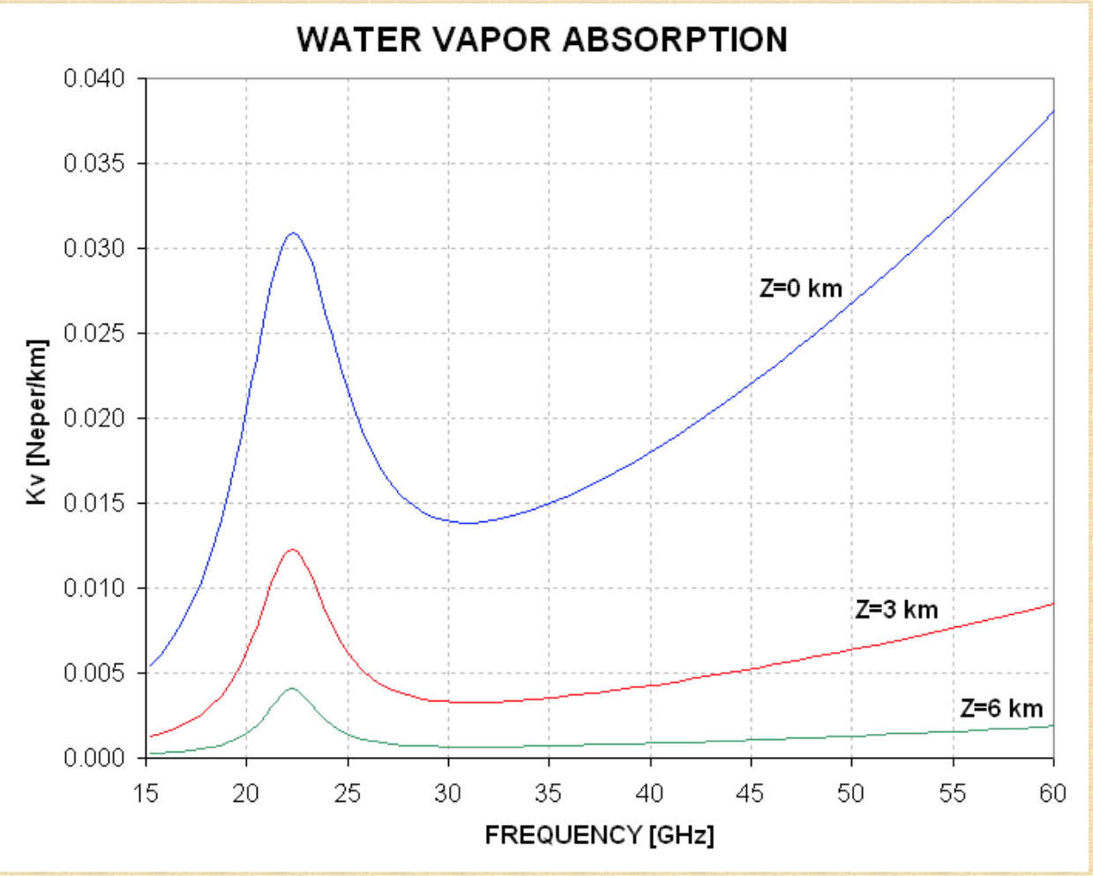
Water vapor absorption (peak at about 23GHz)

