Slide 1
Analysis of a Missed Forecast on April 28th, 2019
Paul Mykolajtchuk

Slide 2
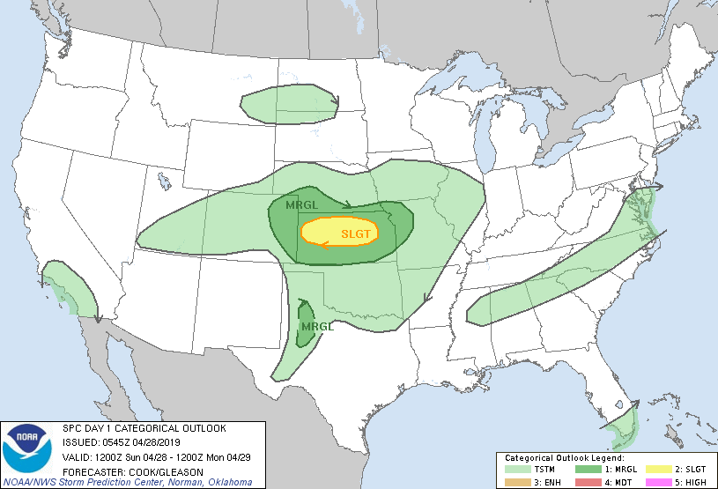
April 28th, 2019 was an Active Severe Weather Day for Kansas

Slide 3
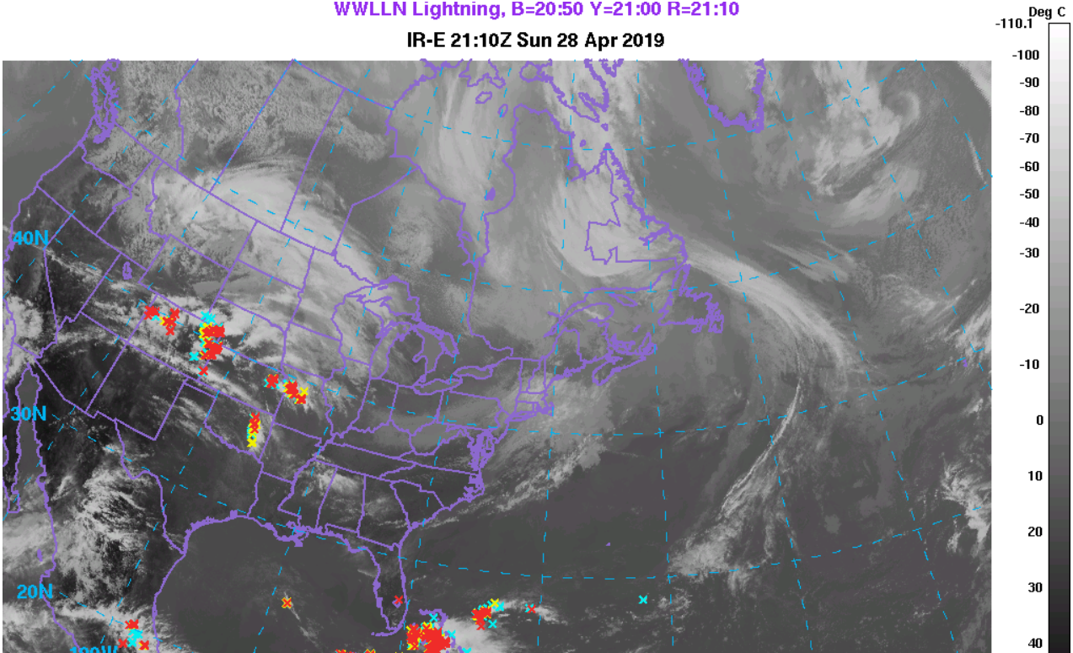
WPC Surface Analysis (21:00 UTC) and Satellite, (21:10 UTC) April 28th, 2019

Slide 4
16z HRRR (4/28) at hour 9 Showed CI in Southern Kansas

Slide 5
4/28/19 Radar Evolution Shows this was not Observed
04/28, 23:00 UTC
4/29, 1:00 UTC
4/29, 3:00 UTC

Slide 6
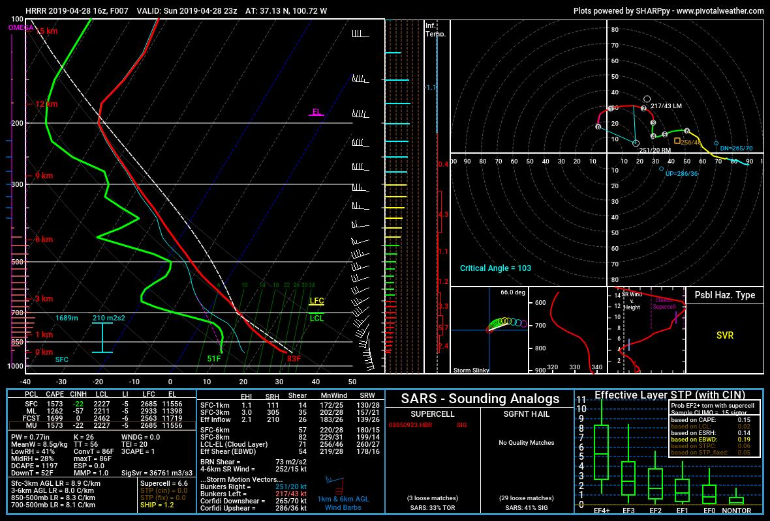
HRRR (left) at 23:00 UTC on April 28th Significantly Steeper with Lapse Rates than Observed (right) at 0:00 UTC on April 29th

Slide 7
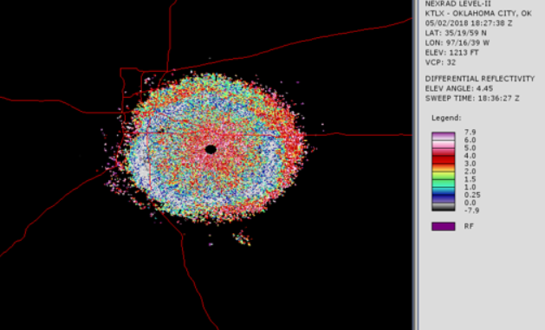
Would Assimilating BL Quasi-Vertical Profile (QVP) Heights Change Forecast Accuracy?
Analyzed ten radar sites for April 28th, 2019 using differential reflectivity averages for a given height from a given distance.
Looking for differential reflectivity minima
Bragg scattering at the top of the boundary layer from bugs can estimate height of the boundary layer, which is important for severe weather forecasting (Banghoff et al. 2018).
Example of a low ZDR ring visualized by the
Weather Climate Toolkit from KTLX on May
2nd, 2018

Slide 8
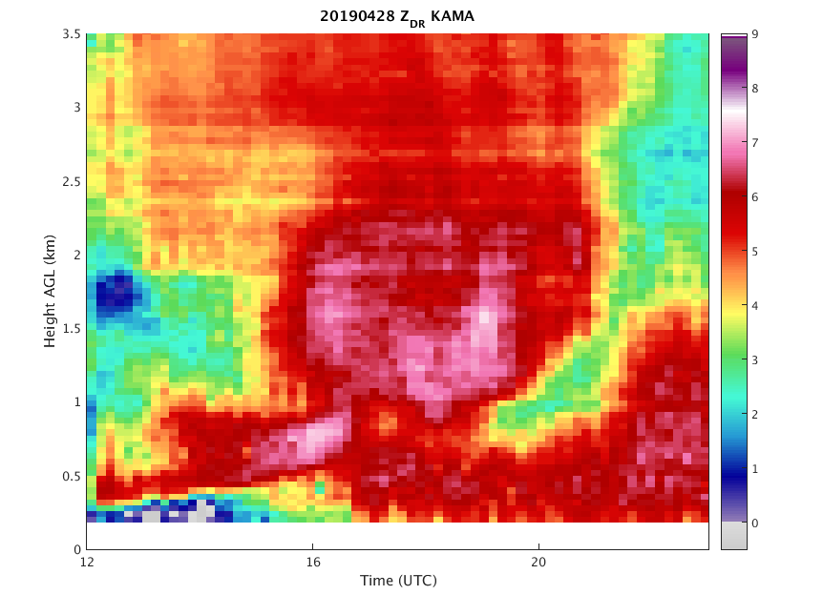
KAMA, April 28th, 2019

Slide 9
KDDC, April 28th, 2019

Slide 10
KVNX, April 28th, 2019

Slide 11
KICT, April 28th, 2019

Slide 12
KGLD, April 28th, 2019

Slide 13
KPUX, April 28th, 2019

Slide 14
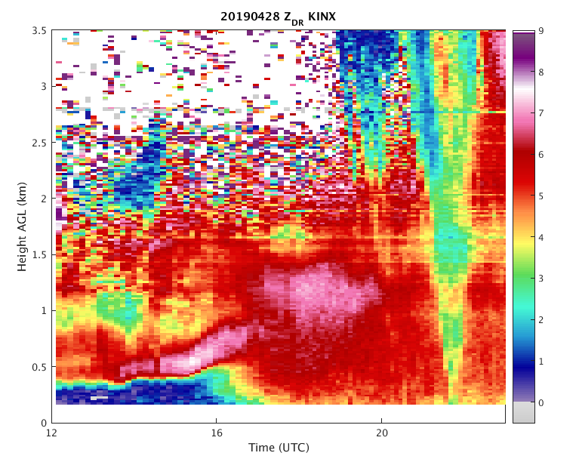
QVP Analysis for KINX, April 28th, 2019

Slide 15
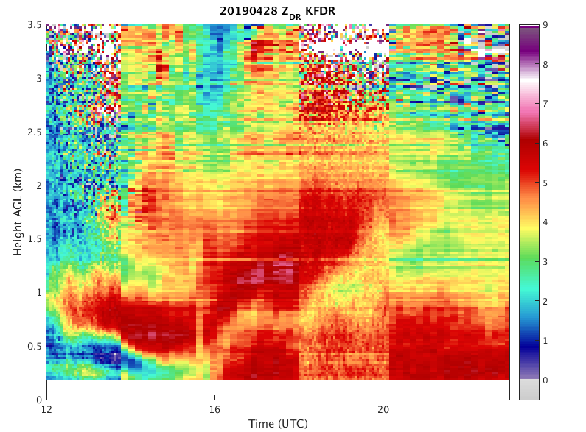
QVP Analysis for KFDR, April 28th, 2019

Slide 16
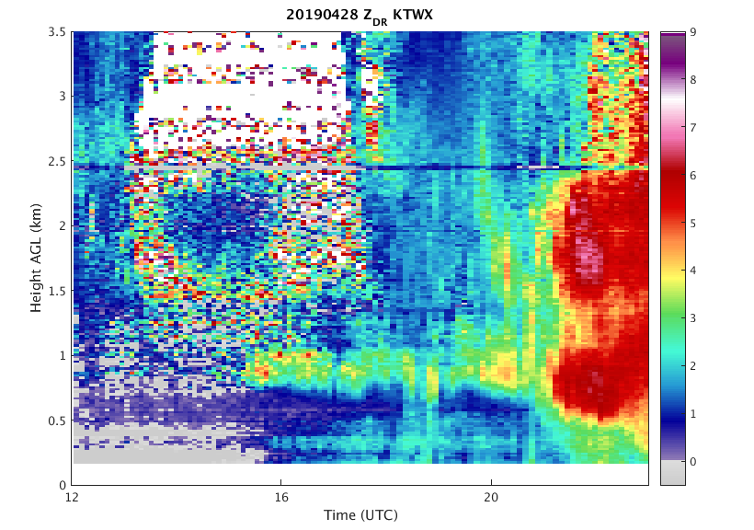
QVP Analysis for KTWX, April 28th, 2019

Slide 17
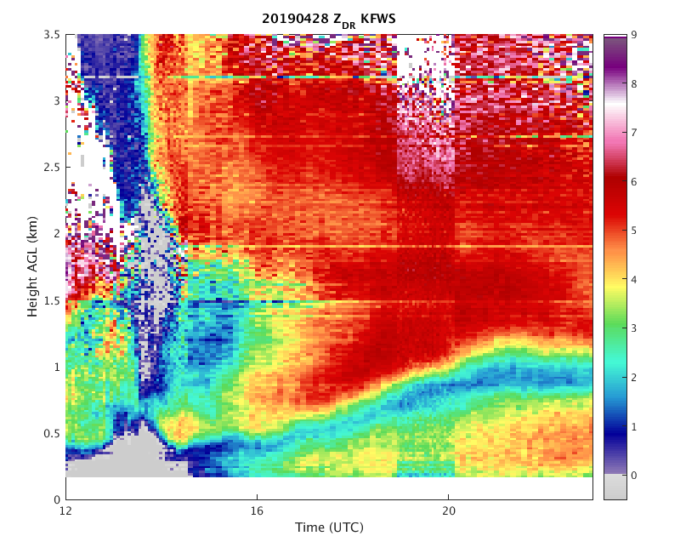
QVP Analysis for KFWS, April 28th, 2019

Slide 18
Conclusions and Future Work
Some identifiable differential reflectivity minima in analyzed radar sites.
Future work will aim to see if these QVP radar observations will have a detectable improvement in CI forecasting for this case.

Slide 19
References
Banghoff, John R., David J. Stensrud, and Matthew R. Kumjian. “Convective Boundary Layer Depth Estimation from S-Band Dual-Polarization Radar.” Journal of Atmospheric and Oceanic Technology 35.8 (2018): 1723-1733.

Slide 20
Thanks for Listening!

