Slide 1


The impact of air-sea fluxes and their uncertainties in the intensification of Hurricane Patricia (2015)
Robert Nystrom and Fuqing Zhang

Slide 2
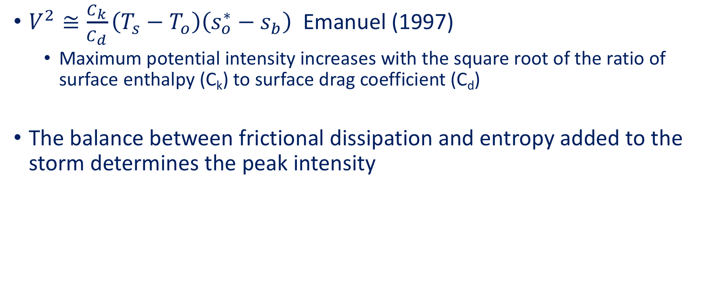
Why do we care about the surface fluxes?
$V^{2}≅\frac{C_{k}}{C_{d}}\left(T_{s}−T_{o}\right)\left(s_{o}^{∗}−s_{b}\right)$ Emanuel (1997)
  Maximum potential intensity increases with the square root of the ratio of surface enthalpy (C_{k}) to surface drag coefficient (C_{d})
The balance between frictional dissipation and entropy added to the storm determines the peak intensity

Slide 3
Patricia’s intensity sensitivity

Slide 4
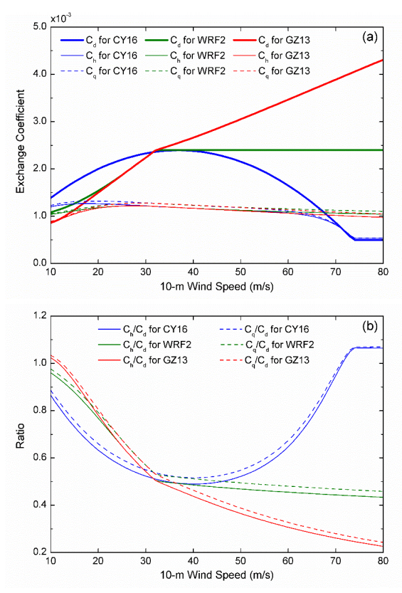
How uncertain are we in these physical processes?
Chen et al. (2018)

Slide 5
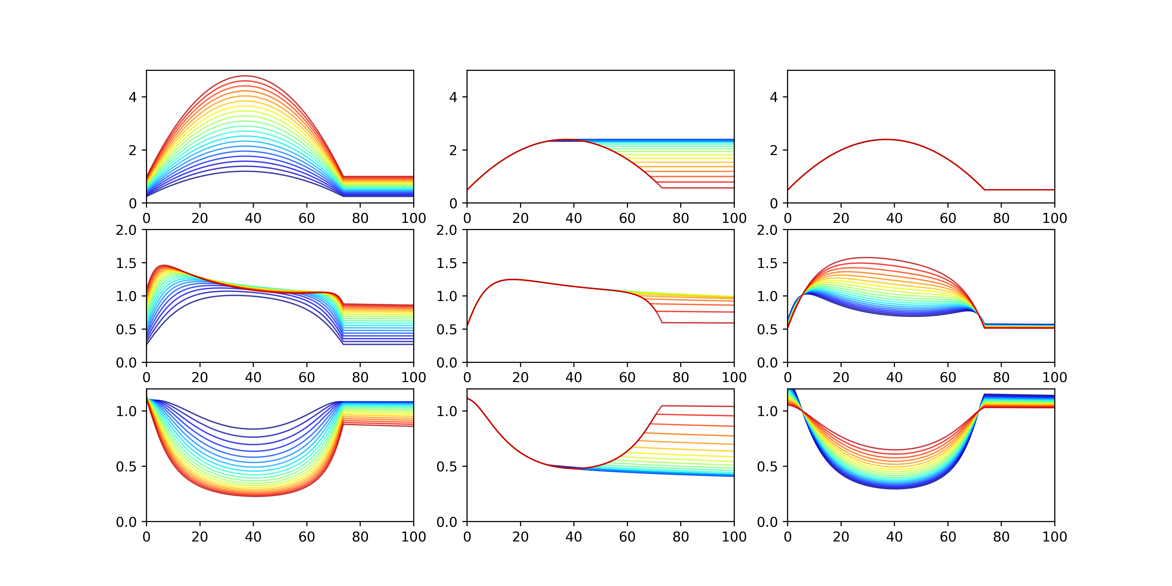
Surface Flux Perturbations
𝛼
V_{c}
β
C_{d}
C_{k}
C_{k}/C_{d}
wind speed (ms^{–1})

Slide 6
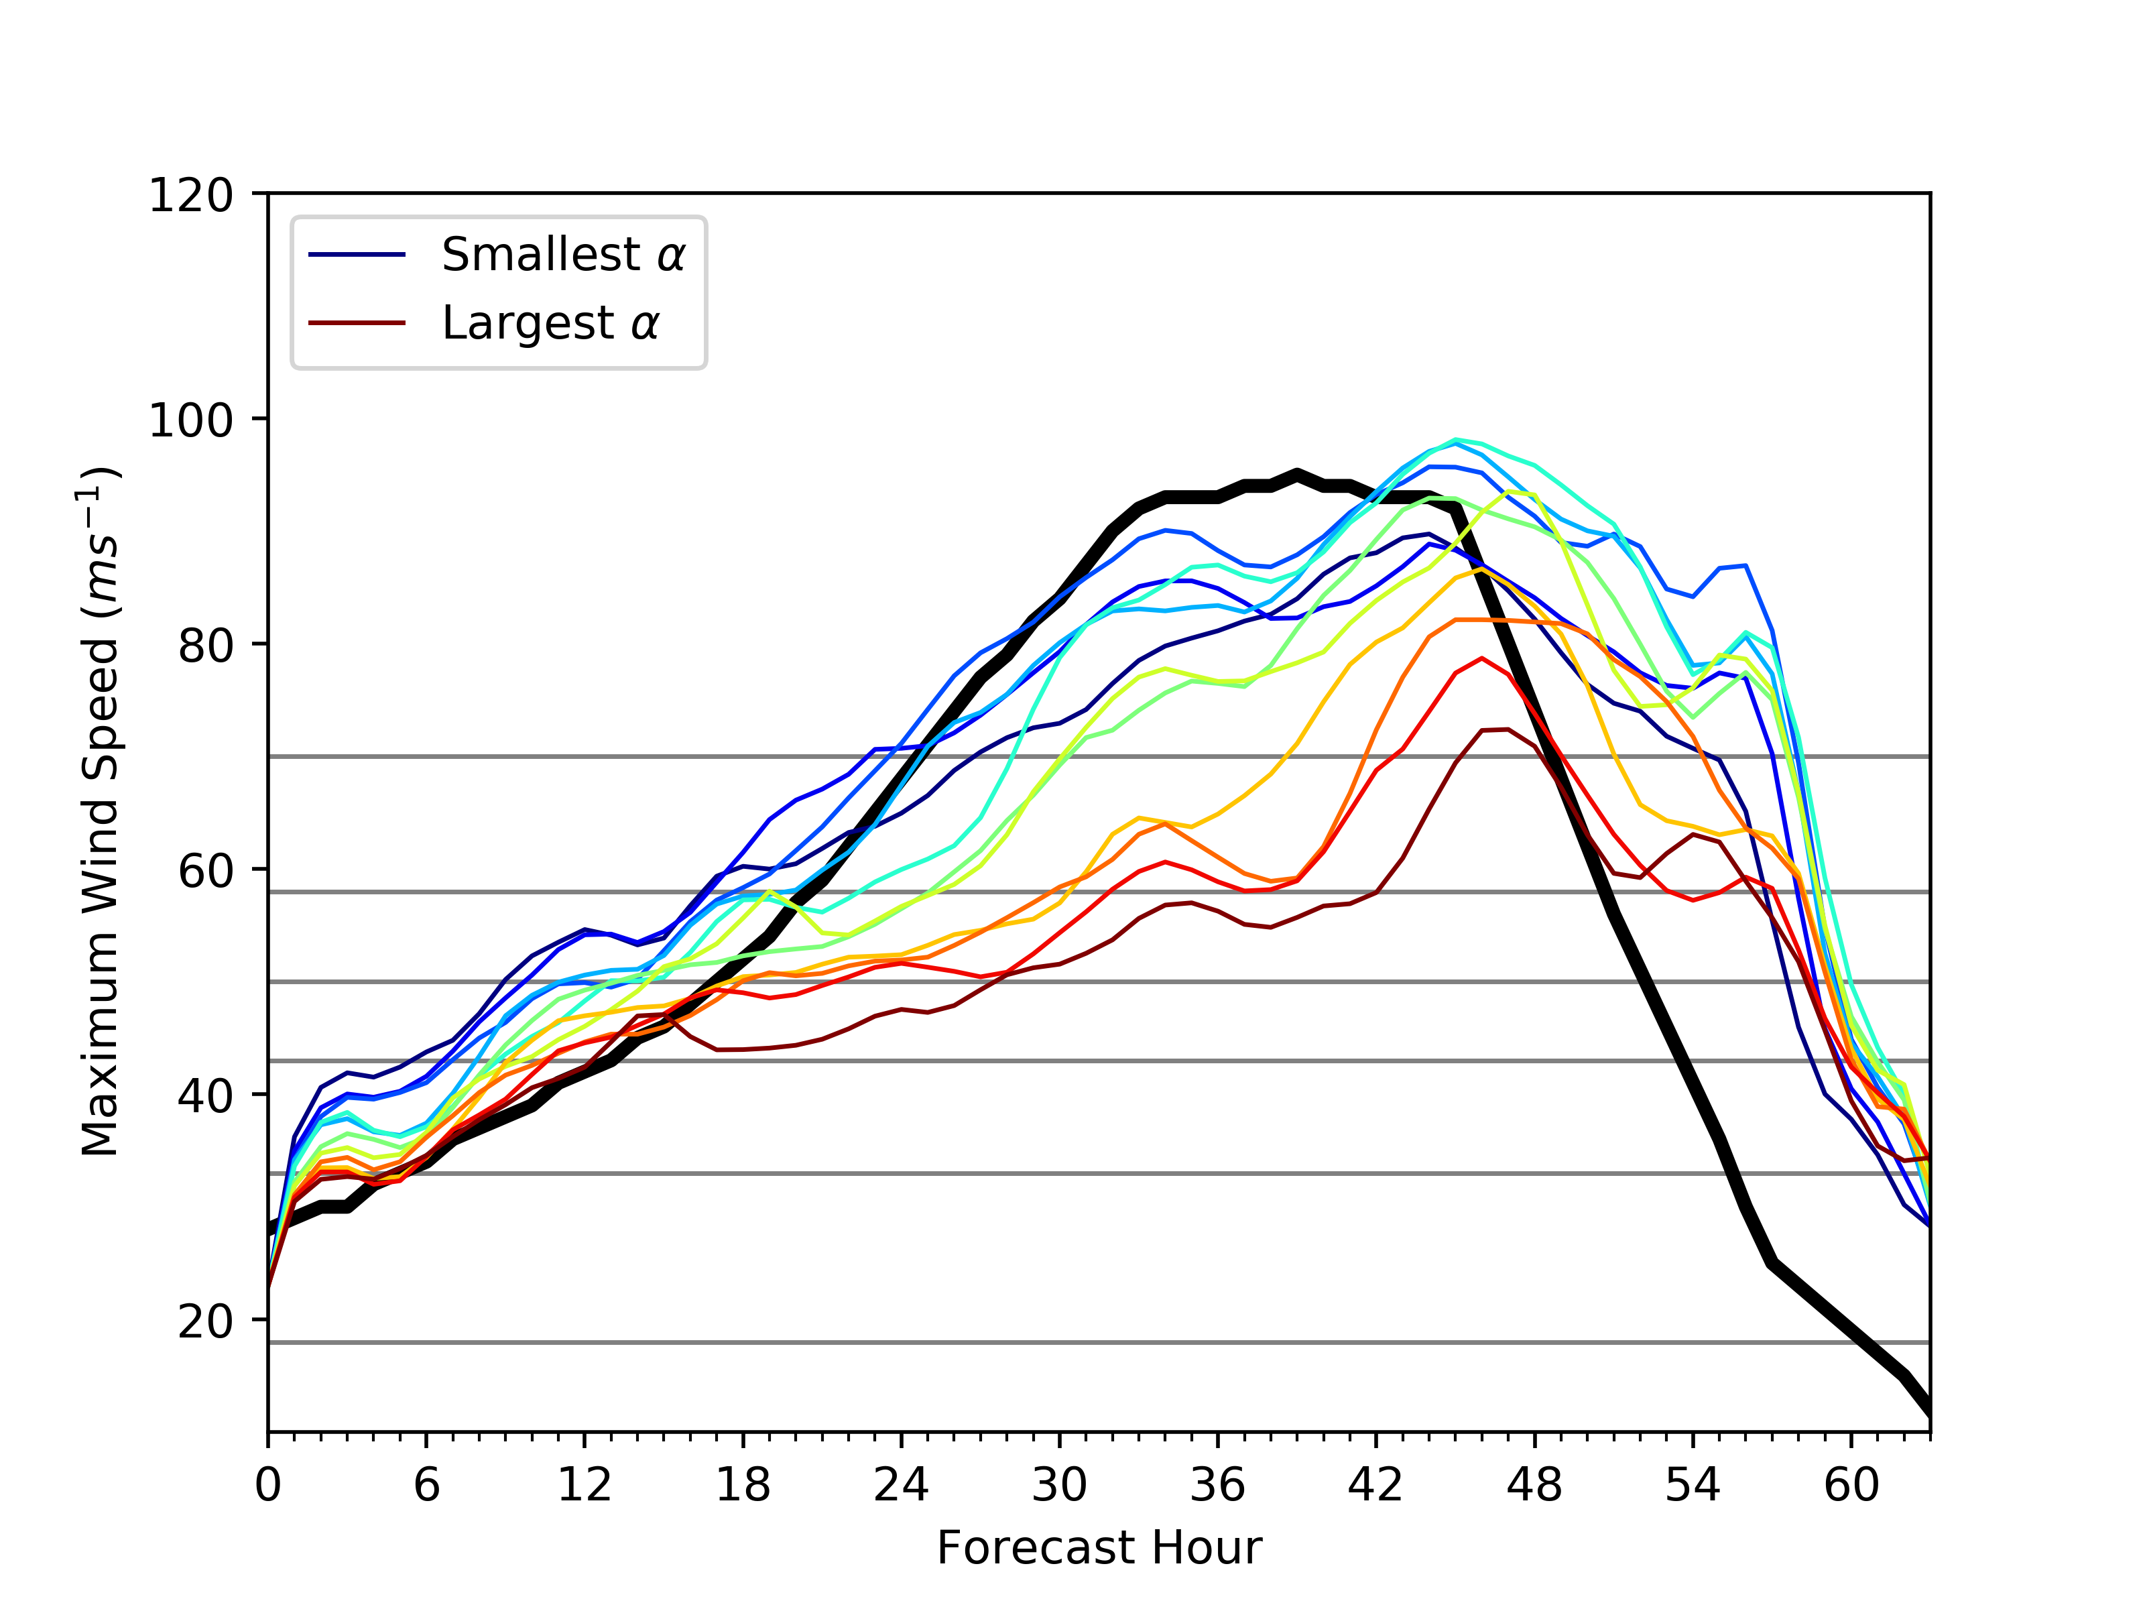
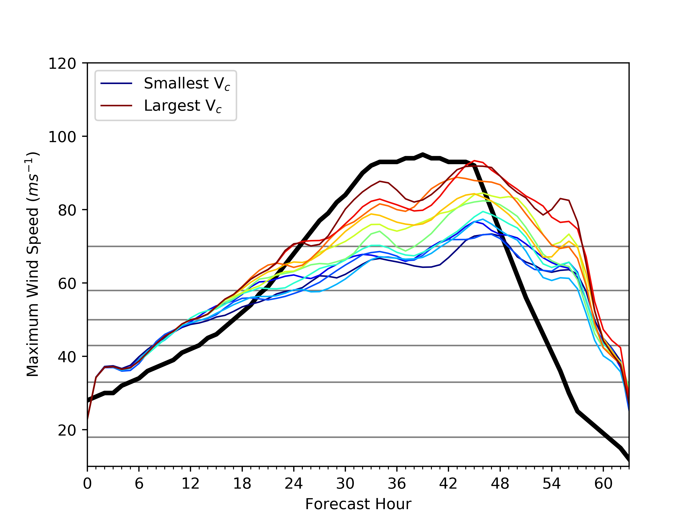
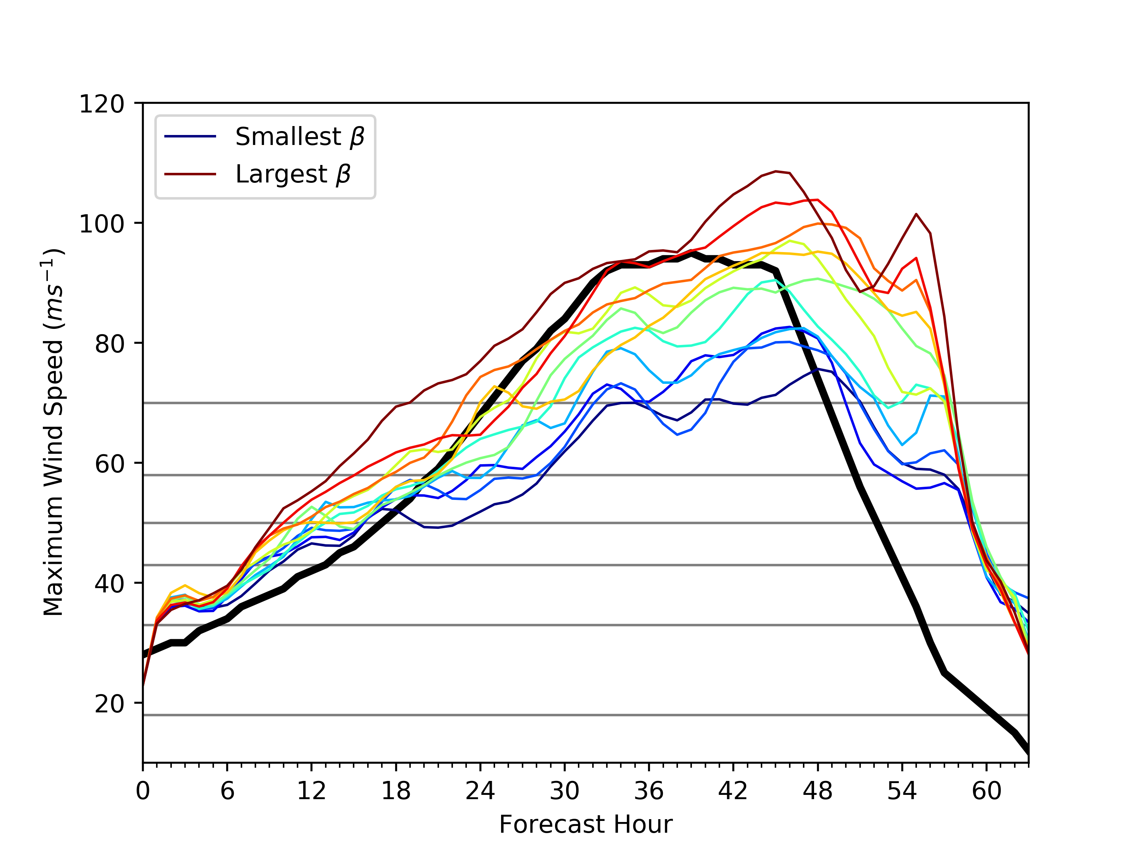
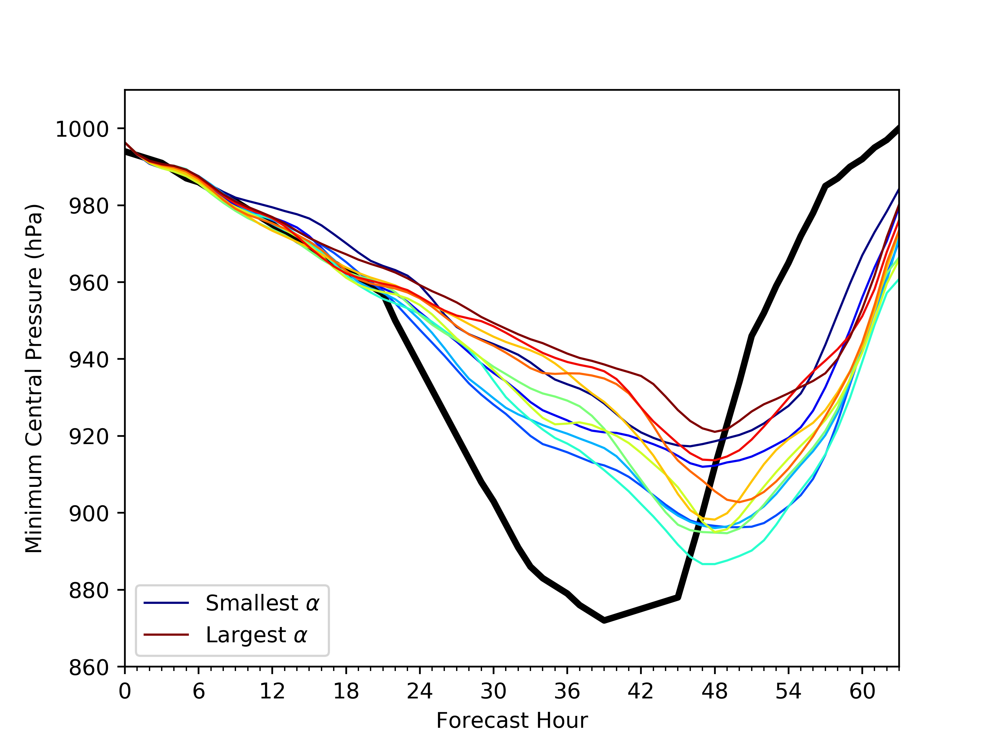
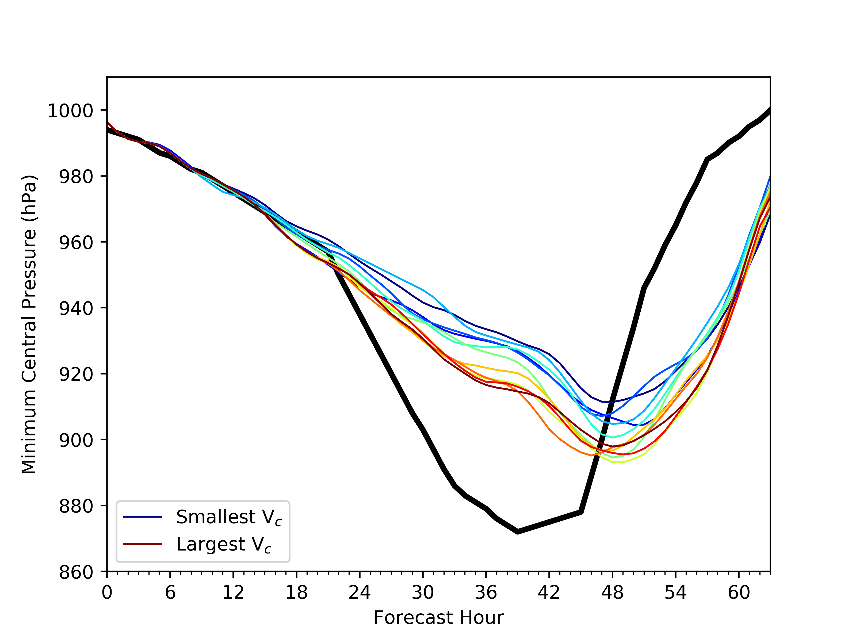
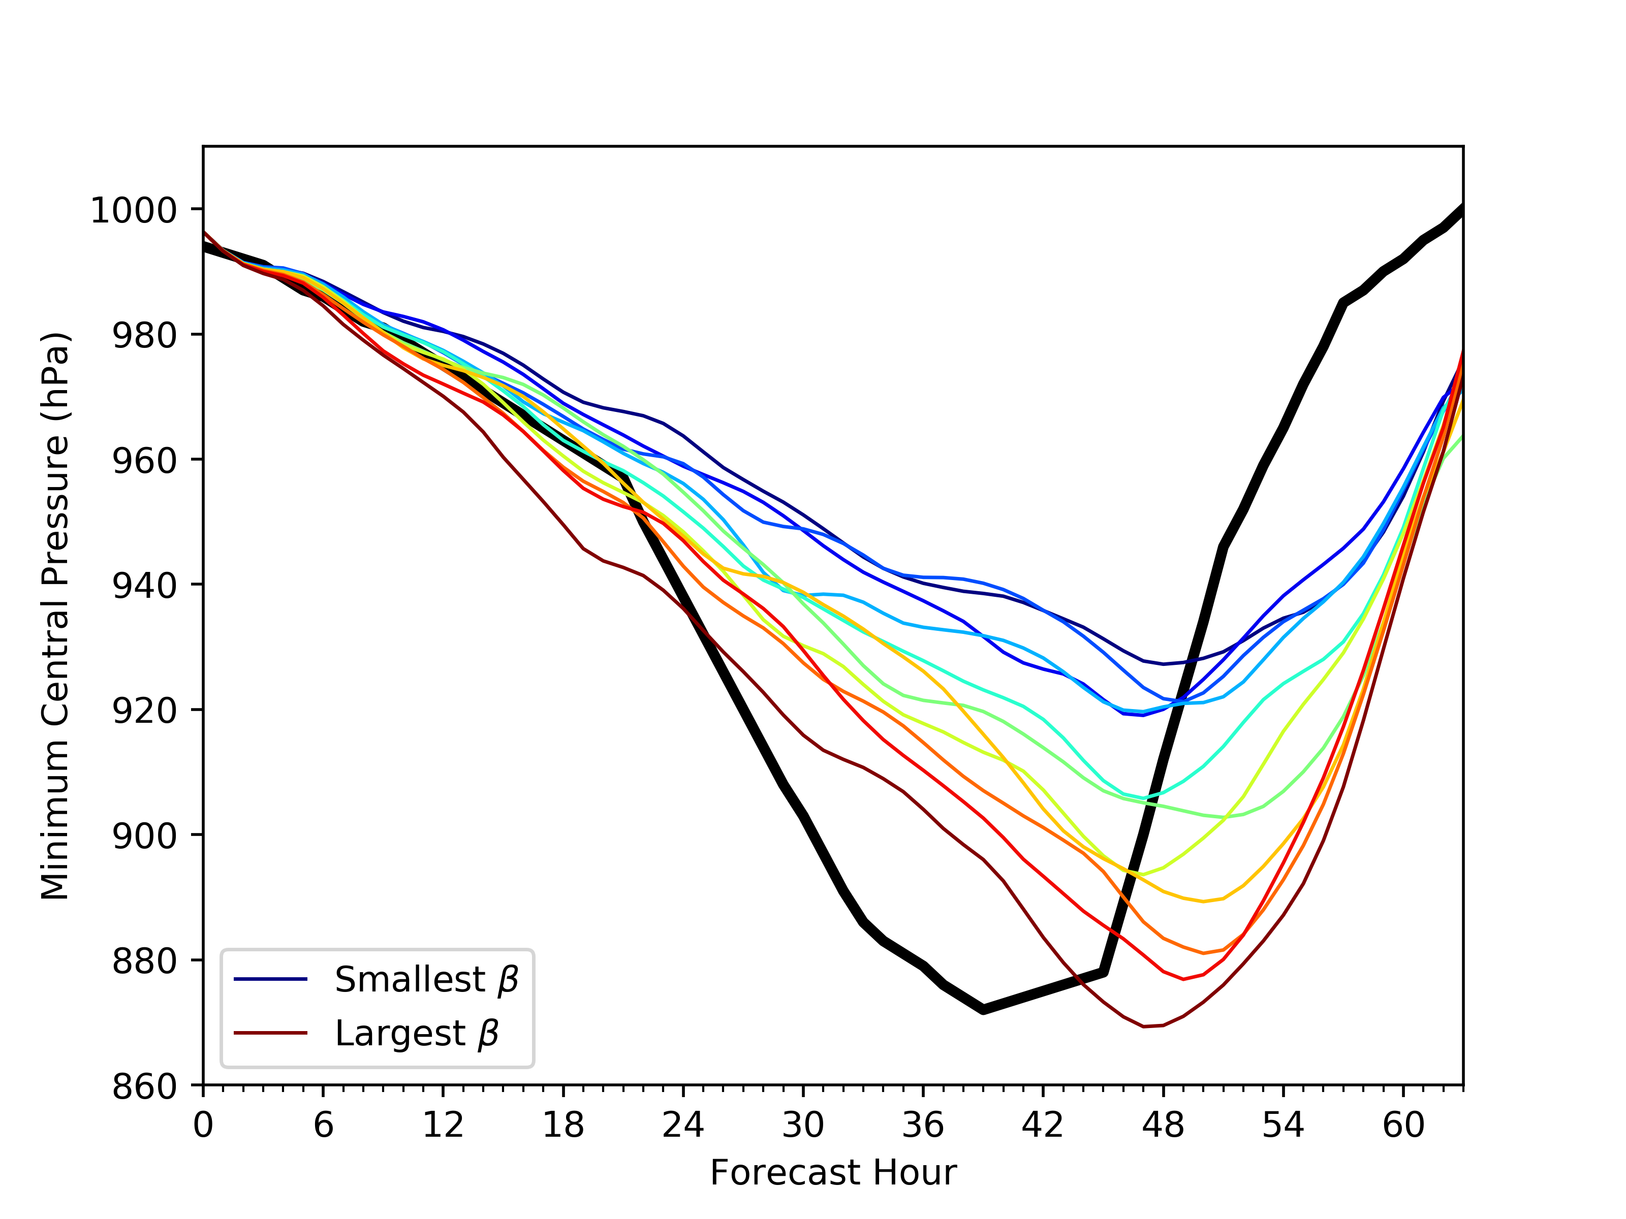
Model Simulated Intensity

Slide 7
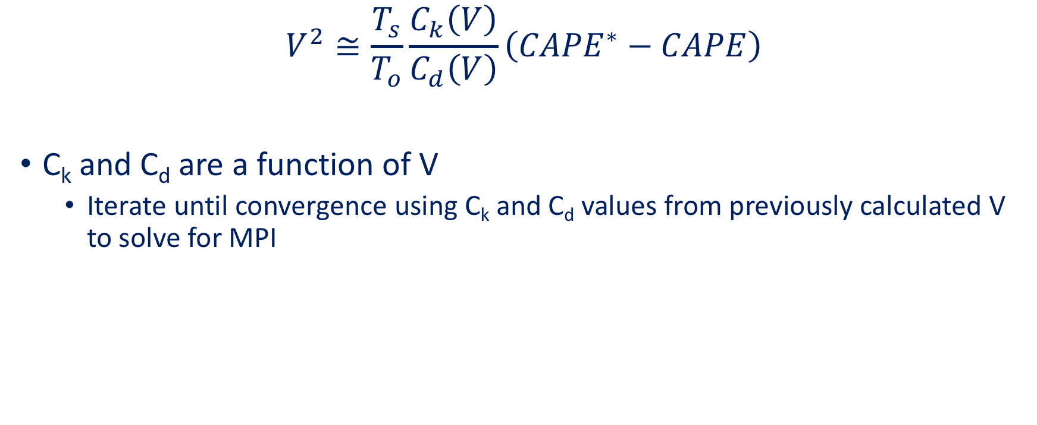
Calculating MPI
$$V^{2}≅\frac{T_{s}}{T_{o}}\frac{C_{k}\left(V\right)}{C_{d}\left(V\right)}\left({CAPE}^{∗}−CAPE\right)$$
C_{k} and C_{d} are a function of V
  Iterate until convergence using C_{k} and C_{d} values from previously calculated V to solve for MPI

Slide 8
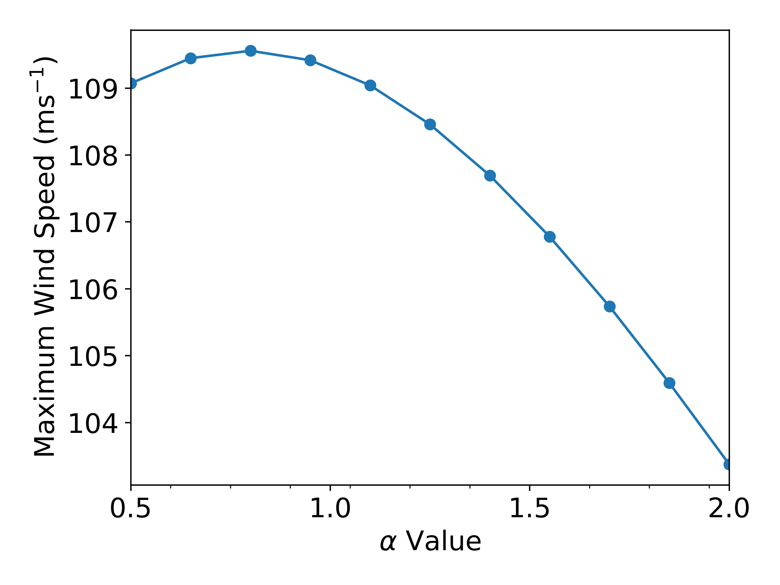
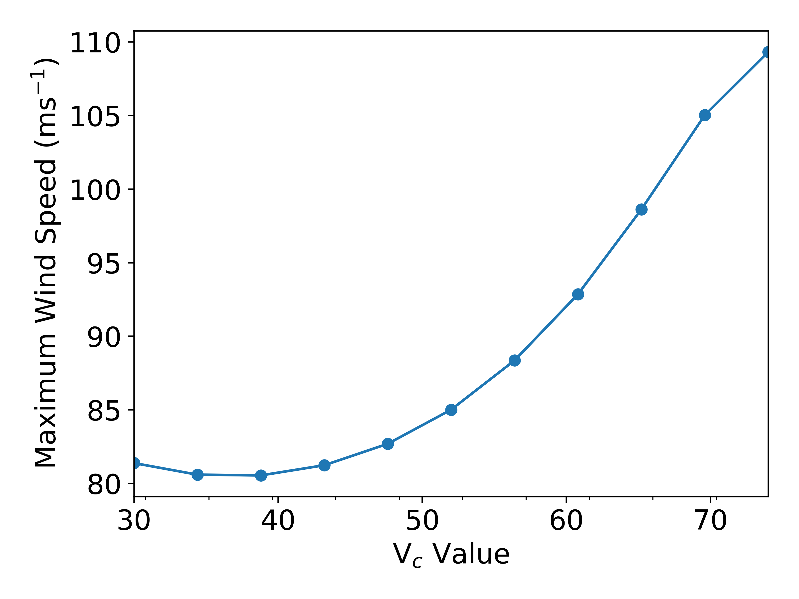
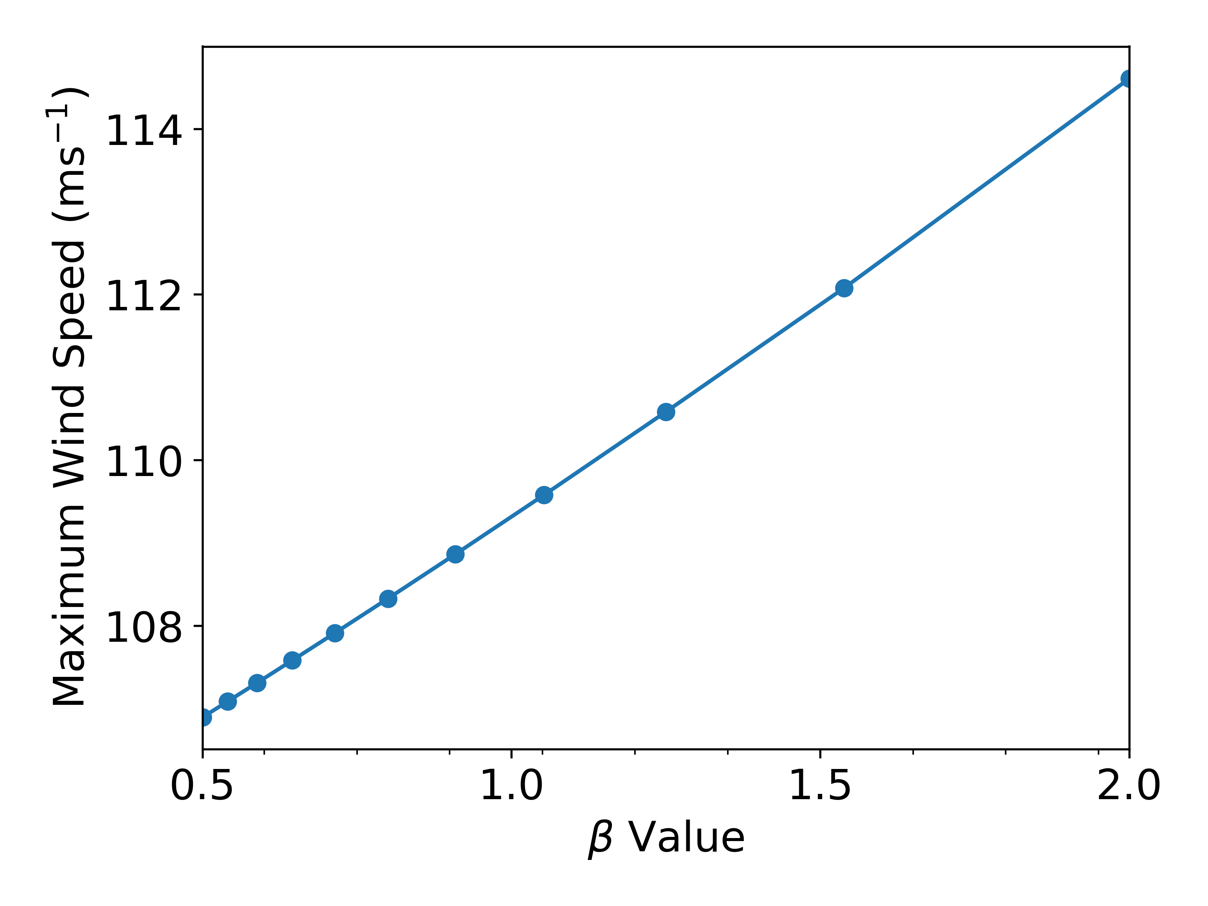
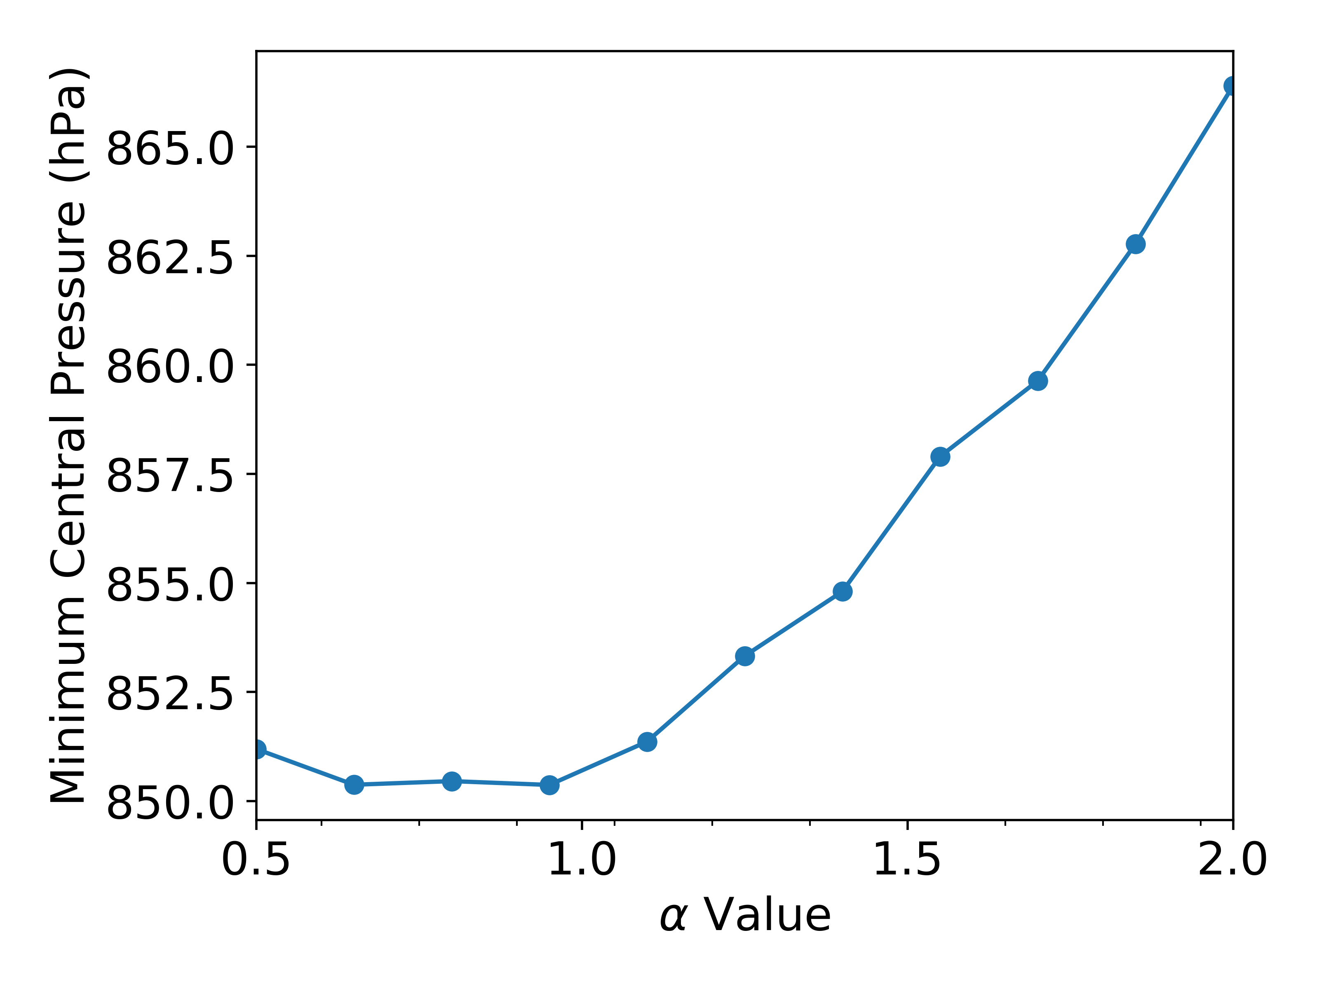
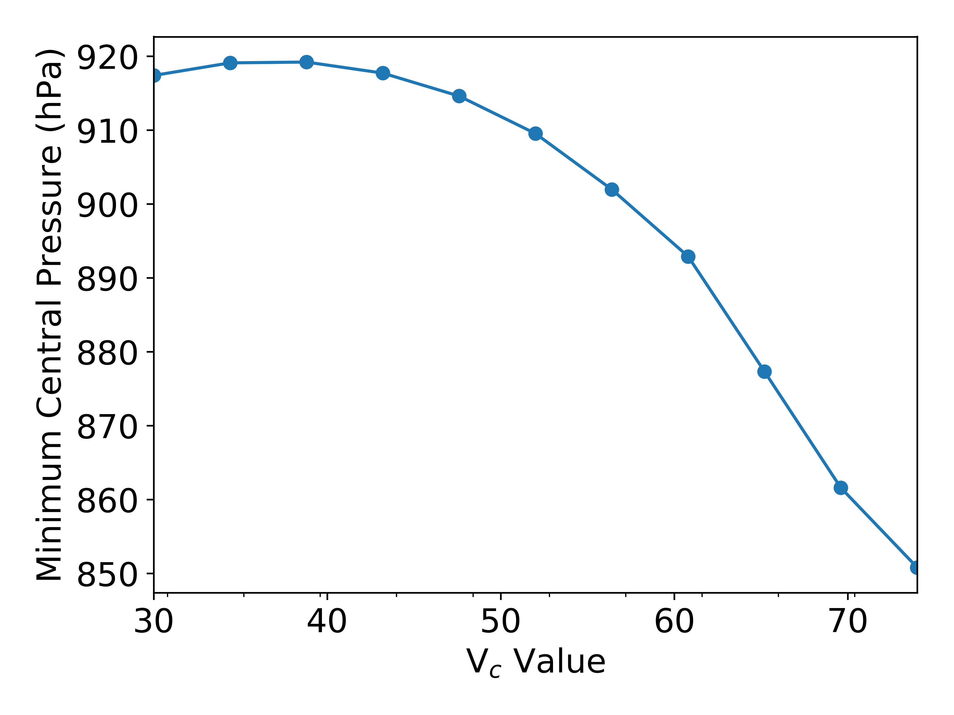
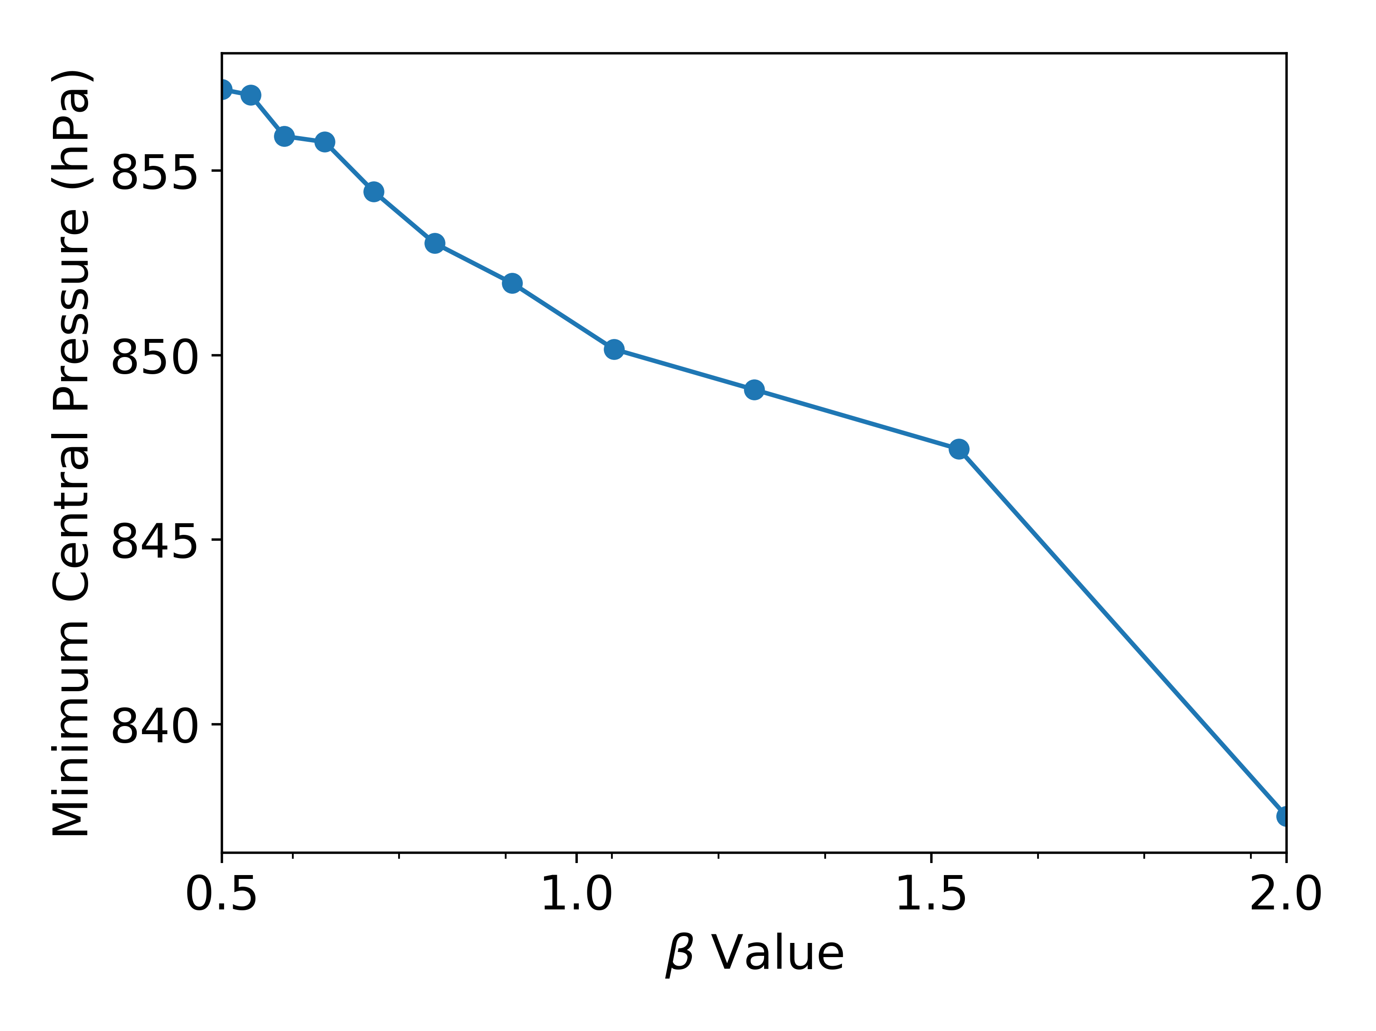
How does MPI Change?

Slide 9
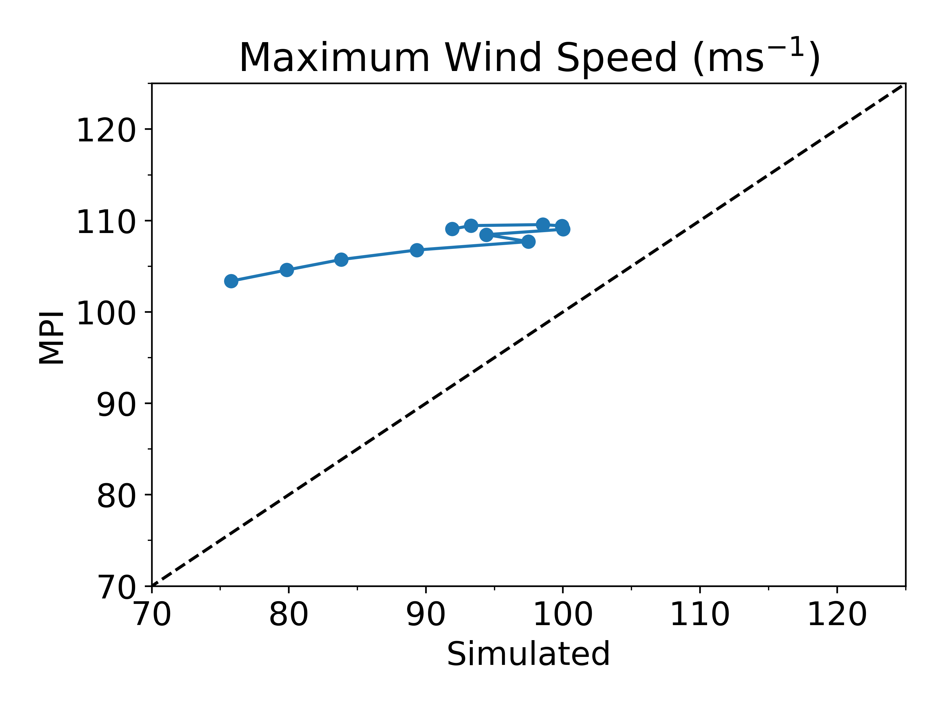
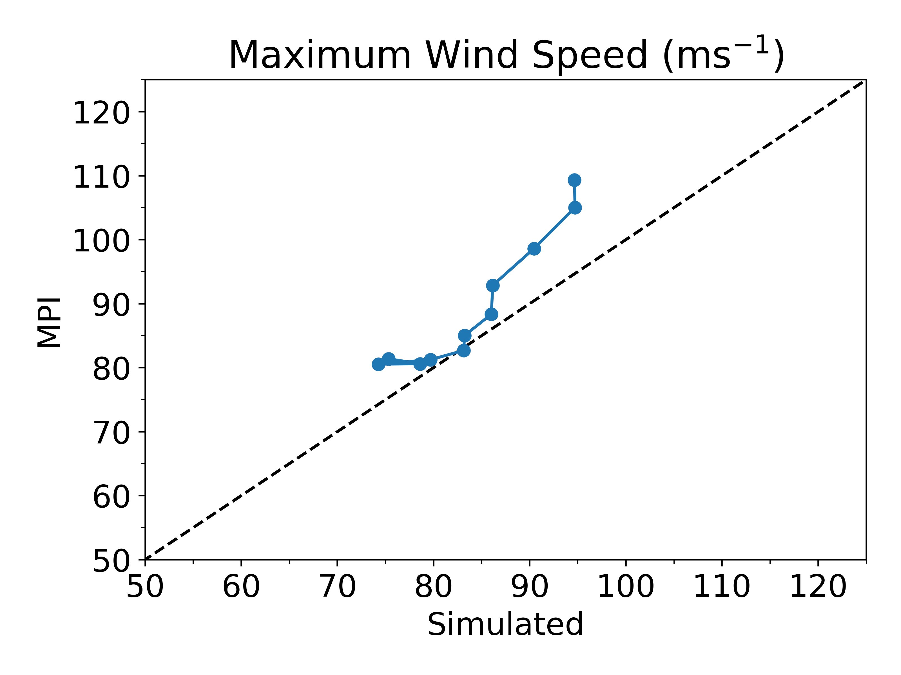
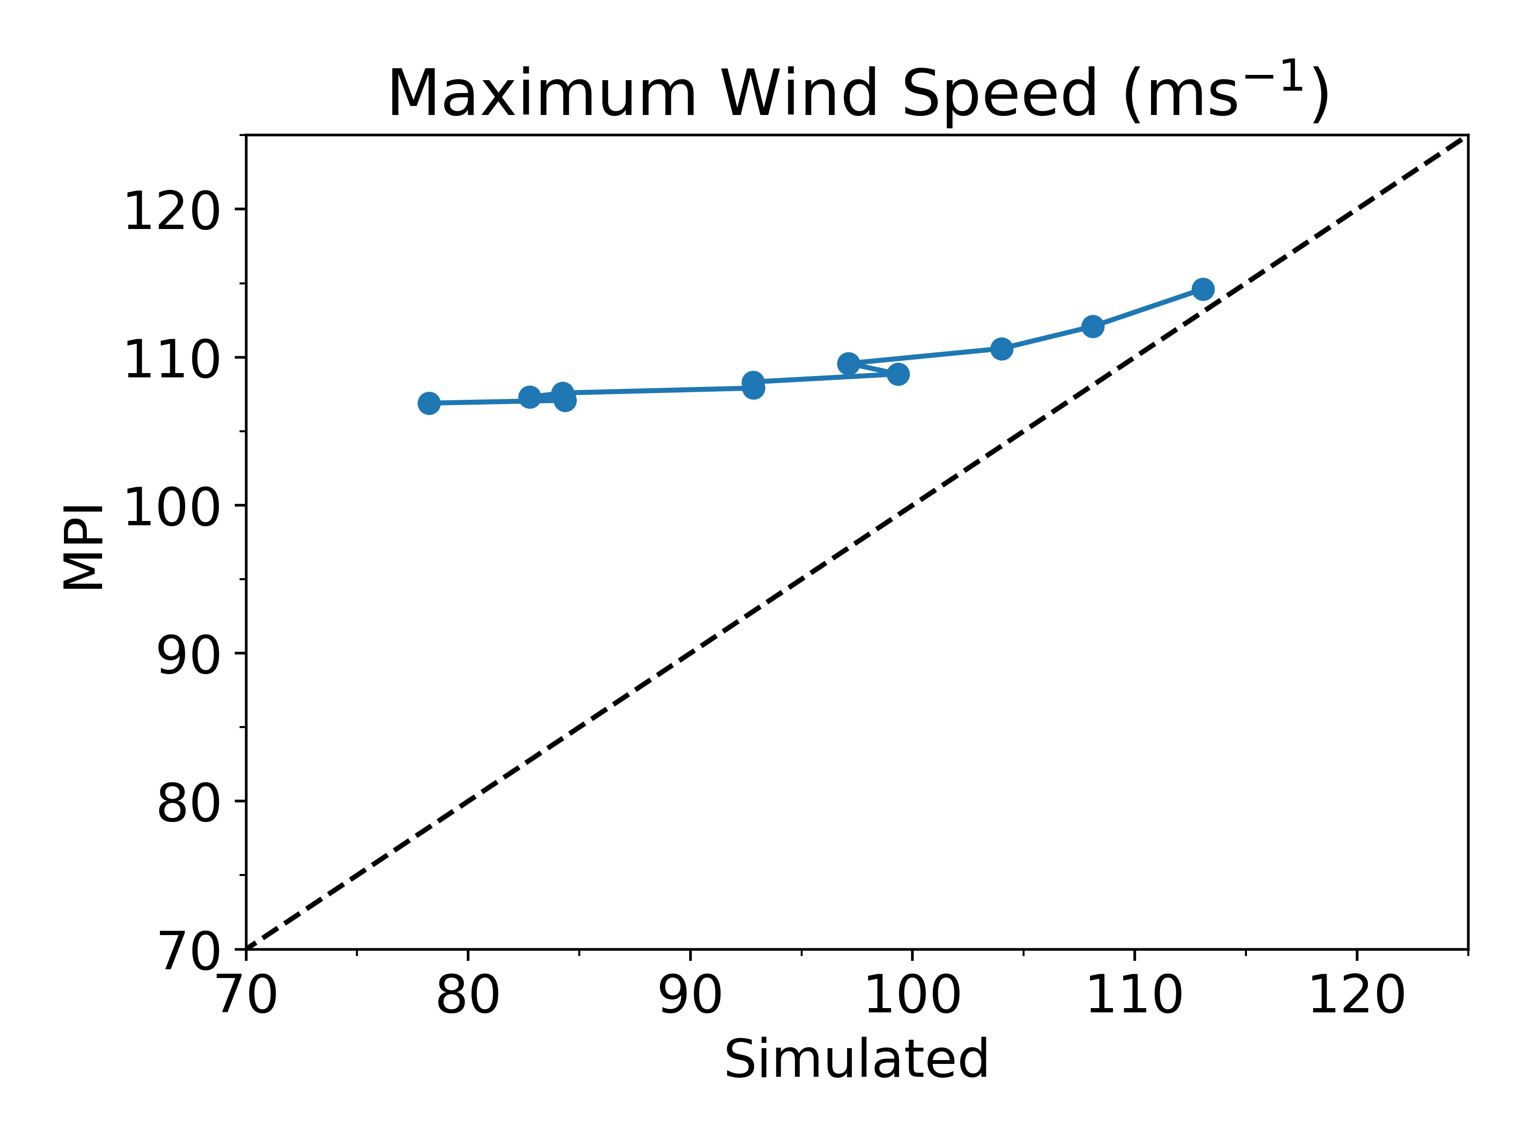
Simulated vs MPI
𝛼
V_{c}
β
They do not agree!

Slide 10
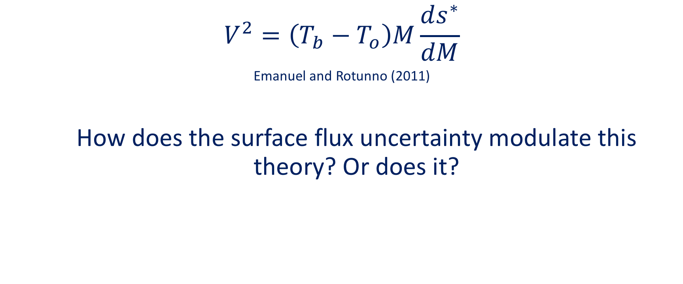
Self-Stratification of Tropical Cyclones
$$V^{2}=\left(T_{b}−T_{o}\right)M\frac{ds^{∗}}{dM}$$
Emanuel and Rotunno (2011)
  How does the surface flux uncertainty modulate this theory? Or does it?

Slide 11
Self-Stratification of Patricia
𝛼
V_{c}
β

Slide 12
Self-Stratification of Patricia
𝛼
V_{c}
β

Slide 13
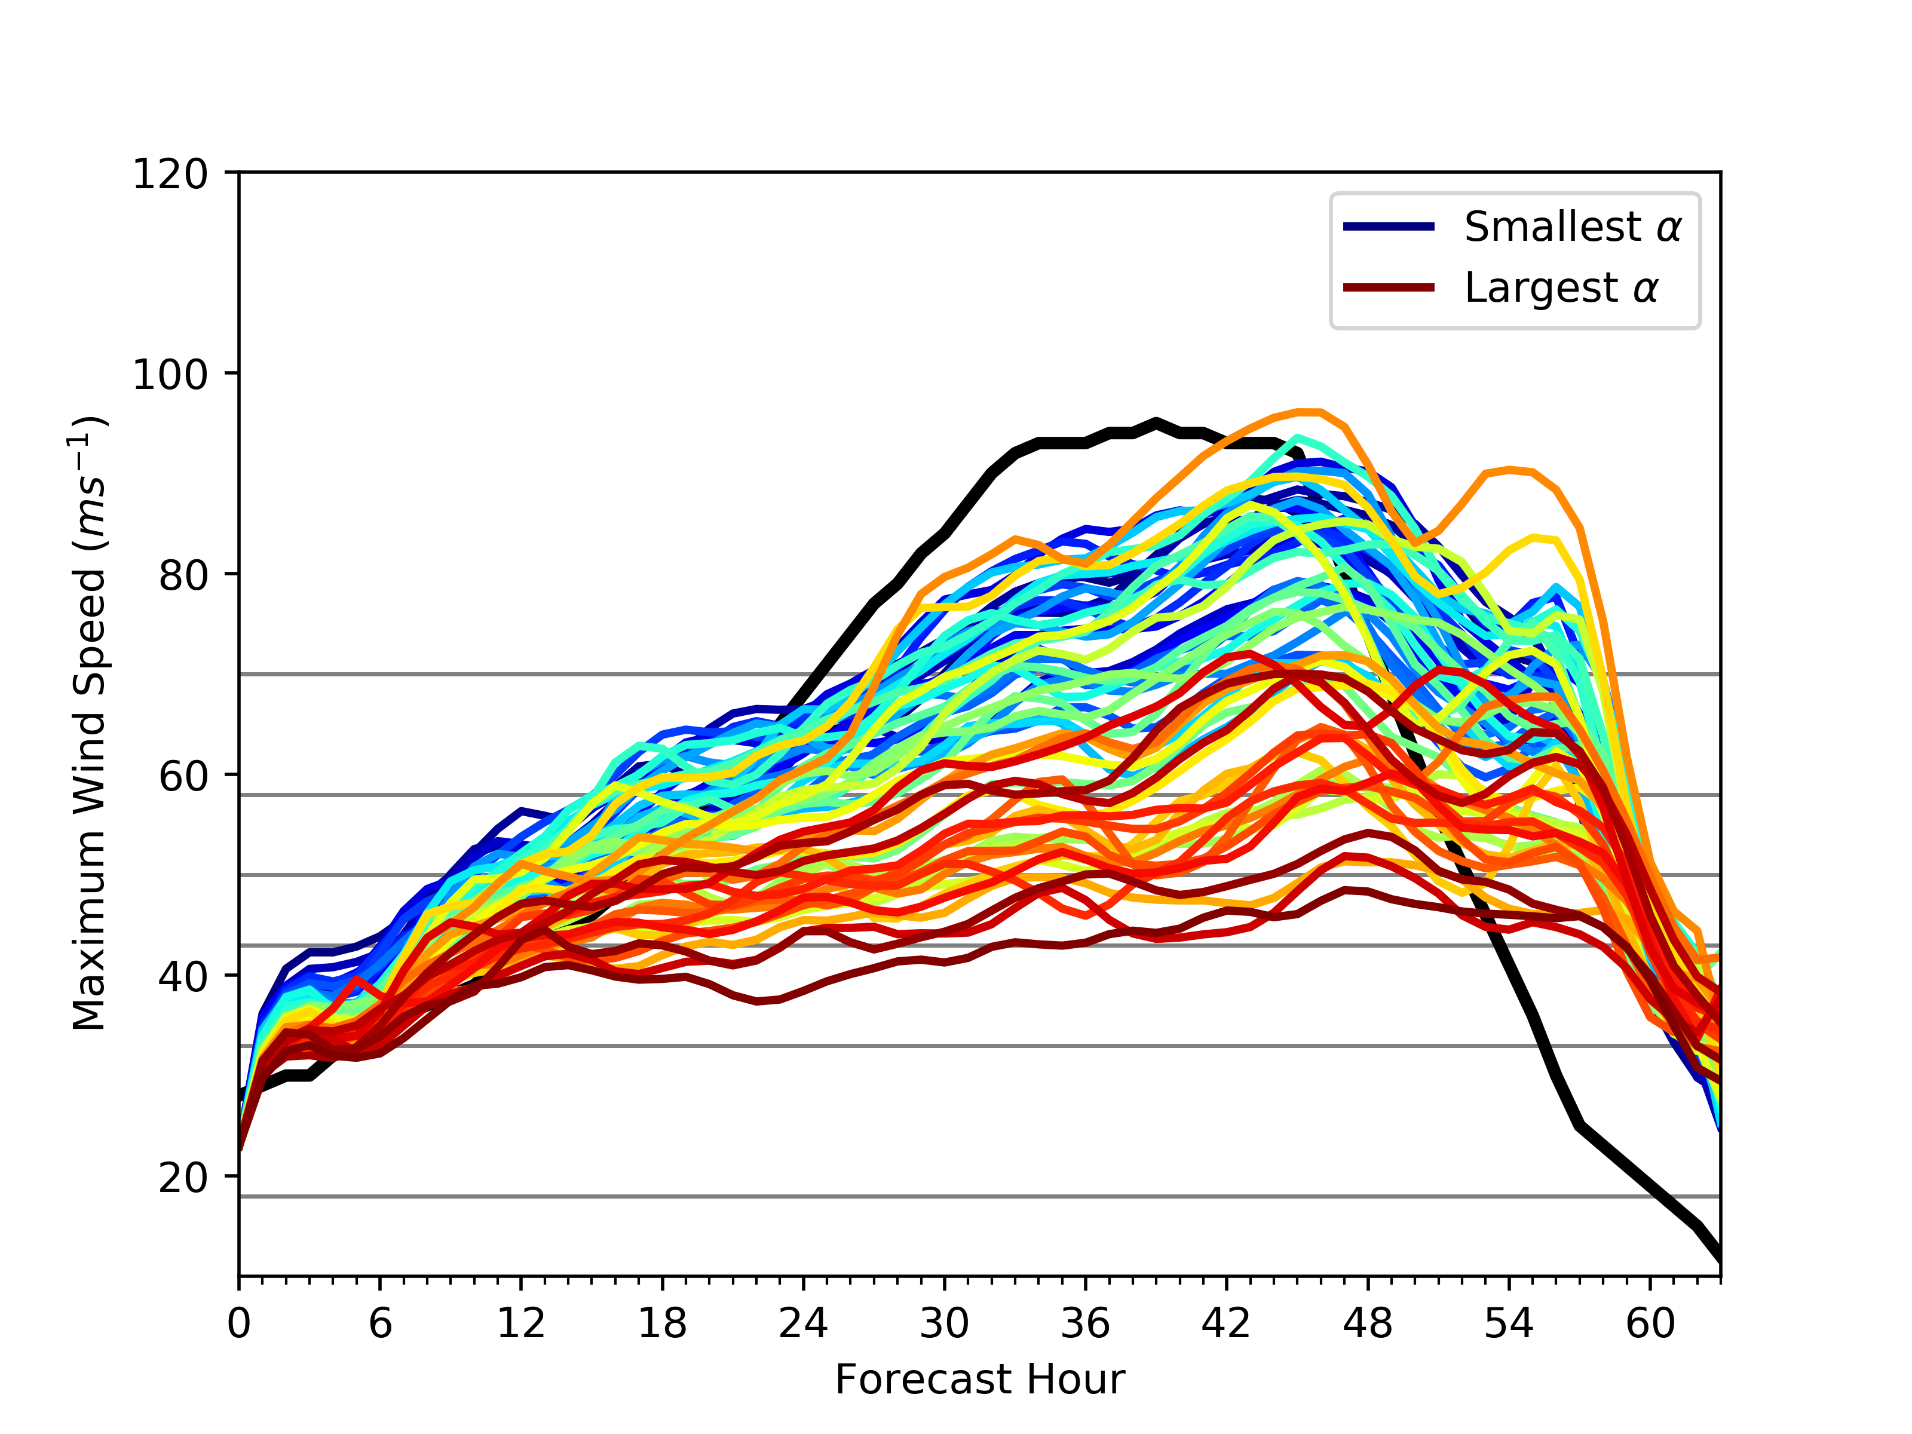
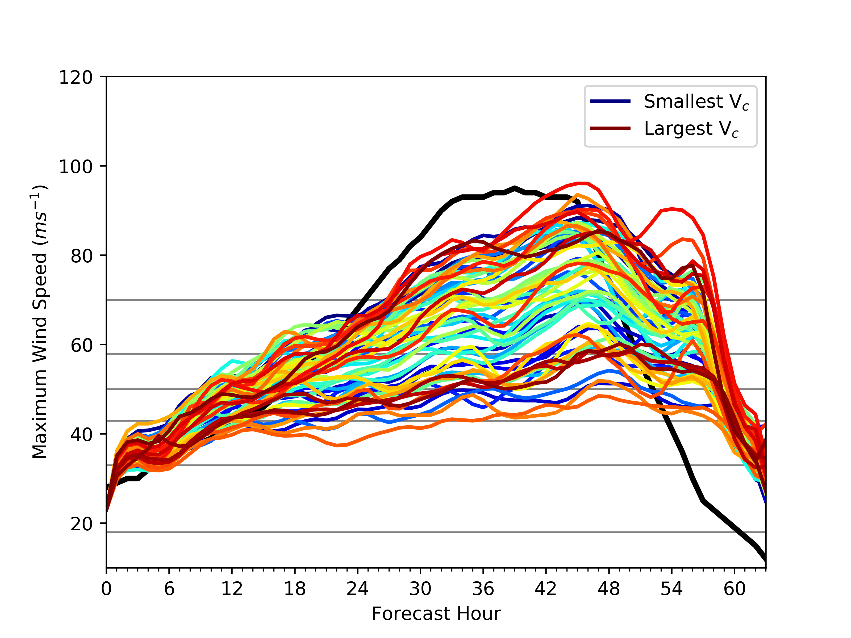
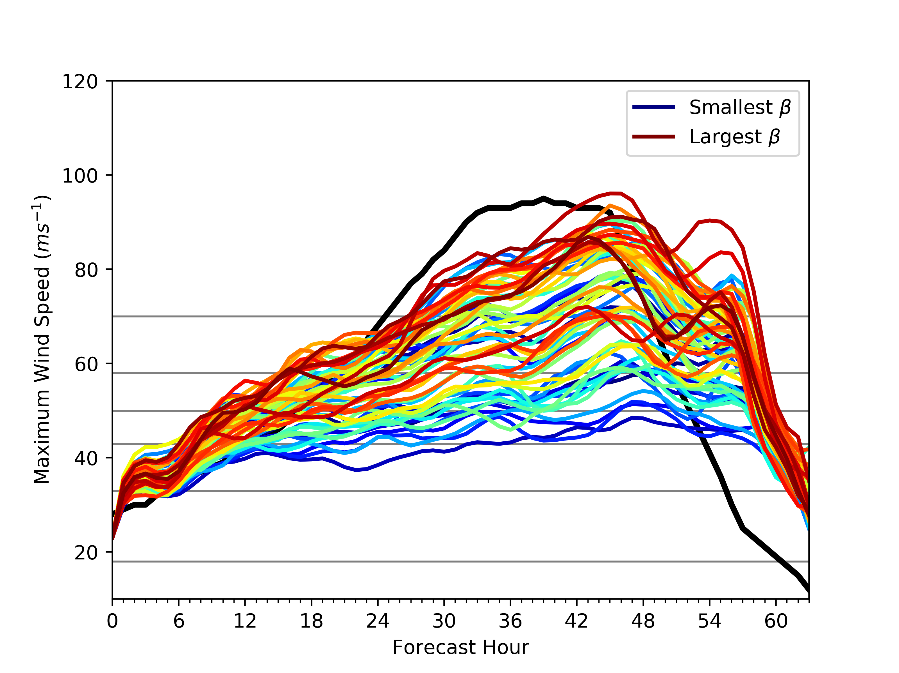
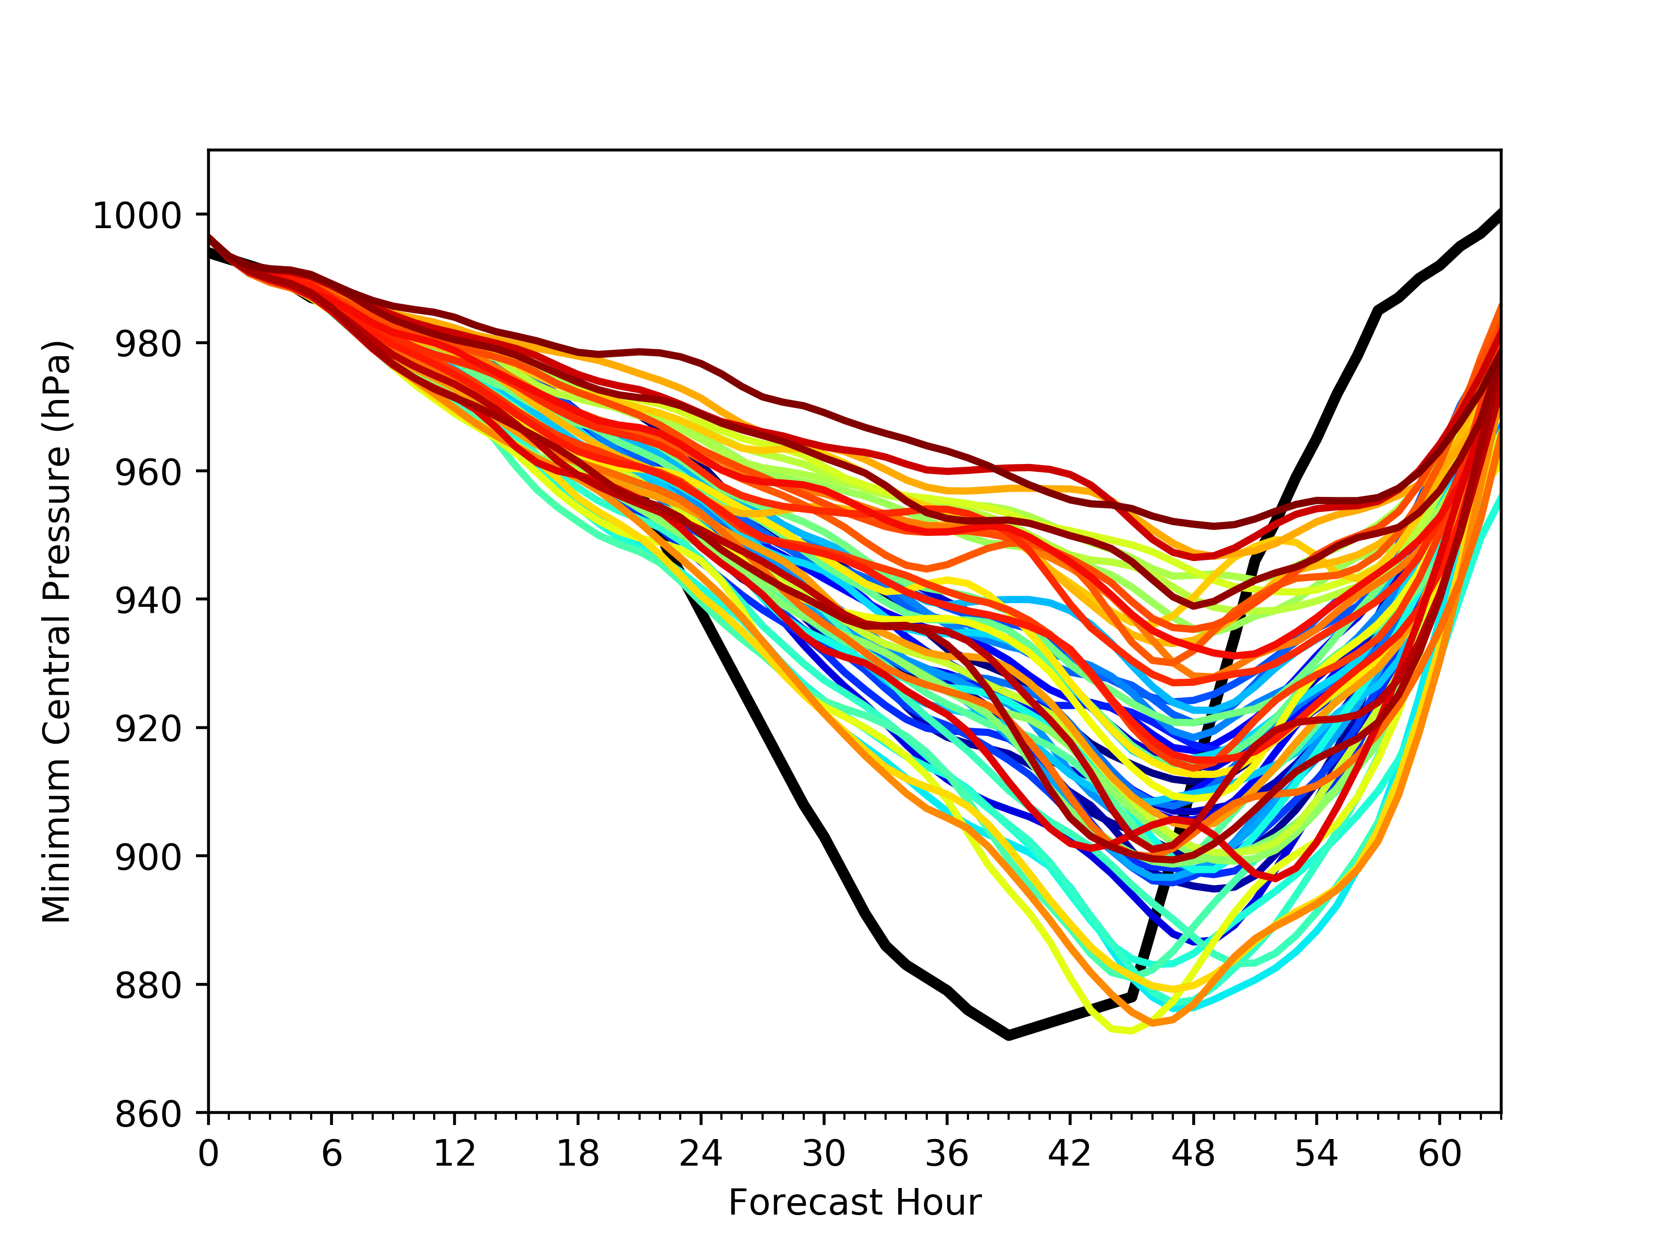
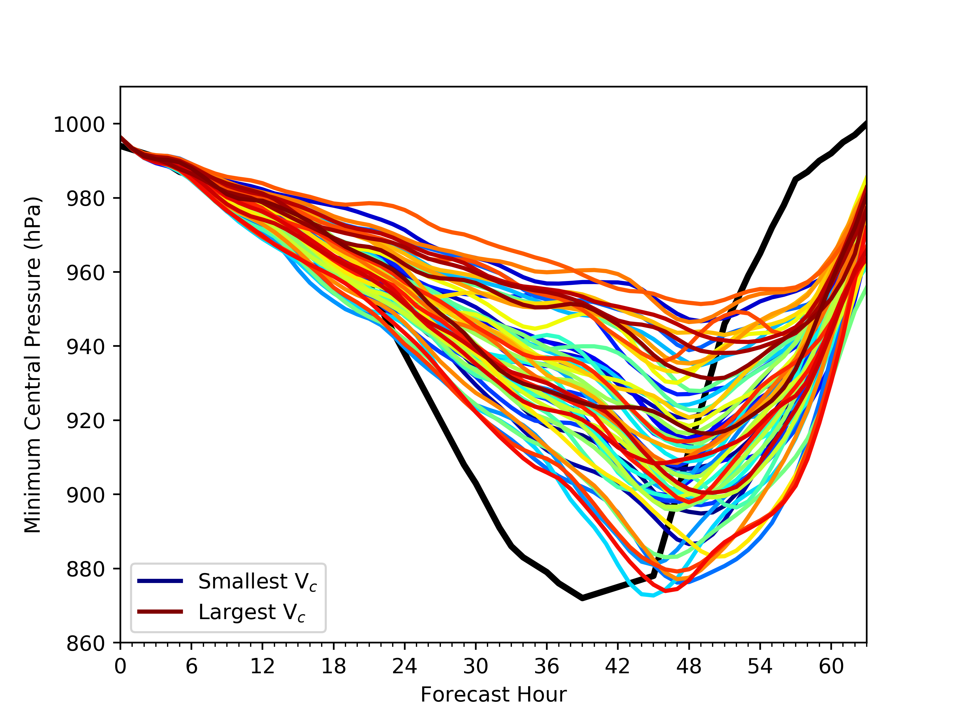
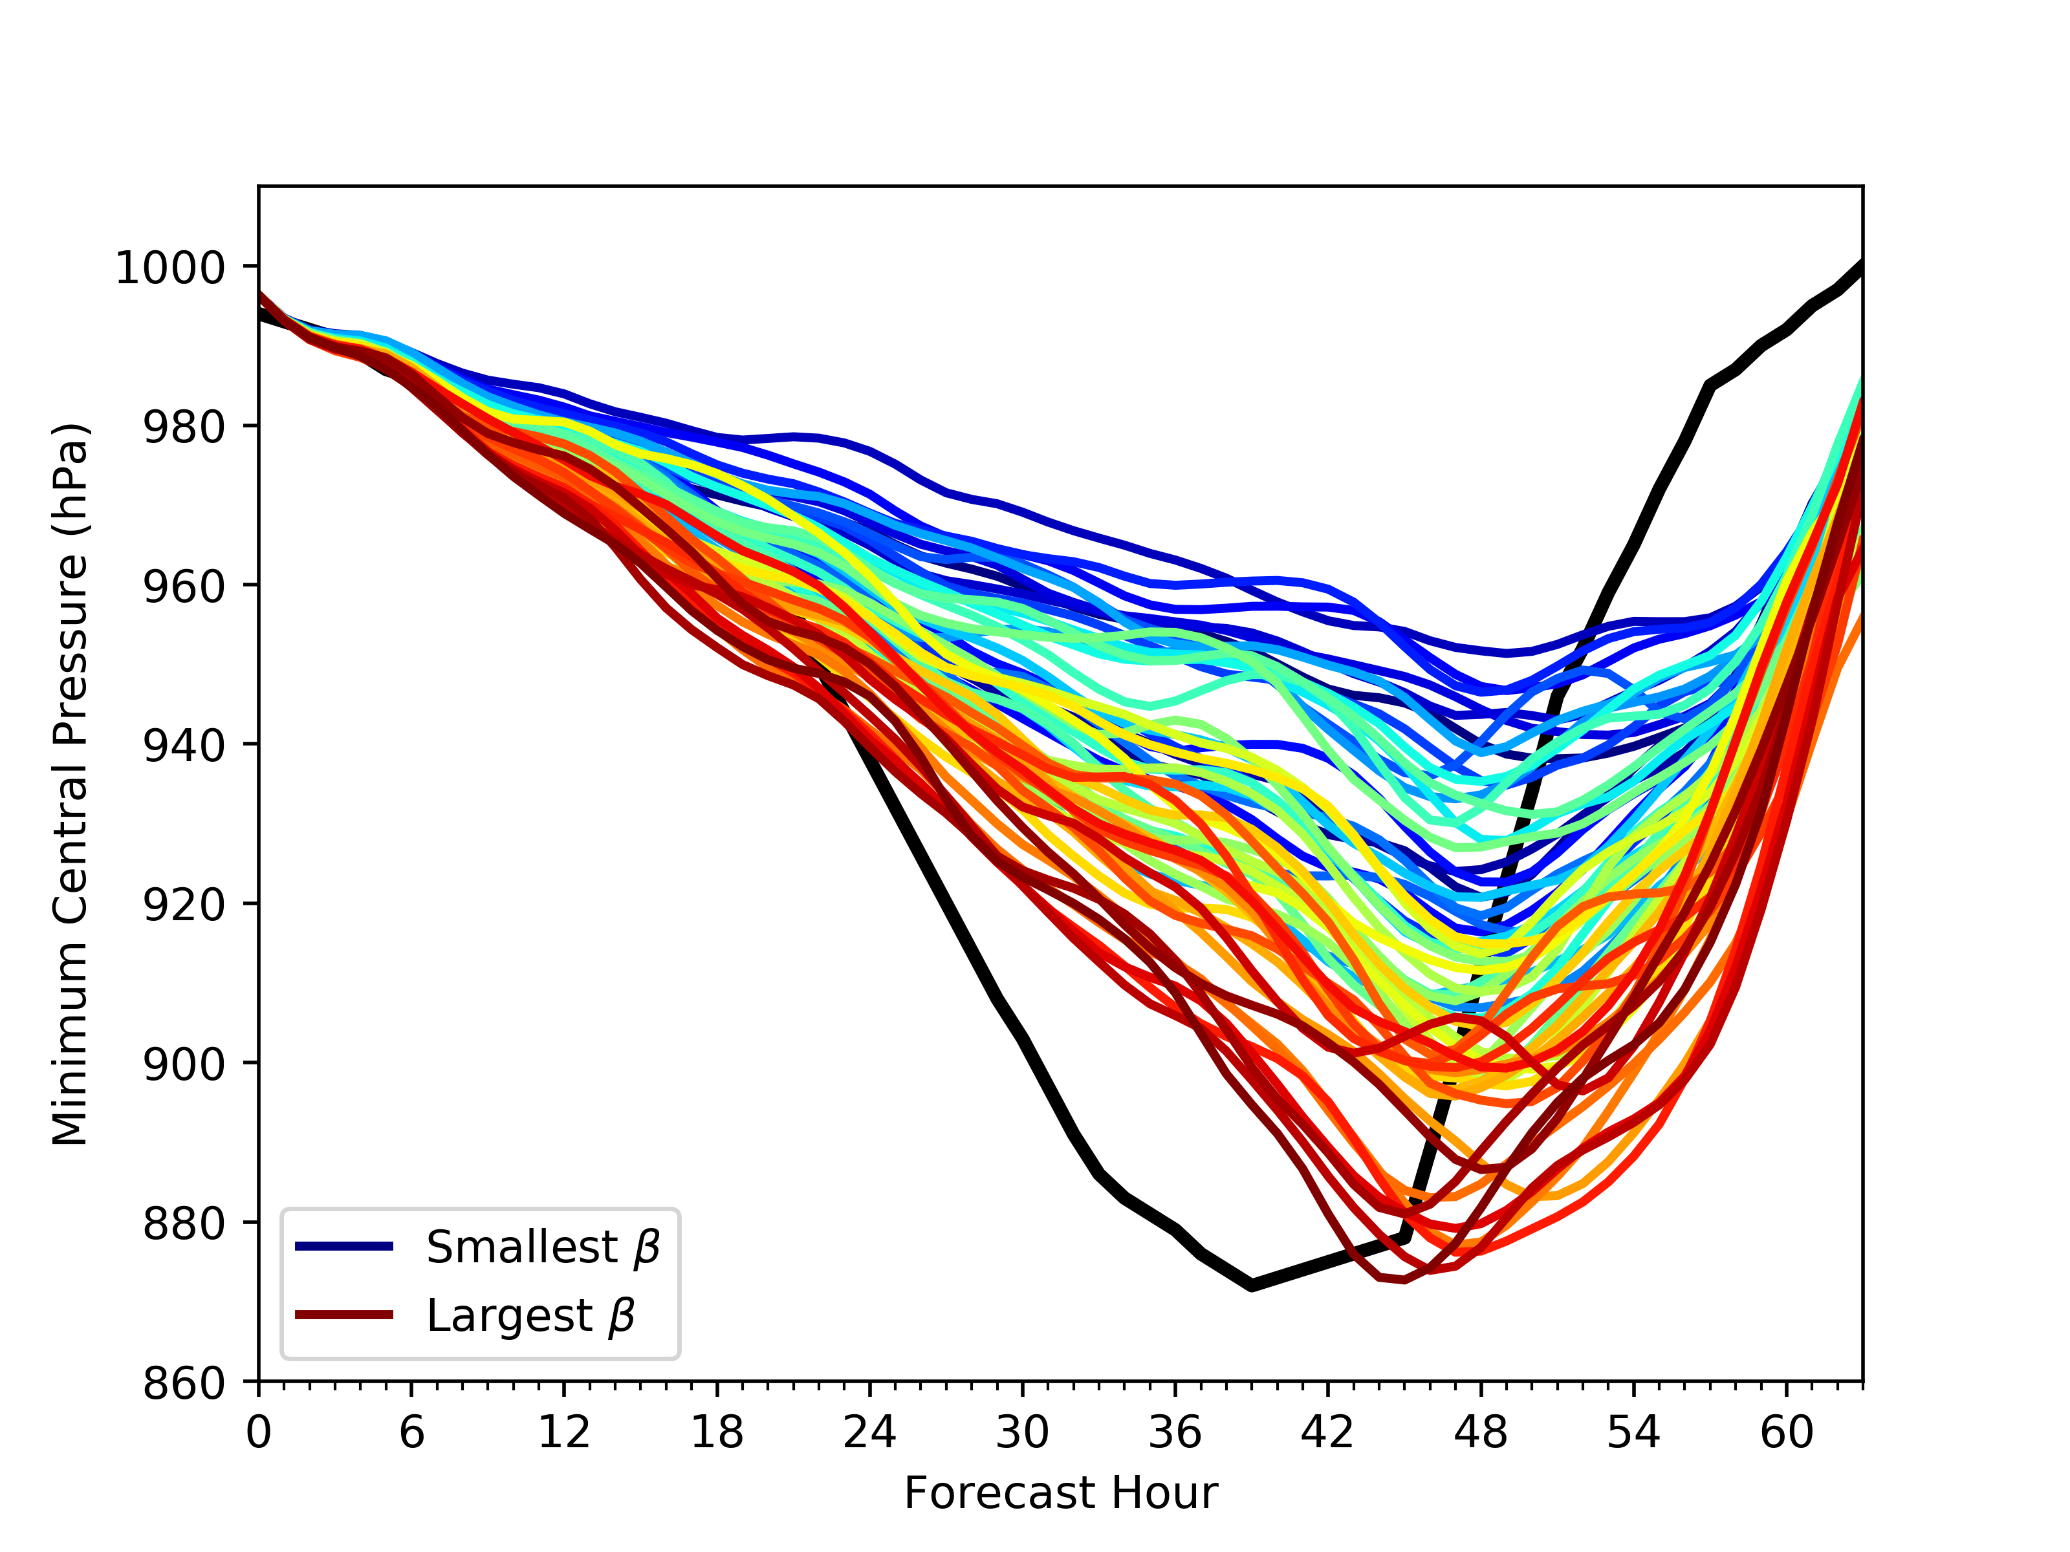
Multi Parameter Ensemble Forecast

Slide 14
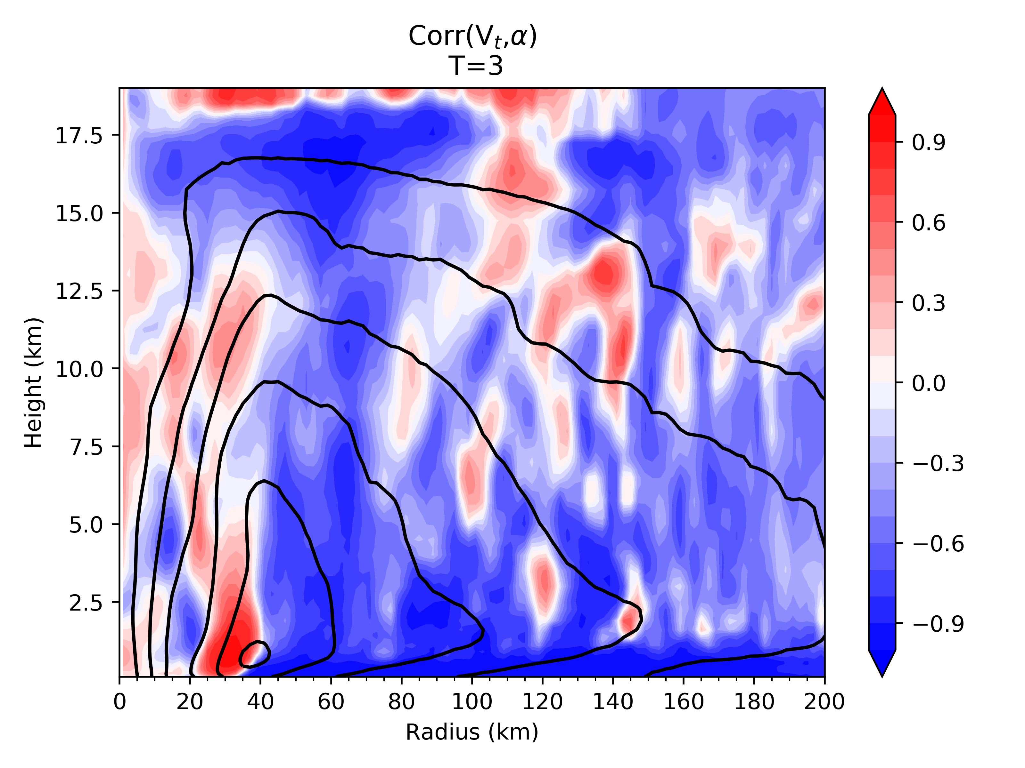
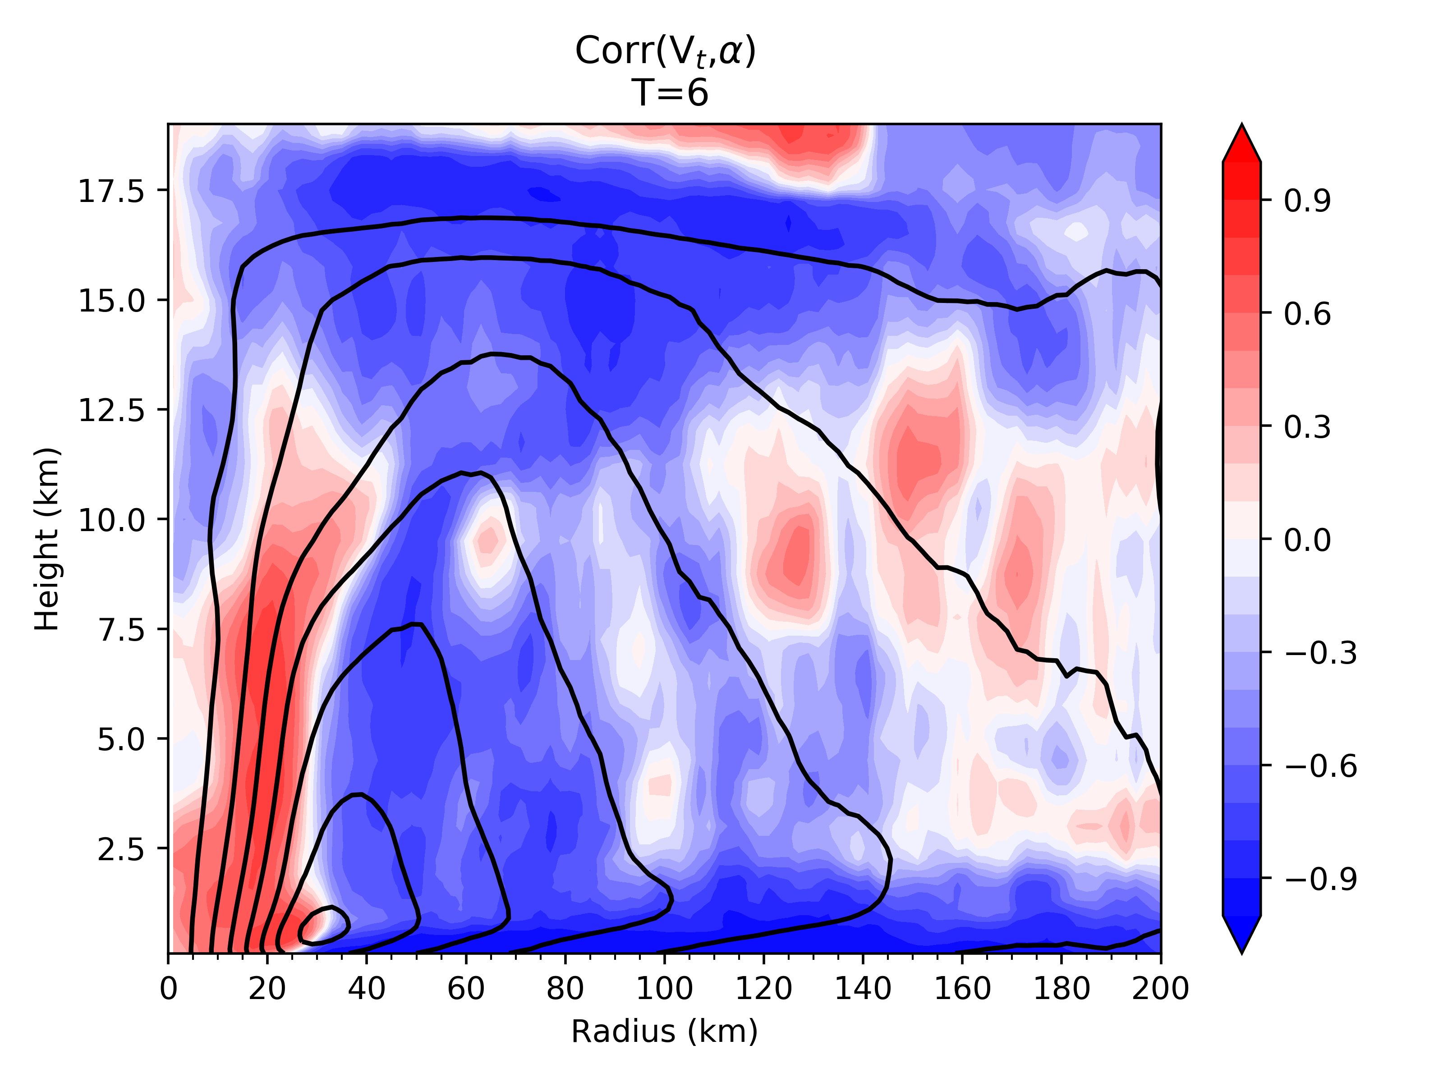
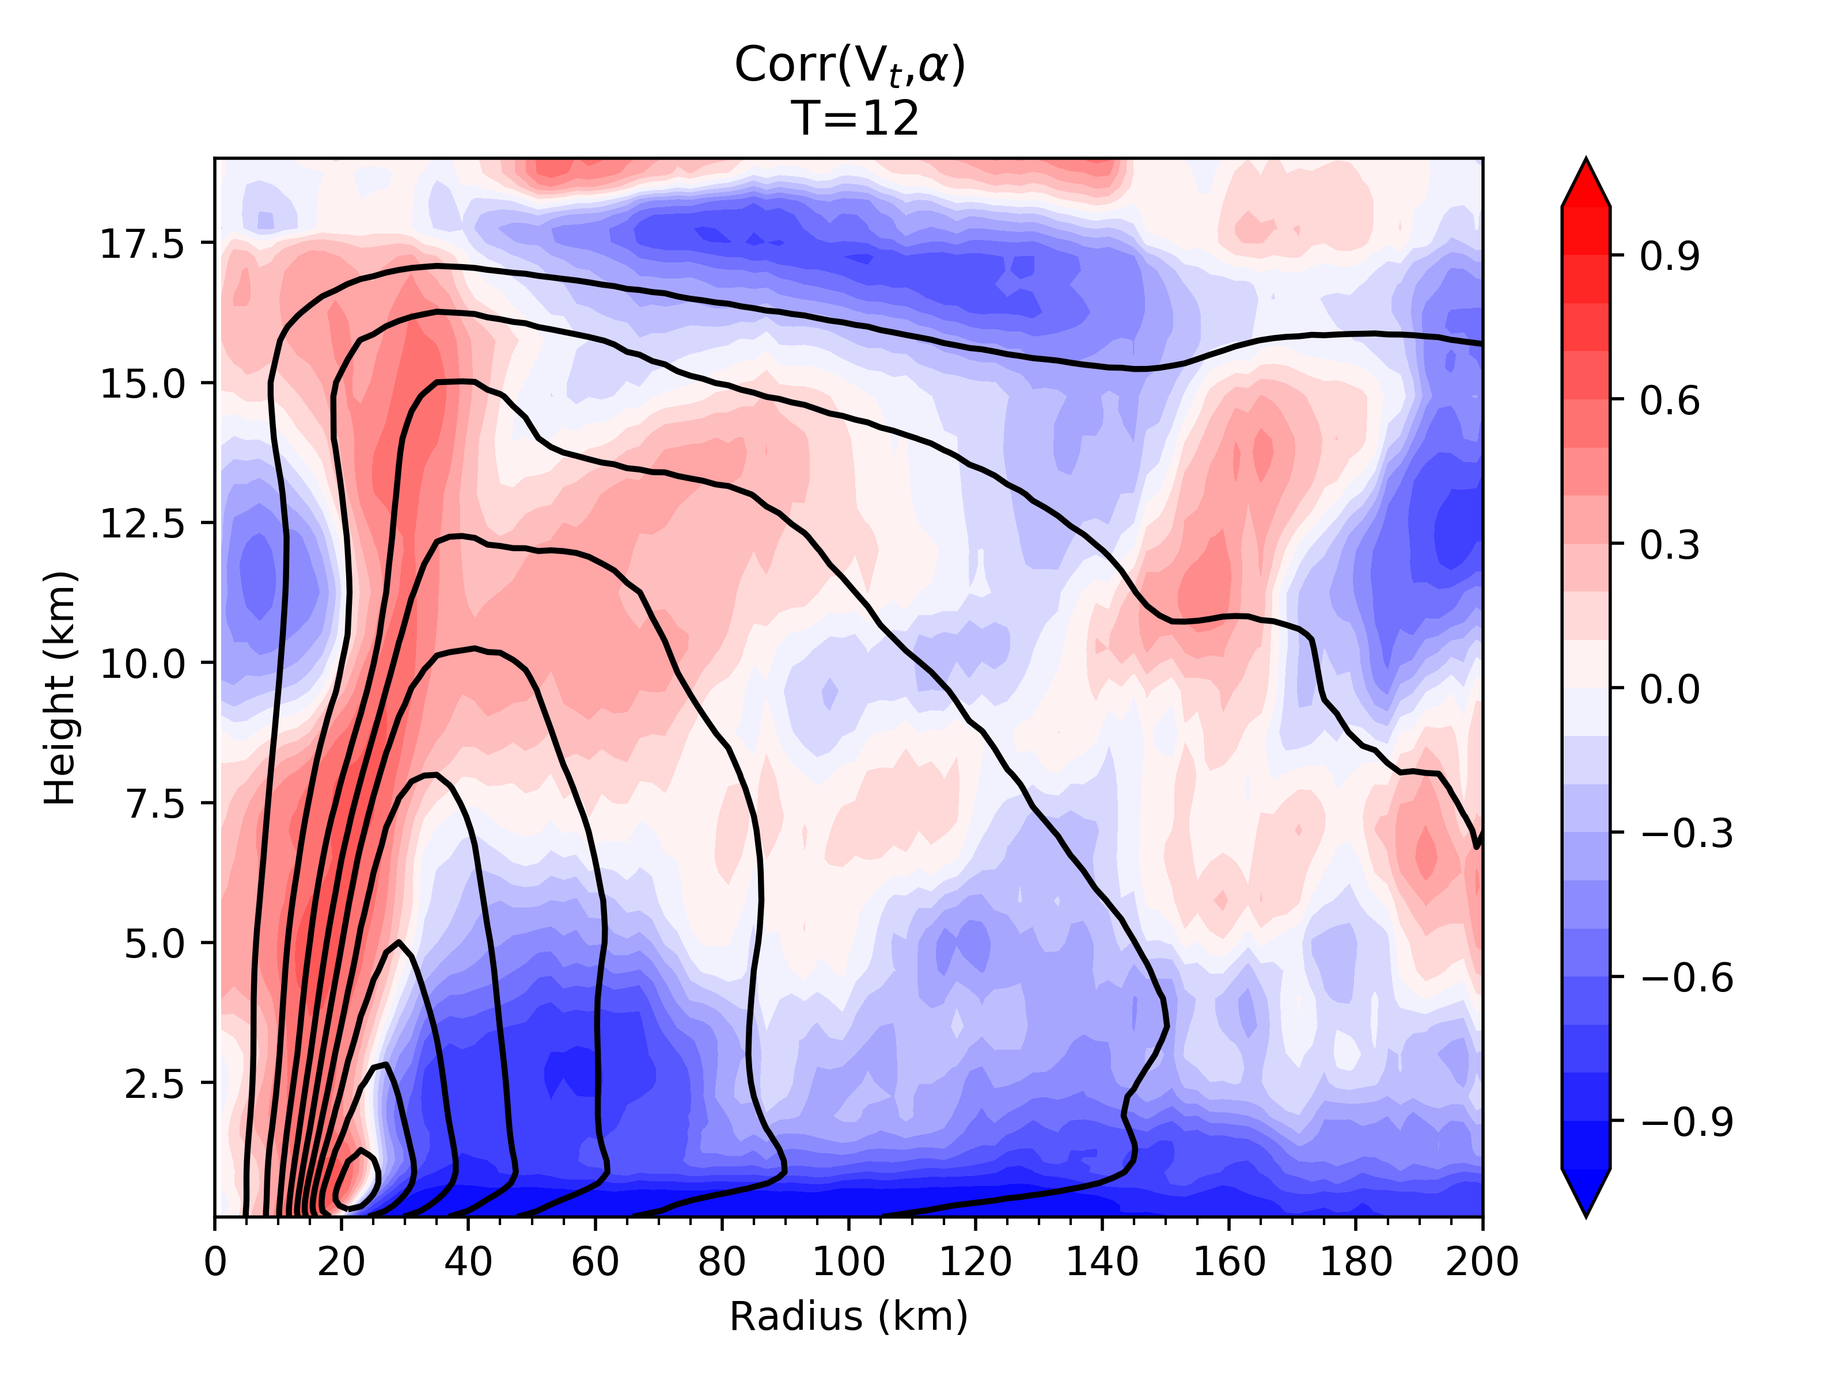
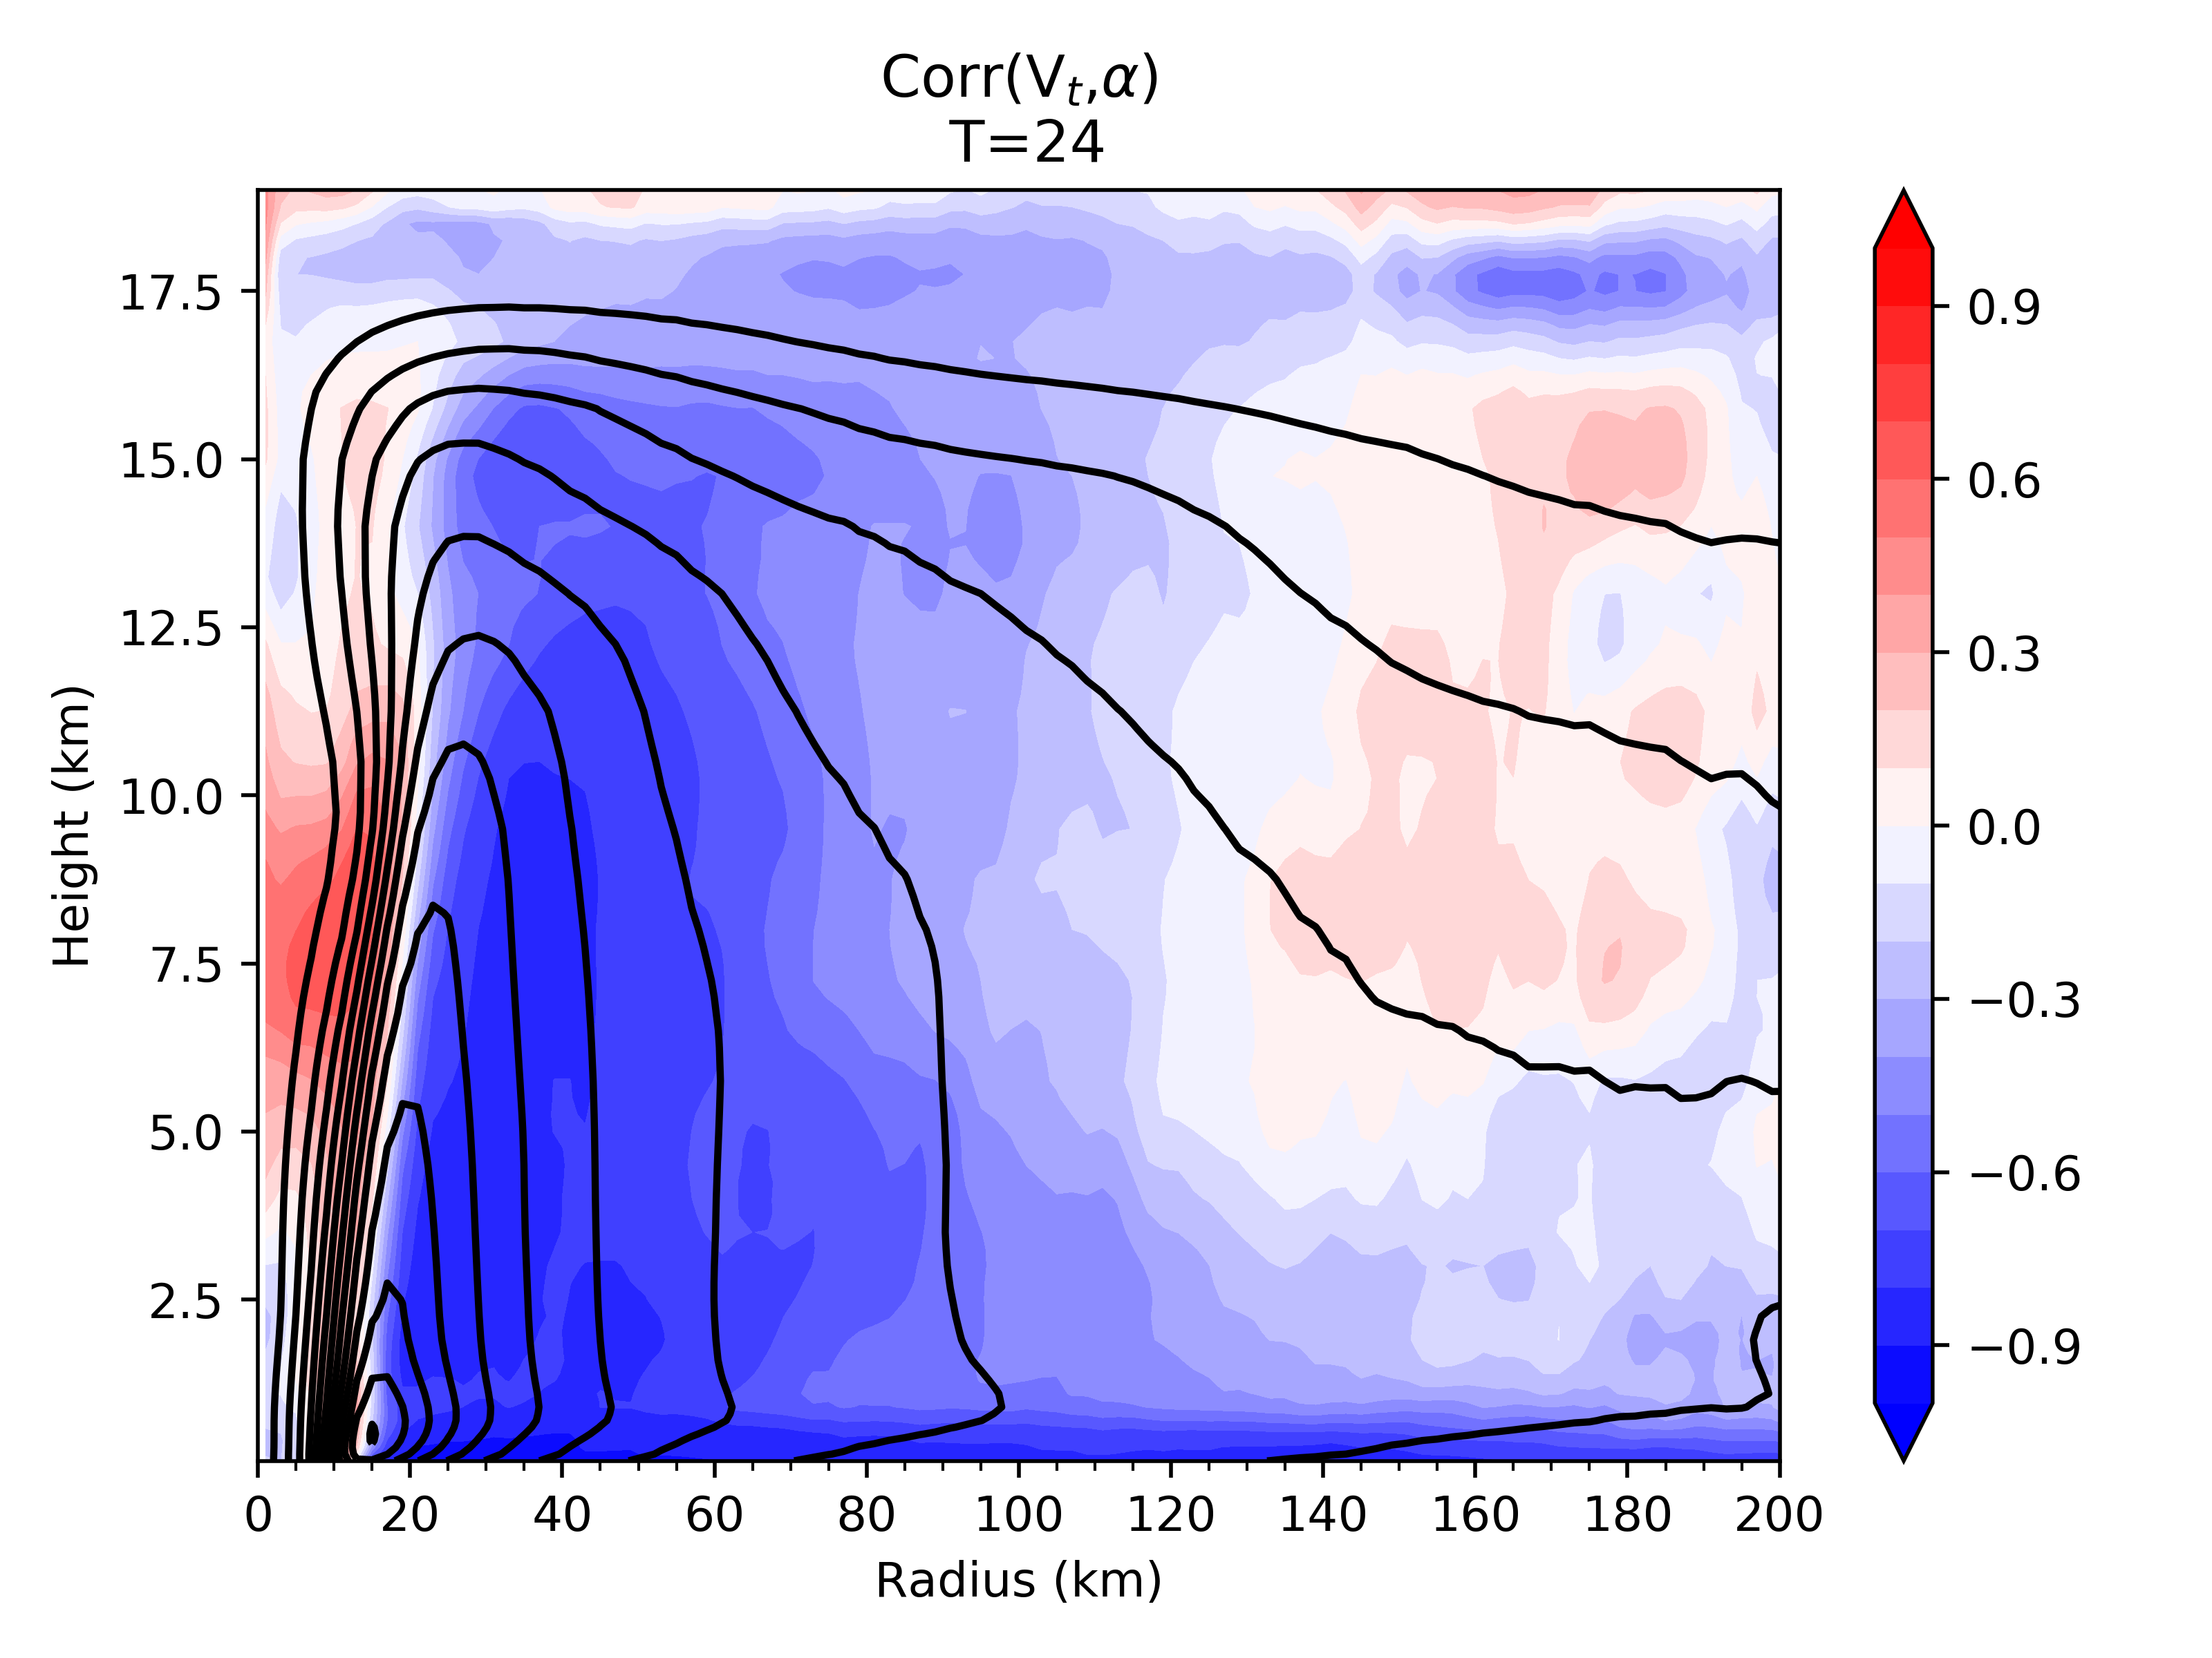
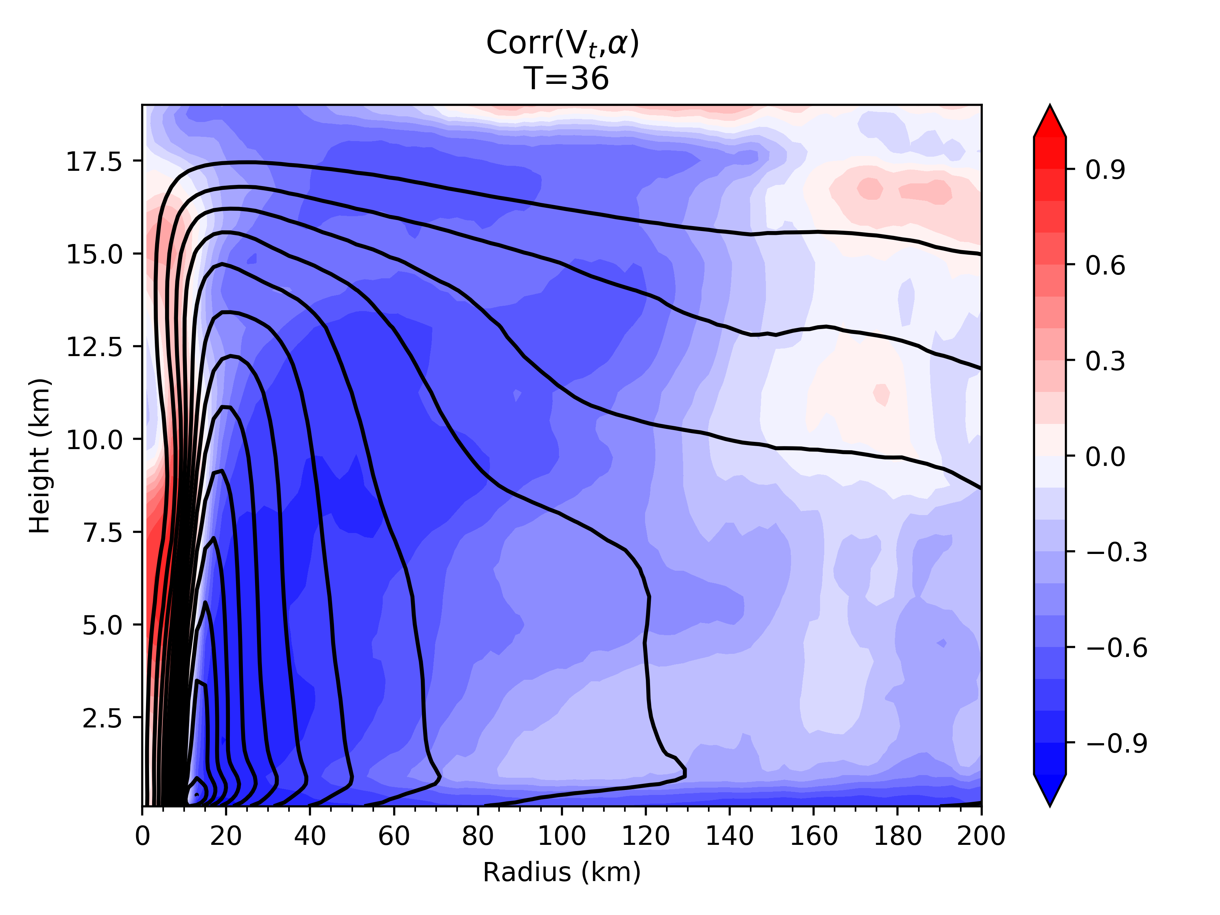
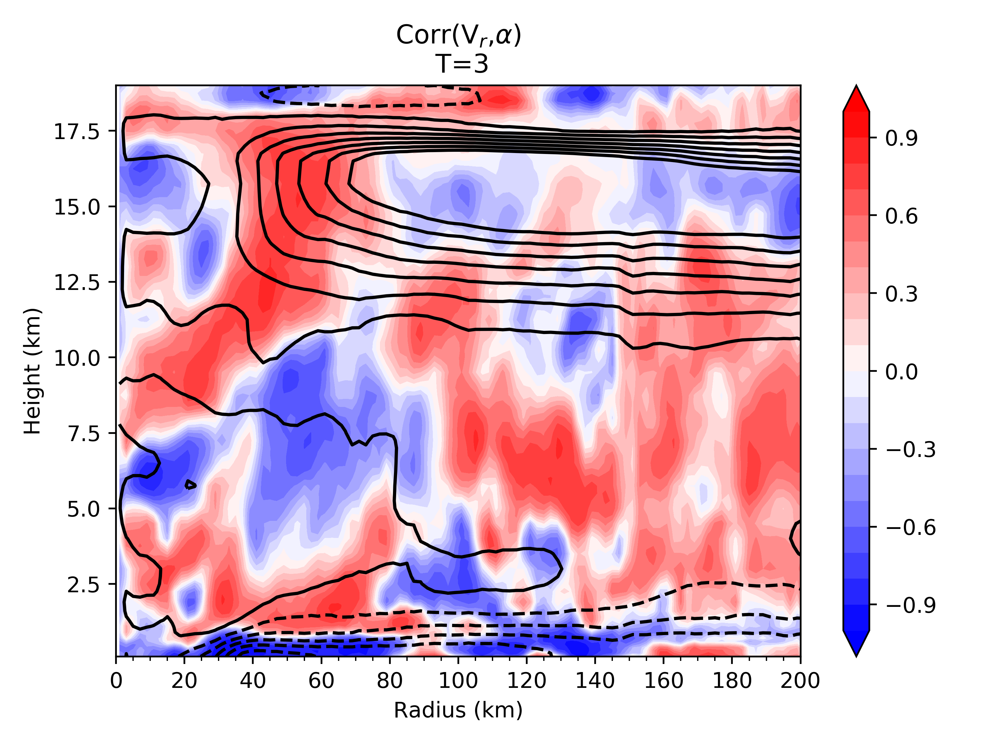
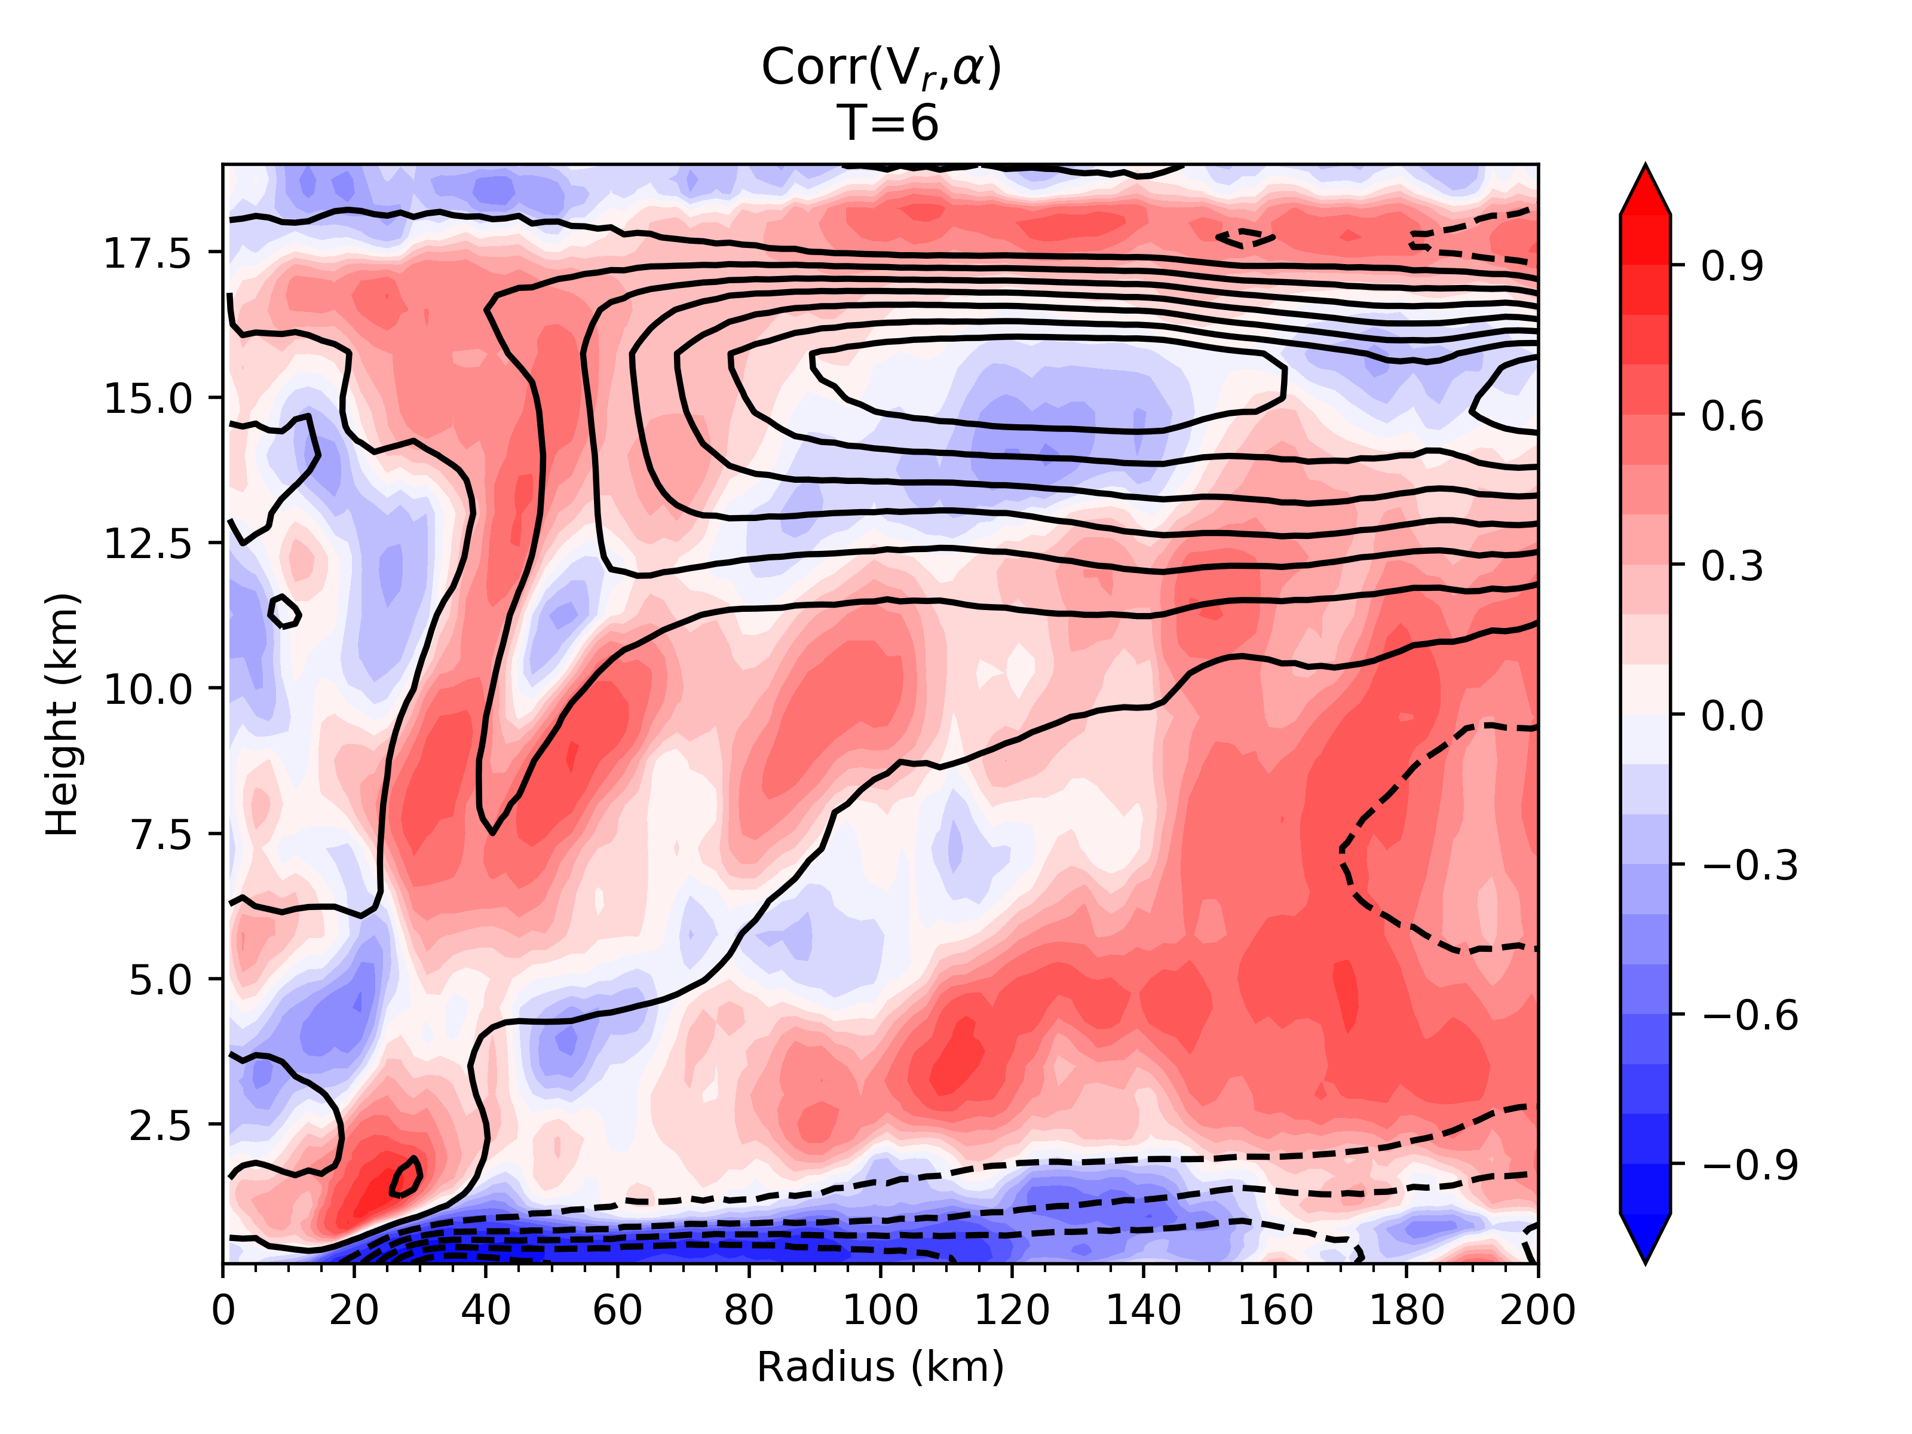
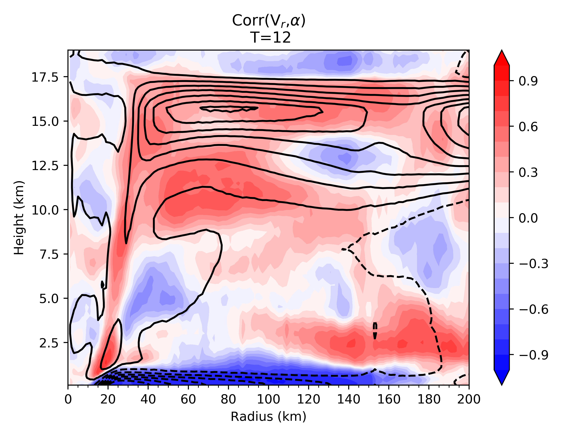
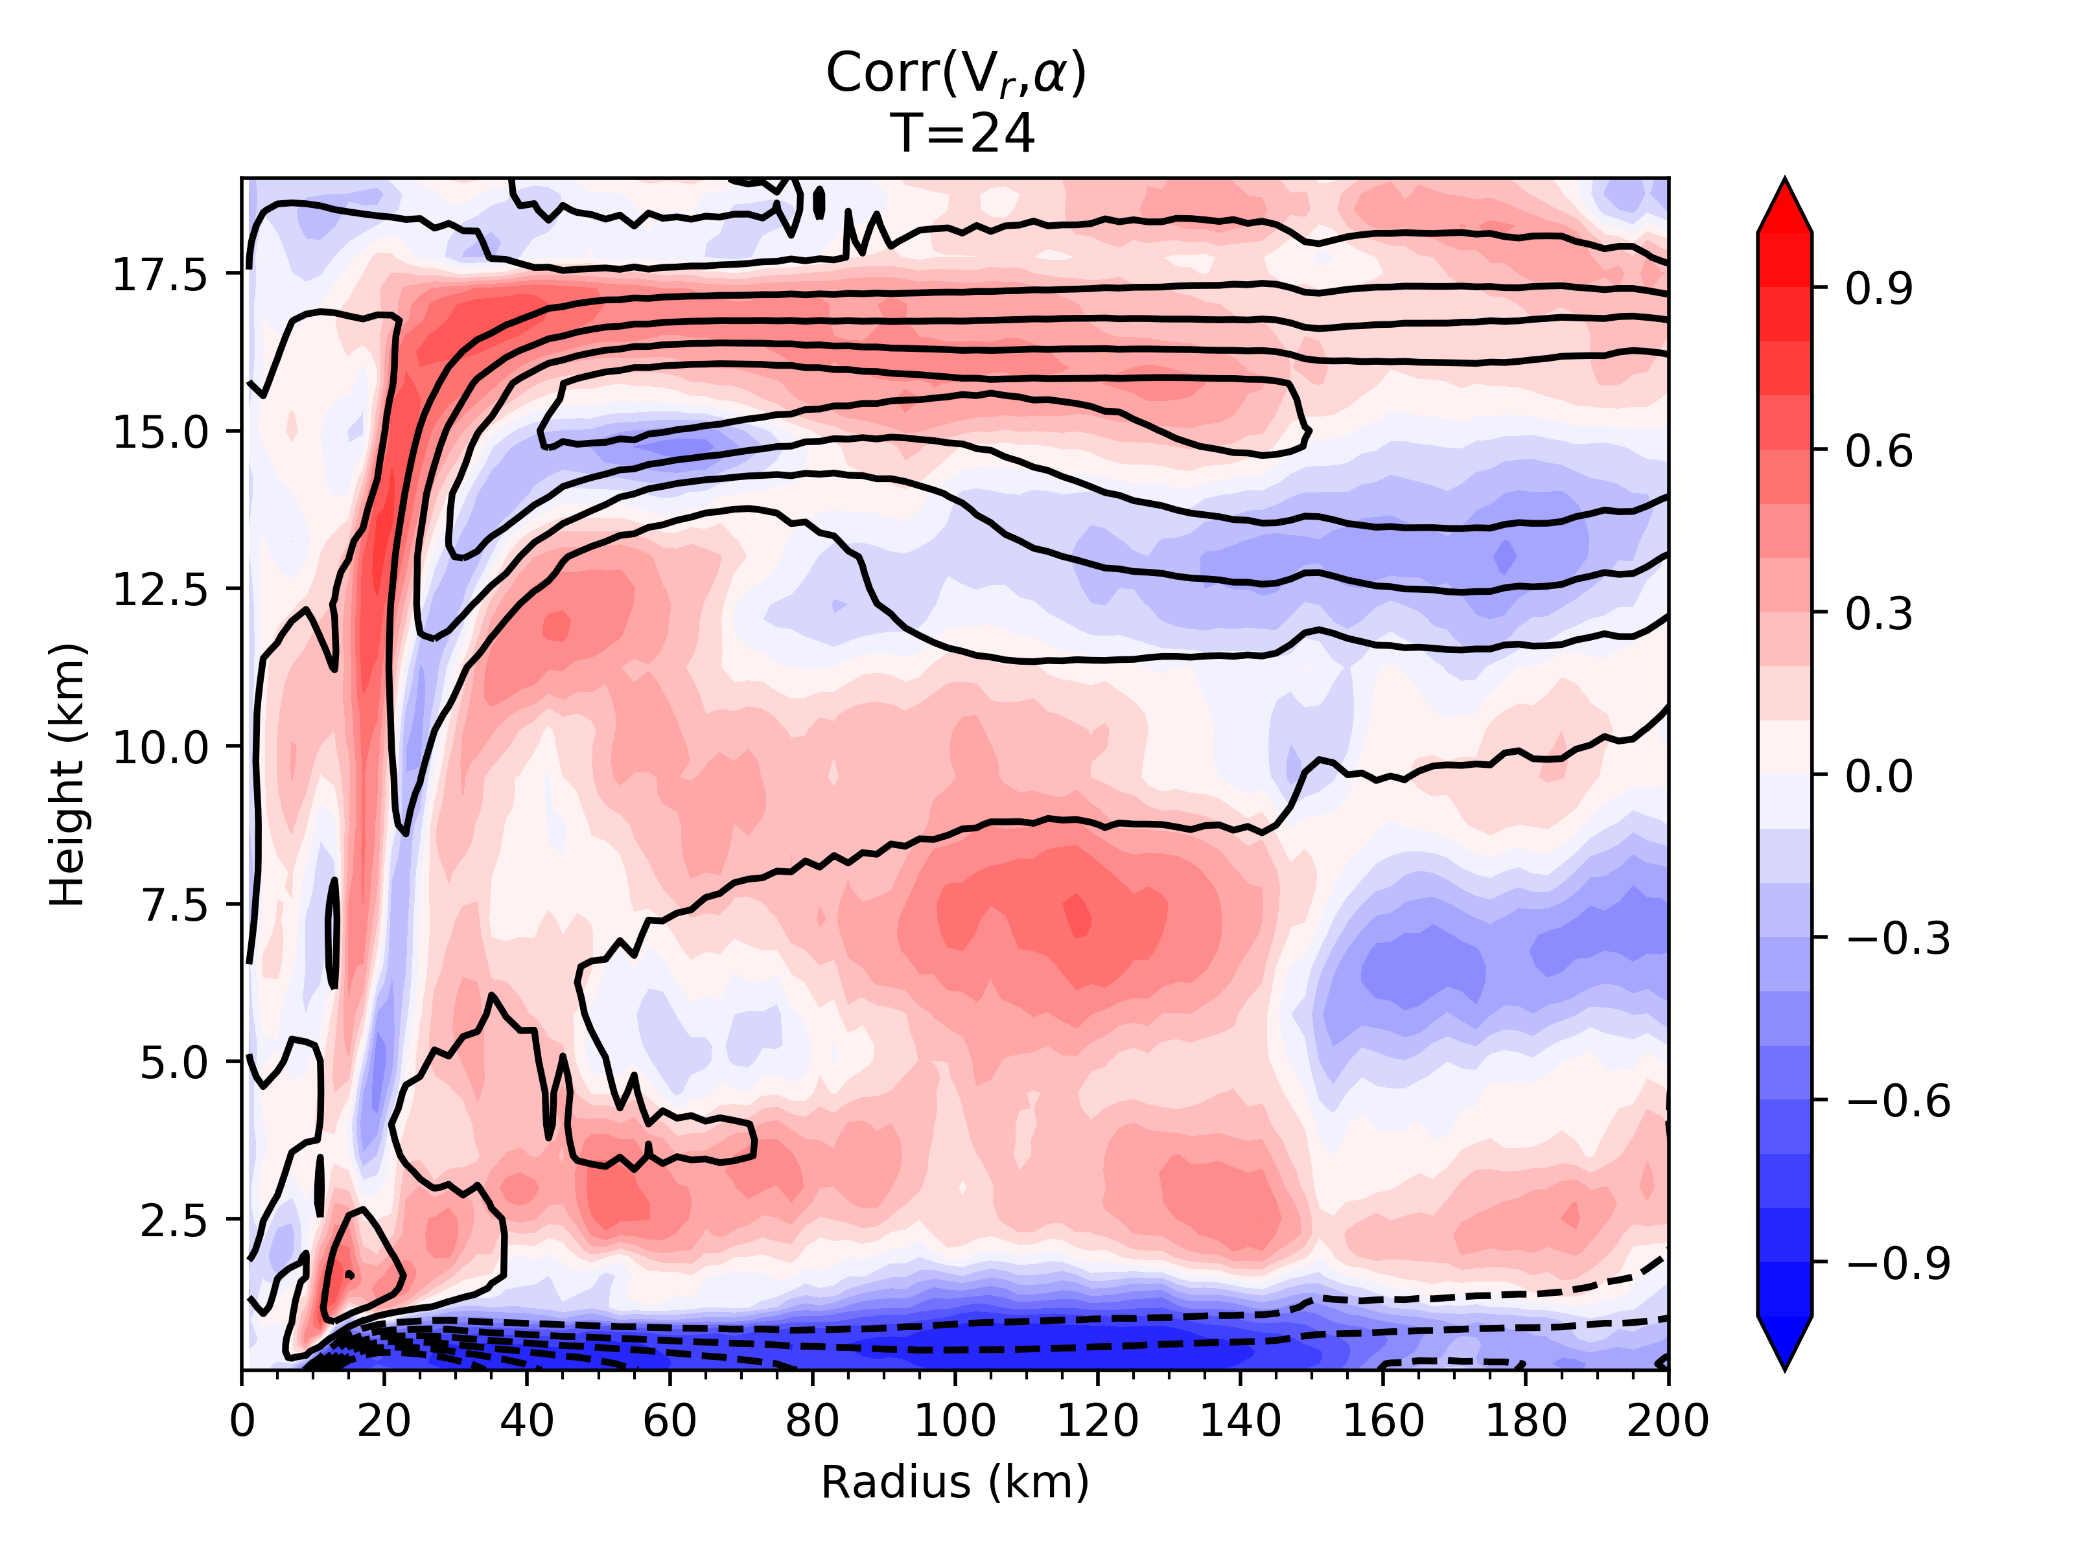
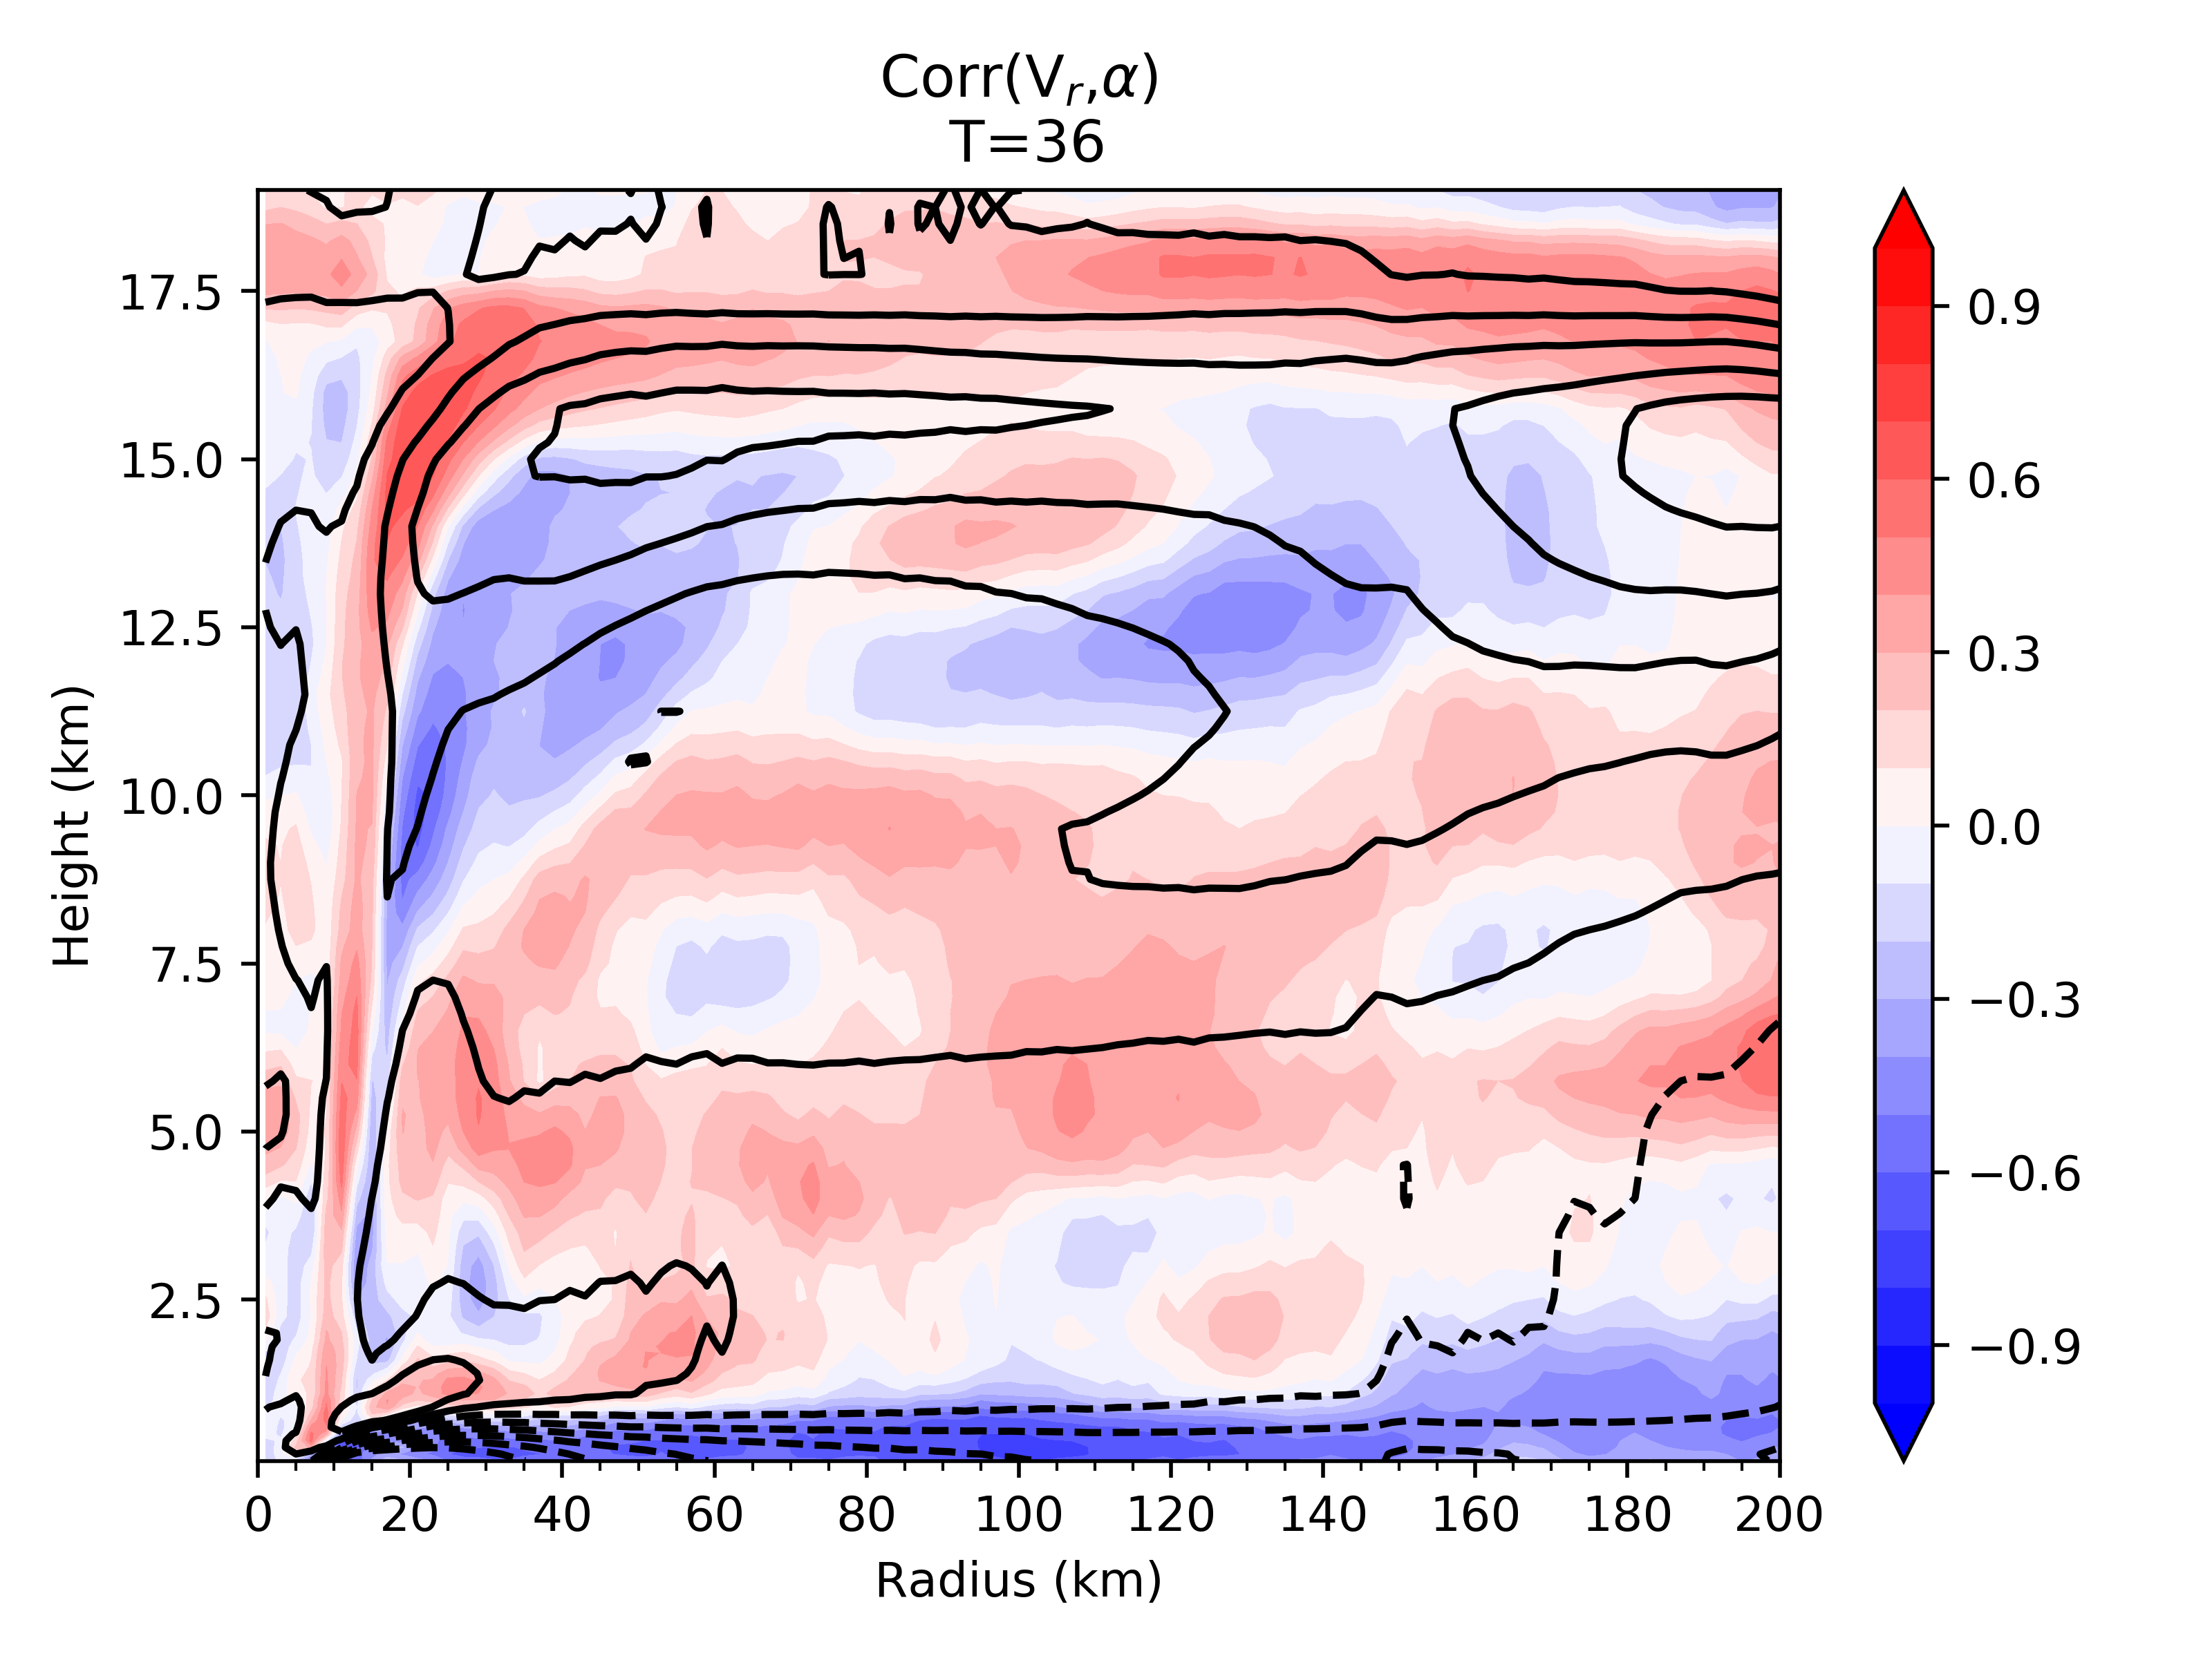
Multi Parameter Ensemble Correlations

Slide 15
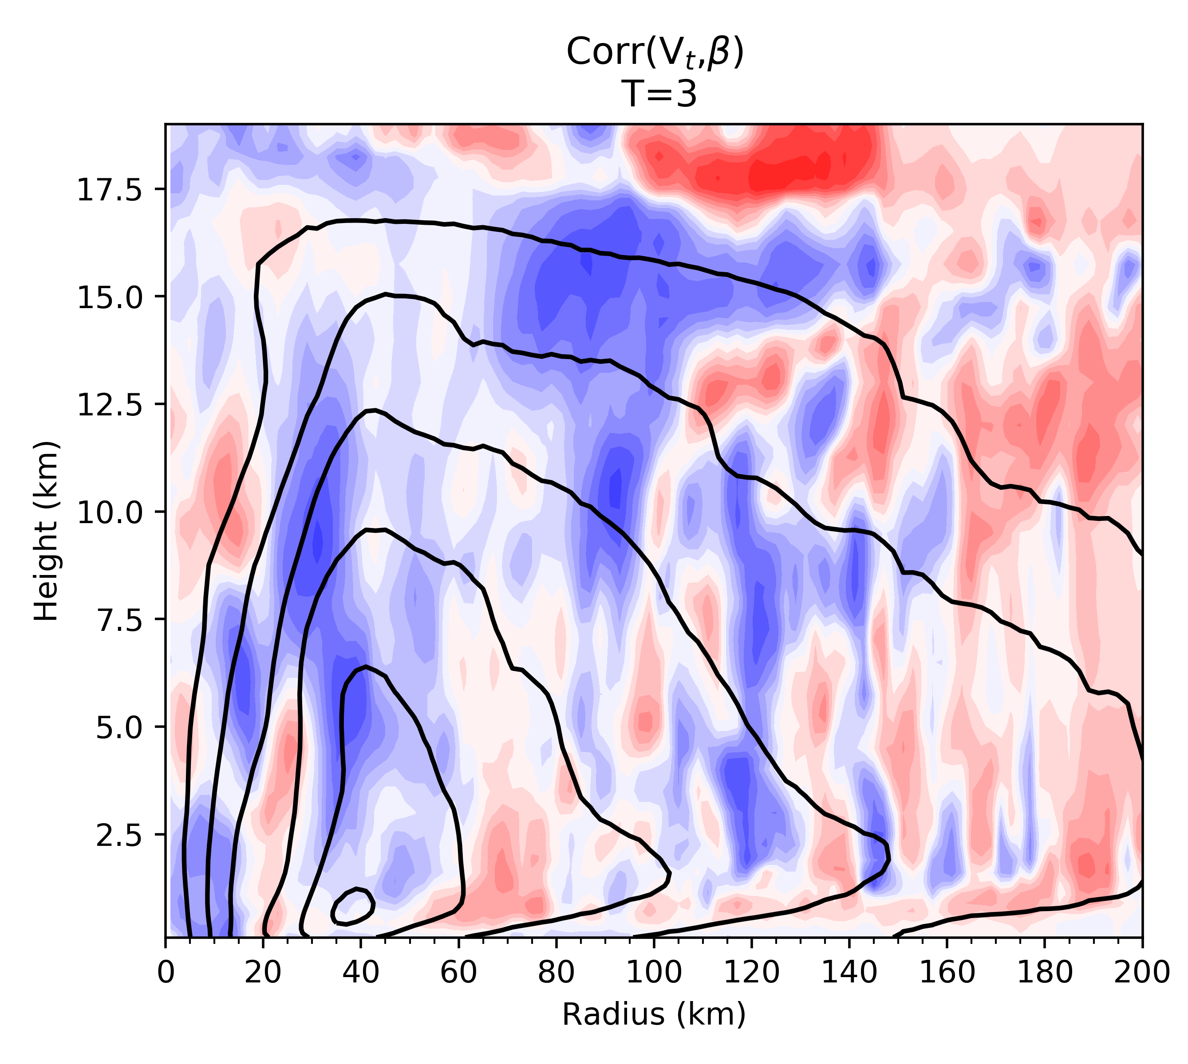
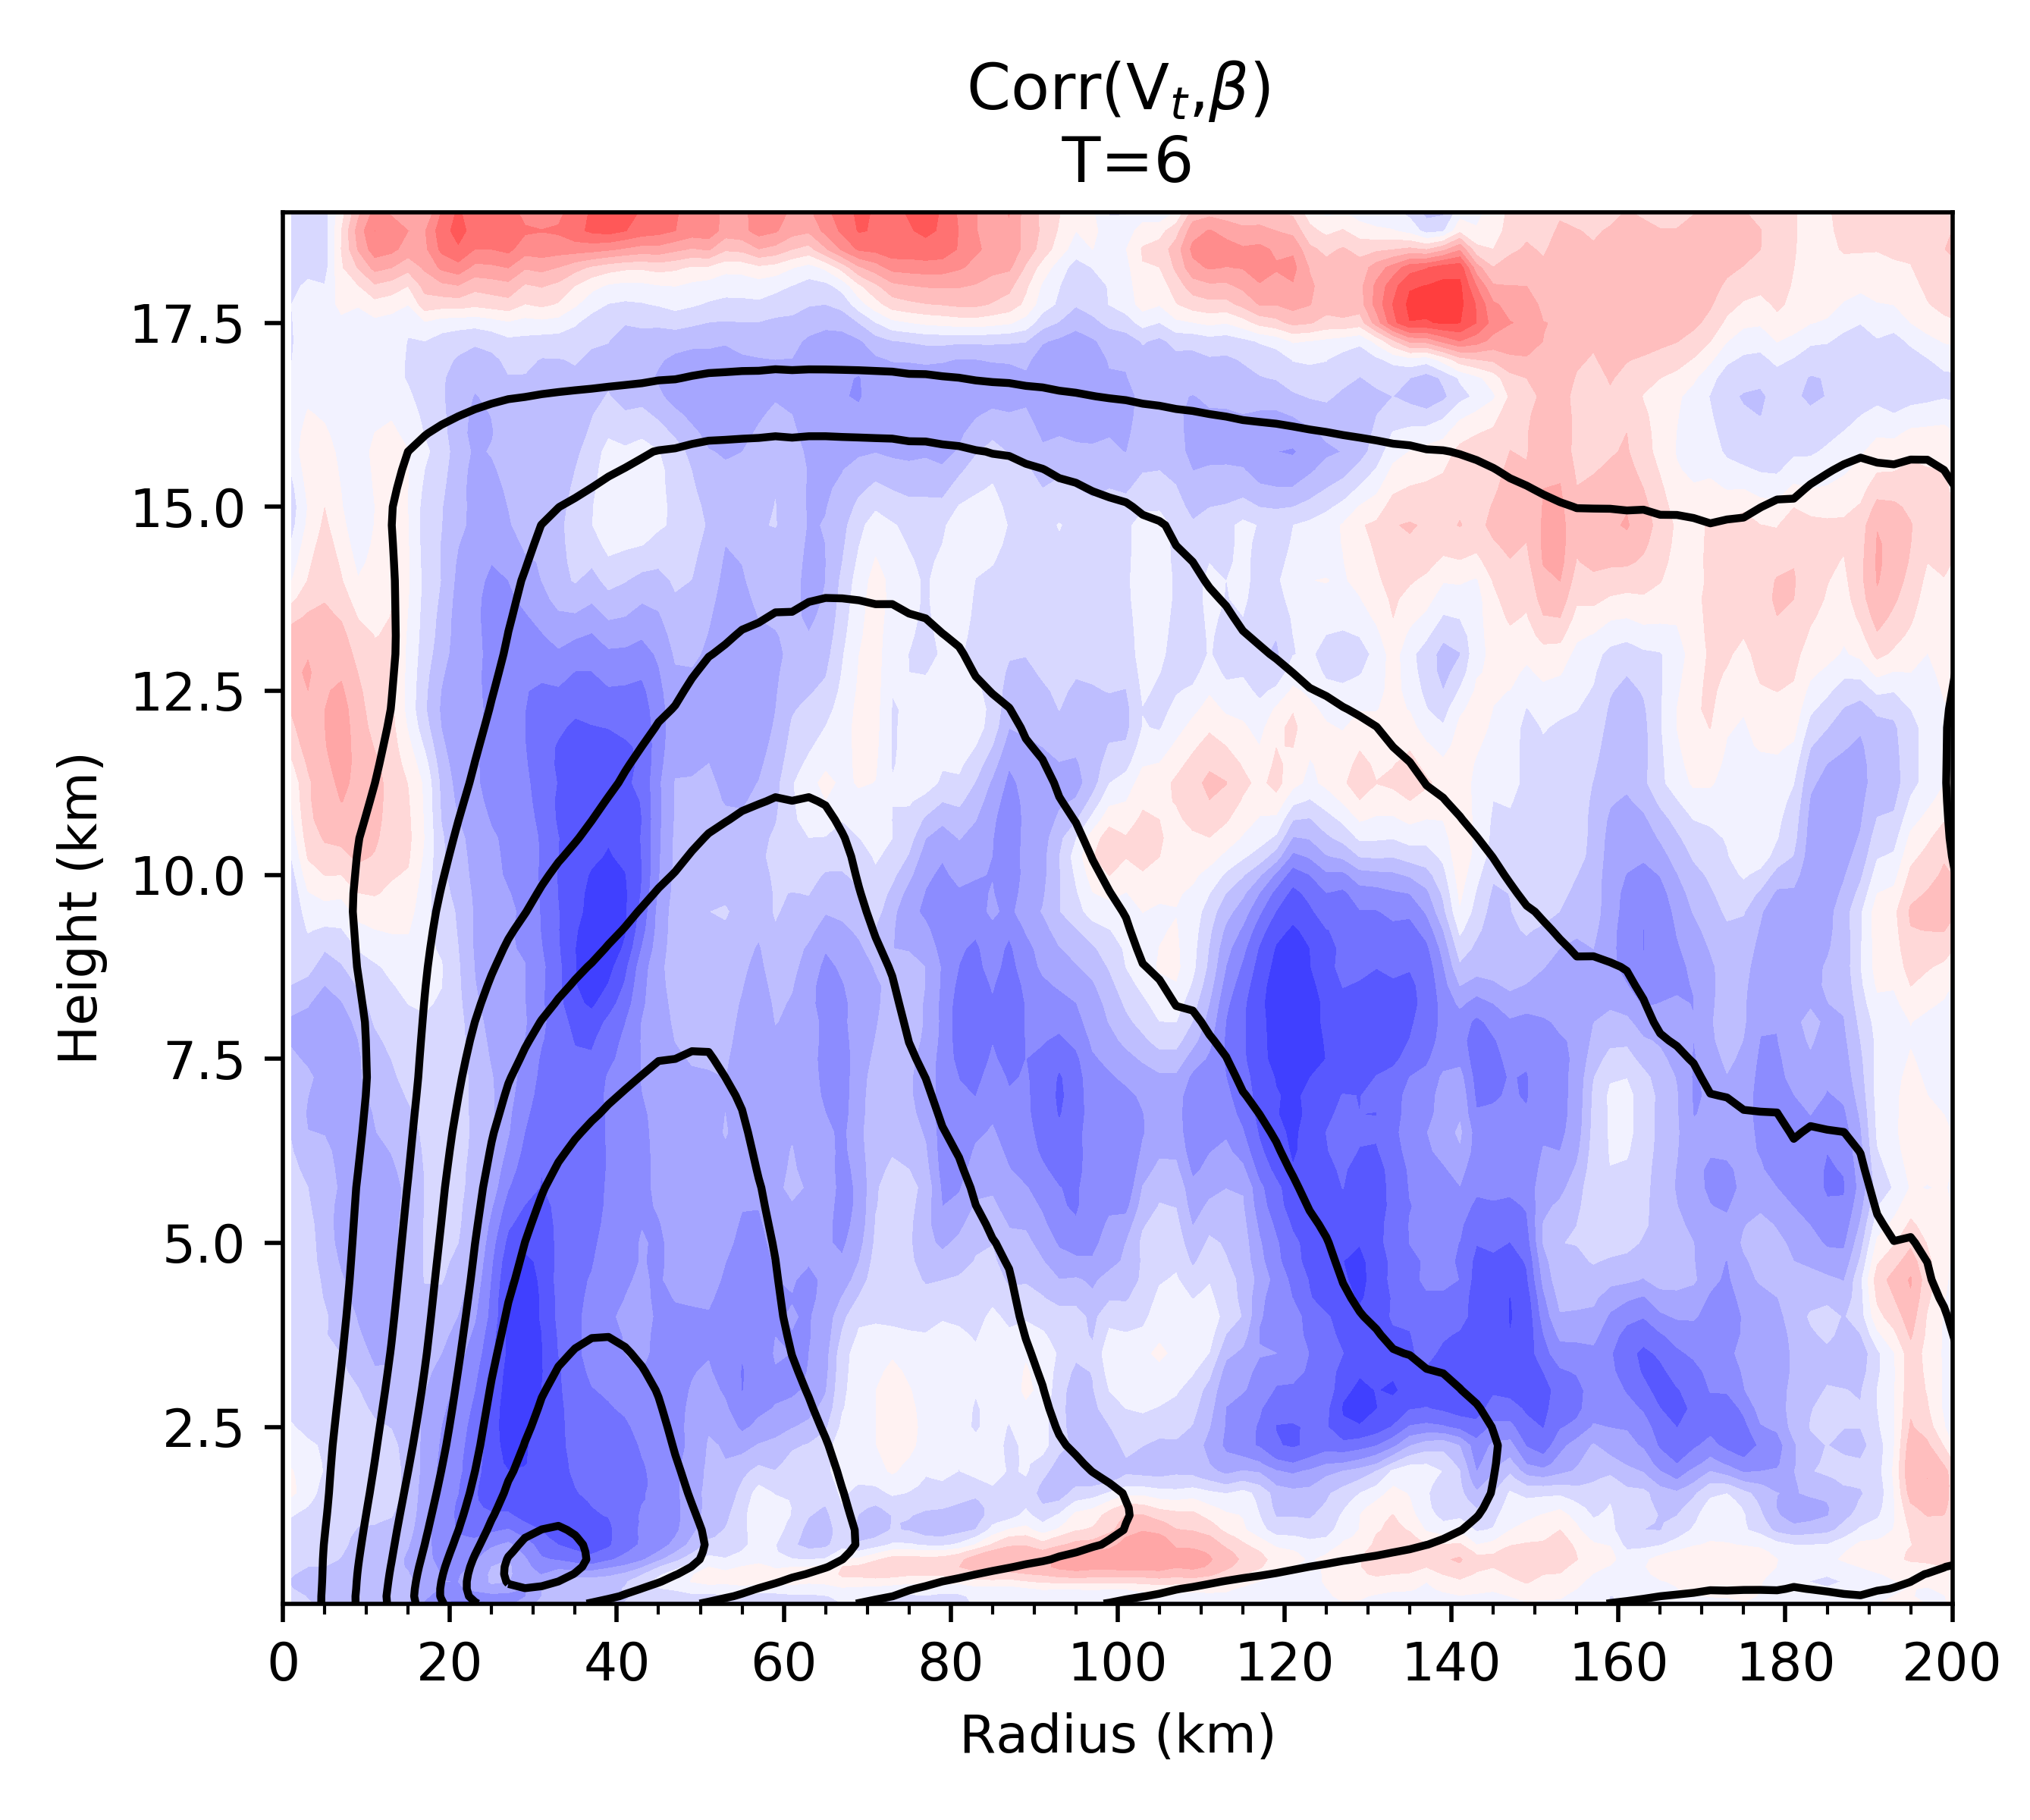
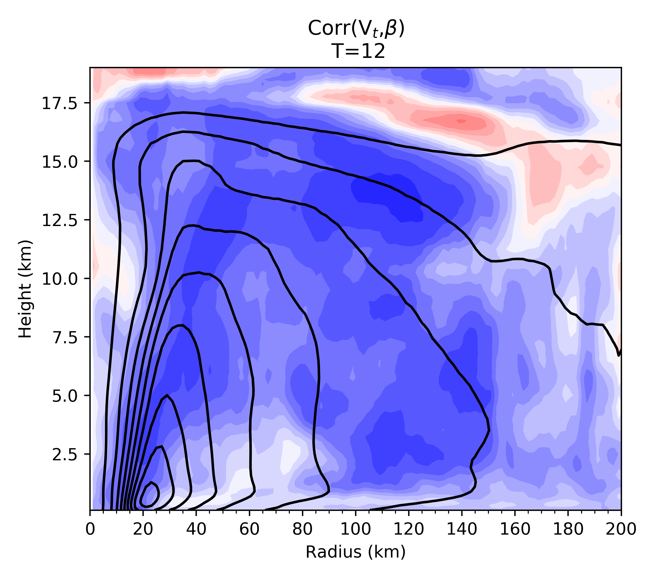
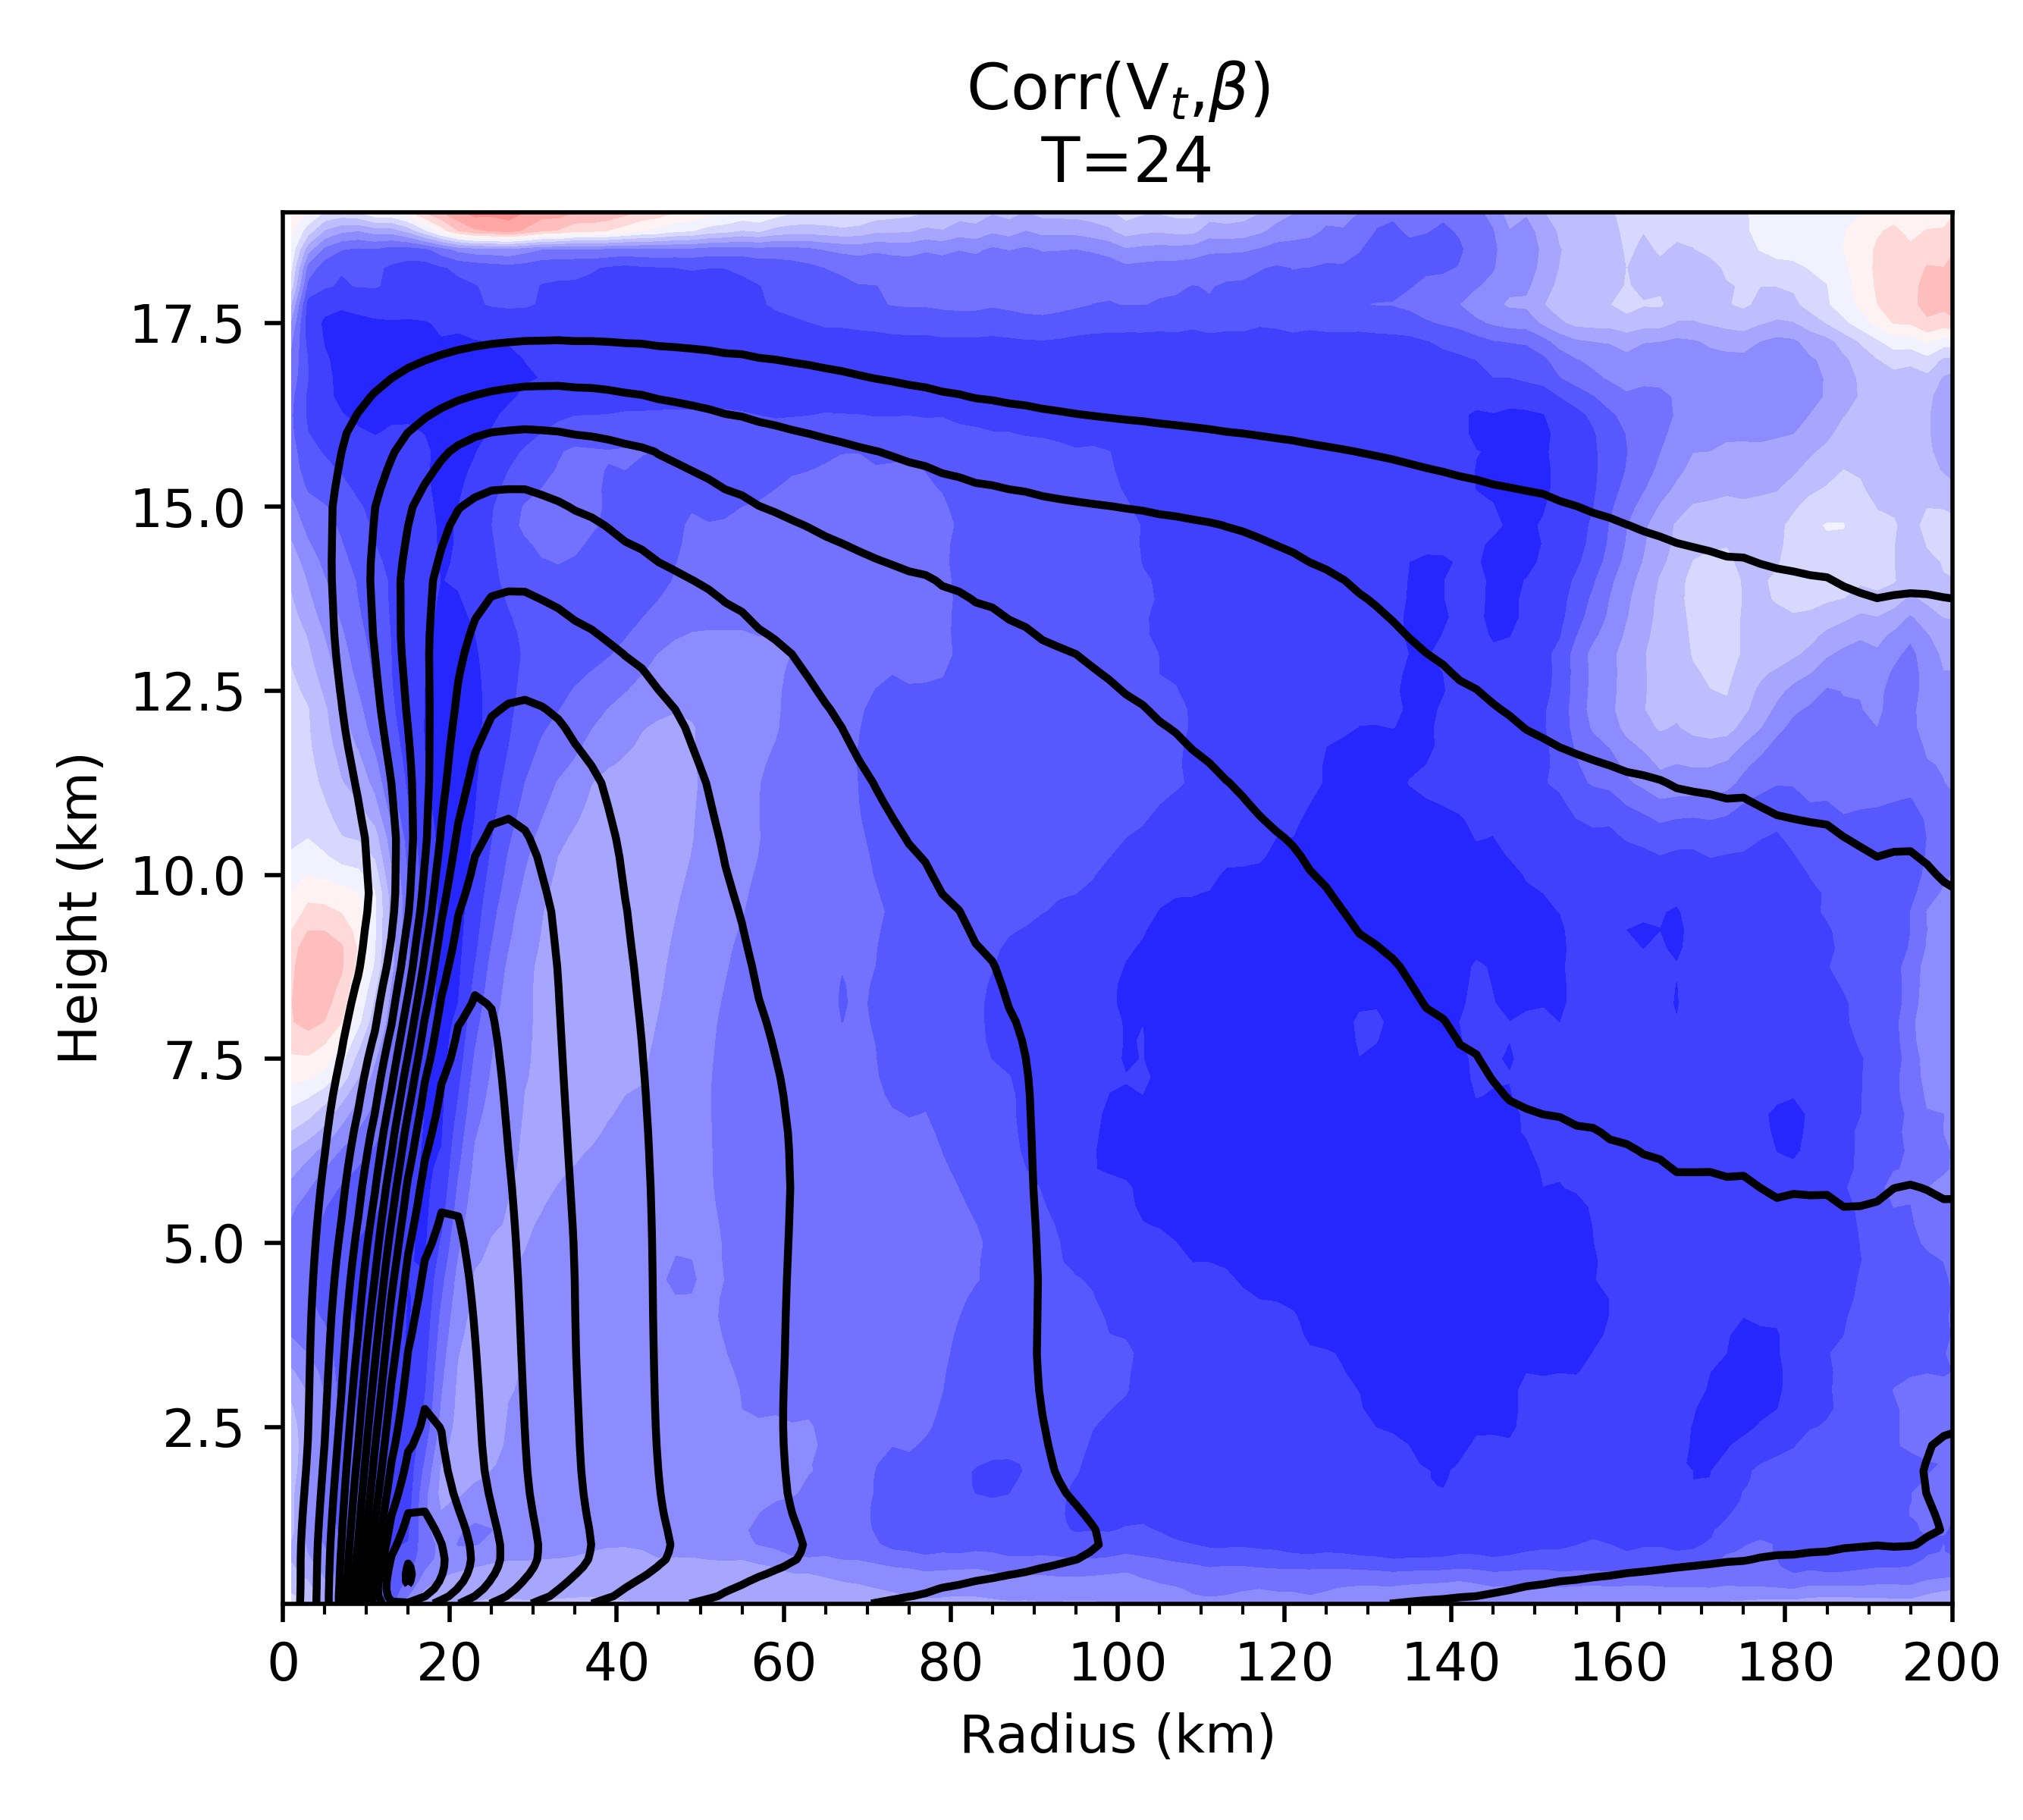
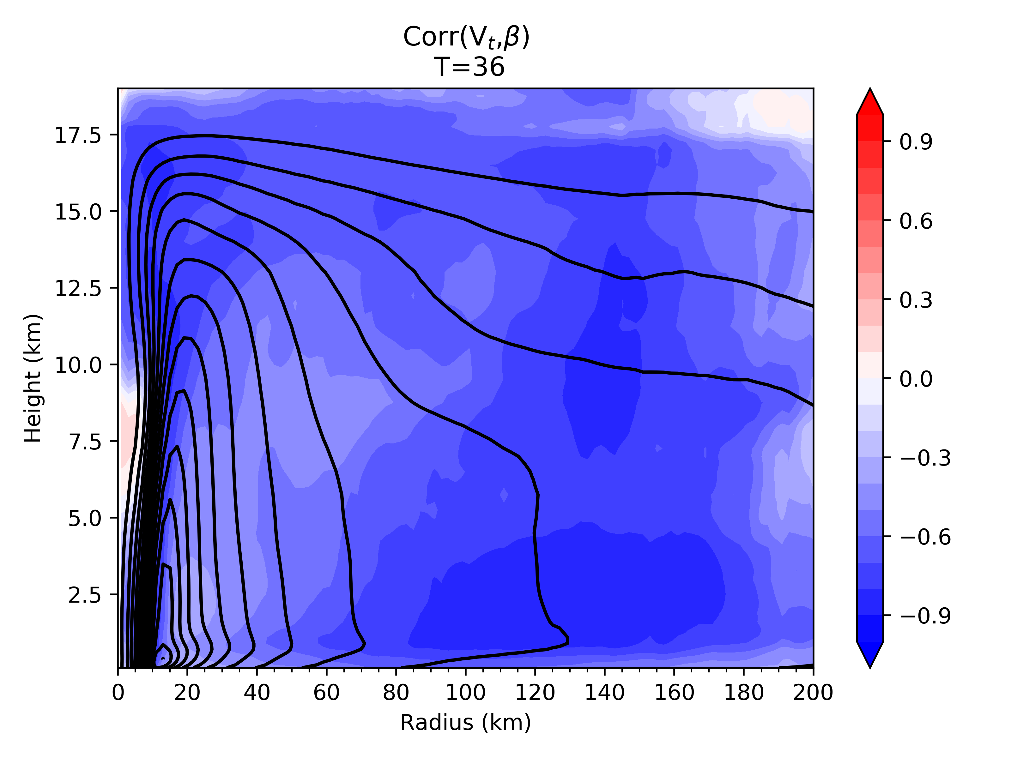
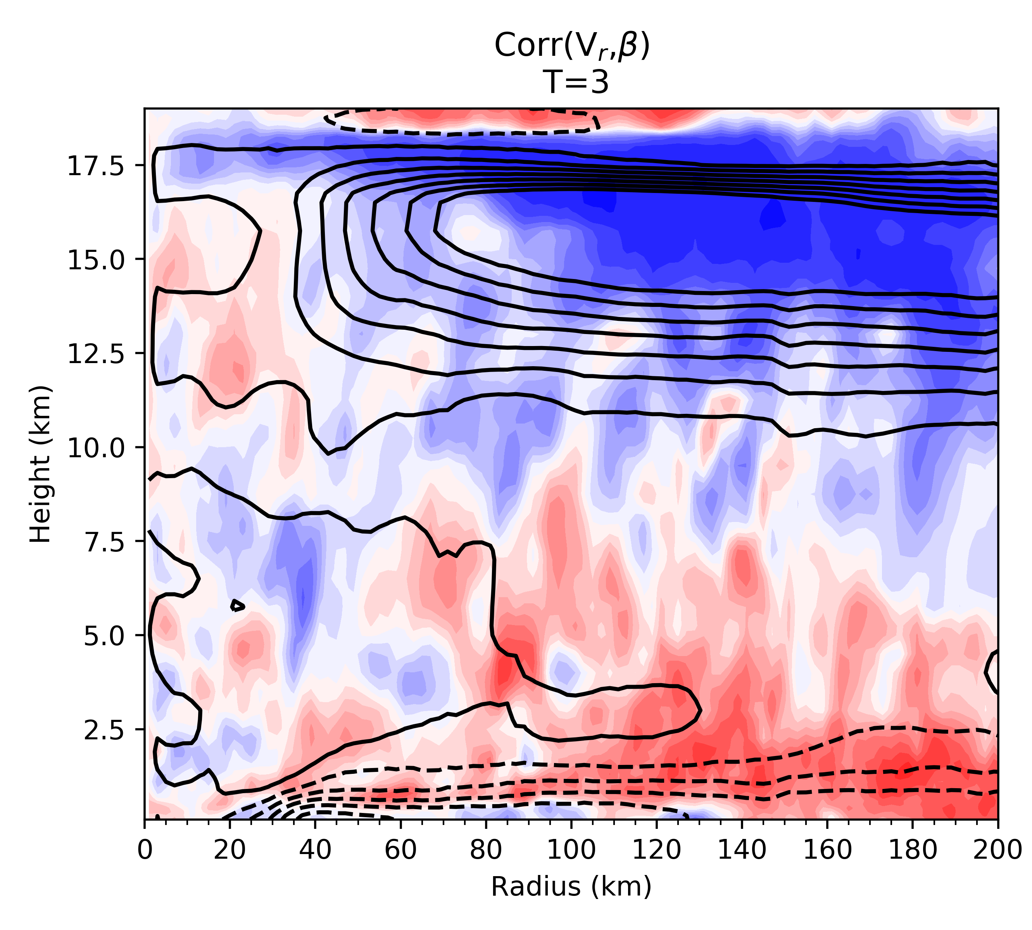
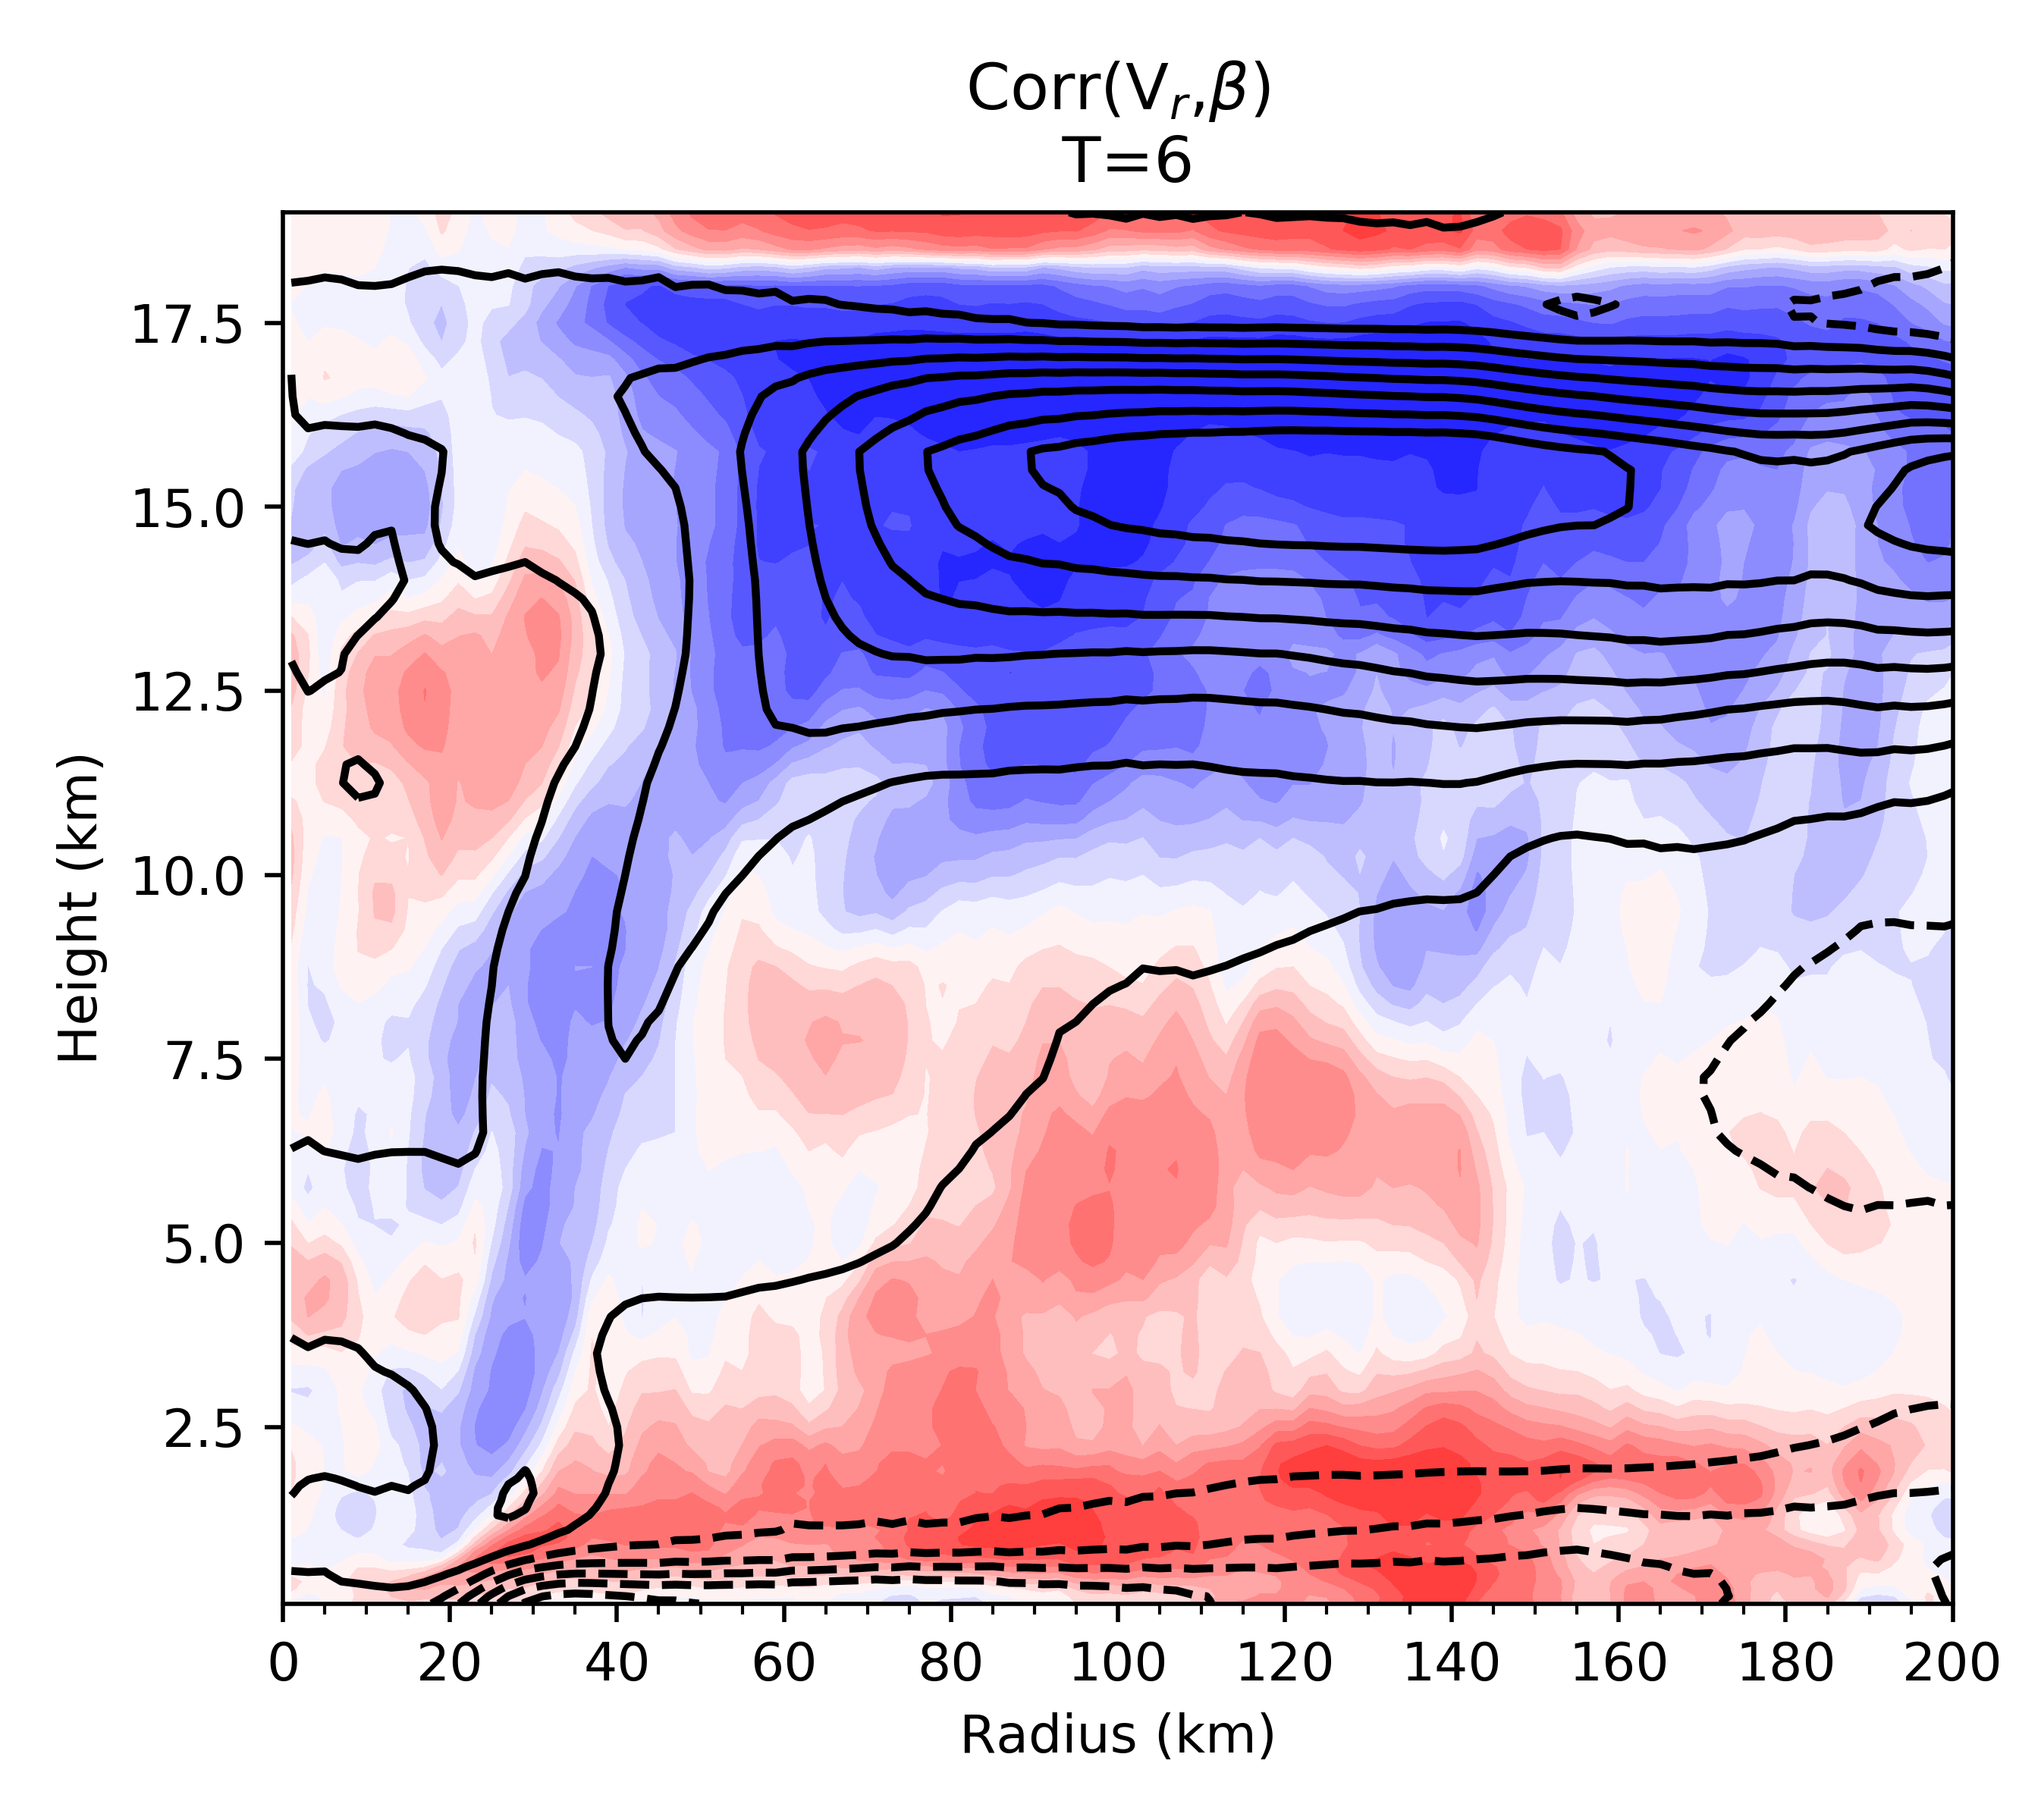
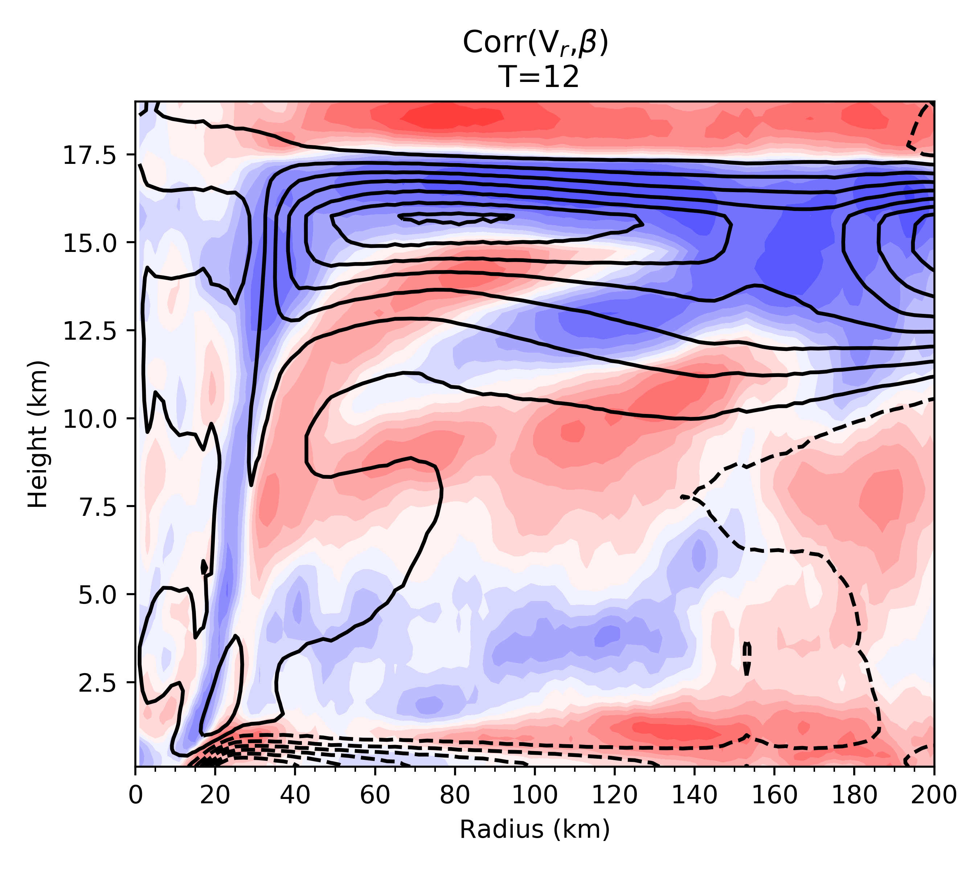
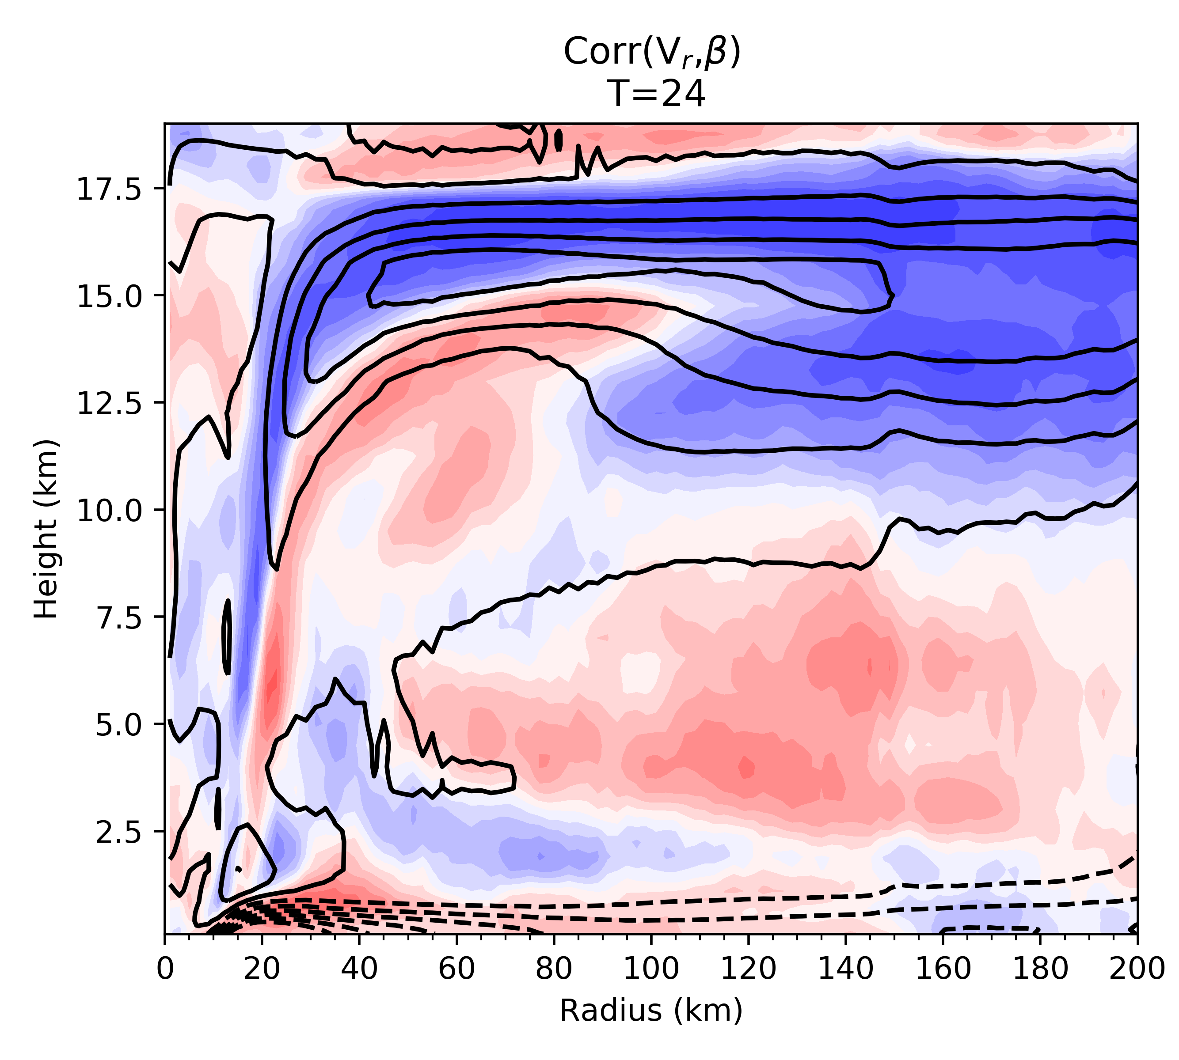
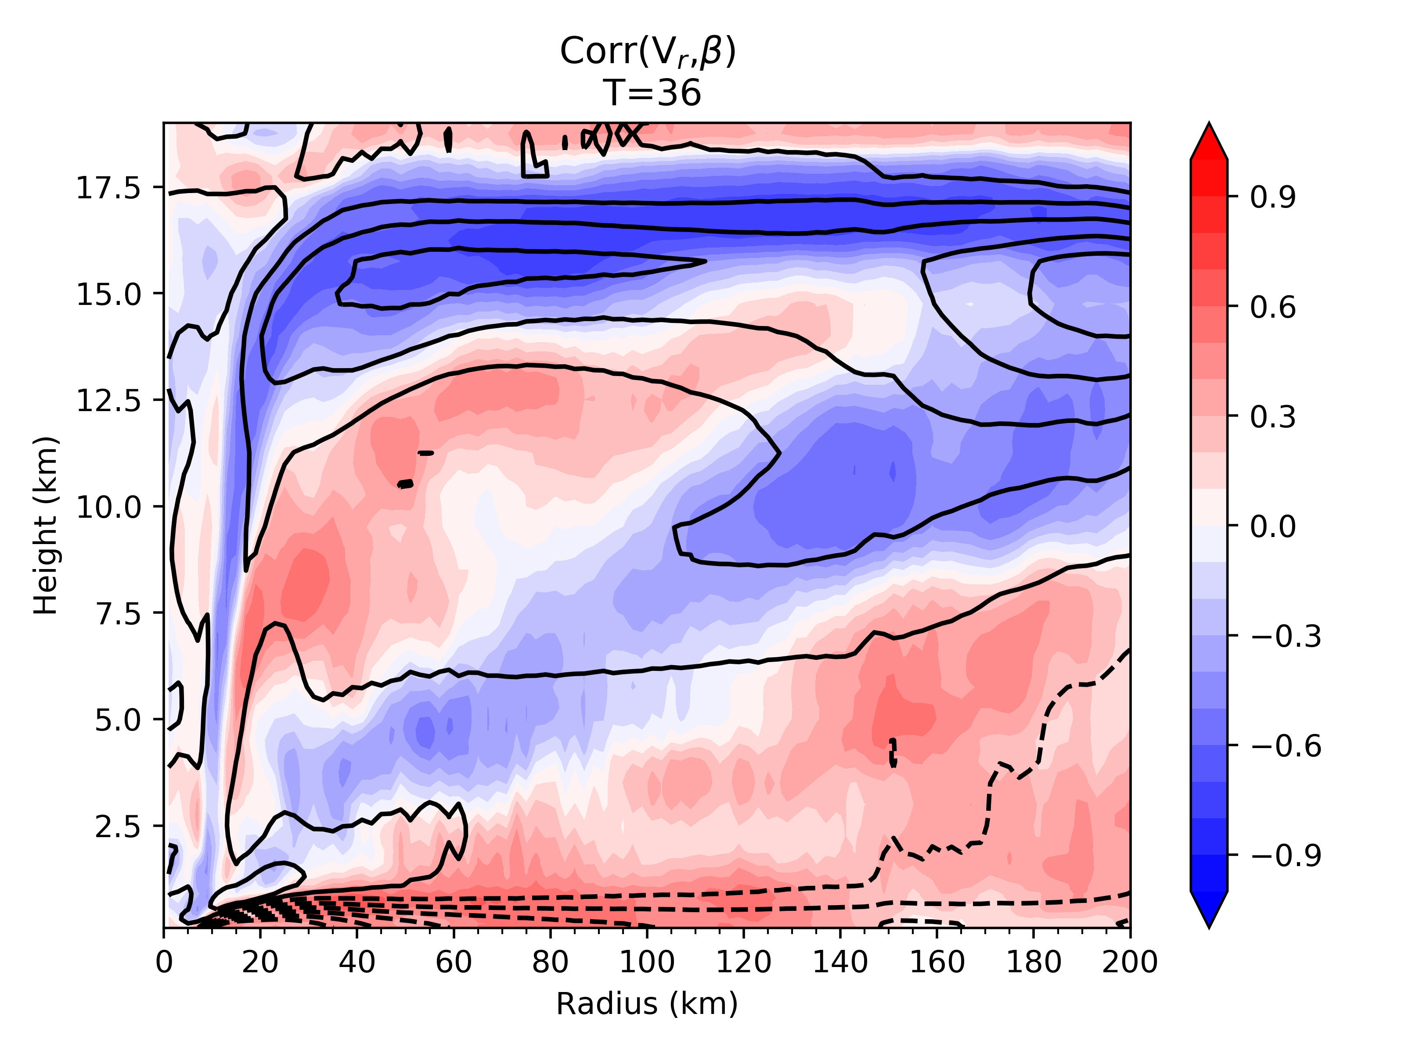
Multi Parameter Ensemble Correlations

Slide 16
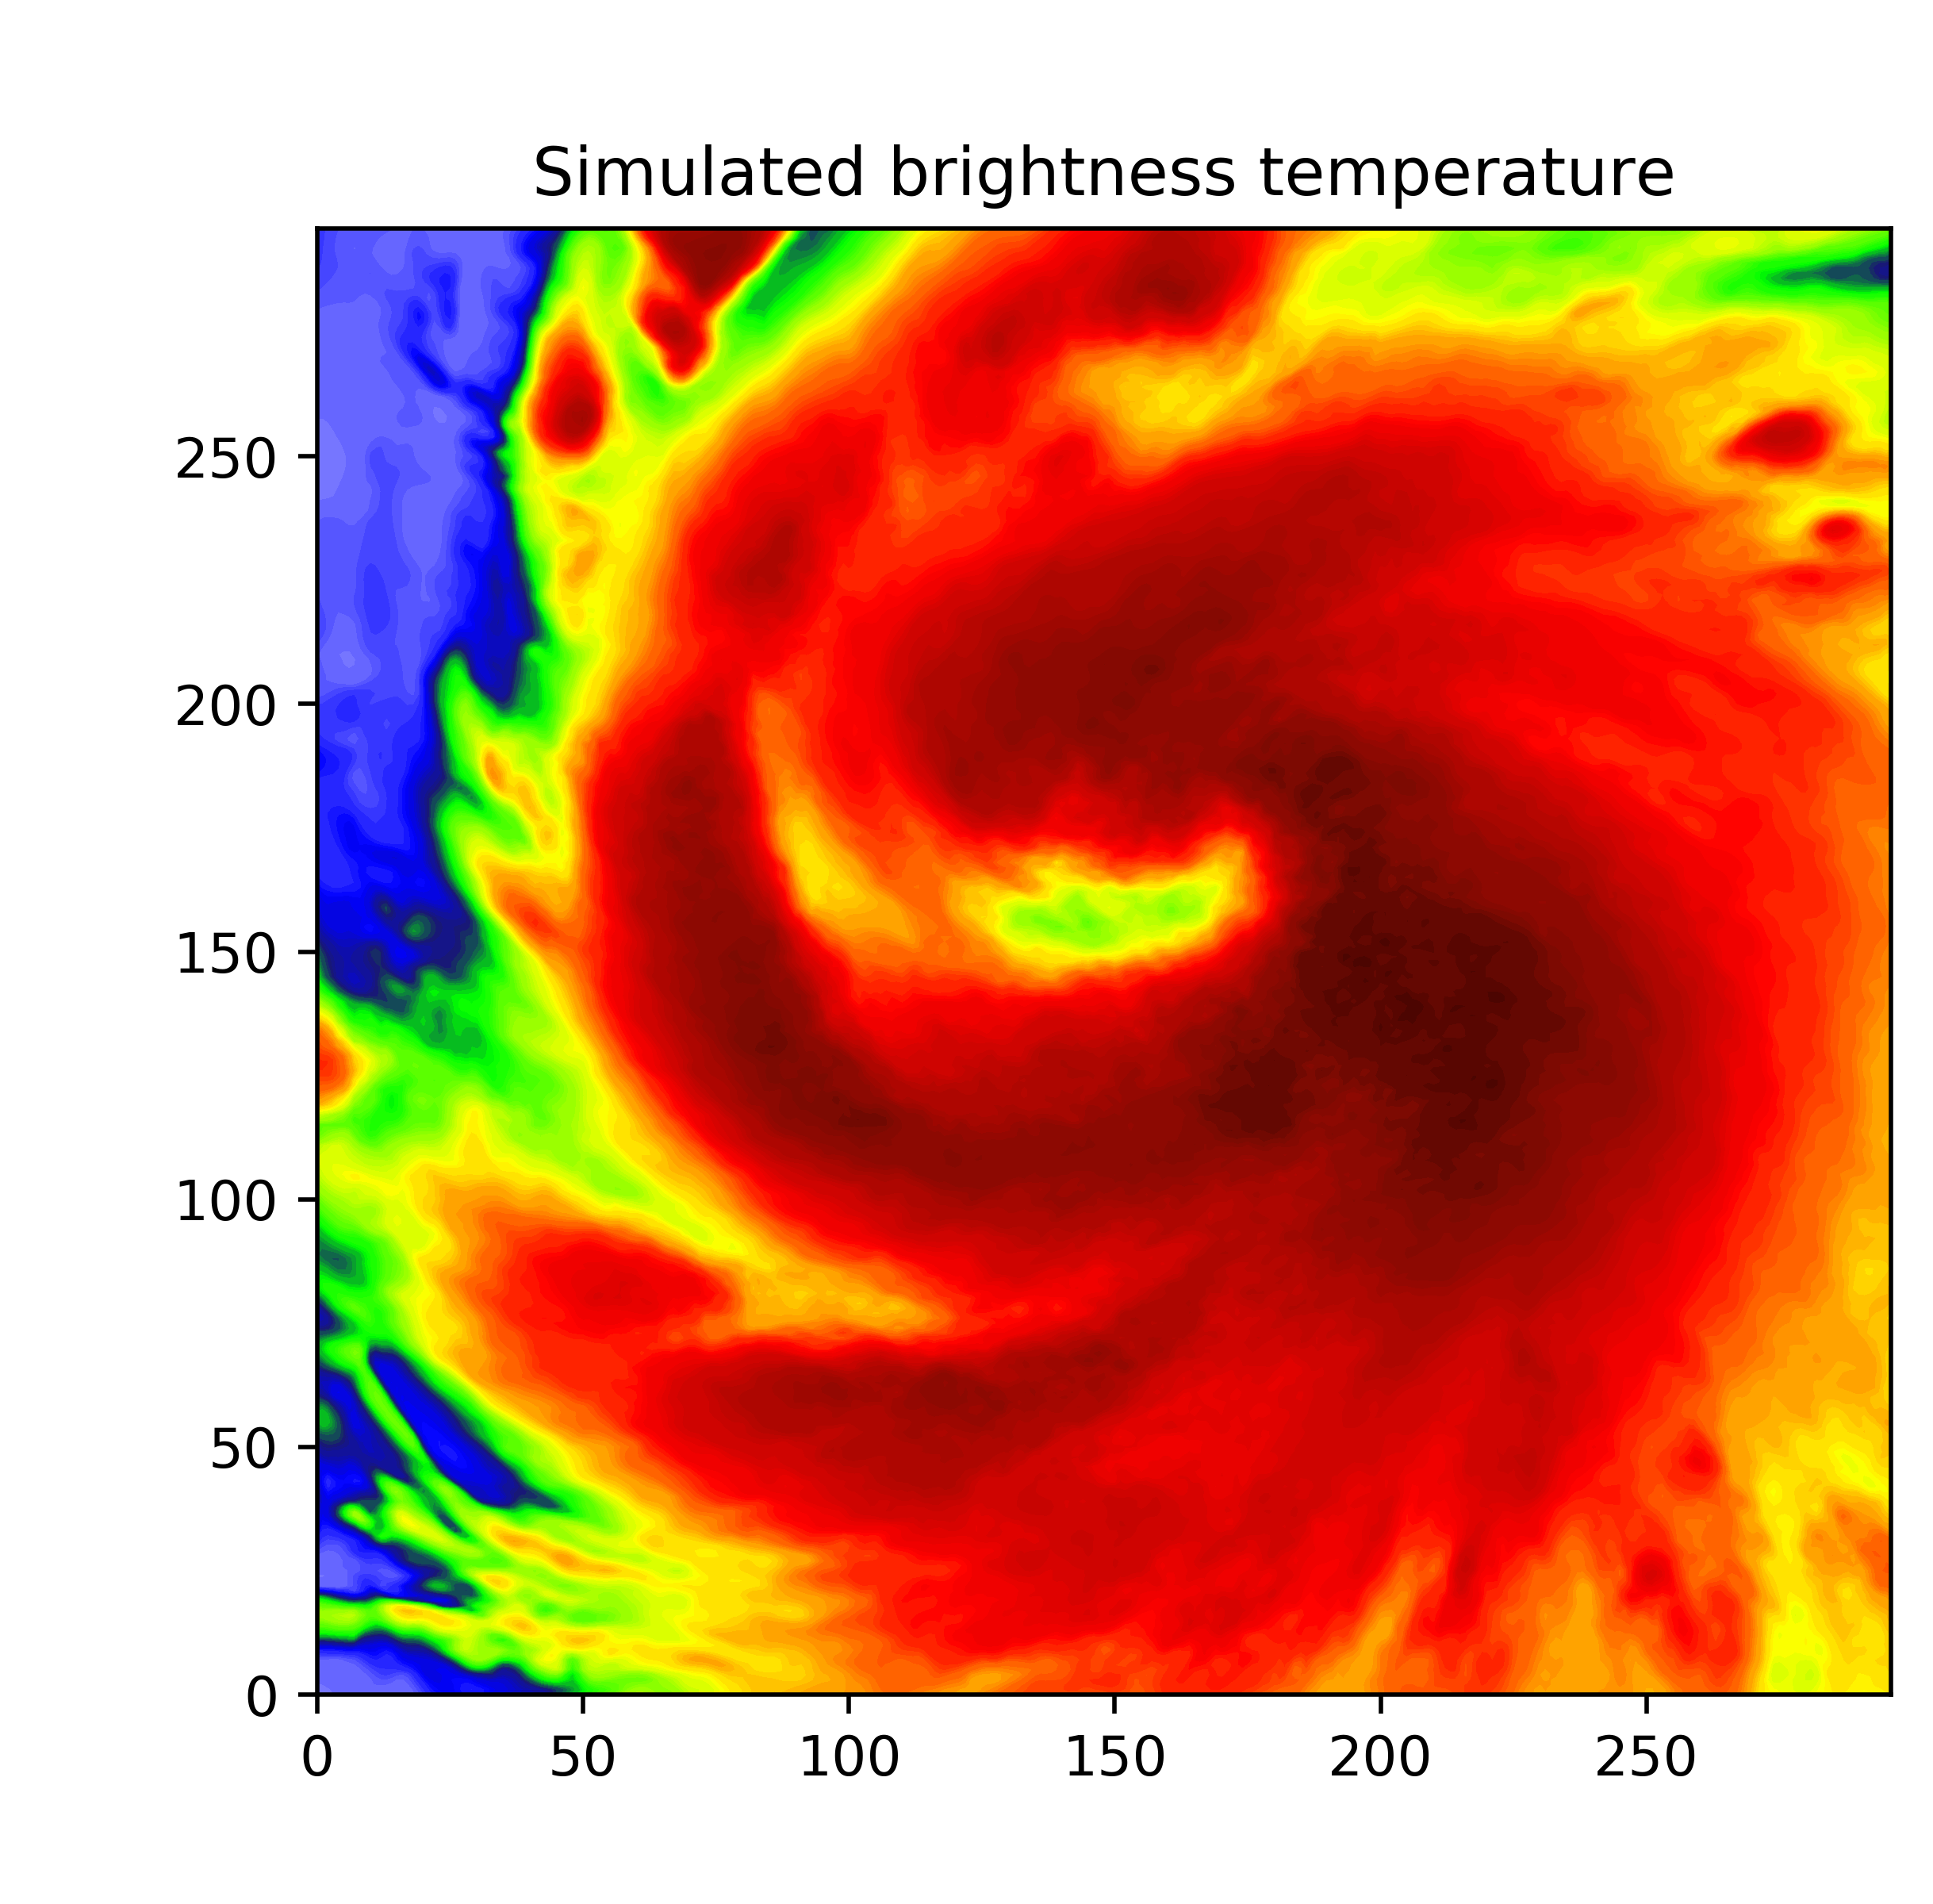
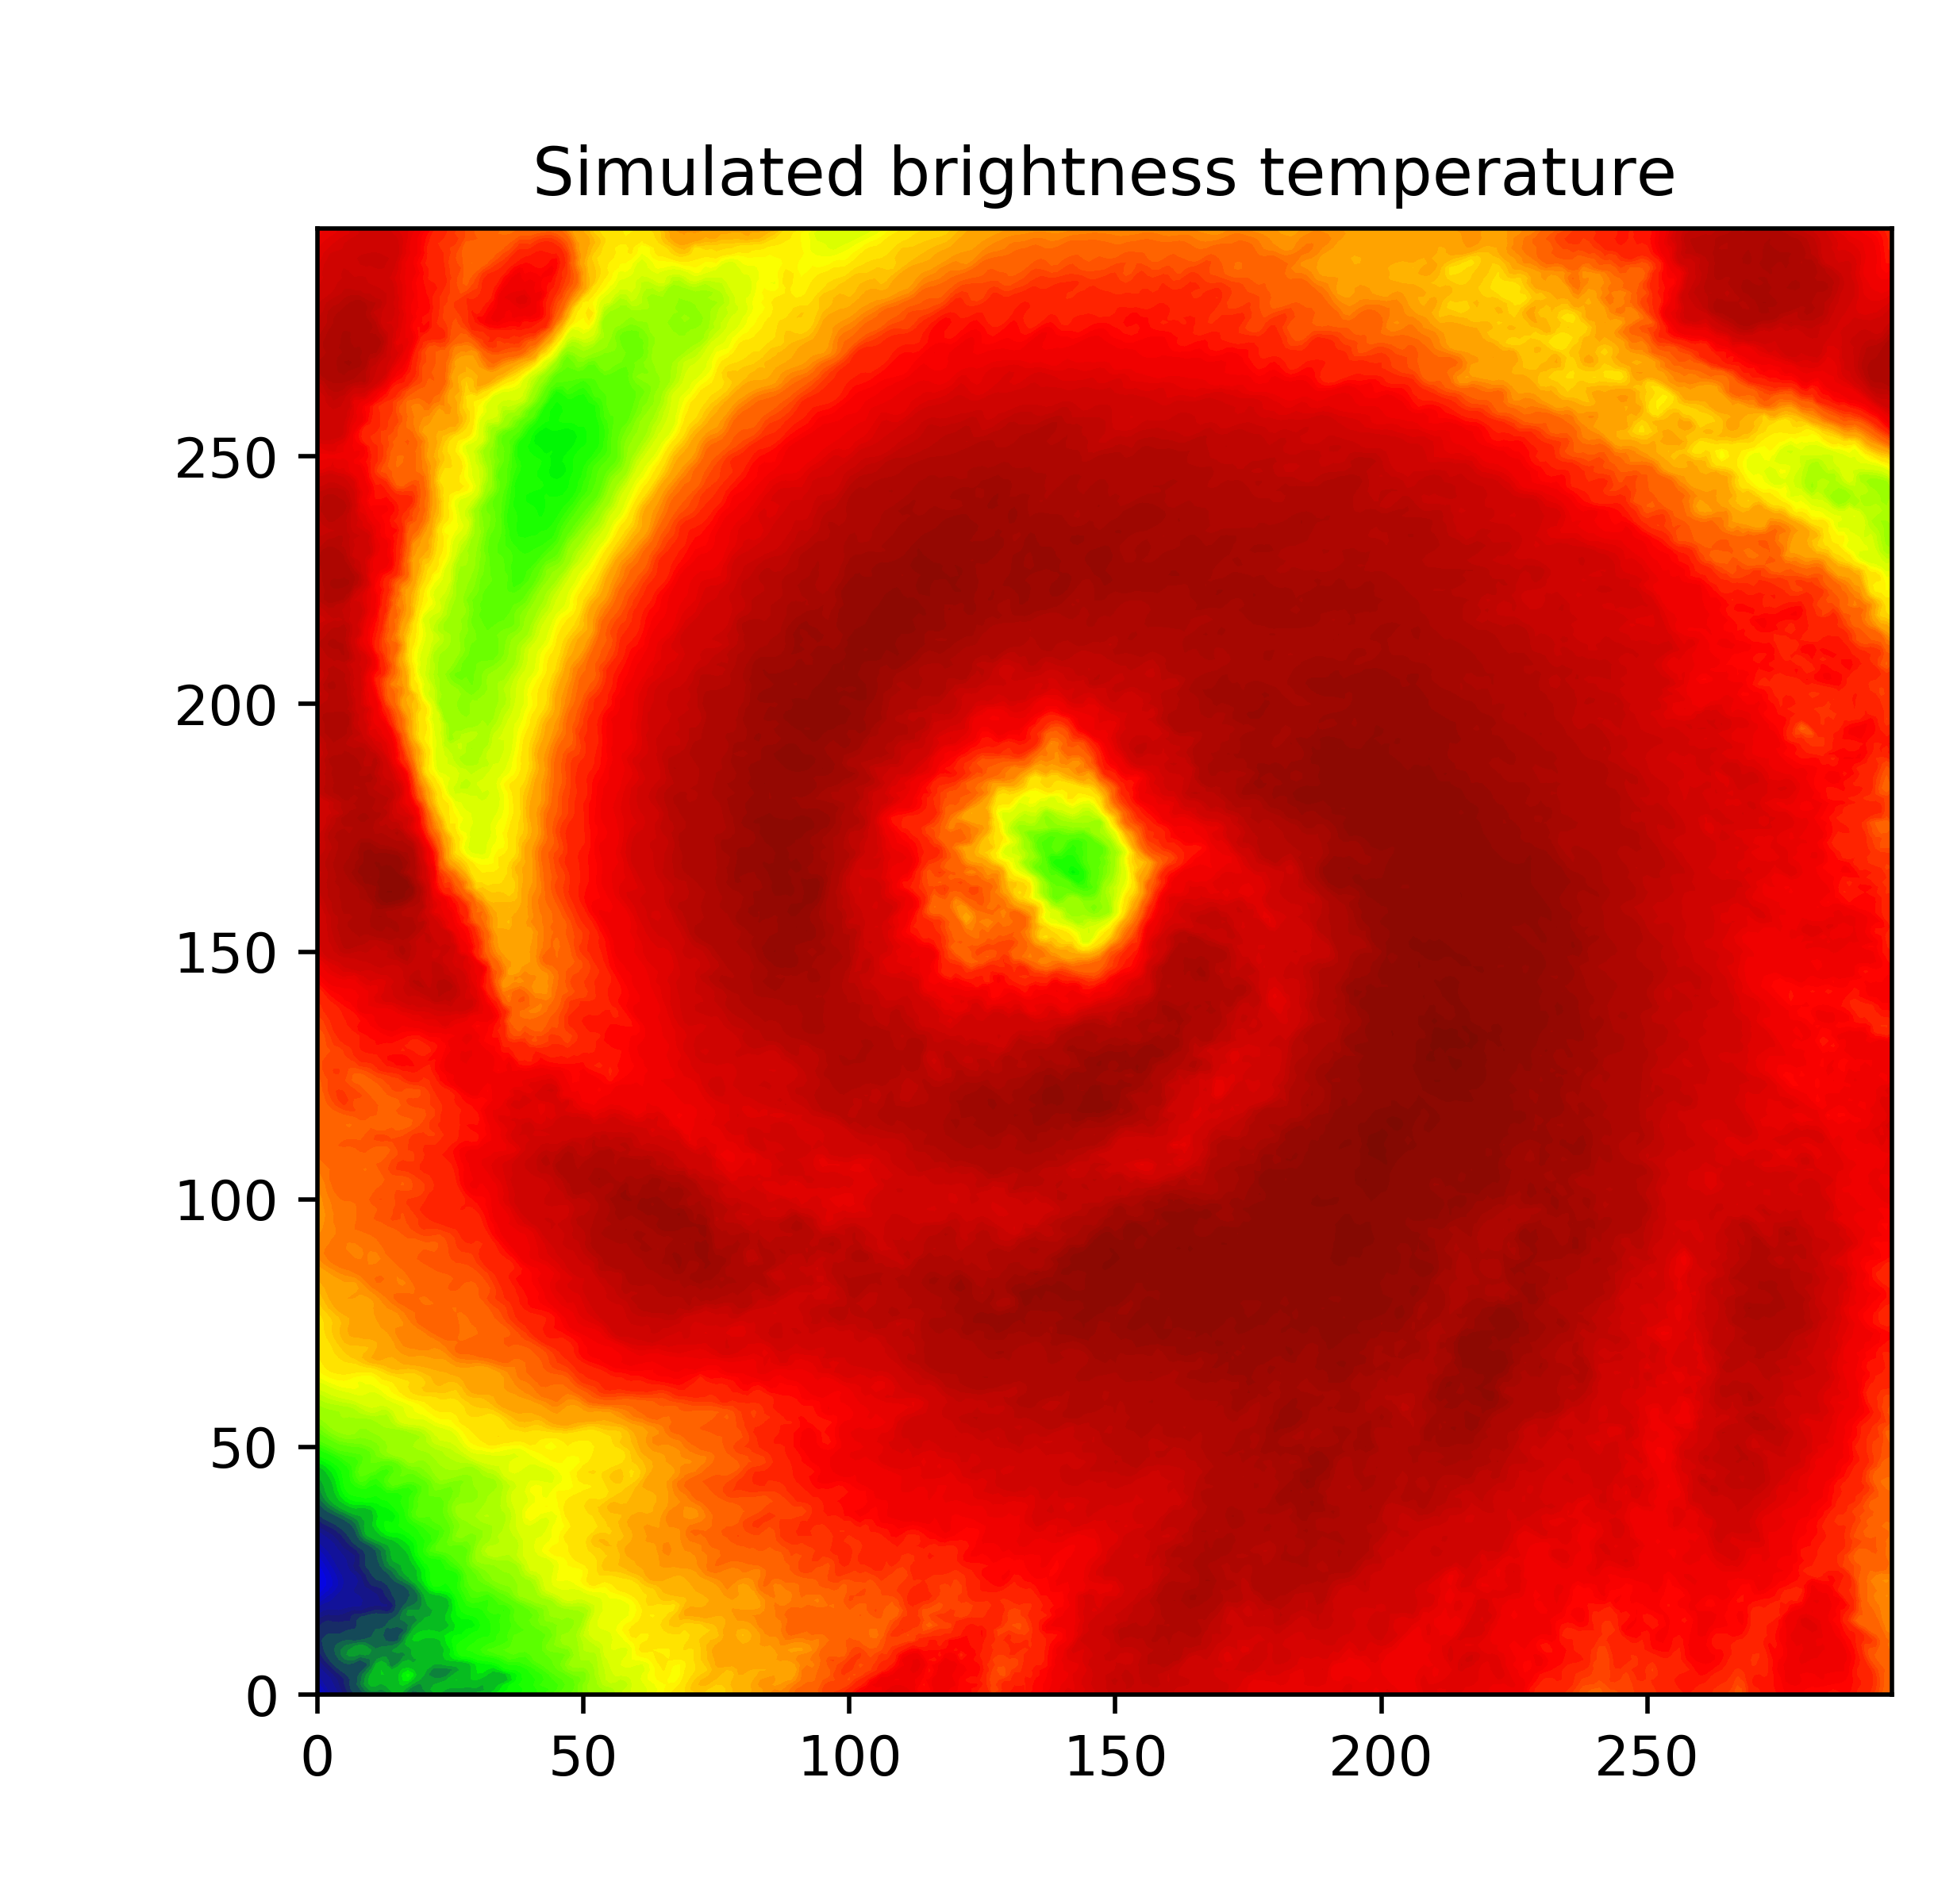
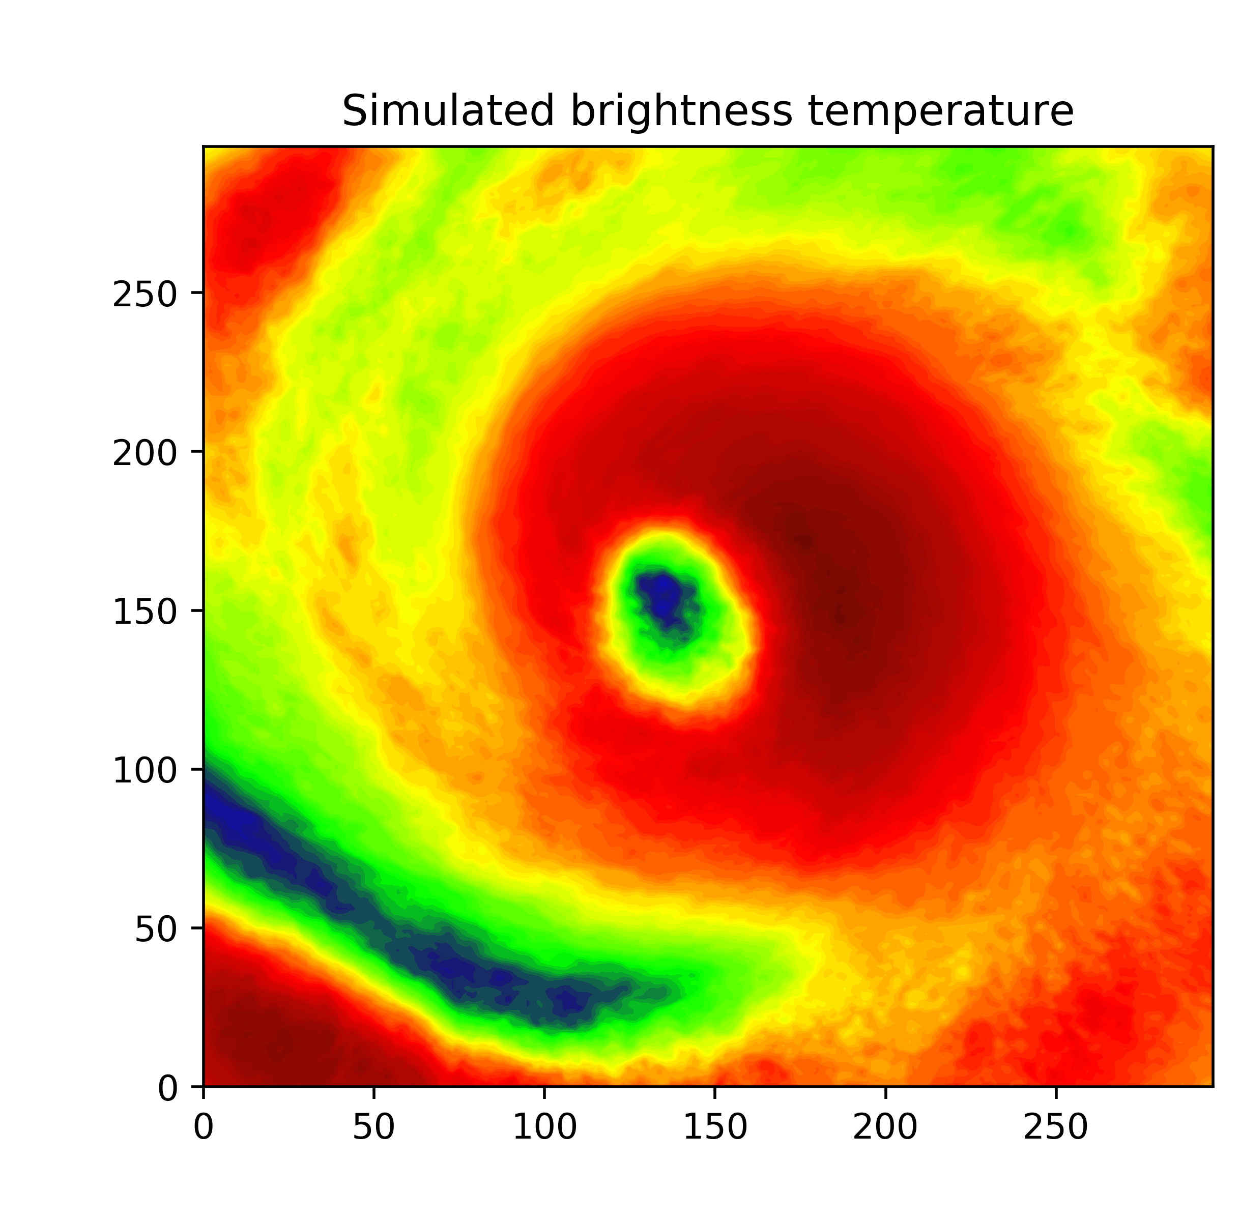
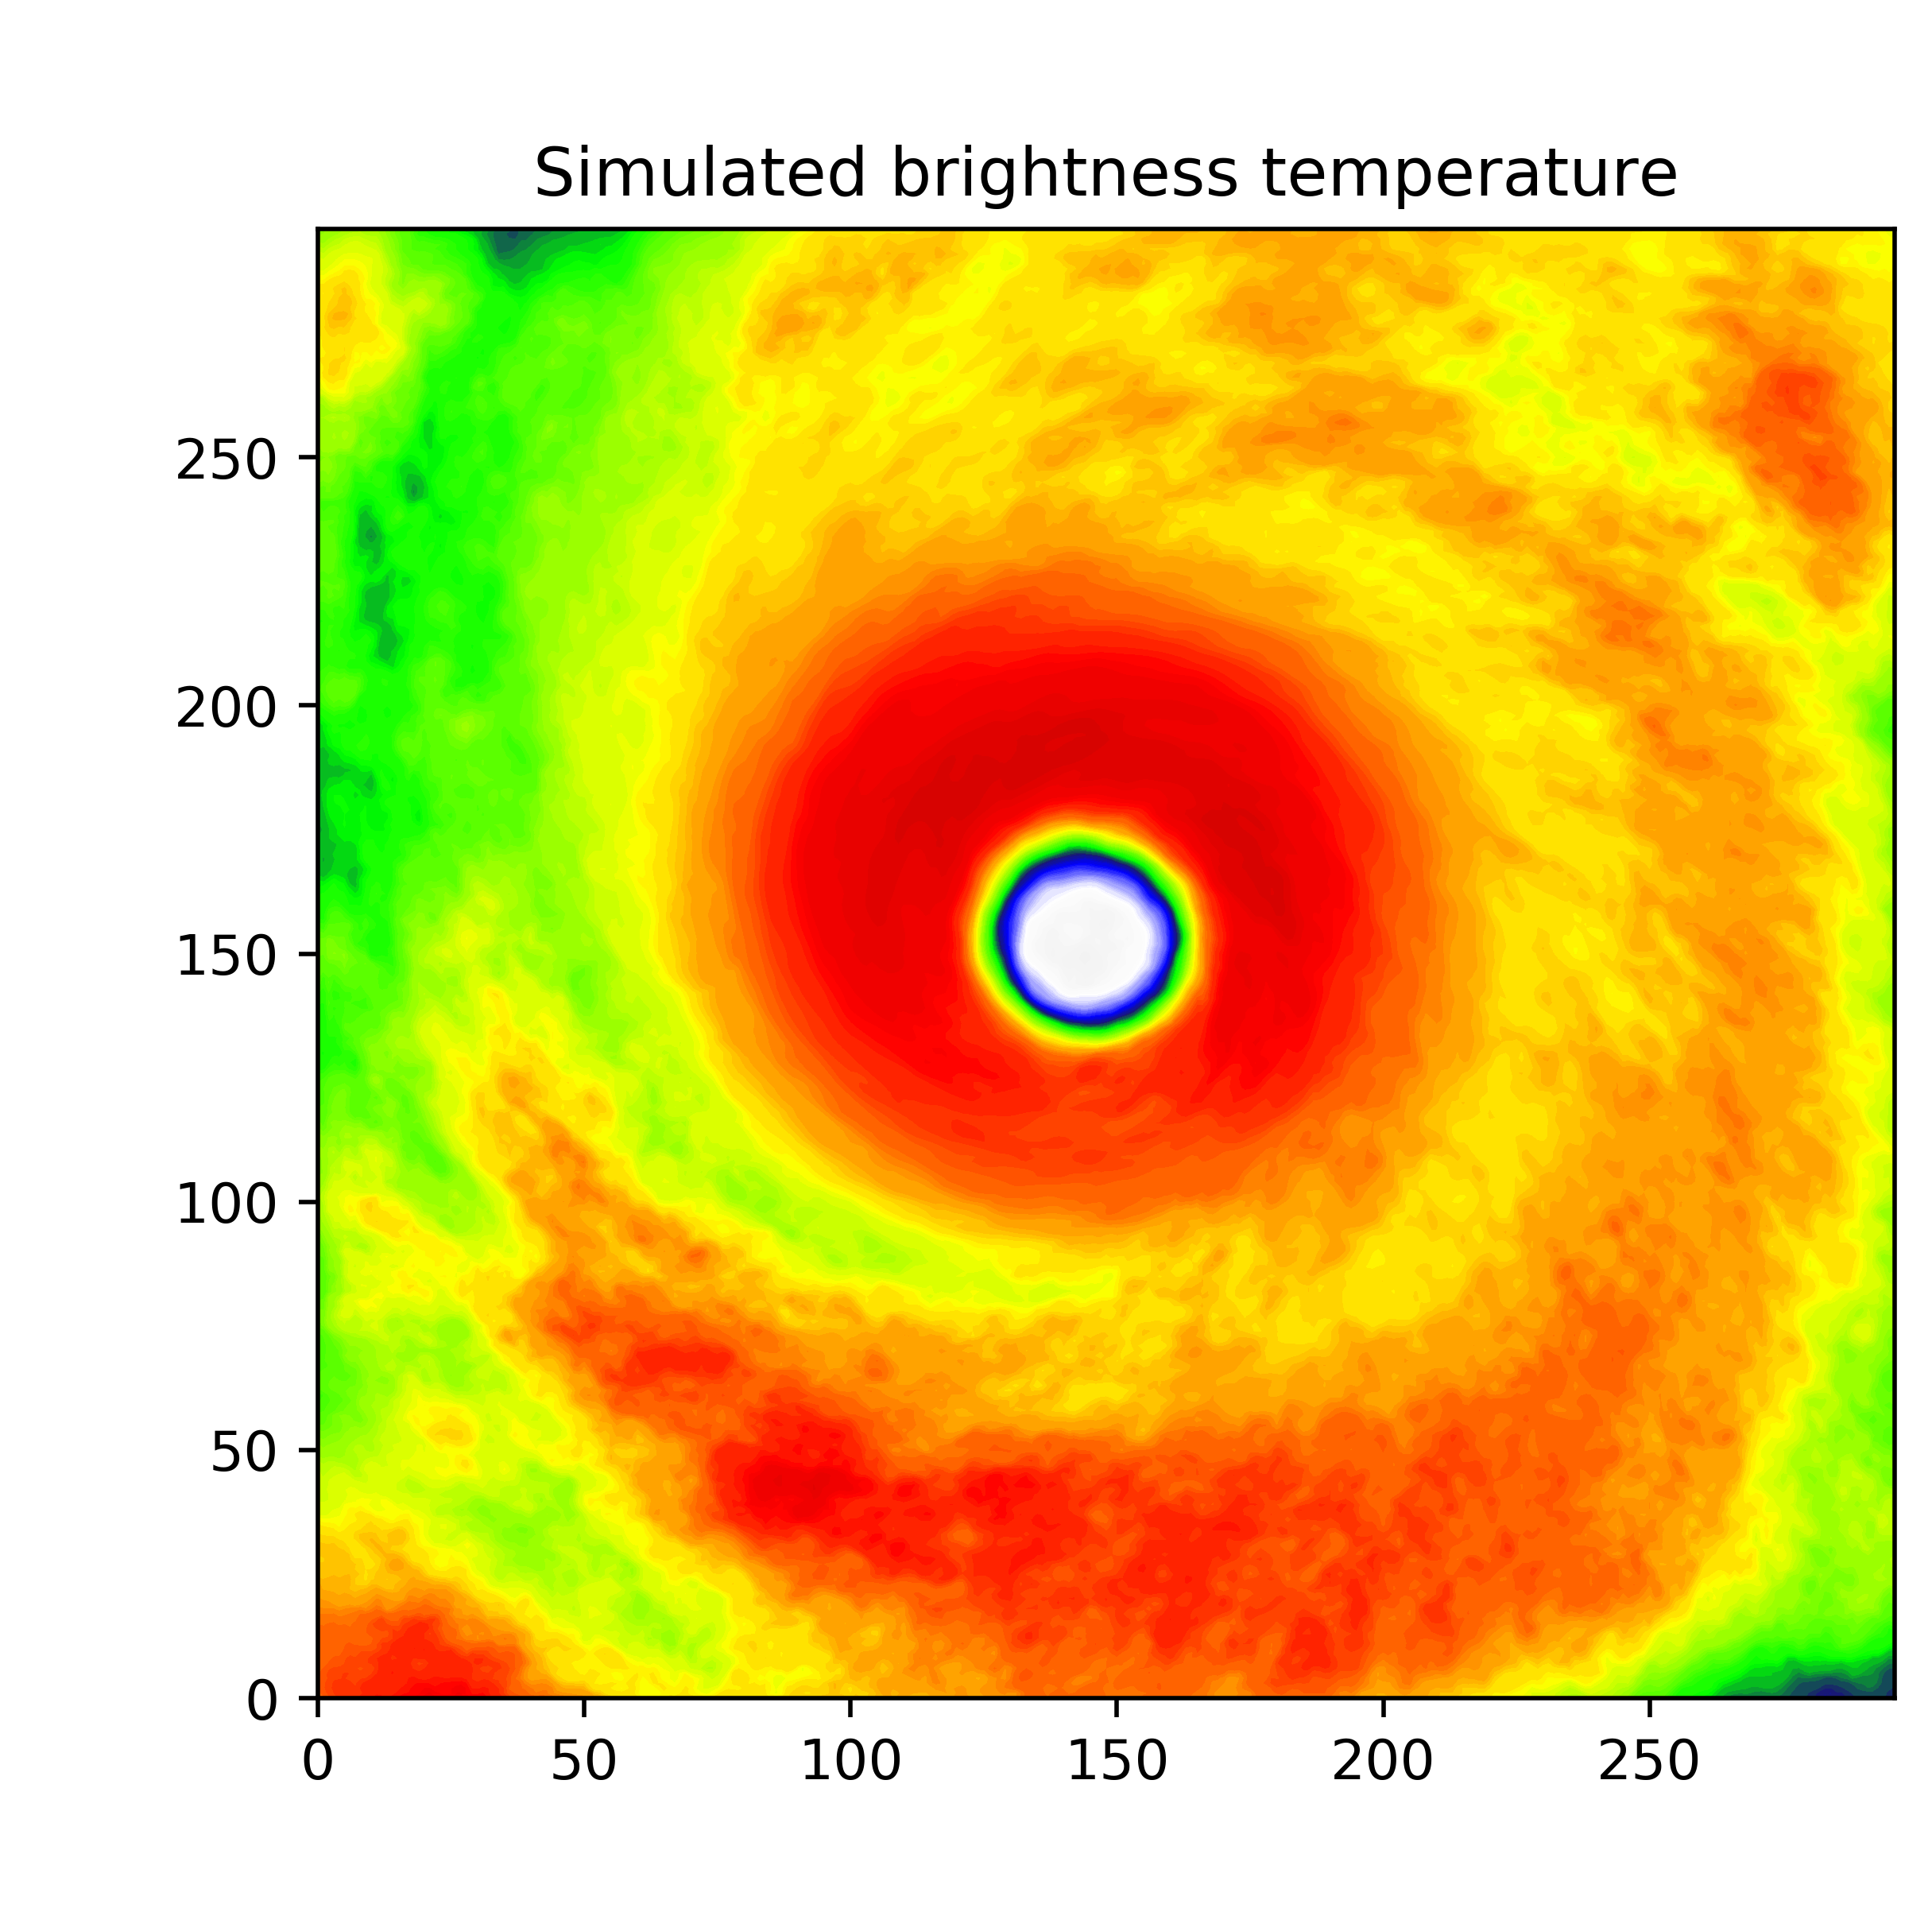











T = 3 h
T = 6 h
T = 12 h
T = 24 h
T = 36 h

Slide 17
Summary and Future Work
Uncertainty in the surface flux physics significantly modulates Patricia’s peak intensity and pressure-wind relationship
Theoretical MPI does not match well with simulated peak intensity for Patricia
Significant correlations are found between the storm structure (V_{T}, V_{r}, and simulated BTs) and 𝛼, β
  Suggesting potential for parameter estimation
Future:
Further explore the self-stratification theory related to surface flux physics uncertainty
Examine surface flux sensitivity in coupled ocean-atmosphere simulations
Perform SSPE using an OSSE and Eventually real-data

