Slide 1
Data Assimilation for the PETM 56 Million Years Ago
Mingsong Li
Penn State | Geosciences & ADAPT
Fuqing Zhang, Lee Kump
Andy Ridgwell, Brewster Malevich, Jess Tierney, Greg Hakim, Robert Tardif, Jiang Zhu, Chris Poulsen

Slide 2
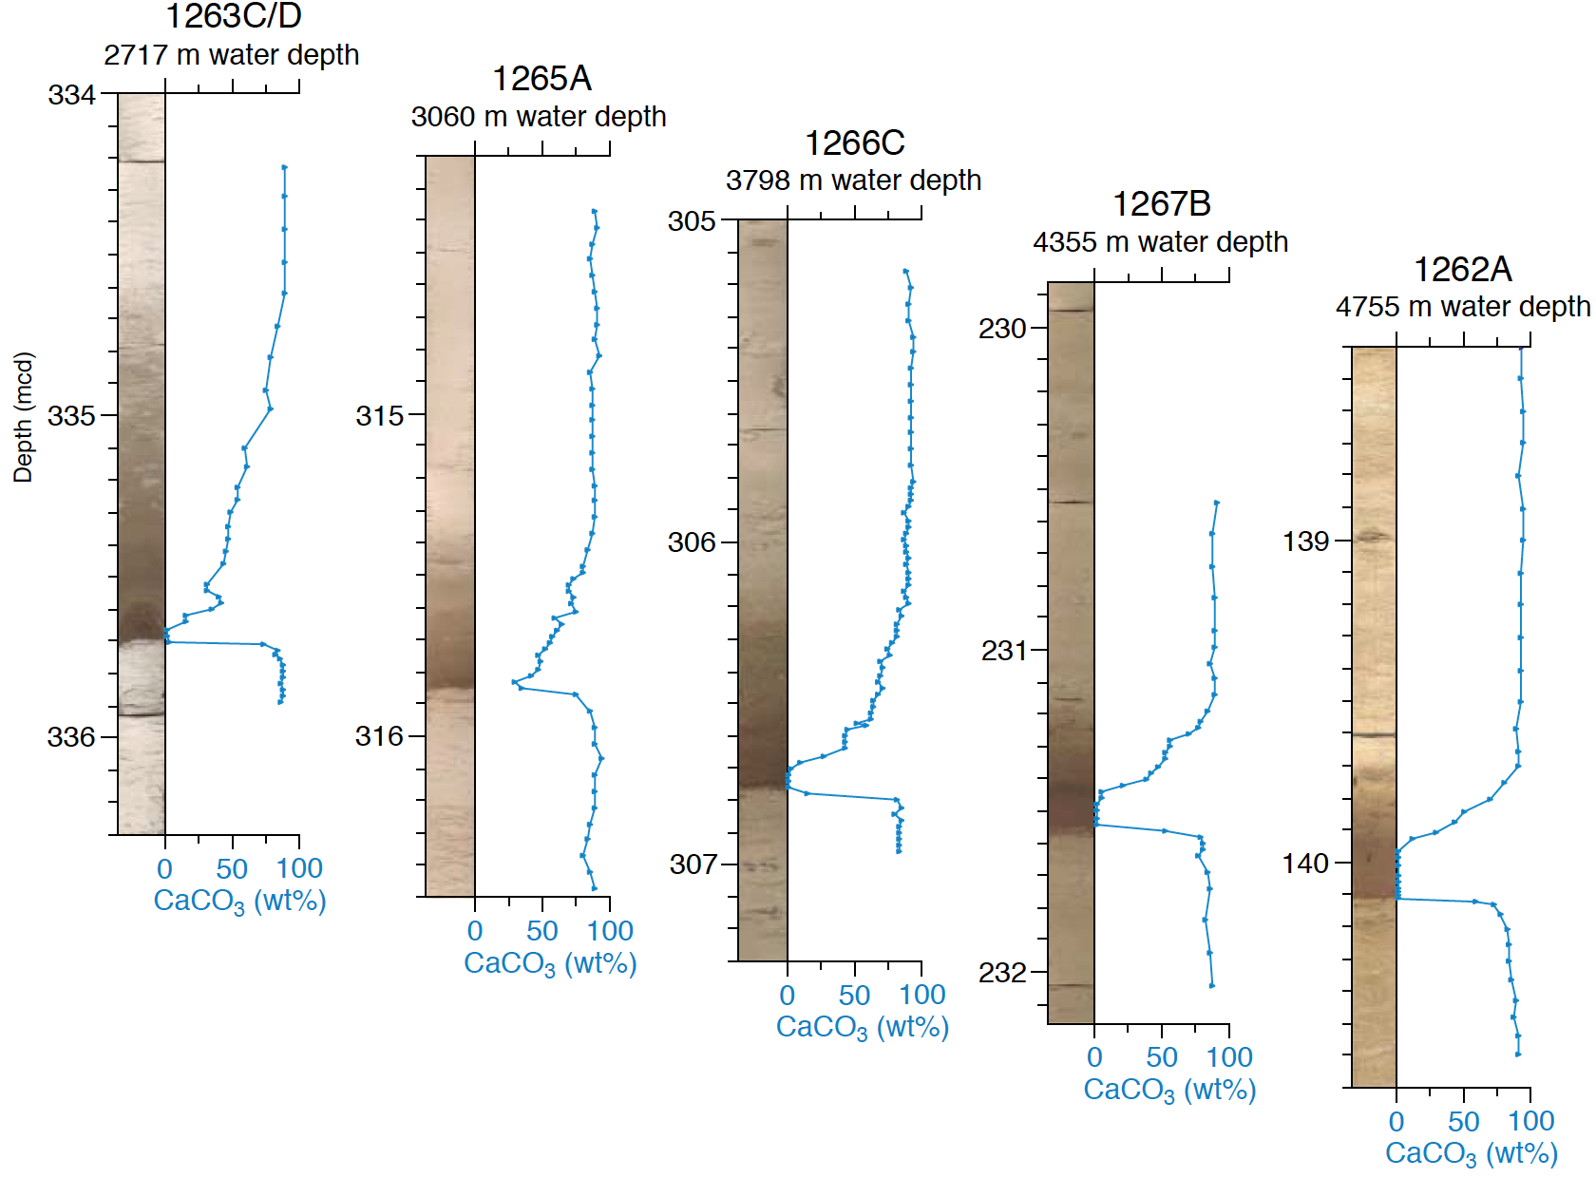
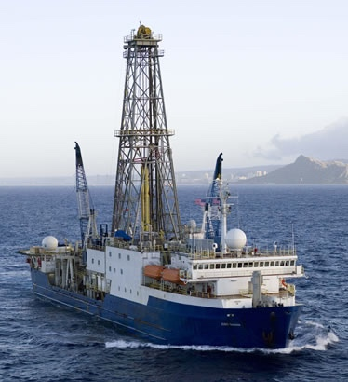
ODP
South Atlantic Ocean
https://en.wikipedia.org/wiki/JOIDES_Resolution
ocean acidification, global warming, sea level rise, …
(almost) everything you ever wanted to know about the future
Kennett & Stott, 1991 Nature
Zachos et al., 2005 Science

Slide 3
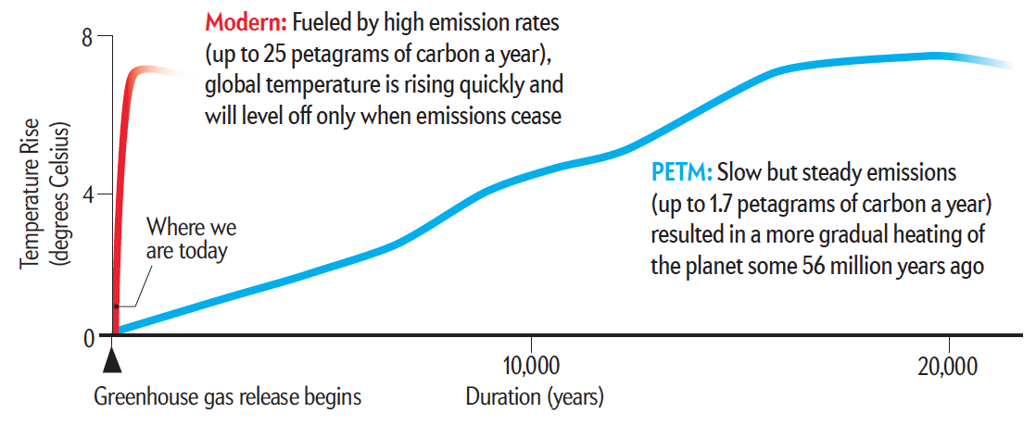
The Past is the Key to Forecasting the Future
Paleocene–Eocene Thermal Maximum
Kump, 2011
Carbon release to atmosphere 10 times faster than in the past
(Cui et al., 2011 Nat. Geosci.)

Slide 4
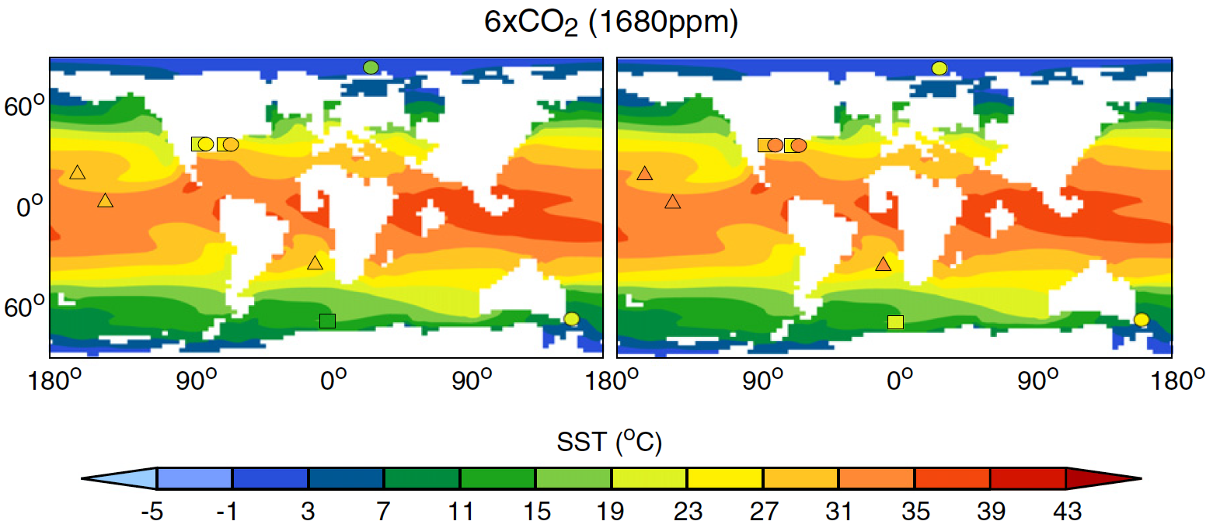
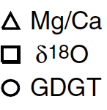
What did we know?
Data – Model comparison
Dunkley Jones et al. (2013)
Global mean surface temperature (SST) anomaly for the PETM is within the range of 4-5 °C

Slide 5
What we do
The first DA study for the PETM will answer questions:
How hot was it during the PETM?
Where should we deploy observations for PETM studies?

Slide 6
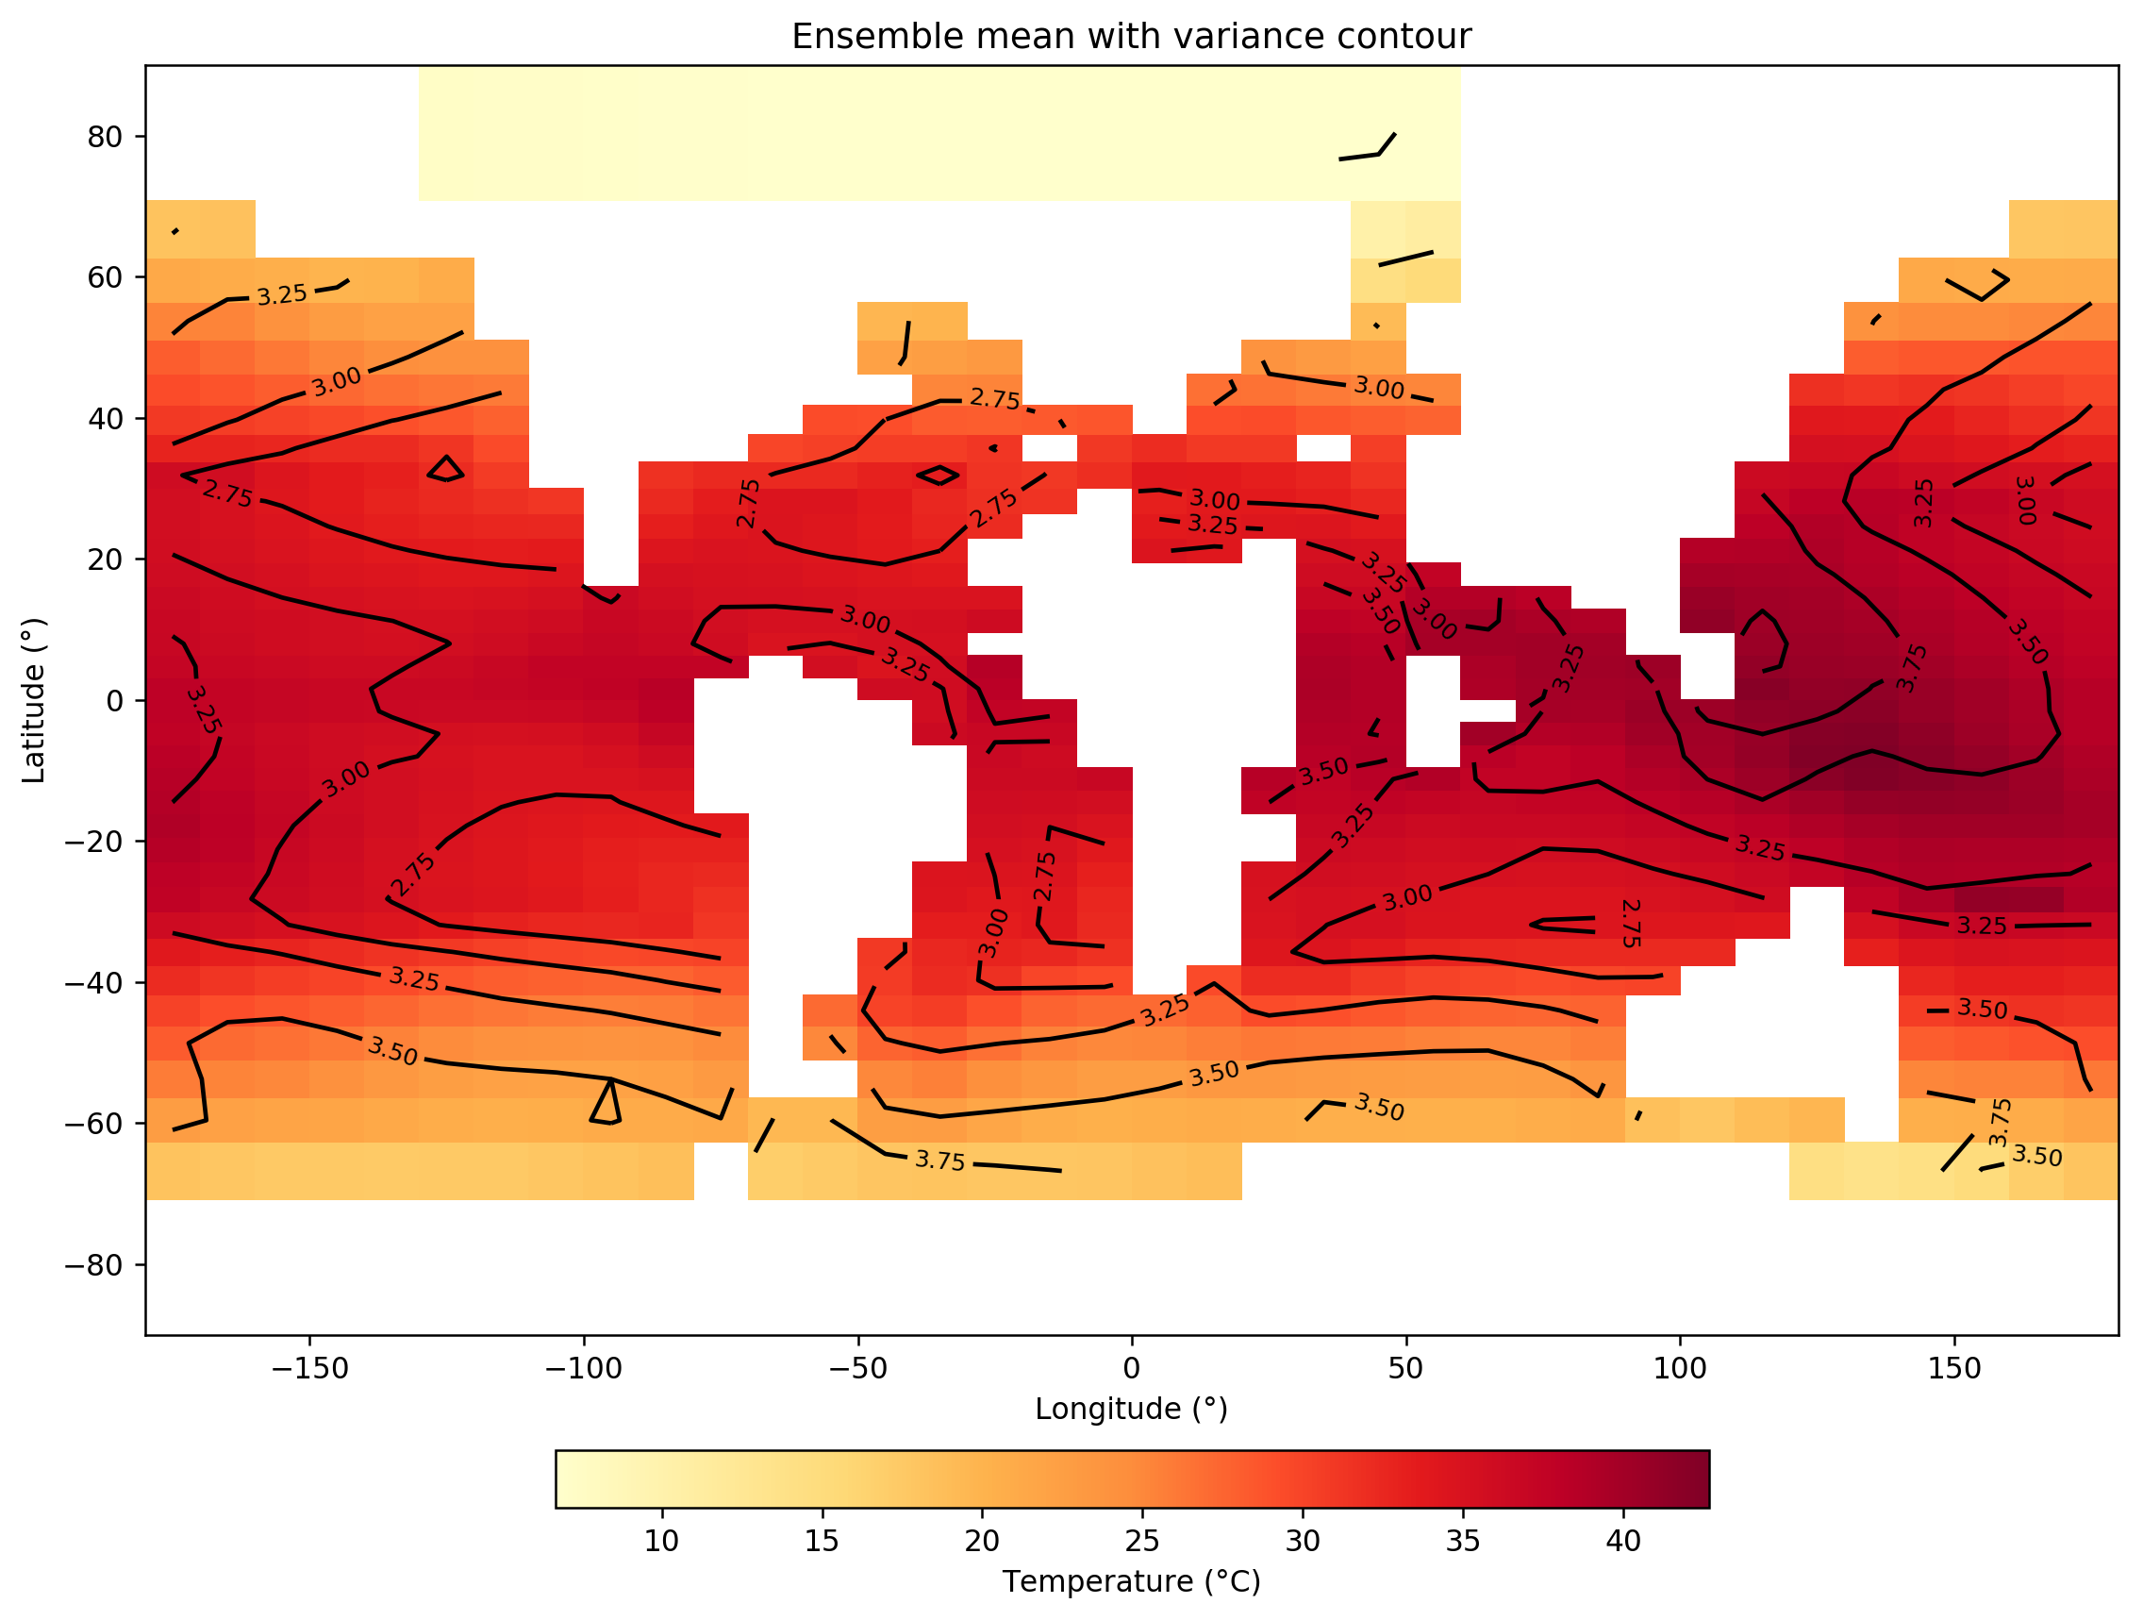
Prior: cGENIE Earth system model
atmosphere
cGENIE model
http://seao2.info
Eocene 36 x 36 (10° lon. x ~5° lat.) configuration, ocean: 16 layers
75-member ensemble
pCO₂ ranges from 4-18 X present atmospheric level (1120 – 5040 ppm)
Steady state after 10,000 years spin-up time

Slide 7
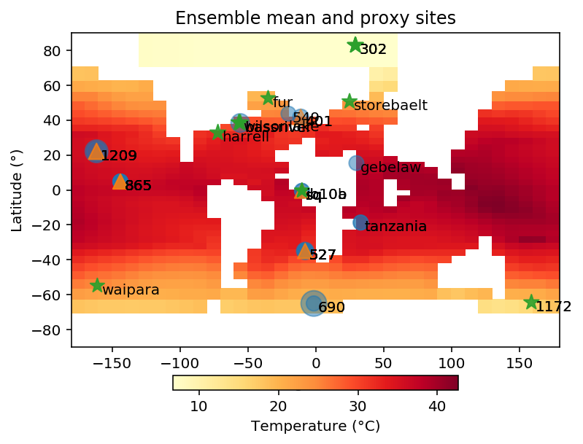
SST paleoclimate proxy
TEX86 ☆
δ¹⁸O O
Mg/Ca △
Size: proxy data numbers

Slide 8
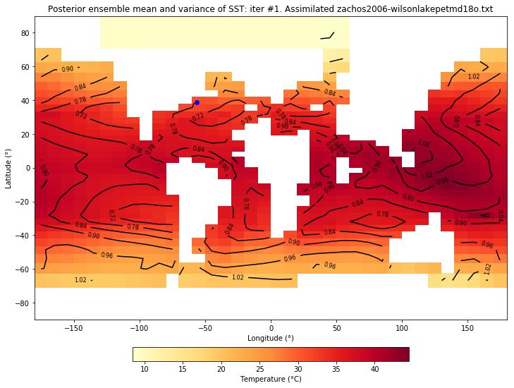
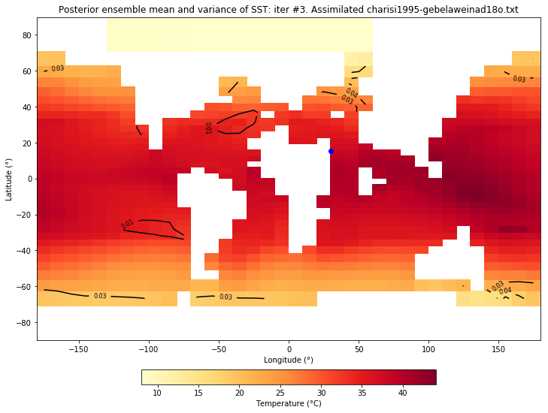
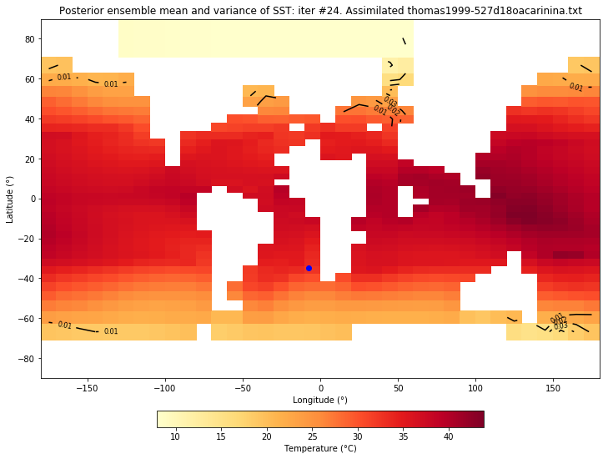
PETM SST Posterior: ensemble mean and variance (only δ18O assimilated)
Iteration #1
Iteration #2
Iteration #3
Iteration #24

Slide 9
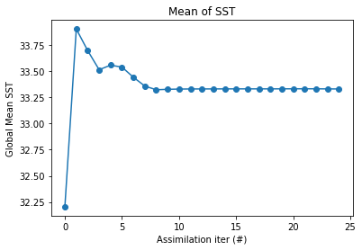
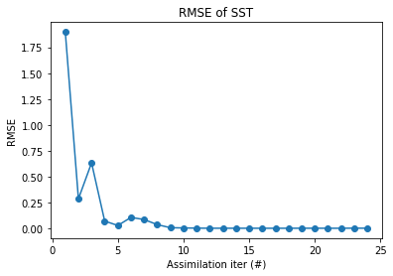
PETM DA (δ¹⁸O only)
33.3°C
very preliminary, maybe incorrect result

Slide 10
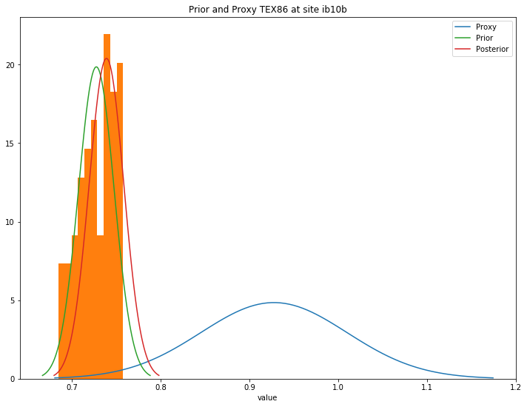
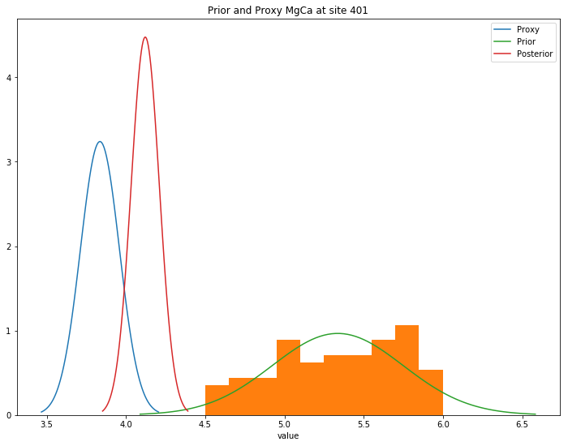
Challenge: Large misfit between proxy and prior(+Proxy System Map)
Site IB10B
Site 401
Prior+PSM
Posterior
Proxy
(Mg/Ca)
Posterior
Proxy (TEX86)
Prior+PSM
TEX86
Mg/Ca

Slide 11
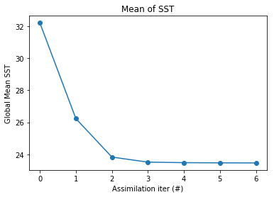
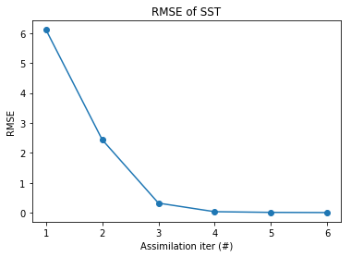
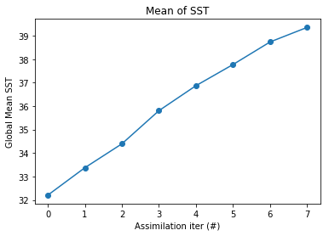
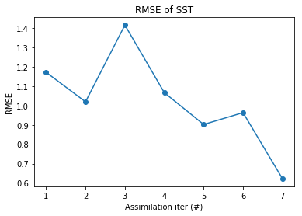
Challenge: Additional large uncertainties?
PETM DA
(Mg/Ca data only)
Global mean SST
(TEX86 data only)
Global mean SST
Diagenesis (destroying primary signal), vital effects (biological processes overriding environmental signals)

Slide 12
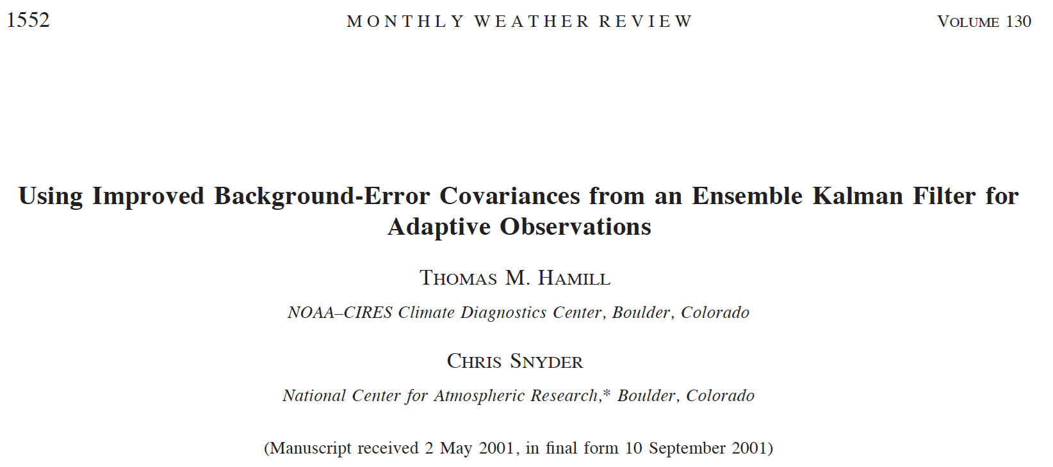
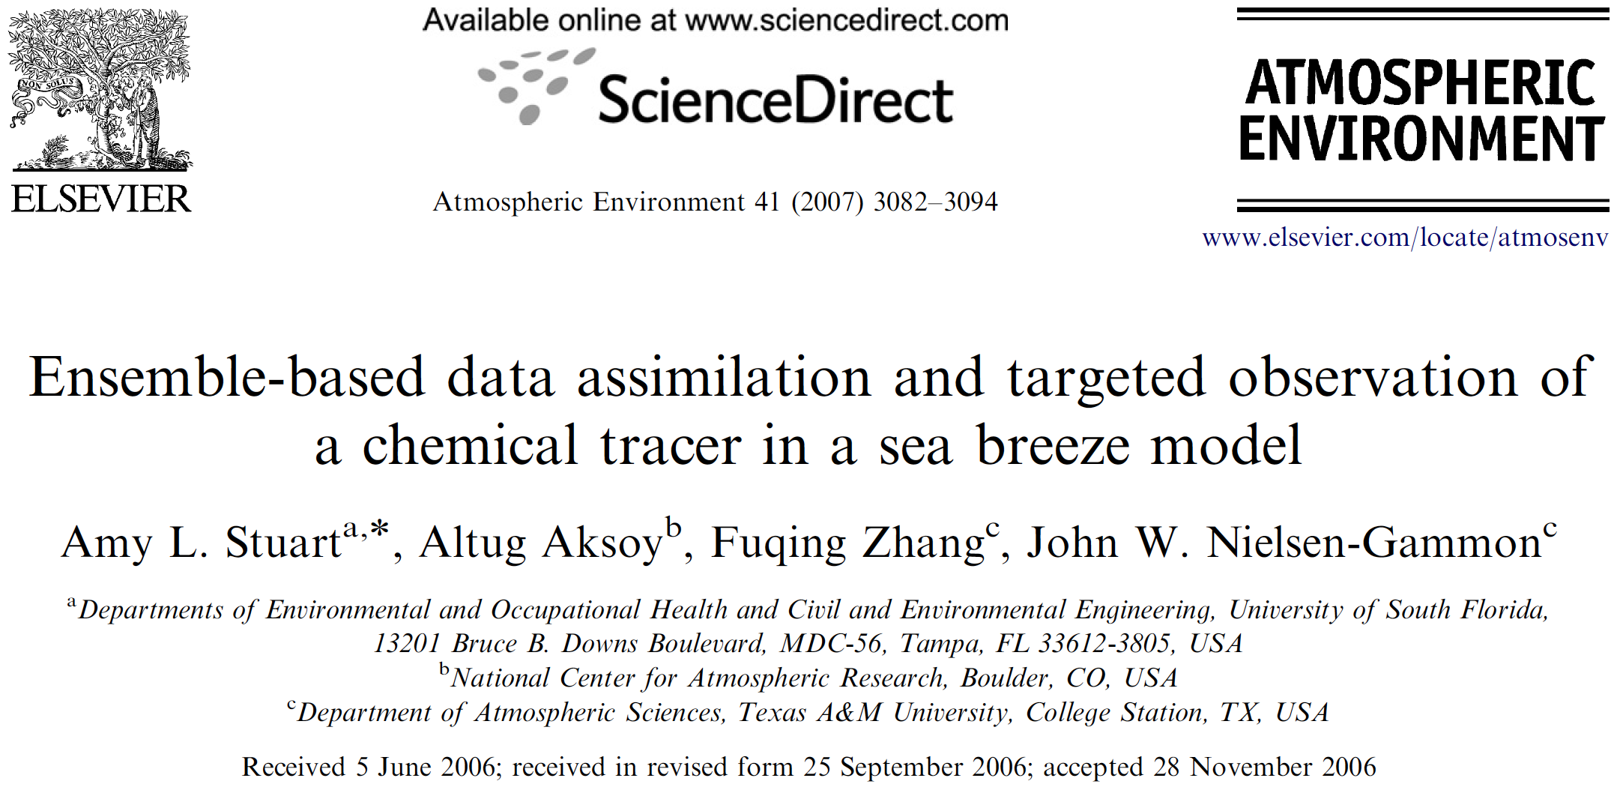
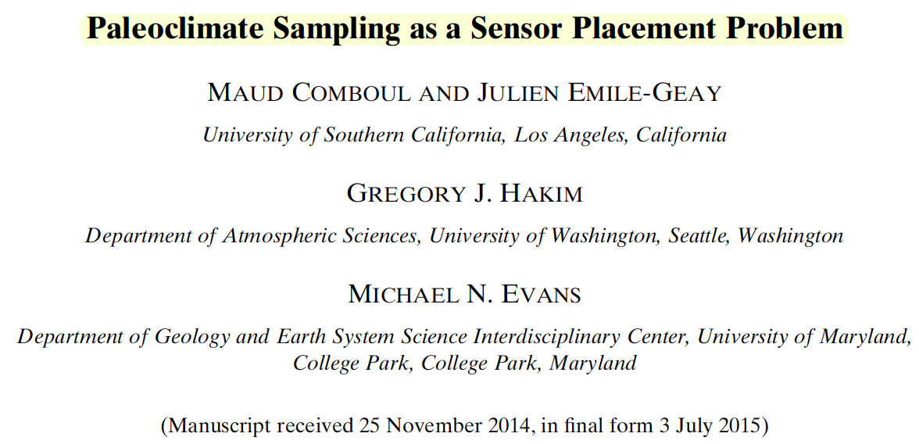
Where should we deploy observations for PETM studies?

Slide 13
Impact factor:
pre-analysis
post-analysis
sum of covariance between the given site and all sites
Trace of P^{b} - Pª =
variance of state variable
observation variance
(Hamill and Snyder, 2002; Stuart et al., 2007; Bei et al., 2012; Xie et al., 2013)

Slide 14
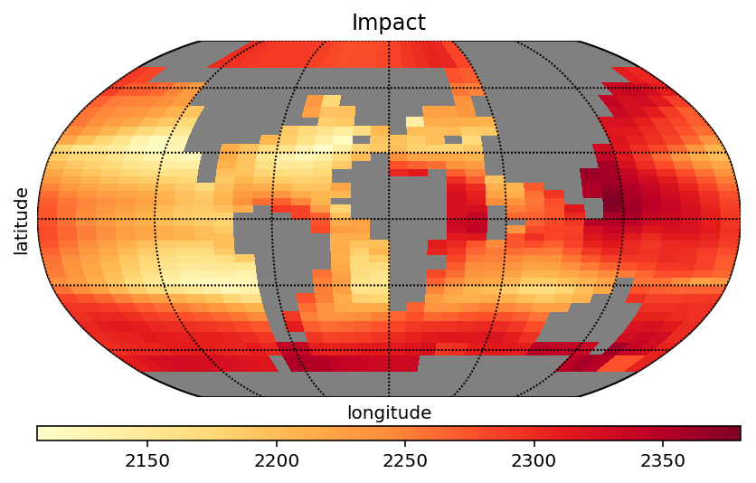
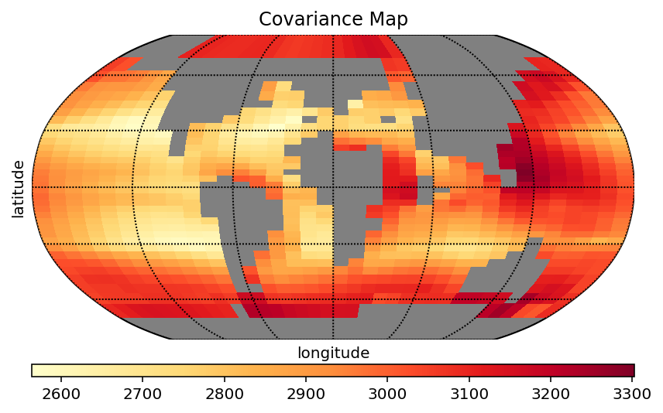
Impact factor:
Trace of P^{b} - Pª =
Impact
sum of covariance between the given site and all sites

Slide 15
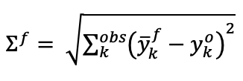
Evaluating impact factor
Hypothesis: A site with a higher impact factor has better performance to reduce the proxy-prior misfit, and vice versa
Misfit between prior and proxy (before assimilation)
Misfit between posterior and proxy (after assimilation)
Evaluation
Reduced misfit =
-

Slide 16
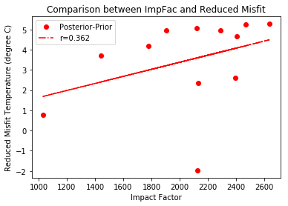
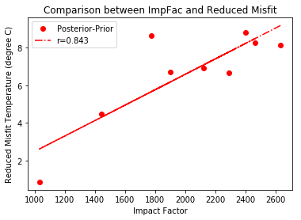
Evaluating impact factor
IB10b
IB10a
TEX₈₆=0.928
TEX₈₆=0.935
Fur, Denmark
TEX₈₆ data only
R = 0.362
R = 0.843
Nice, but a couple of outliers?

Slide 17
Future work
How to evaluate additional large uncertainties in proxy data?
Will more δ¹⁸O and Mg/Ca data be helpful for evaluation of impact factor?

