Slide 1
Improving Hurricane Intensity Forecasts through Convection-Permitting Ensemble Data Assimilation of All-Sky Satellite Radiance
Chris Hartman
5/10/19
ADAPT Spring Group Conference

Slide 2
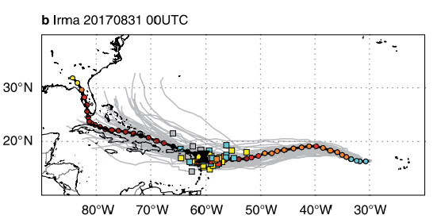
Hurricane Intensity Forecasts Need Improvement
Hourglass = min SLP @ time of landfall
Boxes = ECMWF forecasted min SLP @ time of landfall.
Figure 1b of Magnusson et al., 2019
(Featured in March 2019 issue of BAMS)

Slide 3
Motivation – we need better initial conditions!
Small initial condition errors can grow rapidly.
Properly initializing inner-core moisture is especially important (Emanuel and Zhang, 2017).
Inner-core observations are limited.
Approach: data assimilation combined with satellite observations.

Slide 4
Methodology
PSU WRF-EnKF:
60 members
3 two-way nested domains (27 km; 9 km; 3 km)
60 vertical levels
Community Radiative Transfer Model (CRTM) used as forward operator.
Hourly Assimilation with PSU WRF-EnKF of:
Conventional obs only (“No GOES-16”)
Conventional obs + radiances from water vapor sensitive channels (8-10) of GOES-16 Advanced Baseline Imager (“GOES-16”)
Notes:
In case someone asks: SCL was applied with a 30 km ROI for BT obs thinned every 12 km and with a 200 km ROI for BT obs thinned every 18 km.
Covariance relaxation method w/coefficient of 0.75, together w/an adaptively estimated spatially homogeneous multiplicative inflation factor, was used to maintain sufficient ensemble spread and avoid filter divergence.
AOEI was performed.

Slide 5
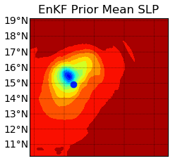
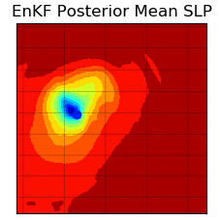
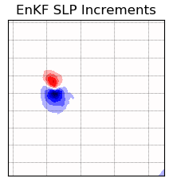
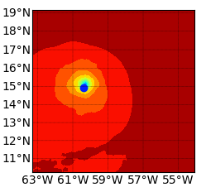
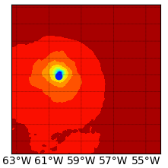
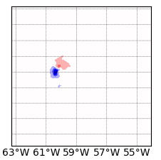
Hurricane Position Improved by Satellite DA
hPa
hPa
20
1005
10
990
0
975
- 10
960
- 20

Slide 6
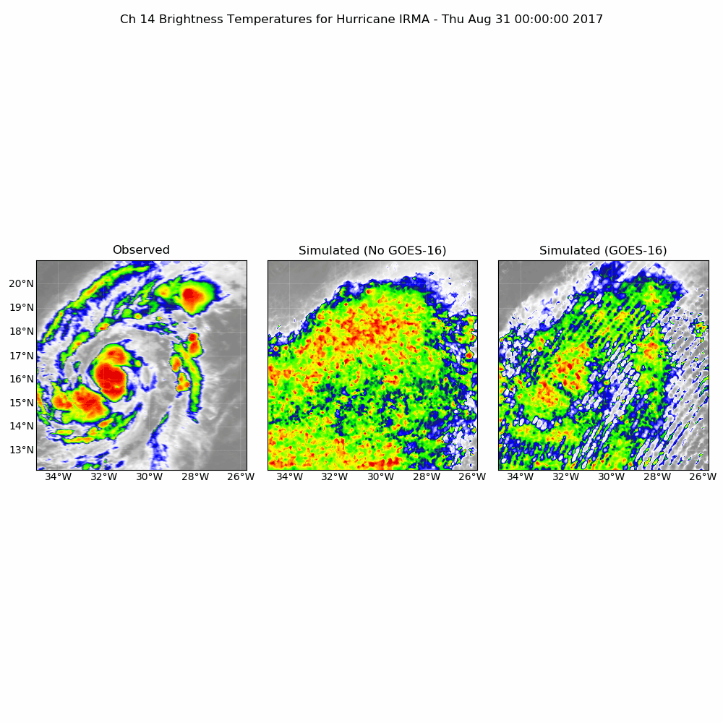
Hurricane Irma
Simulated Ch 14 Brightness Temperature (K)

Slide 7
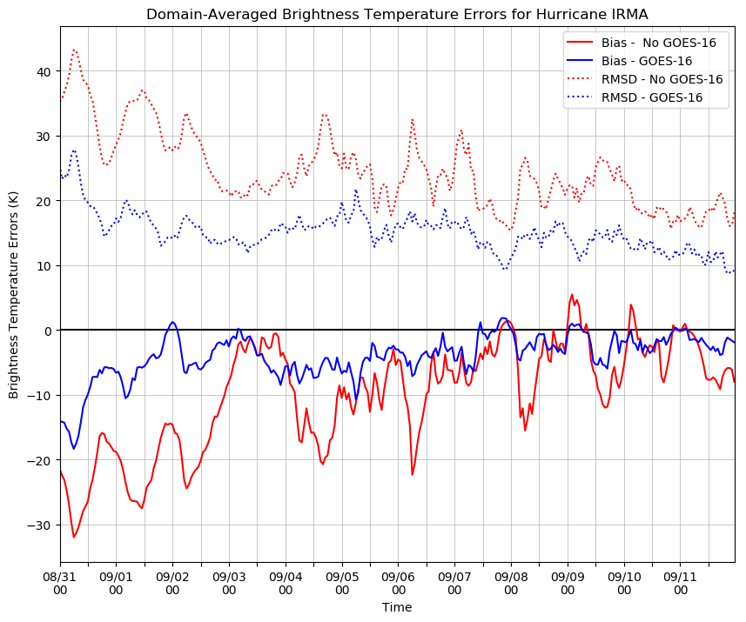
Brightness Temperature Fields Improved by Satellite DA
Domain-Averaged Brightness Temperature Statistics for Hurricane Irma
RMSD reduced by satellite DA!!
*Channel 14 brightness temperatures used for verification
Brightness Temperature Statistics (K)
*Note:
Bias = Simulated - Observed
Fake clouds removed by satellite DA!!
Time

Slide 8
Hurricane Maria
Simulated Ch 14 Brightness Temperature (K)

Slide 9
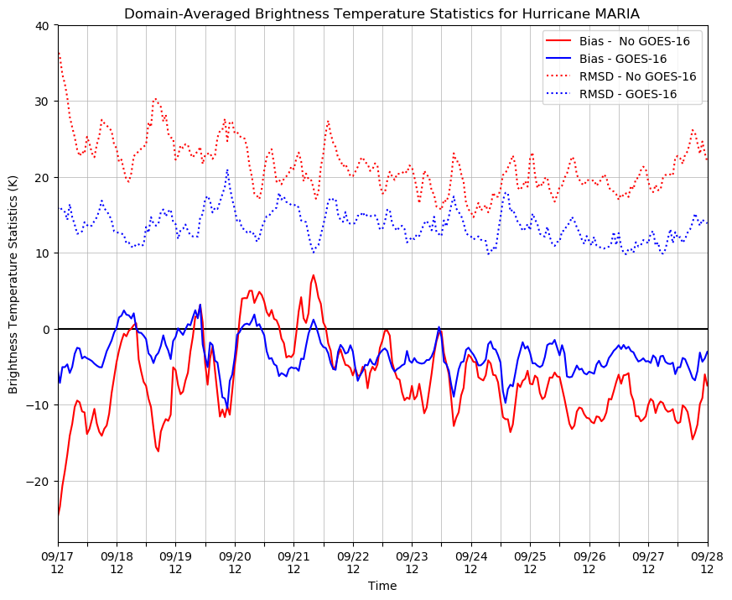
Brightness Temperature Fields Improved by Satellite DA
Domain-Averaged Brightness Temperature Statistics for Hurricane Maria
*Channel 14 brightness temperatures used for verification
Brightness Temperature Statistics (K)
*Note:
Bias = Simulated - Observed
Time

Slide 10
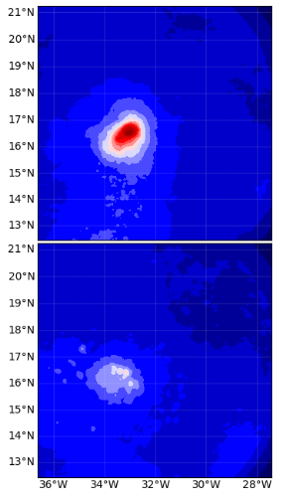
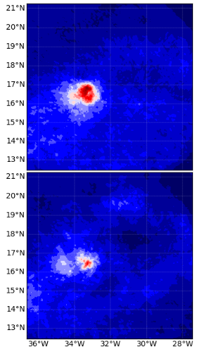
No GOES-16
SLP & Wind
Speed Spread
Reduced by
Satellite DA
No GOES-16
GOES-16
GOES-16
Irma
(8/31/17 12UTC)
Posterior SLP Spread (hPa)
Posterior Sfc Wspd Spread (m s⁻¹)

Slide 11
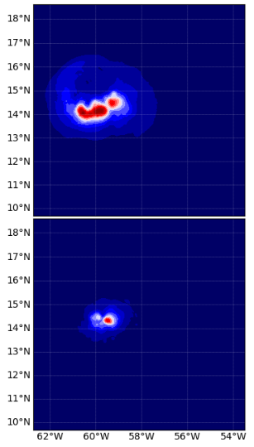
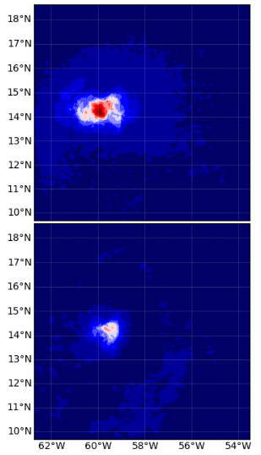
No GOES-16
SLP & Wind
Speed Spread
Reduced by
Satellite DA
No GOES-16
GOES-16
GOES-16
Maria
(9/18/17 12UTC)
Posterior SLP Spread (hPa)
Posterior Sfc Wspd Spread (m s⁻¹)

Slide 12
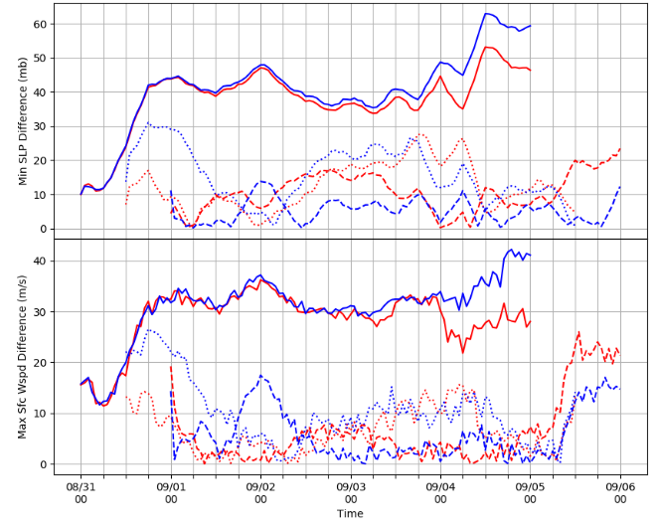
No GOES-16
GOES-16
Hurricane Irma
Deterministic Forecasts initialized with EnKF Analyses during RI Phase

Slide 13
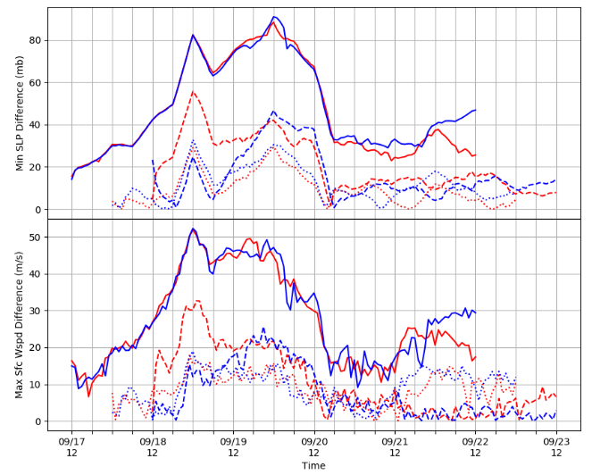
No GOES-16
GOES-16
Hurricane Maria
Deterministic Forecasts initialized with EnKF Analyses during RI Phase

Slide 14
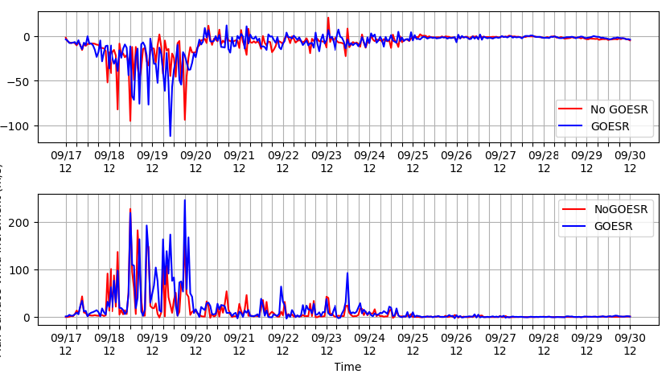
Hurricane Maria Analysis Increments
Cause of unphysical analysis increments??
Min SLP Increment (mb)
No GOES-16
GOES-16
No GOES-16
GOES-16
Max Sfc Wspd (m/s)

Slide 15
Hurricane Irma Analysis Increments
Min SLP Increment (mb)
No GOES-16
GOES-16
No GOES-16
GOES-16
Max Sfc Wspd (m/s)

Slide 16
Conclusions
Hurricane position improved by satellite DA.
Brightness temperature fields improved by satellite DA.
SLP & max wind speed spread reduced by satellite DA.
Intensity improved by satellite DA?

Slide 17
Future Directions
Impacts on other variables (dynamic & thermodynamic)?
Role of inner-core moisture during RI?
Microwave observations?

Slide 18
References
Emanuel, K., and F. Zhang, 2017: The Role of inner-core moisture in tropical cyclone predictability and practical forecast skill. J. Atmos. Sci., 74, 2315- 2324, https://doi.org/10.1175/JAS-D-17-0008.1.
Magnusson, J., R. Bidlot, M. Bonavita, A.R. Brown, P.A. Browne, G. De Chiara, M. Dahoui, S.T.K. Lang, T. McNally, K.S., Mogensen, F. Pappenberger, F. Prates, F. Rabier, D.S. Richardson, F. Vitart, and S. Malardel, 2019: ECMWF Activities for Improved Hurricane Forecasts. Bull. Amer. Meteor. Soc., 100, 445-457, https://doi.org/10.1175/BAMS-D-18-0044.1

