Slide 1
Preliminary Tests of an Air-Sea Fully-coupled Ensemble Data Assimilation System
Xingchao (XC) Chen and Fuqing Zhang

Slide 2
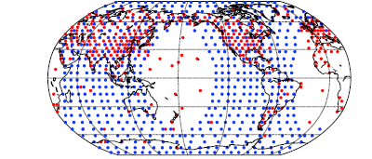
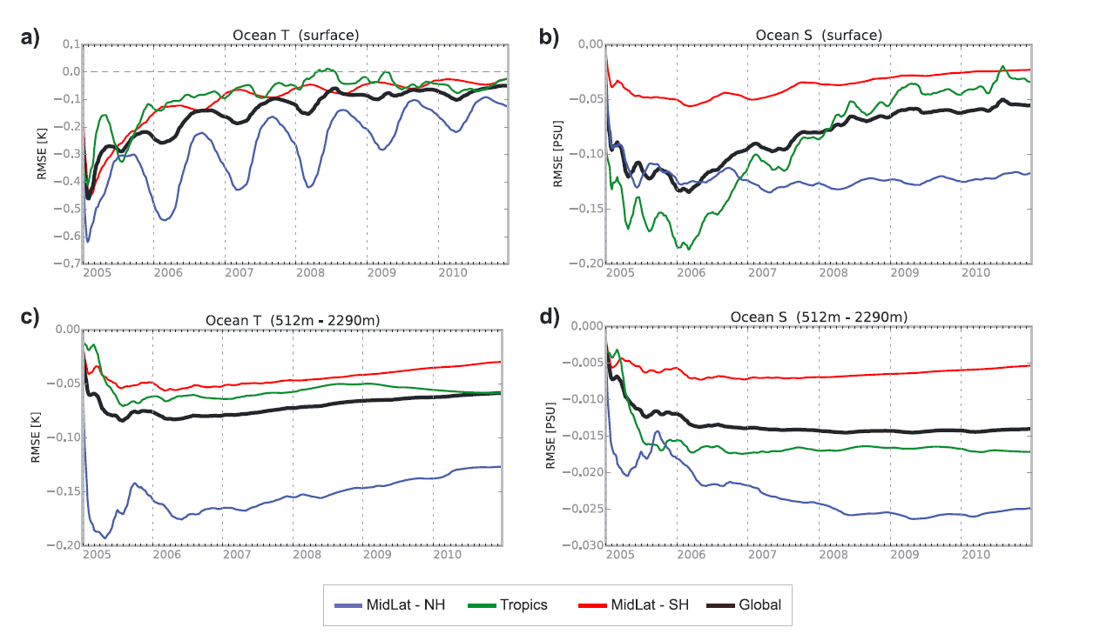
Assimilating atmospheric observations into the ocean using strongly coupled ensemble data assimilation
Sluka et al. (2016)

Slide 3
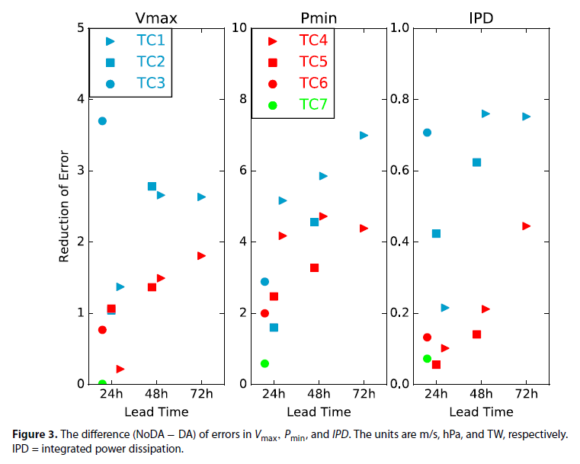
Air-sea fully-coupled DA system using DART (a community facility for ensemble DA )
Li and Toumi (2018)

Slide 4
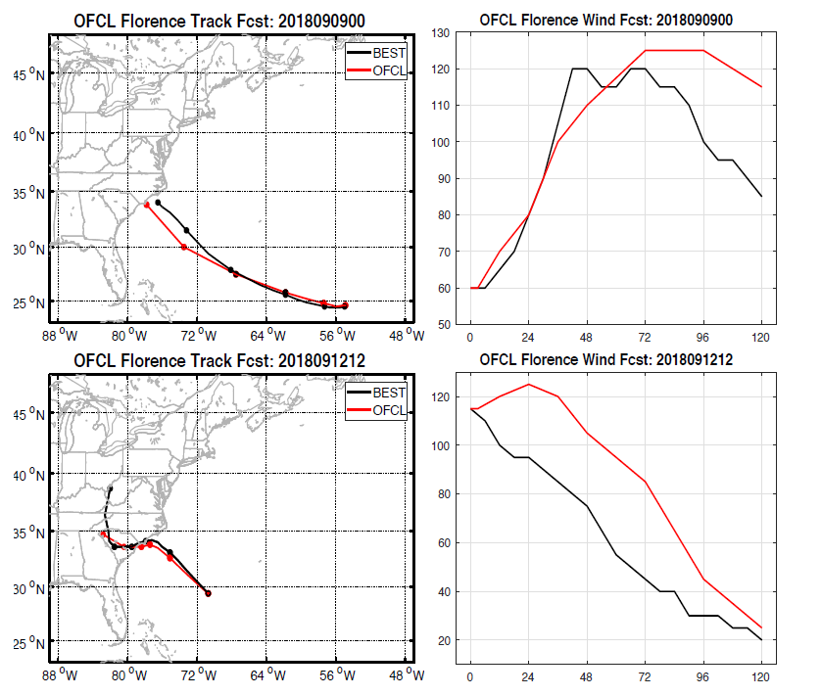
Zhang and Emanuel (2019):
Although it is an idealized study using simulated observations, this may signal the beginning of a new frontier in future hurricane prediction through ingesting in-situ and remotely-sensed observations of oceanic currents into fully-coupled systems.
Rapid weakening of Florence

Slide 5
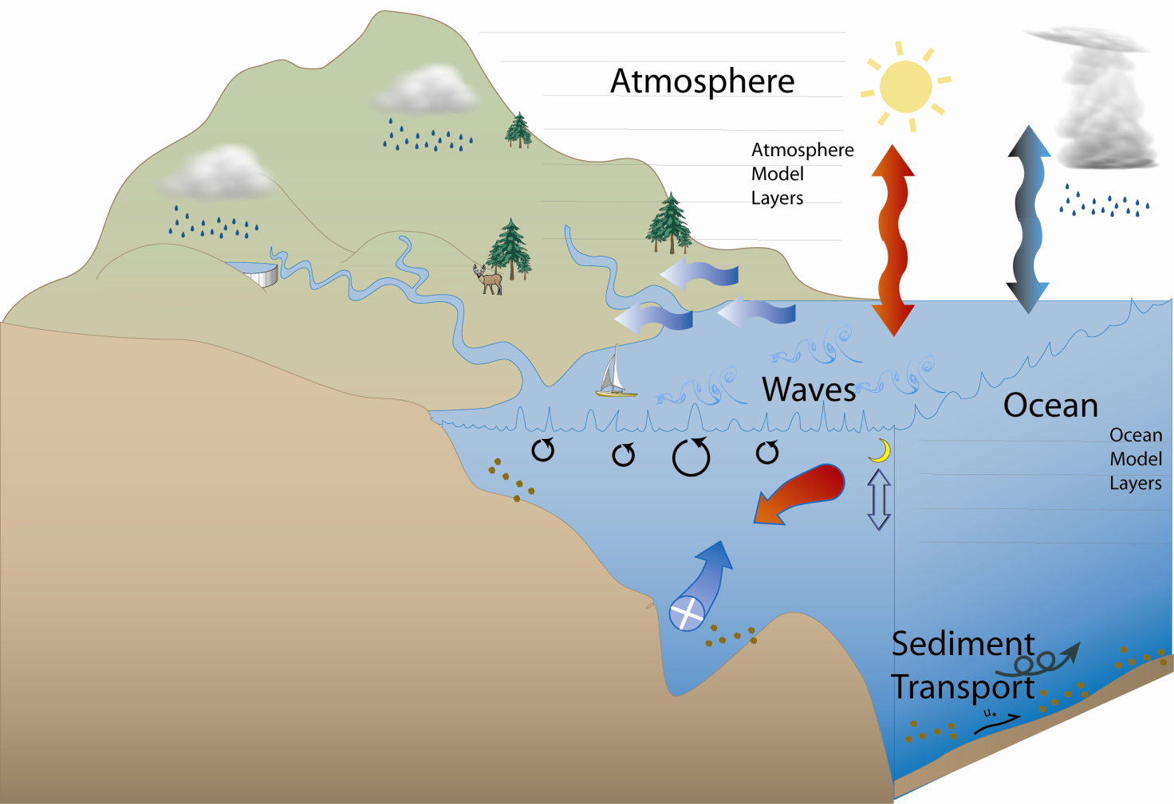
The Coupled-Ocean-Atmosphere-Wave-Sediment Transport (COAWST) Modeling System V 3.1.1
http://woodshole.er.usgs.gov/operations/modeling/COAWST/index.html
Coupler: - Model Coupling Toolkit (MCT) V 2.6.0
Ocean: - Regional Ocean Modeling System (ROMS) svn 904
Atmosphere: - Weather Research and Forecasting Model (WRF) V 3.9.1.1

Slide 6
Regional High-Resolution Air-Sea Fully Coupled
Data Assimilation System Based on Ensemble Kalman Filter
Forecast
Step
Analysis
Step
Forecast
Step
Analysis
Step
Forecast
Step
WRF V 3.9.1.1
$$y^{0}$$
Model Coupling
Toolkit (MCT) v 2.6.0
U10, V10, P, RH, Tsfc, CloudF, Rain, SW, LW
SST
ROMS SVN 904
$$X^{a}\left(t\right)=X^{f}\left(t\right)+K(y^{0}−HX^{f}\left(t\right))$$
$$K=P^{f}H^{T}{(HP^{f}H^{T}+R)}^{−1}$$
$P^{f}$: the cross domain covariance

Slide 7
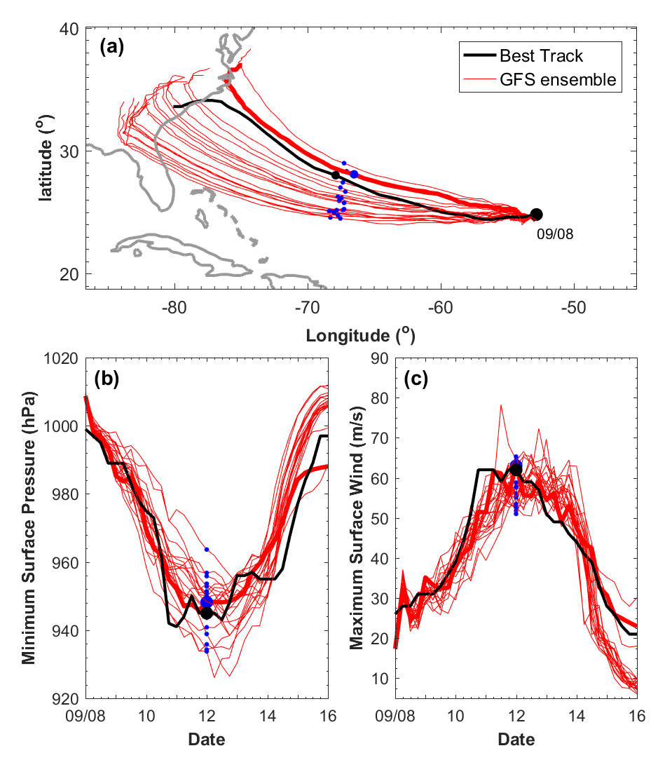
OSSE (9 km grid spacing)
HPI: only assimilate HPI
HPI+SST: assimilate HPI +SST (every 54 km)
HPI+SSH: assimilate HPI +SSH (every 54 km)
HPI+CURRENT: assimilate HPI +sea surface current (every 54 km)
Ensemble (a) track and (b, c) intensity forecasts of Florence initialized from the GFS ensemble (red lines). The bold red line shows the member 10 forecast (the verifying truth). The blue dots show the position and intensity of Florence at 00Z/12 in the ensemble forecast. The black line shows the best track of Florence. The black dot shows the observed position and intensity of Florence at 00Z/12.

Slide 8
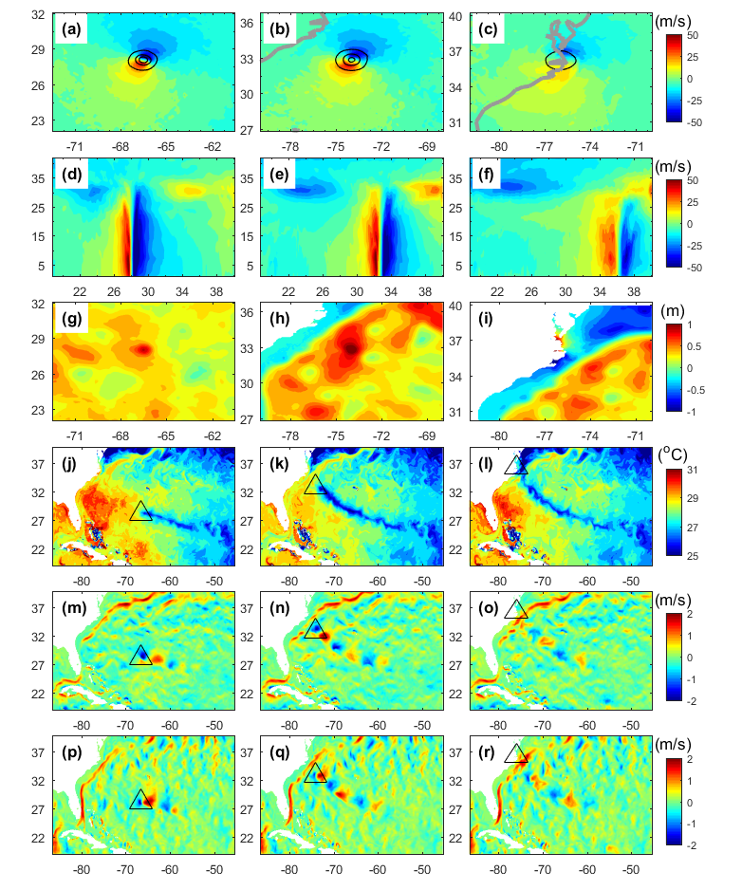
Verifying Truth
00Z/12
00Z/15
12Z/13
(a, b, c) surface U wind (color shading) and surface pressure (black contours, starting at 1000 hPa with a -20 hPa interval), (d, e, f) the U winds along the vertical cross sections that pass through storm center, (g, h, i) sea surface height (SSH), (j, k, l) sea surface temperature (SST), (m, n, o) sea surface U current (SSU), and (p, q, r) sea surface V current (SSV) at 00Z/12, 12Z/13, and 00Z/15 from the verifying truth. The black triangle shows the position of Florence from the verifying truth.

Slide 9
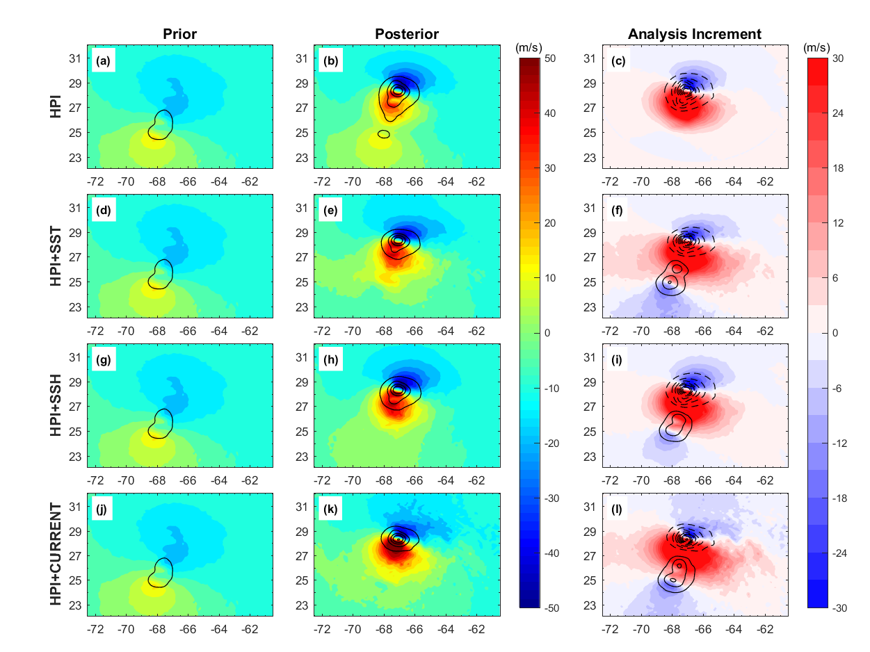
(a, d, g, j) Prior and (b, e, h, k) posterior of surface U wind (color shading) and surface pressure (black contours) at 00Z/12 (the first DA cycle) from HPI, HPI+SST, HPI+SSH, HPI+CURRENT experiments. (c, f, i, l) the analysis increment of surface U wind (color shading) and surface pressure (dashed contours show the negative increment and solid contours show the positive increment, with a 10 hPa interval) in four DA experiments.

Slide 10
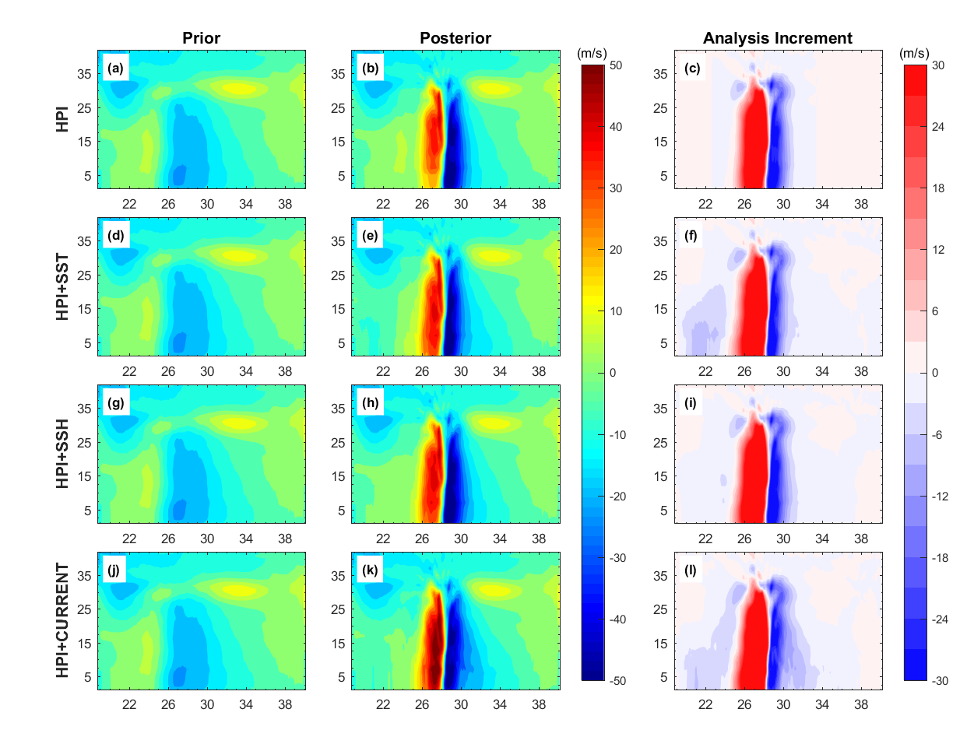
Same as Figure 04, but for the U winds along the vertical cross sections that pass through the verifying truth storm center.

Slide 11
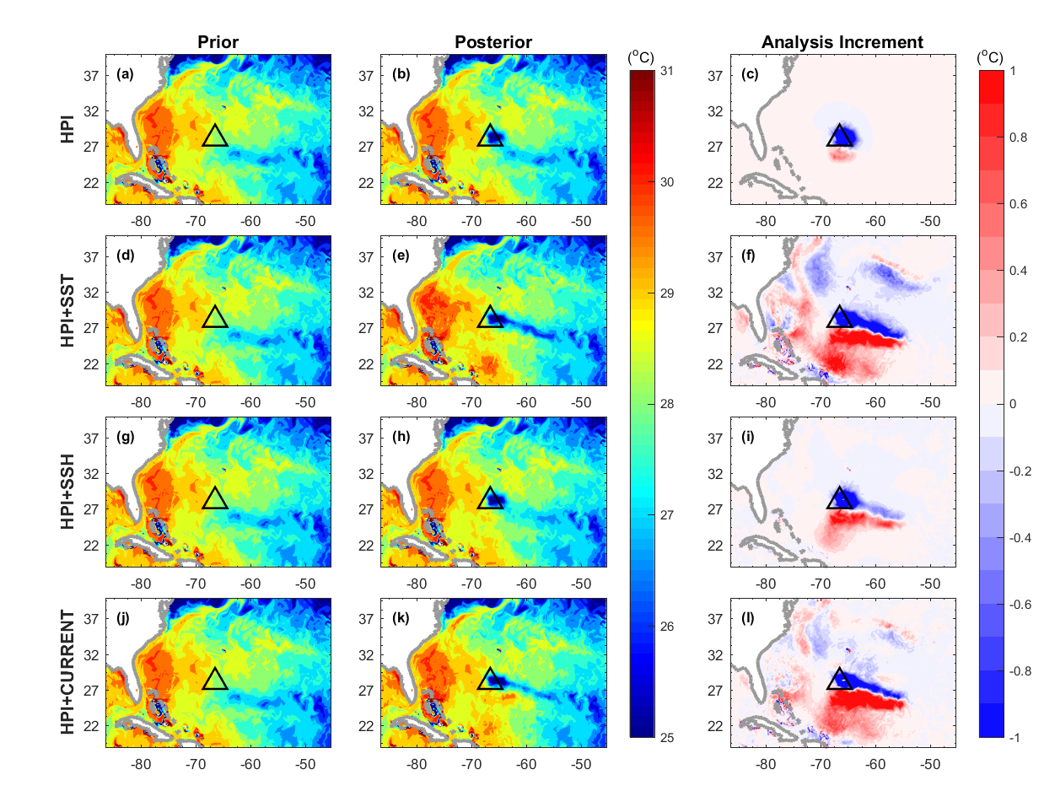
Same as Figure 04, but for SST.

Slide 12
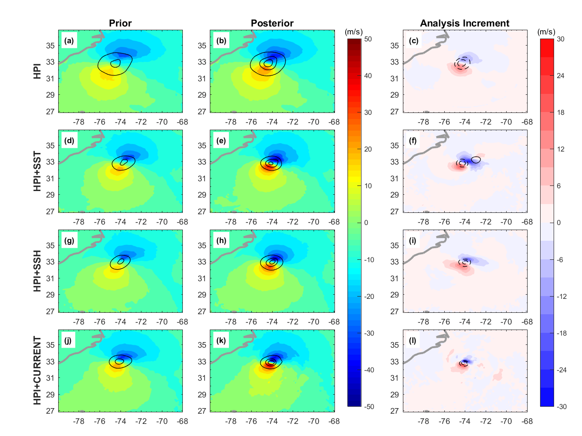
Same as Figure 04, but at 12Z/13 (the 7th DA cycle).

Slide 13
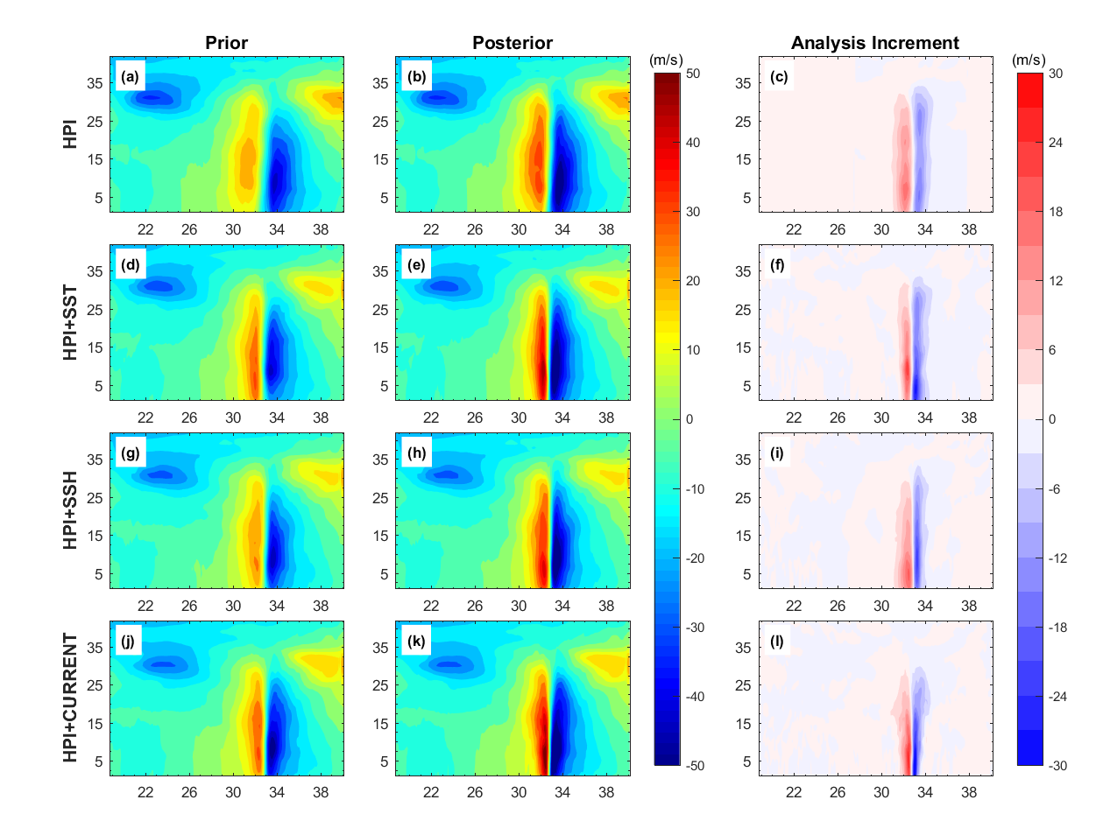
Same as Figure 06, but at 12Z/13 (the 7th DA cycle).

Slide 14
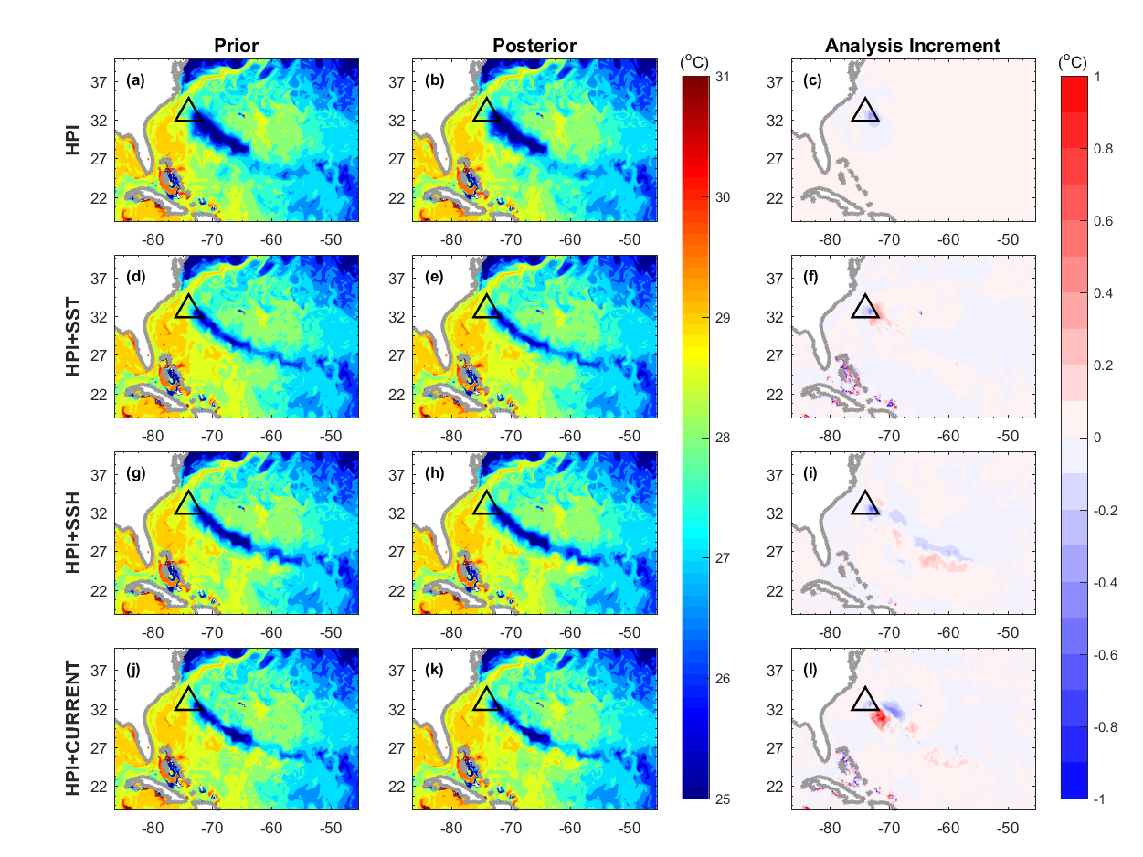
Same as Figure 08, but at 12Z/13 (the 7th DA cycle).

Slide 15
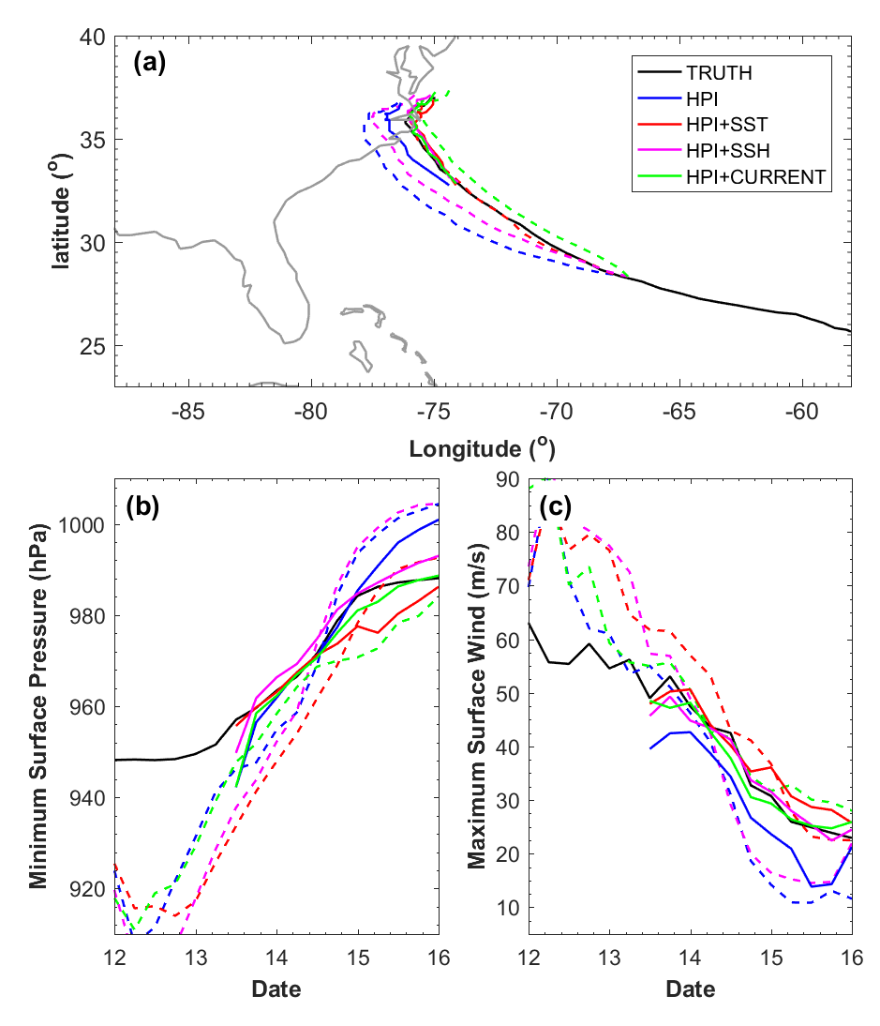
The track and Intensity of Florence from the verifying truth and the forecasts from HPI, HPI+SST, HPI+SSH, HPI+CURRENT experiments initialized from 00Z/12 (dashed lines, the first DA cycle) and 12Z/13 (solid lines, the 7th DA cycle)

Slide 16
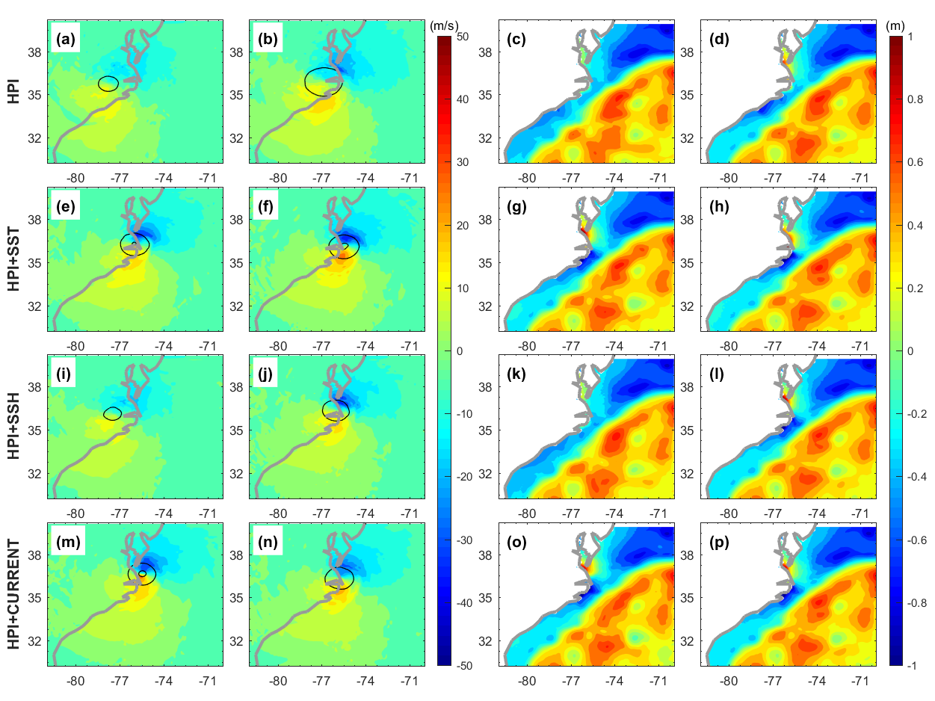
First DA cycle
7th DA cycle
First DA cycle
7th DA cycle
The forecasts of (a, e, i, m) surface wind (color shading) and surface pressure (contours), and (c, g, k, o) SSH at 00Z/15 from HPI, HPI+SST, HPI+SSH, HPI+CURRENT experiments initialized from 00Z/12 (the first DA cycle). (b, f, j, n) and (d, h, l, p) are same as (a, e, i, m) and (c, g, k, o), but are initialized from 12Z/13 (the 7th DA cycle)

Slide 17
Conclusions：
The PSU-EnKF system has been upgraded to an air-sea fully-coupled DA system (beta version)
The OSSE experiments show the potential for improving tropical cyclone forecasts by assimilating ocean observations using a fully-coupled DA system
Future work:
Real Data experiments
Use the system to better estimate uncertain model physics’ parameters such as the air-sea exchange coefficients
Extend the benefits of the air-sea-coupled DA system beyond hurricane prediction, in particular for forecasts longer than 2 weeks where the impacts from air-sea interactions become increasingly larger (for example MJO and Monsoon)

Slide 18
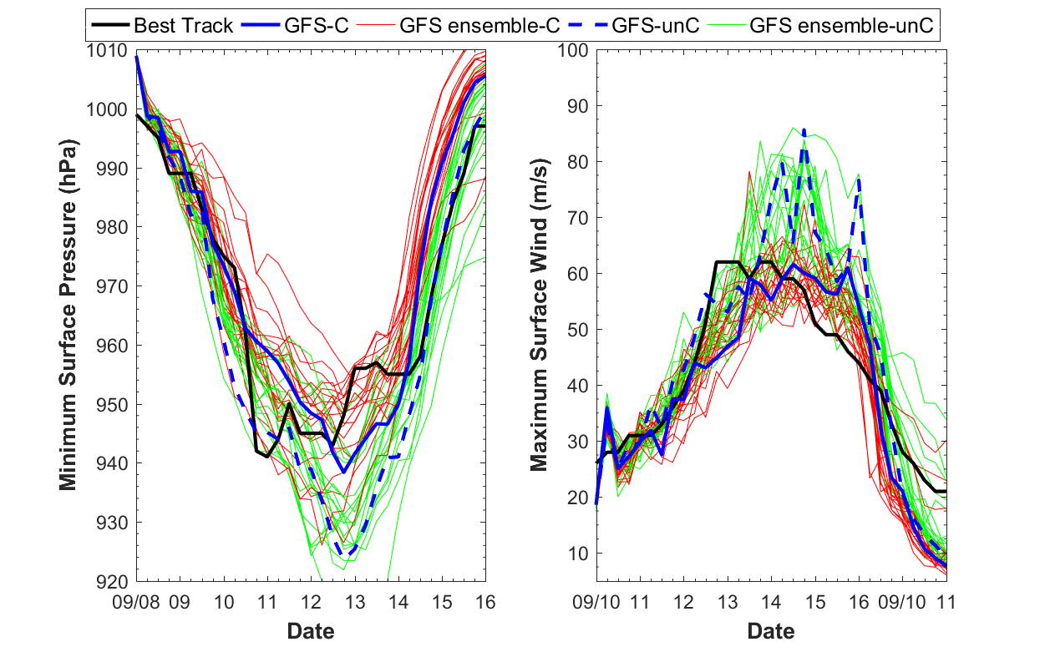

Slide 19
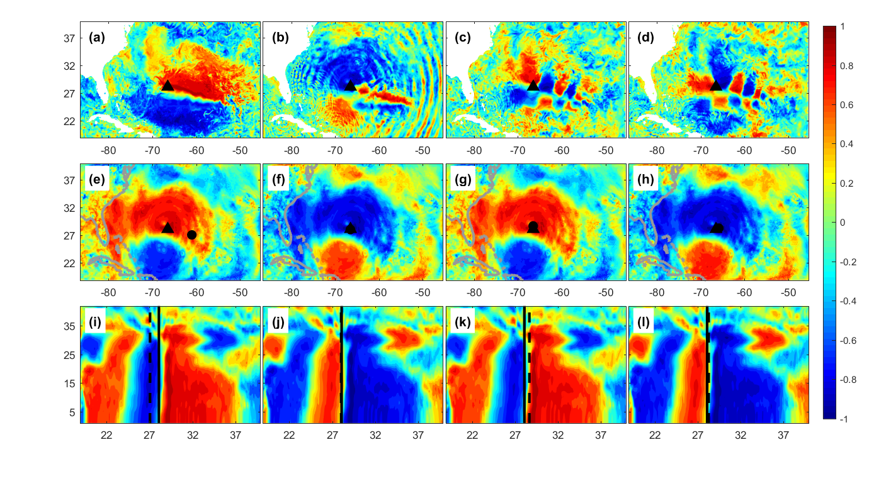
First row: Ensemble correlations (color shading) between the sea surface pressure at the varying truth storm center (HPI, shown by the black triangle) with (a) SST; (b) SSH; (c) SSU; (d) SSV at 00Z/12.
Second row: Ensemble correlations (color shading) between (e) SST; (f) SSH; (g) SSU; (h) SSV points which have the largest correlation to HPI (black dots) with sea surface pressure. The black triangle shows the position of Florence at 00Z/12 from the verifying truth.
Third row: Ensemble correlations (color shading) between the (i) SST; (j) SSH; (k) SSU; (l) SSV points which have the largest correlation to HPI (dashed lines) with the meridional winds along the vertical cross sections that pass through the verifying truth storm center (solid line) at 00Z/12

Slide 20
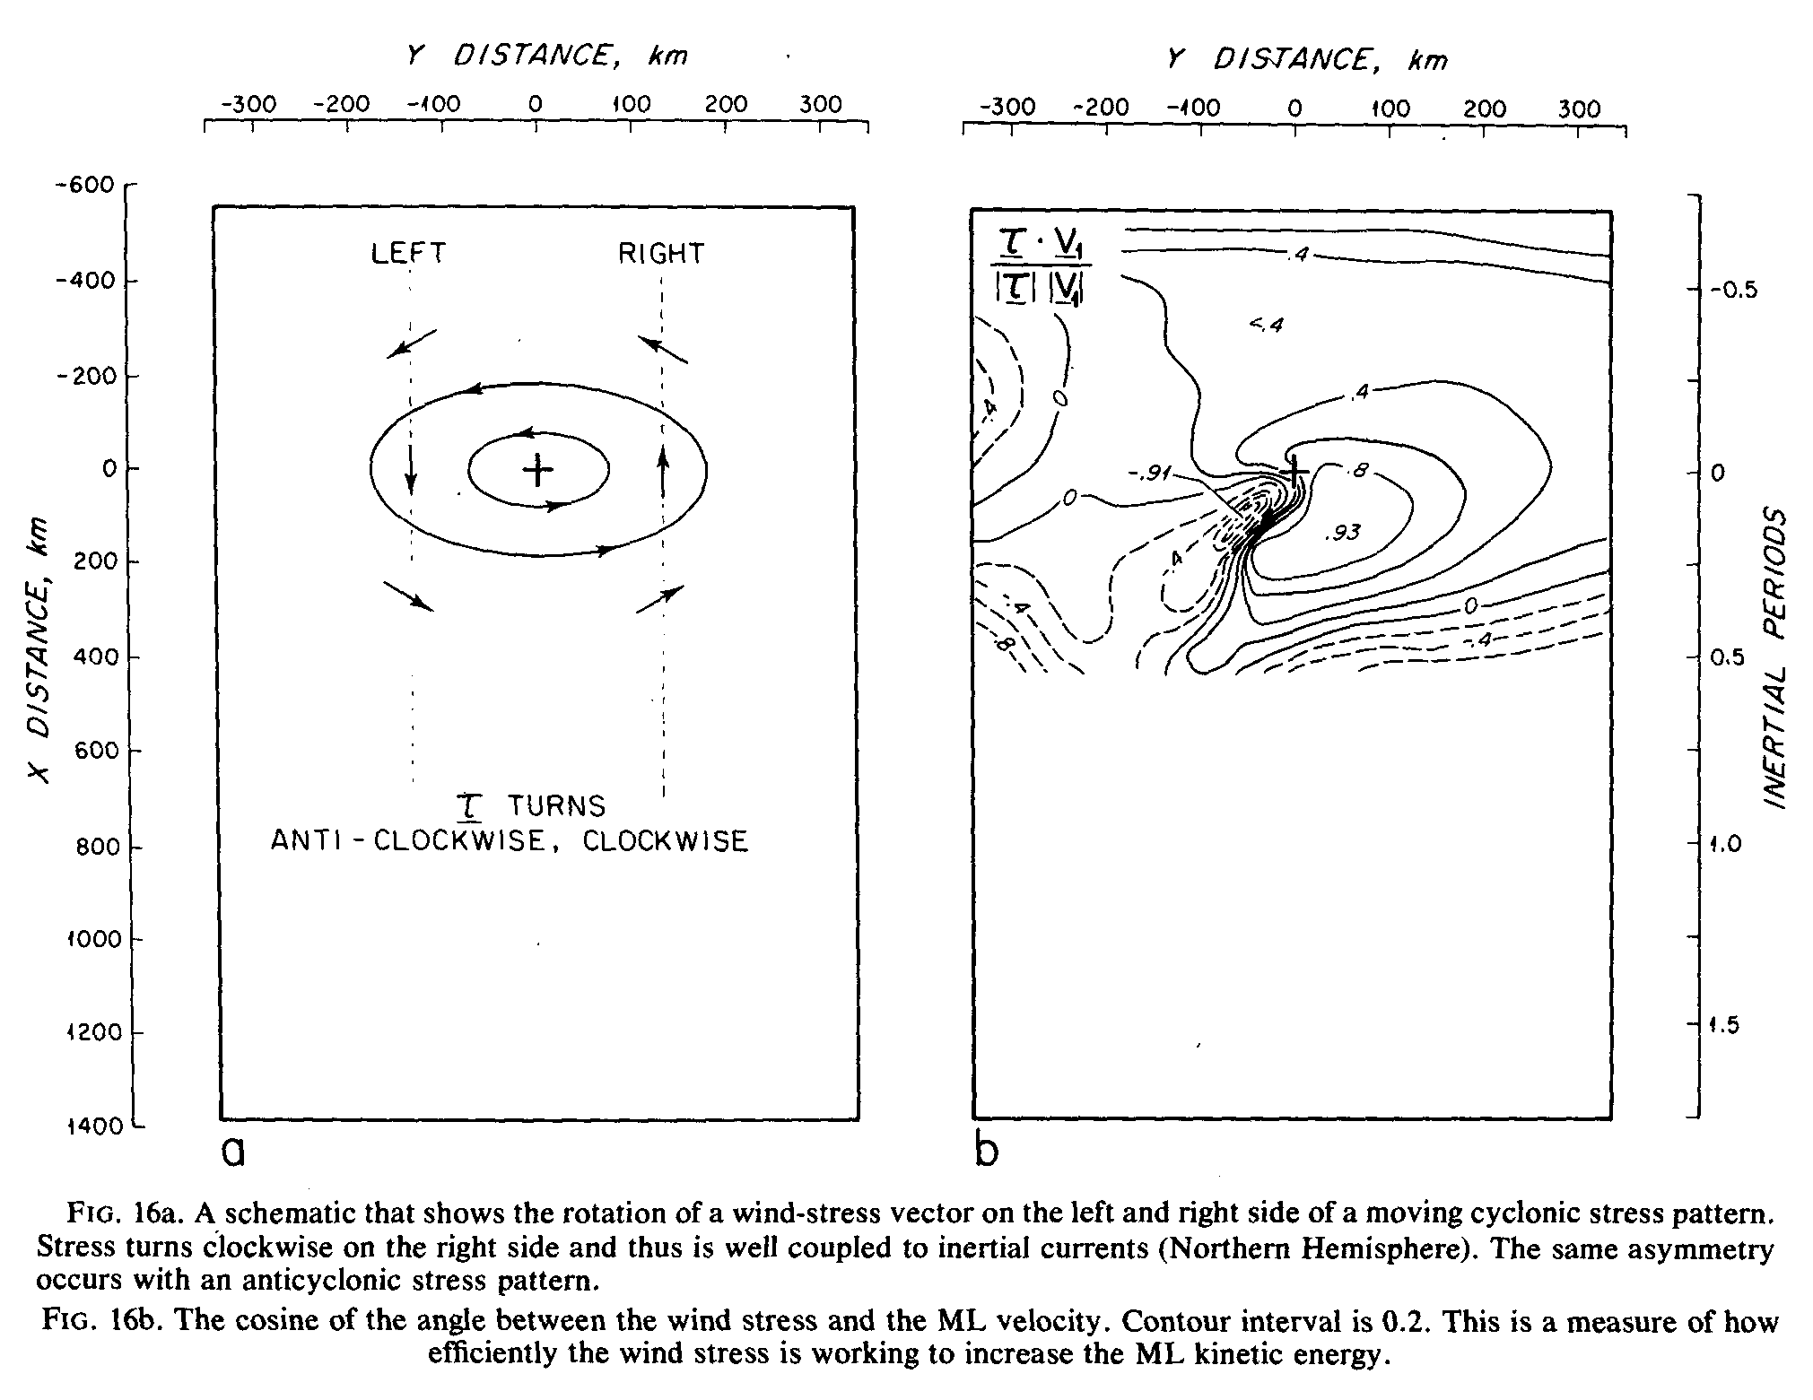
Wind-stress vector turns clockwise in time on the right side of the track. For typical hurricane dimensions and translation speed the rate of turning of the stress vector on the right side is comparable to the tuning rate of an inertial motion. Hence there is a near-resonant coupling of the wind stress and the wind-driven near-inertial rotating ML velocity
Price (1981)

Slide 21
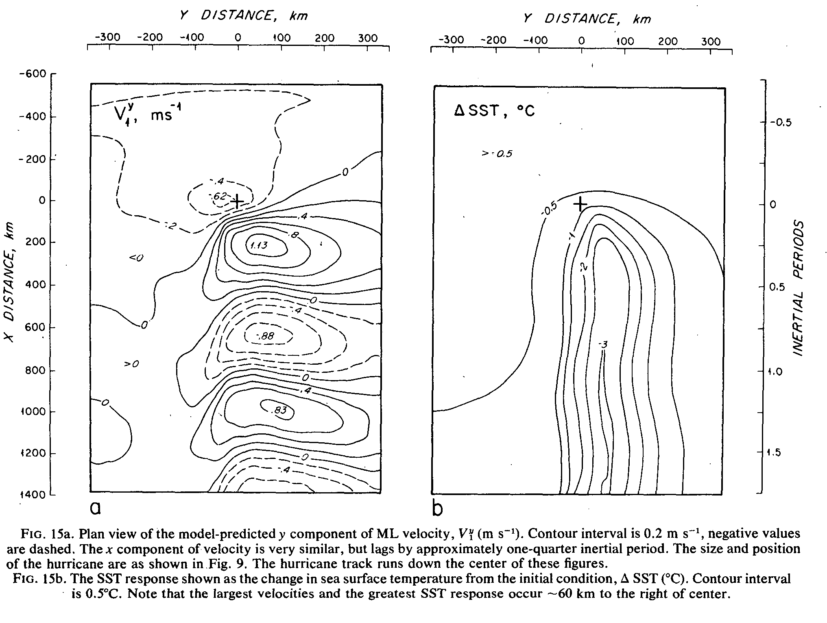
Price (1981)

Slide 22
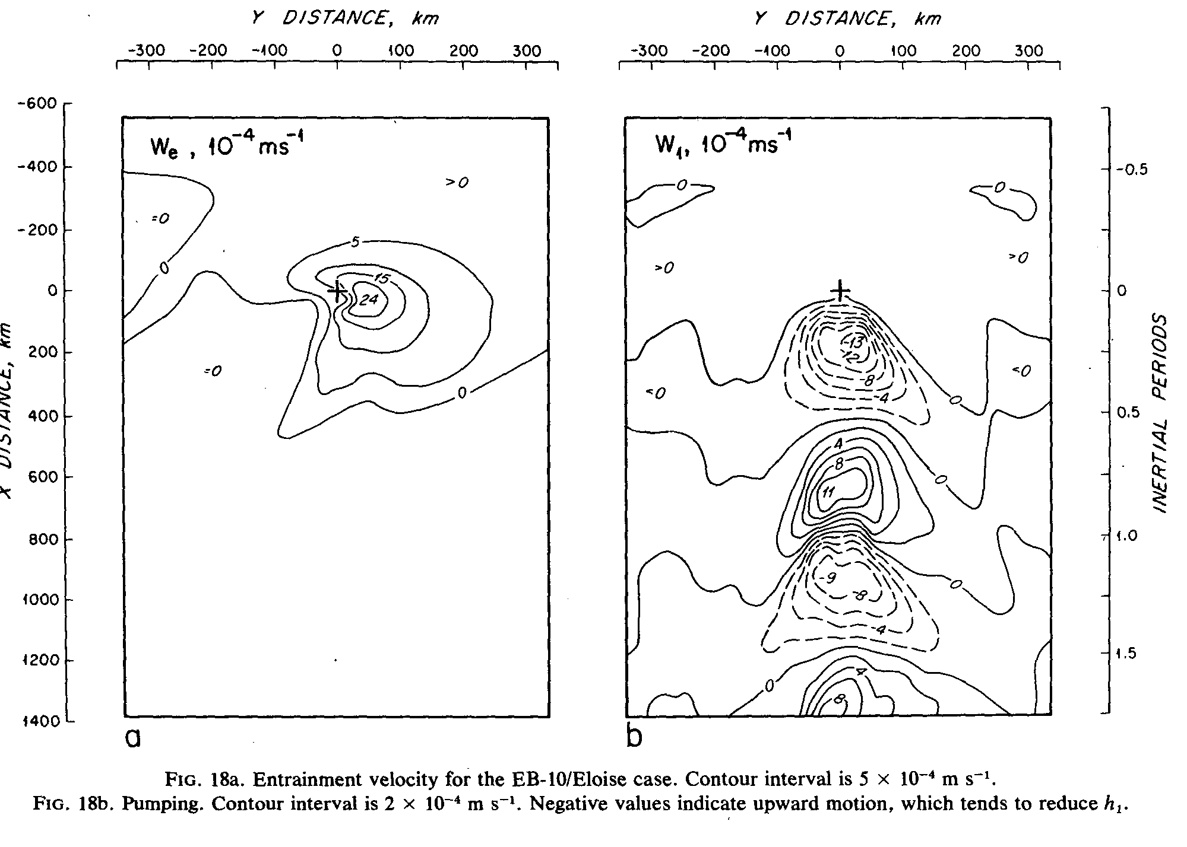
Entrainment is the primary mechanism that lowers the SST beneath a moving hurricane. Air-sea heat exchange plays only a minor role.
The well-documented rightward bias in the response of SST occurs because the asymmetry in turning direction of the wind-stress vector drives a very strong asymmetry in the ML velocity, and thus in entrainment.
Price (1981)

Slide 23
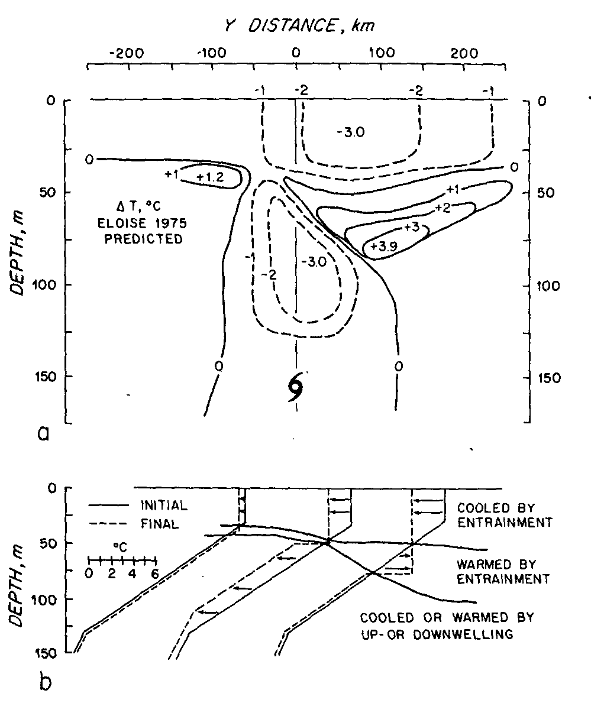
Price (1981)

Slide 24
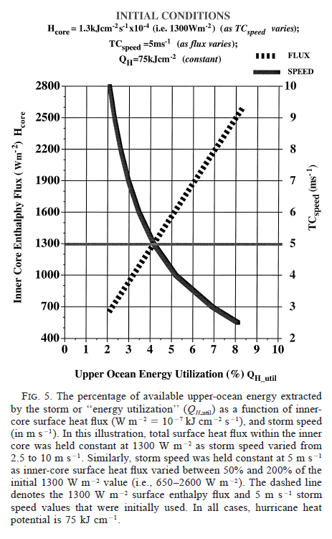
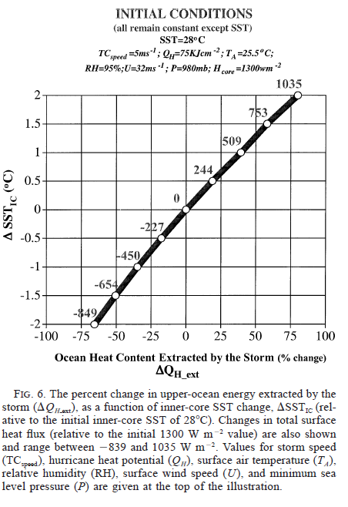
1. Under most circumstances, the energy available to the tropical cyclone is at least an order of magnitude greater than the energy extracted by the storm.
2. The magnitude of SST change (ambient minus inner core) was statistically linked to subsequent changes in
storm intensity for the 23 hurricanes included in this research.
3. Relatively modest changes in inner-core SST can dramatically alter air–sea fluxes within the high-wind inner-core storm environment. Initial estimates show that SST changes on the order of 18C lead to surface enthalpy flux changes of 40% or more.
Cione and Uhlhorn (2003)

