Slide 1
Bias correction and data assimilation of satellite
radiance from GOES-16
Jie He, Fuqing Zhang, Yinghui Lu, Yunji Zhang
Group meeting, May 10, 2019

Slide 2
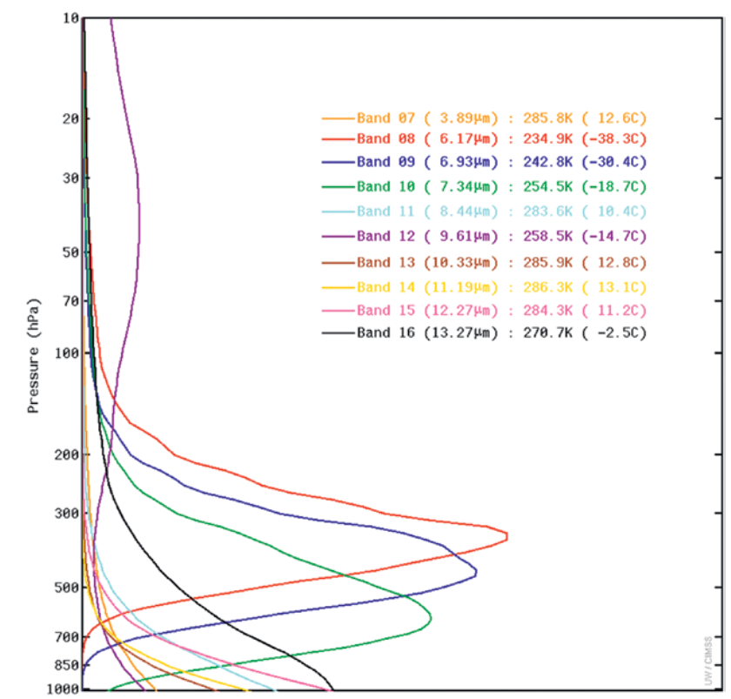
Motivation
Uncertainties of channels due to surface emissivity and skin temperature (e.g. channel 13 14 15)
Bias correction by using channel-synthesizing method ( Lu and Zhang, GRL, 2018)
Data assimilation of synthesized channel
(Schmit et al., BAMS, 2017)

Slide 3
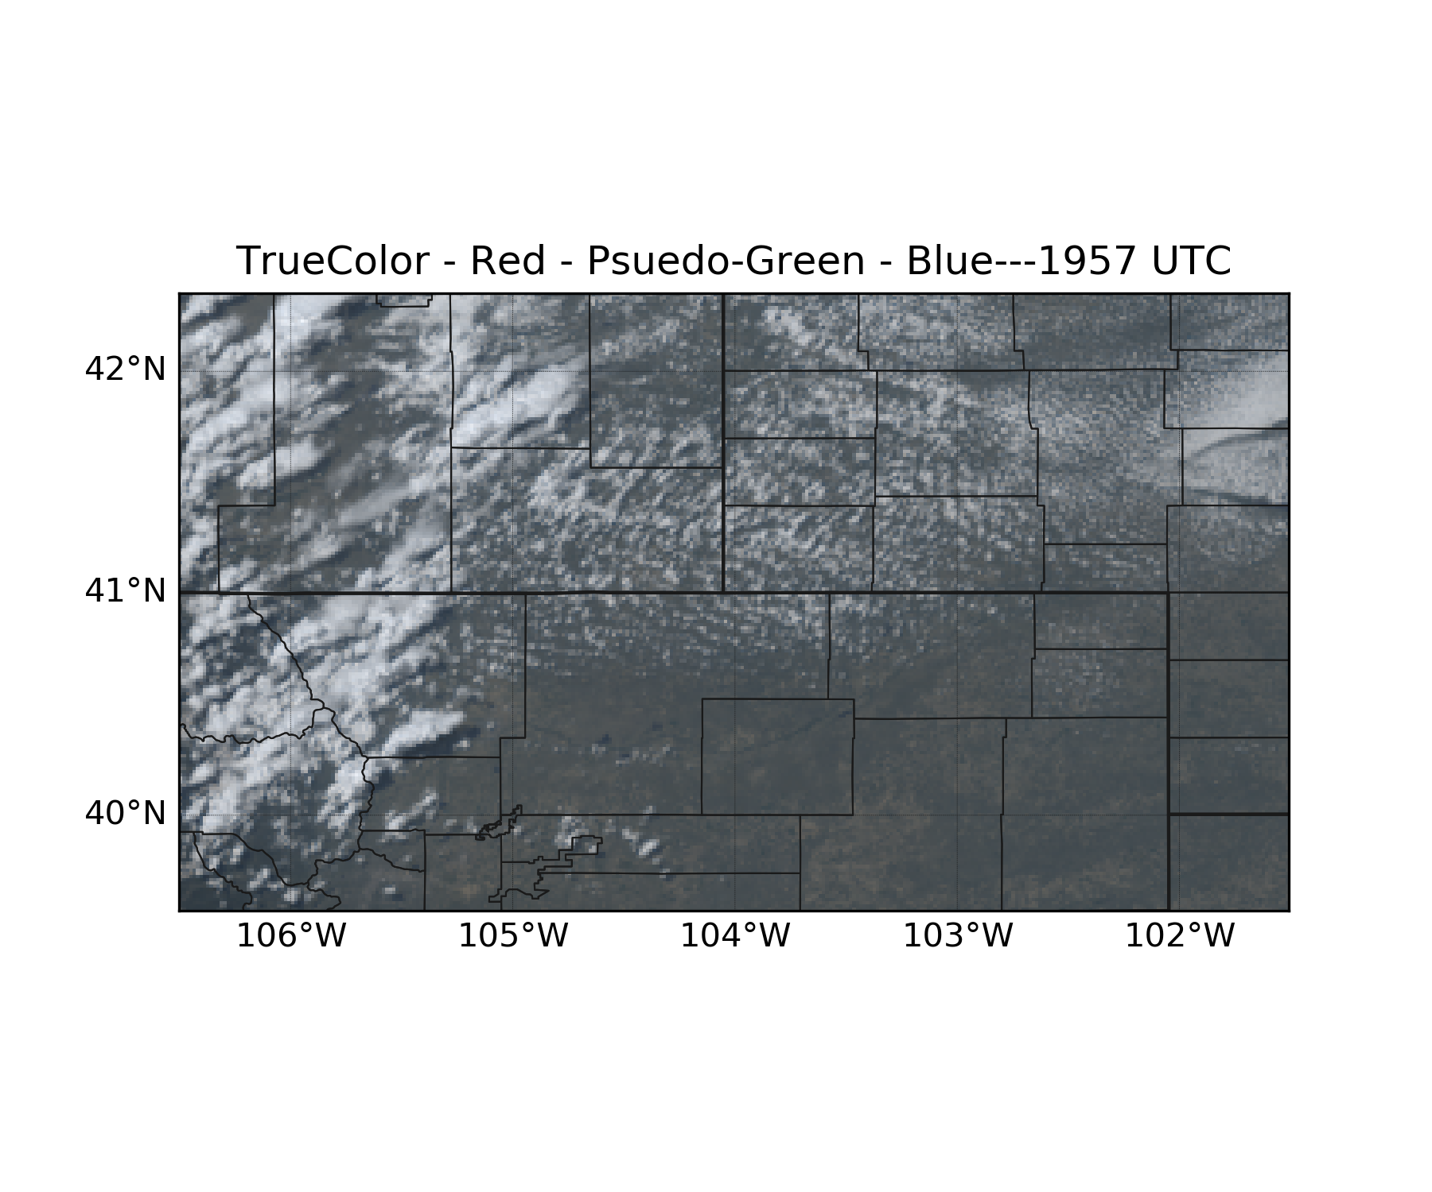
EnKF analysis used by channel-synthesizing method
Model | PSU WRF-EnKF System
Case | Severe thunderstorms
Resolution | 1-km
Method | EnKF (40 members) : perturbation from GEFS add to HRRR analysis
Cycle time | 5 min (EnKF)
Observation | GOES-16 channel 10
Time | 1800 UTC – 2040 UTC 12 June, 2017
Domain | west southern of United Sates
(Zhang et al., MWR, 2018)
Cloud image at 1957 UTC
in thunderstorm case

Slide 4
Channel-synthesizing experiments
Input data | Analysis (ensemble mean) at 2000 UTC from EnKF
Model | CRTM (version 2.3.0) model
Individual channels | 13, 14, 15
Experiments | Sensitivity experiment ( clear sky and all sky ), Real-data experiment ( clear sky and all sky ).
Method | Channel-synthesizing algorithm ( Lu and Zhang, GRL, 2018)
Time | 2000 UTC 12 June, 2017

Slide 5
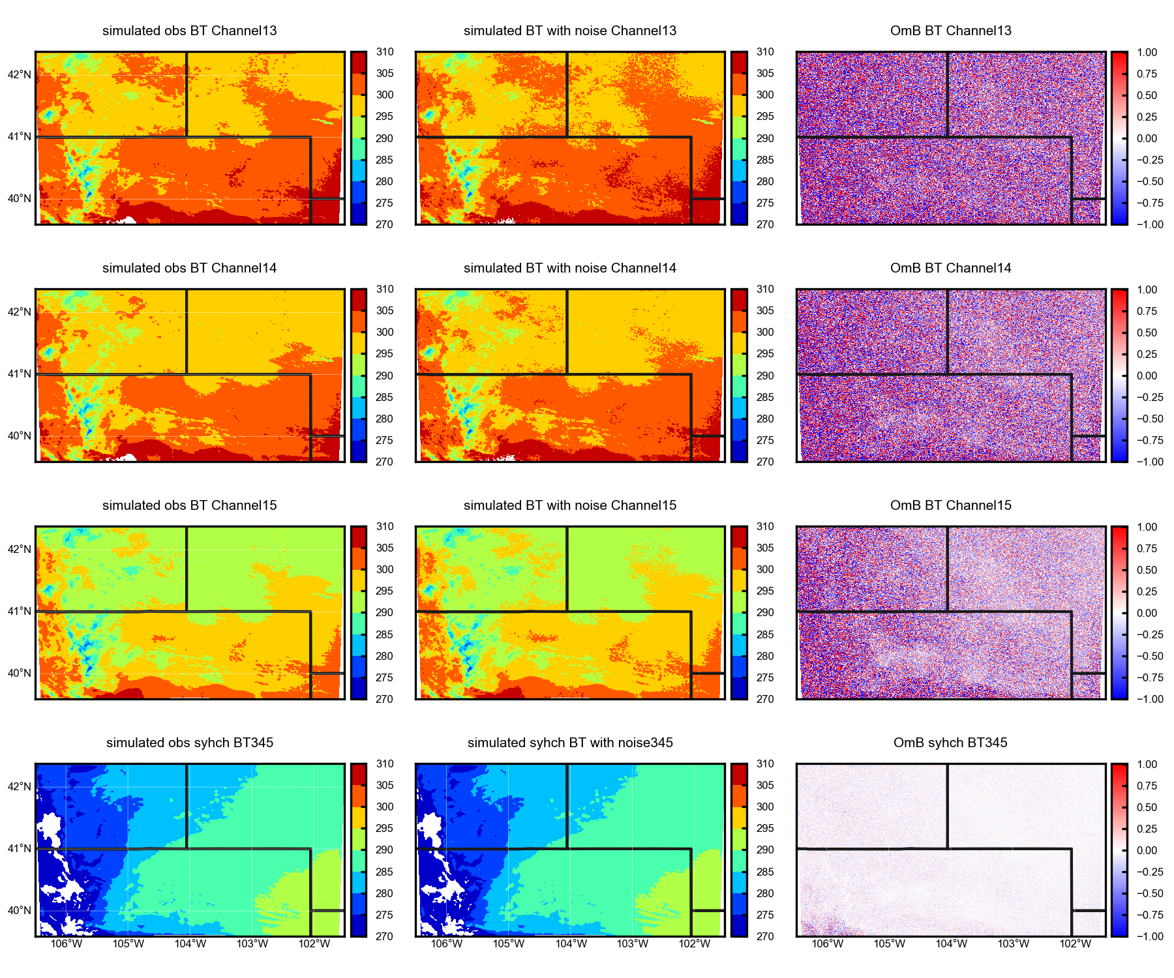
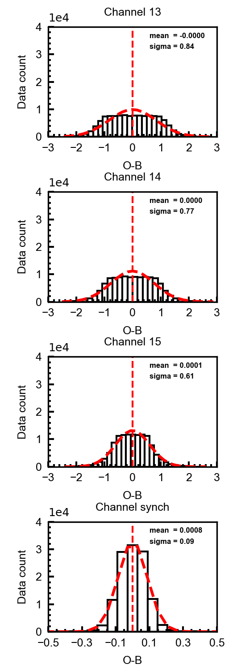
Sensitivity experiment over clear sky
Noise is the uncertainties of surface skin temperature and surface emissivity
abs(T) < 2 K abs(emissivity) < 0.02
( Lu and Zhang, GRL, 2018)
Simulated truth BT
Simulated BT with noise
Differences
O minus B
O minus B statistics
Channel 13
Bias reduced significantly
Synthesizing < individual (BT)
Smaller standard deviation
Better Gaussian fit
More centered
Channel 14
Channel 15
Synthesizing Channel

Slide 6
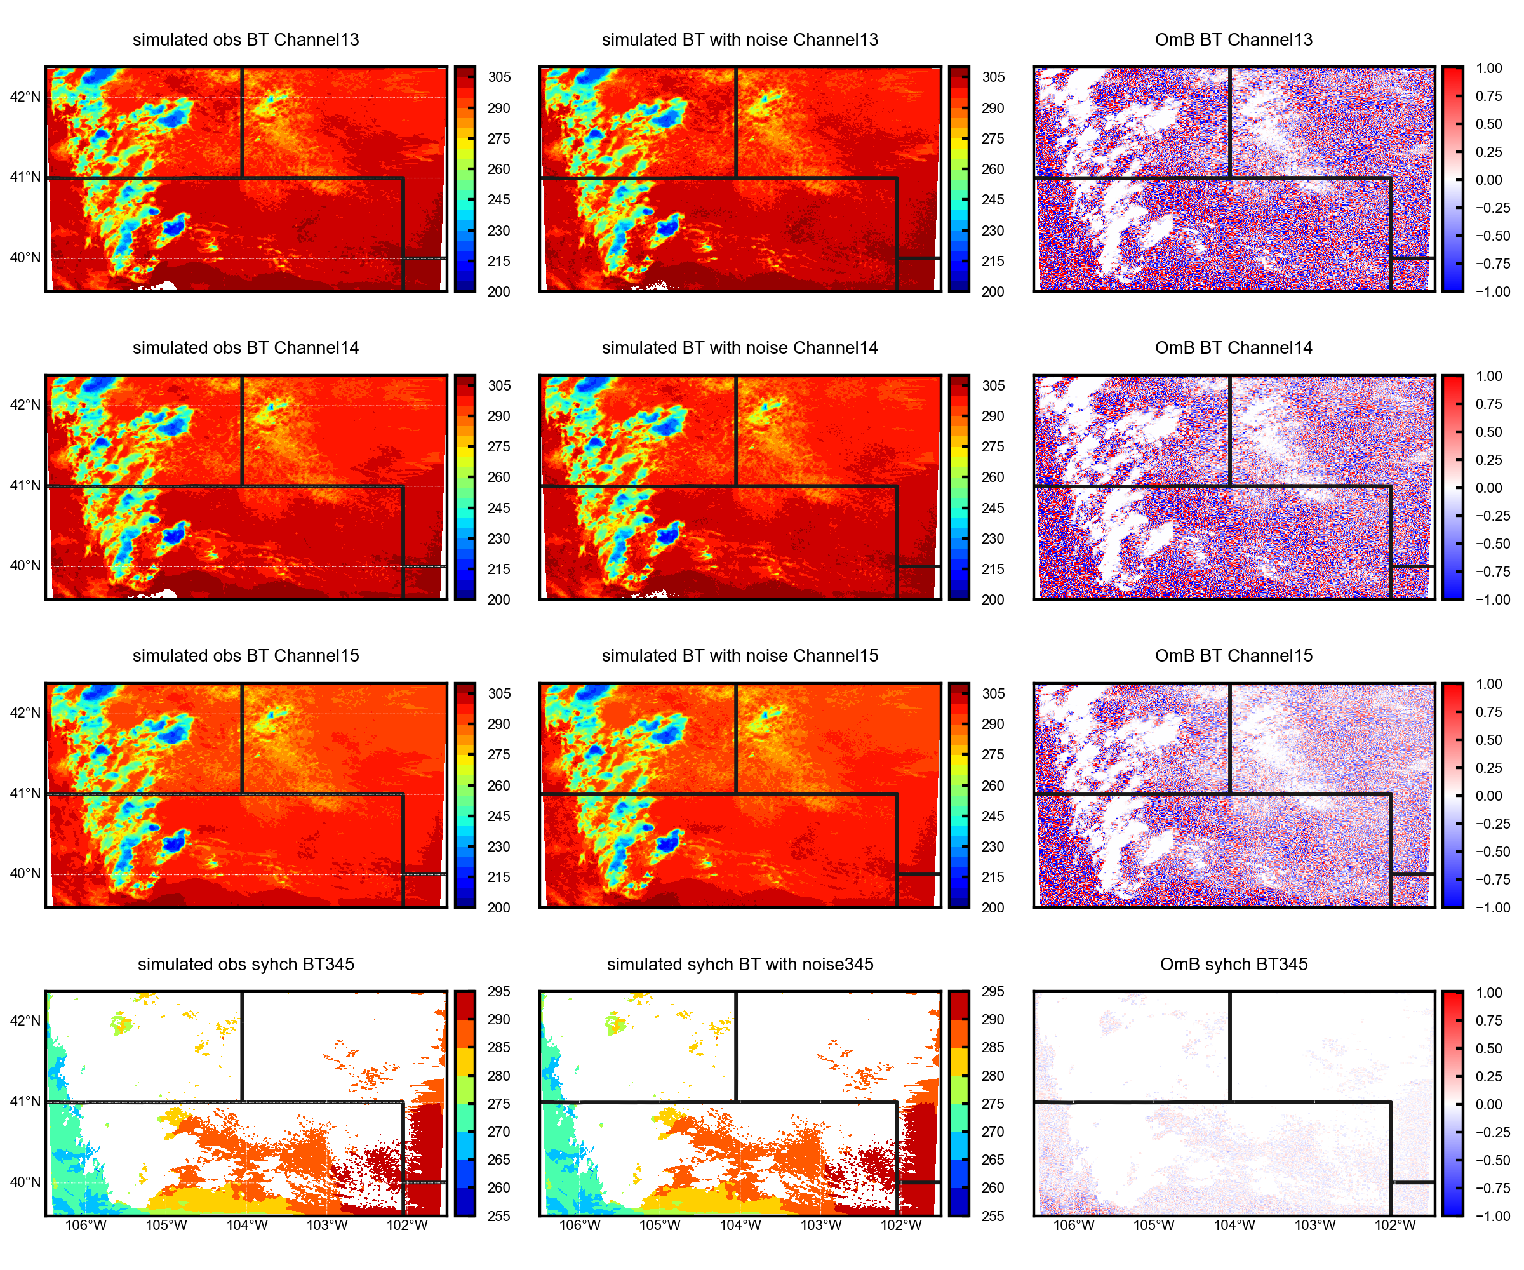
Sensitivity experiment over all sky
Failed synthesizing channel over cloud areas
Effective over some clear sky
Synthesize channel over all sky using the synthesizing coefficients of simulation without cloud
? ? ?
Cloud observation
1957 UTC

Slide 7
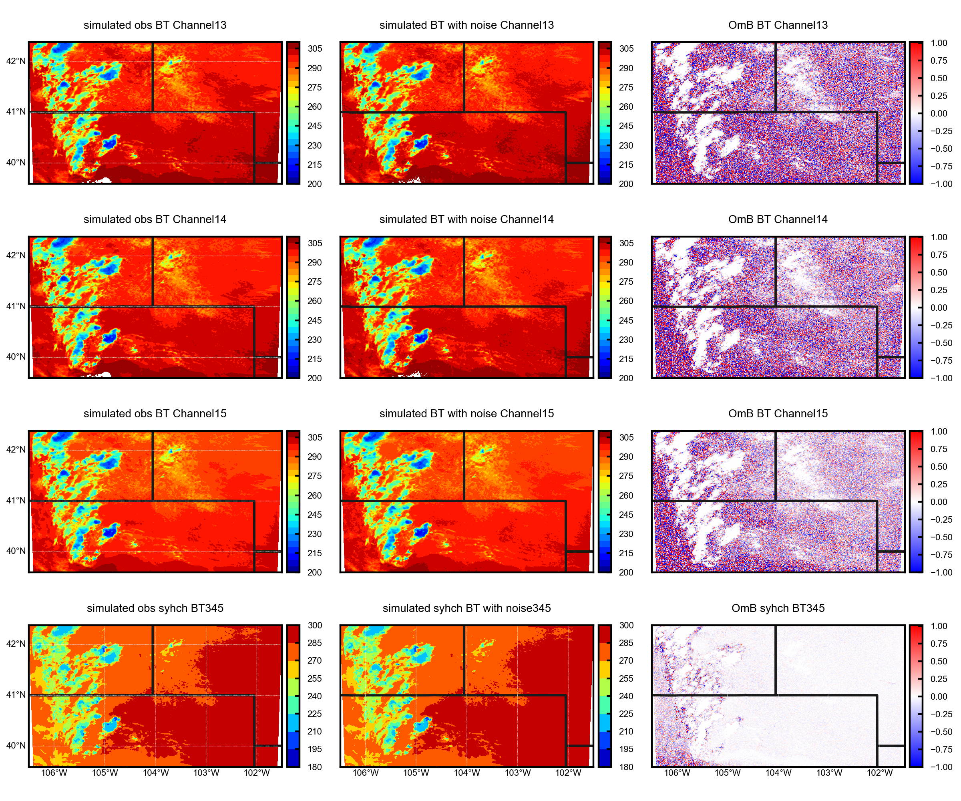
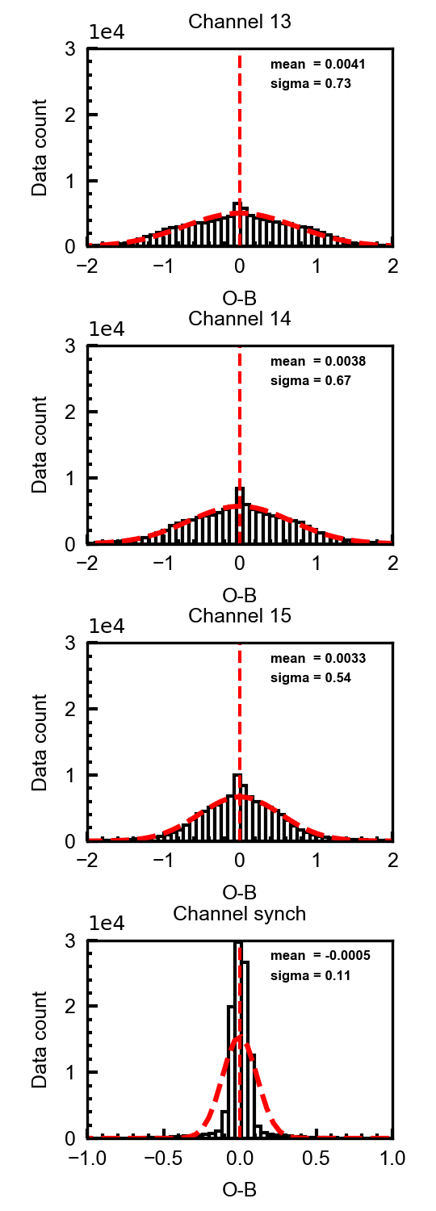
Sensitivity experiment over all sky
synthesizing truth and noisy simulation over all sky using the synthesizing coefficients of simulation without cloud
Ignore the BT < 260 K
Bias reduced significantly
Smaller standard deviation
More centered

Slide 8
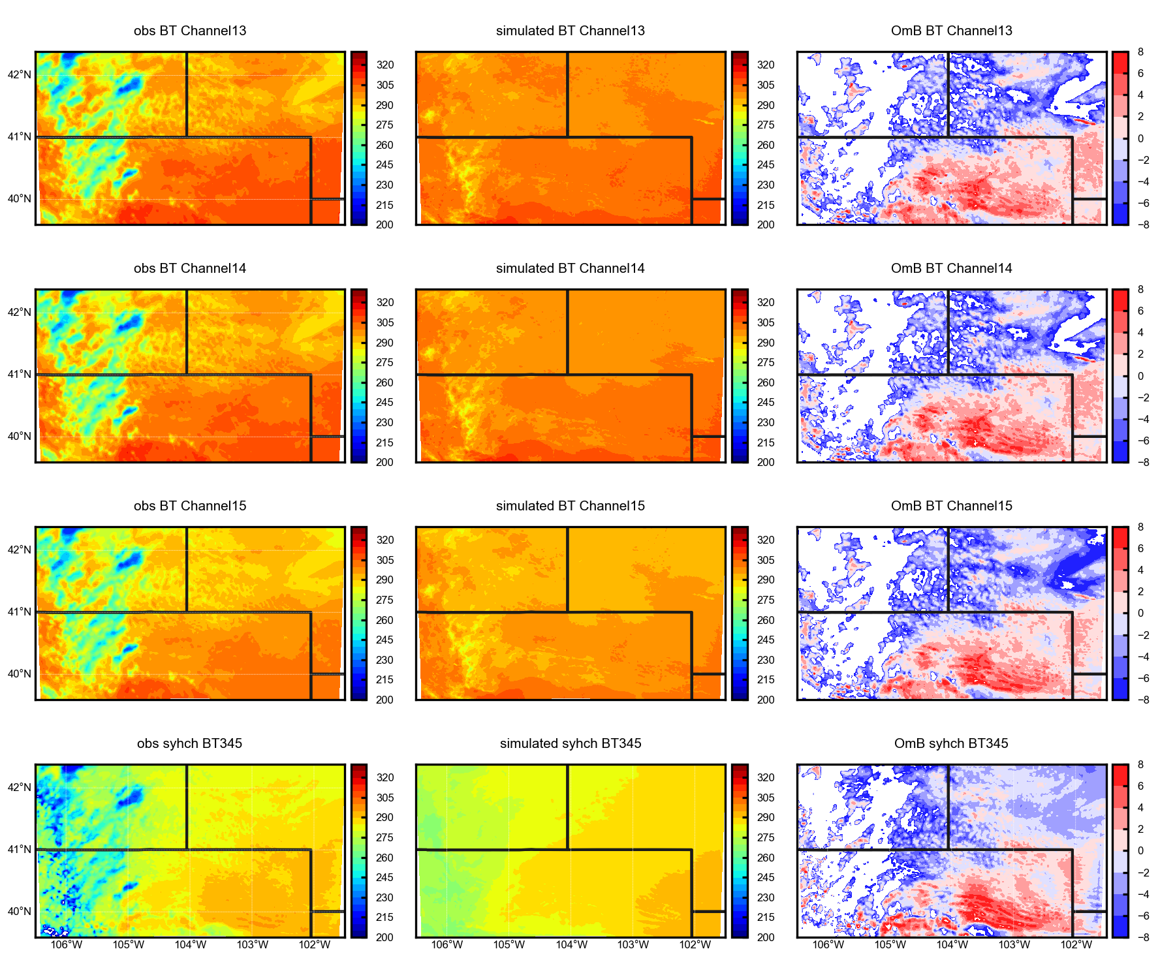
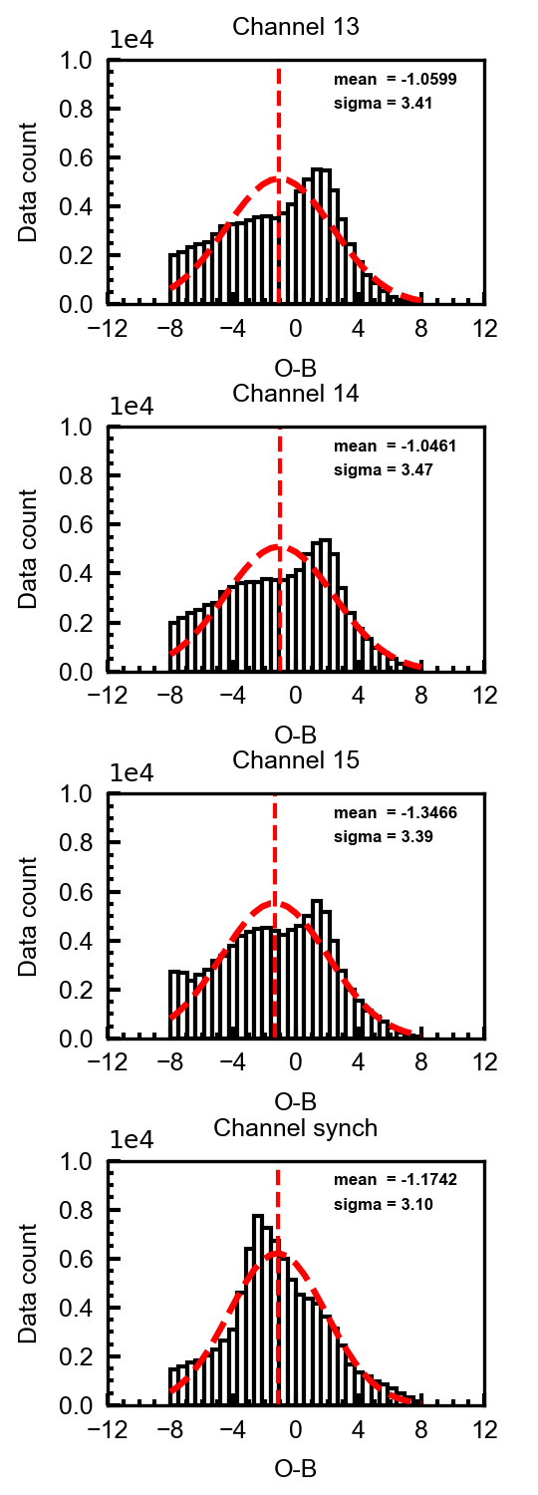
Real-data case over clear sky
Only synthesizing observation over all sky using the synthesizing coefficients of simulation without cloud
Differences
O minus B
O minus B statistics
Observation
Simulated BT
Channel 13
Remove |O-B| < 8 K
Bias reduced significantly over clear sky and lower cloud
Synthesizing < individual (BT)
Smaller standard deviation
Better Gaussian fit
Channel 14
Channel 15
Synthesizing Channel

Slide 9
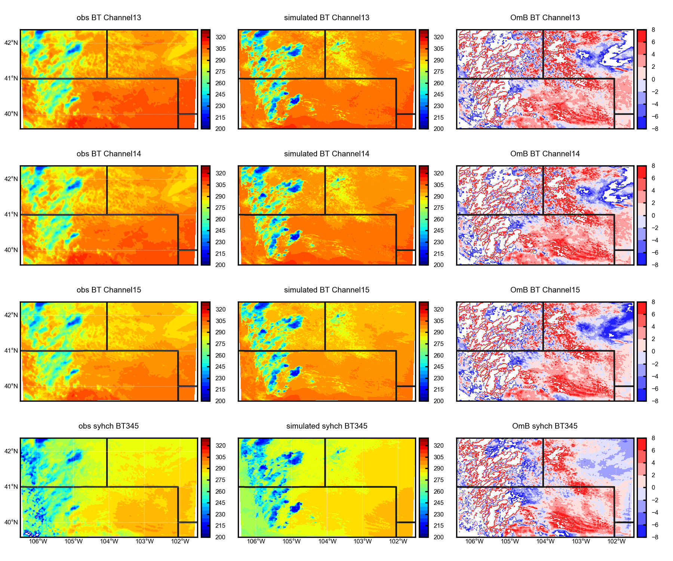
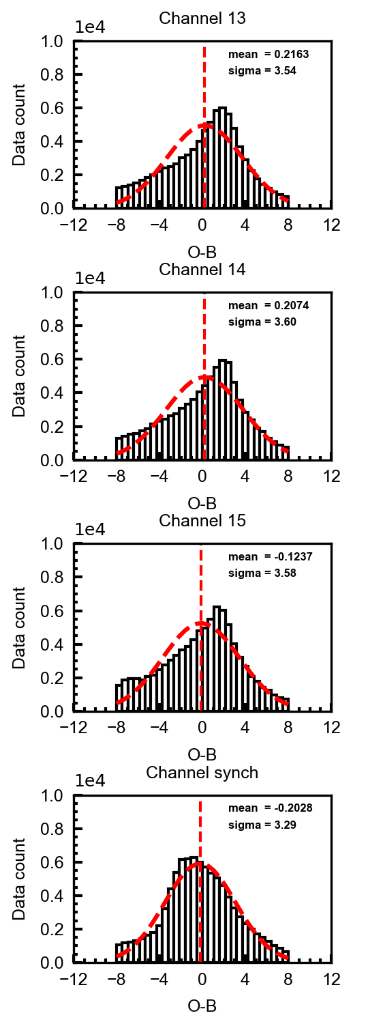
Real-data case over all sky
synthesizing observation and simulation channel over all sky using the synthesizing coefficients of simulation without cloud
Remove |O-B| < 8 K
Bias reduced significantly over clear sky and lower cloud
Synthesizing < individual (BT)
Smaller standard deviation
Better Gaussian fit

Slide 10
Summary and discussion
Synthesizing channel reduce bias significantly over clear sky and low cloud sky.
O-B of synthesizing channel can fit better Gaussian distribution after a background quality control that is benefit for assimilation.
Current synthesizing algorithm (version 1.0) can not be used over high cloud sky.
AOEI and ABEI (Minamide and Zhang, 2017; 2018) probably can make a robust assimilation for synthesizing channel over all sky.

