Slide 1
The 2018 Martian Global Dust Storm: Insights from the Ensemble Mars Atmosphere Reanalysis System (EMARS)
Hartzel E. Gillespie, Steven J. Greybush, and R. John Wilson
Penn State and NASA-Ames
Presented at Spring 2019 Group Meeting
May 10, 2019

Slide 2
Overview
Why study global dust storms?
Methods: Observations and reanalysis
Overview of the storm
Storm dynamics as seen in EMARS

Slide 3
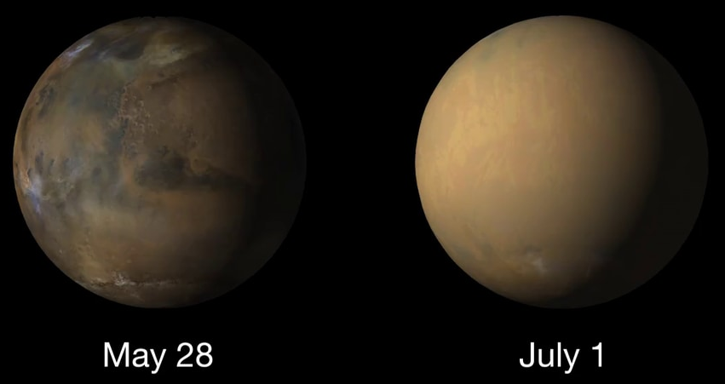
What is a Martian global dust storm?
An event that occurs on Mars once every few Mars years
Airborne dust mostly obscures the Sun from the surface for months
Courtesy of NASA’s Hyperwall

Slide 4
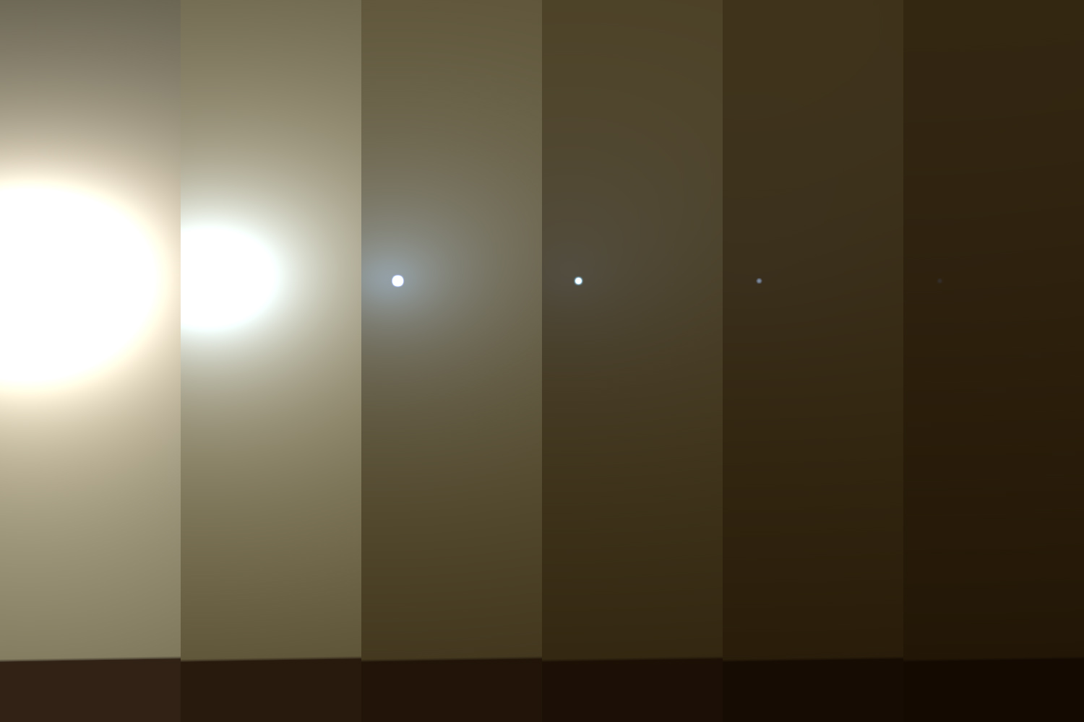
Why study global dust storms?
Mission impacts: Reduced solar
generation, atmosphere expands
Recurrence period of storms
not understood
Transition of storms from regional
(occur every year) to global not
understood
Opportunity’s view of the sun, before its demise
Courtesy of JPL Photojournal

Slide 5
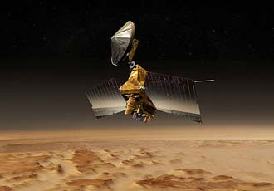
Observations and EMARS Reanalysis
Concept art courtesy of NASA/JPL
Mars Climate Sounder (MCS), aboard a Sun-synchronous polar orbiter, provides vertical profiles of temperature and dust
The Ensemble Mars Atmosphere Reanalysis System (EMARS) (Greybush et al, 2019) is a reanalysis formed by the combination of MCS obs and the GFDL Mars Global Climate Model (MGCM) with the local ensemble transform Kalman filter
EMARS extension was run for the 2018 global dust storm
Temperature obs are assimilated; dust is added to or subtracted from the 10 lowest model levels (~5 km) to match the column-integrated dust in a provisional dust product produced with the methodology of Montabone et al. (2015)

Slide 6
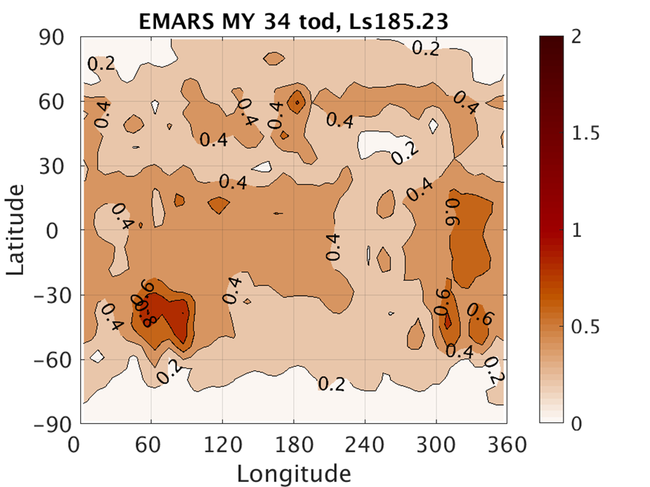
Overview of the 2018 Martian Global Dust Storm: Day 0
Plots are EMARS column-integrated dust opacity, which is heavily based on the provisional dust product produced with the methodology of Montabone et al. (2015).
Future global dust storm is circled in blue
Dust distribution is otherwise typical for this time of year

Slide 7
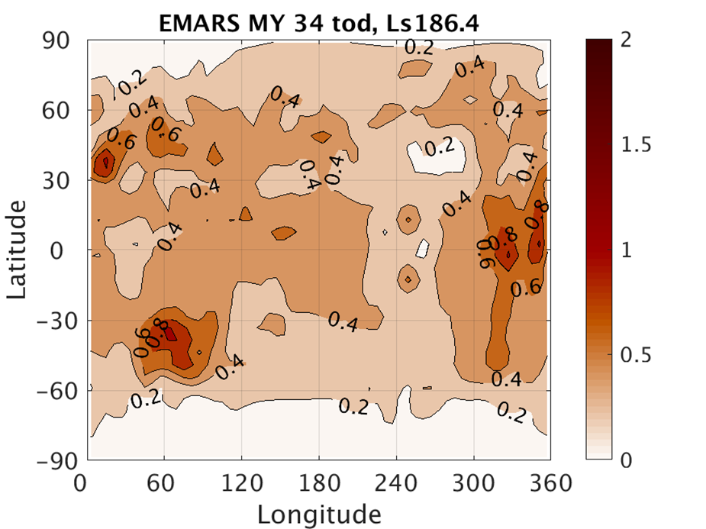
Overview of the 2018 Martian Global Dust Storm: Day 2
The storm center has moved south into the tropics.
Increased opacities begin to travel eastward through the northern midlatitudes at this time.

Slide 8
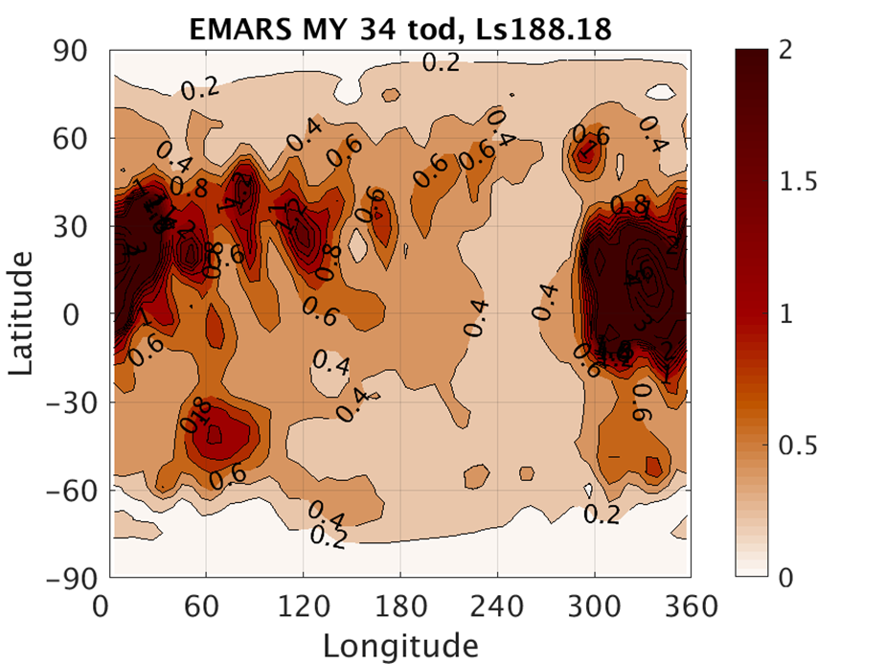
Overview of the 2018 Martian Global Dust Storm: Day 5
Opacities increase greatly on this day, with column opacities greater than 2 filling the southern extension of the Acidalia basin.
Eastward spread of the storm continues.

Slide 9
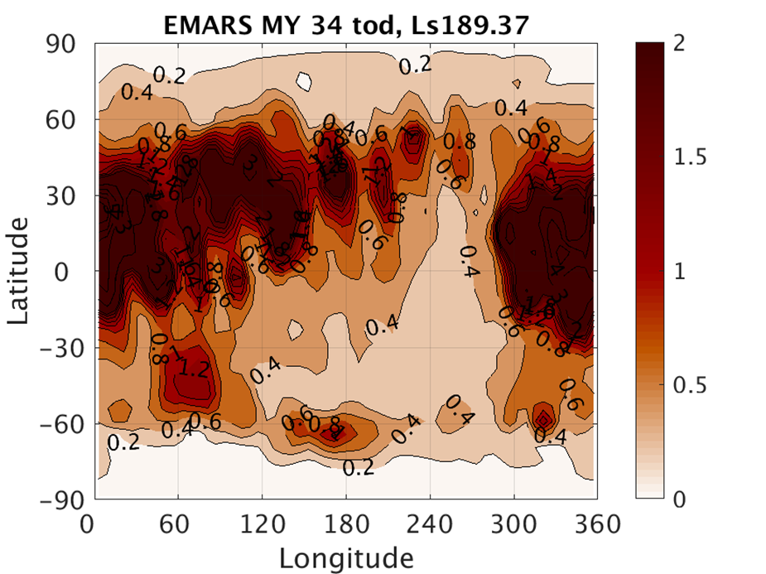
Overview of the 2018 Martian Global Dust Storm: Day 7
The storm has wrapped around the entirety of the northern midlatitudes.
Hints of a similar-looking event can be observed in the southern polar region.

Slide 10
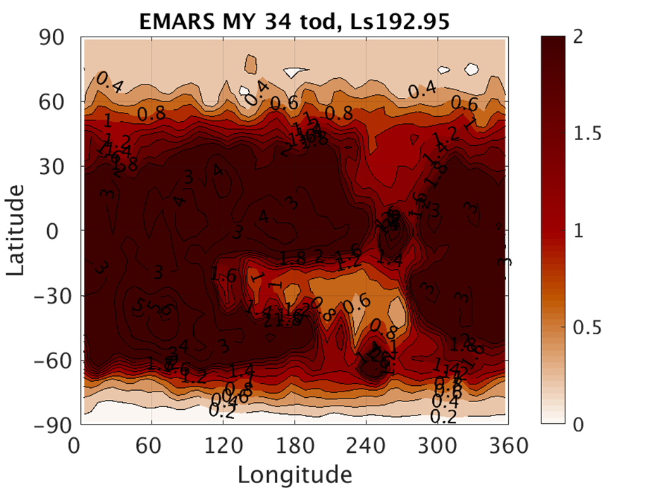
Overview of the 2018 Martian Global Dust Storm: Day 13
Increases in opacity migrate from the northern midlatitudes to the equator.
The storm has also wrapped around the southern polar cap.

Slide 11
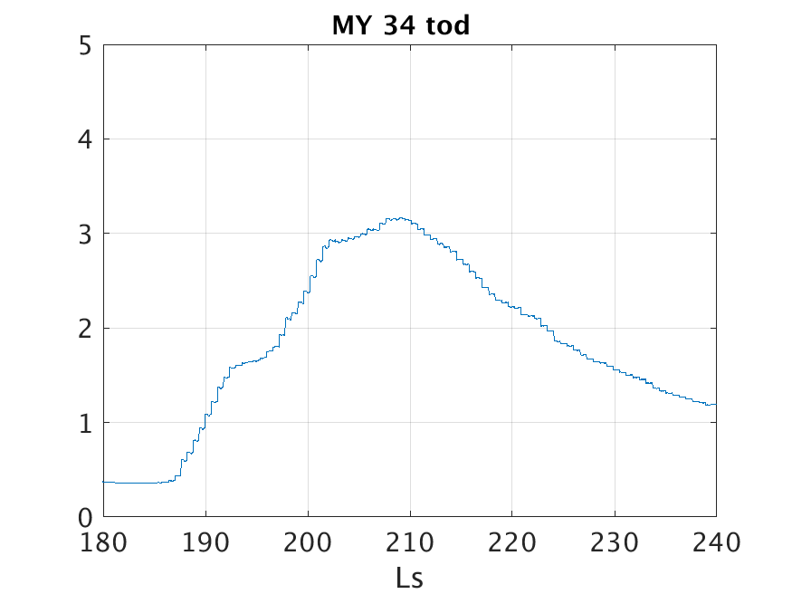
Pre-Storm
Growth
Maturity
Dissipation
Lull
Day 13
Day 28
Day 44
Day 0
Day 19
Col-umn
Opa-city
(Time)

Slide 12
How was this storm able to become global?
The eastward spreading of the storm in the northern midlatitudes seems to be key.
Is that spreading advection of dust?
Does EMARS advect the dust in the way we observe?
If not, then if the vertical distribution of dust in EMARS were correct, does EMARS then suggest that dust would be advected as observed?

Slide 13
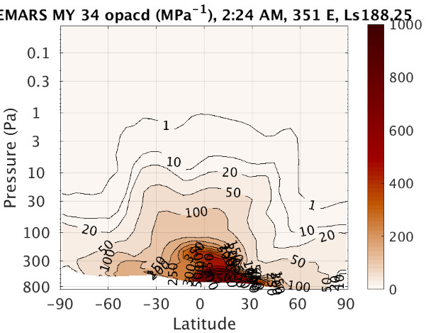
How was this storm able to become global?
Dust can be lofted near the equator by the Hadley circulation and transported to the upper atmosphere.
Once there, it can spread poleward, and once it reaches the mid-latitudes, the dust can spread zonally in the mid-latitude jet.
But the Hadley circulation is itself the average of high-amplitude tidal motions.

Slide 14
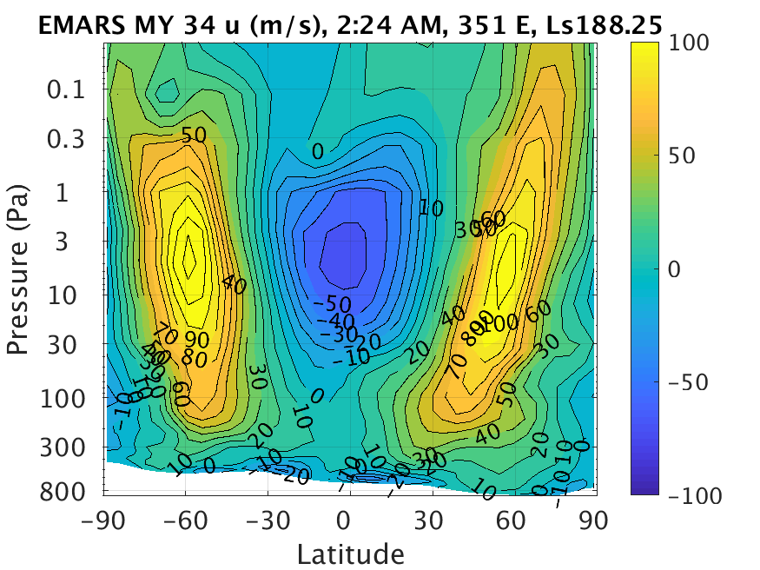
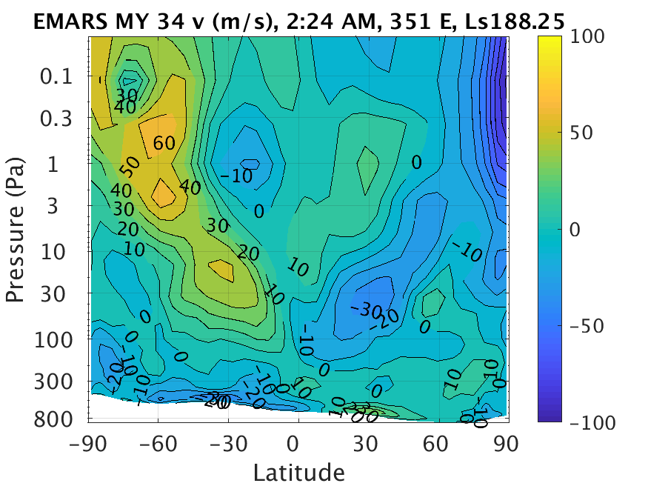
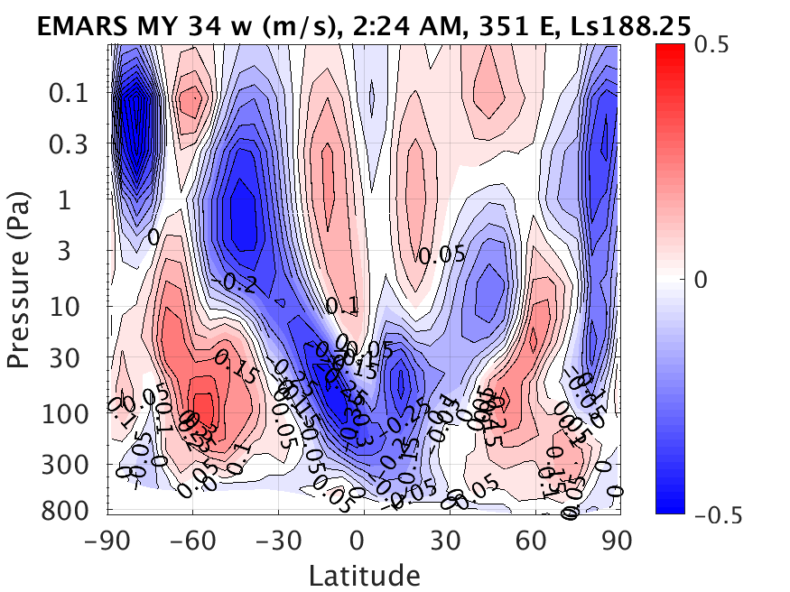

Slide 15
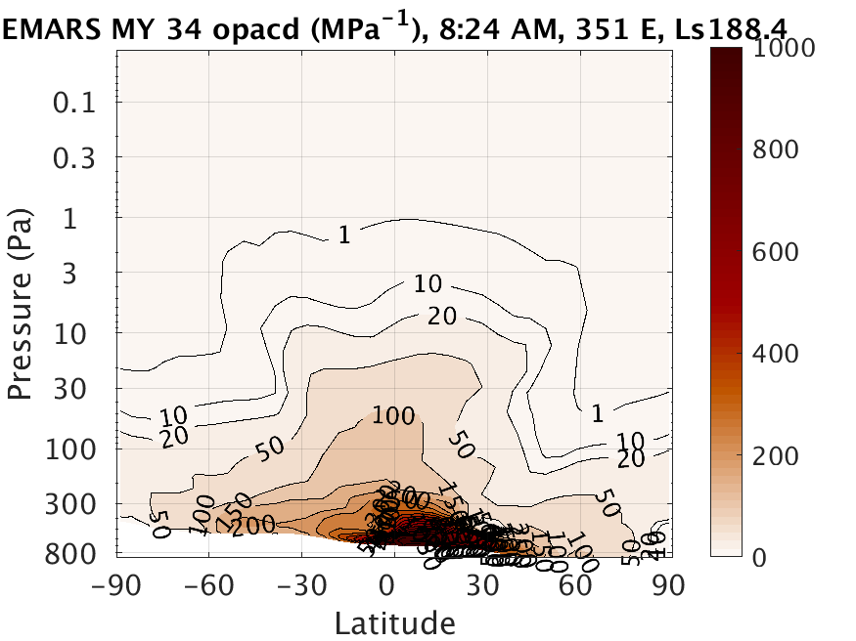
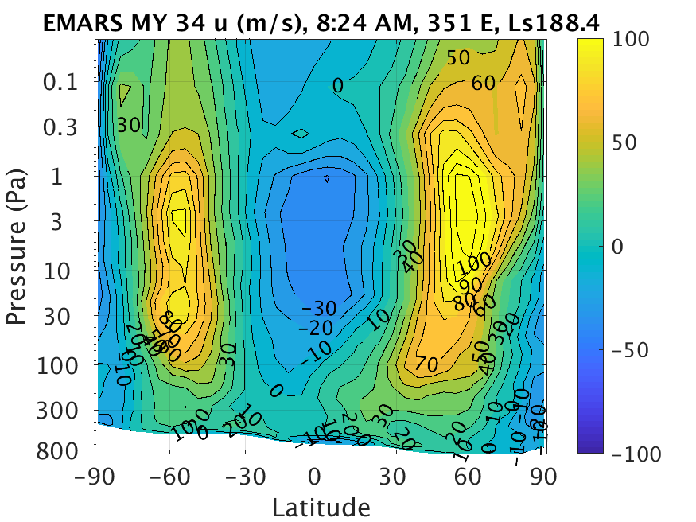
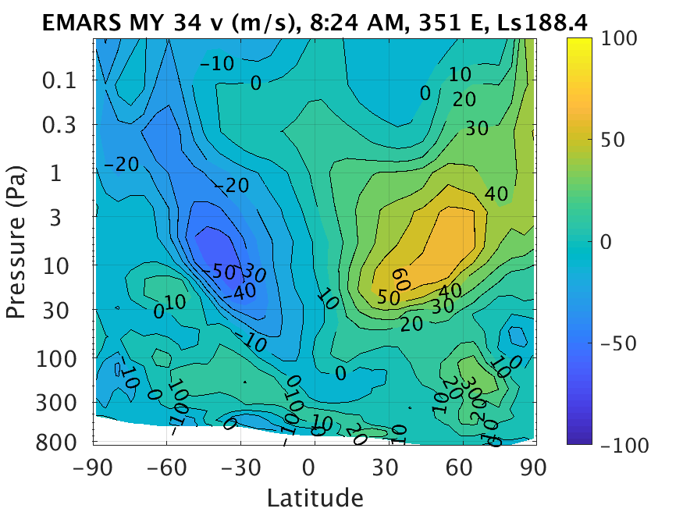
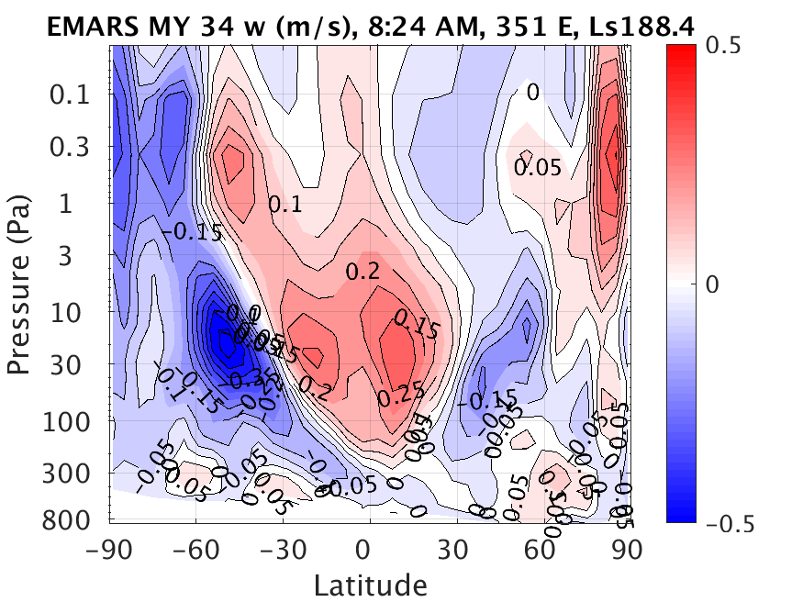

Slide 16
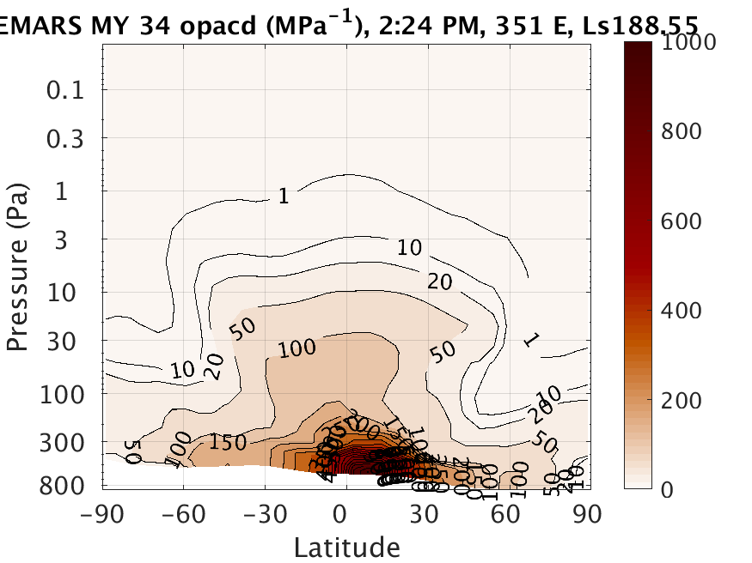
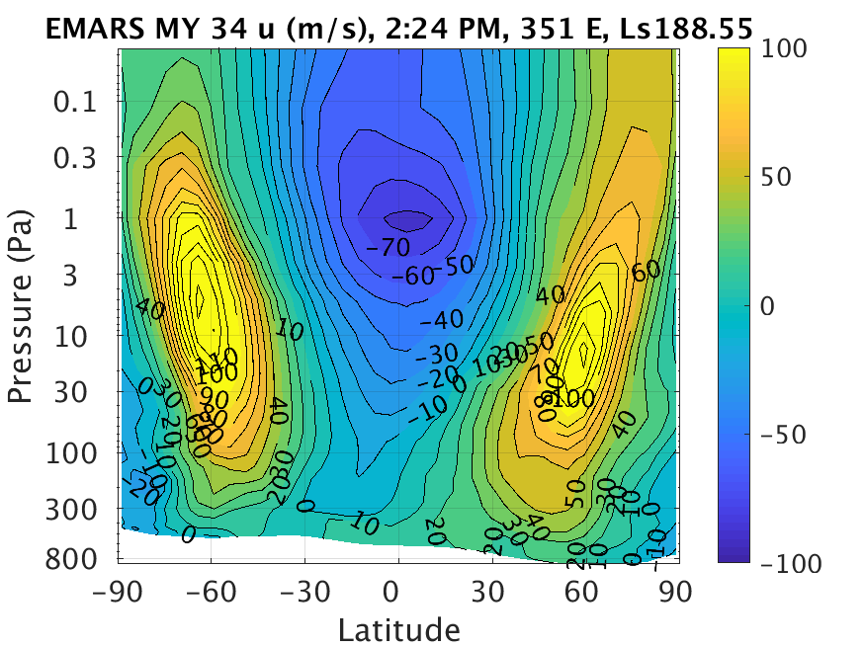
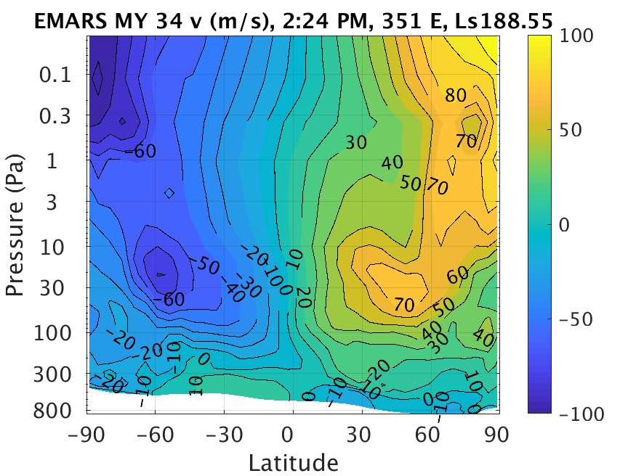
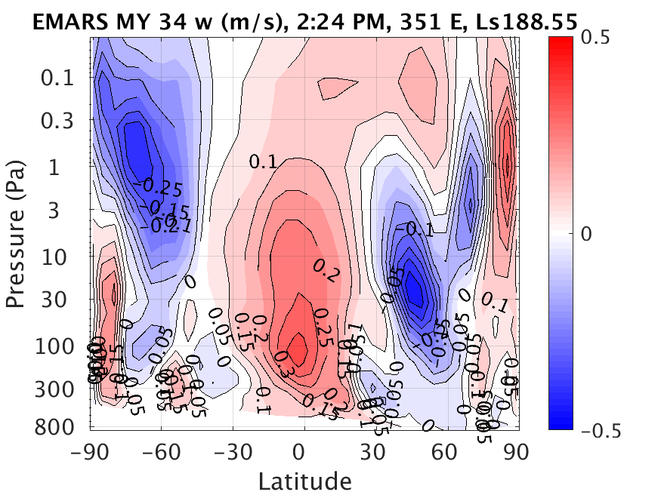

Slide 17
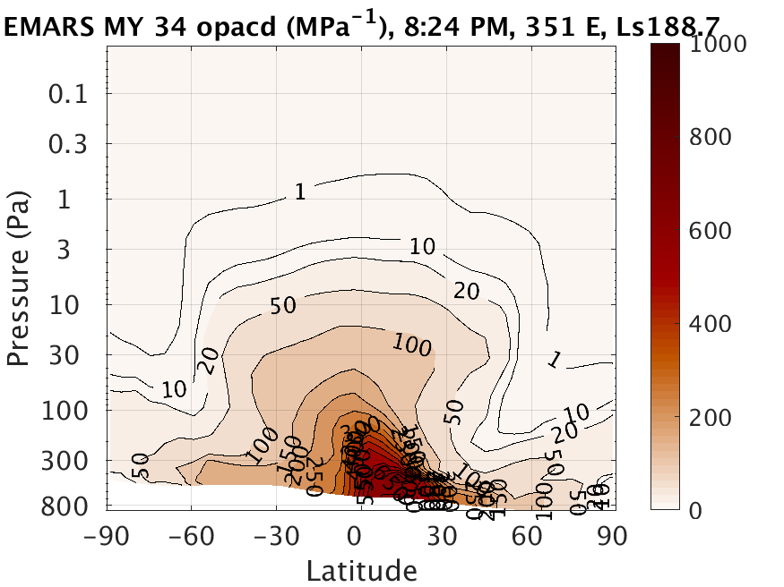
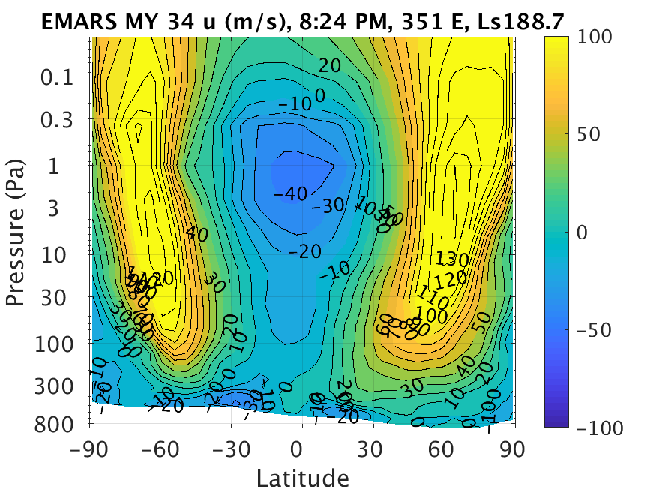
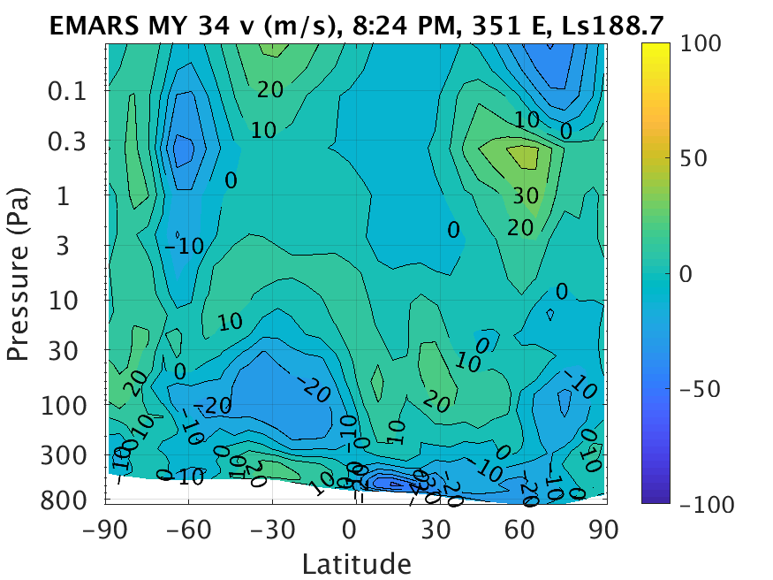
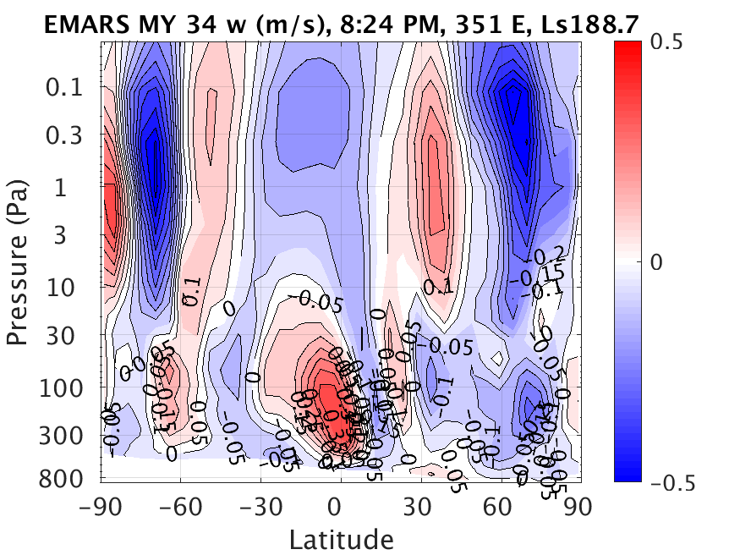

Slide 18
How was this storm able to become global?
Zonal jet advects dust around the planet
Southerlies move dust into zonal jet
Up
Afternoon tidal lofting
Next day’s tidal lofting moves dust into region of strong southerlies
North
Morning tidal sinking, weaker than tidal lifting due to Hadley circulation
Dust storm migrates toward equator
Equator
East

Slide 19
Ongoing Work
Does EMARS suggest that the storm was initiated by a transient eddy?
How does the vertical distribution of dust in EMARS compare to the observed dust distribution?
Do observations suggest that dust lofting from the tropics occurs before or after increases in opacity spread eastward?
What is the mechanism that causes storms to become global rather than remaining regional? Is the idea I’ve presented today on the right track?

