Slide 1

Bred Vectors based tailored perturbations: application to mesoscale ensemble prediction system over the Western Mediterranean
Alejandro Hermoso
Advisor: Victor Homar
Meteorology Group, Physics Department, University of the Balearic Islands, Palma de Mallorca, Spain
alejandro.hermoso@uib.es

Slide 2
Introduction
Numerical weather forecasts are inherently uncertain
Both system state and its uncertainty must be assessed
The uncertainty is quantified by means of probabilistic information expressed in terms of probability density functions (PDF)
The perfect-model evolution of the system fulfils the Liouville equation (LE)
The lack of analytical solution of the LE and the high dimensionality of the system restrain its application for the systems of interest

Slide 3
Introduction
At operational centres, only an ensemble of discrete samples can be considered
Choosing a sampling strategy is a key question for any ensemble prediction system (EPS)
Different sampling strategies:
  Monte Carlo
  Ensemble Data Assimilation (EDA)
  Based on system dynamics
    Singular vectors: Used at ECMWF. Adequate for synoptic scale
    Bred vectors: Used at NCEP. Better for mesoscale

Slide 4
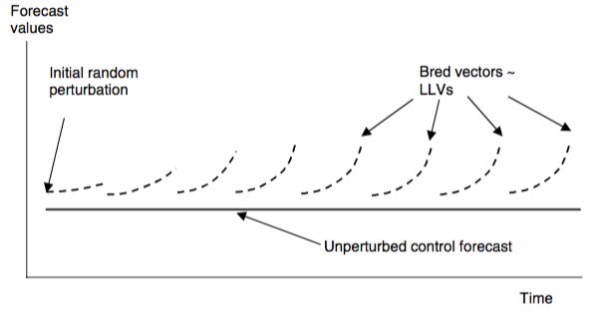
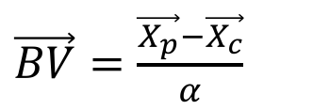
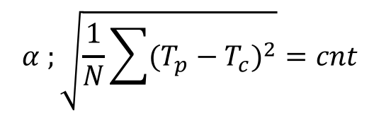
Bred vectors
Step 1: A random initial perturbation is
added to the analysis
Step 2: The model is integrated for the
perturbed and unperturbed initial
conditions for a short integration period
Step 3: The difference between the two
forecasts is rescaled with some norm and
added to the next analysis
$\vec{BV}=\frac{\vec{X_{p}}−\vec{X_{c}}}{α}$
$$α ;\sqrt{\frac{1}{N}\sum{{(T_{p}−T_{c})}^{2}}}=cnt$$
Kalnay, 2003
Arithmetic rescaling

Slide 5
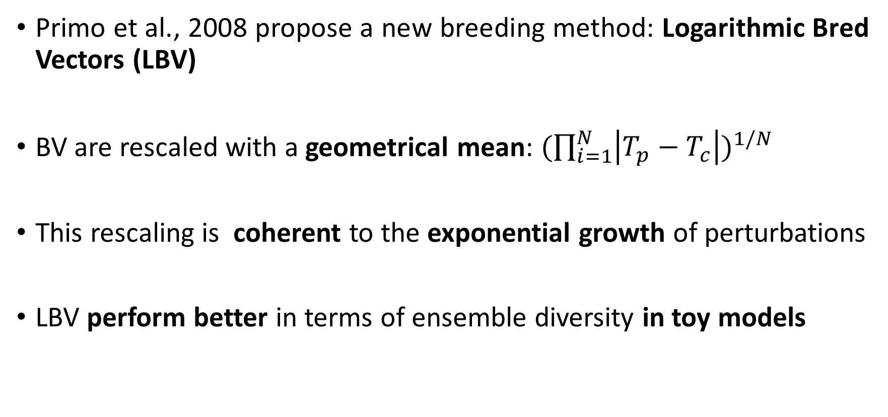
Logarithmic bred vectors
Primo et al., 2008 propose a new breeding method: Logarithmic Bred Vectors (LBV)
BV are rescaled with a geometrical mean: ${(\prod_{i=1}^{N}{\left|T_{p}−T_{c}\right|})}^{1/N}$
This rescaling is coherent to the exponential growth of perturbations
LBV perform better in terms of ensemble diversity in toy models

Slide 6
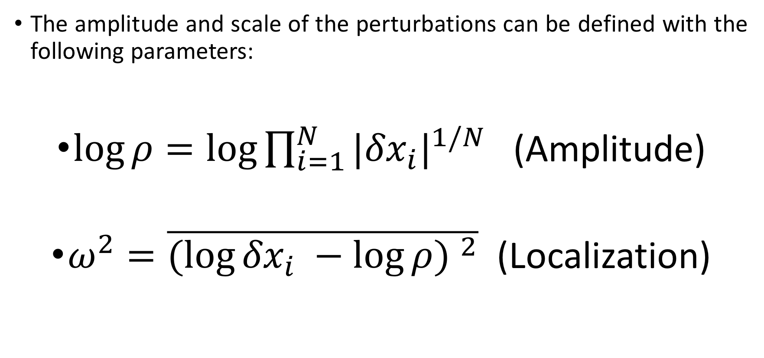
Characterization of perturbation
The amplitude and scale of the perturbations can be defined with the following parameters:
$\log{ρ=\log{\prod_{i=1}^{N}{|{δx}_{i}|^{1/N}}}}$ (Amplitude)
$ω^{2}=\overline{{(log{{δx}_{i} −\log{ρ) }}}^{2}}$ (Localization)

Slide 7


Characterization of perturbation
$$ω^{2}$$
$$\log{ρ}$$

Slide 8
Mediterranean severe weather
Severe weather events are common in the Mediterranean region during fall
Evaporation from the sea and interaction with orography are important mechanisms for its development
Orography of the region contributes to enhance low-level convergence
Many of these phenomena origin over the sea

Slide 9
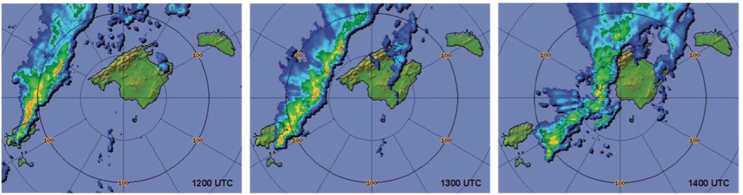

Example
Example of severe weather event: October 29 squall line (Romero et al. 2015)
Rain intensities as high as 260 mm ${\text{h}}^{−1}$
Hailstones of 2.5 cm diameter
Losses of 15 M€

Slide 10
Motivation and objectives
One of the main problems of EPS is the underdispersion
Extreme events may not be represented
In order to improve the high resolution short-range forecast of extreme events, ensemble spread must be controlled (typically increased)
OBJECTIVES:
  to explore the potential of LBVs to more efficiently initialize mesoscale EPS
  to investigate options to increase ensemble diversity and obtain a seamless scale representation compared to traditional BV

Slide 11
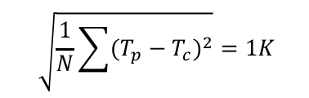
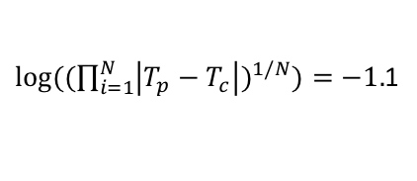
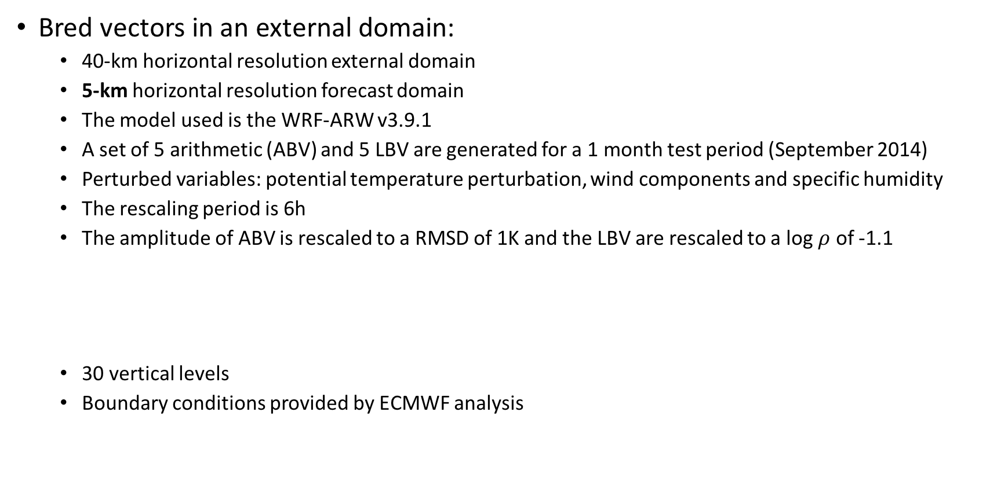
Bred vectors in a limited area domain
Bred vectors in an external domain:
  40-km horizontal resolution external domain
  5-km horizontal resolution forecast domain
  The model used is the WRF-ARW v3.9.1
  A set of 5 arithmetic (ABV) and 5 LBV are generated for a 1 month test period (September 2014)
  Perturbed variables: potential temperature perturbation, wind components and specific humidity
  The rescaling period is 6h
  The amplitude of ABV is rescaled to a RMSD of 1K and the LBV are rescaled to a log $ρ$ of -1.1
  30 vertical levels
  Boundary conditions provided by ECMWF analysis
$$\sqrt{\frac{1}{N}\sum{{(T_{p}−T_{c})}^{2}}}=1K$$
${log⁡((\prod_{i=1}^{N}{\left|T_{p}−T_{c}\right|})}^{1/N})=−1.$1
Forecast domain
  External domain

Slide 12




New method to increase diversity: Bred vectors tailored ensemble perturbations
The scale of the perturbation can be changed:
${BV}^{∗}={δx }^{1/β}$ $β=\frac{ω}{ω^{∗}}$
$ω$ = 0.5
$ω$ = 1.5
$ω$ = 2.5

Slide 13
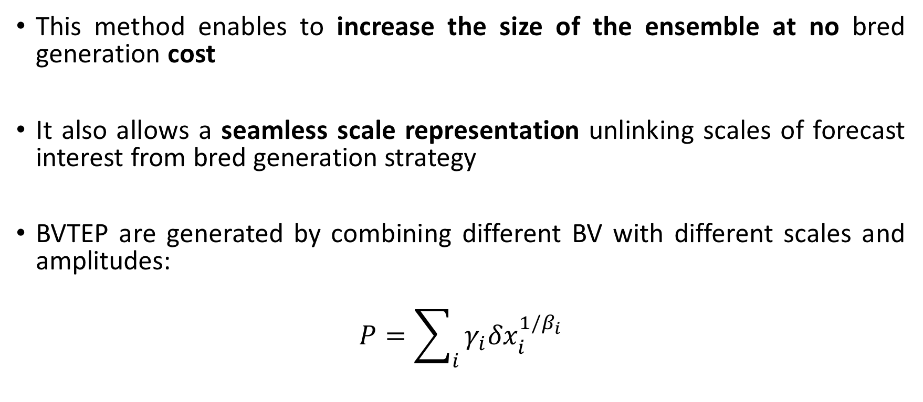
New method to increase diversity: Bred vectors tailored ensemble perturbations
This method enables to increase the size of the ensemble at no bred generation cost
It also allows a seamless scale representation unlinking scales of forecast interest from bred generation strategy
BVTEP are generated by combining different BV with different scales and amplitudes:
$$P=\sum_{i}{γ_{i}{δx}_{i}^{1/β_{i}}}$$

Slide 14
Ensemble experiments setup
Same model configuration described for BV generation
11 ensemble members, 1 control and 5 twin perturbations
00 and 12 UTC forecast cycles are run daily over the test period, and have a lead time of 36 h
Boundary conditions generated from BV perturbed forecasts in the external domain

Slide 15
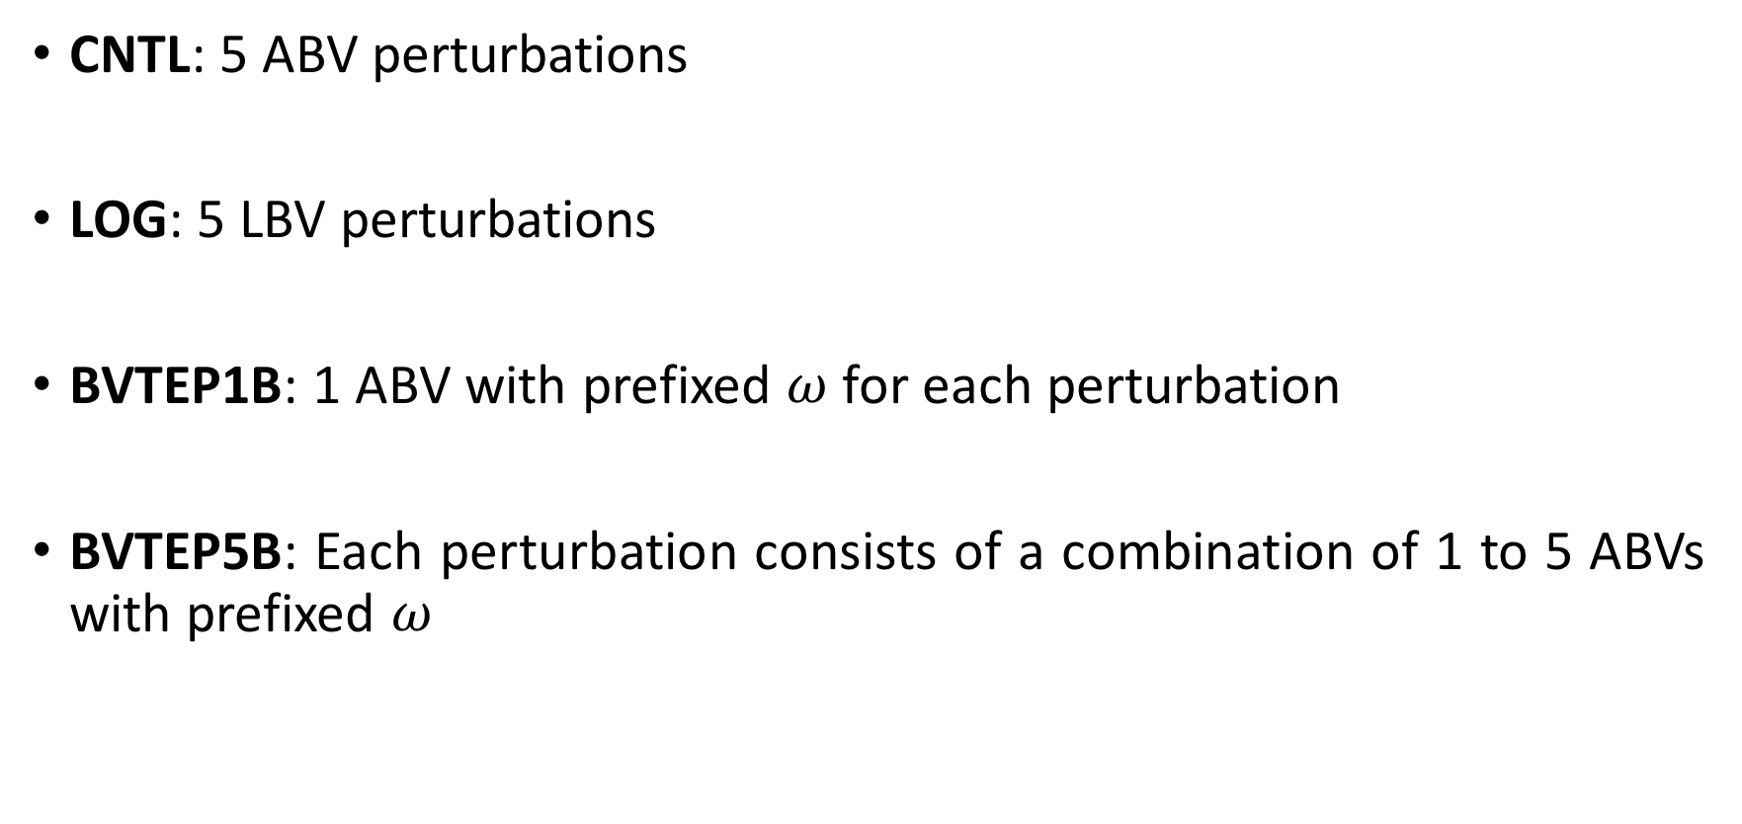
Ensemble configurations
CNTL: 5 ABV perturbations
LOG: 5 LBV perturbations
BVTEP1B: 1 ABV with prefixed $ω$ for each perturbation
BVTEP5B: Each perturbation consists of a combination of 1 to 5 ABVs with prefixed $ω$

Slide 16
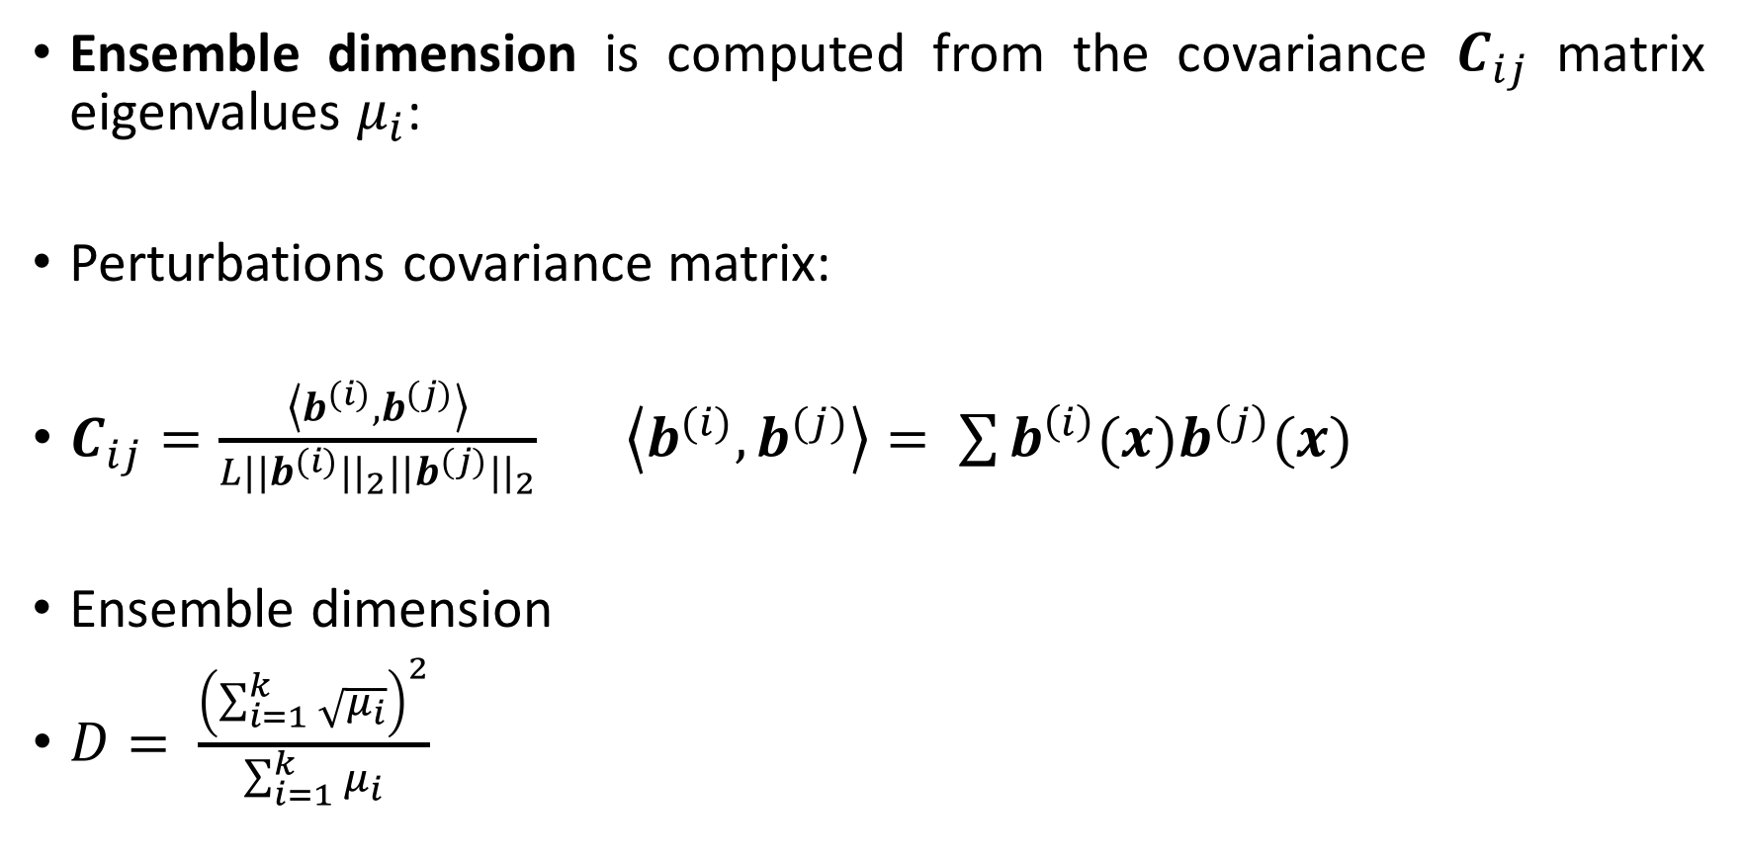
Bred vectors in a limited area domain
Ensemble dimension is computed from the covariance $C_{ij}$ matrix eigenvalues $μ_{i}$:
Perturbations covariance matrix:
$C_{ij}=\frac{\left\langle b^{(i)},b^{(j)}\right\rangle }{L||b^{(i)}{||}_{2}||b^{(j)}{||}_{2}}$ $\left\langle b^{(i)},b^{(j)}\right\rangle = \sum{b^{\left(i\right)}(x)b^{\left(j\right)}(x)}$
Ensemble dimension
$D= \frac{{\left(\sum_{i=1}^{k}{\sqrt{μ_{i}}}\right)}^{2}}{\sum_{i=1}^{k}{μ_{i}}}$

Slide 17
Results
Variation of ensemble dimension with lead times for T at a model level close to 850 hPa

Slide 18
Results
Wind speed Rank histograms
6h
12h
18h
24h

Slide 19
Results
3h accumulated precipitation Rank histograms
6h
12h
18h
24h

Slide 20
Conclusions
The ensemble diversity is similar for forecasts perturbed with arithmetic and logarithmic rescaled bred vectors
Modifying the scale of the initial perturbations increases ensemble diversity and skill
The methodology should be tested in a severe weather event

