Slide 1
Improving Probabilistic Prediction of Convection Initiation Using Radar-Derived Boundary Layer Height Observations with an EnKF
Yunji Zhang, David Stensrud, Fuqing Zhang, Jacob Sorber
The Pennsylvania State University
May 10, 2019

Slide 2
Why do we do that?
Convection initiation (CI) is difficult to predict
Not well observed
Multi-scale interactions
Strongly modulated by the structure of PBL/CBL
Wind shear
Capping inversion
CAPE
…
How can we improve through DA?
Conventional observations (surface stations and rawinsondes)
Any other possibilities?

Slide 3
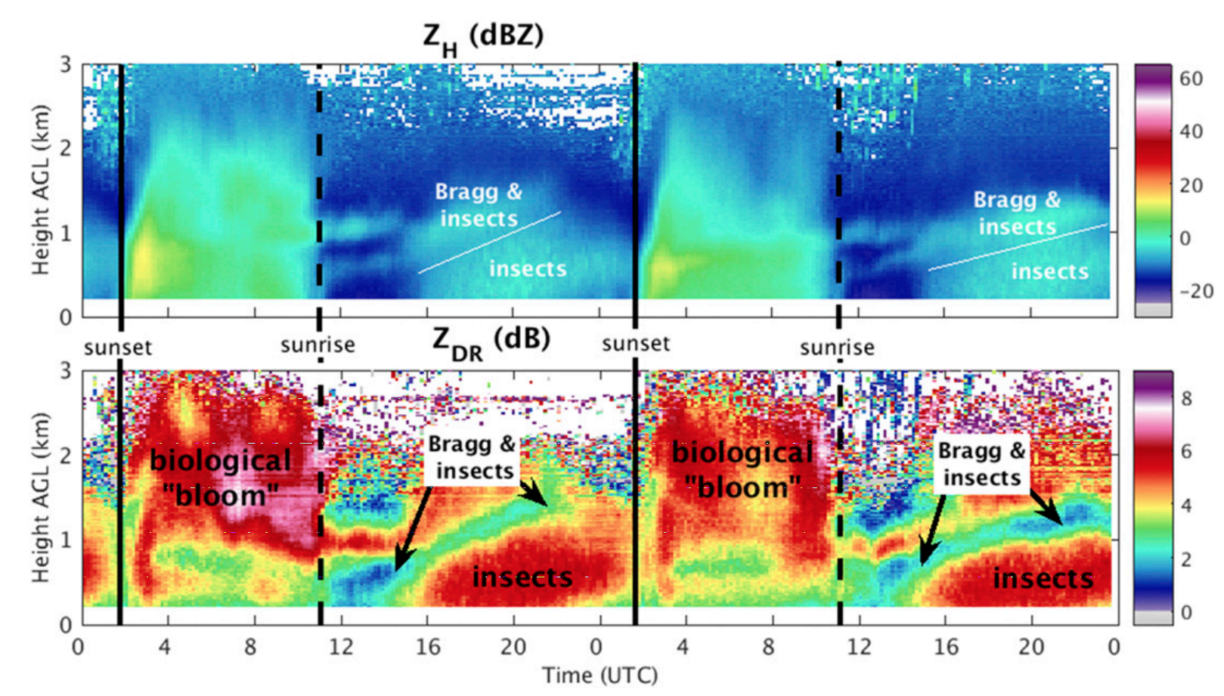
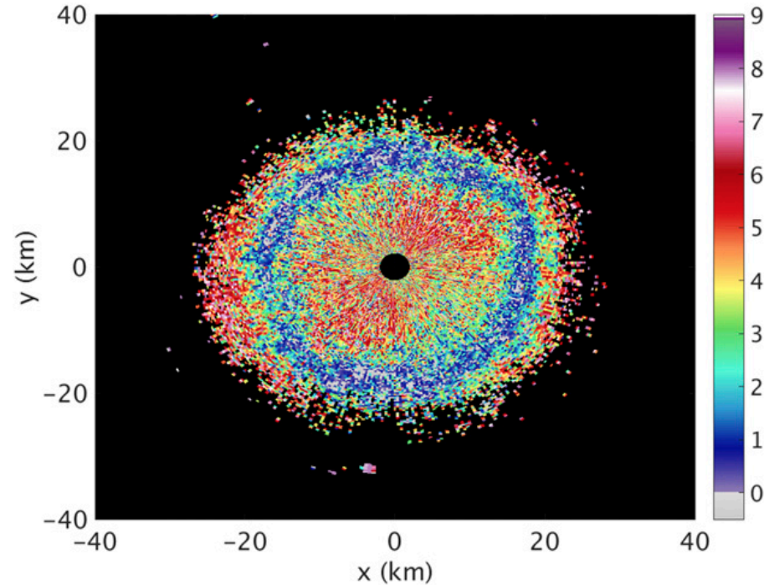
Deriving BL Height from Dual-Pol Radars
(Banghoff et al. 2018 JAOT)
PPI of Z_{DR} at 4.44°
2345 UTC 11 May 2015 @ KTLX
QVPs of Z_{H} and Z_{DR}
20–21 May 2015 @ KTLX

Slide 4
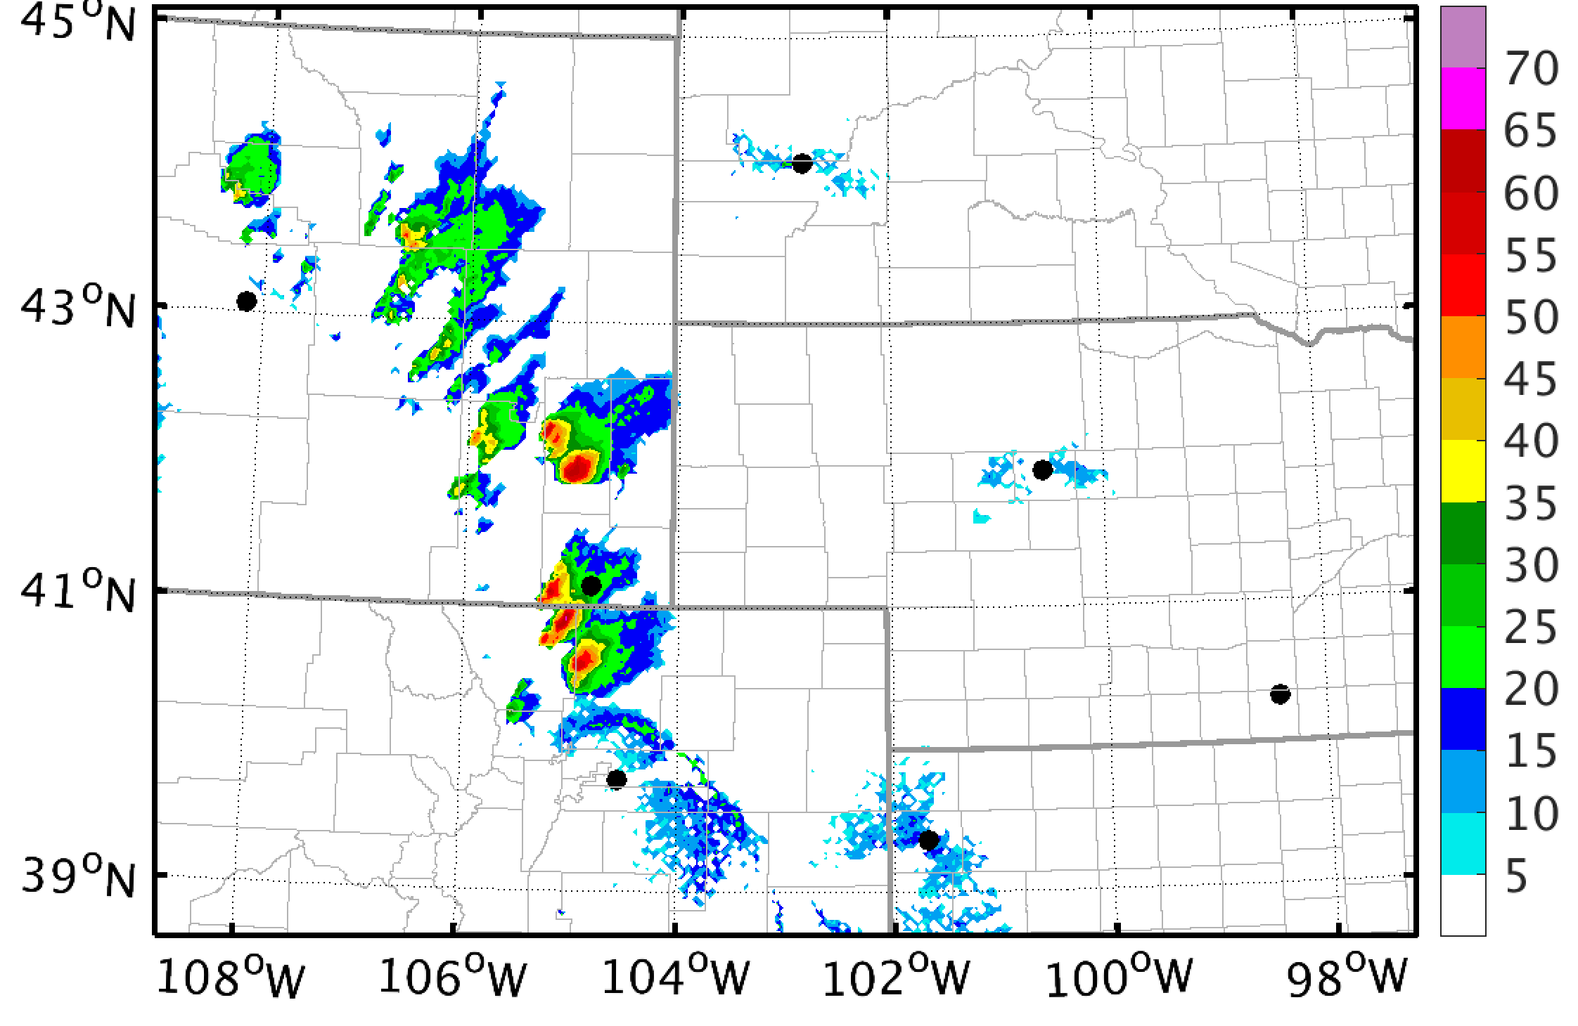
Experiment Design
KUDX
Mimic current operational HRRRv2
WRF/ARW v3.8.1
3-km grid spacing, 50 levels topped at 20 hPa
Thompson, RRTMG, RUC, MYNN, etc.
Ensemble initialization using RAP+GEFS
KRIW
KCYS
KUEX
KFTG
KGLD
20-member ensemble from GEFS analysis and forecasts from 0000 UTC 12 June 2017
Re-center at
RAP analysis
40-member ensemble (NODA)
EnKF from NoDA 1500 outputs
Re-center at
RAP analysis
20-member ensemble from GEFS analysis and forecasts from 0600 UTC 12 June 2017
0000 UTC
12 June 2017
0600
1200
1500
2100
0000 UTC
13 June 2017

Slide 5
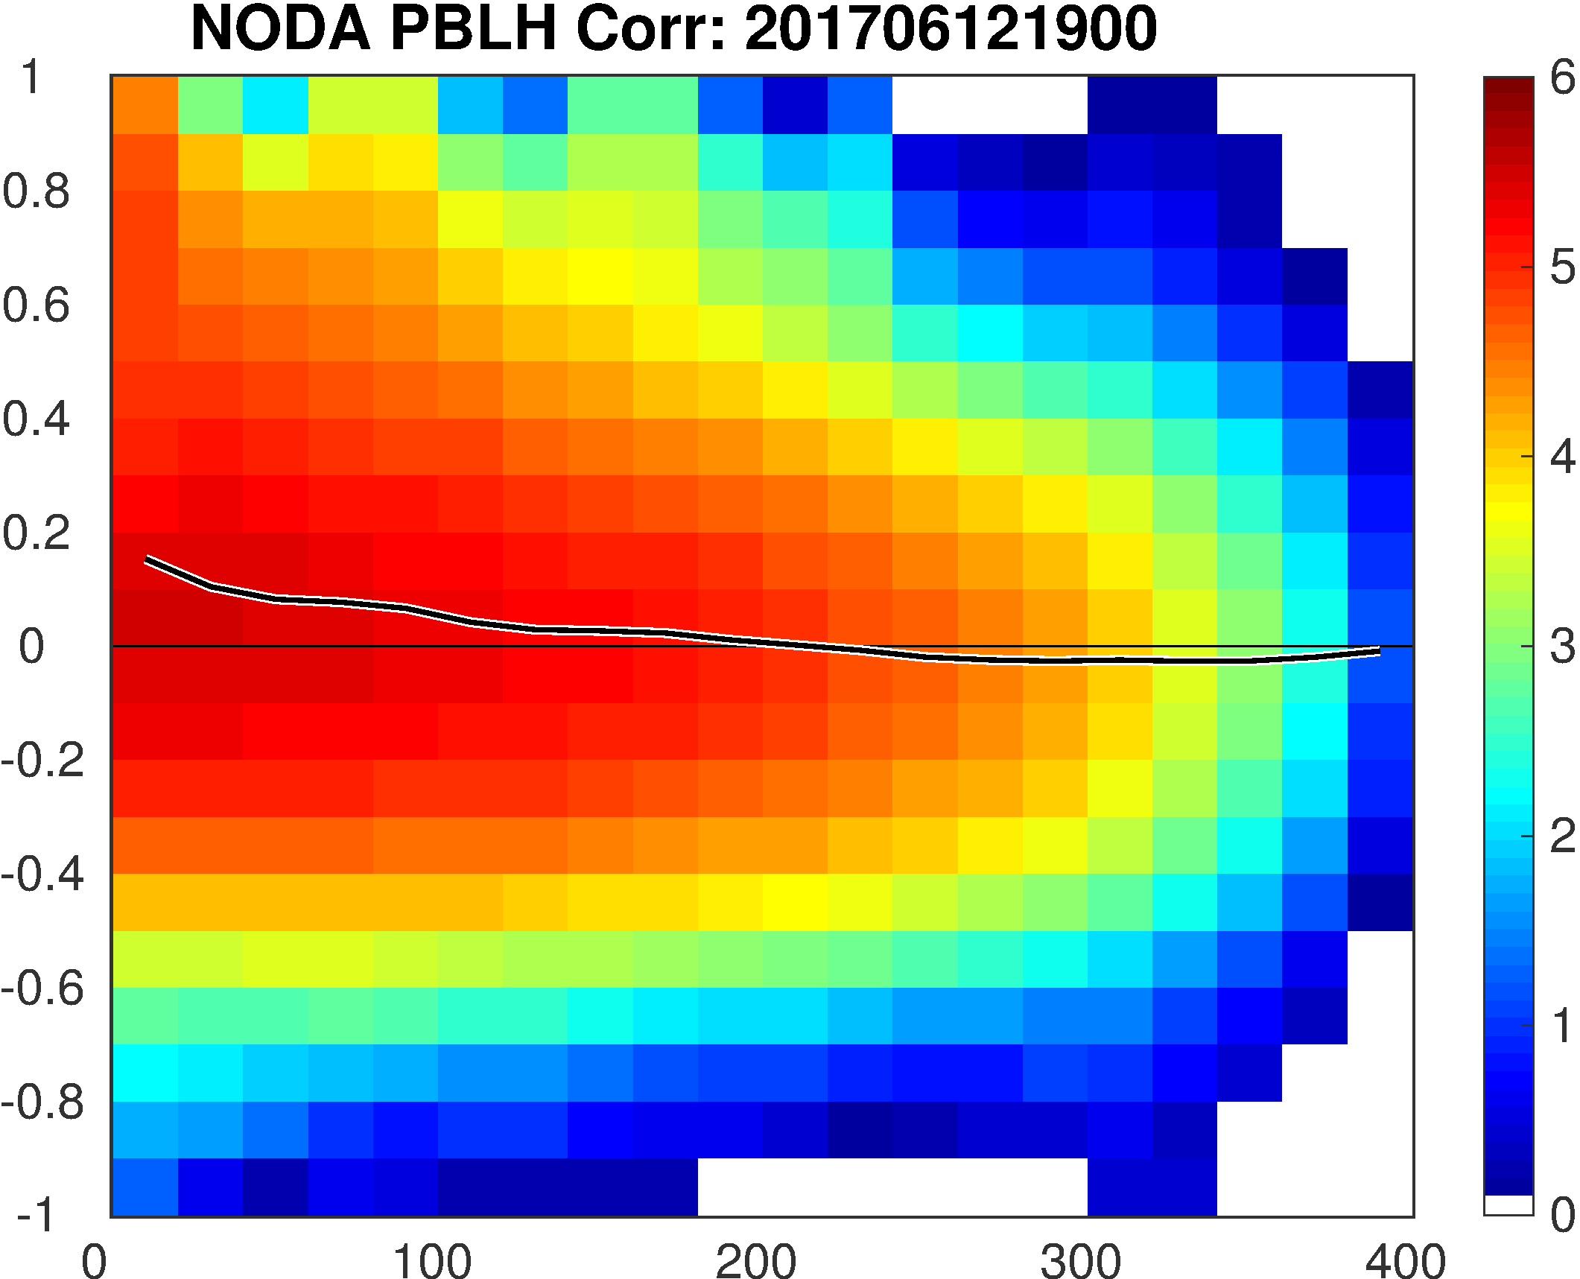
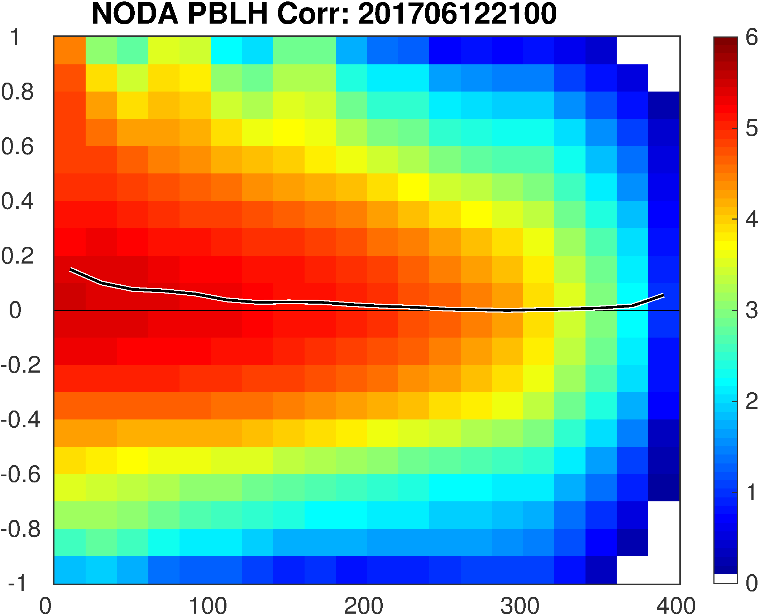
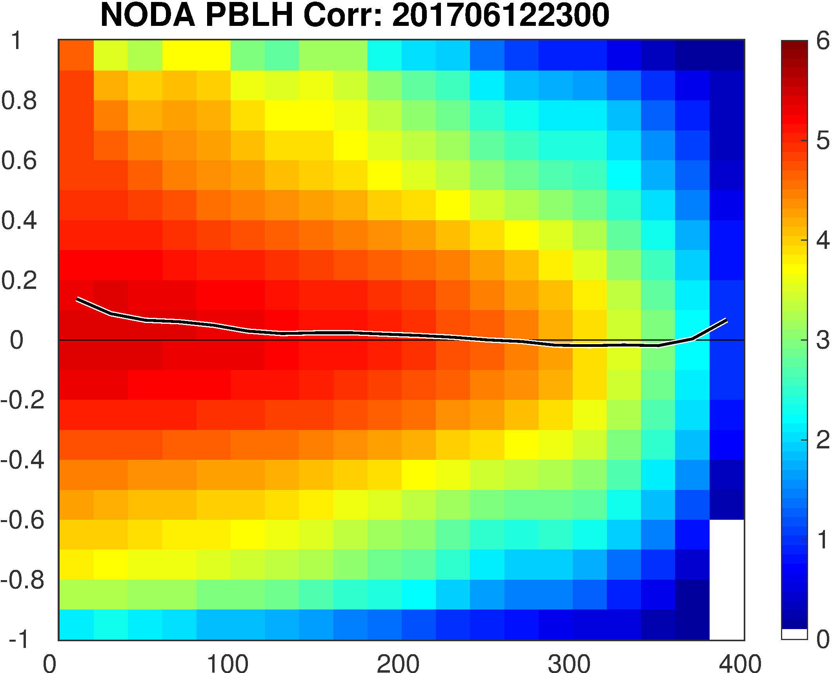
EnKF Design
PSU WRF-EnKF cycling every 30 minutes from 1500 to 2100 UTC
Experiments:
“SFC”: surface observations with ±10 minutes window
300-km HROI, 30-level VROI
“I30”: interpolated hourly PBL height
200-m error, 600-km HROI, 50-level VROI, located at observed height, update QKE
“I30SFC”: combining SFC and I30
Observation operator: lowest level K that θ_{v} is more than 0.5 K higher than the mean θ_{v} of the lowest 50 hPa above surface (at one point)

Slide 6
Example of Z_{DR} PPIs of the Event
KFTG (Denver, CO)
1500 UTC
KFTG (Denver, CO)
1600 UTC
KFTG (Denver, CO)
1700 UTC
KFTG (Denver, CO)
1800 UTC
KFTG (Denver, CO)
1900 UTC
KFTG (Denver, CO)
2000 UTC

Slide 7
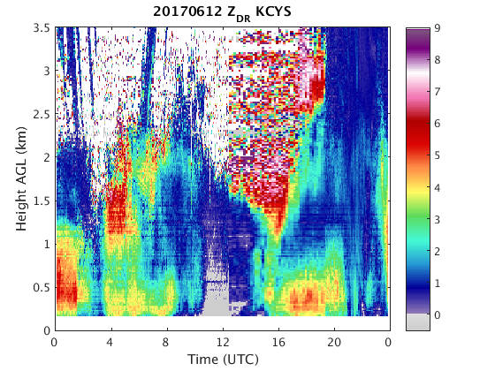
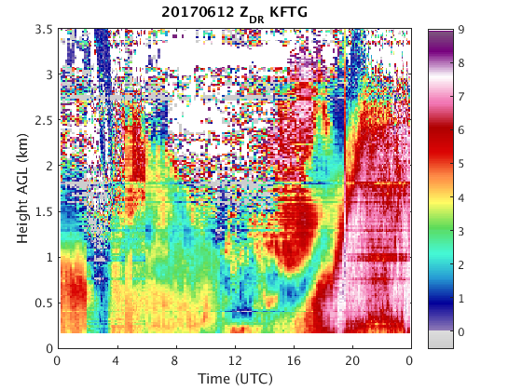
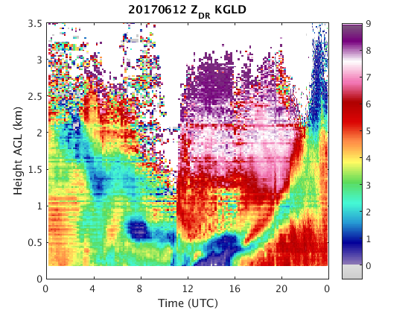
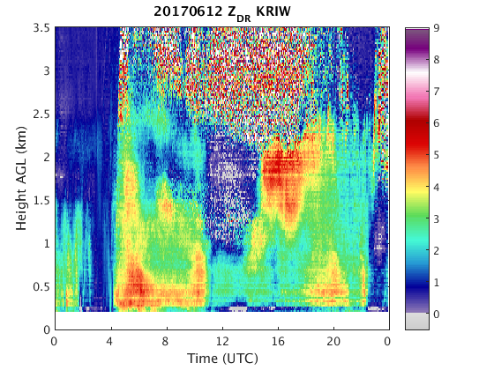
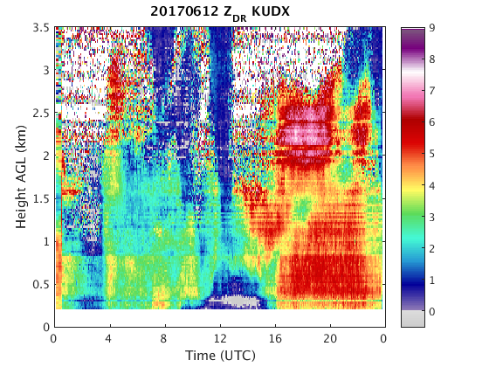
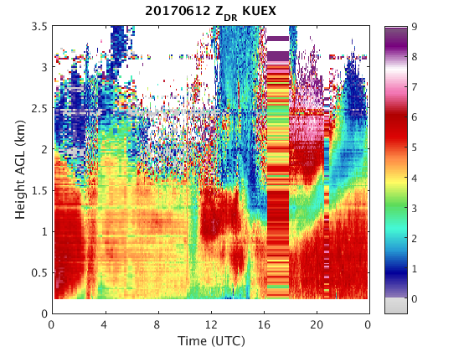
Z_{DR} QVPs of the Event

Slide 8
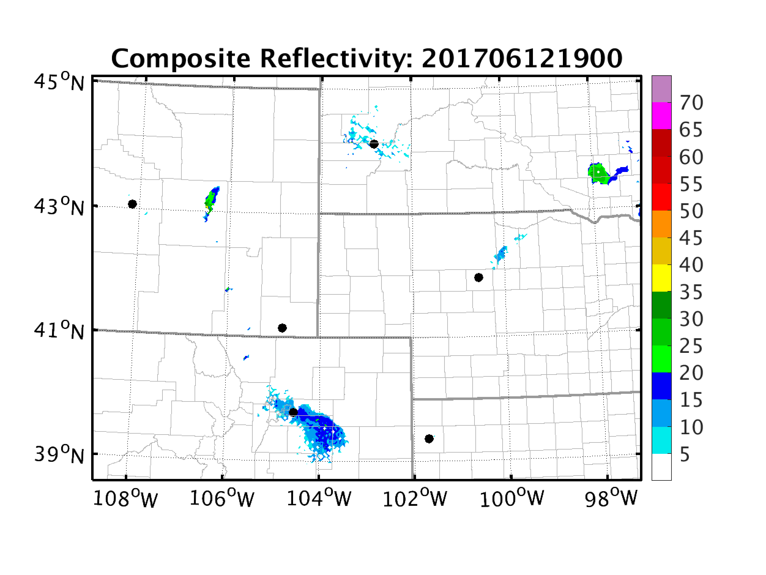
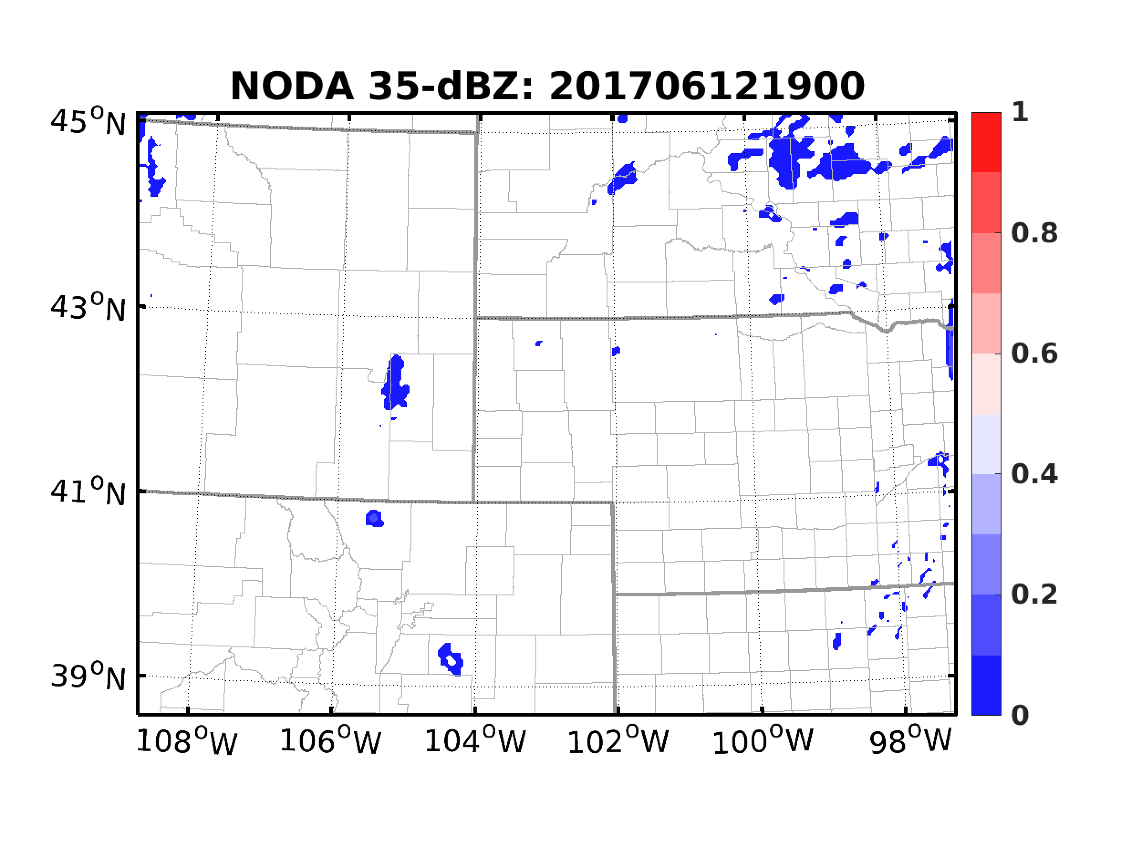
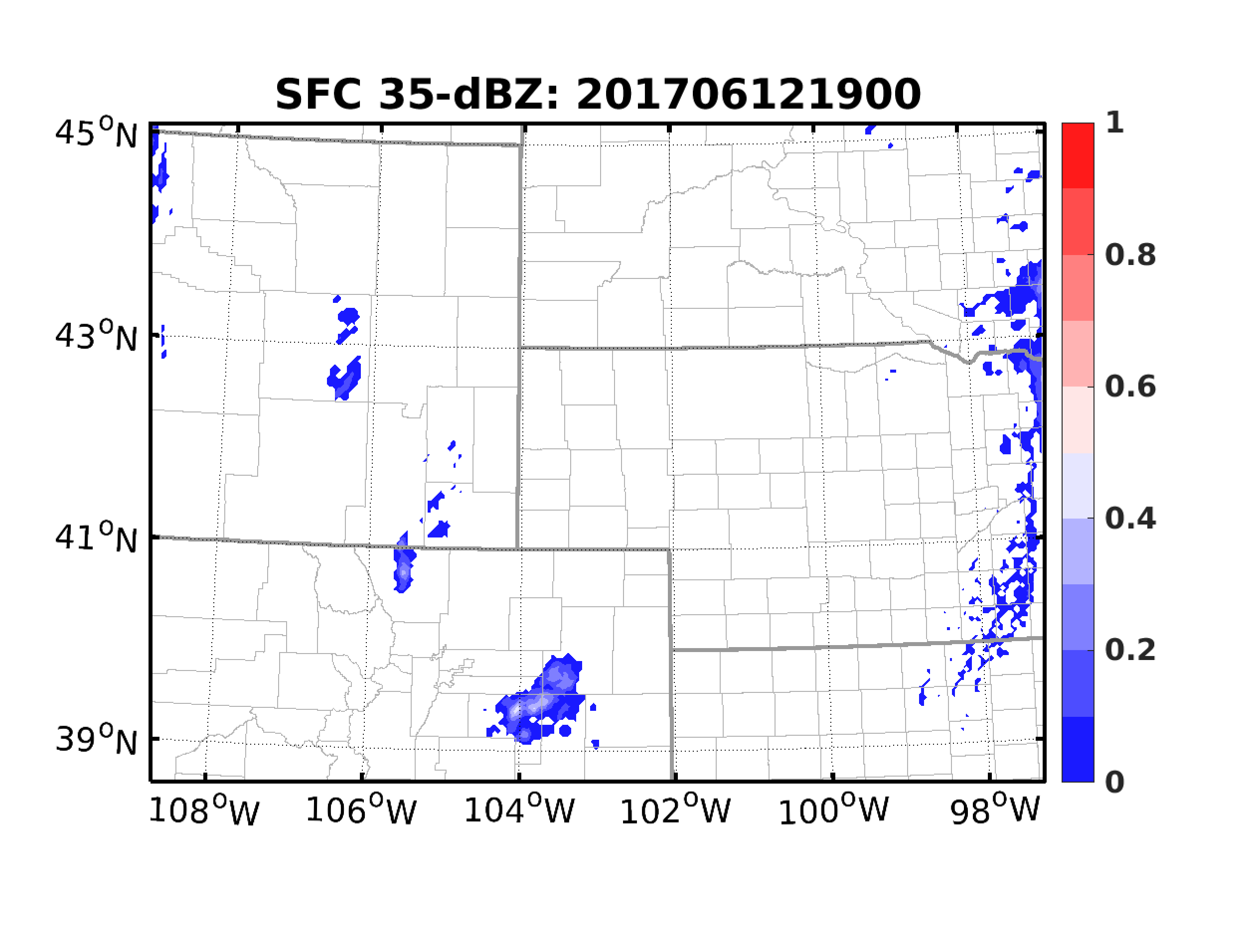
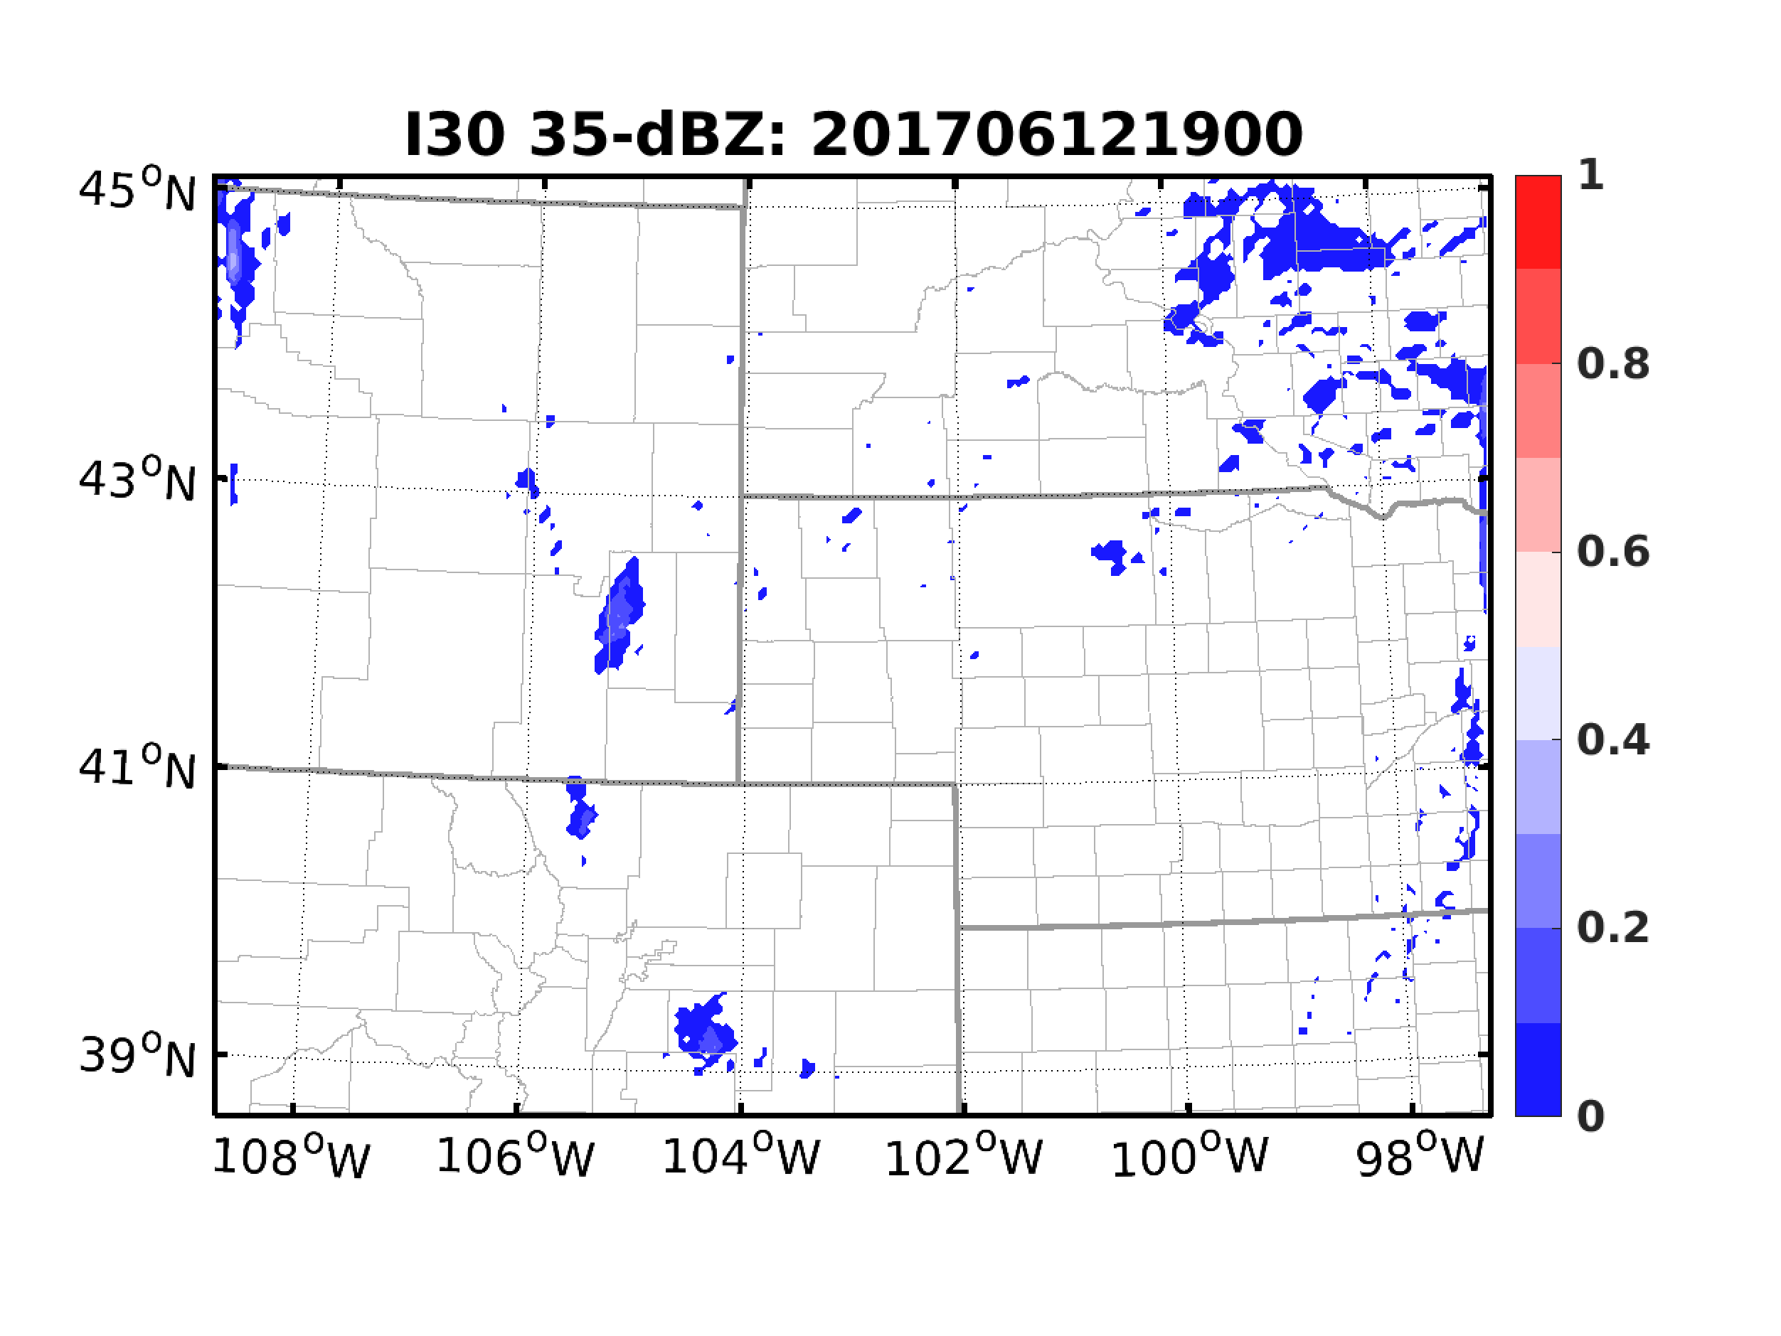
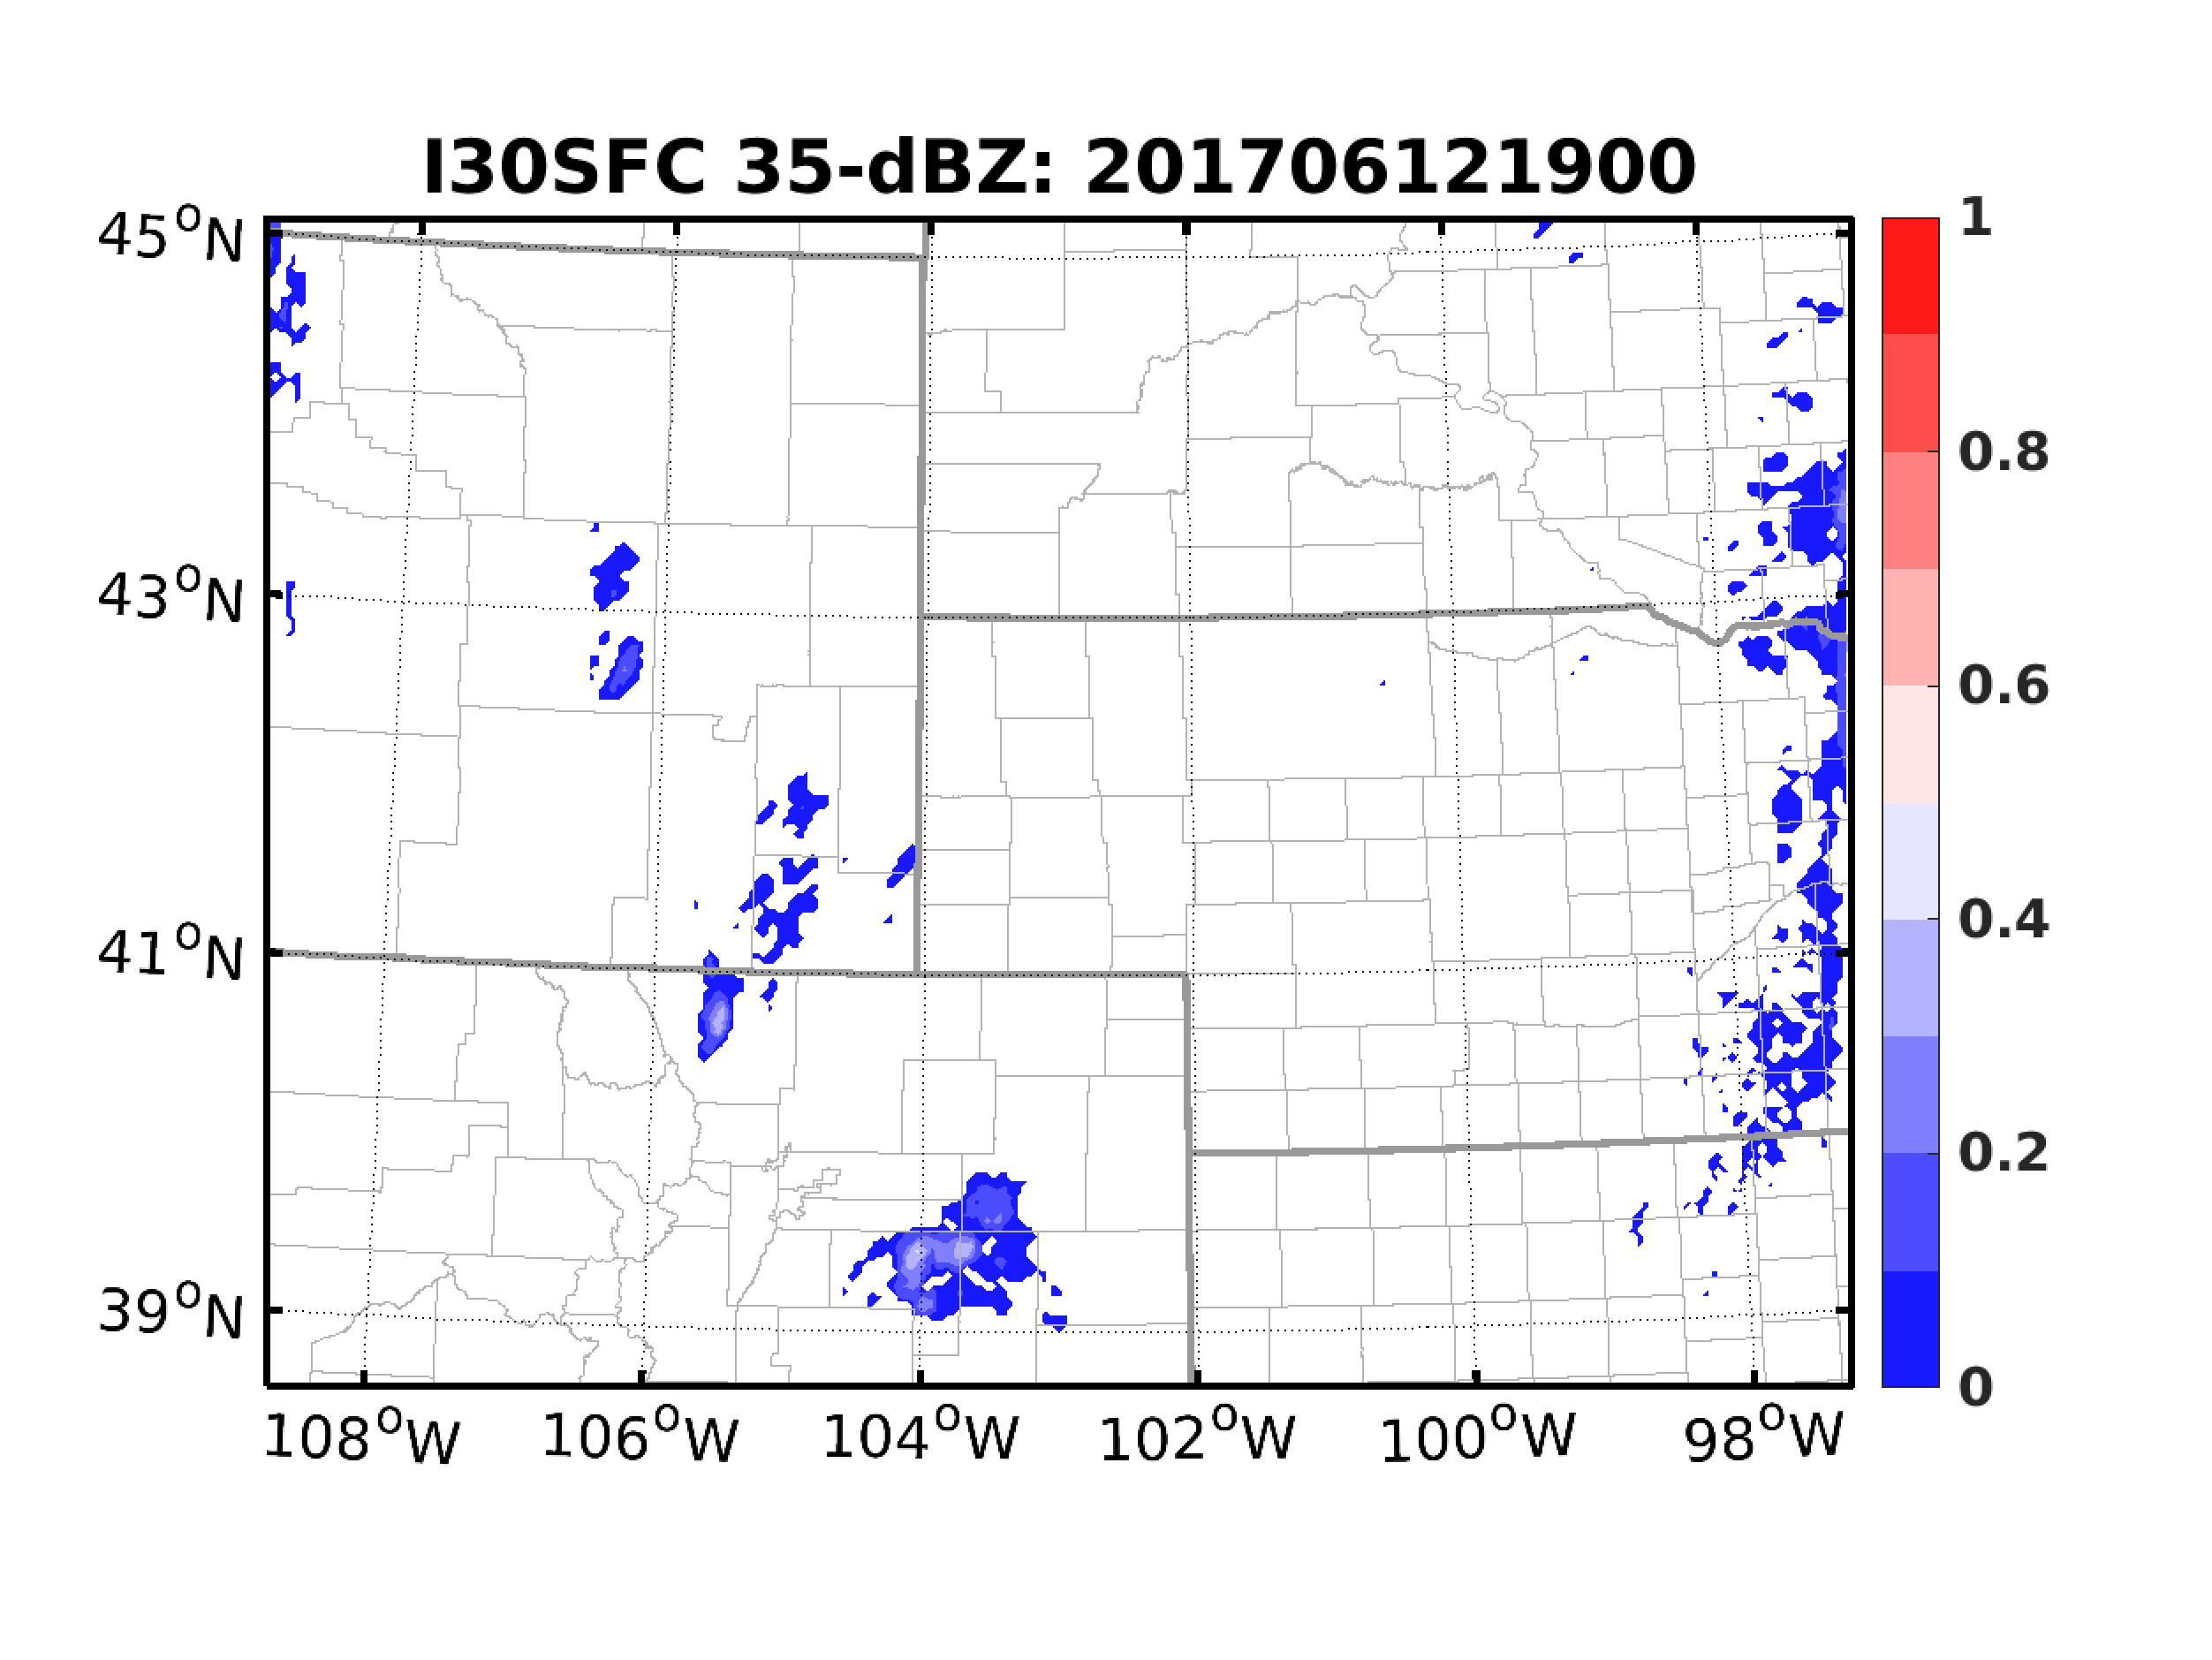
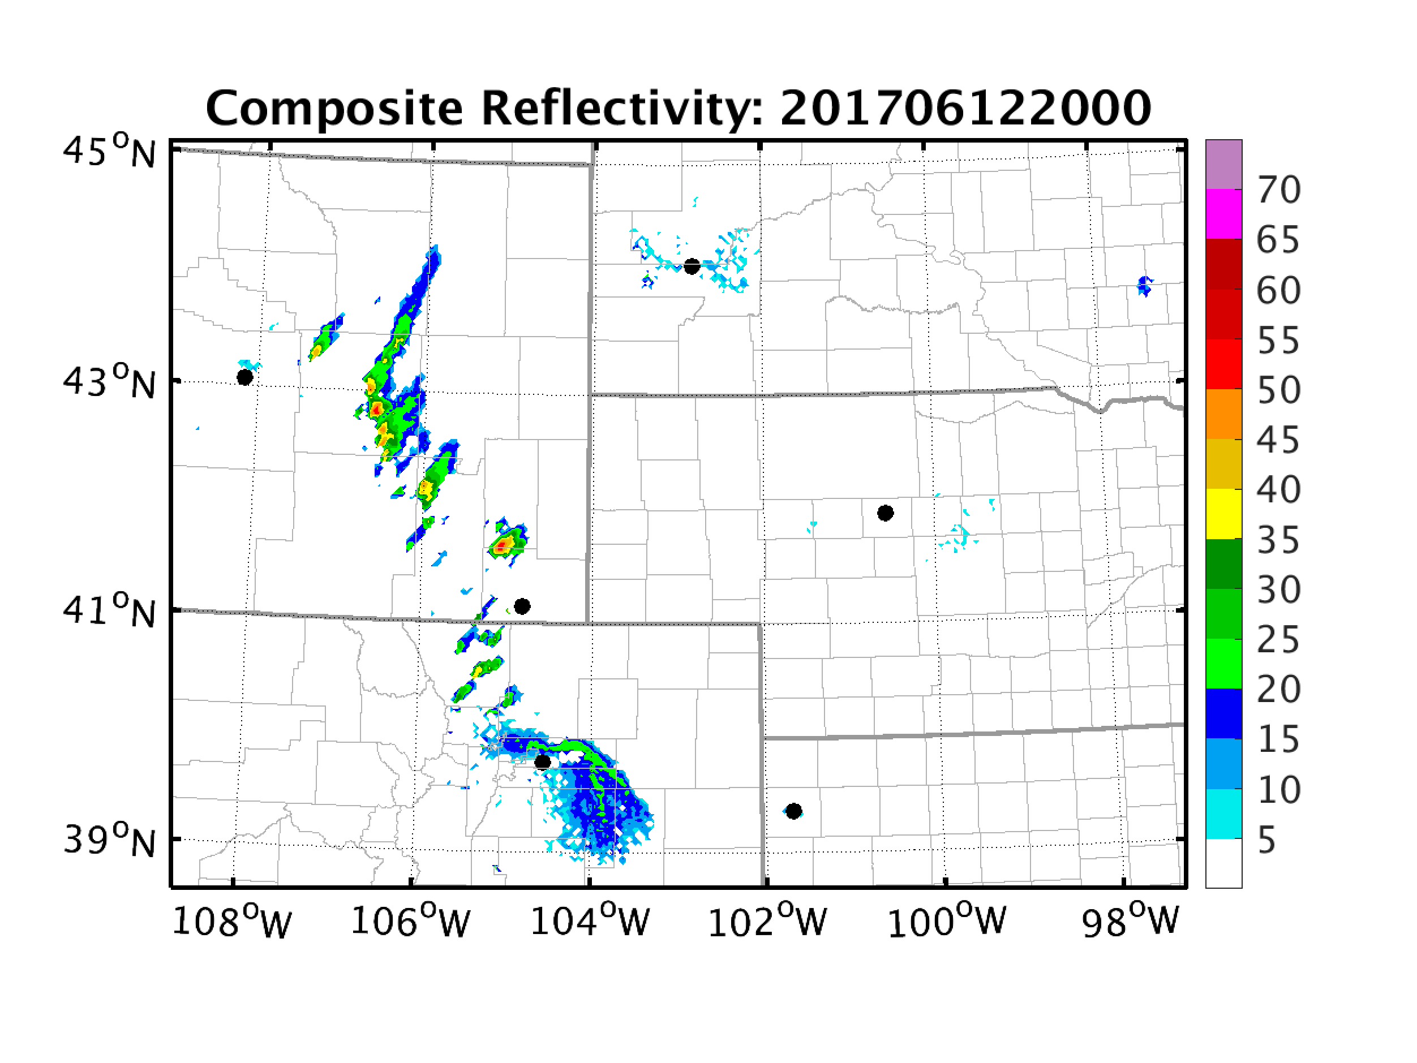
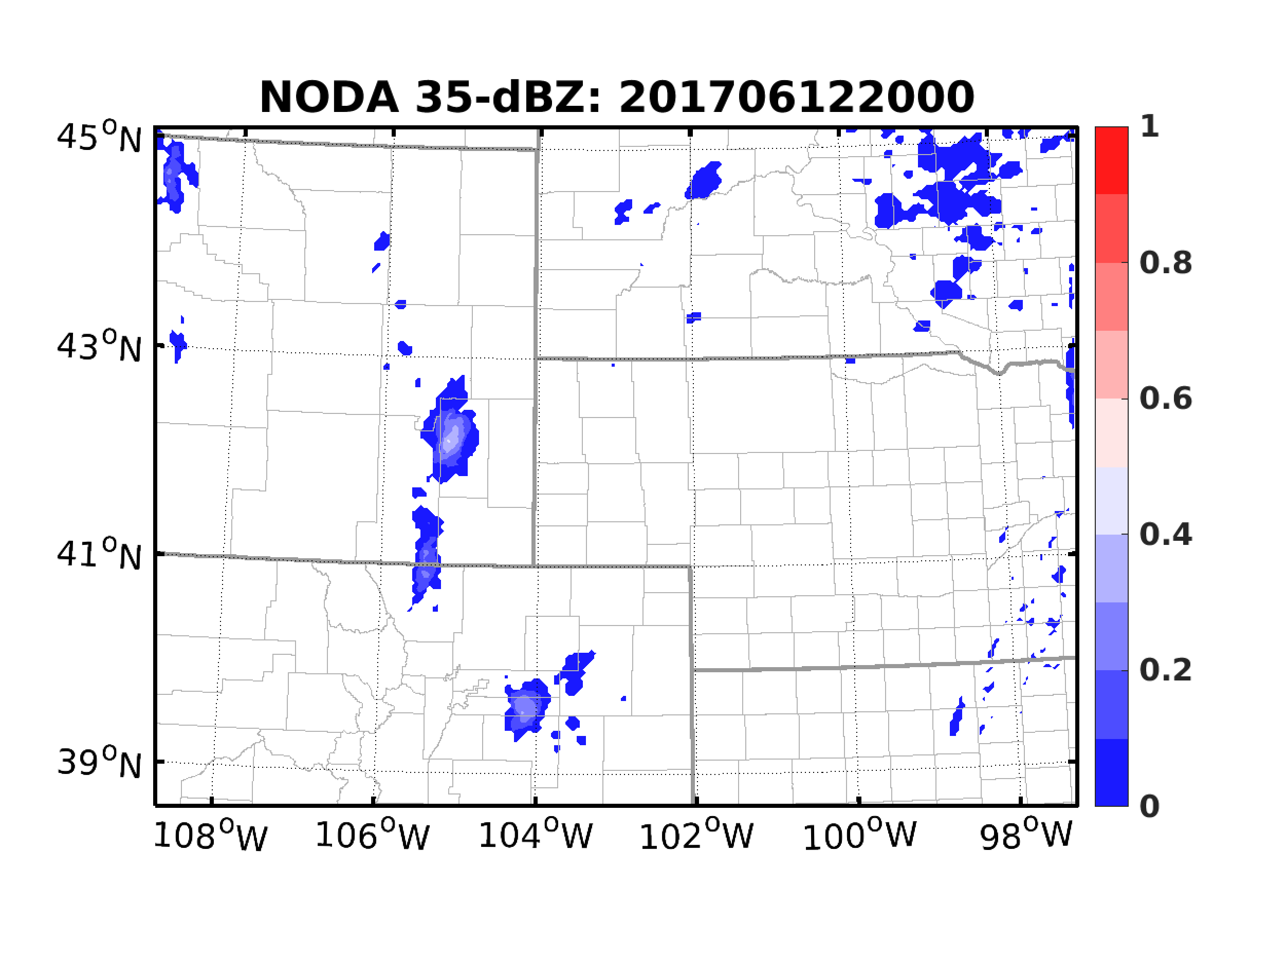
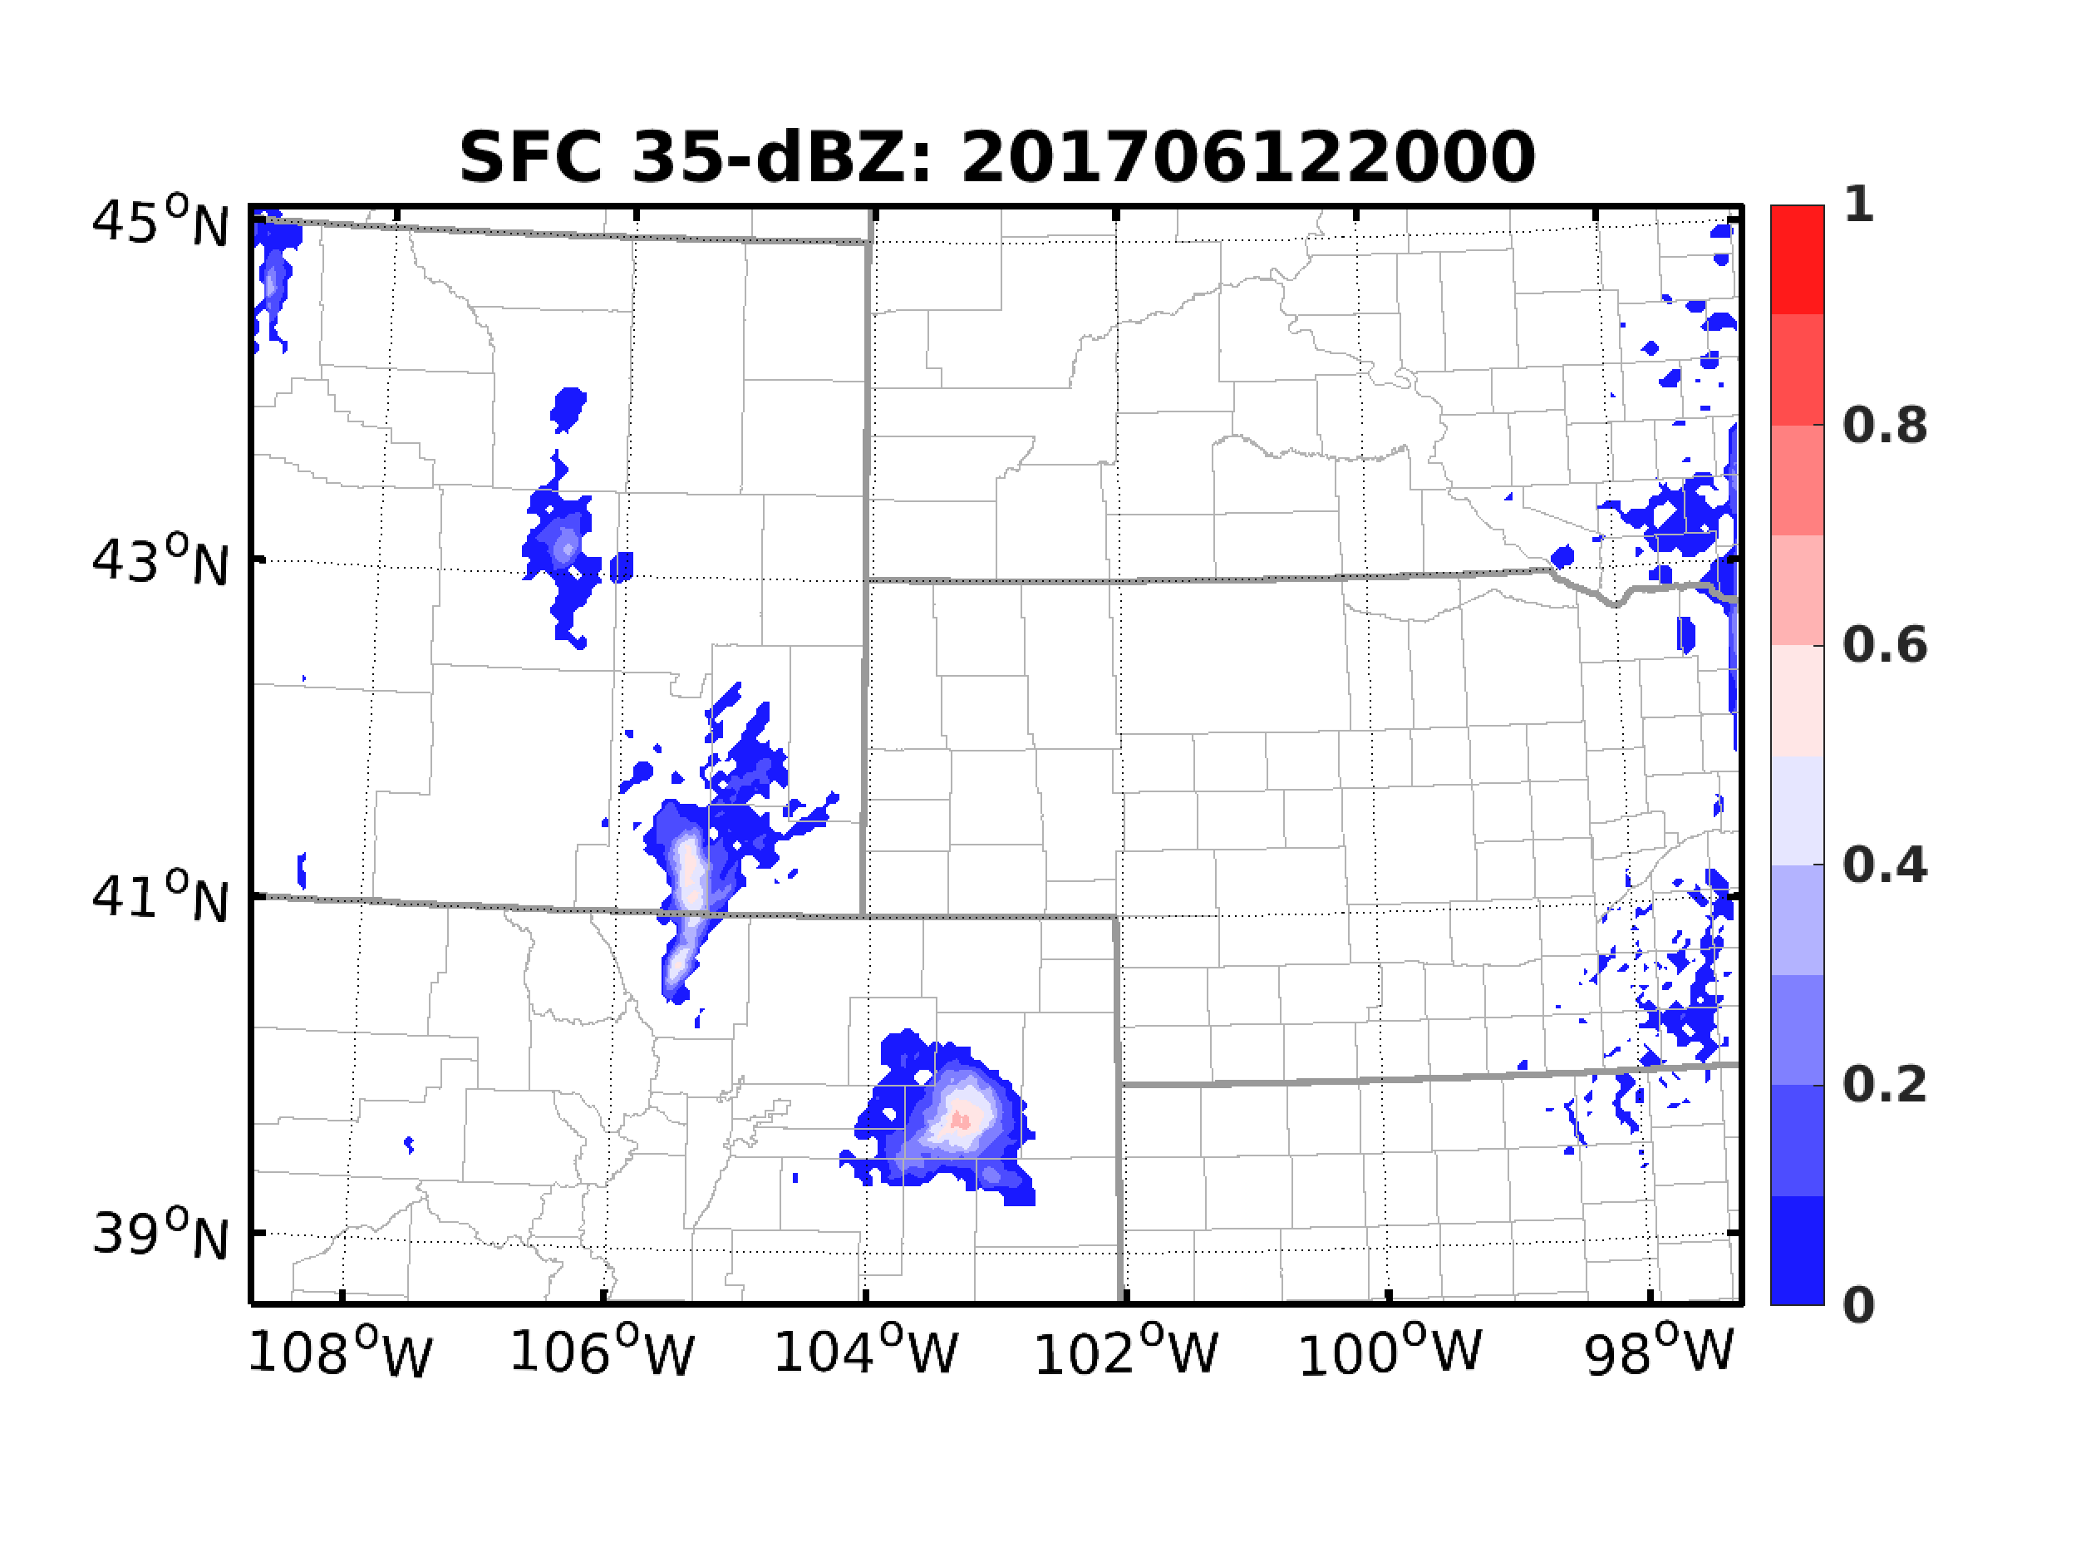
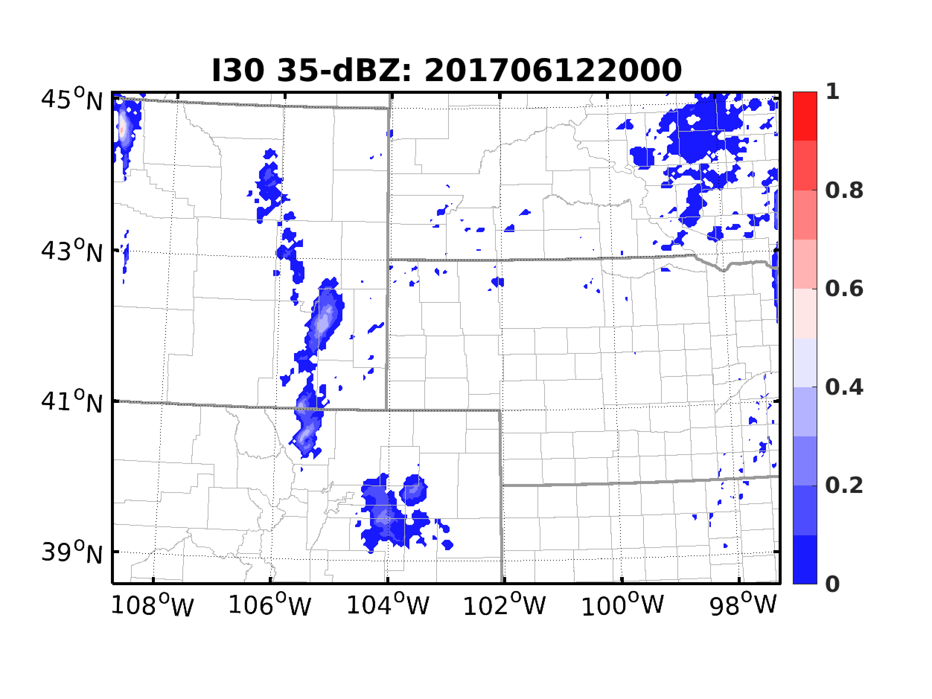
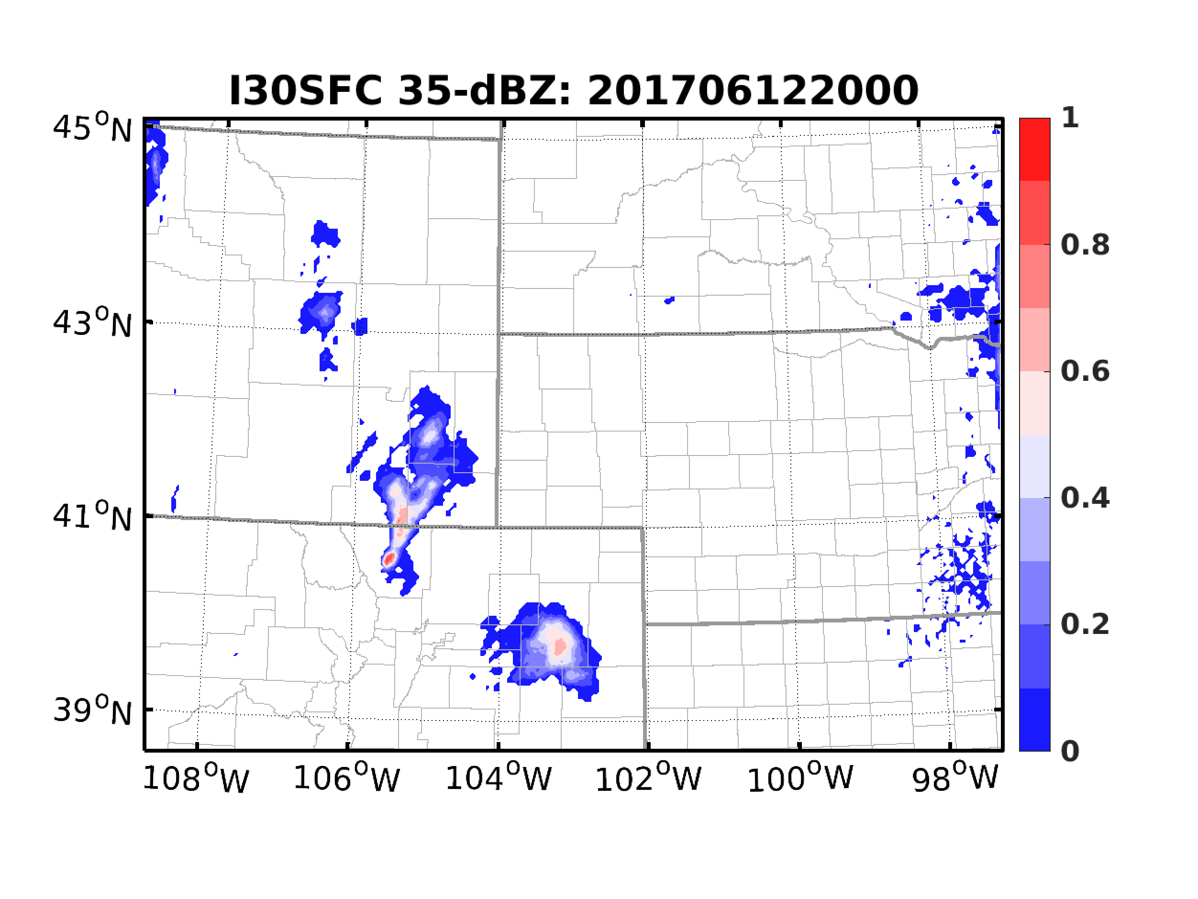
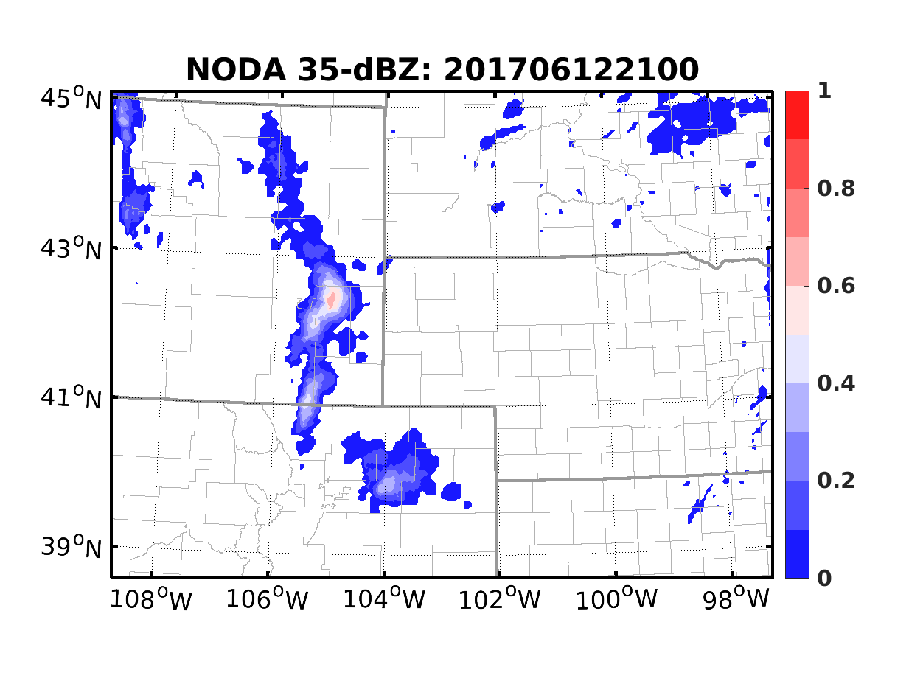
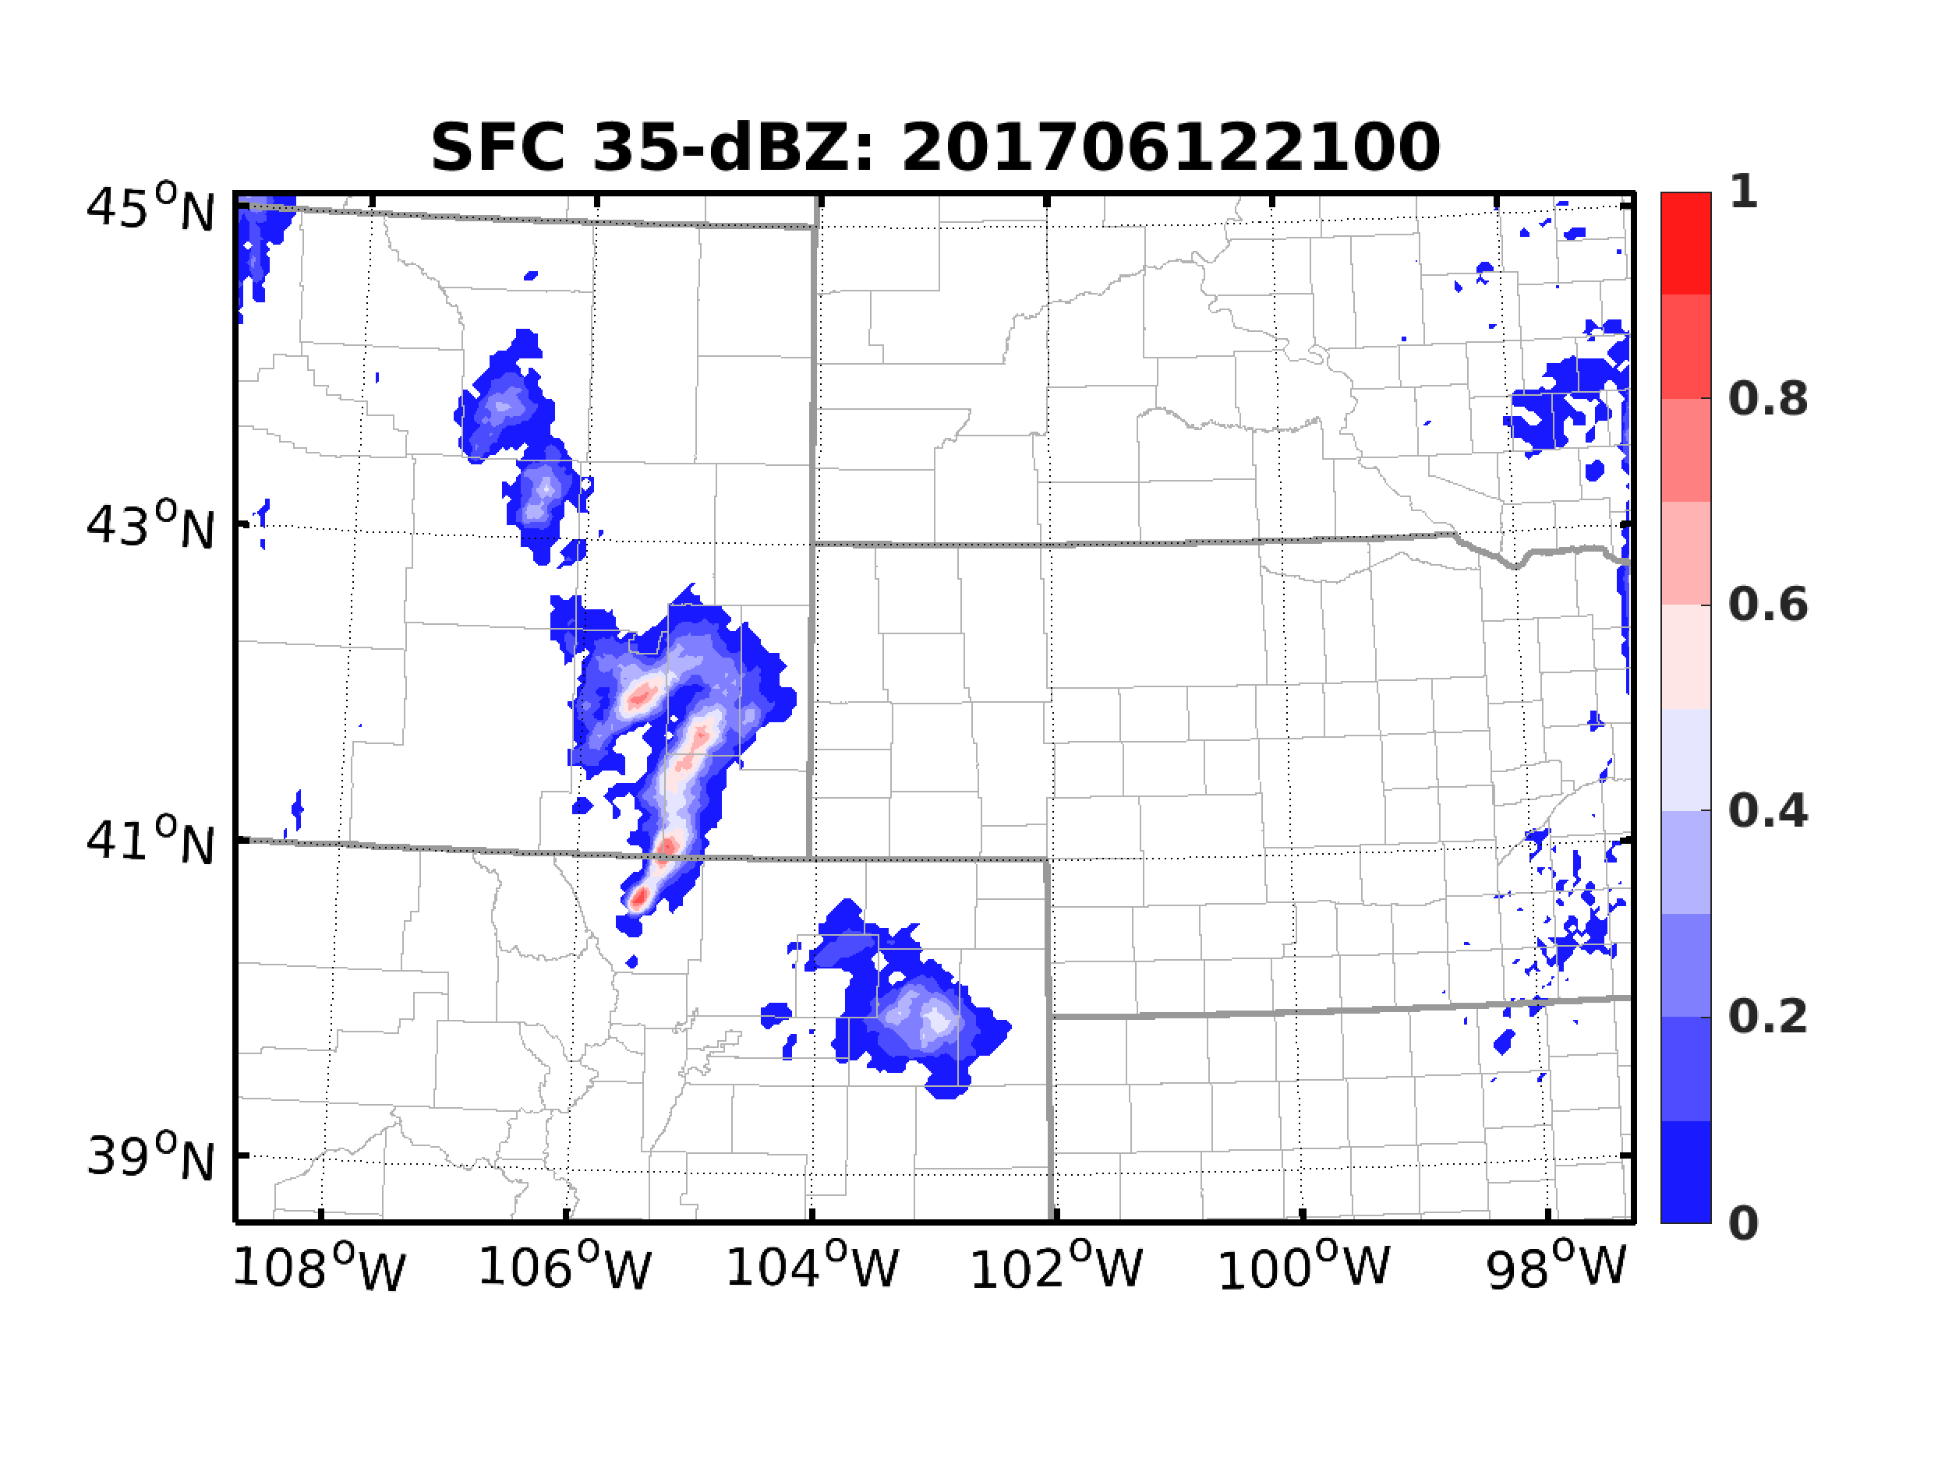
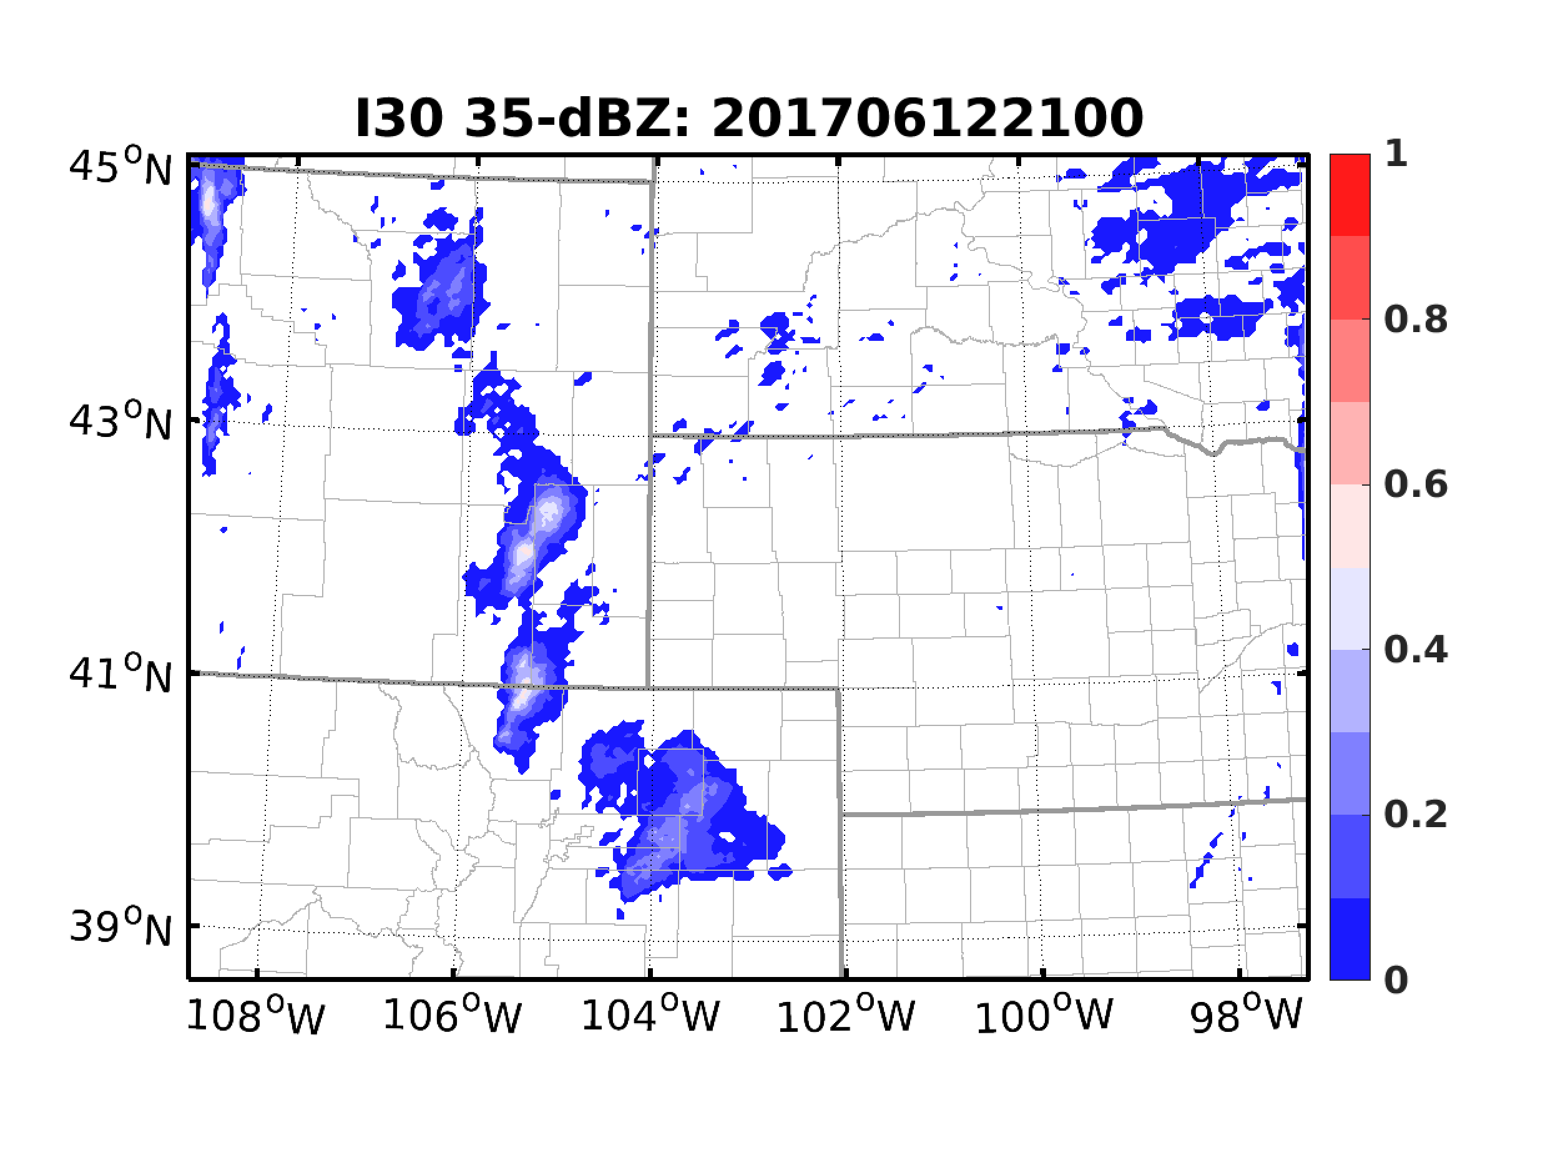
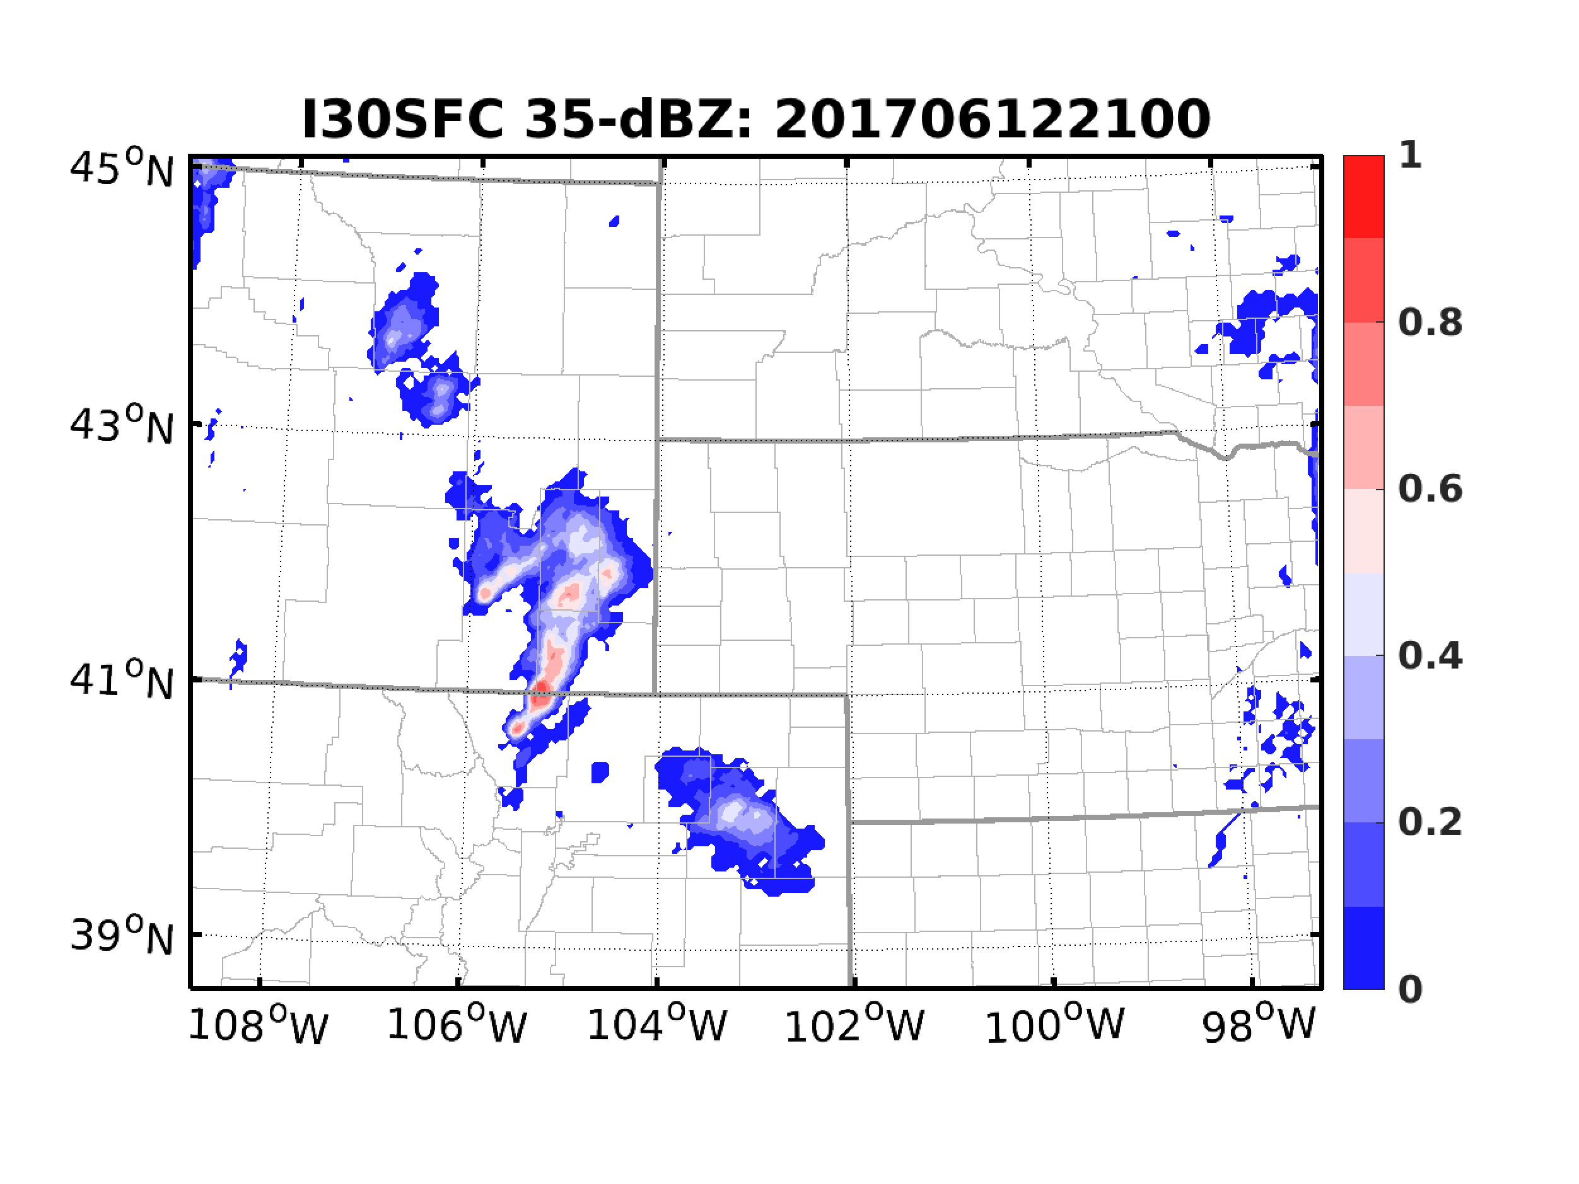
EnKF Analysis
Observations
NODA
SFC
I30
I30SFC

Slide 9
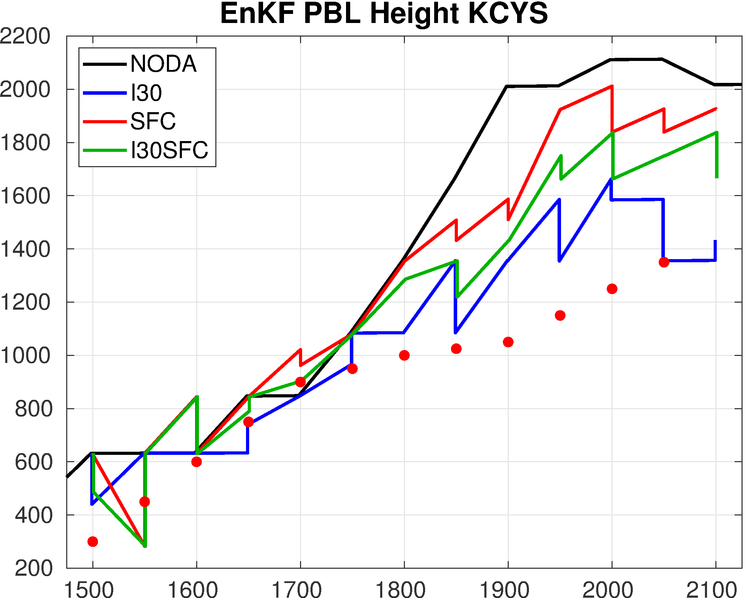
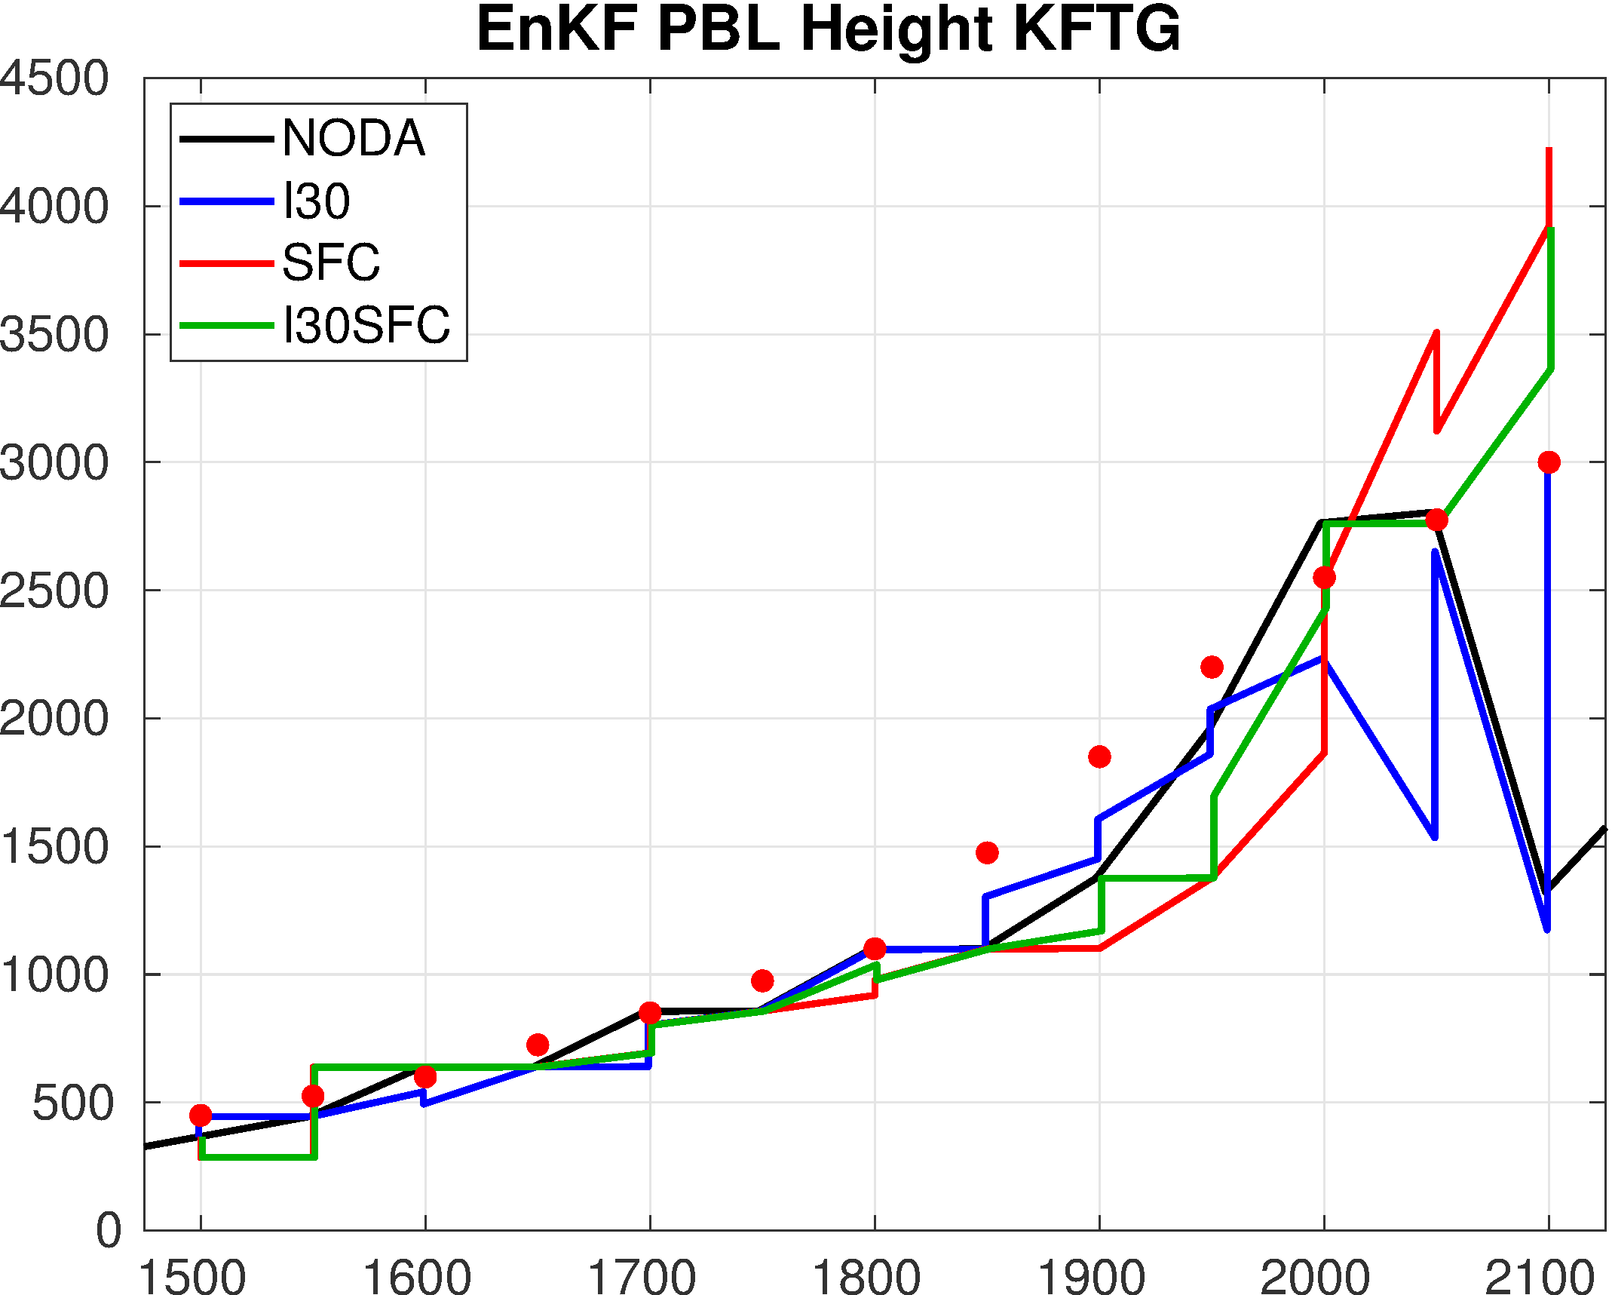
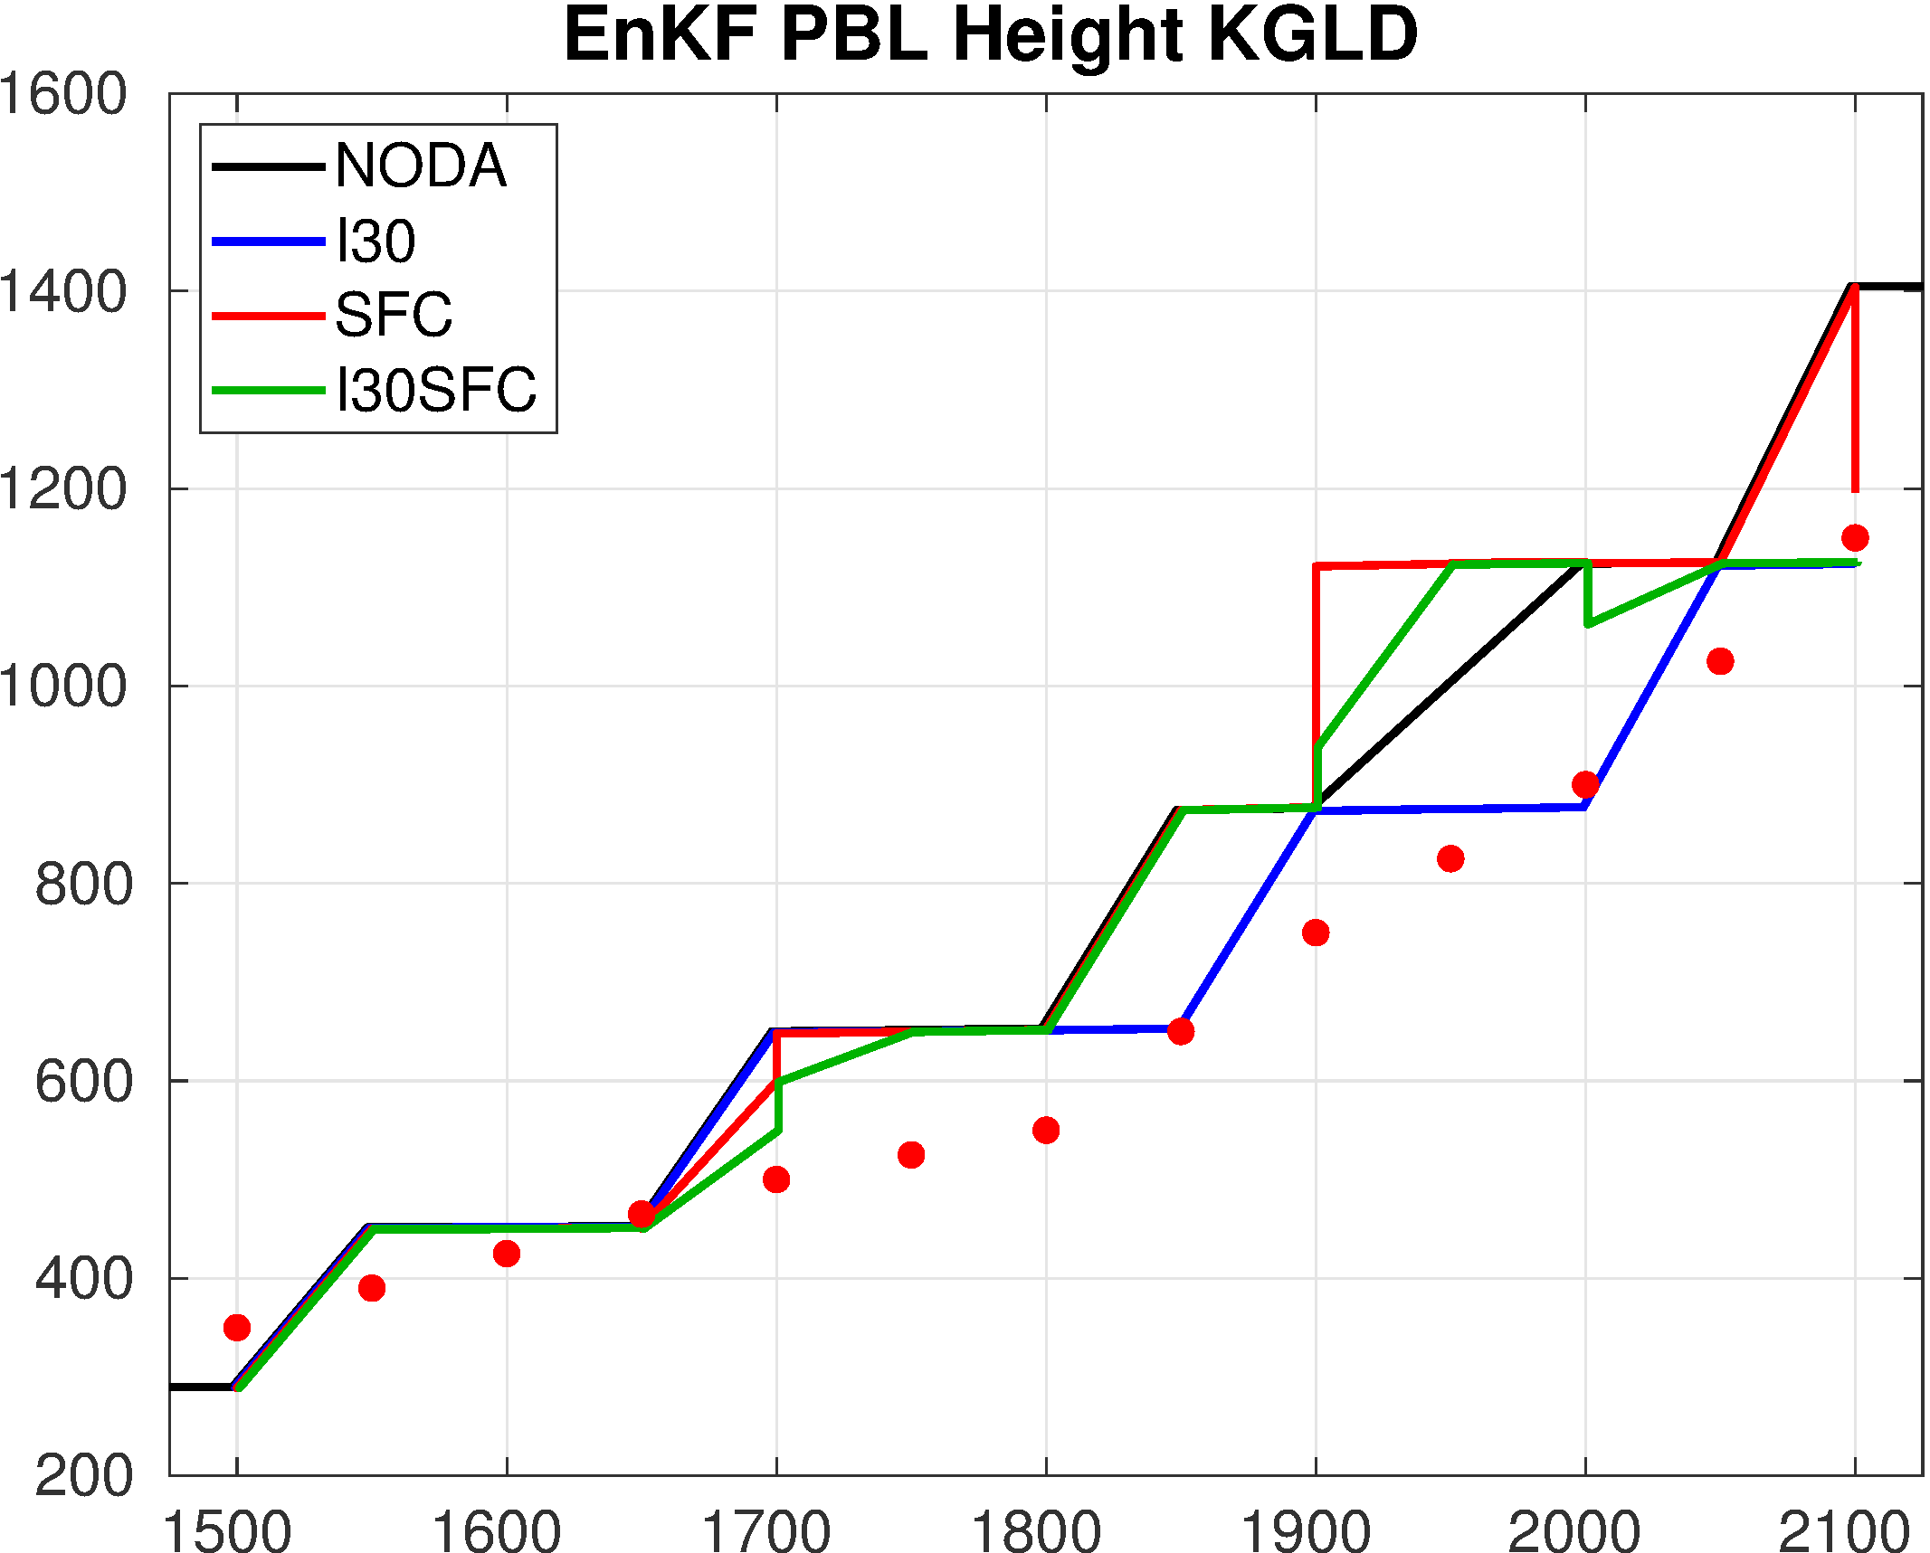
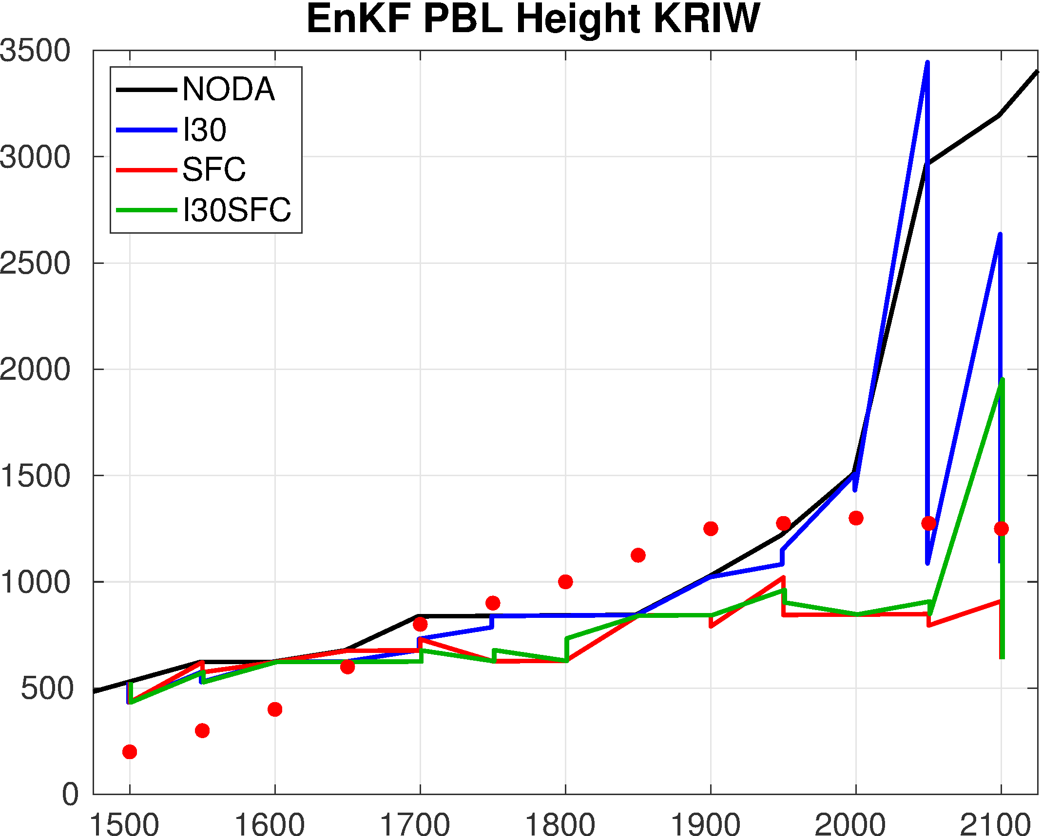
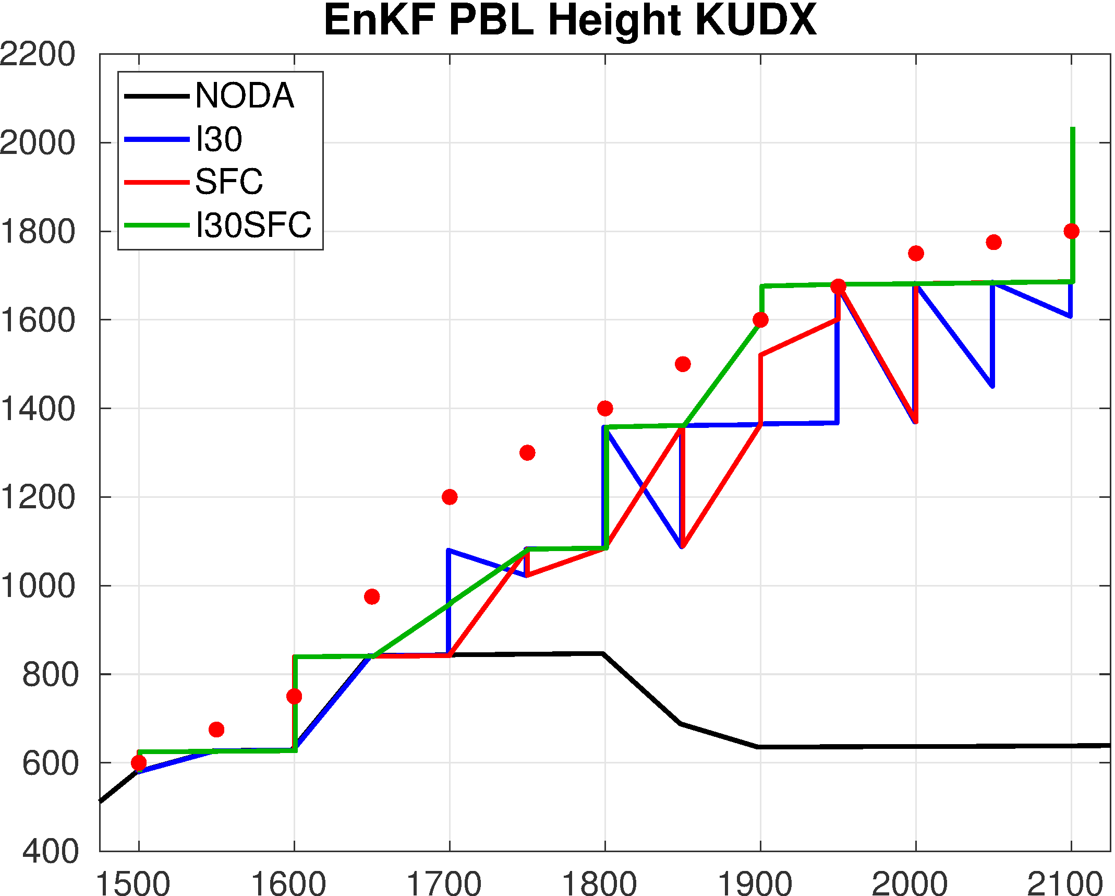
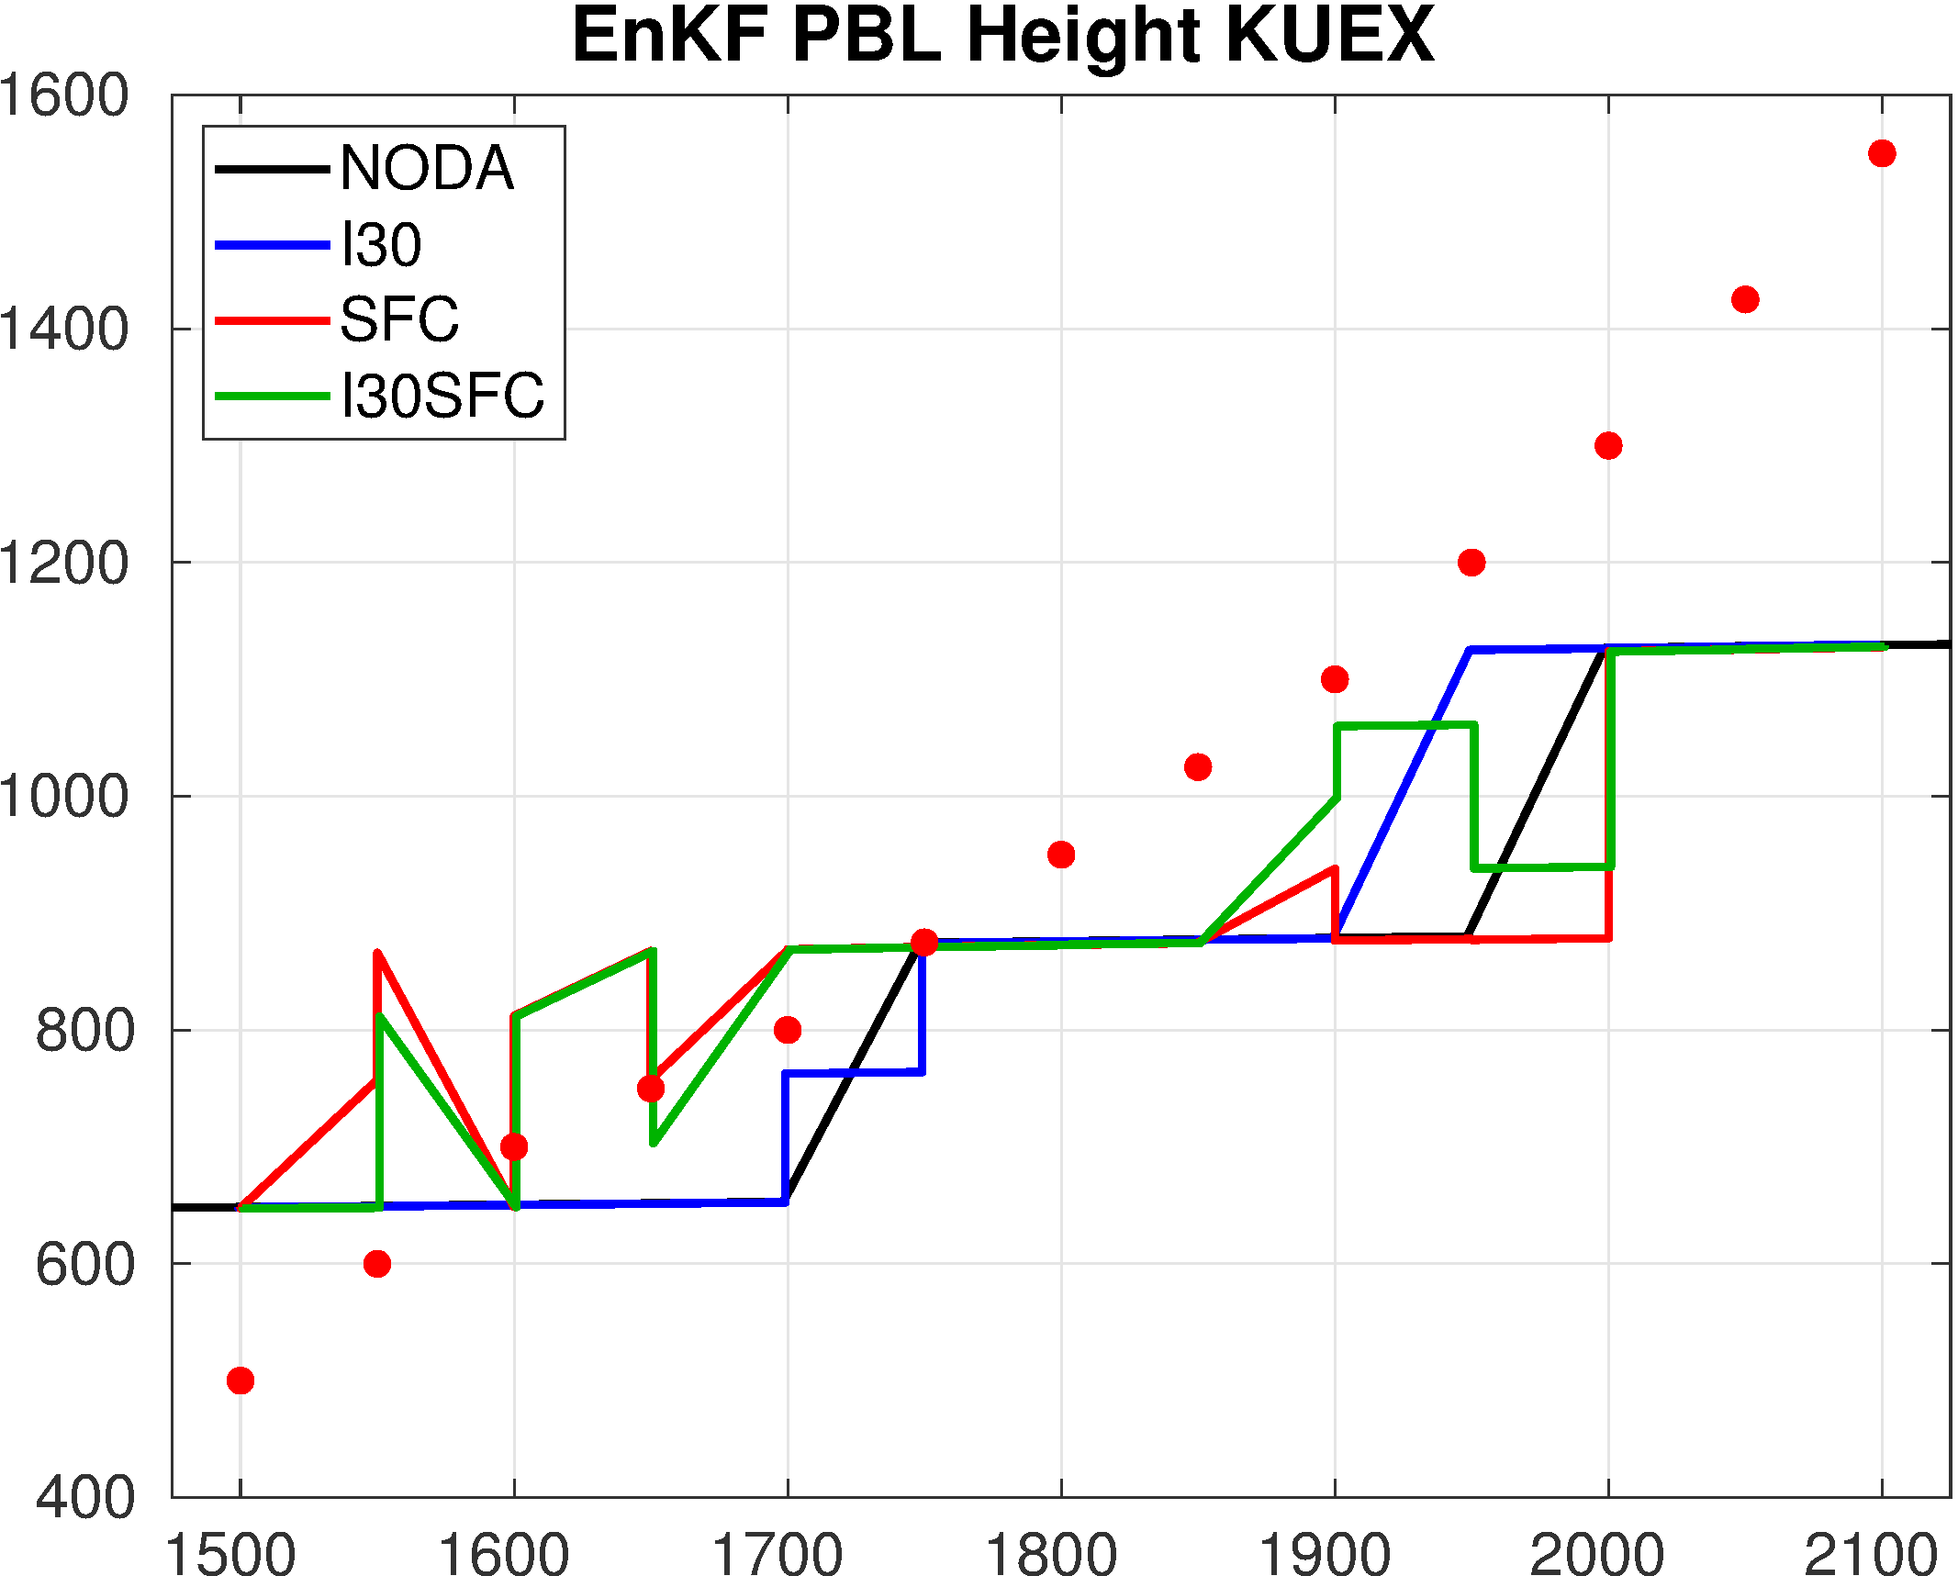
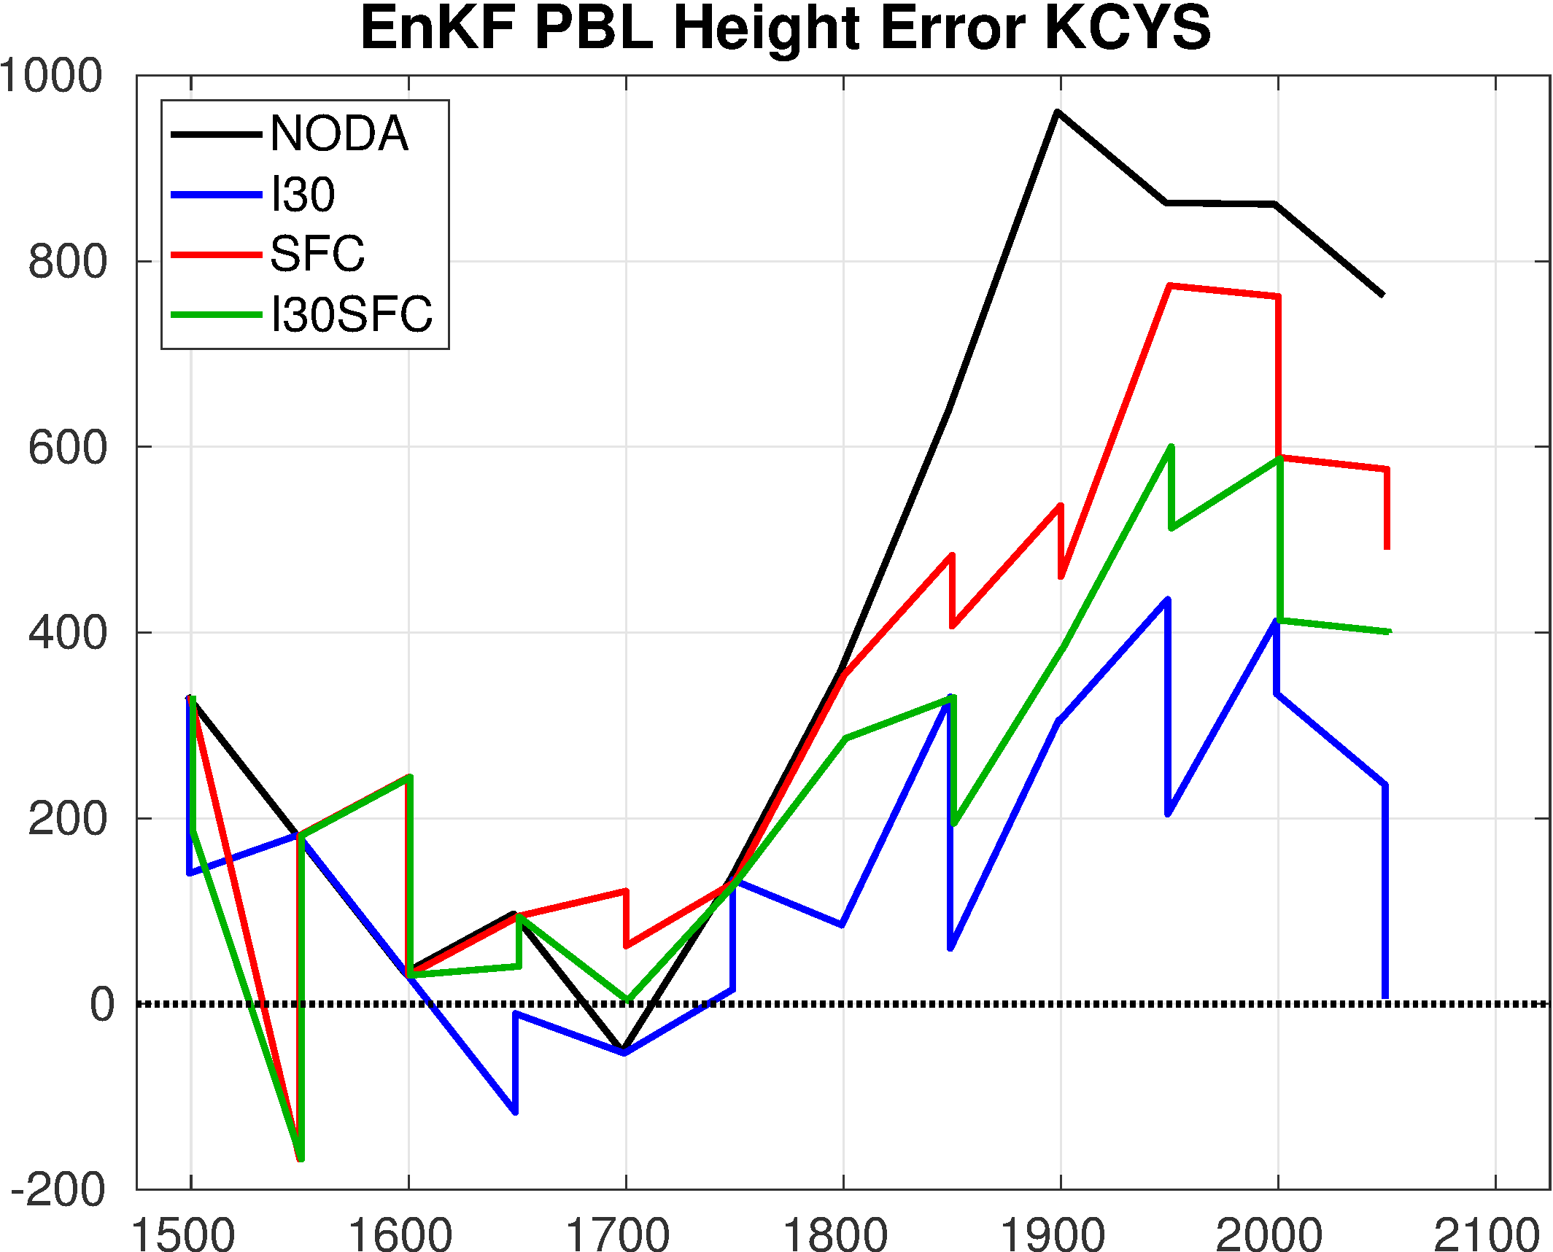
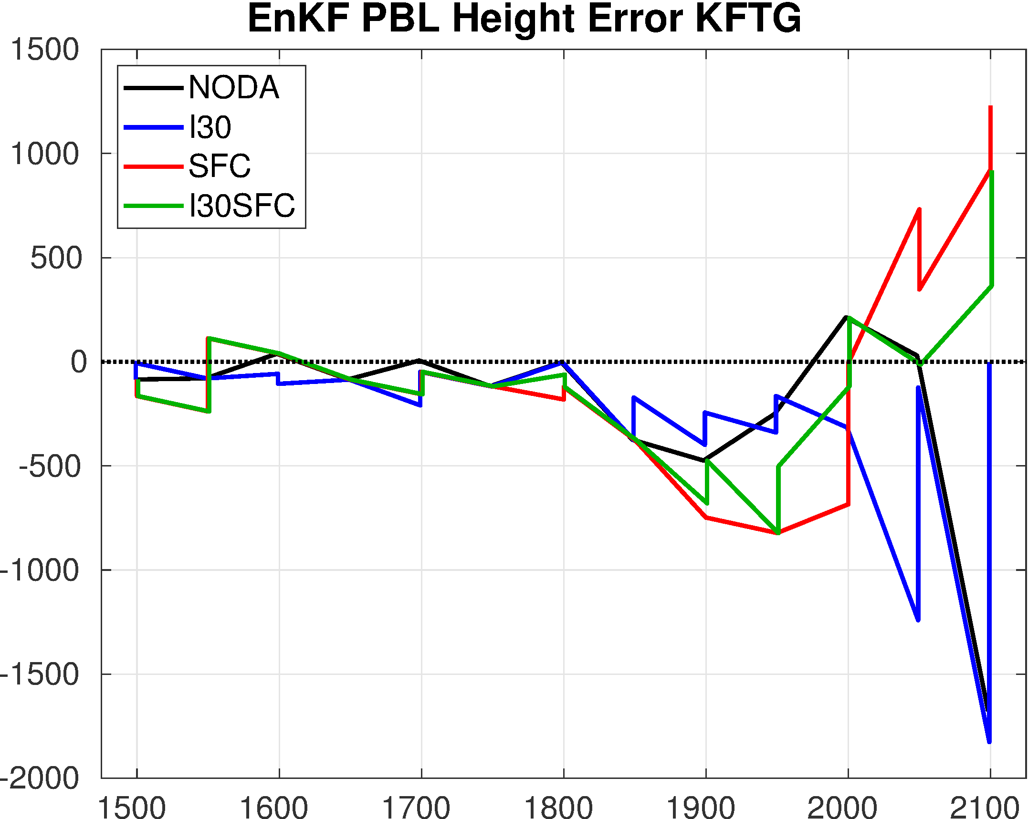
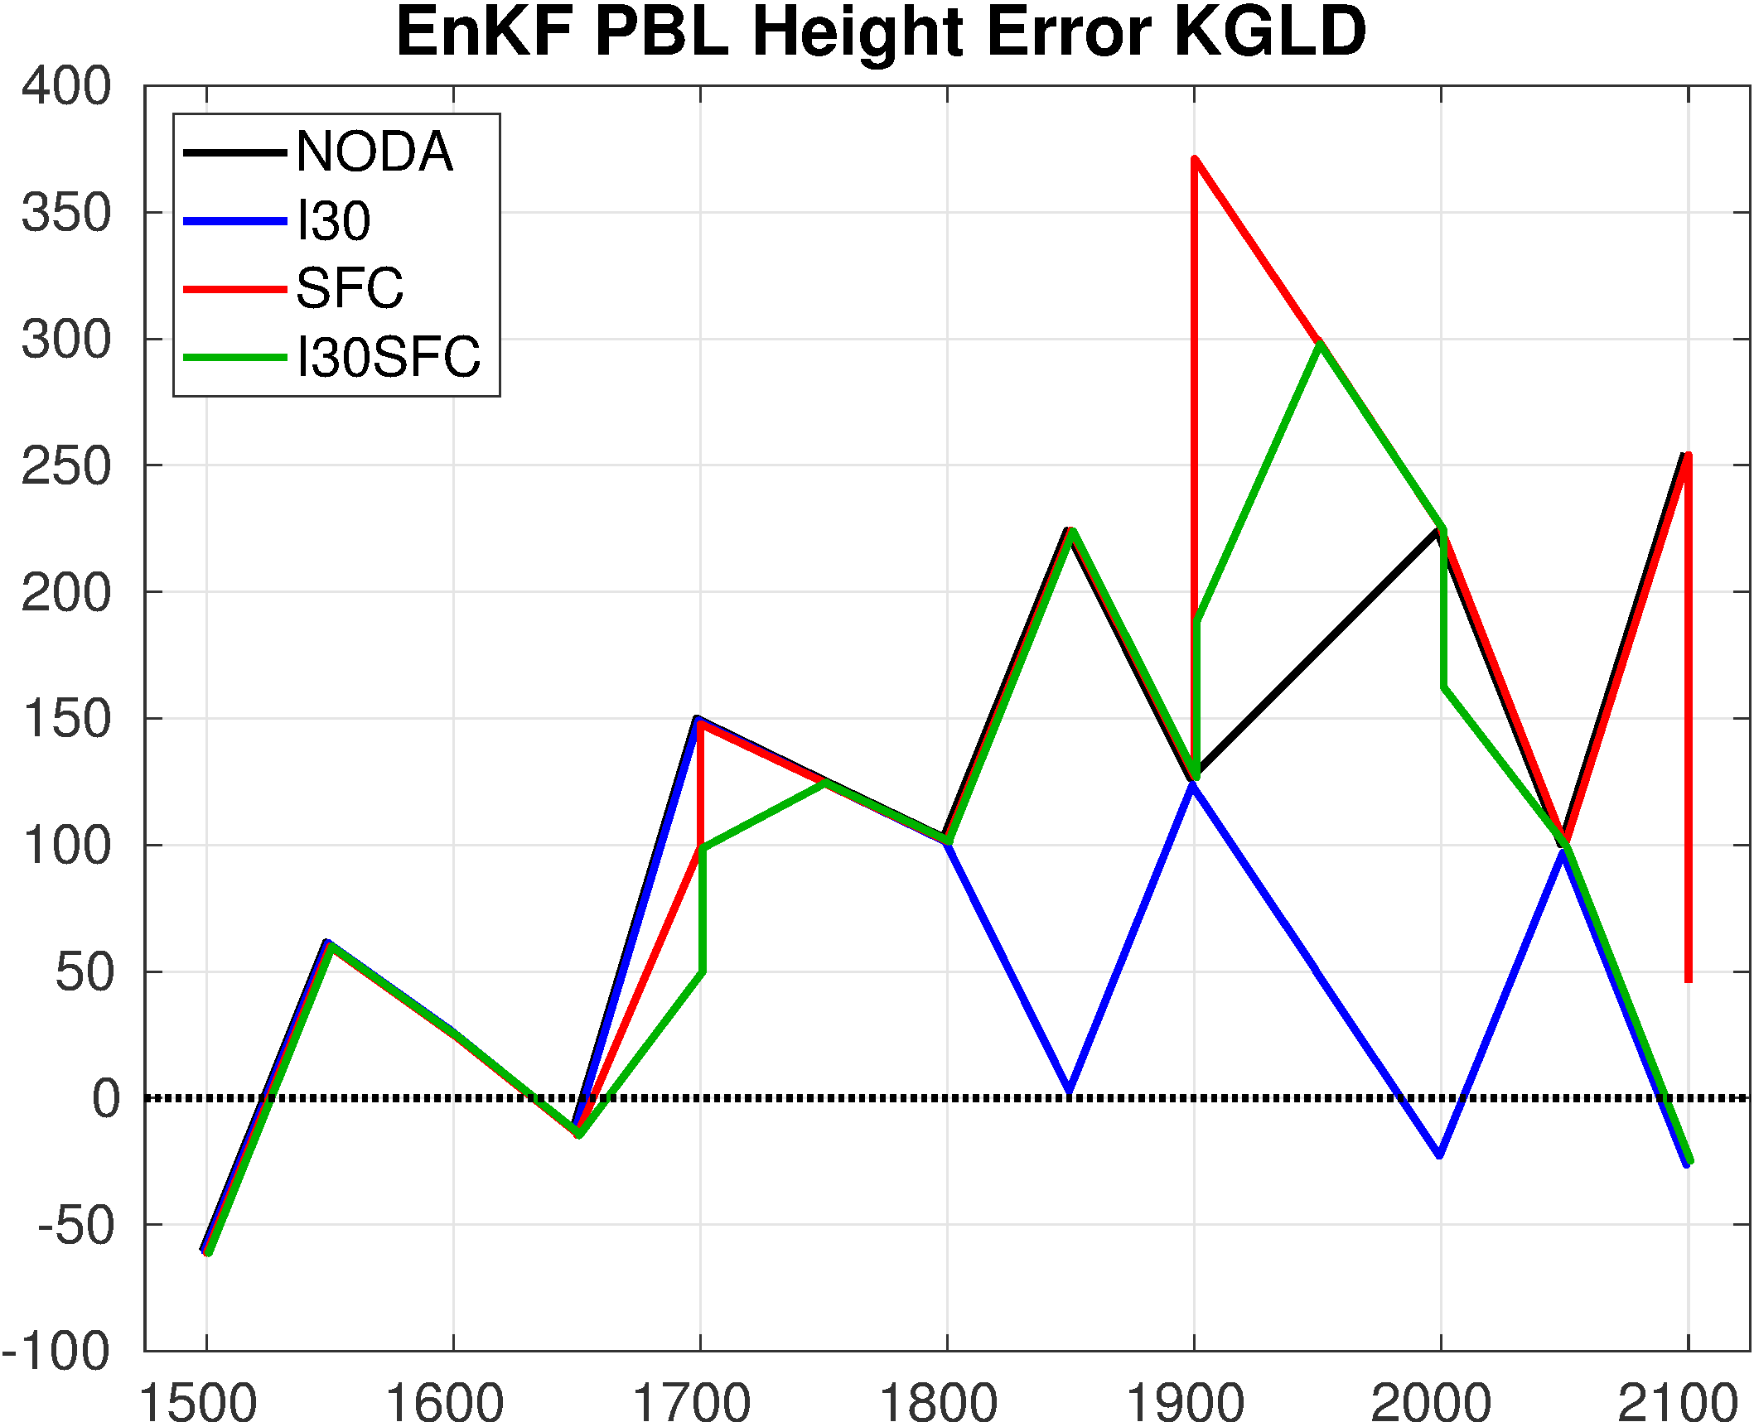
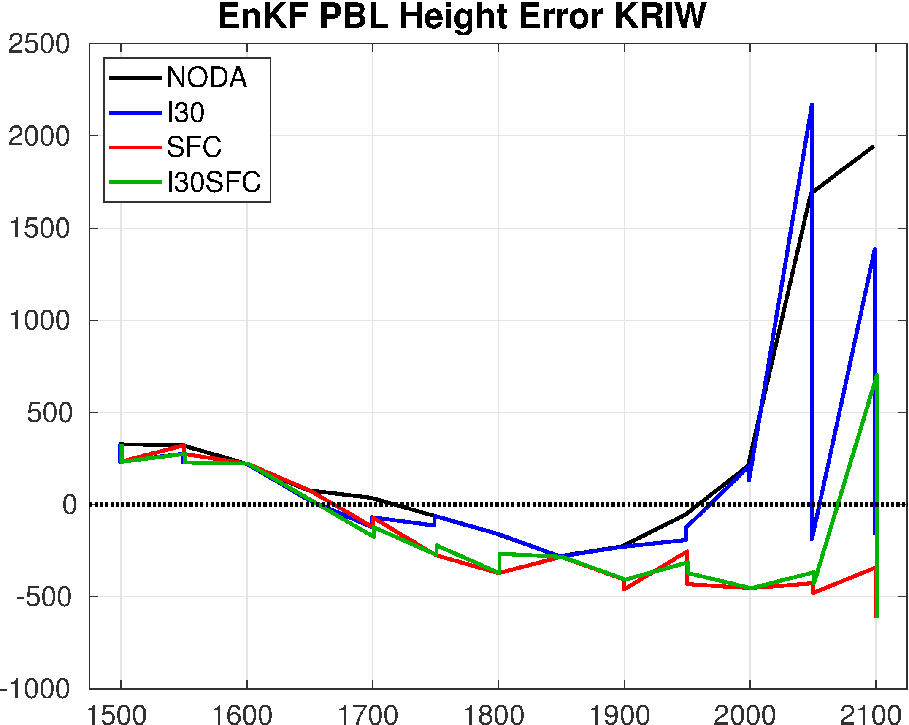
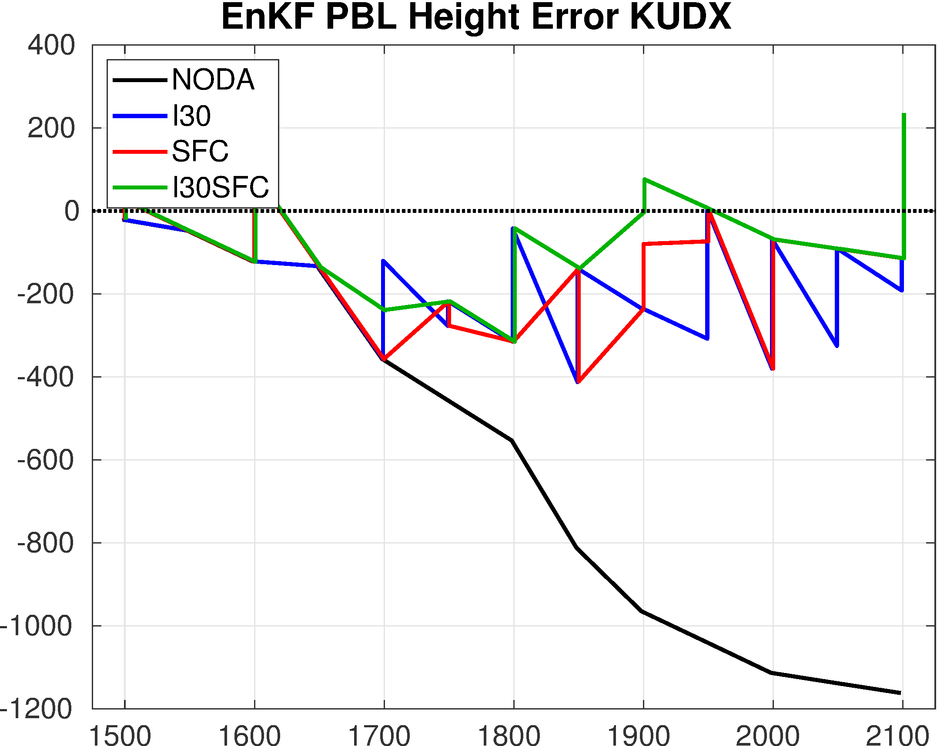
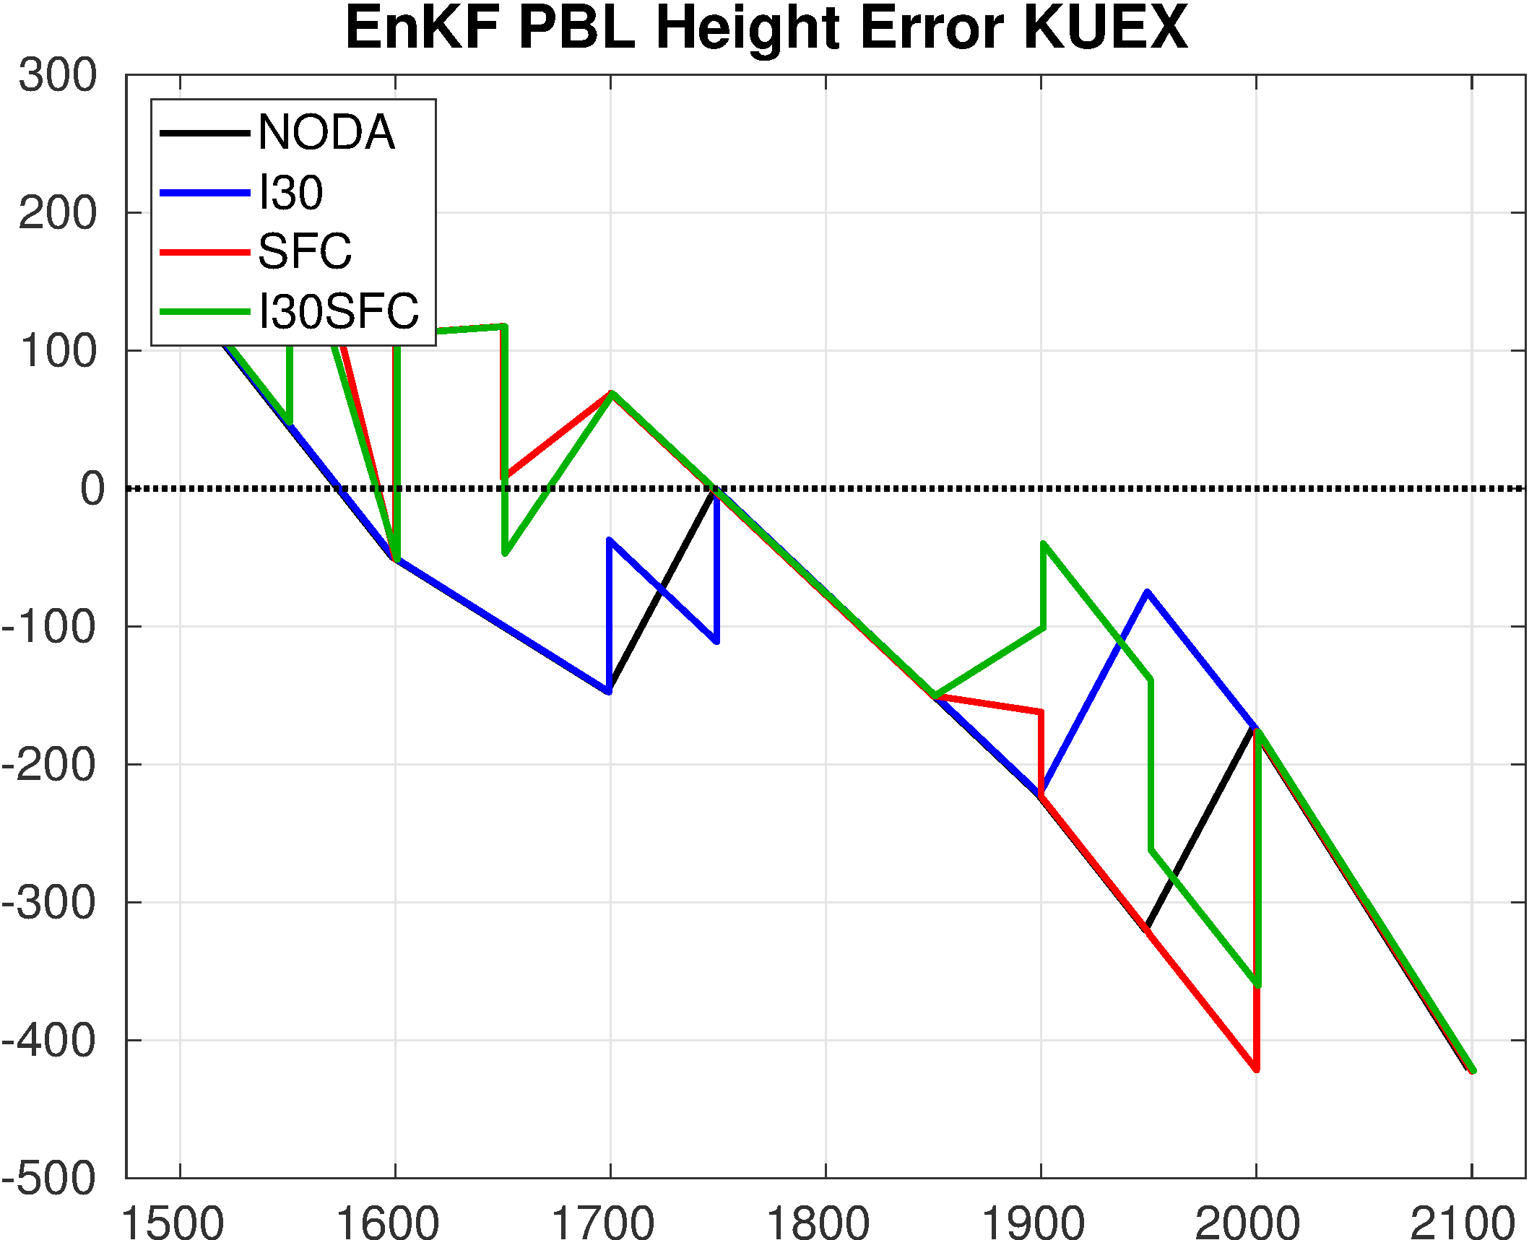
Observation-Space Verifications

Slide 10
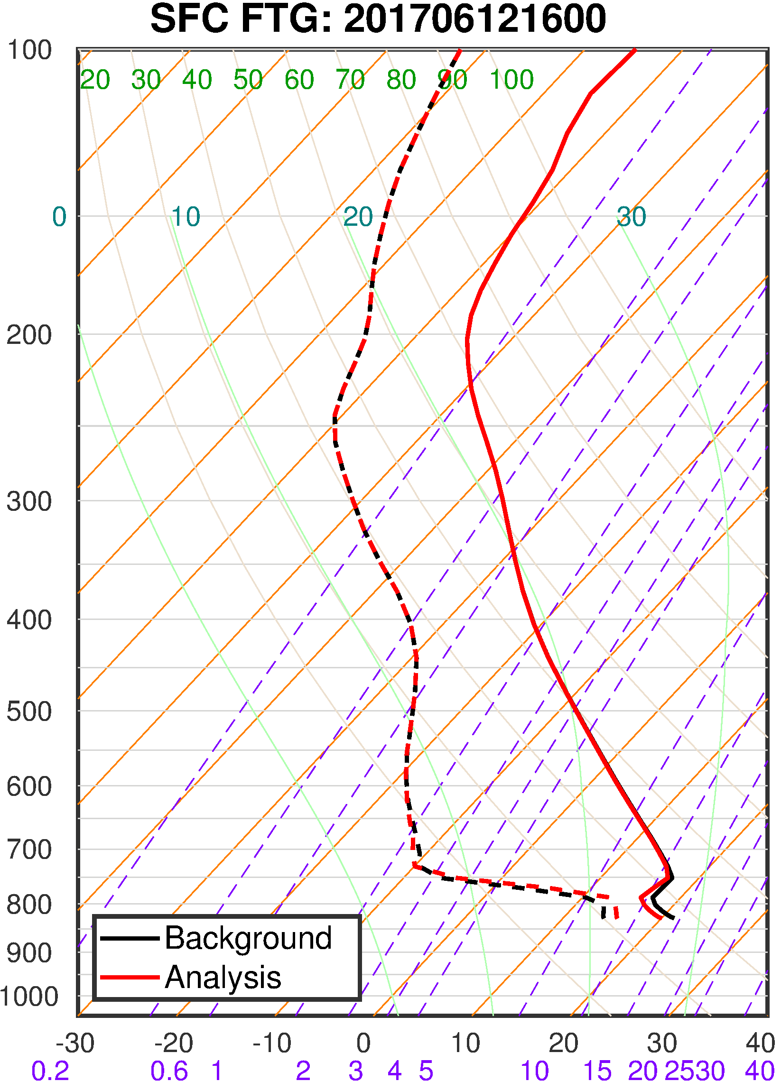
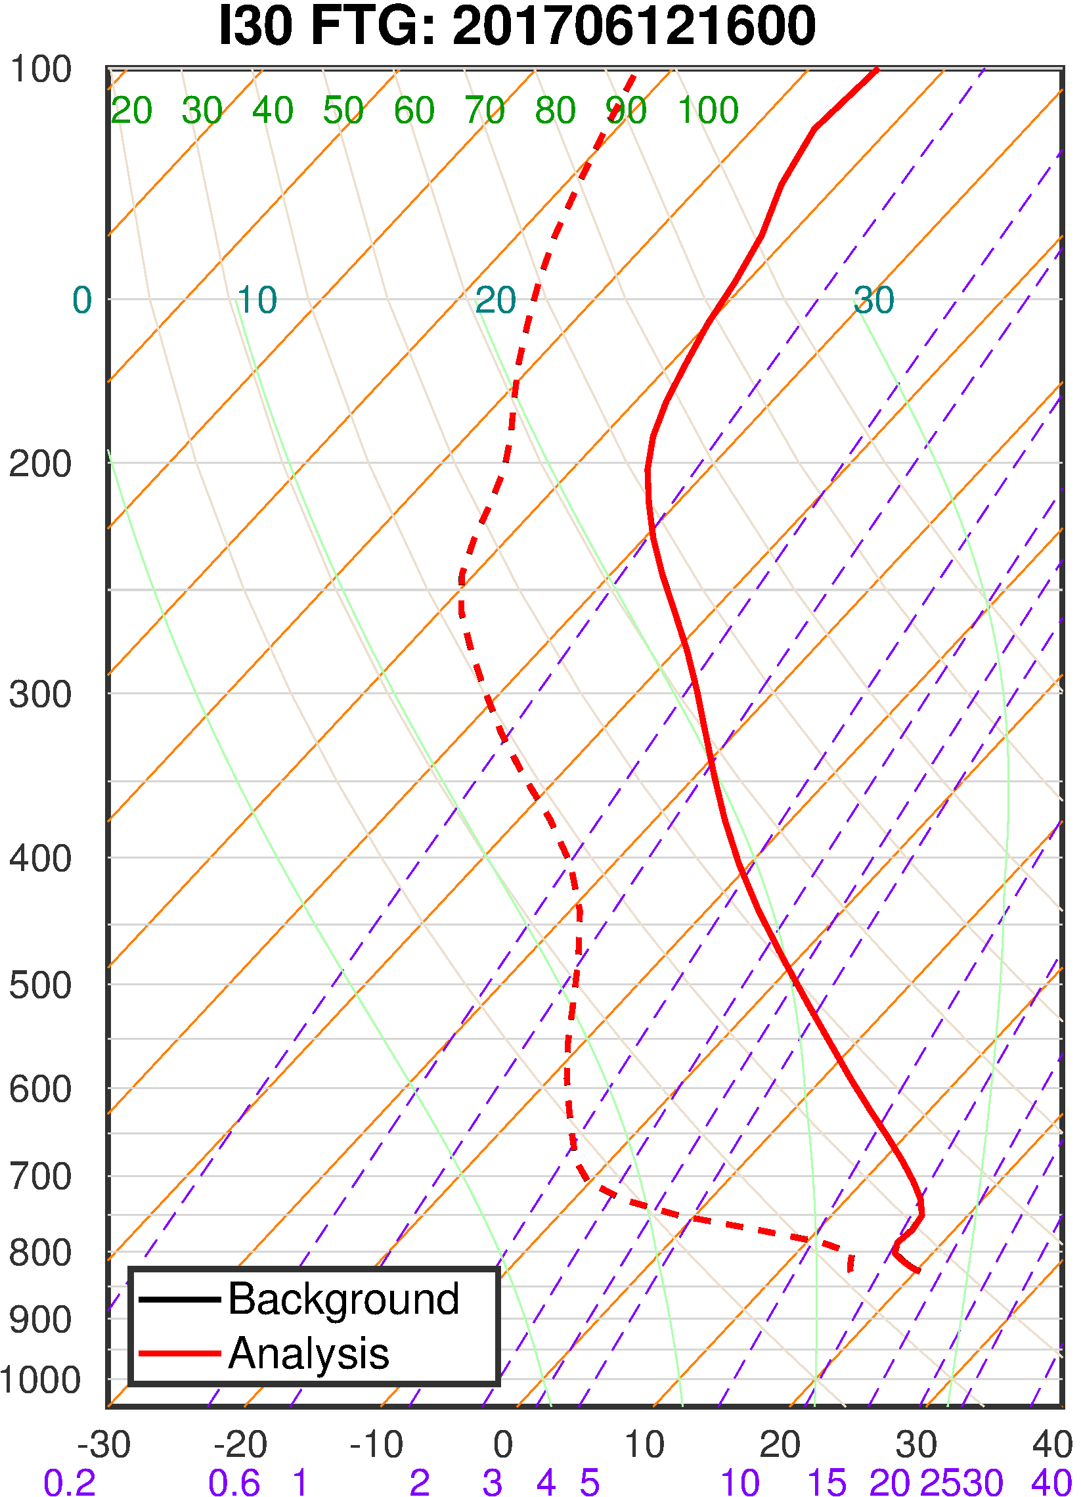
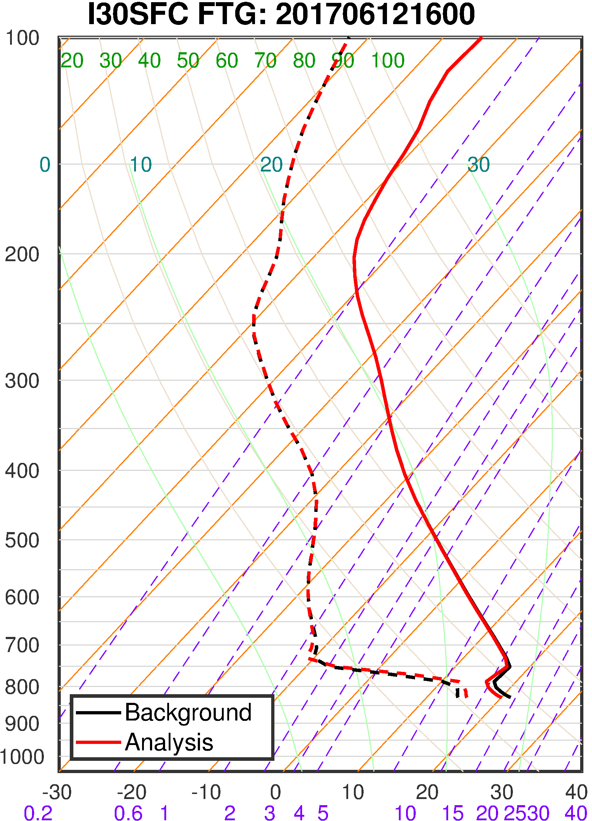
Changing of Thermodynamical Profiles

Slide 11
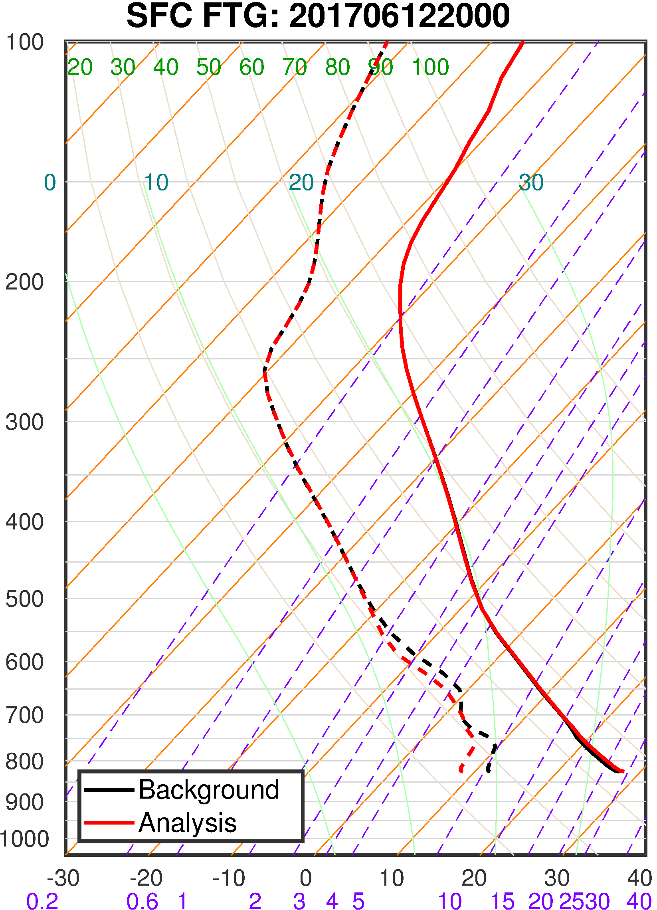
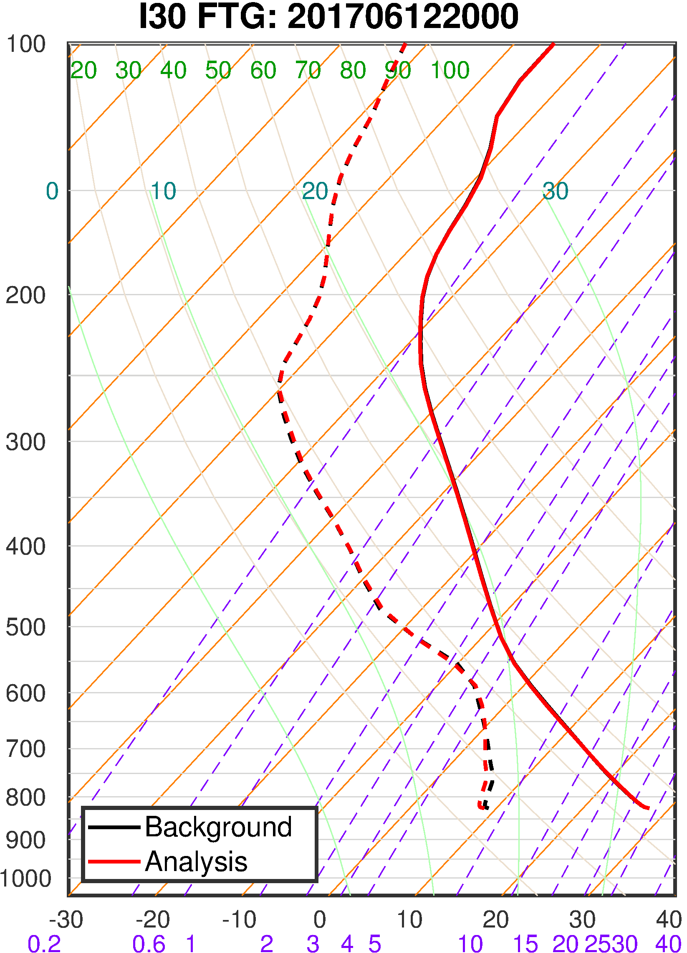
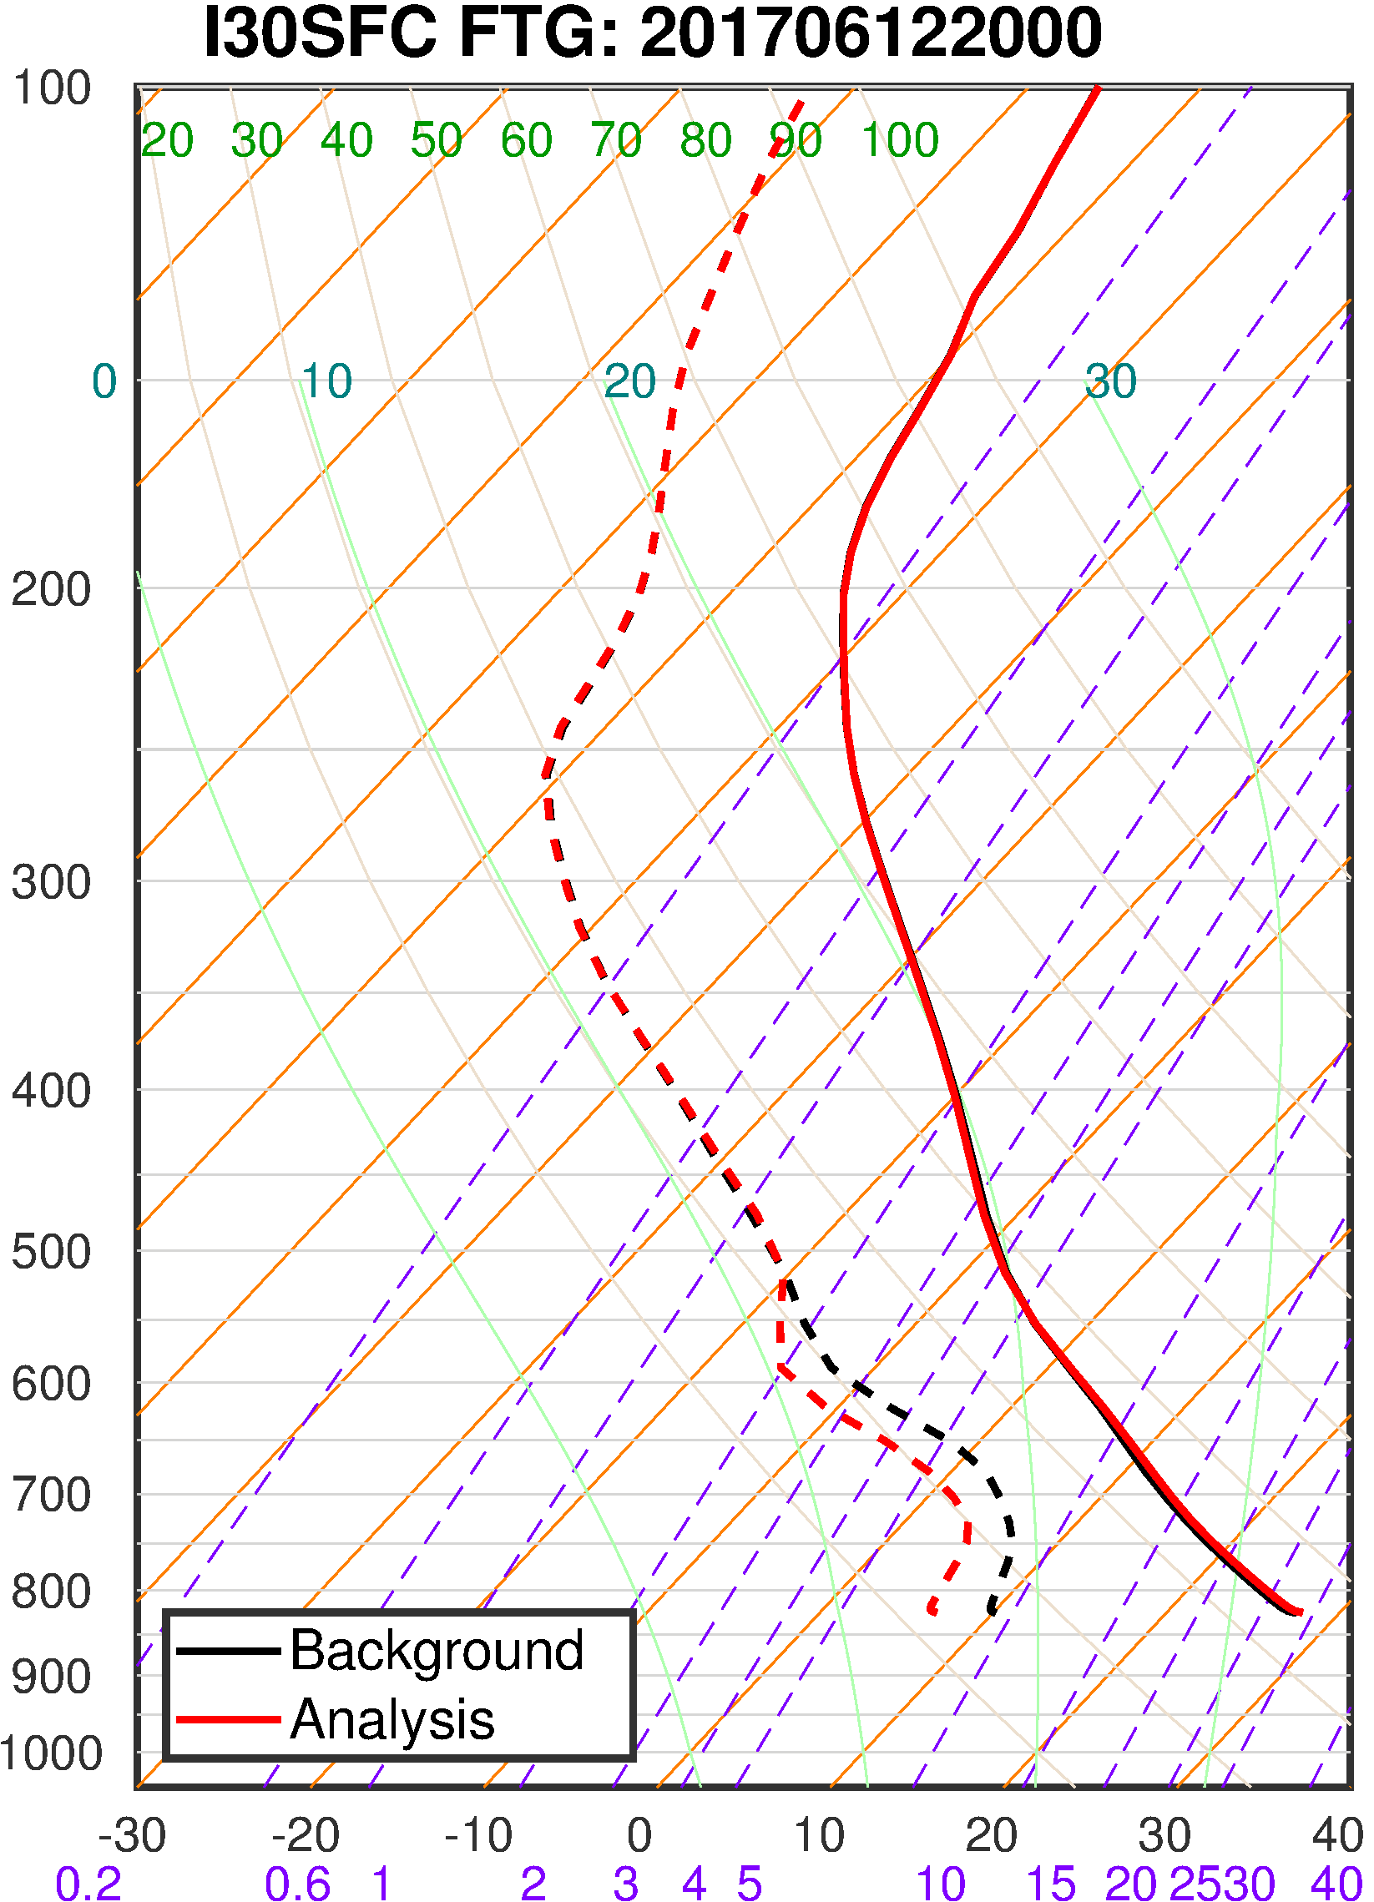
Changing of Thermodynamical Profiles

Slide 12
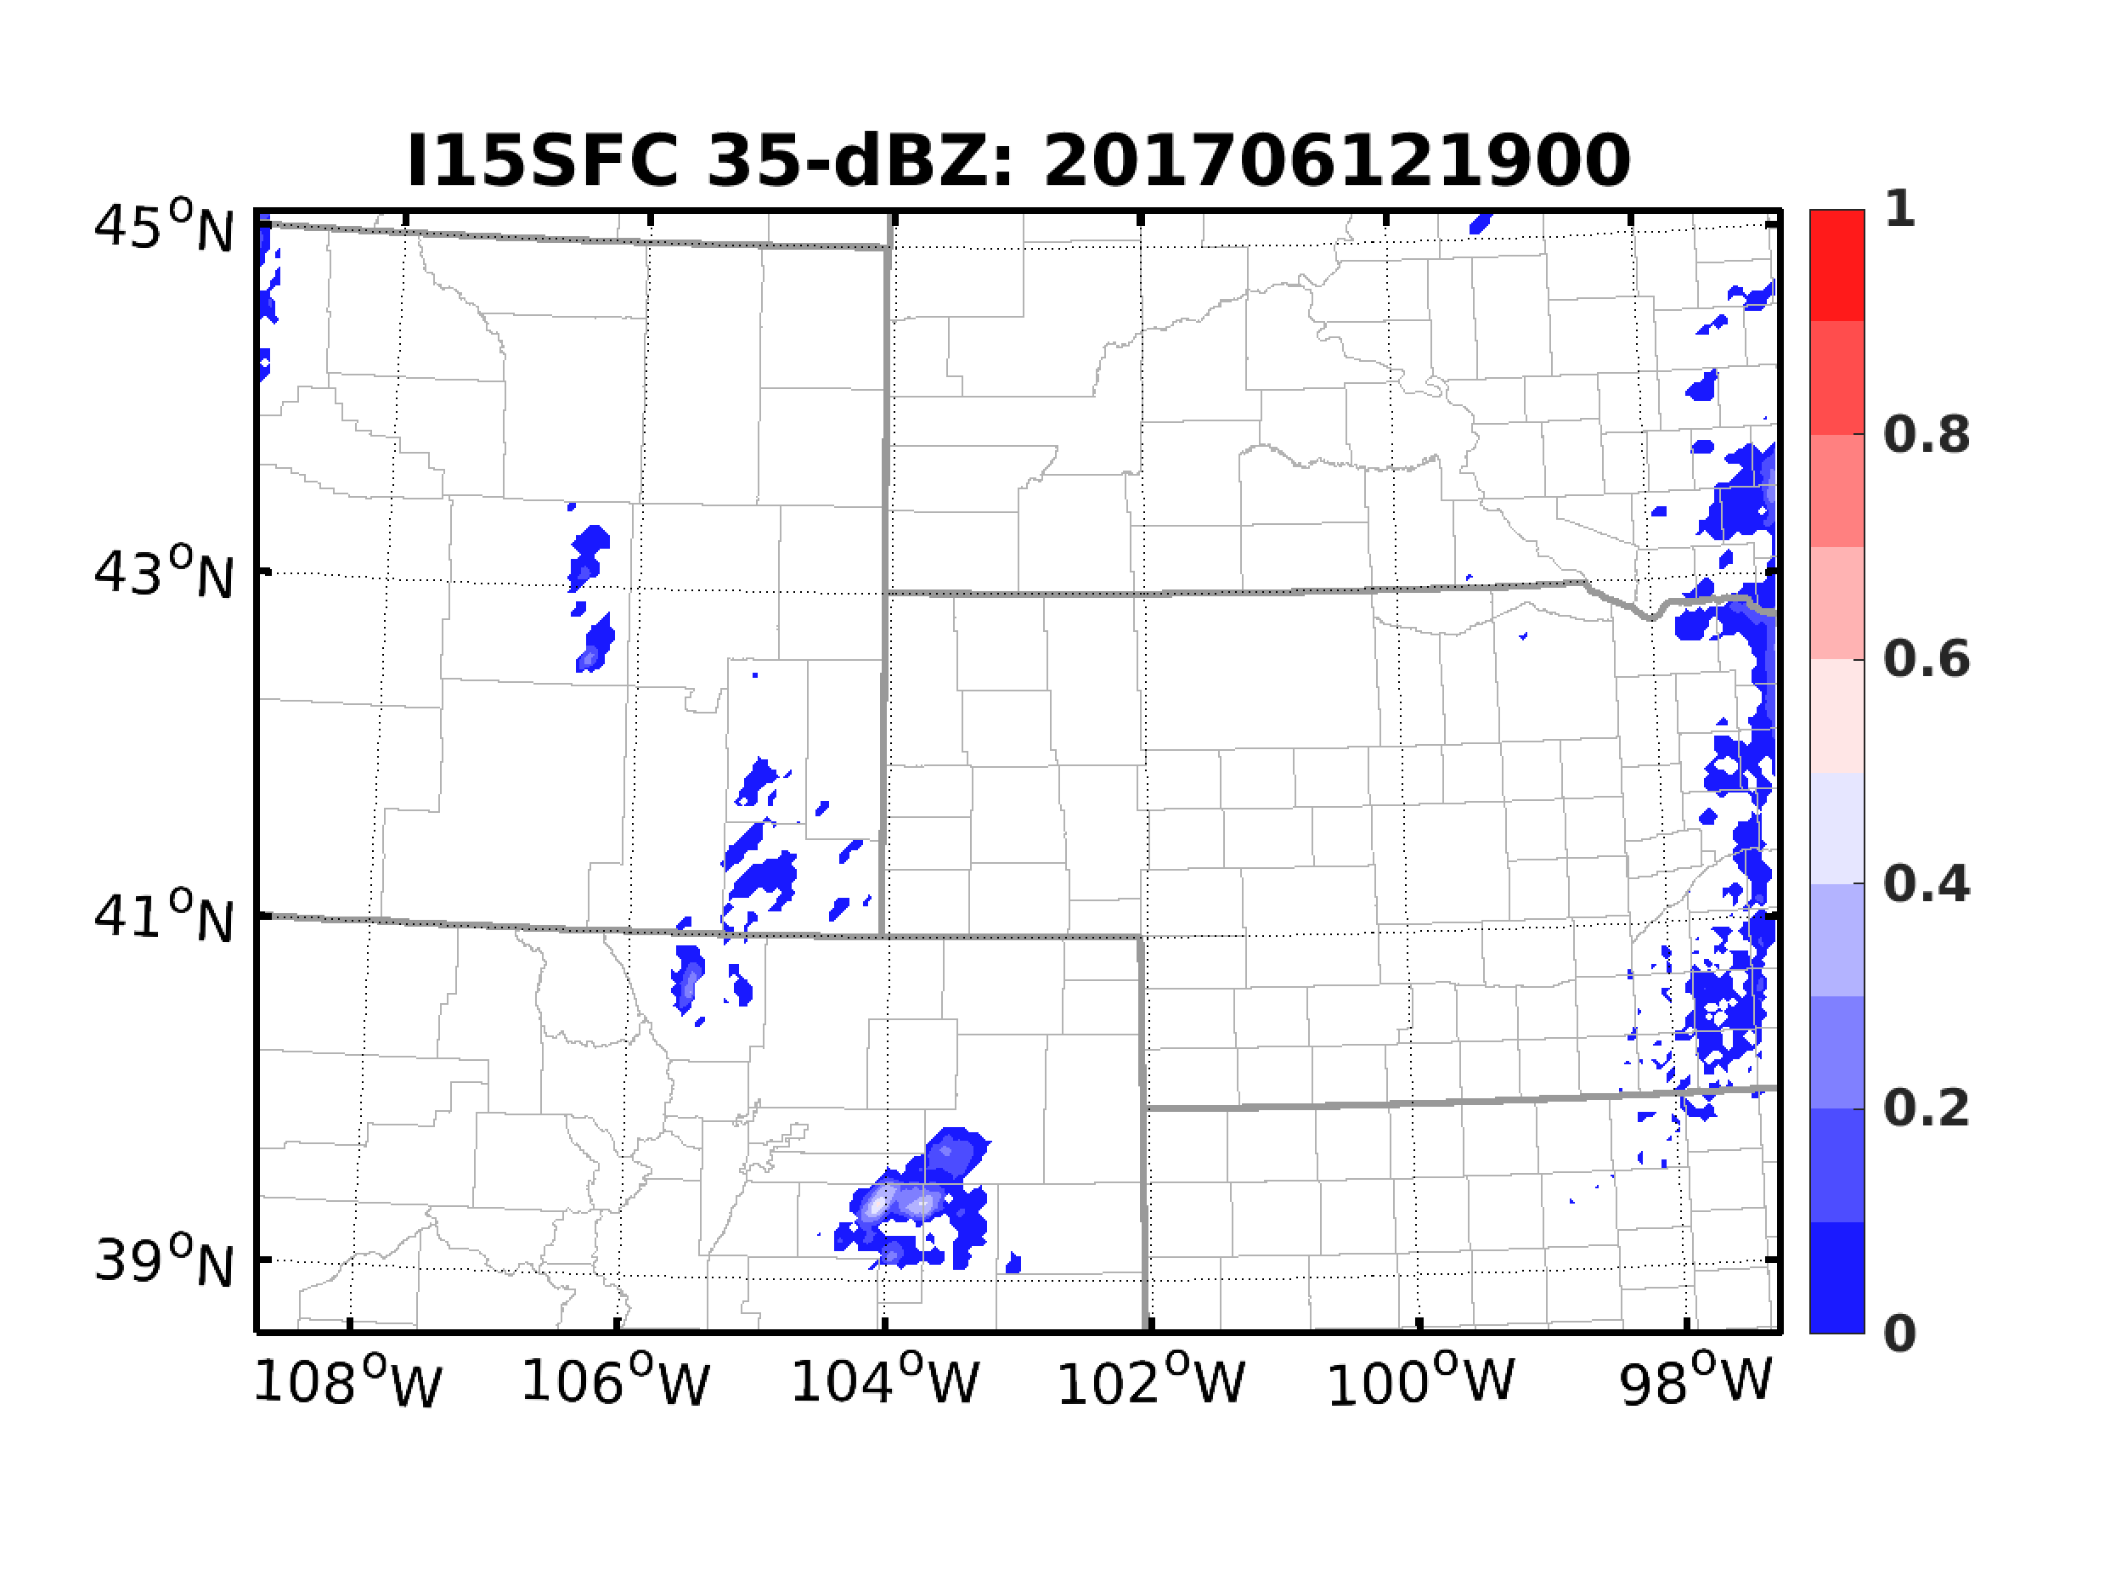
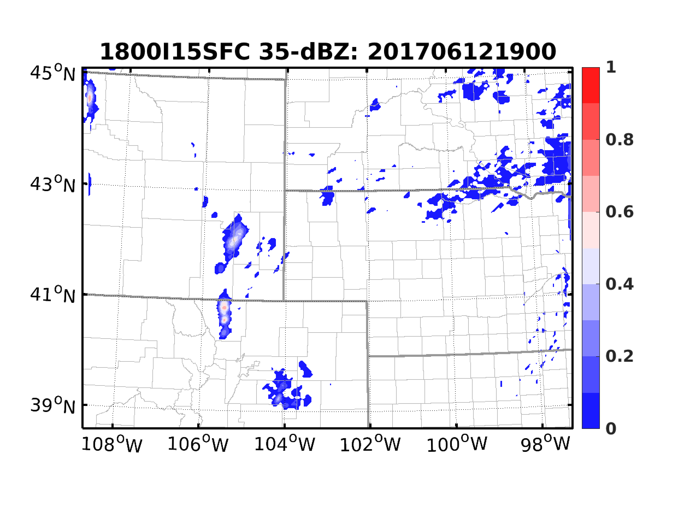
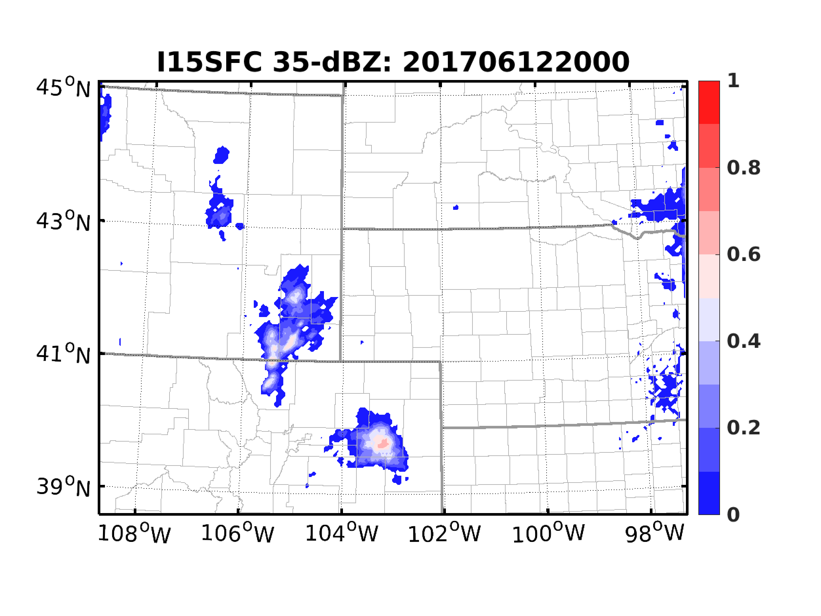
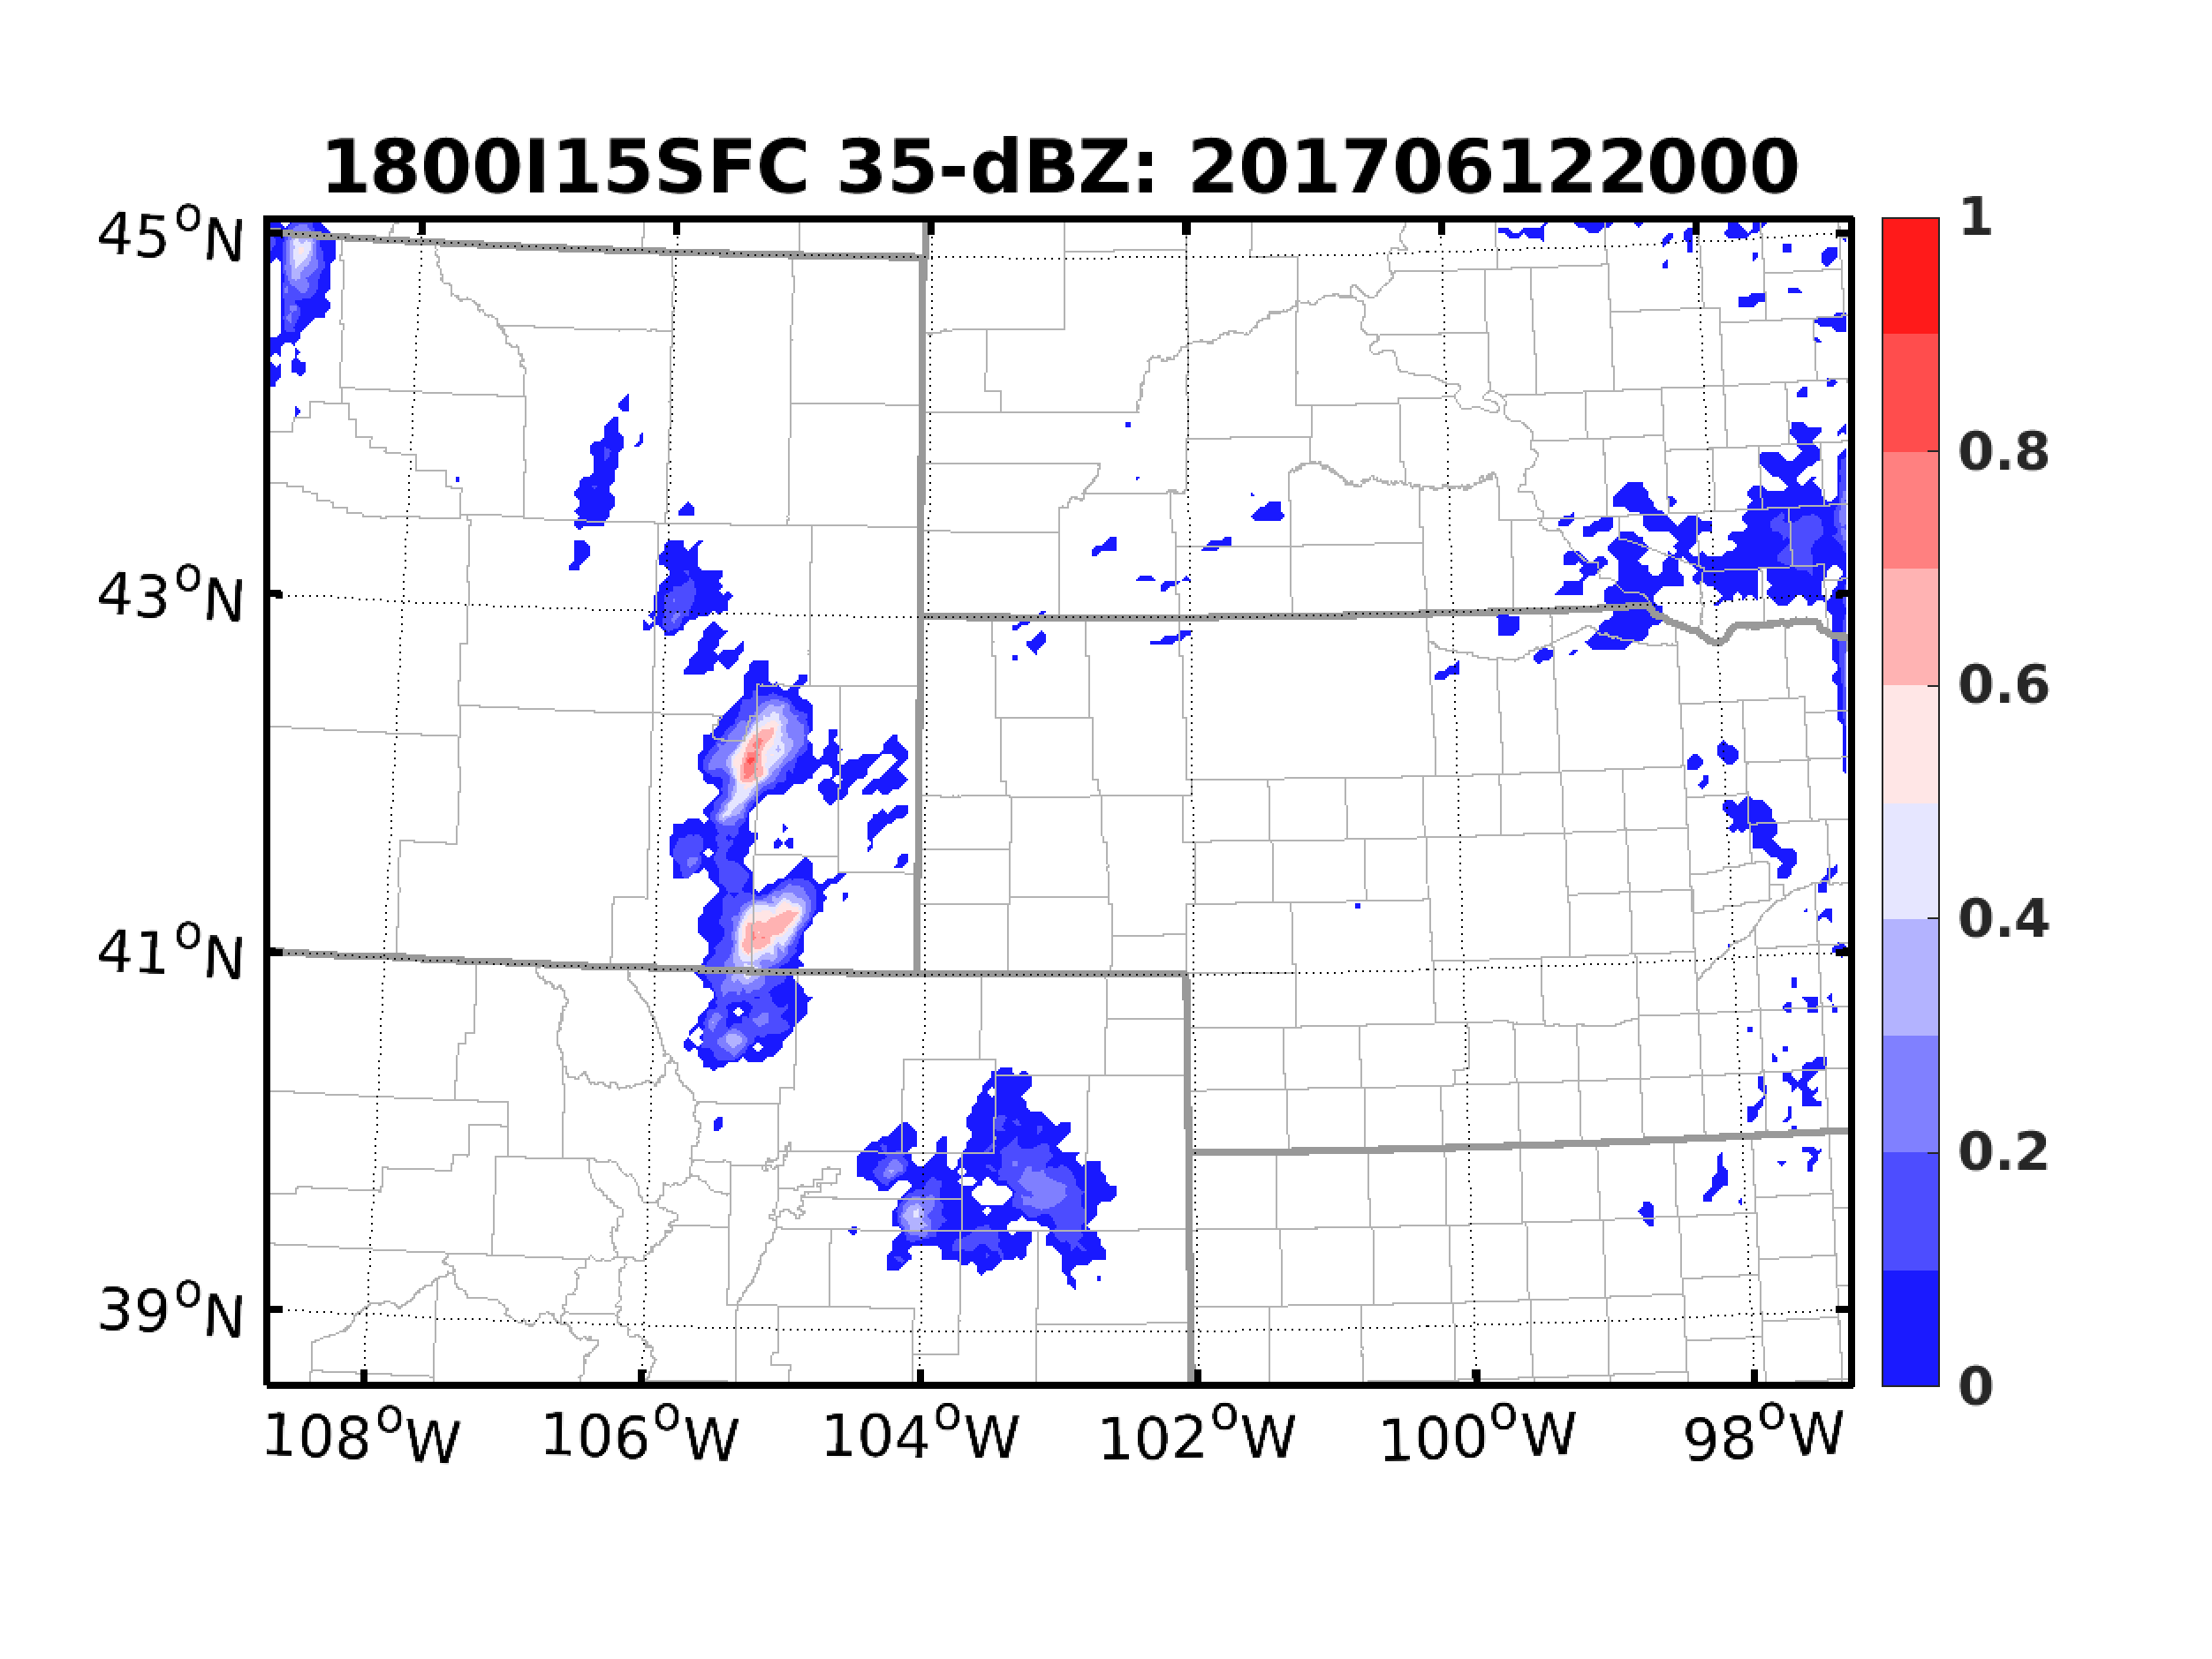
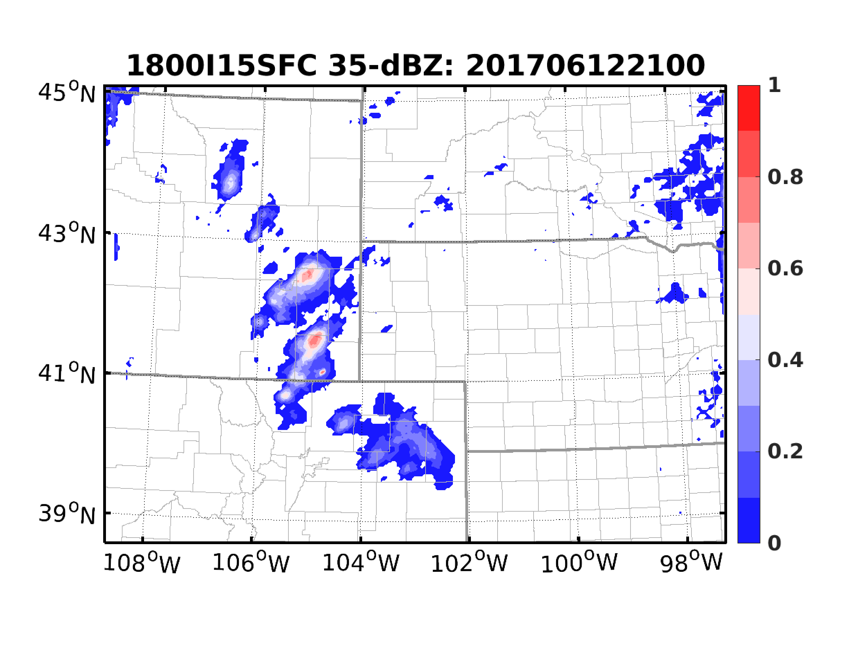
Shorter Interval?
Observations
I30SFC
15-min Interval
EnKF from 18Z
15-min Interval

Slide 13
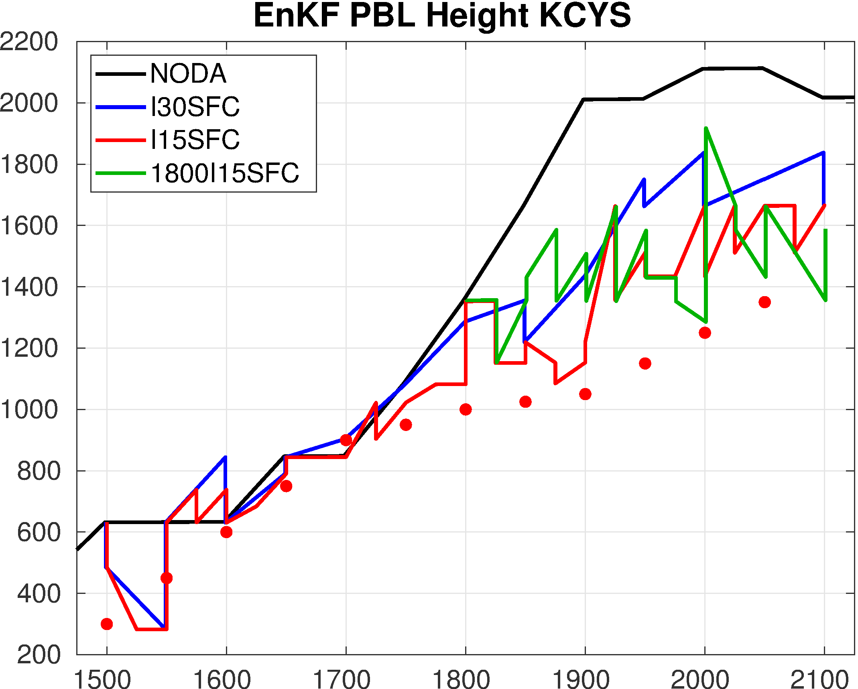
Observation-Space Verifications

Slide 14
Summary
Assimilating PBL height observations derived from dual-pol radars can change structure of PBL
Combining PBL height with surface observations can impact probabilistic predictions of CI
Upcoming questions:
How are PBL height observations correlated with other variables?
How can we more appropriately design observation operator?
How information from PBL height observations spreads out?
How long can these information stay?
How to extract more impact?
Is it possible to automatically derive PBL height from QVP?

