Slide 1
An observation system simulation experiment of the Oct 2011 MJO event
Man Yau (Joseph) Chan

Slide 2
Madden Julian Oscillation: An eastward-moving, planetary-scale pattern
Image drawn by Fiona Martin and found on climate.gov
https://www.climate.gov/sites/default/files/MJO_large.png

Slide 3
Madden Julian Oscillation: An active area of research
The pattern itself is a major contributor to 20-100 day tropical weather variability
Has known multi-scale interactions with tropical weather features
However, multi-scale interactions are not well understood and challenging to model
Motivates use of data assimilation to improve datasets for MJO studies and forecast

Slide 4
Data assimilation: Combines two pieces of information to obtain more precise and accurate information
Truth
p.d.f.
Prior $\left\langle T\right\rangle$
Temperature

Slide 5
Data assimilation: Combines two pieces of information to obtain more precise and accurate information
Truth
p.d.f.
Prior $\left\langle T\right\rangle$
Obs.
Temperature

Slide 6
Data assimilation: Combines two pieces of information to obtain more precise and accurate information
Truth
p.d.f.
Prior $\left\langle T\right\rangle$
Posterior $\left\langle T\right\rangle$
Obs.
Temperature

Slide 7
Ensemble Kalman Filter (EnKF): Represents forecast error covariance with an ensemble of forecasts
Nonlinear forecast
EnKF update
Pressure
$$t=1$$
$$t=0$$
Temperature

Slide 8
Ensemble Kalman Filter (EnKF): Updates ensemble members using observations mm
Nonlinear forecast
EnKF update
Pressure
$$t=1$$
$$t=0$$
Temperature

Slide 9
Ensemble Kalman Filter (EnKF): Is typically cycled multiple times before allowing a free forecast
Nonlinear forecast
EnKF update
Pressure
$$t=1$$
$$t=0$$
$$t=2$$
Temperature

Slide 10
Main goals
Test PSU-EnKF on MJO with simulated truth and simulated observations ( Observation System Simulation Experiment )
Apply PSU-EnKF on MJO with real observations

Slide 11
Main goals
Test PSU-EnKF on MJO with simulated truth and simulated observations ( Observation System Simulation Experiment )
Apply PSU-EnKF on MJO with real observations

Slide 12
Agenda
Background and motivation
Description of Oct 2011 MJO test case
Setup of OSSE experiments
Results
Summary and future work

Slide 13
Agenda
Background and motivation
Description of Oct 2011 MJO test case
Setup of OSSE experiments
Results
Summary and future work

Slide 14
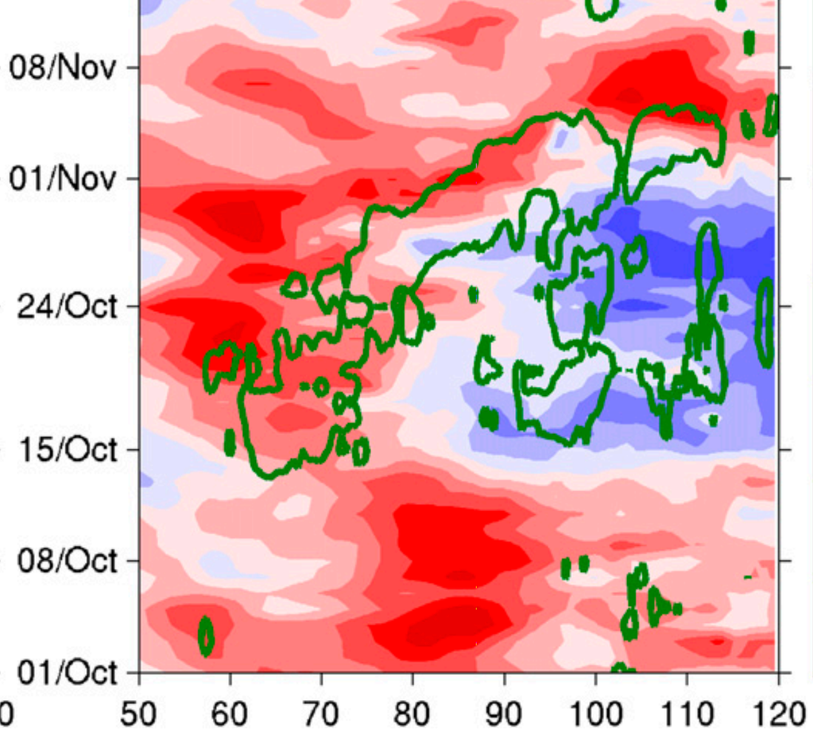
Testbed case: Oct 2011 MJO event
ERA-Interim zonal wind + TRMM precipitation (15mm/day contour)
12
Taken from Wang et al (2015).
6
Zonal wind (m/s)
0
16/Oct
MJO starts
-6
-12
Longitude

Slide 15
Testbed case: Oct 2011 MJO event
ERA-Interim zonal wind + TRMM precipitation (15mm/day contour)
12
Taken from Wang et al (2015).
Successfully reproduced in Wang et al (2015) ARW-WRF simulation.
6
Zonal wind (m/s)
0
16/Oct
MJO starts
-6
-12
Longitude

Slide 16
Agenda
Background and motivation
Description of Oct 2011 MJO test case
Setup of OSSE experiments
Results
Summary and future work

Slide 17
Setup of truth simulation (Ying and Zhang 2018)
ARW-WRF version 3.8.1
9 km horizontal resolution, 45 eta levels
Duration: Oct 12th, 2011 to Nov 2nd, 2011
Initial and lateral boundary conditions: ERA-Interim
Lower boundary conditions: GFS Final Analysis

Slide 18
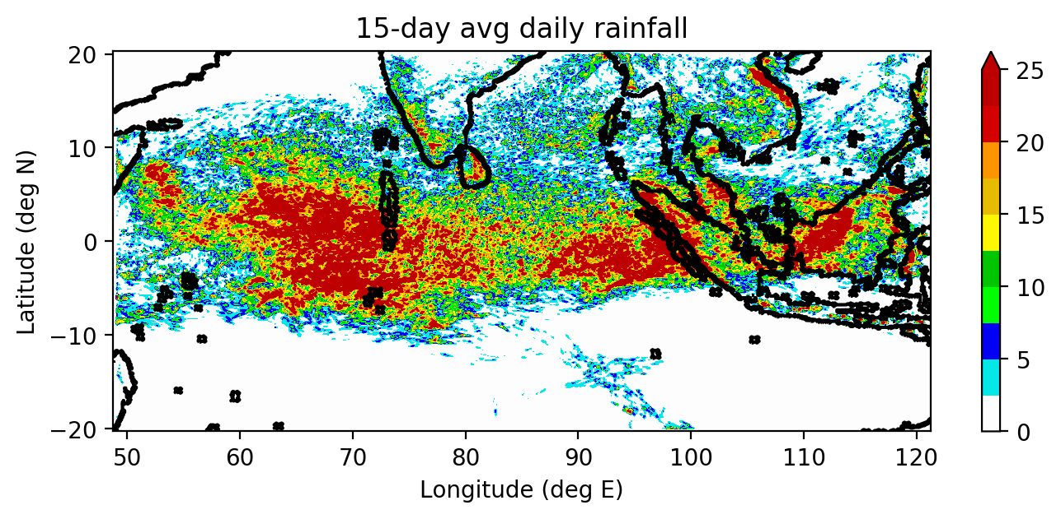
WRF domain
mm/day
Truth domain

Slide 19
Setup of ensemble (Ying and Zhang 2018)
Same physics and dynamics setup as truth
Mean ensemble state and 60-member perturbations drawn from WRFDA CV3 and initialized on 15th Oct, 0000 UTC
EnKF cycles every 3 hours, from 16 Oct, 00 UTC, to 17 Oct, 00 UTC

Slide 20
OSSE domain
mm/day
OSSE domain
Truth domain

Slide 21
Setup of experiments
No data assimilation (NoDA):
Traditional obs (Trad):
Soundings + AMV
Observations | Quantities | Obs. error | Horizontal spacing | Vertical coverage
Vertical soundings | T QVAPOR | ~2 K ~30% | 90 km | Every eta level Every 2 eta levels
Atmospheric motion vectors | U V | 4.5 m/s 4.5 m/s | ~100 km | Mainly around 200 hPa
See Ying and Zhang (2018) for more details.

Slide 22
Agenda
Background and motivation
Description of Oct 2011 MJO test case
Setup of OSSE experiments
Results
Summary and future work

Slide 23
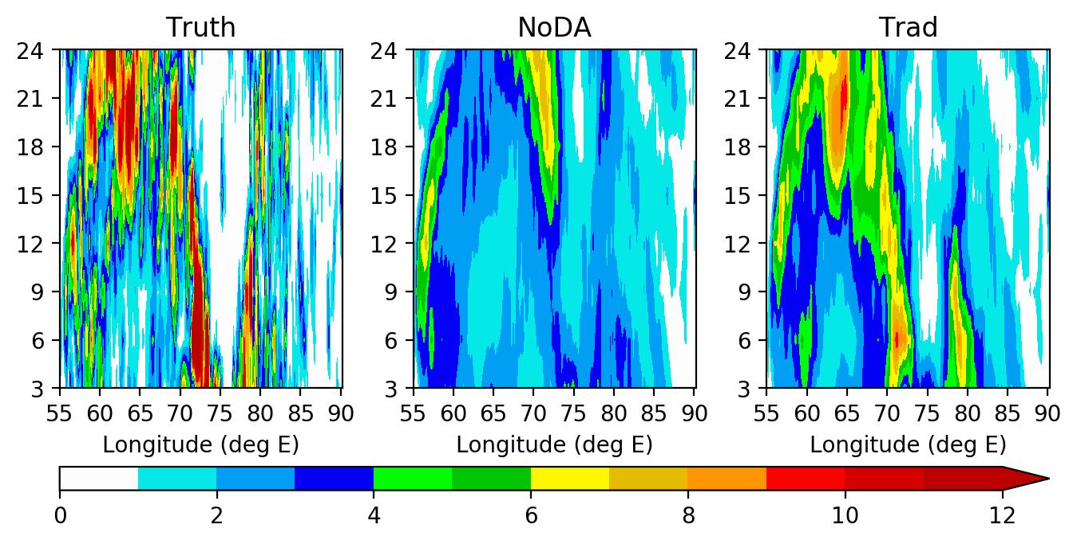
Traditional observation experiment shows better rainfall patterns
Time (hours)
3-hrly rainfall (mm), averaged from 0° to 5°N

Slide 24
Smoother ens avg rainfall features: Smoother 3-hrly rainfall features in ensemble average time-longitude diagrams
Time (hours)
3-hrly rainfall (mm), averaged from 0° to 5°N

Slide 25
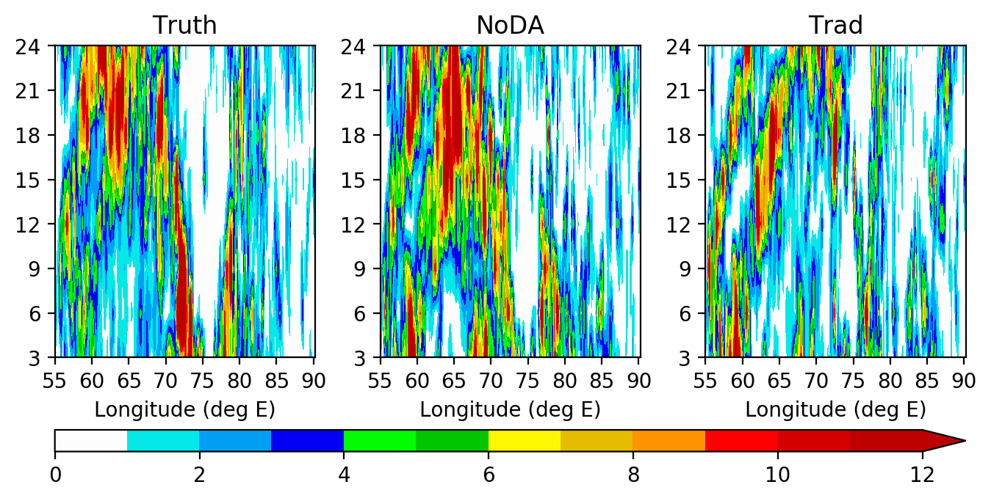
Smoother ens avg rainfall features: Smoothness not present in individual ensemble member hello
Time (hours)
3-hrly rainfall (mm), averaged from 0° to 5°N

Slide 26
Smoother ens avg rainfall features: Smoothing is caused by dislocation of small-scale rainfall structures
Time (hours)
3-hrly rainfall (mm), averaged from 0° to 5°N

Slide 27
Smoother ens avg rainfall features: Smoothing is caused by dislocation of small-scale rainfall structures
Implication:
Ensemble mean errors should be evaluated for $λ_{H}$ >200 km
3-hrly rainfall (mm), averaged from 0° to 5°N

Slide 28
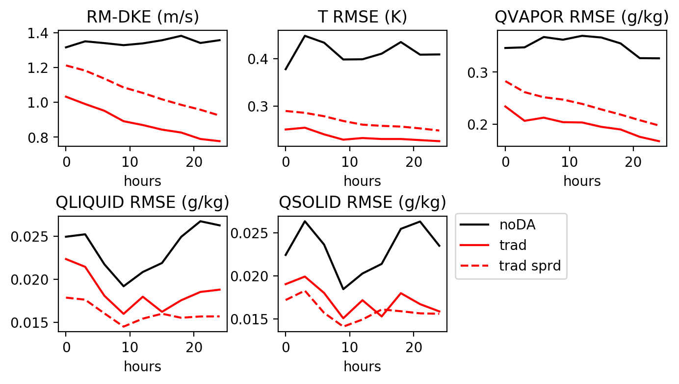
Performance of Trad experiment: Reduced errors for $λ_{H}>$ 200 km
RM-DKE stands for root-mean difference kinetic energy

Slide 29
Performance of Trad experiment: Ensemble envelope contains truth for $λ_{H}>$ 200 km
RM-DKE stands for root-mean difference kinetic energy

Slide 30
Agenda
Background and motivation
Description of Oct 2011 MJO test case
Setup of OSSE experiments
Performance of EnKF with traditional observations
Summary and future work

Slide 31
Summary
Dislocation of small-scale rainfall features cause ensemble means to appear smoother than truth simulations
Assimilation of T,Q soundings and atmospheric motion vectors improve flow, thermodynamic and hydrometeor fields in the ensemble mean
Ensemble’s envelope of uncertainty contains the simulated truth

Slide 32
Future work
Longer experiment runs
Include simulated satellite brightness temperature observations
Real observation experiment

Slide 33
Acknowledgements
Advisor: Fuqing Zhang
ADAPT research group (esp. Michael, Robert and XC)
Family and friends
Funding sources:
PSU Graduate School Fellowship
National Science Foundation

Slide 34
Fin.
Thank you for your attention!

Slide 35
Summary
Dislocation of small-scale rainfall features cause ensemble means to appear smoother than truth simulations
Assimilation of T,Q soundings and atmospheric motion vectors improve flow, thermodynamic and hydrometeor fields in the ensemble mean
Ensemble’s envelope of uncertainty contains the simulated truth

Slide 36
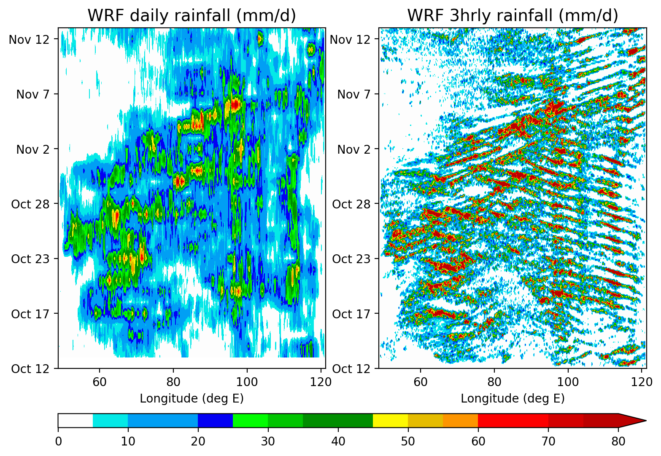
Sanity check: MJO patterns manifest in truth run hell
Figure: Time-longitude diagram of rainfall from WRF truth simulation. Latitude average done over 0° to 5°N.

