Slide 1
Potential use of hyper-spectrum satellite observations under all-sky condition
Yinghui Lu and Fuqing Zhang
Aug. 16, 2018

Slide 2
AIRS: Atmospheric Infrared Sounder
Thousands of channels
High spectral resolution
Not applicable, nor necessary, to assimilate all the AIRS channels.
Need to perform dimension reduction before data assimilation.

Slide 3
Question:
How many independent pieces of information?
Ensemble correlation after dimension reduction?

Slide 4
Data used
Harvey (2017)
WRF output for domain 2 at 2017-08-25 02:00 UTC is used (9km grid).
Brightness temperatures(TB) are calculated using CRTM.
Roughly classify profiles by GOES CH14 TB:
200K~240K: high cloud
240K~270K: mid cloud
270K~300K: low cloud
‘climatological’ data

Slide 5
Inter-channel correlation: high-cloud
Cloud top very high.
Most channels are affected by cloud.
Correlations between channels are very large

Slide 6
Inter-channel correlation: mid-cloud
‘Window channels’ are affected by clouds.
‘Water vapor channels’ are less affected by clouds
Correlations within ‘window channels’ are large
Correlations between ‘window channels’ and ‘water vapor channels’ are small

Slide 7
Principle component analysis (PCA)
Brightness temperatures (TB) of different AIRS channels are linearly correlated.
PCA transforms these correlated TB into a set of linearly uncorrelated variables called principle components (PC).
The first PC has the largest possible variance.
Each succeeding component is orthogonal to the preceding components, and has the largest possible remaining variance.
(Figure from Wikipedia: Principle component analysis:
https://en.wikipedia.org/wiki/Principal_component_analysis )

Slide 8
PC example: mid-cloud

Slide 9
Principle Component Analysis (PCA)
AIRS has more significant PCs than ABI (more information content).
A few leading PCs can explain most of the variance.

Slide 10
Ensemble sensitivity of PC scores
Ensemble modeling
Atm, sfc, ……
WRF output for domain 3 at 2017-08-25 02:00 UTC is used (3km grid).
60 ensemble members
PC components are calculated based on the 60 ensemble members.
PC scores are then calculated by projecting the original spectrum on the PC components.
PC scores are then correlated with model state variables.
Rad. Trans.
Model
TB
Ensemble coefficients
PCA
PC scores

Slide 11
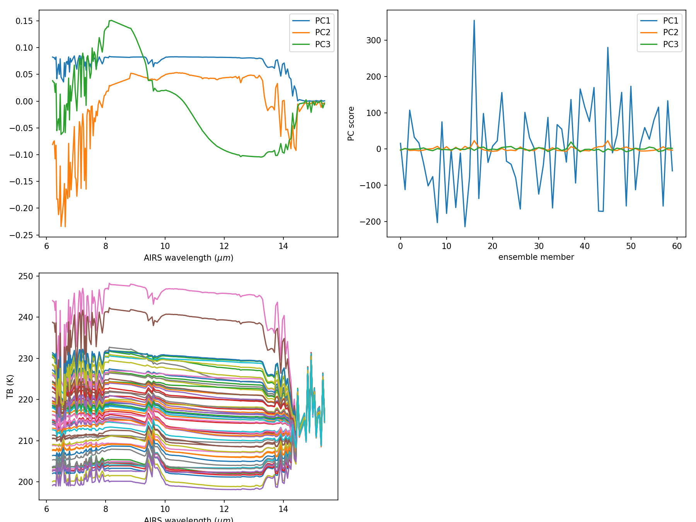
Ensemble correlation: high cloud sky

Slide 12
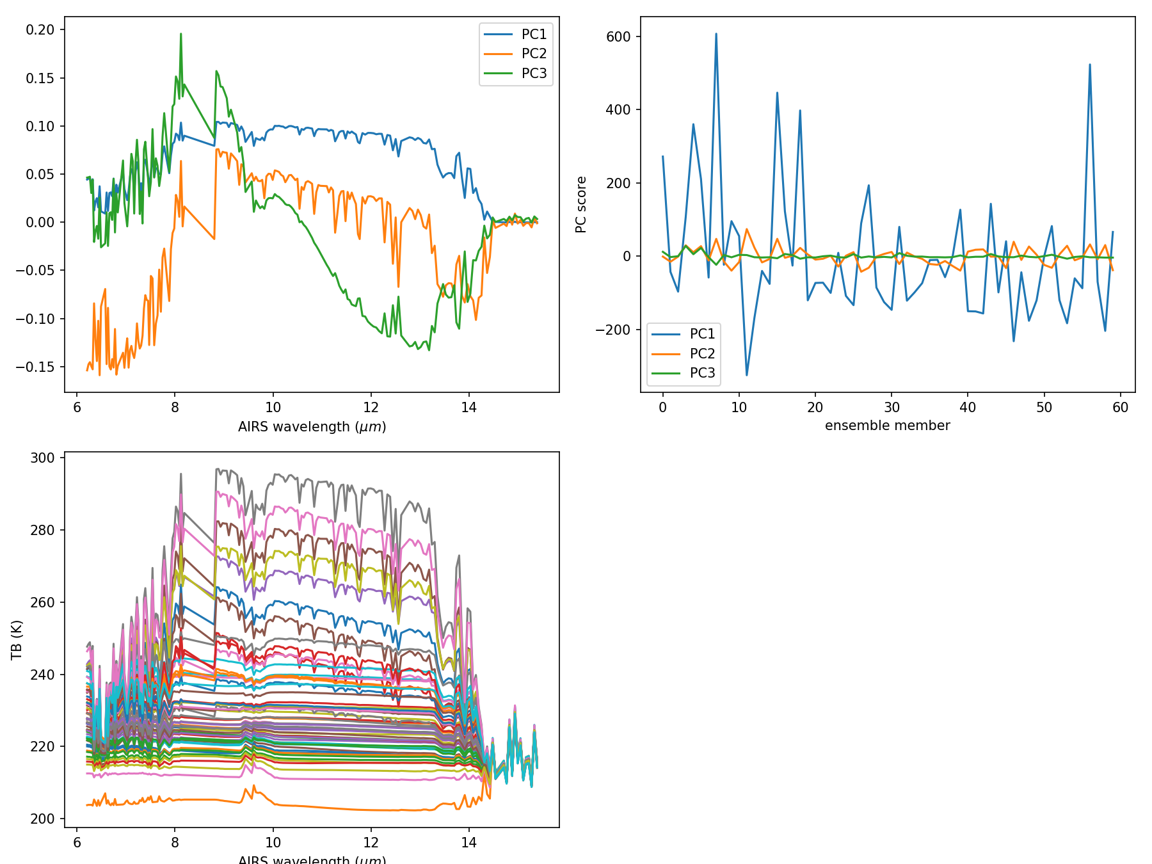
Ensemble correlation: in-between sky

Slide 13
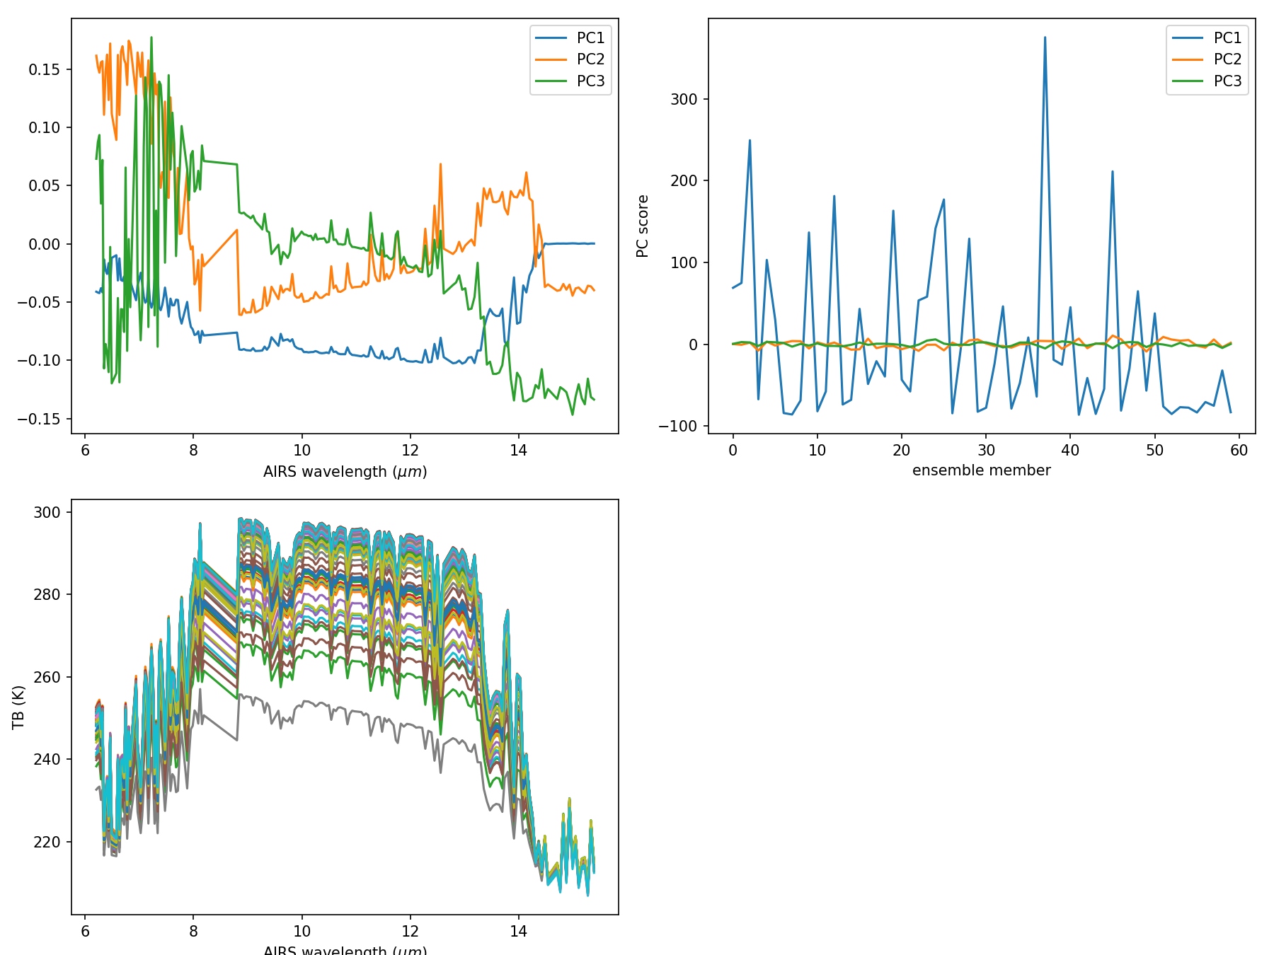
Ensemble correlation: mostly clear sky

Slide 14
Summary
Number of significant principle components of hyper-spectral observations are much smaller than number of channels.
Hyper-spectral observations (AIRS) have more significant PC components than GOES.
Leading PC scores have strong ensemble sensitivity. They are potentially useful in data assimilation.

