Slide 1

Predictability and Dynamics of the
Record-Breaking Intensification of Hurricane Patricia (2015)
Robert Nystrom and Fuqing Zhang
Funding: NASA Earth and Space Science Fellowship Program (NESSF)
Computing: Texas Advanced Computing Center (TACC) and NOAA Jet

Slide 2
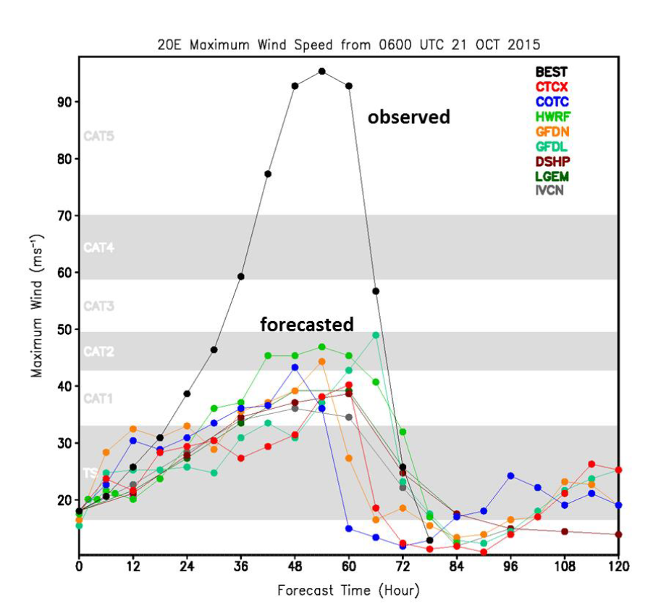
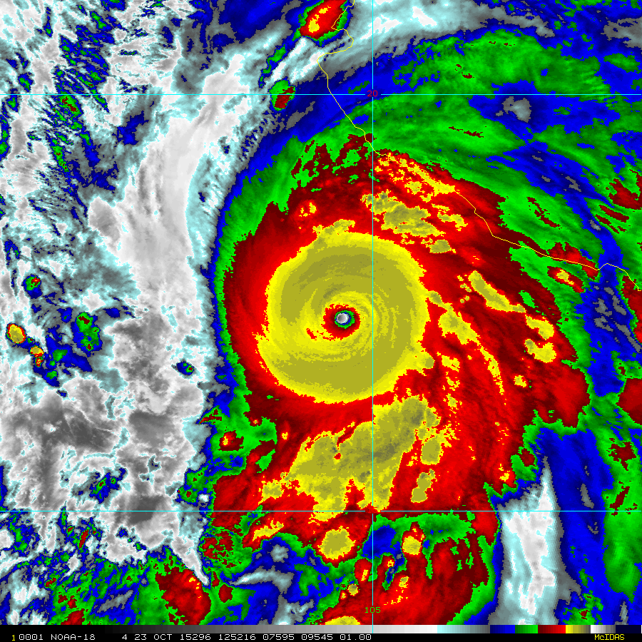
Patricia (2015)
Highest observed surface wind speed (measured by aircraft SFMR), 94 m s⁻¹
Most rapid intensification rate, 54 m s⁻¹ in 24 h
[Rogers et al., 2017]
Notes:
Well observed by TCI field campaign (high density dropsondes) and NOAA P-3

Slide 3
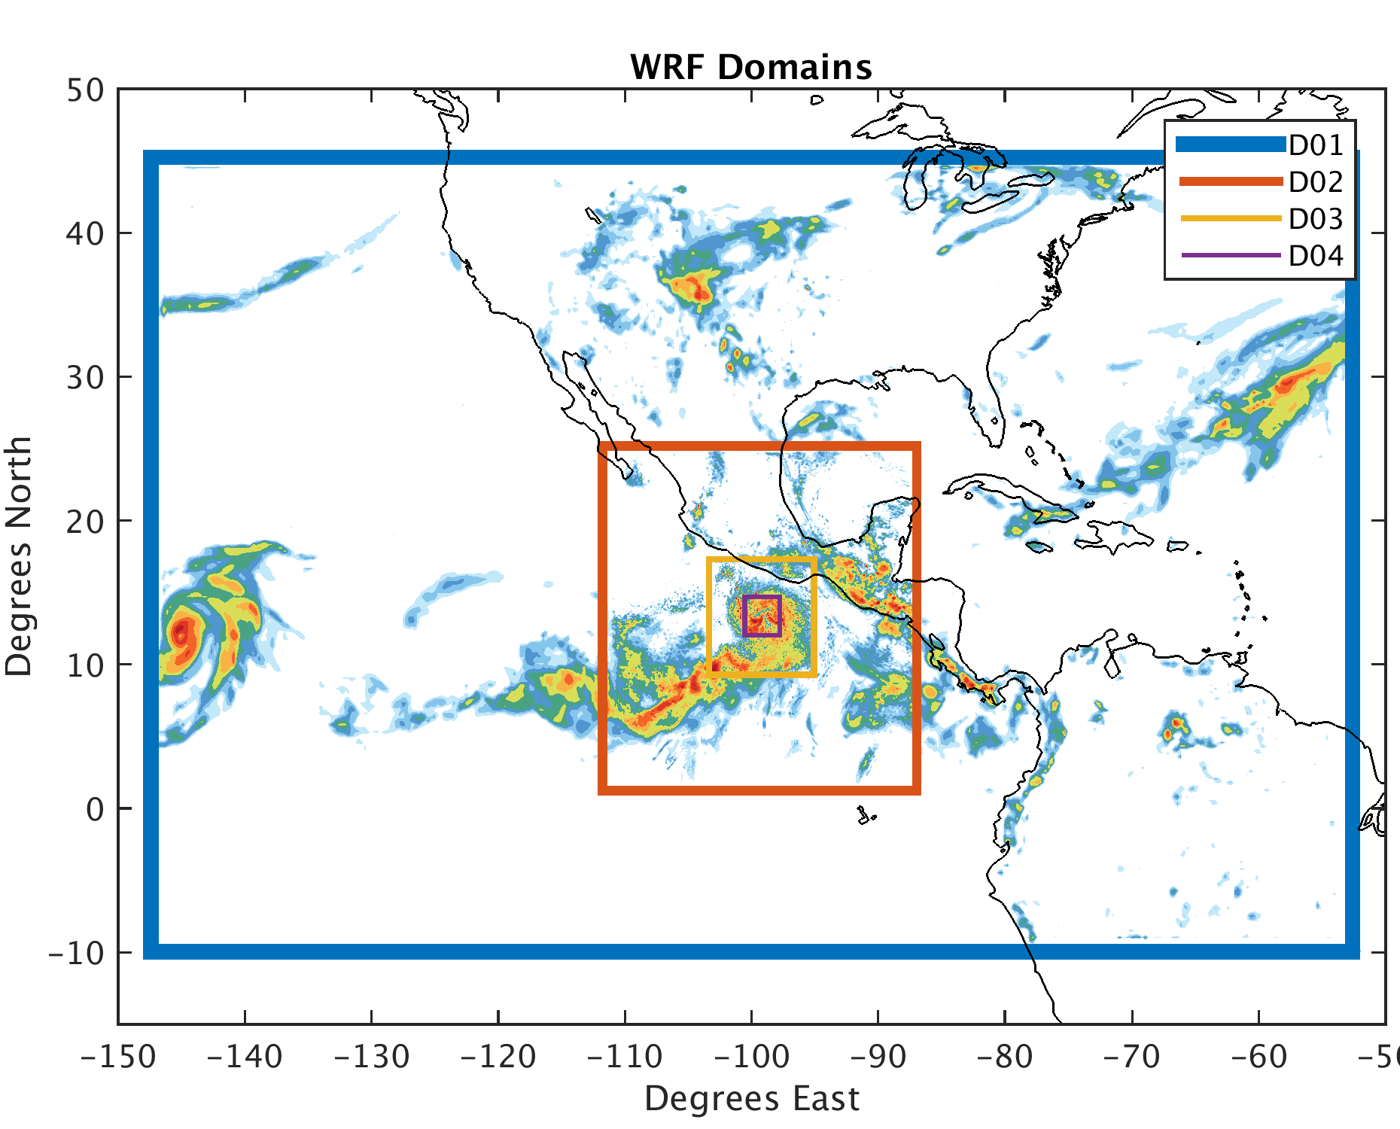
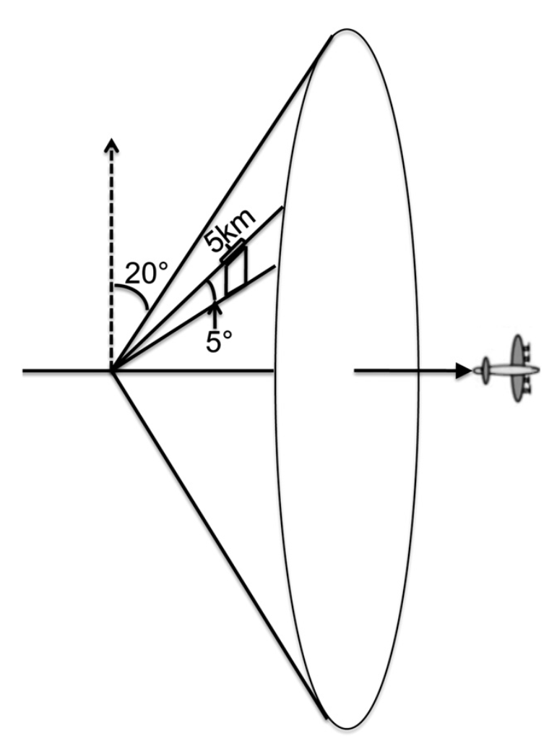
PSU WRF-EnKF Configuration for Patricia
60 member ensemble
1 hour continuous cycling EnKF
27/9/3/1 km grid spacing
IC/BCs provided by GFS
CV3 initial ensemble perturbations
Chen et al. (2016) surface flux scheme
Assimilated conventional obs,
GOES-13 all-sky Radiances,
and P-3 radial velocity SOs
[Weng and Zhang, 2012]
Notes:
Highlight specifications of PSU WRF-EnKF system
-WRF v3.5.1
-4 two-way nested domains
-Assimilate all conventional obs as well as aircraft radar (radial velocities)

Slide 4
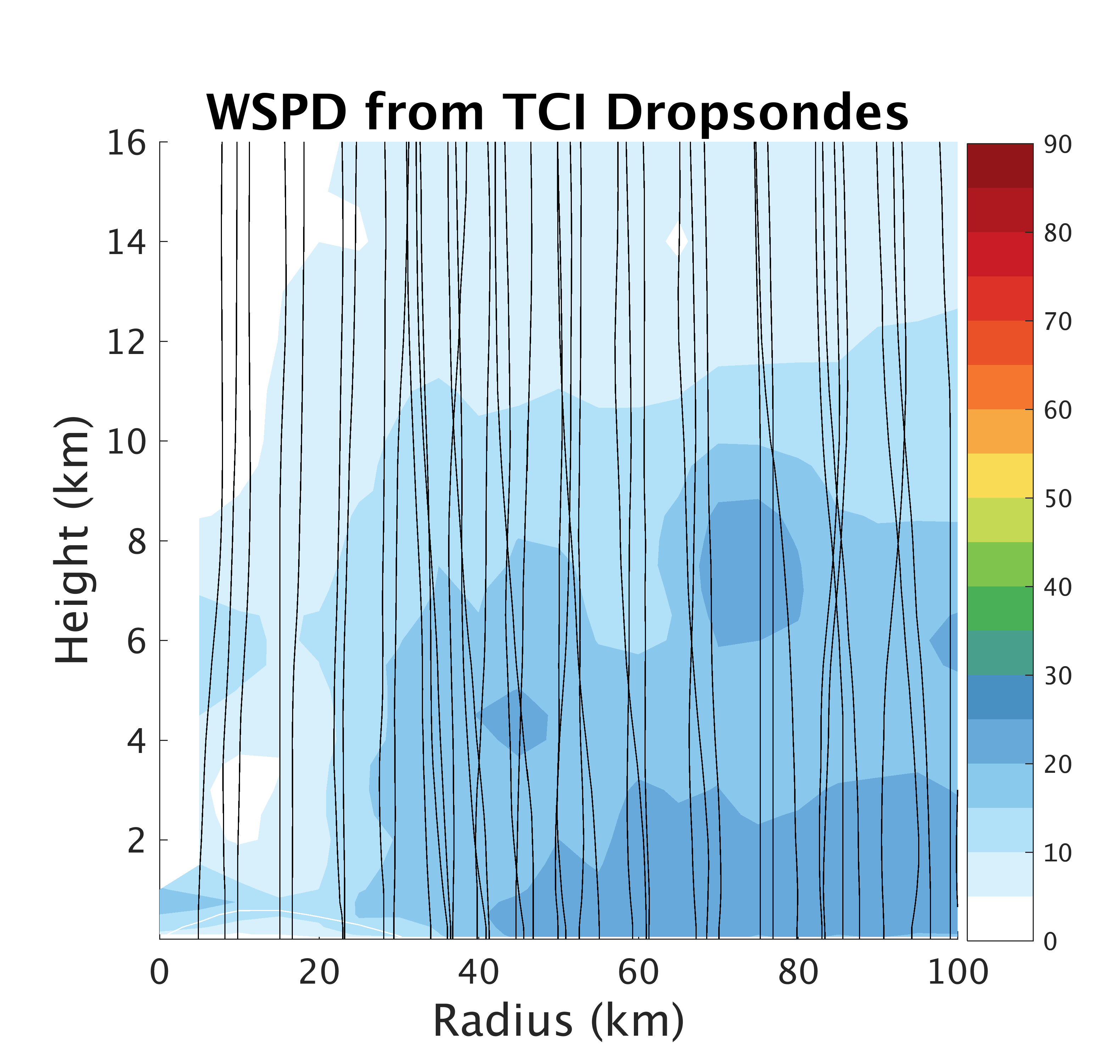
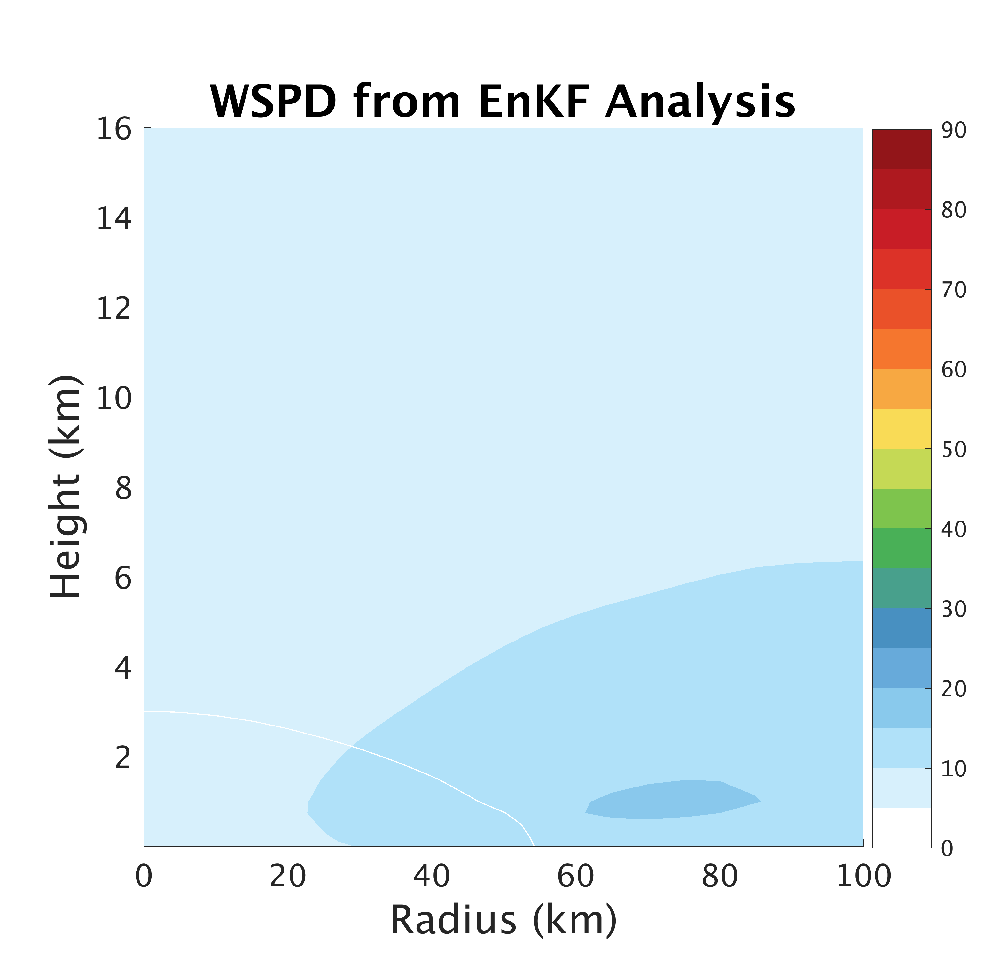
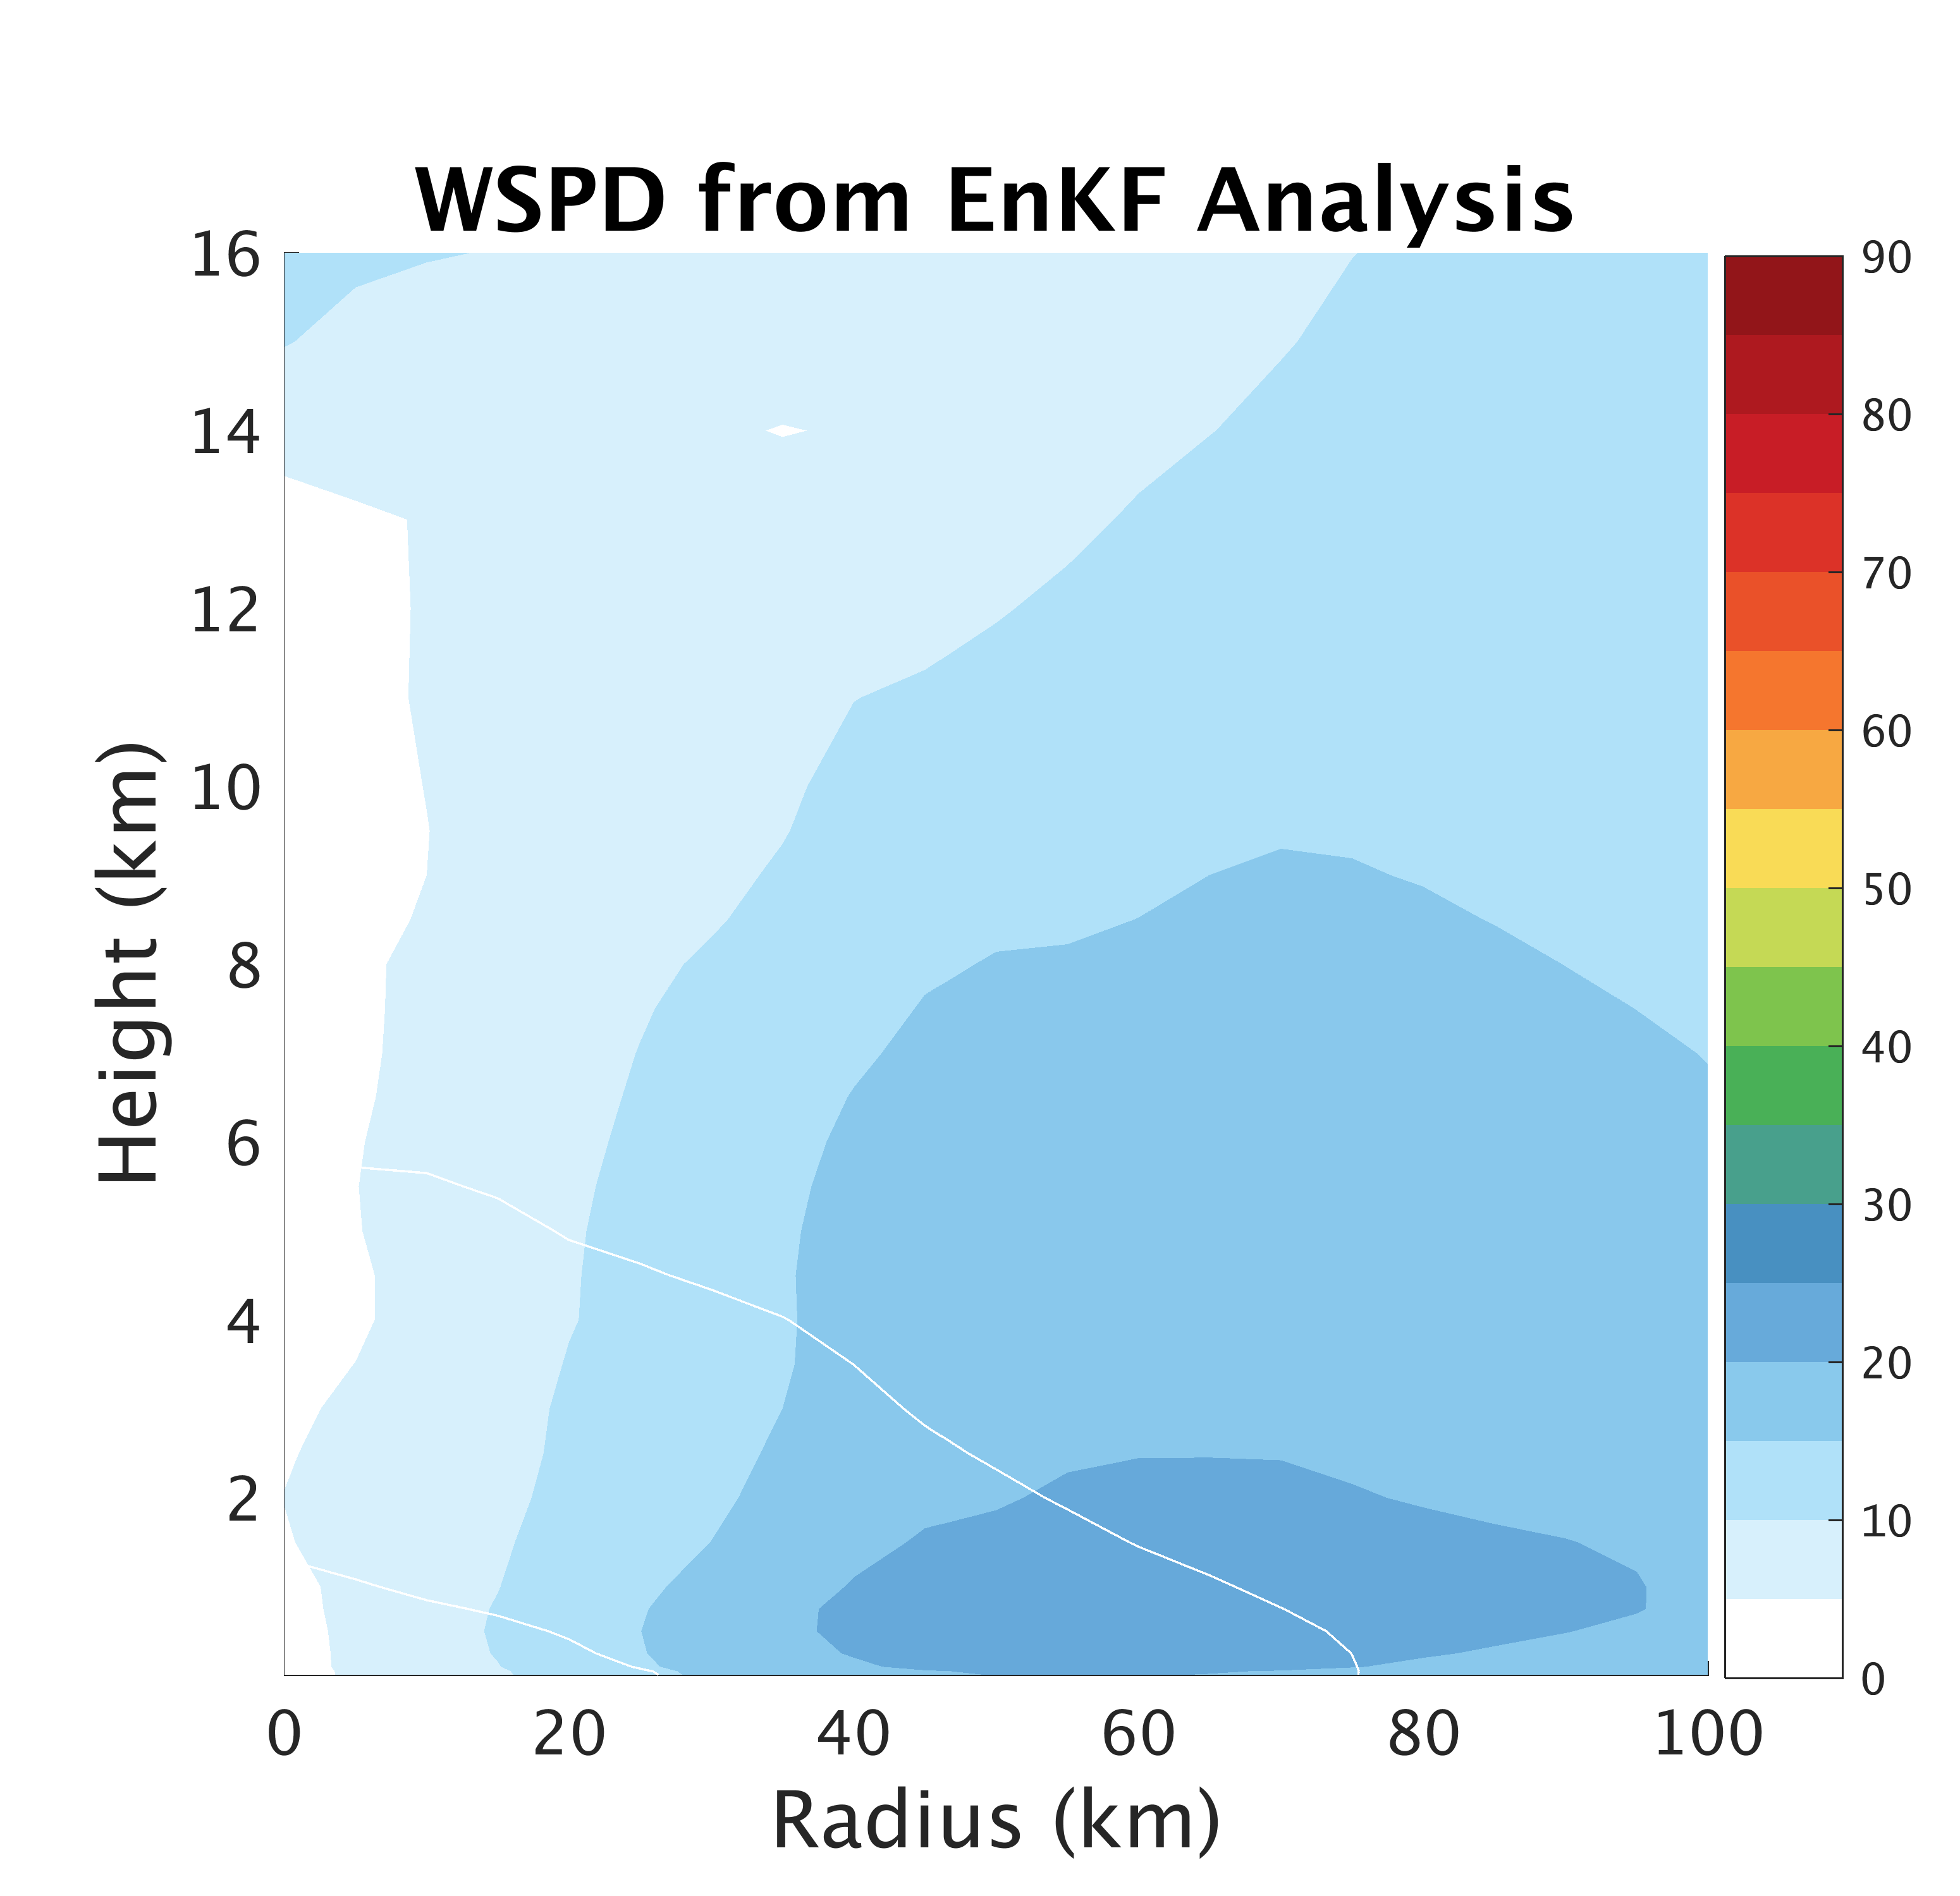
PSU WRF-EnKF Analysis
TCI Dropsonde Verification
TCI Dropsondes
Conv
Conv+Airbone

Slide 5
PSU WRF-EnKF Performance
After some tuning
Conv
Conv+Airbone

Slide 6
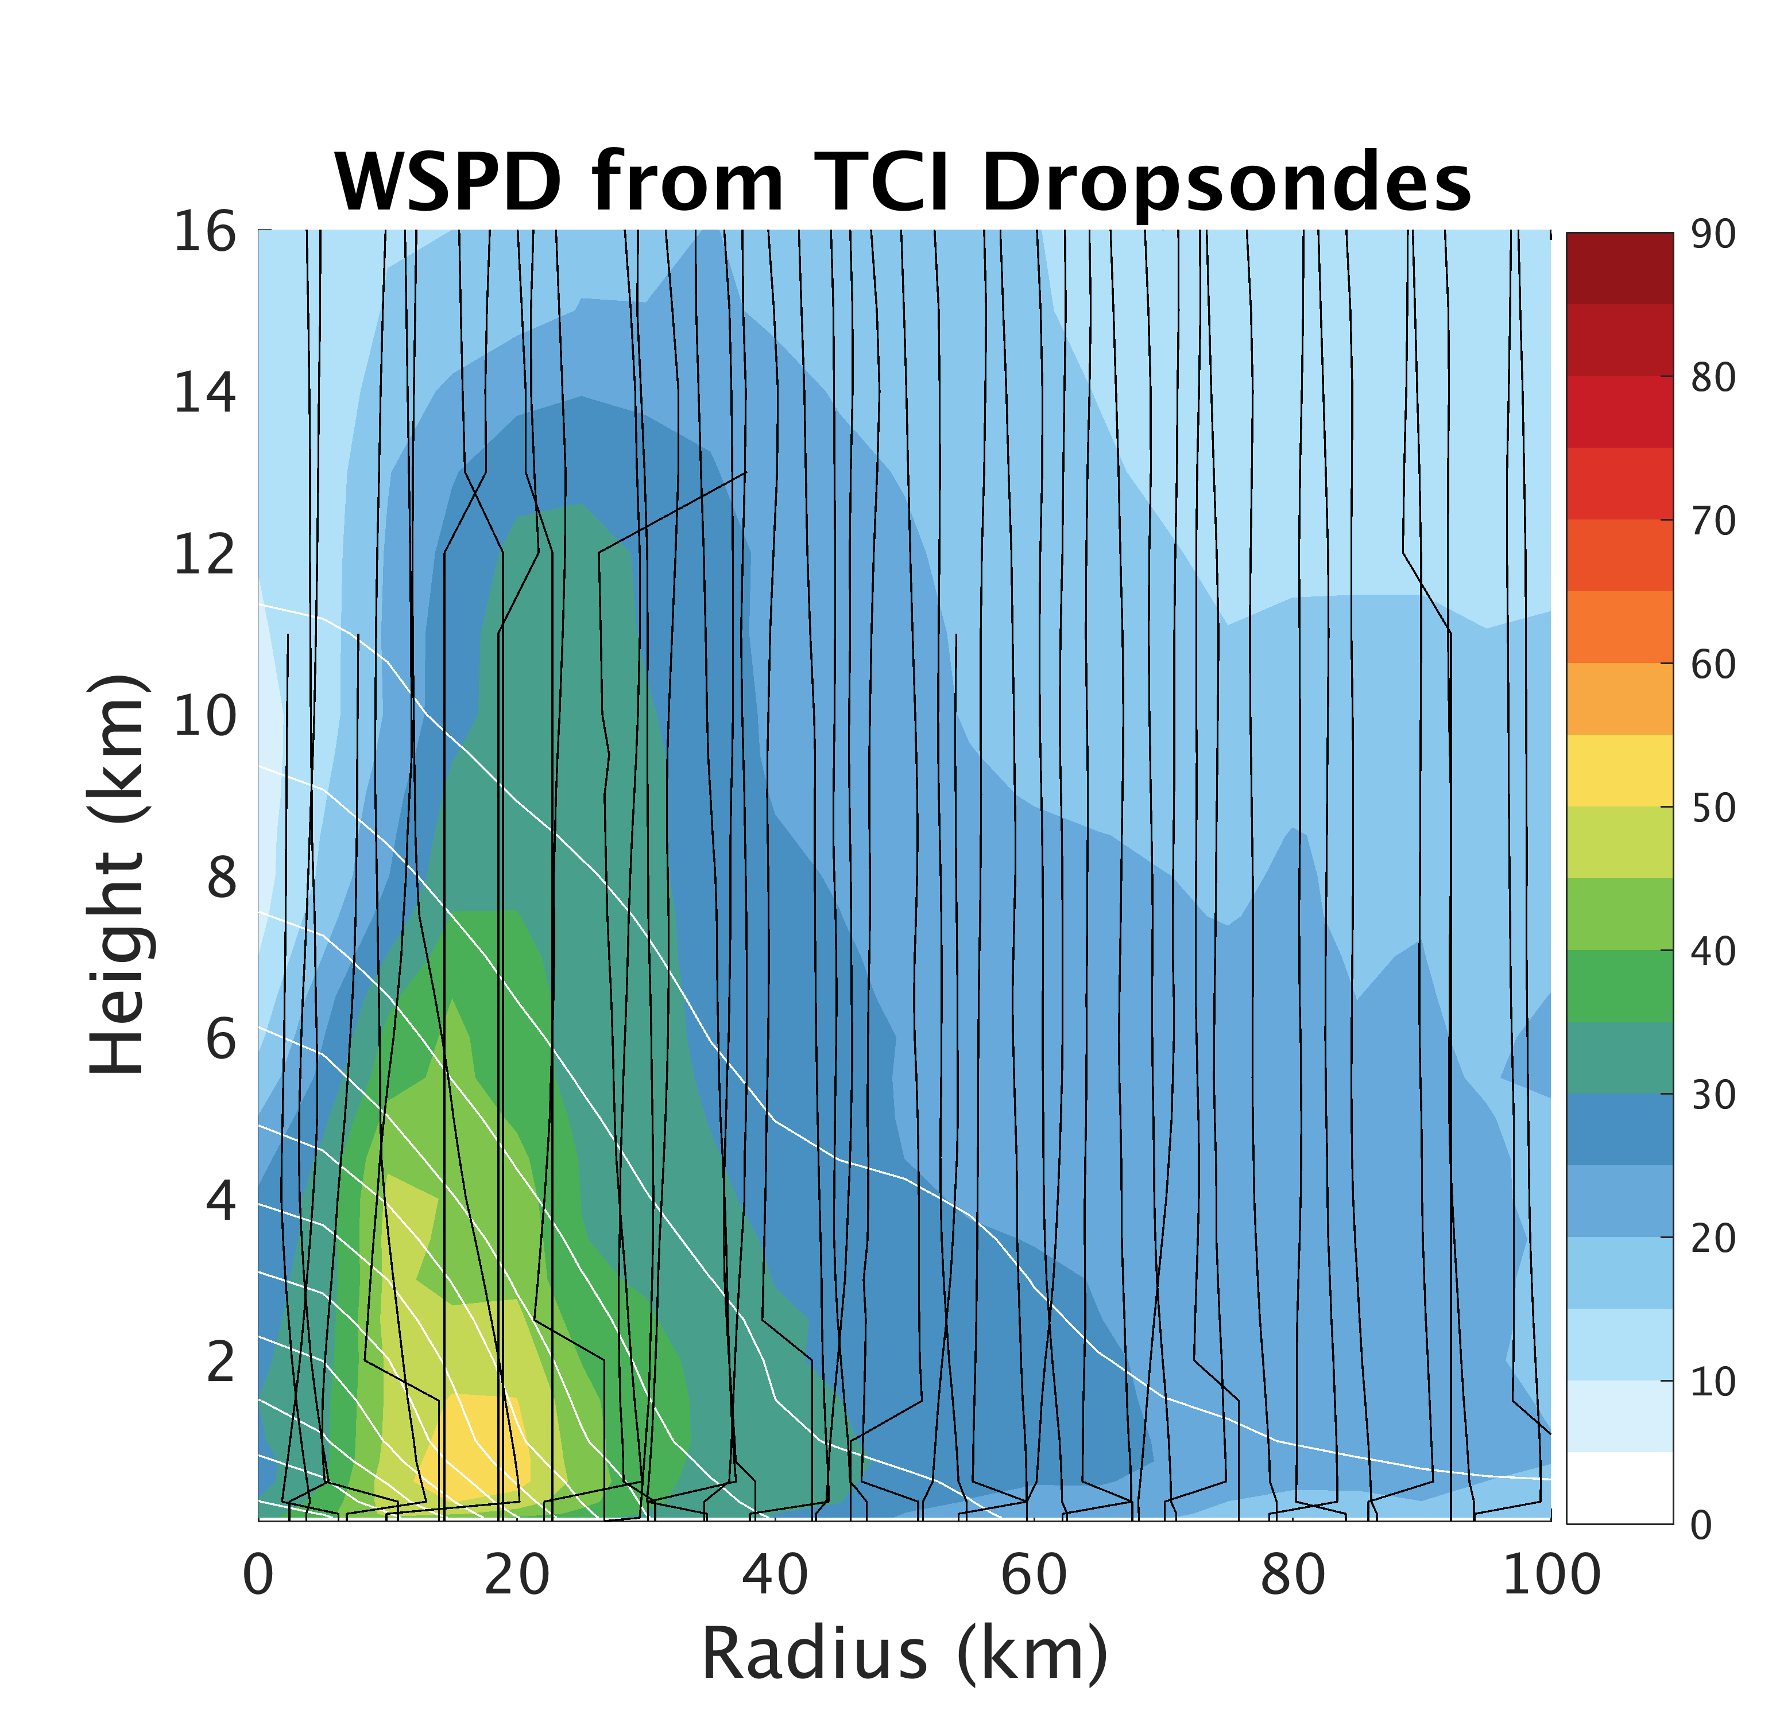
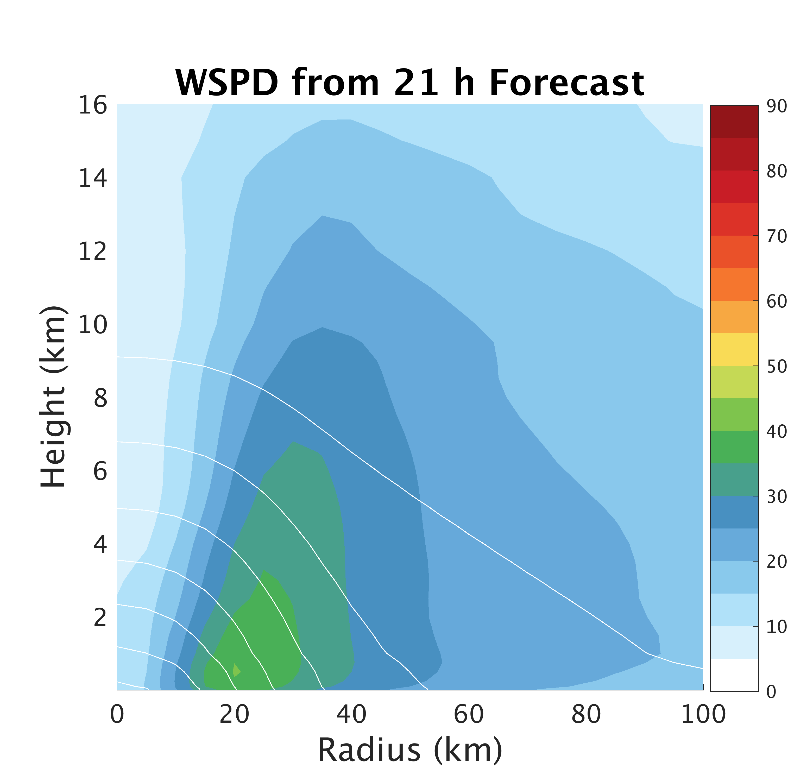
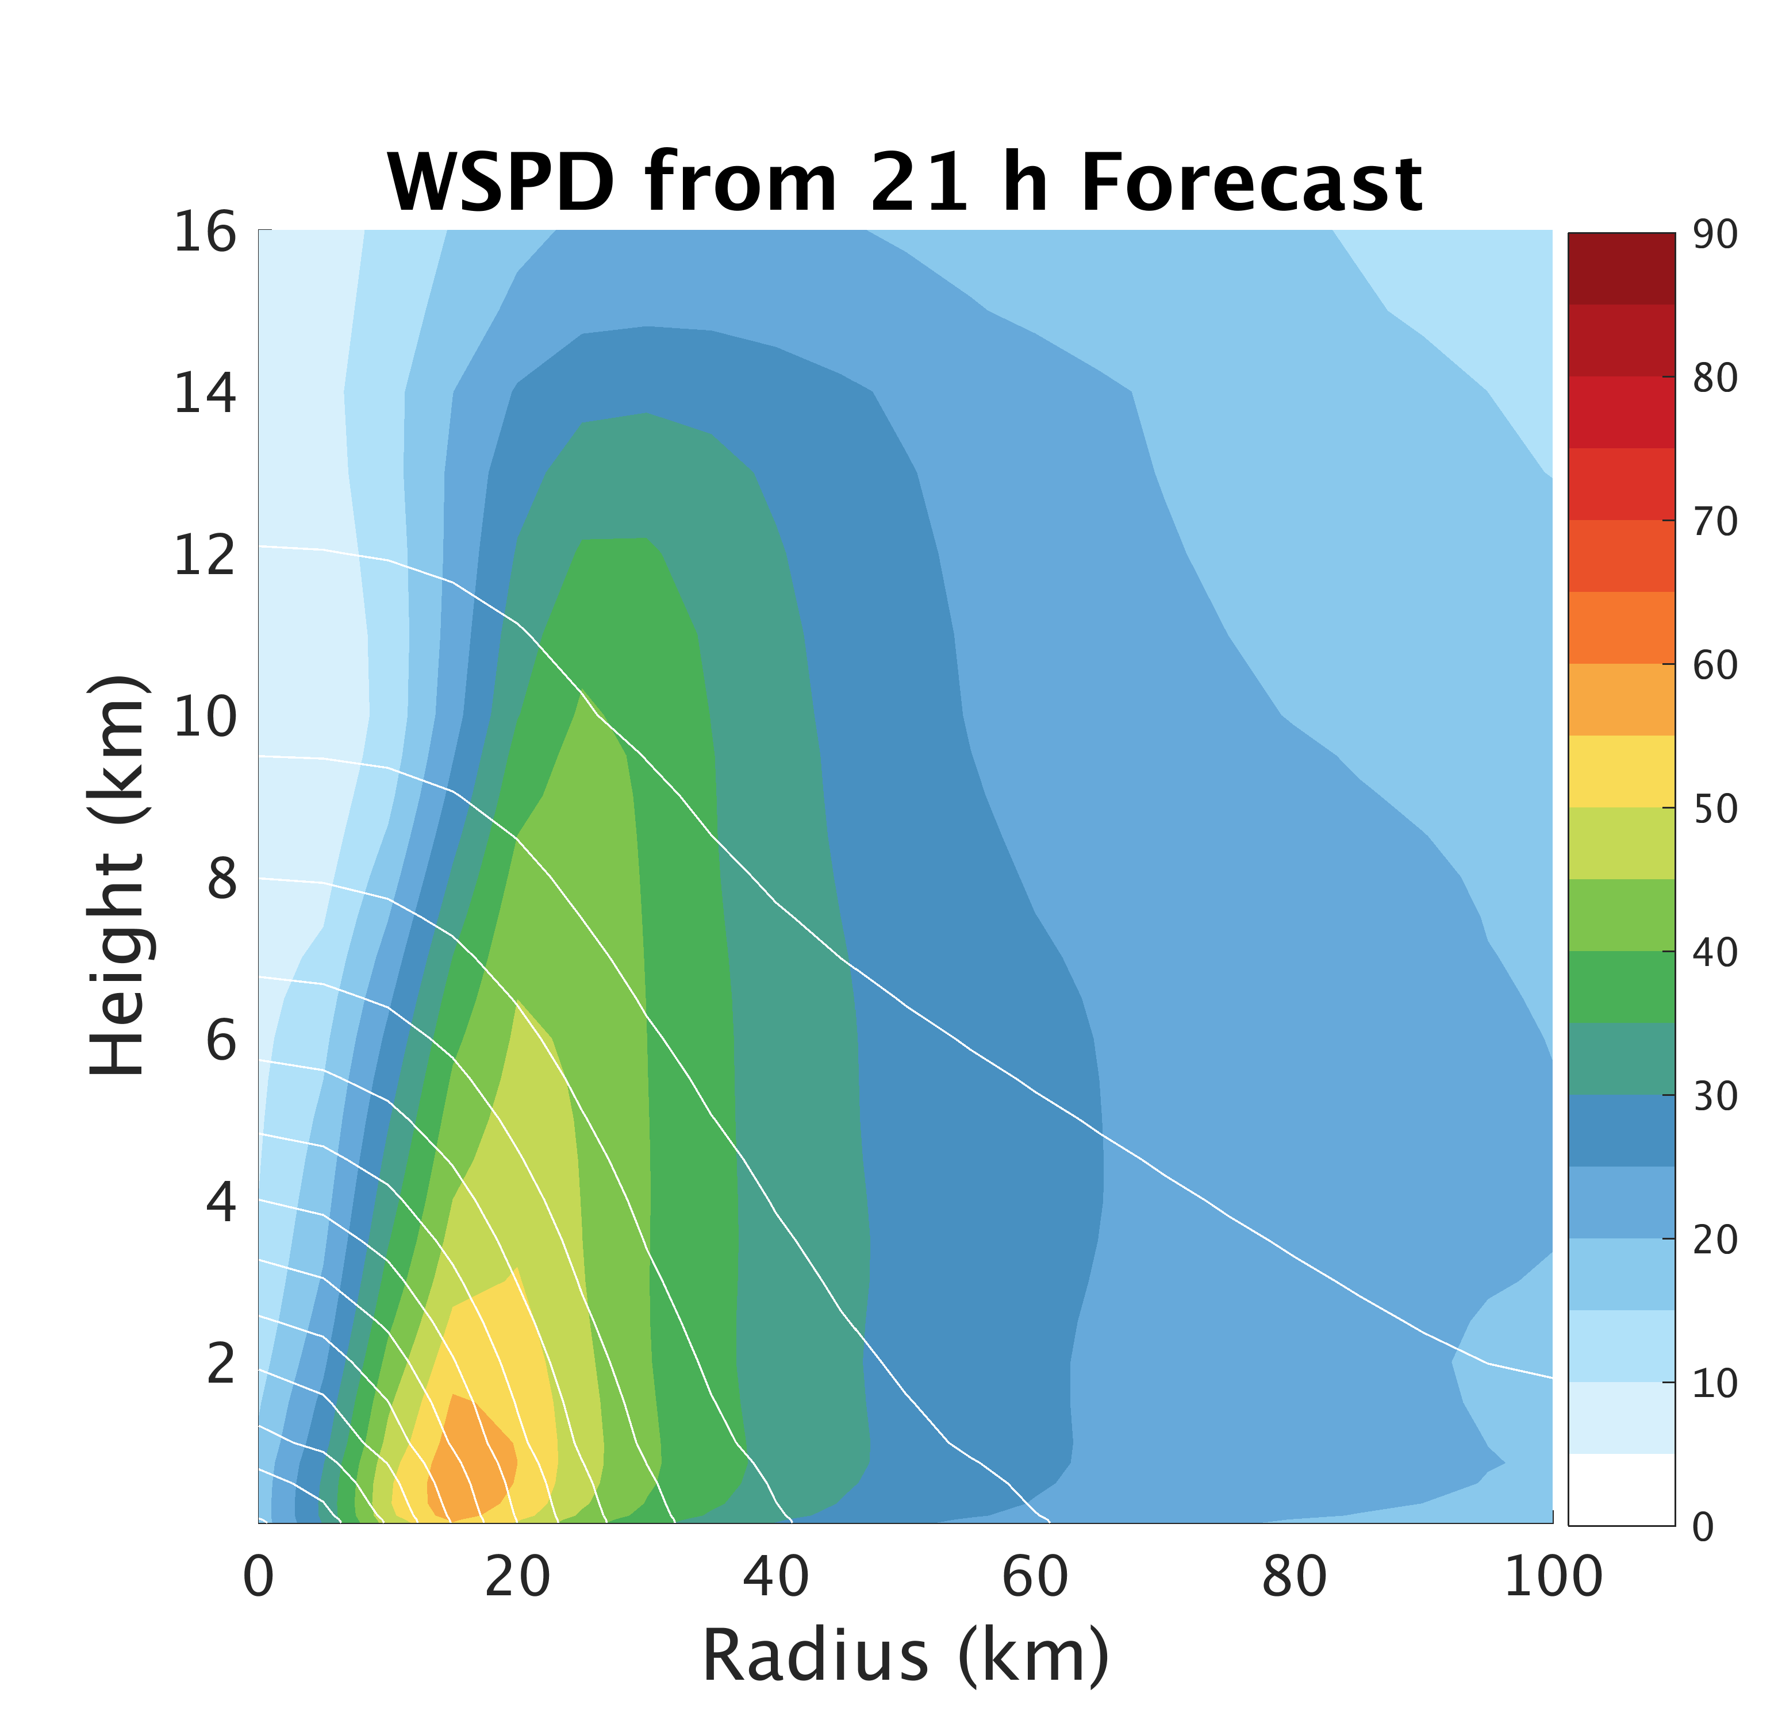
Deterministic Forecast
TCI Dropsonde Verification
TCI Dropsondes
Conv
Conv+Airbone

Slide 7
Ensemble Forecast

Slide 8
Remarkable intensification rate captured by the ensemble
Observed 33 ms⁻¹
Observed 54 ms⁻¹

Slide 9
Very Favorable Environmental Conditions
VWS ~ 5 ms⁻¹
SST ~ 30ºC
600 mb RH > 80%
Inner-core uncertainty likely therefore controls intensification

Slide 10
Inner-Core Conditions
T=0 h

Slide 11
Stronger initial low-level inflow spins up vortex more quickly
T=0 h

Slide 12
Inner-Core Conditions
T=1 h

Slide 13
Tangential winds quickly adjust to secondary circulation
T=1 h

Slide 14
Inner-Core Conditions
T=6 h

Slide 15
Primary circulation hereafter is most strongly correlated w/ intensity
T=6 h

Slide 16
Strong Forecast Sensitivity to
Resolution & Surface Drag

Slide 17
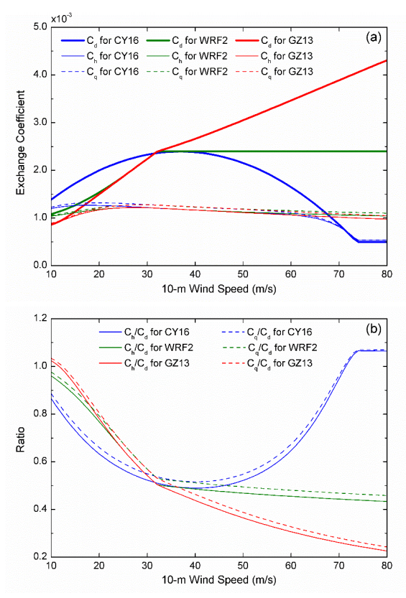
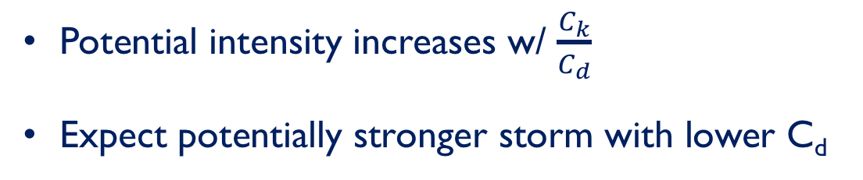
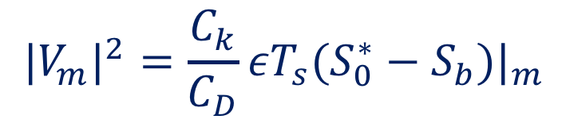
Why Model Surface Flux Param. Matters
MPI:
$${|V_{m}|}^{2}=\frac{C_{k}}{C_{D}}εT_{s}(S_{0}^{∗}−S_{b})|_{m}$$
Potential intensity increases w/ $\frac{C_{k}}{C_{d}}$
Expect potentially stronger storm with lower C_{d}
[Emanuel, 1997]
[Chen et al. 2018]

Slide 18
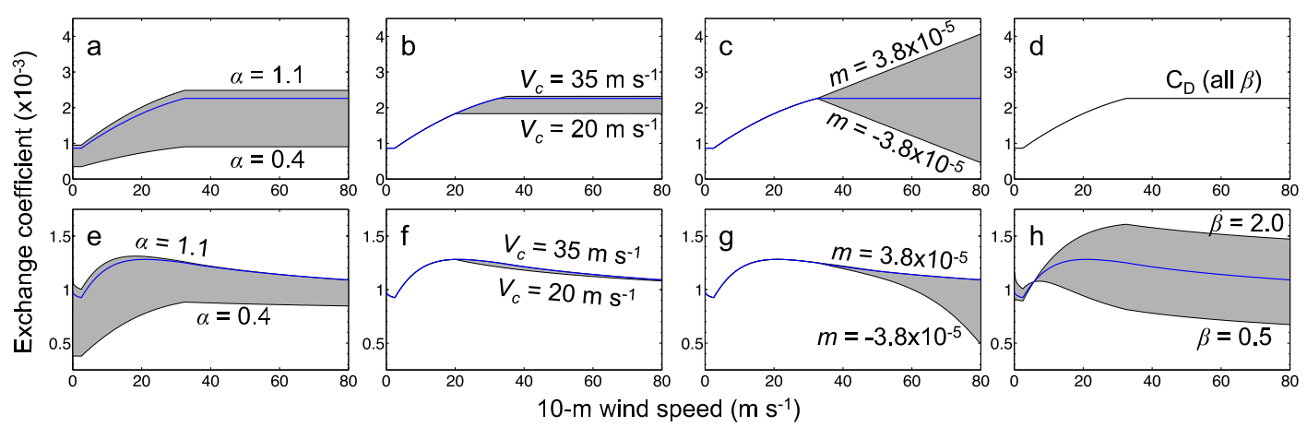
C_{d}/C_{k} Patricia Ensemble
Green and Zhang [2014]

Slide 19
Summary
Cycling DA w/ modified Cd and 1 km horizontal resolution able to well simulate the historic RI and peak intensity of Patricia following P-3 flights
Favorable environmental conditions and accurate inner core initialization,
following P-3 flights, allowed for relatively skillful prediction
Forecasted peak intensity at strongly influenced by initial secondary circulation
  acts to quickly spin up primary circulation
Very strong sensitivity between Patricia’s intensification and surface flux parametrization
Forecast intensity and inner-core structure/size also sensitive to horizontal resolution
Plan to investigate impact of C_{d}/C_{k} on the energetics of Patricia’s intensification
Opportunity for Simultaneous State and Parameter Estimation of surface flux parametrization?

Slide 20
Supplemental Slides

Slide 21
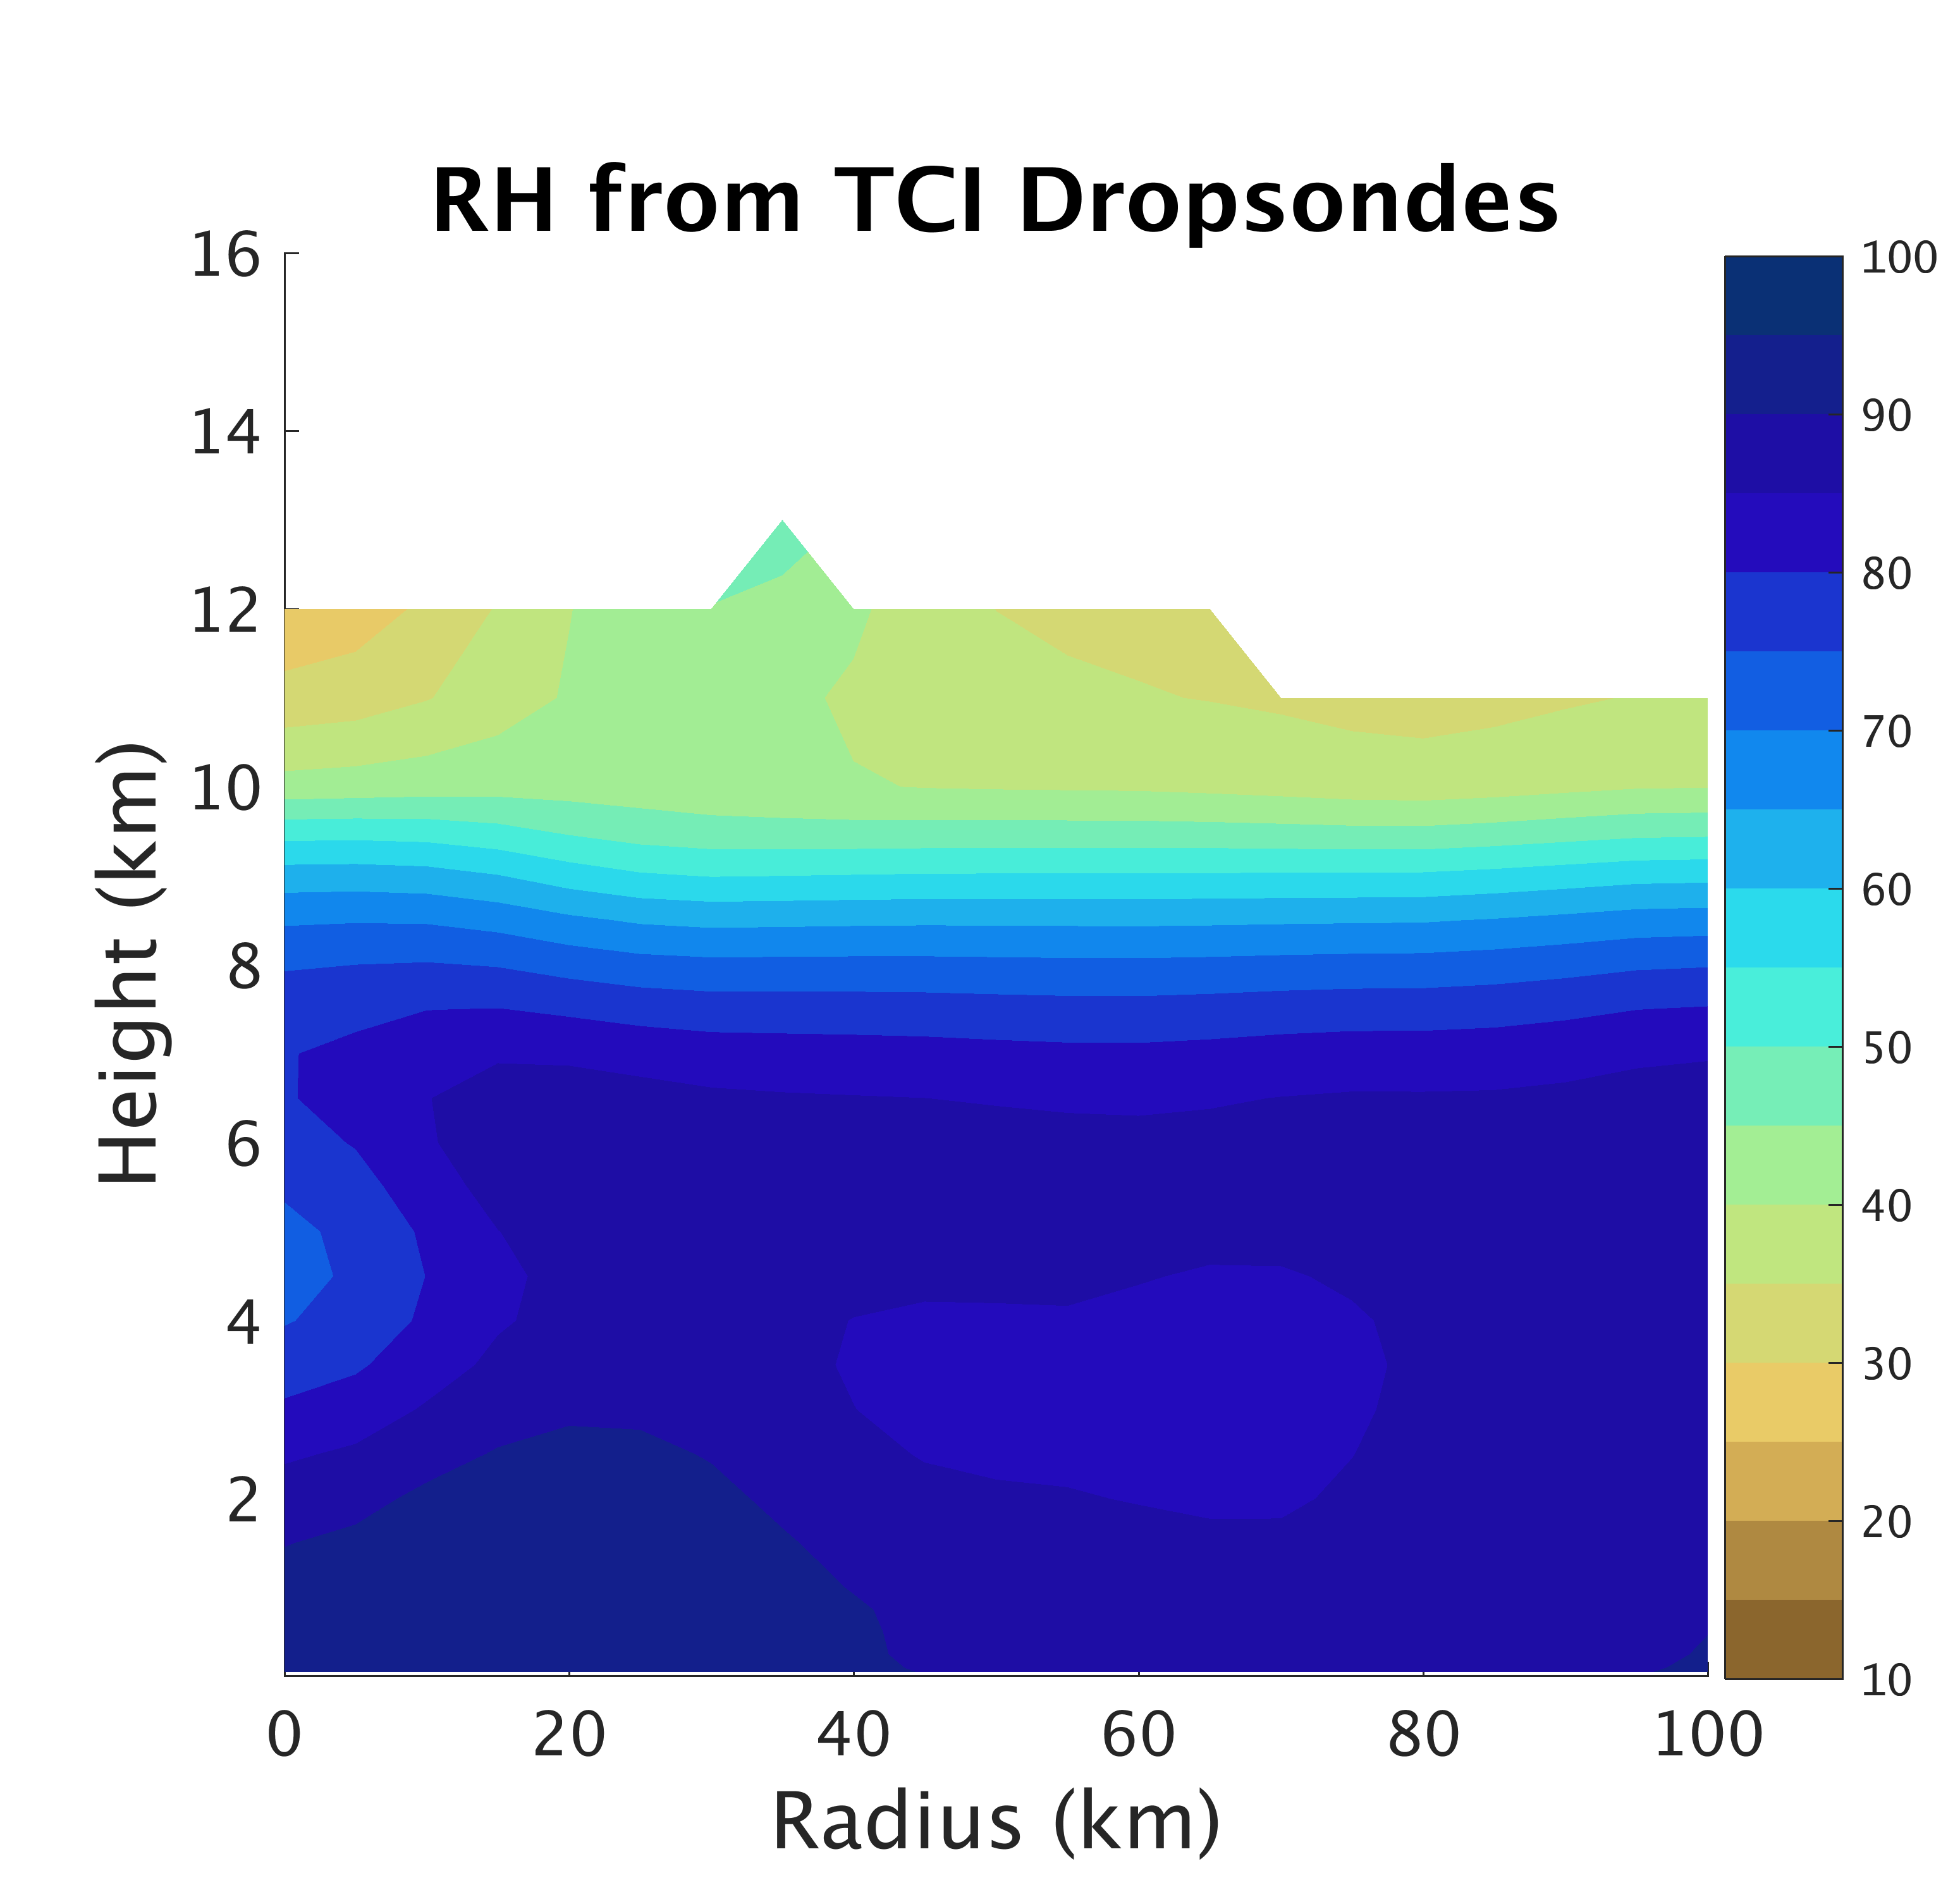
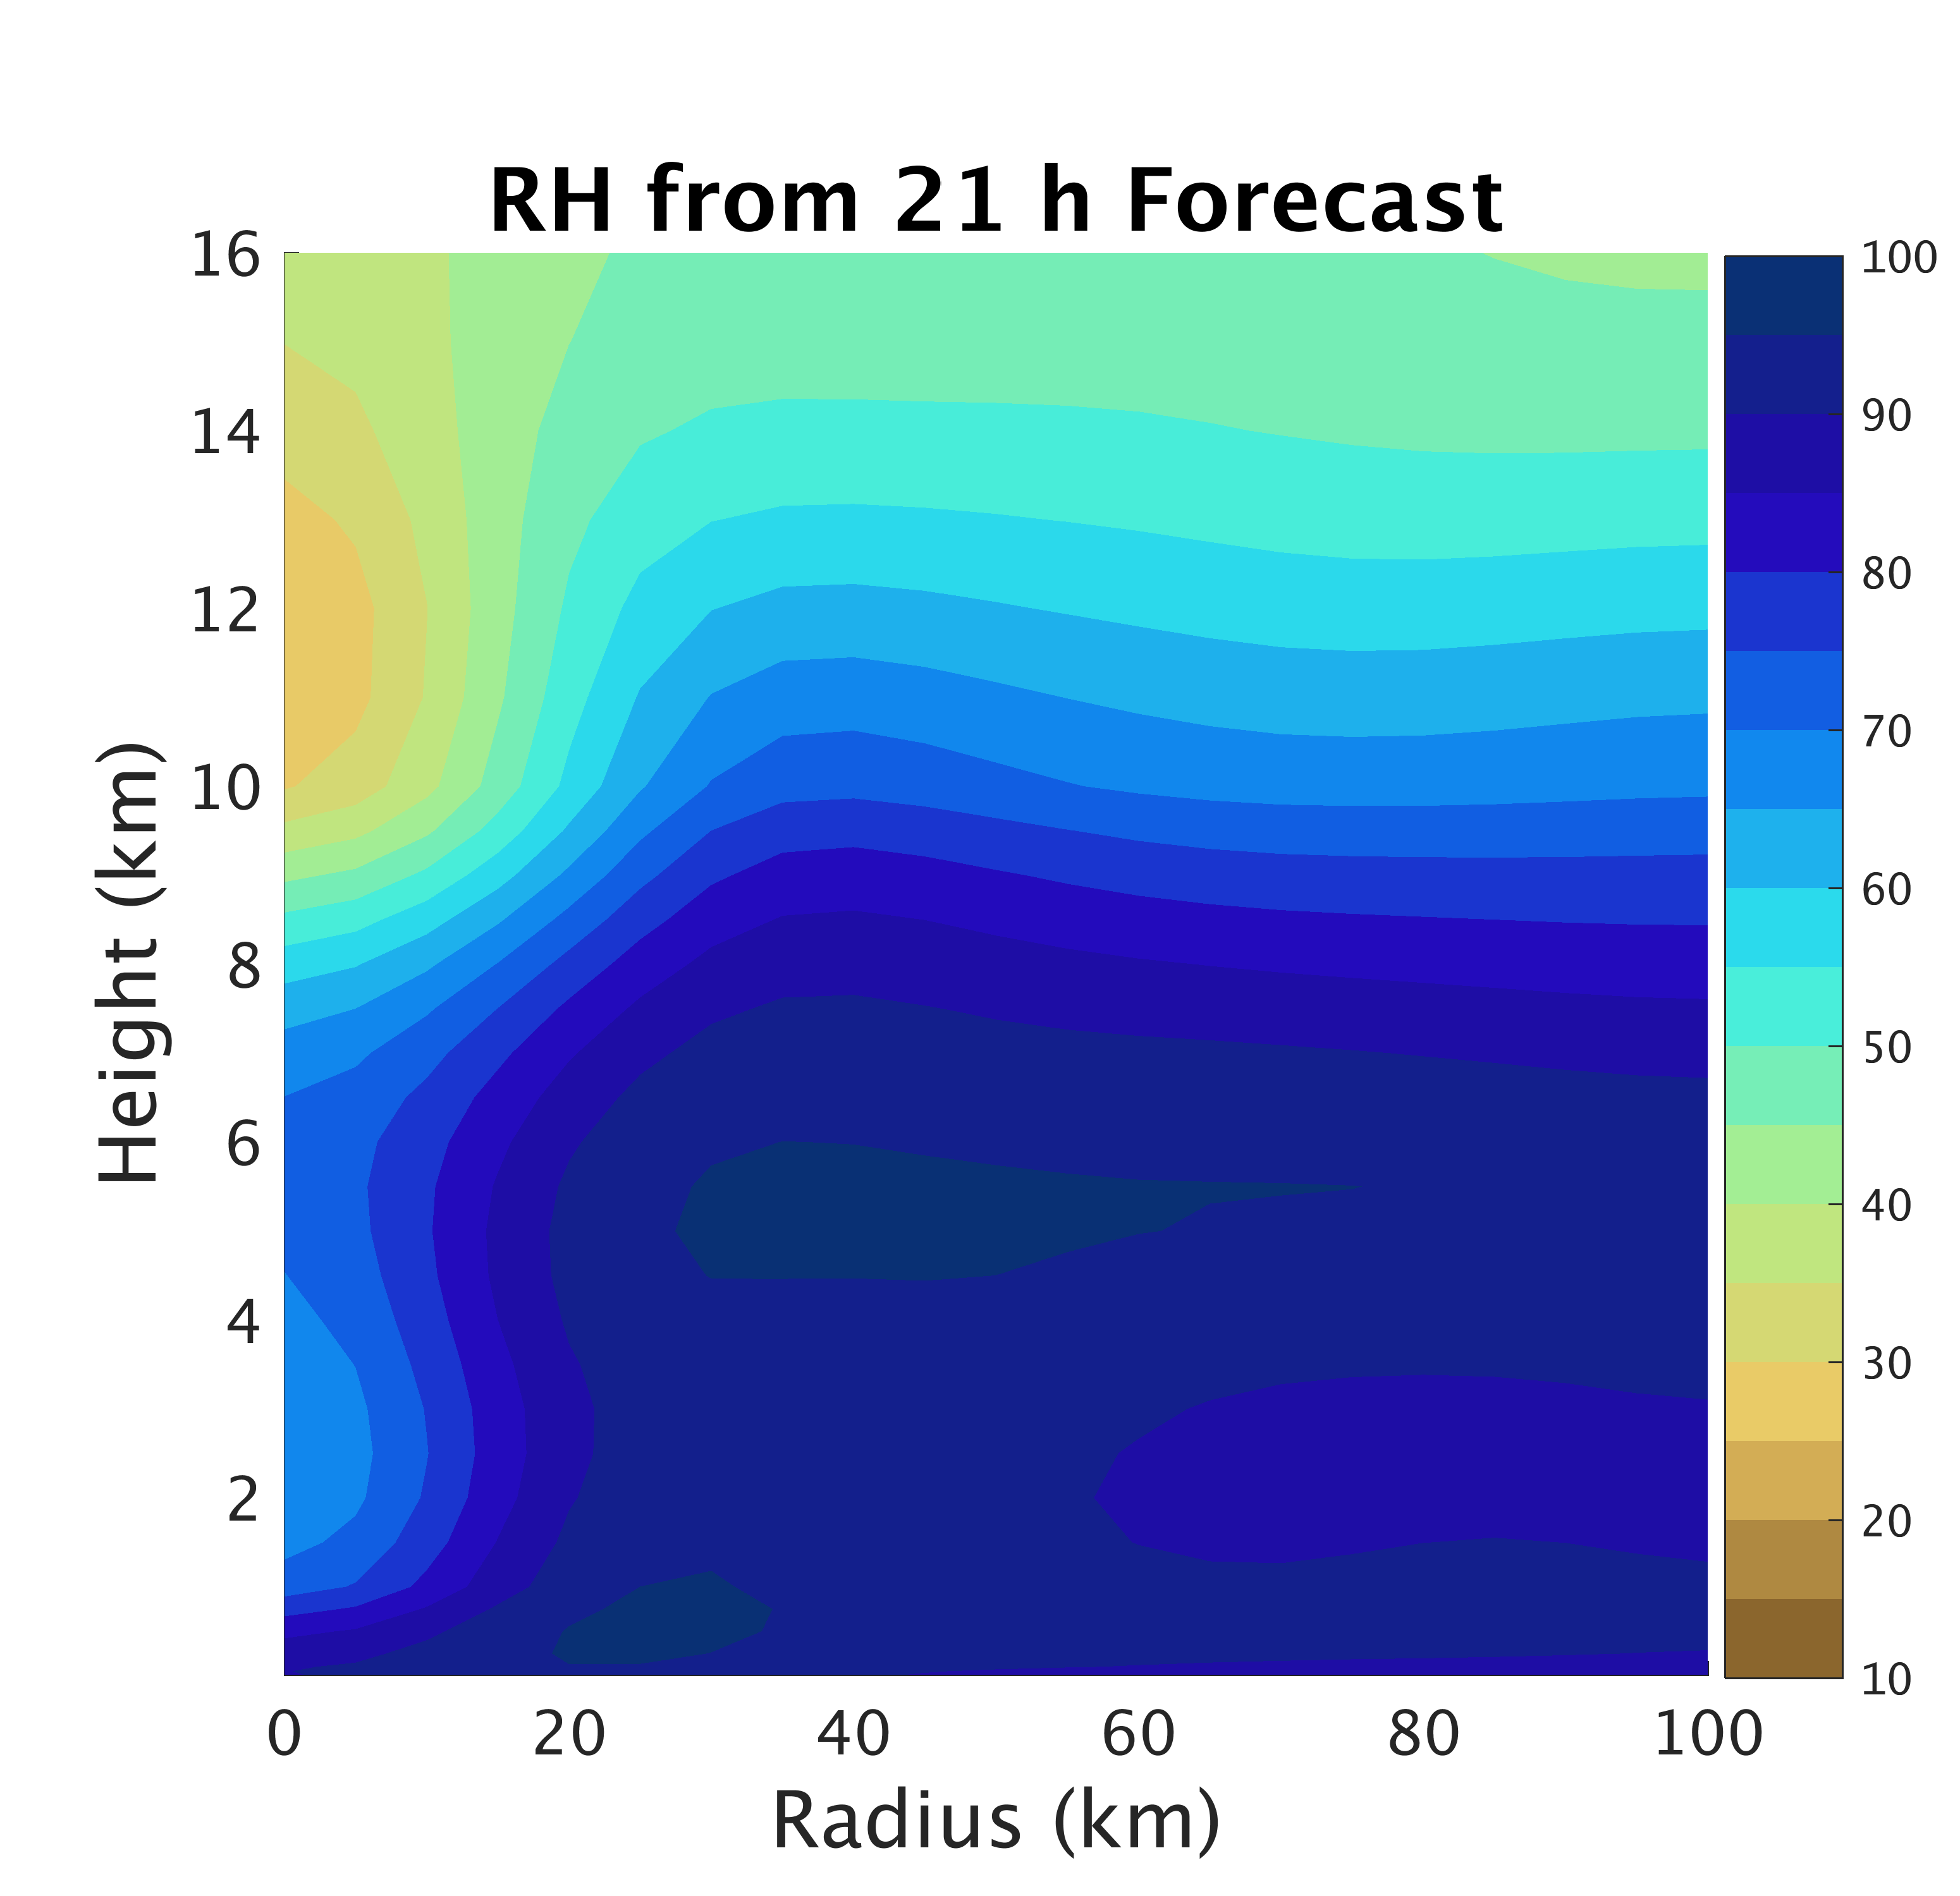
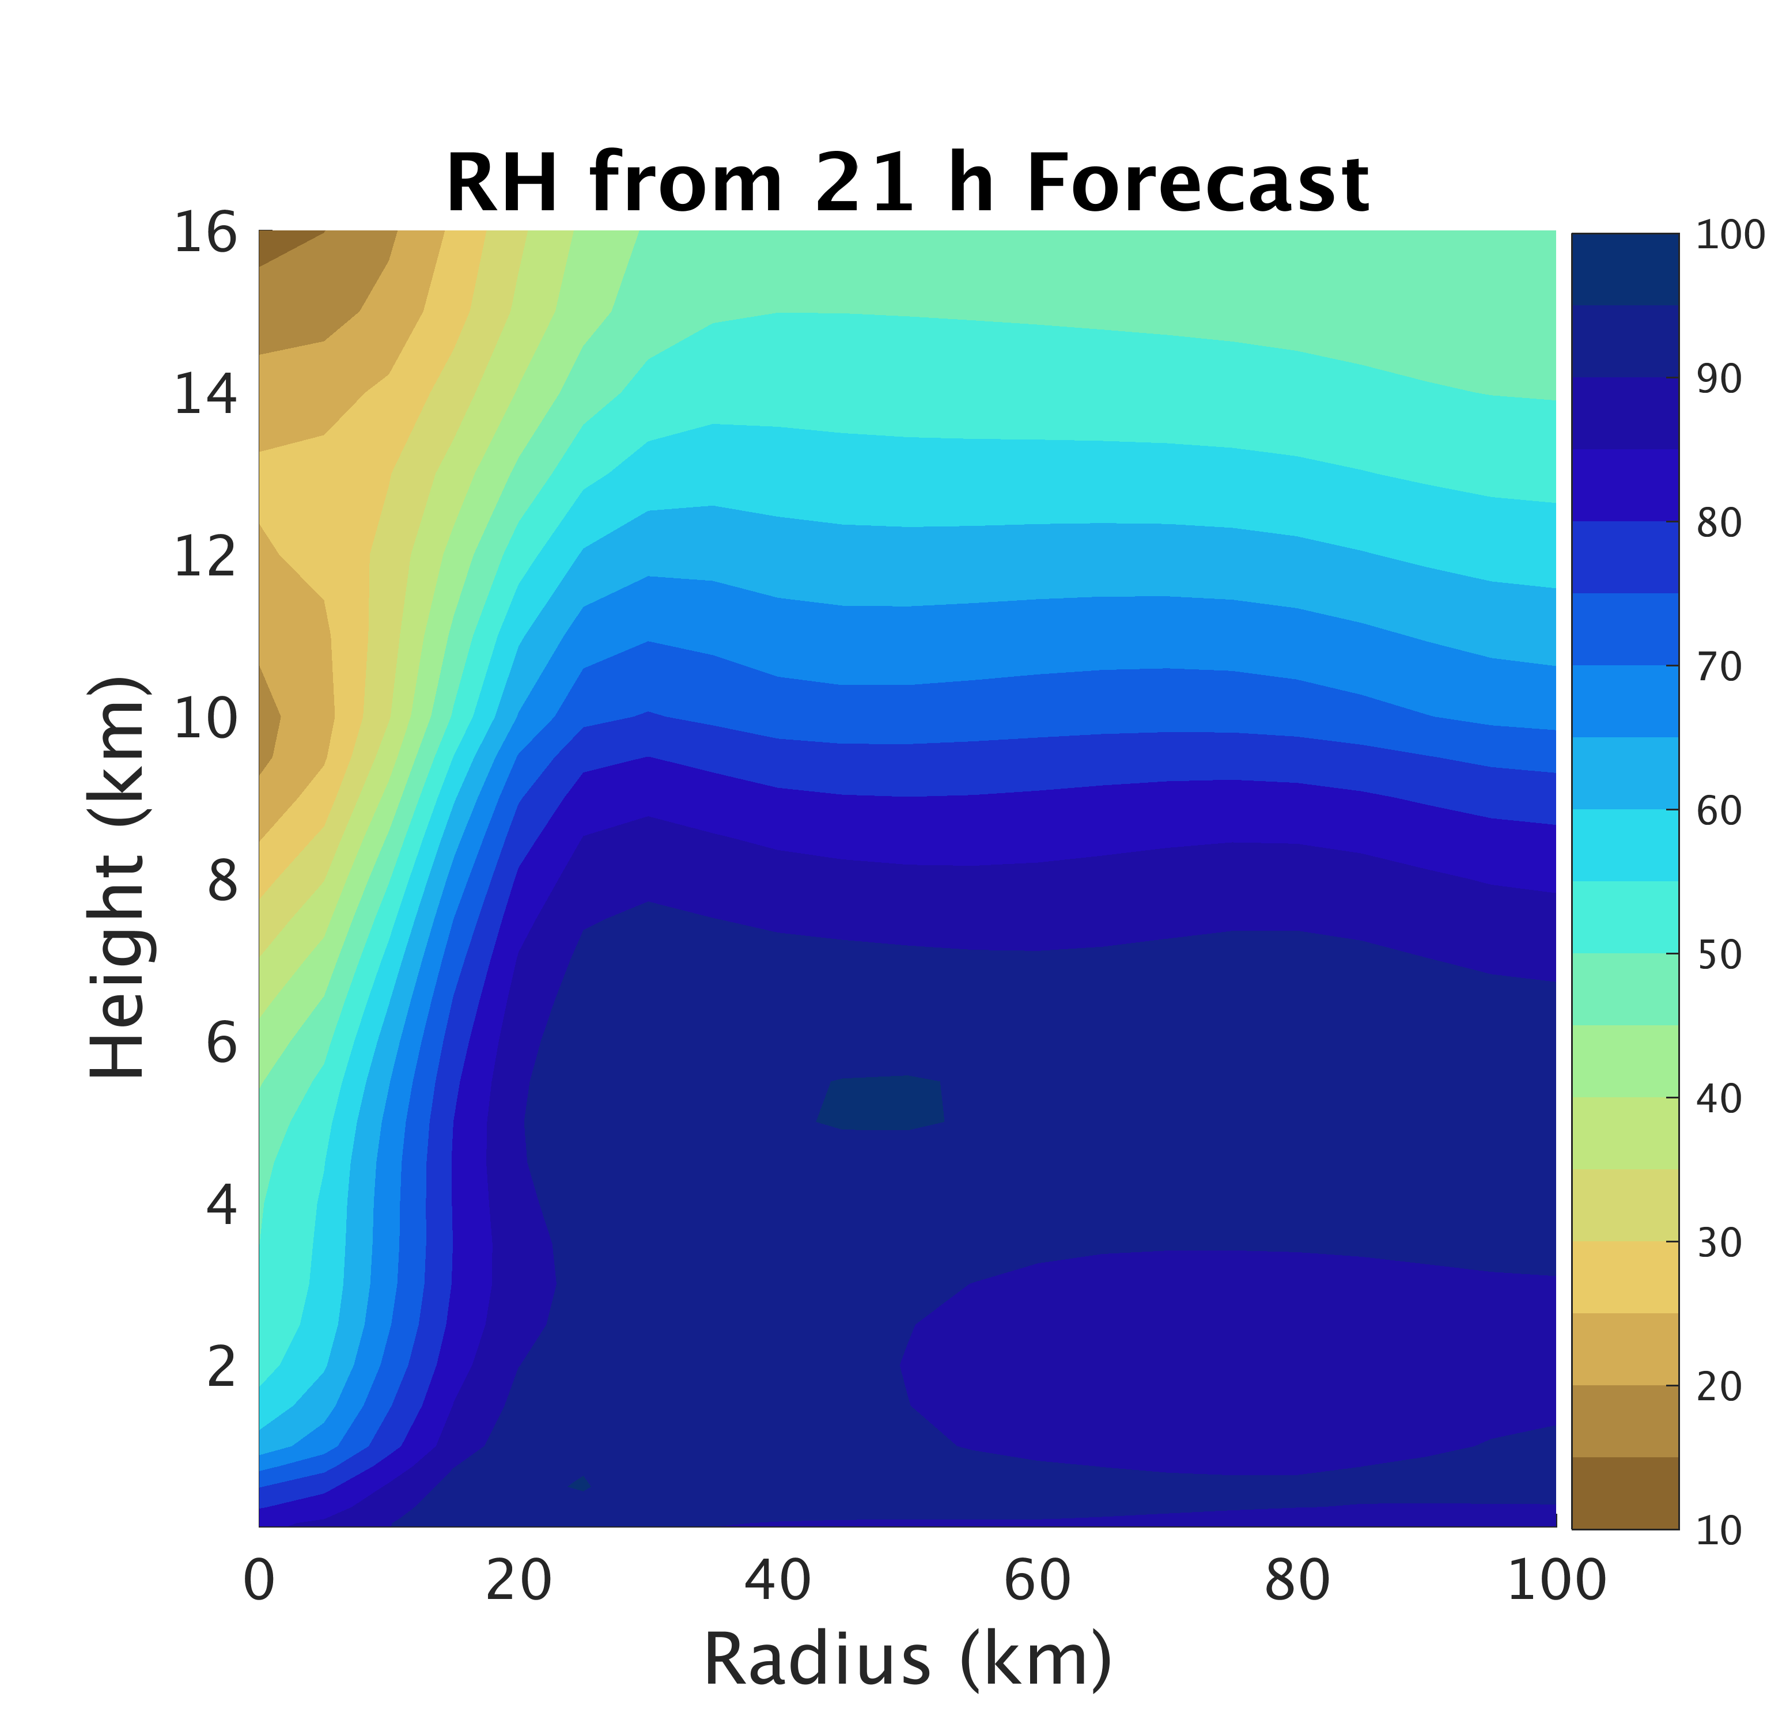
Deterministic Forecast
TCI Dropsonde Verification
TCI Dropsondes
Conv
Conv+Airbone

Slide 22
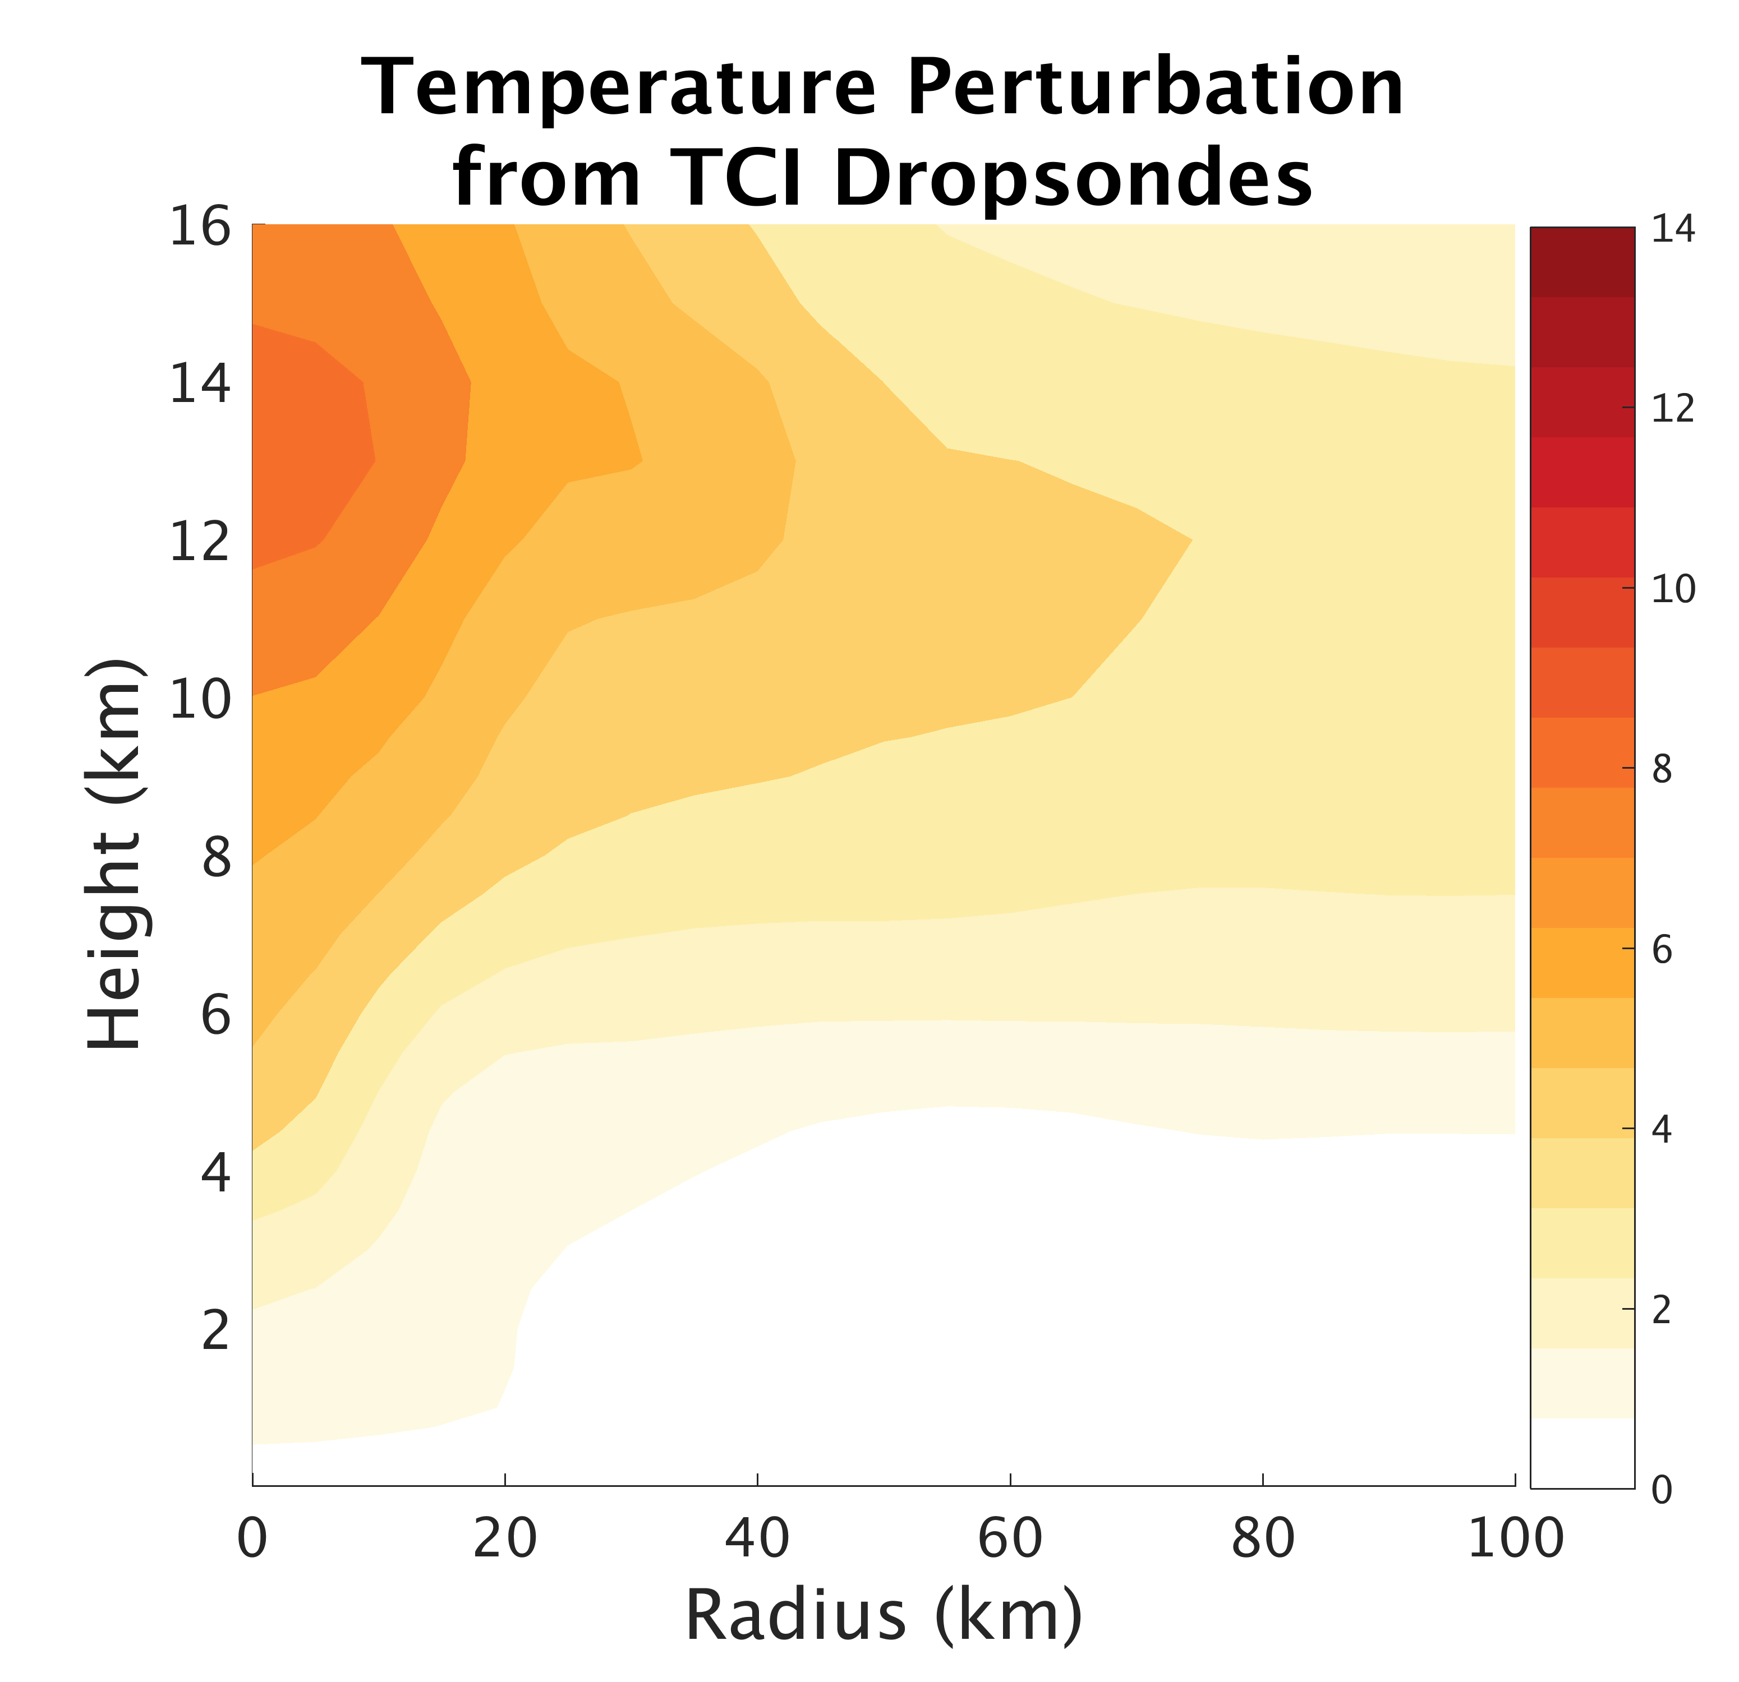
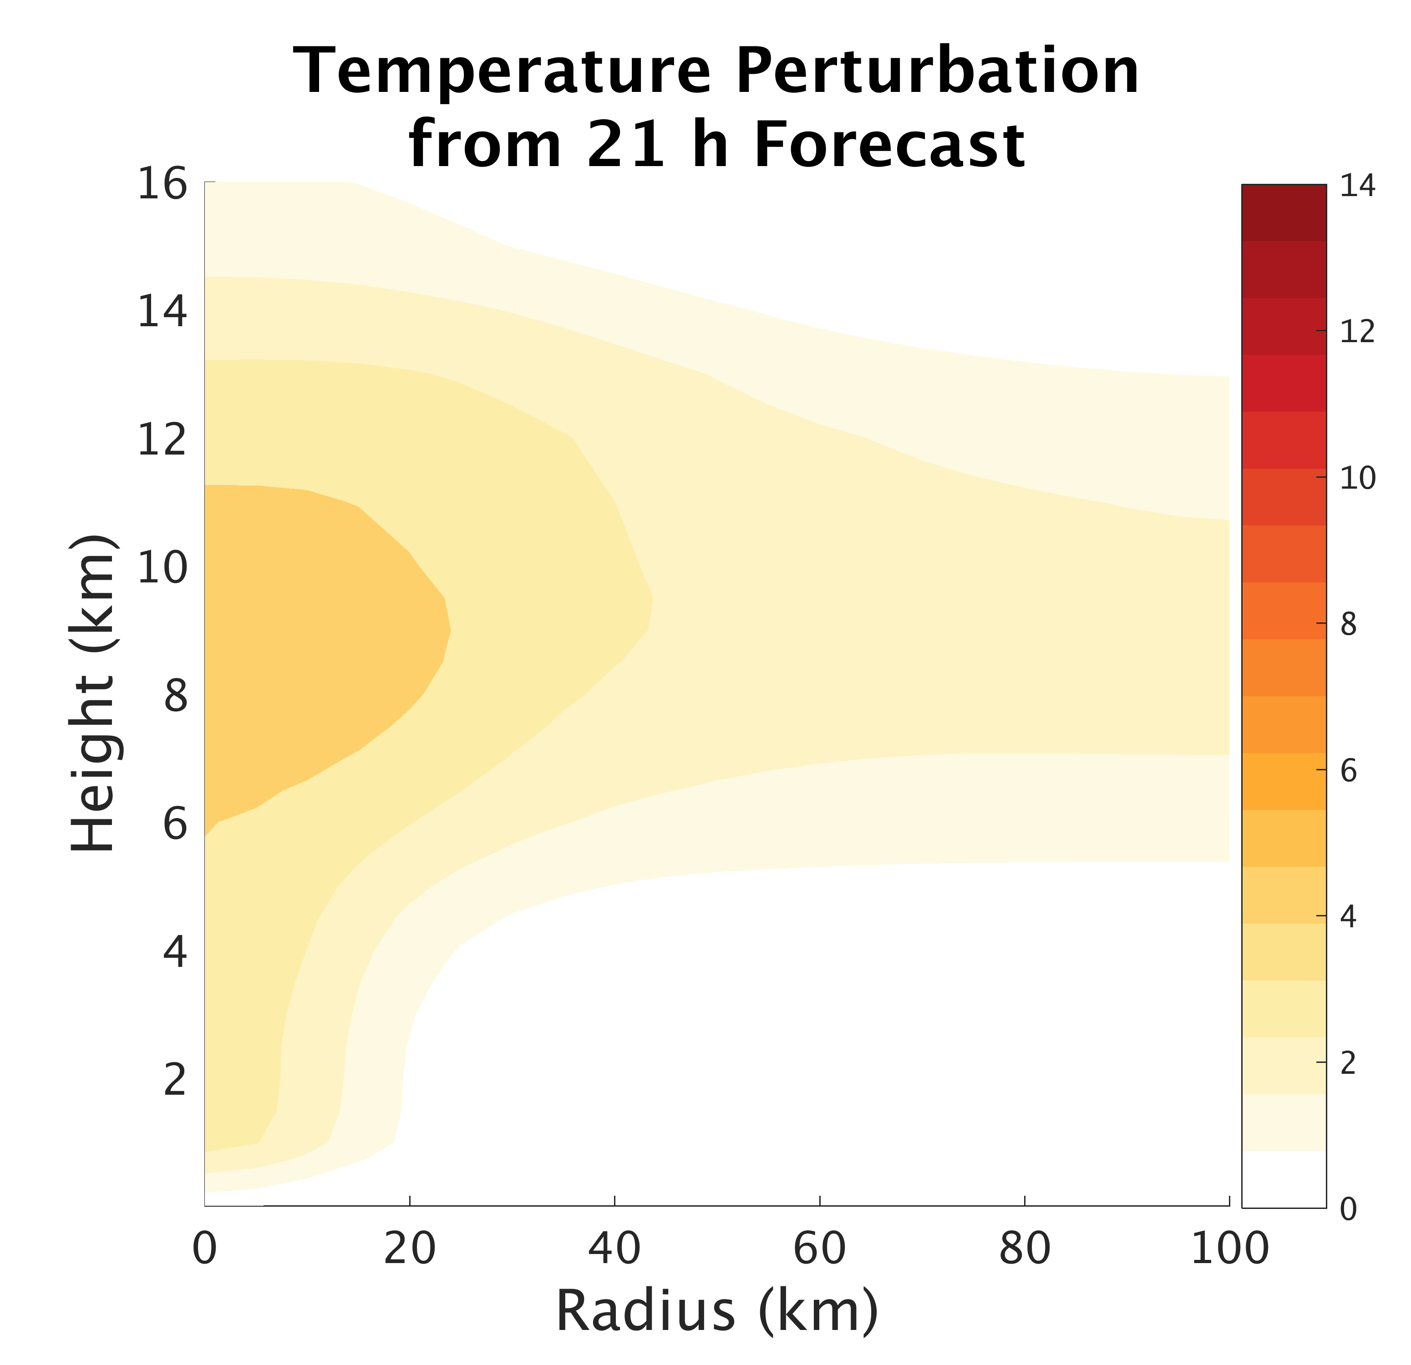
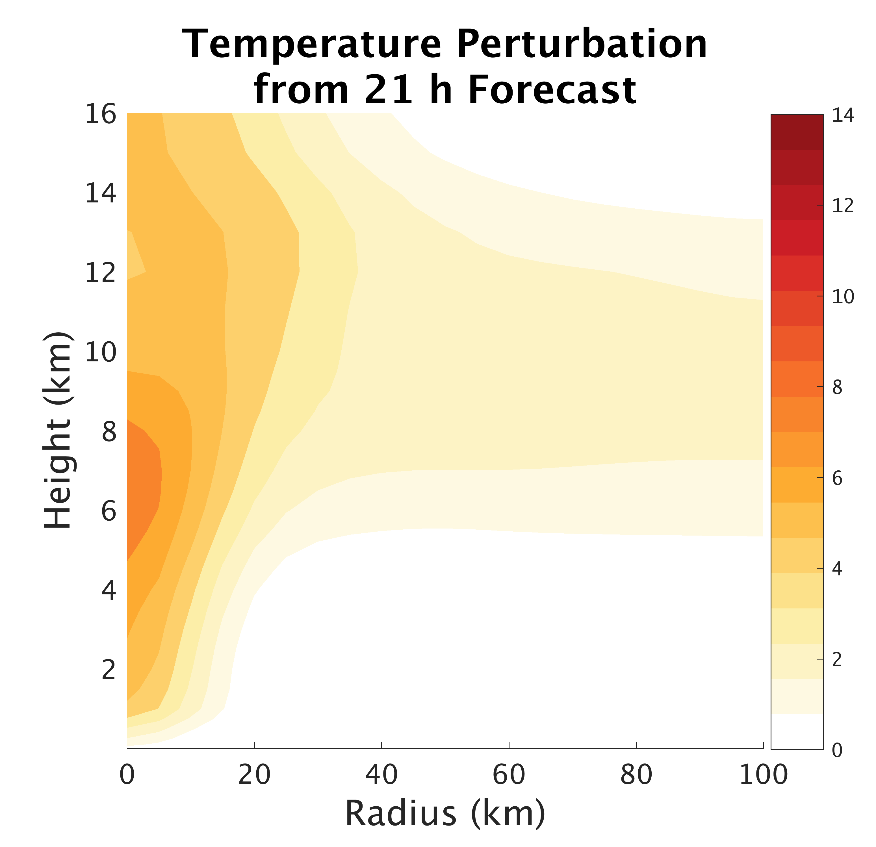
Deterministic Forecast
TCI Dropsonde Verification
TCI Dropsondes
Conv
Conv+Airbone

Slide 23
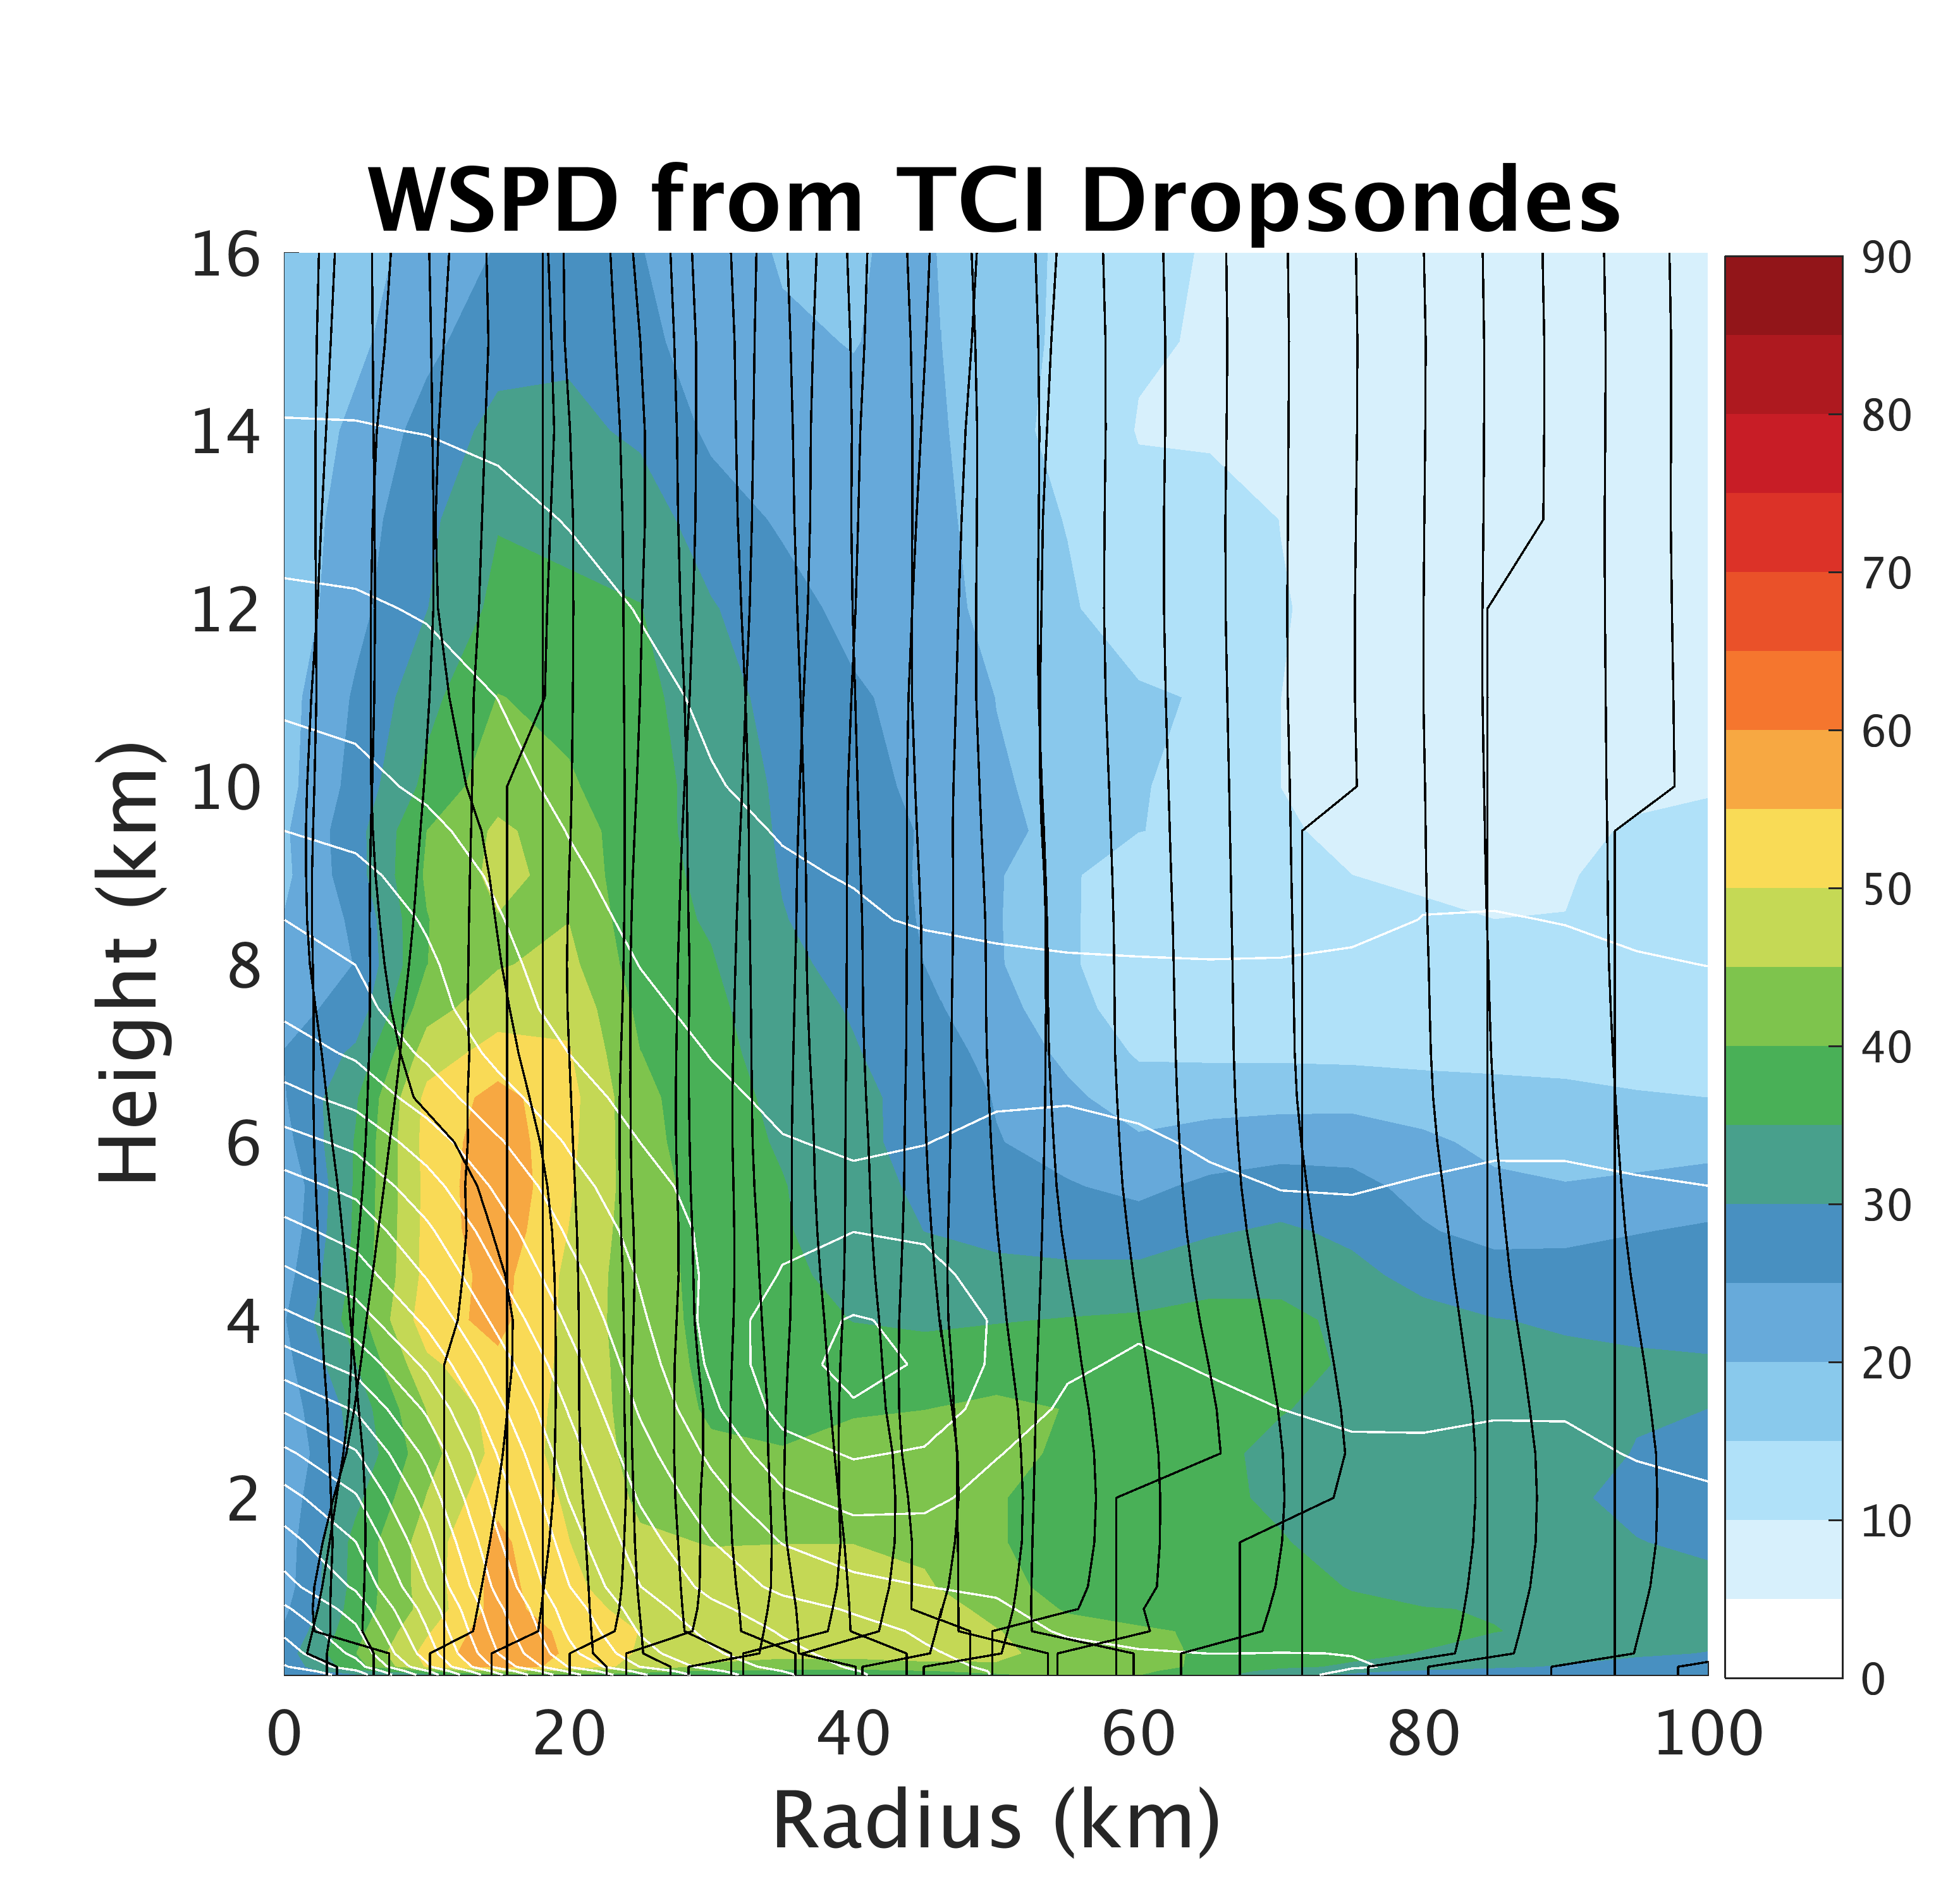
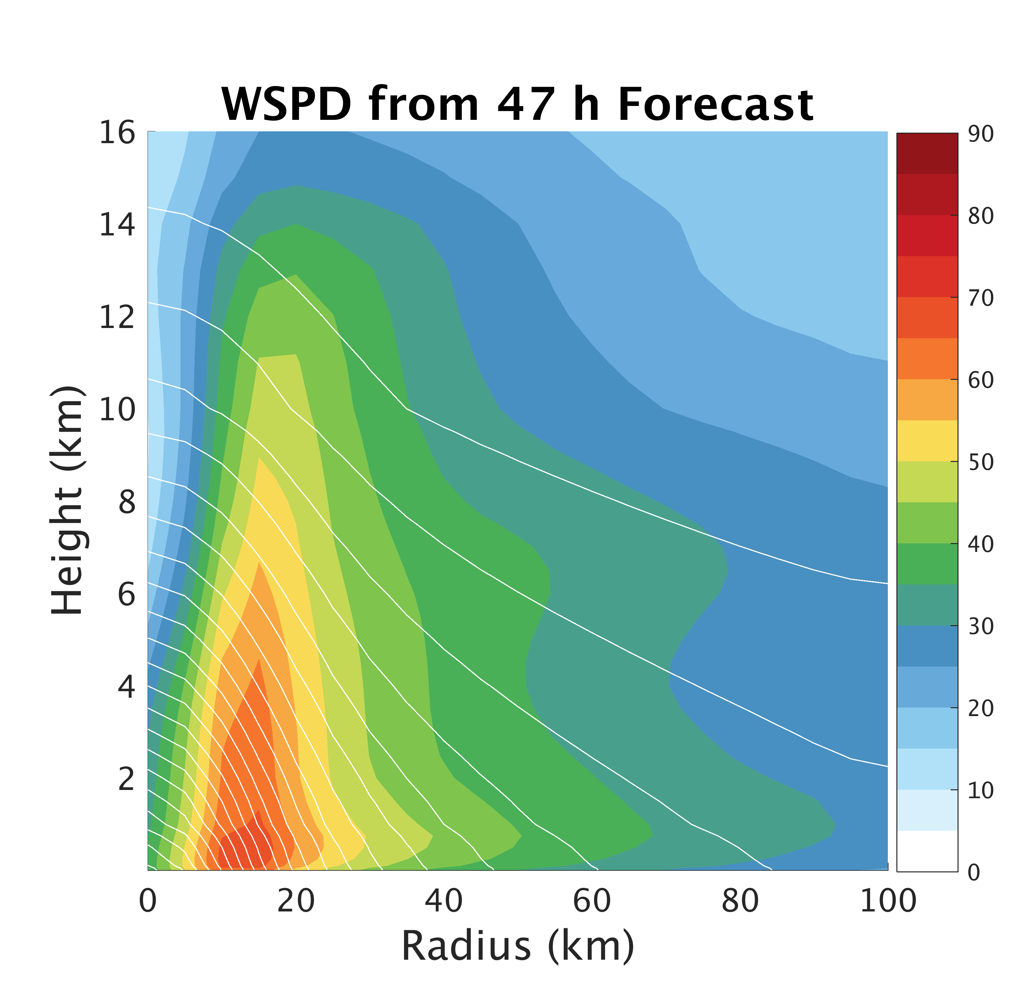
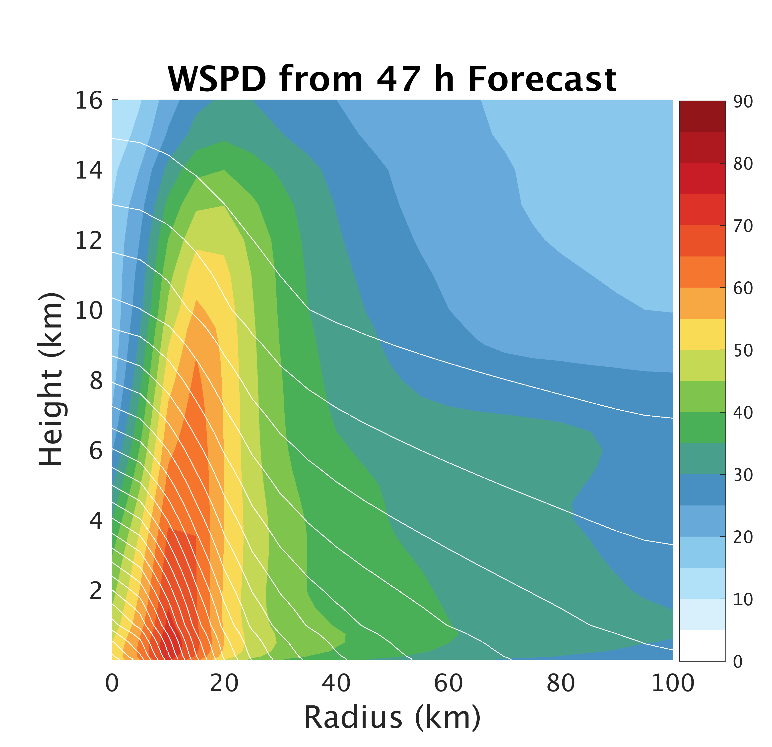
Deterministic Forecast
TCI Dropsonde Verification
TCI Dropsondes
Conv
Conv+Airbone

Slide 24
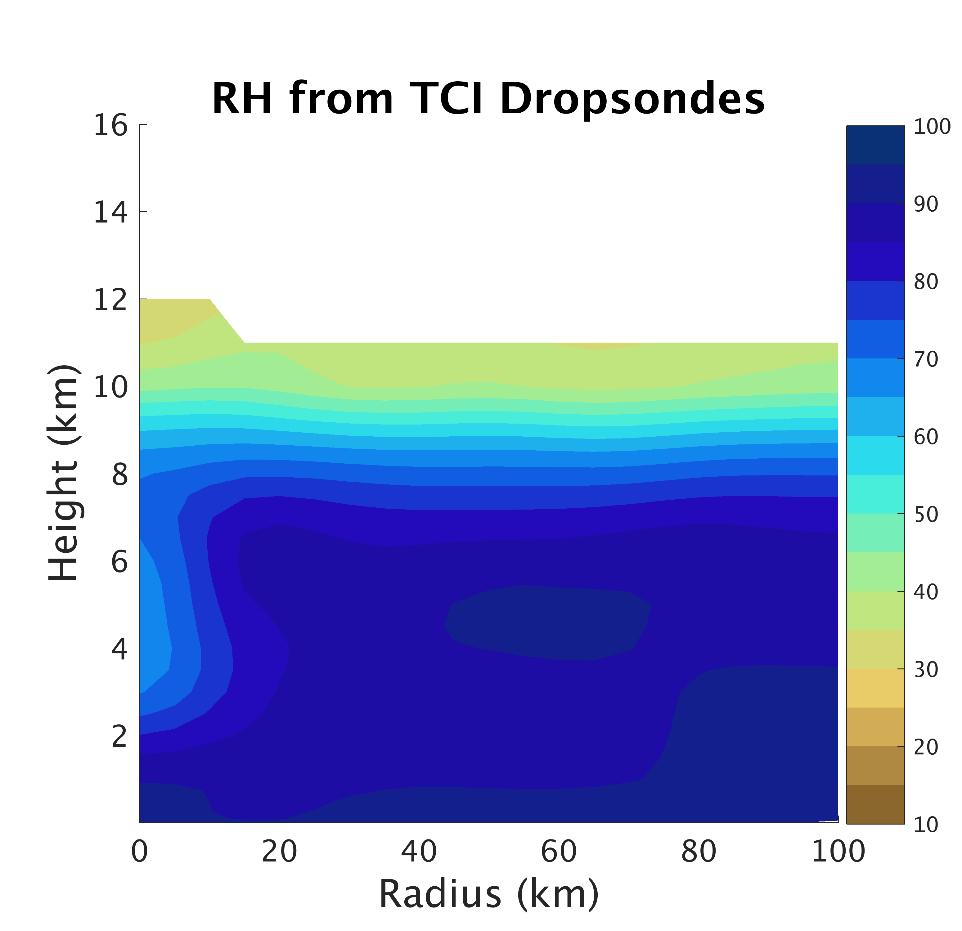
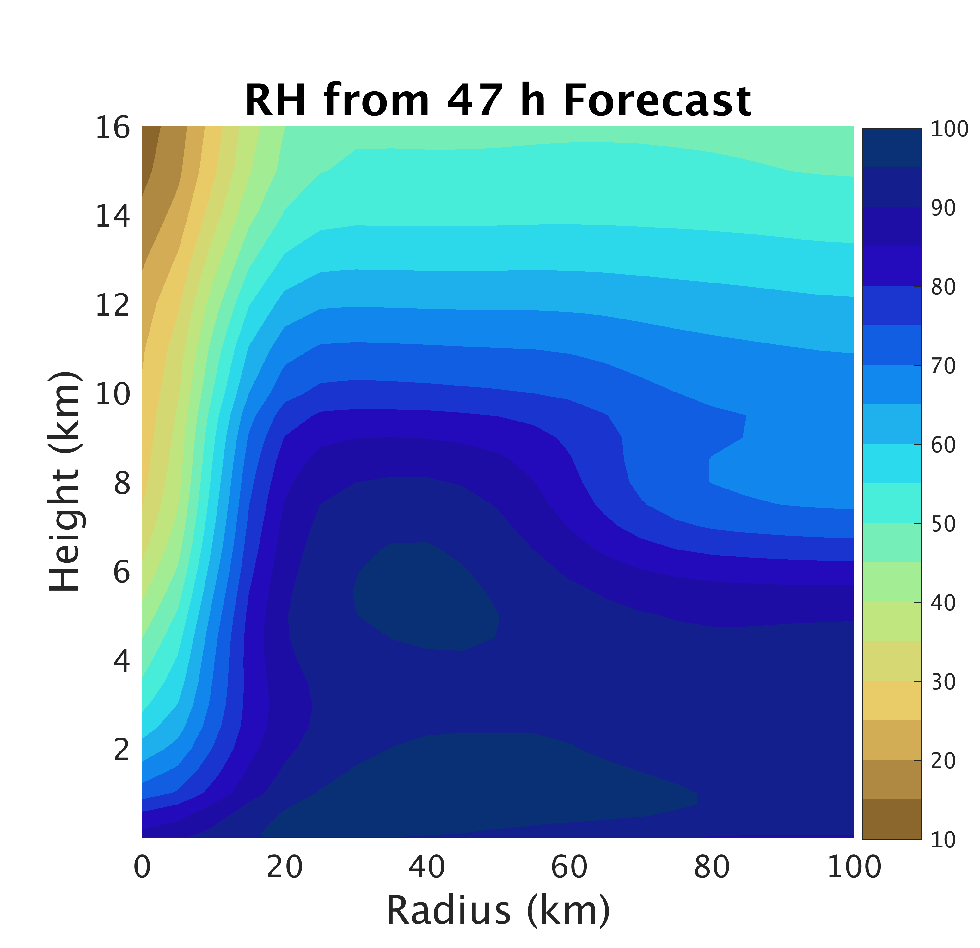
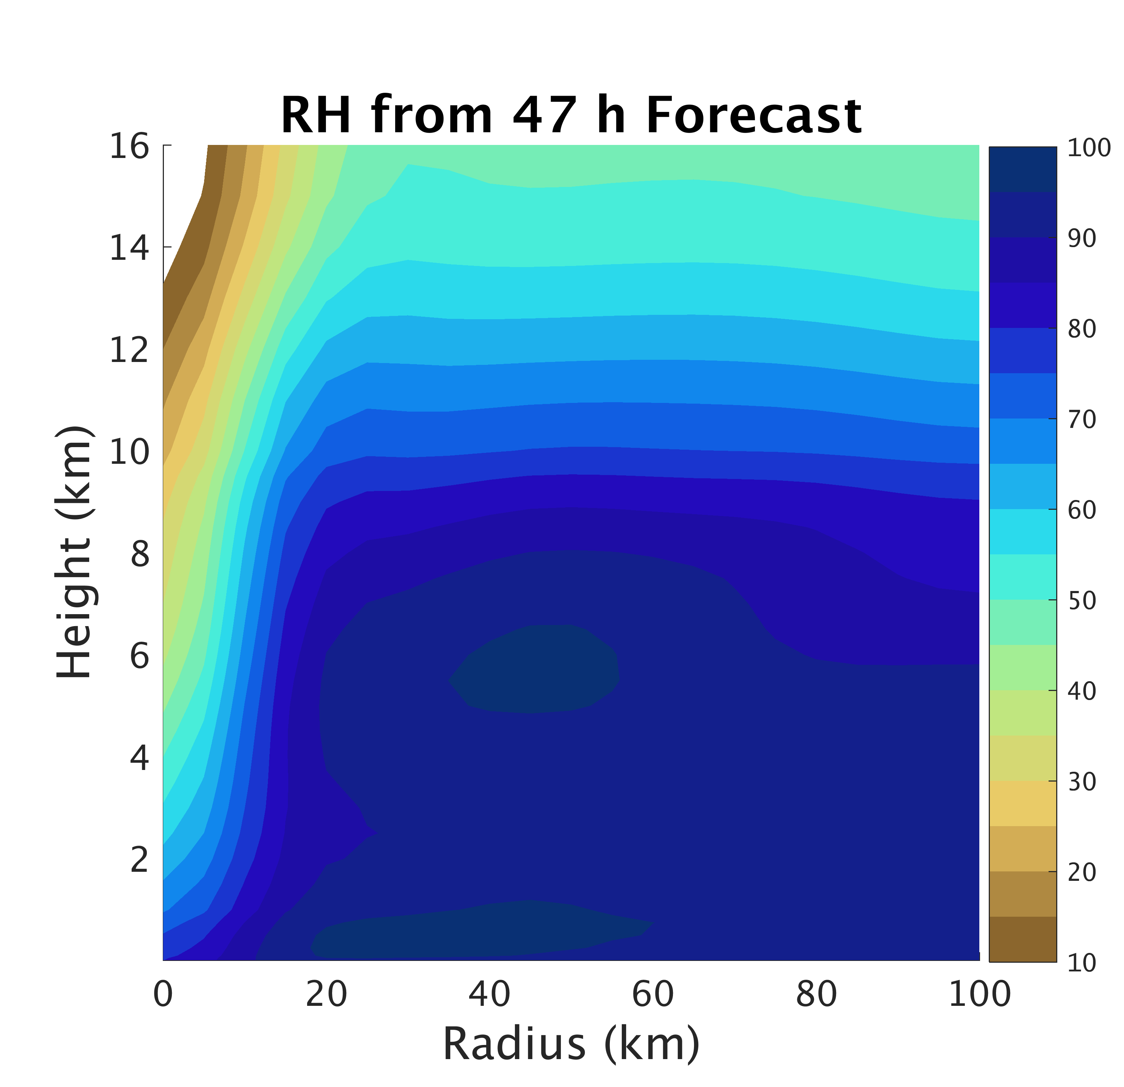
Deterministic Forecast
TCI Dropsonde Verification
TCI Dropsondes
Conv
Conv+Airbone

Slide 25
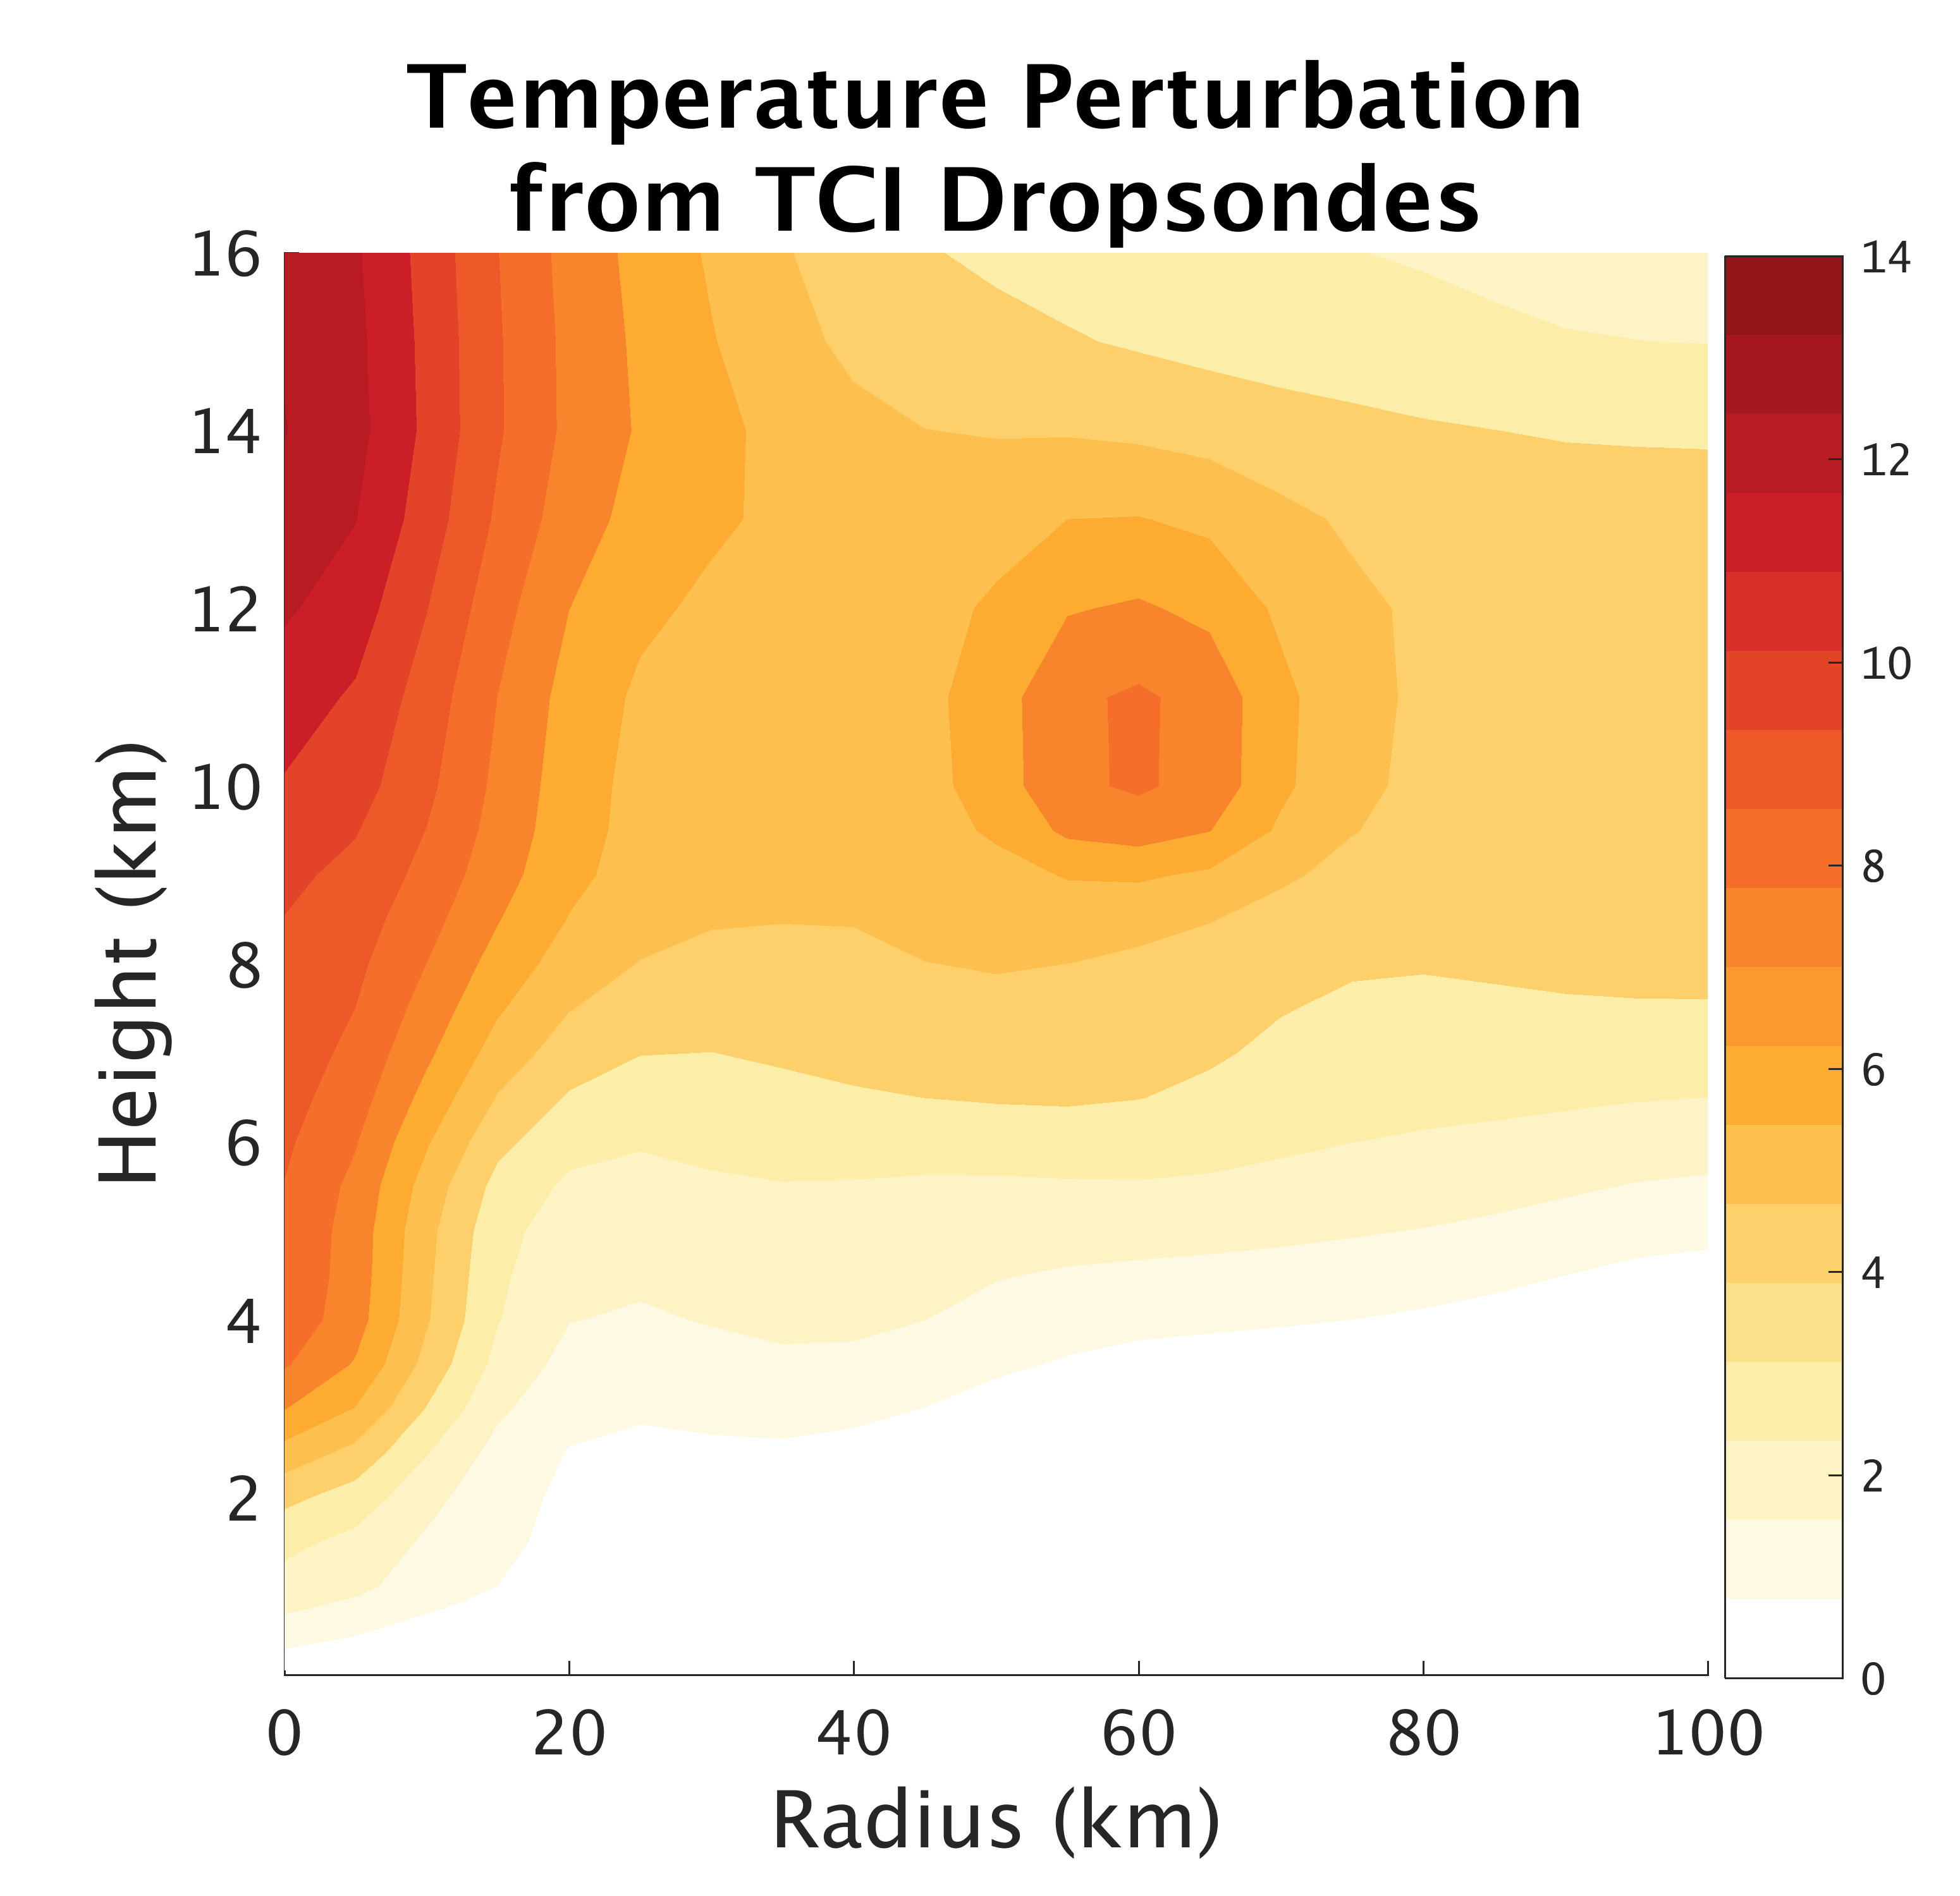
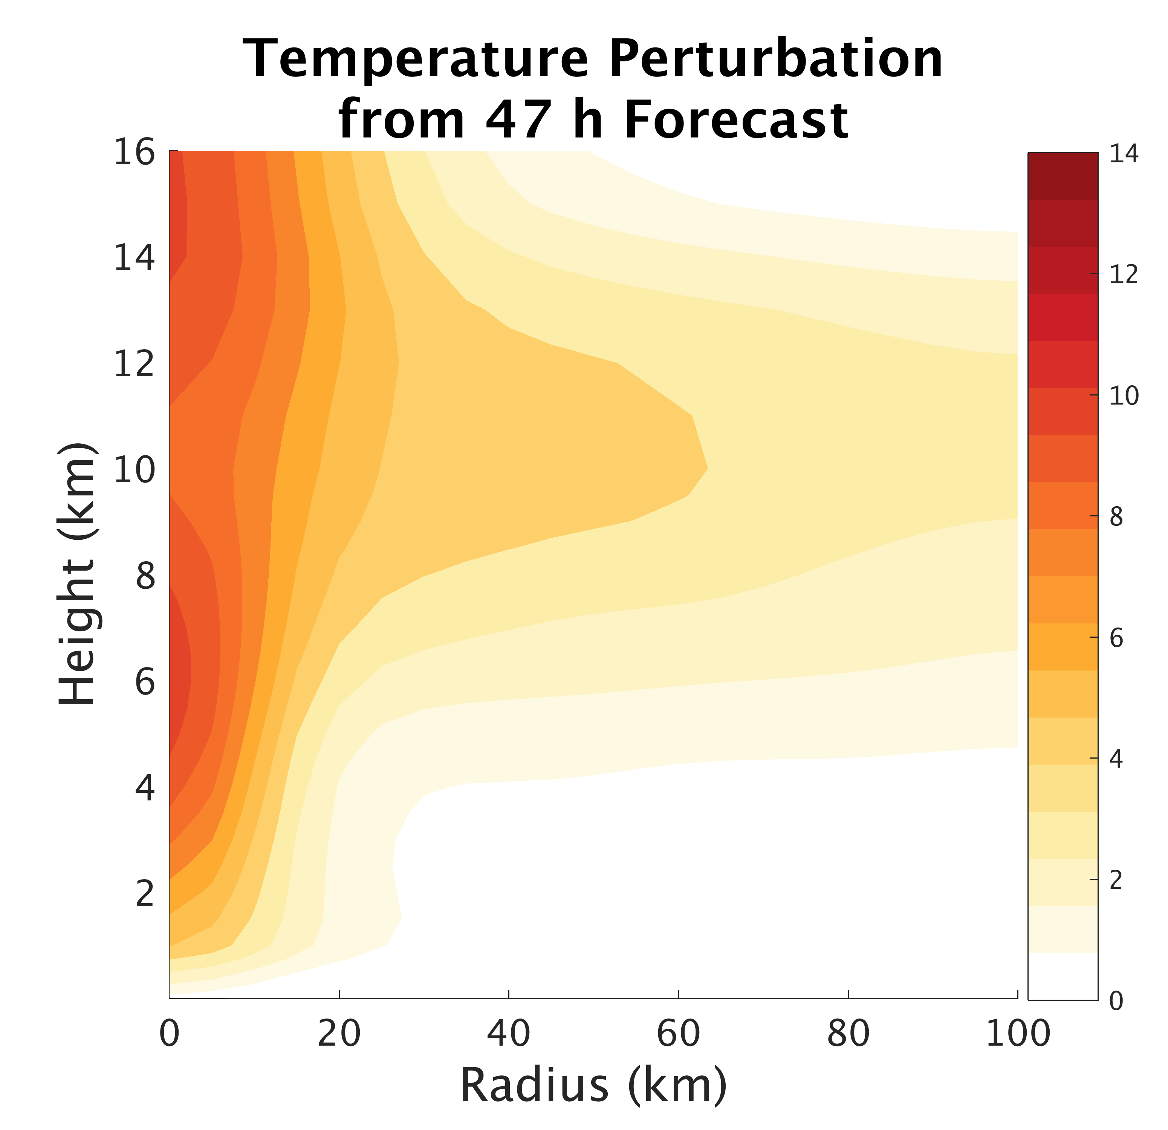
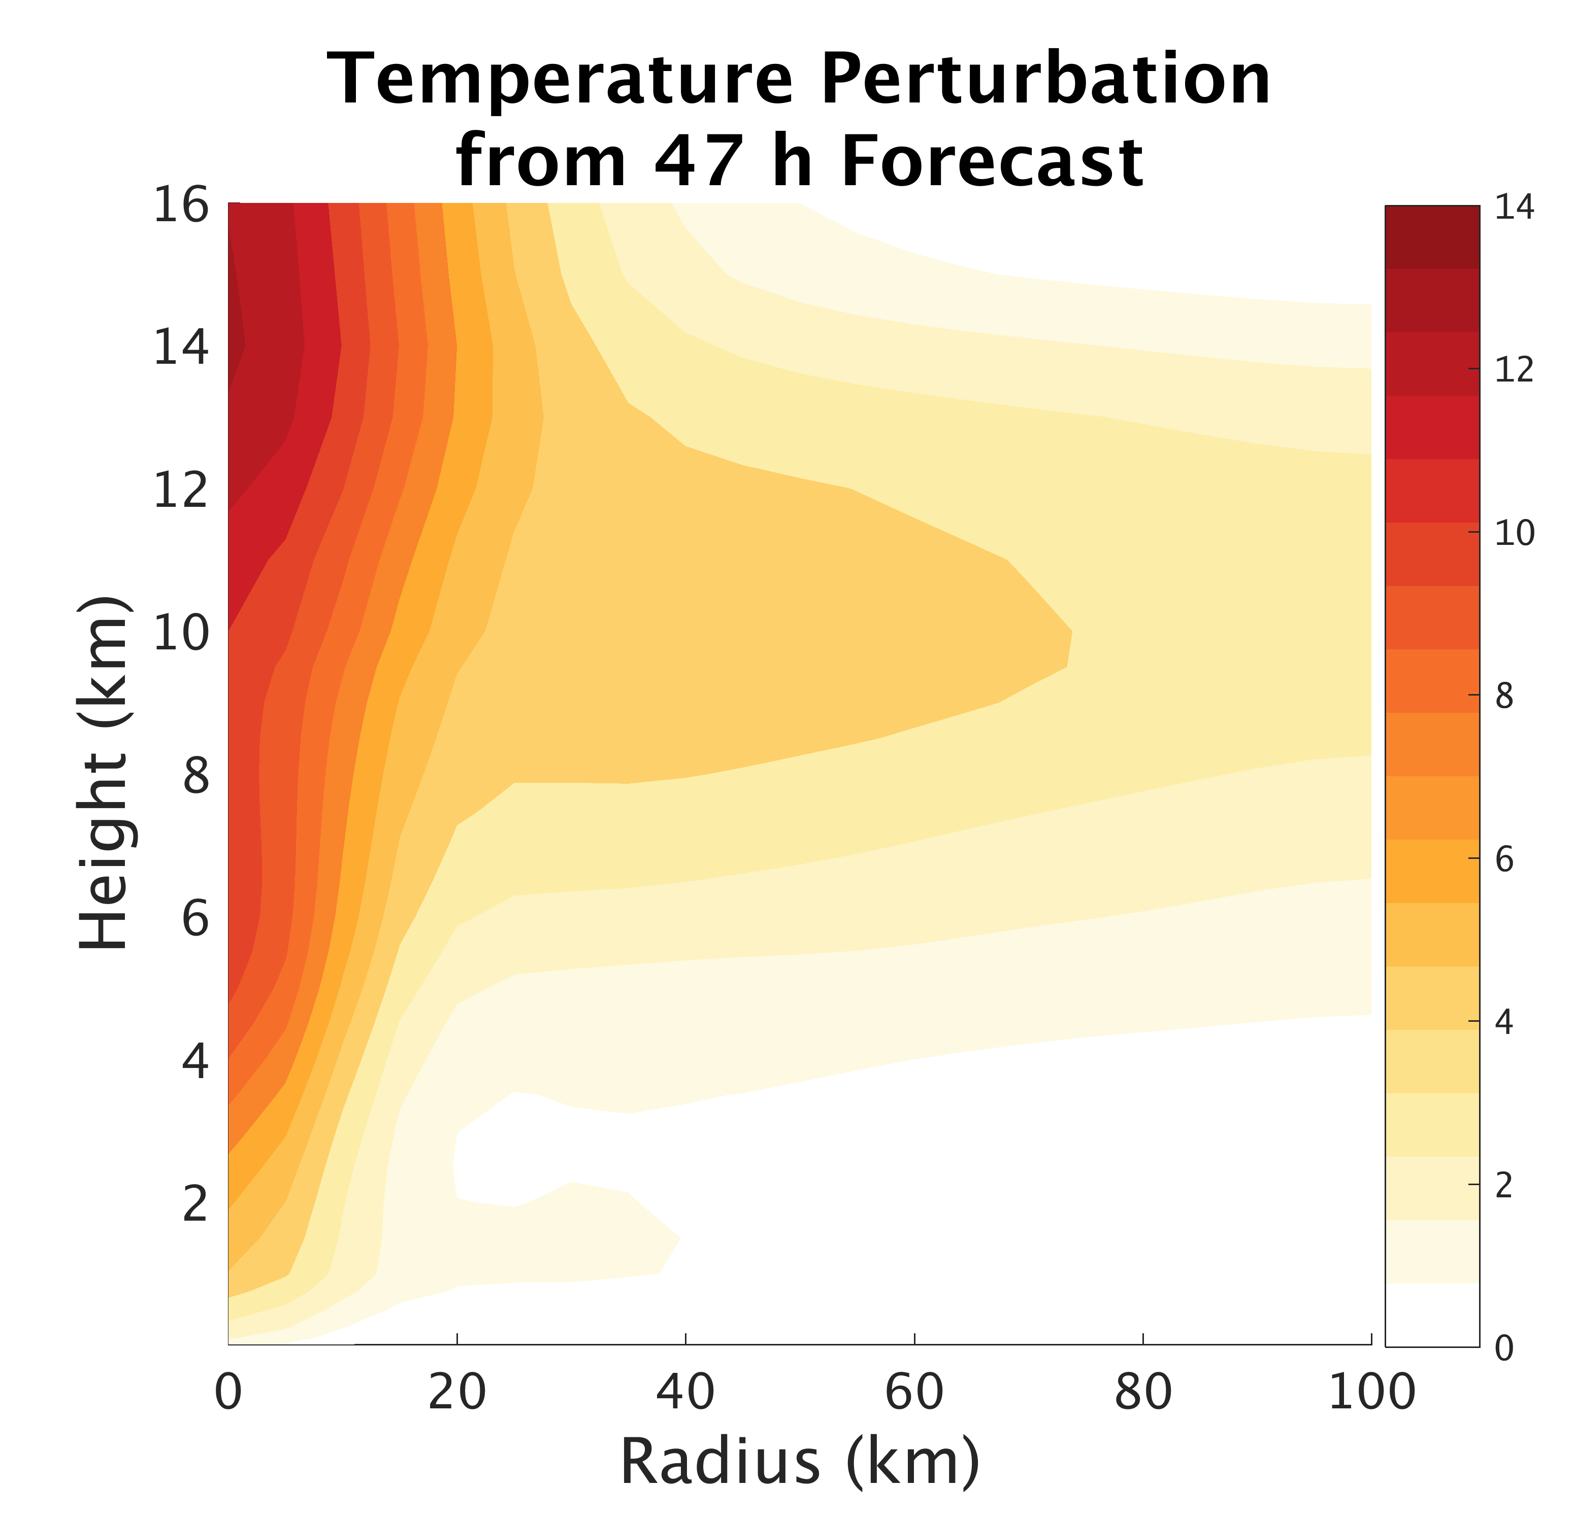
Deterministic Forecast
TCI Dropsonde Verification
TCI Dropsondes
Conv
Conv+Airbone

Slide 26
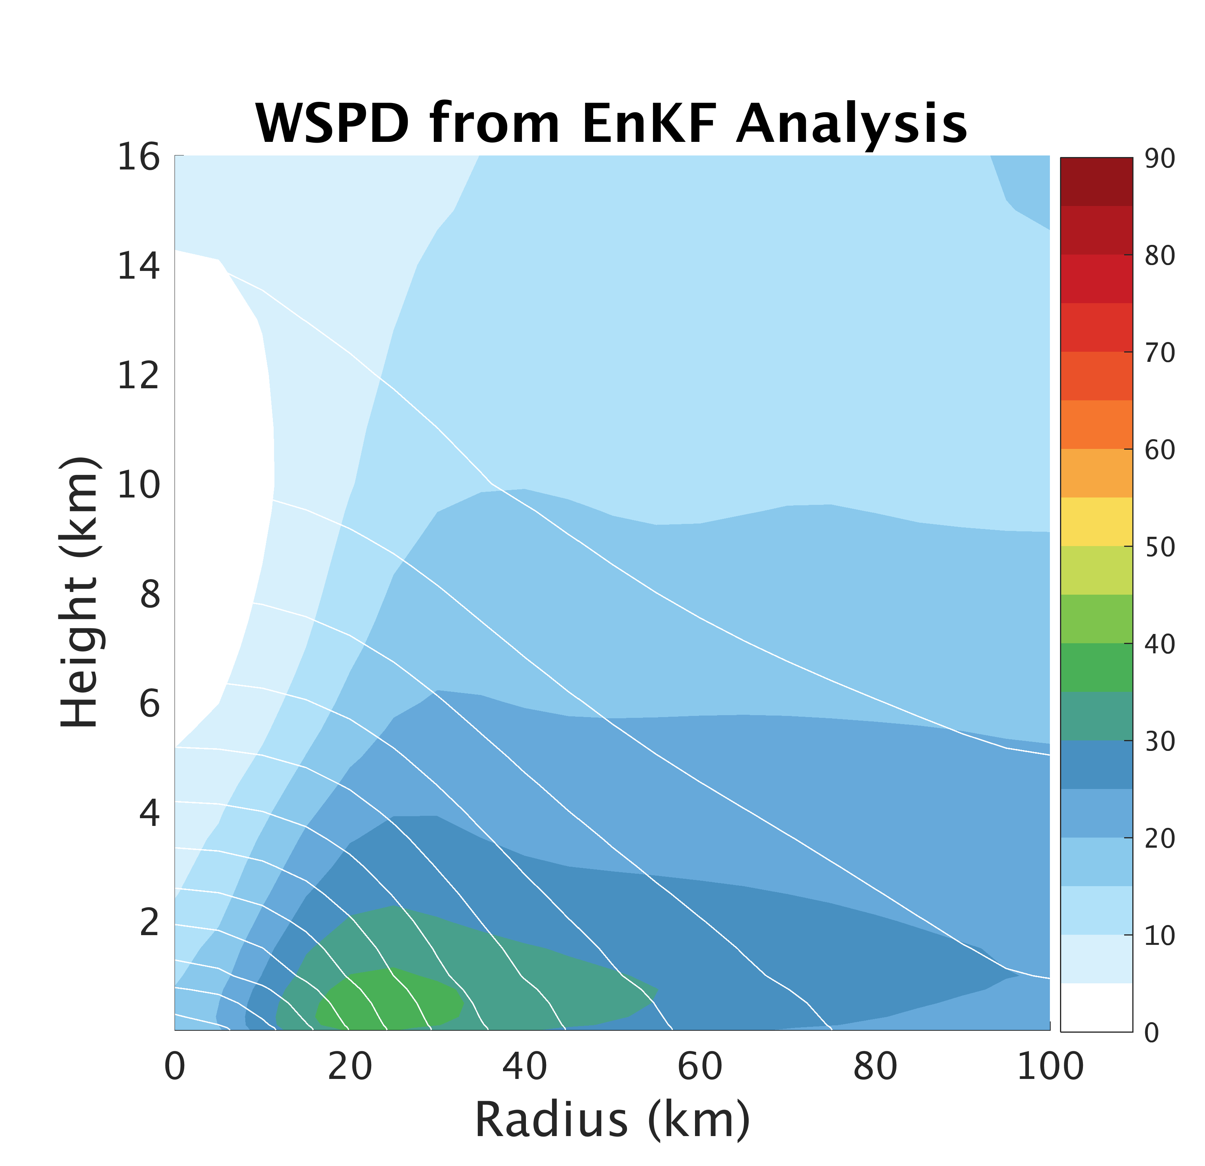
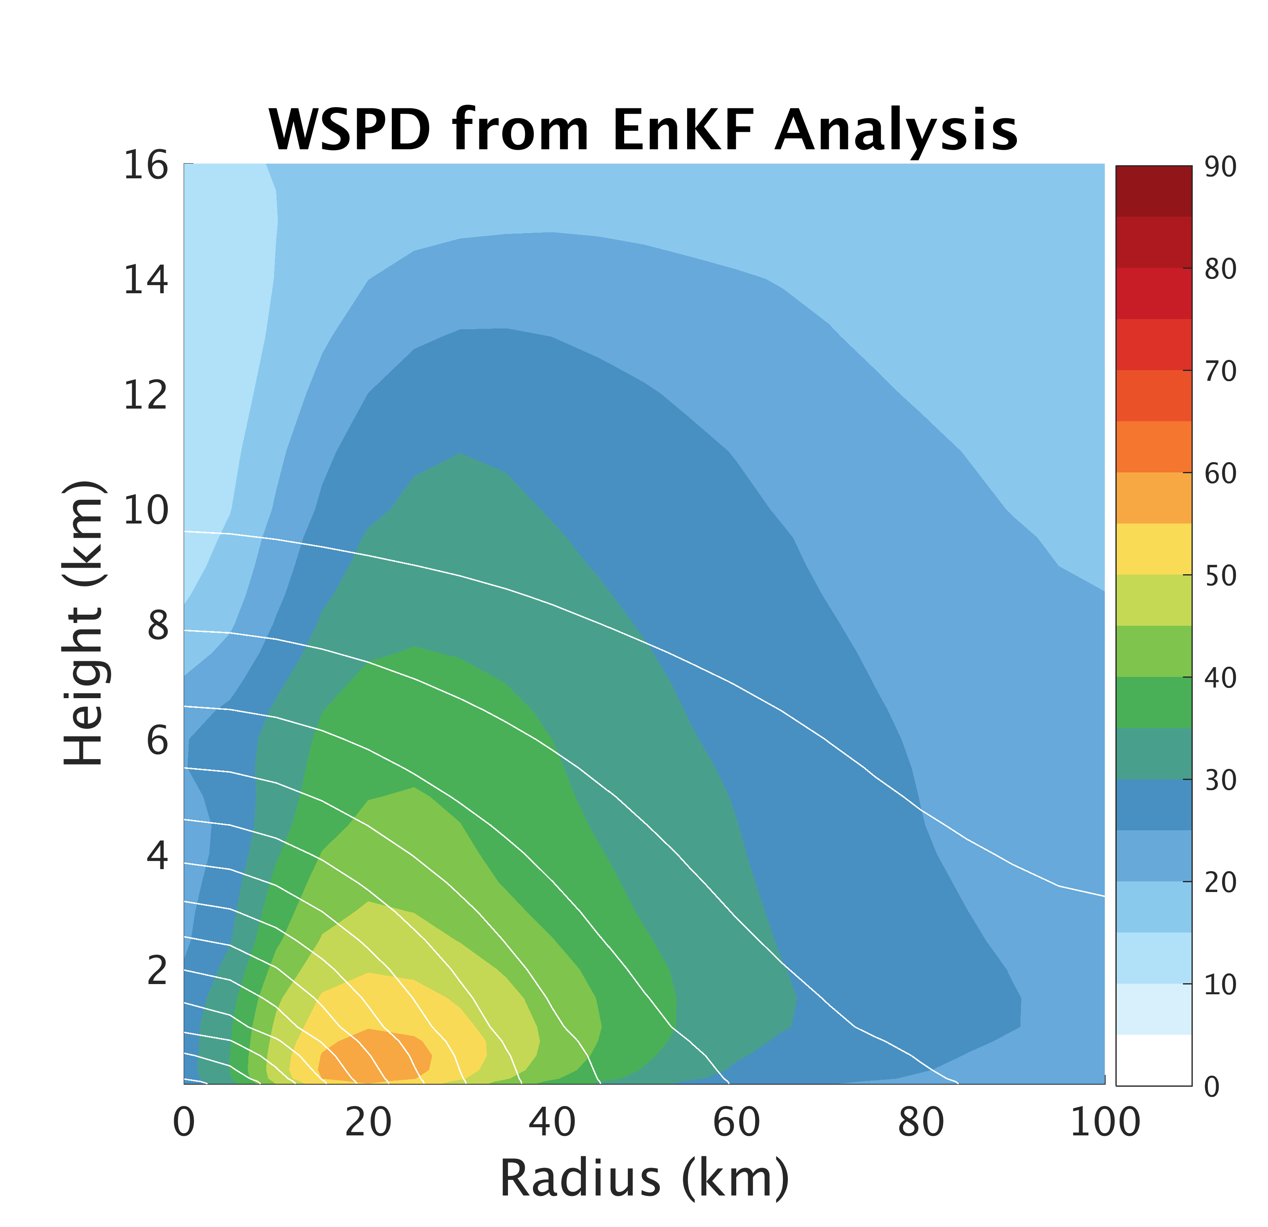
PSU WRF-EnKF Analysis
TCI Dropsonde Verification
TCI Dropsondes
Conv
Conv+Airbone

Slide 27
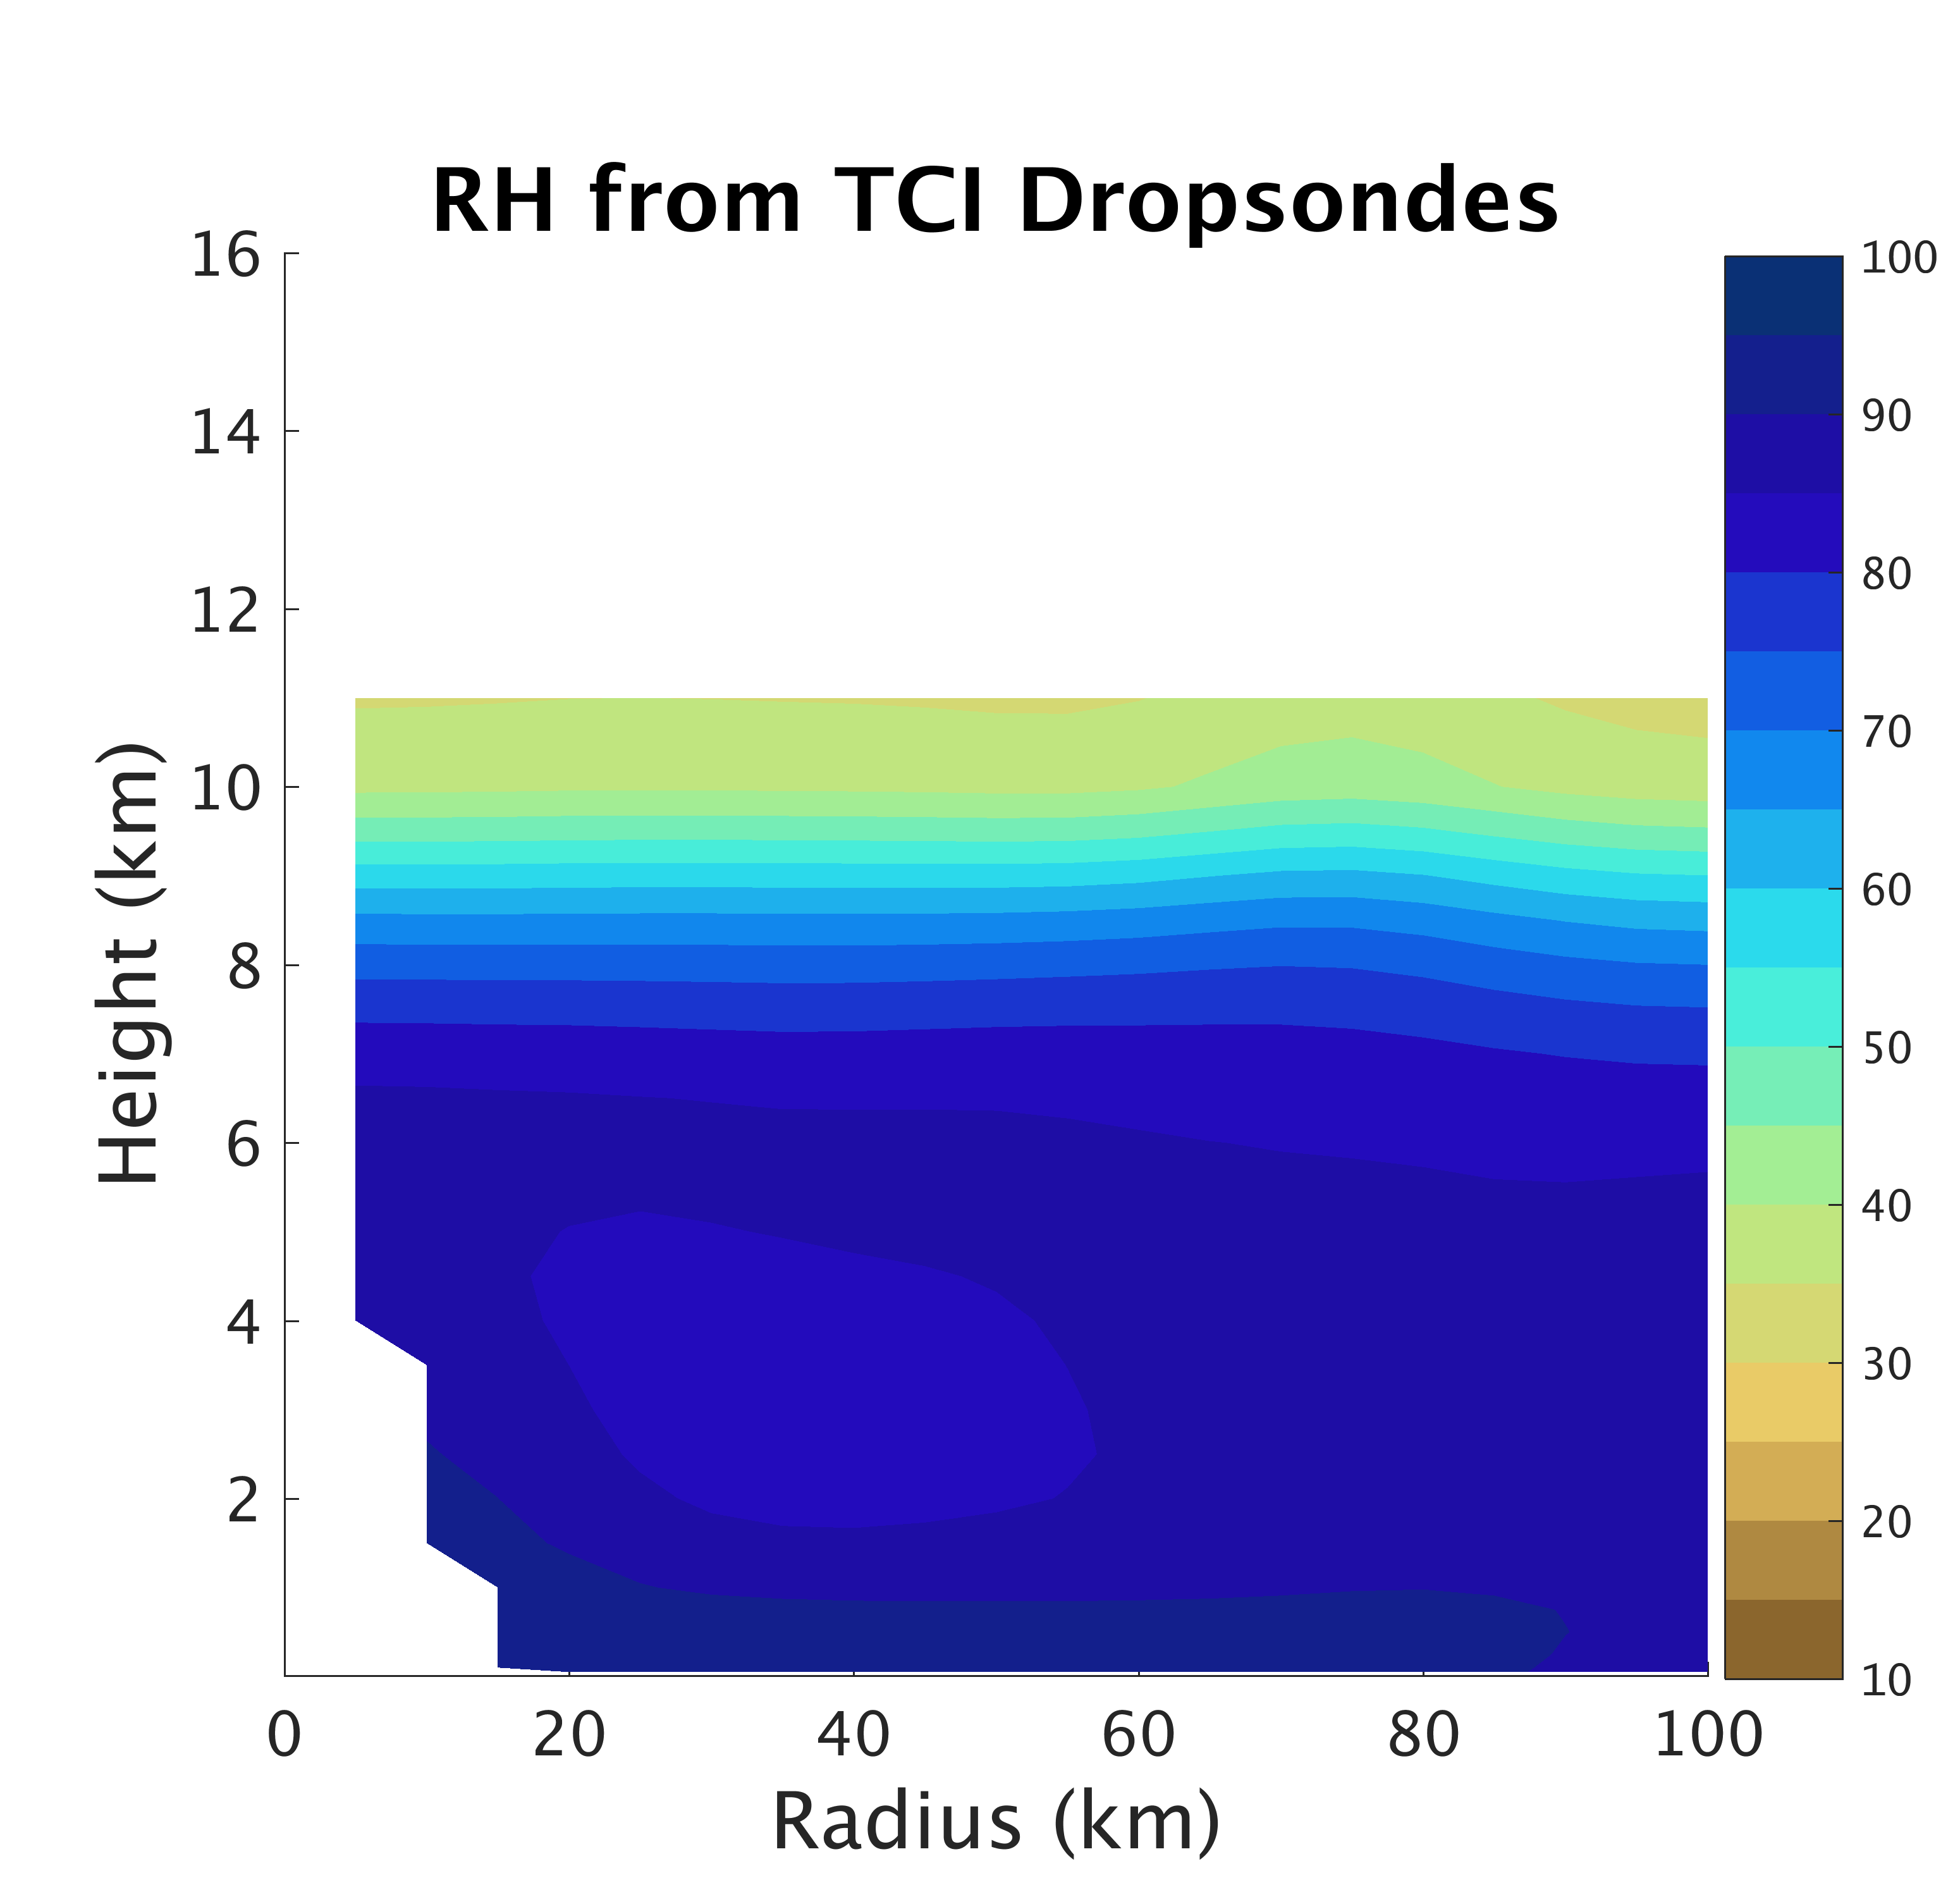
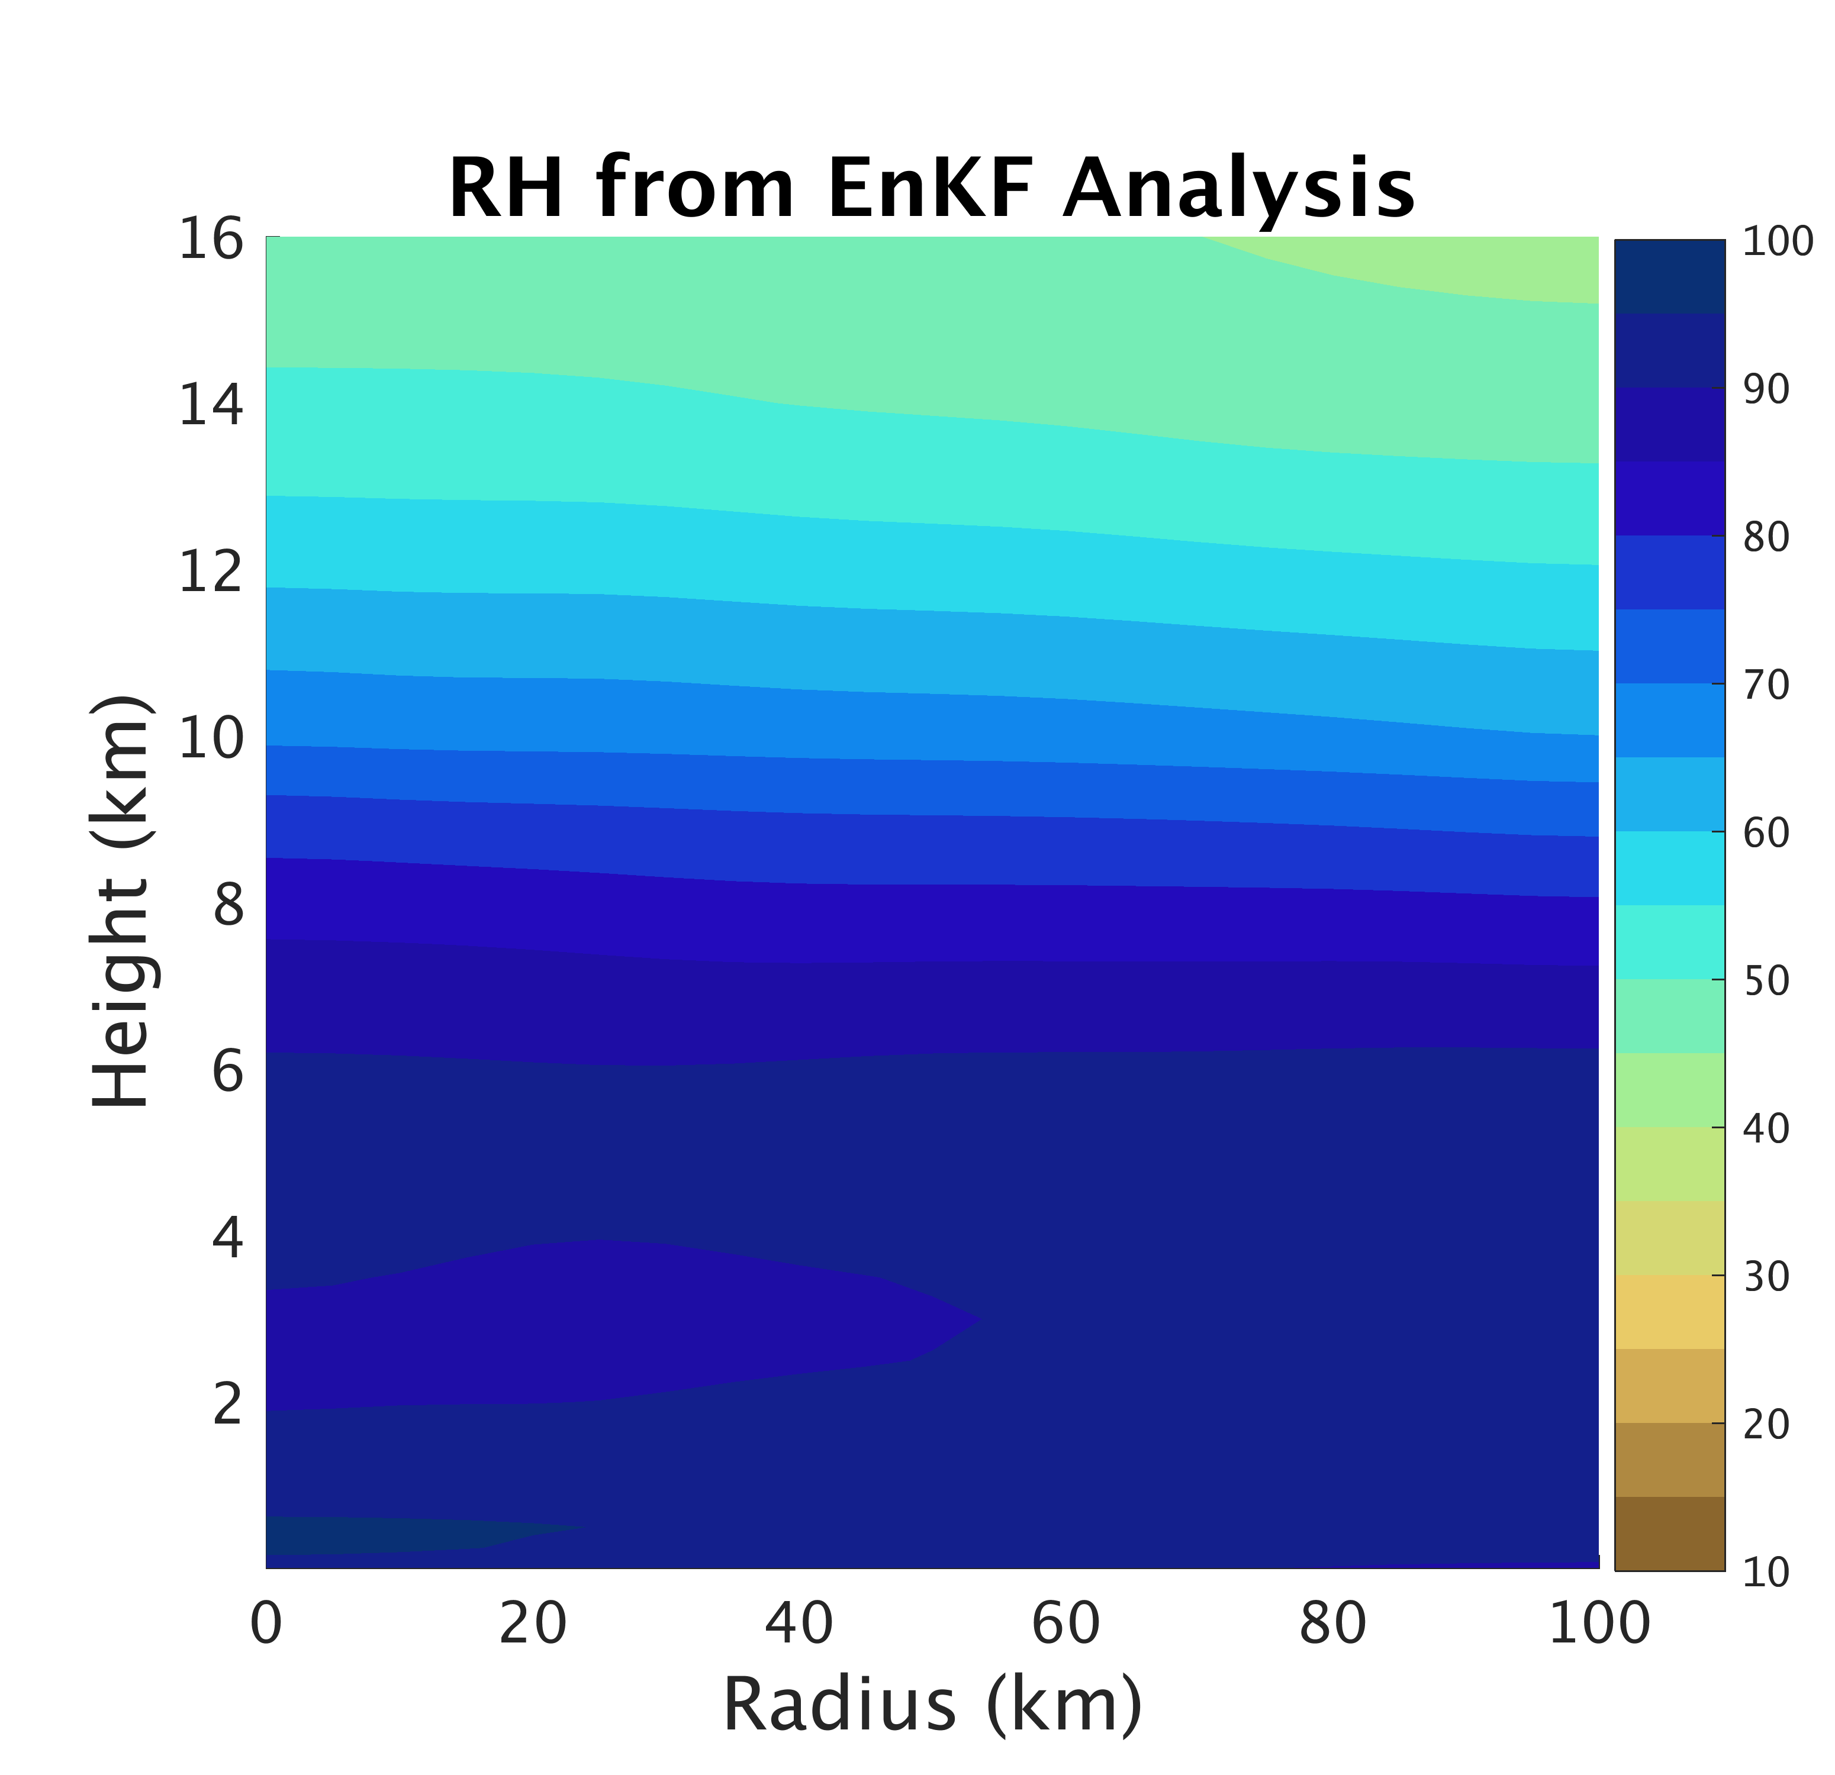
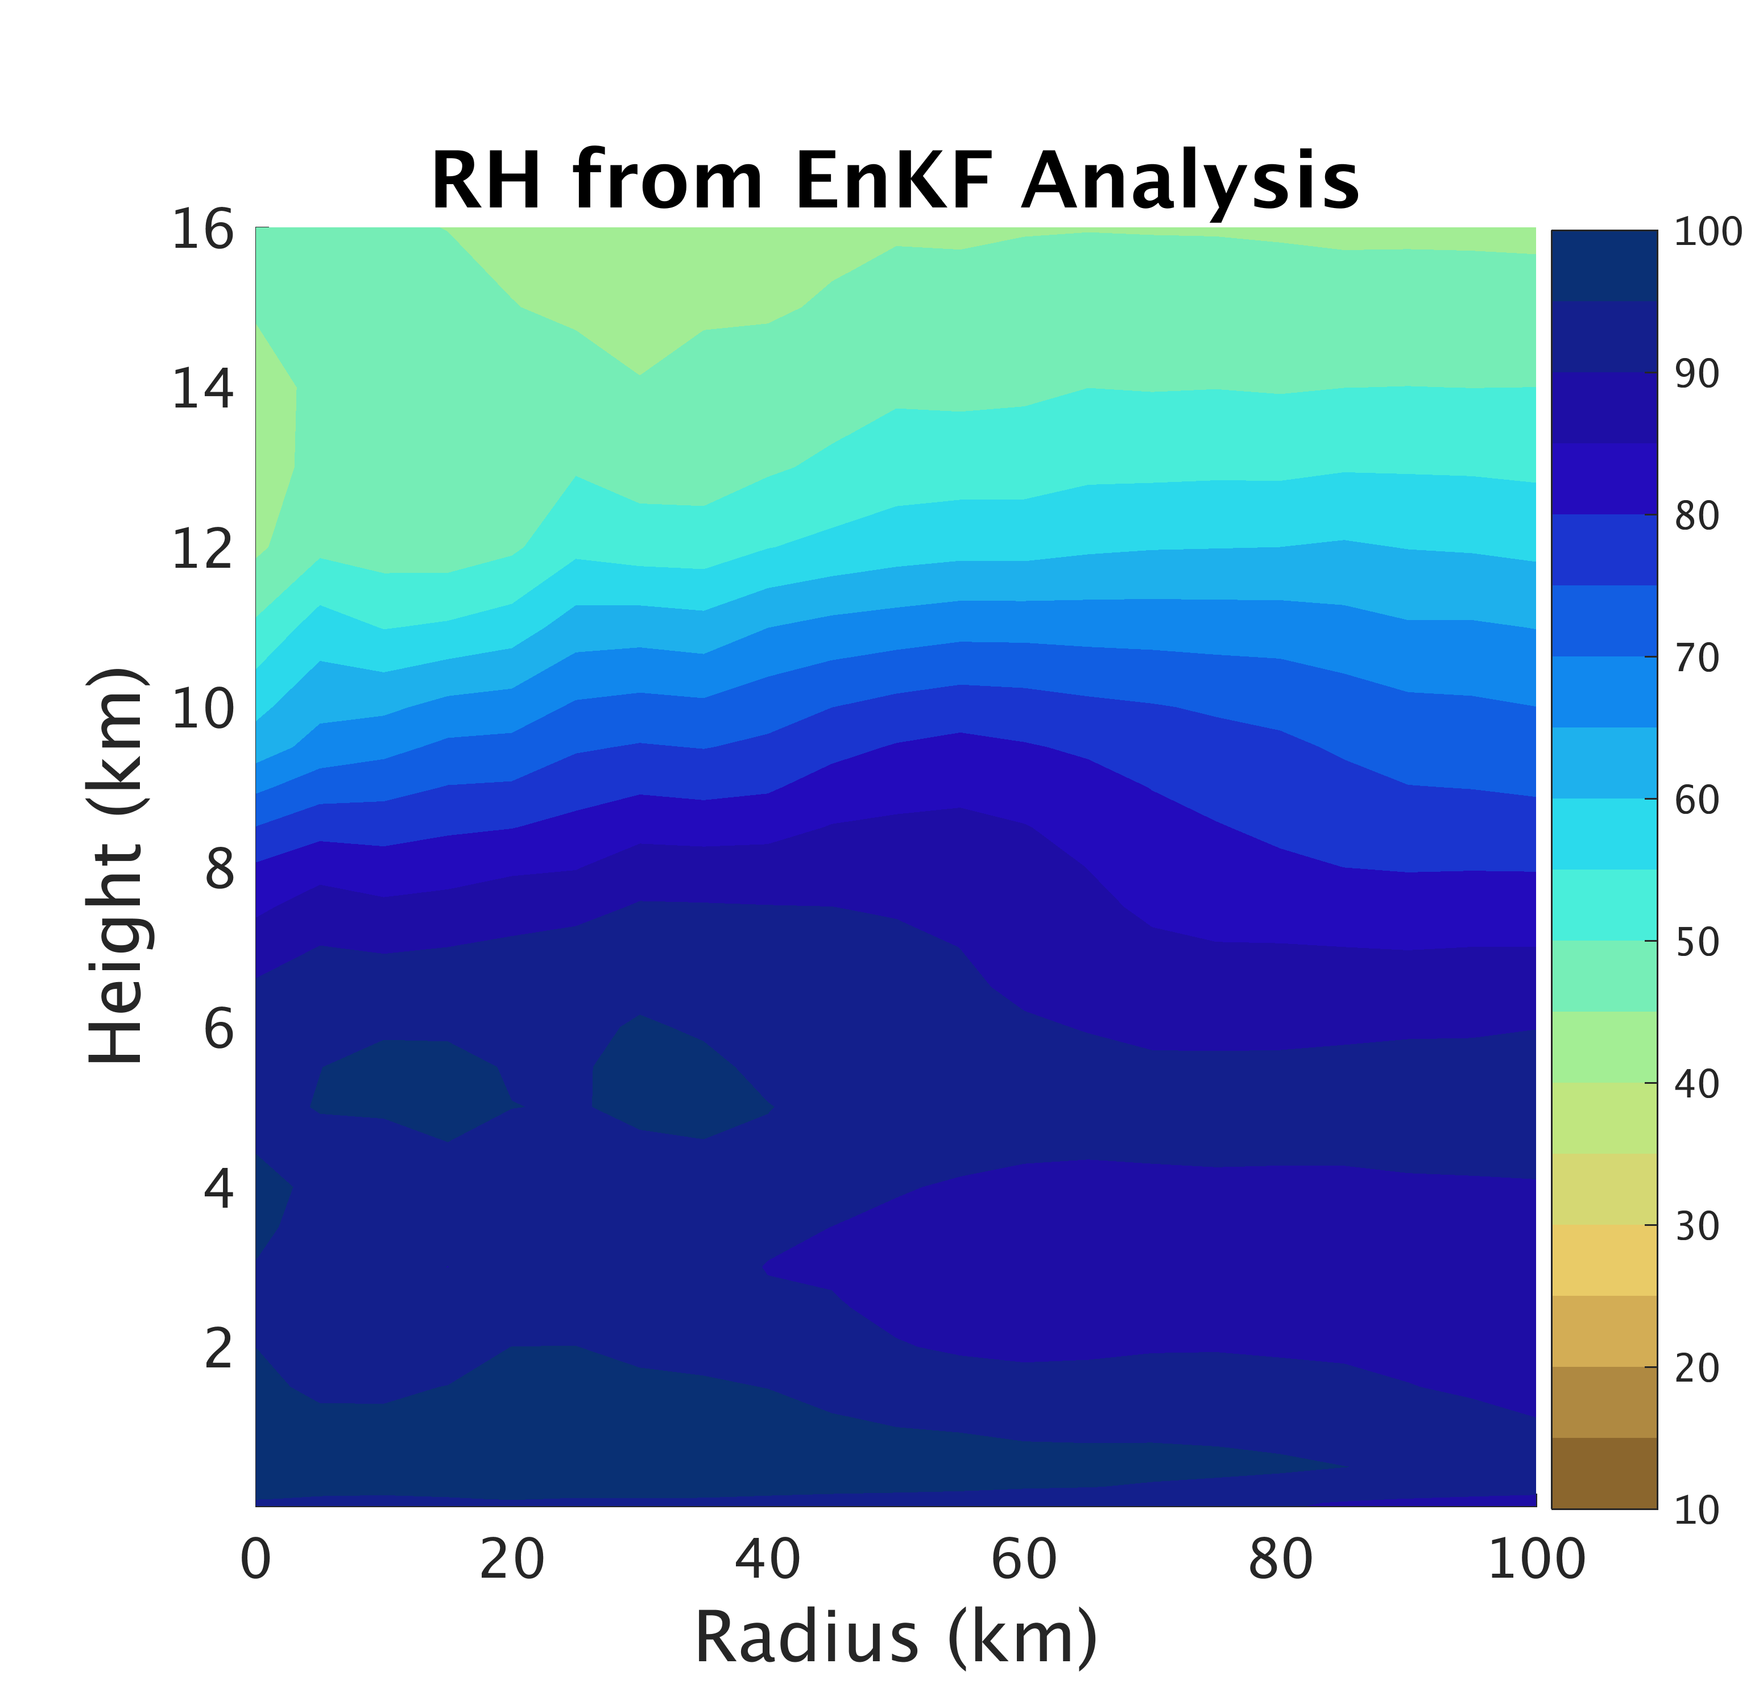
PSU WRF-EnKF Analysis
TCI Dropsonde Verification
TCI Dropsondes
Conv
Conv+Airbone

Slide 28
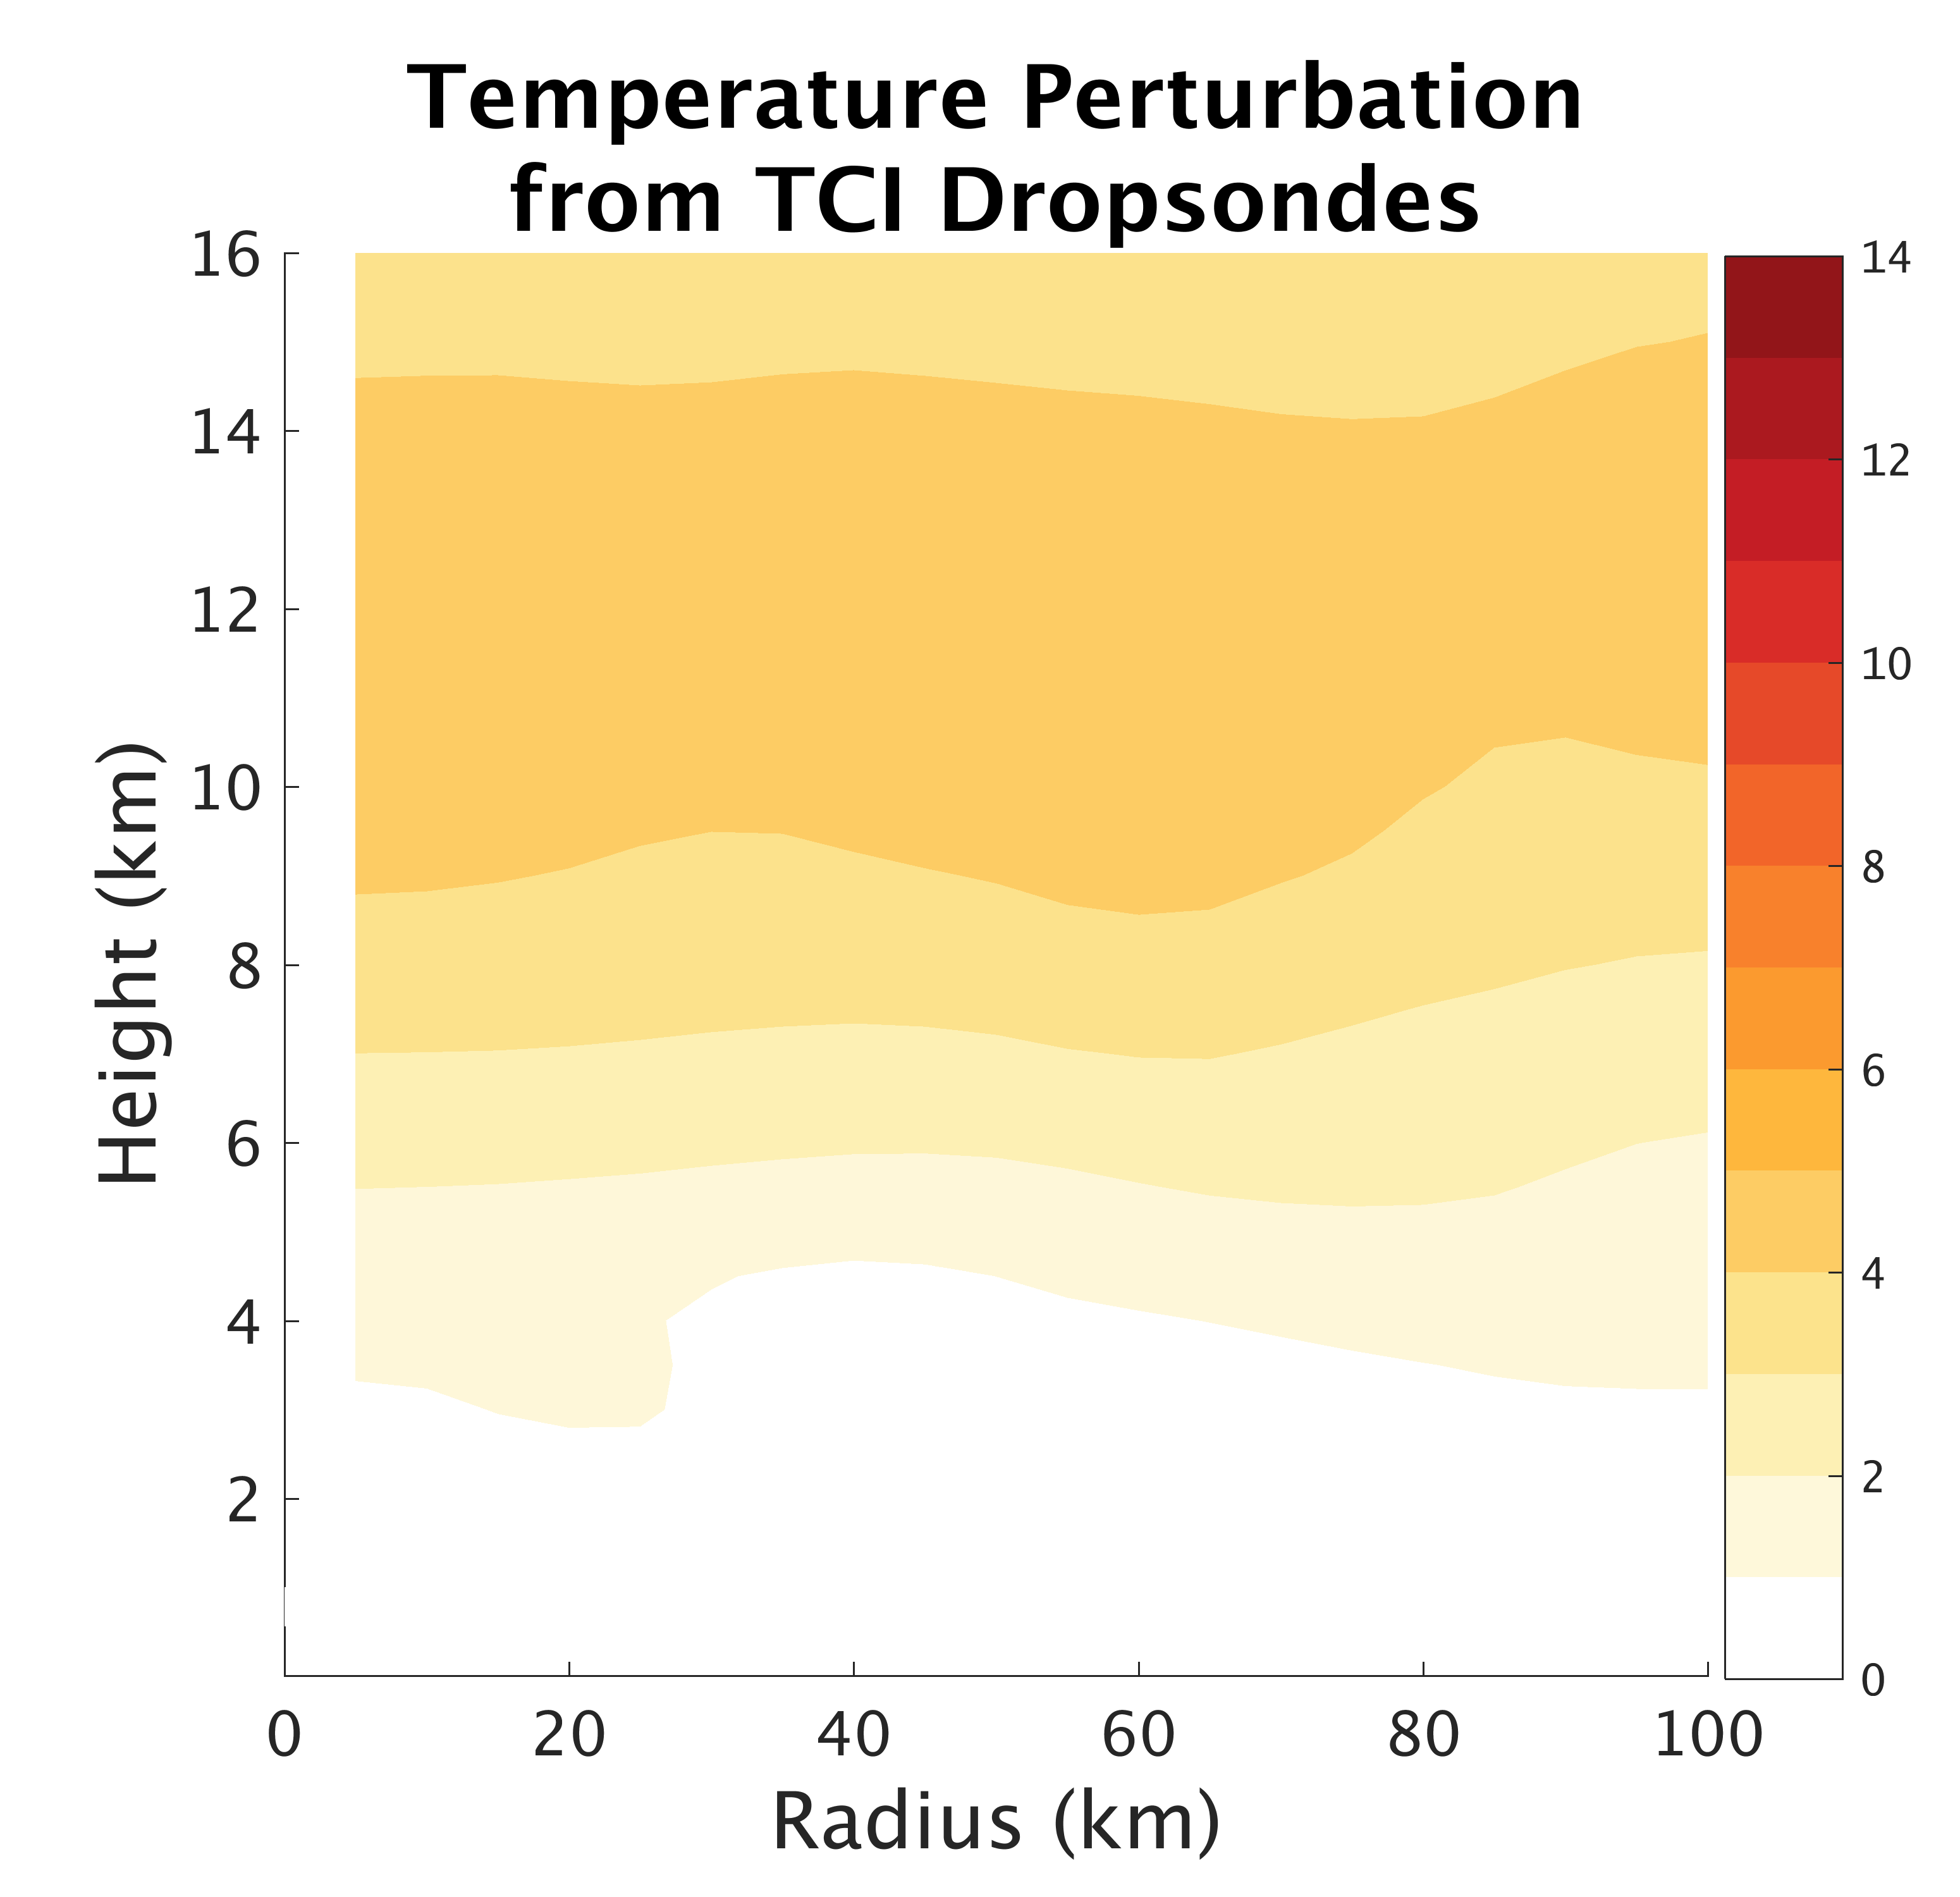
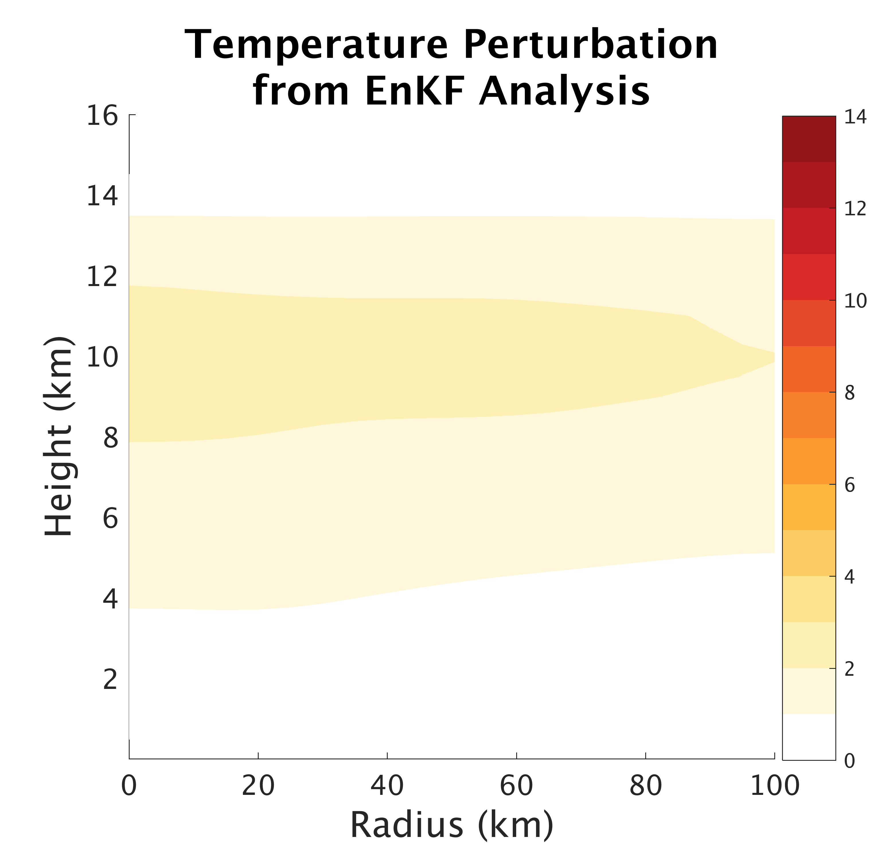
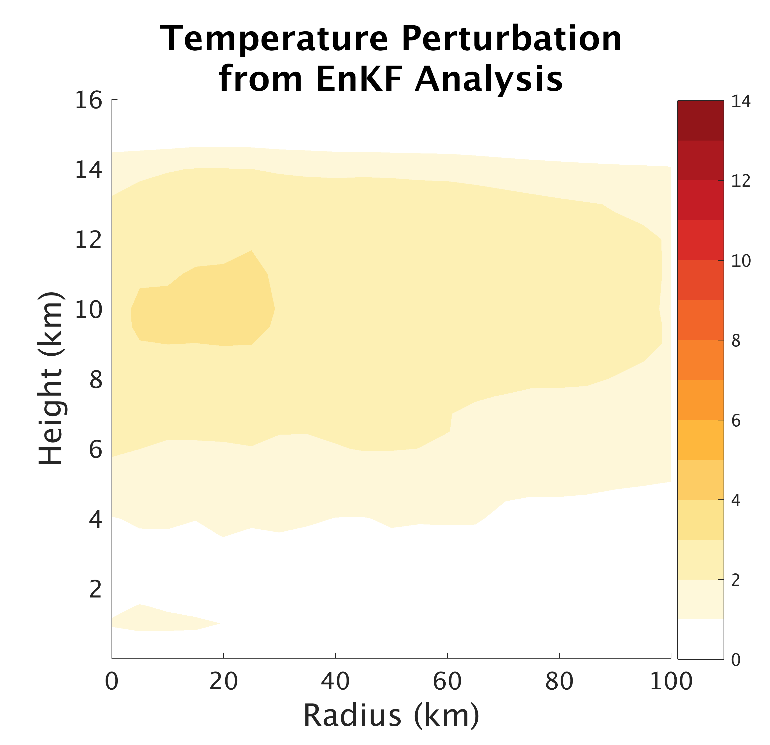
PSU WRF-EnKF Analysis
TCI Dropsonde Verification
TCI Dropsondes
Conv
Conv+Airbone

Slide 29
Inner-Core Conditions
T=0 h

Slide 30
Inner-Core Conditions
T=1 h

Slide 31
Inner-Core Conditions
T=6 h

Slide 32
Inner-Core Conditions
T=12 h

Slide 33
Secondary circulation rebalanced with primary circulation
T=12 h

Slide 34
Inner-Core Conditions
T=12 h

Slide 35
Inner-Core Conditions
T=0 h
Weakest
Strongest

Slide 36
Inner-Core Conditions
T=1 h
Weakest
Strongest

Slide 37
Inner-Core Conditions
T=6 h
Weakest
Strongest

Slide 38
Inner-Core Conditions
T=12 h
Weakest
Strongest

