Slide 1
Ensemble-based satellite and radar assimilation for severe storms and its sensitivity to ABEI and AOEI
Yunji Zhang, Fuqing Zhang
Aug 16, 2018
Acknowledgements: Masashi Minamide, David J. Stensrud

Slide 2
Brief Overview
Previous Works
AOEI & ABEI (Minamide and Zhang 2017, 2018)
Assimilating satellite IR BT for severe thunderstorm event (Zhang et al. 2018)
Current Study
Satellite DA:
Apply both AOEI and ABEI for severe thunderstorm as benchmark
Radar DA:
Test the feasibility of AOEI in assimilating reflectivity
Determine a better strategy when assimilating radar observations
Satellite + Radar DA:
Determine a better strategy when assimilating radiance and radial velocity
Assimilating all satellite and radar observations

Slide 3
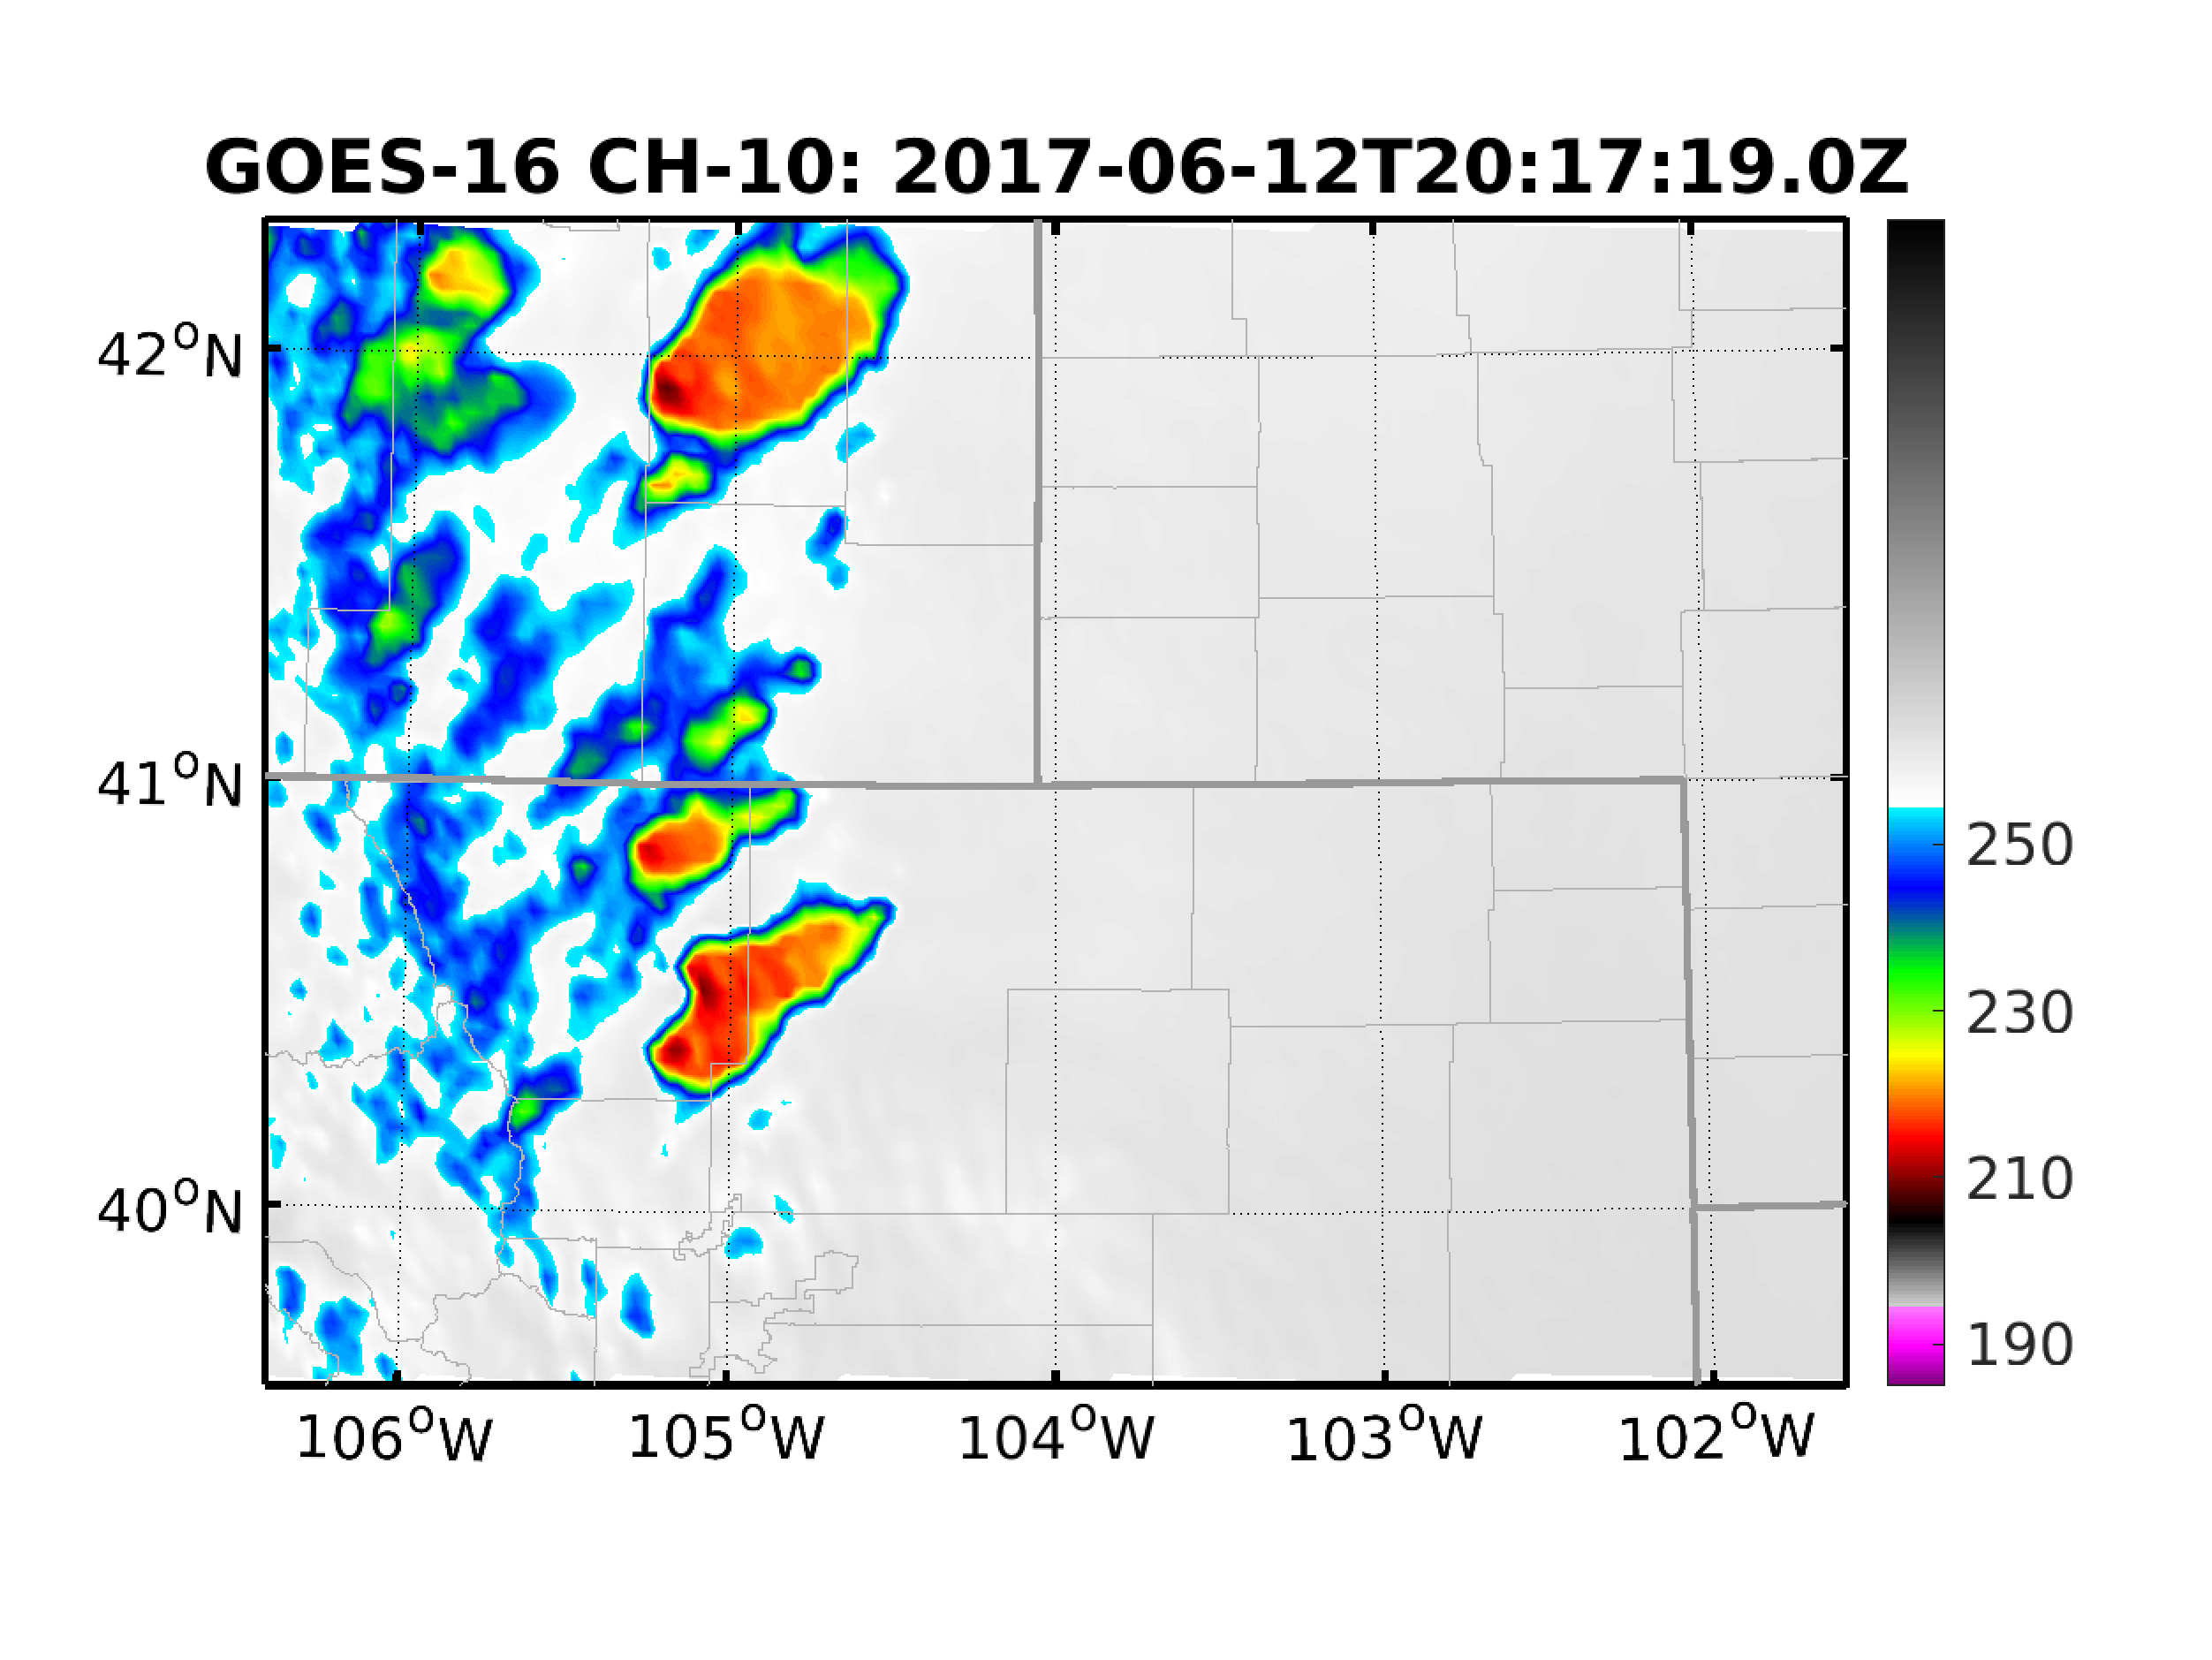
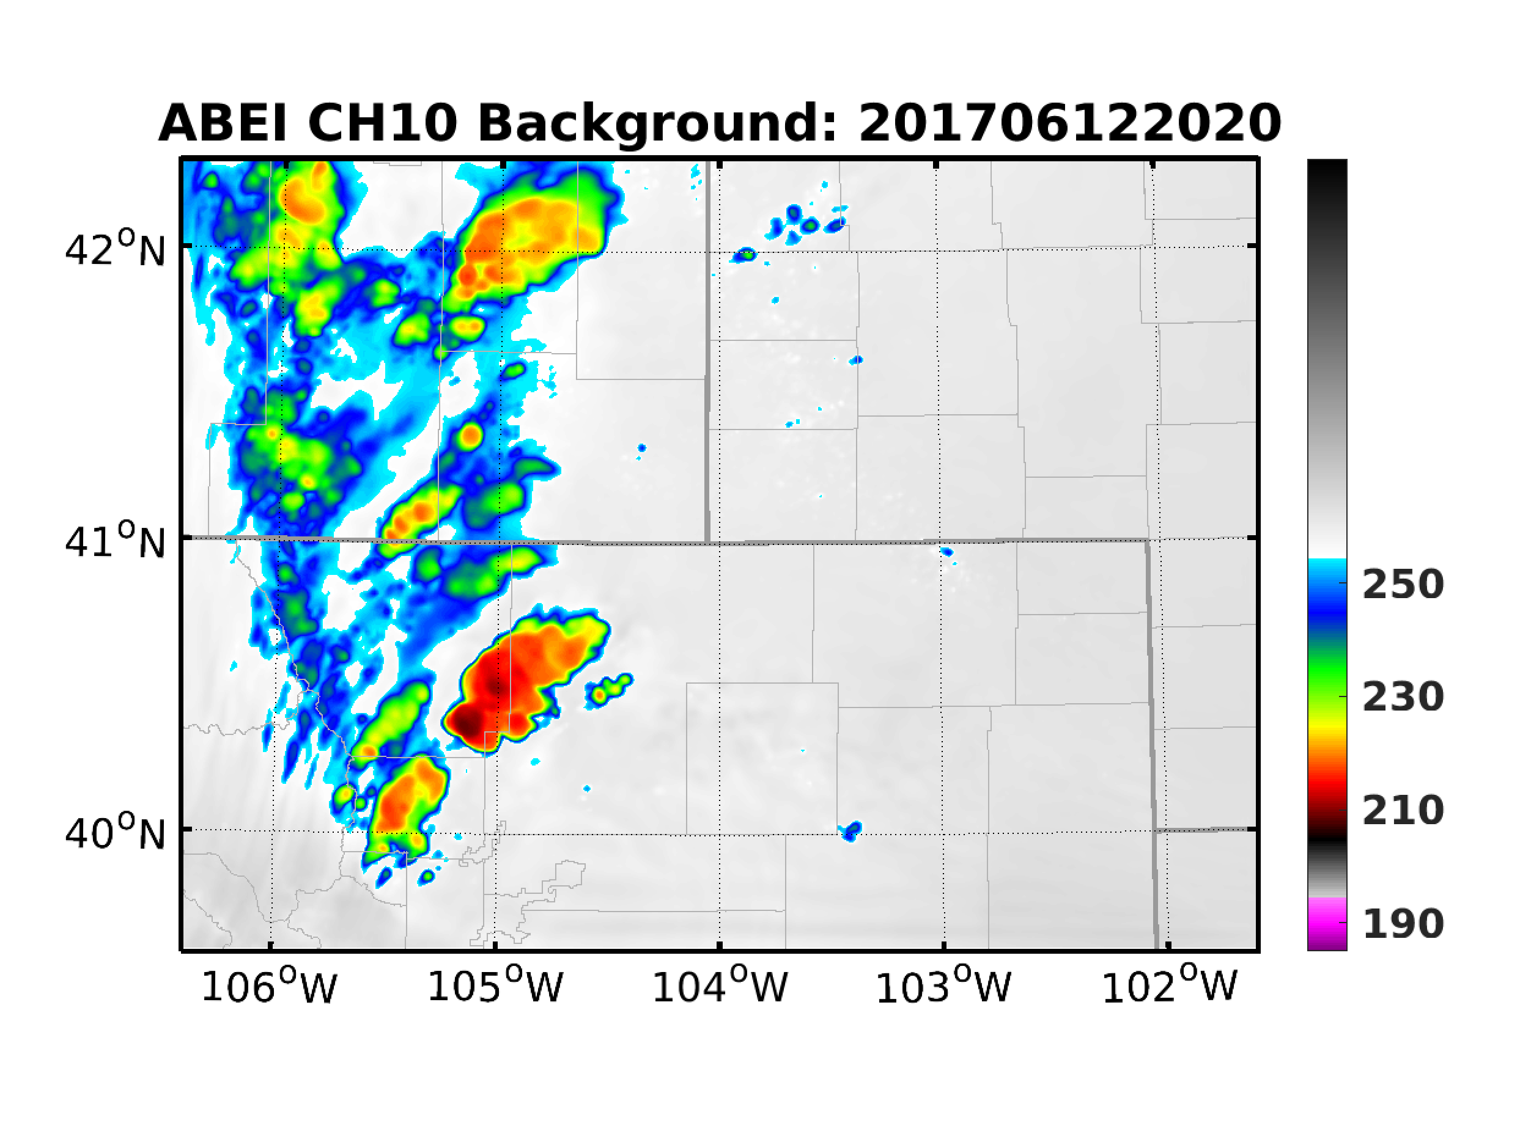
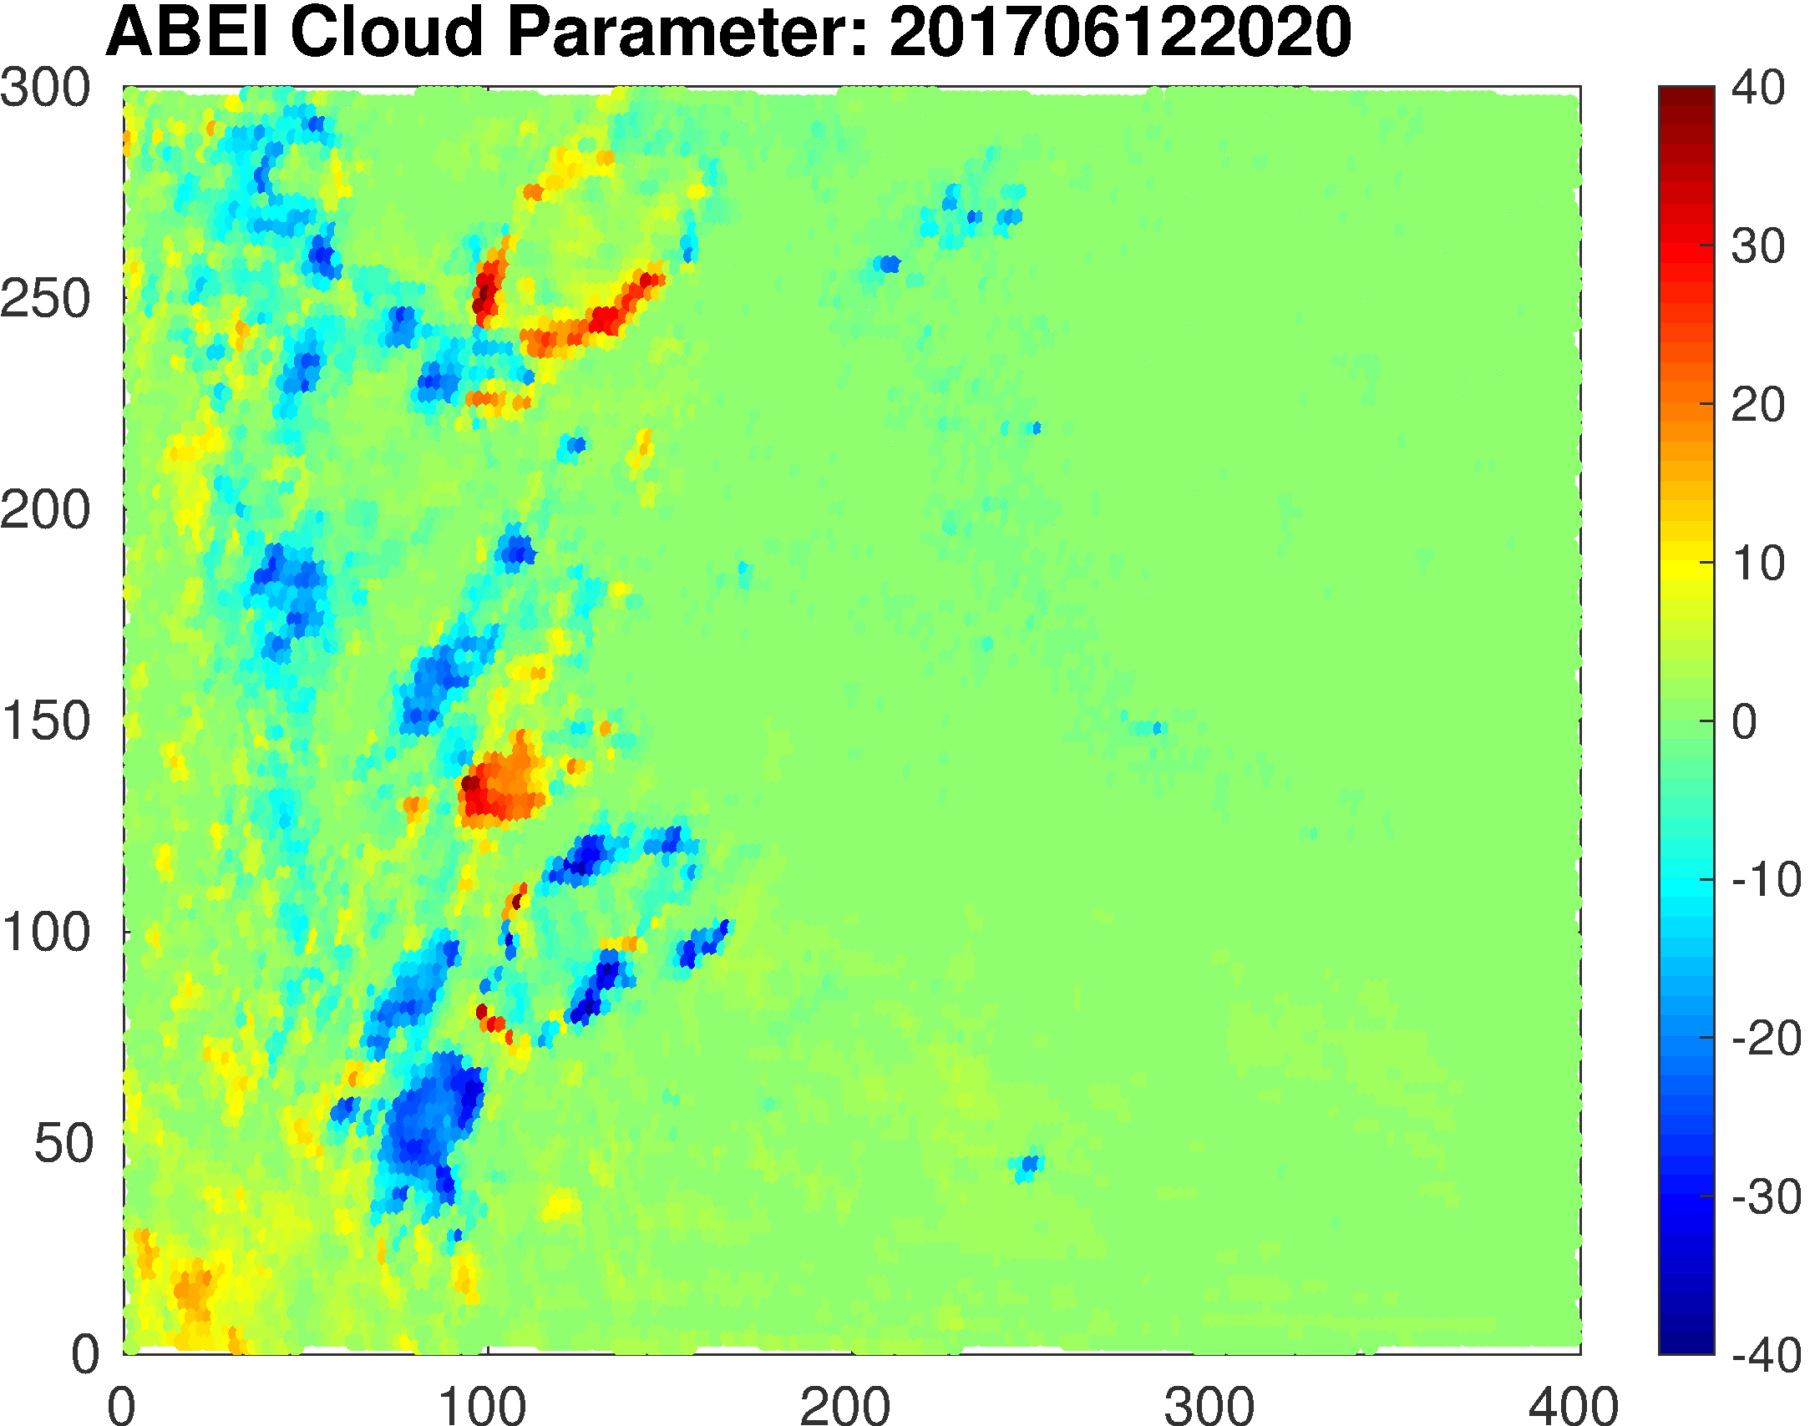
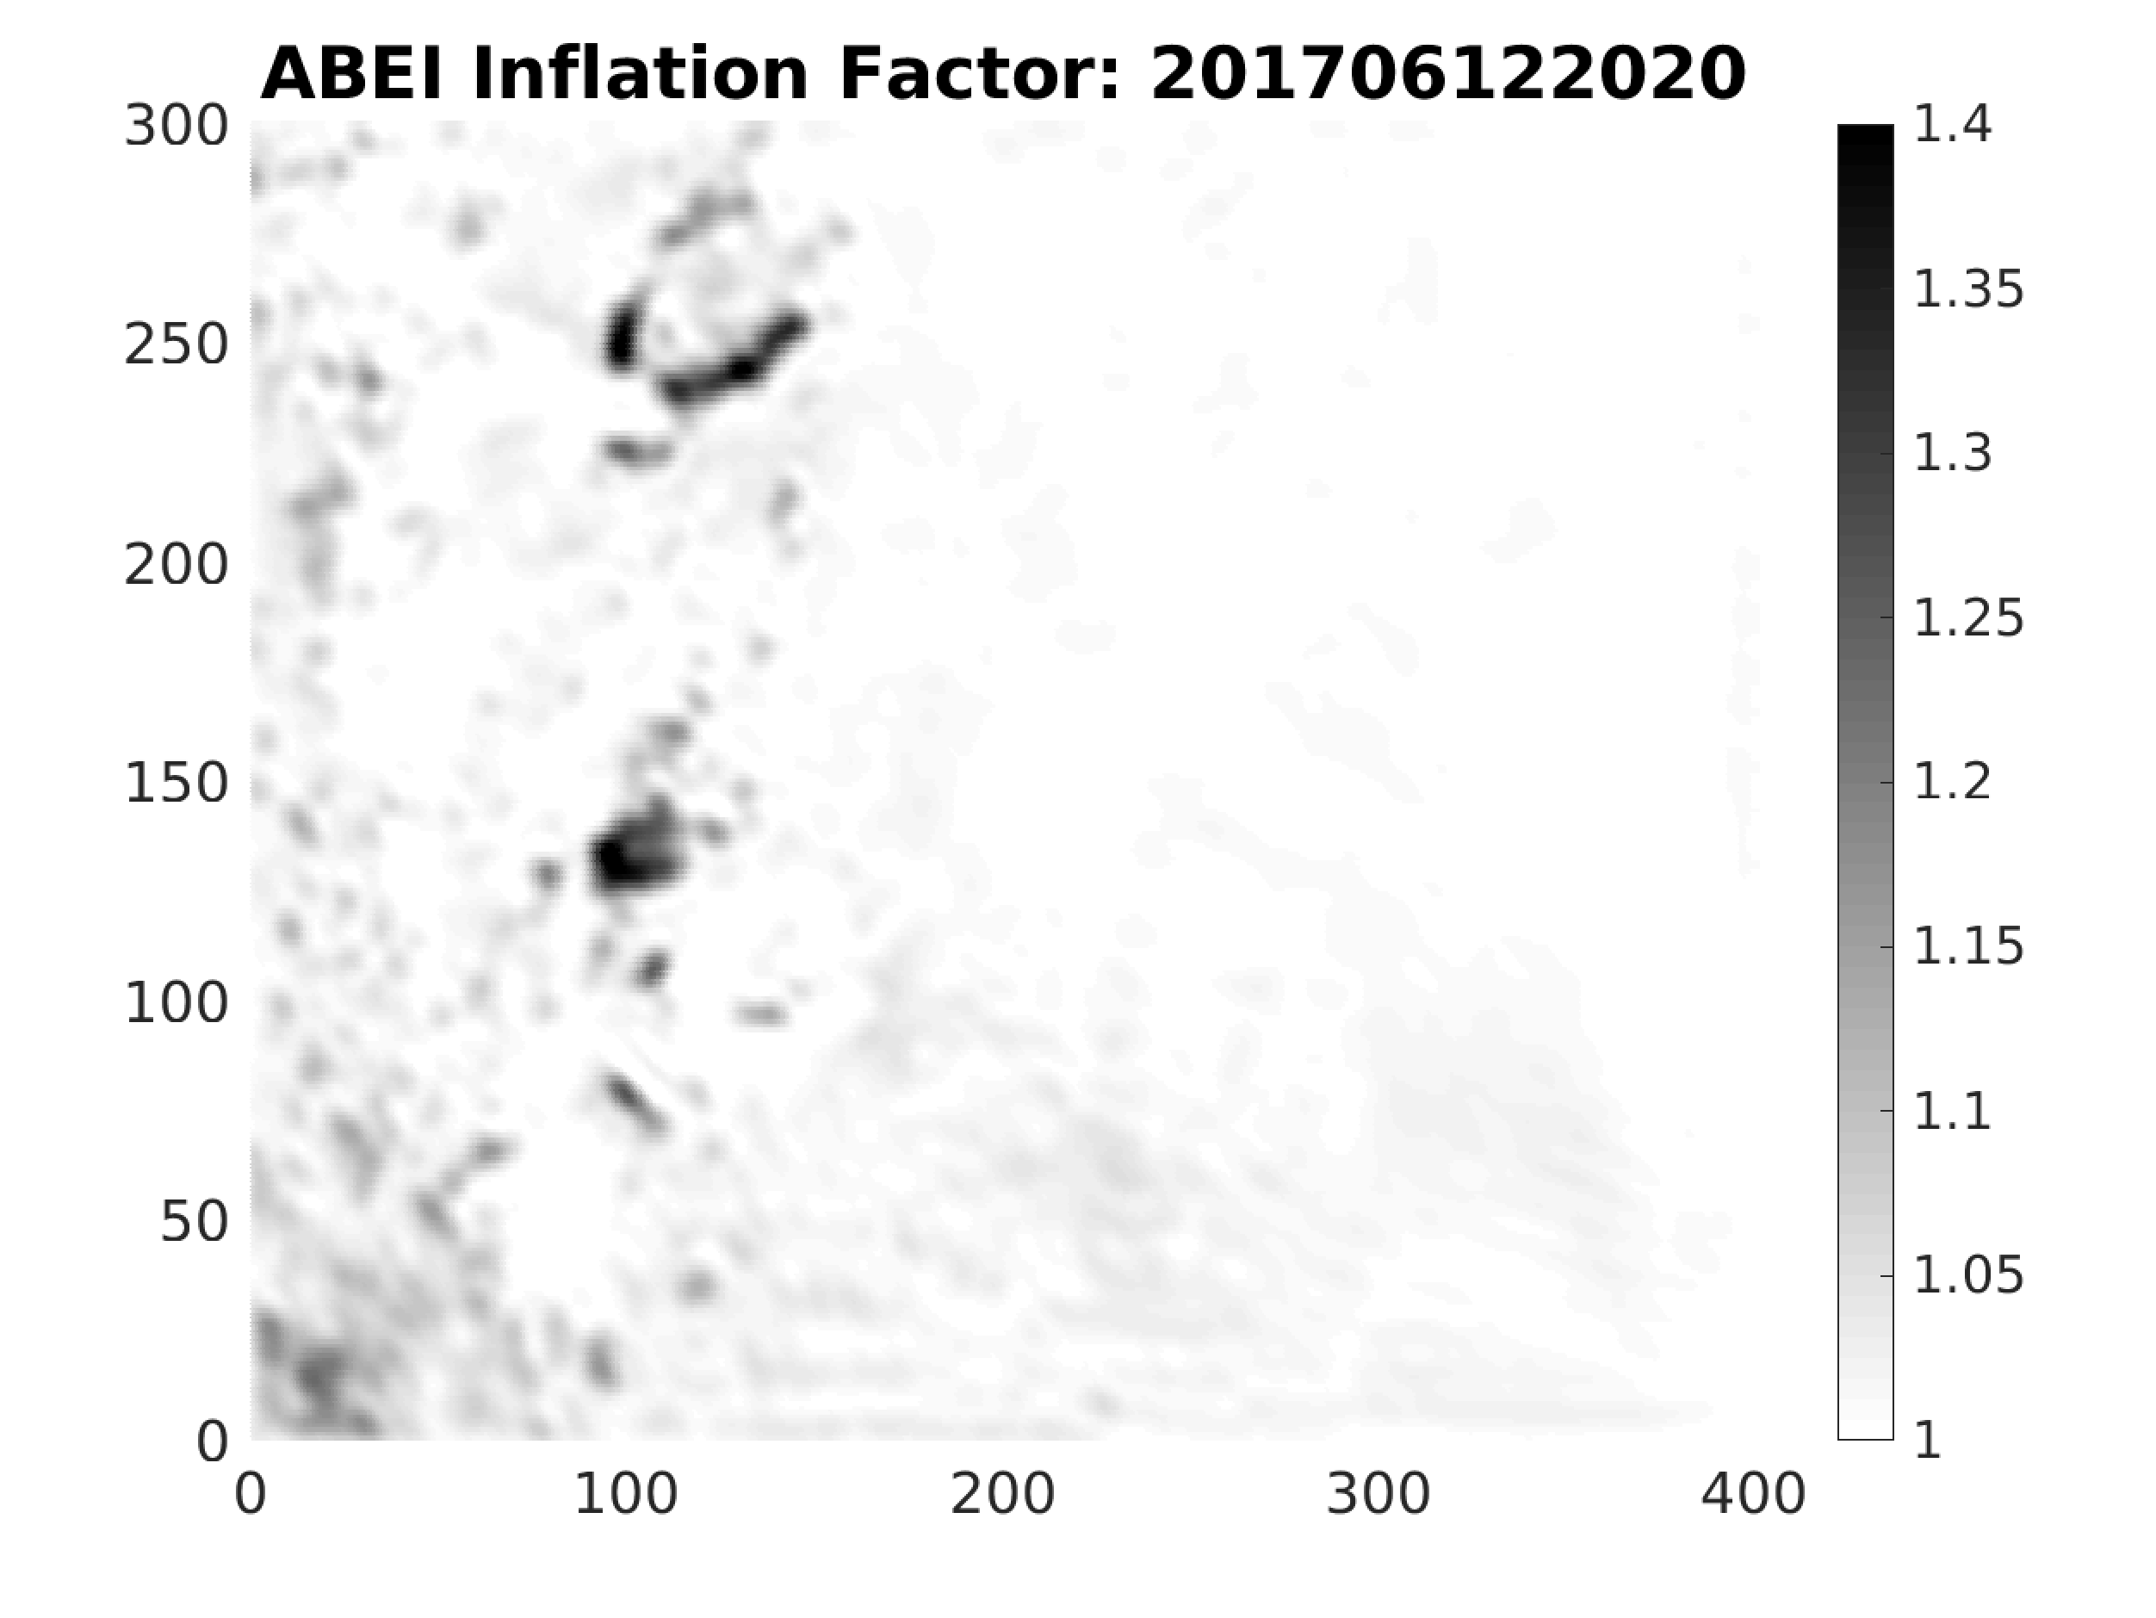
Application of ABEI: Example
(G-C function smoothing scale: 10 grids)

Slide 4
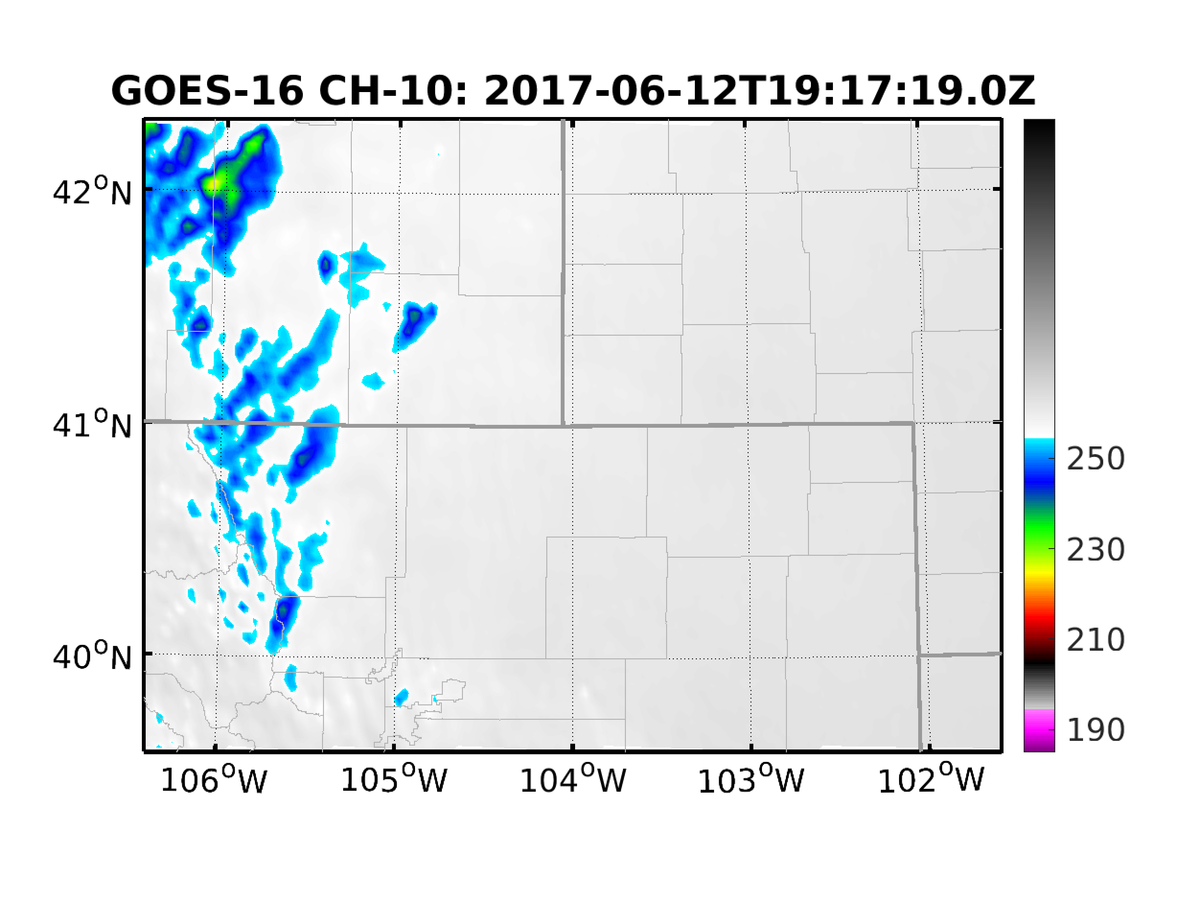
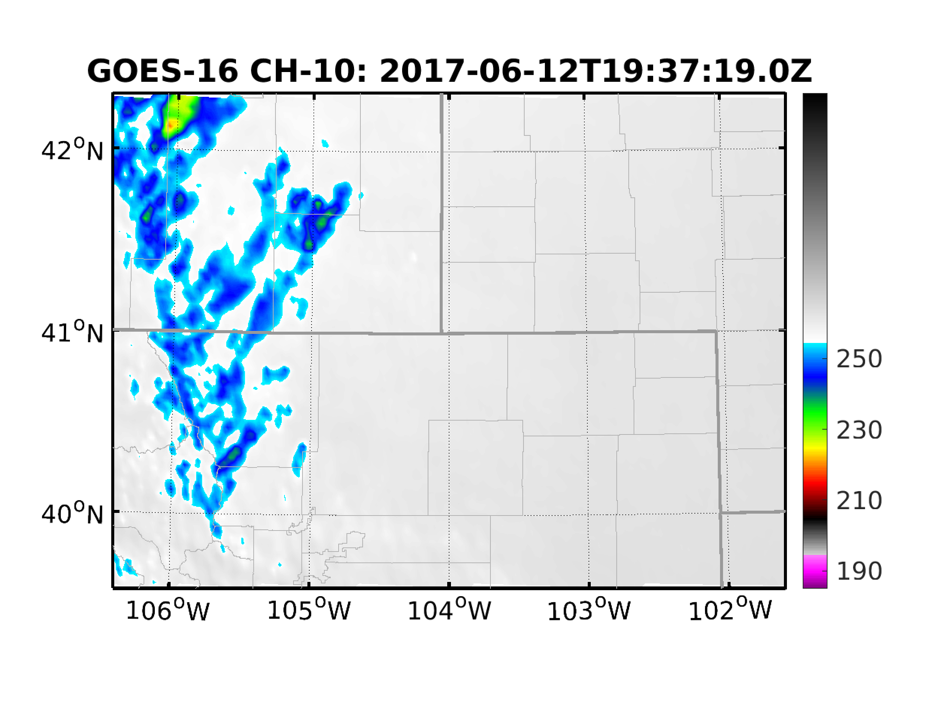
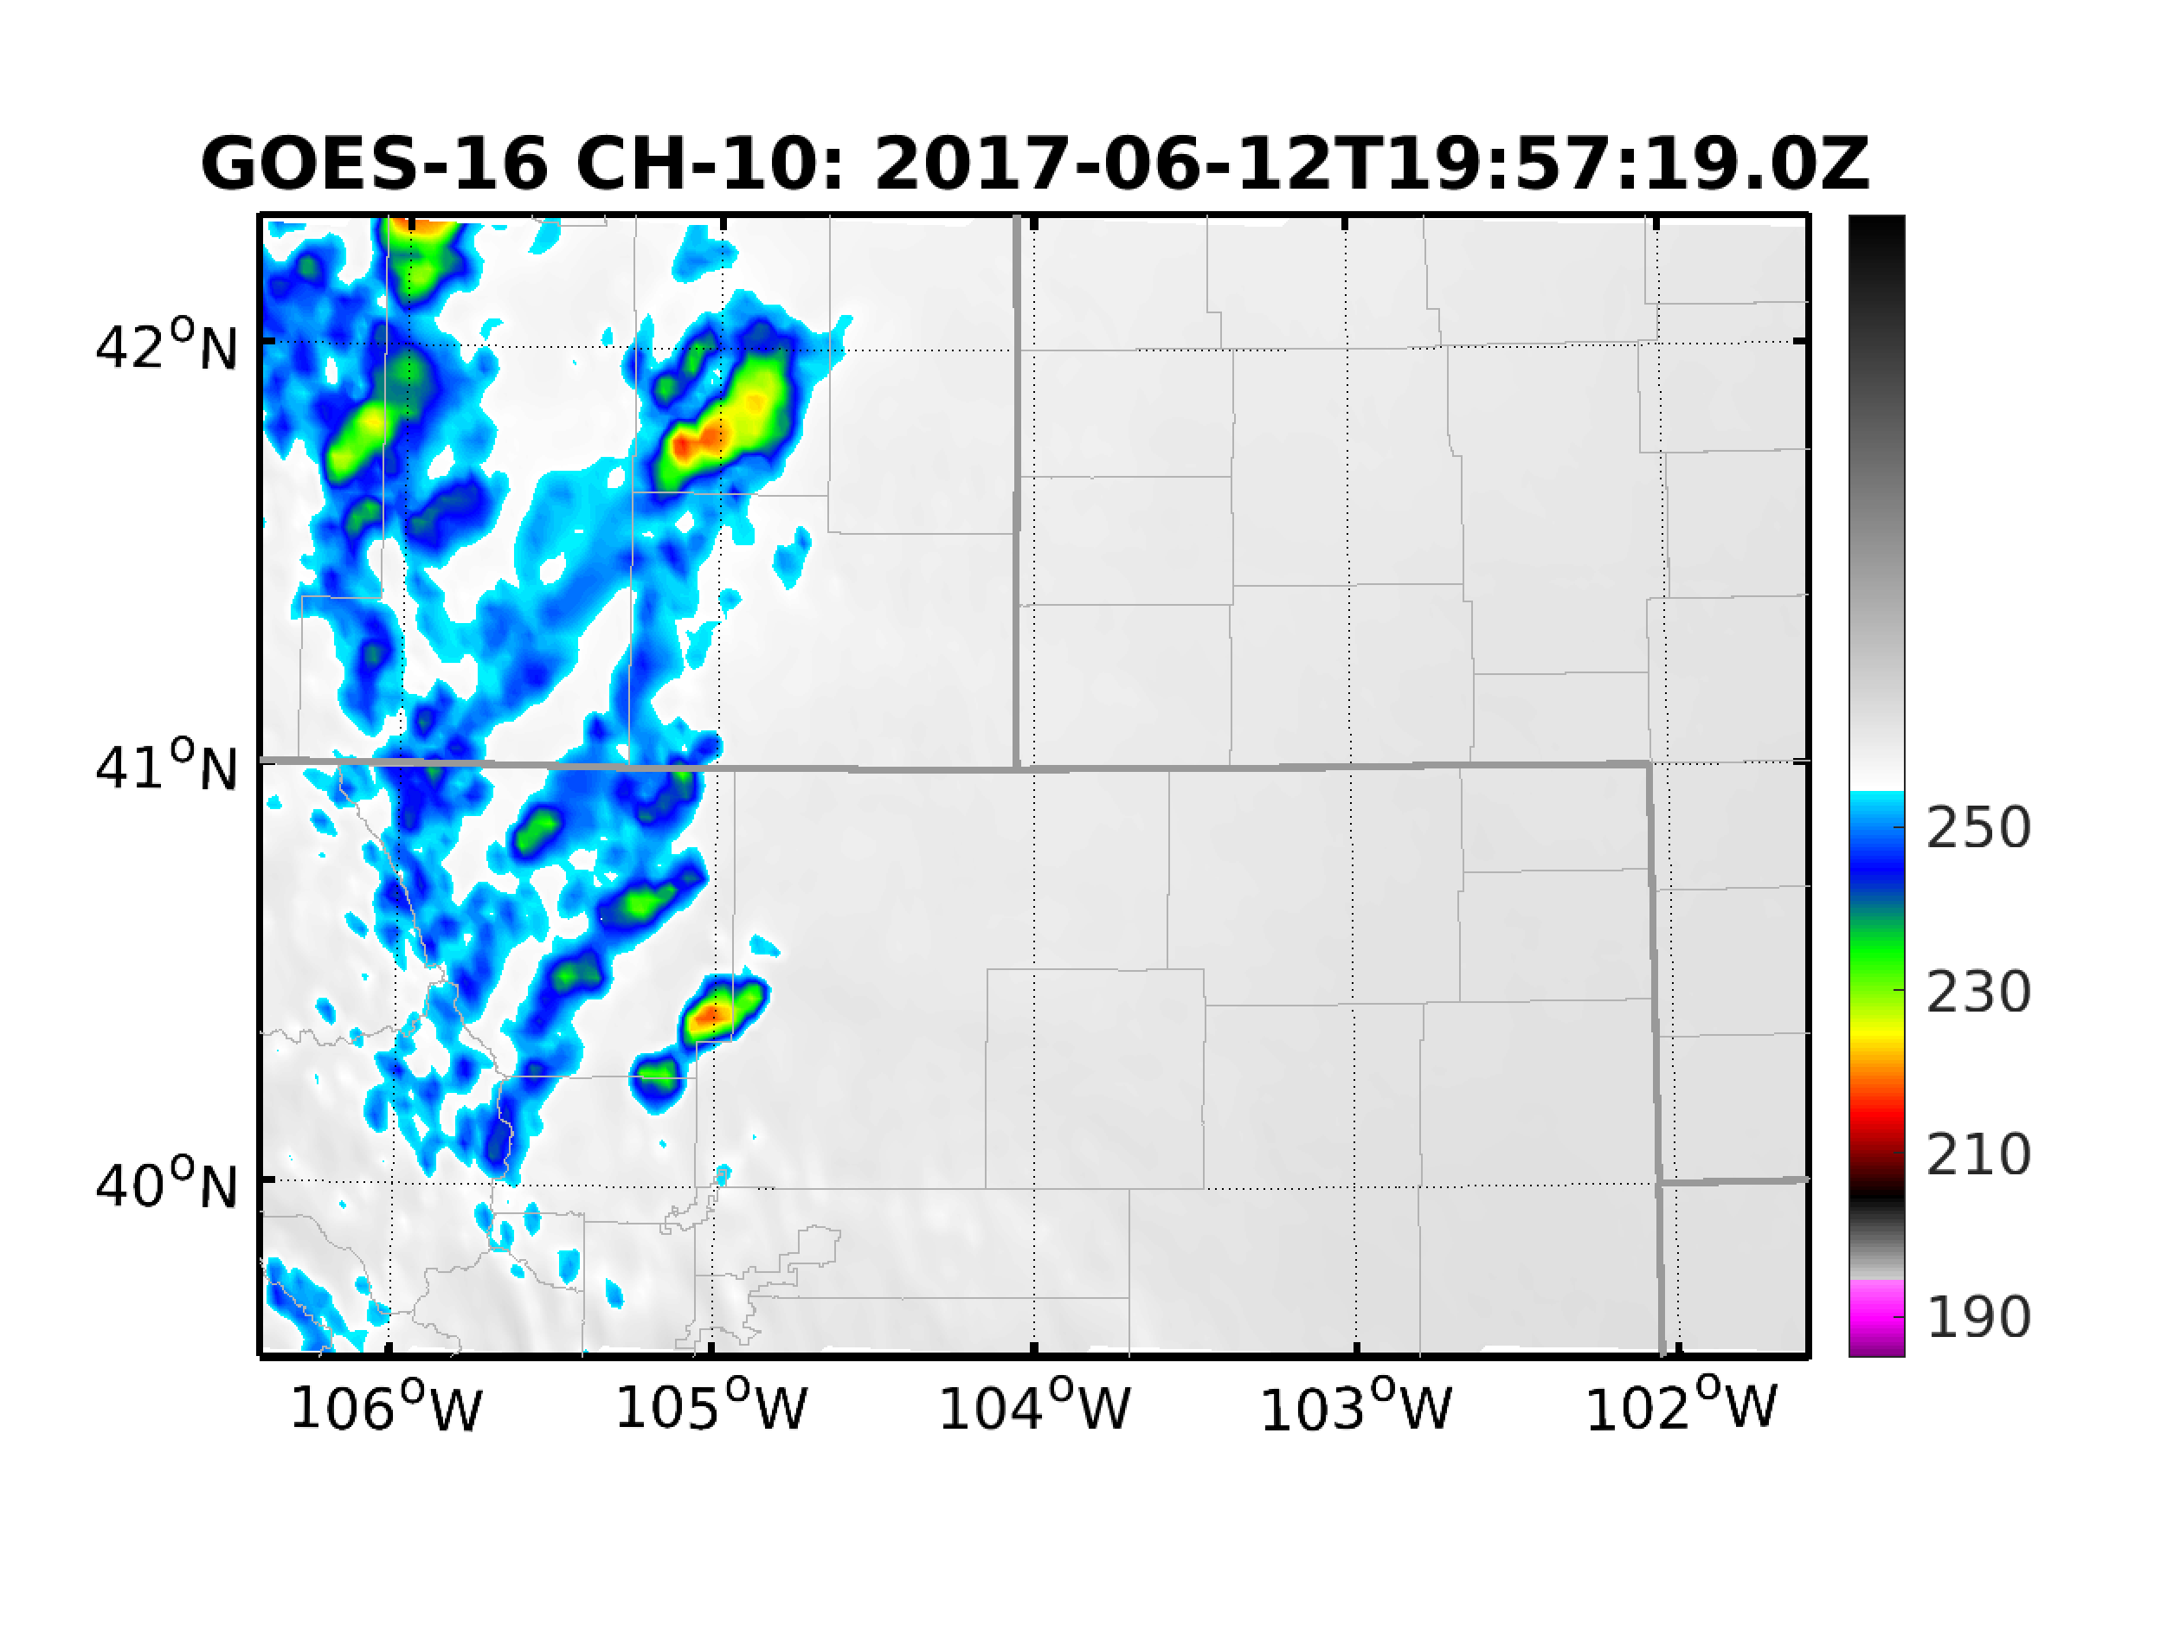
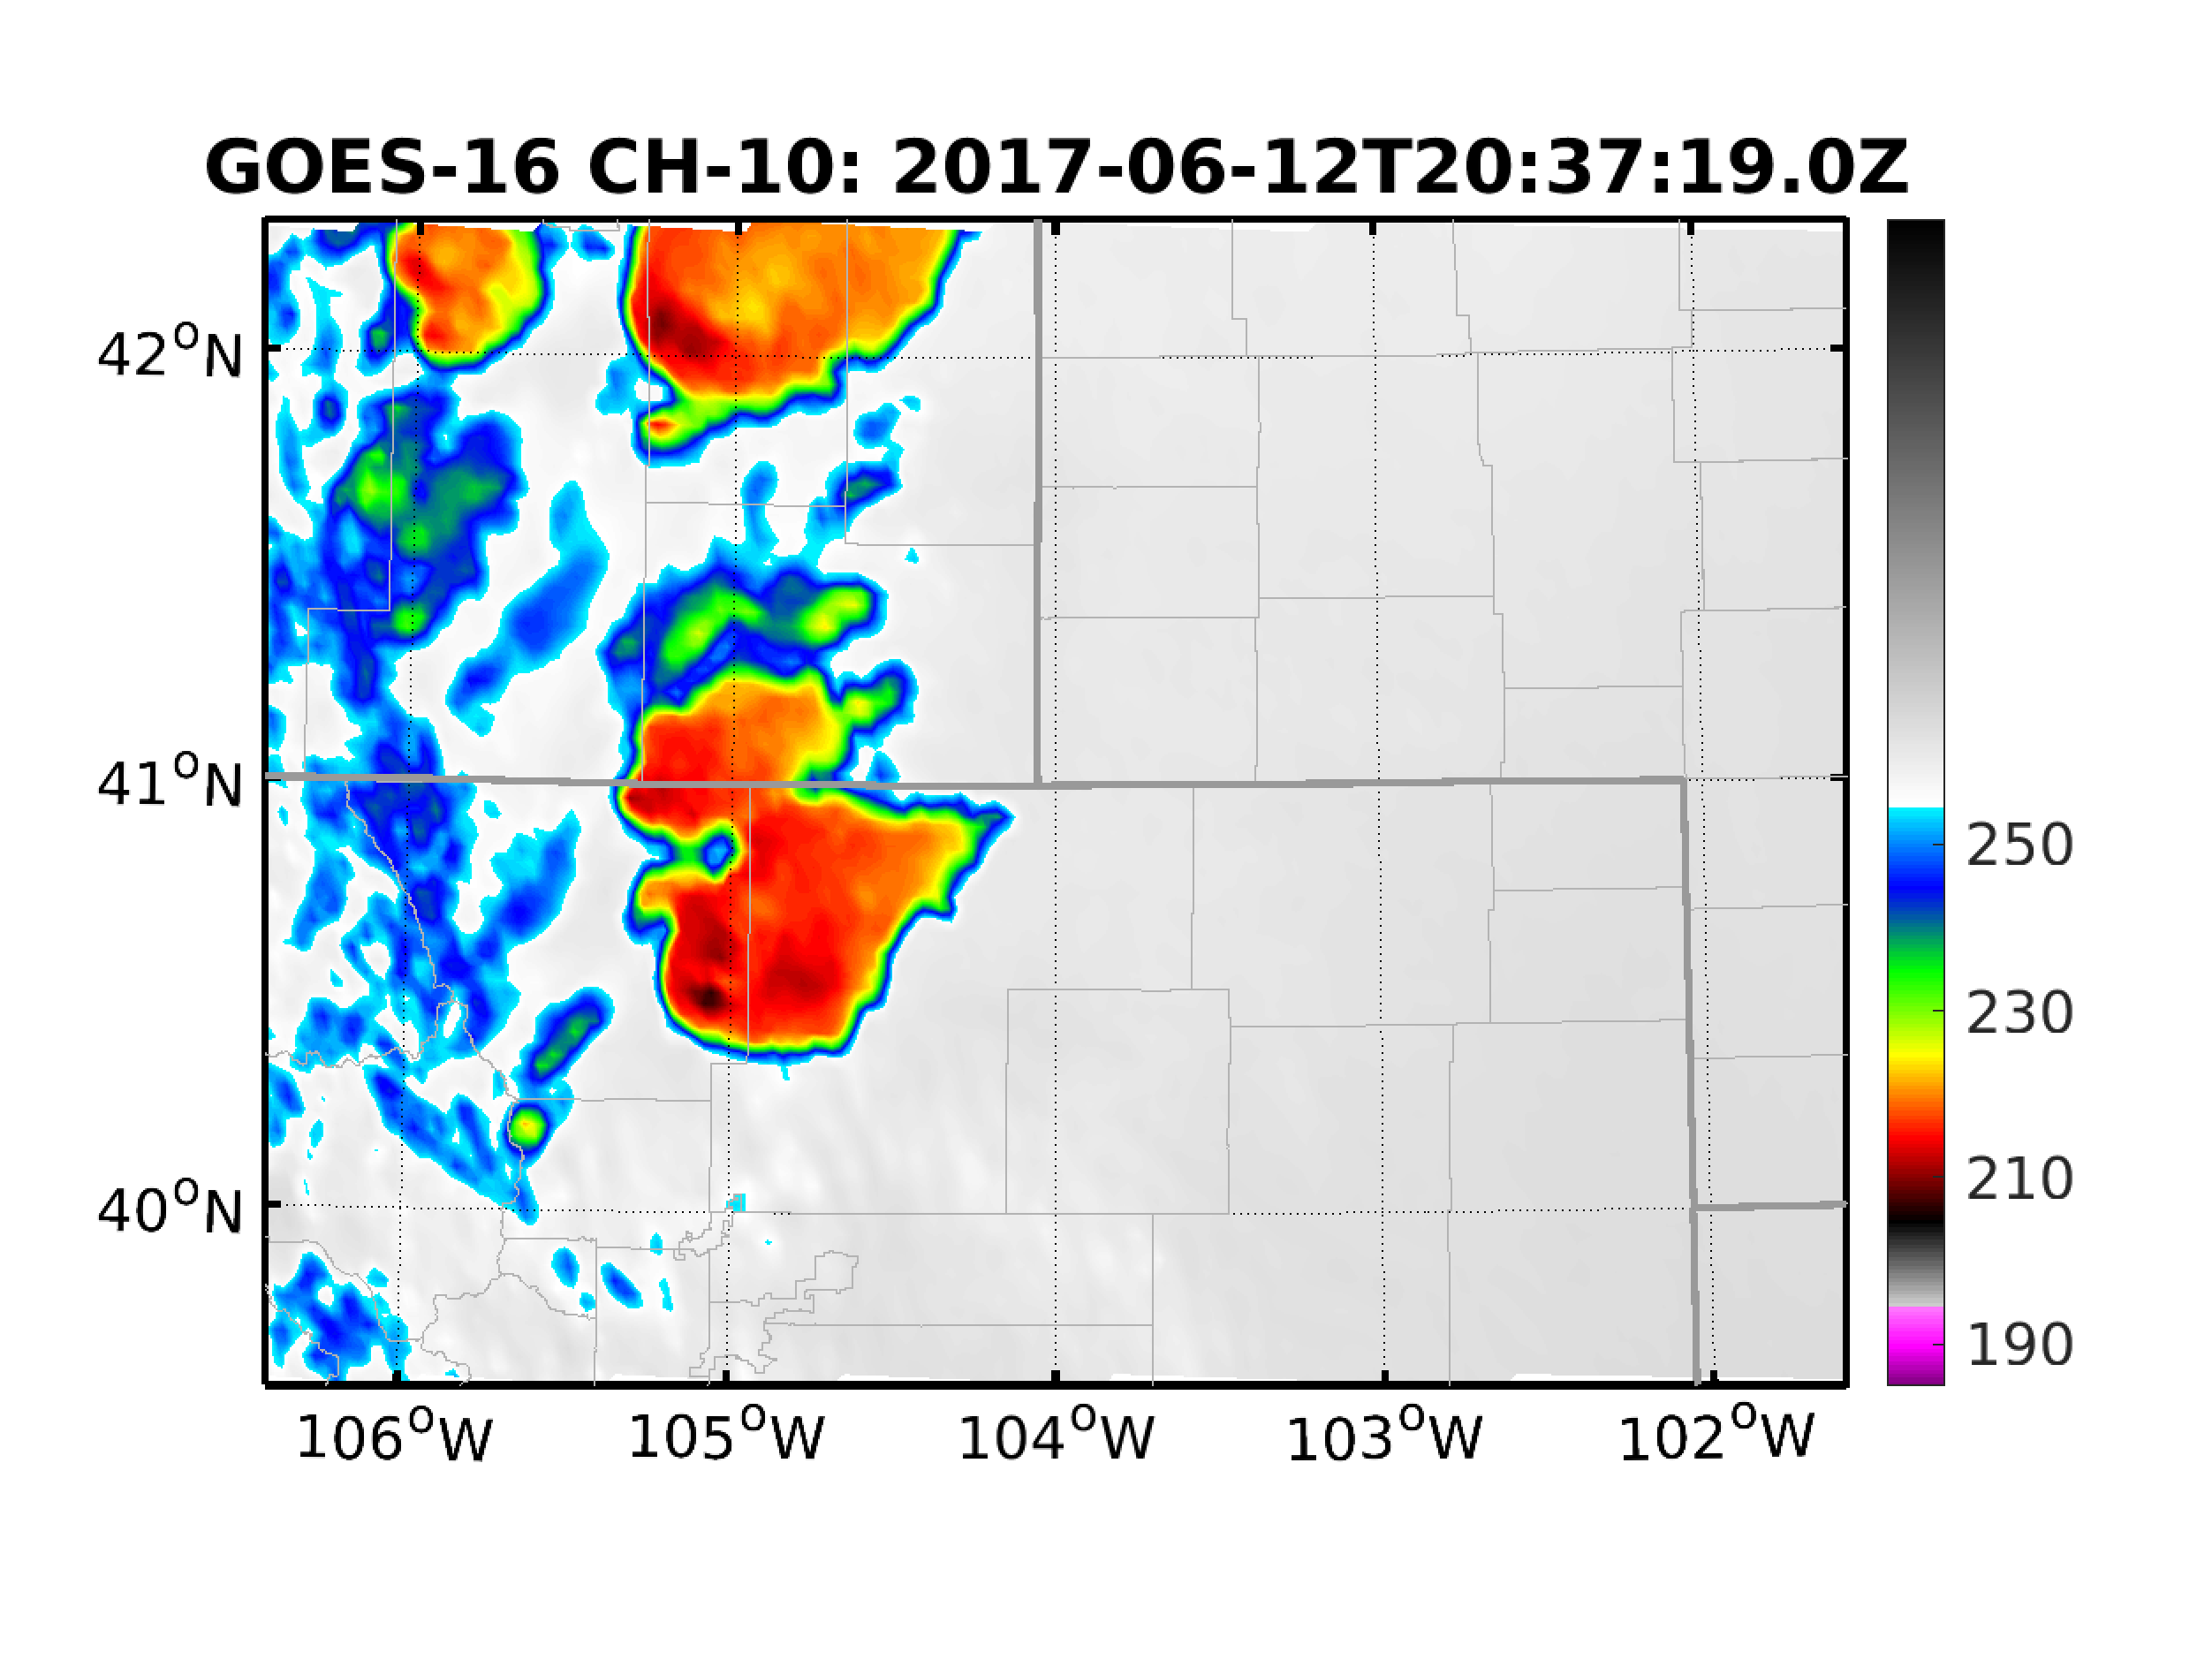
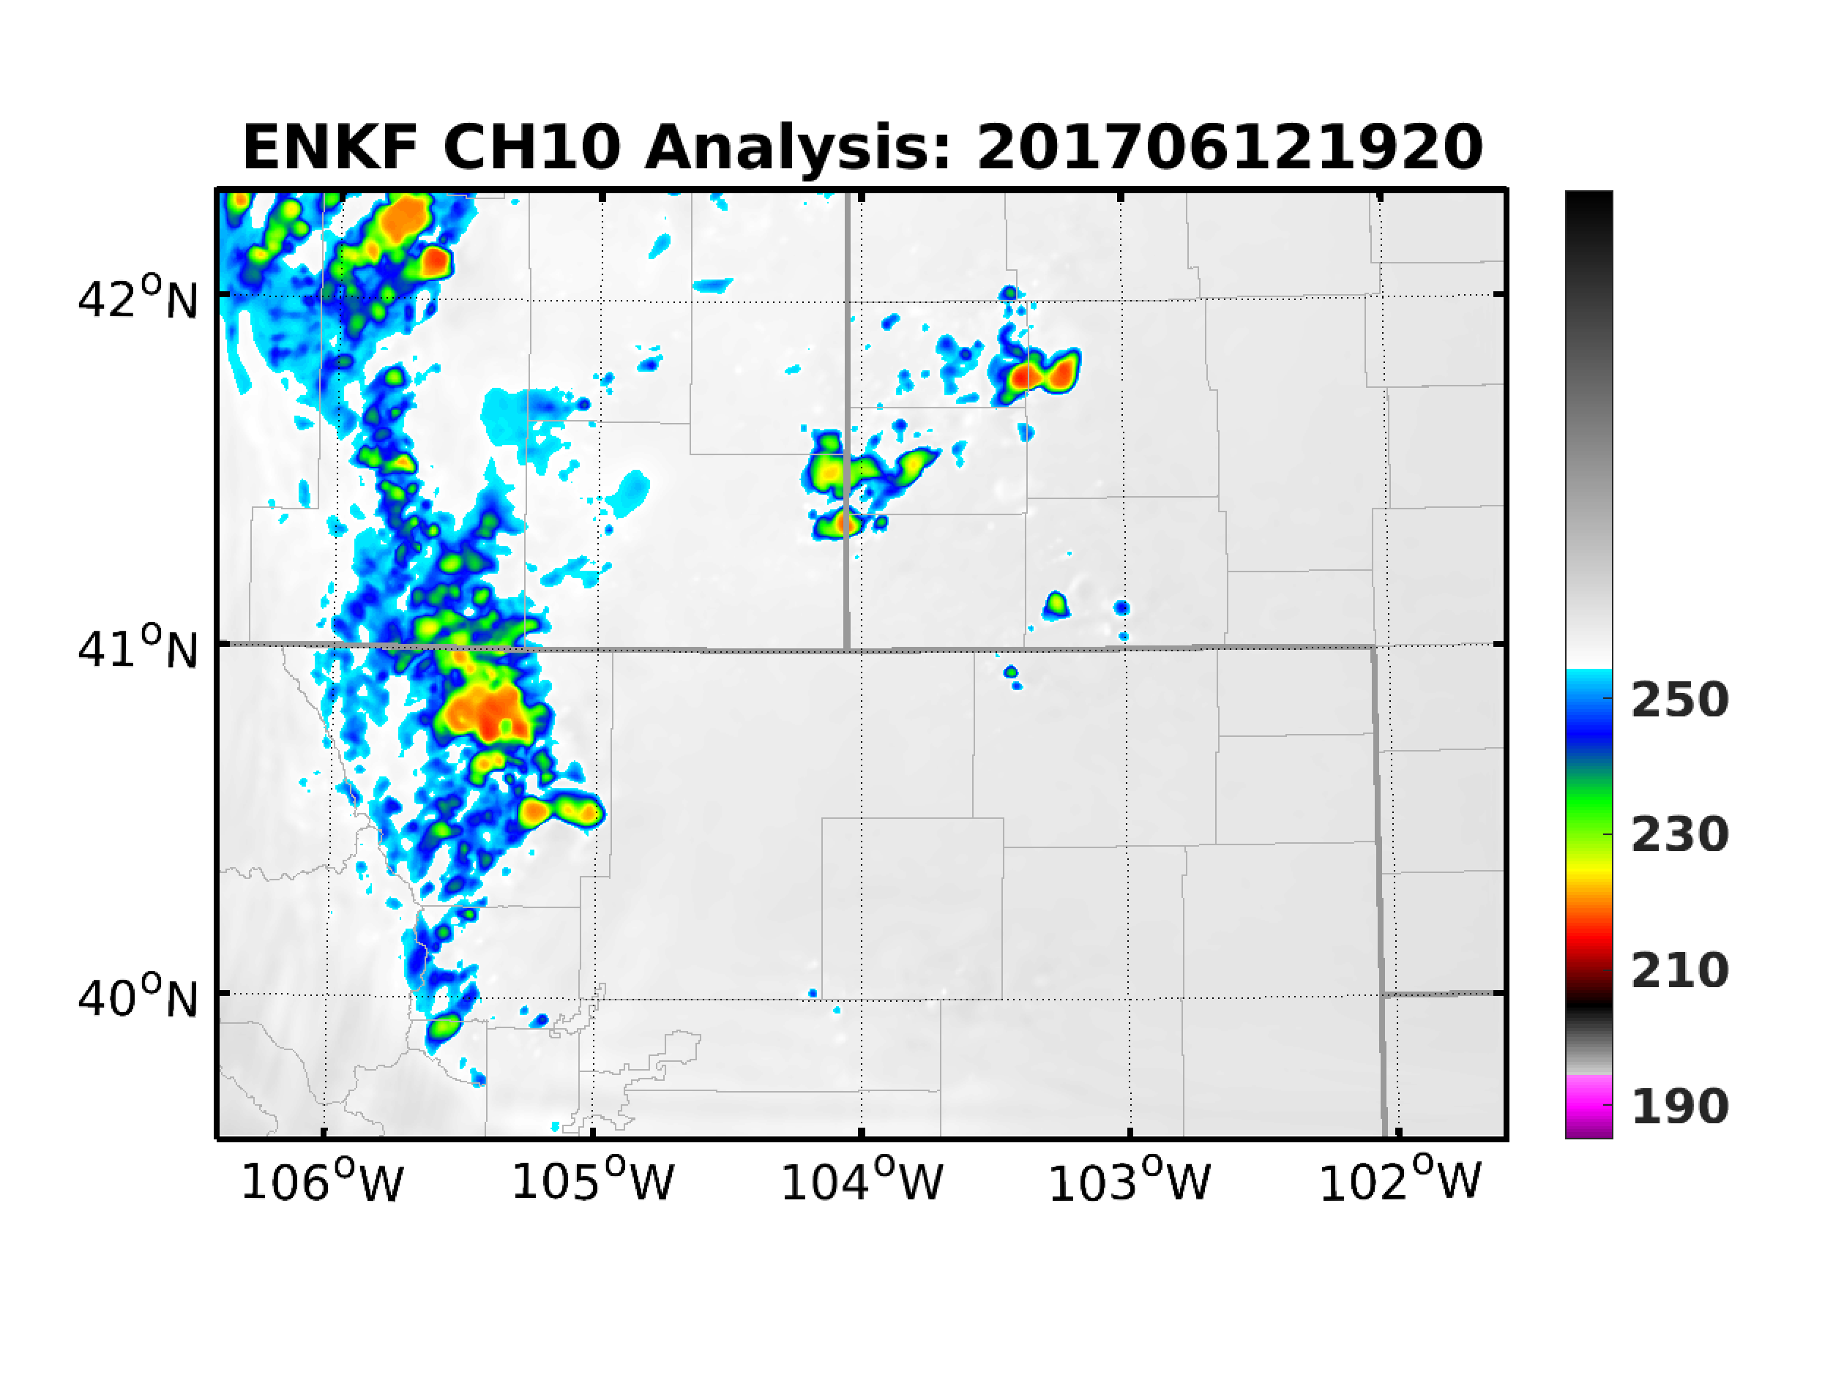
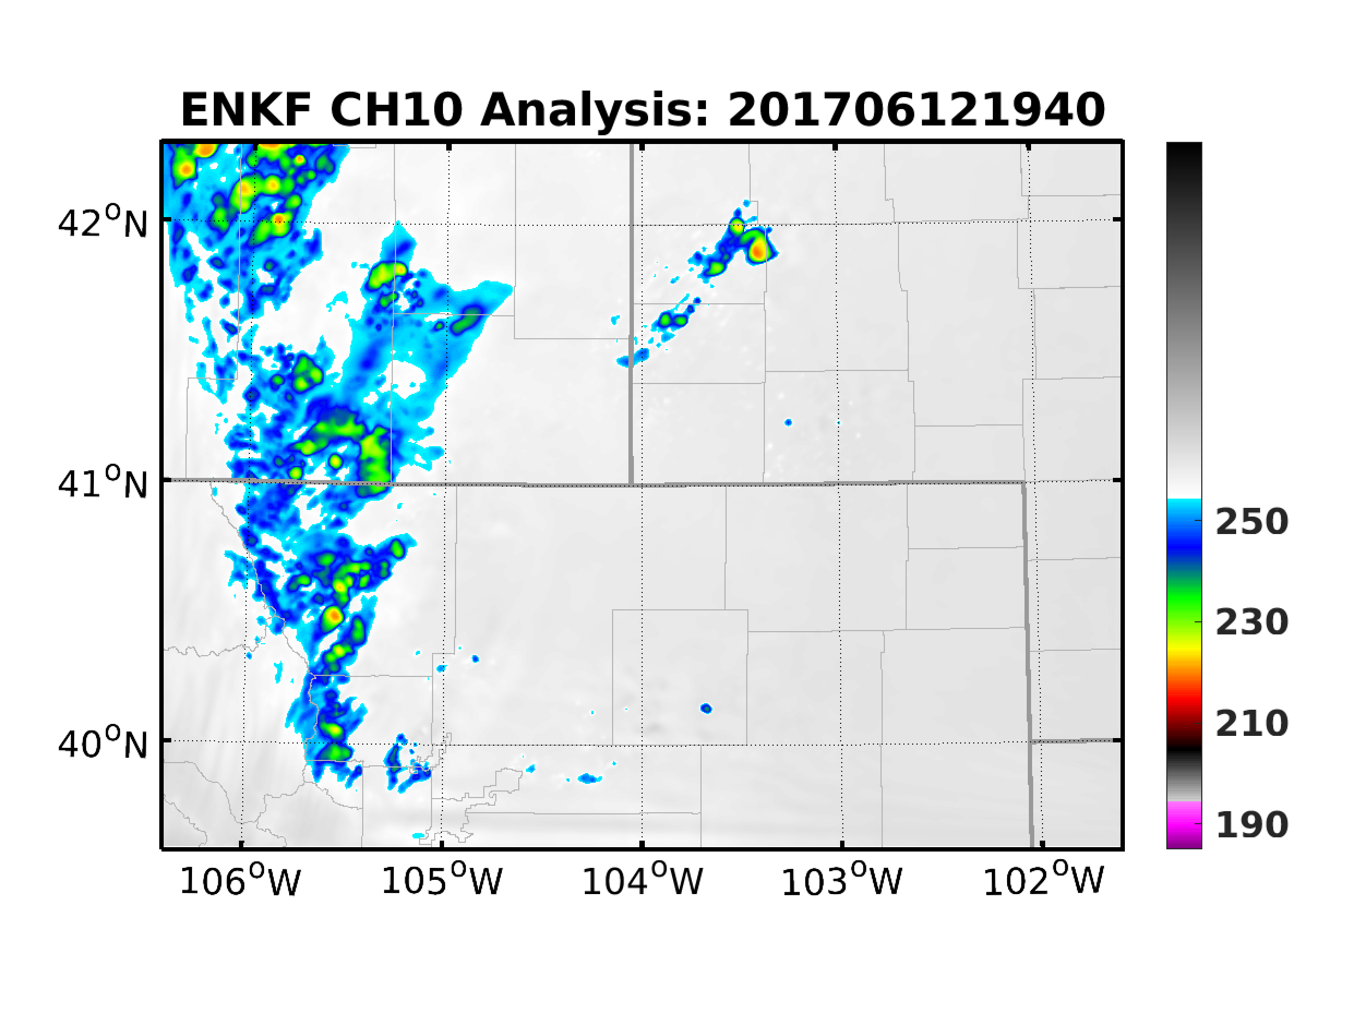
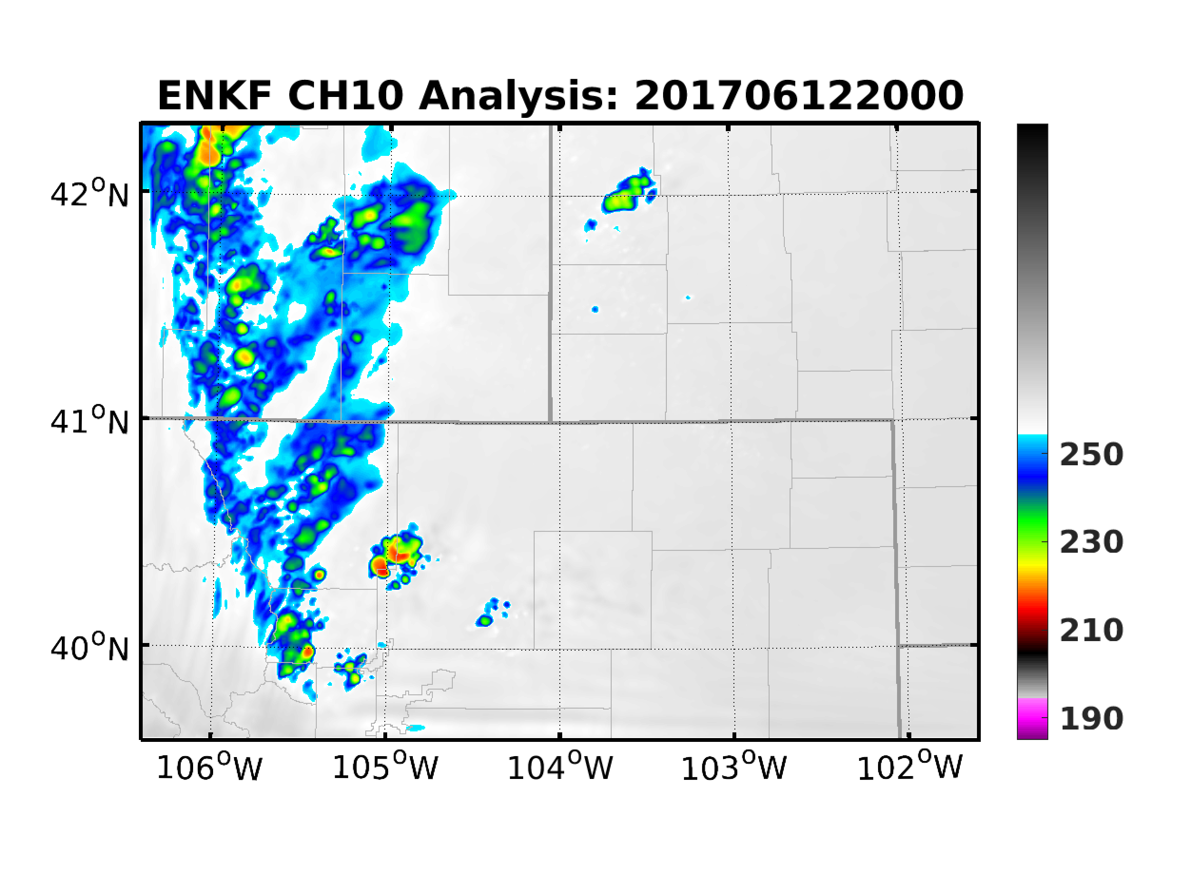
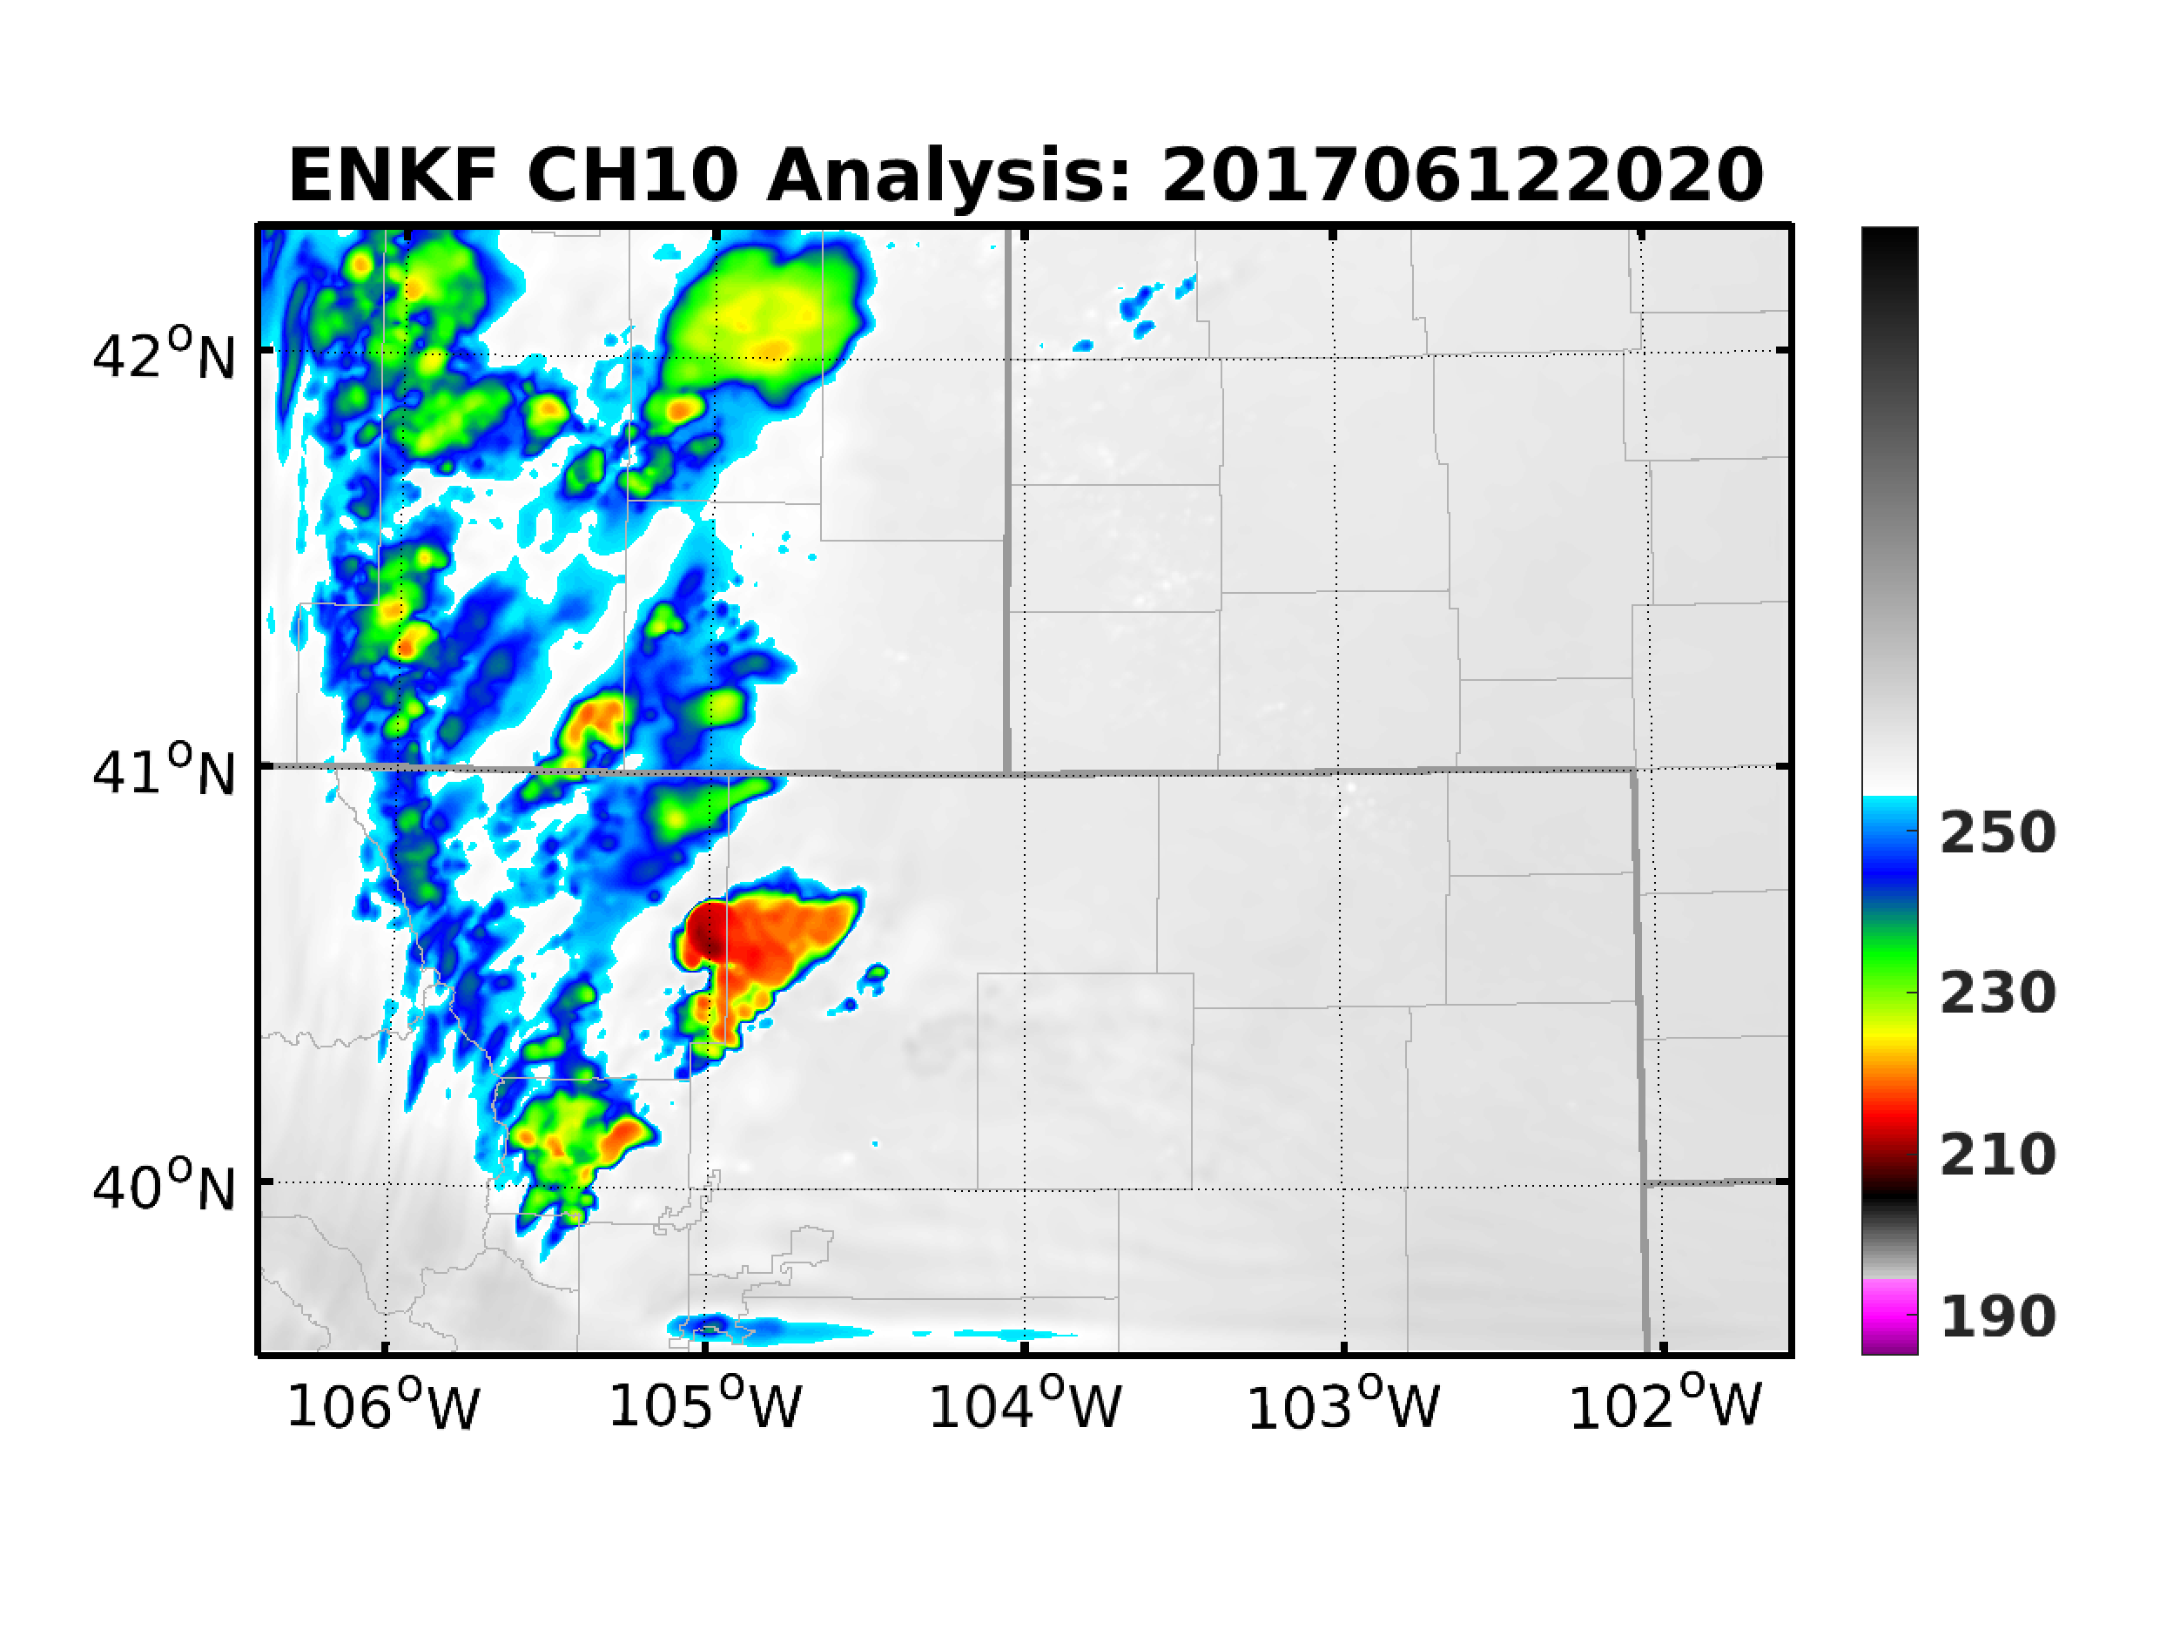
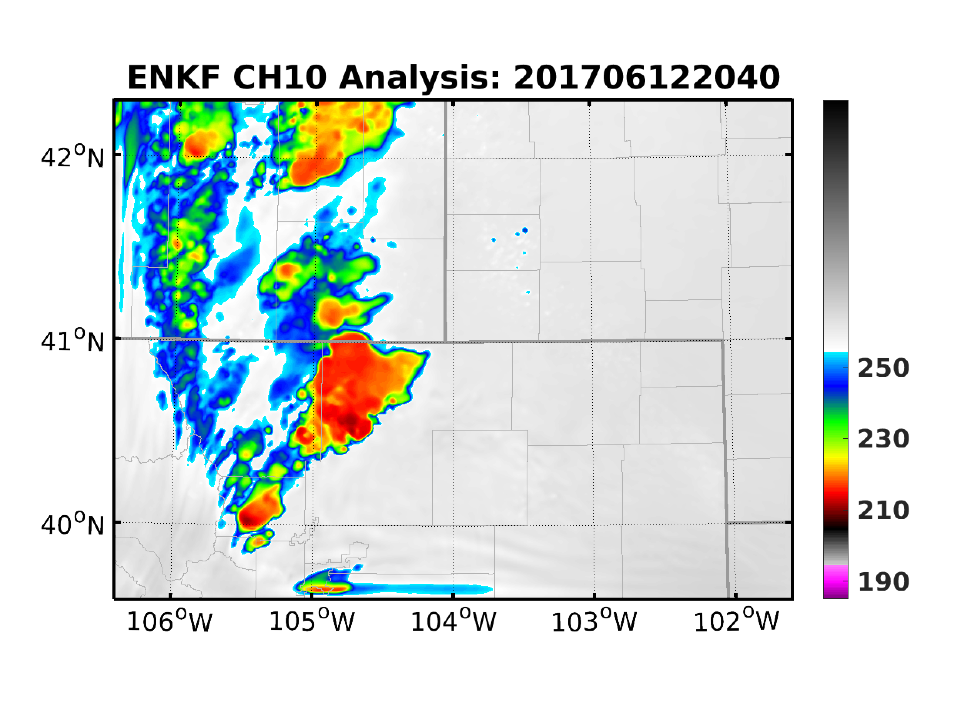
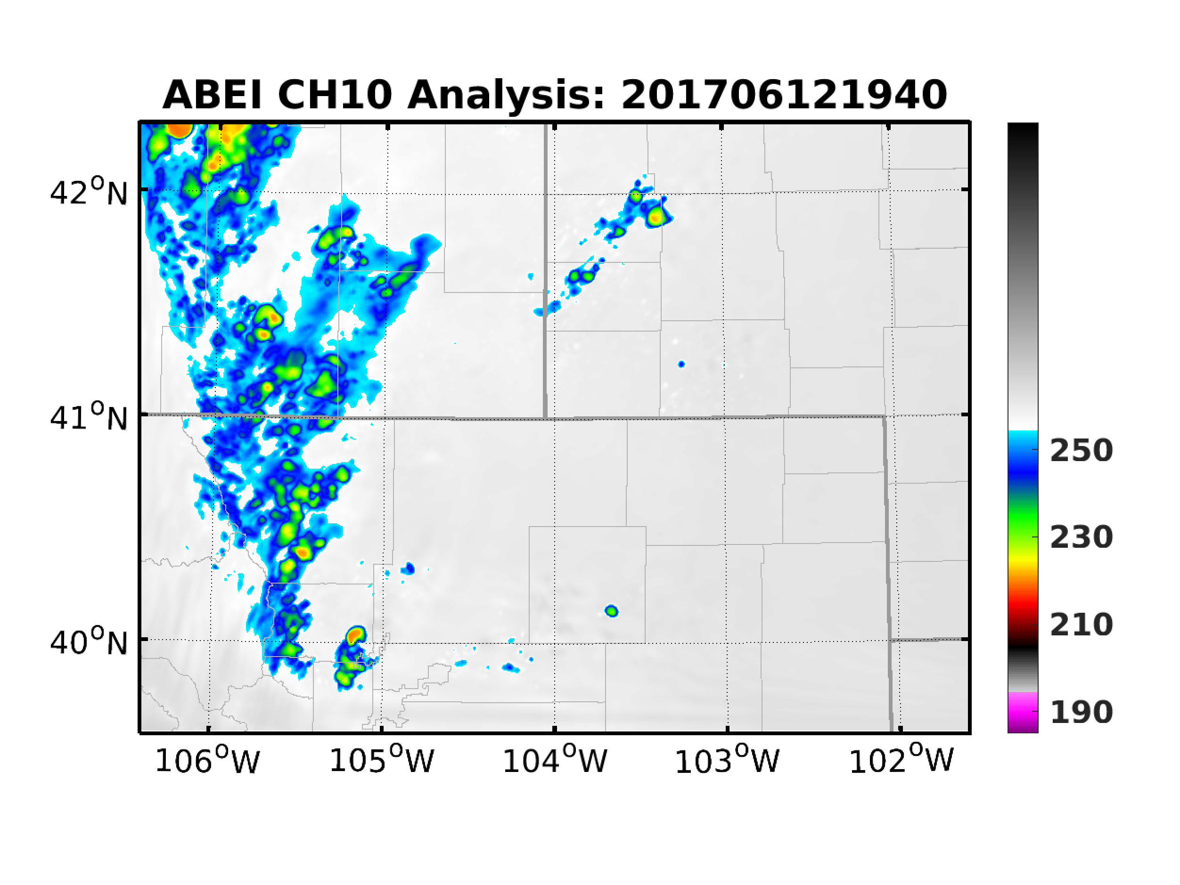
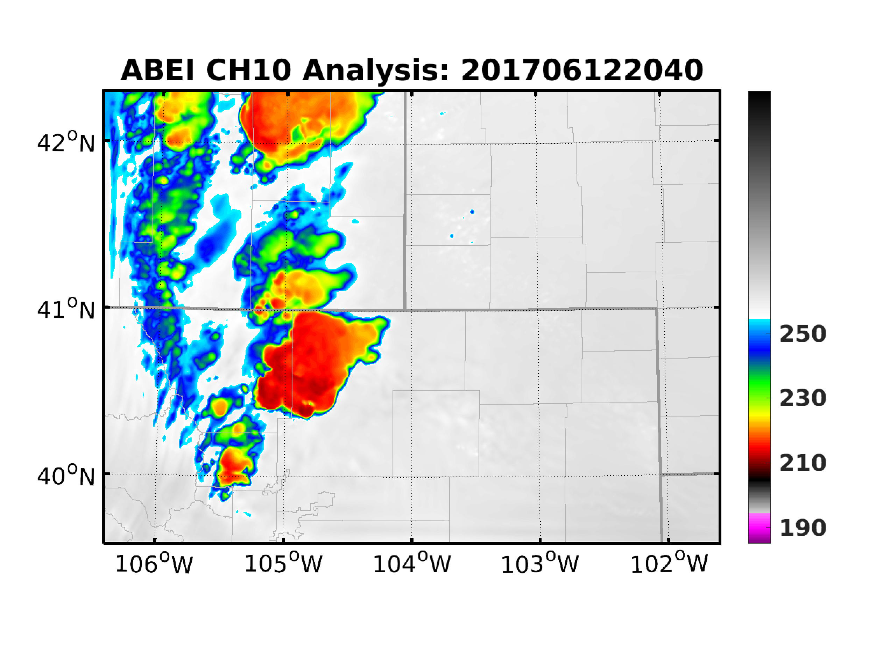
Application of ABEI: Analysis
ABI
ENKF
ABEI

Slide 5
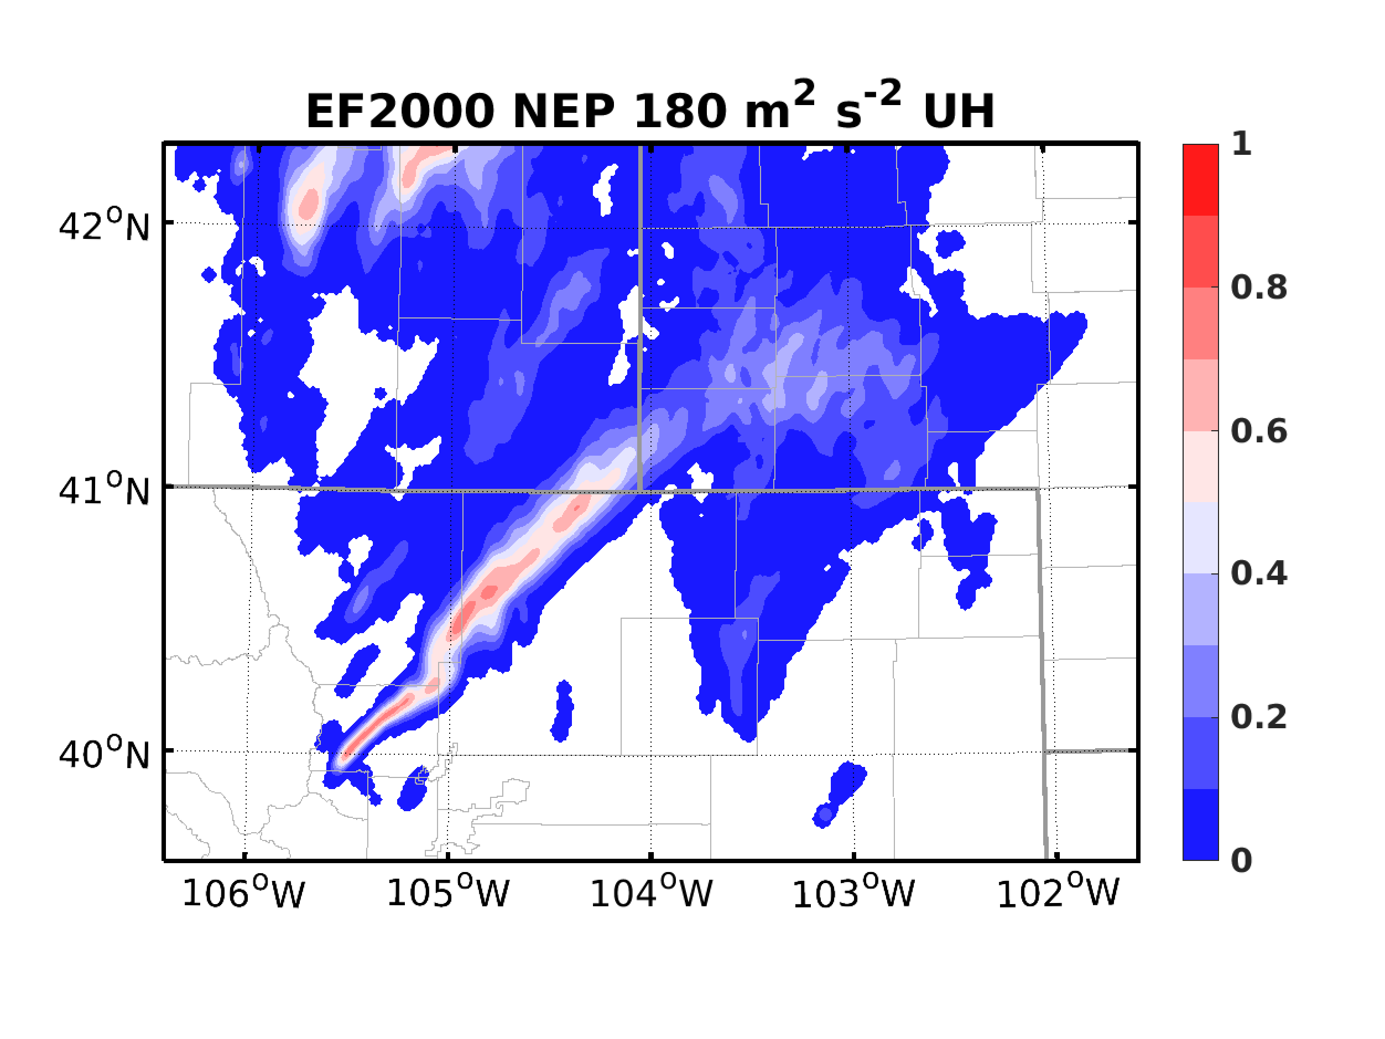
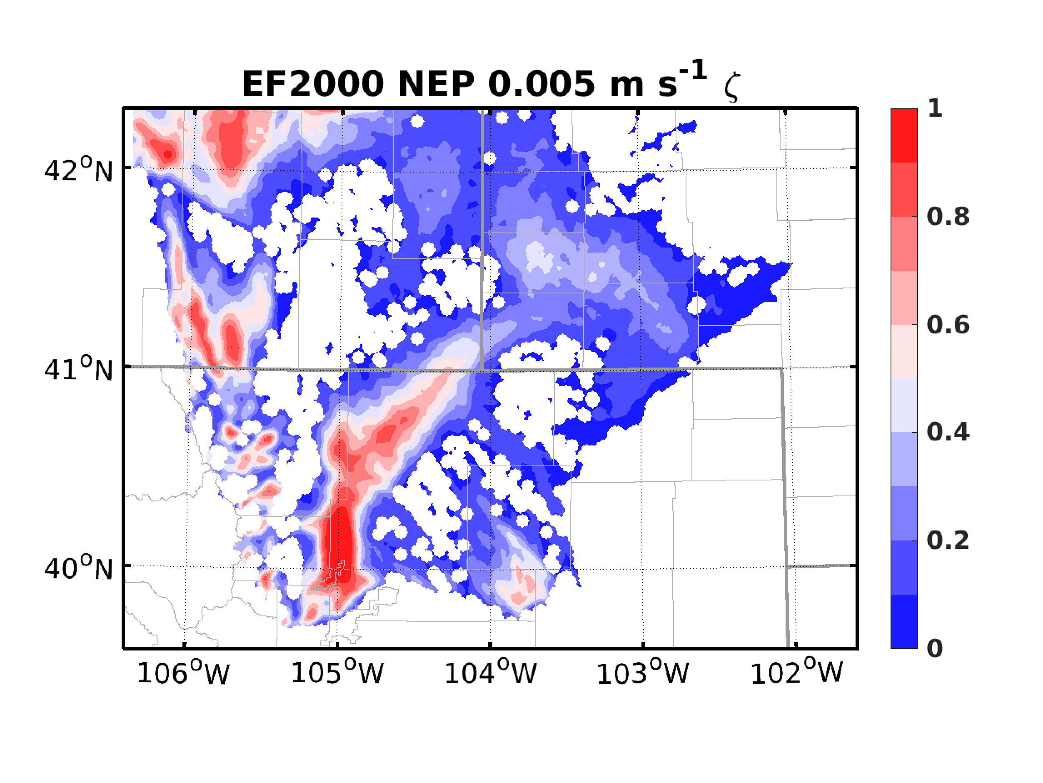
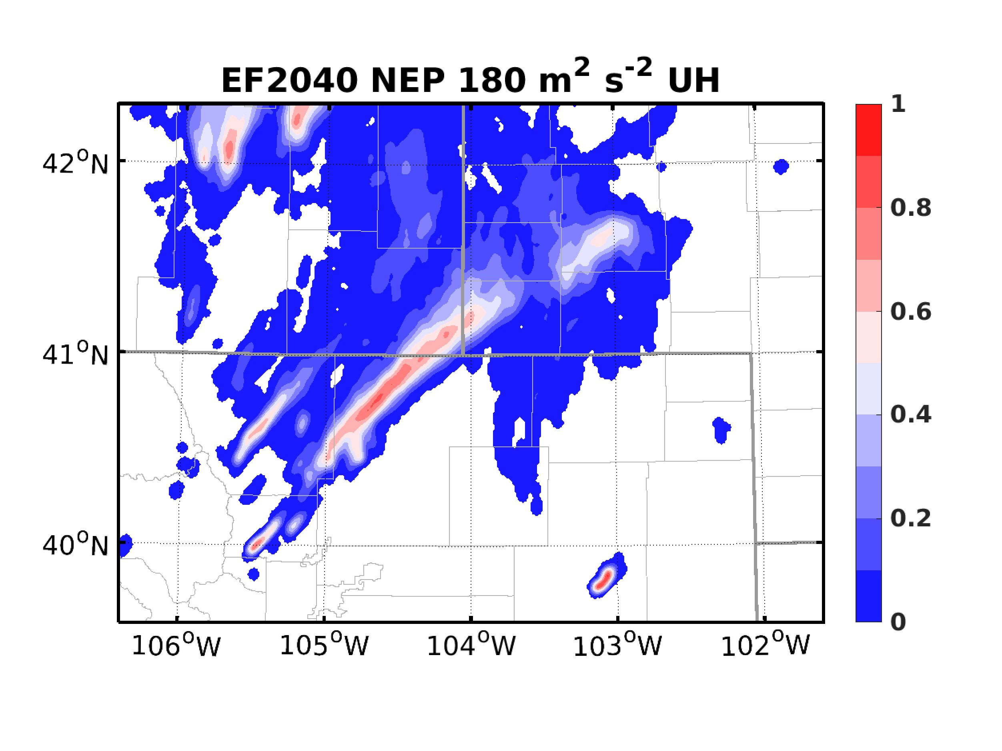
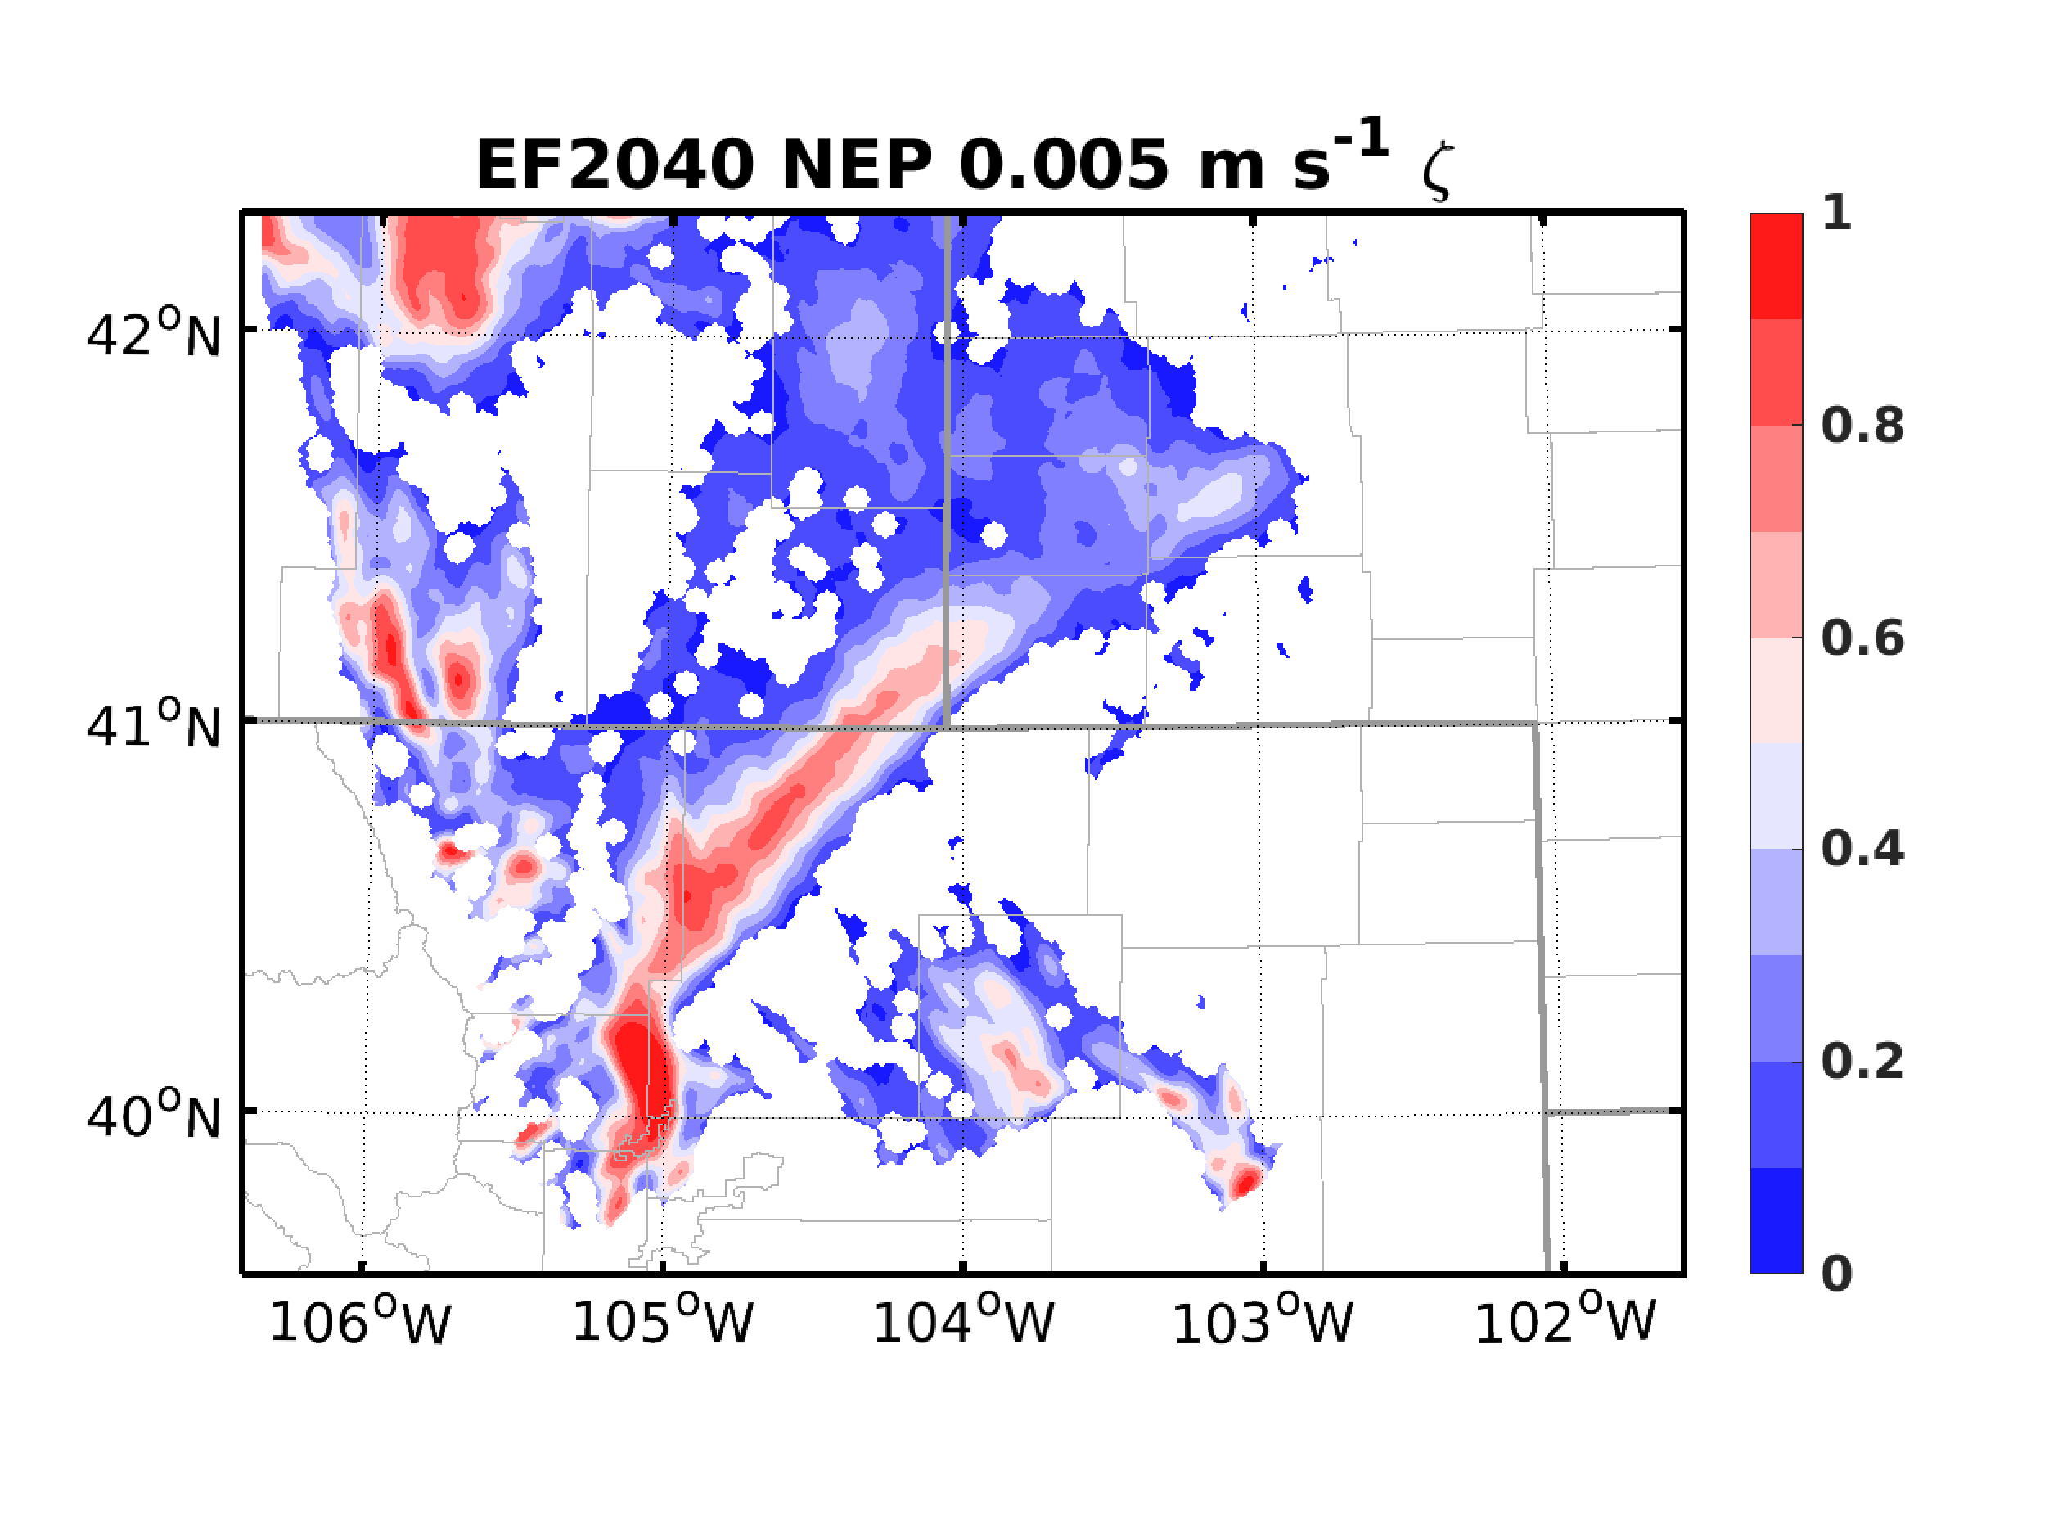
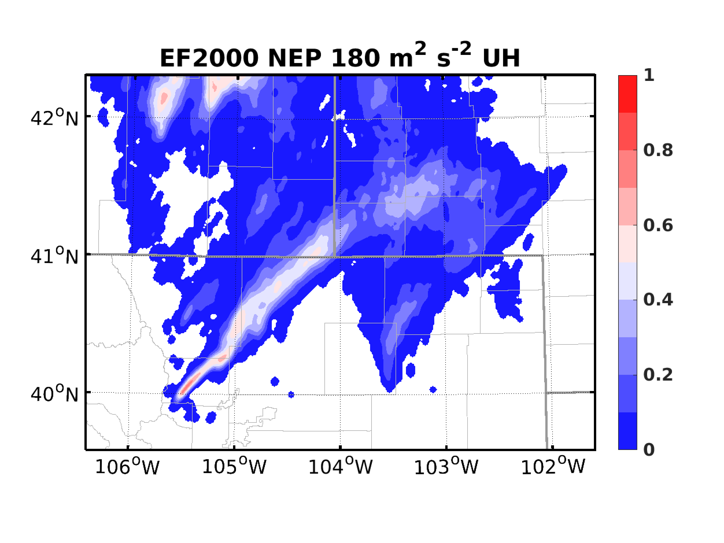
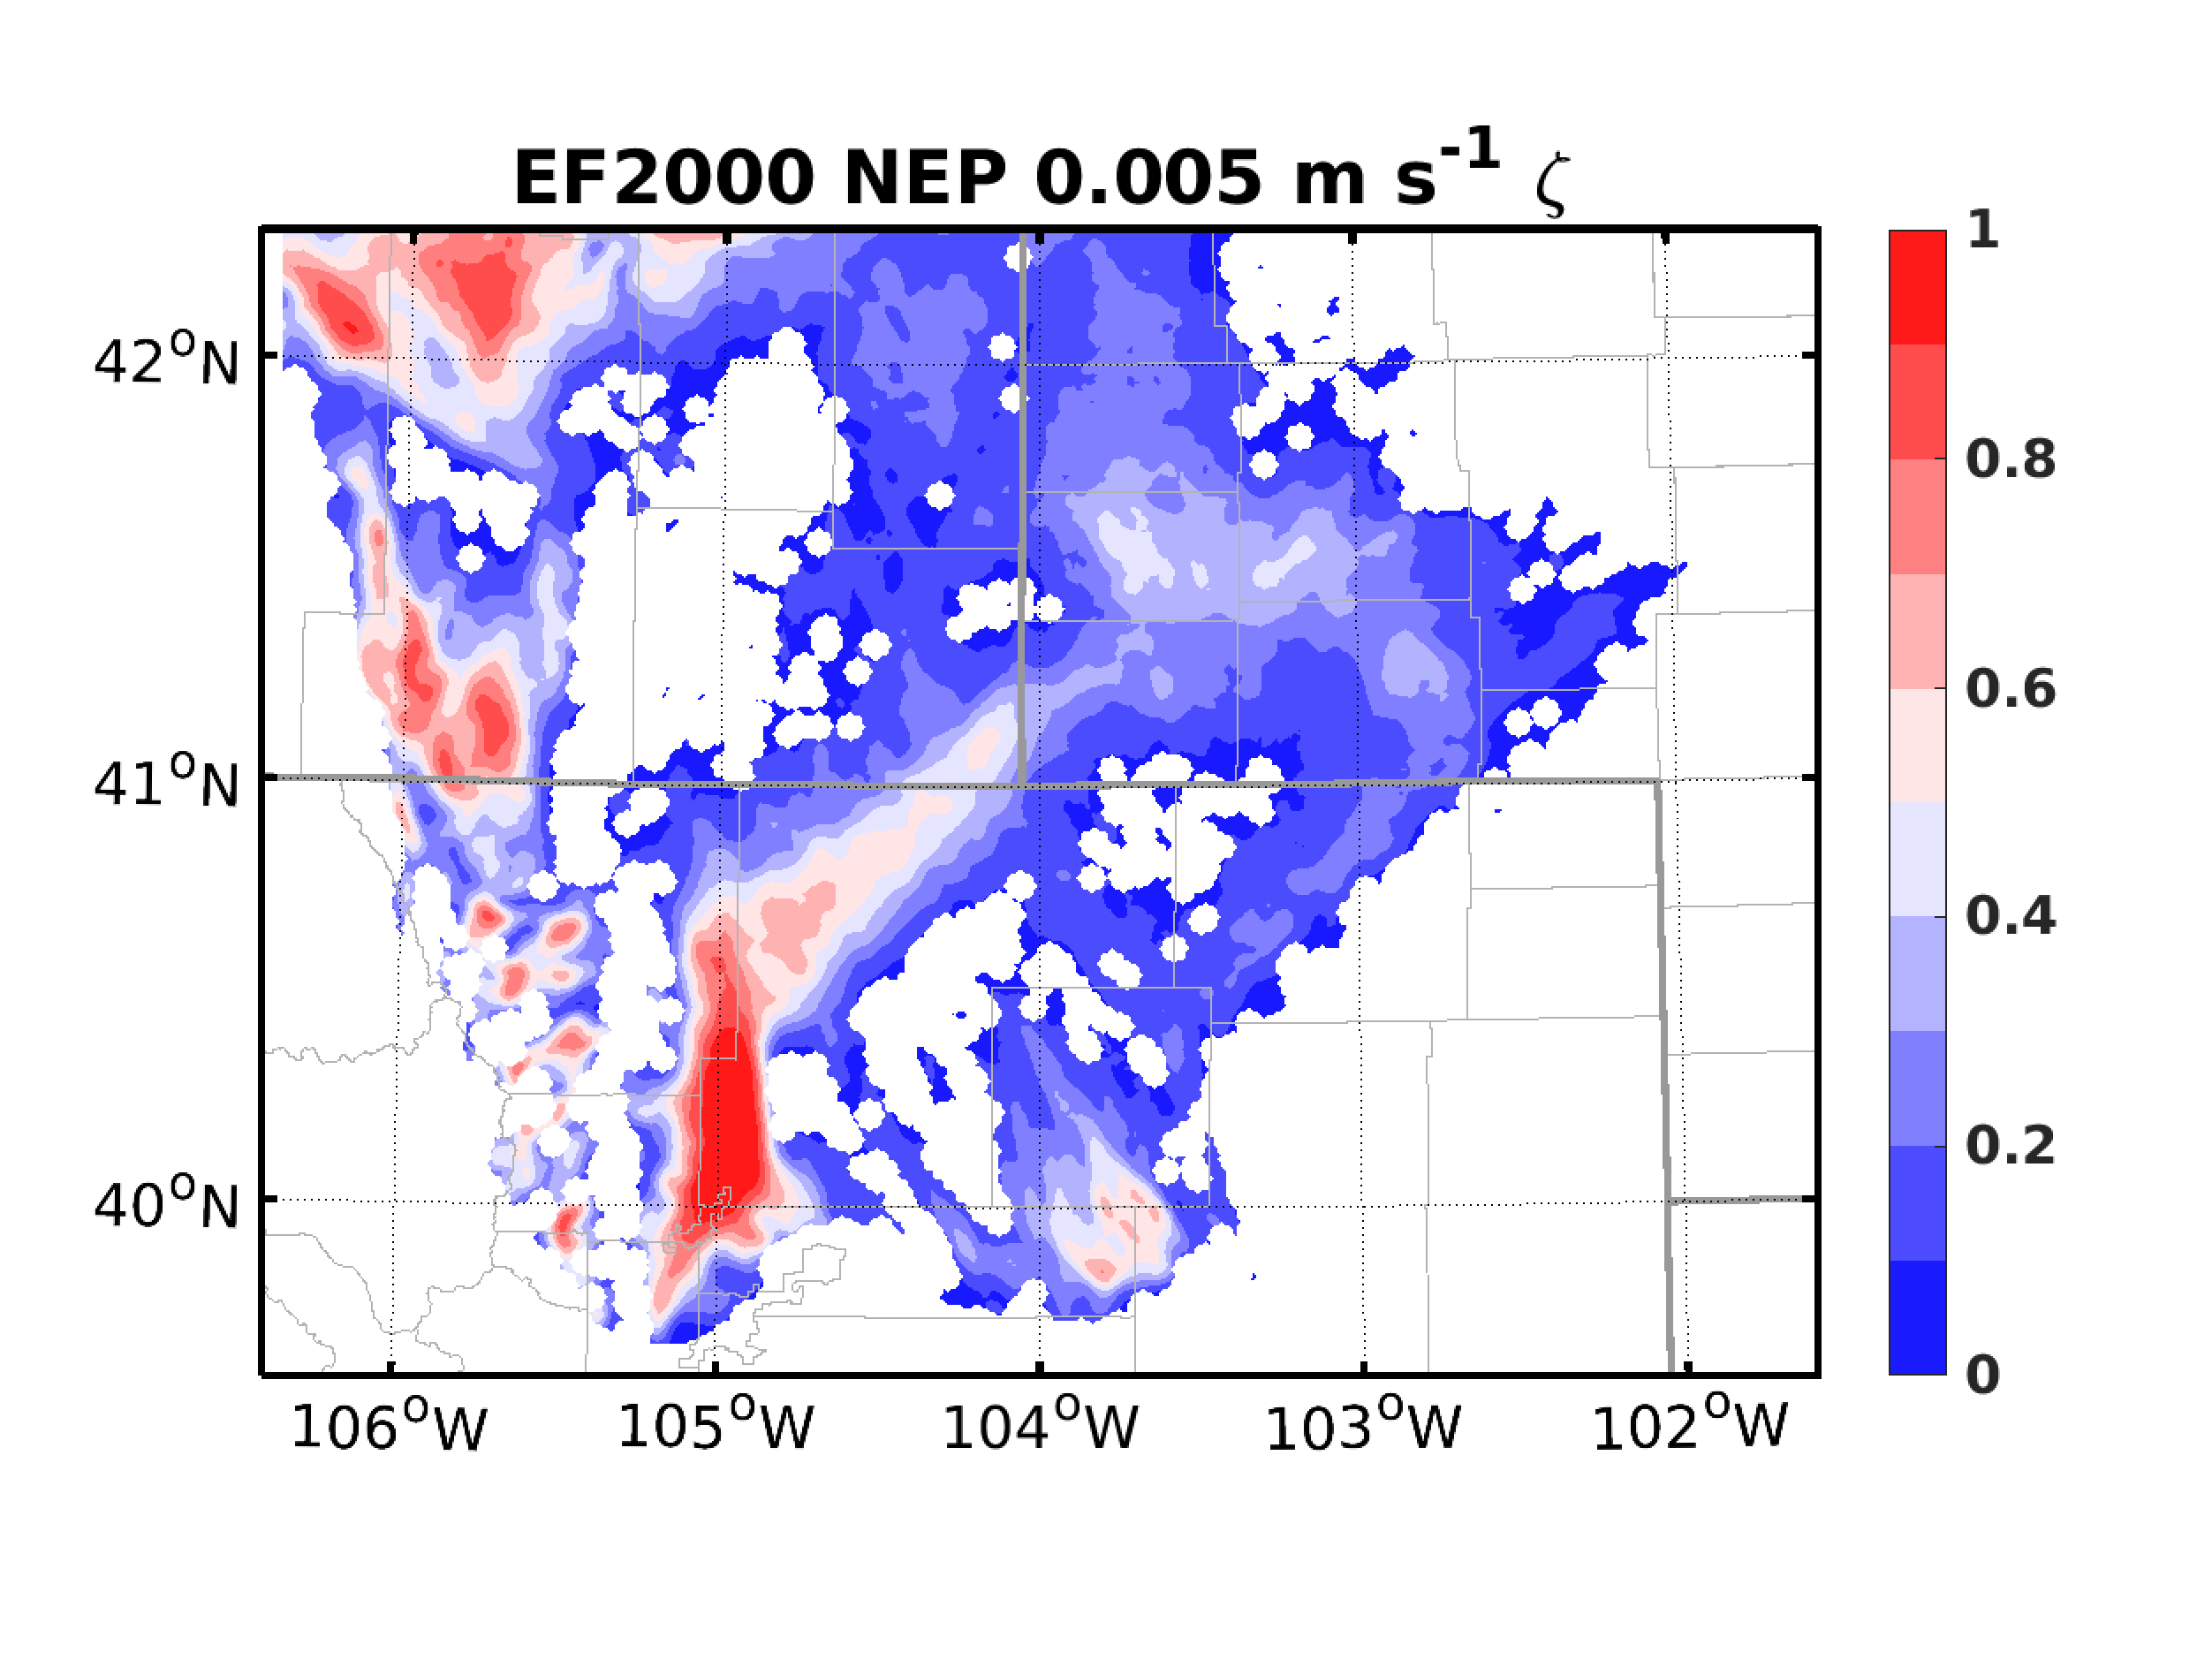
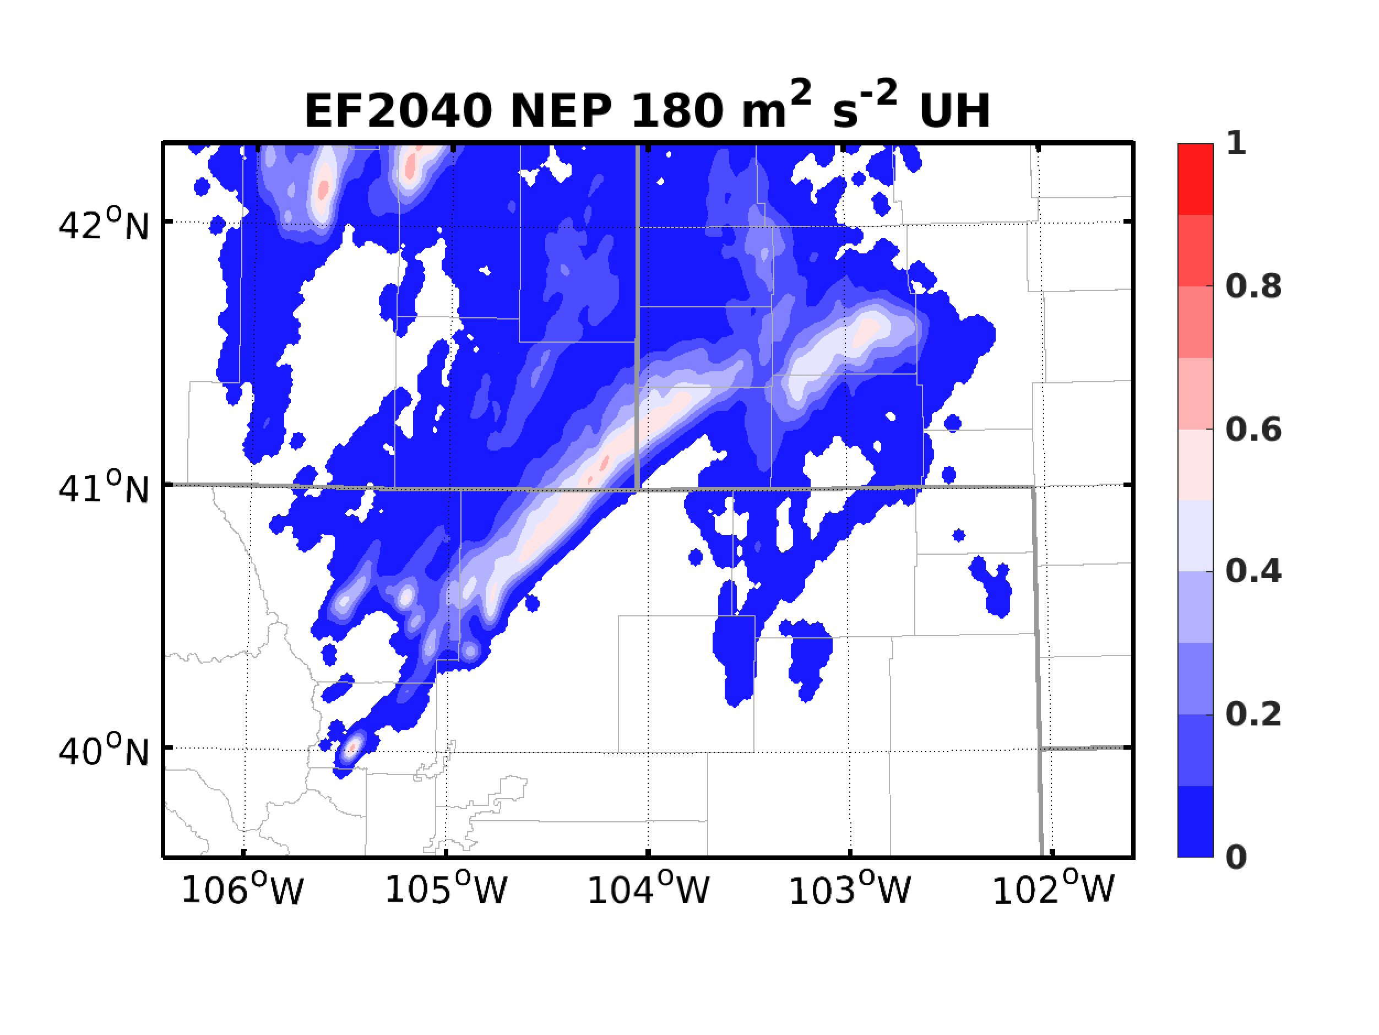
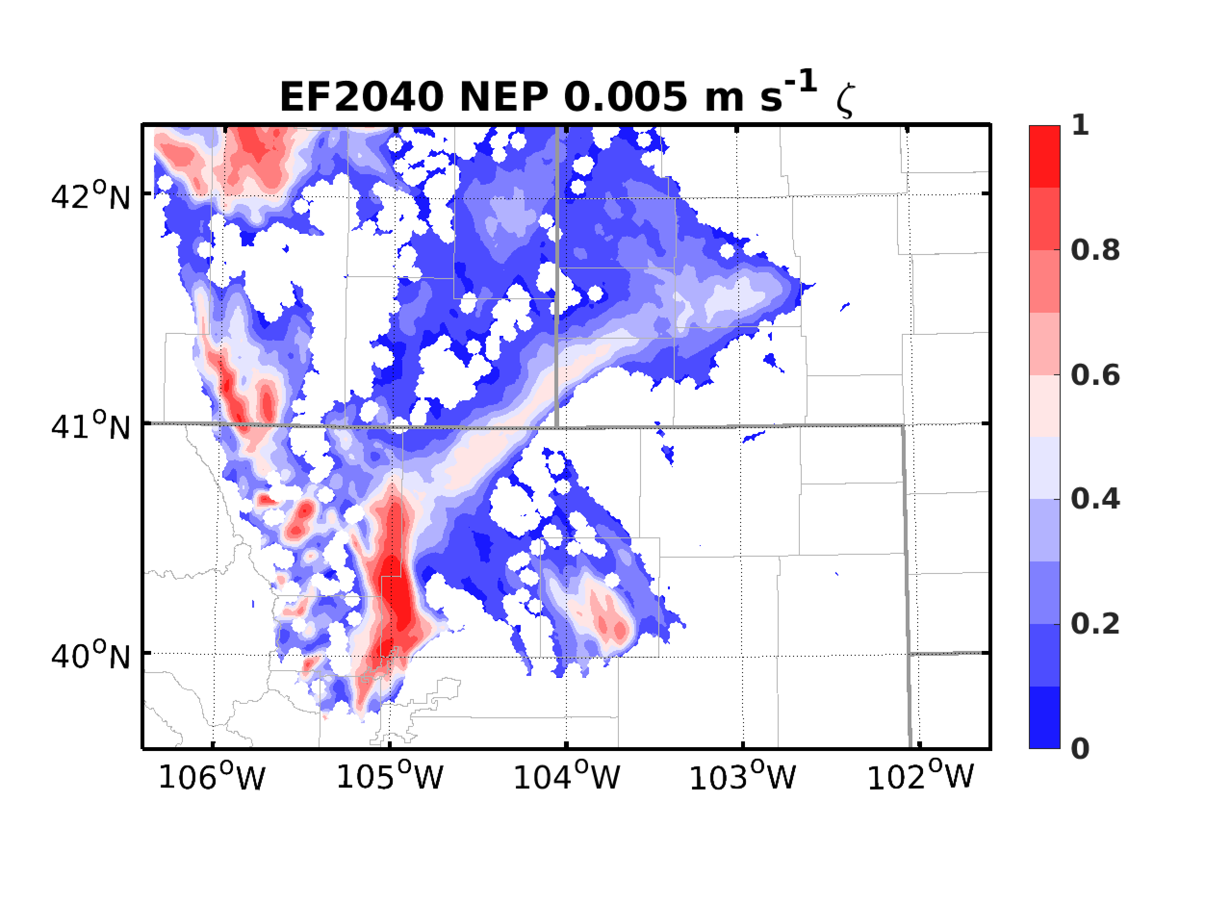
Application of ABEI: Forecasts
ENKF EF2000
ENKF EF2040
ABEI EF2000
ABEI EF2040
(Neighborhood ensemble probability with 3-km neighborhood, not grid-based probability)

Slide 6
Radar Data Assimilation
Test on influence of AOEI on reflectivity assimilation
With and without AOEI when assimilating reflectivity > 15 dBZ
Super-obbing to 2 km
Treatment of non-precipitating reflectivity
Reflectivity lower than 5 dBZ will be regarded as non-precipitating
Assimilating non-precipitating reflectivity as 0-dBZ observations is insufficient
Will be assimilated as 0 g/kg total precipitating mixing ratios (Qr+Qs+Qg)
Observational error equal to ensemble spread
Super-obbing to 4 km
HROI: 20 km & 40 km; VROI: 20 levels
Starting from 1930 UTC (when radar observations became available)

Slide 7
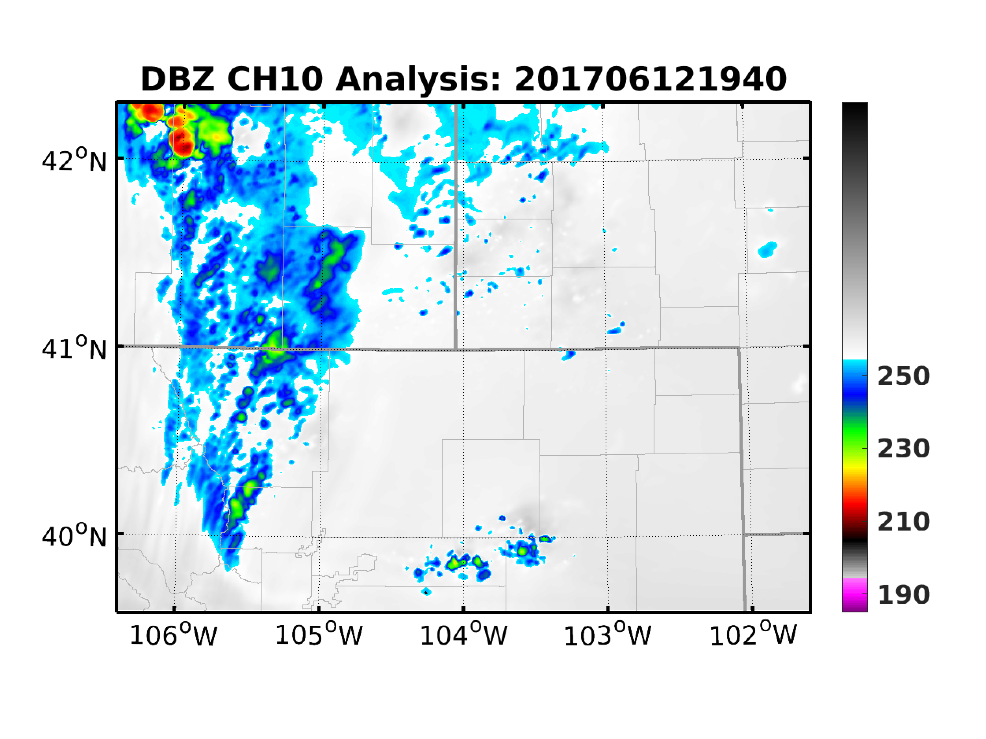
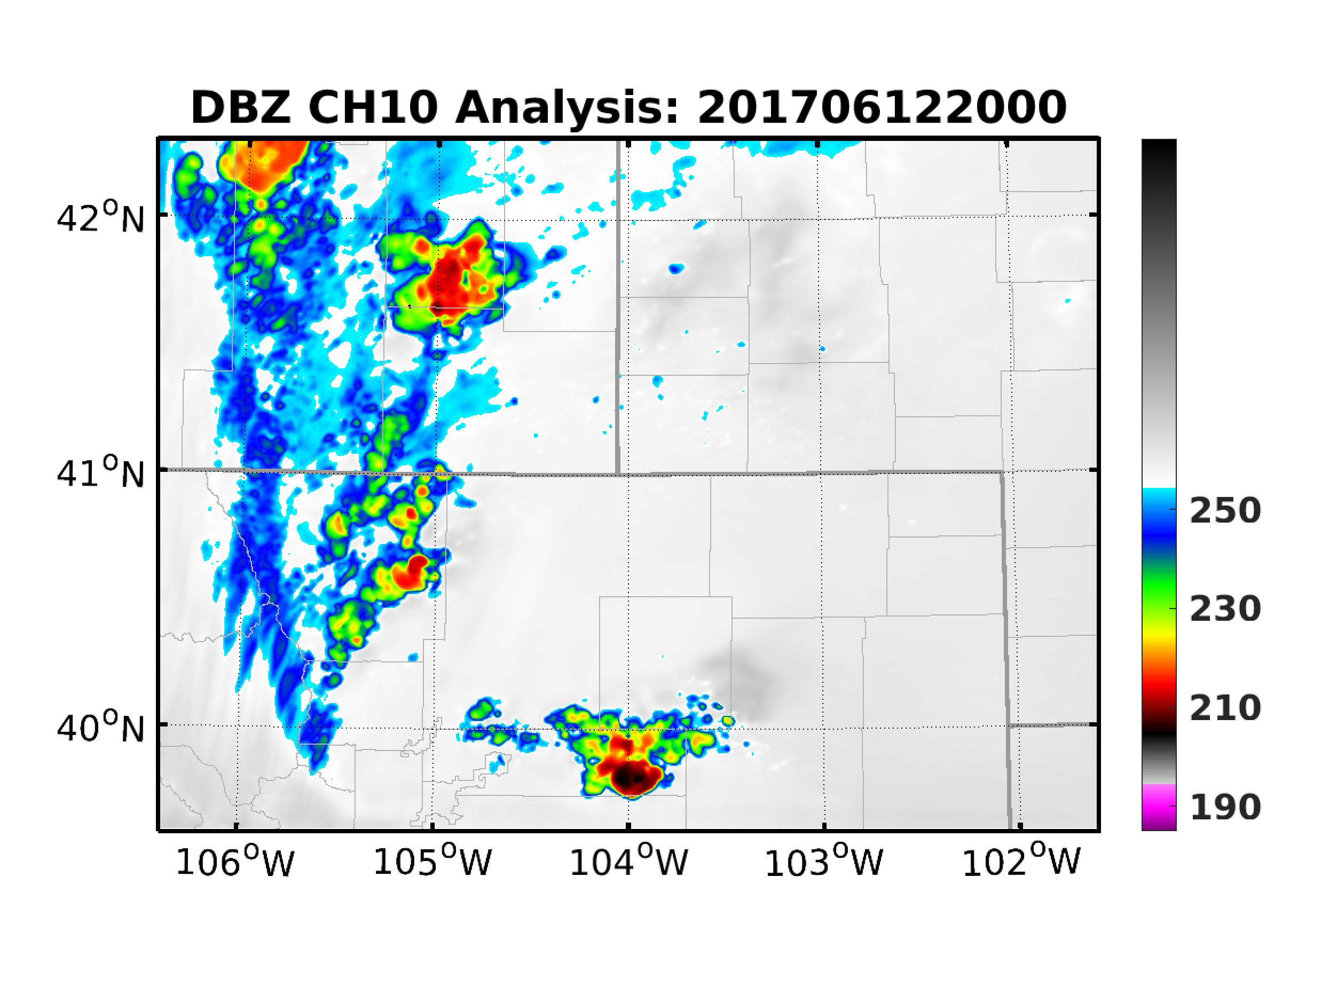
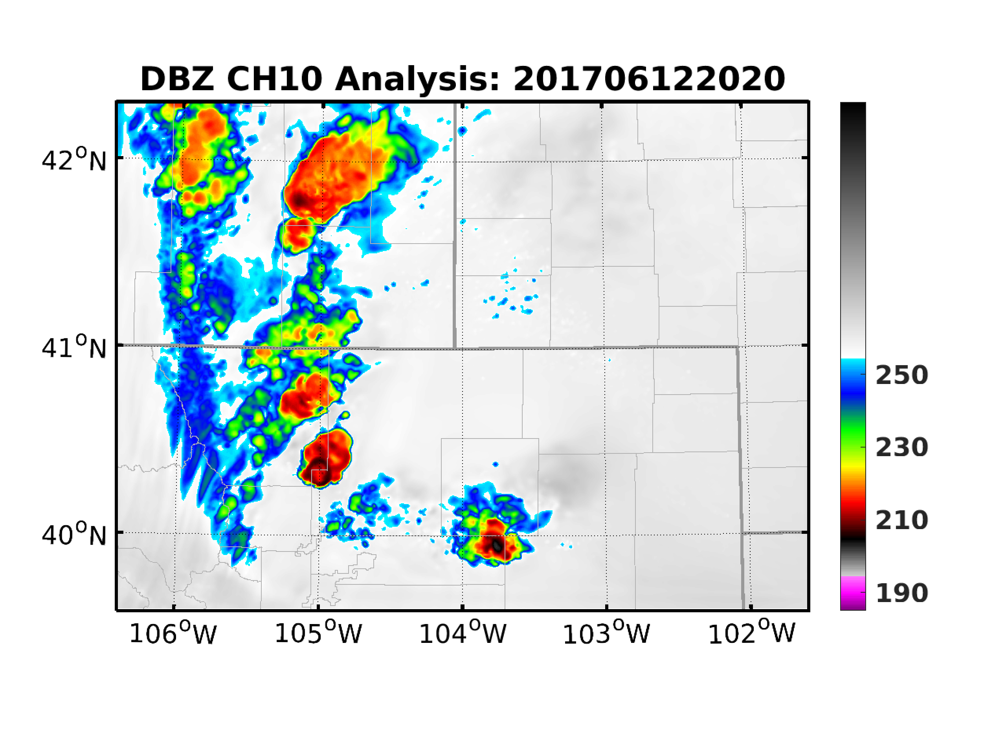
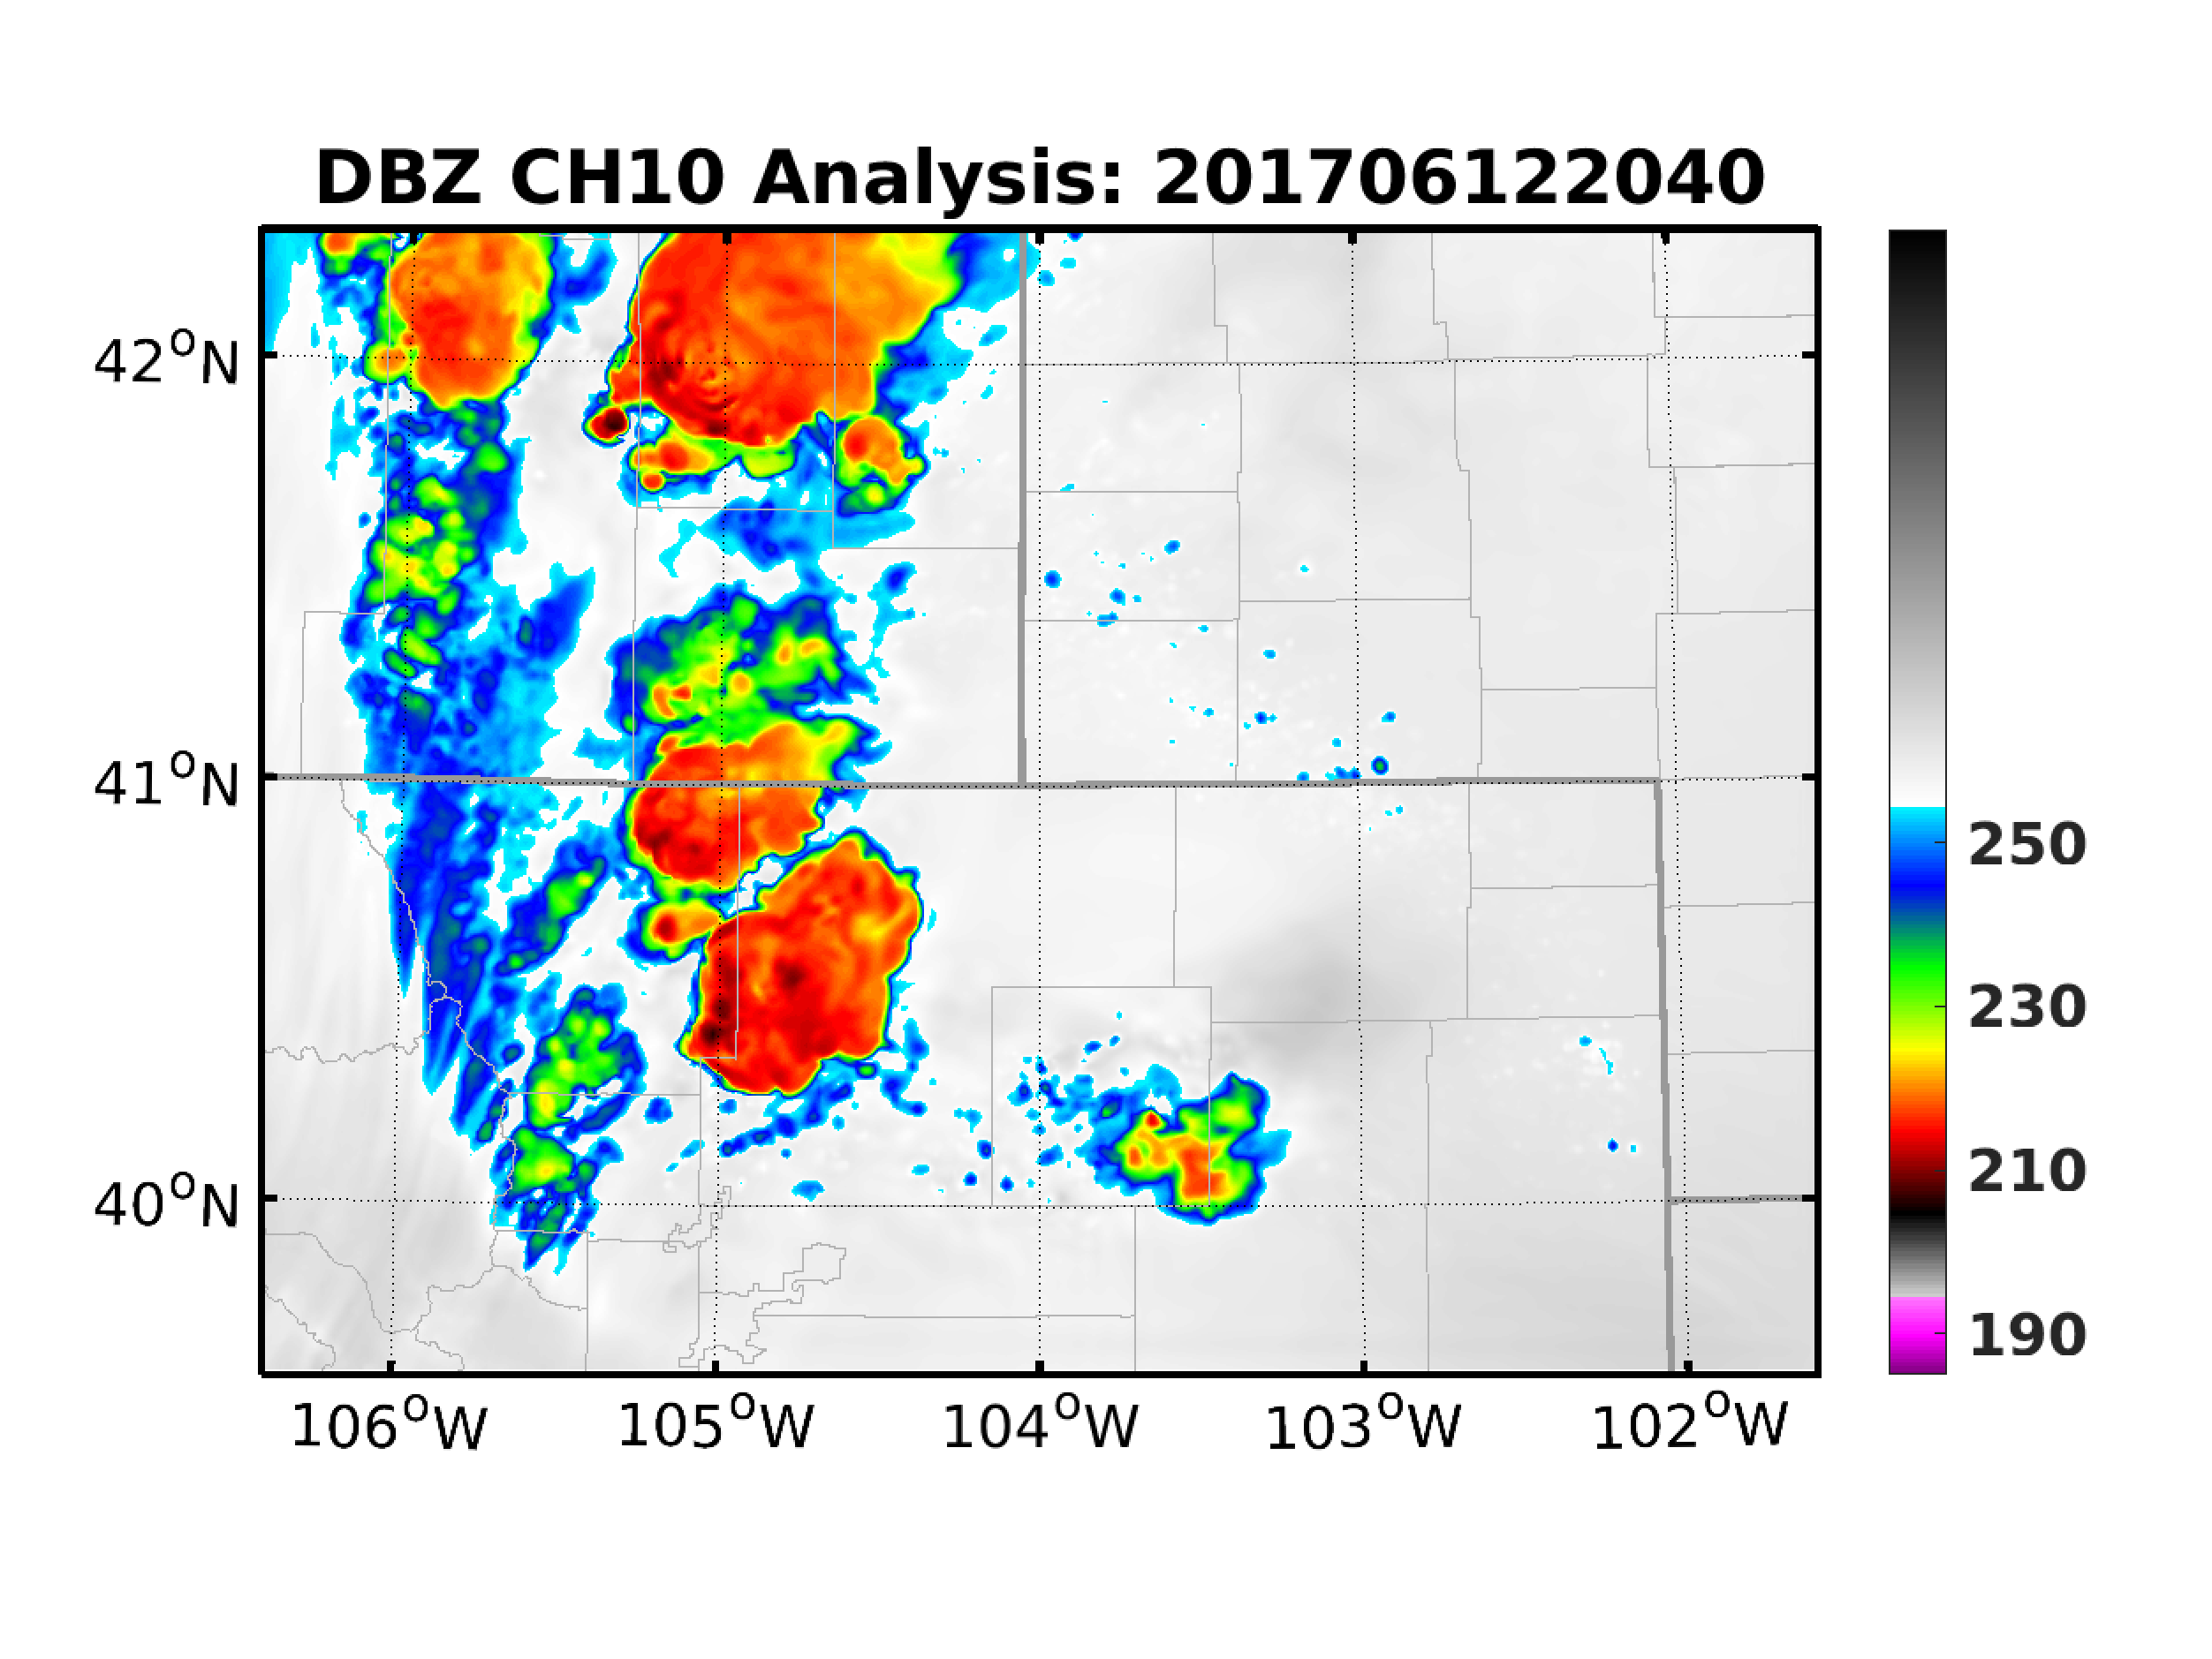
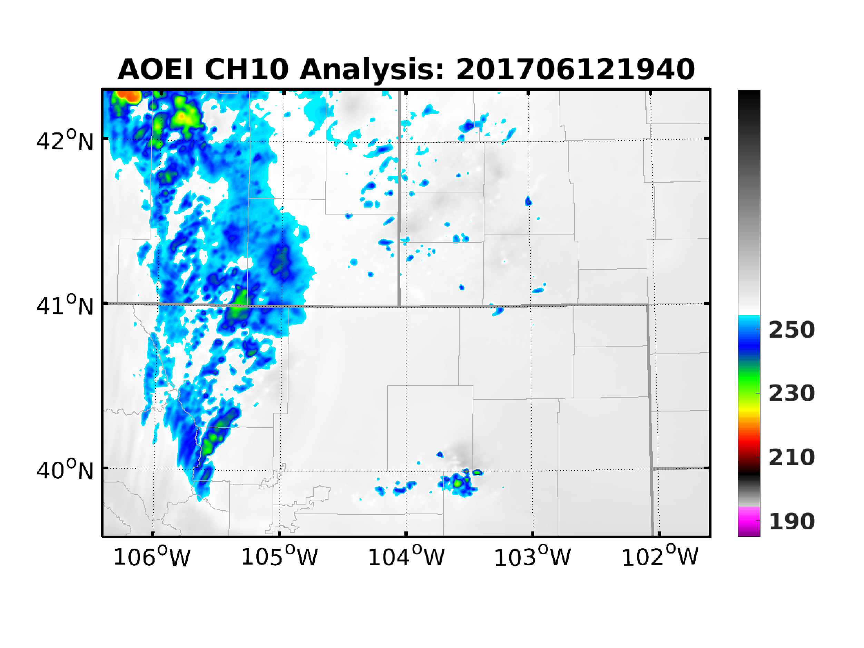
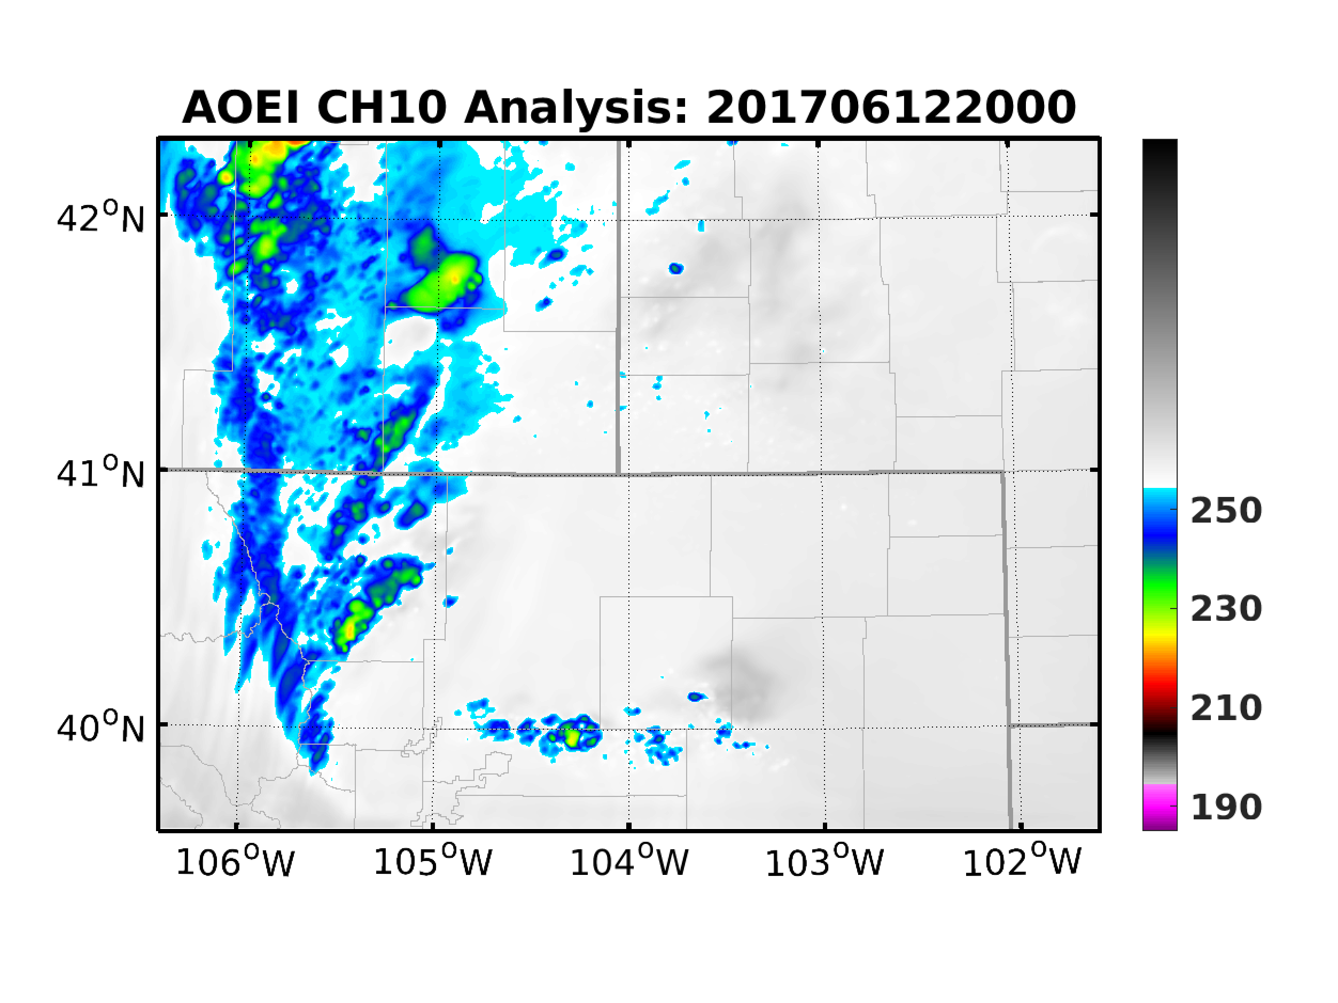
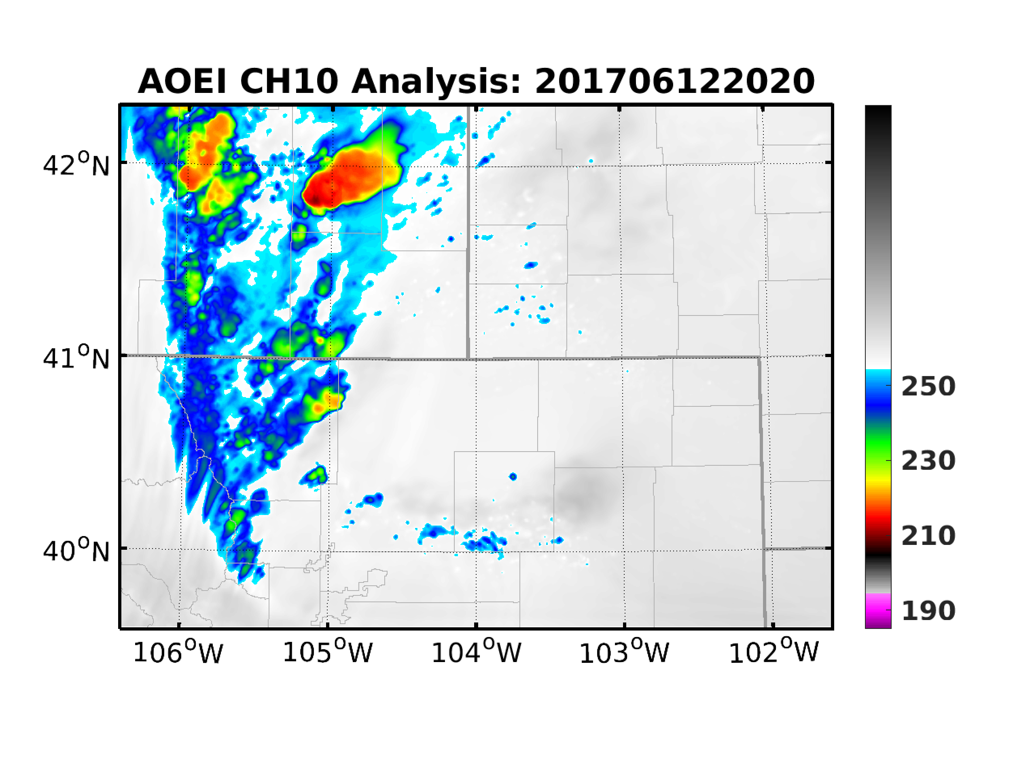
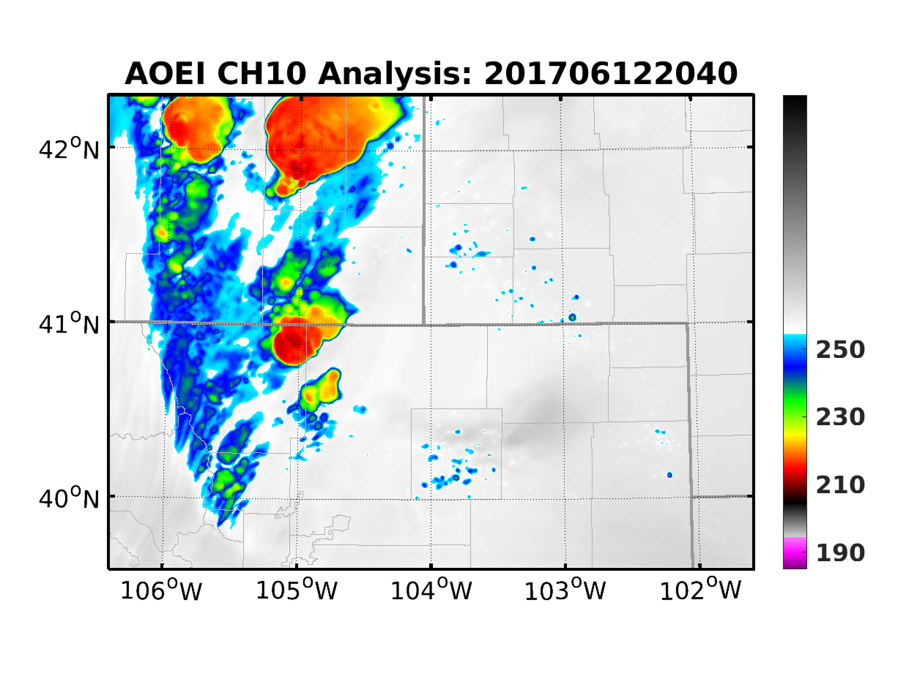
Radar Data Assimilation: Analysis
ABI
DBZ
AOEI

Slide 8
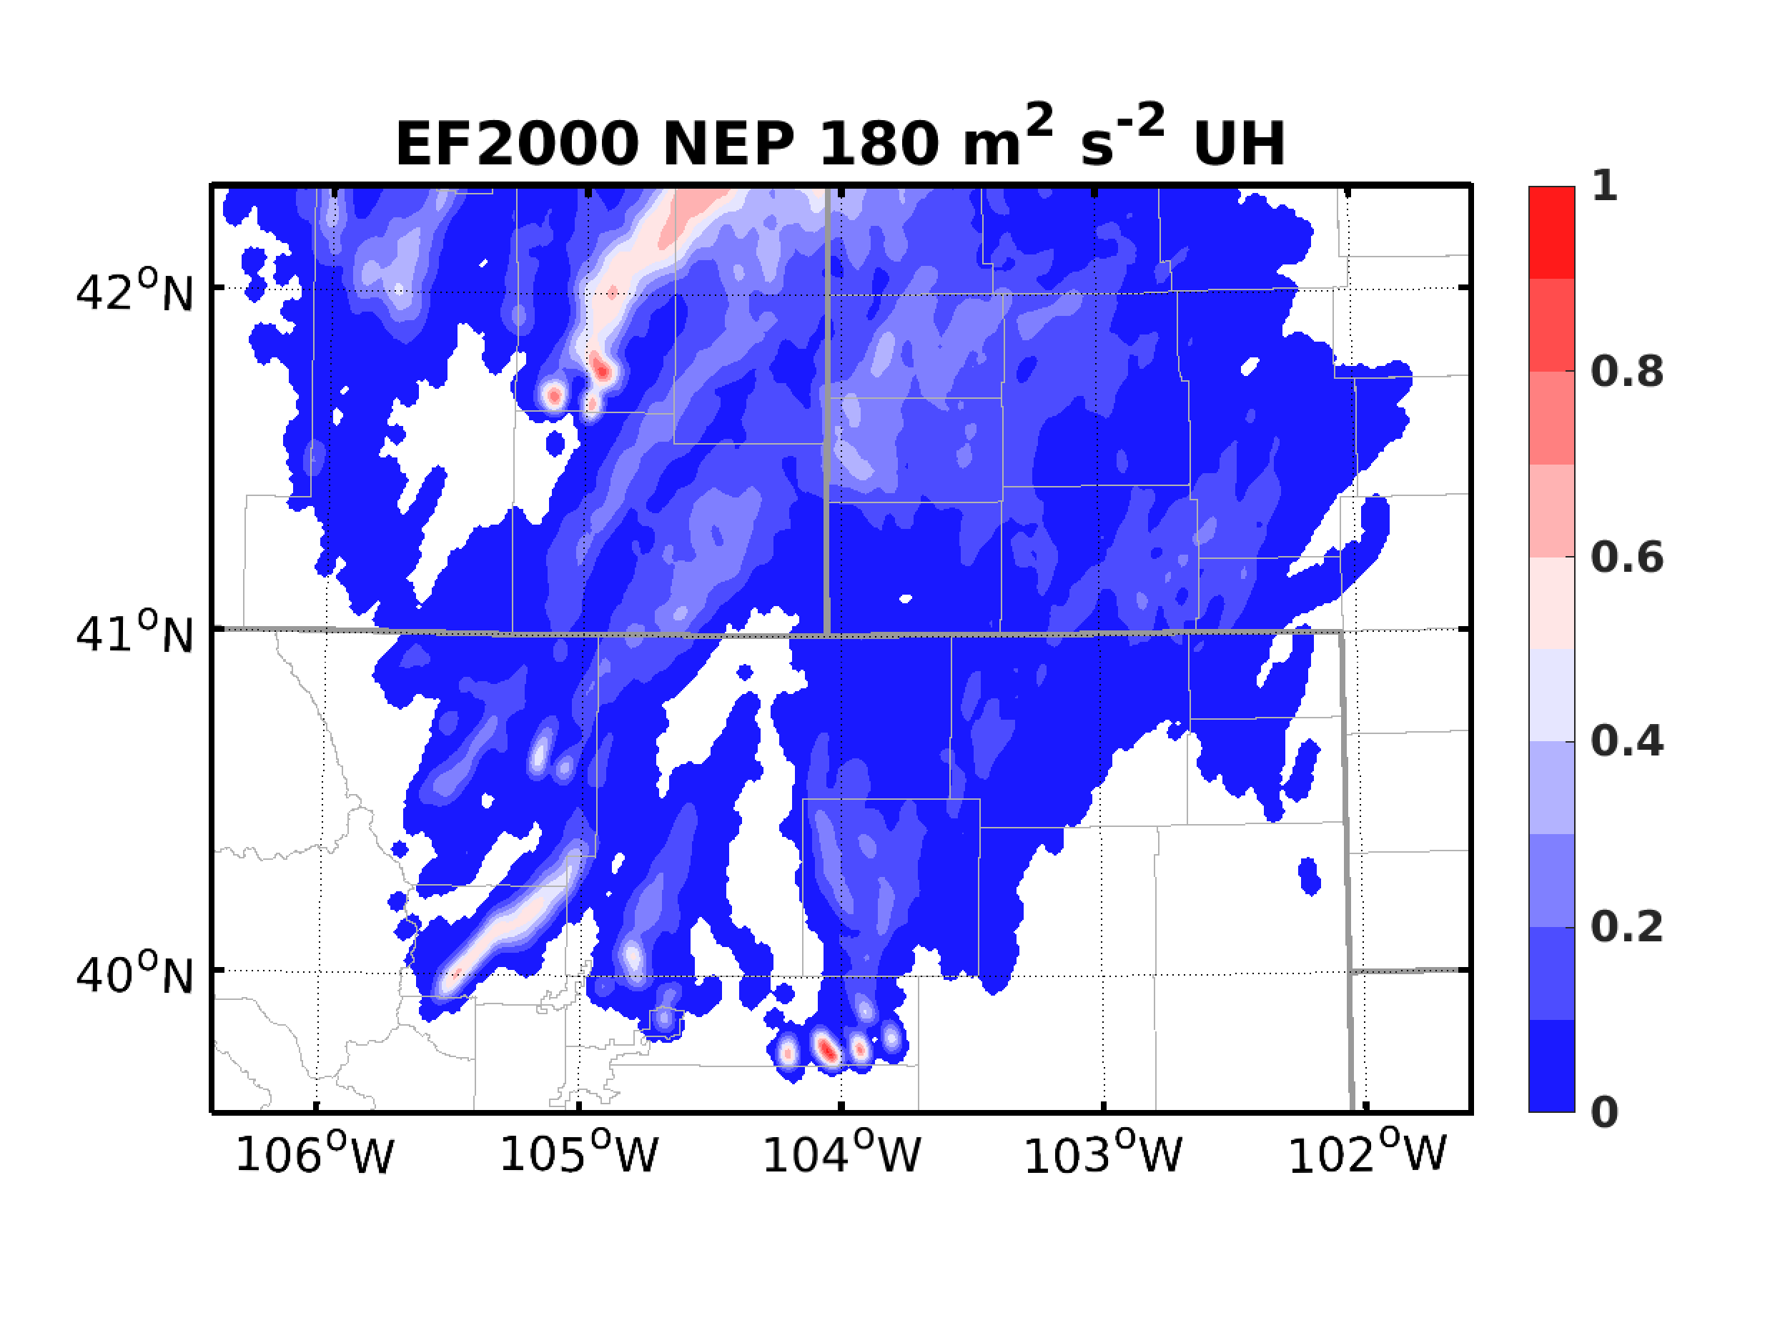
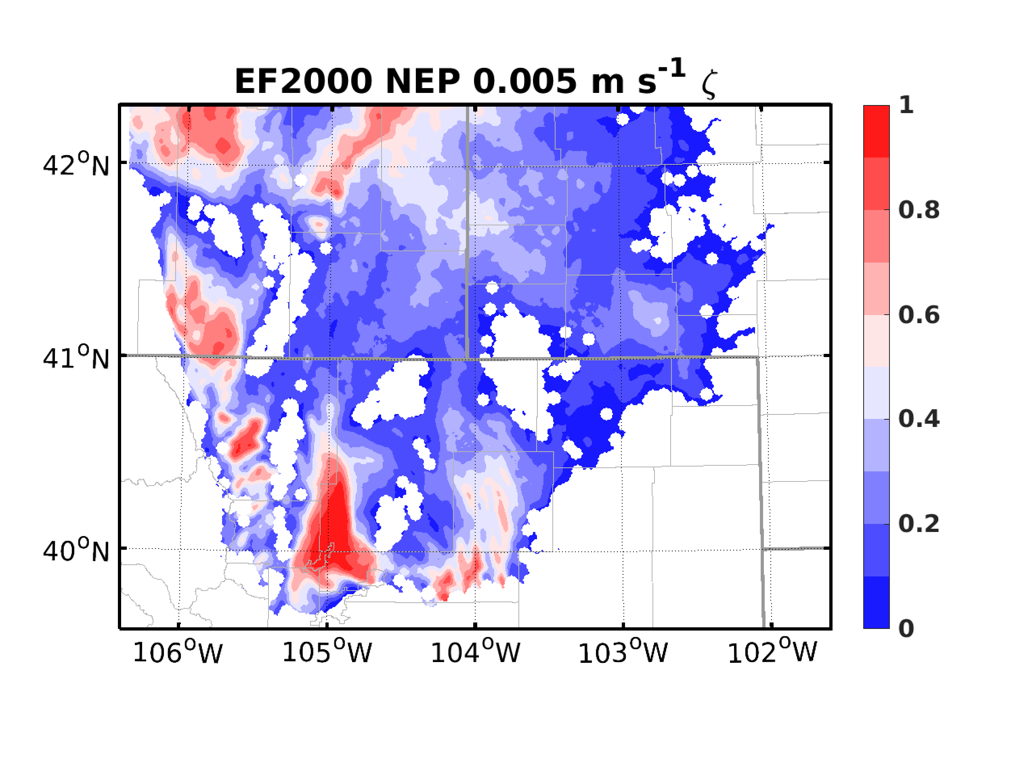
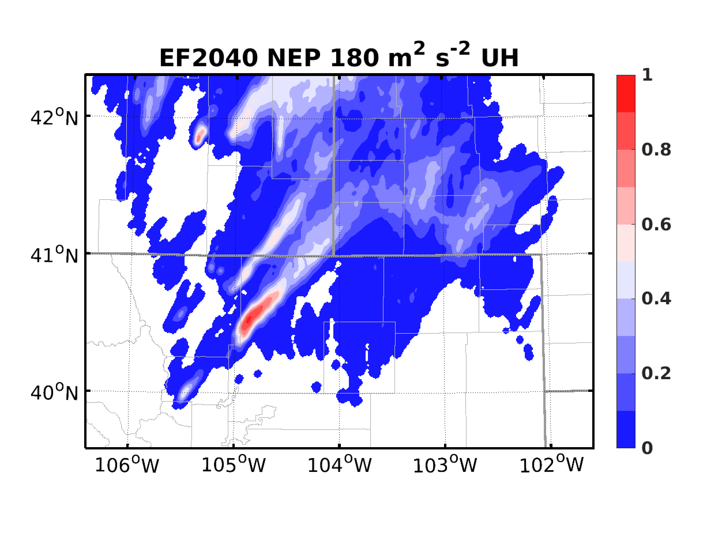
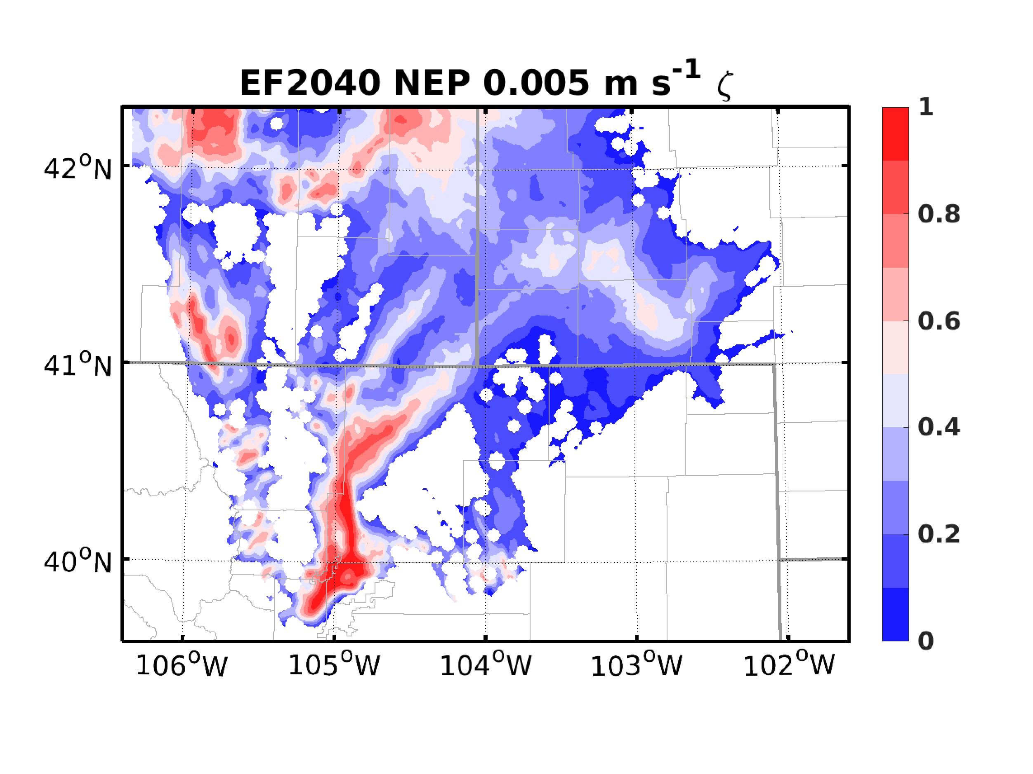
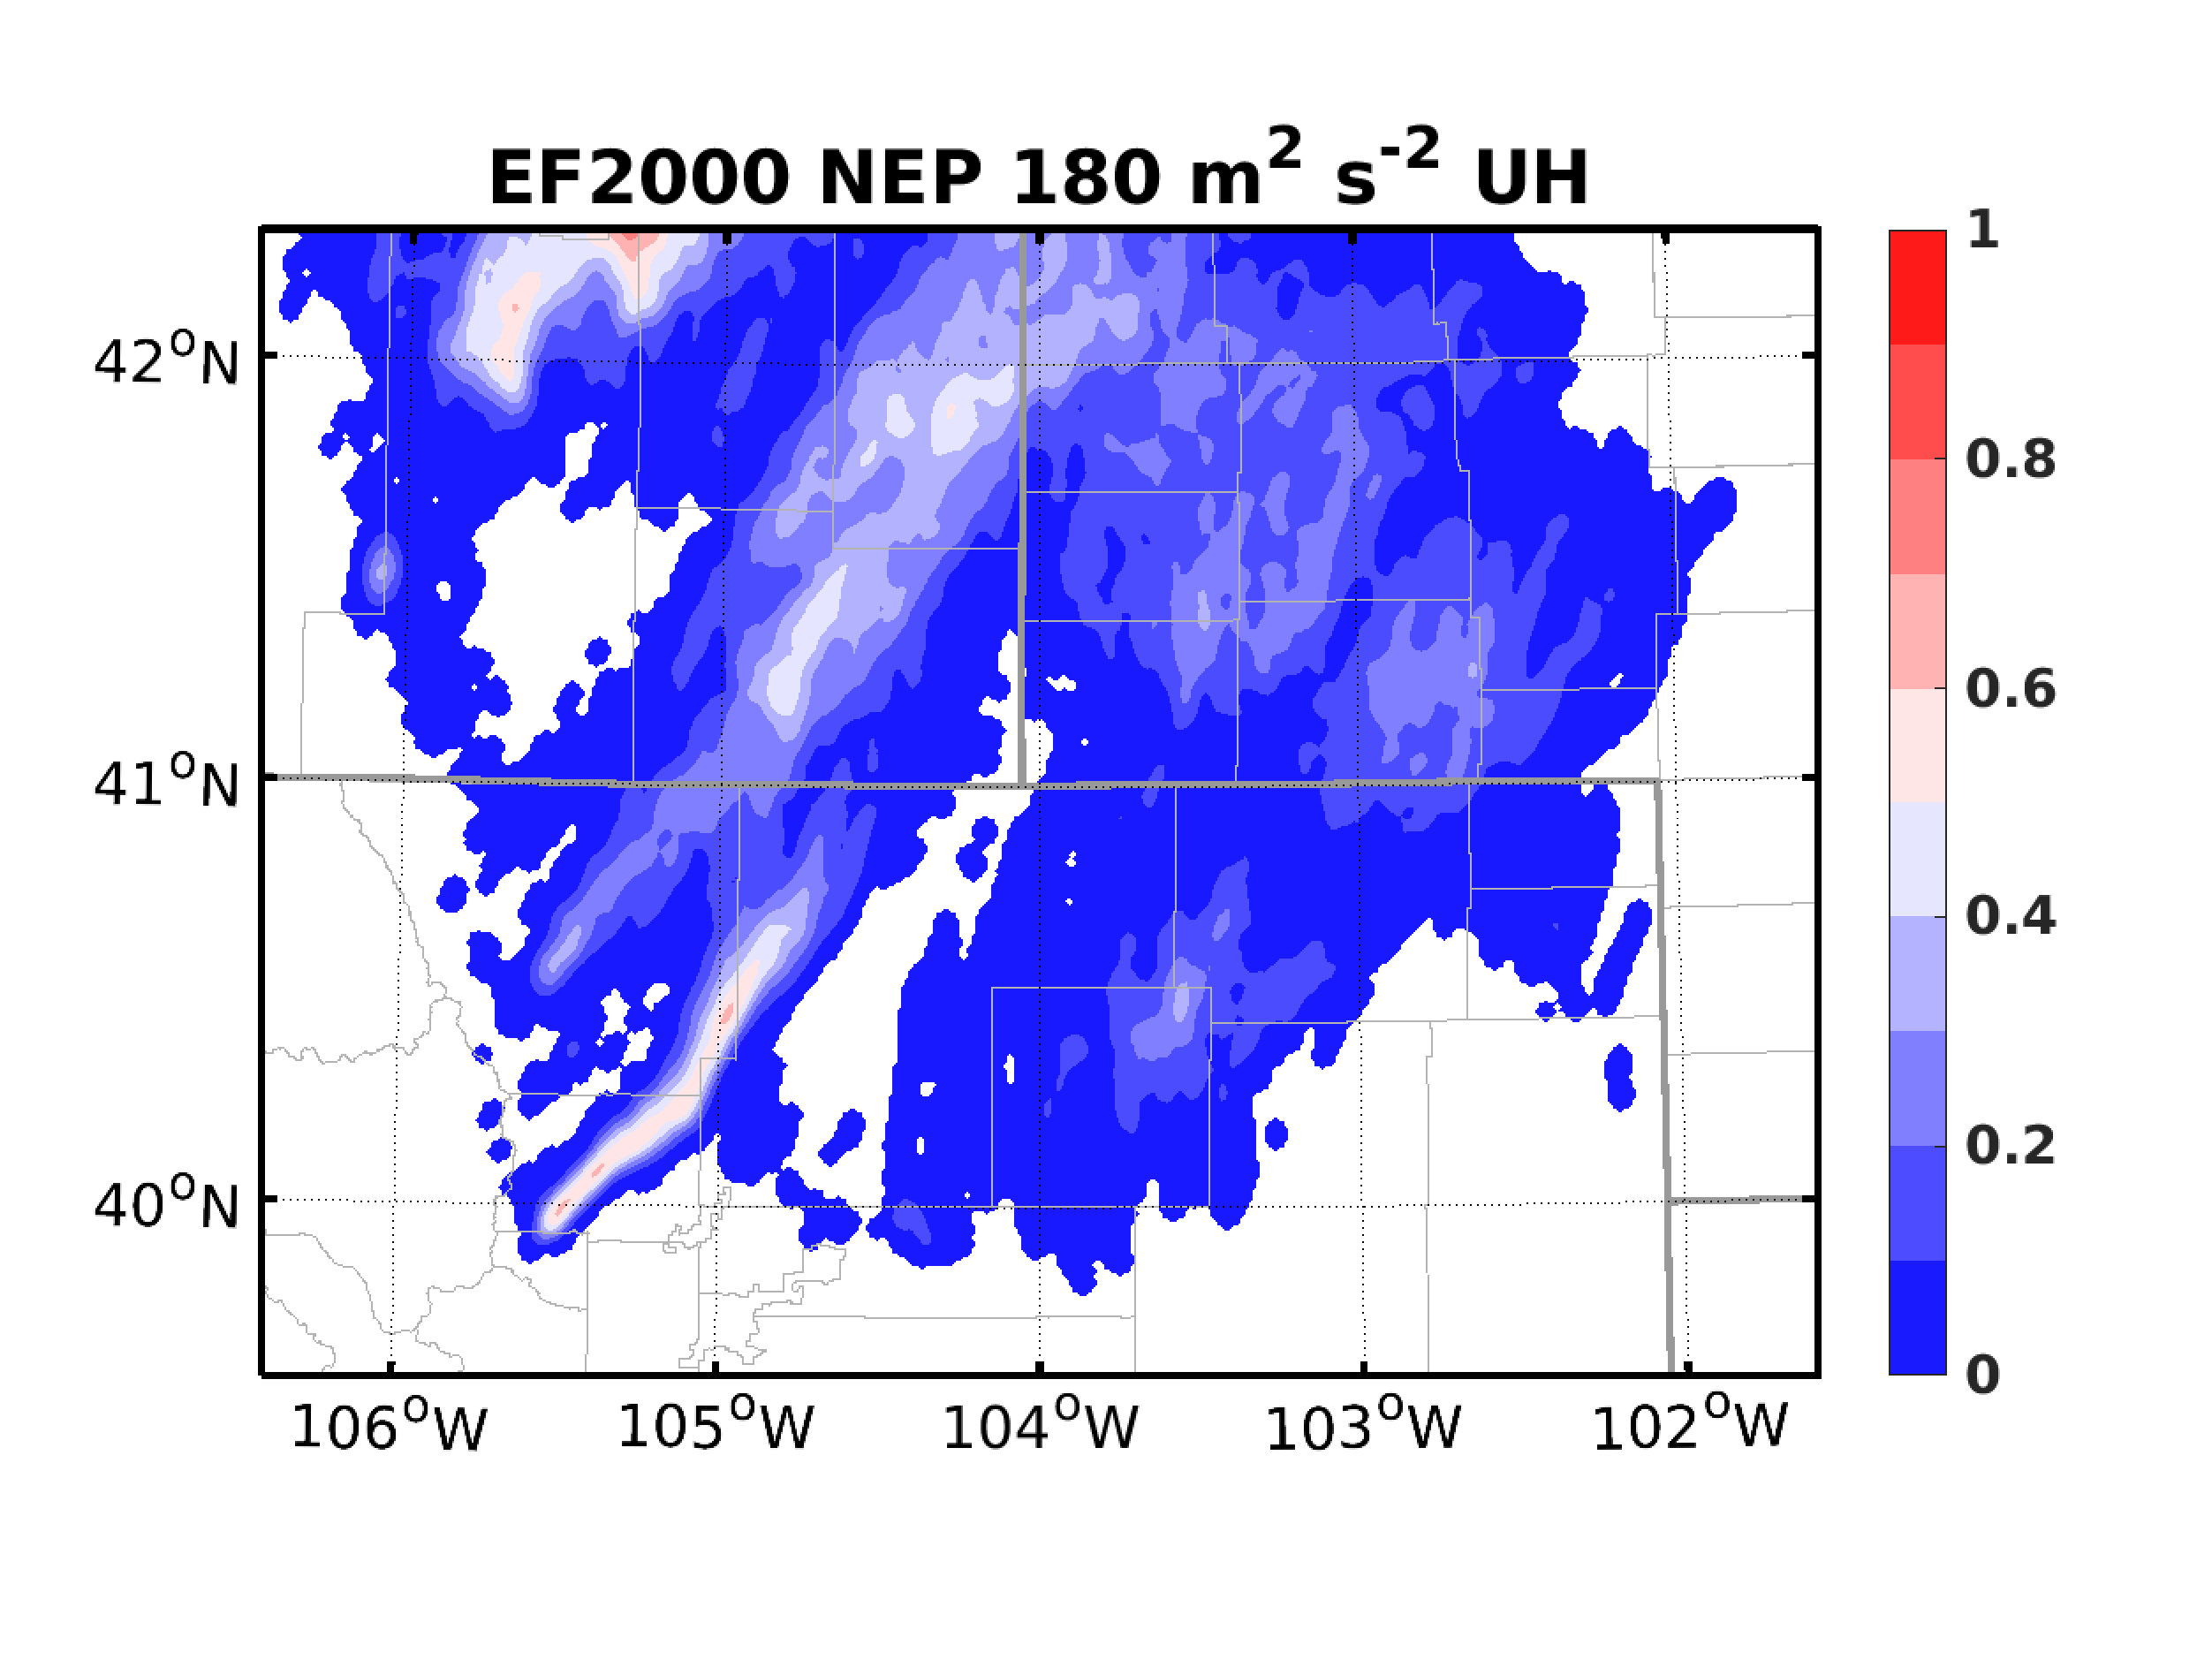
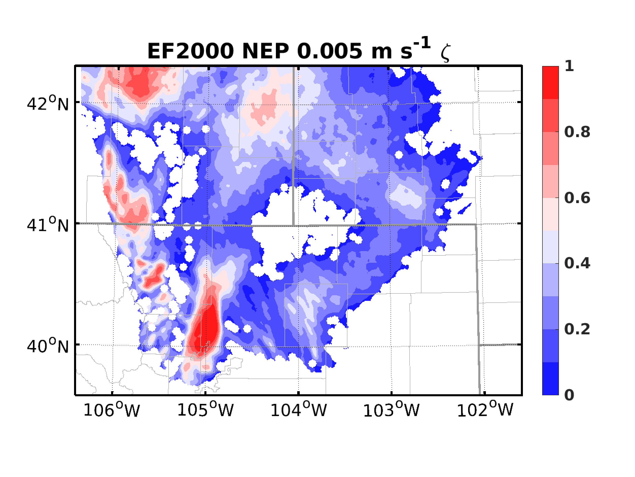
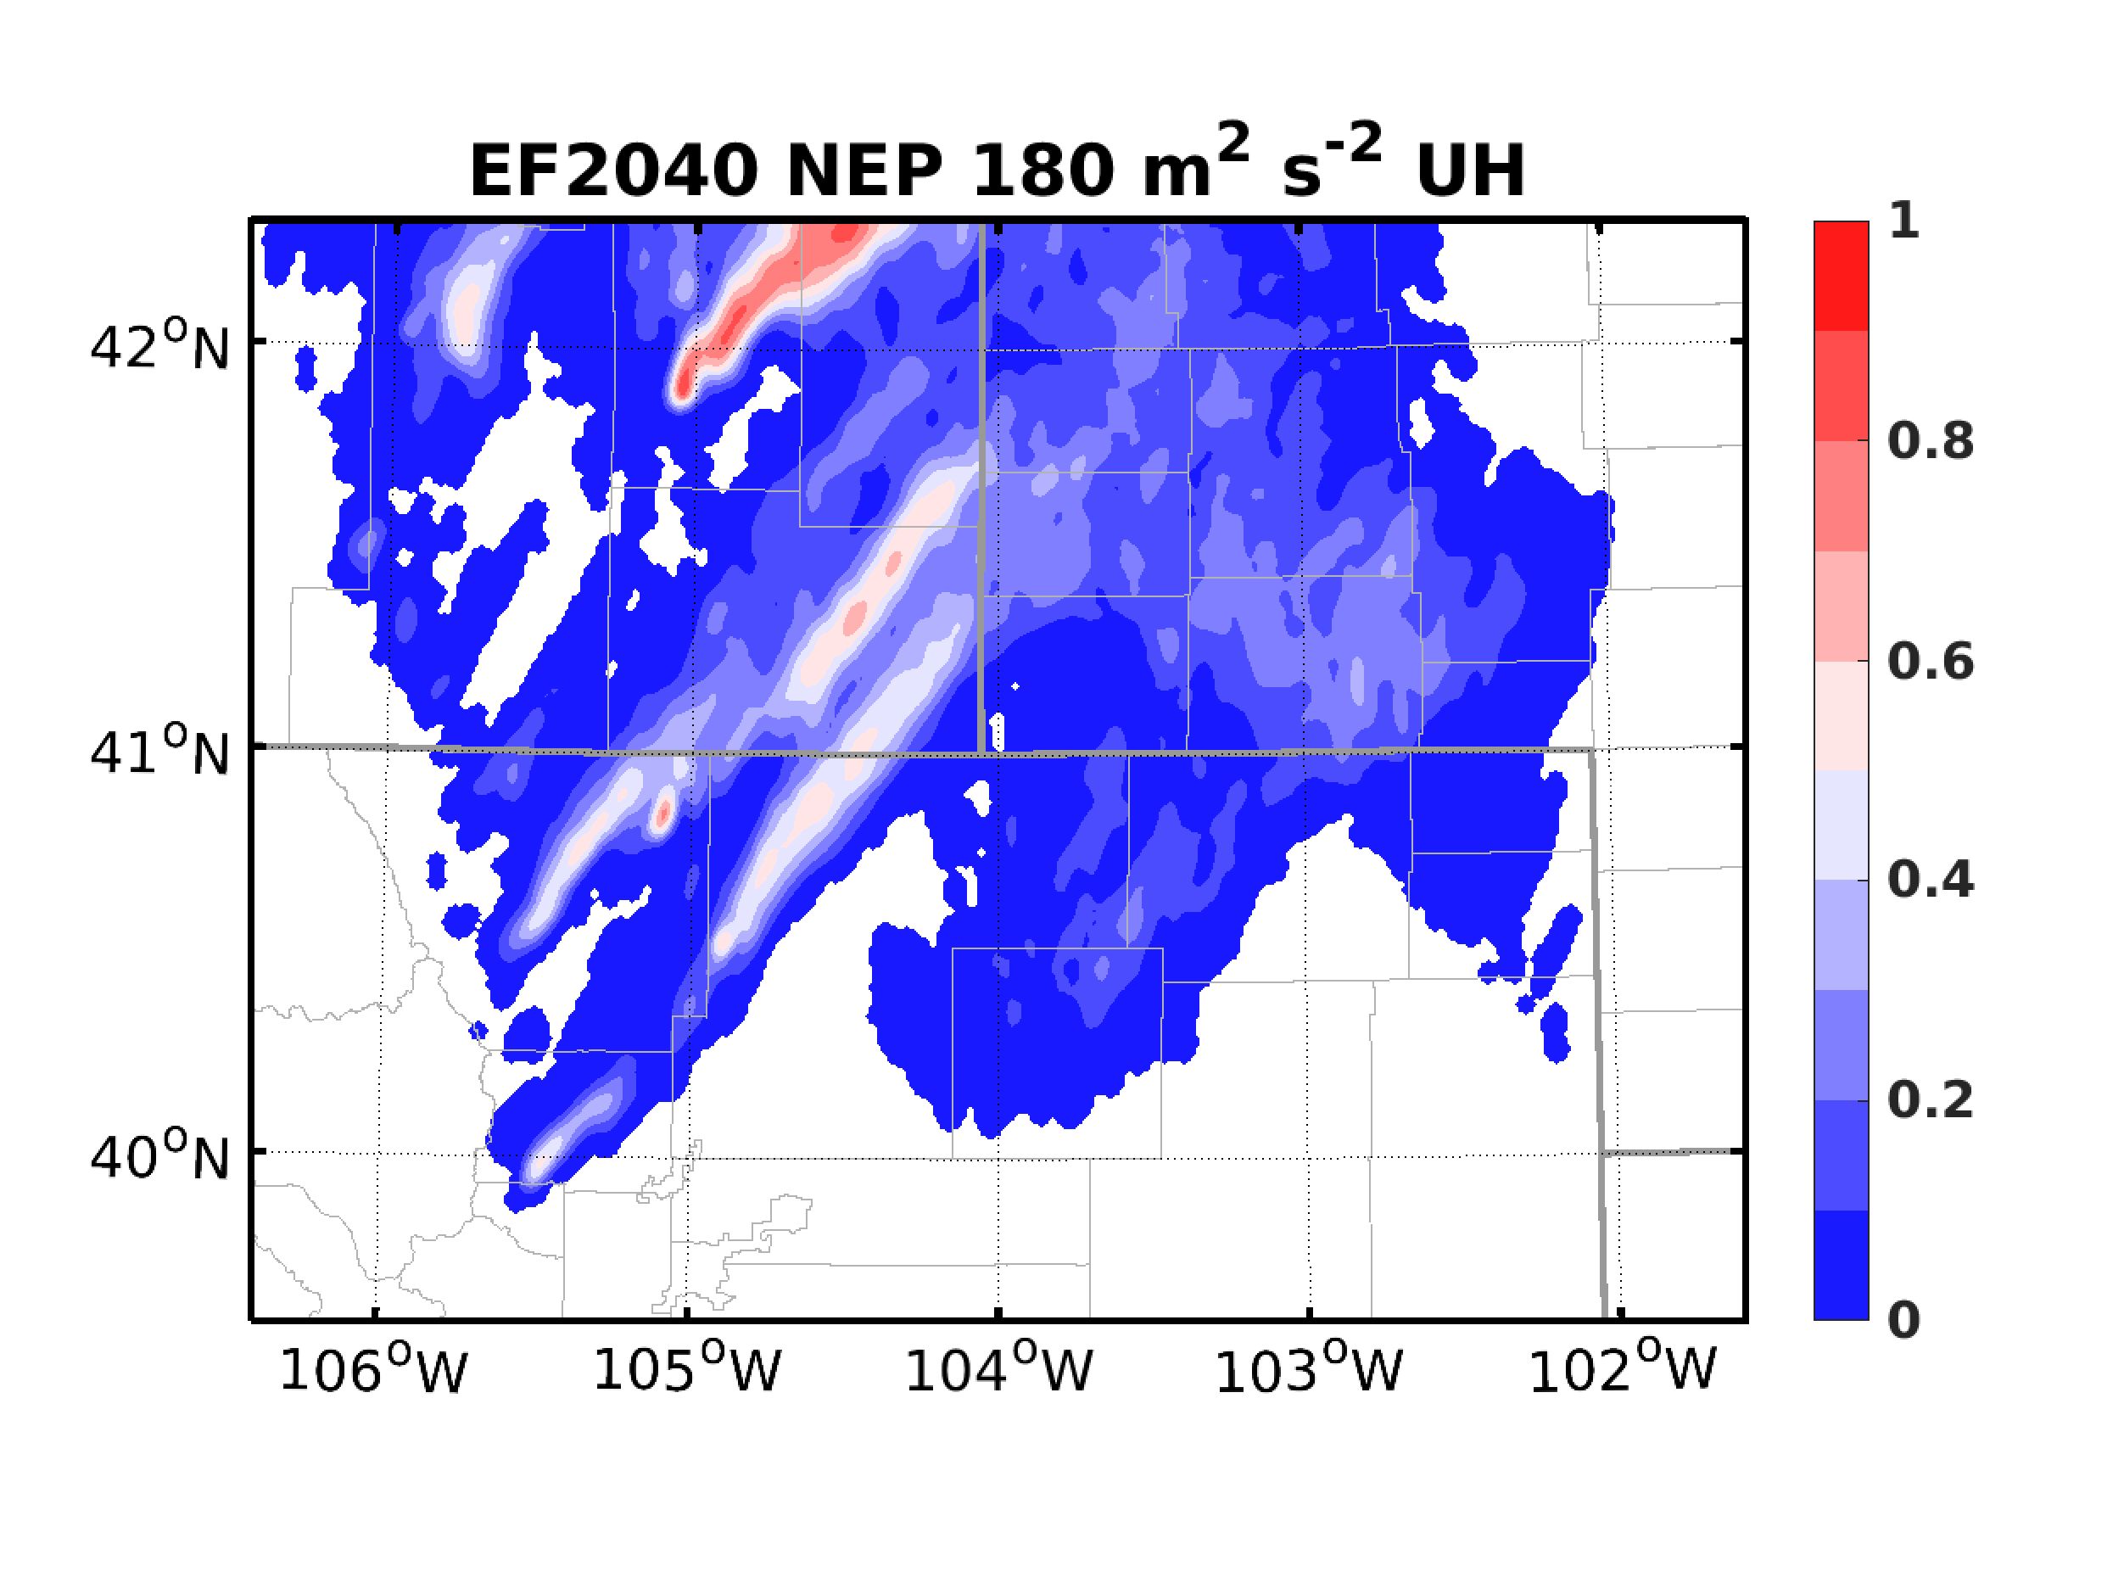
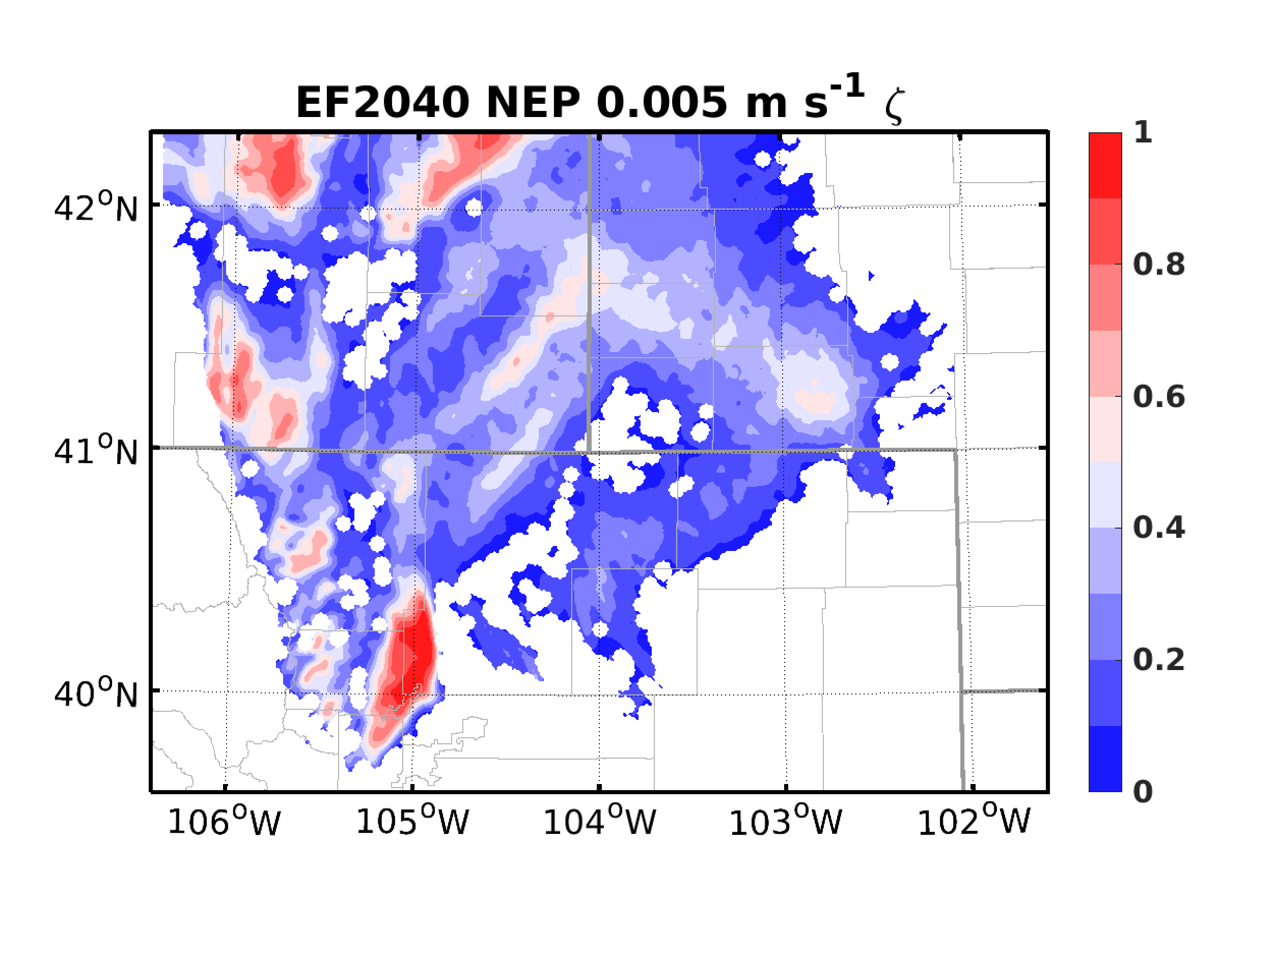
Radar Data Assimilation: Forecasts
DBZ EF2000
DBZ EF2040
AOEI EF2000
AOEI EF2040

Slide 9
Combining Radiance and Radial Velocity
Examine analysis and prediction sensitivity to the assimilation order
RAD-VR: Assimilating radiance first, then radial velocity
VR-RAD: Assimilating radial velocity first, then radiance
Radiance will be assimilated using AOEI + ABEI
Radiance assimilation from 1900 UTC, radial velocity from 1930 UTC

Slide 10
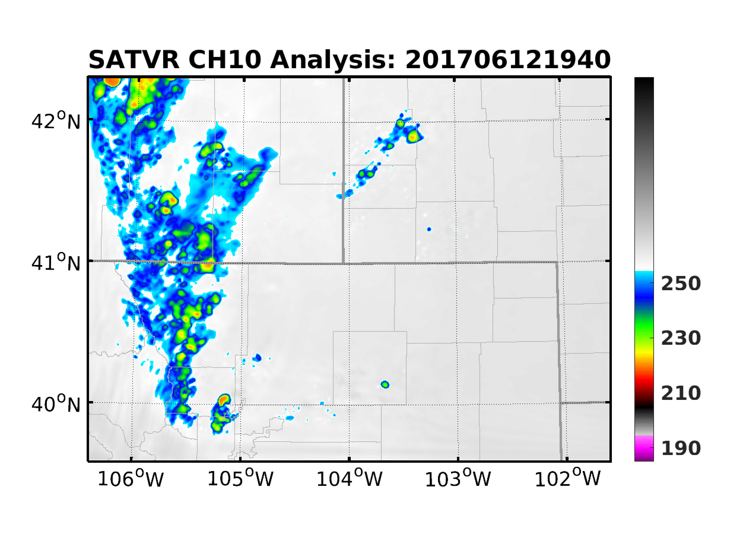
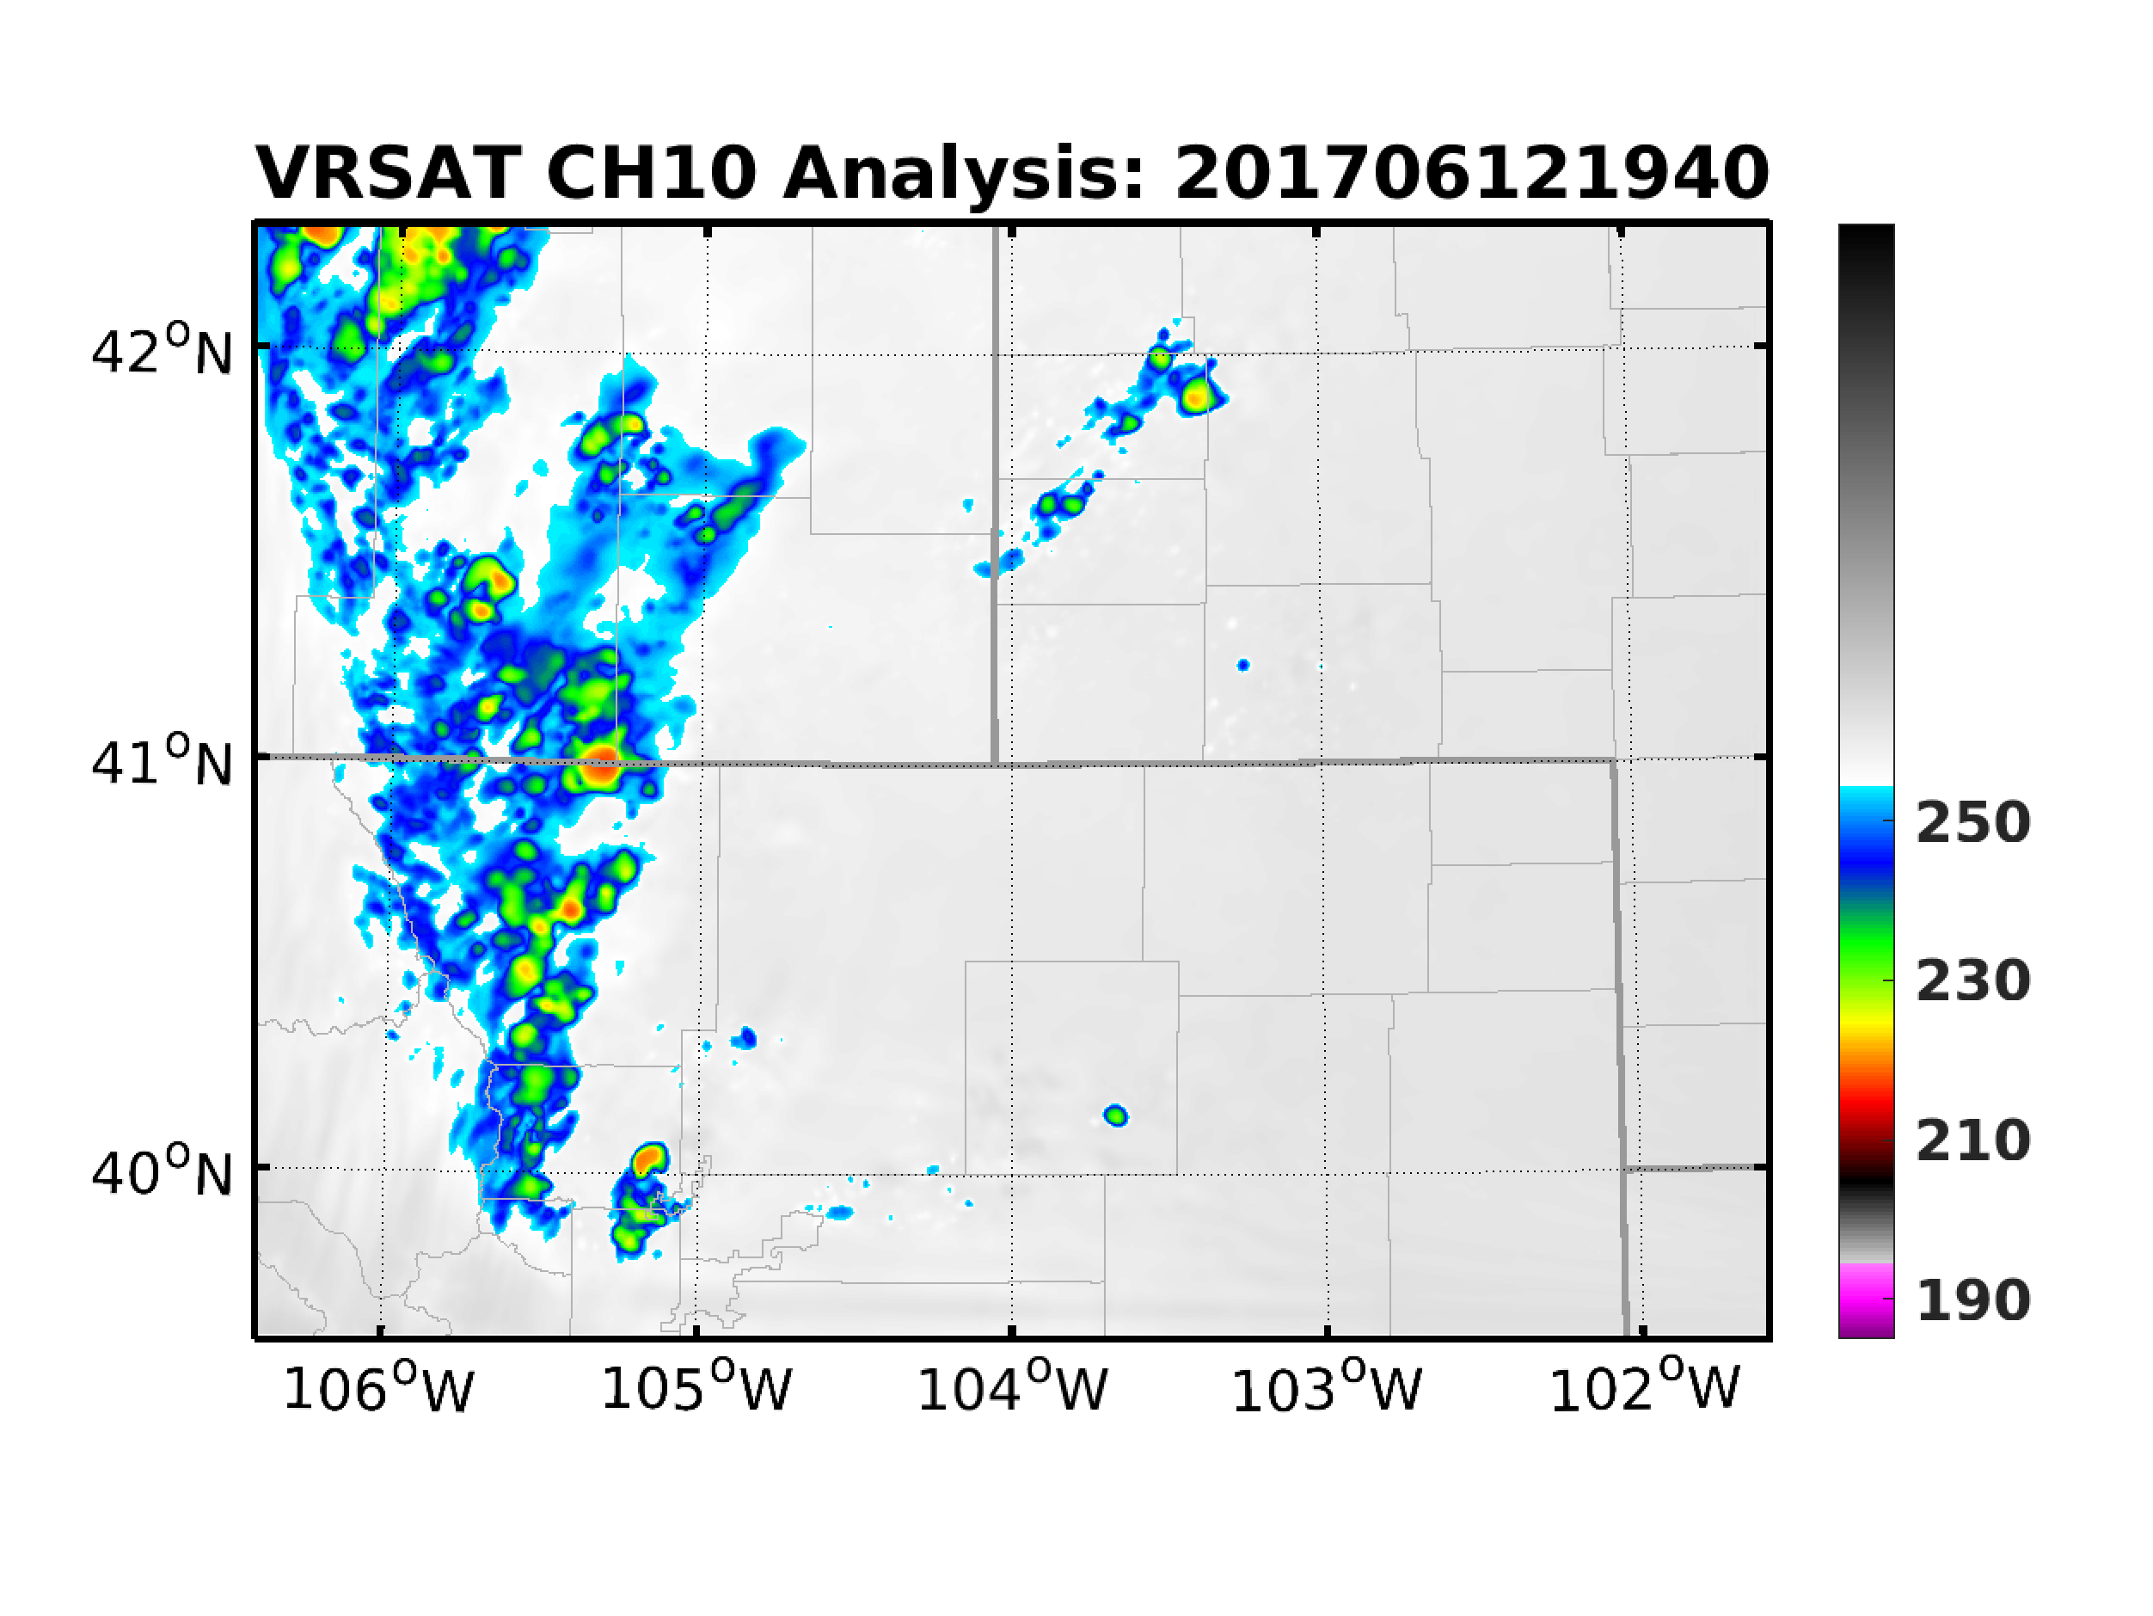
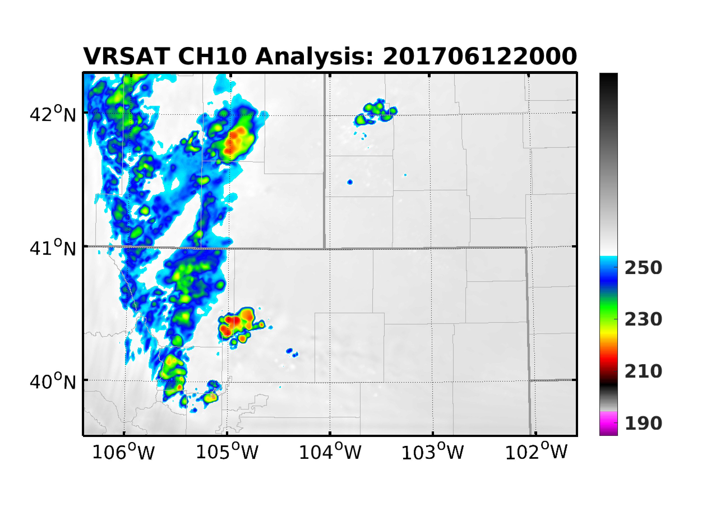
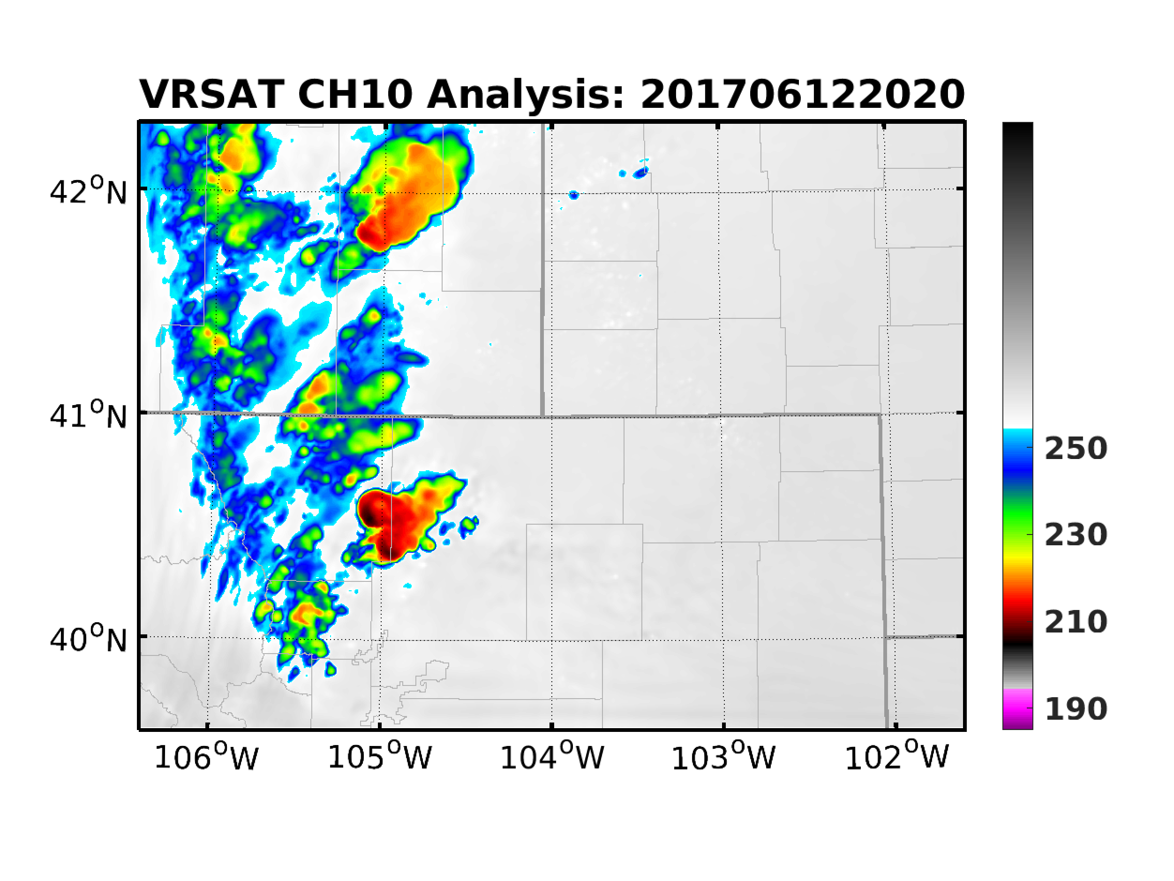
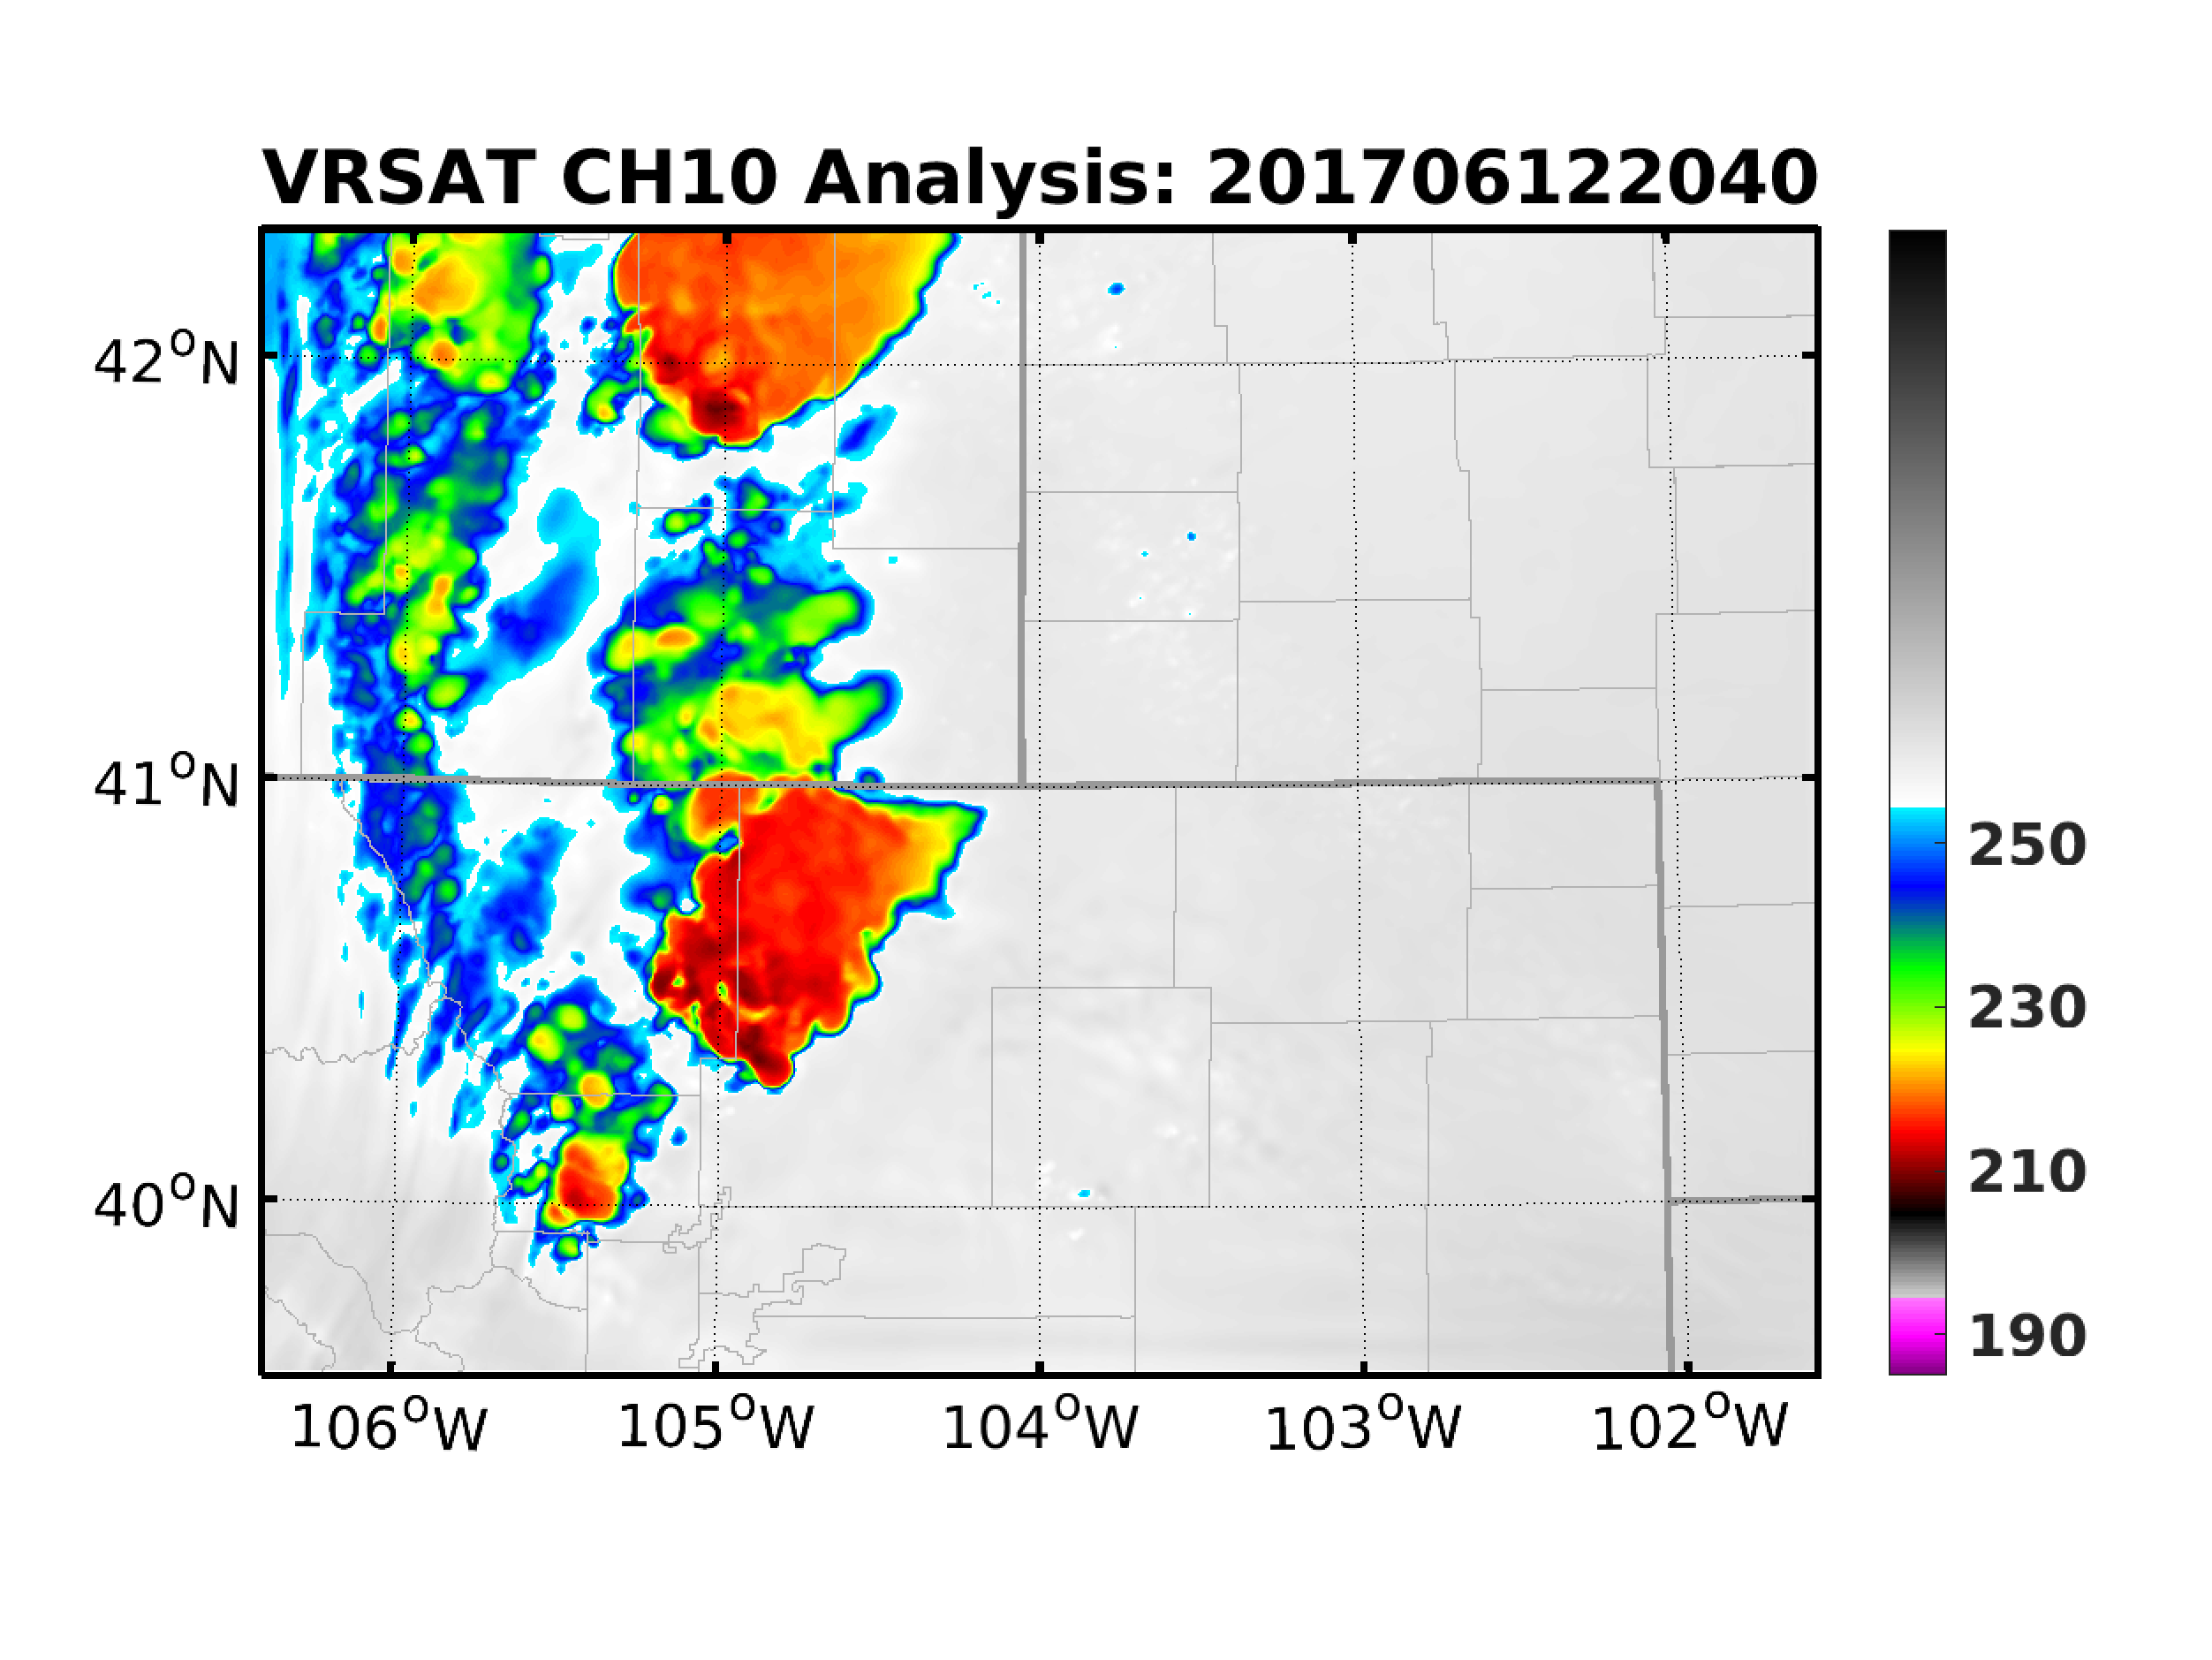
Radiance + V_{R}: Analysis
ABEI
RAD-VR
VR-RAD

Slide 11
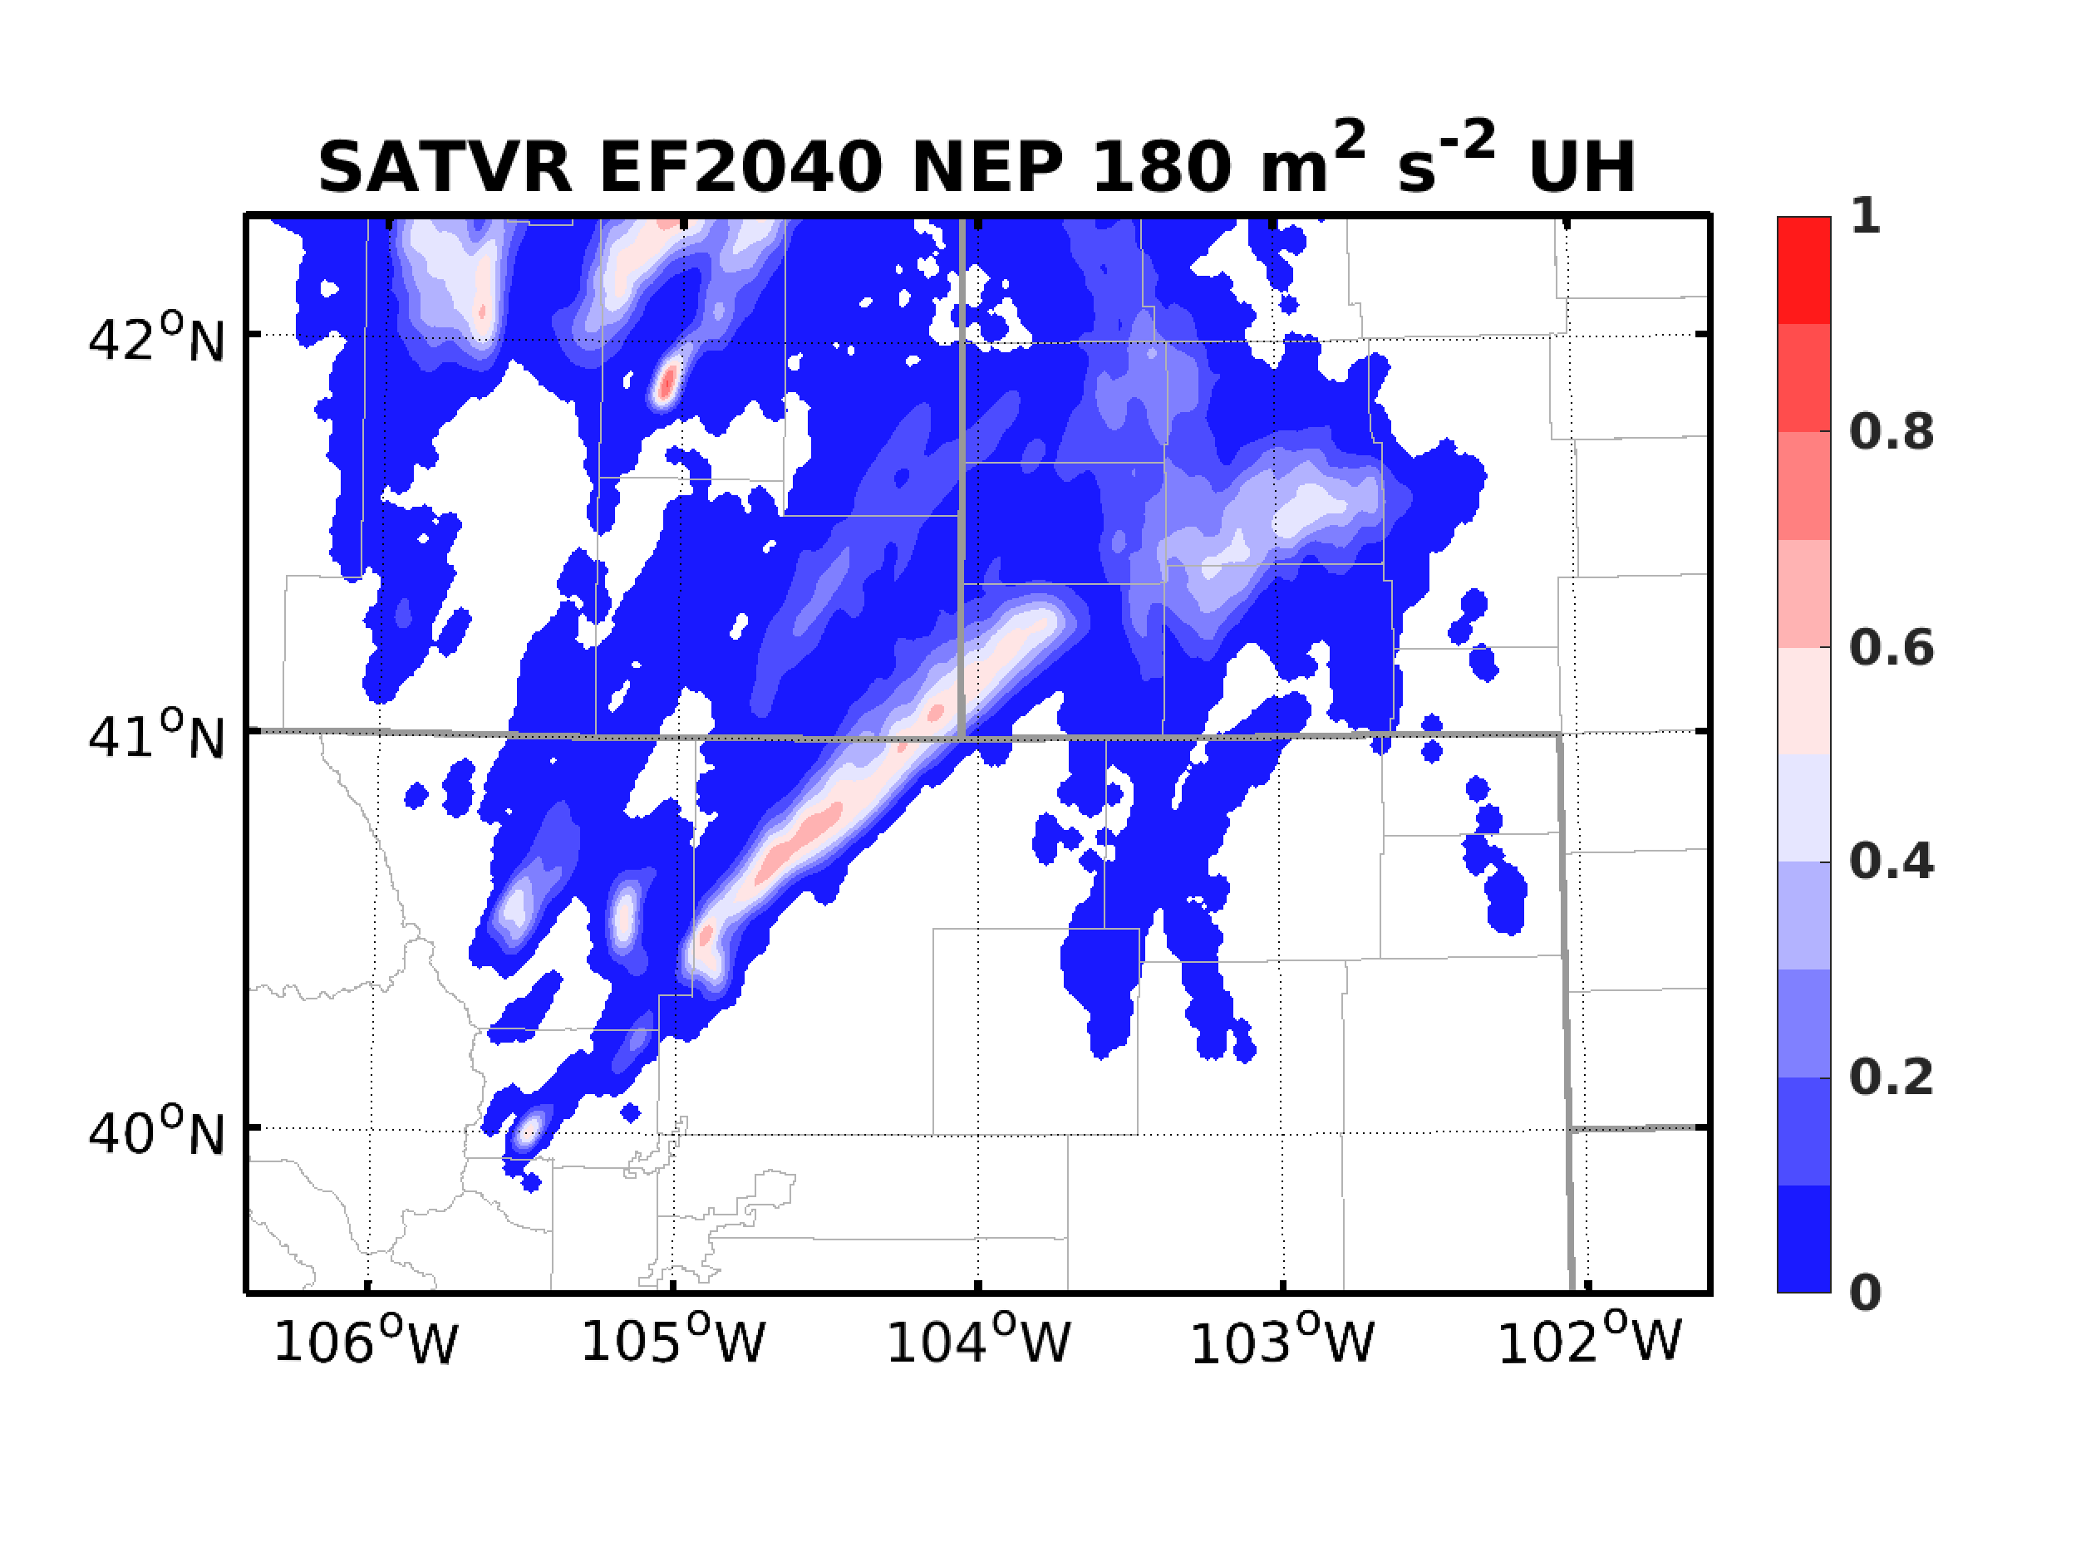
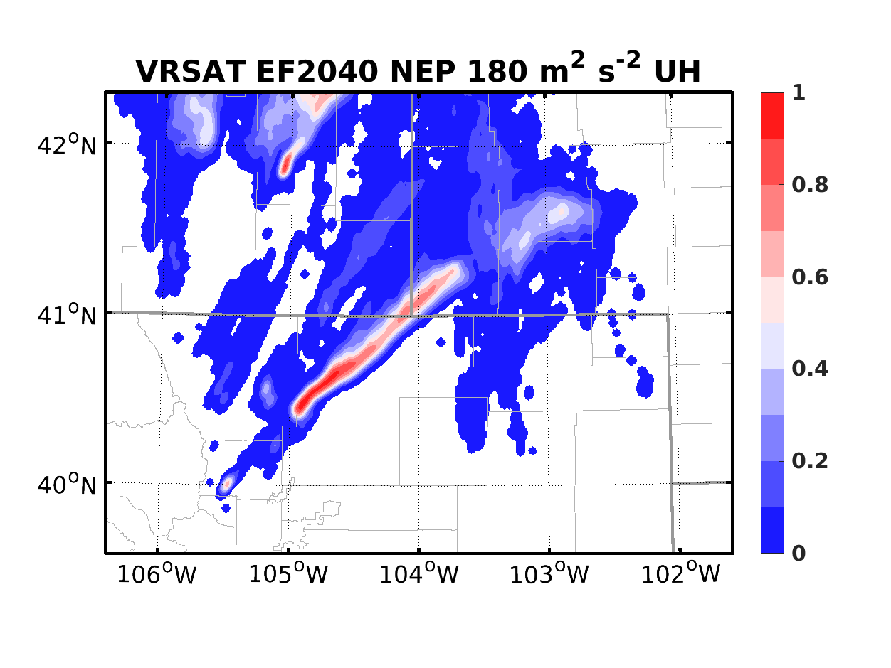
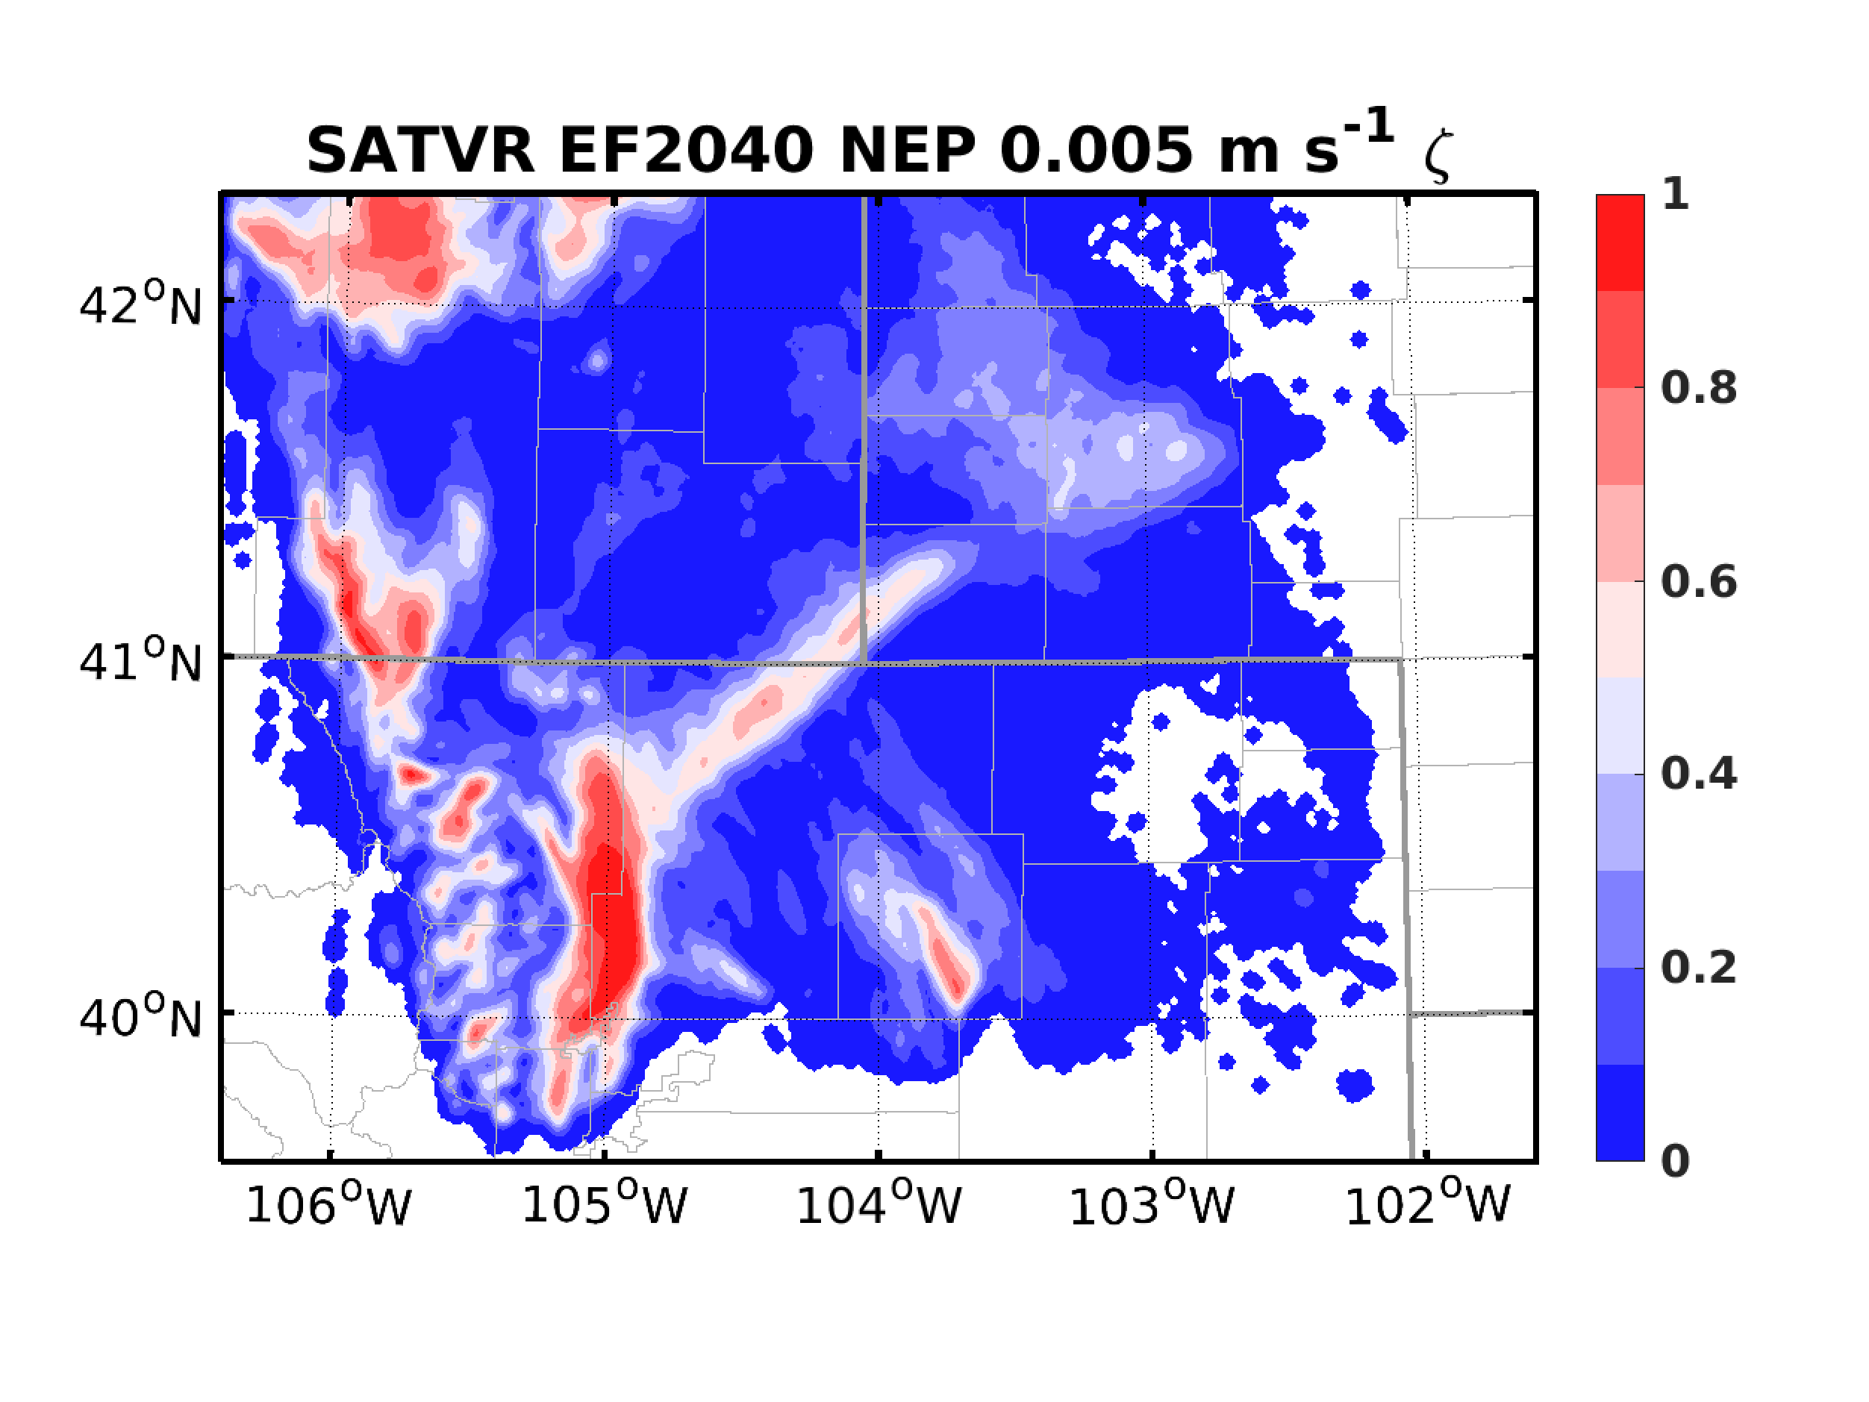
Radiance + V_{R}: Forecasts
ABEI EF2040
RAD-VR EF2040
VR-RAD EF2040

Slide 12
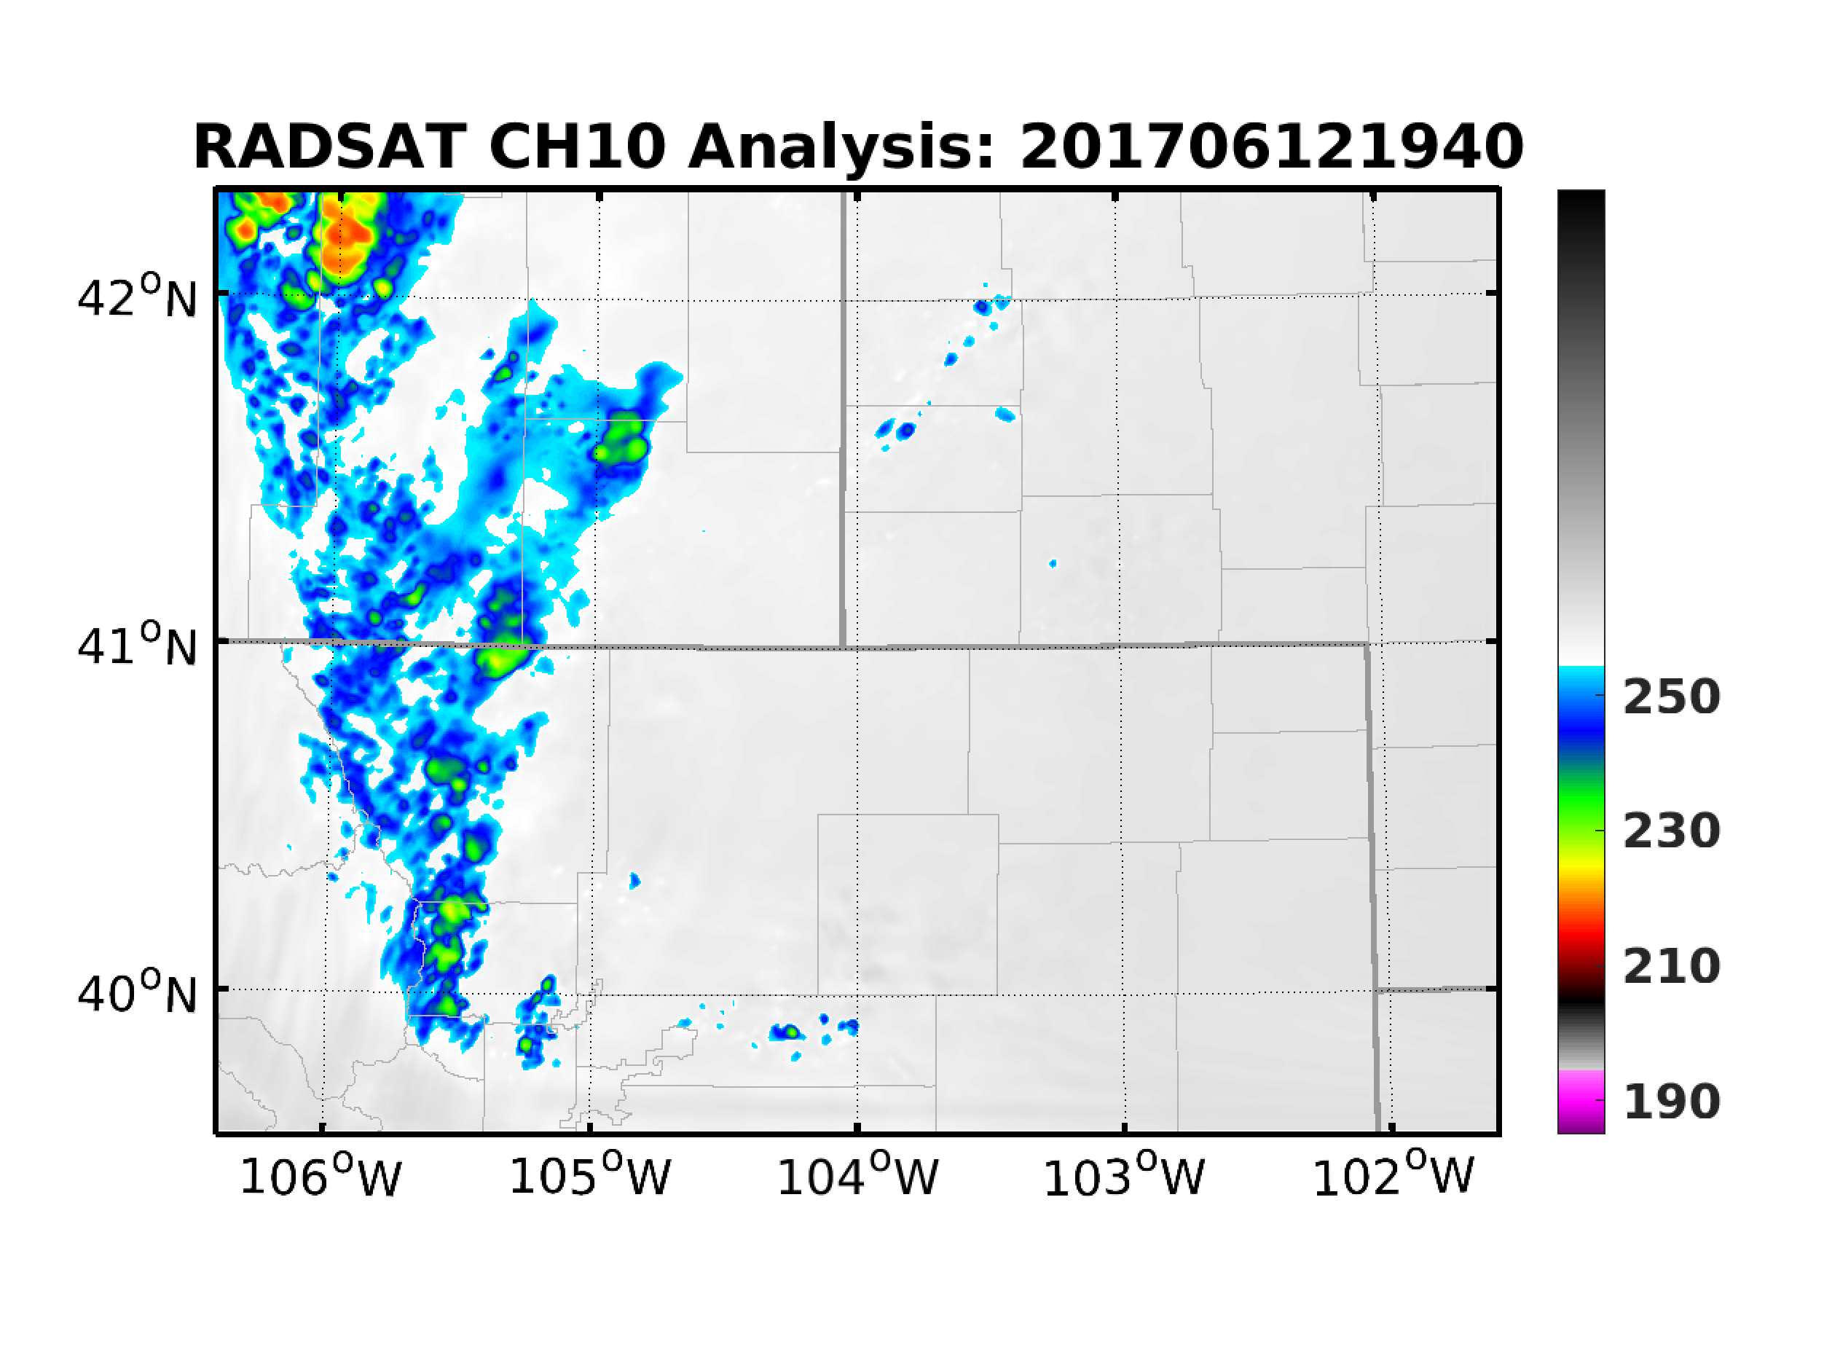
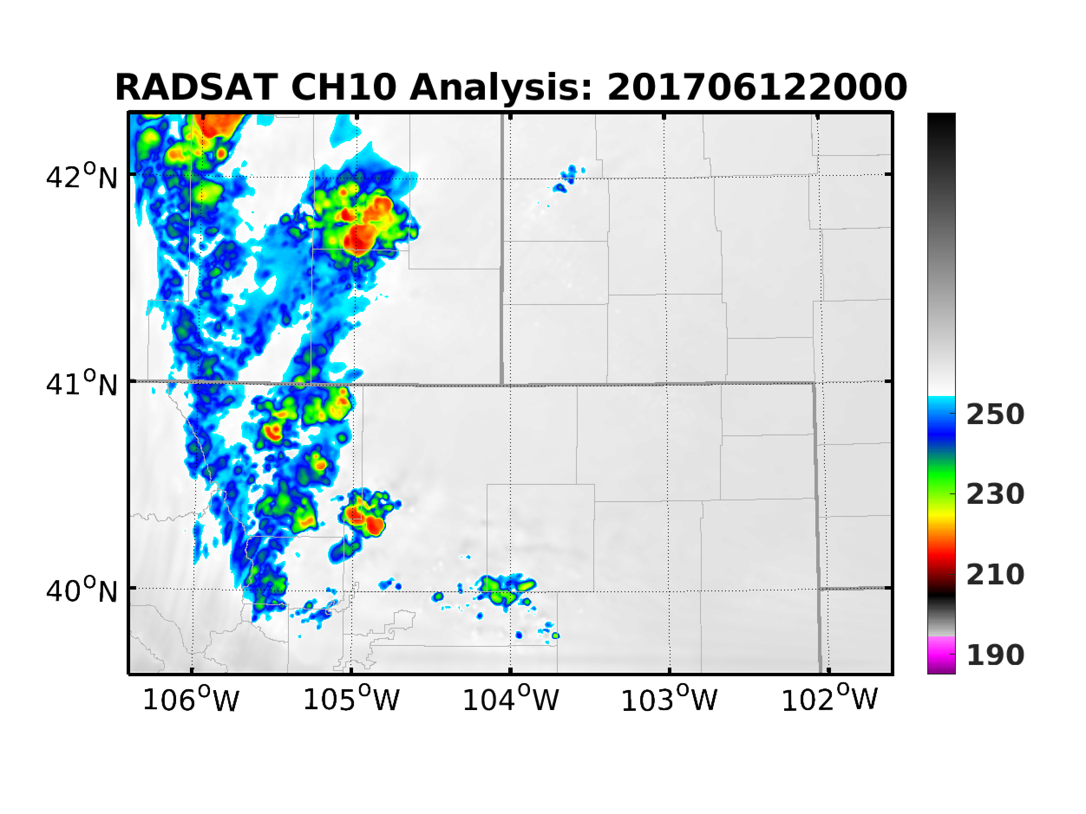
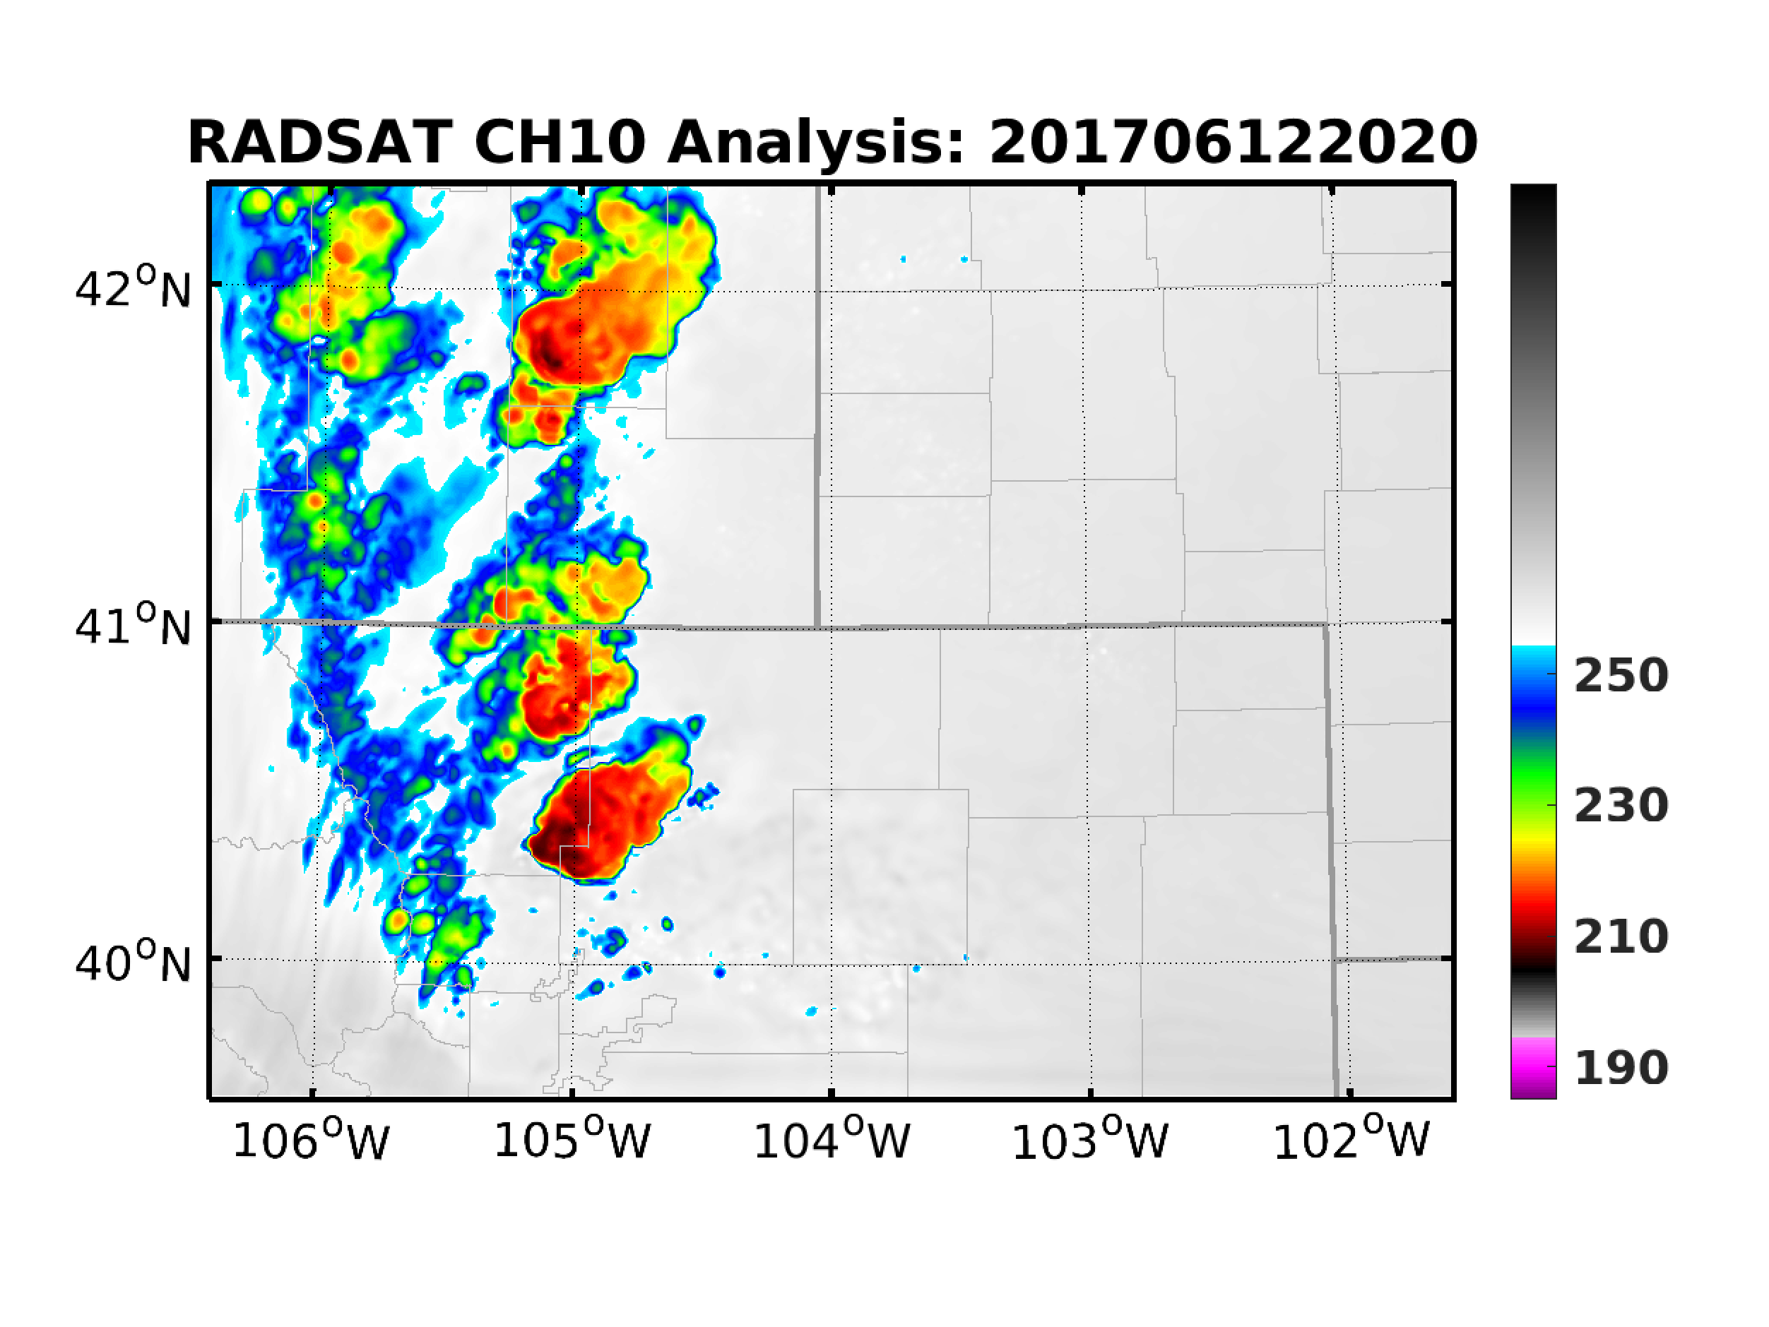
Radiance + V_{R} + dBZ: Analysis
ABEI
DBZ
RAD-SAT

Slide 13
Radiance + V_{R} + dBZ: Parallax Error
Location error occurred w/ reflectivity assimilation

Slide 14
Parallax Correction: Procedures
Significant dislocations
Much better collocation
Satellite looking angel calculation based on Soler and Eisemann (1994, J. Surv. Eng.)

Slide 15
Parallax Correction: Before and After

Slide 16
Summary
ABEI on radiance:
Analysis accuracy ▲, prediction probability ▼.
AOEI on reflectivity:
Analysis accuracy ▼, prediction accuracy and probability ▼.
Combining radial velocity and radiance:
Analysis accuracy ►, prediction probability ▲▲.
Combining reflectivity, radial velocity and radiance:
Need parallax correction to improve location accuracy.
What’s next: doing assimilation with parallax-corrected observations.

