Slide 1
Evaluation of high resolution regional reanalysis developed by EnKF method over the Tibetan Plateau
Jie He，Fuqing Zhang ，Xingchao Chen
Group meeting, Aug 16, 2018

Slide 2
Background and Motivation
The world’s largest and highest plateau
thermodynamic and dynamic effects
climate and weather
East Asia and the whole world
Applications of a high-quality reanalysis
climatic variability
climate model
parameterization studies
… …
However, no high-quality reanalysis over the TP
develop high-quality TP reanalysis
evaluate high-quality TP reanalysis
Tibetan Plateau (TP)
Notes:
TP has crucial influence on the climate and weather over East Asia and around the whole world due to both the thermodynamic and dynamic effects induced by the high terrains

Slide 3
Model configuration
Model | PSU WRF-EnKF System
Domain | D01
Resolution | 30 km
Method | EnKF （40 members）
Time window | 6 hours
I.C. and B.C. | ERA-Interim
Observation | GTS observation
Time | June, July, 2015
Verification observation
Sounding of GTS (26)
Intensive sounding ( 12 )

Slide 4
Schematic of developing new reanalysis
ECMWF
00 03 06 09 12 15 18 21 00
fg
fg
fg
fg
EnKF
00 03 06 09 12 15 18 21 00
EnKF
EnKF
EnKF
EnKF
EnKF
Assimilation window
Assimilation window
Assimilation window
Assimilation window
Assimilation window
Reanalysis / Forecast
Reanalysis / Forecast
Reanalysis / Forecast
Reanalysis / Forecast
Reanalysis / Forecast

Slide 5
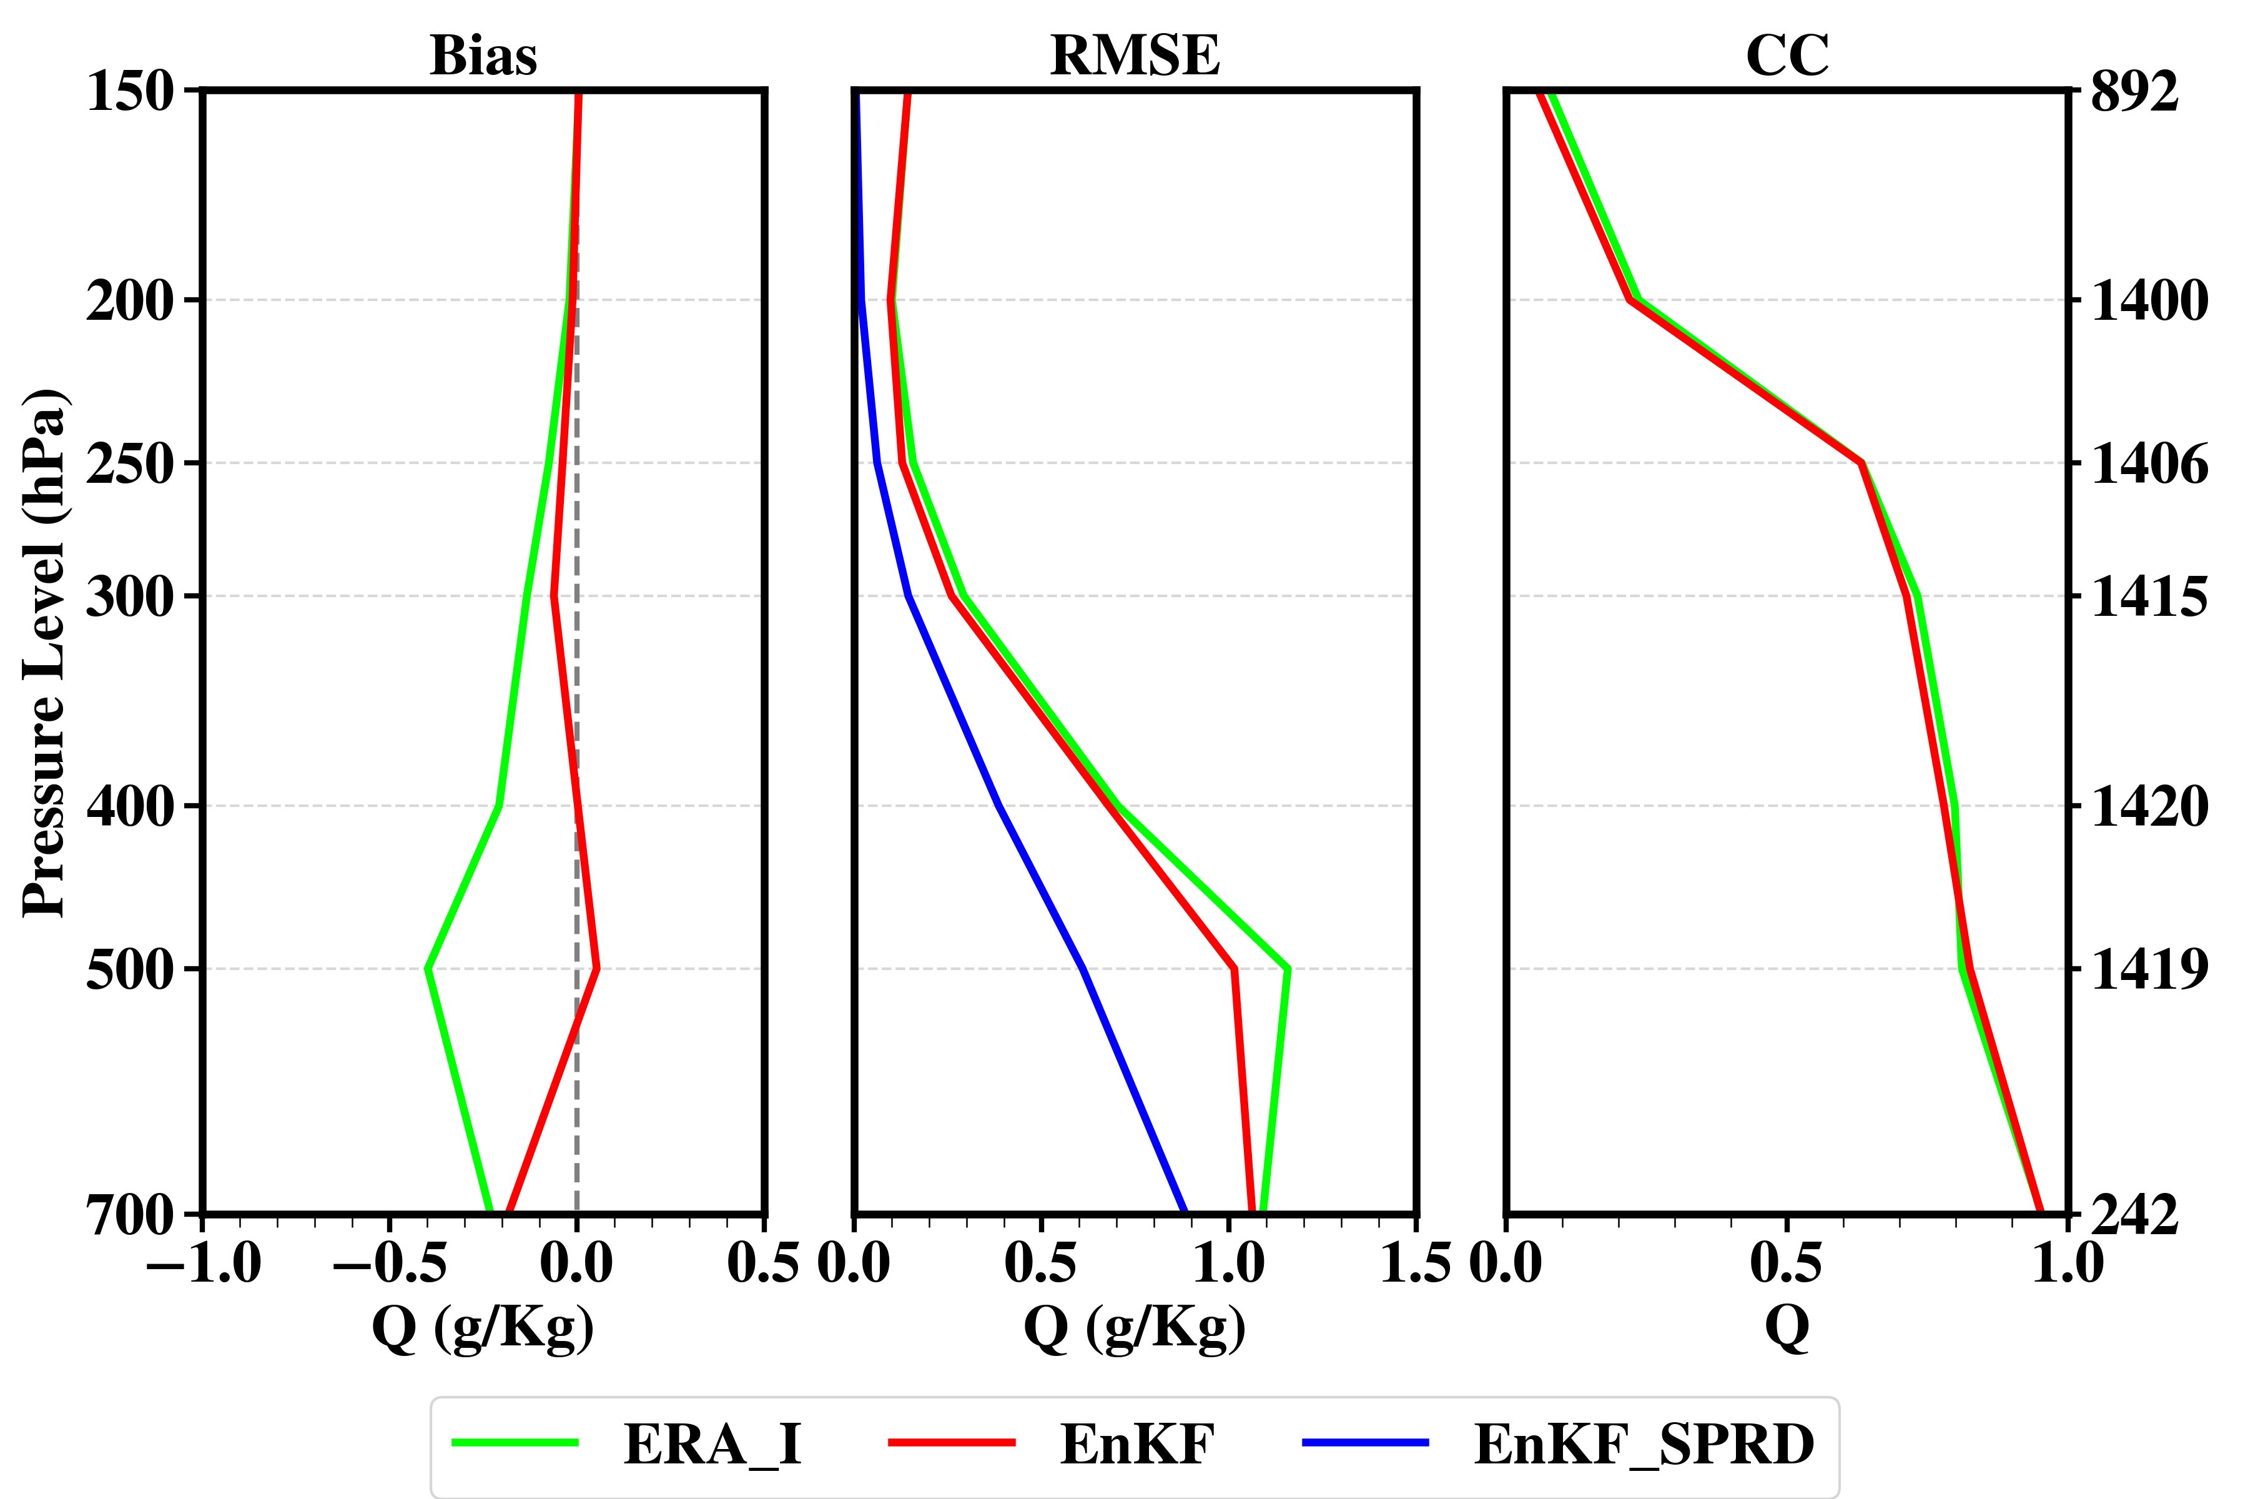
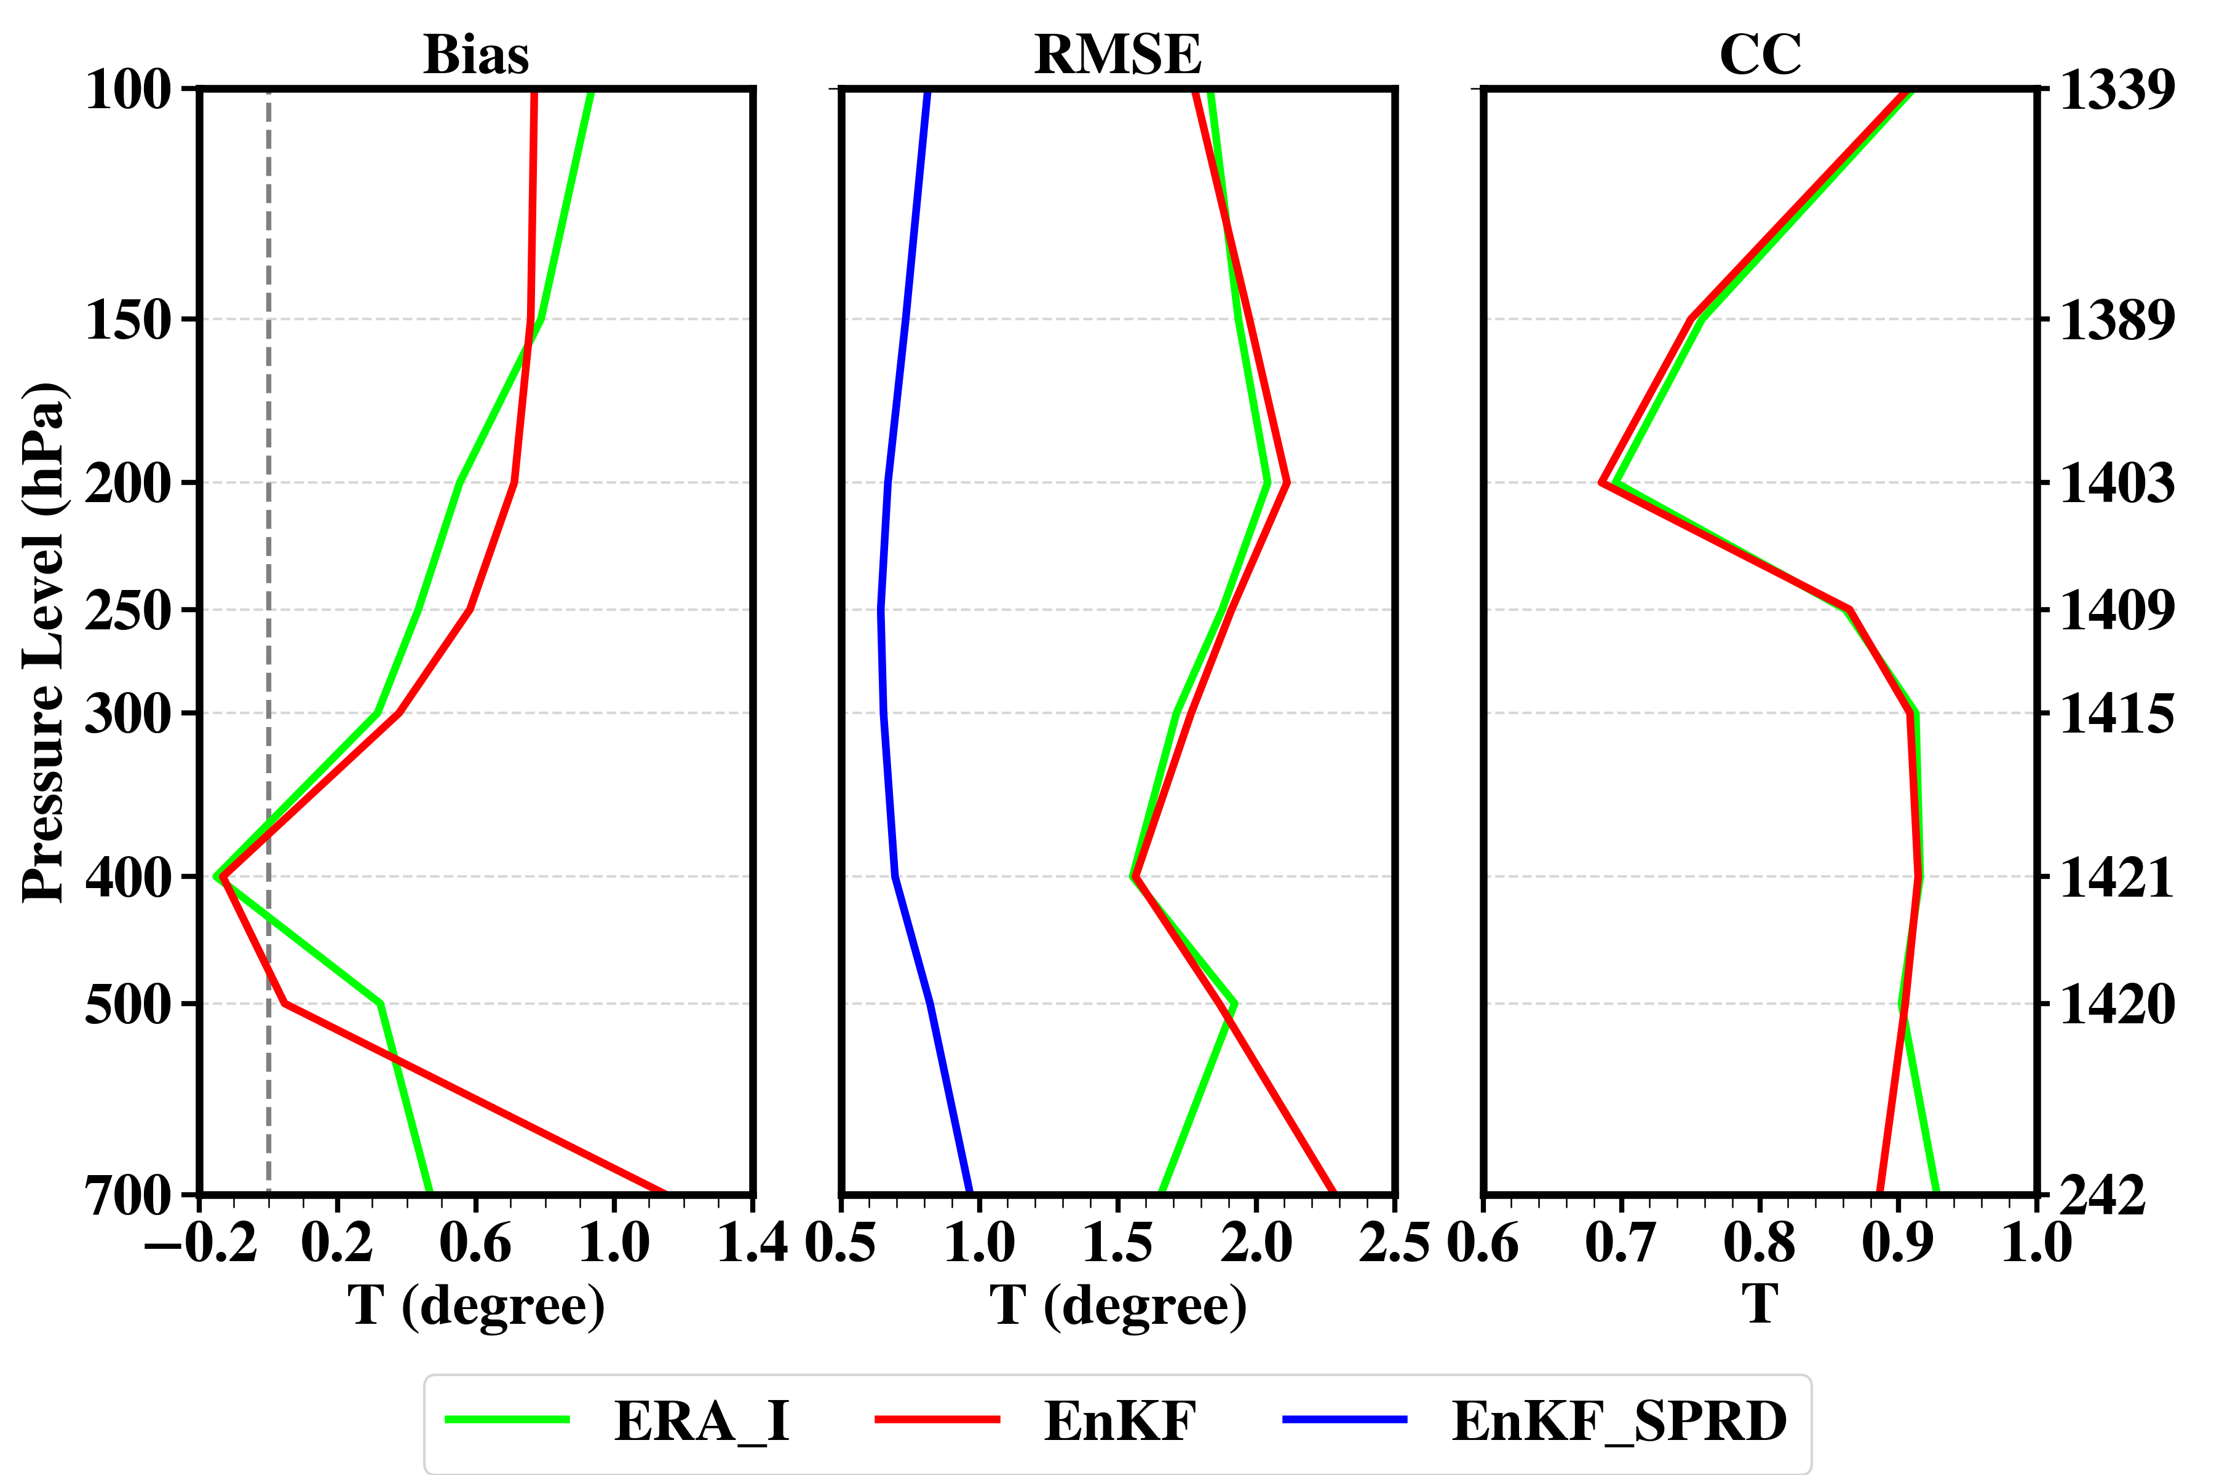
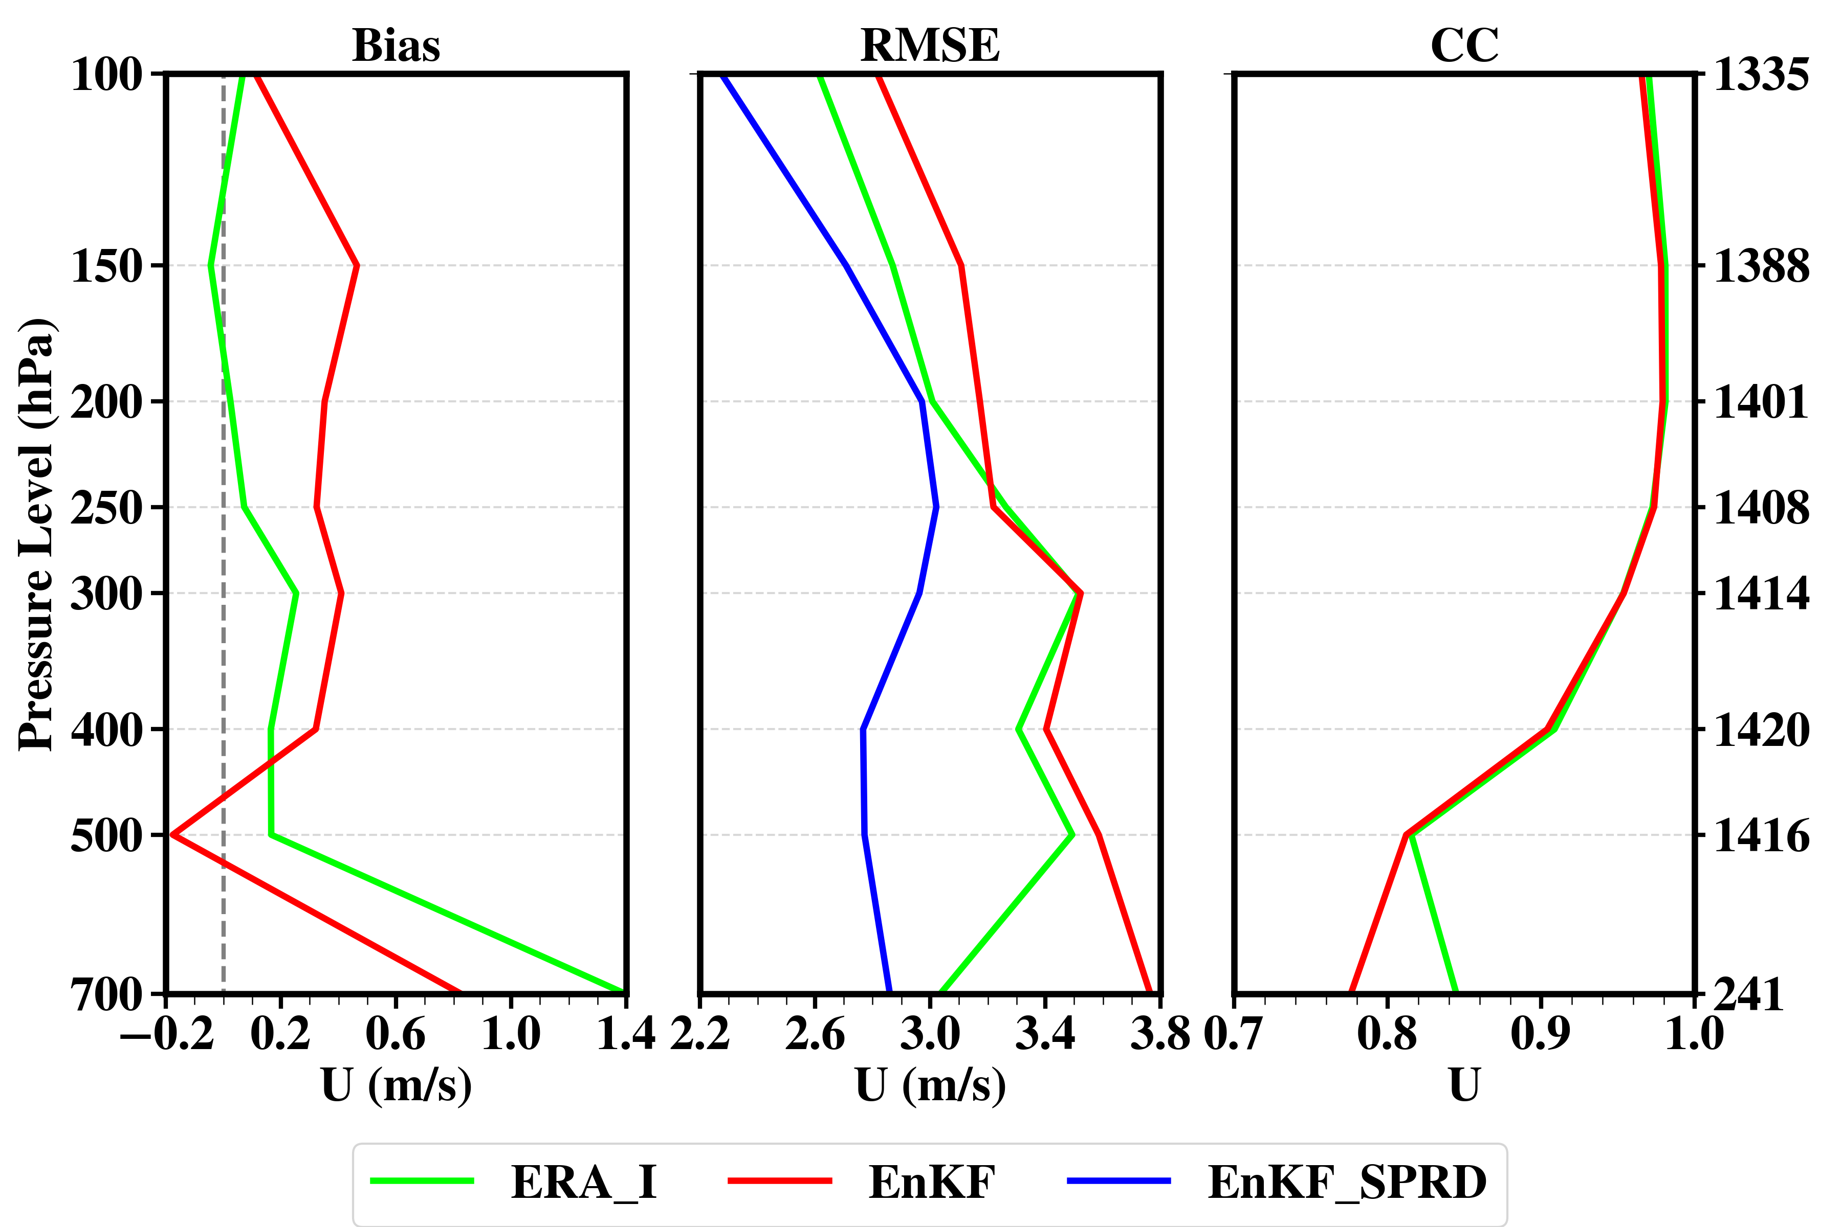
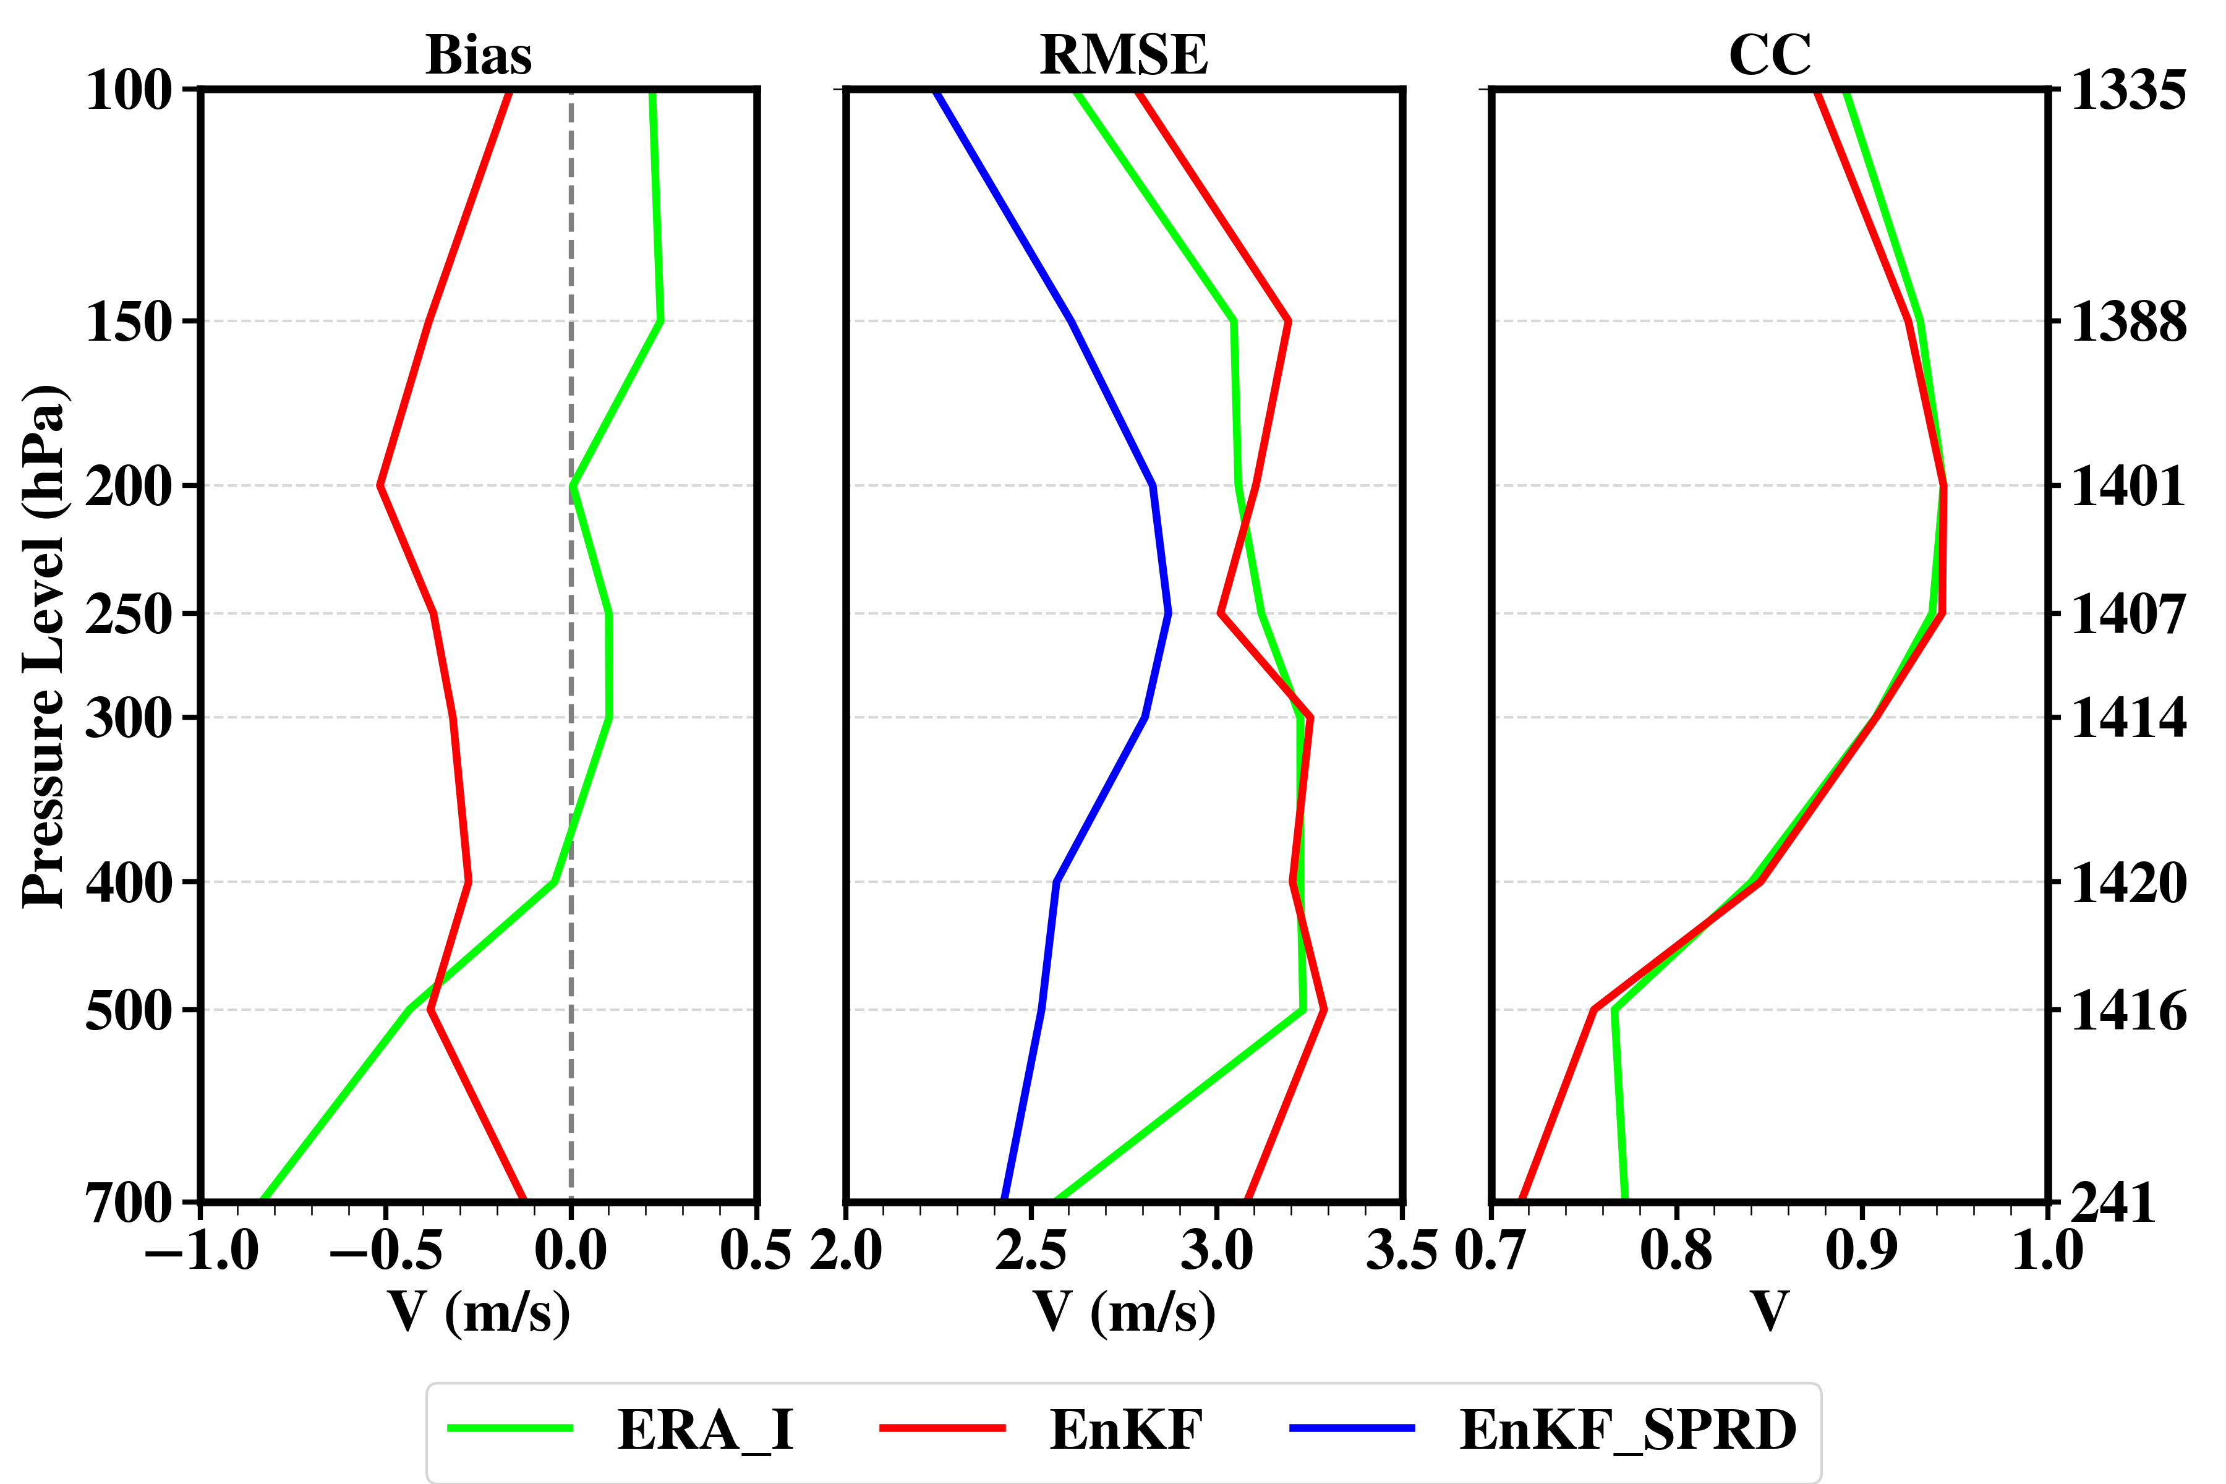
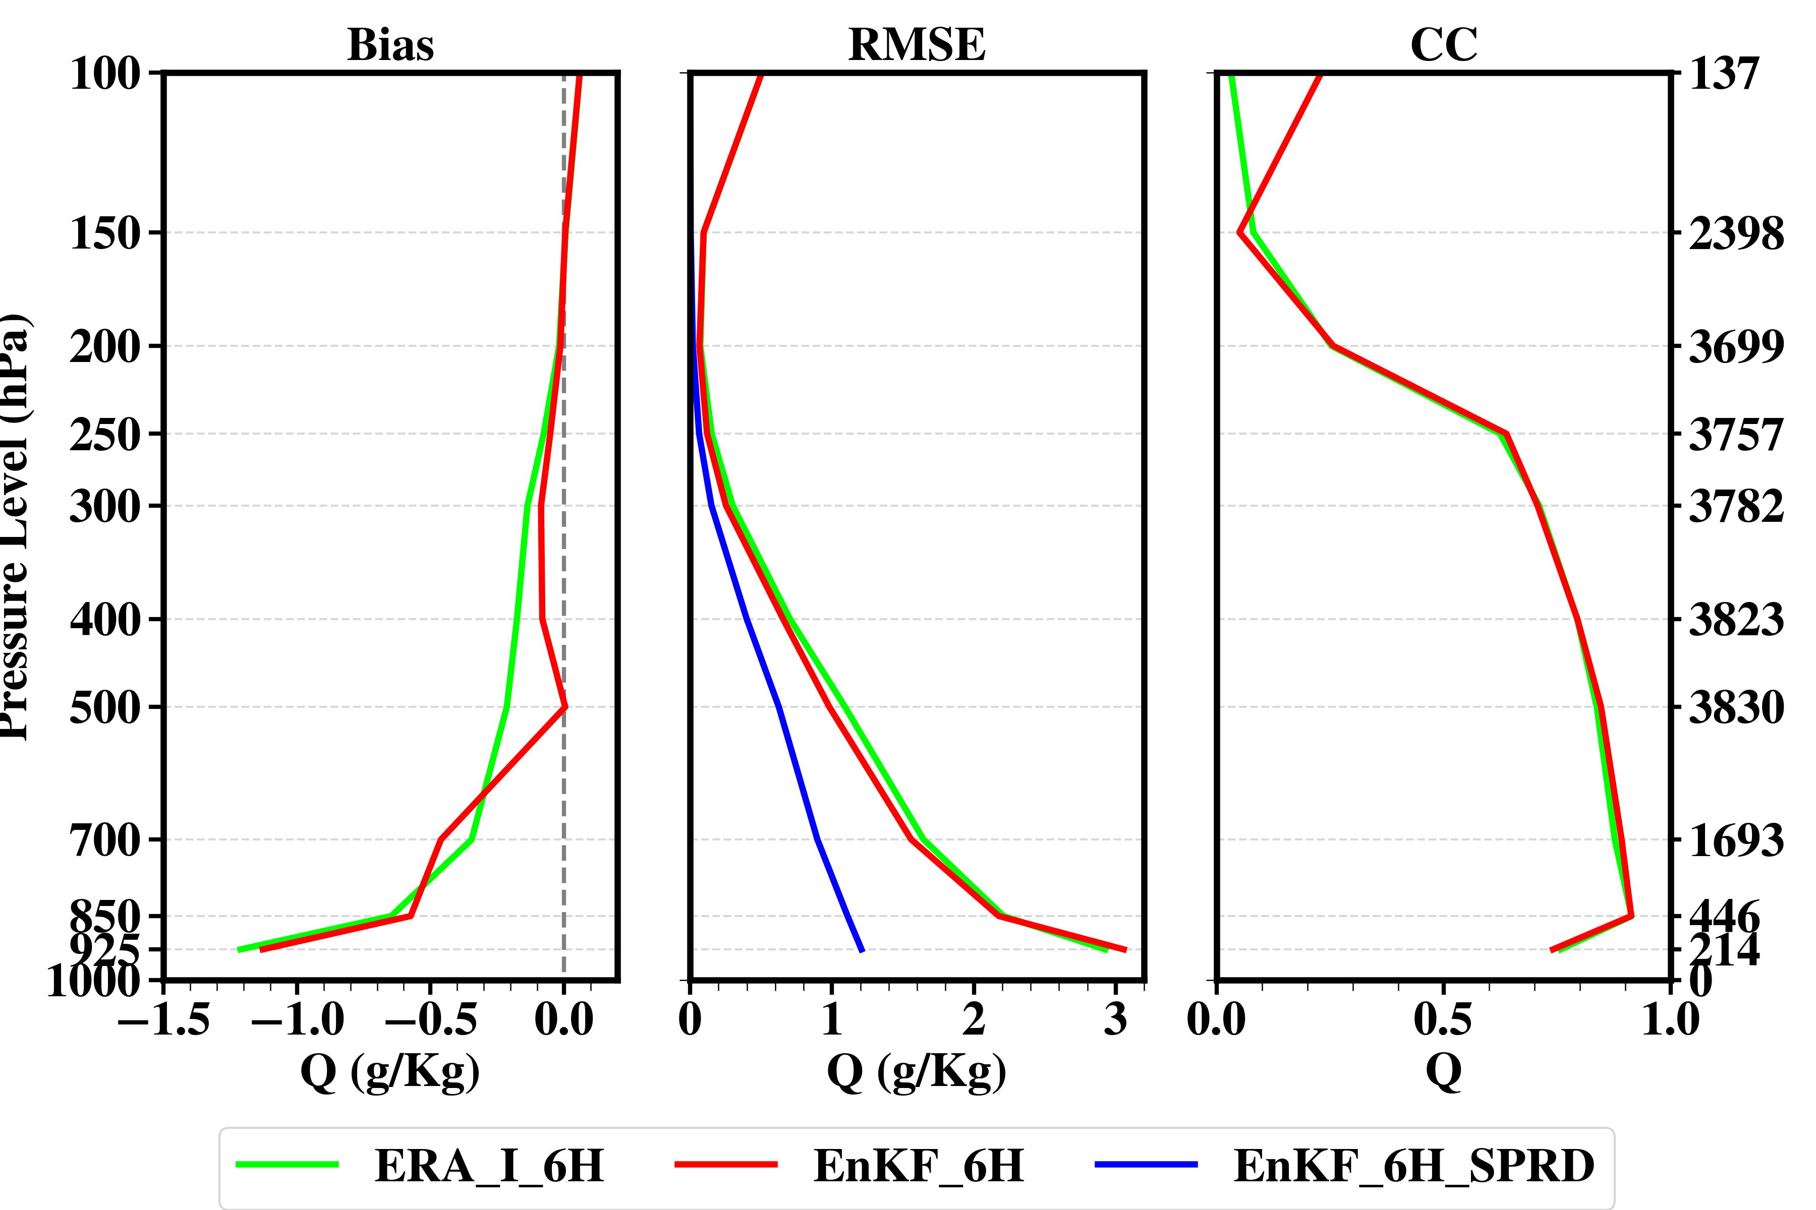
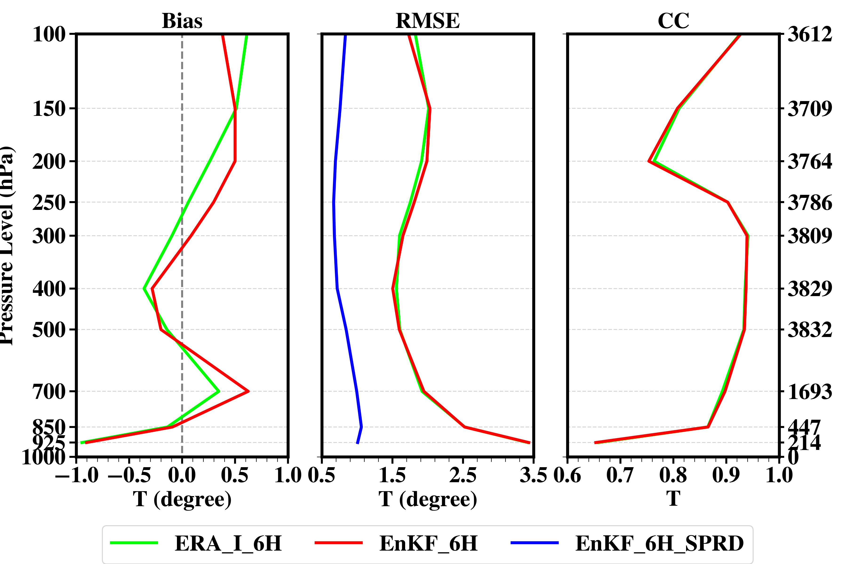
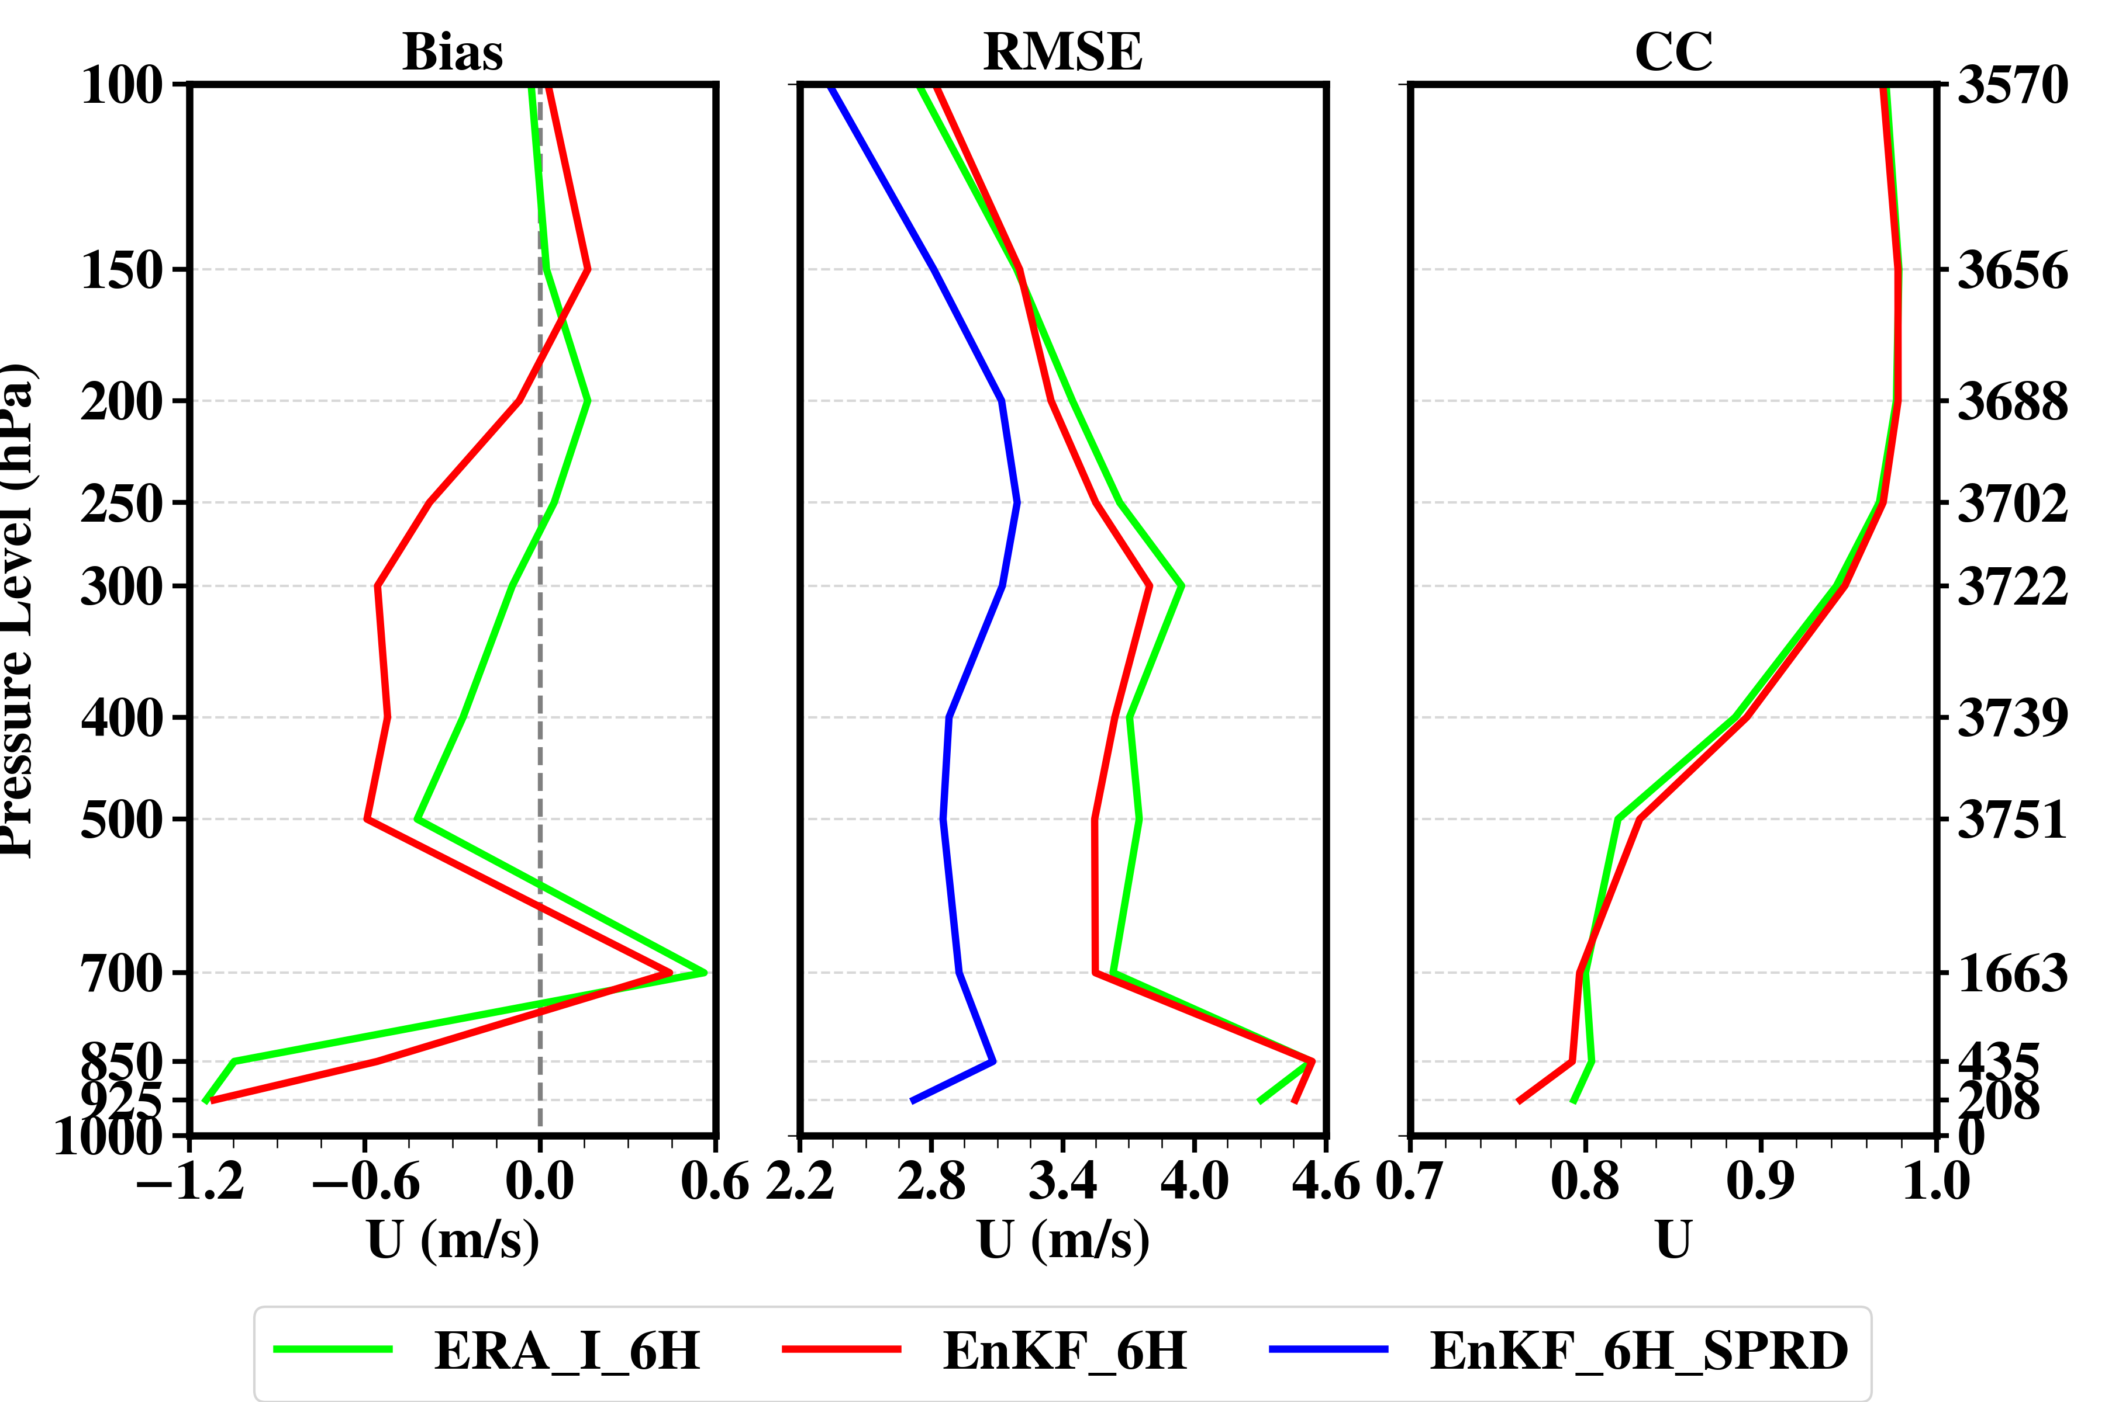
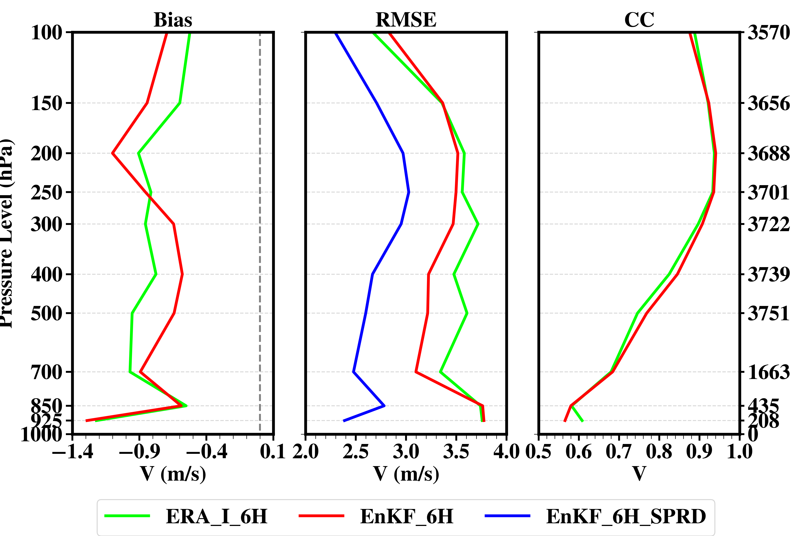
Evaluation and Verification
Analysis
Forecast
Independent verification with sounding obs.
Include 00, 12 UTC during June and July, 2015

Slide 6
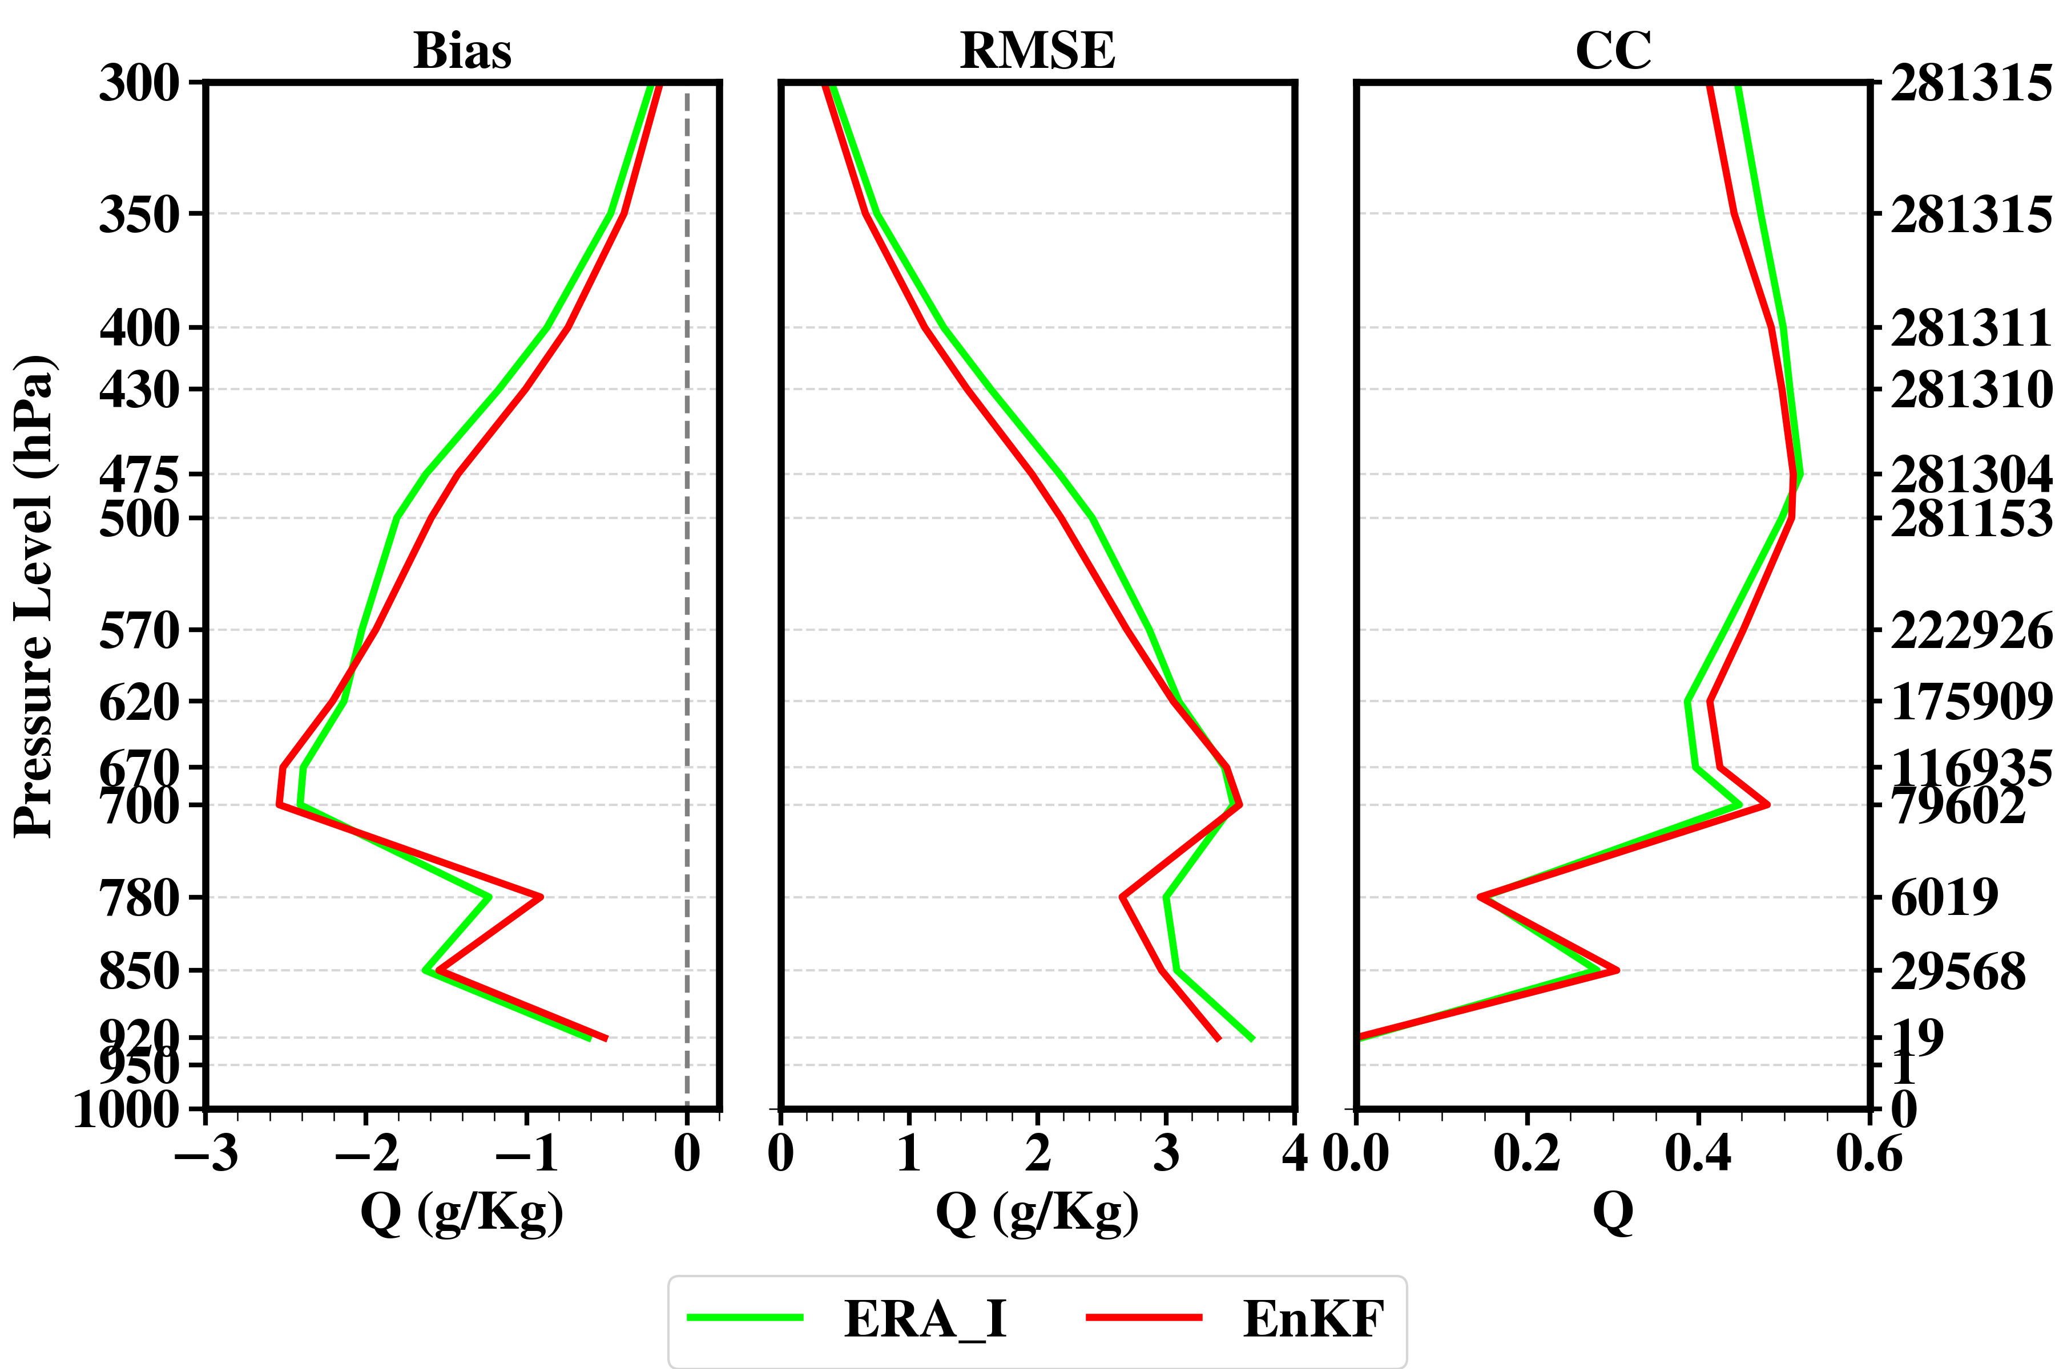
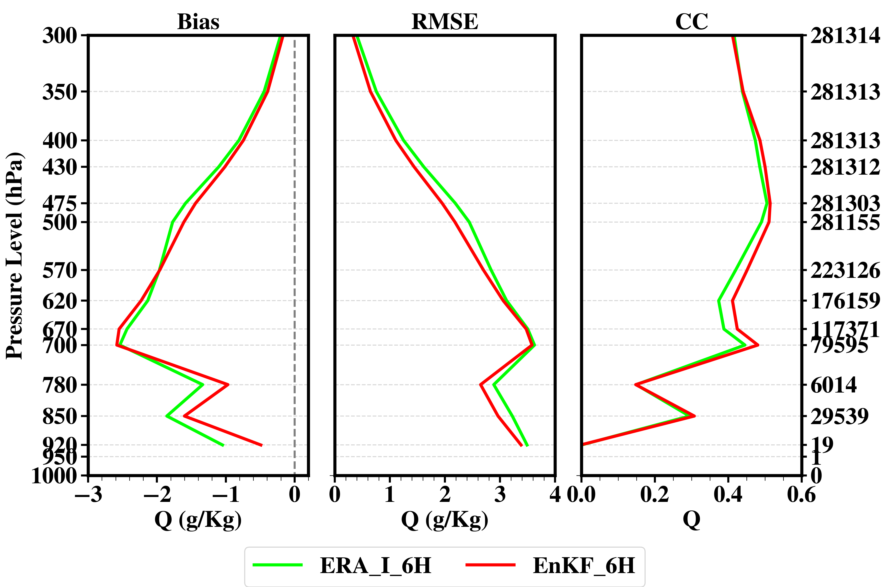
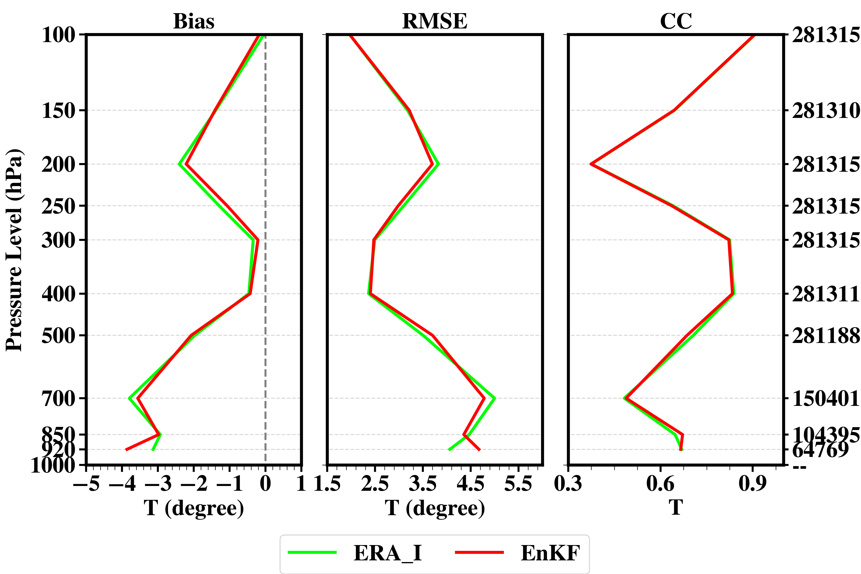
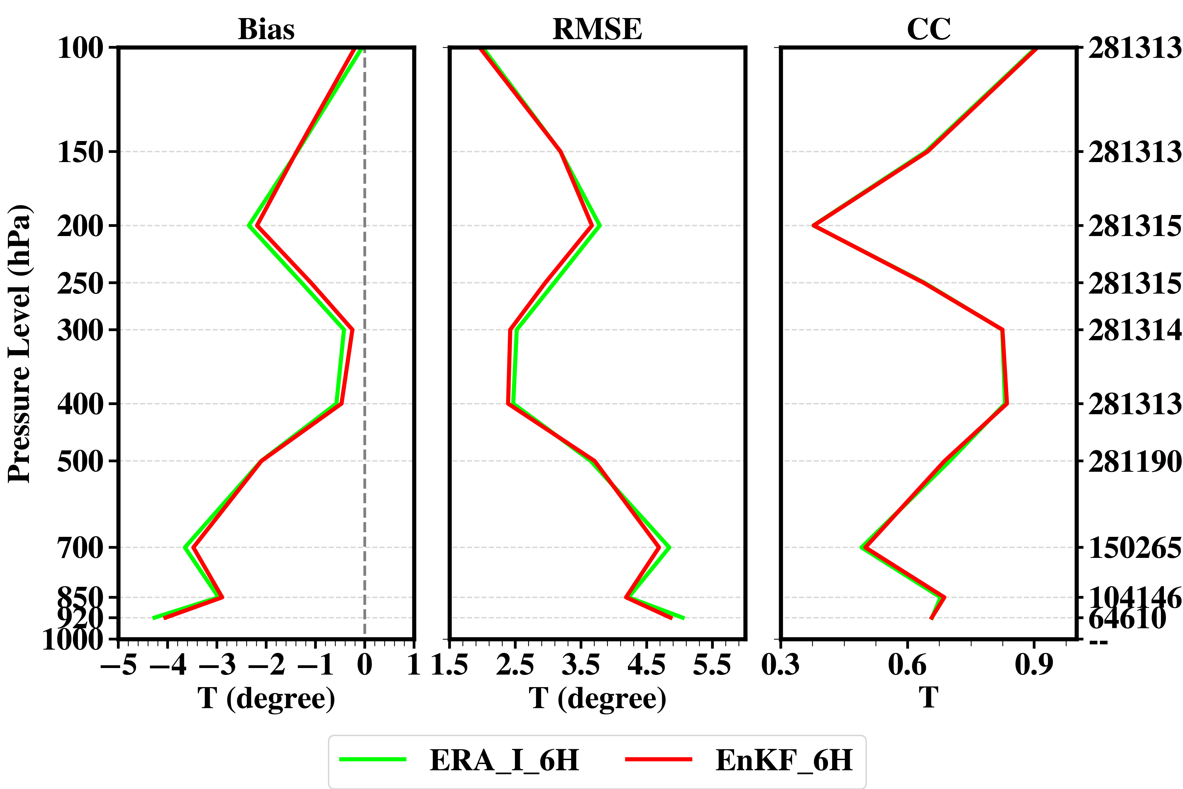
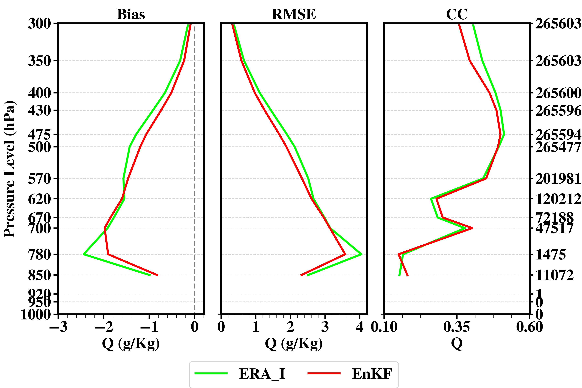
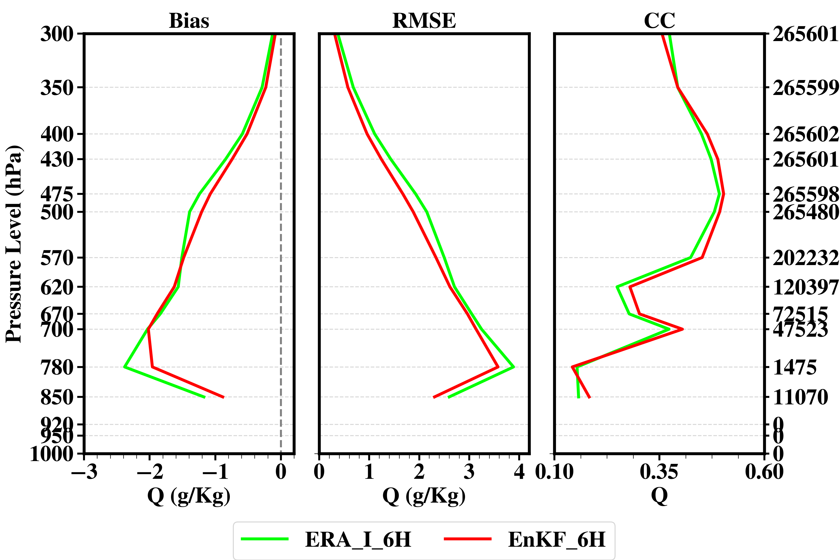
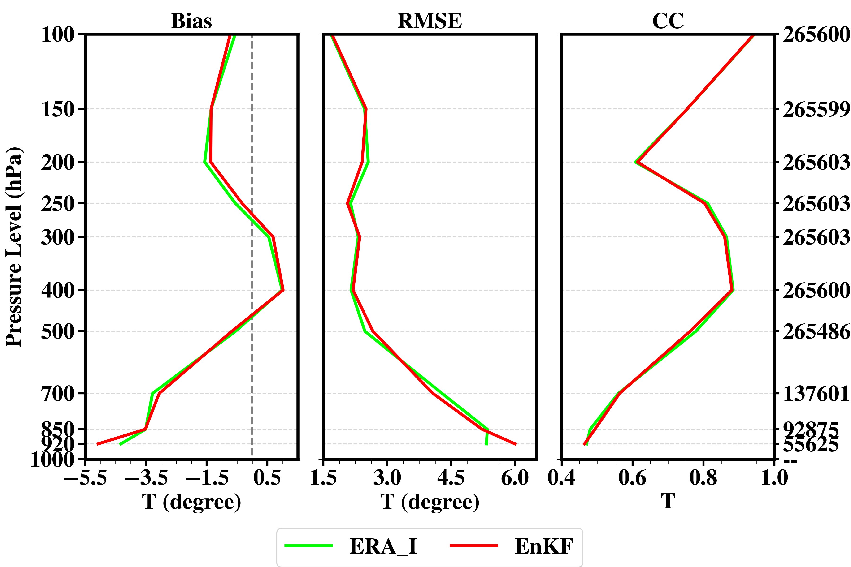
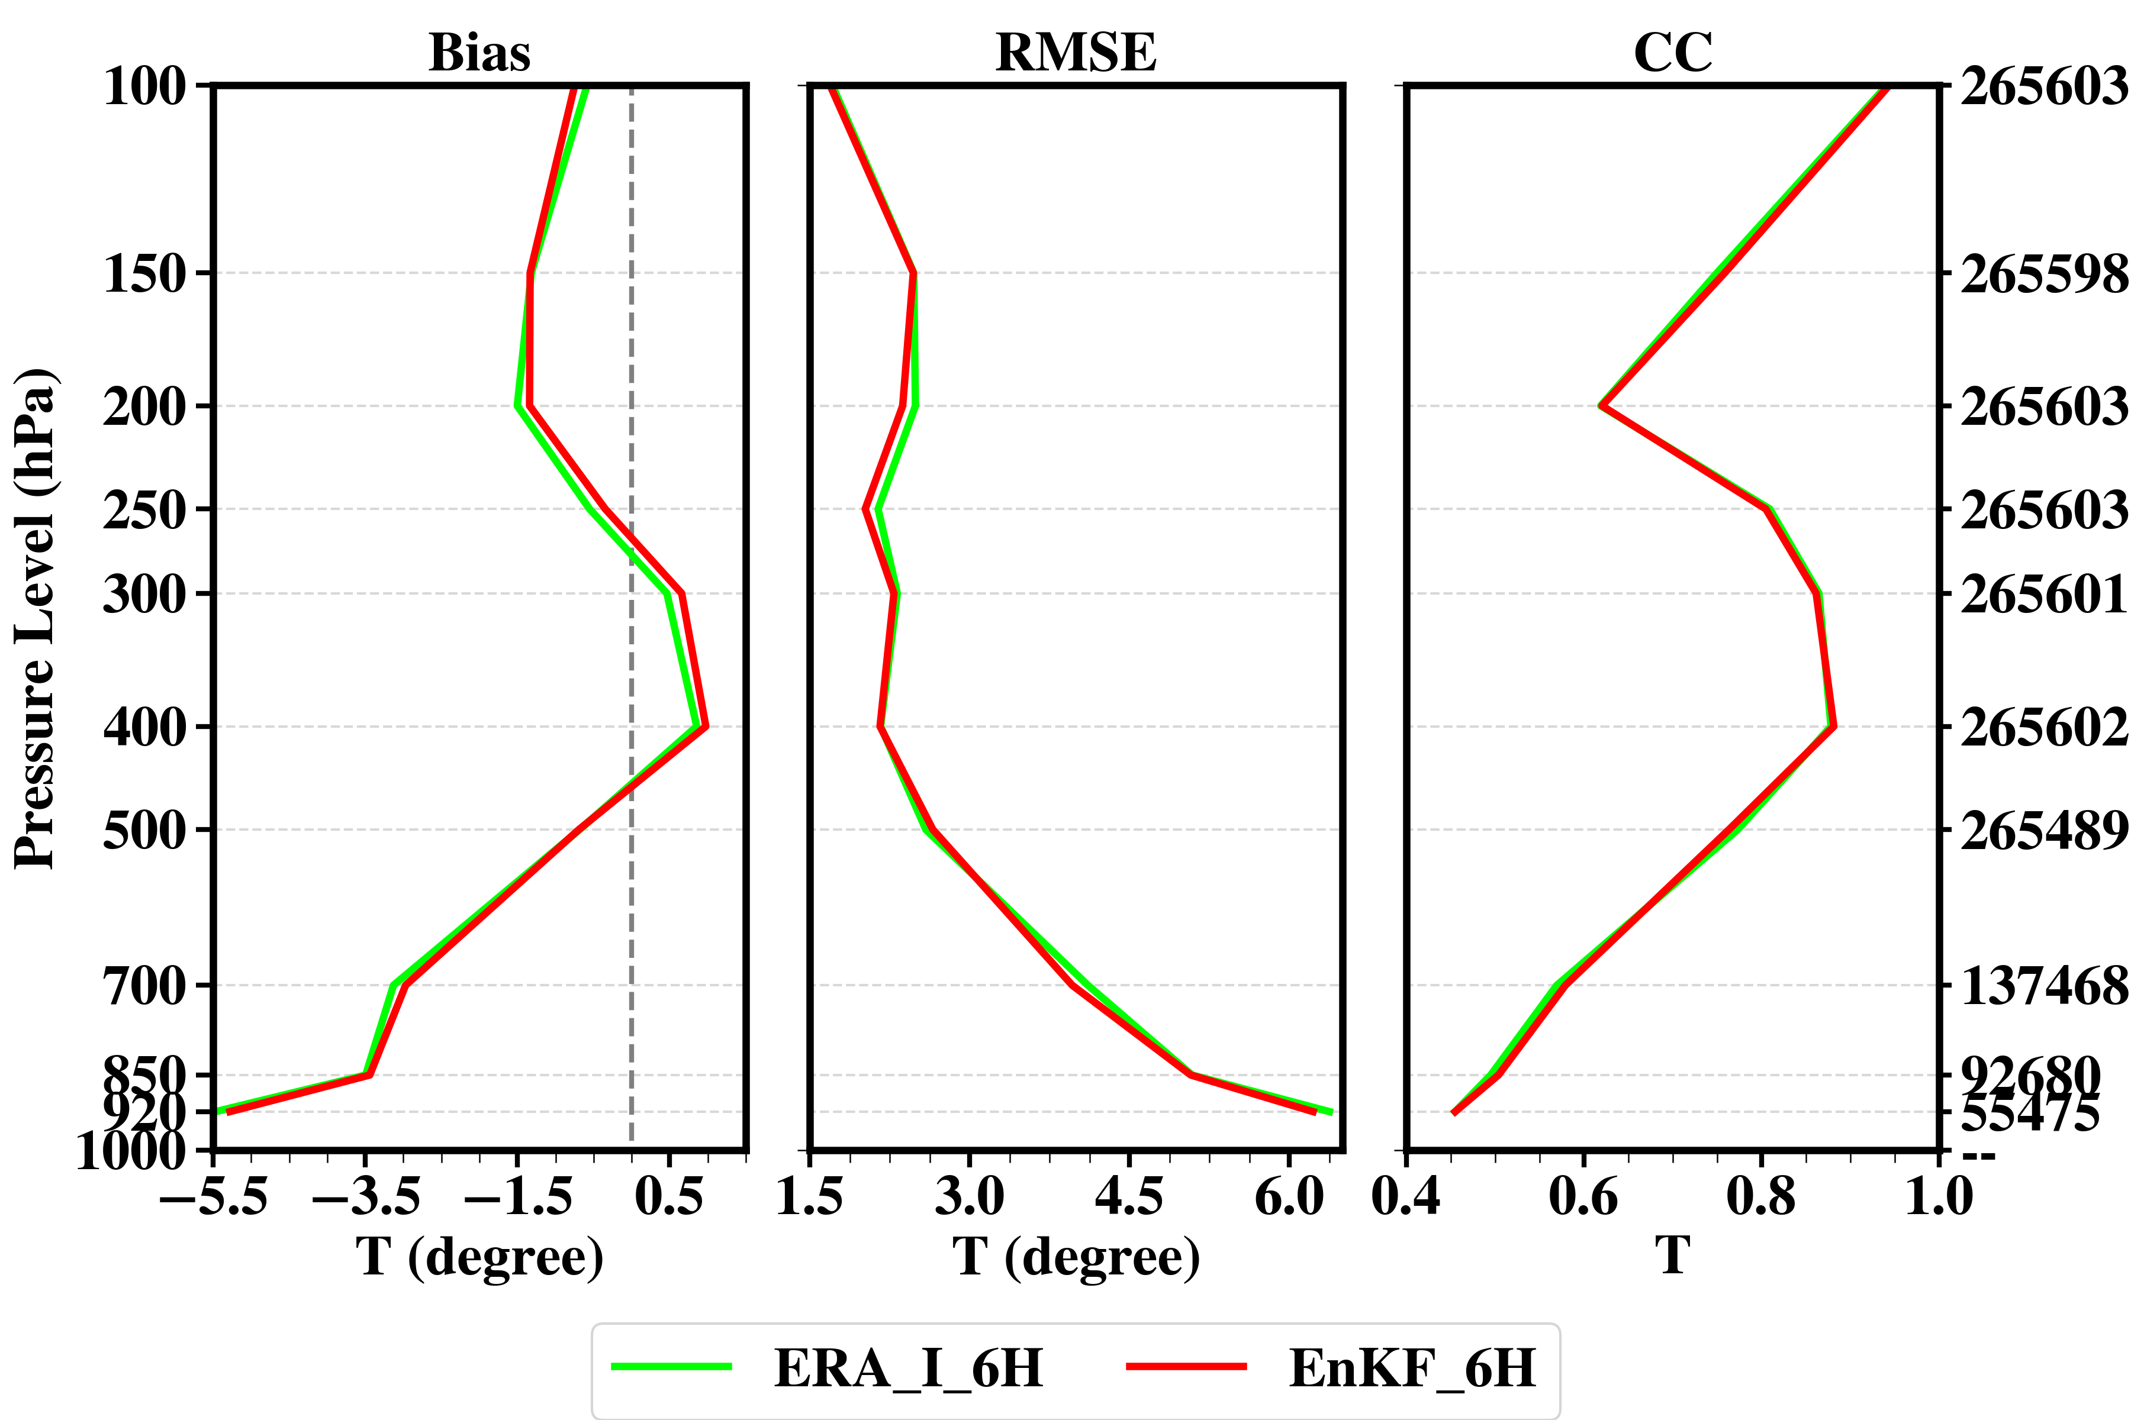
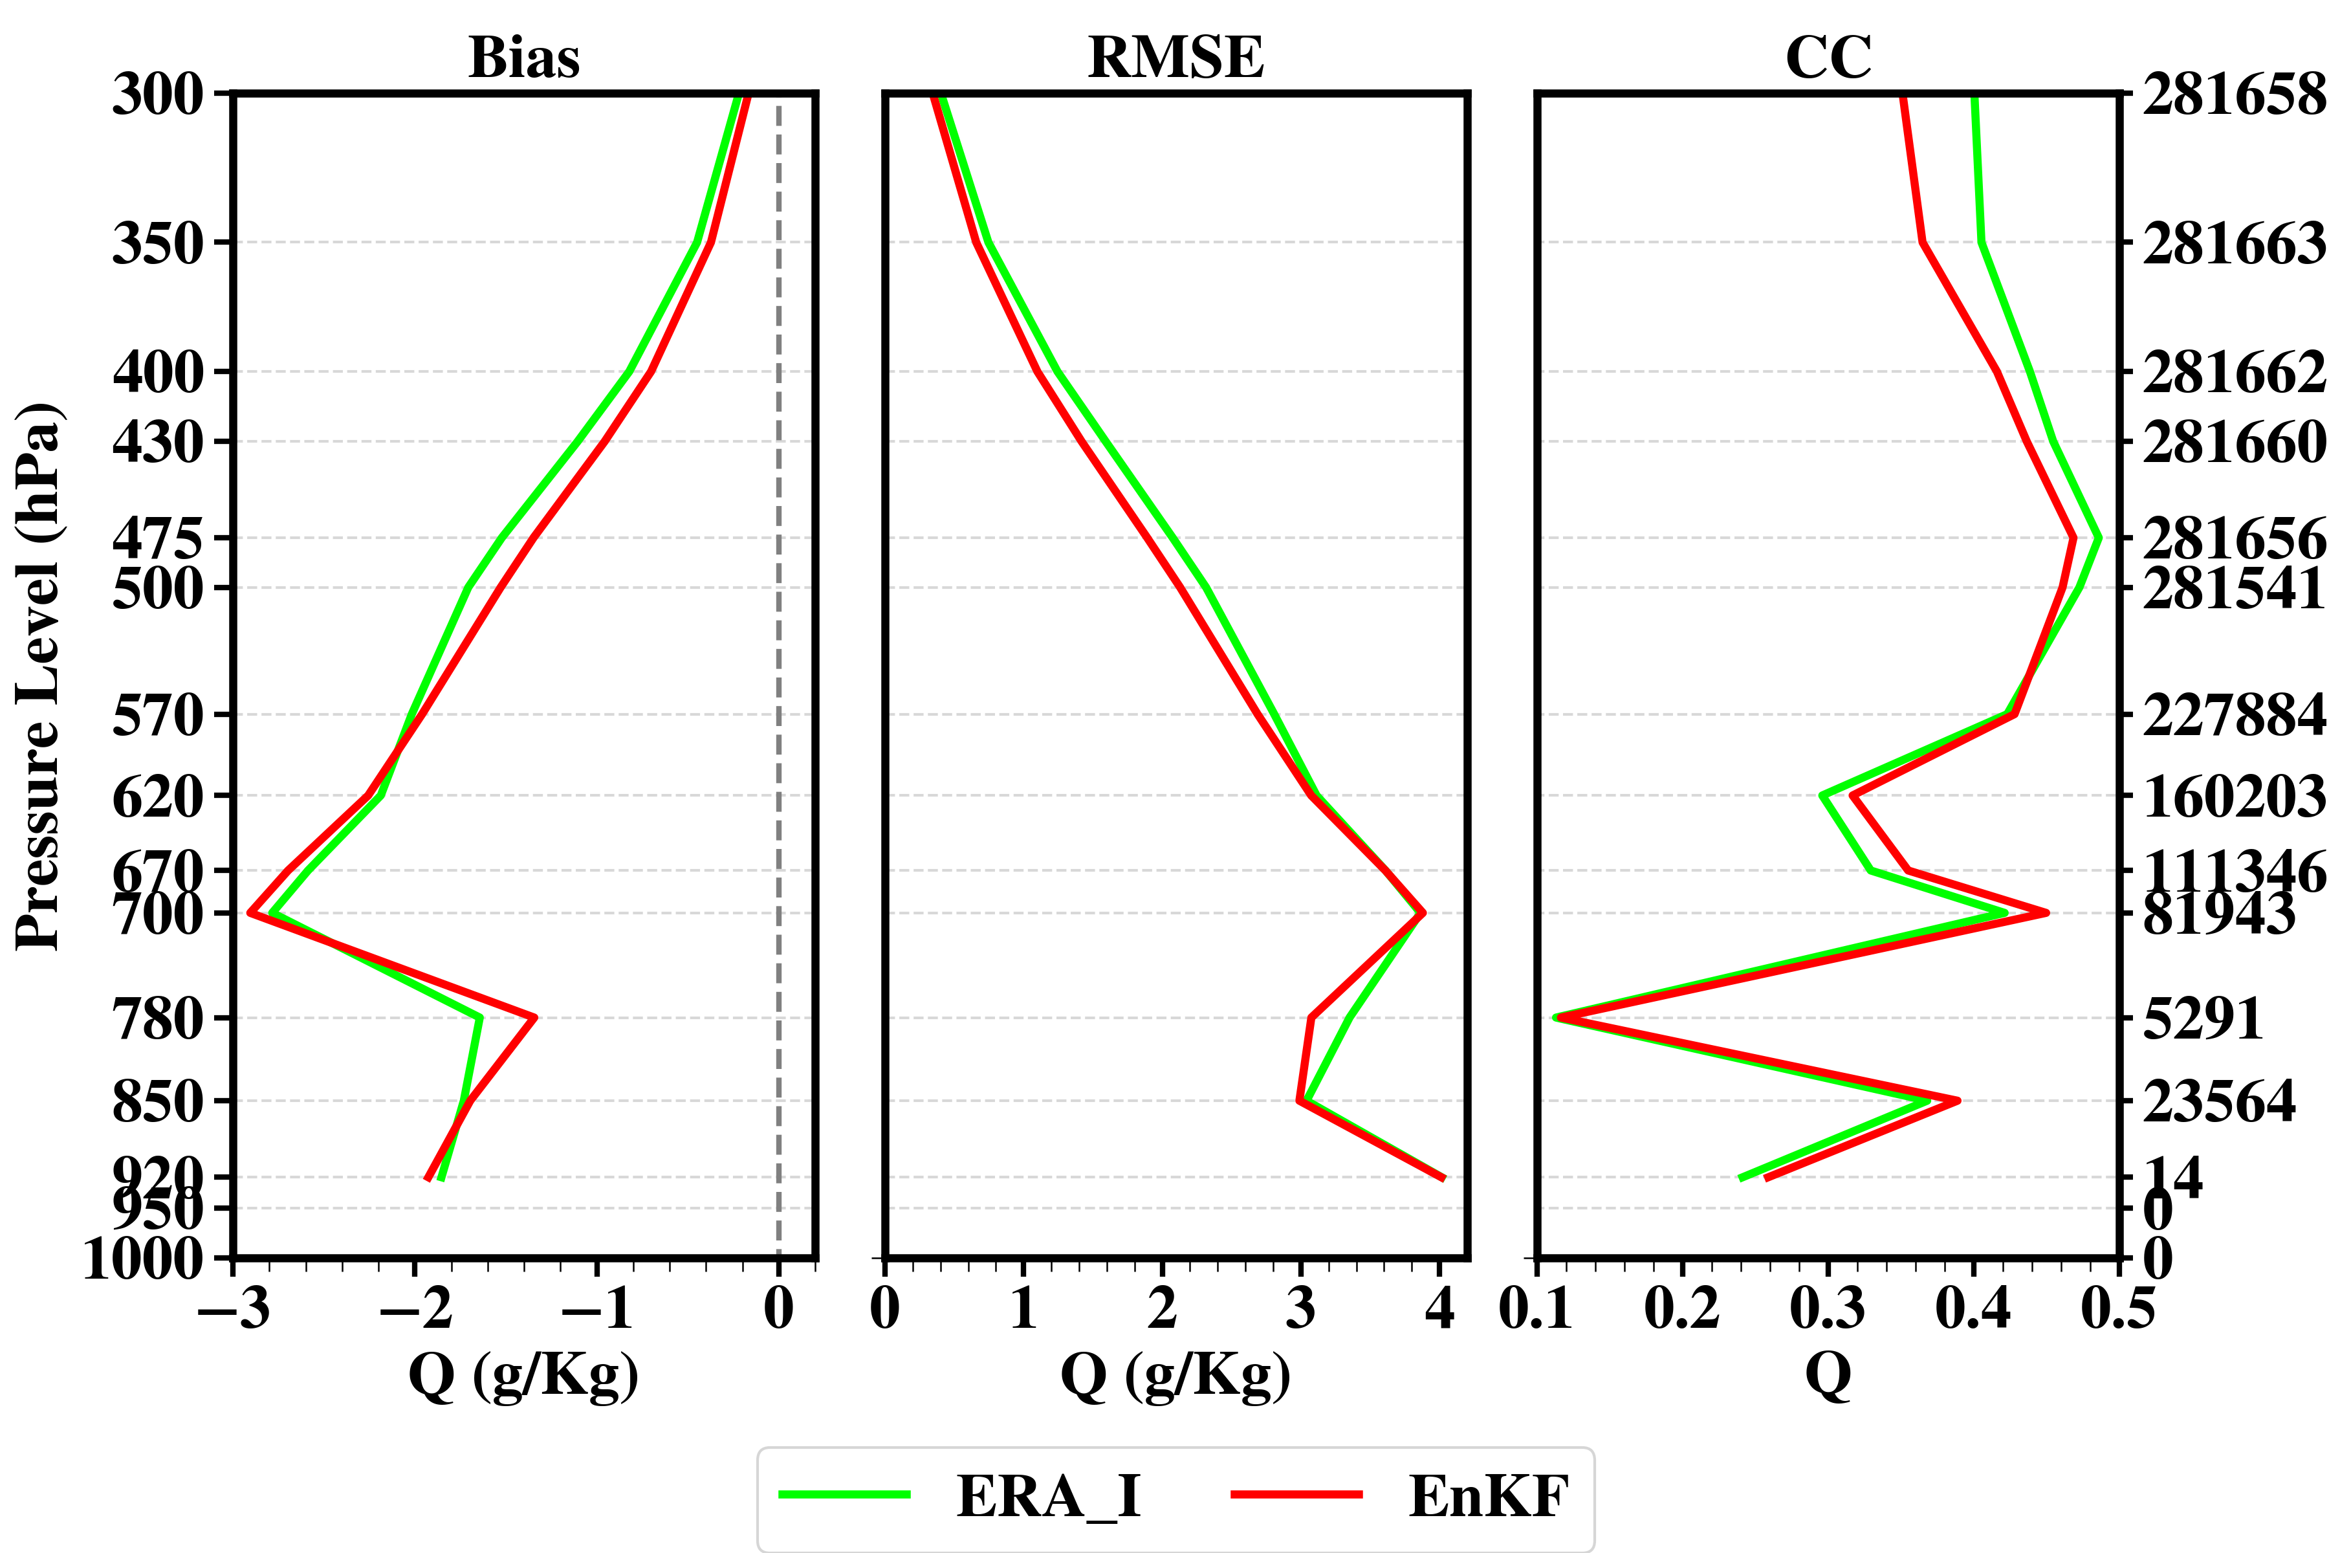
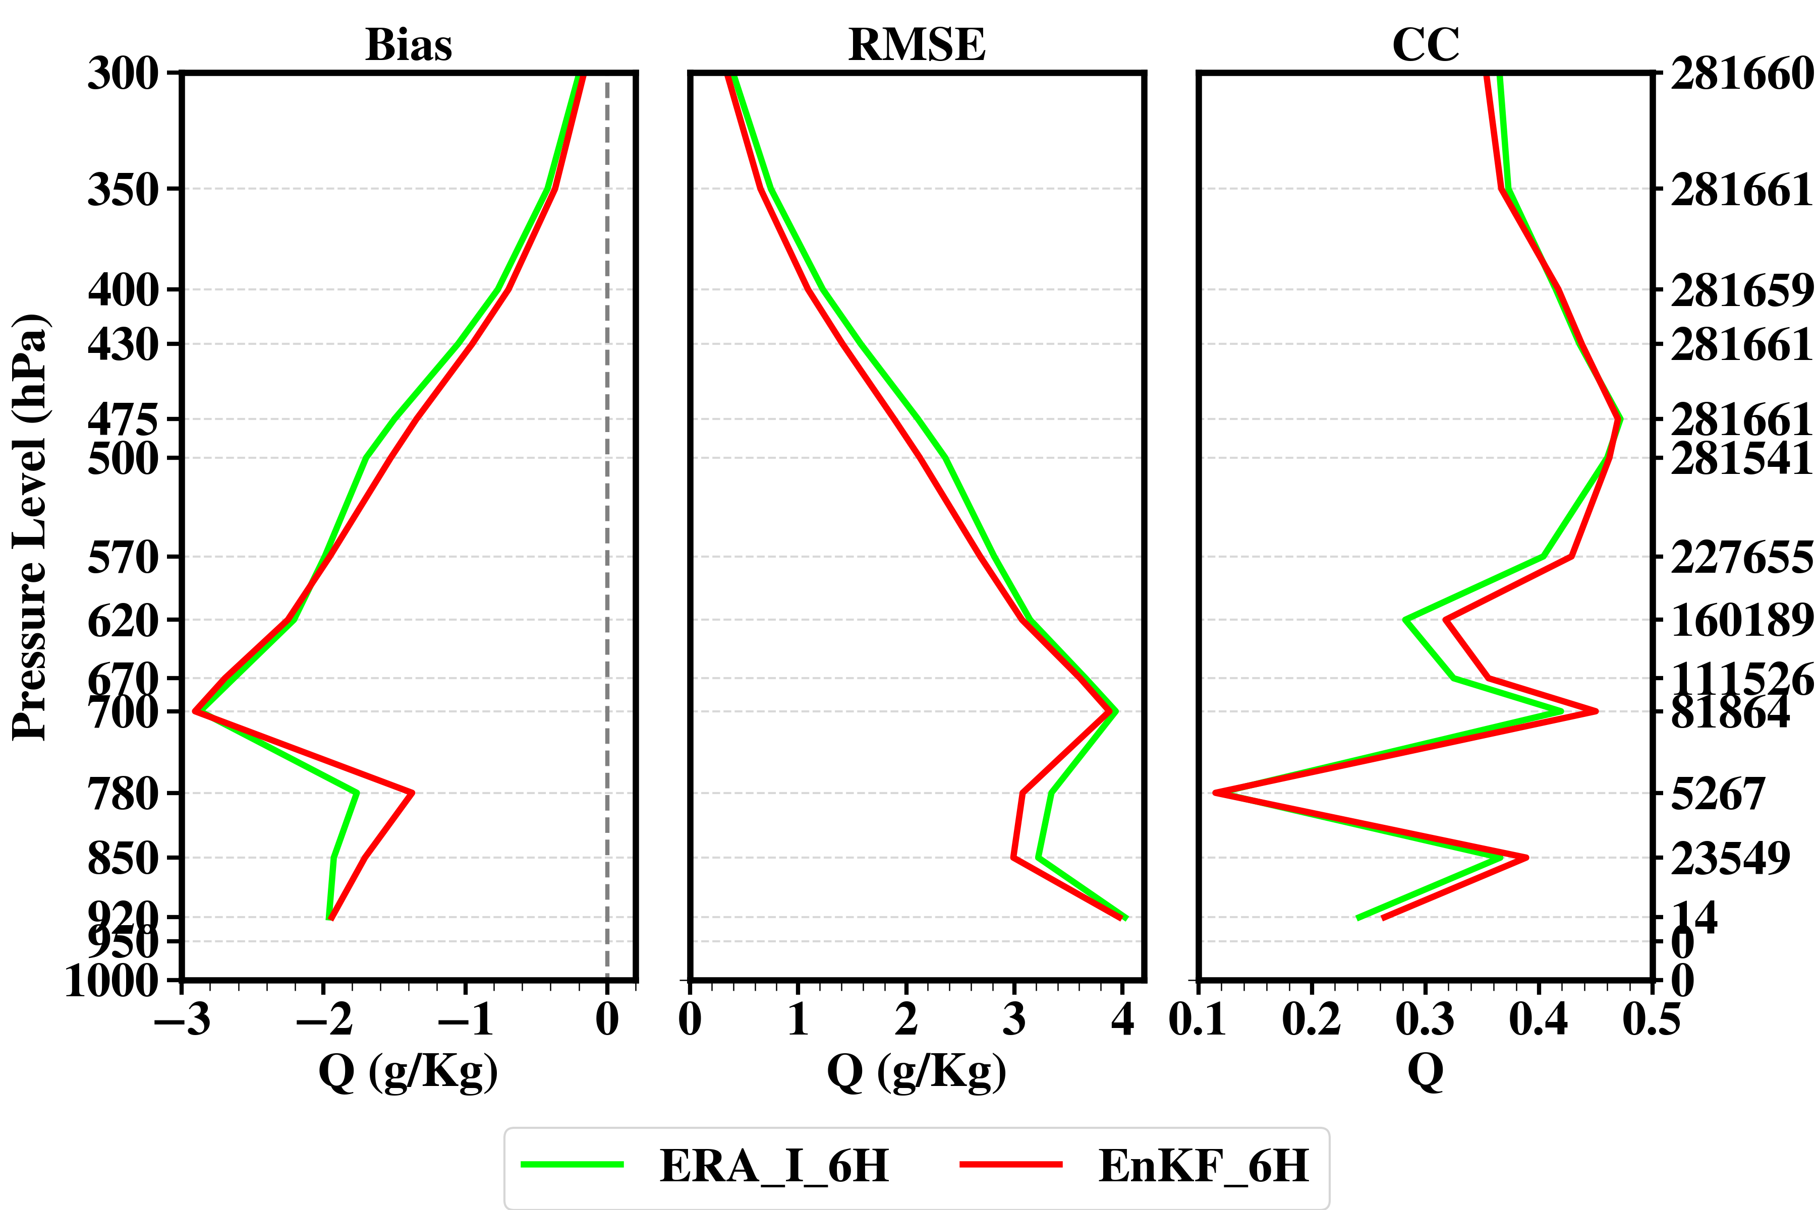
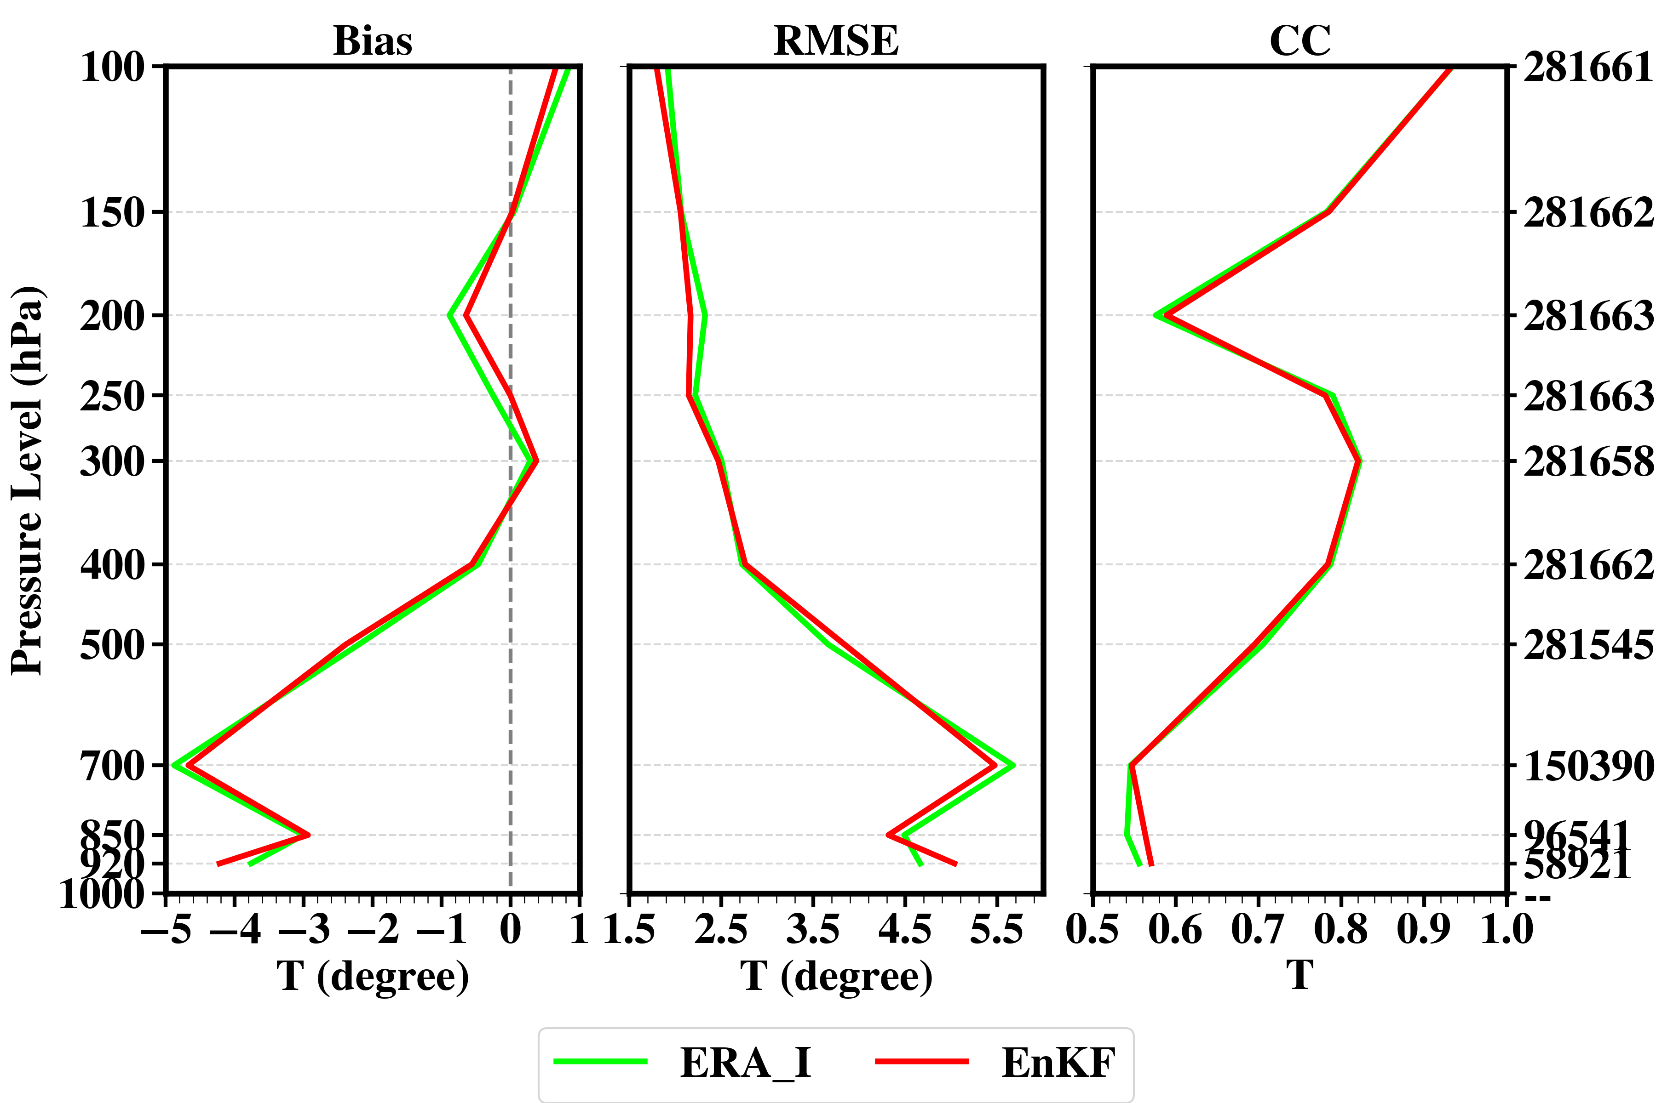
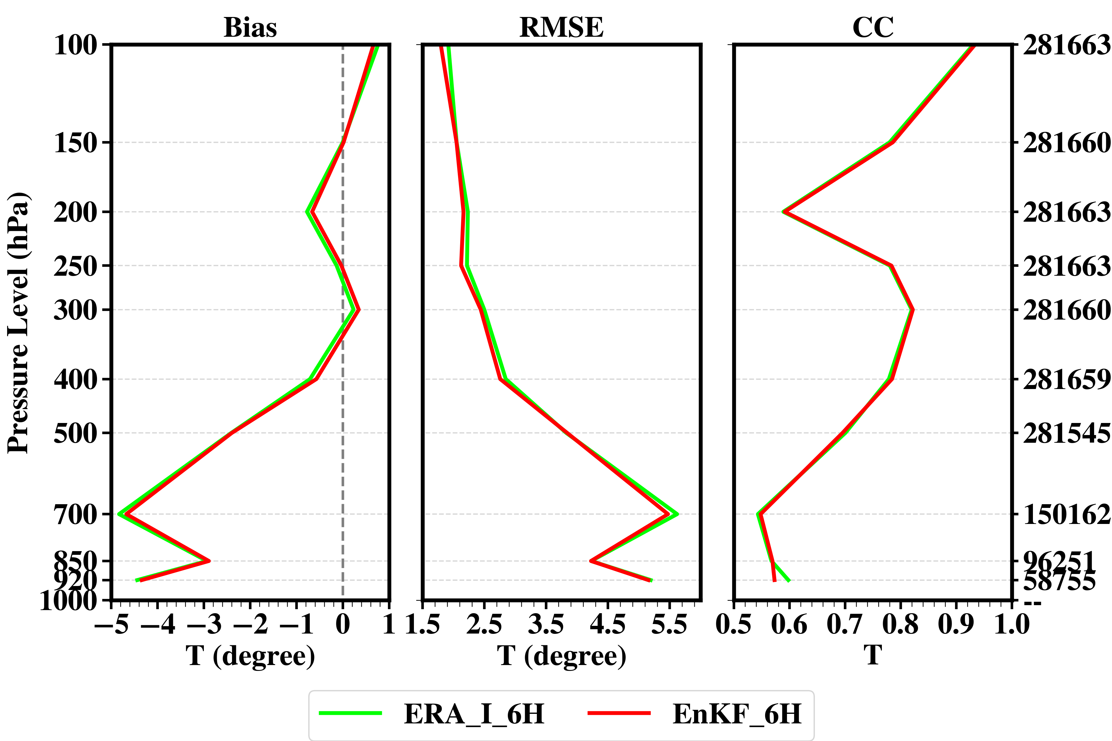
Specific Humidity
Temperature
Analysis
Forecast (6 h )
Analysis
Forecast (6 h )
MetopA
MetopB
NOAA19
Verify with ATOVSL2 sounding observations
MetopA/B (06, 12 UTC) , NOAA19 (06, 18 UTC)

Slide 7
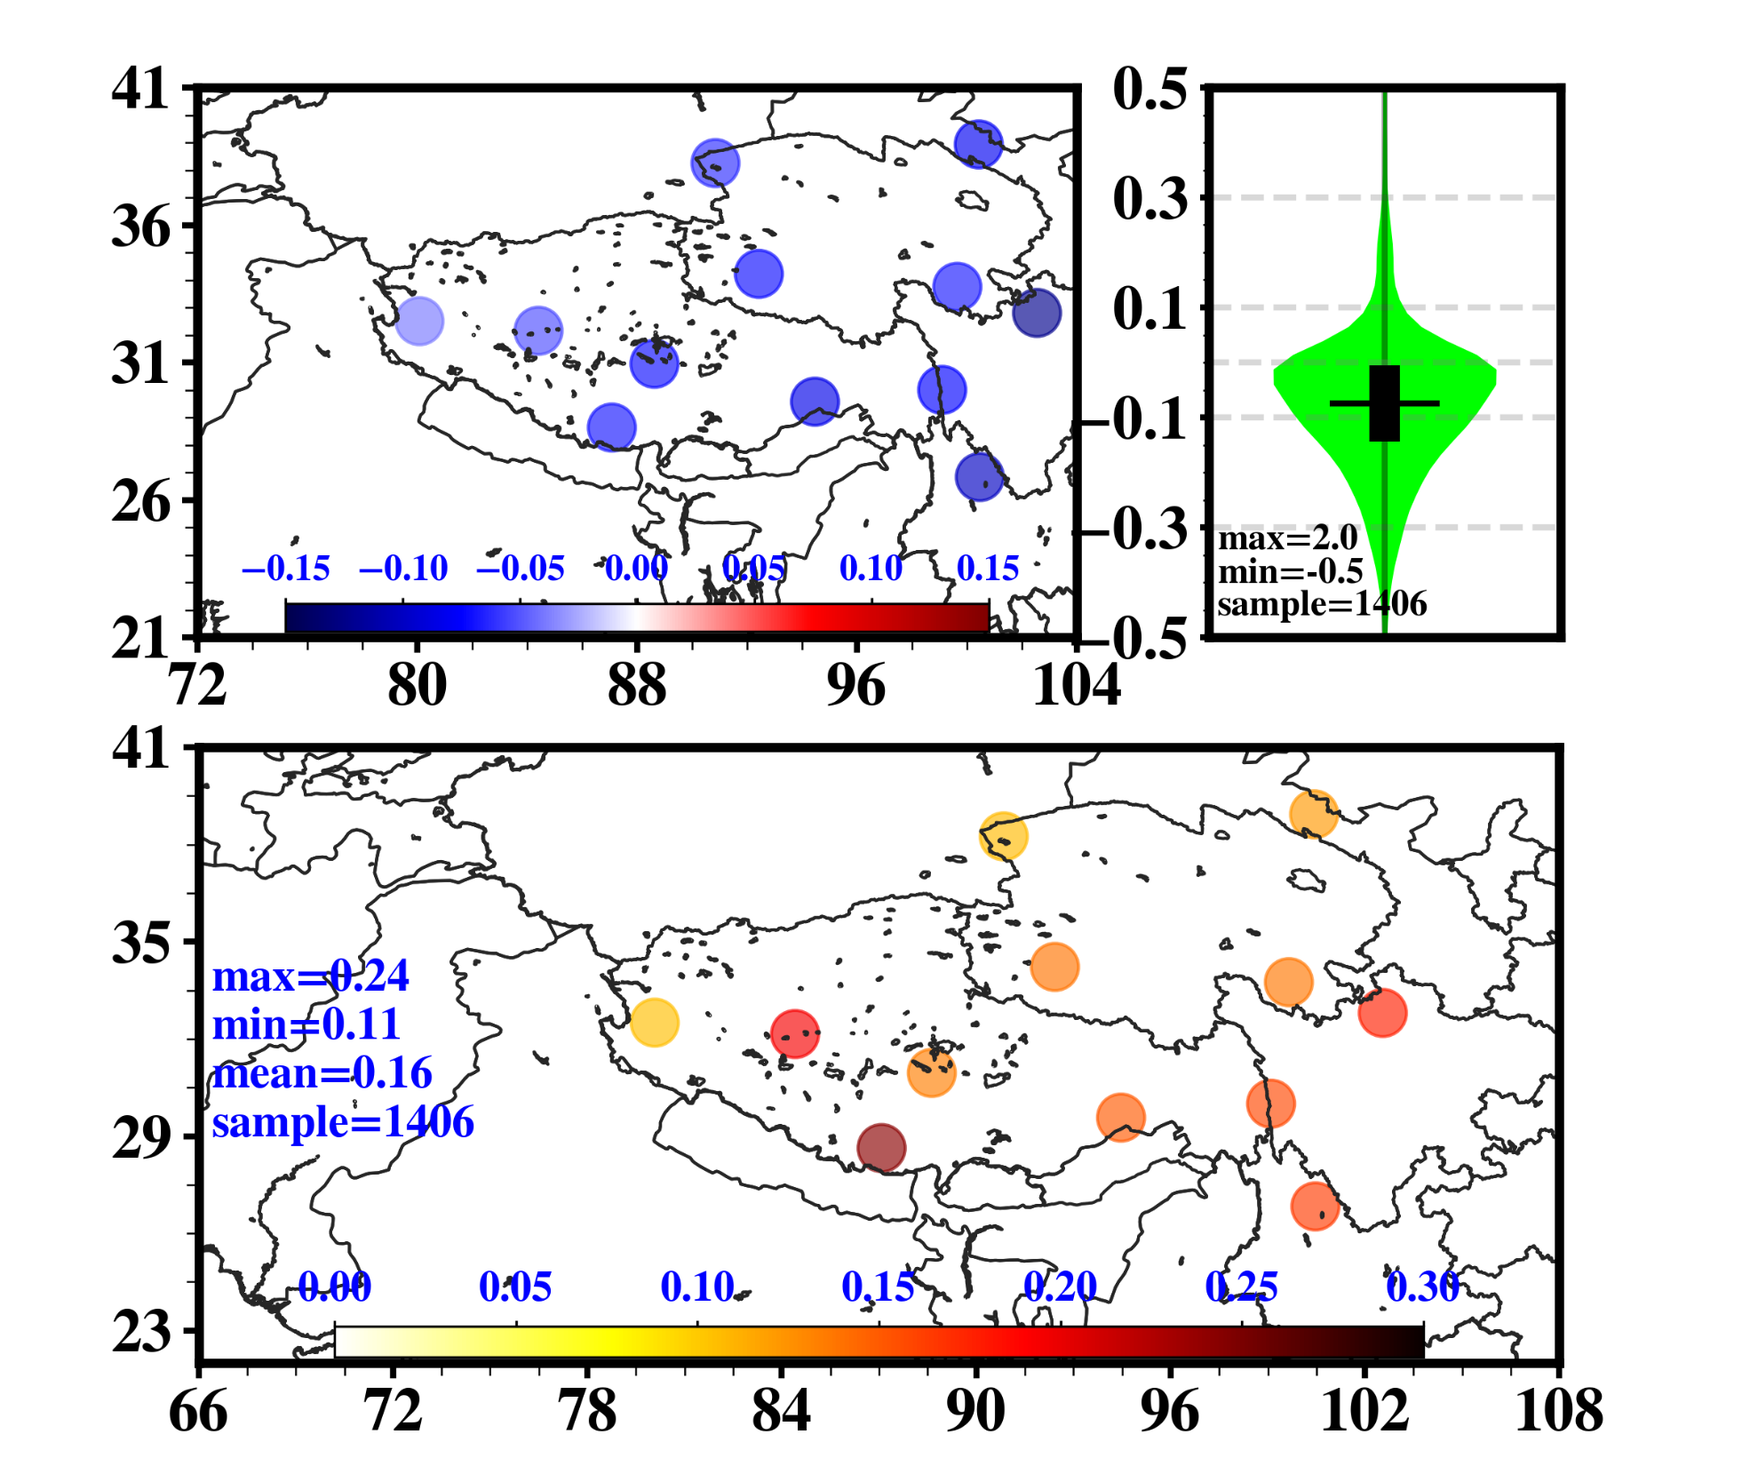
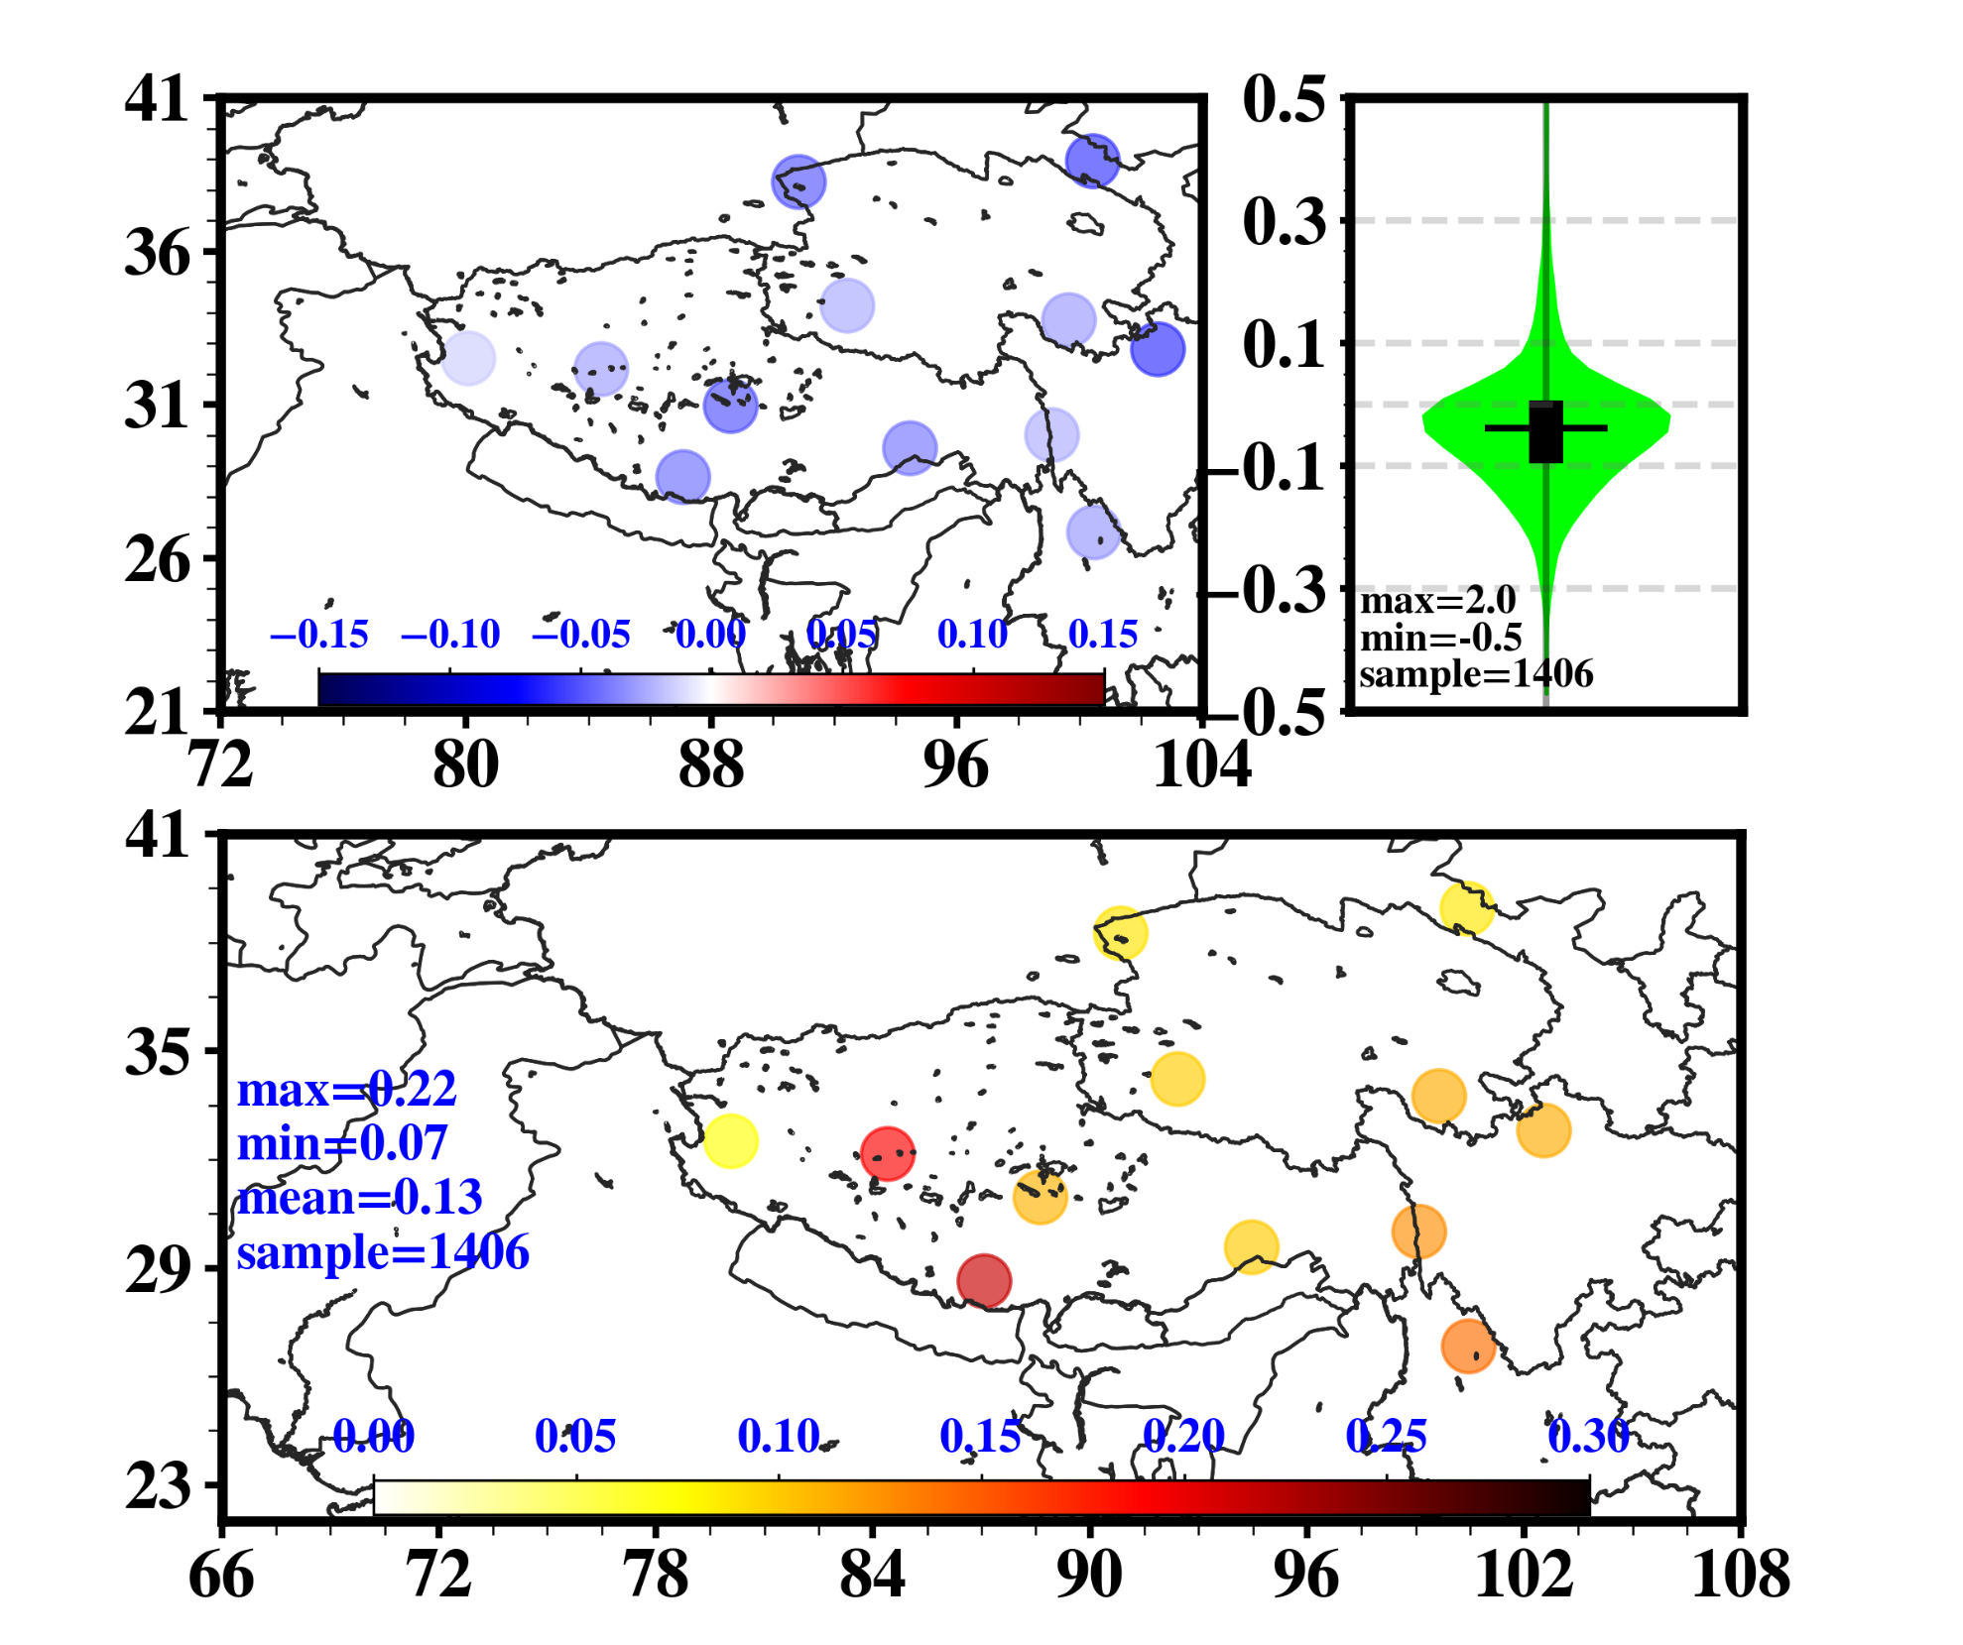
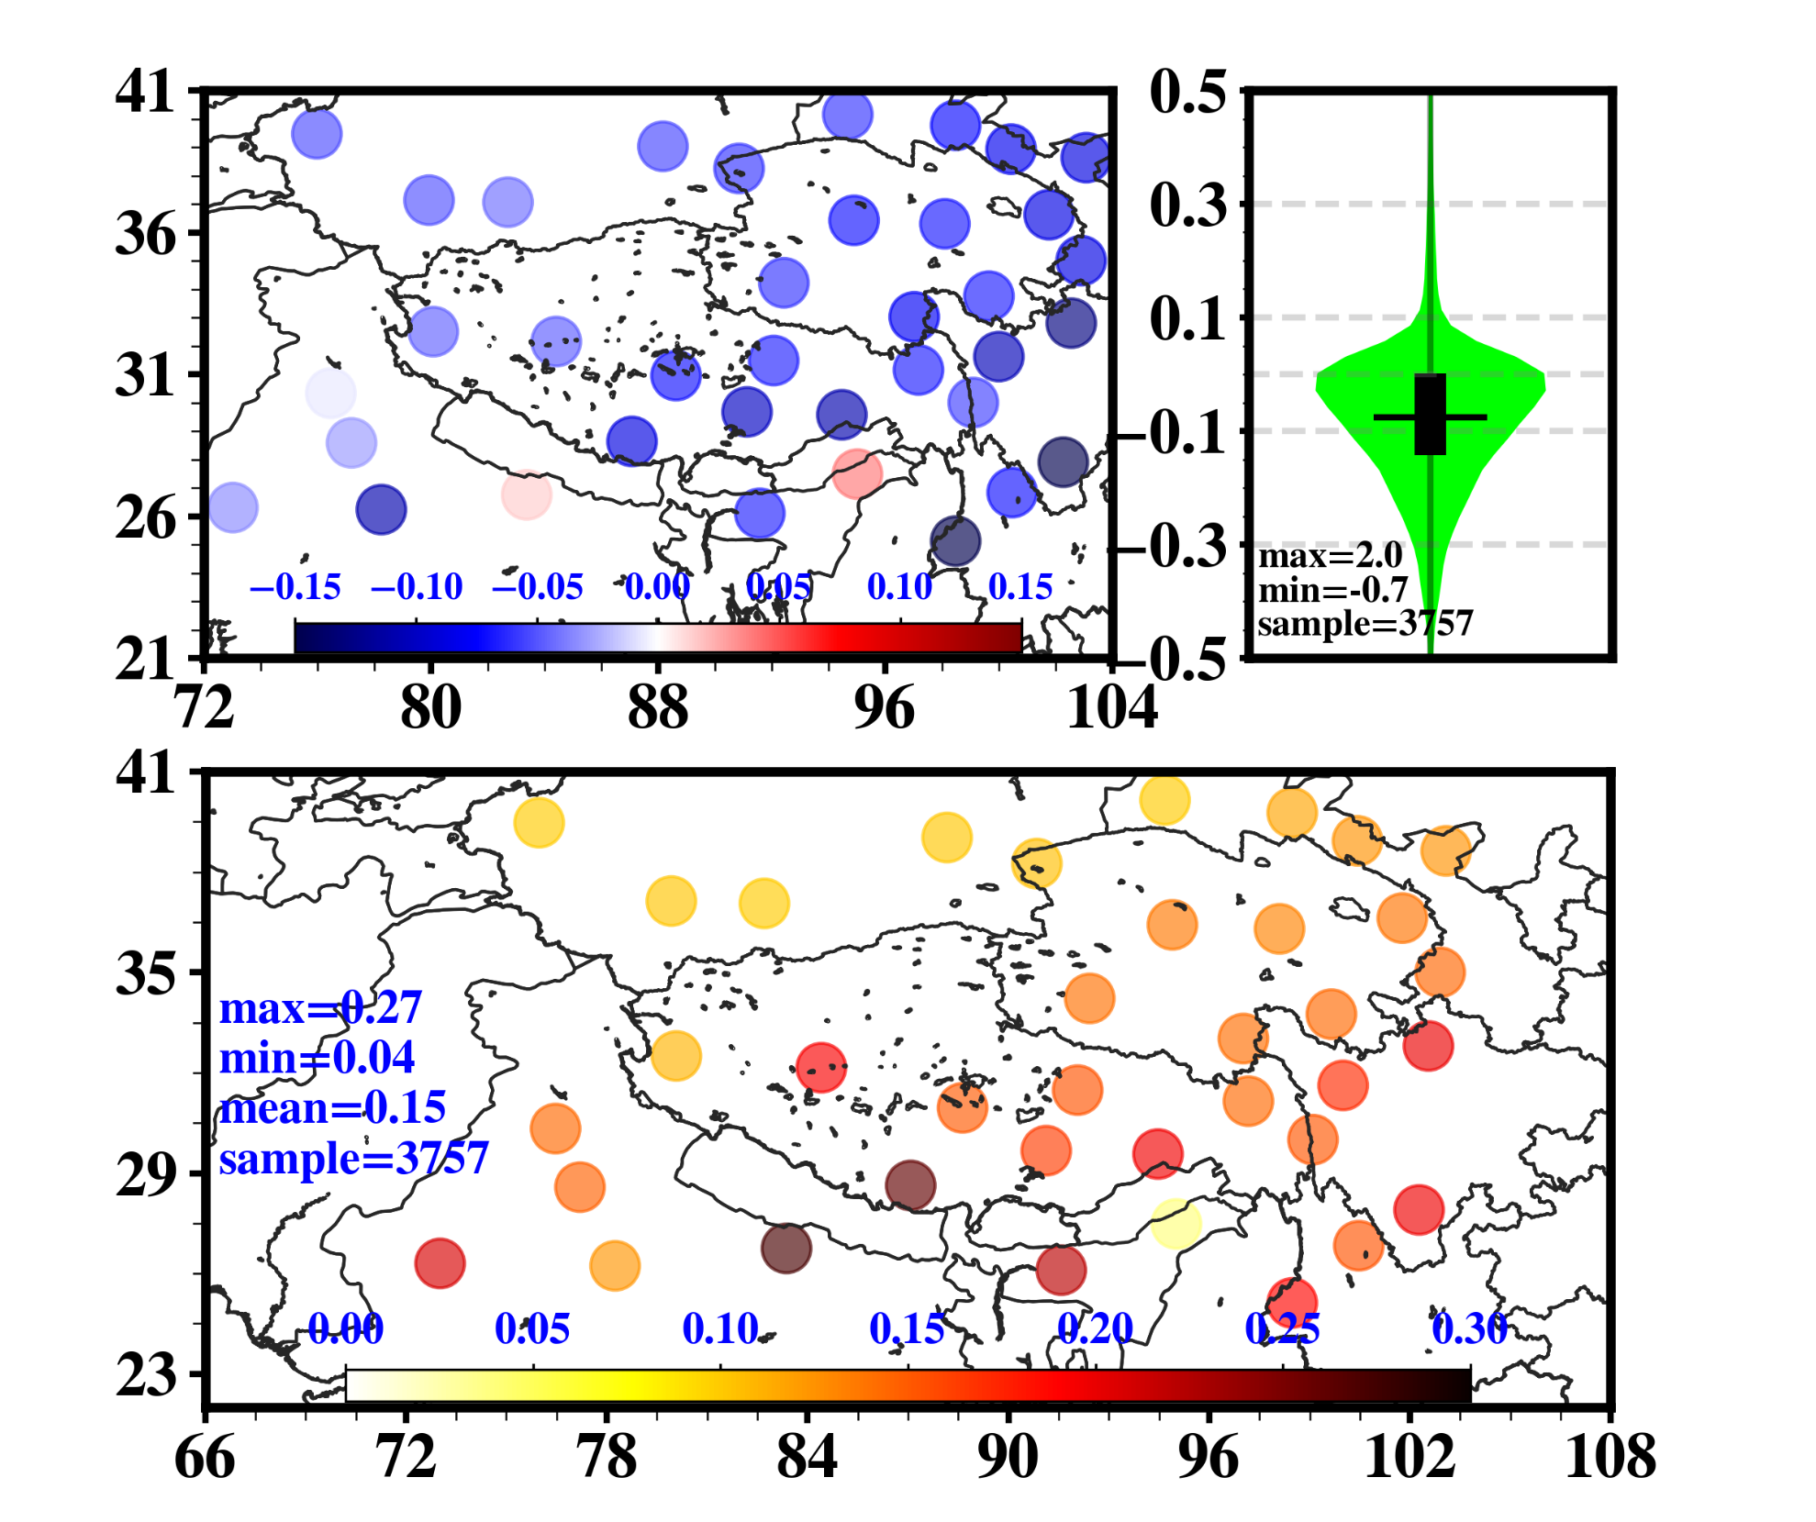
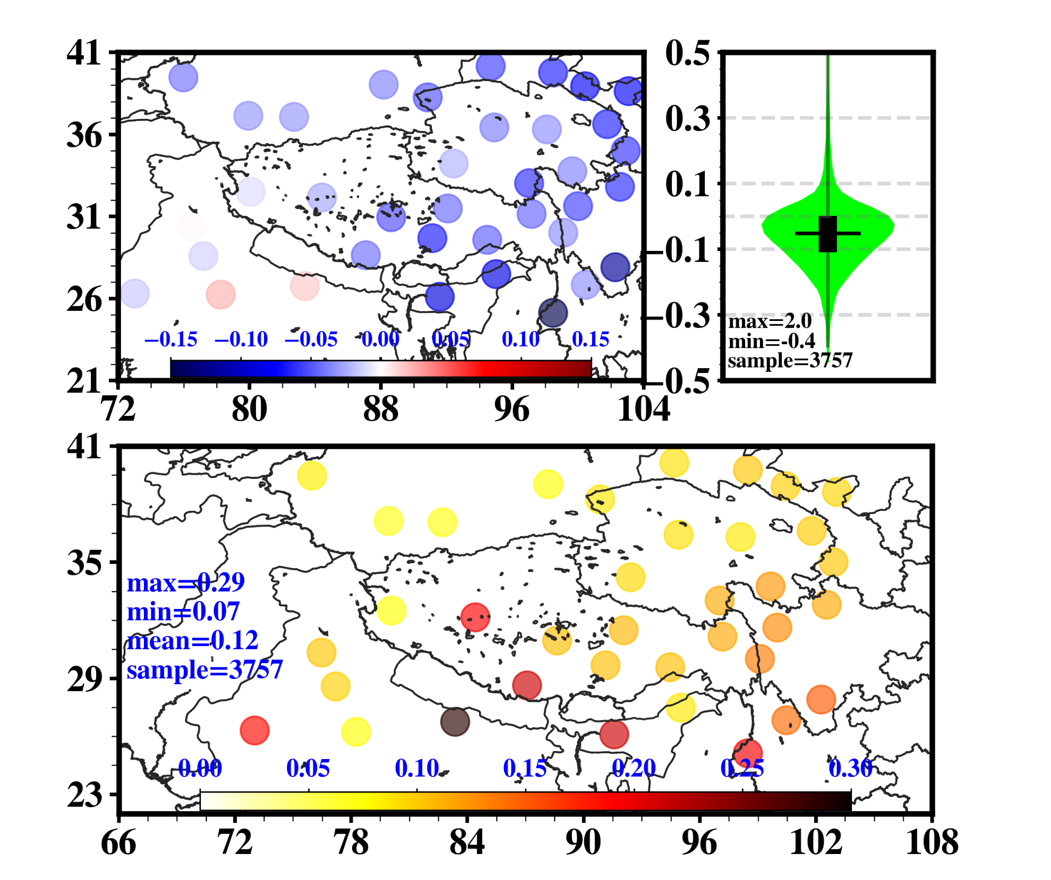
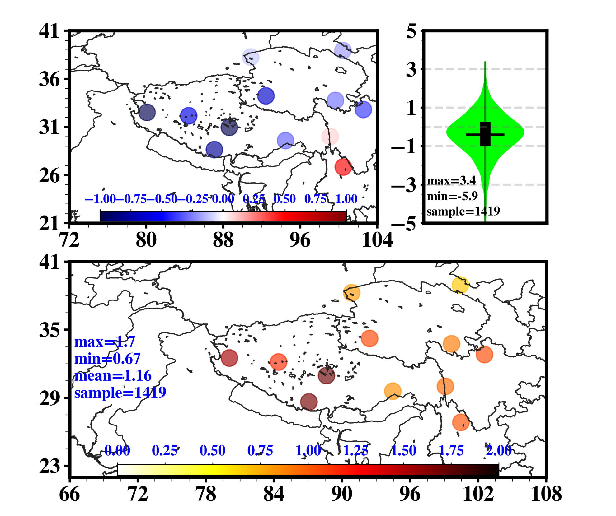
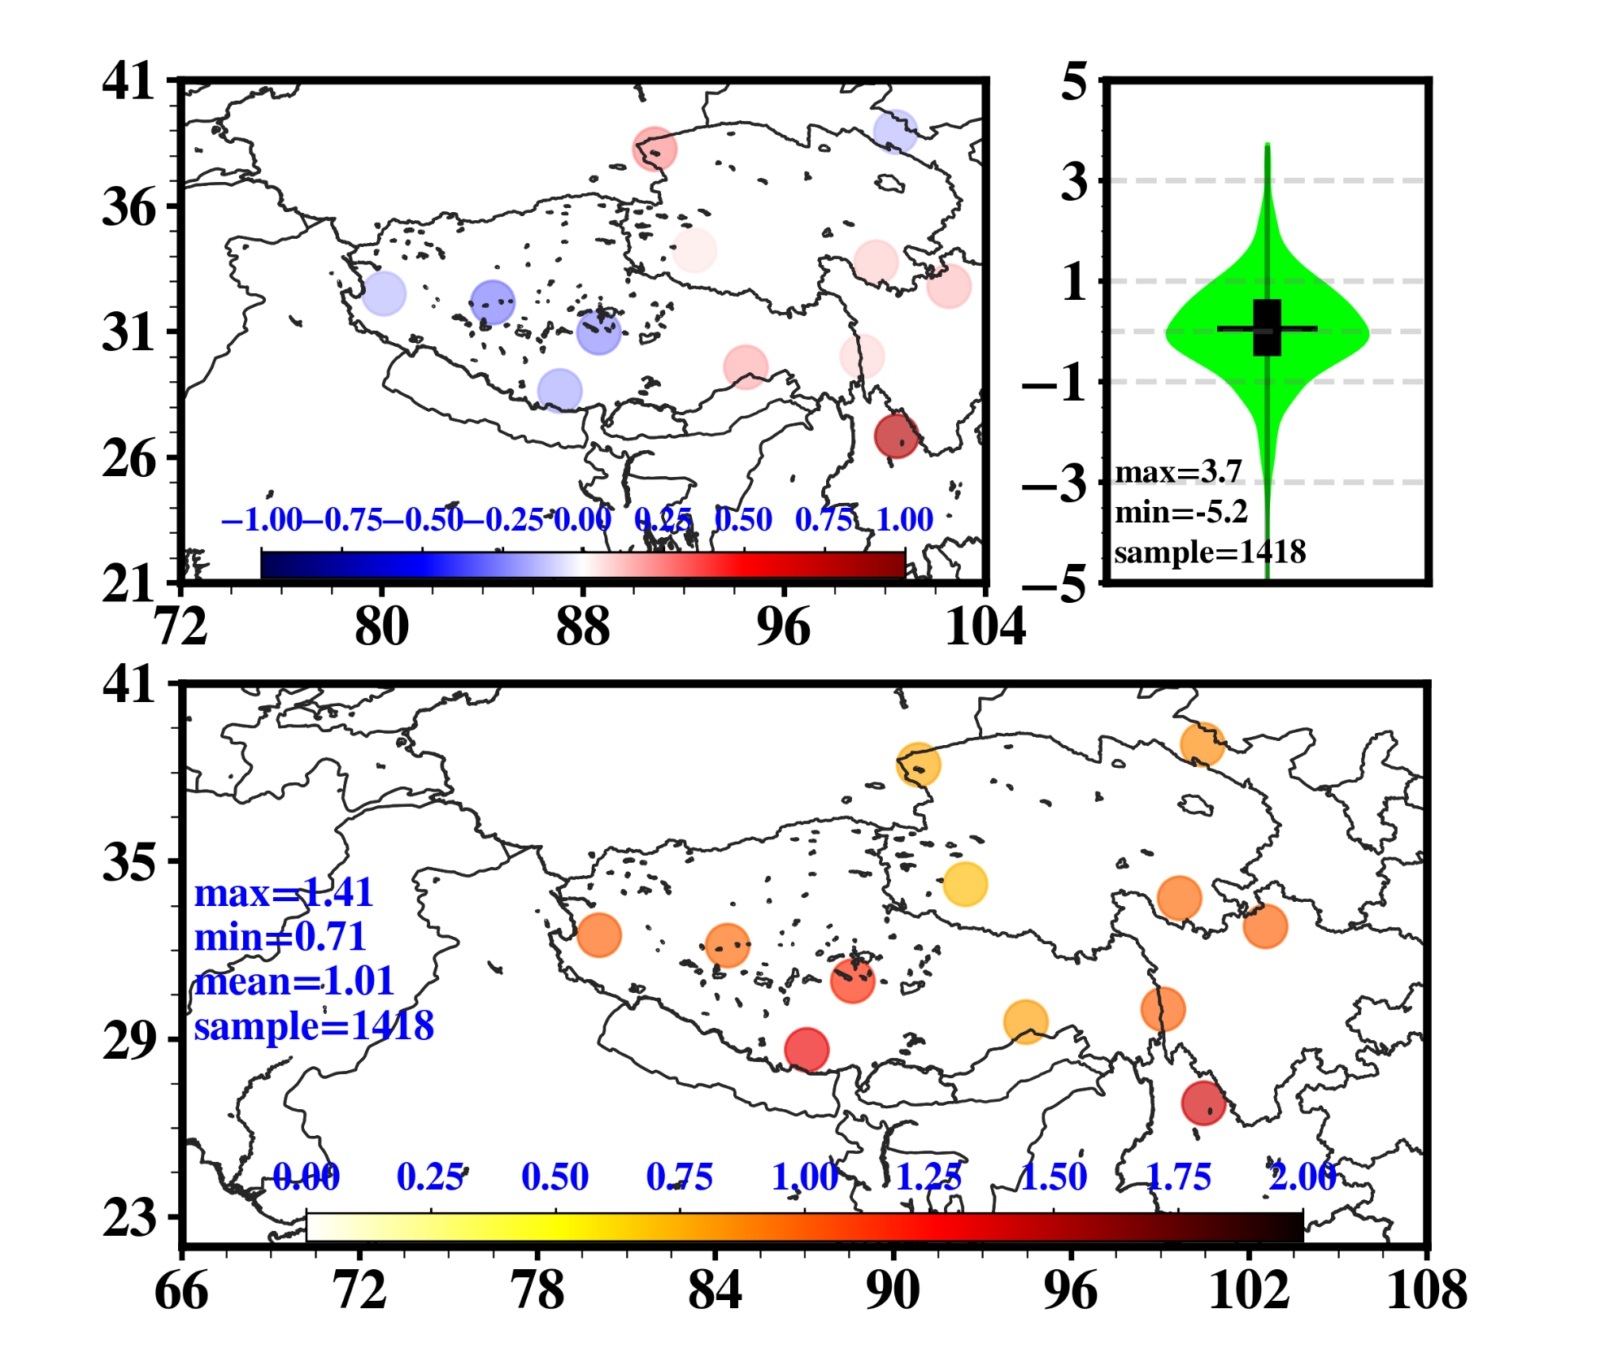
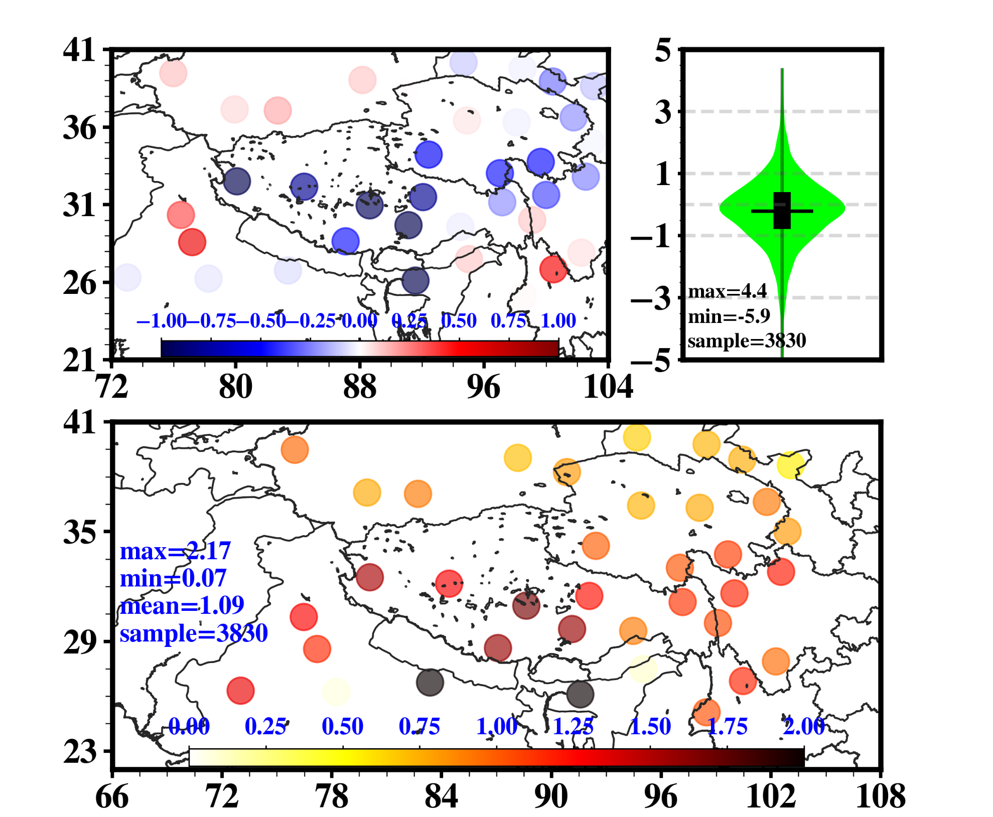
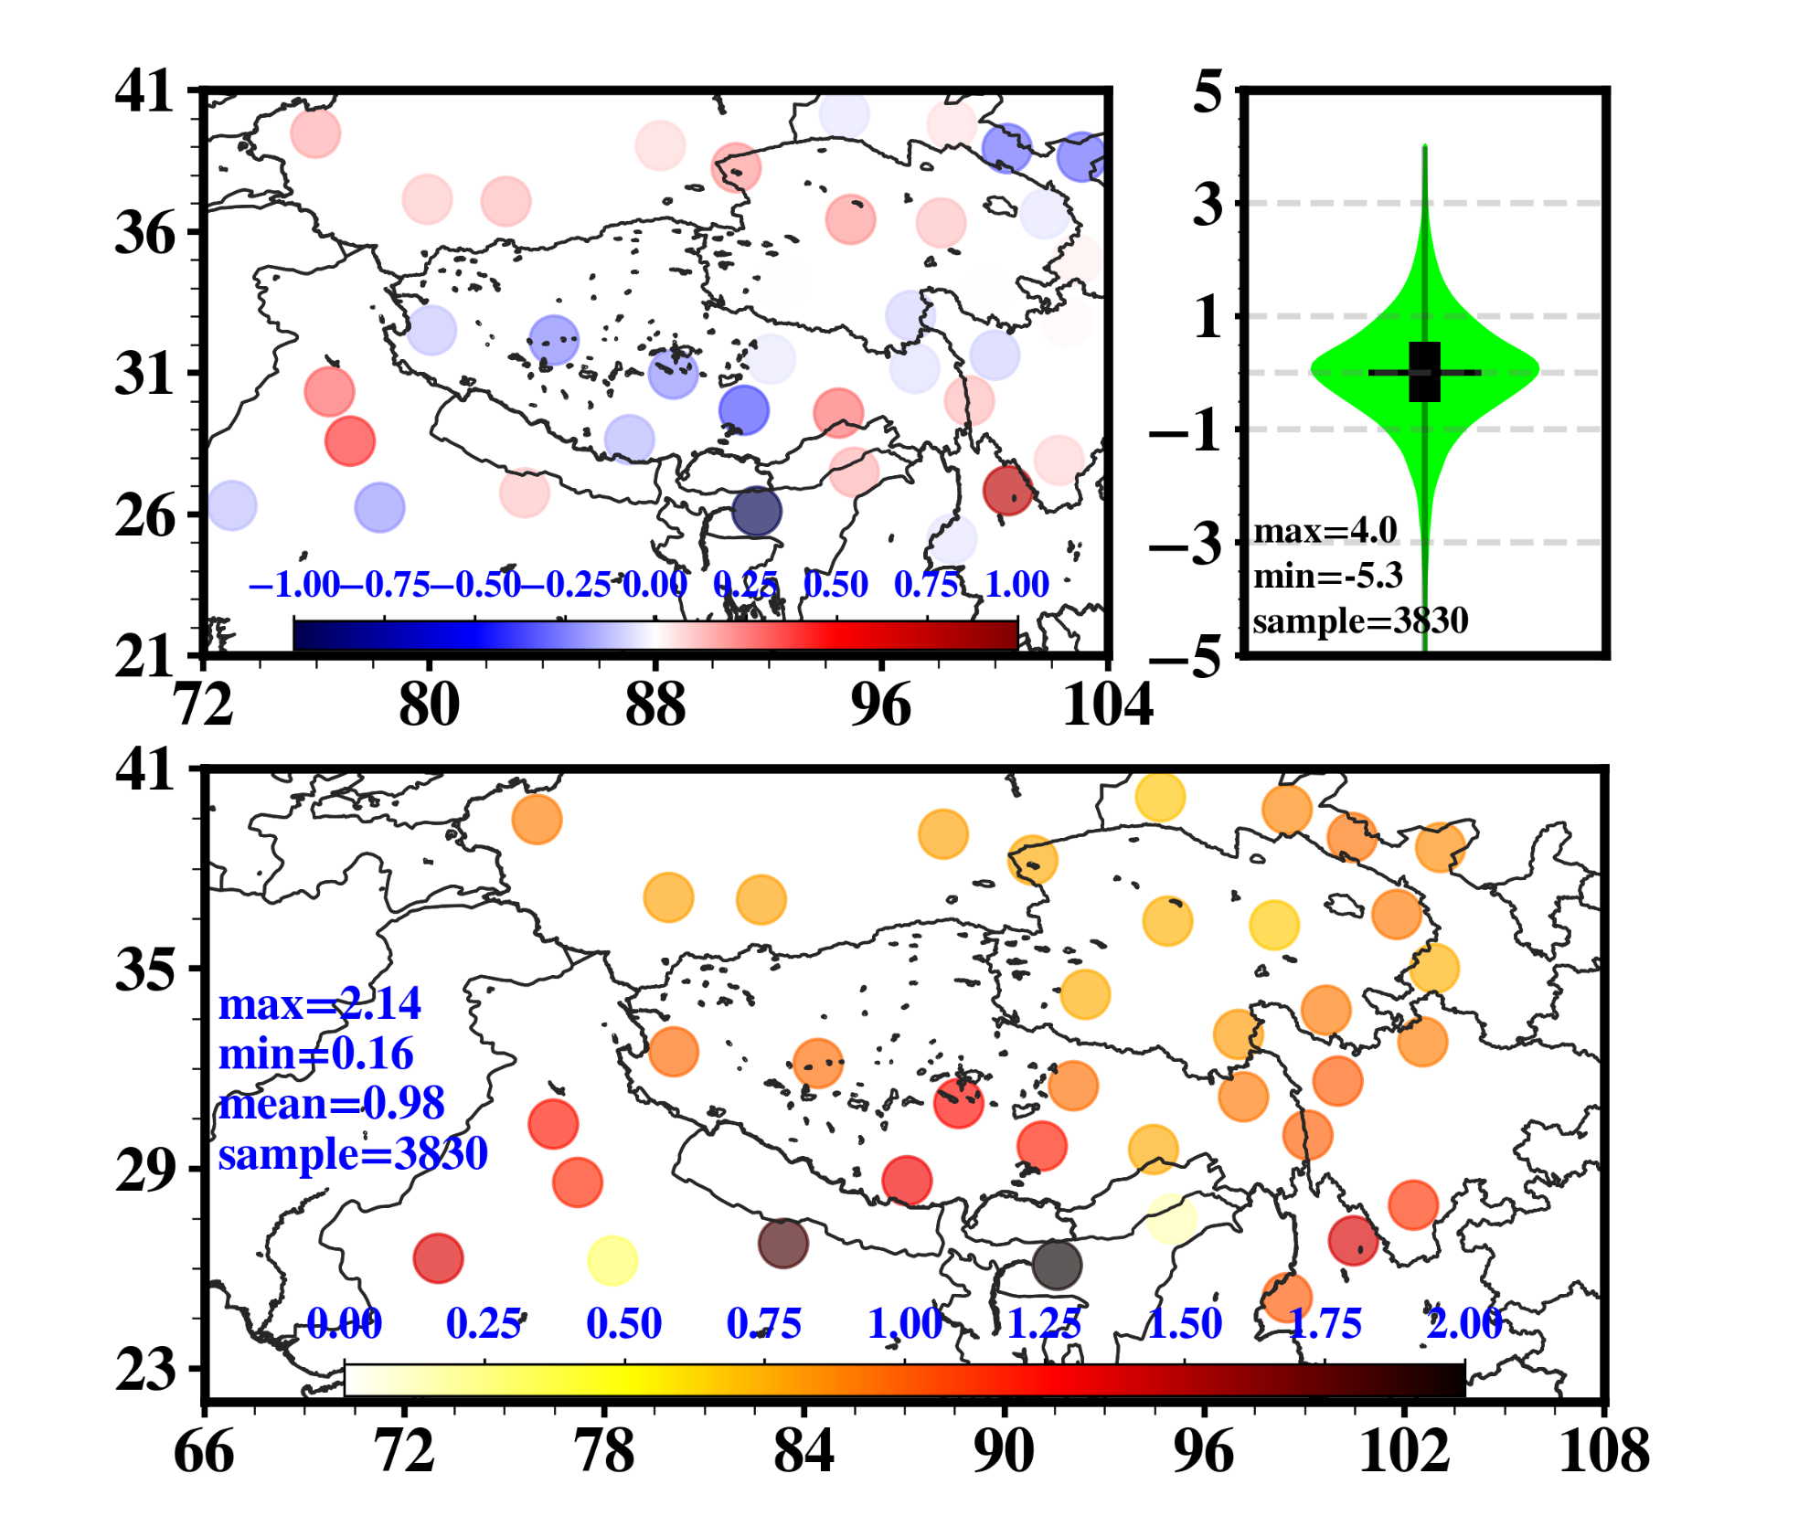
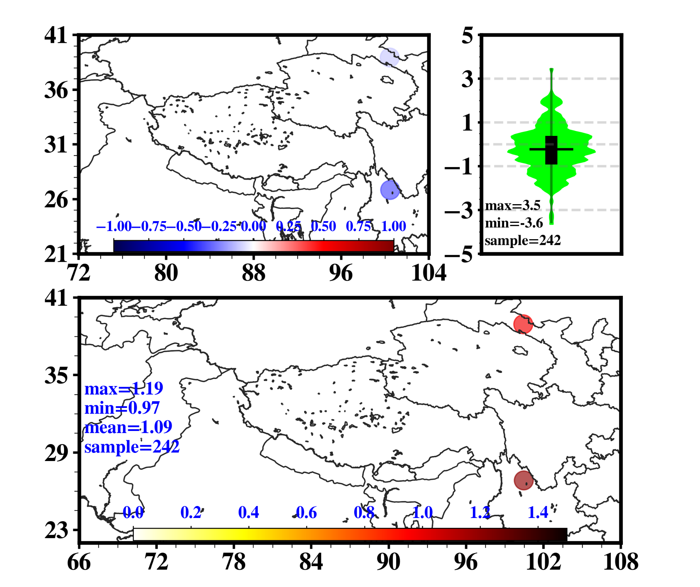
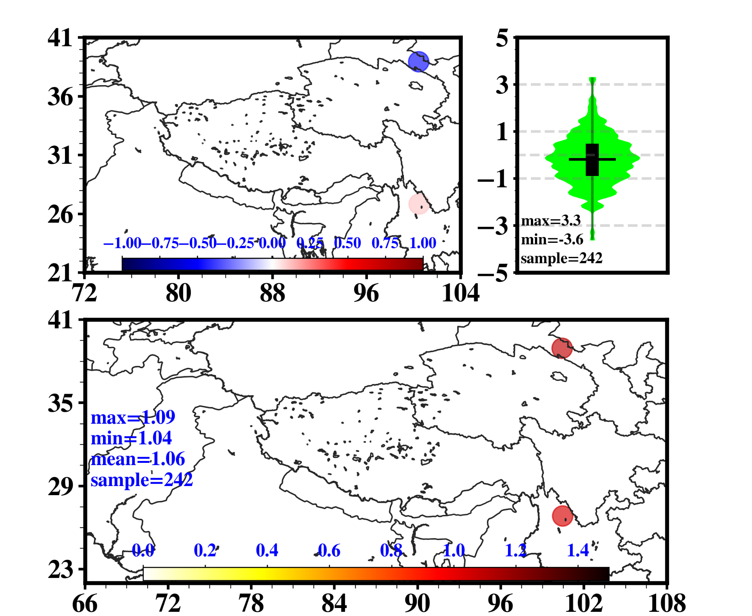
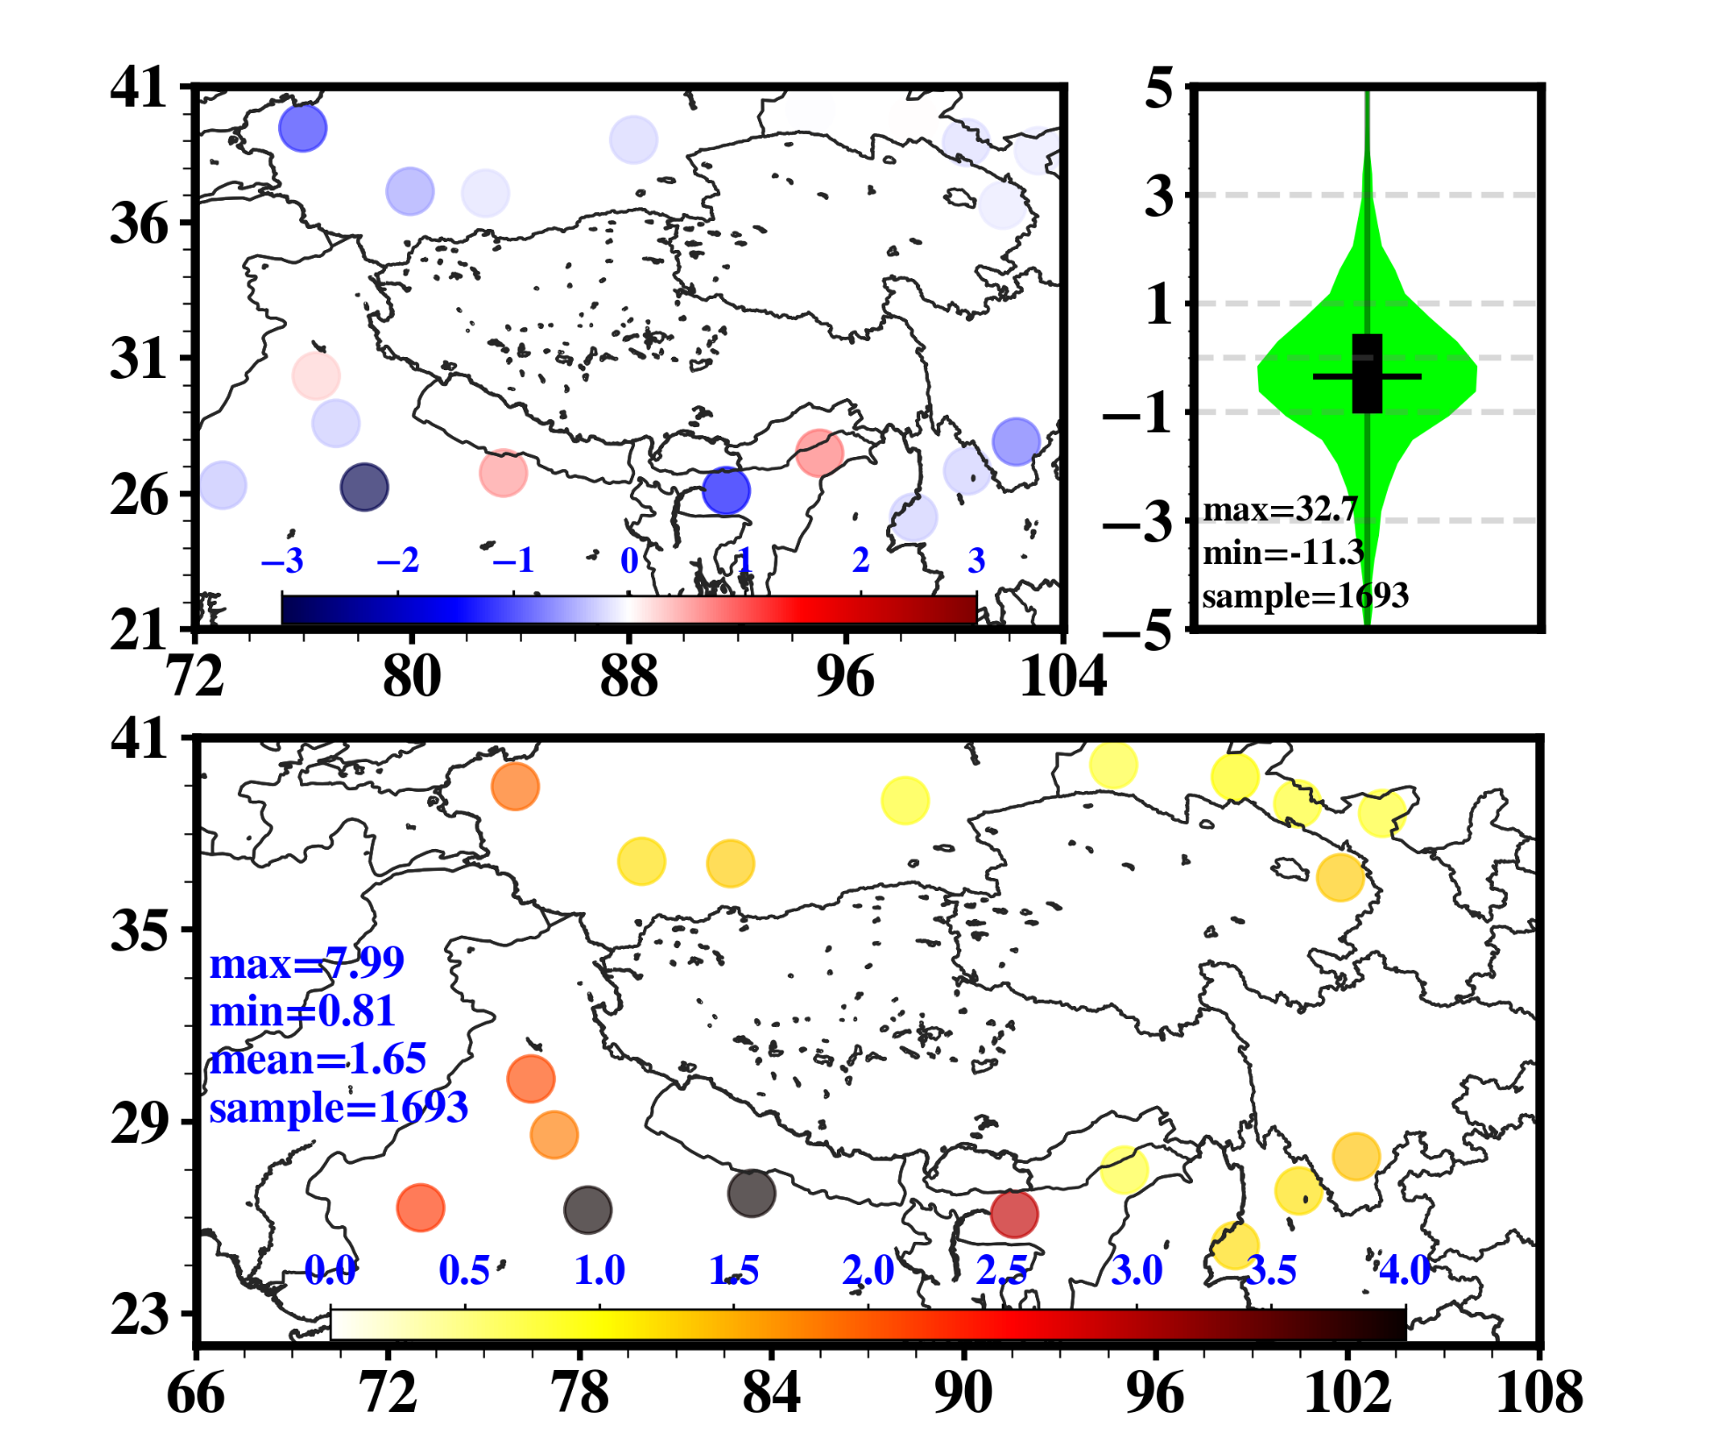
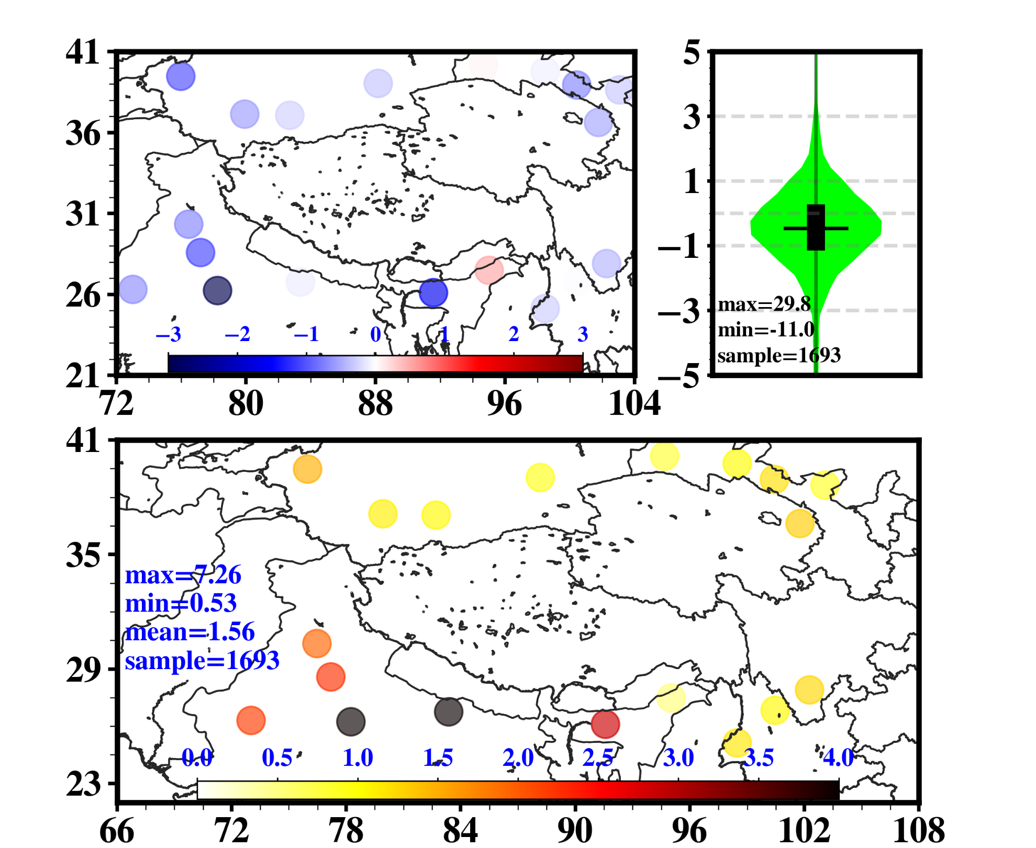
Analysis
Forecast (6 h )
ERA-Interim
EnKF
ERA-Interim
EnKF
250 hPa
500 hPa
700 hPa
Bias (upper left) , Bias distribution (upper right) and RMSEs (bottom) of specific humidity at each station.
The distributions of Bias (violin) is difference between observations and two reanalysis

Slide 8
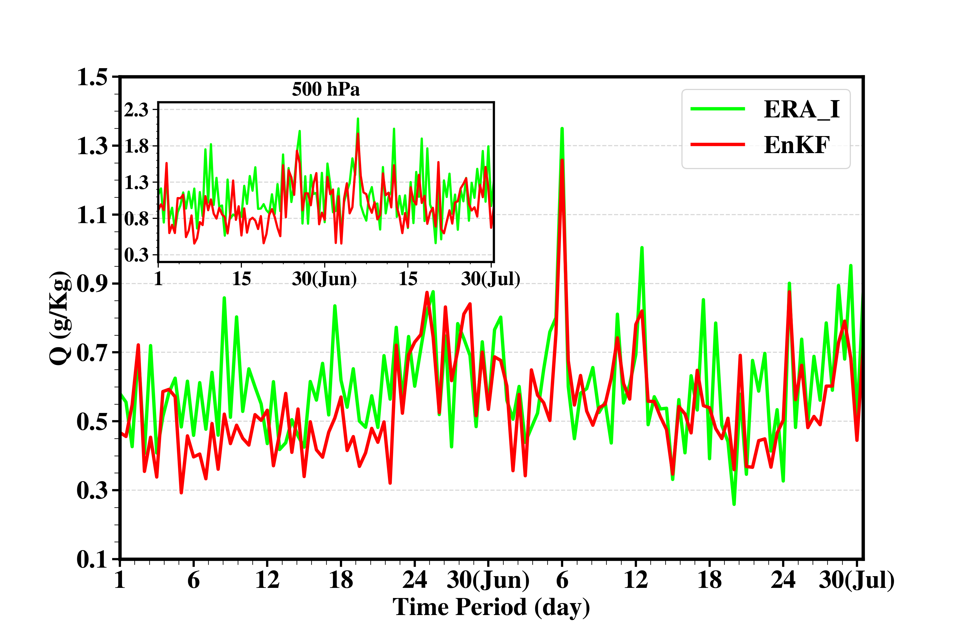
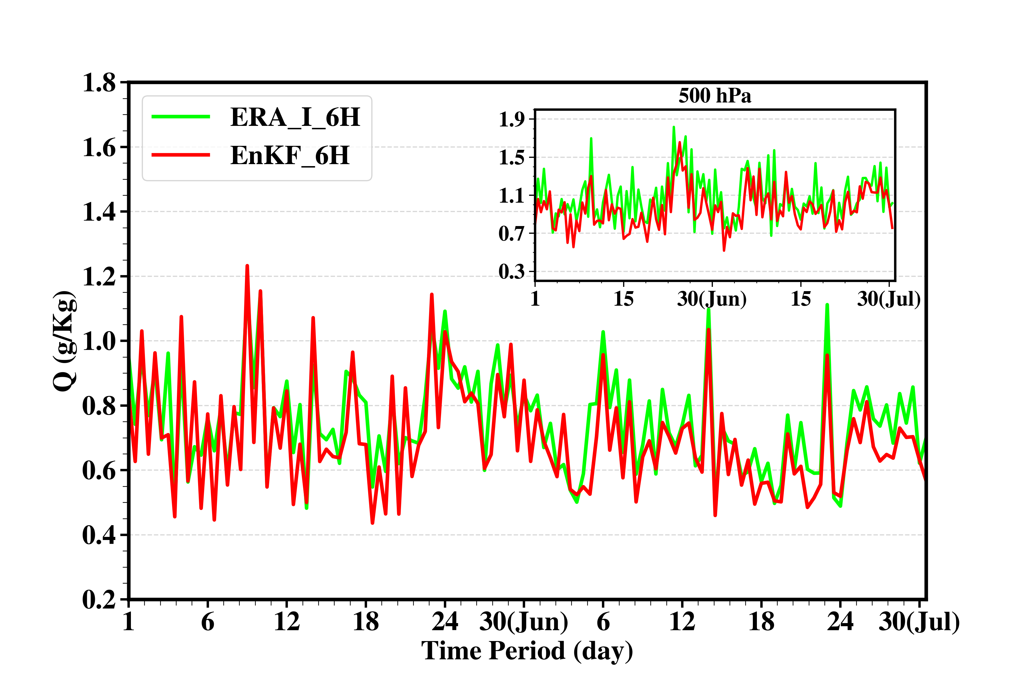
Analysis
Time evolution of the vertical averaged RMSEs of specific humidity during two months
The smaller plot represents 500 hPa.
Forecast

Slide 9
Downscale
From D01 (30 km) into D02 (10 km)
Run 12 hours forecasting
During June, 2015

Slide 10
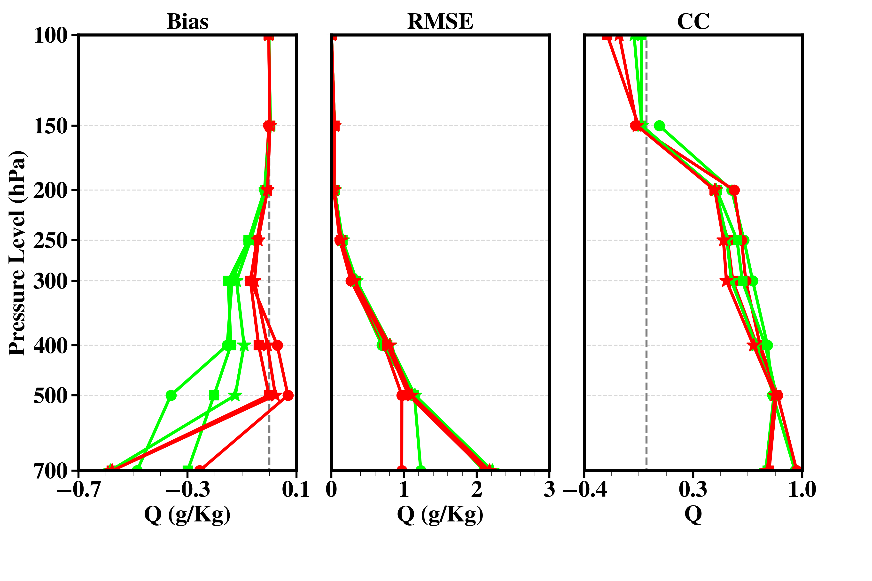
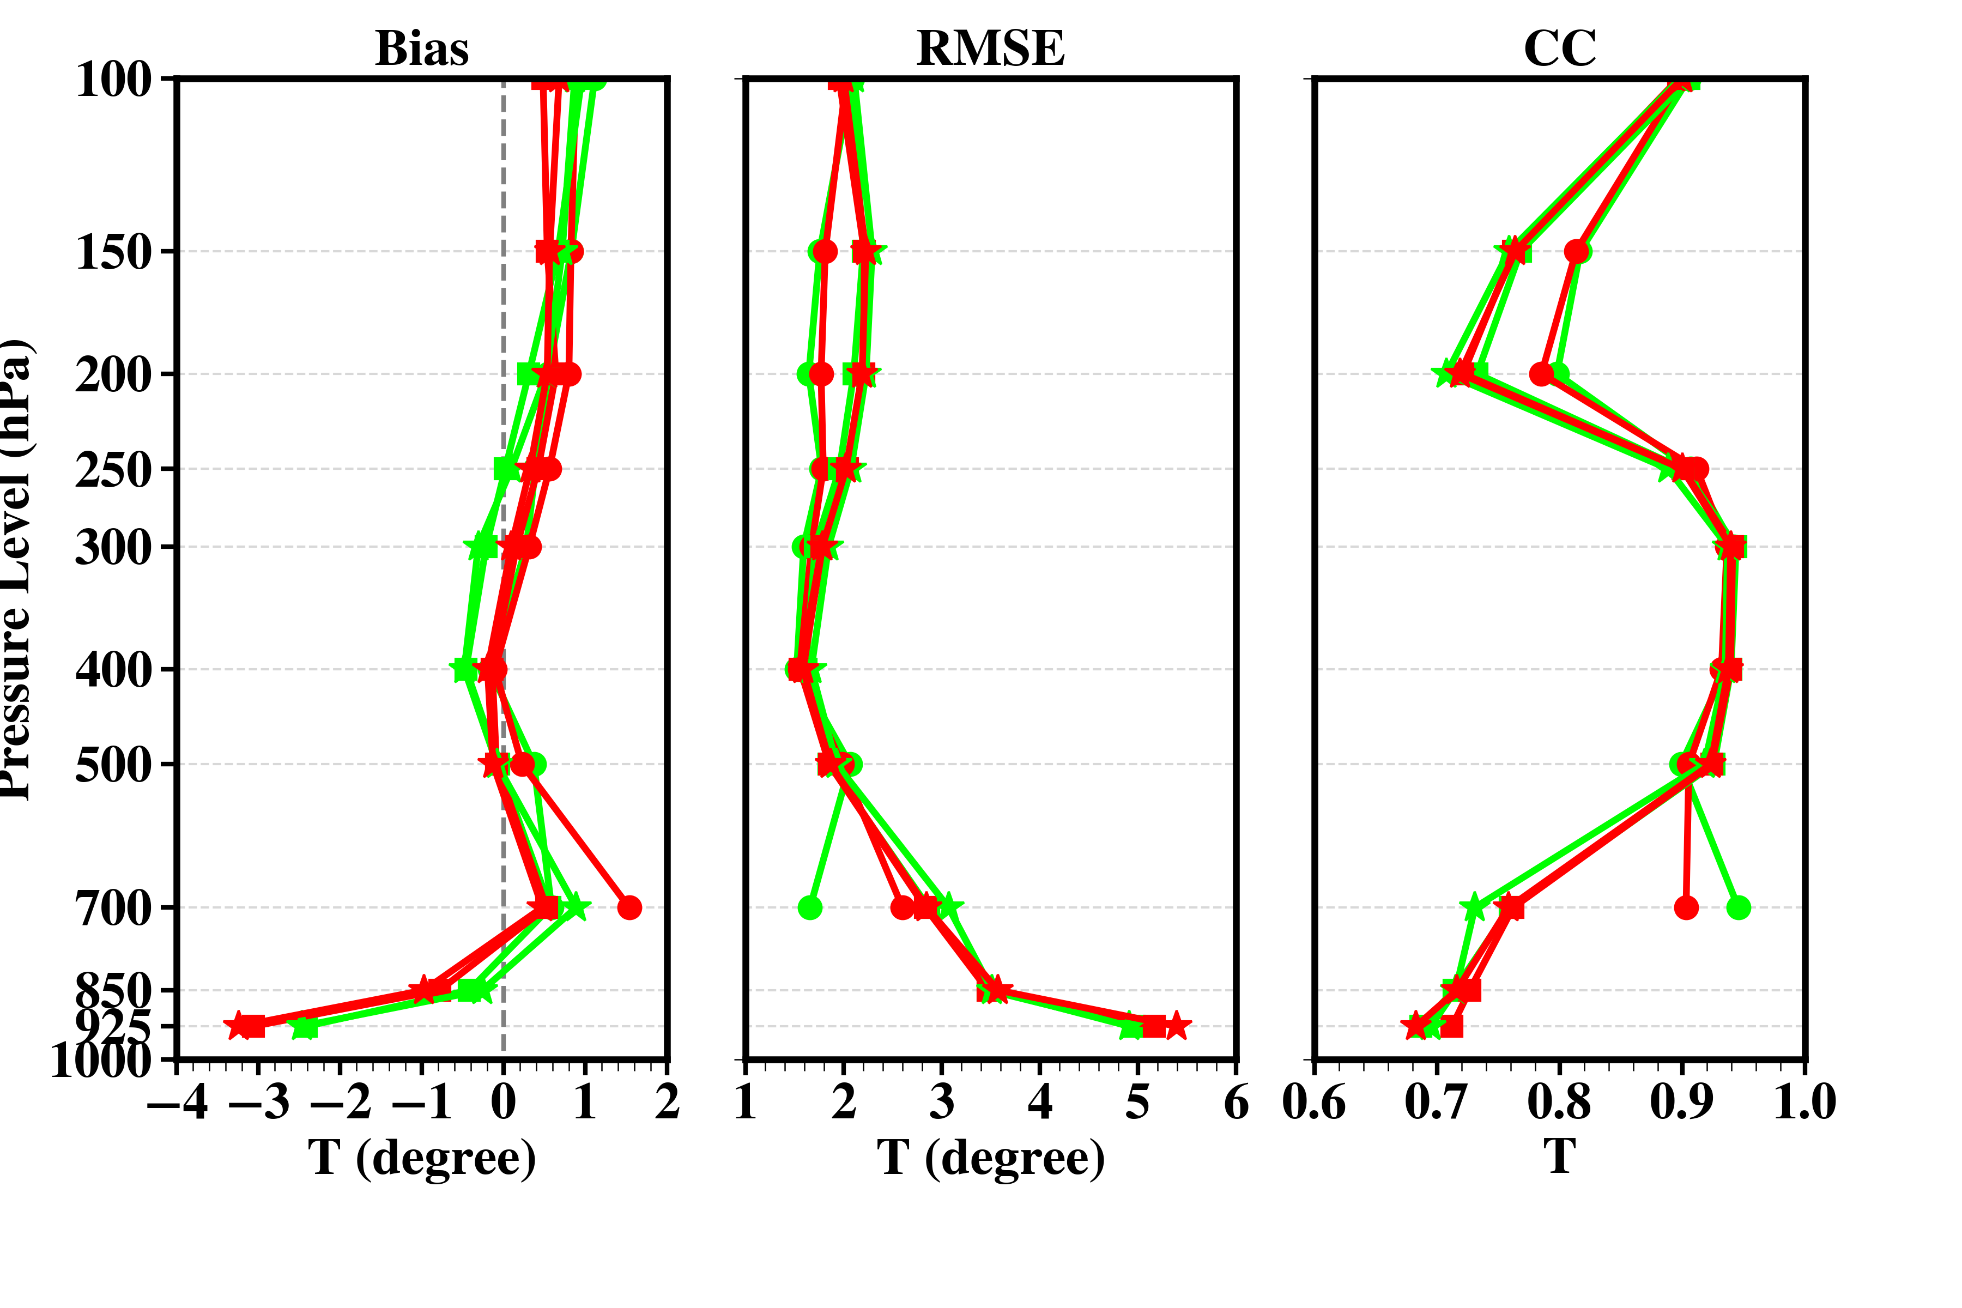
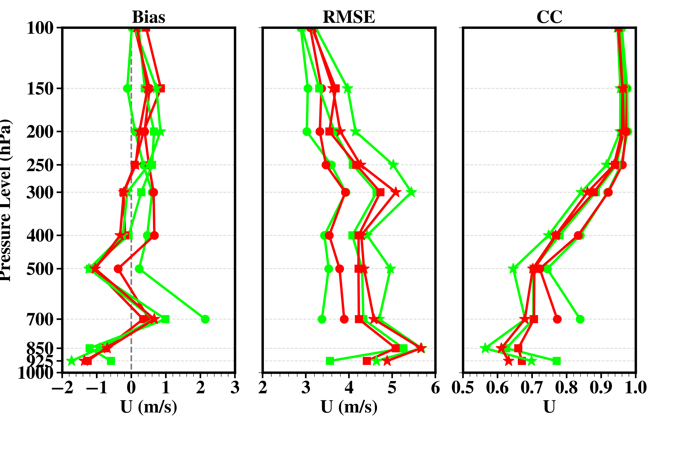
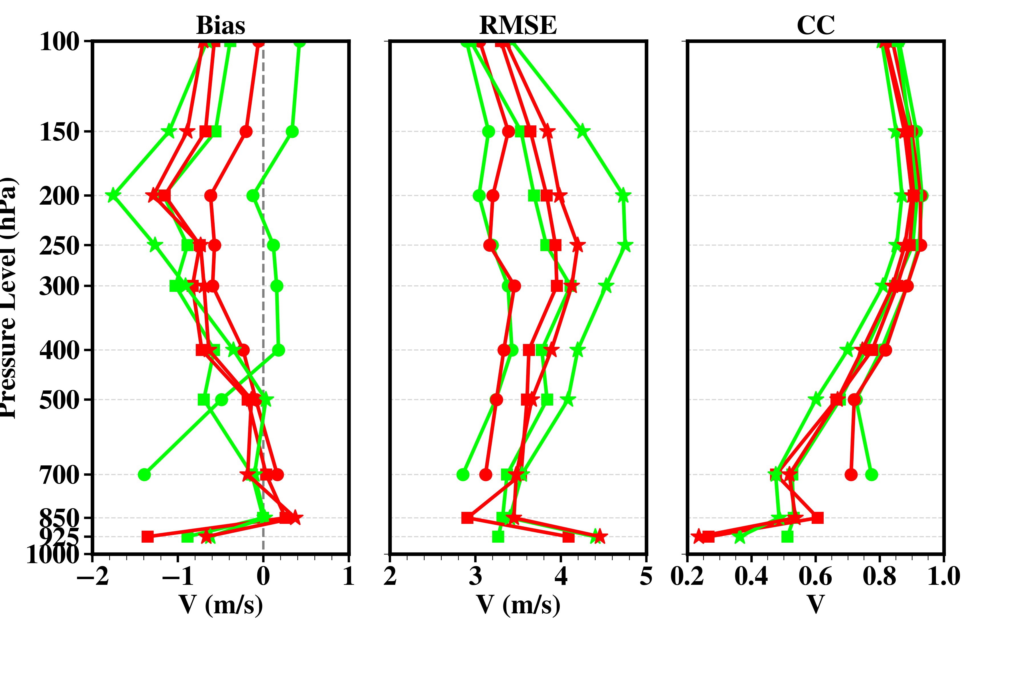
Evaluation and Verification
Independent verification with sounding obs.
Include 00, 12 UTC during June 2015 in small domain (D02)

Slide 11
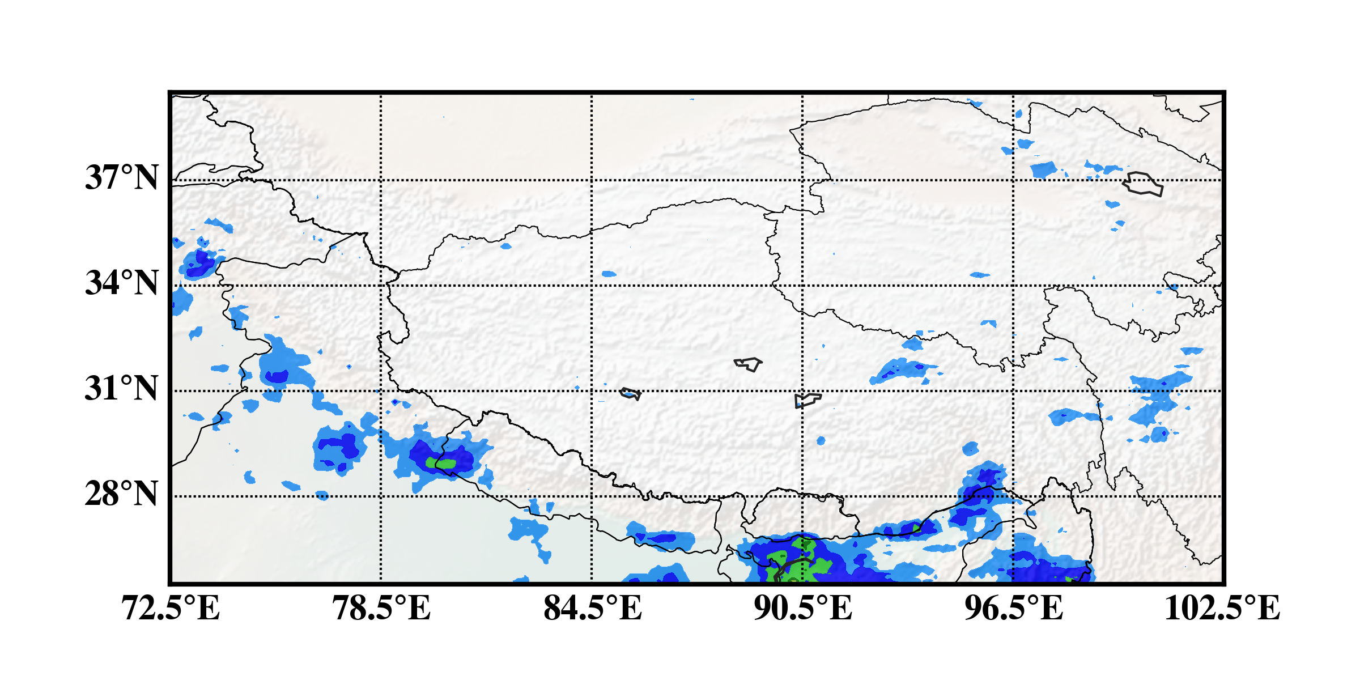
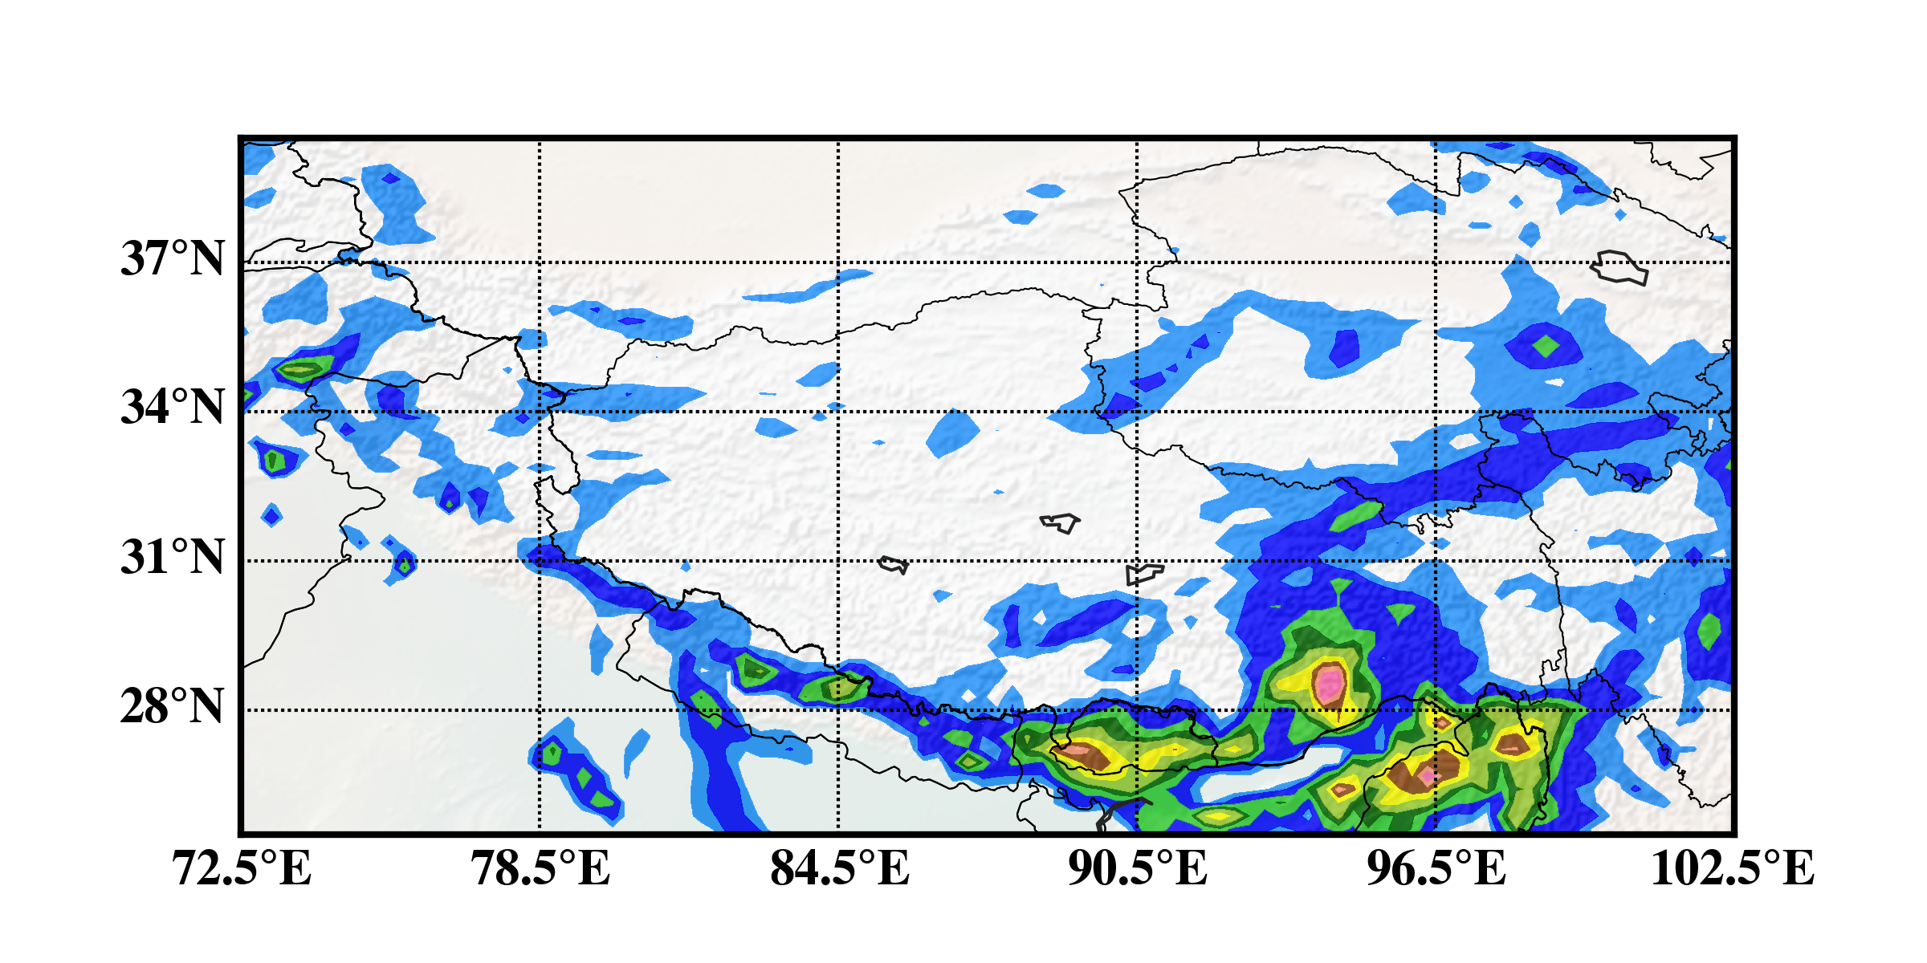
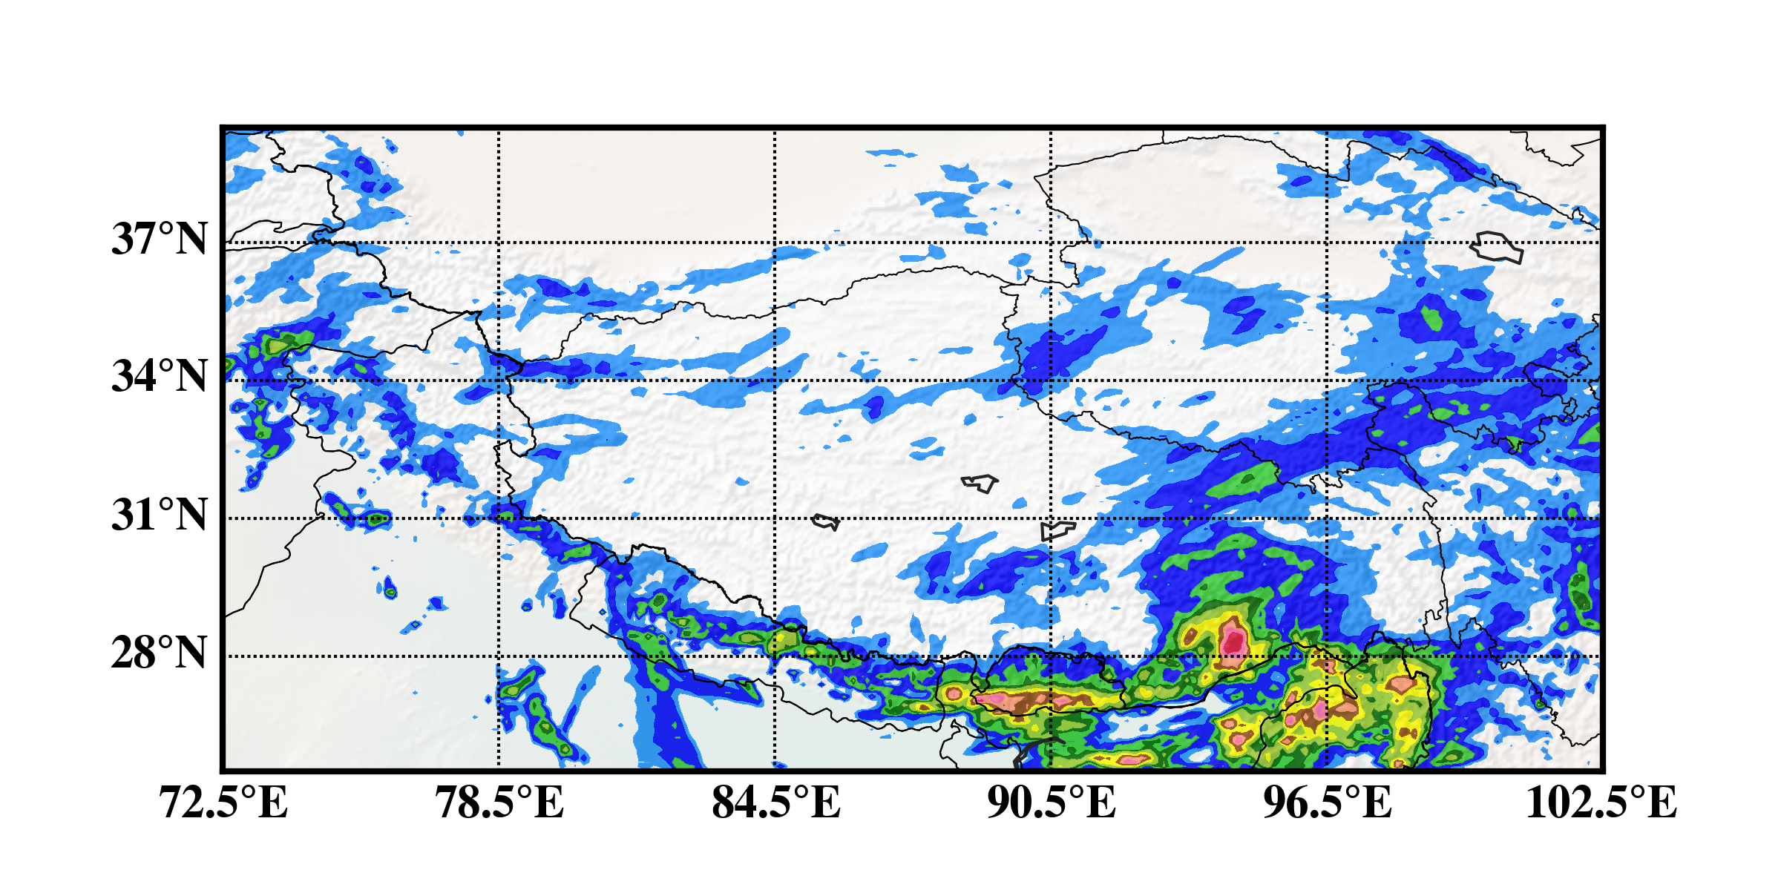
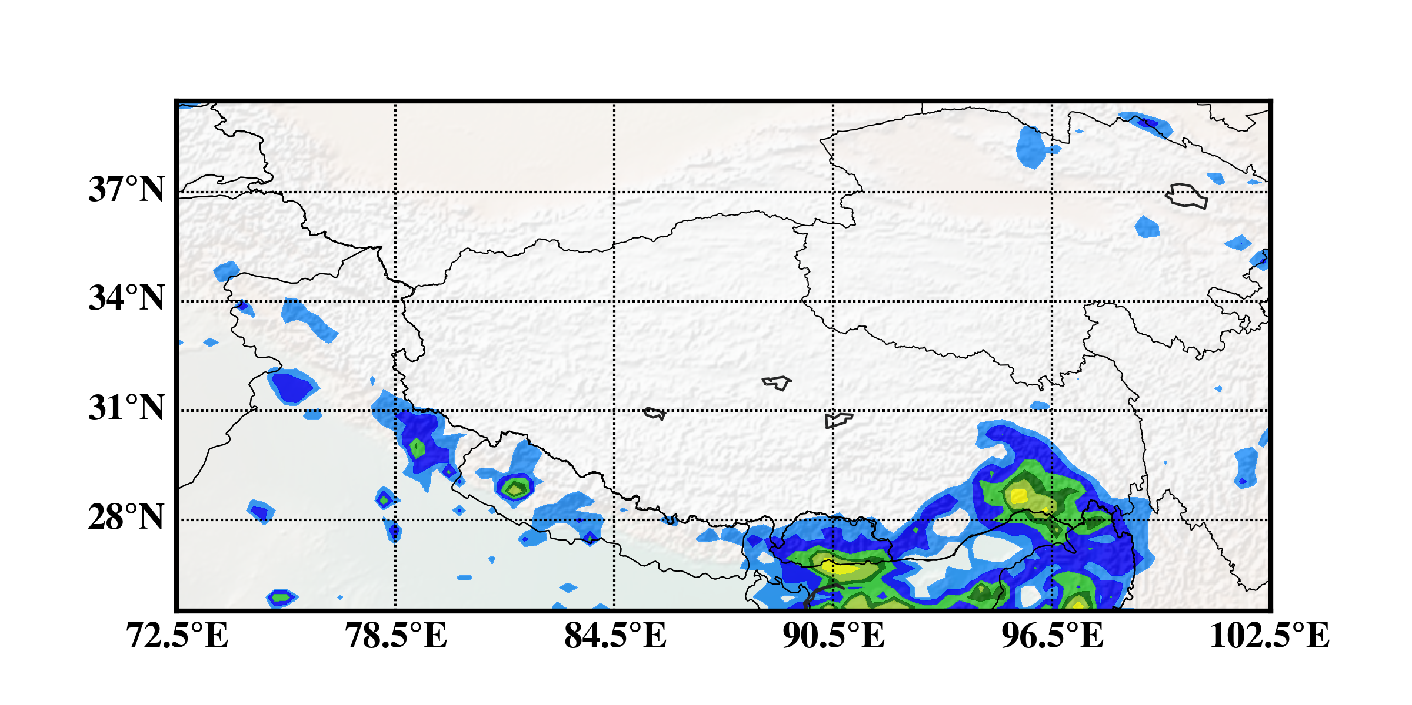
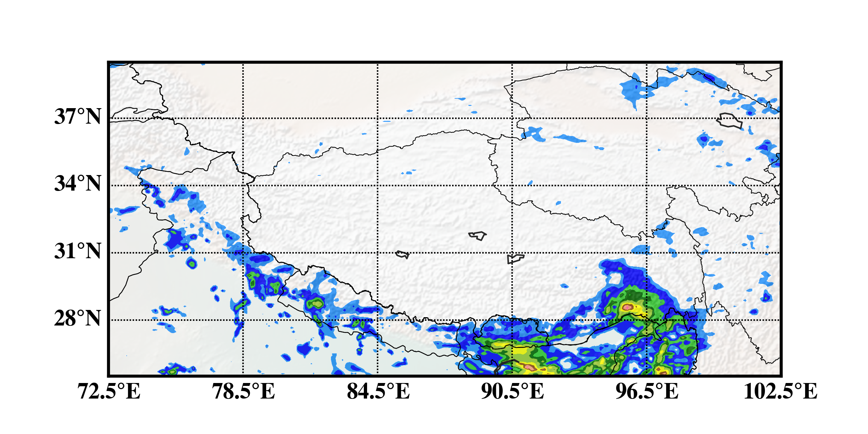
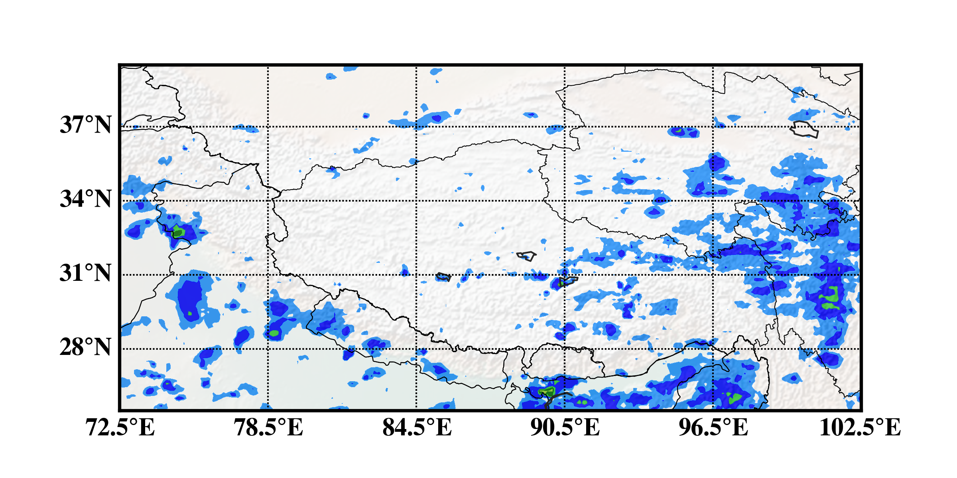
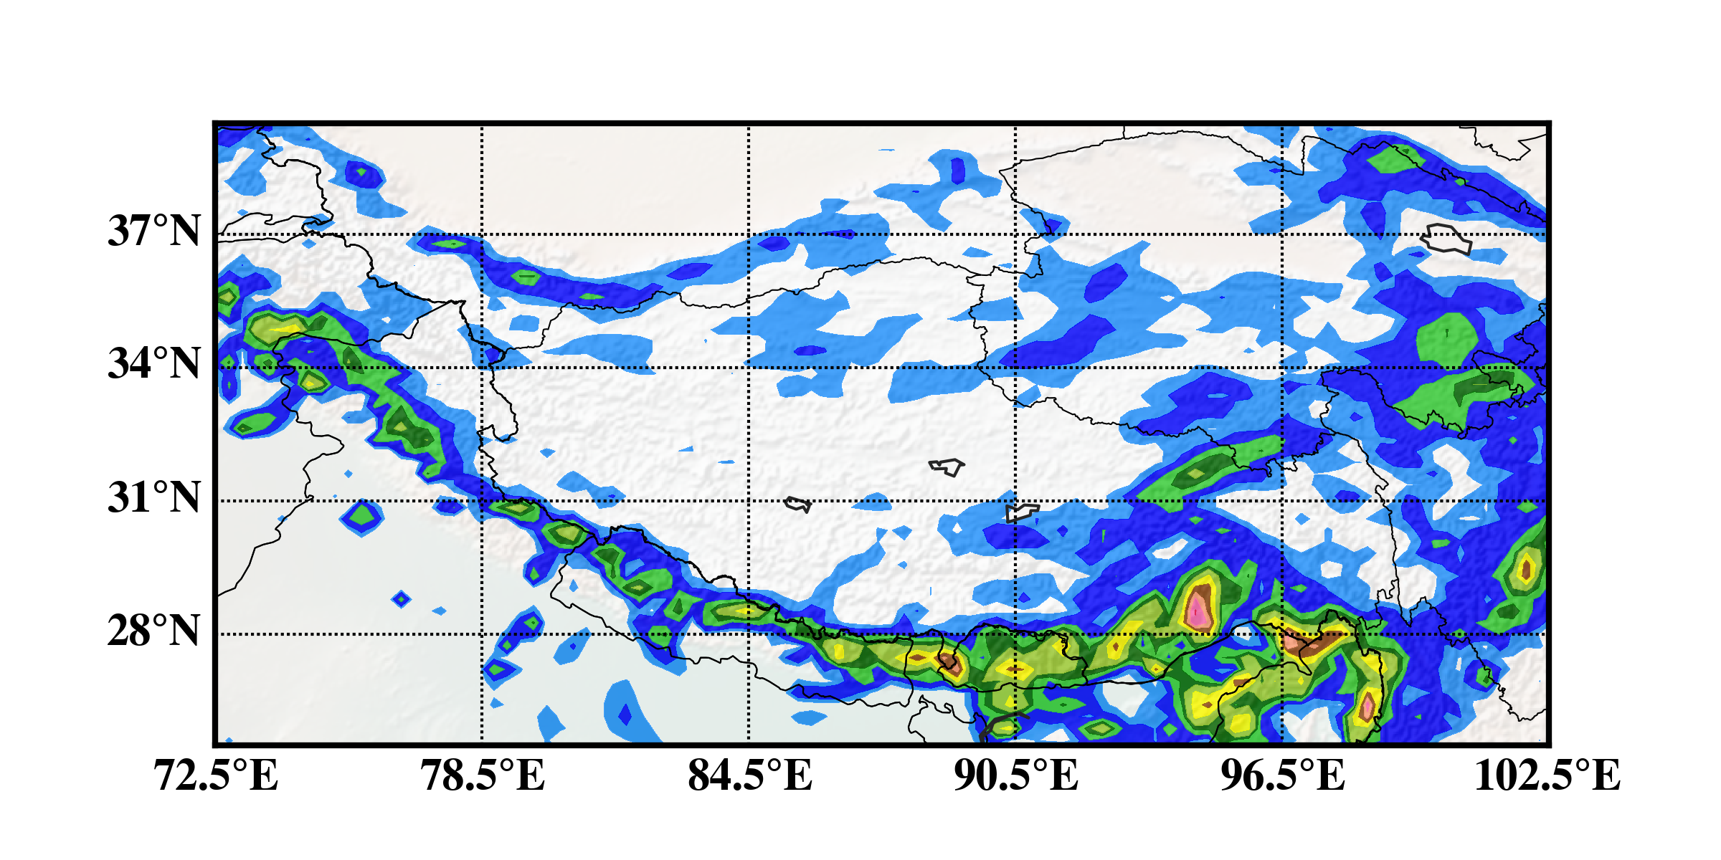
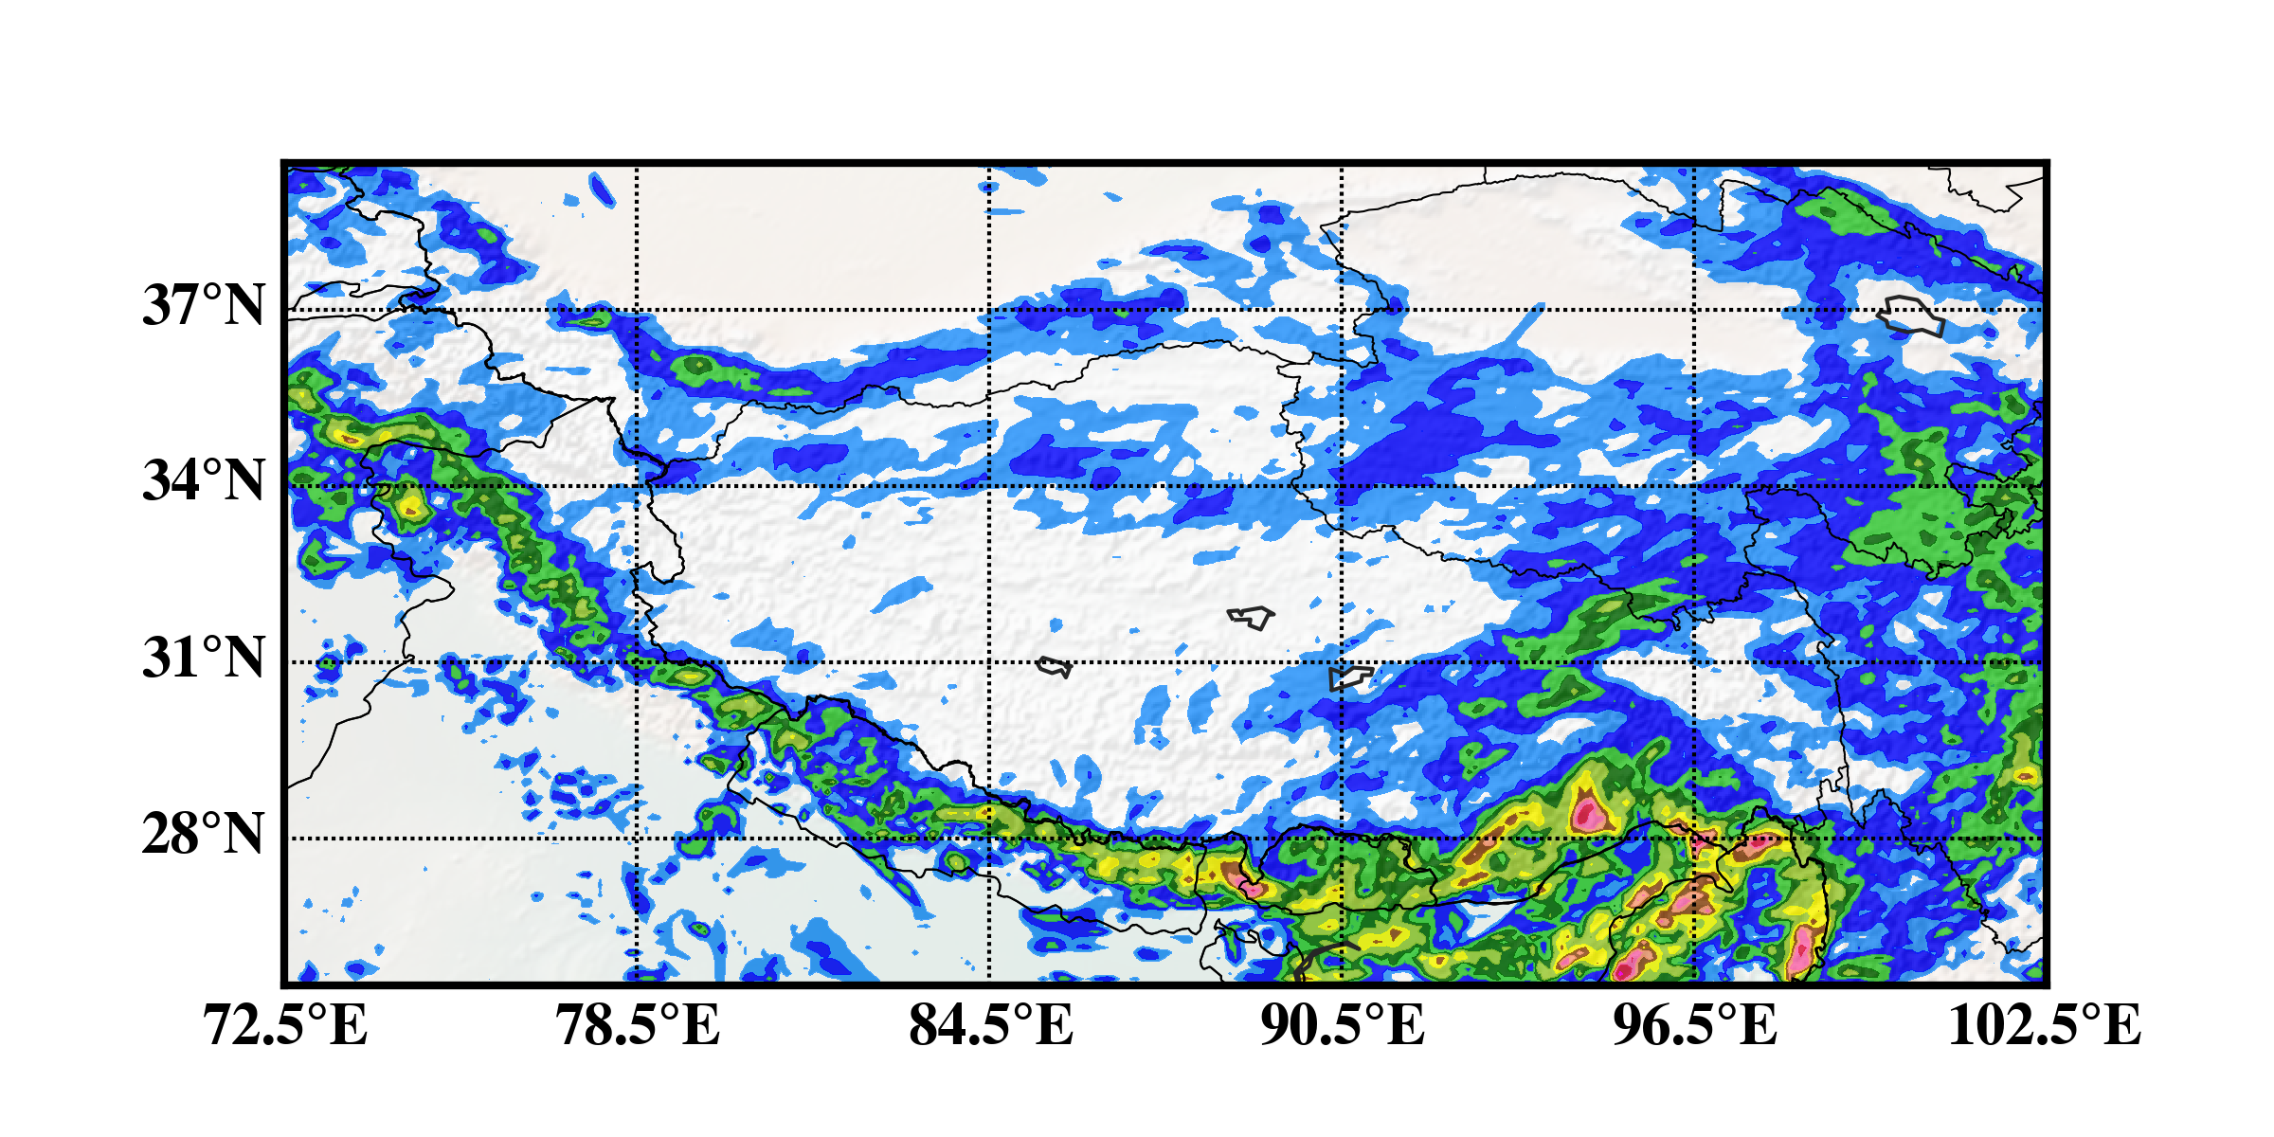
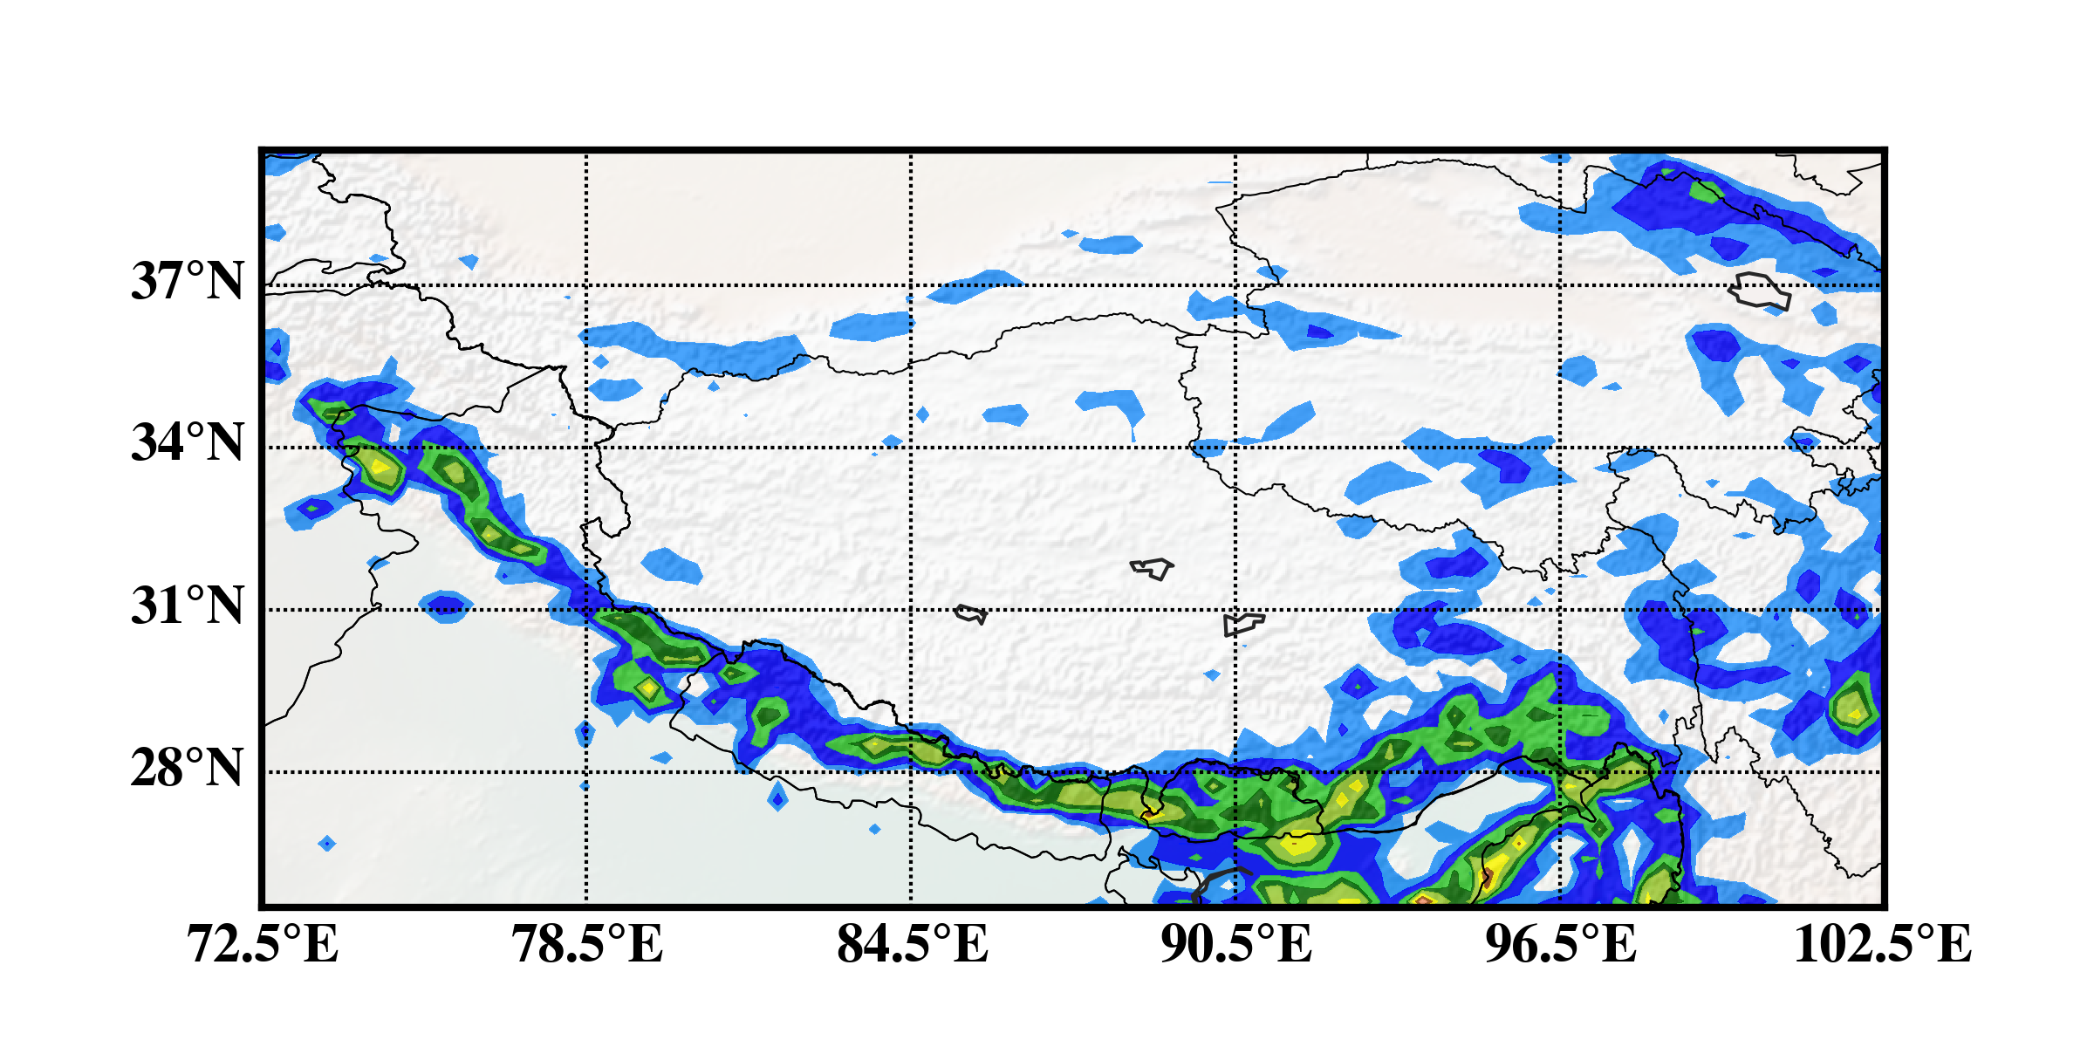
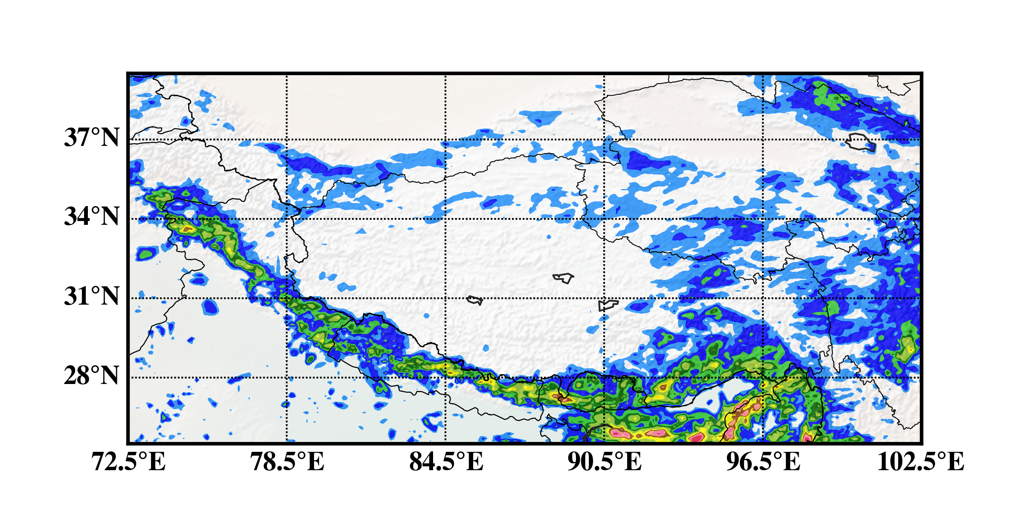
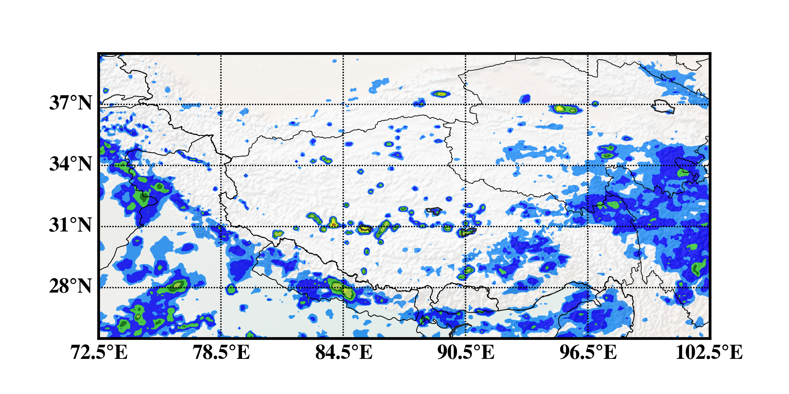
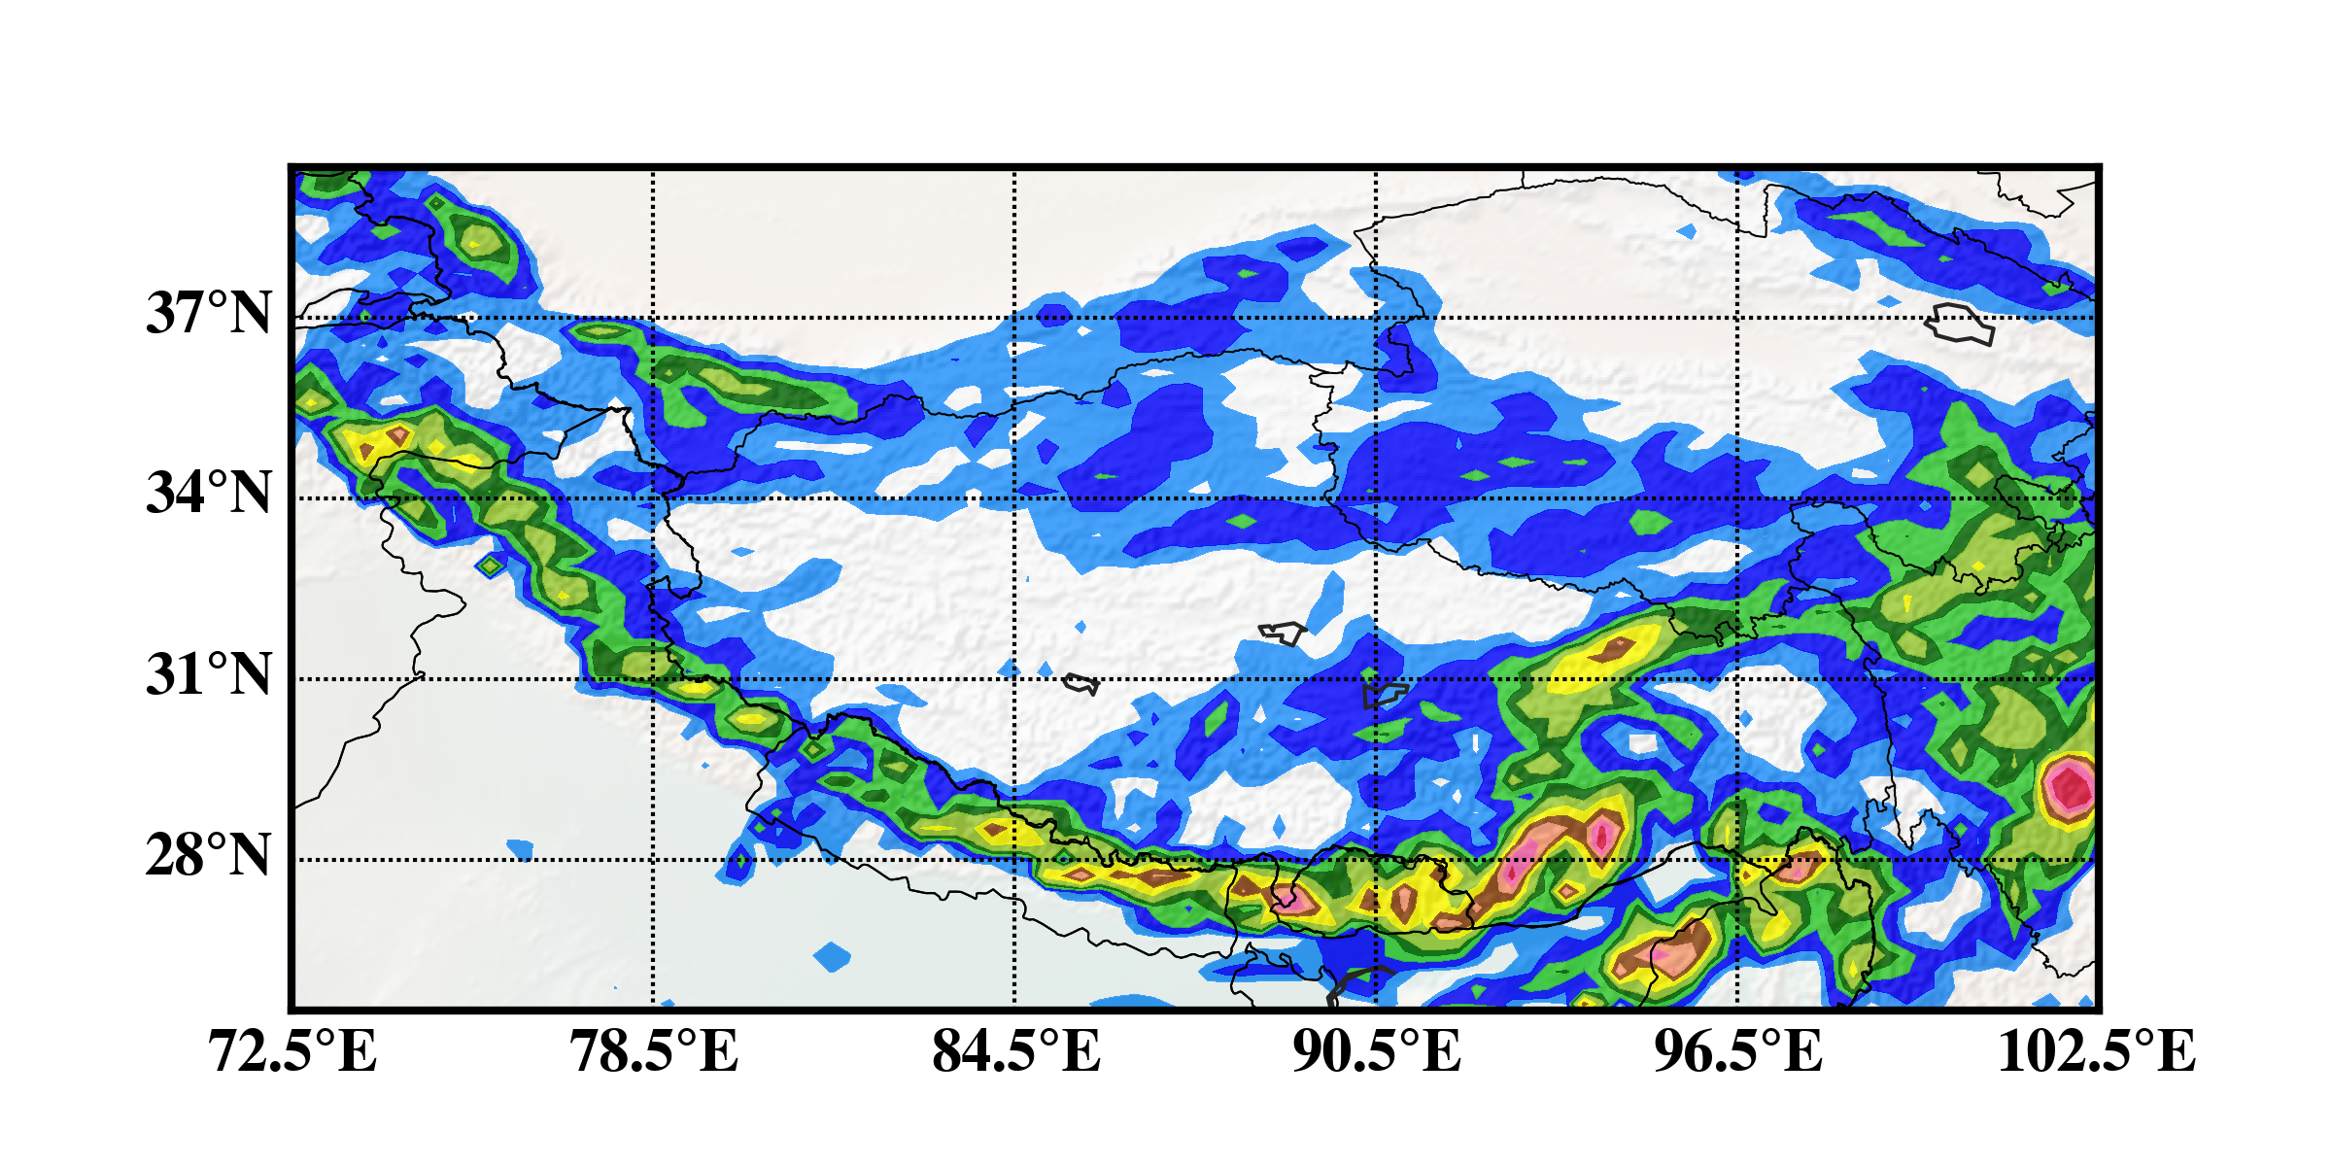
Diurnal variation of precipitation
Real rain
ERA-I_30km
ERA-I _10km
EnKF_30km
EnKF_10km
06 UTC
09 UTC
12 UTC
15 UTC
18 UTC
21 UTC
00 UTC
03 UTC

Slide 12
Time series of average total rain rate (a), maximum rain (b) over the domain of 10km (D02) during 1-30 June 2015
Time evolution of Bias and RMSEs of precipitation during 1-30 June 2015

Slide 13
Summary
A high resolution regional reanalysis over TP was developed and verified compared to ERA-Interim during two month-long time.
Based on evaluative results, EnKF reanalysis exhibits a better performance than ERA-Interim, especially for specific humidity.
EnKF reanalysis significantly improves precipitation prediction including diurnal variation, intensity and distribution, although it only assimilates GTS observation

