Slide 1
Kinematics and Microphysics of Convection in the Outer Rainband of Typhoon Nida (2016) revealed by Polarimetric Radar
Dan Wu^{1, 2}, Kun. Zhao², M. R. Kumjian³, Xiaomin Chen²,
A. C. Didlake Jr.³, and Fuqing Zhang³
¹Shanghai Typhoon Institute, Shanghai, China ²Key Laboratory for Mesoscale Severe Weather/MOE and School of Atmospheric Sciences, Nanjing University, Nanjing, China
³Department of Meteorology and Atmospheric Science, The Pennsylvania State University, University Park, Pennsylvania

Slide 2
Outlines
Introduction
Case Overview
Data and Method
Result
Summary

Slide 3
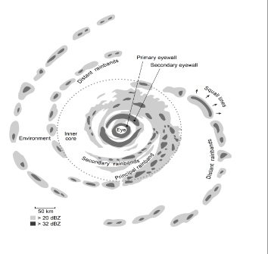
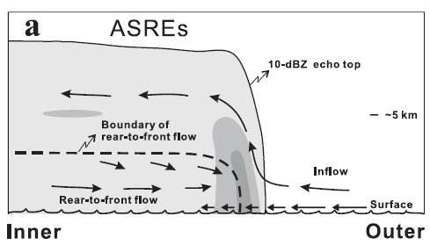
Introduction
> 150 km
Yu and Tsai (2013)
Moon and Nolan (2015)
Didlake and Houze (2009)
(Willoughby 1988; Houze 2010)

Slide 4
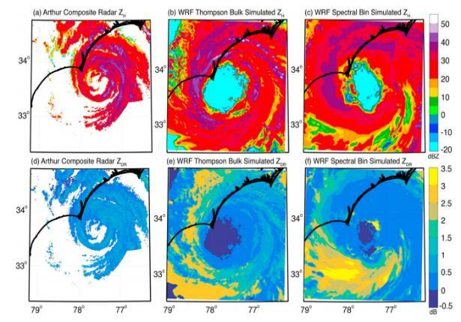
Introduction
Obs
Simulation
Understand the real microphysics
Improve the microphysical scheme
Improve TC precipitation forecast
Radar Z_{H}
Thompson Bulk Z_{H}
Spectral Bin Z_{H}
Most of the microphysical parameterizations produced a higher frequency of larger raindrops than observed.
Radar Z_{DR}
Thompson Bulk Z_{DR}
Spectral Bin Z_{DR}
Questions:
1. What is the microphysical characteristics in the outer rainband?
2. Which microphysical processes contribute most to the heavy precipitation in the outer rainband?
Brown et al. (2015)

Slide 5
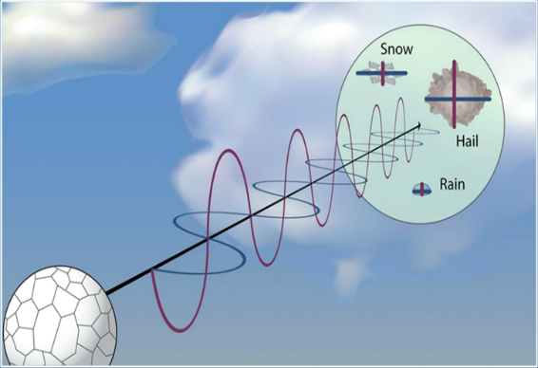
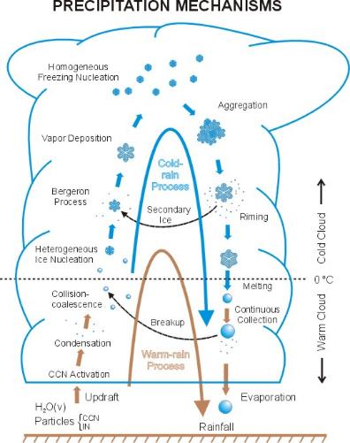
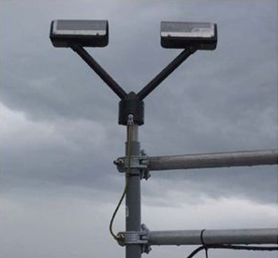
Introduction
aggregation
deposition
Z_{H} - $∑D^{6}$, dependent on the size and concentration of particles
Z_{DR} – Z_{H}/Z_{V}, dependent on the shape of particles
K_{DP} – sensitive to the water content
CC - a measure of the variability of particles within a sample volume
riming
freezing
coalescence
melting
Aircraft Probe
fixed path
time limited
breakup
condensation
evaporation
Better!
3-Dimensional
particle size
hydrometeor types
water content
…
Distrometer
surface DSD at a fixed point

Slide 6
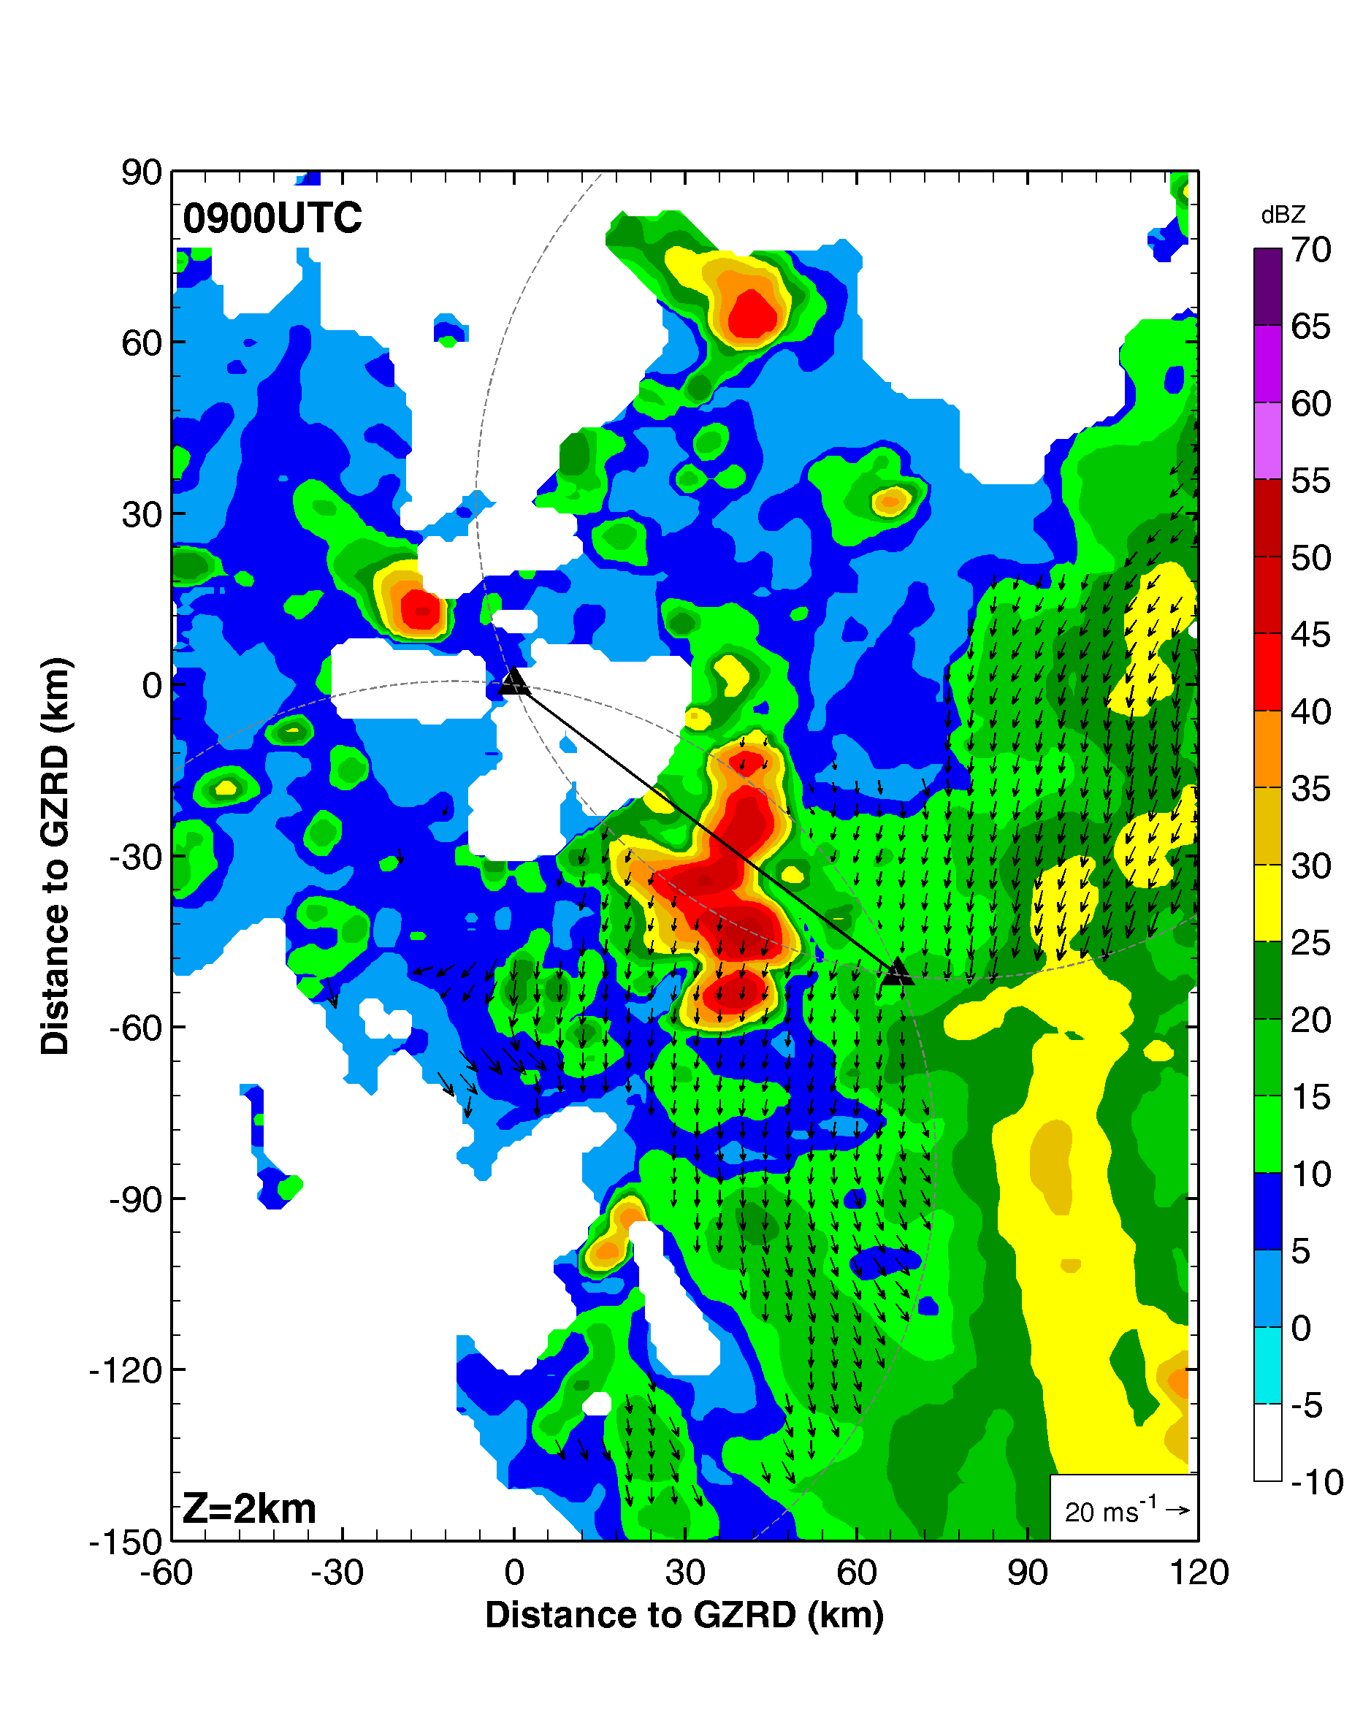
Case Overview
0900 – 1200 UTC 1 Aug
Nida (2016)
Composite Reflectivity
Rain_{_3h} > 50 mm

Slide 7
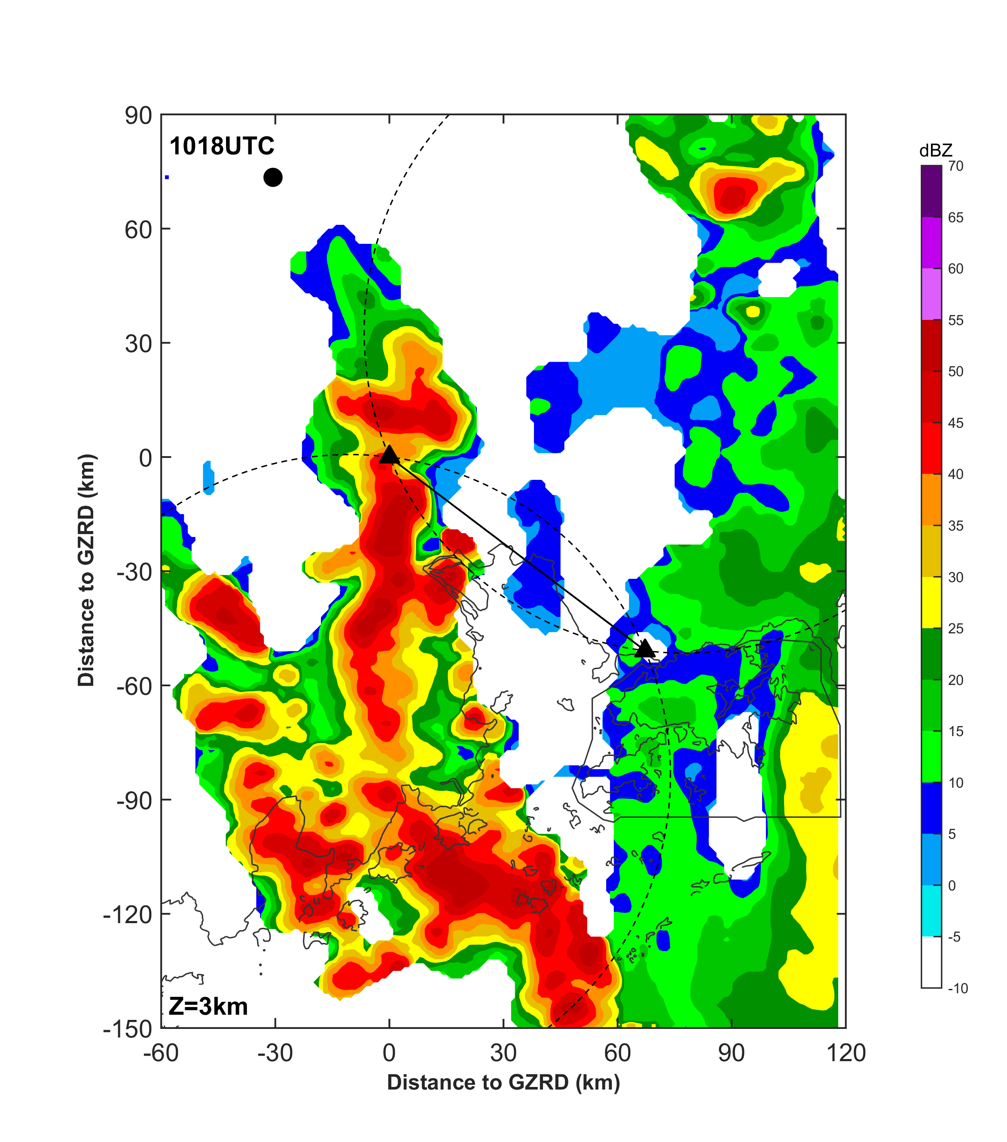
Data and Method
S-band Polarimetric radar located at Guangzhou
S-band Doppler radar at Shenzhen
(0900–1200 and 1900-2000 UTC1 August)
A rawinsonde released at Qingyuan at 0600 UTC
QY
GZRD
Method:
Dual-Doppler synthesis
(Ray et al., 1978; Doviak and Zrnić 1993)
Hydrometeor Identification Algorithm (HID, Dolan et al., 2013)
SZRD

Slide 8
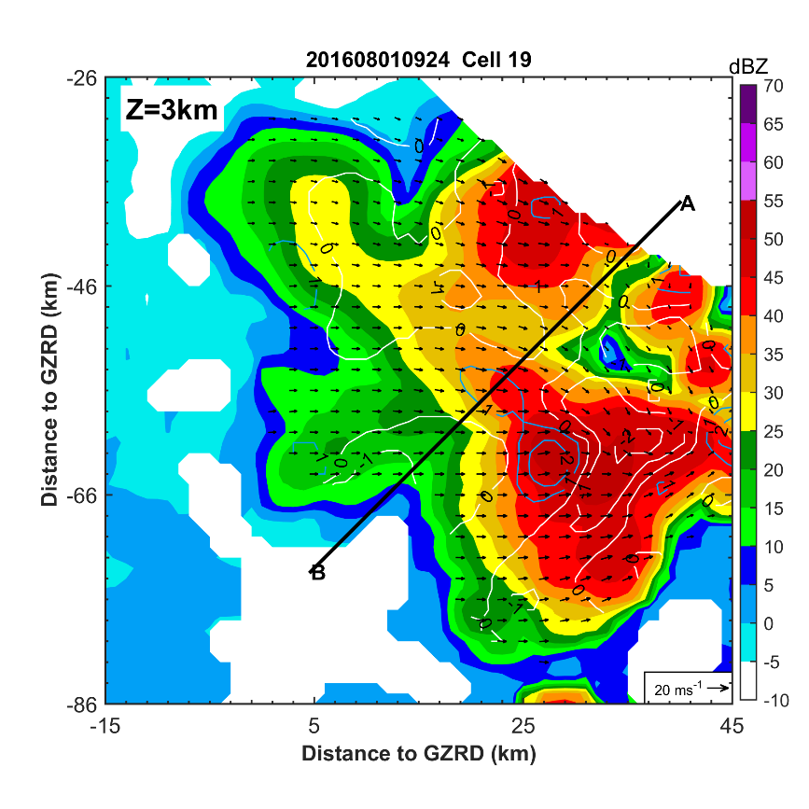
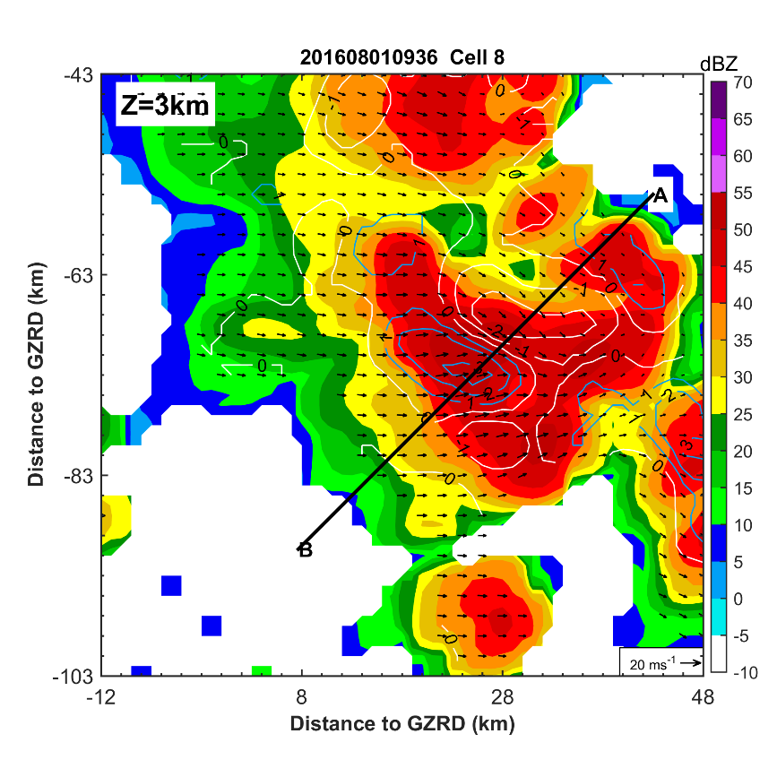
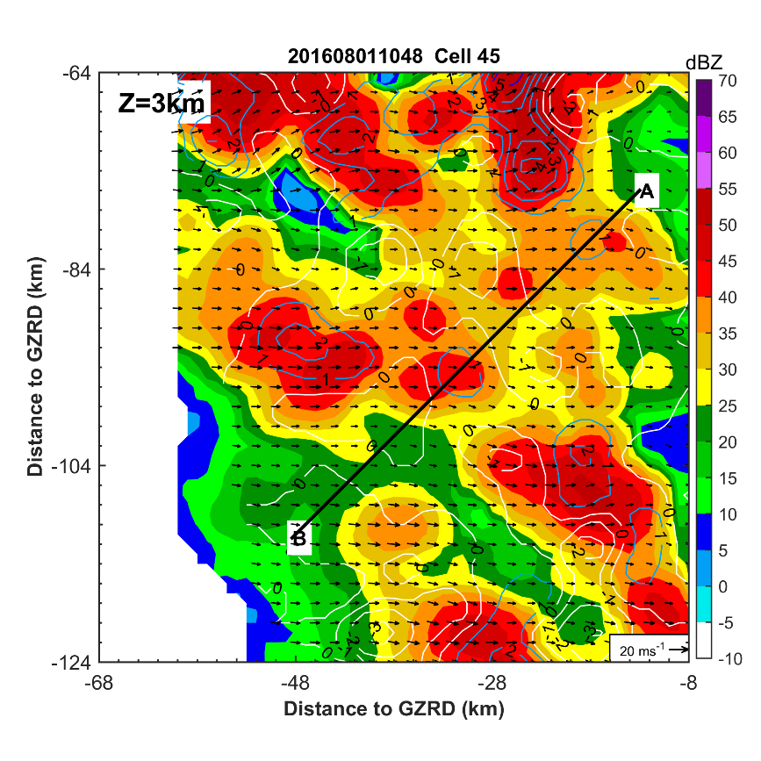
Data and Method
Convective cell identification and classification:
- based on vertical velocity (w) at 3 km altitude (following Moon and Nolan 2015)
Developing
w < 3m s⁻¹
n_{_developing} = 93
Mature
w >= 3 m s⁻¹
n_{_mature} = 164
Decaying
w < 3 m s⁻¹ again
n_{_decaying} = 69
1
3
1
2
1

Slide 9
Results
a. Microphysical characteristics of mature convective cells
Z_{H}
“column”
liquid water
0˚C
Z_{DR}
Large
raindrop
Yu and Tsai (2013)
K_{DP}
An example of a mature convective cell at 1018 UTC 1 August.

Slide 10
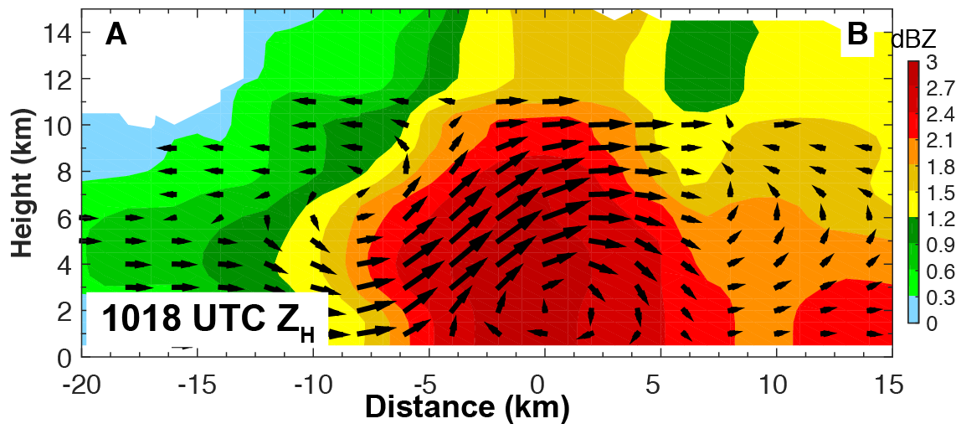
Results
b. Evolution of the Microphysical Characteristics
Developing
The strongest surface precipitation and the largest raindrops occurred in the mature stage.
Mature
composite mean
Decaying
Z_{H}
Z_{DR}
K_{DP}

Slide 11
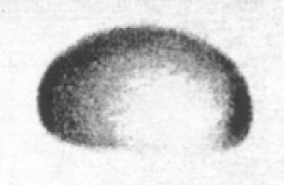
Results
b. Evolution of the Microphysical Characteristics
aggregation
riming
Supercooled water
(Kumjian 2013)
The median profiles of (a) reflectivity, (b) Z_{DR}, (c) K_{DP}, (d) vertical velocity at the convective center

Slide 12
Results
c. Ice Microphysical Process as Inferred from the HID retrievals
the occurrence frequency (freq) relative to the updraft
_{X = -5, Y = 8}
_{HID: Grauple}
N_{_mature} = 164
if 50 out of the 164 cells at the mature stage are identified as graupel at this point (-5, 8)
freq_{_graupel}(-5,8) = 50/164 ~ 0.3
The identified particle types can be used to infer the underlying microphysical processes.
deposition
freq_{_riming} = freq_{_graupel} + freq_{_hail}
The process that has the highest occurrence frequency at a given point can be considered as the most possible/dominant microphysical processes at that point.
aggregation
riming
melting

Slide 13
Results
c. Ice Microphysical Process as Inferred from the HID retrievals
Developing
Mature
Decaying
Deposition
Aggregation
Riming

Slide 14
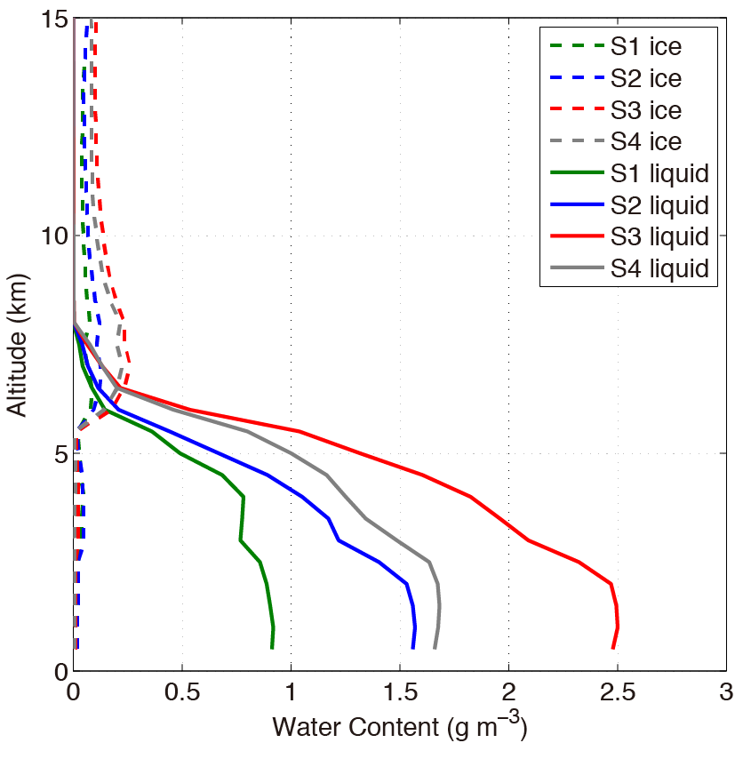
Results
d. Comparison between outer and inner rainband
Wang et al. (2016)
The particle growth in a TC inner rainband is mainly through warm rain processes, primarily from the conversion of cloud water to rainwater through cloud water accretion by the raindrops.
The vertical profiles of the water content in a inner rainband.

Slide 15
Results
d. Comparison between outer and inner rainband
Outer Rainband
Inner Rainband

Slide 16
Results
d. Comparison between outer and inner rainband
The ice phase processes are more important in the outer rainband, while the warm rain processes are dominant in the inner rainband.
Inner rainband
Outer rainband
The ice water content is about 5% of the liquid water content on the surface.
The ice water content is about 62% of the liquid water content on the surface.
The median profiles of (a) reflectivity, (b) Z_{DR}, (c) K_{DP}, (d) vertical velocity
(e) ice water content, (f) liquid water content at the convective center

Slide 17
Summary
The kinematic structure of the mature convective cells in this outer rainband exhibits a deep-layer inflow, a rearward updraft, and a low-level rear inflow, similar to the previously observed wind structures.
Unlike the dominant warm-rain processes in the inner rainband, the major pathway to rainfall in this outer rainband is via ice-phase microphysical processes above the melting level, including aggregation and riming.
The ice-phase microphysical processes are organized systematically relative to the updraft, with riming near the -5 ˚C level within the updraft, aggregation around -15 ˚C level, and deposition anywhere above 0 ˚C level.
Riming is the major microphysical contributor to the intense surface precipitation in the outer rainband.

Slide 18
Thanks for your attention!

