Slide 1
Detection of anthropogenic influence on fixed threshold indices of extreme temperature
Hong Yin
National Climate Center, China Meteorological Administration
May, 23, 2018

Slide 2
Outline
Introduction
Data (homogenized observations; CMIP5 model simulations)
Data processing
Optimal detection method
Detection and Attribution results
Conclusions

Slide 3
Introduction
Over the last few decades, extreme temperature events have exhibited significant changes at global and regional scales, with more extreme warm events and less extreme cold events observed.
The ETCCDI (Expert Team on Climate Change Detection and Indices) defined a set of indices to describe different aspects of extreme events in the observations, including intensity, percentile, absolute, fixed threshold and duration indices, which can be used to assess different aspects of changes in climate extremes
Previous many studies have indicated detectable human influence in intensity and percentile extreme temperatures at the global, continental, and subcontinental scales.
However, these fixed threshold indices have received less attention than other indices in previous studies, although a few studies indicate that the fixed threshold indices display pronounced changes at the global and regional scales
Notes:
Research indicates that increased temperatures over the twentieth century have led to an increase in the moisture content of the atmosphere.
Trends calculated from various datasets based on station observations showed high latitude precipitation increased.
Available evidence suggests human induced global warming may be a contributing factor to the precipitation increase at high latitude.
A previous study from Min and coauthors used observations from GHCN+Canadian adjusted precipitation datasets and cmip3 model simulations linked the observed intensification of Arctic precipitation to human .
Better availability of Russian climate data in recent years and CMIP5 model simulations which cover more recent period, we think it is now appropriate to revisit the analysis. So the aim …..

Slide 4
Extreme temperature indices
In this study, we focus on the fixed threshold indices of extreme temperature, specifically
FD (frost days, FD) : the annual count when the daily minimum temperature is <0 °C
ID (ice days, ID): the annual count when the daily maximum temperature is <0 °C
SU (summer days, SU): the annual count when the daily maximum temperature > 25 °C
TR (tropical nights, TR): the annual count when the daily minimum temperature > 20 °C
Whether the changes in these fixed threshold indices in the regions of the world can be detected using the multi-model results is unclear.
Notes:
Research indicates that increased temperatures over the twentieth century have led to an increase in the moisture content of the atmosphere.
Trends calculated from various datasets based on station observations showed high latitude precipitation increased.
Available evidence suggests human induced global warming may be a contributing factor to the precipitation increase at high latitude.
A previous study from Min and coauthors used observations from GHCN+Canadian adjusted precipitation datasets and cmip3 model simulations linked the observed intensification of Arctic precipitation to human .
Better availability of Russian climate data in recent years and CMIP5 model simulations which cover more recent period, we think it is now appropriate to revisit the analysis. So the aim …..

Slide 5
Data
Observational data
Homogenized extreme temperature indices (FD, ID, SU, TR) data from Hadex2. Hadex2 is the second generation of the global land extreme indices dataset developed by Donat et al. (2013) (https://www.climdex.org/gewocs.html).
It is based on high-quality observations from over 7000 stations distributed over the global land area. The data cover the period of 1901-2010; however, we only use the information after 1961, given the good quality, better and more consistent data density/sampling of the data in that period.
Climate model simulations (CMIP5 simulations)
ALL: 96 runs (21 models);
NAT: 36 runs (9 models);
GHG: 32 runs (9 models);
ANT: ALL-NAT;
CTL: 28 models (230 chunks)
estimate climate responses to external forcings and internal variability of the climate system
calculate the noise

Slide 6
CMIP5 Simulations
Model Name | ALL(26) | CTL（41） | NAT (12)
ACCESS1-0 |  | 7
ACCESS1-3 | 3 | 7
BCC-CSM1-1 | 3 | 7
BCC-CSM1-1-m | 3 | 6
BNU-ESM |  | 8
CanESM2 | 5 | 15 | 5 (to 2012)
CCSM4 | 6 | 7 | 4
CESM1-BGC |  | 7
CESM1-CAM5 | 3 | 5
CESM1-CAM5-1-FV2 | 4
CESM1-FASTCHEM | 3 | 3
CESM1-WACCM |  | 3
CMCC-CESM |  | 4
CMCC-CM |  | 5
CMCC-CMS |  | 7
CNRM-CM5 | 10 | 13 | 6 (to 2012)
CSIRO-Mk3-6-0 | 9 | 7 | 5 (to 2012)
EC-EARTH |  | 7
FGOALS-g2 |  | 11 | 3
FIO-ESM | 3 | 12
GFDL-CM2p1 | 10
GFDL-CM3 | 5 | 7 | 3
GFDL-ESM2G | 3 | 7
GFDL-ESM2M |  | 7
GISS-E2-H | 6 | 8 | 5 (to 2012)
Model Name | ALL(26) | CTL（41） | NAT (12)
GISS-E2-H-CC |  | 3
GISS-E2-R | 6 | 8 | 5 (to 2012)
GISS-E2-R-CC |  | 3
HadCM3 | 10
HadGEM2-CC |  | 3
HadGEM2-ES | 4 |  | 4 (to 2012)
INMCM4 |  | 7
IPSL-CM5A-LR | 6 | 15 | 3 (to 2012)
IPSL-CM5A-MR | 3 | 4 | 3 (to 2012)
IPSL-CM5B-LR |  | 4
MIROC-ESM | 3 | 10 | 3
MIROC-ESM-CHEM |  | 4
MIROC4h |  | 1
MIROC5 | 5 | 10
MPI-ESM-MR | 3 | 15
MPI-ESM-LR | 3 | 15
MPI-ESM-P |  | 18
MRI-CGCM3 | 3 | 7
NorESM1-M | 3 | 7
NorESM1-ME |  | 4
SUM(models) | 125(26) | 308(41) | 49(12)

Slide 7
Study Regions
In this study, detection and attribution are conducted for the globe (GLB) and five continental regions defined by Giorgi and Francisco (2000), specifically Europe (EUR; 30°-75°N, 10°W-40°E), Asia (ASI; 20°-70°N, 40°E-180°), Australia (AUS; 45°-11°S, 110°–155°E), North America (NAM; 25°-72°N, 170°-50°W) and South America (SAM; 56°S-25°N, 116°-40°W) (boxes in Fig. 1). China (CHI) is also used as a study region, since we have a strong interest in changes in extreme temperatures . The black dots in the figure indicate land grid boxes where observations are not available..

Slide 8
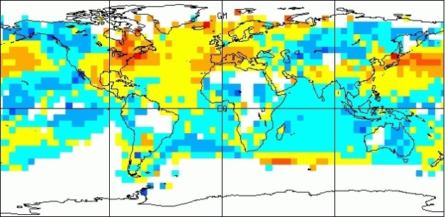
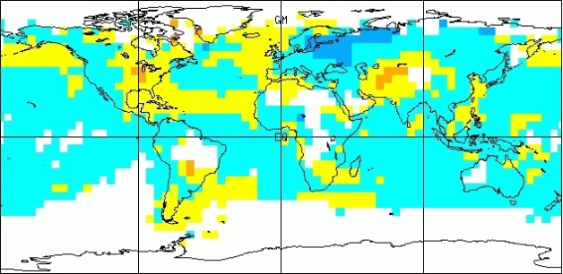
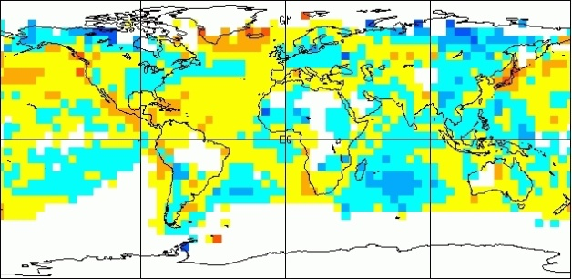
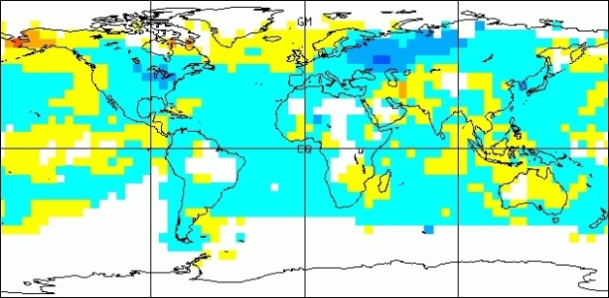
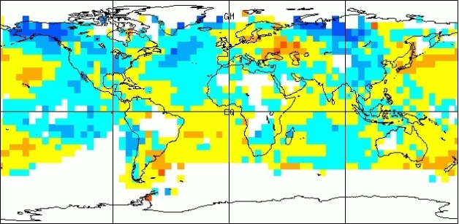
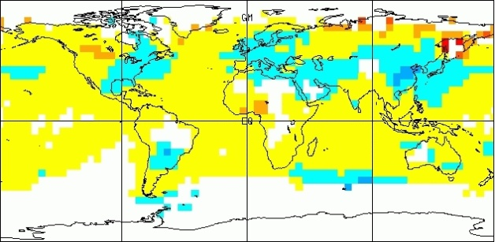
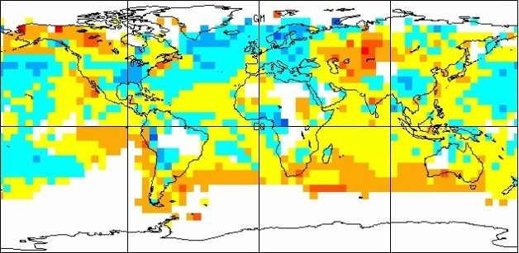
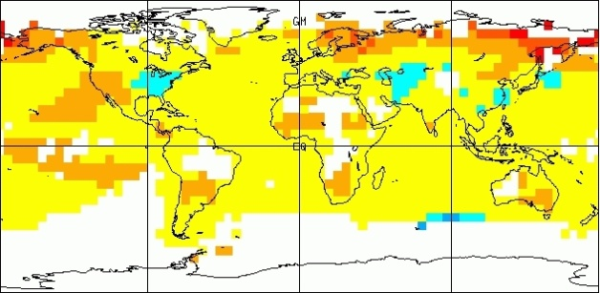
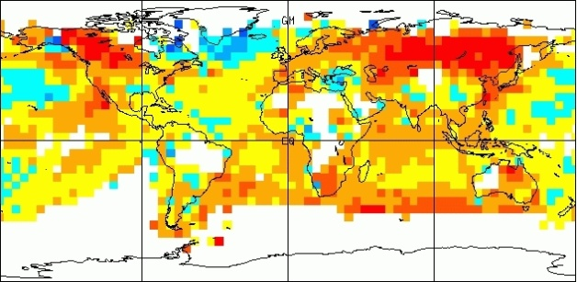
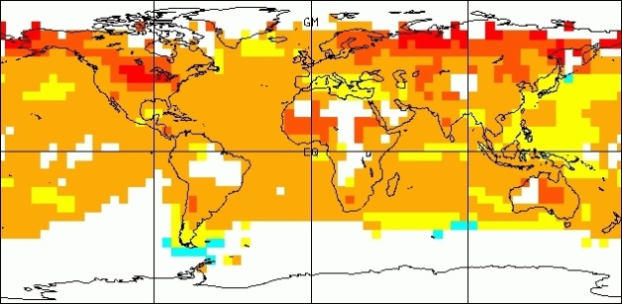
Optimal Fingerprinting Method
Observations
Model
1946-56
1986-96
Filtering
and projection
onto reduced
dimension space
Total least squares regression
in reduced dimension space
Scaling factors Evaluate
amplitude
estimates
Evaluate goodness of fit
Weaver and Zwiers, 2000
Notes:
A detection and attribution analysis typically involves the comparison of observed climate data with model simulated signals using a regression-based method. Y are the observations, and x is the climate response to the external forcing considered, which usually calculated from model simulations, Ɛ represents the internal climate variability and is assumed to be a Gaussian random variable. We usually uses fingerprints that vary in time and space, and a reduction or filtering in both of time and space are always used. Beta the scaling factor adjust the amplitude of signal patterns to best match the observed amplitude. If beta is above zero, we consider the signal is detected and if beta is a vector of units, we consider model simulated signal are consistent with observations.
Regression. Signal from model. Error term. Covariance residual estimation limits on dimention. Ɛ needs two pieces of data

Slide 9
Data Processing
Observations:
Hadex2 gridded anomalies were computed relative to the 1961-1990 mean at each 3.75° x2. 5° latitude-longitude grid box.
Computing area-weighted averages for Global, five continental and China to to reduce space dimension.
Non-overlapping 5-yr / 3-yr mean annual anomalies to reduce temporal dimension
Model simulations:
Interpolated to 3.75° x2. 5° grid
Masked with observations and then calculated regional mean temperature extreme indices anomalies
Ensemble average to estimate signals
Construct 2 samples of noise data
Externally forced runs (ALL, GHG, NAT): two chunks each, 1961-2010, 1910-1950
Control runs: organize into 50-yr “chunks”

Slide 10
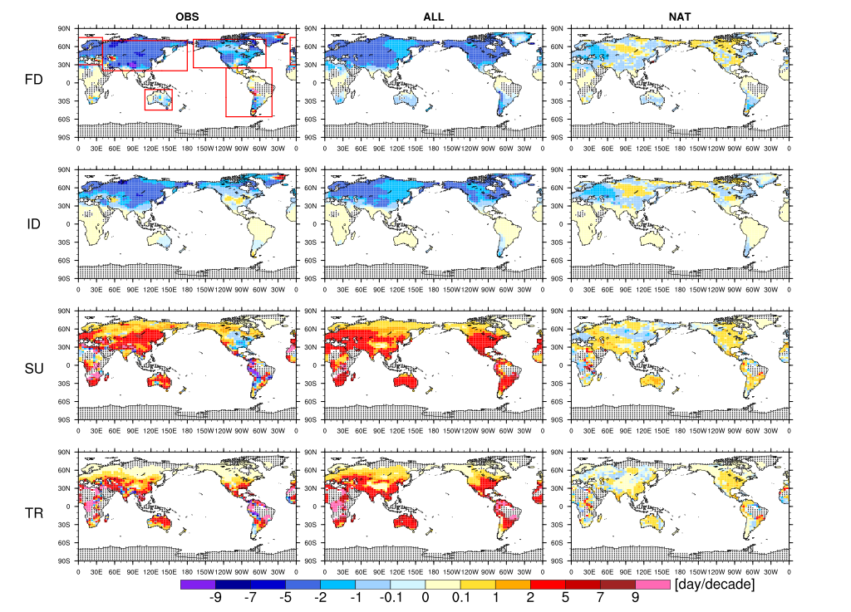
Observed and simulated trends in fixed extreme temperature indices (1961-2010)
FIG. 1. Geographical distributions of the observed (left column) and the multi-model mean simulated trends under the ALL (middle column) and NAT (right column) forcings for four extreme temperature indices during 1961-2010.

Slide 11
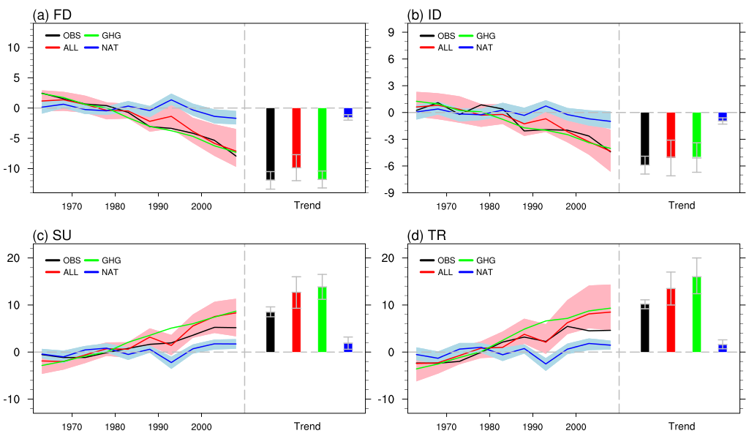
Five-year mean anomalies and trend of the four indices ( relative to 1961–1990) from observations (black) and multi-model ensembles in global
“ALL” forcing (red line), “GHG” forcing (green line) and “NAT” forcing (blue line). Shading shows the 5-95% ranges of the individual model simulations

Slide 12
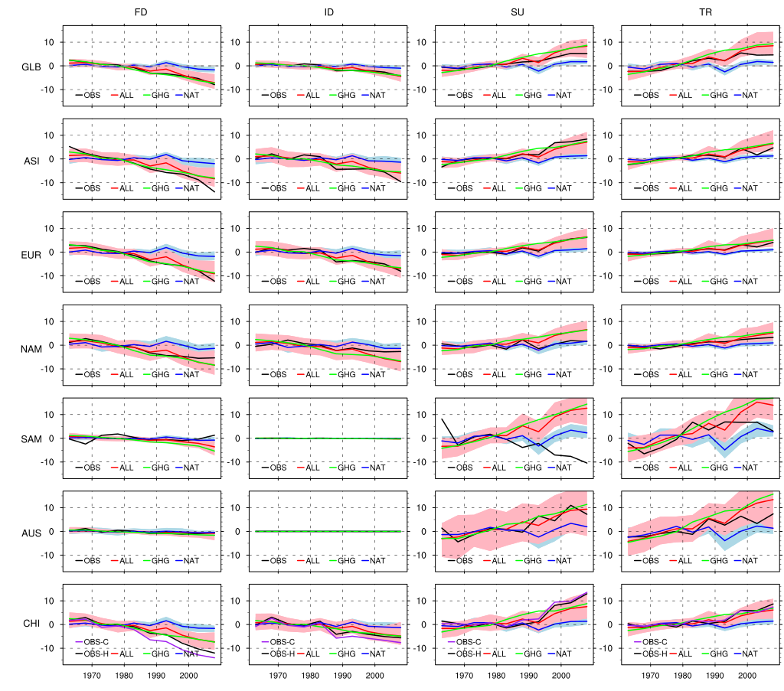
Five-year mean anomalies of the four indices ( relative to 1961–1990, from 1961 to 2010) from observations (black) and multi-model ensembles for global, five continental and China
the ALL results reproduce most of the observed changes, except in the Americas.
Previous studies (e.g., Knutson et al., 2017) have shown that the observed trends in some extreme temperatures in parts of the Americas are inconsistent with CMIP5 ALL forcing
the reason is unknown, but it may be due to the effects of anthropogenic aerosols, atmospheric circulation, internal climate variability and changes in land use, among other factors.

Slide 13
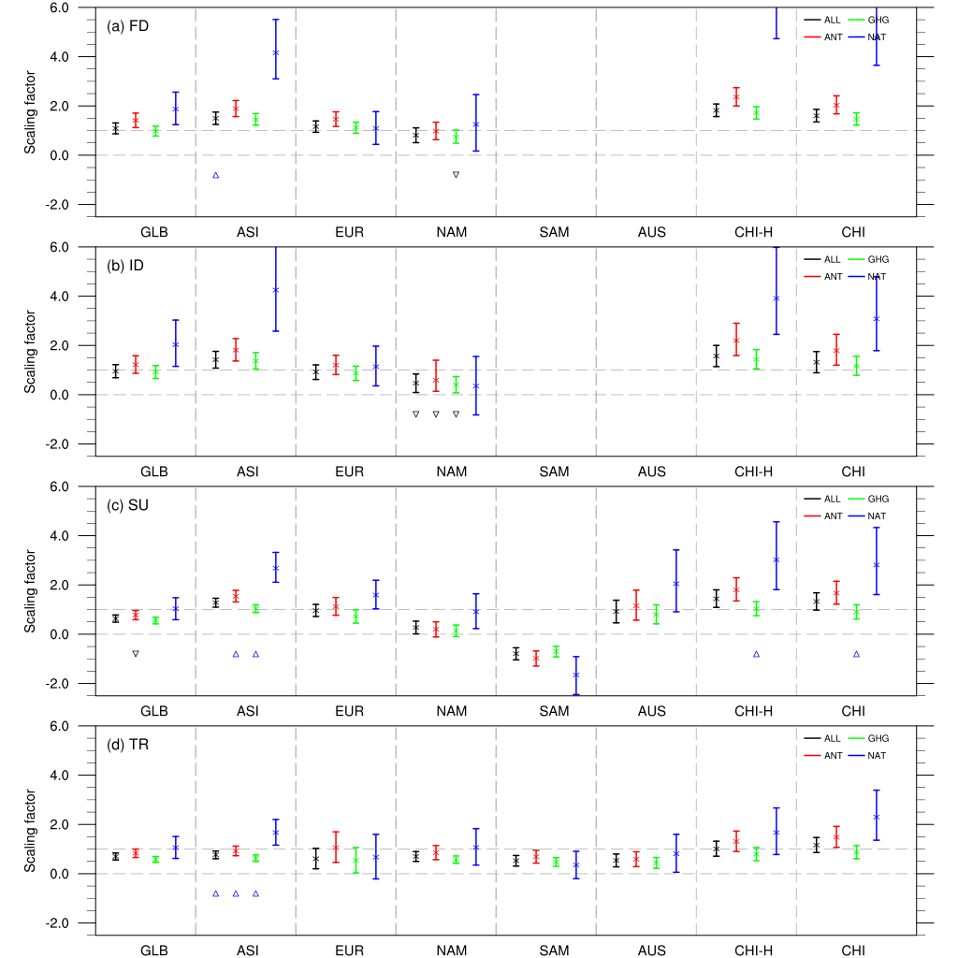
one-signal analyses based on Optimal Fingerprinting Method
If the 90% confidence interval of the scaling factor is above zero, the signals of the external forcings are considered to be detected in the observations.
If the 90% ranges of the scaling factors also include unity, the observed changes are consistent with the response of the model simulations to external forcing.
FIG. 4. Best estimates of scaling factors and their 5–95% confidence intervals from single -signal analyses from 1961 to 2010 for the globe (GLB), Asia (ASI), Europe (EUR), North America (NAM), South America (SAM), Australia (AUS), and China (CHI).

Slide 14
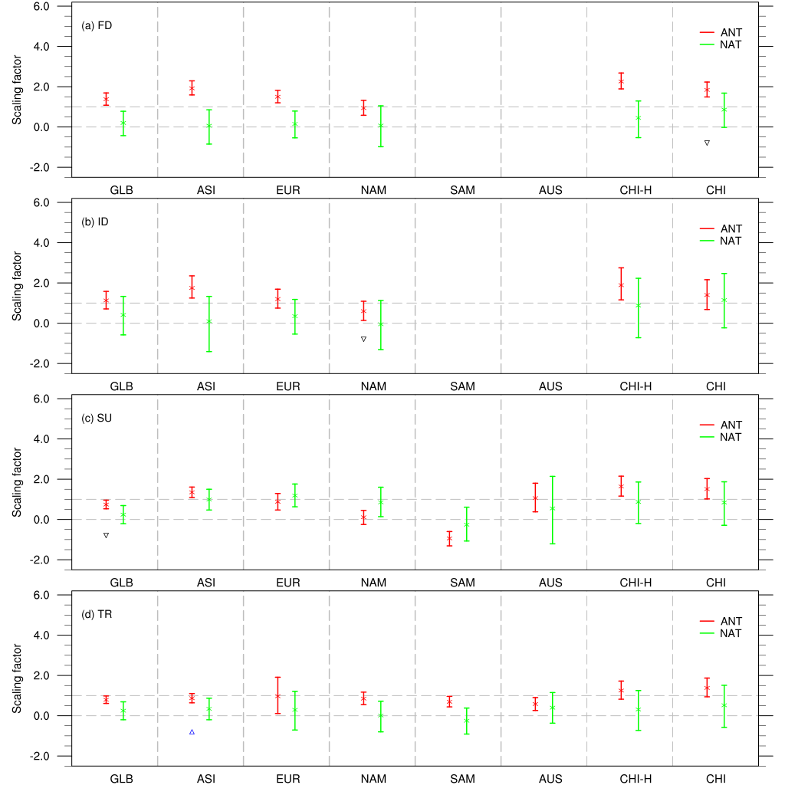
Two-signal analyses based on Optimal Fingerprinting Method
All of these results show the strong effects of the human influence on the fixed threshold indices and confirm the robustness of the detection results obtained using one-signal detection.
FIG. 5. Best estimates of the scaling factors and their 5–95% confidence intervals obtained using two-signal analyses for 1961-2010 for the globe (GLB), Asia (ASI), Europe (EUR), North America (NAM), South America (SAM), Australia (AUS), and China (CHI).

Slide 15
Discussion and Conclusion
Understanding the causes of observed climate changes and the underlying mechanisms provides an important basis for properly projecting future climate conditions and for making decisions to adapt to climate change.
This study focuses on the detection of the fixed threshold indices of extreme temperature at the global scale, as well as over five of the continents and China, using the results of a multi-model ensemble for the first time.
The results show that the CMIP5 multi-model simulations generally reproduce the observed changes in the fixed threshold indices of extreme temperature, both at the global scale and over most of the continents.
The indices related to the daily maximum temperature in the Americas show some degree of inconsistency with the observations; the reasons for this inconsistency are unknown.
The ANT signal cannot be detected in the changes in summer days in the North and South Americas, which lends additional support to the conclusion from the Fourth National Climate Assessment in the US (Knutson et al., 2017) that the anthropogenic forcing in temperature extremes in the US can be detected with only medium confidence.
The detection analyses show that an anthropogenic signal can be identified for most of the fixed threshold indices, whereas the natural signal cannot be detected.
Yin H et al. Journal of Climate , accepted, 2018

Slide 16
Thanks for attentions!

