Slide 1
Parallel algorithm for the EnKF
Yue (Michael) Ying and Fuqing Zhang
Group meeting, May, 2018

Slide 2
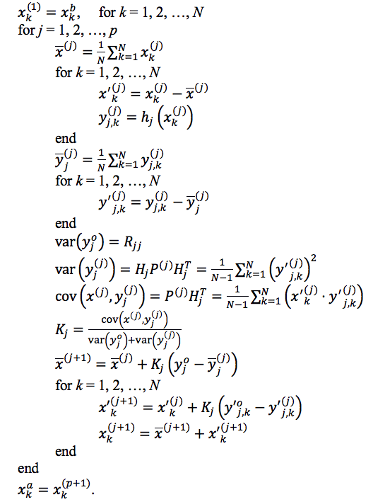
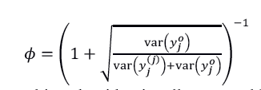
A serial square root EnKF algorithm:
loop over observations
calculate observation priors
update equations

Slide 3
Modification to h(x) calculation
move out of the
observation loop
…

Slide 4
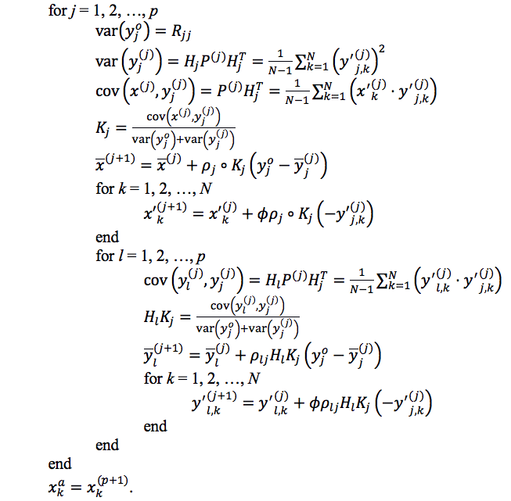
Modification to h(x) calculation
Inside the observation loop,
The observations y are updated as well as the states x.

Slide 5
Parallelization strategy
data structure for state vector x
x(ix+1, jx+1, nk, nv, nens+1)
separate work load along the ensemble dimension nens+1
decompose the domain into horizontal slabs (ix+1,jx+1)
why no decomposing in observation dimension?
zonal, meridional, vertical
dimensions
ensemble size
number of
variables

Slide 6
The MPI environment
member 1
member 2
Example:
nicpu=2, njcpu=2, nmcpu=4
ncpus=16
proc_id
gid=int(proc_id/(nicpu*njcpu))
sid=mod(proc_id,nicpu*njcpu)
0
0
1
0
4
1
5
1
0
1
0
1
2
0
3
0
6
1
7
1
2
3
2
3
member 3
ensemble mean
8
2
9
2
12
3
13
3
0
1
0
1
10
2
11
2
14
3
15
3
2
3
2
3
data stored on each processor:
x(ni, nj, nk, nv, nm)
ni=ceil((ix+1)/nicpu)
nj=ceil((jx+1)/njcpu)
nm=ceil((nens+1)/nmcpu)
horizontal slabs
member

Slide 7
Taking ensemble average with MPI_Allreduce
member 1
member 2
0
0
1
0
4
1
5
1
0
1
0
1
2
0
3
0
6
1
7
1
2
3
2
3
call MPI_Allreduce(sum(x,5),
xm,
ni*nj*nk*nv,
MPI_REAL,
MPI_SUM,
g_comm, ierr)
xm=xm/real(nens)
member 3
ensemble mean
8
2
9
2
12
3
13
3
0
1
0
1
10
2
11
2
14
3
15
3
2
3
2
3
x(ni, nj, nk, nv, nm)

Slide 8
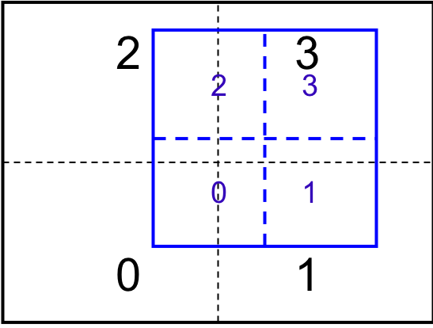
Collect domain slabs for Kalman gain calculation
y_{j}
decompose the update zone in the same fashion
0,1,2,3 => 0
1,3 => 1
2,3 => 2
3 => 3
How to write one piece of code to be executed by all processors,
and perform two-way communication successfully?

Slide 9
Deadlocks during two-way communication
naïve code:
for is = 0, nicpu*njcpu-1
if is == sid
get slab locally
else
MPI_Recv slab from is
MPI_Send slab to is
end
end
y_{j}
what actually happens:
Processor 0 | Processor 1 | Processor 2 | Processor 3
<=1 | <=3 | <=3 | =>0
<=2 | =>0 | =>0 | =>1
<=3 |  |  | =>2

Slide 10
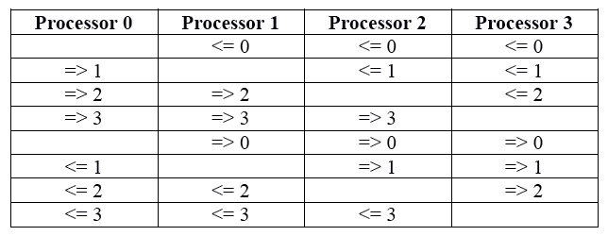
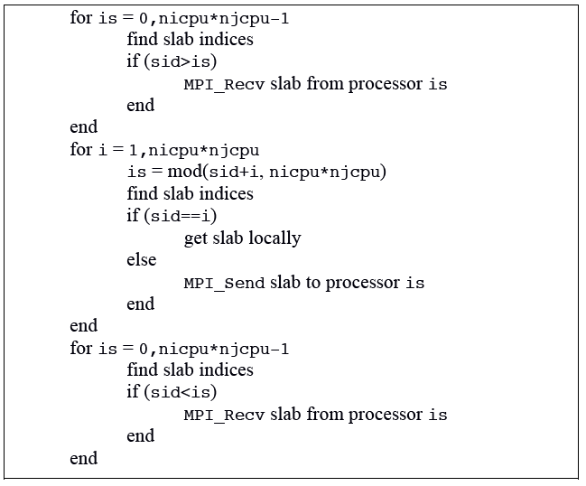
Choreographed inter-processor exchanges
prevents deadlocks!

Slide 11
Performance
Reportedly ~10x speed up compared to an older version.
Enabled all kinds of crazy data assimilation application later in our group.
Computation
Speed
saturation
1 10 100 …
ncpus

Slide 12
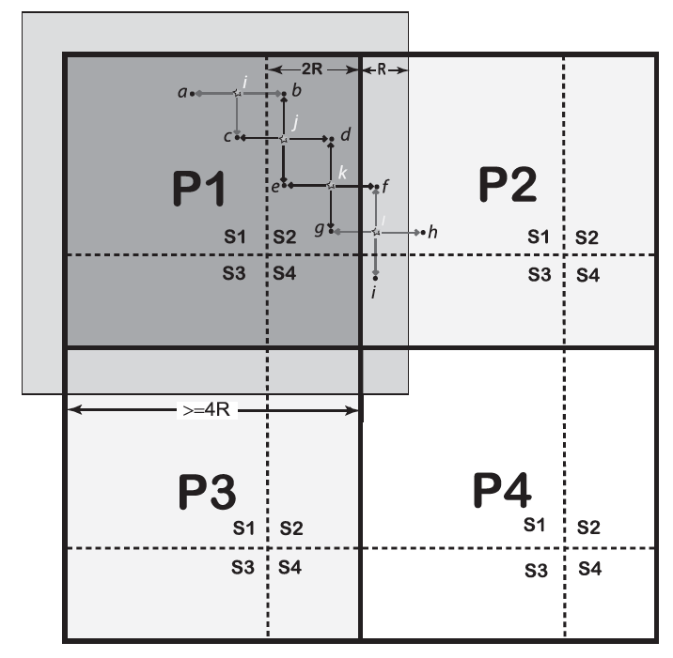
Future improvements
Current algorithm and parallel strategy scales well when:
number of observation p is relatively small
localization ROI is large
For high-density observation with more local impact:
LETKF
Simultaneously assimilate batches of observations (Wang et al. 2013)

