Slide 1
Experimenting with All-Sky Microwave Imaging Observation Assimilation for Tropical Cyclones
Research Group Meeting
23 May 2018
Scott Sieron
Advisors: Fuqing Zhang, Eugene Clothiaux

Slide 2
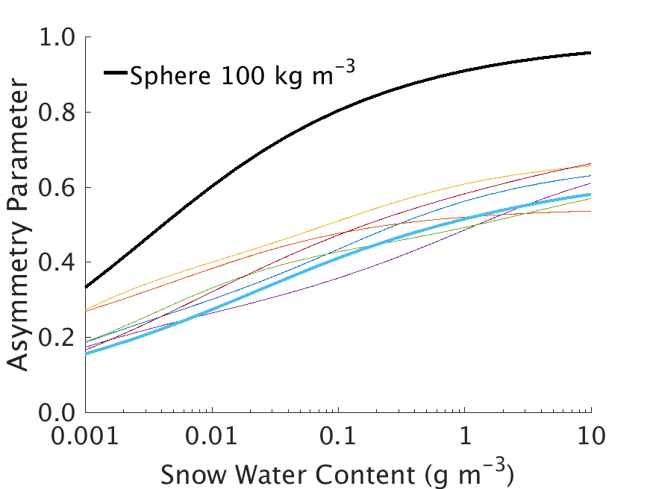
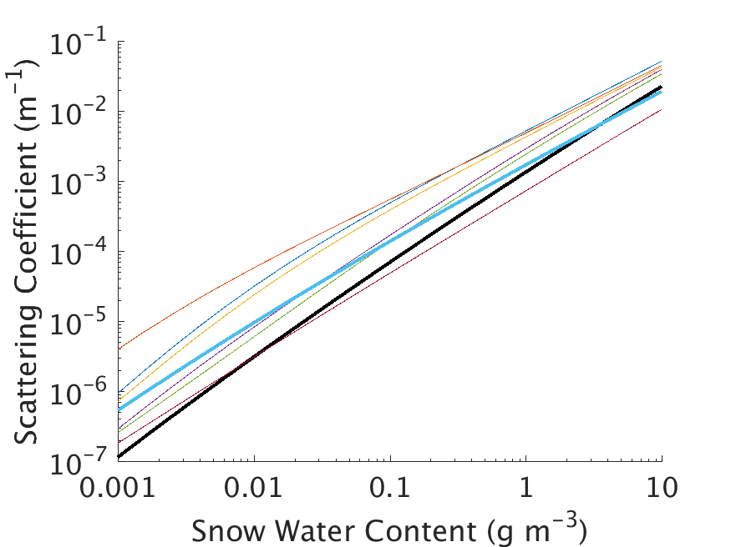
Non-spherical Cloud Scattering Properties
Cloud properties made consistent with particle size distribution of the microphysics scheme (WSM6; Sieron et al. 2017, JGR)
Replaced sphere snow particles with the Liu (2008; MWR) sector snowflake (Sieron et al. 2018, JAME)
Spherical particles produce outlying values of scattering coefficient and asymmetry parameter
183 GHz

Slide 3
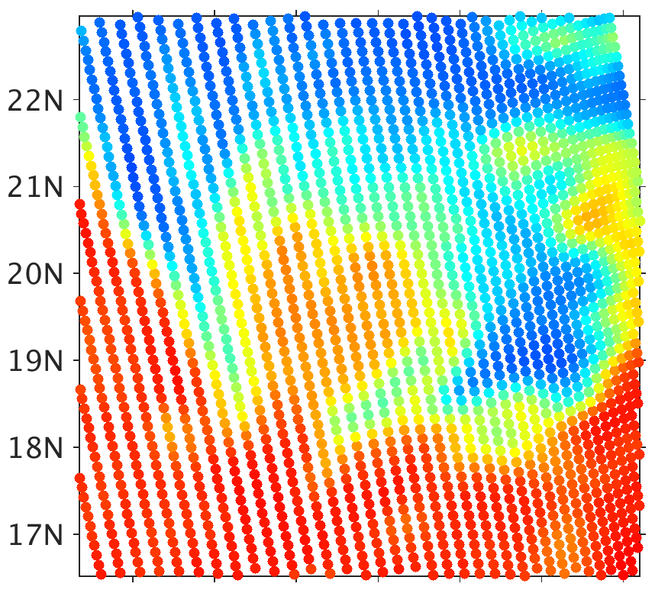
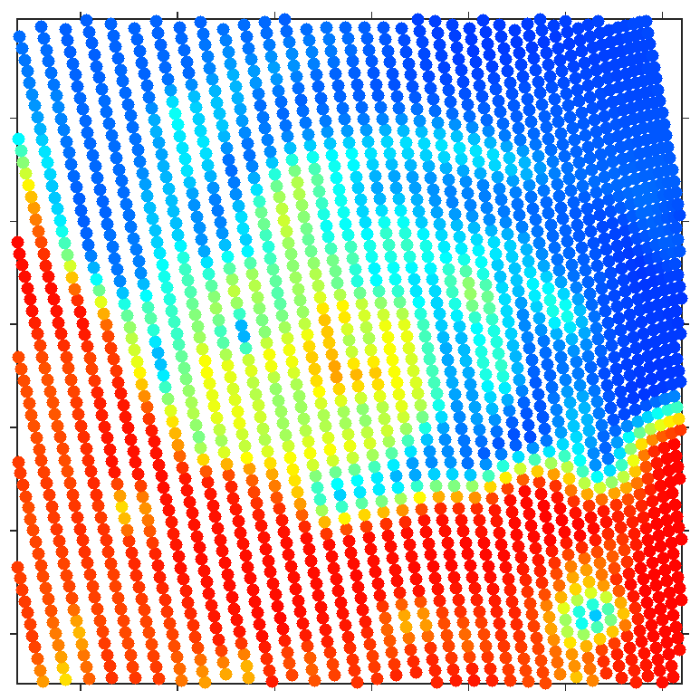
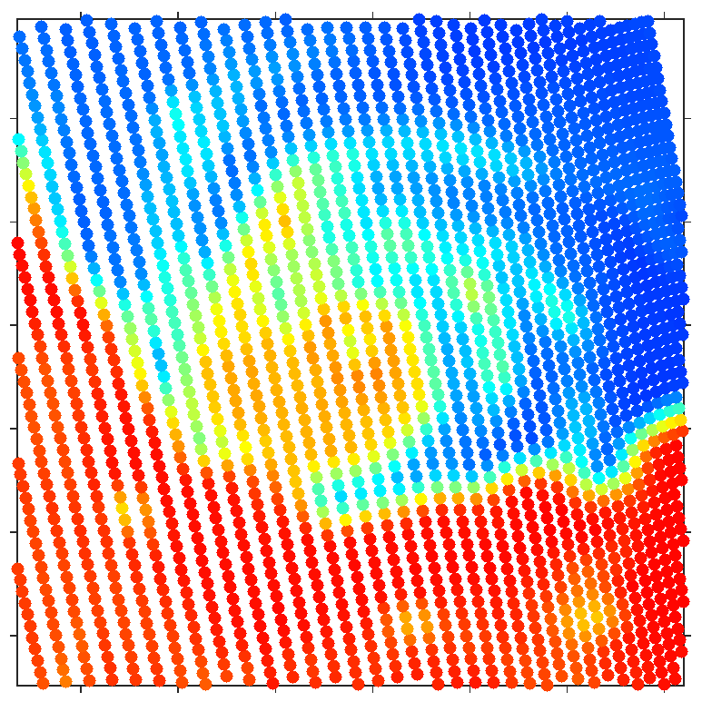
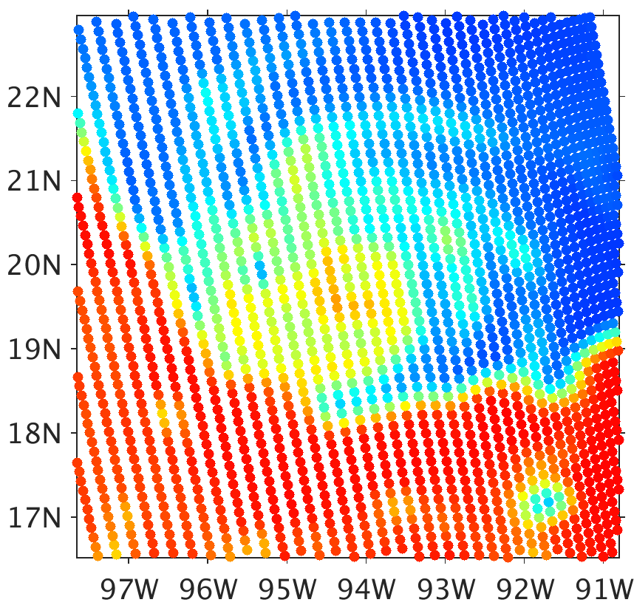
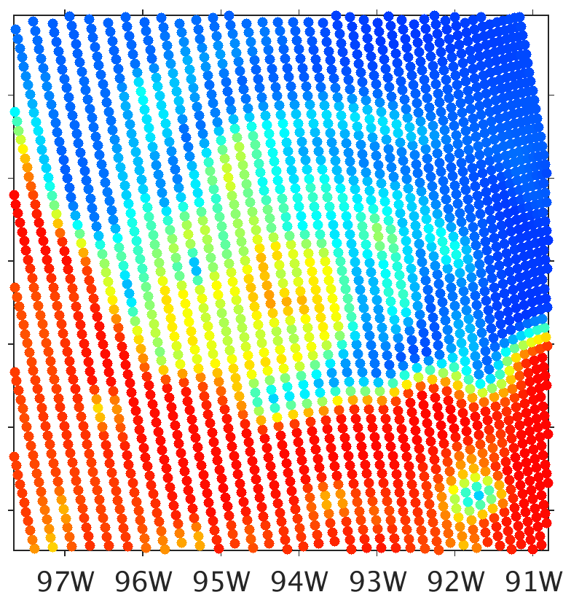
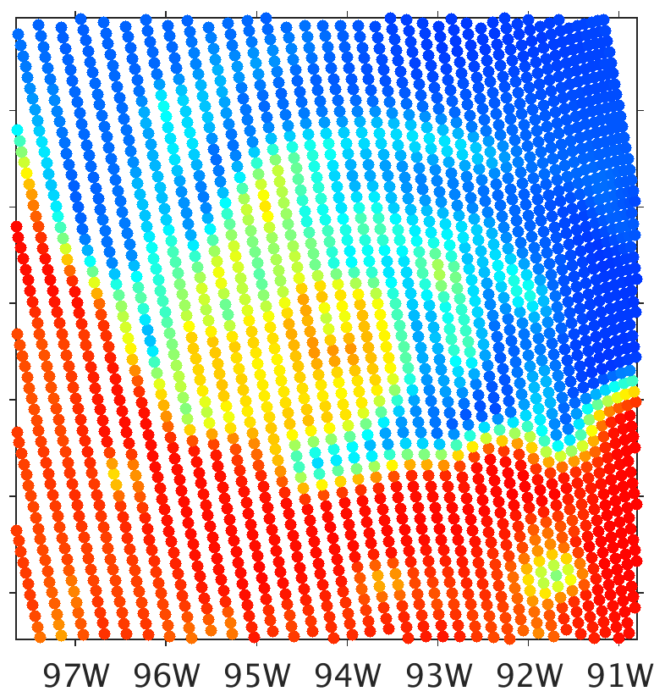
Spheres vs. Sector Snowflakes BTs
300
a) SSMIS Observation
b) All Spheres
c) Sector Flakes (all)
280
260
240
220
200
180
d) Sector Flakes (Snow Only)
e) Sector Flakes (Snow Only)
f) Sector Flakes (Snow Only)
160
½ Snow IWC
½ Graupel IWC
140
120
100
80
Brightness Temperature (K)

Slide 4
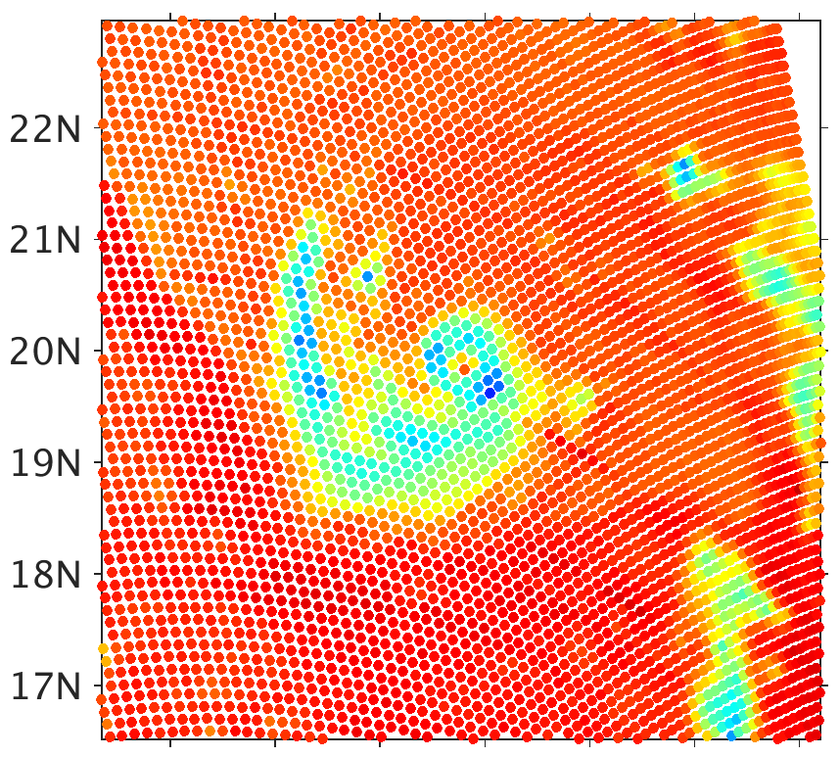
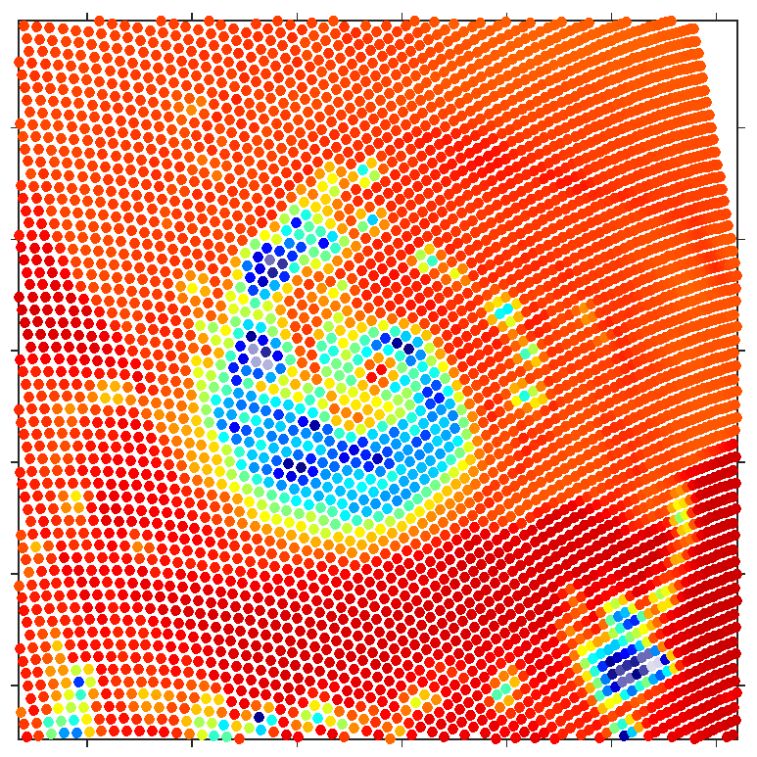
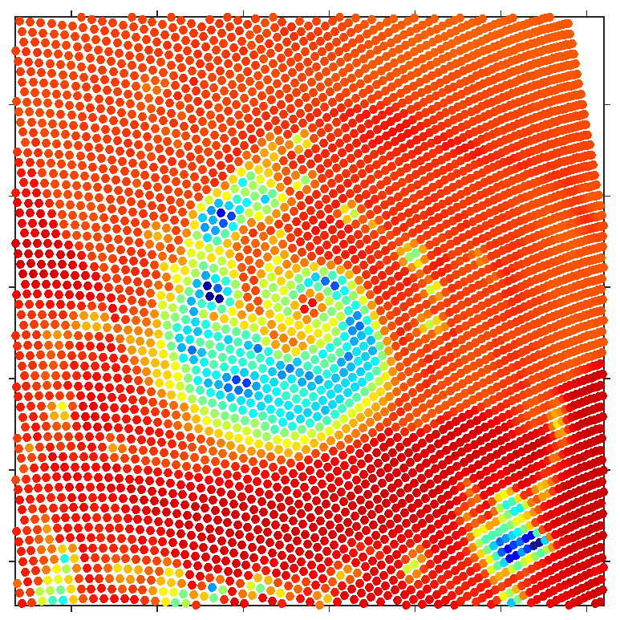
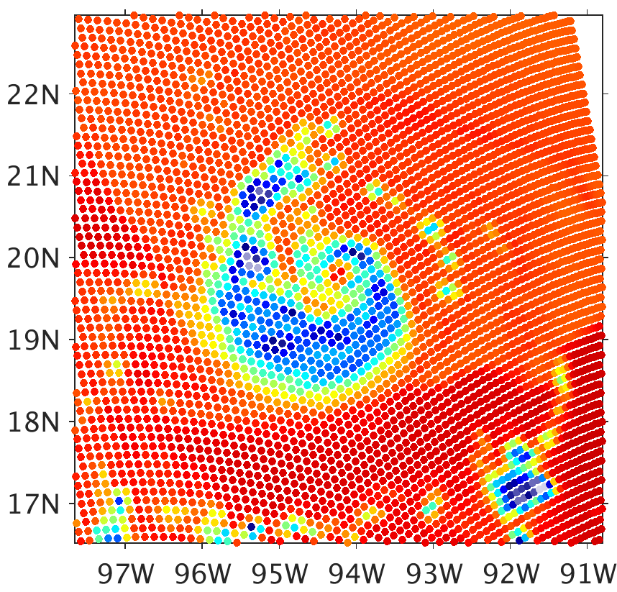
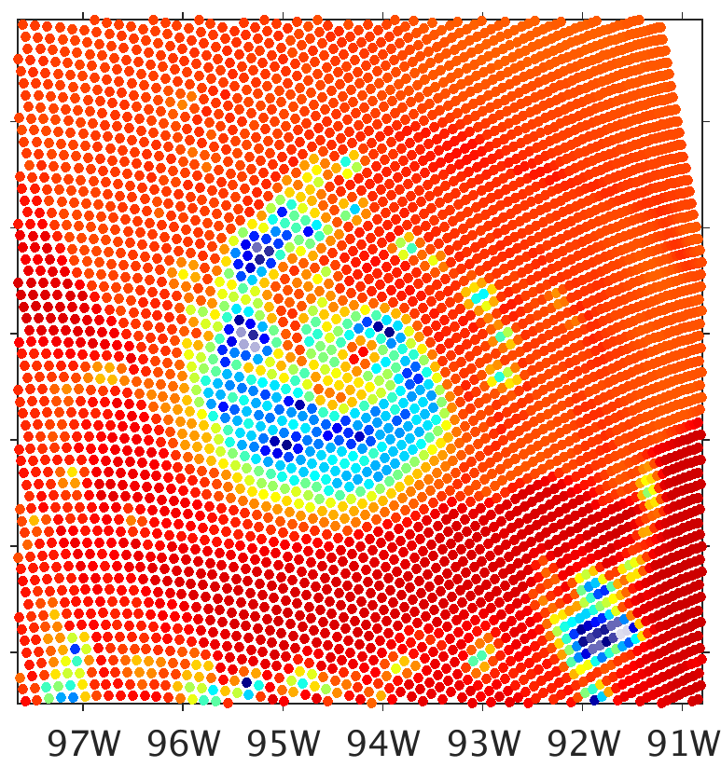
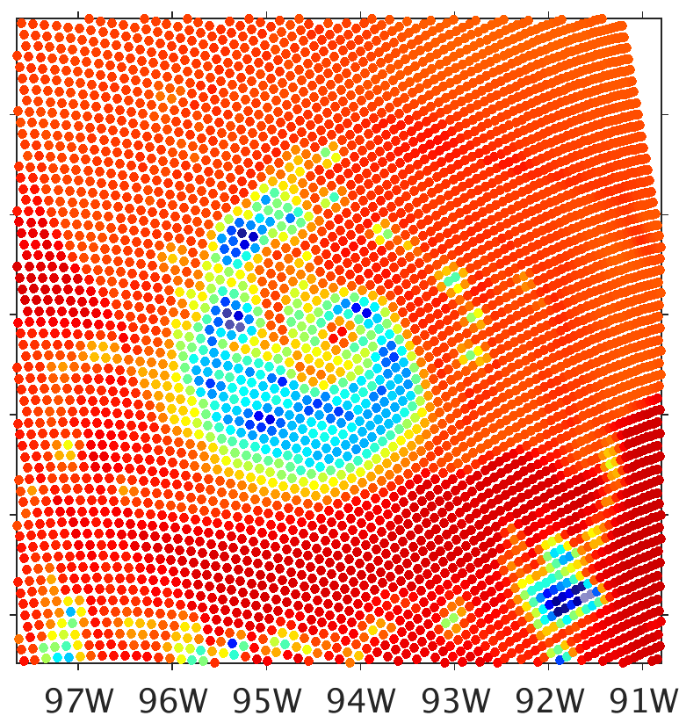
Spheres vs. Sector Snowflakes BTs
300
a) SSMIS Observation
b) All Spheres
c) Sector Flakes (all)
280
260
240
220
200
180
d) Sector Flakes (Snow Only)
e) Sector Flakes (Snow Only)
f) Sector Flakes (Snow Only)
160
½ Snow IWC
½ Graupel IWC
140
120
100
80
Brightness Temperature (K)

Slide 5
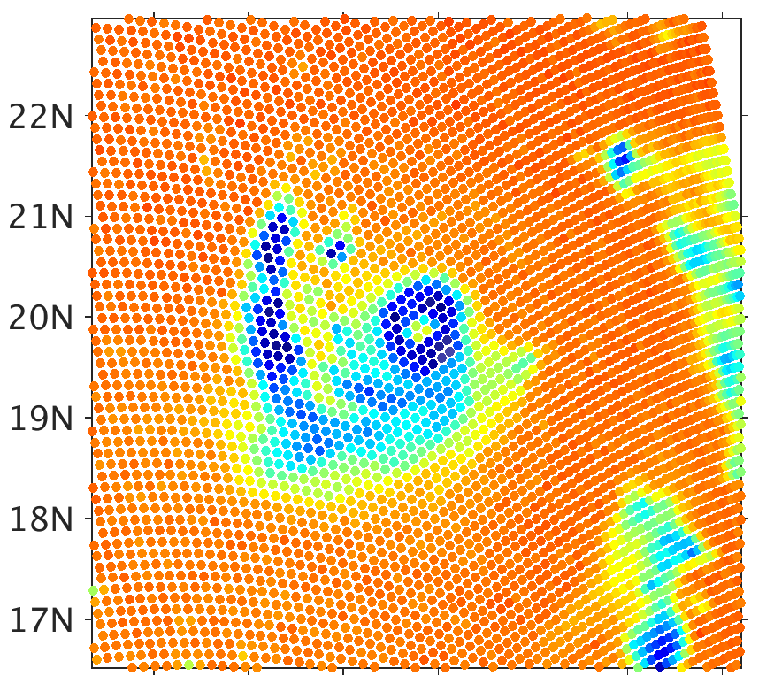
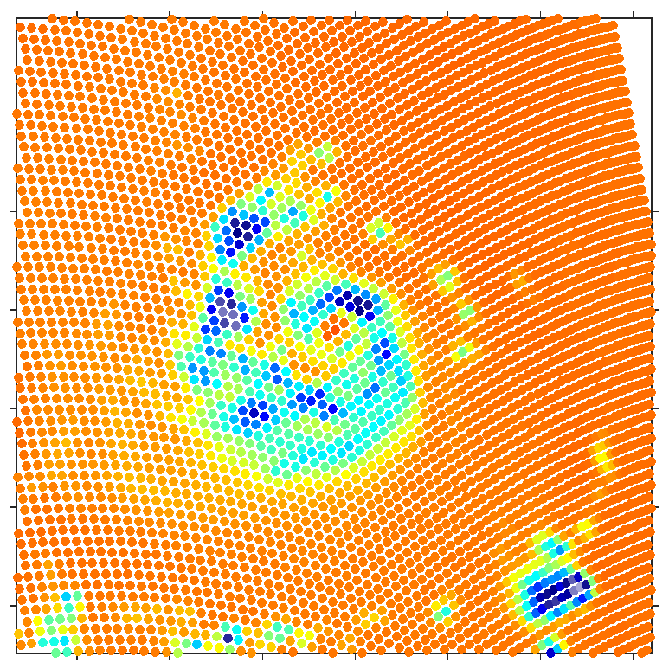
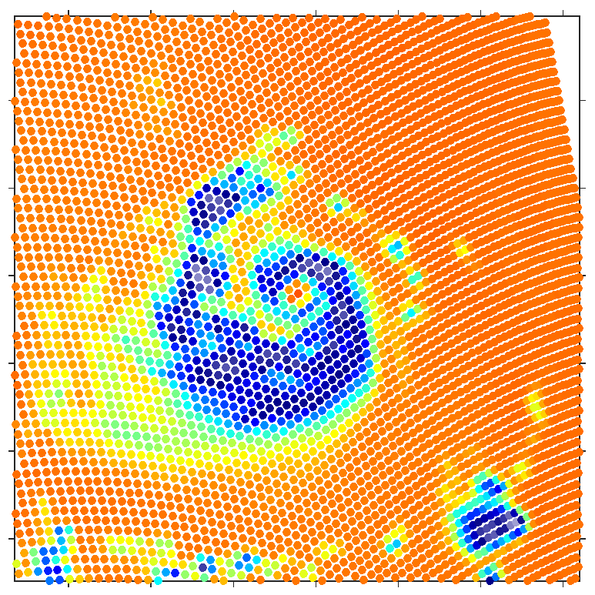
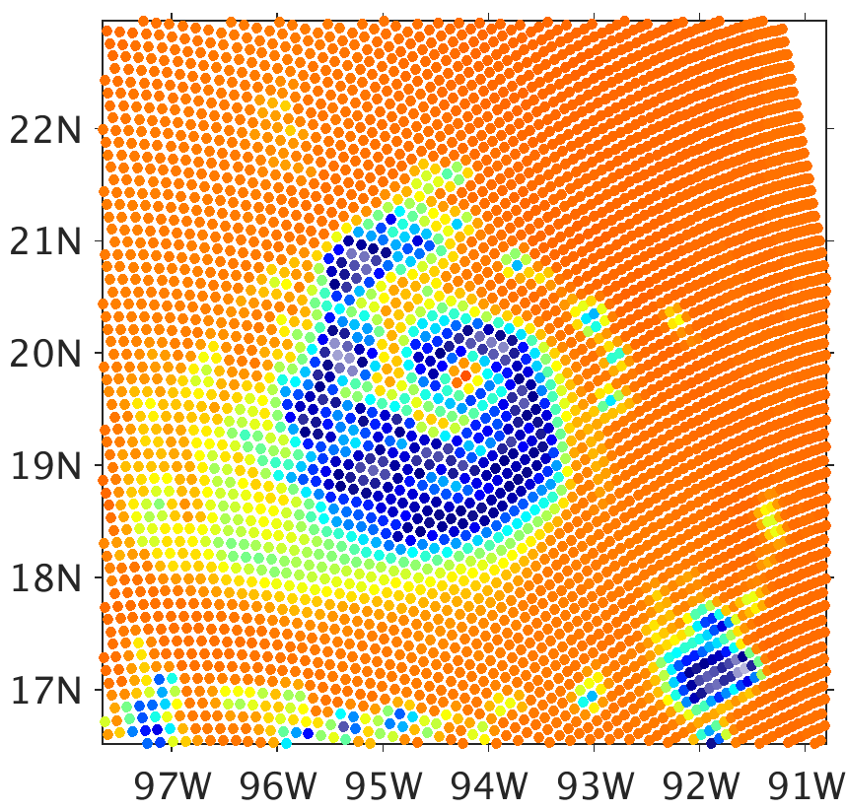
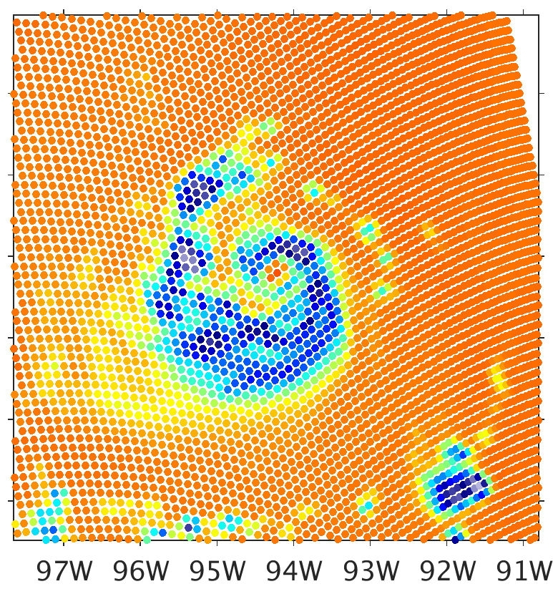
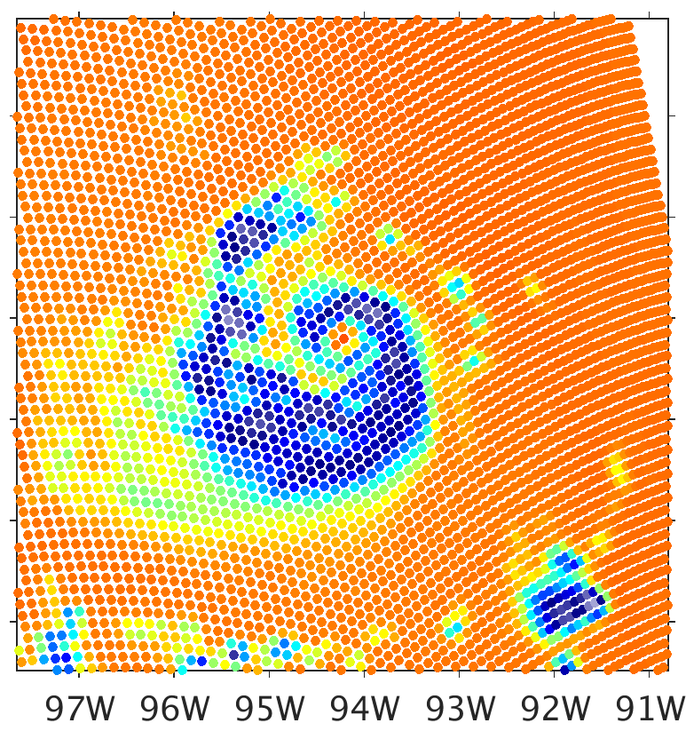
Spheres vs. Sector Snowflakes BTs
300
a) SSMIS Observation
b) All Spheres
c) Sector Flakes (all)
280
260
240
220
200
180
d) Sector Flakes (Snow Only)
e) Sector Flakes (Snow Only)
f) Sector Flakes (Snow Only)
160
½ Snow IWC
½ Graupel IWC
140
120
100
80
Brightness Temperature (K)

Slide 6
Spheres vs. Sector Snowflakes BTs
Replacing soft spheres with non-spheres for snow is necessary to make 183 GHz colder than 91.7 GHz in precipitation scenes.
Sector snowflakes do this better than any other particle type.
High-frequency BTs simulated much lower than observations suggest that the simulation has too great of snow mixing ratios.
There are BT depressions at 37 GHz in areas of graupel when using spheres. These can be resolved by reducing graupel water contents, or replacing graupel soft spheres with sector snowflakes.
Since spheres better represent graupel particle constructions, this could suggest overproduction of graupel in this simulation.

Slide 7
Preliminary Data Assimilation Experiments
Cycling DA of both infrared (e.g., Minamide and Zhang 2017, MWR) and microwave for mesoscale model tropical cyclone
Microwave (MW) observations
+ directly informative of vertically-integrated liquid and ice water contents
- only on polar-orbiting satellites, thus not continuously available and at irregular time intervals
Infrared (IR) observations
+ Continuously-available high-resolution observations from geostationary satellites (e.g., GOES-R, Himawari-8)
- Not directly informative of integrated water contents, just cloud top

Slide 8
Preliminary Data Assimilation Experiments
Hurricane Harvey (2017), hourly cycling from 23 Sept 12 UTC to 24 Sept 00 UTC
Geostationary IR (GOES-16 ABI) observations, as well as storm position and intensity, are assimilated every hour
Most of the available MW observations of ~19 GHz and ~183±7 are assimilated
23 Sept 00 UTC
24 Sept 00 UTC
12 UTC
15 UTC
18 UTC
21 UTC
Ensemble
Initialization
GMI
SSMIS
AMSR2 &
SAPHIR
SSMI &
SAPHIR
SSMIS

Slide 9
Preliminary Data Assimilation Experiments
60 members; inner-most domain grid spacing 3 km
IR and MW brightness temperatures calculated with the CRTM
Distribution-specific MW cloud scattering properties, with snow modeled as sector snowflakes
Data thinning & successive covariance localization
Observation errors: 3 K (IR and MW), 3 hPA
Adaptive Observation Error Inflation (Minamide and Zhang 2017; MWR)
Adaptive Background Error Inflation (Minamide and Zhang 2018, QJR)

Slide 10
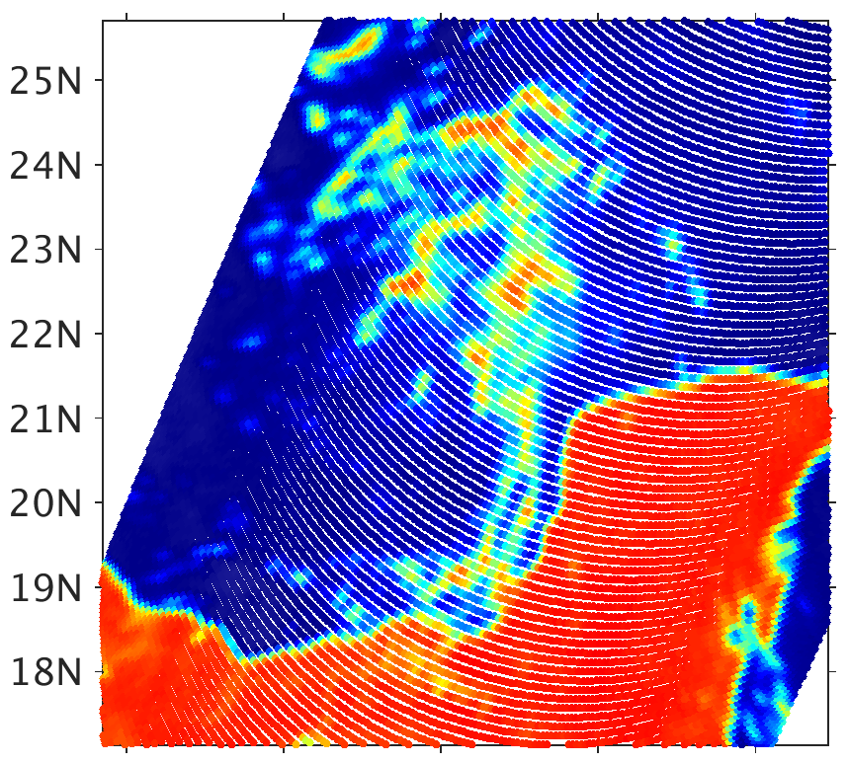
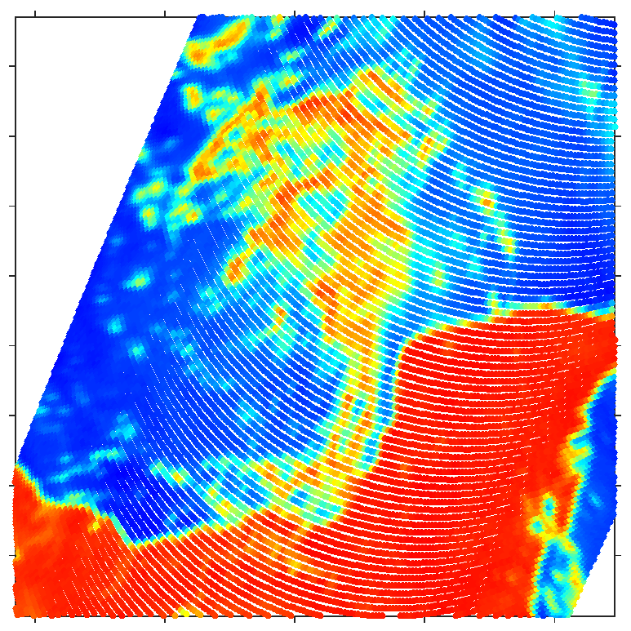
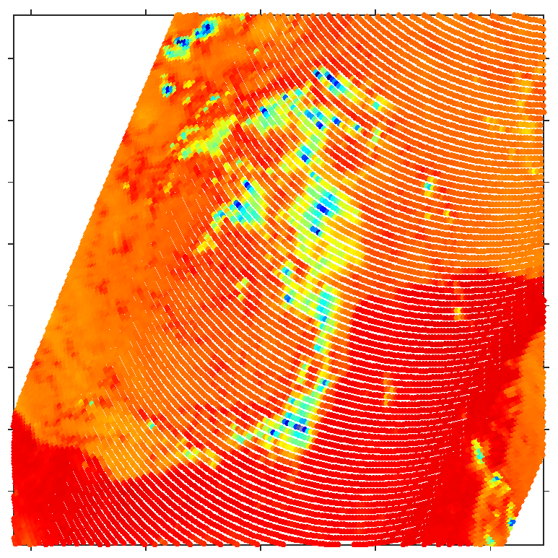
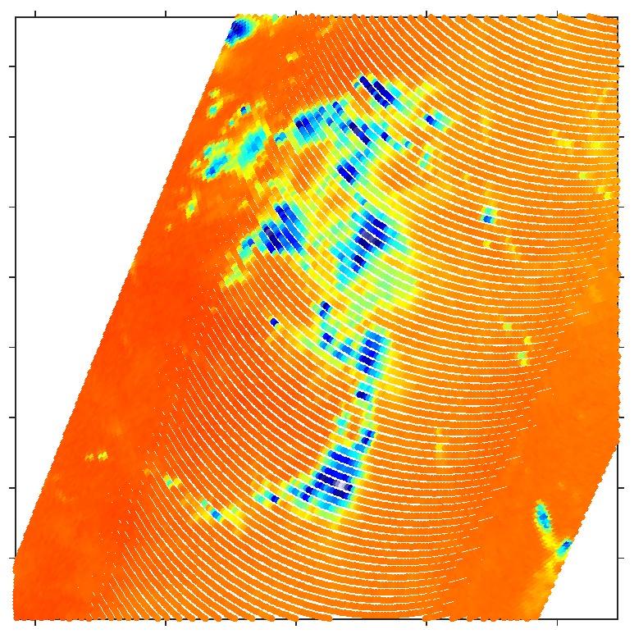
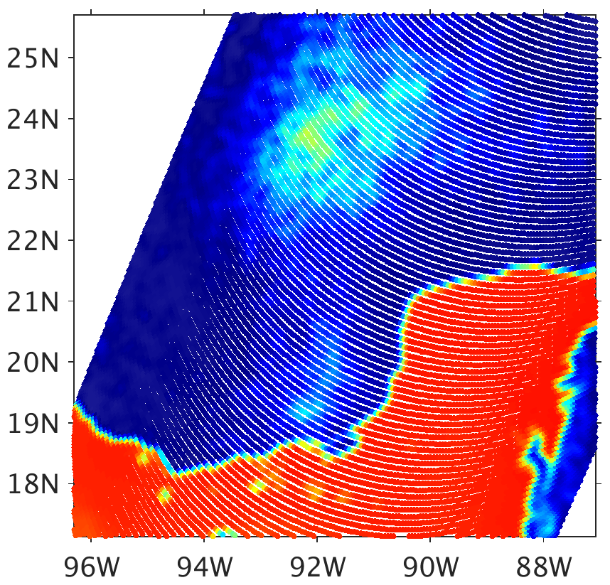
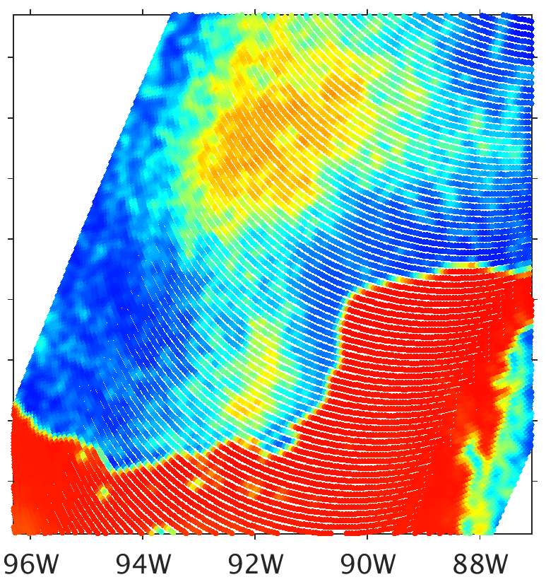
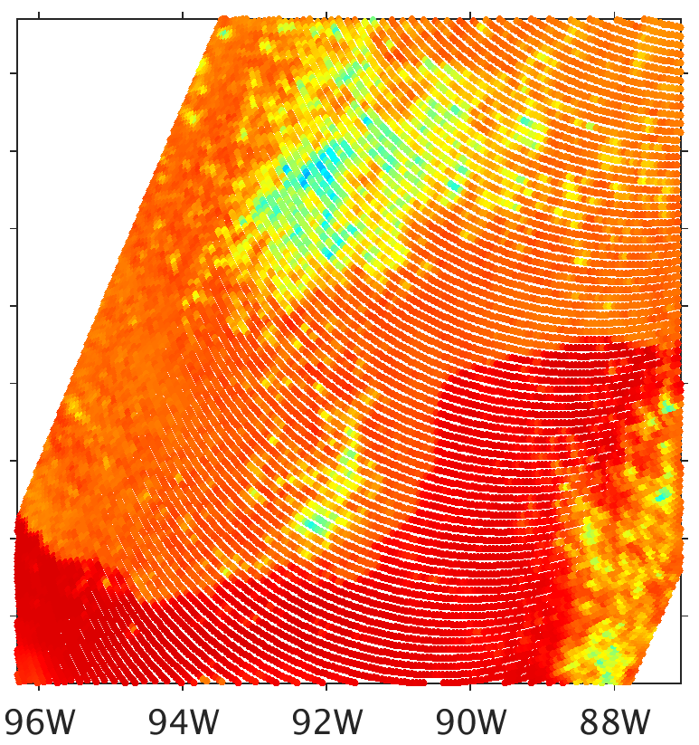
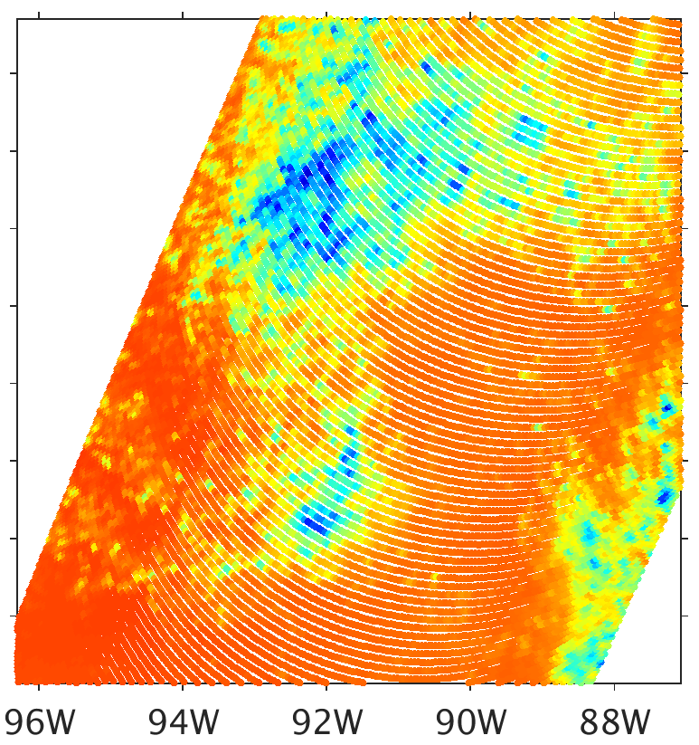
Assimilating All-sky Satellite Radiances: Harvey (2017)
WRF/CRTM simulated radiance, 1st cycle
Prior (12 UTC) vs. 12 UTC GPM observations
CRTM-DS Sector Snowflakes
Brightness Temperature (K)
80
100
120
140
160
180
200
220
240
260
280
300
18.7 GHz
37 GHz
89 GHz
183.3±7 GHz
Obs
$$H\left(\overline{x_{b}}\right)$$
IR

Slide 11
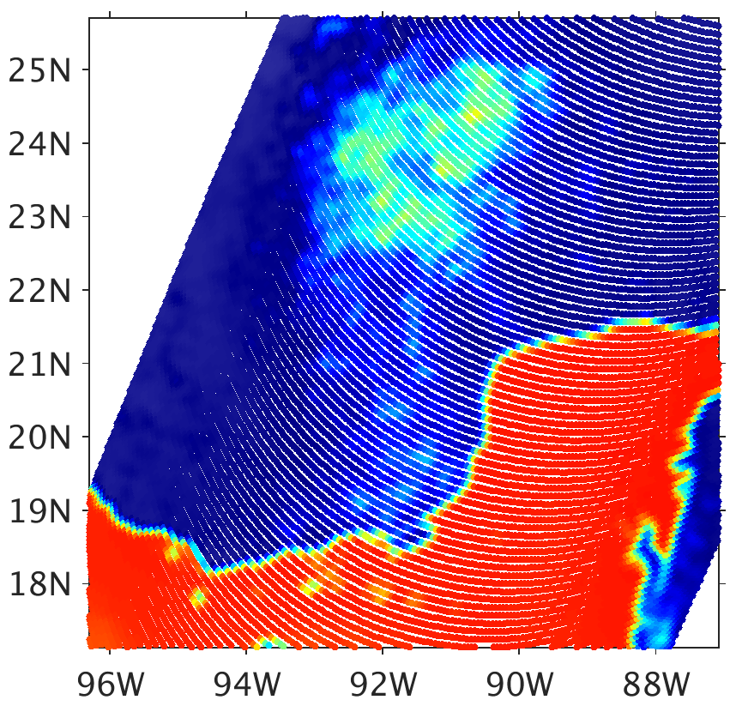
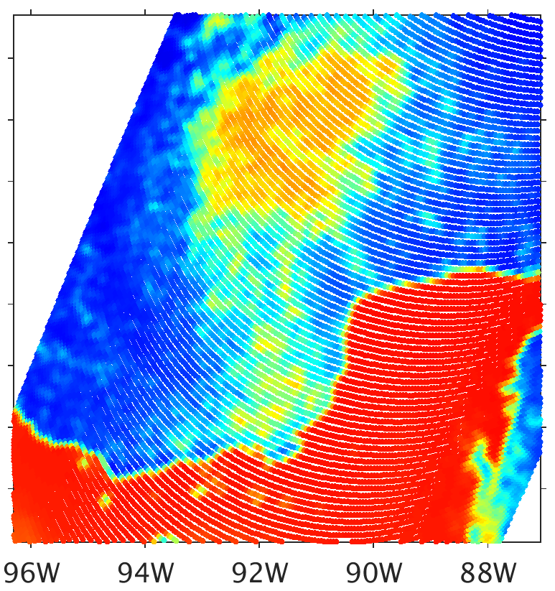
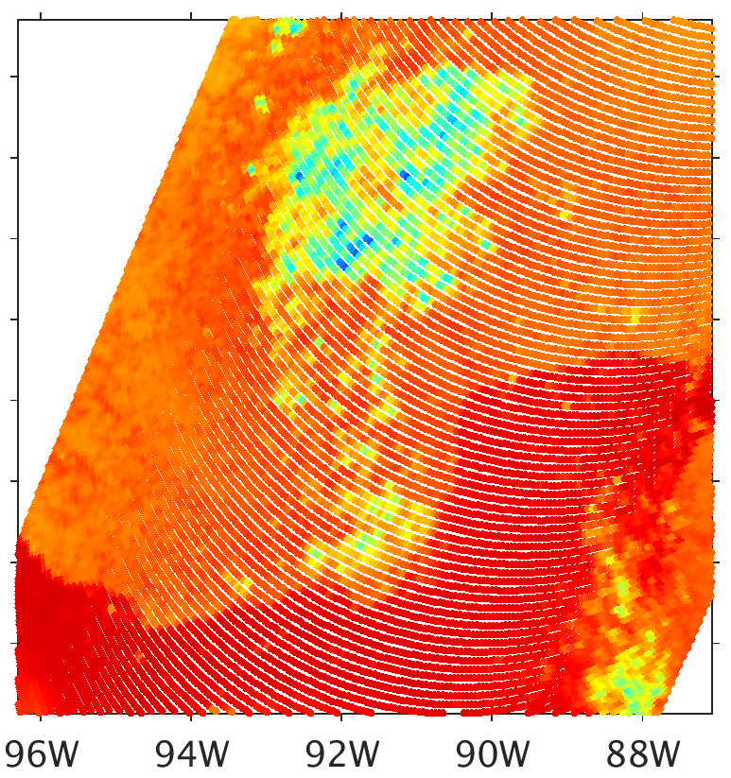
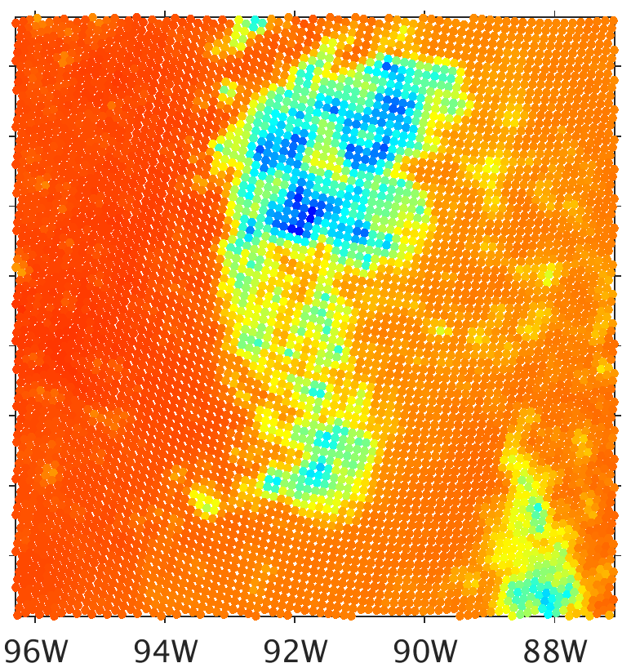
Assimilating All-sky Satellite Radiances: Harvey (2017)
*not using ABEI
WRF/CRTM simulated radiance, 1st cycle
Analysis, IR only (12 UTC) vs. 12 UTC GPM observations
CRTM-DS Sector Snowflakes
Brightness Temperature (K)
80
100
120
140
160
180
200
220
240
260
280
300
18.7 GHz
37 GHz
89 GHz
183.3±7 GHz
Obs
$$H\left(\overline{x_{a}}\right)$$
IR only

Slide 12
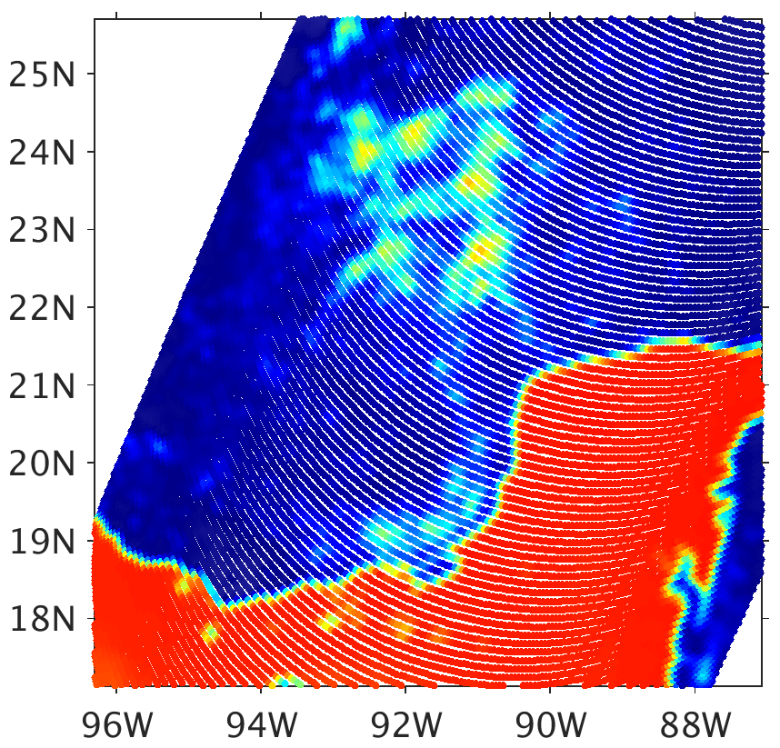
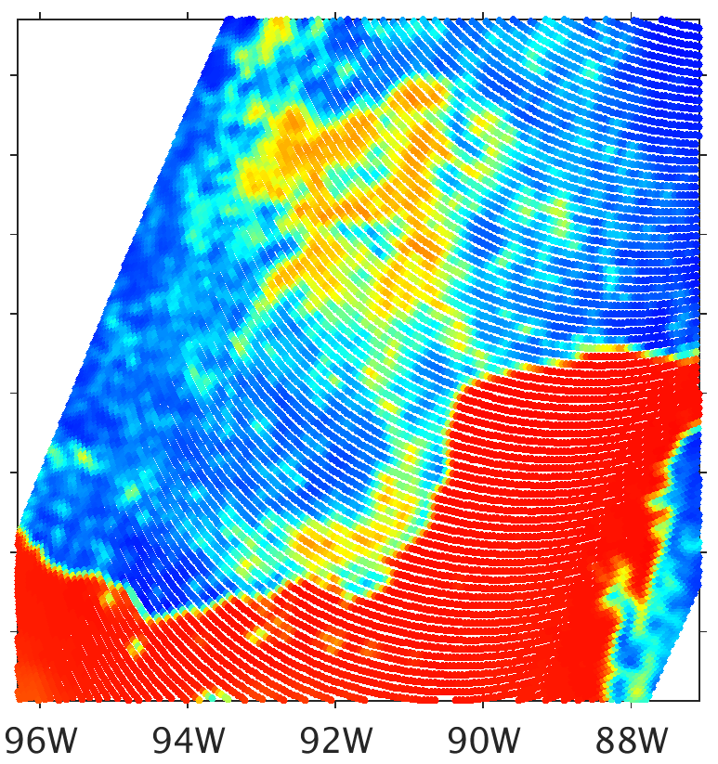
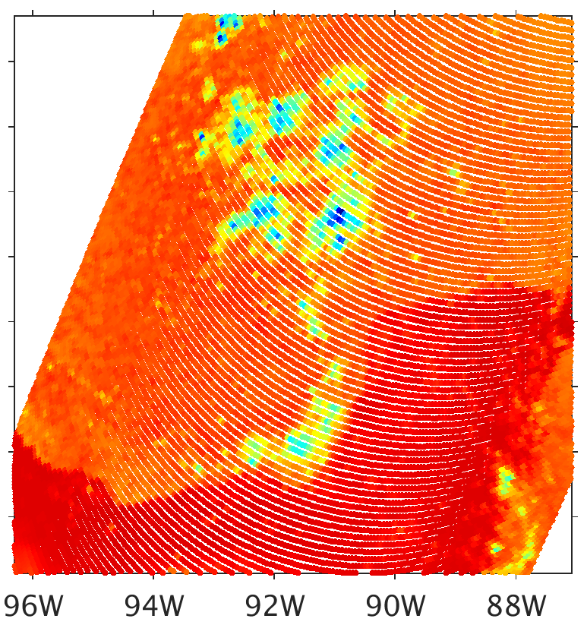
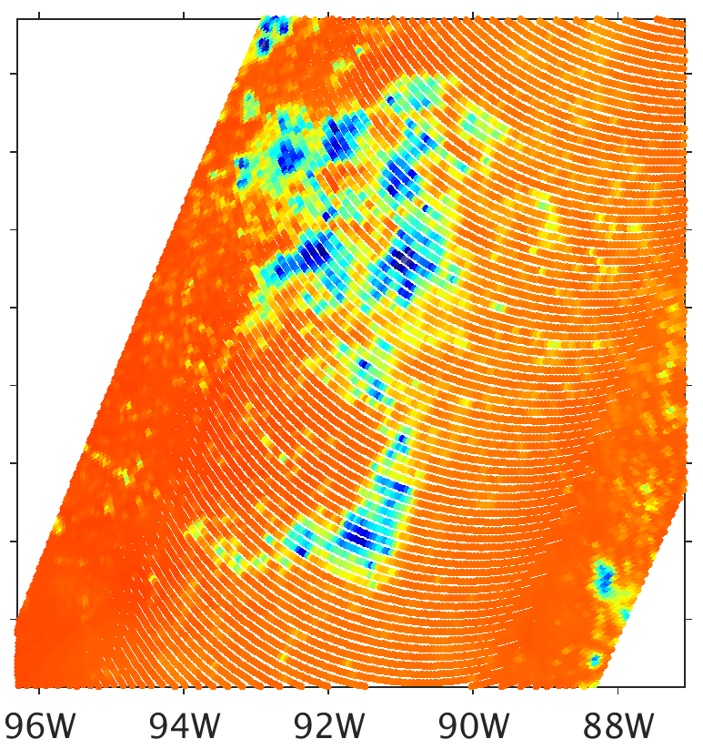
Assimilating All-sky Satellite Radiances: Harvey (2017)
WRF/CRTM simulated radiance, 1st cycle
Analysis, IR & MW (12 UTC) vs. 12 UTC GPM observations
CRTM-DS Sector Snowflakes
Brightness Temperature (K)
80
100
120
140
160
180
200
220
240
260
280
300
18.7 GHz
37 GHz
89 GHz
183.3±7 GHz
Obs
$$H\left(\overline{x_{a}}\right)$$
IR & MW

Slide 13
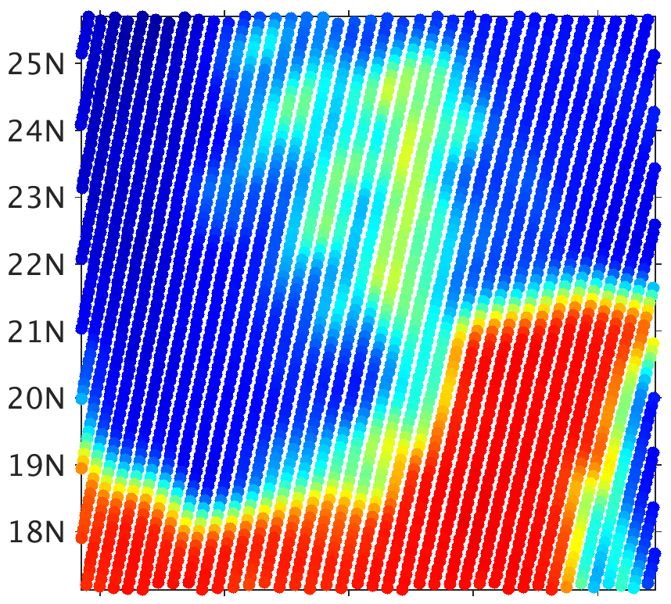
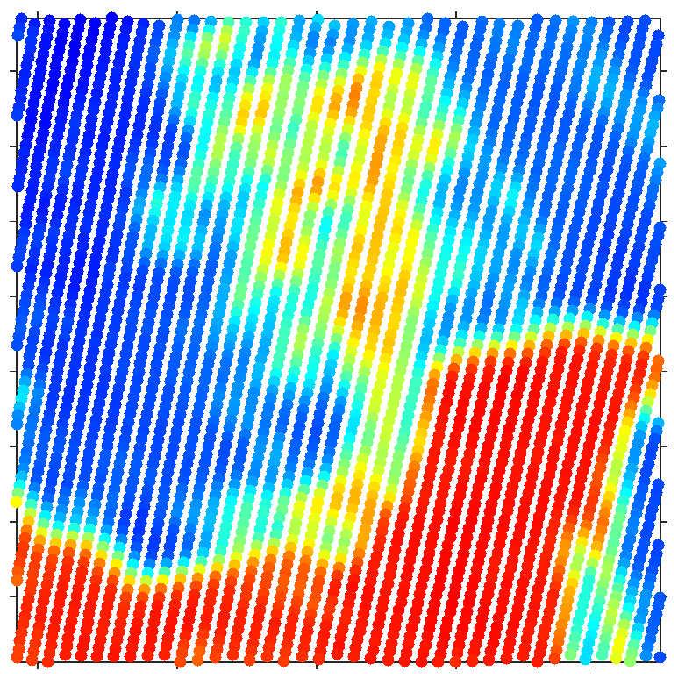
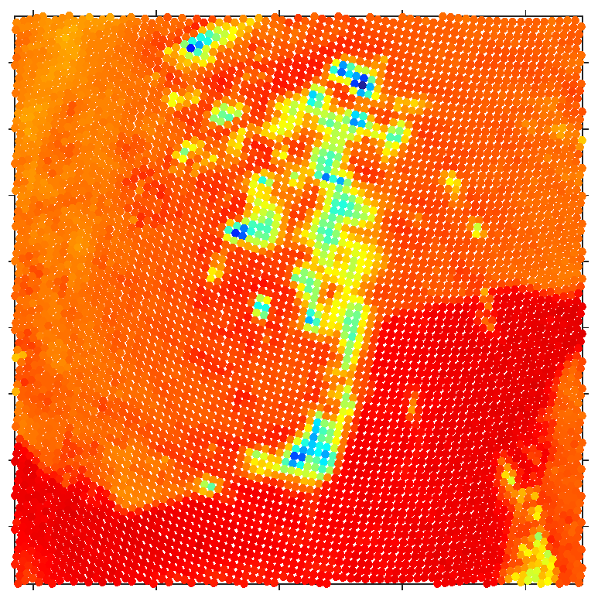
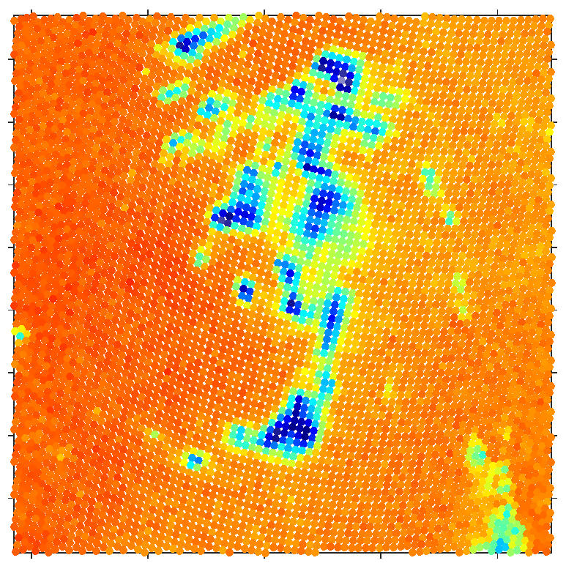
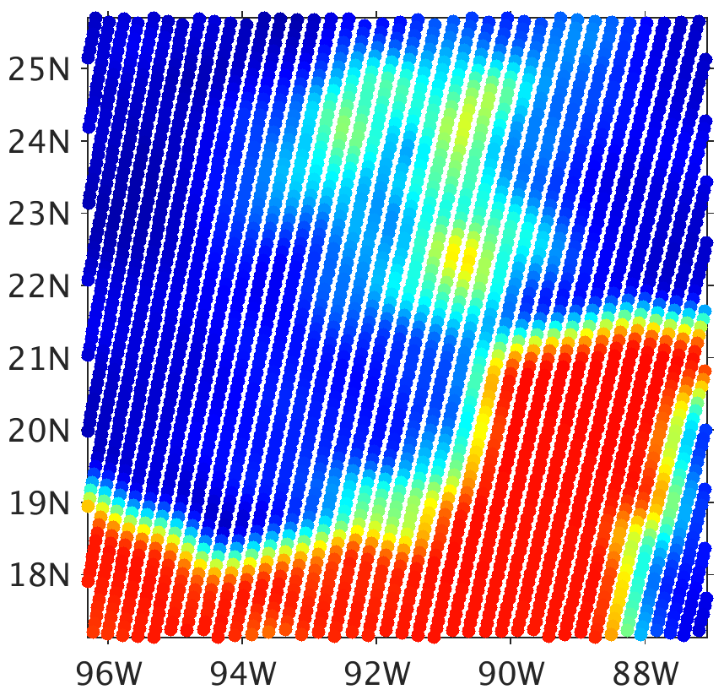
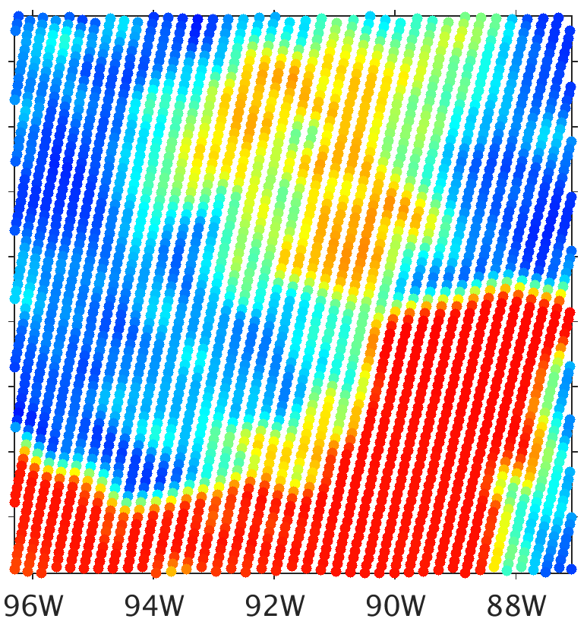
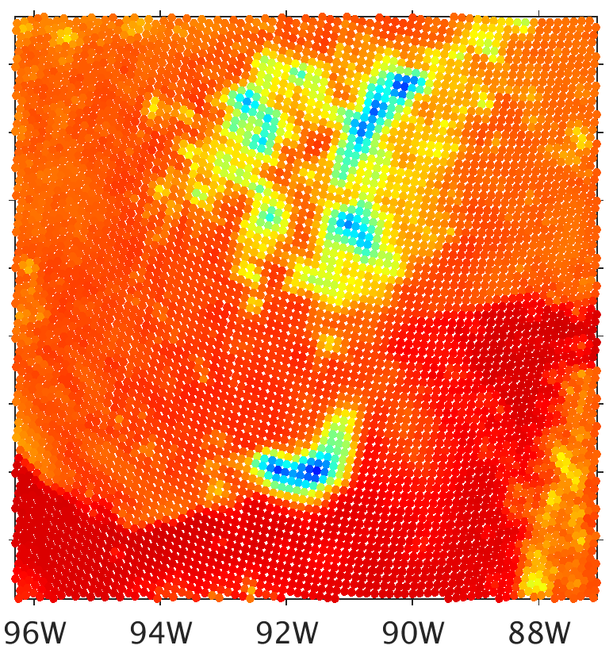
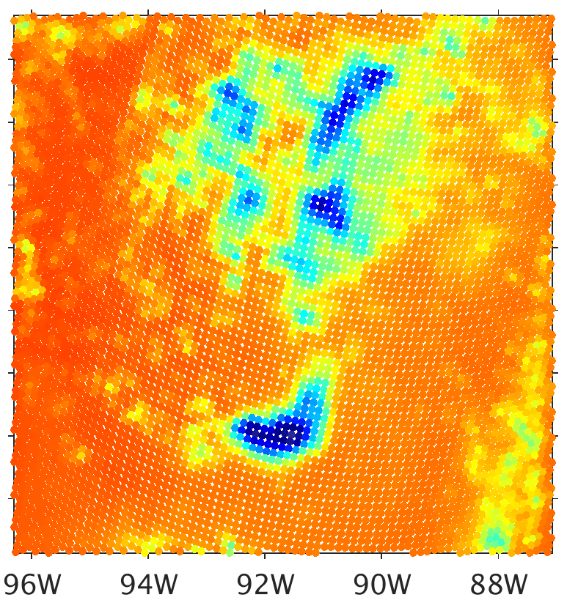
Assimilating All-sky Satellite Radiances: Harvey (2017)
WRF/CRTM simulated MW radiance, 2nd cycle (IR & MW)
Prior (13 UTC) vs. 13 UTC SSMIS observations
CRTM-DS Sector Snowflakes
Brightness Temperature (K)
80
100
120
140
160
180
200
220
240
260
280
300
19.35 GHz
37 GHz
91.7 GHz
183.3±7 GHz
Obs
$$H\left(\overline{x_{b}}\right)$$

Slide 14
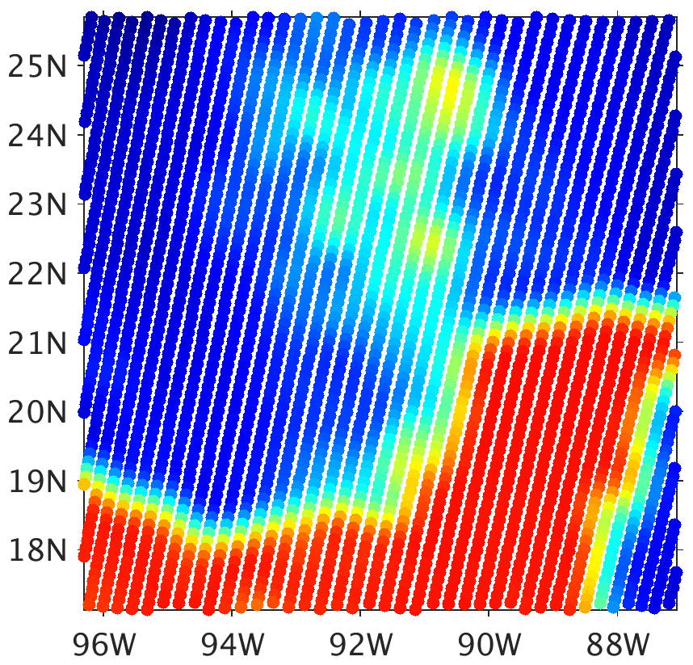
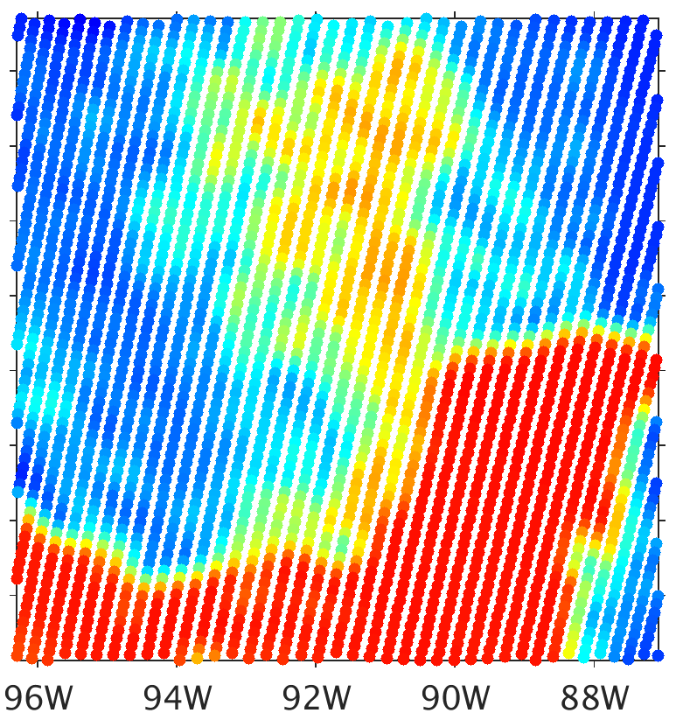
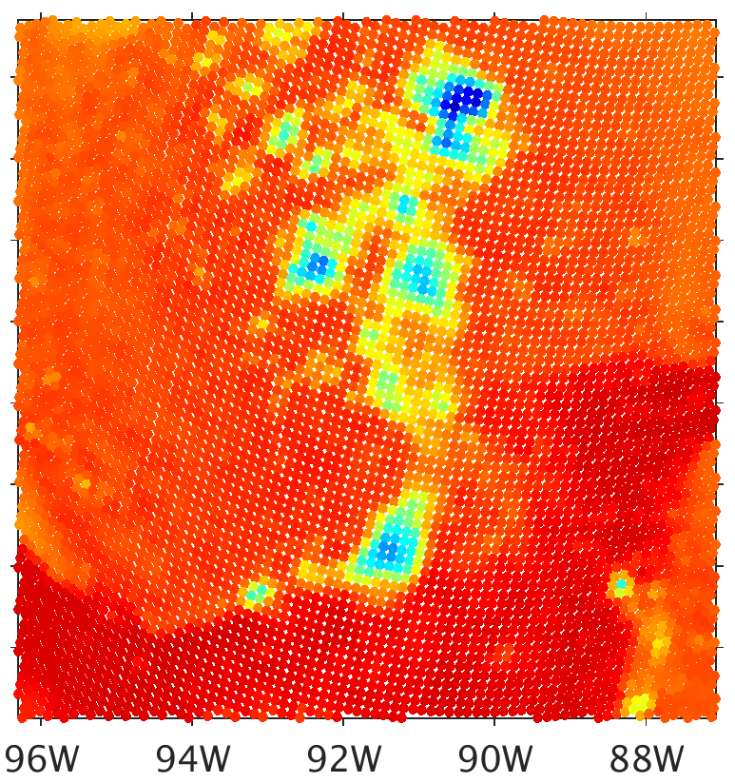
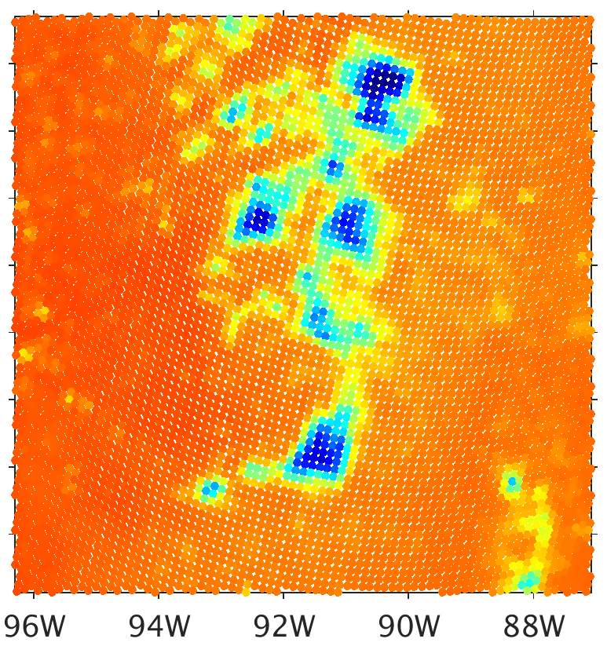
Assimilating All-sky Satellite Radiances: Harvey (2017)
WRF/CRTM simulated MW radiance, 2nd cycle (IR & MW)
Analysis (13 UTC) vs. 13 UTC SSMIS observations
CRTM-DS Sector Snowflakes
Brightness Temperature (K)
80
100
120
140
160
180
200
220
240
260
280
300
19.35 GHz
37 GHz
91.7 GHz
183.3±7 GHz
Obs
$$H\left(\overline{x_{a}}\right)$$
IR & MW

Slide 15
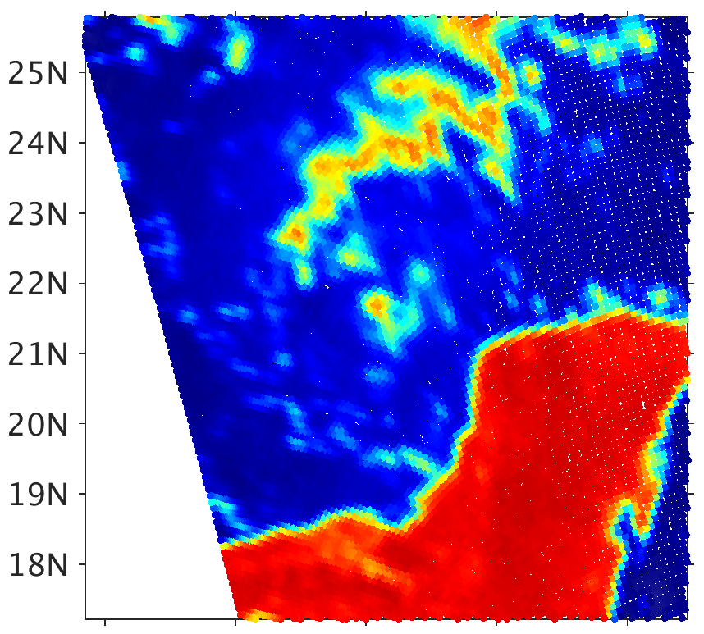
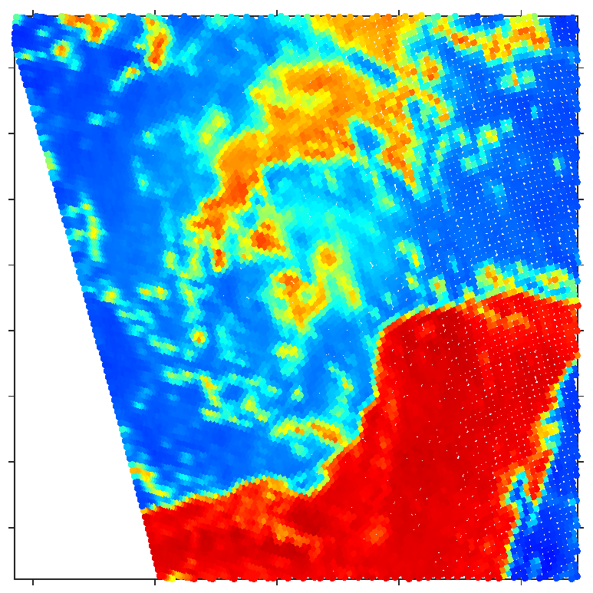
Assimilating All-sky Satellite Radiances: Harvey (2017)
WRF/CRTM simulated MW radiance, 7th cycle (IR only)
Background (18 UTC) vs. 19 UTC AMSR2 & SAPHIR observations
CRTM-DS Sector Snowflakes
Brightness Temperature (K)
80
100
120
140
160
180
200
220
240
260
280
300
18.7 GHz
36.5 GHz
89 GHz
183.3±7 GHz
Obs
$$H(\overline{x_{b}})$$

Slide 16
Assimilating All-sky Satellite Radiances: Harvey (2017)
WRF/CRTM simulated MW radiance, 7th cycle (IR only)
Analysis (18 UTC) vs. 19 UTC AMSR2 & SAPHIR observations
CRTM-DS Sector Snowflakes
Brightness Temperature (K)
80
100
120
140
160
180
200
220
240
260
280
300
18.7 GHz
36.5 GHz
89 GHz
183.3±7 GHz
Obs
$$H\left(\overline{x_{a}}\right)$$
IR

Slide 17
Assimilating All-sky Satellite Radiances: Harvey (2017)
WRF/CRTM simulated MW radiance, 8th cycle (IR & MW)
Background (19 UTC) vs. 19 UTC AMSR2 & SAPHIR observations
CRTM-DS Sector Snowflakes
Brightness Temperature (K)
80
100
120
140
160
180
200
220
240
260
280
300
18.7 GHz
36.5 GHz
89 GHz
183.3±7 GHz
Obs
$$H(\overline{x_{b}})$$

Slide 18
Assimilating All-sky Satellite Radiances: Harvey (2017)
WRF/CRTM simulated MW radiance, 8th cycle (IR & MW)
Analysis (19 UTC) vs. 19 UTC AMSR2 & SAPHIR observations
CRTM-DS Sector Snowflakes
Brightness Temperature (K)
80
100
120
140
160
180
200
220
240
260
280
300
18.7 GHz
36.5 GHz
89 GHz
183.3±7 GHz
Obs
$$H\left(\overline{x_{a}}\right)$$
IR & MW

Slide 19
Assimilating All-sky Satellite Radiances: Harvey (2017)
WRF/CRTM simulated MW radiance, 10th cycle (IR & MW)
Background (21 UTC) vs. 21 UTC SSMI & SAPHIR observations
CRTM-DS Sector Snowflakes
Brightness Temperature (K)
80
100
120
140
160
180
200
220
240
260
280
300
19.35 GHz
37 GHz
91.7 GHz
183.3±7 GHz
Obs
$$H(\overline{x_{b}})$$

Slide 20
Assimilating All-sky Satellite Radiances: Harvey (2017)
WRF/CRTM simulated MW radiance, 10th cycle (IR & MW)
Analysis (21 UTC) vs. 21 UTC SSMI & SAPHIR observations
CRTM-DS Sector Snowflakes
Brightness Temperature (K)
80
100
120
140
160
180
200
220
240
260
280
300
19.35 GHz
37 GHz
91.7 GHz
183.3±7 GHz
Obs
$$H\left(\overline{x_{a}}\right)$$
IR & MW

Slide 21
Assimilating All-sky Satellite Radiances: Harvey (2017)
WRF/CRTM simulated MW radiance, 13th cycle (IR & MW)
Background (00 UTC) vs. 00 UTC SSMIS observations
CRTM-DS Sector Snowflakes
Brightness Temperature (K)
80
100
120
140
160
180
200
220
240
260
280
300
19.35 GHz
37 GHz
91.7 GHz
183.3±7 GHz
Obs
$$H(\overline{x_{b}})$$

Slide 22
Assimilating All-sky Satellite Radiances: Harvey (2017)
WRF/CRTM simulated MW radiance, 13th cycle (IR & MW)
Analysis (00 UTC) vs. 00 UTC SSMIS observations
CRTM-DS Sector Snowflakes
Brightness Temperature (K)
80
100
120
140
160
180
200
220
240
260
280
300
19.35 GHz
37 GHz
91.7 GHz
183.3±7 GHz
Obs
$$H\left(\overline{x_{a}}\right)$$
IR & MW

Slide 23
Harvey (2017) EnKF Analyses and Forecasts,
Assimilating IR and MW (19 GHz & 183 GHz)
Min SLP (hPA)

Slide 24
Preliminary Conclusions - EnKF Priors
Compared to free forecasts, simulated 37 GHz and 91.7 GHz BTs in precipitation areas have much greater correspondence to observations
Lower maximum magnitudes of graupel water content in ensemble mean caused by dislocations of deep moist convection between the members
Though by 18 UTC, some BTs at 37 GHz are being substantially lowered by precipitation ice
Clear-sky BTs at 37 and 183 GHz are less prevalent than in observations
Consistent with taking an ensemble averaging of spatially-dislocated liquid and snow water contents

Slide 25
Preliminary Conclusions - EnKF Priors
SSMIS F18 appears to have a substantial cold bias to observations in clear-sky over ocean at 19.35 GHz, leading to excess increment of liquid and ice when assimilated. May be due to errors in surface emissivity.

Slide 26
Preliminary Conclusions
Applying CRTM microwave forward model on deterministic forecast from EnKF analyses:
Big drop in 19.35 GHz and, especially, 37 GHz BTs in first moments of deterministic forecast from EnKF analysis
Evaporation of non-physical liquid water content in unsaturated conditions, probably produced by taking the ensemble average of all fields independently
New deep moist convection develops in the first hours of forecast from the EnKF analysis. This produces more snow and high concentrations of graupel, resulting in lower BTs.

Slide 27
Preliminary Conclusions
IR assimilation alone is relatively poor at constraining liquid water content and precipitation ice
Continual divergence from observations (as implied by MW observations) after consecutive DA cycles with no MW assimilation

Slide 28
Summary
CRTM-DS with sector snowflake for snow produces an EnKF prior which is relatively unbiased to observations
Assimilating MW observations provides substantial updates to precipitation fields in both clear and cloudy skies alongside regular cycling of IR with our EnKF system
Great progress has been made with forward model errors in areas of precipitation, but challenges remain with the forward model overall

Slide 29
1200 UTC IR DA Analysis
19.35 GHz
37 GHz
91.7 GHz
183 GHz

Slide 30
1230 UTC 0.5 Hour Forecast from 1200 UTC Analysis
19.35 GHz
37 GHz
91.7 GHz
183 GHz

Slide 31
1300 UTC 1 Hour Forecast from 1200 UTC Analysis
19.35 GHz
37 GHz
91.7 GHz
183 GHz

Slide 32
1400 UTC 2 Hour Forecast from 1200 UTC Analysis
19.35 GHz
37 GHz
91.7 GHz
183 GHz

Slide 33
1600 UTC 4 Hour Forecast from 1200 UTC Analysis
19.35 GHz
37 GHz
91.7 GHz
183 GHz

Slide 34
1800 UTC 6 Hour Forecast from 1200 UTC Analysis
19.35 GHz
37 GHz
91.7 GHz
183 GHz

Slide 35
2000 UTC 8 Hour Forecast from 1200 UTC Analysis
19.35 GHz
37 GHz
91.7 GHz
183 GHz

Slide 36
2158 UTC F16 SSMIS Observation
19.35 GHz
37 GHz
91.7 GHz
183 GHz

