Slide 1

Hurricane Patricia (2015): Challenges in Ensemble Analysis and Prediction
Robert Nystrom and Fuqing Zhang
Funding: NASA Earth and Space Science Fellowship Program (NESSF)
Computing: Texas Advanced Computing Center (TACC) and NOAA Jet

Slide 2
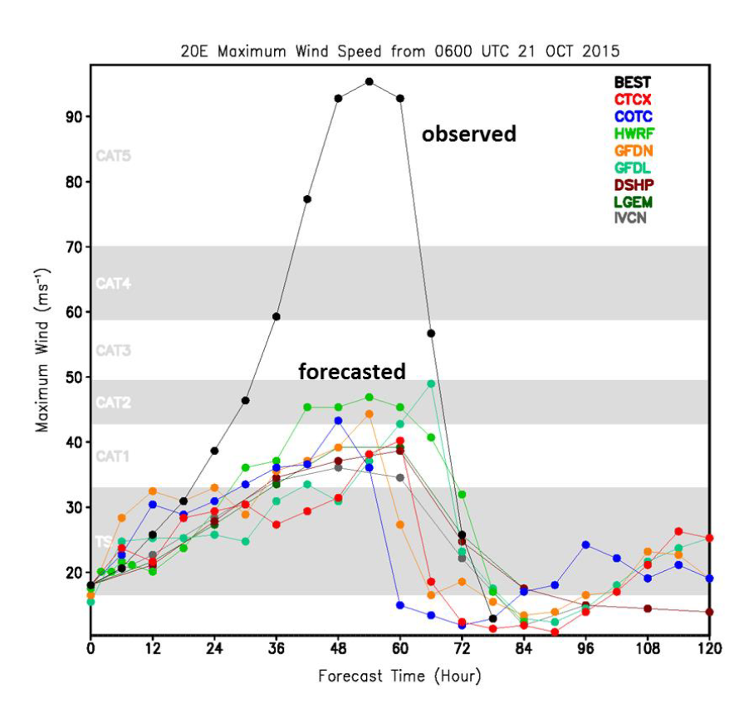
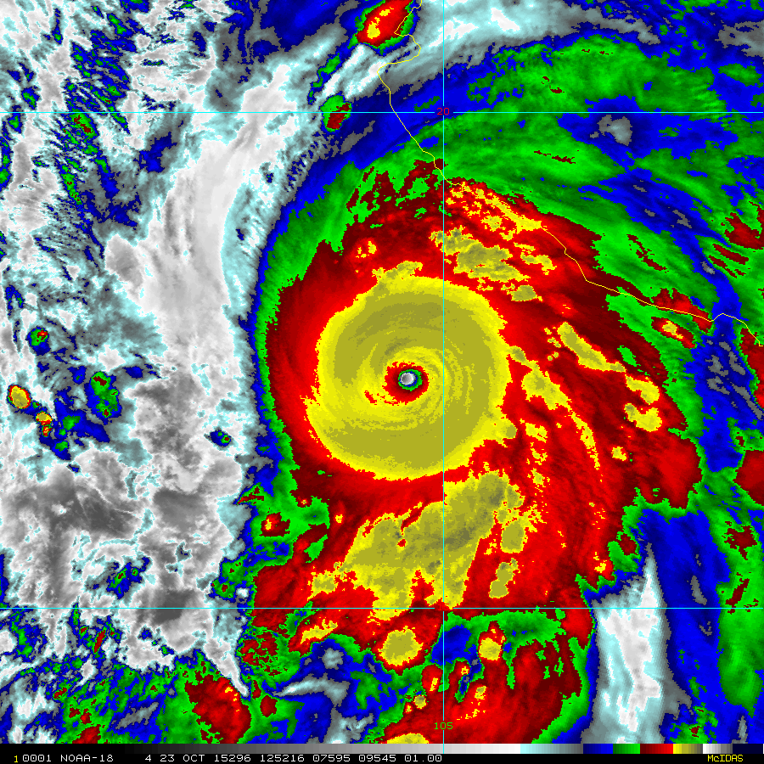
Patricia (2015)
Highest observed surface wind speed (measured by aircraft SFMR), 94 m s⁻¹
Most rapid intensification rate, 54 m s⁻¹ in 24 h
[Rogers et al., 2017]
Notes:
Well observed by TCI field campaign (high density dropsondes) and NOAA P-3

Slide 3
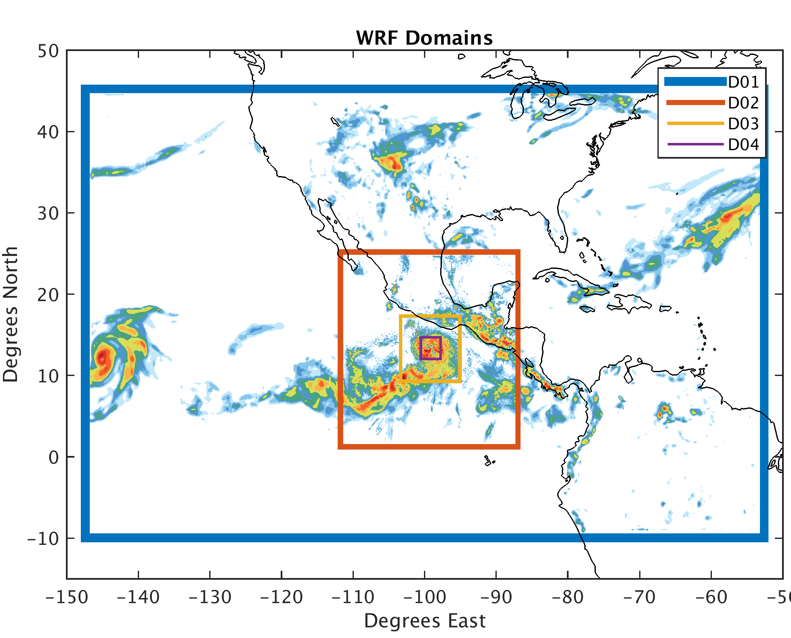
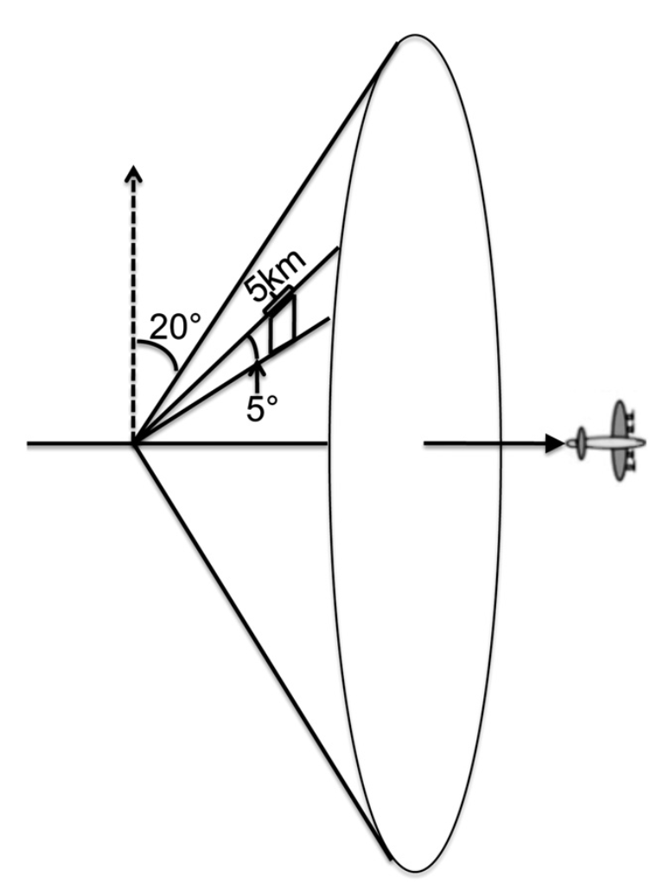
PSU WRF-EnKF Configuration for Patricia
60 member ensemble
1 hour continuous cycling EnKF
27/9/3/1 km grid spacing
IC/BCs provided by GFS
CV3 initial ensemble perturbations
Chen et al. (2016) surface flux scheme
Assimilated conventional obs,
GOES-13 all-sky Radiances,
and P-3 radial velocity SOs
[Weng and Zhang, 2012]
Notes:
Highlight specifications of PSU WRF-EnKF system
-WRF v3.5.1
-4 two-way nested domains
-Assimilate all conventional obs as well as aircraft radar (radial velocities)

Slide 4
Strong Forecast Sensitivity to Resolution
3 km
1 km
Notes:
-increase cost for forecasts

Slide 5
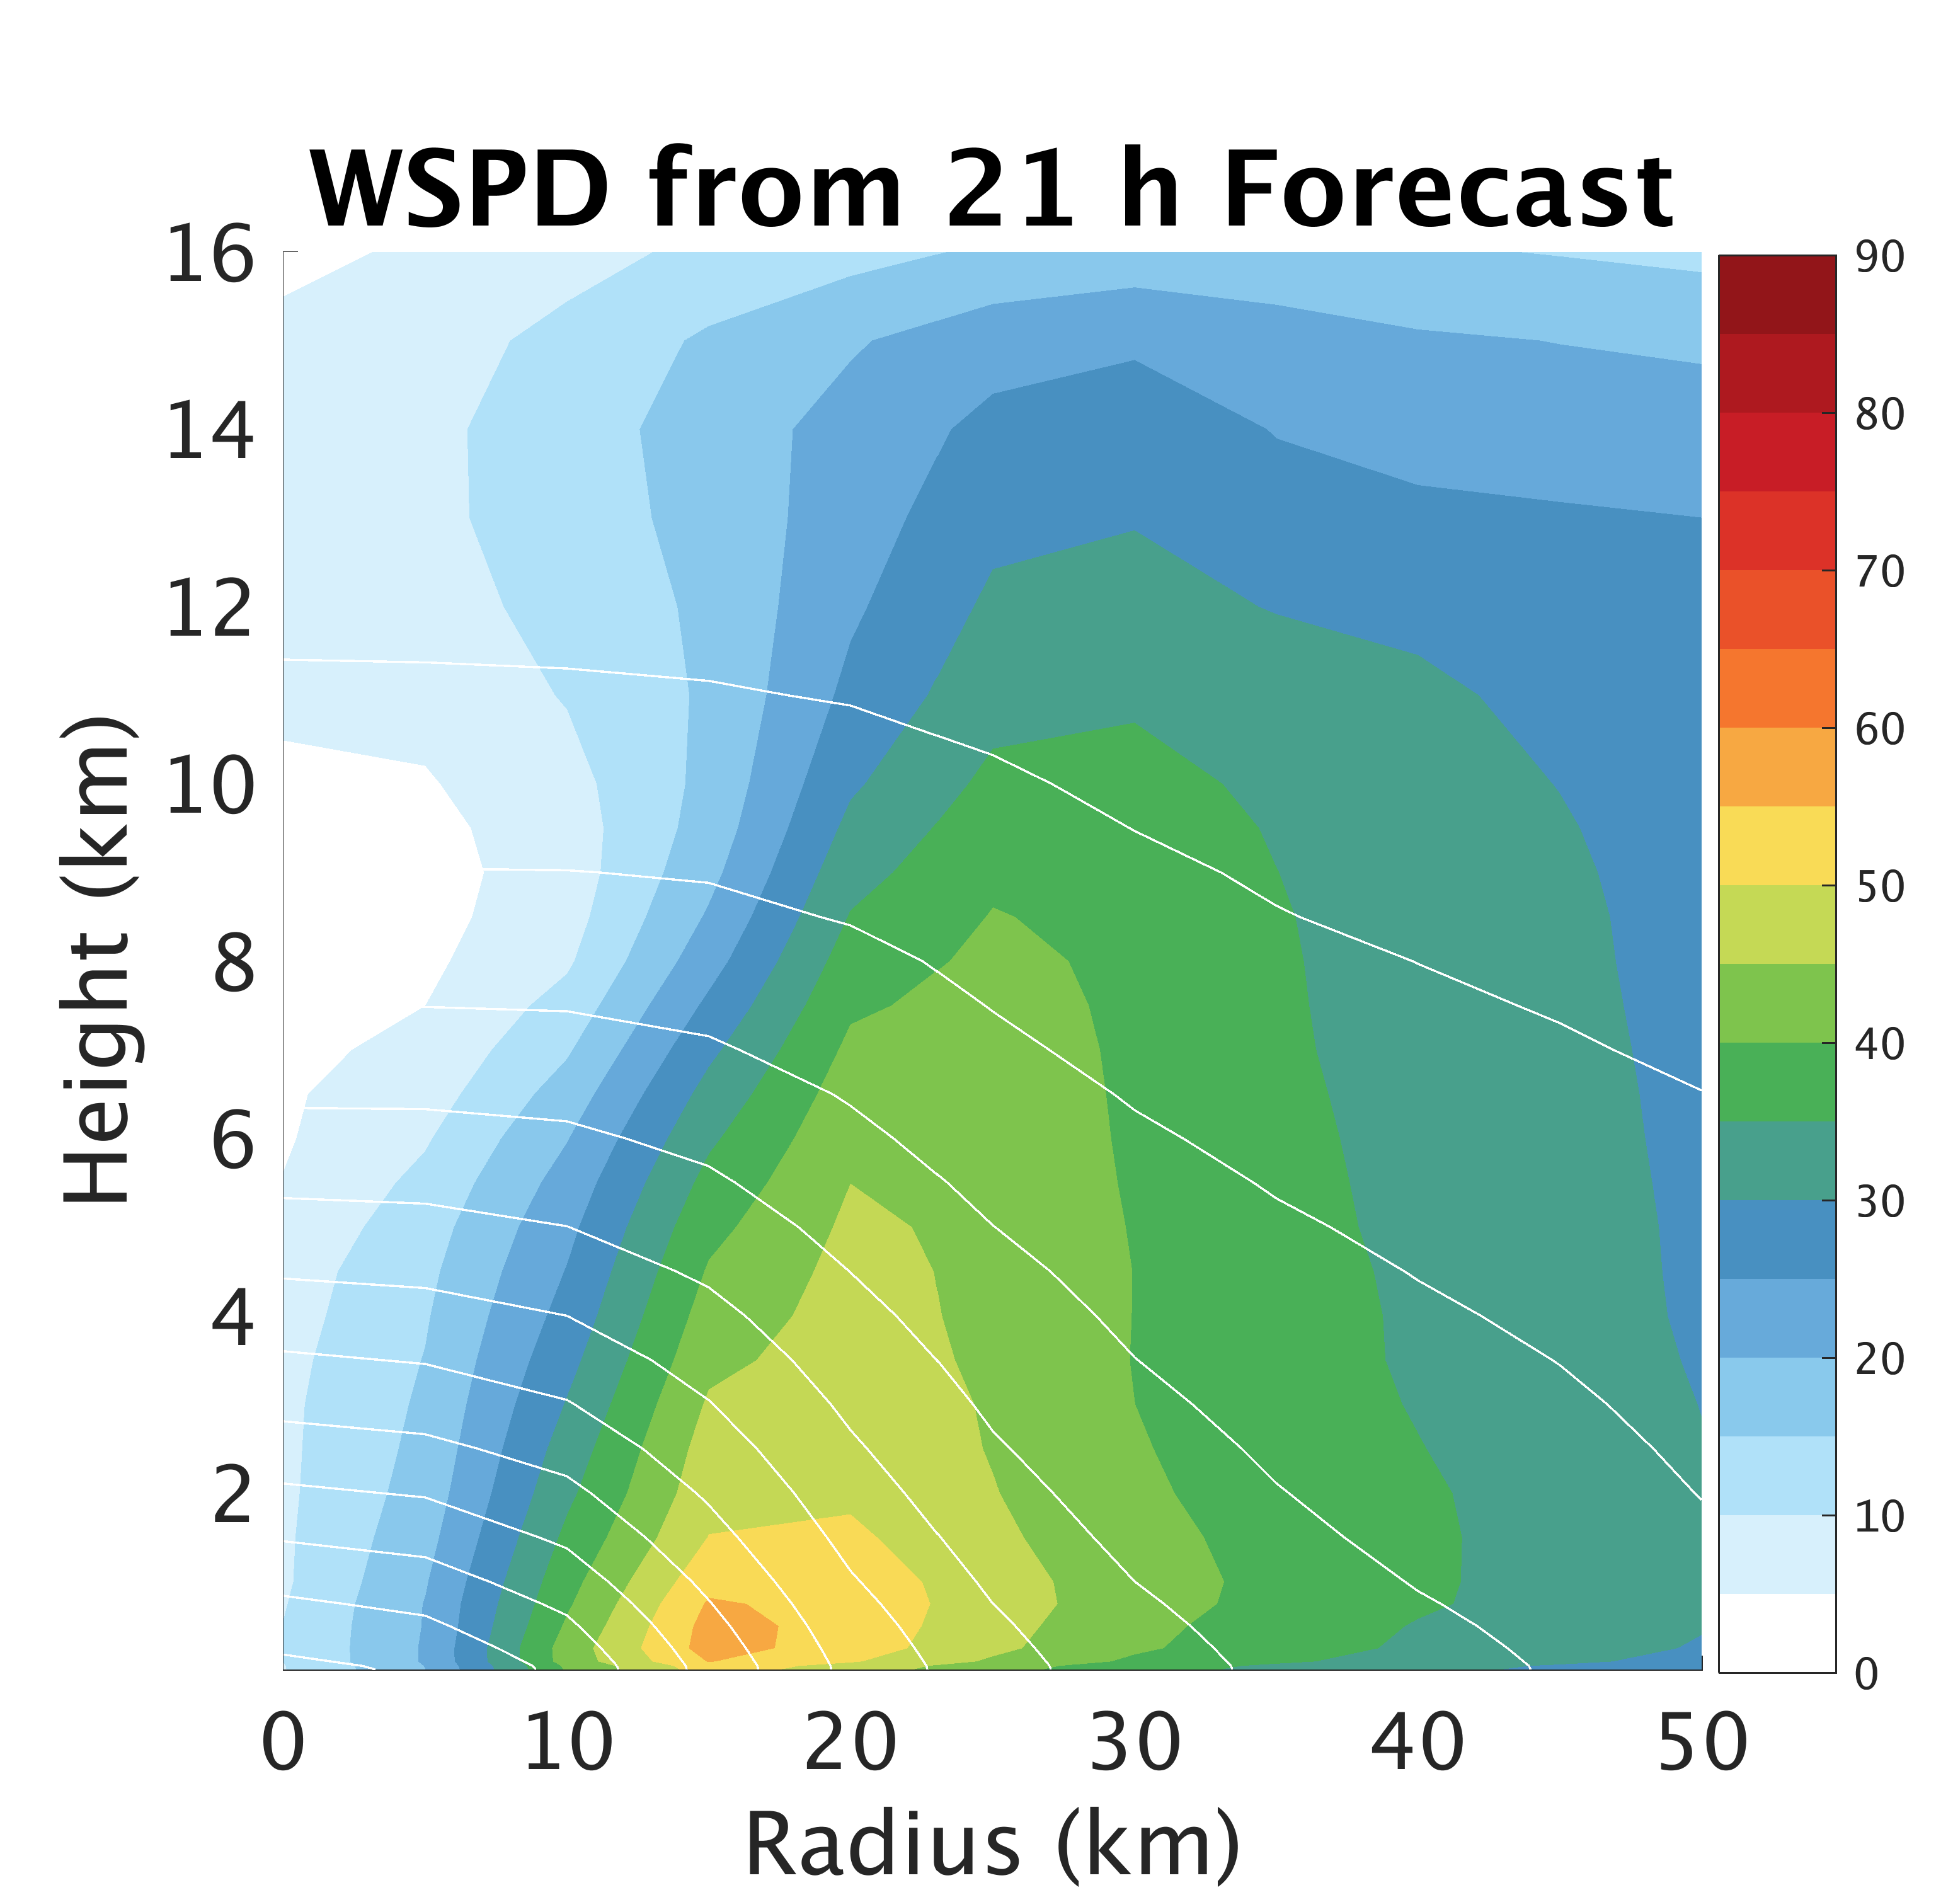
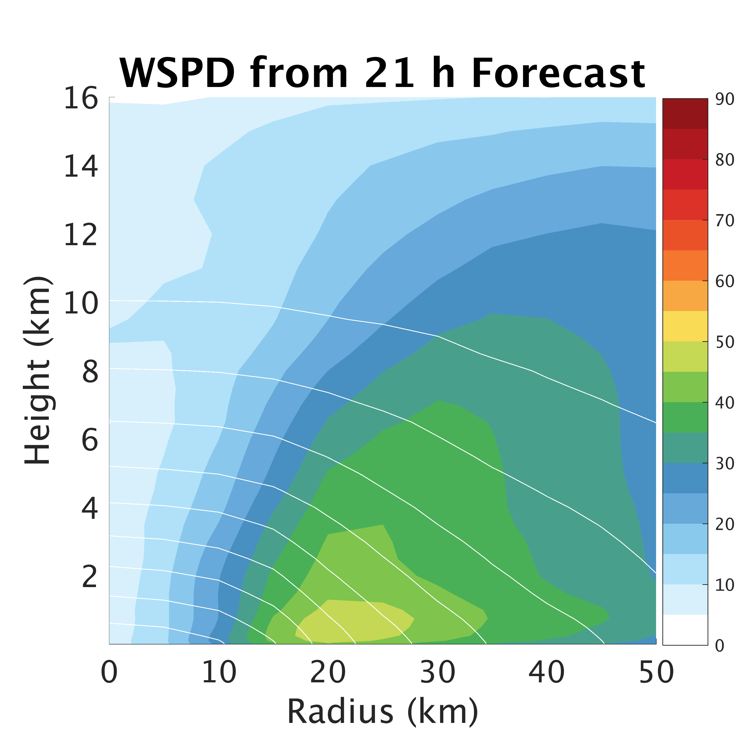
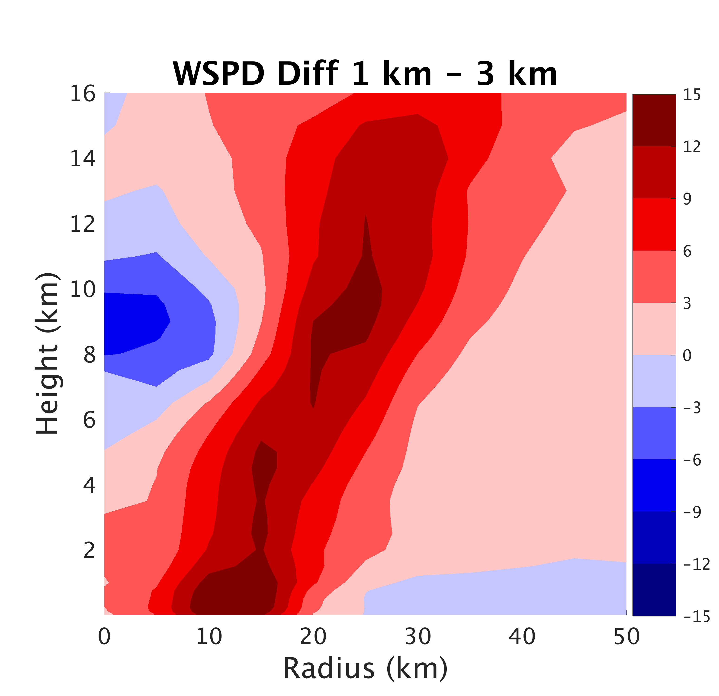
Higher resolution improves inner-core structure/size
1 km
3 km
1km – 3km
Notes:
-small inner-core for Patricia
-white lines are pressure perturbation from environment (helps depict radial pressure gradient)

Slide 6
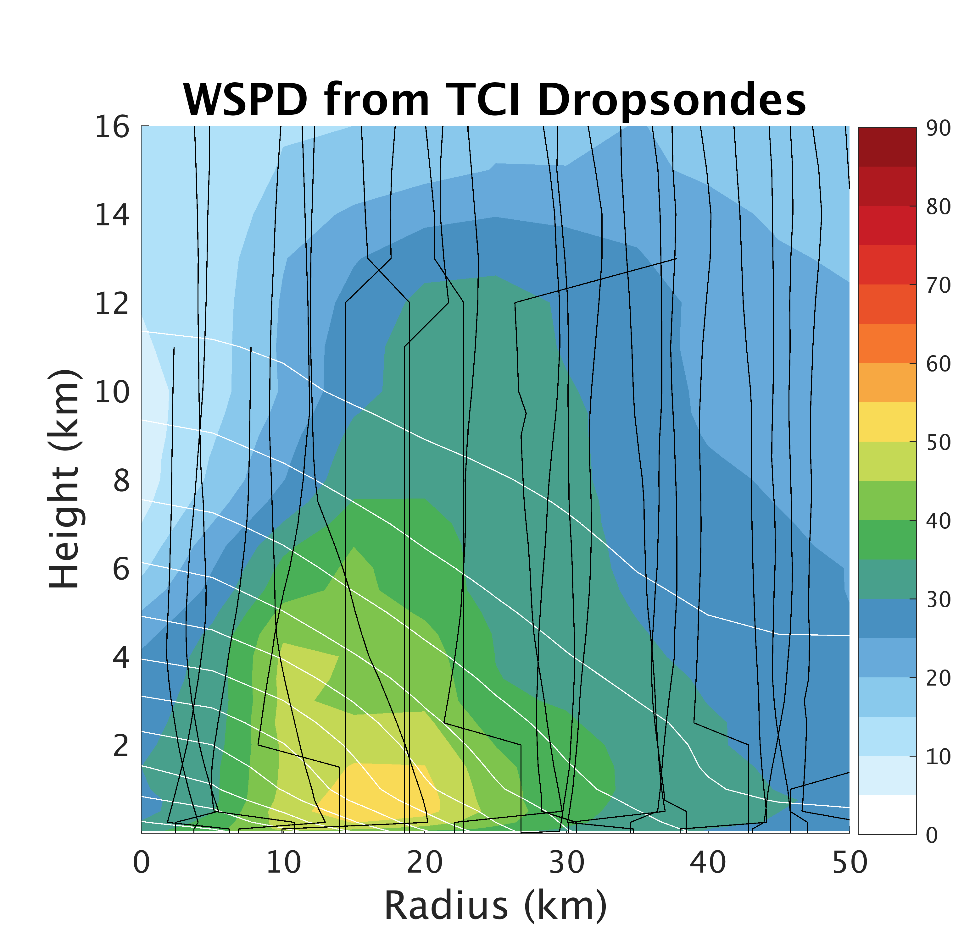
Higher resolution improves inner-core structure/size
obs
1 km
3km
Notes:
-small inner-core for Patricia
-white lines are pressure perturbation from environment (helps depict radial pressure gradient)

Slide 7
Forecasts Very Sensitive to Surface Flux Param.
Green and Zhang (2013)
Chen et al. (2016)
Notes:
-only difference is surface flux parameterization (mainly Cd wind speed relationship)

Slide 8
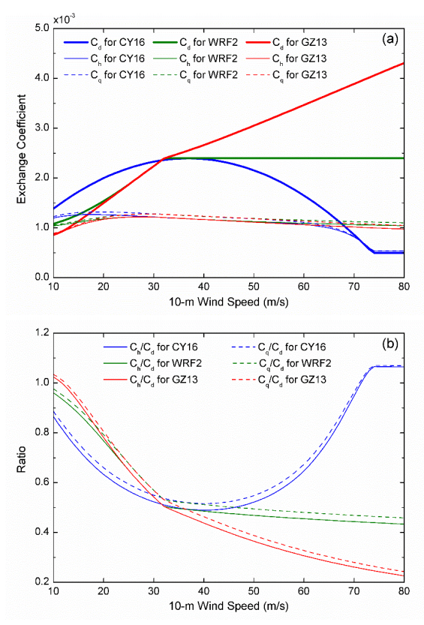
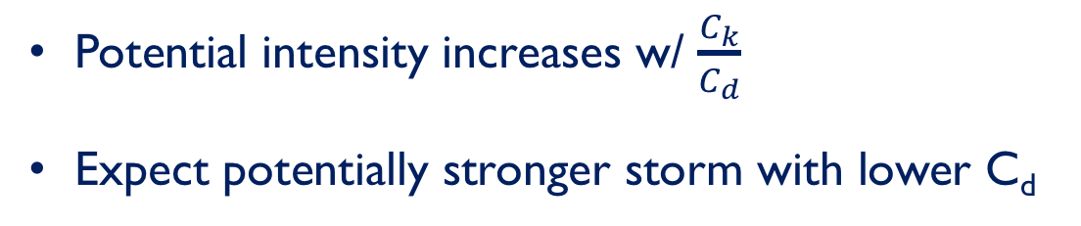
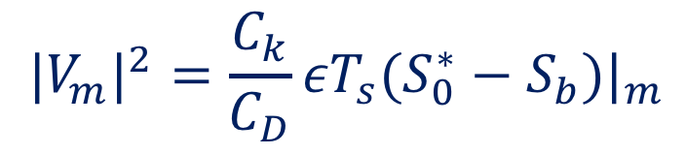
Why Model Surface Flux Param. Matters
MPI:
$${|V_{m}|}^{2}=\frac{C_{k}}{C_{D}}εT_{s}(S_{0}^{∗}−S_{b})|_{m}$$
Potential intensity increases w/ $\frac{C_{k}}{C_{d}}$
Expect potentially stronger storm with lower C_{d}
[Emanuel, 1997]
[Chen et al. 2018]

Slide 9
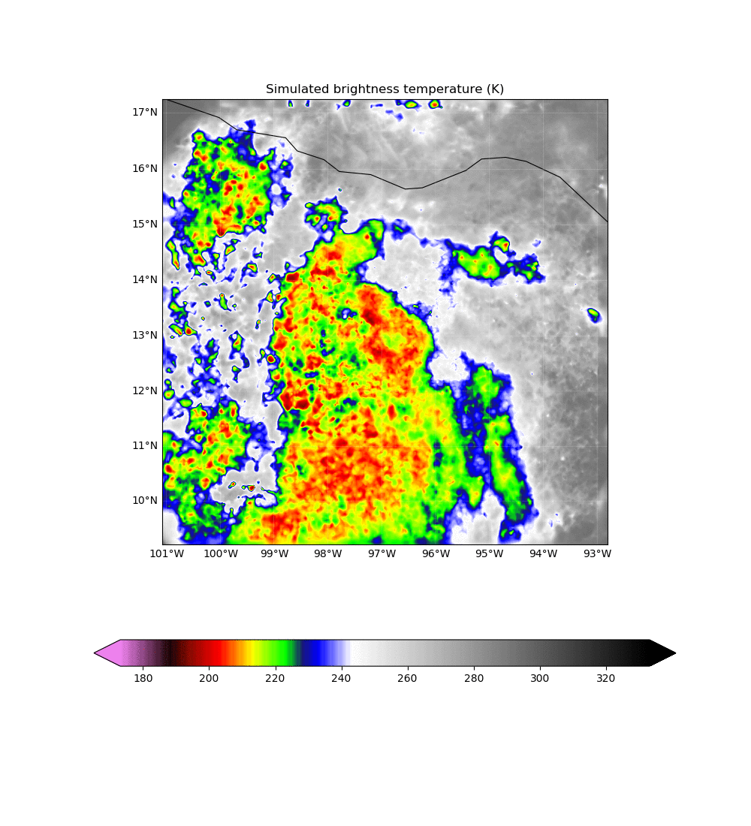
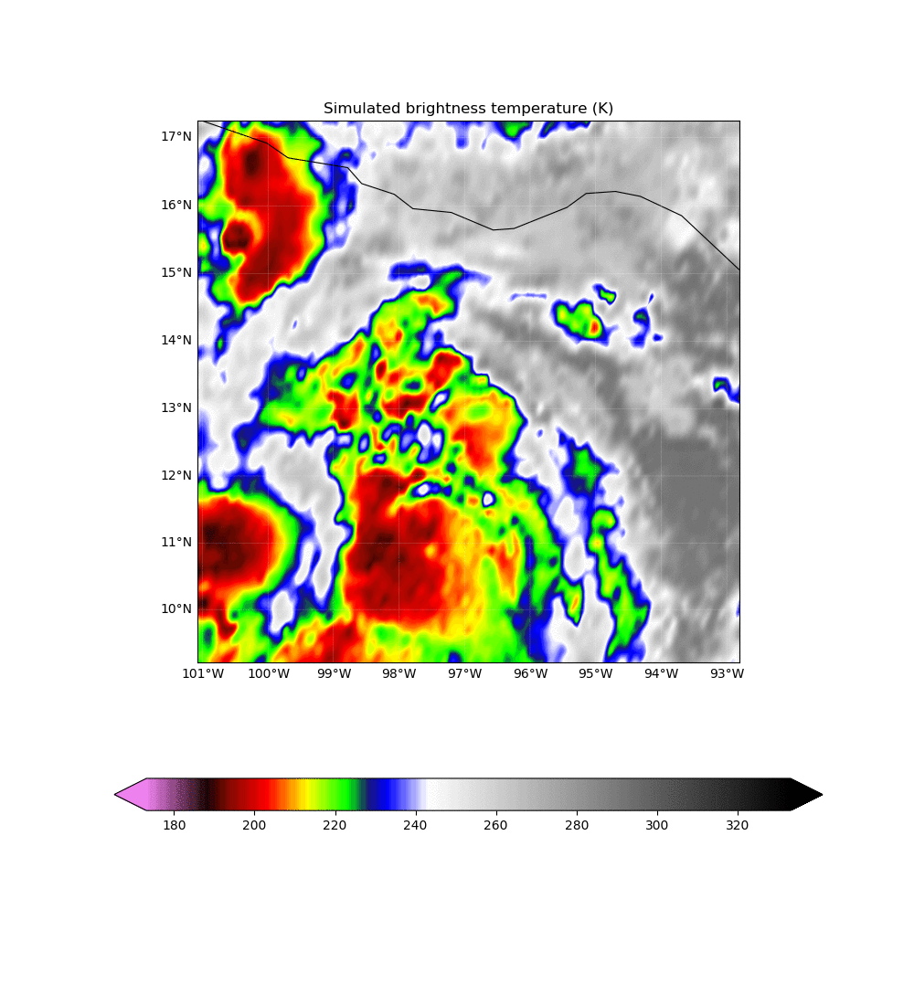
All-Sky GOES-13 assimilation
AOEI [Minamide and Zhang, 2017]
ABEI [Minamide and Zhang, 2018 submitted]
EnKF Analysis
GOES-13 Observations
Notes:
-AOEI and ABEI

Slide 10
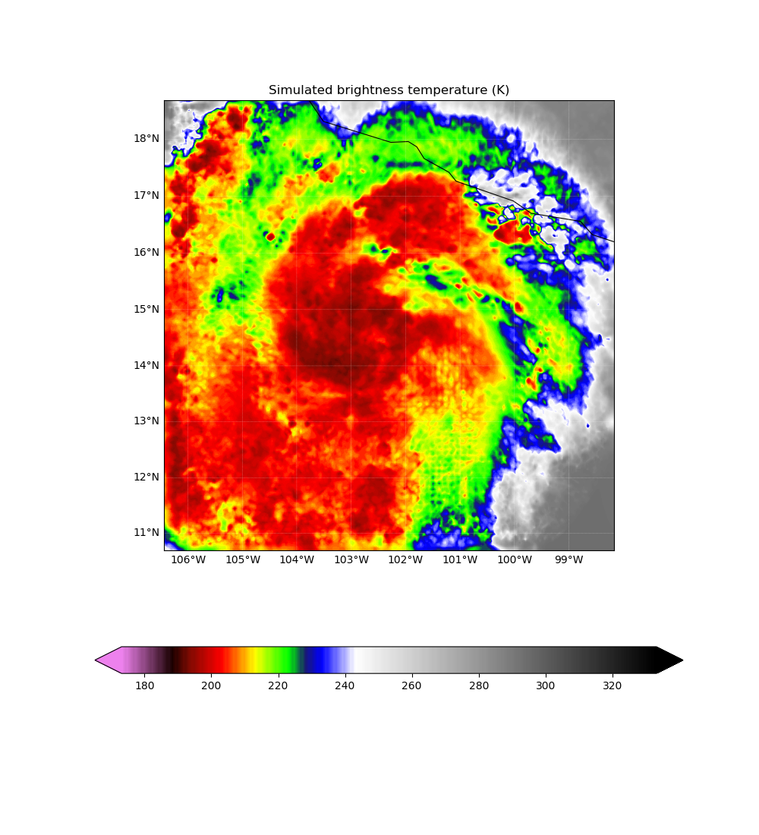
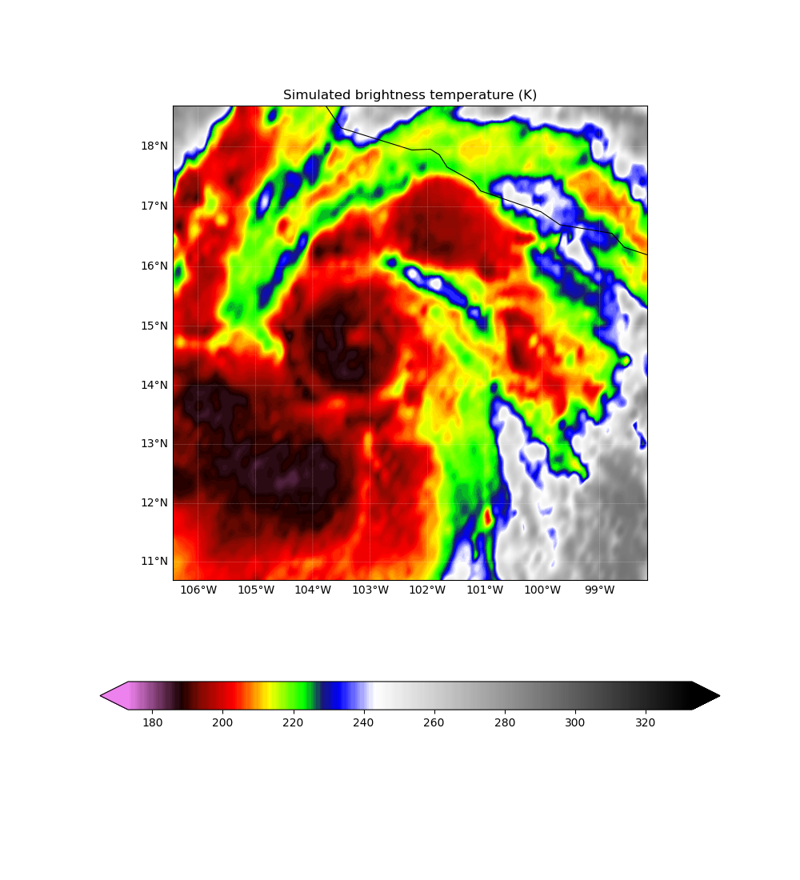
All-Sky GOES-13 assimilation
EnKF Analysis 12z 22nd
GOES-13 Observations 12z 22nd
Notes:
-good match to obs in location of convection

Slide 11
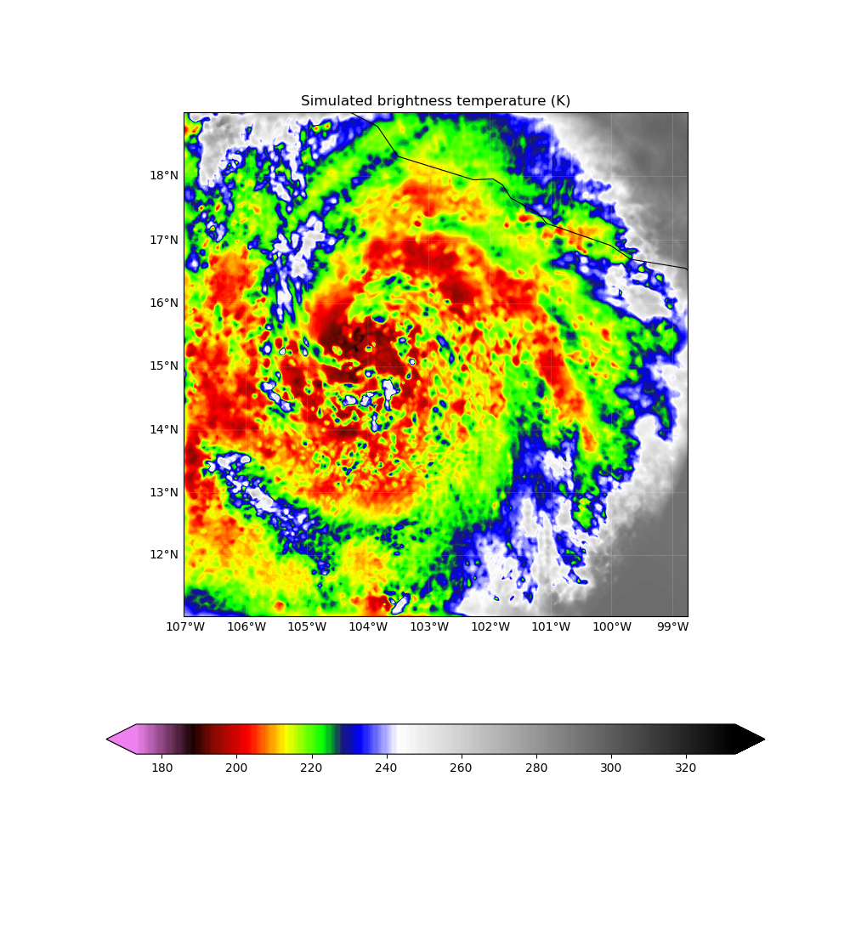
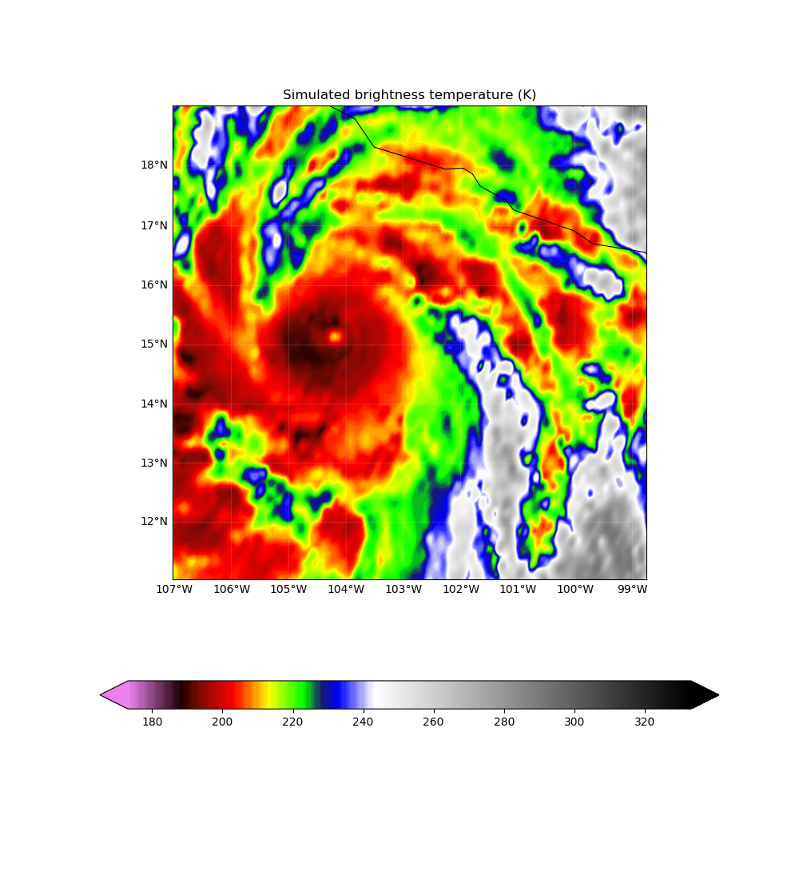
All-Sky GOES-13 w/ Airborne RV assimilation
EnKF Analysis 18z 22nd
GOES-13 Observations 18z 22nd
Notes:
-assimilation of RV observations messes up match to observations in obs space

Slide 12
Can effective all-sky radiance assimilation replace in-situ airborne observations?
GOES-13+RV+Conv
GOES-13+Conv
Notes:
-GOES-13+RV+Conv performs best
-better match to timing of RI

Slide 13
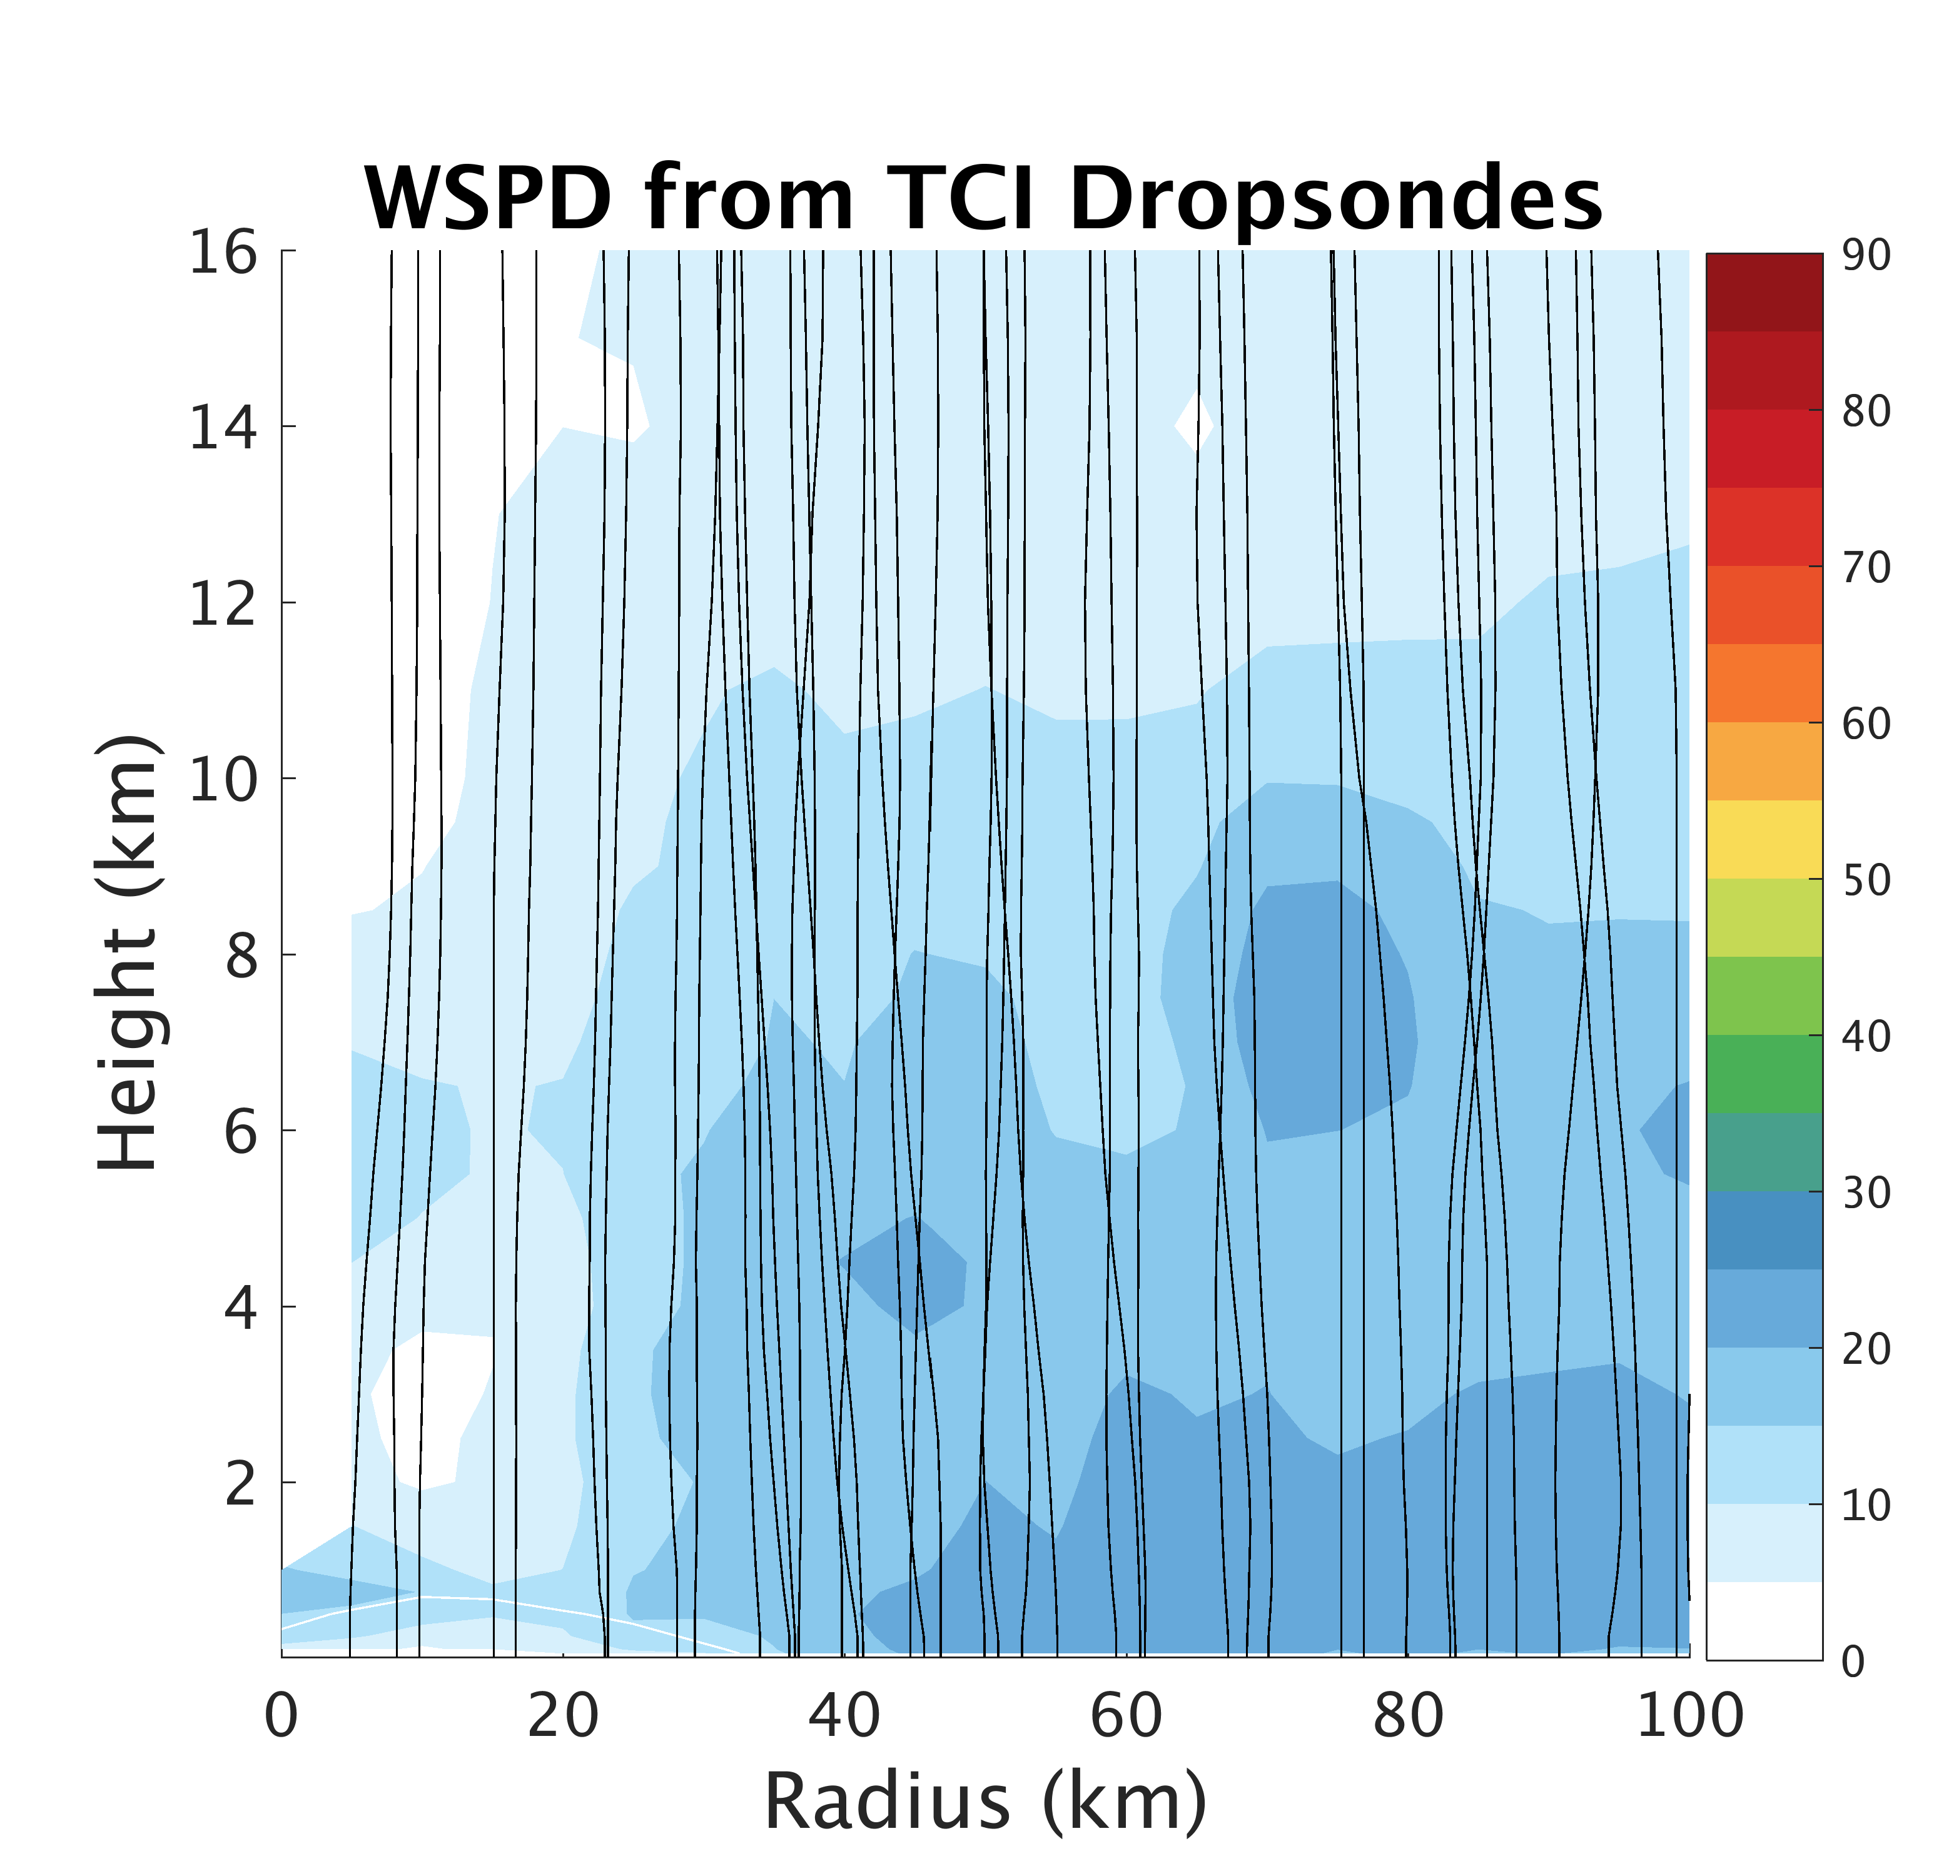
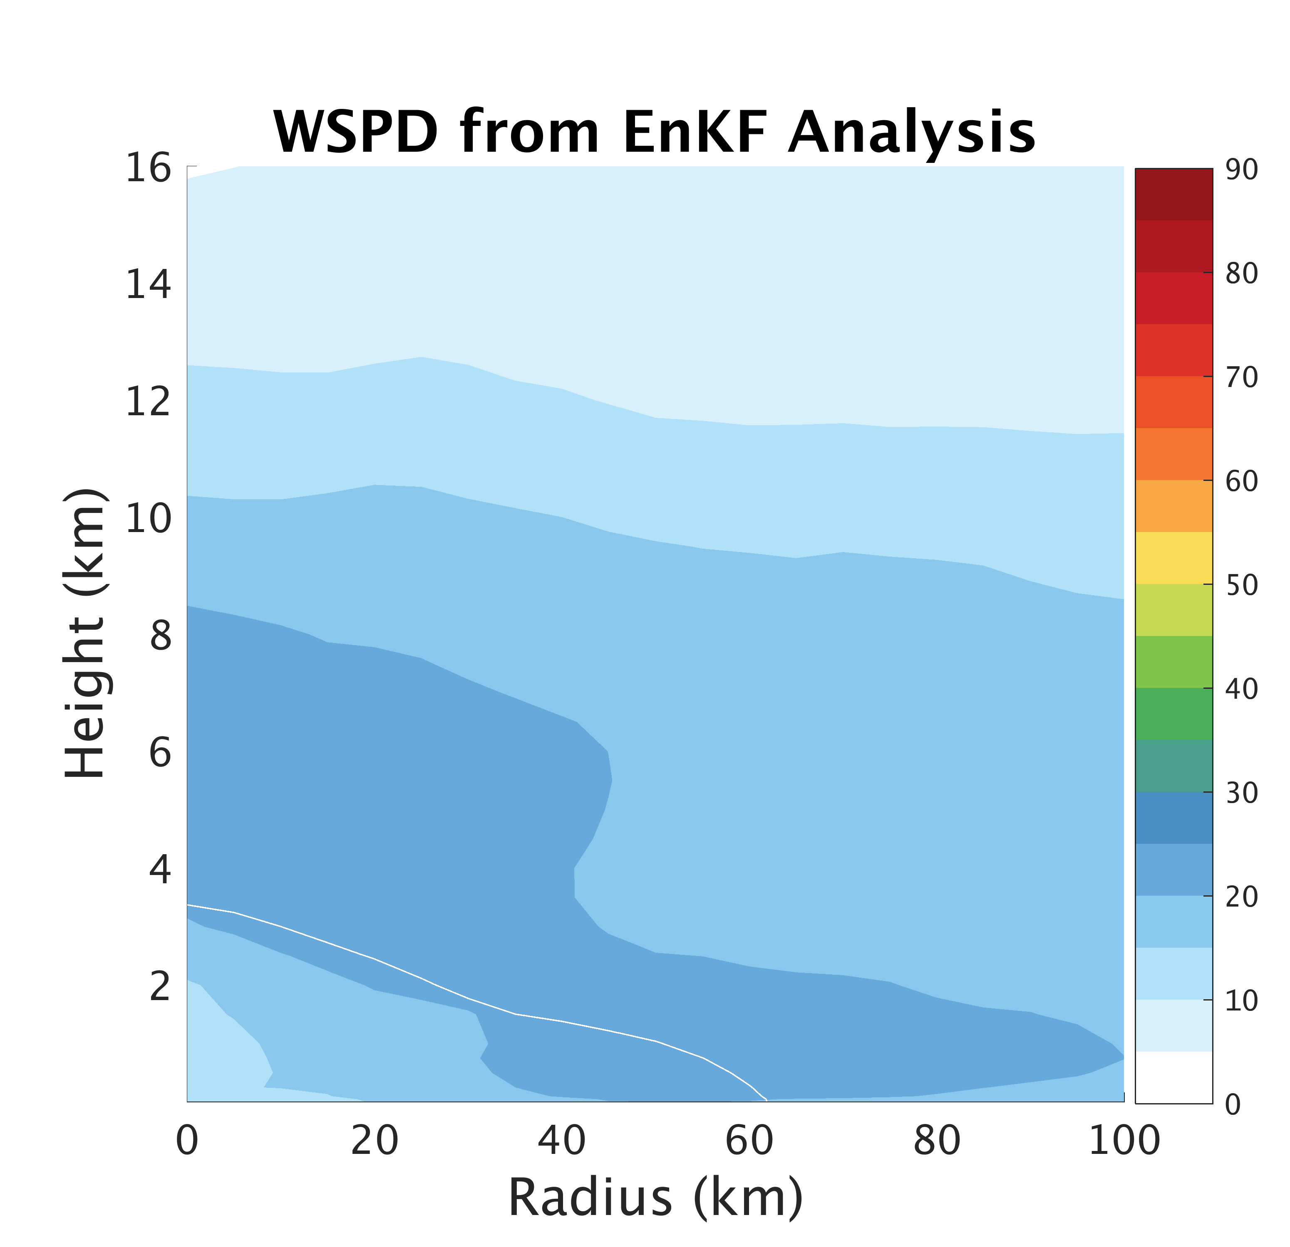
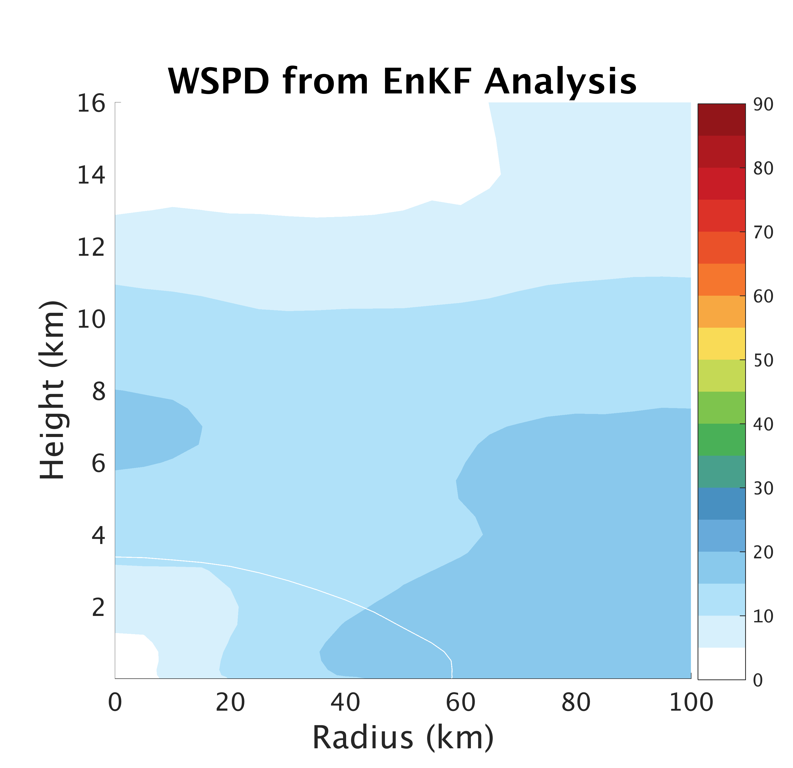
GOES-13+RV+Conv better match to maximum wind speed
Observations
GOES-13+RV+Conv
GOES-13+Conv
Notes:
Flight 1, 21st 19-21z compared with EnKF Analysis at 21z 21st
Dropsondes location relative to NOAA HRD wind center track

Slide 14
Summary and Ongoing Work
Very strong sensitivity between Patricia’s intensification and surface flux parametrization
Forecast intensity and inner-core structure/size also sensitive to horizontal resolution
Assimilation of GOES-13 all-sky radiances, P-3 radial velocity obs, and conventional conventional obs results in best forecasts
Examine the ensemble predictability of Patricia
  Inner-core and environmental ICs necessary for peak intensity and RI
Plan to investigate opportunity for Simultaneous State and Parameter Estimation of surface flux parametrization

Slide 15
Supplemental Patricia Slides

Slide 16
20 Member Ensemble Forecast Performance
Notes:
Some confidence from ensemble forecast in RI of Patricia but uncertainty in timing and rate. Plan to look into this further in the near future.

Slide 17
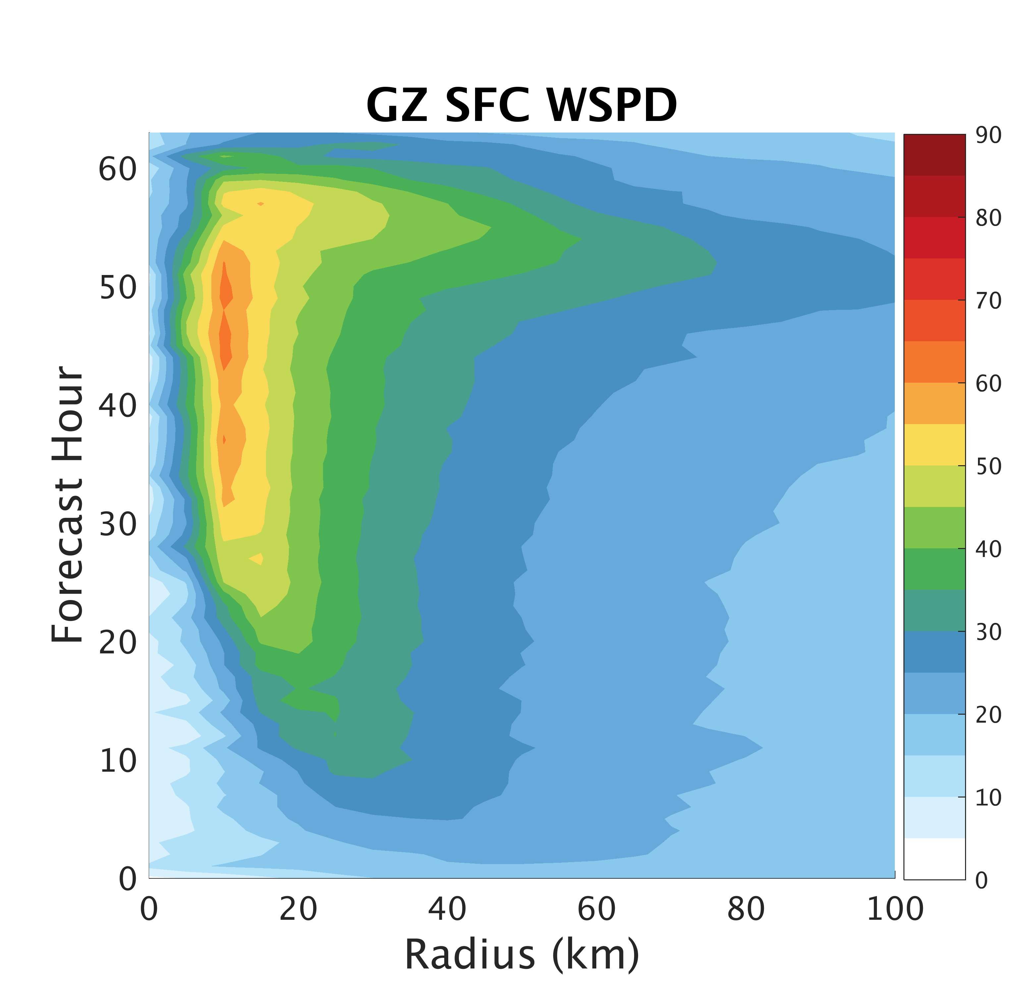
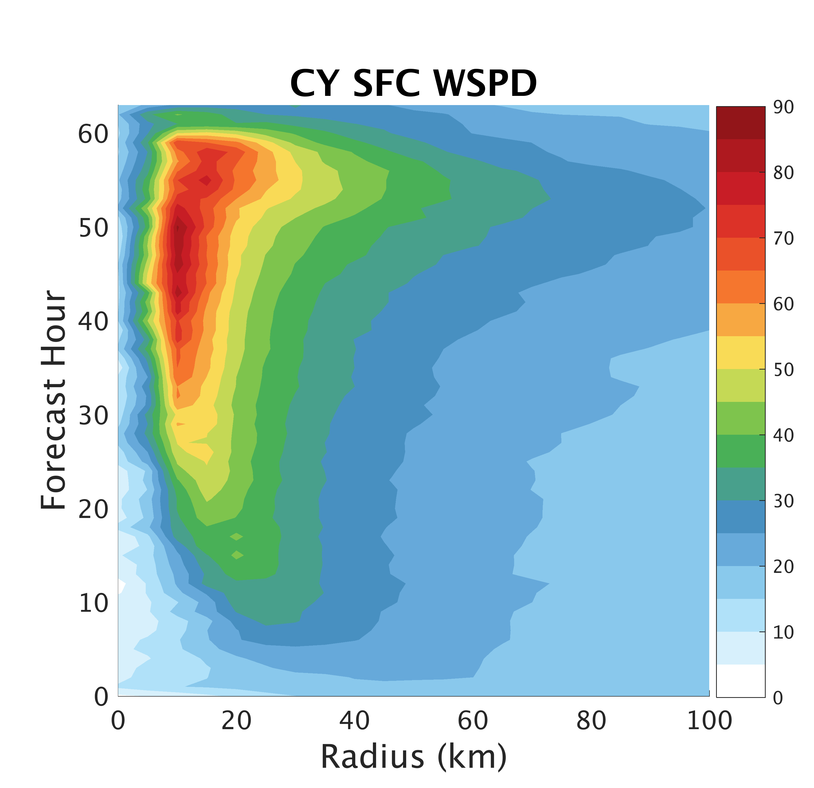
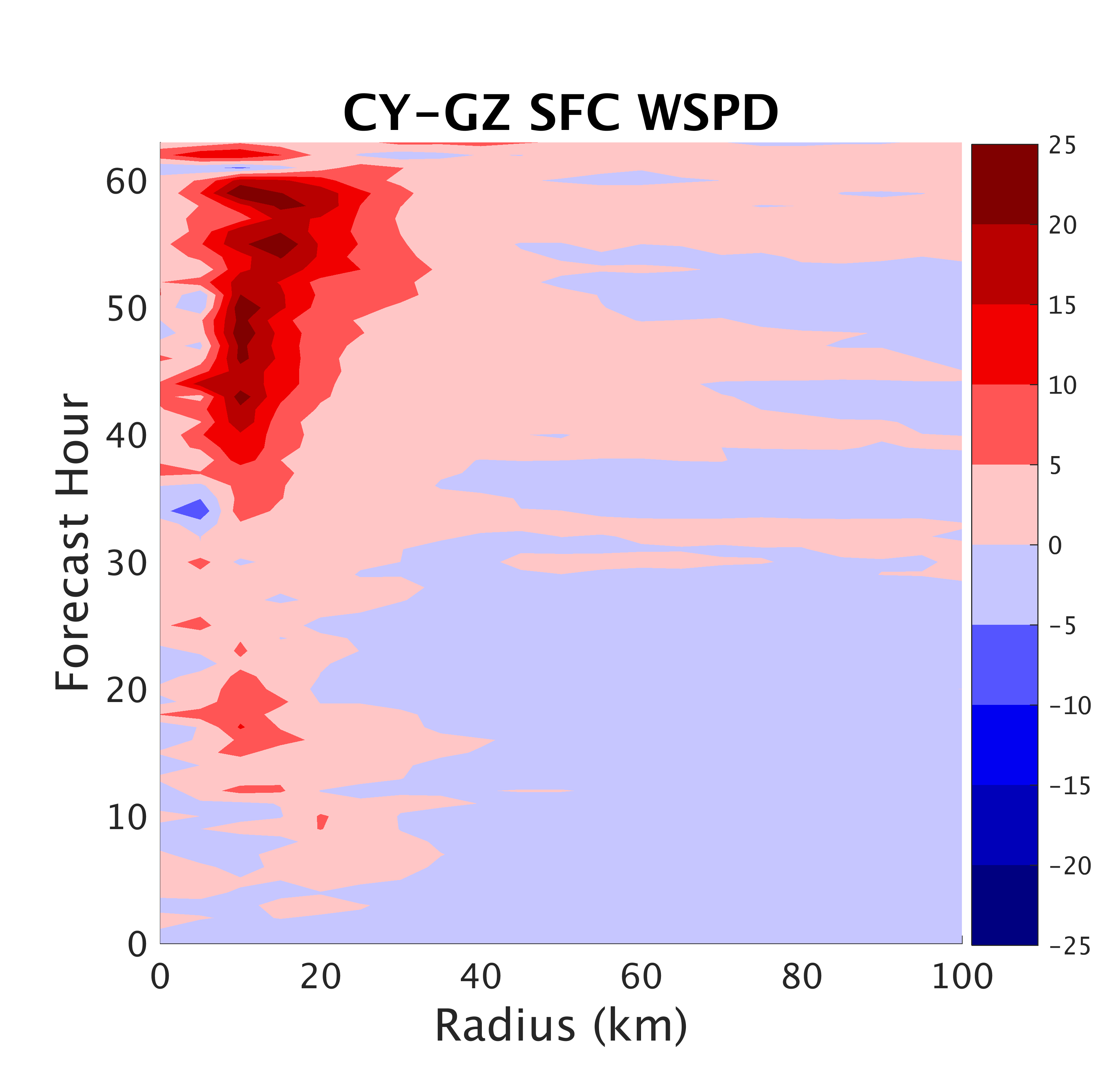
Surface Flux:
Impacts on Structure
Surface winds speeds always larger in CY
Notes:
-

Slide 18
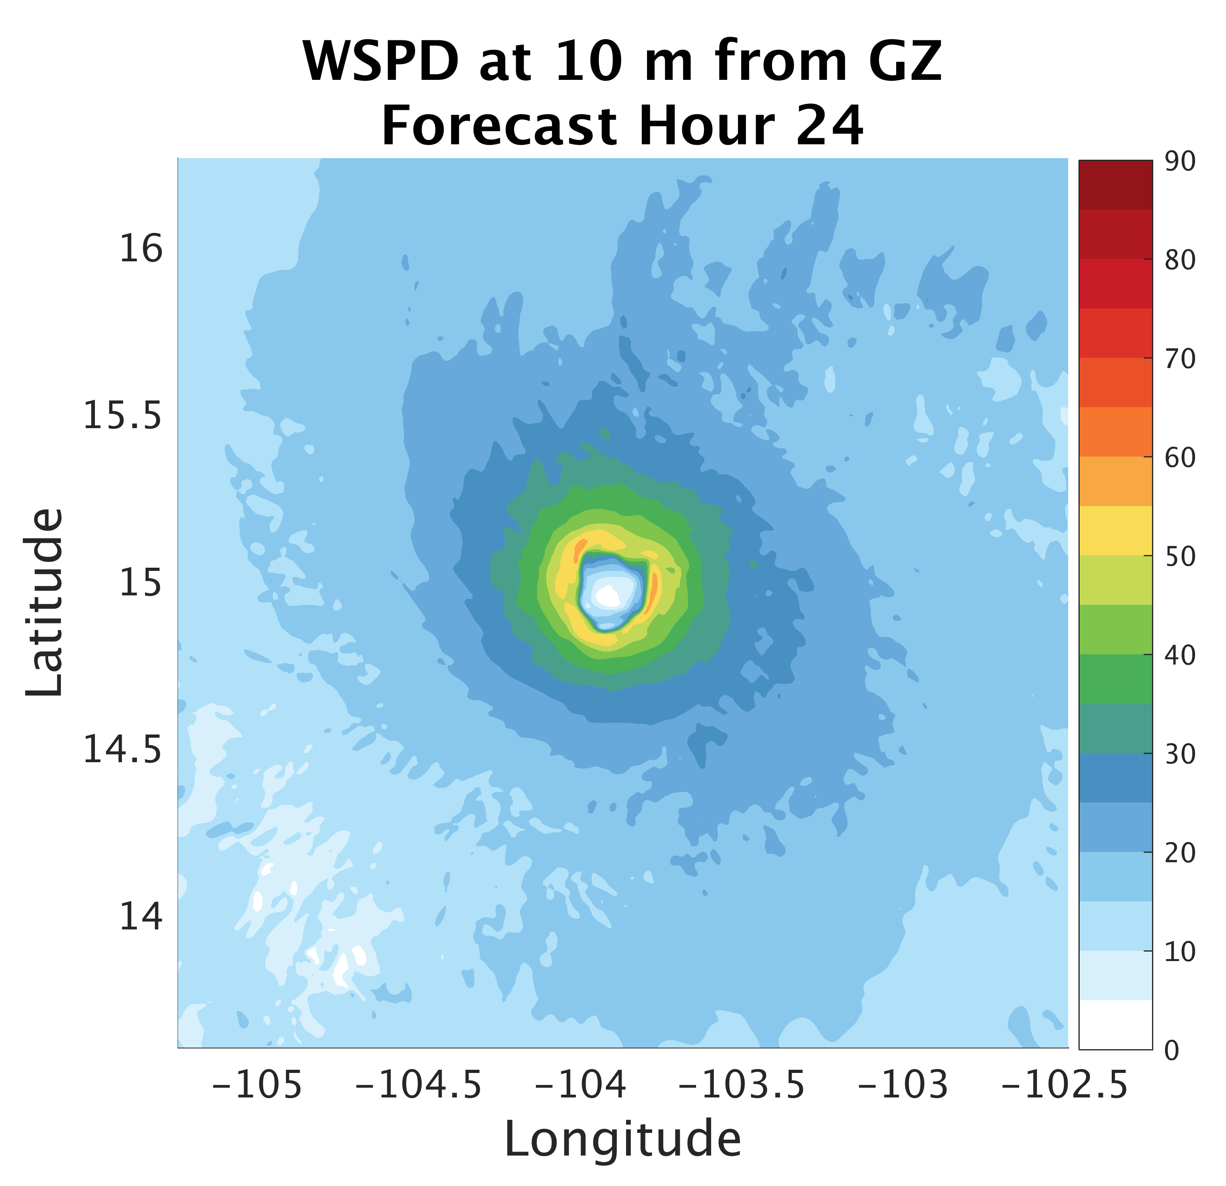
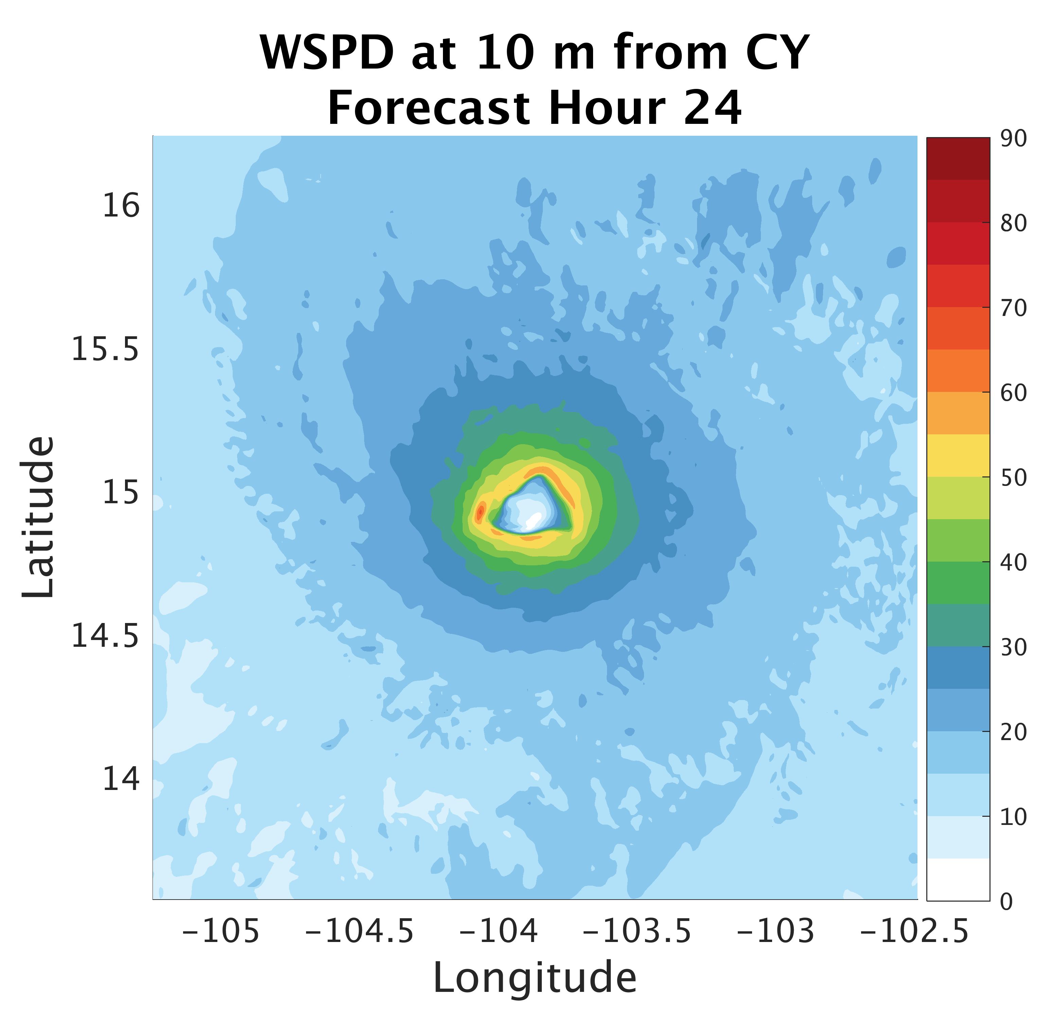
Surface Flux:
Impacts on Structure
Notes:
-

Slide 19
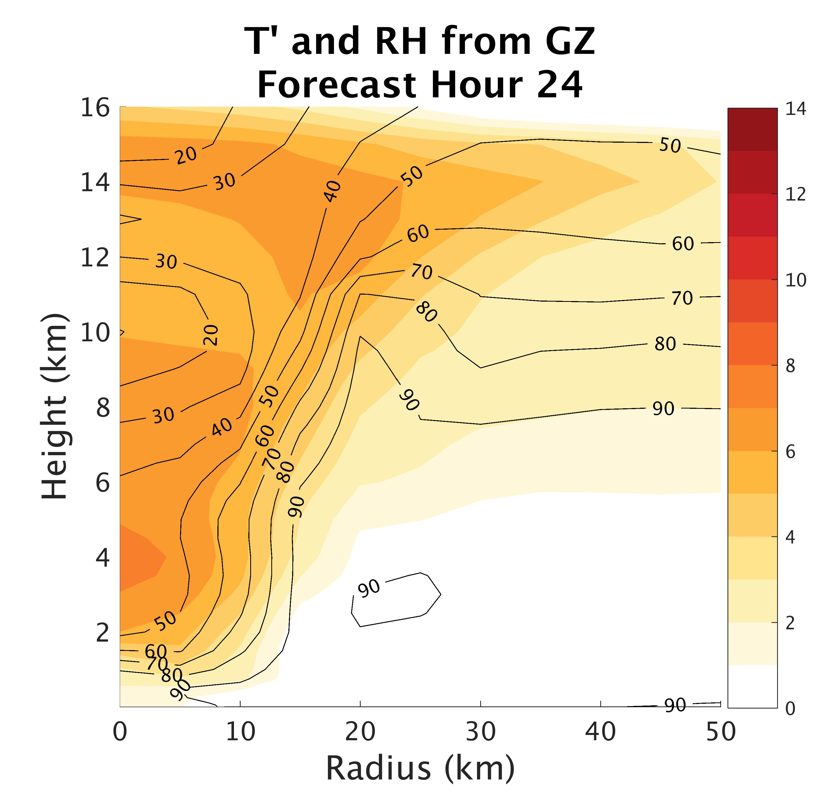
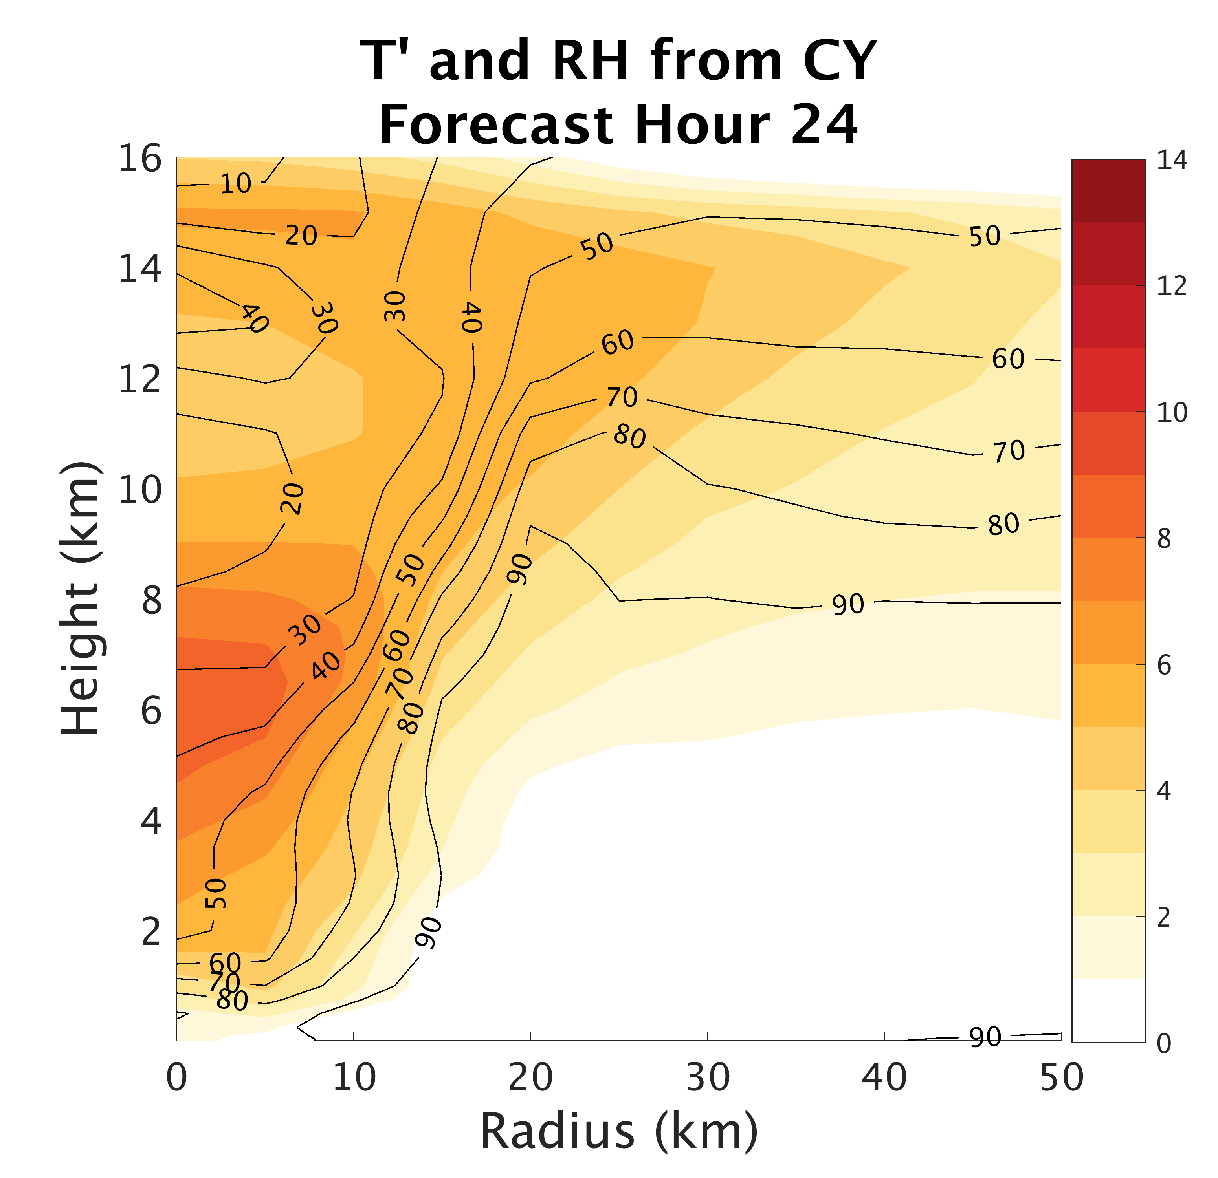
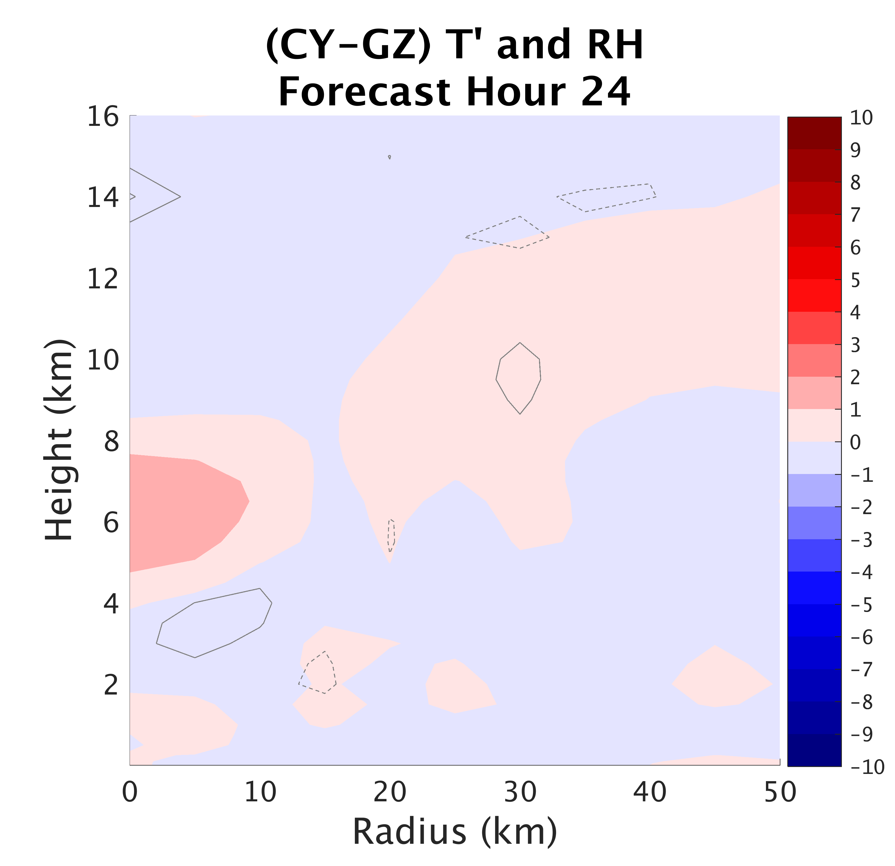
Surface Flux:
Impacts on Structure
Notes:
-

Slide 20
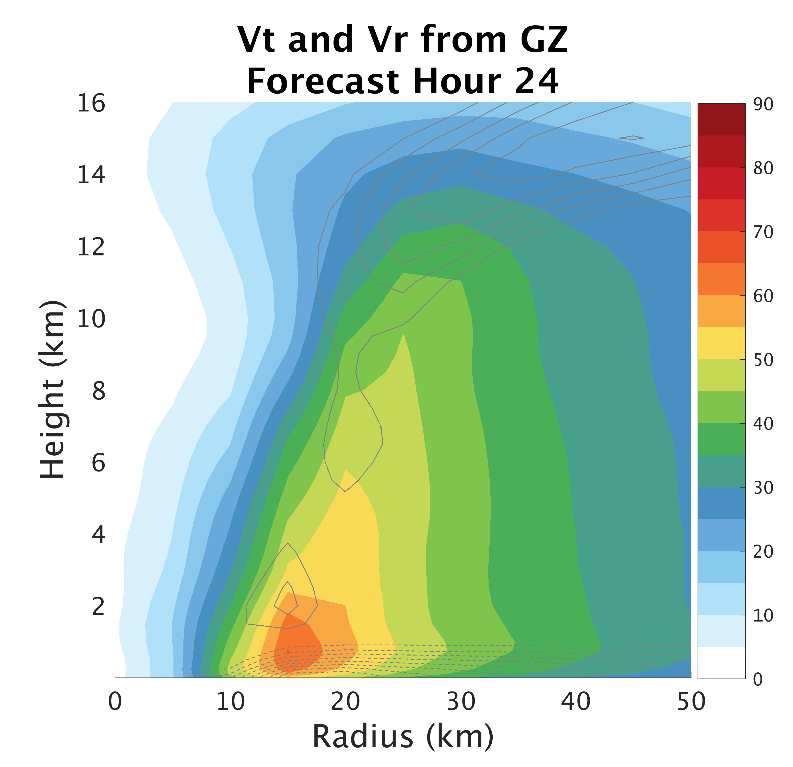
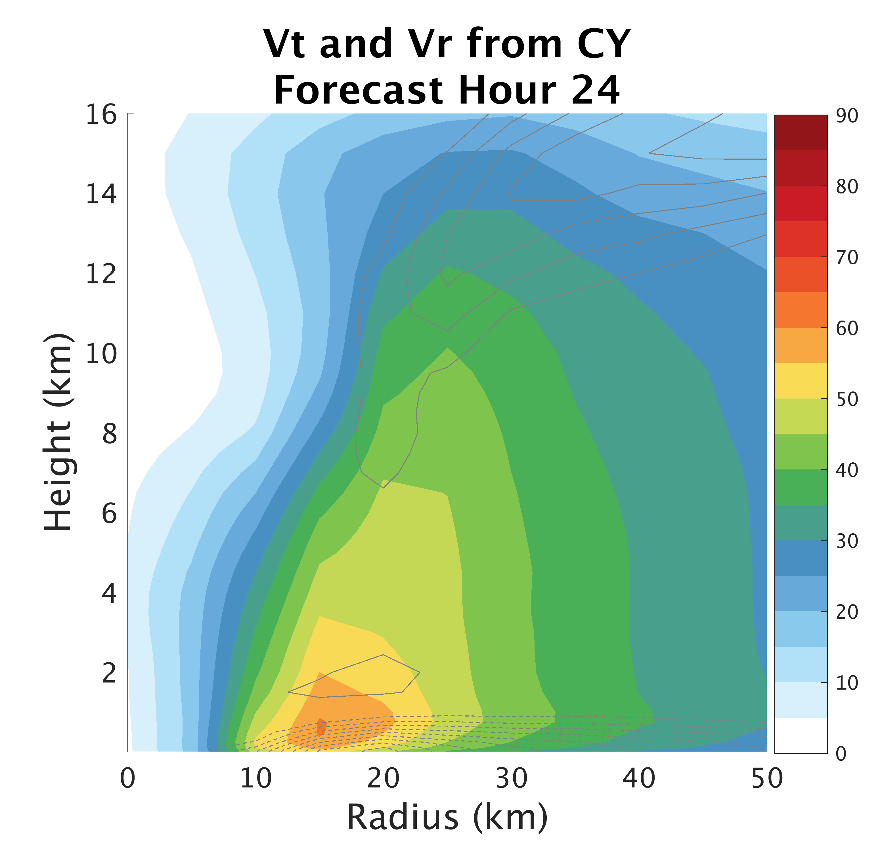
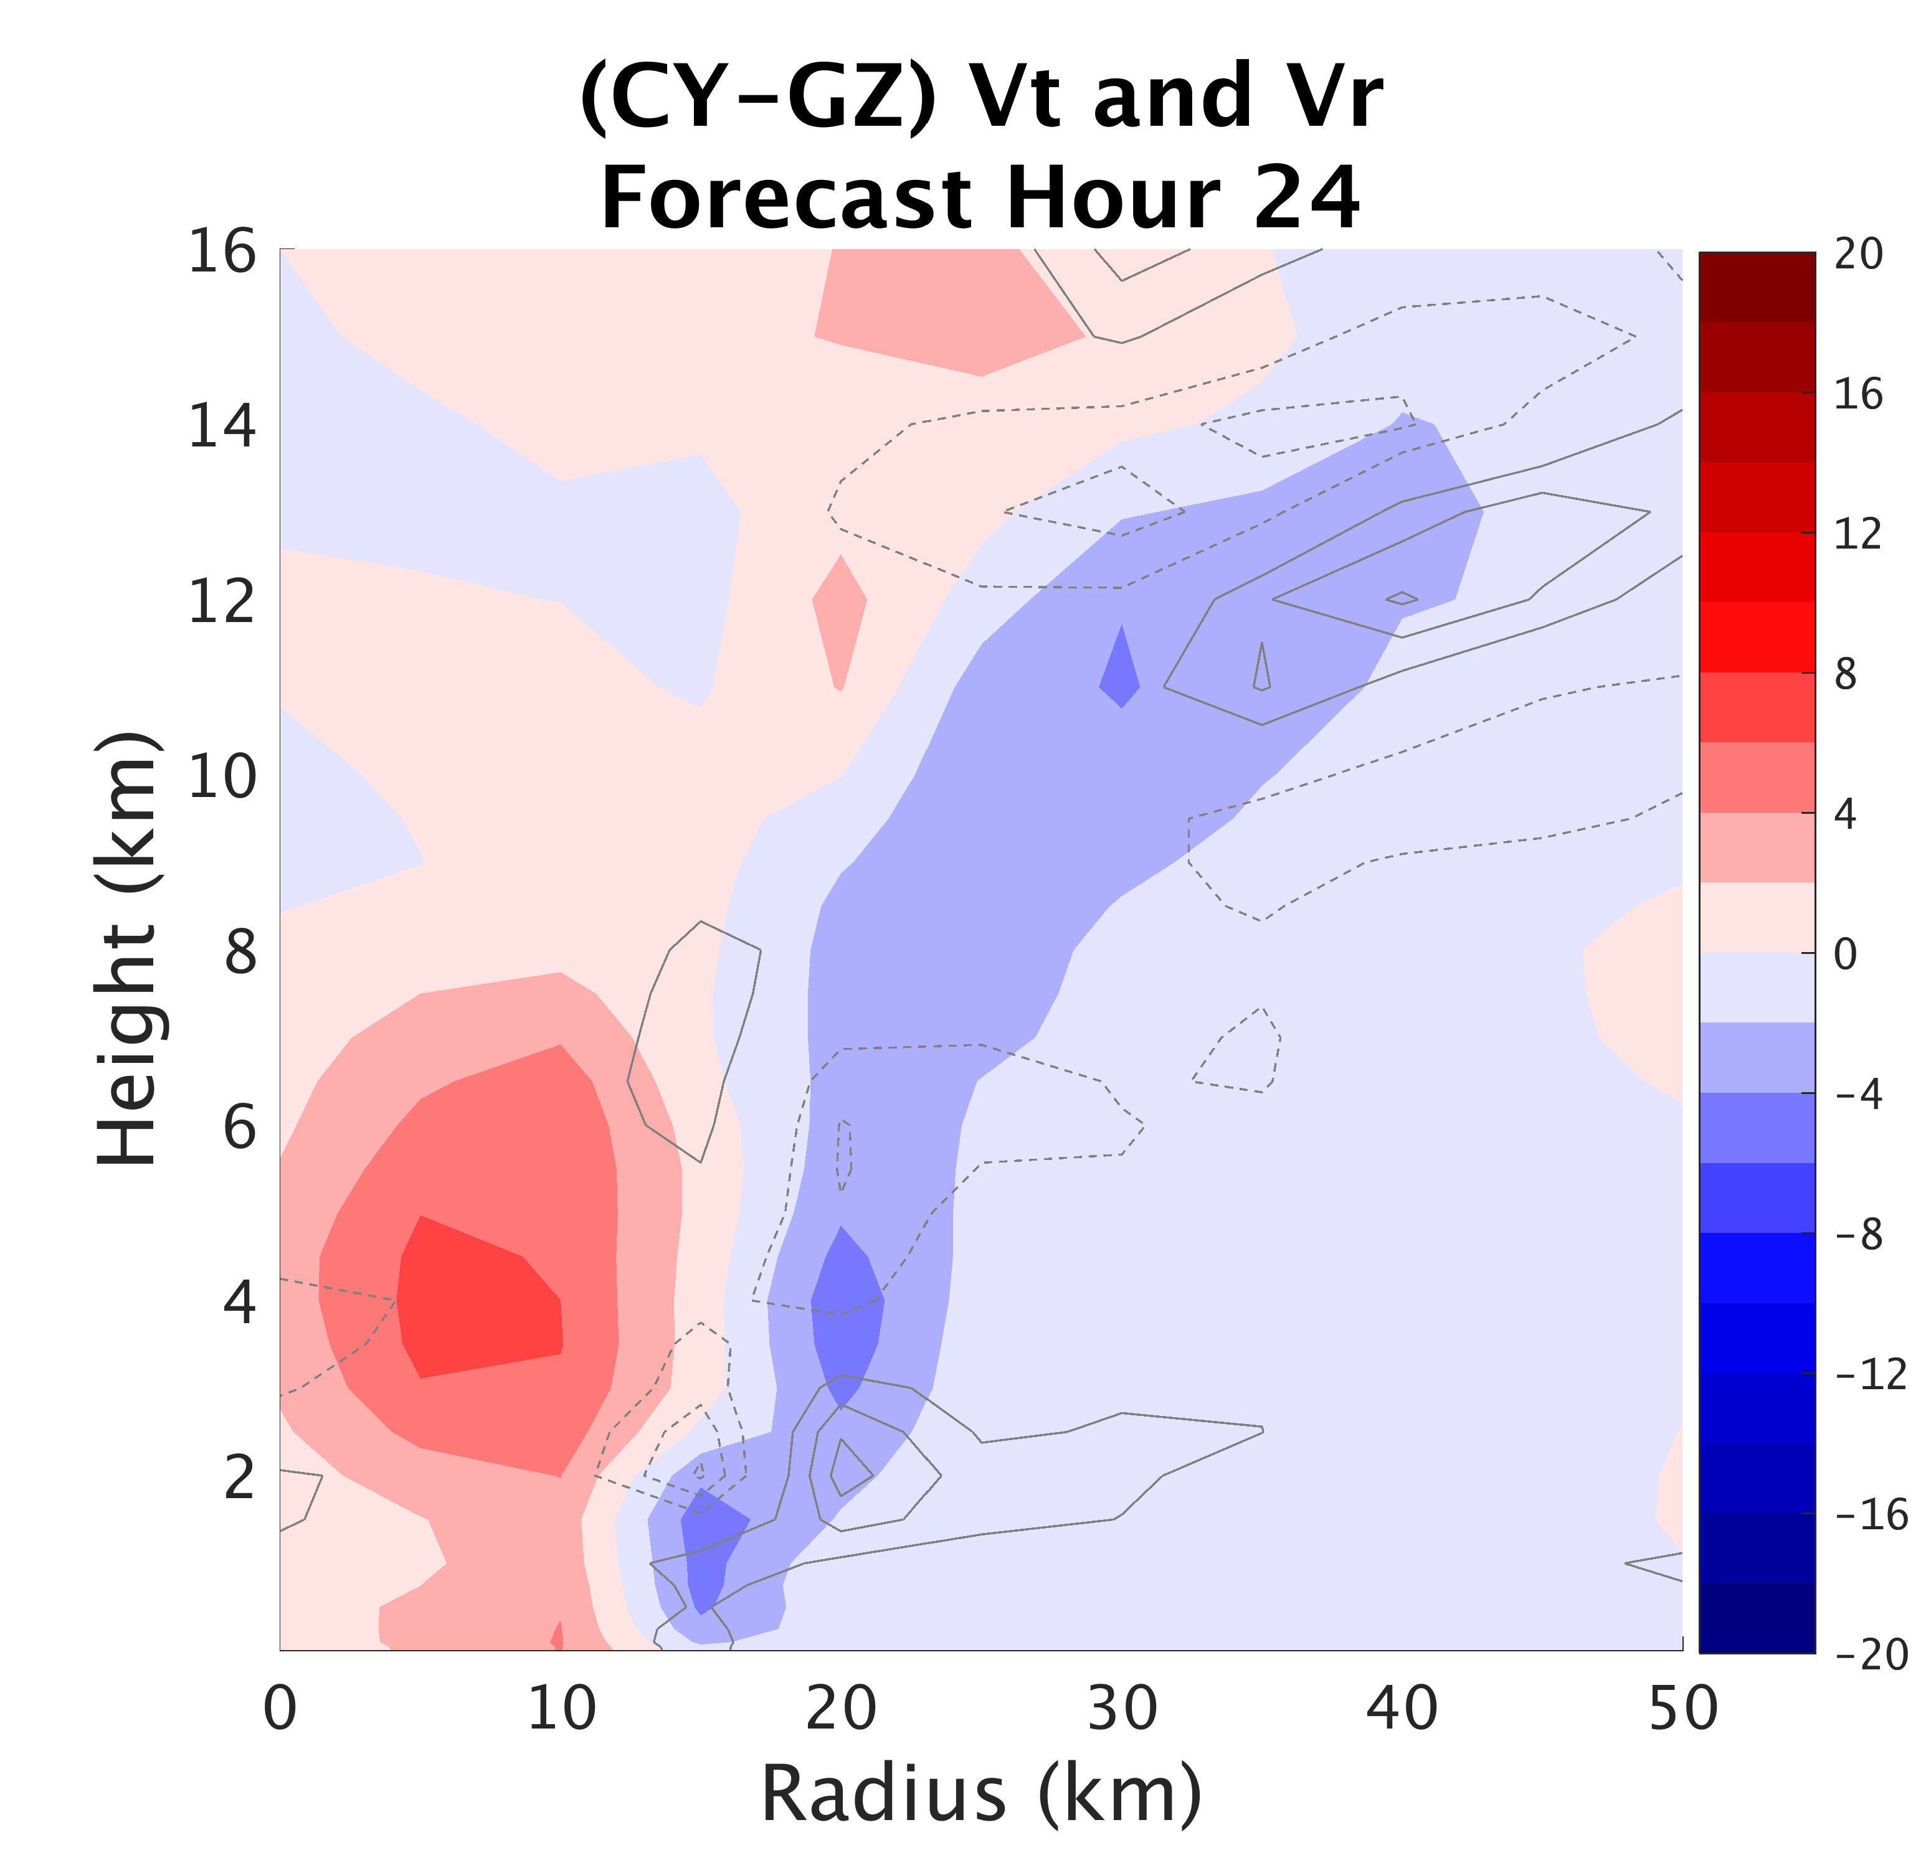
Surface Flux:
Impacts on Structure
Notes:
-

Slide 21
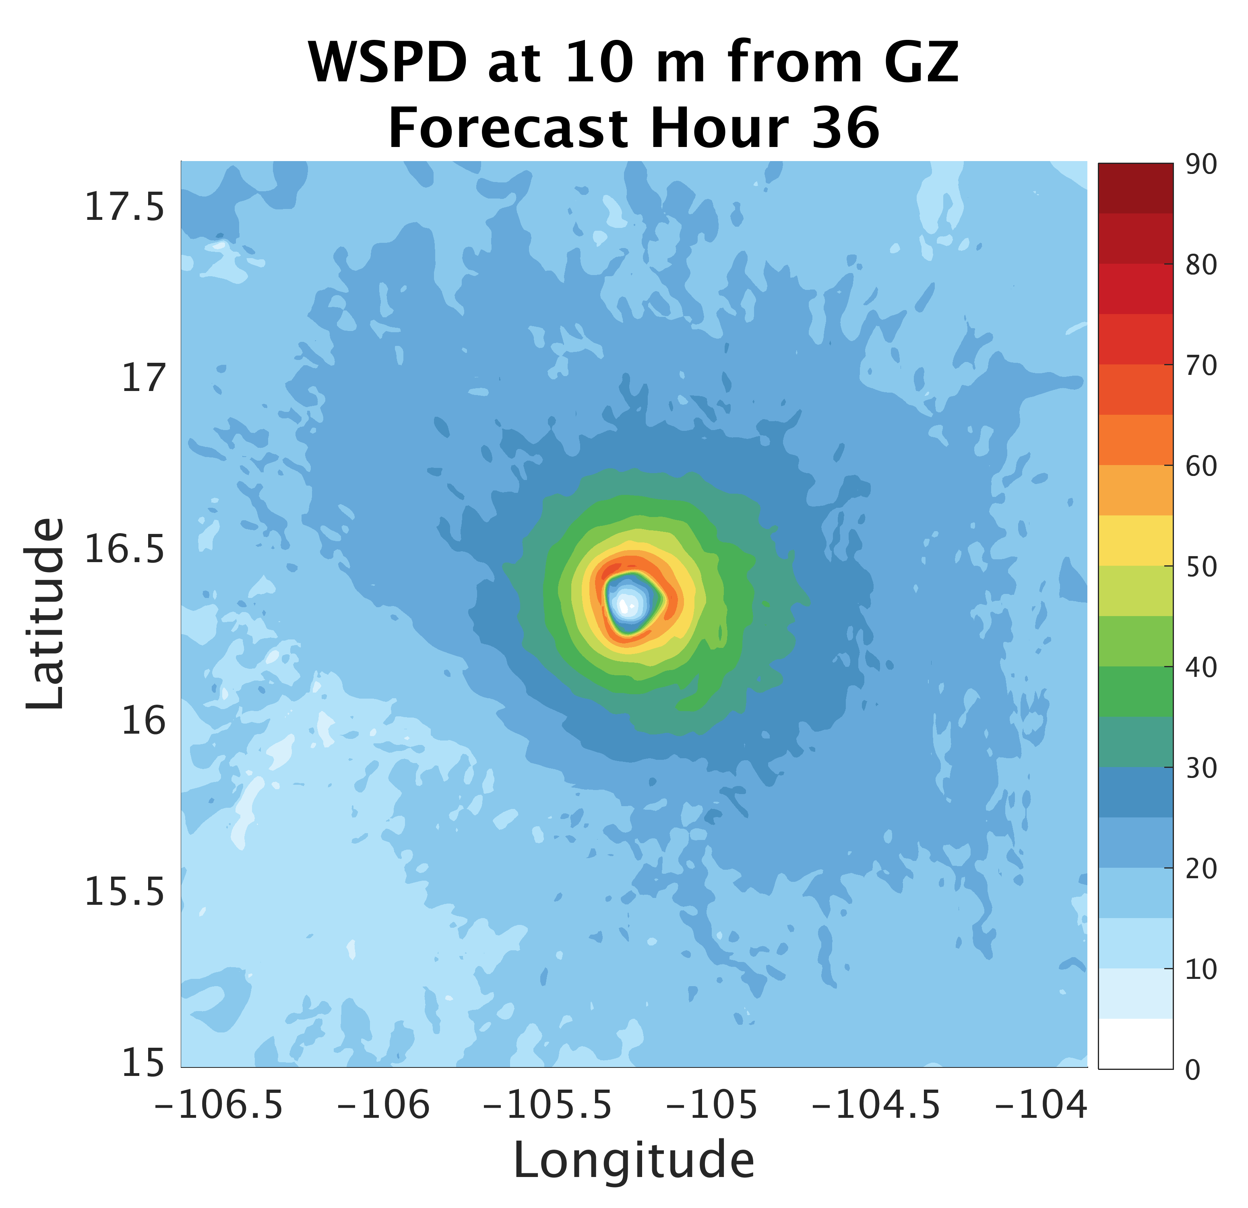
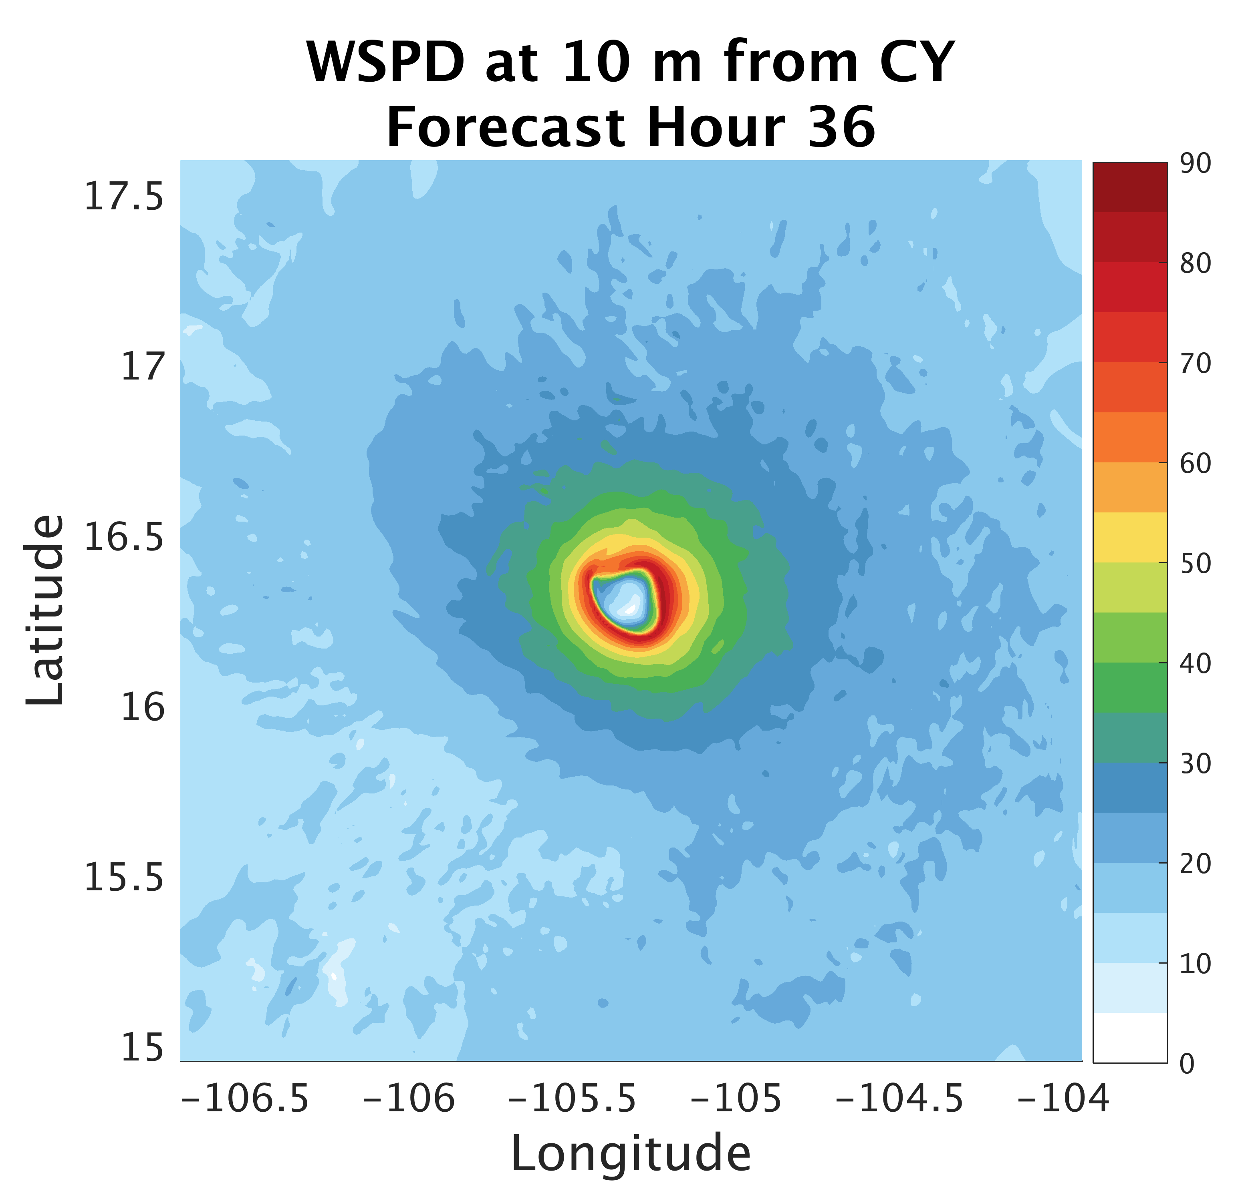
Surface Flux:
Impacts on Structure
Notes:
-

Slide 22
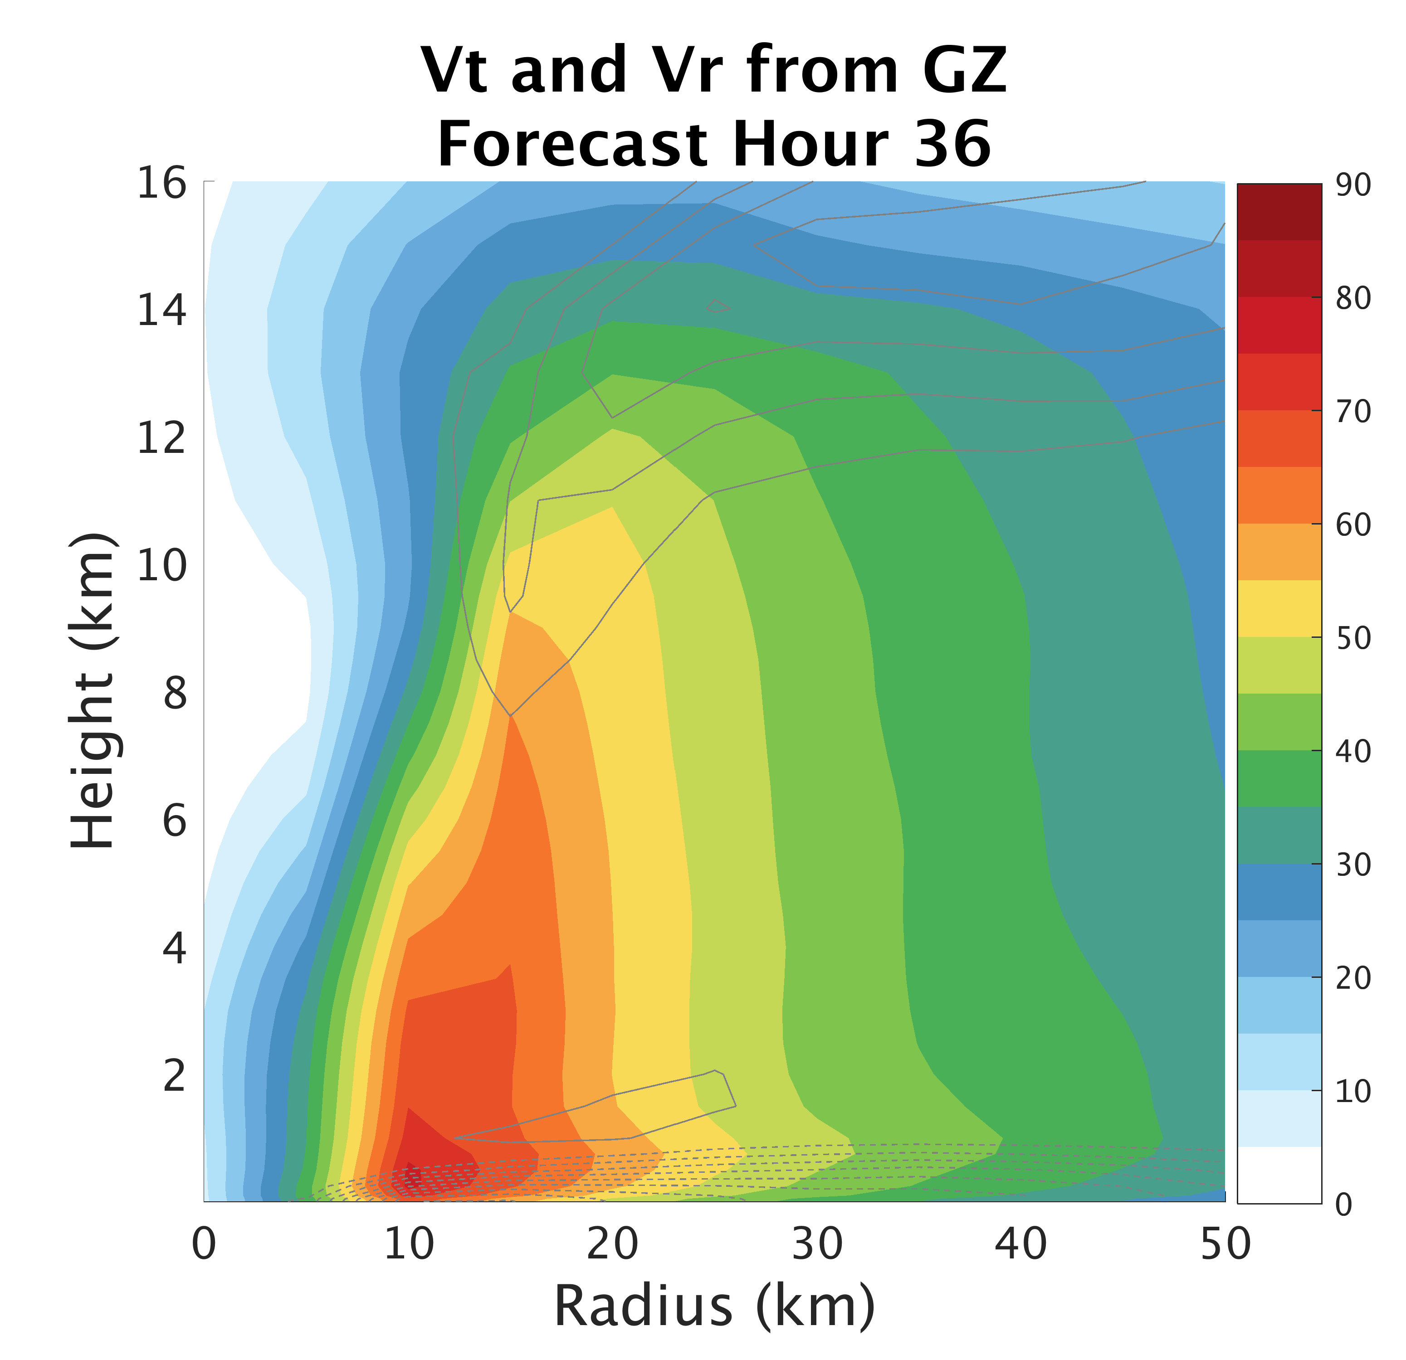
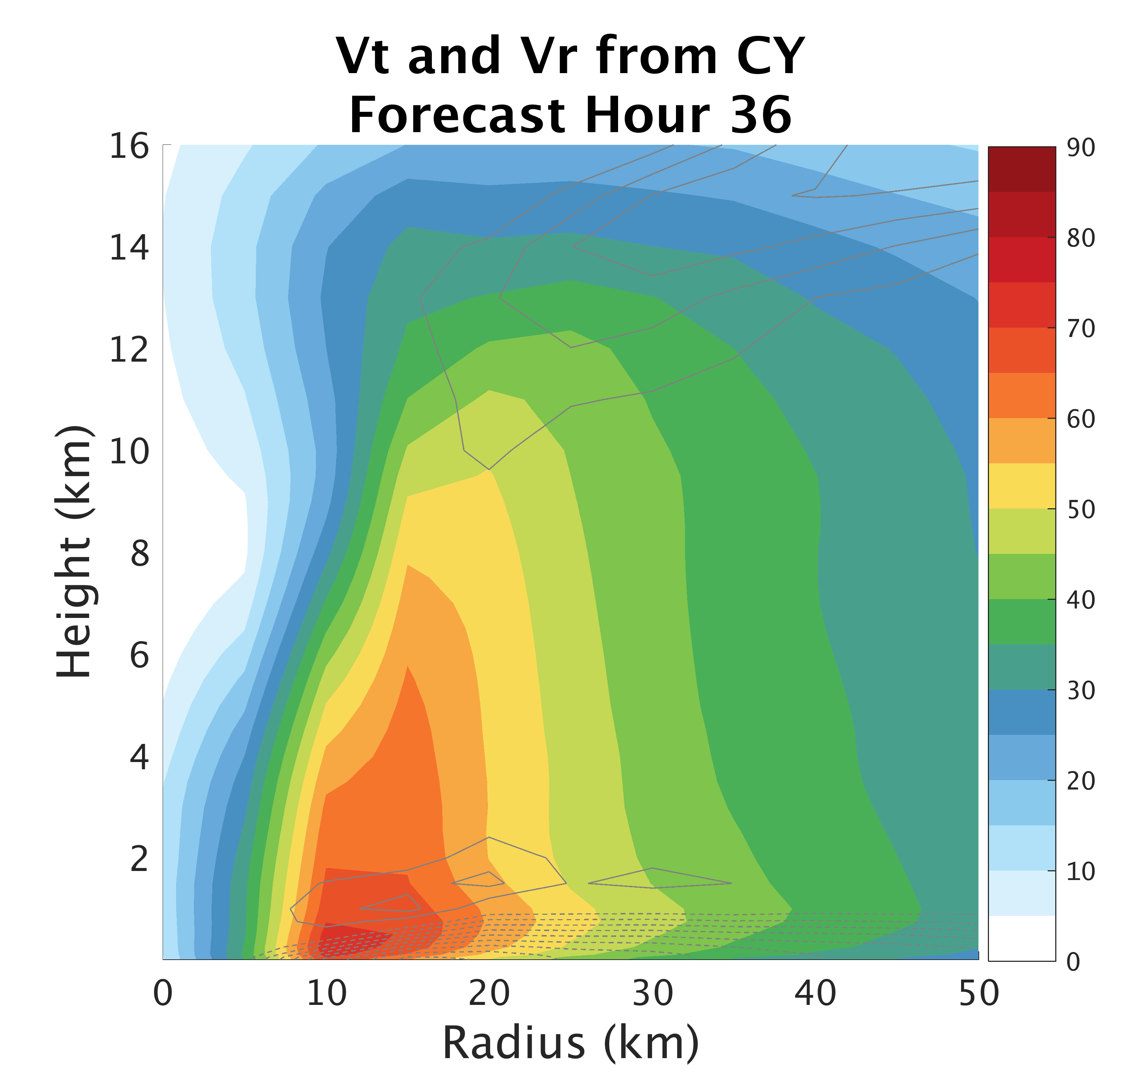
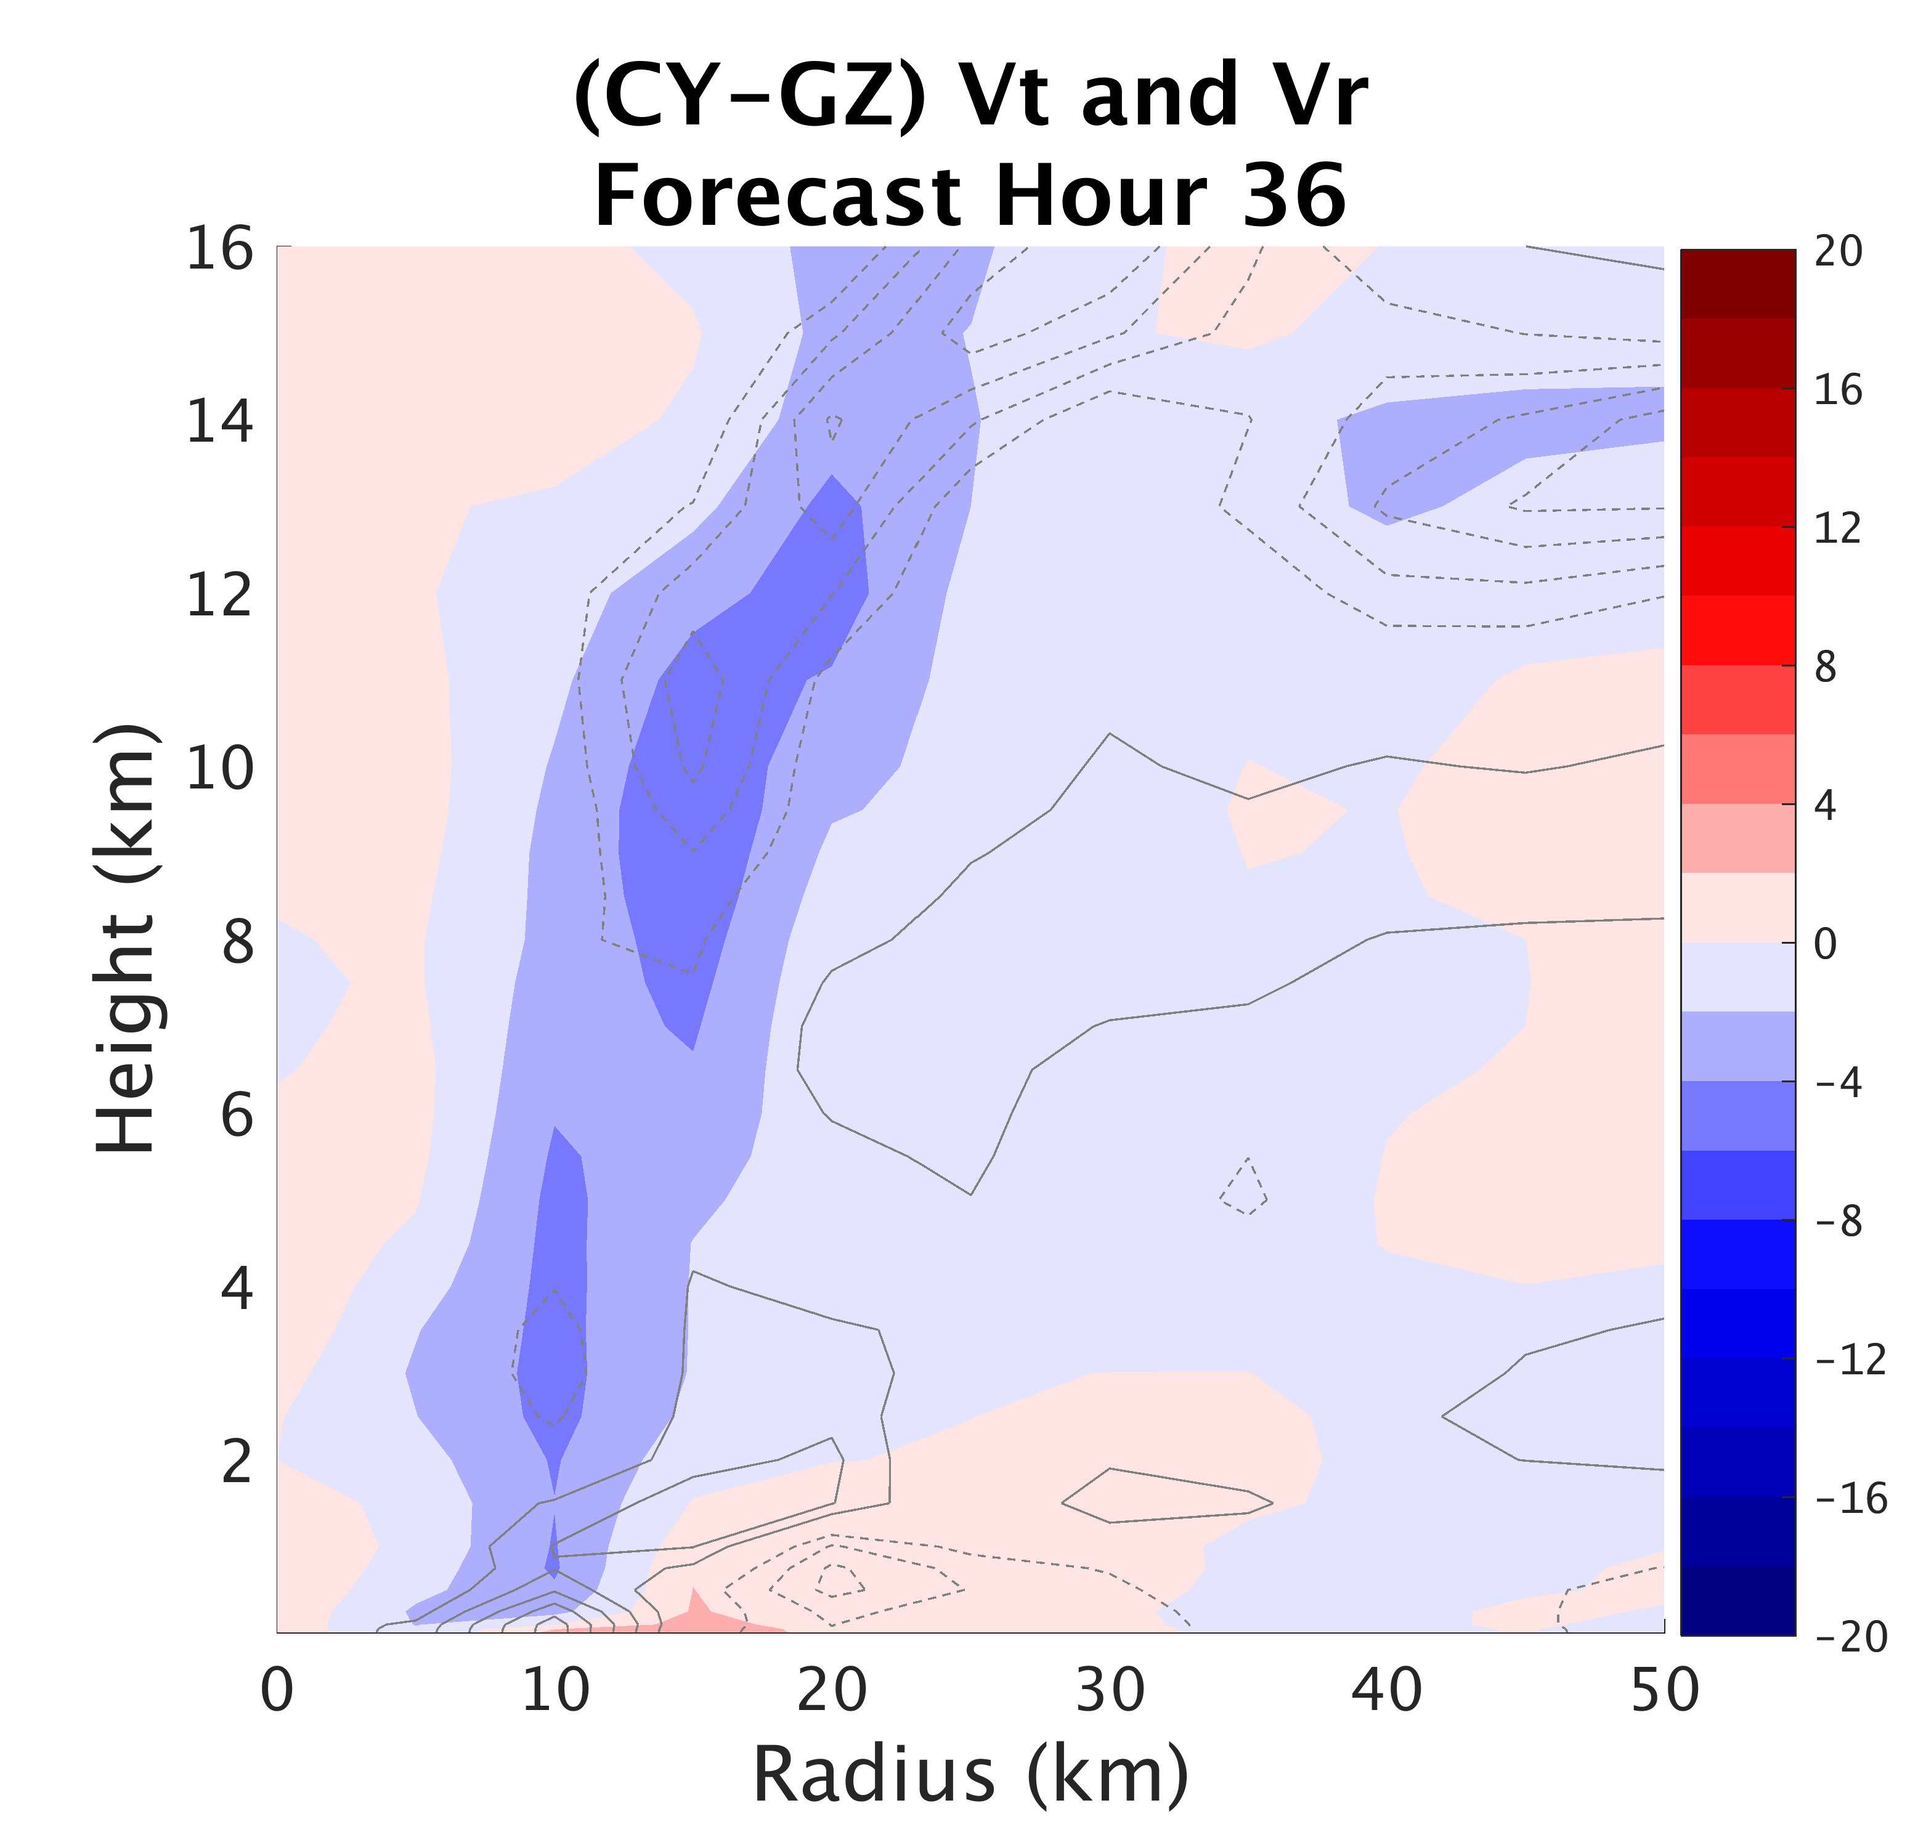
Surface Flux:
Impacts on Structure
Notes:
-stronger eyewall surface convergence from larger Cd → increased frictional effect
-also stronger outflow from larger Cd (GZ)

Slide 23
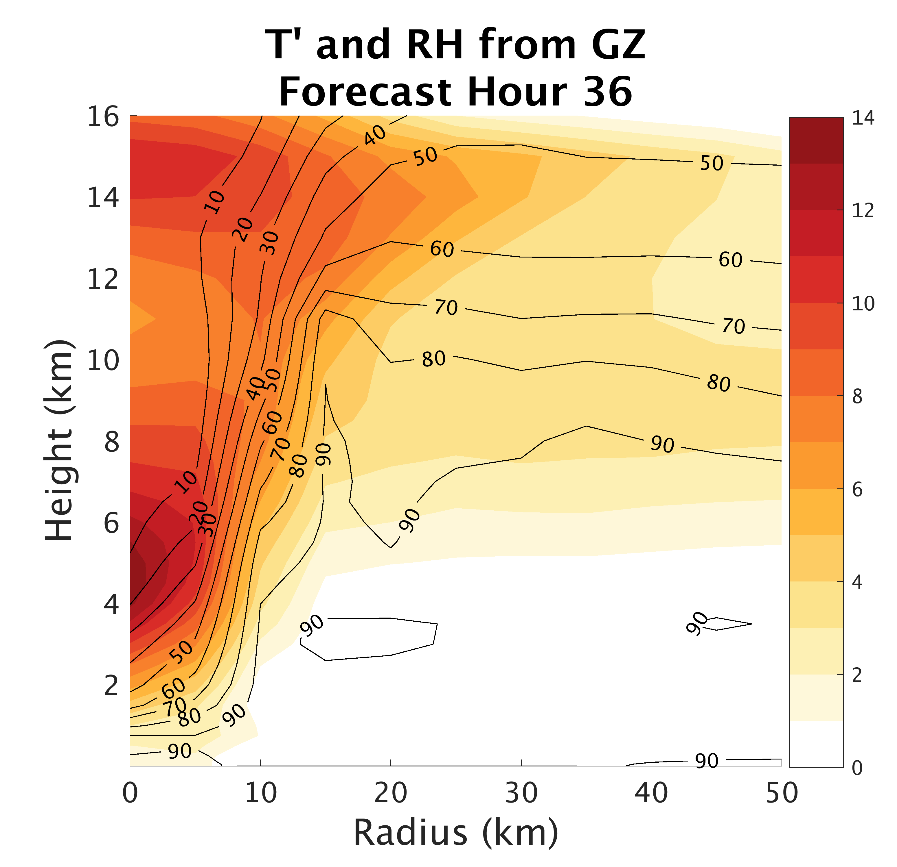
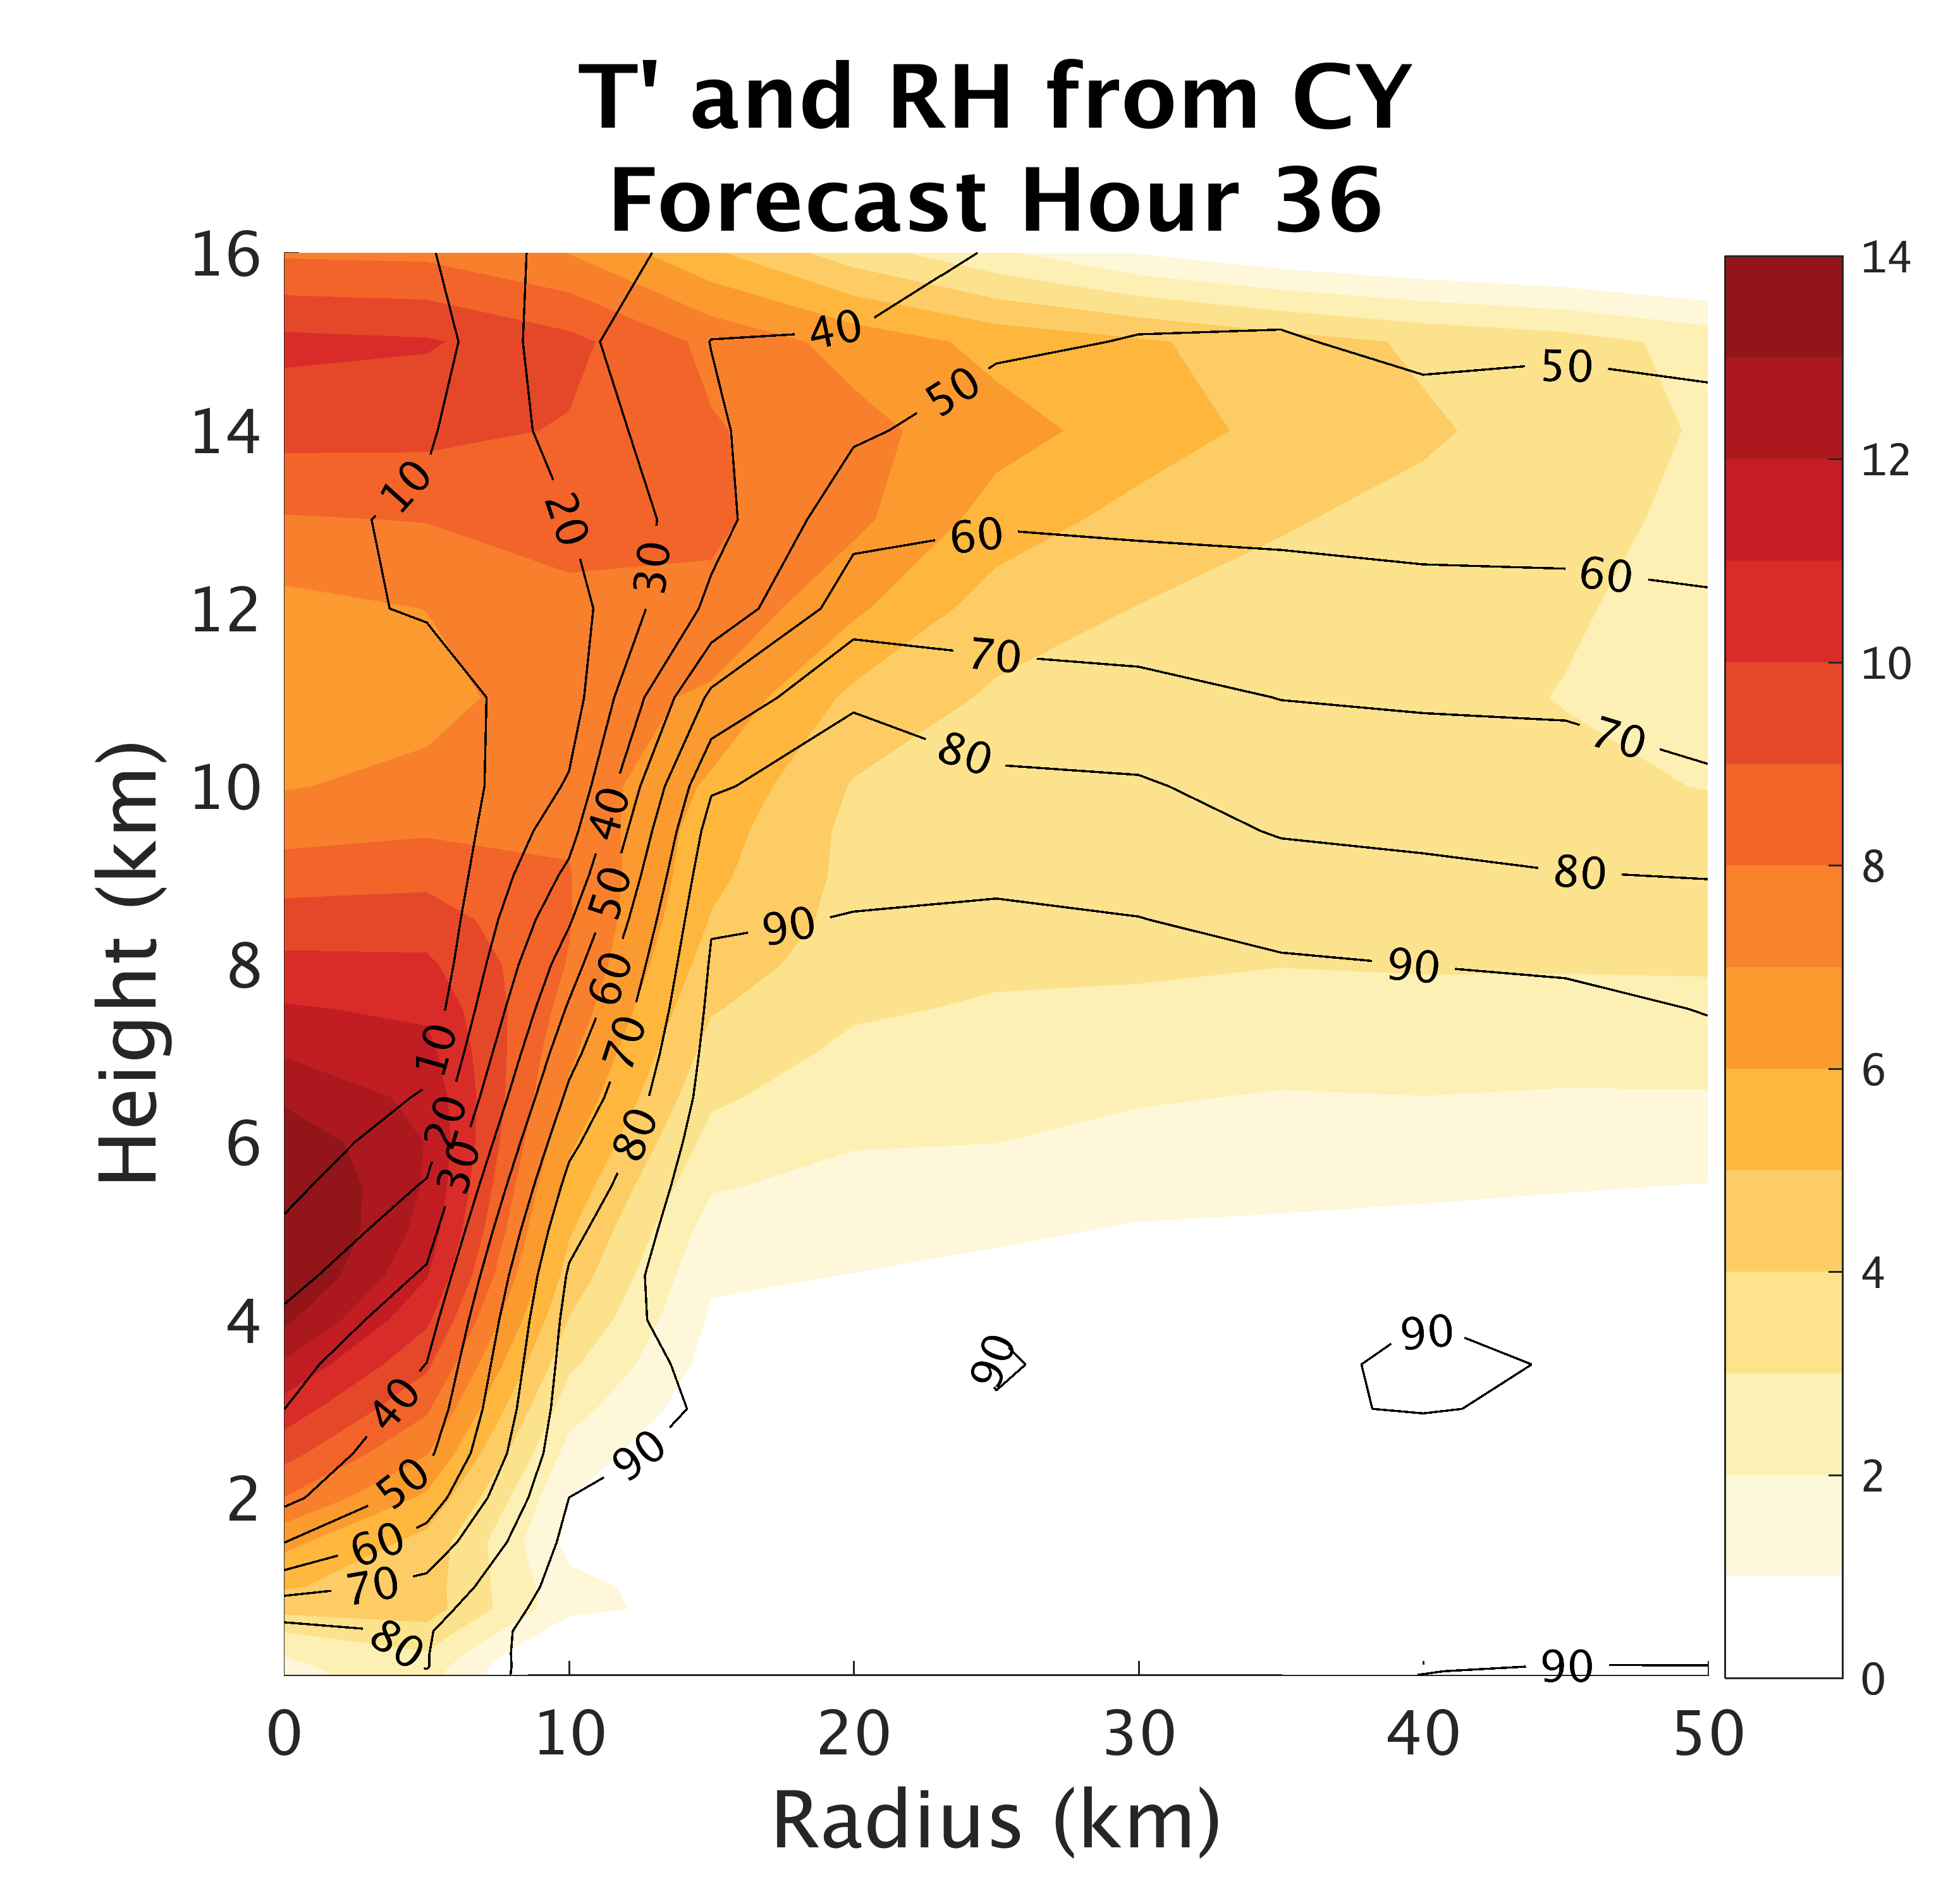
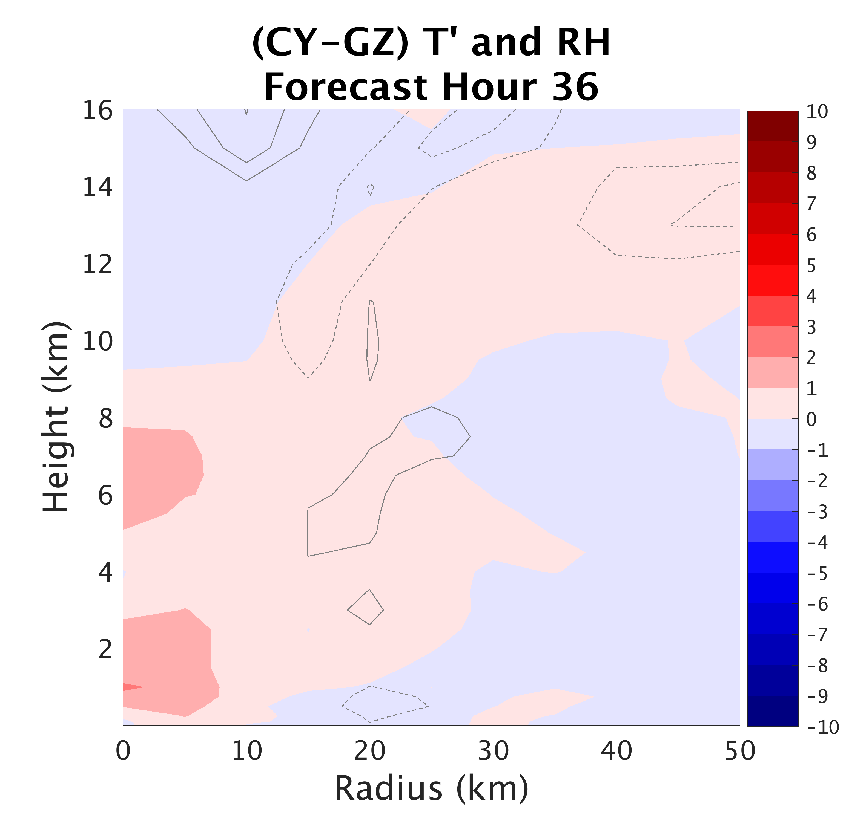
Surface Flux:
Impacts on Structure
Notes:
-

Slide 24
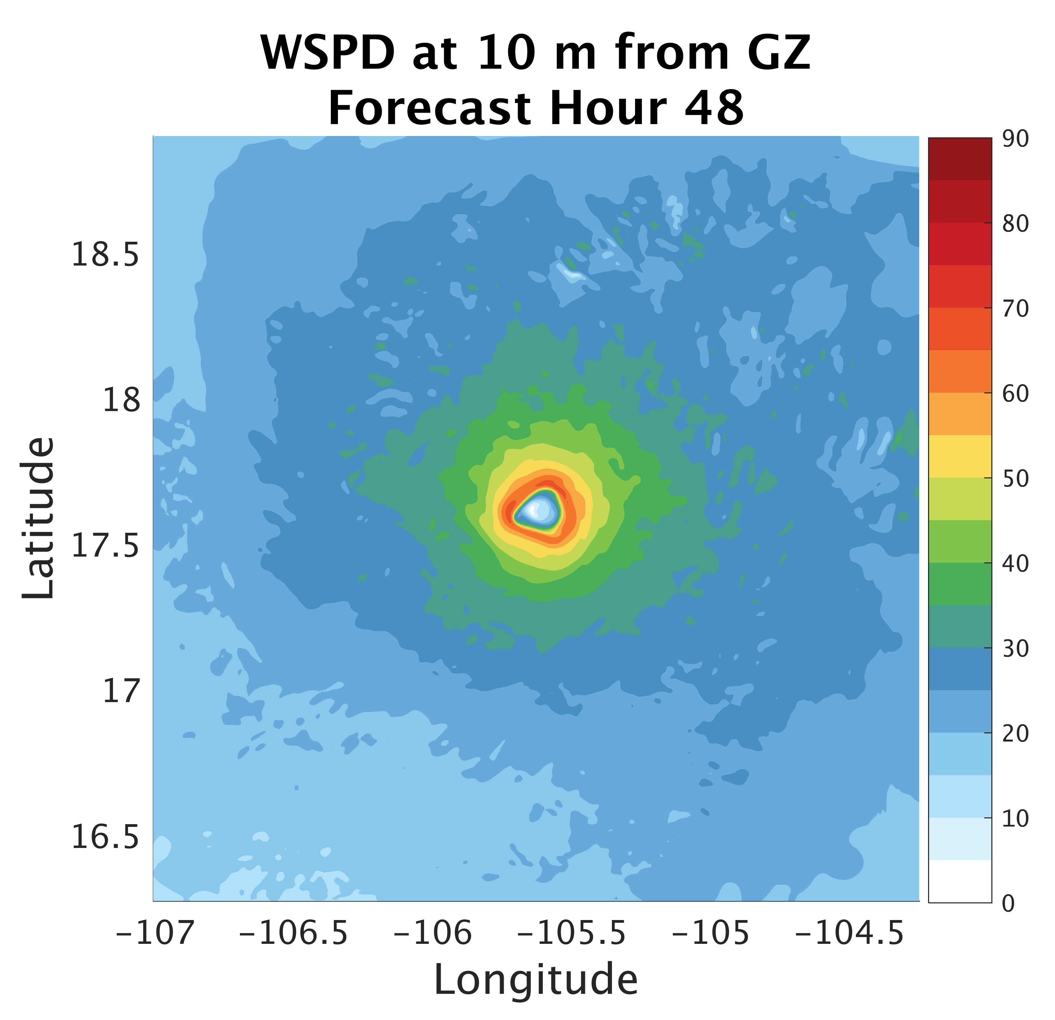
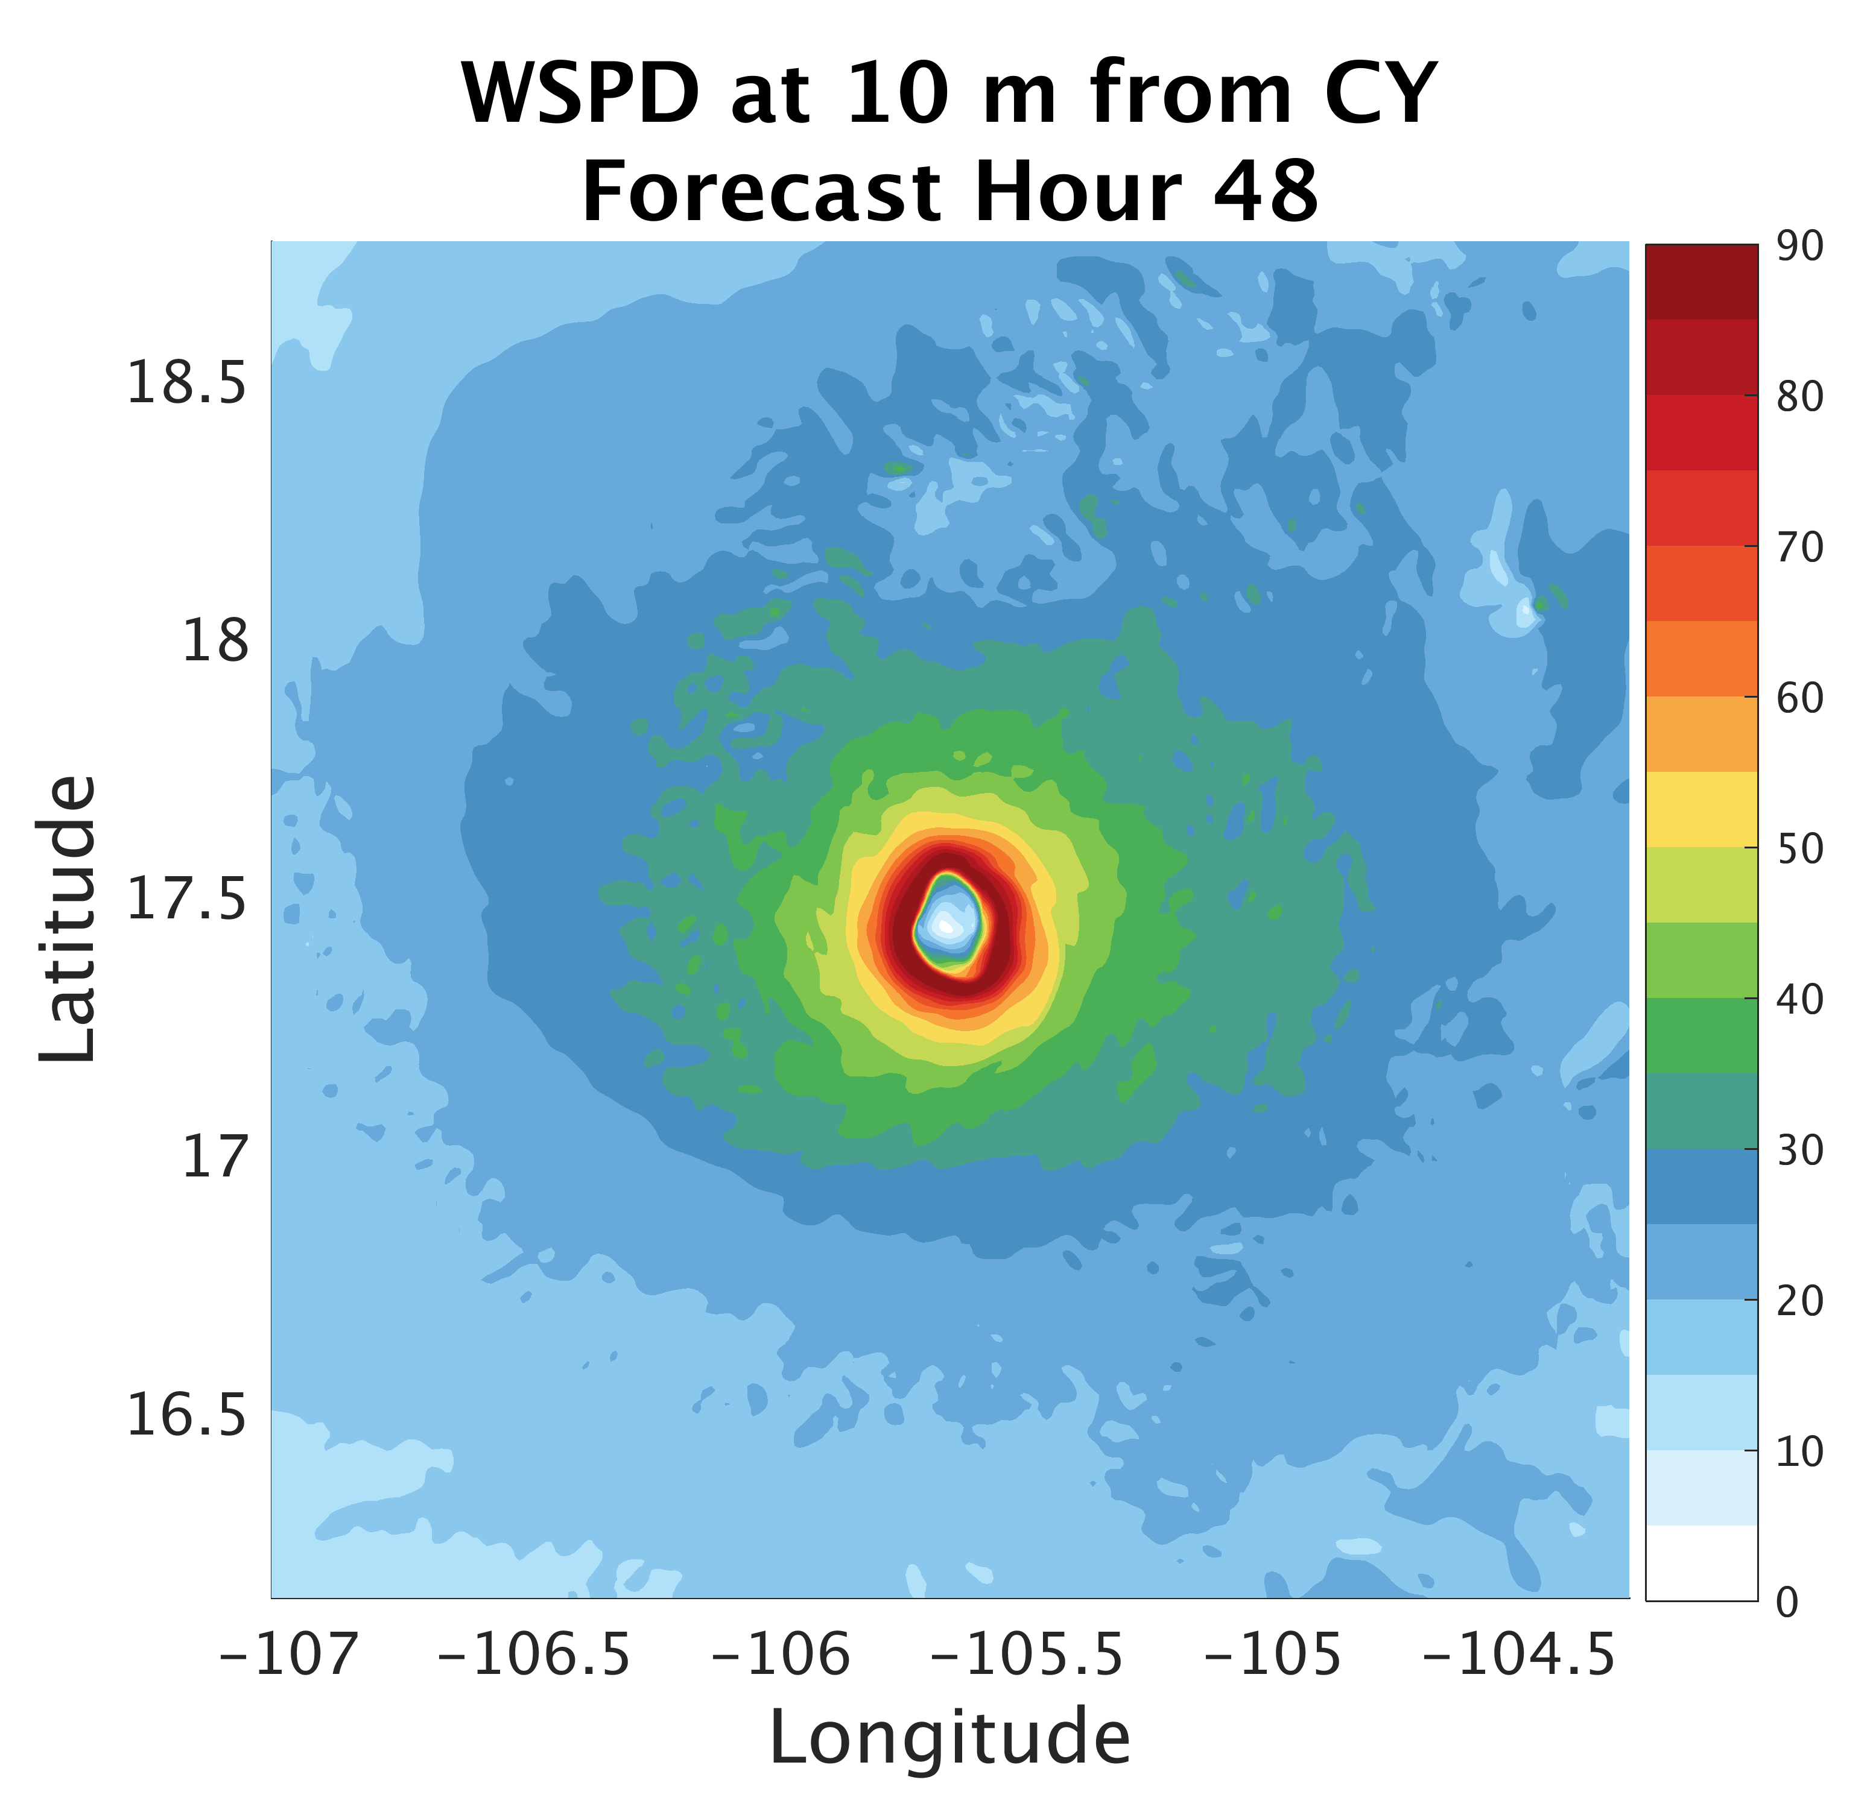
Surface Flux:
Impacts on Structure
Notes:
-

Slide 25
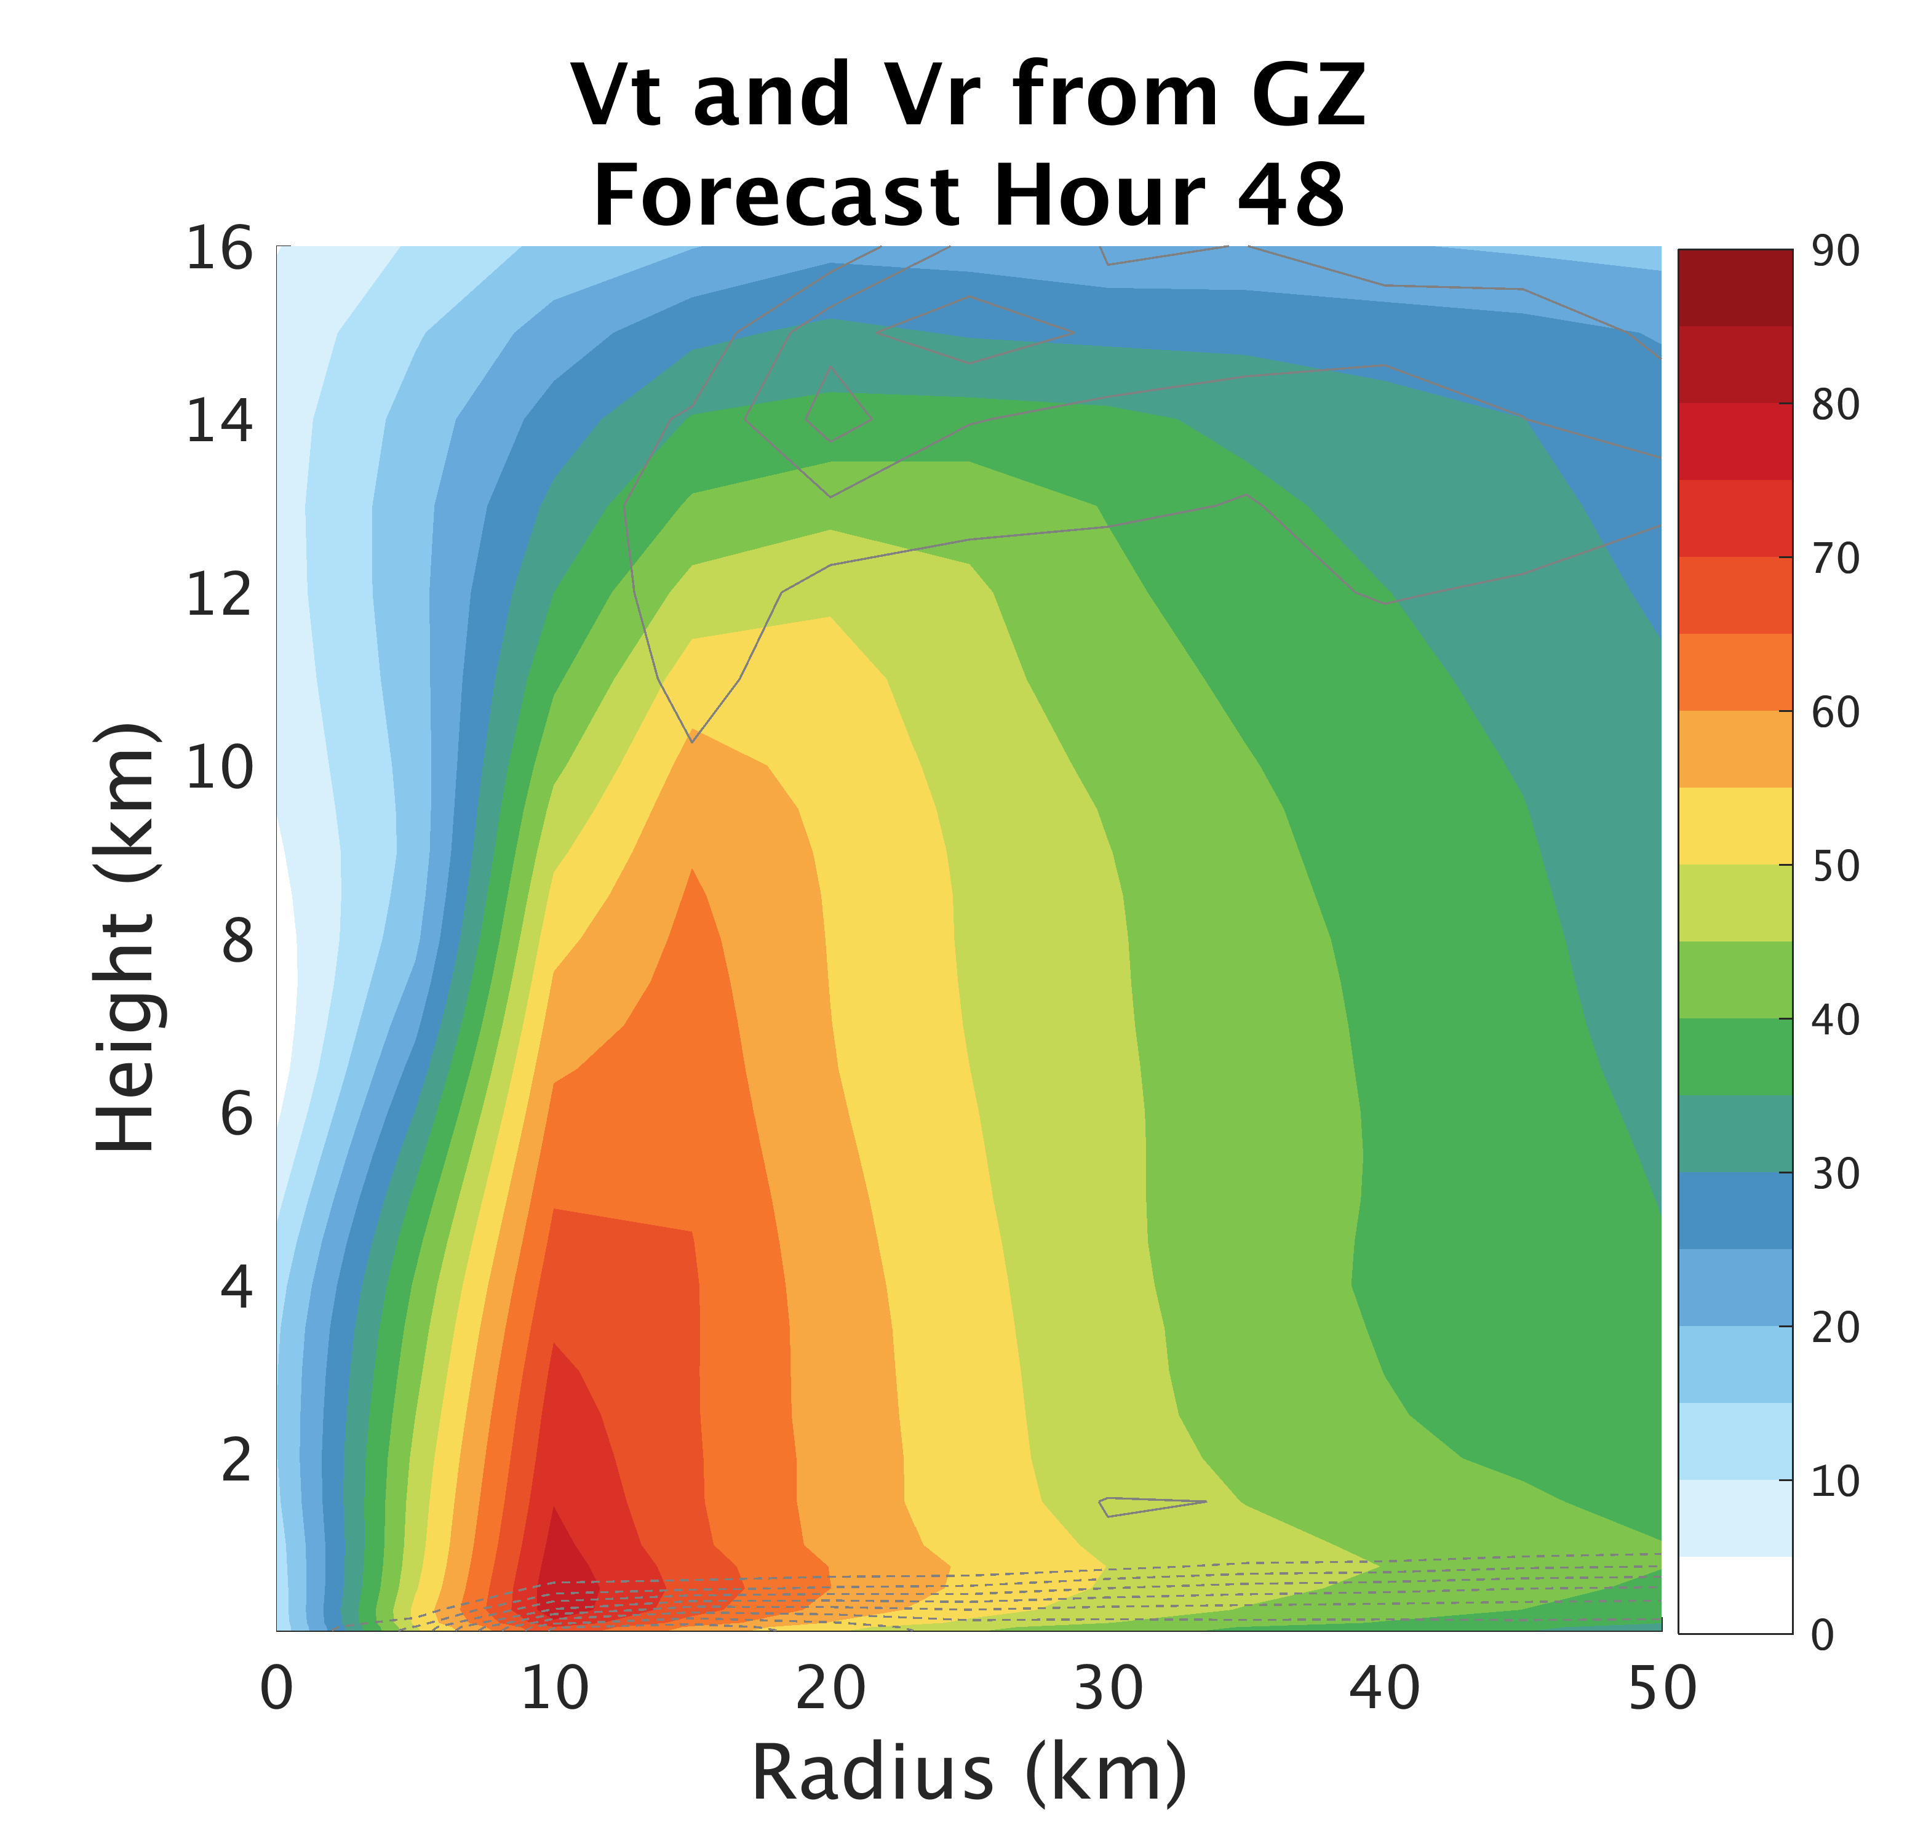
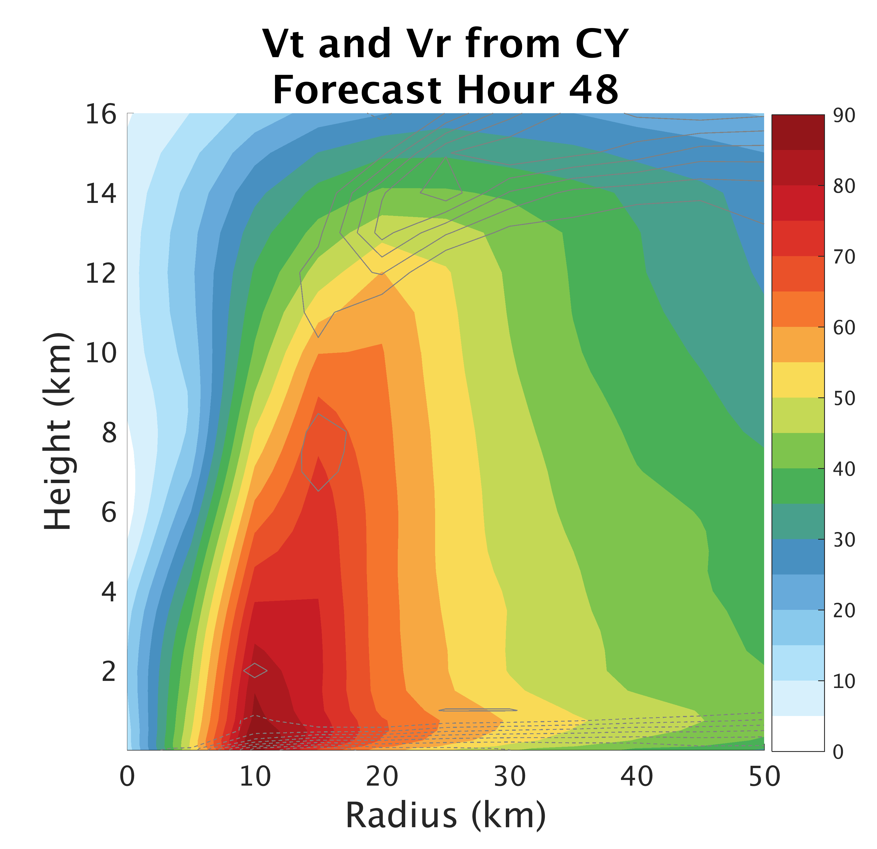
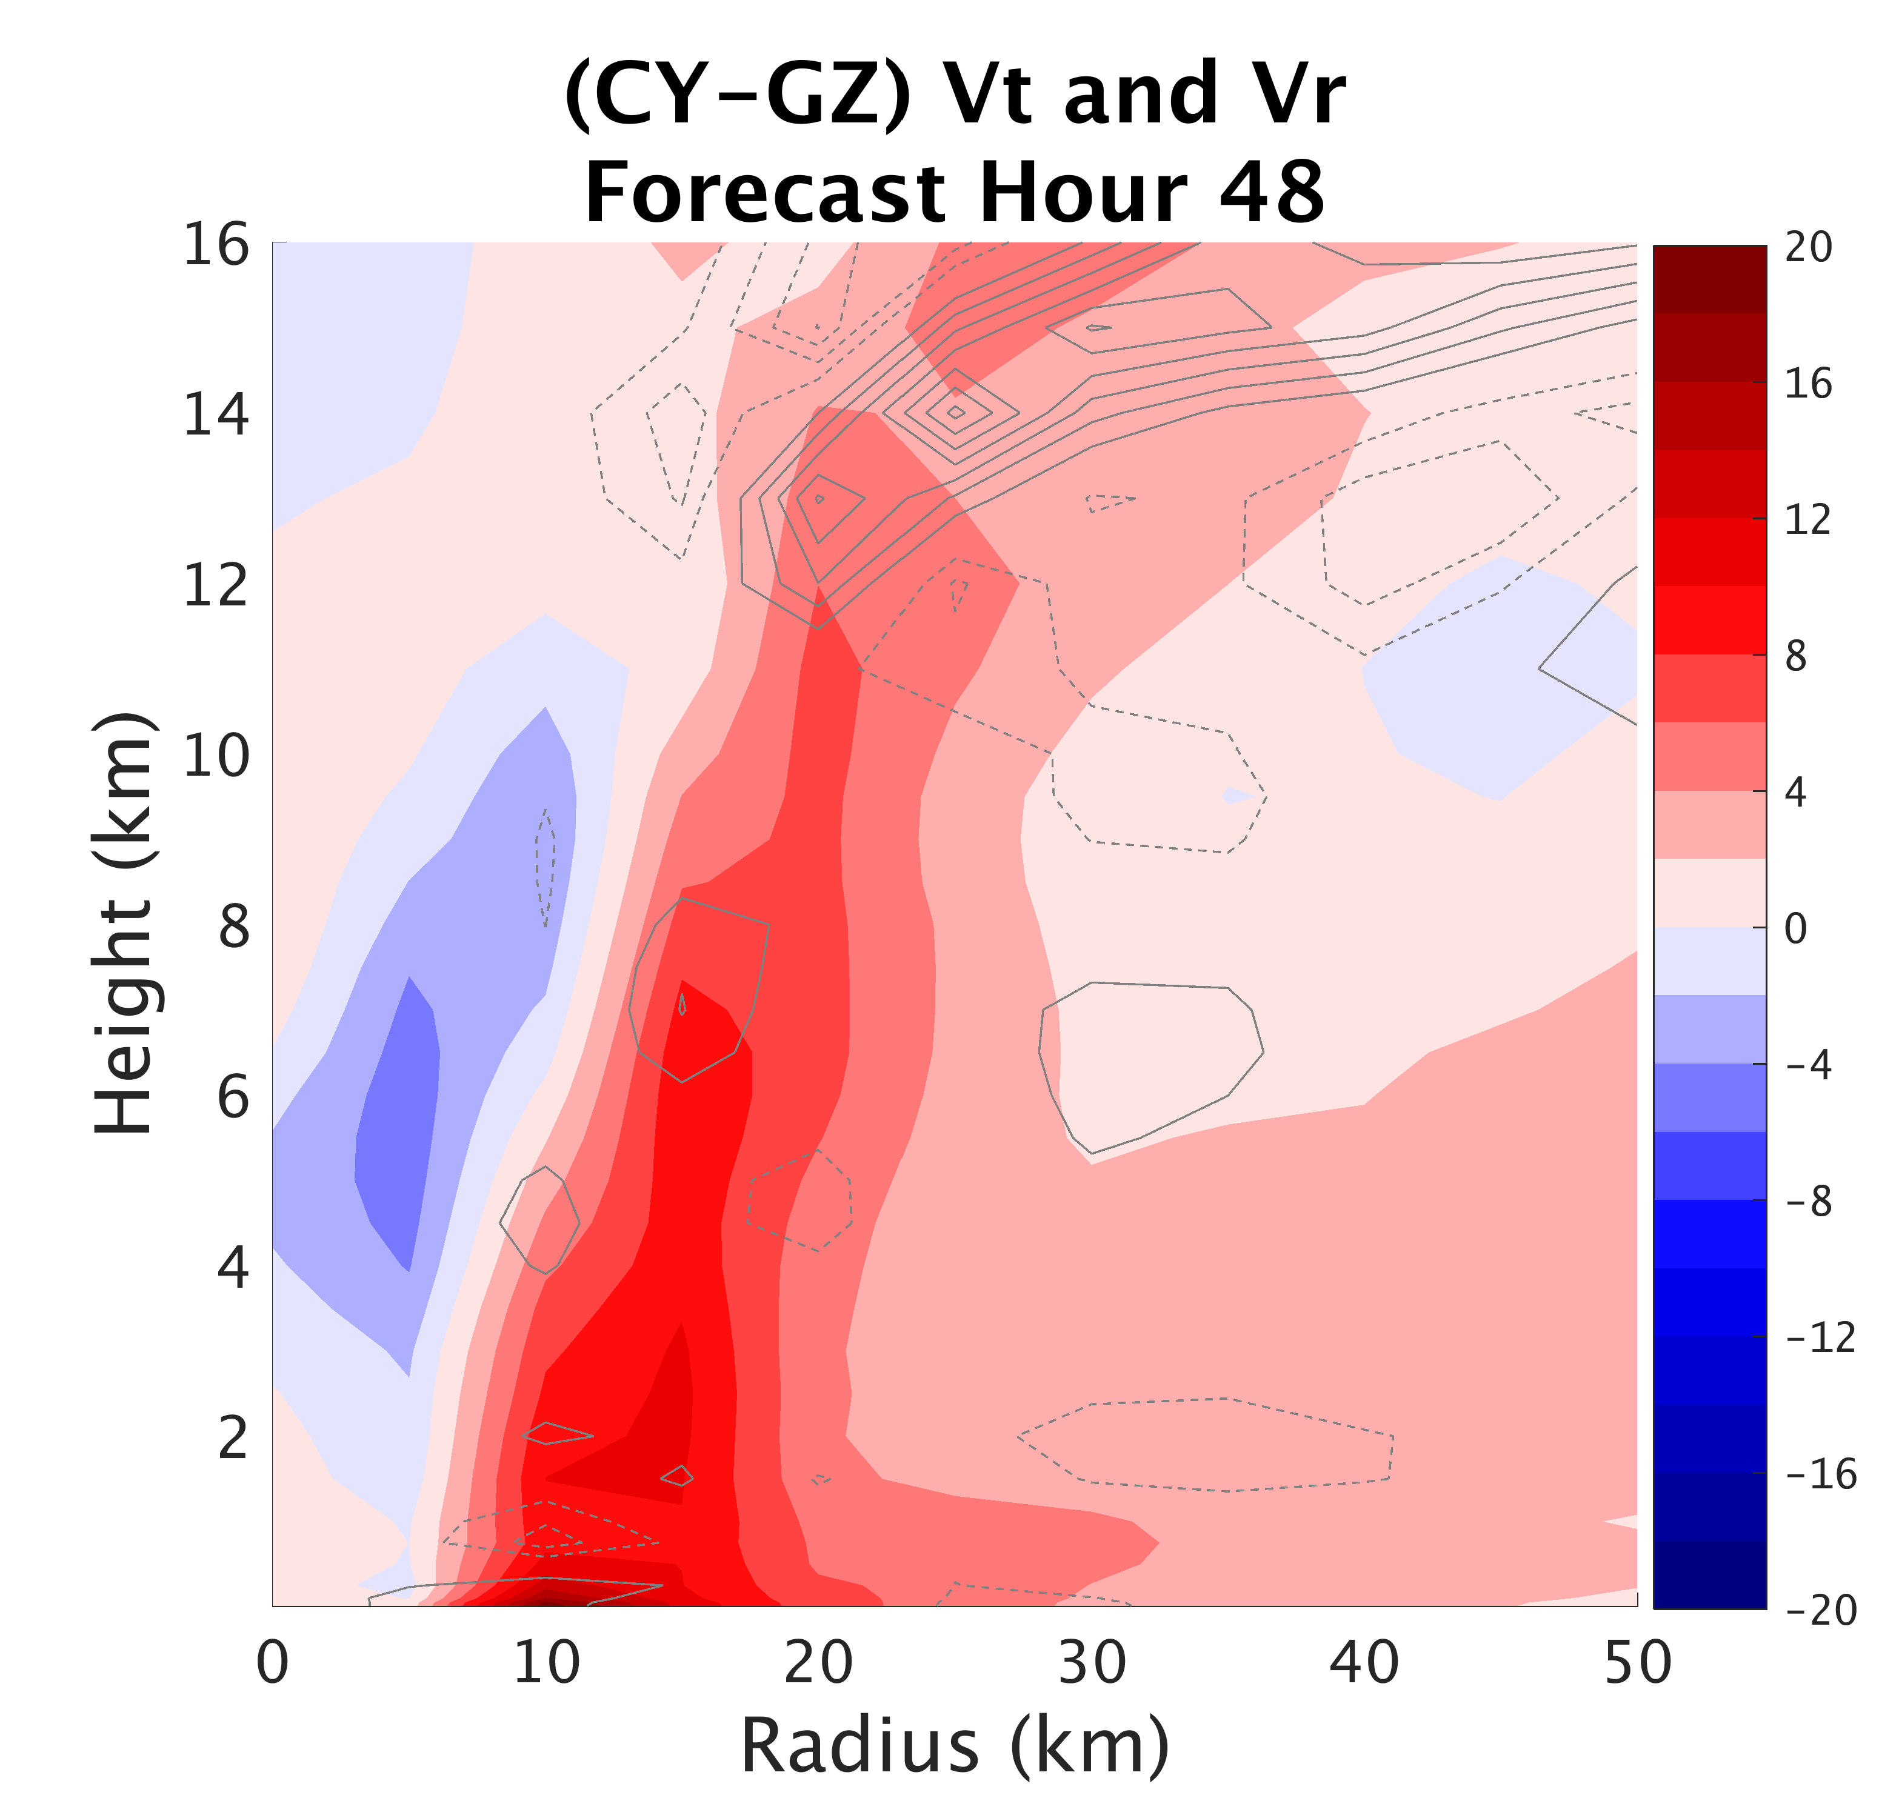
Surface Flux:
Impacts on Structure
Notes:
-Now, maller Cd has stronger Vt at surface and throughout vertical extent of vortex

Slide 26
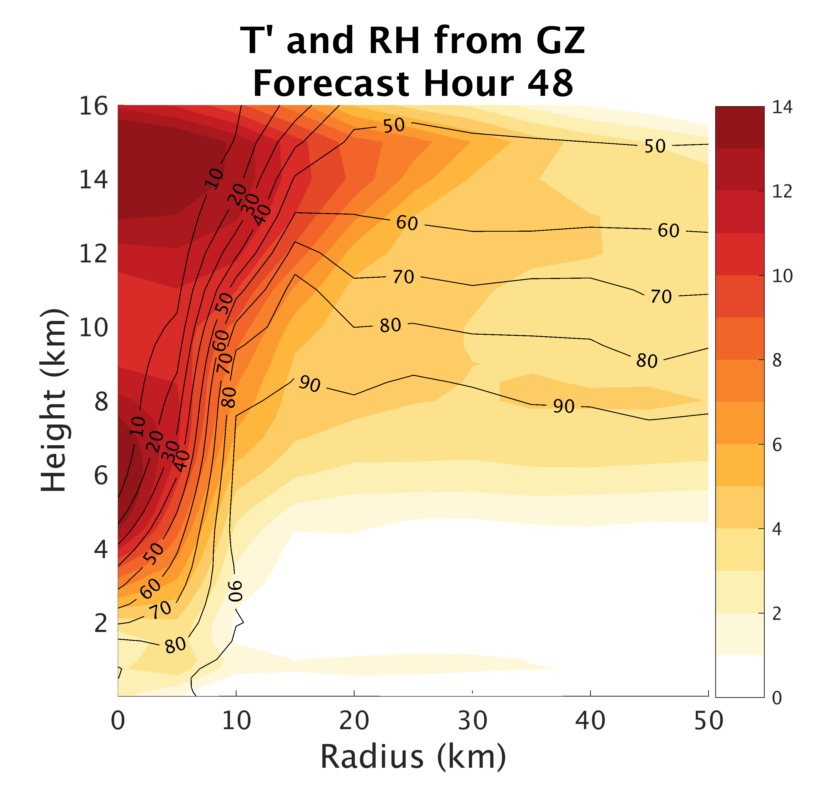
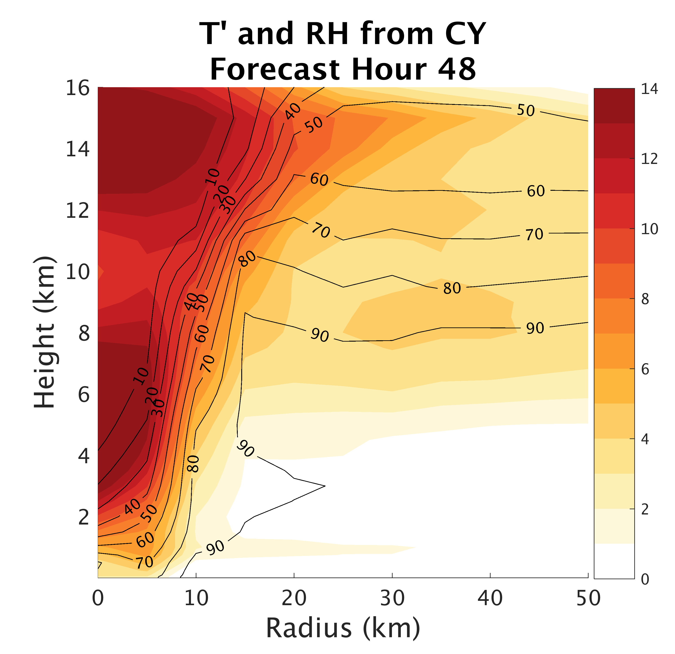
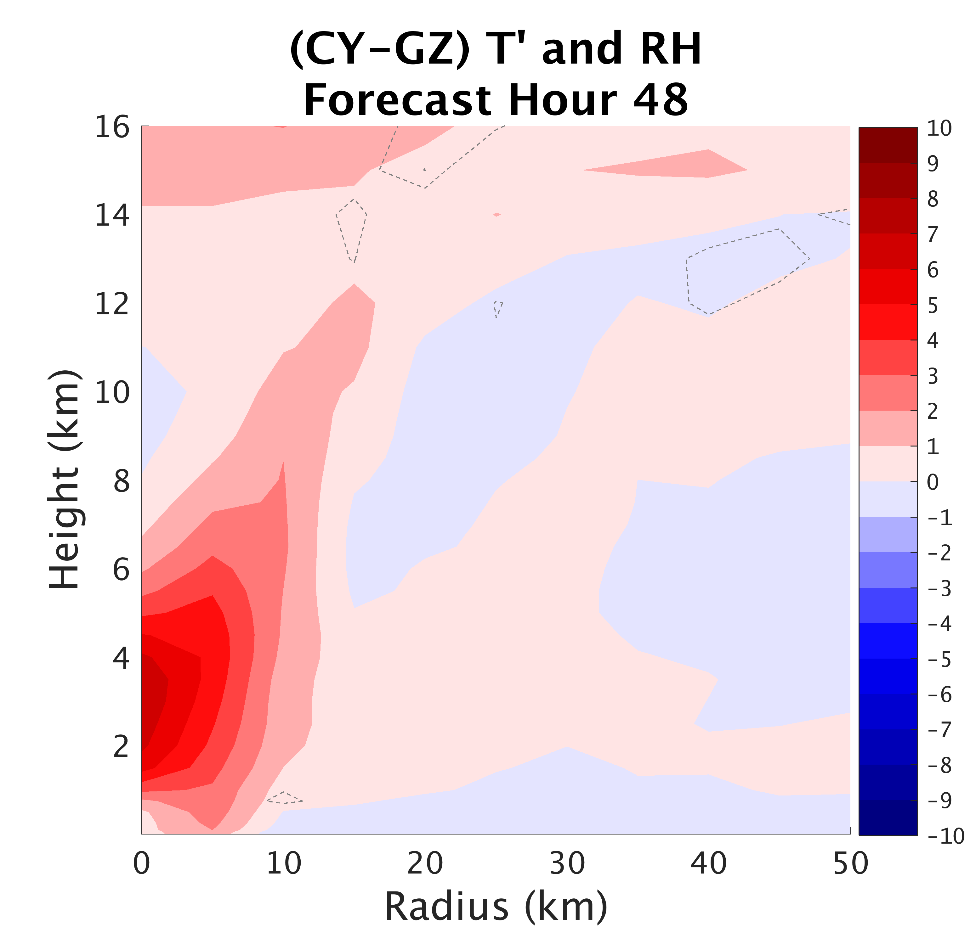
Surface Flux:
Impacts on Structure
Notes:
-

Slide 27
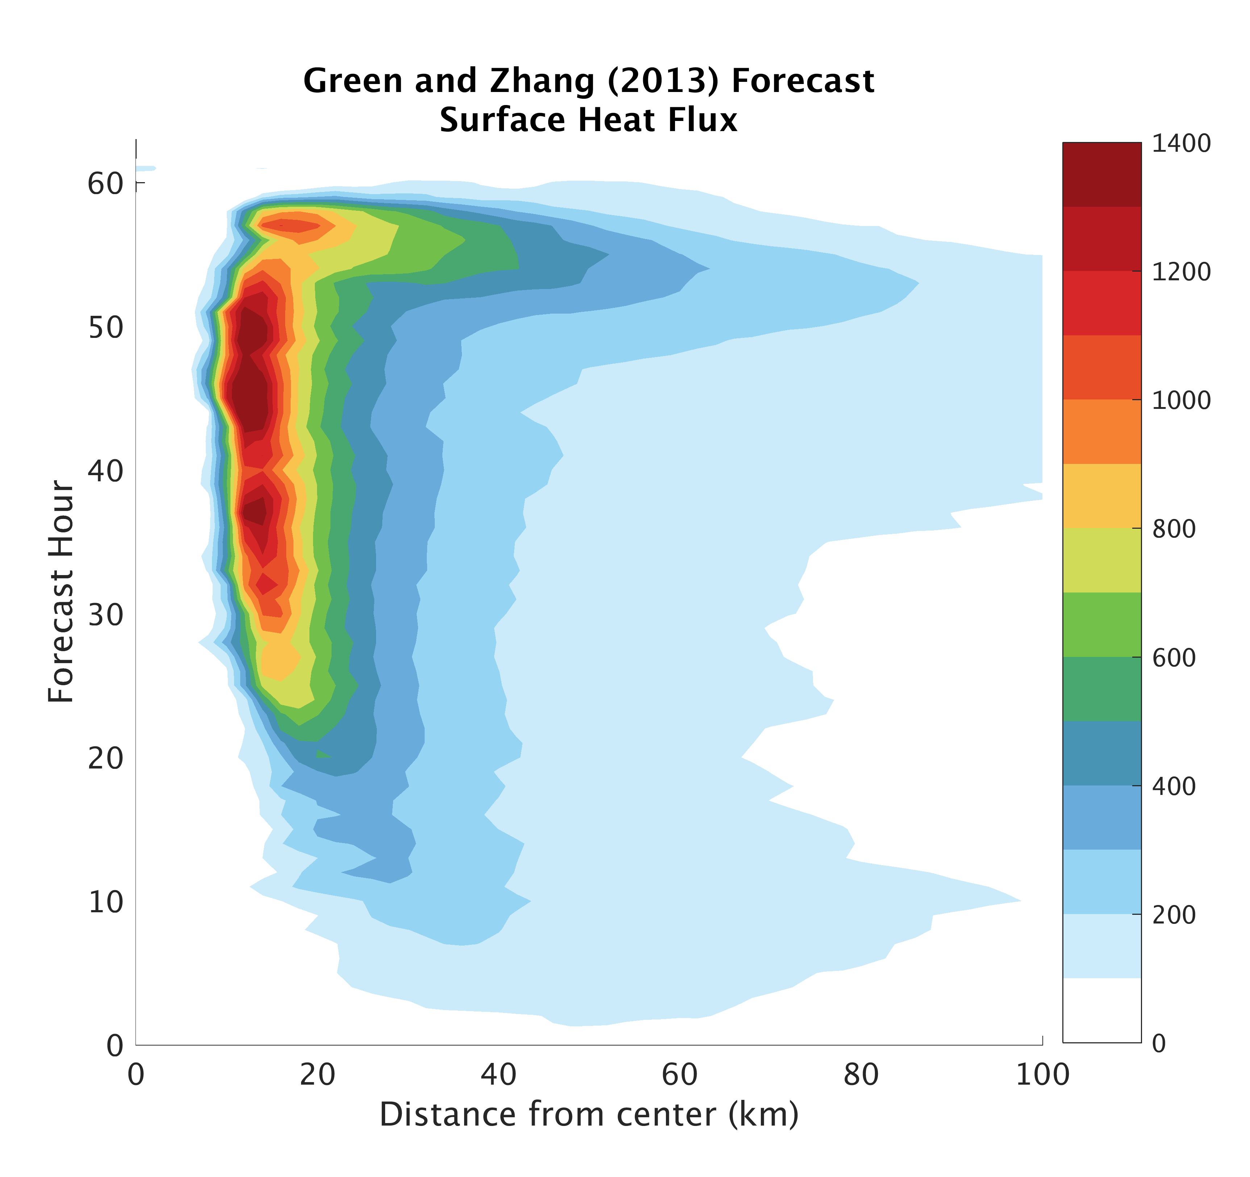
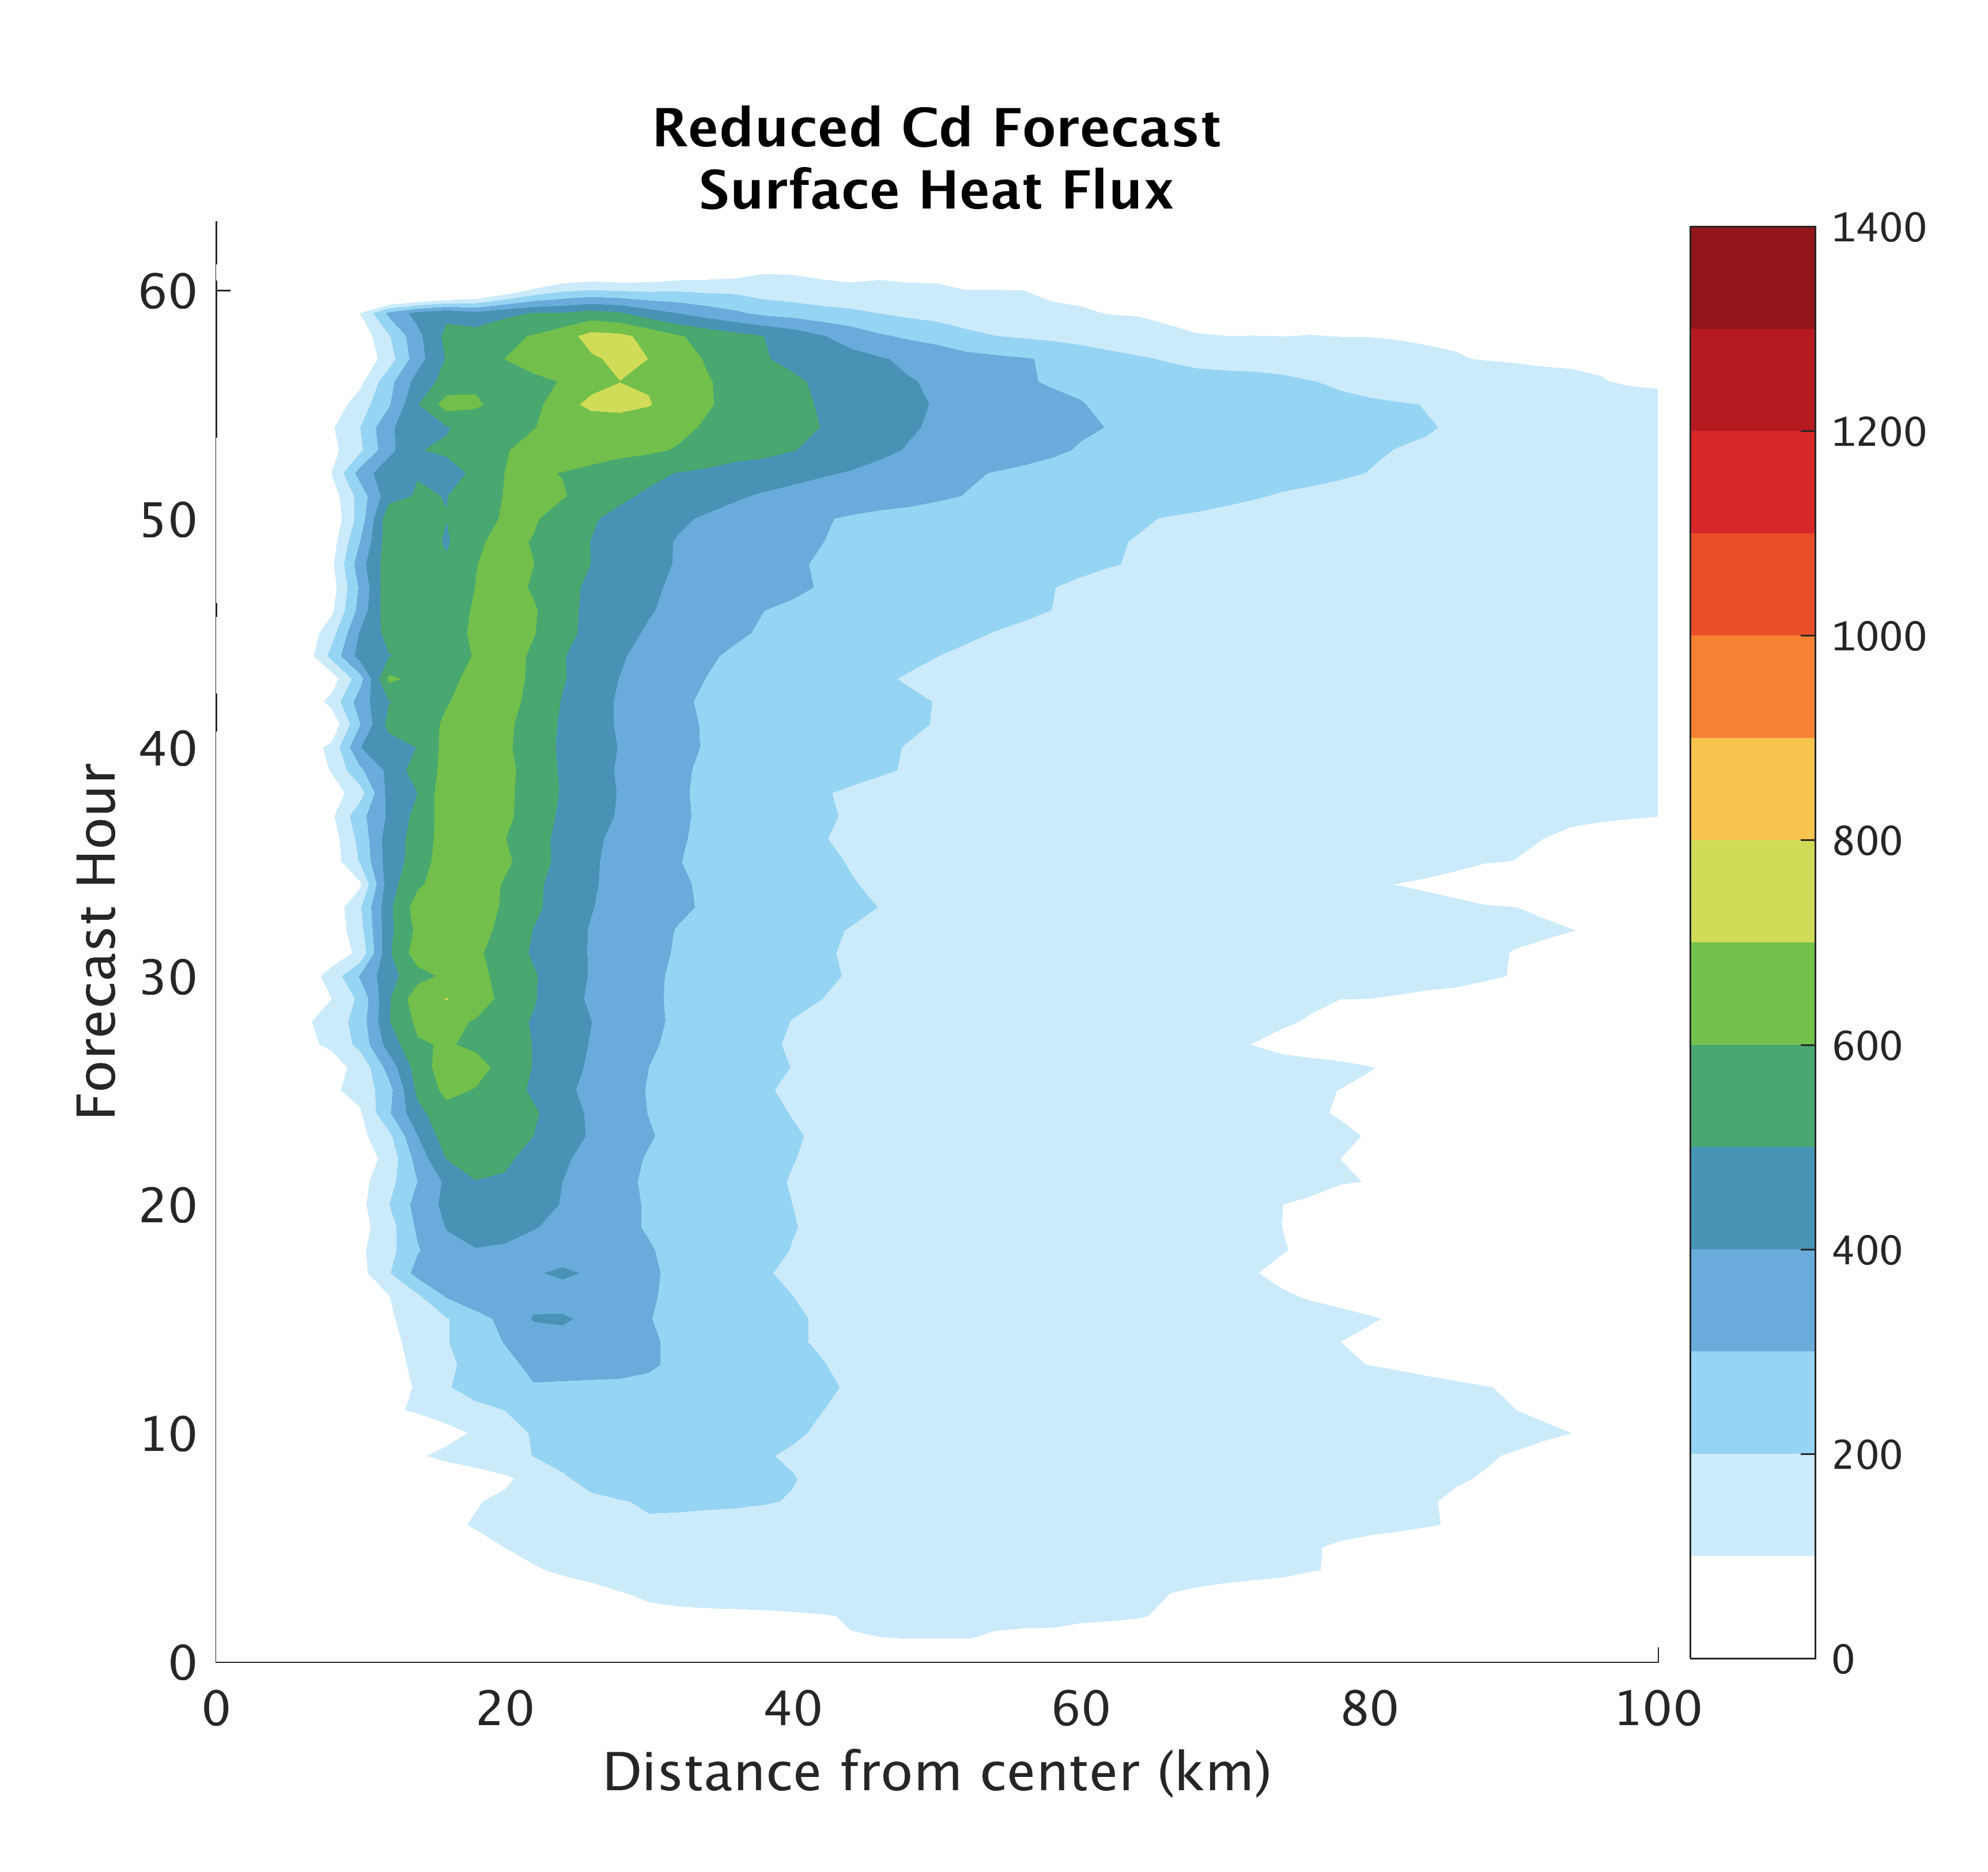
Surface Fluxes
Chen et al. 2013

Slide 28
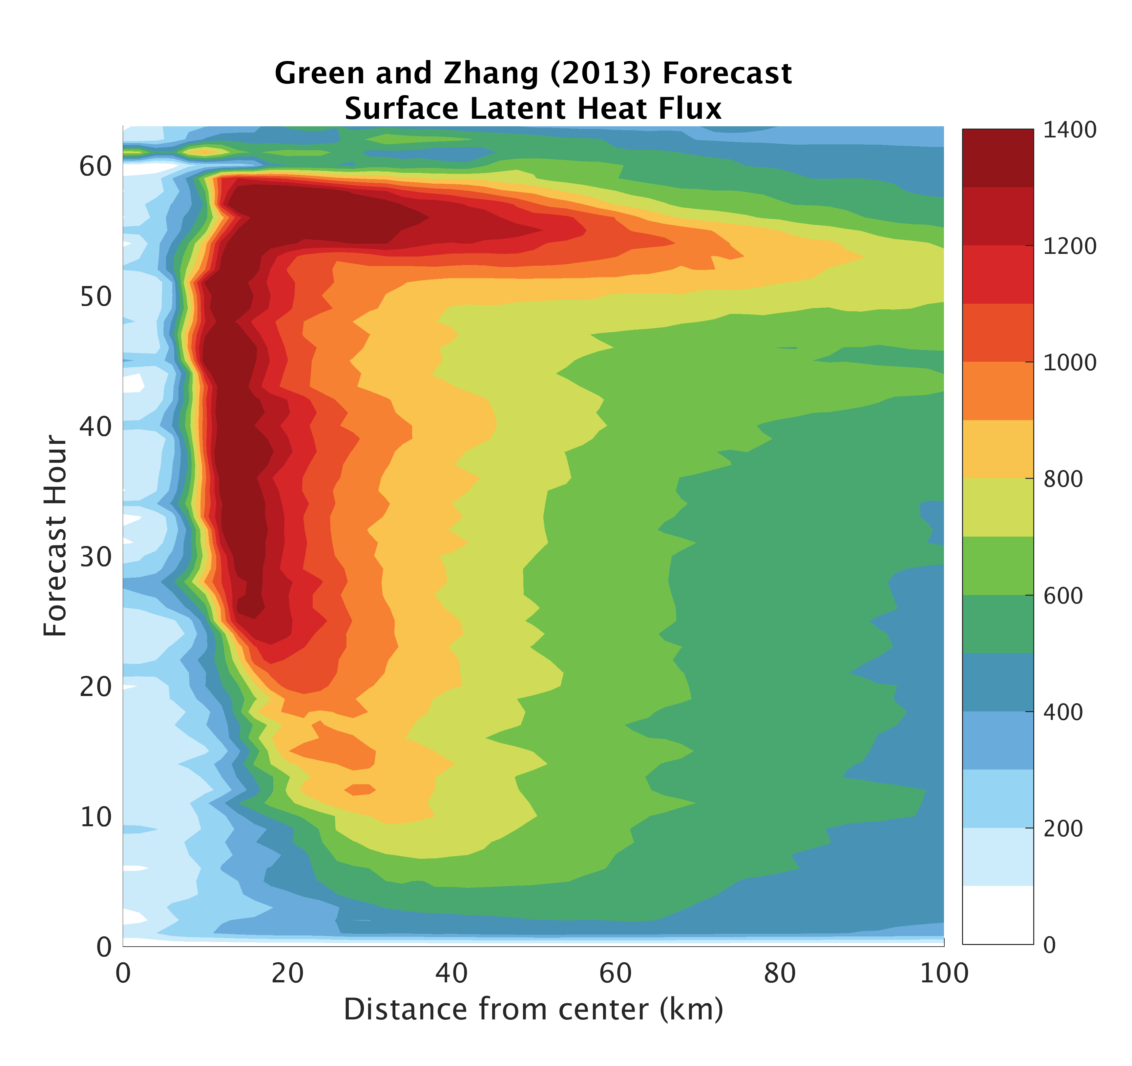

Surface Fluxes
Chen et al. 2013

Slide 29


Surface Fluxes
Chen et al. 2013

Slide 30





Green and Zhang (2014)
Wind Speed (kts)
Forecast Hour
Notes:
Well demonstrated sensitivity between surface flux parameterization and wind speed (shown) and minimum SLP (not shown here)

Slide 31
Correlation between Simulated GOES-16 IR radiance and surface flux model parameters
Notes:
Significant correlation between BT and Alpha all over
BT and m correlation only significant in eyewall region where winds are strongest

Slide 32
Correlation between Simulated GOES-16 IR radiance and surface flux model parameters
Notes:
Significant correlation between BT and Alpha all over
BT and m correlation only significant in eyewall region where winds are strongest

