Slide 1
Microbiological VarDA: Multi-experiment parameter estimation
Man Yau Chan

Slide 2
Motivations
Current parameter estimation methods are costly/imprecise
Many parameters, insufficient data from one experiment

Slide 3
Overview
Theory and methods
VarDA and Verification
Issues

Slide 4
NUS-iGEM2016 lactate tracker: Model schematic
Bac.
Growth
Food
Death
Gene activation
Enz
Interconversion
High Lactate
dooF

Slide 5
NUS-iGEM2016 lactate tracker: Model schematic
Bac.
Growth
Food
Death
Gene activation
Enz
Interconversion
Low
Lactate
dooF

Slide 6
NUS-iGEM2016 lactate tracker: Model schematic
12 parameters needed
Bac.
Growth
Food
Death
Gene activation
Enz
Interconversion
Lactate
dooF

Slide 7
Multi-experiment cost function
4 Experiments -- 4 sets of dynamical variables
Augmented vector: $s_{t}=\left[\begin{aligned}\begin{matrix}x_{1,t} \\ x_{2,t} \\ x_{3,t}\end{matrix} \\ x_{4,t} \\ θ\end{aligned}\right]$
Cost function:
$J\left(s_{0}\right)=J_{b}\left(s_{0}\right)+J_{o}\left(s_{0}\right)$
$J_{b}\left(s_{0}\right)≡{\left(s_{0}−s_{0}^{b}\right)}^{⊤}B^{−1}\left(s_{0}−s_{0}^{b}\right)$
$J_{o}\left(s_{0}\right)≡\sum_{i=1}^{n}{{\left[h\left(s_{t_{i}}\right)−y_{i}\right]}^{⊤}R_{i}^{−1}\left[h\left(s_{t_{i}}\right)−y_{i}\right]}$
Dynamic variable vectors
Parameter vector

Slide 8
Numerics
NUS-iGEM2016 lactate tracker model
Runge-Kutta 4th order integration
Variational data assimilation (VarDA)
Numerically determined gradient (no TLM or ADM)
Non-linear conjugate gradient with Polak–Ribière formula
No preconditioning

Slide 9
Overview
Theory and methods
Model of NUS-iGEM2016 tumor lactate tracker
Multi-experiment cost function
VarDA and Verification
Issues

Slide 10
VarDA experiment setup
Laboratory data
Background values
Parameters: Order of magnitude estimates followed by coarse refinements
Dynamical values: based on laboratory logbook and order of magnitude guesses
Lactate conc. (mol/L) | Food supplied (mg/ml) | dooF supplied (mg/ml)
0 | 0.5 | 0.25
0 | 0 | 0.25
$${10}^{−4}$$ | 0 | 0.25
$${10}^{−2}$$ | 0 | 0.25
$${10}^{−3}$$ | 0 | 2.5
VarDA cost function
Verification

Slide 11
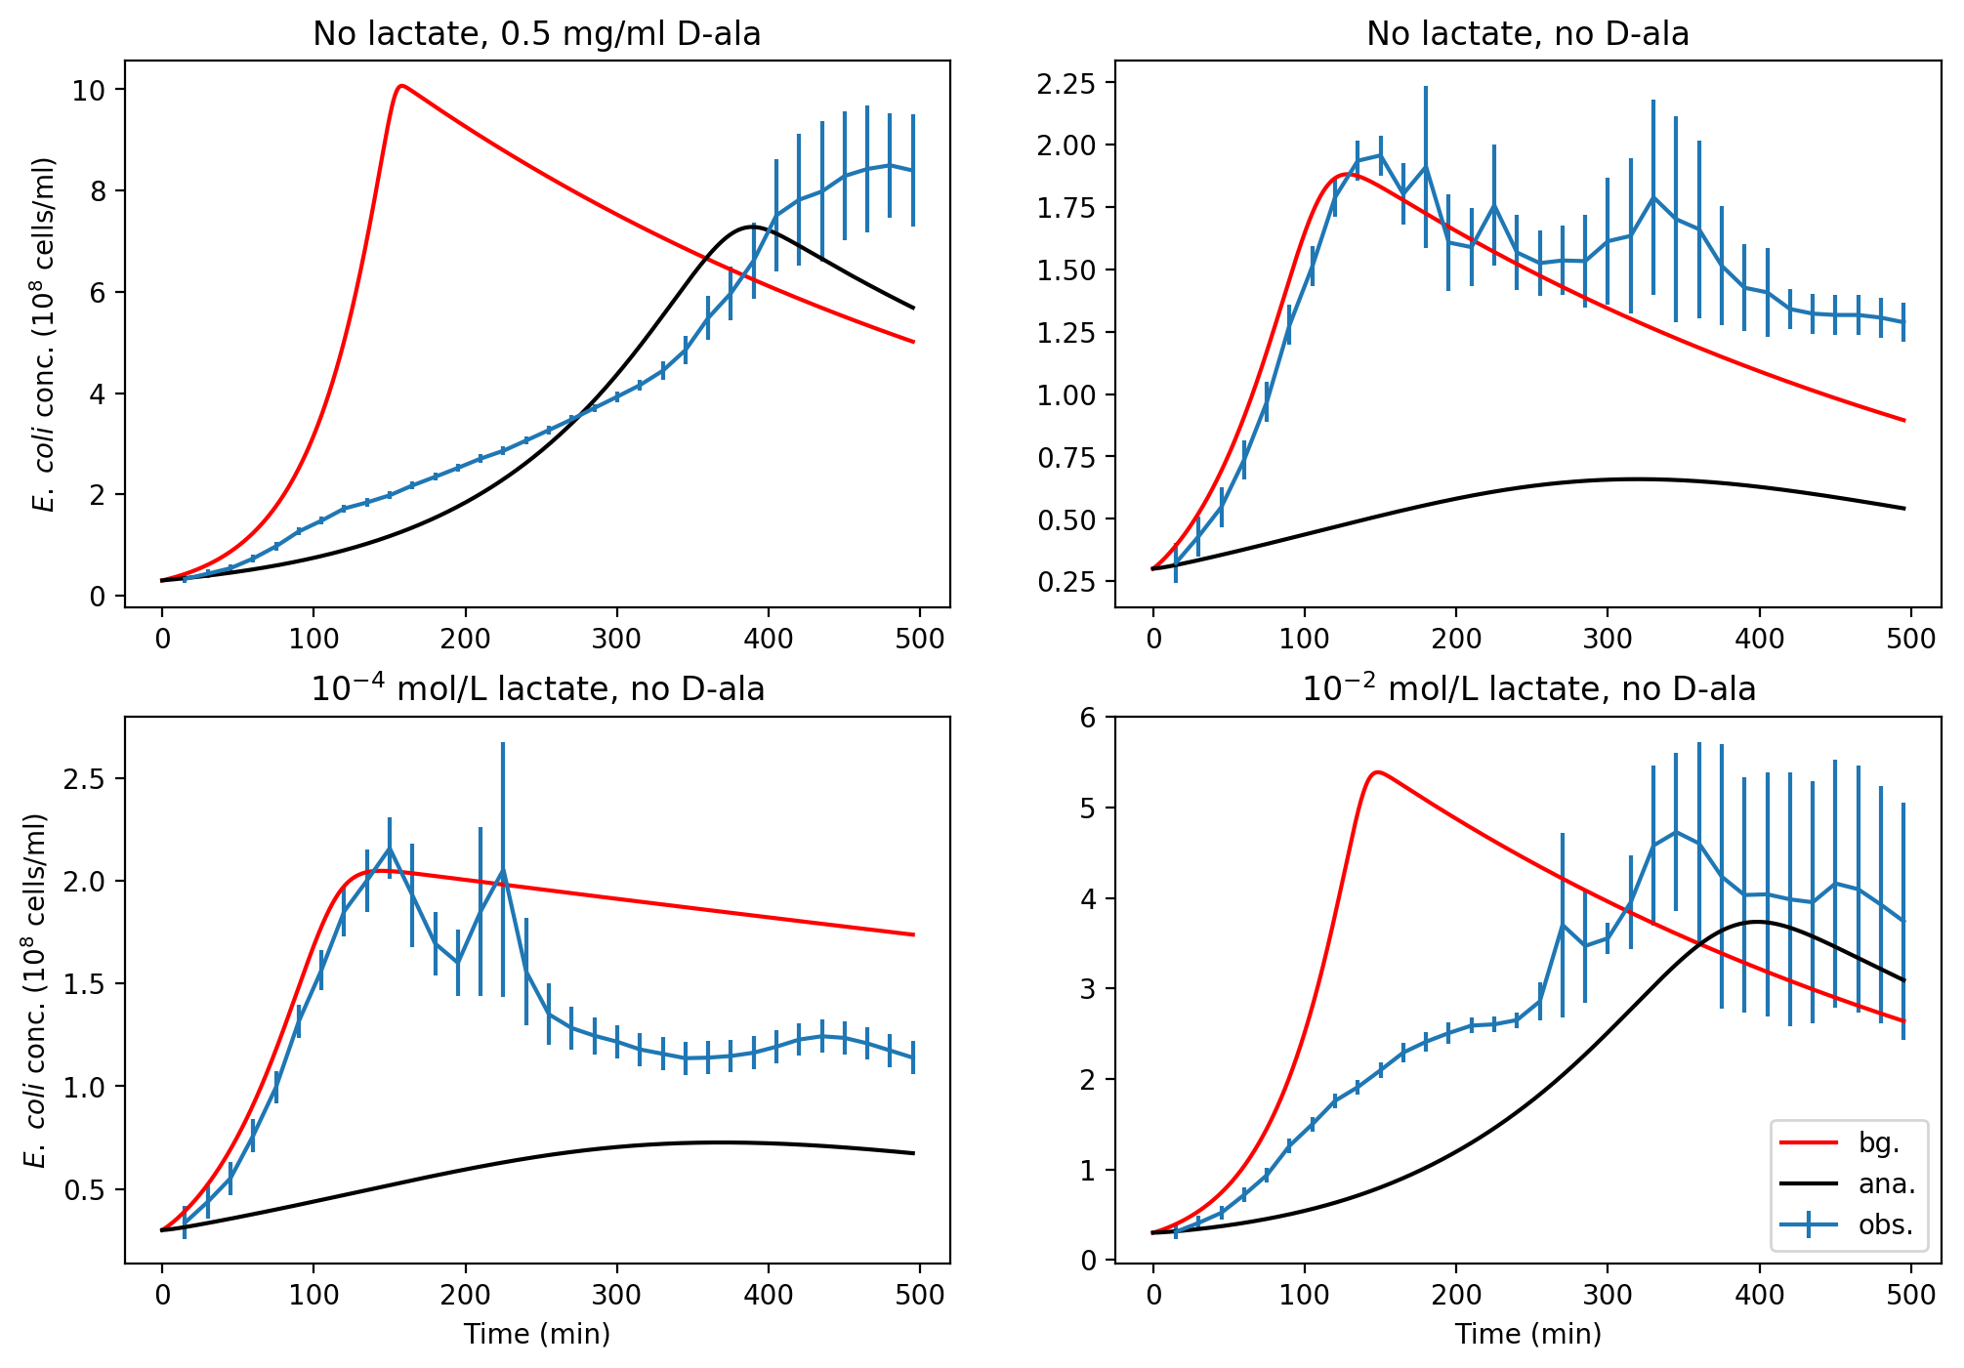
Prior vs posterior trajectories: Competitive cost reduction
$$Δ J=− 68 000$$
$$Δ J=+2 100$$
$$Δ J=+360$$
$$Δ J=−5 500$$

Slide 12
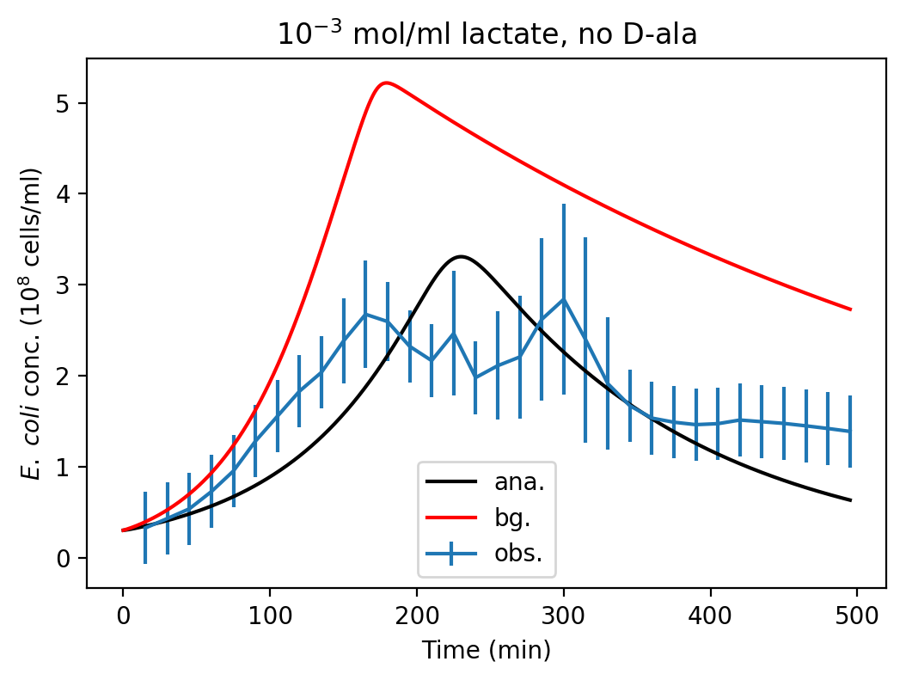
Verification population trajectory: VarDA improved model

Slide 13
Overview
Theory and methods
Model of NUS-iGEM2016 tumor lactate tracker
Multi-experiment cost function
VarDA and Verification
4-experiment VarDA
Competitive cost reduction
Posterior parameters perform better
Issues

Slide 14
VarDA only significantly updates a few parameters
$$s_{t=0}^{a}={\left[\begin{aligned}\begin{matrix}x_{1,t=0} \\ x_{2,t=0} \\ x_{3,t=0}\end{matrix} \\ x_{4,t=0} \\ \\ θ\end{aligned}\right]}^{a}$$
Analysis dynamical variables same as background
Only 4 / 12 analysis parameters show >1% diff from background

Slide 15
Parameters with insignificant increments indirectly control bacteria population?
Genetic parameters
“Secondary” parameters
Food uptake/return parameters
Bac.
Growth
Food
Death
Gene activation
Enz
Inter-conversion
Lactate
dooF

Slide 16
Possible future work
Reduction of parameters in system
Examination of cost function structure
Other microbiological systems

Slide 17
Overview
Theory and methods
Model of NUS-iGEM2016 tumor lactate tracker
Multi-experiment cost function
VarDA and Verification
4-experiment VarDA
Competitive cost reduction
Posterior parameters perform better
Issues
Only 4/12 parameters updated
Types of un-updated parameters
Future work

Slide 18
Take-home message
Encouraging results from running multi-experiment VarDA on homemade microbiological model
Only 4/12 of the parameters show significant update. Need future work
Augmented vector: $s_{t}=\left[\begin{aligned}\begin{matrix}x_{1,t} \\ x_{2,t} \\ x_{3,t}\end{matrix} \\ x_{4,t} \\ θ\end{aligned}\right]$
Cost function: $J\left(s_{0}\right)=J_{b}\left(s_{0}\right)+J_{o}\left(s_{0}\right)$

Slide 19
Acknowledgements
Main lecturer: Yue (Michael) Ying
Data source: Hoang Diem Phuong Nguyen from National University of Singapore, iGEM2016.

Slide 20
Fin.

Slide 21
Take-home message
Encouraging results from running multi-experiment VarDA on homemade microbiological model
Only 4/12 of the parameters show significant update. Need future work
Augmented vector: $s_{t}=\left[\begin{aligned}\begin{matrix}x_{1,t} \\ x_{2,t} \\ x_{3,t}\end{matrix} \\ x_{4,t} \\ θ\end{aligned}\right]$
Cost function: $J\left(s_{0}\right)=J_{b}\left(s_{0}\right)+J_{o}\left(s_{0}\right)$

Slide 22
NUS-iGEM2016 lactate tracker: Bacteria tracks tumors via lactate
Cancer cell
NUS-iGEM2016 lactate sensor
High lactate
Low lactate

Slide 23
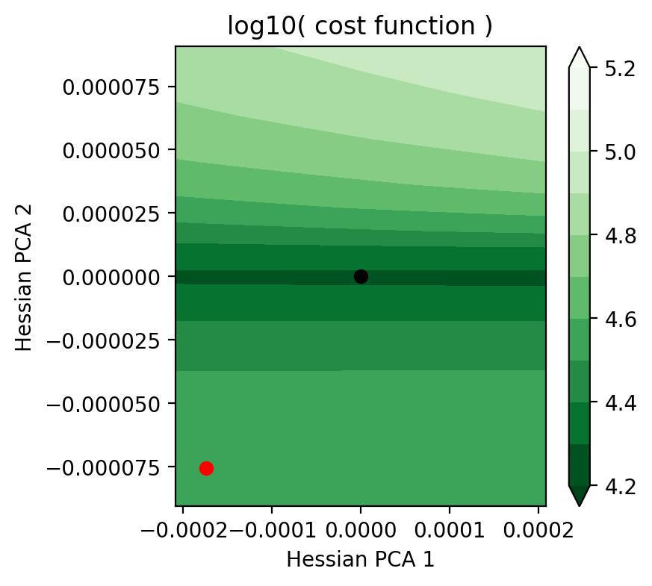
VarDA experiment sanity check
Analysis state
Background state

Slide 24
Microbiology model
13 parameters needed
Bac.
Growth
Food
Death
Gene activation
Enz
Interconversion
Lactate
dooF

Slide 25
Multi-experiment cost function
4 Experiments -- 4 sets of dynamical variables
Augmented vector: $s_{t}=\left[\begin{aligned}\begin{matrix}x_{1,t} \\ x_{2,t} \\ x_{3,t}\end{matrix} \\ x_{4,t} \\ θ\end{aligned}\right]$
Cost function:
$J\left(s_{0}\right)=J_{b}\left(s_{0}\right)+J_{o}\left(s_{0}\right)$
$J_{b}\left(s_{0}\right)≡{\left(s_{0}−s_{0}^{b}\right)}^{⊤}B^{−1}\left(s_{0}−s_{0}^{b}\right)$
$J_{o}\left(s_{0}\right)≡\sum_{i=1}^{n}{{\left[h\left(s_{t_{i}}\right)−y_{i}\right]}^{⊤}R_{i}^{−1}\left[h\left(s_{t_{i}}\right)−y_{i}\right]}$
Dynamic variable vectors
Parameter vector

Slide 26
VarDA experiment sanity check
Analysis state
Background state

Slide 27
Competitive cost reduction
$$Δ J=− 68 000$$
$$Δ J=+2 100$$
$$Δ J=+360$$
$$Δ J=−5 500$$

Slide 28
Microbiological modelling: general idea
Environment
Bacteria interacts with environment
DNA produce internal “machines”
“Machines” perform internal processes
Modelling parameters needed.
Nutrients &
signals
Waste & signals
“Machines”
DNA
Bacterium

