Slide 1
Ensemble sensitivity of ice flow speed and ice thickness to uncertain parameters
Wenjie (Wendall) Li
Advisor: Fuqing Zhang, Richard Alley and Byron Parizek
Group Meeting
May 23rd, 2018

Slide 2
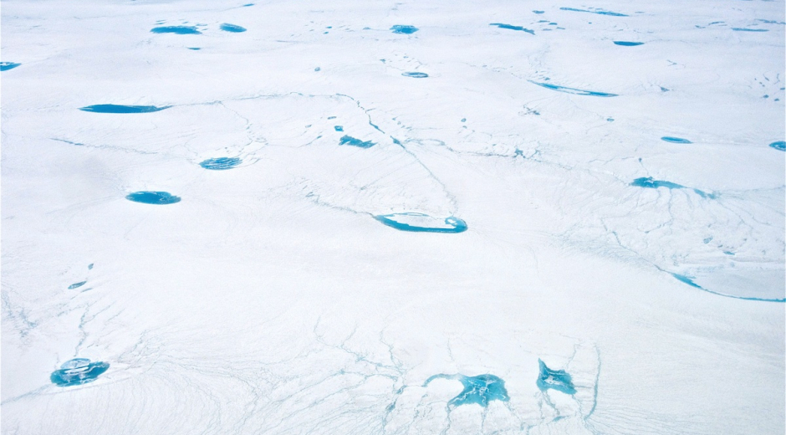
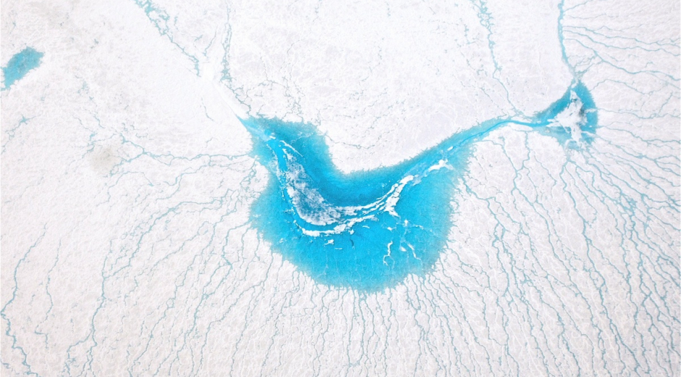
Motivation
Greenland meltwater lakes, by Tyler Jones, 2012.
http://instaar.colorado.edu/galleries/meltwater-lakes-on-the-greenland-ice-sheet/

Slide 3
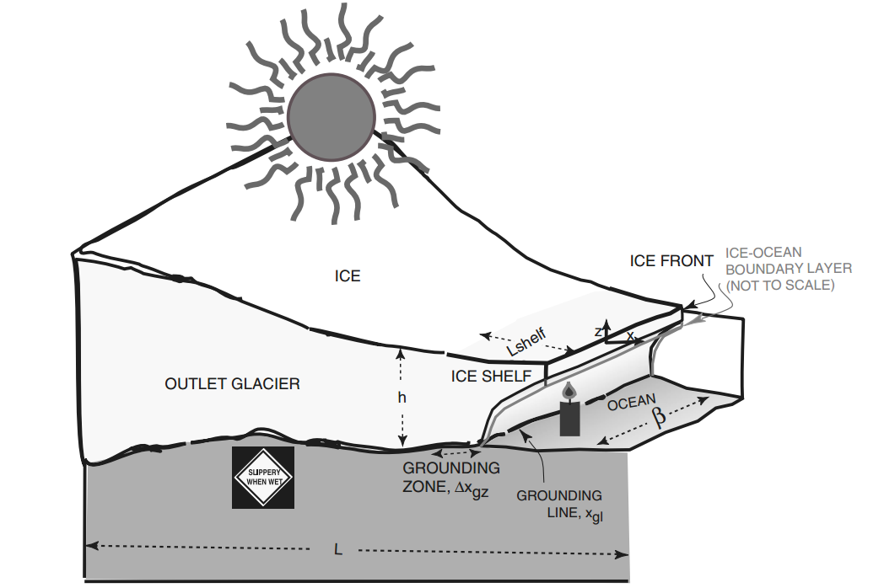
Motivation
Lake
Parizek et al. (2013)

Slide 4
Motivation
Lake
Parizek et al. (2013)

Slide 5
Motivation
Forecast of the ice evolution is needed.
Require knowledge of basal friction profile, which can not be measured directly.
The uncertainty of upstream mass flux is not considered in the retrieval of basal friction profile
How will this affect the retrieval results?
Parizek et al. (2013)

Slide 6
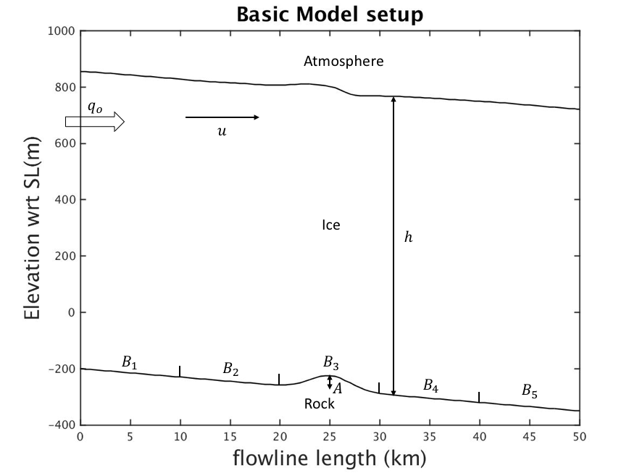
Model Introduction
2D flowline model
Same width everywhere
Basal elevation decreases linearly with Gaussian bump in the middle
Use 51 ensembles in each experiment
Study correlations between surface horizontal velocity/ice thickness and model parameters

Slide 7
Model Introduction
Mass balance
$$\frac{∂h}{∂t}=−\frac{∂\left(h\overline{u}\right)}{∂x}−\frac{h\overline{u}}{β}\frac{∂β}{∂x}+\dot{A}−\dot{B}$$
Momentum balance
$$\frac{∂}{∂x}\left(2ν\left(2\frac{∂u}{ ∂x}+\frac{u}{β}\frac{∂β}{∂x}\right)\right)+\frac{∂}{∂z}\left(ν\frac{∂u}{∂z}\right)=ρg\frac{∂\left(s−z\right)}{∂x}+\frac{2}{β}τ_{s}$$
Basal drag $τ_{b}=B_{b} u^{\frac{1}{m}}$ , where $m=3$ in our experiments
At upstream end, time-dependent Dirichlet Boundary Condition $u\left(x=0,t\right)=\frac{q_{0}}{h(x=0,t)}$
Control values:
$$B_{b_0}=1.3∗{10}^{6} Pa s^{\frac{1}{3}} m^{−\frac{1}{3}}$$
$$A=50 m$$
$$u\left(x=0,t=0\right)=240 m/yr$$

Slide 8
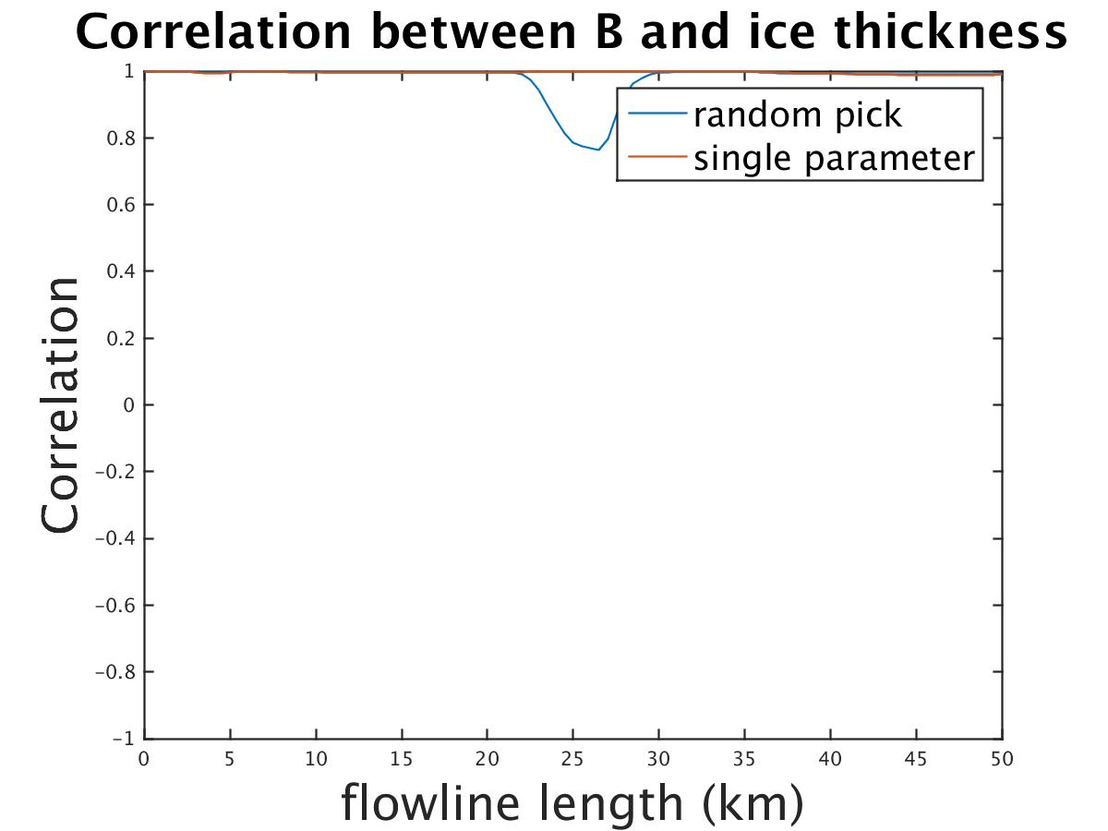
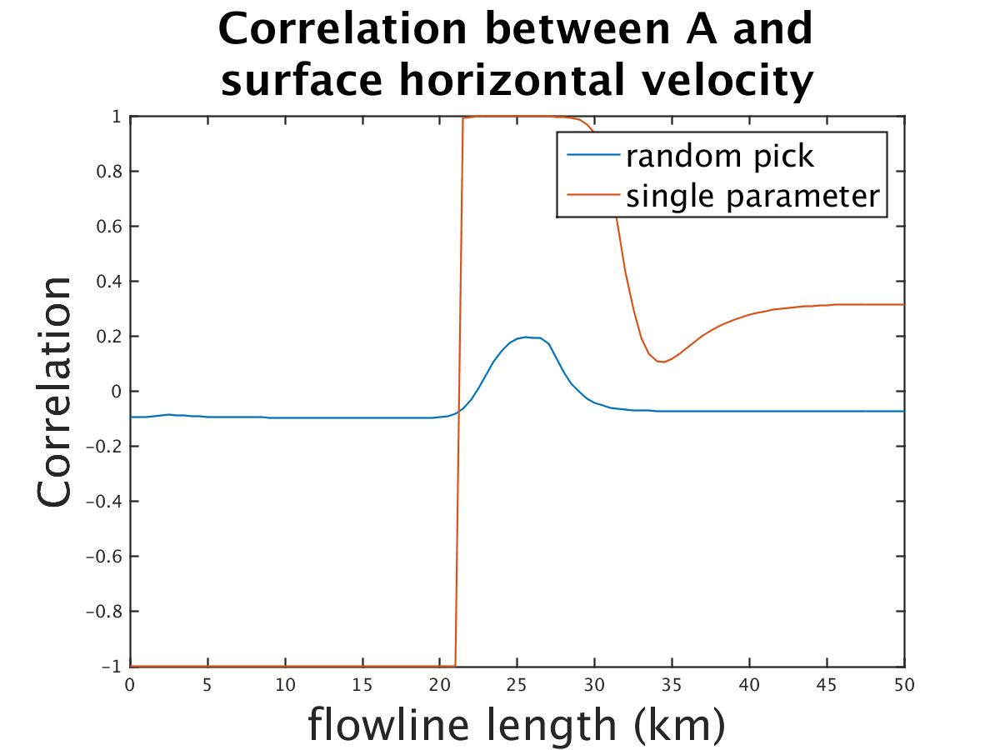
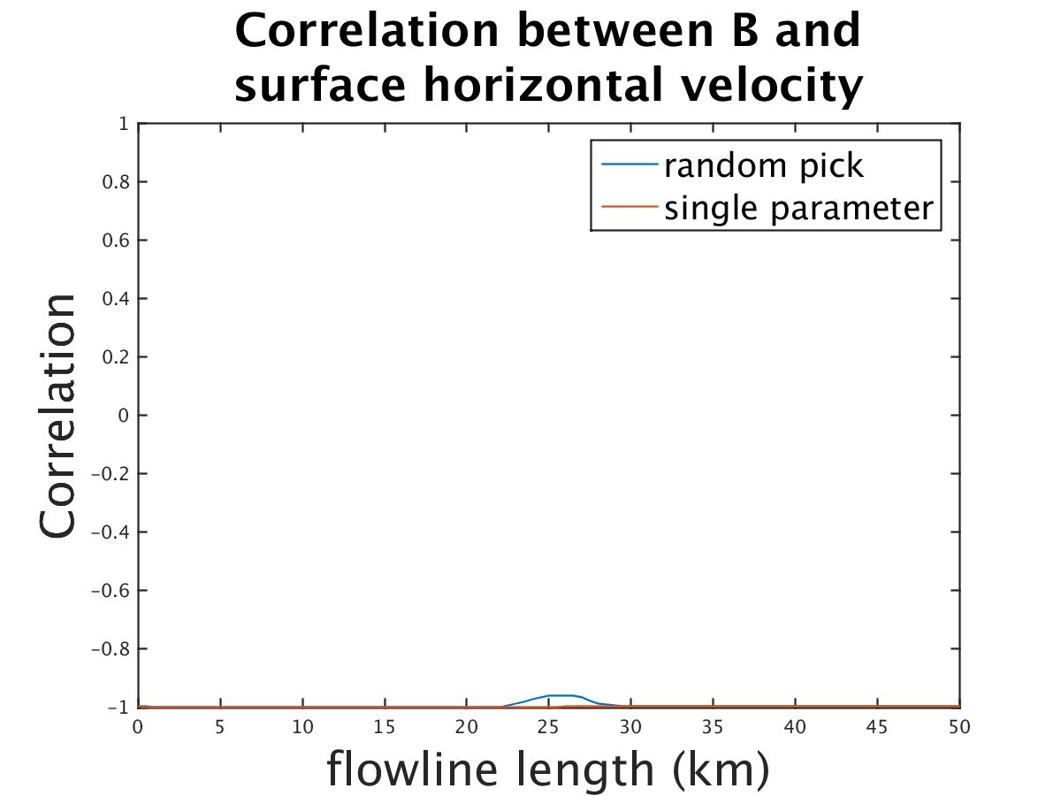
Correlation results changed after introducing new uncertainties
Orange curve: Only perturbing A or B
Blue curve: Perturbing A and B simultaneously
Correlation results @ 20yr

Slide 9
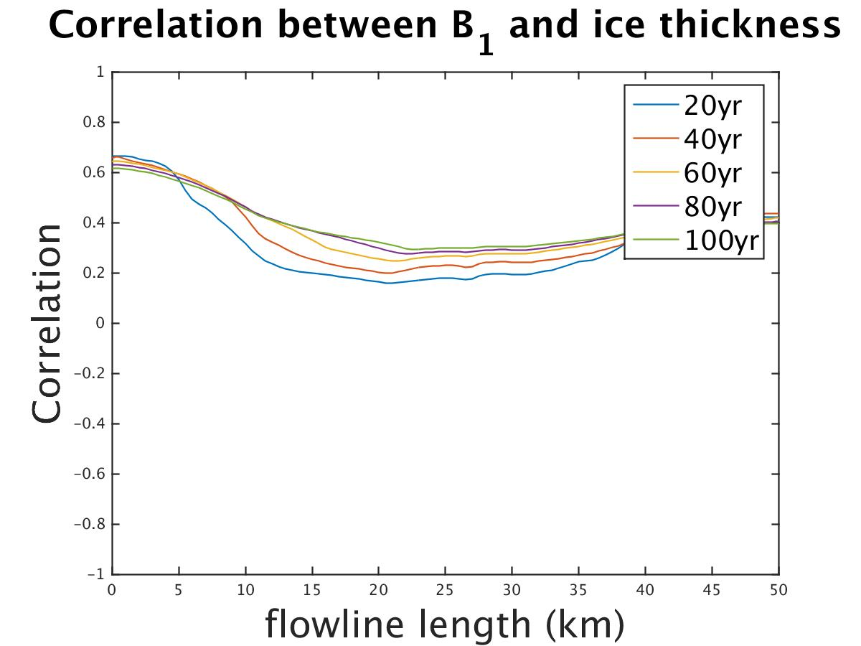
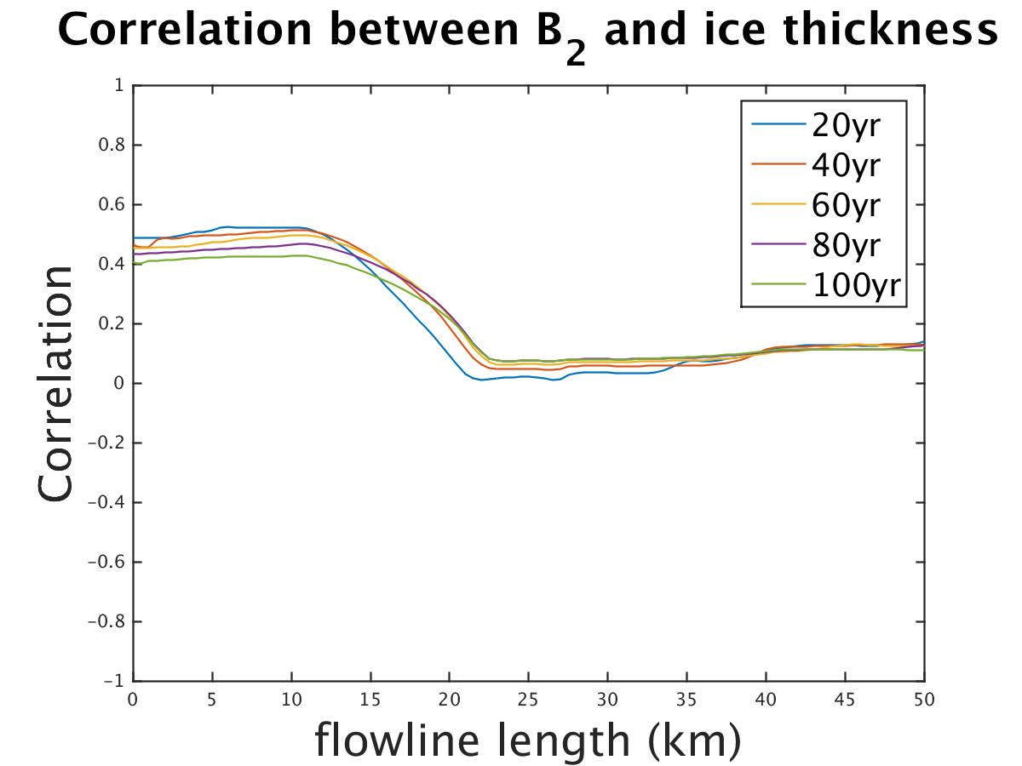
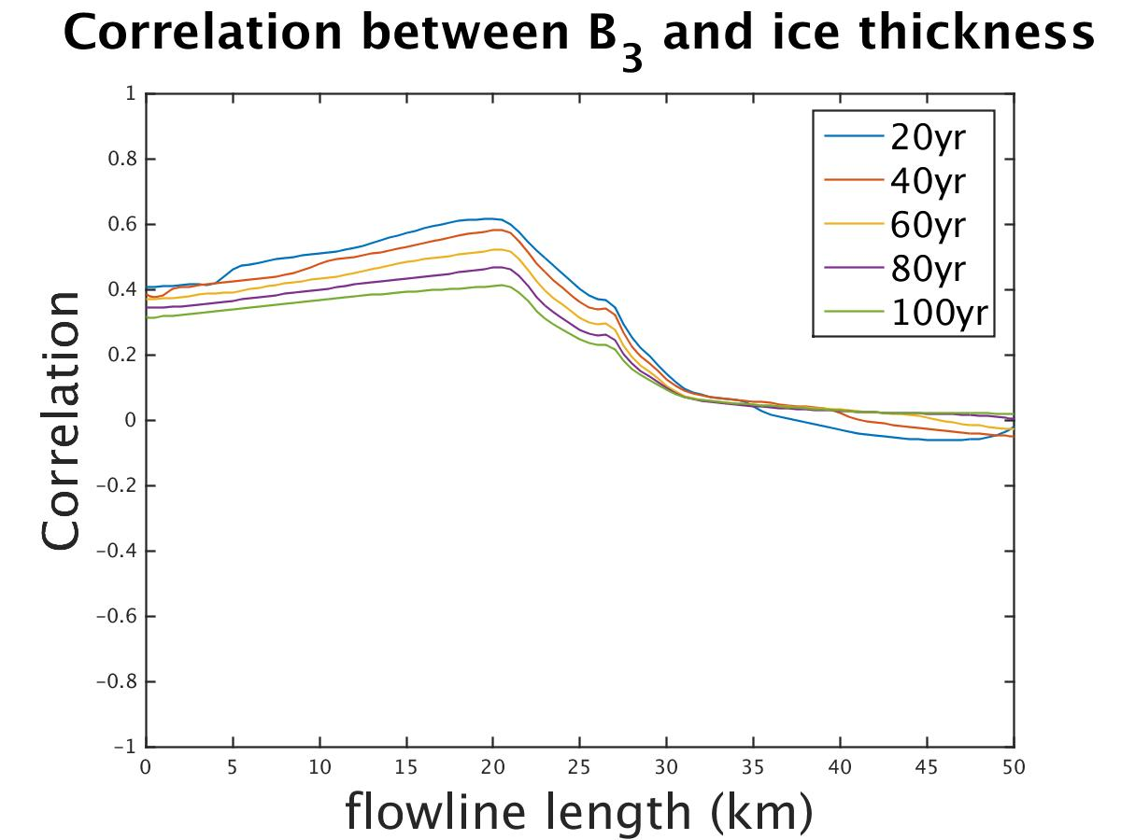
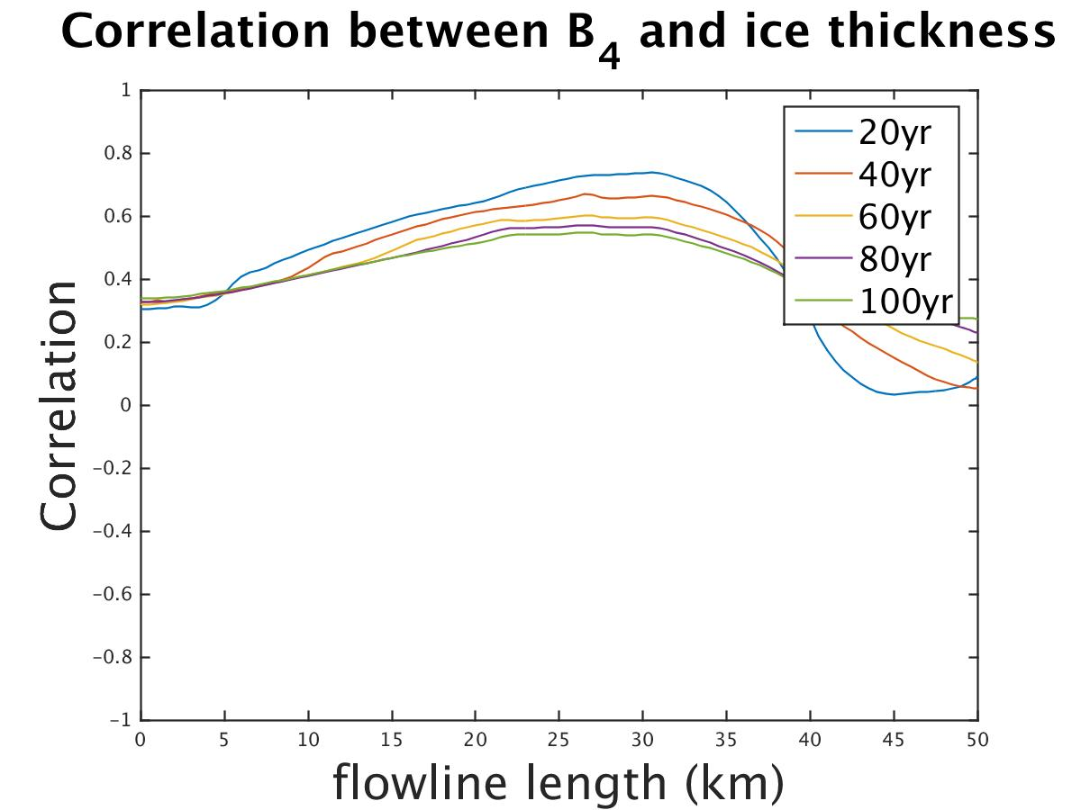
Evolution of correlation results
Perturb B_{i} for 100 yr
$$B_{1}$$
$$B_{2}$$
$$B_{3}$$
$$B_{4}$$

Slide 10
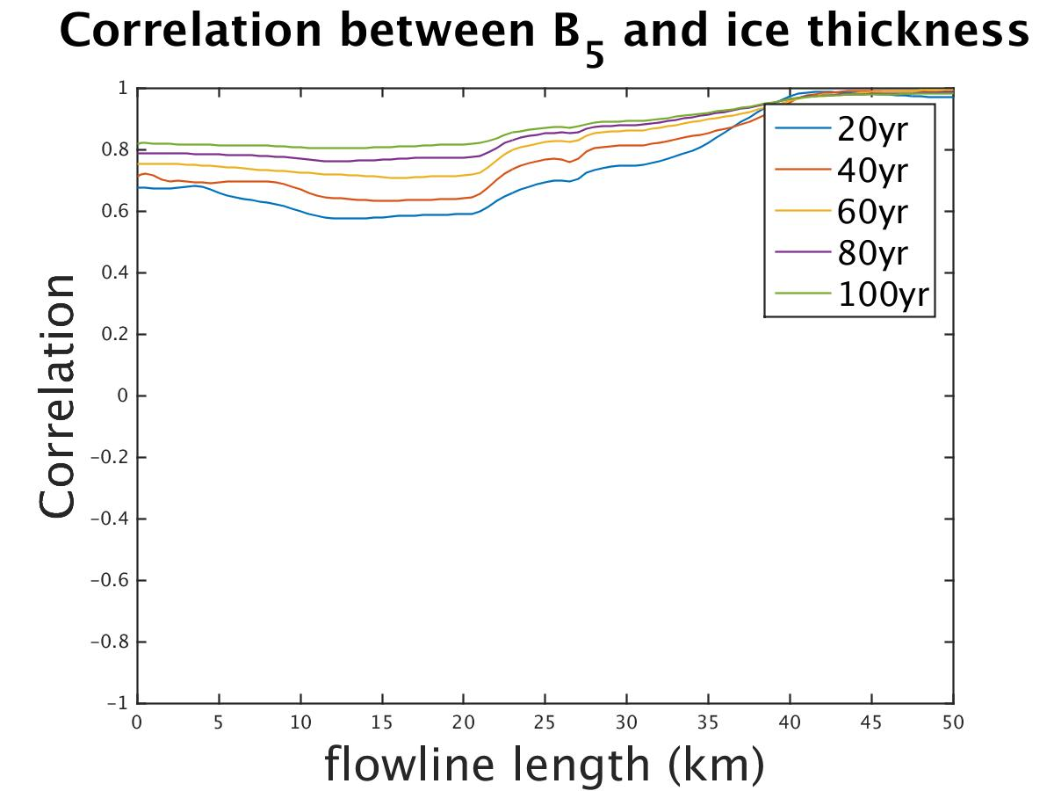
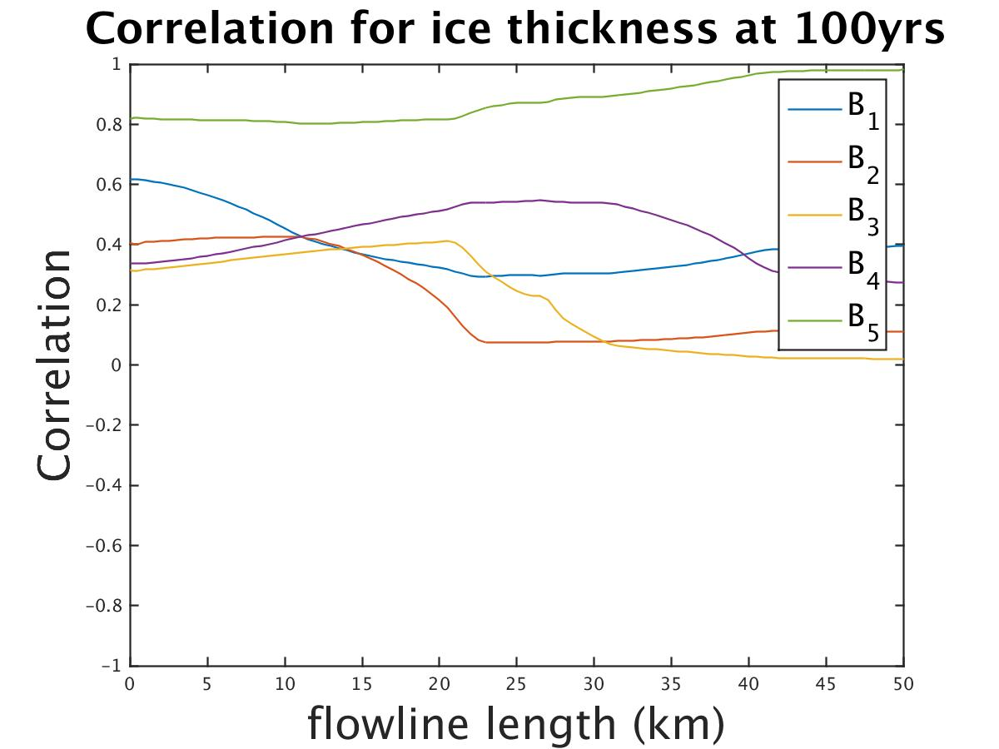
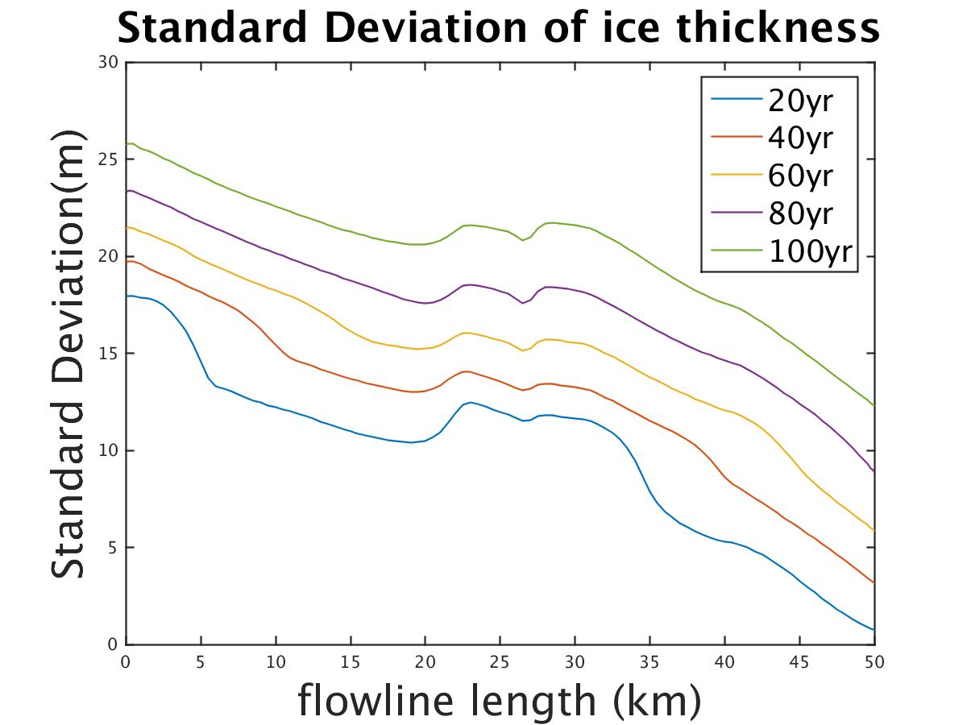
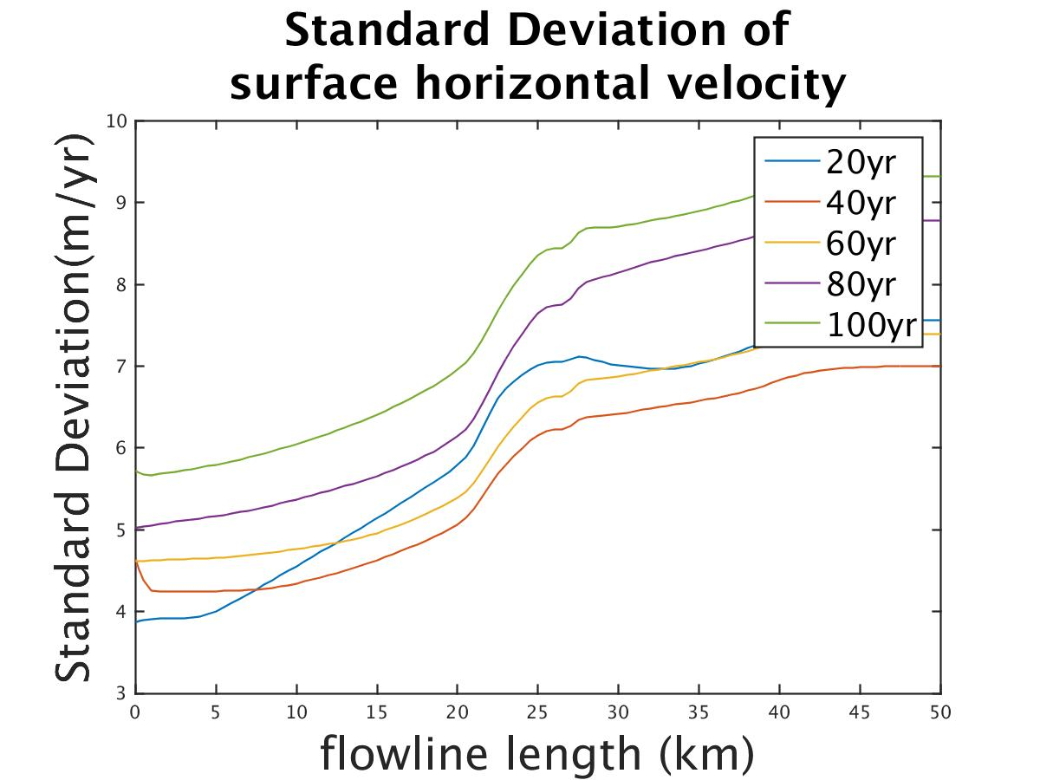
Buttressing Effect
$$B_{5}$$
$$B_{1}$$
$$B_{2}$$
$$B_{3}$$
$$B_{4}$$
$$B_{5}$$
$u\sim 240 m/yr$
$L=240\frac{m}{yr}∗20 yr=4.8km$

Slide 11
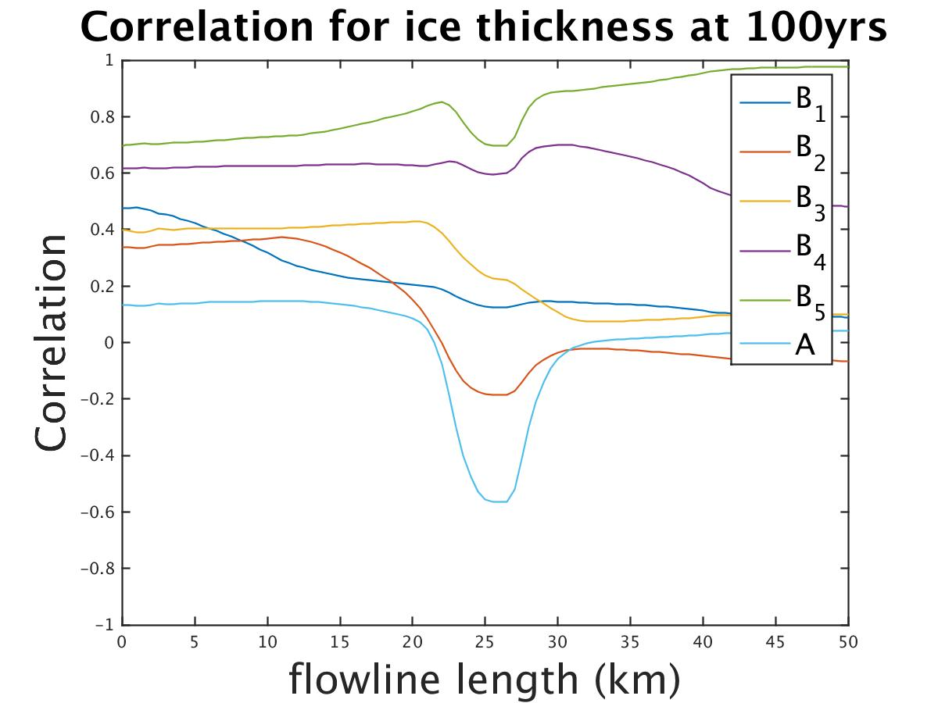
Basal friction coefficient (B_{i}) is more dominant than the terrain height (A)
perturbing B_{i} @ 100yr
perturbing A, B_{i} @ 100yr

Slide 12
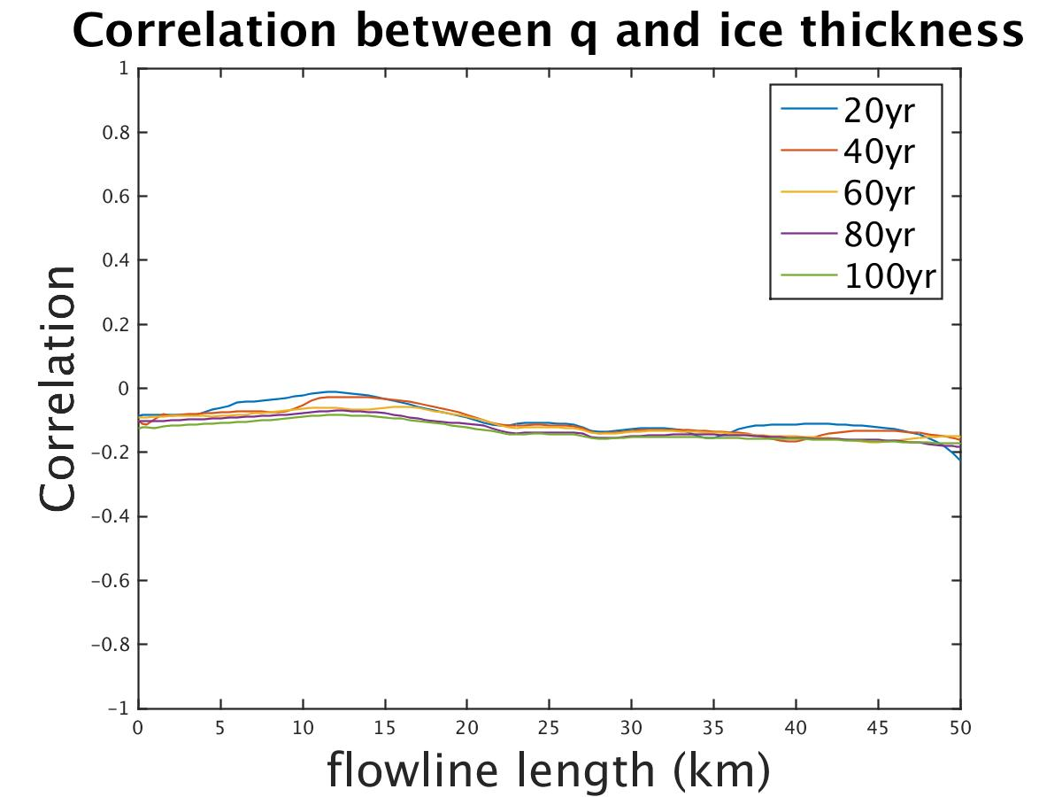
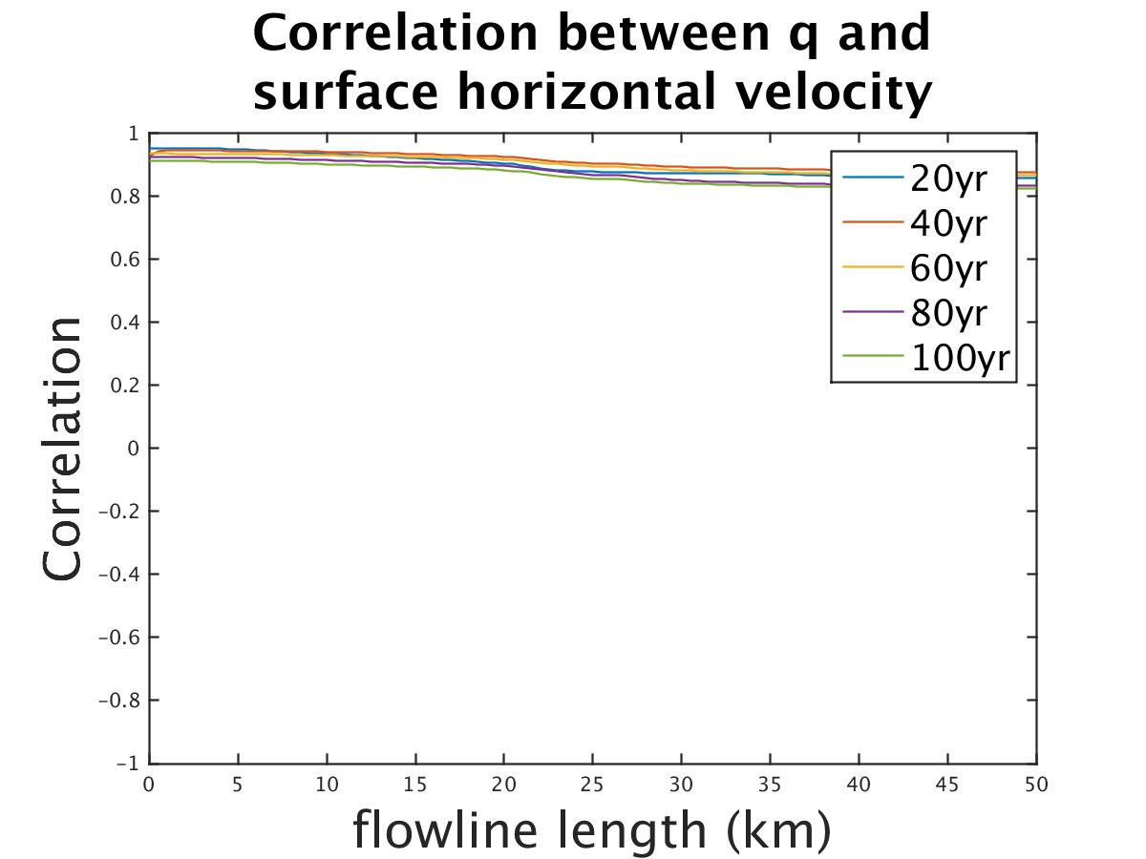
5% uncertainty on upstream flux have large correlation with surface horizontal velocity
perturbing q(5%), B_{i} for 100 yrs

Slide 13
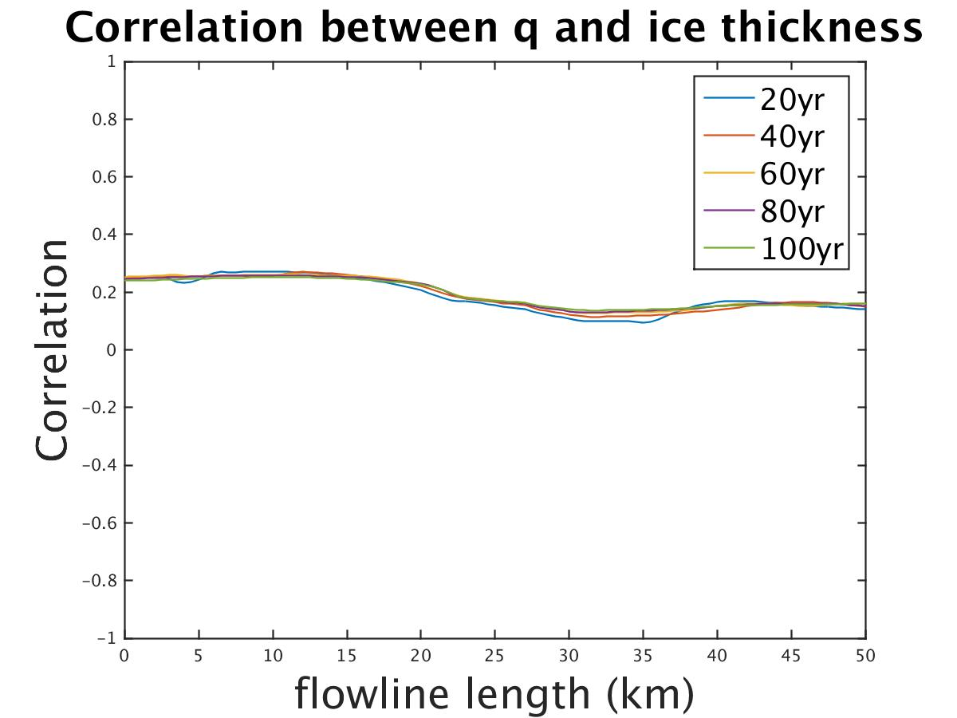
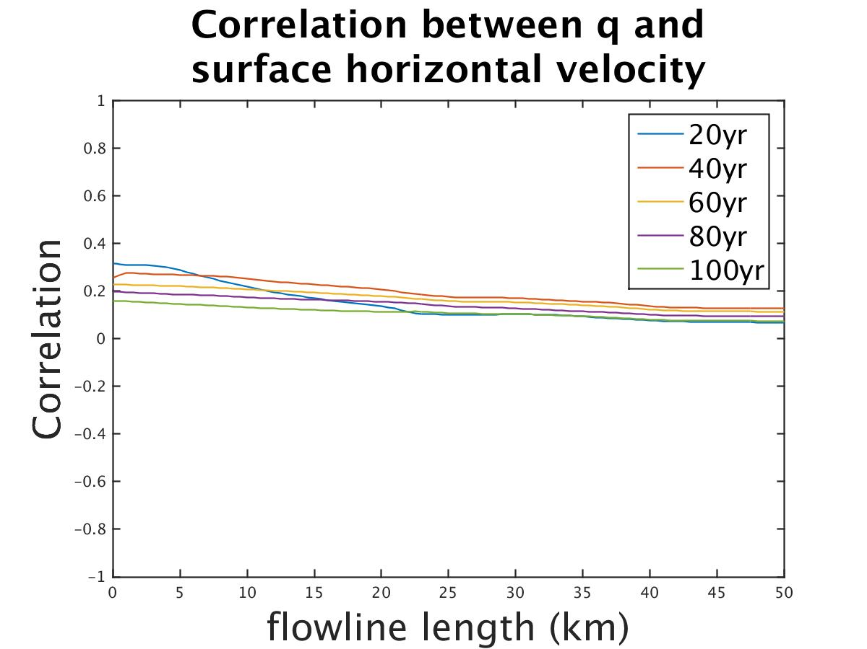
1% uncertainty on upstream flux have minor correlation with surface horizontal velocity
perturbing q(1%), B_{i} for 100 yrs

Slide 14
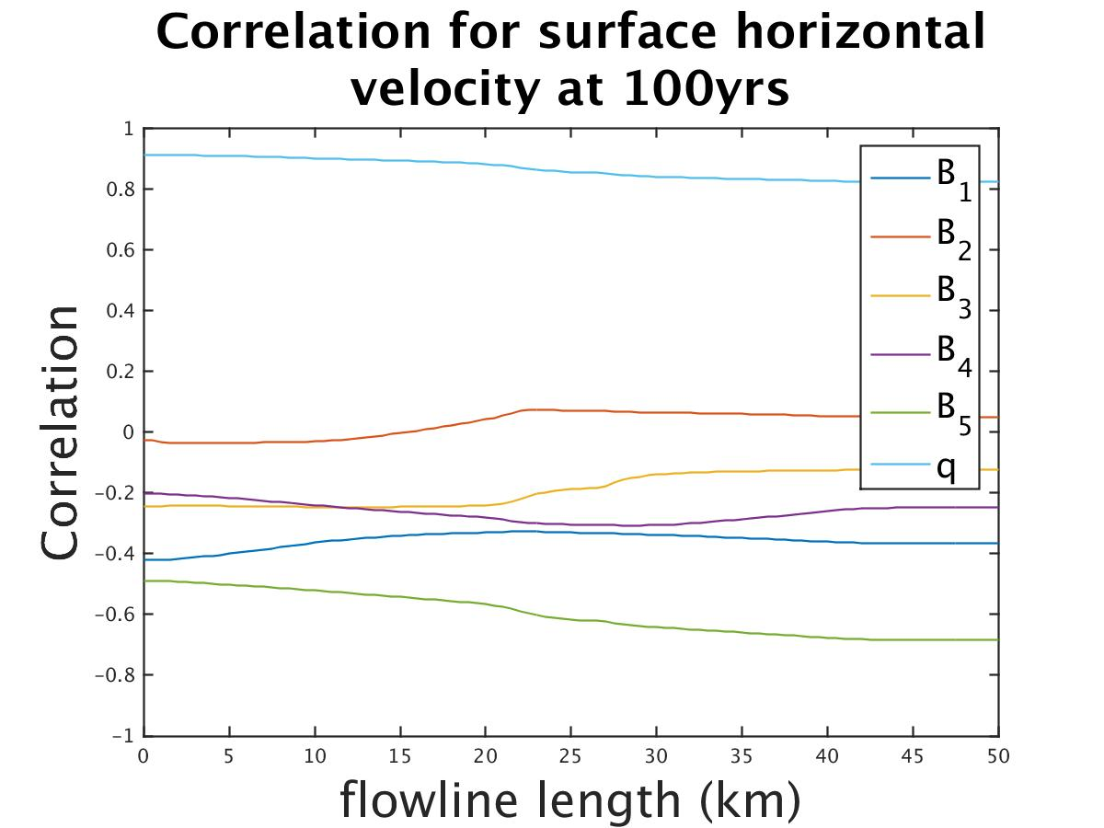
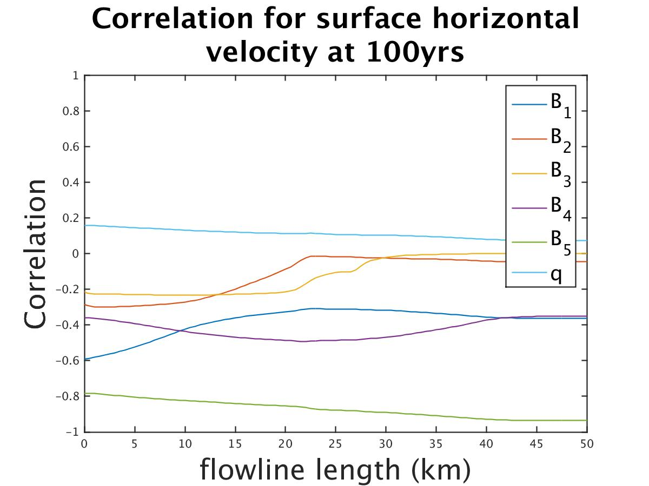
Compare the correlation results between 5% uncertainty and 1% uncertainty on q @ 100 yr
perturbing q(5%), B_{i} @ 100 yr
perturbing q(1%), B_{i} @ 100 yr

Slide 15
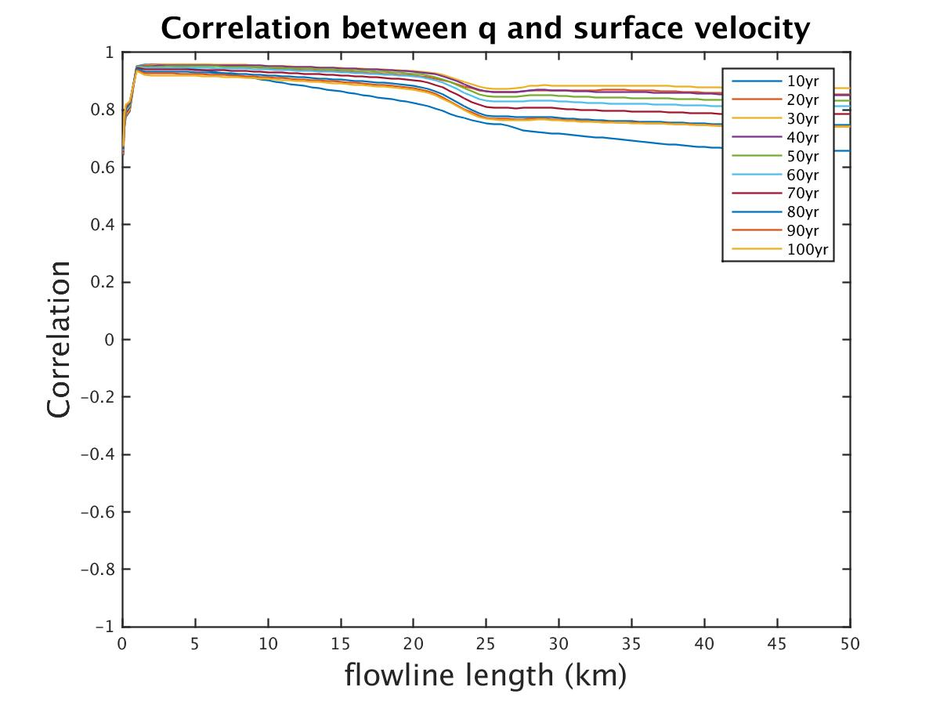
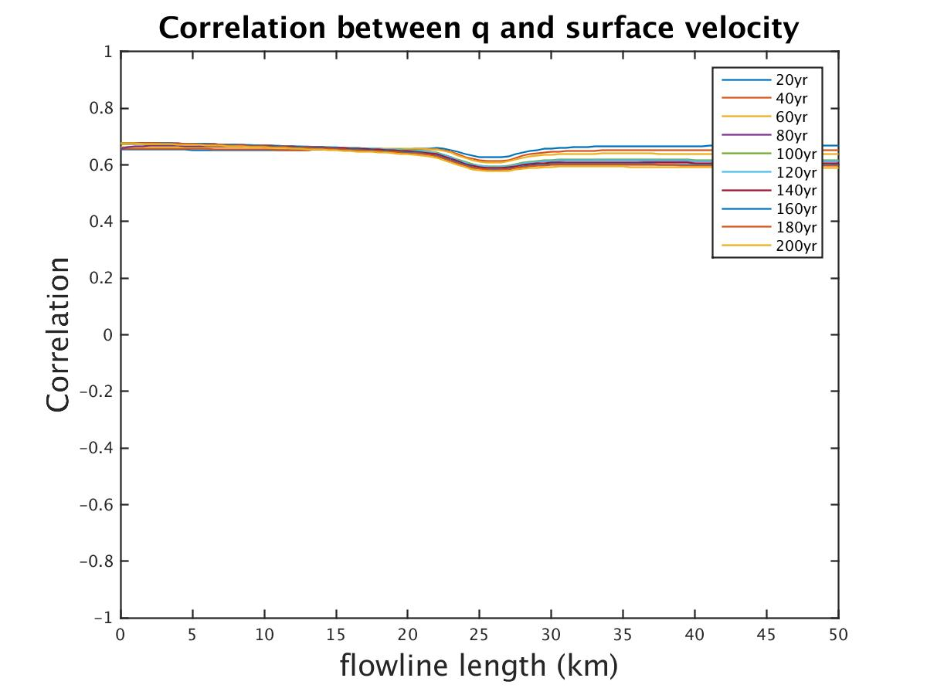
5% uncertainty on upstream flux with different upstream b.c.
perturbing h_{(x=0,t=0)} (5%), B_{i} for 100 yrs
perturbing u_{(x=0,t=0)},h_{(t=0)} (5%), B_{i} for 100 yrs

Slide 16
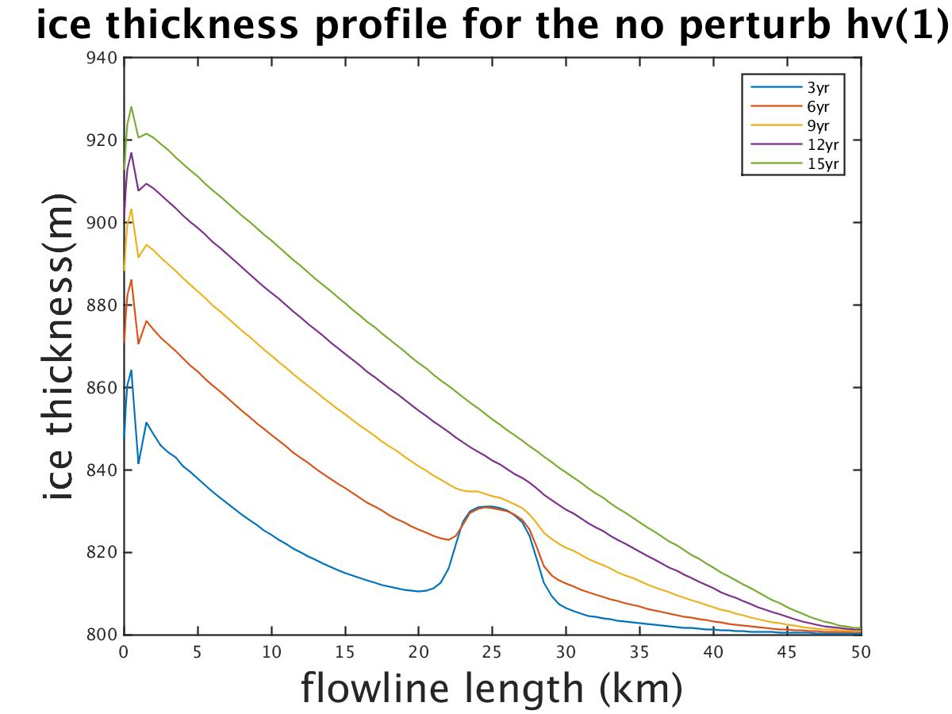
The perturbation is propagated mostly by dispersion instead of ice advection
uniform B, uniform thick, no perturbation on upstream

Slide 17
Conclusion
The terrain only affect the local region, while the basal friction (especially B₅ at downstream) is more dominant than the terrain.
For the uncertainty of upstream flux, 5% has a large correlation (around 0.9) with the surface velocity
The impact of uncertainty on upstream is propagated by dispersion instead of ice advection

Slide 18
Conclusion
Original question: How will the uncertainty of upstream flux affect the retrieval results?
In the real world, the upstream flux has an uncertainty of approximately 5% (sometimes can up to 10%), so the previous retrieval results that did not consider uncertainty in the upstream flux may be overconfident.
Thanks!

