Slide 1
Simultaneous Assimilation of GOES‑16 ABI and WSR‑88D Observations for a Severe Thunderstorm Event
Yunji Zhang, Fuqing Zhang, David J. Stensrud
Acknowledgments: Masashi Minamide, Scott Sieron
23 May 2018

Slide 2
Recent Progresses
Tropical cyclone applications by Masashi
AOEI, ABEI
Convective phenomena applications
Flood in Japan in Sep 2015 (Honda et al. 2018 JGR)
All-sky GOES-16 for 12 June 2017 WY-NE thunderstorm
NSSL’s NEWS-e assimilating GOES-13 clear-sky
Satellite-derived observations with radar
Simultaneous assimilation of ABI all-sky BT with WSR-88D observations

Slide 3
Experiment Design
1900 UTC
1930 UTC
2000 UTC
2020 UTC
2040 UTC
SAT
ABI Channel 10 BT
forecast
forecast
forecast
RAD
KFTG+KCYS Vr
Non-precipitating hydrometeors
forecast
forecast
forecast
ABI Channel 10 BT
SAT+RAD
(w/ and w/o dBZ)
KFTG+KCYS Vr
Non-precipitating hydrometeors
forecast
forecast
forecast
Perform EnKF every 5 minutes with RTPP=0.8

Slide 4
Non-precipitating Assimilation
Reflectivity < 5 dBZ will convert to 0 g/kg Q_{r}+Q_{s}+Q_{g}
Doubled horizontal resolution (4 km) and horizontal ROI (20 km), halved vertical ROI (5 levels)
Obs error variance equal to ensemble spread

Slide 5
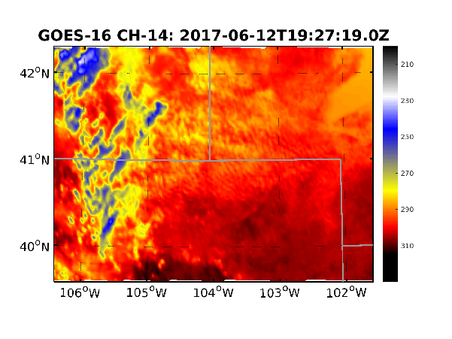
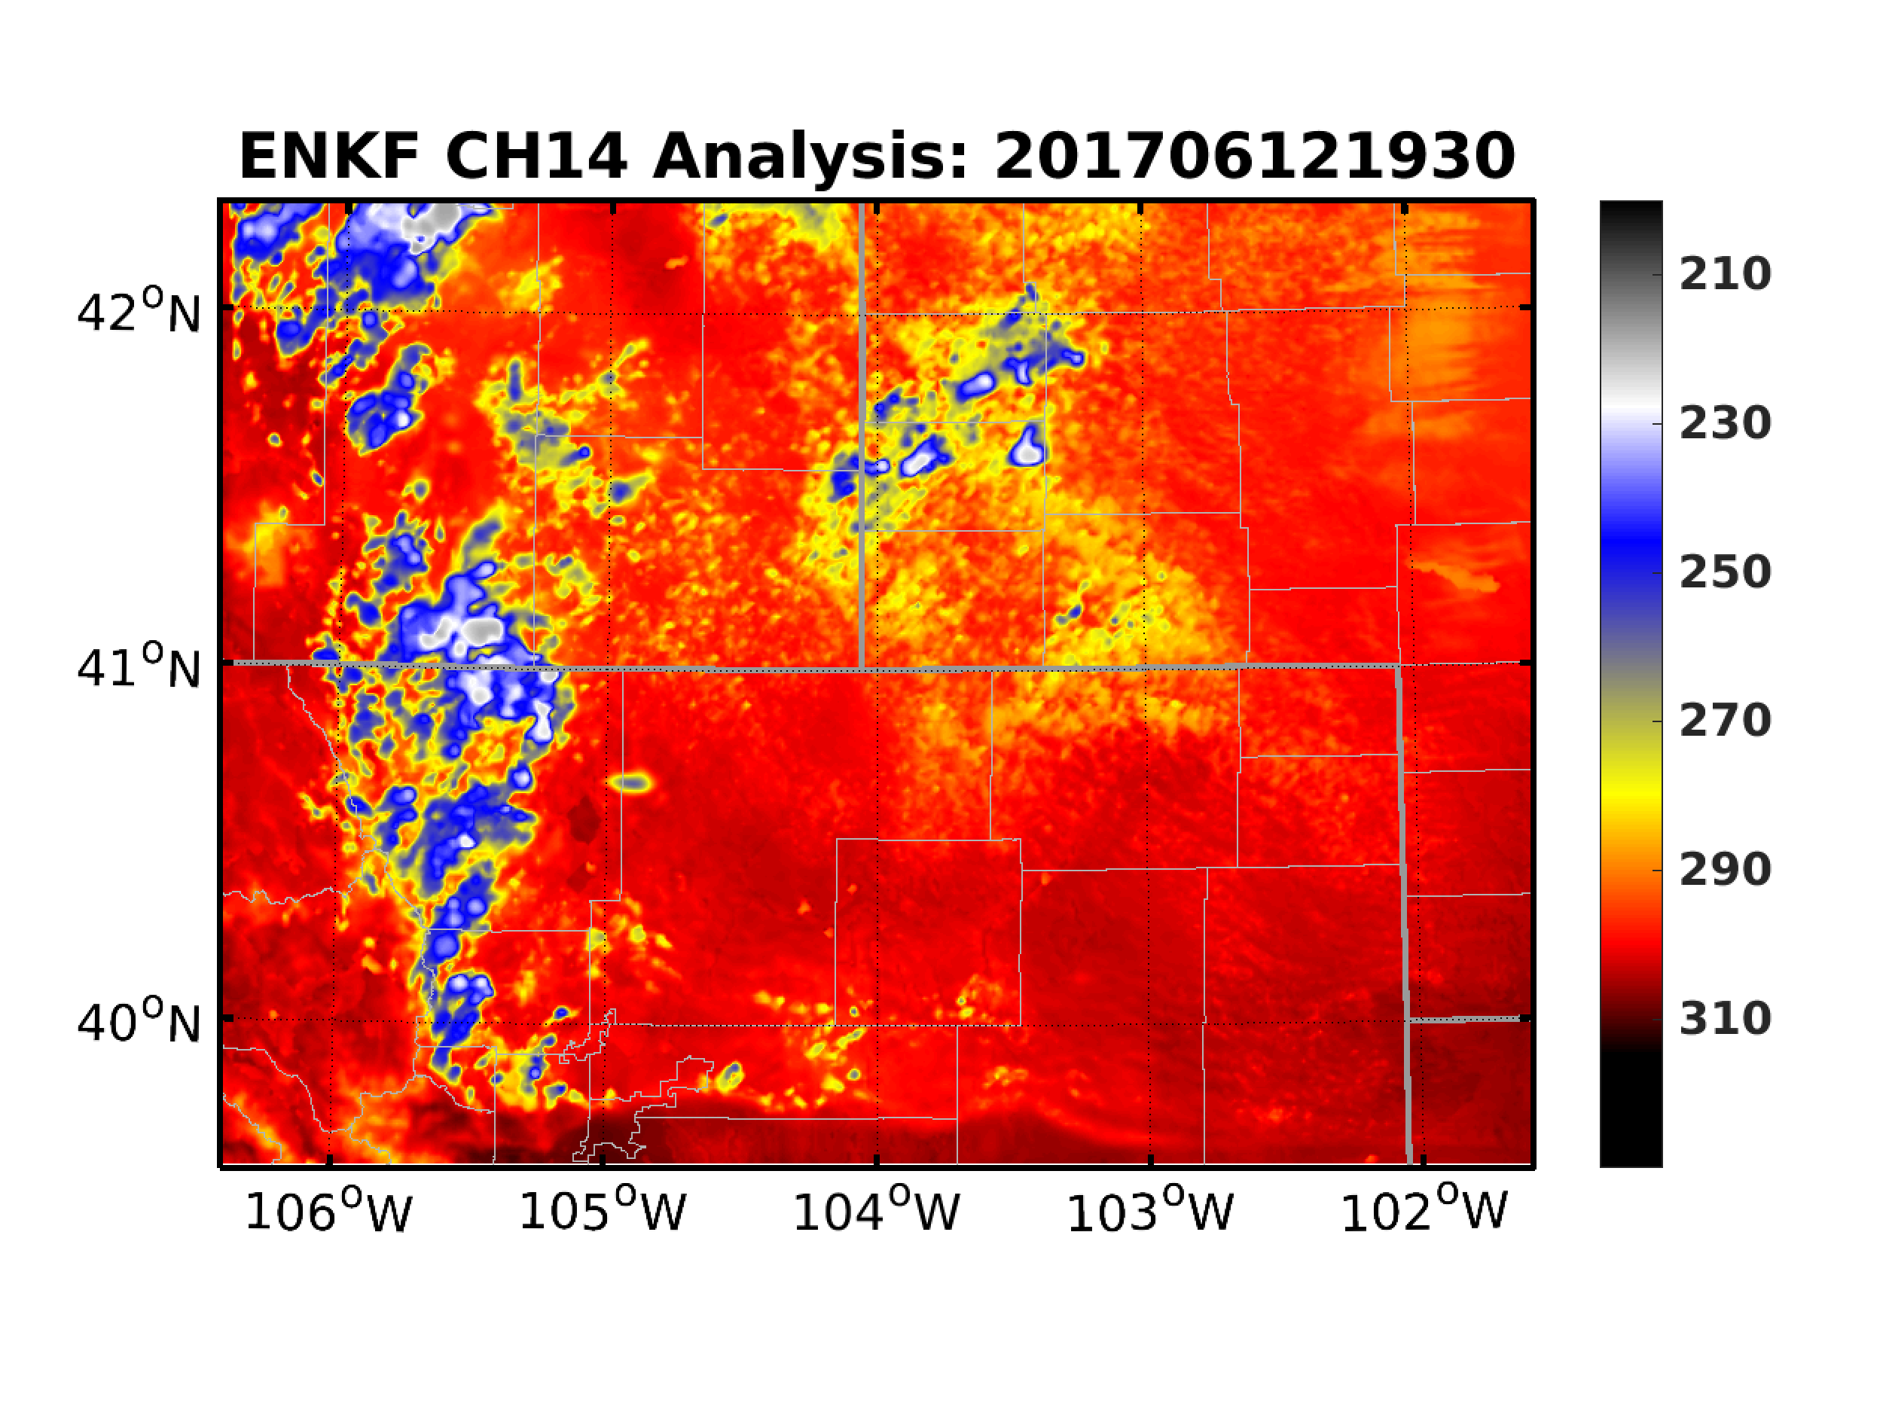
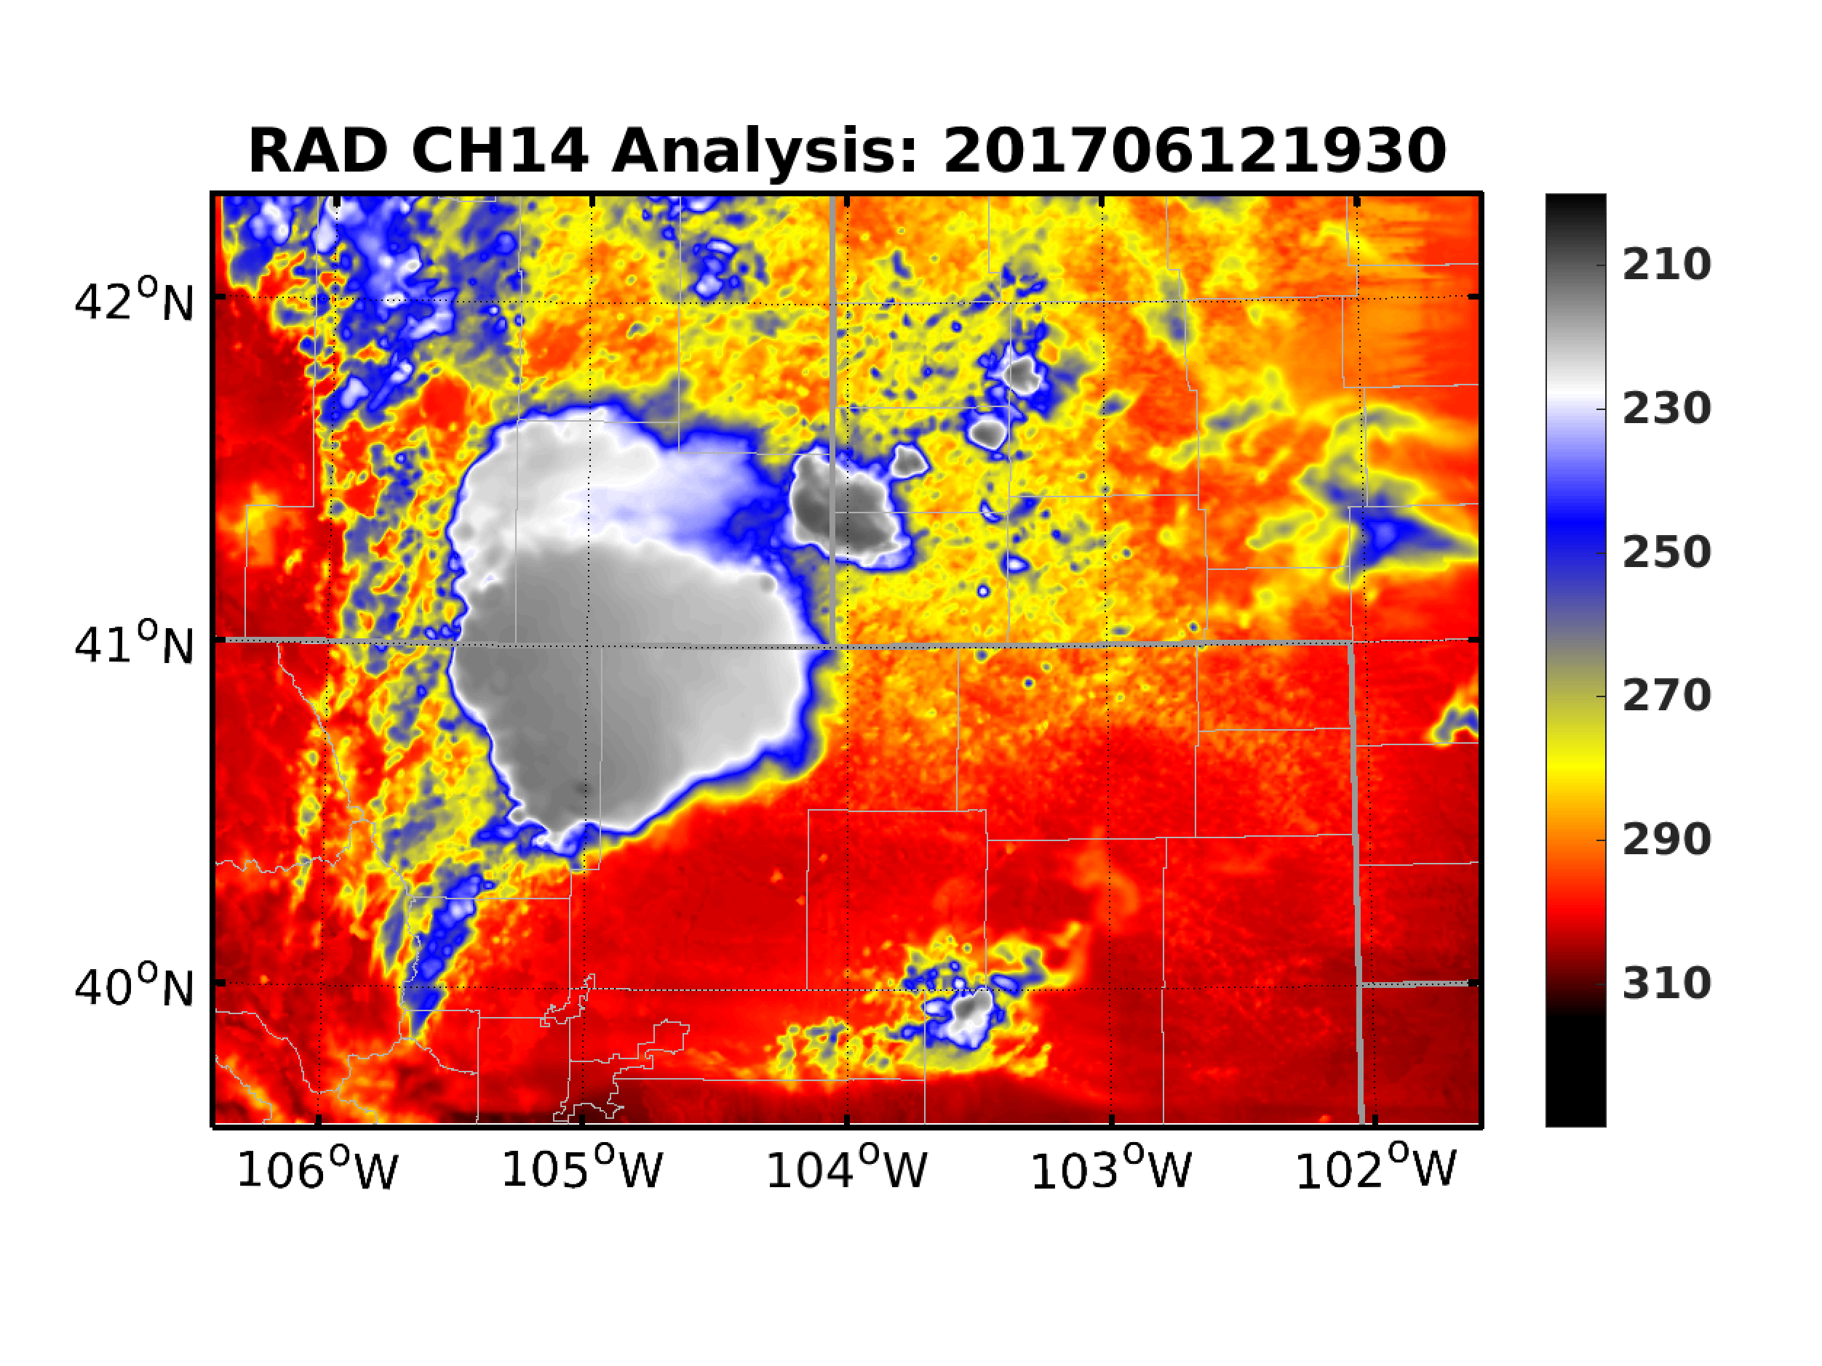
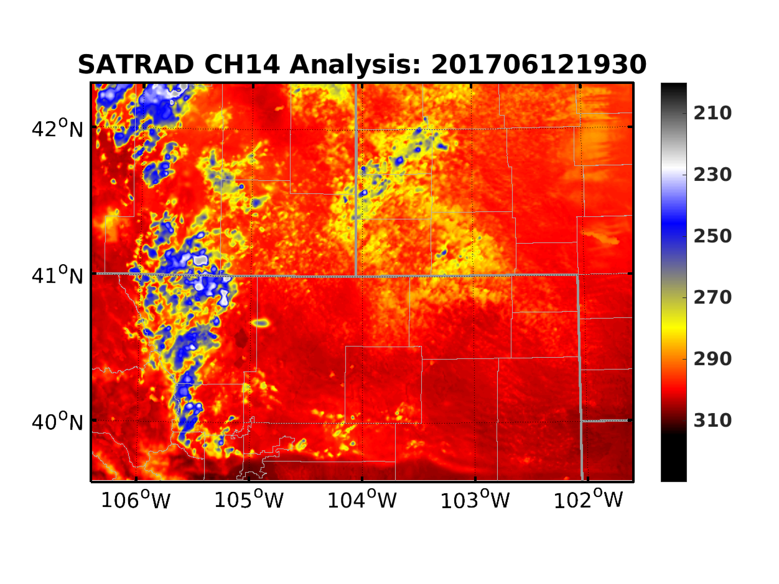
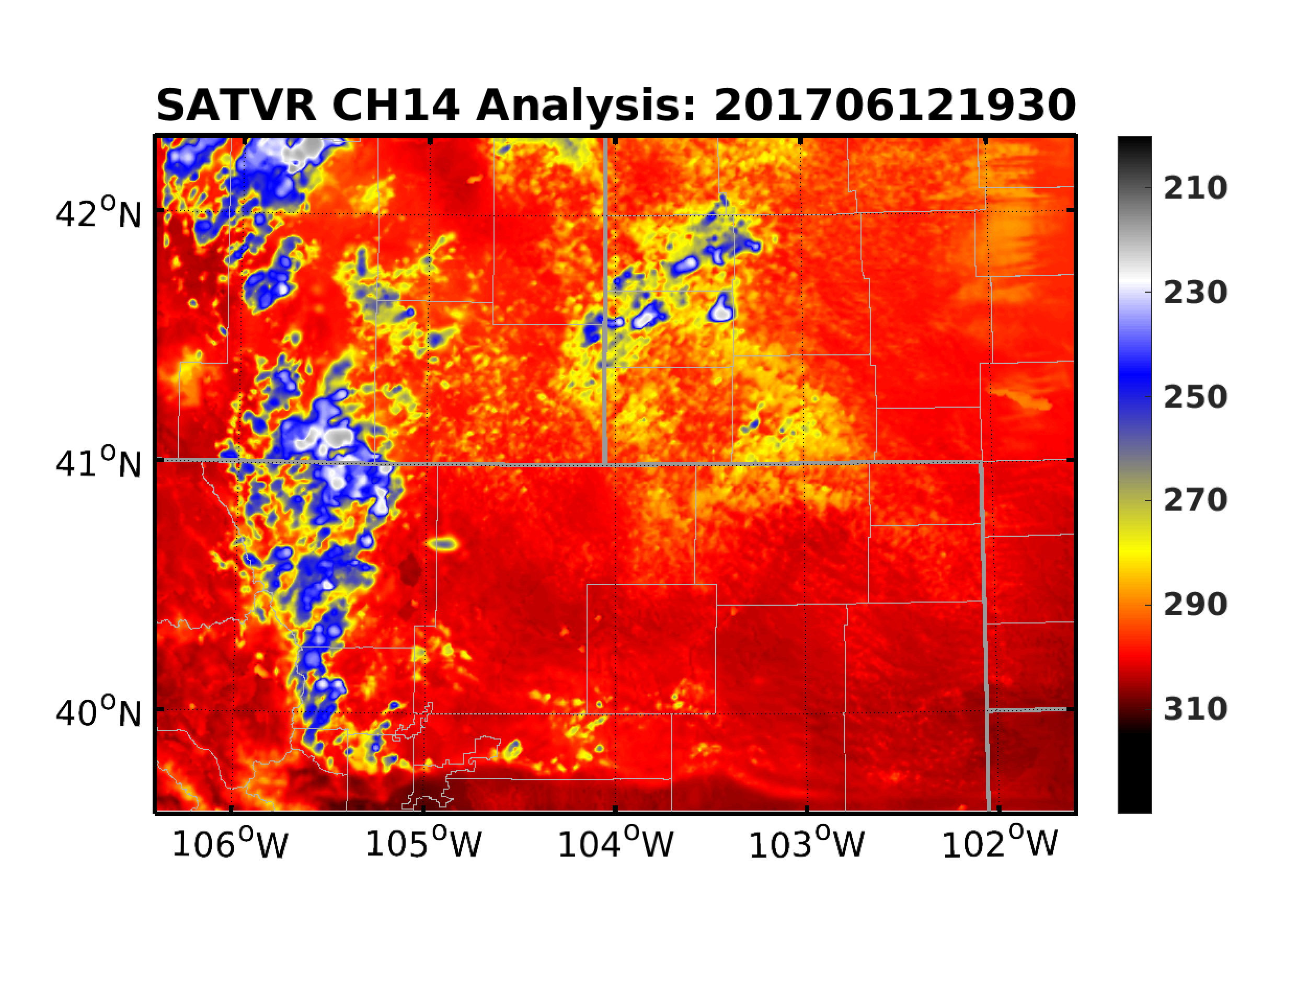
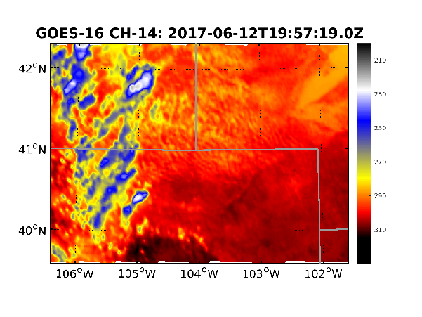
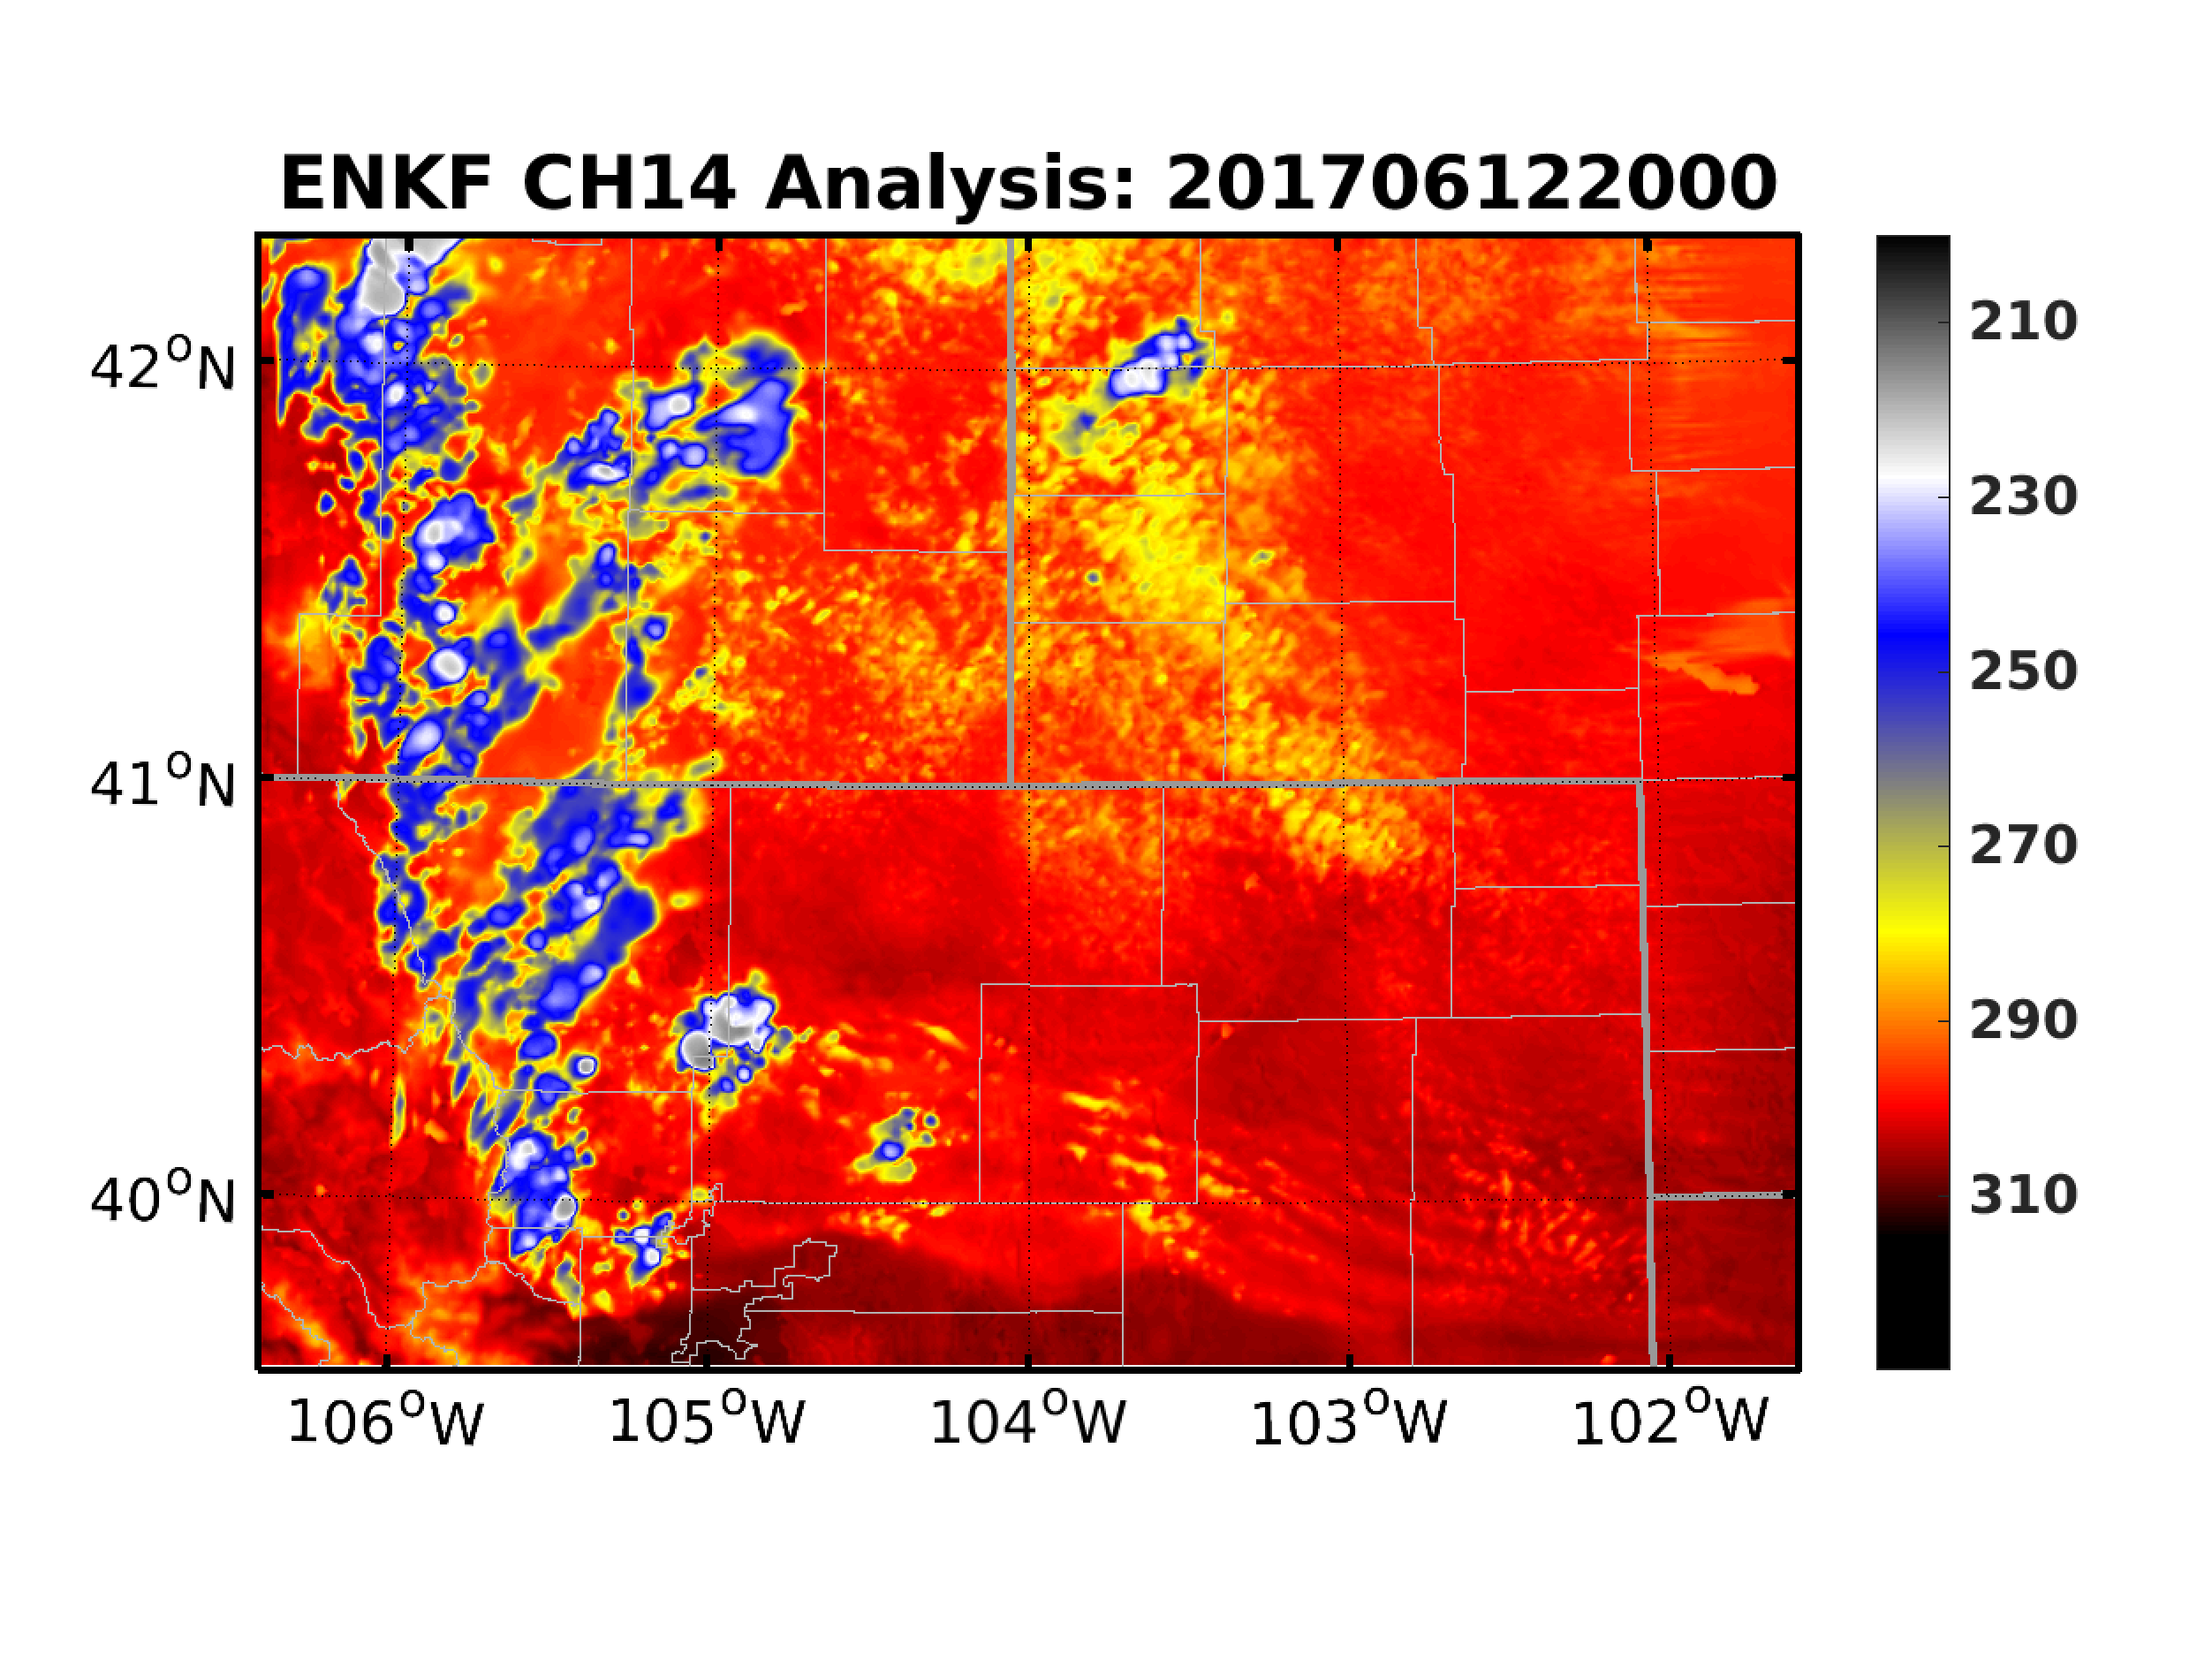
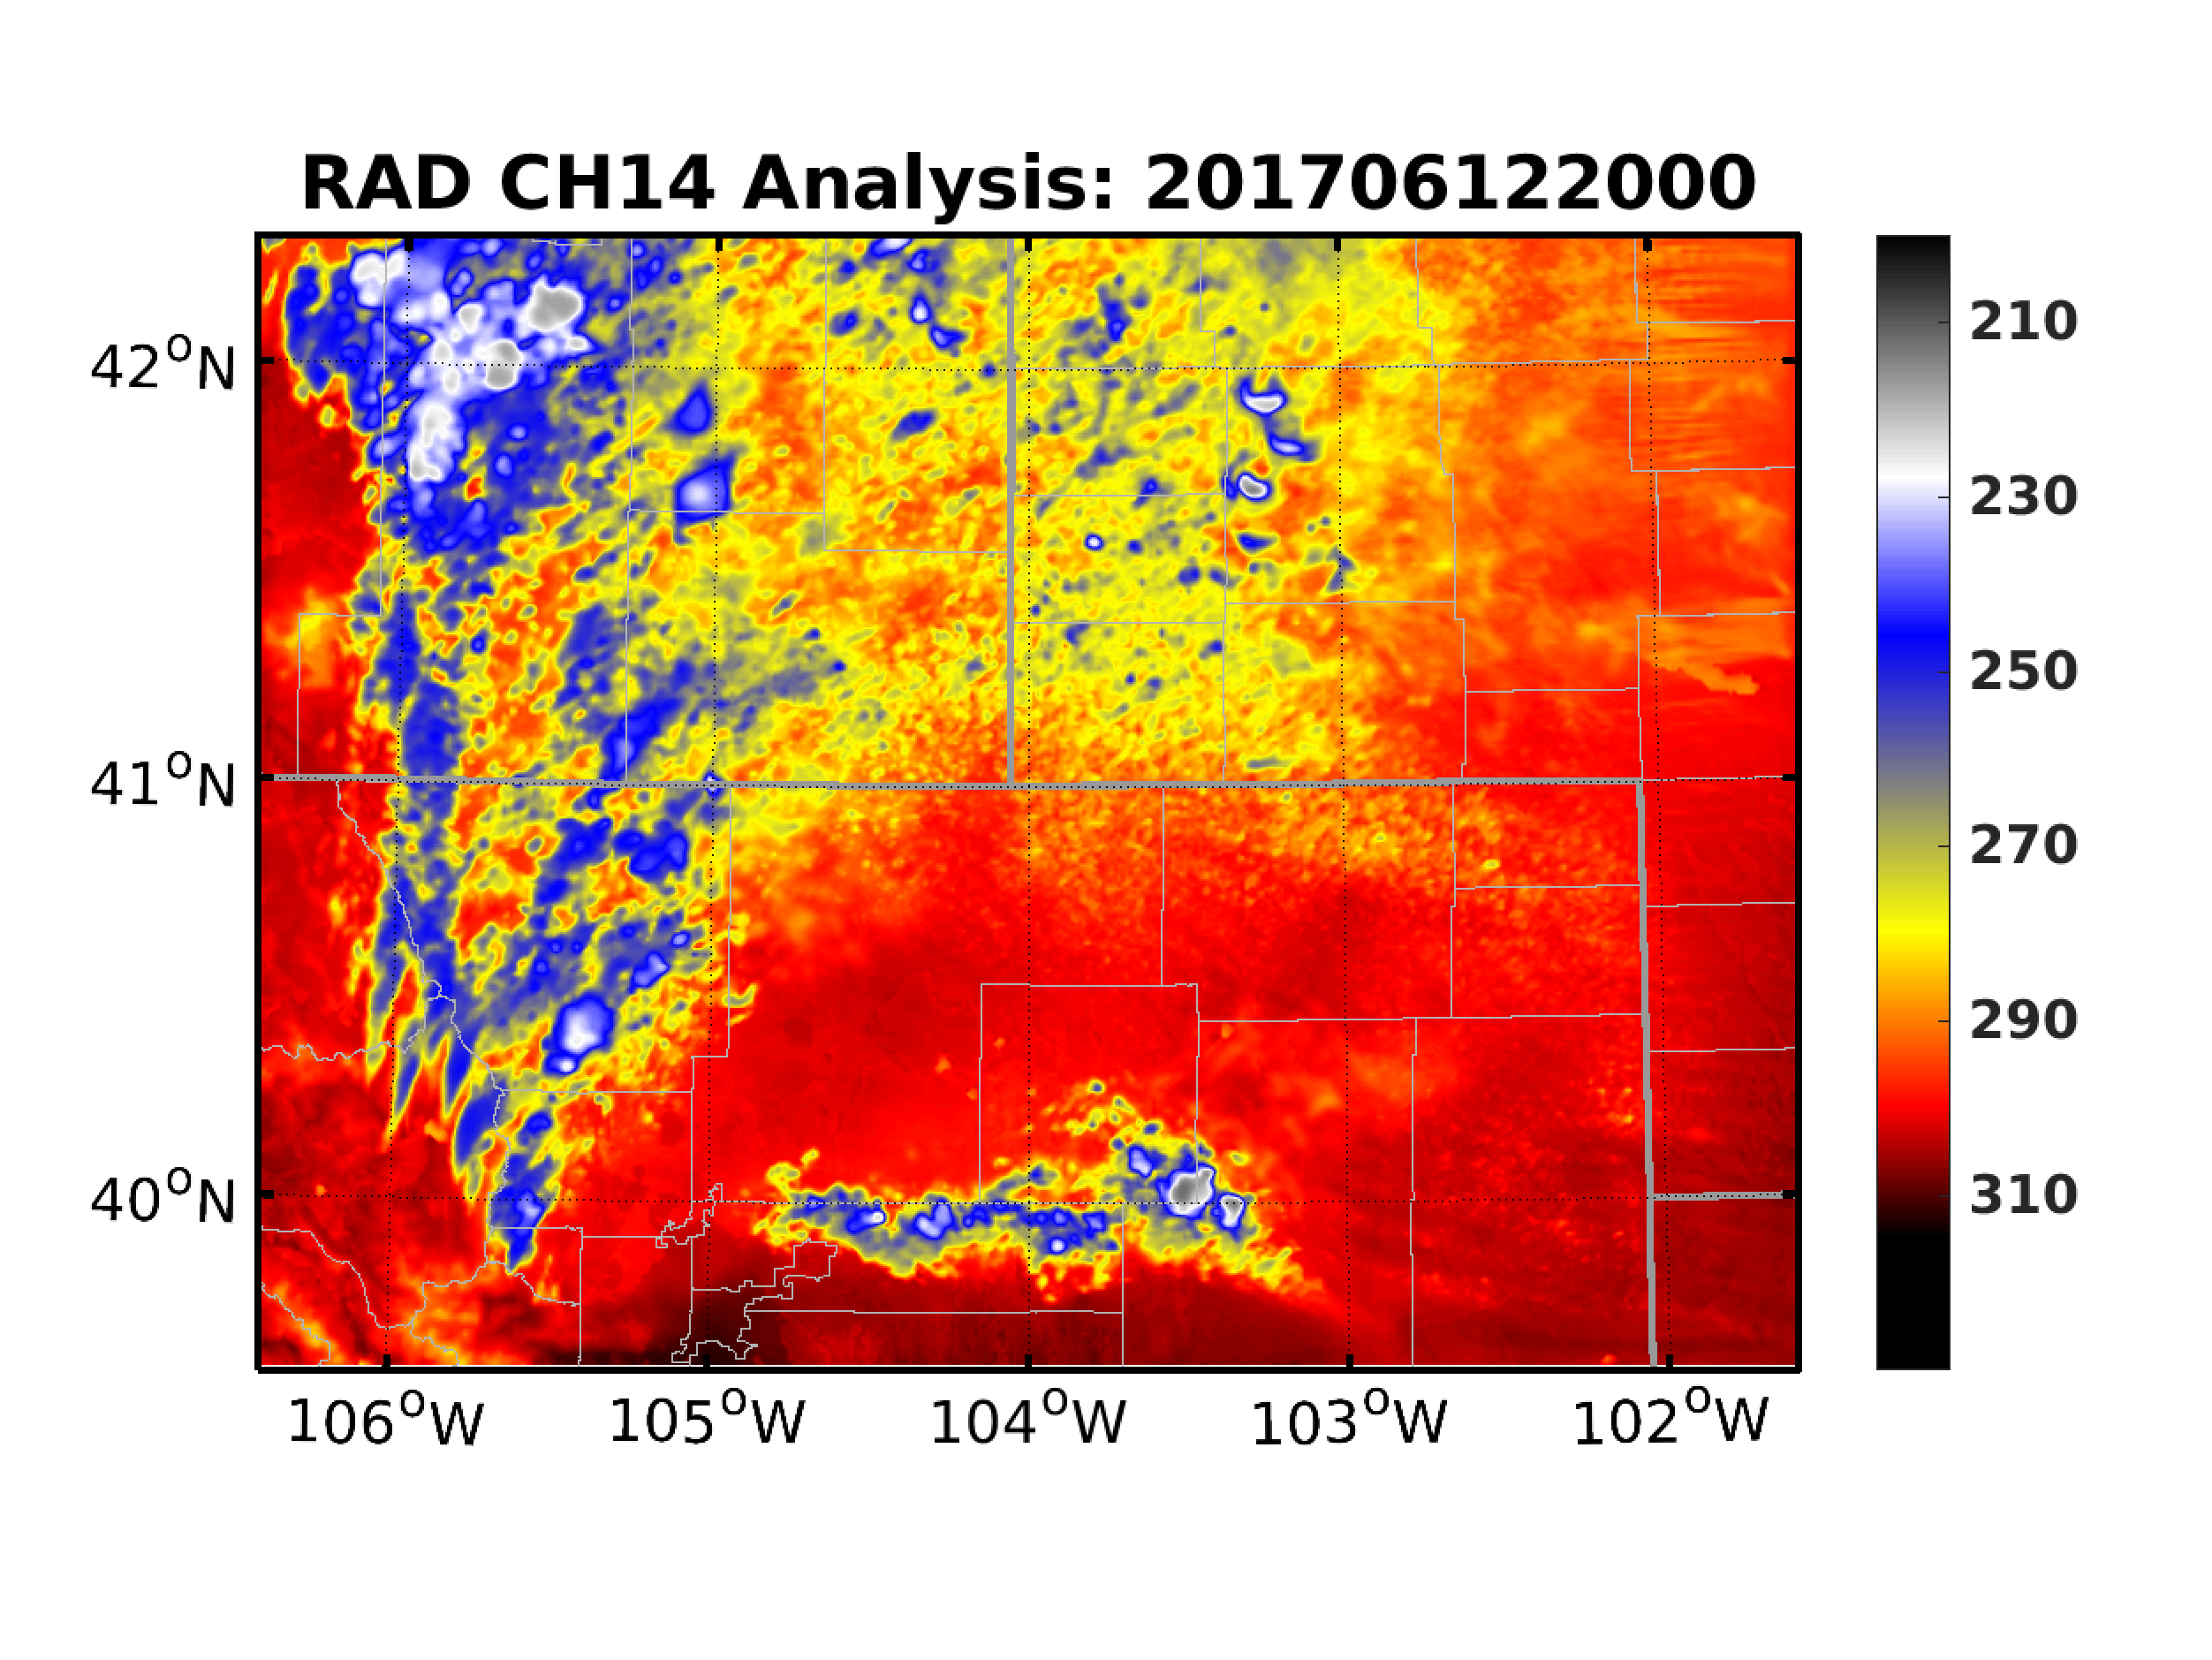
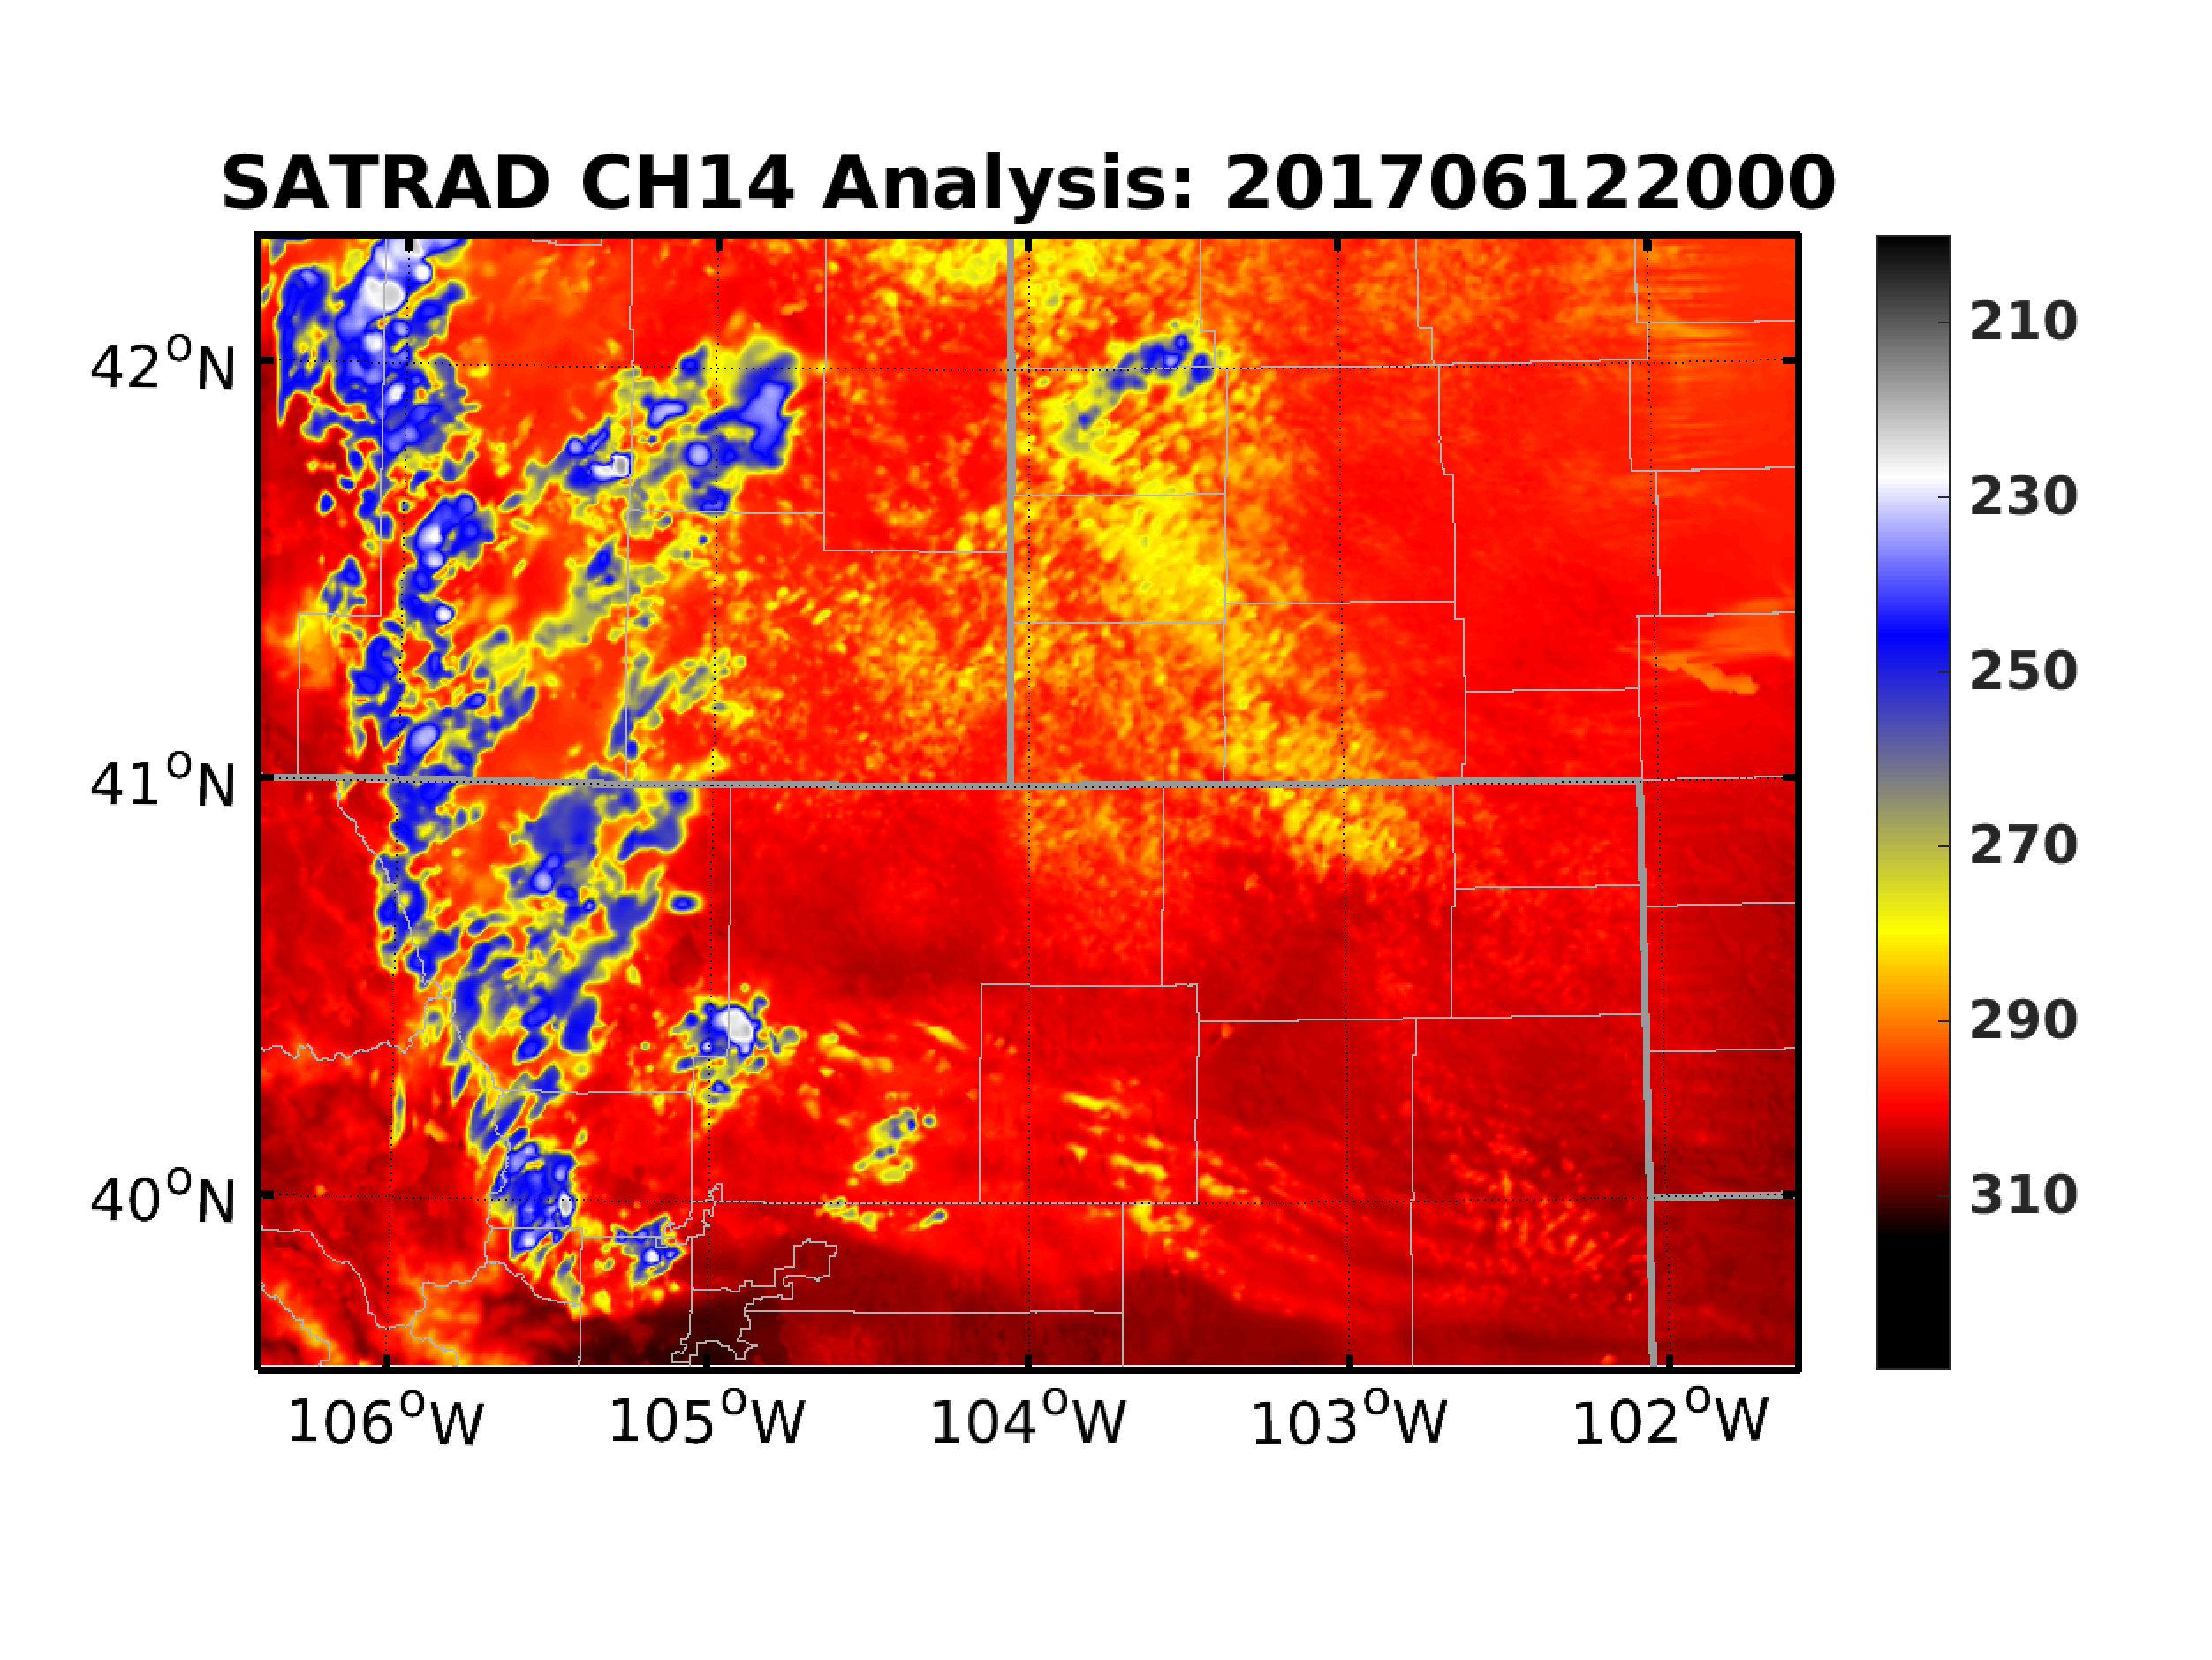
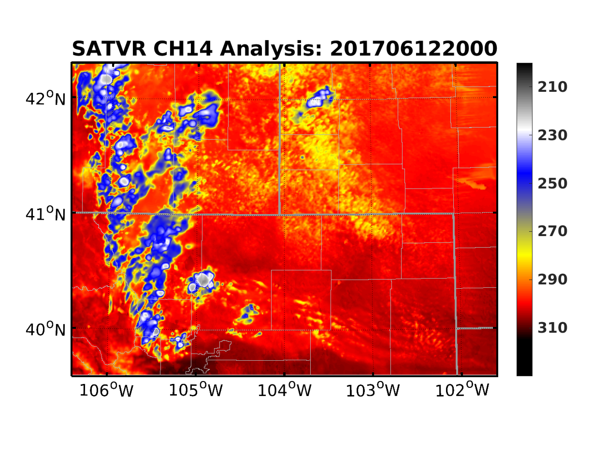
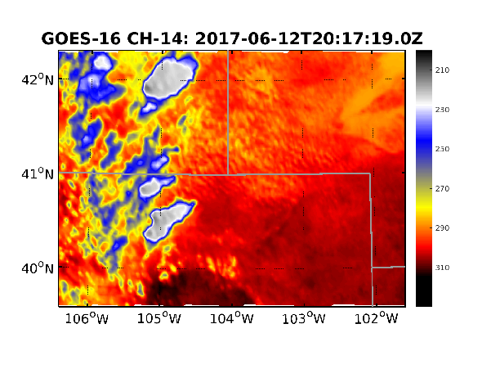
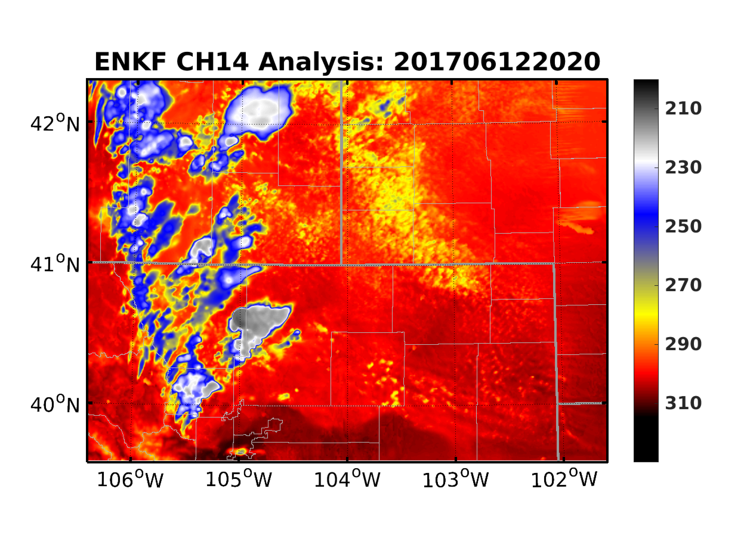
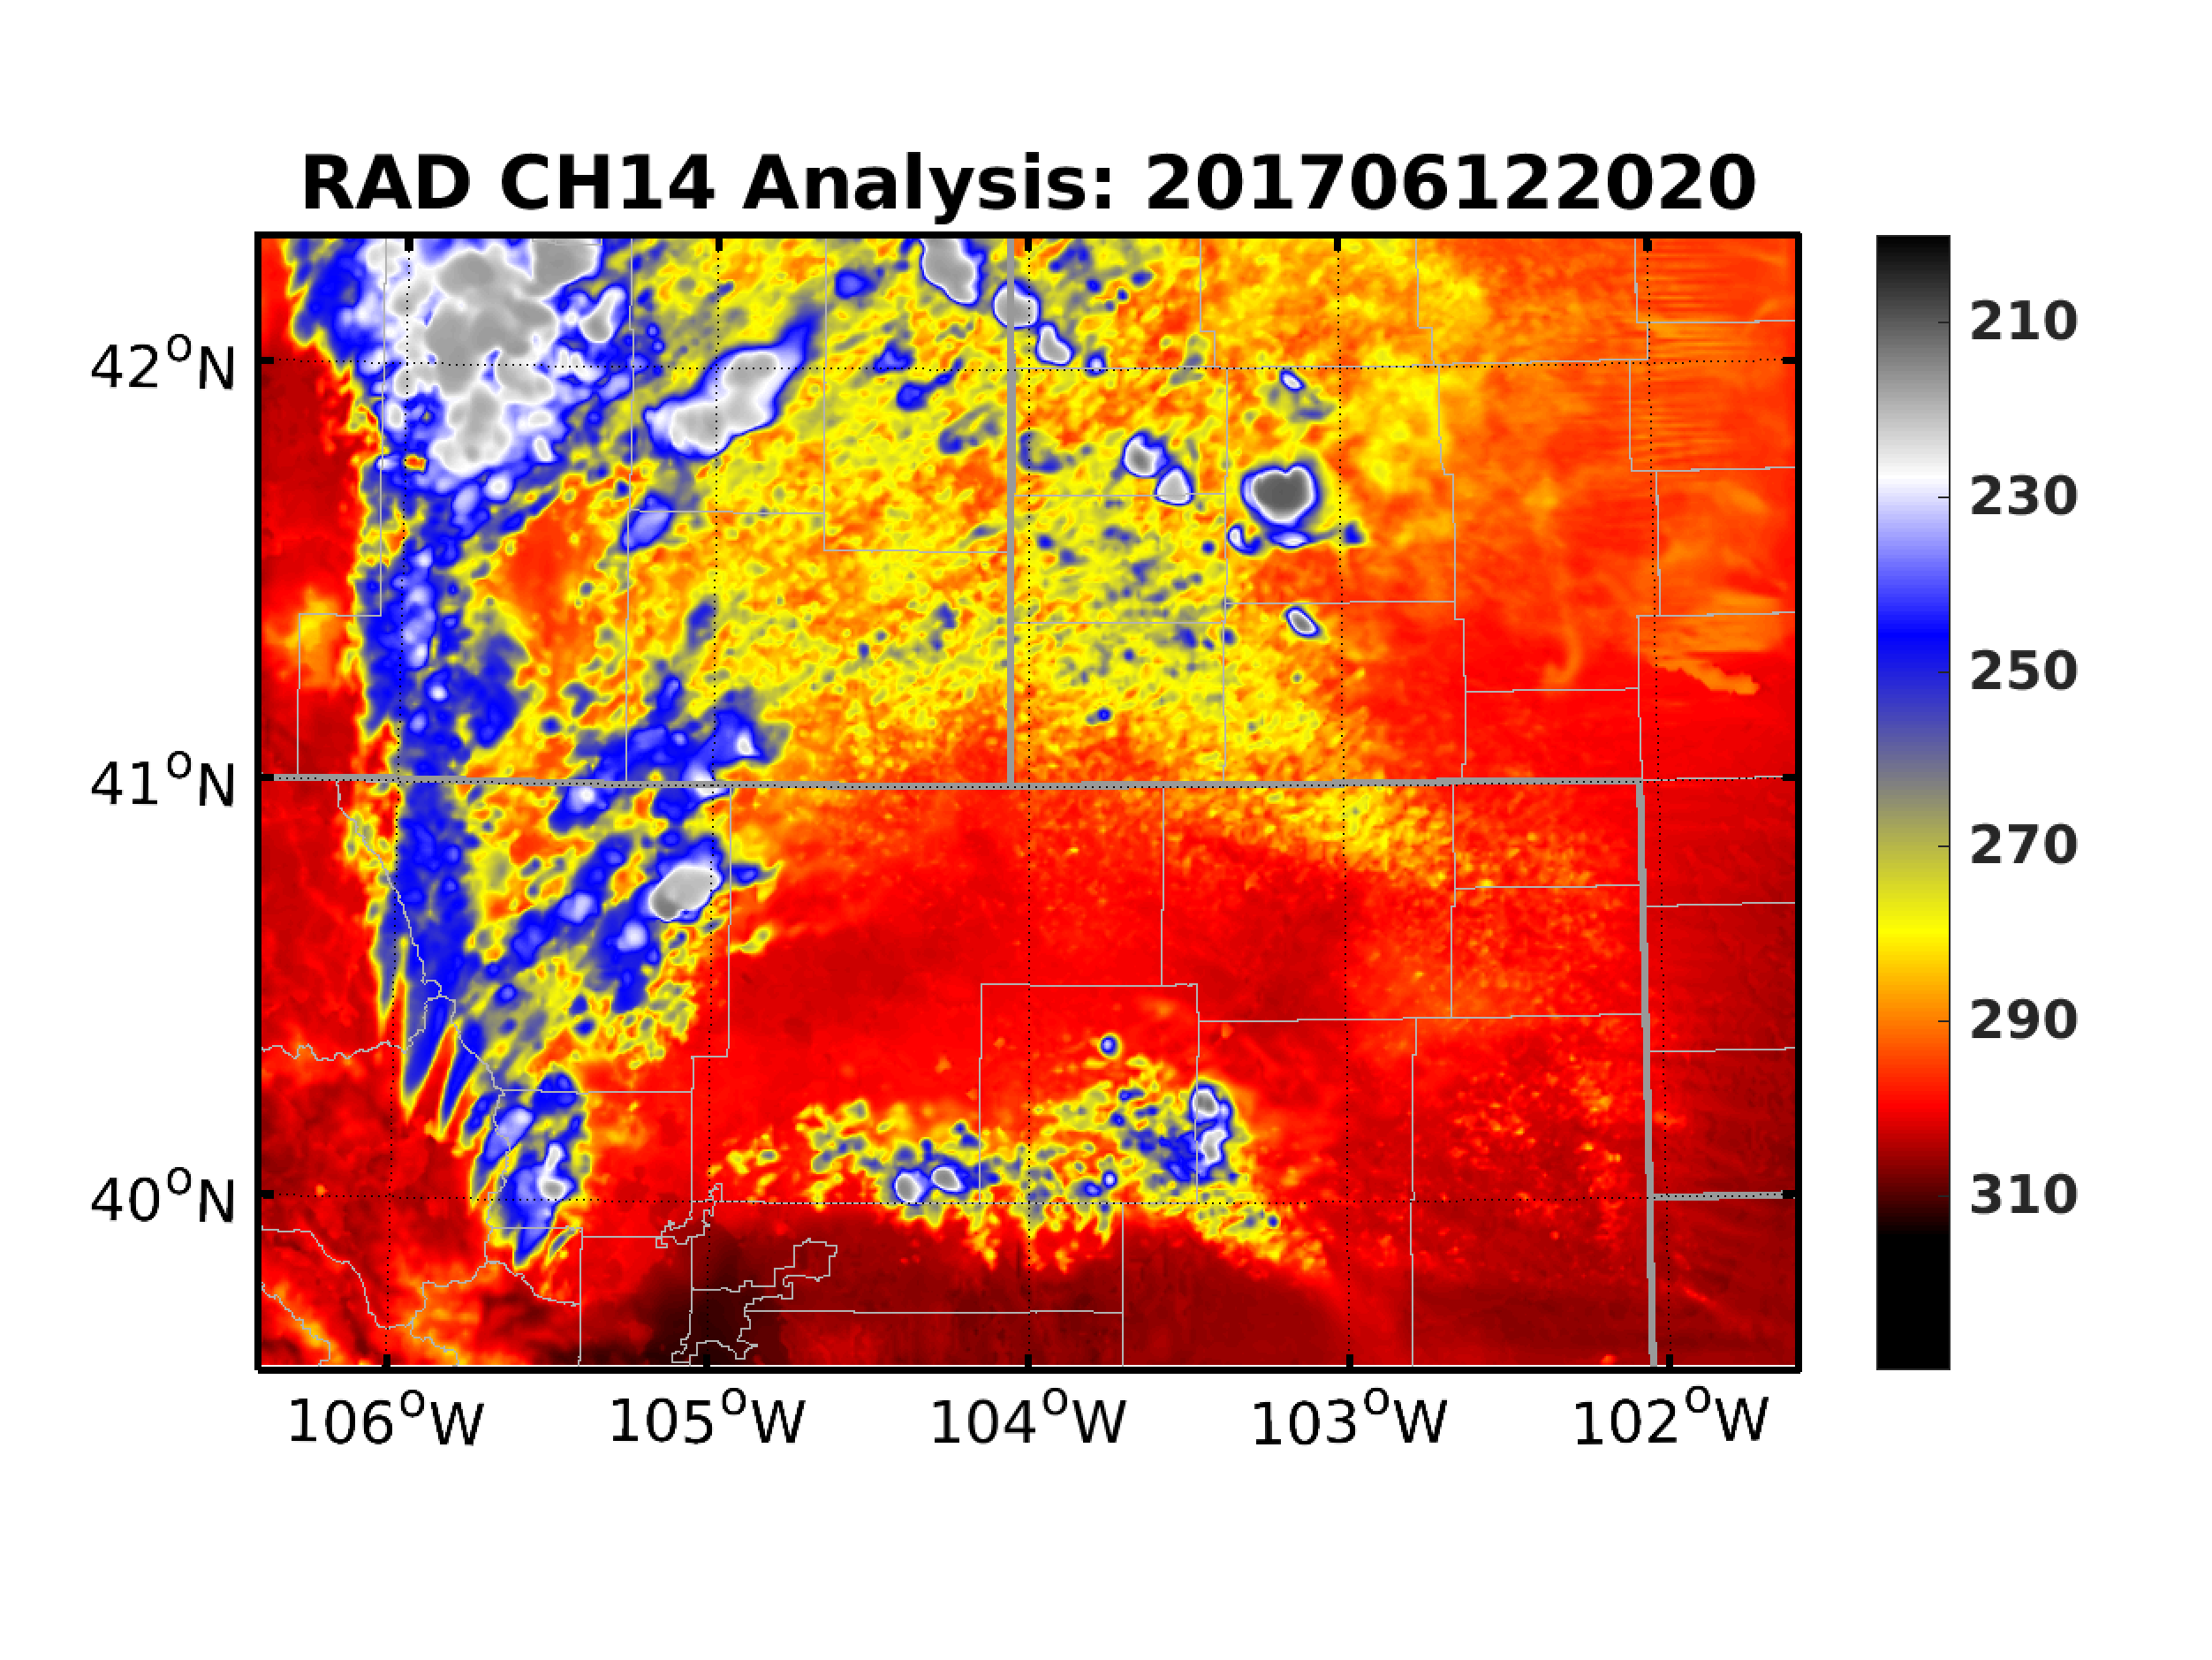
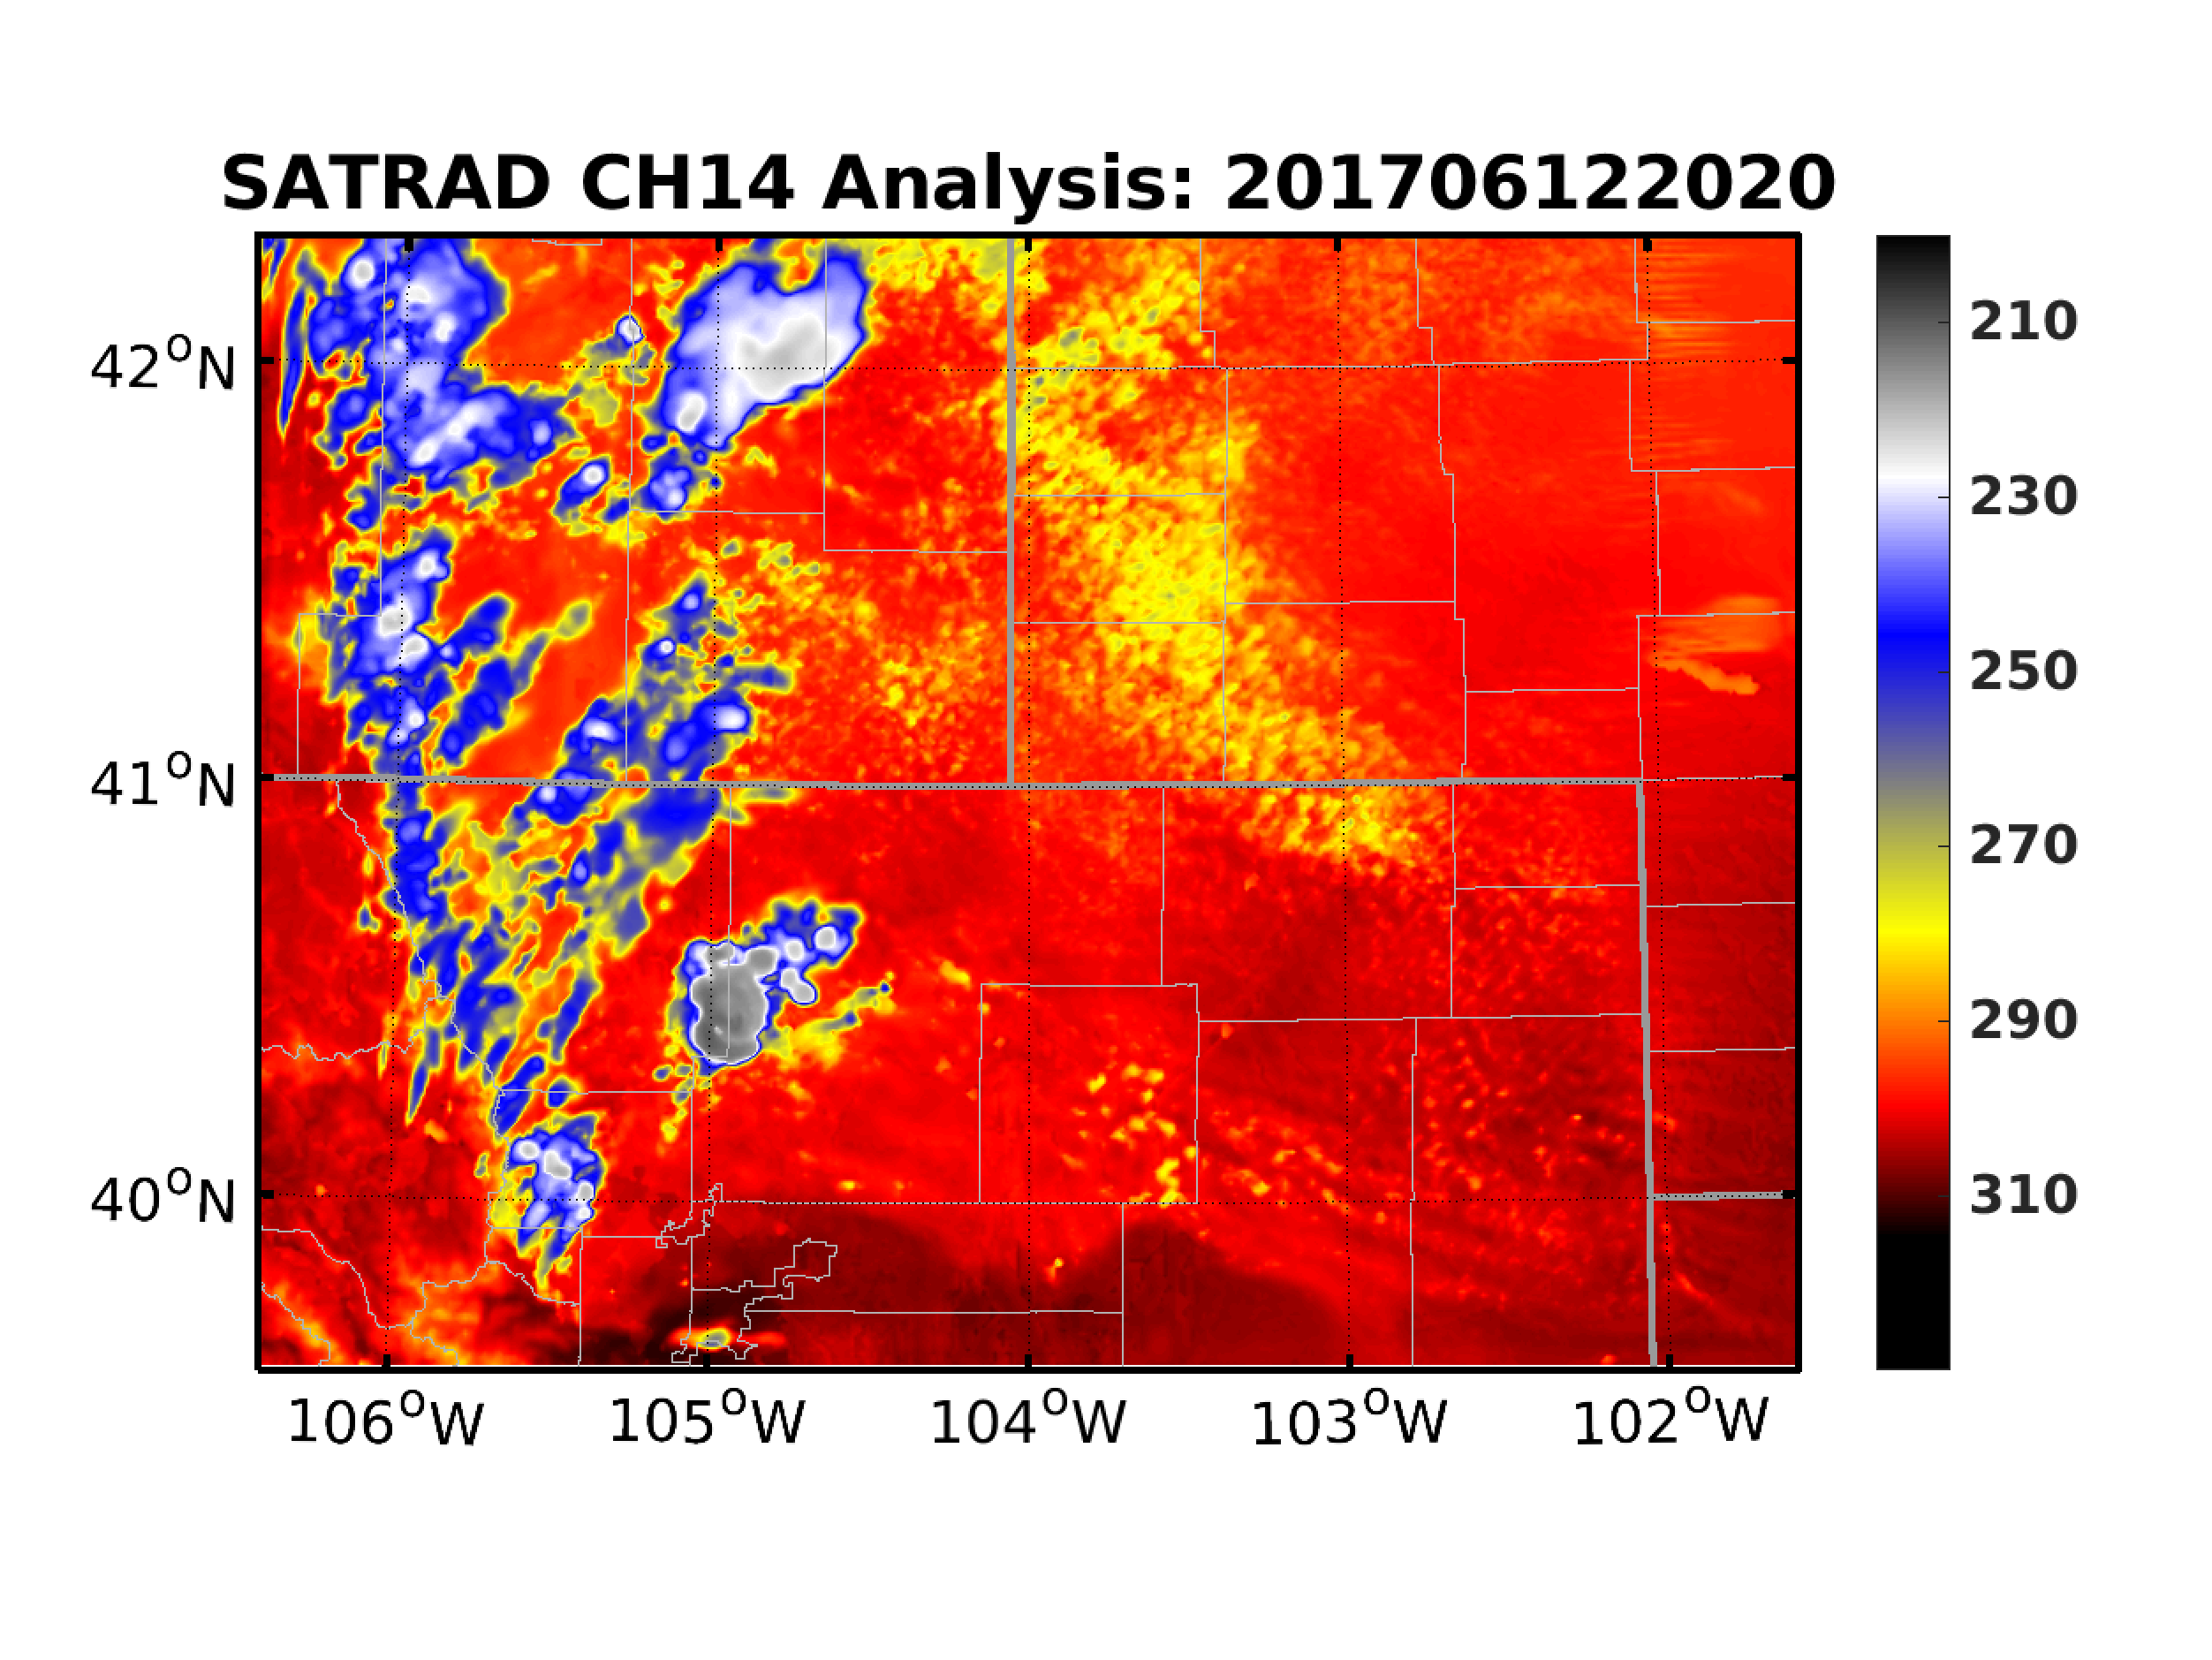
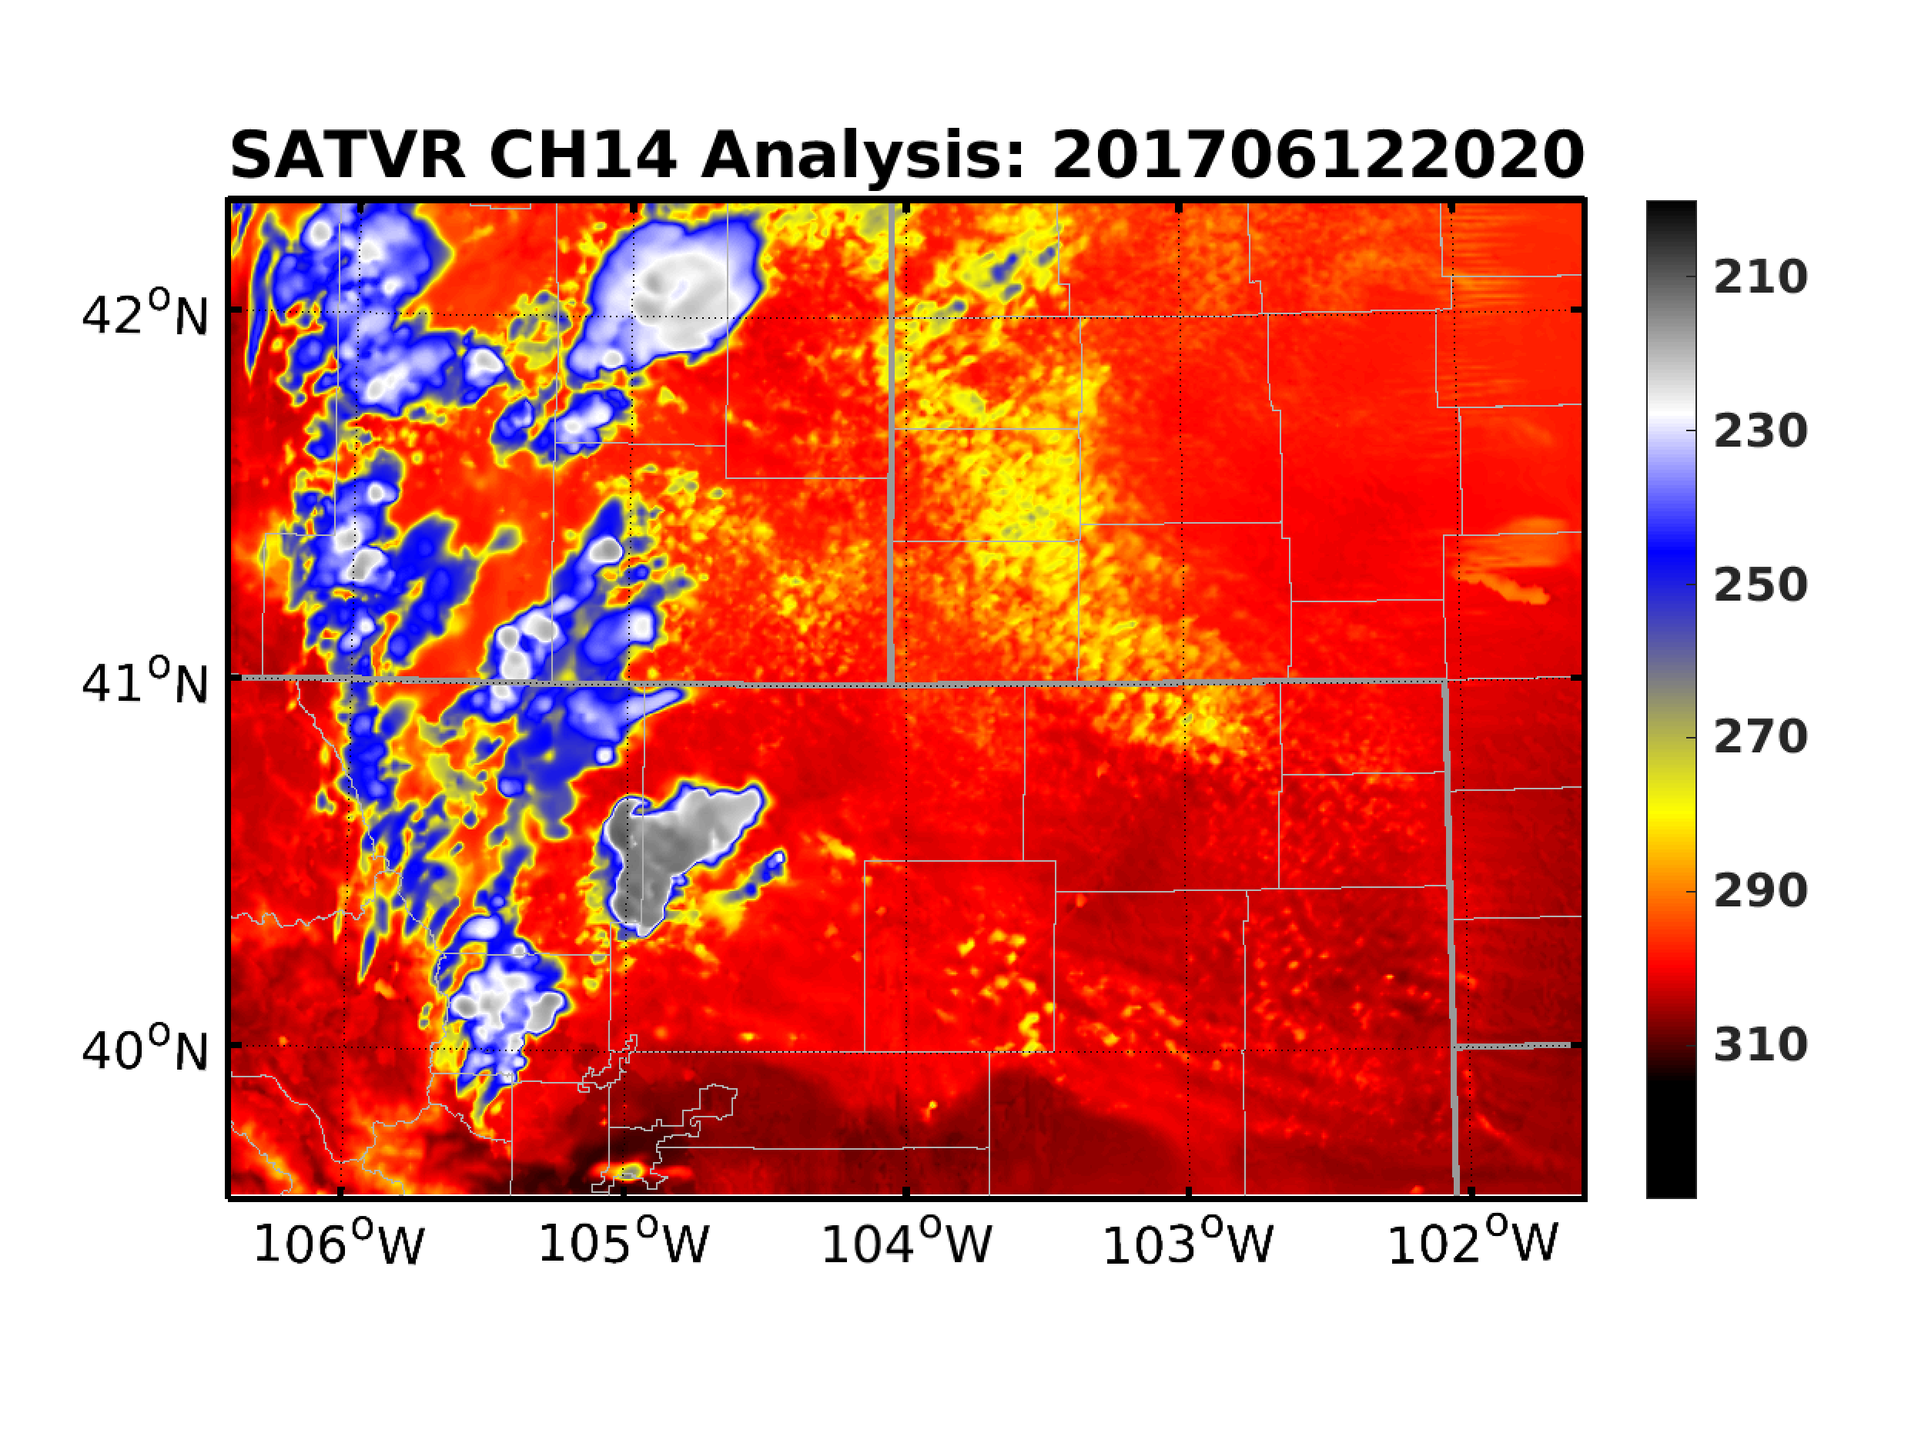
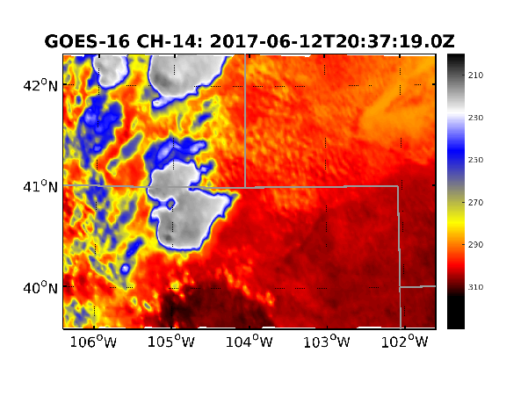
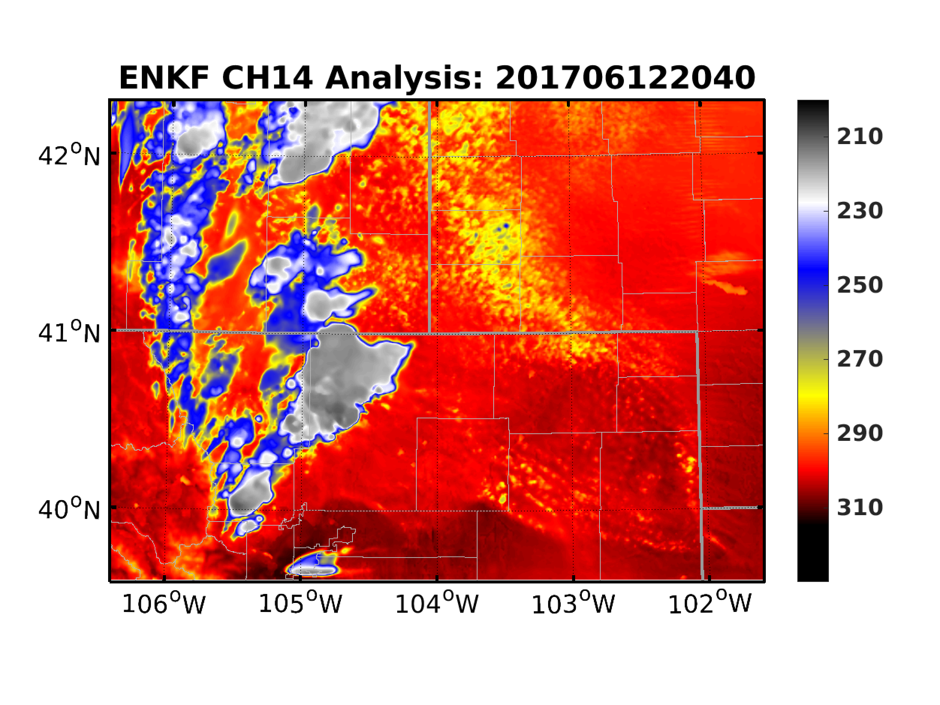
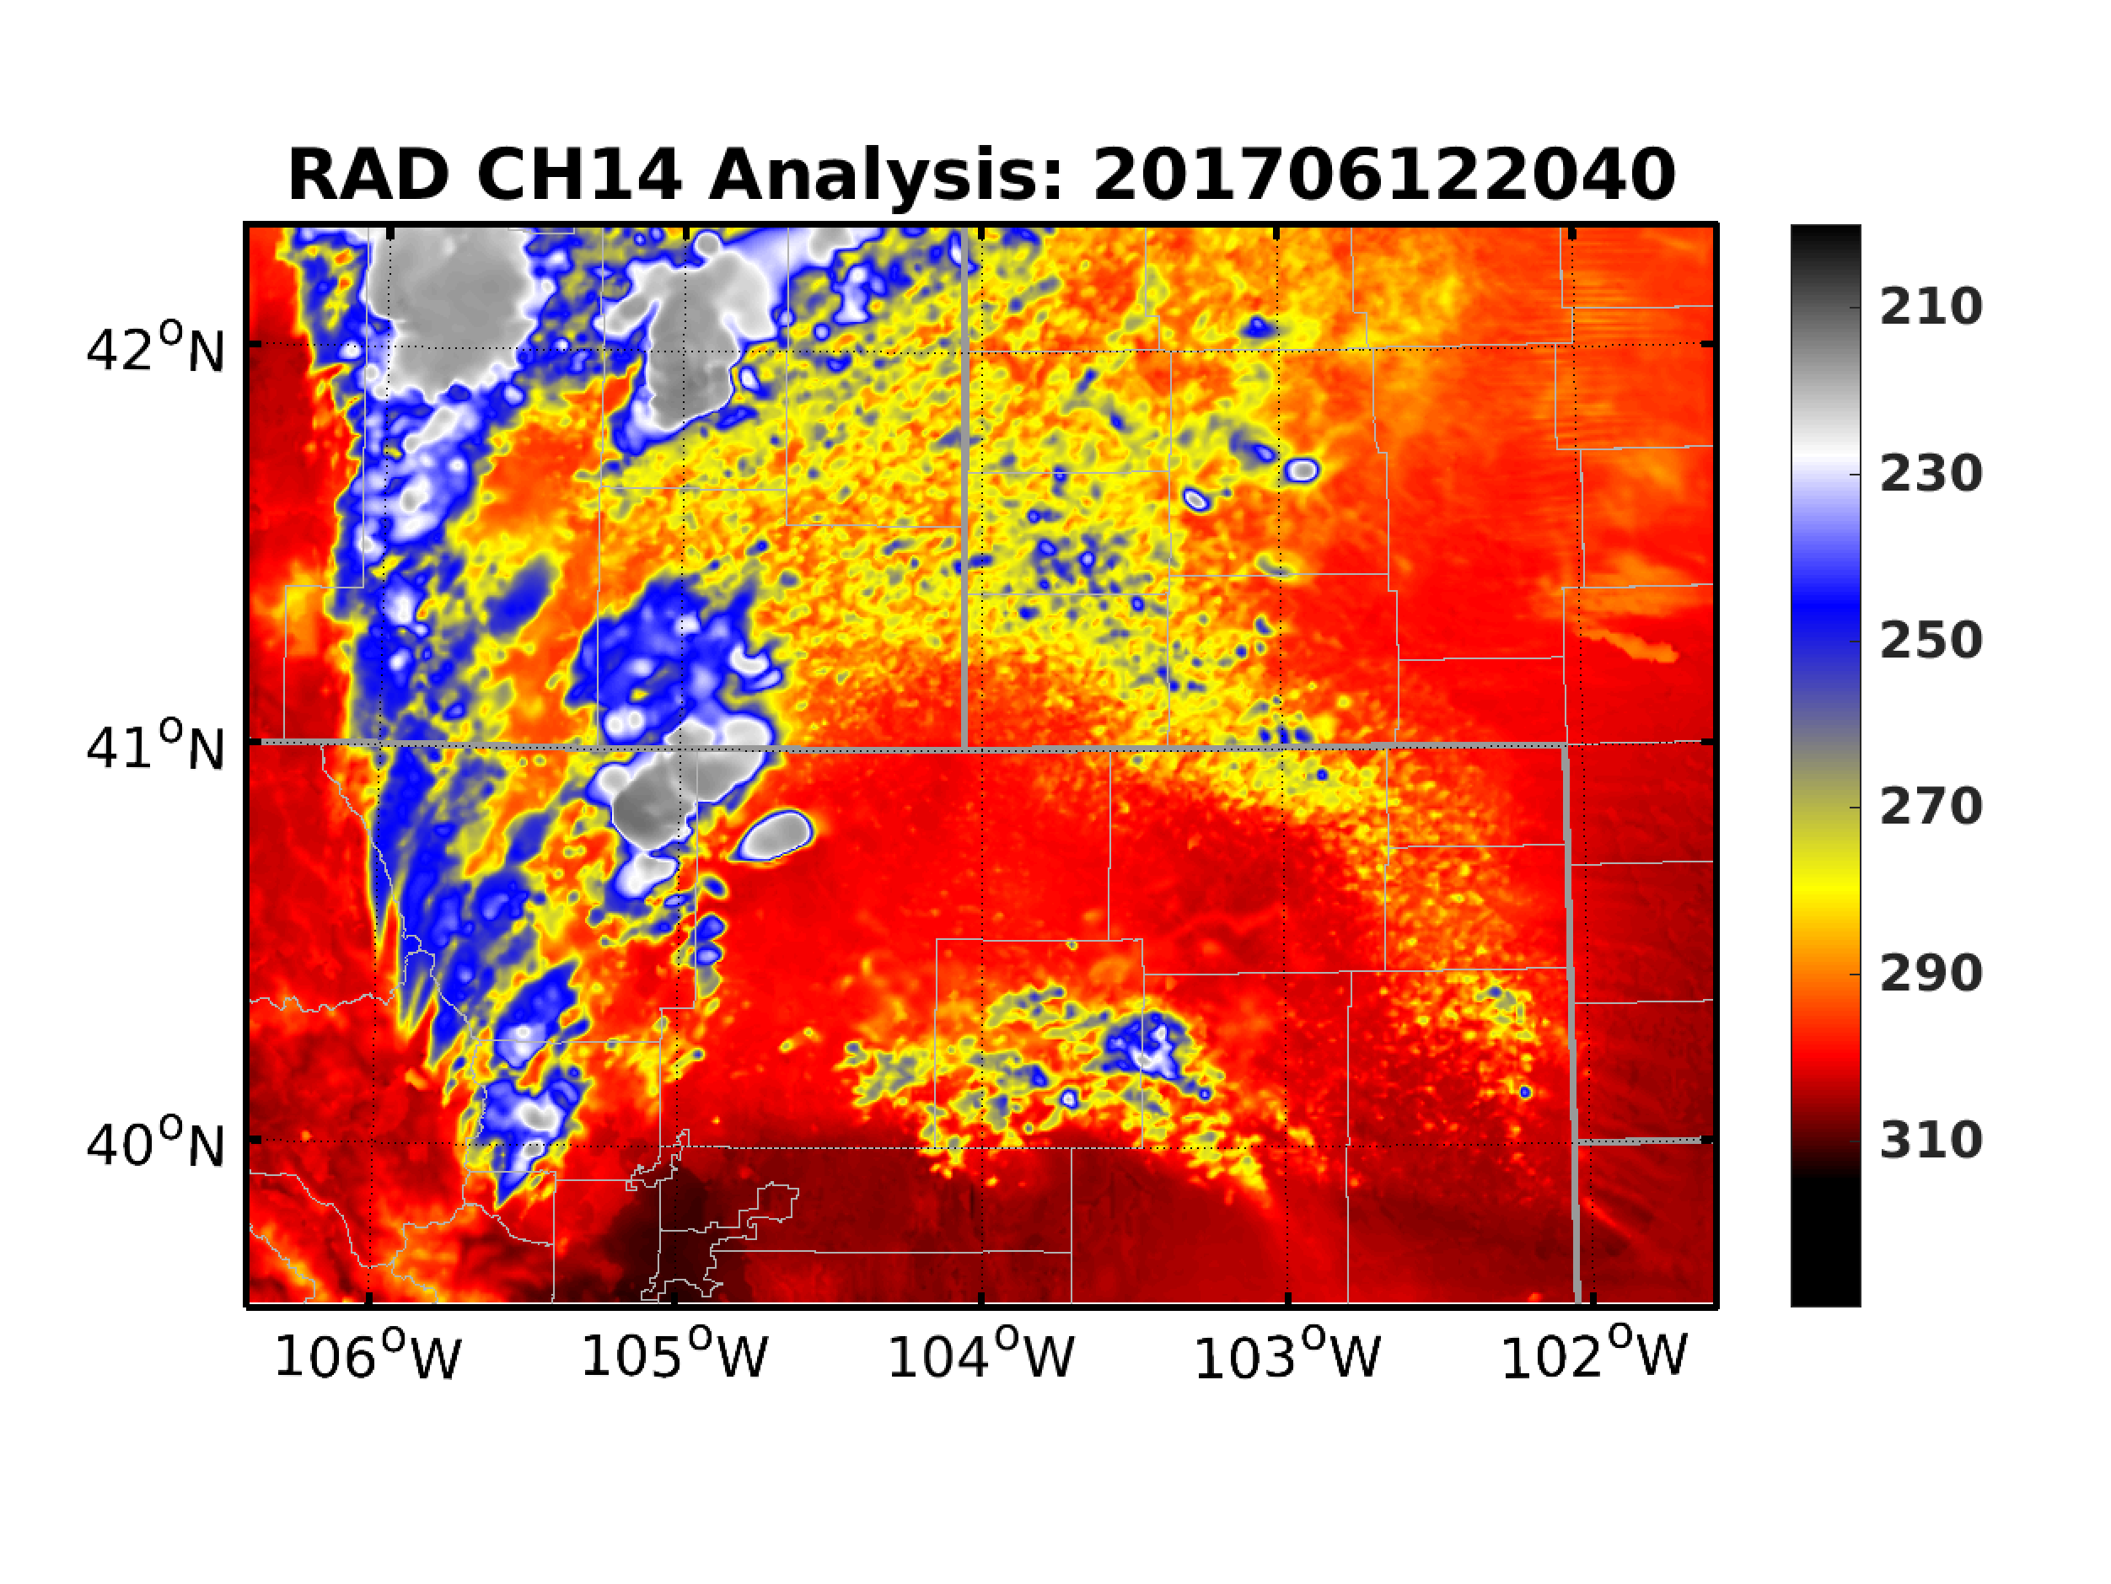
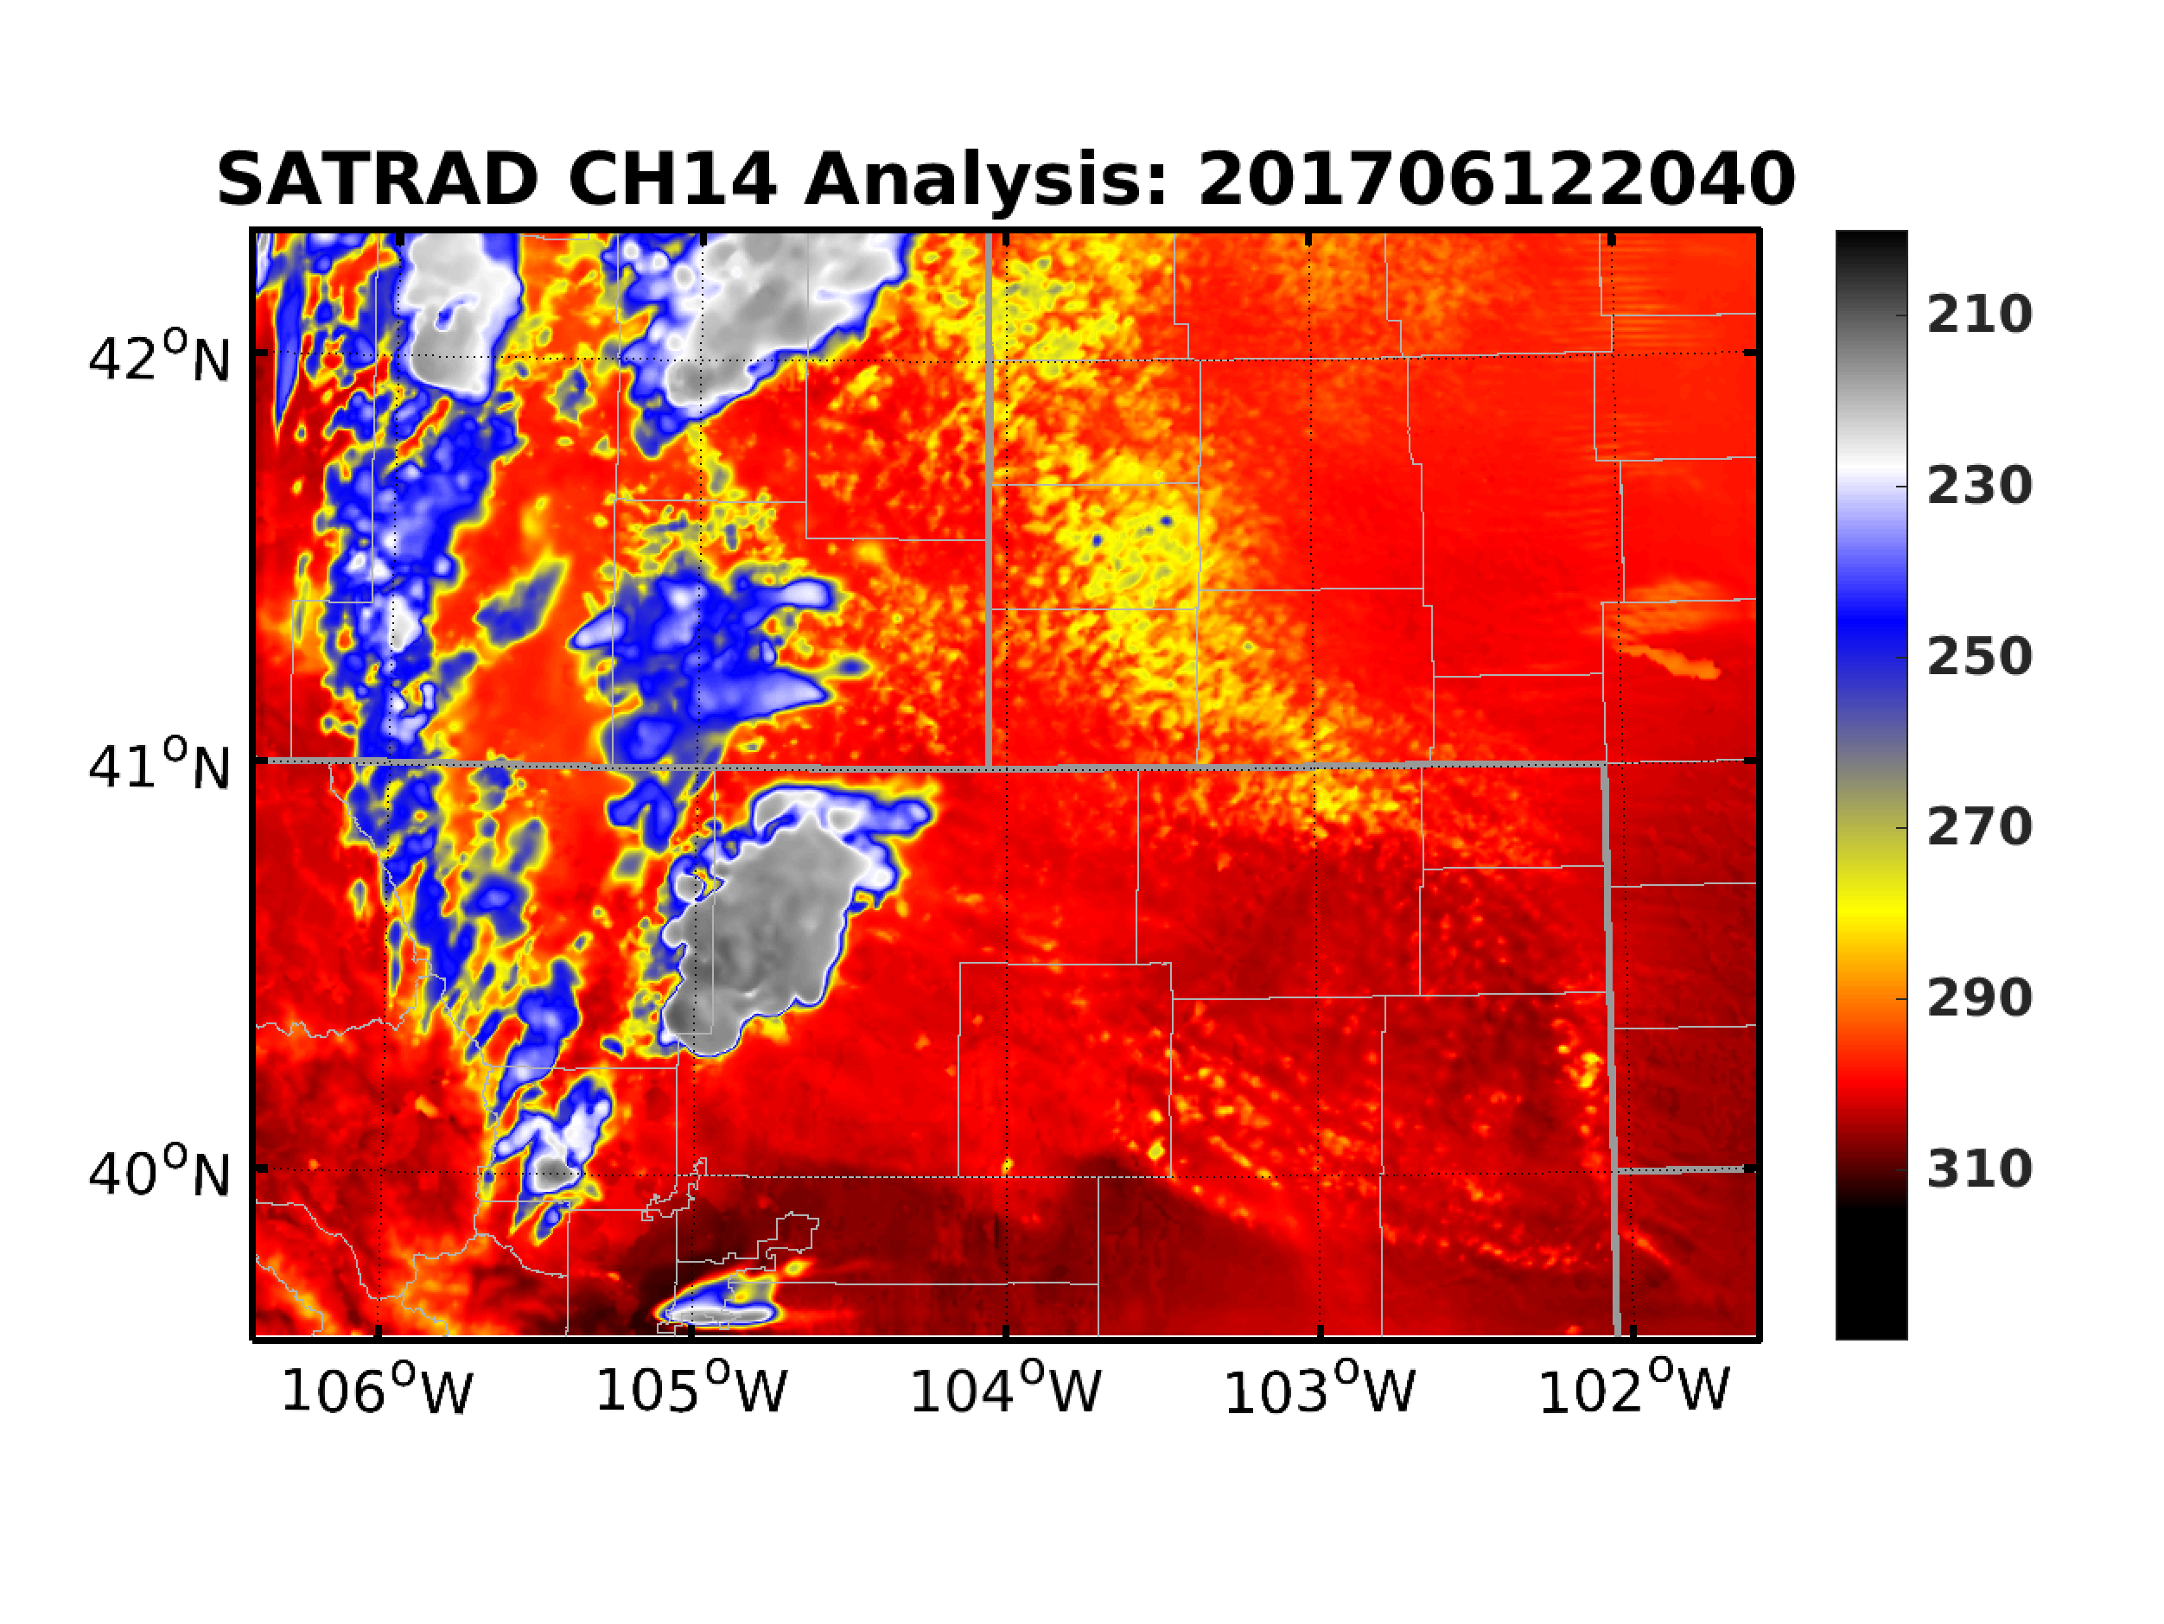
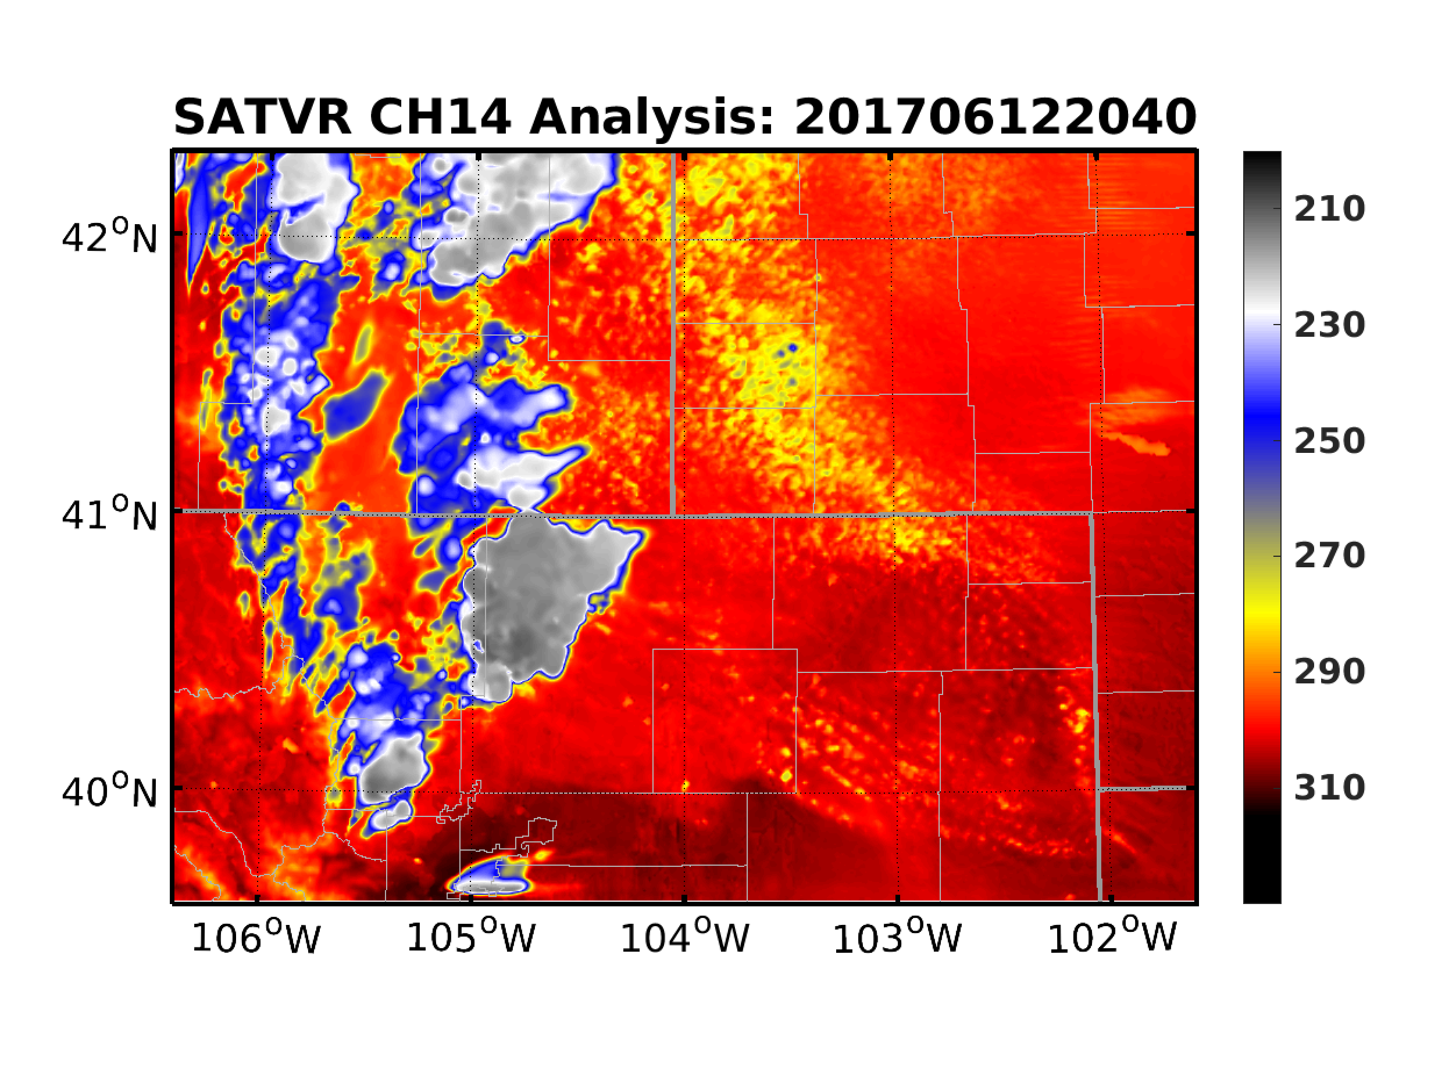
Comparison of EnKF Analysis
Observation
SAT
RAD
SATRAD
SATVR

Slide 6
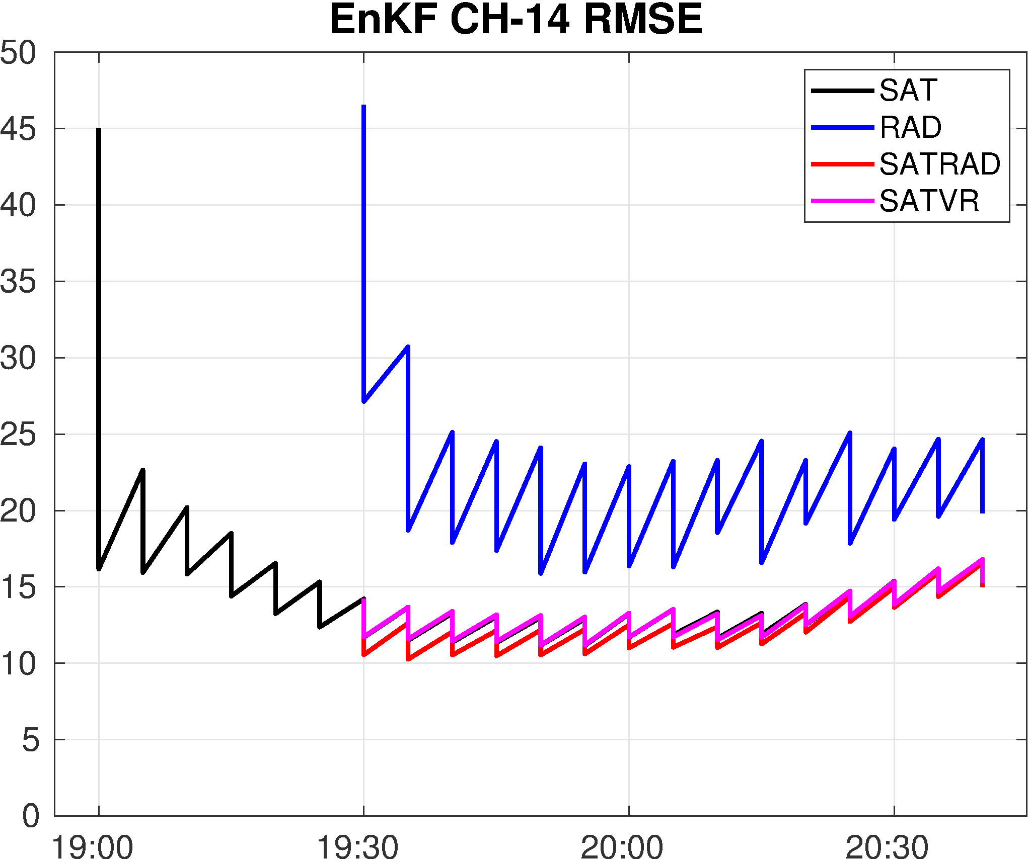
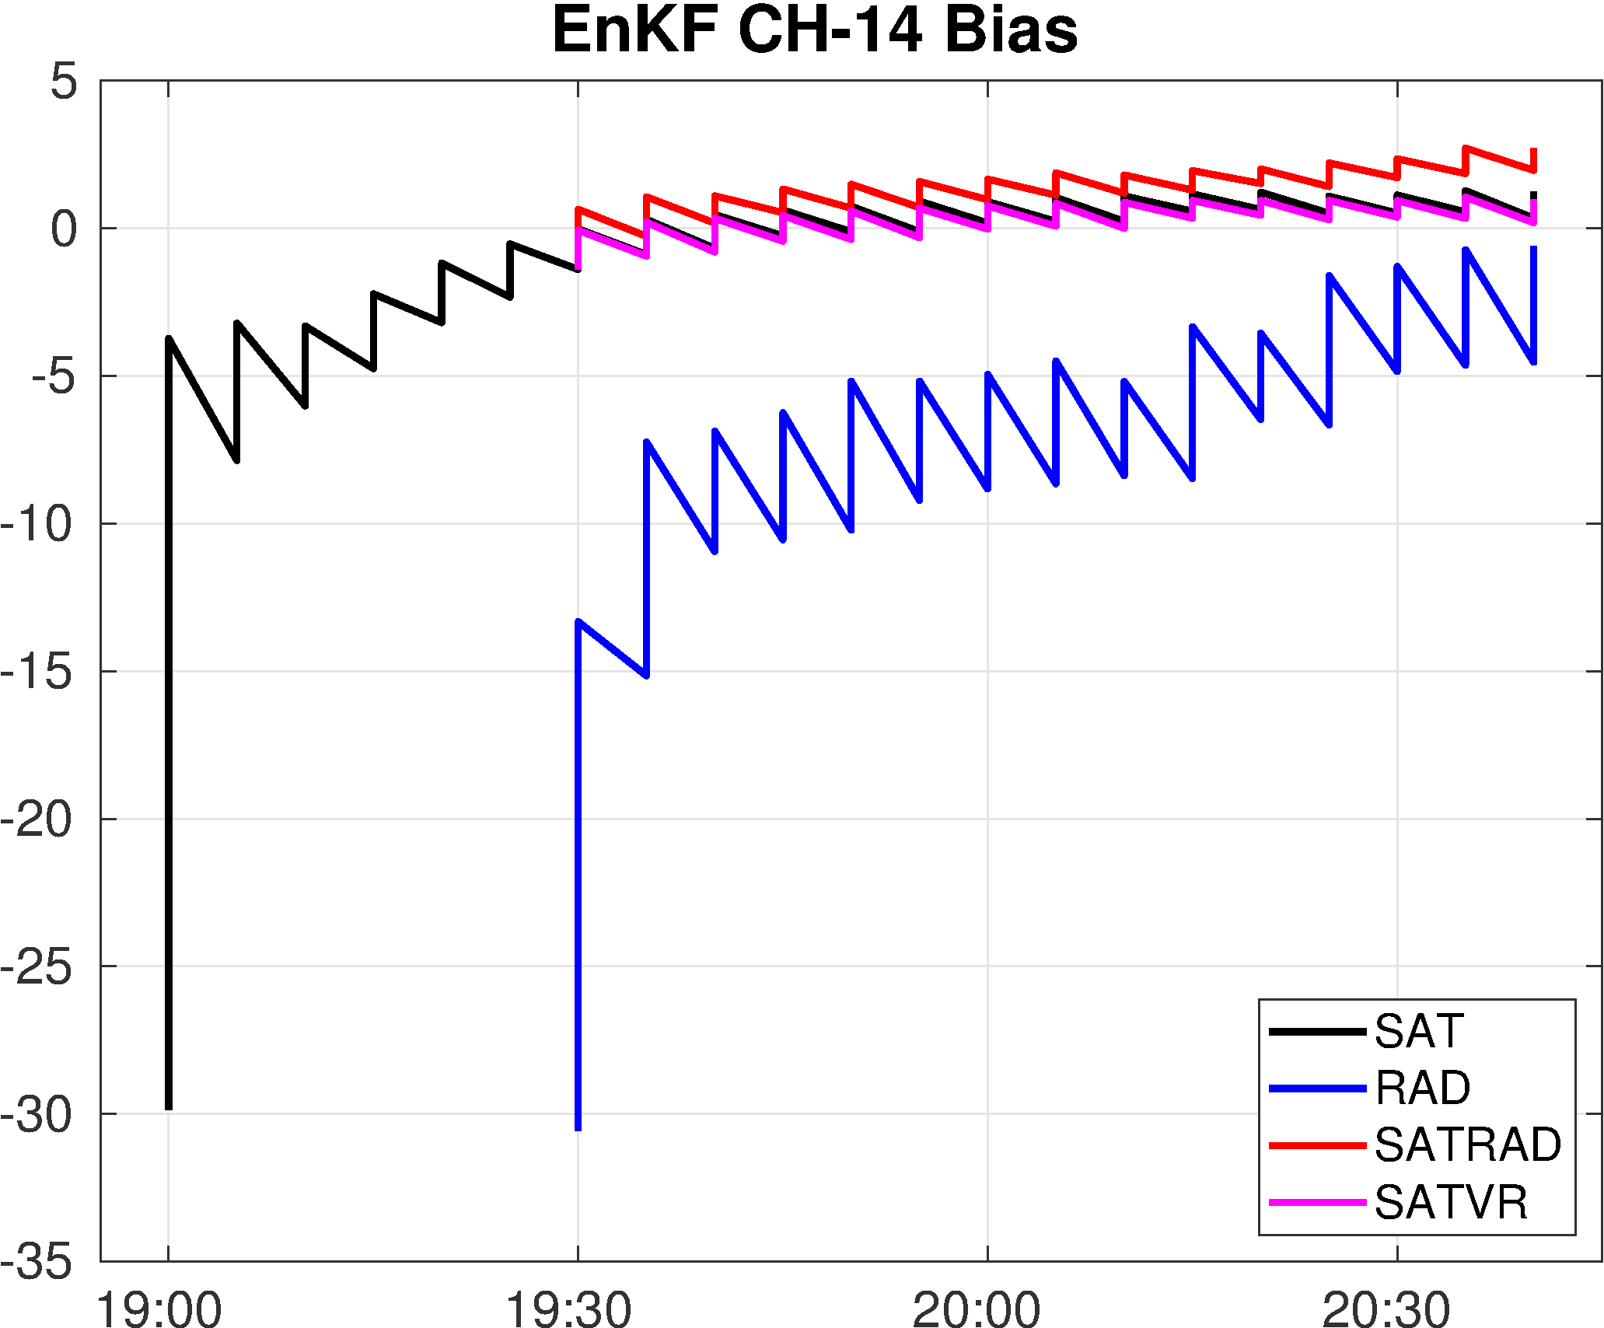
Quantitative Verification

Slide 7
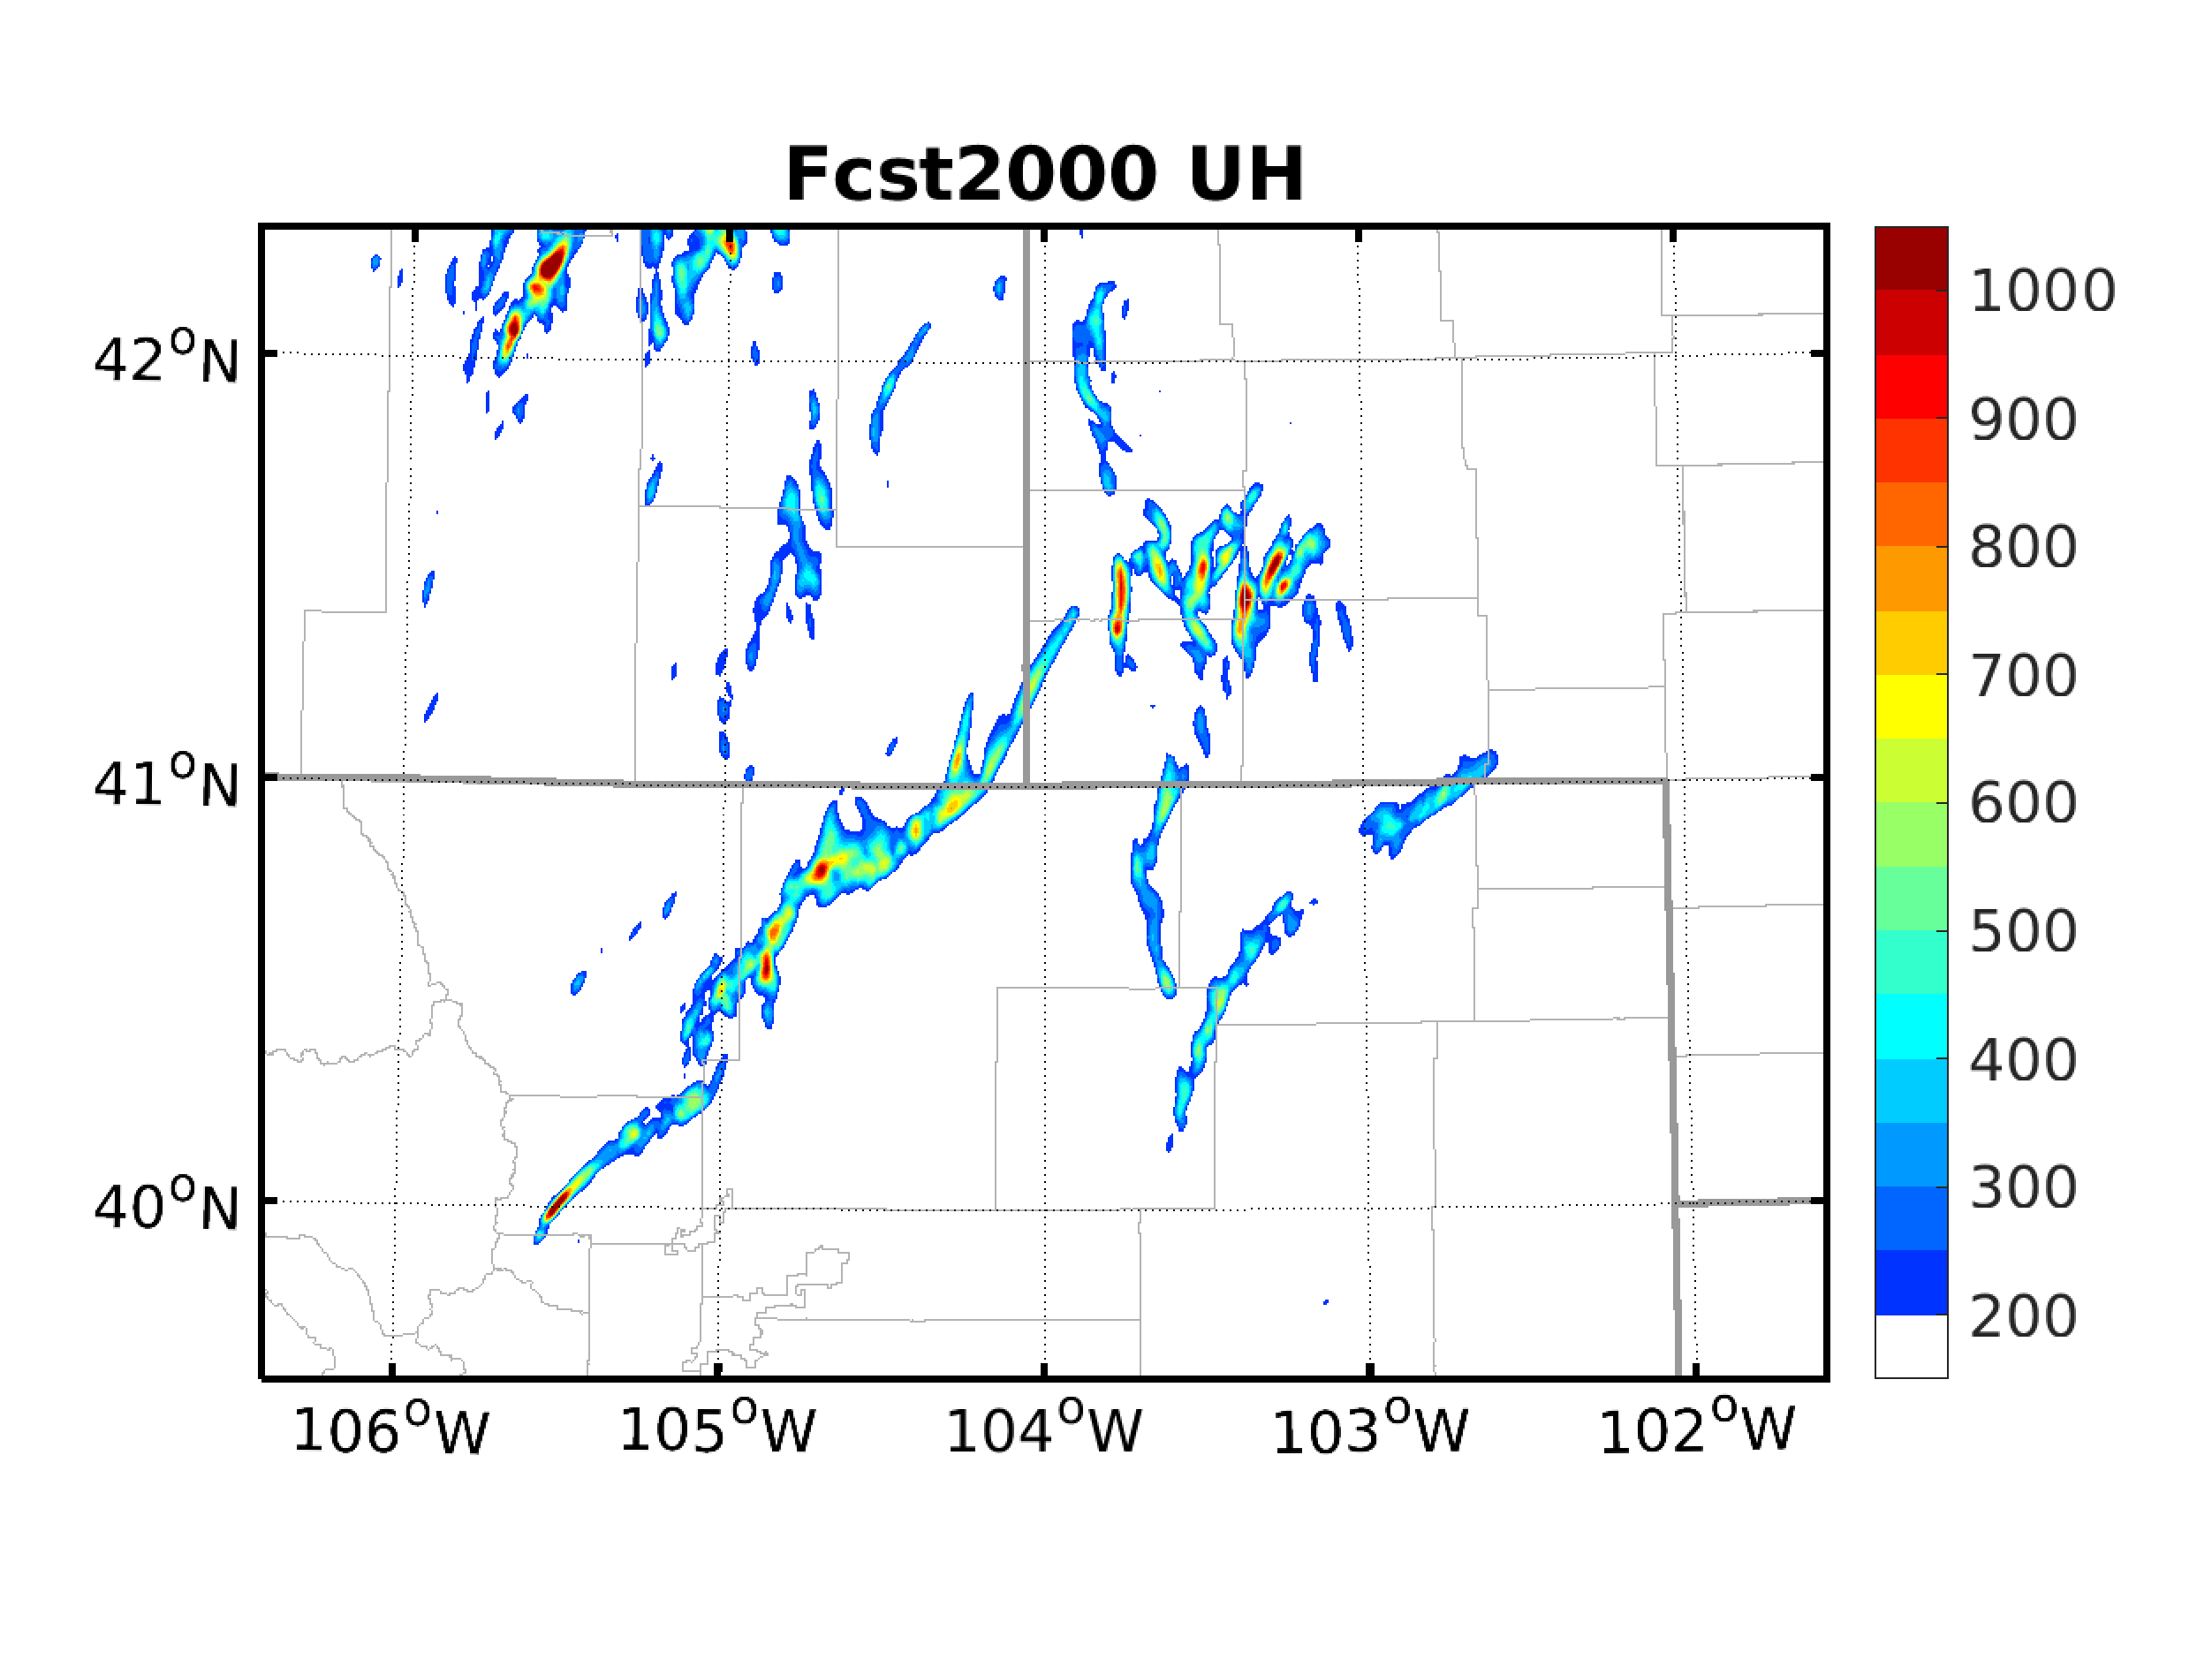
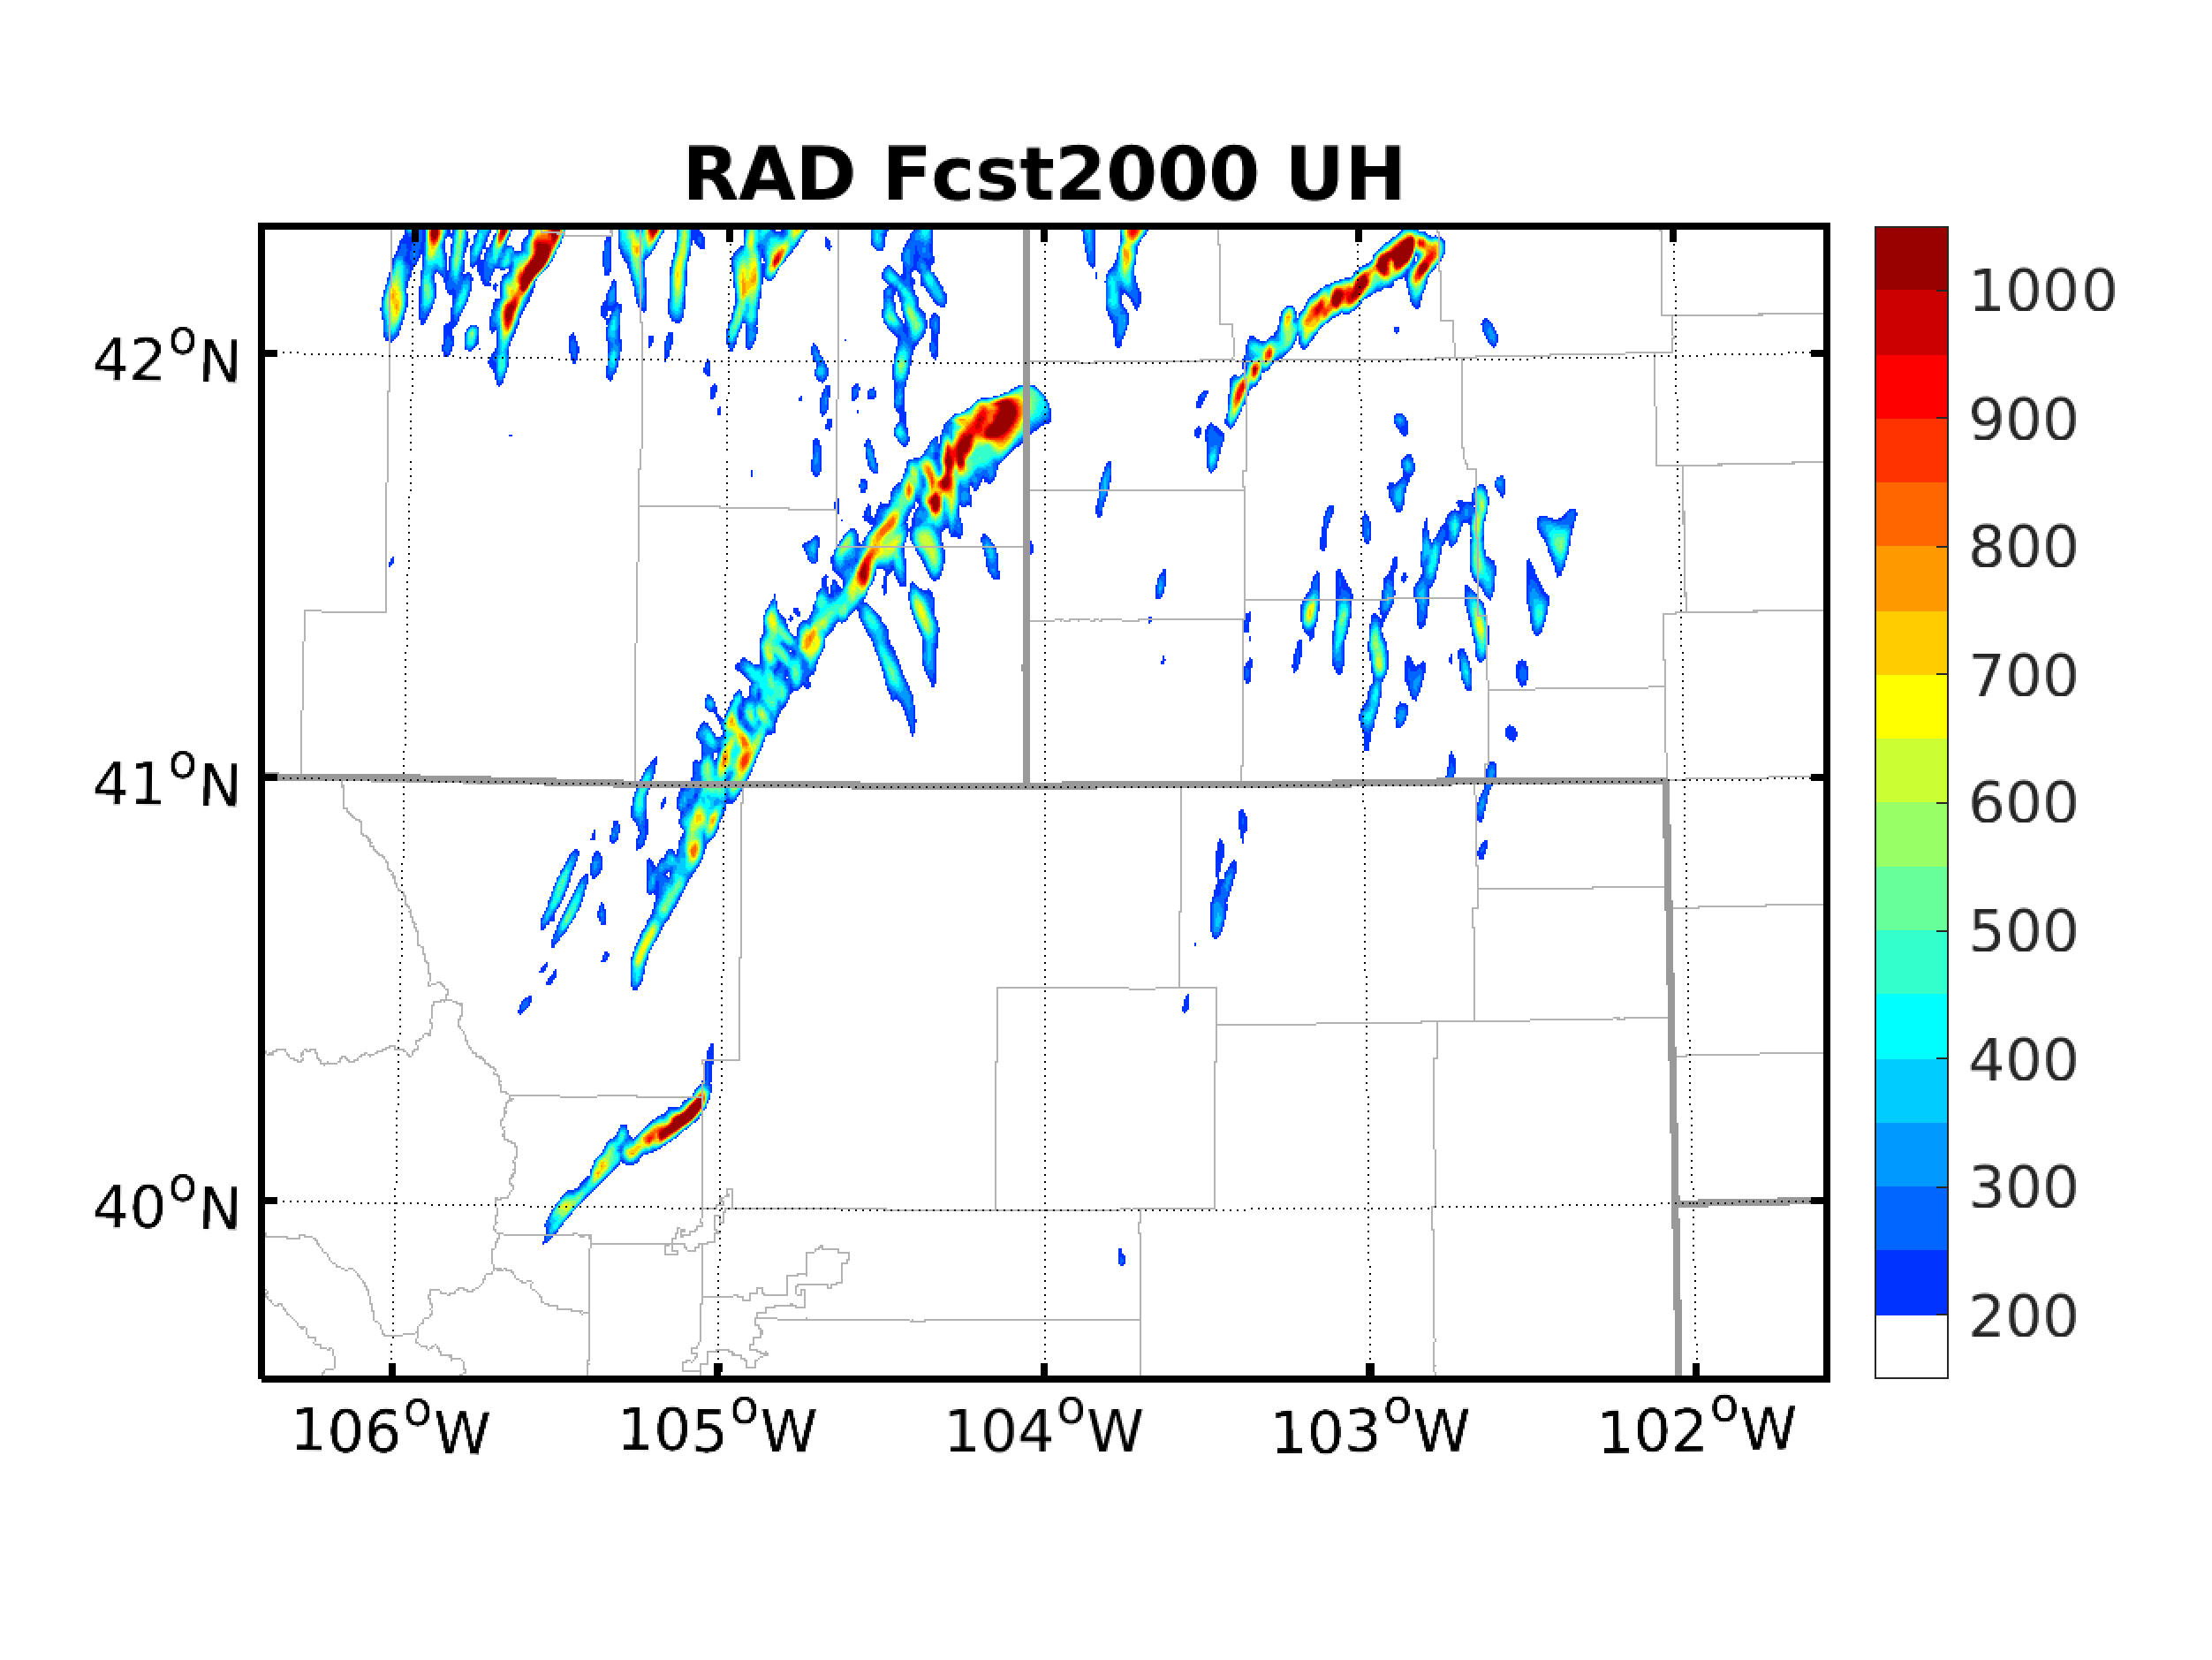
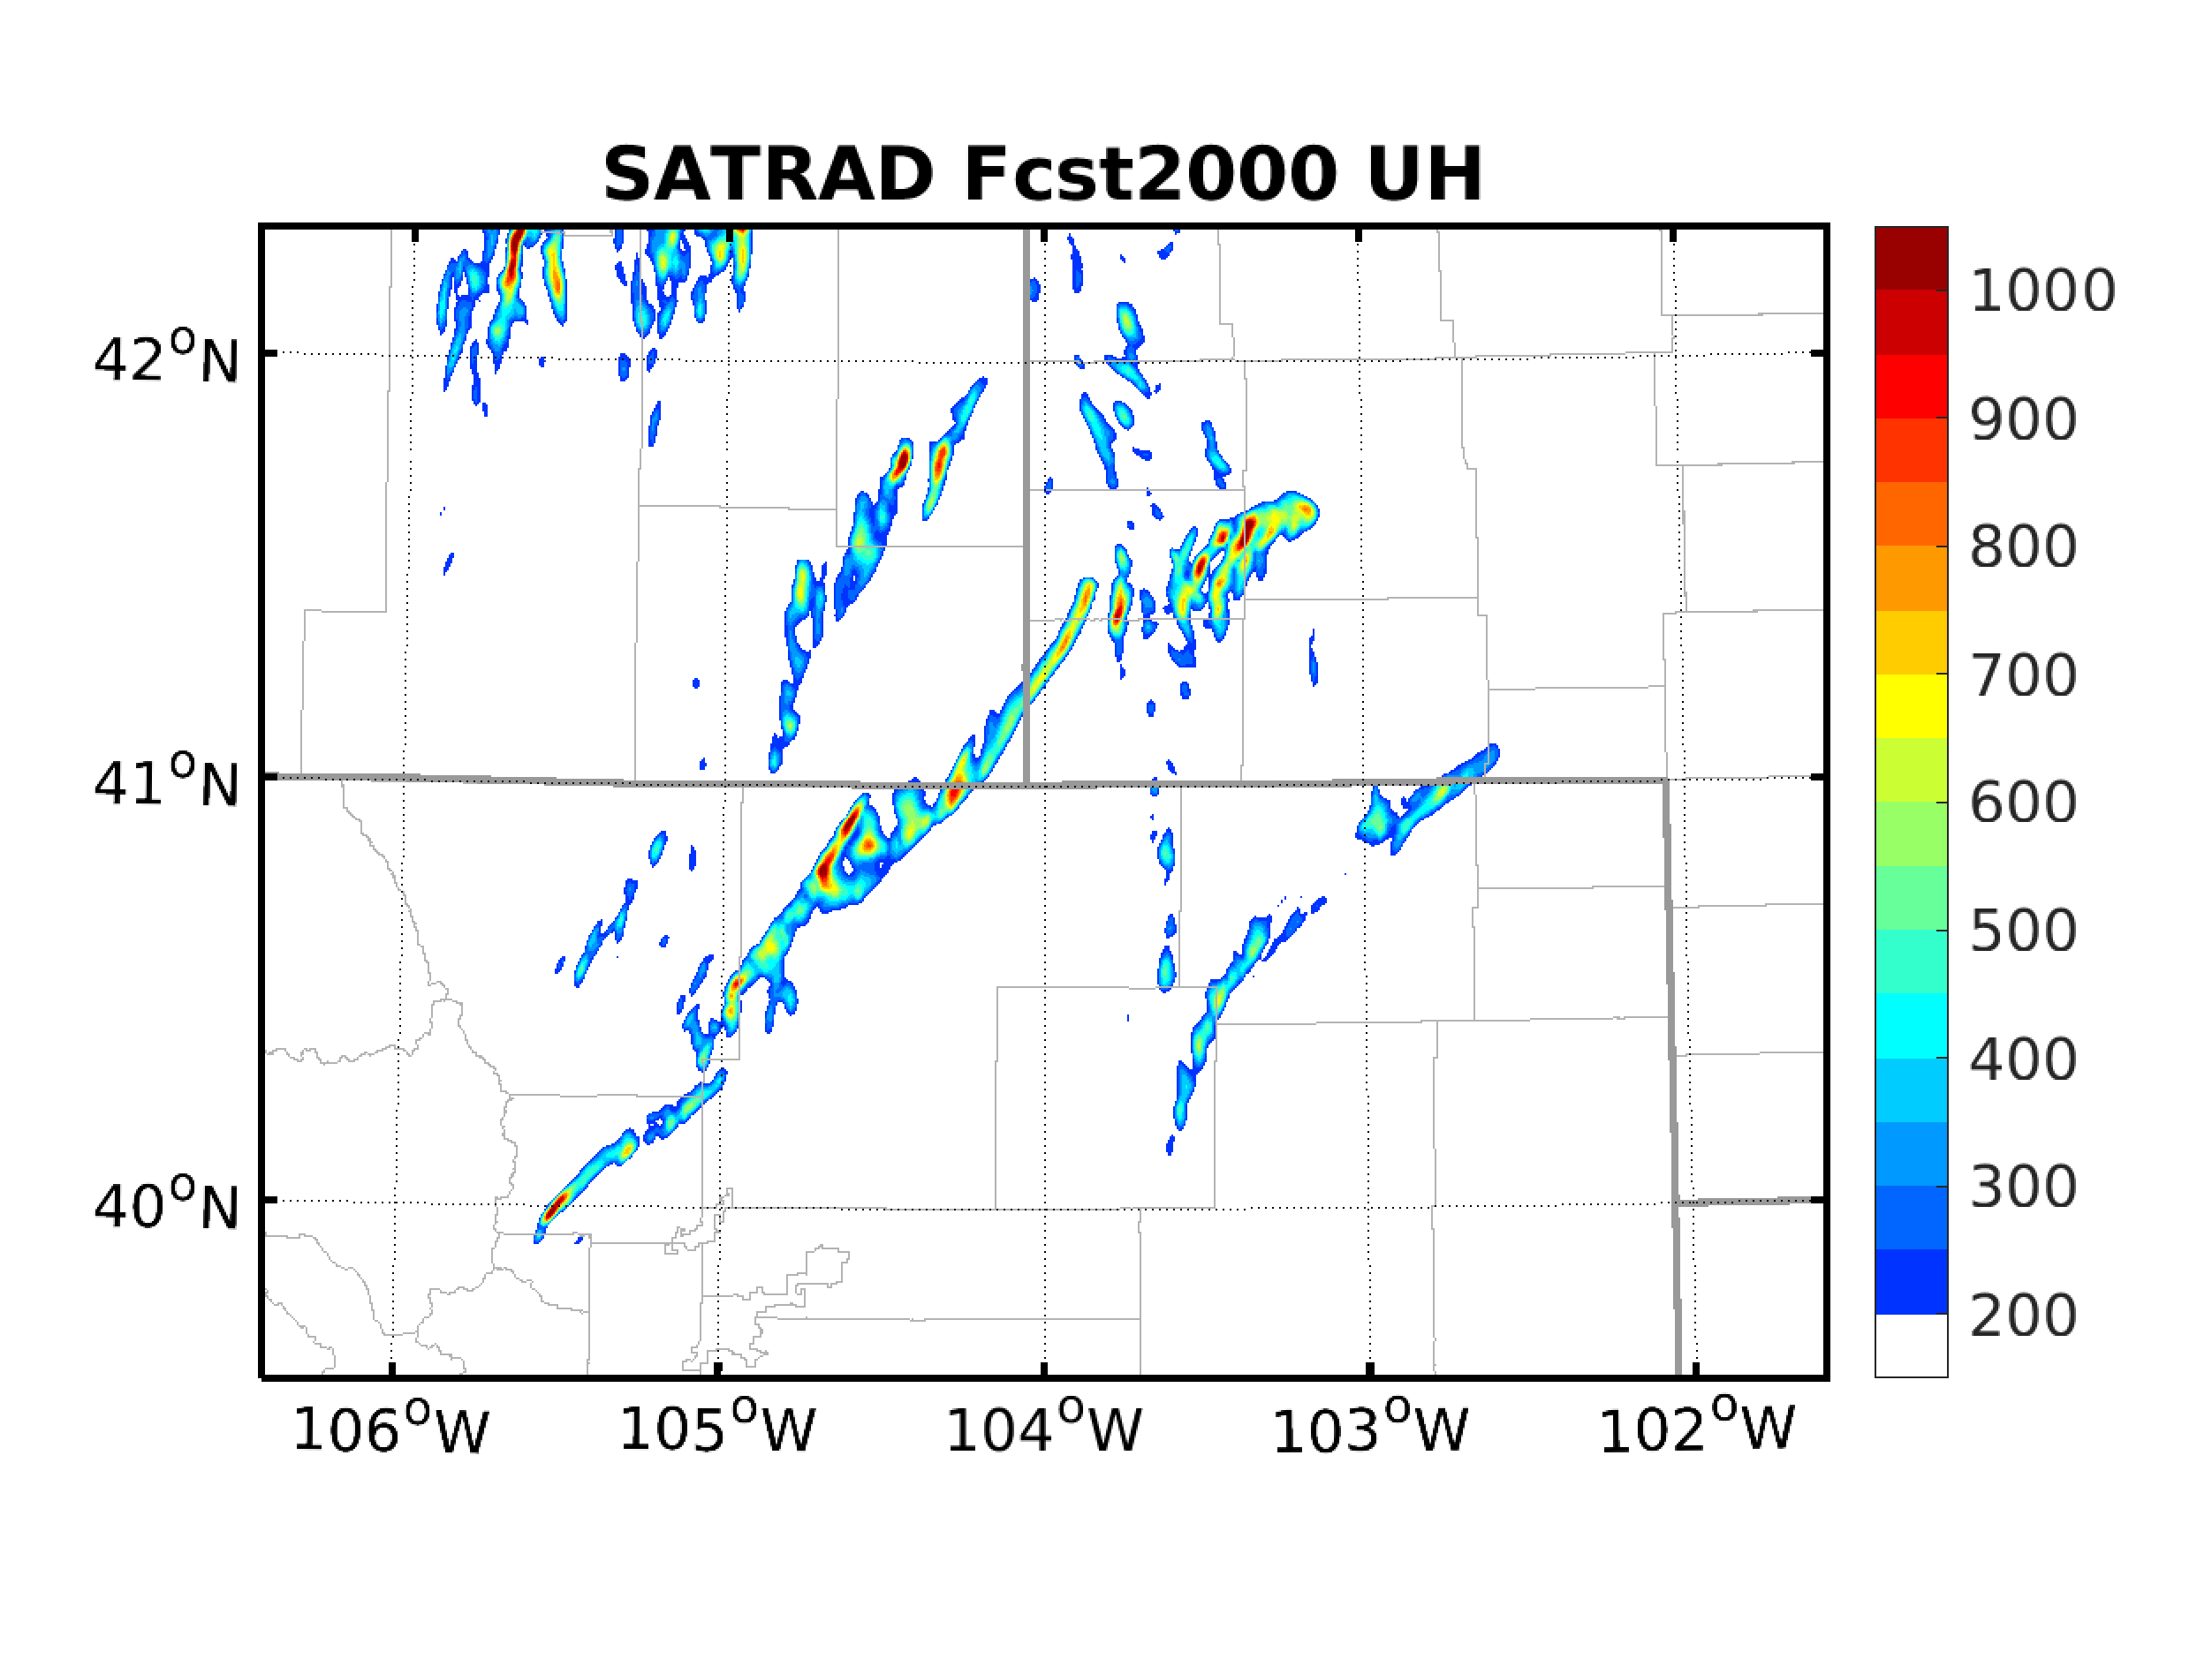
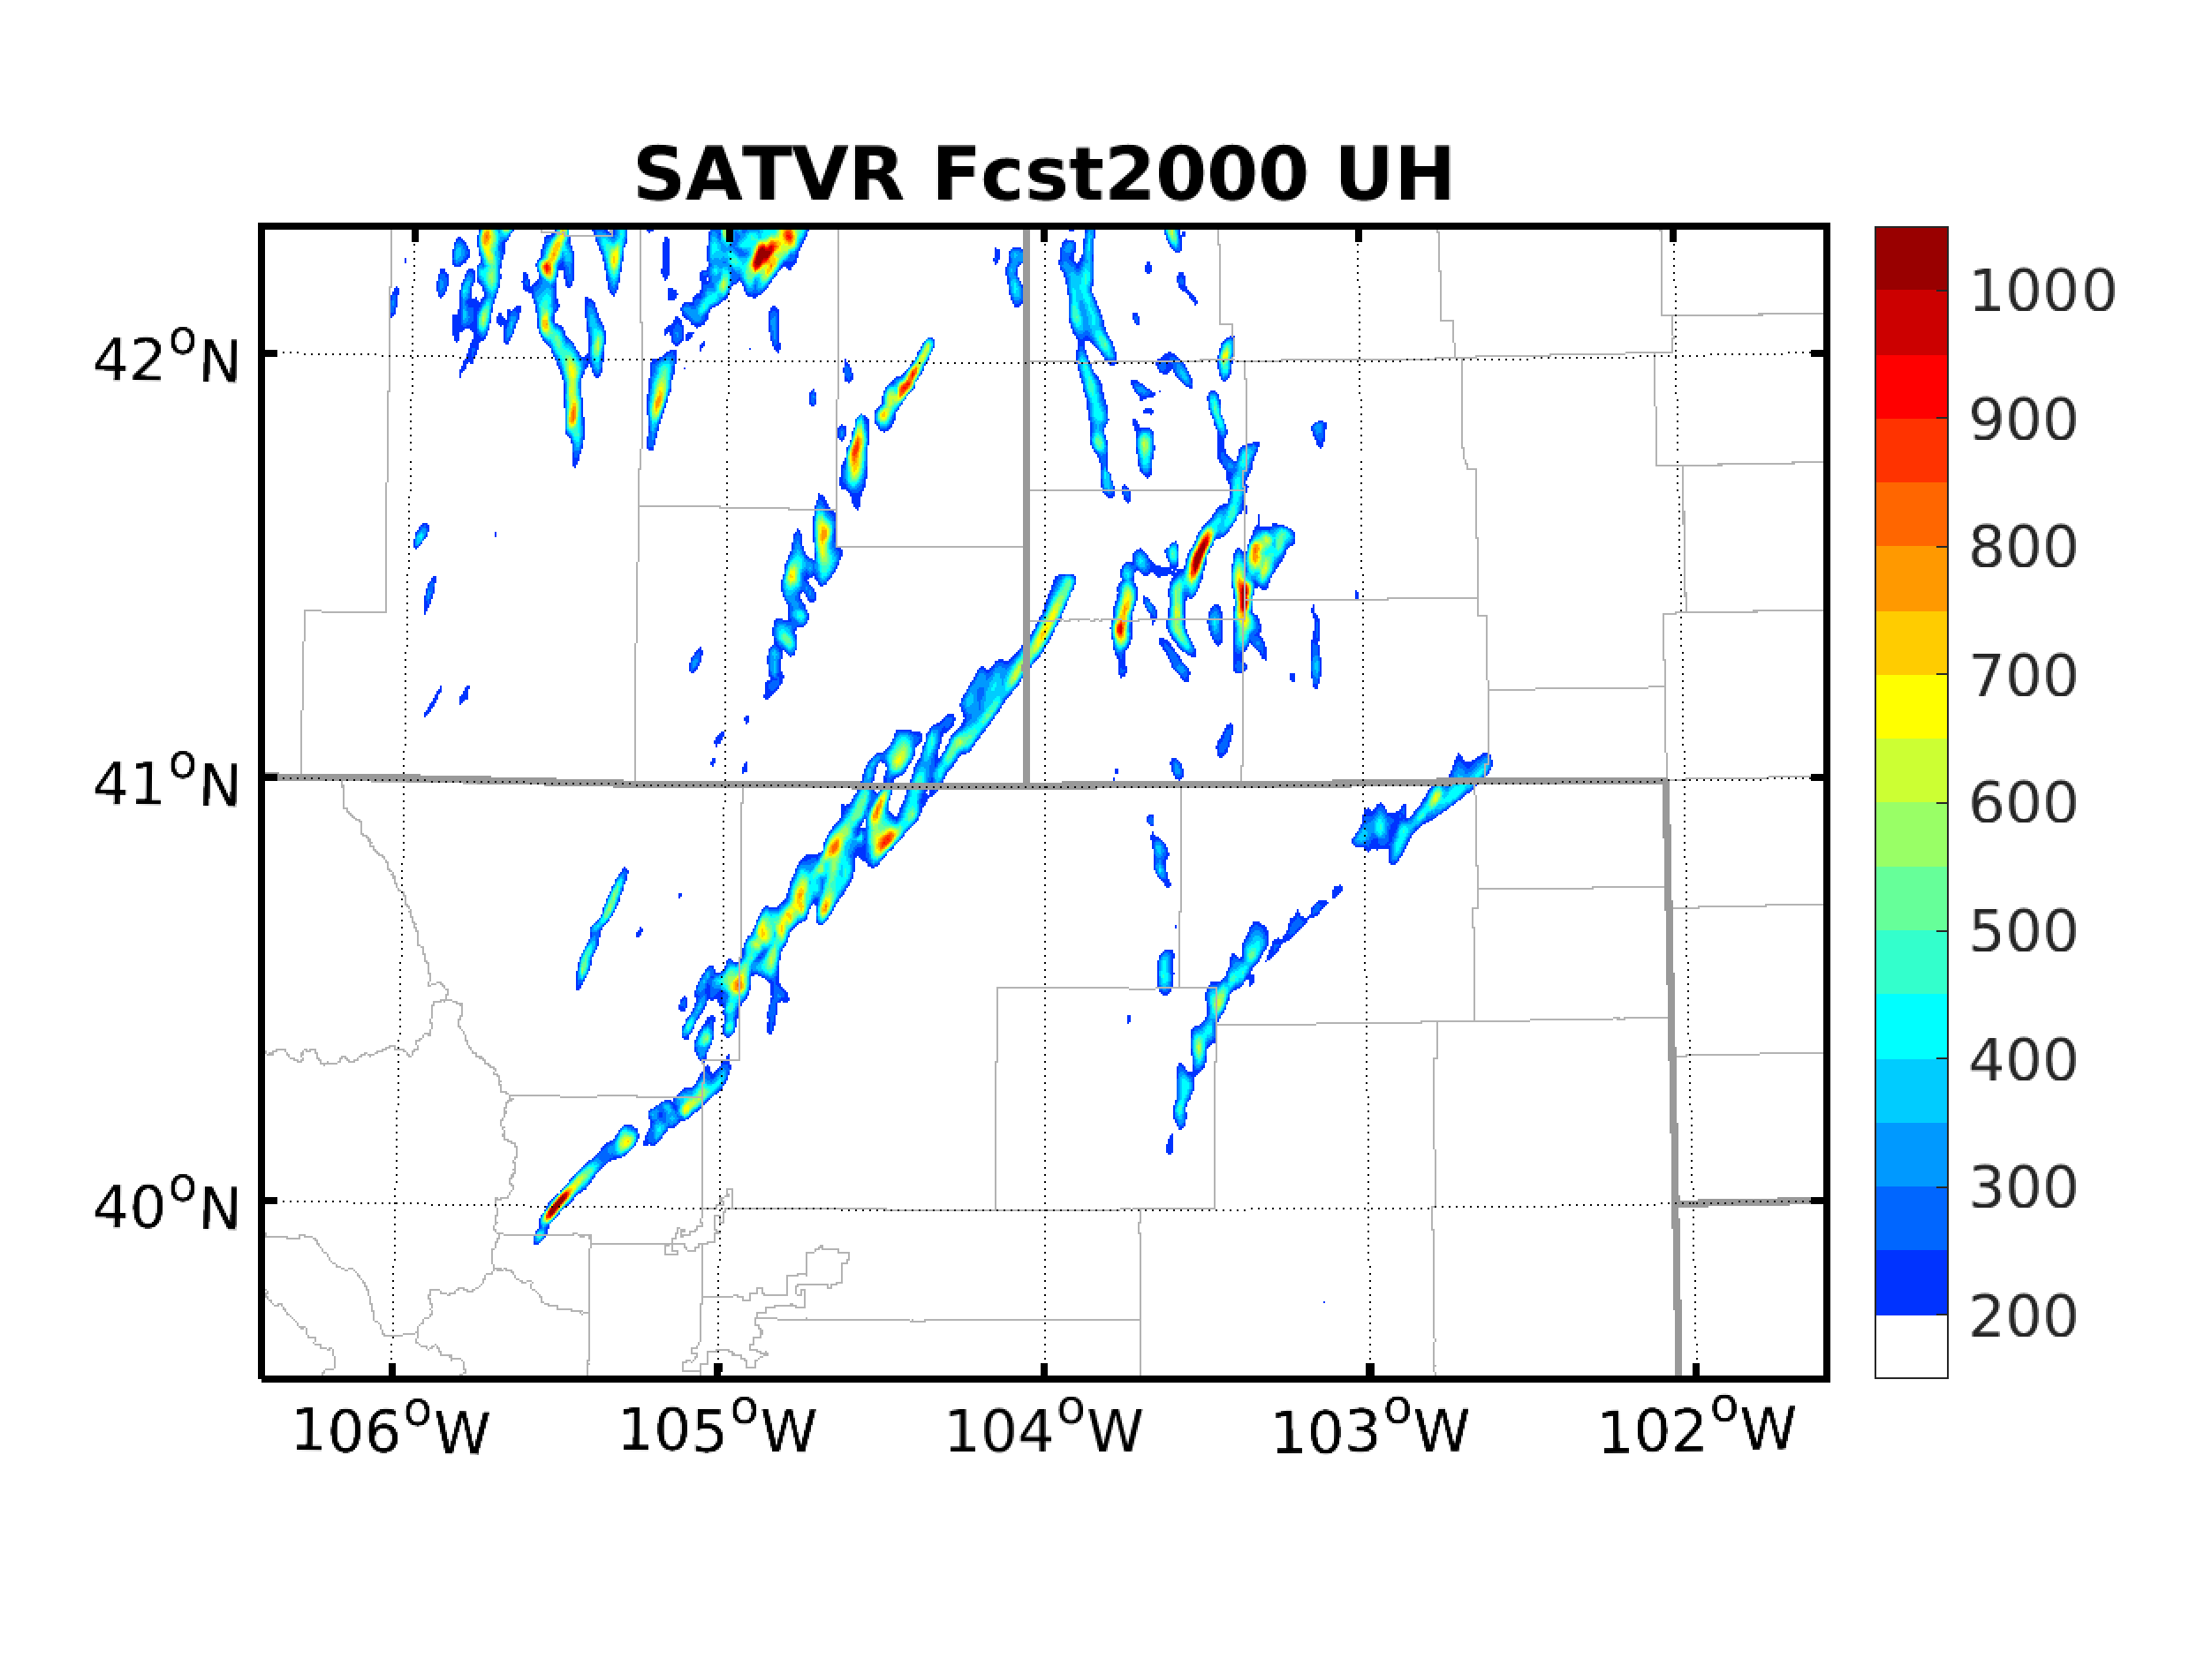
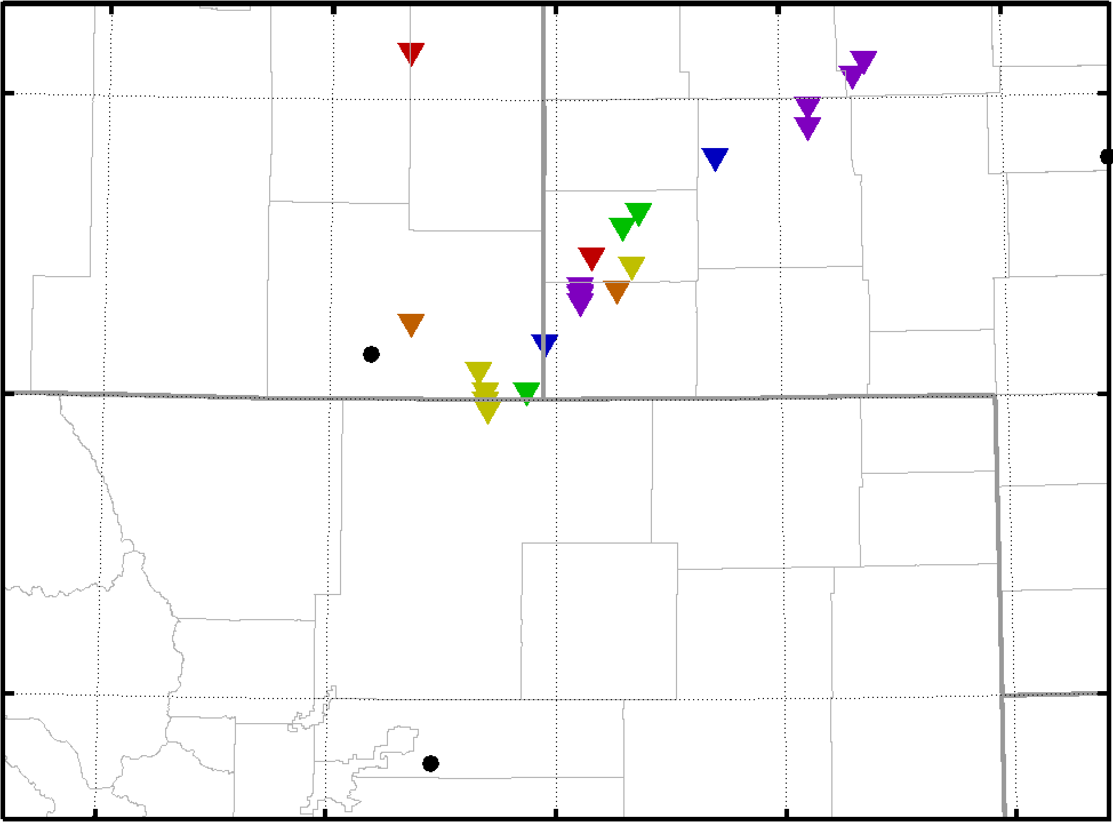
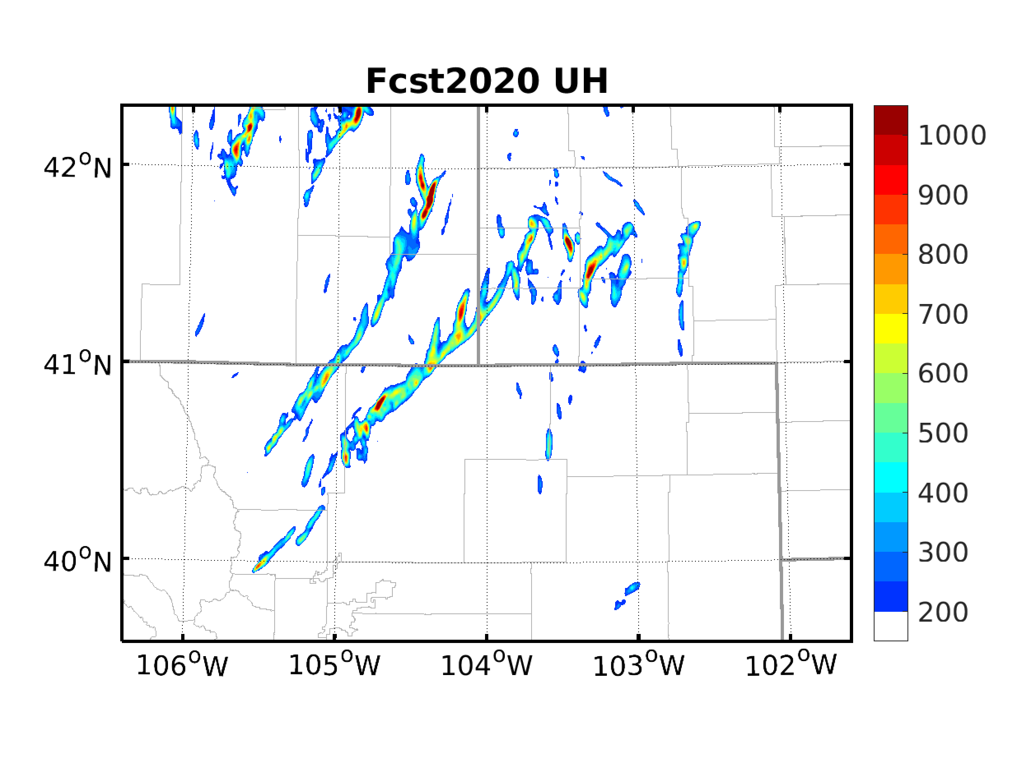
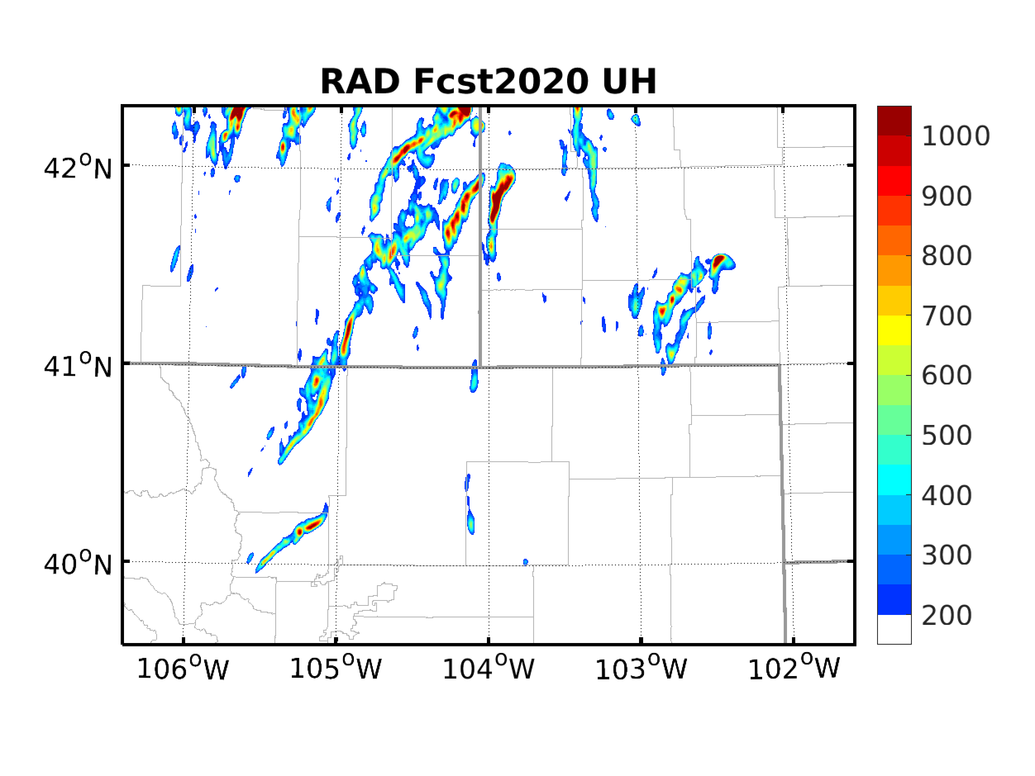
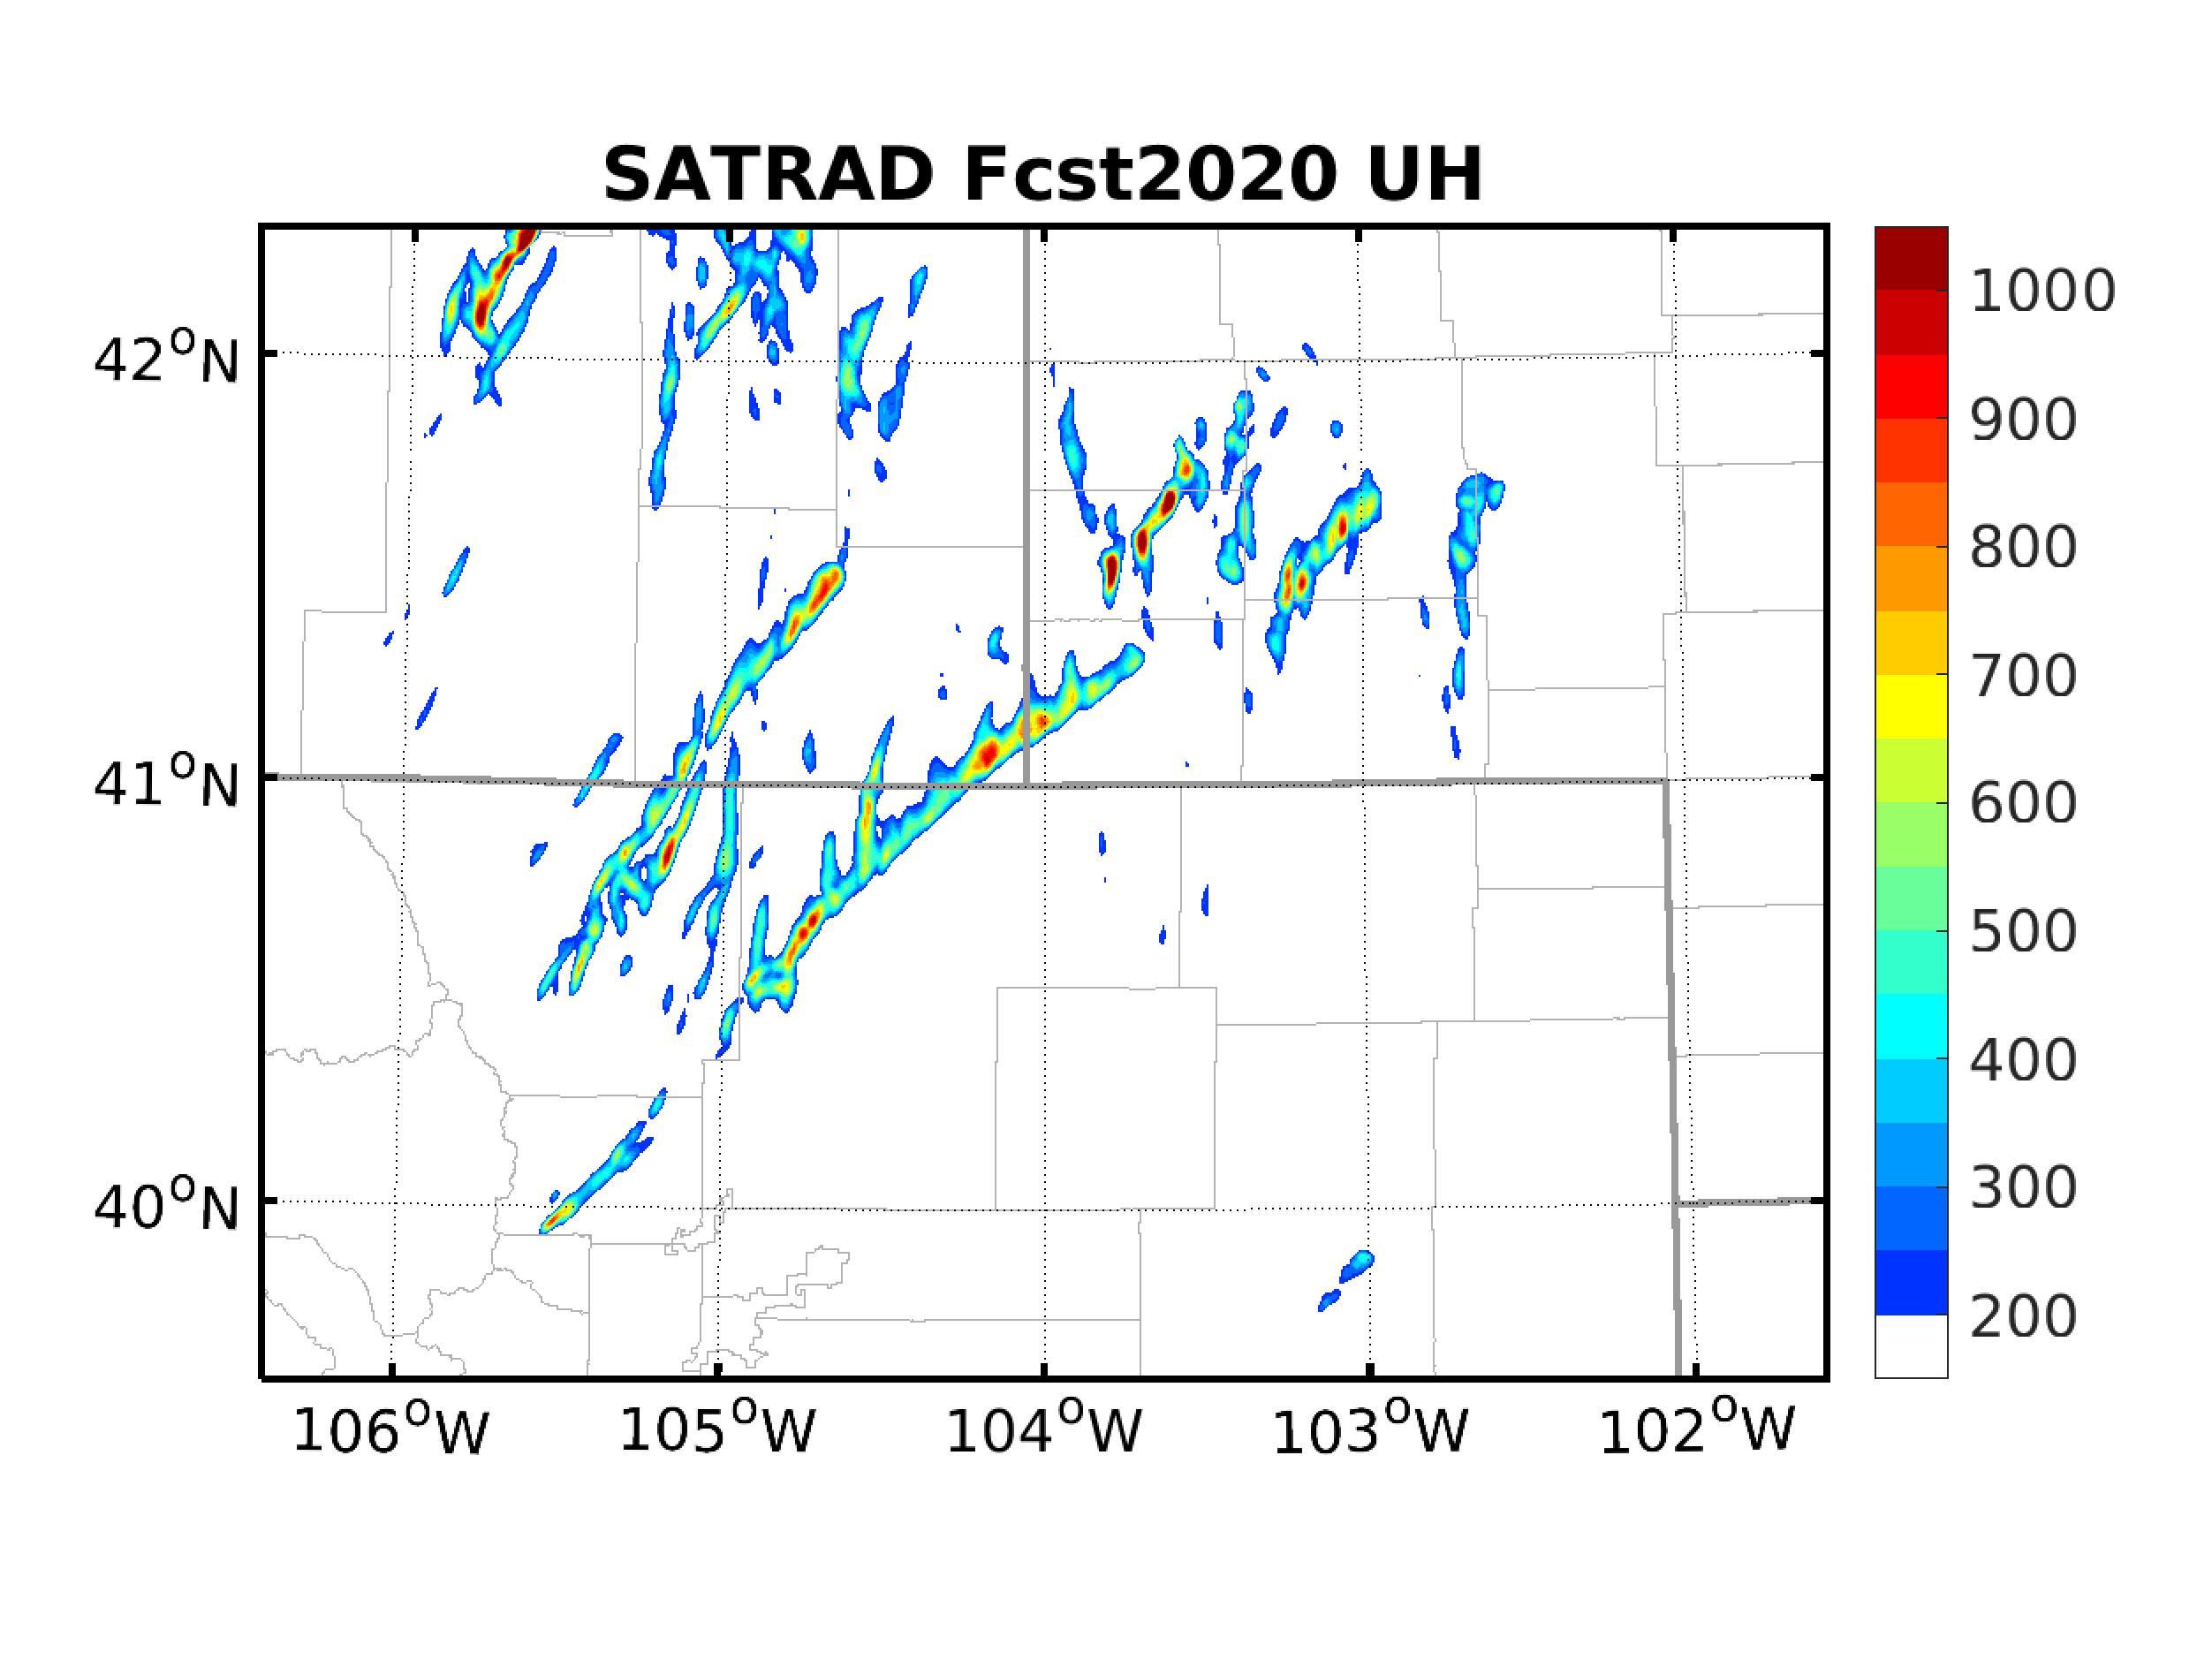
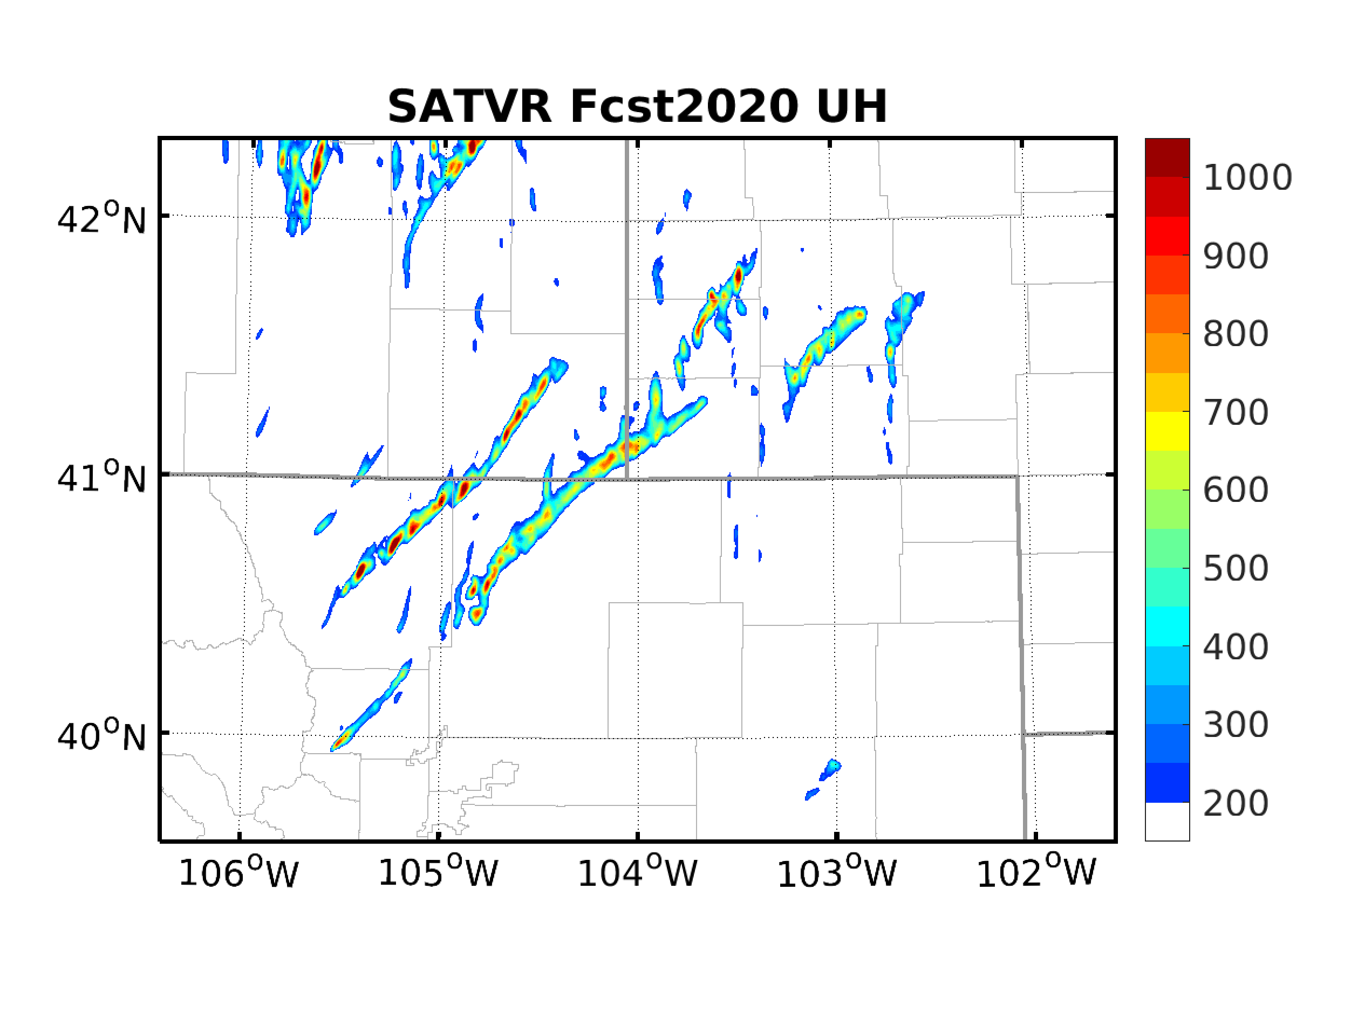
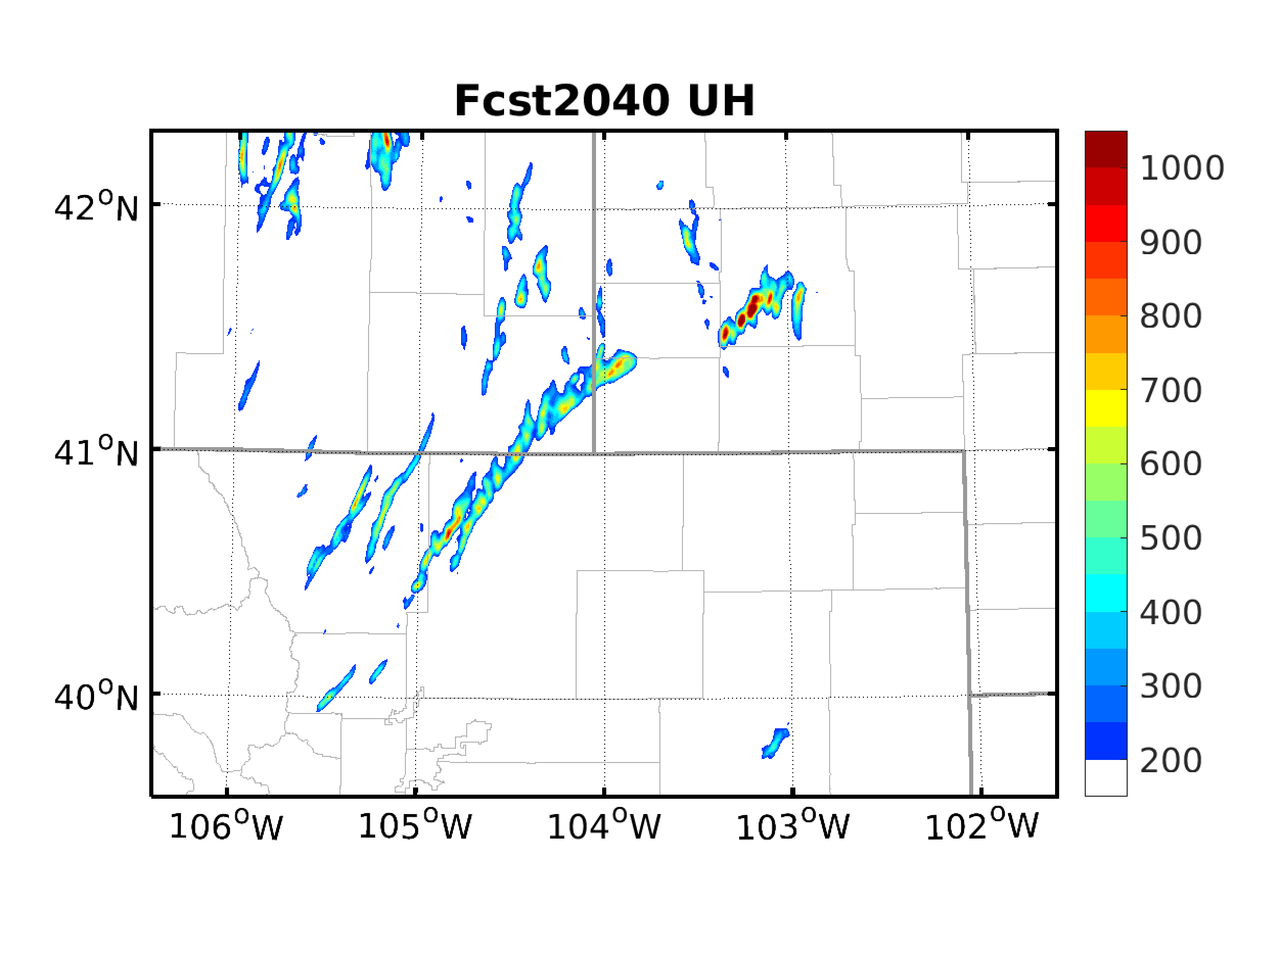
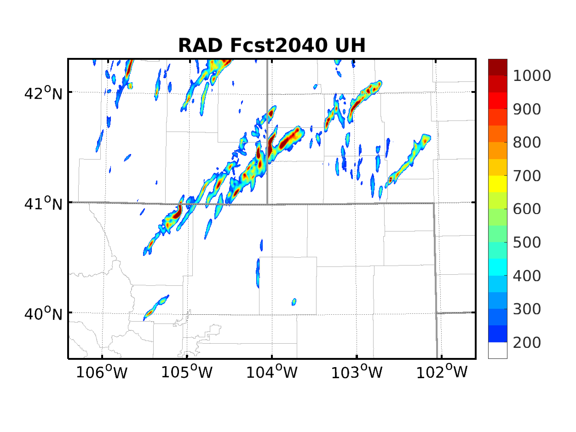
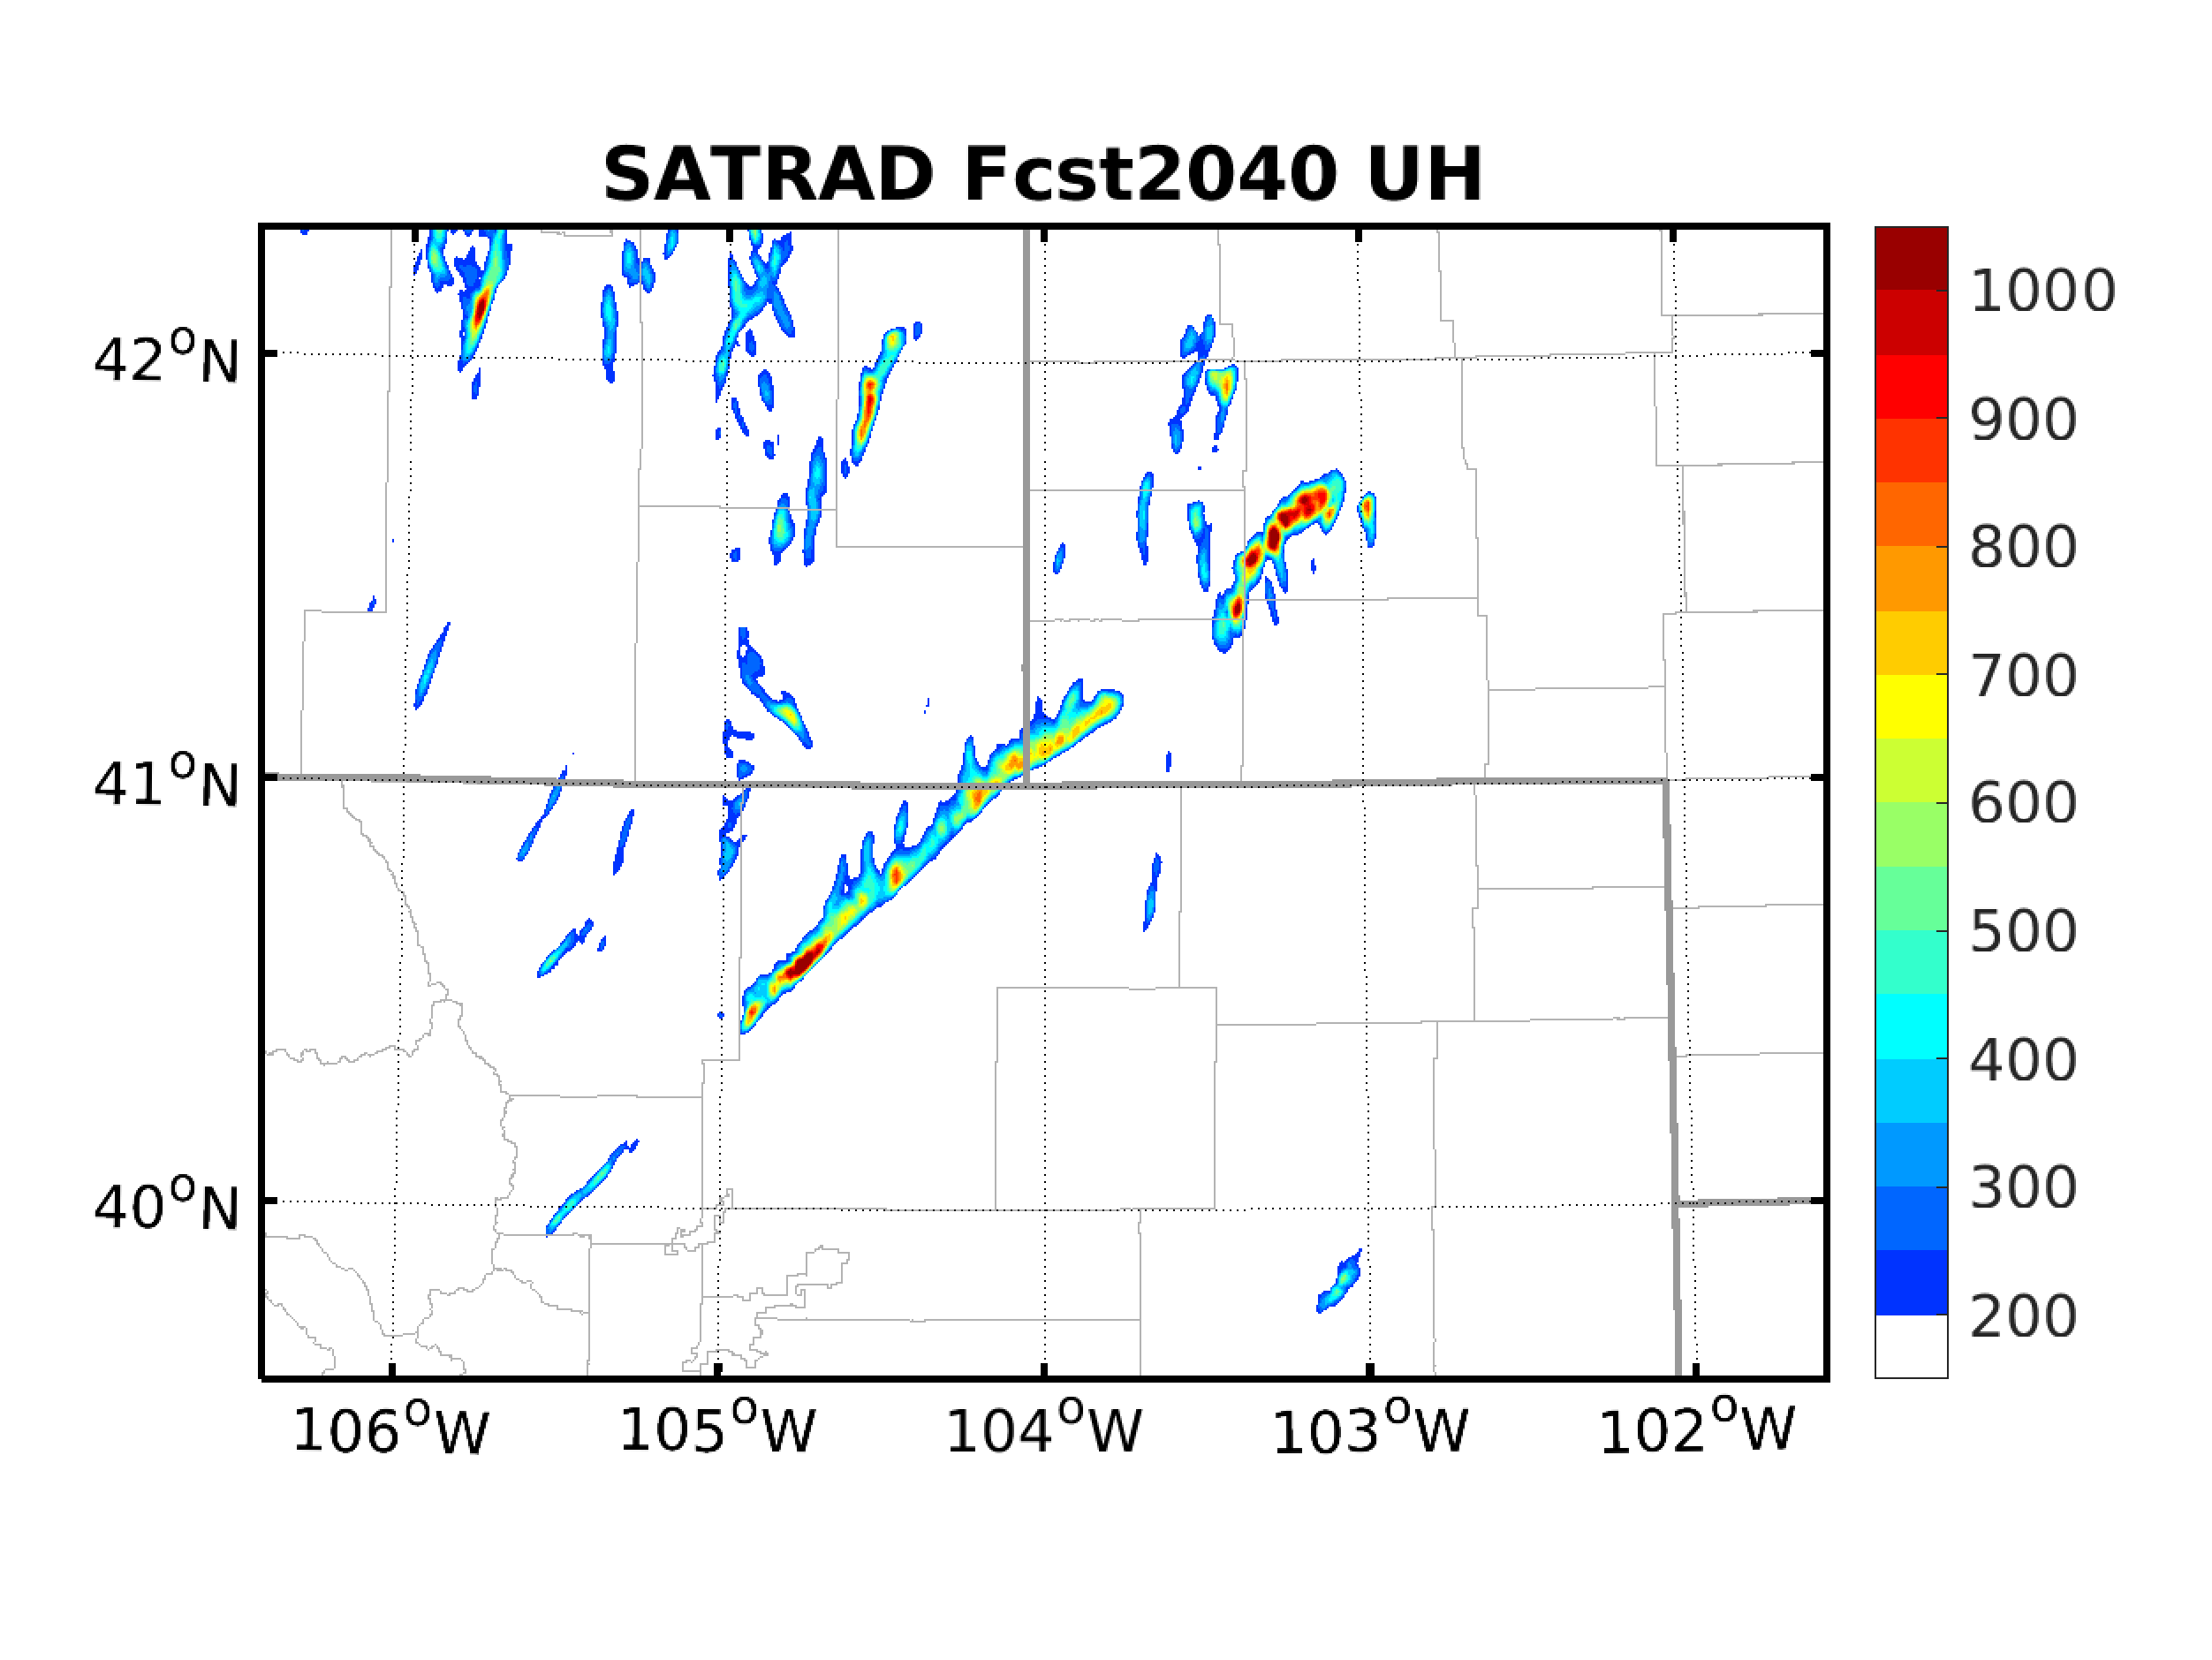
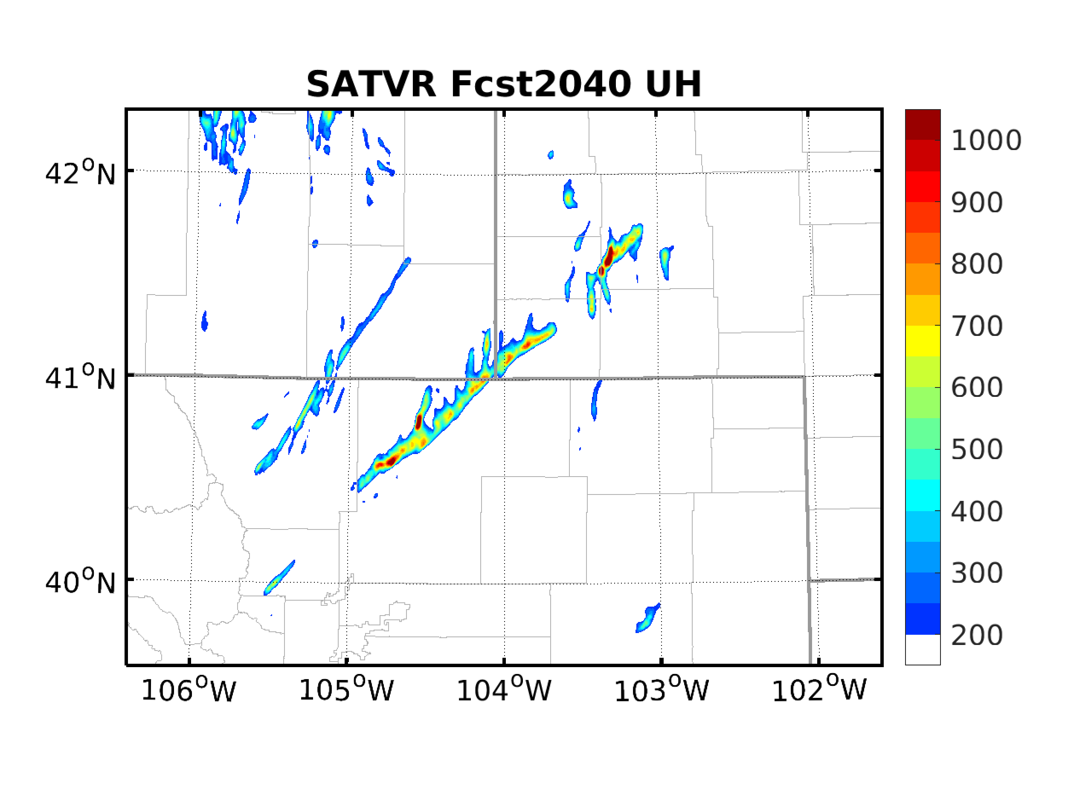
Comparison of Deter. UH Fcst.

Slide 8
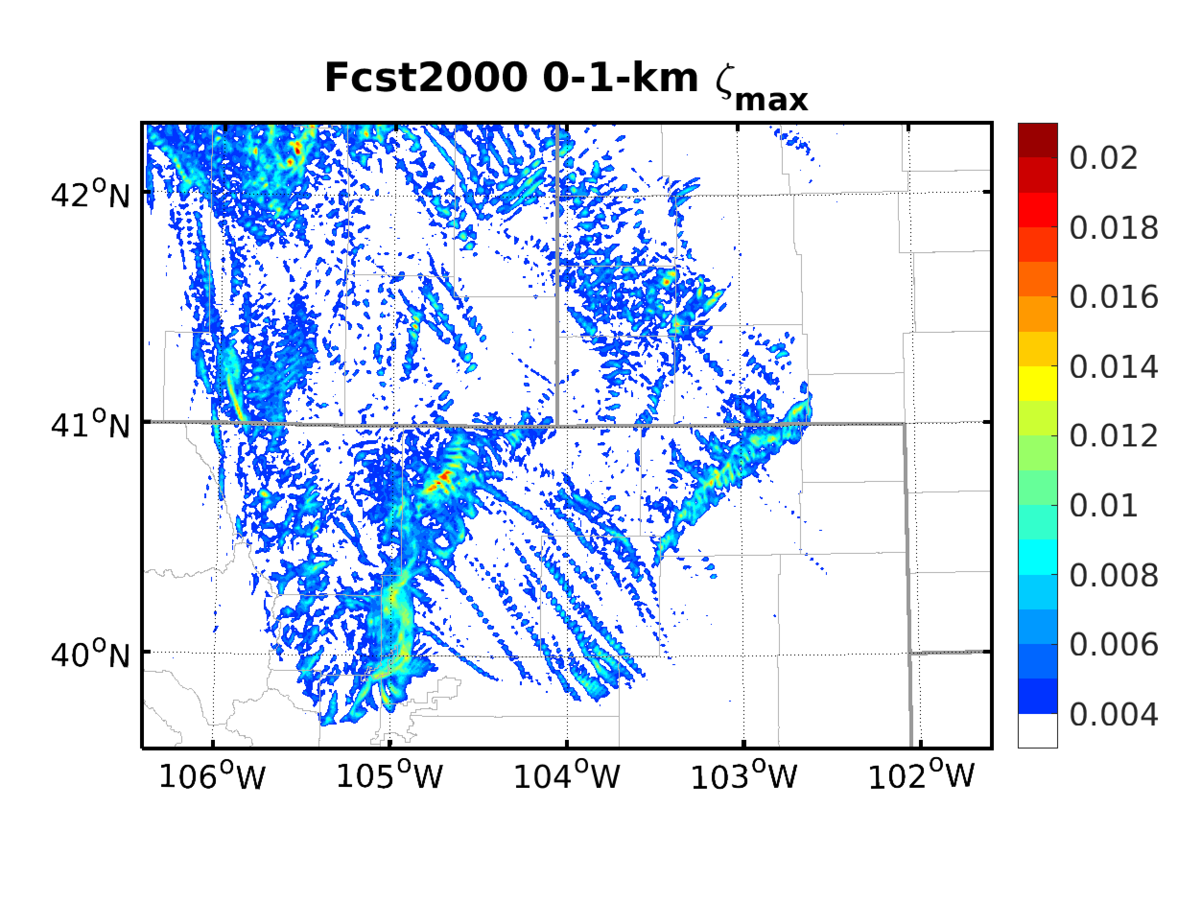
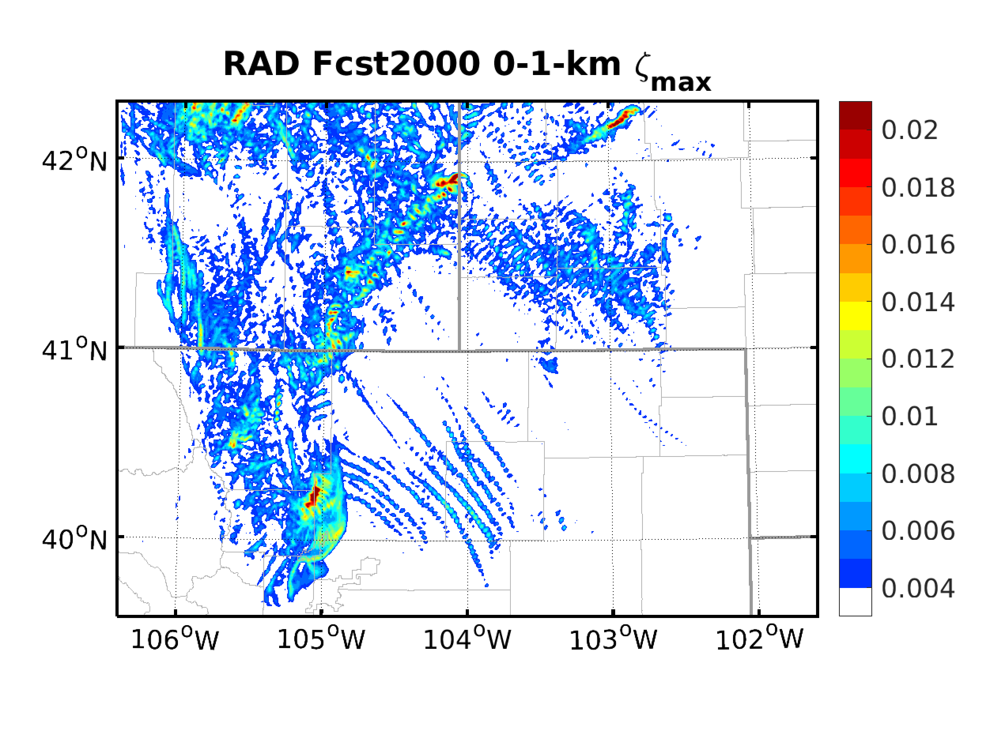
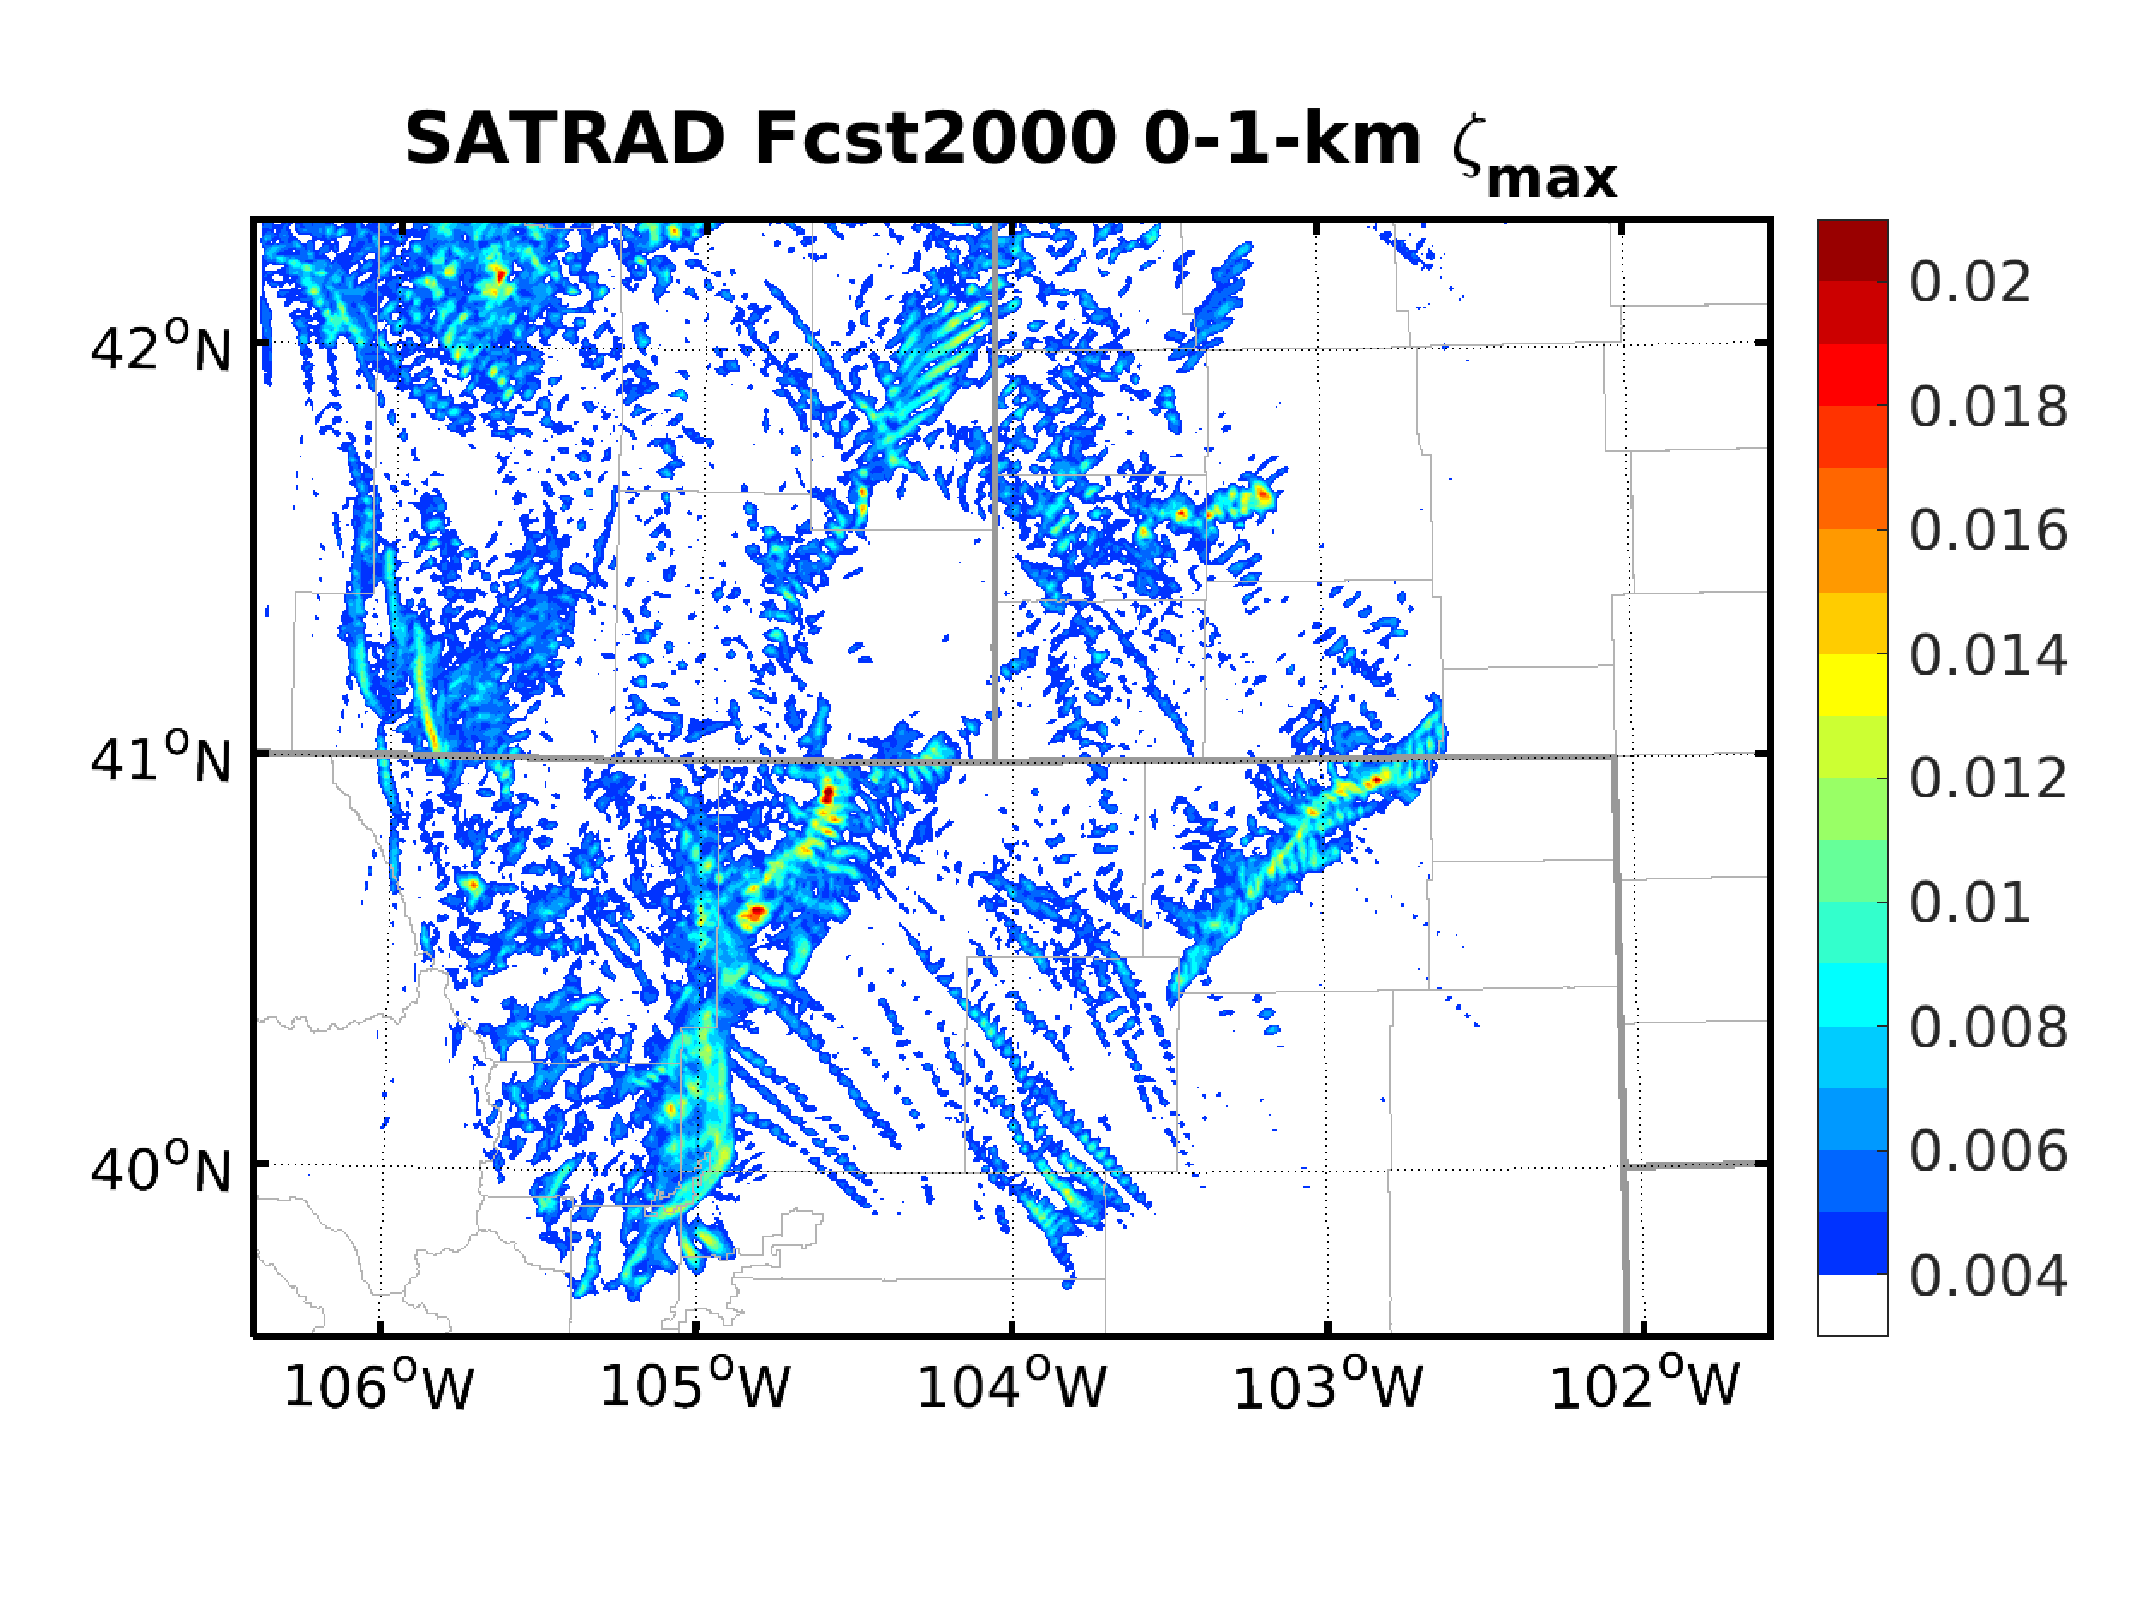
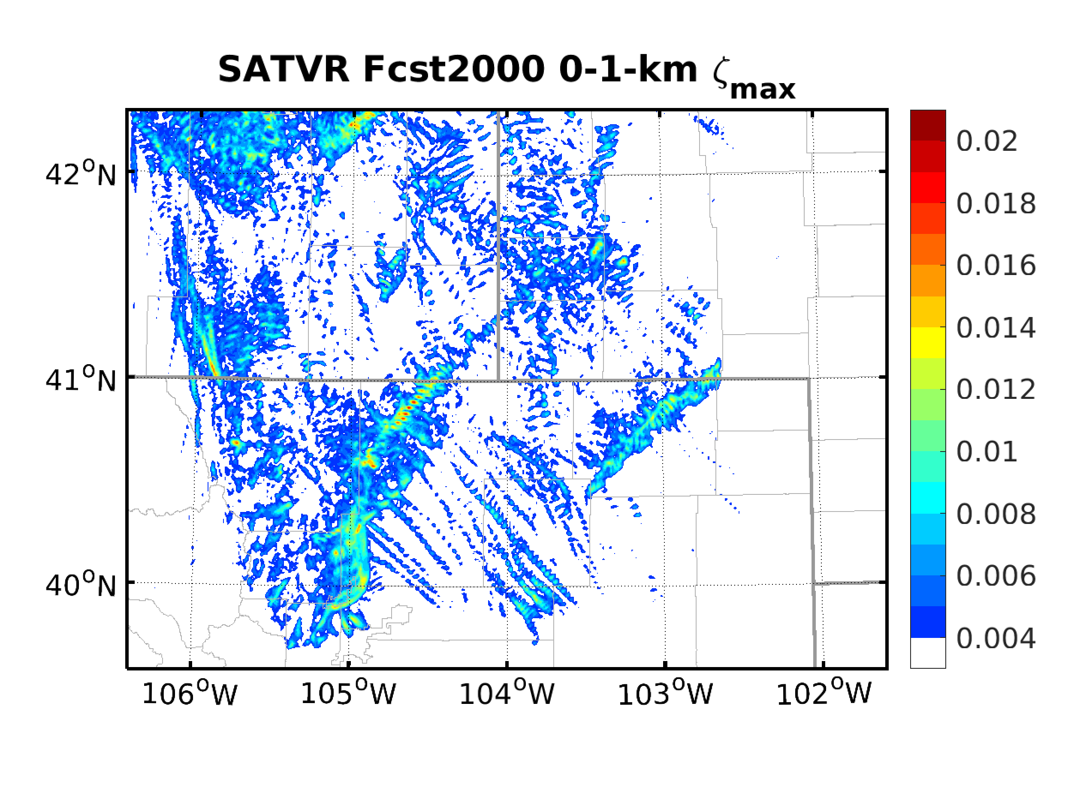
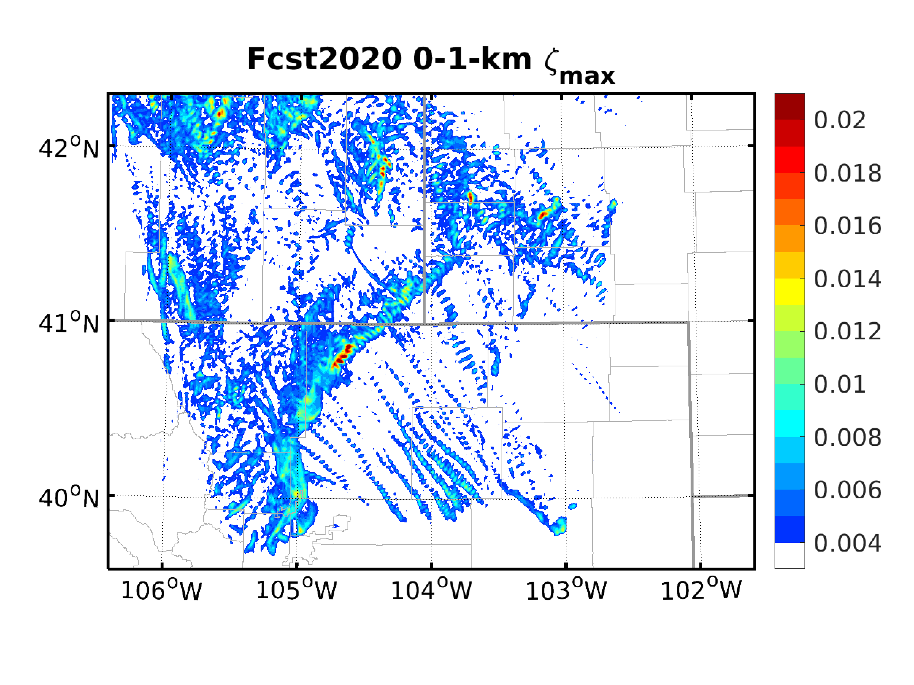
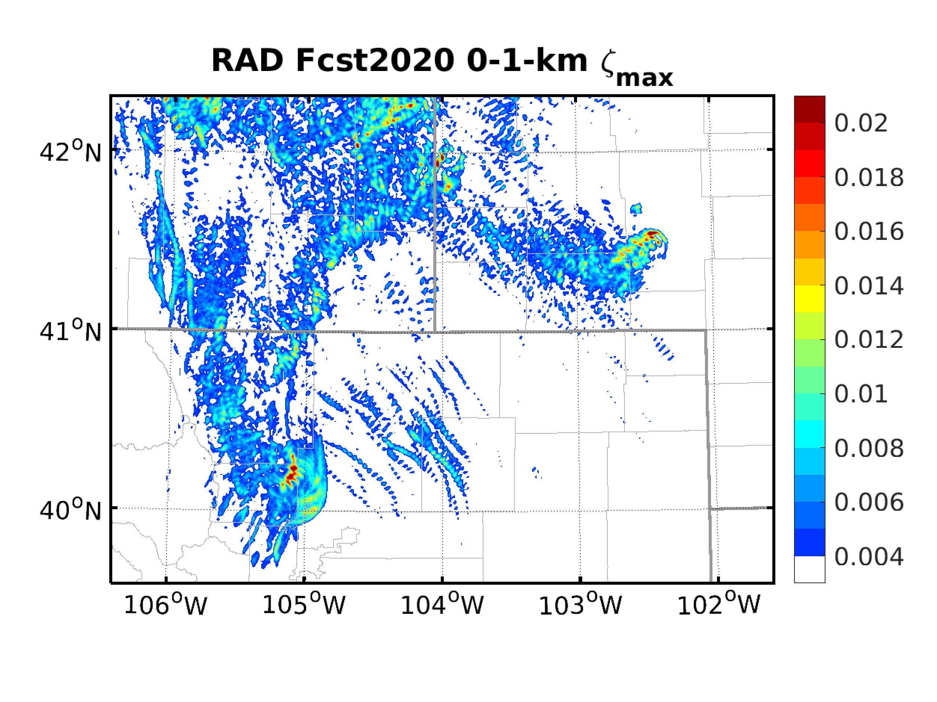
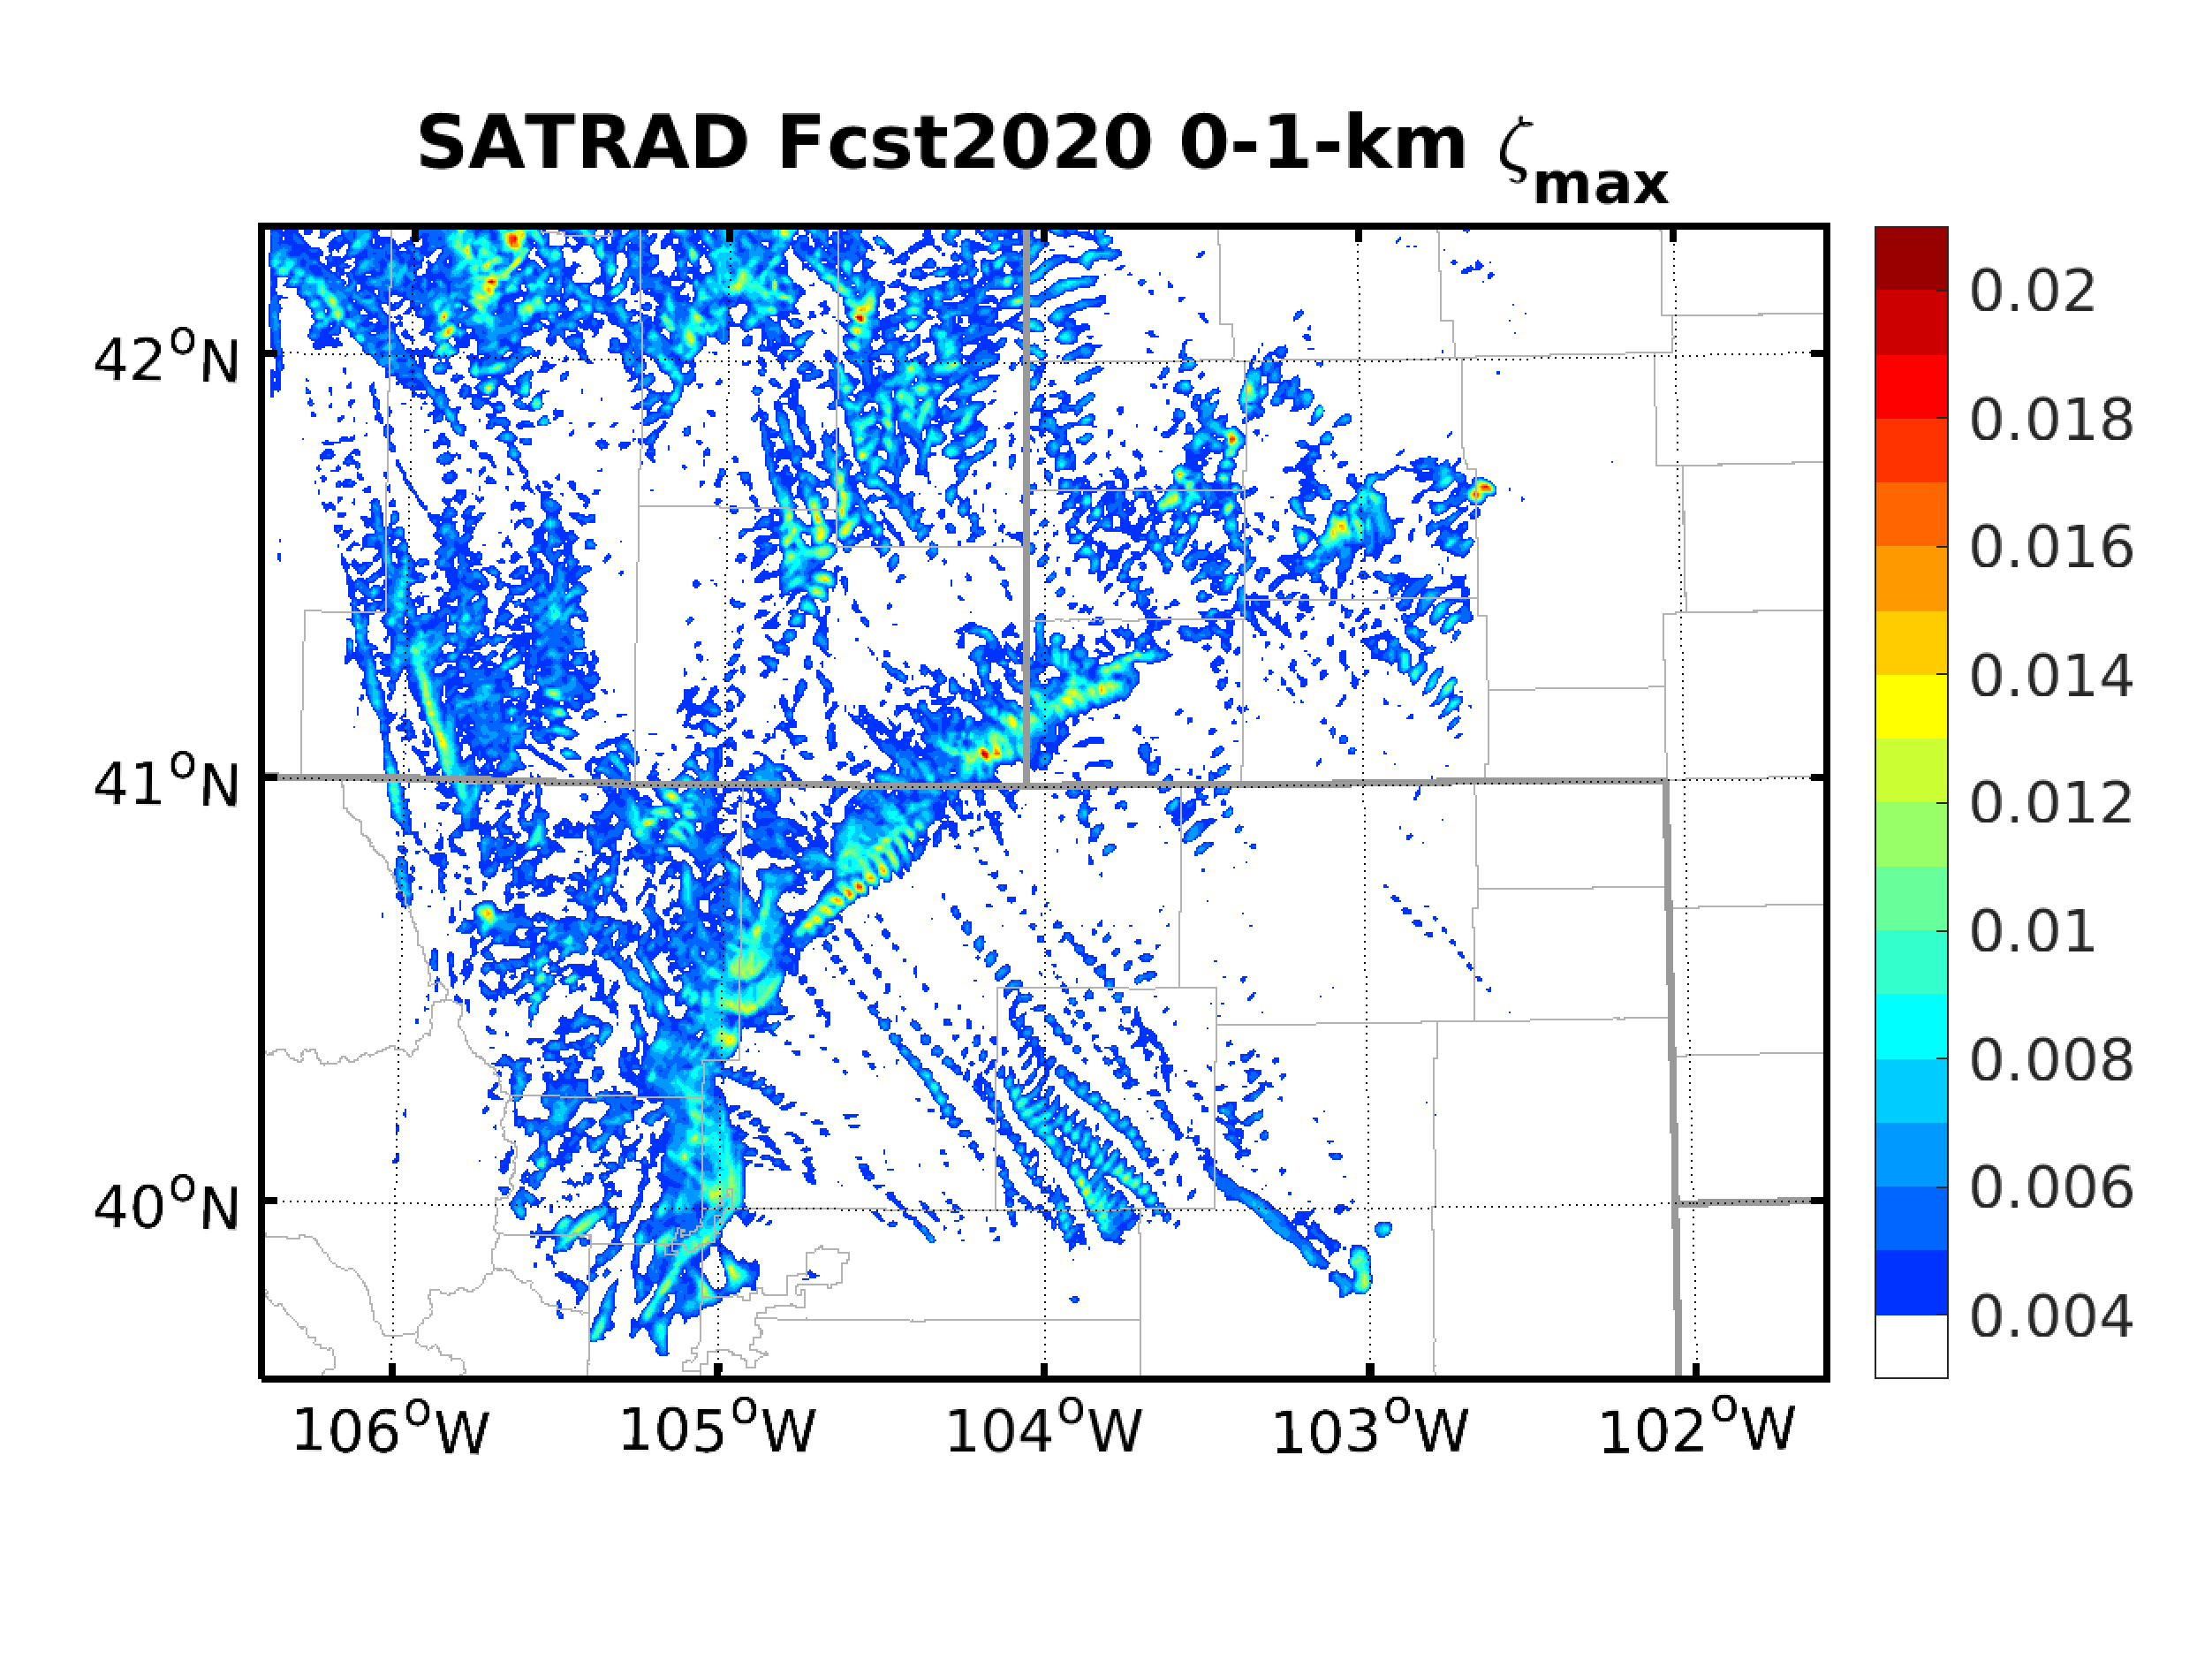
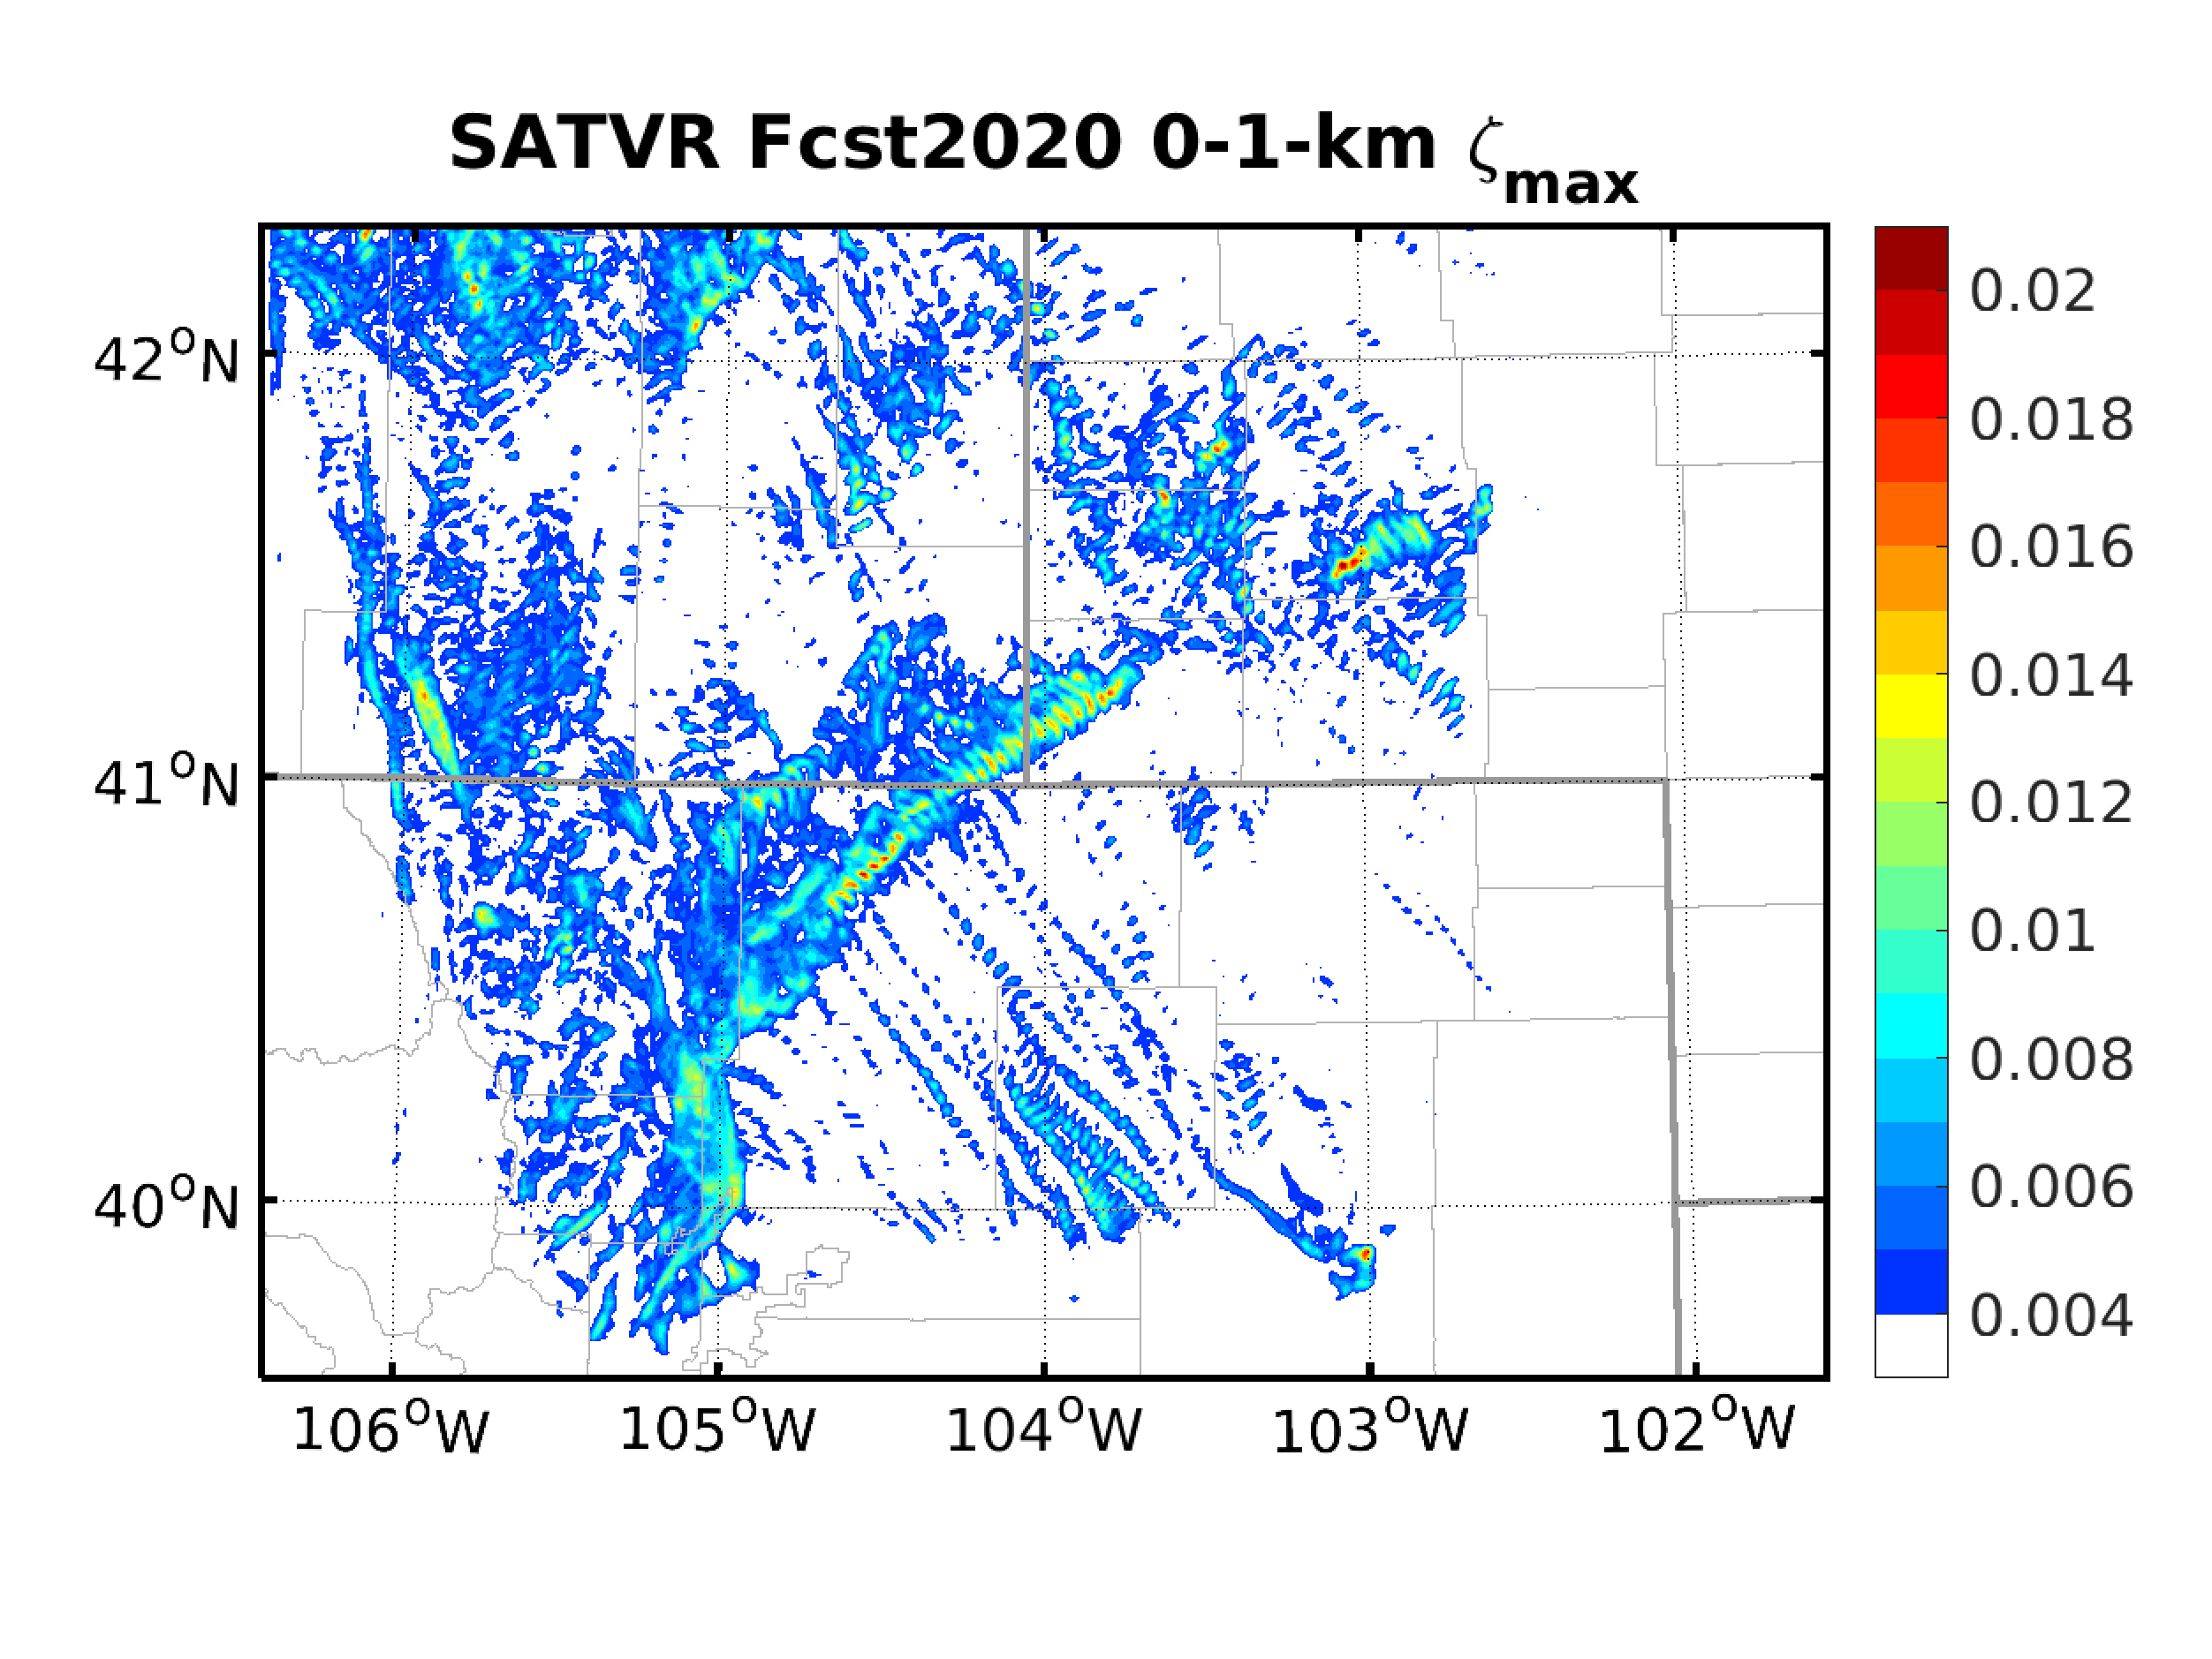
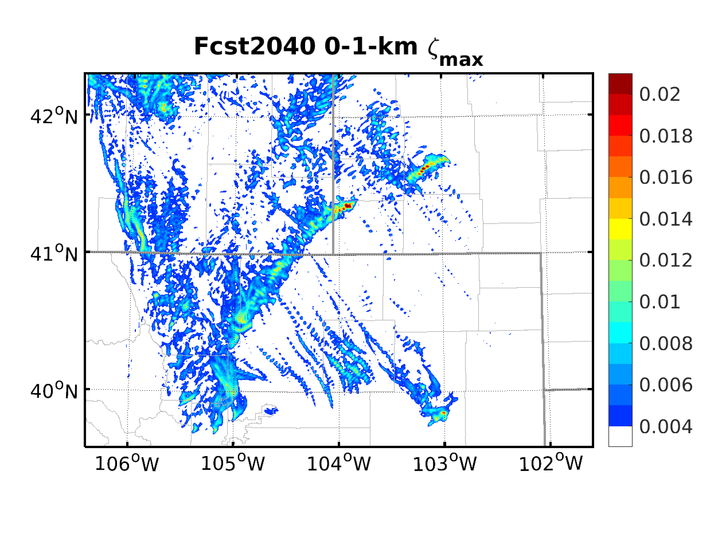
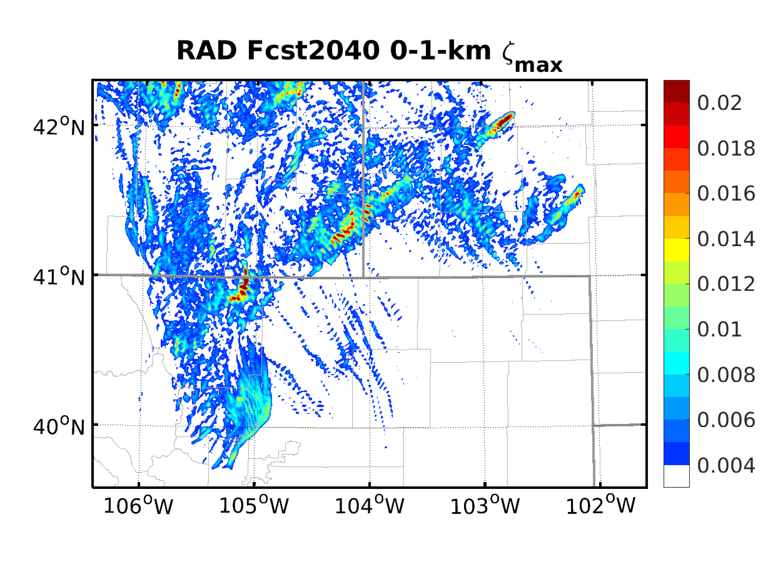
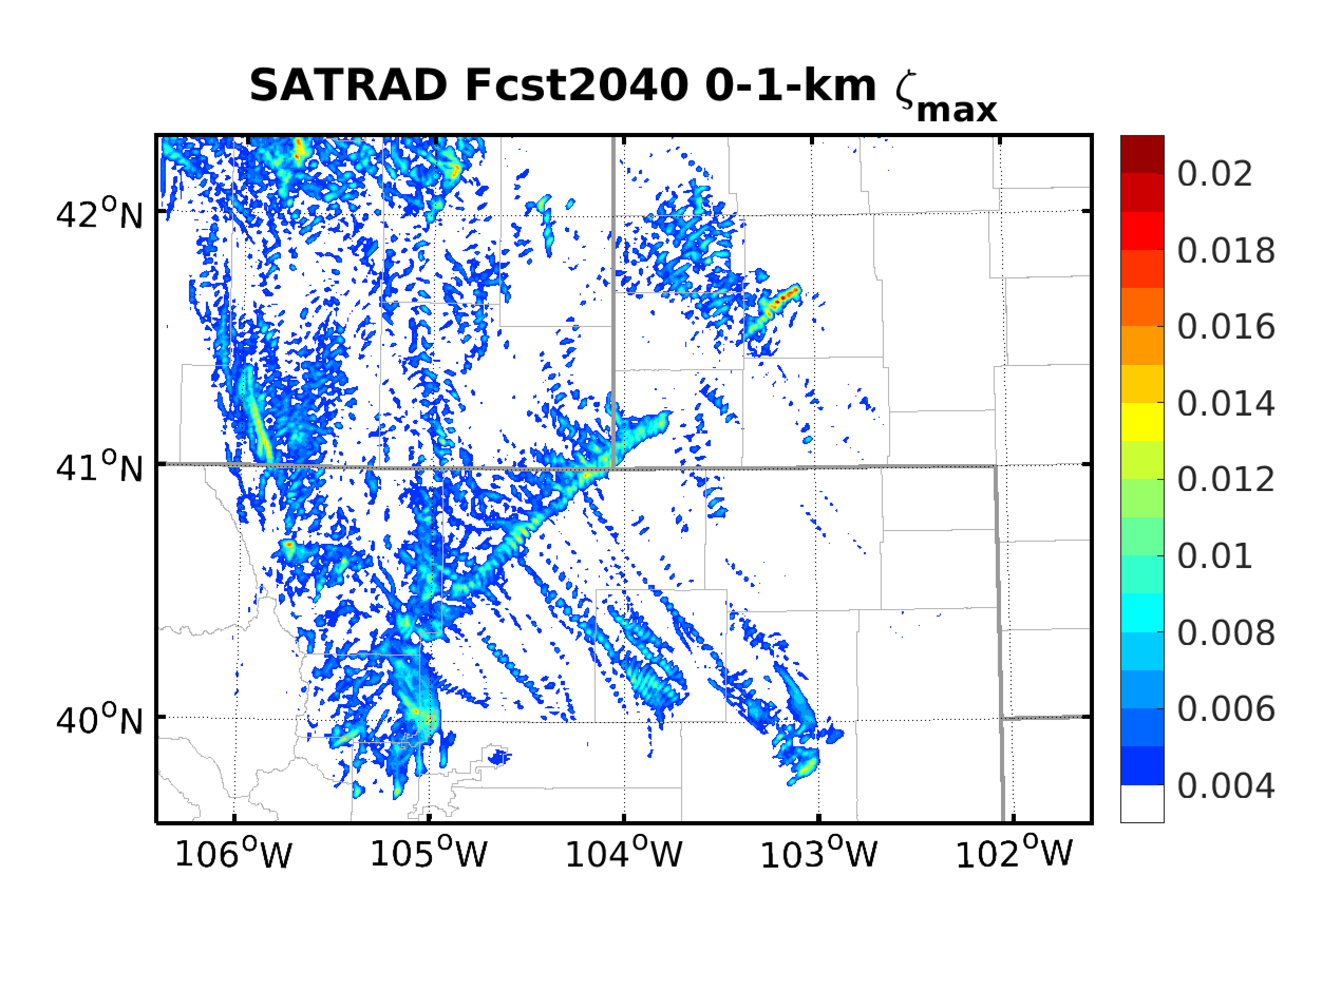
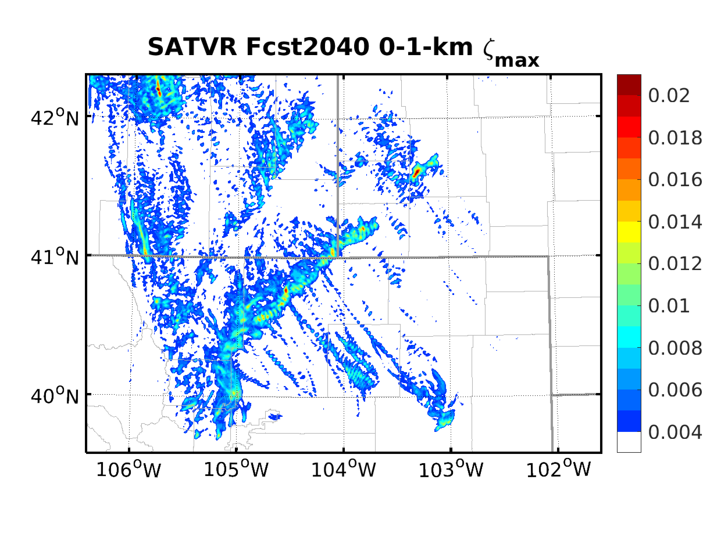
Comparison of Deter. Vor. Fcst.

Slide 9
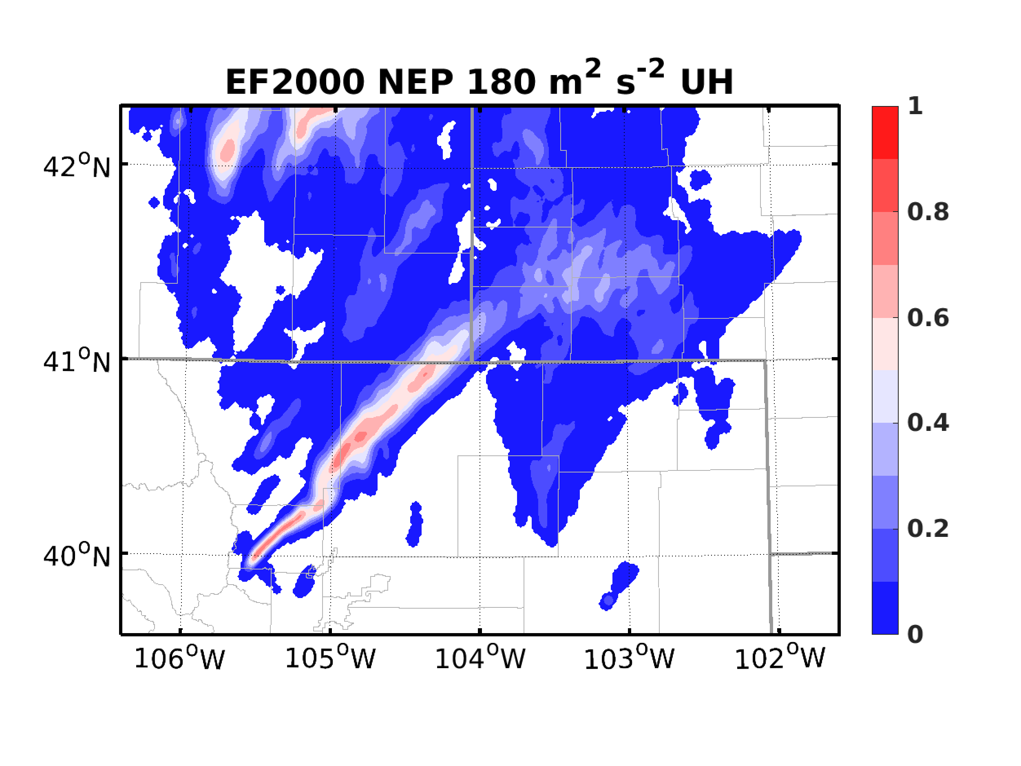
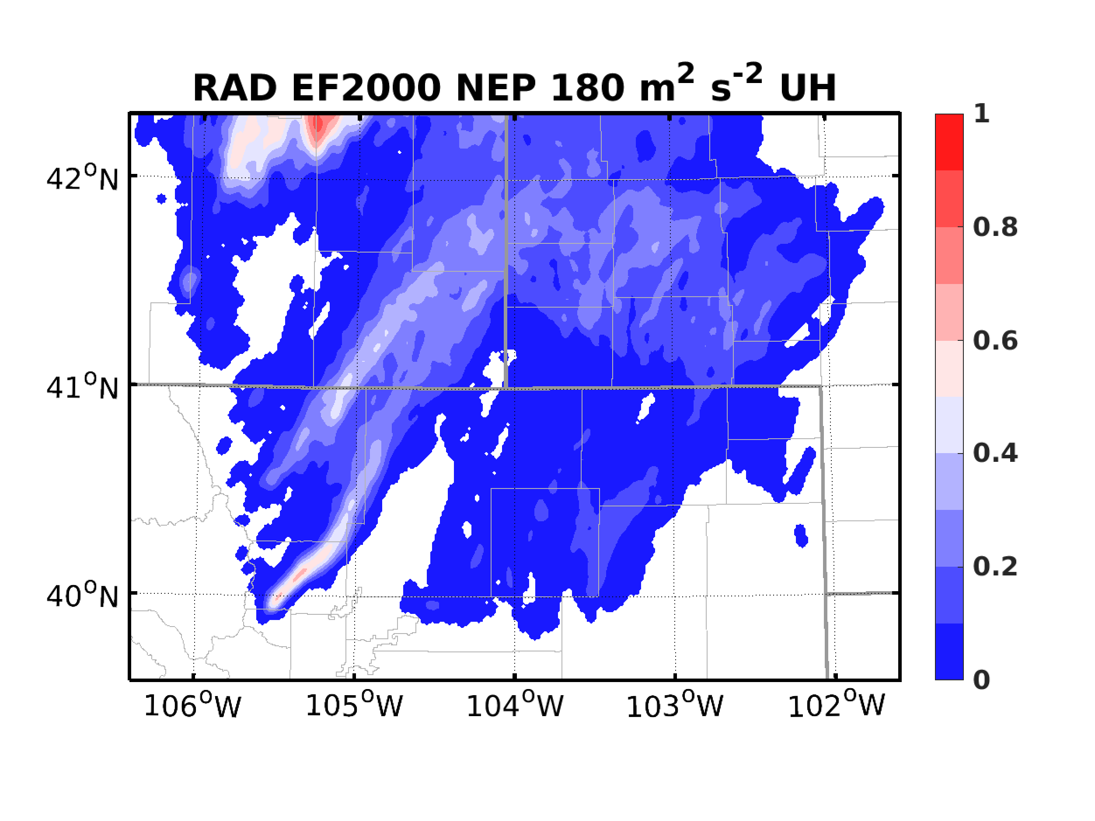
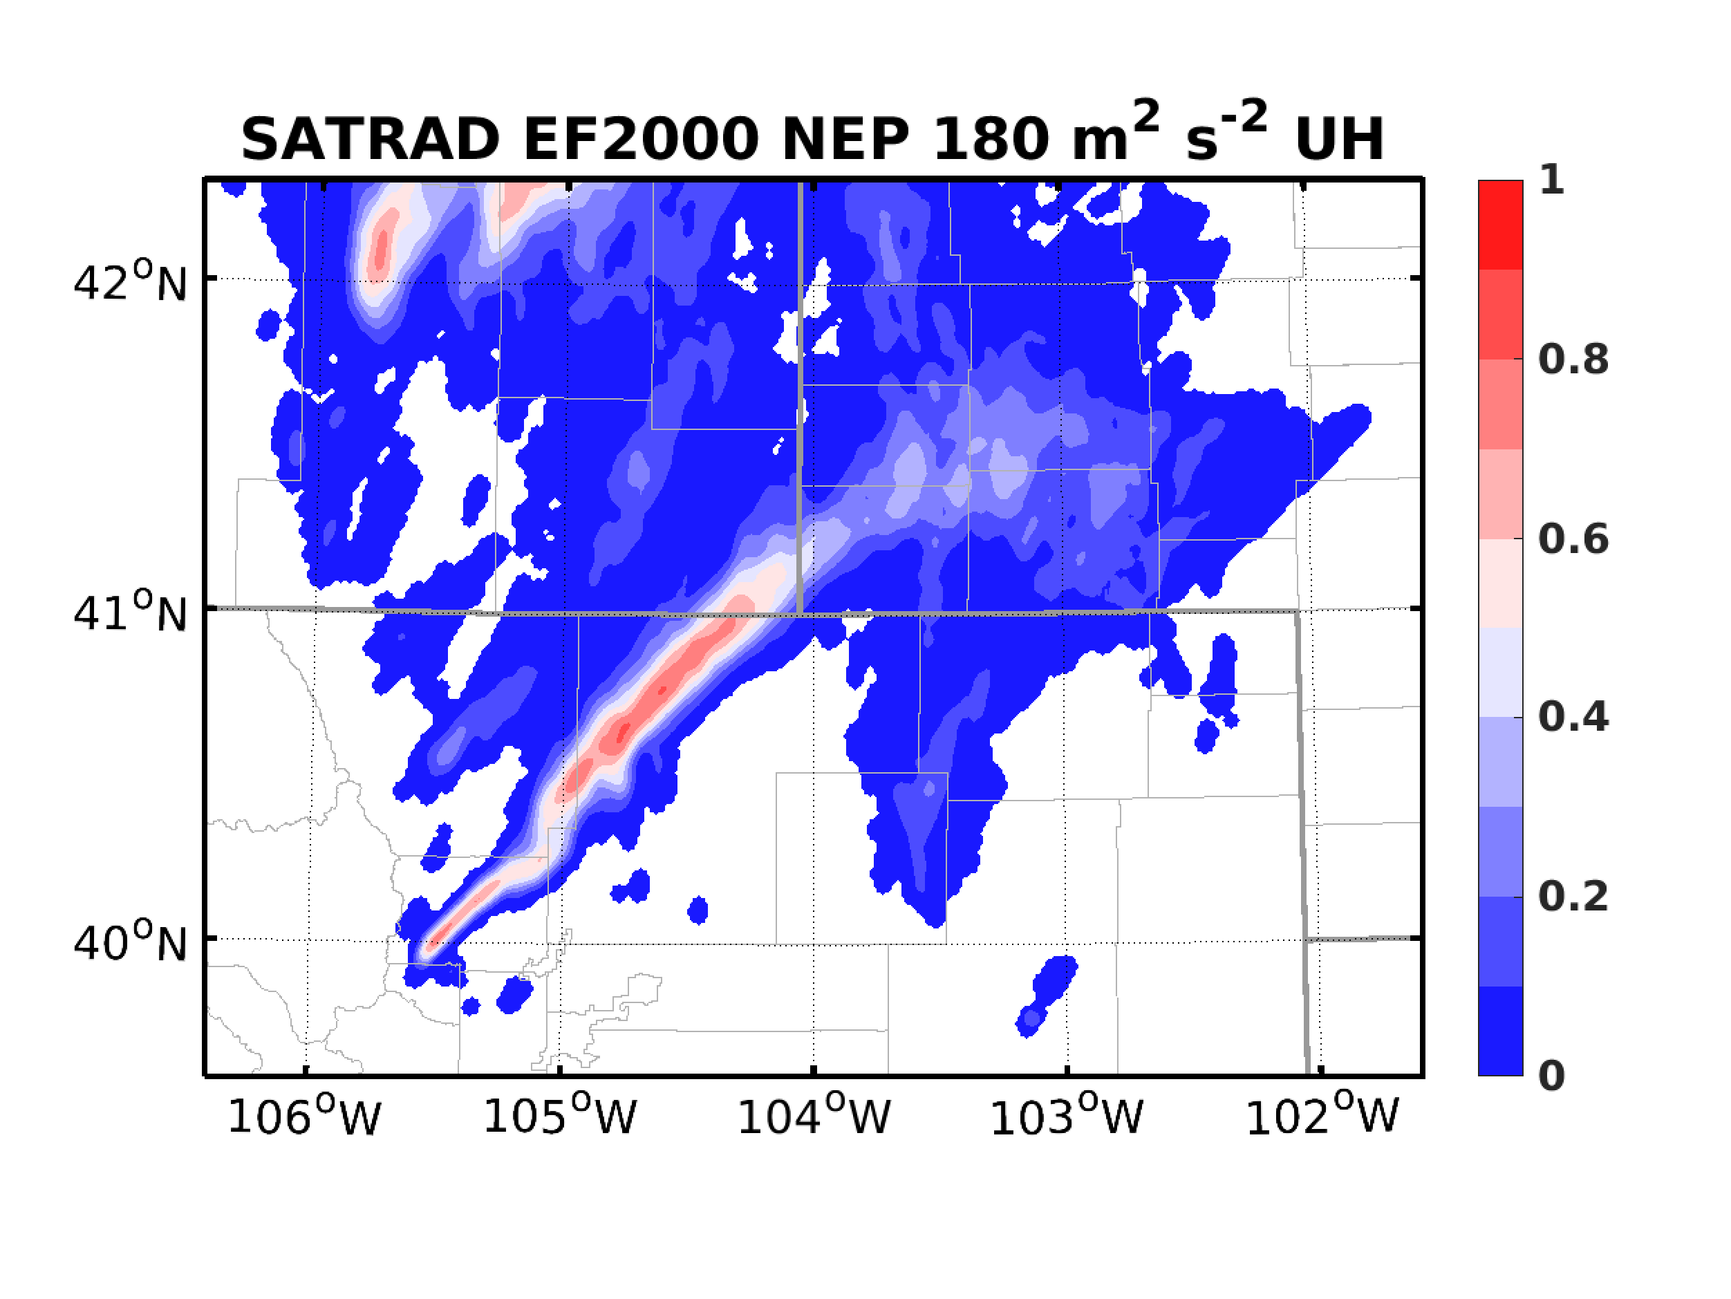
Comparison of Prob. UH Fcst.

Slide 10
Comparison of Prob. Vor. Fcst.

Slide 11
Impact of Radar Data Volume
Include Vr and 0-dBZ within ± 2.5 min
Include Vr and 0-dBZ within ± 1 min

Slide 12
Ongoing and Future Works
Including non-zero reflectivity
Failed due to CFL violation:
0-dBZ + reflectivity > 15 dBZ
0-hydro + reflectivity > 10 dBZ
Finished: 0-hydro + reflectivity > 15 dBZ
Adapt AOEI to reflectivity assimilation
Test on BT super-obbing based on cloud conditions
Comparing raw versus derived satellite observations

