Slide 1
Development and Evaluation of a Regional Reanalysis over Tibetan Plateau
Jie He and Fuqing Zhang
Group meeting, May 23, 2018

Slide 2
Background and Motivation
The world’s largest and highest plateau
thermodynamic and dynamic effects
climate and weather
East Asia and the whole world
Applications of a high-quality reanalysis
climatic variability
climate model
parameterization studies
… …
However, no high-quality reanalysis over the TP
develop high-quality TP reanalysis
evaluate high-quality TP reanalysis
Tibetan Plateau (TP)
Notes:
TP has crucial influence on the climate and weather over East Asia and around the whole world due to both the thermodynamic and dynamic effects induced by the high terrains

Slide 3
Model configuration
Model | PSU WRF-EnKF System
Test Domain | 24 °N ~ 40 °N 72 °E ~ 102 °E
Resolution | 30 km
Assimilation | EnKF, 4DVar, E4DVar
Time Window | 6 hours
I.C. and B.C. | ERA-Interim reanalysis
Assimilate Observation | GTS observation
Test Time | 2015062518 UTC ~ 2015062818 UTC
Test domain
Verification domain
Verification observation
Sounding of GTS (16)
Intensive Sounding ( 9 )

Slide 4
ECMWF
00 03 06 09 12 15 18 21 00
Assimilation Schemes
EnKF
fg
fg
fg
fg
00 03 06 09 12 15 18 21 00
EnKF
EnKF
EnKF
EnKF
EnKF
4DVar
fg
fg
fg
fg
00 03 06 09 12 15 18 21 00
4DVar
4DVar
4DVar
4DVar
E4DVar
fg
fg
fg
fg
fg
fg
fg
fg
00 03 06 09 12 15 18 21 00
EnKF
4DVar
EnKF
4DVar
EnKF
4DVar
EnKF
4DVar
EnKF
Assimilation window
Assimilation window
Assimilation window
Assimilation window
Assimilation window
Reanalysis / Forecast
Reanalysis / Forecast
Reanalysis / Forecast
Reanalysis / Forecast
Reanalysis / Forecast

Slide 5
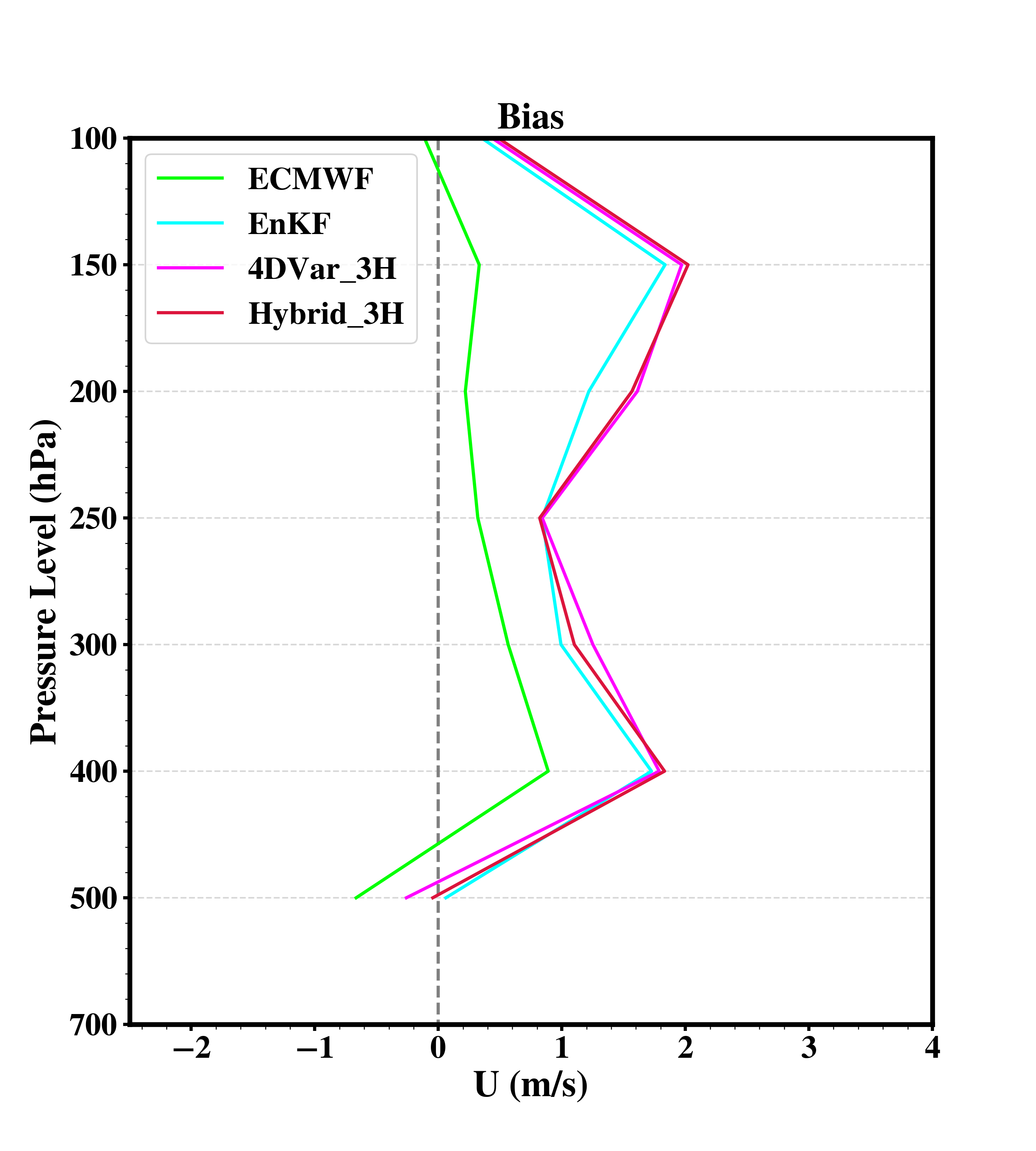
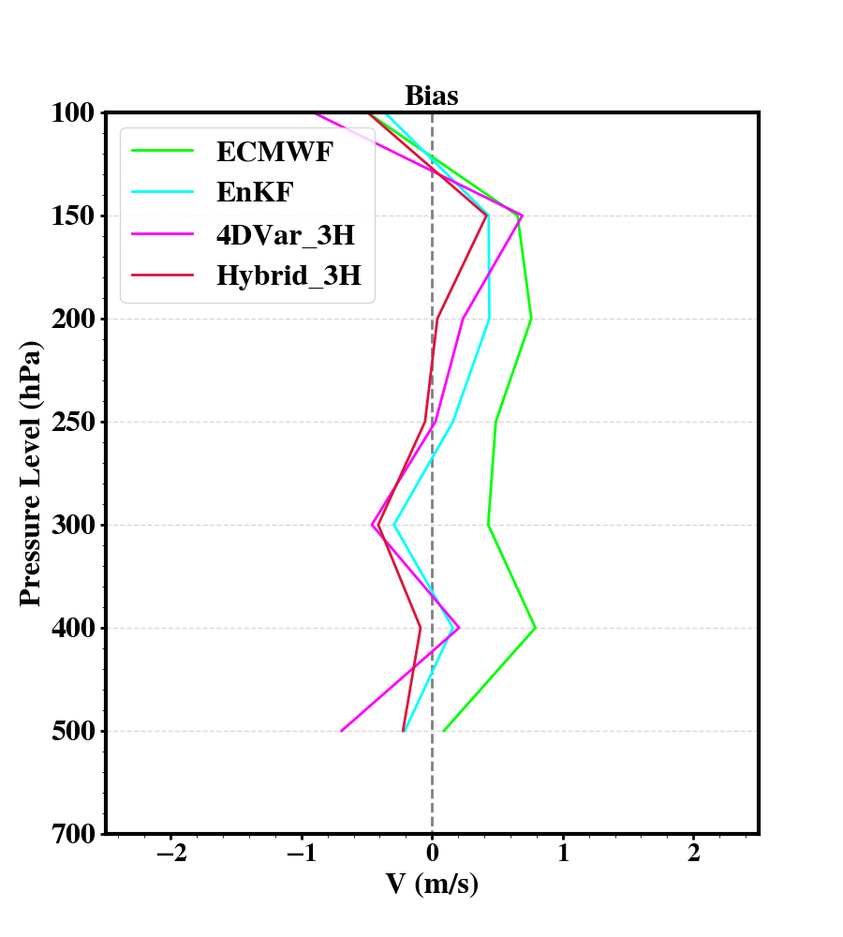
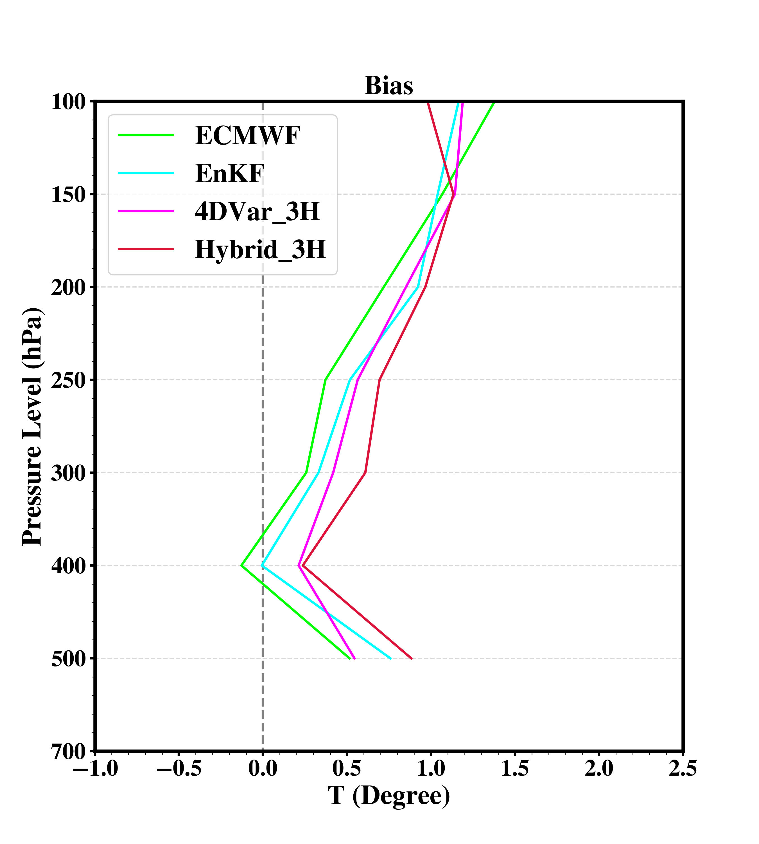
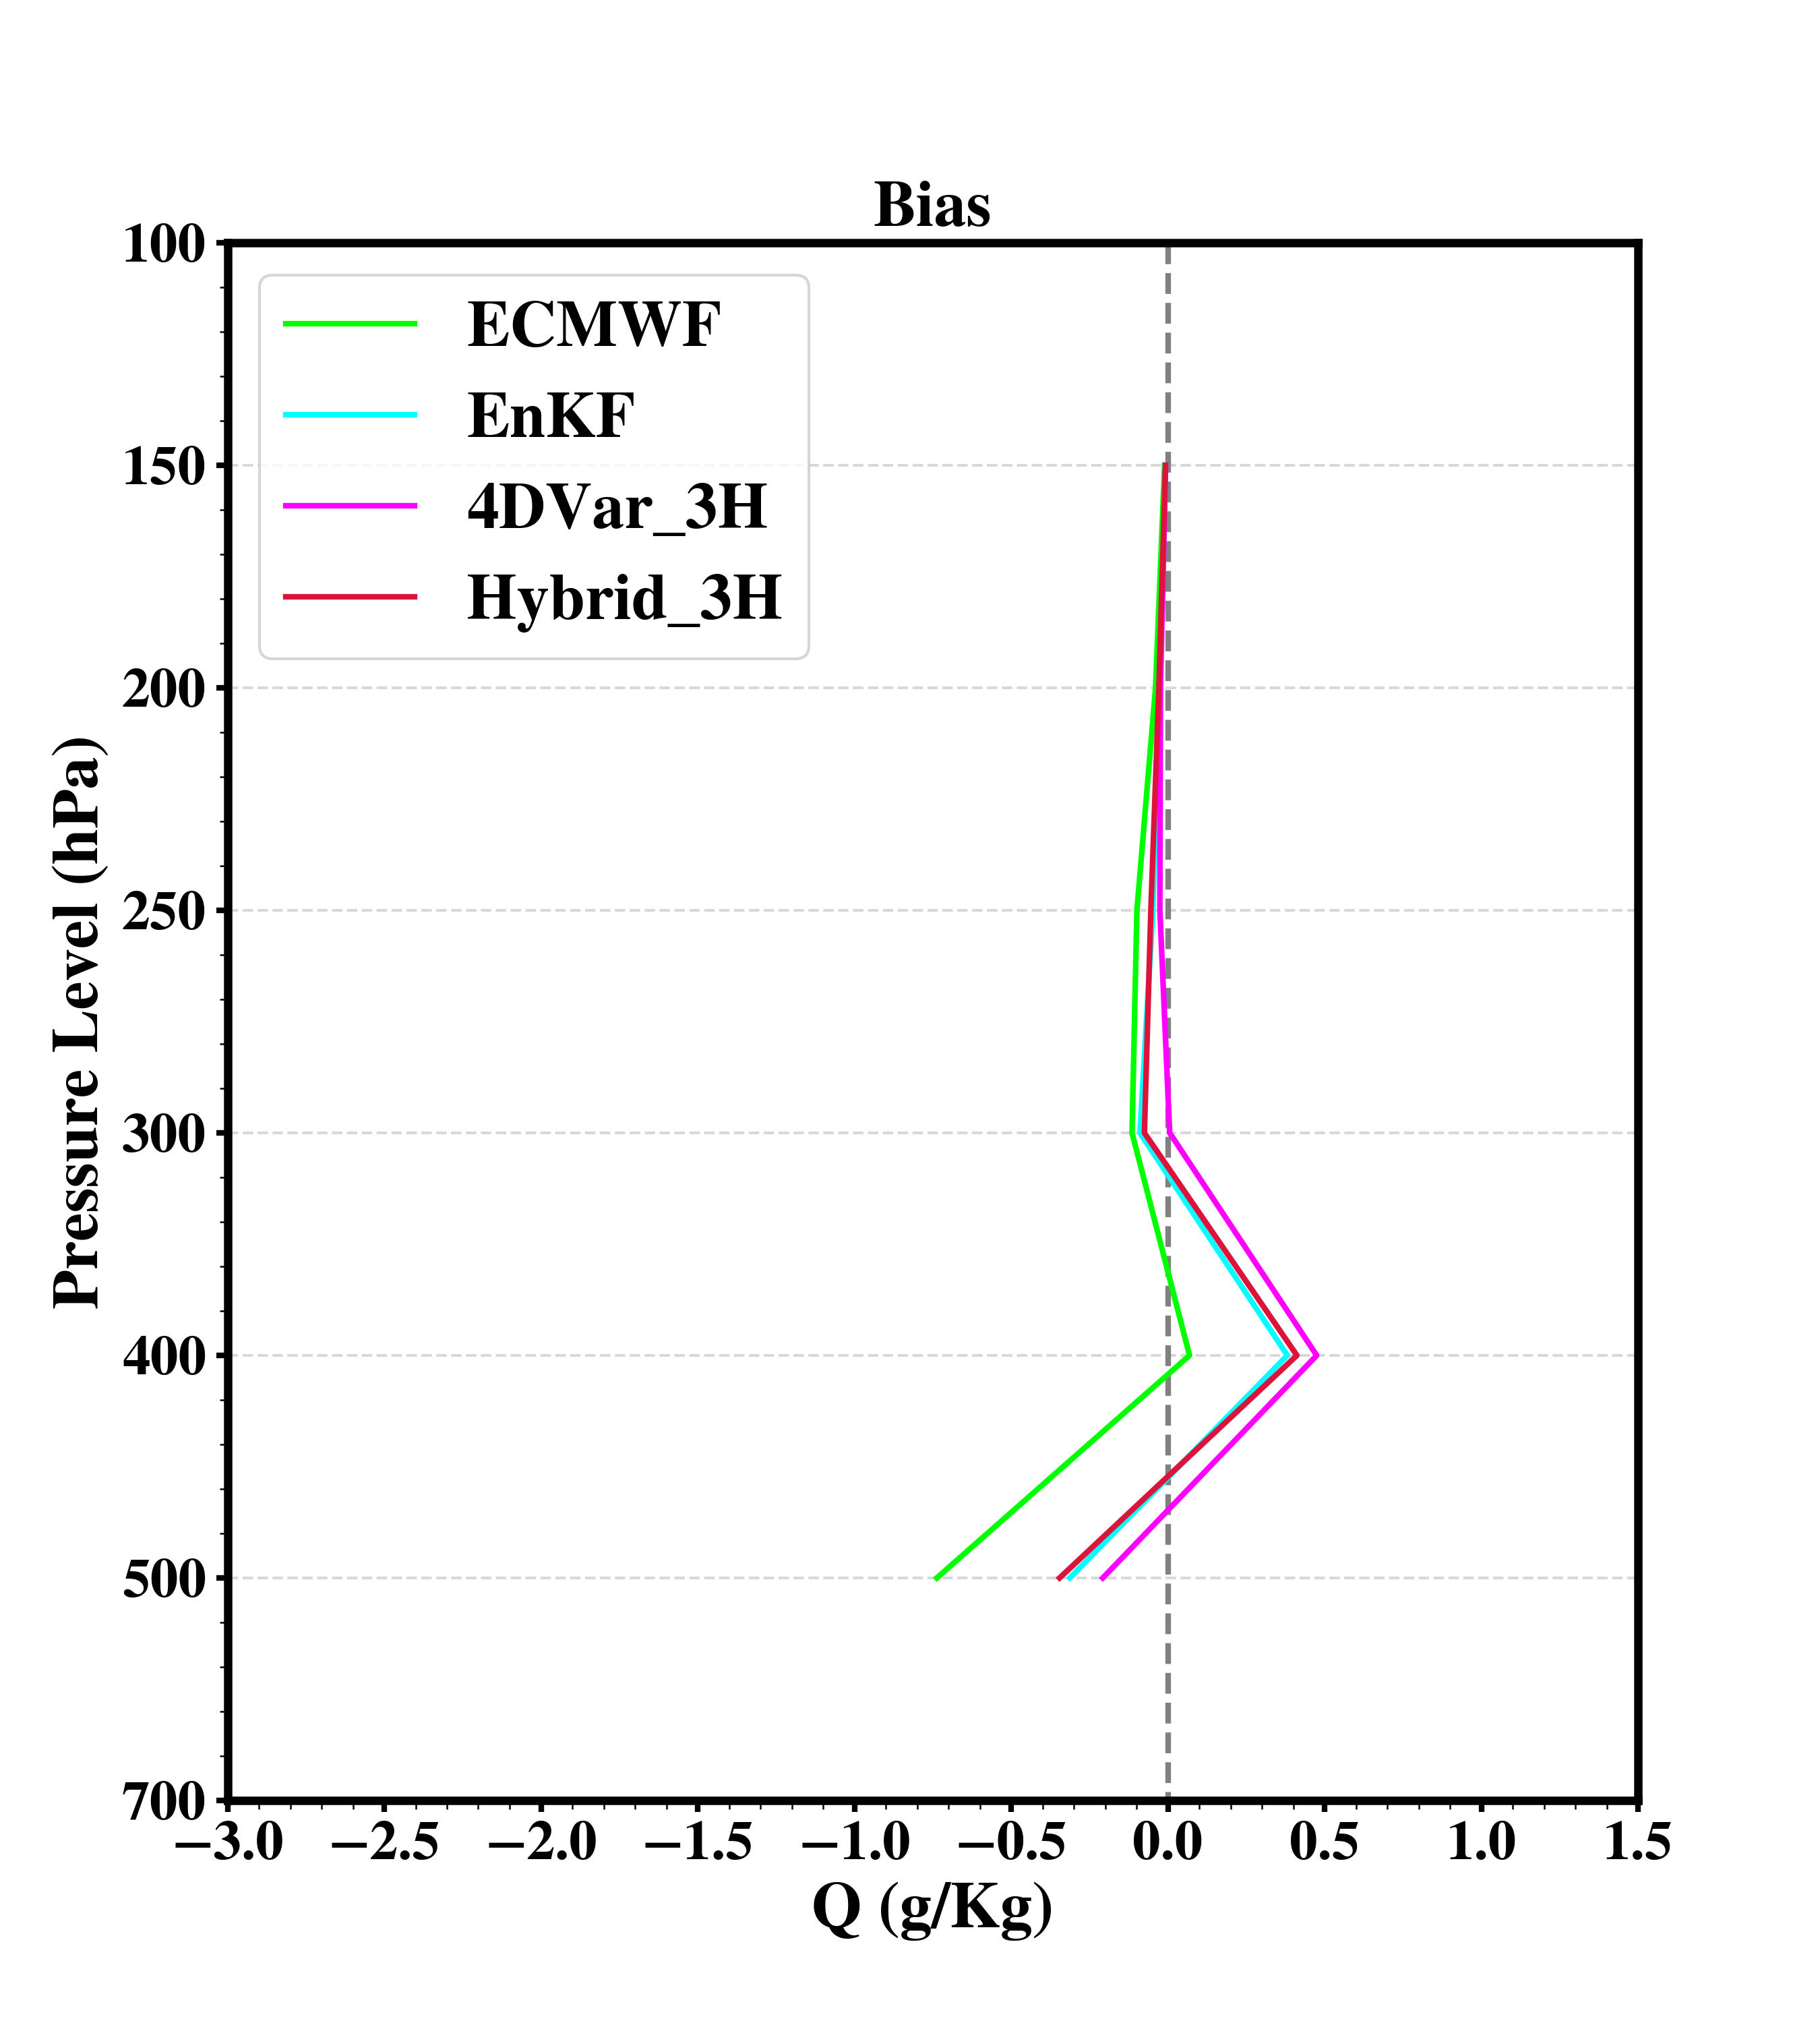
Bias and RMSE statistics
analysis or 3 hours forecast at same times
verify with intensive sounding obs.
(00, 06, 12, 18 UTC)
Bias Profiles 2518 - 2818 June 2015 UTC

Slide 6
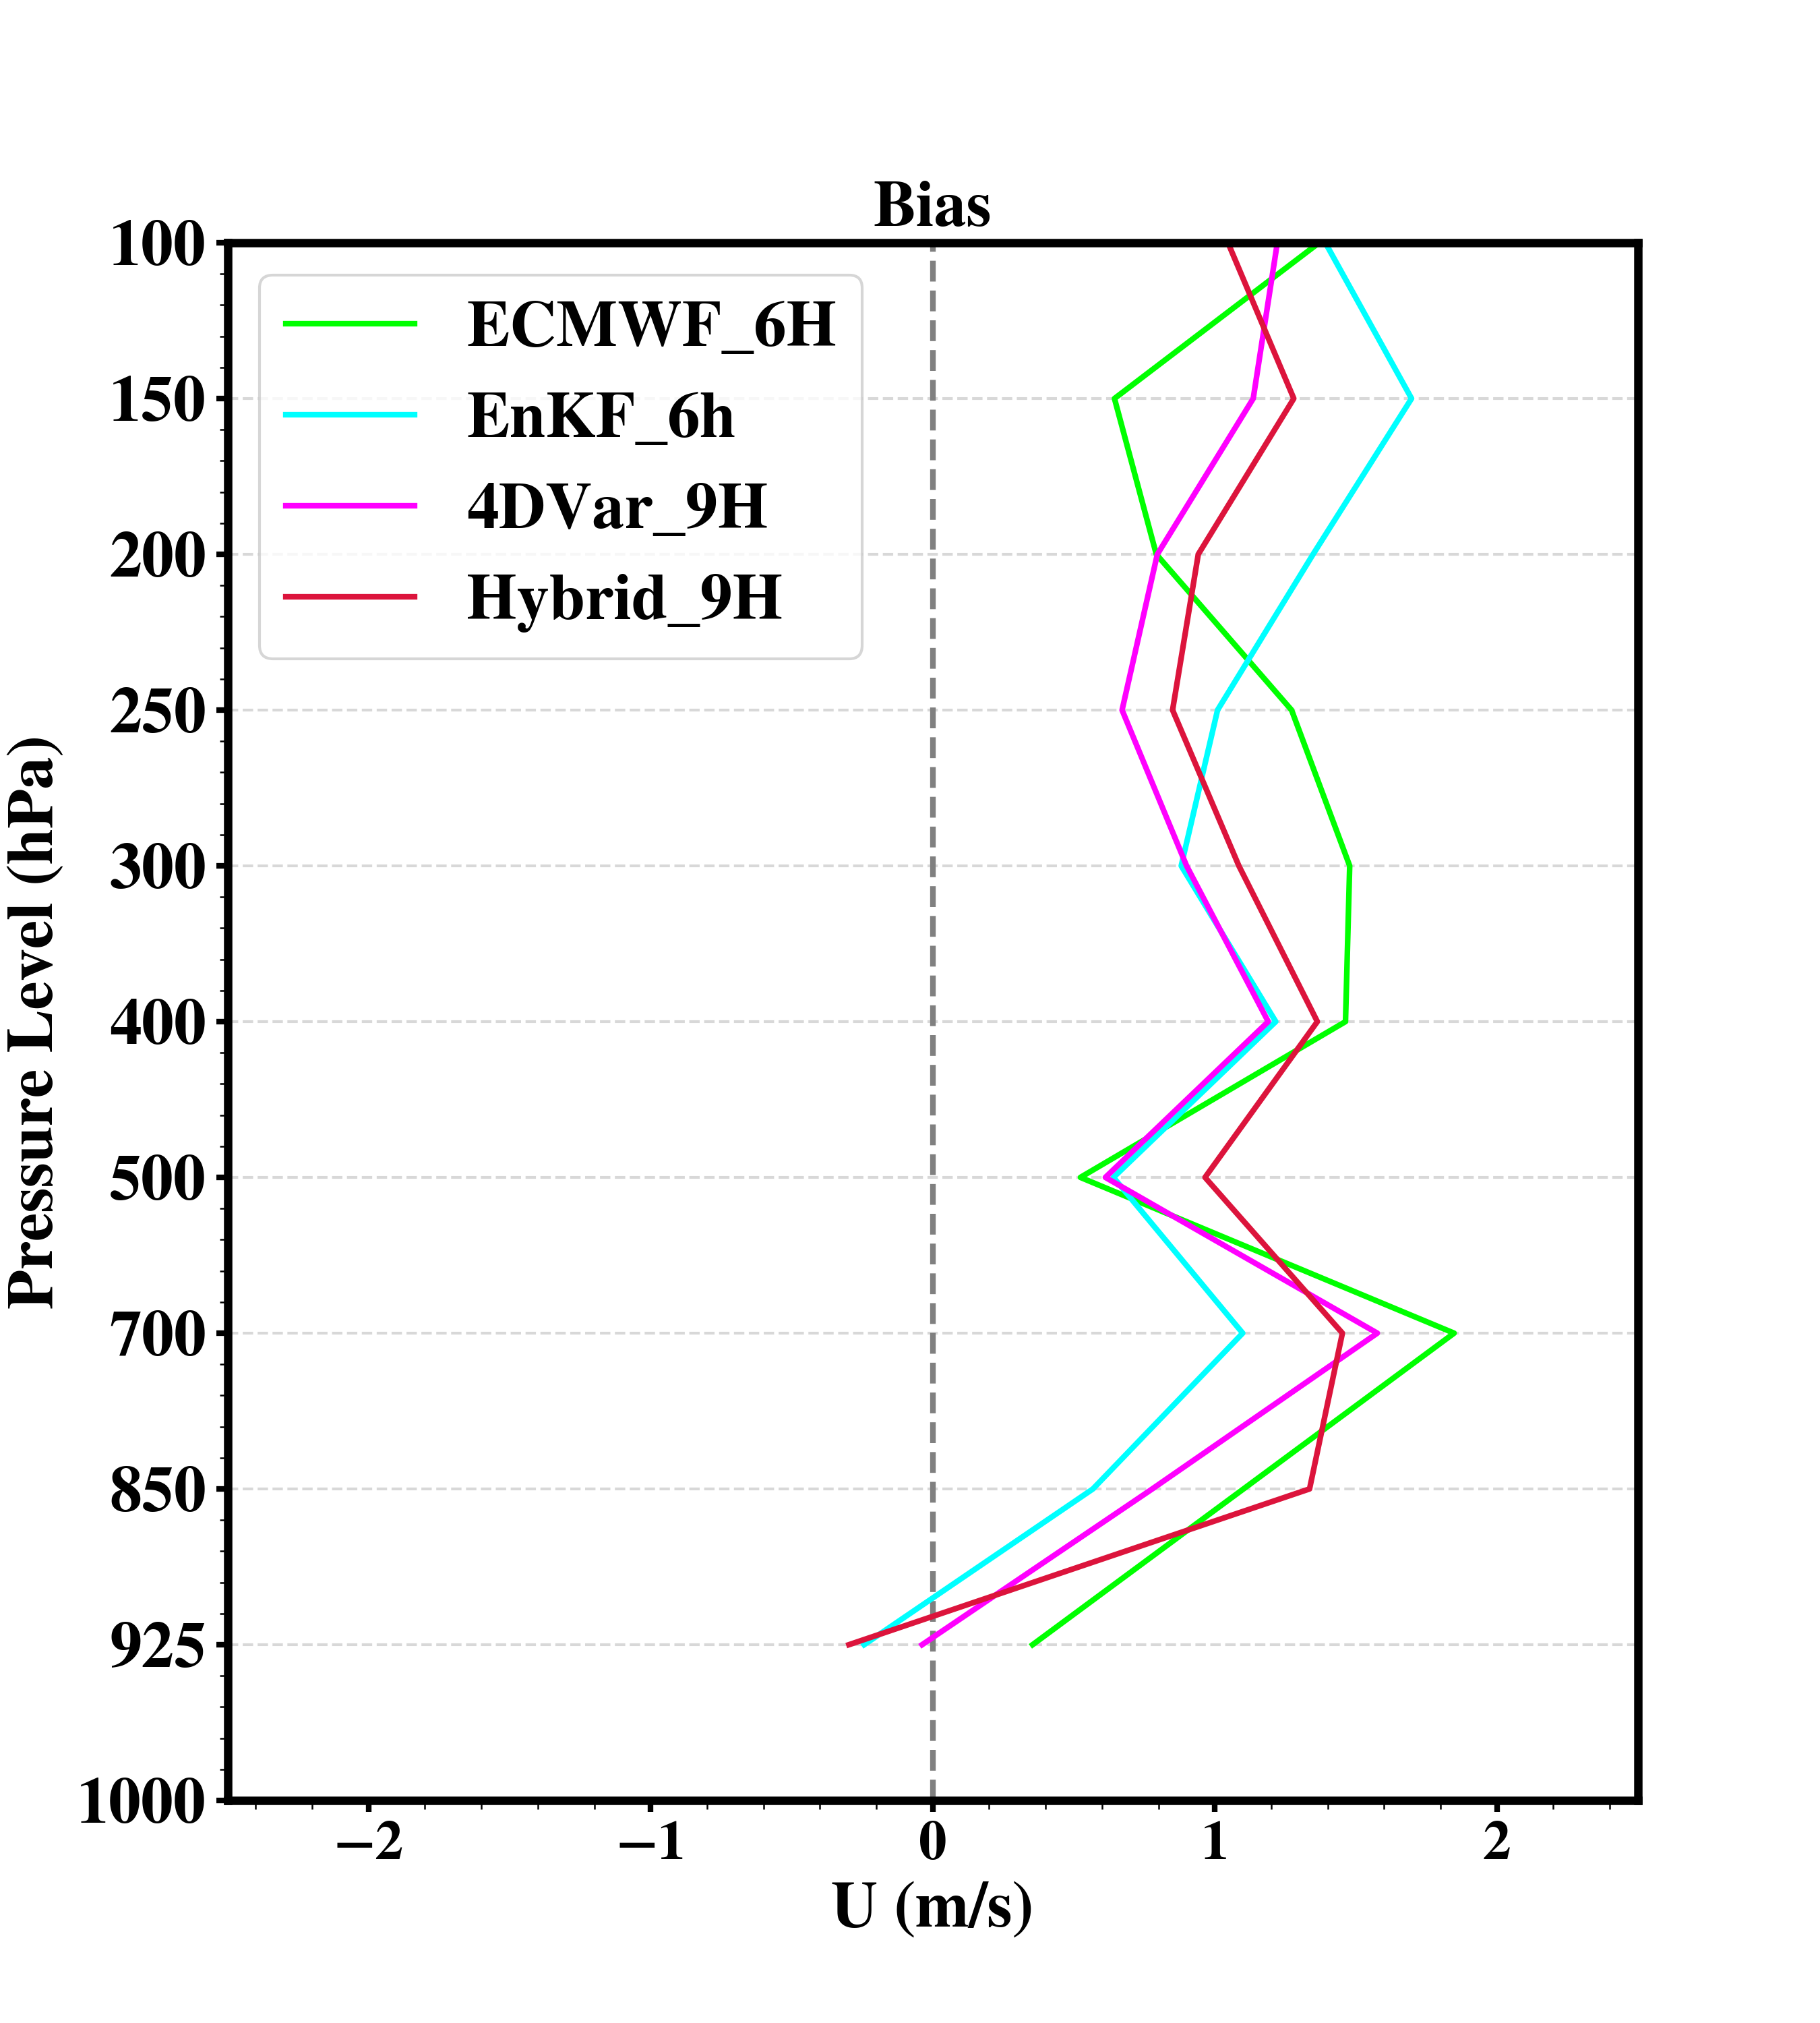
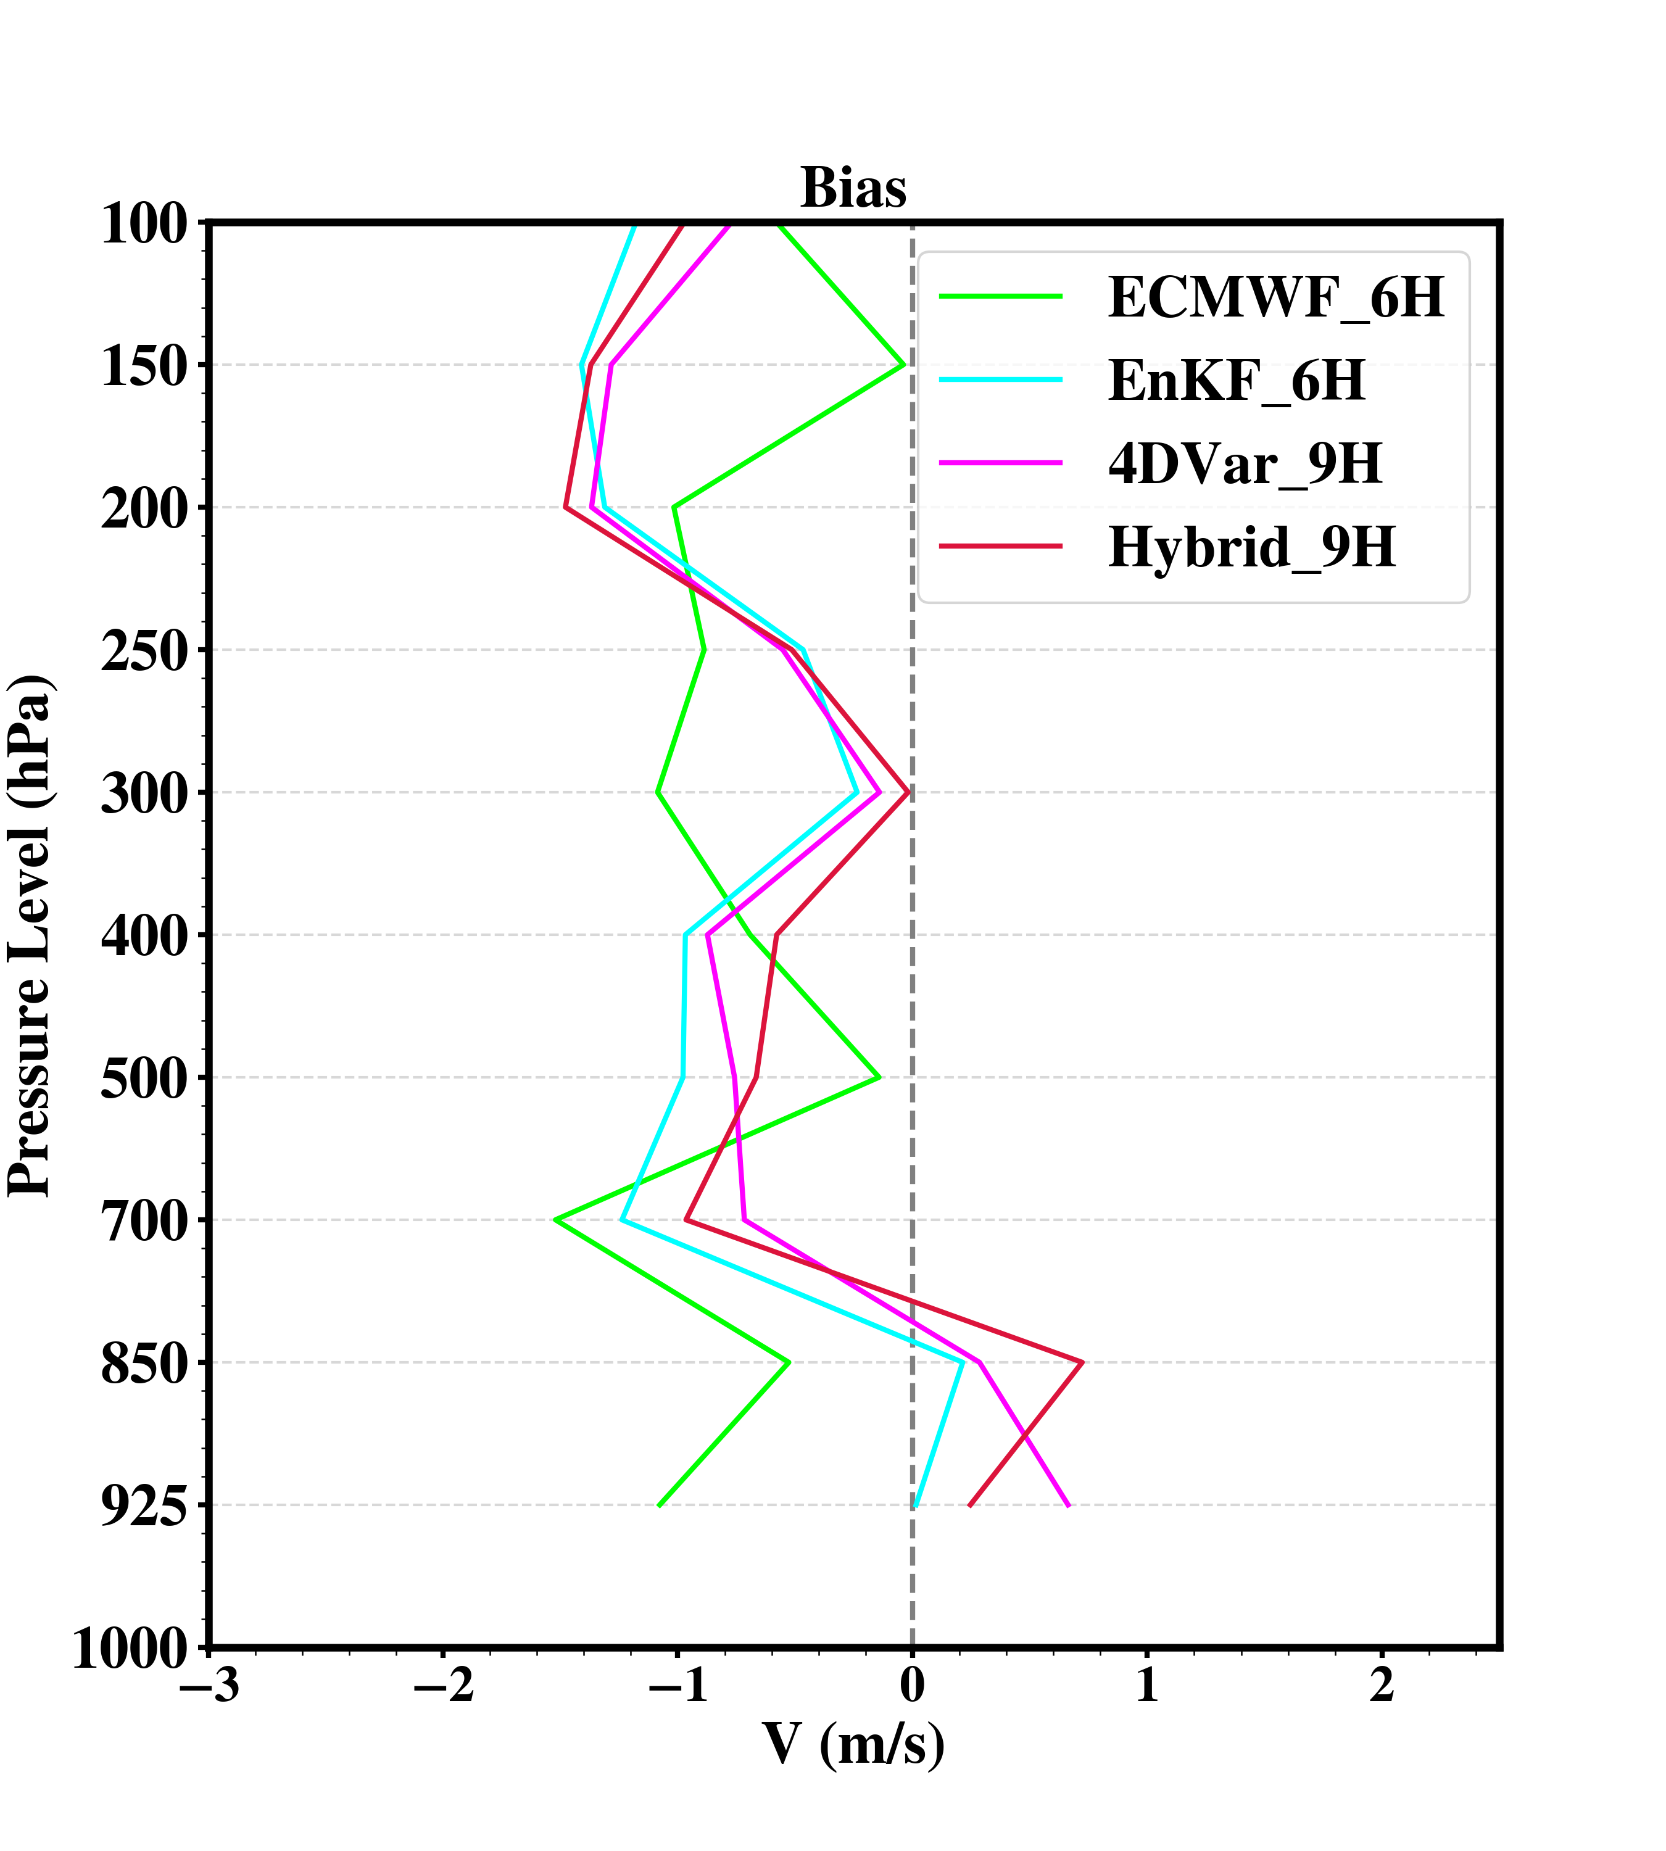
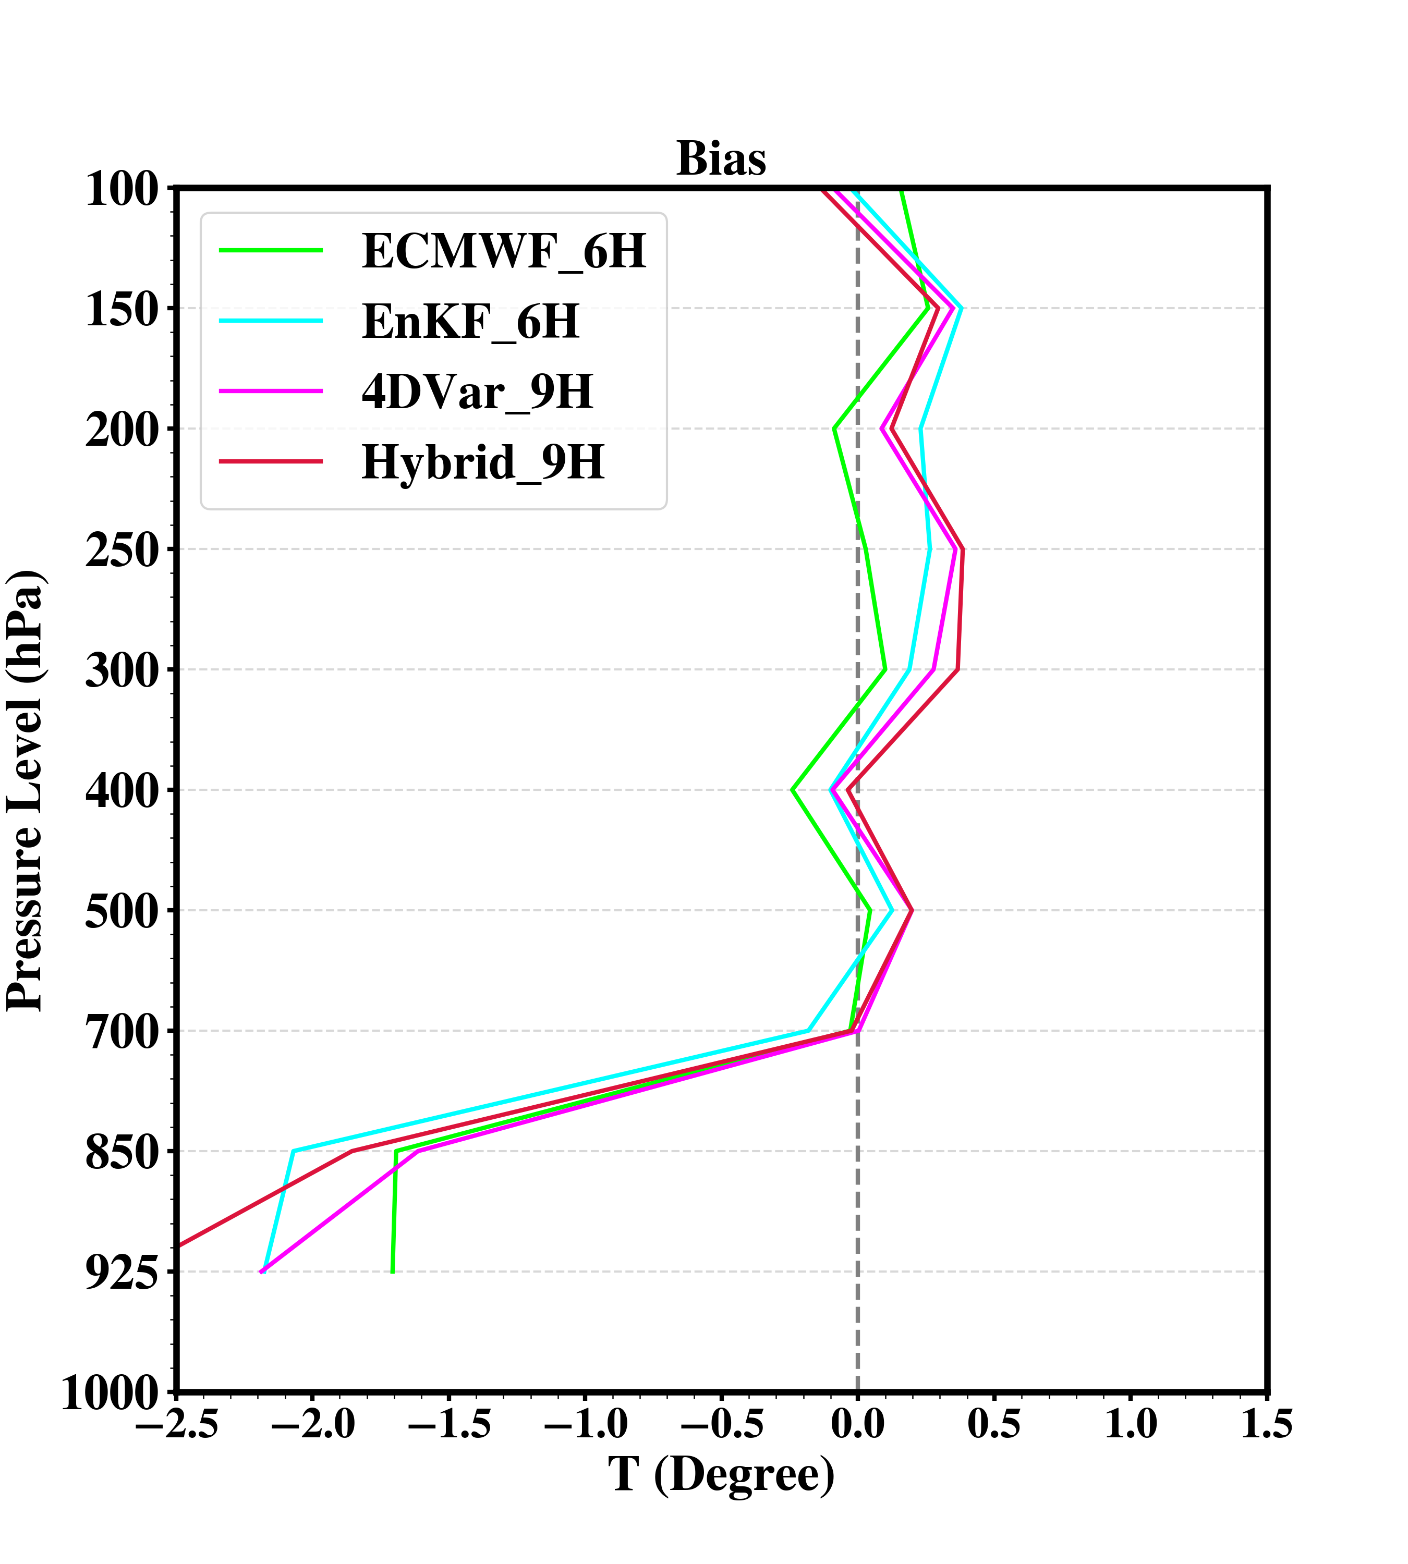
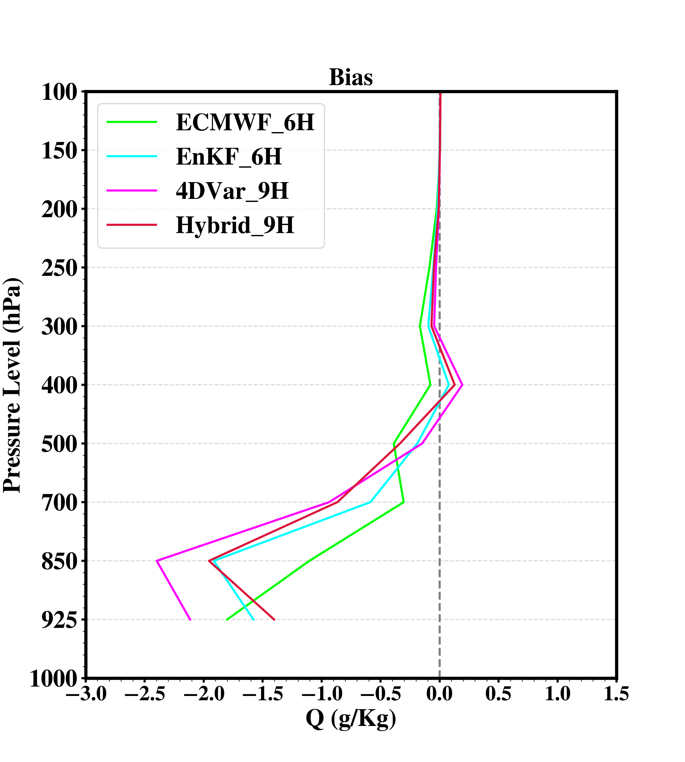
Bias Profiles 2600 - 2812 June 2015 UTC
6 hours or 9 hours forecast at same times
verify with GTS sounding obs.
(00, 12 UTC)

Slide 7
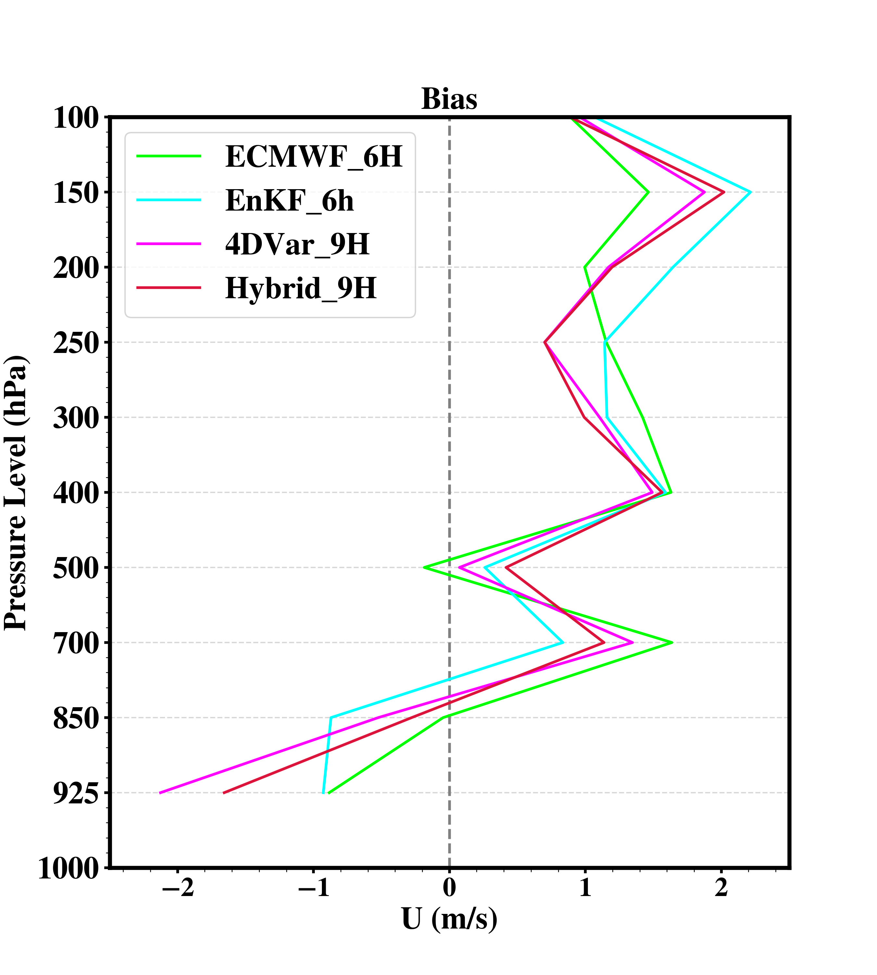
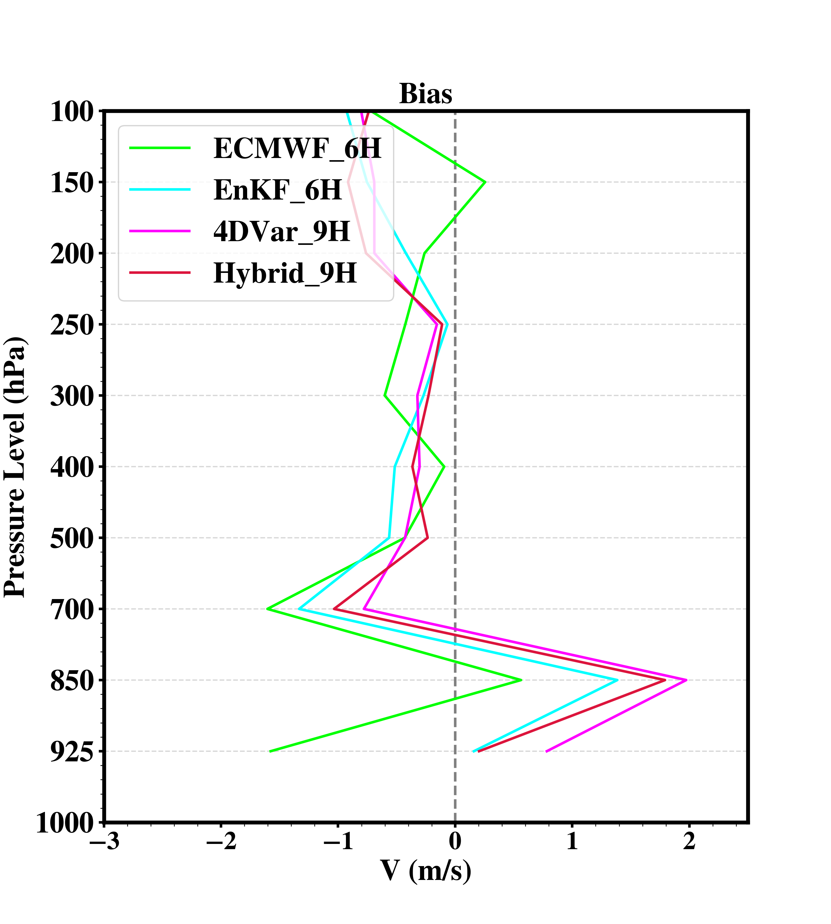
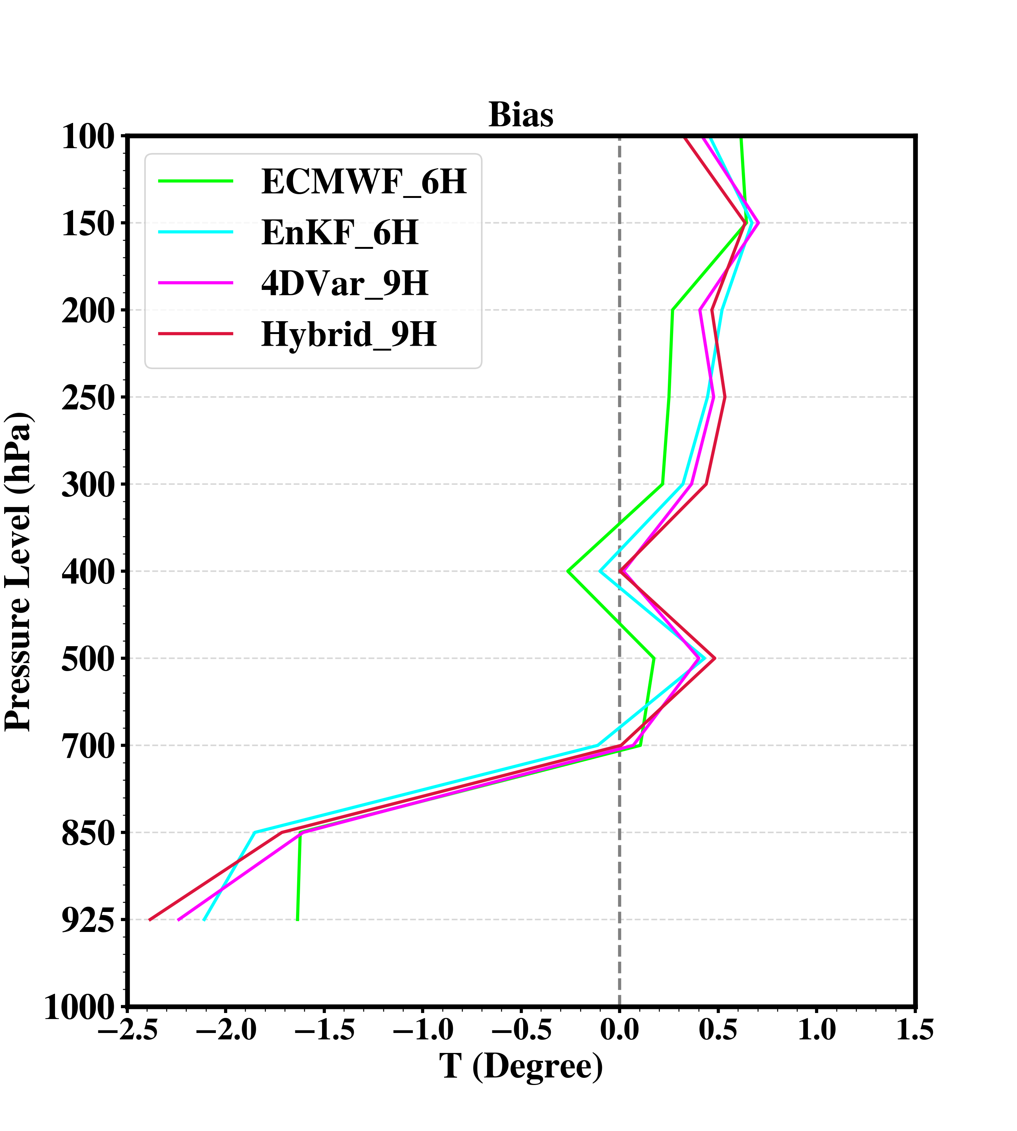
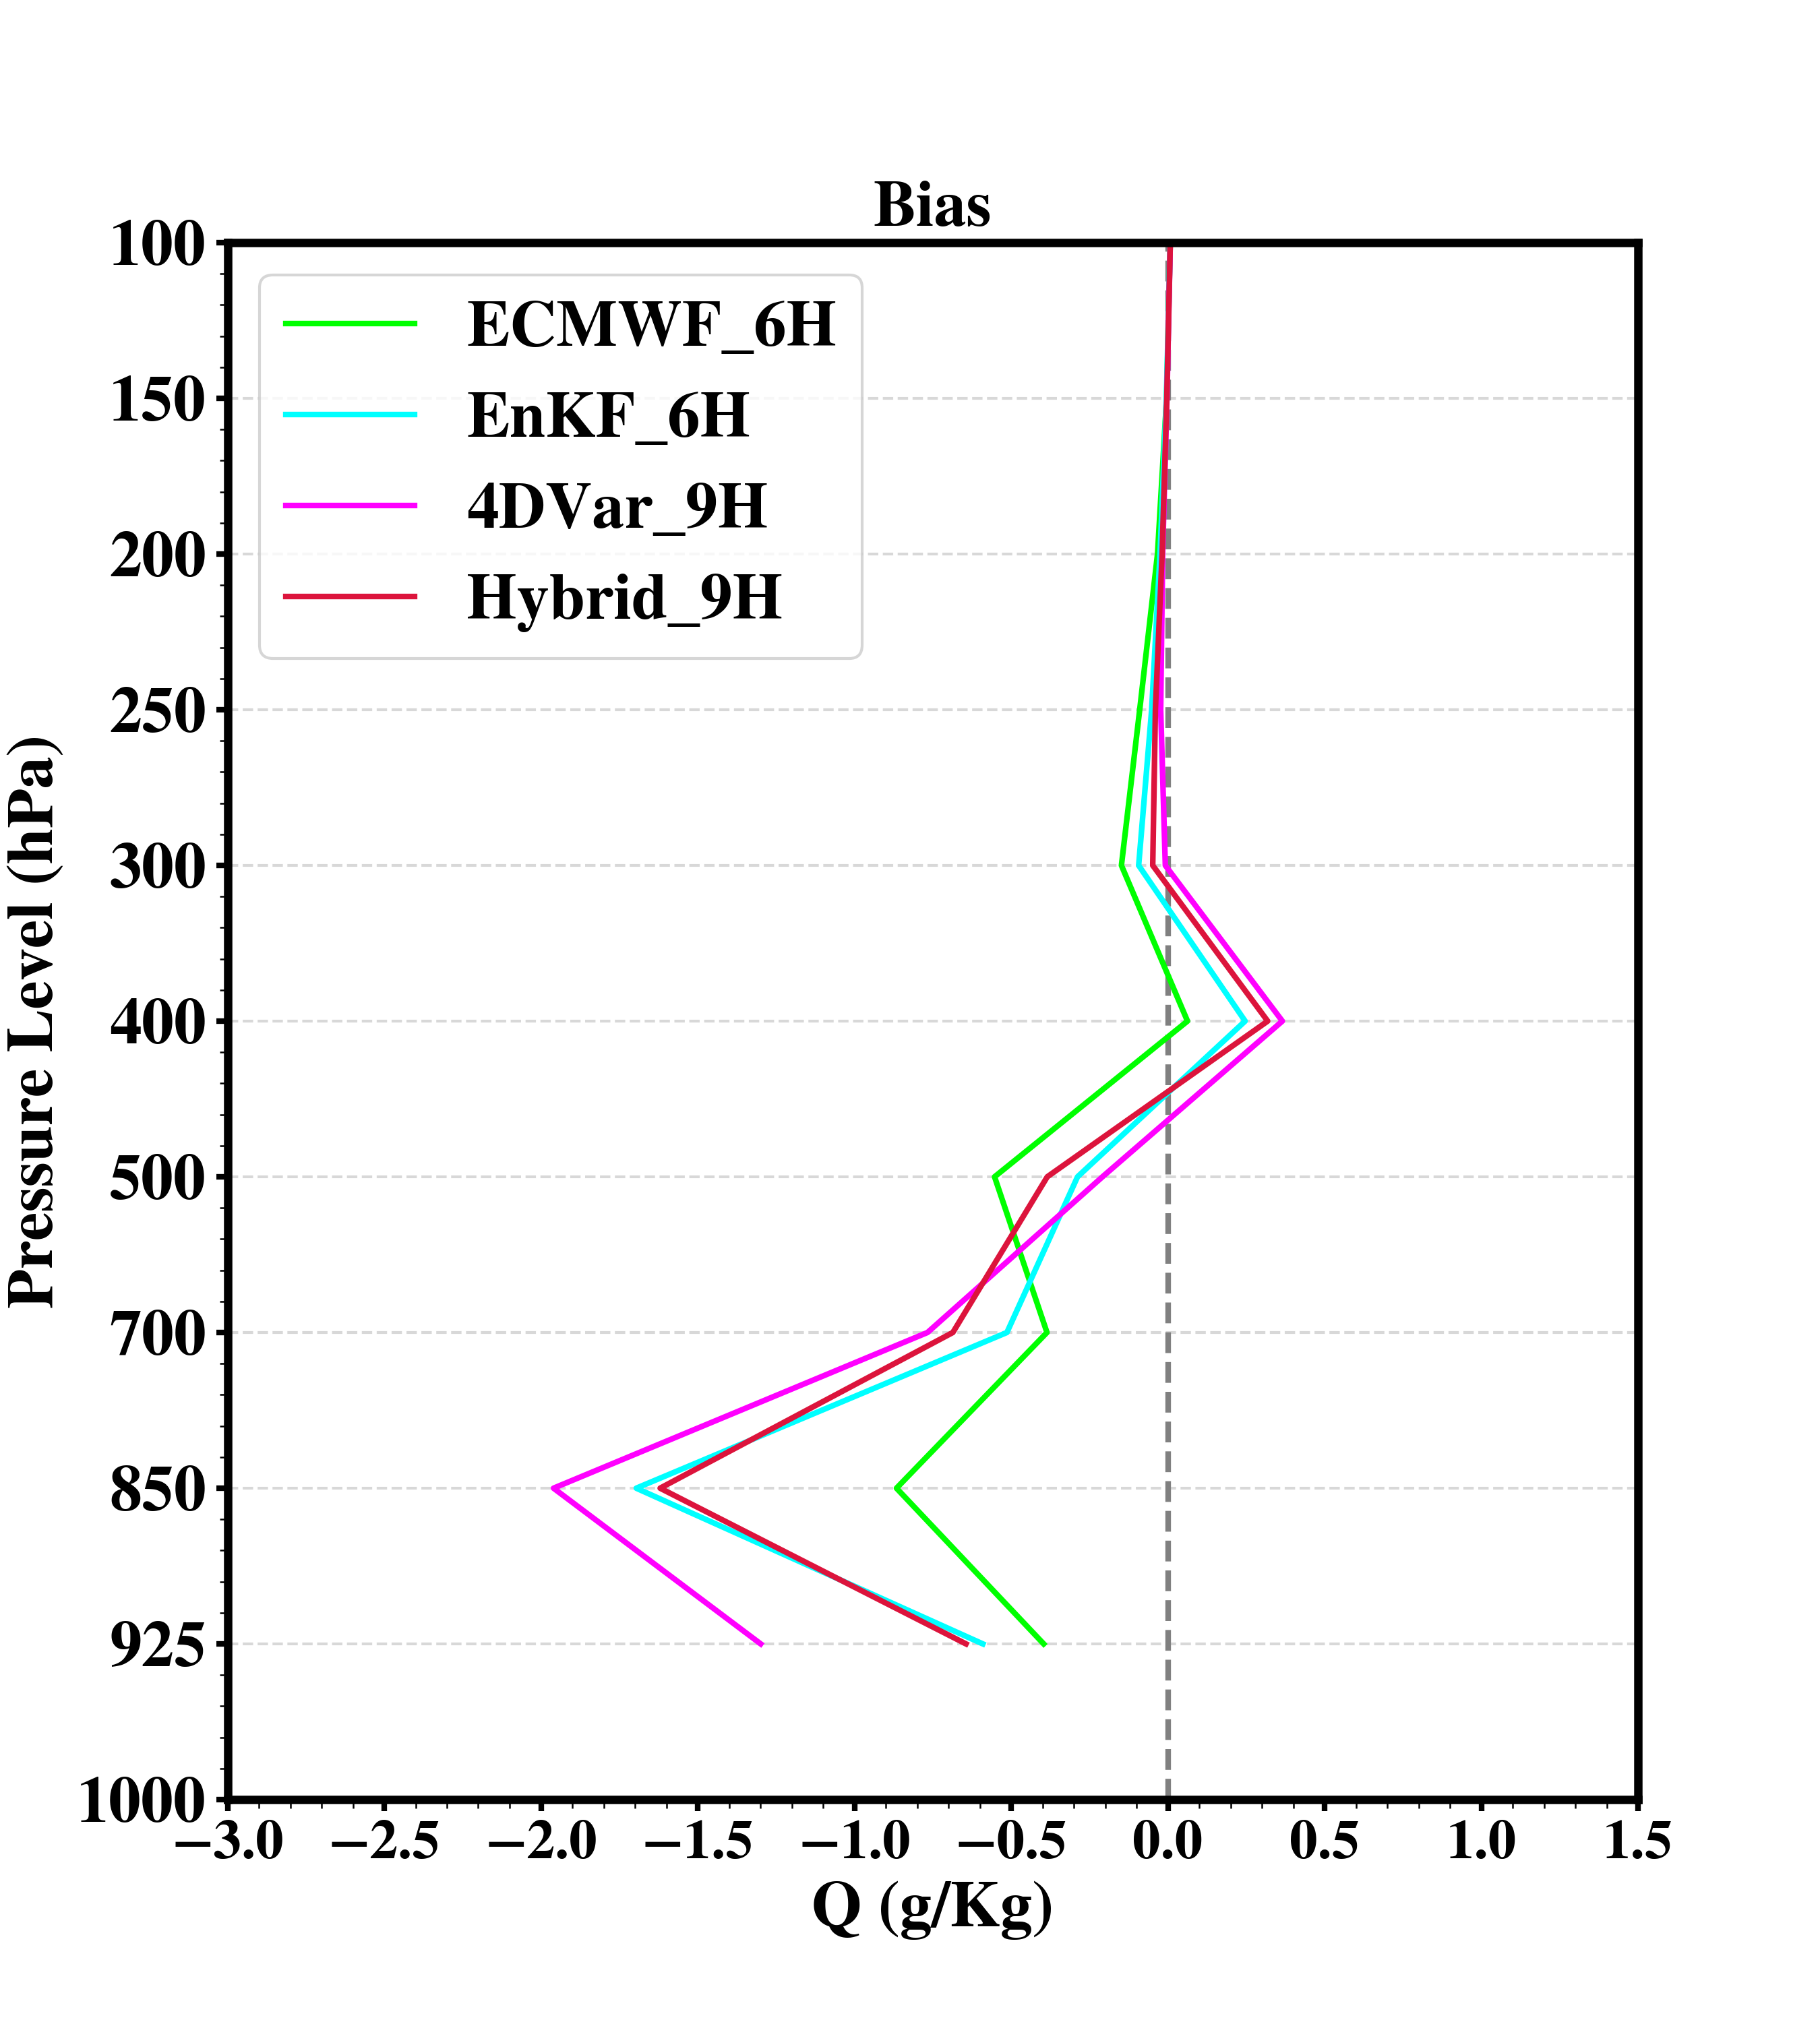
Bias Profiles 2518 - 2818 June 2015 UTC
6 hours or 9 hours forecast at same times
verify with intensive sounding obs. and GTS sounding
(00, 06, 12, 18 UTC)

Slide 8
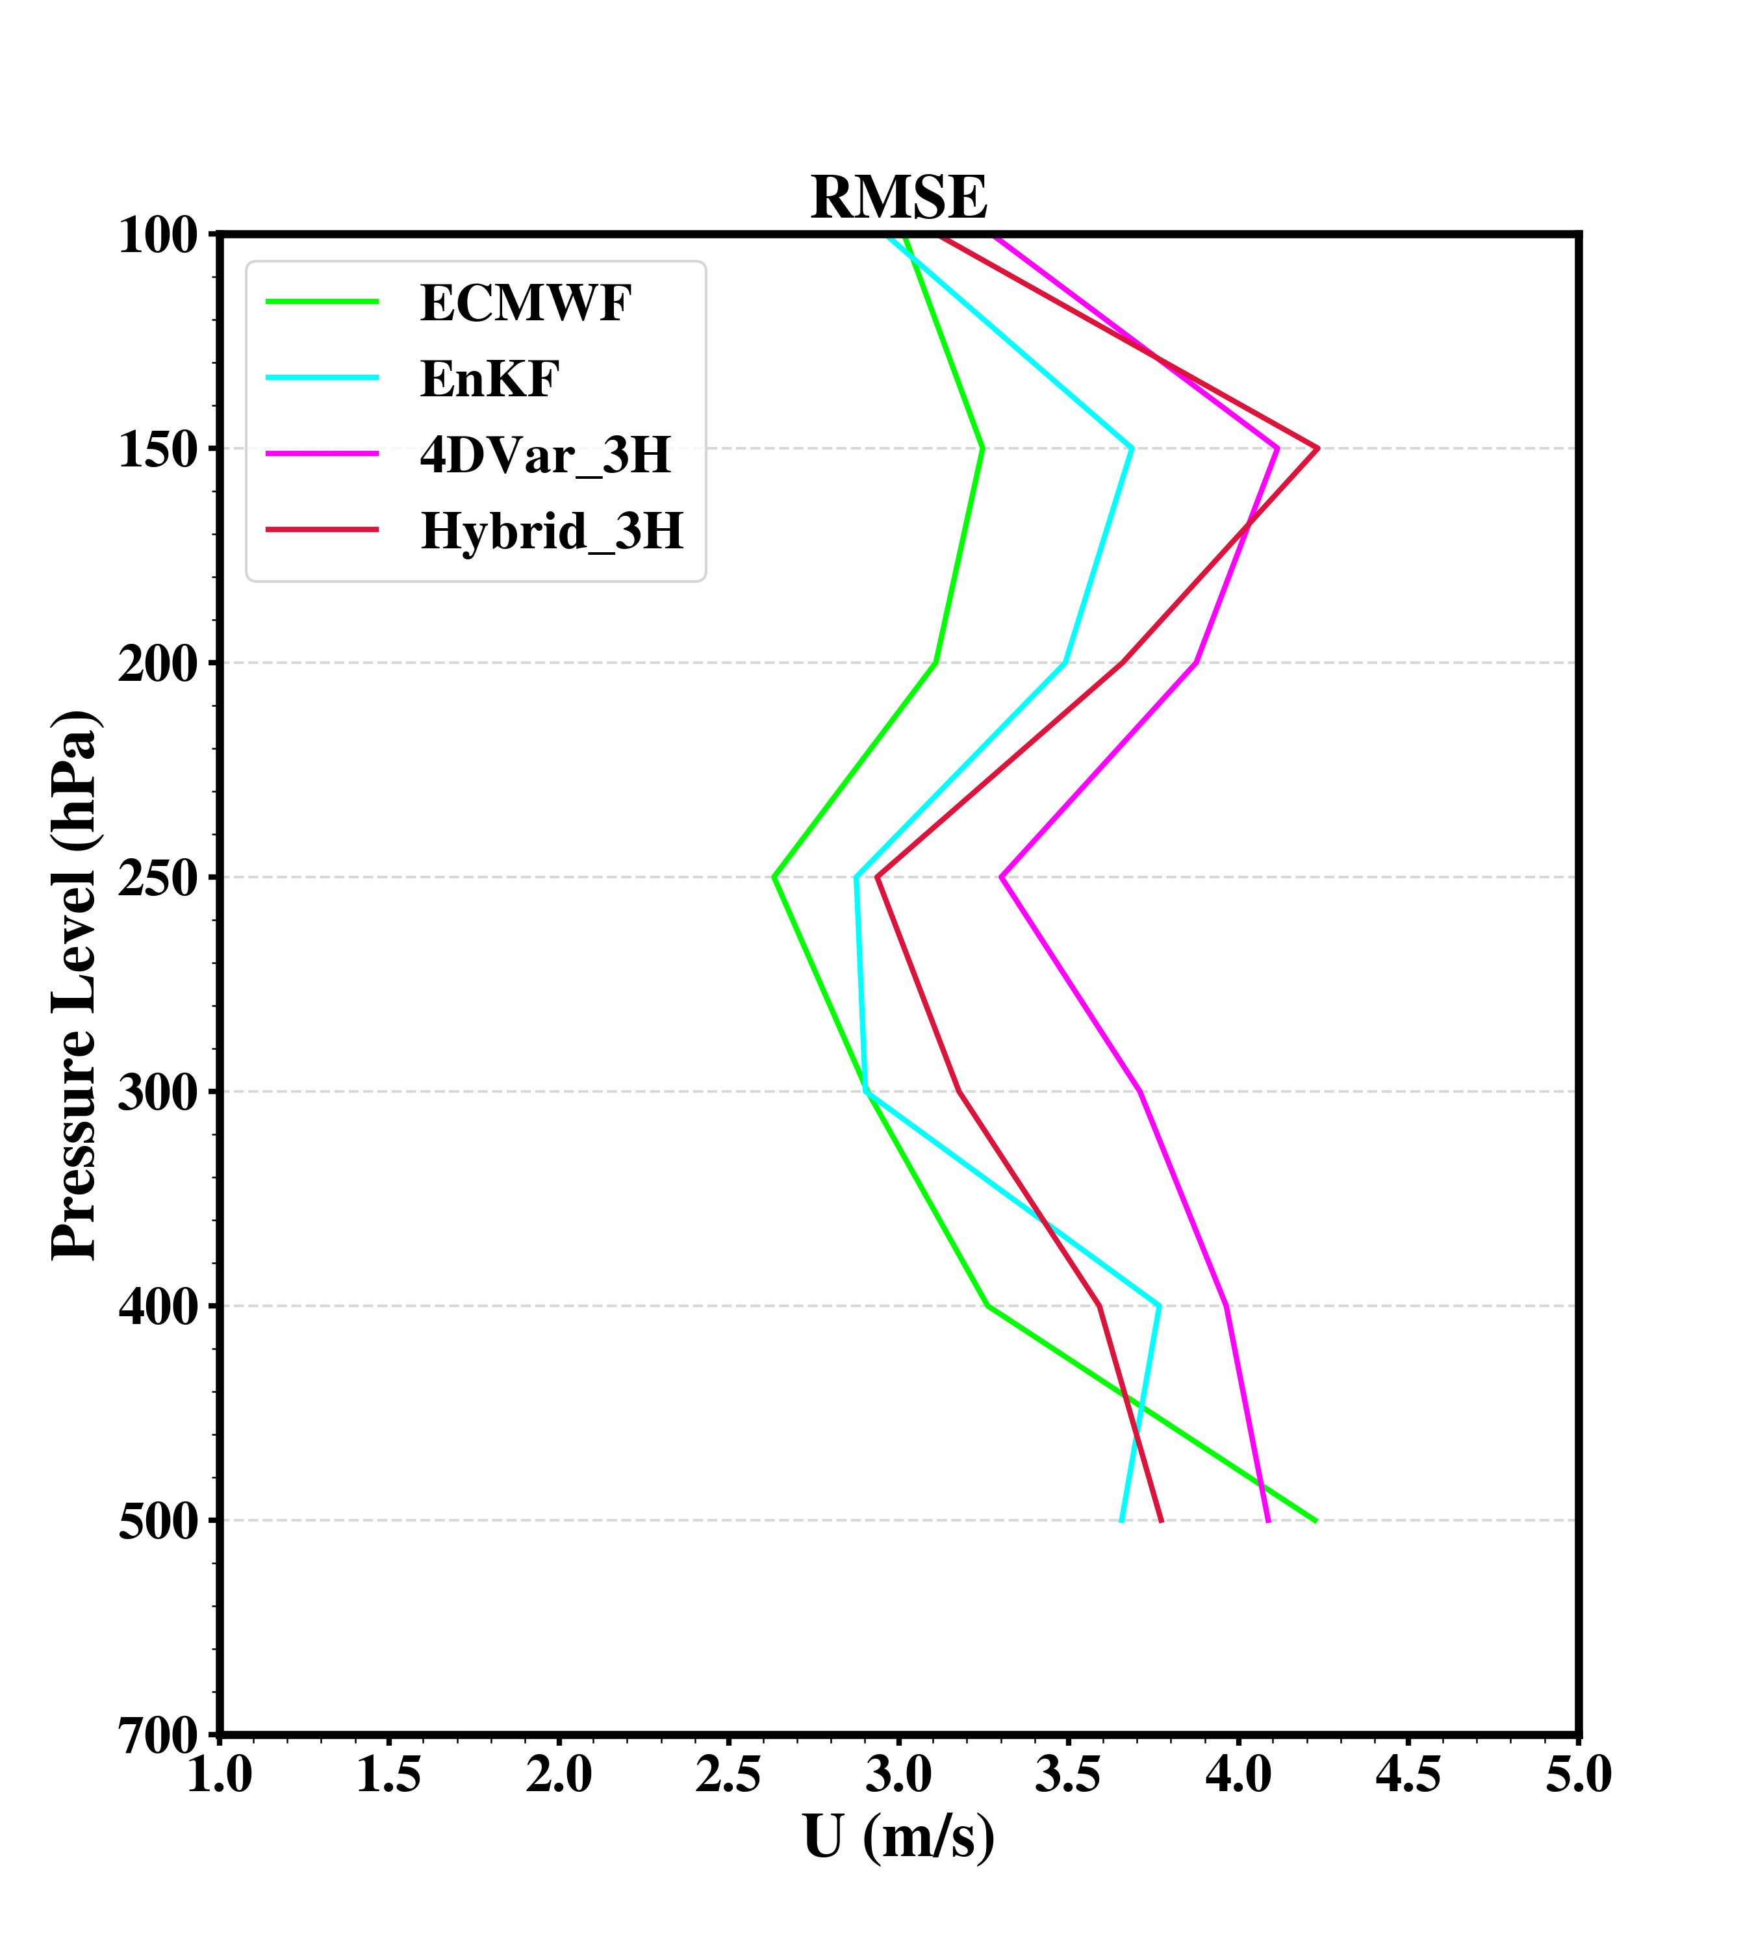
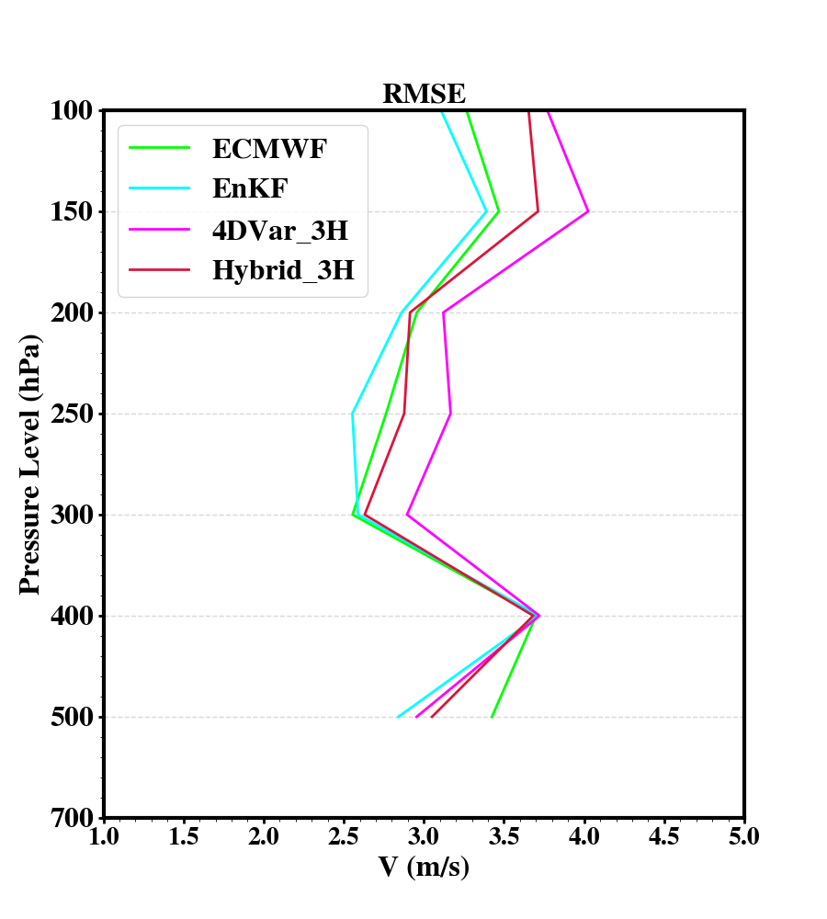
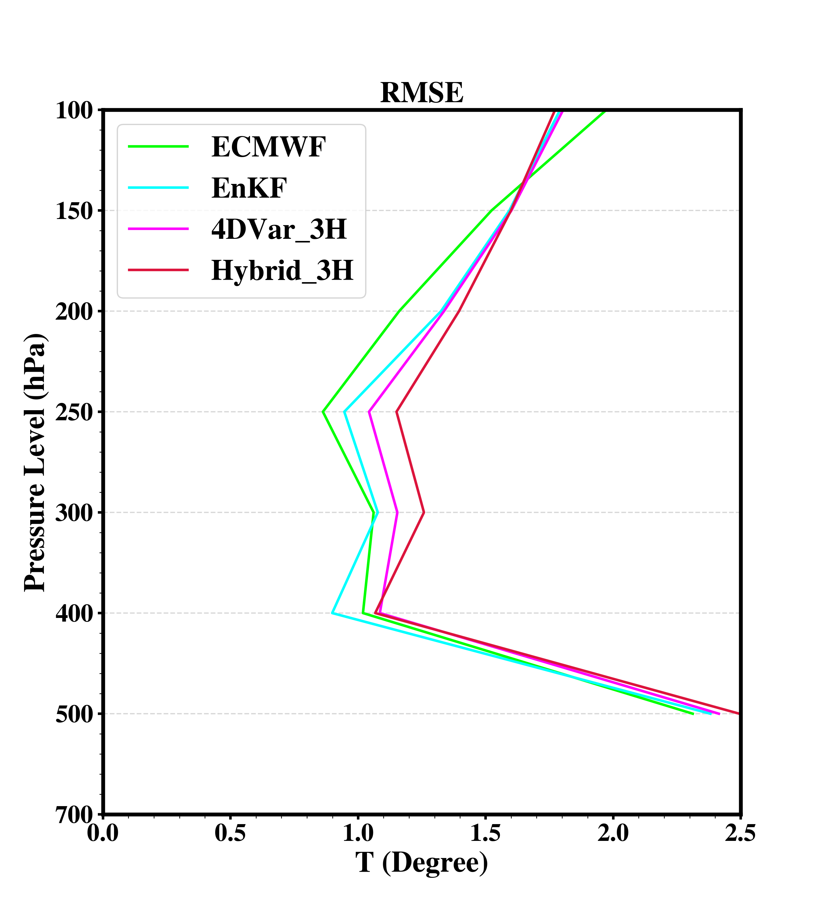
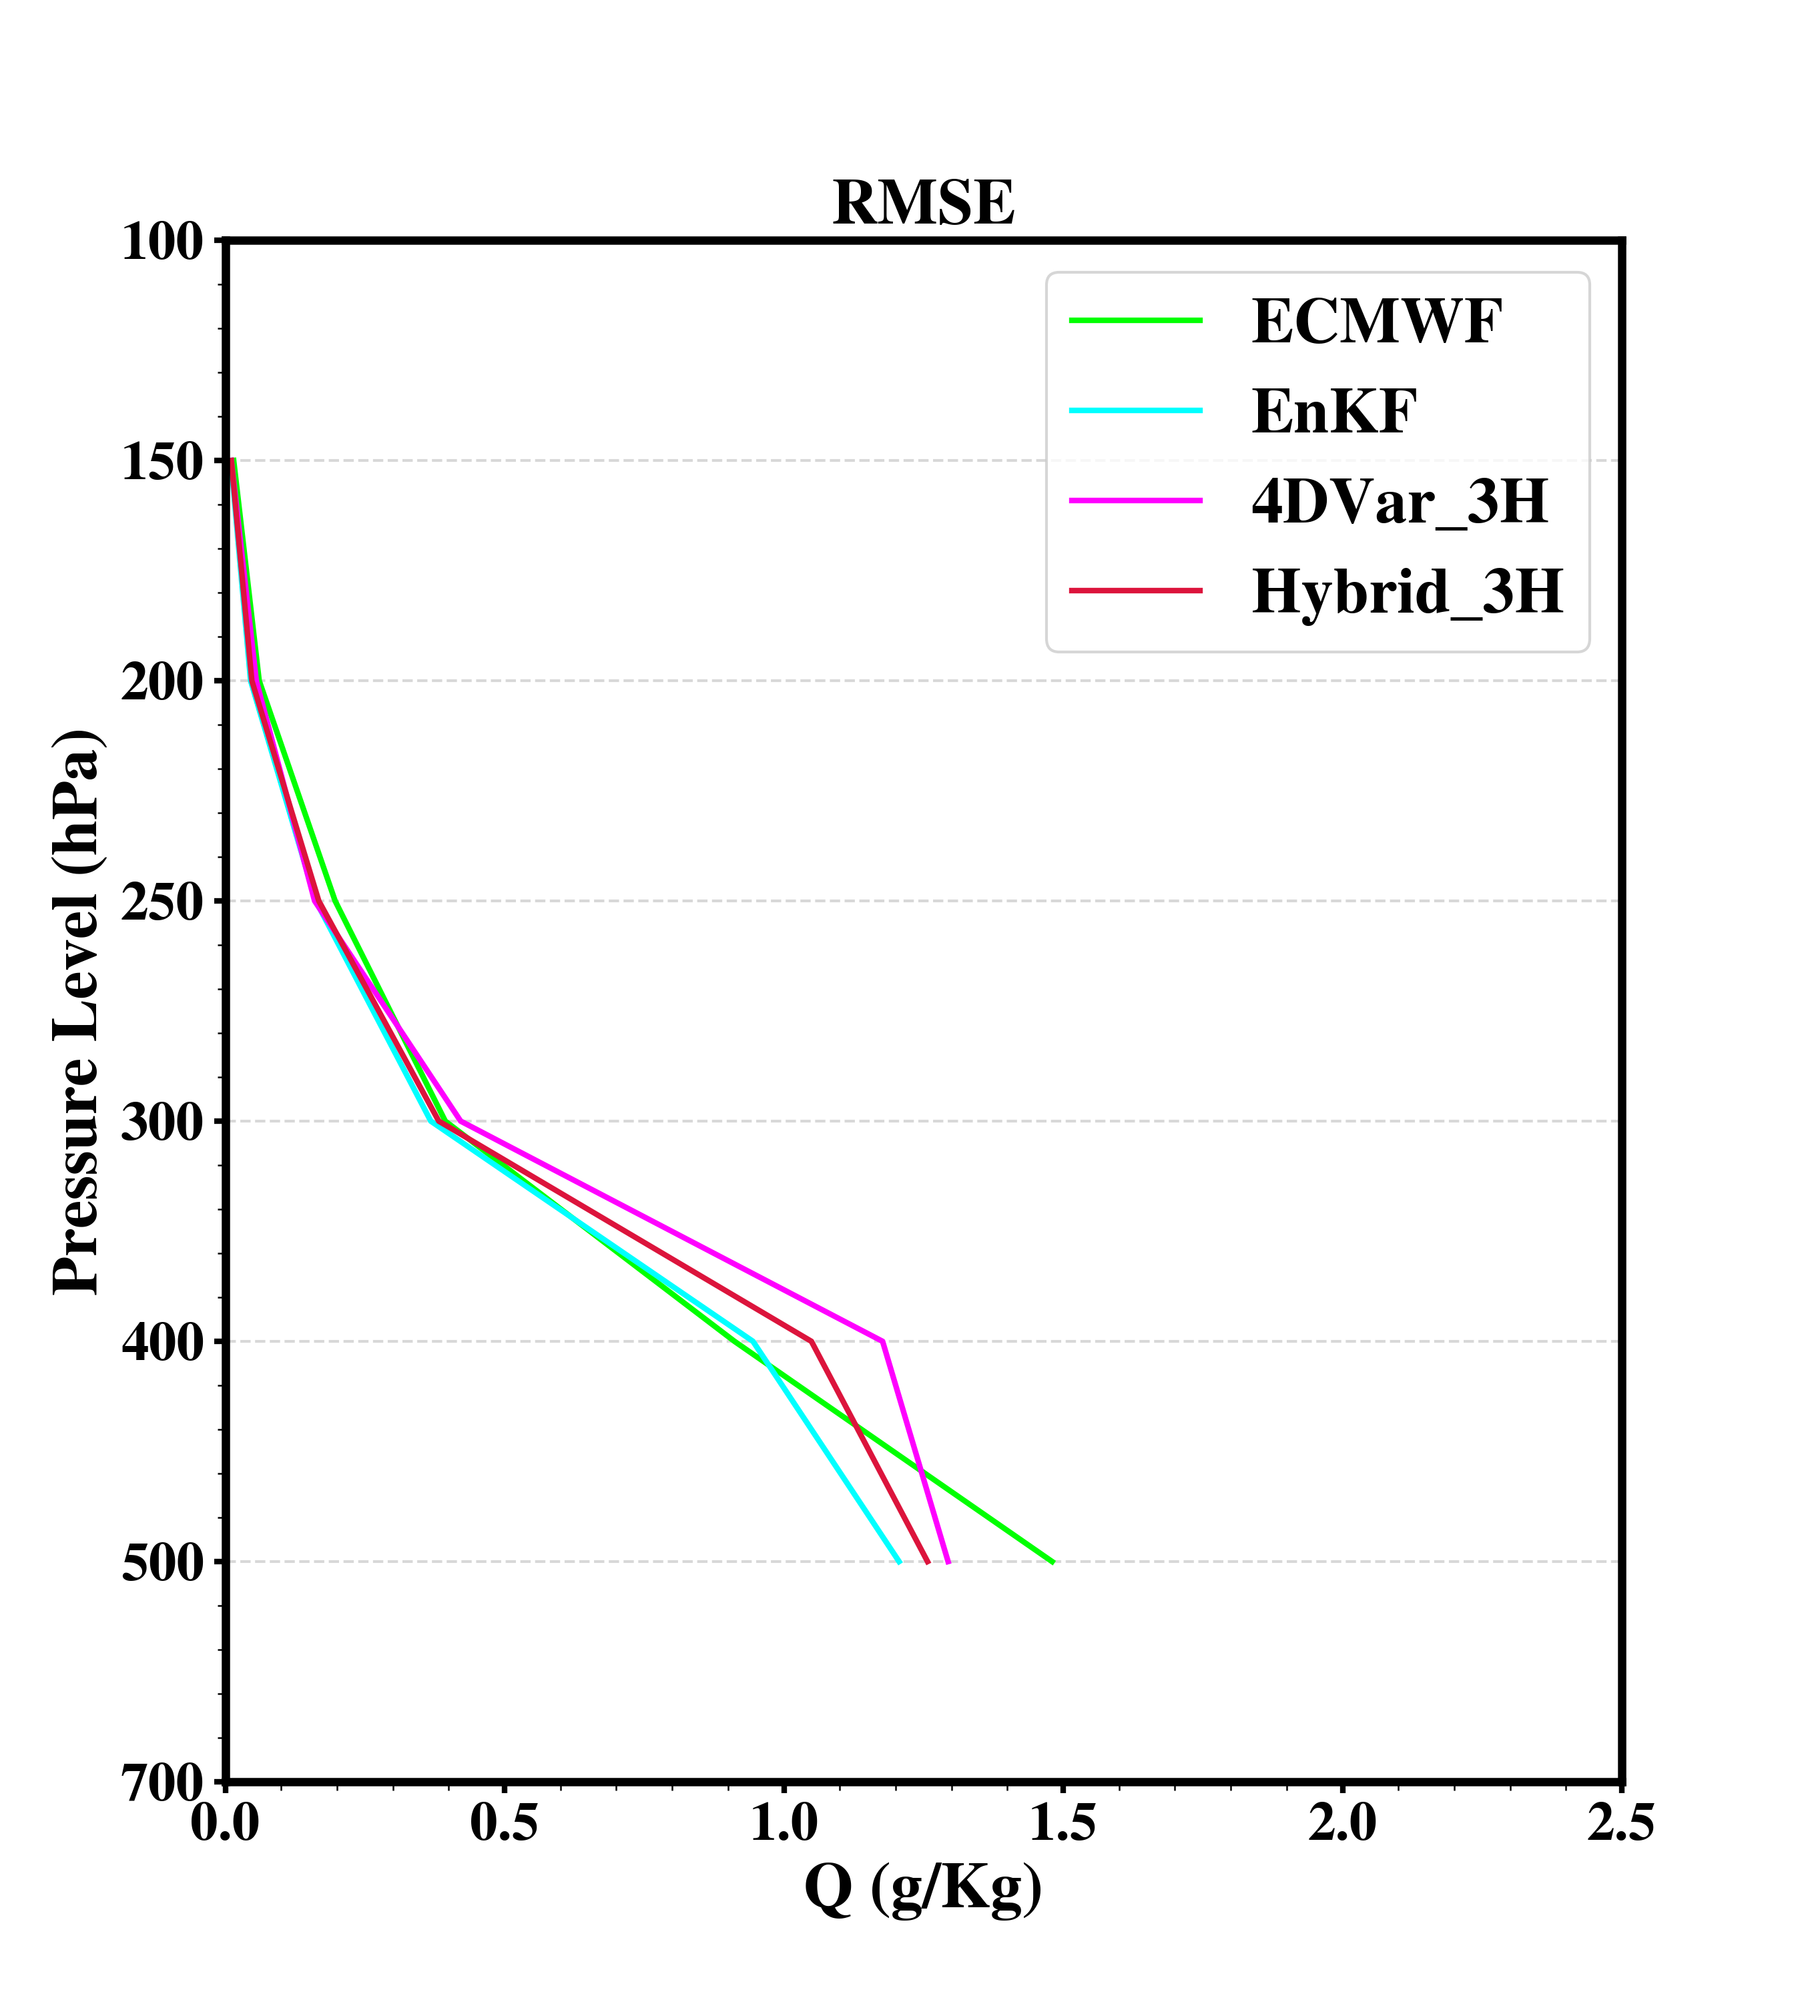
RMSE Profiles 2518 - 2818 June 2015 UTC
analysis or 3 hours forecast at same times
verify with intensive sounding obs.
(00, 06, 12, 18 UTC)

Slide 9
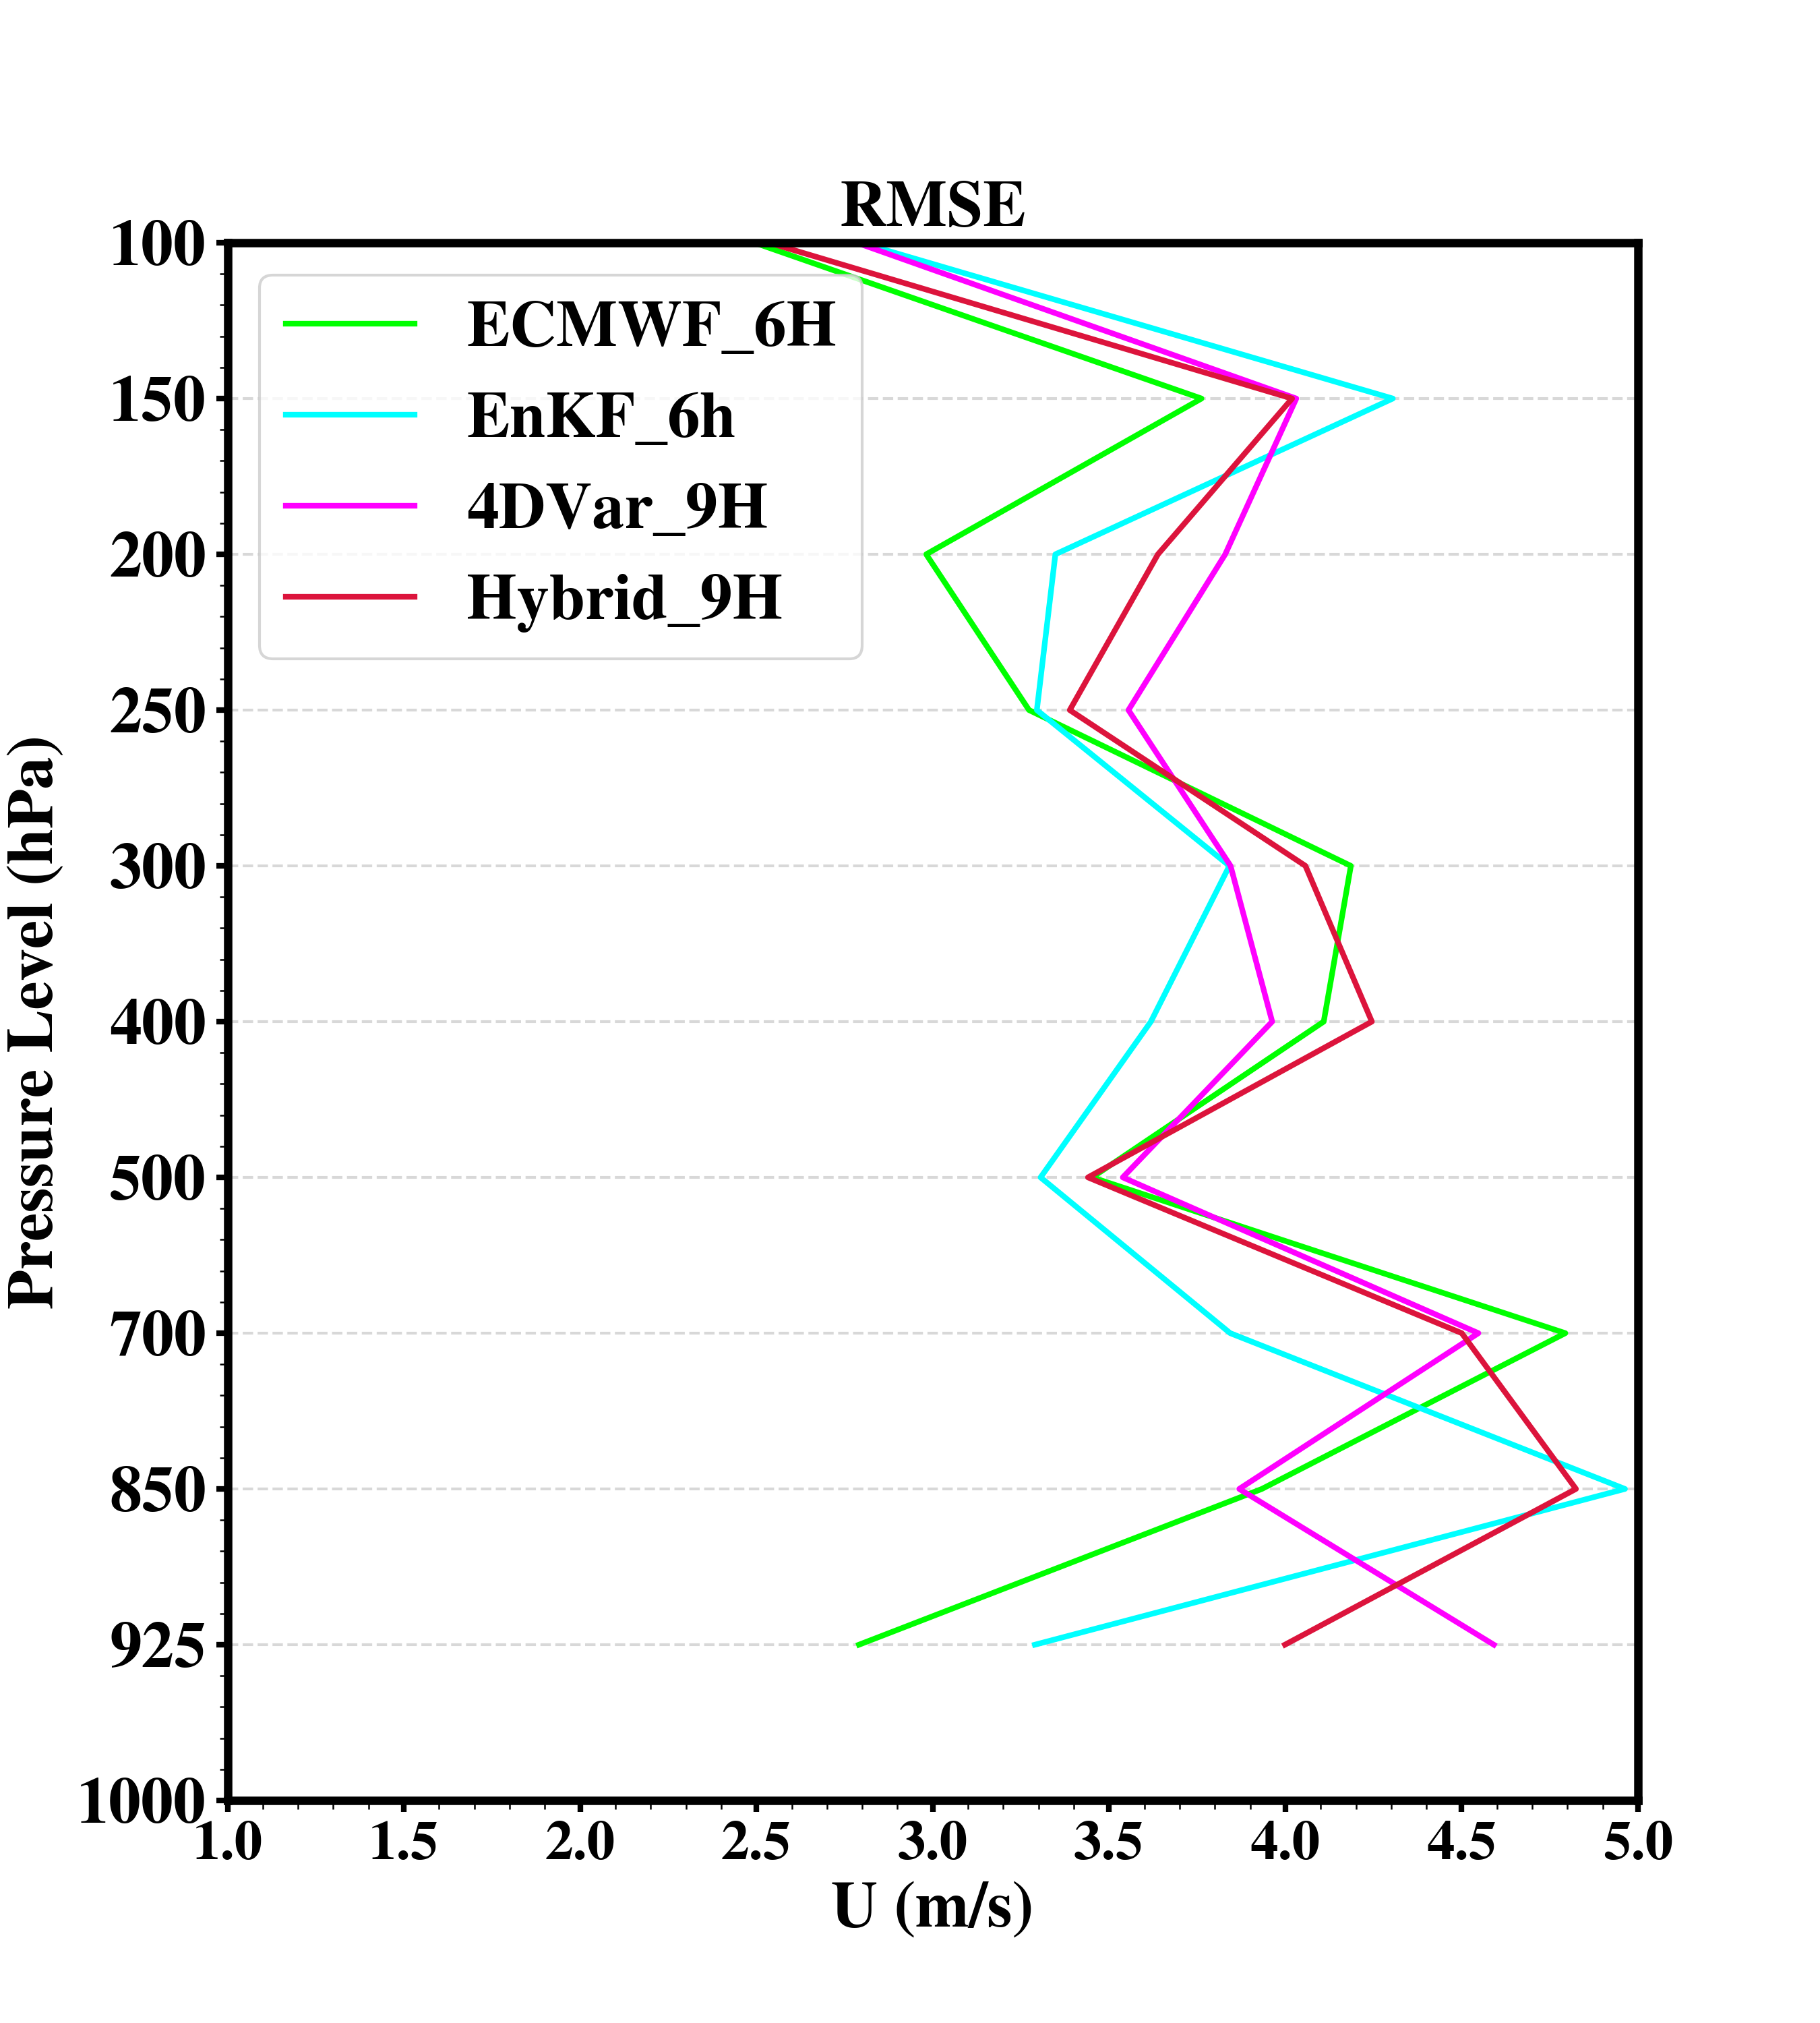
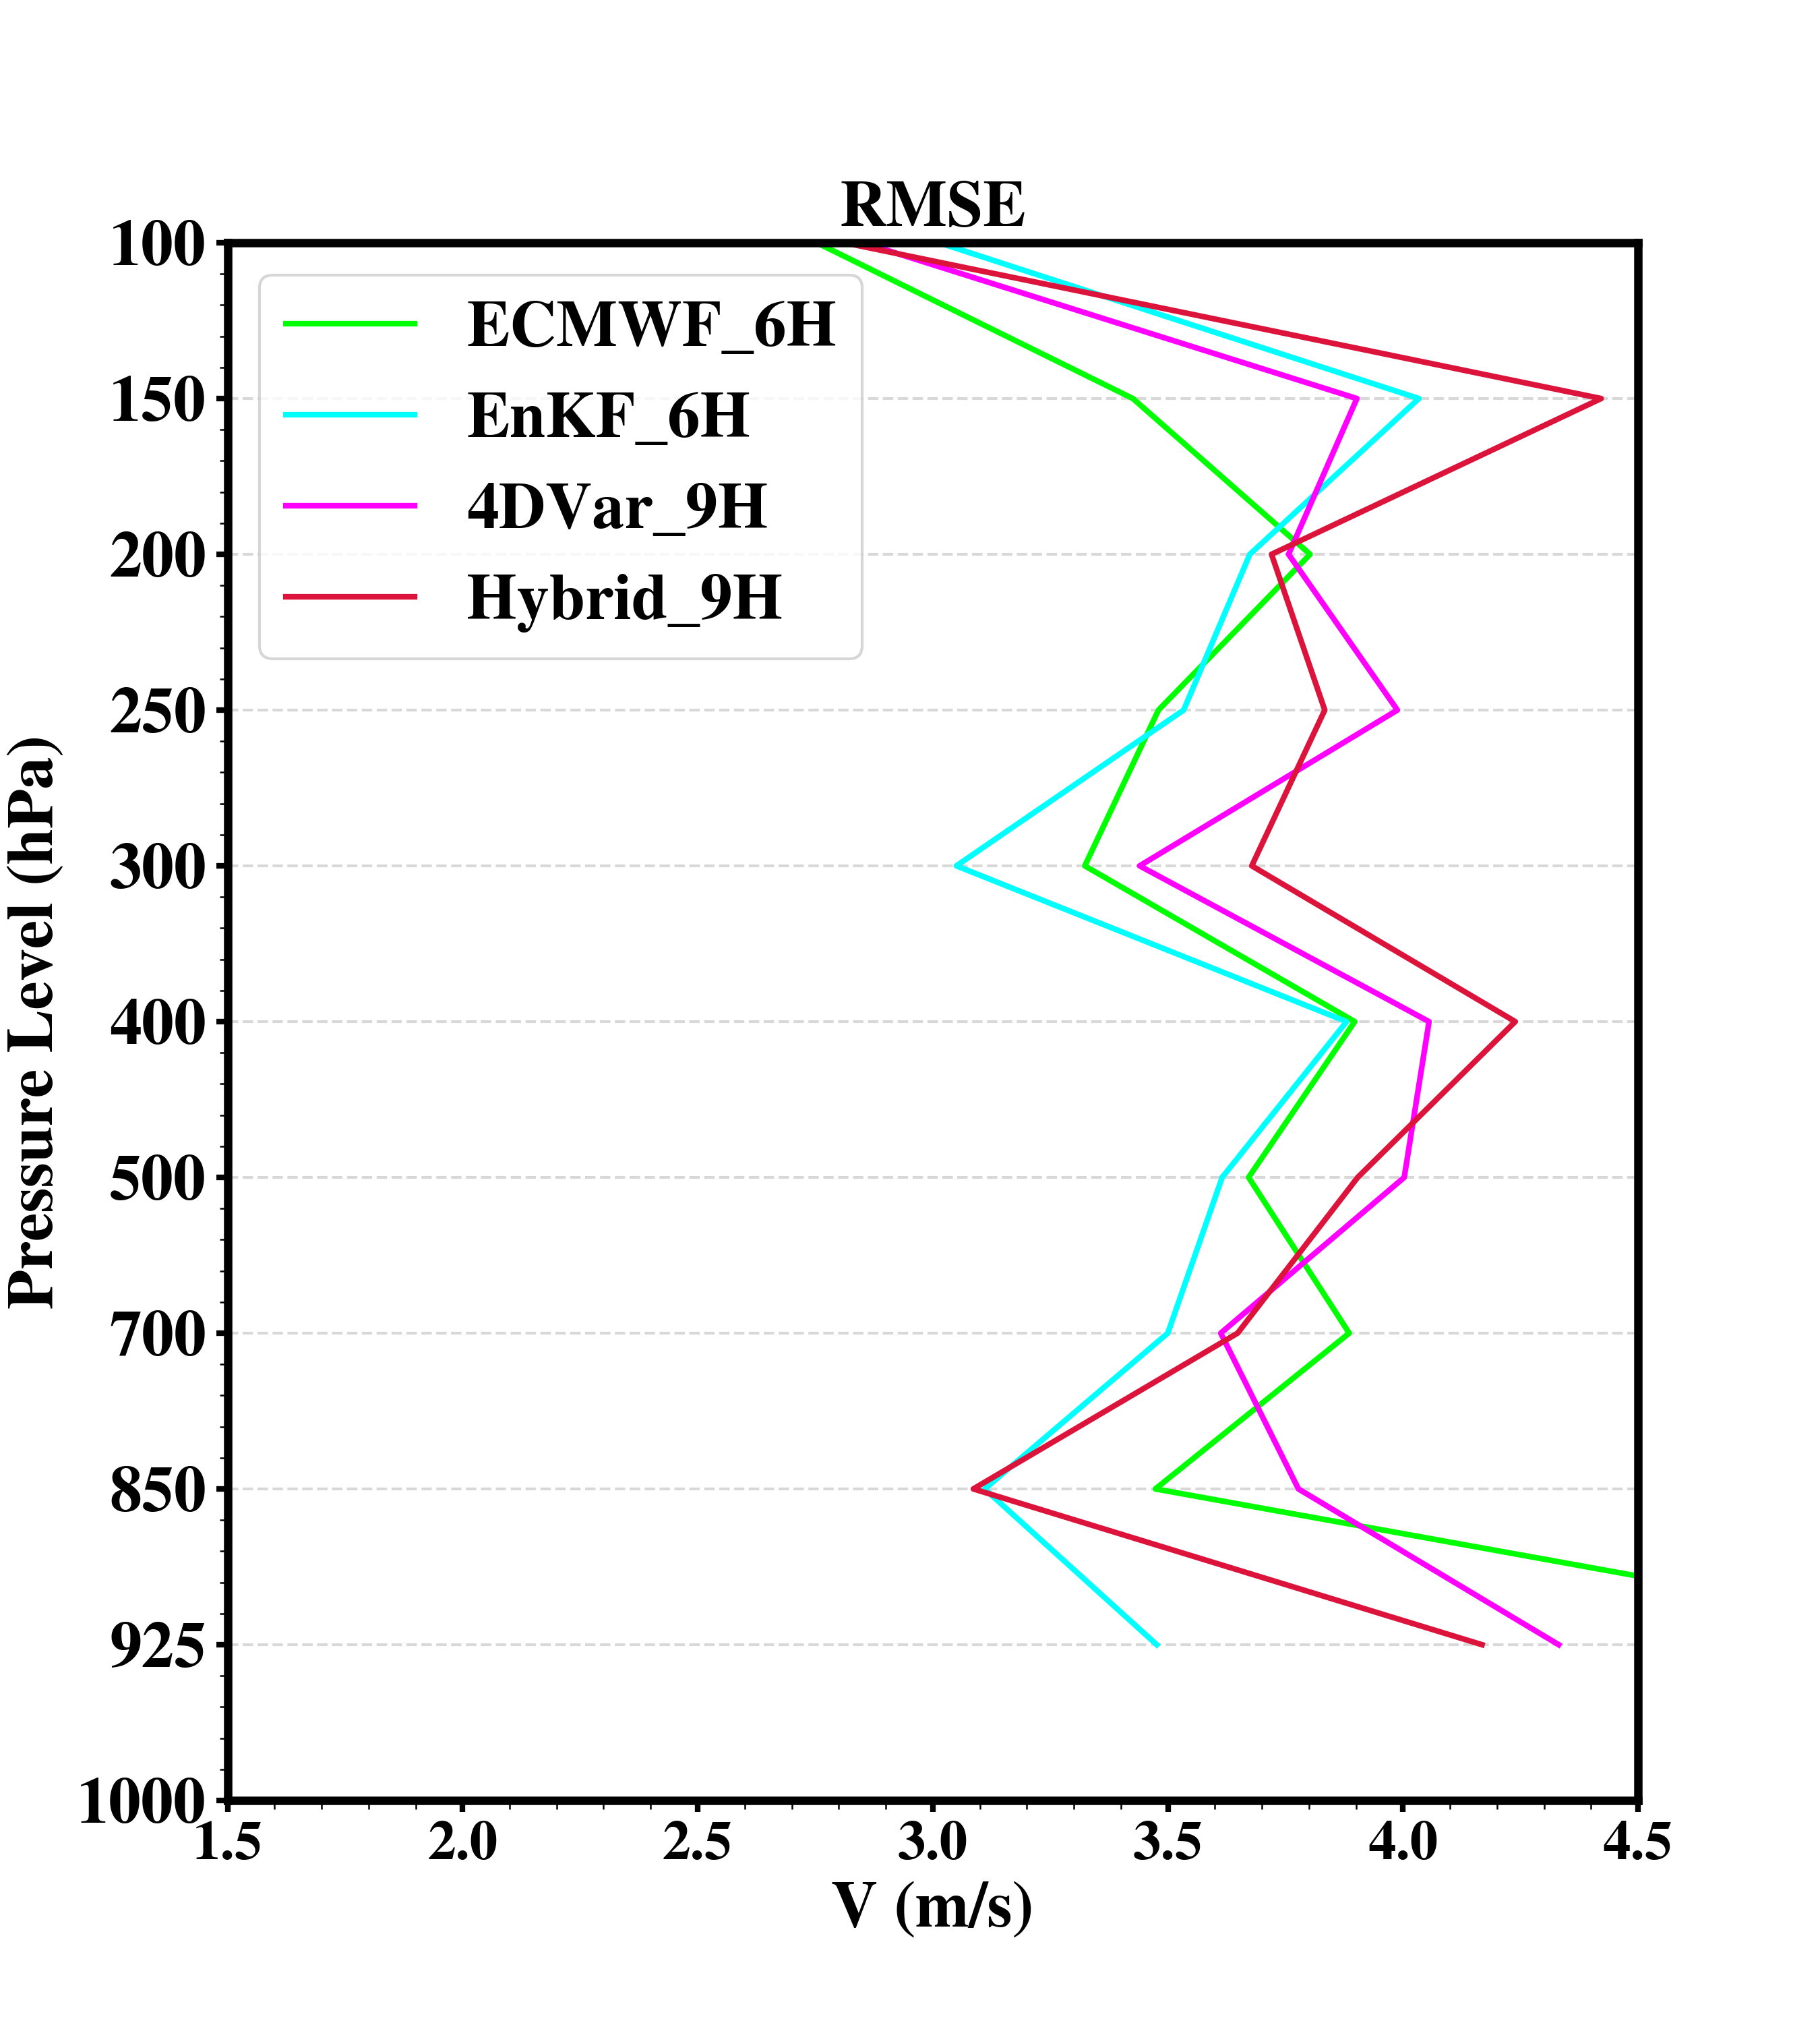
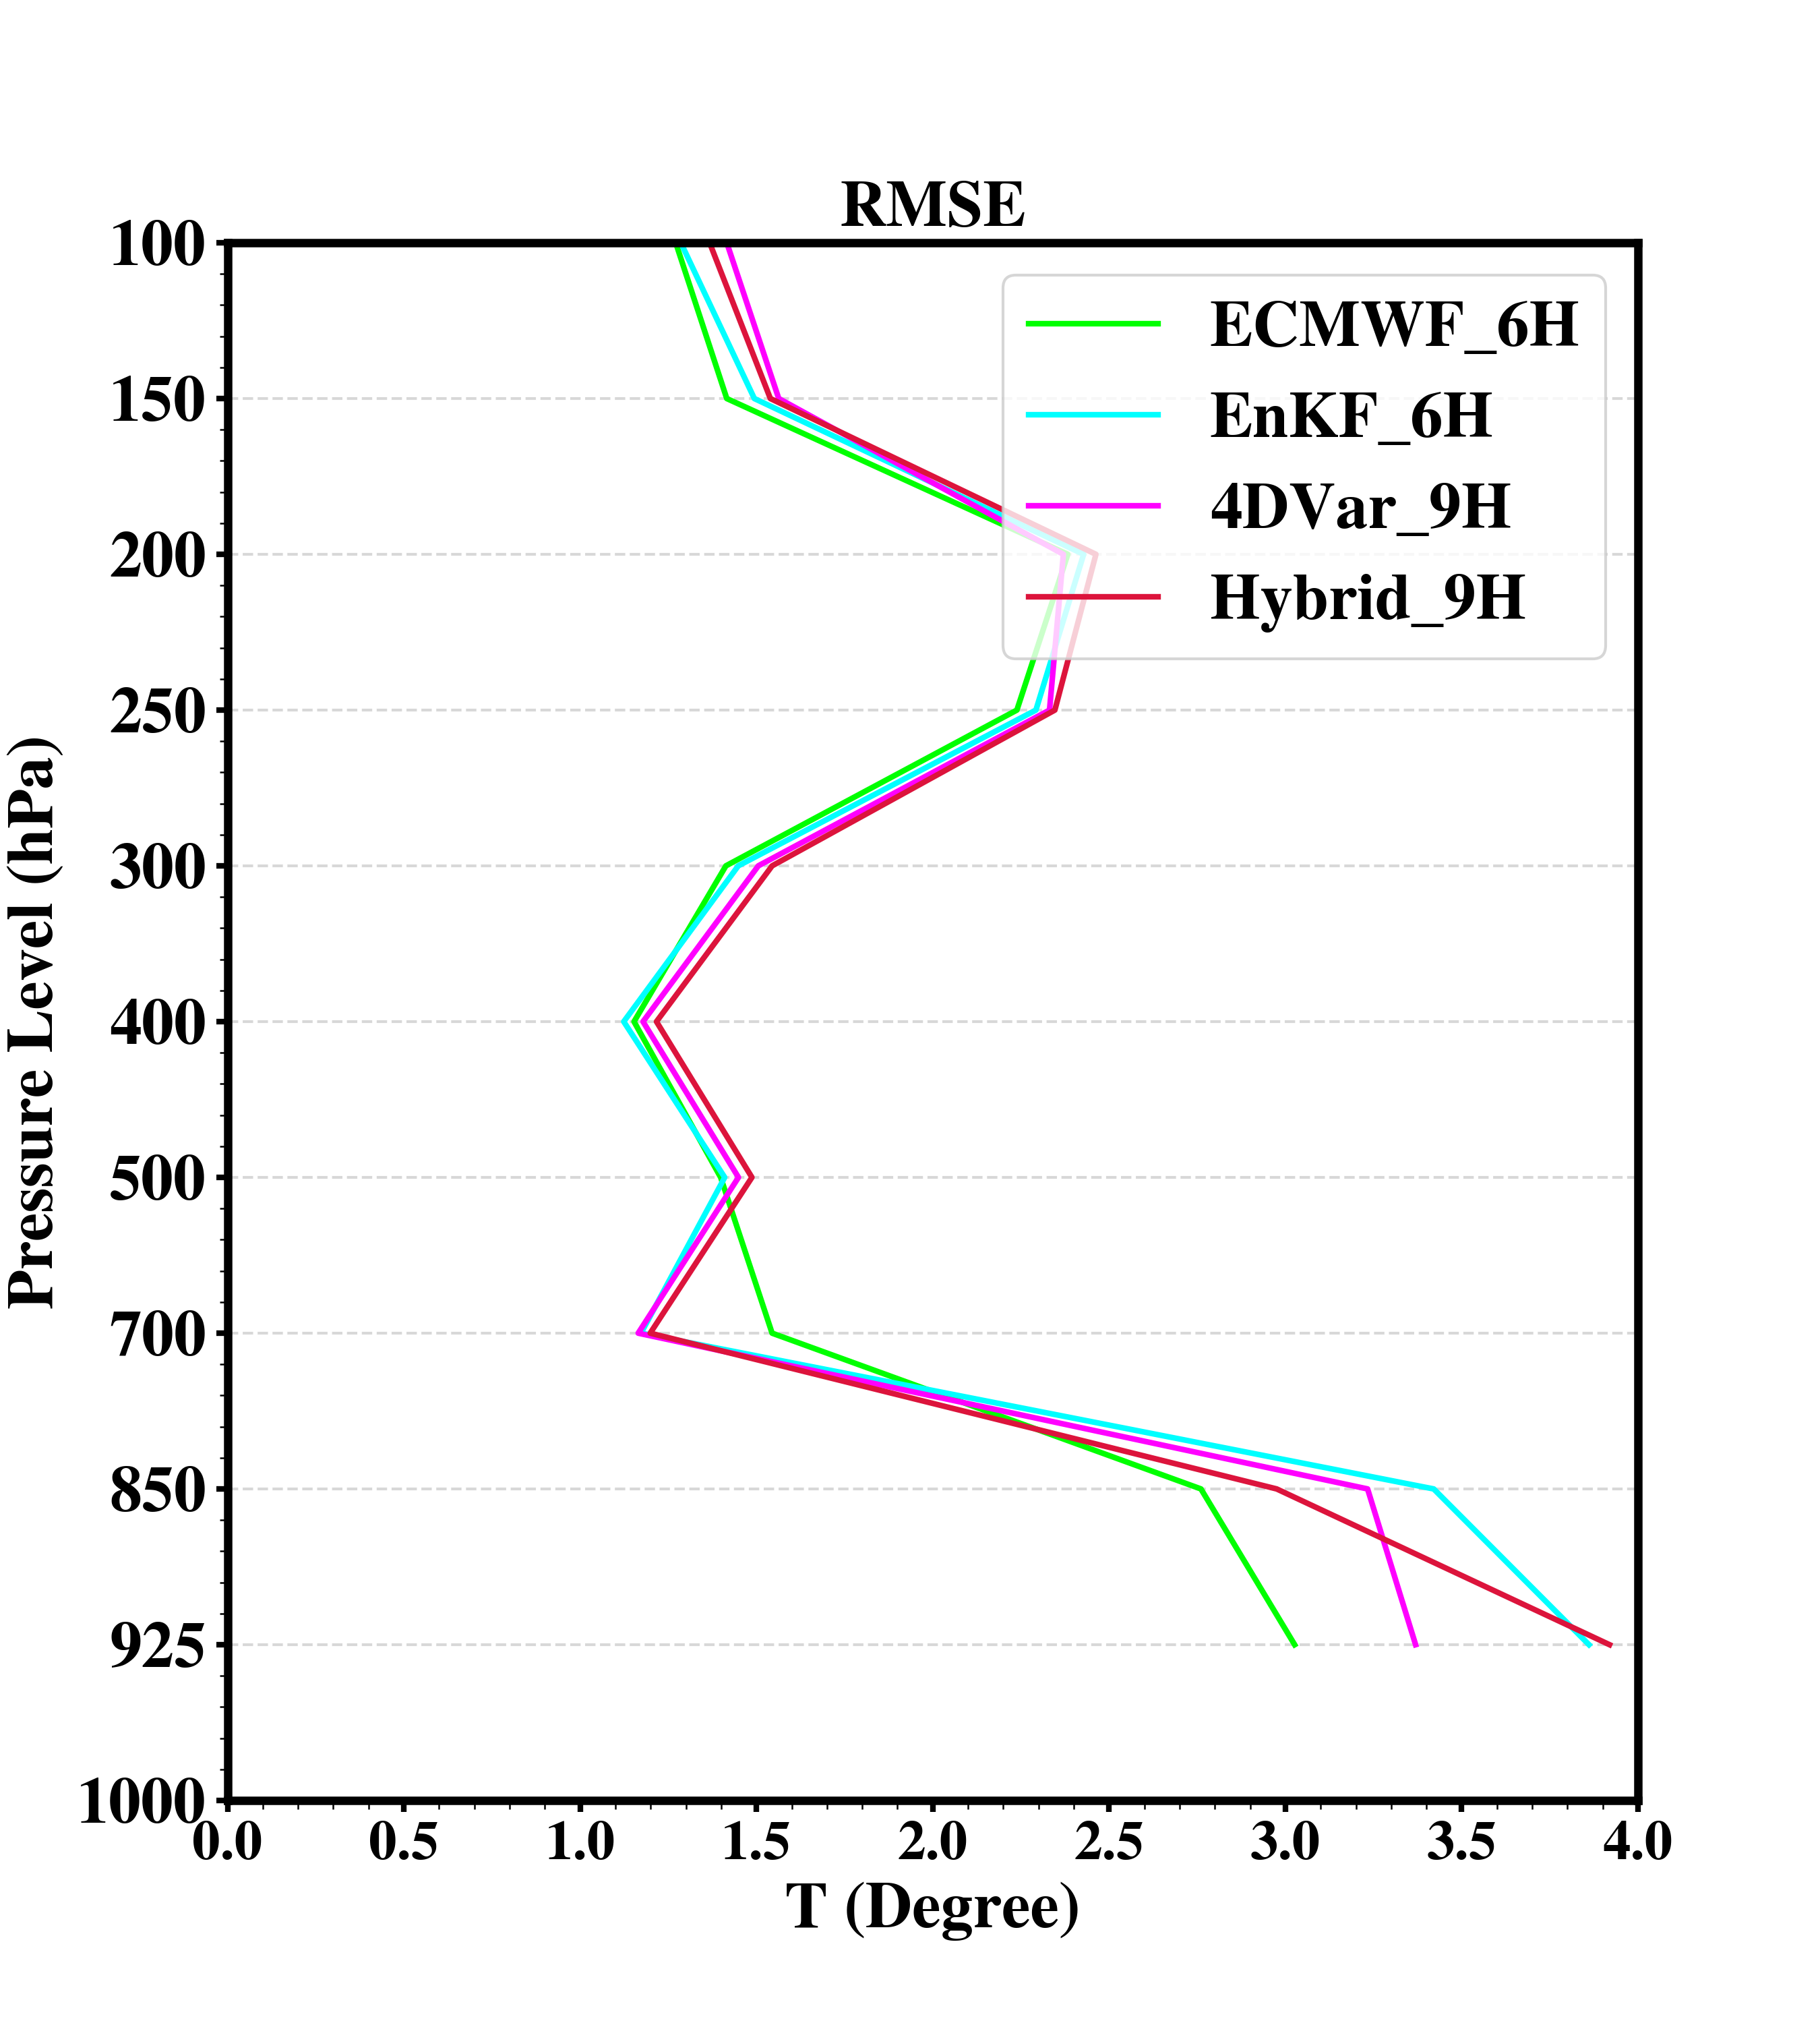
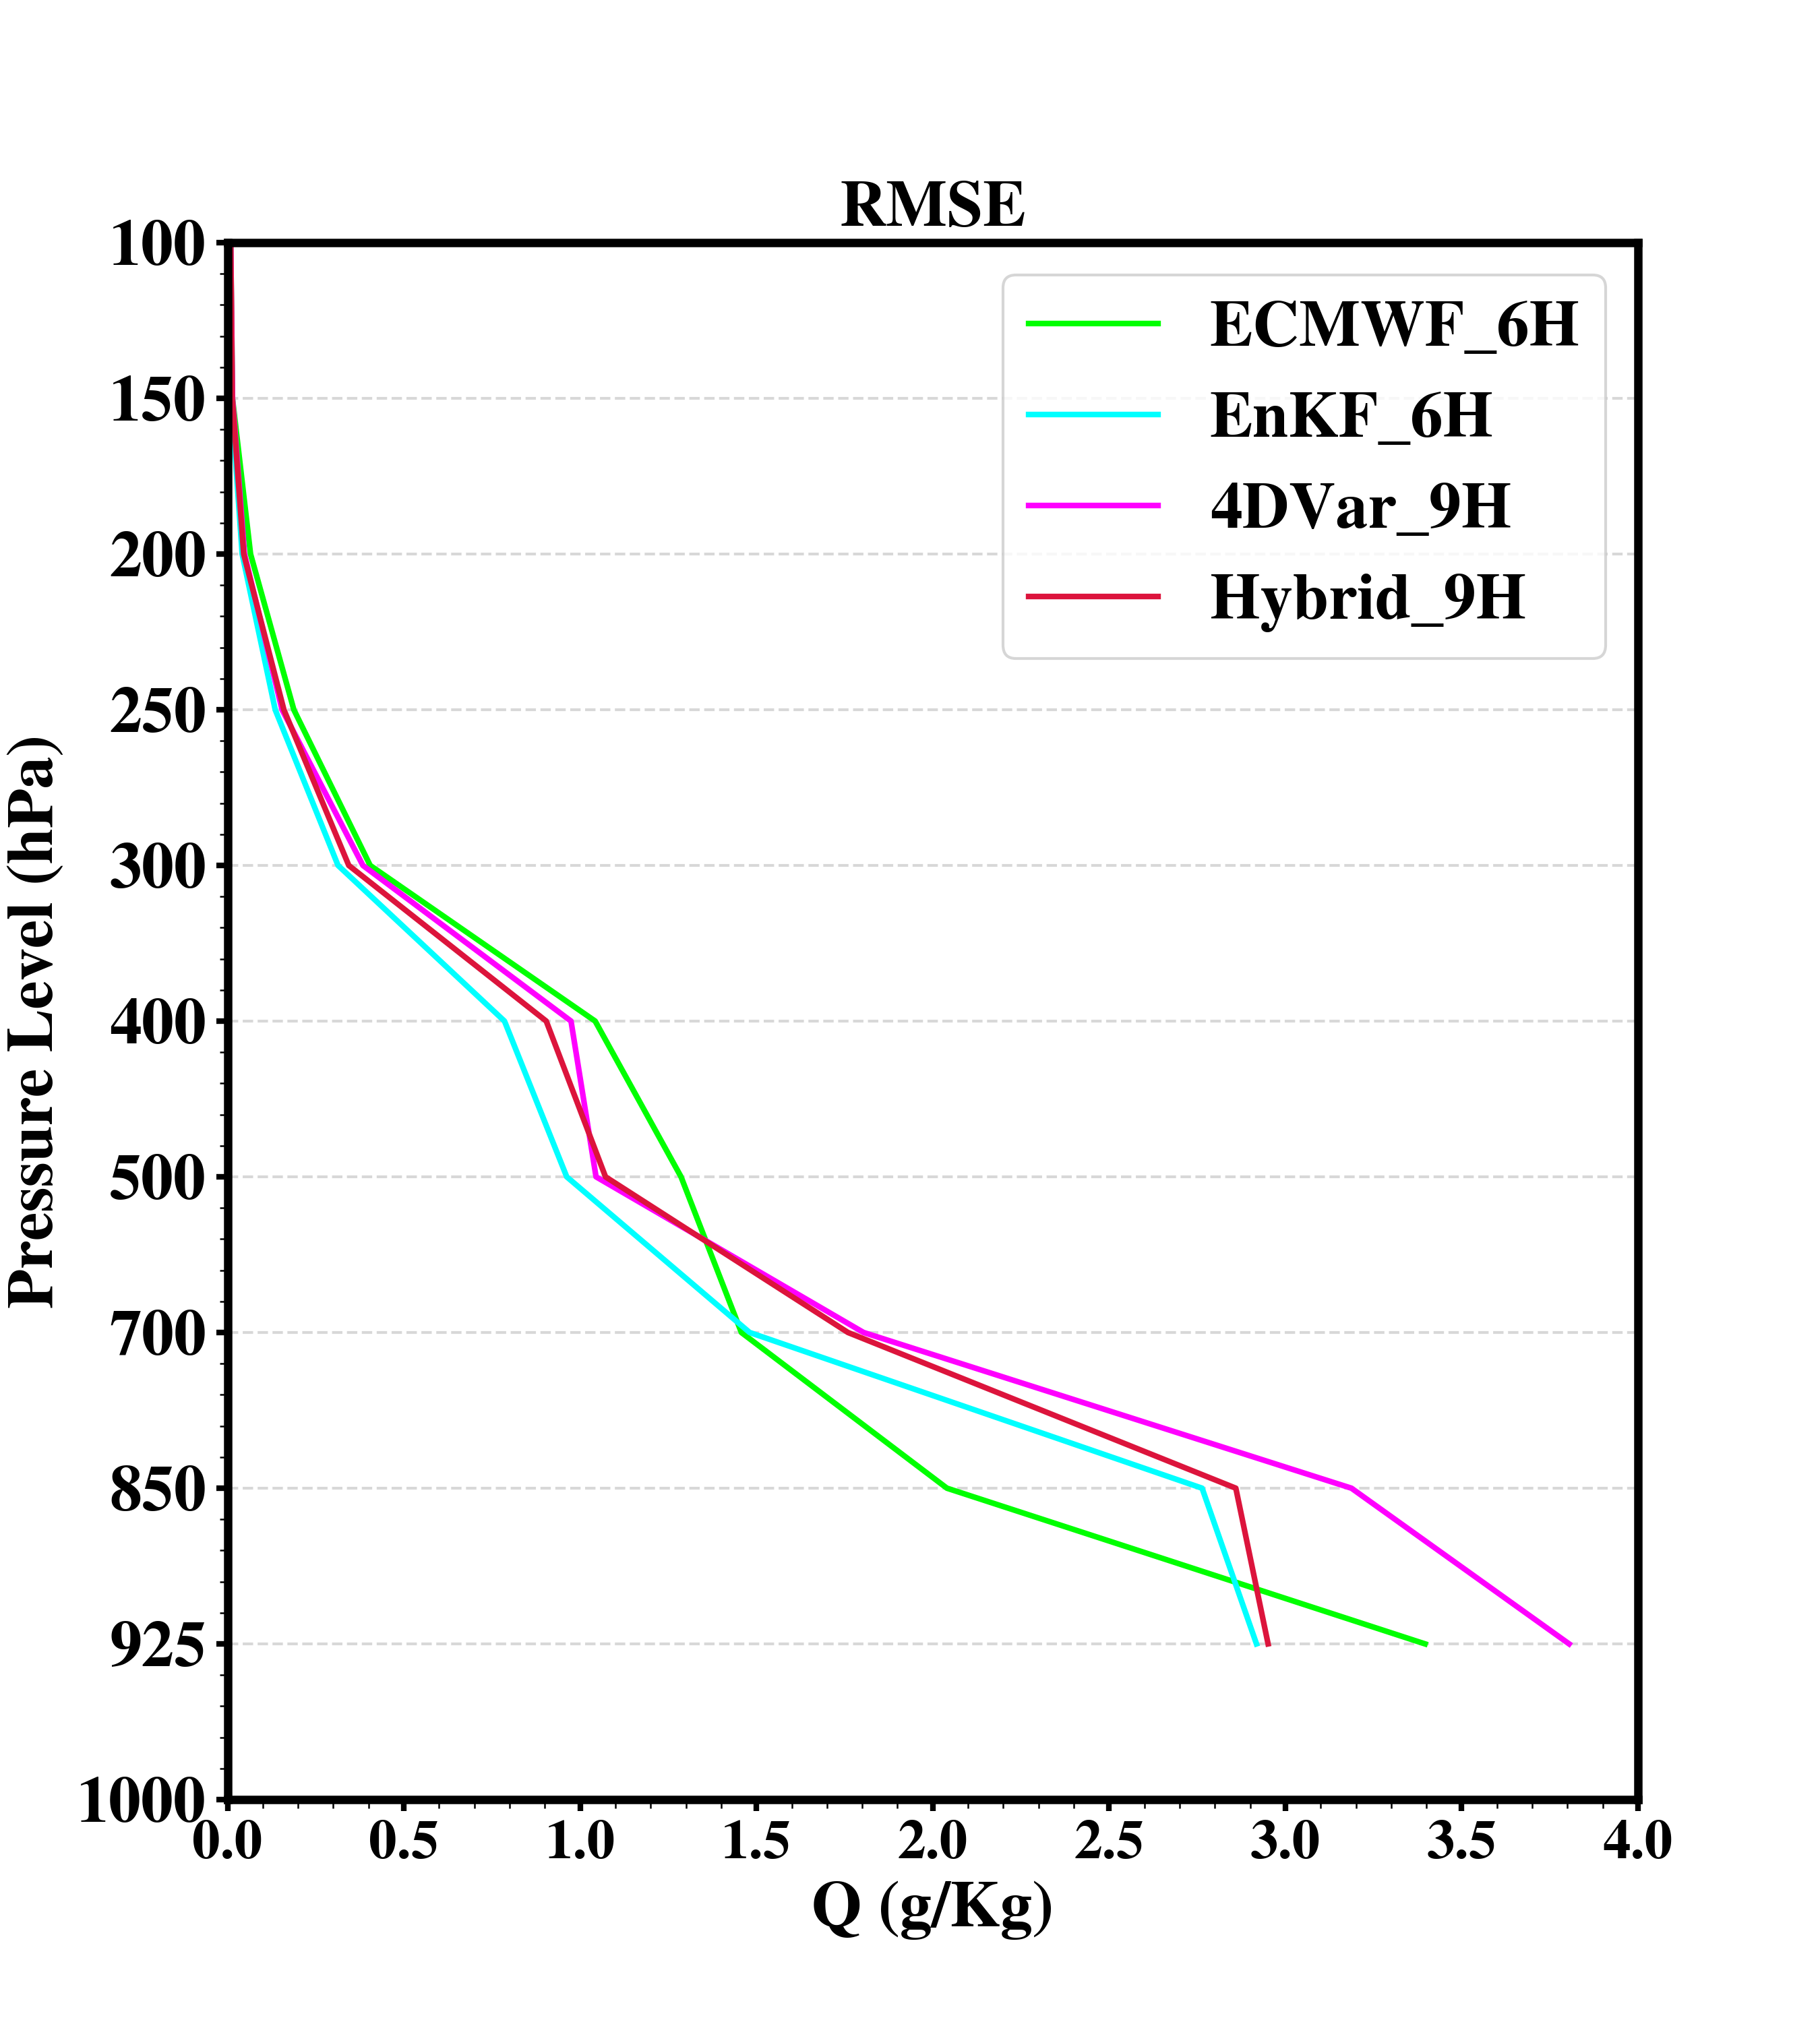
RMSE Profiles 2600 - 2812 June 2015 UTC
6 hours or 9 hours forecast at same times
verify with GTS sounding obs.
(00, 12 UTC)

Slide 10
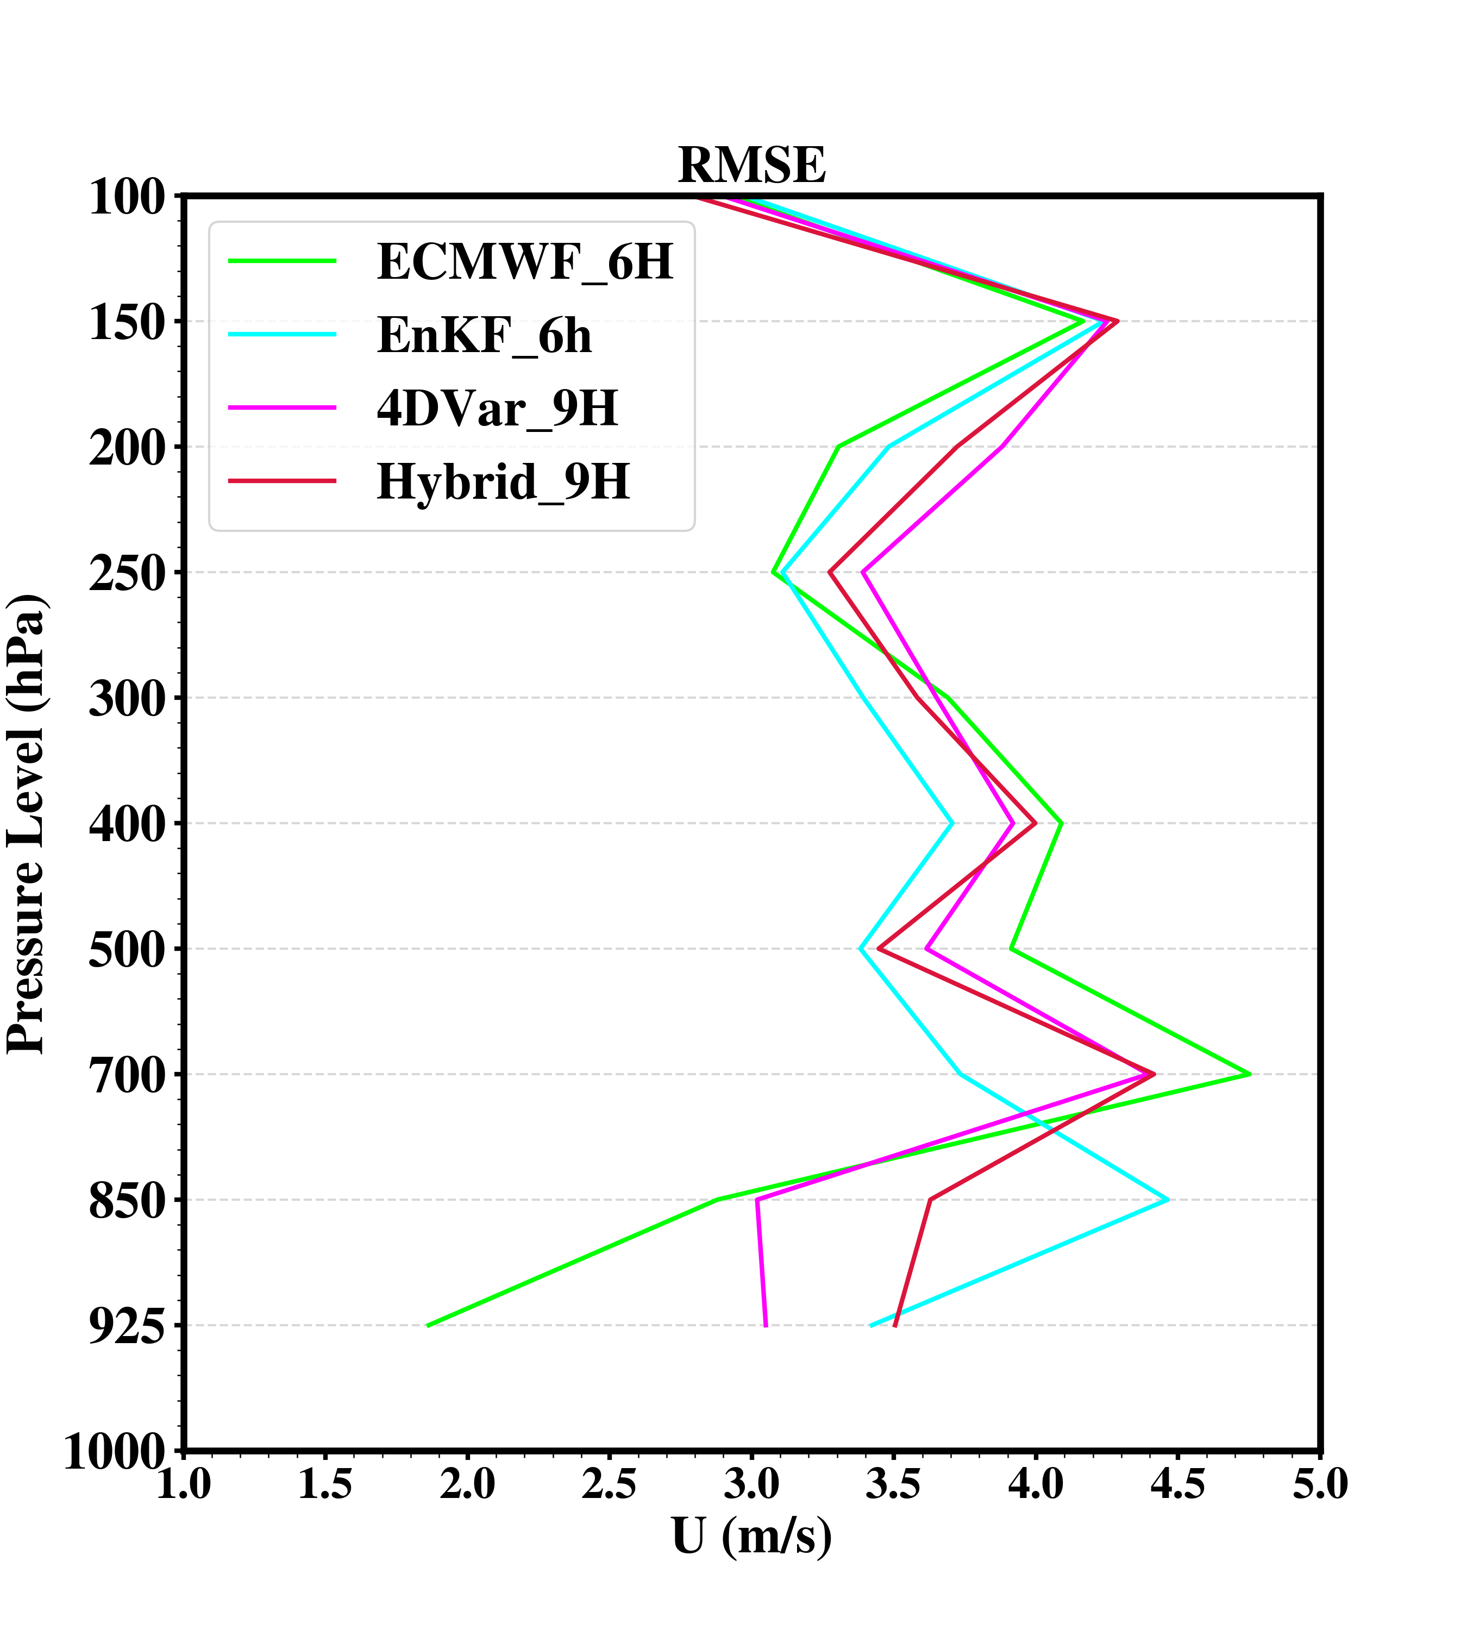
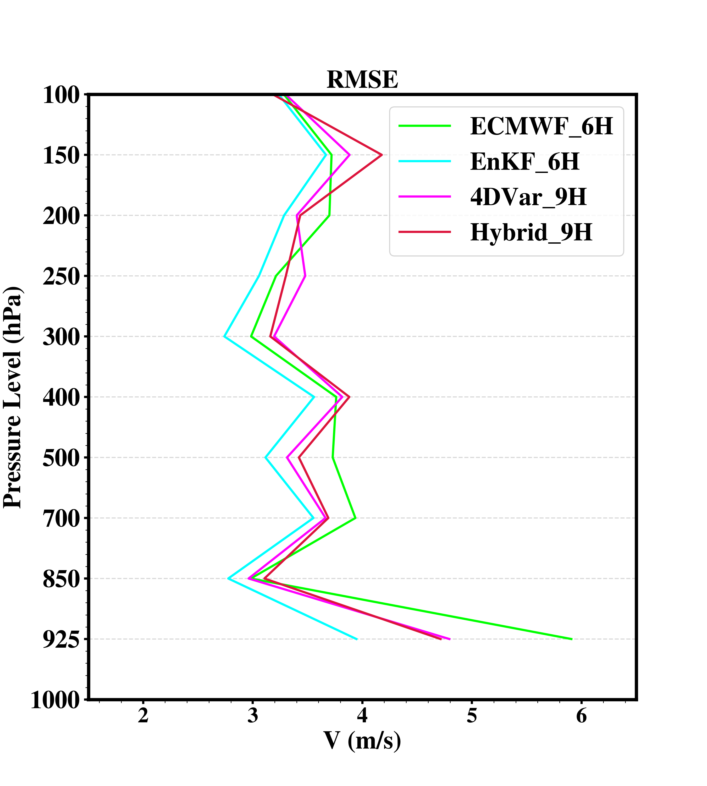
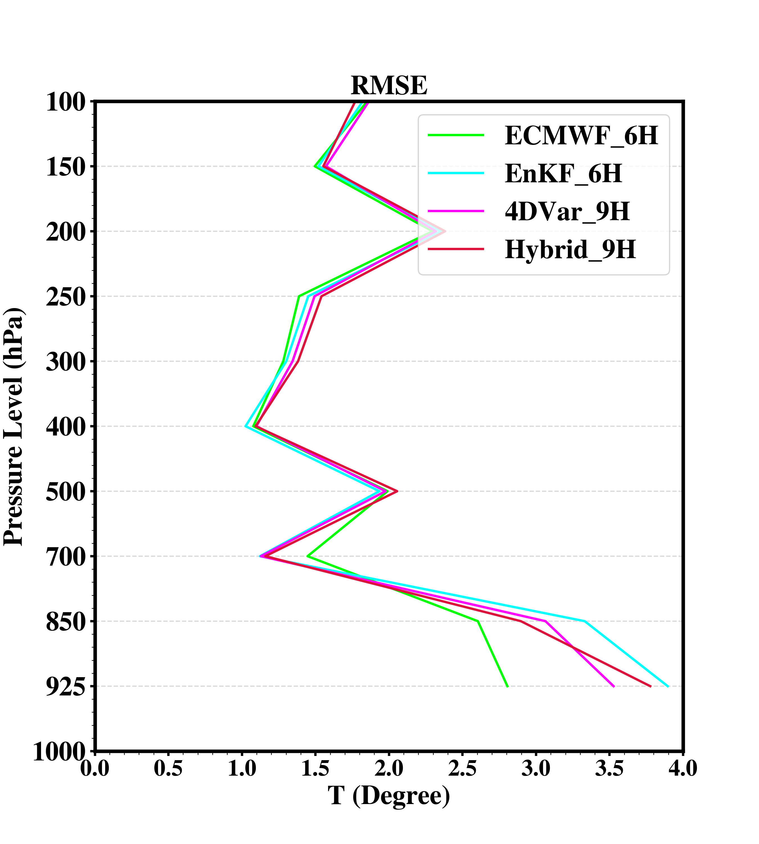
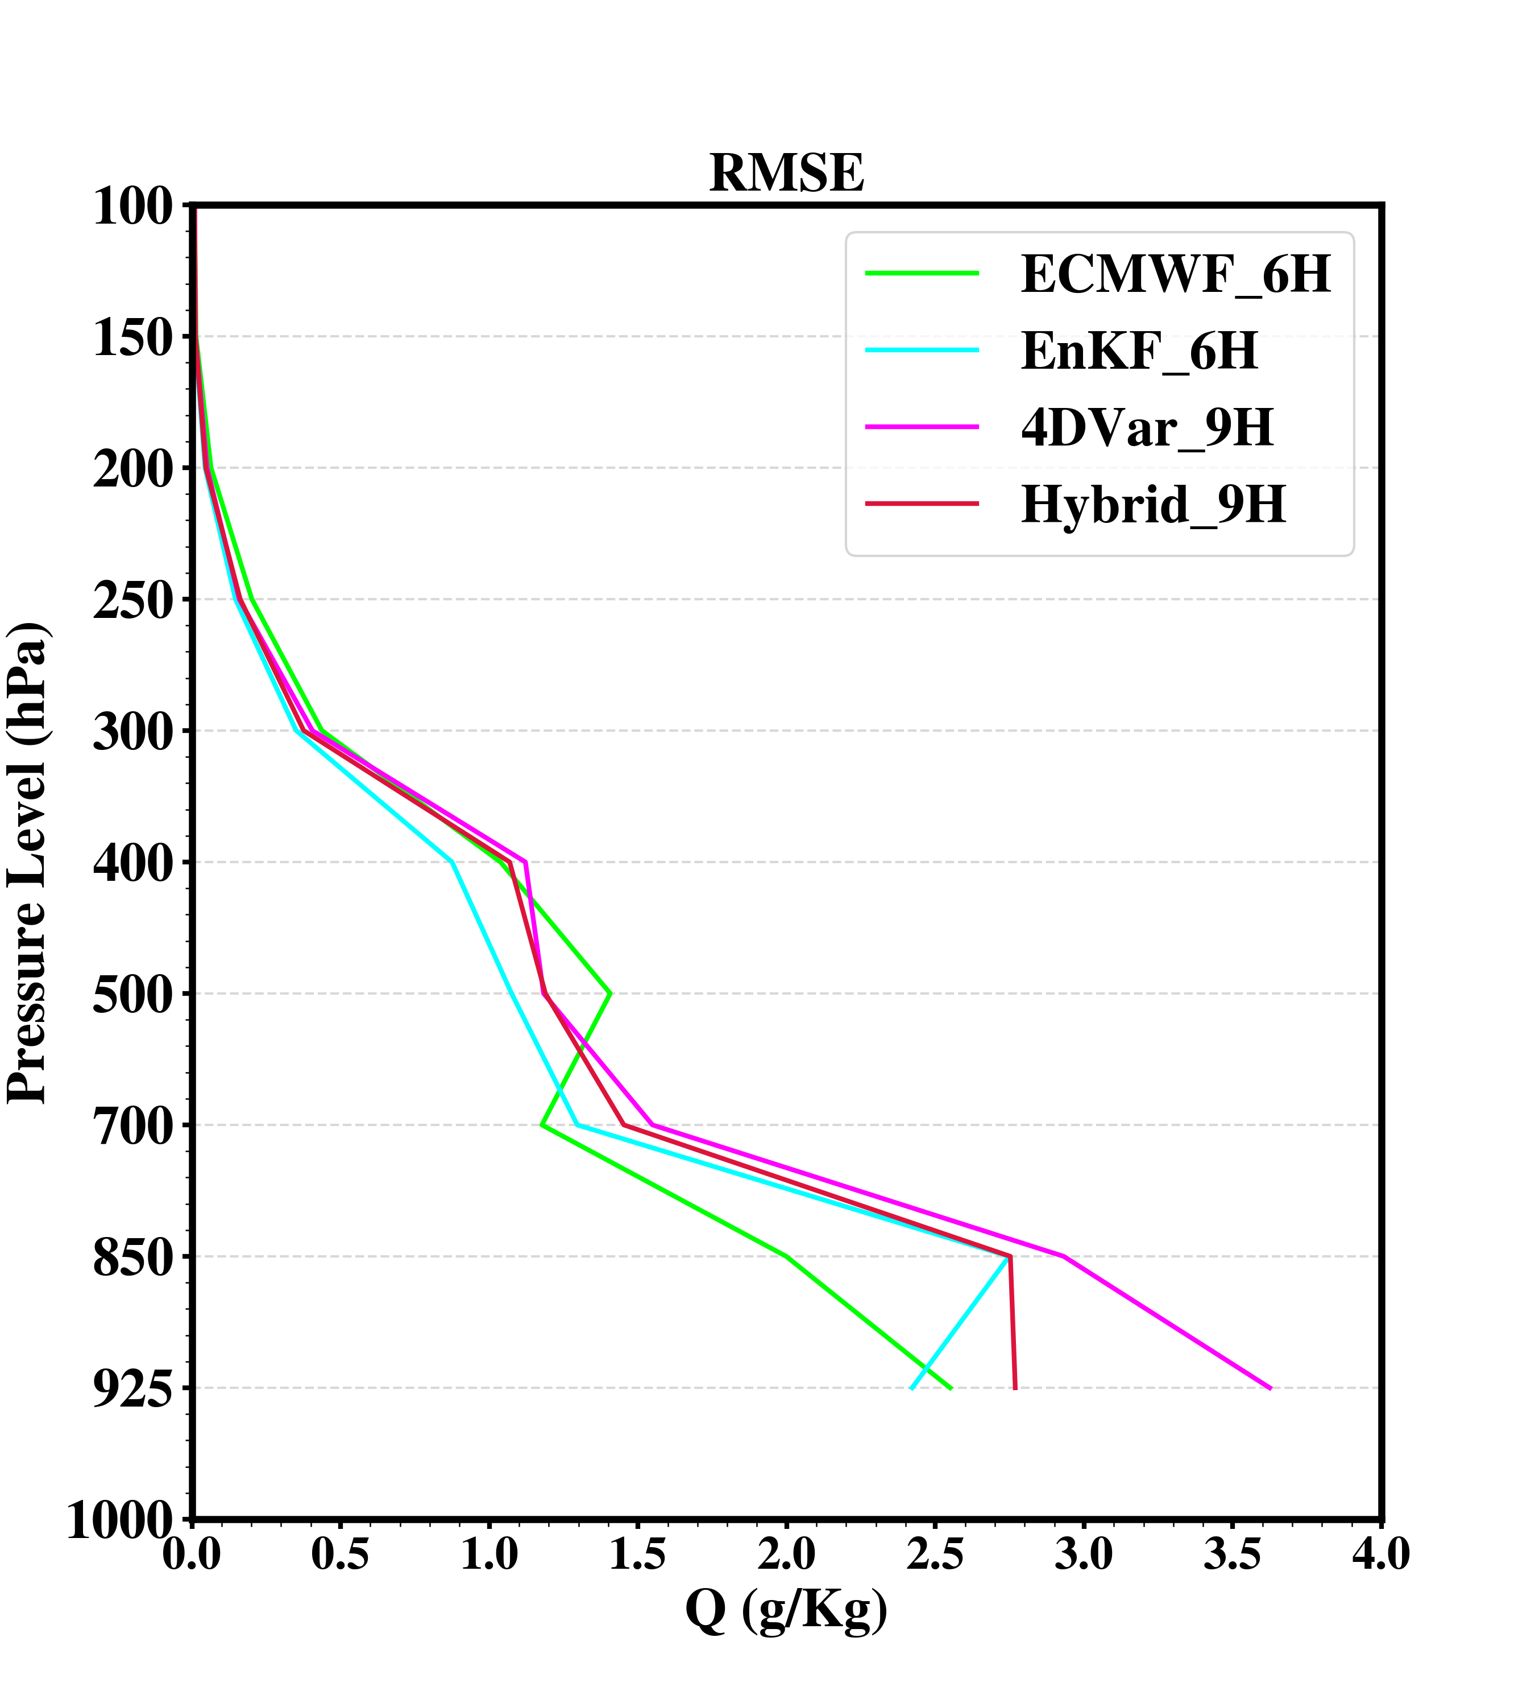
RMSE Profiles 2518 - 2818 June 2015 UTC
6 hours or 9 hours forecast at same times
verify with intensive sounding obs. and GTS sounding
(00, 06, 12, 18 UTC)

Slide 11
Summary
A regional reanalysis over TP was developed and examined compared to ERA-Interim reanalysis by a short-term testing
Based on the results of Bias and RMSE statistics, the accuracy of analysis fields from EnKF is better than other methods except the U wind and upper levels temperature from ERA-Interim reanalysis, followed by E4DVar and 4DVar
The performance of 6 hours (9h) forecasting from E4DVar and 4DVar are comparable to ECMWF forecasting, and EnKF is the best , although the testing (EnKF, 4DVar, E4DVar) only assimilated GTS observation

