Slide 1
The influence of Equatorial rossby waves on phytoplankton blooms
Man Yau Chan (Joseph)
Image source: NASA Earth Observatory https://eoimages.gsfc.nasa.gov/images/imagerecords/86000/86895/chloro_amo_2014274_lrg.png

Slide 2
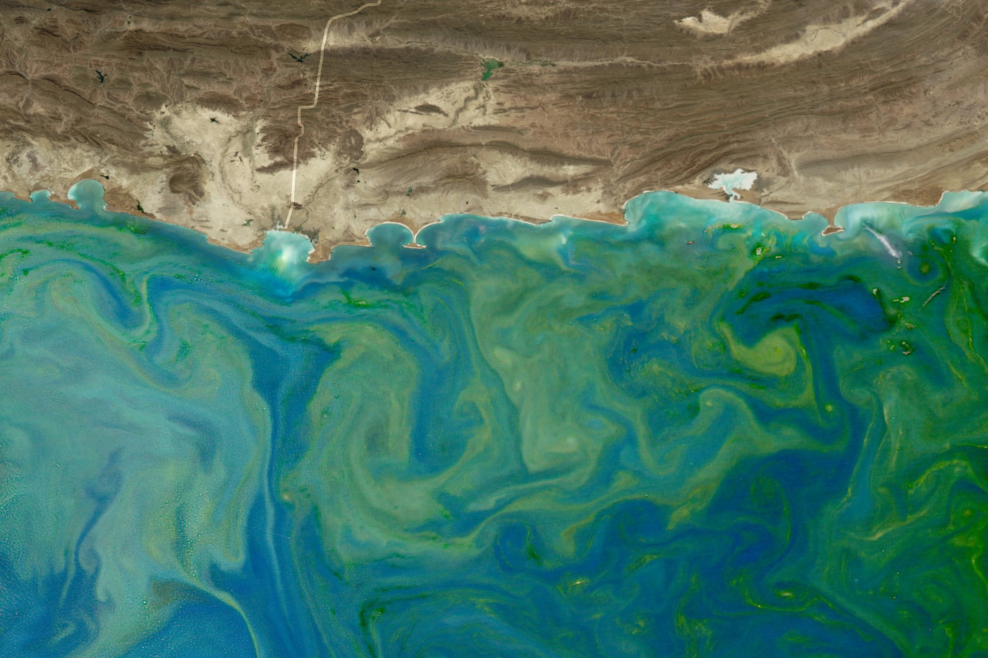
Motivation: blooms adversely affects ecology & fisheries
Figure: A phytoplankton bloom in the Arabian Sea.
Image source: Popular Science
https://www.popsci.com/article/science/big-pic-texas-sized-algae-bloom

Slide 3
Motivation: Tropical instability waves seen in blooms
Figure: Tropical instability wave observed in an equatorial Pacific phytoplankton bloom by SeaWIFS satellite sensor.
The images were generated from SeaWIFS data from (a) 19 to 20 July 1998, (b) 2 to 4 August 1998, and, (c) 14 to 16 August 1998.
Image source: Strutton, P. G., Ryan, J. P., and, Chavez, F. P. (2001). Enhanced chlorophyll associated with tropical instability waves in the equatorial Pacific. Geophysical Research Letters, 28, 10, 2005 – 2008

Slide 4
How do equatorial Rossby waves impact phytoplankton blooms?

Slide 5
Synopsis
Numerically investigated the influence of equatorial Rossby waves on phytoplankton blooms.
Tracer advection
Biology + advection
Cancellation of interface wave
Rossby deforms interface
Rossby deforms interface
Increasing phase diff.
Interface mixing ⬆ growth
Downwelling max growth
Increasing phase difference
Wave cancellation + vertical mixing brings bloom up

Slide 6
Outline
Setup
Results
Concl.

Slide 7
Flow field: Matsuno’s soln + baroclinic mode
$k=0.00125 km^{−1}$, $ω=0.0816 day^{−1}$, $v_{p}=65.3 km/day$.
Maximum flow speed: $0.88 m/s$.
8.6
4.3
Vertical velocity (cm/hr)
0.0
-4.3
-8.6
Figure: Plot of Rossby wave flow pattern (arrows and filled contours) and geopotential perturbations (contours), at 100 m depth.
Matsuno, T. (1966). Quasi-geostrophic motions in the equatorial area. Journal of the Meteorological Society of Japan, 44, 1, 25—42.

Slide 8
Nitrate-phytoplankton interactions
Nitrate
Phytoplankton
Phytoplankton growth
Phytoplankton death
Model equations:
Nitrate concentration
Phytoplankton density

Slide 9
Nitrate-phytoplankton interactions
Phytoplankton density equation
Rate of change and advection
Growth rate
Death rate
Max. growth
Nitrate dependence
Light dependence
$g_{max}=0.97 day^{−1}$, $γ=0.0018 day^{−1}$, $K_{S}=53.5 mmol/m^{3}$, $α=0.167\frac{mmol}{{10}^{8} cells }$
Aksnes, D. L., and J. K. Egge (1991). A theoretical model for nutrient uptake in phytoplankton, Marine Ecology Progress Series, 70, 65—72.
Michaelis, L., and Menten, M. L. (1913). Die Kinetik der Invertinwirkung.
Berges, J. A., and Falkowski, P. G. (1998). Physiological stress and cell death in marine phytoplankton: induction of proteases in response to nitrogen or light limitation. Limnology and Oceanography, 43, 1, 129—135.
Ho, T.-Y., Quigg, A., Finkel, Z. W., Milligan, A. J., Wyman, K., Falkowski, P. G., and Morel, F. M. M. (2003). The elemental composition of some marine phytoplankton. Journal of Phycology, 39, 1145—1159 .

Slide 10
Diffusive turbulent mixing
Horizontal diffusive mixing
Vertical diffusive mixing
Munk W., and Wunsch, C. (1998). Abyssal recipes II: energetics of tidal and wind mixing. Deep-Sea Research Part 1, 45, 1977—2010.

Slide 11
Initial Concentration fields: Nitrate
$1 mmol/m^{3}$ or $1 μg/kg$
100 m interface
$10 mmol/m^{3}$ or $10 μg/kg$
Figure: Vertical cross section of the horizontally homogeneous nitrate concentration field along the 4.0°N latitude line.
Talley, L. D., G. L. Pickard, W. J. Emery, and J. H. Swift. 2011. Descriptive physical oceanography: an introduction. 6th ed. Elsievier.

Slide 12
Initial Concentration fields: Phytoplankton
$$1×{10}^{8}\frac{cells}{m^{3}}$$
100 m interface
$$0 \frac{cells}{m^{3}}$$
Figure: Vertical cross section of the horizontally homogeneous phytoplankton concentration field along the 4.0°N latitude line.

Slide 13
Simulation runs
Tracer run (nitrate only, no biology)
Biology run (full simulation)

Slide 14
Outline
Flow field
Nitrate-phytoplankton interactions
Diffusive turbulent mixing
Simulation runs: tracer run and biology run
Setup
Results
Concl.

Slide 15
Tracer Run
Video and Figure: Evolution of the nitrate concentration field in the tracer run (left). Snapshots of the interface at four times (right).
0
36
Time elapsed (days)
Nitrate concentration (mmol/$m^{3}$)
66
76
Depths: 20 m to 170 m

Slide 16
Tracer interface Cycle
Direction of vertical velocity
0
Cancellation of interface wave
Rossby deforms interface
36
Time elapsed (days)
Nitrate concentration (mmol/$m^{3}$)
Increasing phase difference
66
76
Depths: 20 m to 170 m

Slide 17
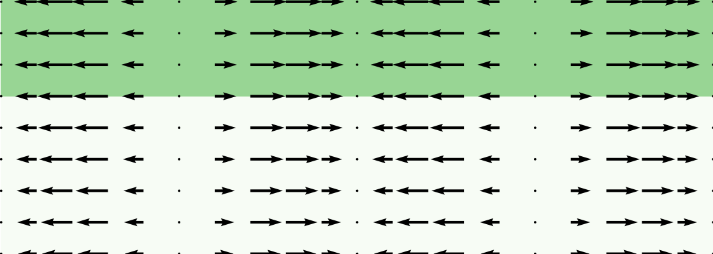
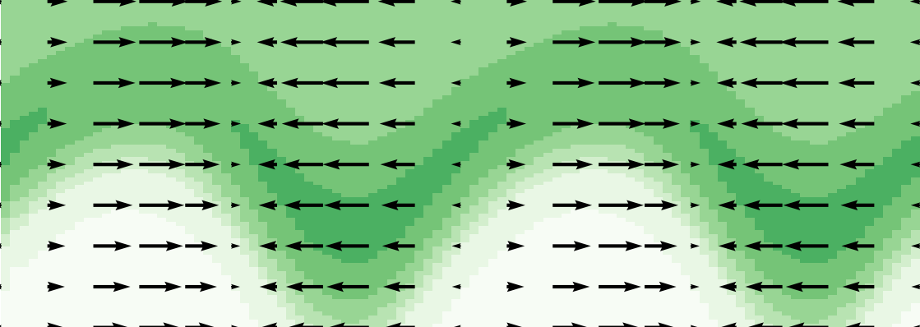
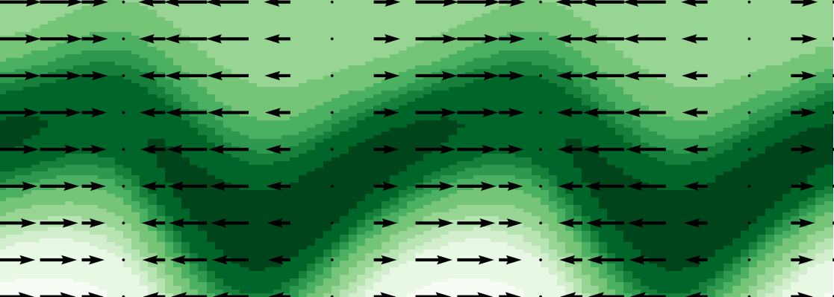
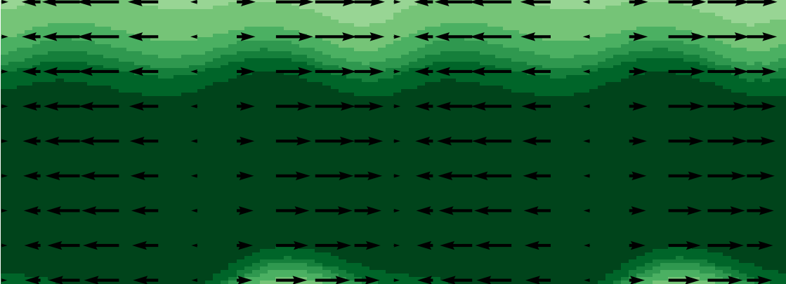
Rossby wave triggers bloom
0
36
Time elapsed (days)
Phyto. concentration (${10}^{8}$ cells/$m^{3}$)
54
75
Depths: 50 m to 200 m

Slide 18
Rossby wave triggers bloom
Direction of vertical velocity
0
Rossby deforms interface
36
Interface mixing ⬆ growth
Max growth at downwelling
Increasing phase diff.
Time elapsed (days)
Phyto. concentration (${10}^{8}$ cells/$m^{3}$)
54
Wave cancellation + vertical mixing brings bloom up
75
Depths: 50 m to 200 m

Slide 19
Outline
Flow field
Nitrate-phytoplankton interactions
Diffusive turbulent mixing
Simulation runs: tracer run and biology run
Setup
Tracer run: Deforming low-high nitrate interface with periodic amplitude
Biology run: Phytoplankton blooms at interface with downwelling maxima & shifts up.
Results
Summary of findings
Possible future avenues
Concl.

Slide 20
Summary
Numerically investigated the influence of equatorial Rossby waves on phytoplankton blooms.
Tracer advection
Biology + advection
Cancellation of interface wave
Rossby deforms interface
Rossby deforms interface
Increasing phase diff.
Interface mixing ⬆ growth
Downwelling max growth
Increasing phase difference
Wave cancellation + vertical mixing brings bloom up

Slide 21
Future work
Tropical instability waves of varying strength
Realistic mixing scheme (shear-dependence)

Slide 22
Fin.

Slide 23
Summary
Numerically investigated the influence of equatorial Rossby waves on phytoplankton blooms.
Tracer advection
Biology + advection
Cancellation of interface wave
Rossby deforms interface
Rossby deforms interface
Increasing phase diff.
Interface mixing ⬆ growth
Downwelling max growth
Increasing phase difference
Wave cancellation + vertical mixing brings bloom up

Slide 24
Flow field
Matsuno, T. (1966). Quasi-geostrophic motions in the equatorial area. Journal of the Meteorological Society of Japan, 44, 1, 25—42.
Figure: Plot of Rossby wave flow pattern (arrows and filled contours) and geopotential perturbations (contours), at two different depths.
8.6
4.3
Vertical velocity (cm/hr)
0.0
-4.3
-8.6
1.7
0.9
Vertical velocity (cm/hr)
0.0
-0.9
-1.7

Slide 25
Semi-analytical flow
Desired flow expression:
and likewise for $v$ and $w.$
Meridional component
Zonal wave
Vertical component

Slide 26
Semi-analytical flow
Linear perturbation equations
Assume:
No base flow, small perturbations
Horizontally constant base density and pressure
$β$-plane approximation
Bousinesq approximation
Start with this part

Slide 27
Semi-analytical flow
Eliminate w and $ρ$
Next: simplify this

Slide 28
Semi-analytical flow
Consider this Sturm-Liouville problem
Eigenfunctions are orthogonal and form a complete set.

Slide 29
Semi-analytical flow

Slide 30
Semi-analytical flow
Reduced the number of equations
Simplify even further by projecting onto $ψ_{ℓ}$

Slide 31
Semi-analytical flow
After some algebra: shallow water equations
Analytically solved by Matsuno (1966)
Vertical velocity obtained from .

Slide 32
Semi-analytical flow (Rossby Wave)
Vertical velocity (m/s)
Figure: Plot of Rossby wave flow pattern (arrows and filled contours) and geopotential perturbations (contours).

Slide 33
Semi-analytical flow
Still need vertical eigenfunctions
Solved numerically using an ocean with a lid

Slide 34
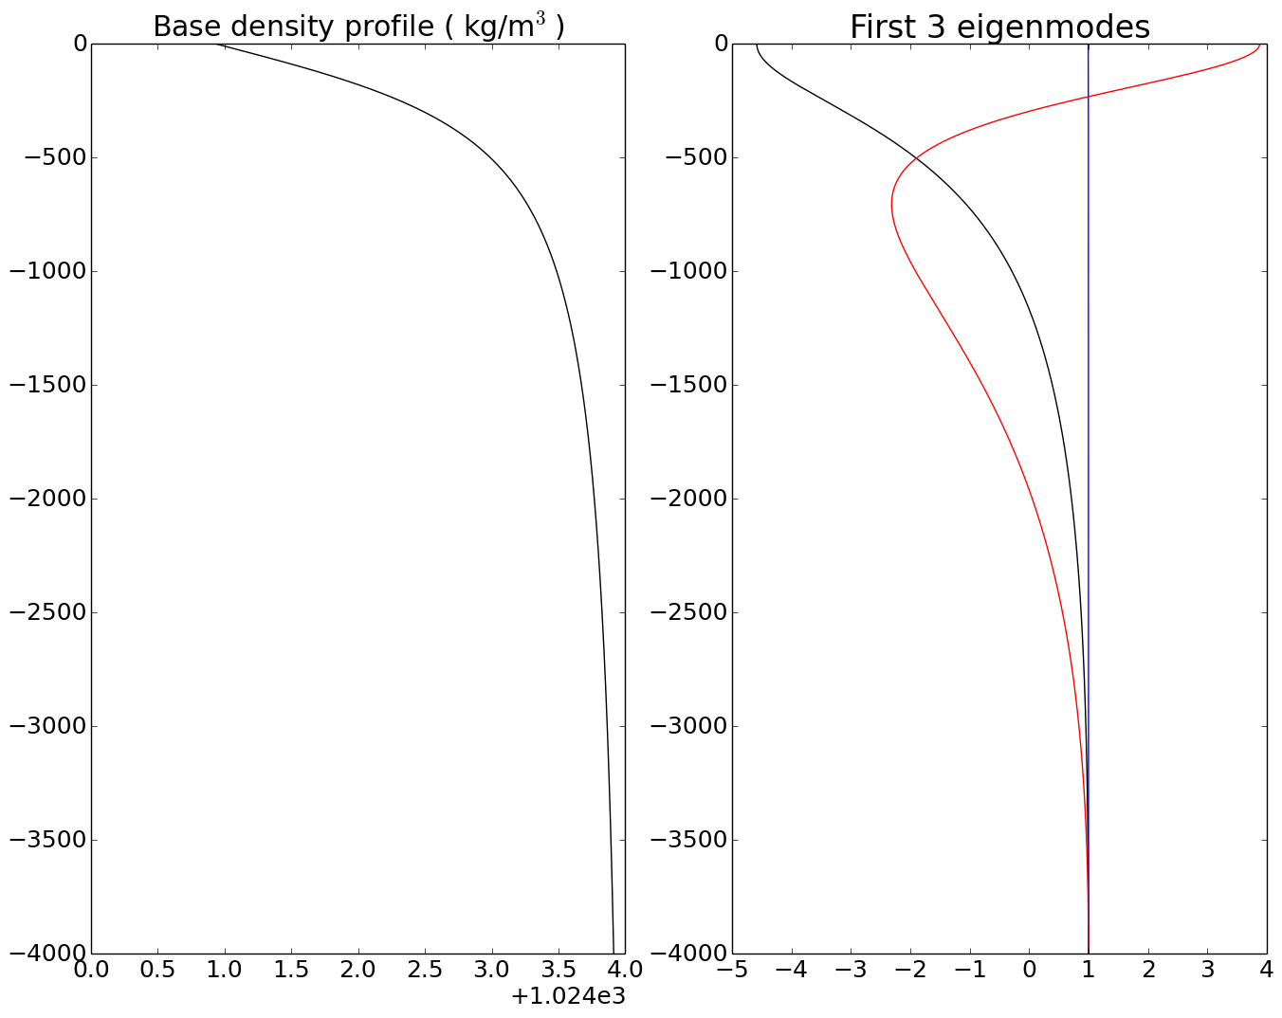
First baroclinic
Second baroclinic
Barotropic
Figure 2: Vertical profiles of base density (left) and eigenfunctions (right).

Slide 35
Semi-analytical flow
Structure of flow expression:
and likewise for $v$ and $w.$
Meridional component from Matsuno (1996)
Zonal wave
Vertical component coming from vertical eigenfunction

Slide 36
Vertical velocity (m/s)
Vertical velocity (m/s)
Figure: Plot of Rossby wave flow pattern (arrows and filled contours) and geopotential perturbations (contours), at two different depths.

Slide 37
Nitrate-phytoplankton interactions
Nitrate
Phytoplankton
Phytoplankton growth
Phytoplankton death
Model equations:
Phytoplankton density
Nitrate concentration

Slide 38
Nitrate-phytoplankton interactions
Phytoplankton density equation
Rate of change and advection
Growth rate
Death rate
Maximum growth rate
Nitrate dependence
Light dependence

Slide 39
Diffusive turbulent mixing
Horizontal diffusive mixing
Vertical diffusive mixing

Slide 40
Theory summary
Semi-analytical flow:
Nitrate-phytoplankton dynamics:
Diffusive mixing:

