Slide 1
Variational Quality Control
Jie He & Xulin Ma
8 December PSU

Slide 2
Outline
Non-Gaussian observation error distribution
Variational quality control method
Simulation experiments
robust test
data assimilation experiments
forecasting cases
Summary and discussion

Slide 3
Observation error distribution
Gaussian distribution
innovation:
operator
background
observation
The innovation distribution is Gaussian distribution ？

Slide 4
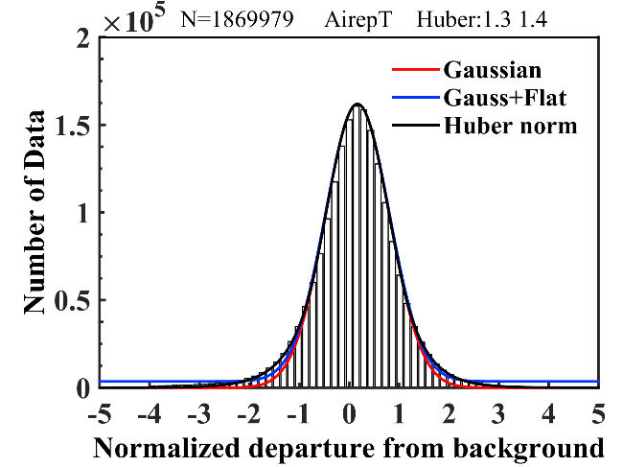
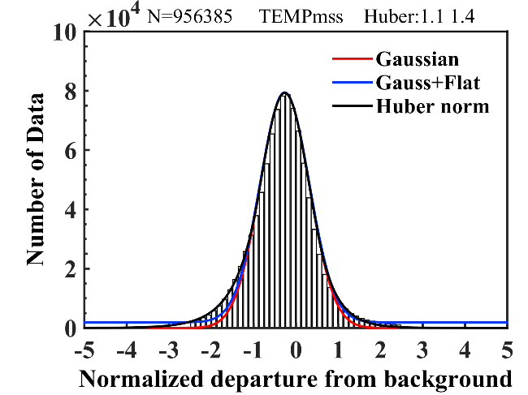
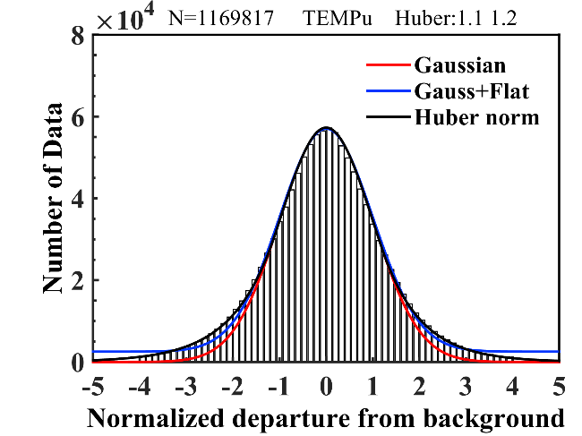
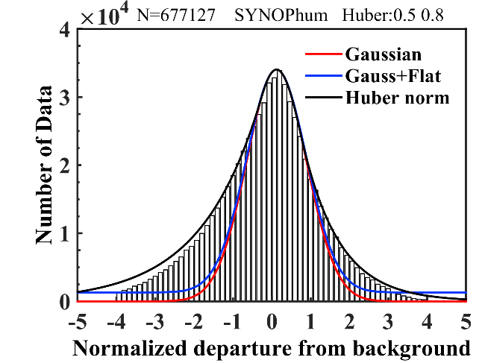
3 months data
fat tail
outlier in tail
trust data of tail
？
（Huang, 1990；Andersson, et al, 1999；Tavolato, et al, 2015）

Slide 5
Variational quality control method
Cost Function
Observation Function
3D-Var
Huber-VarQC
Huber norm
PDF
function
gradient
（ Andersson, et al, 1999；Lorenc, 1986）

Slide 6
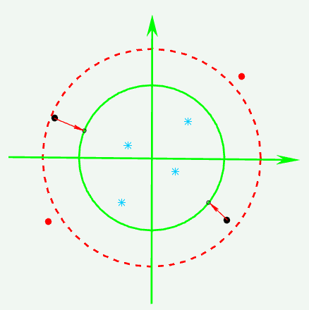
weight
function
bad
data
traditional QC
effective data
DA System
usable data
VarQC
variational quality control diagram

Slide 7
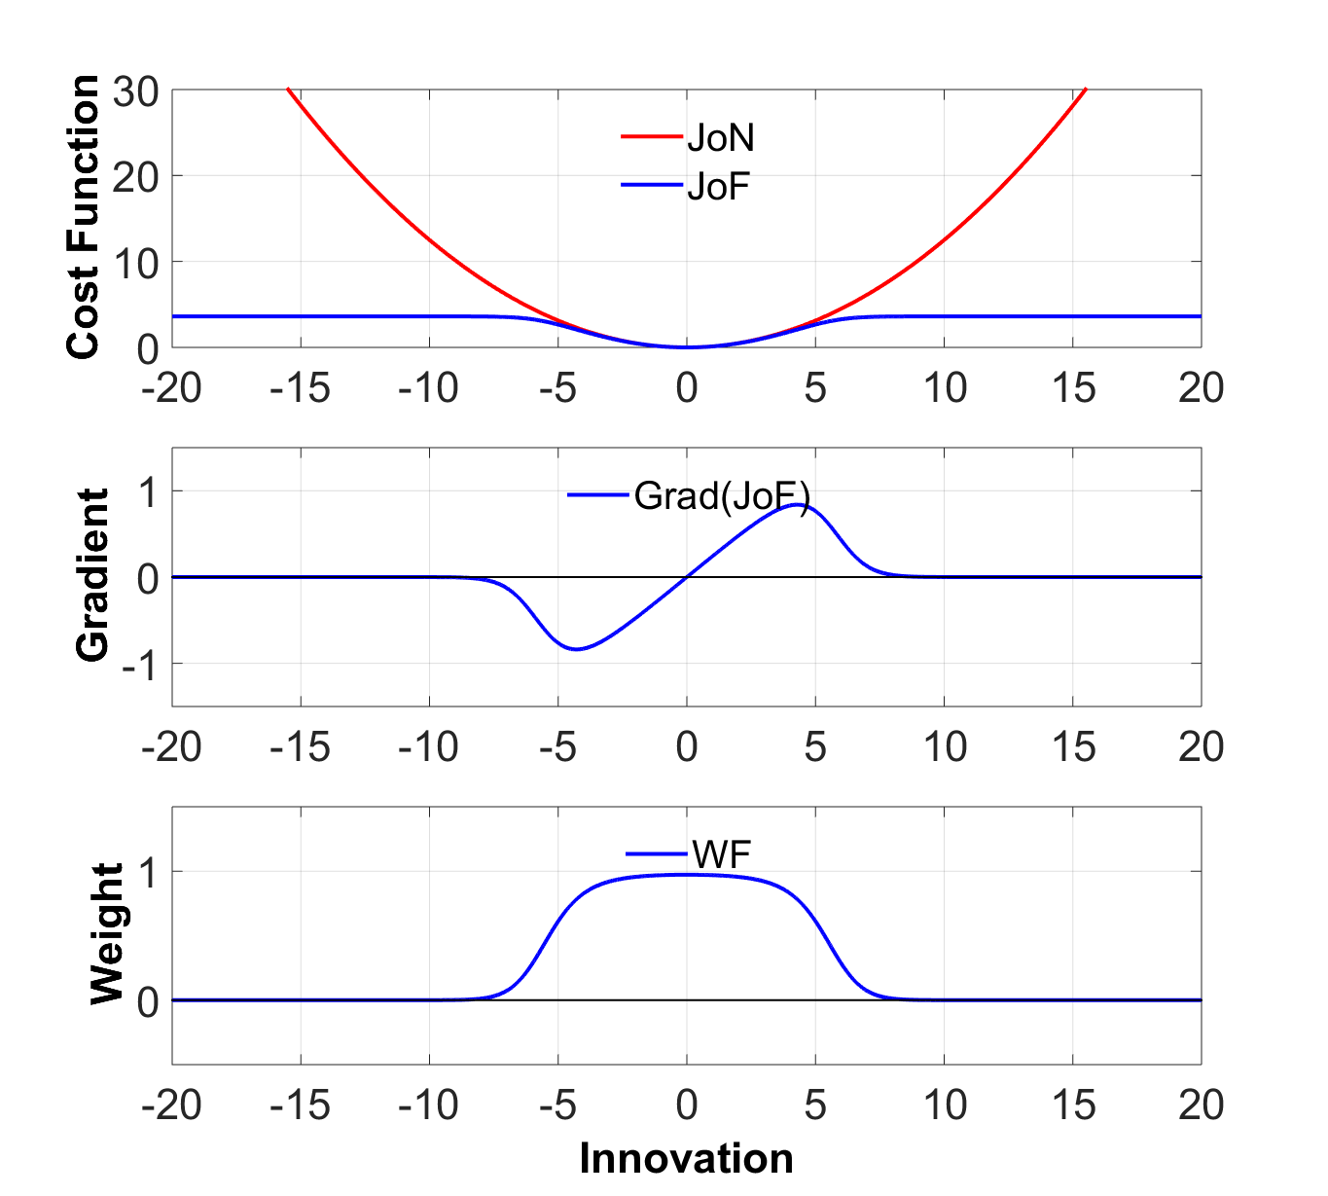
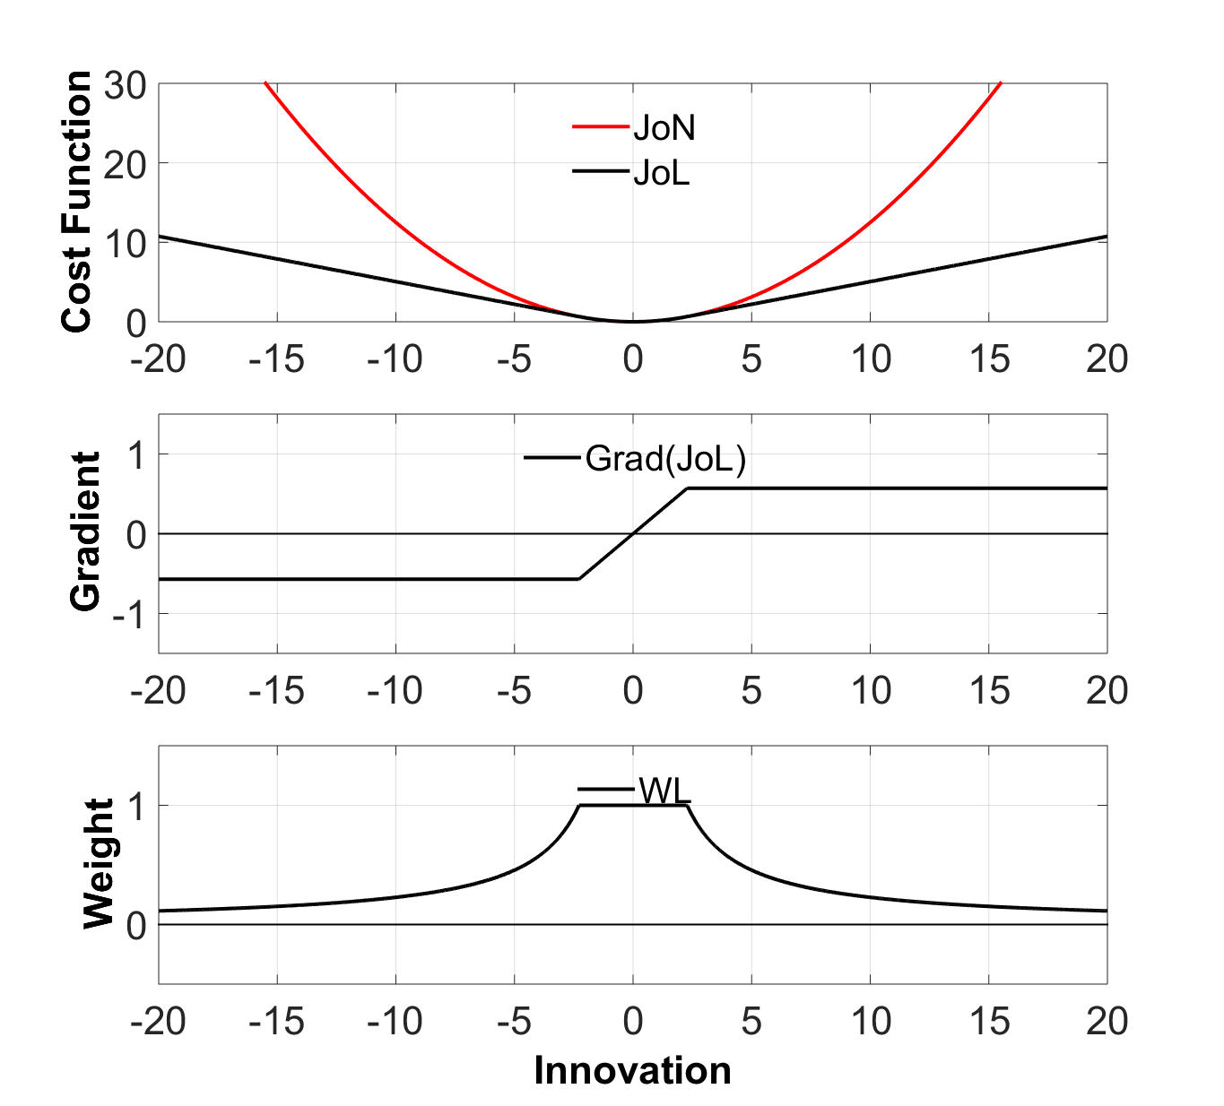
Flat-VarQC
Huber-VarQC
slope
Reduce the analysis weight with innovation increase
Small weight can reduce impact by larger innovation

Slide 8
Simulation experiments
Model & Data
GRAPES_Meso V3.0
Global/Regional Assimilation and PrEdiction System ；
Simulation area：70～140 °E，10～60 °N；
Background：GFS data , 1°x 1°；
Observation：TEMP, SYNOP, SHIPS, AIRP, SATOB, COSMIC
Experiments：CTRL , Flat-VarQC , Huber - VarQC
3D-Var
Gaussian + Flat PDF
Huber norm
PDF

Slide 9
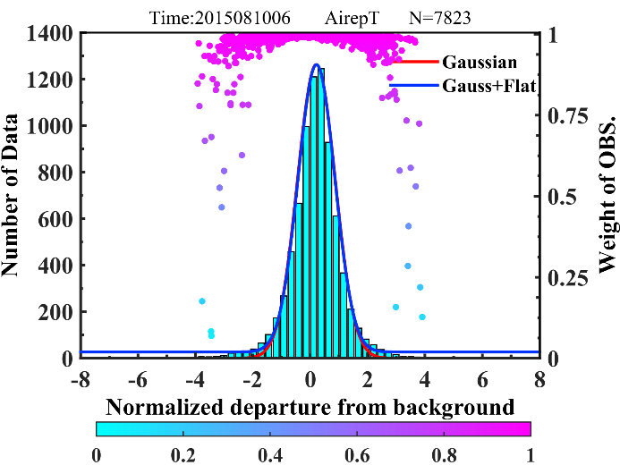
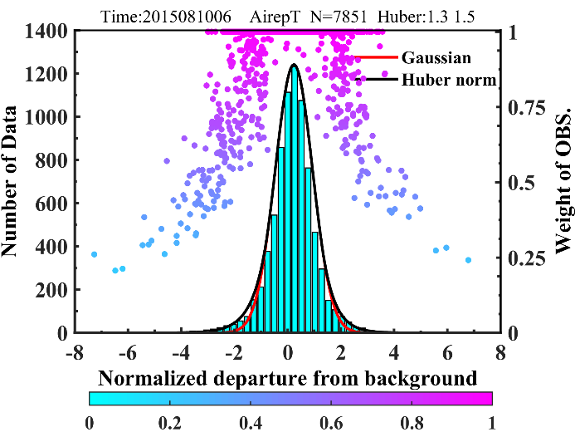
Flat-VarQC
Huber-VarQC
Weight function is only related to innovation

Slide 10
Schemes Name | VarQC | Observation
CTRL | NO | Original data
CTRL-Outlier | NO | Outlier data
Flat-Outlier | YES (Flat-VarQC ) | Outlier data
Huber-Outlier | YES (Huber-VarQC) | Outlier data
Experiment Schemes
Set up outlier (red) in observation data
Stations Pressure Level | 1 | 2 | 3 | 4 | 5 | 6
500 hPa | 501.085 | 500.000 | 498.441 | 500.000 | 501.408 | 500.000
850 hPa | 851.633 | 848.206 | 851.506 | 851.002 | 848.148 | 851.356
Stations Pressure Level | 7 | 8 | 9 | 10 | 11 | 12
500 hPa | 500.000 | 500.000 | 500.000 | 500.000 | 500.000 | 500.000
850 hPa | 851.612 | 851.001 | 851.165 | 851.679 | 850.000 | 850.000
Data setting

Slide 11
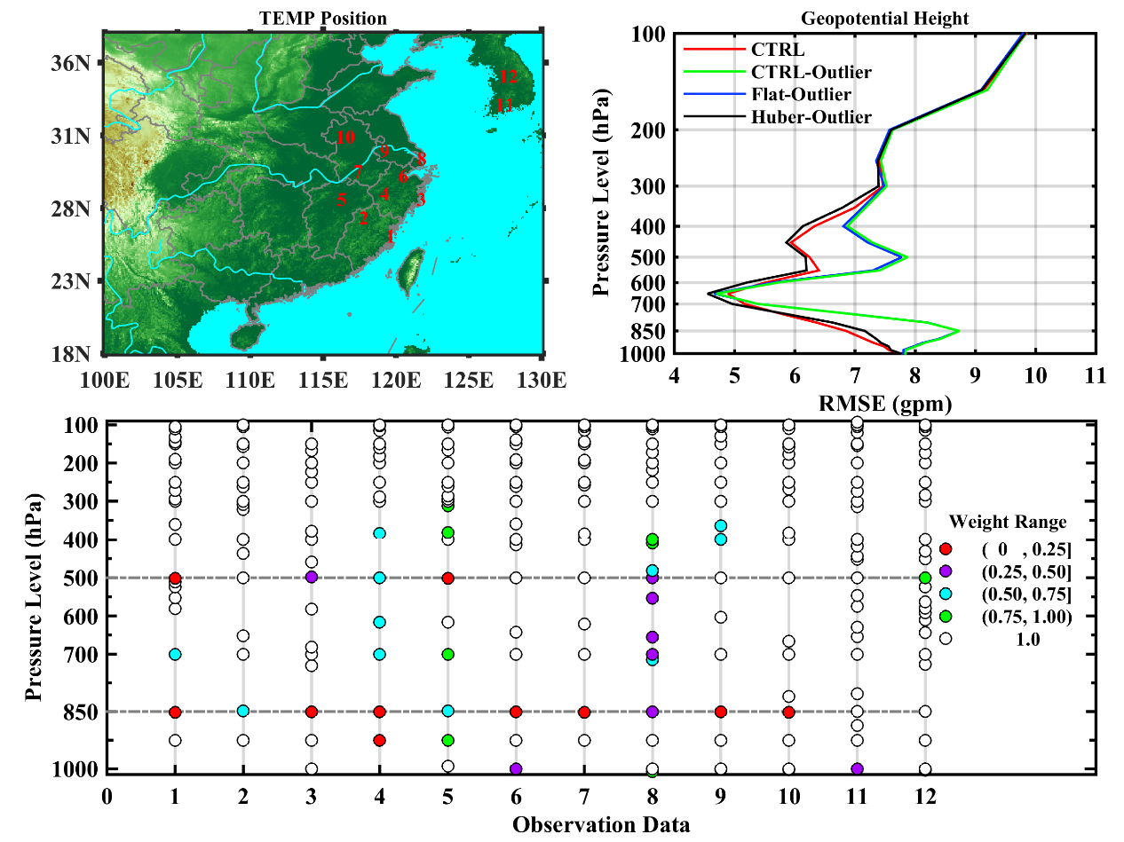
TEMP Stations

Slide 12
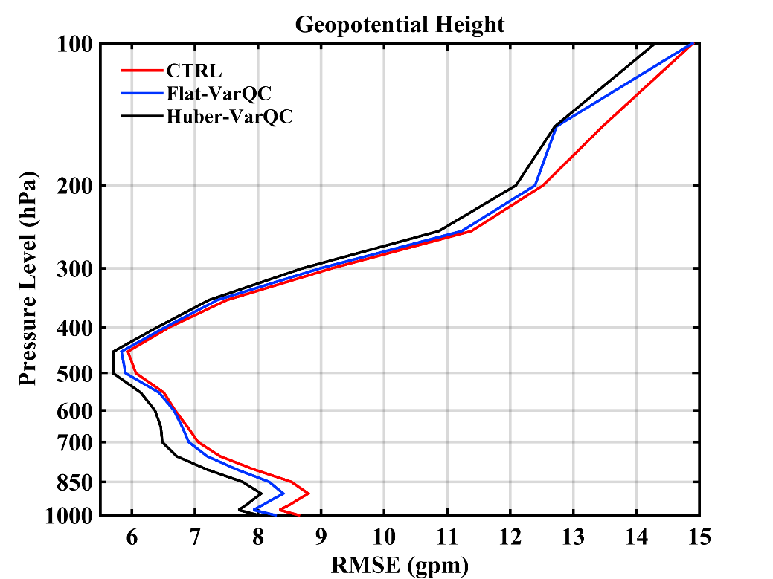
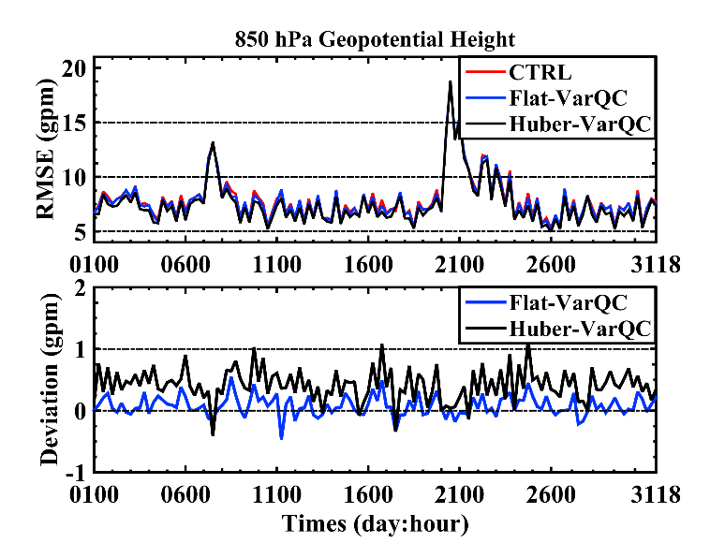
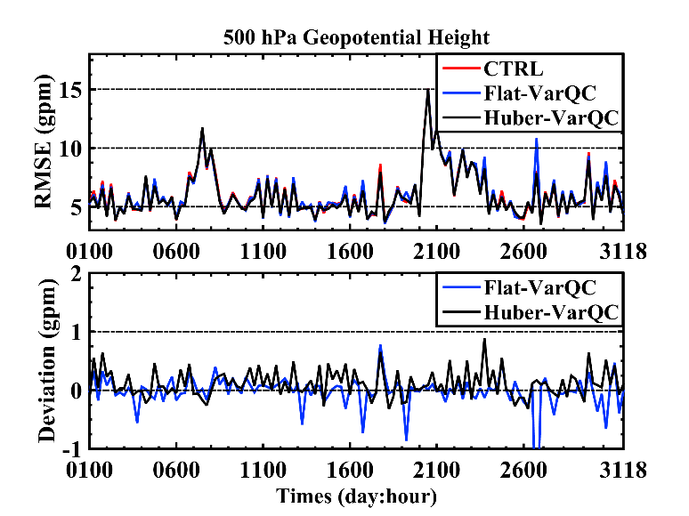
16 August 2015
06 UTC
Analysis Field

Slide 13
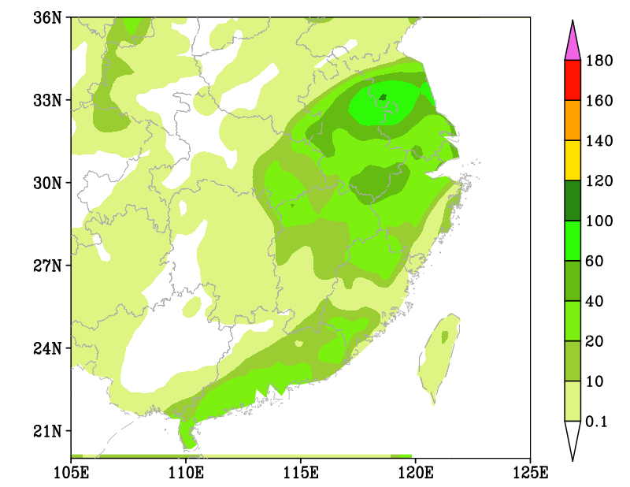
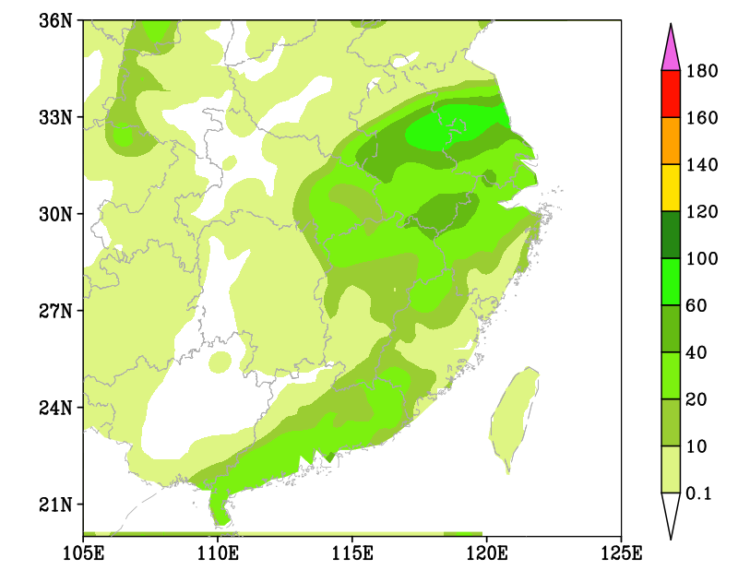
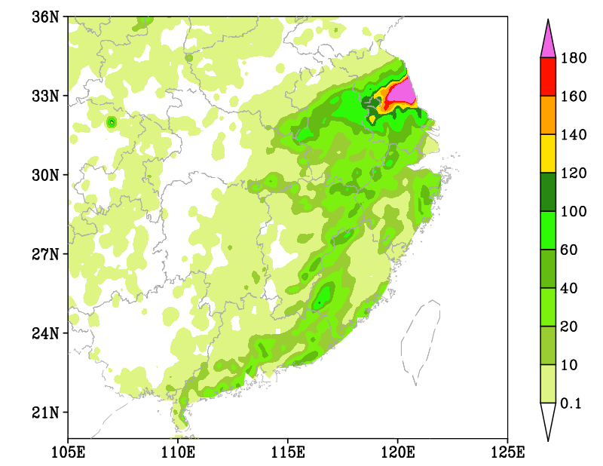
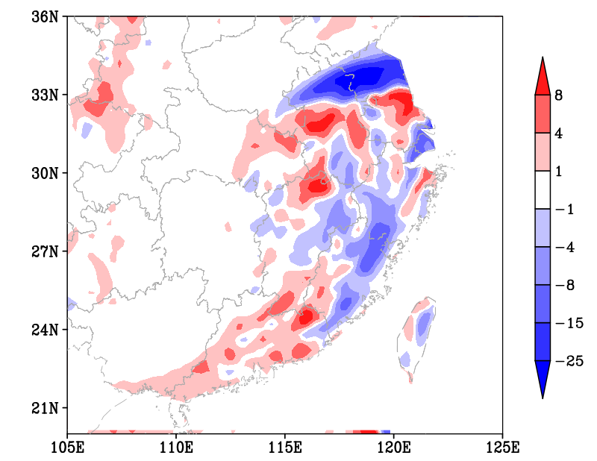
24 hr rain
CRTL
VarQC-Huber
distribution
center
strength
Real
Bais
9 August 2015 18 UTC

Slide 14
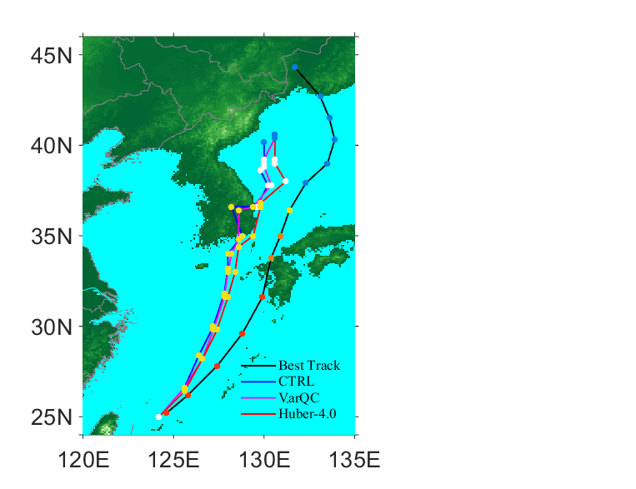
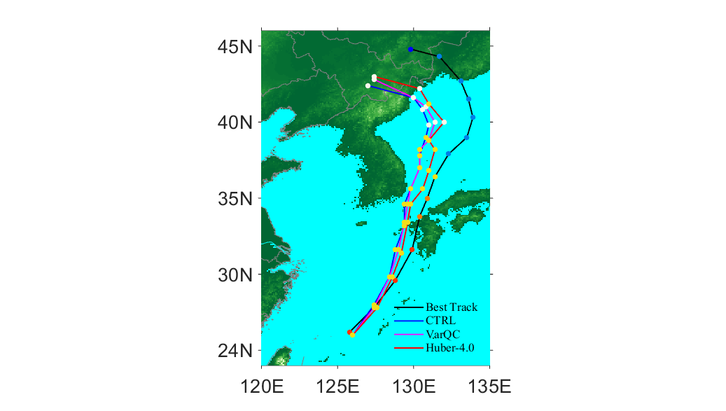
Gini
Best Track
CTRL
Flat-VarQC
Huber-VarQC
Best Track
CTRL
Flat-VarQC
Huber-VarQC
Best Track
CTRL
Flat-VarQC
Huber-VarQC
Best Track
CTRL
Flat-VarQC
Huber-VarQC
23 August 2015 00 UTC 23 August 2015 18 UTC 24 August 2015 00 UTC 24 August 2015 06 UTC

Slide 15
Summary and discussion
The non-Gaussian PDF fits observed pdf better than Gaussian, Huber norm PDF is the best；
Robust advantage for outliers;
A positive impact on analysis and forecasting, especially for heavy rain, typhoon and other mesoscale and microscale severe weather process.
？Retune observation error in the model
？ Calculated more reasonable transition point C（following height）

