Slide 1
Non-spherical Particle Scattering for Assimilating Microwave Imaging Observations of Tropical Cyclones
Research Group Meeting
8 December 2017
Scott Sieron
Advisors: Fuqing Zhang, Eugene Clothiaux
Collaborators: Lu Yinghui, Lily Zhang

Slide 2
Introduction to Particle Shape
Mainstream microphysics schemes specifies particles as a spherical homogeneous mixture of air and ice of a certain bulk density
Real snow particles are nothing like this shape (graupel somewhat)
This symmetry and homogeneity leads to unique scattering properties which could lead to biased simulated brightness temperatures

Slide 3
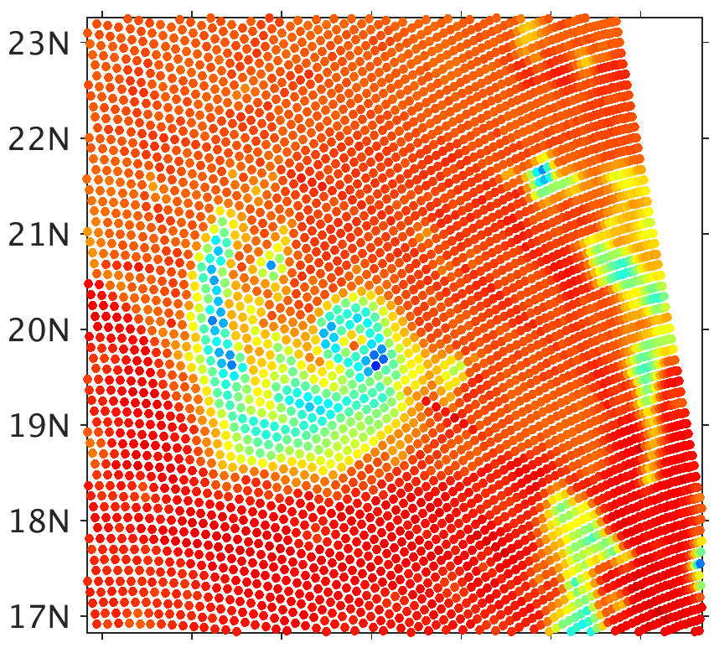
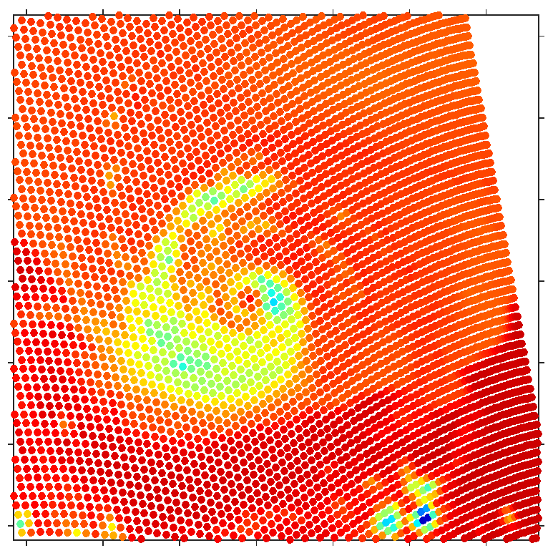
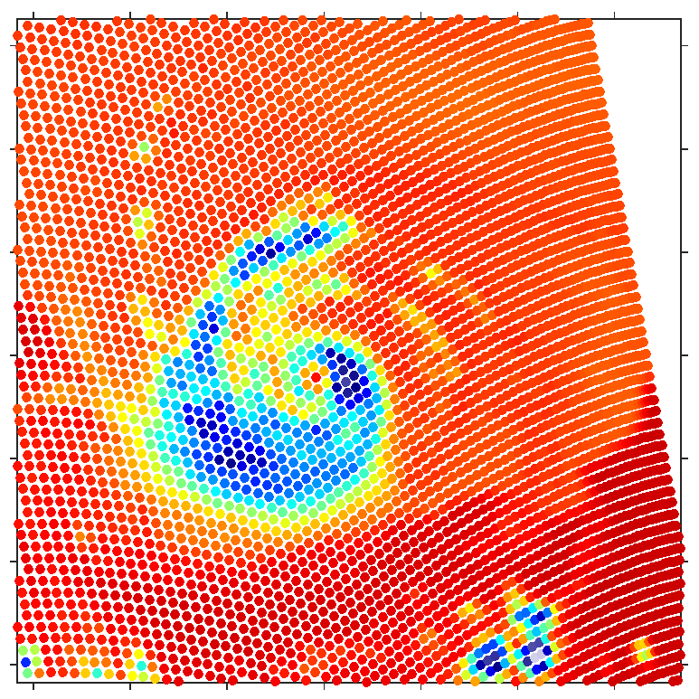
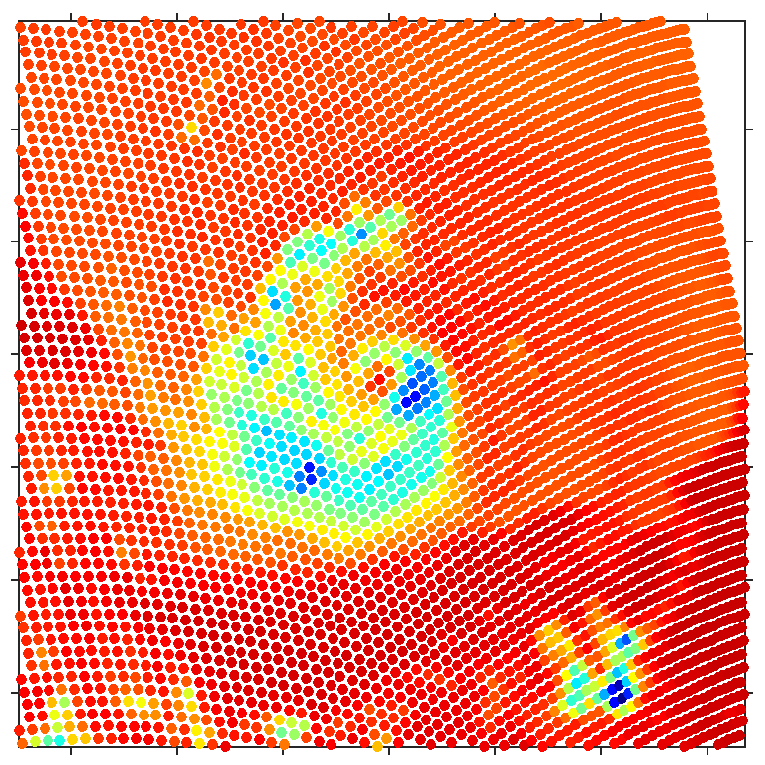
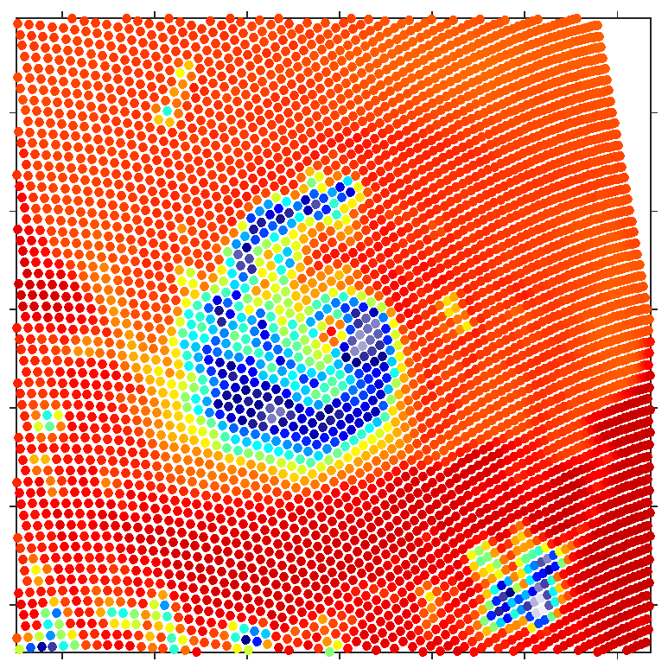
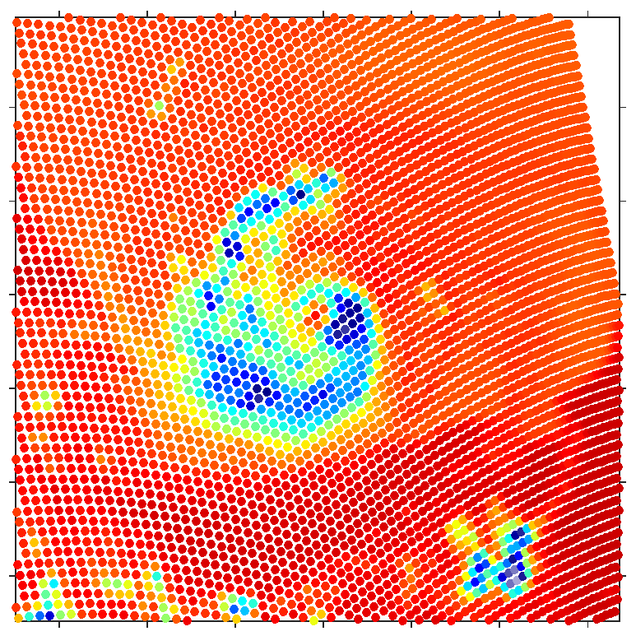
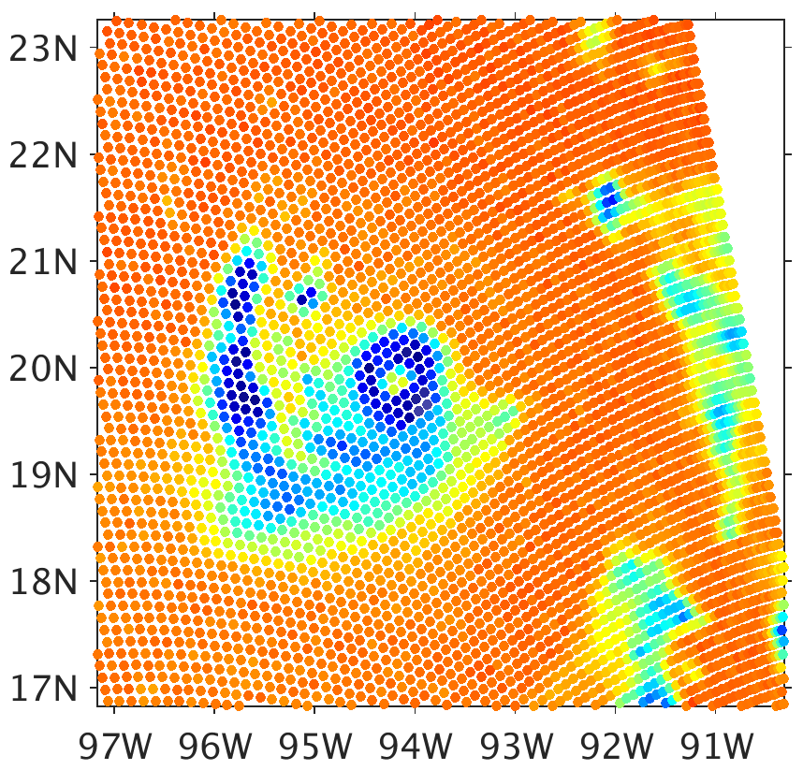
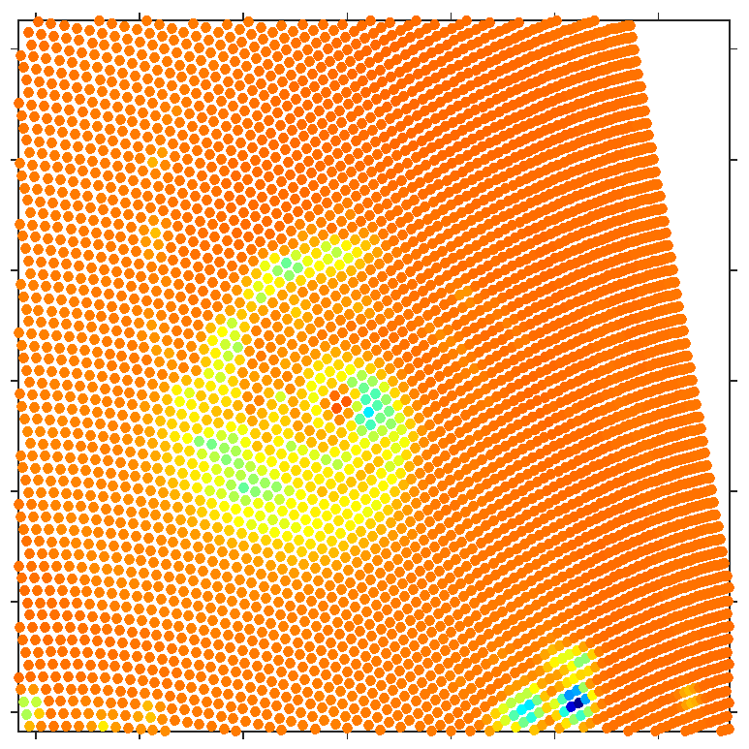
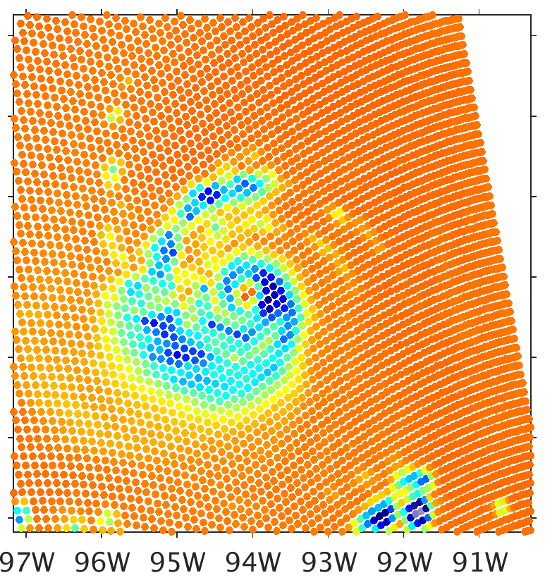
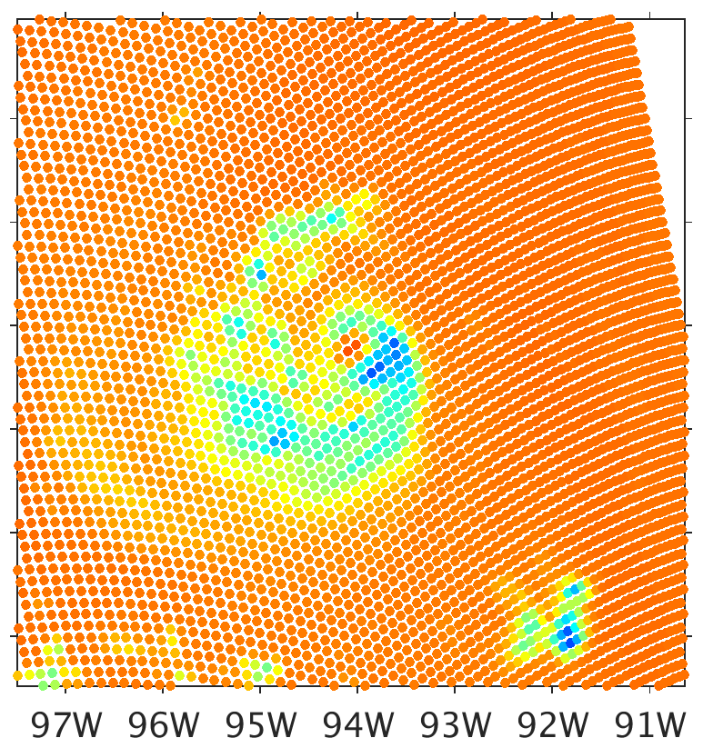
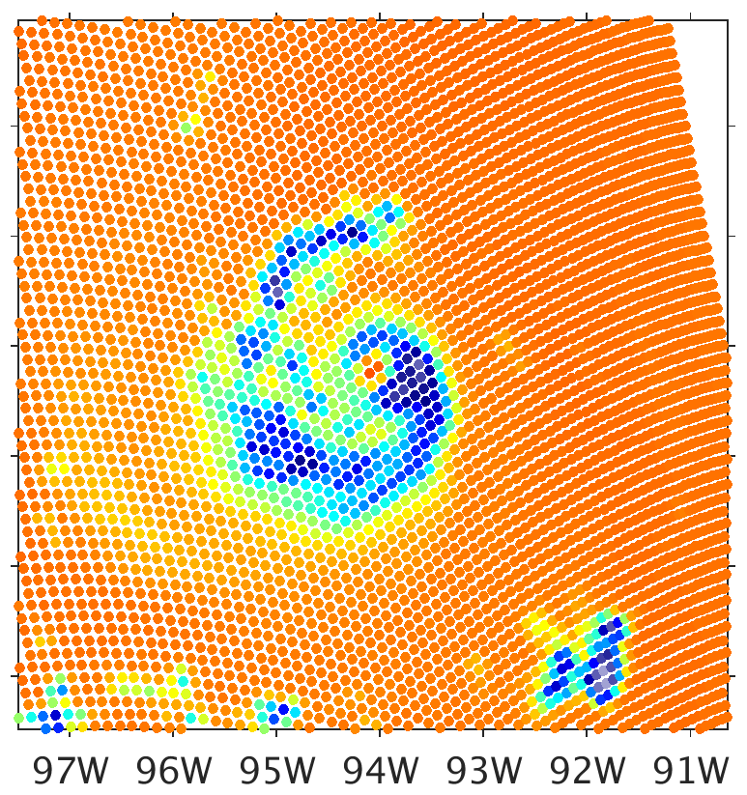
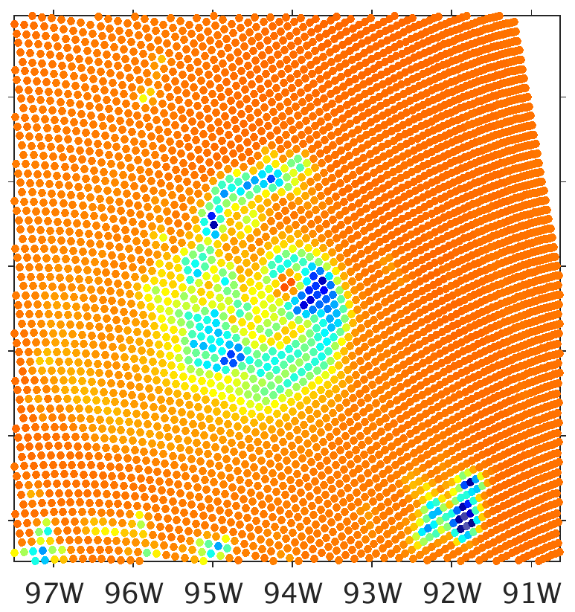
Common Issues with Forward Model Results
Brightness temperatures (BTs) at 183 GHz (2nd row) are consistently equal to or higher than at 91.7 GHz (1st row), contrary to observations
Observation
CRTM As-Released
CRTM-DS
DS Fluffy Graupel
DS Dense Graupel
Field Distribution
300
280
260
240
220
200
180
160
140
120
100
80
BT (K)
Notes:
This has been seen with every simulation using spherical particle scattering (at least when using model output water contents) while exploring the sensitivity of particle bulk density and particle size distribution.

Slide 4
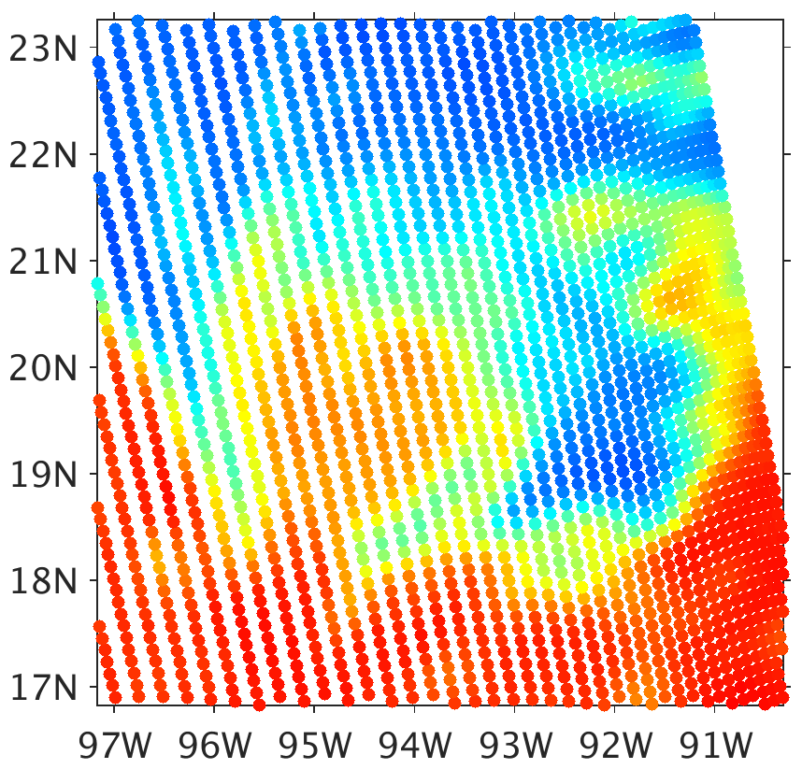
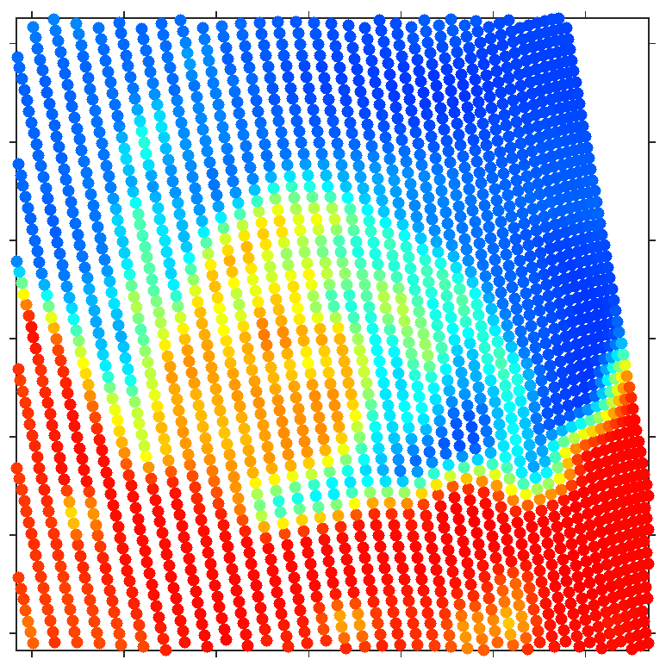
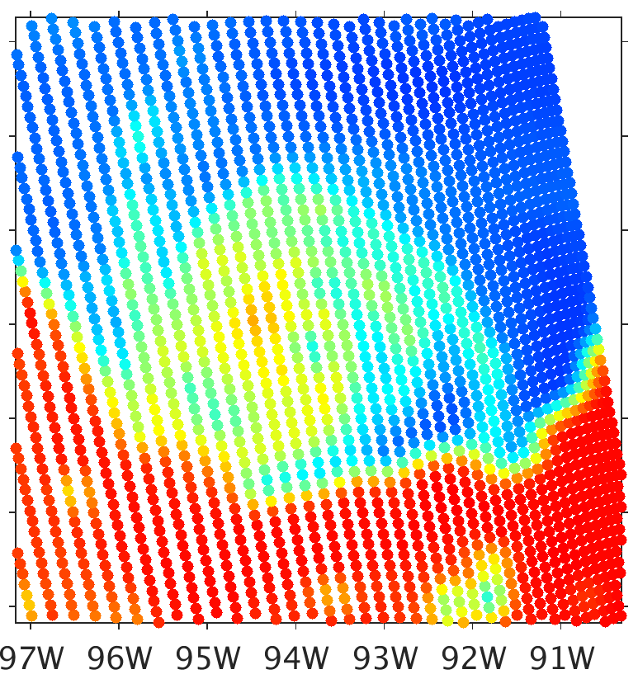
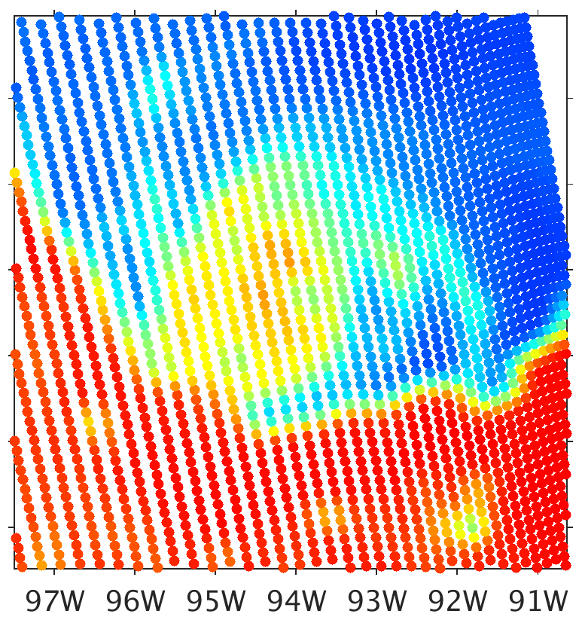
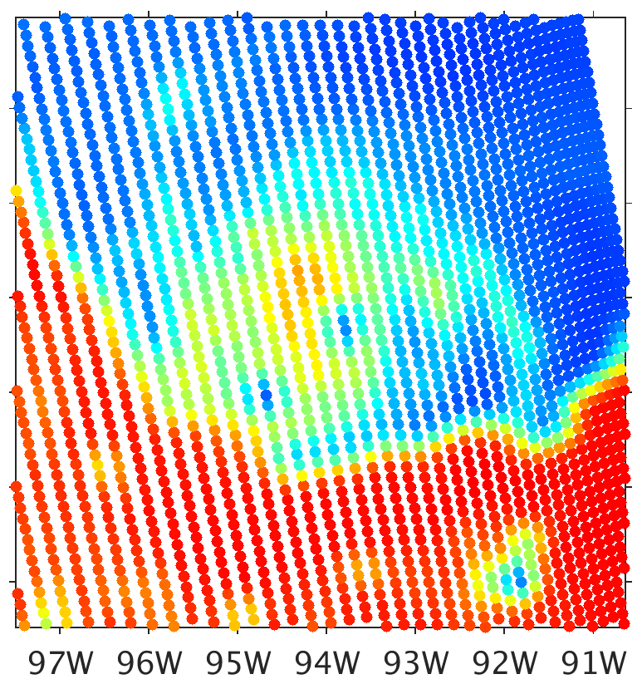
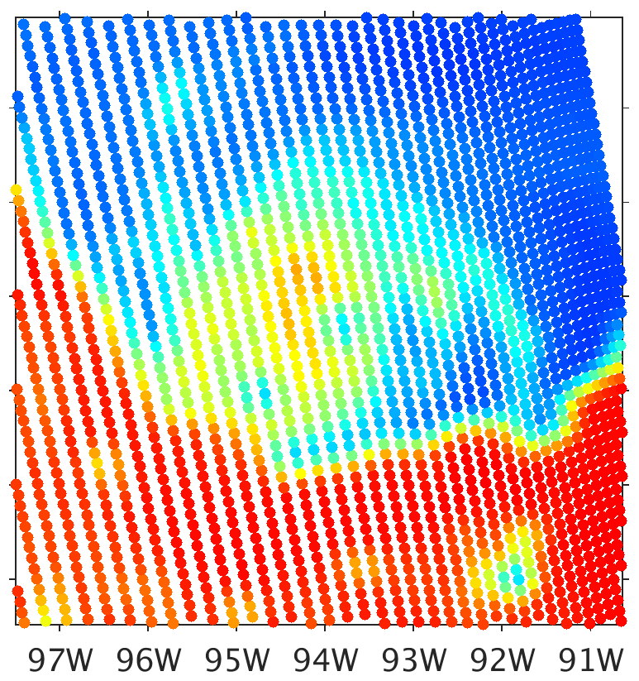
Common Issues with Forward Model Results
Relatively widespread and high-magnitude BT depressions at 37 GHz in areas of highest snow and graupel water content
Should be primarily sensitive to liquid water content net addition of radiation
Observation
CRTM As-Released
CRTM-DS
DS Fluffy Graupel
DS Dense Graupel
Field Distribution
300
280
260
240
220
200
180
160
140
120
100
80
BT (K)

Slide 5
Research Questions
Can replacing spherical particle scattering with non-spherical particle scattering address these issues in simulated BTs?
How to calculate non-spherical particle cloud scattering property lookup tables as consistently as possible with the specifications of the microphysics scheme?
As the microphysics scheme specifies that particles are spheres

Slide 6
Non-spherical Particle Scattering Properties
Utilize database by Gousheng Liu (2008; MWR), which contains 11 particle constructions
Shapes of (a) columns and plates, (b) rosettes, (c) sector snowflakes, and (d) dendrite snowflakes. The drawings are made of small dots that are the dipoles used in DDA model simulations. (Adapted from Liu 2008.)

Slide 7
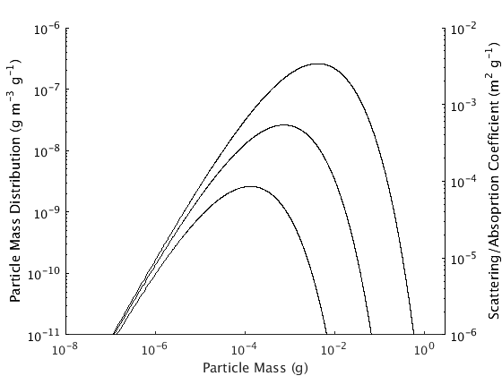
Microphysics Consistency
Substitute non-spherical particle for sphere of same mass
Non-spherical particles do not approach high enough masses to sufficiently span the microphysics-specified particle size distribution
Most massive sector snowflake is less than 2 mg
c
b
a
Formulaically consistent with particle size distribution and particle mass distribution, but…
No representation of large/massive particles
a. 1 g m³
b. 0.1 g m³
c. 0.01 g m³
Water Content (log10) →
Water Content (log10) →

Slide 8
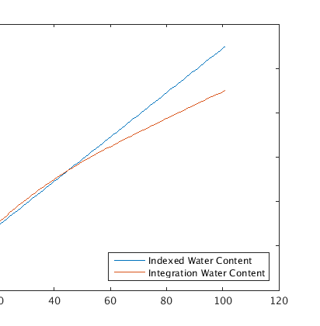
Microphysics Consistency
Substitute non-spherical particle for sphere of same size
Medium/large snowflake and cloud ice particles are not nearly as massive as the 100 kg m⁻³ spheres in snow (even worse for 500 kg m⁻³ spheres in graupel)
Consistent with the particle size distribution, but inconsistent with the particle mas distribution (and total mass)
Water Content (log10) →
(small non-spherical particles are more massive than the size-equivalent sphere)
Water Content (log10) →

Slide 9
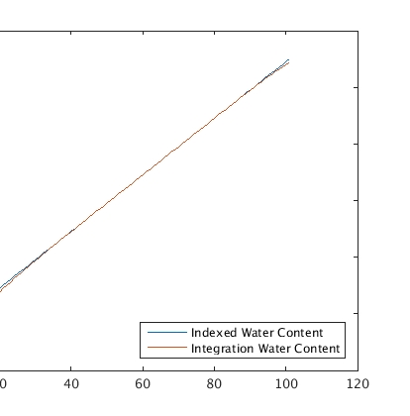
Microphysics Consistency
Substitute non-spherical particle for sphere of same size, then adjust number of particles of a given size to preserve total mass of particles of such size
The chosen method
Consistent with the particle mass distribution, but inconsistent with the particle size distribution (and total number of particles)
Water Content (log10) →
Water Content (log10) →

Slide 10
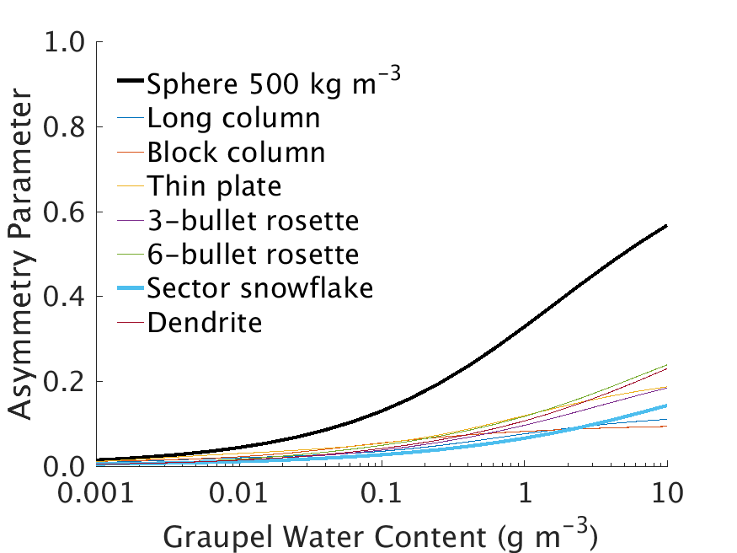
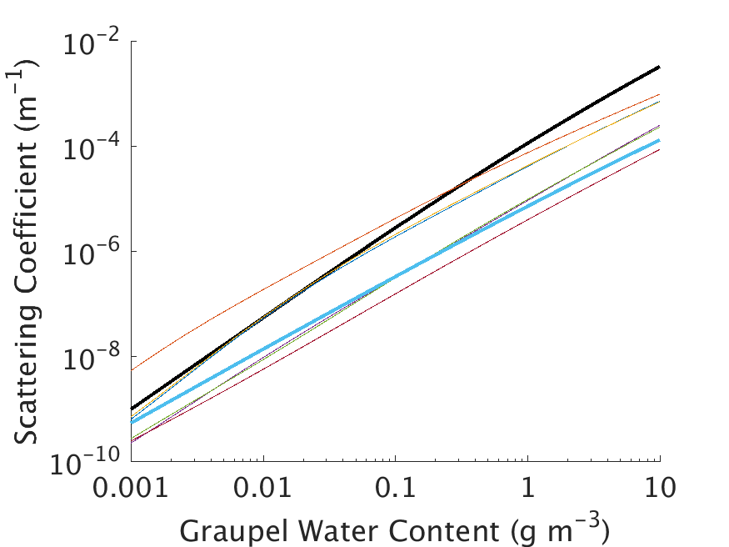
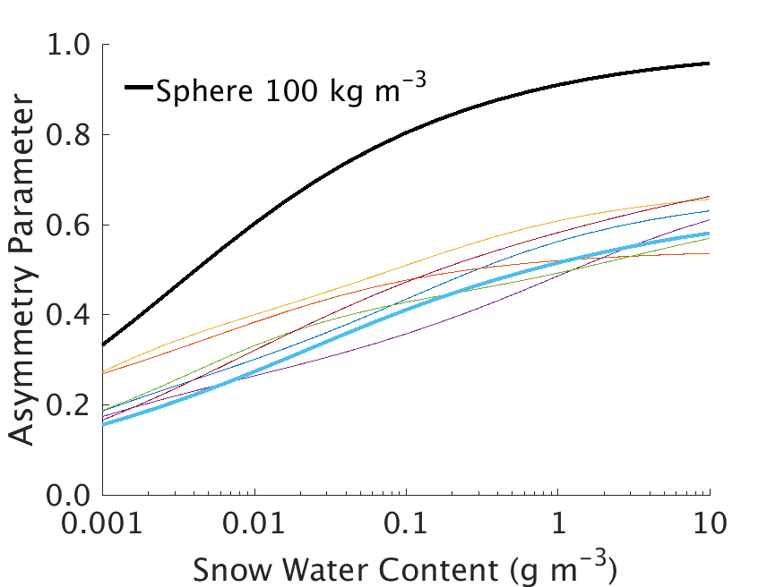
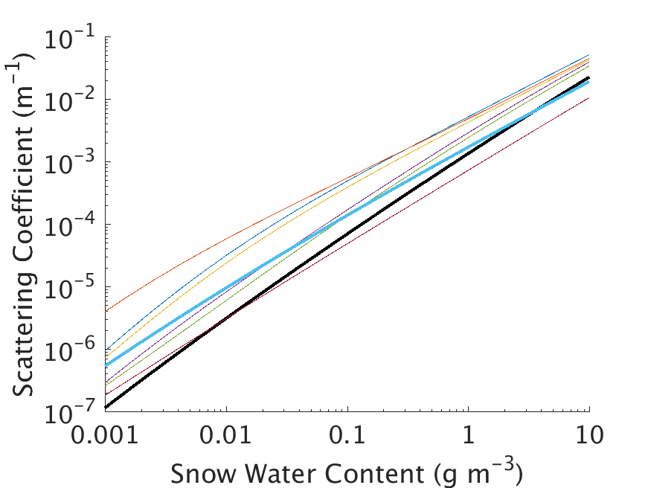
Non-spherical Cloud Scattering Properties
Using the chosen non-spherical particle replacement method with the WSM6 microphysics scheme
Spherical particles produce outlying values of scattering coefficient and asymmetry parameter
37 GHz
183 GHz

Slide 11
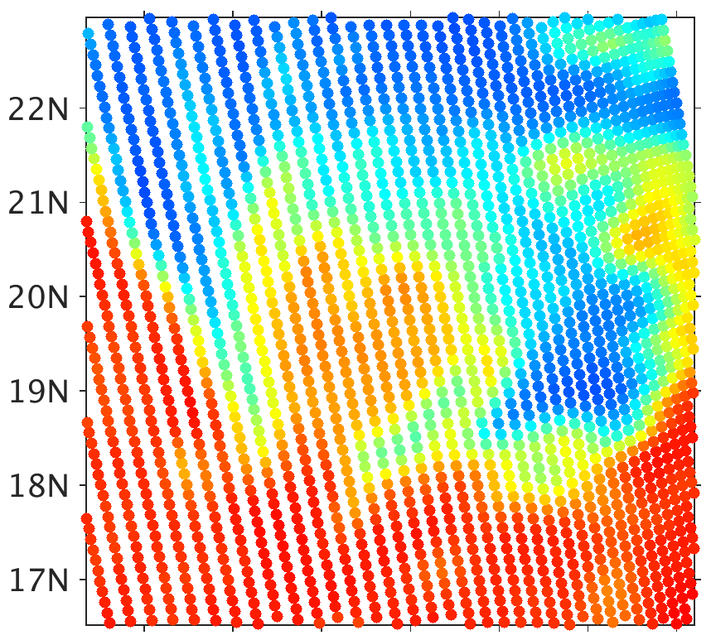
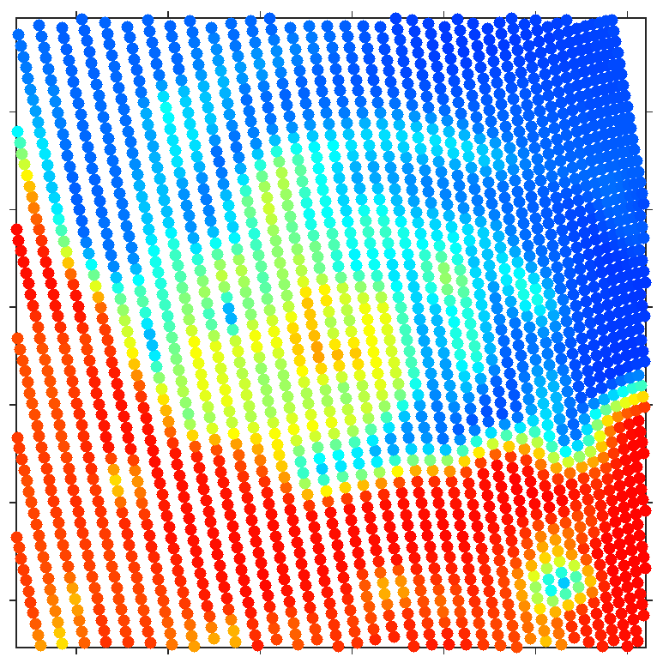
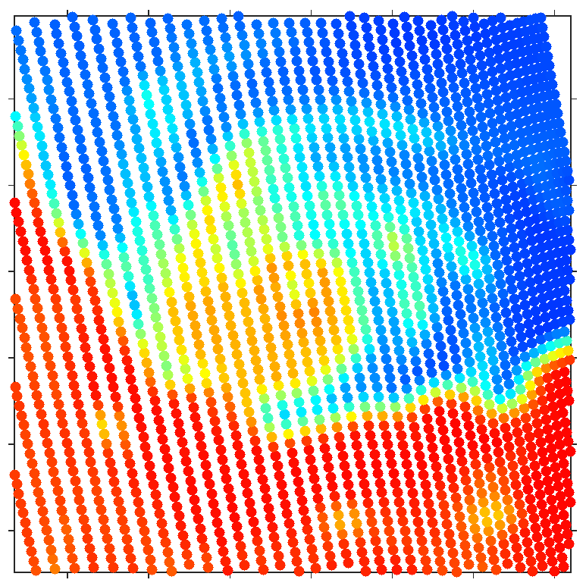
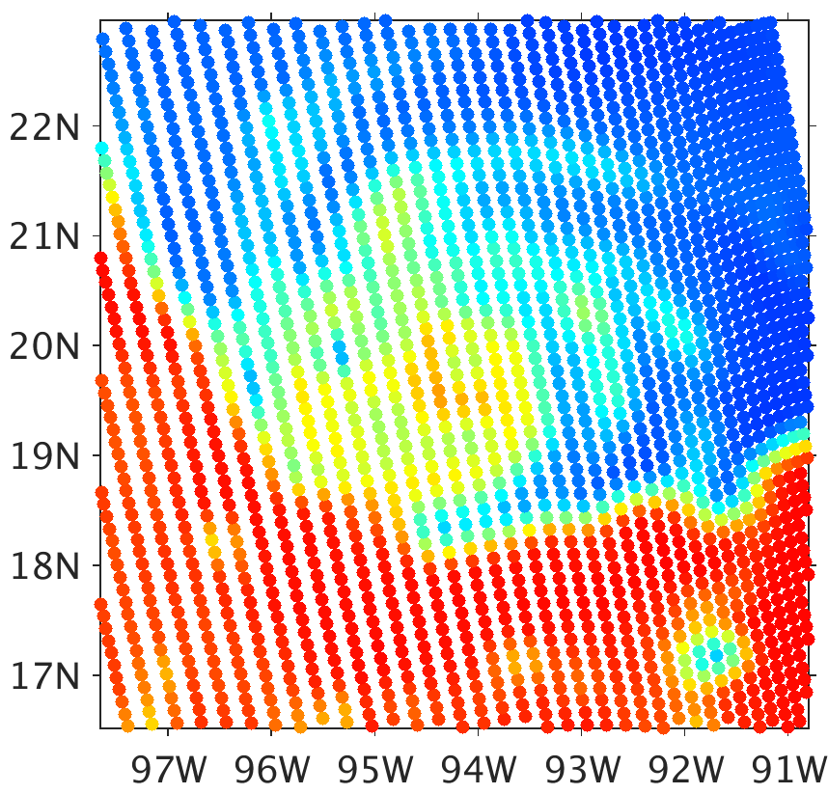
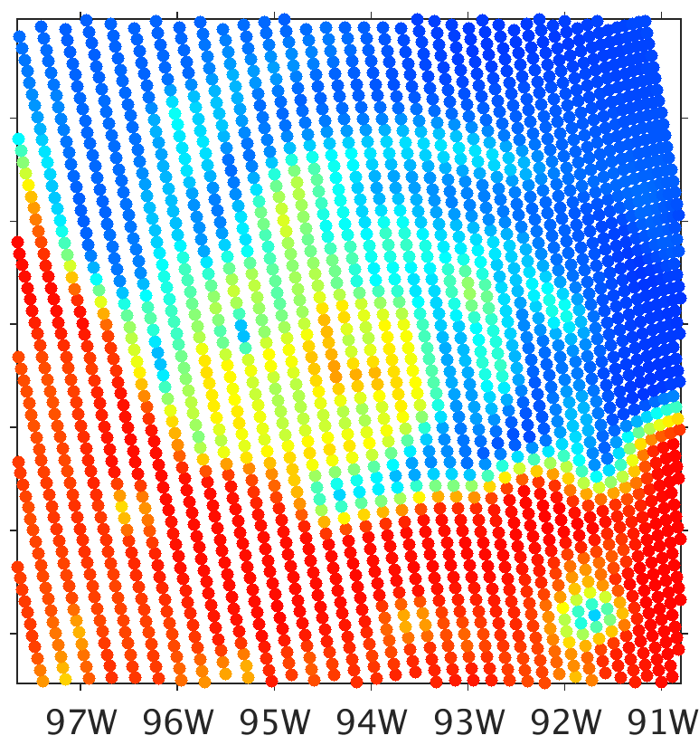
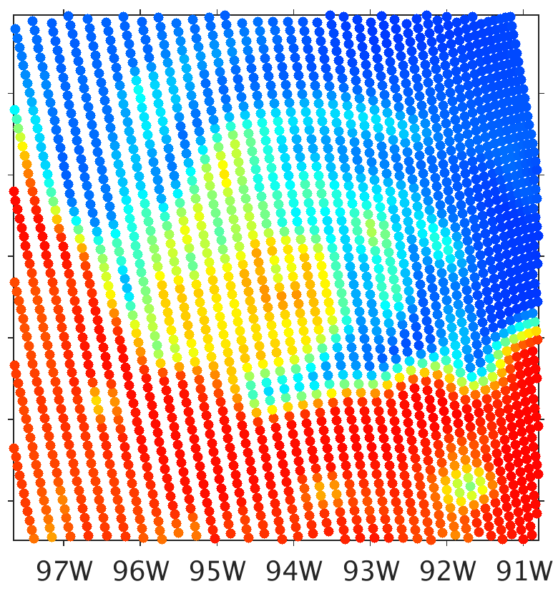
Spheres vs. Sector Snowflakes BTs
300
a) SSMIS Observation
b) All Spheres
c) Sector Flakes (all)
280
260
240
220
200
180
d) Sector Flakes (Snow Only)
e) Sector Flakes (Snow Only)
f) Sector Flakes (Snow Only)
160
½ Snow IWC
½ Graupel IWC
140
120
100
80
Brightness Temperature (K)

Slide 12
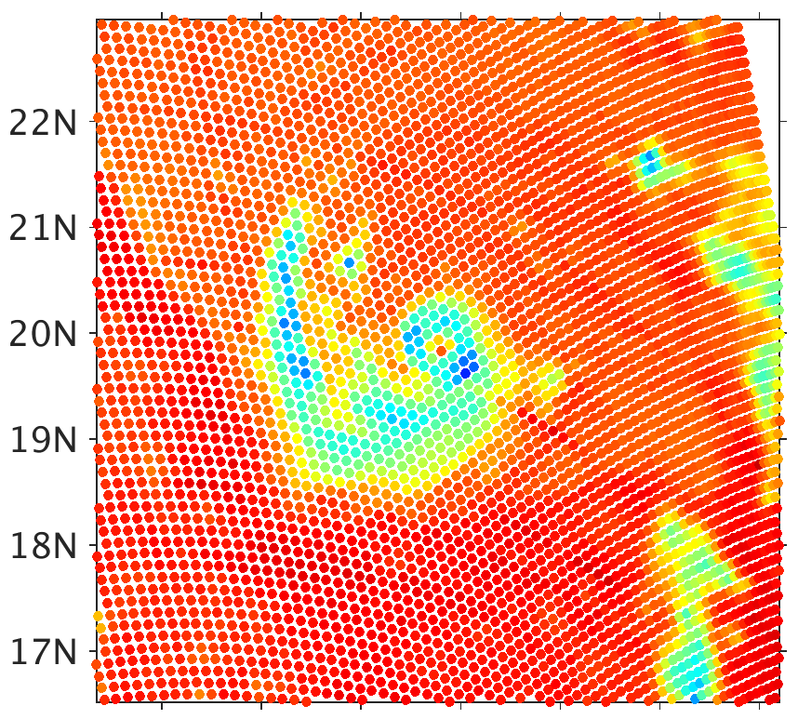
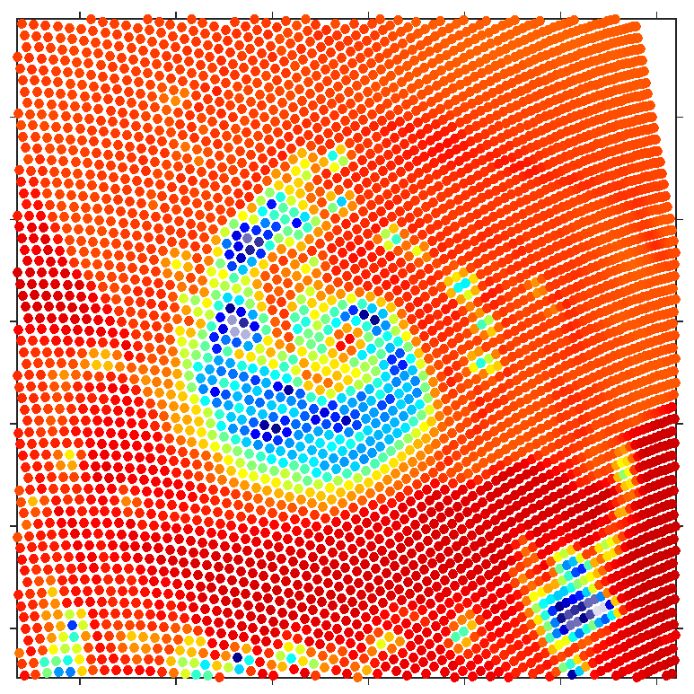
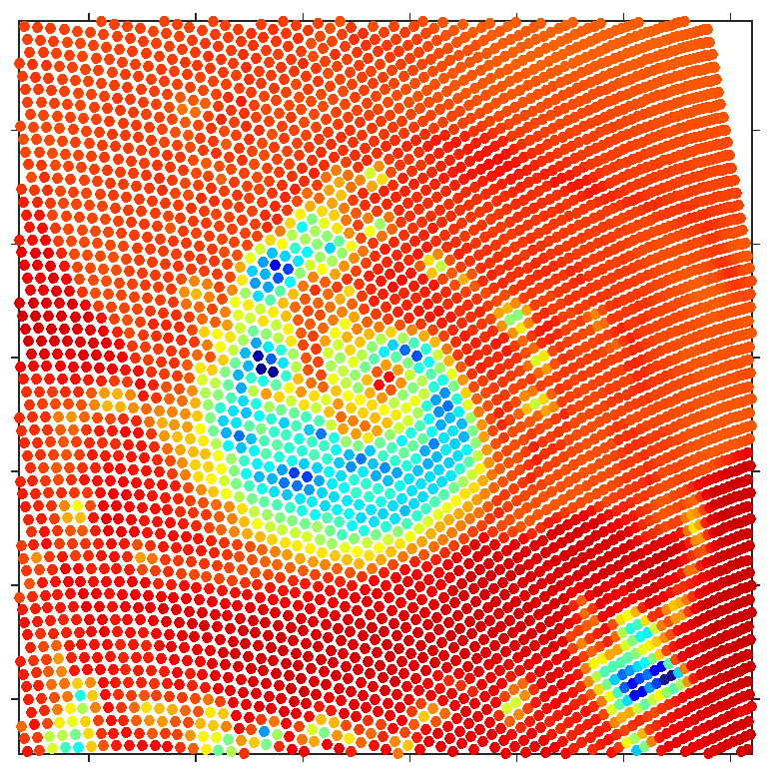
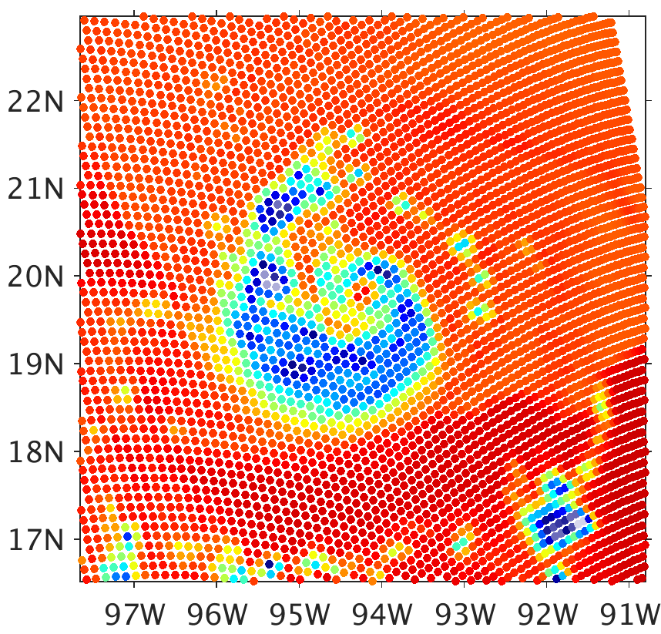
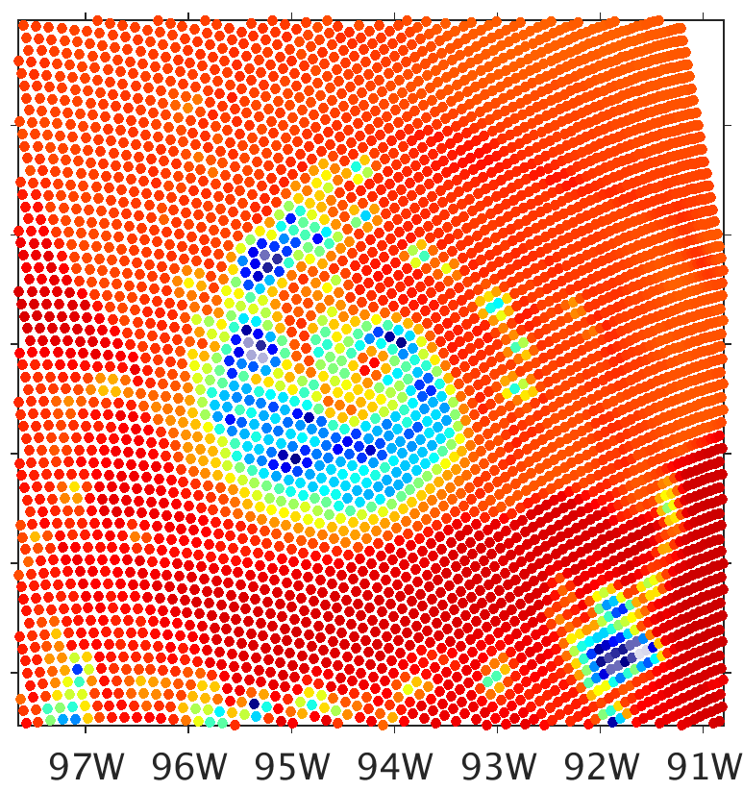
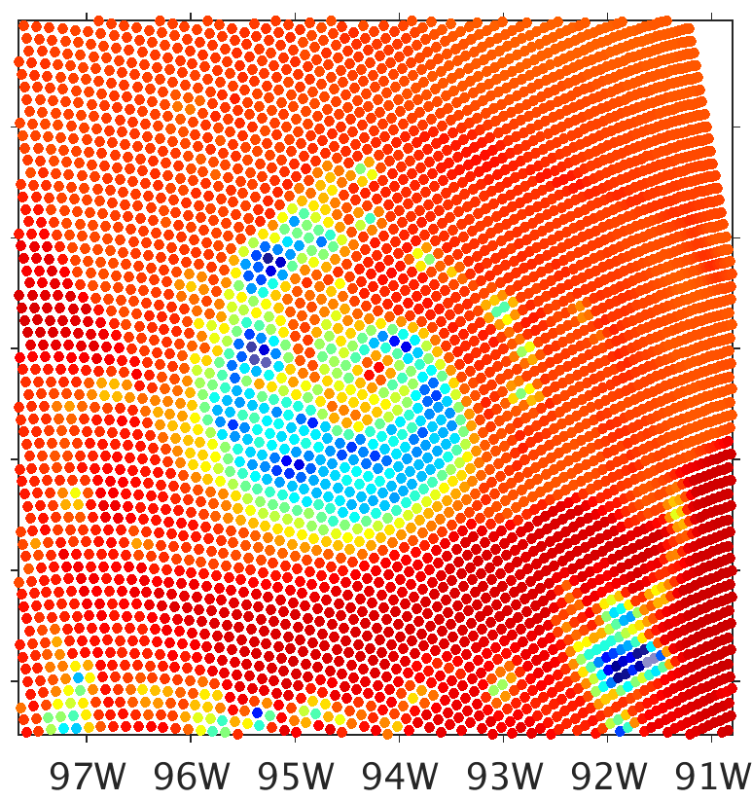
Spheres vs. Sector Snowflakes BTs
300
a) SSMIS Observation
b) All Spheres
c) Sector Flakes (all)
280
260
240
220
200
180
d) Sector Flakes (Snow Only)
e) Sector Flakes (Snow Only)
f) Sector Flakes (Snow Only)
160
½ Snow IWC
½ Graupel IWC
140
120
100
80
Brightness Temperature (K)

Slide 13
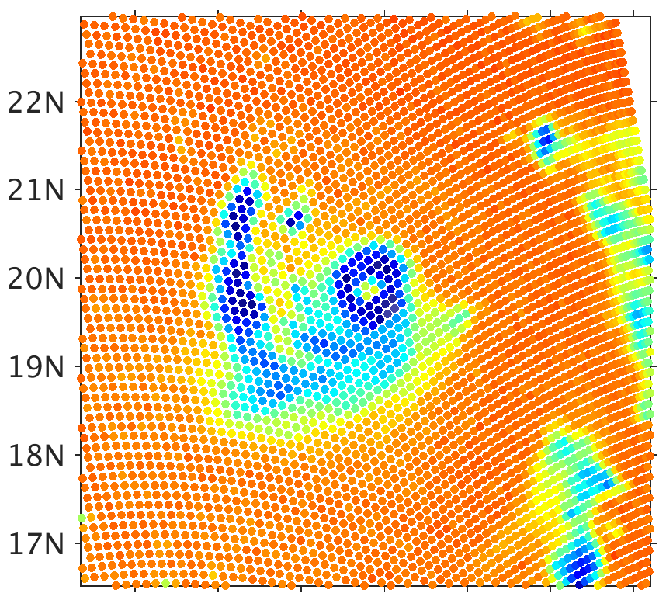
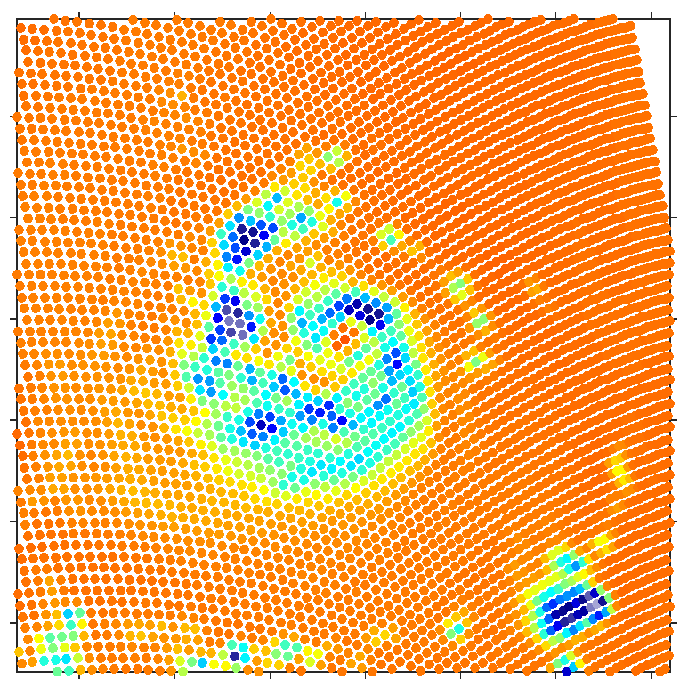
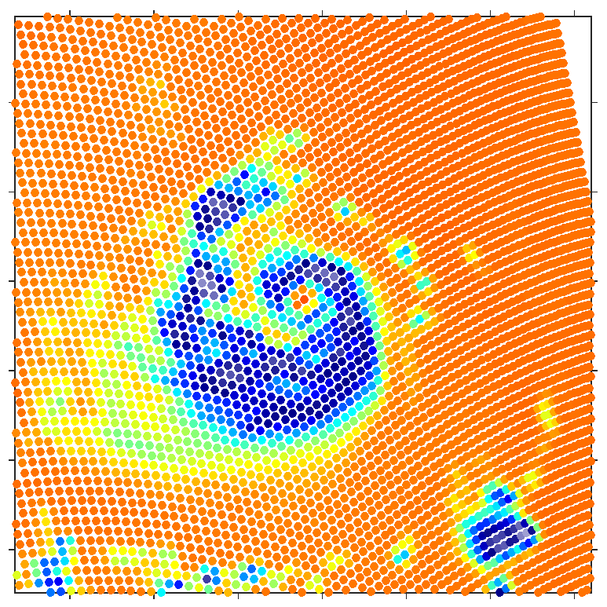
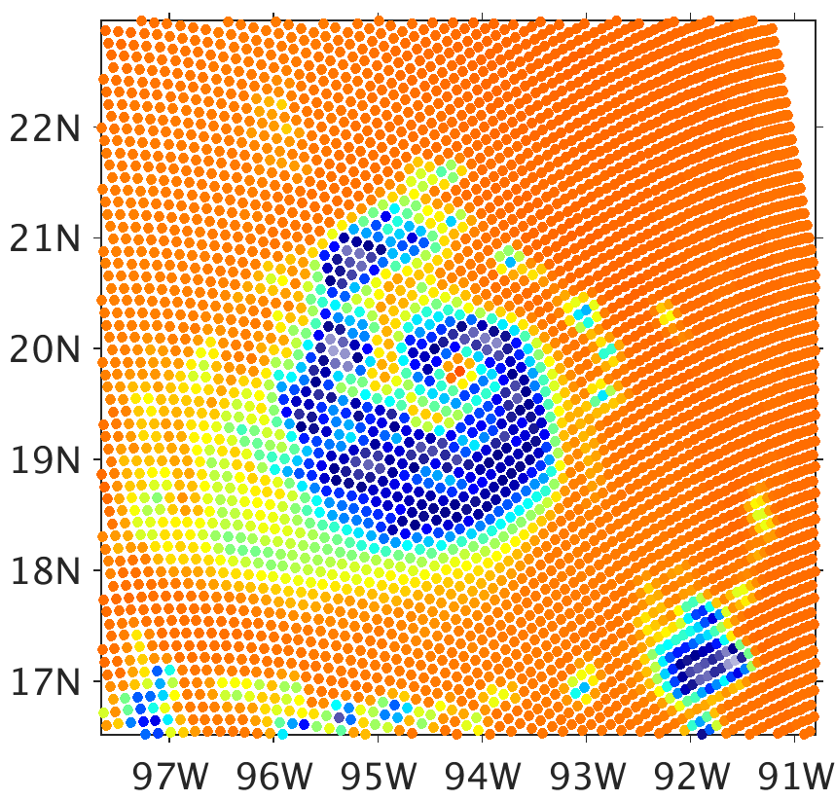
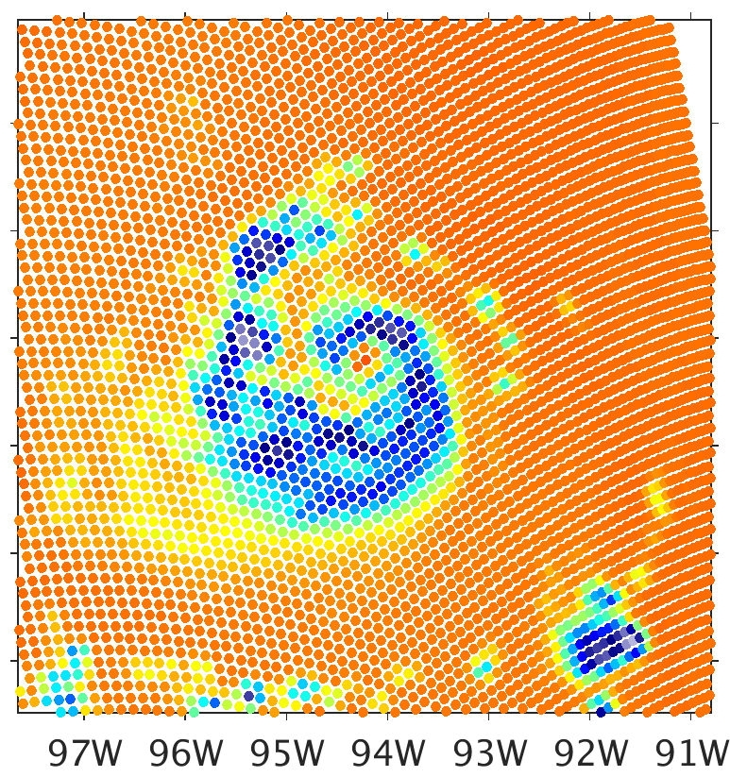
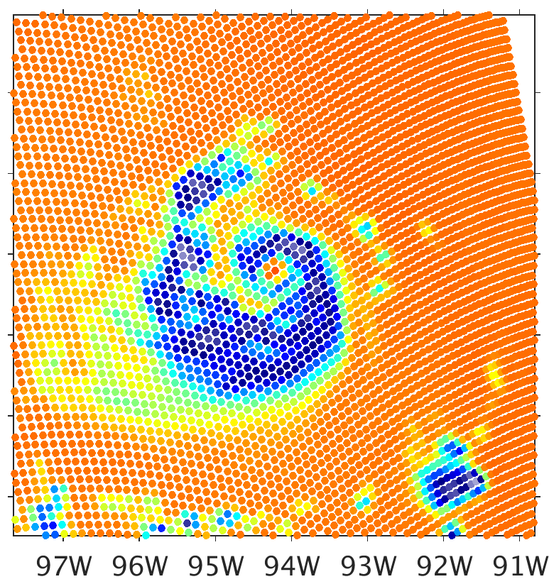
Spheres vs. Sector Snowflakes BTs
300
a) SSMIS Observation
b) All Spheres
c) Sector Flakes (all)
280
260
240
220
200
180
d) Sector Flakes (Snow Only)
e) Sector Flakes (Snow Only)
f) Sector Flakes (Snow Only)
160
½ Snow IWC
½ Graupel IWC
140
120
100
80
Brightness Temperature (K)

Slide 14
Spheres vs. Sector Snowflakes BTs
Replacing soft spheres with non-spheres for snow is necessary to resolve the 183/91.7 GHz bias. (Sector snowflakes do this better than any other particle type.)
With this substitution, both high frequencies have low simulated brightness temperatures, suggesting that snow is being overproduced in this simulation.
Graupel causes BT depressions at 37 GHz in areas of precipitation. The depressions can be reduced either by reducing graupel water contents or replacing soft spheres with sector snowflakes.
Since spheres better represent graupel particle constructions, this could suggest overproduction of graupel in this simulation.

Slide 15
Preliminary Data Assimilation Experiments
Hurricane Harvey (Sept. 2017)
IR hourly cycling data assimilation from 12 UTC 23rd to 12 UTC 24th
Then assimilate SSMIS F18 overpass at 1227 UTC 24
Filtering: assimilating 50% at 19.35 GHz, 25% at 183 GHz

Slide 16
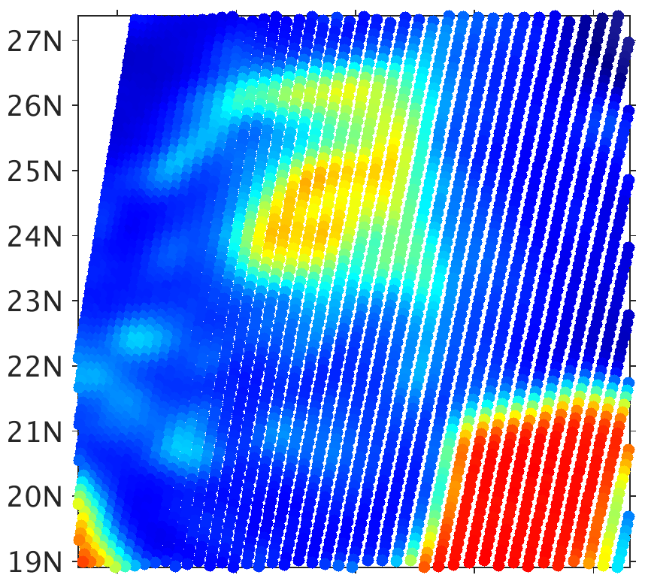
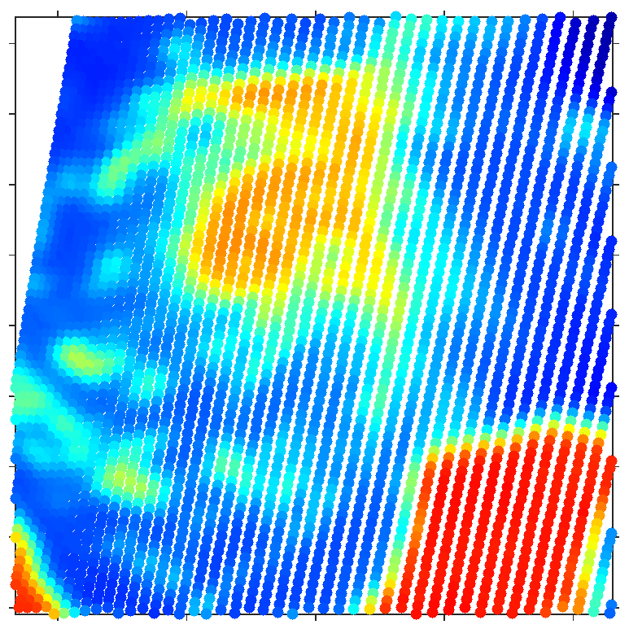
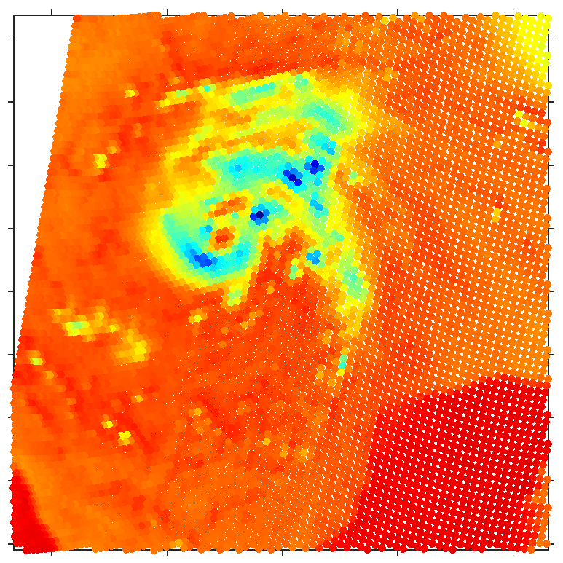
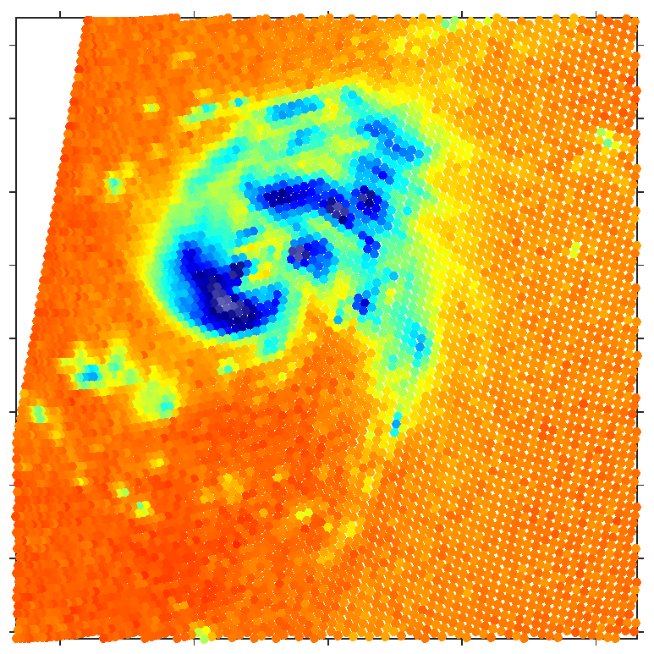
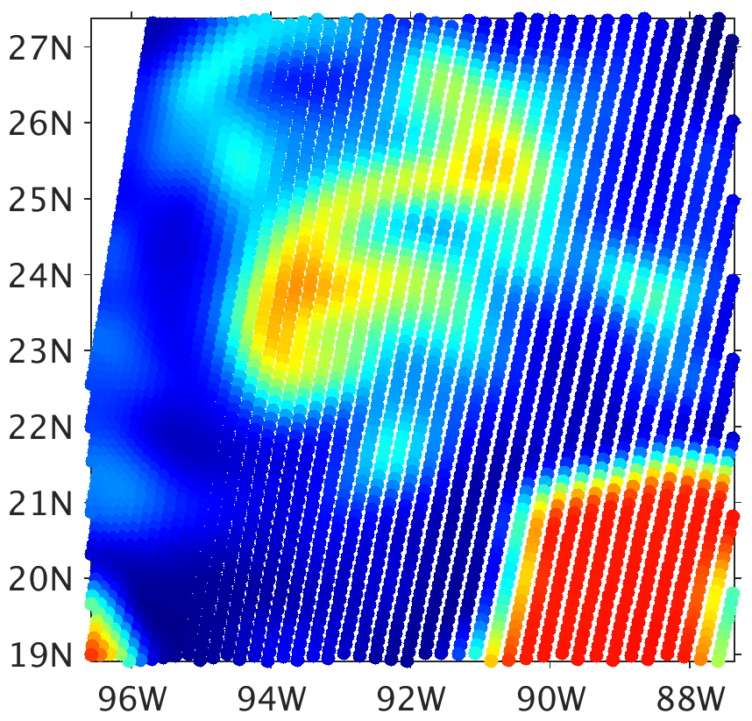
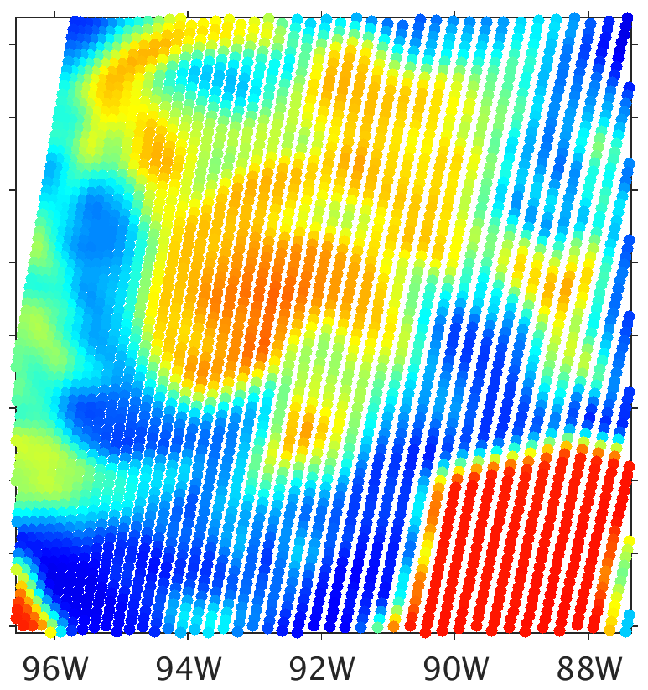
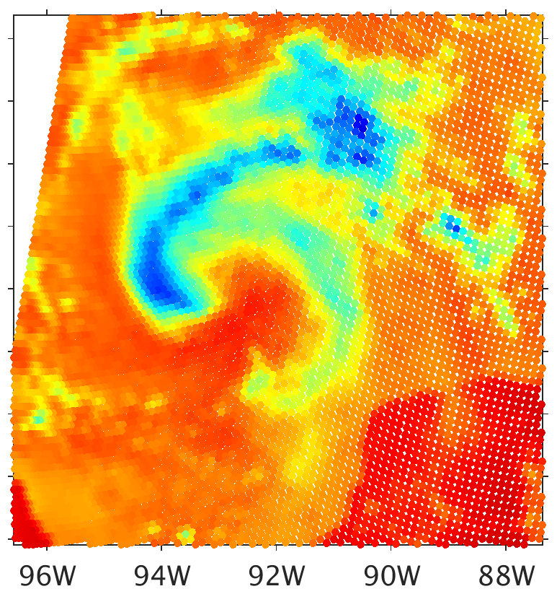
CRTM-DS Sector Snowflakes, Before Assimilating IR (25th hourly cycle)
Brightness Temperature (K)
80
100
120
140
160
180
200
220
240
260
280
300
19.35 GHz
37.0 GHz
91.66 GHz
183.31±7 GHz
Obs
$$H(\overline{x_{b}})$$

Slide 17
CRTM-DS Sector Snowflakes, After Assimilating IR (25th hourly cycle)
Brightness Temperature (K)
80
100
120
140
160
180
200
220
240
260
280
300
19.35 GHz
37.0 GHz
91.66 GHz
183.31±7 GHz
Obs
$$H\left(\overline{x_{a}}\right)$$
IR

Slide 18
CRTM-DS Sector Snowflakes, Assimilating IR & 183.31±7 GHz
Brightness Temperature (K)
80
100
120
140
160
180
200
220
240
260
280
300
19.35 GHz
37.0 GHz
91.66 GHz
183.31±7 GHz
Obs
$$H\left(\overline{x_{a}}\right)$$
IR & MW

Slide 19
CRTM-DS Sector Snowflakes, Assimilating IR & 19.35 GHz
Brightness Temperature (K)
80
100
120
140
160
180
200
220
240
260
280
300
19.35 GHz
37.0 GHz
91.66 GHz
183.31±7 GHz
Obs
$$H\left(\overline{x_{a}}\right)$$
IR & MW

Slide 20
Preliminary DA Experiments – IR Only
The 25th hourly cycling of assimilating IR observations produces little change to the primary precipitation field of the cyclone
Liquid water north of center of circulation is dislocated to the east such that it is directly underneath snow and cloud-top
183/91.7 GHz bias substantially reduced even further with the CRTM being applied to this ensemble average
Excessive area of high 37 GHz BTs is consistent with taking an ensemble averaging of spatially-dislocated liquid water content

Slide 21
Preliminary DA Experiments – IR Only
Applying CRTM microwave forward model on deterministic forecast from IR cycling DA analysis:
Big drop in 19.35 GHz and, especially, 37 GHz BTs in first moments of deterministic forecast from EnKF analysis
Evaporation of non-physical liquid water content in unsaturated conditions, probably produced by taking the ensemble average of all fields independently
As the model produces deep moist convection (mostly 1-2 hours after initialization), 91.7 GHz cools significantly to values much closer to 183 GHz BTs

Slide 22
Preliminary DA Experiments – IR + MW
Assimilating MW observations at either frequency produces substantial changes to the precip field throughout the domain
Assimilating 183 GHz produces a great match to observations at both high frequencies
Assimilating 19.35 GHz is somewhat effective in relocating rain (ensemble may be under-dispersive
19.35 GHz clear-sky bias (due to modeled emissivity of ocean surface) produces excess increment of liquid and ice

Slide 23
Preliminary DA Experiments – IR + MW
Deterministic forecasts with correct WRF configuration was delayed :-(

Slide 24
Summary
Non-spherical particle scattering for snow is necessary to resolve persistent biases between different high-frequency simulated BTs in areas of precipitation
Suggestions of overproduction of snow and graupel, underproduction of liquid water, by WRF with WSM6 microphysics
Assimilating MW observations provides substantial updates to precipitation fields in both clear and cloudy skies alongside regular cycling of IR with our EnKF system
Great progress has been made with forward model errors in areas of precipitation, but challenges remain with the forward model overall

Slide 25
1200 UTC IR DA Analysis
19.35 GHz
37 GHz
91.7 GHz
183 GHz

Slide 26
1230 UTC 0.5 Hour Forecast from 1200 UTC Analysis
19.35 GHz
37 GHz
91.7 GHz
183 GHz

Slide 27
1300 UTC 1 Hour Forecast from 1200 UTC Analysis
19.35 GHz
37 GHz
91.7 GHz
183 GHz

Slide 28
1400 UTC 2 Hour Forecast from 1200 UTC Analysis
19.35 GHz
37 GHz
91.7 GHz
183 GHz

Slide 29
1600 UTC 4 Hour Forecast from 1200 UTC Analysis
19.35 GHz
37 GHz
91.7 GHz
183 GHz

Slide 30
1800 UTC 6 Hour Forecast from 1200 UTC Analysis
19.35 GHz
37 GHz
91.7 GHz
183 GHz

Slide 31
2000 UTC 8 Hour Forecast from 1200 UTC Analysis
19.35 GHz
37 GHz
91.7 GHz
183 GHz

Slide 32
2158 UTC F16 SSMIS Observation
19.35 GHz
37 GHz
91.7 GHz
183 GHz

