Slide 1




Constraining surface carbon dioxide fluxes using advanced ensemble-based data assimilation techniques
Hans Chen, Fuqing Zhang, Thomas Lauvaux, Kenneth J. Davis, Richard B. Alley
Department of Meteorology and Atmospheric Science
The Pennsylvania State University

Slide 2
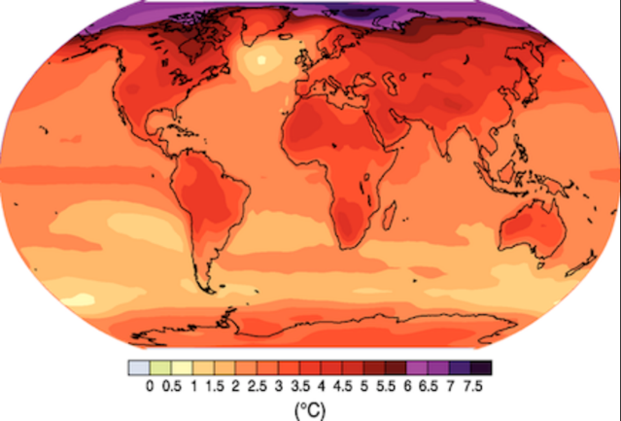
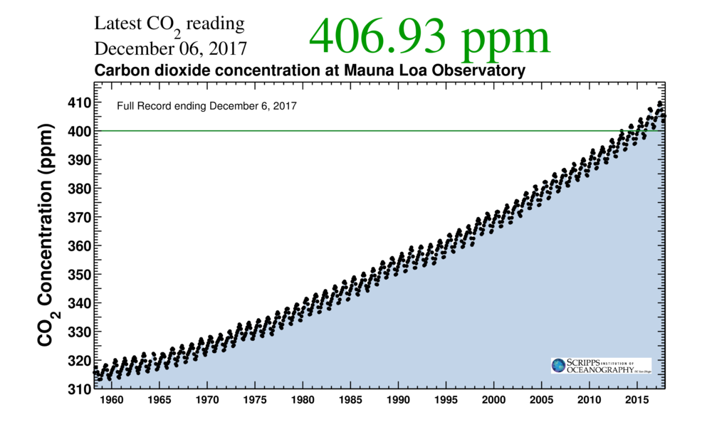
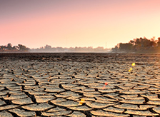
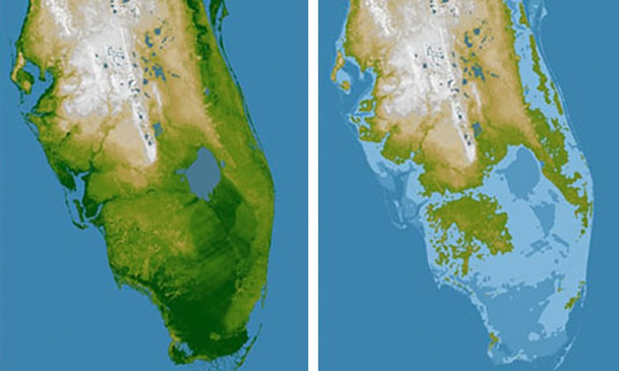
Increasing atmospheric CO₂ due to human activity may radically alter our climate system

Slide 3
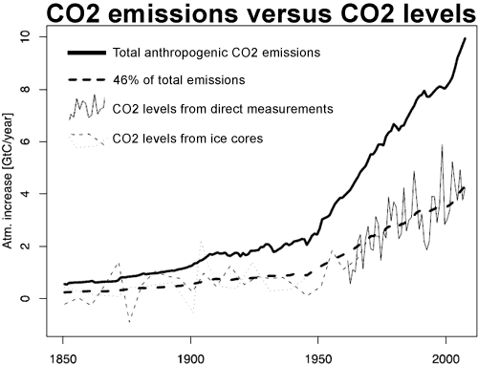
Atmospheric increase in CO₂ has been partially offset by increasing CO₂ sinks
[Knorr 2009, GRL]

Slide 4
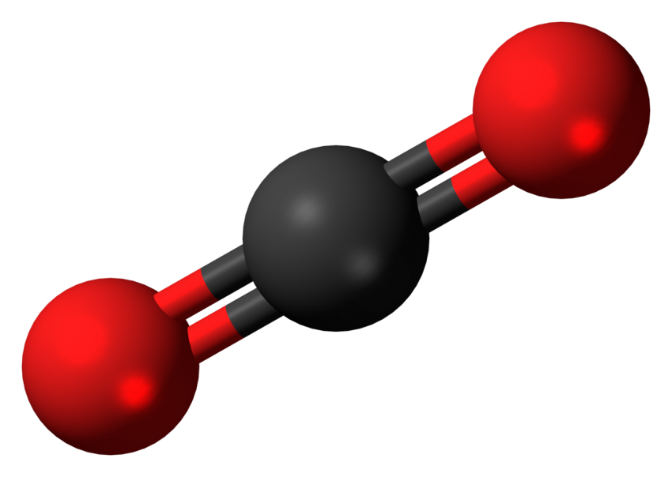
Where does CO₂ come from, and where does it go?
How much CO₂ is emitted and absorbed?
When? Where? How?

Slide 5
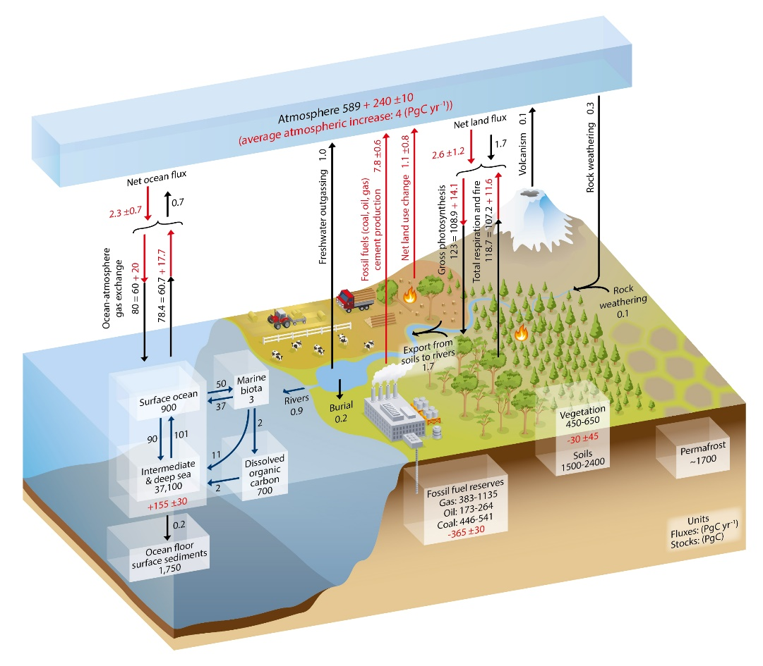
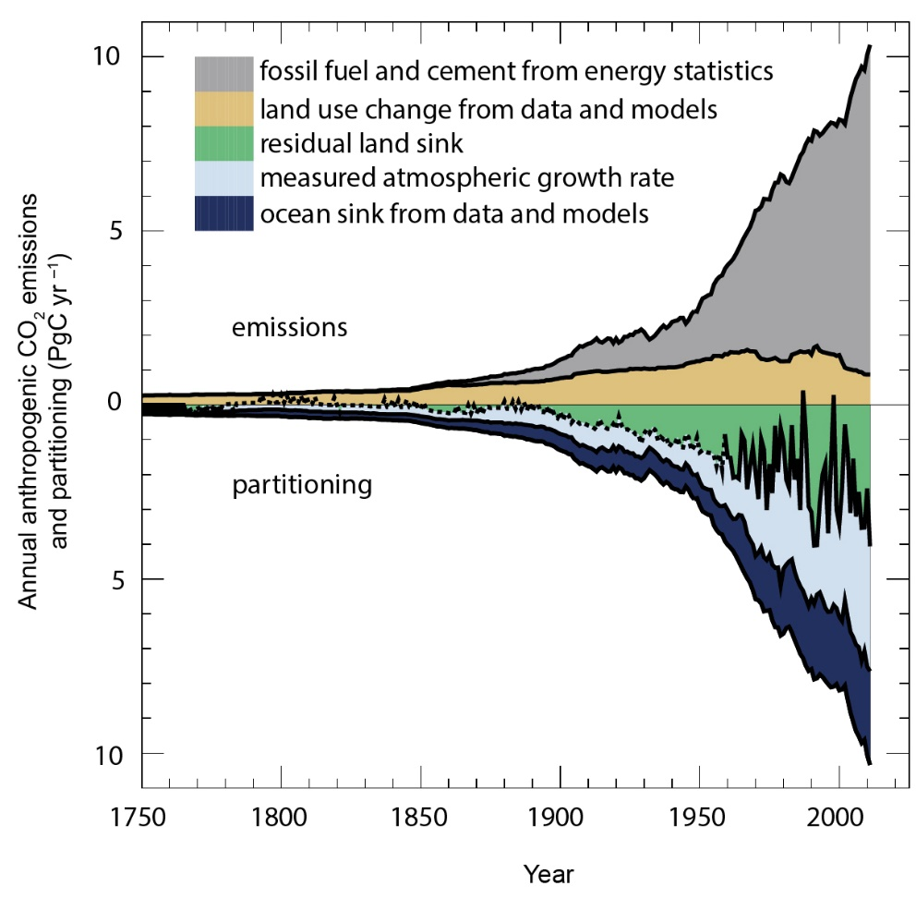
We have a good idea of the sources and sinks of CO₂, but their magnitudes remain highly uncertain
[IPCC AR5 WG1, 2013]
The terrestrial source/sink is one of the largest unknowns

Slide 6
Why does it matter?
Data assimilation
Numerical weather prediction
Data assimilation
Initial conditions
Climate prediction
Parameters
Model
Boundary conditions
Prediction
The ultimate goal is to predict the future

Slide 7
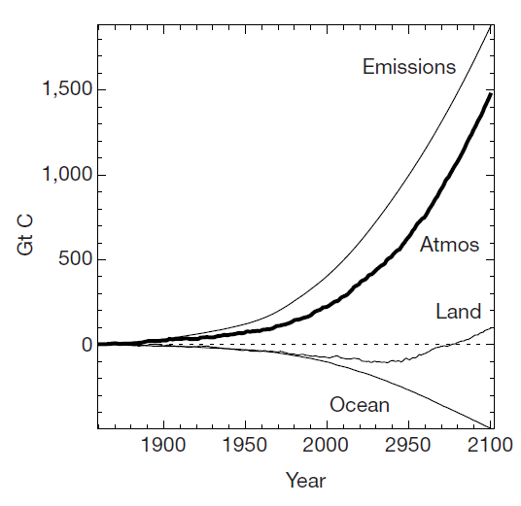
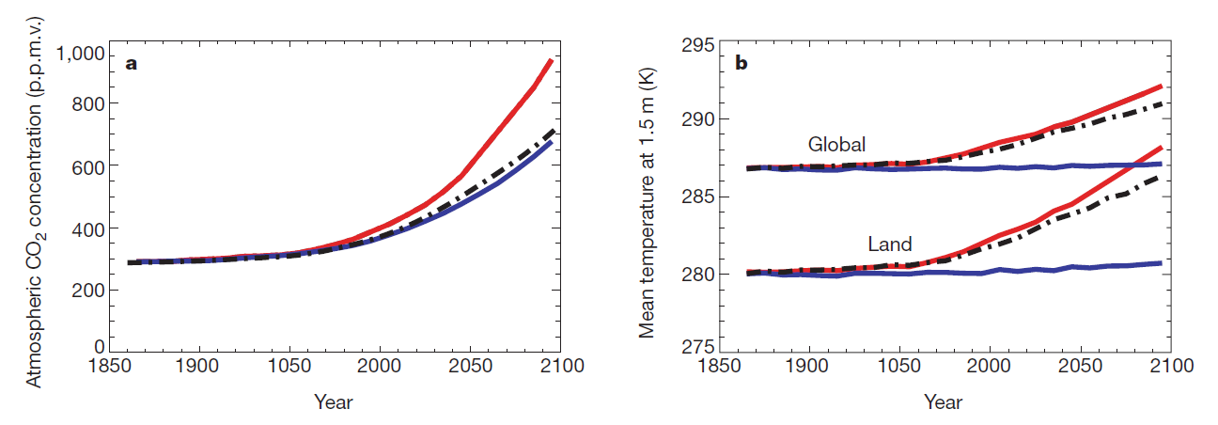
How will CO2 sources and sinks change in the future?
[Cox et al. 2000, Nature]

Slide 8
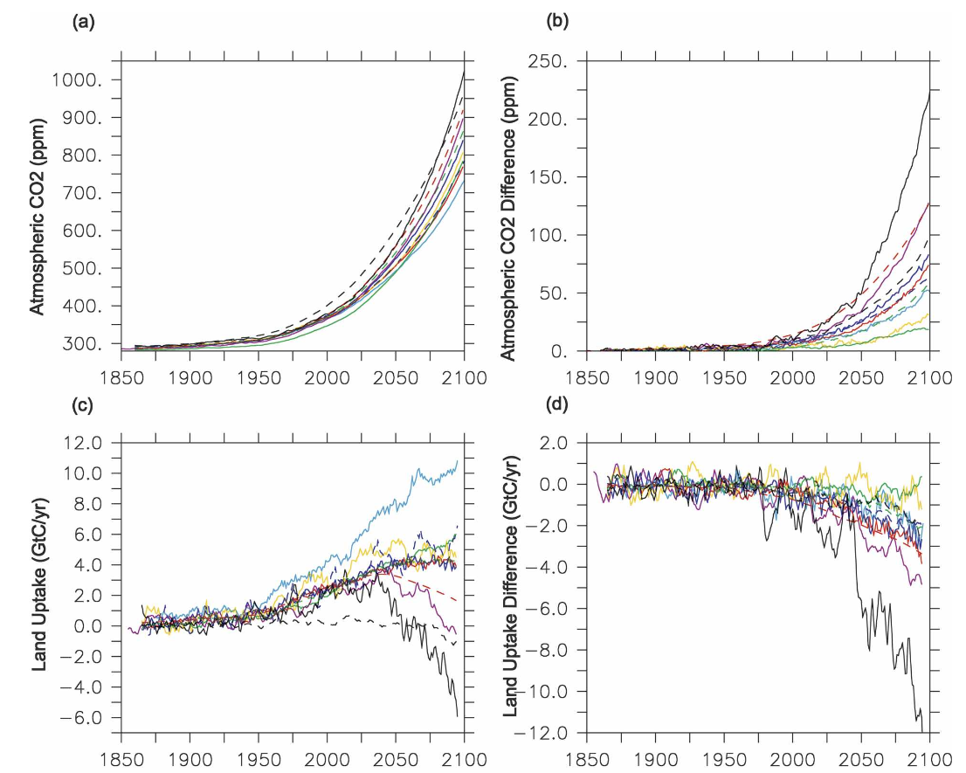
Large range of predicted CO₂ land uptake
[Friedlingstein et al. 2006, JCLI]

Slide 9
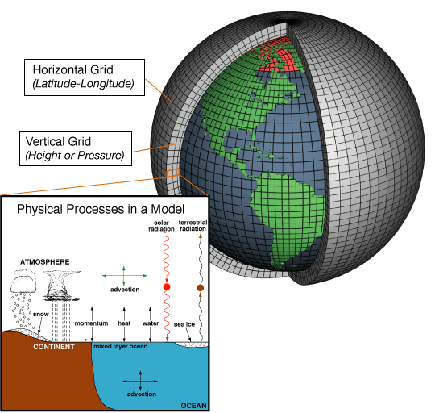
We need better quantifications of the carbon cycle
Is this the reality?
Monitor present
conditions
Improve climate model predictions

Slide 10
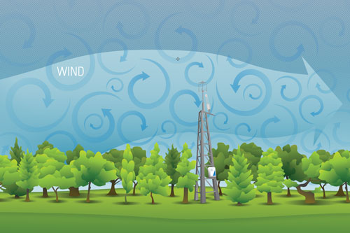
CO₂ surface fluxes are hard to observe
Flux measurements are representative of small areas.
How to upscale fluxes to climate-relevant scales?

Slide 11
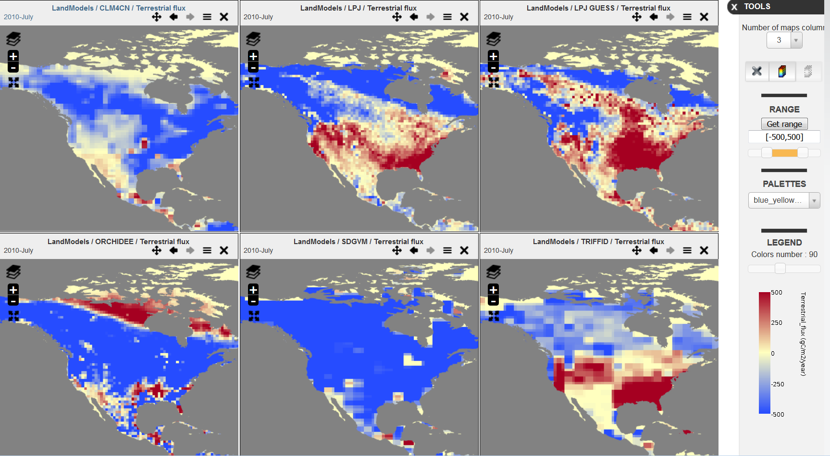
Current “bottom-up” methods disagree about the magnitude and sign of CO₂ fluxes
[http://globalcarbonatlas.org]

Slide 12
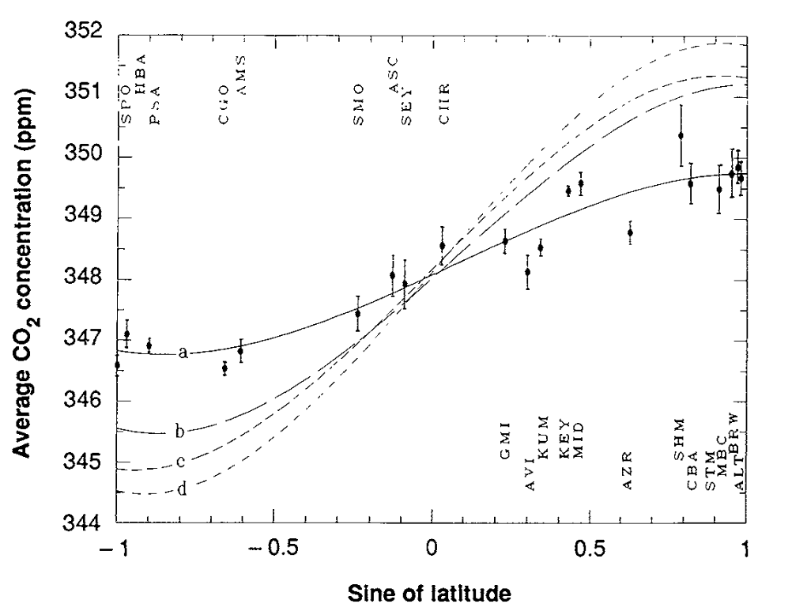
Data-driven “top-down” approaches can provide additional constraints on unobserved processes
NH sources/sinks
Northern Hemisphere
1 year
Southern Hemisphere
SH sources/sinks
[Tans et al. 1990, Science]

Slide 13
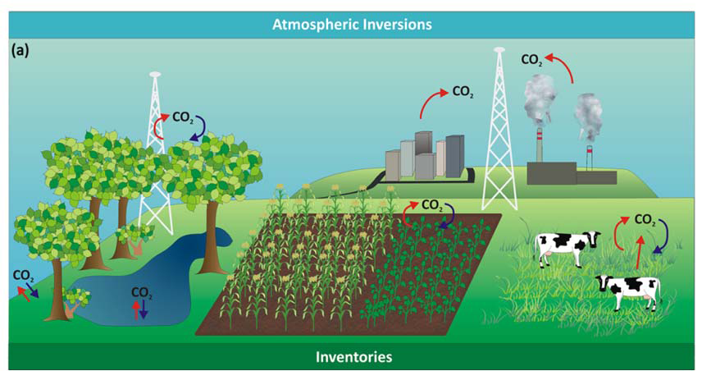
CO₂ fluxes can be inferred from CO₂ concentration using inversion techniques
[Ogle et al. 2013]

Slide 14
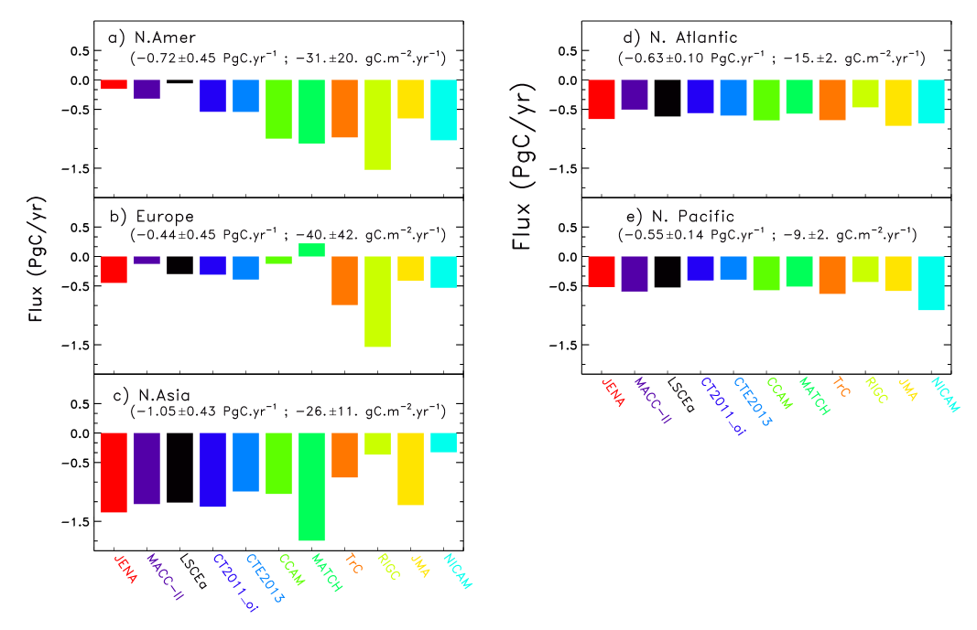
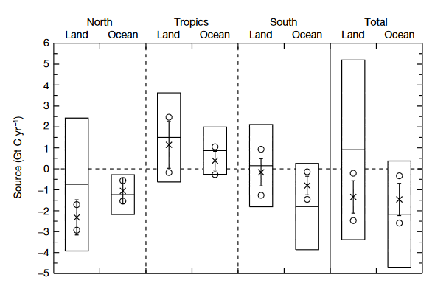
Multiple error sources can contribute to errors in inverse estimates
[Peylin et al. 2013]
Atmospheric transport plays an important role for inverse results at regional scales
[Gurney et al. 2002, Nature]

Slide 15
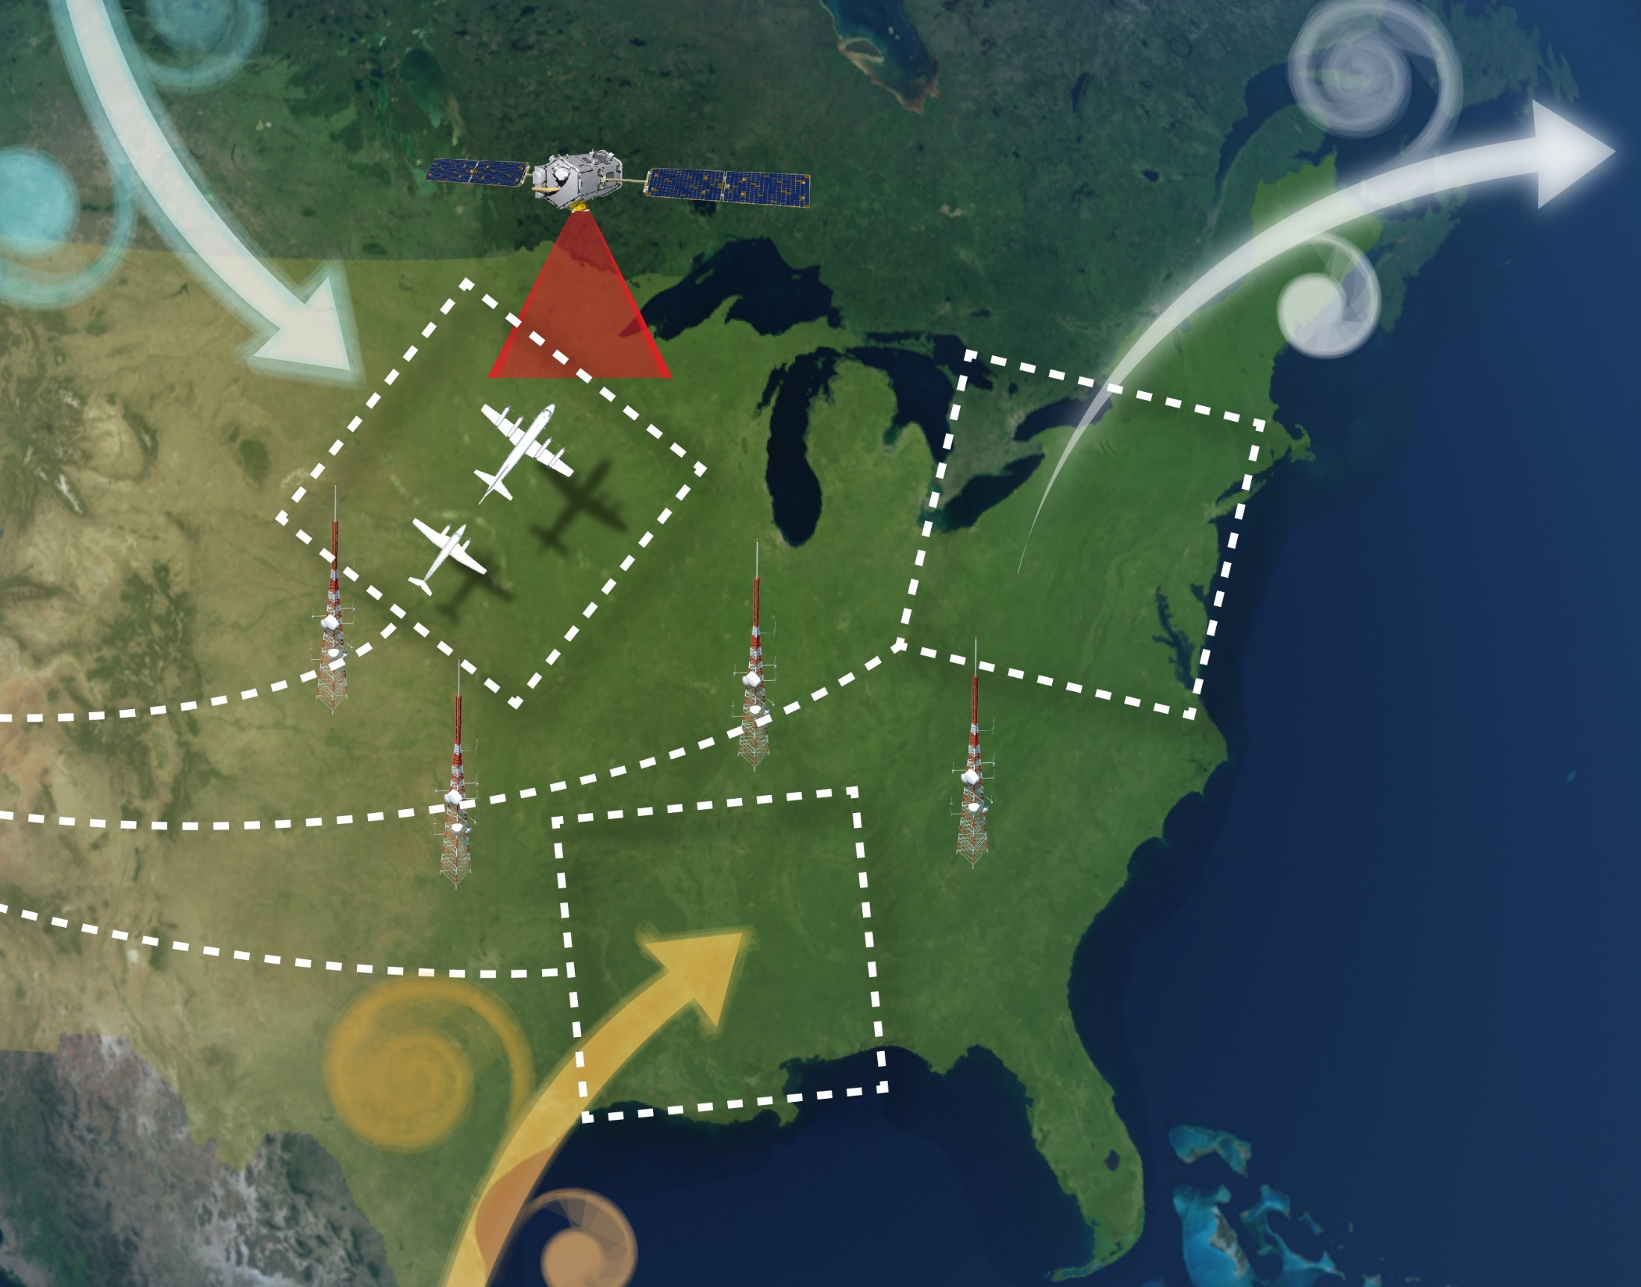

Atmospheric Carbon and Transport – America
Goals
“To quantify and reduce atmospheric transport uncertainties.
To improve regional-scale, seasonal prior estimate of CO₂ and CH₄ fluxes.
To evaluate the sensitivity of Orbiting Carbon Observatory (OCO-2) column measurements to regional variability in tropospheric CO₂.”

Slide 16
Atmospheric Carbon and Transport – America
Personal goals
Quantify and understand CO₂ transport errors at the regional scale.
Develop a joint carbon—meteorological data assimilation system.
Adapt and devise new data assimilation techniques for CO₂ concentration and flux estimation.

Slide 17
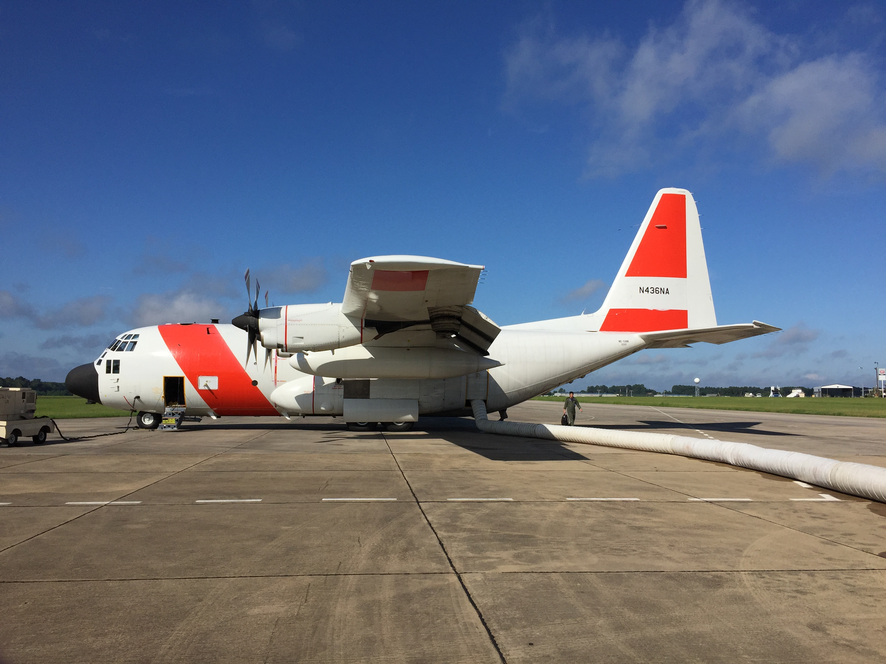

Slide 18
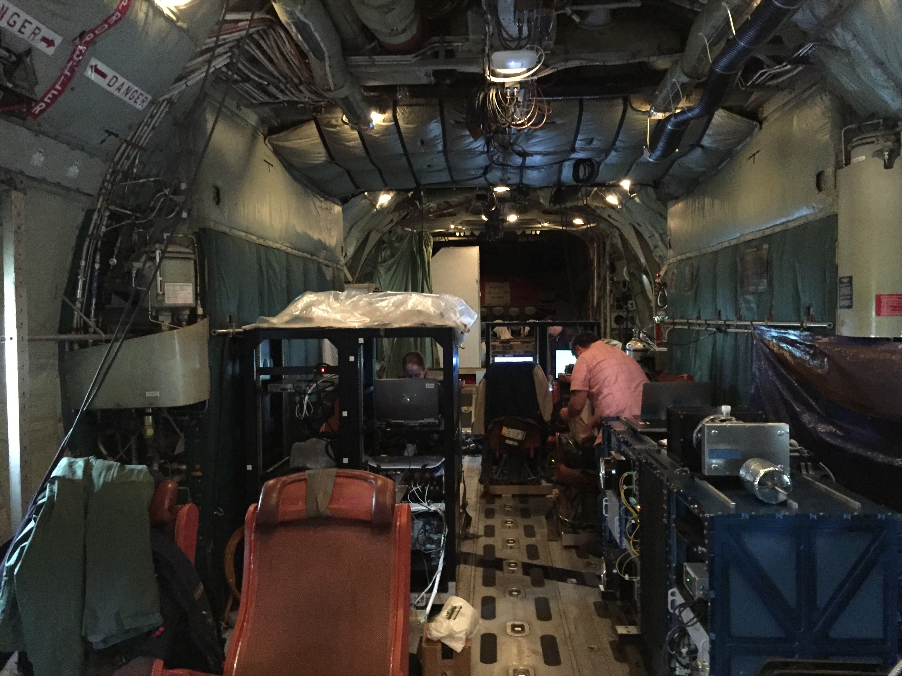

Slide 19
Flight patterns for the summer 2016 campaign
[Zhang et al. 2017, In preparation]

Slide 20
Modeled CO₂ concentration from ECMWF and NOAA generally agree with flight observations
[Zhang et al. 2017, In preparation]

Slide 21
Quantify impact of transport errors on atmospheric CO₂ using WRF
Assimilate simulated sounding observations to constrain transport errors
[Chen et al. 2017, In preparation]

Slide 22
Errors in modeled CO₂ due to transport uncertainties are similar to flux uncertainties
[Chen et al. 2017, In preparation]

Slide 23
Transport errors impact the CO₂ concentration throughout the entire atmosphere
[Chen et al. 2017, In preparation]

Slide 24
Transport errors show flux-dependent structure near the surface and flow-dependent higher up
[Chen et al. 2017, In preparation]

Slide 25
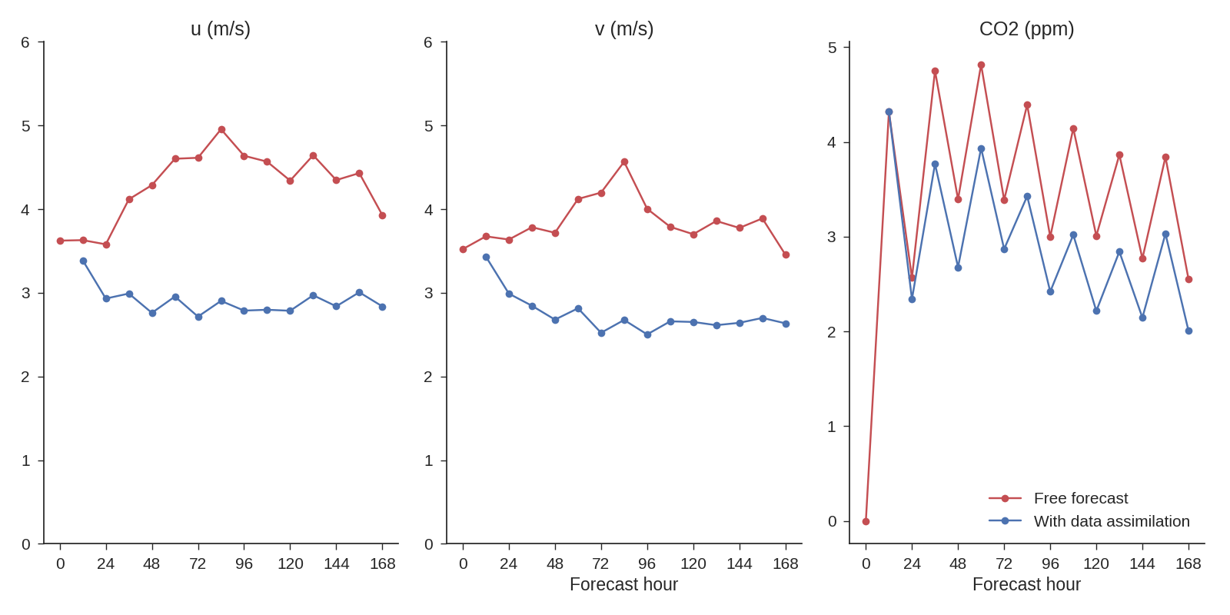
Optimizing meteorological fields with data assimilation can improve the CO₂ field

Slide 26
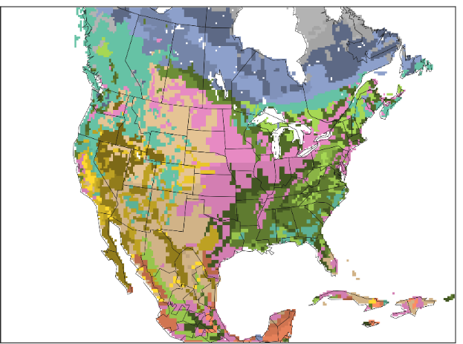
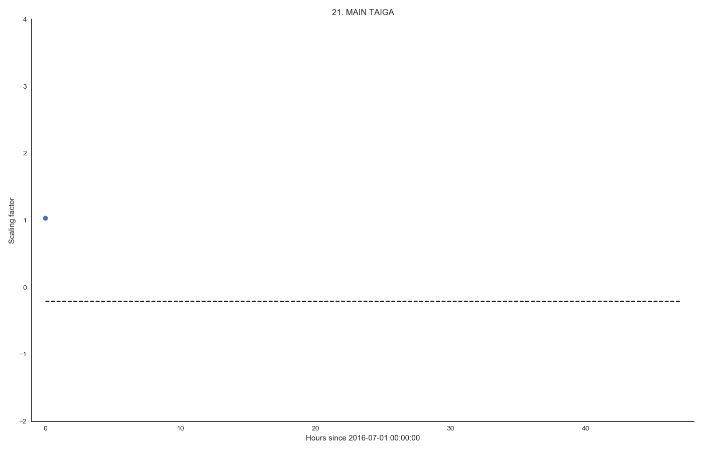

The data assimilation system can also optimize CO₂ fluxes
First guess
Goal
Truth
Notes:
The goal is to reach the dashed “Truth” line.
Blue dot is our first guess (prior).
X-axis is time, y-axis is the scaling factor, Flux_true = scaling_factor x Flux_prior
After animation starts:
Thin lines are ensemble members, thick blue line is the ensemble mean.
Here we assimilate tower observations every hour.

Slide 27
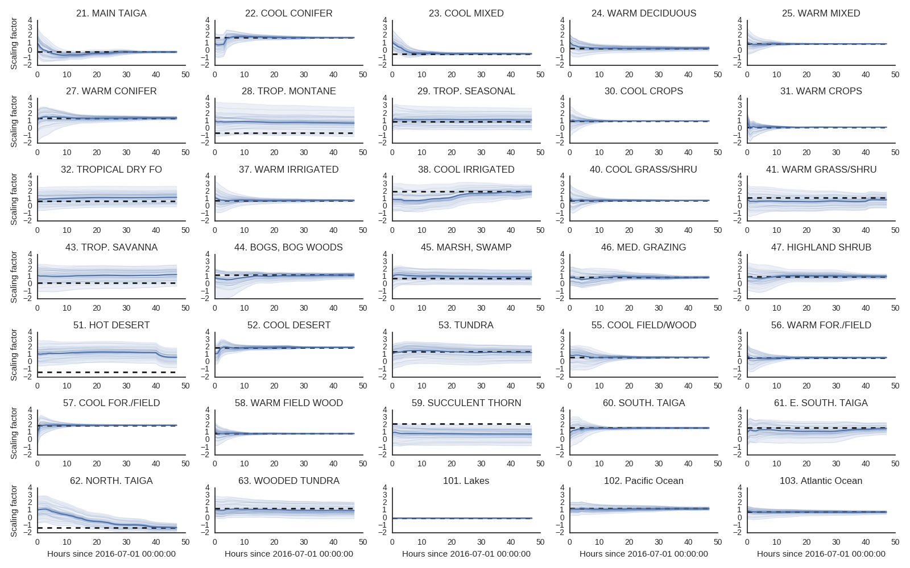
Notes:
The goal is to reach the dashed “Truth” line.
Blue dot is our first guess (prior).
X-axis is time, y-axis is the scaling factor, Flux_true = scaling_factor x Flux_prior
After animation starts:
Thin lines are ensemble members, thick blue line is the ensemble mean.
Here we assimilate tower observations every hour.

Slide 28
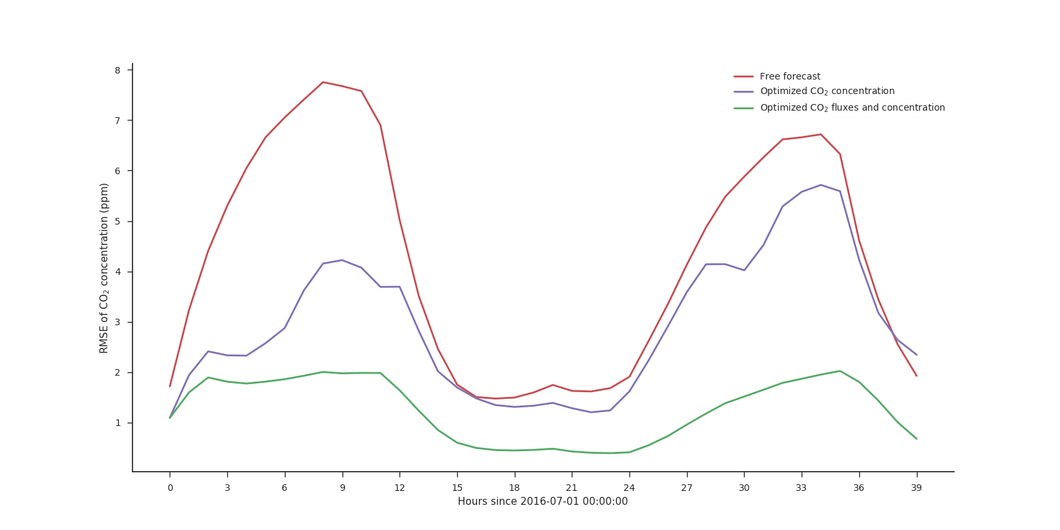
Optimizing fluxes leads to significantly smaller errors in CO₂ concentration

Slide 29
Conclusions
Atmospheric transport errors account for a large part of the atmospheric CO₂ uncertainty

Slide 30
Conclusions
Initial conditions
Transport errors
Parameters
Model
Transport errors
Boundary conditions
What is the practical and intrinsic “constrainability” of CO₂?
Observations
Prediction
Optimized CO2 surface fluxes
Data assimilation

