Slide 1
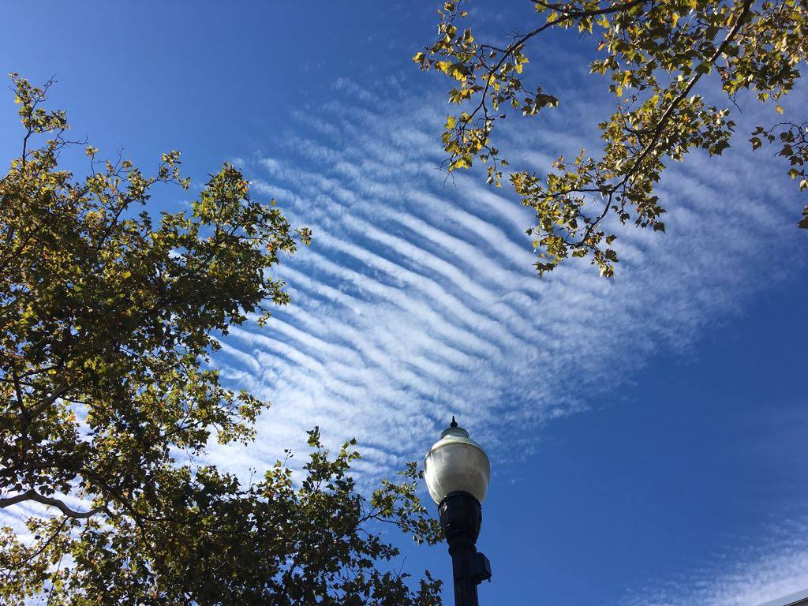
A case study of Arctic mixed-phase cloud properties from remote sensing
Hui-Wen Lai, Eugene Clothiaux, Fuqing Zhang and Hans Verlinde
Collaborators: David Stauffer, and Brian Gaudet
Group Conference December 8 2017

Slide 2
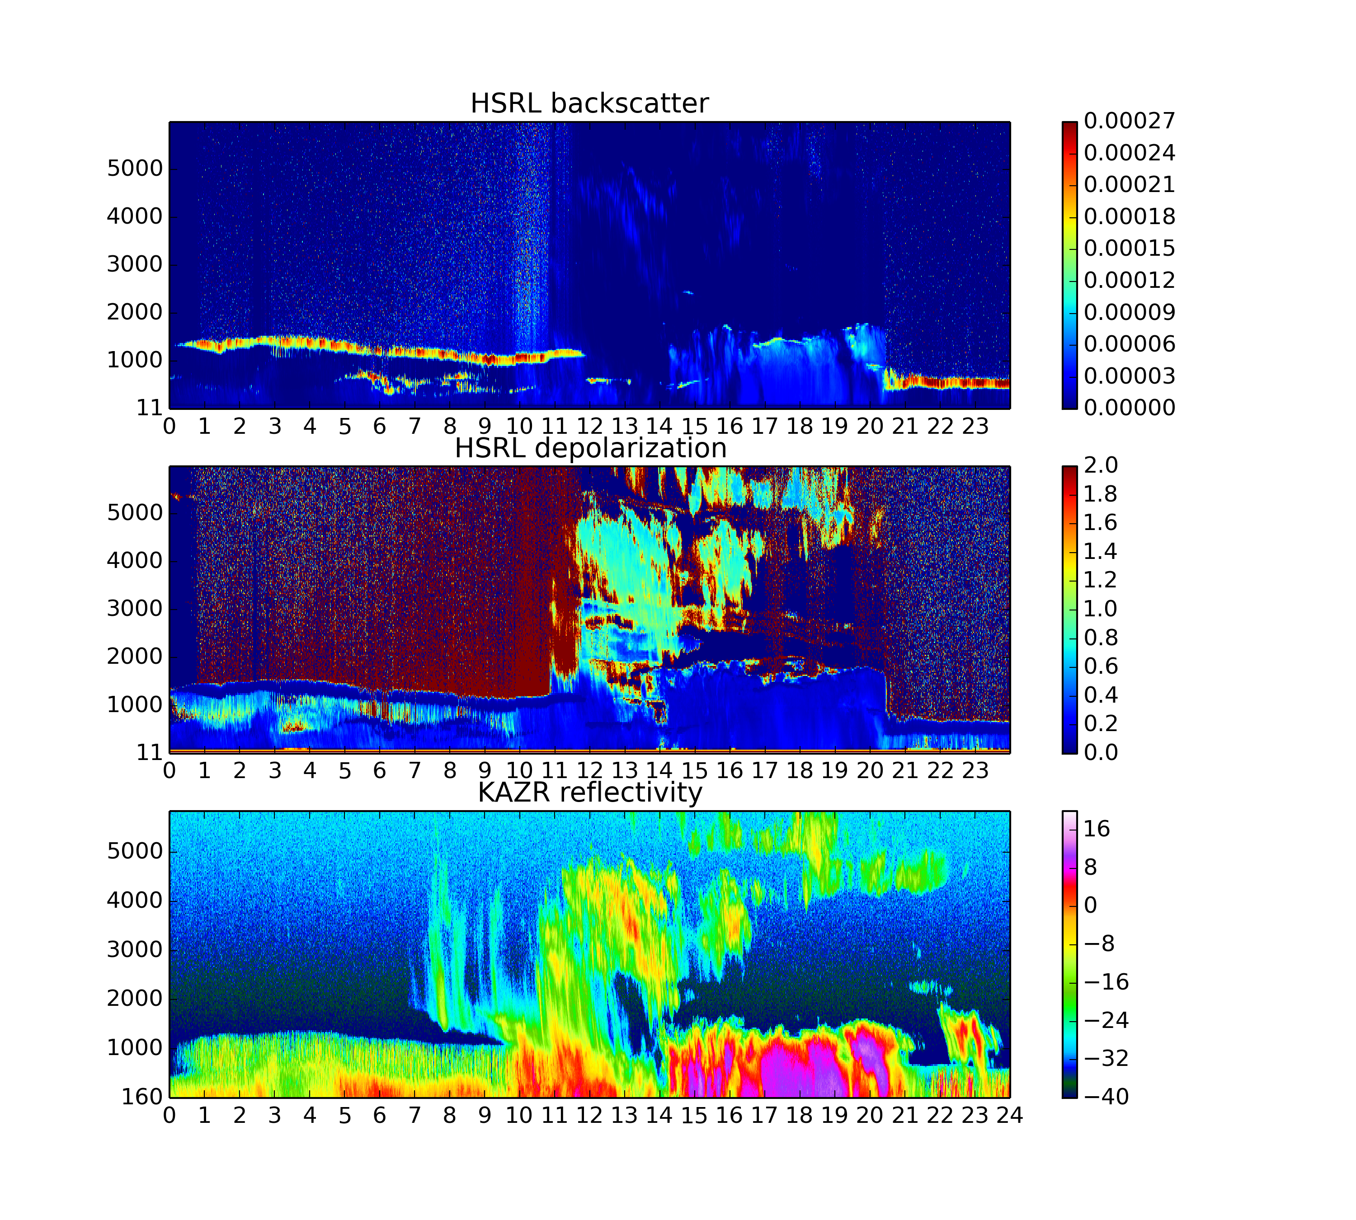
Motivation
May 02 2013 @ Barrow, Alaska
Single and Multi-layered mixed-phase clouds
Different type of ice precipitation
B.T.

Slide 3
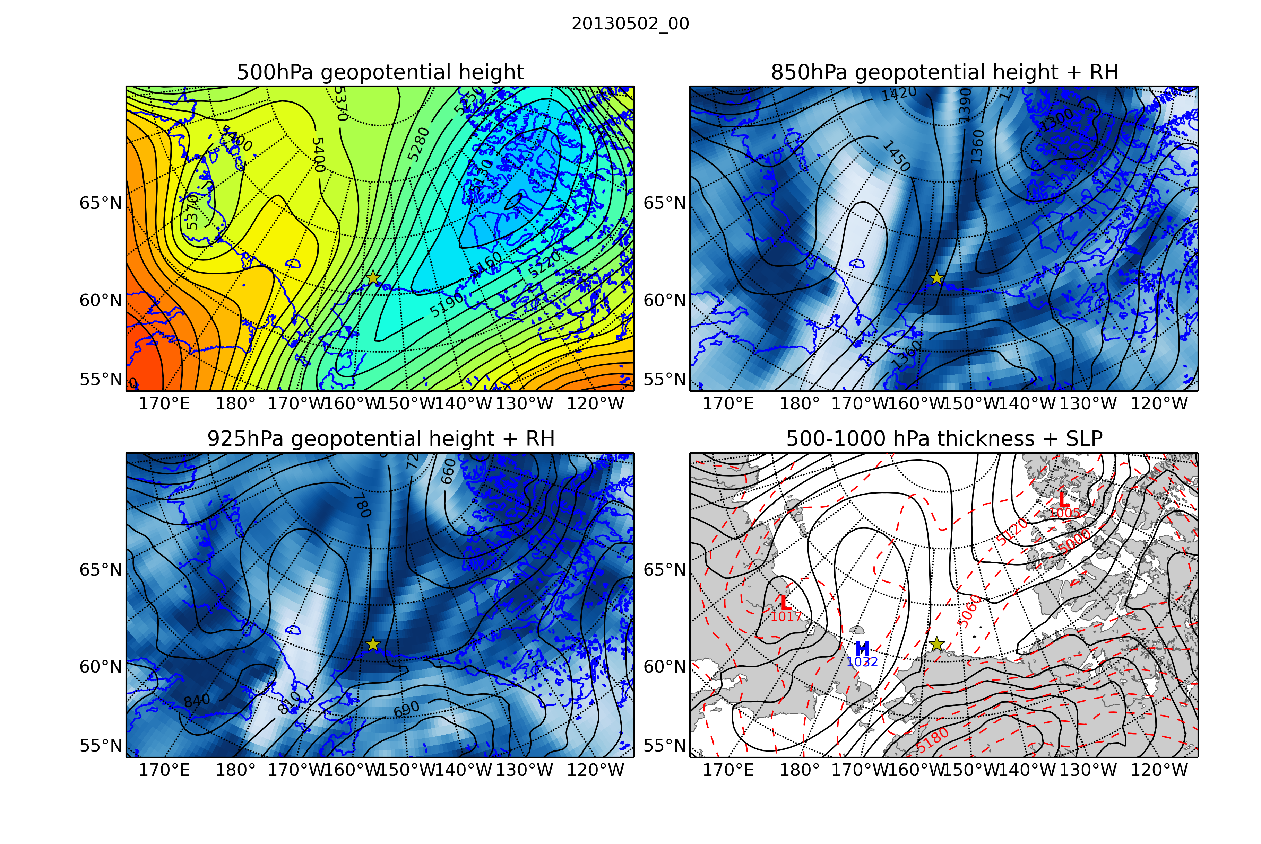
ERA-Interim

Slide 4
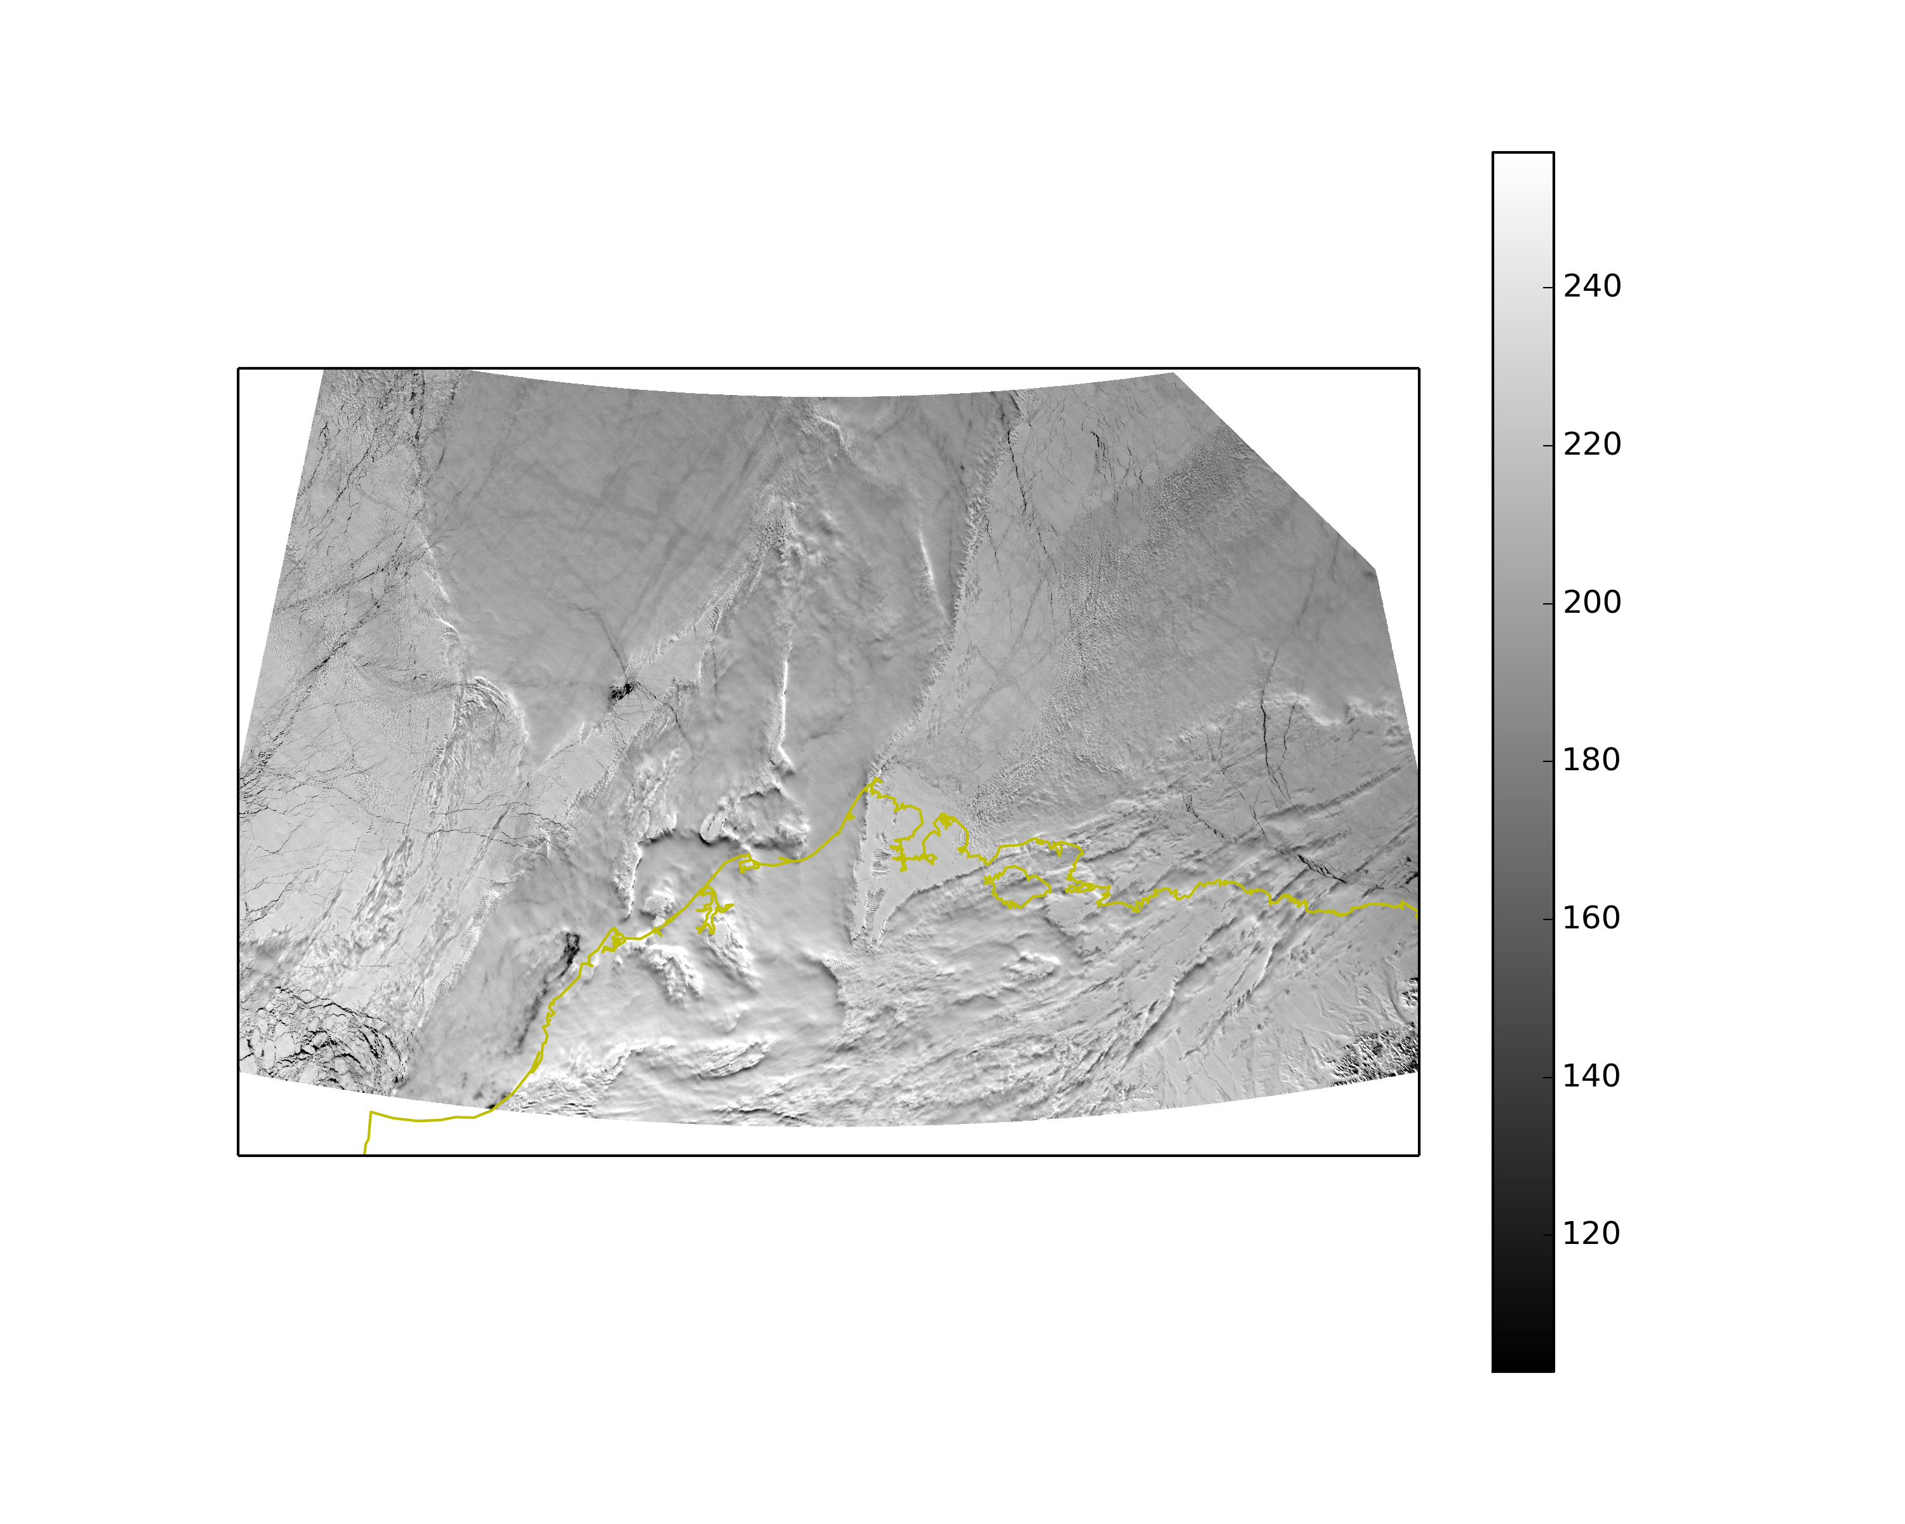
Terra 2355 UTC May 02 2013
VIS (250m)
Rad.

Slide 5
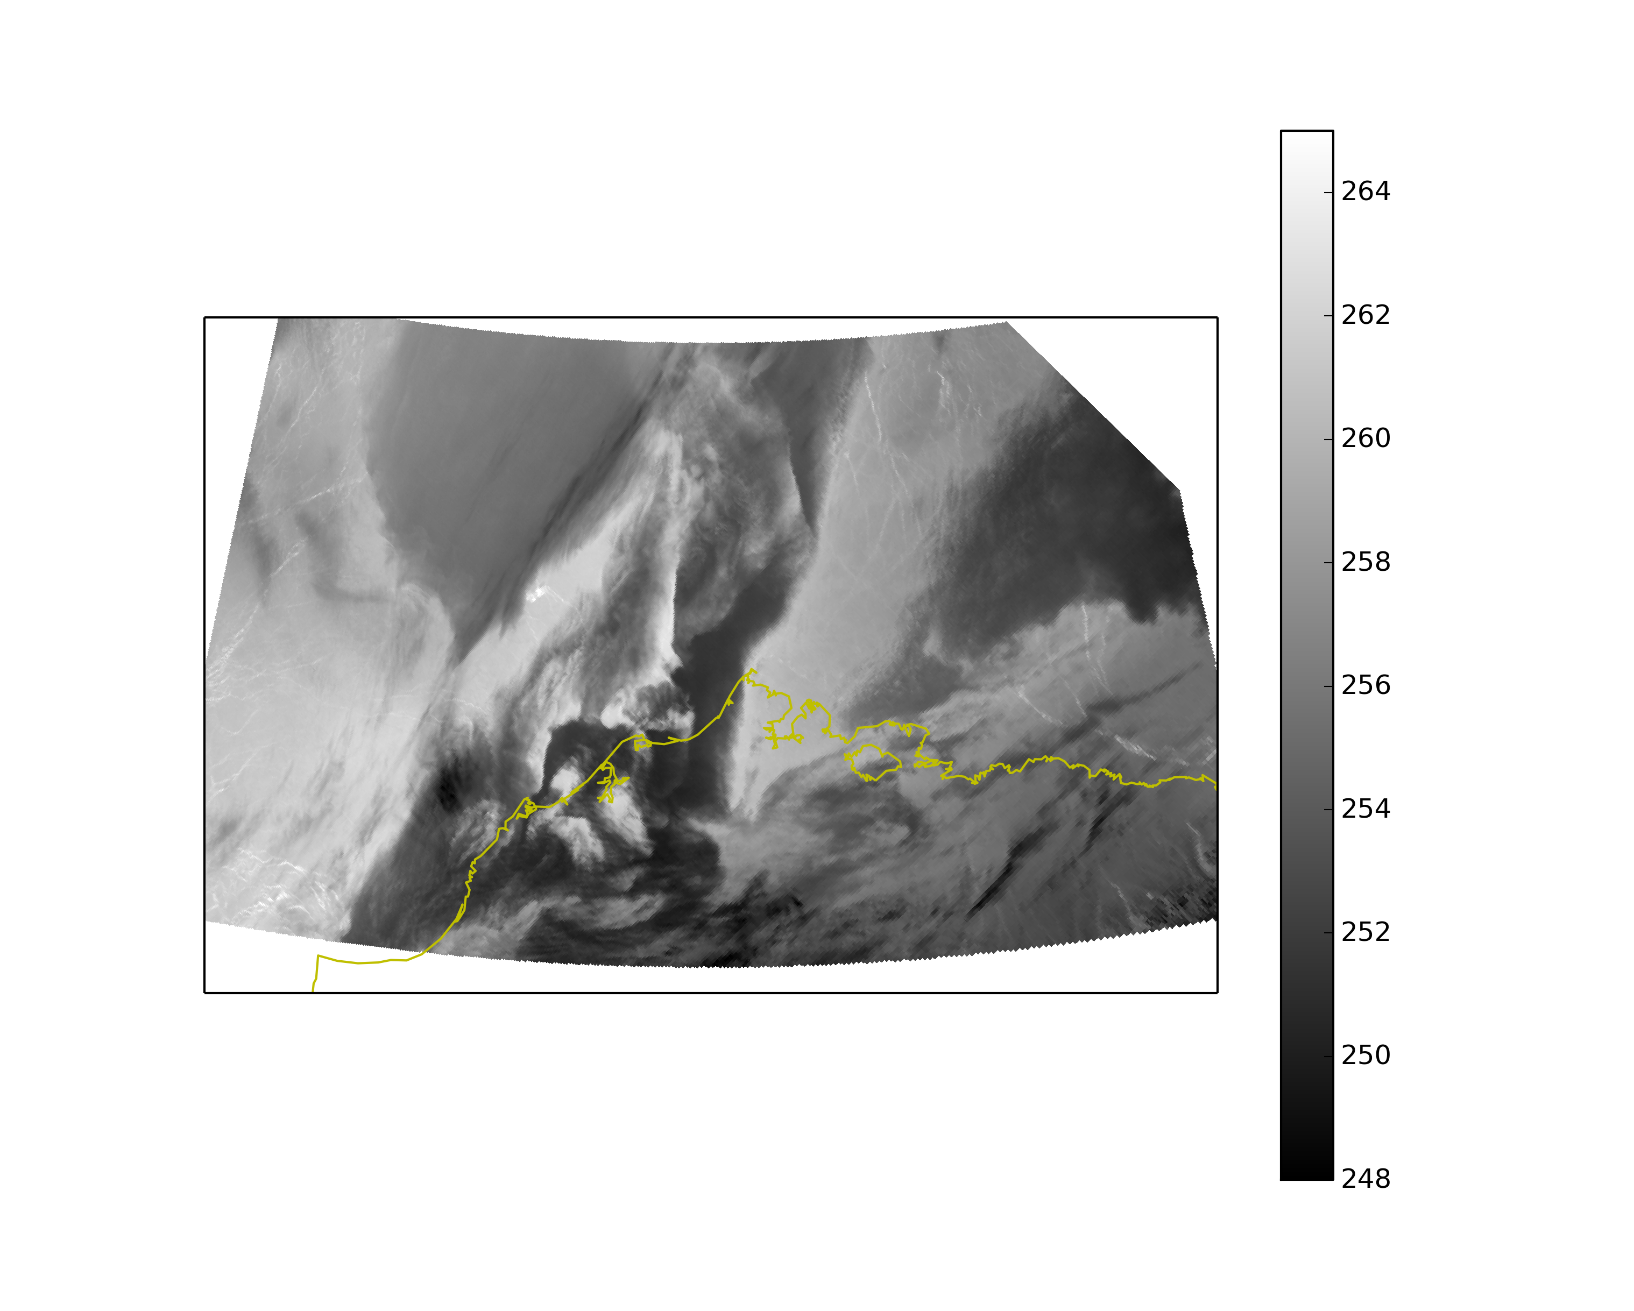
B.T.
Terra 2355 UTC May 01 2013
IR (1km)
NSA sounding at Barrow
0530 UTC May 02
T
$$θ$$
Td
Notes:
Barrow: 251K
Left side: 258-259

Slide 6
Terra 2355 UTC May 02 2013
VIS (250m)
Rad.

Slide 7
Terra 2355 UTC May 01 2013
VIS (250m)
Rad.

Slide 8
Rad.
Terra 2355 UTC May 01 2013
VIS (250m)
Rad.

Slide 9
Terra 2355 UTC May 01 2013
VIS (250m)
Rad.

Slide 10
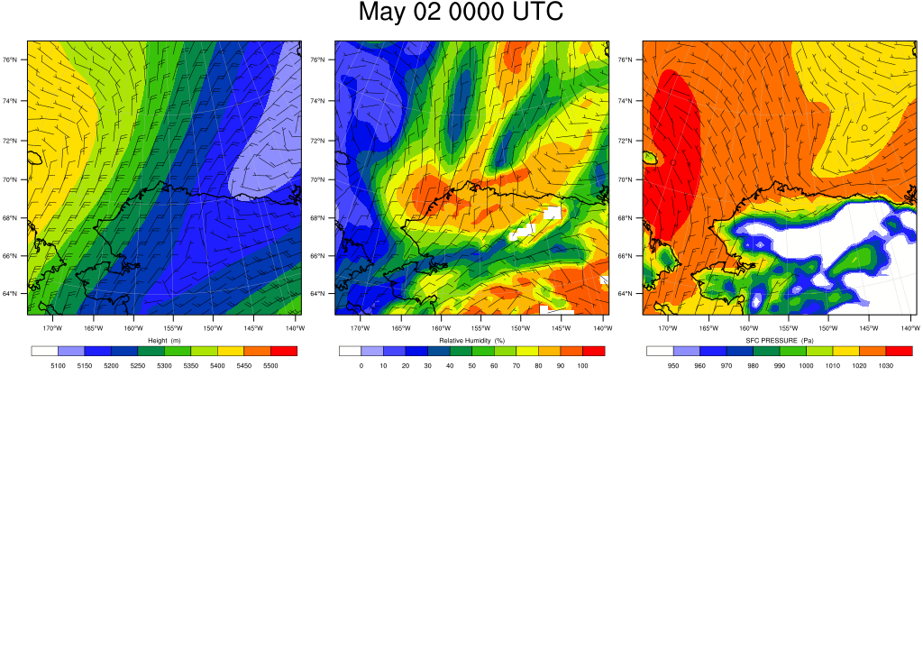
WRF domain 01 (Δx = 27-km) with FNL input
500 hPa geopotential height
850 hPa wind + RH
1000 hPa wind +SLP

Slide 11
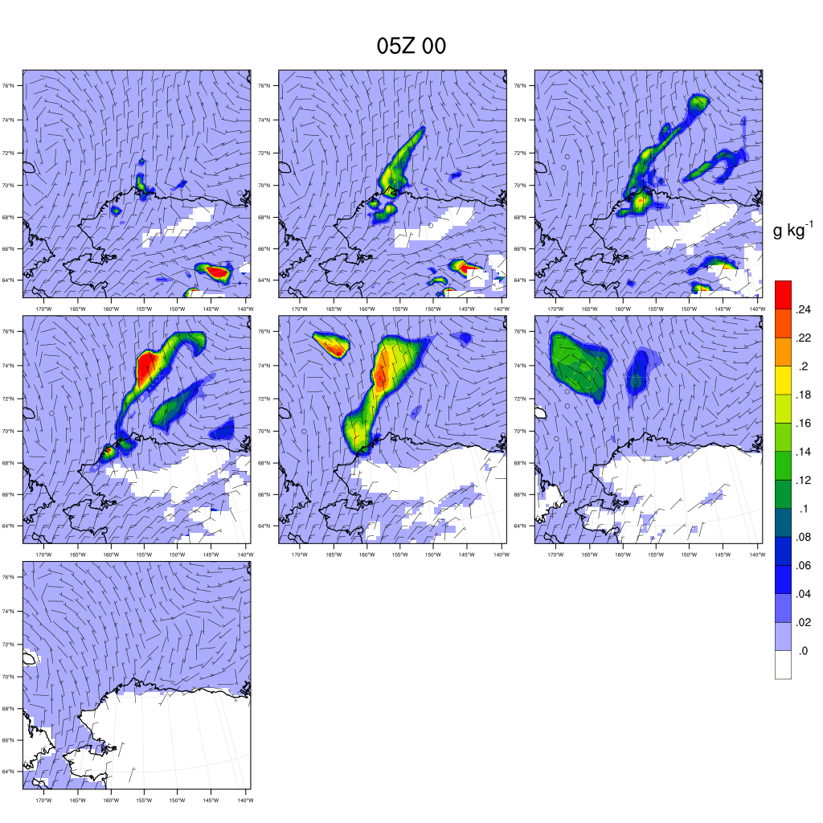
May 02 0500 UTC
1200 m
1000 m
800 m
600 m
400 m
200 m
50 m

Slide 12
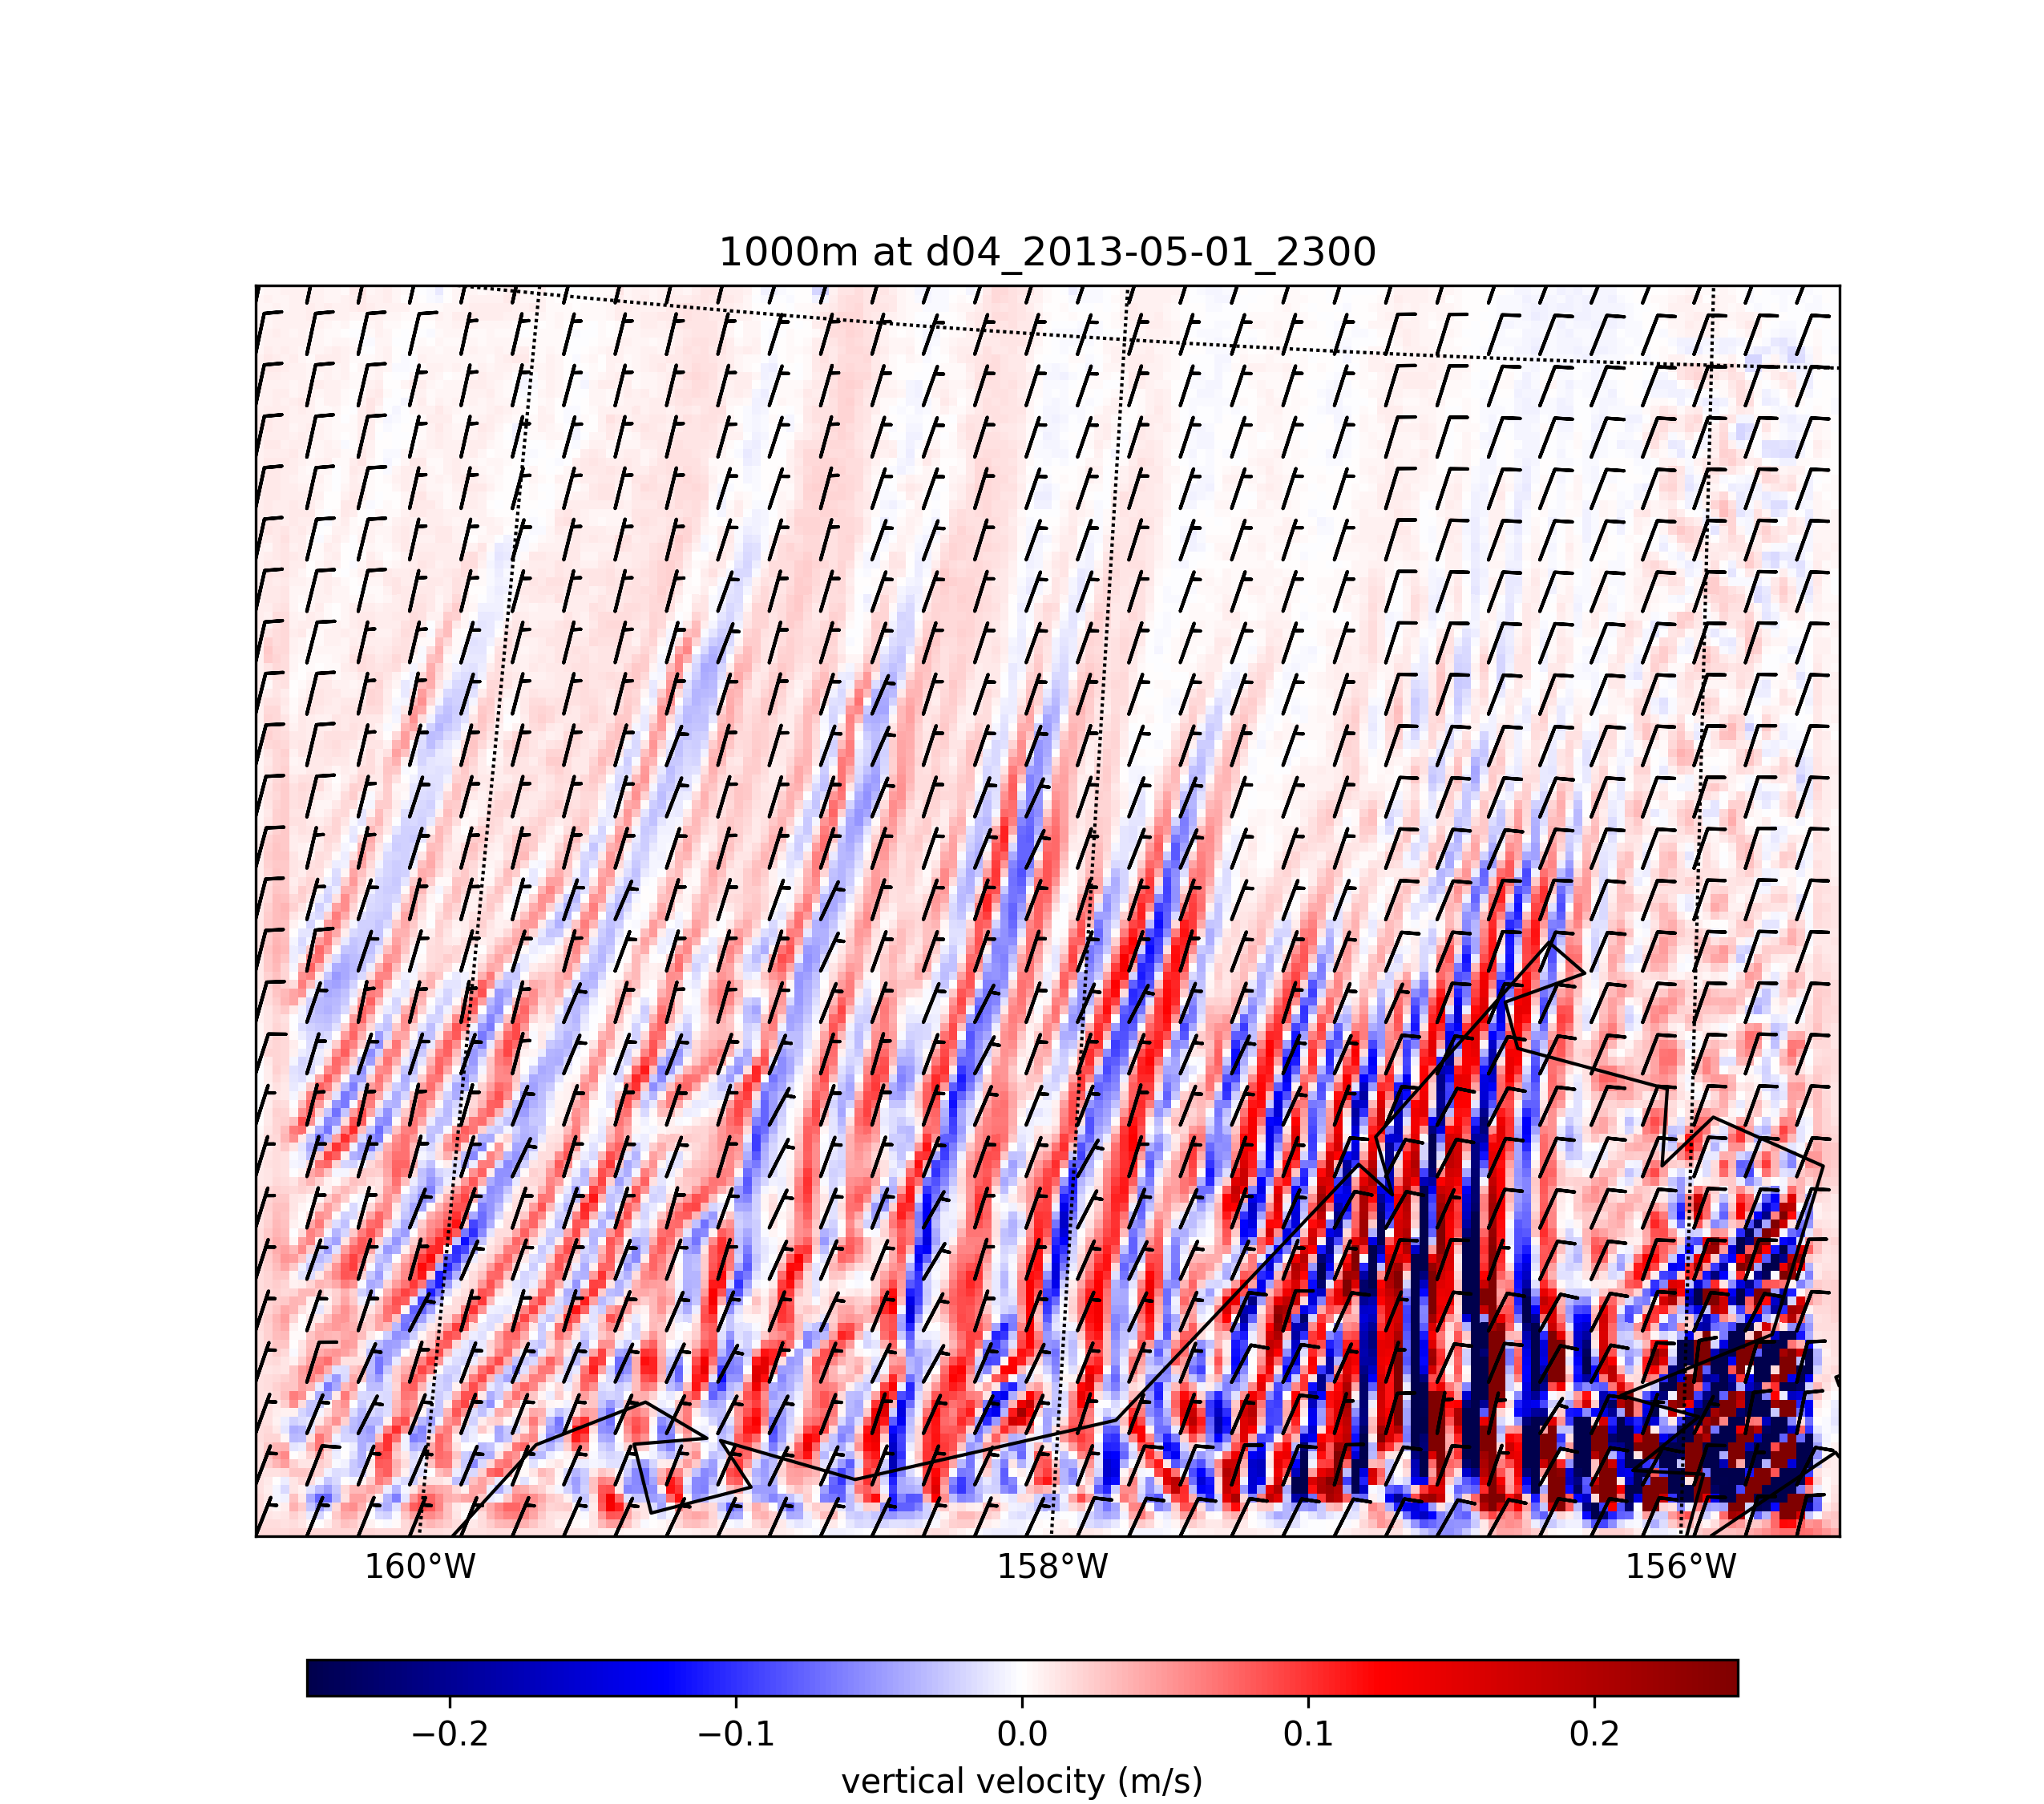
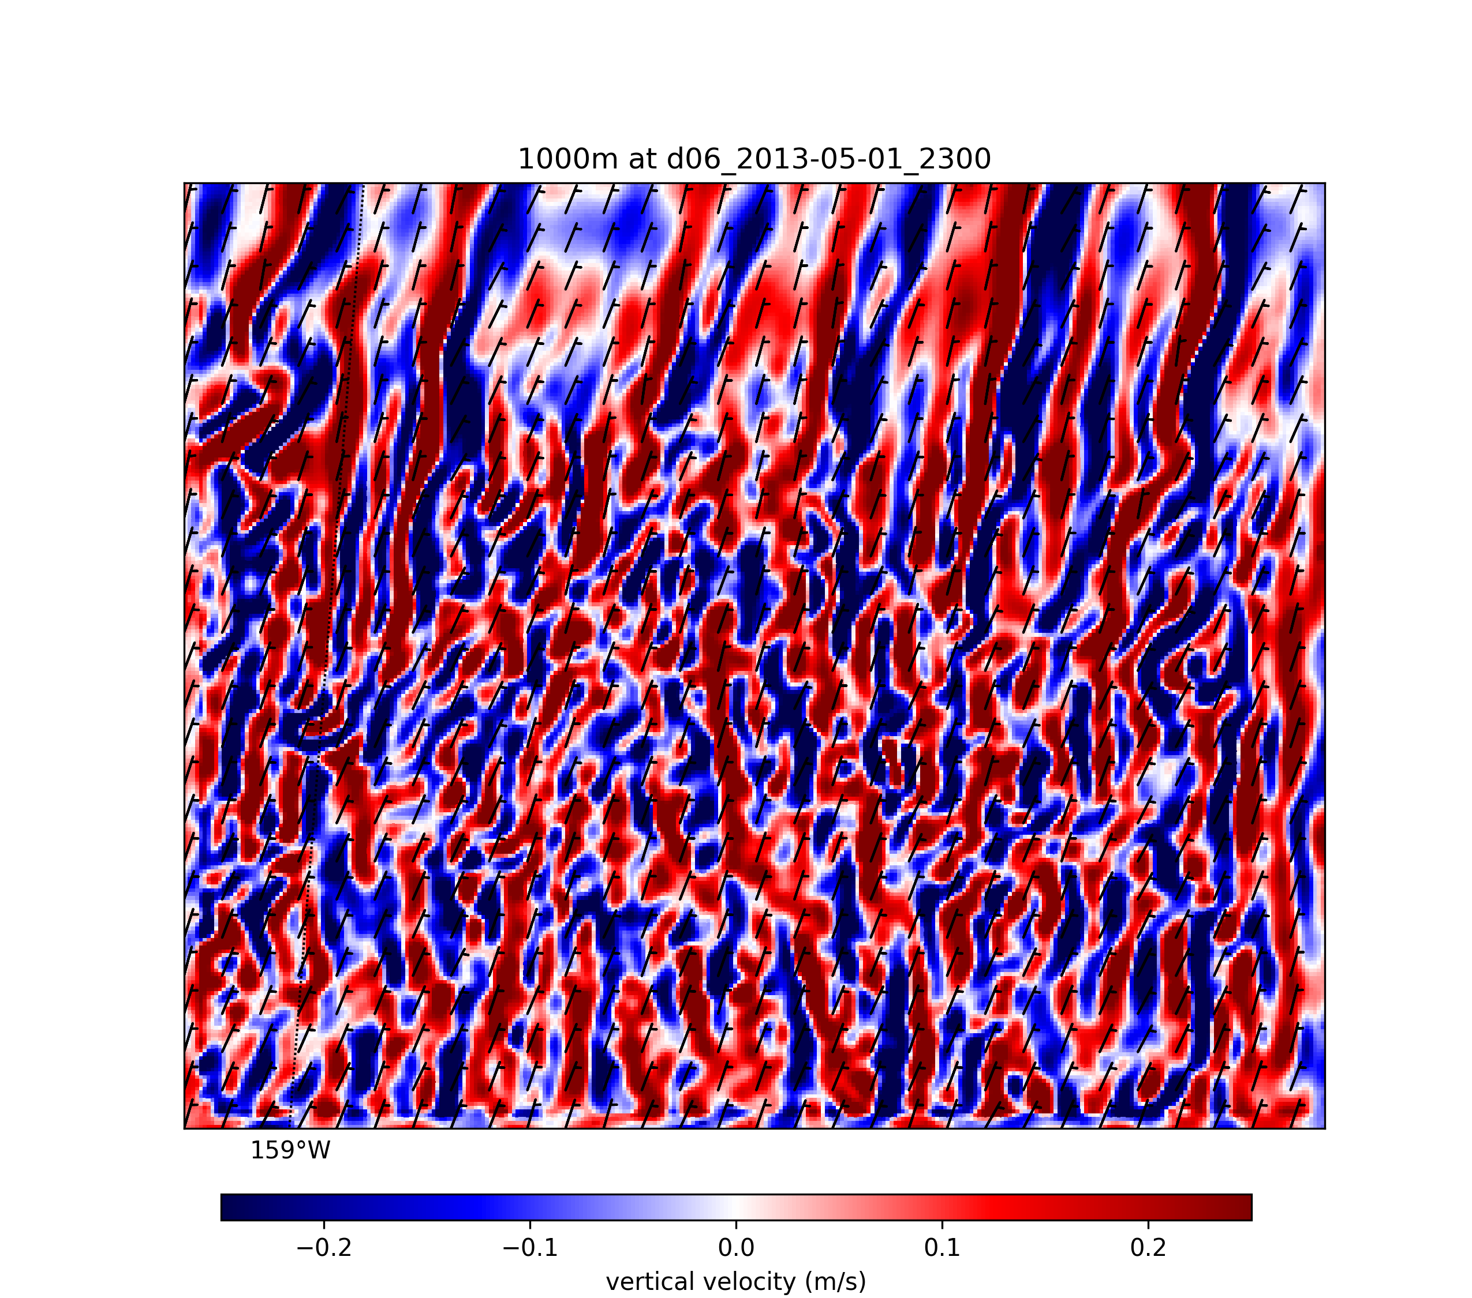
(Δx = 1-km)
(Δx = 0.111-km)

Slide 13
Summary
Wave clouds was observed everywhere over the Arctic region.
Model is able to capture the synoptic scale mixed-phase cloud features.
Future works
Characterize the boundary layer condition by using model results and explain the clouds formation.
@State College

Slide 15
3 waves/hour with wind speed 10 m/s
Wave length = 12 km
V
U

Slide 16
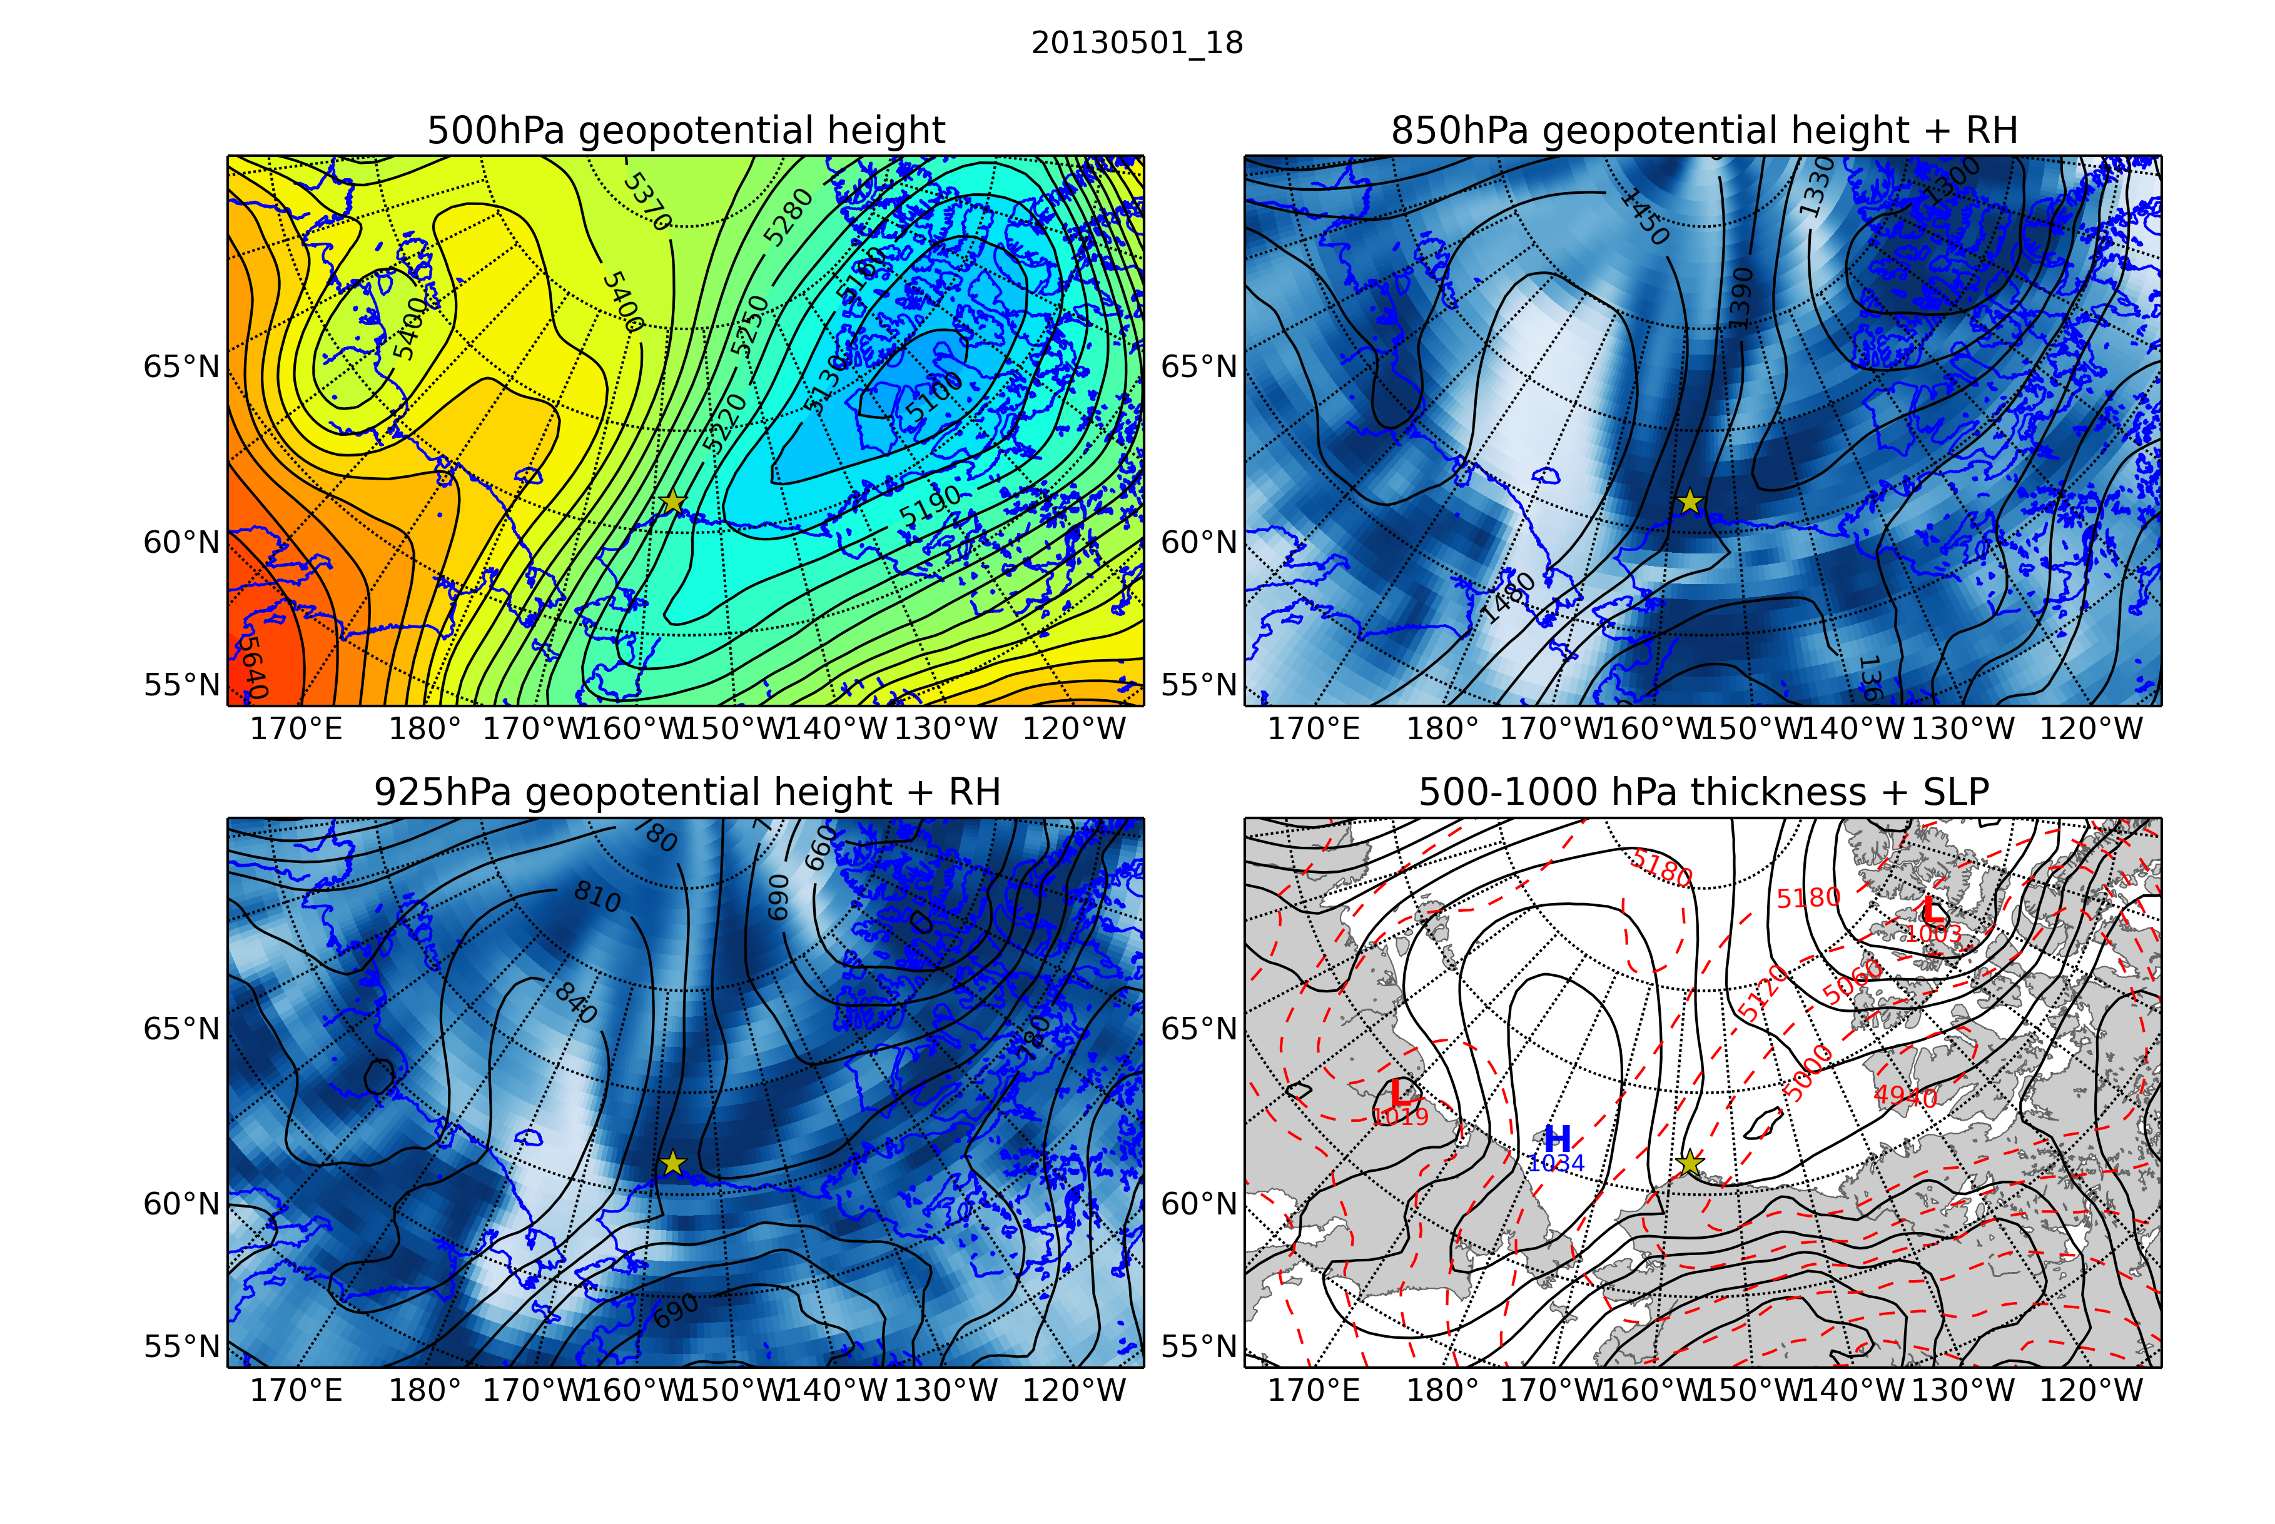
ERA-Interim

Slide 17
ERA-Interim

Slide 18
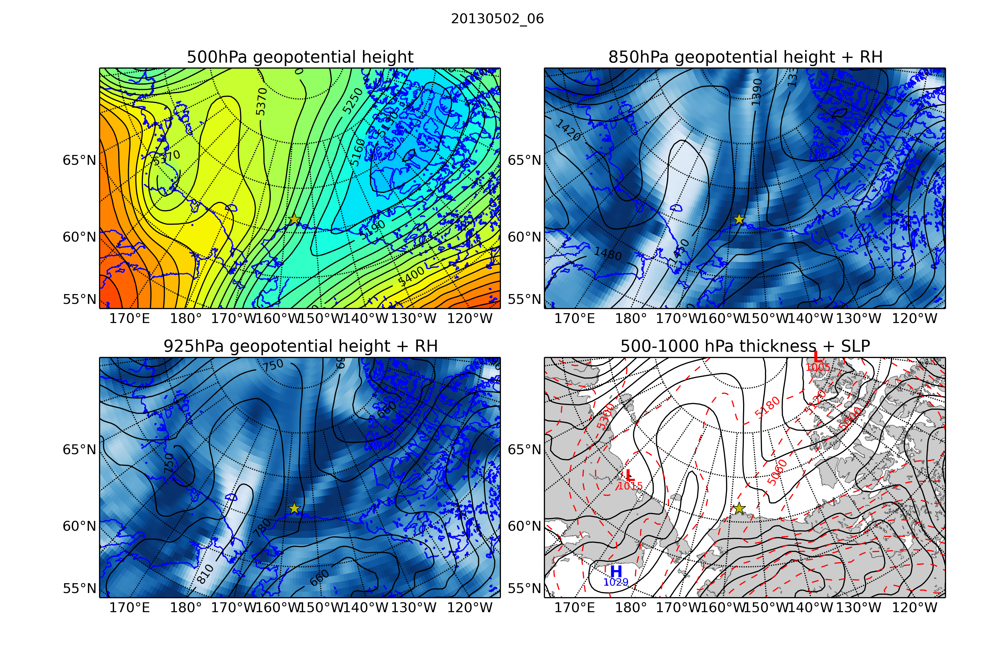
ERA-Interim

Slide 19
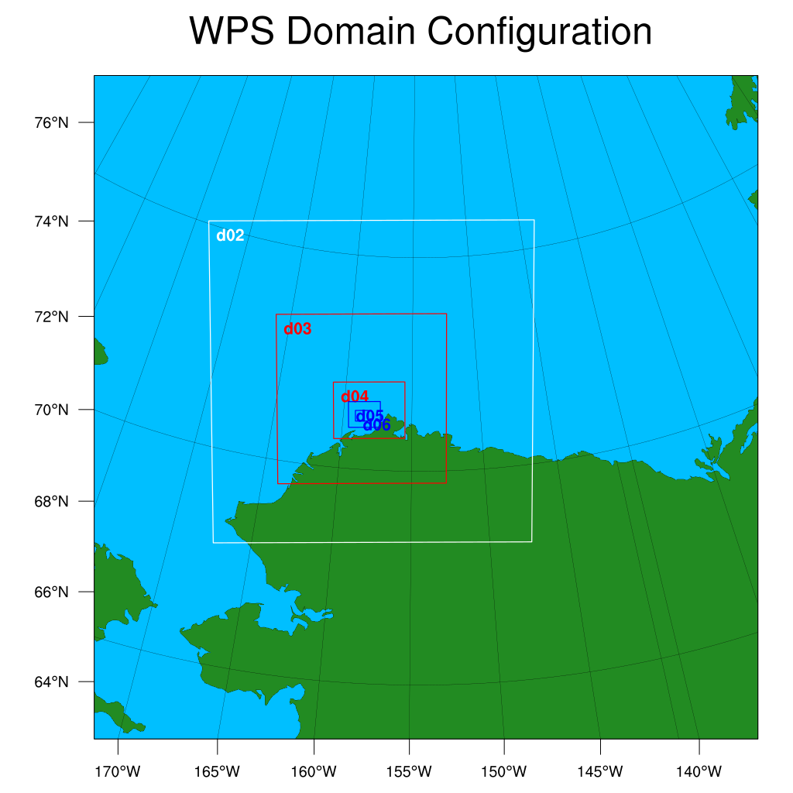
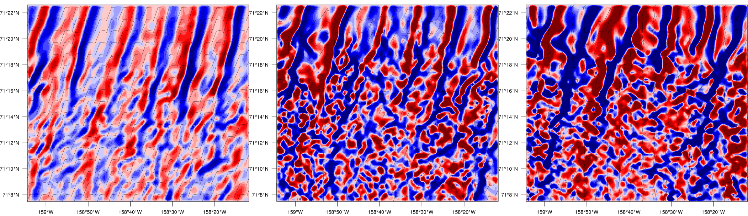
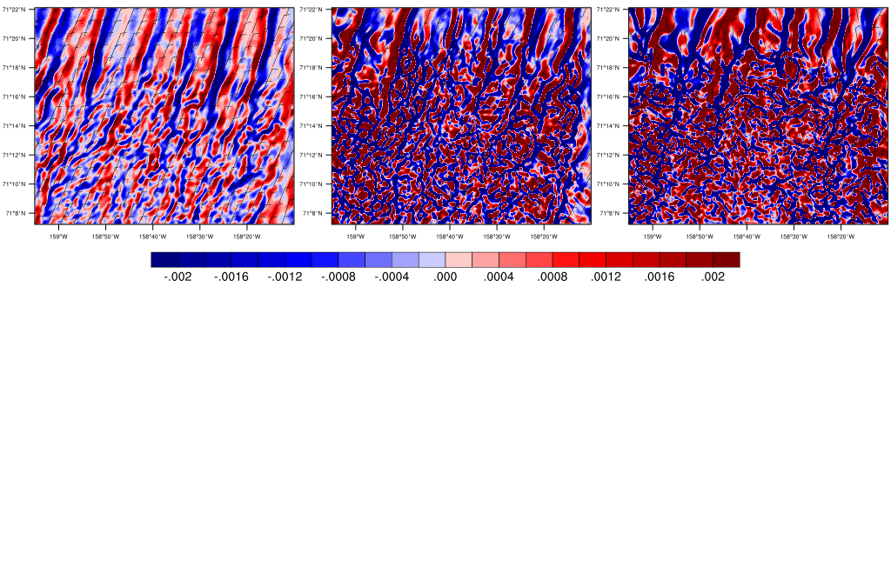
Convergence line in domain 5 and 6 in 6 domains-simulation
2300 UTC May 1
(a) 1200-m
(b) 600-m
(c) 50-m
27.77 km
d01 : 65 × 65 × 130 (27 km)
d02 : 94 × 94 × 130 (9 km)
d03 : 148 × 148 ×130 (3 km)
d04 : 187 × 148 ×130 (1 km)
d05 : 250 × 202 ×130 (0.333 km)
d06 : 301 × 250 ×130 (0.111 km)
convergence
divergence
33.44 km

Slide 20
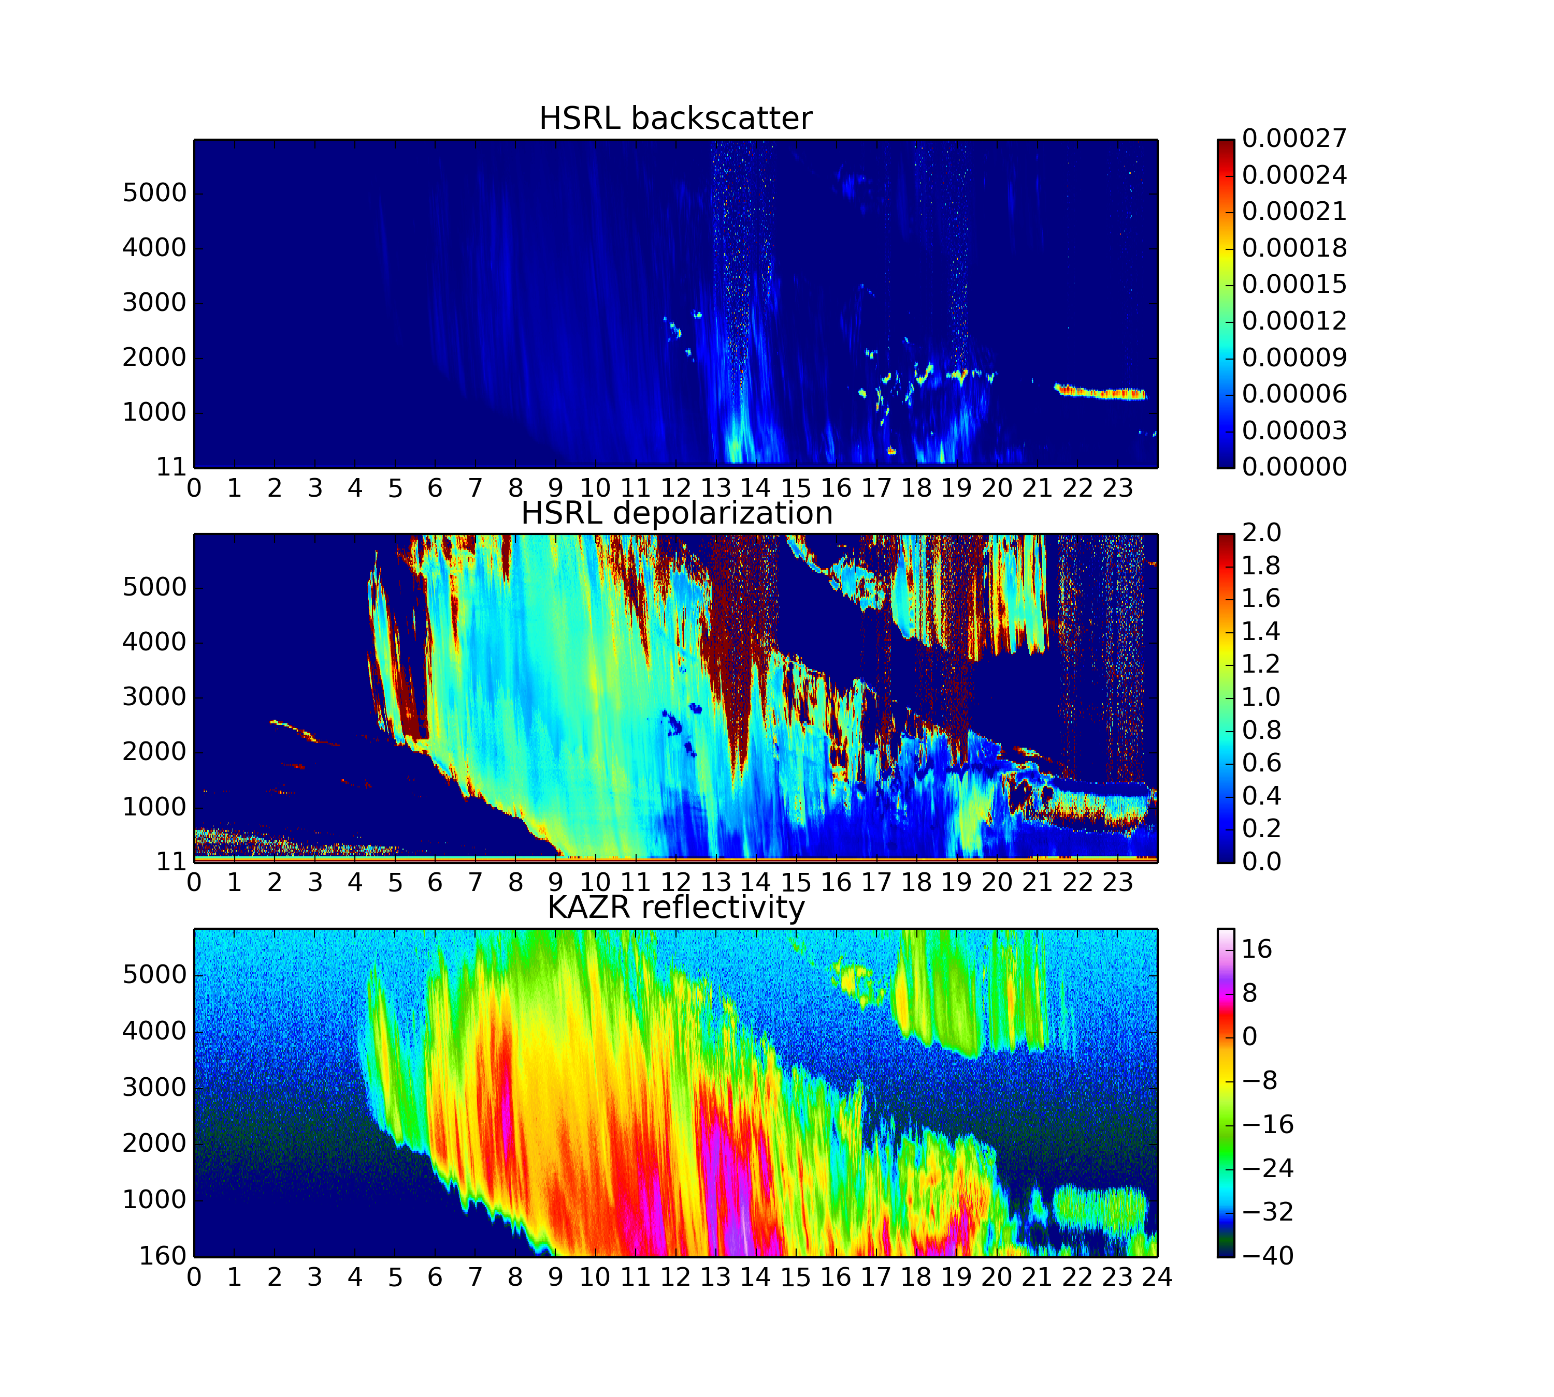
May 01 2013
Height
Time

Slide 21
May 02 2013
Height
Time

Slide 22
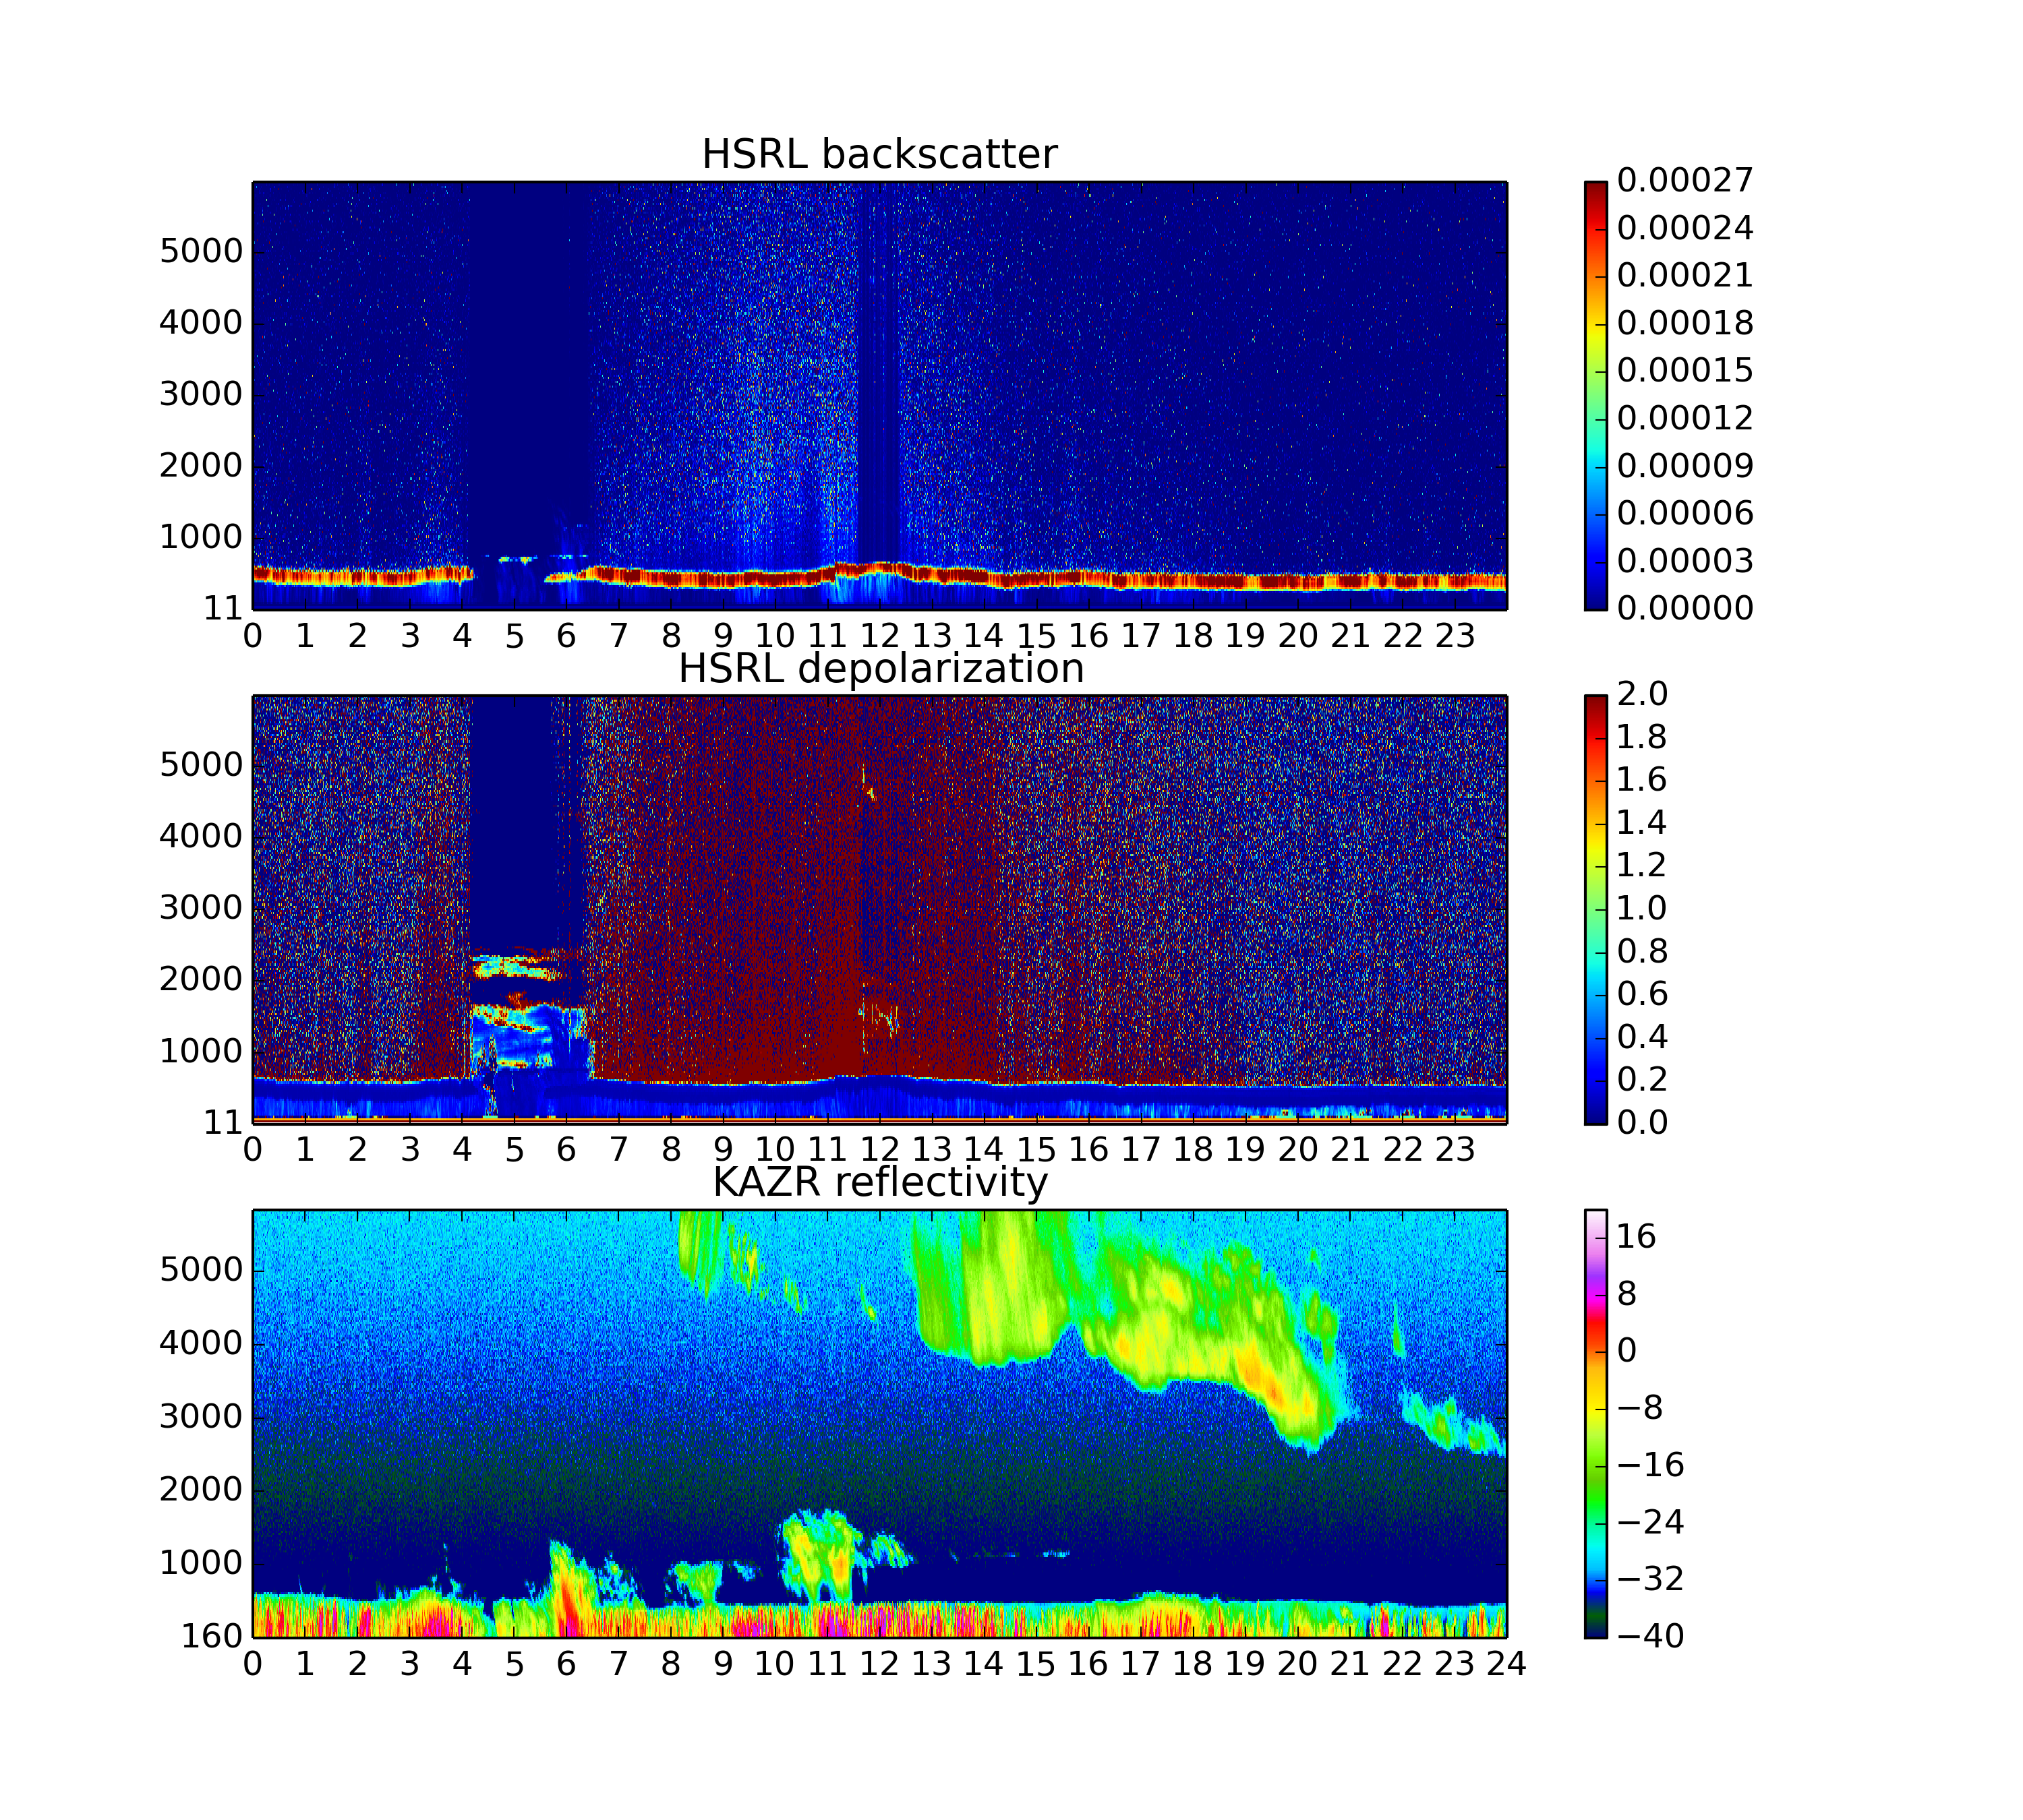
May 03 2013
Height
Time

Slide 23
Terra 2355 UTC May 01 2013
Rad.
B.T.
VIS (250m)
IR (1km)
T
U
V
Td
$$θ$$
NSA sounding at Barrow
2300 UTC May 01

Slide 24
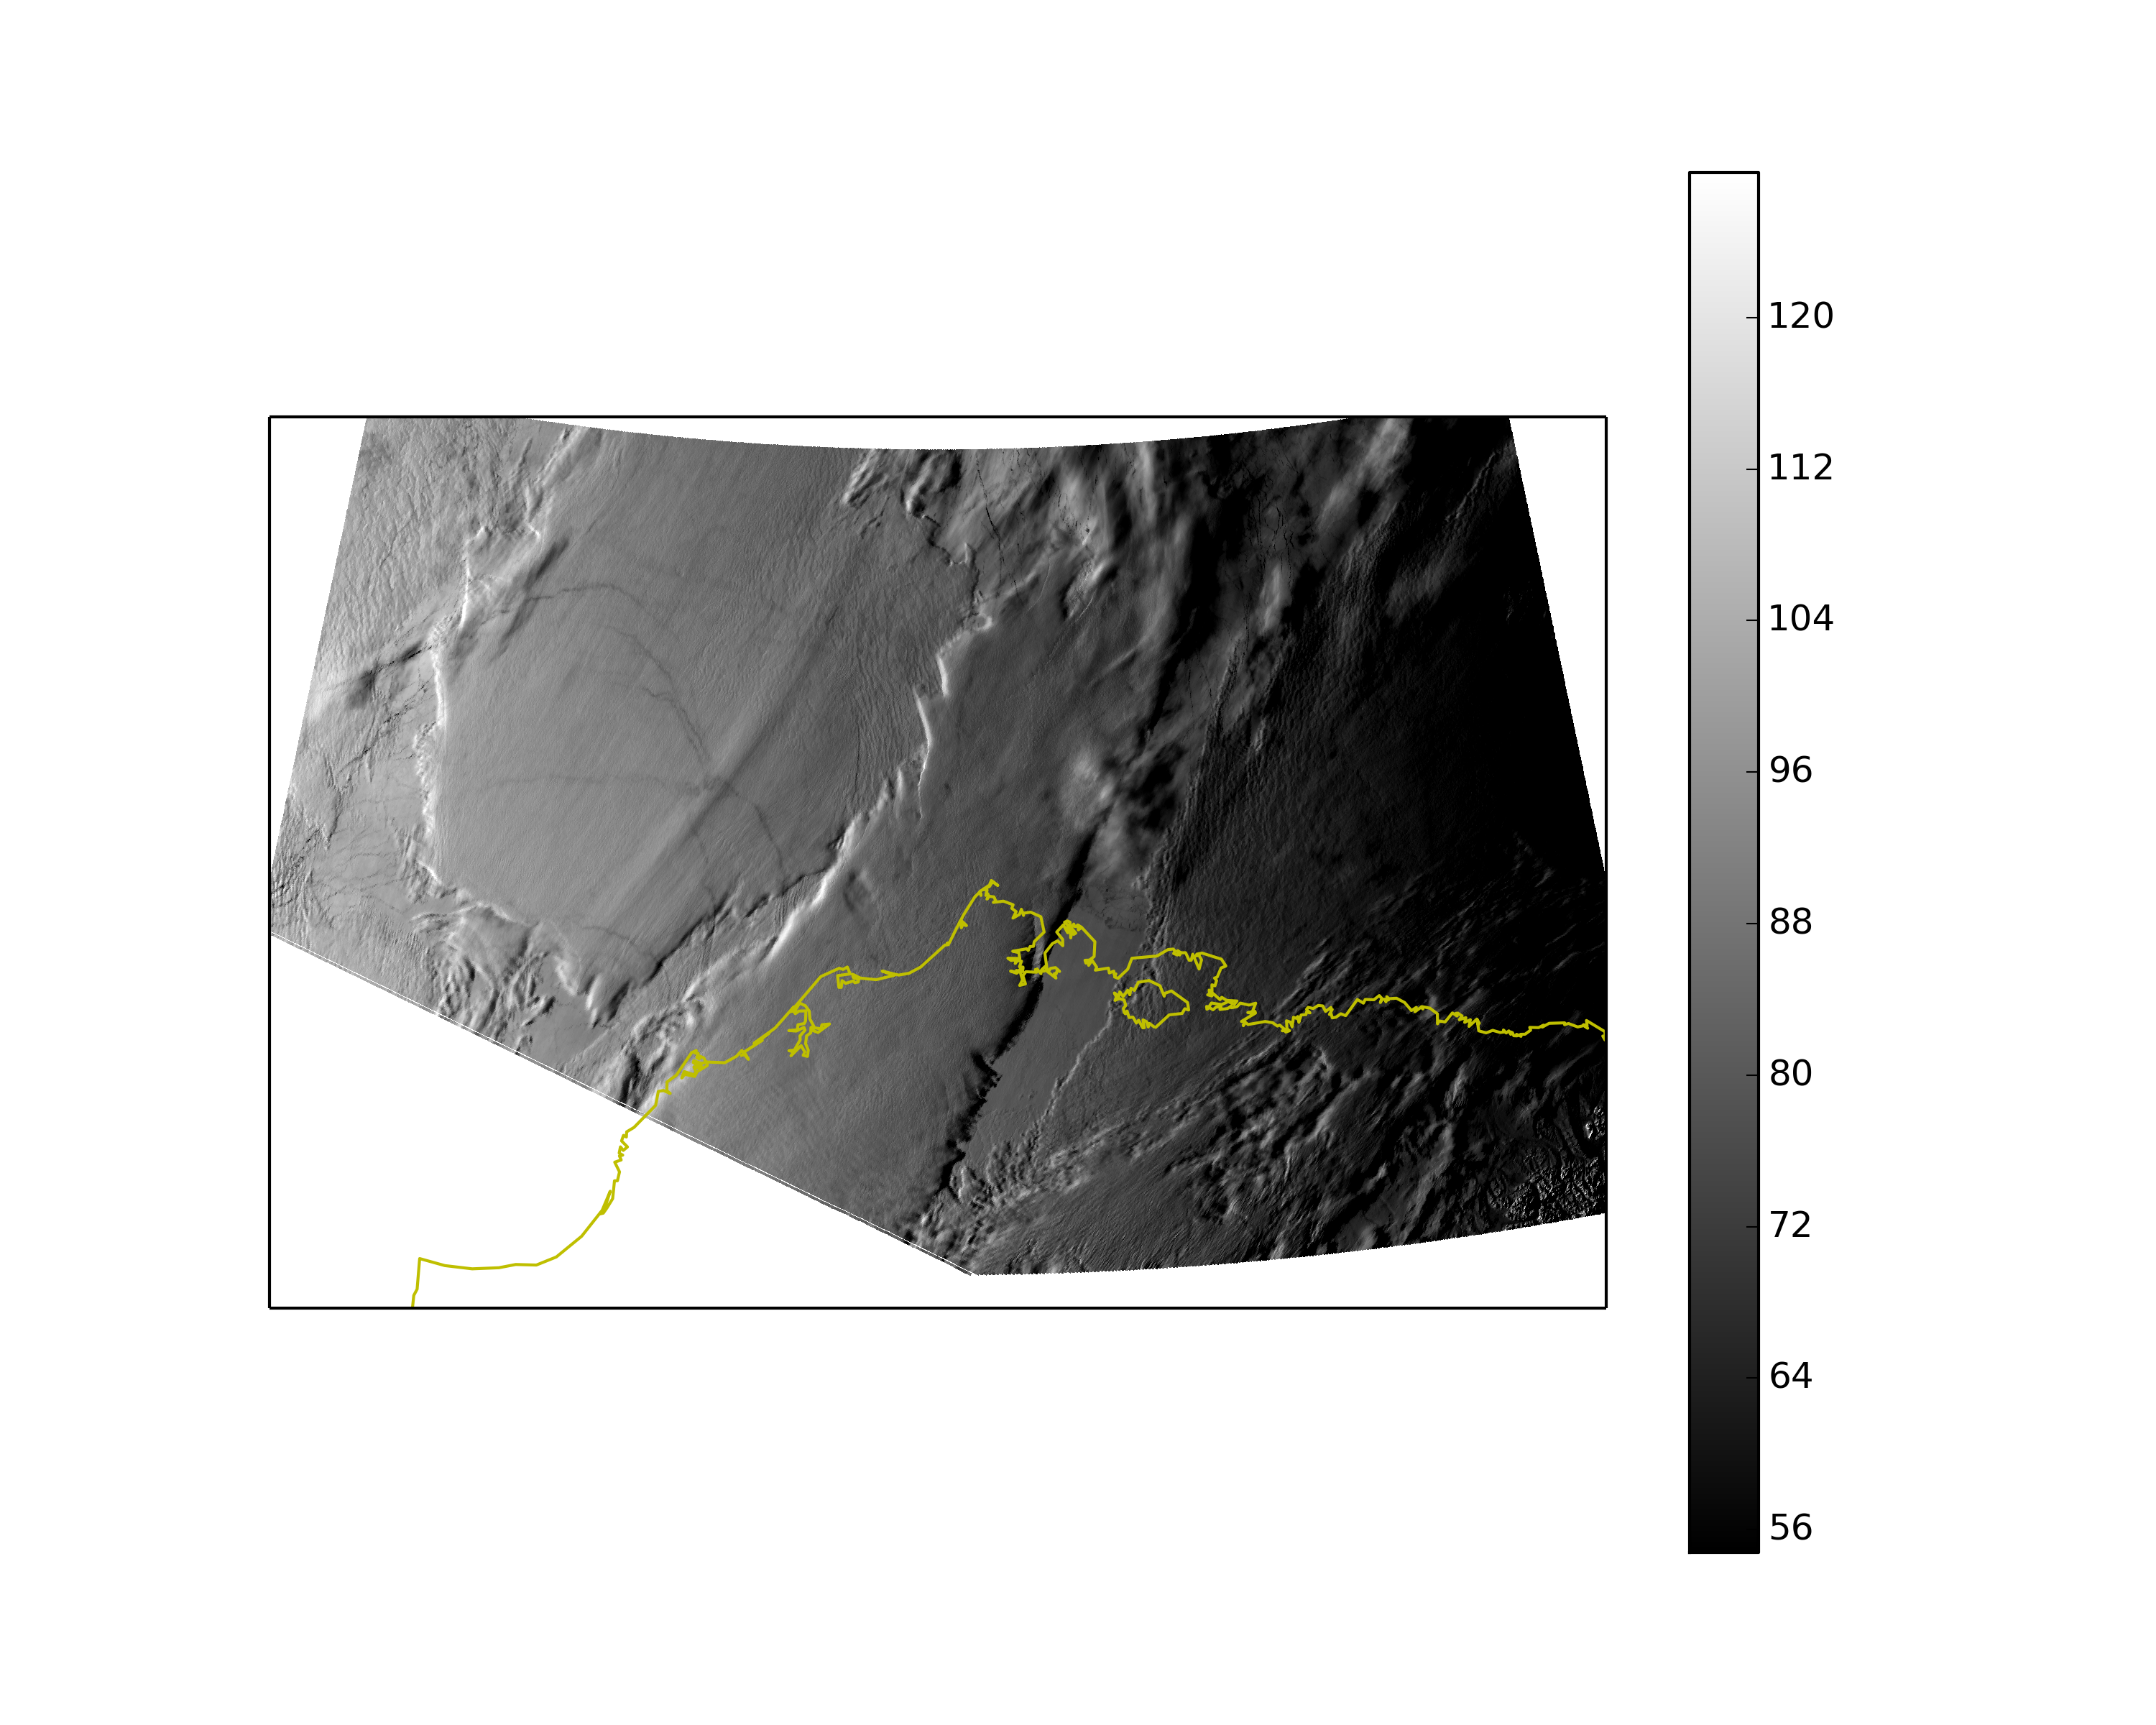
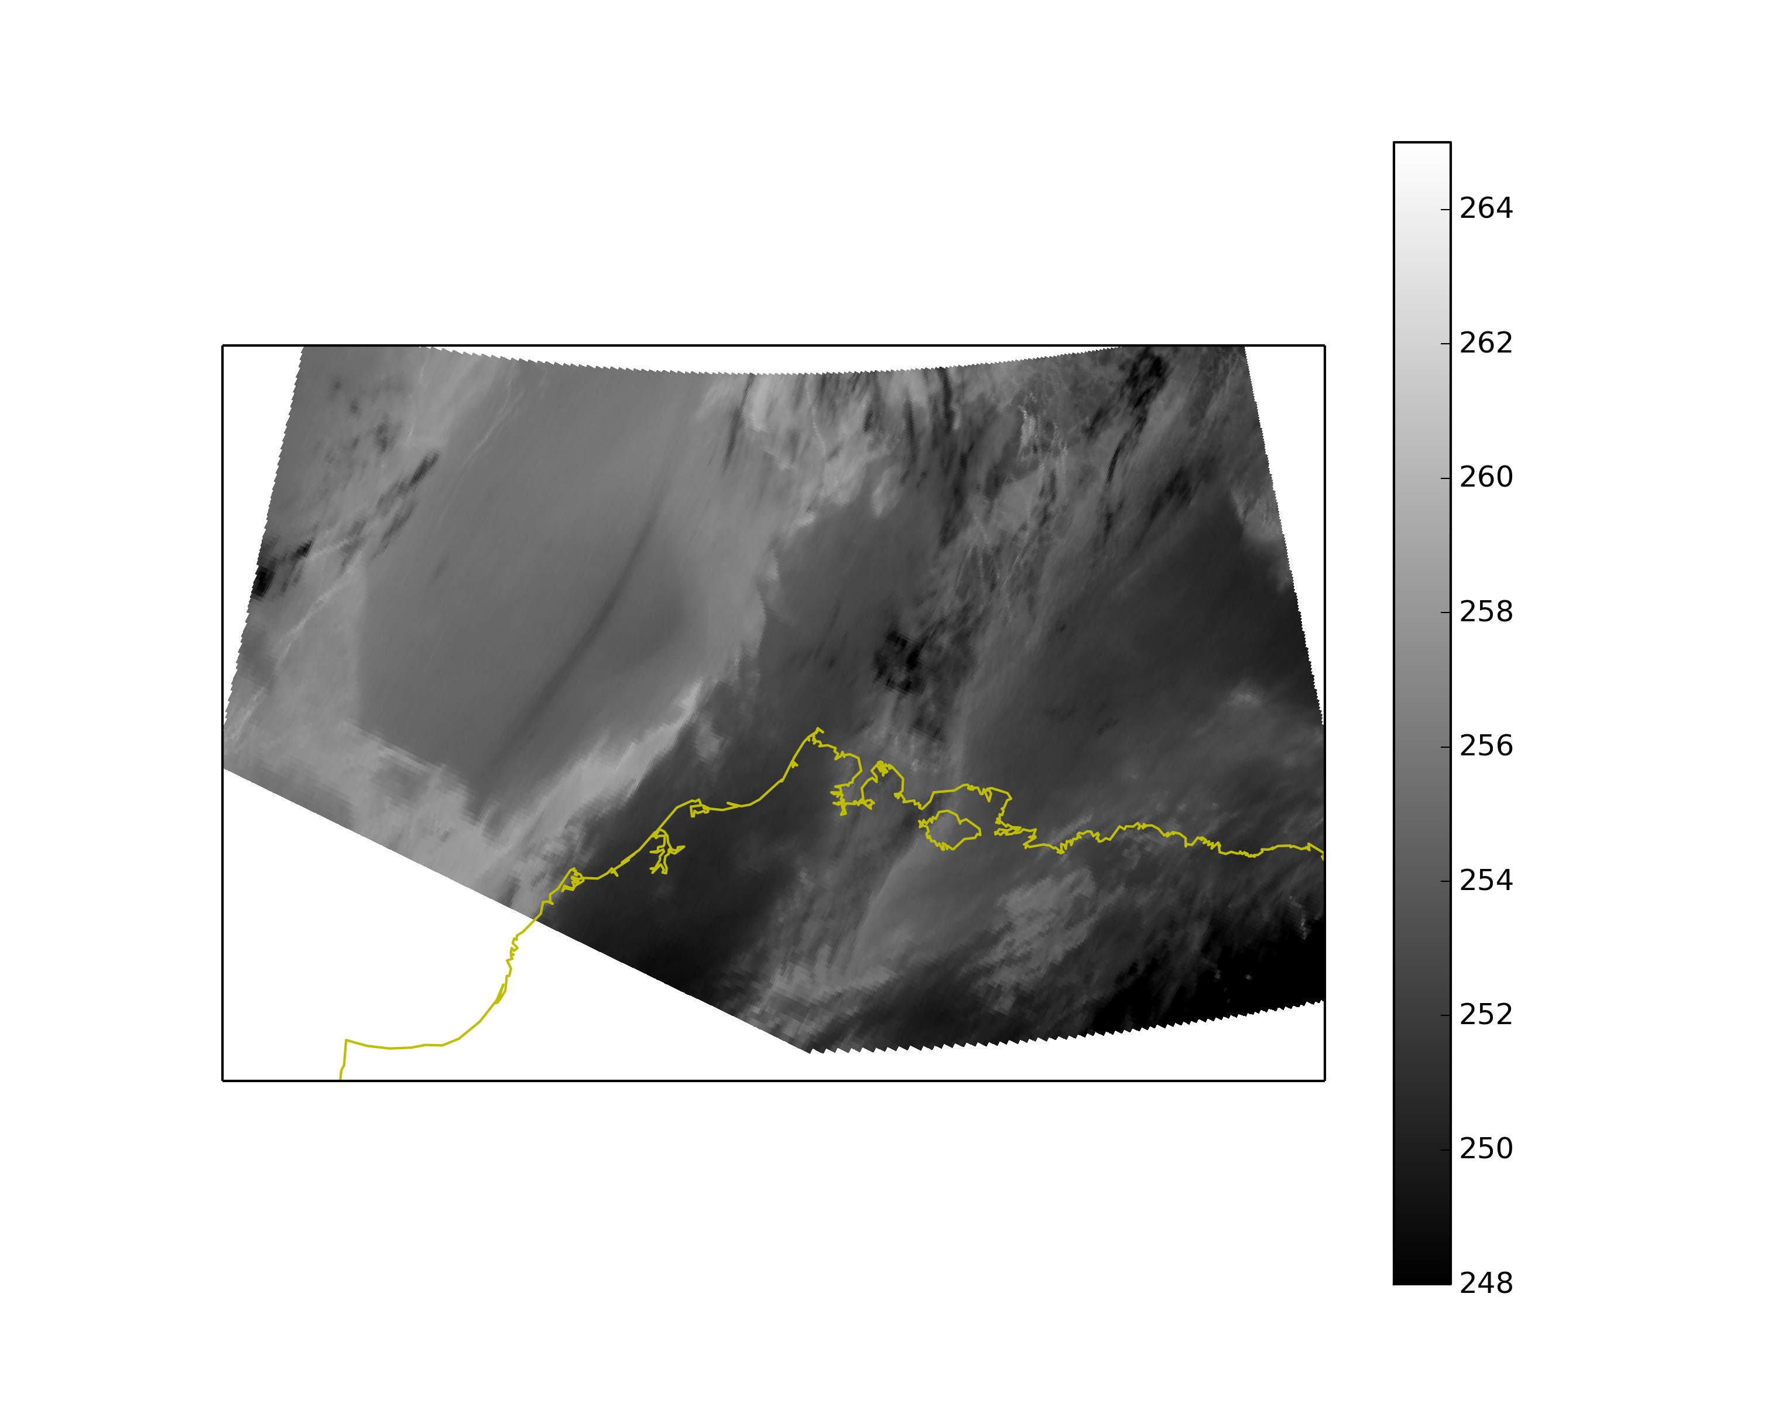
Terra 0445 UTC May 02 2013
Rad.
B.T.
VIS (250m)
IR (1km)
T
U
V
Td
$$θ$$
NSA sounding at Barrow
0530 UTC May 02

Slide 25
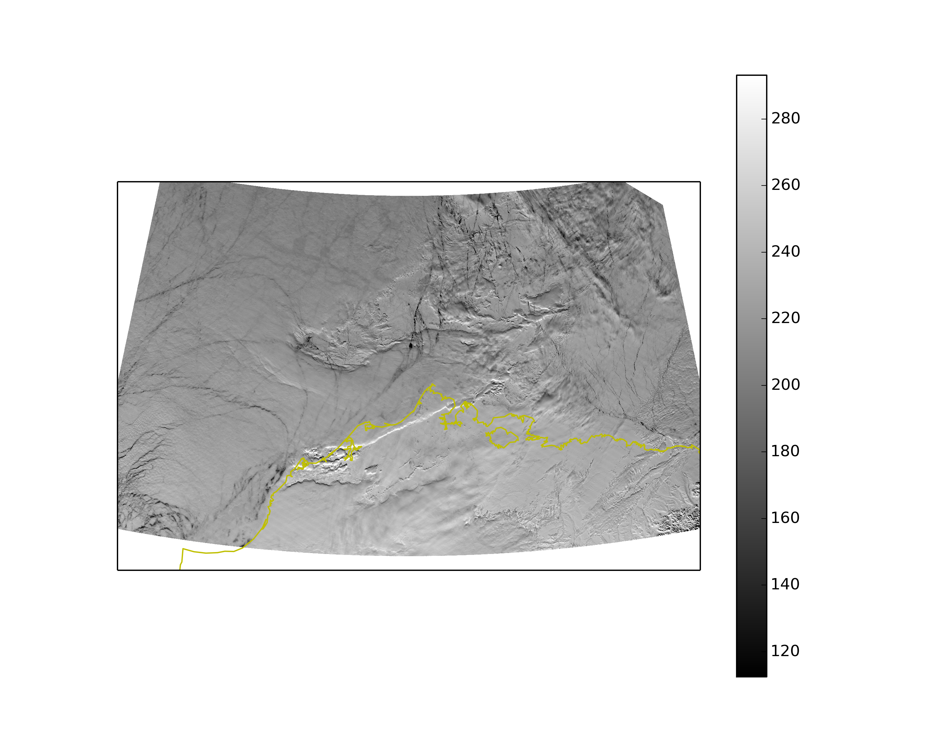
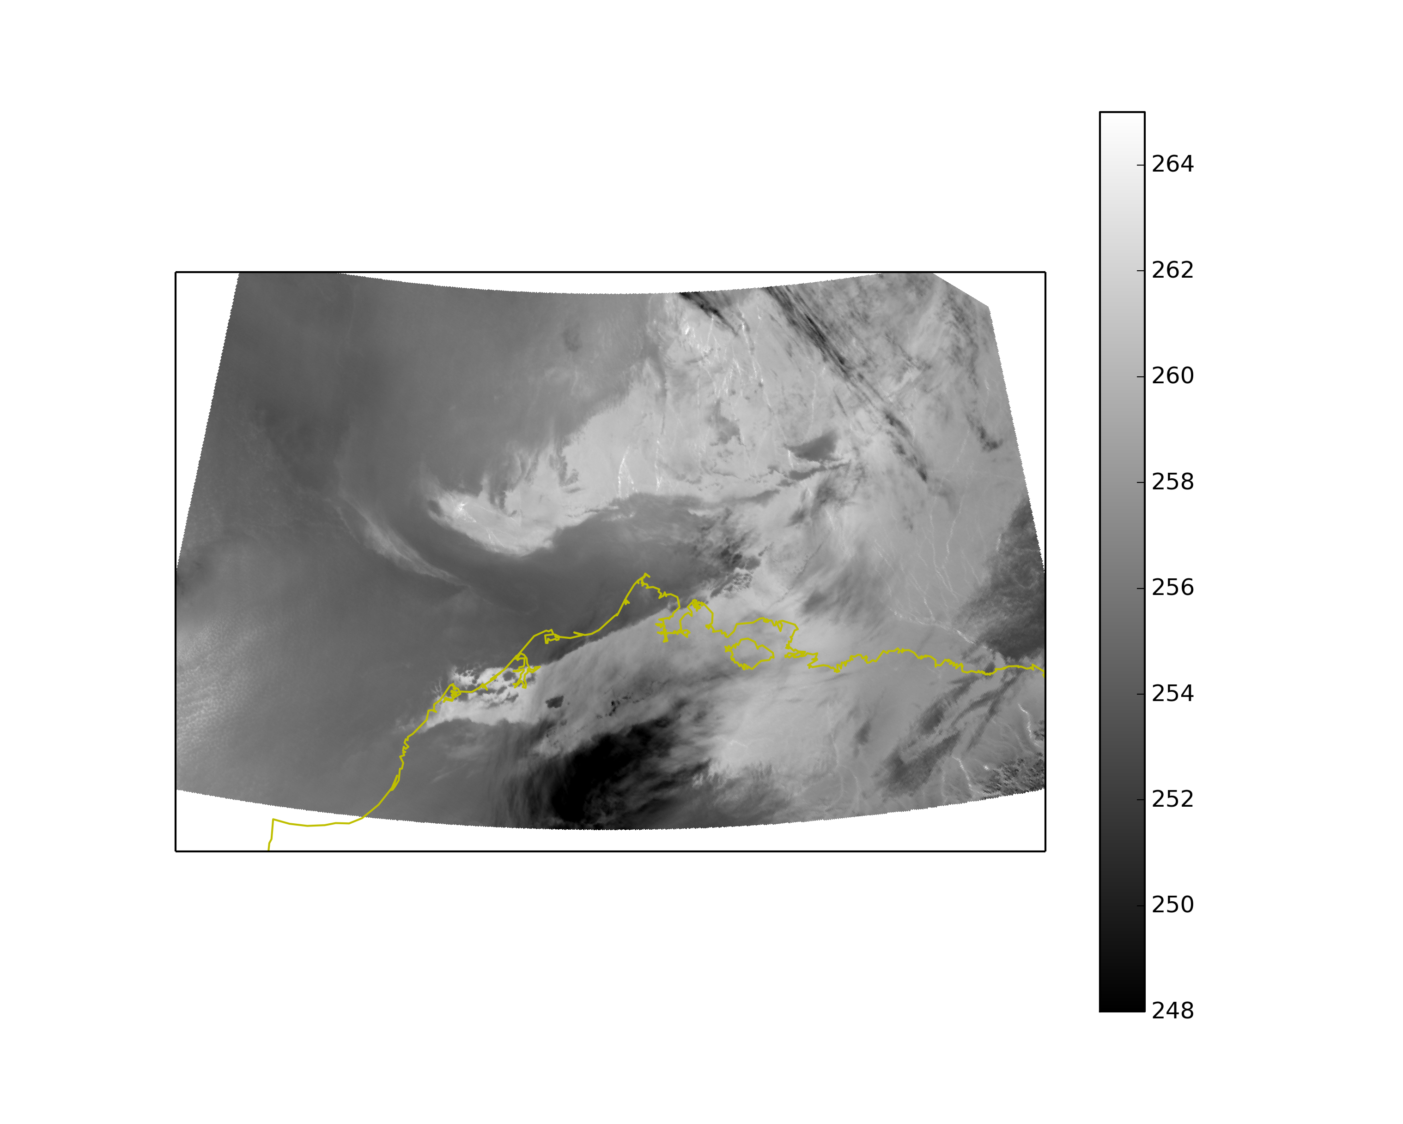
Terra 2300 UTC May 02 2013
Rad.
B.T.
VIS (250m)
IR (1km)
T
U
V
Td
$$θ$$
NSA sounding at Barrow
2301 UTC May 02

Slide 26
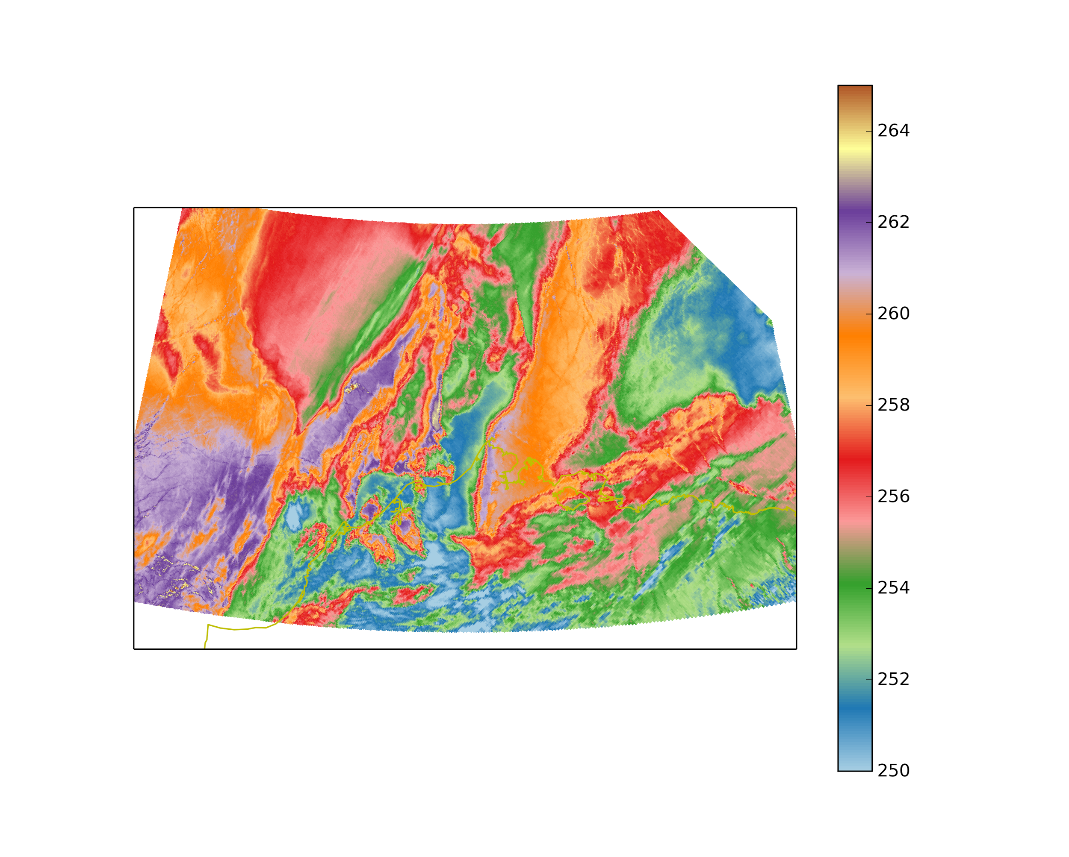
Terra 121.2355
1 km
BT from Band 31 (1-km image)
0.25 km
Rad from Band 1 (0.25-km image)
2300 UTC 1 May
U
V
Td
T
θ
Heating from the surface? Near superadiabatic
WRF(d05)@2345 UTC

