Slide 1

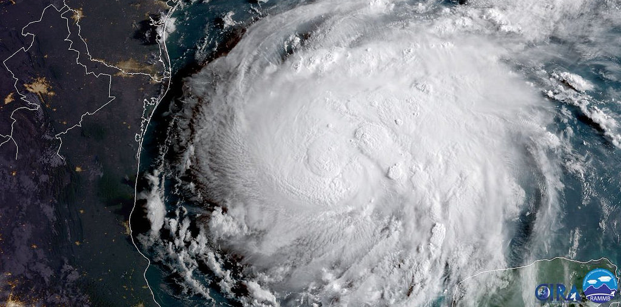
Cloud-situation-dependent covariance inflation in all-sky radiance assimilation for the prediction of Hurricane Harvey (2017)
Masashi Minamide and Fuqing Zhang
GOES-16 image of Hurricane Harvey (2017) from
Notes:
Direct Assimilation of all-sky infrared radiance satellite observation for the analysis and forecast of tropical cyclones

Slide 2
Hurricane Harvey (2017)
First landfall major hurricane observed by GOES-16
Re-intensified in the Gullf of Mexico
GOES-16 animation from http://tropic.ssec.wisc.edu/

Slide 3
Cloud-situation
Observation
Forecast
Observation
Forecast
Observation & forecast
consistent
Large ensemble spread
helps to remove clouds.
Observation
Forecast
Observation
Forecast
Very hard to develop clouds!!
Observation & forecast
consistent
Notes:
Firstly, let me explain what “cloud-situation” means,
In assimilating all-sky radiances, there are four situations with the combination of observation and model forecast, or EnKF prior.
One is the case that both observation and model shows clear-sky, The second one is …
In the assimilation, what do you think is the most problematic?
Observation and forecast are consistent in these 2 cases. However, if there is a mismatch between observation and forecast, strong nonlinearity comes into play.
It is known that, it is relatively easier to remove the spurious cloud, but …

Slide 4
How to quantify cloud-situation?
Cloud parameter
Okamoto et al. (2014), QJRMS
Jerry’s talk at the last group conference
$$C_{A}=\left|B−B_{clr}\right|−\left|O−B_{clr}\right|$$
Positive
Negative

Slide 5
How much do we currently improve?
Prior and posterior bias for GOES-16 ch8 (6.19um)
Dashed-line: EnKF prior
Solid-line: EnKF posterior
Almost no improvement
Large error reduction
Calculated using OSSE for hurricane Karl (2010) (details in Zhang et al., 2016, GRL)
Notes:
By using this, here, we show the bias of EnKF prior and posterior as a function of asymmetric cloud parameter.

Slide 6

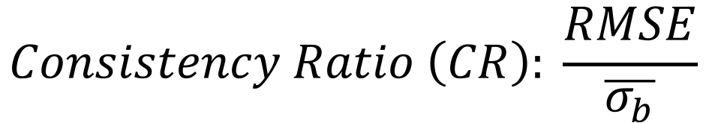
Consistency Ratio as a function of $C_{A}$
$$Consistency Ratio \left(CR\right): \frac{RMSE}{\overline{σ_{b}}}$$
CR of QVAPOR
Dashed-line:
simple inflation model
Inflate
Not inflate
Asymmetric cloud effect parameter $C_{A}$
Climatologically derive the inflation factor for model space

Slide 7
Application sample: situation-dependent inflation
Observation
EnKF prior
Cloud parameter
Inflation factor
Only inflate

Slide 8
Experimental settings
DA cycle: Genesis stage, 12Z/23– AUG, to predict RI
Model: WRF ver.3.6.1(Skamarock 2008), CRTM (Han et al. 2006)
PSU WRF-EnKF (Weng and Zhang, 2016)
  Observation error variance:
  Adaptive Observation Error Inflation (Minamide and Zhang, 2017)
  ROI: Successive Covariance Localization (Zhang et al., 2009)
  (30km with 4x4 grid, 200km with 6x6 grid)

Slide 9
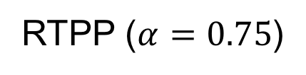
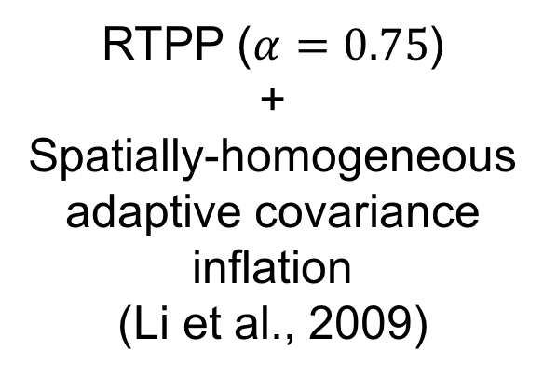
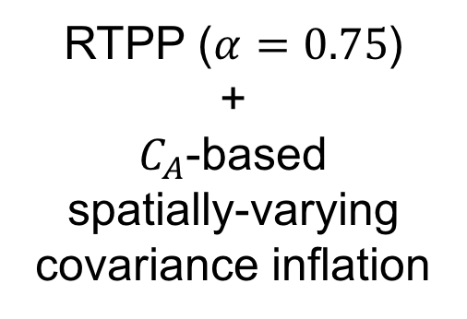
Experimental settings
minSLP (Hurricane Position & Intensity)
All-sky infrared BT (ch8: 6.19 μm)
12Z/23
Every 1 hour
12Z/24 AUG 2017
CNTL
hACI
Ca-INF
RTPP ($α=0.75$)
RTPP ($α=0.75$)
+
Spatially-homogeneous adaptive covariance inflation
(Li et al., 2009)
RTPP ($α=0.75$)
+
$C_{A}$-based
spatially-varying covariance inflation

Slide 10
EnKF Performance on TC intensity forecast
CNTL
hACI
Ca-INF
Minimum SLP
Max 10-m wind speed
BT-INF can avoid filter-divergence & over-spread.

Slide 11
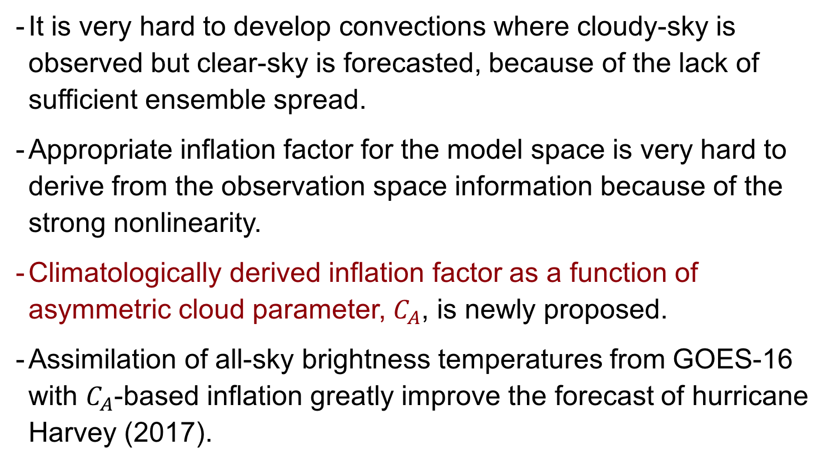
Summary
  It is very hard to develop convections where cloudy-sky is observed but clear-sky is forecasted, because of the lack of sufficient ensemble spread.
  Appropriate inflation factor for the model space is very hard to derive from the observation space information because of the strong nonlinearity.
  Climatologically derived inflation factor as a function of asymmetric cloud parameter, $C_{A}$, is newly proposed.
  Assimilation of all-sky brightness temperatures from GOES-16 with $C_{A}$-based inflation greatly improve the forecast of hurricane Harvey (2017).
Thank you for your attention. (minamide@psu.edu)

Slide 12

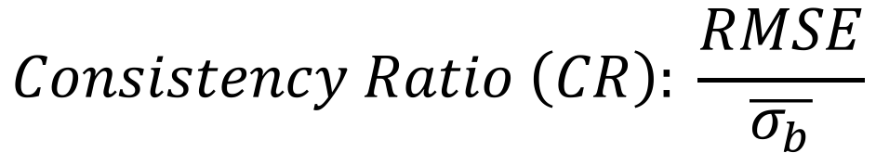
Consistency Ratio as a function of $C_{A}$
$$Consistency Ratio \left(CR\right): \frac{RMSE}{\overline{σ_{b}}}$$
CR of brightness temperature for GOES-16 ch8
CR of QVAPOR
Dashed-line:
simple inflation model
Inflate
Asymmetric cloud effect parameter $C_{A}$
Not inflate
Asymmetric cloud effect parameter $C_{A}$
Climatologically derive the inflation factor for model space

Slide 13
Consistency Ratio as a function of $C_{A}$

Slide 14
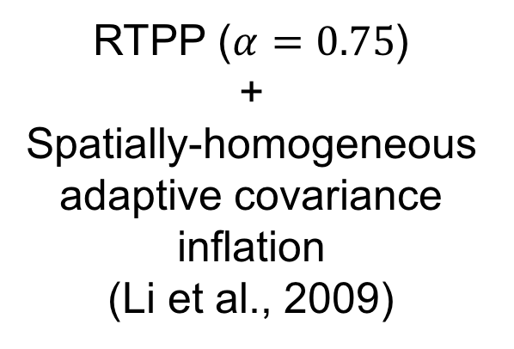
Experimental settings
minSLP (Hurricane Position & Intensity)
All-sky infrared BT (ch8: 6.19 μm)
12Z/22
Every 1 hour
00Z/24 AUG 2017
hACI
Ca-INF
RTPP ($α=0.75$)
+
Spatially-homogeneous adaptive covariance inflation
(Li et al., 2009)
RTPP ($α=0.75$)
+
$C_{A}$-based
spatially-varying covariance inflation

Slide 15
EnKF Performance on TC intensity forecast
hACI
Ca-INF
Minimum SLP
Max 10-m wind speed
BT assimilation with BT-INF greatly helped to capture RI.

Slide 16
Cloud-situation
Observation
Forecast
Observation
Forecast
Observation
Forecast
Observation
Forecast
Forecast
Observation

