Slide 1
Automatic bias correction for satellite radiance through combining multiple channels
Yinghui Lu, Fuqing Zhang
Dec. 8, 2017

Slide 2
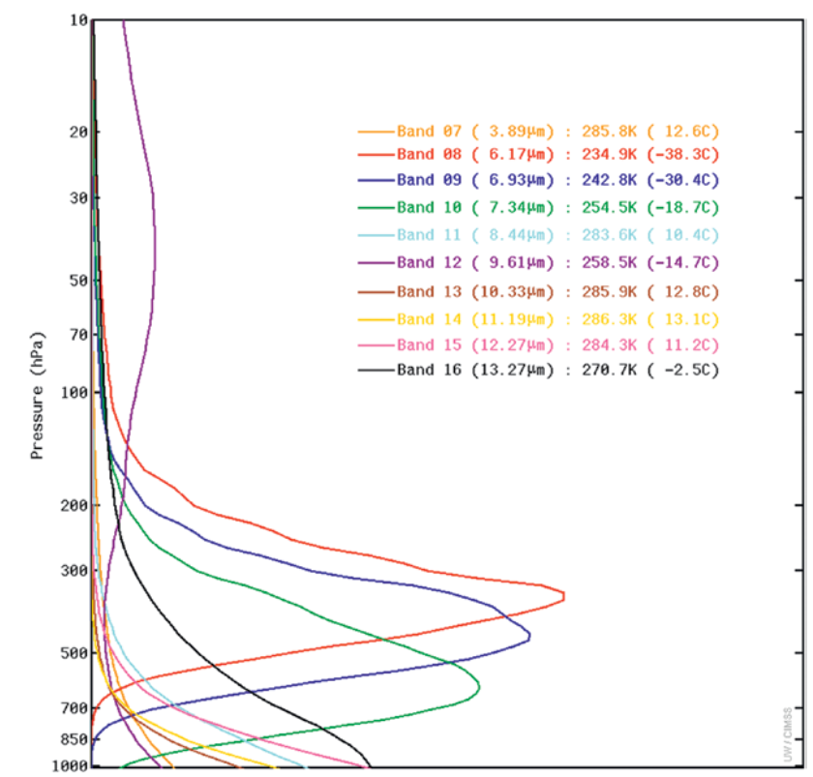
Motivation
Can we reduce bias in window channels due to uncertainties in surface emissivity and temperature?
(Schmit et al., BAMS, 2017)

Slide 3
Theoretical basis
$$I\left(ν\right)=$$
$$τ\left(ν\right)ε\left(ν\right)B\left(ν,T_{s}\right)+$$
$${τ\left(ν\right)\left[1−ε\left(ν\right)\right]I}_{atm}^{↓}\left(ν\right)+$$
Assumption: $ΔT_{s}$ and $Δε$ are the same for all channels
Define synthetic channel $I_{syn}=\sum_{i}{a_{i}I_{i}}$ so that bias from different channels cancel each other.
Solving
$$\left\{\begin{aligned}a_{1}M_{1}+a_{2}M_{2}+a_{3}M_{3}=0 \\ a_{1}N_{1} +a_{2}N_{2}+a_{3}N_{3} =0 \\ a_{1} +a_{2} +a_{3} =1\end{aligned}\right.$$
leads to an appropriate combination of the three channels.
$$I_{atm}^{↑}\left(ν\right)$$
atmosphere
Earth surface
Uncertainty in $ε$ and $T_{s}$ leads to
$ΔI\left(ν\right)=$ $τε\frac{∂B}{∂T}{\left.​\right|}_{T_{s}}ΔT_{s}+τ\left[B−I_{atm}^{↓}\right]Δε+ΔI_{atm}$
$$= M ΔT_{s}+ N Δε+ΔI_{atm}$$

Slide 4
OSSE-IR, Q+10%
OmB CH 15
OmB Synthetic channel

Slide 5
OSSE-IR, Q+10% + ΔTs + Δ $ε$
OmB CH 15
OmB Synthetic channel

Slide 6
New synthetic channel
Previous assumption: $ΔT_{s}$ and $Δε$ are the same for all channels
$$ΔI\left(ν\right)= M ΔT_{s}+ N Δε+ΔI_{atm}$$
New assumption: $Δε$ are different for different channels
$$ΔI\left(ν\right)= M ΔT_{s}+ N ( Δε+δ)+ΔI_{atm}$$
$$\left\{\begin{aligned}a_{1}M_{1}+a_{2}M_{2}+a_{3}M_{3}=0 \\ a_{1}N_{1} +a_{2}N_{2}+a_{3}N_{3} =0 \\ a_{1} +a_{2} +a_{3} =1\end{aligned}\right.$$
Cost function:
J=($a_{1}N_{1}+a_{2}N_{2}+a_{3}N_{3})2$+W*[($a_{1}N_{1}δ$)²+($a_{2}N_{2}δ$)²+($a_{3}N_{3}$ $δ$)²]
Calculate $a_{i}$ by minimizing J

Slide 7
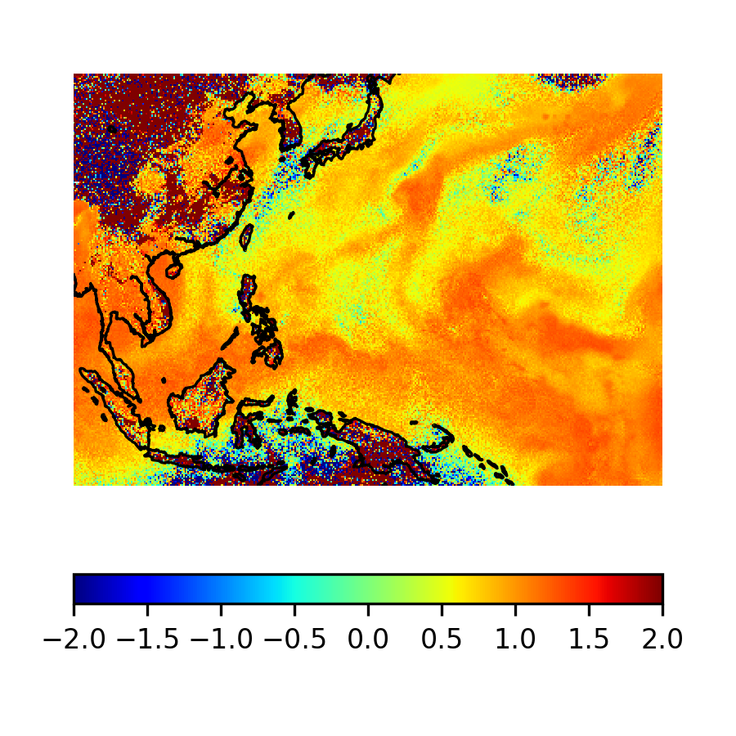
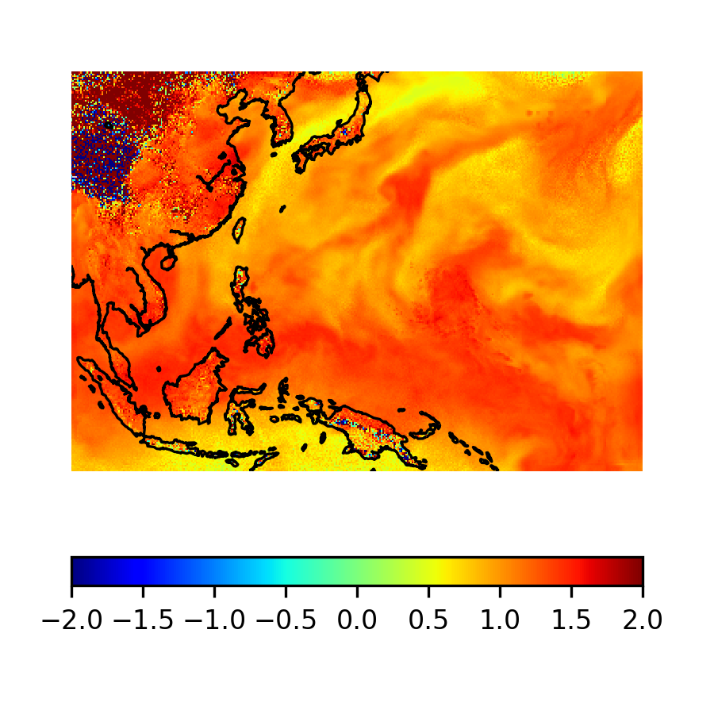
OSSE-IR, Q+10% + ΔTs +Δ$ε$+$δε$
OmB CH 15
OmB old syn CH
OmB new syn CH

Slide 8
Acknowledgements
Thanks to Masashi for providing simulation results!
Thank you for your attention!

