Slide 1
Assimilating All-Sky Infrared Radiance from GOES-16 ABI using Ensemble Kalman Filter for Convection-Permitting Severe Thunderstorm Predictions
Yunji Zhang, Fuqing Zhang
Acknowledgments: Masashi Minamide, David J. Stensrud
Dec 8, 2017

Slide 2
Background
Previously presented experiments for June 17, 2017 Kansas event
Having problems in suppressing spurious convection
Other severe weather events from SPC’s database
Initiated from cloud-free environment
Appropriate timing for design of data assimilation
After June 1, 2017
June 12, 2017 Wyoming-Nebraska severe weather outbreak

Slide 3
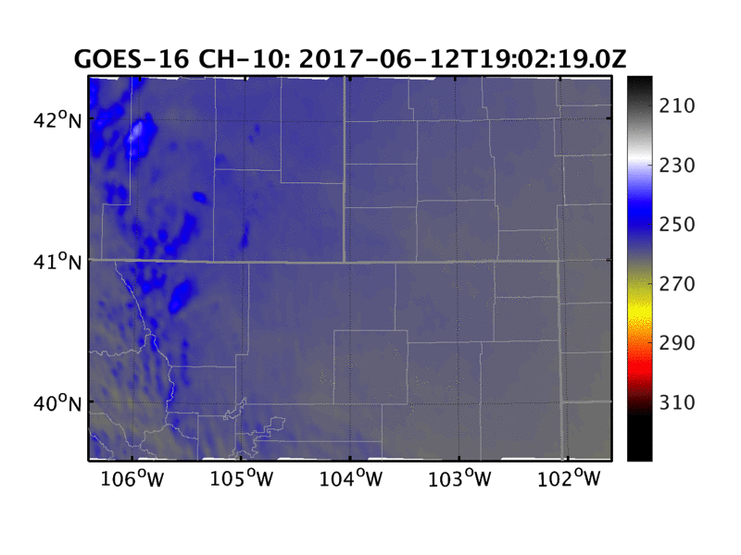
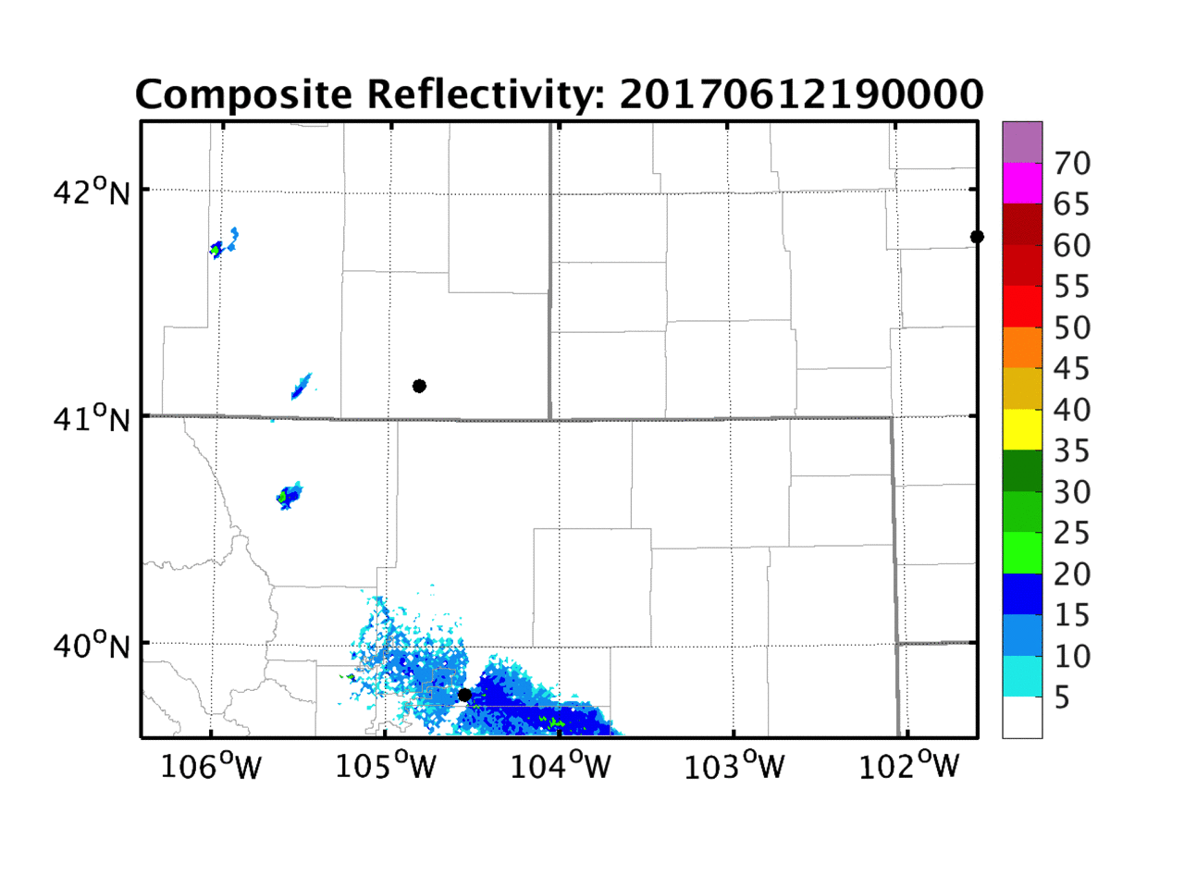
The June 12 WY-NE Severe Weather Outbreak
First ever particularly dangerous situation tornado watch issued for Wyoming by SPC
Change of scan mode 2040~2100 UTC
Cheyenne, WY
Denver, CO

Slide 4
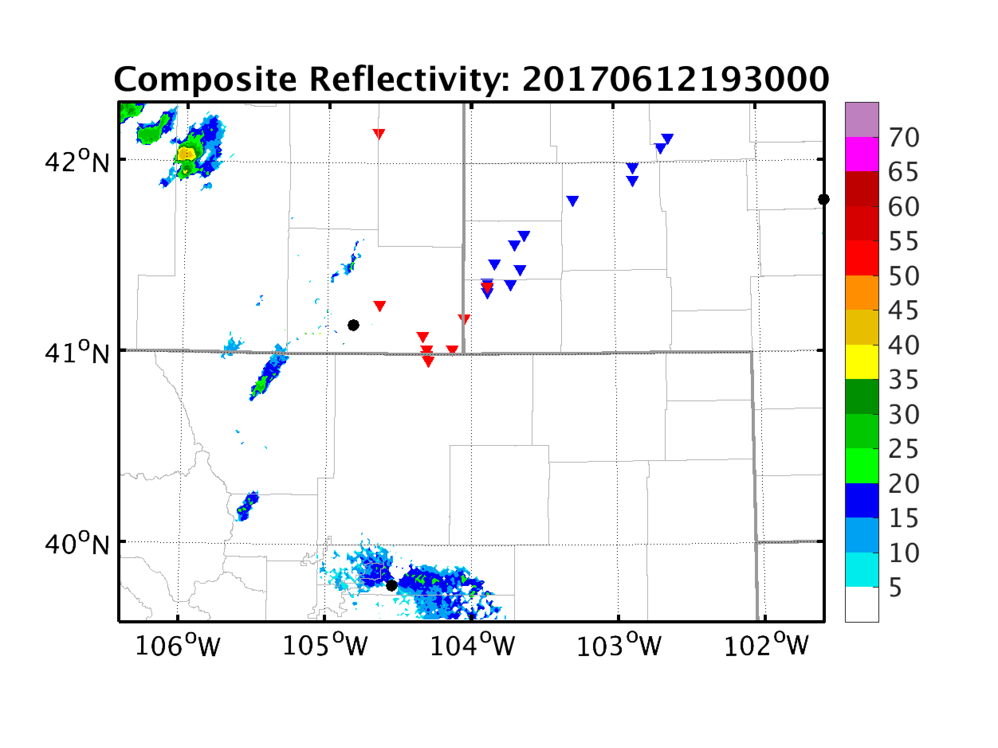
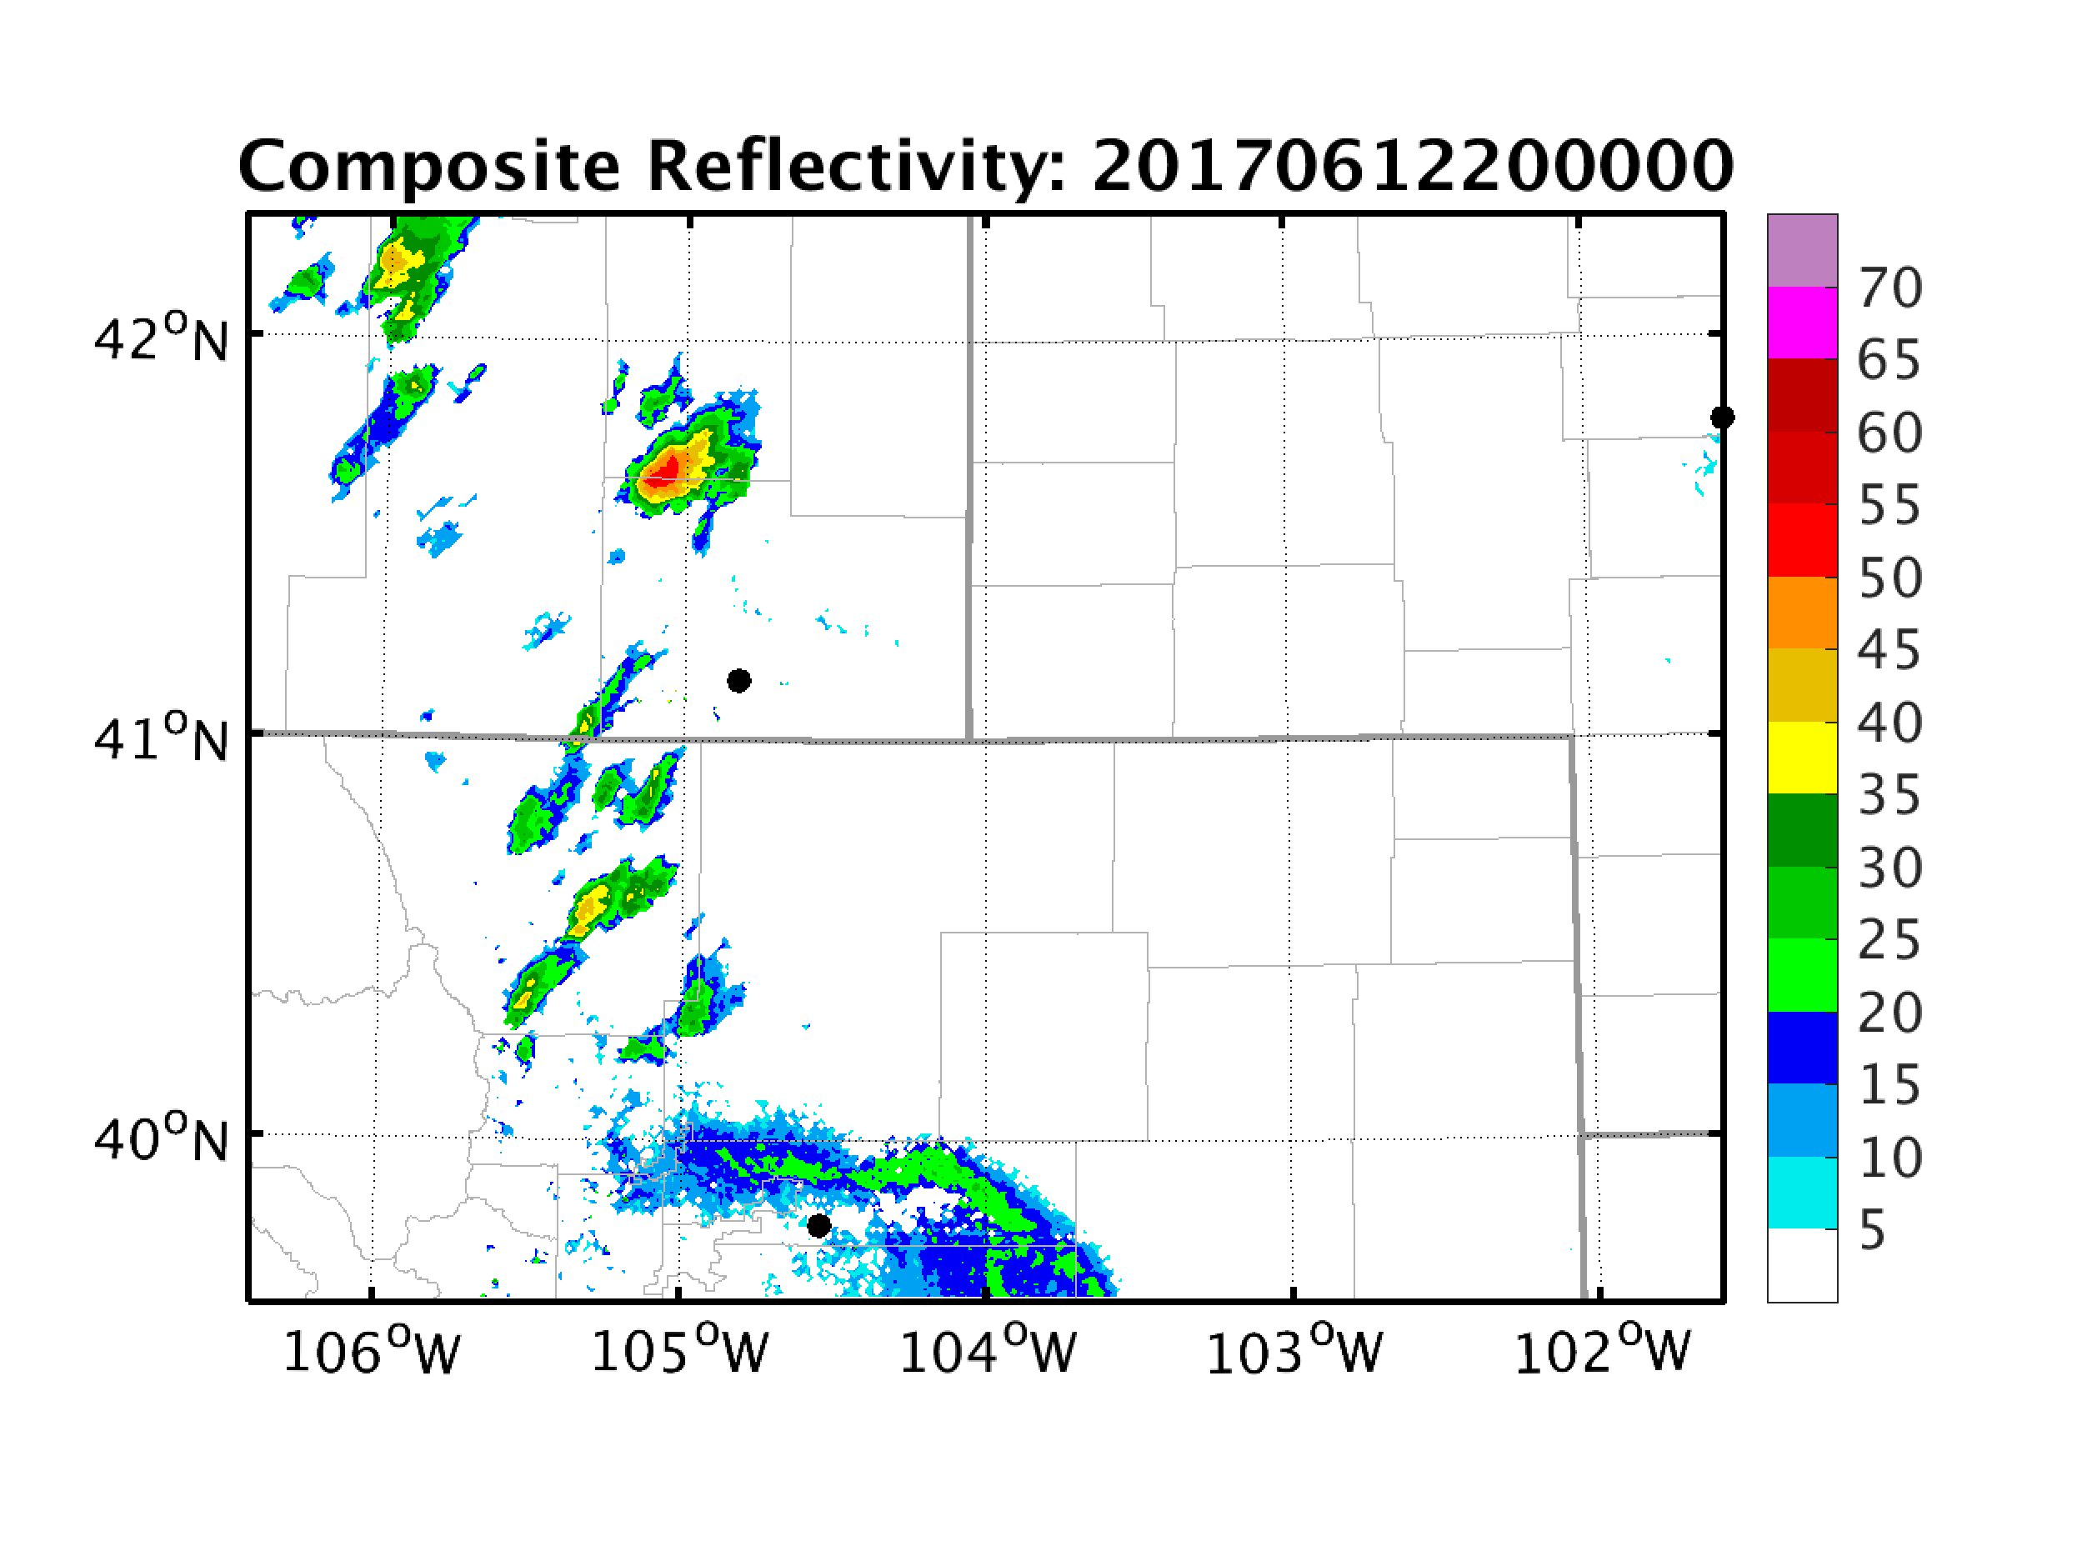
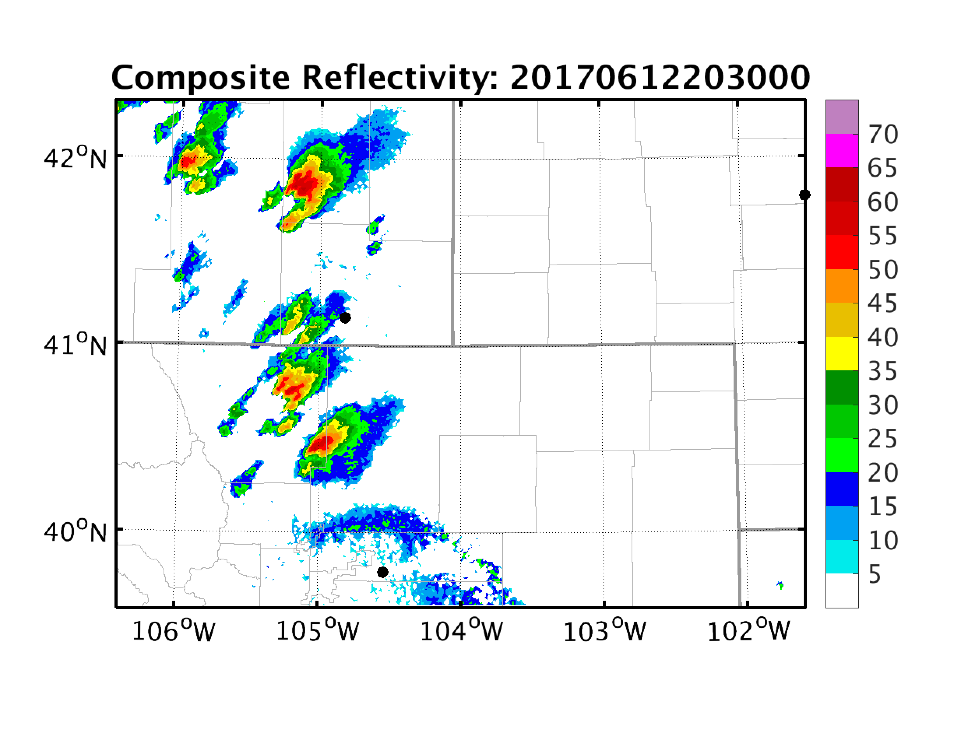
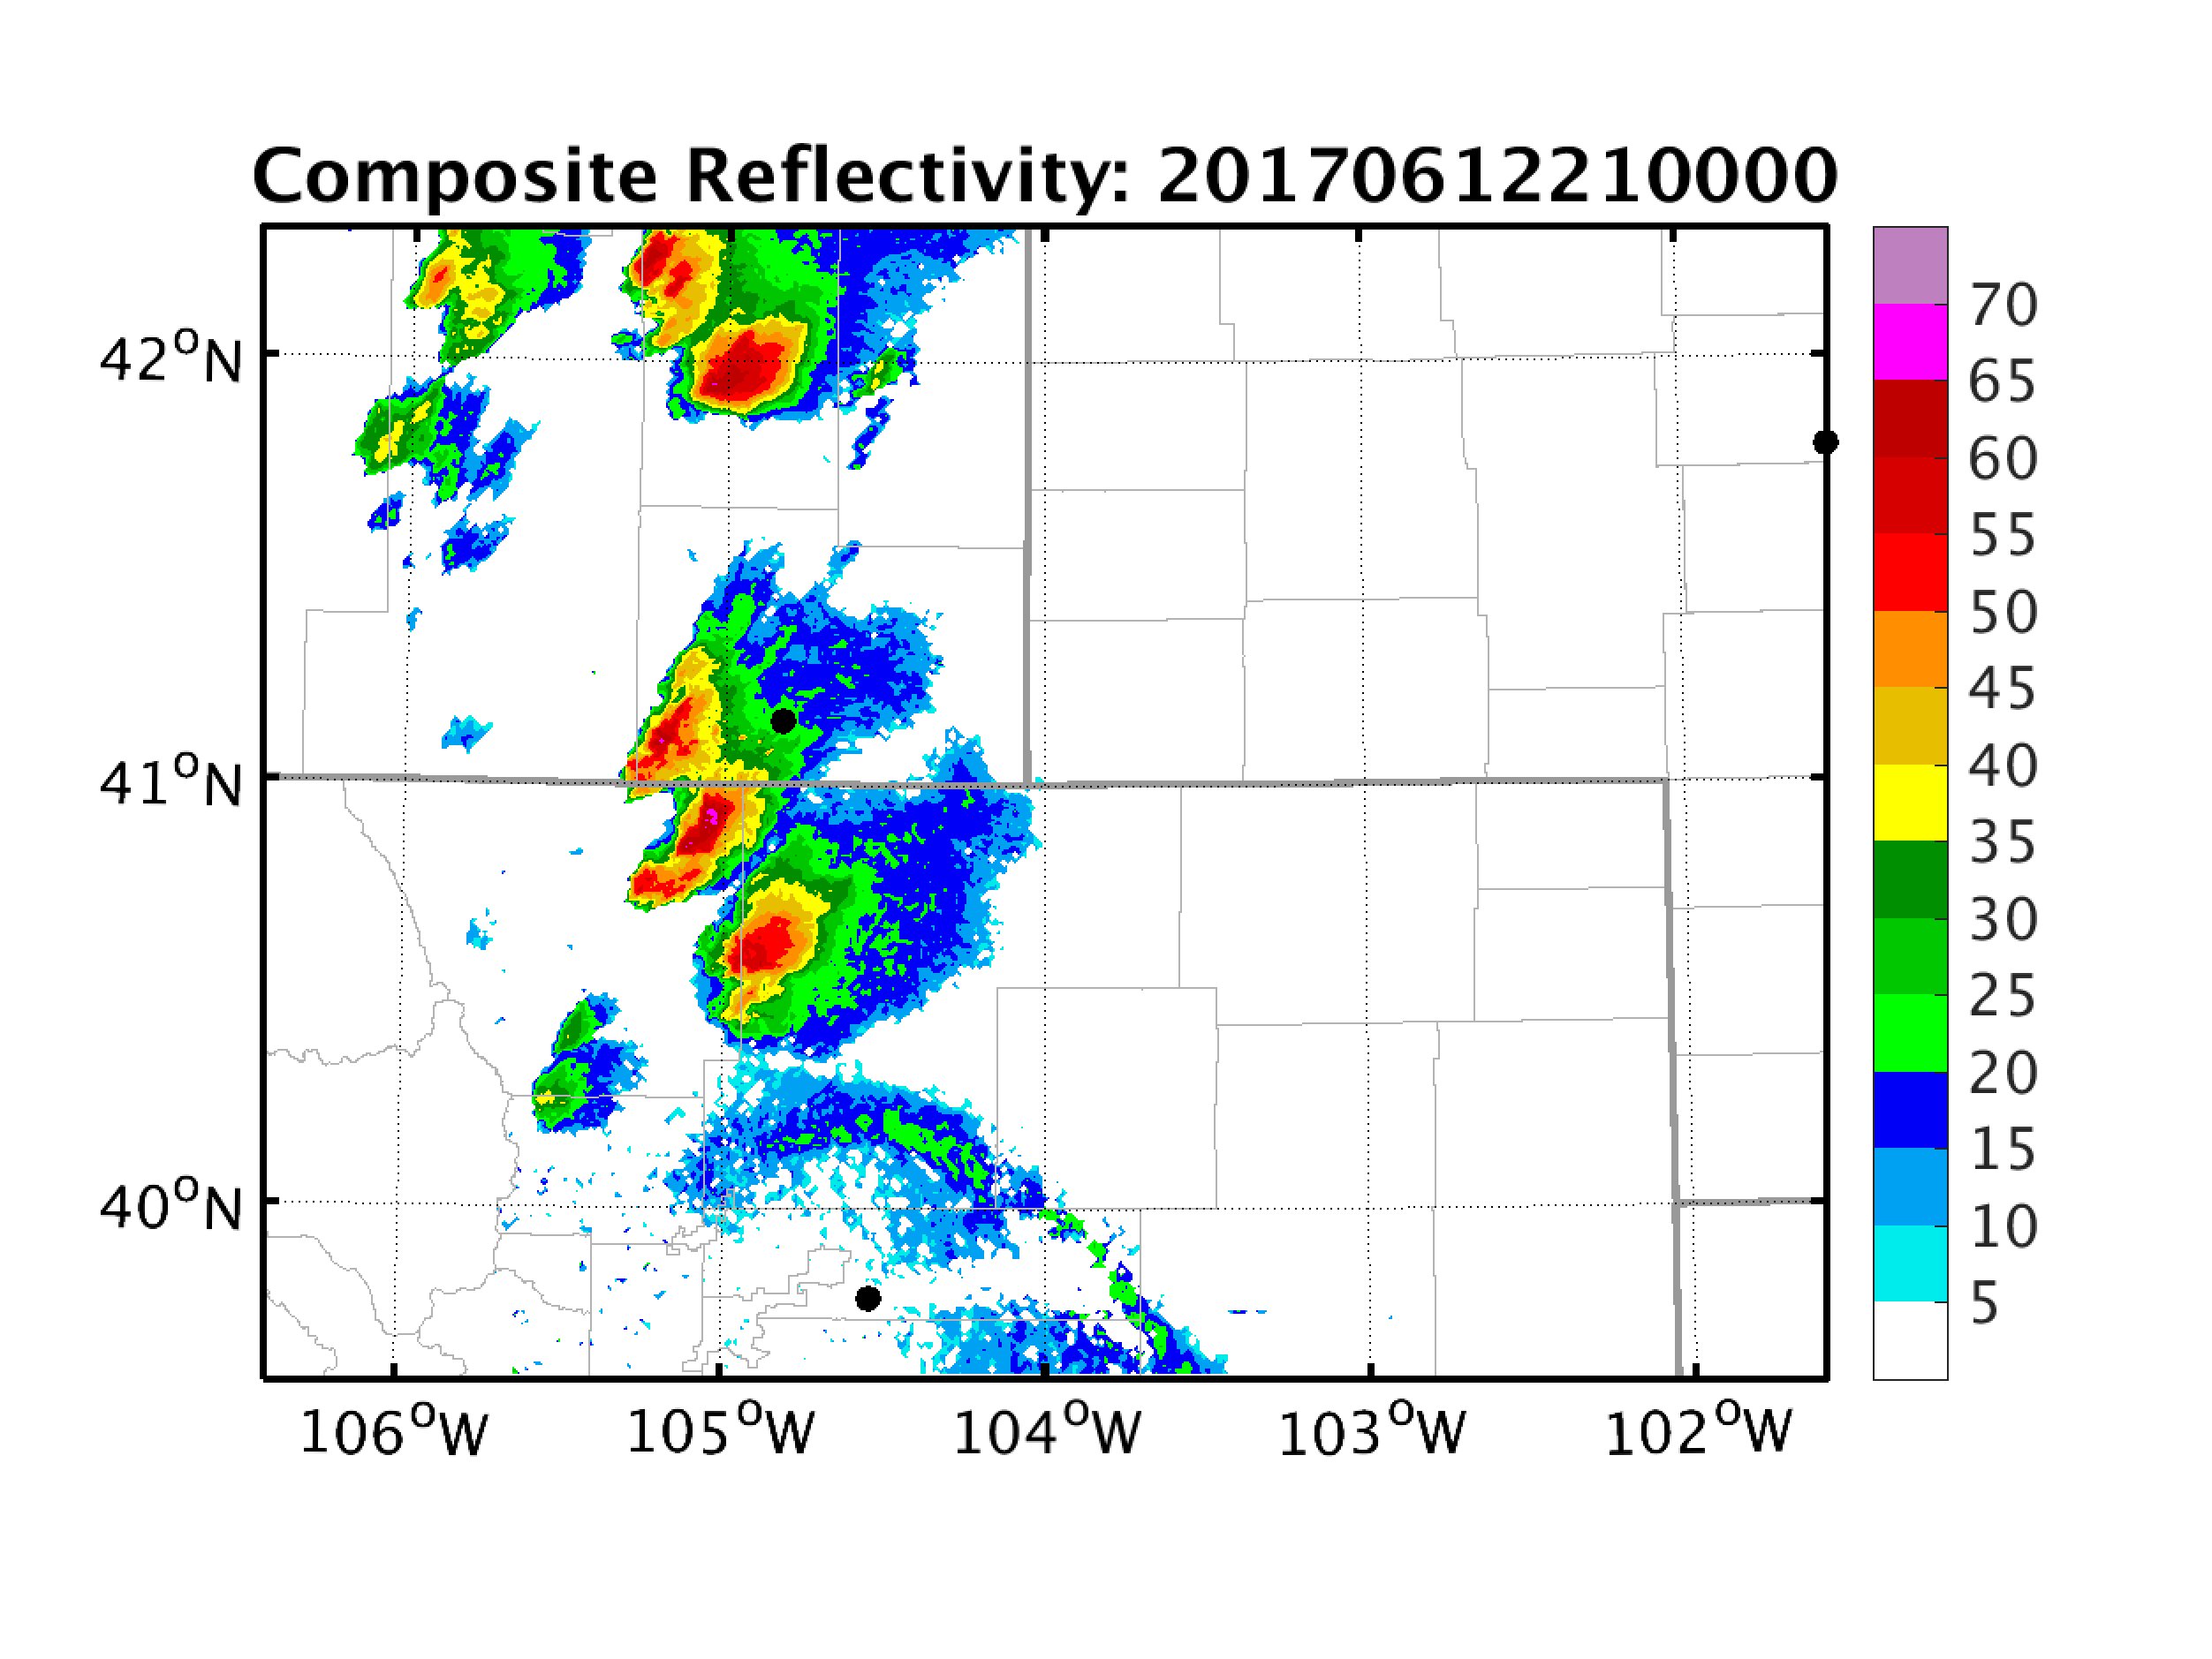
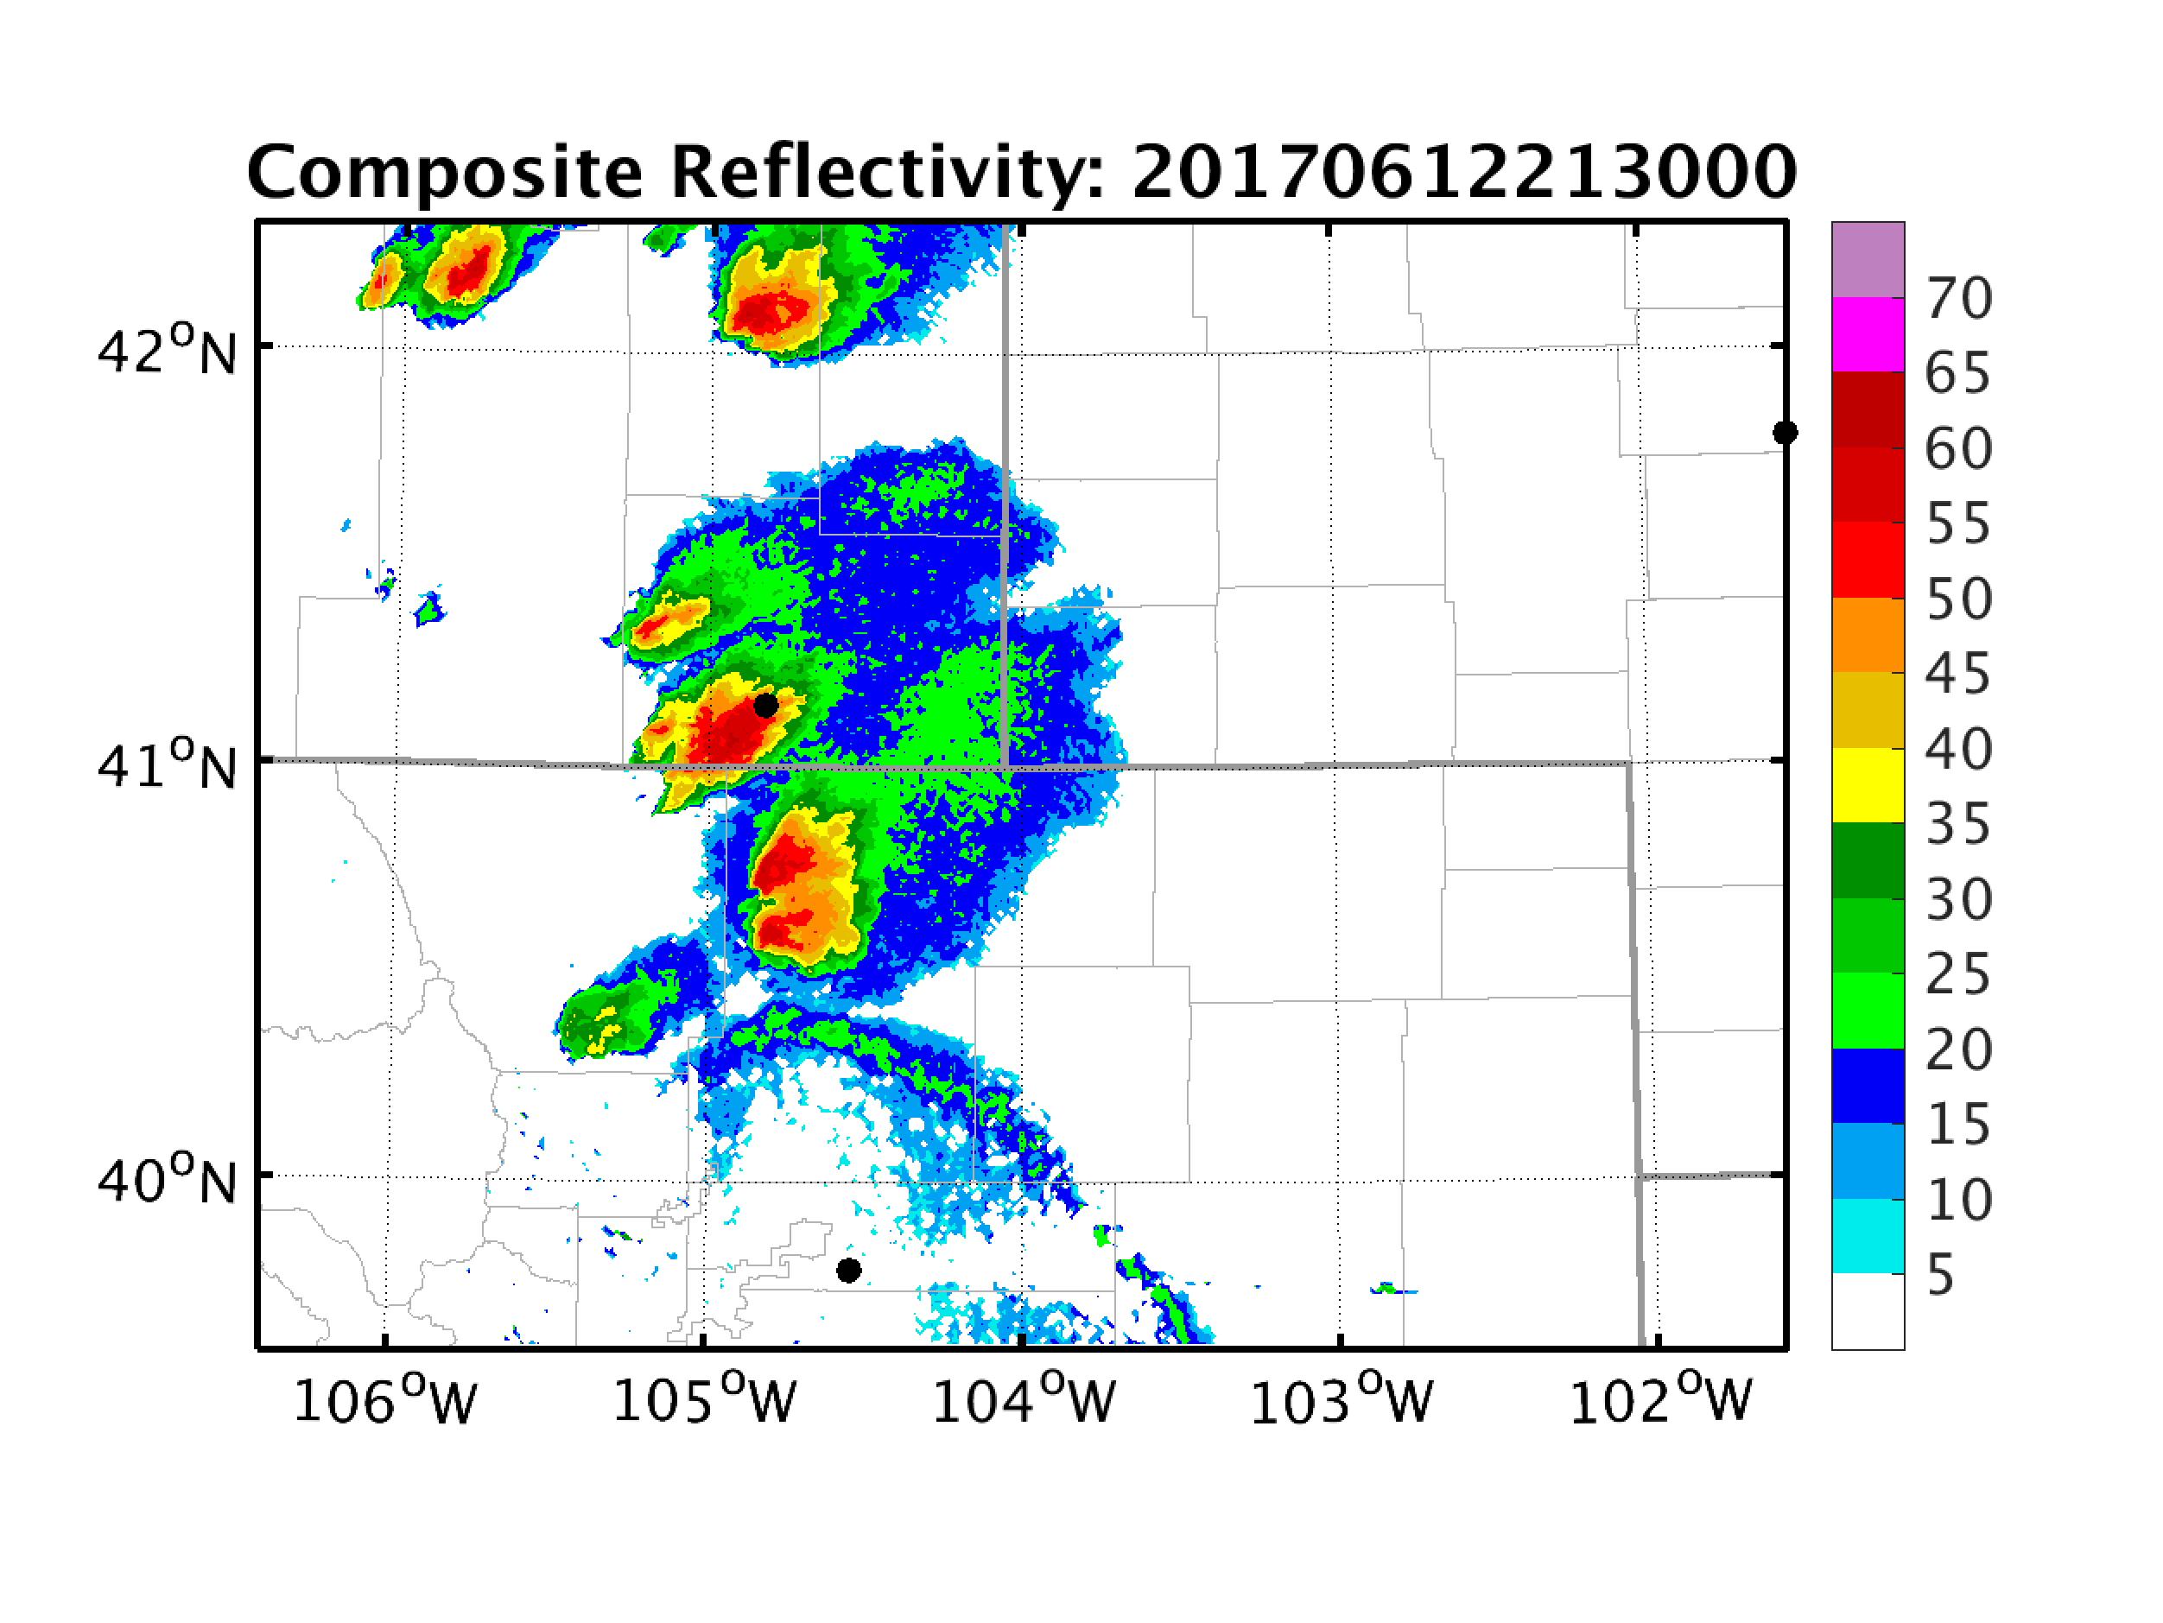
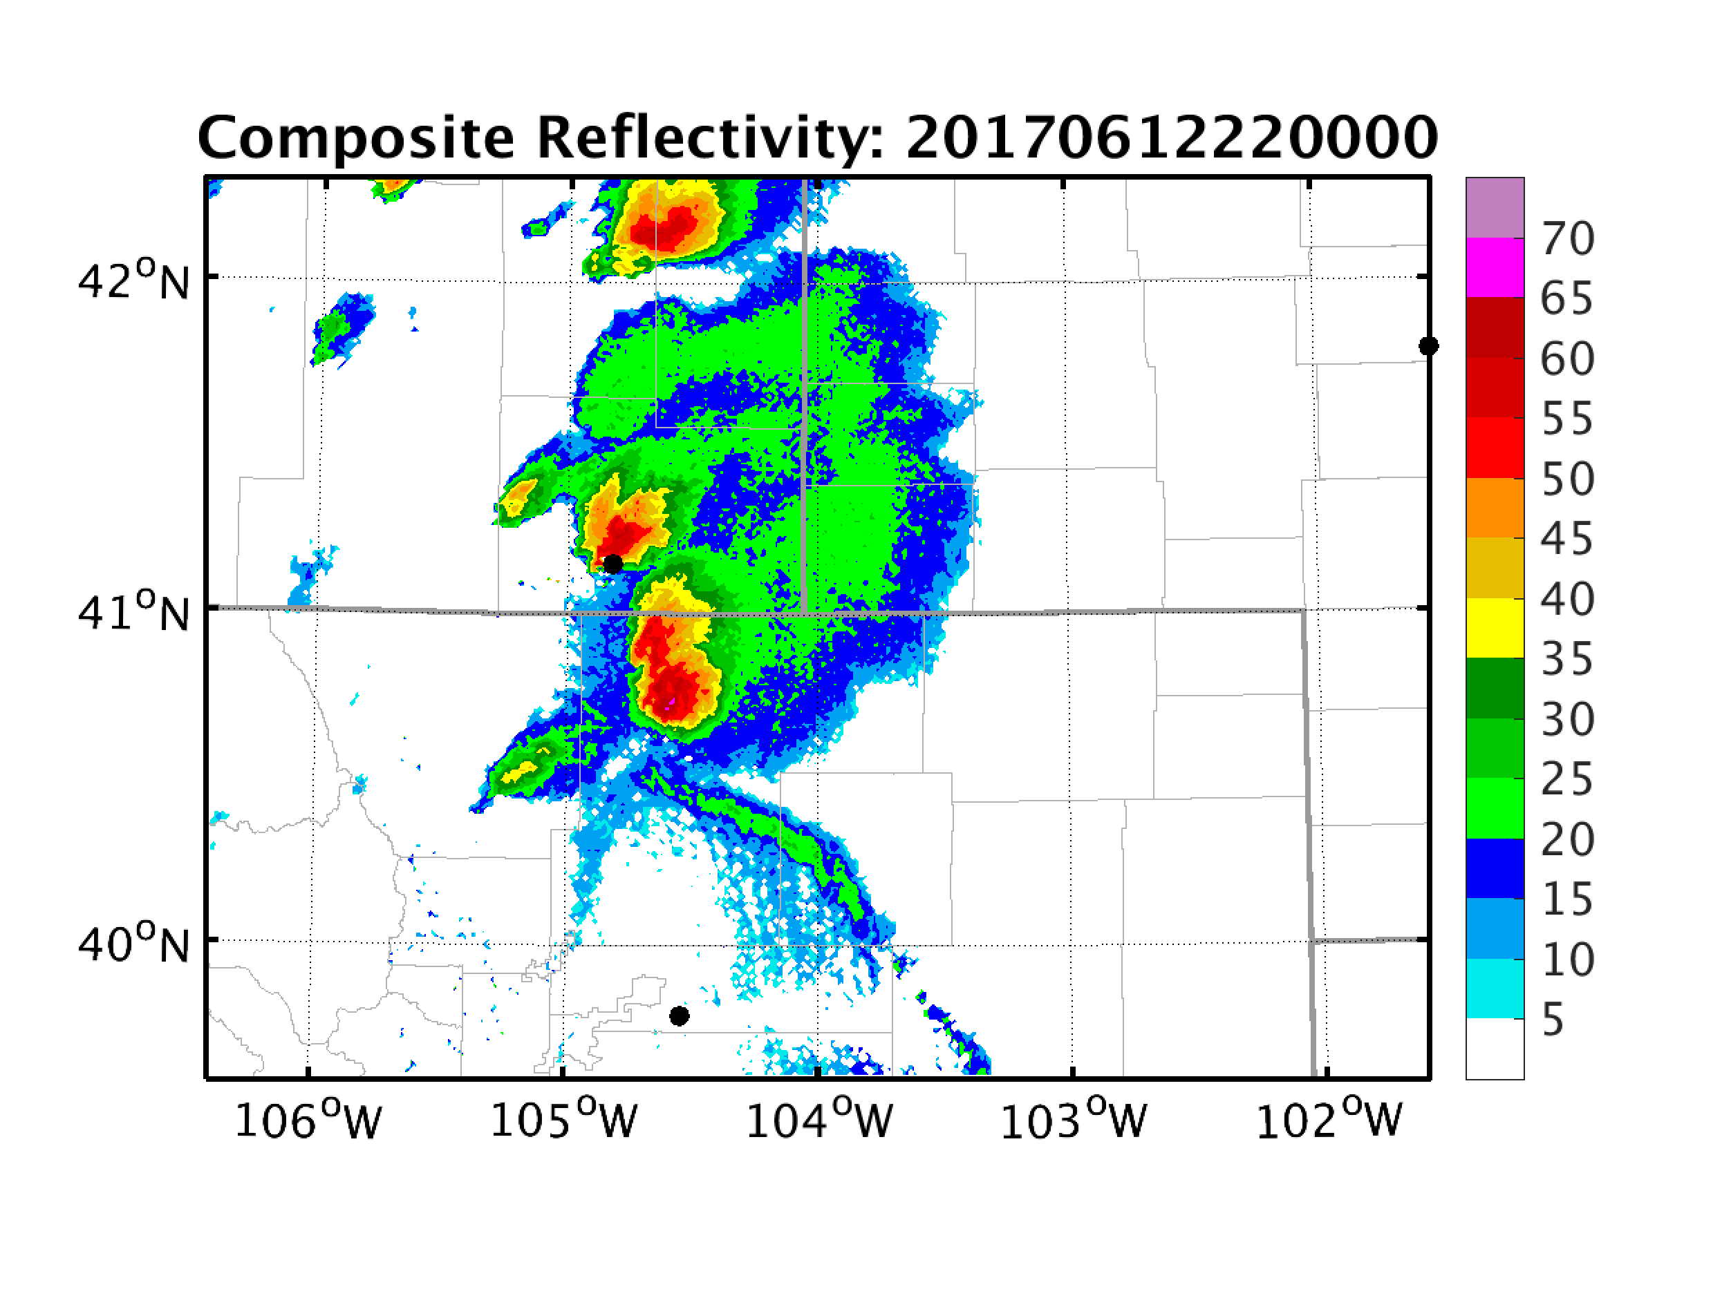
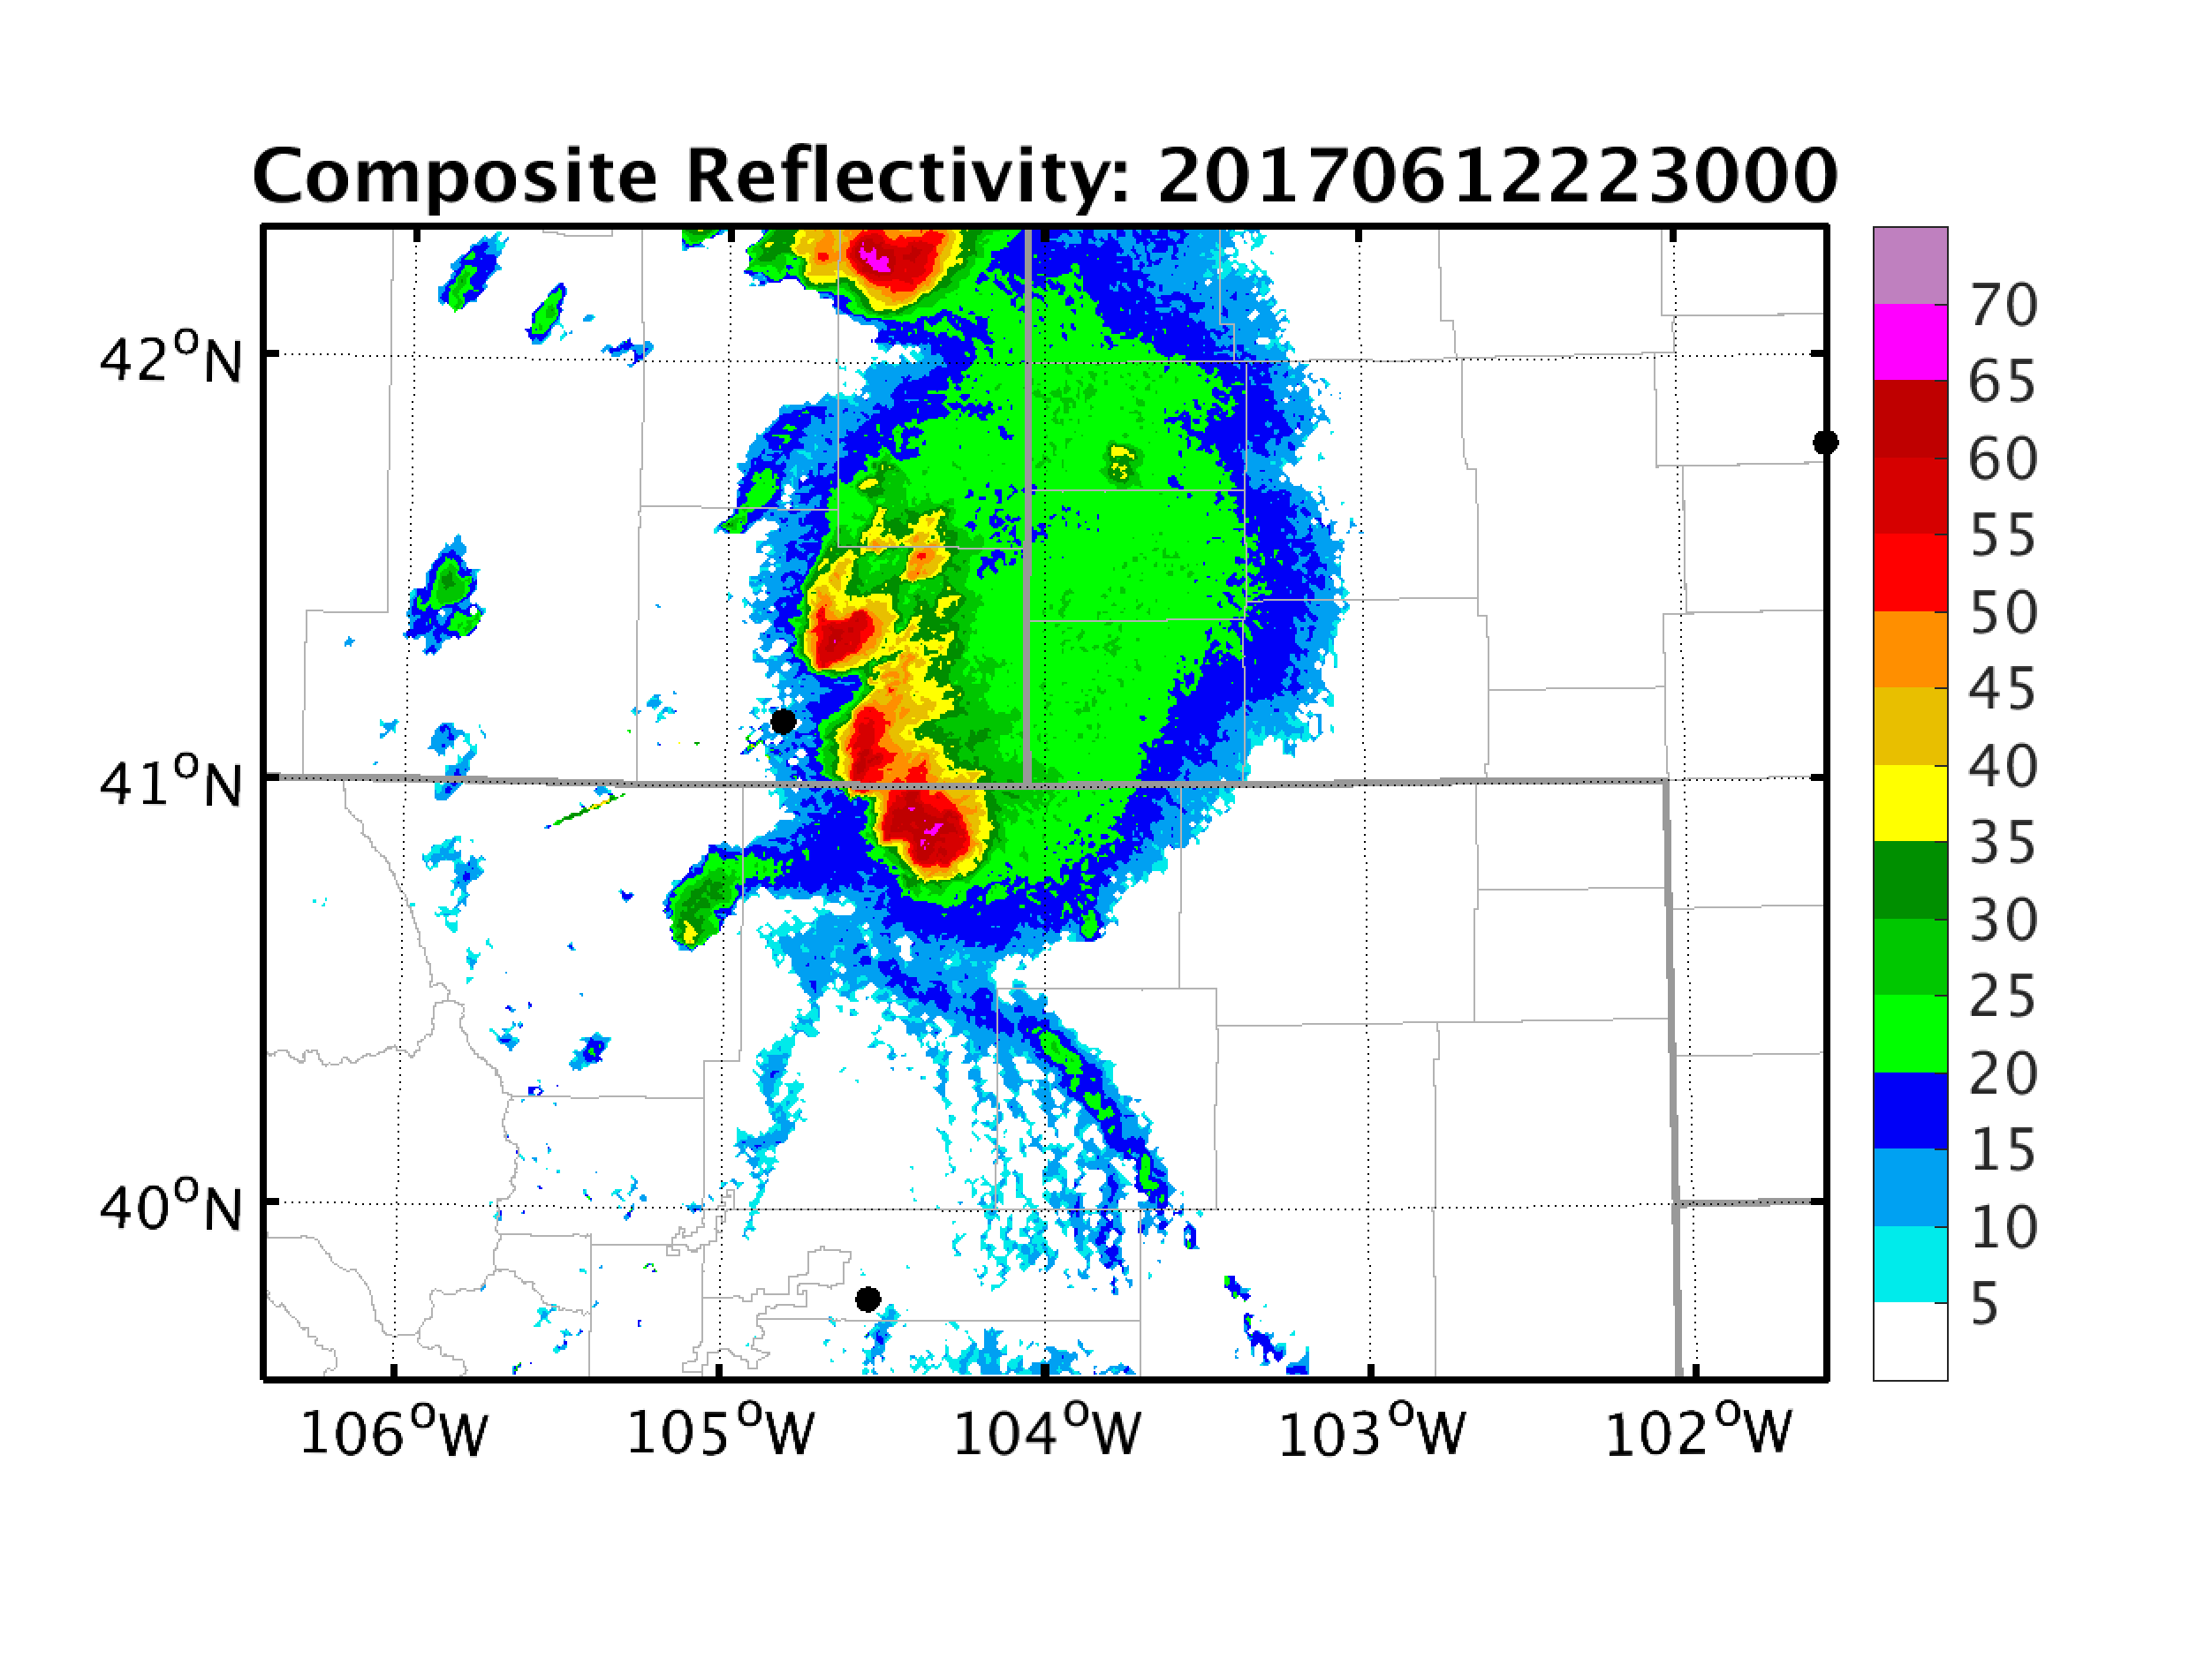
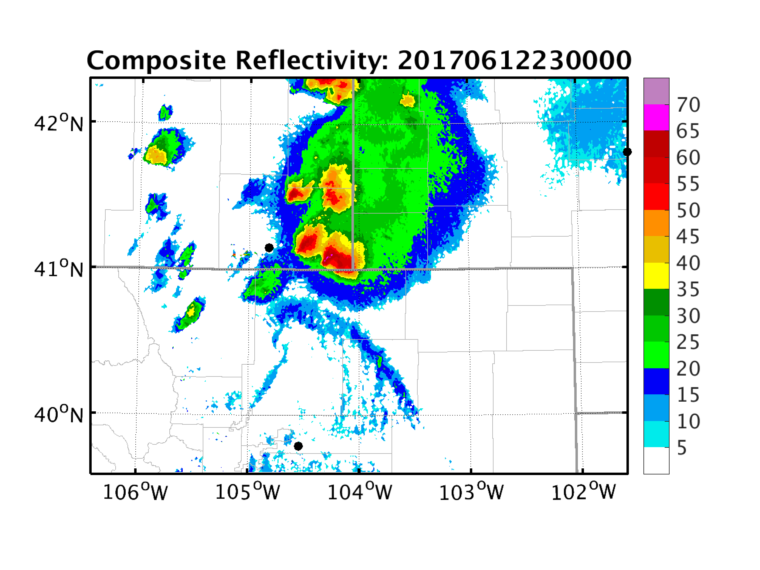
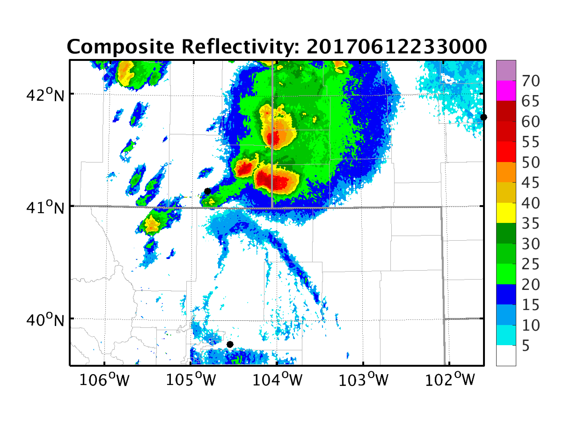
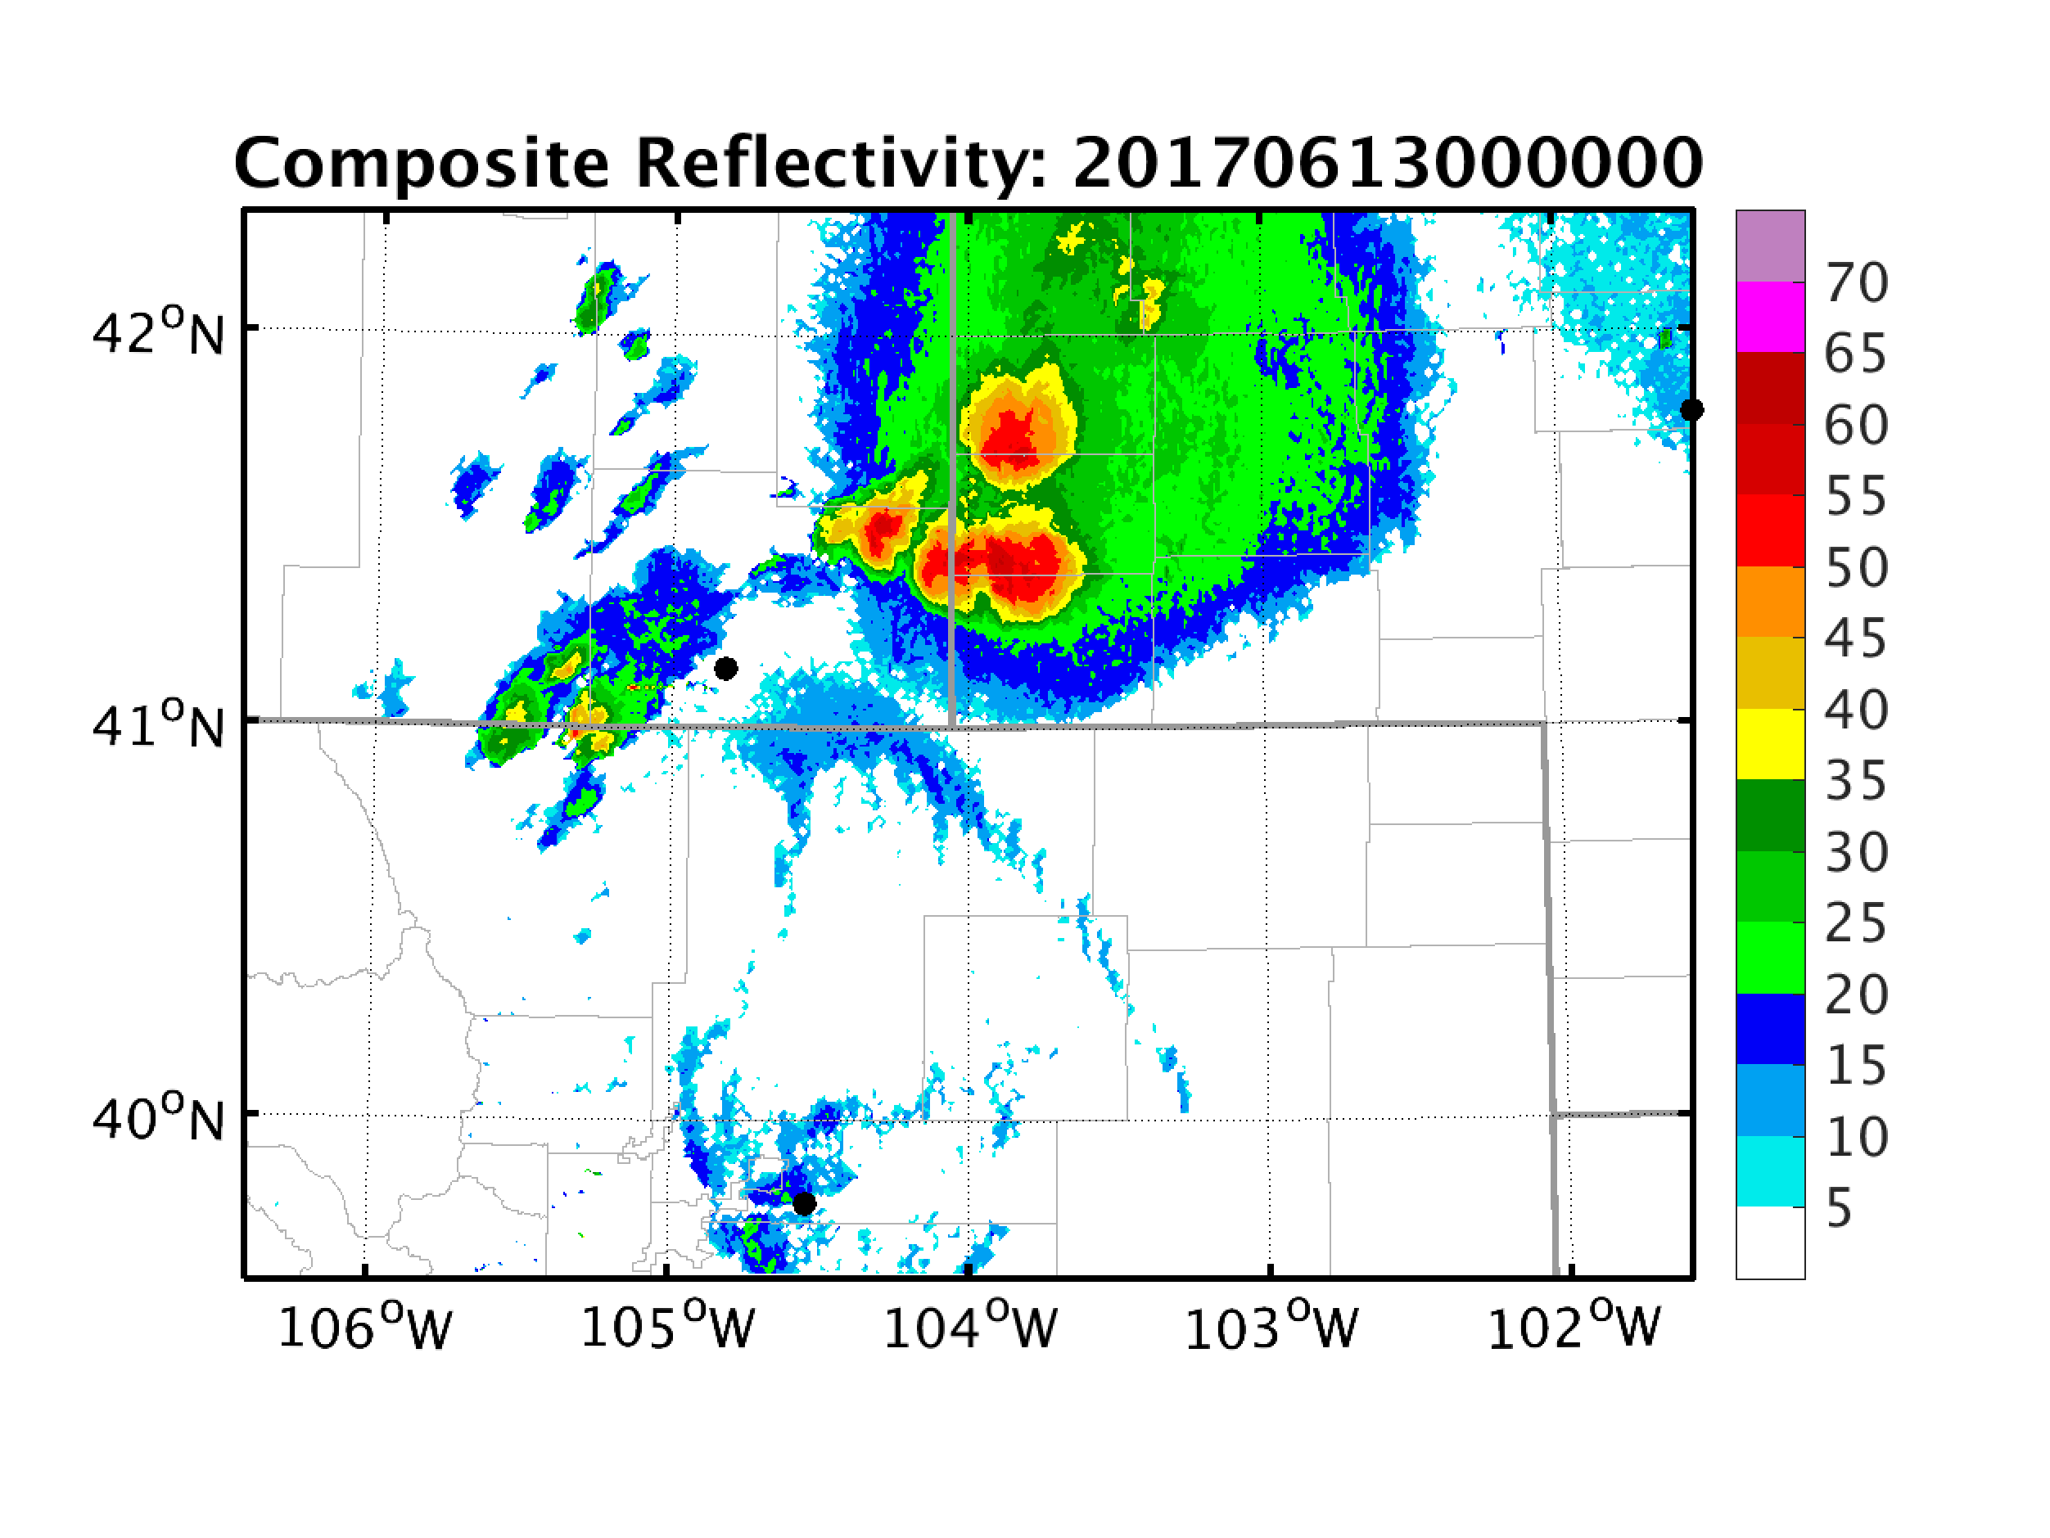
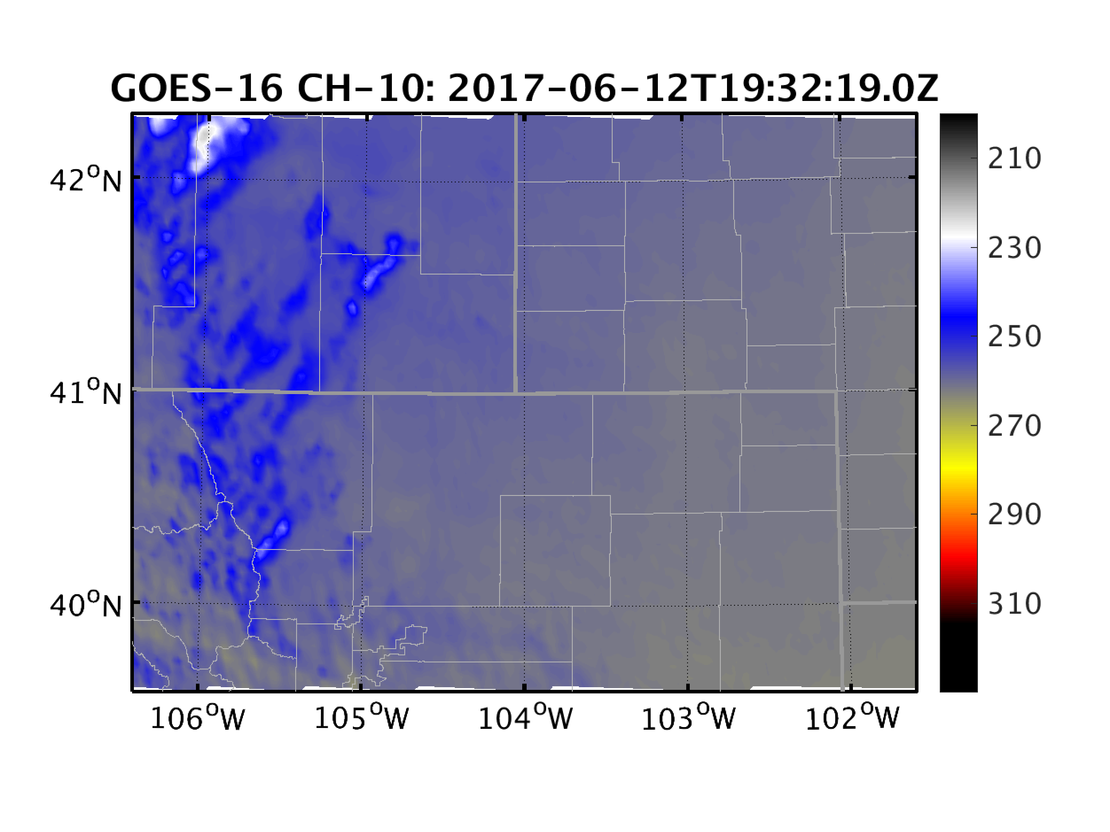
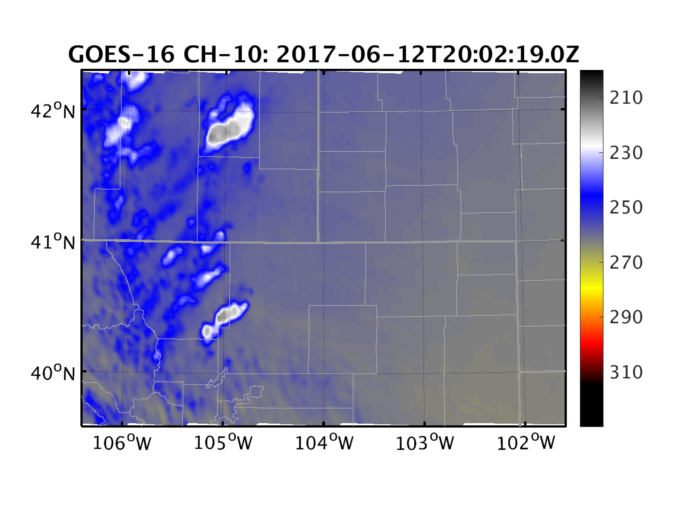
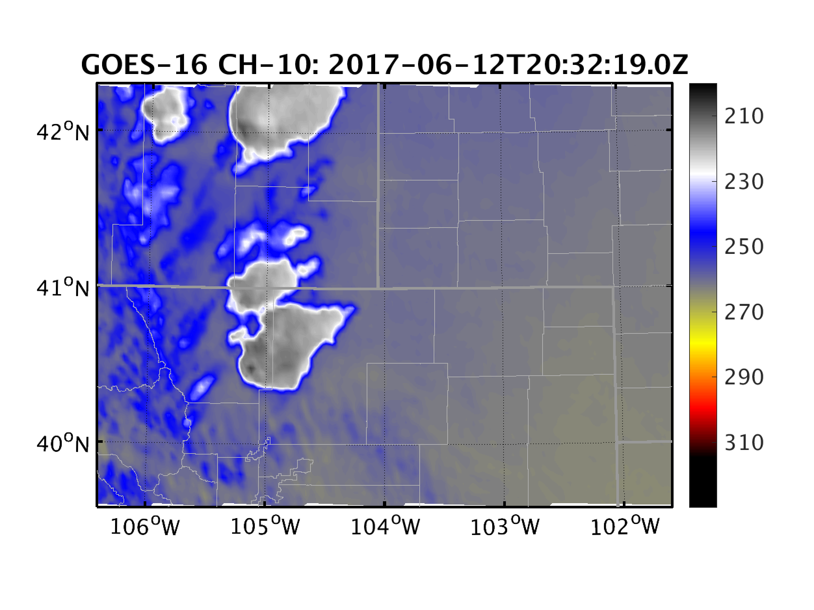
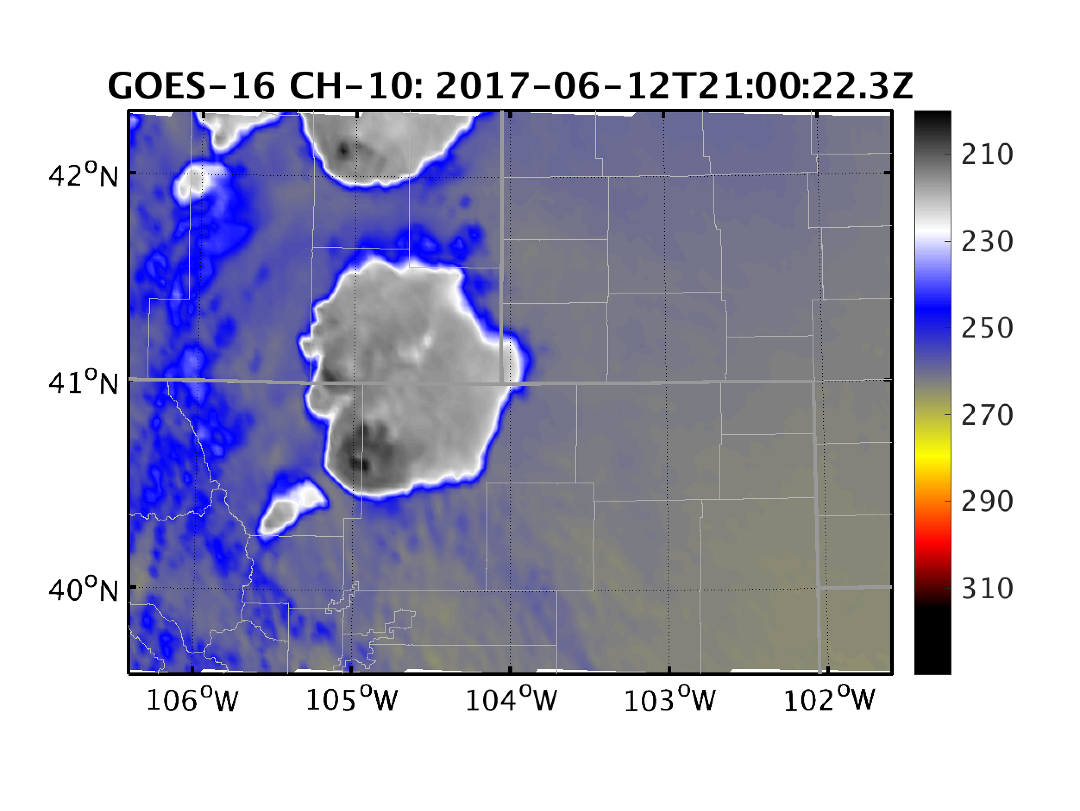
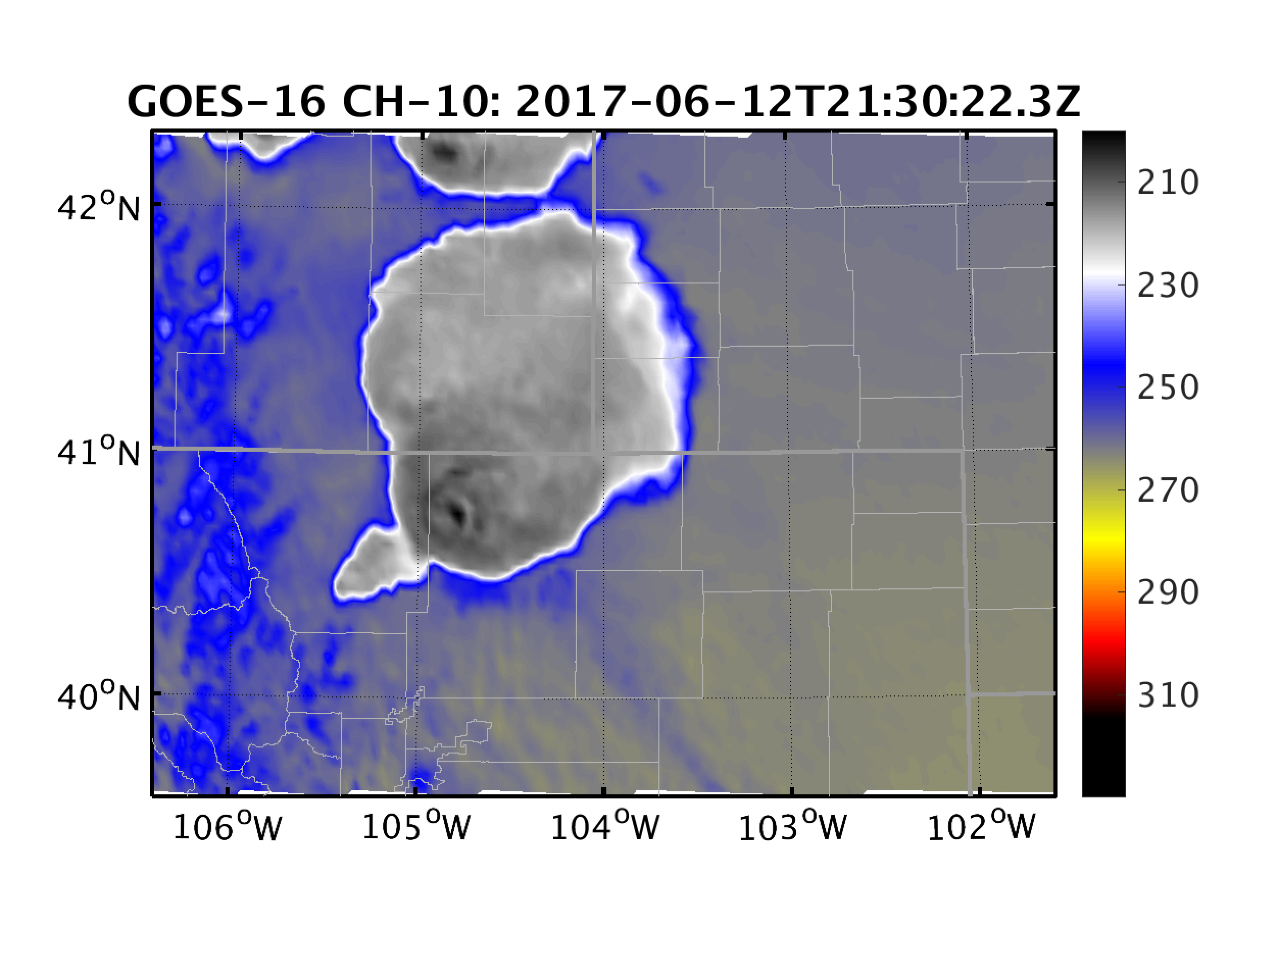
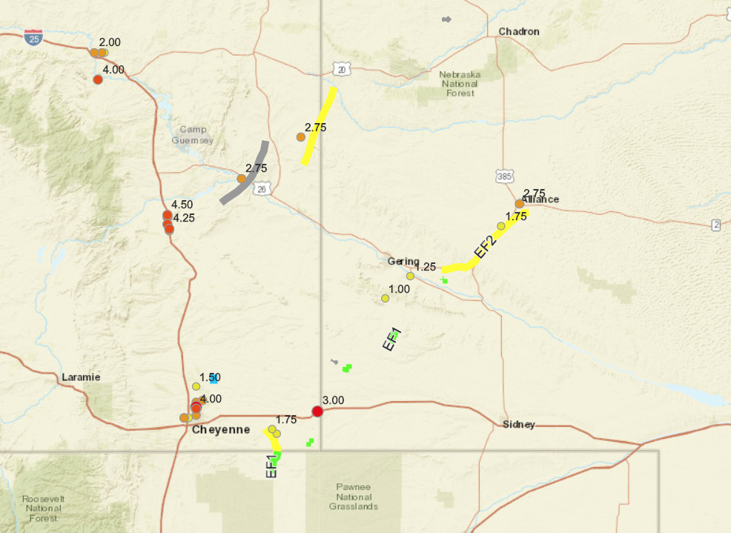
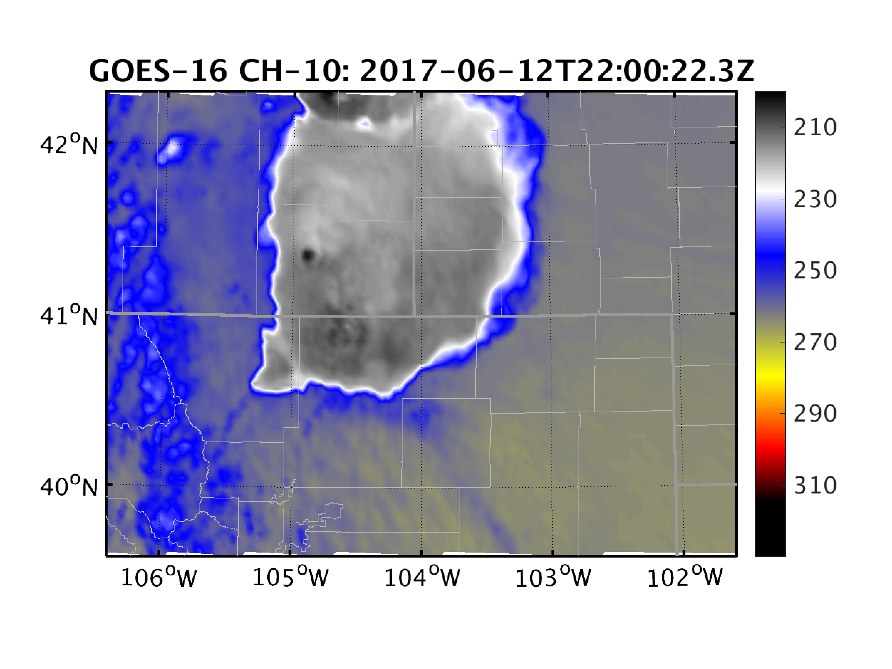
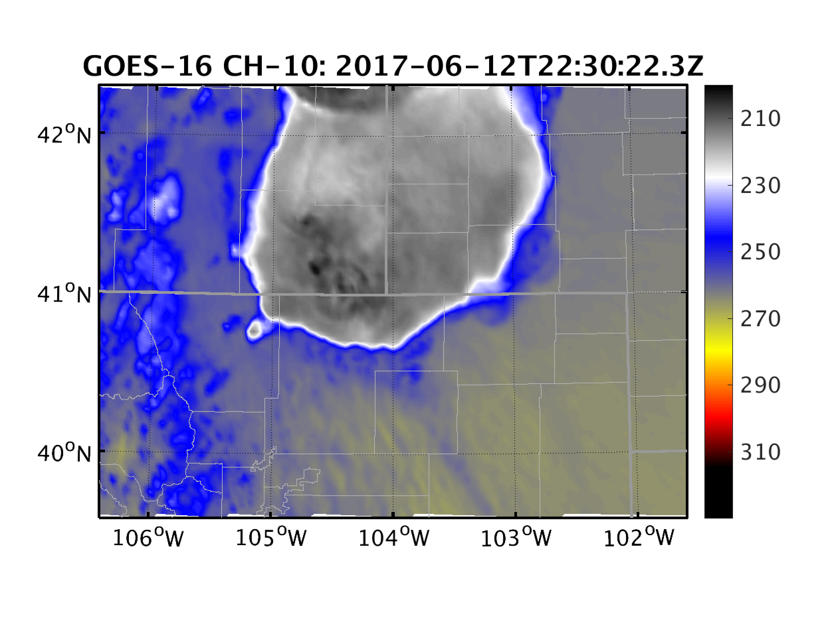
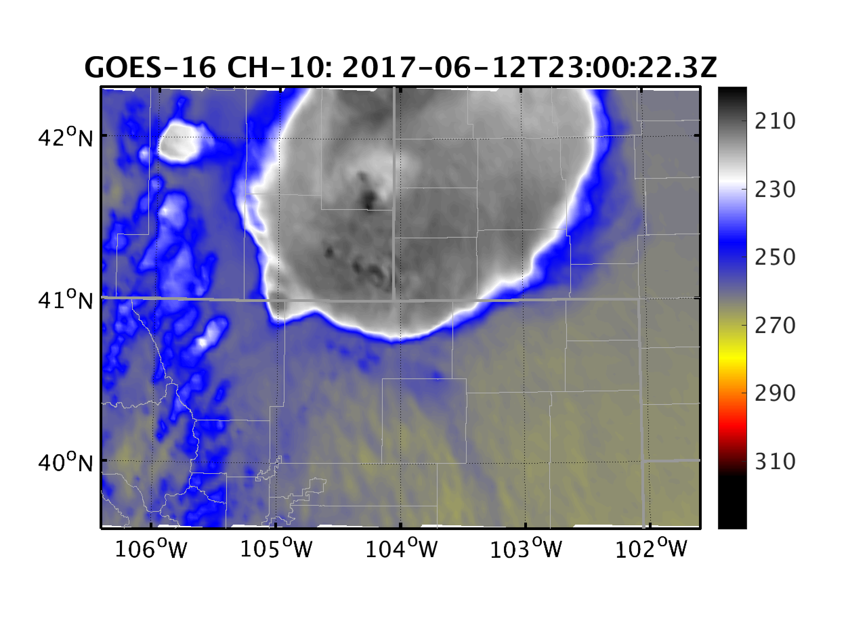
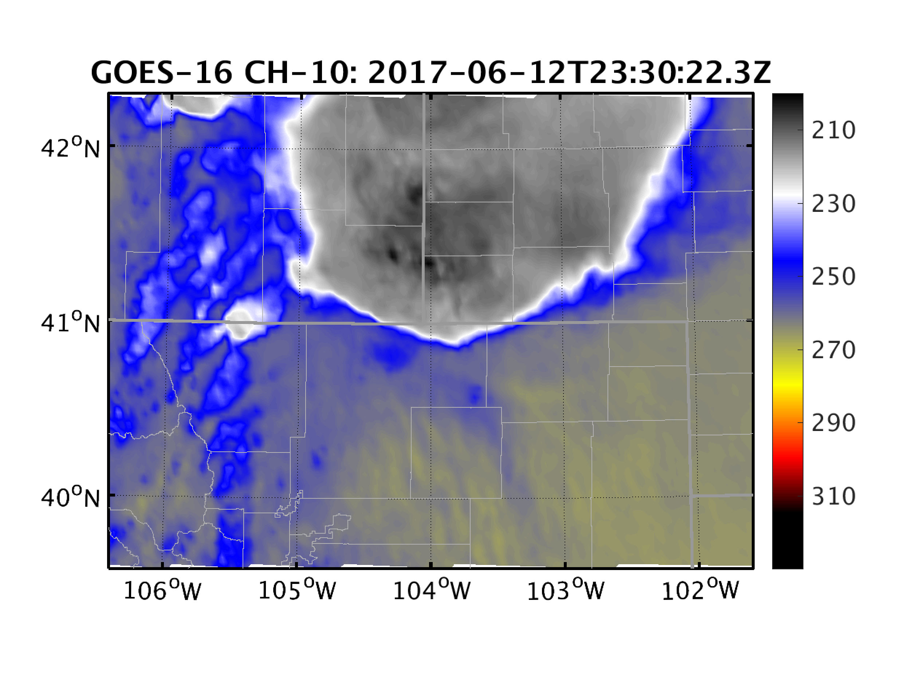
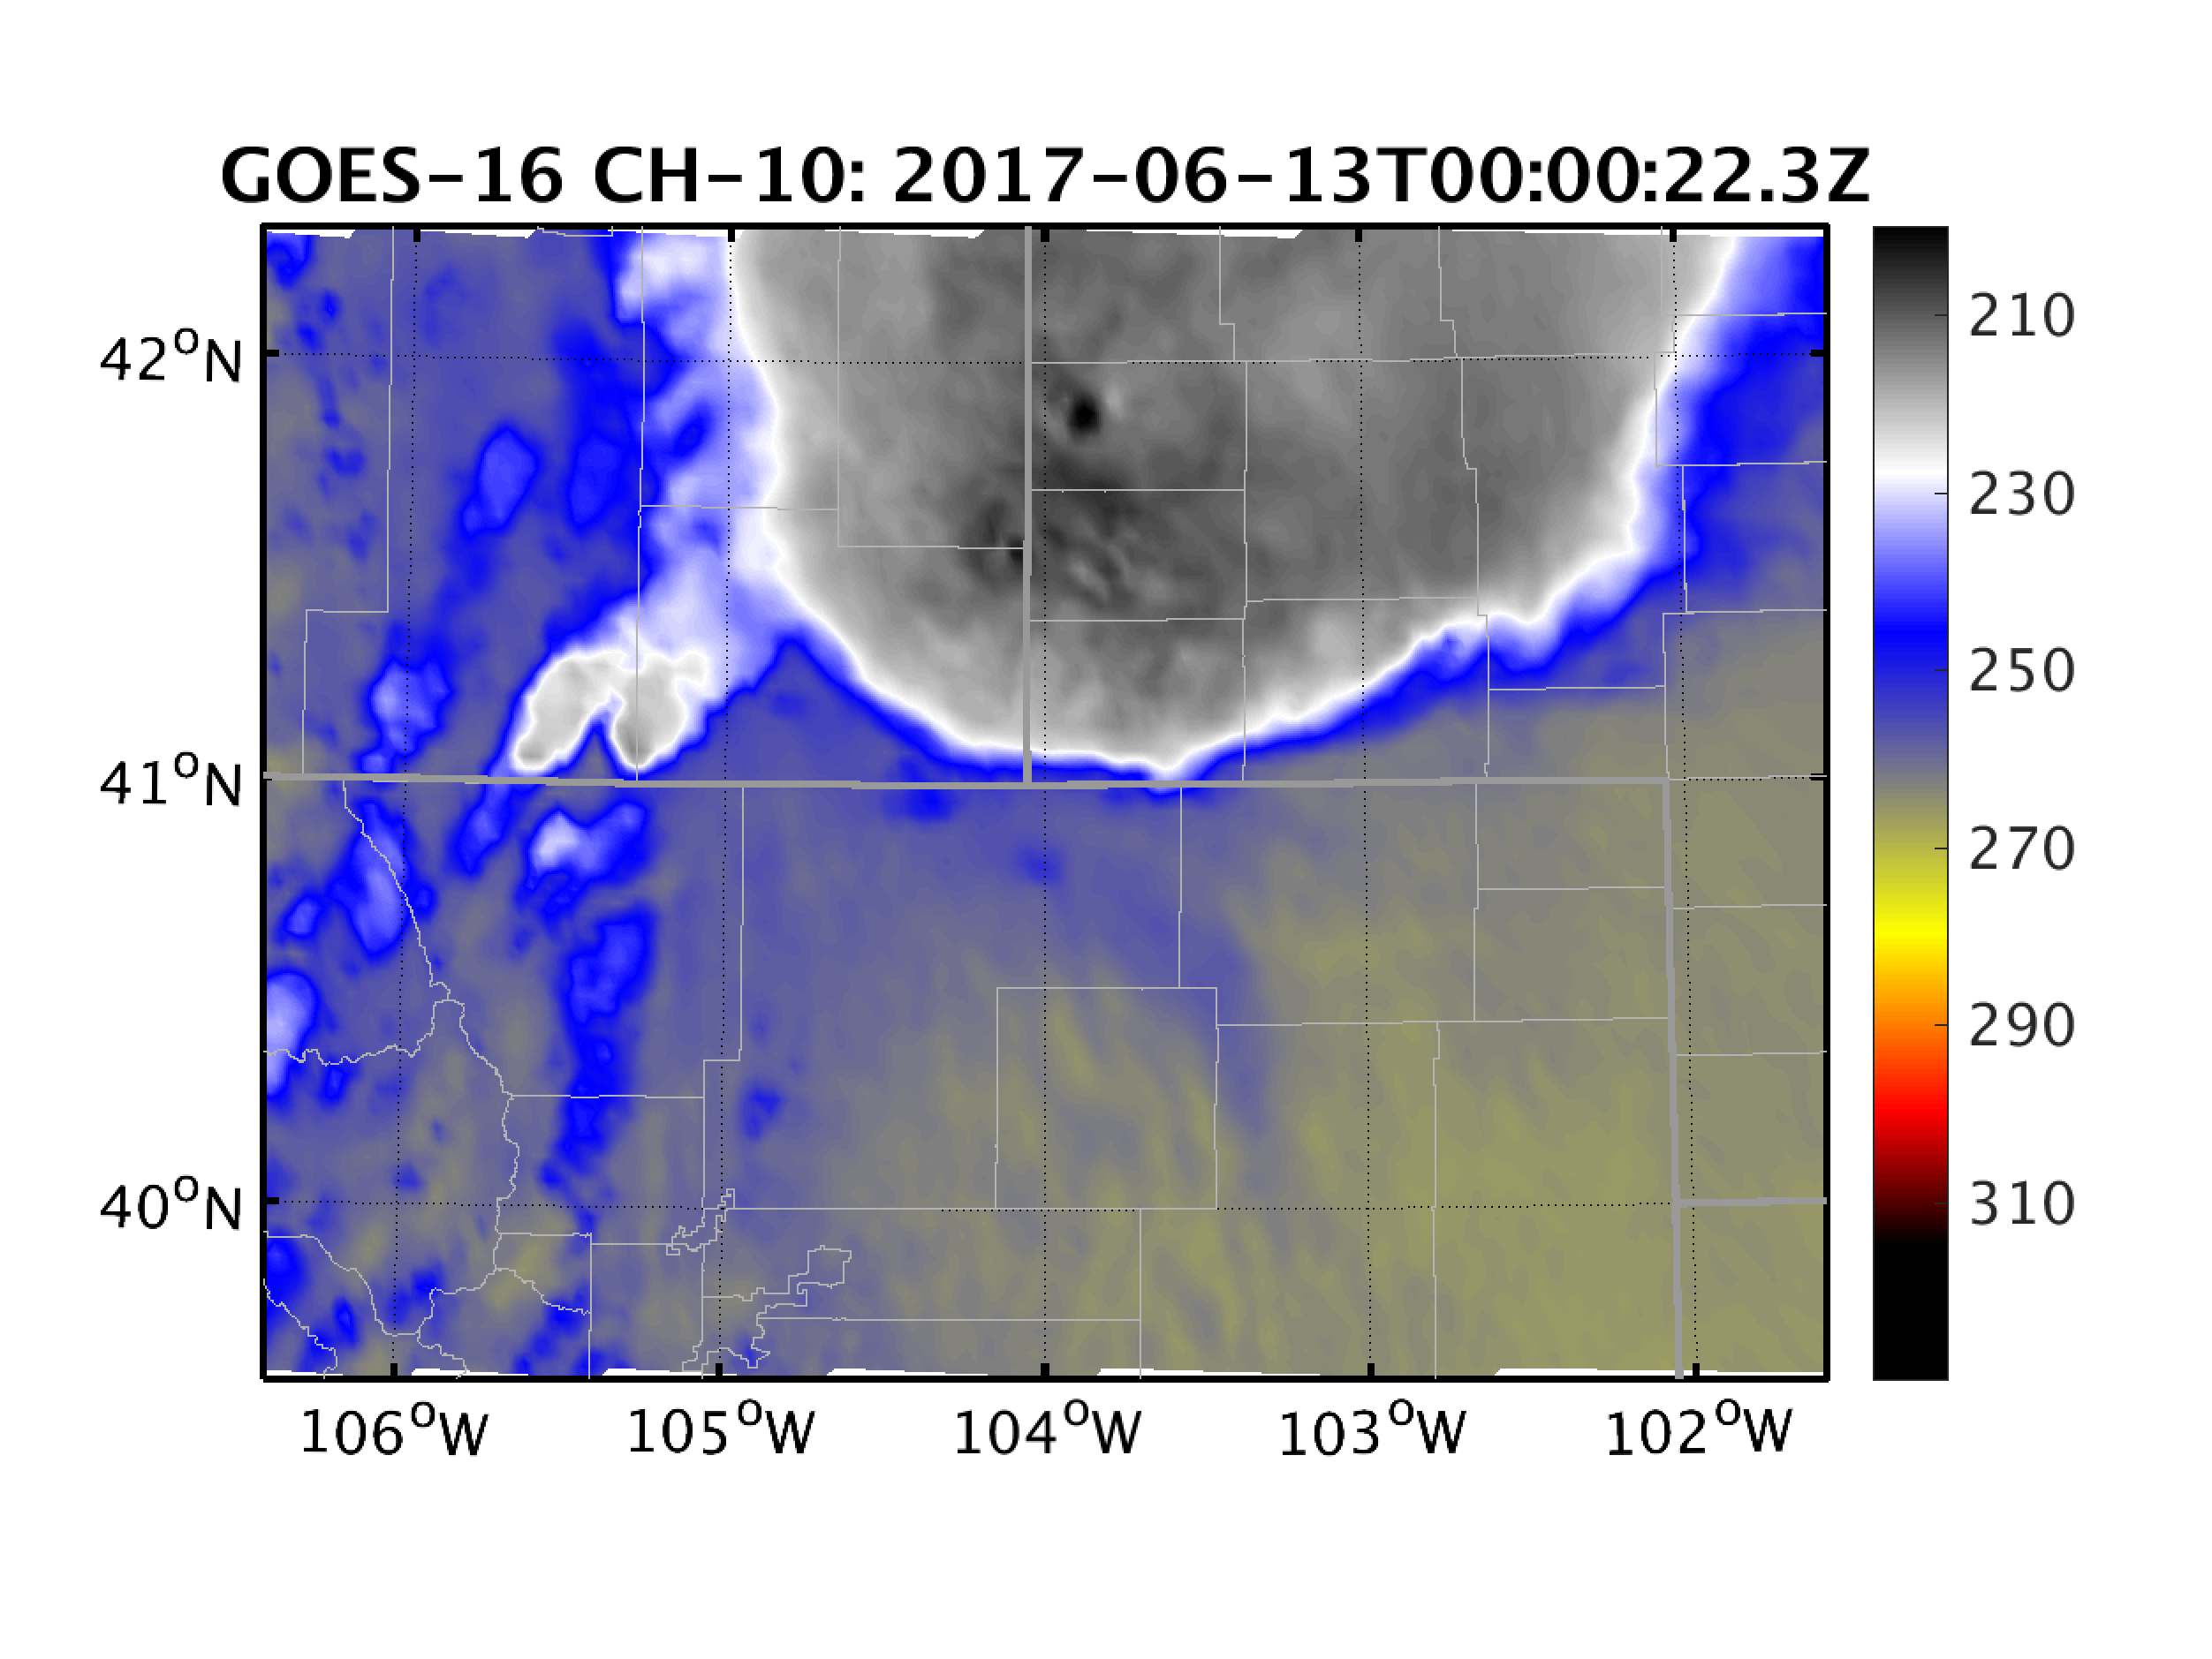
The June 12 WY-NE Severe Weather Outbreak
WPC Surface Analysis 18Z
SPC Storm Reports
(No parallax error in this set of observations??)

Slide 5
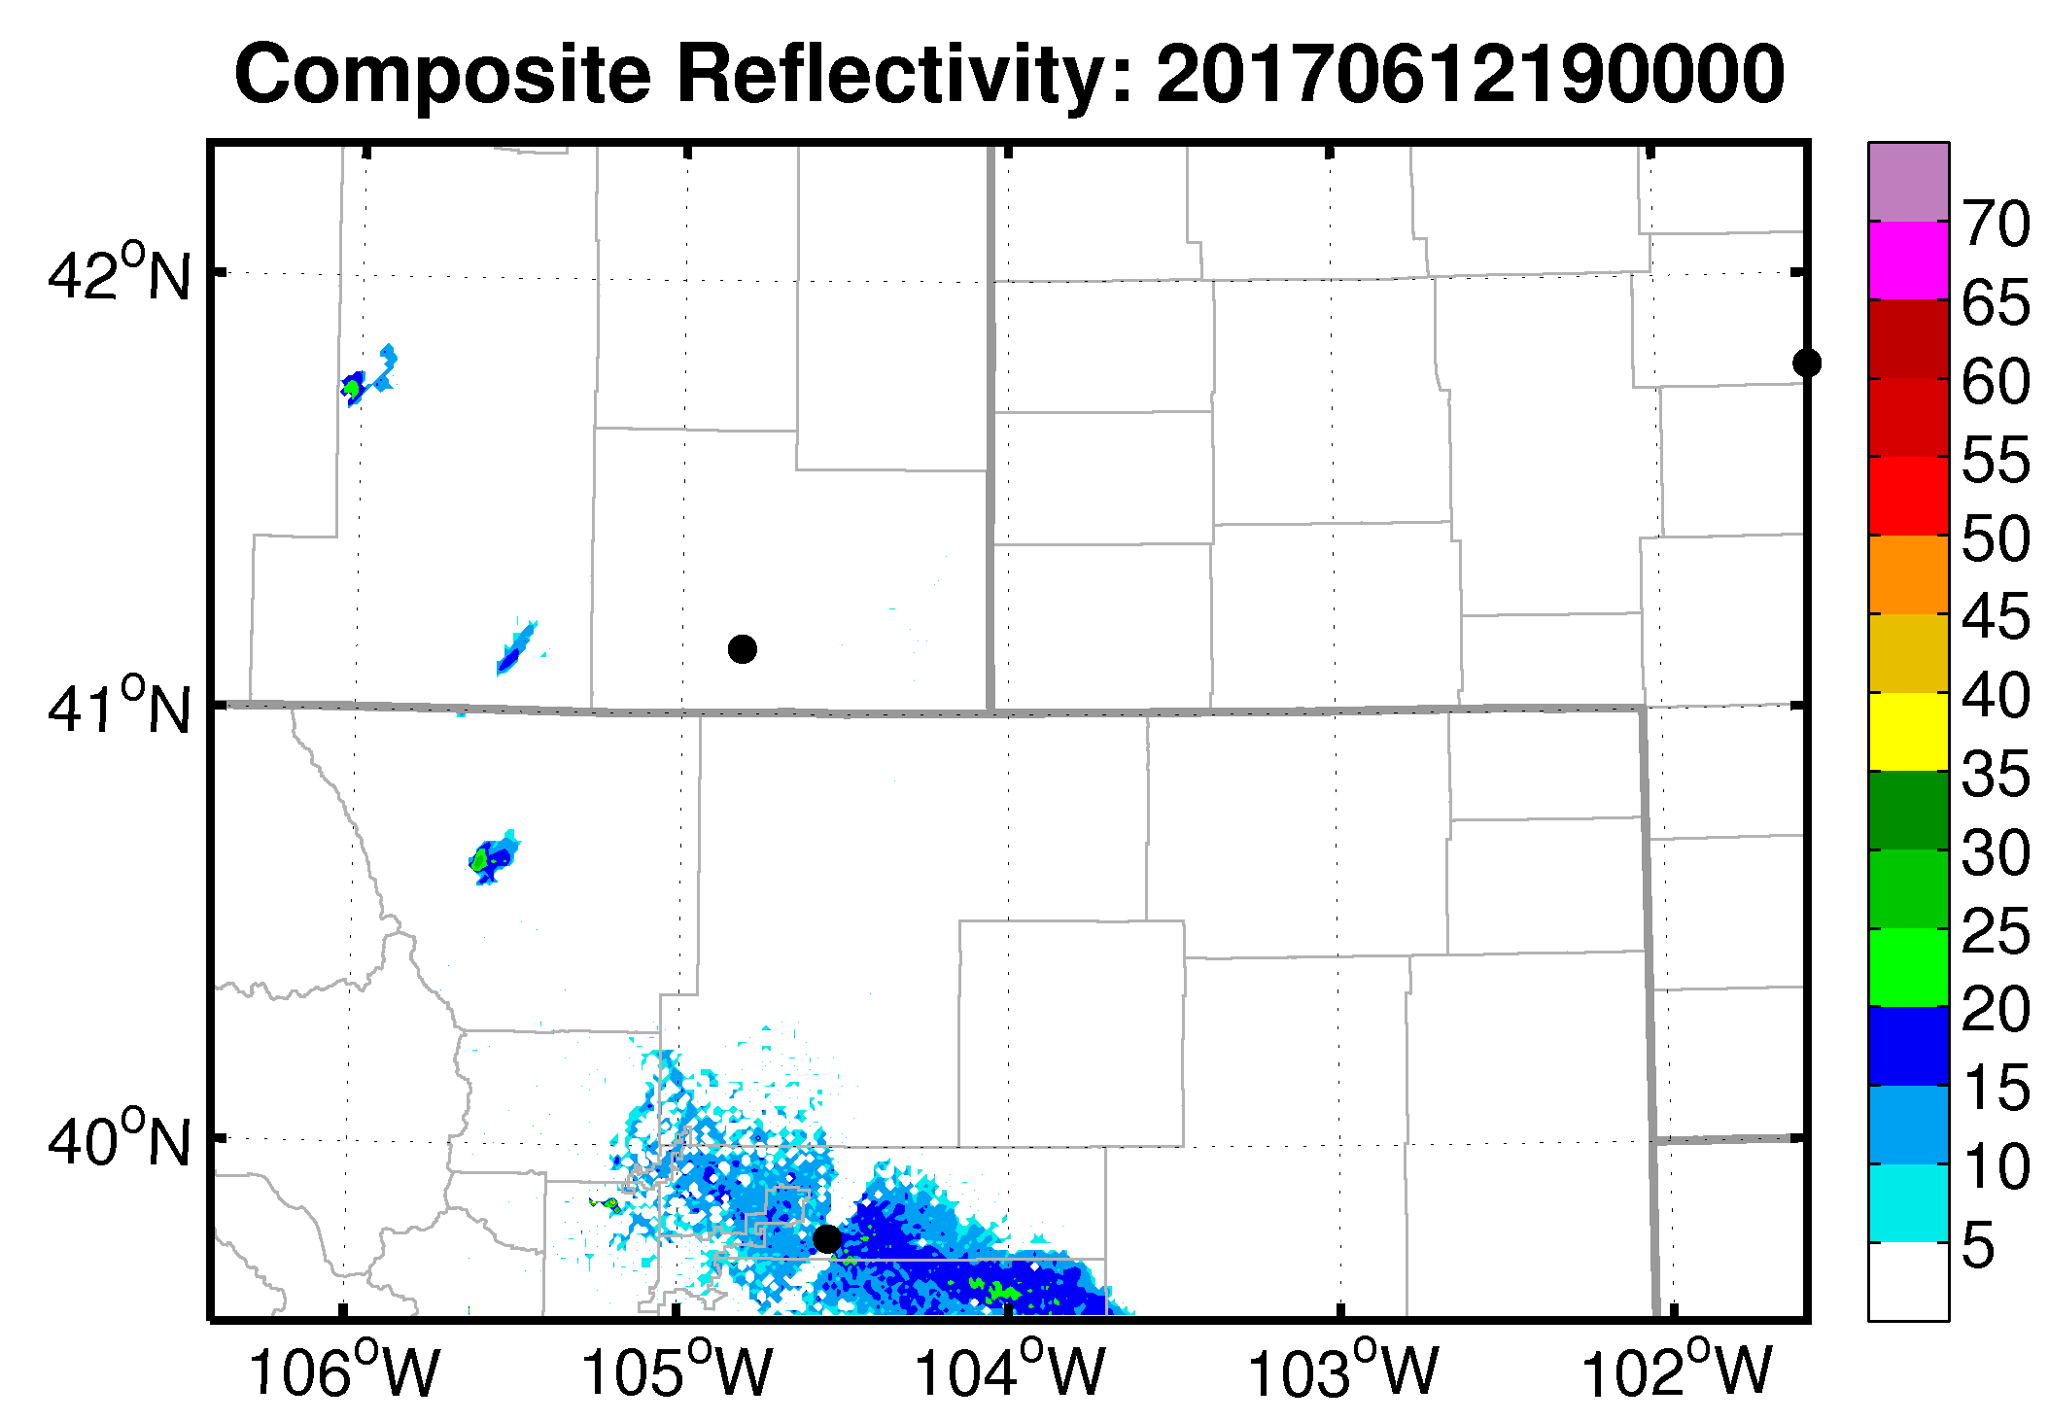
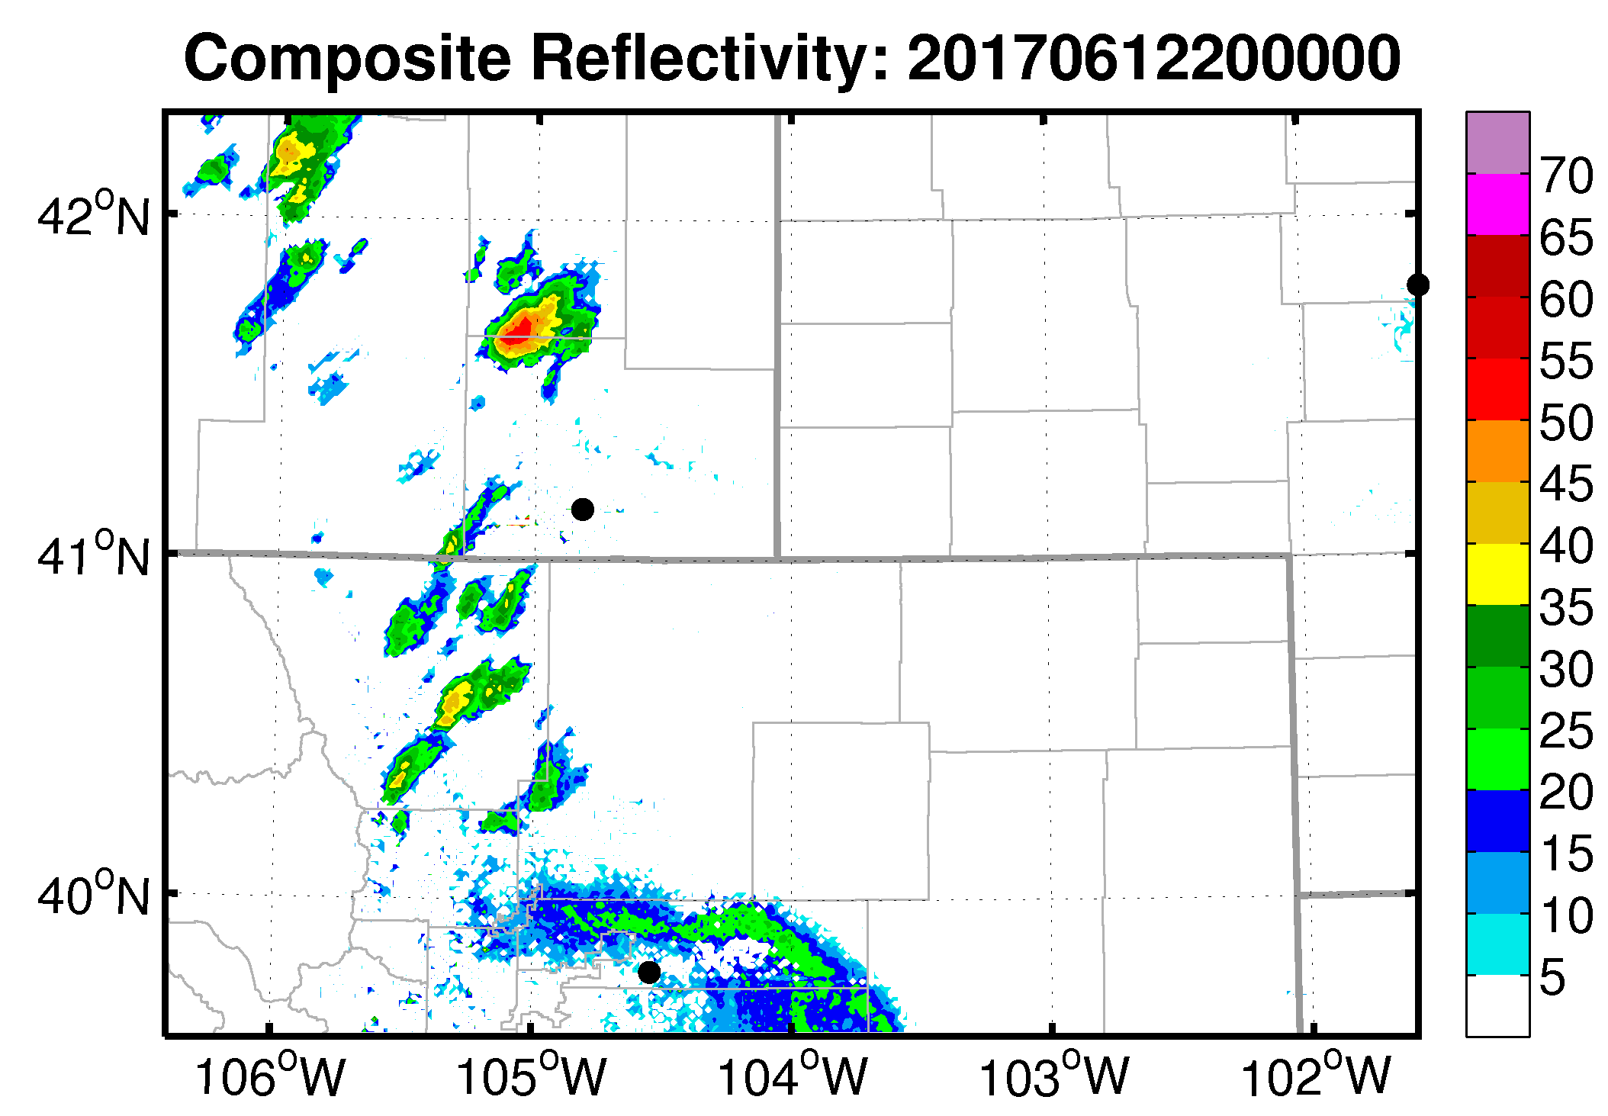
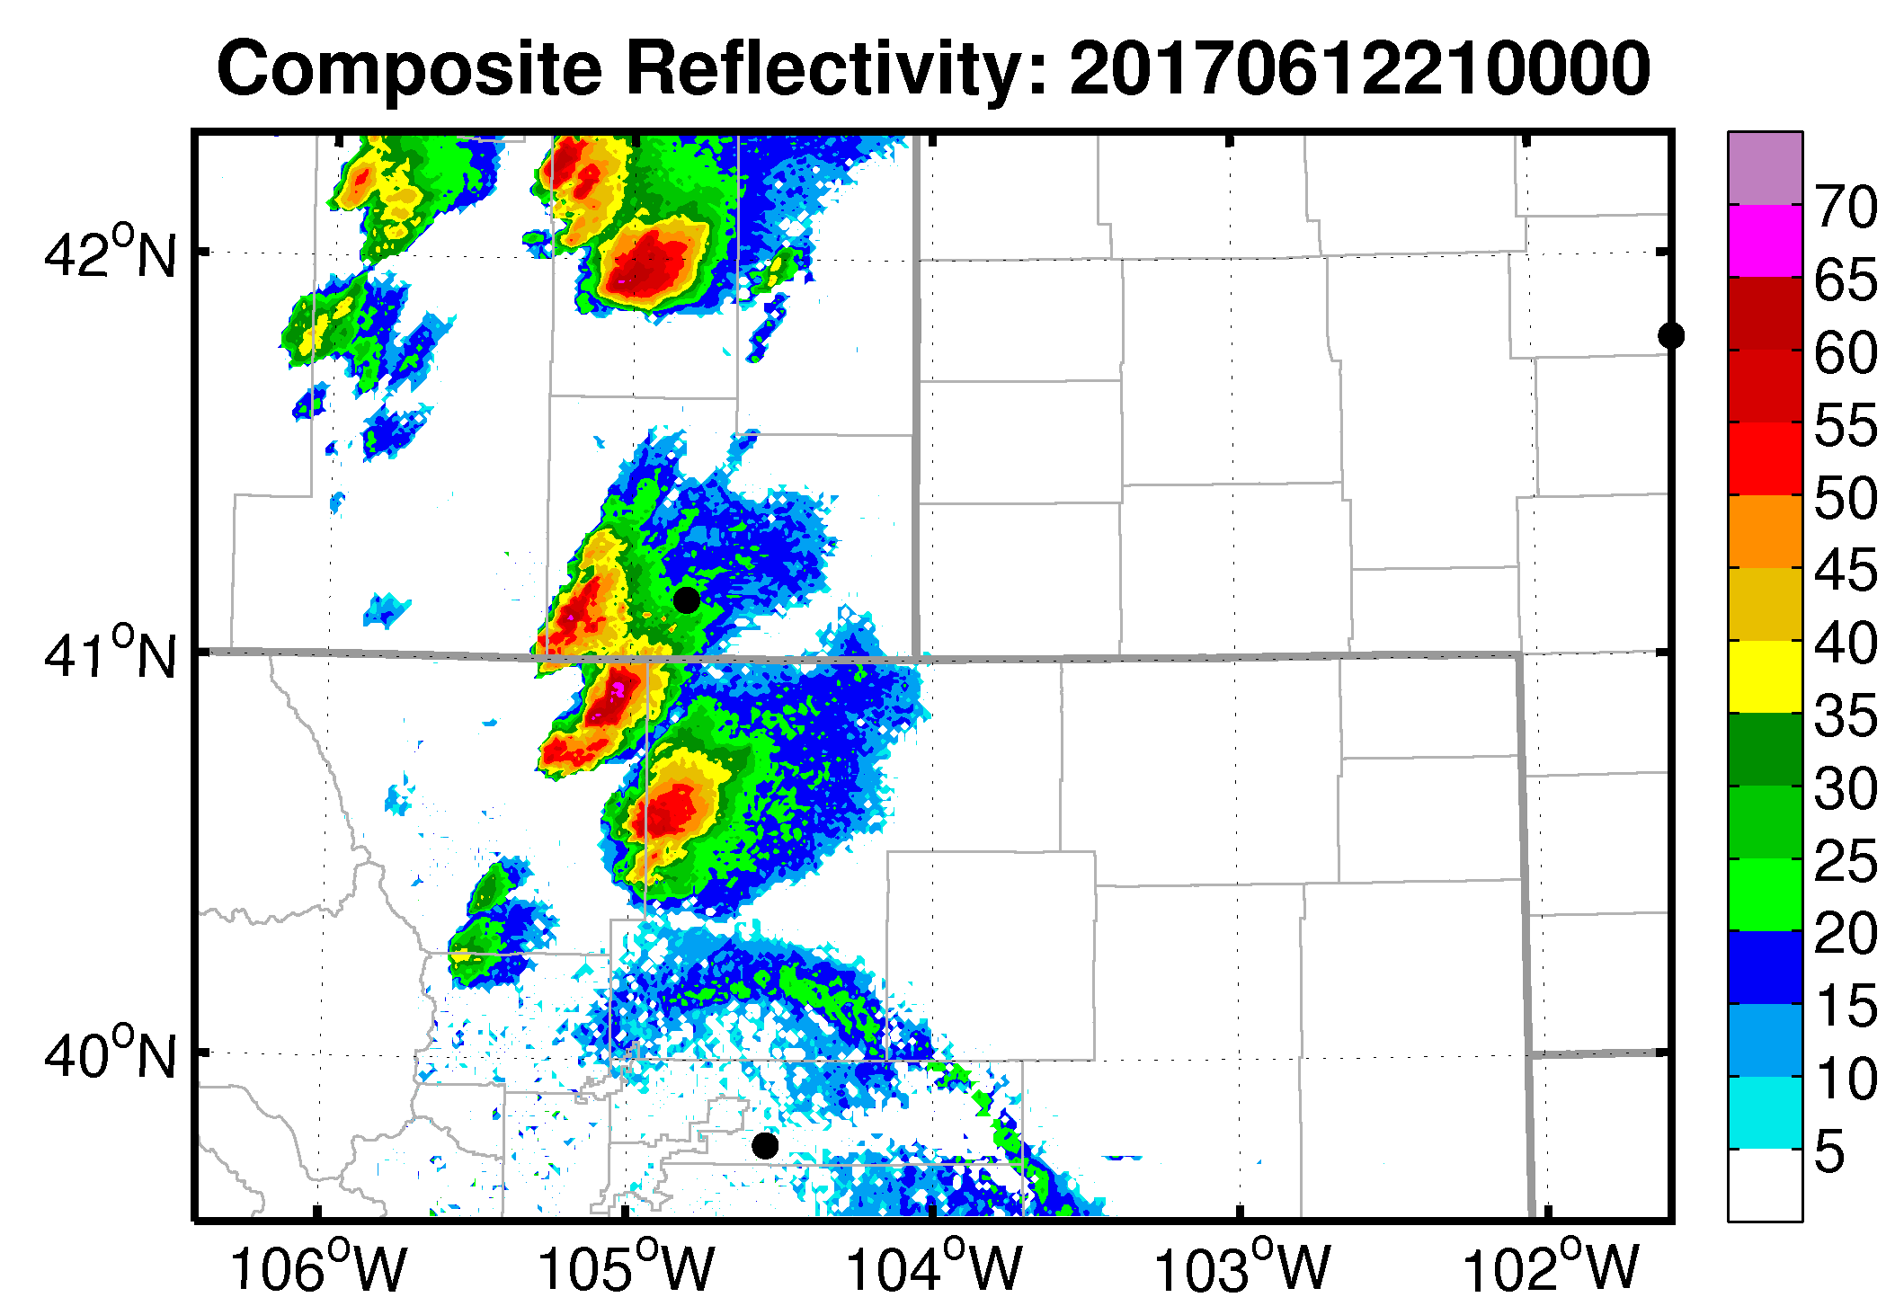
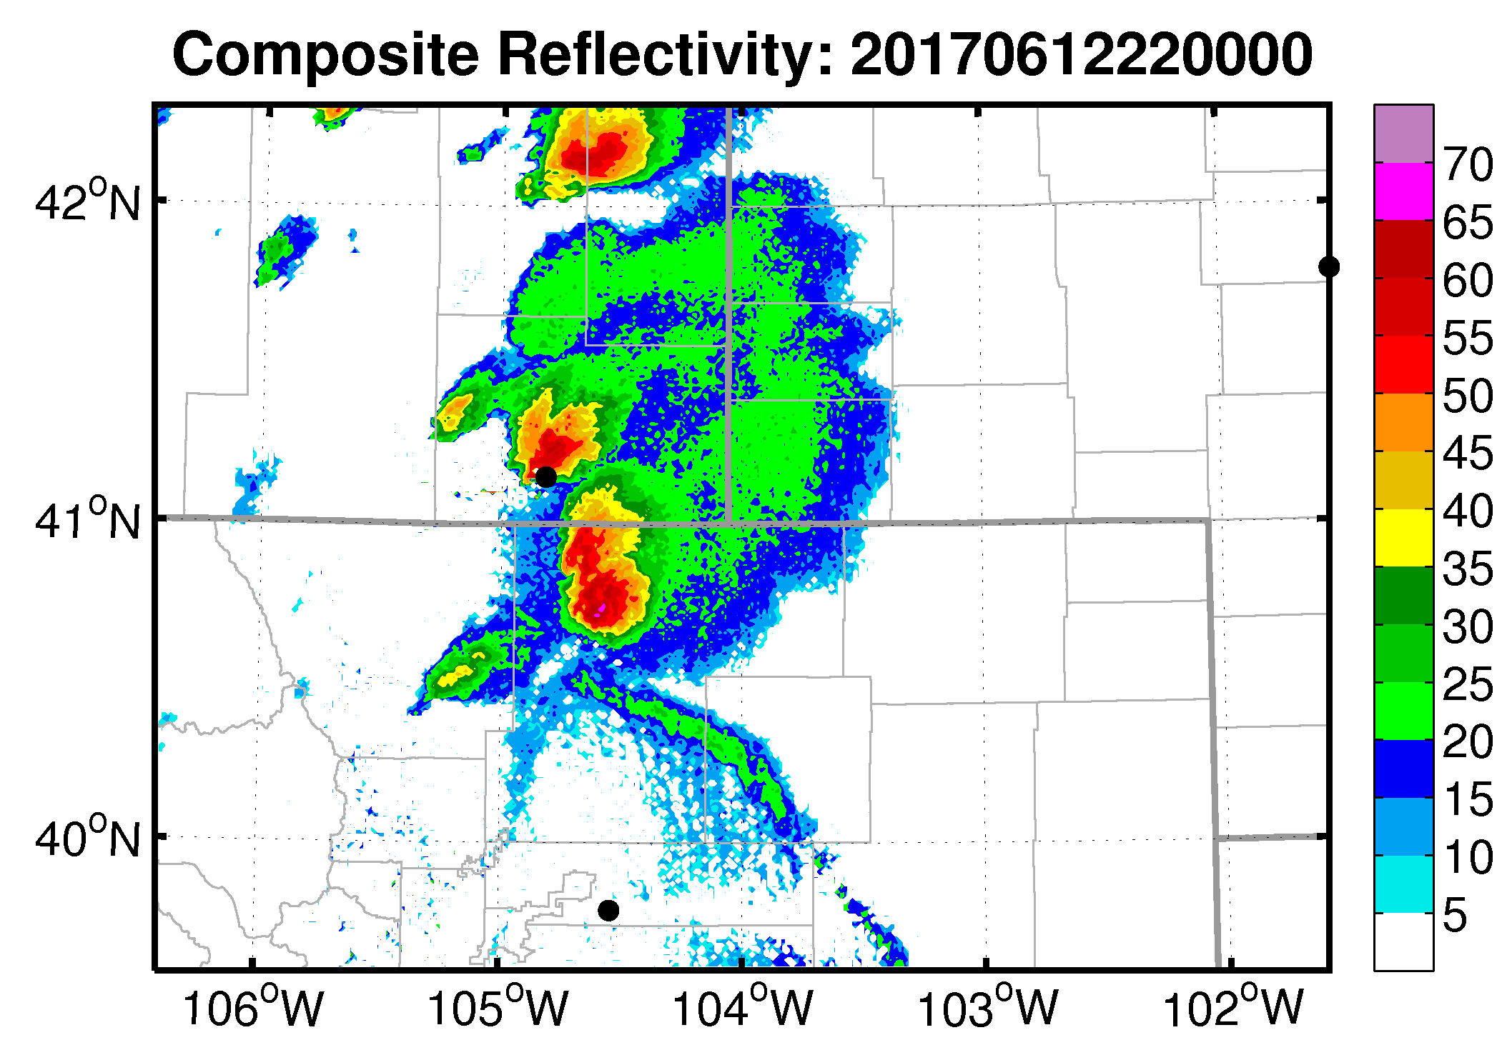
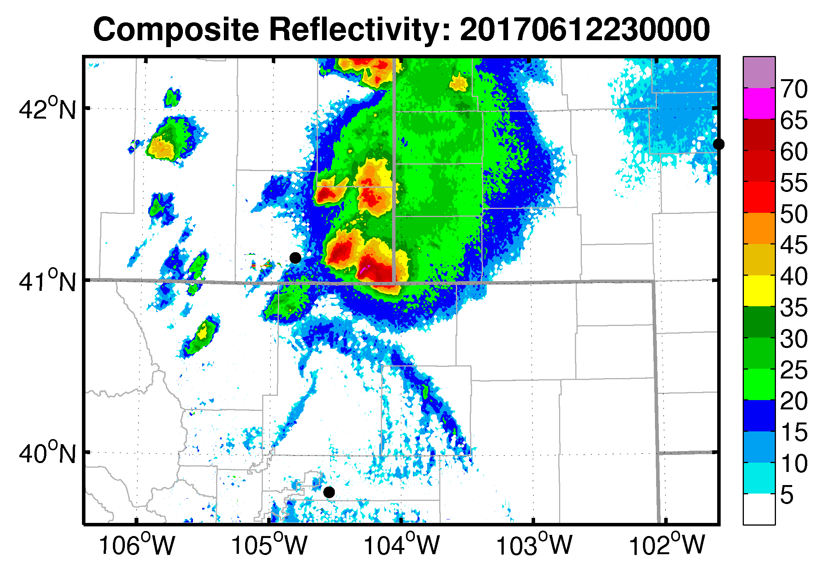
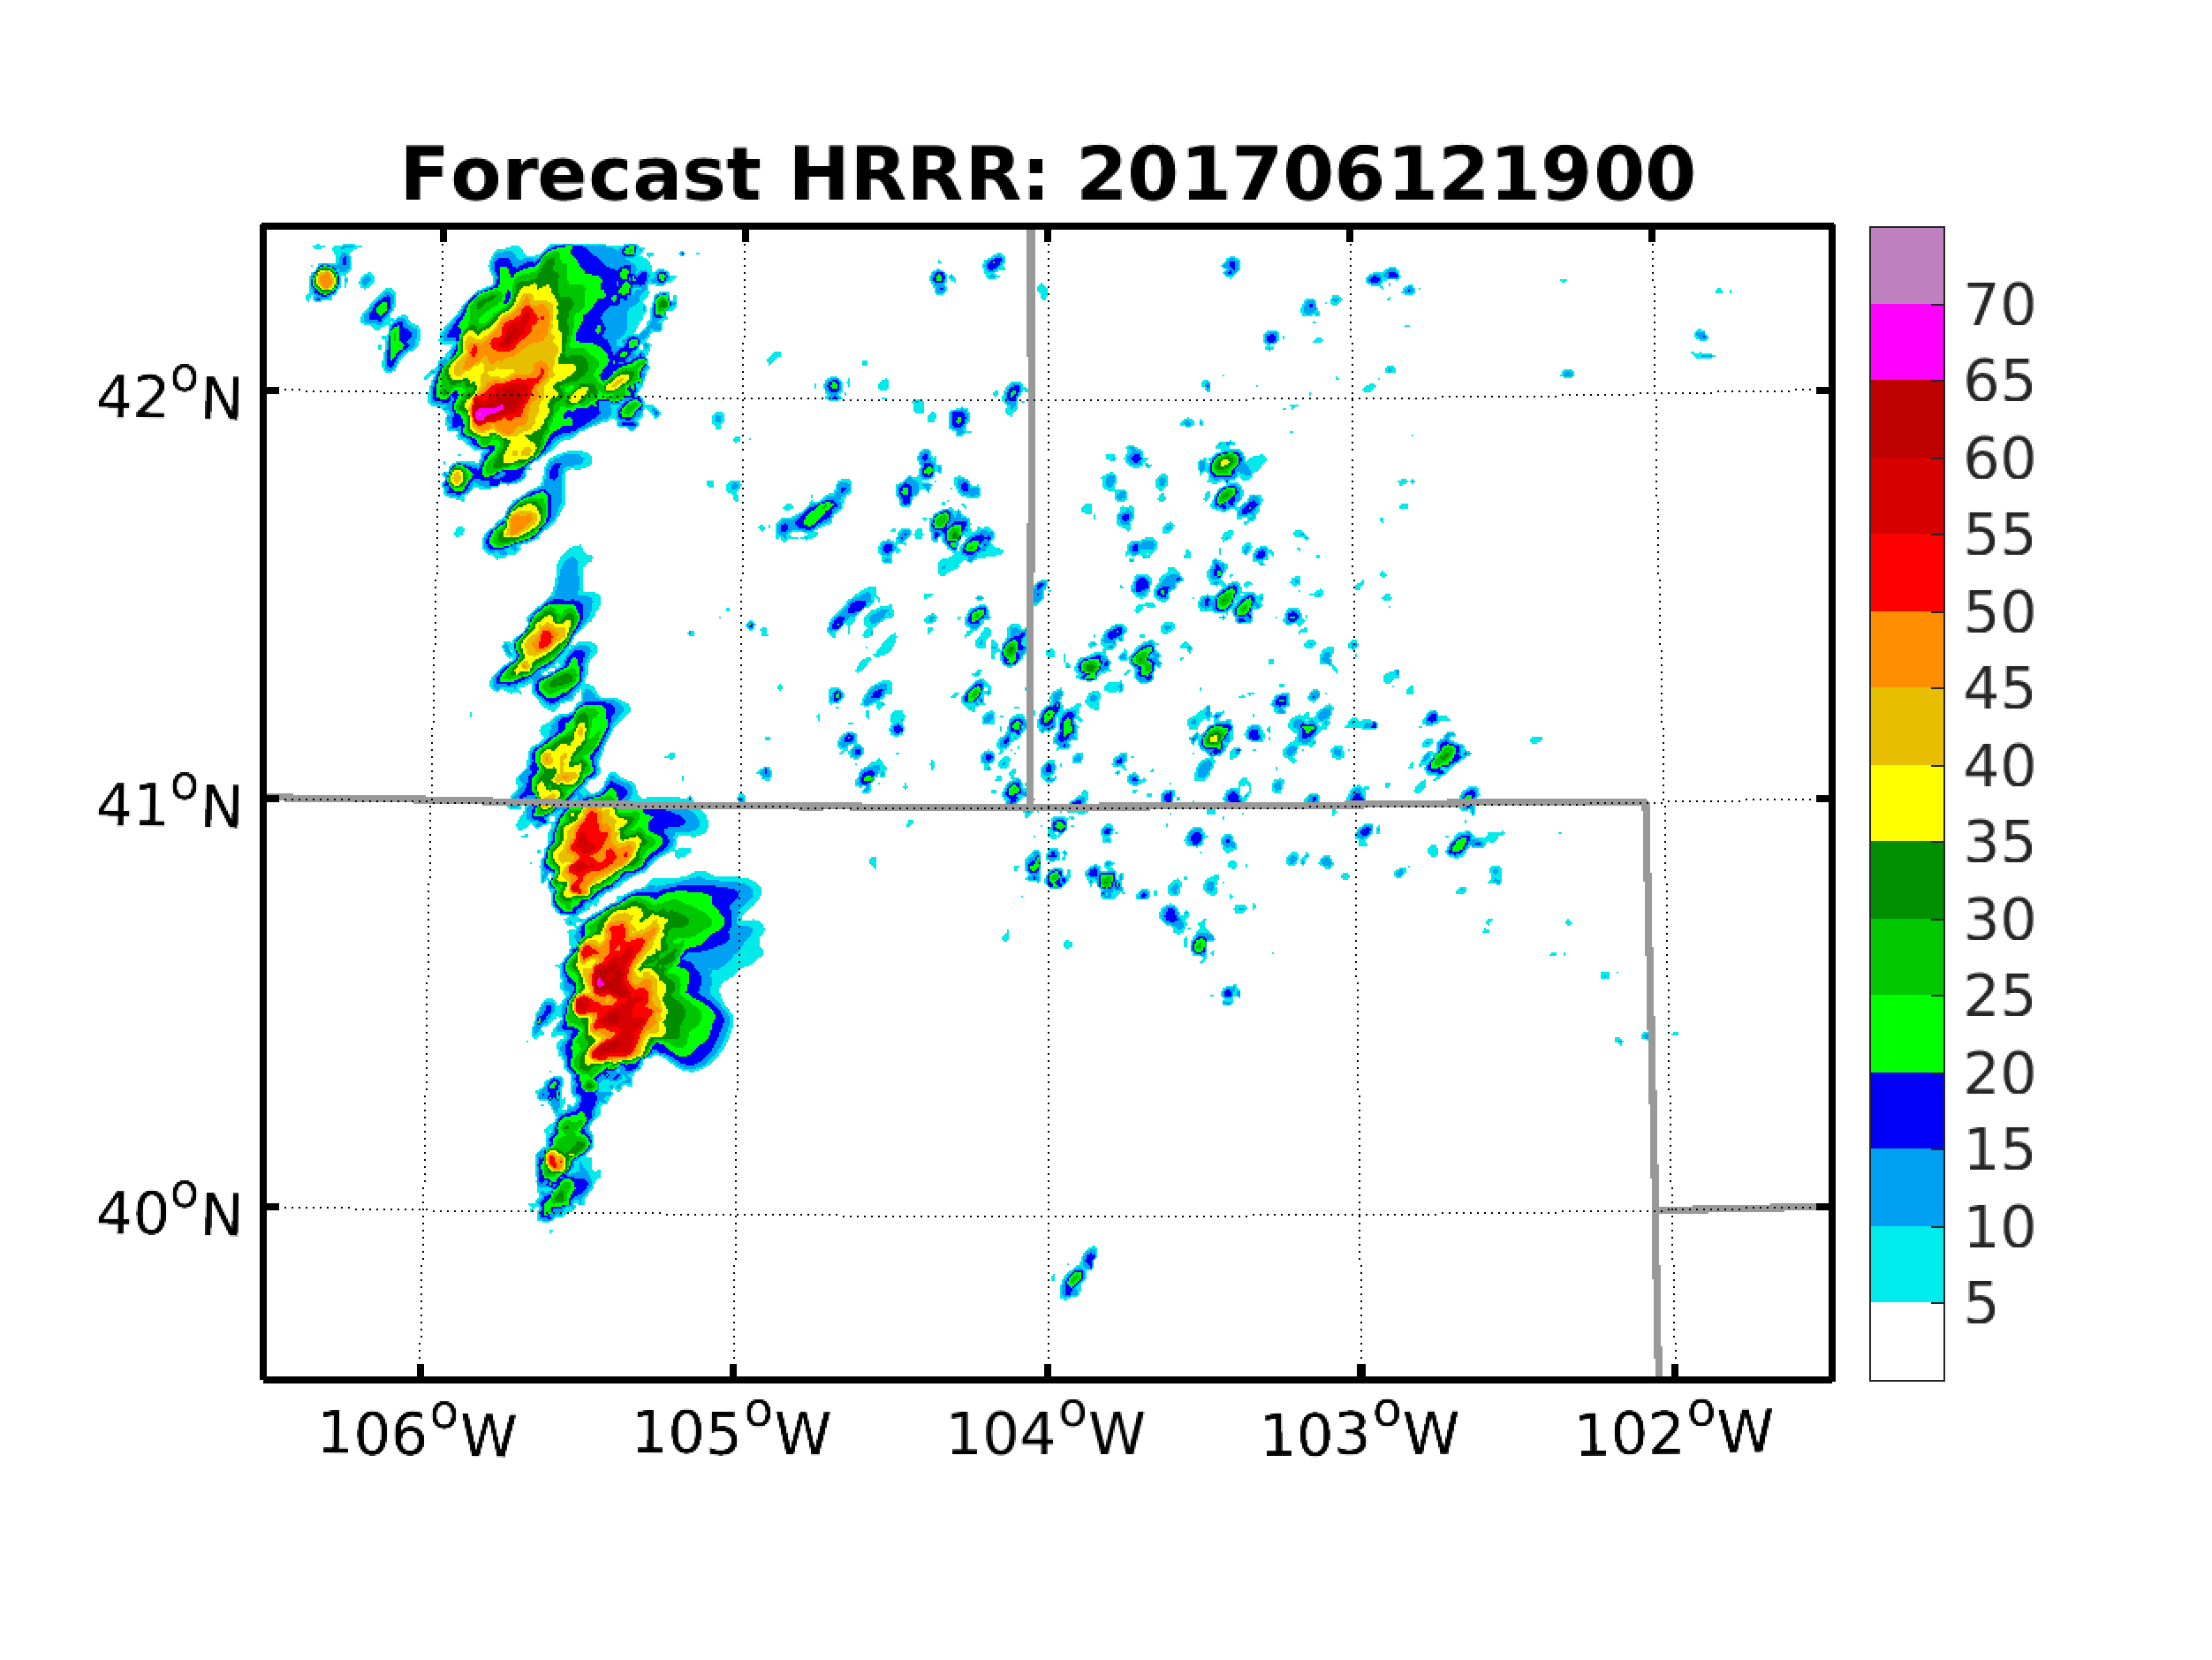
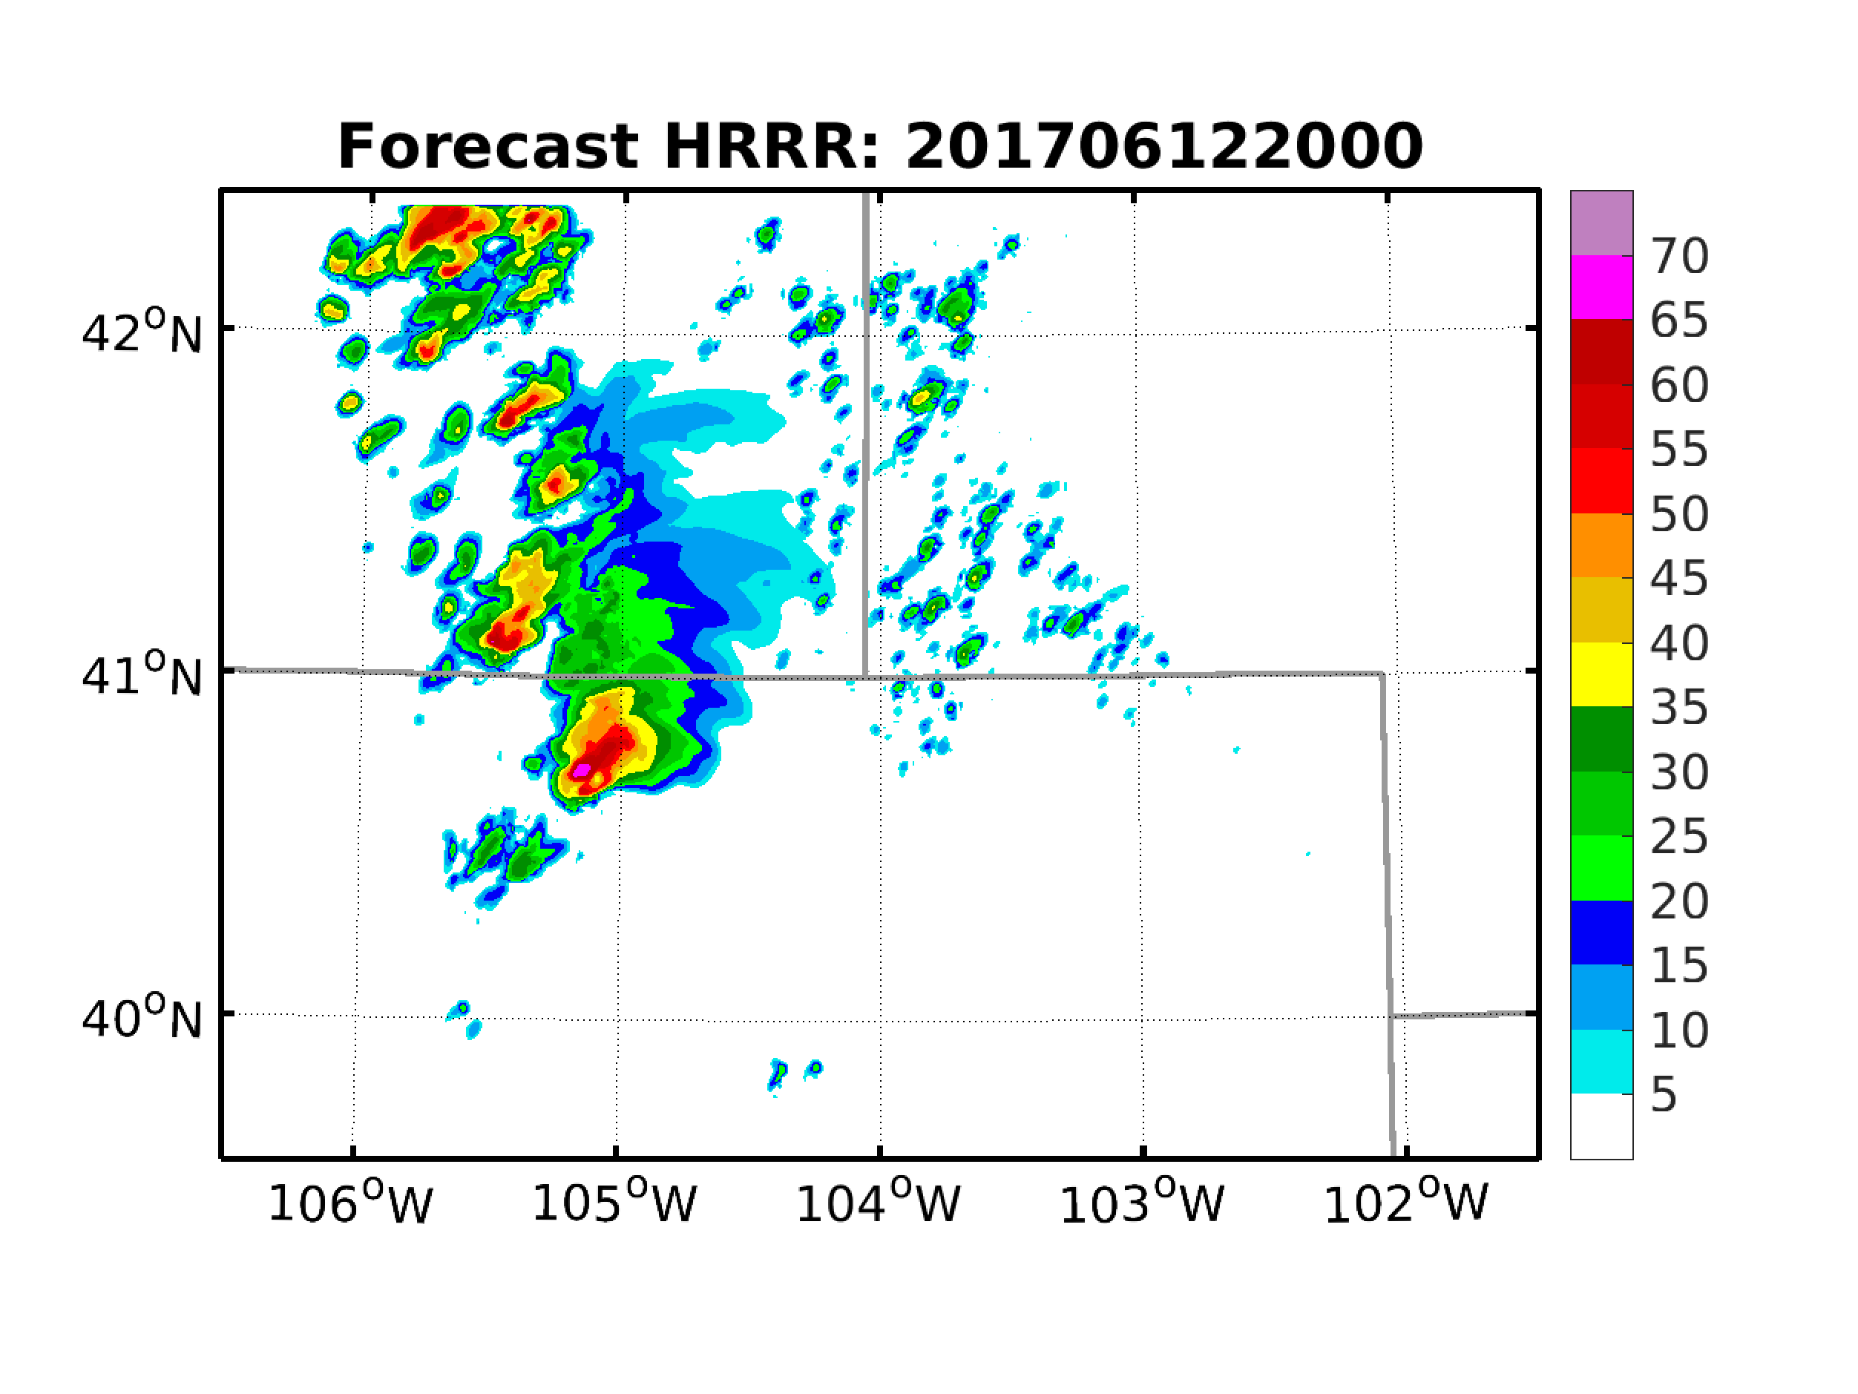
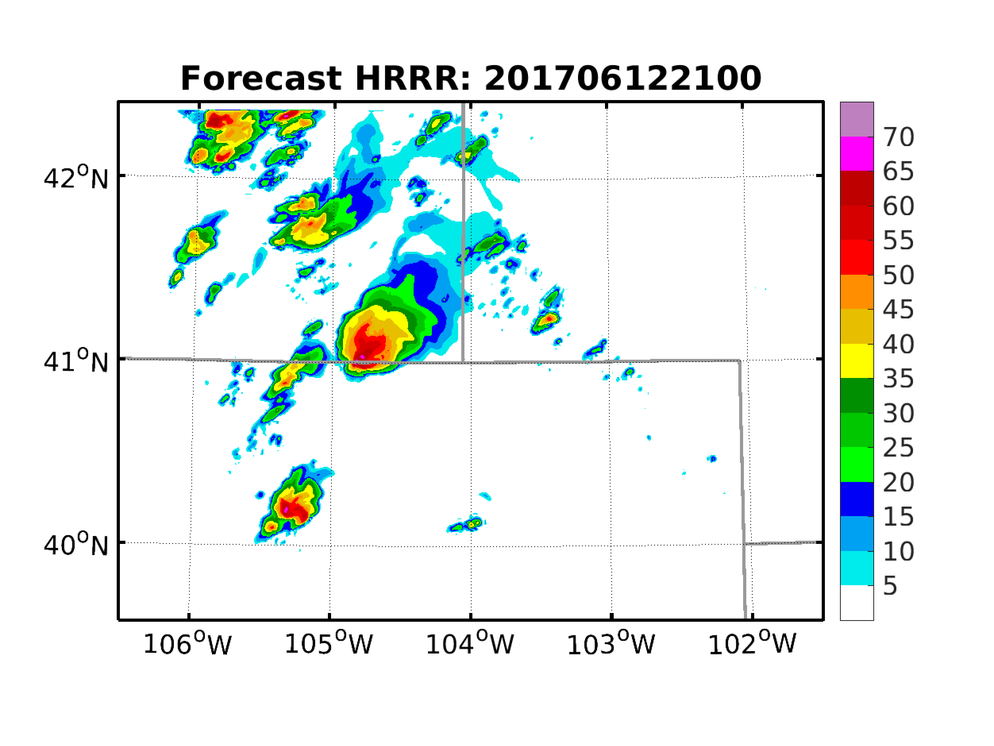
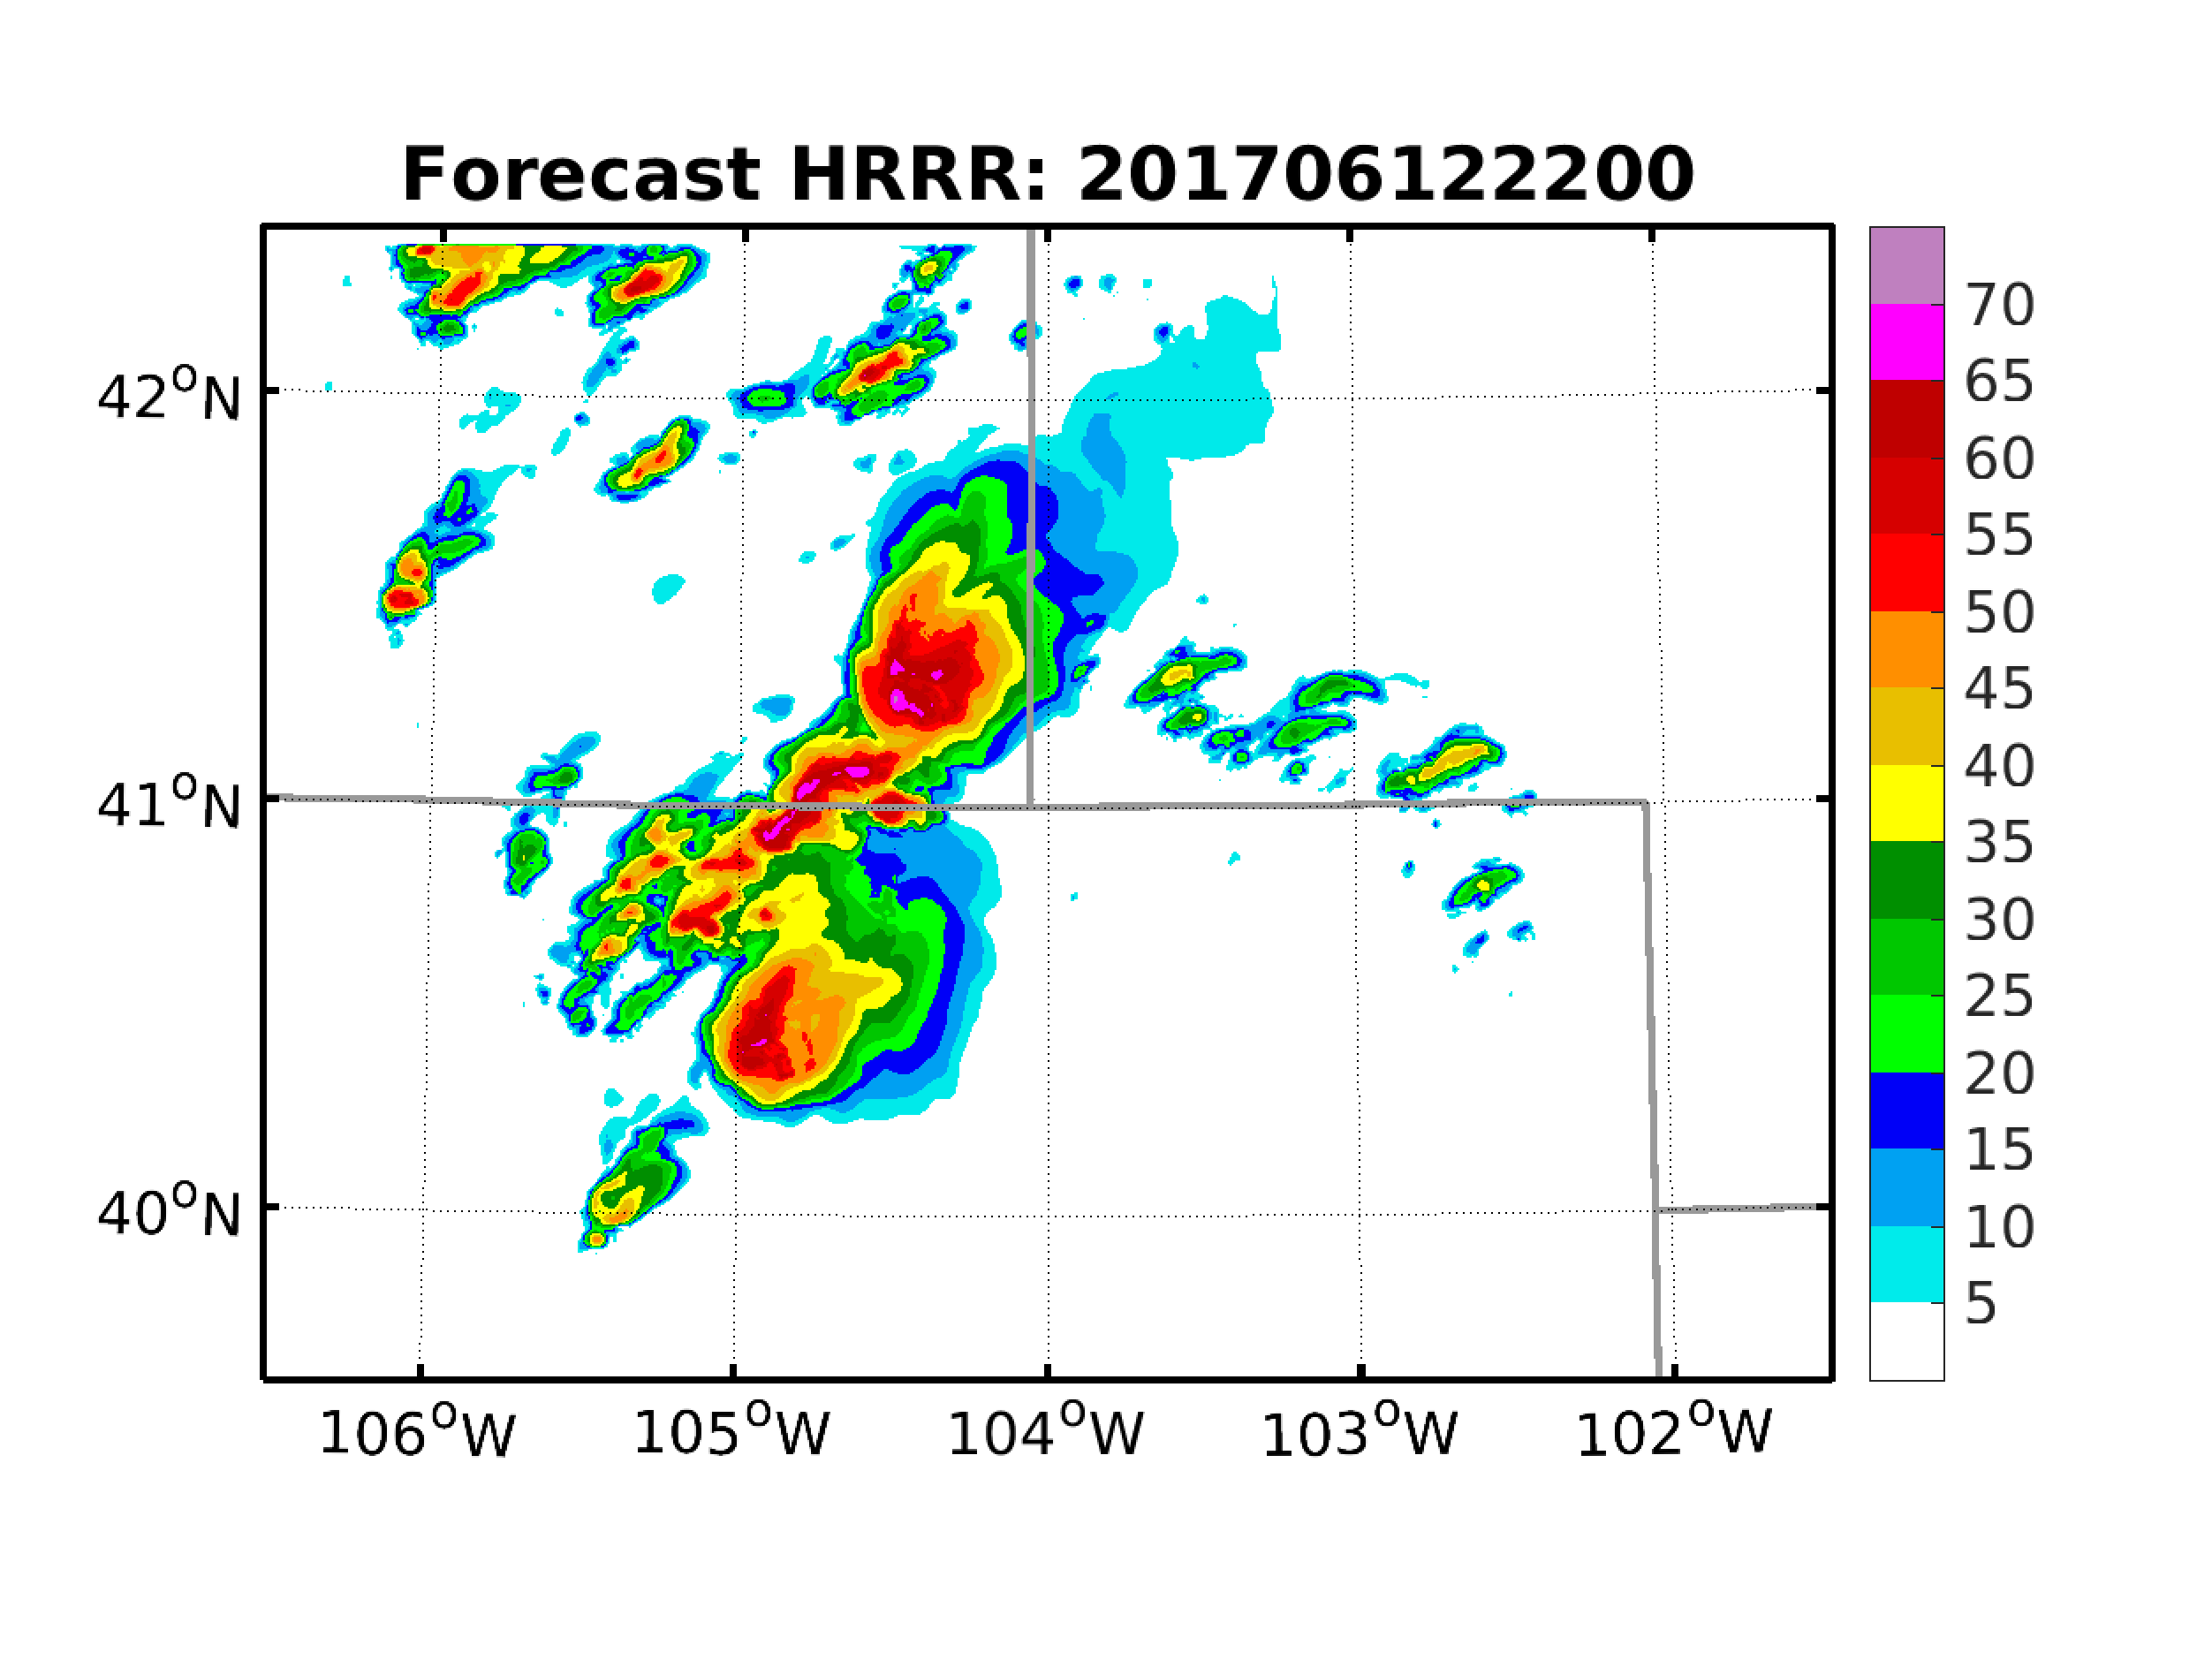
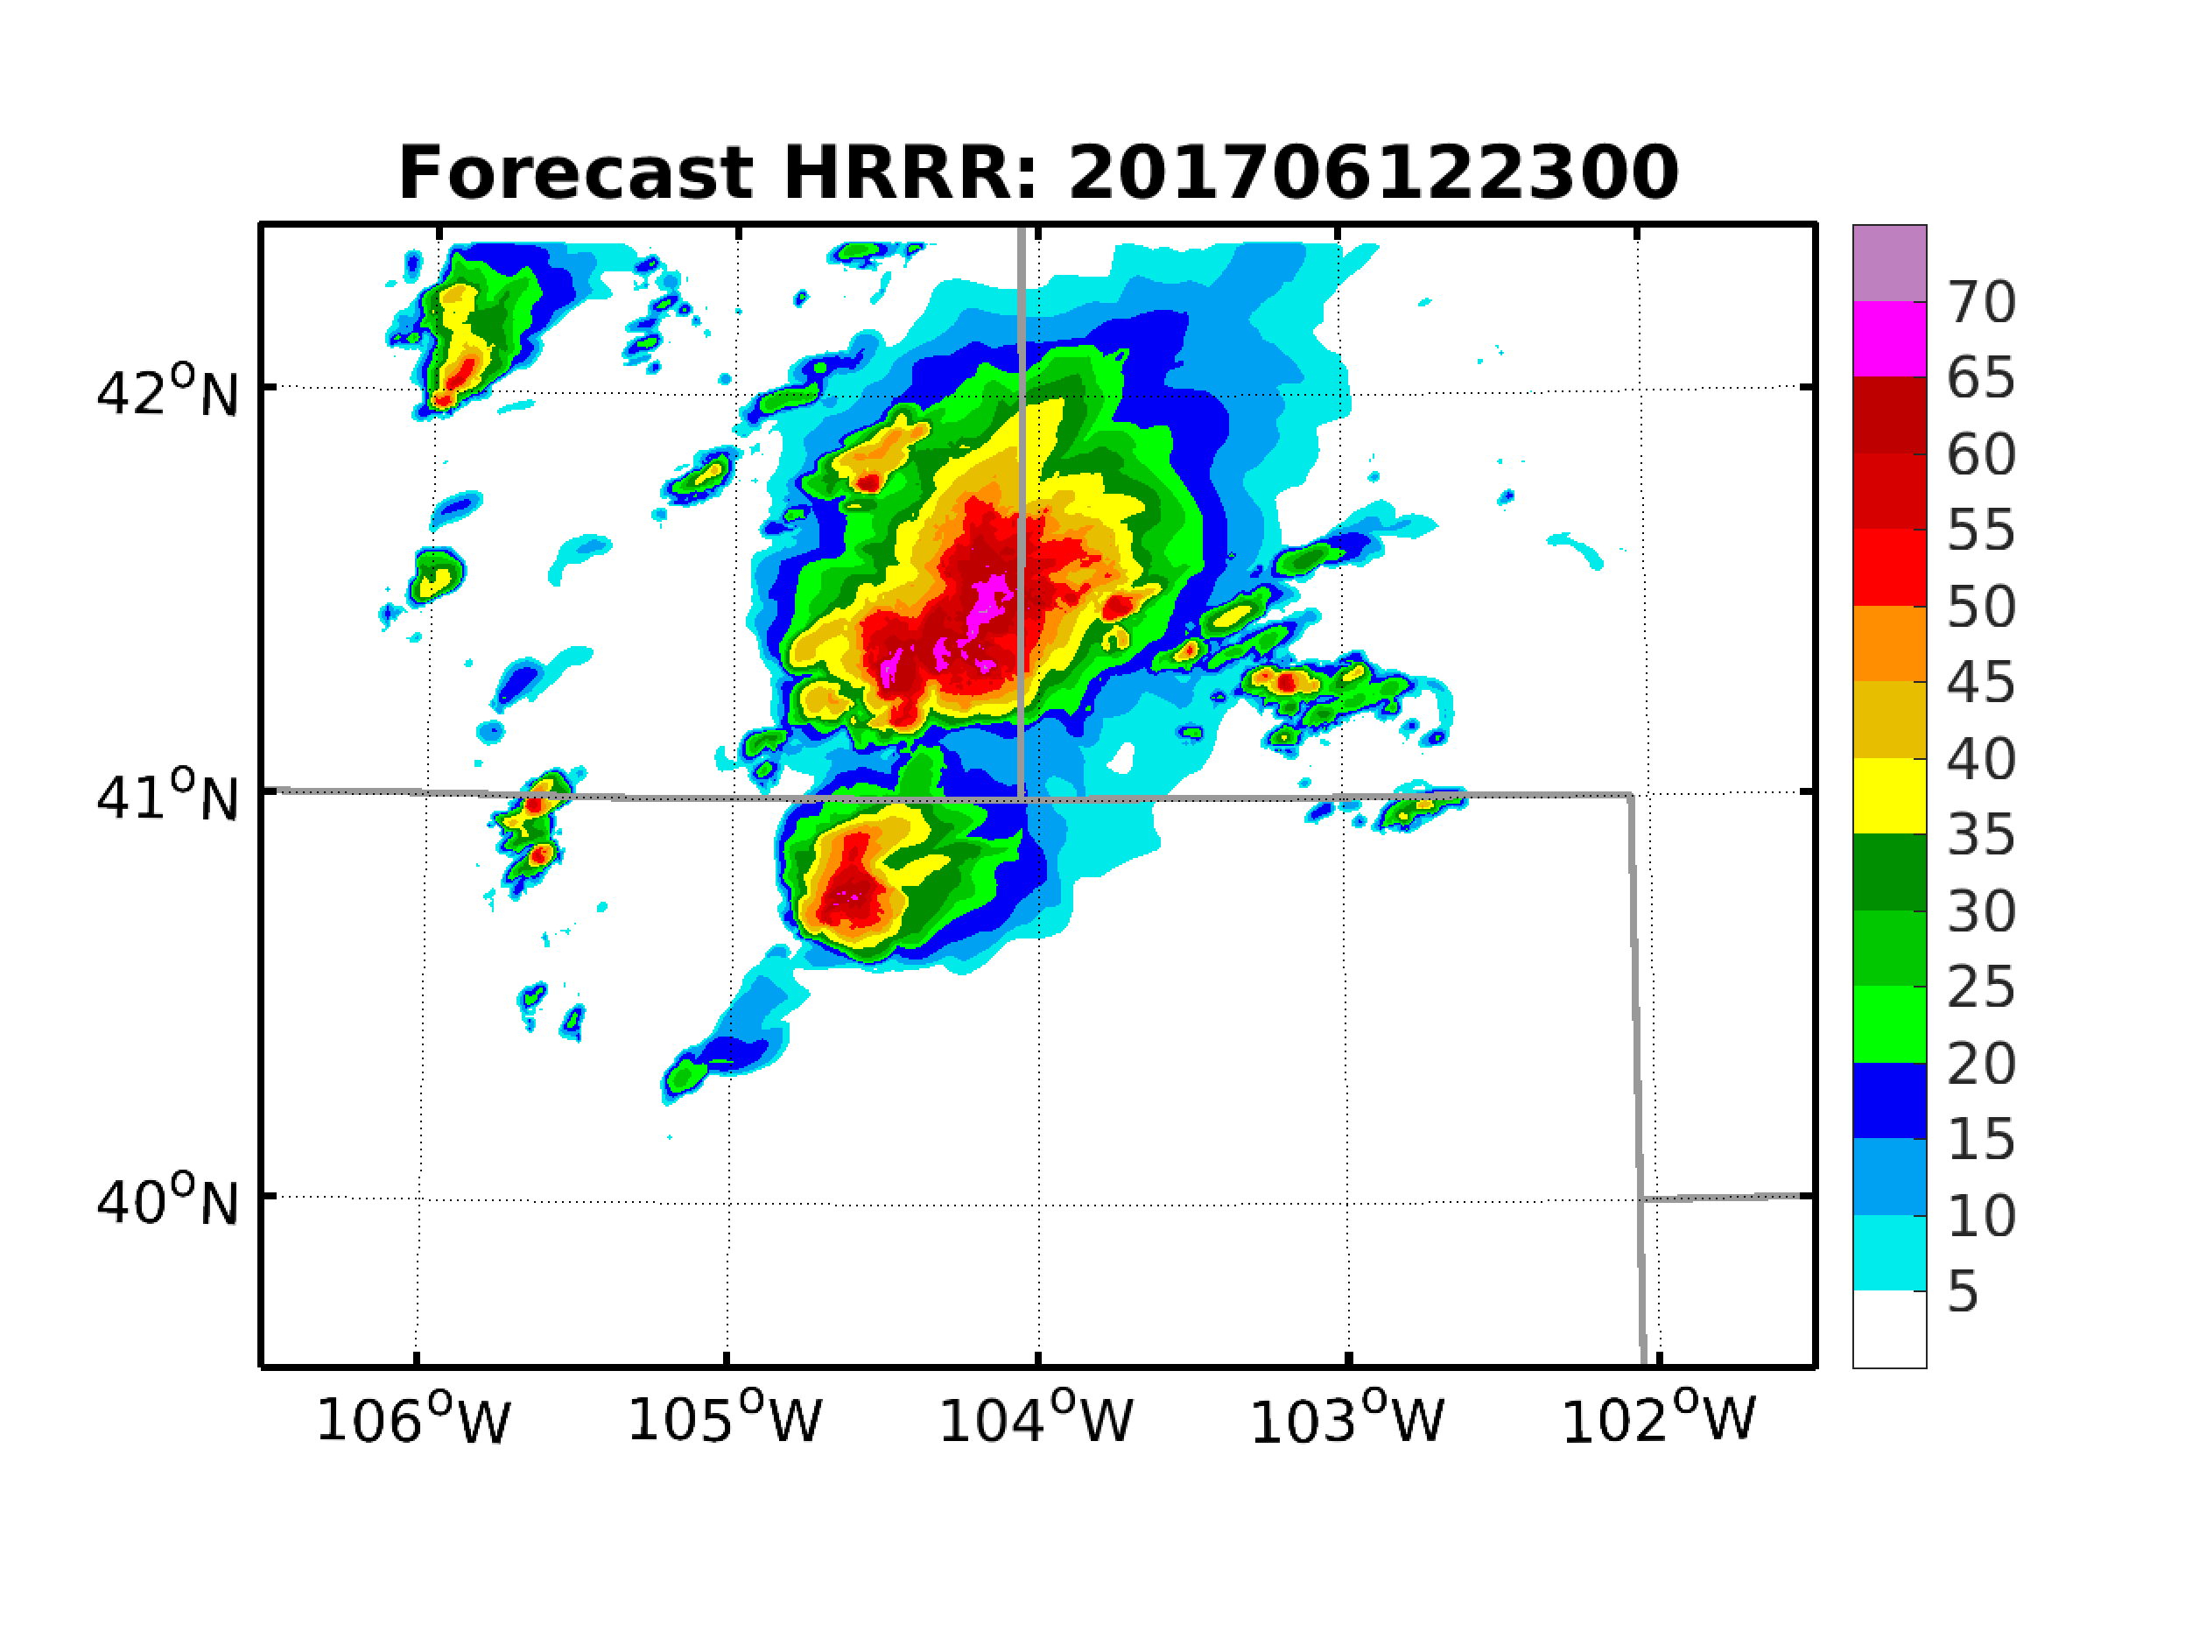
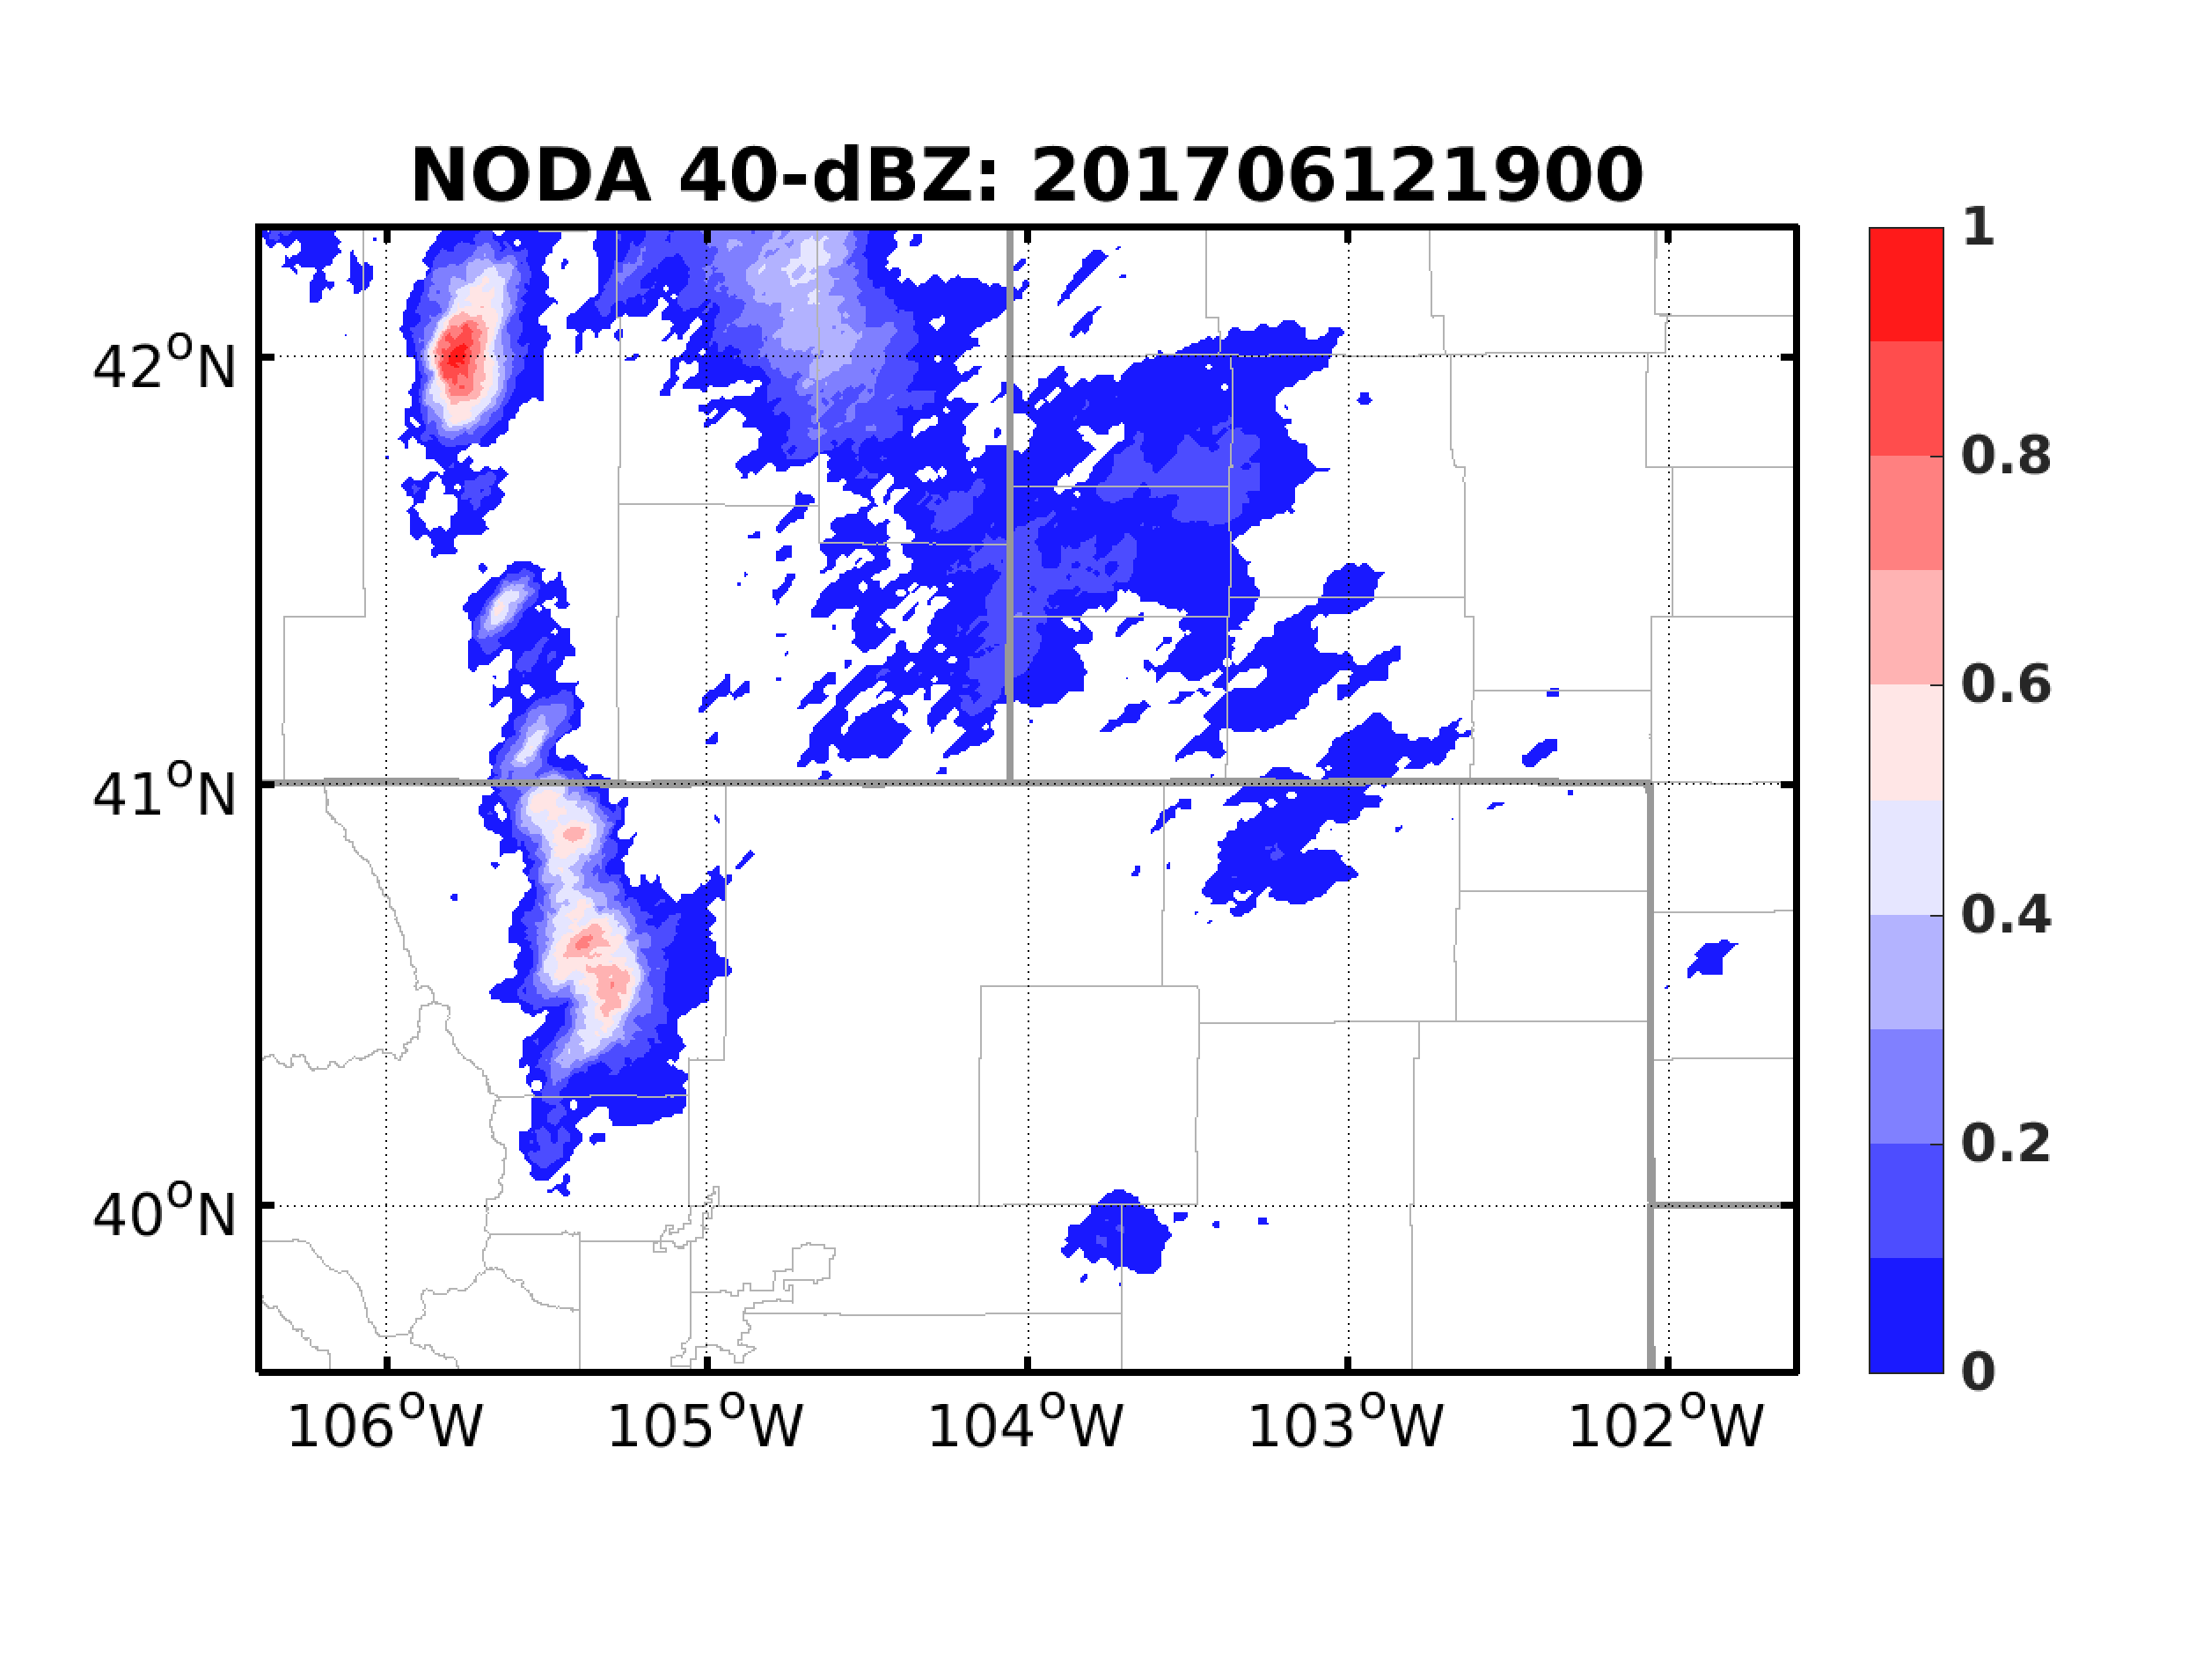
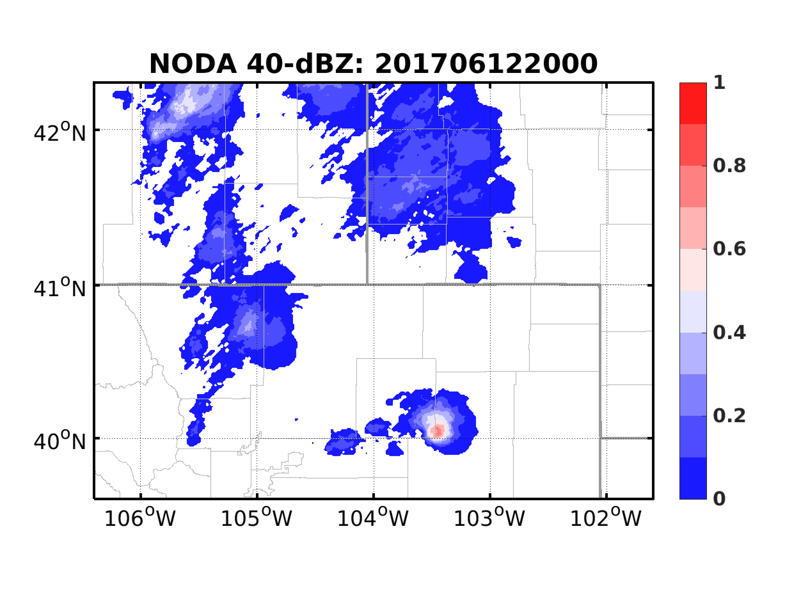
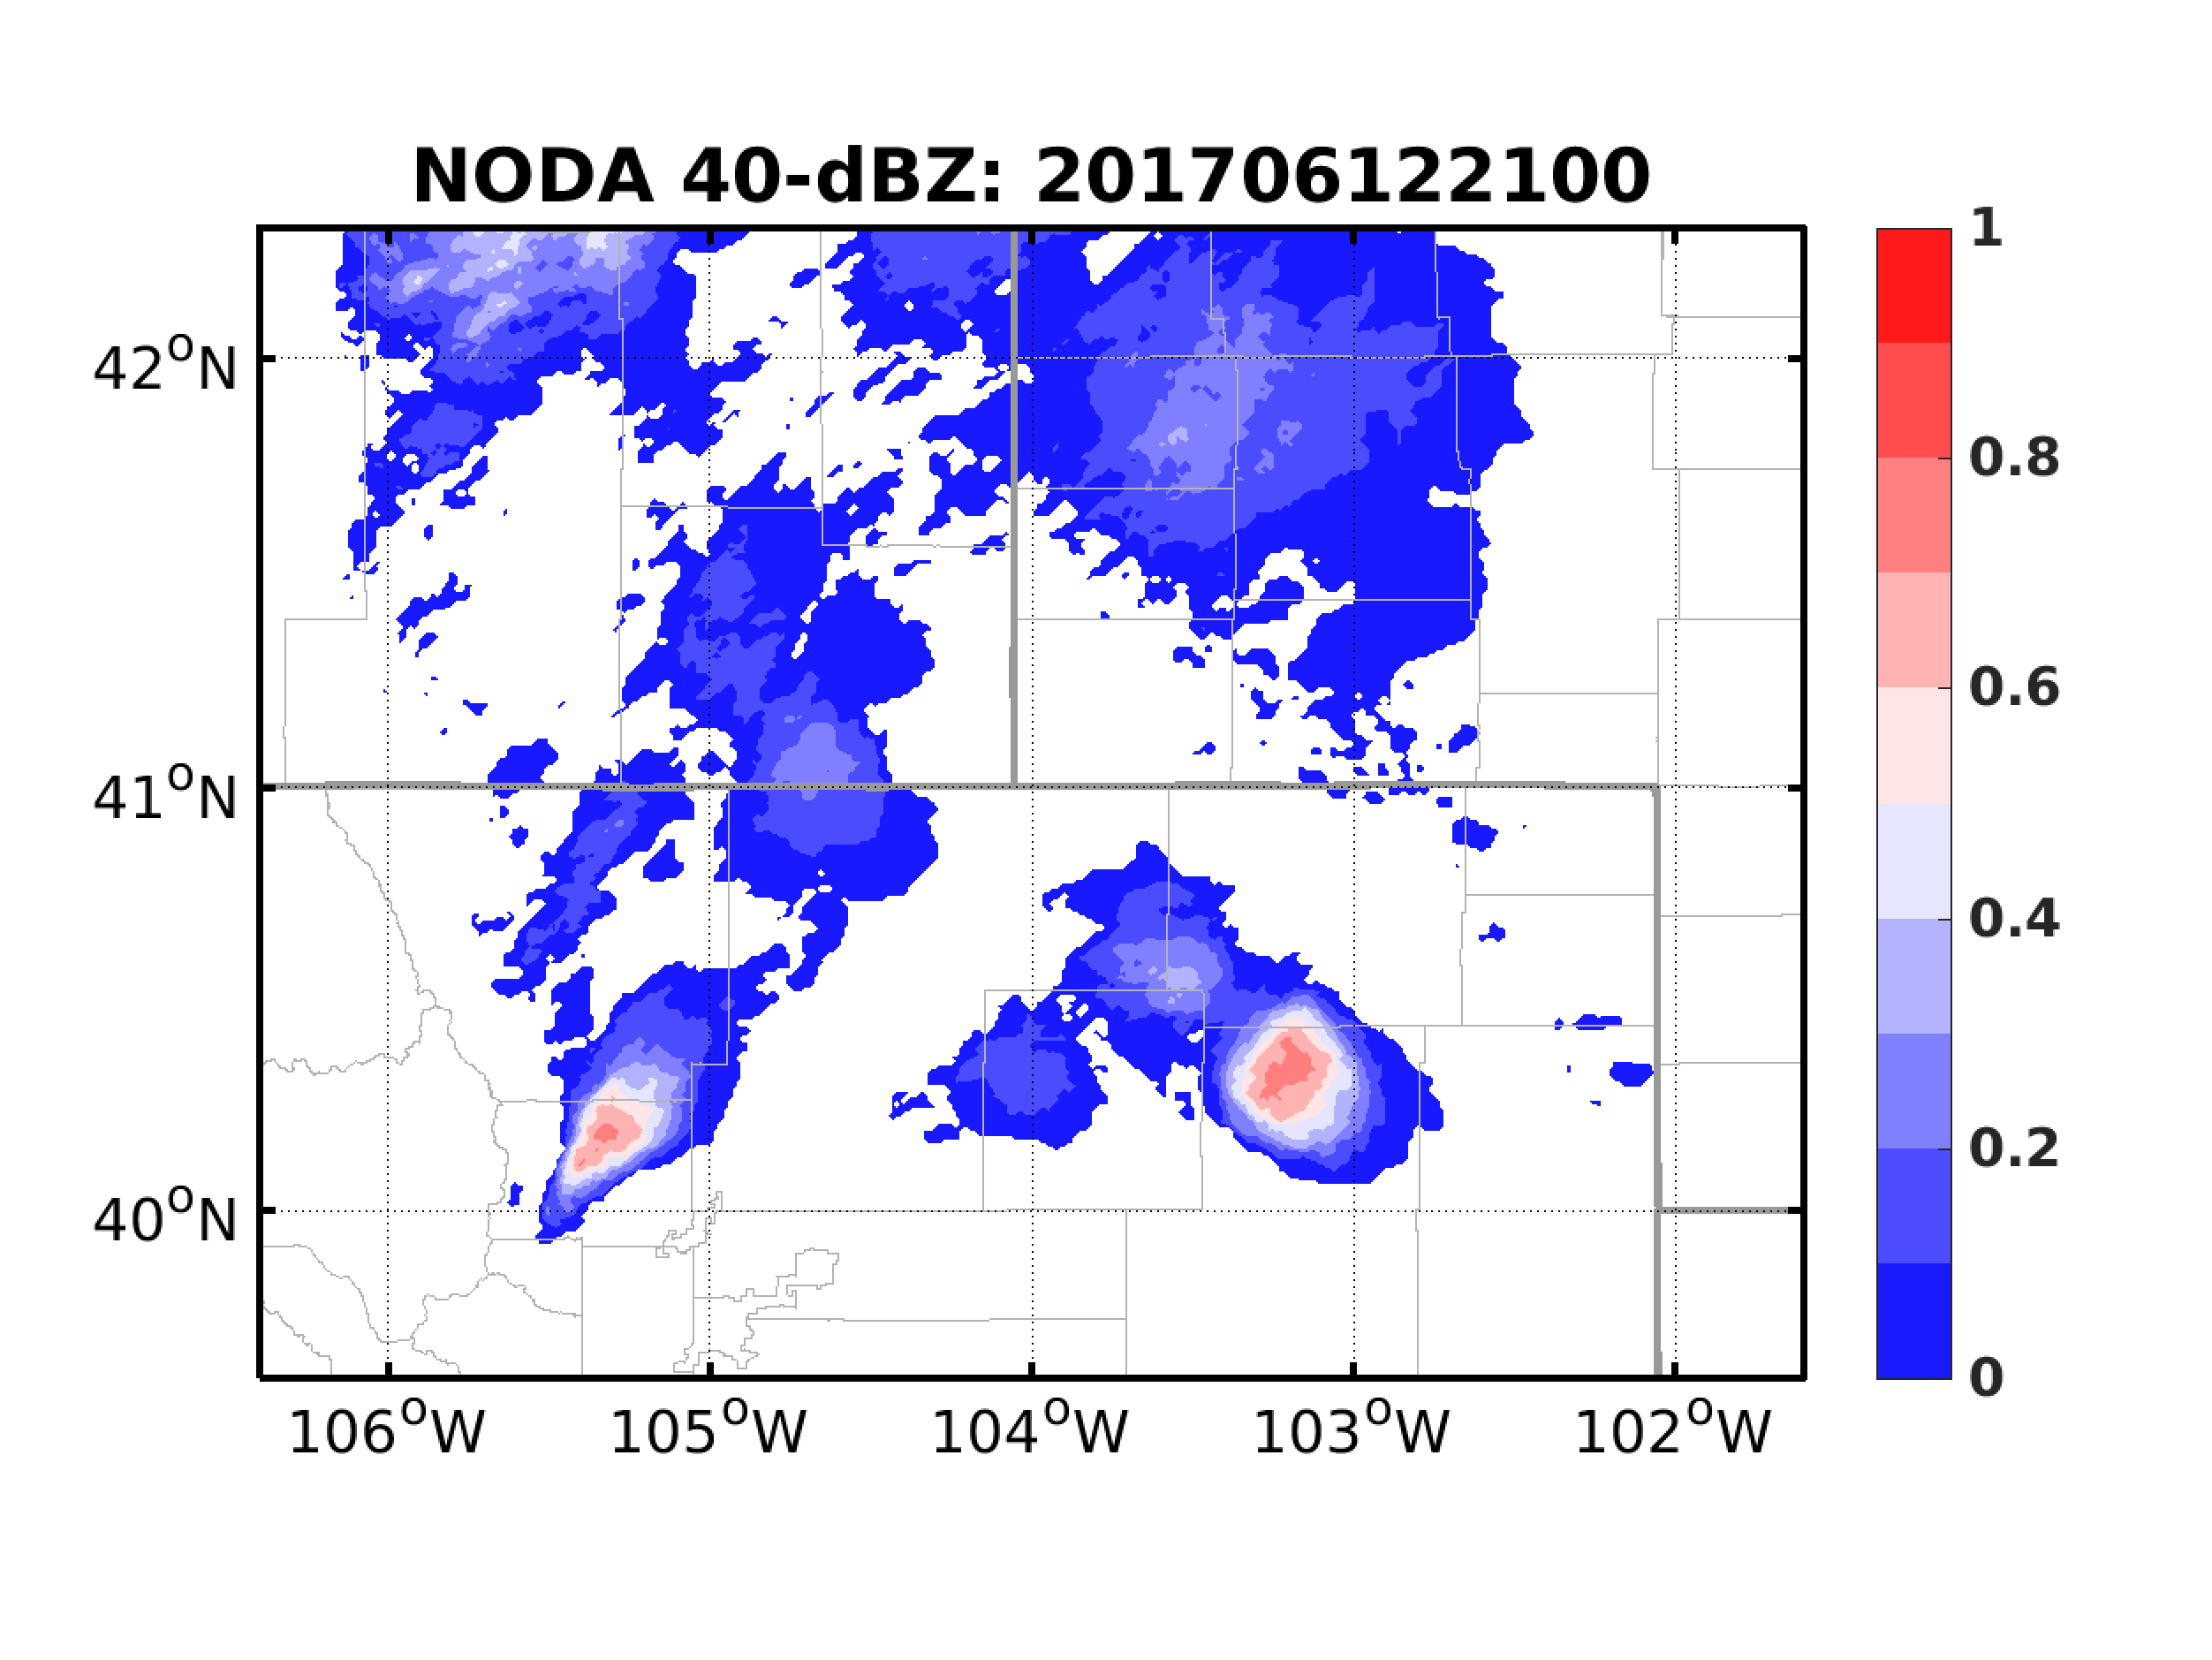
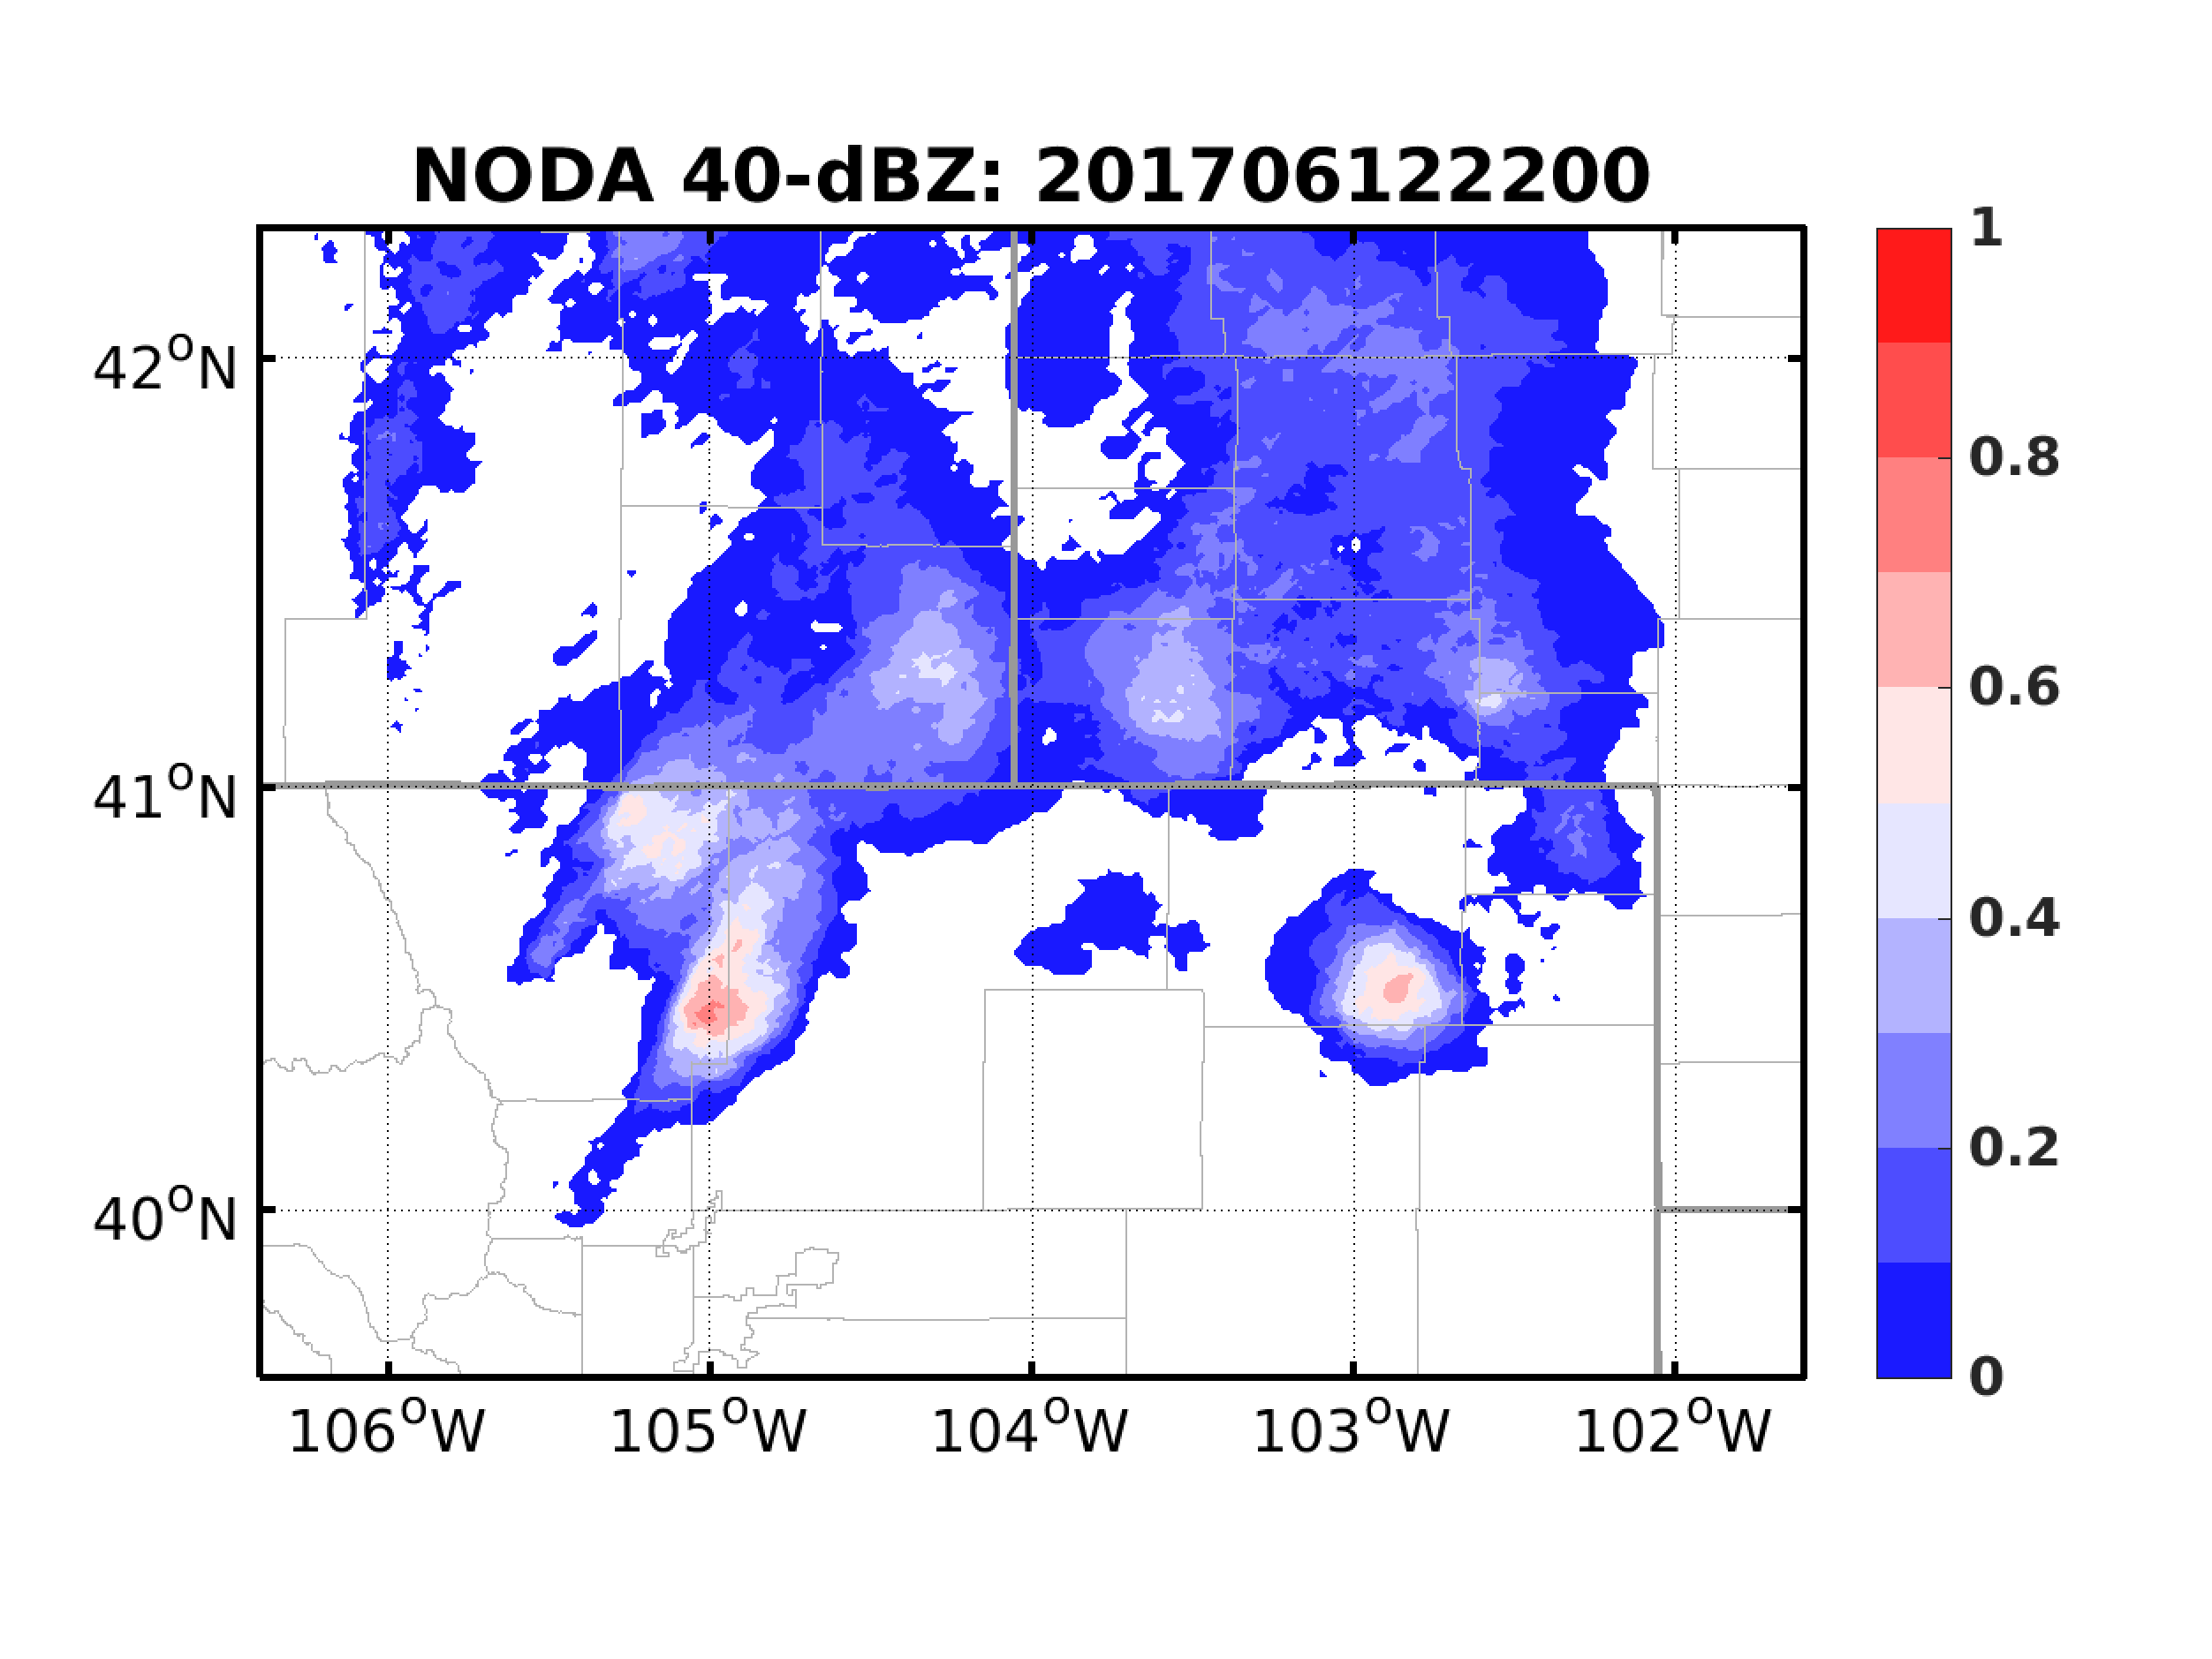
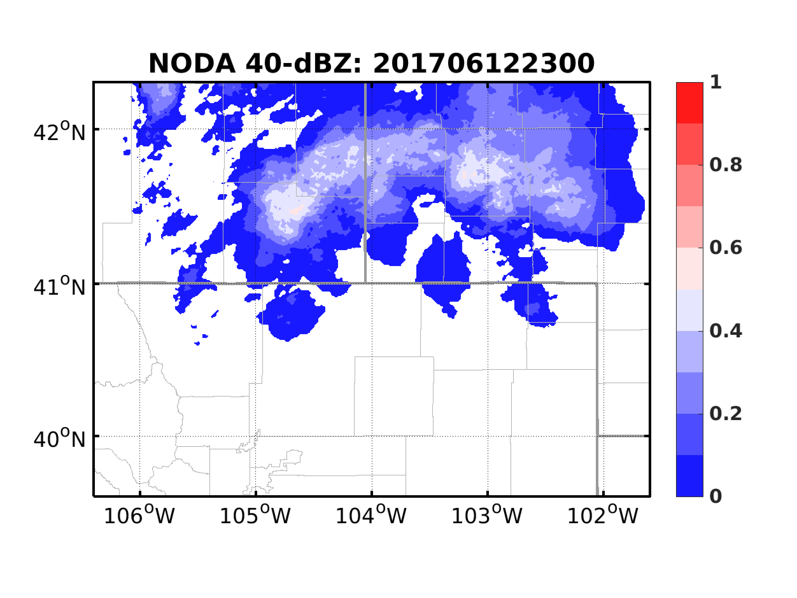
Deterministic and Ensemble from 18Z w/o DA
WRF 3.8.1 1-km simulation initialized from HRRR analysis
40-member forecast with perturbations of ensemble at 1800 UTC from 0600 UTC and 1200 UTC GEFS

Slide 6
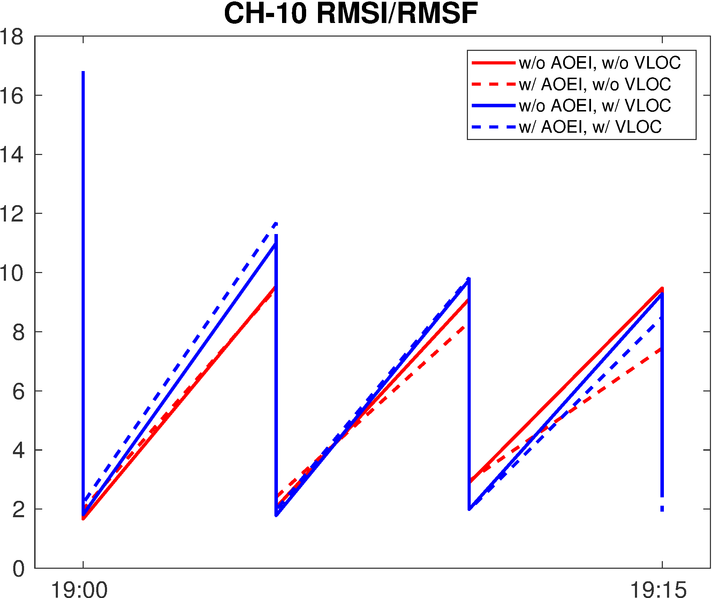
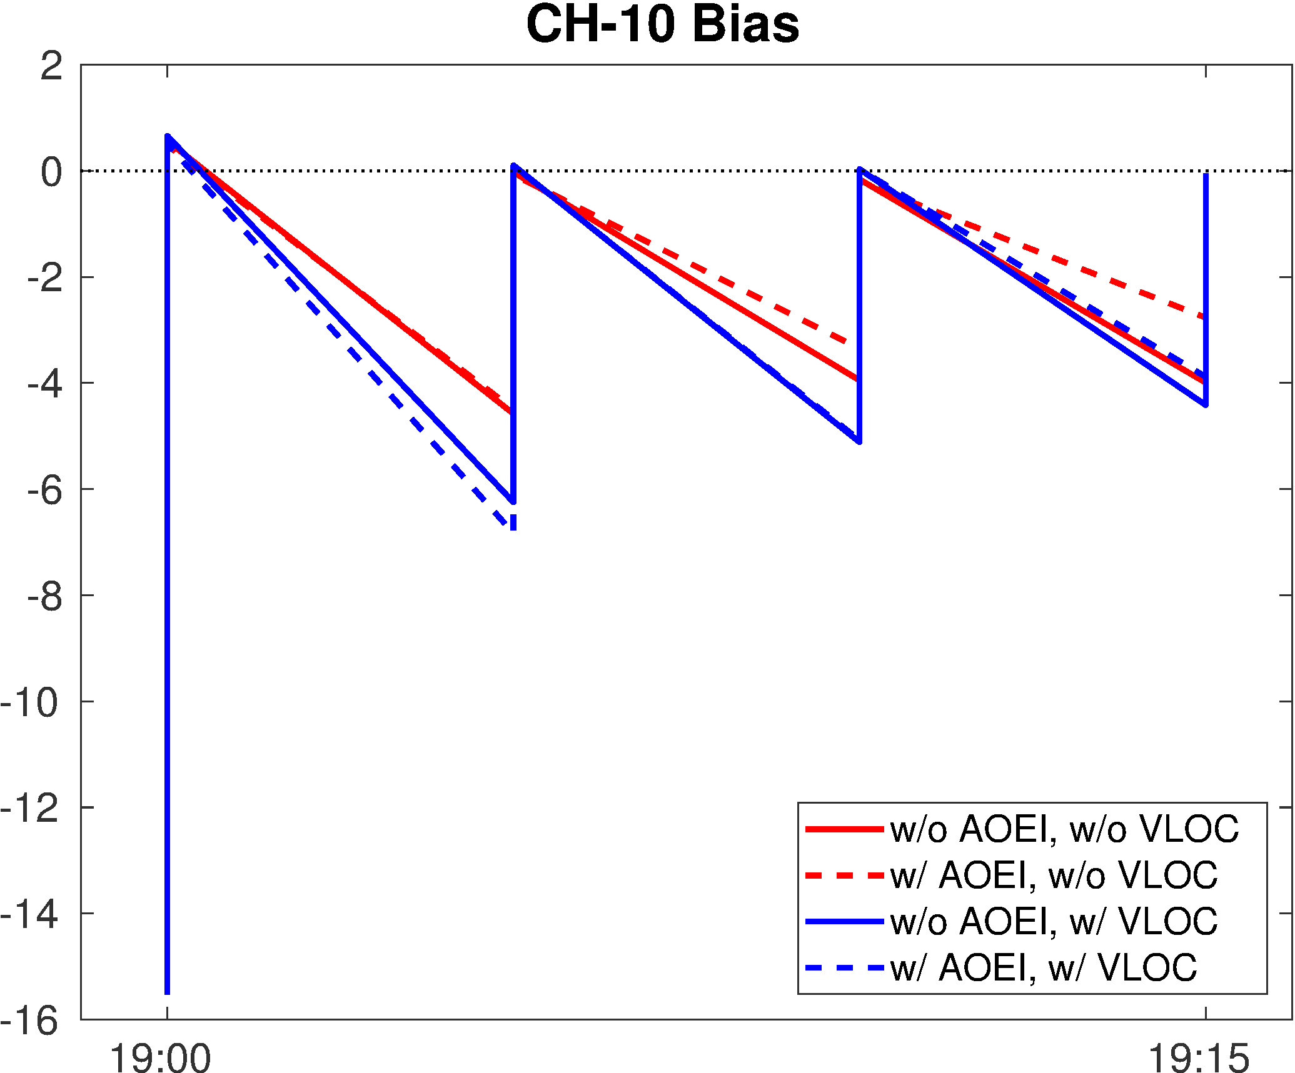
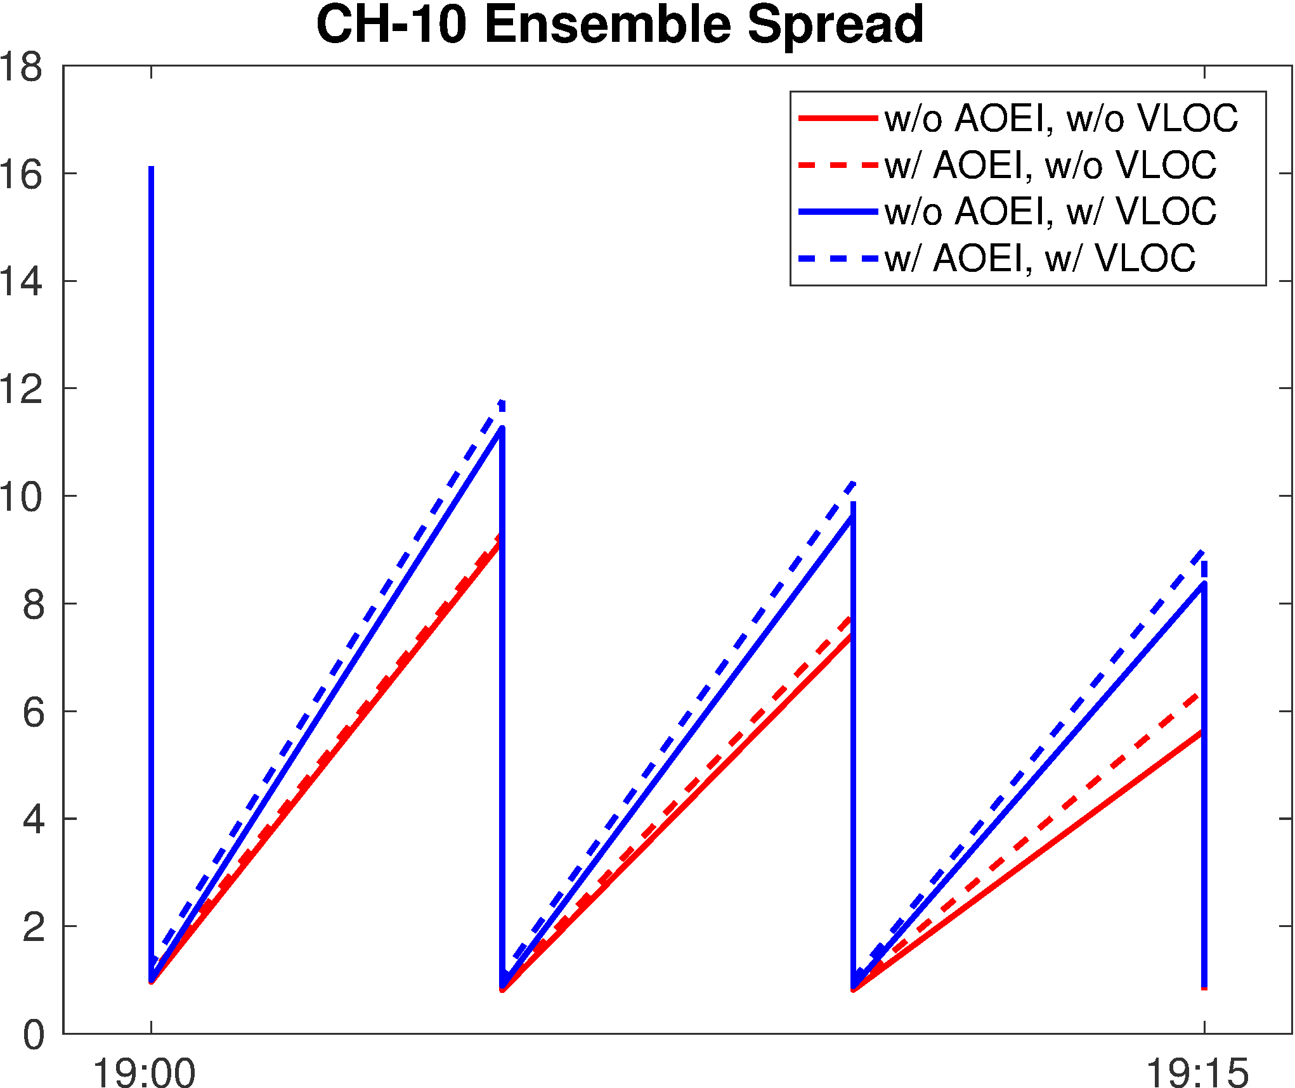
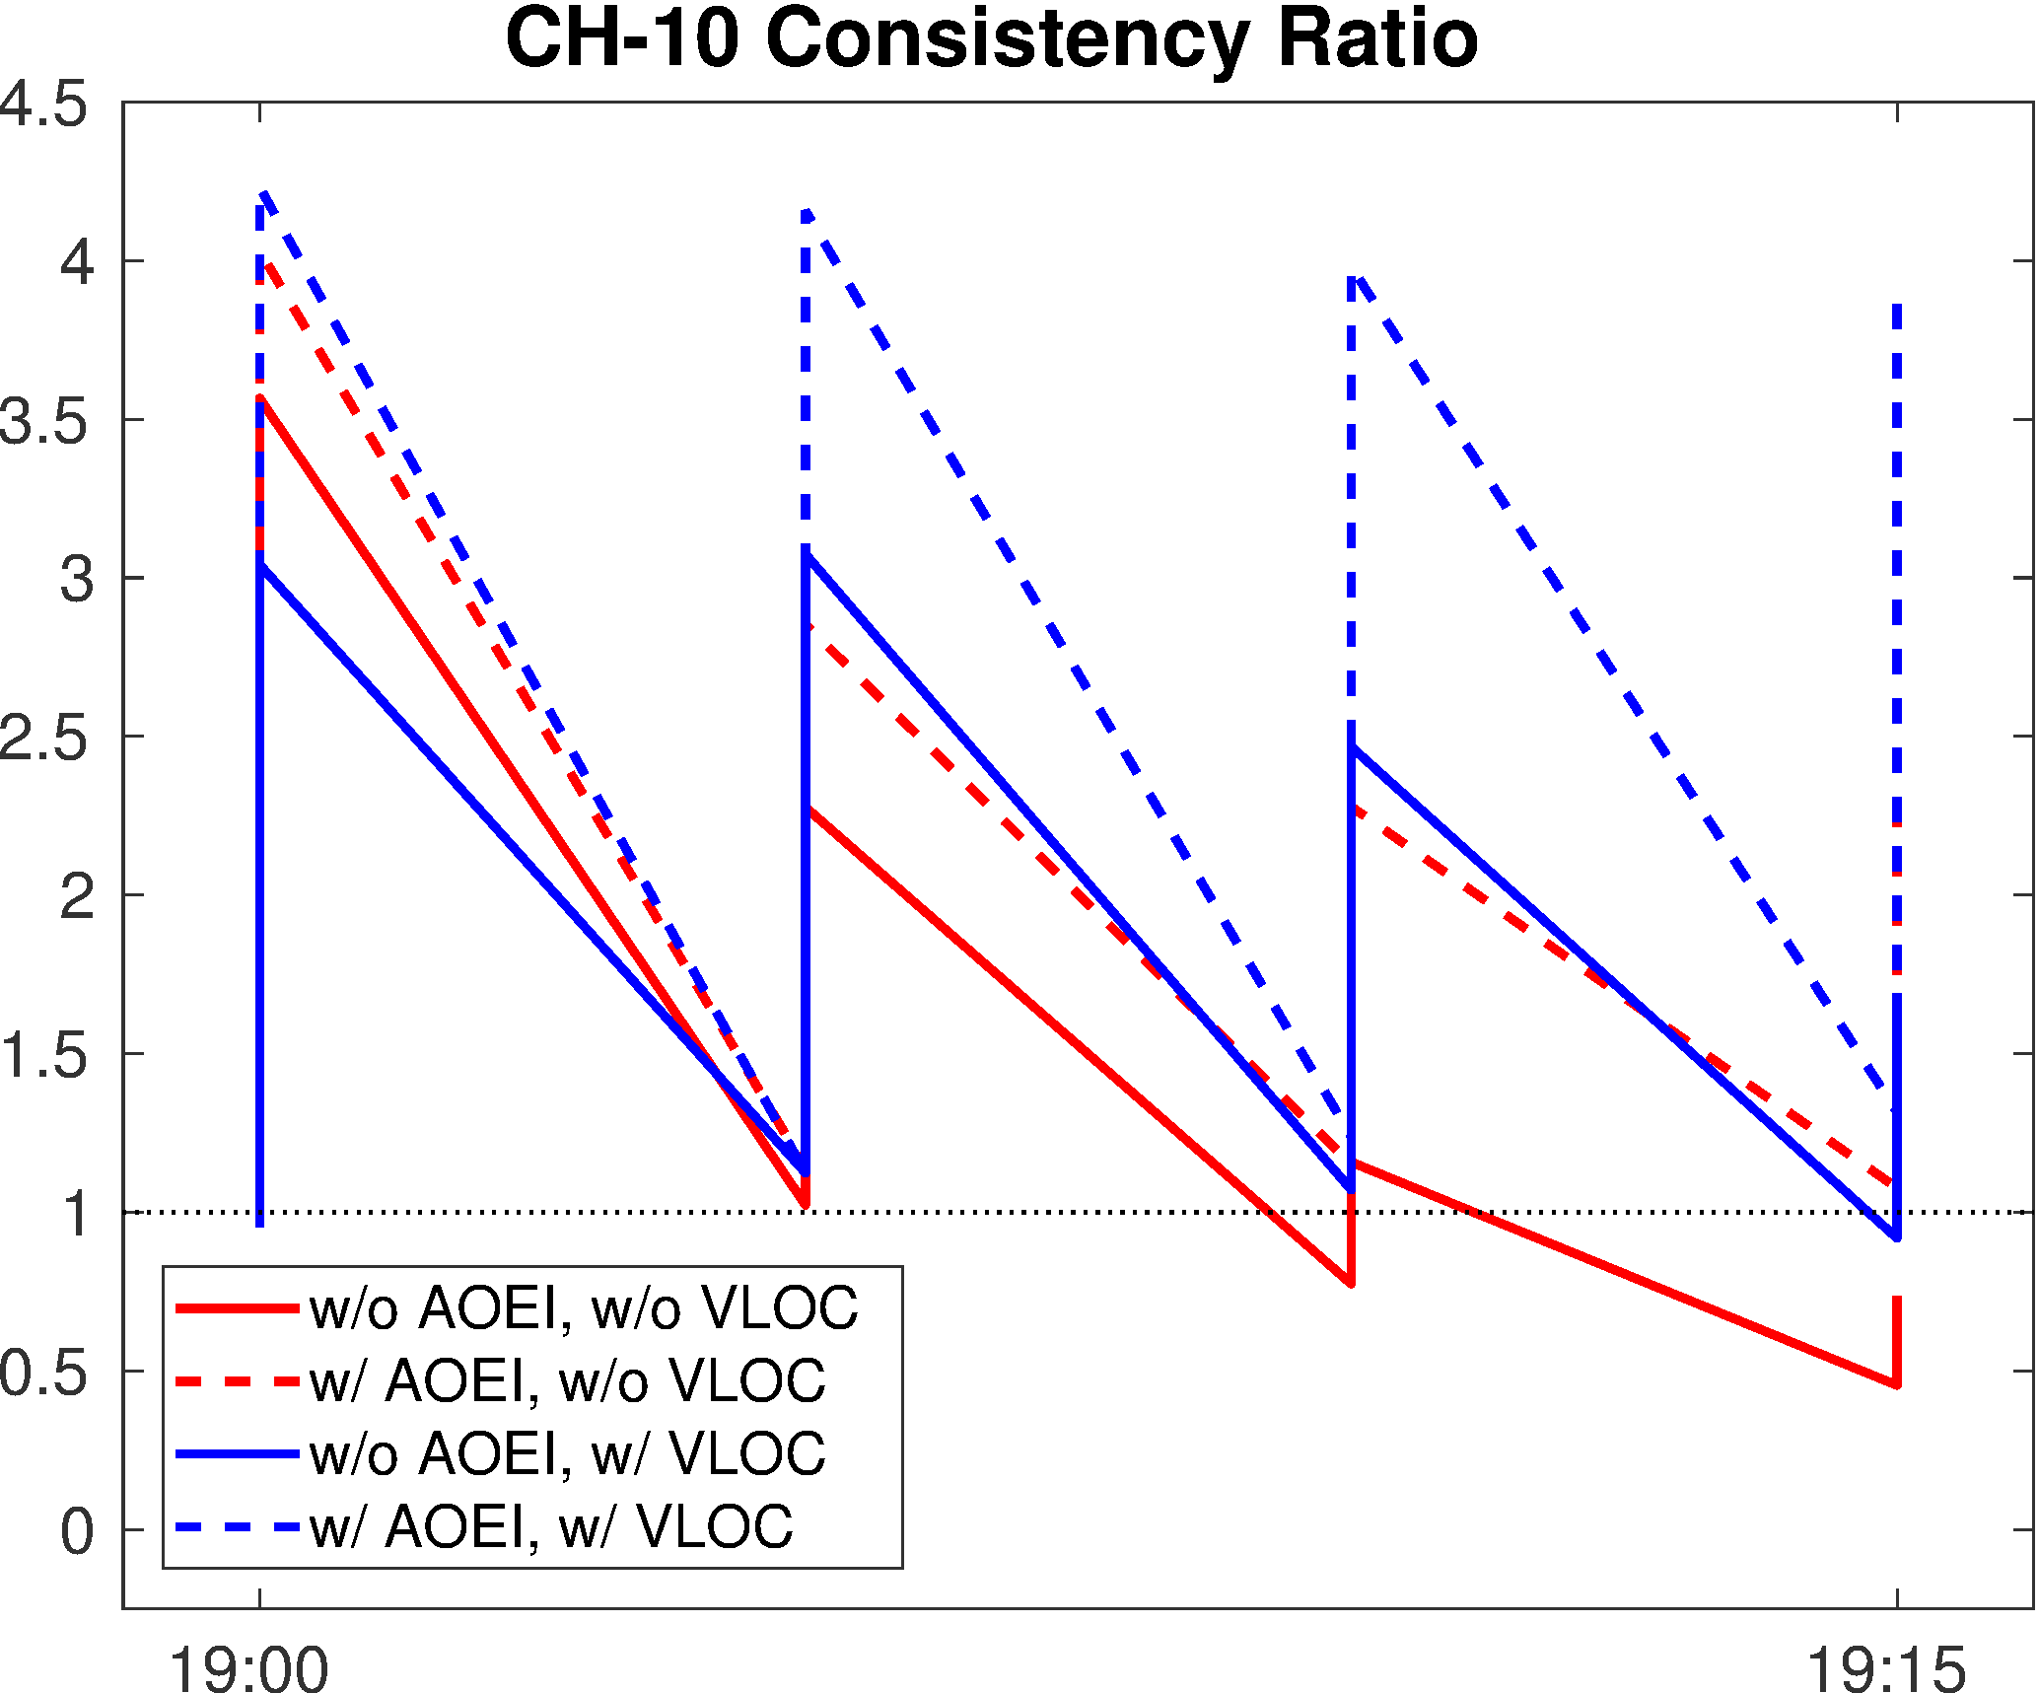
Short-Term Tests on AOEI and VLOC
 |  | AOEI
 |  | No | Yes
VLOC | No | —— | ----
 | Yes | —— | ----
Influence of AOEI:
Solid versus dashed lines
Influence of VLOC:
Red versus blue lines
Drawback of VLOC: Mismatch between location of observation and spurious clouds lead to smaller reduction of hydrometeors

Slide 7
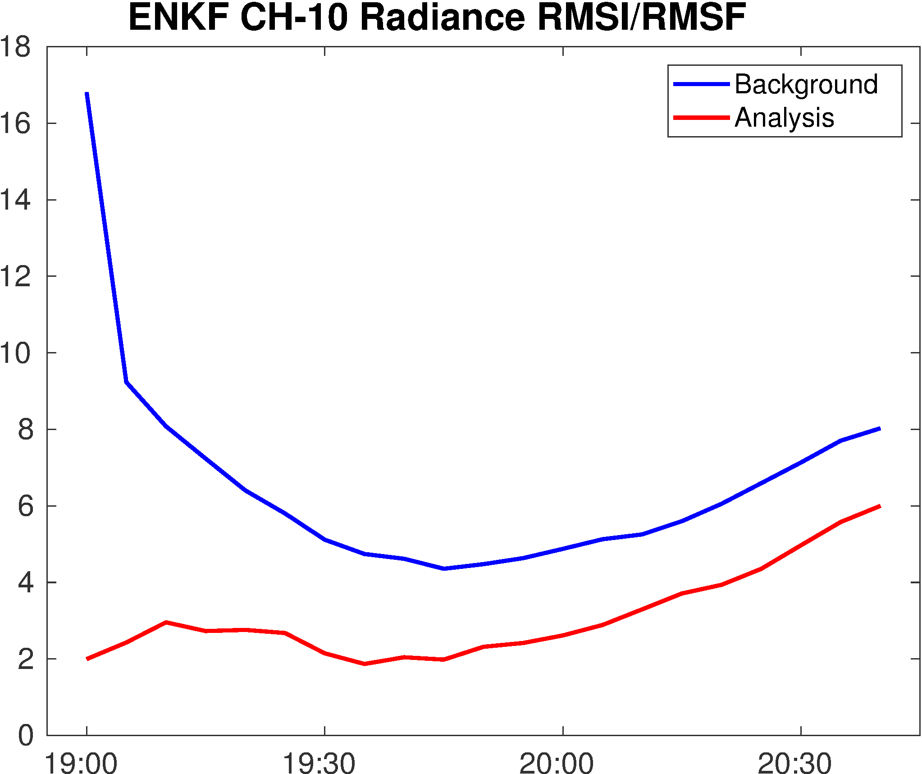
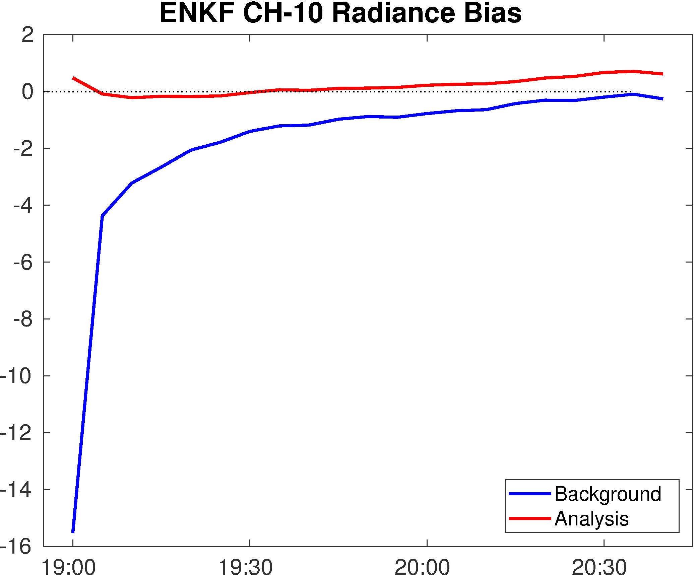
Long-Term Cycling EnKF w/ AOEI w/o VLOC

Slide 8
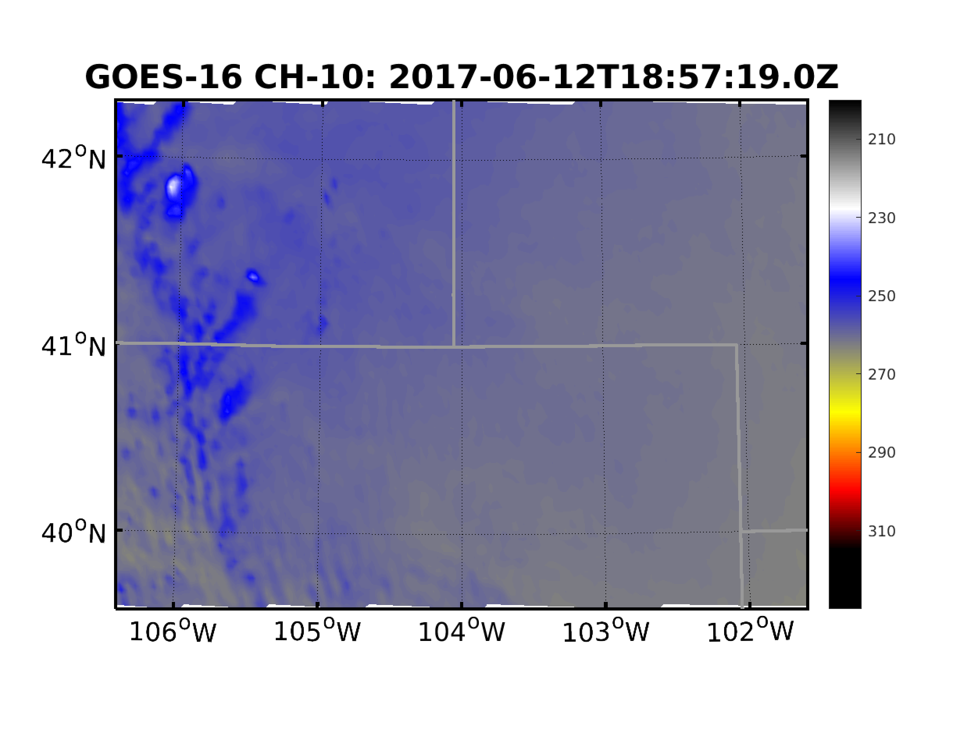
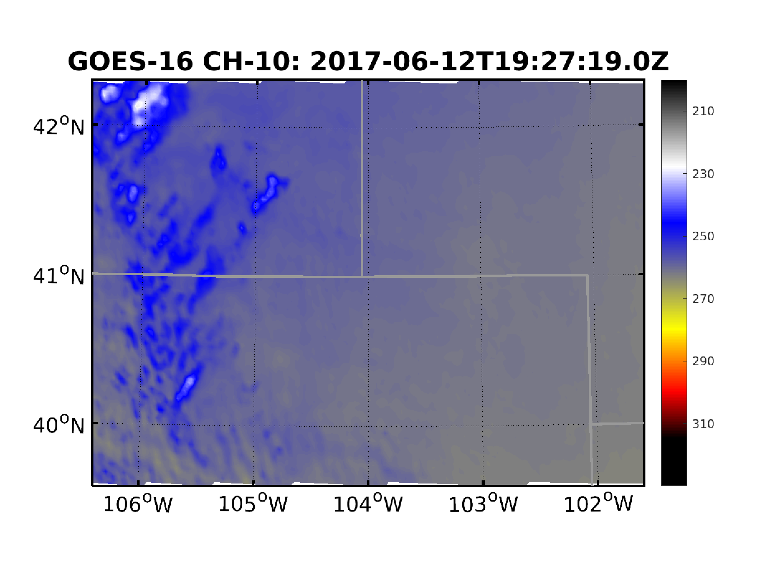
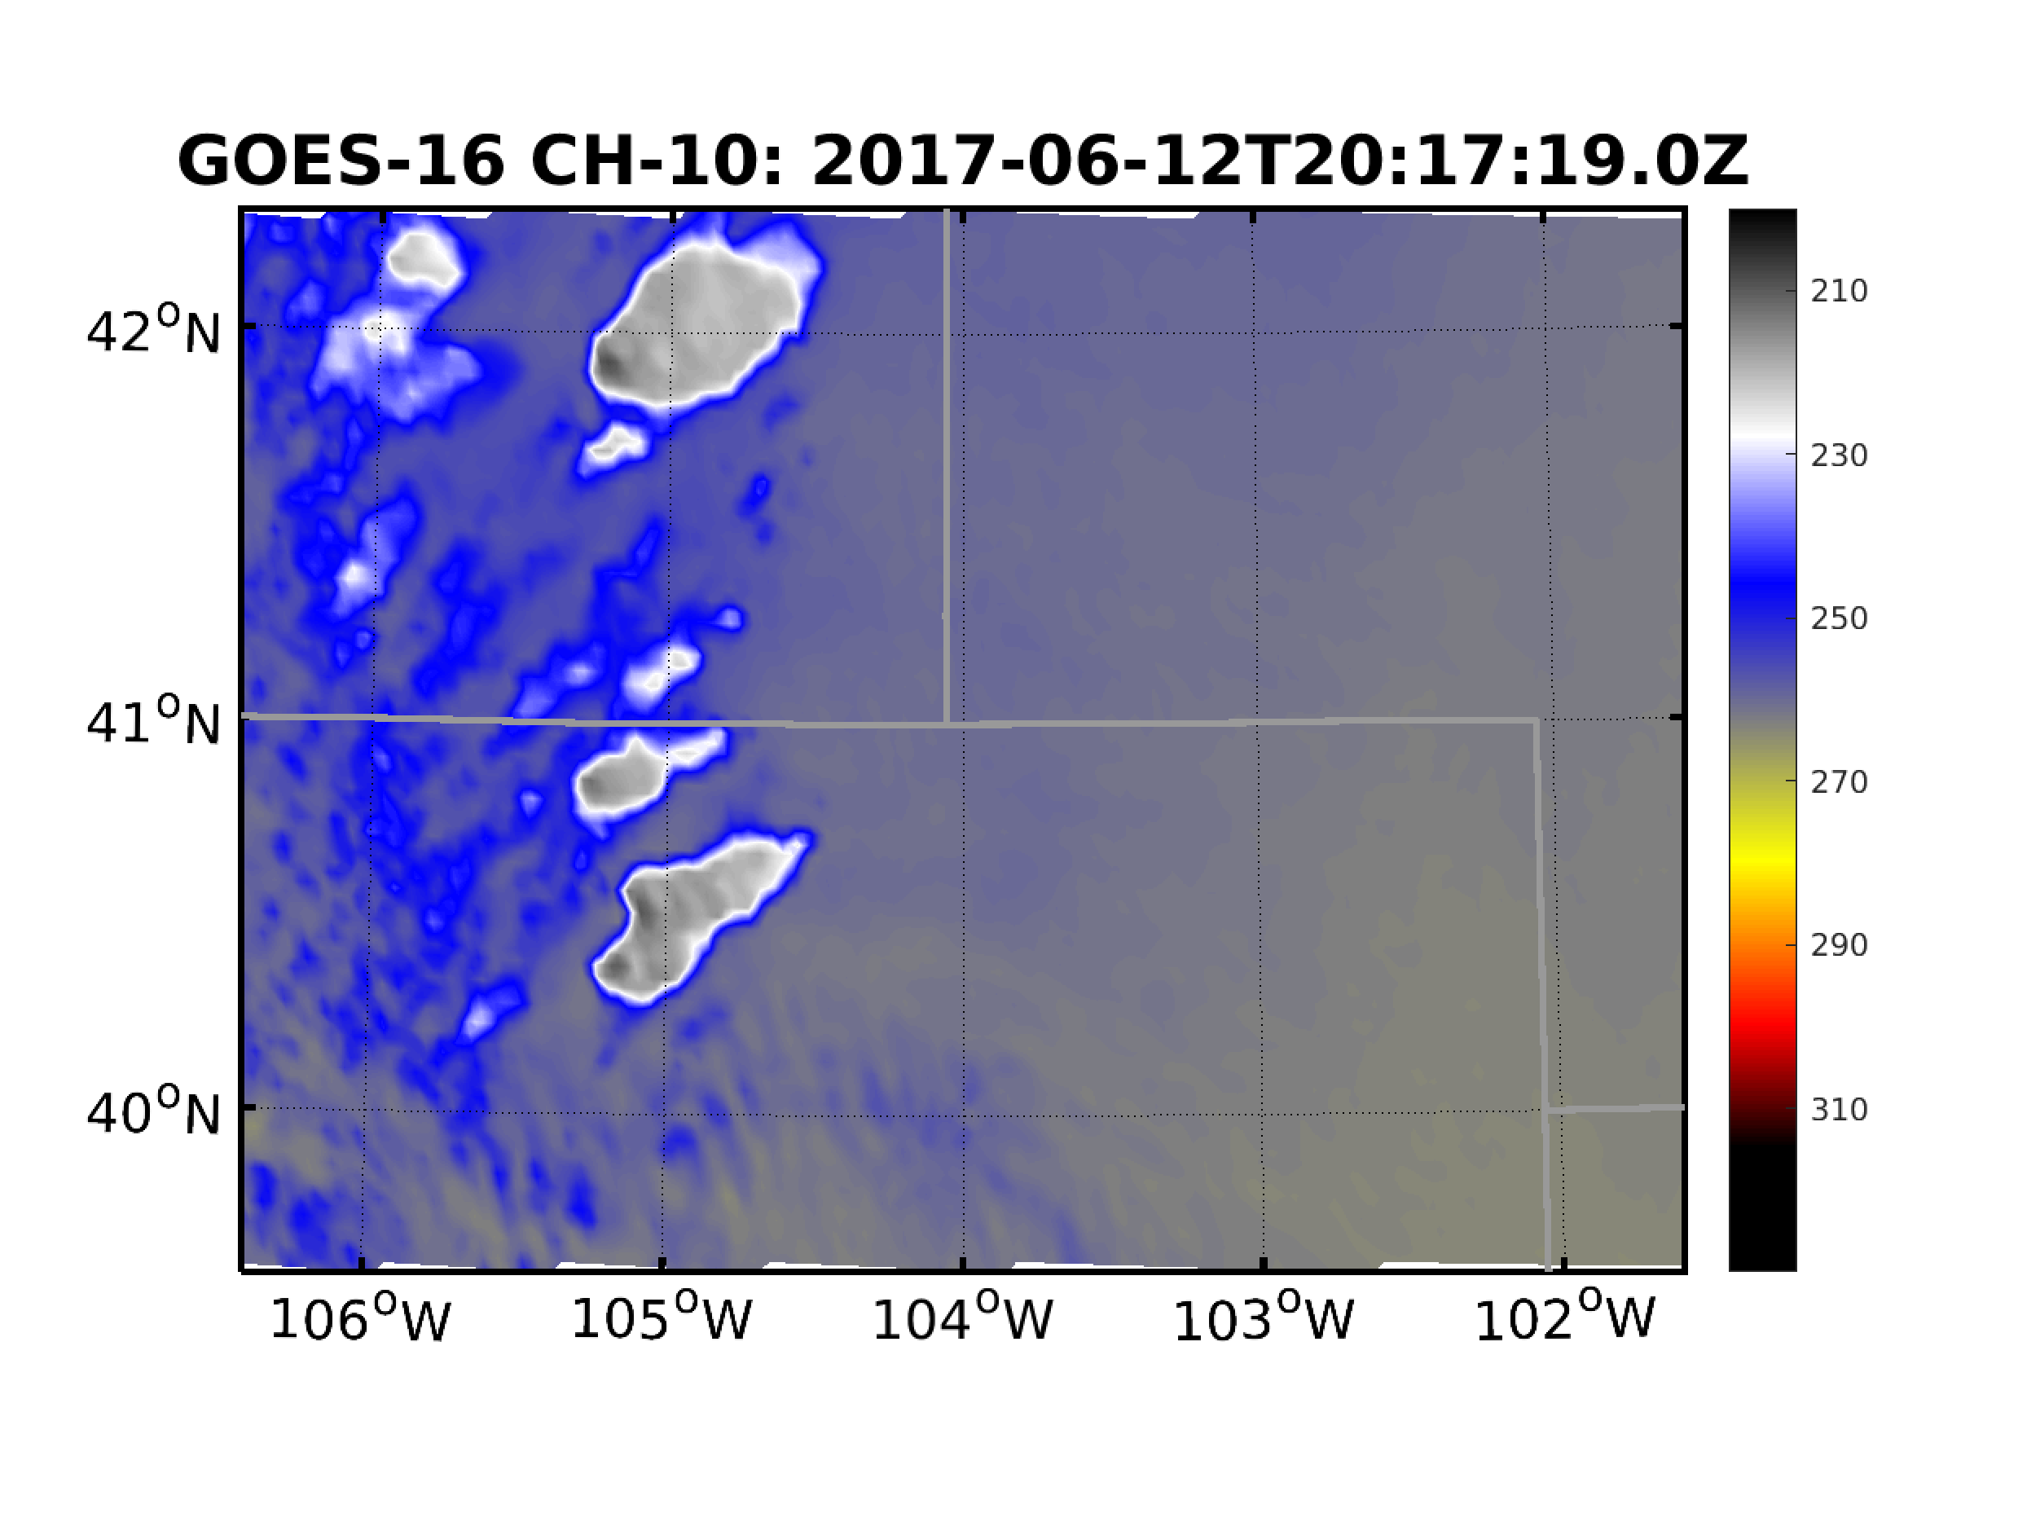
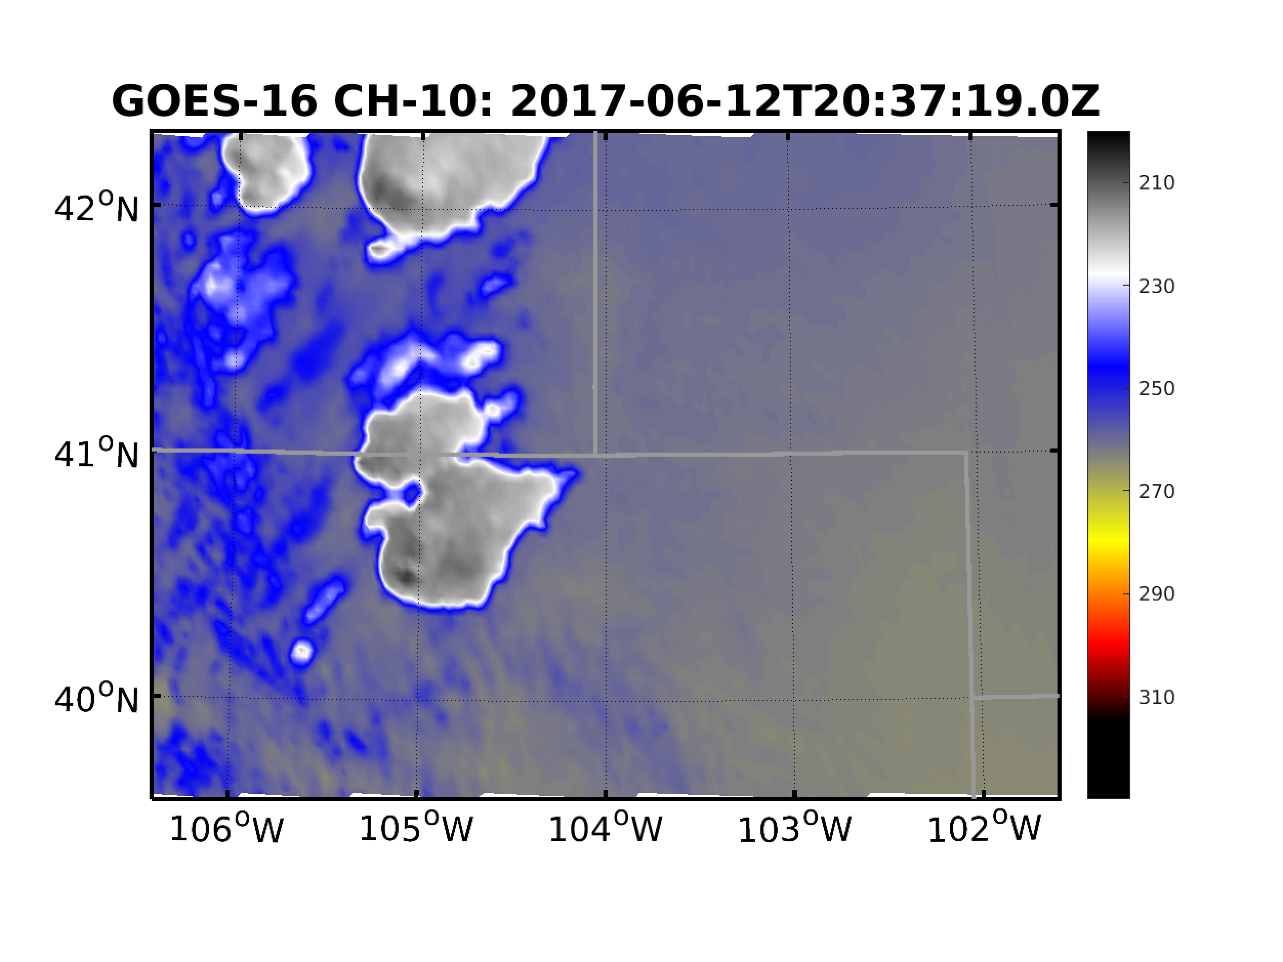
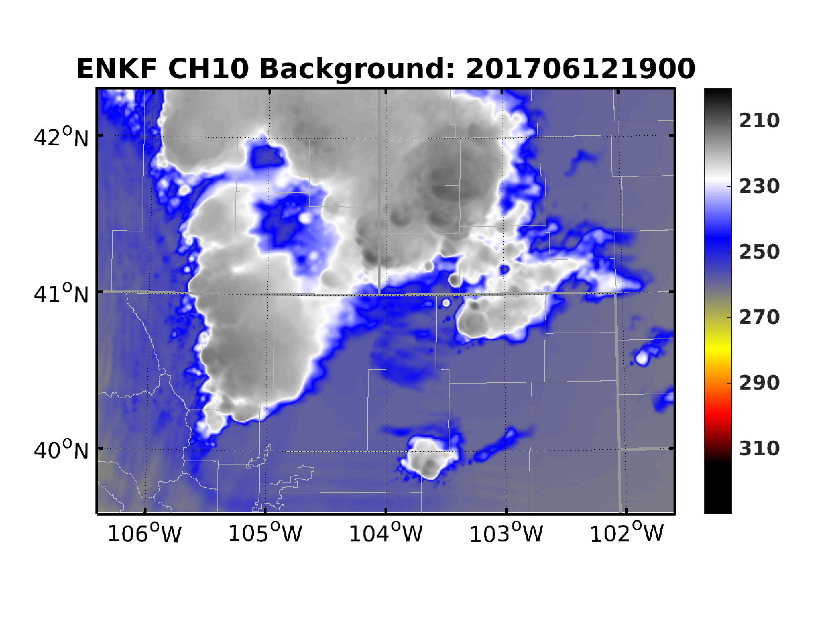
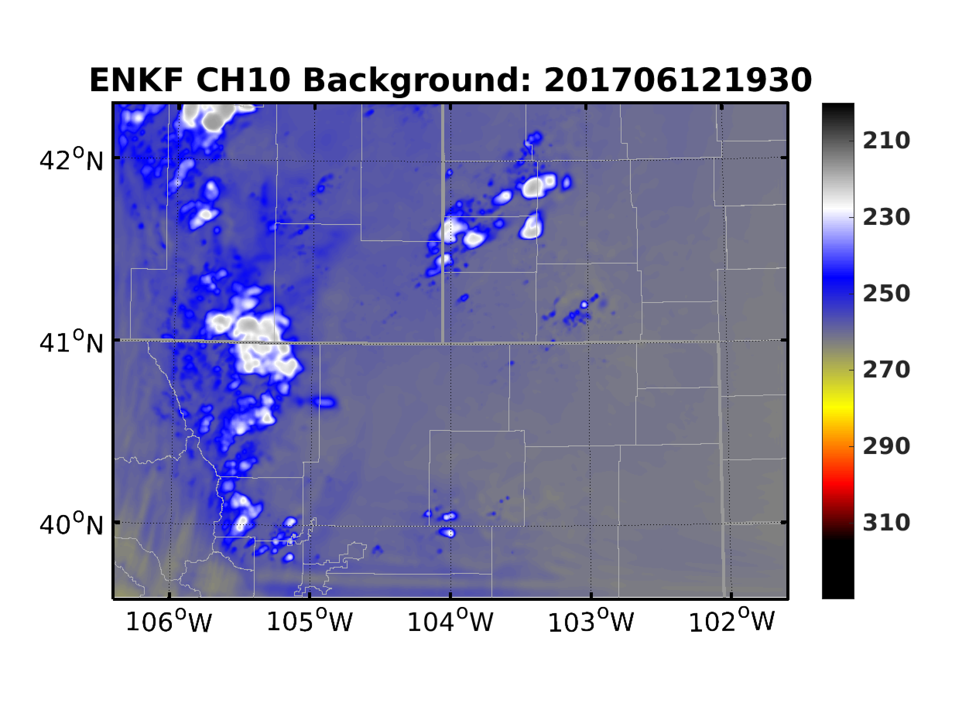
EnKF Cycles: Radiance
Obs
Background
Analysis

Slide 9
EnKF Cycles: Modifications on Hydrometeors

Slide 10
EnKF Cycles: Modifications on Hydrometeors

Slide 11
EnKF Cycles: Modifications on Hydrometeors

Slide 12
Deterministic Forecasts: Reflectivity
Observation
1930 Forecast
2000 Forecast
2030 Forecast

Slide 13
Deterministic Forecasts: UH and Vorticity
Maximum of 2–5-km UH
0–1-km Maximum Vorticity
Infrequent output of every 15 min ☹

Slide 14
Ensemble: Reflectivity Probability
Obs
1930 Fcst
2000 Fcst
2030 Fcst

Slide 15
Ensemble: UH and Vorticity Probabilities

Slide 16
Summary
Assimilating infrared radiance can improve probabilistic and deterministic forecasts of initiation and development of severe storms
Remaining issues:
Correcting parallax errors
Improving analysis of cloudy regions

Slide 17
Evolution of Innovations
No AOEI
No VLOC
AOEI
No VLOC
No AOEI
VLOC
AOEI
VLOC
O-B 1900
O-A 1900
O-B 1905
O-A 1905
O-B 1910
O-A 1910
O-B 1915
O-A 1915

