Slide 1
A parametric tropical cyclone precipitation model in NWP
Yanting Ye 08-17-2017

Slide 2
content
$${ R}_{R−CLIPER} + R_{Shear,motion}$$
Modified R-CLIPER in NWP
Result
Asymmetric factors
R-CLIPER in NA
method
Result

Slide 3
R-CLIPER in NA
Tropical Cyclone Rainfall Climatology and Persistence (R-CLIPER )
R-CLIPER was developed and tested based on climatological rain gauge and satellite microwave estimates (TRMM)
R-CLIPER uses the track and intensity(sustained wind speed) to produce the rain estimates
R-CLIPER function represents the radial curve of azimuthally averaged precipitation
Reference: Frank D. Marks, Jr. 2003. Development of a Tropical Cyclone Rainfall Climatology and Persistence Model

Slide 4
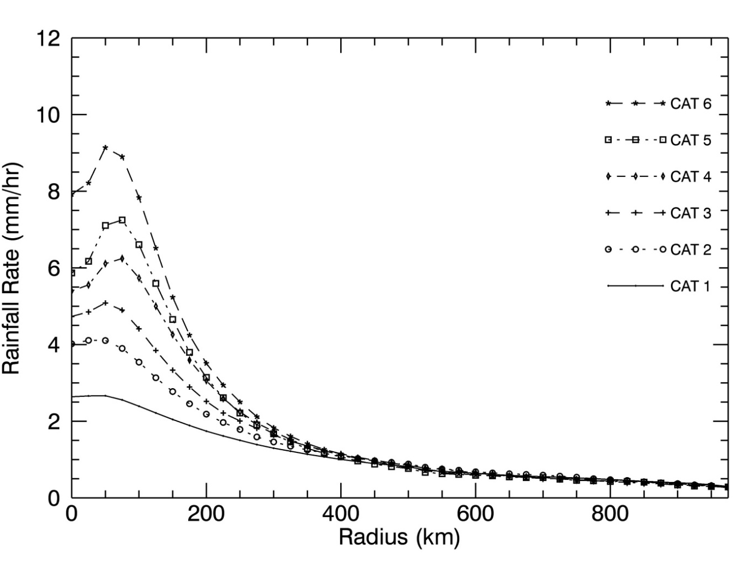
R-CLIPER in NA
Tropical Cyclone Rainfall Climatology and Persistence (R-CLIPER )
R0 = a1 + b1*MWS
Rm = a2 + b2*MWS
rm = a3 + b3*MWS
Re = a4 + b4*MWS
Rainfall Rate= $\left\{\begin{aligned}R_{0}+\left(R_{m}−R_{0}\right)\left(\frac{r}{r_{m}}\right),r<r_{m} \\ R_{m}\exp\left[−\frac{r−r_{m}}{r_{e}}\right],r≥r_{m}\end{aligned}\right.$
Notes:
Reference: Frank D. Marks, Jr. 2003. Development of a Tropical Cyclone Rainfall Climatology and Persistence Model

Slide 5
Modified R-CLIPER in NWP
Tropical Cyclone Rainfall Climatology and Persistence (R-CLIPER )
TRMM 3B42
Time Period：1998~2012
Spatial resolution： 0.25*0.25 °
Temporal resolution：3 hourly

Slide 6
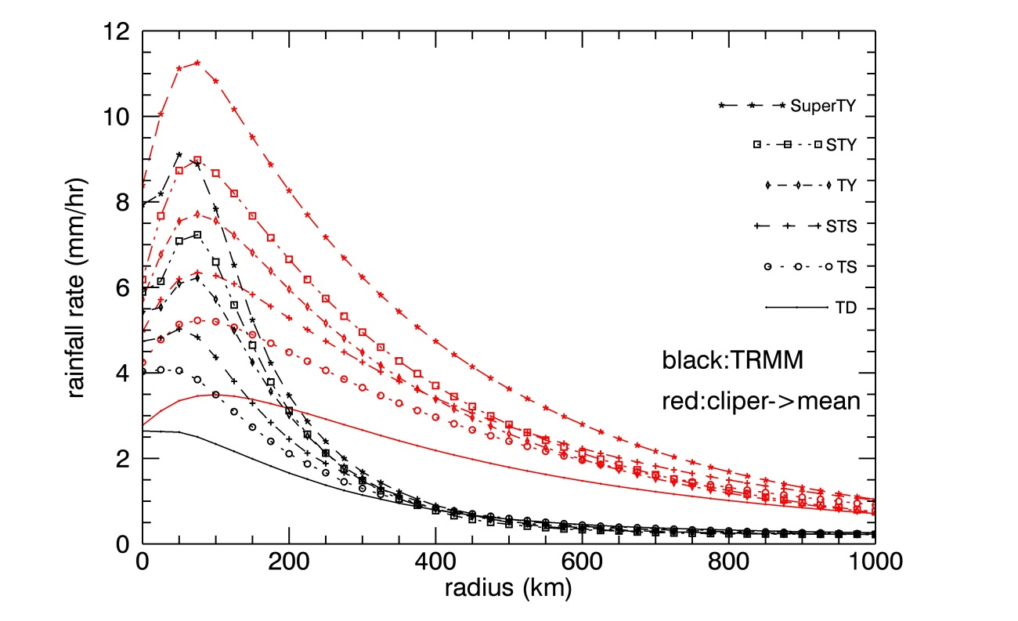
Modified R-CLIPER in WP: function
Tropical Cyclone Rainfall Climatology and Persistence (R-CLIPER )
Rainfall Rate= $\left\{\begin{aligned}R_{0}+\left(R_{m}−R_{0}\right)\left(\frac{r}{r_{m}}\right),r<r_{m} \\ R_{m}\exp\left[−\frac{r−r_{m}}{r_{e}}\right],r≥r_{m}\end{aligned}\right.$
Overestimated in exponential decay in NWP!

Slide 7
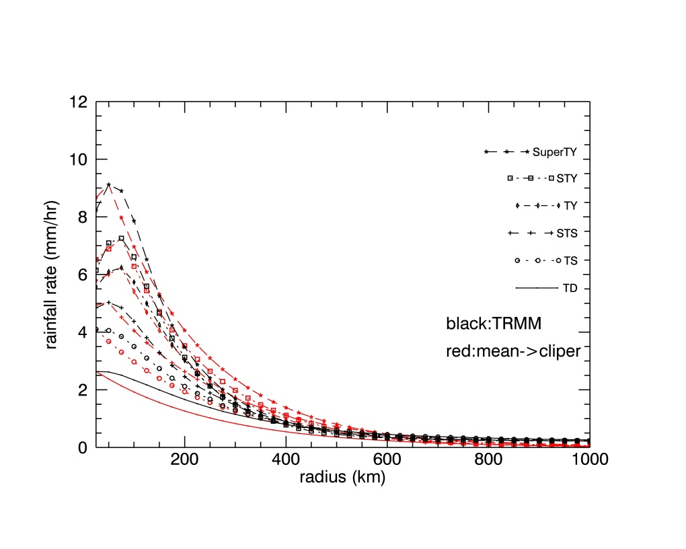
Modified R-CLIPER in WP: function
Tropical Cyclone Rainfall Climatology and Persistence (R-CLIPER )
Rainfall Rate=
$\left\{\begin{aligned}R_{0}+\left(R_{m}−R_{0}\right)\left(\frac{r}{r_{m}}\right),r<r_{m} \\ R_{m}\exp\left[−C∗R_{m}∙\frac{r−r_{m}}{r_{e}}\right],r≥r_{m}\end{aligned}\right.$

Slide 8
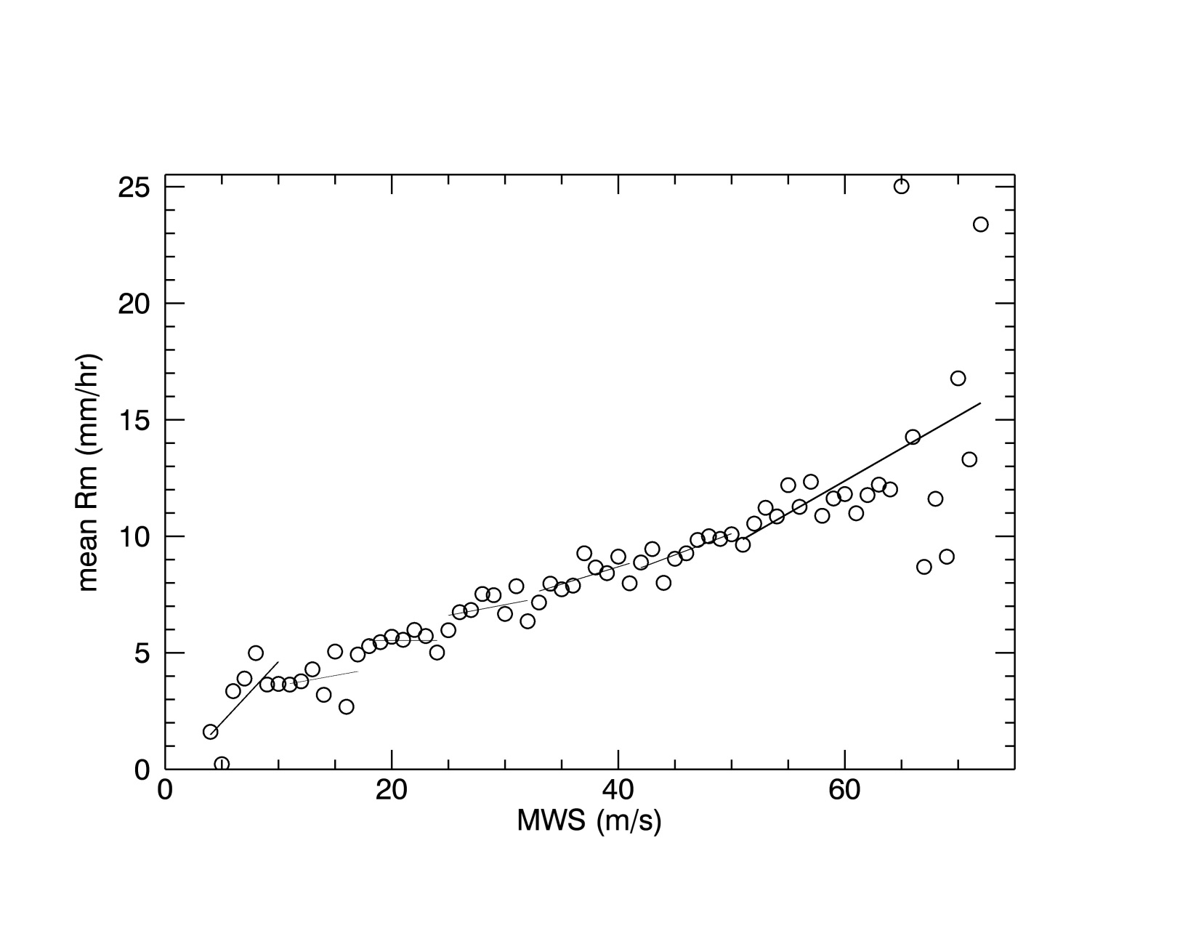
Modified R-CLIPER in WP: parameters
Tropical Cyclone Rainfall Climatology and Persistence (R-CLIPER )
Parameter Rm: linear function of MWS

Slide 9
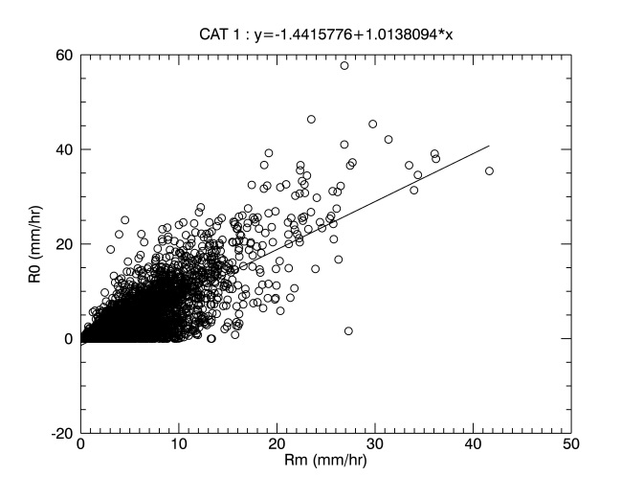
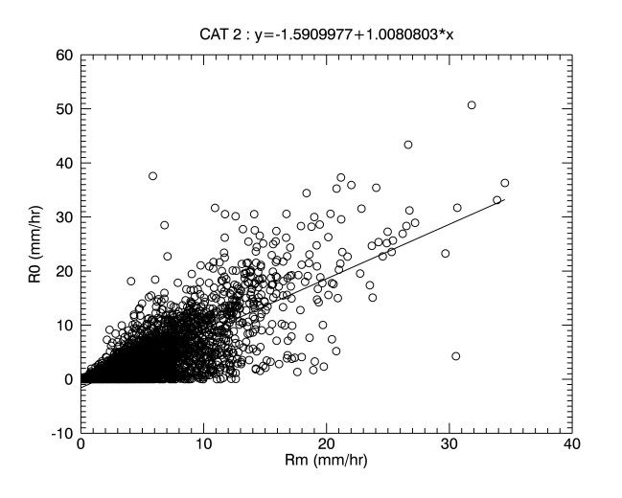
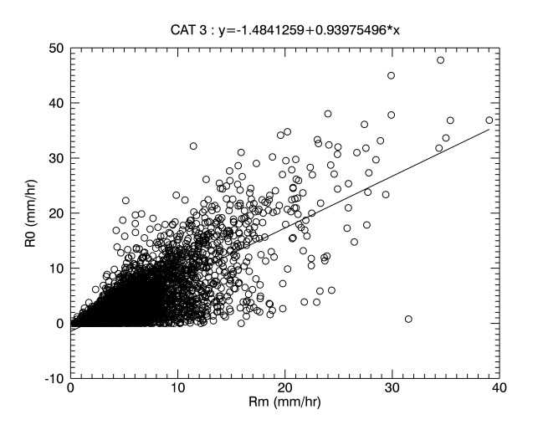
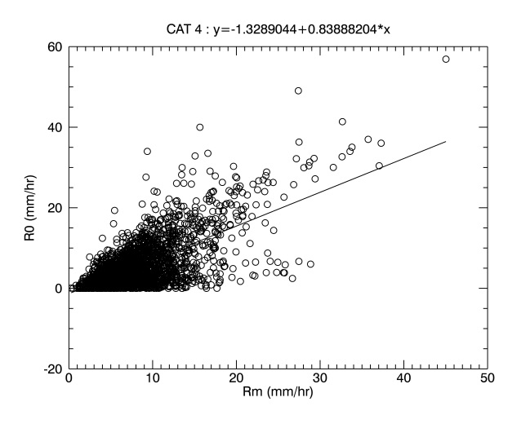
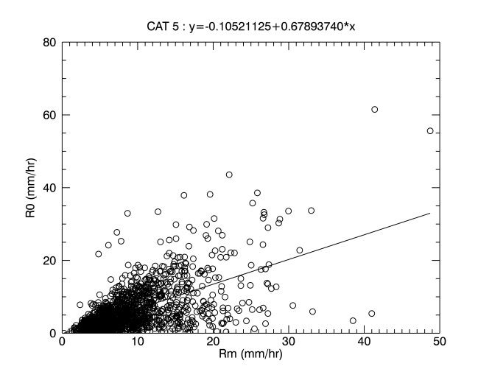
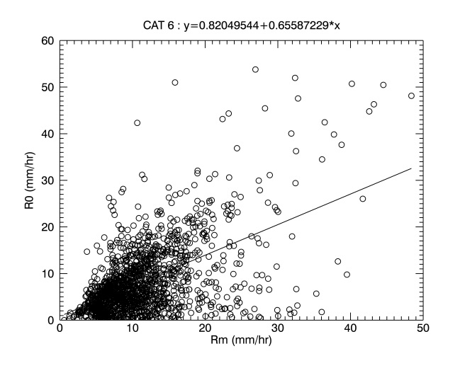
Modified R-CLIPER in WP: parameters
Tropical Cyclone Rainfall Climatology and Persistence (R-CLIPER )
Parameter R0: linear function of Rm

Slide 10
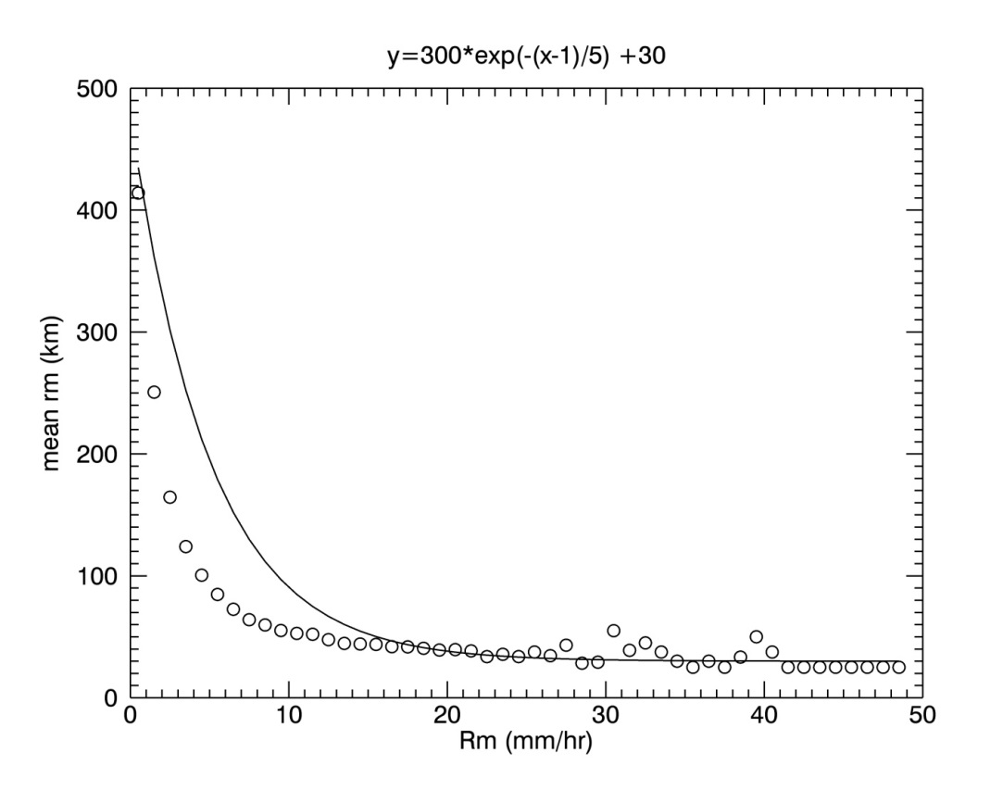
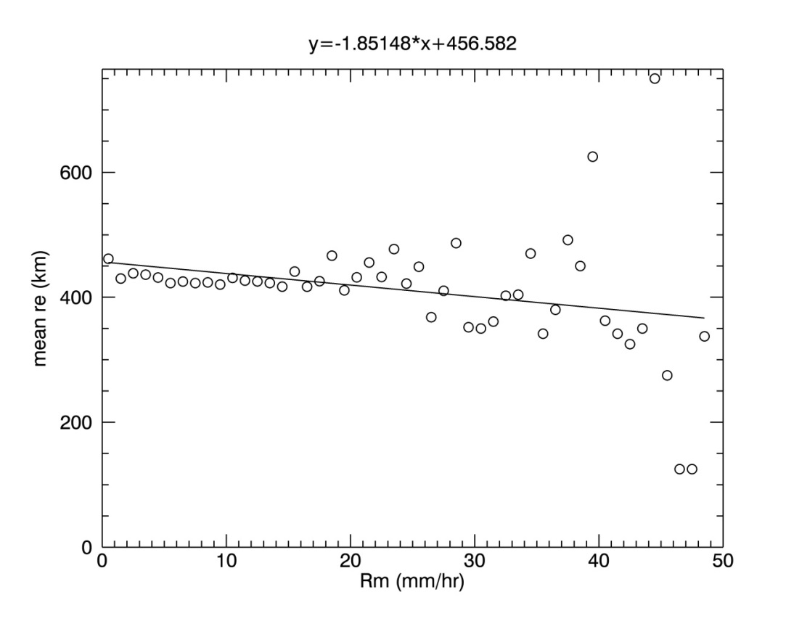
Modified R-CLIPER in WP: parameters
Tropical Cyclone Rainfall Climatology and Persistence (R-CLIPER )
Parameter rm: exponential function of Rm
Parameter re: linear function of Rm

Slide 11
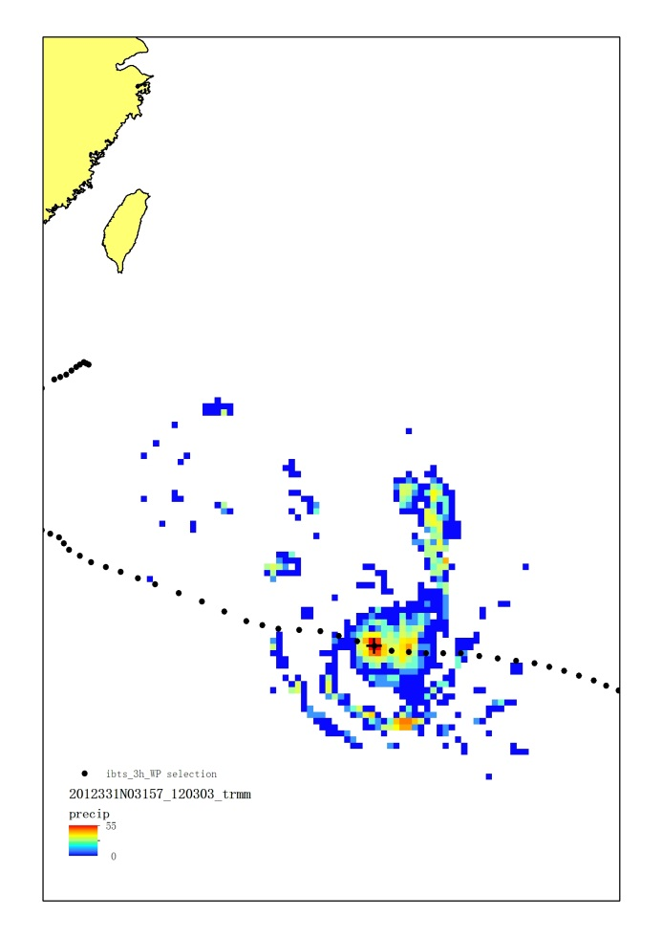
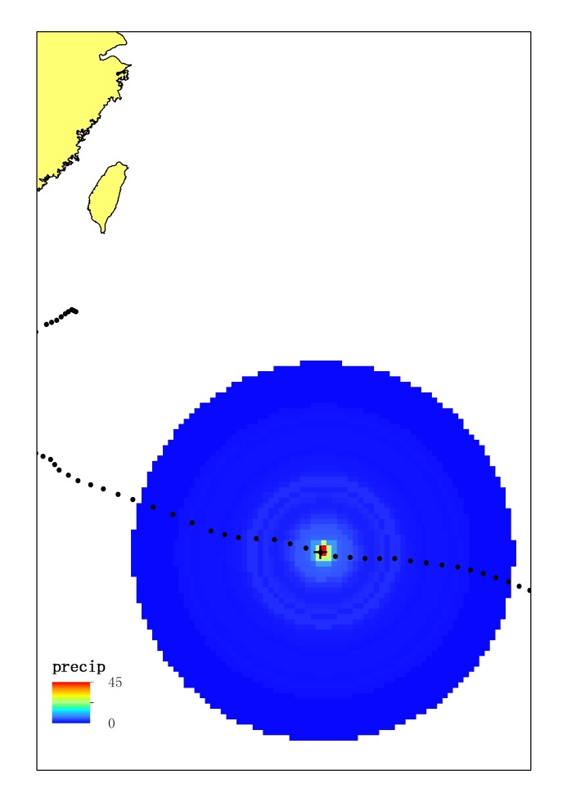
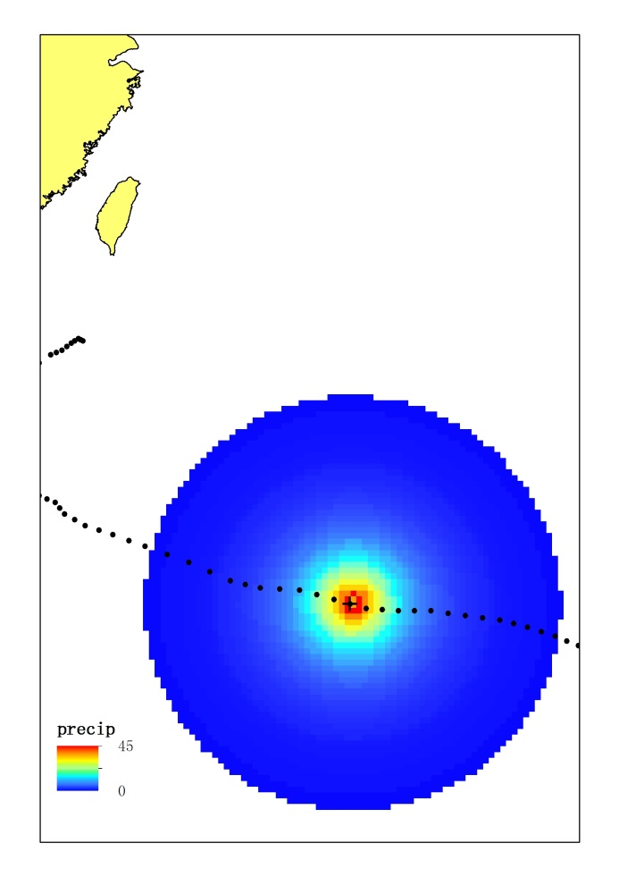
Result
Tropical Cyclone Rainfall Climatology and Persistence (R-CLIPER )
TC: Bopha (2012331N03157)
Time: 12-03 -2012 03:00
MWS: 54.63 m/s
Intensity: Catogory 6
TRMM azimuthally averaged TRMM R-CLIPER
0~1000km

Slide 12
Asymmetric precipitation: factors
Asymmetric precipitation
Vertical wind shear
VWS is defined as the difference mean wind vectors of 200 and 850 hPa levels over an region of 200–800 km from TC center
Data source: NCEP reanalysis dataset
Time Period：1998~2012
Spatial resolution： 2.5*2.5 °
Temporal resolution：6 hourly
Motion
Translation speed and angle are calculated based on the IBTrACS

Slide 13
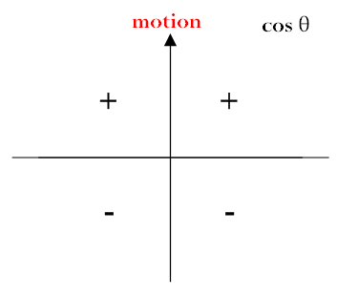
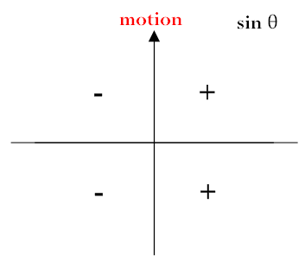
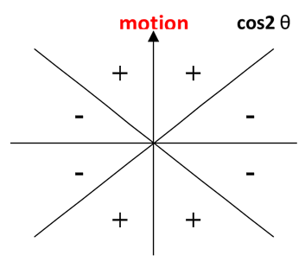
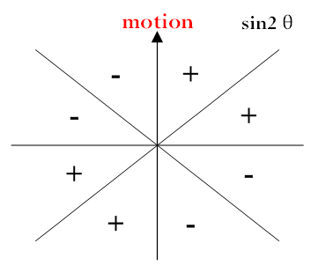
Asymmetric precipitation: method
Asymmetric precipitation
Fourier function:
where, amplitude
Front/rear
Left/right
wavenumber-1 and 2 rainfall asymmetry

Slide 14
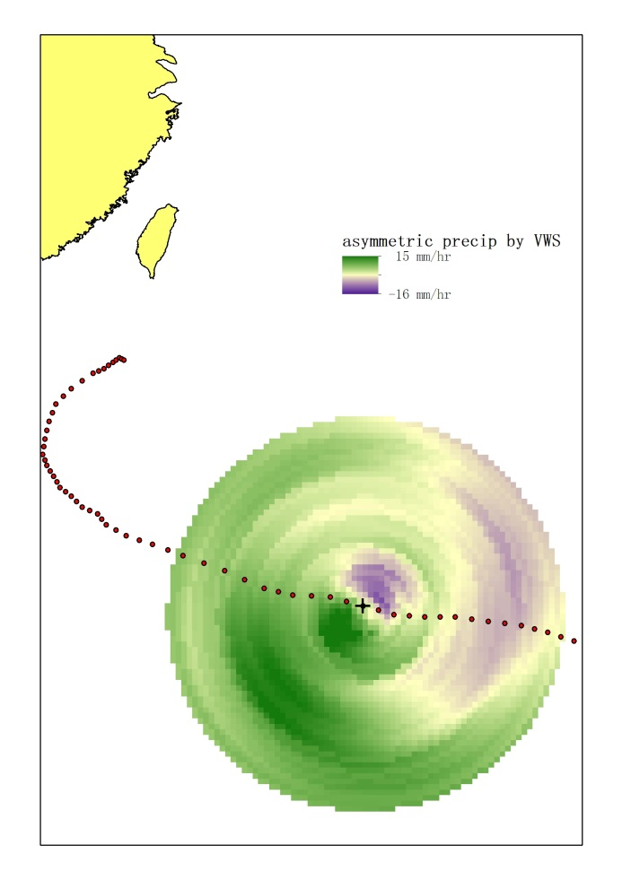
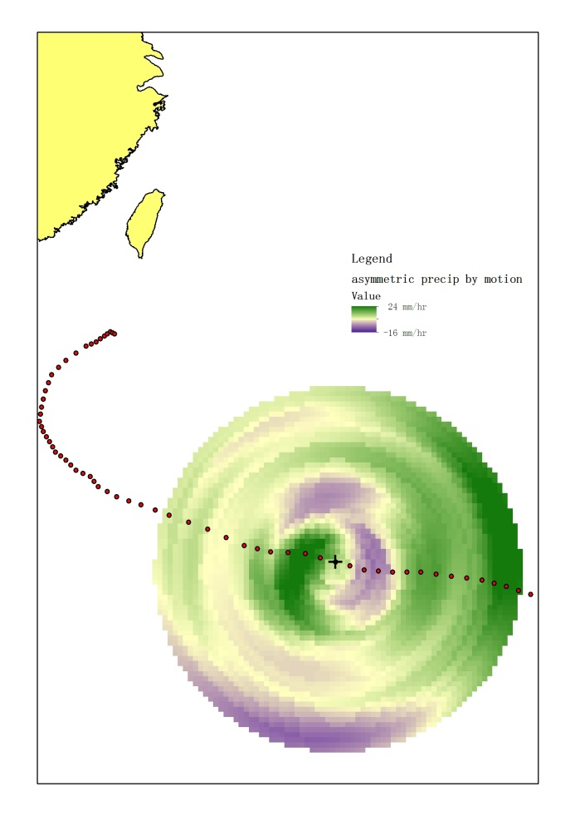
Result
Asymmetric precipitation
TC: Bopha (2012331N03157)
Time: 12-03 -2012 06:00
MWS: 59.1 m/s
Intensity: Catogory 6
VWS value：
2.3 m/s
VWS angle:
192.7°
Translation speed：27.7km/hr
Translation angle:
285.1°
asymmetric precipitation by VWS (left) and motion (right)
0~1000km

Slide 15
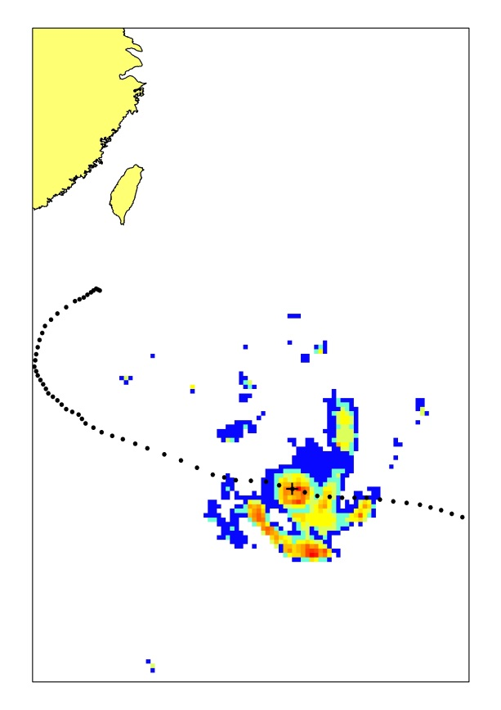
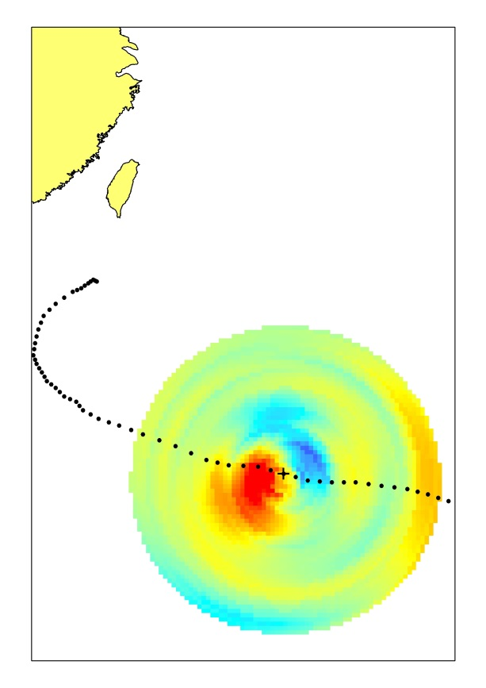
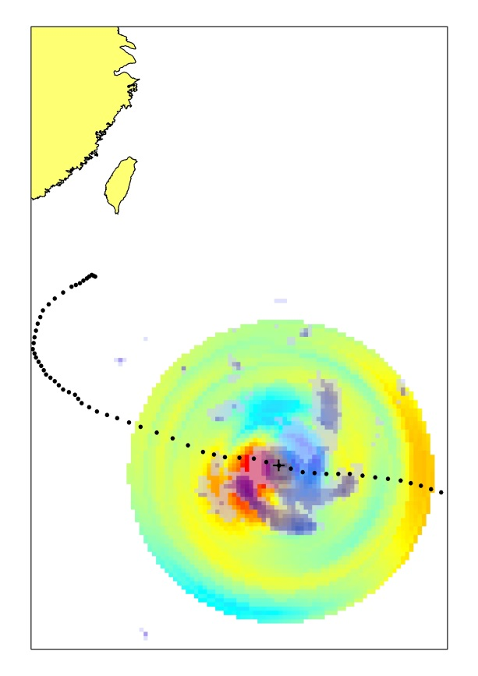
Result
Asymmetric precipitation
TC: Bopha (2012331N03157)
Time: 12-03 -2012 06:00
MWS: 59.1 m/s
Intensity: Catogory 6
TRMM RCLIPER+asymmetric overlapped
0~1000km

Slide 16
Future work
Asymmetric precipitation
Validation of total/maximum/mean precipitation, and spatial distribution
Precipitation after landfall

