Slide 1
Climatology of mesoscale vortices in China
Yu Shu, Fuqing Zhang, and Jisong Sun

Slide 2
1 Review of past studies
2 Data and method
3 MV climotology
4 Composite MV
5 Summary and conclusions

Slide 3
Review of past studies
Statistical studies of MV over US:
1. Bartels and Maddox (1991) 2. Trier et al. (2000)
3. Davis et al. (2002) 4. James and Johnson (2010)
Lack of high resolution data with a large time range
Time consuming, amounts of manual work are needed
Statistical studies of MV over China:
Southwest vortex: Fu et al. (2014, 2015)
Tibetan Plateau vortex: Feng et al. (2014)
Dabie vortex: Fu et al. (2016)
Vortex on Meiyu front: Yang et al. (2010), Shen et al. (2013)
Notes:
2的方法，从图像动画上来找涡旋是主观的，但是从云迹风可以定量客观的来判断涡旋和追踪涡旋。

Slide 4
Motivation
Past studies are lack of a large spatial-temporal range climatology.
To facilitate the generalization about MV physical characteristics. To provide a statistical robust basis for the validation of numerical simulations

Slide 5
1 Review of past studies
2 Data and method
3 MV climotology
4 Composite MV
5 Summary and conclusions

Slide 6
Data and Method
Data: EC-interim, 0.125º, 6h; and cmorph: 8km, 0.5h
Method:
(1) MV at each time: DAT (2002)
(2) MV track: a modified TREC
(3) MV categories:
By the initial situation: MCV, MSV (Mesoscale Stratiform Vortex), and MDV (Mesoscale Dry Vortex).
circular
symmetric
R<300km
monotonic decrease
> 4.5*10⁻⁵
Notes:
Correlation coefficient

Slide 7
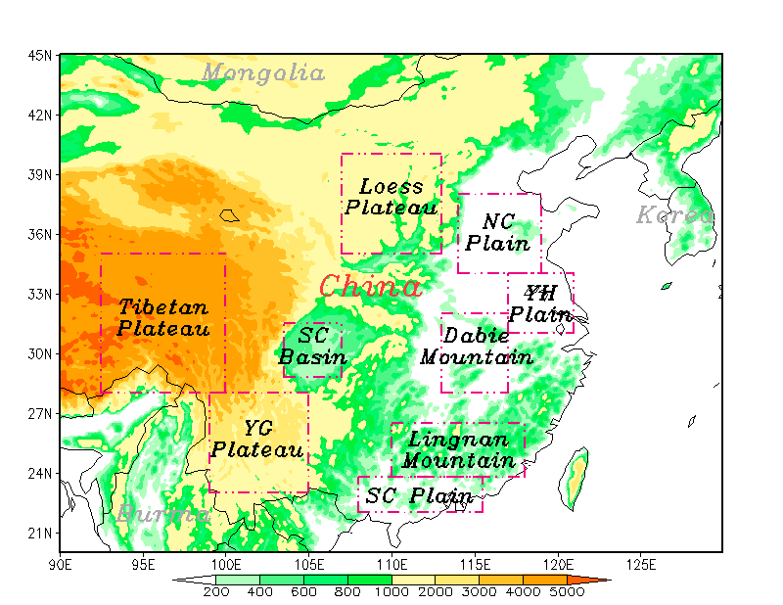
Region
Time: 2007.01 ~ 2016.12
Region: 20N – 45N, 90E – 130E

Slide 8
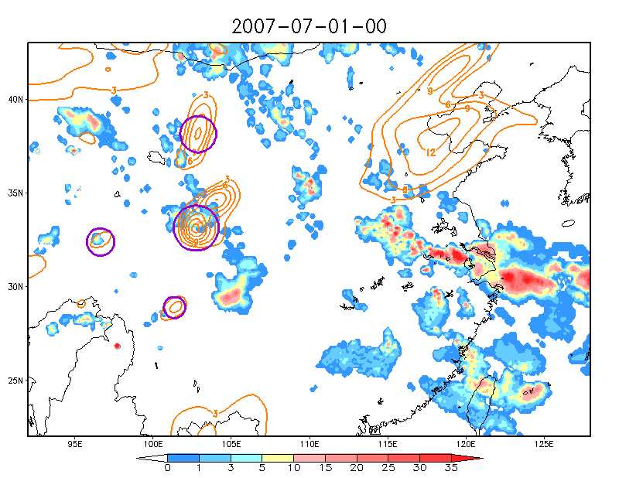

Slide 9
1 Review of past studies
2 Data and method
3 MV climotology
4 Composite MV
5 Summary and conclusions

Slide 10
Statistical Results
Statistics of different MV categories from 2007 to 2016
 | MV | MCV | MSV | MDV | With-sec | Without-sec
Number | 21053 | 10148 (7177) | 9421 (2178) | 1484 (155) | 9510 | 11543
Intensity (10⁻⁵ s⁻¹) | 9.2 | 9.8 | 8.8 | 7.7 | 10.1 | 8.5
Radius (km) | 189.5 | 198.4 | 174.3 | 182.3 | 199.8 | 181.0
Duration (h) | 11.0 | 11.5 | 10.7 | 9.2 | 13.9 | 8.6
Max pre. (mm/h) | 14.5 | 22.8 | 7.4 | 3.3 | 27.8 | 3.6
70.7% 23.1% 10.4%
12
200
Notes:
Davis(2002)，86/203的MCV,40%有新对流；形成于对流中的MV强度和时间更大、5倍更可能激发新对流；水平尺度和强度时间没有明显关系.Trier（2000）MCV一半略多的有sec(9/16). James(2010)统计MCV平均值：200km,1.2*10⁻⁴；强度和时间没有显著关系；40%MCV有继生对流；有无继生对流对生命史影响较小。

Slide 11
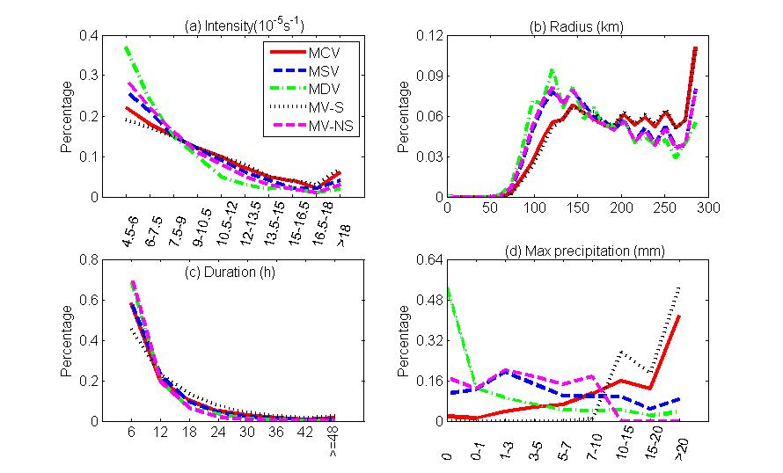

Slide 12
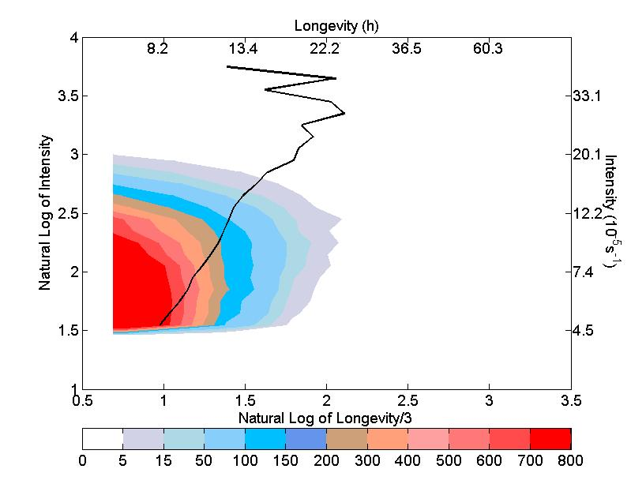
Relationship between intensity and longevity
Notes:
Davis（2002）强度是时间存在某种关系；James（2010）强度和时间没有显著关系。已知强度的情况下，可以预期存活时间。

Slide 13
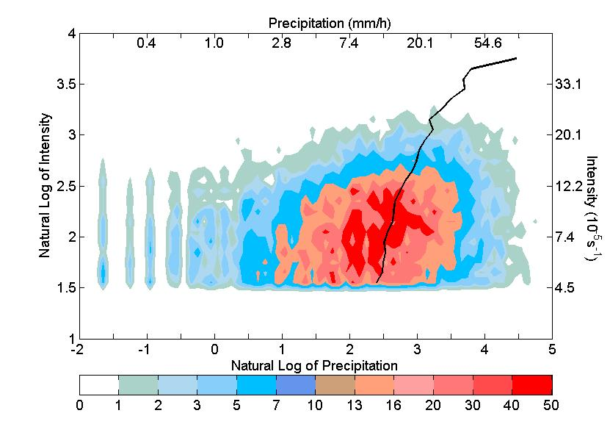
Relationship between intensity and precipitation
Notes:
红色曲线是所有个例，黑色是有降水个例。降水0.0和0.1的，都放在了x轴为 -1.95里。强度越大，造成的降水强度越大。涡旋强度达到2.5以上（12*10⁻⁵）几乎都能造成降水了。涡旋强度较小时（<1*10⁻⁵），几乎很难造成降水。

Slide 14
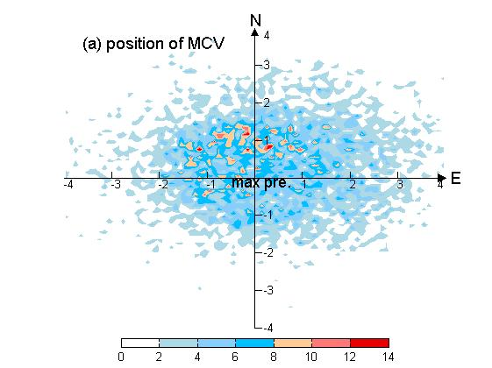
MCV position relative to max pre.
Notes:
北纬30度，96km每经纬度，3.125度为300km，降水激发涡旋的300km搜索半径的合理性。坐标为经纬度间隔，填色为系统个数。MCV更多的出现在了最强降水的北侧，第4象限的很少。强风暴中，气流斜升；强降水所在的位置应该是下沉运动的位置，涡旋形成的位置应该是强上升气流所在的位置，可以考虑合成分析、分析垂直运动。强上升运动，有利于倾斜项，也有大量潜热释放、随着斜升气流降水被抬升、然后随着下沉气流及地。

Slide 15
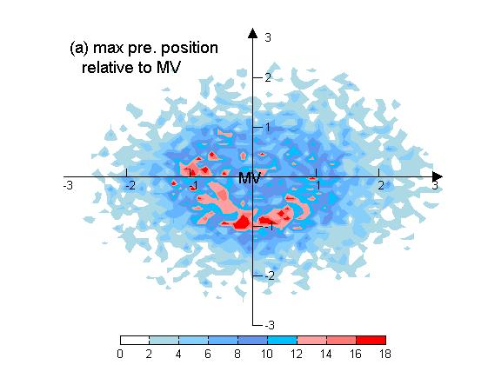
Position of secondary convection (MV)

Slide 16
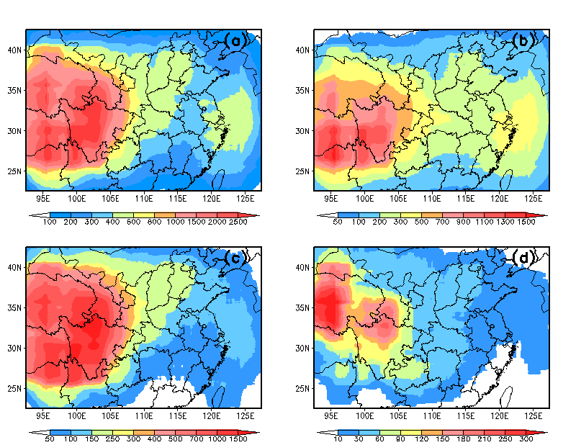
Geographical distribution
MV
MCV
MSV
MDV
Notes:
MV, MCV, MSV, MDV

Slide 17
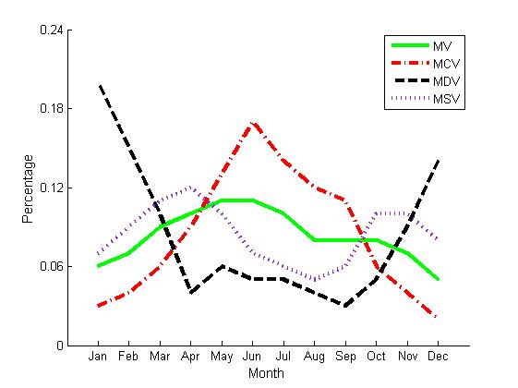
Monthly variation

Slide 19
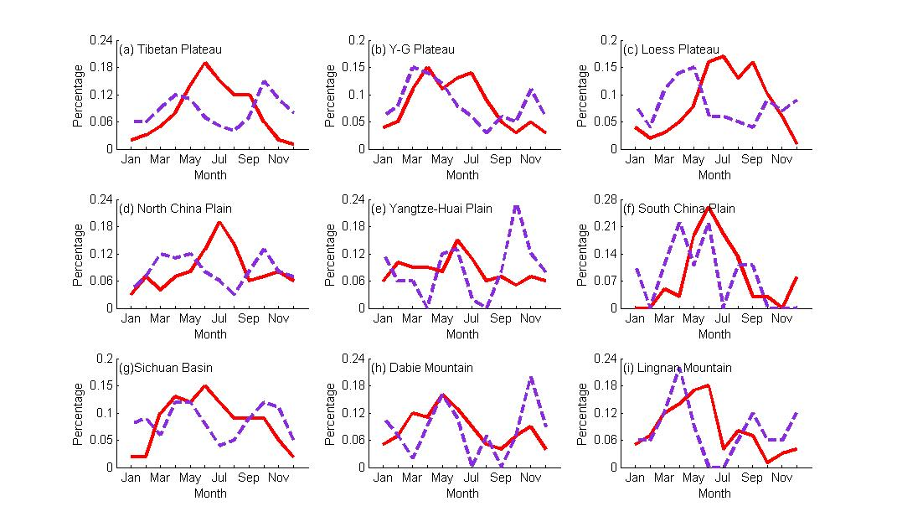
Monthly variation
Notes:
Zhang(2015)西南涡7月上旬最多，大别涡6月上旬最多。可能需要把所有涡旋的绿色曲线加上。

Slide 20
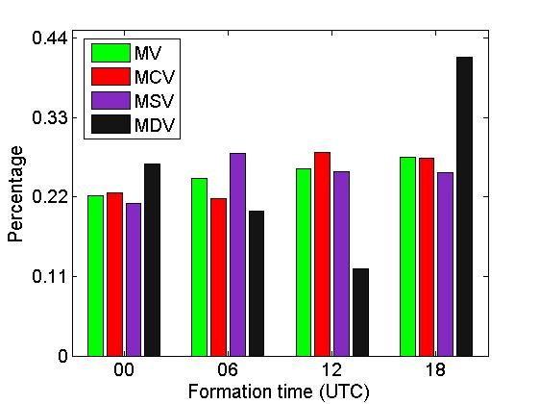
Diurnal variation (formation time)
Notes:
所有涡旋而言，更多的形成于午后和夜间（06和18UTC），有继生对流的多形成于午后。MCV 20时形成的最多。MSV 06时形成的最多。干涡旋夜间形成多，多形成于背风坡，夜间山谷风环流，风从山顶往下吹，动力下沉涡度增加。

Slide 21
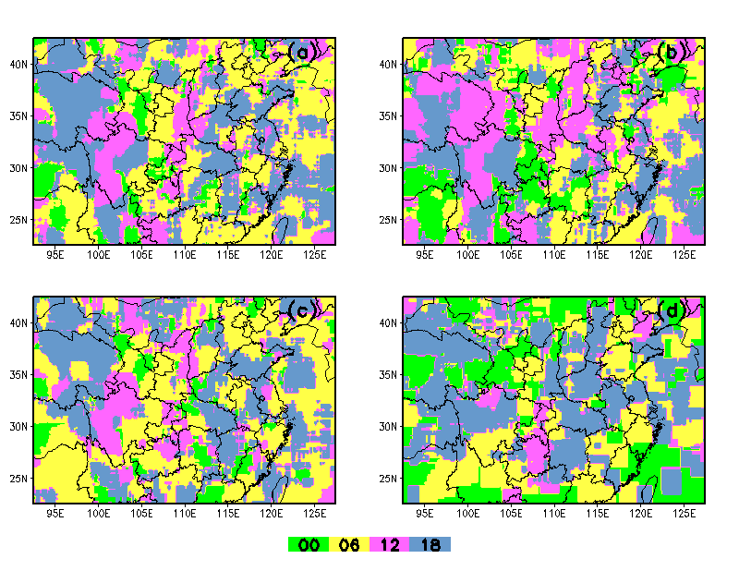
Formation time
MV
MCV
MSV
MDV
Notes:
MV,MCV,MSV,MDV.

Slide 22
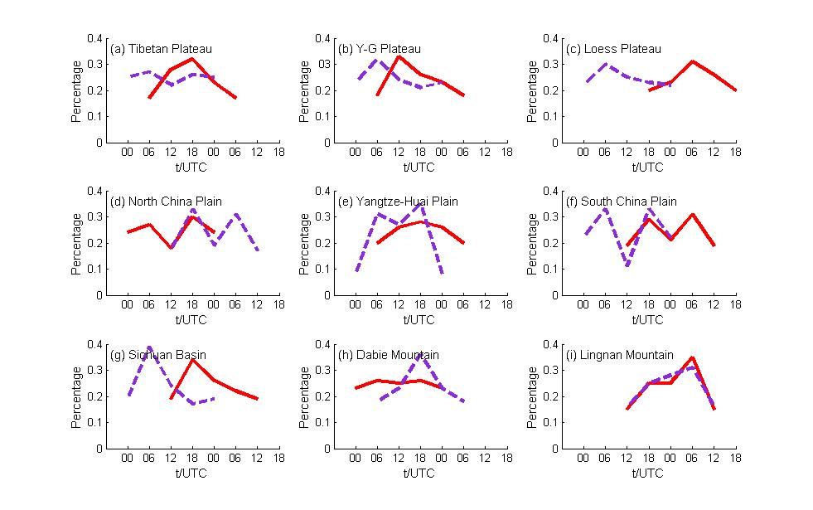
Formation time of different regions

Slide 23
1 Review of past studies
2 Data and method
3 MV climotology
4 Composite MV
5 Summary and conclusions

Slide 24
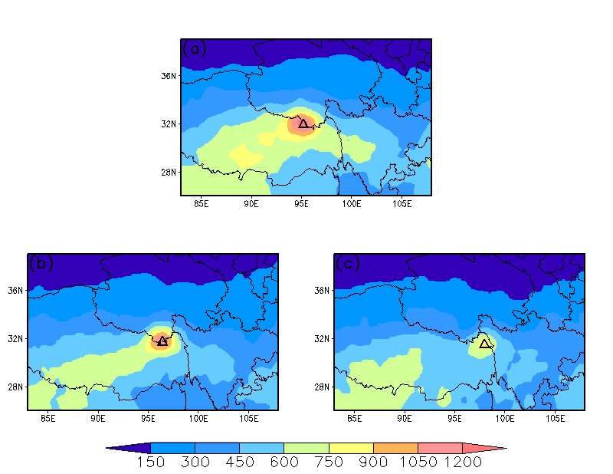
Suface features (CAPE) Plateau MCV
initiation
maturity
dissipation

Slide 25
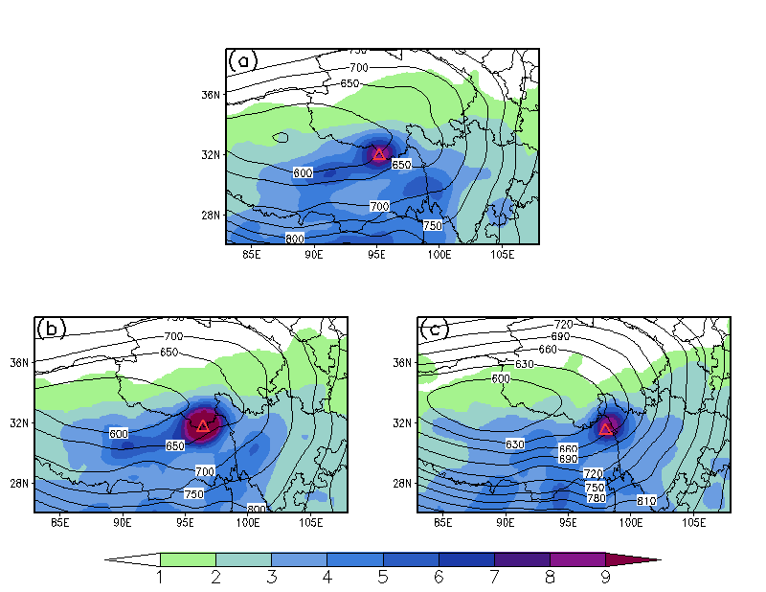
Suface features (sp+tp) Plateau MCV
initiation
maturity
dissipation
Notes:
忽略大的低压背景，随着生命史，地面气压逐渐升高

Slide 26
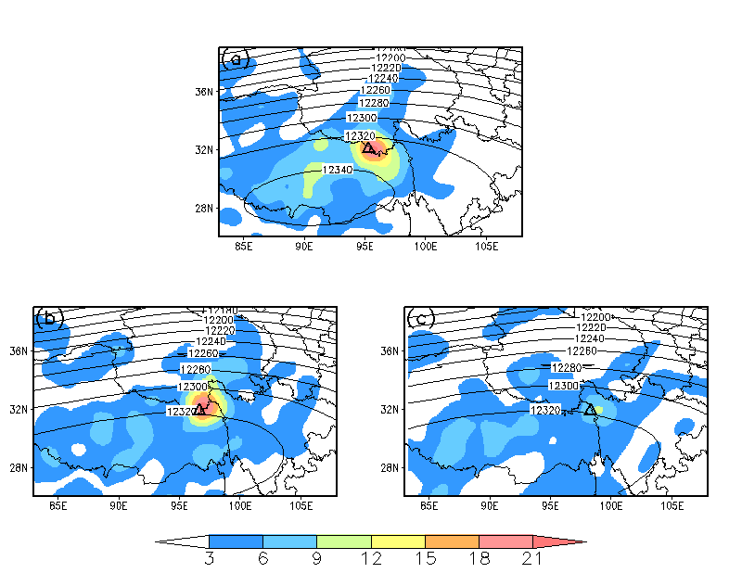
High level features (200: height,divergence) Plateau MCV
initiation
maturity
dissipation
10⁻⁶s⁻¹

Slide 27
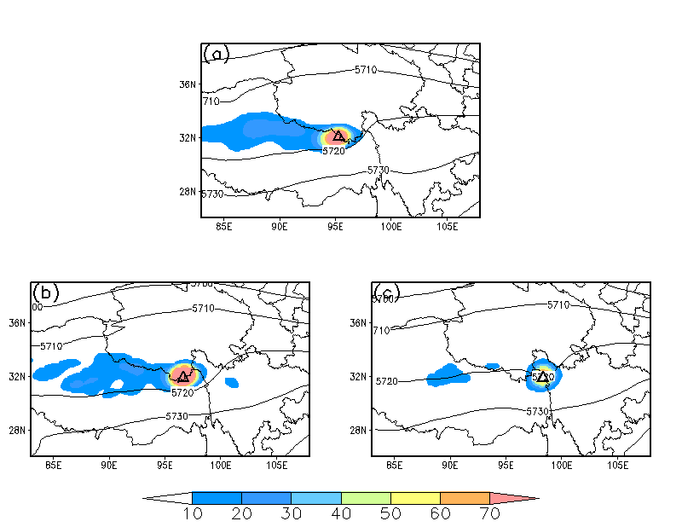
Middle level features (500: height,vorticity) Plateau MCV
initiation
maturity
dissipation
10⁻⁶s⁻¹

Slide 28
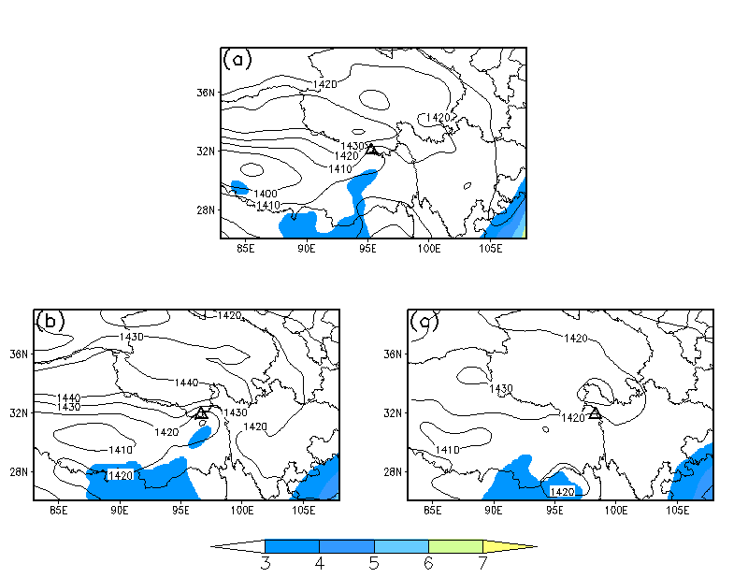
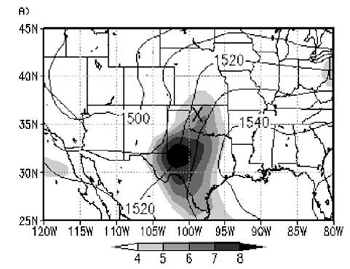
Low level features (850: height,wind) Plateau MCV
initiation
maturity
dissipation

Slide 29
Summary
A 10-year MV climatology are done, some of the basic MV characteristics are analyzed.
The composite of Plateau MCV are done. We get some primary results. More composite work need to be done in future days, such as the vertical structure, the role of vertical shear, as well as the differences among different composite MCVs.

Slide 30
Thanks!

