Slide 1
WRF-Chem Sensitivity of Tropospheric Ozone in the Mid-Atlantic Region in June 2016
By: Andrew Thomas
Amy Huff
Fuqing Zhang

Slide 2
Setup of the Experiment

Slide 3
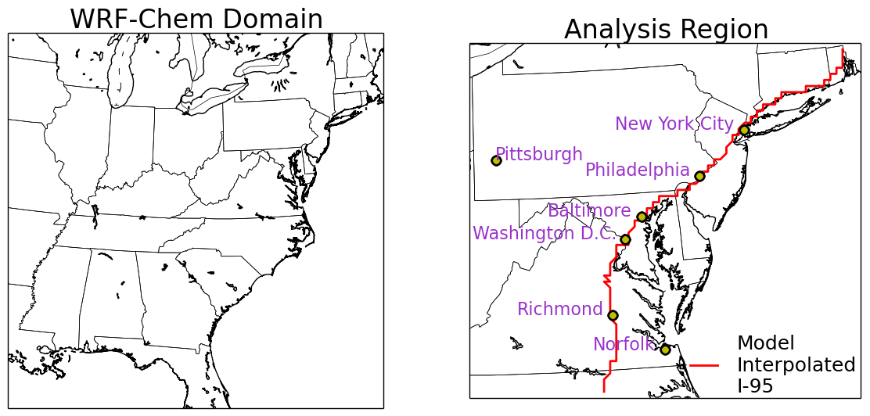

Slide 4
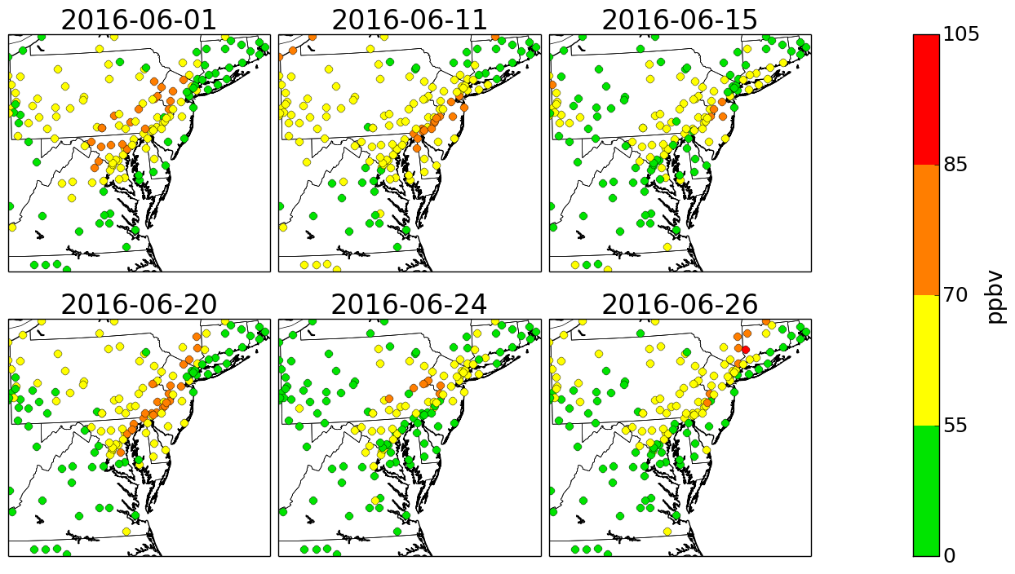
Observed MD8-O₃ in the Upper Quintile
Notes:
Constituent days of the upper quintile.
6/1 – 21 stations exceeded
6/11 – 15 stations exceeded
6/15 – 4 stations exceeded
6/20 – 20 stations exceeded
6/24 – 8 stations exceeded
6/26 – 2 stations exceeded

Slide 5
Setting | Choice | Reference
Longwave Radiation | RRTM | Mlawyer et al., 1997
Shortwave Radiation | Dudhia | Dudhia, 1989
Cumulus | Grell-Devenyi | Grell and Devenyi, 2002
Microphysics | WSM6 | Lim and Hong, 2010
Land Surface Model | NOAH | Tewari et al., 2004
Chemistry | RACM | Stockwell et al., 1997
Biogenic Emissions | MEGAN | Guenther et al., 2006
Photolysis | Madronich | Madronich, 1987

Slide 6
Ensemble Members
Ensemble Member | PBL | IC/BC | Emissions
CNTL | YSU | GFS | 2011
ACM2 | ACM2 | GFS | 2011
MYJ | MYJ | GFS | 2011
NEI-05 | YSU | GFS | 2005
NEI-14 | YSU | GFS | 2014*
MERRA-2 | YSU | MERRA-2 | 2011
ERA | YSU | ERA | 2011

Slide 7
Creation of the NEI-14
Area NO_{x} emissions were decreased per state using factors provided by Daniel Tong of NOAA, similarly to Pan et al., 2014.
Point NO_{x} emissions were altered using Clean Air Market data.
All other emissions were kept the same from the NEI-11.

Slide 8
Vertical and Spatial Distribution of MD8-O₃

Slide 9
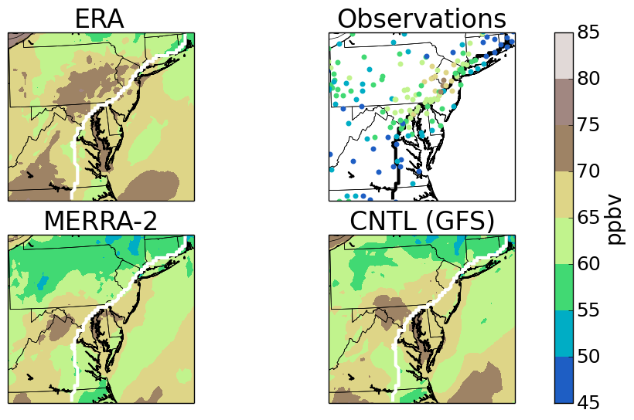
Average MD8-O₃ of the Upper Quintile: IC/BC
Notes:
This figure shows that the ERA-GFS overpredicts ozone the most. This also demonstrates that MERRA-2 produces less ozone than the other subensemble members.

Slide 10
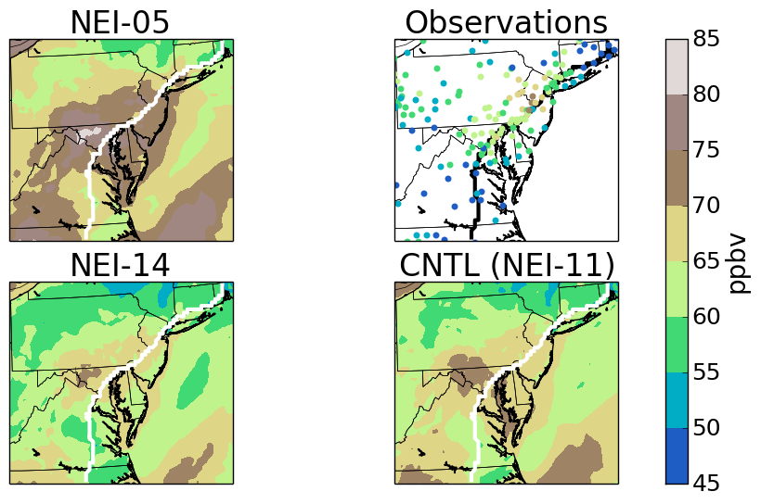
Average MD8-O₃ of the Upper Quintile: Emissions
Notes:
This figure shows that the emissions inventory sub-ensemble shows the decrease in ozone due to emissions inventory.

Slide 11
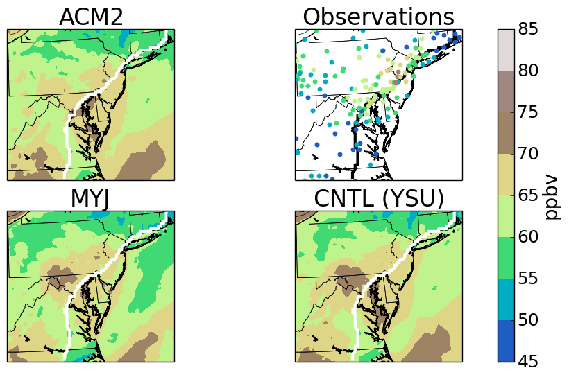
Average MD8-O₃ of the Upper Quintile: PBL
Notes:
This Figure shows that there are very few differences between the PBL ensemble members.

Slide 12
Uncertainty of MD8-O₃

Slide 13
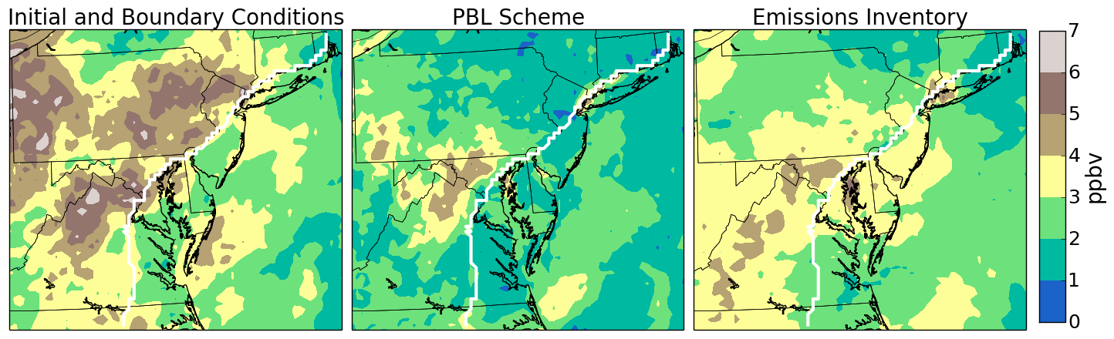
Average Standard Deviation of MD8-O₃ for the Upper Quintile
Notes:
Sub-ensemble standard deviation of surface MD8-O3 for the upper quintile. The initial and boundary conditions are the most uncertain, followed by the Emissions Inventory.

Slide 14
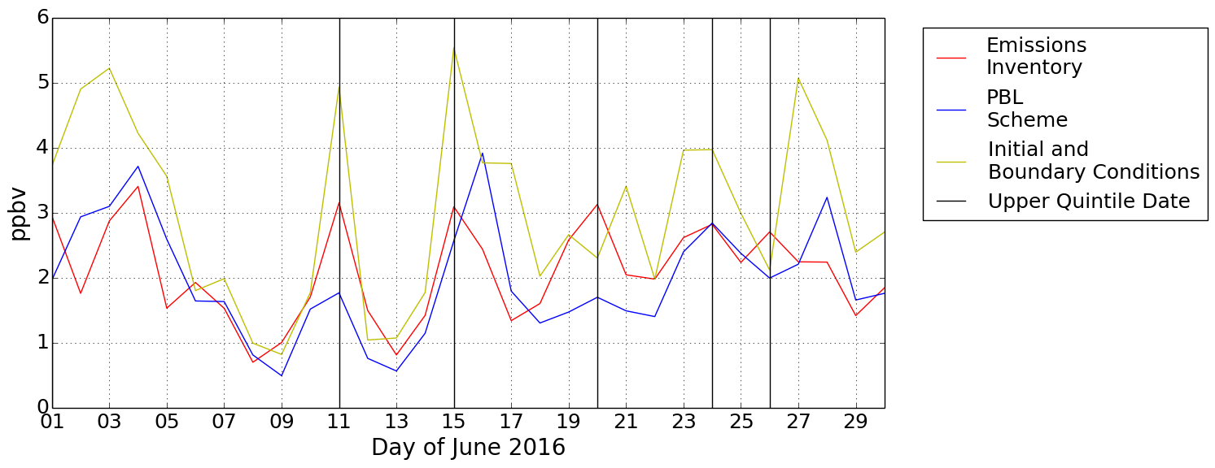
Spatially Averaged Standard Deviation of MD8-O₃ over Land
Notes:
This figure demonstrates the extent that the initial and boundary conditions sensitivity is enhanced. The emissions inventory is the next most sensitive feature.

Slide 15
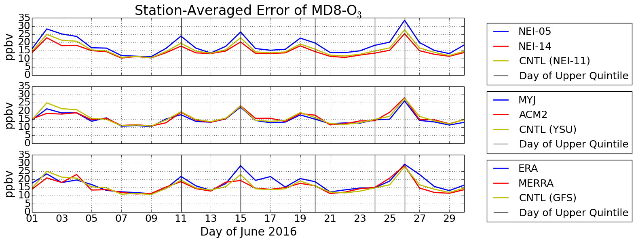
Notes:
This Figure helps support the idea that the later emissions inventory will provide the more accurate mixing ratios of MD8-O3.

Slide 16
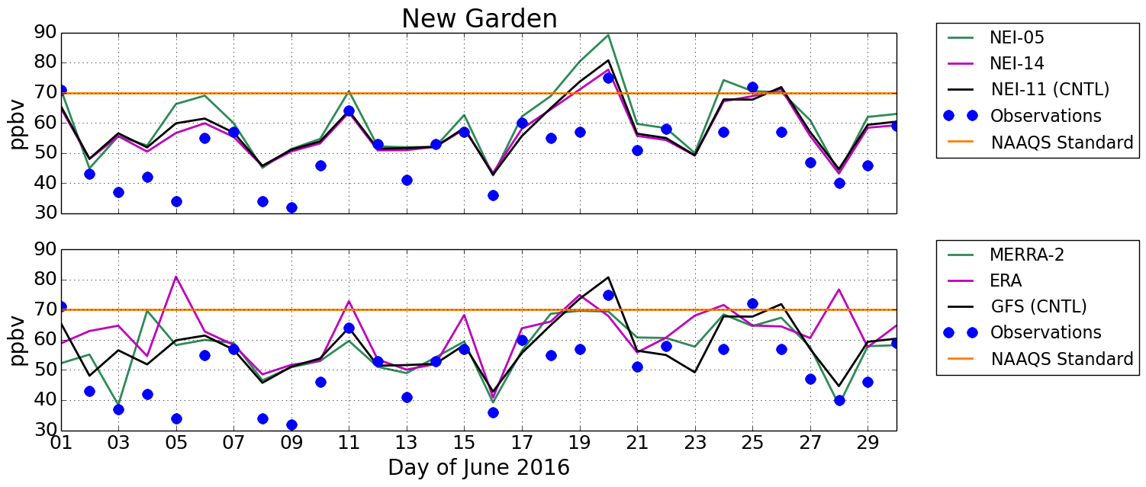
Time-series of MD8-O₃ at New Garden
Notes:
20, 18 observations outside ensemble for emissions and icbc respectively

Slide 17
Results:
Surface MD8-O₃ is generally most sensitive to initial and boundary conditions.
Boundary layer MD8-O₃ is more sensitive to emissions inventory than PBL scheme.
More accurate mixing ratios of MD8-O₃ are associated with more accurate emissions inventories.

Slide 18
Supplemental Figures + Slides

Slide 19
Mean Absolute Error of MD8-O₃ During the Upper Quintile
Ensemble Member | Mean Absolute Error
CNTL | 10.22
NEI-05 | 13.41
NEI-14 | 9.11
MYJ | 9.65
ACM2 | 10.34
ERA | 11.70
MERRA-2 | 11.22

Slide 20
Conclusions: Implications
Accurate data assimilation of meteorological information is critical for accurate air quality forecasts
The choice of initial and boundary conditions led to a less foreseeable outcome than the choice of emissions inventory.

Slide 21
Conclusions: Future Work
Extend the ensemble and sub-ensemble sizes:
  Use combinations of the chosen model settings, such as NEI-14 with the ACM2 PBL scheme.
  Include model settings that have not been tested, such as cumulus and photolysis parameterizations.
Identify the major causes for the enhanced sensitivity of tropospheric ozone to initial and boundary conditions by comparing model tendencies.
Develop better emissions modeling or inverse pollutant modeling techniques

Slide 22
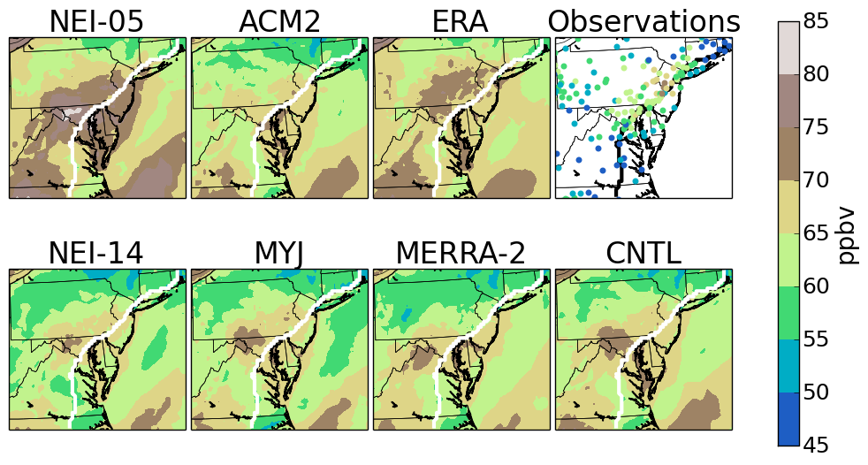
Average MD8-O₃ of the Upper Quintile
Notes:
This figure summarizes the three previous figures.

Slide 23
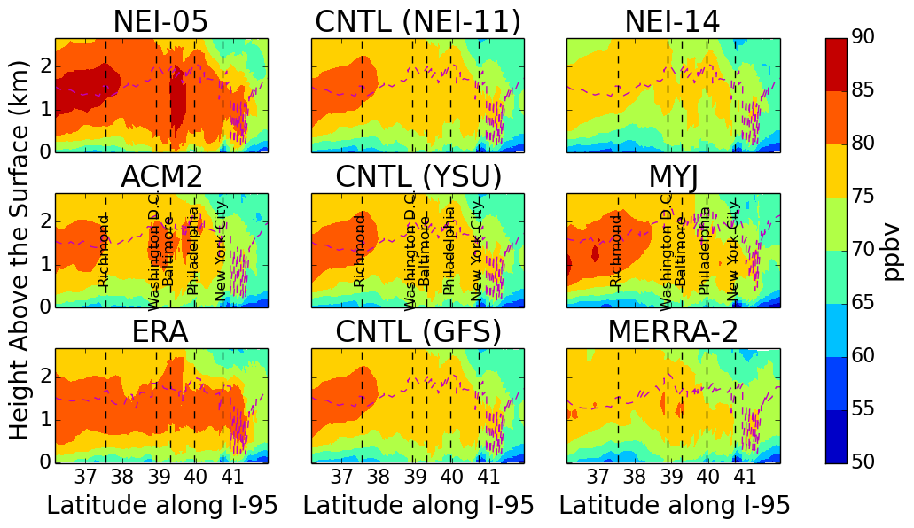
Average Cross-section of MD8-O₃ over I-95 for the Upper Quintile
Notes:
Cross-section of MD8-O3 of each sub-ensemble along I-95. The vertical coordinate was calculated by taking the using the hypsometric equation using the upper quintile- averaged pressure and average temperature. The upper quintile averaged peak 8-Hour average PBL height is denoted by the purple dashed line.

Slide 24
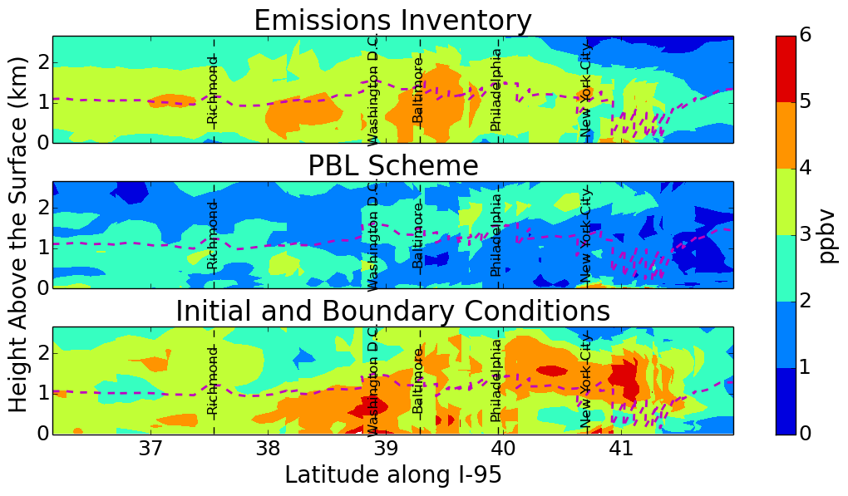
Average Cross-section of the Upper Quintile of MD8-O₃ Sensitivity Over I-95
Notes:
Cross-section of the sensitivity of MD8-O3 of each sub-ensemble along I-95. The vertical coordinate was calculated by taking the using the hypsometric equation using the upper quintile- averaged pressure and average temperature. The upper quintile averaged peak 8-Hour average PBL height is denoted by the purple dashed line.

Slide 25
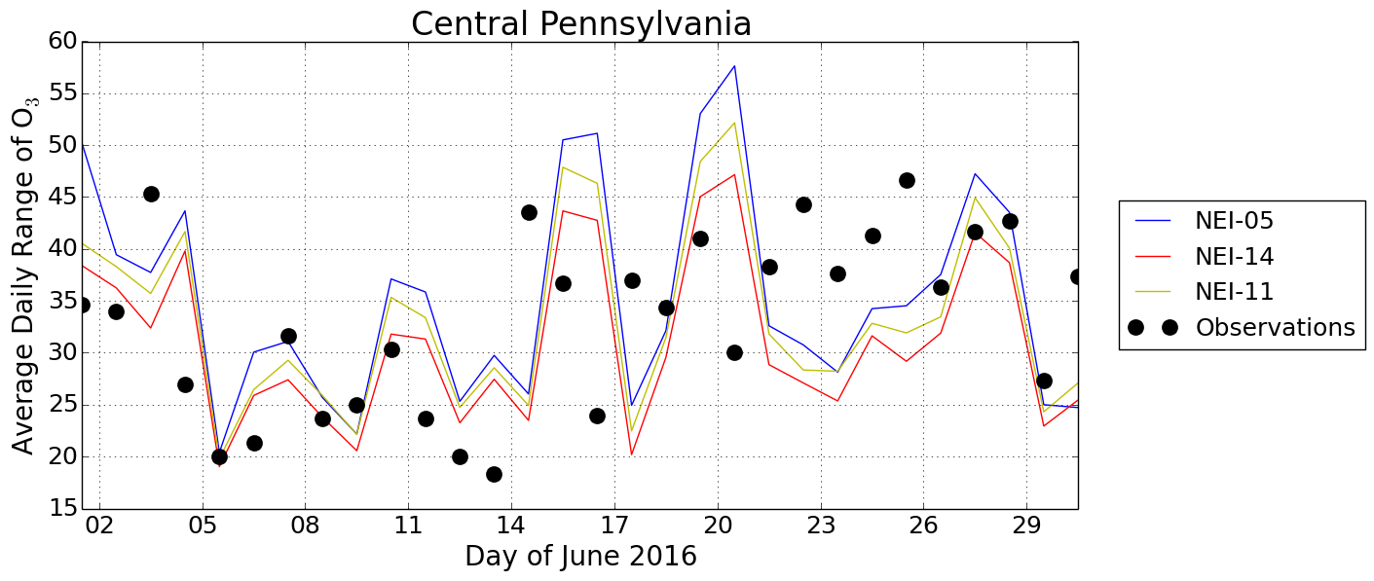
Station-Averaged Daily Range of O₃

Slide 26
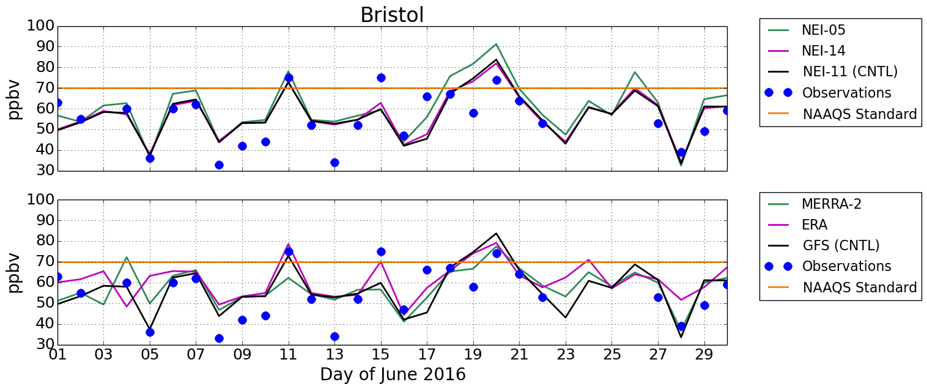
Time-series of MD8-O₃ at Bristol

Slide 27
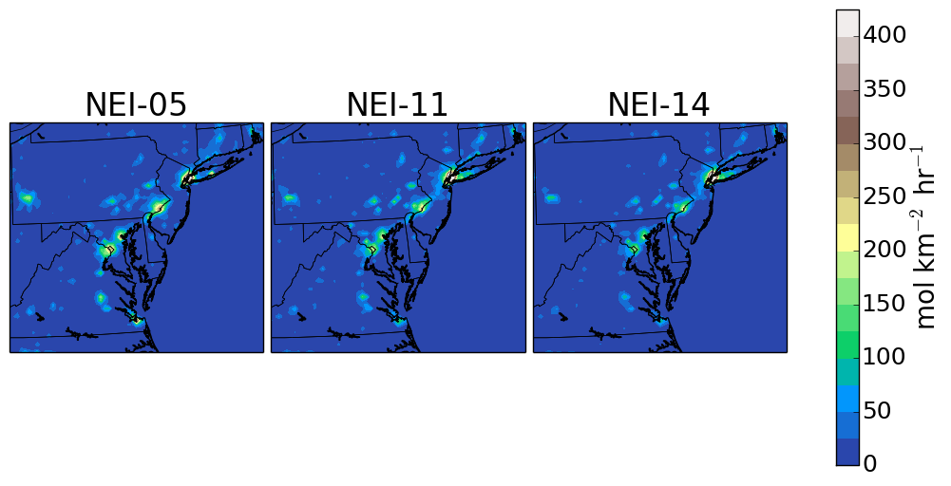
Peak Hourly NO_{x} Emissions

Slide 28
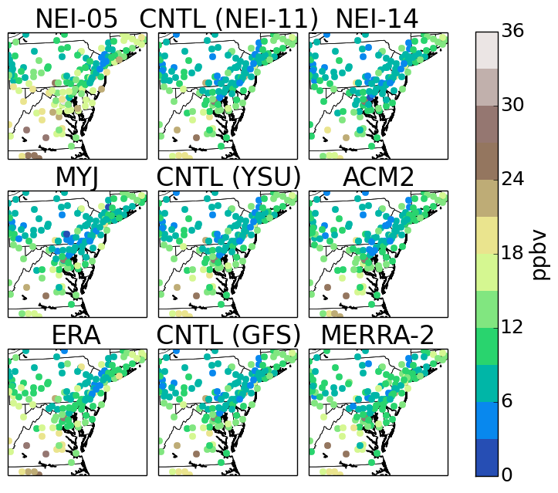
Mean Absolute Error of MD8-O₃ for the Upper Quintile

Slide 29
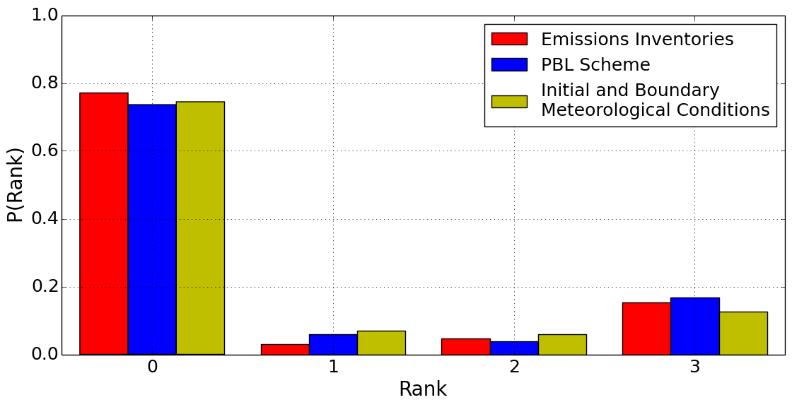
Rank Histogram of MD8-O₃ for each Sub-Ensemble
Notes:
This Figure shows that all of the sub-ensemble most frequently overpredicts MD8-O3. The emission inventory is most underdispersive, as noted by the lower probability of ranks 2 and 3, as compared to the other sub-ensembles. In contrast, the larger probability of 2 and 3 in the icbc sub-ensemble shows that is more likely to be

Slide 30
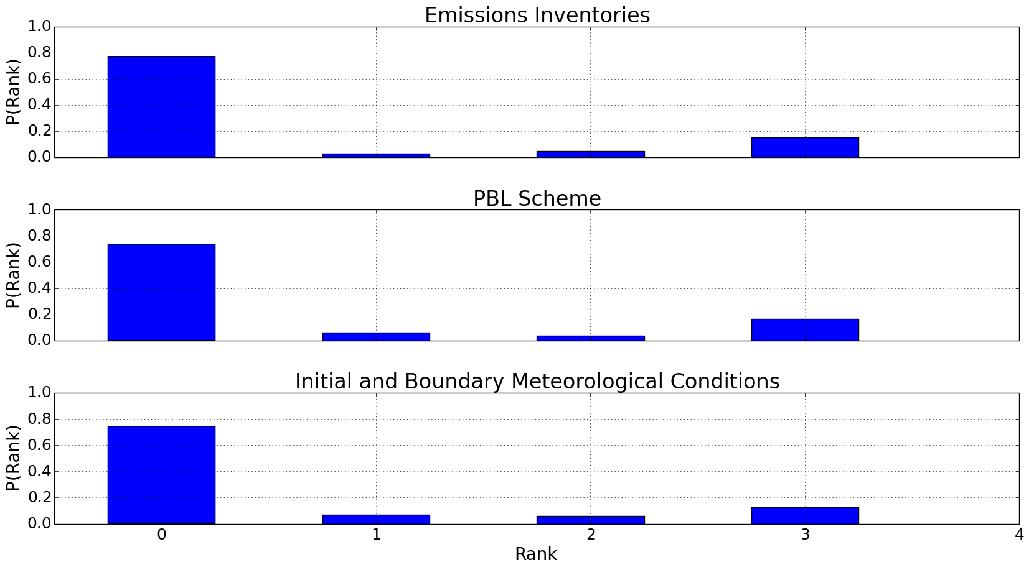
Rank Histogram of MD8-O₃ for each Sub-Ensemble
Notes:
This Figure shows that all of the sub-ensemble most frequently overpredicts MD8-O3. The emission inventory is most underdispersive, as noted by the lower probability of ranks 2 and 3, as compared to the other sub-ensembles. In contrast, the larger probability of 2 and 3 in the icbc sub-ensemble shows that is more likely to be

Slide 31
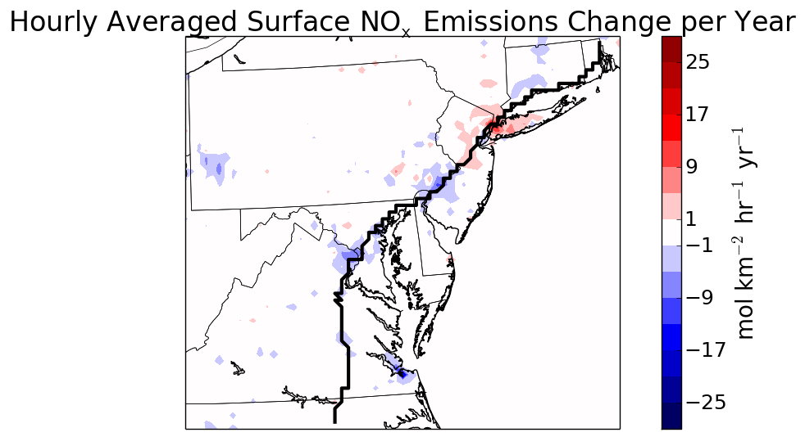

Slide 32
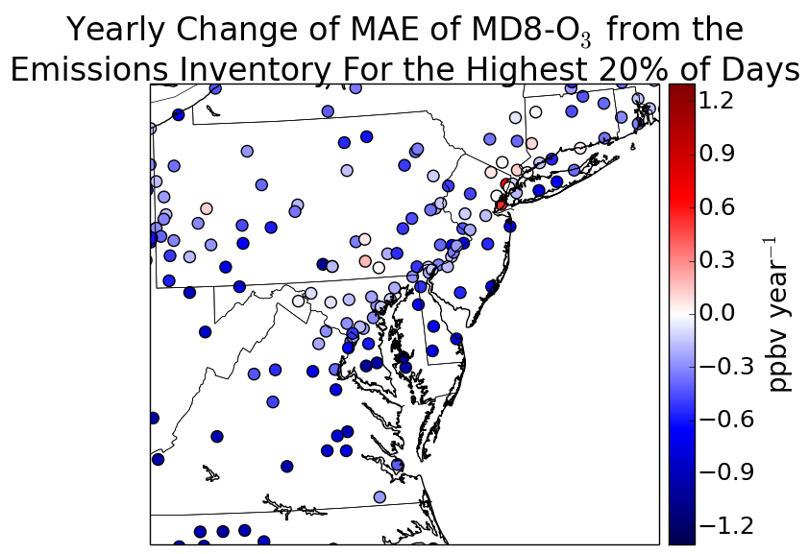

Slide 33
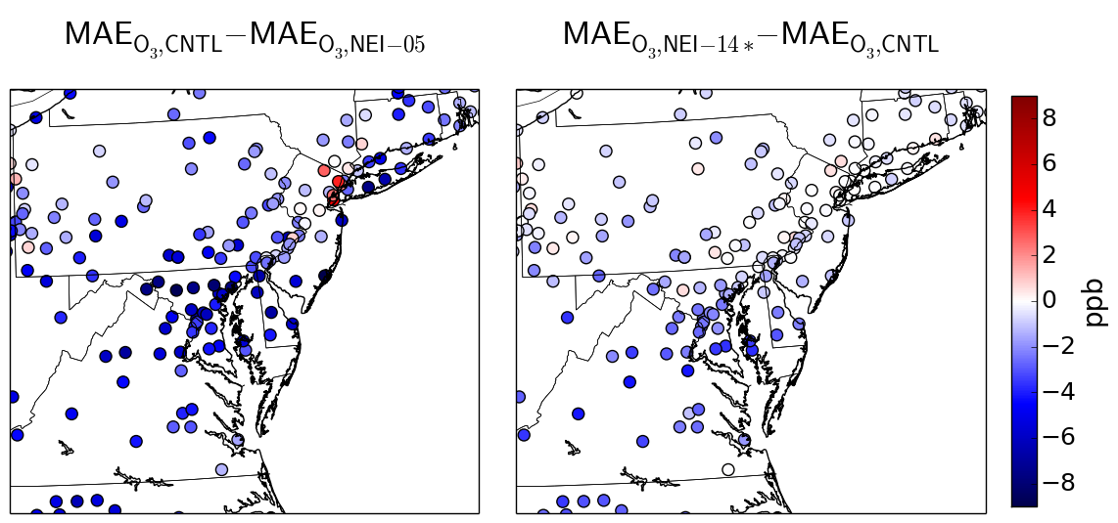
Decrease of the Mean Absolute Error of MD8-O₃ for the Upper Quintile

Slide 34
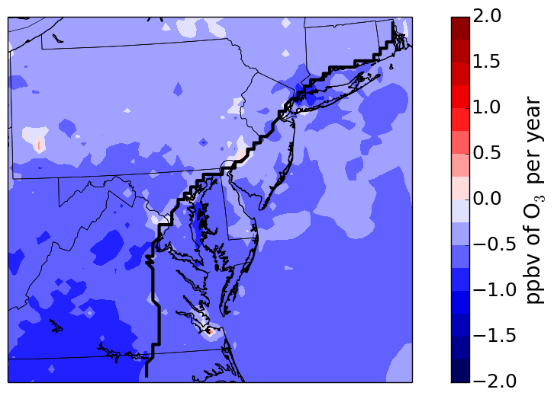
Upper Quintile Average MD8-O₃ Decrease Per Year

Slide 35
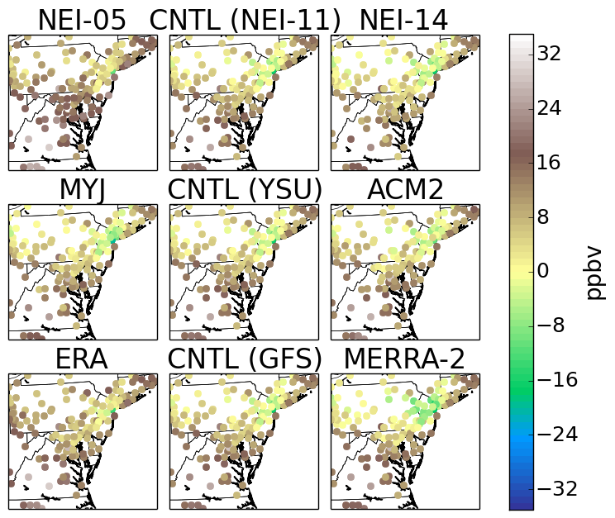
Mean Bias of MD8-O₃ for the Upper Quintile
Notes:
This Figure demonstrates that the ensemble generally overpredicts ozone. Near NYC, MD8-O3 has a weak negative bias. This is enhanced in MERRA-2.

