Slide 1
Parameter Sensitivity of a simple ice model
Wenjie (Wendall) Li
Advisor: Fuqing Zhang, Richard Alley and Byron Parizek

Slide 2
Motivation
Greenland meltwater lakes, by Tyler Jones, 2012.
http://instaar.colorado.edu/galleries/meltwater-lakes-on-the-greenland-ice-sheet/

Slide 3
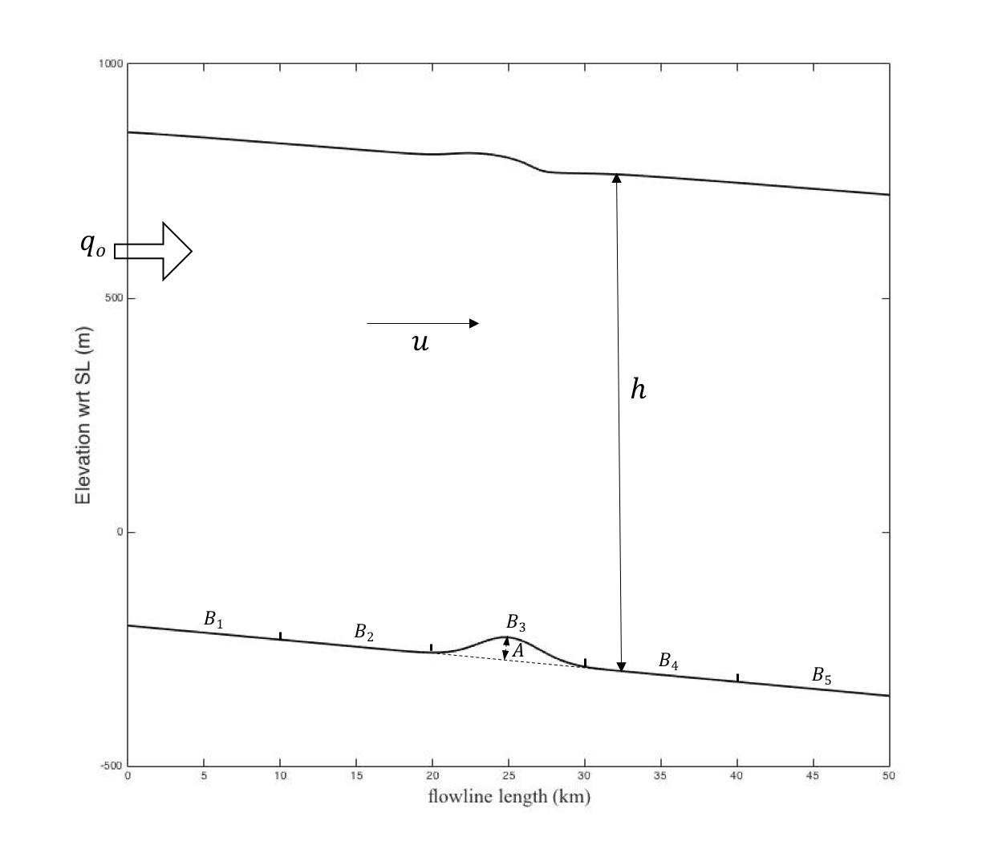
Model Introduction
2D flowline model with same width everywhere$(β=100km)$, ice is treated as fluid with large viscosity $\left(\sim 2×{10}^{13}Pa∙s\right)$.
Horizontal length scale $L=50km$, with resolution $δx=0.5km$
Use initial thickness profile $(h\sim 1km)$
Basal elevation decreases li$nearly$with a Gaussian
bump in the middle$\left(σ=2km,k=0.003\right)$
$\frac{∂h}{∂t}=−\frac{∂\left(h\overline{u}\right)}{∂x}−\frac{h\overline{u}}{β}\frac{∂β}{∂x}+\dot{A}−\dot{B}$
$\frac{∂}{∂x}\left(2ν\left(2\frac{∂u}{∂x}+\frac{u}{β}\frac{∂β}{∂x}\right)\right)+\frac{∂}{∂z}\left(ν\frac{∂u}{∂z}\right)=ρg\frac{∂\left(s−z\right)}{∂x}+\frac{2}{β}τ_{s}$

Slide 4
Experiment Design
Study correlation between surface u velocity/ice thickness and variable.
A and Bb_o are changed from 0.5 to 1.5 with interval of 0.02 [times control value].
Control value
Bb_o=1.3e6 Pa s^1/3 m^-1/3
A=50m (located at 25 km with sigma=2000m)
q_o=800m*300m/yr

Slide 5
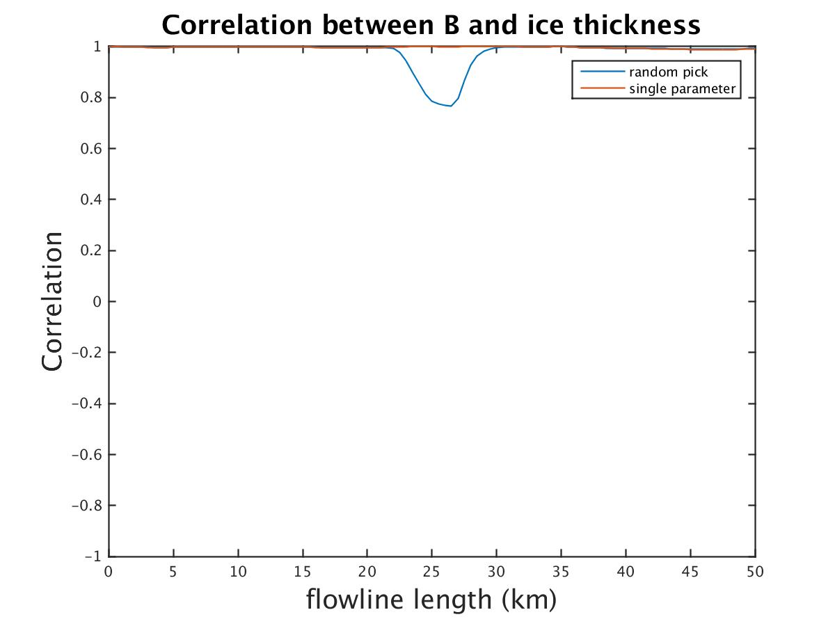
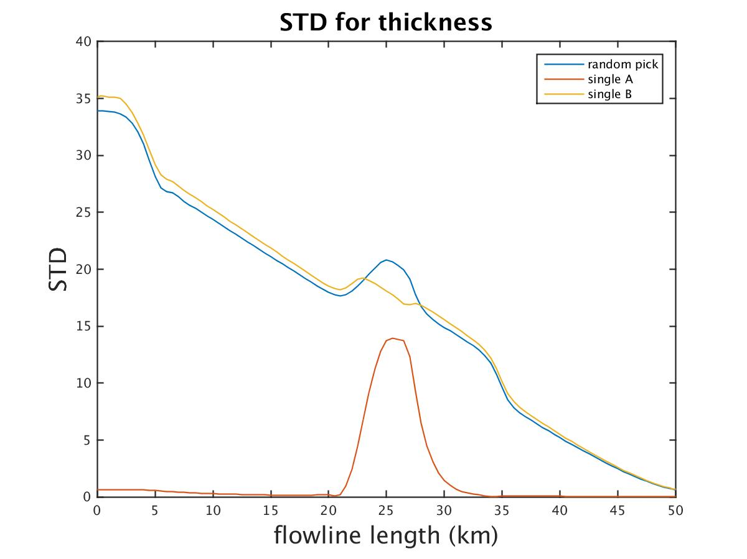
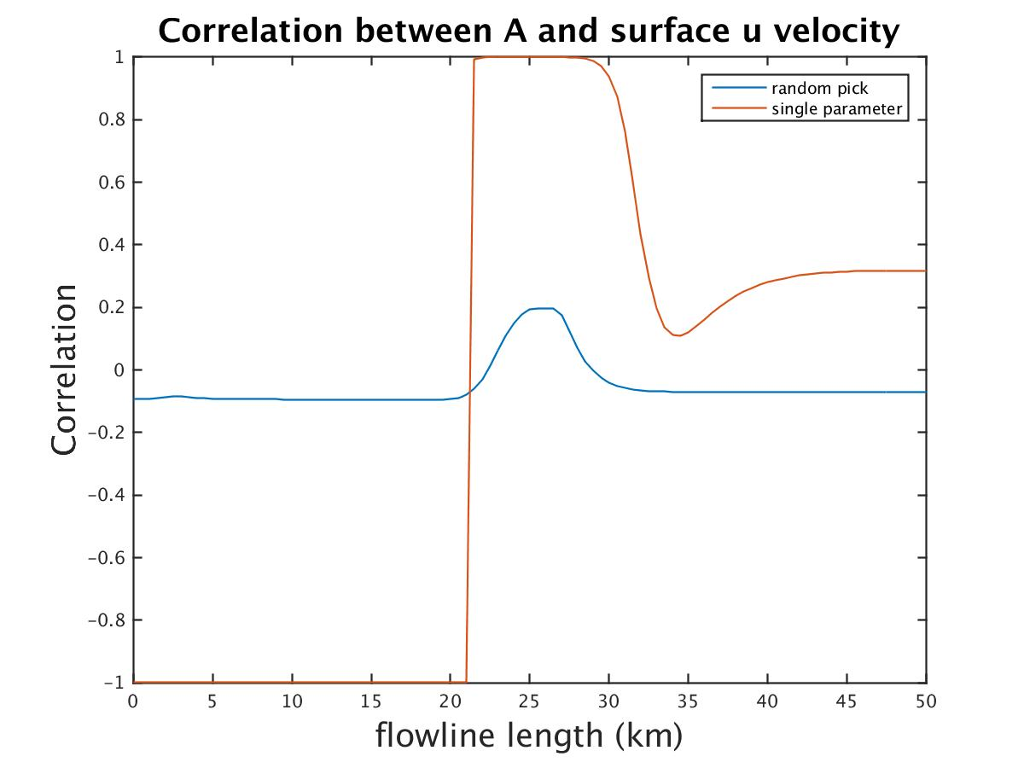
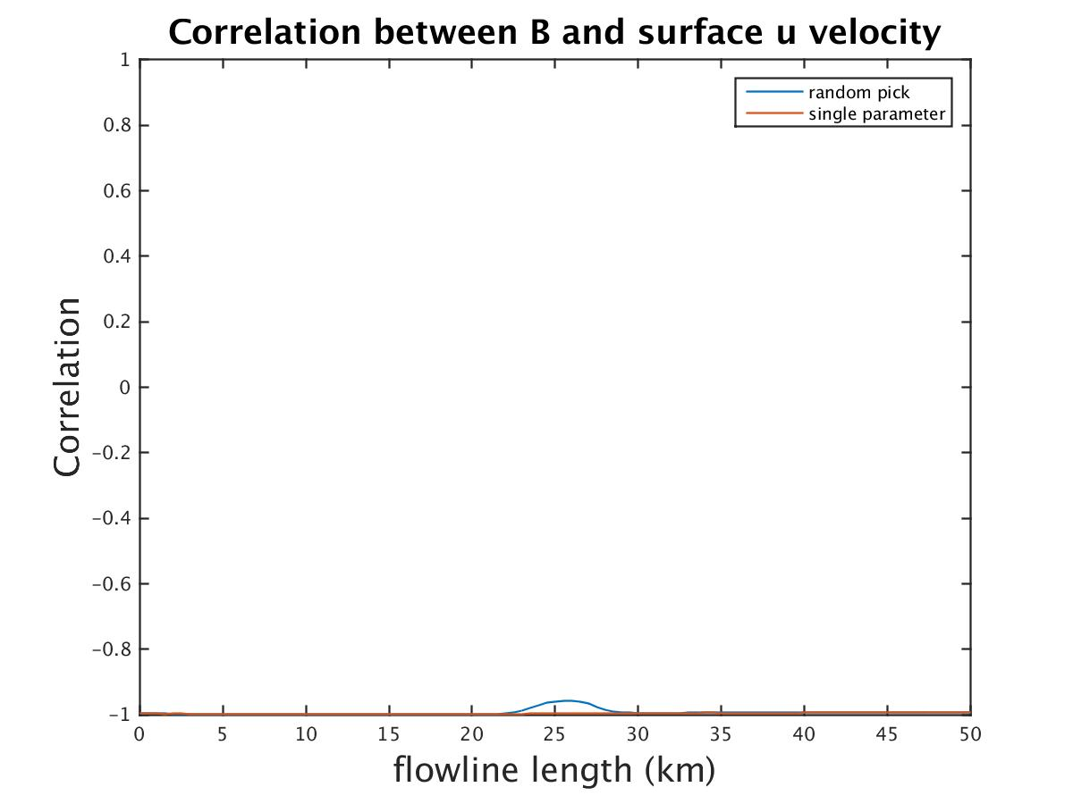
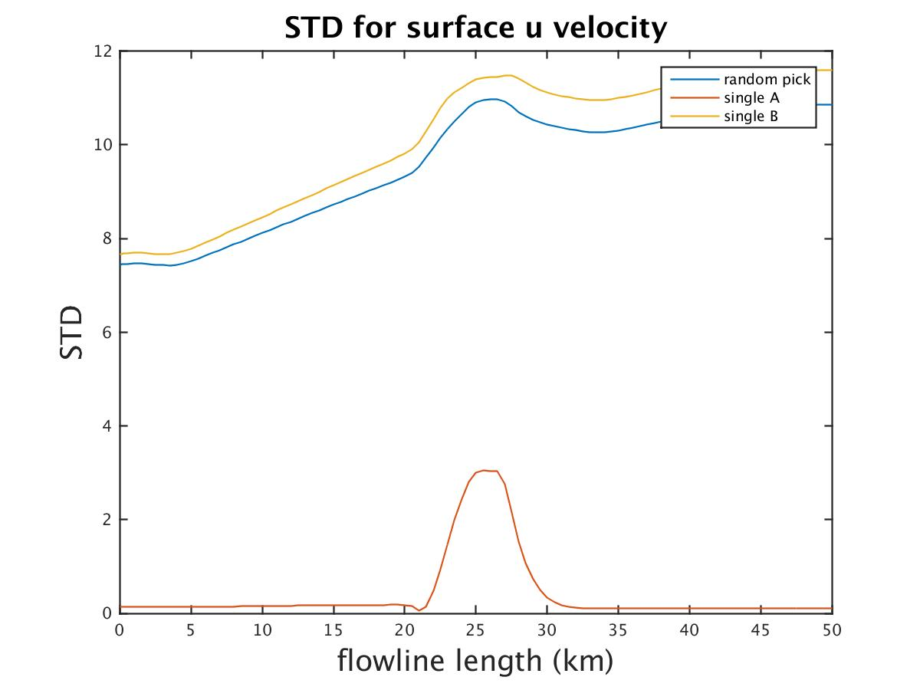
A_B_20yr
Single parameter: change Bb_o continuously (51 runs)
Single parameter: change A continuously (51 runs)
Random pick Bb_o and A (30 runs).
Ice thickness
Surface velocity

Slide 6
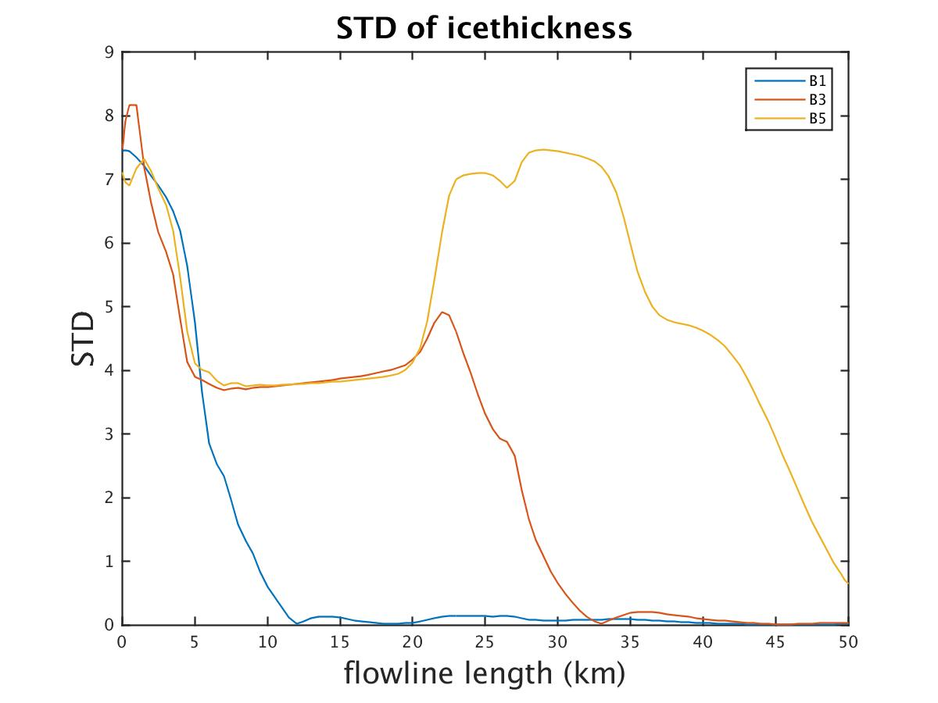
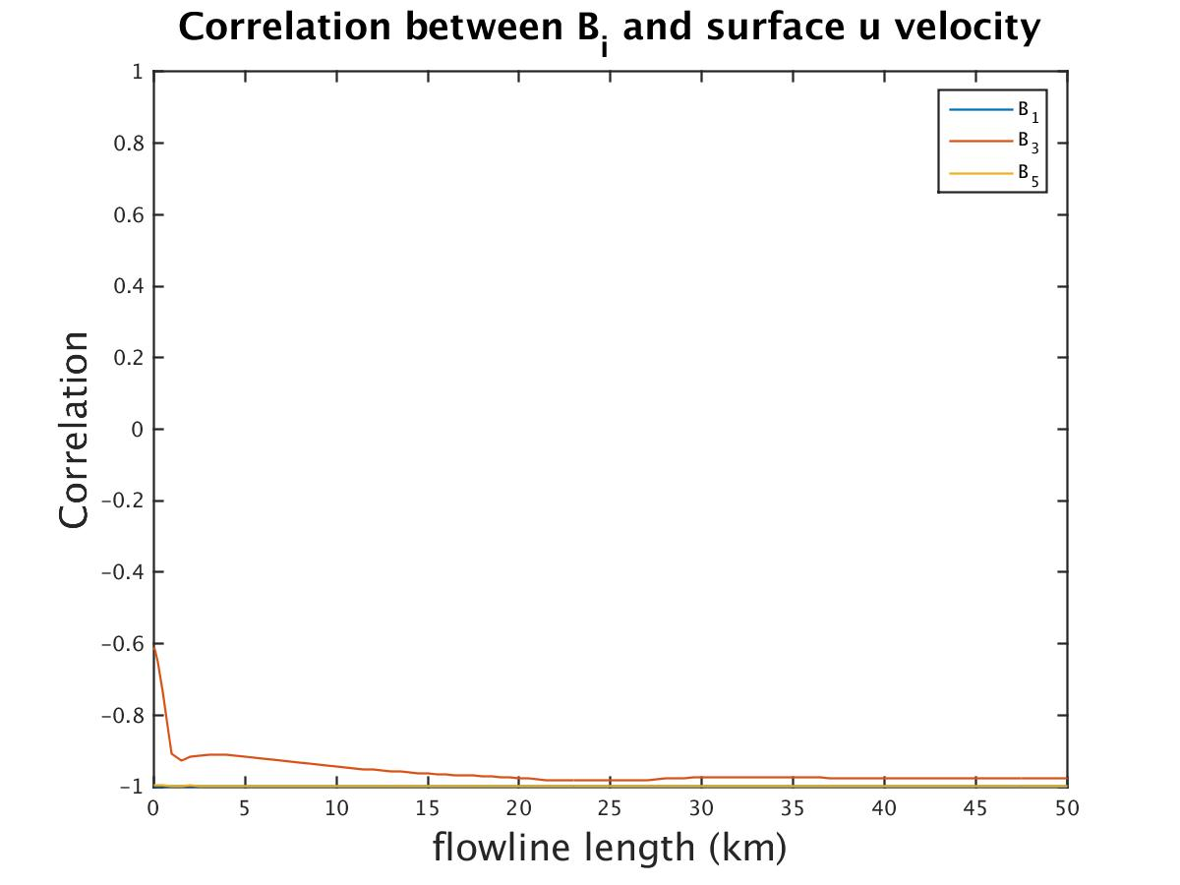
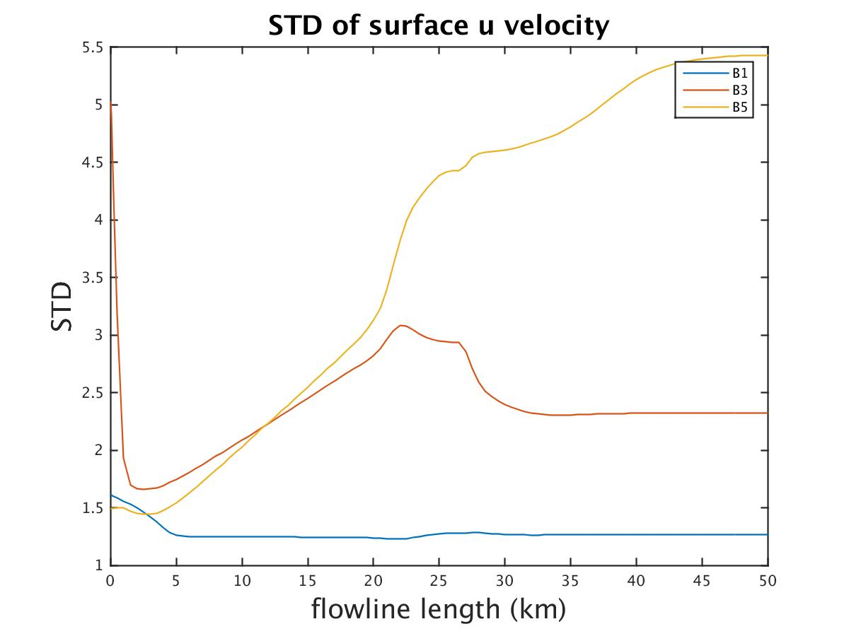
B1,B3,B5_20yr
Random pick single parameter B1 (for 0-10km), B3 (for 20-30km) or B5 (for 40-50km) with continuous transition($±2.5km$) (51 runs).
Ice thickness
Surface velocity

Slide 7
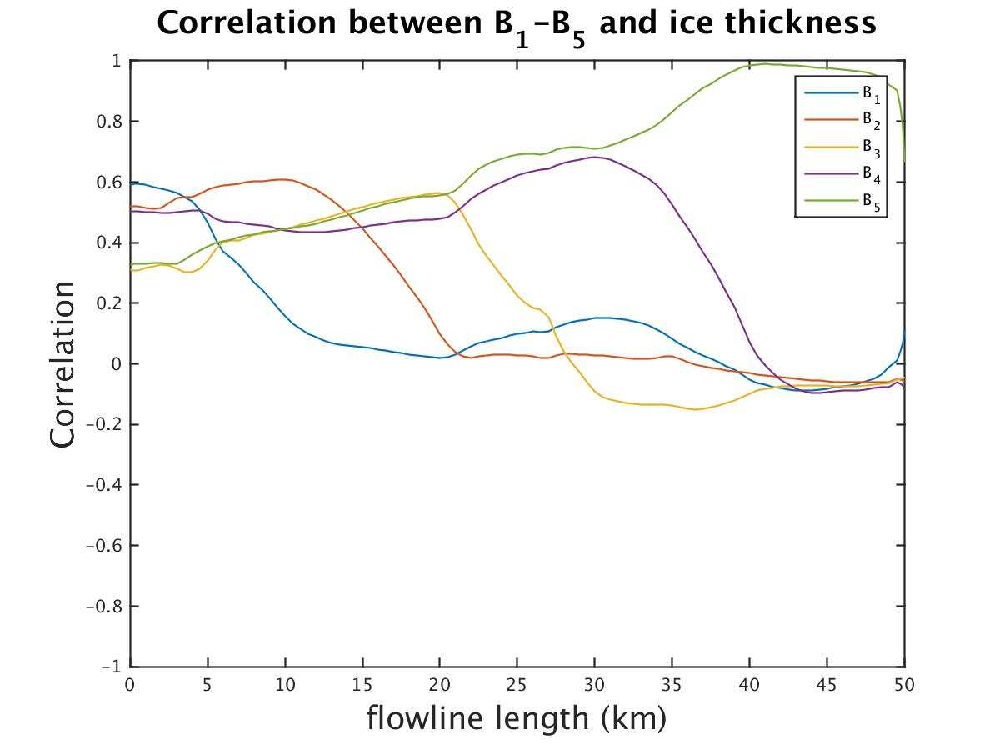
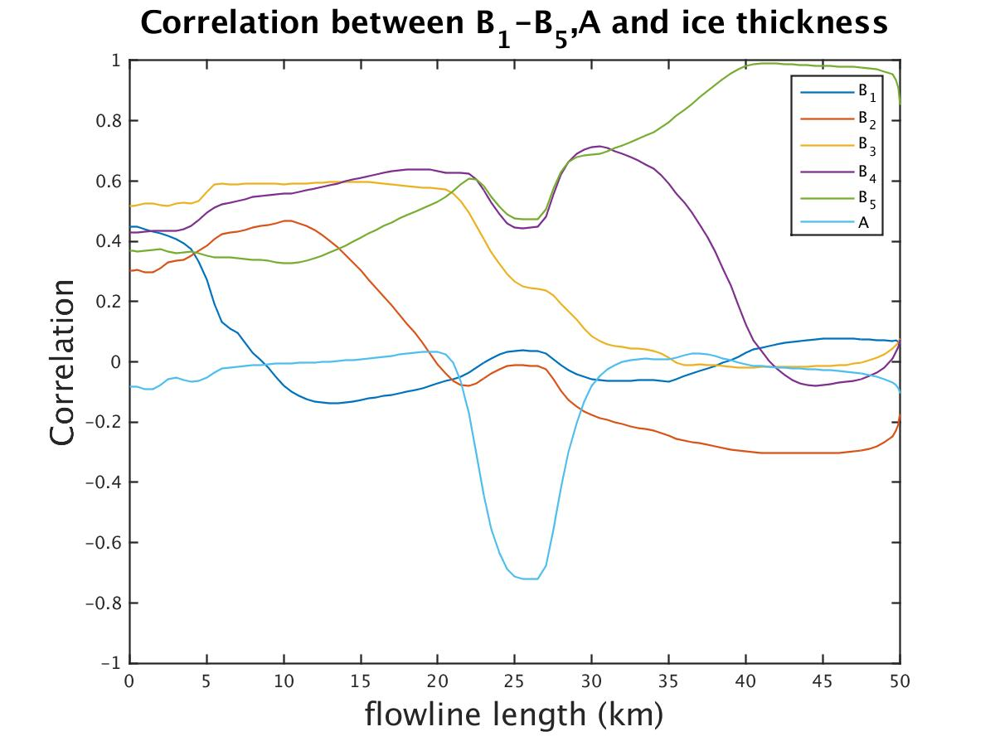
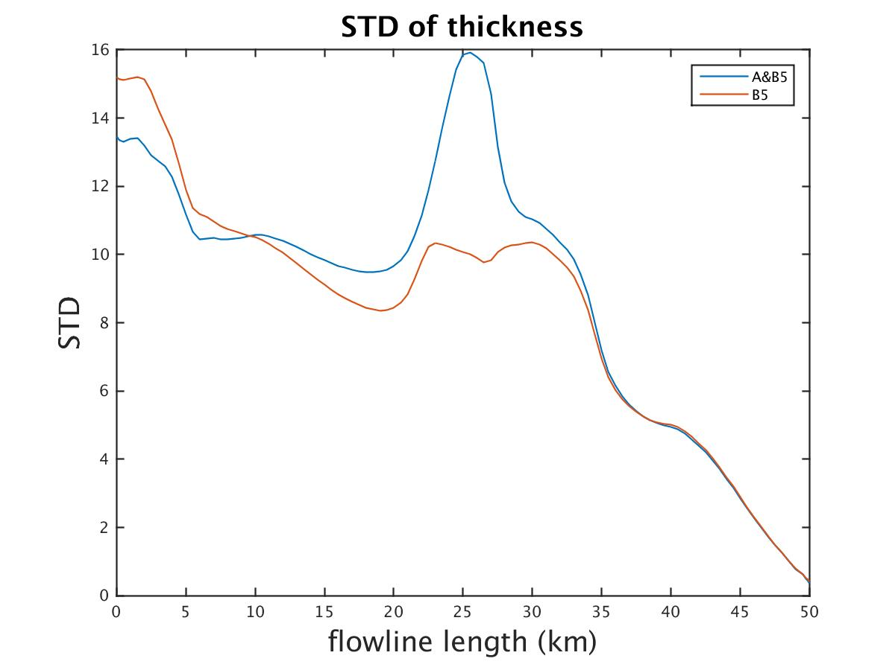
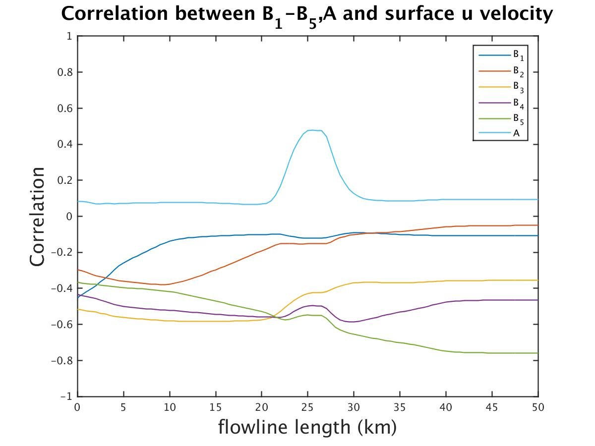
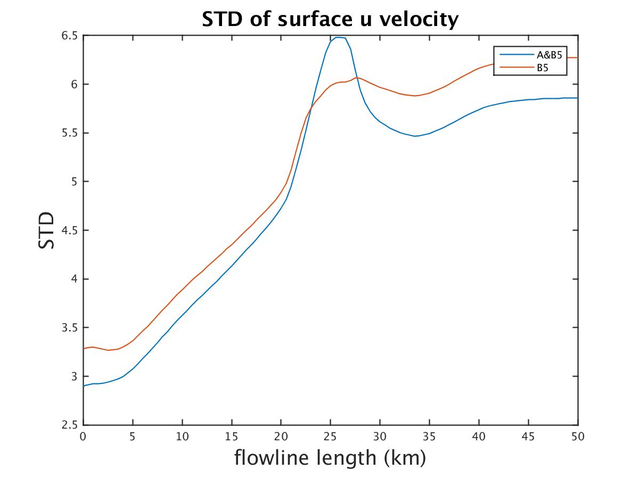
A_B_{i}_20yr
 | A | B_{i} | q
left |  | √
right | √ | √
Ice thickness
Surface velocity

Slide 8
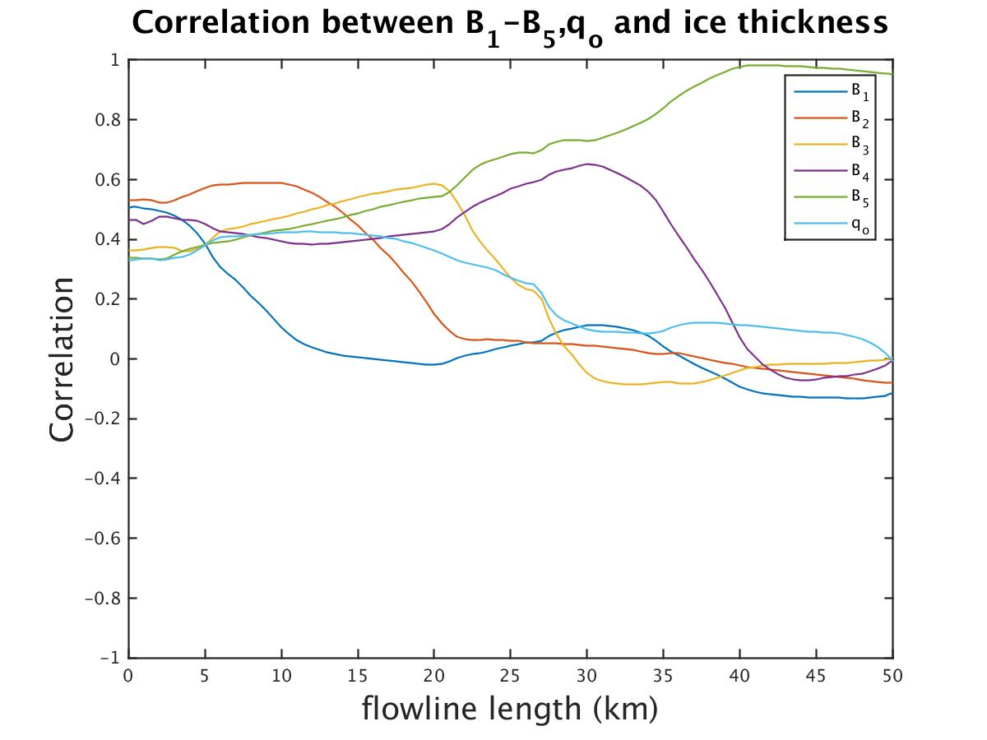
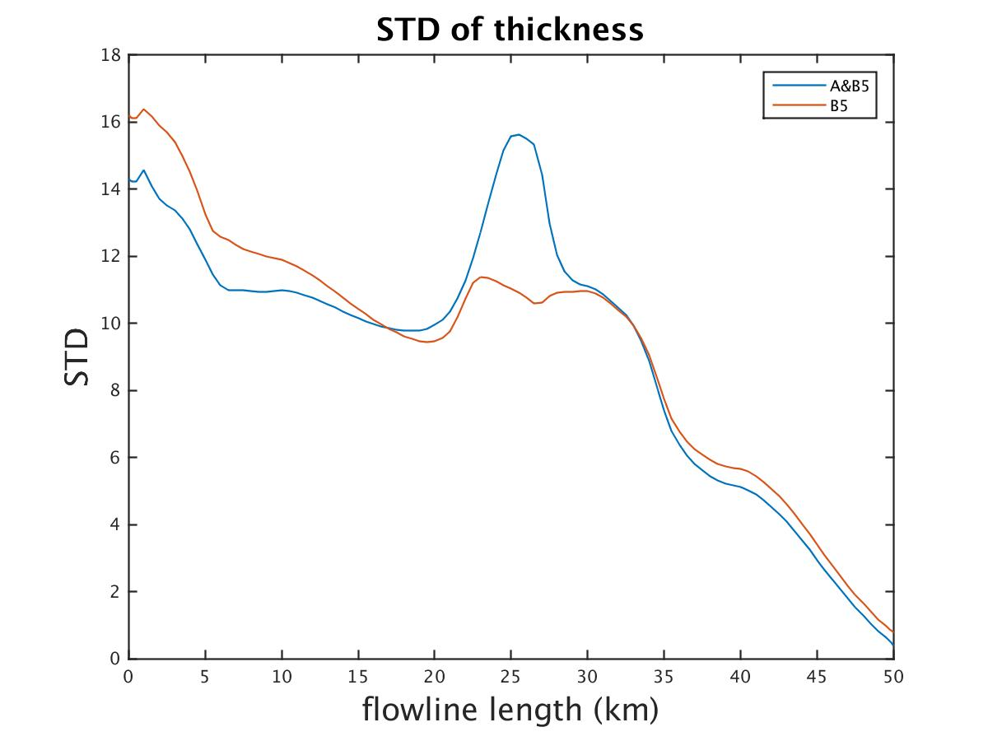
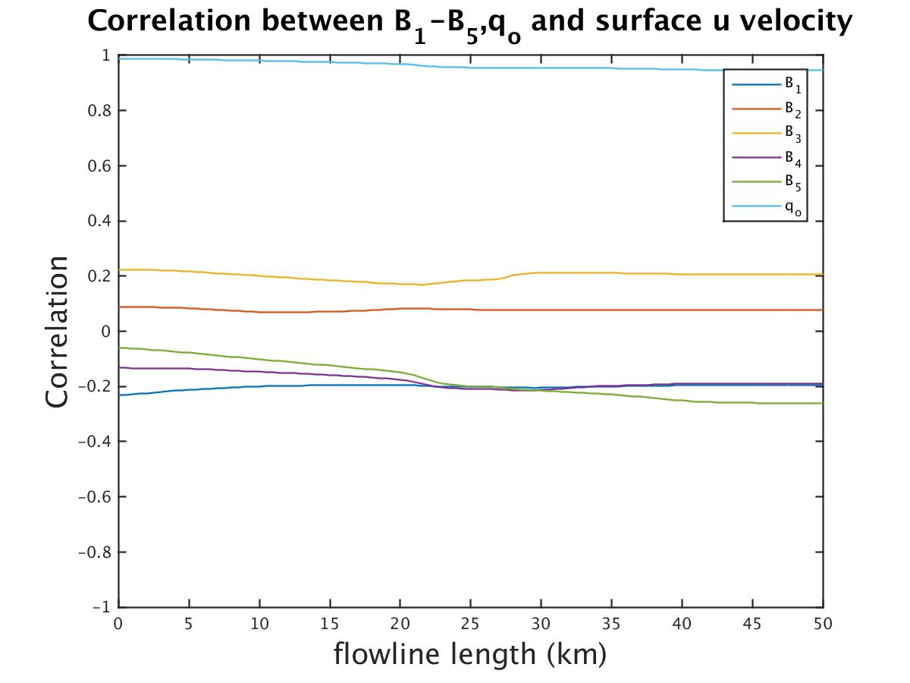
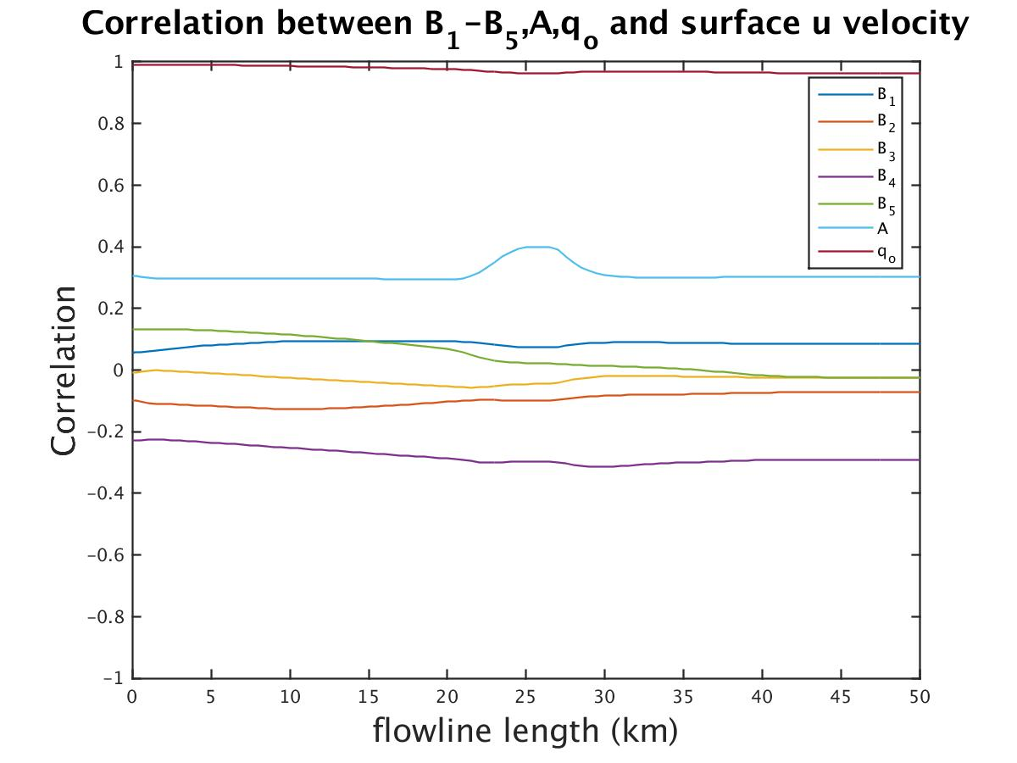
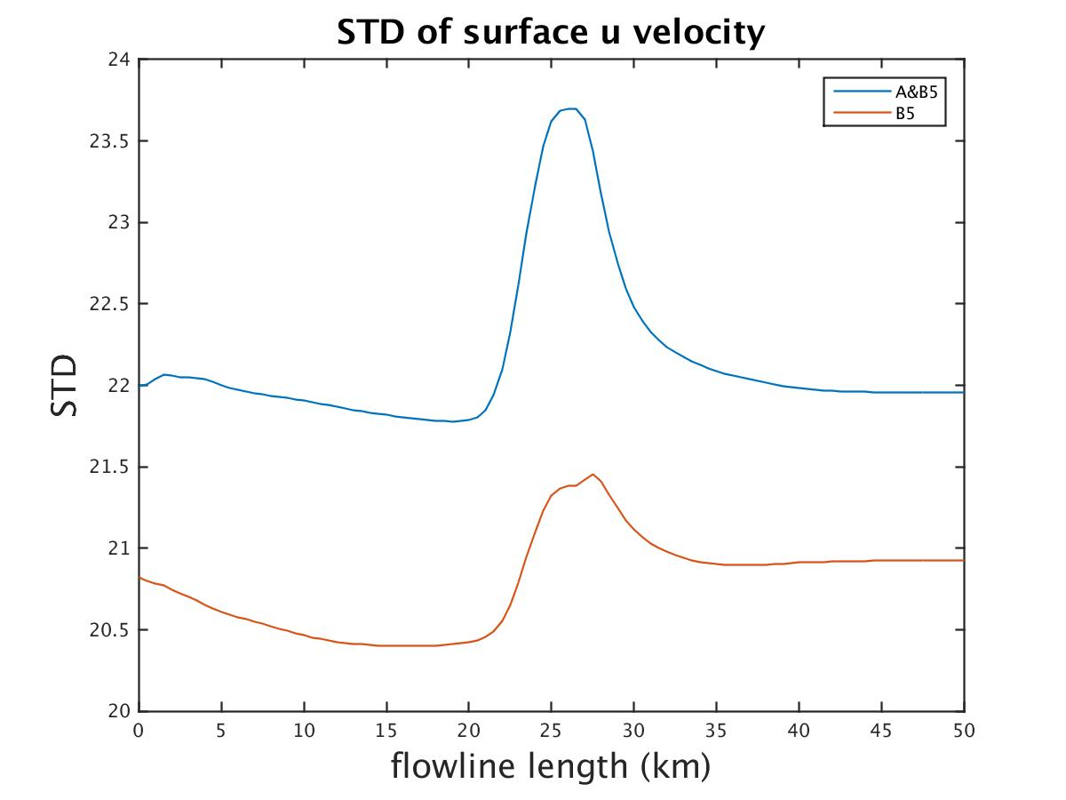
A_B_{i}_20yr
 | A | B_{i} | q
left |  | √ | 10%
right | √ | √ | 10%
Ice thickness
Surface velocity

Slide 9
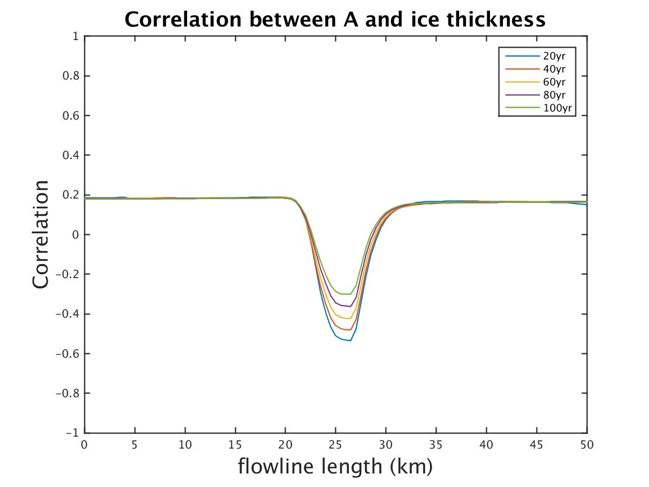
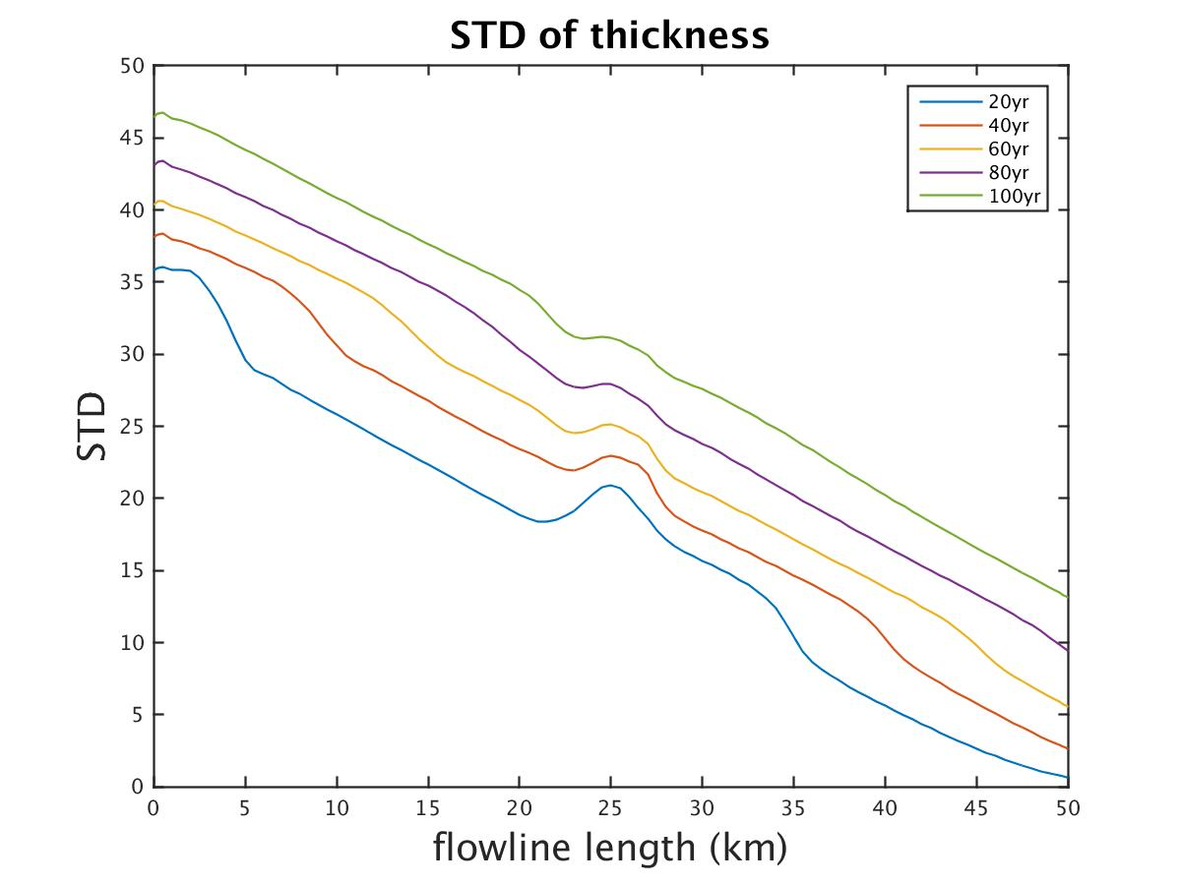
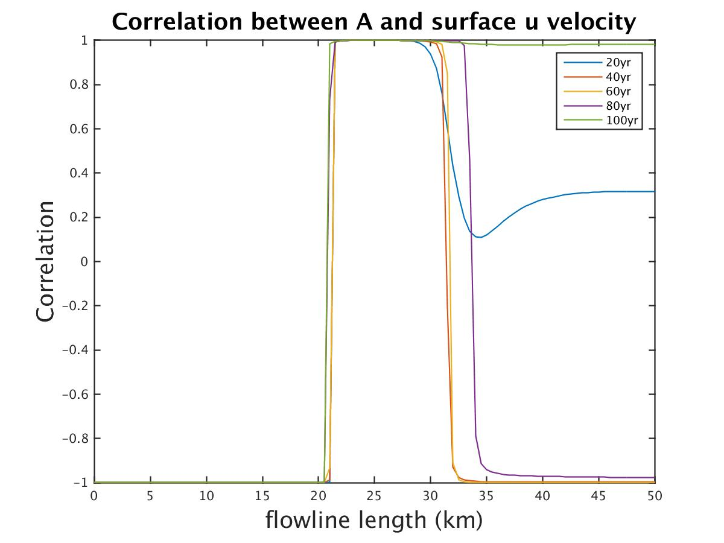
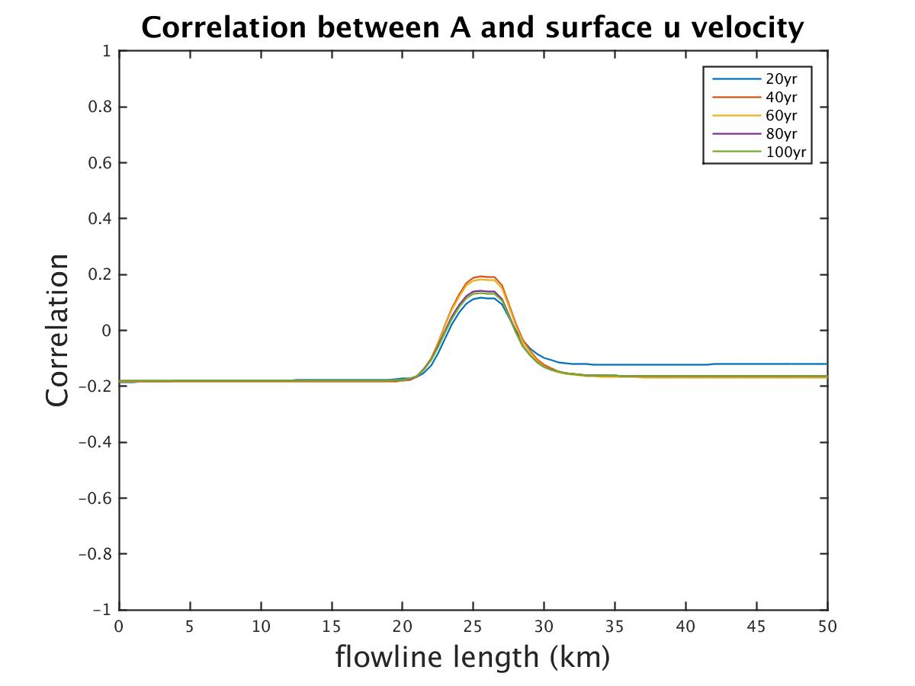
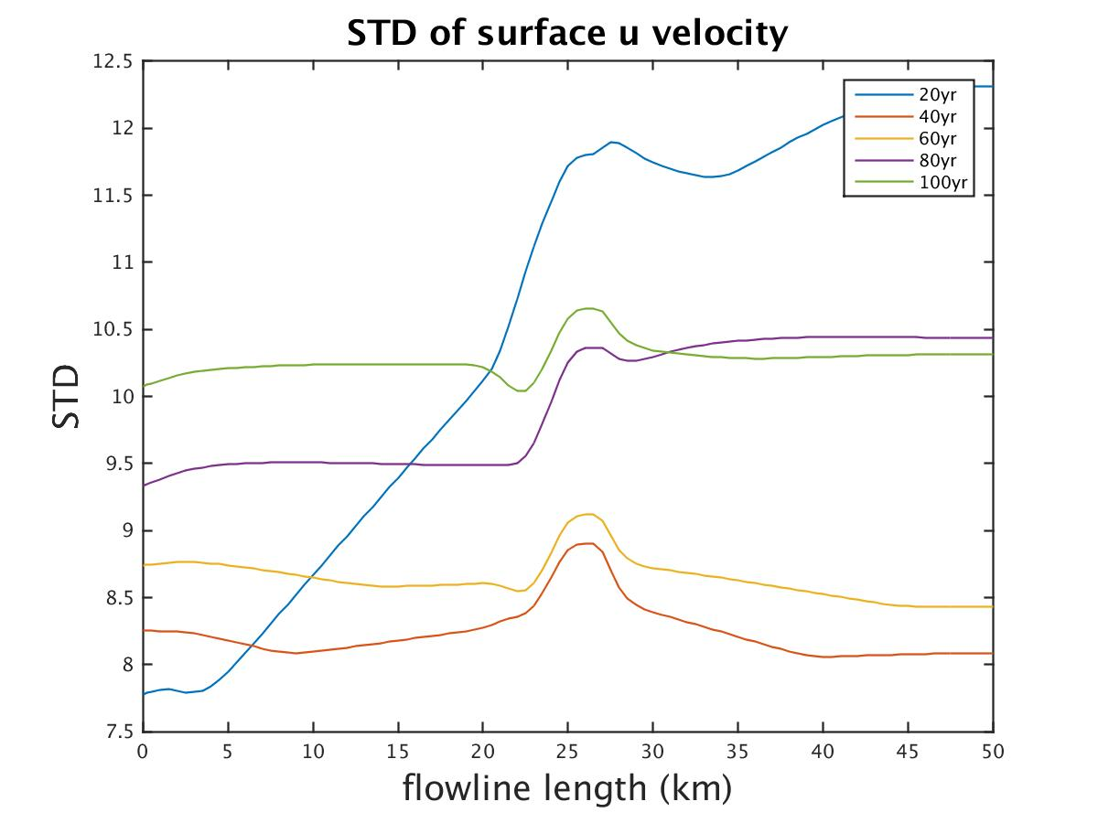
A_B_100yr
Single parameter: change A continuously (51 runs)
Random pick Bb_o and A (51 runs).
Single A
Random pick A and B
Ice thickness
Surface velocity

Slide 10
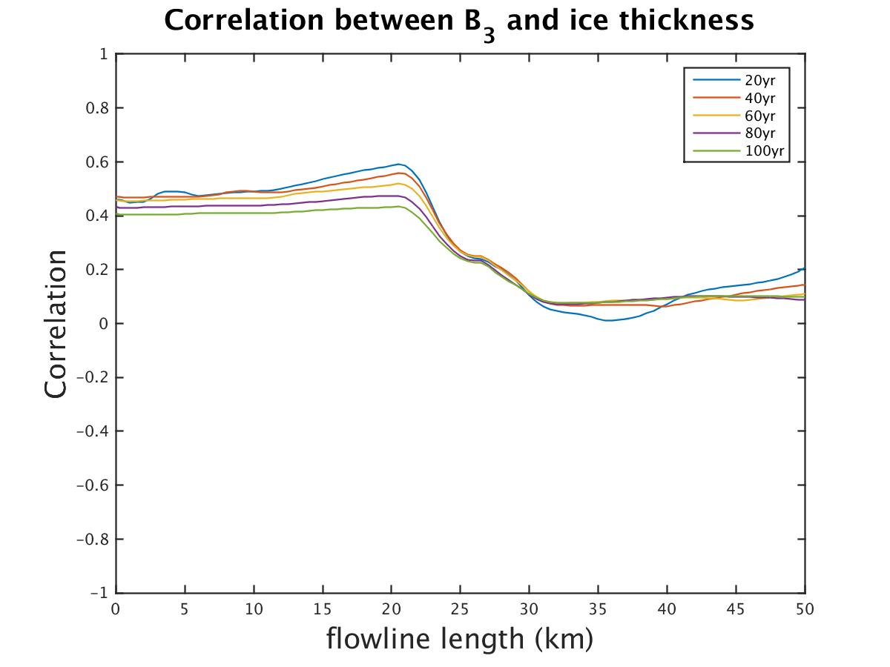
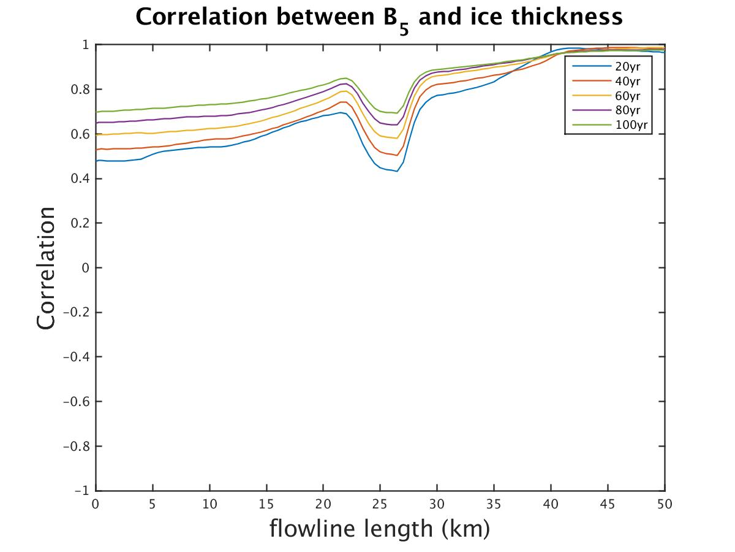
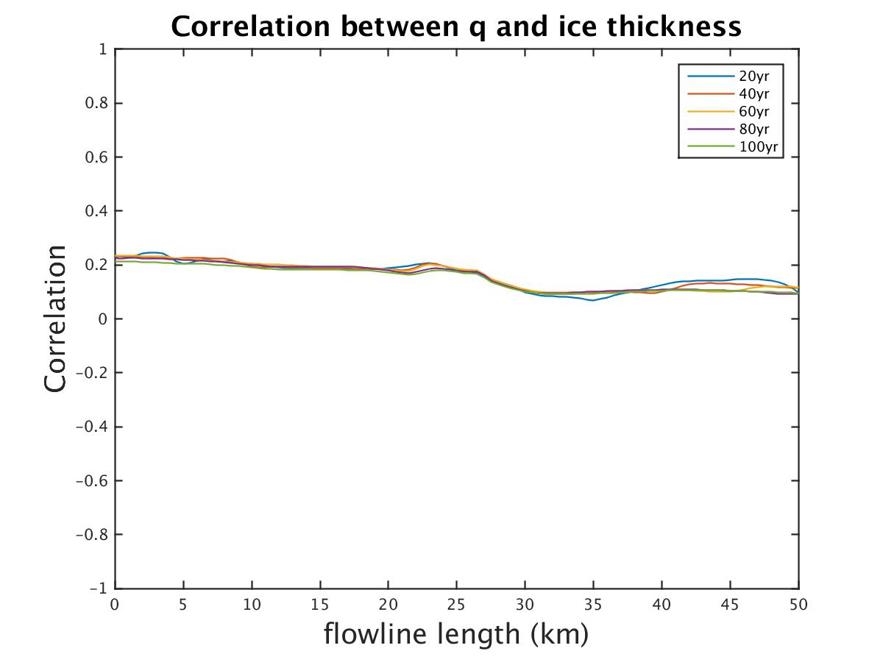
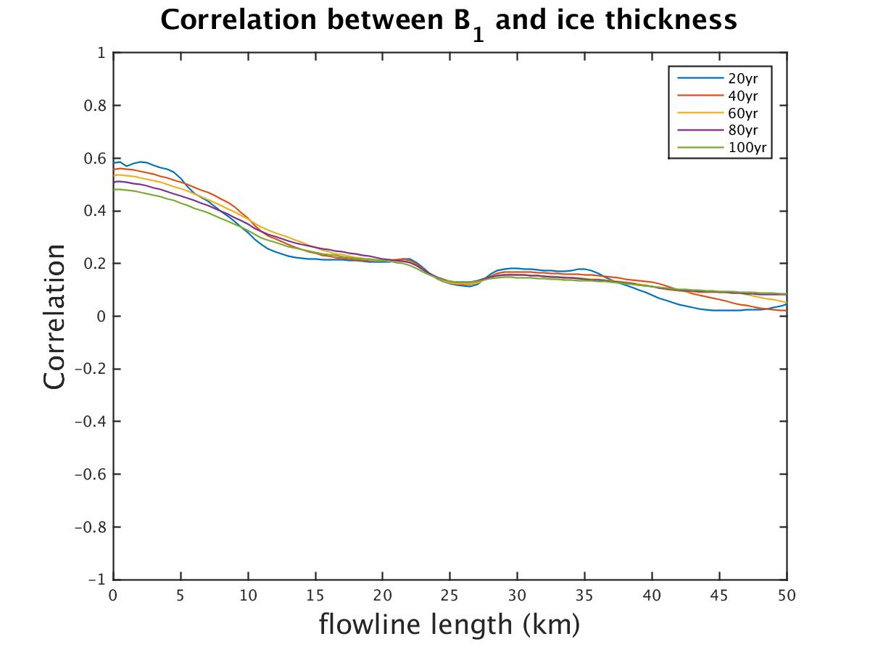
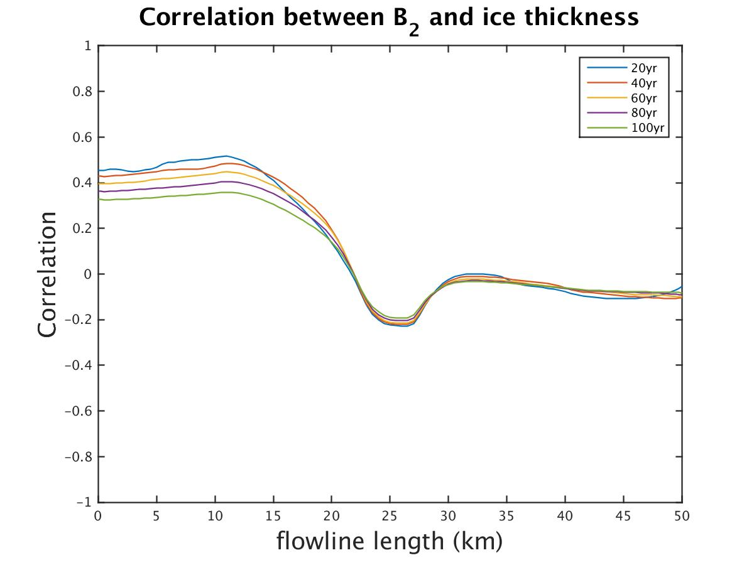
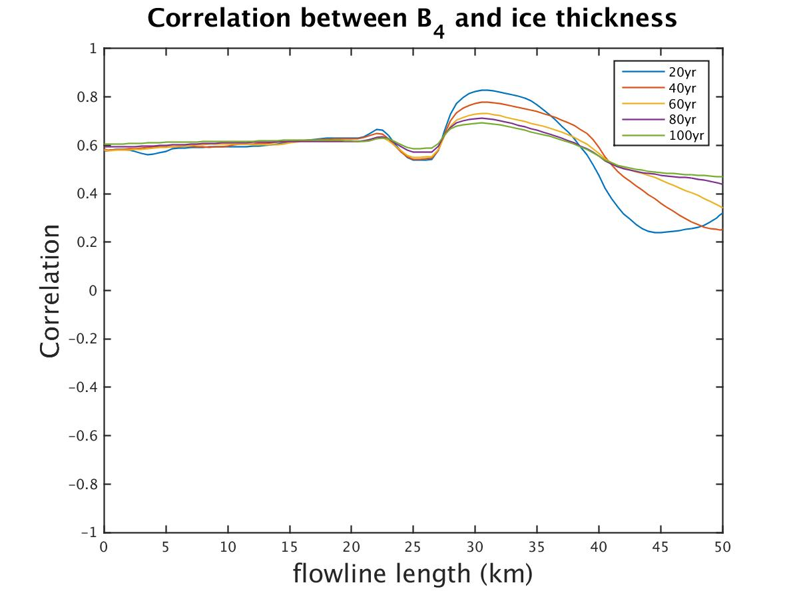
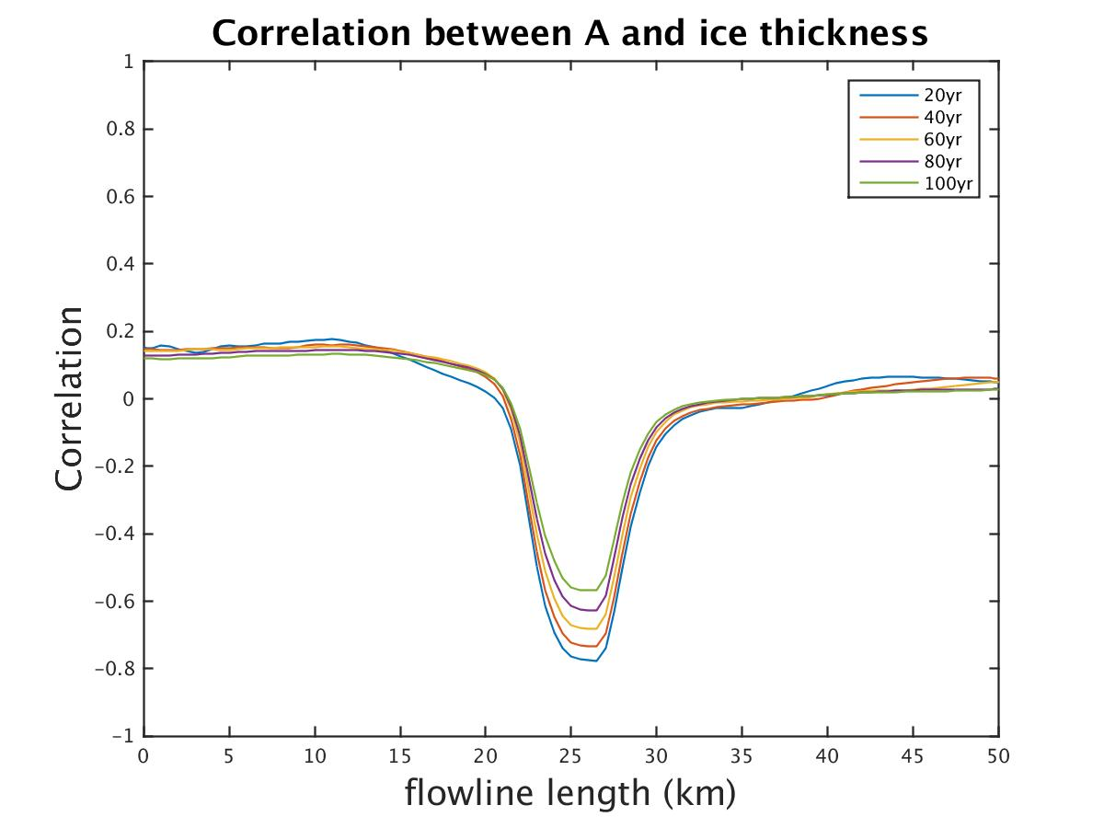
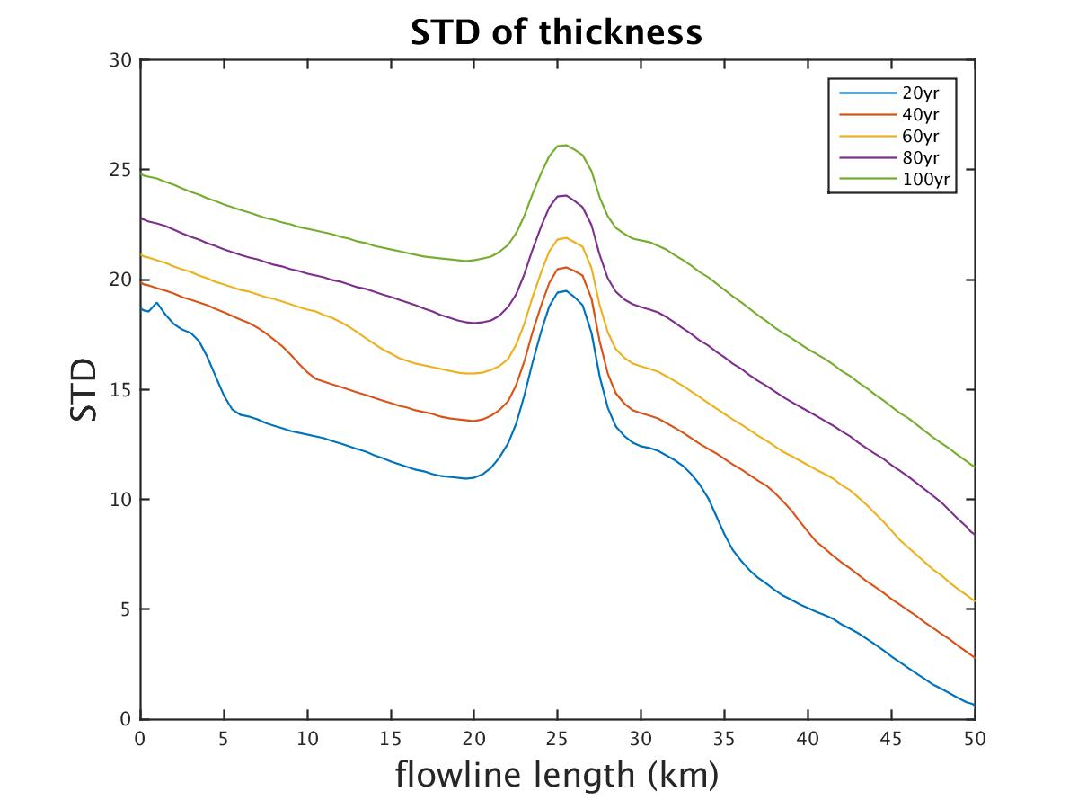
A_B_{i}_q_100yr
Ice thickness
A | B_{i} | q
√ | √ | 5%

Slide 11
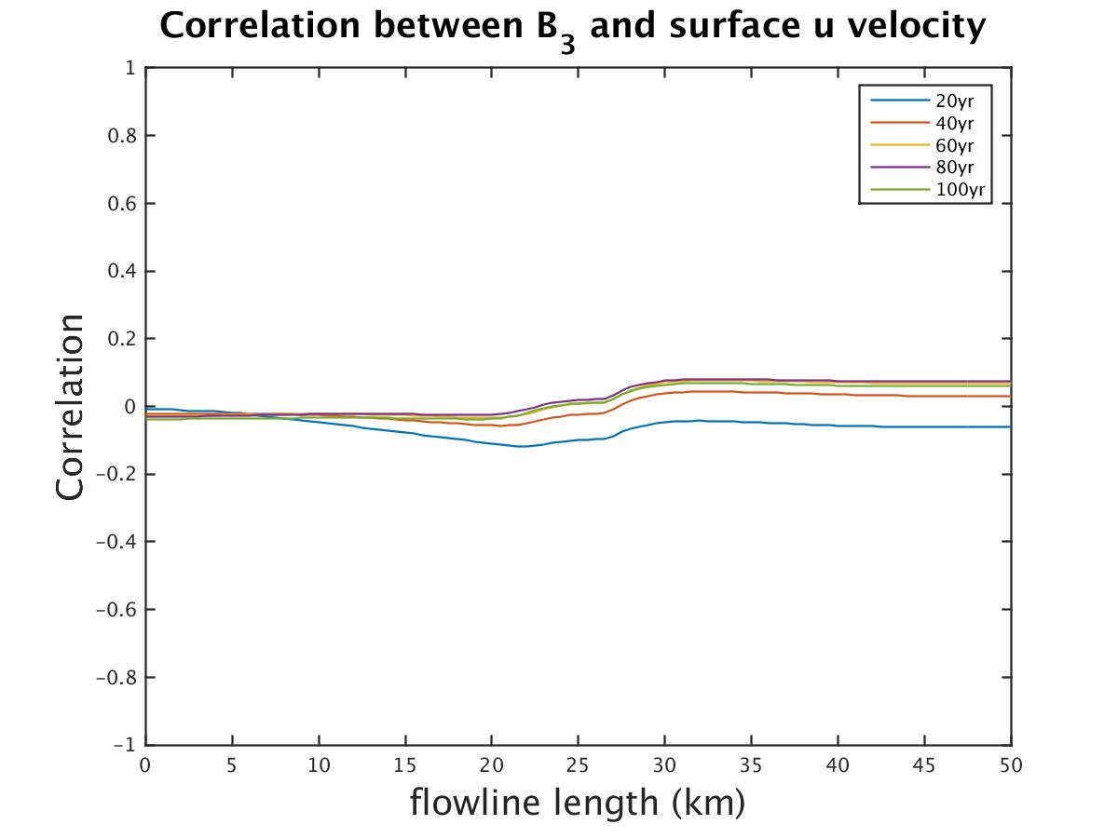
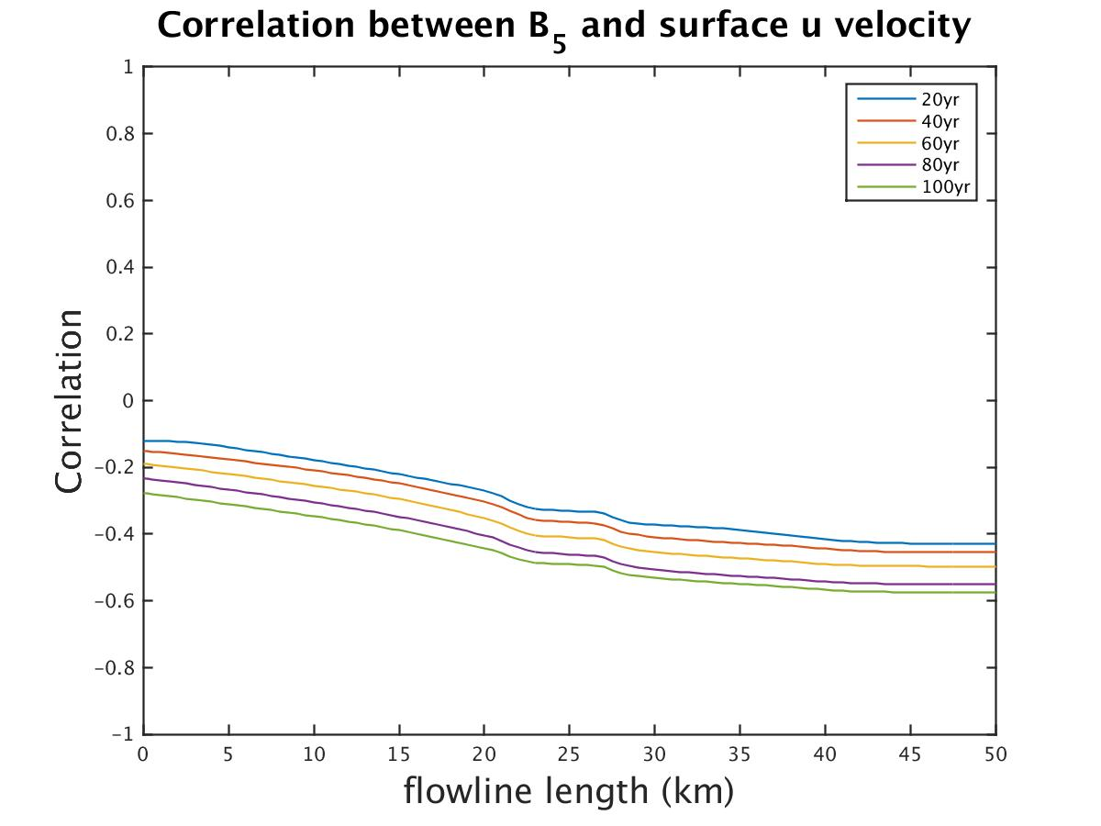
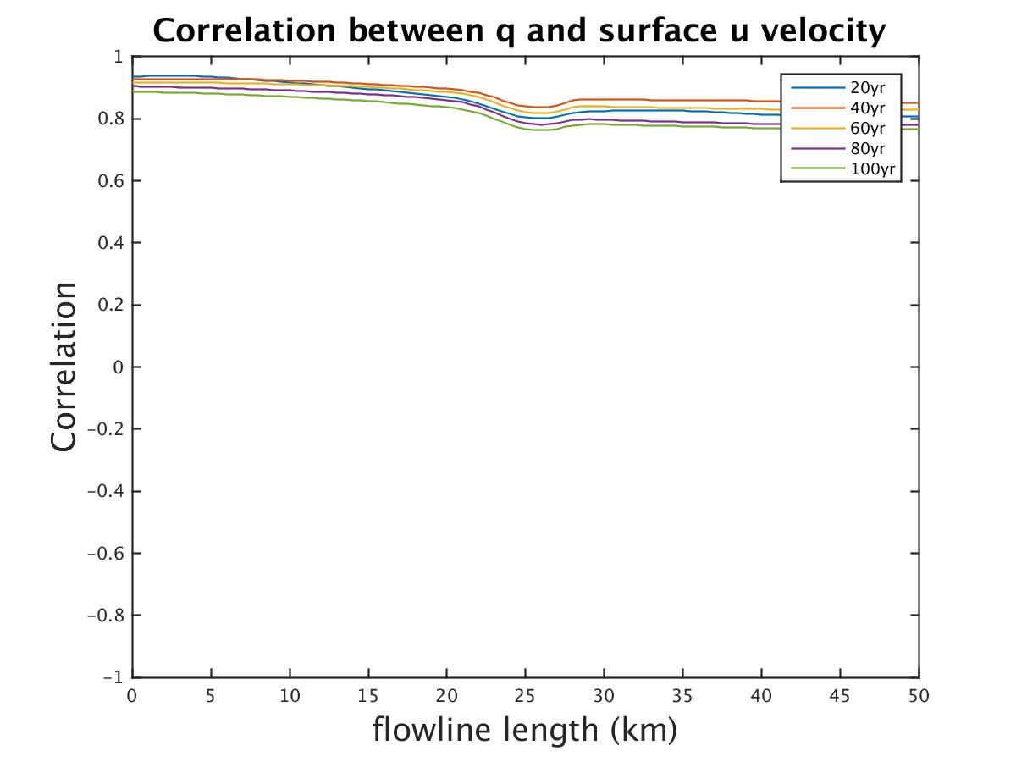
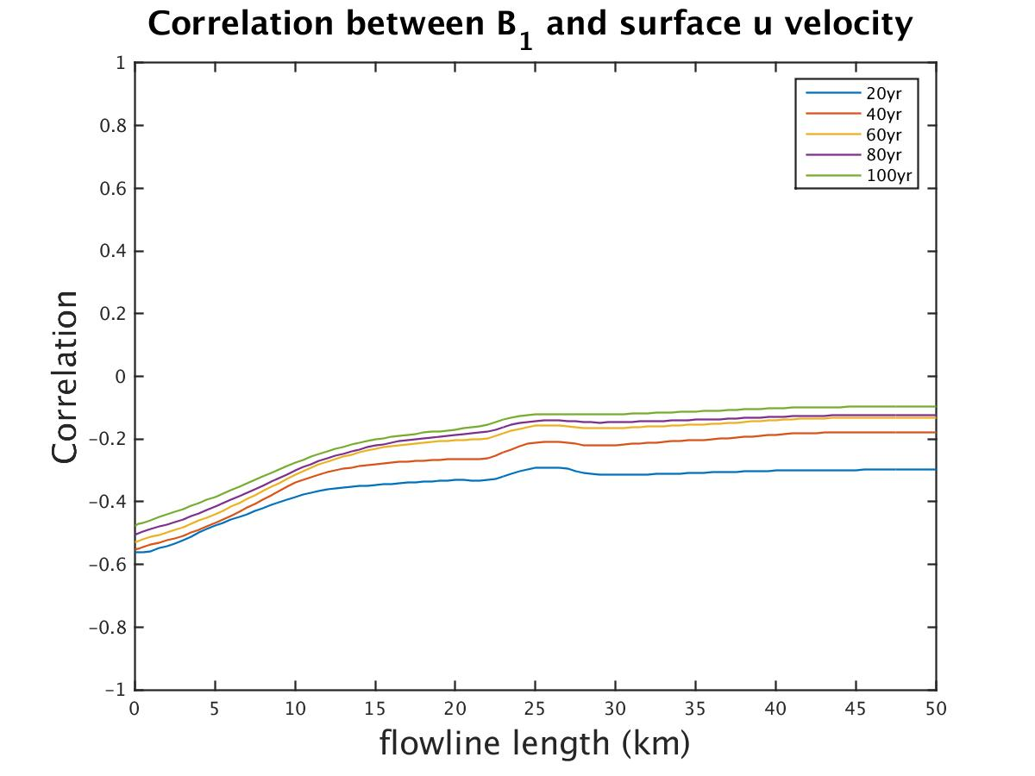
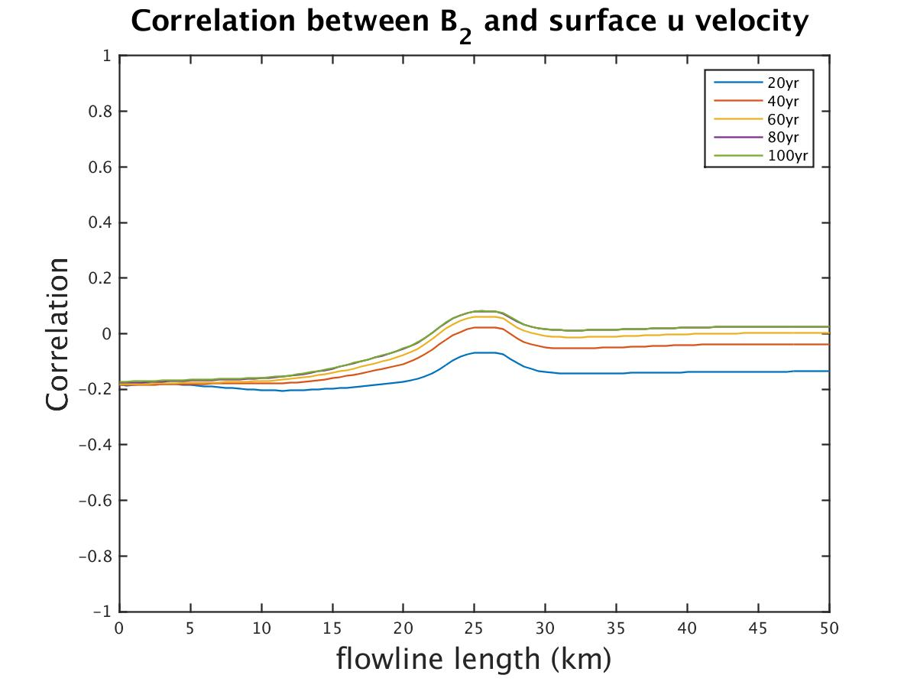
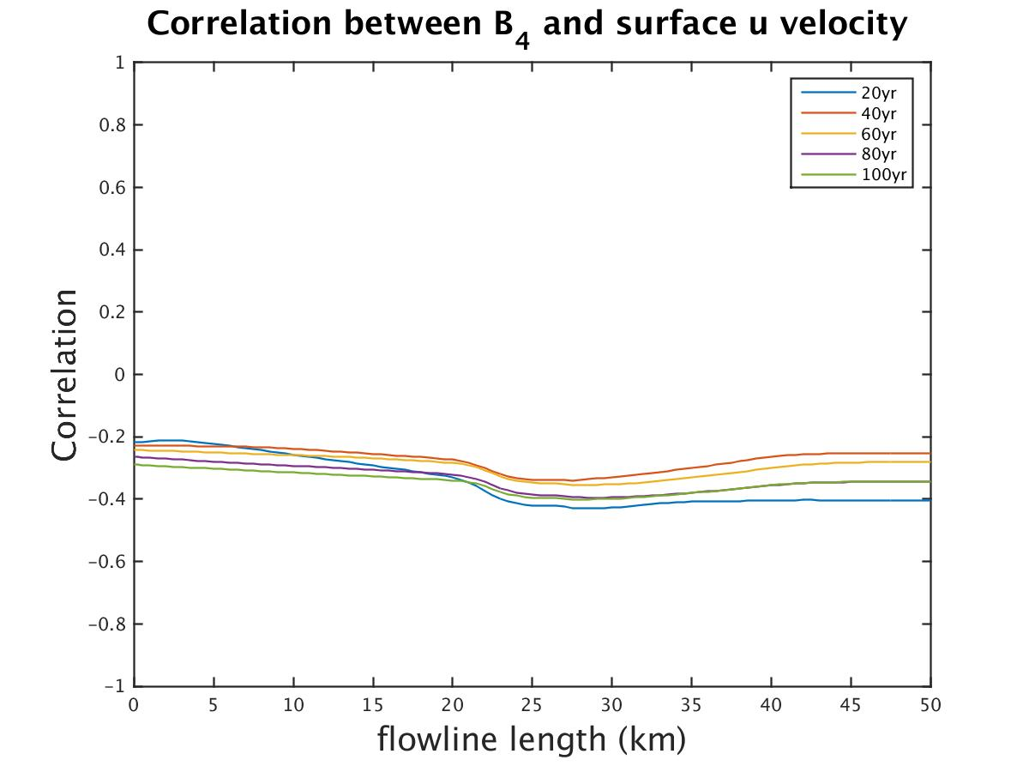
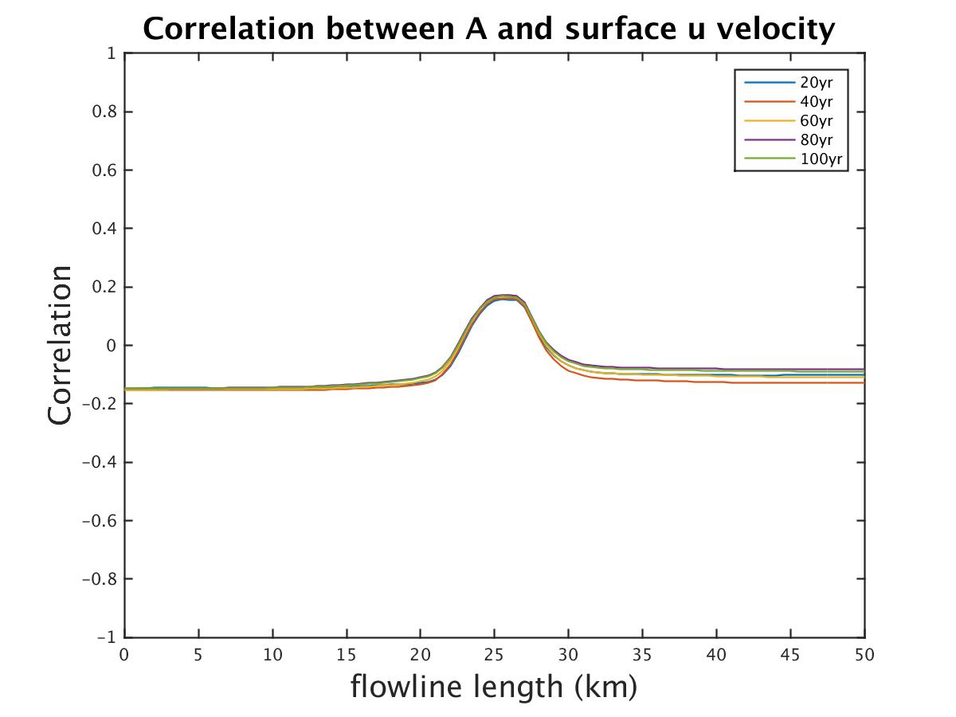
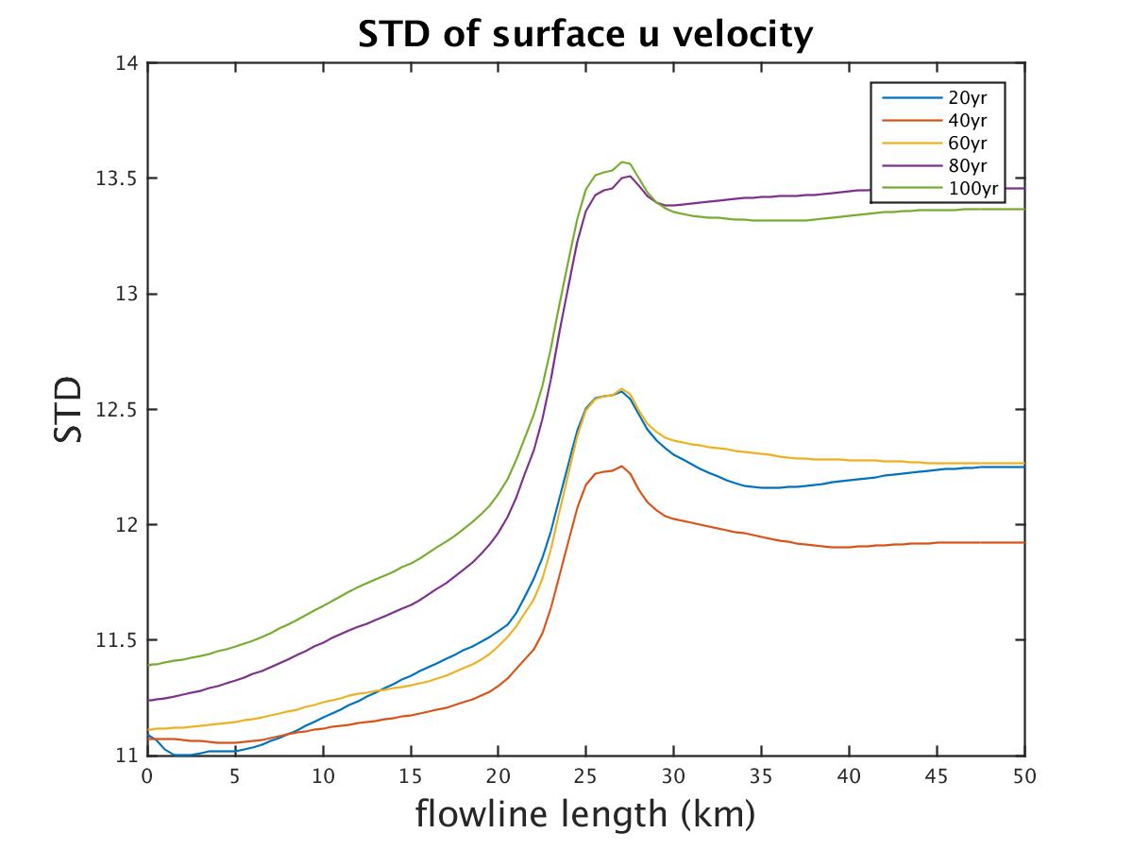
A_B_{i}_q_100yr
A | B_{i} | q
√ | √ | 5%
Surface velocity

Slide 12
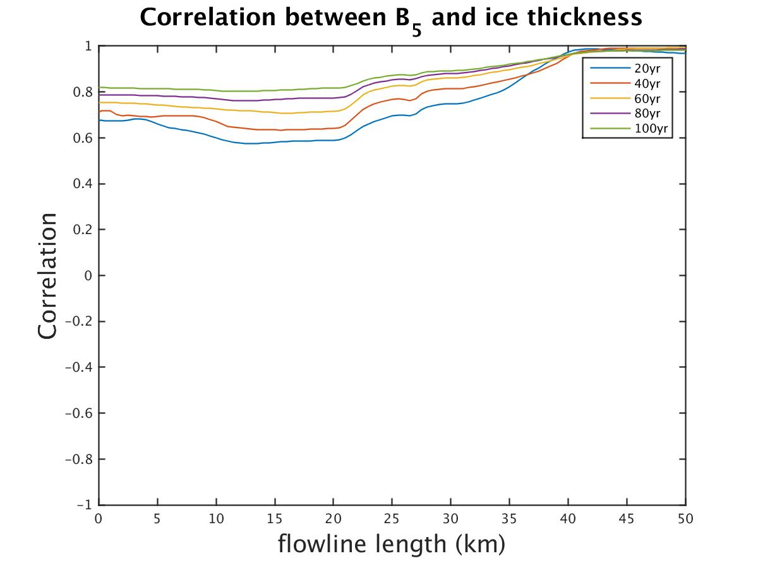
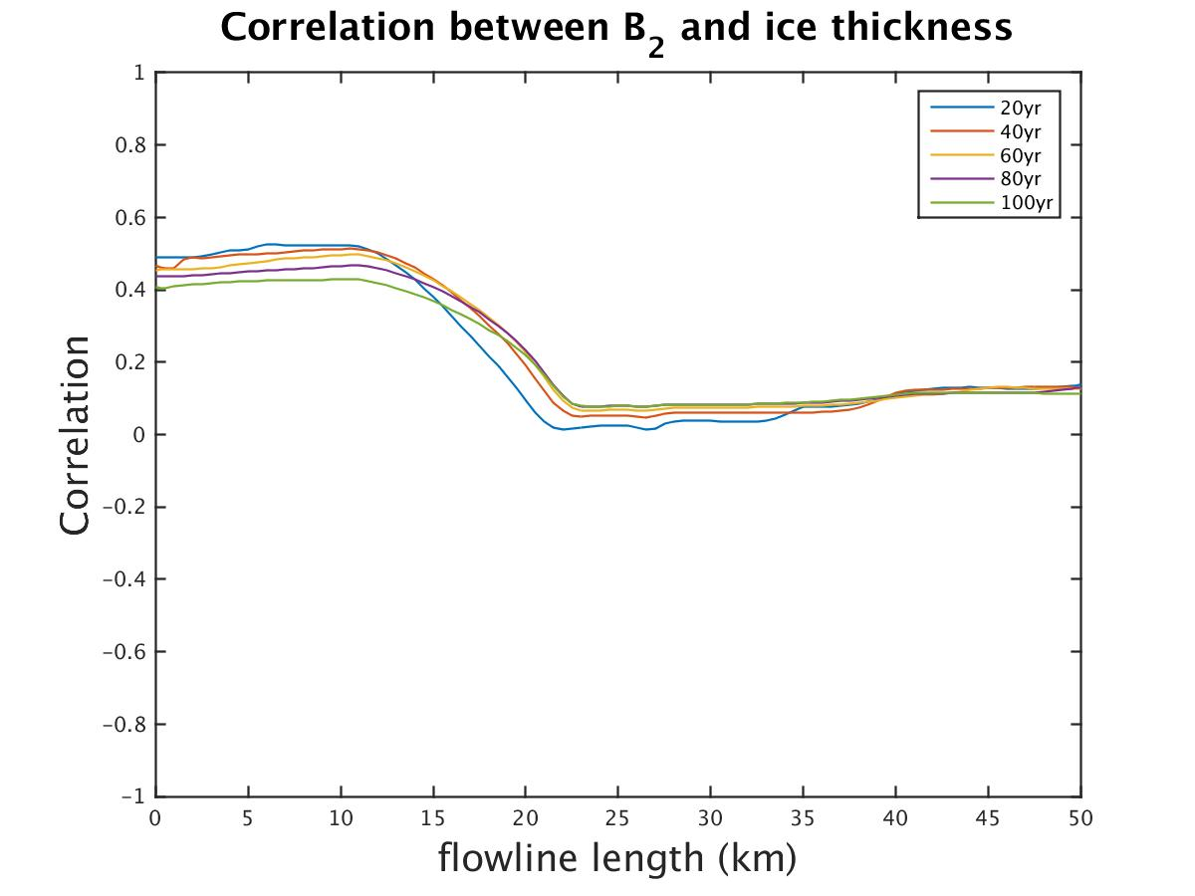
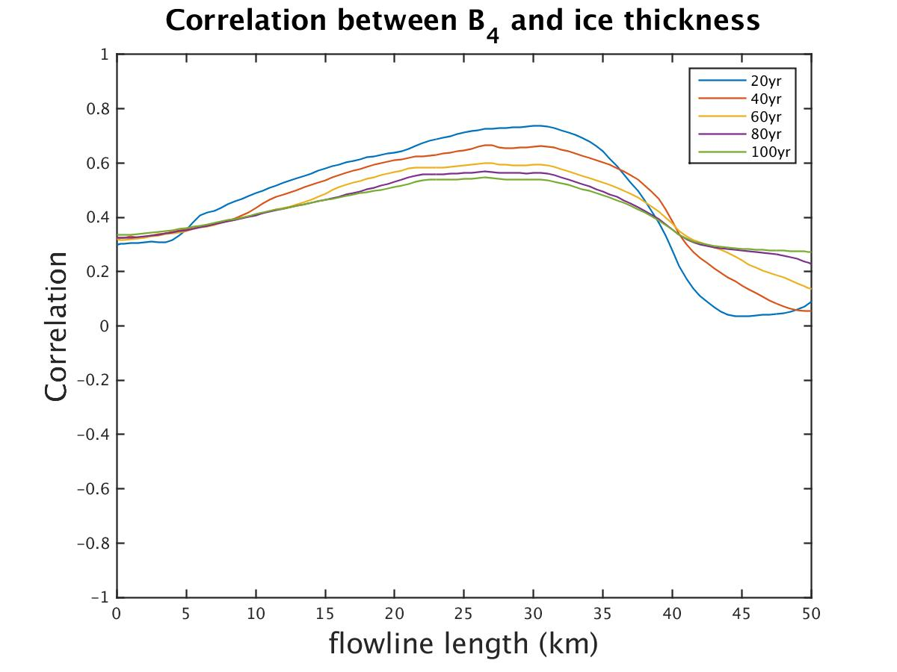
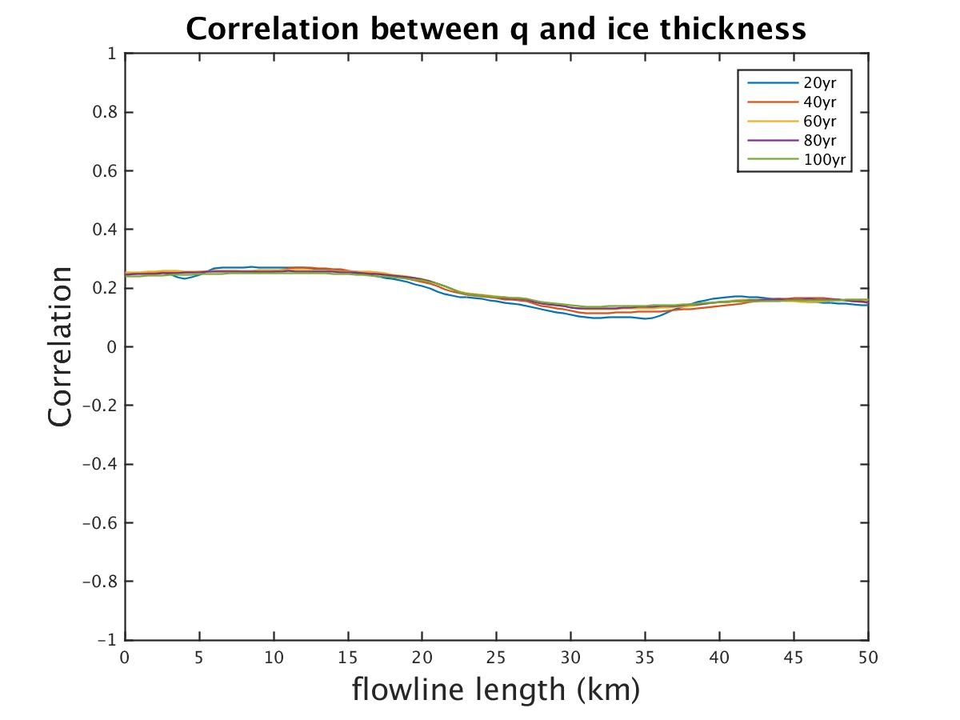
B_{i}_q_100yr
Ice thickness
A | B_{i} | q
 | √ | 1%

Slide 13
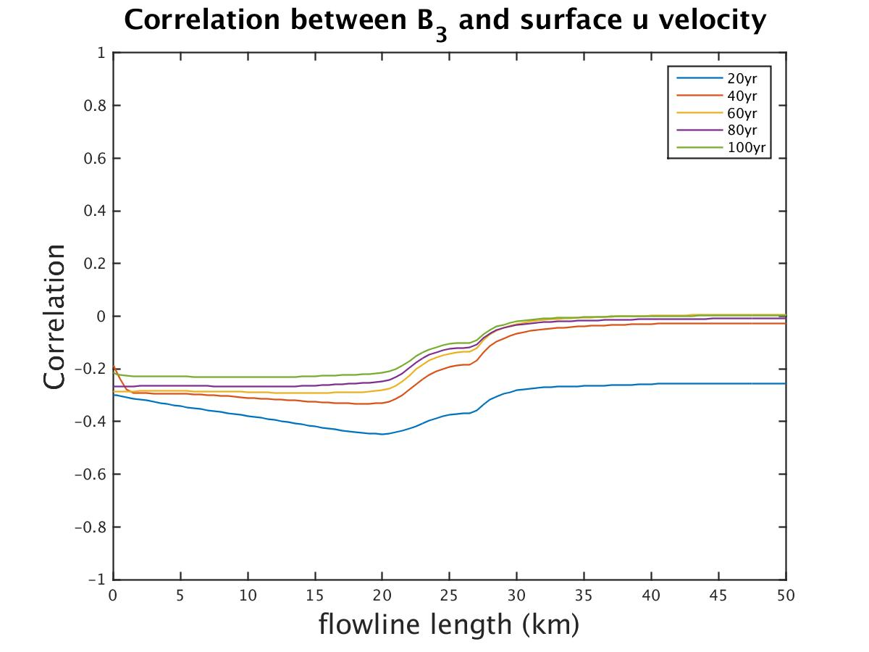
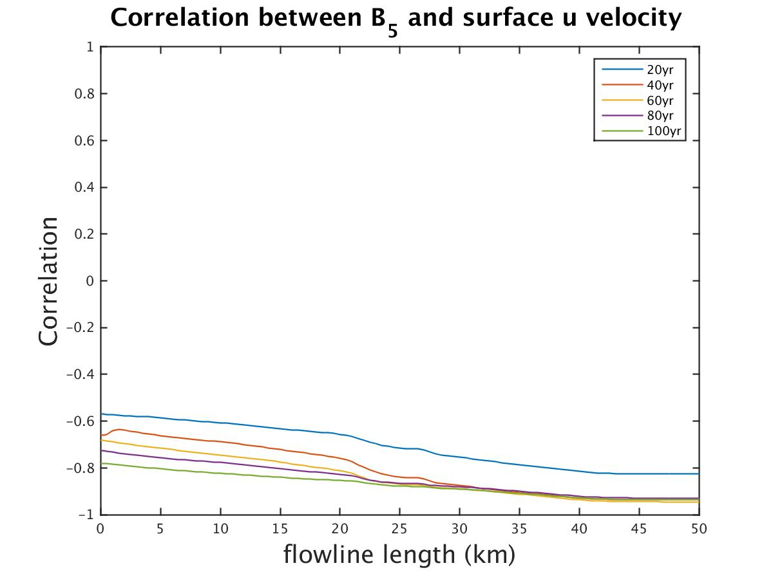
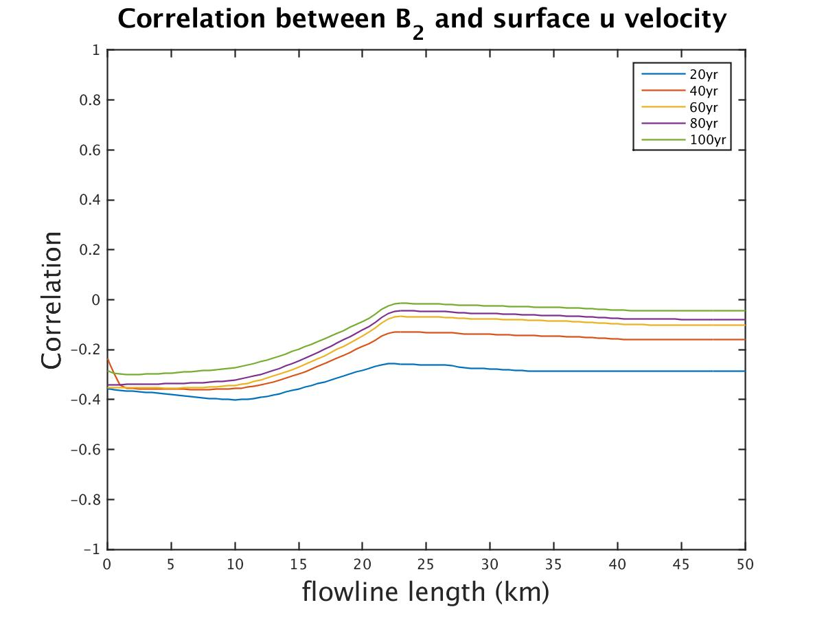
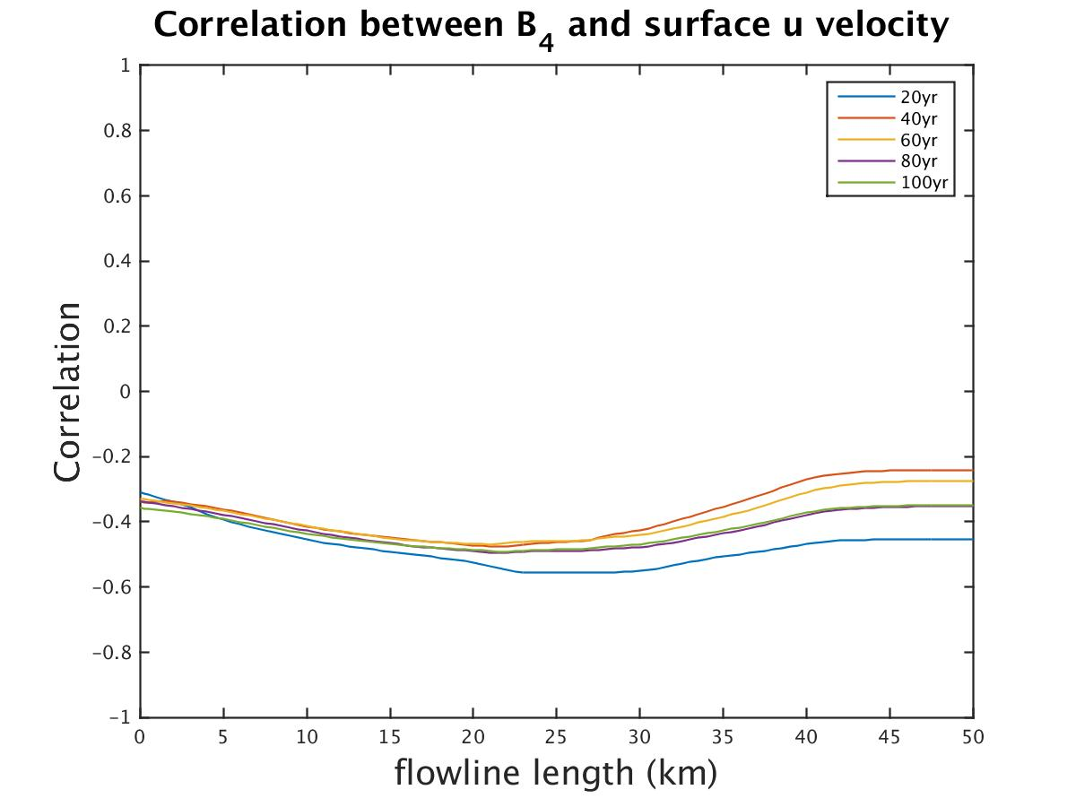
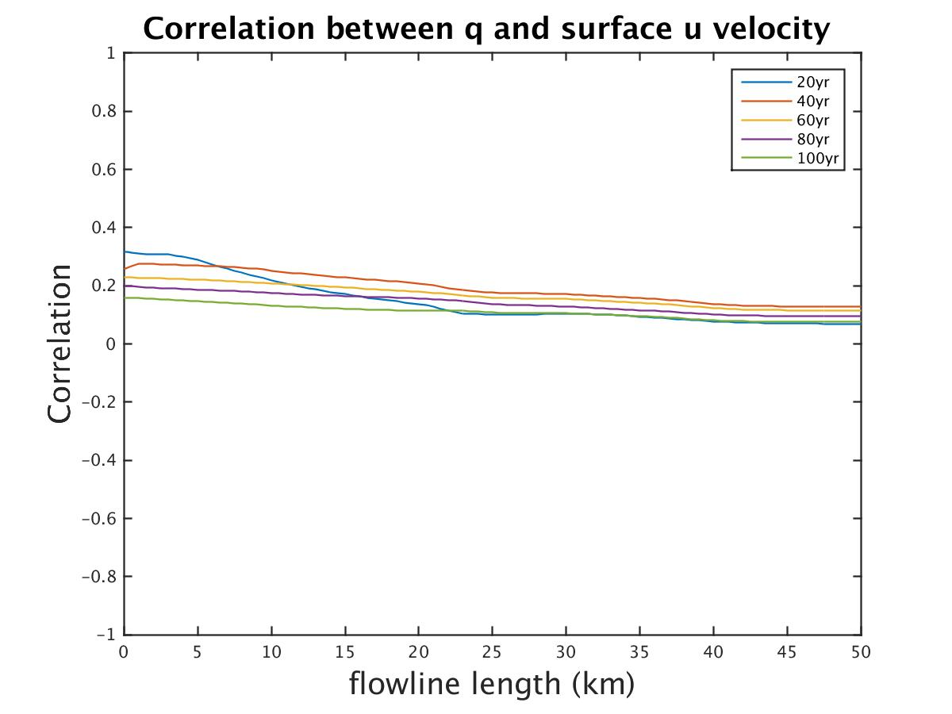
B_{i}_q_100yr
Surface velocity
A | B_{i} | q
 | √ | 1%

Slide 14
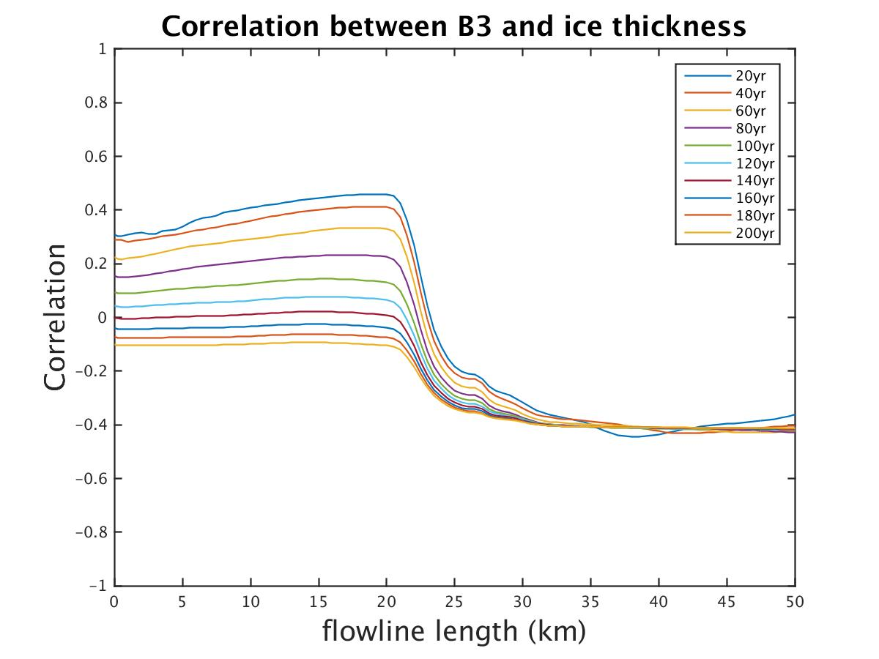
A_B_{i}_q_200yr
Ice thickness
A | B_{i} | q
√ | √ | 5%

Slide 15
A_B_{i}_q_200yr
A | B_{i} | q
√ | √ | 5%
Surface velocity

Slide 16
A_B_{i}_q_200yr
A | B_{i} | q
√ | √ | 5%

Slide 17
Conclusion & Future Plan
Correlation with many uncertainties varies from single parameter case.
Results from some reverse model may overconfident without taking the uncertainty of initial flux into consideration.
Try different set up for initial flux perturbation
Adding more uncertainties (ice thickness profile, ice hardness parameter, etc)
Find the distribution of uncertainty importance

