Slide 1
Influences of Particle Bulk Density of Snow and Graupel in Microphysics-Consistent Microwave Brightness Temperature Simulations
Research Group Meeting
17 August 2017
Scott Sieron
Advisors: Fuqing Zhang, Eugene Clothiaux
Major Collaborator: Lu Yinghui

Slide 2
Background
Particle (bulk) density, $ρ$, is the ratio of particle mass and volume
If $m=aV$, bulk density exactly describes how the particle size relates to particle mass ($a=ρ$)
A sphere of solid ice has a density ~916 kg m⁻³
Used by microphysics schemes for representing the different shapes of different types of frozen hydrometeors. Common values:
Hail: 900 kg m⁻³
Graupel: 400-500 kg⁻³
Snow: 100 kg m⁻³
Notes:
The volume of a spherical particle is unambiguous (${\frac{π}{6}D}^{3}$), unlike the volume of a non-spherical particle

Slide 3
Background
Many bulk microphysics schemes use simple particle size distributions (PSDs) which assume that all particles of snow (or graupel, hail), regardless of size/mass, are spheres with some value of bulk density
Hence $m ∝ {aD}^{3}$
Some newer microphysics schemes (not investigated here) use PSDs for snow which do not assume spherical mass-size relationship
When lacking further specification of particle shape, bulk density is represented by constructing a homogeneous mixture of ice and air
Low bulk densities result in particles describable as “soft” or “fluffy”

Slide 4
How Can Changing Bulk Density Influence T_{B}?
Changing the microphysics scheme, ultimately leading to different evolution of snow and graupel water contents
E.g., particle fall speeds*
Changing the particle size/mass distributions that are integrated to calculate cloud optical properties
Changing the optical properties of the spherical particles that are used to calculate cloud optical properties

Slide 5
1. Changing snow and graupel water contents
Experiment:
Modify the value of the bulk density of snow or graupel in the microphysics scheme (WSM6)
Snow: 50 kg m⁻³ or 200 kg m⁻³ (default: 100 kg m⁻³)
Graupel: 200 kg m⁻³ or 800 kg m⁻³ (default: 500 kg m⁻³)
Run WRF with unmodified and each modified scheme, all else kept the same
Use each WRF output as input to CRTM
Apply the SAME lookup table (consistent with the unmodified microphysics) to each simulation output

Slide 6
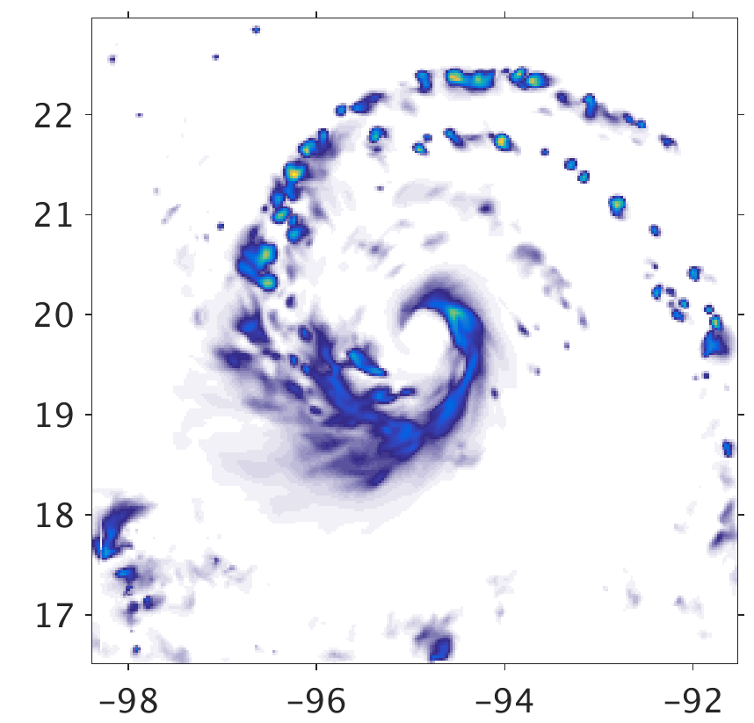
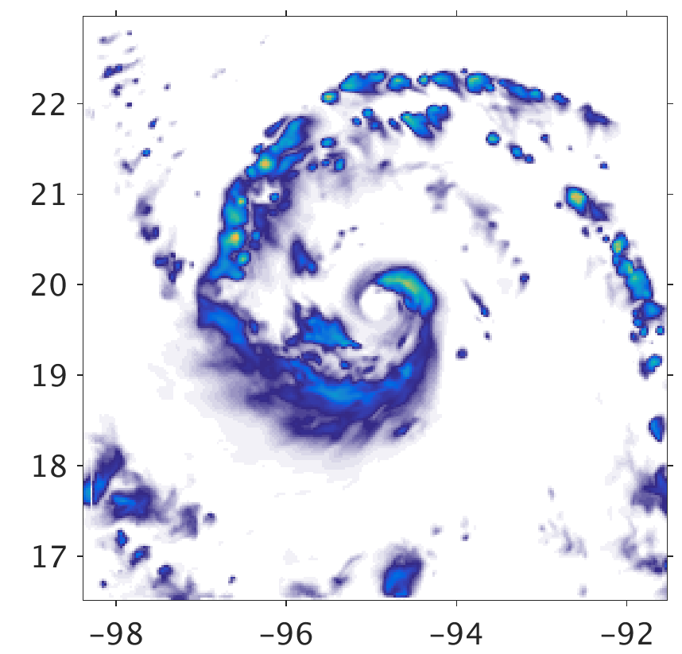
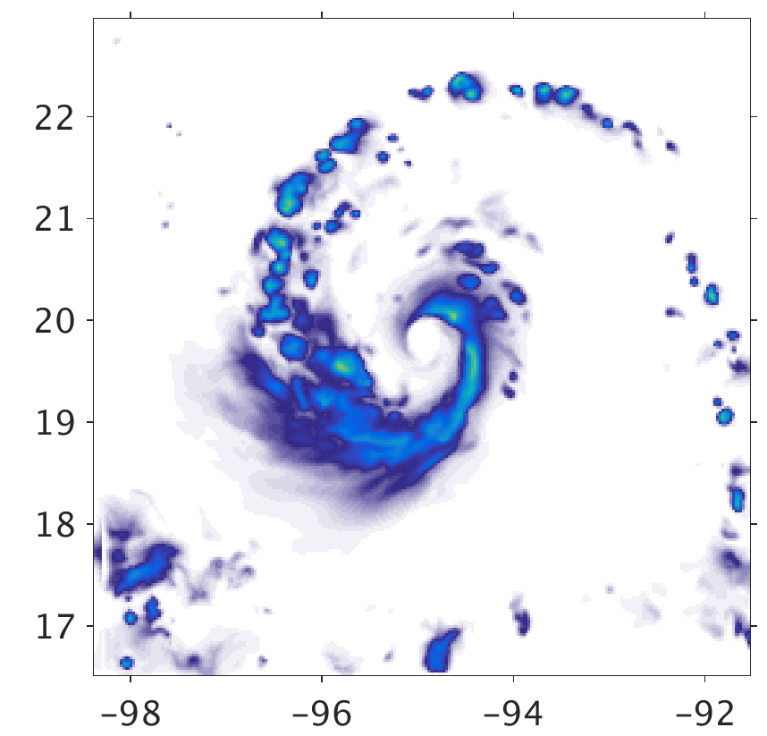
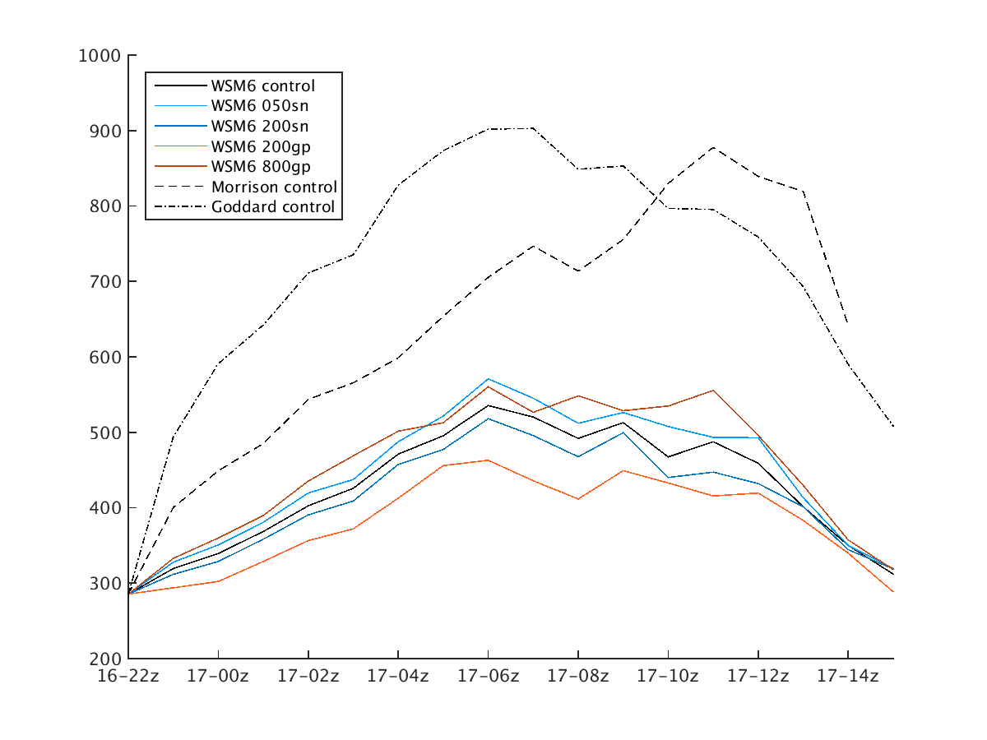
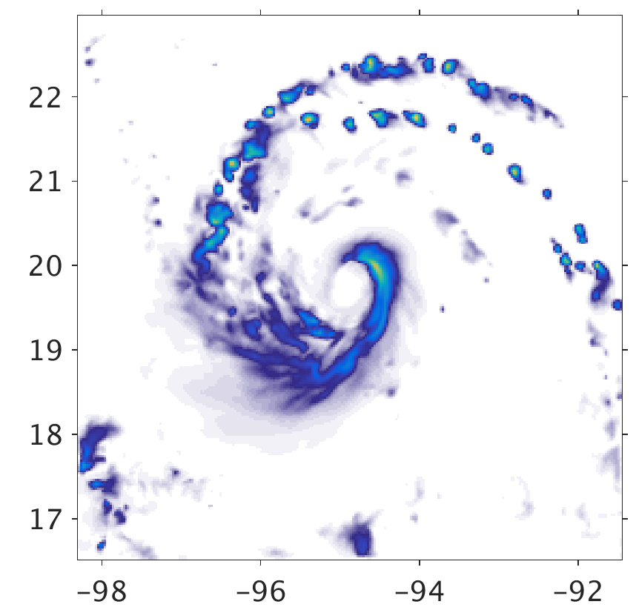
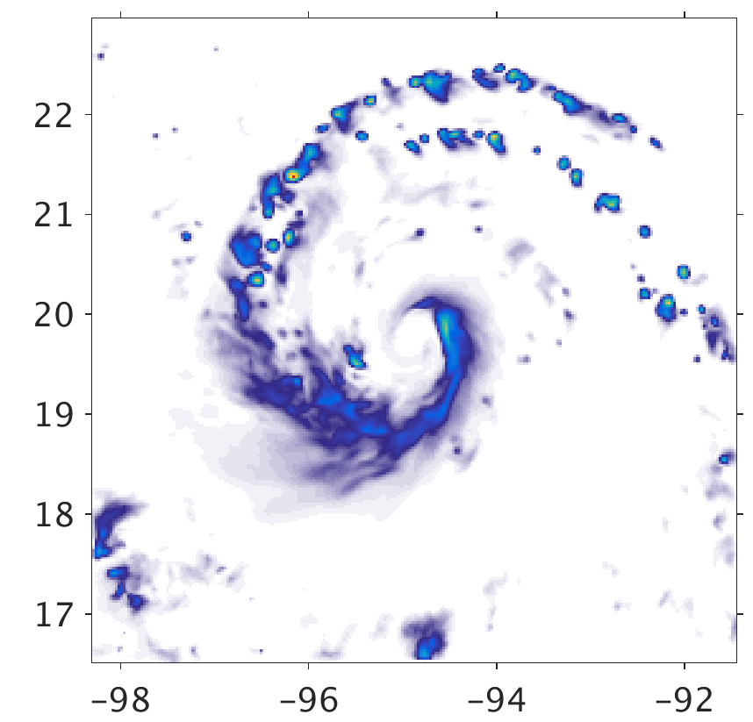
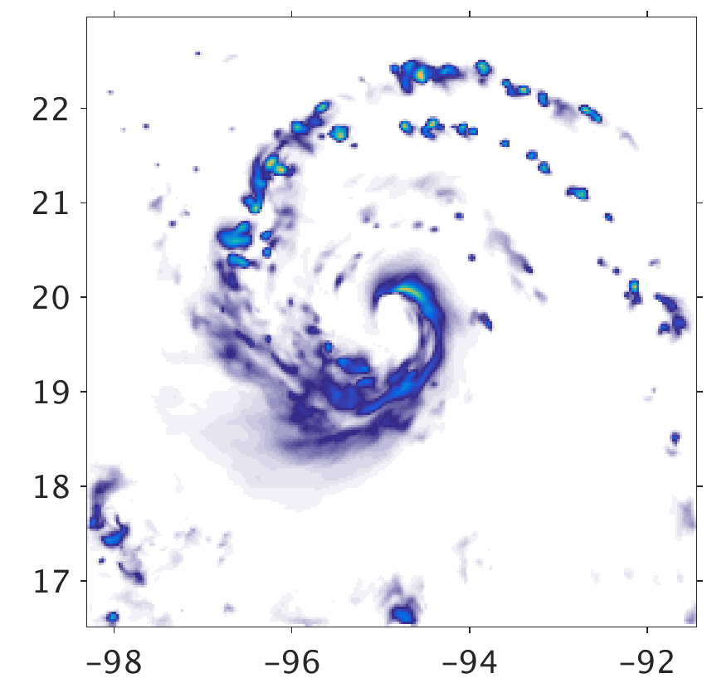
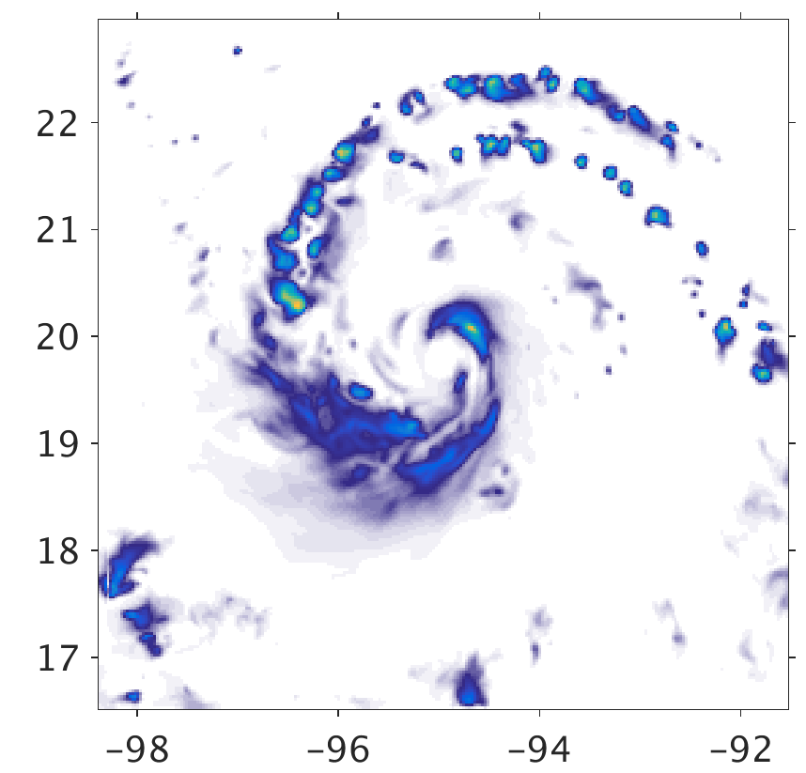
1. Changing snow and graupel water contents
Snow + Graupel Water Path
WSM6
Goddard
Morrison
Total Snow and Graupel Mass in Domain (Gg)
535 Gg
902 Gg
705 Gg
Time
050sn
200sn
200gp
800gp
571 Gg
518 Gg
463 Gg
560 Gg
Snow + Graupel Water Path (g m⁻²)

Slide 7
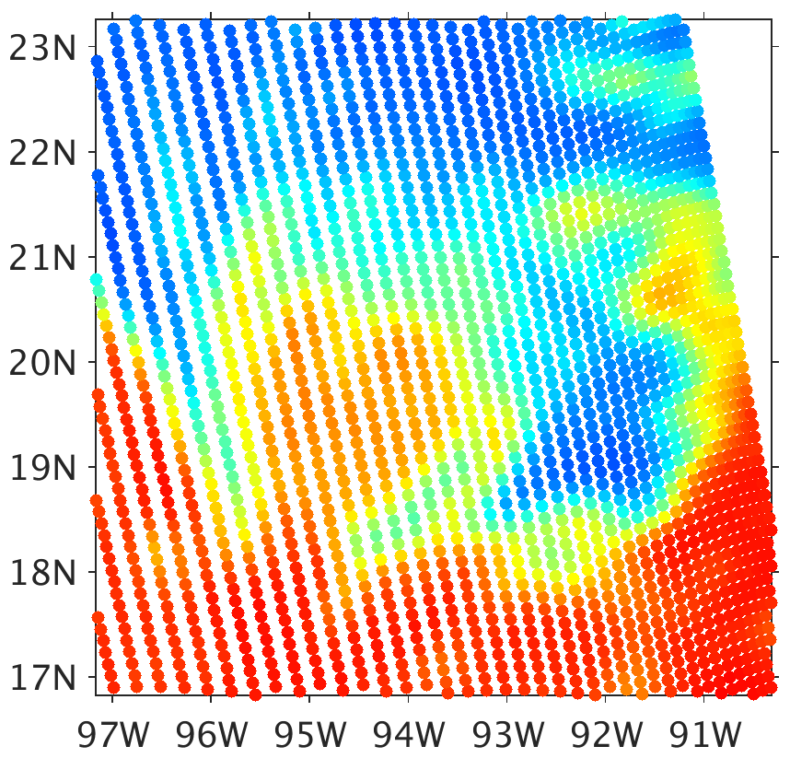
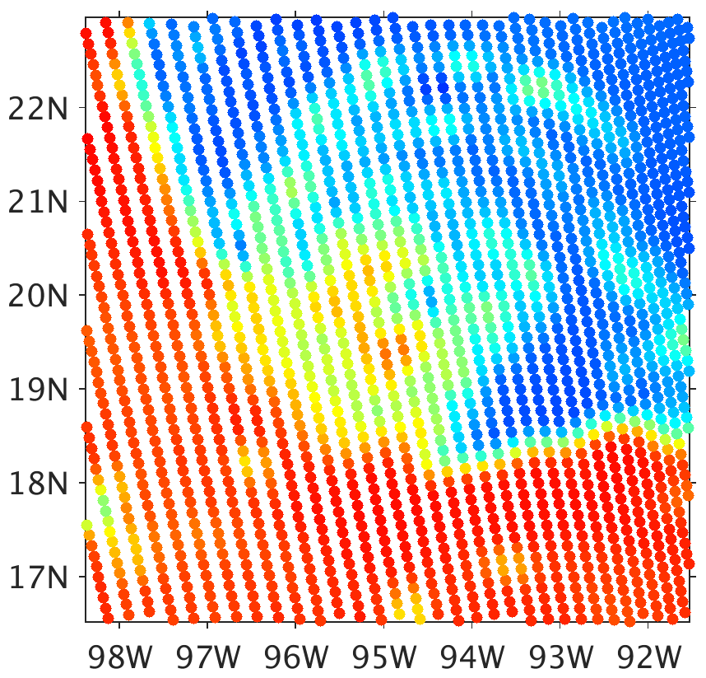
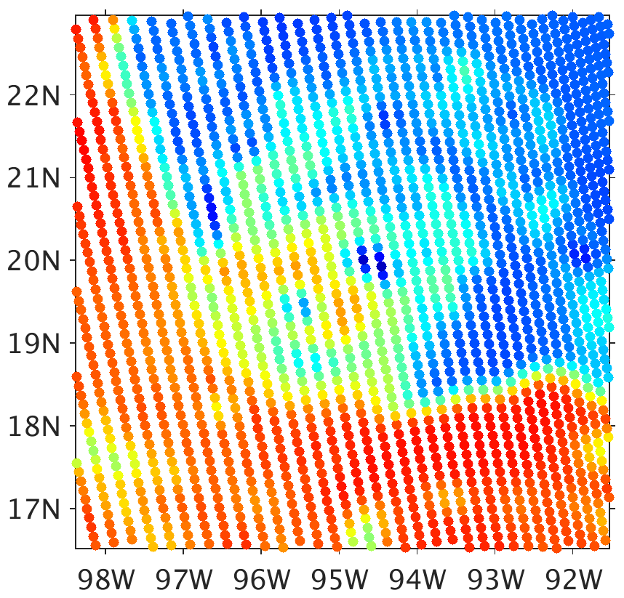
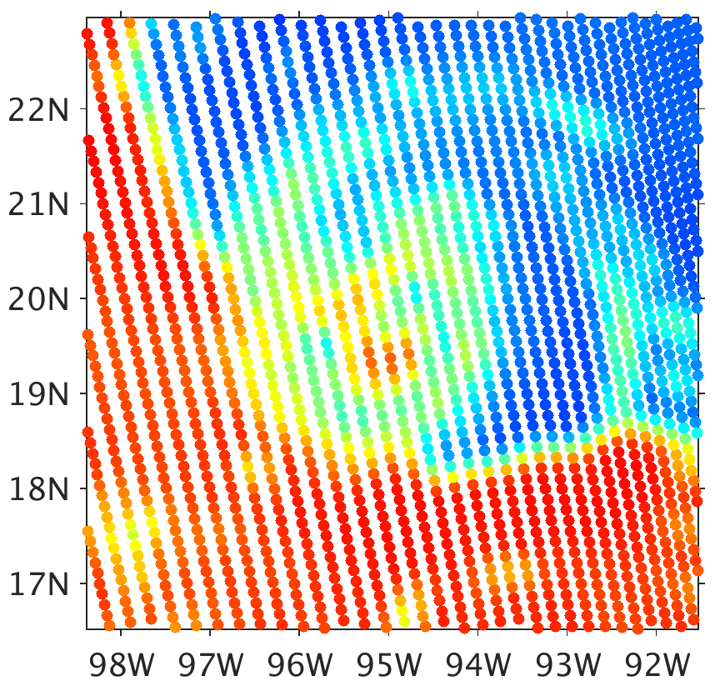
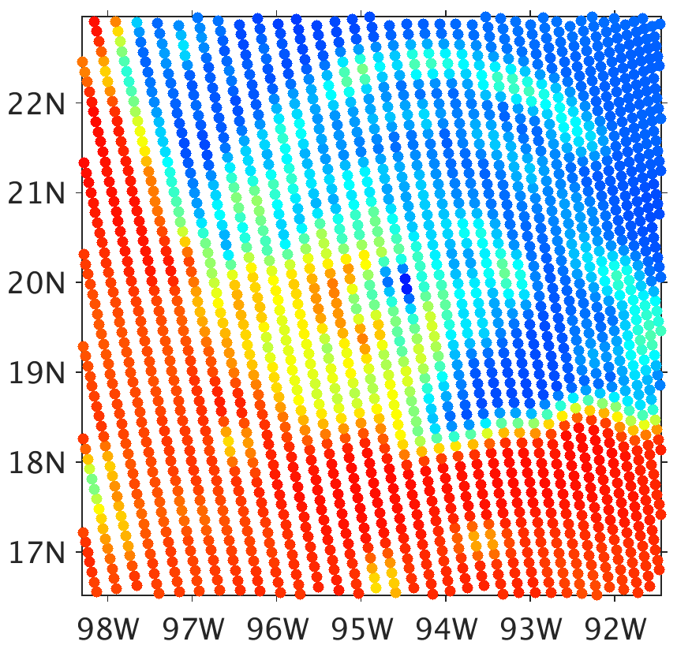
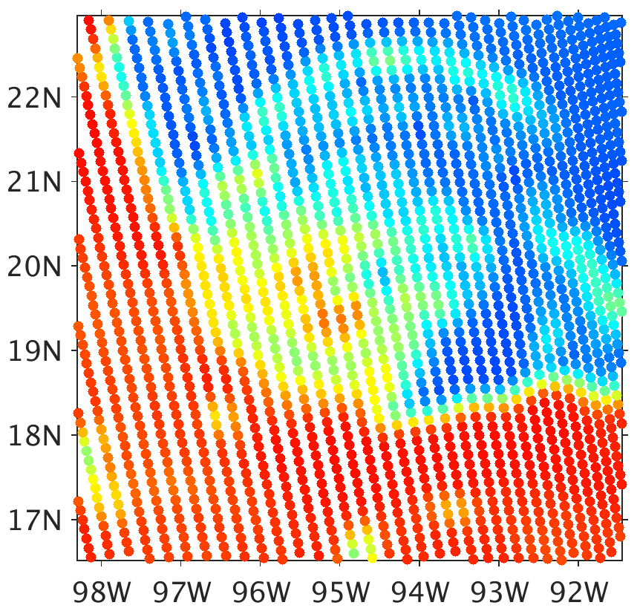
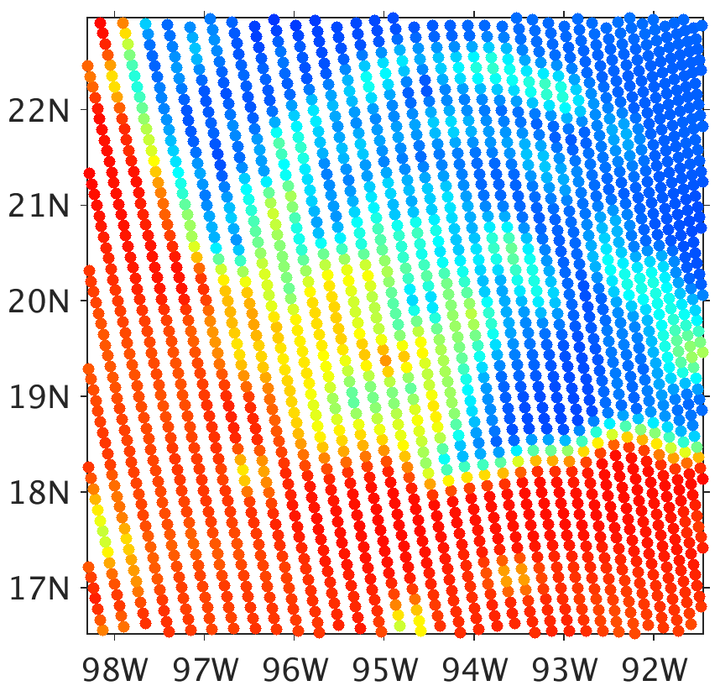
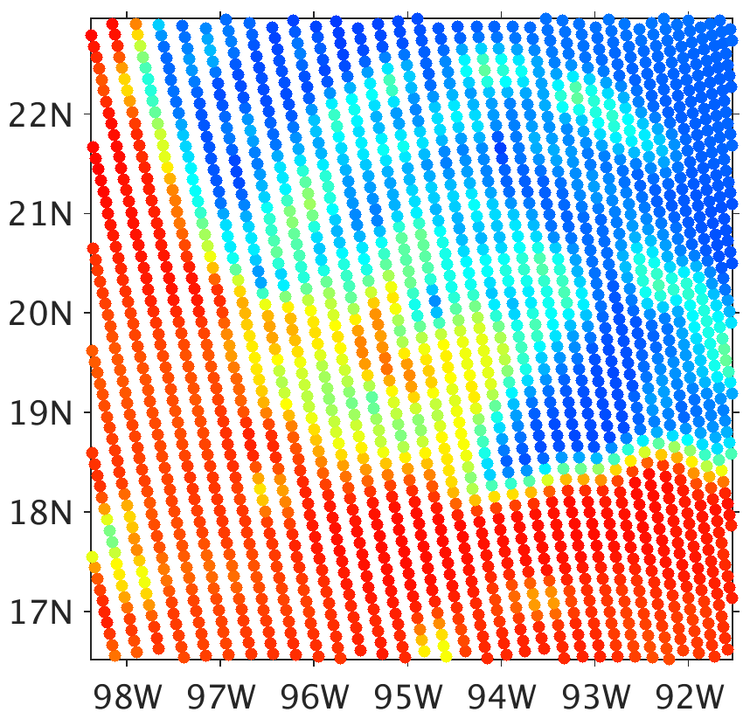
1. Changing snow and graupel water contents
37 GHz Brightness Temperature
300
Obs (5 hours prior)
WSM6
Goddard
Morrison
280
260
240
220
200
180
050sn
200sn
200gp
800gp
160
140
120
100
80
Brightness Temperature (K)
All of bottom row using lookup table consistent with unmodified WSM6

Slide 8
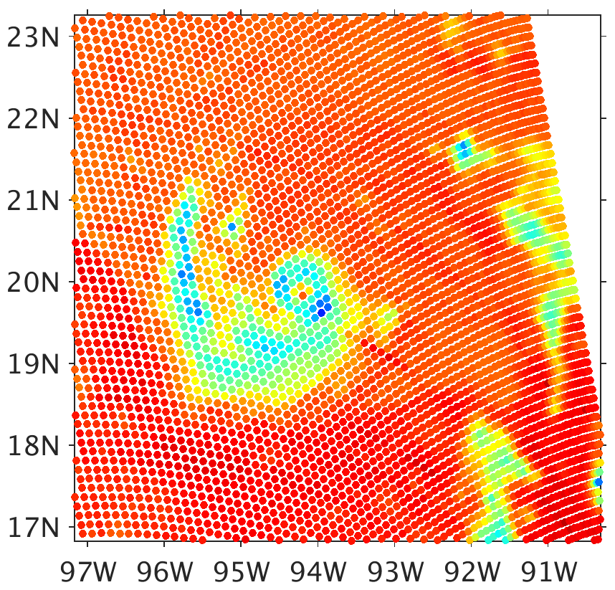
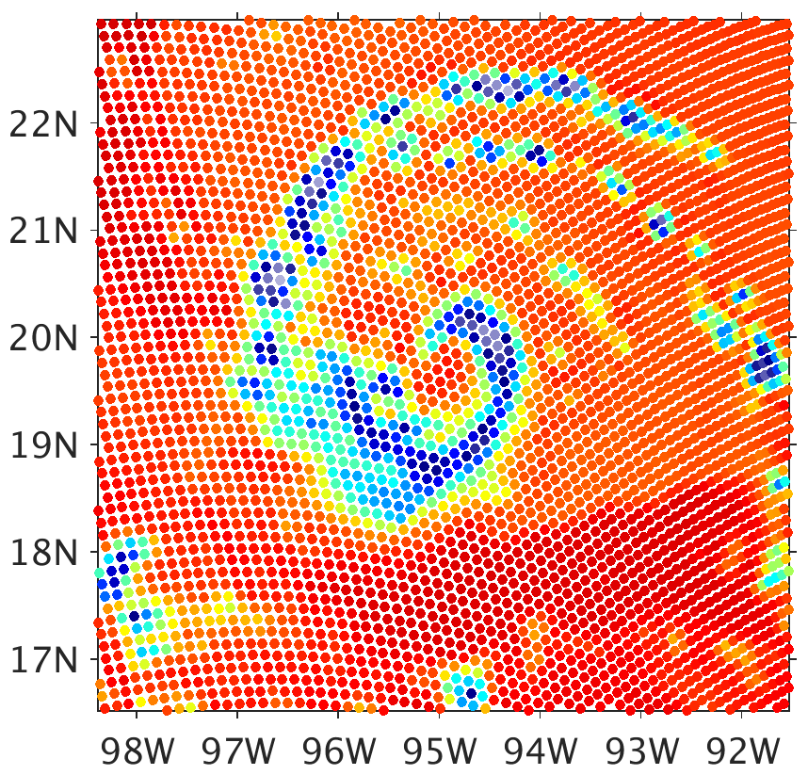
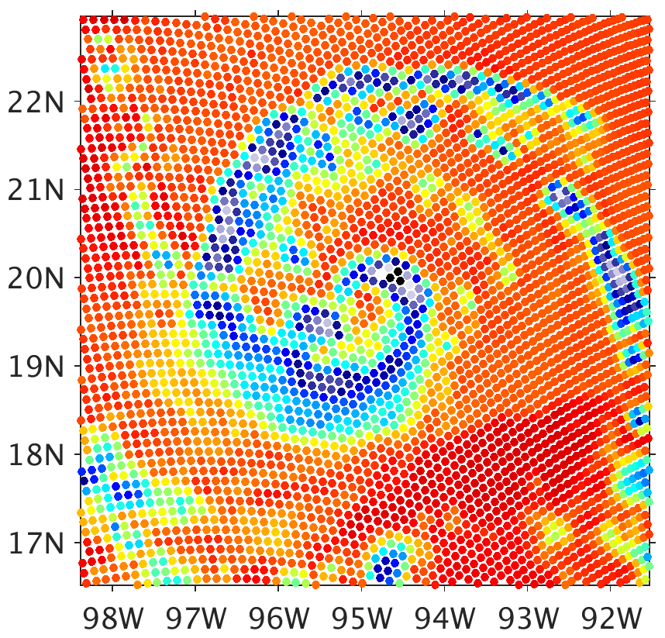
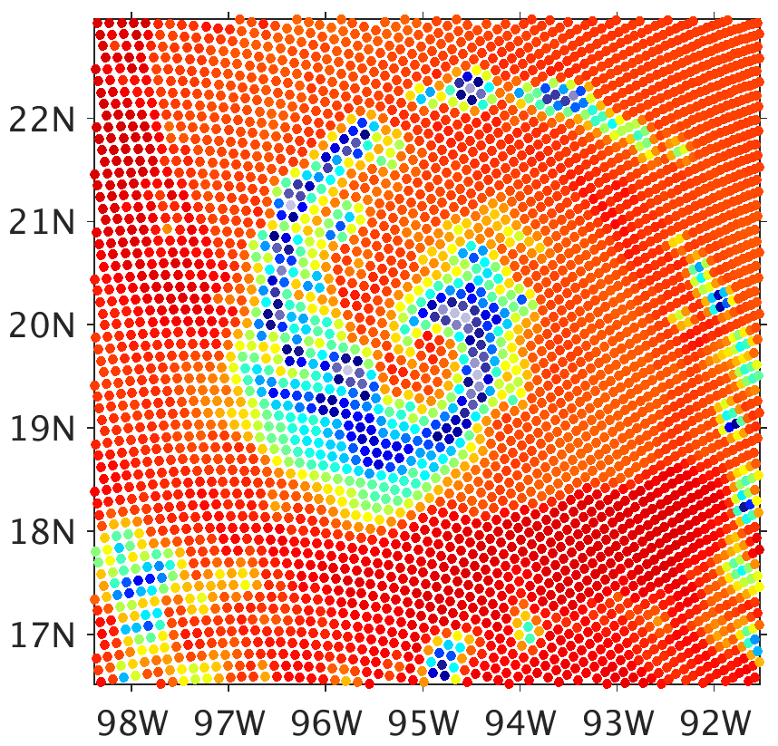
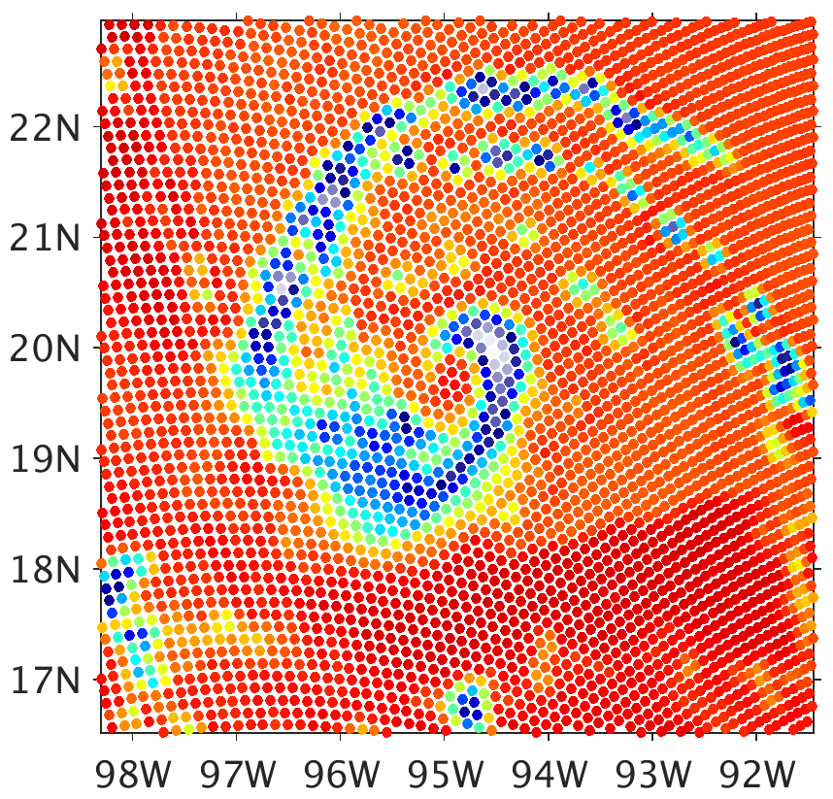
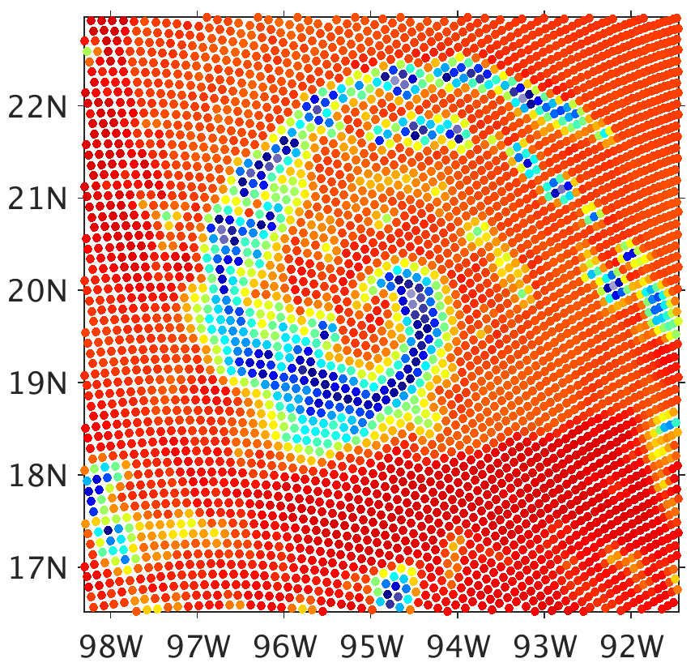
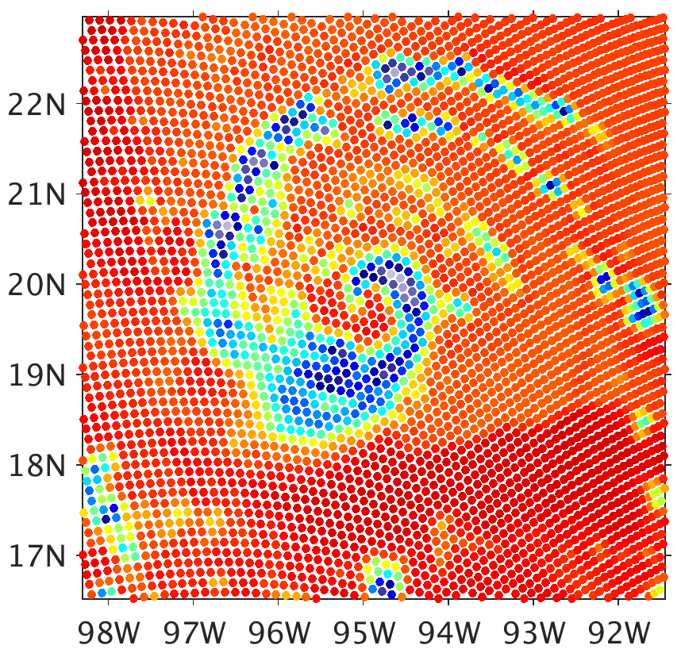
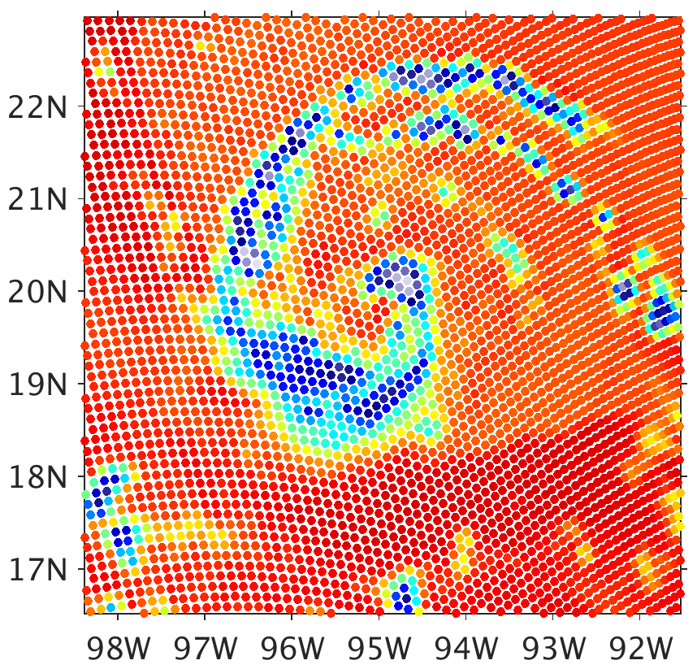
1. Changing snow and graupel water contents
91.7 GHz Brightness Temperature
300
Obs (5 hours prior)
WSM6
Goddard
Morrison
280
260
240
220
200
180
050sn
200sn
200gp
800gp
160
140
120
100
80
Brightness Temperature (K)
All of bottom row using lookup table consistent with unmodified WSM6

Slide 9
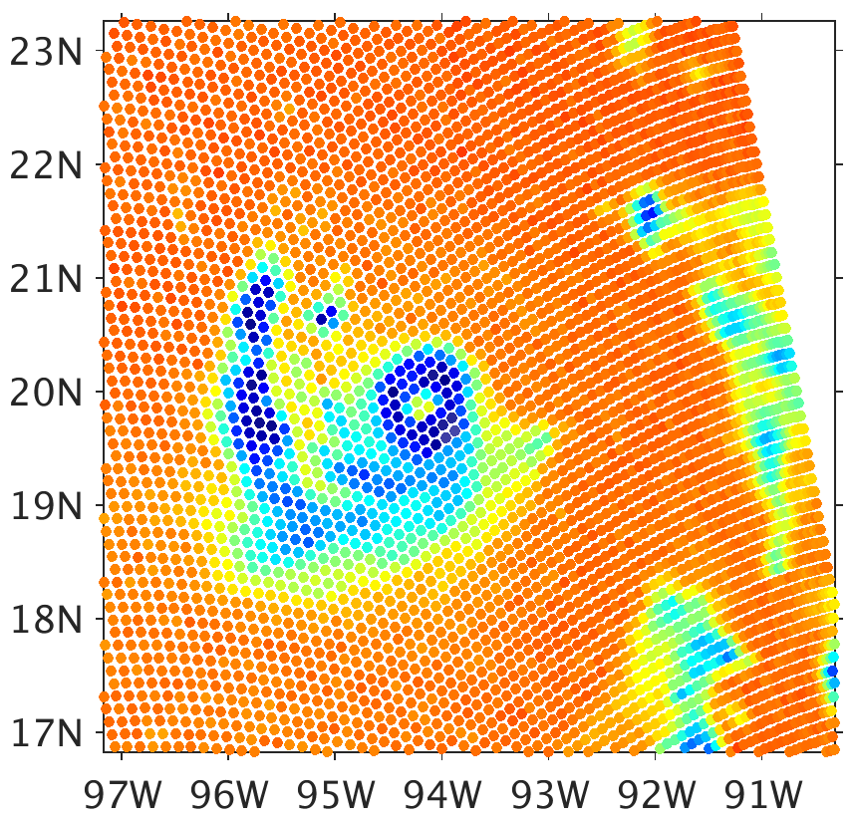
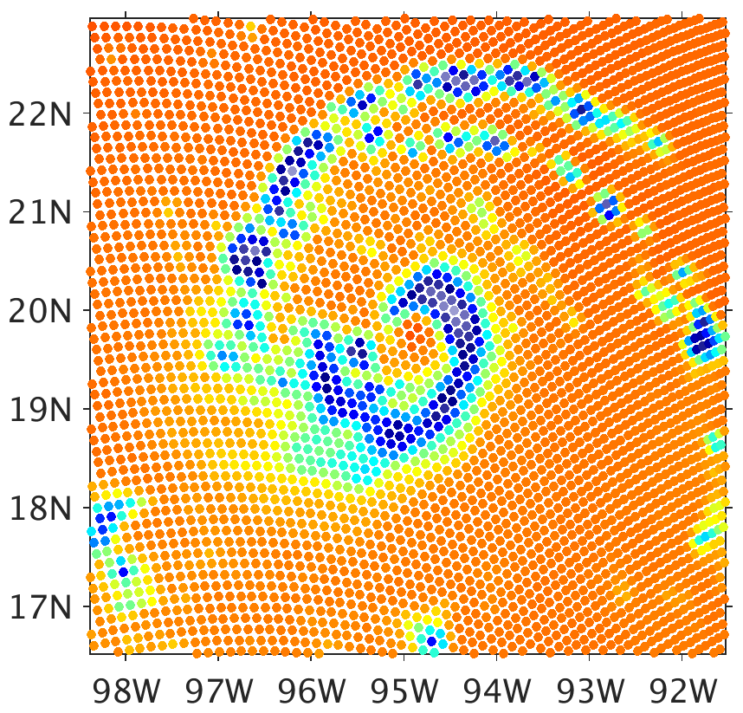
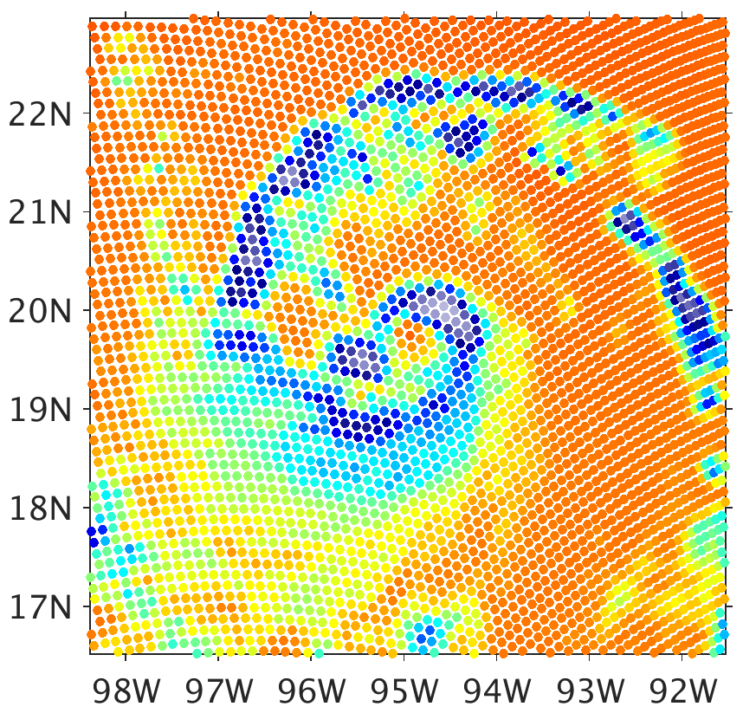
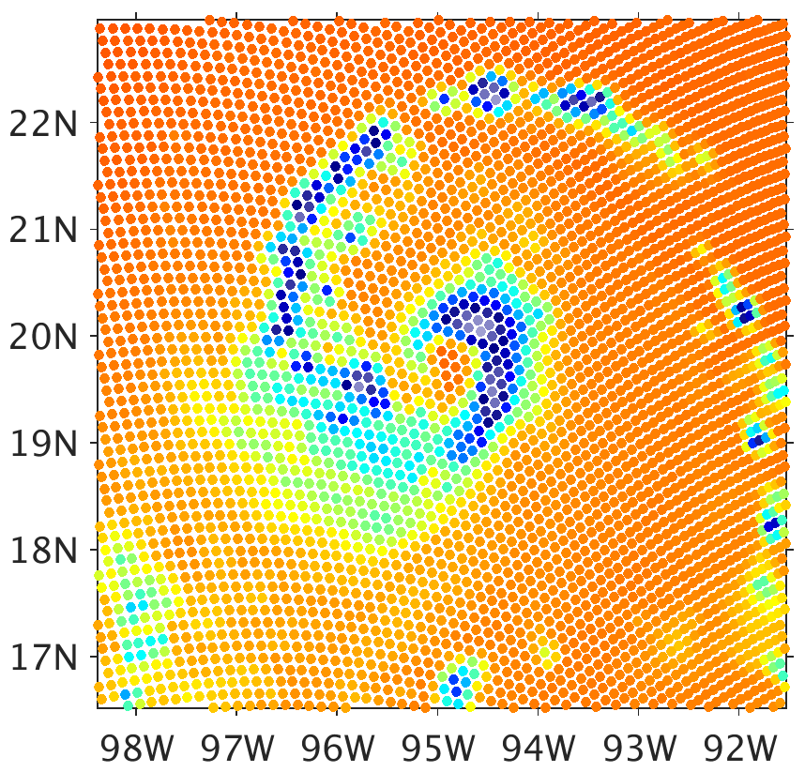
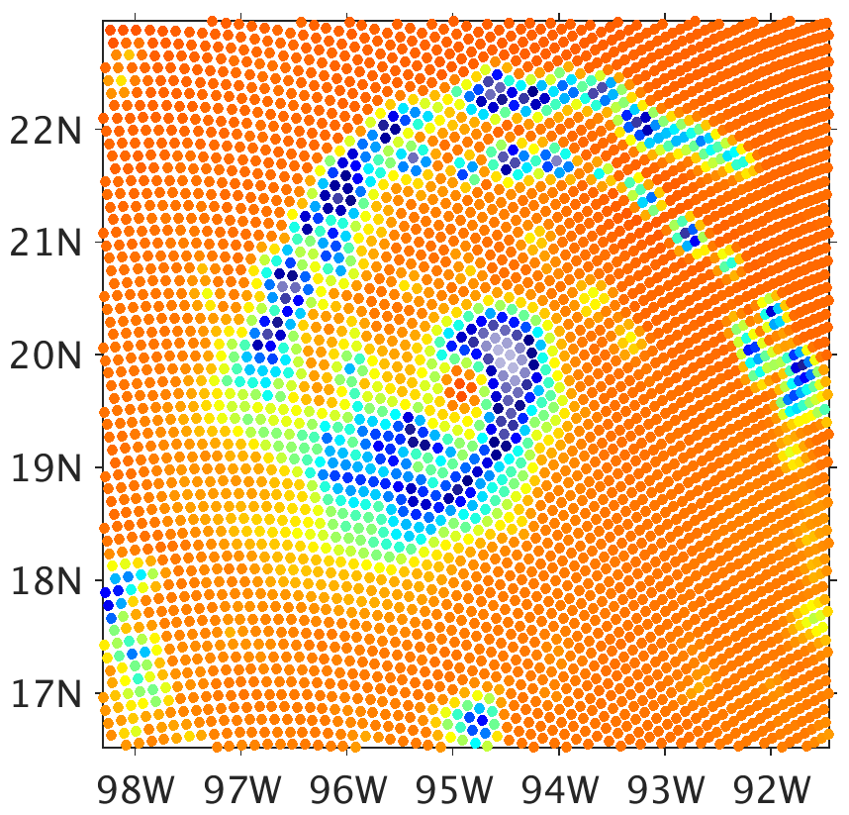
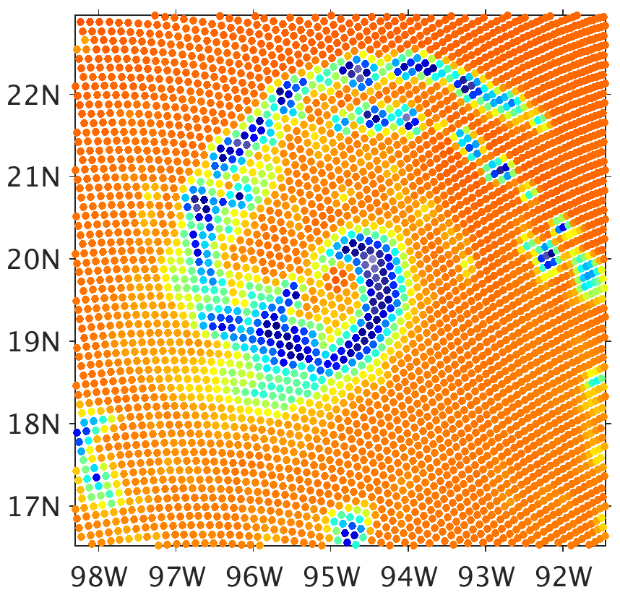
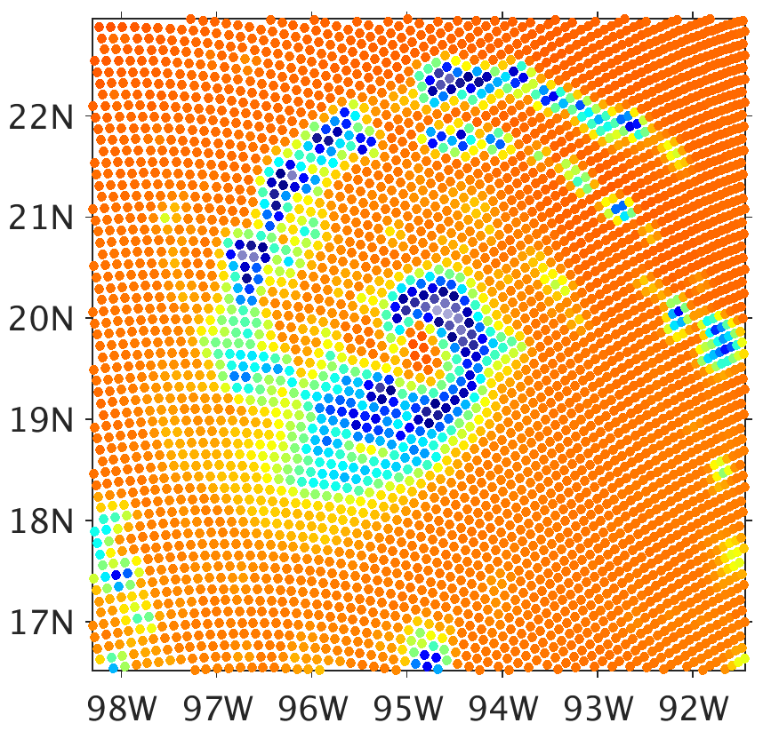
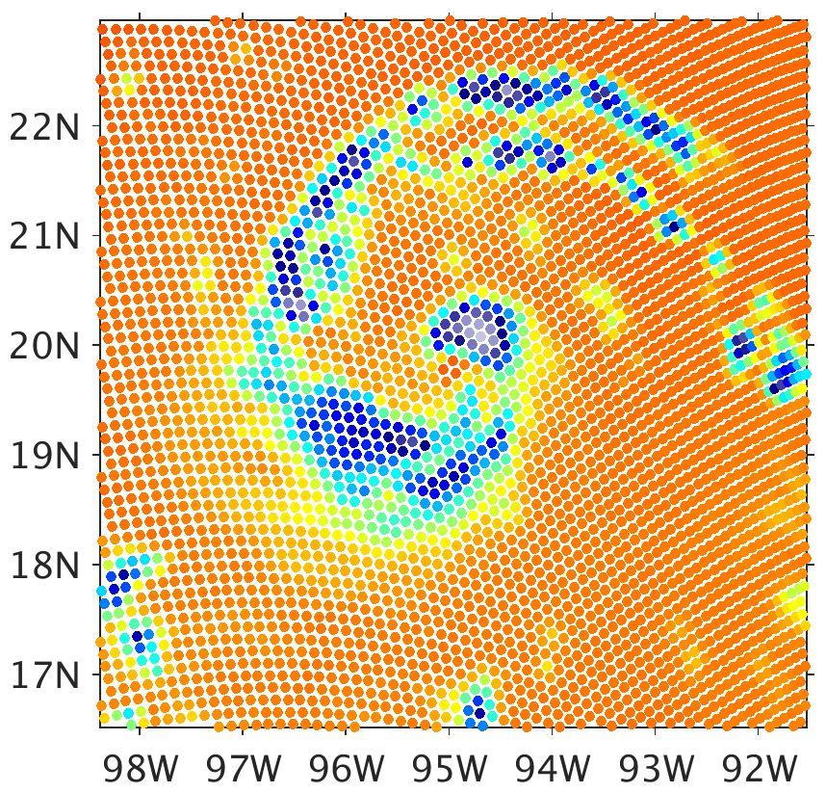
1. Changing snow and graupel water contents
183 GHz Brightness Temperature
300
Obs (5 hours prior)
WSM6
Goddard
Morrison
280
260
240
220
200
180
050sn
200sn
200gp
800gp
160
140
120
100
80
Brightness Temperature (K)
All of bottom row using lookup table consistent with unmodified WSM6

Slide 10
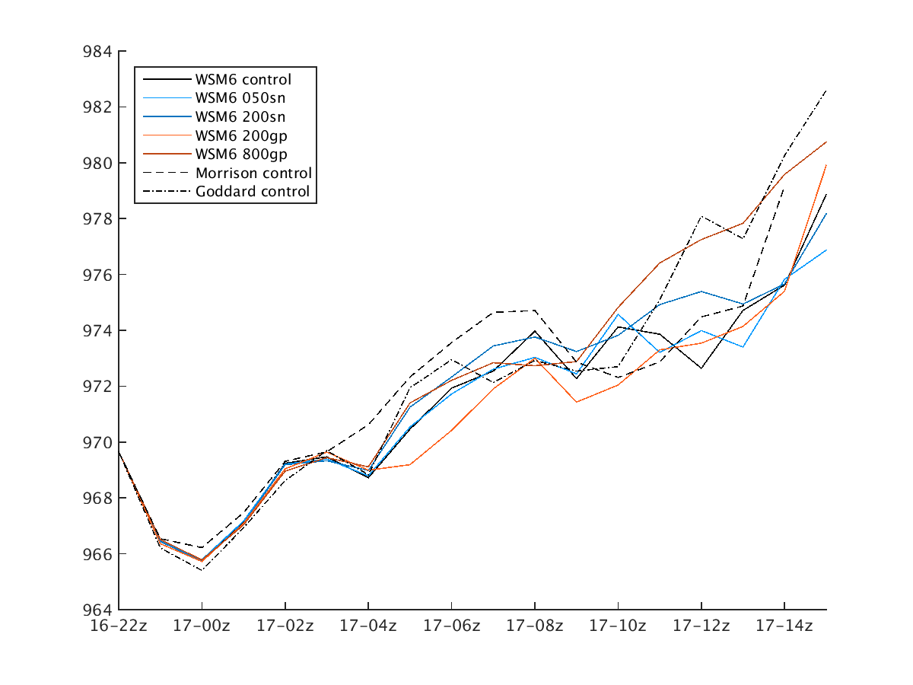
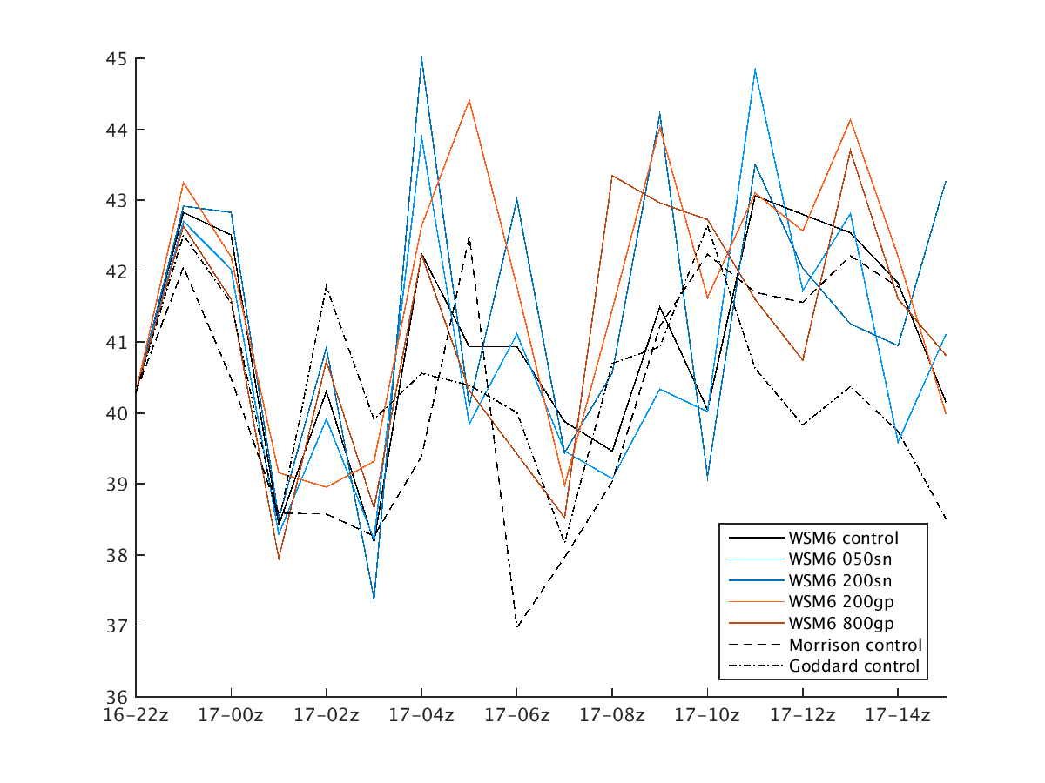
1. Changing snow and graupel water contents
Hurricane Minimum Surface Pressure (hPA)
Hurricane Maximum Surface Wind (m/s)
Time
Time
No discernable, systematic sensitivity to the dynamical evolution of the hurricane

Slide 11
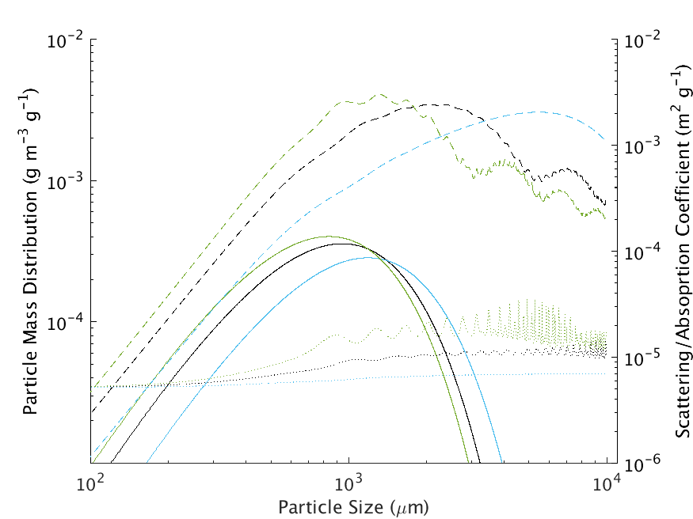
2 and 3. Particle optical properties, particle size/mass distribution
Solid lines: exponential particle mass distribution for WSM6 graupel
$M_{g}\left(D_{g}\right)=\frac{π}{6}ρ_{g}D^{3}N_{0,g}e^{−λ_{g}D_{g}}$, with $λ_{g}[m^{−1}]={\left(\frac{πρ_{g}N_{0,g}}{ρ_{a}q_{g}}\right)}^{1/4}$
Dash lines: scattering coefficient
Dotted lines: absorption coefficient
Different color line for each bulk density
PMD lines are with the same intercept parameter, $N_{0}$, and with water content 1 g m⁻³
91.7 GHz
200 kg m⁻³
µm⁻¹)
500 kg m⁻³
800 kg m⁻³

Slide 12
2 and 3. Particle optical properties, particle size/mass distribution
Cloud scattering/absorption coefficient is calculating by integrating the product of the PSD and the particle optical properties
Mass-weighted optical properties of particles with a given size vary with bulk density
Lower bulk density shifts more mass to larger particles
Those larger particles are themselves less massive
91.7 GHz
200 kg m⁻³
µm⁻¹)
500 kg m⁻³
800 kg m⁻³

Slide 13
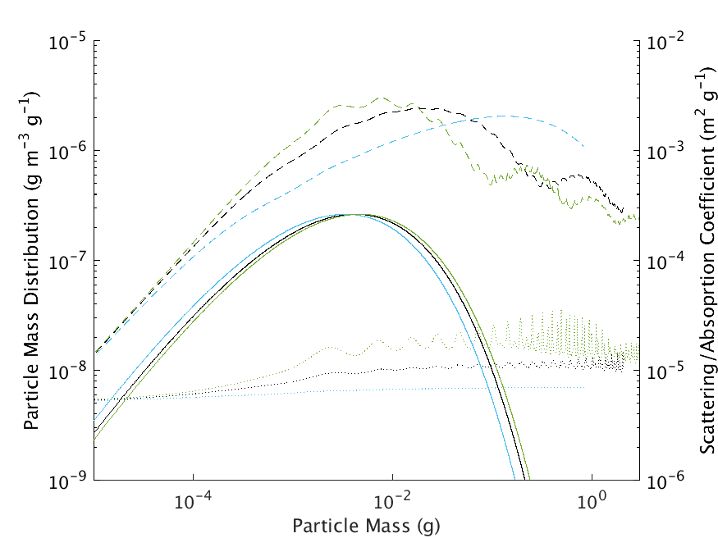
2 and 3. Particle optical properties, particle size/mass distribution
Solid lines: exponential particle mass distribution for WSM6 graupel
$M_{g}\left(m_{g}\right)={(\frac{2π}{9}\frac{m_{g}}{ρ_{g}})}^{1/3}N_{0,g}e^{−λ_{g}a}$, with $a={\left(\frac{6m_{g}}{πρ_{g}}\right)}^{1/3}$
Lower bulk density slightly shifts PMD to less massive particles
“Small” particles of different bulk density but same mass have the same values of scattering/absorption coefficient, but “large” particles have different values
91.7 GHz
200 kg m⁻³
500 kg m⁻³
800 kg m⁻³

Slide 14
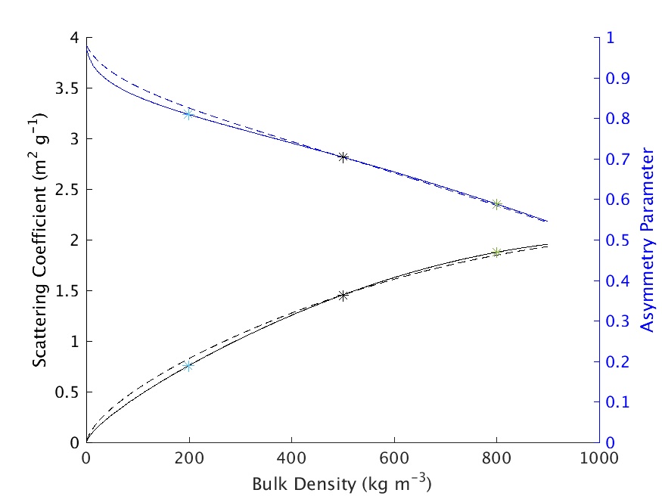
2 and 3. Particle optical properties, particle size/mass distribution
Scattering coefficients and asymmetry parameters (91.7 GHz) of a 1 g m⁻³ cloud of WSM6 graupel as a function of bulk density
Using optical properties of spheres of specified bulk density, and…
always using particle mass distribution consistent with 500 kg m⁻³ bulk density (dashed line), vs.
using particle mass distribution consistent with specified bulk density (solid line)
Little difference between solid and dashed lines
Changes in particle properties is much more significant than changes in particle mass distribution

Slide 15
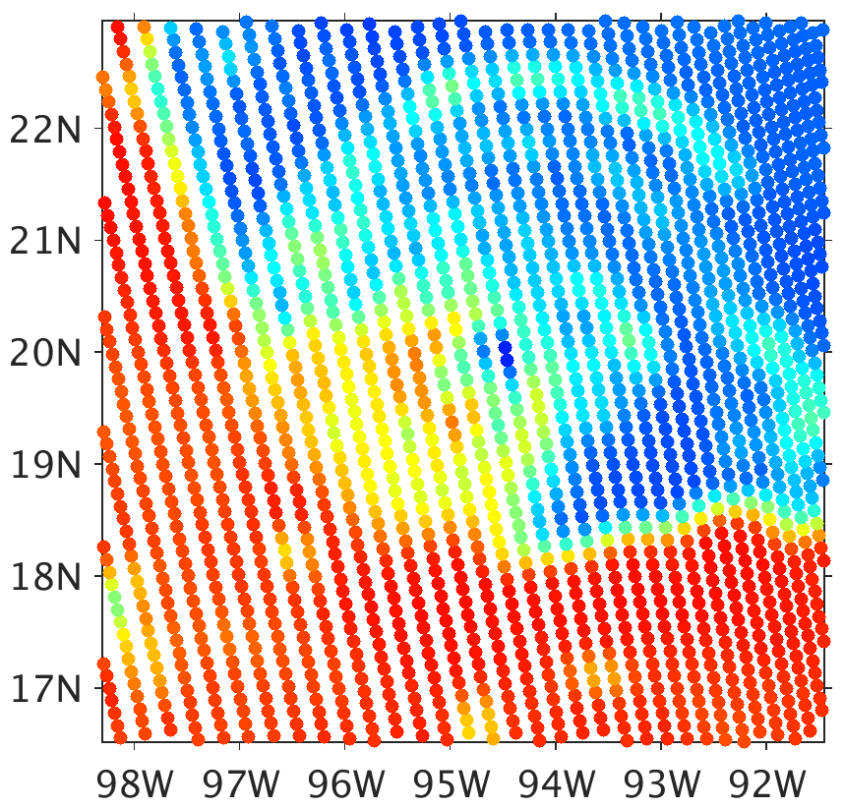
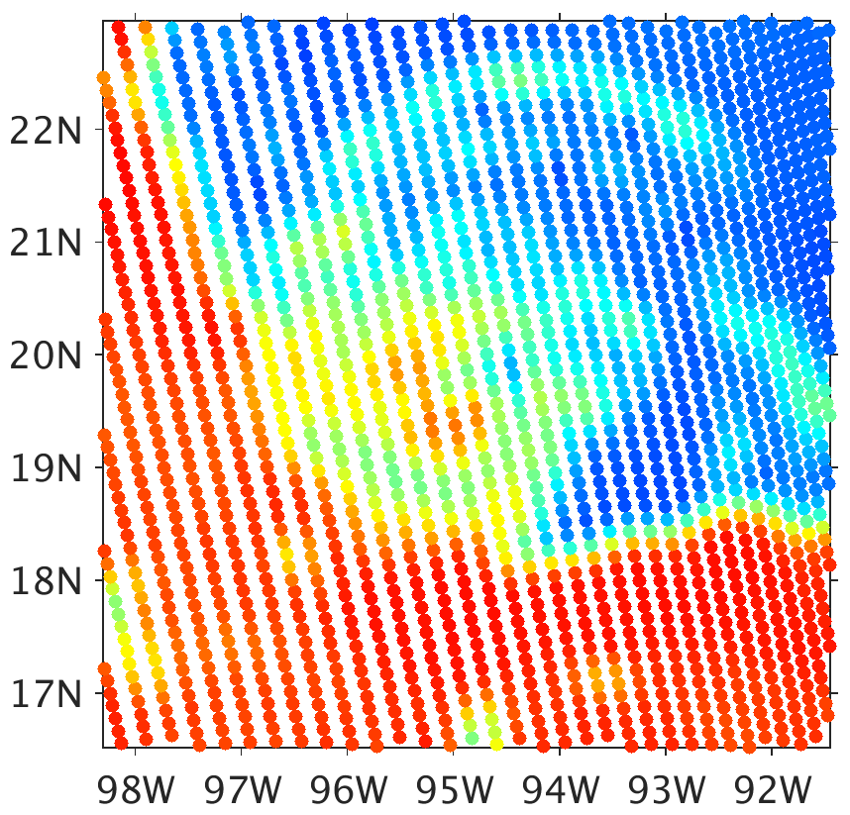
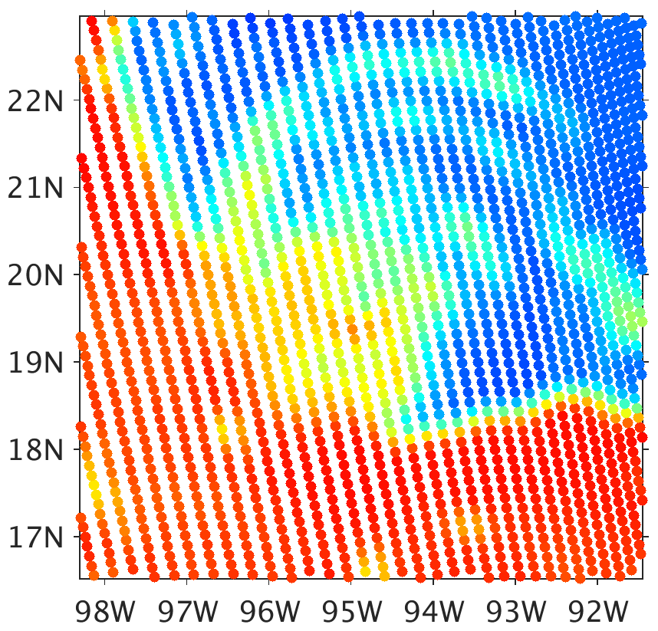
2 and 3. Particle optical properties, particle size/mass distribution
37 GHz Brightness Temperature
300
Obs (5 hours prior)
WSM6
Goddard
Morrison
280
260
240
220
200
180
050sn
200sn
200gp
800gp
160
140
120
100
80
Brightness Temperature (K)
All of bottom row using lookup table consistent with modified bulk density variant of WSM6

Slide 16
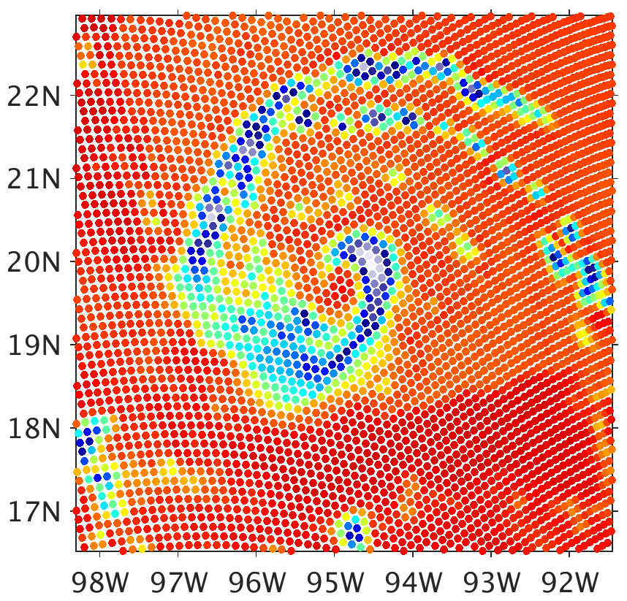
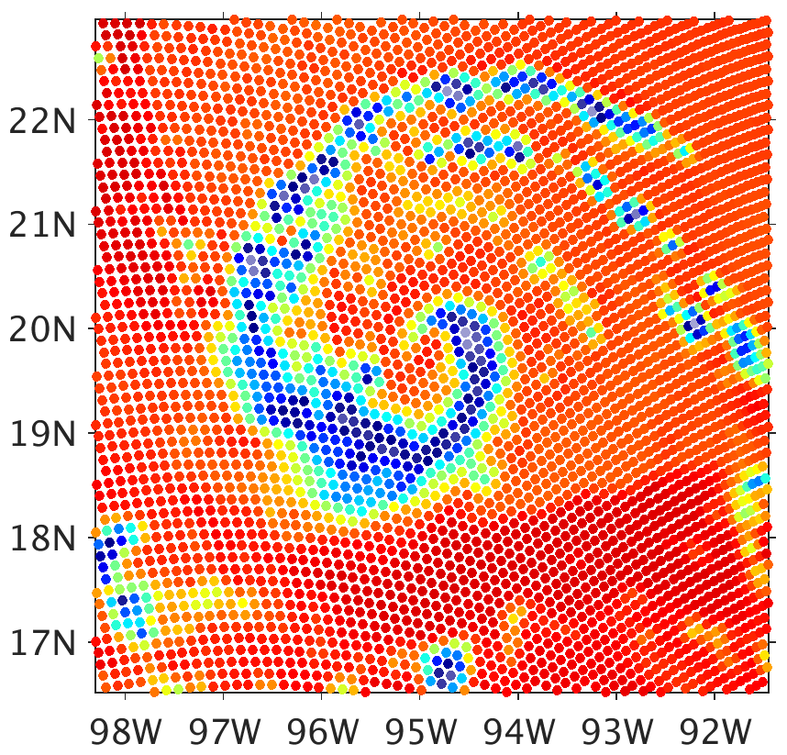
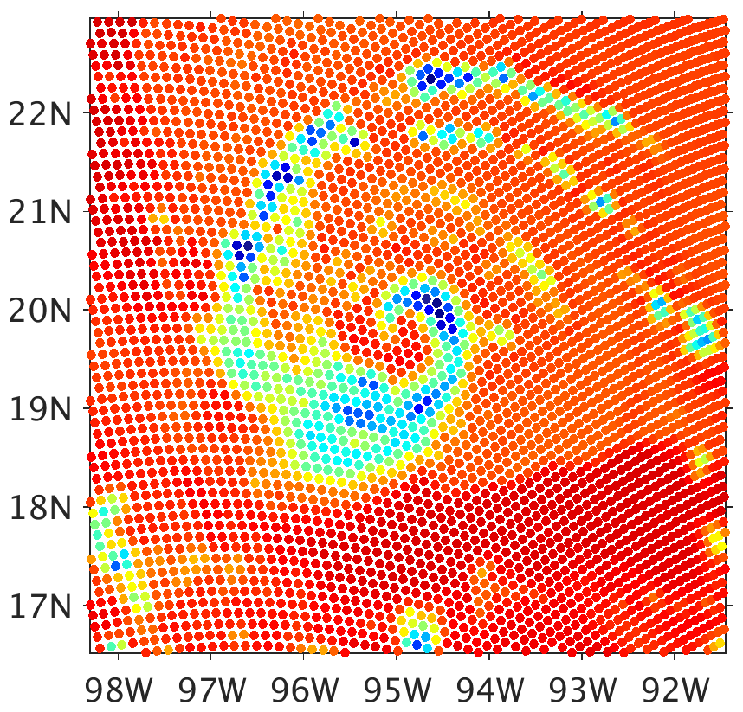
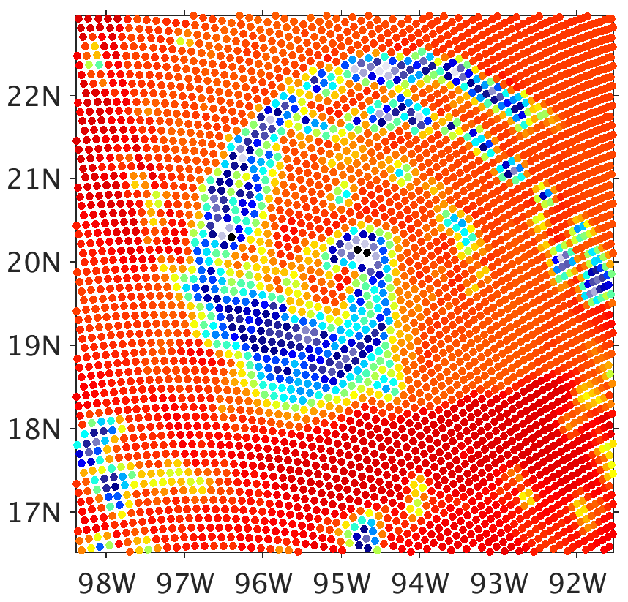
2 and 3. Particle optical properties, particle size/mass distribution
91.7 GHz Brightness Temperature
300
Obs (5 hours prior)
WSM6
Goddard
Morrison
280
260
240
220
200
180
050sn
200sn
200gp
800gp
160
140
120
100
80
Brightness Temperature (K)
All of bottom row using lookup table consistent with modified bulk density variant of WSM6

Slide 17
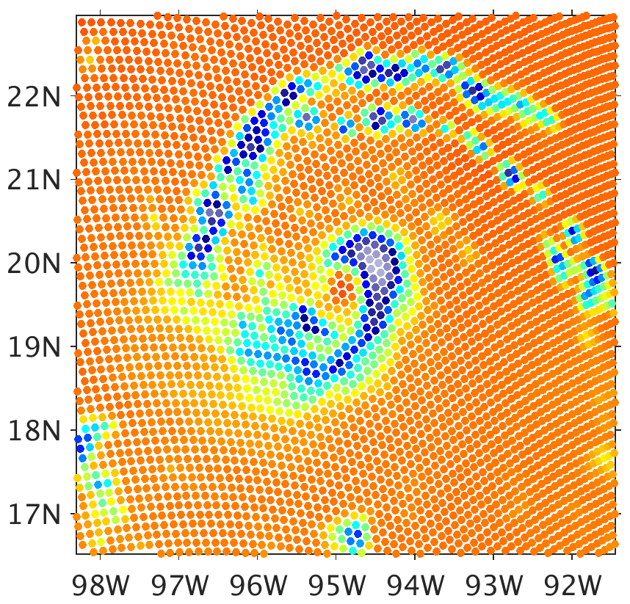
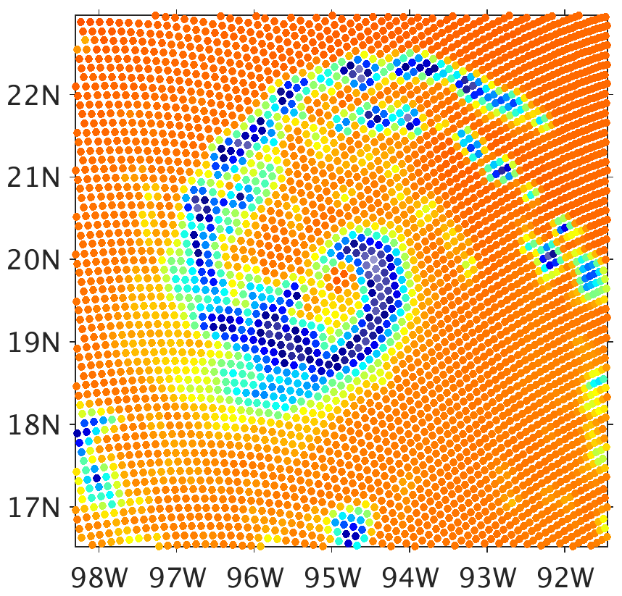
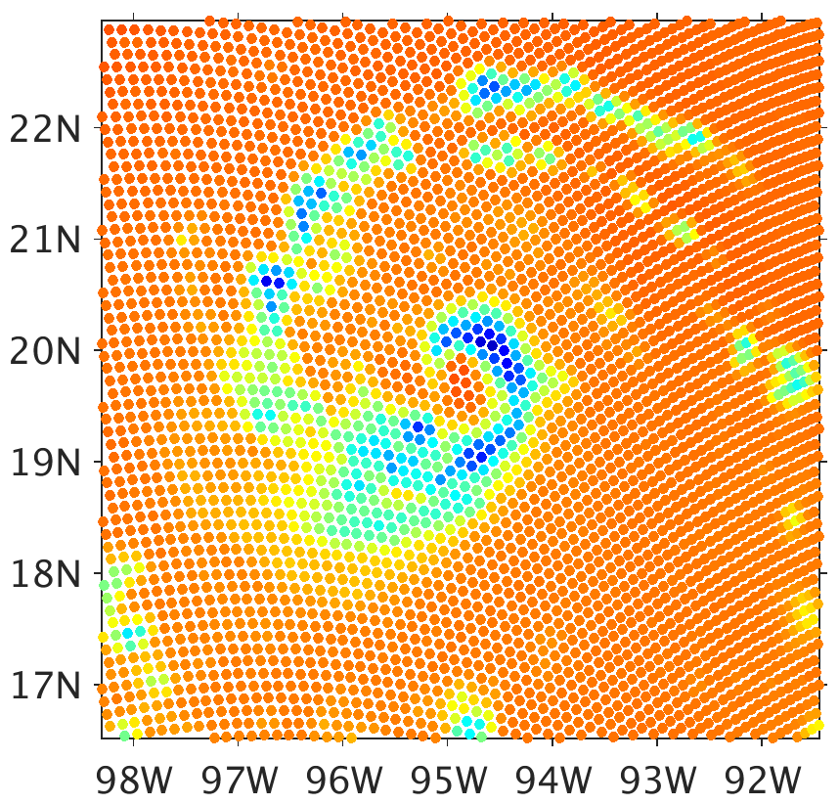
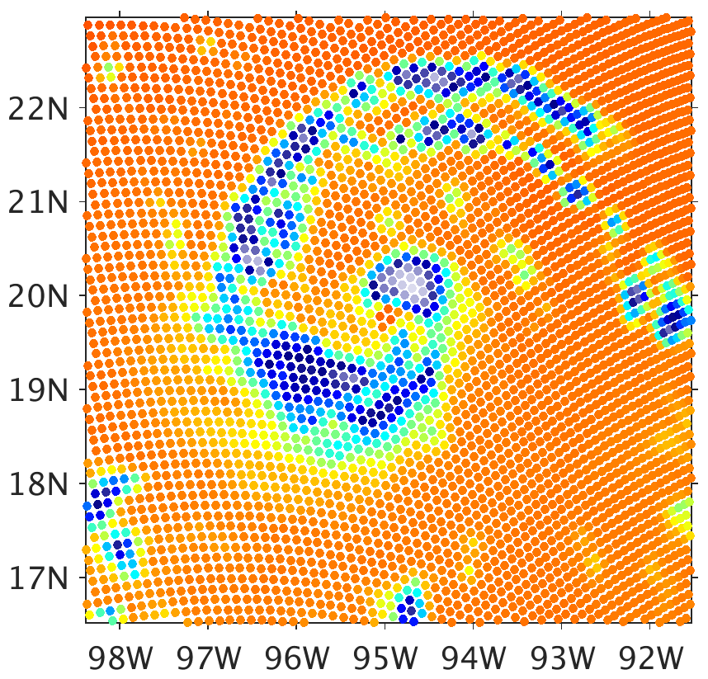
2 and 3. Particle optical properties, particle size/mass distribution
183 GHz Brightness Temperature
300
Obs (5 hours prior)
WSM6
Goddard
Morrison
280
260
240
220
200
180
050sn
200sn
200gp
800gp
160
140
120
100
80
Brightness Temperature (K)
All of bottom row using lookup table consistent with modified bulk density variant of WSM6

Slide 18
Three Potential Sources for Changes in T_{B}
Changing bulk density in microphysics scheme produces some change in snow and graupel water contents
but changes are not significant with respect to resolving biases of simulated brightness temperatures to observations
Changing the bulk density in the particle size/mass distribution is insignificant…
Relative to how particle optical properties of spheres differ with bulk density.
The combined effect of cloud optical properties consistent with the different bulk densities produces substantially different simulated brightness temperatures

Slide 19
Additional Thoughts
Previously-identified issues with using scattering properties of spheres still exist in all experiments
Cold bias at 37 GHz, excessive scattering by precipitation ice
183 GHz is simulated warmer than 91 GHz

